Slide 1
Caesarea
Herod’s Harbor City
Notes:
This presentation begins with aerial views and then proceeds through the excavations moving generally from south (the theater) to north (the Roman aqueduct). See also the presentation on the Sharon Plain.
The Pictorial Library of Bible Lands provides PowerPoint files in addition to individual jpg images. The PowerPoint files are organized in logical sequence and may provide a quicker option for copying slides into other presentations. The PowerPoint files also include annotations about the sites and images that are not available elsewhere.
The images in the PowerPoints are approximately 1024x768 pixels, the maximum size displayed by many projectors. Users will particularly benefit from accessing the individual higher-resolution jpg images if (1) they have a projection system higher than 1024x768; (2) they want to zoom in on a particular portion of an image; or (3) they want to crop, edit, adapt, or print an image.
This presentation, including its maps and photographs, are copyrighted by Todd Bolen. Permission to use is granted for personal and educational purposes. Commercial use or re-distribution requires written permission.

Slide 2
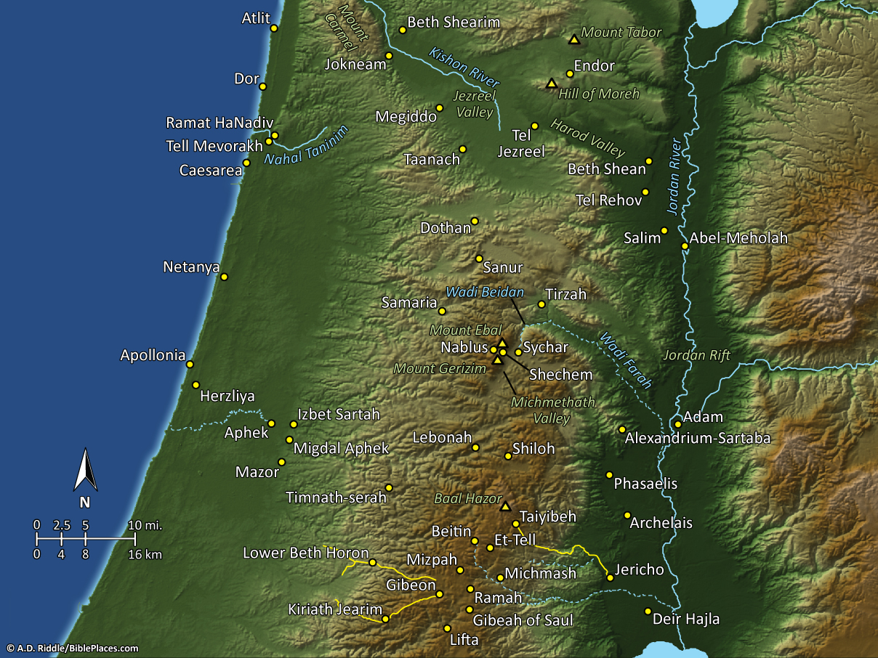
Pictorial Library Vol. 2: Samaria
& the Center
Notes:
This map is intended to help users locate the places which appear in the photographs in this presentation. The map therefore does not represent or label every geographic feature, and the sites are a mixture of modern and ancient place names.

Slide 3
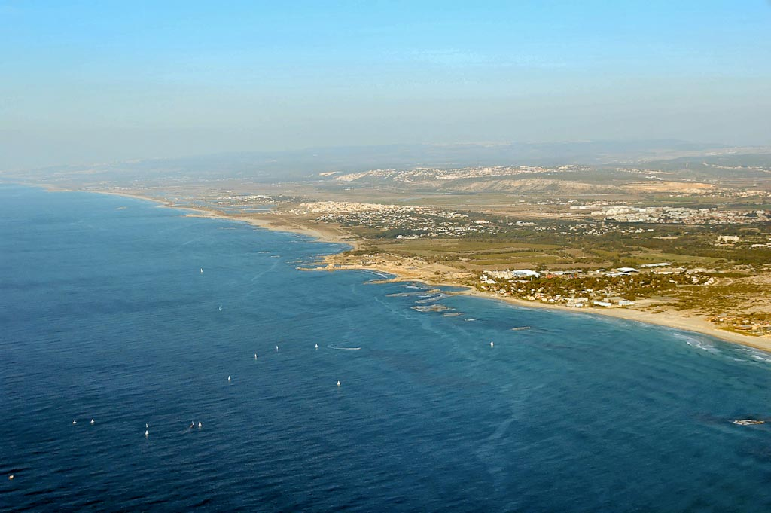
Caesarea aerial from southwest
Notes:
Caesarea: Introduction
Caesarea is located on the northern end of the Sharon Plain, midway between Tel Aviv and Haifa.
The ruins occupy nearly 2 miles (3.2 km) of coastal dunes.
Caesarea was surveyed by the Palestine Exploration Fund in 1873. Since that time a number of excavators have continued its exploration, including: J. Ory in 1945, S. Yeivin in 1951, Avi-Yonah in 1956 and 1962, the Italians under A. Frova from 1959 to 1964 (the theater), and A. Negev in 1960-64. The Joint Expedition then worked for 12 seasons beginning in 1971, Levine and Netzer excavated in 1975-76, and 1979, and Raban and Holum began their Combined Caesarea Expeditions (CCE) in 1989-90.
tb121704913

Slide 4
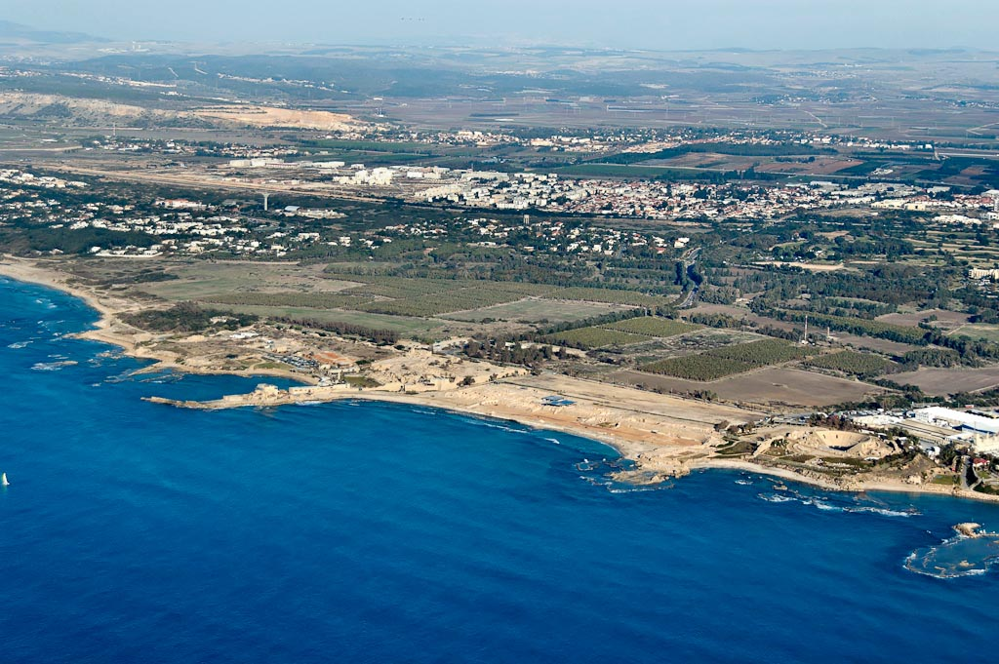
Caesarea aerial from southwest
Notes:
Strato’s Tower
Because of their help in fighting the Greeks, the Persians gave the coastline between Dor and Joppa to the Phoenicians. The site was known as “Strato’s Tower.” Strato was the name of three different Sidonian kings in the 4th century BC.
Strato’s Tower was first mentioned by Zenon, an Egyptian official who landed at the site for supplies in 259 BC.
A “tower,” in this context, does not refer to a “lookout tower” but to a fortified town.
Strato’s Tower was conquered by Alexander Jannaeus in 103 BC.
tb121704920

Slide 5
hill country of Samaria
Sharon Plain
aqueducts
Hadrian’s hippodrome
Byzantine
bathhouse
Herod’s
hippodrome
theater
Herodian harbor
Crusader castle
Herod’s
Promontory Palace
Caesarea aerial from southwest
Notes:
tb121704920

Slide 6
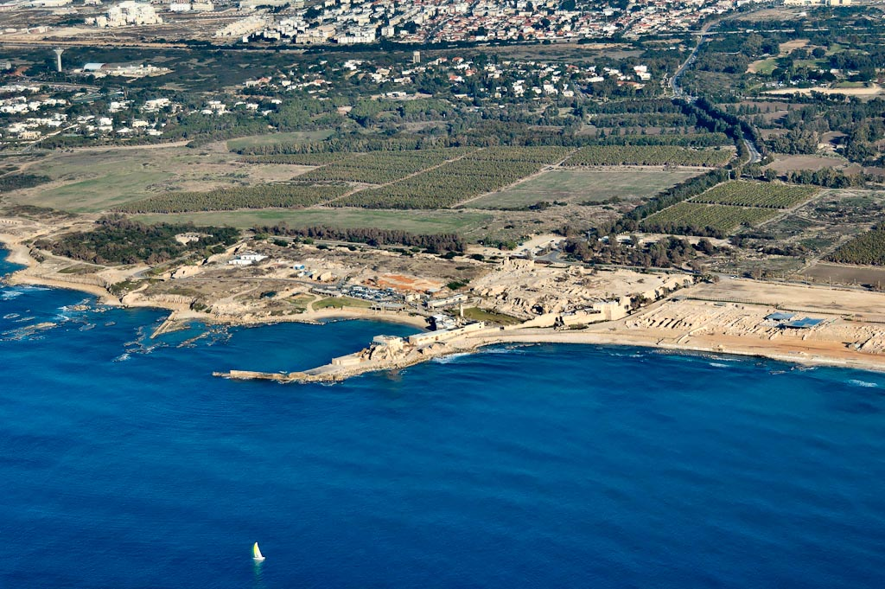
Caesarea aerial from southwest
Notes:
Herod’s City
Caesarea was given to King Herod by Caesar Augustus in 30 BC, and construction was begun by Herod in 22. The city was named after the giver, and the port was named Sebastos, which is Greek for Augustus.
“The great port city of Caesarea was born out of the genius of one man: Herod the Great (c. 73-74 BC). This Idumean politician, with the support of the rulers at Rome, rose to become king of Judea. On the site of a dilapidated town, he built a glorious new city, splendid in every detail—from its chief temple down to its sewer system. The effort took over a decade (from 22 to 10/9, when festivities were held to commemorate completion), but Herod spared no expense in materials or in construction. He named the new city Caesarea as a politic compliment to the emperor under whose aegis he rose, Caesar Augustus” (Burrell, Gleason, and Netzer 1993: 50).
Caesarea was built upon an artificial hill podium. From Herod’s viewpoint, this city was one of the most important cities in his kingdom economically. It is not clear whether Herod’s city was walled or not, but the later Byzantine city was walled.
In Herod’s day, the city had a population of 100,000, larger even than Jerusalem, and covered about 170 acres.
tb121704923

Slide 7
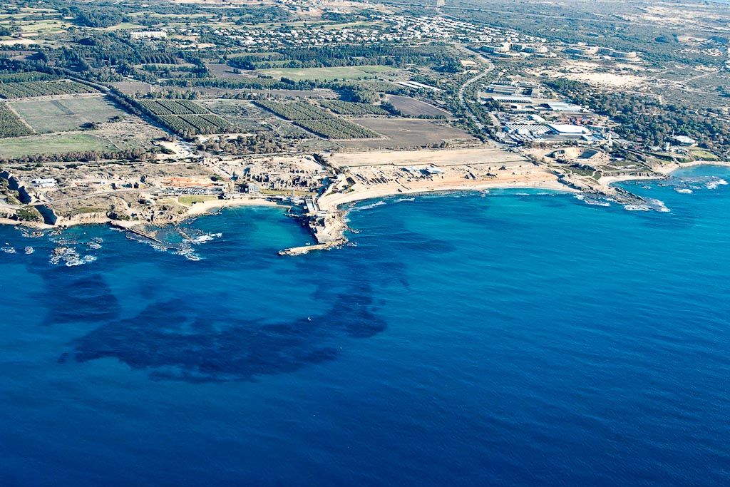
Caesarea aerial from west
Notes:
Josephus on Herod’s Construction of Caesarea
“When Herod had observed that there was a place near the sea, formerly called Strato’s Tower, which was very well suited to be the site of a city, he set about making a magnificent plan and put up buildings all over the city, not of ordinary material but of white stone. He also adorned it with a very costly palace, with civic halls and--what was greatest of all and required the most labor--with a well-protected harbor, of the size of the Piraeus [of Athens], with landing-places and secondary anchorages inside…. In a circle round the harbor there was a continuous line of dwellings constructed of the most polished stone, and in their midst was a mound on which stood a temple of Caesar, visible a great way off to those sailing into the harbor, which had a statue of Rome and also one of Caesar….Herod also built a theater of stone in the city, and on the south side of the harbor, farther back, an amphitheater large enough to hold a great crowd of people, and conveniently situated for a view of the sea” (Ant. XV.331-341). Herod “displayed here, as nowhere else, the innate grandeur of his character.” He “triumphed over nature….Notwithstanding the totally recalcitrant nature of the site, he grappled with the difficulties so successfully that the solidity of his masonry defied the sea, while its beauty was such as if no obstacle had existed” (War 1.408-15).
tb121704931

Slide 8
hippodrome
Byzantine
bathhouse
theater
hippodrome
temple
Crusader
castle
Herod’s
Promontory Palace
Herodian harbor
harbor
entrance
Herodian breakwater
(submerged)
Caesarea aerial from west
Notes:
tb121704931

Slide 9
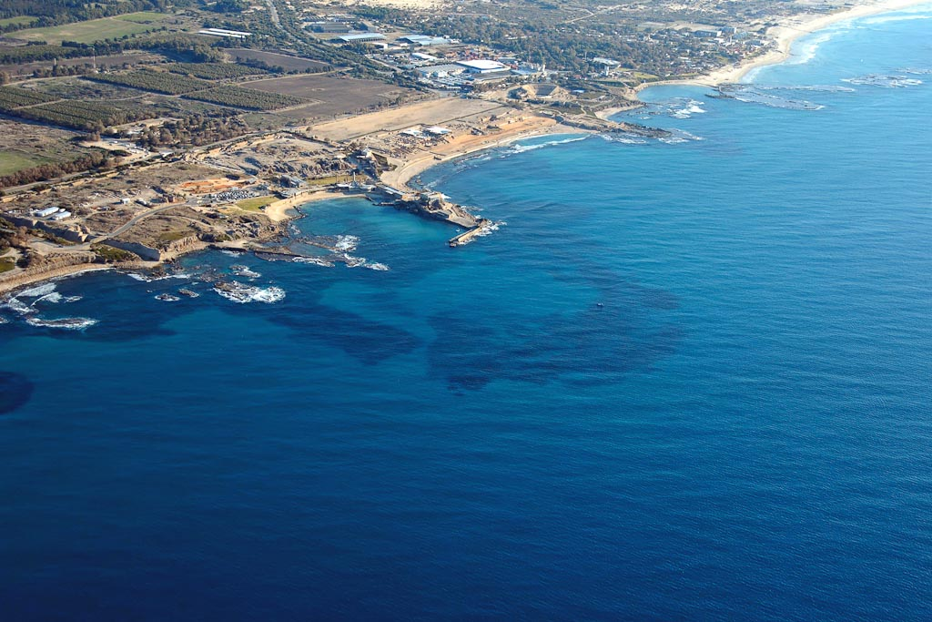
Caesarea aerial from northwest
Notes:
Caesarea in the New Testament Period
After the removal of Herod’s son Archelaus (AD 6), Rome annexed Judea to the empire and Caesarea became the main port and administrative capital of the Roman province, including the seat of the Roman procurators. Herod’s palace became “Herod’s praetorium,” as mentioned in Acts 23:35, and it was the official residence of the Roman governor, including Pilate, during his rule.
Philip the Evangelist set up a house and had a family here in Caesarea, including four daughters who prophesied. Paul once visited Philip here (Acts 8:40, 21:8-9).
Peter came to Caesarea to see Cornelius the centurion (Acts 10:1-48; 11:11), and shortly thereafter the first Gentile was converted to Christianity at Caesarea. It is interesting that such conversions took place in a city with so many tensions between Jews and non-Jews. Later, these first Gentile converts were indwelt with the Spirit in a very obvious manner.
Agrippa I died here because he chose not to give glory to the real God when the people declared him to be a god (Acts 12:19-23). Throughout history, many Roman leaders declared, or allowed others to declare, that they were gods. So, why would Agrippa be punished for it? Perhaps it was because he was a Jew, and perhaps it was because he was in the land of God’s revelation. It could have been that it was simply the strategic time God had planned for the church.
Paul was held in prison in Caesarea (Acts 23:22-35). a. Paul stood before three rulers at Caesarea: Felix (Acts 24:1-27), Festus (Acts 25:1-22), and Agrippa II (Acts 25:23-26:32). b. Paul departed to Rome from Caesarea (27:1).
Caesarea was a very mixed city, and the tensions which arose between the various people groups, particularly related to the desecration of the synagogue, were responsible for the revolt in AD 66. At that time, 20,000 people were killed and others were taken prisoner. Jerusalem was destroyed in 70, but Caesarea remained. It was the headquarters of the Roman troops, used both as a station and for the purpose of rest and relaxation, and eventually became the main supply port for the Romans fighting against the Jews in the Bar Kochba revolt of 135.
tb121704937

Slide 10
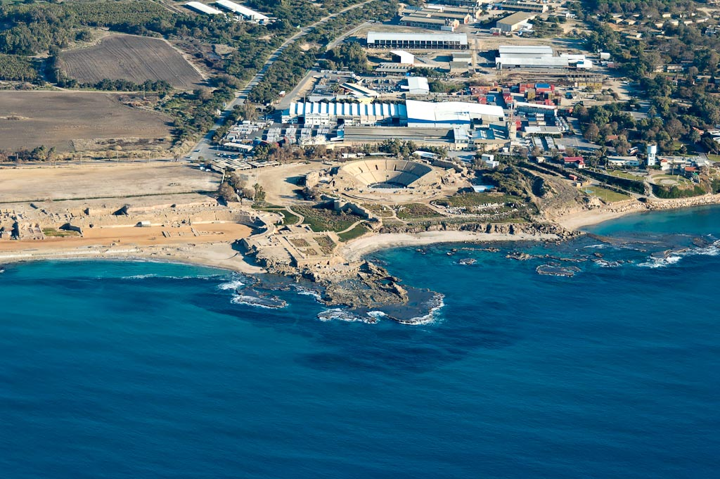
Caesarea Herod’s Promontory Palace and theater aerial from west
Notes:
tb121704924

Slide 11
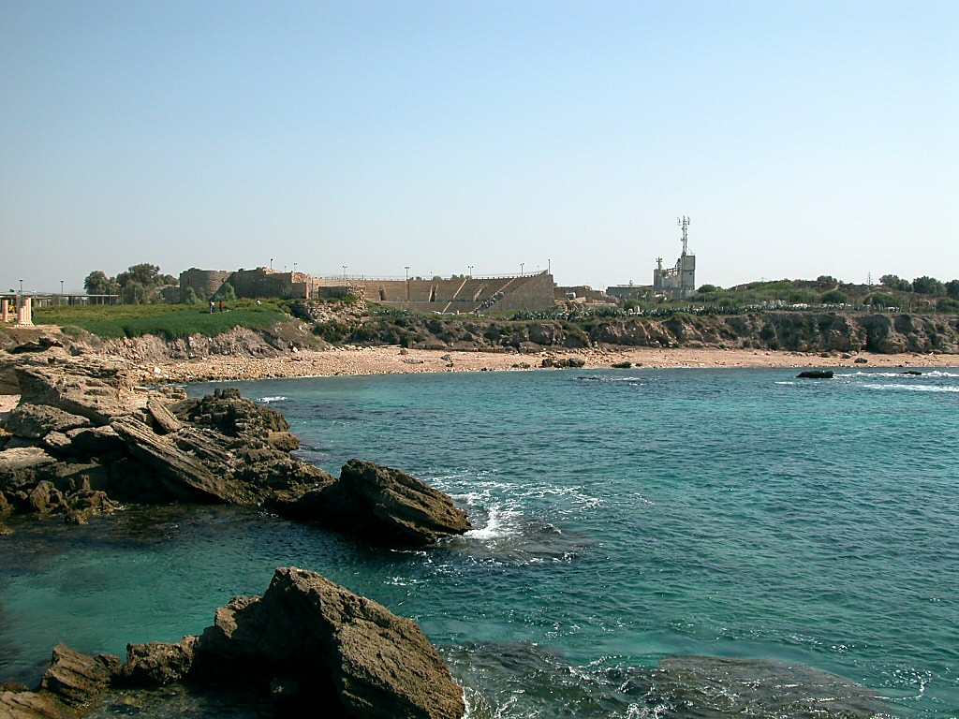
Caesarea theater from Herod’s Promontory Palace
Notes:
tb102302066

Slide 12
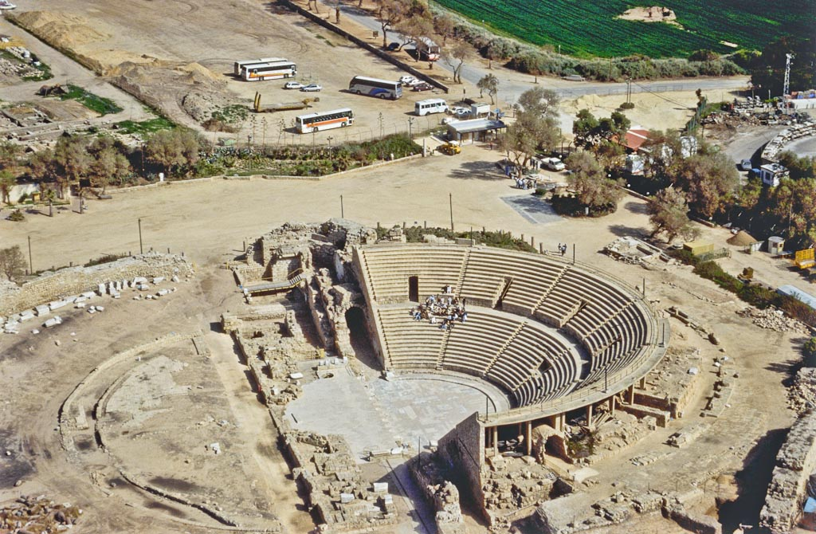
Caesarea theater aerial from south
Notes:
bb00190048. Photo by Barry Beitzel.

Slide 13
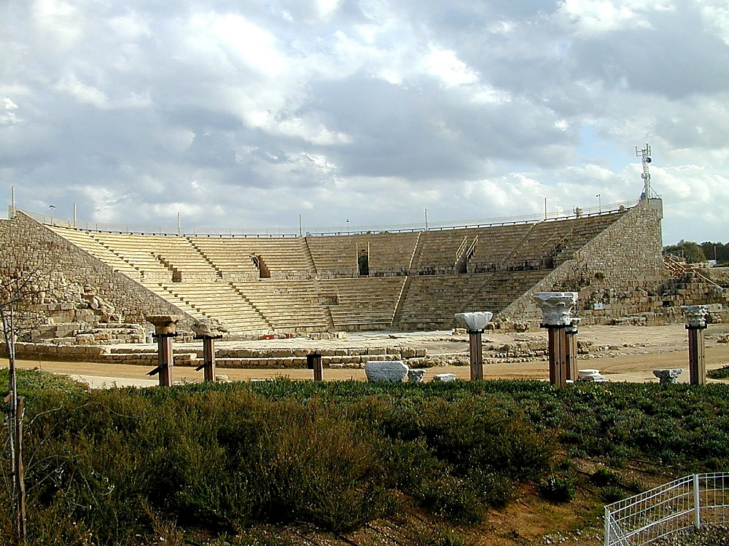
Caesarea theater
Notes:
Construction of the Theater
Built in Herod’s time and used for hundreds of years, the theater at Caesarea is apparently the oldest of all the theaters in Israel. Most of the theaters which have been found in Israel were built around AD 200.
In the 2nd century, the orchestra floor was covered with plaster, which looked like marble, and the seats were also renovated.
The theater held 3,500-4,000 people.
During the 3rd-4th centuries, the orchestra was redesigned and the area was filled with water for naval games.
The theater was incorporated into a Byzantine fortress in the 6th century, as evidenced by the poorly built wall surrounding it, which made use of the high back of the theater as part of its defenses, but was deserted after the Arab conquest. On the north side of the theater, two round towers from this fortress are visible projecting from a wall which leads to the ocean.
tb122000108

Slide 14
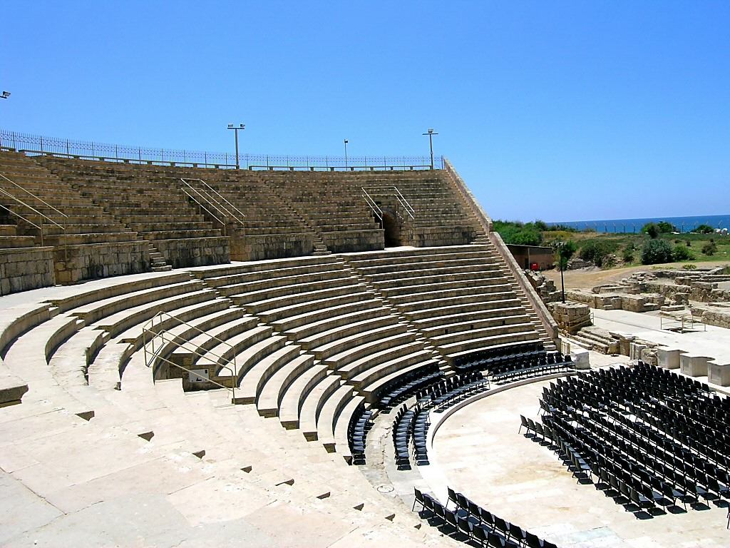
Caesarea theater
Notes:
Features of the Theater
The scaenae frons was three stories high. In Greek, “scaenae” means “tent,” and it is from this term that the English word “scene” is derived. Actors would go into a tent to change their costumes and thus began a new “scene.”
The cavea.
The seating area is known as the cavea, which was subdivided by a passageway, creating an upper cavea (summacavea) and a lower cavea (immacavea).
The orchestra was in the center of the cavea, and was used for the choir.
During the Roman period, the choir was not used in the theater, so the orchestra area became the place for seating more important people. Large stone or marble chairs were made for important guests, sometimes with their names engraved upon on them.
Six entrance vaults lead into the auditorium. These entrances were called vomitoria, because the Romans visualized the theatre as a big monster that “vomits” the crowds out at the end.
A large curtain of cloth or “vellum” could be placed over the theater to provide shade, and was held up by tall wooden supports.
“From the focal point of stage center of the theater in Caesarea Maritima, whispers can be heard in the final row of seats” (Crisler 1976: 129). There were all sorts of acoustical devices in the theatres:
Empty jars were used for projecting the actor’s voice.
A projecting roof from the scenae frons also served to project an actor’s voice.
Tall shoes may have been used so that more people could see the actors.
The actors wore masks which amplified their voices.
The seats of the theater were stepped and every seat had a projection, under which the person could put his feet without disturbing the person in front of him. The spectators usually brought their own cushions.
tb052304860

Slide 15
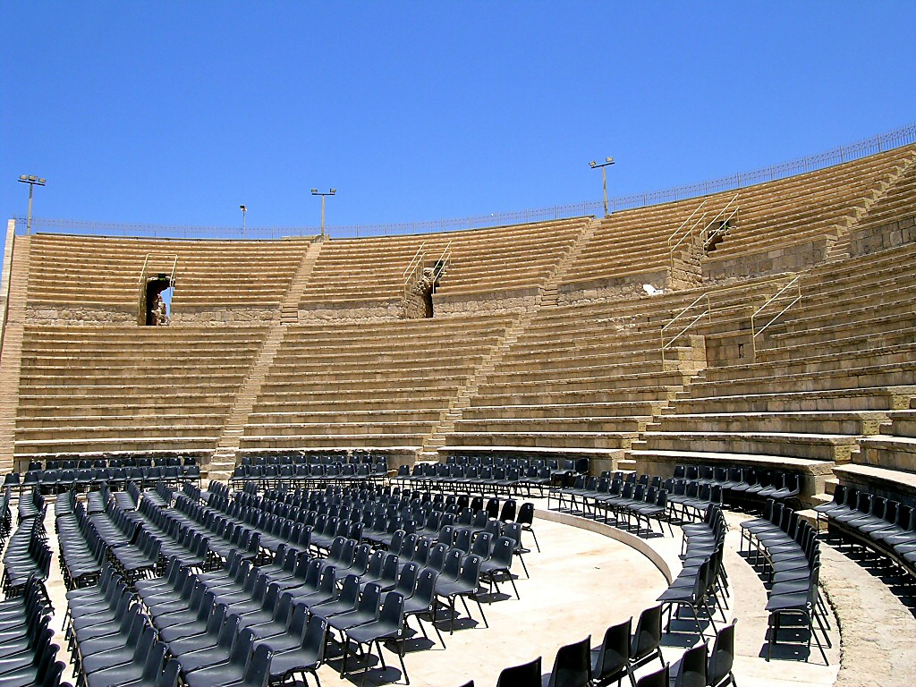
Caesarea theater
Notes:
For discussion of the possibility of Herod Agrippa I’s death within the theater, see the notes in connection with the hippodrome.
tb052304866

Slide 16
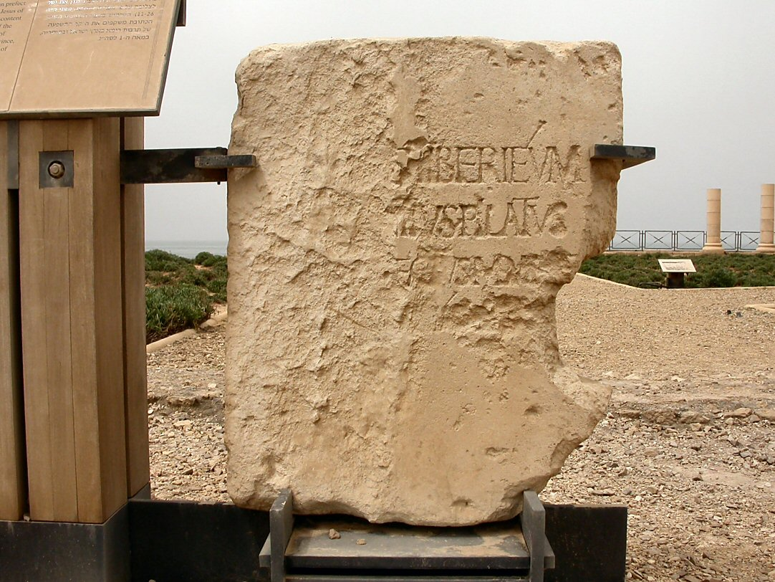
Caesarea Pontius Pilate inscription replica
Notes:
Pilate Inscription
An inscription mentioning Pilate was found in the excavations of the theater in 1961. The original is in the Israel Museum; the inscription shown in this photo is a replica. This stone was found reused as a step in the theater at a later period.
A suggested restoration reads: “Pontius Pilate, Prefect of Judea, made and dedicated the Tiberium to the Divine Augustus.” The stone is the first and only mention of Pilate from an archaeological source, and it is currently unknown to which temple this inscription belonged.
“One of the most interesting things about this inscription is that Pilate is called a ‘prefect.’ Most historians, based on Josephus and others, have called him a ‘procurator.’ But we know now that Roman governors of Judea were not called procurators until later, during the reign of Claudius (AD 41-54). This inscription confirms that Pilate was indeed a prefect, and the New Testament accurately labels him as ‘governor’ (hegemon), not a procurator” (Sailhamer 1998: 114).
tb040603200

Slide 17
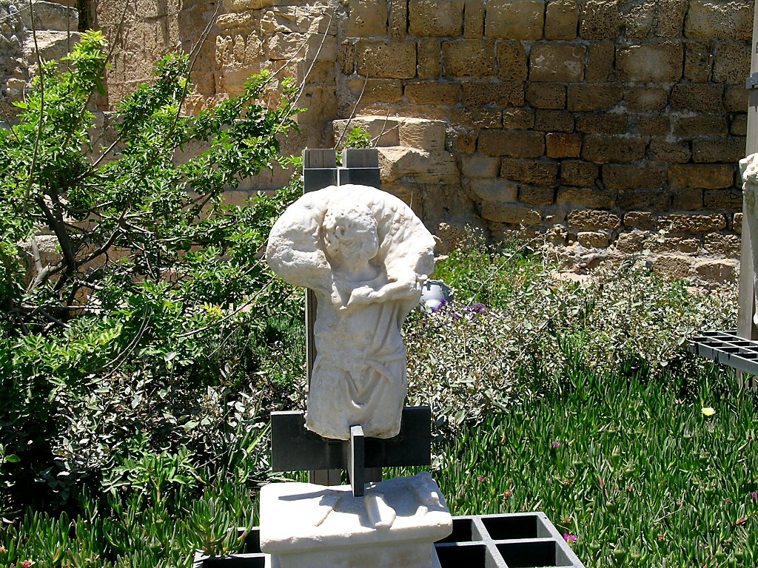
Caesarea marble statue of shepherd with sheep
Notes:
tb052304859

Slide 18
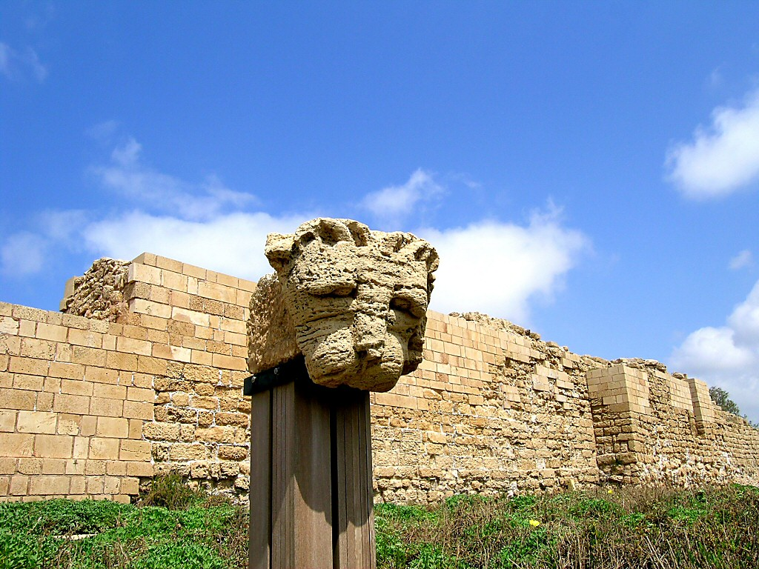
Caesarea lion's head
Notes:
tb032504026

Slide 19
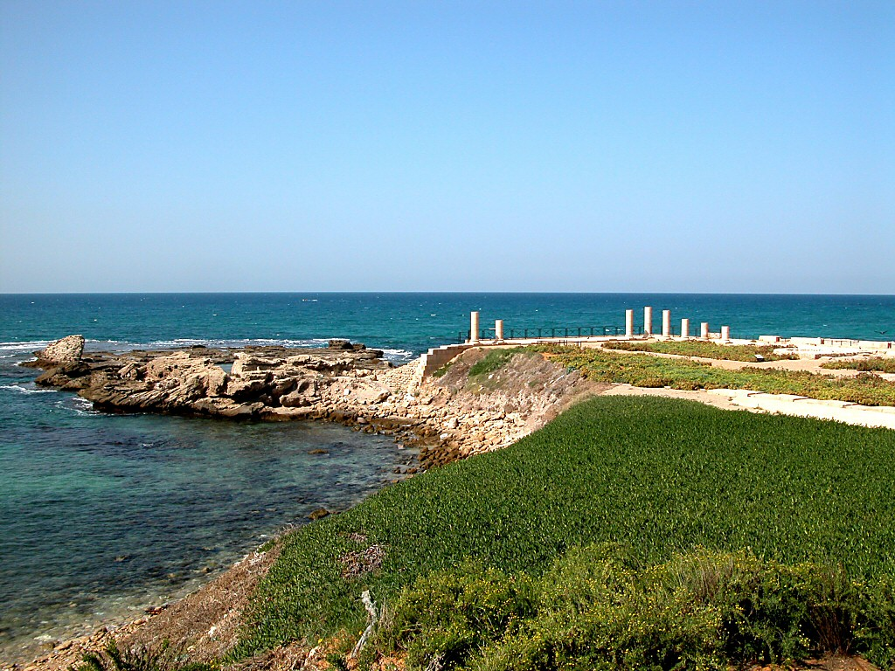
Caesarea Herod's Promontory Palace from southeast
Notes:
Promontory Palace
Herod built a “most magnificent palace” (Josephus) on a sandstone promontory by the theatre at Caesarea.
The centerpiece of this palace is the pool, which is nearly Olympic in size (115 feet [36 m] long, 59 feet [18.5 m] wide, at least 8 feet [2.5 m] deep). A square pedestal, probably for a statue, stood in its center. Water channels that led to the pool from the shore indicate that the pool may have once been filled with fresh water. The three sides of the pool that faced the sea were lined by colonnades.
On the east side of the palace was a very beautiful dining room with a multi-colored mosaic. Its design imitated the Roman opus sectile flooring of geometric shapes cut from rare stones.
The walls of the promontory palace were made of local sandstone, but they were plastered and painted to give the polished effect of finer stone (contrary to Josephus).
Many of the walls had been red and were later repainted white.
tb102302037

Slide 20
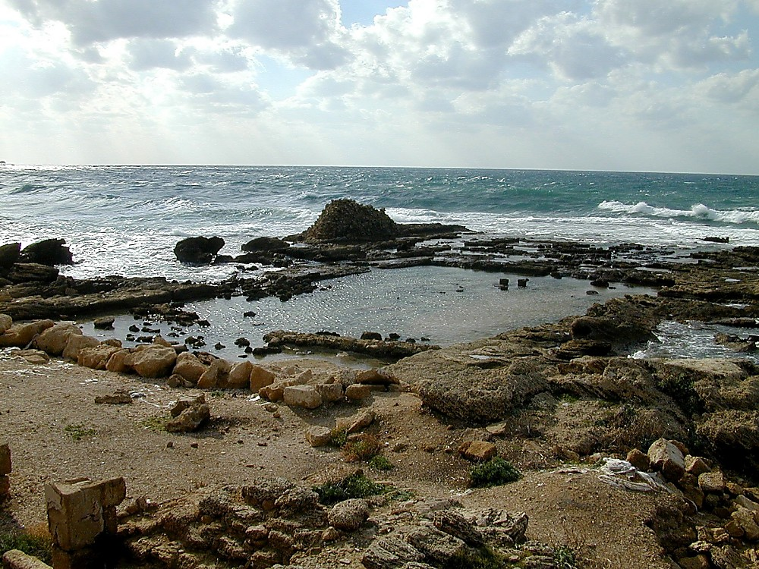
Caesarea Herod’s Promontory Palace
Notes:
Promontory Palace
The palace at Caesarea had a caldarium for a bath, in which the floor was raised on circular columns made of brick. Hundreds of artifacts have been found on this site.
Two columns were found at the site bearing inscriptions which reveal the names of some previously unknown governors of the 2nd-3rd centuries AD.
A colonnaded courtyard and gardens were part of an upper terrace to the east of the palace.
Herod could spend the cold winters in his palace at Jericho, and then spend the hot summers at his ocean palace at Caesarea. At each of these locations, Herod “triumphed over its disadvantages with masterful engineering…. guests were to be impressed or, if possible, astounded. Thus has architecture become a statement of political power” (Burrell, Gleason, and Netzer 1993: 56).
If this was the only palace of Herod in Caesarea, then this was the place to which the Jews of Jerusalem came and “gathered around his house and fell to the earth and lay there five days and five nights” so that Pilate would remove the images of Caesar which were at that time placed on the Temple Mount.
After the building had been destroyed, channels were cut into the rock, and the pool served as a local fish hatchery.
The palace was first excavated in 1976 by Netzer. He returned in 1990 with an American team.
tb122000106

Slide 21
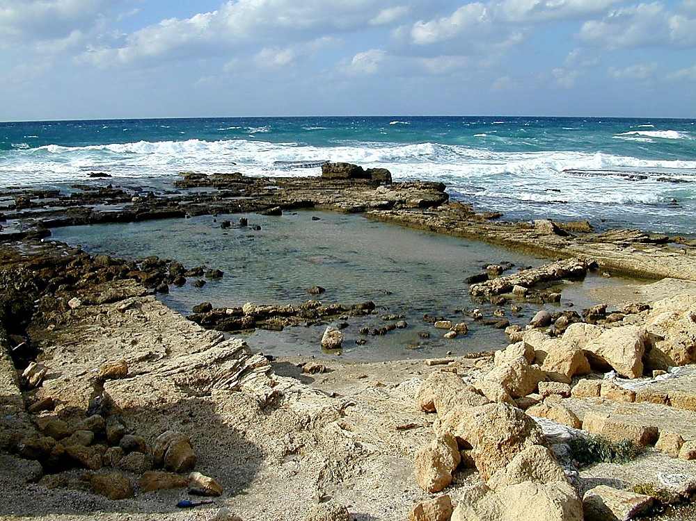
Caesarea Herod’s Promontory Palace
Notes:
tb122000107

Slide 22
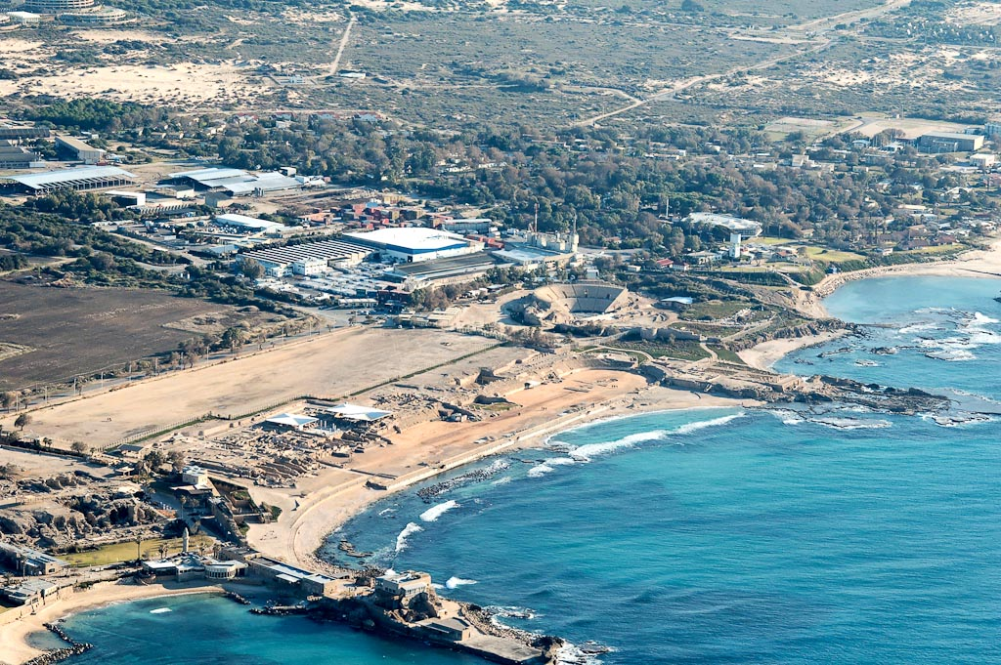
Caesarea hippodrome aerial from northwest
Notes:
Herodian Hippodrome/Amphitheater
Herod constructed this building in the 1st century BC as a hippodrome.
In the mid-2nd century AD, the hippodrome was converted into an amphitheater, and horse races were then held in the new hippodrome built by Hadrian.
Hippodromes did not exist in the Greek world, but were only built after the beginning of the Roman empire.
tb121704938

Slide 23
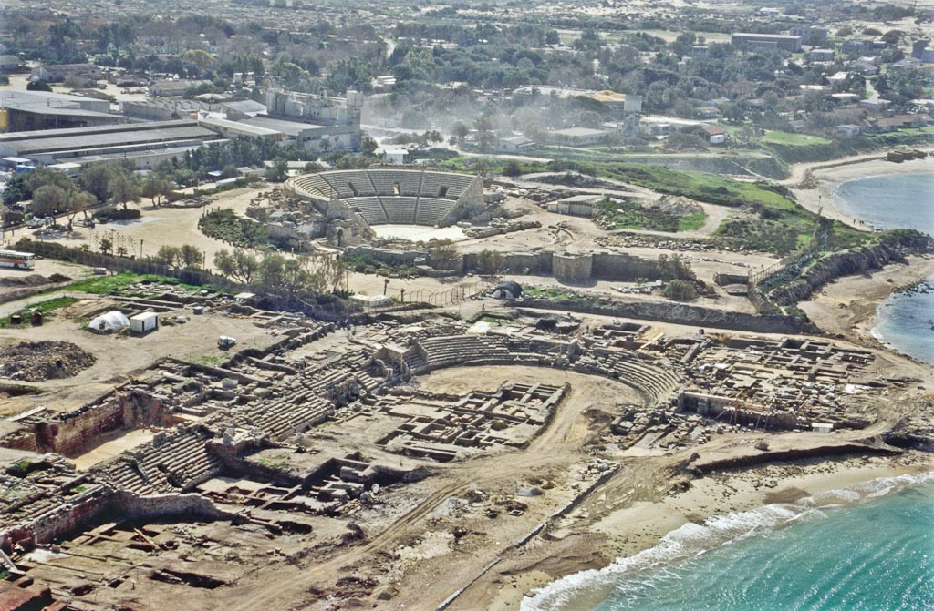
Caesarea amphitheater and theater aerial from north
Notes:
bb00190042. Photo by Barry Beitzel.

Slide 24
theater
Herod’s
Promontory Palace
hippodrome
Caesarea amphitheater and theater aerial from north
Notes:
bb00190042. Photo by Barry Beitzel.

Slide 25
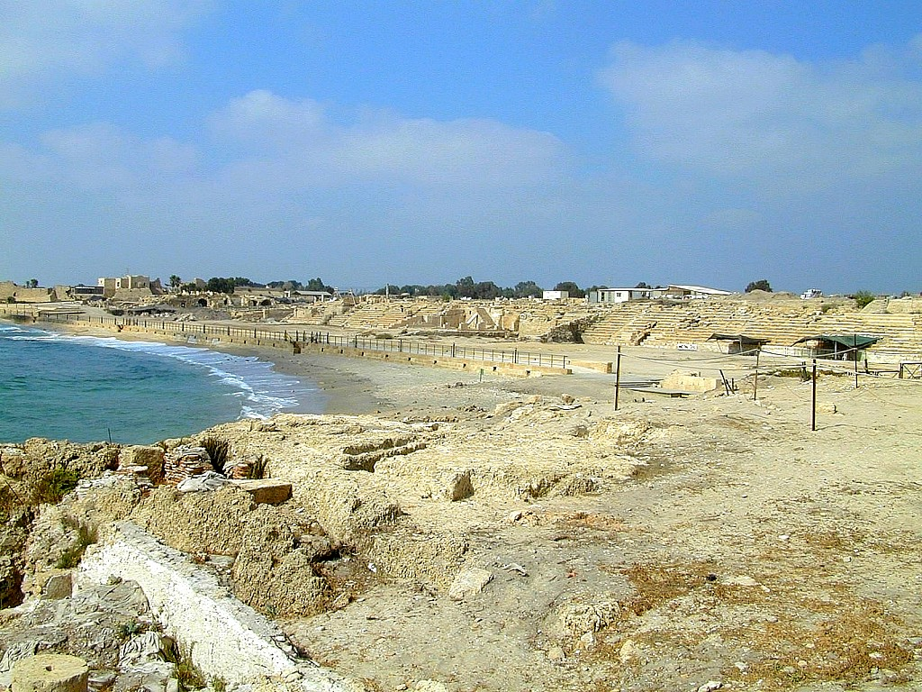
Caesarea hippodrome
Notes:
Hippodrome Design
The hippodrome at Caesarea was 985 feet (300 m) long and 164 feet (50 m) wide.
Originally, it had 12 rows of seats and space for up to 15,000 spectators.
Part of the spina is preserved on the southern side of the hippodrome.
Riders emerged from compartments on the northern side of the complex. The hippodrome’s total capacity was 12 chariots, racing simultaneously, for a maximum of seven laps.
tb062700101

Slide 26
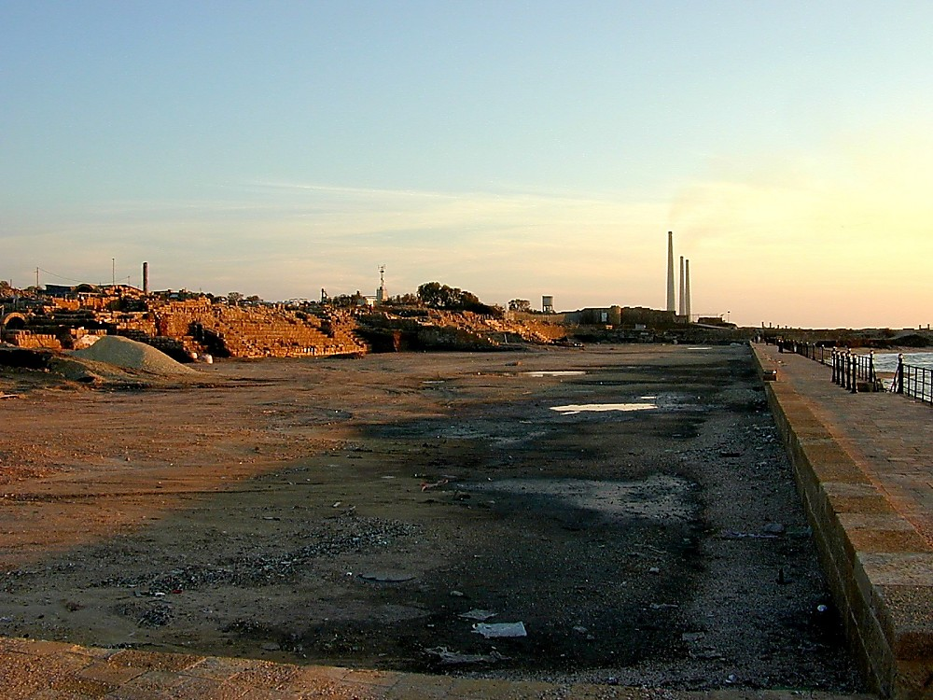
Caesarea hippodrome
Notes:
The Location of Agrippa’s Speech in Acts 12
While Josephus describes the death of Herod Agrippa I as occurring in the theater, an analysis of his account indicates that the amphitheater was the setting for his public address. The first clue that Josephus gives is the time of day. He says that it occurred at “the beginning of the day” (ἀρχομένης ἡμέρας). Dressed in a garment made “wholly of silver,” Agrippa dazzled the crowd when his robes were “illuminated by the fresh reflection of the sun’s rays upon it.” The theater, however, faces west. If the king was positioned on the stage, the sun would not have reached over the multi-storied seating area before mid-morning. And if he was speaking from the seating area, the sun would not have reflected off his clothes until even later. The amphitheater, by contrast, is wide, and the twelve rows of seating would not have blocked the sun. Agrippa could have been addressing the crowd from the western side of the amphitheater where the sun would be able to reflect off his clothes early in the morning.
tb011300100

Slide 27
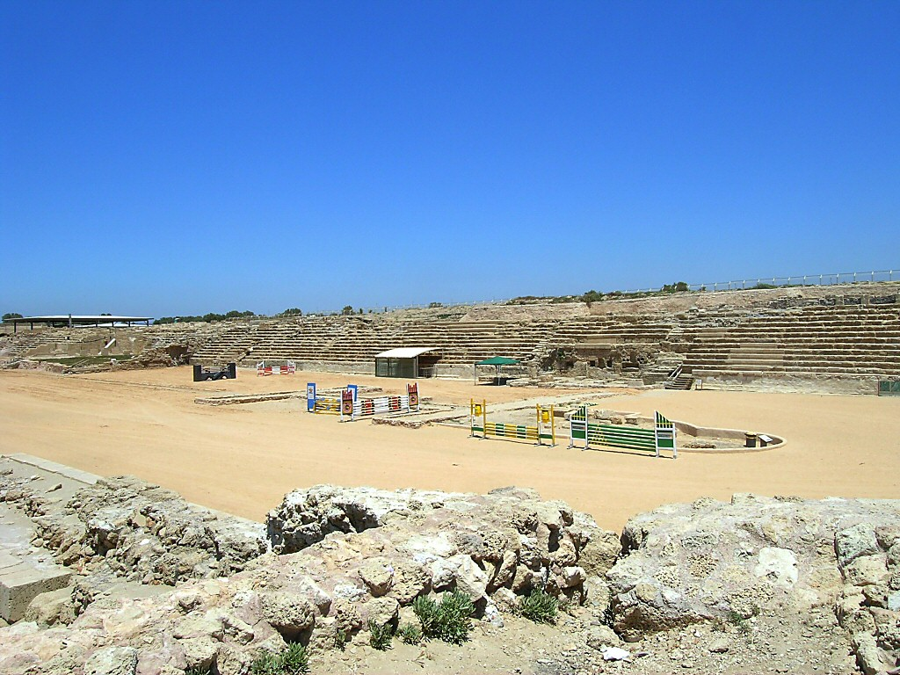
Caesarea hippodrome from south
Notes:
The Location of Agrippa’s Speech in Acts 12
The second indication that Agrippa was struck down in the amphitheater is the occasion of his death. Acts says only that it occurred “on the appointed day” (τακτῇ δὲ ἡμέρᾳ), but Josephus describes the event as occurring on the second day of a festival in honor of Caesar, in which a great multitude was assembled. Scholars identify this festival with either the quinquennial celebration of the city’s founding, on March 5, AD 44, or a celebration of Emperor Claudius’s birthday on August 1 of that same year. The former was originally organized by King Herod in 12 BC and was styled after the Olympic Games, but called “Caesar’s Games” (Josephus, War 1.21.8 §415). These games included combats and horse races (Josephus, Ant. 16.5.1 §§136-141), and were conducted in the amphitheater, not in the theater which was designed for dramatic performances. The emperor’s birthday was also celebrated with sports, and thus a setting in the amphitheater is most likely for this event as well.
Additional evidence and supporting documentation for this theory is given in an article by Todd Bolen published by the Bible and Interpretation:
http://www.bibleinterp.com/opeds/agrippa357926.shtml
tb052304869

Slide 28
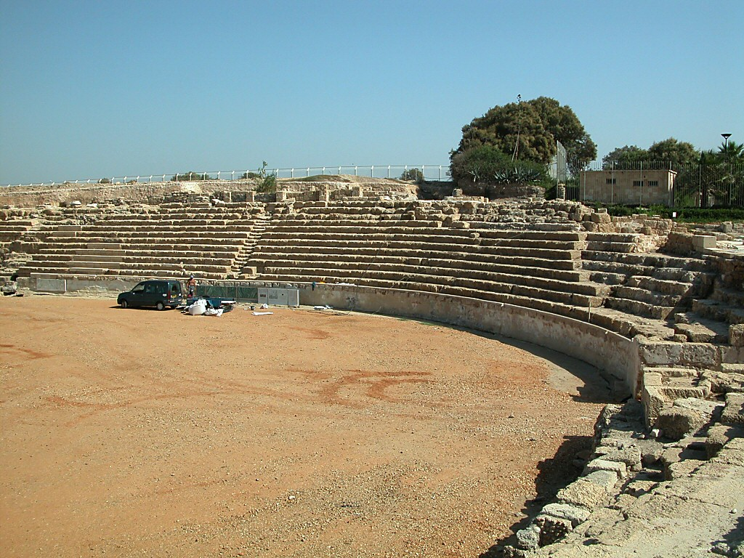
Caesarea hippodrome seating
Notes:
Josephus on the Death of Herod Agrippa I
“Now when Agrippa had reigned three years over all Judea, he came to the city Caesarea, which was formerly called Strato’s Tower; and there he exhibited shows in honor of Caesar, upon his being informed that there was a certain festival celebrated to make vows for his safety. At which festival a great multitude was gotten together of the principal persons, and such as were of dignity through his province.
“On the second day of which shows he put on a garment made wholly of silver, and of a contexture truly wonderful, and came into the theater early in the morning; at which time the silver of his garment being illuminated by the fresh reflection of the sun’s rays upon it, shone out after a surprising manner, and was so resplendent as to spread a horror over those that looked intently upon him; and presently his flatterers cried out, one from one place, and another from another, (though not for his good,) that he was a god; and they added, ‘Be thou merciful to us; for although we have hitherto reverenced thee only as a man, yet shall we henceforth own thee as superior to mortal nature.’
“Upon this the king did neither rebuke them, nor reject their impious flattery. But as he presently afterward looked up, he saw an owl sitting on a certain rope over his head, and immediately understood that this bird was the messenger of ill tidings, as it had once been the messenger of good tidings to him; and fell into the deepest sorrow. A severe pain also arose in his belly, and began in a most violent manner. He therefore looked upon his friends, and said, ‘I, whom you call a god, am commanded presently to depart this life; while Providence thus reproves the lying words you just now said to me; and I, who was by you called immortal, am immediately to be hurried away by death. But I am bound to accept of what Providence allots, as it pleases God; for we have by no means lived ill, but in a splendid and happy manner.’ When he said this, his pain was become violent.
“Accordingly he was carried into the palace, and the rumor went abroad every where, that he would certainly die in a little time. But the multitude presently sat in sackcloth, with their wives and children, after the law of their country, and besought God for the king’s recovery. All places were also full of mourning and lamentation. Now the king rested in a high chamber, and as he saw them below lying prostrate on the ground, he could not himself forbear weeping. And when he had been quite worn out by the pain in his belly for five days, he departed this life, being in the fifty-fourth year of his age, and in the seventh year of his reign; for he reigned four years under Caius Caesar, three of them were over Philip’s tetrarchy only, and on the fourth he had that of Herod added to it; and he reigned, besides those, three years under the reign of Claudius Caesar; in which time he reigned over the forementioned countries, and also had Judea added to them, as well as Samaria and Cesarea. The revenues that he received out of them were very great, no less than twelve millions of drachme. Yet did he borrow great sums from others; for he was so very liberal that his expenses exceeded his incomes, and his generosity was boundless” (Ant. XIX.8.2).
tb102302048

Slide 29
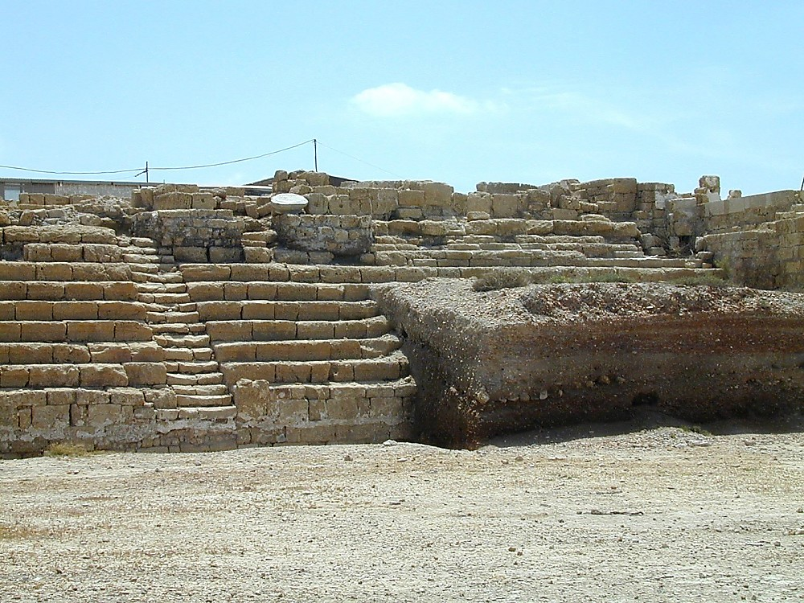
Caesarea hippodrome, some unexcavated
Notes:
Within the hippodrome, the seats began at a level above the arena for the protection of the audience, and a tall wall stood between the first rows of seats and the arena.
tb052600107

Slide 30
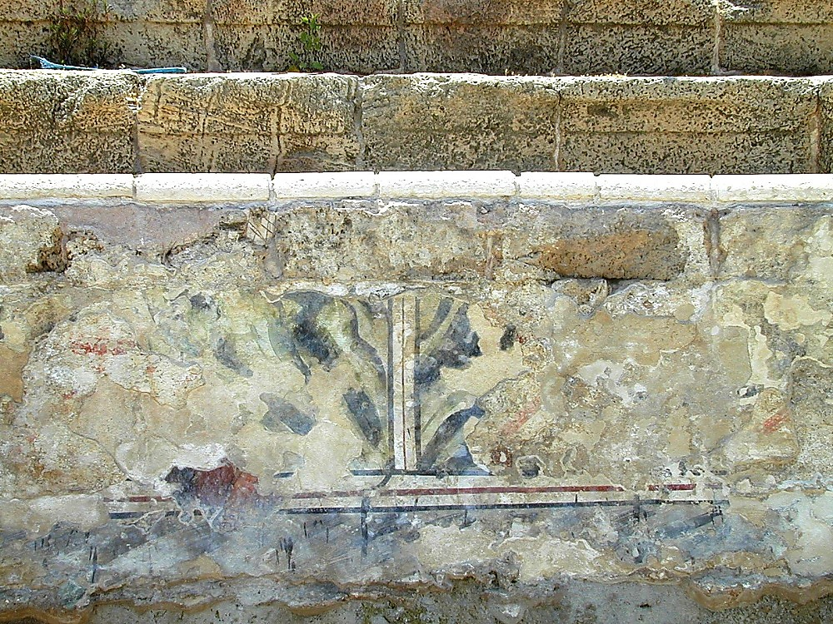
Caesarea hippodrome fresco
Notes:
The walls of the hippodrome were decorated with beautiful, multi-colored frescoes.
tb052600106

Slide 31
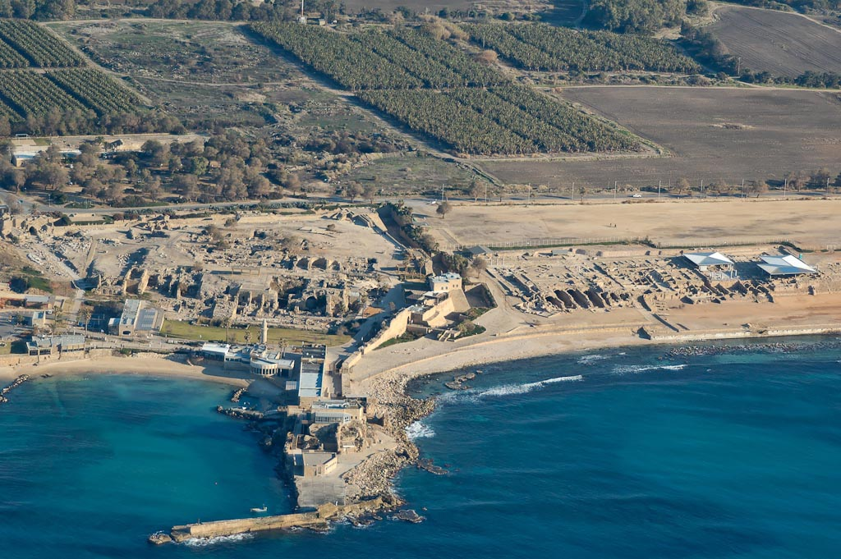
Caesarea excavations aerial from west
Notes:
tb121704929

Slide 32
Byzantine
bathhouse
temple
commercial
area vaults
Herodian quay
Herodian harbor
Crusader castle
Caesarea excavations aerial from west
Notes:
tb121704929

Slide 33
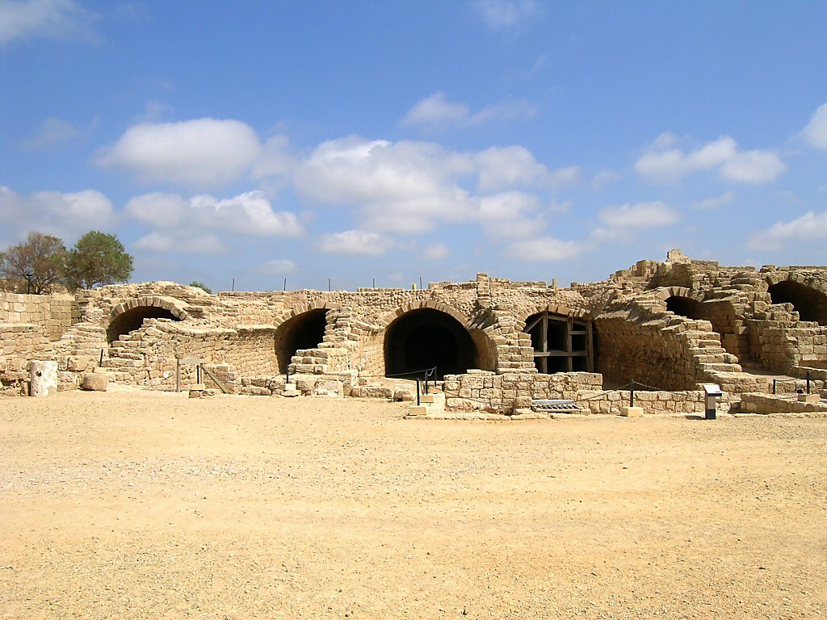
Caesarea commercial area vaults from west
Notes:
The Commercial Area
The commercial area of Caesarea was located between the hippodrome and the harbor.
These vaults originally supported the palace of the Roman financial procurator. Later these vaults were converted into warehouses.
One of the vaulted chambers served as a Mithraeum (sanctuary of the god Mithras).
A hoard of 99 gold coins from the time of the Roman Empire was found underneath a mosaic floor in a private dwelling in the area.
tb032504038

Slide 34
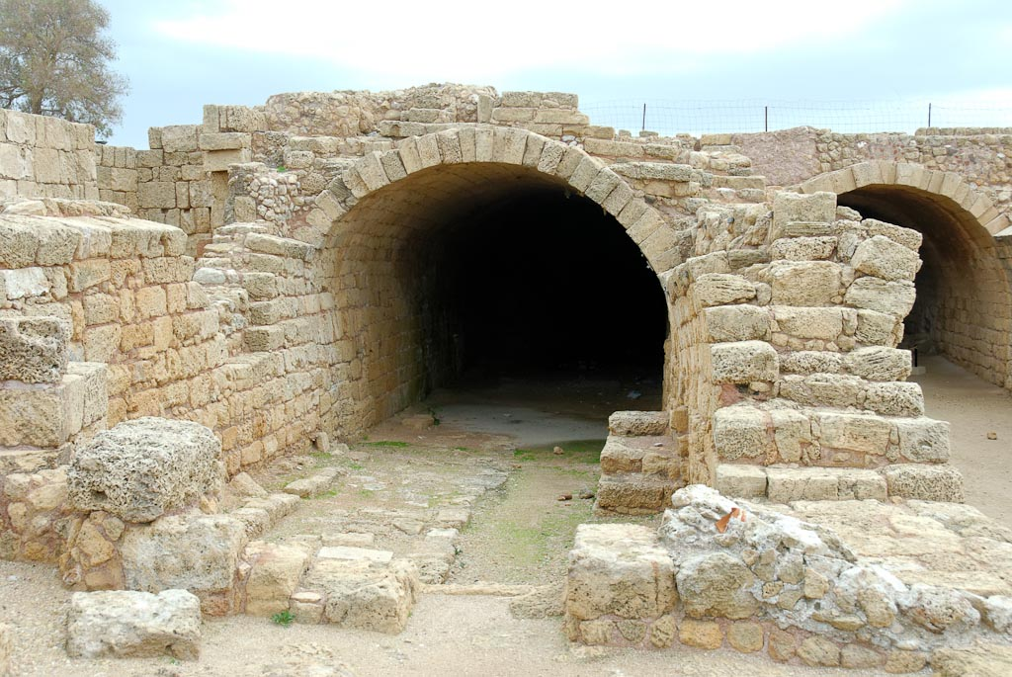
Caesarea Mithraeum
Notes:
This vault was converted into a sanctuary for the cult of Mithras in the 2nd century AD.
tb011112410

Slide 35
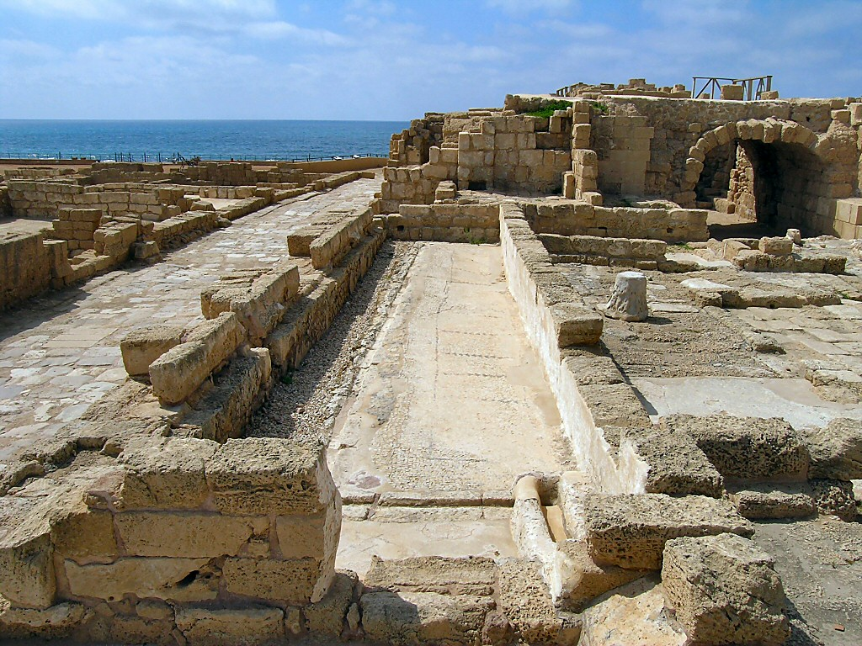
Caesarea latrine
Notes:
tb032504043

Slide 36
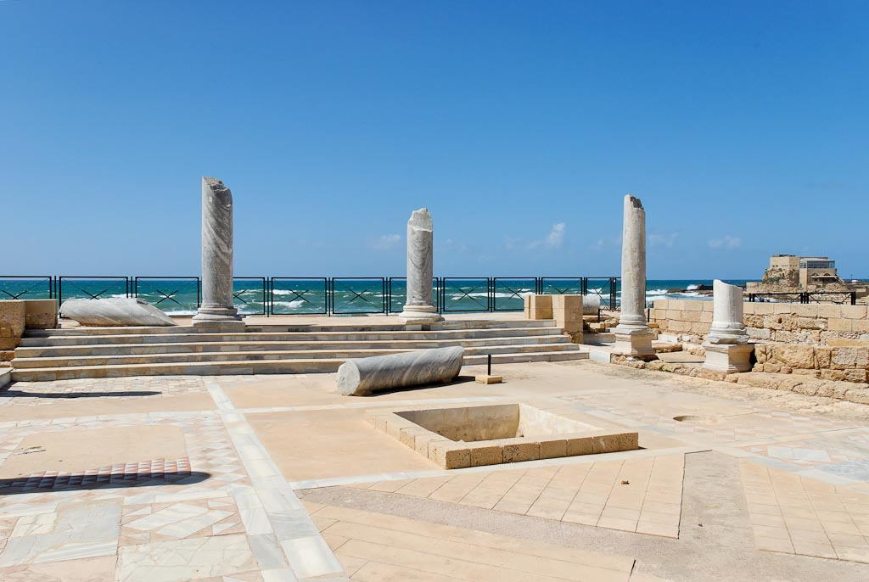
Caesarea Byzantine bathhouse
Notes:
A large public bathhouse was constructed in insula W2S3 in the fifth century. The courtyard is depicted above with its marble columns.
tb032407464

Slide 37
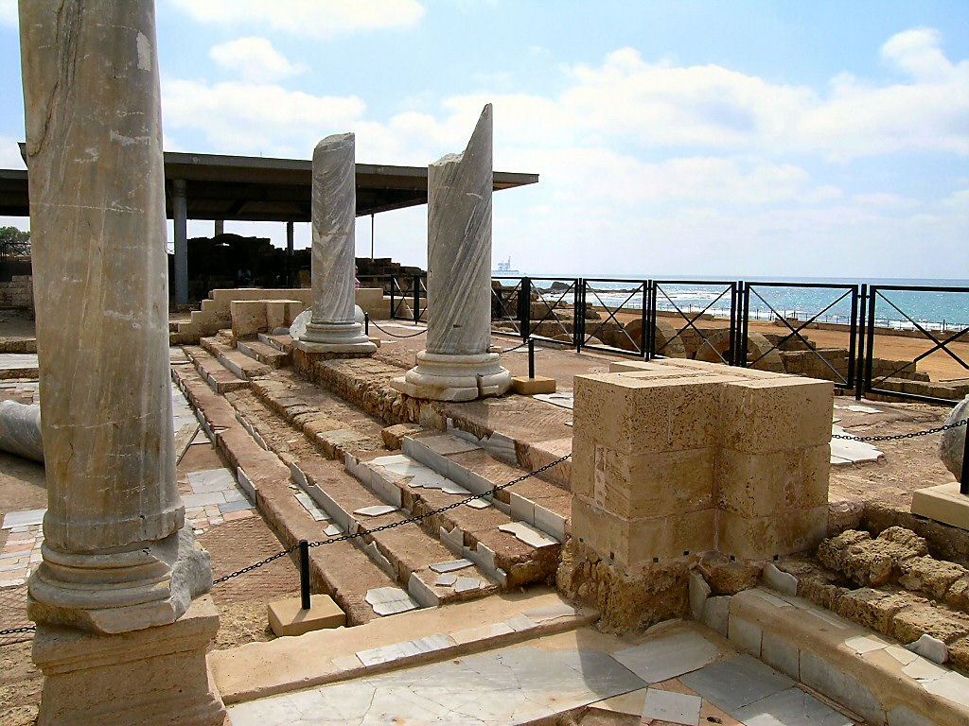
Caesarea Byzantine bathhouse southern section
Notes:
tb032504046

Slide 38
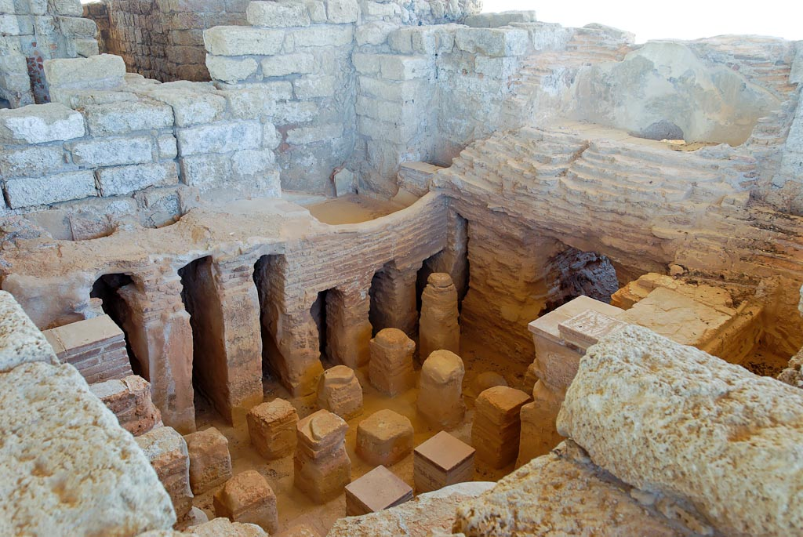
Caesarea Byzantine bathhouse caldarium
Notes:
The caldarium was the steam room, and the hot air was pumped under the elevated floor. Archaeologists also uncovered the dressing room (apodyterium), cold room (frigidarium), palestra, and public latrines.
tb032407457

Slide 39
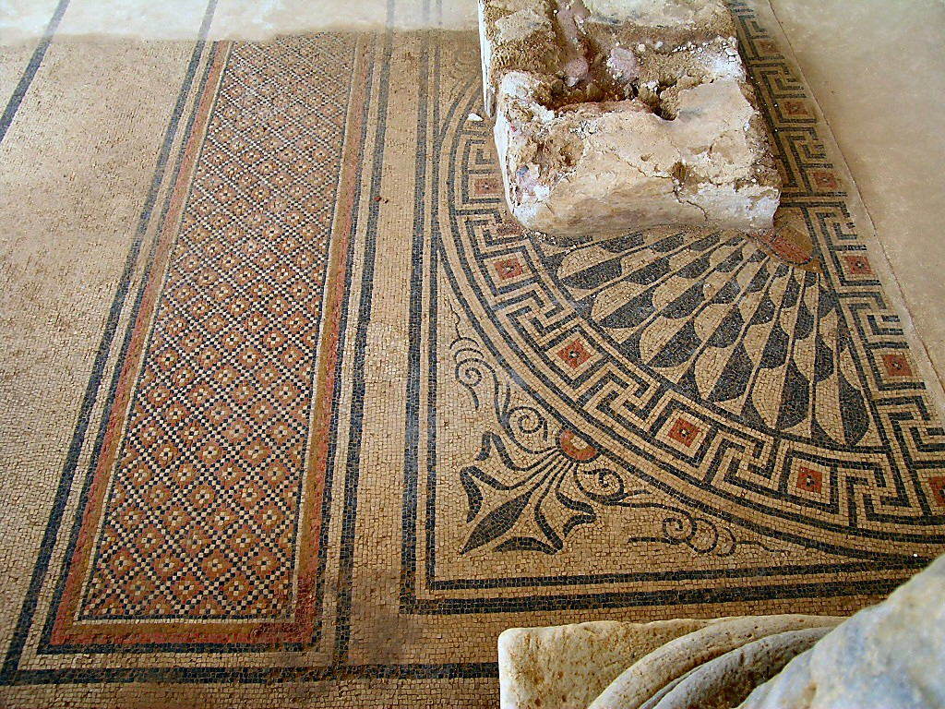
Caesarea Byzantine bathhouse southern section mosaic
Notes:
tb032504047

Slide 40
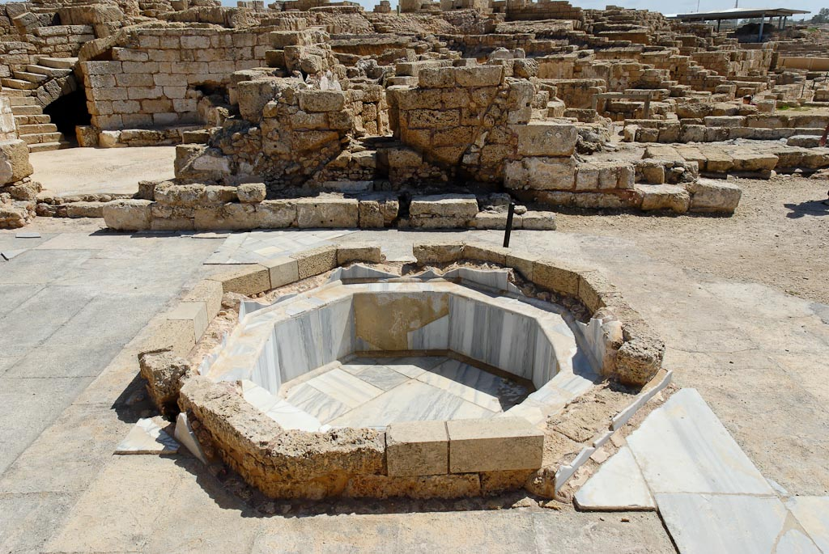
Caesarea Byzantine governor's bath
Notes:
tb032407473

Slide 41
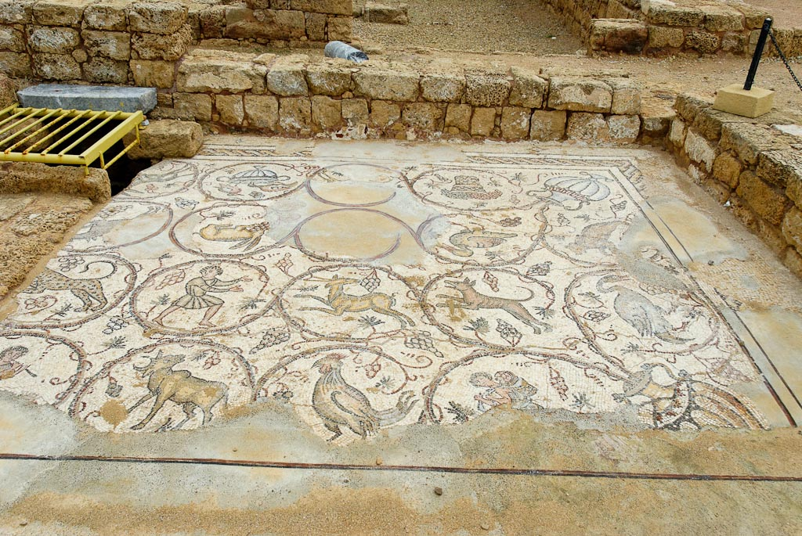
Caesarea mosaic with decorative medallions
Notes:
tb011112406

Slide 42
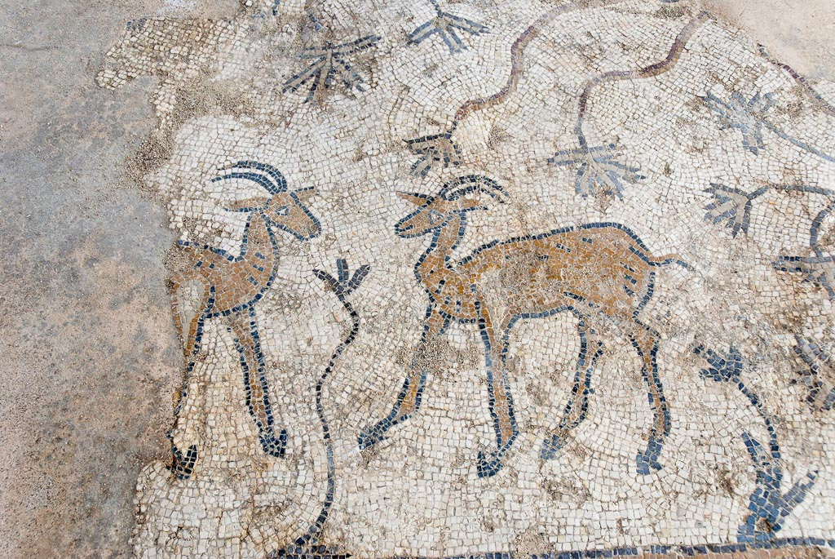
Caesarea ibex mosaic
Notes:
tb032407467

Slide 43
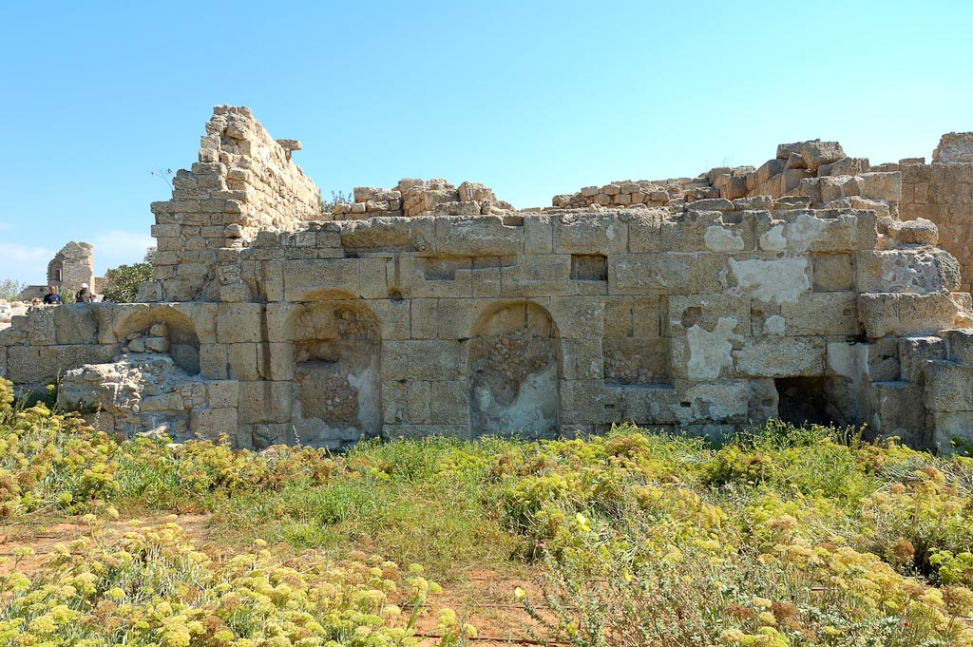
Caesarea nymphaeum
Notes:
tb100505485

Slide 44
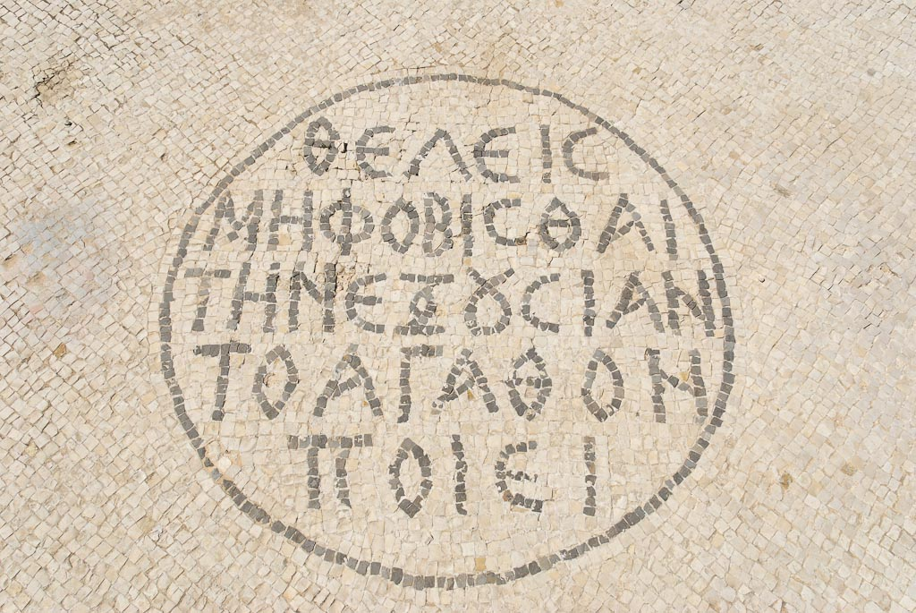
Caesarea mosaic with Romans 13:3
Notes:
Mosaic Inscription
Several inscriptions were found in Caesarea.
The imperial governor’s tax department office had a Greek inscription in the mosaic pavement entryway on which was written Romans 13:3b, “If you would not fear the authority, do good and you will receive praise from it.”
tb032407469

Slide 45
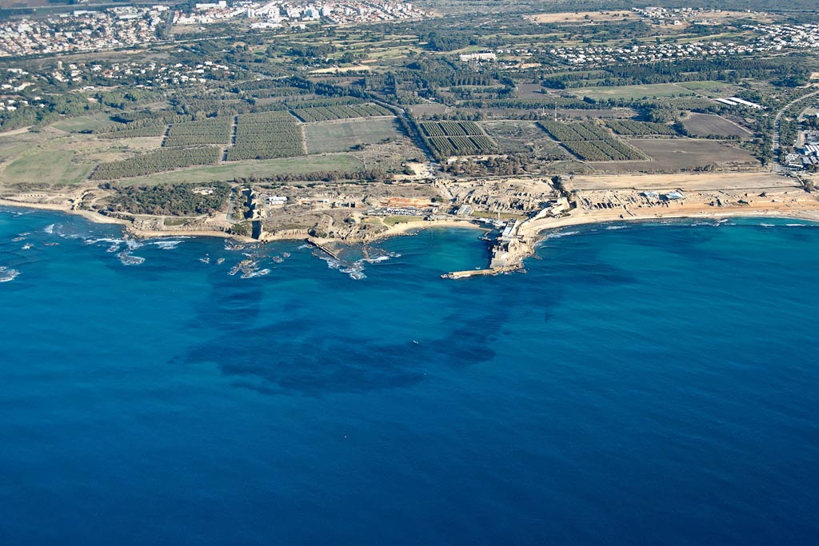
Caesarea harbor aerial from west
Notes:
Herod’s Harbor: Construction
According to Josephus, the builders of Herod’s harbor used stone blocks to build its foundation. The excavations have uncovered wooden forms filled with rubble, which are held together by underwater mortar made of lime combined with pozzolana, a volcanic ash from central Italy. This volcanic ash replaced the sand as the key ingredient of the mixture. Thus, the concrete could be poured, and then would harden, under water.
Double-walled wooden forms (13 feet [4 m] tall, 46 feet [14 m] long, and 23 feet [7 m] wide) were used for the construction of the concrete blocks.
To make the harbor, the builders used sand pebbles and hydraulic cement as the foundation for the breakwater walls. The breakwaters protected the ships from the prevailing southwest winds.
To keep the harbor silt-free, Herod designed a sluice system that allowed the water into the harbor basin, while the continuous current flushed out the existing silt.
tb121704927

Slide 46
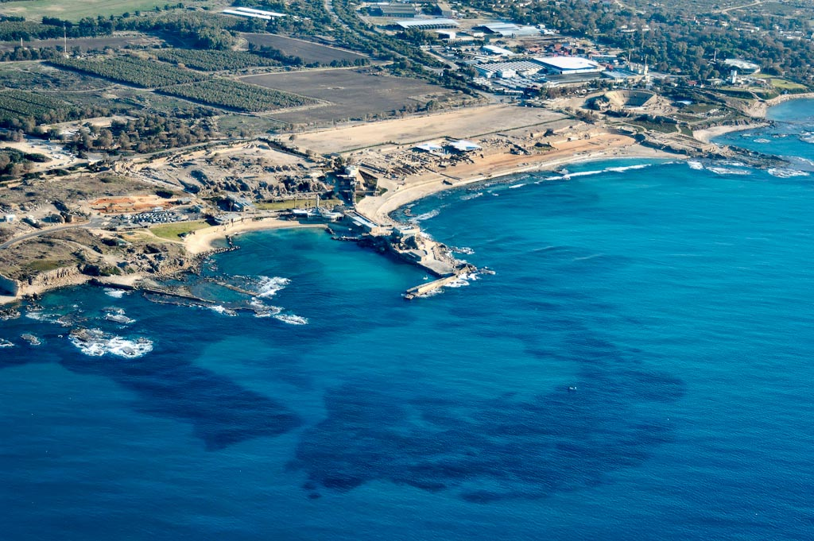
Caesarea harbor aerial from west
Notes:
Herod’s Harbor: Josephus’ Record
“Having calculated the relative size of the harbor, Herod let down stone blocks into the sea to a depth of 20 fathoms [120 ft]. Most of them were 50 feet long, 9 high, and 10 wide, some even larger. When the submarine foundation was finished, he then laid out the mole above sea level 200 feet across. Of this, a 100-foot portion was built out to break the force of the waves, and consequently was called the breakwater. The rest supported the stone wall that encircled the harbor. At intervals along it were great towers, the tallest and most magnificent of which was named Drusion, after the stepson of Caesar. There were numerous vaulted chambers for the reception of those entering the harbor, and the whole curving structure in front of them was a wide promenade for those who disembarked. The entrance channel faced north, for in this region the north wind always brings the clearest skies. At the harbor entrance were colossal statues, three on either side set up on columns. A massively built tower supported the columns on the port side of boats entering the harbor whereas those on the starboard side were supported by two upright blocks of stone yoked together and higher than the tower on the other side” (War 1:411-13)
tb121704936

Slide 47
Hadrian’s hippodrome
theater
Byzantine
bathhouse
palace
temple
hippodrome
Herodian
harbor
Herodian
breakwater
(submerged)
Herodian
breakwater
(submerged)
harbor
entrance
Caesarea harbor aerial from west
Notes:
tb121704936

Slide 48
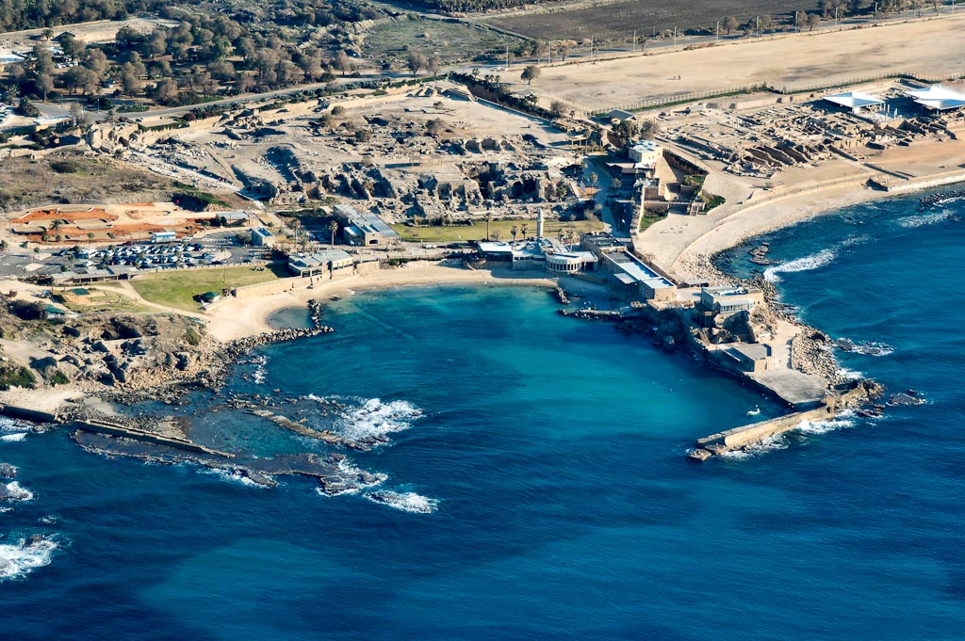
Caesarea harbor aerial from west
Notes:
Herod’s Harbor
Herod needed a port:
For economic trade.
For building material supplies.
For welcoming certain traveling Roman officials.
For easy access from the west to his important cities of Sebaste and Jerusalem.
tb121704935

Slide 49
Byzantine
bathhouse
temple
Herodian quay
Crusader
castle
modern
harbor
Caesarea harbor aerial from west
Notes:
tb121704935

Slide 50
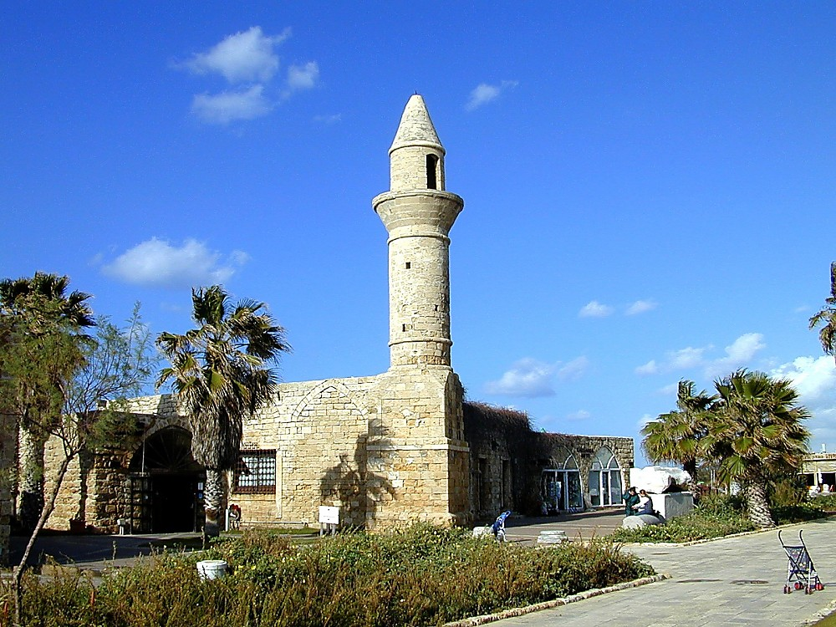
Caesarea Bosnian mosque
Notes:
Later History of Caesarea
In the 7th century AD, the Arabs took the city by surprise, after a Jew informed them of a secret entrance through the low-level aqueduct. The Arabs allowed the port to silt up, but kept the city as one of the richest in the area.
The Crusader city occupied only a fraction of the area of earlier cities. The Crusader population was about 12,000. Crusader fortifications and a moat 30 feet (9 m) deep were built by Louis IX of France (1251-1252) but were ineffective against the Sultan Baybars in 1265. The wall was 2,953 feet (900 m or 0.6 mi) long and 43 feet (13 m) high, had gates on all sides but the west, and had several posterns. The principal entrance was the East Gate, which has been beautifully restored. The ruins of the city became a source of building stone and lime.
The Mamluk sultan ordered the Crusader city destroyed in order to keep it from ever becoming an entry point for Western invaders.
Bosnian Muslim refugees were settled here by the Turks. In 1878 they had a flourishing business here, selling cut stones from the ancient sites. This was destroyed in the 1948 War. All that remains of their settlement is the little mosque beside the port (pictured above).
tb122000100

Slide 51
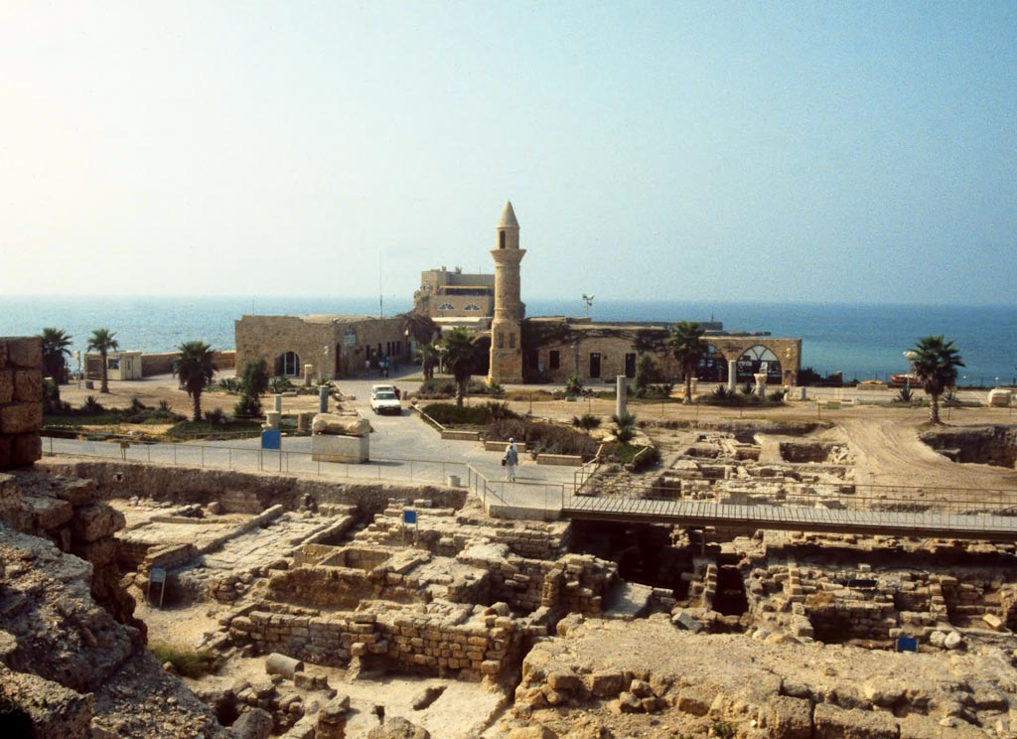
Caesarea harbor excavations
Notes:
This photo was taken in October 1992 before the excavations were covered (see next slide).
tbs70039210

Slide 52
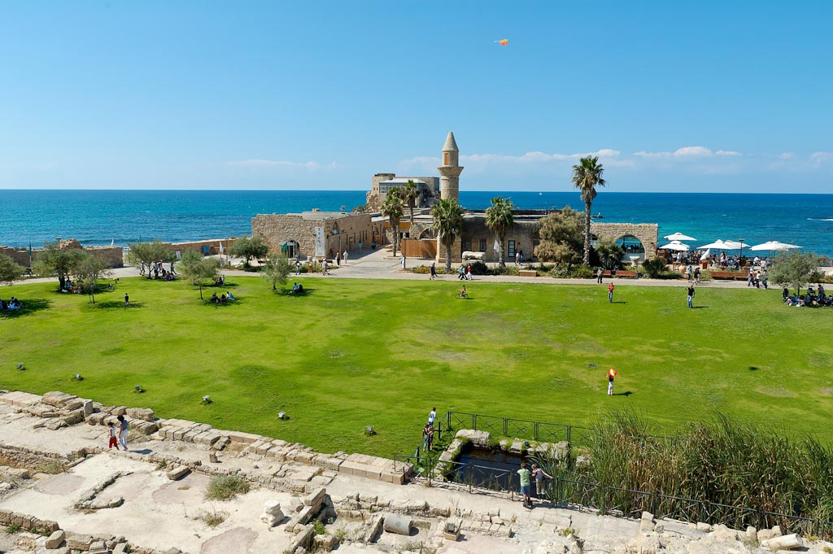
Caesarea harbor
Notes:
Herod’s Harbor: Size and Design
Herod’s port anchorage was 40 acres, and Josephus says that it could accommodate 300 ships. The harbor was named Sebastos, the Greek name of Augustus.
Three colossal statues, each one set up on a column, greeted the arriving ship as it entered the harbor.
Of all the statues, “the tallest and most magnificent...was named Drusion, after the stepson of Caesar” (War 1.411). Drusion was apparently the heir at the time. Archaeologists have found foundations of a gigantic tower near the end of this breakwater which may be Drusion.
Josephus does not mention the inner harbor, whose eastern limit was just in front of the podium of the temple of Augustus and some 260 feet (80 m) inland from the present shoreline. Its western limit is marked by a circular tower, now in just over 3 feet (1 m) of water, some 65 feet (20 m) from the bathing beach. This tower must have anchored a seawall running to the north.
A 1,920-foot (600 m) breakwater, on the southern side, protected the harbor against the prevailing southern winds.
tb100505495

Slide 53
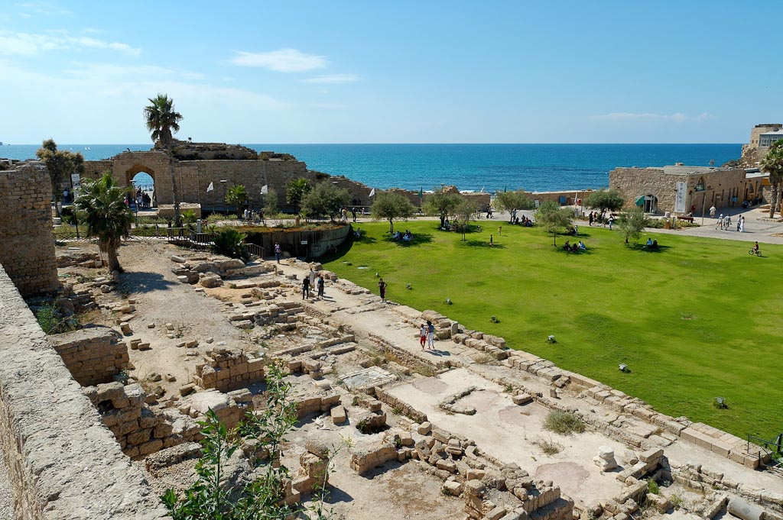
Caesarea harbor excavations
Notes:
Herod’s Harbor: Destruction and Later History
Remains from cargo ships wrecked on the breakwaters indicate that the harbor declined no later than the end of the 1st century AD. This may have happened by the time of the First Revolt, because the Roman legions landed at Akko. They most likely did this because Caesarea was already surrounded by the dangerous reefs of the ancient breakwaters.
“Such brilliant ingenuity was defeated by the sinking of the sea bed. The great blocks tilted, separated, and were undercut by the current. The sand it carried gradually wore away the wood and concrete. As the foundations moved and crumbled the structures above collapsed. By the end of the C1 AD, the breakwater had become a rubble mole. A further drop in the sea bed, possibly associated with the earthquake of AD 130, transformed the mole into dangerous reef, ready to tear the bottom out of any unwary ship. At least 23 wrecks have been found on the ruined breakwaters” (Murphy-O’Connor 2008: 246).
The harbor was repaired by the Byzantine emperor Anastasius (491-518), but seems to have fallen out of use by the middle of the 6th century because of tectonic movements.
The harbor was apparently intentionally filled in following the Muslim conquest.
The Crusaders built a new breakwater.
A modern fishing dock was built after 1948.
tb100505496

Slide 54
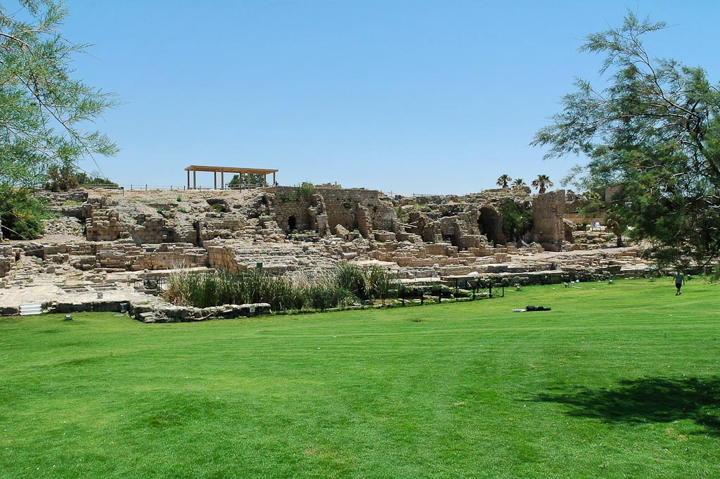
Caesarea harbor area from northwest
Notes:
tb052905368

Slide 55
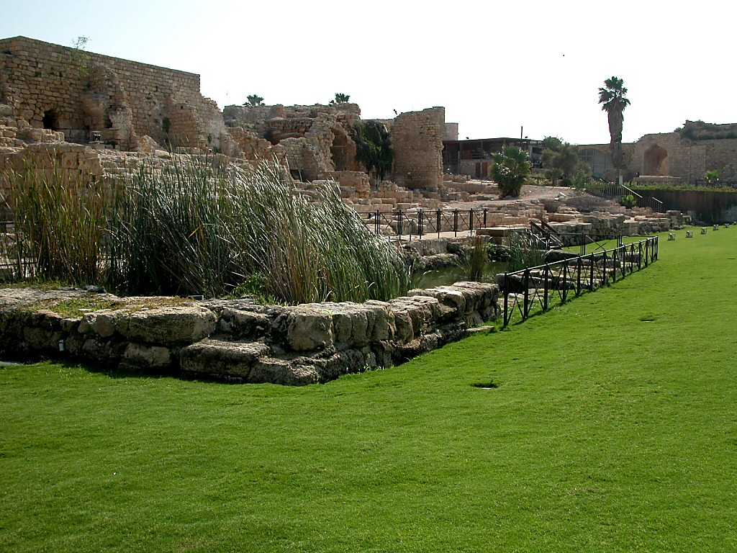
Caesarea harbor landing
Notes:
tb102302032

Slide 56
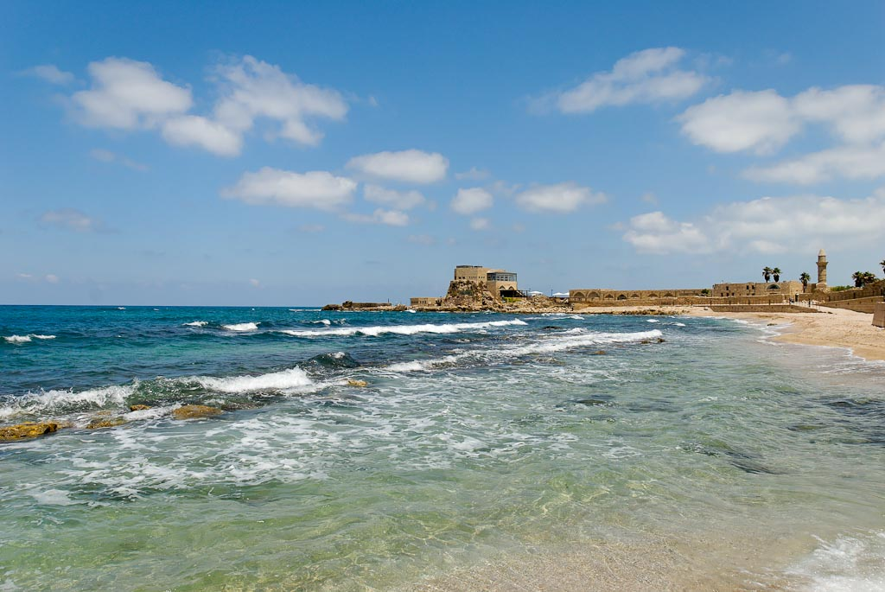
Caesarea harbor
Notes:
tb052508462

Slide 57
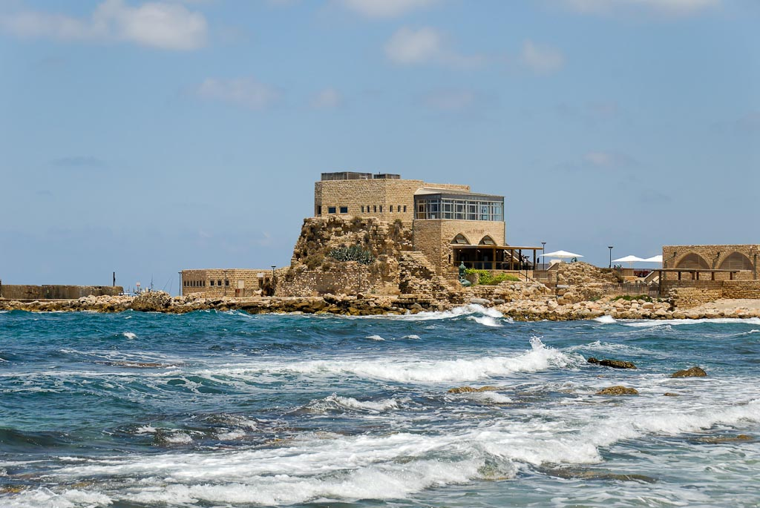
Caesarea Crusader castle remains
Notes:
tb052508464

Slide 58
Caesarea harbor at sunset
Notes:
tb011300103

Slide 59
Caesarea harbor with waves
Notes:
tb032407488

Slide 60
Caesarea harbor
Notes:
tb052806609

Slide 61
Caesarea harbor from north
Notes:
tb052905389

Slide 62
Caesarea harbor columns in water
Notes:
tb052905380

Slide 63
Caesarea harbor columns in water
Notes:
tb052905397

Slide 64
Caesarea harbor
Notes:
tbs48329011

Slide 65
Caesarea harbor with scuba divers
Notes:
Underwater Excavations
The earliest underwater studies were carried out by the Caesarea Ancient Harbour Excavation Project (CAHEP). This program was succeeded by the maritime unit of the Combined Caesarea Expeditions (CCE) under the direction of A. Raban and E. G. Reinhardt. “The ongoing project conducts an annual field season with student volunteers from both institutions [the University of Haifa and McMaster University] as well as others from around the world. The focus of the underwater research has shifted lately toward geoarchaeology, in an attempt to comprehend the history of maritime activity at Caesarea and the demise of Sebastos in the context of environmental changes and topographical alternations on the waterfront” (Raban 2008: 1680).
tb052806600

Slide 66
Caesarea harbor with scuba divers
Notes:
Underwater Museum
Visitors to Caesarea may tour the ancient harbor underwater by means of four trails. Each diver is provided with a waterproof map of the underwater park by which they can find their way from signpost to signpost. There are a total of 28 marked sites. On the trails, divers can see the harbor foundations, shipwrecks, lighthouse, and a series of anchors from different periods.
tb052806606

Slide 67
Caesarea buildings near northern breakwater
Notes:
tb052905372

Slide 68
Caesarea Byzantine church above temple
Notes:
The Early Church in Caesarea
Caesarea was the main city for Christianity in the first centuries.
Origen lived here from 231 to 250.
Pamphilius (d. 309) continued Origen’s tradition of scholarship, and created a library second only to that of Alexandria. In 630, the library contained 30,000 volumes.
Eusebius (260-340) was Pamphilius’ student. He lived here 25 years, writing the Onomasticon and Ecclesiastical History. He became bishop of Caesarea in 314.
Caesarea was the capital of the province of Palestine for nearly 600 years.
The Byzantine city had an estimated population of 100,000.
tb100505493

Slide 69
Caesarea Crusader fortifications aerial from northeast
Notes:
The Crusader city occupied only a fraction of the area of the Roman and Byzantine cities, and it had a population of about 12,000.
bb00190102. Photo by Barry Beitzel.

Slide 70
Caesarea Crusader walls and moat
Notes:
tbs48309011

Slide 71
Caesarea Crusader moat
Notes:
Crusader fortifications and a 30-foot (9-m) deep moat were built by Louis IX of France (1251-1252) but were ineffective against the Sultan Baybars in 1265. The wall was 2,953 feet (900 m or 0.6 mi) long and 43 feet (13 m) high, had gates on all sides but the west, and had several posterns. The principal entrance was the East Gate, which has been beautifully restored. The ruins of the city became a source of building stone and lime.
tb052304877

Slide 72
Caesarea Crusader moat
Notes:
tb032407472

Slide 73
Caesarea Crusader northern fortifications
Notes:
The Mamluk sultan ordered the Crusader city destroyed in order to keep it from ever becoming an entry point for Western invaders.
tb052905370

Slide 74
Caesarea Crusader gatehouse
Notes:
The eastern gatehouse has been restored in modern times.
tb052304871

Slide 75
Caesarea Crusader gatehouse interior
Notes:
tb052304876

Slide 76
Caesarea Crusader arcade
Notes:
tb100505490

Slide 77
Caesarea Byzantine street with porphyry statue of Hadrian
Notes:
The street dates to the Byzantine period but two statues on display come from the Roman period. The headless porphyry statue is believed to represent the Roman emperor Hadrian (AD 117-38).
tb052304879

Slide 78
Caesarea porphyry statue of Hadrian
Notes:
tb052304880

Slide 79
Caesarea hippodrome aerial from north
Notes:
Hippodromes
Specific Features
This hippodrome was probably a contribution of the emperor Hadrian in AD 130. It is a rectangular 1, 475 foot-long (450 m) space, and could seat 30,000 spectators.
The square base of the obelisk lies against the east fence. The granite obelisk itself, which must have been brought from Egypt, was discovered where it fell from the spina in the middle of the racecourse. Piled beside it are the bases of the conical turning-points—their upper portions were found in the harbor. A 89 foot-high (27 m) porphyry obelisk was found here.
Origin
Hippodromes were introduced in the early Roman period.
The largest hippodrome was the Circus Maximus in Rome, which was 1,640 foot (500 m) long and could hold a quarter of a million people.
“Hippodrome” in Greek means “place for horses to run.” The Latin name for this is “circus.”
bb00190108. Photo by Barry Beitzel.

Slide 80
Caesarea hippodrome with obelisk
Notes:
Hippodrome Design
Hippodromes were built for horse and chariot races.
The structure was oblong, rounded on one end and closed off or open on the other end.
A wall was built in the center, around which the horses and chariots raced.
At one end of the spina was an obelisk, that is, a tall pillar, that decorated the arena.
Next to the obelisk was a red stone known as a traxhippos. This word means “the one which frightens the horses.” It was put there to encourage the horses to run faster.
tb100505501

Slide 81
Caesarea Byzantine mansion mosaic
Notes:
This beautiful mosaic was part of a large mansion in the Byzantine period. Archaeologists originally discovered the building in the 1950s but they buried it because of a lack of funds to properly excavate and conserve it. In 2004, a grant made possible the excavation and opening of this mosaic to the public. The cost of the excavations was about $125,000.
tb011006326

Slide 82
Caesarea Byzantine mansion mosaic, entrance
Notes:
The mansion measures 200 by 130 feet (62 by 40 m) and has a 50 by 46 foot (16 by 14.5 m) mosaic in the center.
tb011006327

Slide 83
Caesarea Byzantine mansion mosaic, bird
Notes:
Because there are representations of 120 birds in the mosaic, this floor is popularly known as the “birds mosaic.”
tb011006333

Slide 84
Caesarea Byzantine mansion mosaic, pelican
Notes:
This mansion is located in a neighborhood northeast of the archaeological park, and is easily accessible along the road to the Herodian aqueduct.
tb011006330

Slide 85
Caesarea Byzantine mansion mosaic, peacock
Notes:
tb011006334

Slide 86
Caesarea Byzantine mansion mosaic, bear
Notes:
Various animals are represented along the border, including a bear, elephant, dog, gazelle, lion, ibex, wild boar, and panther.
tb011006338

Slide 87
Caesarea Byzantine mansion mosaic, dog
Notes:
tb011006339

Slide 88
Caesarea Byzantine mansion mosaic, gazelle
Notes:
tb011006337

Slide 89
Caesarea Byzantine mansion mosaic, lion
Notes:
tb011006340

Slide 90
Caesarea Byzantine mansion mosaic, tree
Notes:
The mansion was apparently destroyed by fire in about AD 640.
tb011006344

Slide 91
Caesarea beach
Notes:
tb100505525

Slide 92
Caesarea Herodian aqueduct aerial from northeast
Notes:
High-Level Aqueduct
The high-level aqueduct was fed by the Zerka (Shuni) River, Kabara springs and the Nahal Taninim at the foot of Mount Carmel.
The aqueduct is made of two channels with independent foundations. The eastern side was built by Herod while the western side was an addition by Hadrian.
The Crusaders filled in one of the channels to create a higher and smaller channel.
The arched portion of the aqueduct is 5 miles (9 km) long.
The aqueduct has a gradient of 13 inches for each mile (20 cm for each km), and it reached Caesarea at a height of 26 feet (8 m) above sea level.
The aqueduct passes through a kurkar ridge by means of a 1,312 feet (400 m) hewn tunnel at the Arab village of Jisr es-Zarka.
Other photos of this arched aqueduct are included in the Sharon Plain presentation.
bb00190065. Photo by Barry Beitzel.

Slide 93
Caesarea Herodian aqueduct aerial from northeast
Notes:
bb00190065. Photo by Barry Beitzel.

Slide 94
Caesarea Herodian aqueduct aerial from northeast
Notes:
bb00190017. Photo by Barry Beitzel.

Slide 95
Roman aqueduct
Byzantine lower aqueduct
Caesarea Herodian aqueduct aerial from northeast
Notes:
bb00190017. Photo by Barry Beitzel.

Slide 96
Caesarea Herodian aqueduct aerial from northeast
Notes:
bb00190022. Photo by Barry Beitzel.

Slide 97
Caesarea aqueducts aerial from west
Notes:
tb121704941

Slide 98
Caesarea aqueducts aerial from west
Notes:
tb121704942

Slide 99
Byzantine lower aqueduct
Roman aqueduct
Caesarea aqueducts aerial from west
Notes:
tb121704942

Slide 100
Caesarea Roman aqueduct covered in sand
Notes:
tb032504079

Slide 101
Caesarea Roman aqueduct
Notes:
kg111500101

Slide 102
Caesarea Roman aqueduct
Notes:
tb032504092

Slide 103
Caesarea Roman aqueduct
Notes:
tb011112413

Slide 104
Caesarea Roman aqueduct
Notes:
tb052600101

Slide 105
Caesarea Roman aqueduct
Notes:
tb052600100

Slide 106
Caesarea Roman aqueduct cross-section
Notes:
This cross-section reveals the two earliest portions of the aqueduct. The portion on the right was built by Herod (notice the protrusions on the left side) in the 1st century BC. About AD 135, the Roman legions under Emperor Hadrian constructed a new aqueduct next to the Herodian one (on the left).
tb032504096

Slide 107
Caesarea Roman aqueduct inscription
Notes:
Hadrian doubled the capacity of the aqueduct with a western addition in about AD 135. Inscriptions along the aqueduct identify Hadrian as the builder and indicate that construction of the aqueduct was carried out by the Second, Sixth, and Tenth Legions.
tb062700100

Slide 108
Caesarea Byzantine lower aqueduct
Notes:
Low-Level Aqueduct
The low-level aqueduct dates to the 4th, or early 5th, century AD. It was fed by Kabara Swamp spring water, 2 miles (3 km) north of Caesarea. Because the swamp itself was lower than Caesarea, the water level was raised by the construction of two dams.
Estimates of the city’s population, based upon the demand for water in the Byzantine period, indicate a population four times greater than the 2nd century AD population.
tb032504077

Slide 109
Caesarea Byzantine lower aqueduct
Notes:
Helpful Sources on Caesarea
Burrell, Barbara; Kathryn Gleason; and Ehud Netzer.
1993 Uncovering Herod's Seaside Palace. Biblical Archaeology Review 19/3: 50-57, 76.
Crisler, B. Cobbey.
1976 The Acoustics and Crowd Capacity of Natural Theaters in Palestine. Biblical Archaeologist 39: 128-41.
Holum, Kenneth G. and Avner Raban.
1993a Caesarea. Pp. 270-72 in The New Encyclopedia of Archaeological Excavations in the Holy Land, vol. 1, ed. E. Stern. Jerusalem; New York: Israel Exploration Society and Carta; Simon & Schuster.
1993b The Joint Expedition's Excavations, Excavations in the 1980s and 1990s, and Summary. Pp. 282-86 in The New Encyclopedia of Archaeological Excavations in the Holy Land, vol. 1, ed. E. Stern. Jerusalem; New York: Israel Exploration Society and Carta; Simon & Schuster.
Holum, Kenneth; Avner Raban; and Joseph Patrich.
2008 Caesarea: The Combined Caesarea Expeditions Excavations. Pp. 1665-84 in The New Encyclopedia of Archaeological Excavations in the Holy Land, vol. 5, ed. E. Stern. Jerusalem: Israel Exploration Society and Carta; New York: Simon & Schuster.
Levine, Lee I. and Ehud Netzer.
1993 Caesarea: Excavations in the 1970s. Pp. 280-82 in The New Encyclopedia of Archaeological Excavations in the Holy Land, vol. 1, ed. E. Stern. Jerusalem; New York: Israel Exploration Society and Carta; Simon & Schuster.
Murphy-O'Connor, Jerome.
2008 The Holy Land: An Oxford Archaeological Guide. 5th ed. Oxford: Oxford University Press.
Negev, Avraham; Antonio Frova; and Michael Avi-Yonah.
1993 Caesarea: Excavations in the 1950s and 1960s. Pp. 272-80 in The New Encyclopedia of Archaeological Excavations in the Holy Land, vol. 1, ed. E. Stern. Jerusalem; New York: Israel Exploration Society and Carta; Simon & Schuster.
Netzer, Ehud.
2008 The Architecture of Herod the Great Builder. paperback with new preface ed. . Grand Rapids: Baker.
Porath, Yosef.
2008 Caesarea: The Israel Antiquities Authority Excavations. Pp. 1656-65 in The New Encyclopedia of Archaeological Excavations in the Holy Land, vol. 5, ed. E. Stern. Jerusalem; New York: Israel Exploration Society and Carta; Simon & Schuster.
Raban, Avner.
1993 Caesarea: Maritime Caesarea. Pp. 286-91 The New Encyclopedia of Archaeological Excavations in the Holy Land, vol. 1, ed. E. Stern. Jerusalem; New York: Israel Exploration Society and Carta; Simon & Schuster.
2008 Caesarea: Underwater Excavations. Pp. 1680-83 in The New Encyclopedia of Archaeological Excavations in the Holy Land, vol. 5, ed. E. Stern. Jerusalem; New York: Israel Exploration Society and Carta; Simon & Schuster.
Raban, Avner and Kenneth G. Holum, eds.
1996 Caesarea Maritima: A Retrospective after Two Millennia. Leiden: Brill.
Richardson, Peter.
1996 Herod: King of the Jews and Friend of the Romans. Minneapolis: Fortress.
Sailhamer, John H.
1998 Biblical Archaeology. Zondervan Quick Reference Library. Grand Rapids: Zondervan.
Shanks, Hershel.
1994 Caesarea Maritima Yields More Treasures. Biblical Archaeology Review 20/1: 52.
tb011300102

Slide 110
This sampler is taken from the Pictorial Library of Bible Lands, Revised and Expanded edition, Volume 2: Samaria and the Center.
Samaria and the Center includes more than 1,200 photos like these – all in high-resolution.
Each photo is clearly labeled. Most slides have descriptive explanations (see notes section at bottom).
Designed for ease of use. PowerPoint presentations, jpg files, no watermarks, few restrictions.
If you don’t love it, return it!
Free shipping within U.S.
For more information about this volume, go to: http://www.bibleplaces.com/02-samaria-and-the-center-revised.htm

Slide 111
This sampler is taken from the Pictorial Library of Bible Lands, Revised and Expanded edition, Volume 2: Samaria and the Center. Other presentations on this volume include:
Benjamin
Beth Shean
Beth Shearim
Bethel-Ai
Dor
Gibeon
Jericho
Jericho-Later Periods
Jezreel Valley
Jordan Rift
Kiriath Jearim
Megiddo
Michmash and Geba
Mount Carmel
Ramat HaNadiv
Samaria
Samaria-Sebaste
Sharon Plain
Shechem and Mount Gerizim
Shiloh
For more information about this volume, go to: http://www.bibleplaces.com/02-samaria-and-the-center-revised.htm

Slide 112
Samaria and the Center is volume 2 of the Pictorial Library of Bible Lands, a collection of 17,600 high-resolution images of biblical sites and scenes. Other volumes in the collection include:
Galilee and the North
Jerusalem
Judah and the Dead Sea
Negev and the Wilderness
Jordan
Egypt
Lebanon
Eastern and Central Turkey
Western Turkey
Greece
The Greek Islands
Cyprus and Crete
Italy and Malta
Rome
Trees, Plants, and Flowers of the Holy Land
Cultural Images of the Holy Land
Signs of the Holy Land
For more information about the Pictorial Library of Bible Lands, go to: http://www.bibleplaces.com/details.htm

