Slide 1
JOSHUA 2
Notes:
This is a free sample of the Joshua 2 presentation from the Photo Companion to the Bible. To purchase the full volume, visit https://www.bibleplaces.com/joshua/
The Photo Companion to the Bible is an image-rich resource for Bible students, teachers, and researchers. Just as a librarian stocks the shelves with as many relevant materials as possible, so we have tried to provide a broad selection of images. Our goal is that you will find in this “library” whatever it is you are looking for.
Credits: The primary creators of this presentation are Chris McKinny, Kris Udd, and Todd Bolen. The photographs have an individual file code which usually includes the initials of the photographer. Other images have additional credit or source information.
Updates: We plan to update this collection as we are able. We welcome your suggestions for improving this resource (photocompanion@bibleplaces.com). Purchasers of the Joshua volume are provided free, lifetime updates to the collection.
Copyright: This photo collection is protected by copyright law and may not be distributed without written permission from BiblePlaces.com. Slide notes should be treated as any other copyrighted written material, with credit given when quoting from these notes.
For more information, see our complete “Introduction to the Photo Companion to the Bible” online at http://www.BiblePlaces.com/Intro-Photo-Companion-Bible/. Here you will find more information about photo selection, explanatory notes, Bible translation, credit information, and copyright allowances.

Slide 2
JOSHUA 2
This is a free sample of the Joshua 2 presentation from the Photo Companion to the Bible. To purchase the full volume, visit https://www.bibleplaces.com/joshua/ The Photo Companion to the Bible is an image-rich resource for Bible students, teachers, and researchers. Just as a librarian stocks the shelves with as many relevant materials as possible, so we have tried to provide a broad selection of images. Our goal is that you will find in this “library” whatever it is you are looking for. For more details (for this and every slide), see the Notes section below.
Notes:
This is a free sample of the Joshua 2 presentation from the Photo Companion to the Bible. To purchase the full volume, visit https://www.bibleplaces.com/joshua/
The Photo Companion to the Bible is an image-rich resource for Bible students, teachers, and researchers. Just as a librarian stocks the shelves with as many relevant materials as possible, so we have tried to provide a broad selection of images. Our goal is that you will find in this “library” whatever it is you are looking for.
Credits: The primary creators of this presentation are Chris McKinny, Kris Udd, and Todd Bolen. The photographs have an individual file code which usually includes the initials of the photographer. Other images have additional credit or source information.
Updates: We plan to update this collection as we are able. We welcome your suggestions for improving this resource (photocompanion@bibleplaces.com). Purchasers of the Joshua volume are provided free, lifetime updates to the collection.
Copyright: This photo collection is protected by copyright law and may not be distributed without written permission from BiblePlaces.com. Slide notes should be treated as any other copyrighted written material, with credit given when quoting from these notes.
For more information, see our complete “Introduction to the Photo Companion to the Bible” online at http://www.BiblePlaces.com/Intro-Photo-Companion-Bible/. Here you will find more information about photo selection, explanatory notes, Bible translation, credit information, and copyright allowances.

Slide 3
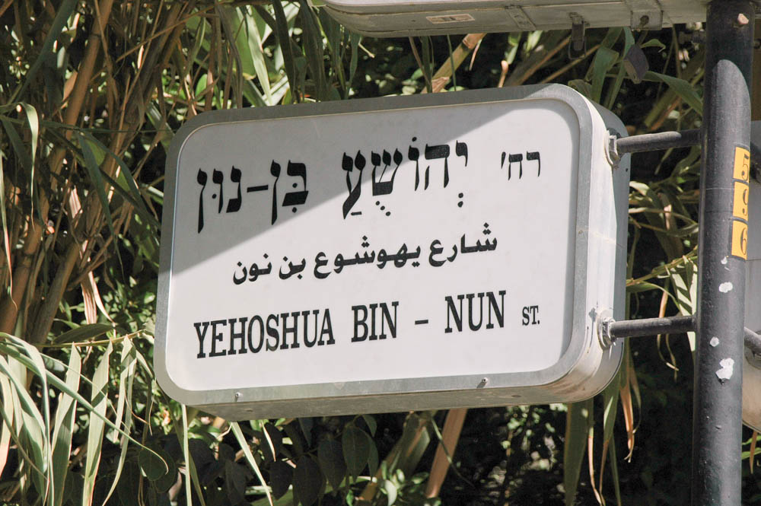
And Joshua the son of Nun
“Joshua son of Nun Street,” sign in Jerusalem
2:1
Notes:
This street sign in Jerusalem identifies this street name in Hebrew, Arabic, and English as “Joshua son of Nun.” This street is located near Emek Refaim Street, southwest of the Old City.
tb072404783c

Slide 4
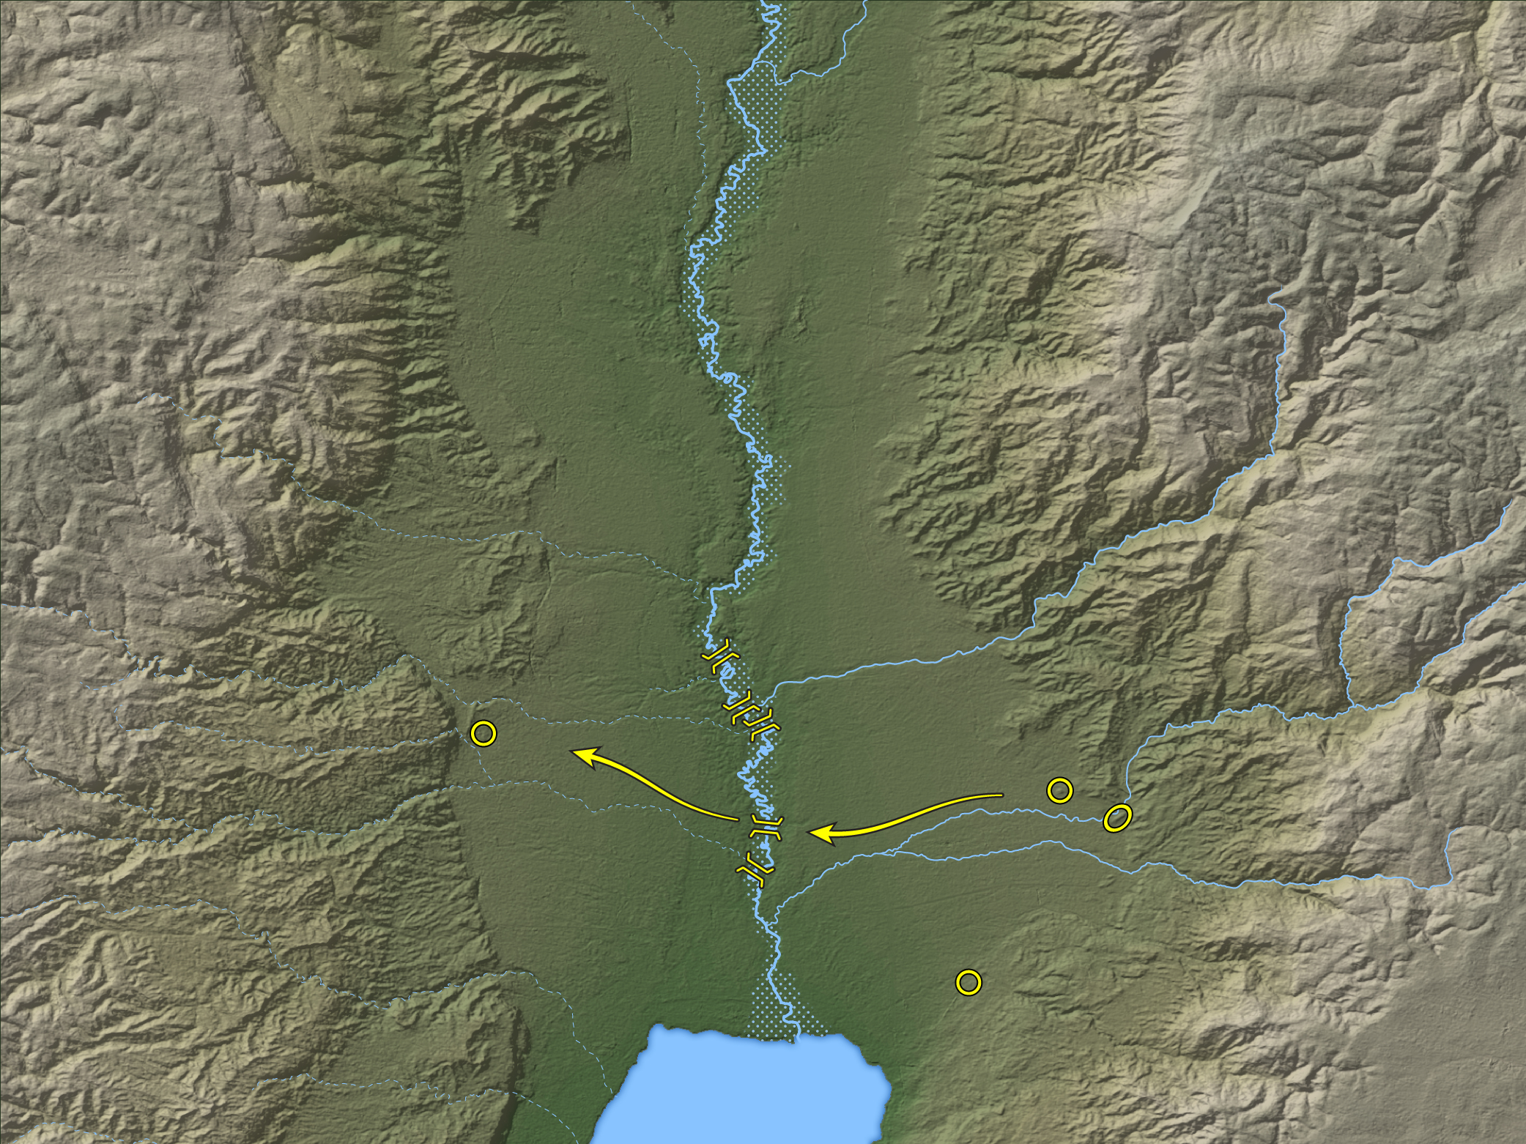
And Joshua the son of Nun sent out of Shittim two men as spies secretly
Jordan River
Abel-shittim?
(Tell el-Kefrein)
Jericho
(Tell es-Sultan)
Abel-shittim?
(Tell el-Hammam)
Beth-jeshimoth
(Tell Azeimeh)
Dead Sea
Route of spies from the Plains of Moab to Jericho
2:1
Notes:
The map shows five fords across the Jordan that were recorded in the 19th century, and the map represents the approximate width of the Jordan River at flood stage based on modern information. The Israelites were encamped between Abel-shittim/Shittim and Beth-jeshimoth (Num 33:49). This map was created by A.D. Riddle, RiddleMaps.com. Data source: ASTER-GDEM 2 was used to render the terrain (https://asterweb.jpl.nasa.gov/gdem.asp).

Slide 5
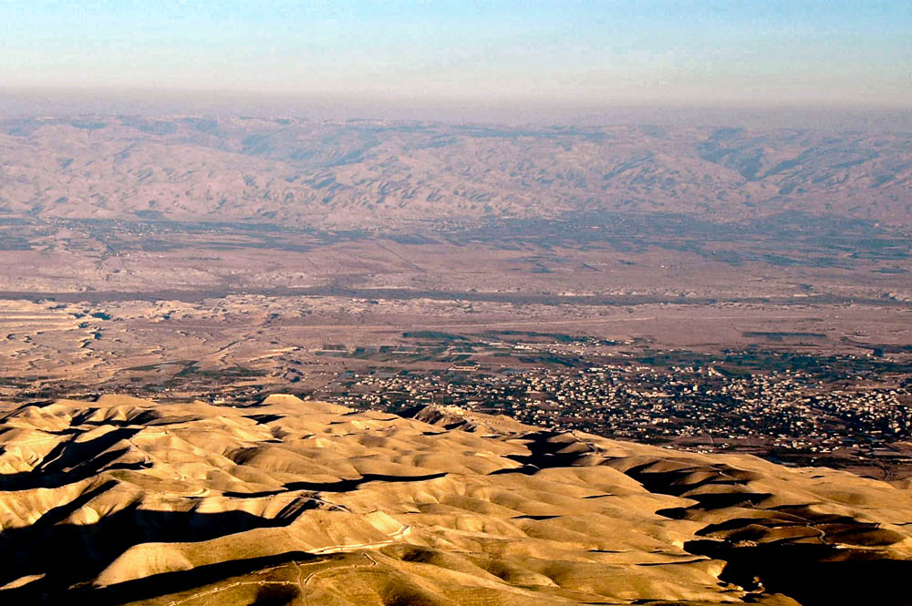
And Joshua the son of Nun sent out of Shittim two men as spies secretly
Region of Jericho and Shittim (aerial view from the west)
2:1
Notes:
This photo provides a broad view of the land where the events of chapter 2 took place. At the beginning of the chapter, the spies leave Shittim and travel to Jericho. At the end, they journey from the hills in the foreground back across the Jordan River to the Israelite encampment. See the next slide for labels.
tb121704157

Slide 6
And Joshua the son of Nun sent out of Shittim two men as spies secretly
Shittim?
Jordan River
Jericho
Region of Jericho and Shittim (aerial view from the west)
2:1
Notes:
This photo provides a broad view of the land where the events of chapter 2 took place. At the beginning of the chapter, the spies leave Shittim and travel to Jericho. At the end, they journey from the hills in the foreground back across the Jordan River to the Israelite encampment.
tb121704157

Slide 7
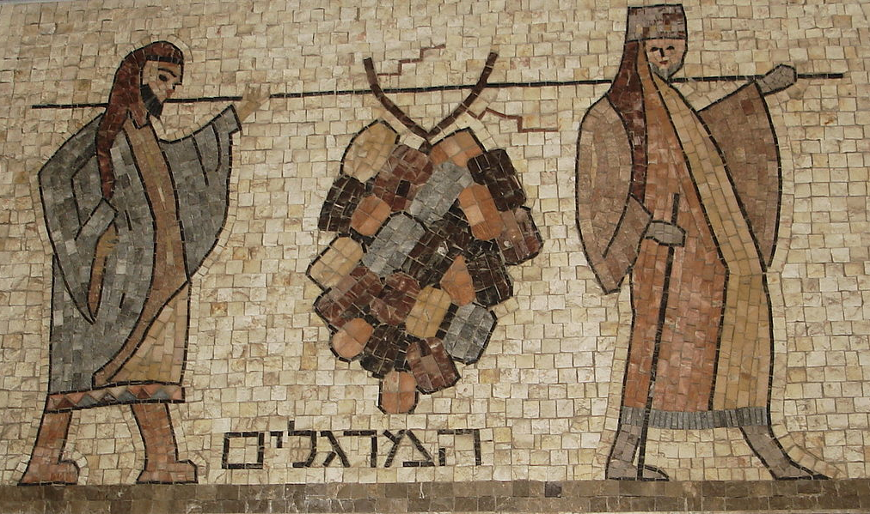
And Joshua the son of Nun sent out of Shittim two men as spies secretly
Return of the spies from Canaan depicted on a mosaic from a synagogue in Acco
2:1
Notes:
Joshua’s sending out of two spies is reminiscent of Numbers 13, where twelve spies were sent by Moses but only two returned with a good report. The two spies depicted on the mosaic shown here are easily identified as some of those sent by Moses because of the very large cluster of grapes they carry (cf. Num 13:23). The legend on this modern mosaic from a synagogue in Acre, Israel, reads “the spies” (המרגלימ). This image comes from FLLL and is licensed under CC-BY-SA-4.0, via Wikimedia Commons: https://commons.wikimedia.org/wiki/File:Syna_Acco_-_Mosaic_of_the_Land_of_grapes_-Below_coins._(cropped).JPG
wiki120920152309

Slide 8
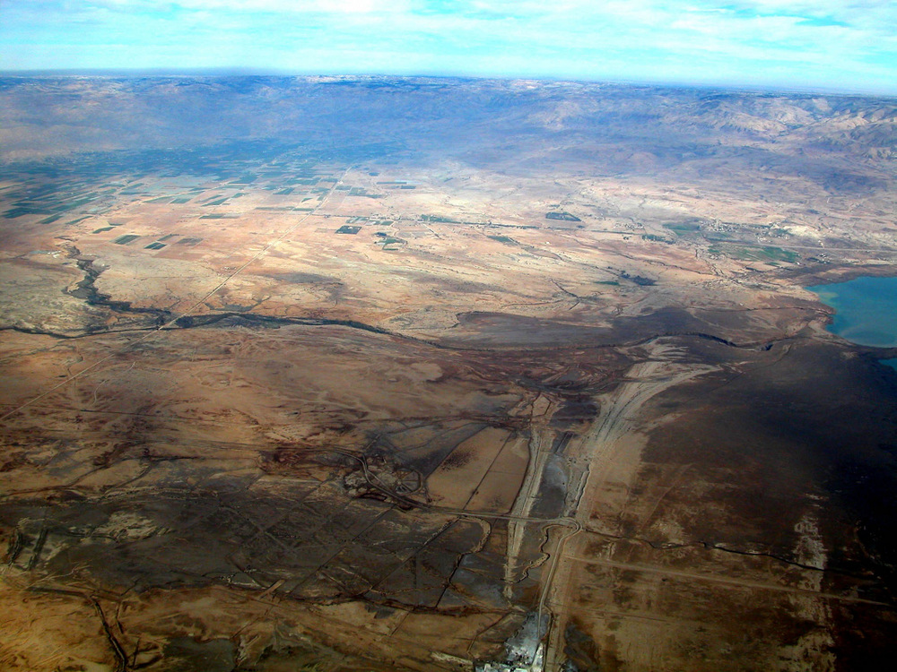
And Joshua the son of Nun sent out of Shittim two men as spies secretly
Possible locations of Shittim (aerial view from the west)
2:1
Notes:
Shittim (also known as Abel-shittim) should probably be identified with either Tell el-Kefrein or Tell el-Hammam, both of which are located northeast of the Dead Sea in the plains of Moab (Slayton 1992: 222). The text does not specifically state Shittim was a city at the time, so it may be used here as a regional term for a specific locale in the Plains of Moab. The name Abel-shittim means “plain of the acacia trees.” See the next slide for labels.
Reference:
Slayton, J. C.
1992 Shittim (Place). Anchor Bible Dictionary vol. 5, ed. D. N. Freedman. New York: Doubleday.
tb010703748

Slide 9
And Joshua the son of Nun sent out of Shittim two men as spies secretly
Tell el-Hammam
Mt. Nebo
Tell el-Kefrein
Dead Sea
Jordan River
Possible locations of Shittim (aerial view from the west)
2:1
Notes:
Shittim (also known as Abel-shittim) should probably be identified with either Tell el-Kefrein or Tell el-Hammam, both of which are located northeast of the Dead Sea in the plains of Moab (Slayton 1992: 222). The text does not specifically state Shittim was a city at the time, so it may be used here as a regional term for a specific locale in the Plains of Moab. The name Abel-shittim means “plain of the acacia trees.”
Reference:
Slayton, J. C.
1992 Shittim (Place). Anchor Bible Dictionary vol. 5, ed. D. N. Freedman. New York: Doubleday.
tb010703748

Slide 10
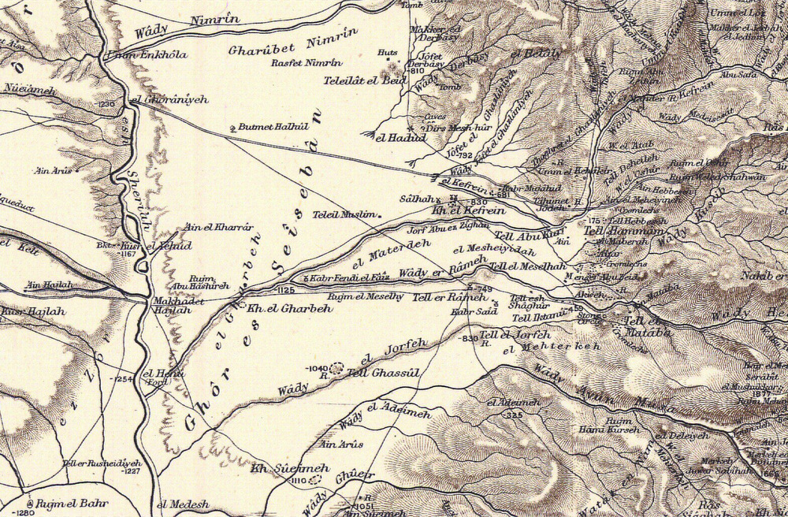
And Joshua the son of Nun sent out of Shittim two men as spies secretly
Possible locations of Shittim on the Survey of Eastern Palestine
2:1
Notes:
This map shows the location of Tell (or Khirbet) el-Kefrein and Tell el-Hammam, two possible locations for Abel-shittim (Shittim). The Survey of Eastern Palestine was conducted by C. R. Condor in 1881, and this map was published in 1889. See the next slide for labels.

Slide 11
And Joshua the son of Nun sent out of Shittim two men as spies secretly
Abel-shittim?
Abel-shittim?
Jordan River
Dead Sea
Possible locations of Shittim on the Survey of Eastern Palestine
2:1
Notes:
This map shows the location of Tell (or Khirbet) el-Kefrein and Tell el-Hammam, two possible locations for Abel-shittim (Shittim). The Survey of Eastern Palestine was conducted by C. R. Condor in 1881, and this map was published in 1889. See the next slide for a close-up of the candidates for Shittim.

Slide 12
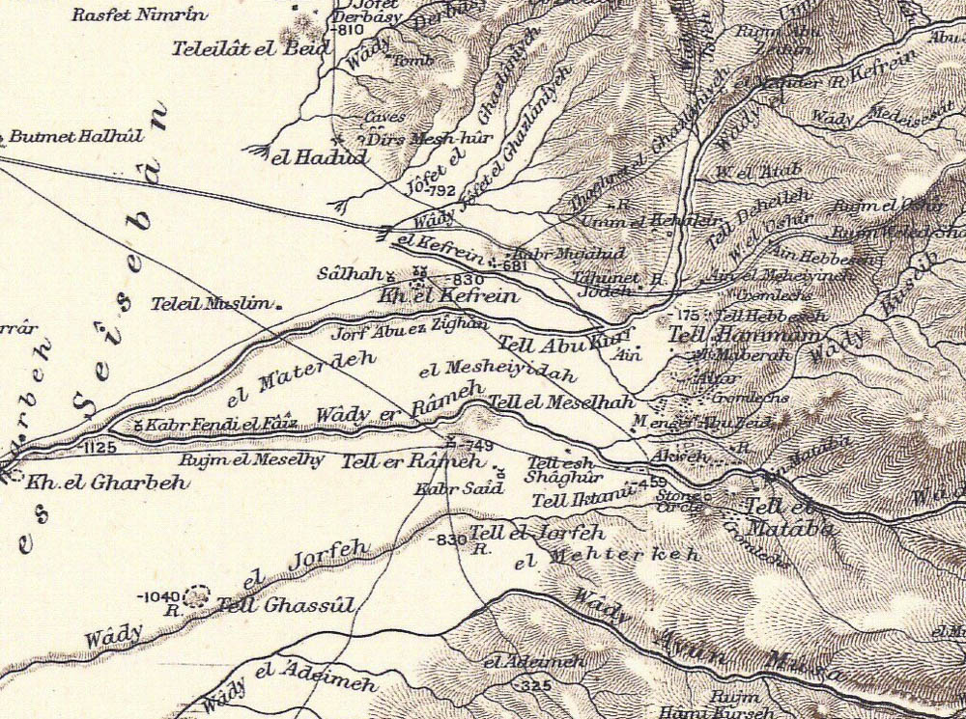
And Joshua the son of Nun sent out of Shittim two men as spies secretly
Possible locations of Shittim on the Survey of Eastern Palestine
2:1
Notes:
This map shows the location of Tell (or Khirbet) el-Kefrein and Tell el-Hammam, two possible locations for Abel-shittim (Shittim). The Survey of Eastern Palestine was conducted by C. R. Condor in 1881, and this map was published in 1889.

Slide 13
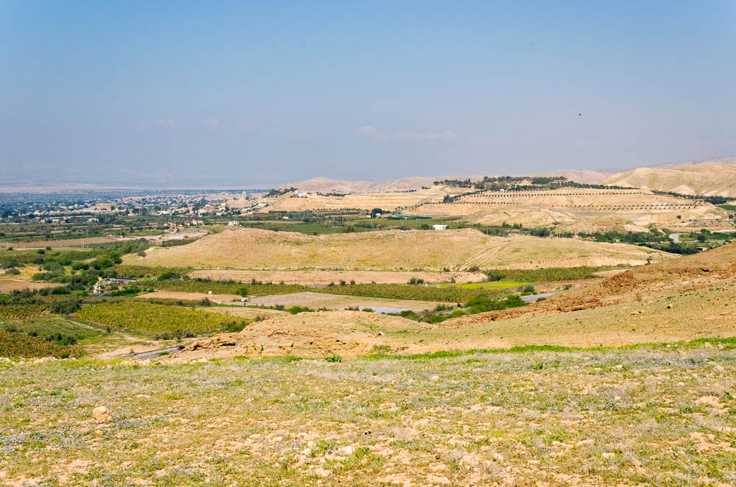
And Joshua the son of Nun sent out of Shittim two men as spies secretly
Tell el-Hammam, possible location of Shittim (from the southeast)
2:1
Notes:
The acropolis of Tell el-Hammam is located in the center of the photo. Its large size indicates that it was a significant city in the Middle Bronze Age, and thus Nelson Glueck proposed that it was Shittim.
tb031315304

Slide 14
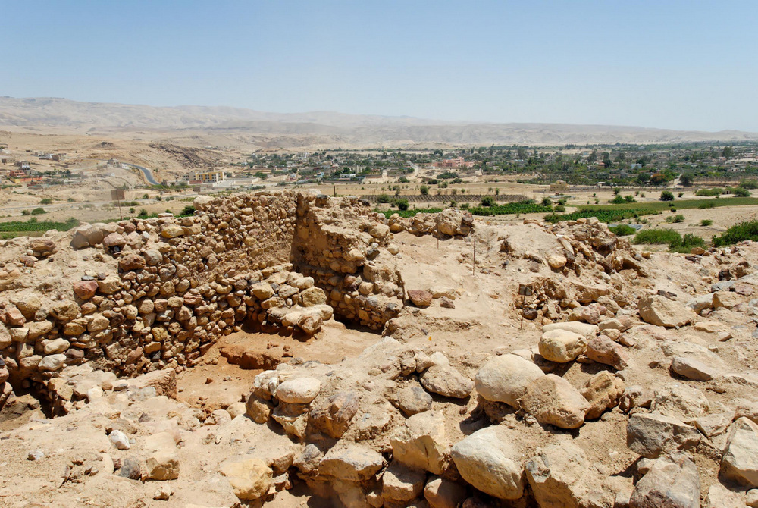
And Joshua the son of Nun sent out of Shittim two men as spies secretly
Excavations at Tell el-Hammam, possible location of Shittim
2:1
Notes:
Excavations in recent years at Tell el-Hammam have revealed extensive Middle Bronze and Iron Age remains, although evidence of the Late Bronze remains scanty.
tb060108198

Slide 15
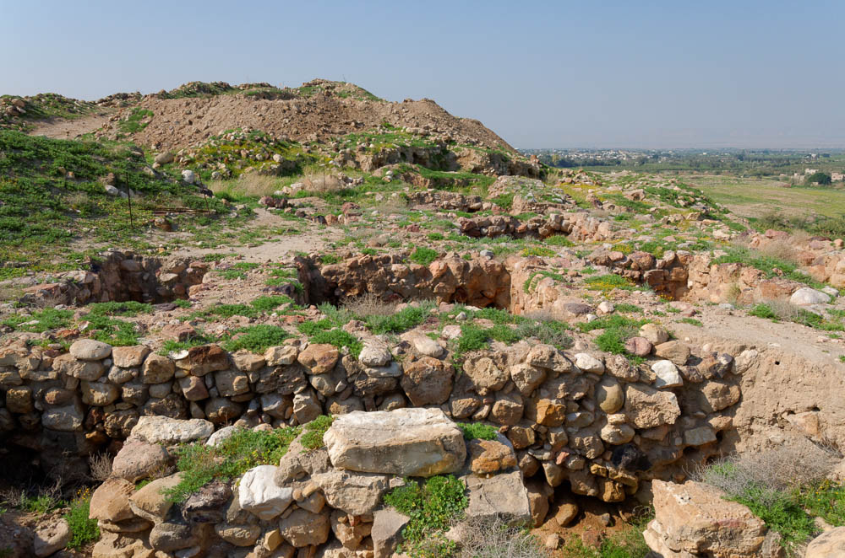
And Joshua the son of Nun sent out of Shittim two men as spies secretly
Excavations on the acropolis of Tell el-Hammam, possible location of Shittim
2:1
Notes:
The Israelites arrived at Shittim at the end of their wilderness travels, and it was here that they were seduced by the Moabite women (Num 25:1). The prophet later recalled the “journey from Shittim to Gilgal” as evidence of God’s righteousness to His people (Mic 6:5).
tb031315201

Slide 16
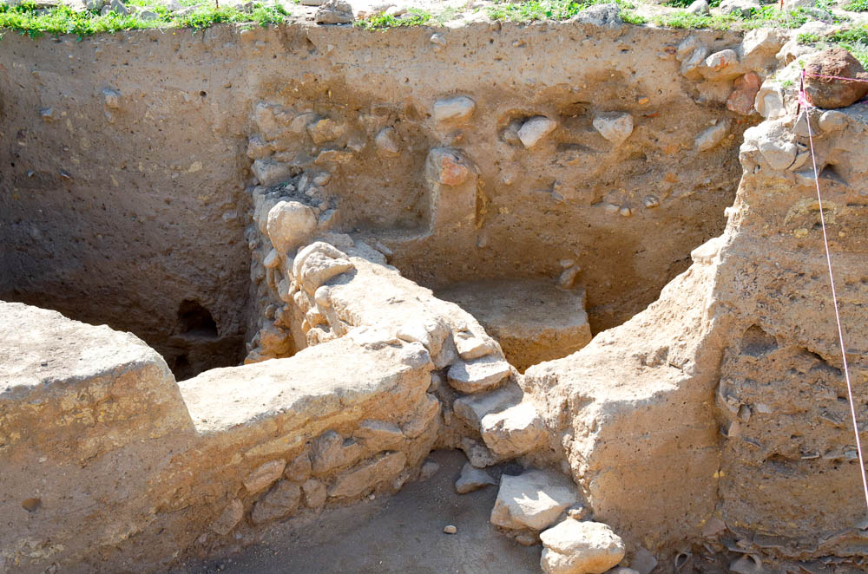
And Joshua the son of Nun sent out of Shittim two men as spies secretly
Excavations on the acropolis of Tell el-Hammam, possible location of Shittim
2:1
Notes:
Tell el-Hammam has been excavated by a team directed by Steven Collins since 2005. He believes the site may be biblical Sodom, Shittim, and the Roman city of Livias (Julias).
tb031315190

Slide 17
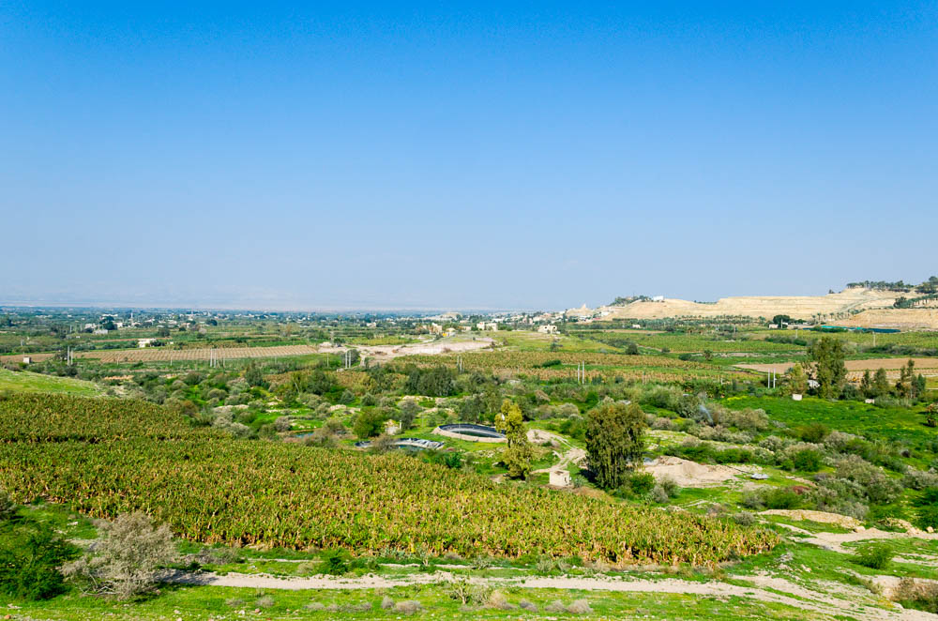
And Joshua the son of Nun sent out of Shittim two men as spies secretly
View from Tell el-Hammam to Tell el-Kefrein, possible locations of Shittim (from the southeast)
2:1
Notes:
These two candidates for Shittim are located 1.3 miles (2.1 km) from each other. See the next slide for a label marking Tell el-Kefrein.
tb031315215

Slide 18
And Joshua the son of Nun sent out of Shittim two men as spies secretly
Tell el-Kefrein
View from Tell el-Hammam to Tell el-Kefrein, possible locations of Shittim (from the southeast)
2:1
Notes:
These two candidates for Shittim are located 1.3 miles (2.1 km) from each other.
tb031315215

Slide 19
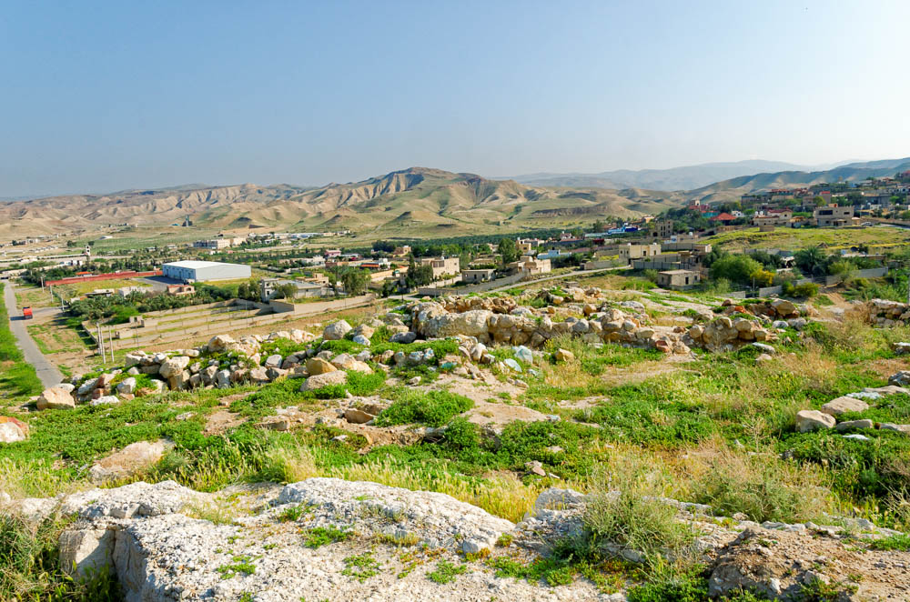
And Joshua the son of Nun sent out of Shittim two men as spies secretly
Tell el-Kefrein, possible location of Shittim
2:1
Notes:
The foreground in this picture is the top of Tell el-Kefrein. Tell el-Kefrein (= Tall Kafrein) was on the caravan route from Arabia to the Mediterranean coast. It overlooks all the approaches to the southern end of the Jordan River valley, with a view of Jericho and even Jerusalem across the Jordan River. Excavations by a Greek team began in 2002 and uncovered initial evidence of habitation from prehistoric to Islamic times, with significant levels that date from the Middle Bronze to the Iron Age. It was suggested as a candidate for Abel-shittim by Albright in the 1920s, by Glueck in the 1940s, and more recently by Rainey and Notley (2014: 124).
Reference:
Rainey, Anson F. and Notley, R. Steven.
2014 The Sacred Bridge. 2nd edition. Jerusalem: Carta.
tb031315156

Slide 20
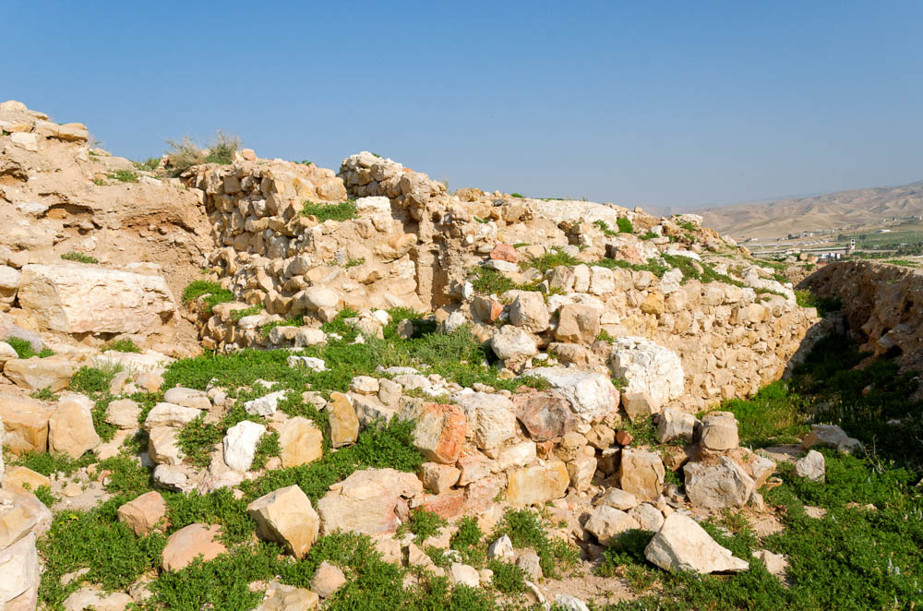
And Joshua the son of Nun sent out of Shittim two men as spies secretly
Excavations of Tell el-Kefrein, possible location of Shittim
2:1
Notes:
tb031315165

Slide 21
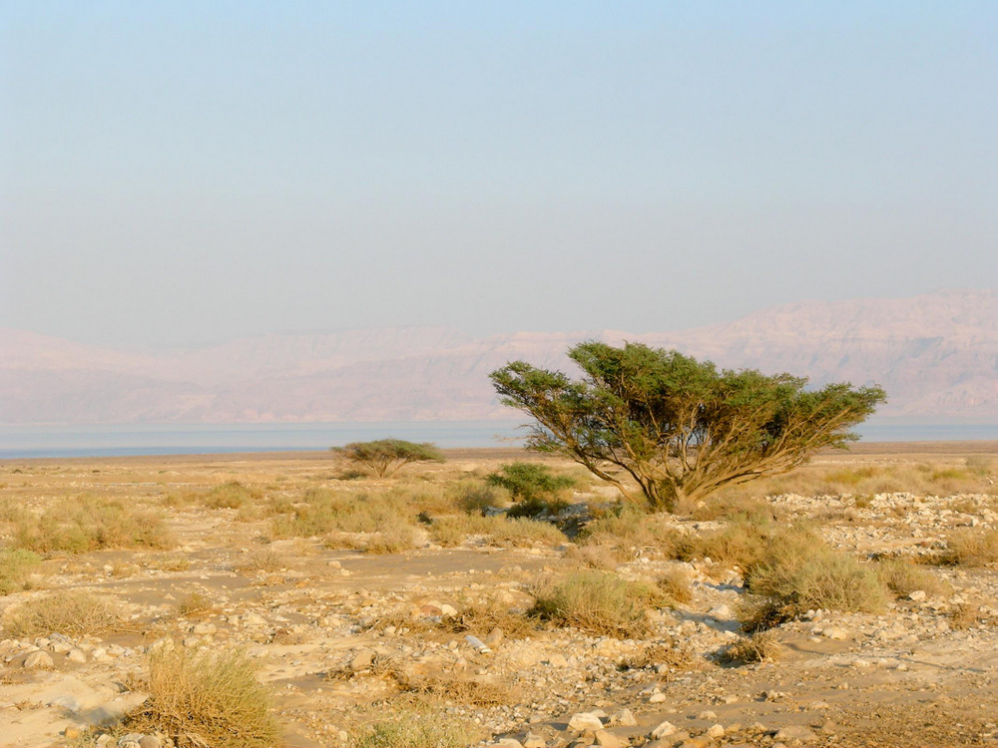
And Joshua the son of Nun sent out of Shittim two men as spies secretly
Acacia trees (shittim) near the Dead Sea
2:1
Notes:
The Hebrew word for acacia wood is shittah (שִׁטָּה), or the plural shittim (שִׁטִּים), which has led some scholars to speculate that the location mentioned in this verse may have been known at that time for its acacia trees.
tb120703102

Slide 22
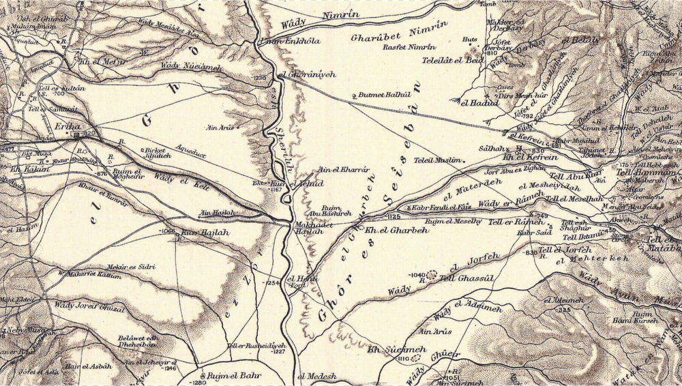
Go view the land, especially Jericho
Location of Abel-shittim in relation to Jericho
2:1
Notes:
This map shows the relation between the area of Abel-shittim and Jericho. Num 33:49 indicates that the Israelites camped between Beth-jeshimoth and Abel-shittim. Beth-jeshimoth may be located at Tell Azeimeh (Tall al-‘Azeimeh), which preserves the name, fits the geographical details, and has remains from the Iron I-II. The Survey of Eastern Palestine was conducted by C. R. Condor in 1881, and this map was published in 1889. See the next slide for labels.
sep01

Slide 23
Go view the land, especially Jericho
Jericho
Abel-shittim?
Jordan River
Beth-jeshimoth?
Dead Sea
Location of Abel-shittim in relation to Jericho
2:1
Notes:
This map shows the relation between the area of Abel-shittim and Jericho. Num 33:49 indicates that the Israelites camped between Beth-jeshimoth and Abel-shittim. Beth-jeshimoth may be located at Tell Azeimeh (Tall al-‘Azeimeh), which preserves the name, fits the geographical details, and has remains from the Iron I-II. The Survey of Eastern Palestine was conducted by C. R. Condor in 1881, and this map was published in 1889.
sep01

Slide 24
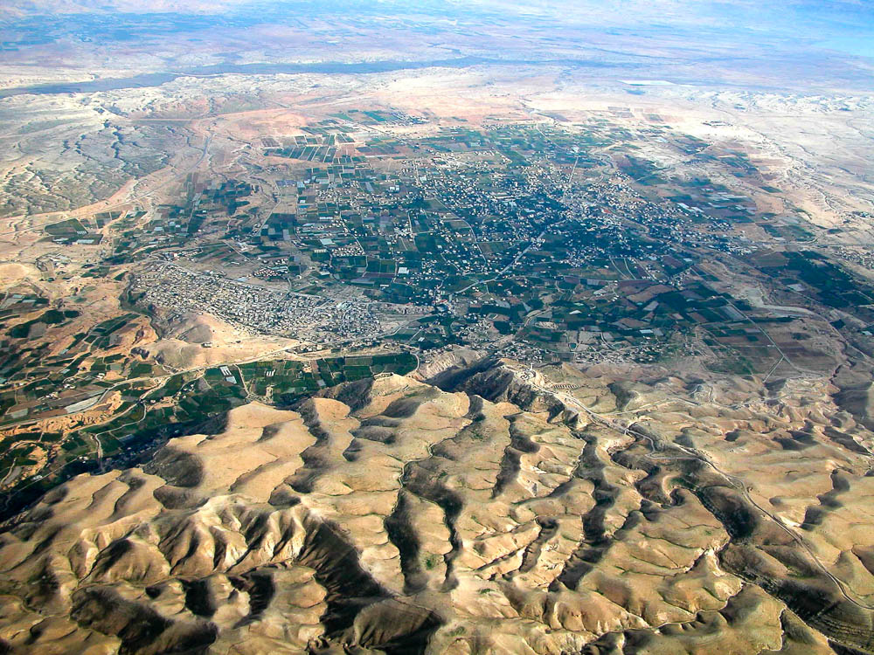
Go view the land, especially Jericho
Area of Jericho (aerial view from the west)
2:1
Notes:
This aerial view shows the broad, fertile plain that lies between Jericho and the Jordan River. The view is toward the east, looking back toward the Plains of Moab and Shittim. Notice the lushness of this area compared to its surroundings, due to the springs in this area. The prosperity of the city was due to its reliable water sources, which allowed the cultivation of crops. Combined with its low elevation (some 850 ft [260 m] below sea level) and heat, this allowed the regular cultivation of date palms, leading to its name “City of Palms” (Judg 1:16, 3:13). See the next slide for labels.
tb010703108

Slide 25
Go view the land, especially Jericho
Jordan River
Dead Sea
Shittim
Wadi Qilt
Jericho
Judean wilderness
Area of Jericho (aerial view from the west)
2:1
Notes:
This aerial view shows the broad, fertile plain that lies between Jericho and the Jordan River. The view is toward the east, looking back toward the Plains of Moab and Shittim. The Wadi Qilt, visible on the far right, originates near Jerusalem. Notice the lushness of this area compared to its surroundings, due to the springs in this area. The prosperity of the city was due to its reliable water sources, which allowed the cultivation of crops. Combined with its low elevation (some 850 ft [260 m] below sea level) and heat, this allowed the regular cultivation of date palms, leading to its name “City of Palms” (Judg 1:16, 3:13).
tb010703108

Slide 26
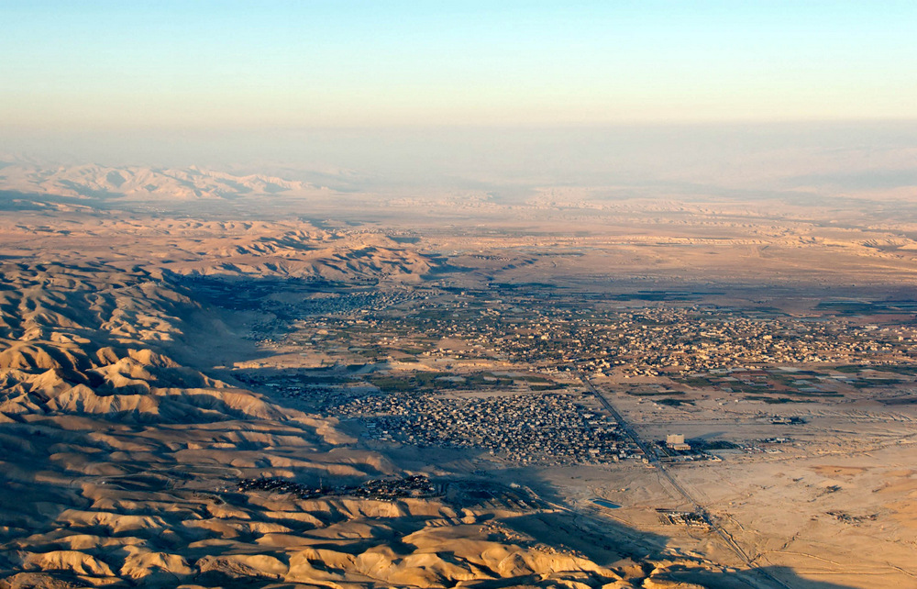
Go view the land, especially Jericho
Area of Jericho (aerial view from the south)
2:1
Notes:
This view of Jericho is toward the north, up the Jordan Valley. The hills of the Judean desert rise steeply to the west. See the next slide for labels.
tb121704191

Slide 27
Go view the land, especially Jericho
OT Jericho
modern Jericho
refugee camp
Area of Jericho (aerial view from the south)
2:1
Notes:
This view of Jericho is toward the north, up the Jordan Valley. The hills of the Judean desert rise steeply to the west.
tb121704191

Slide 28
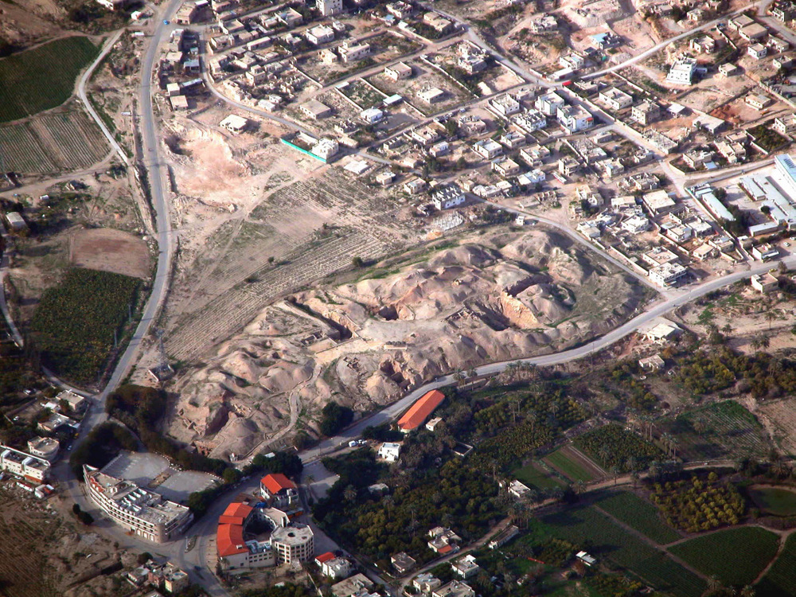
Go view the land, especially Jericho
Ruins of ancient Jericho (aerial view from the southeast)
2:1
Notes:
The remains of the Old Testament city of Jericho (Tell es-Sultan) lie today on the outskirts of the modern city of Jericho. The mound was excavated numerous times in the last century, revealing habitation as early as the Neolithic period. Much of the shape of the city is due to the massive Middle Bronze fortifications that were built around its perimeter. A spring, which was the water source for the ancient city, lies on its eastern side. See the next slide for labels.
tb010703122

Slide 29
Go view the land, especially Jericho
Neolithic tower
exposed revetment wall
Elisha’s spring
Ruins of ancient Jericho (aerial view from the southeast)
2:1
Notes:
The remains of the Old Testament city of Jericho (Tell es-Sultan) lie today on the outskirts of the modern city of Jericho. The mound was excavated numerous times in the last century, revealing habitation as early as the Neolithic period. Much of the shape of the city is due to the massive Middle Bronze fortifications that were built around its perimeter. A spring, which was the water source for the ancient city, lies on its eastern side.
tb010703122

Slide 30
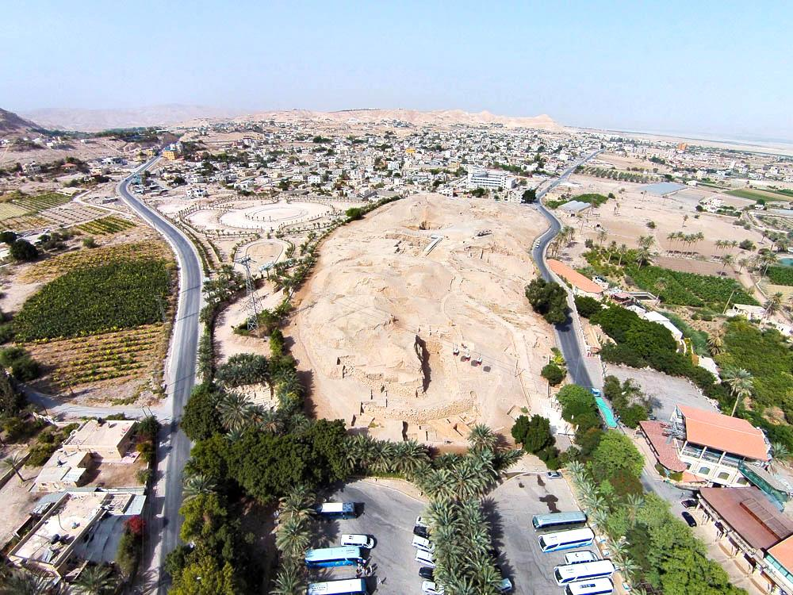
Go view the land, especially Jericho
Ruins of ancient Jericho (aerial view from the south)
2:1
Notes:
ws092414405

Slide 31
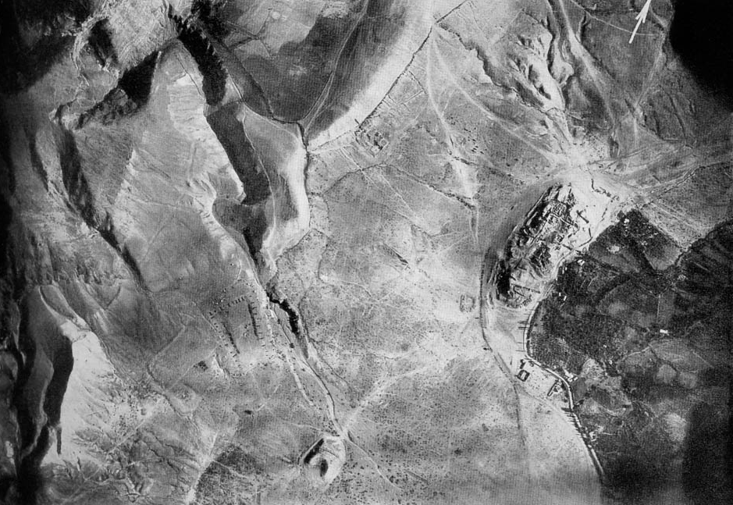
Go view the land, especially Jericho
Jericho area with tell and Elisha’s spring (aerial view from the southeast)
2:1
Notes:
This photo was taken by the German Air Force 304 on June 4, 1918 at 6:45 in the morning from an elevation of 16,400 feet (5,000 m). The dramatic effect of “Elisha’s Spring” on its eastern side is evident in the fertile fields. This image comes from Gustaf Dalman, Hundert deutsche Fliegerbilder aus Palaestina (1925); an English edition is forthcoming from BiblePlaces.com. See the next slide for labels.
gd0071

Slide 32
Go view the land, especially Jericho
Jebel Kuruntul
Jericho
Tell es-Samarat
Jericho area with tell and Elisha’s spring (aerial view from the southeast)
2:1
Notes:
This photo was taken by the German Air Force 304 on June 4, 1918 at 6:45 in the morning from an elevation of 16,400 feet (5,000 m). The dramatic effect of “Elisha’s Spring” on its eastern side is evident in the fertile fields. Jebel Kuruntul is the traditional Mount of Temptation. Tell es-Samarat is the location of King Herod’s hippodrome. This image comes from Gustaf Dalman, Hundert deutsche Fliegerbilder aus Palaestina (1925); an English edition is forthcoming from BiblePlaces.com.
gd0071

Slide 33
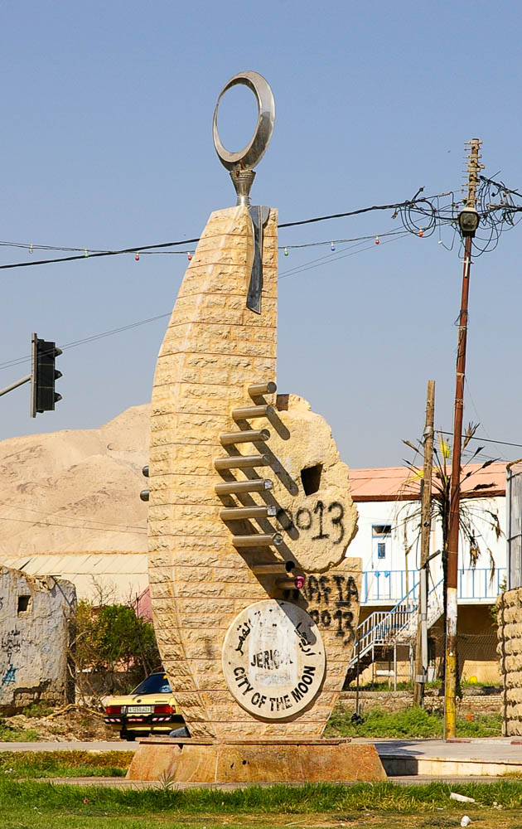
Go view the land, especially Jericho
“City of the Moon” sculpture at Jericho
2:1
Notes:
The name “Jericho” (יְרִחוֹ) may be related to the Hebrew word for “moon,” yareach (יָרֵחַ). It is possible that Jericho was especially associated with the worship of the moon goddess. This modern sculpture in Jericho features several symbols related to the moon.
adr0807115961

Slide 34
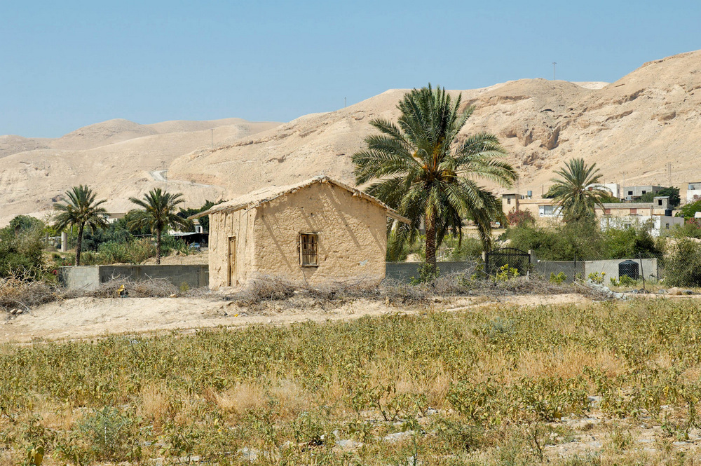
And they came into the house of a prostitute whose name was Rahab
Mudbrick house at Jericho
2:1
Notes:
Archaeology has shown that virtually all construction in ancient Jericho was of either stone or mudbrick. This small modern house at Jericho is made of mudbrick, although in antiquity roofs were flat, rather than sloped like this one.
tb051106878

Slide 35
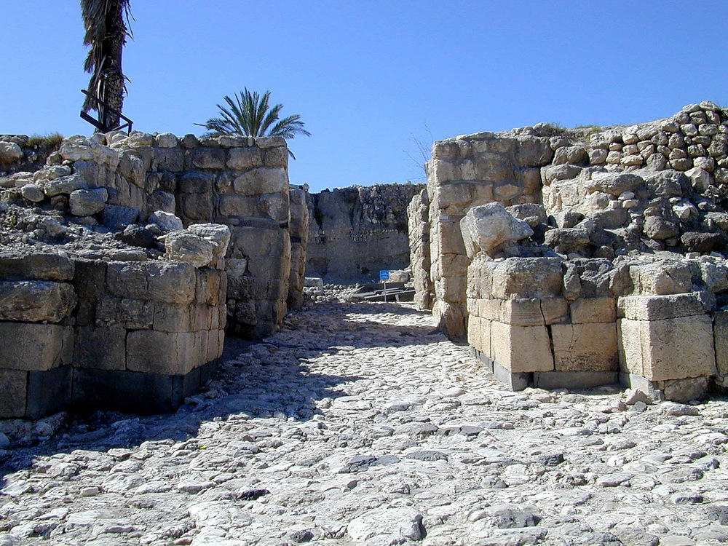
When it was time to shut the gate
Middle Bronze gate at Megiddo, circa 1700 BC
2:5
Notes:
This stone-built gate complex from Megiddo, although incomplete, shows the imposing nature of ancient gate systems. They typically had multiple sets of doors that would be closed in the evening. Rahab told the king that the spies had left during the busy time prior to the closing of the gate, the best time to enter or leave undetected.
tb032901104

Slide 36
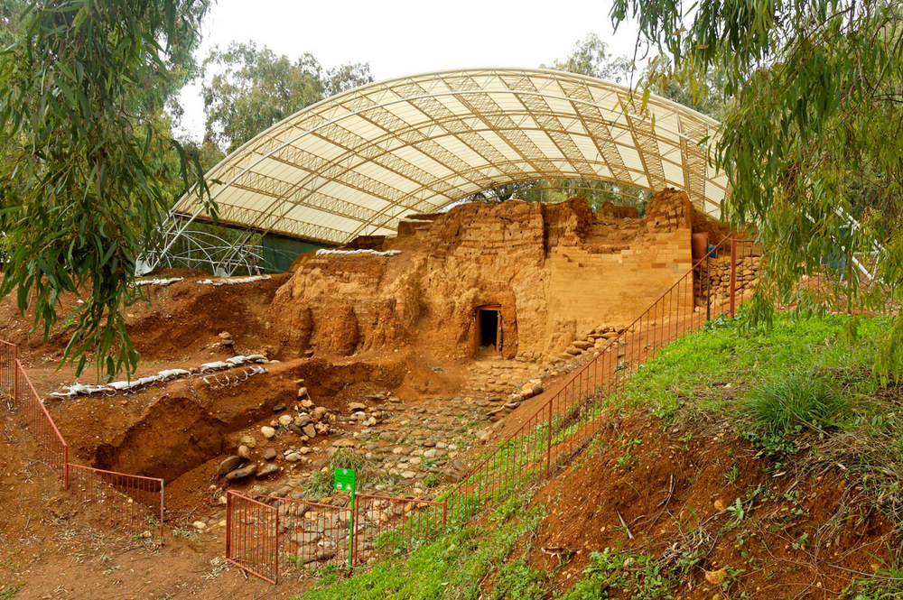
When it was time to shut the gate
Middle Bronze mudbrick gate at Dan, circa 1800 BC
2:5
Notes:
The gate of Jericho has not been found, but it may have resembled this well-preserved example from Tel Dan. Along with a mudbrick gate found at Ashkelon, this is a very rare example of an early arched gate. It was the Romans who introduced the wide-scale use of the arch in architecture.
tb011206375

Slide 37
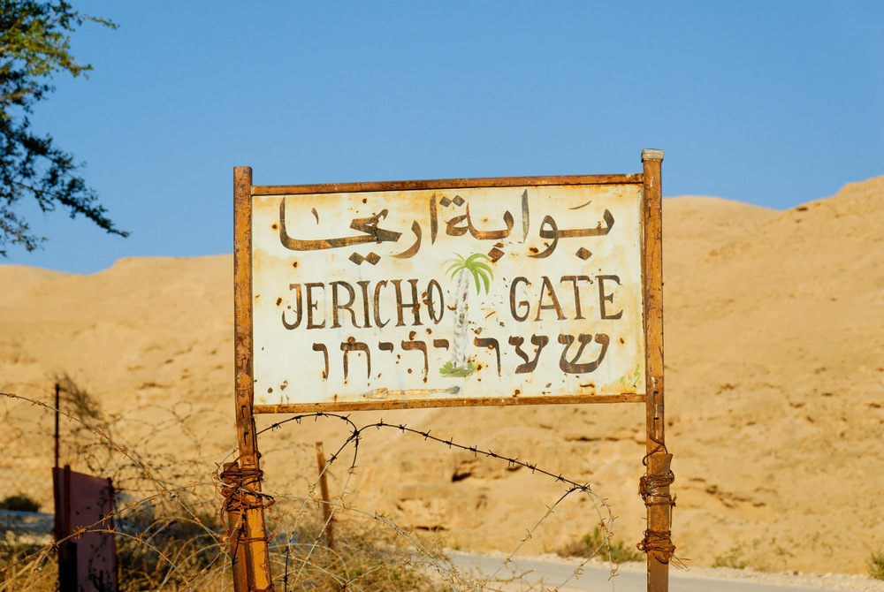
When it was time to shut the gate
“Jericho Gate” sign
2:5
Notes:
This weathered sign marks a modern entrance to the area of Jericho.
tb113006523

Slide 38
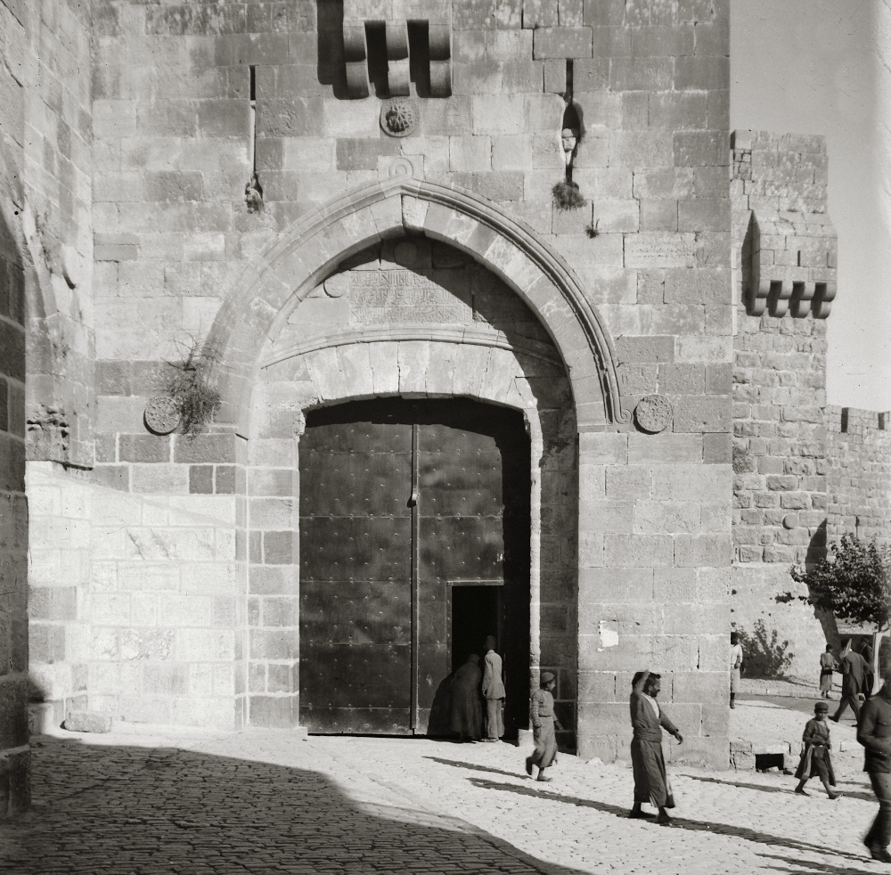
When it was time to shut the gate
Jaffa Gate in Jerusalem, closed
2:5
Notes:
Later gates often consisted of both a very large set of doors and a smaller door that could be opened for individual persons to pass. This American Colony photograph was taken between 1900 and 1920.
mat04998

Slide 39
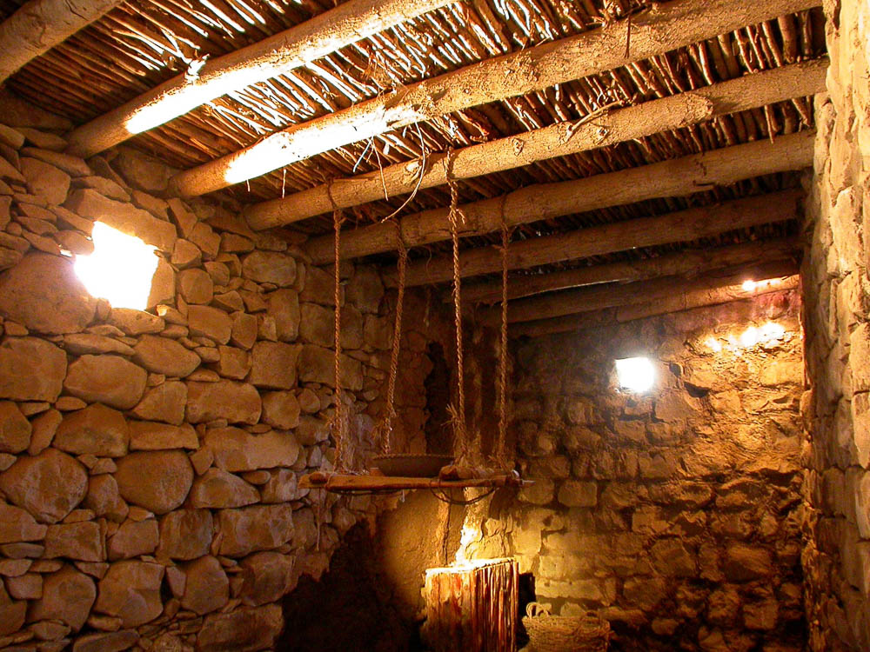
But she had brought them up to the roof
Kitchen roof at Qatzrin
2:6
Notes:
This reconstruction at Qatzrin shows the typical way in which flat roofs were constructed. Once the walls were built to their full height, wooden beams were laid across, and smaller sticks were laid across the beams. The entire surface was then coated with plaster, providing a flat, sturdy roof that could also be used for other purposes, including working and sleeping. This photo was taken at the Qatzrin Museum.
tb041103238

Slide 40
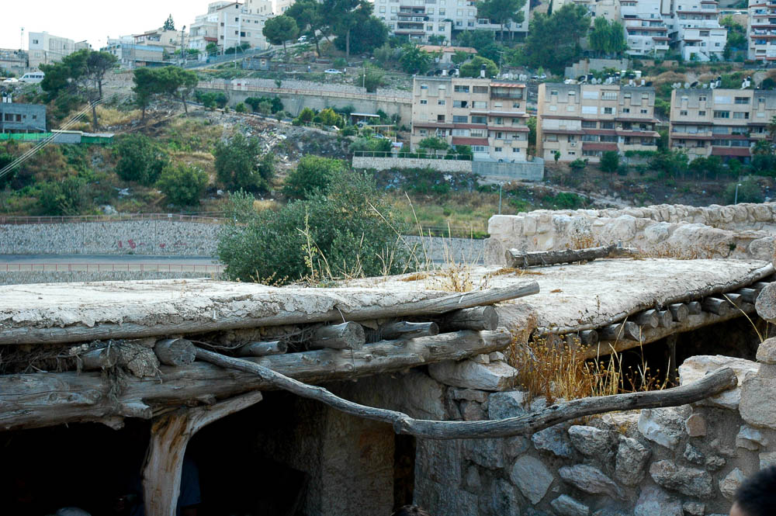
But she had brought them up to the roof
Roof made of wood and mud
2:6
Notes:
Here the layer of mud/plaster on top of the roof can be seen. This photo was taken at Nazareth Village.
tb053005488

Slide 41
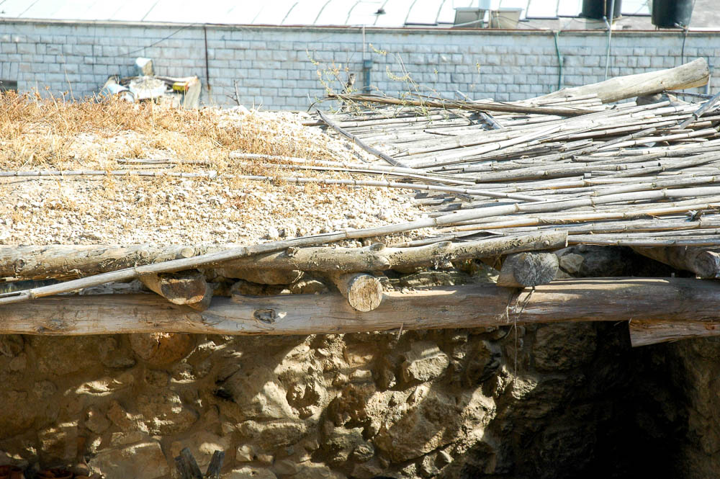
But she had brought them up to the roof
Roof made of wood and mud
2:6
Notes:
Roofs of this sort required constant maintenance to keep them in working order. This photo was taken at Nazareth Village.
tb053005496

Slide 42
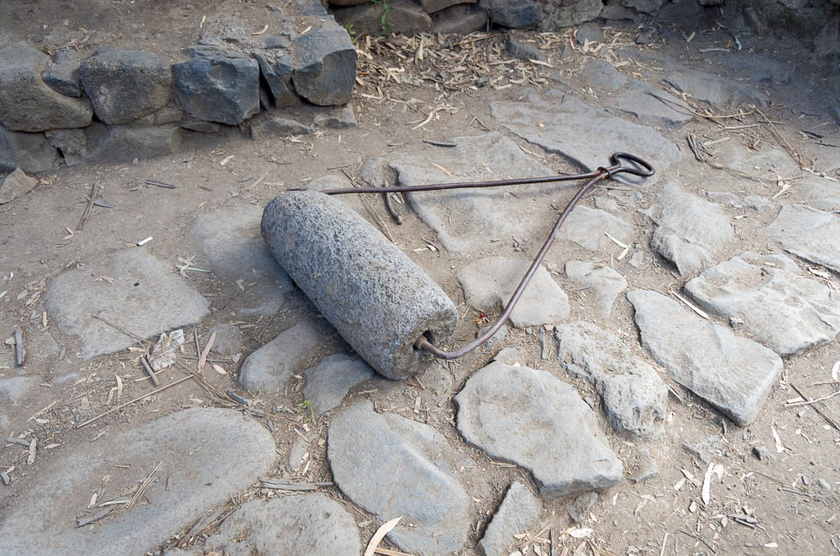
But she had brought them up to the roof
Basalt roof roller, from Qatzrin
2:6
Notes:
During the long, hot, dry summers the clay covering on the flat roofs would crack. This was remedied when rain came again by the use of a heavy stone roller that compacted and smoothed the clay, making the roof watertight again. This roof roller was photographed at the Golan Archaeological Museum at Qatzrin.
tb053016989

Slide 43
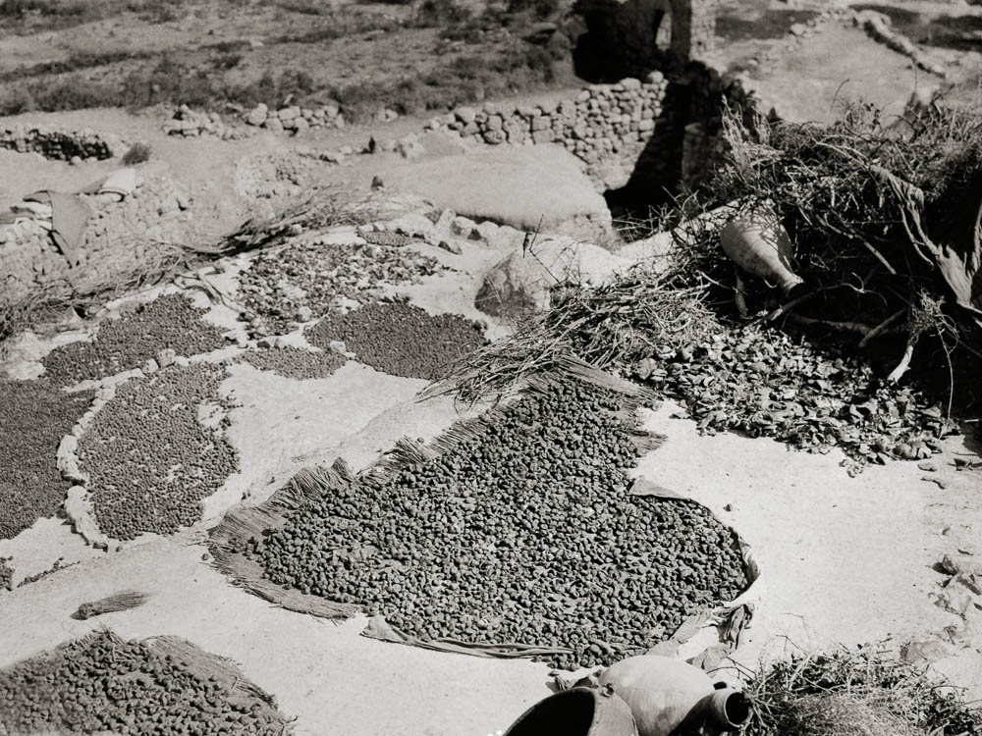
And hid them with the stalks of flax, which she had laid in order upon the roof
Fruit drying on a roof
2:6
Notes:
Roofs made excellent surfaces for drying a variety of different items. They typically had full sun exposure and were out of the way of animals and street-level dirt and dust. This photo shows a flat roof being used for drying fruits. This American Colony photograph was taken between 1900 and 1920.
mat05300

Slide 44
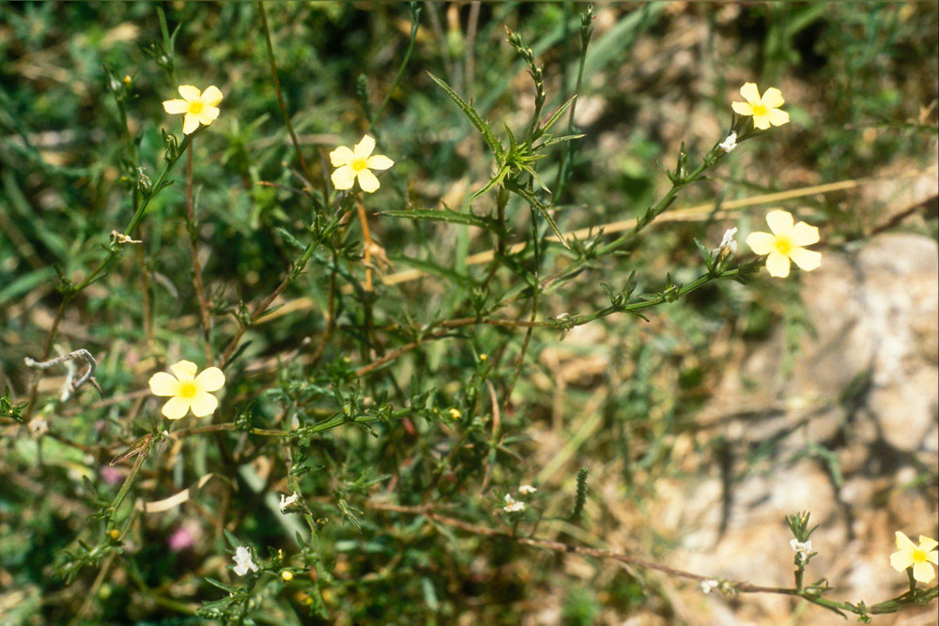
And hid them with the stalks of flax, which she had laid in order upon the roof
Flax at Ramat HaNadiv
2:6
Notes:
Flax had several different uses in the ancient world. The stems were valued for their fiber, used to make linen, and is most likely the use intended by Rahab. The seeds, though small, could also be eaten, either whole or ground into a meal. Today the seeds are used to produce linseed oil.
gs040197517

Slide 45
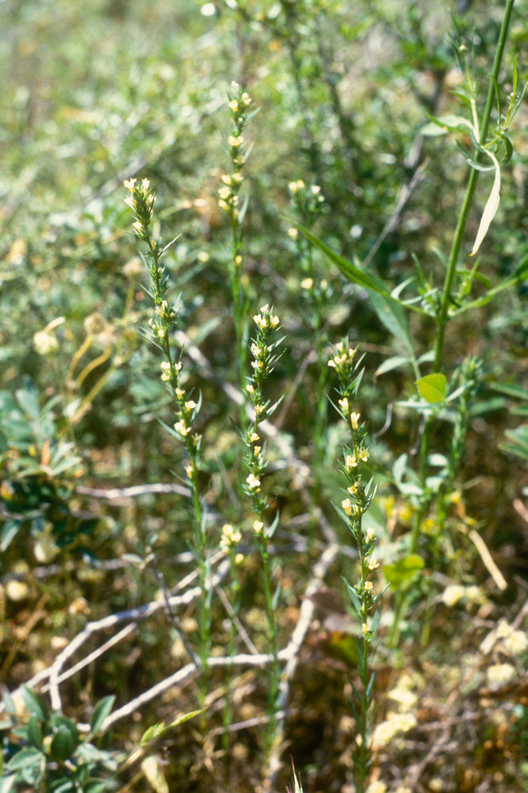
And hid them with the stalks of flax, which she had laid in order upon the roof
Flax at Ramat HaNadiv
2:6
Notes:
Ramat HaNadiv is a nature park in northern Israel, at the southern end of the Mount Carmel range.
gs040197521

Slide 46
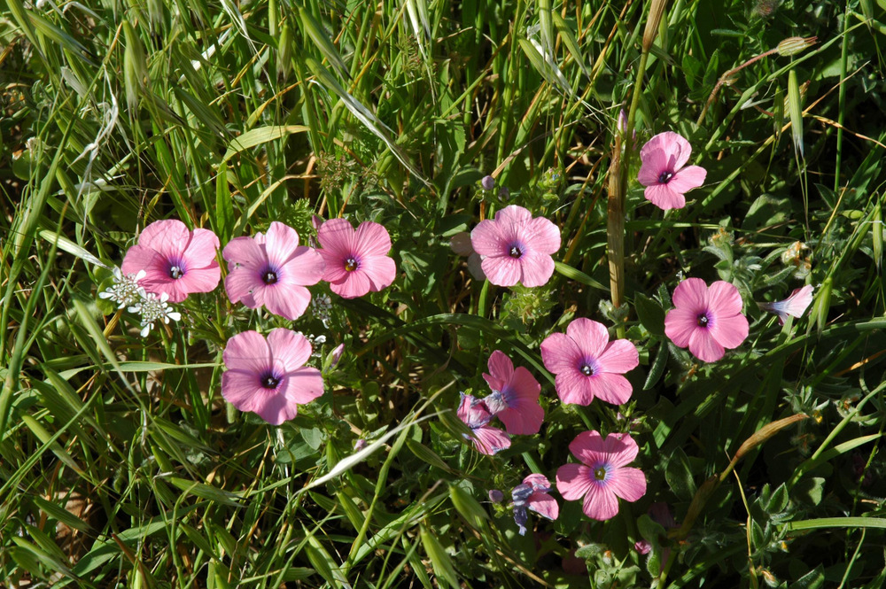
And hid them with the stalks of flax, which she had laid in order upon the roof
Hairy flax on Mount Gilboa
2:6
Notes:
tb032505994

Slide 47
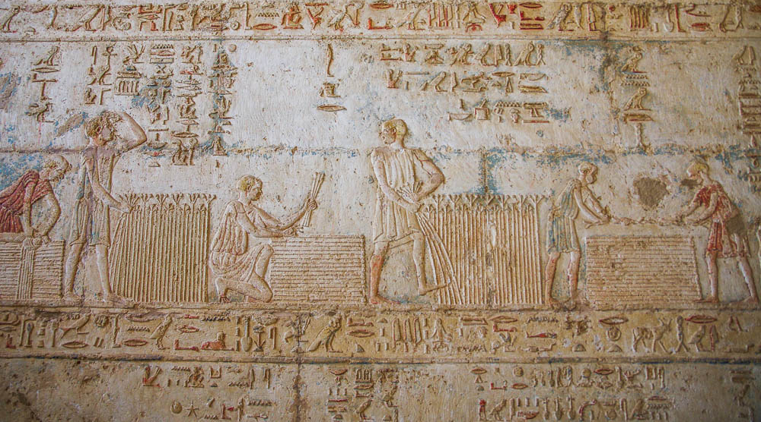
And hid them with the stalks of flax, which she had laid in order upon the roof
Harvesting and bundling flax, depiction in the Petosiris temple-tomb at Tuna el-Gebel
2:6
Notes:
In ancient times flax was used for everything from fishing nets to wicks for lamps. The priest’s clothes, according to God’s instructions in Leviticus, were made of linen.
adr1603247174

Slide 48
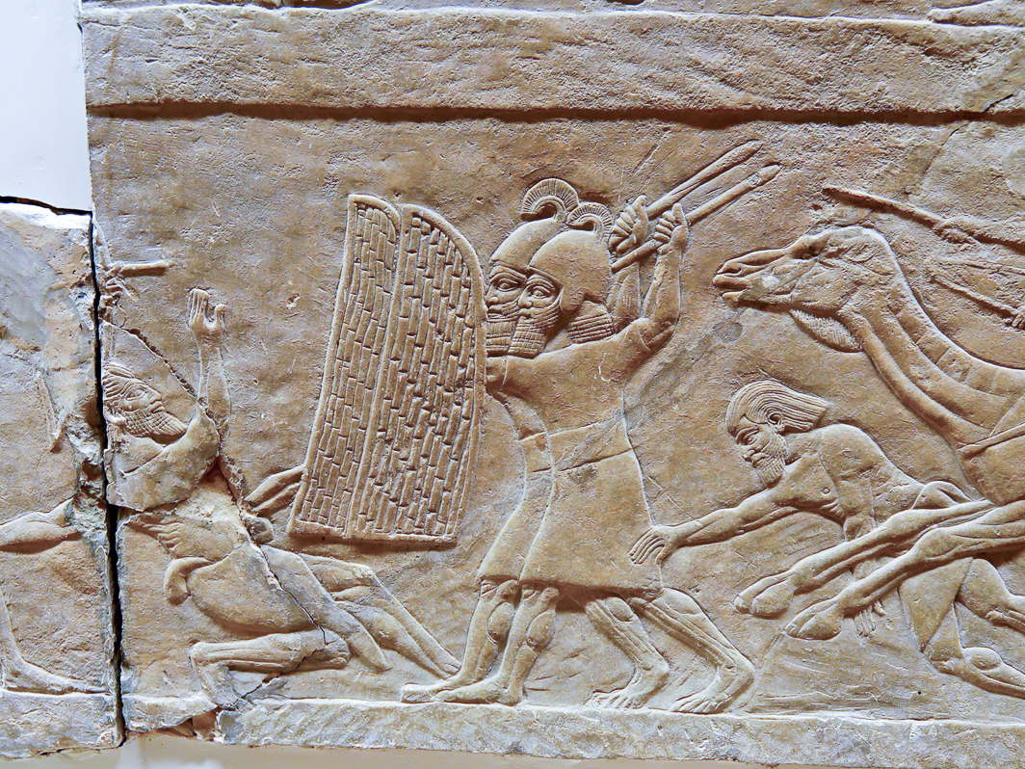
And the men pursued them
Assyrian soldiers pursuing Arabs, circa 640 BC
2:7
Notes:
The men of Jericho hoped to run down the Israelite spies and capture or kill them, as these Assyrian soldiers are doing to their Arab enemies in the relief shown here. This relief comes from the north palace of Ashurbanipal at Nineveh, dating roughly to 640 BC. It was photographed at the British Museum.
tb112004748

Slide 49
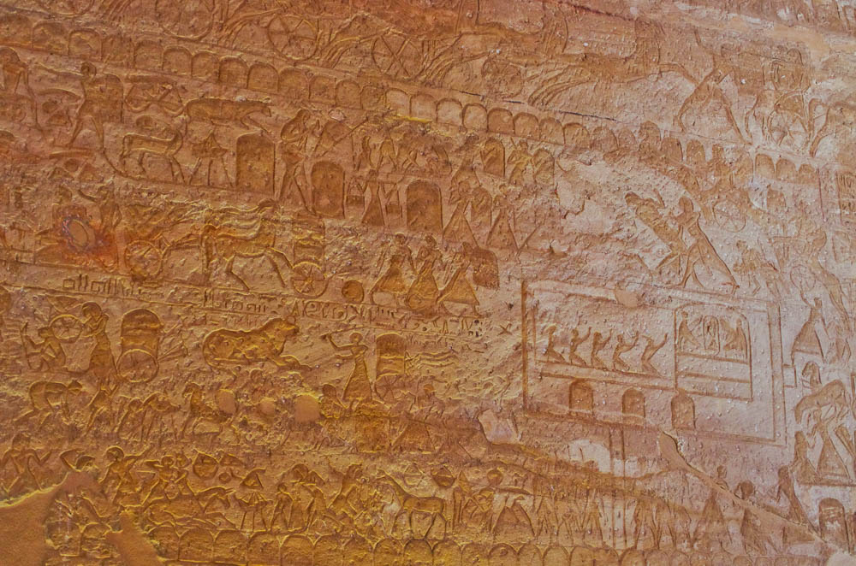
And the men pursued them
Beating of captured Hittite spies at the Egyptian camp, Battle of Kadesh, about 1270 BC
2:7
Notes:
In this image, captured Hittite spies are beaten by Egyptians (top right) in front of the war tent of Ramses II. Had the Israelite spies been captured they would have likely experienced a similar fate. This scene appears on the wall of the Great Temple of Ramesses II at Abu Simbel.
adr1603215724

Slide 50
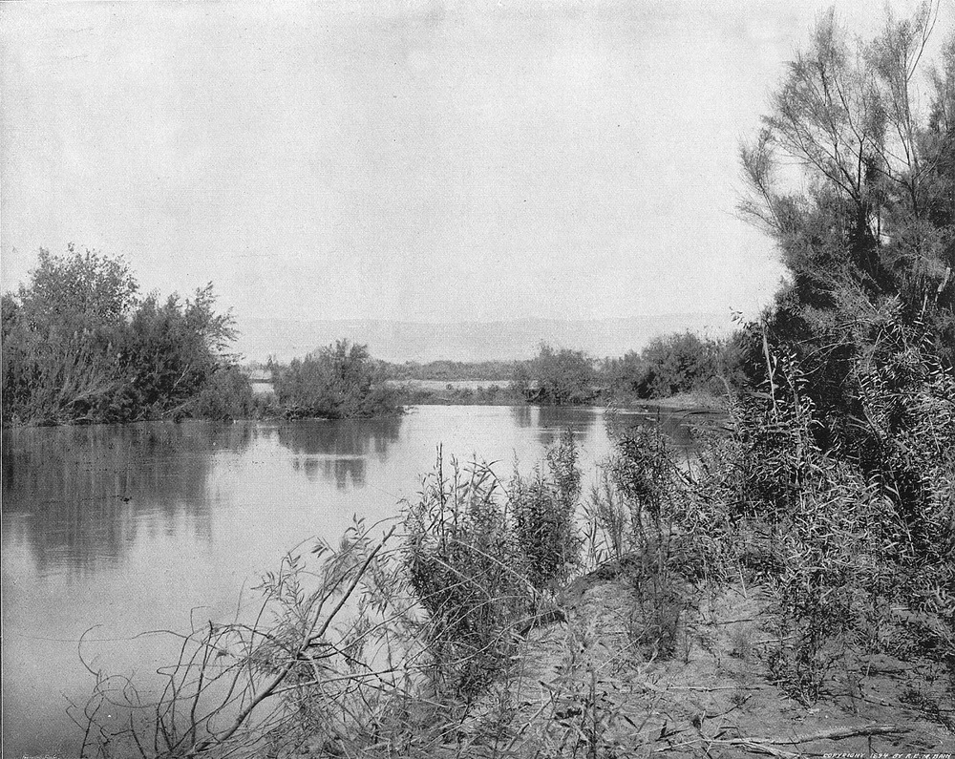
And the men pursued them along the way to the Jordan, as far as the fords
Ford of the River Jordan
2:7
Notes:
Prior to the construction of bridges, rivers had to be crossed by wading or swimming across. Some places were naturally easier to cross because of depth, the steepness of the banks, and the makeup of the river bottom. Roads led to and from these crossing places and would have been the natural place to look for the fleeing spies. In a flat plain like the lower Jordan, the location of fords sometimes changes as the course of the river changes, making it impossible to tell exactly where the ancient ford might have been located. This is an early photo of one of the fords of the Jordan. This photograph comes from Earthly Footsteps of the Man of Galilee and was taken in the early 1890s.
ef0161

Slide 51
And the men pursued them along the way to the Jordan, as far as the fords
Jericho
Abel-shittim?
Jordan Fords
Beth-jeshimoth?
Dead Sea
Location of Abel-shittim in relation to Jericho
2:7
Notes:
This map shows the relation between the area of two fords near Jericho. The Survey of Eastern Palestine was conducted by C. R. Condor in 1881, and this map was published in 1889. Thompson describes two fords near Jericho as follows: “There are two fords within 8 miles of Jericho: al-Maghtas (at the end of the Wâdī Qilt) and the el-Henu (half a mile to its S)” (Thompson 1992: 957).
Reference:
Thompson, H. O.
1992 Jordan River. Anchor Bible Dictionary vol. 3, ed. D. N. Freedman. New York: Doubleday.
sep01

Slide 52
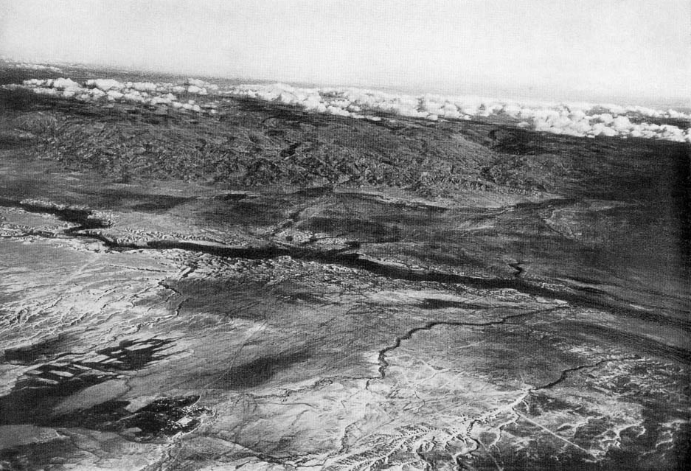
And the men pursued them along the way to the Jordan, as far as the fords
Jordan Valley near Jericho (aerial view from the southwest)
2:7
Notes:
This aerial view was taken in the 1920s, looking eastward and slightly to the north. It shows the plain east of Jericho. Notice the dry, arid nature of the plain between Jericho and the Jordan River in the days before widespread irrigation. Jericho itself is just off the map to the left, but the area naturally irrigated by its springs is visible in the lower left corner as a dark splotch. The Jordan River valley is visible, even though the river itself is concealed by vegetation. This image comes from Gustaf Dalman, Hundert deutsche Fliegerbilder aus Palaestina (1925); an English edition is forthcoming from BiblePlaces.com. See the next slide for labels.
gd0079

Slide 53
And the men pursued them along the way to the Jordan, as far as the fords
Plains of Moab
Jordan River
OT Jericho
Jordan Valley near Jericho (aerial view from the southwest)
2:7
Notes:
This aerial view was taken in the 1920s, looking eastward and slightly to the north. It shows the plain east of Jericho. Notice the dry, arid nature of the plain between Jericho and the Jordan River in the days before widespread irrigation. Jericho itself is just off the map to the left, but the area naturally irrigated by its springs is visible in the lower left corner as a dark splotch. The Jordan River valley is visible, even though the river itself is concealed by vegetation. This image comes from Gustaf Dalman, Hundert deutsche Fliegerbilder aus Palaestina (1925); an English edition is forthcoming from BiblePlaces.com. See the next slide for labels.
gd0079

Slide 54
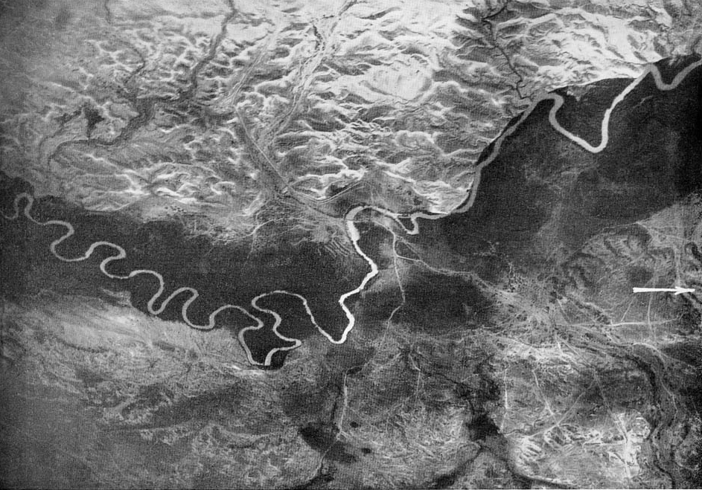
And the men pursued them along the way to the Jordan, as far as the fords
Jordan River near Jericho bridge (aerial view from the east)
2:7
Notes:
This aerial photo, taken in 1918 from a height of 13,100 feet (4000 m), shows the area of the Jordan that lay between Jericho and the Plains of Moab. The best ford at that time is visible in the area crossed by two bridges, which also determined where the roads ran. It can be seen that the river is wider (shallower) in that area, and that the vegetation is less dense there. Notice also that the natural drainage patterns in the low hills on either side of the river affect the routes of the roads. This image comes from Gustaf Dalman, Hundert deutsche Fliegerbilder aus Palaestina (1925); an English edition is forthcoming from BiblePlaces.com. This photograph was taken by the German Airforce Division 304 on April 21, 1918, around 8 am. See the next slide for labels.
gd0081

Slide 55
And the men pursued them along the way to the Jordan, as far as the fords
to Jericho
Ford
Plains of Moab
Jordan River near Jericho bridge (aerial view from the east)
2:7
Notes:
This aerial photo, taken in 1918 from a height of 13,100 feet (4000 m), shows the area of the Jordan that lay between Jericho and the Plains of Moab. The best ford at that time is visible in the area crossed by two bridges, which also determined where the roads ran. It can be seen that the river is wider (shallower) in that area, and that the vegetation is less dense there. Notice also that the natural drainage patterns in the low hills on either side of the river affect the routes of the roads. This image comes from Gustaf Dalman, Hundert deutsche Fliegerbilder aus Palaestina (1925); an English edition is forthcoming from BiblePlaces.com. This photograph was taken by the German Airforce Division 304 on April 21, 1918, around 8 am.
gd0081

Slide 56
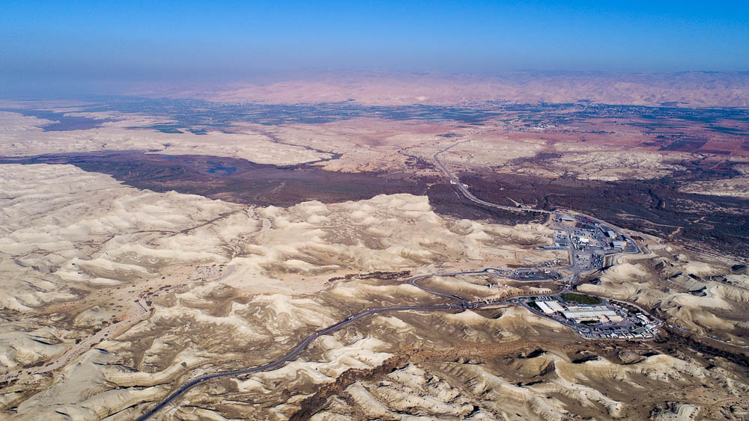
And the men pursued them along the way to the Jordan, as far as the fords
Jordan River and the Plains of Moab (aerial view from the west)
2:7
Notes:
The men of Jericho pursued in the direction they thought the two Israelite spies had gone, toward the fords on the Jordan River. They presumed that the spies were headed back to the plains of Moab, where their camp was located. Although the location of the ford is impossible to pinpoint, it would likely have been somewhere in the area seen here. The Allenby Bridge has been the major crossing point for more than a hundred years (though the bridge itself has been reconstructed several times). See the next slide for labels.
ws122617234

Slide 57
And the men pursued them along the way to the Jordan, as far as the fords
Shittim?
Plains of Moab
Jordan River
Allenby Bridge
to Jericho
Jordan River and the Plains of Moab (aerial view from the west)
2:7
Notes:
The men of Jericho pursued in the direction they thought the two Israelite spies had gone, toward the fords on the Jordan River. They presumed that the spies were headed back to the plains of Moab, where their camp was located. Although the location of the ford is impossible to pinpoint, it would likely have been somewhere in the area seen here. The Allenby Bridge has been the major crossing point for more than a hundred years (though the bridge itself has been reconstructed several times).
ws122617234

Slide 58
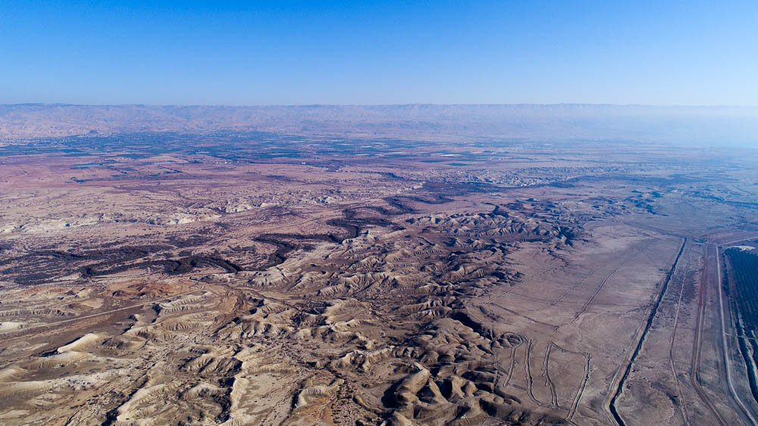
And the men pursued them along the way to the Jordan, as far as the fords
Jordan River and the Plains of Moab (aerial view from the northwest)
2:7
Notes:
This photo provides a better view of the winding Jordan River. See the next slide for labels.
ws122617276

Slide 59
And the men pursued them along the way to the Jordan, as far as the fords
Shittim?
Plains of Moab
to Jericho
Jordan River
Jordan River and the Plains of Moab (aerial view from the northwest)
2:7
Notes:
This photo provides a better view of the winding Jordan River.
ws122617276

Slide 60
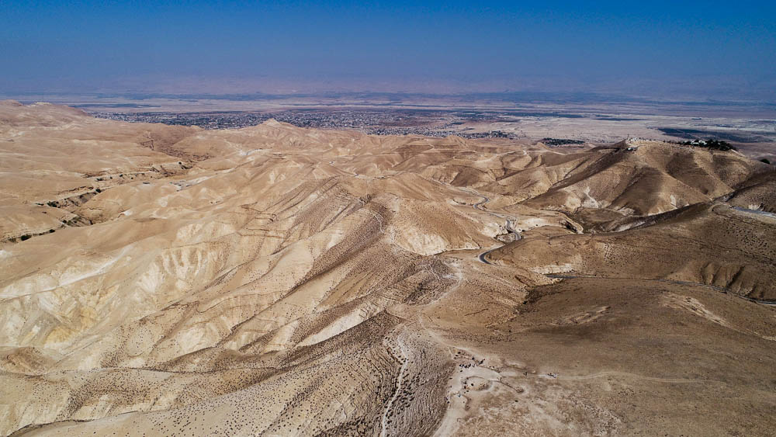
I know that Yahweh has given you this land
Judean Wilderness looking toward Jericho (aerial view from the west)
2:9
Notes:
This photo provides a perspective of the land around Jericho. Rahab’s words reflect her knowledge of God’s promise of the land of Canaan to the descendants of Abraham. Jericho sat at the intersection of several roads; a regional road ran east across the ford toward Amman, a secondary road that traversed the Rift Valley ran by it to the north and to the south, and two major roads ran west, one toward Jerusalem and the other toward Bethel and eventually Joppa on the coast. In this way, Jericho was a significant gateway to the land of Canaan from the east.
ws092717013

Slide 61
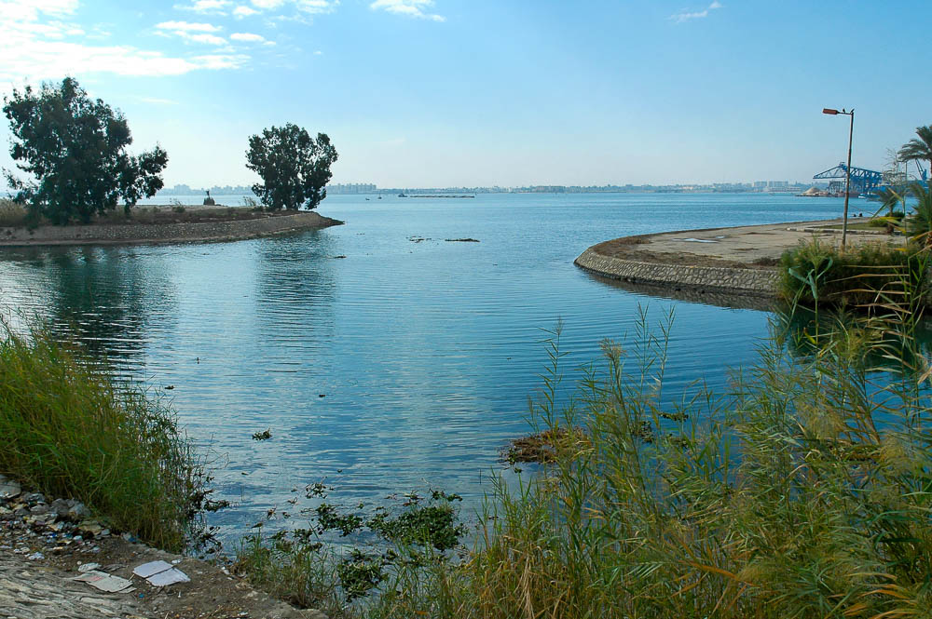
We have heard how Yahweh dried up the water of the Red Sea before you
Lake Timsah, a possible candidate for the Red Sea crossing (from the north)
2:10
Notes:
This picture is of Lake Timsah in Egypt, one of the bodies of water that has been suggested to be the Red Sea (lit. “Sea of Reeds,”) crossed by the Israelites. There are a chain of small lakes and marshes on the Isthmus of Suez, between the modern Gulf of Suez and the Mediterranean Sea. From north to south they are Lake Manzala, the Ballah Lakes, Lake Timsah, and the Bitter Lakes. Today, the lakes are linked by the Suez Canal which joins Port Taufiq with Port Said.
The “Red Sea”
The Bitter Lakes, Lake Timsah, and the Ballah Lakes have all been regarded as candidates for the location of the Red Sea and the miraculous exodus of the Israelites from Egypt. In Exodus 13:18, the name of the body of water the Israelites crossed is usually translated “Red Sea.” The Hebrew name is yam suph, (יָמּ סּוּף), which is literally “Sea of Reeds,” but which was rendered Red Sea (eruthran thalassan) in the Septuagint. At the same time, 1 Kings 9:26 refers to Elat as a port as located on the yam suph, which is at the northern end of the Red Sea. Perhaps yam suph derived from the Egyptian place name p3 twf(y) which refers to papyrus reeds (Beitzel 2009: 108–09; Hoffmeier 2005: 81–89). According to Hoffmeier, Lake Timsah and the Bitter Lakes were known as “Great Black” in Egyptian (km wr), and they seem to be distinguished from p3 twf(y) which may have been located to the north, i.e. the Ballah Lakes (Hoffmeier 2005: 86). The traditional route has the Israelites crossing the northern tip of the Red Sea (Currid and Barrett 2010: 85).
References:
Beitzel, Barry J.
2009 The New Moody Atlas of the Bible. Chicago: Moody.
Currid, John D., and Barrett, David P.
2010 ESV Bible Atlas. Wheaton: Crossway.
Hoffmeier, James K.
2005 Ancient Israel in Sinai: The Evidence for the Authenticity of the Wilderness Tradition. New York: Oxford University Press.
tb010605557

Slide 62
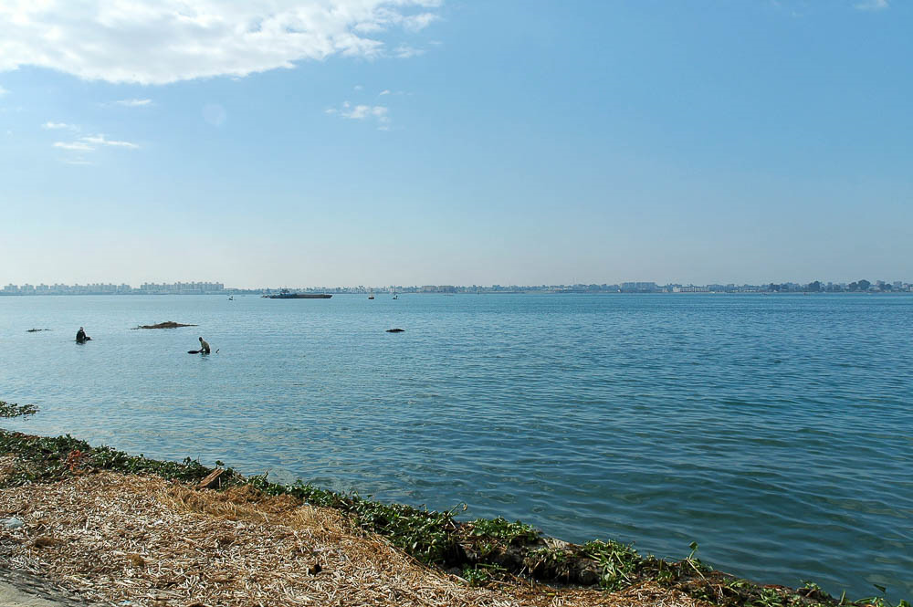
We have heard how Yahweh dried up the water of the Red Sea before you
Lake Timsah, a possible candidate for the Red Sea crossing (from the northeast)
2:10
Notes:
tb010605563

Slide 63
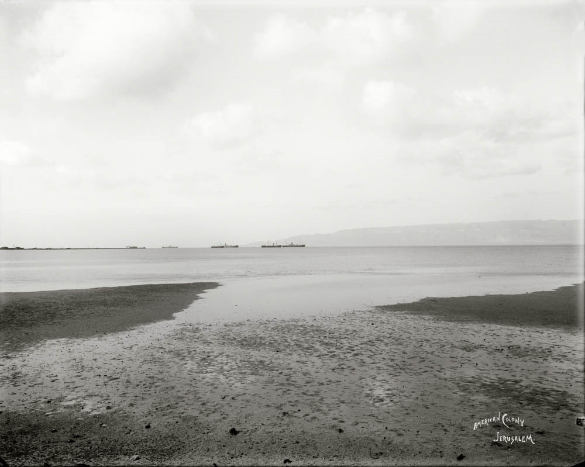
We have heard how Yahweh dried up the water of the Red Sea before you
North end of the Gulf of Suez
2:10
Notes:
Another possibility is that the Israelites crossed the relatively shallow northern end of the Gulf of Suez. This American Colony photo was taken between 1898 and 1914, not many years after the completion of the Suez Canal, which connected the gulf with the Mediterranean Sea.
mat07224

Slide 64
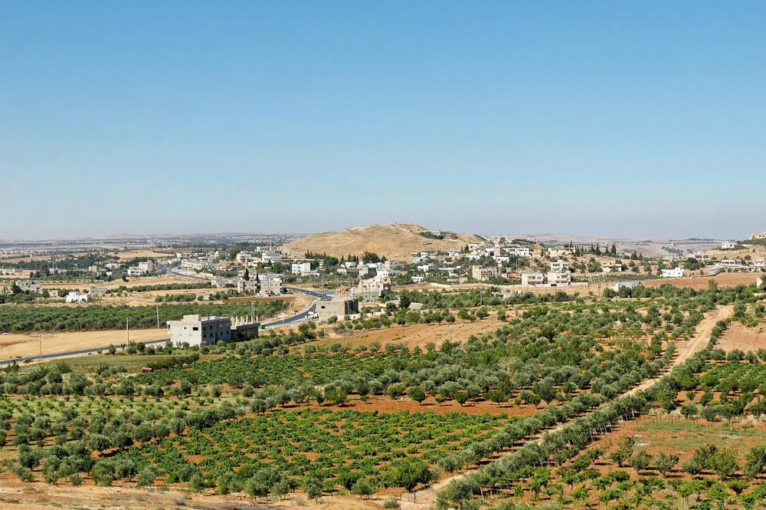
And what you did unto the two kings of the Amorites . . . unto Sihon and to Og
Tell Hesban, possible Heshbon, capital of Sihon (from the north)
2:10
Notes:
Heshbon was the capital of Sihon’s kingdom (Num 21:26). The identification of that ancient city with Tell Hesban remains difficult. Little has been found at the site that predates the Iron Age, except for scattered evidence of Egyptian presence during the 18th, 19th, and 22nd dynasties. If Heshbon was located at another site, it could not have been far from here.
tb061304043

Slide 65
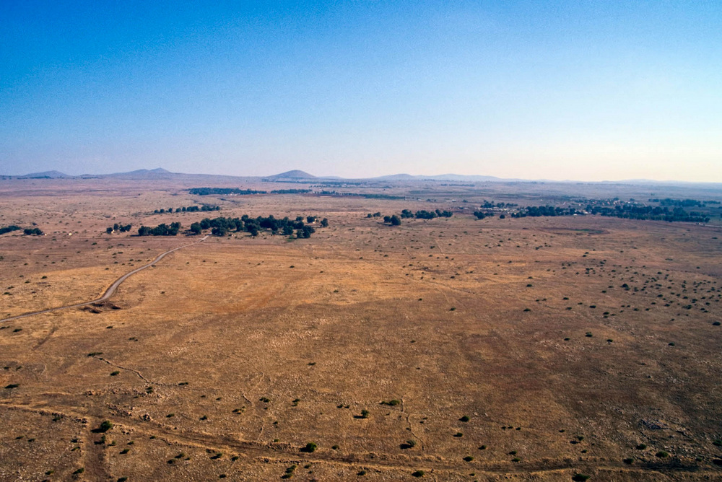
And what you did unto the two kings of the Amorites . . . unto Sihon and to Og
Golan Heights, ancient Bashan, home of Og (aerial view from the west)
2:10
Notes:
The Golan Heights are the region of ancient Bashan. It was a fertile and fairly flat land located east of the Sea of Galilee. Bashan was the area ruled by Og. The account of Og’s defeat by Israel appears in Numbers 21:33-35.
tbs113300011

Slide 66
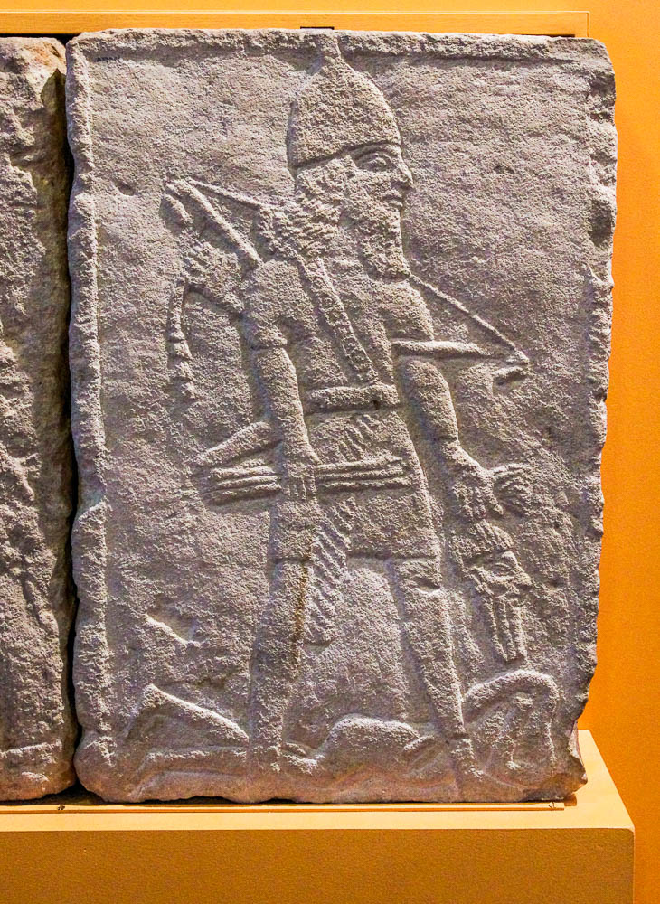
And as soon as we had heard it, our hearts melted
Assyrian soldier holding an enemy head, circa 750 BC
2:11
Notes:
When the Canaanites heard how God had fought for His people, they were terrified. The same response was intended by the Assyrians when they depicted their brutality in carvings like this limestone orthostat from Tell Tayinat in southeast Turkey. This carving, which dates to about 750 BC, was photographed at the Oriental Institute Museum at the University of Chicago.
adr1503110426

Slide 67
For Yahweh your God, he is God in heaven above
Clouds over Dead Sea at sunrise
2:11
Notes:
tb021906198

Slide 68
For Yahweh your God, he is God in heaven above and on the earth below
Jericho area (from the northwest)
2:11
Notes:
The “earth” that Rahab knew was the environs of Jericho. She would have had a view similar to this one if she ever climbed up the mountain to Jericho’s west. The ancient city is located just left of the center of the photo. See the next slide for a label.
tb091405156

Slide 69
For Yahweh your God, he is God in heaven above and on the earth below
Tell of Jericho
Jericho area (from the northwest)
2:11
Notes:
The “earth” that Rahab knew was the environs of Jericho. She would have had a view similar to this one if she ever climbed up the mountain to Jericho’s west. The ancient city is located just left of the center of the photo.
tb091405156

Slide 70
And that you will save alive my father, and my mother, and my brothers, and my sisters
Peasant family of Ramallah
2:13
Notes:
Rahab was concerned for the preservation of her extended family. This American Colony photo of a peasant family at Ramallah was taken between 1898 and 1914.
mat06850

Slide 71
Then she let them down by a rope through the window
Window grill from a house at Tell el-Amarna, circa 1345–1335 BC
2:15
Notes:
Windows on the first floor were uncommon in antiquity, since they could provide access to the house by unwanted guests. This limestone window from Tell el-Amarna in Egypt solved the problem with the use of a grill. Rahab’s house was part of the city wall and would have been well above the height that would have required protection like this, and thus could have been open. This photo was taken at the Ashmolean Museum of the University of Oxford.
adr1305228465

Slide 72
Then she let them down by a rope through the window
House made of mudbrick and stone at Tell Rabud
2:15
Notes:
The tiny window in this crumbling house at Tell Rabud would be more typical for a ground-level window. It is too small for an adult to use for entry or exit, while still letting in light and air. Tell Rabud is a small village located a few miles southwest of Hebron.
tb022407382

Slide 73
Then she let them down by a rope through the window
The Flight of the Spies, by James Tissot, circa 1898
2:15
Notes:
This image comes from James Tissot and is in the public domain, via The Jewish Museum: https://thejewishmuseum.org/collection/26408-the-flight-of-the-spies.
tjm26408

Slide 74
For her house was on the side of the wall, and she lived on the wall
Illustration of a house in the city wall of Damascus
2:15
Notes:
This picture illustrates dwellings with windows built into the city wall of 19th–century Damascus. The apostle Paul was let down from a window above the city wall when he fled from the authorities in Damascus (Acts 9:25; 2 Cor 11:33). Although the account of the spies in Joshua 2 does not specify whether the window was set out like those illustrated here, it would certainly not be unreasonable to think that they could have been. This illustration comes from Picturesque Palestine, volume 2.
pp2172

Slide 75
For her house was on the side of the wall, and she lived on the wall
Israelite four-room house at Beersheba, with the back room built into the casemate city wall
2:15
Notes:
This Israelite four-room house at Beersheba is later than the time of Joshua, but illustrates a house built into a city wall. Casemate walls were city walls that were comprised of two walls, with the space in between divided into separate rooms. In this example the back room of the house is actually built in the city wall.
tb122304348

Slide 76
For her house was on the side of the wall, and she lived on the wall
Casemate wall and gate of Hazor, circa 950 BC
2:15
Notes:
This multi-chambered gate at Hazor flanked on either side by casemate walls. The gate itself has six chambers plus two projecting towers. The casemate walls consist of two walls stretching in either direction from the gate. The space between the walls is broken into separate rooms. These were often used for storage or living spaces in times of peace, but could be filled with rubble in times of siege, thus creating a very thick and durable wall. This defensive system at Hazor is widely attributed to Solomon.
ws040616013

Slide 77
For her house was on the side of the wall, and she lived on the wall
Casemate walls and gates at Khirbet Qeiyafa, circa 1000 BC (aerial view from the east)
2:15
Notes:
This aerial view of Khirbet Qeiyafa is from the east. The two gates of the site are visible on the west and south, as are the walls of the site. In the areas that have been excavated, the double-walls of the casemates are clearly visible. It is also notable that most of the cells created by the casemates are open on the city side, thus connecting each of them with the house built against that part of the wall. Khirbet Qeiyafa was only occupied briefly, during the reign of David. See the next slide for labels.
ws021917026

Slide 78
For her house was on the side of the wall, and she lived on the wall
Casemate walls
Gate
Gate
Casemate walls
Casemate walls and gates at Khirbet Qeiyafa, circa 1000 BC (aerial view from the east)
2:15
Notes:
This aerial view of Khirbet Qeiyafa is from the east. The two gates of the site are visible on the west and south, as are the walls of the site. In the areas that have been excavated, the double-walls of the casemates are clearly visible. It is also notable that most of the cells created by the casemates are open on the city side, thus connecting each of them with the house built against that part of the wall. Khirbet Qeiyafa was only occupied briefly, during the reign of David. See the next slide for a close-up of a portion of the wall.
ws021917026

Slide 79
For her house was on the side of the wall, and she lived on the wall
Casemate wall at Khirbet Qeiyafa, circa 1000 BC
2:15
Notes:
This portion of the Khirbet Qeiyafa casemate wall is near south gate. Close inspection of the photo will show that the interior section of wall does not meet the next, but a gap (door) is left to access the cell. Thus the city wall itself became a useful part of the house built against it. Rahab’s house seems to have been built “upon the wall” in a similar fashion.
tb010412804

Slide 80
Go to the hills, lest the pursuers find you; and hide yourselves there three days
Jericho and the Judean wilderness (aerial view from the south)
2:16
Notes:
Rahab advised the spies to flee west into the mountains rather than east toward their camp on the plains of Moab. They would have likely hidden in the rugged region of the Judean wilderness to the west of Jericho. Their ascent may have taken the spies near the vicinity of Ai (the Ophrah-Ephraim-Taybeh ridge leads to this region), which would become the next target of the Israelite campaign. See the next slide for labels.
tb010703124

Slide 81
Go to the hills, lest the pursuers find you; and hide yourselves there three days
Mt. Hermon
Ophrah-Ephraim-Taybeh ridge
Valley of Zeboiim
Jericho
Wadi Qilt
Jericho and the Judean wilderness (aerial view from the south)
2:16
Notes:
Rahab advised the spies to flee west into the mountains rather than east toward their camp on the plains of Moab. They would have likely hidden in the rugged region of the Judean wilderness to the west of Jericho. Their ascent may have taken the spies near the vicinity of Ai (the Ophrah-Ephraim-Taybeh ridge leads to this region), which would become the next target of the Israelite campaign.
tb010703124

Slide 82
You shall tie this cord of scarlet thread in the window
Loom weights from Dothan and Shechem, Late Bronze and Iron Age II
2:18
Notes:
Spinning was a common household occupation in antiquity. The fact that Rahab was drying flax on her rooftop may indicate that she was also involved in this practice. She may have even had a loom in her home, which would have been a ready source of thread. Looms required the use of weights to pull down the warp threads. They were often made of clay, as shown here. This photo was taken at the Harvard Semitic Museum.
tb072811120

Slide 83
You shall tie this cord of scarlet thread in the window
Prayer hanging by a red thread at the Western Wall
2:18
Notes:
Although the thread shown here is rather small, that appears to be the meaning of the word chut (חוּט), “thread.” (e.g. Gen 14:23). Apparently the sign of the red thread was not supposed to be ostentatious or visible from any great distance, but relatively modest.
tb092603059

Slide 84
You shall tie this cord of scarlet thread in the window
Skeins of colored thread used for weaving
2:18
Notes:
This colored yarn illustrates the kind of thread Rahab may have hung from her window. It was photographed at a carpet maker’s shop in western Turkey.
jc0103150527

Slide 85
You shall tie this cord of scarlet thread in the window
Bedouin shepherdess spinning wool
2:18
Notes:
Spinning is the production of twisted yarn or thread from clumps of wool, as this Bedouin shepherdess is doing. This process has changed very little since the time of Joshua. This American Colony photo was taken in August 1932.
mat03790

Slide 86
You shall tie this cord of scarlet thread in the window
Bedouin woman spinning wool
2:18
Notes:
This American Colony photo was taken between 1898 and 1946.
mat06321

Slide 87
Gather . . . your father, and your mother, and your brothers, and all your father’s household
Family in Nazareth
2:18
Notes:
This American Colony photo was taken between 1900 and 1920.
mat01235

Slide 88
Whoever shall go out of the doors of your house into the street
“House of Naaman” in Damascus
2:19
Notes:
This humble-looking house was the traditional “House of Naaman” in the 1890s. It was located outside the east gate of Damascus. The mudbrick construction with a wooden door is not far removed from what Rahab’s house may have looked like. This photograph comes from Earthly Footsteps of the Man of Galilee.
ef0282

Slide 89
Whoever shall go out of the doors of your house into the street
Iron Age houses and streets at the tell of Beersheba
2:19
Notes:
The narrow street shown here between houses at Beersheba illustrates the immediate access from house to street. One step across the threshold placed a person in the street. Notice also that the buildings are constructed of a stone foundation with mudbrick superstructure. Although this street and buildings are centuries later than the time of Joshua, the construction methods would not have been very different. See the next slide for labels.
tb110702430

Slide 90
Whoever shall go out of the doors of your house into the street
street
doorway
doorway
Iron Age houses and streets at the tell of Beersheba
2:19
Notes:
The narrow street shown here between houses at Beersheba illustrates the immediate access from house to street. One step across the threshold placed a person in the street. Notice also that the buildings are constructed of a stone foundation with mudbrick superstructure. Although this street and buildings are centuries later than the time of Joshua, the construction methods would not have been very different.
tb110702430

Slide 91
And they went up into the hills, and stayed there three days, until the pursuers returned
Jericho and the hills where the spies fled (aerial view from the east)
2:22
Notes:
This photograph shows the relationship of the walled city where Rahab’s house was to the hills where she sent them for safety. Bryant Wood has suggested that Rahab’s house may have been on the northern side of the city. He writes, “The German excavation of 1907–1909 found that on the north a short stretch of the lower city wall did not fall as everywhere else. A portion of that mudbrick wall was still standing to a height of 8 ft (Sellin and Watzinger 1973: 58). What is more, there were houses built against the wall! It is quite possible that this is where Rahab’s house was located. Since the city wall formed the back wall of the houses, the spies could have readily escaped. From this location on the north side of the city, it was only a short distance to the hills of the Judean wilderness where the spies hid for three days (Jos 2:16, 22). Real estate values must have been low here, since the houses were positioned on the embankment between the upper and lower city walls. Not the best place to live in time of war! This area was no doubt the overflow from the upper city and the poor part of town, perhaps even a slum district” (Wood 1999: 37). See the next slide for labels.
Reference:
Wood, Bryant G.
1999 The Walls of Jericho. Bible and Spade 12/2: 35–42.
tb010703123

Slide 92
And they went up into the hills, and stayed there three days, until the pursuers returned
Jericho
Rahab’s house?
Jericho and the hills where the spies fled (aerial view from the east)
2:22
Notes:
This photograph shows the relationship of the walled city where Rahab’s house was to the hills where she sent them for safety. Bryant Wood has suggested that Rahab’s house may have been on the northern side of the city. He writes, “The German excavation of 1907–1909 found that on the north a short stretch of the lower city wall did not fall as everywhere else. A portion of that mudbrick wall was still standing to a height of 8 ft (Sellin and Watzinger 1973: 58). What is more, there were houses built against the wall! It is quite possible that this is where Rahab’s house was located. Since the city wall formed the back wall of the houses, the spies could have readily escaped. From this location on the north side of the city, it was only a short distance to the hills of the Judean wilderness where the spies hid for three days (Jos 2:16, 22). Real estate values must have been low here, since the houses were positioned on the embankment between the upper and lower city walls. Not the best place to live in time of war! This area was no doubt the overflow from the upper city and the poor part of town, perhaps even a slum district” (Wood 1999: 37).
Reference:
Wood, Bryant G.
1999 The Walls of Jericho. Bible and Spade 12/2: 35–42.
tb010703123

Slide 93
And they went up into the hills, and stayed there three days, until the pursuers returned
Jericho and the hills where the spies fled (aerial view from the east)
2:22
Notes:
This is a lower perspective showing the same features as the previous slide. The spies would have had to cover 740 yards (0.7 km) before they reached the nearest hill. Their escape must have been facilitated by darkness. The arrow points to the general area on the northern side of the city where a portion of the standing wall was found that some have suggested may have been the location of Rahab’s house. See the next slide for a label.
ws092414418

Slide 94
And they went up into the hills, and stayed there three days, until the pursuers returned
Rahab’s house?
Jericho and the hills where the spies fled (aerial view from the east)
2:22
Notes:
This is a lower perspective showing the same features as the previous slide. The spies would have had to cover 740 yards (0.7 km) before they reached the nearest hill. Their escape must have been facilitated by darkness. The arrow points to the general area on the northern side of the city where a portion of the standing wall was found that some have suggested may have been the location of Rahab’s house.
ws092414418

Slide 95
And they went up into the hills, and stayed there three days, until the pursuers returned
Judean wilderness (aerial view from the south)
2:22
Notes:
The two spies fled from Jericho west to the hills of the Judean wilderness. This and the following photos provide various views of the area and terrain where they would have hid until it was safe to cross back over the Jordan. See the next slide for labels.
tb010703378

Slide 96
And they went up into the hills, and stayed there three days, until the pursuers returned
Jordan Rift
Jericho
Judean wilderness
Wadi Qilt
Judean wilderness (aerial view from the south)
2:22
Notes:
The two spies fled from Jericho west to the hills of the Judean wilderness. This and the following photos provide various views of the area and terrain where they would have hid until it was safe to cross back over the Jordan.
tb010703378

Slide 97
And they went up into the hills, and stayed there three days, until the pursuers returned
Judean wilderness with the Ephraim ridge ascent (aerial view from the west)
2:22
Notes:
This aerial photo shows more of the rugged terrain of the Judean wilderness. At the bottom, a modern road travels up the ridge from the region of Jericho. This route was known in ancient times and may have been used later by Joshua’s forces when they went up to attack Ai. See the next slide for labels.
ws122617228

Slide 98
And they went up into the hills, and stayed there three days, until the pursuers returned
Shittim
Dead Sea
Jericho
Judean wilderness
Ephraim ridge route
Judean wilderness with the Ephraim ridge ascent (aerial view from the west)
2:22
Notes:
This aerial photo shows more of the rugged terrain of the Judean wilderness. At the bottom, a modern road travels up the ridge from the region of Jericho. This route was known in ancient times and may have been used later by Joshua’s forces when they went up to attack Ai.
ws122617228

Slide 99
And they went up into the hills, and stayed there three days, until the pursuers returned
Judean wilderness in springtime near Jericho
2:22
Notes:
The hills are rugged and the terrain difficult for travel, making this an easy place to escape pursuers (as later David would do). This image shows the area in February after the winter rains when there was still some green grass on the hills. The journey of the spies probably took place in March, to judge from the Passover that the Israelites would soon celebrate (5:10).
tb022207359

Slide 100
And they went up into the hills, and stayed there three days, until the pursuers returned
Judean wilderness with the Wadi Qilt (from the southwest)
2:22
Notes:
This view provides more of the scenery west of Jericho. The Wadi Qilt, marked by the green trees and shrubs near the center of the photo, is one of the larger drainage systems in the northern Judean wilderness. The city of Jericho lies in the right distance, just below the conical hill known as Cypros. See the next slide for labels.
tb051708048

Slide 101
And they went up into the hills, and stayed there three days, until the pursuers returned
Jericho
Cypros
Wadi Qilt
Judean wilderness with the Wadi Qilt (from the southwest)
2:22
Notes:
This view provides more of the scenery west of Jericho. The Wadi Qilt, marked by the green trees and shrubs near the center of the photo, is one of the larger drainage systems in the northern Judean wilderness. The city of Jericho lies in the right distance, just below the conical hill known as Cypros.
tb051708048

Slide 102
And they went up into the hills, and stayed there three days, until the pursuers returned
Judean wilderness with the Wadi Qilt
2:22
Notes:
This slide and the ones following provide more imagery for the type of land that the spies would have seen and where they may have hid.
tb091504749

Slide 103
And they went up into the hills, and stayed there three days, until the pursuers returned
Wadi Qilt in the Judean wilderness
2:22
Notes:
tbs46039010

Slide 104
And they went up into the hills, and stayed there three days, until the pursuers returned
Wadi Qilt in the Judean wilderness (from the south)
2:22
Notes:
tb092706258

Slide 105
And they went up into the hills, and stayed there three days, until the pursuers returned
Wadi Qilt in the Judean wilderness
2:22
Notes:
tb091504754

Slide 106
And they went up into the hills, and stayed there three days, until the pursuers returned
Judean wilderness at the confluence of Nahal Perat and Wadi Suwenit
2:22
Notes:
If the spies traveled even further west, they may have seen a landscape like the one shown in this photo. These two drainage systems join together to become the Wadi Qilt and flow down to Jericho. Note the presence of caves in the hillside on the right, a ubiquitous feature in this region.
tb020804382

Slide 107
And they went up into the hills, and stayed there three days, until the pursuers returned
Cliffs of Wadi Suwenit (aerial view from the northwest)
2:22
Notes:
This area will later become significant when Jonathan defeats the Philistines (1 Sam 14:1-14), but it’s possible that the spies traveled up this way in an effort to avoid detection.
ws022617015

Slide 108
And they went up into the hills, and stayed there three days, until the pursuers returned
Wadi Suwenit near the cliffs of Michmash
2:22
Notes:
This photo provides a more close-up perspective of the terrain of this area, making it easier to see how easy it would to hide among the cliffs and caves of the Judean wilderness.
tb092706111

Slide 109
Then the two men returned, and descended from the hills . . . and came to Joshua the son of Nun
Jericho and the Jordan Valley (aerial view from the south)
2:23
Notes:
This aerial view shows the sharp topographical difference between the hills to the west and the plain to the east of Jericho. See the next slide for labels.
tb121704191

Slide 110
Then the two men returned, and descended from the hills . . . and came to Joshua the son of Nun
Jordan River
2. spies return to Shittim
Jericho
1. pursuers return from search
Jericho and the Jordan Valley (aerial view from the south)
2:23
Notes:
This aerial view shows the sharp topographical difference between the hills to the west and the plain to the east of Jericho.
tb121704191

Slide 111
Then the two men returned, and descended from the hills . . . and came to Joshua the son of Nun
Area of Jericho (aerial view from the west)
2:23
Notes:
This view is looking east in the direction that the spies eventually returned to Joshua and the Israelites. Rahab’s suggestion, which they followed, was to hide in the hills to the west, the edge of which can be seen at the bottom of this photo. See the next slide for labels.
tb010703115

Slide 112
Then the two men returned, and descended from the hills . . . and came to Joshua the son of Nun
Shittim
Jordan River “crossed over”
2. spies return to Shittim
1. pursuers return from search
Jericho
Area of Jericho, with a possible return route of the spies (aerial view from the west)
2:23
Notes:
This view is looking east in the direction that the spies eventually returned to Joshua and the Israelites. Rahab’s suggestion, which they followed, was to hide in the hills to the west, the edge of which can be seen at the bottom of this photo.
tb010703115

Slide 113
Then the two men returned, and descended from the hills, and crossed over
Ferry boat crossing the Jordan River
2:23
Notes:
The spies of Israel would have had to swim the river, perhaps at a place near where this photo was taken. At the time, the river was swollen with spring runoff and would have been much broader and more formidable (cf. 3:15). This American Colony photo was taken between 1934 and 1939.
mat04186

Slide 114
Then the two men returned, and descended from the hills, and crossed over
Jordan River east of Jericho
2:23
Notes:
The Jordan River as it flows through the Rift Valley, east of Jericho. This picture was taken by David Bivin in the 1960s.
db6601080703

Slide 115
Then the two men returned, and descended from the hills, and crossed over
Jordan River east of Jericho
2:23
Notes:
This view of the Jordan River is near Bethany Beyond the Jordan, the traditional southern location of Jesus’s baptism, near Jericho. Notice how the banks of the river in the near distance are steep, not suitable for easy crossing like a ford would be. However, it is quite possible that the spies, knowing that they were the objects of recent pursuit, would choose such a location rather than show their faces at one of the regular crossing places.
tb060303267

Slide 116
All the inhabitants of the land melt away before us
Roman statue of a girl chasing a partridge, late 1st century BC to early 1st century AD
2:23
Notes:
This bronze statue of a young Roman girl chasing a partridge illustrates the vulnerability of the land before the Israelites. It lay before them for the taking, as the spies now realized. This sculpture, which comes from the late 1st century BC to early 1st century AD, is on display at the Metropolitan Museum of Art in New York City.
adr1605243739

Slide 117
More than 3,100 slides in PowerPoint format. Available now from BiblePlaces.com.
Notes:
This is a free sample of the Joshua 2 presentation from the Photo Companion to the Bible. To purchase the full volume, visit https://www.bibleplaces.com/joshua/
The Photo Companion to the Bible is an image-rich resource for Bible students, teachers, and researchers. Just as a librarian stocks the shelves with as many relevant materials as possible, so we have tried to provide a broad selection of images. Our goal is that you will find in this “library” whatever it is you are looking for.
Credits: The primary creators of this presentation are Chris McKinny, Kris Udd, and Todd Bolen. The photographs have an individual file code which usually includes the initials of the photographer. Other images have additional credit or source information.
Updates: We plan to update this collection as we are able. We welcome your suggestions for improving this resource (photocompanion@bibleplaces.com). Purchasers of the Joshua volume are provided free, lifetime updates to the collection.
Copyright: This photo collection is protected by copyright law and may not be distributed without written permission from BiblePlaces.com. Slide notes should be treated as any other copyrighted written material, with credit given when quoting from these notes.
For more information, see our complete “Introduction to the Photo Companion to the Bible” online at http://www.BiblePlaces.com/Intro-Photo-Companion-Bible/. Here you will find more information about photo selection, explanatory notes, Bible translation, credit information, and copyright allowances.

