Slide 1
JOSHUA 1-6 Preview
Notes:
The Photo Companion to the Bible is an image-rich resource for Bible students, teachers, and researchers. Just as a librarian stocks the shelves with as many relevant materials as possible, so we have tried to provide a broad selection of images. Our goal is that you will find in this “library” whatever it is you are looking for.
Credits: The primary creators of this presentation are Chris McKinny, Kris Udd, and Todd Bolen. The photographs have an individual file code which usually includes the initials of the photographer. Other images have additional credit or source information.
Updates: Free updates are provided to the purchaser.
Copyright: This photo collection is protected by copyright law and may not be distributed without written permission from BiblePlaces.com. Slide notes should be treated as any other copyrighted written material, with credit given when quoting from these notes.

Slide 2
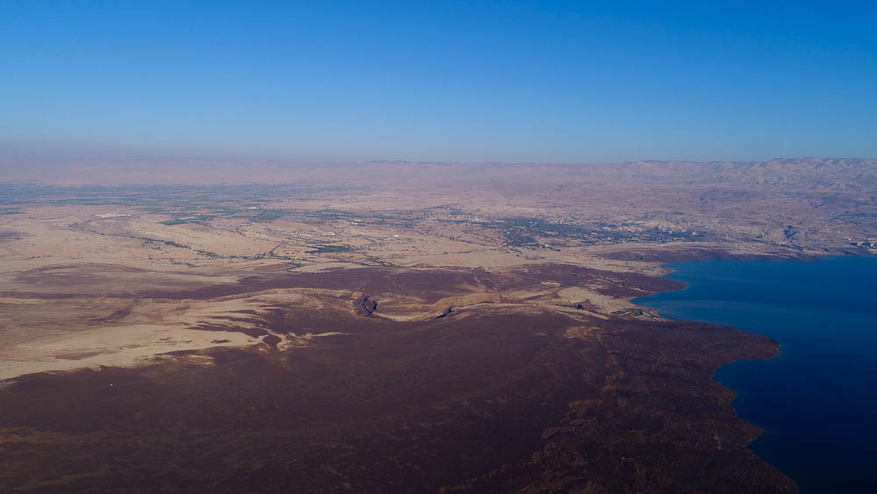
Now therefore arise and go over this Jordan
Mt. Nebo
Plains of Moab
Dead Sea
Jordan River
Northern end of the Dead Sea (aerial view from the west)
1:2
Notes:
This view also shows the northern end of the Dead Sea. Mount Nebo is the location from which Moses was allowed by God to view the land prior to his death. On a very clear day, even Jerusalem is visible from Mount Nebo.
ws122617291

Slide 3
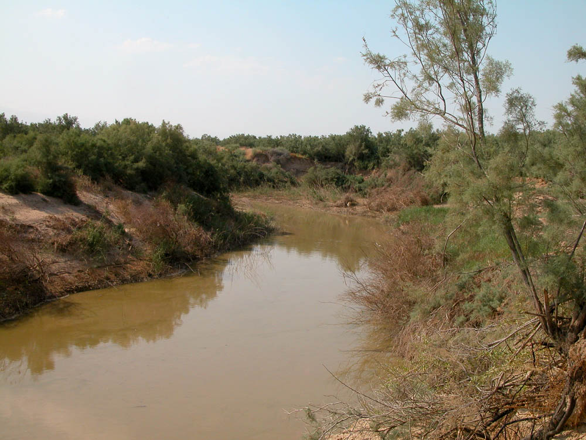
Now therefore arise and go over this Jordan
Jordan River east of Jericho
1:2
Notes:
The flow of the Jordan River today is less than five percent of its historical flow, as most of the tributaries of the Jordan are now dammed, and the water is used for other purposes. When modern tourists see how small the Jordan River is today, they often wrongly assume that it was only a small stream in biblical times as well.
tb060303267

Slide 4
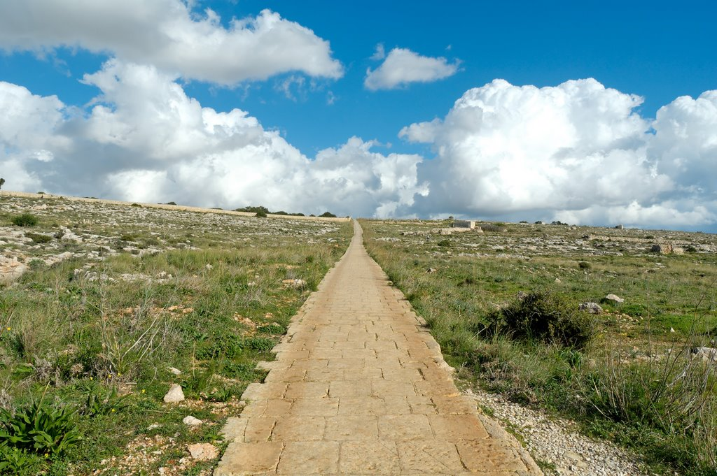
Turn not from it to the right hand or to the left
Straight path through the Malta countryside
1:7
Notes:
This path is located near the Hagar Qim temple on the island of Malta. It illustrates the straight path that the Israelites were to walk in their obedience to God, straying in neither direction.
tb112005821

Slide 5
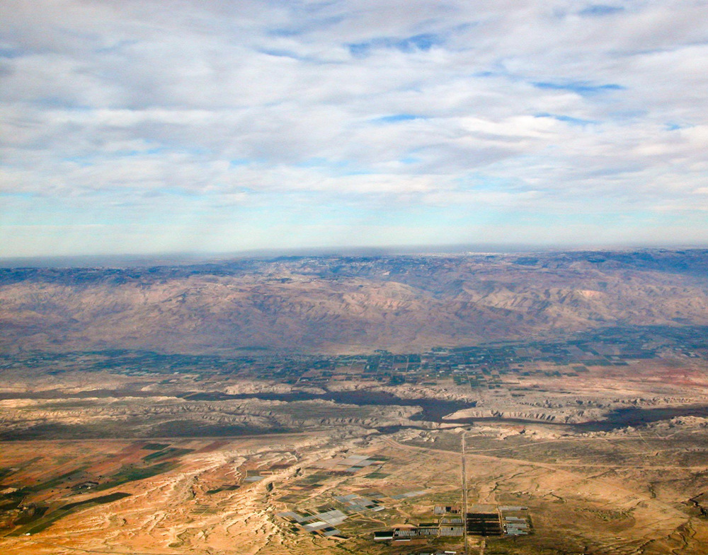
Then you shall return unto the land of your possession . . . beyond the Jordan toward the sunrise
The Jordan Rift Valley and Transjordan (aerial view from the west)
1:15
Notes:
Once the warriors of Reuben, Gad, and half the tribe of Manasseh had finished helping the other tribes conquer their territory, they could return to their own land. This aerial photo views the some of the territory of Reuben, Gad, and Manasseh from the direction of the hills of Canaan that they were to help conquer. To return to their own land, located in the east, they would have crossed the Jordan, perhaps in an area like this.
tb010703126

Slide 6
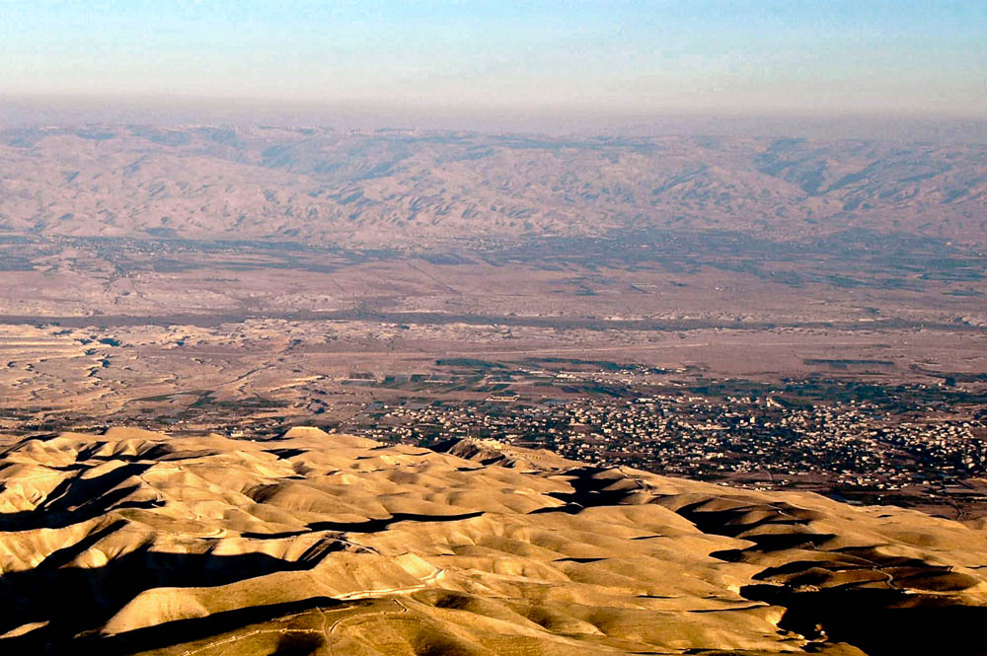
And Joshua the son of Nun sent out of Shittim two men as spies secretly
Shittim?
Jordan River
Jericho
Region of Jericho and Shittim (aerial view from the west)
2:1
Notes:
This photo provides a broad view of the land where the events of chapter 2 took place. At the beginning of the chapter, the spies leave Shittim and travel to Jericho. At the end, they journey from the hills in the foreground back across the Jordan River to the Israelite encampment.
tb121704157

Slide 7
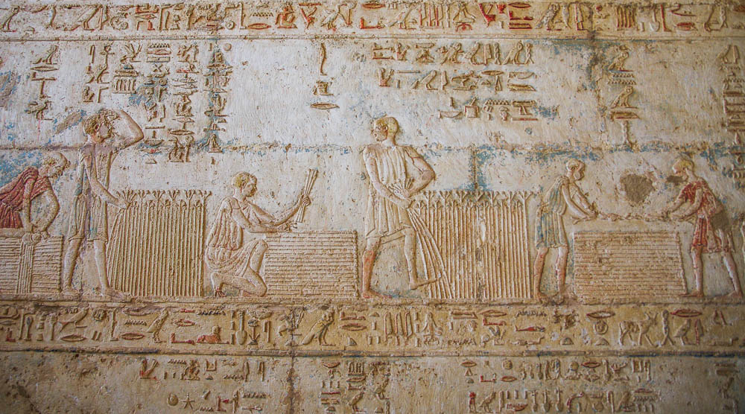
And hid them with the stalks of flax, which she had laid in order upon the roof
Harvesting and bundling flax, depiction in the Petosiris temple-tomb at Tuna el-Gebel
2:6
Notes:
In ancient times flax was used for everything from fishing nets to wicks for lamps. The priest’s clothes, according to God’s instructions in Leviticus, were made of linen.
adr1603247174

Slide 8
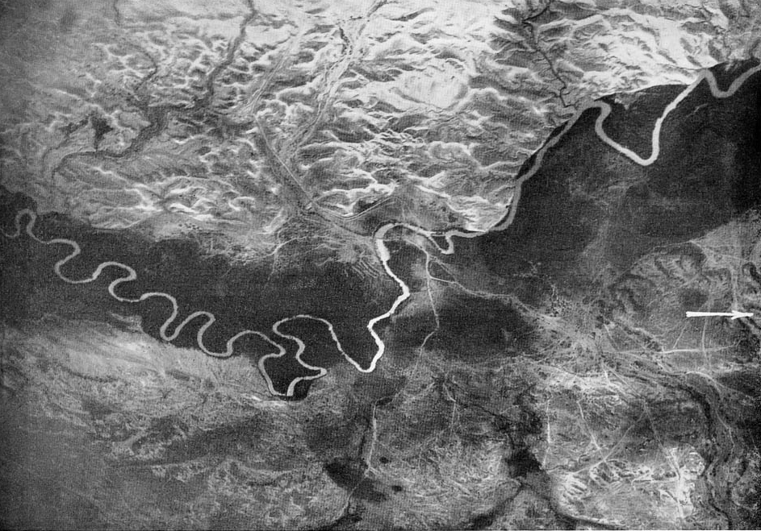
And the men pursued them along the way to the Jordan, as far as the fords
to Jericho
Ford
Plains of Moab
Jordan River near Jericho bridge (aerial view from the east)
2:7
Notes:
This aerial photo, taken in 1918 from a height of 13,100 feet (4000 m), shows the area of the Jordan that lay between Jericho and the Plains of Moab. The best ford at that time is visible in the area crossed by two bridges, which also determined where the roads ran. It can be seen that the river is wider (shallower) in that area, and that the vegetation is less dense there. Notice also that the natural drainage patterns in the low hills on either side of the river affect the routes of the roads. This image comes from Gustaf Dalman, Hundert deutsche Fliegerbilder aus Palaestina (1925); an English edition is forthcoming from BiblePlaces.com. This photograph was taken by the German Airforce Division 304 on April 21, 1918, around 8 am.
gd0081

Slide 9
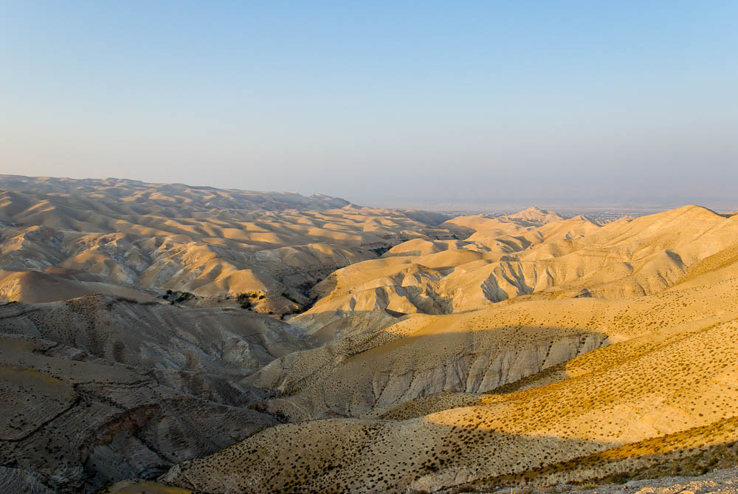
And they went up into the hills, and stayed there three days, until the pursuers returned
Jericho
Cypros
Wadi Qilt
Judean wilderness with the Wadi Qilt (from the southwest)
2:22
Notes:
The two spies fled from Jericho west to the hills of the Judean wilderness. This view provides more of the scenery where they hid. The Wadi Qilt, marked by the green trees and shrubs near the center of the photo, is one of the larger drainage systems in the northern Judean wilderness. The city of Jericho lies in the right distance, just below the conical hill known as Cypros.
tb051708048

Slide 10
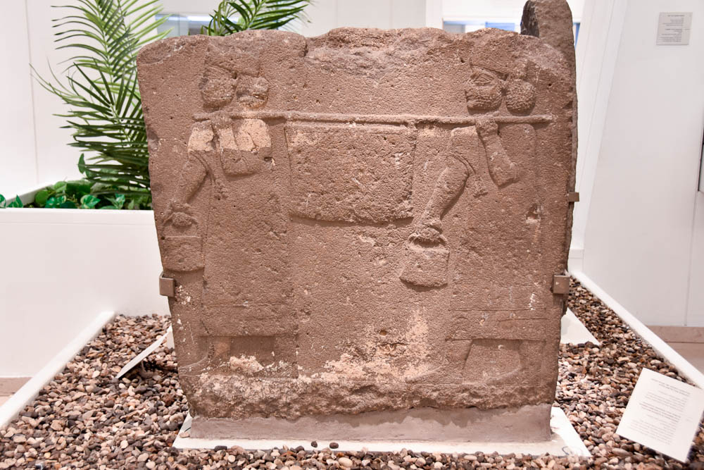
You shall command the priests that carry the ark of the covenant
Orthostat with tribute bearers carrying vessel on pole, from Arslan Tash, 800–750 BC
3:8
Notes:
This relief depicts men carrying a container on a pole, somewhat similar to the way the Lord required the ark of the covenant to be carried. This relief comes from ancient Hadatu in northern Syria. This basalt orthostat was photographed in the Bible Lands Museum in Jerusalem.
mjb1904258099

Slide 11
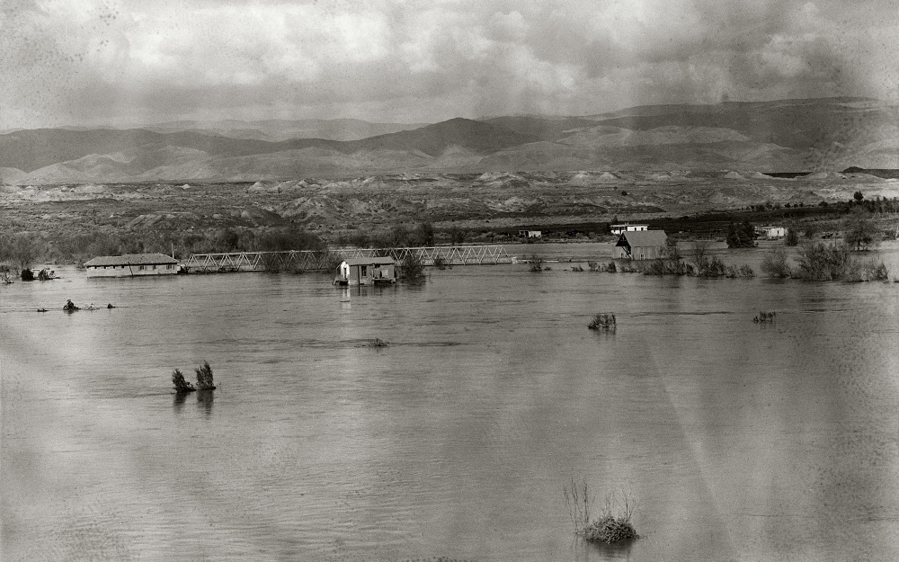
For the Jordan overflows all its banks all the time of harvest
Area of the Allenby Bridge during a flood of the Jordan River
3:15
Notes:
The Jordan does not flood today due to the heavy use of waters from its tributaries in the national water systems of Israel and Jordan. Even the Sea of Galilee, through which the river flows on its way south, often experiences low levels today because of the large quantities that are pumped out. This photo and those that follow show the Jordan River in flood stage. Having overflowed its banks, it spread out across the valley and became quite wide, if not particularly deep. This American Colony photograph was taken in February 1935.
mat00450

Slide 12
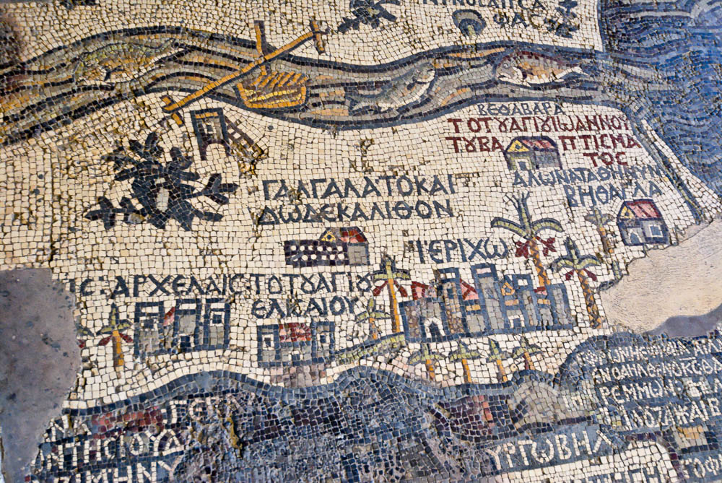
And camped in Gilgal, on the east side of Jericho
Gilgal, which is also Twelve Stones
Jericho
“Gilgal, which is also Twelve Stones” on the Medeba Map, circa AD 580
4:19
Notes:
The Medeba Map, which dates to the late 6th century AD, shows a location for Gilgal to the east of Jericho. The Dead Sea is on the right, and Jerusalem is just off the edge on the lower right. The area of Jericho and Gilgal is just below the Jordan River near where it enters the Dead Sea. The text above the site identifies it as “Gilgal, which is also Twelve Stones” (ΓΑΛΓΑΛΑΤΟ ΚΑΙ ΔΩΔΕΚΑΛΙΘΟΝ). Below this is shown a church and what appears to be a pile of twelve stones. The site is not shown as a village (see the three sites located below it for the portrayal of villages) but as a church with some edifice in front of it representing twelve stones. Presumably the ruins of this Byzantine church lie somewhere undiscovered in the Jericho region today. Whether or not the church preserves the accurate location of Gilgal, however, is another question.
tb053108977

Slide 13
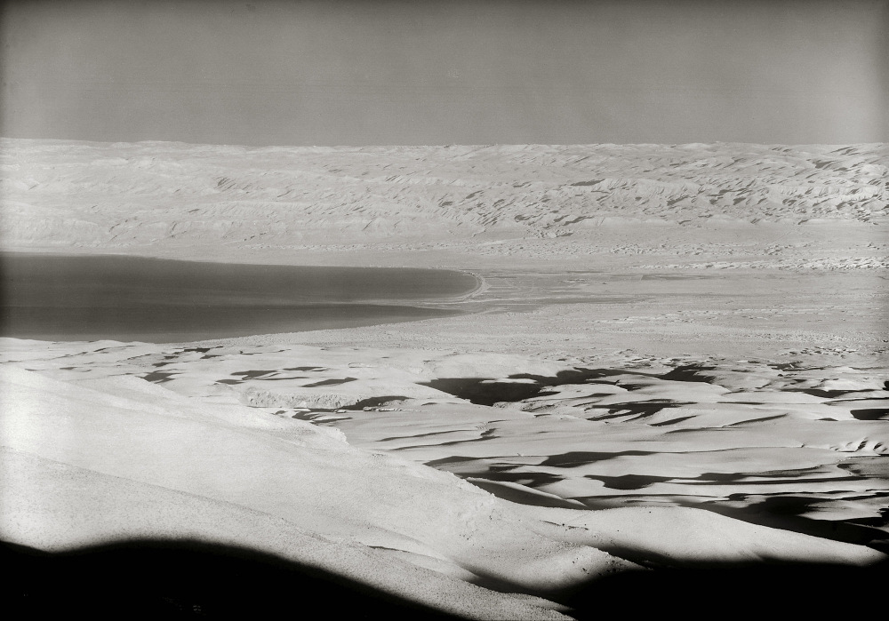
When all the kings of the Amorites, that were beyond the Jordan westward
Dead Sea and the Judean Wilderness, from Mount Nebo
5:1
Notes:
This view looks west toward the Judean hills. This and the next several slides illustrate the land in which the Amorite kings mentioned here were living. This American Colony photograph was taken between 1934 and 1939.
mat03779

Slide 14
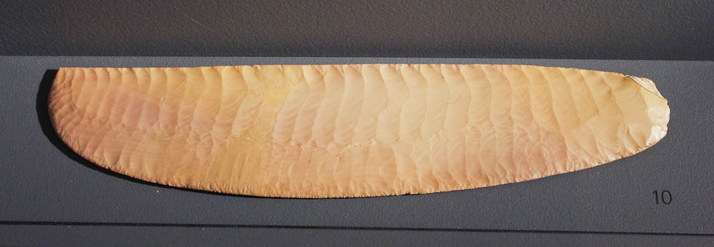
At that time Yahweh said to Joshua, “Make knives of flint”
Egyptian ripple-flaked flint knife, circa 3250–3100 BC
5:2
Notes:
This gorgeous ripple-flake flint knife is from a very early stage of Egyptian civilization known as Naqada III, circa 3250–3100 BC. It would have originally been affixed to a handle. The reverse side is hand ground to a smooth finish, rather than ripple-flaked. A number of blades like this are known from ancient Egypt, and they probably had a ceremonial rather than mundane use. The craftsmanship used to make such a blade was outstanding. This artifact was photographed at the Michael C. Carlos Museum in Atlanta.
adr1511187429

Slide 15
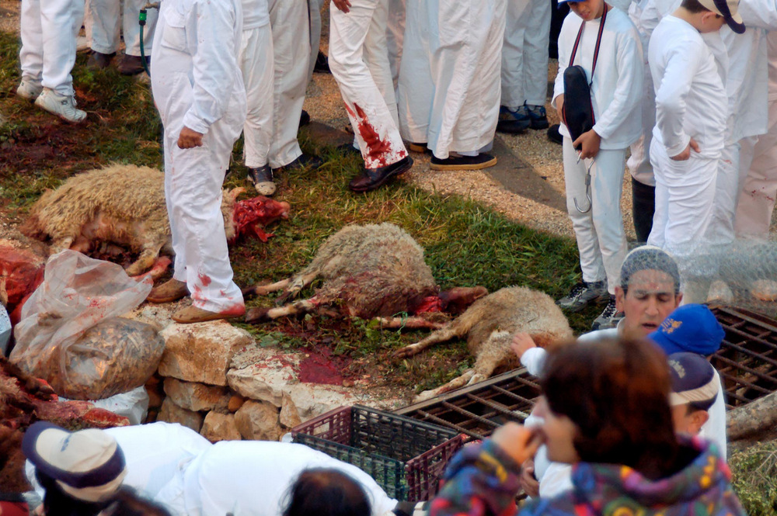
They kept the Passover on the fourteenth day of the month at evening
Lambs slain during the Samaritan Passover
5:10
Notes:
The Samaritan Passover service begins around sunset. The men are dressed in white garments, the leaders wear red hats, and the priests are dressed in a distinctive turquoise-green garb. They begin by chanting and praying, much of which sounds like the familiar wails of the Muslim call to prayer. When the signal is given, the head of each household reaches for his knife to slice the throat of his family’s lamb. As soon as the deed is done, the Samaritans all begin clapping, congratulating each other and celebrating. Today, 30–40 sheep are slain at Passover, about one for each larger family unit (there are no more than 600 Samaritans alive in the world today). The sheep are then skinned and put on a pole (skewer) and carried over to one of the 6.5–10 foot (2–3 m) deep roasting pits to be cooked for most of the night.
tb041106729

Slide 16
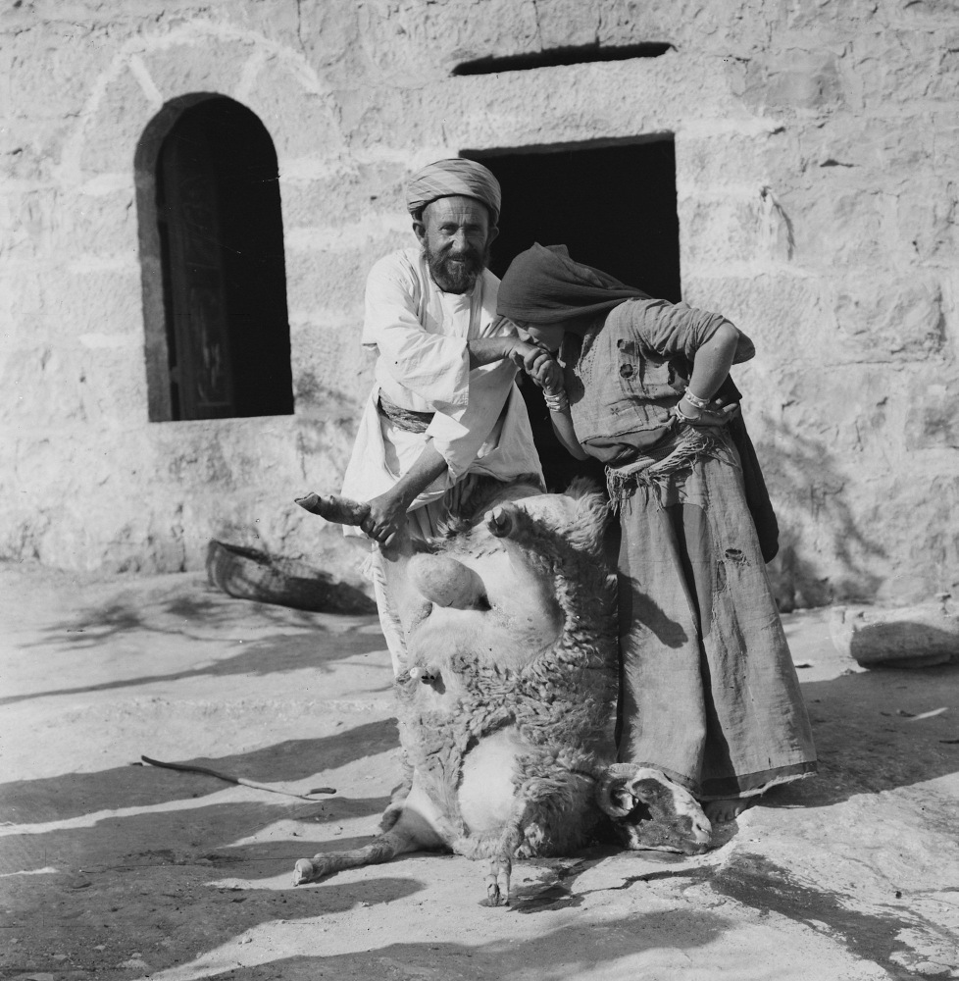
They kept the Passover on the fourteenth day of the month at evening
Weli of Budrieh with a sacrificed sheep
5:10
Notes:
This American Colony photograph, taken between 1900 and 1926, shows a Muslim ceremony involving a sacrificed sheep and blood placed on the doorframe of the house.
mat01421

Slide 17
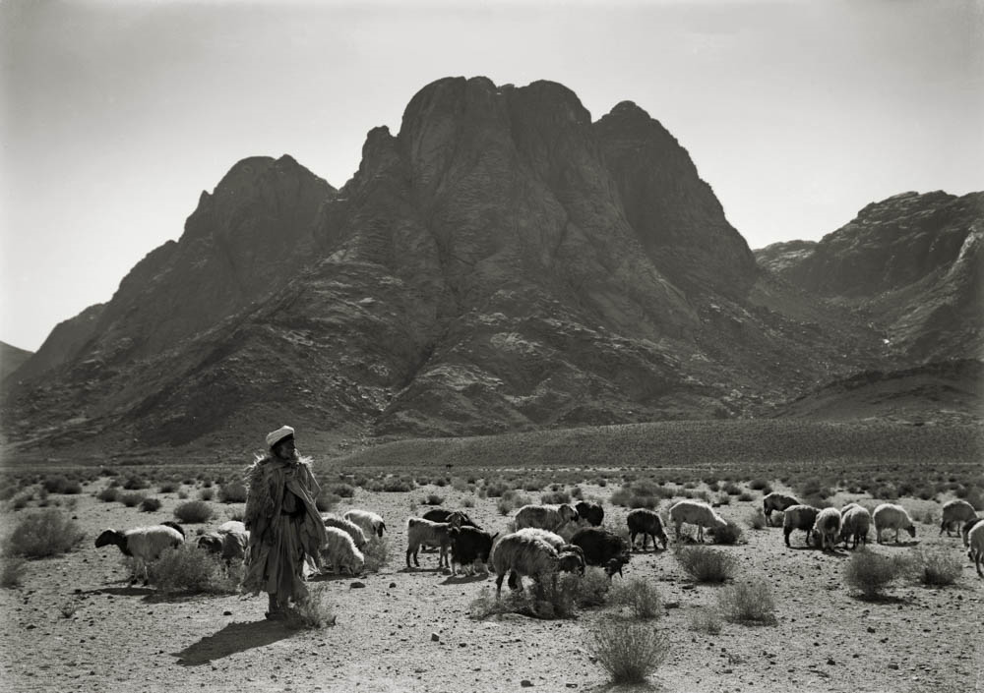
Take your sandals off of your feet; for the place where you are standing is holy
Shepherd and flock in Wadi er-Raha near Jebel Musa, the traditional Mount Sinai
5:15
Notes:
This shepherd and his flock are in Wadi er-Raha, with Ras Safsafa in the background. (Ras Safsafa is the peak just south of the traditional summit that Moses climbed.) This scene is reminiscent of Moses tending his flocks when he encountered the burning bush and was given a command similar to what Joshua heard in this verse. This American Colony photograph was taken between 1898 and 1946.
mat05411

Slide 18
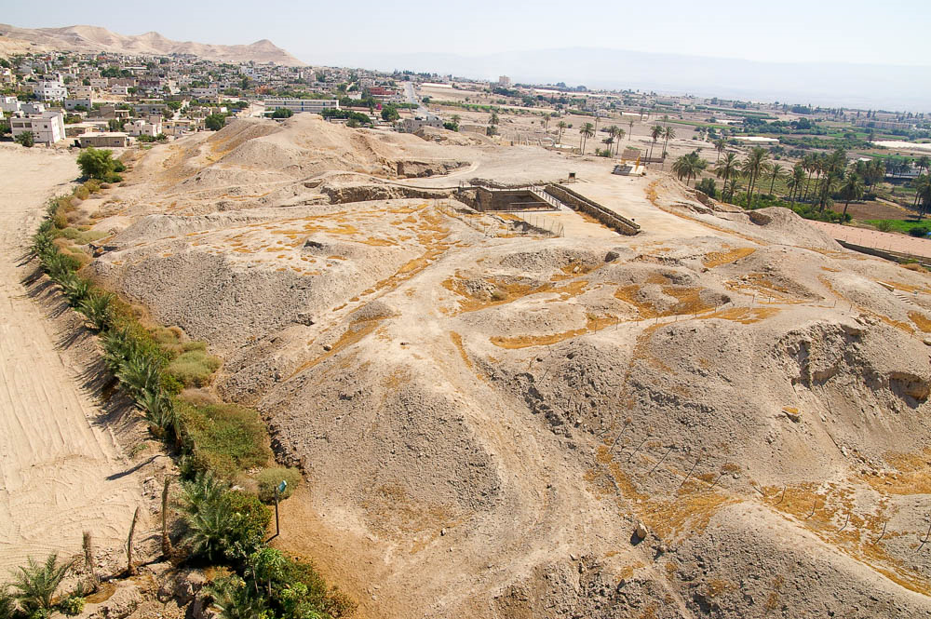
Now Jericho was shut up because of the children of Israel
The mound of ancient Jericho
6:1
Notes:
Jericho covers about 6 acres (2.5 ha), and today it stands about 70 feet (21.5 m) above the valley floor. The mound today is largely made up of disintegrated mudbrick that was originally used for the construction of houses and walls on the mound.
adr0807116251

Slide 19
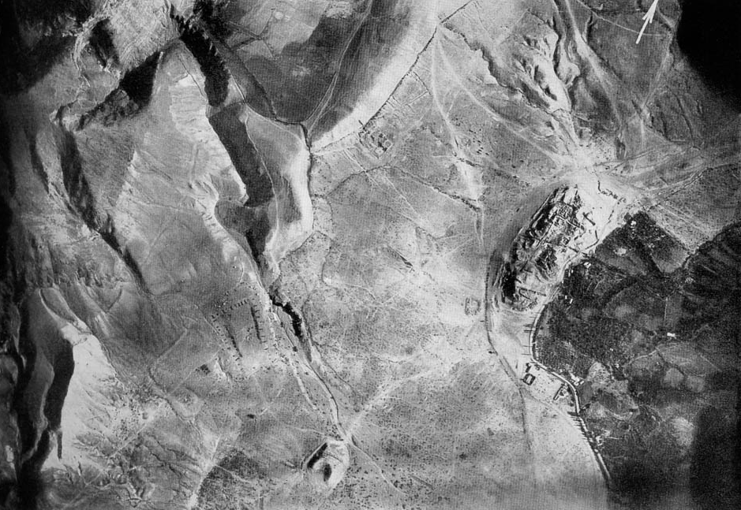
Pass on, and circle the city
Jericho
Israelite camp
Jericho area (aerial view from the southeast)
6:7
Notes:
Although the text does not indicate which direction (clockwise or counterclockwise) the Israelites went when they circled Jericho, the intuitive direction would be counterclockwise, as it would allow a shield carried in the left hand to face the city. The aerial photo shown here was taken by the German Air Force 304 on June 4, 1918 at 6:45 in the morning from an elevation of 16,400 feet (5,000 m). The dramatic effect of “Elisha’s Spring” on its eastern side is evident in the fertile fields. This image comes from Gustaf Dalman, Hundert deutsche Fliegerbilder aus Palaestina (1925); an English edition is forthcoming from BiblePlaces.com.
gd0071

Slide 20
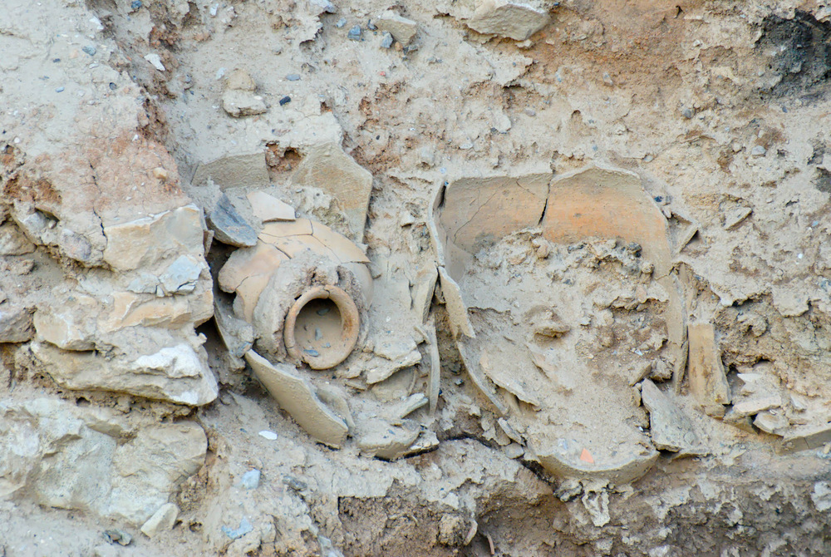
And the city shall be devoted, all that is in it, to Yahweh
Grain jars preserved at Jericho
6:17
Notes:
The grain jars shown here were among dozens that were discovered at Jericho and date to the time of Joshua (according to the Early Date view; those who follow a Late Date view would date this to a destruction prior to Joshua’s attack). The excavators found these jars full of charred grain, indicating that the inhabitants of the city did not starve to death, and that whoever conquered the city did not attempt to recover the grain.
tb020707494

Slide 21
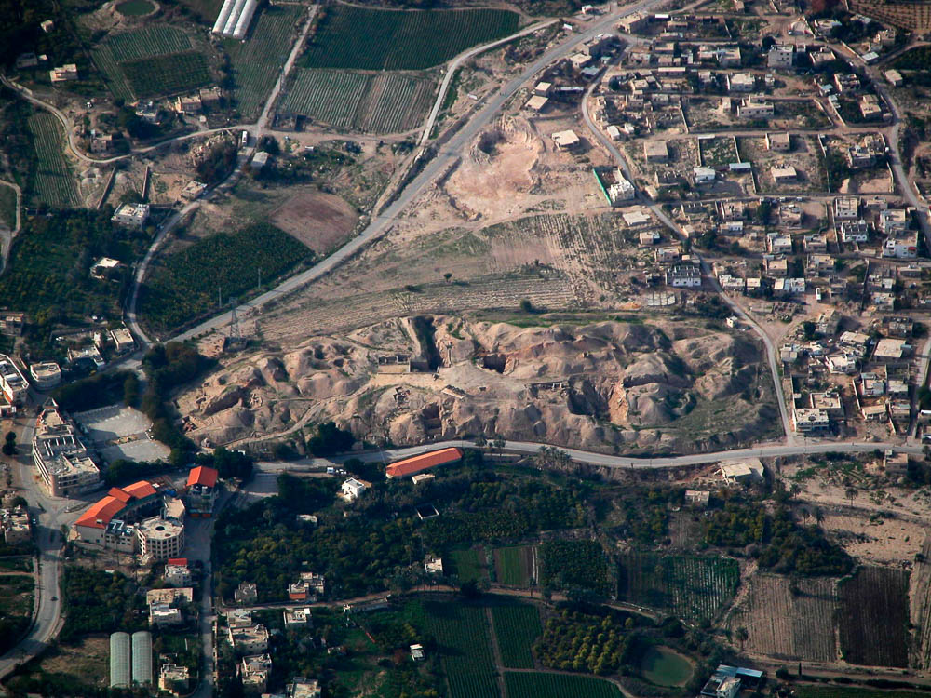
The wall fell down flat, so that the people went up into the city, every man straight before him
ancient Jericho
Jericho, modern Tell es-Sultan (aerial view from the east)
6:20
Notes:
This aerial photo shows the mound of ancient Jericho as it looks today. The mound is not more than 10 acres (4 ha) in size.
tb010703121

