Slide 1
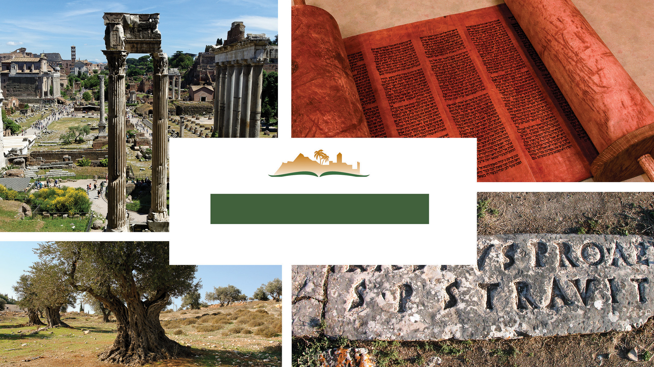
ROMANS 12
Notes:
This is a free sample of the Romans 12 presentation from the Photo Companion to the Bible. To purchase the full volume, visit https://www.bibleplaces.com/romans/
The Photo Companion to the Bible is an image-rich resource for Bible students, teachers, and researchers. Just as a librarian stocks the shelves with as many relevant materials as possible, so we have tried to provide a broad selection of images. Our goal is that you will find in this “library” whatever it is you are looking for.
Credits: The primary creators of this presentation are Christian Locatell, Steven D. Anderson, Kris Udd, and Todd Bolen. The photographs have an individual file code which usually includes the initials of the photographer. Other images have additional credit or source information.
Updates: We plan to update this collection as we are able. We welcome your suggestions for improving this resource (photocompanion@bibleplaces.com). Purchasers of the Romans volume are provided free, lifetime updates to the collection.
Copyright: This photo collection is protected by copyright law and may not be distributed without written permission from BiblePlaces.com. Slide notes should be treated as any other copyrighted written material, with credit given when quoting from these notes.
For more information, see our complete “Introduction to the Photo Companion to the Bible” online at http://www.BiblePlaces.com/Intro-Photo-Companion-Bible/. Here you will find more information about photo selection, explanatory notes, Bible translation, credit information, and copyright allowances.

Slide 2
ROMANS 12
This is a free sample of the Romans 12 presentation from the Photo Companion to the Bible. To purchase the full volume, visit https://www.bibleplaces.com/romans/ The Photo Companion to the Bible is an image-rich resource for Bible students, teachers, and researchers. Just as a librarian stocks the shelves with as many relevant materials as possible, so we have tried to provide a broad selection of images. Our goal is that you will find in this “library” whatever it is you are looking for. For more details (for this and every slide), see the Notes section below.
Notes:
This is a free sample of the Romans 12 presentation from the Photo Companion to the Bible. To purchase the full volume, visit https://www.bibleplaces.com/romans/
The Photo Companion to the Bible is an image-rich resource for Bible students, teachers, and researchers. Just as a librarian stocks the shelves with as many relevant materials as possible, so we have tried to provide a broad selection of images. Our goal is that you will find in this “library” whatever it is you are looking for.
Credits: The primary creators of this presentation are Christian Locatell, Steven D. Anderson, Kris Udd, and Todd Bolen. The photographs have an individual file code which usually includes the initials of the photographer. Other images have additional credit or source information.
Updates: We plan to update this collection as we are able. We welcome your suggestions for improving this resource (photocompanion@bibleplaces.com). Purchasers of the Romans volume are provided free, lifetime updates to the collection.
Copyright: This photo collection is protected by copyright law and may not be distributed without written permission from BiblePlaces.com. Slide notes should be treated as any other copyrighted written material, with credit given when quoting from these notes.
For more information, see our complete “Introduction to the Photo Companion to the Bible” online at http://www.BiblePlaces.com/Intro-Photo-Companion-Bible/. Here you will find more information about photo selection, explanatory notes, Bible translation, credit information, and copyright allowances.

Slide 3
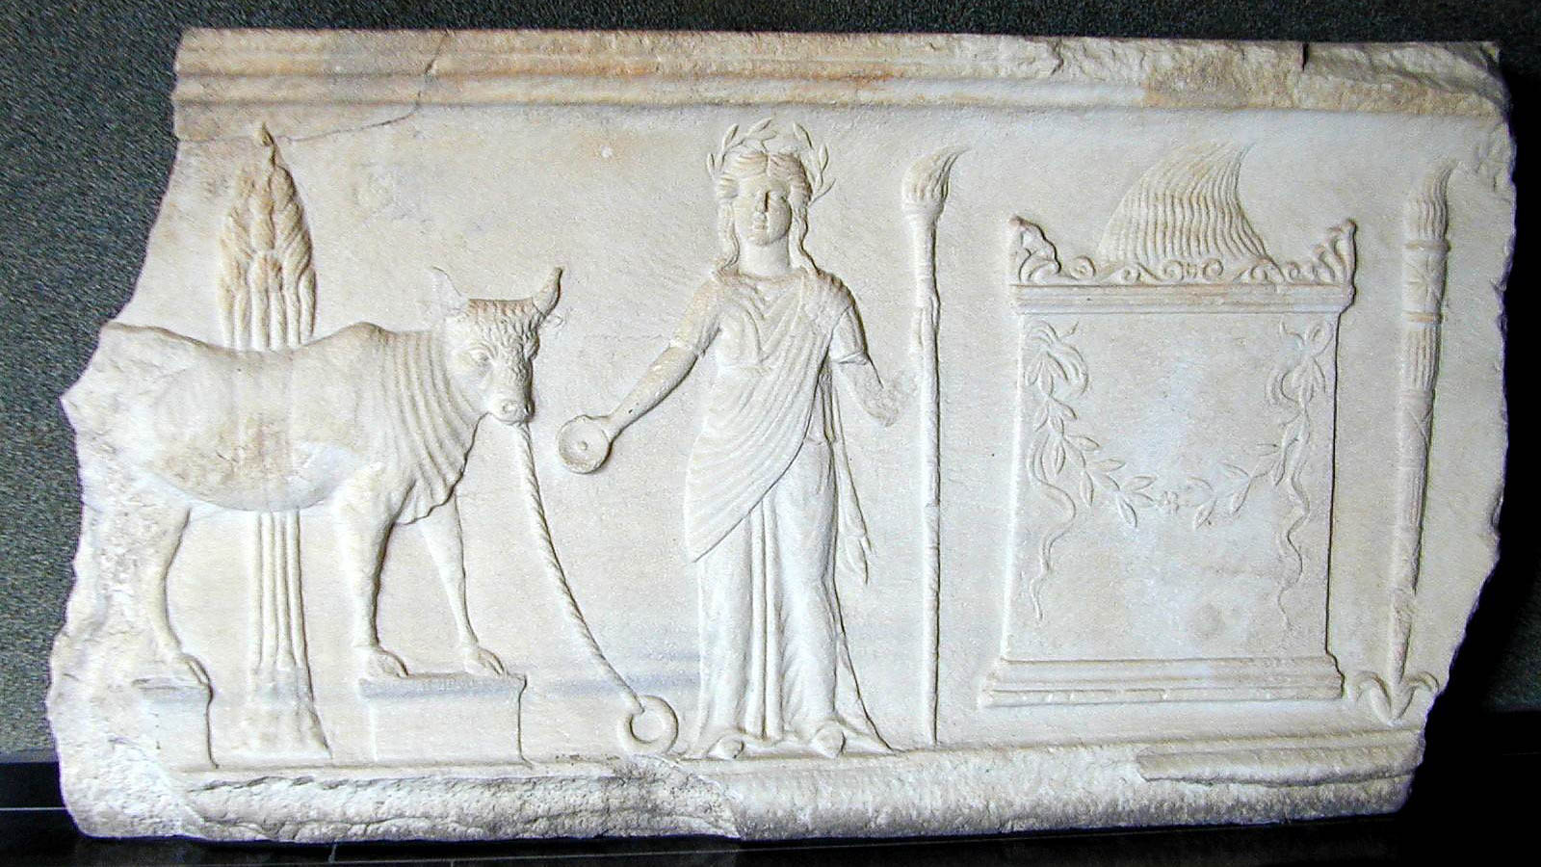
I appeal to you . . . to present your bodies as a living sacrifice, holy, acceptable to God
Relief of a bull about to be sacrificed, from Pergamum, circa 1st century AD
12:1
Notes:
A sacrifice was normally something offered up to the deity. Although the word could be used figuratively (e.g., Heb 13:16), its primary literal meaning was something offered up on an altar (e.g., Luke 13:1). Thus to speak of a “living sacrifice” was somewhat unusual. It highlights the fact that death is no longer required to cover sin, since Christ paid the price for sin once for all (Rom 6:10). Paul’s Roman audience would have been extremely familiar with the practice of sacrifice from a pagan perspective. This relief comes from the Terrace of Demeter in Pergamum. The woman is Demeter, the Greek goddess of agriculture, with the torch and wreath as her symbols. Although the temple of Demeter at Pergamum was constructed as early as the 4th century BC, it was refurbished numerous times. The relief scene shown here likely dates to the early Roman period and was photographed in the Bergama Museum (biblical Pergamum) in Turkey.
rs032002108h

Slide 4
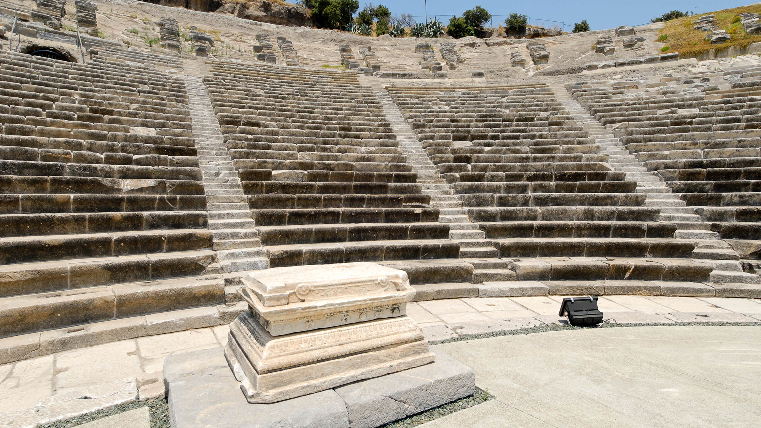
I appeal to you . . . to present your bodies as a living sacrifice, holy, acceptable to God
Altar at the theater at Halicarnassus, 4th century BC
12:1
Notes:
In front of the first row of seats in the Halicarnassus theater is a rectangular altar to Dionysios, the Greek god of wine and merrymaking. A visit to the theater was intrinsically related to pagan worship, and sacrifices were offered here before each performance.
tb062106060h

Slide 5
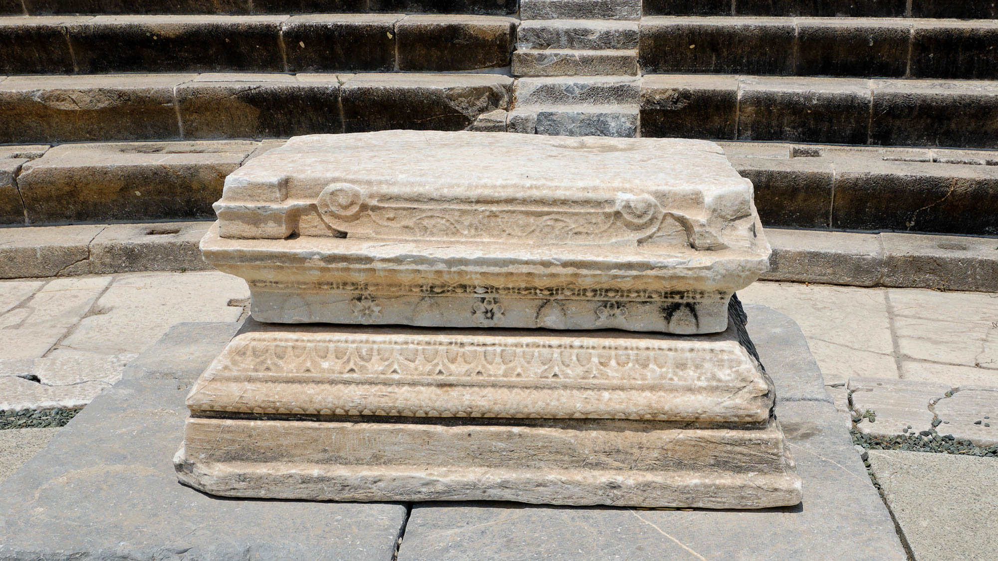
I appeal to you . . . to present your bodies as a living sacrifice, holy, acceptable to God
Altar at the theater at Halicarnassus, 4th century BC
12:1
Notes:
tb062106059h

Slide 6
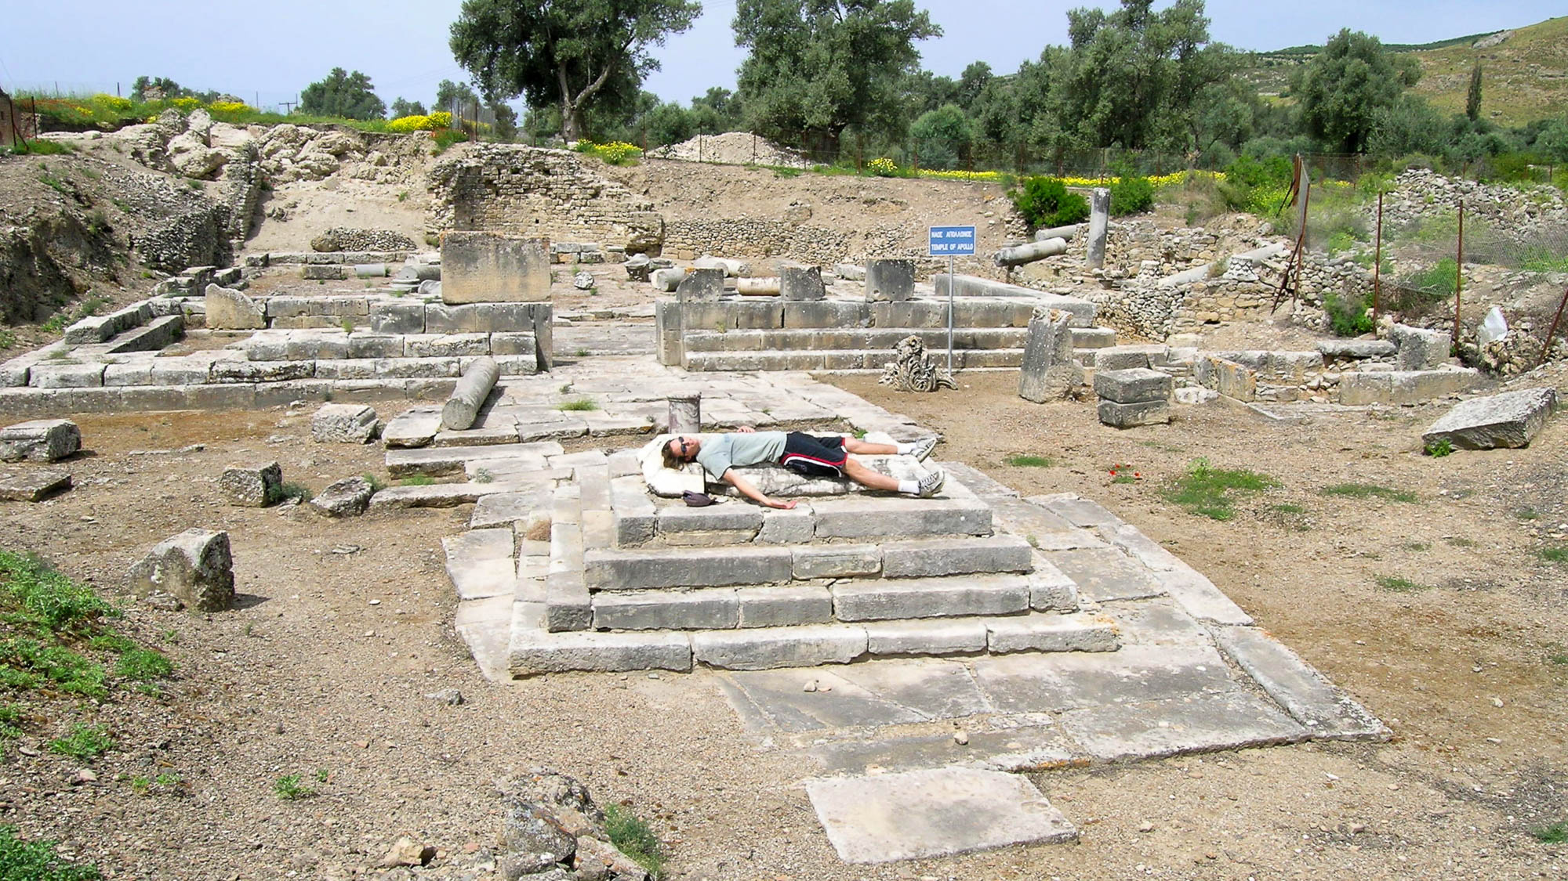
I appeal to you . . . to present your bodies as a living sacrifice, holy, acceptable to God
Sacrificial altar at the temple of Apollo in Gortyn, Crete, circa 1st century AD
12:1
Notes:
Altars were commonly located in front of pagan temples, as with this altar at the temple of Apollo in Gortyn. This allowed those who brought offerings to the god to observe the offering of the sacrifice. The earliest temple at this site on Crete was built in the 7th century BC. It is thought that the stone altar seen here was built as part of a reconstruction effort in the early Roman period, likely during the 1st century BC or the 1st century AD.
tb041204637h

Slide 7
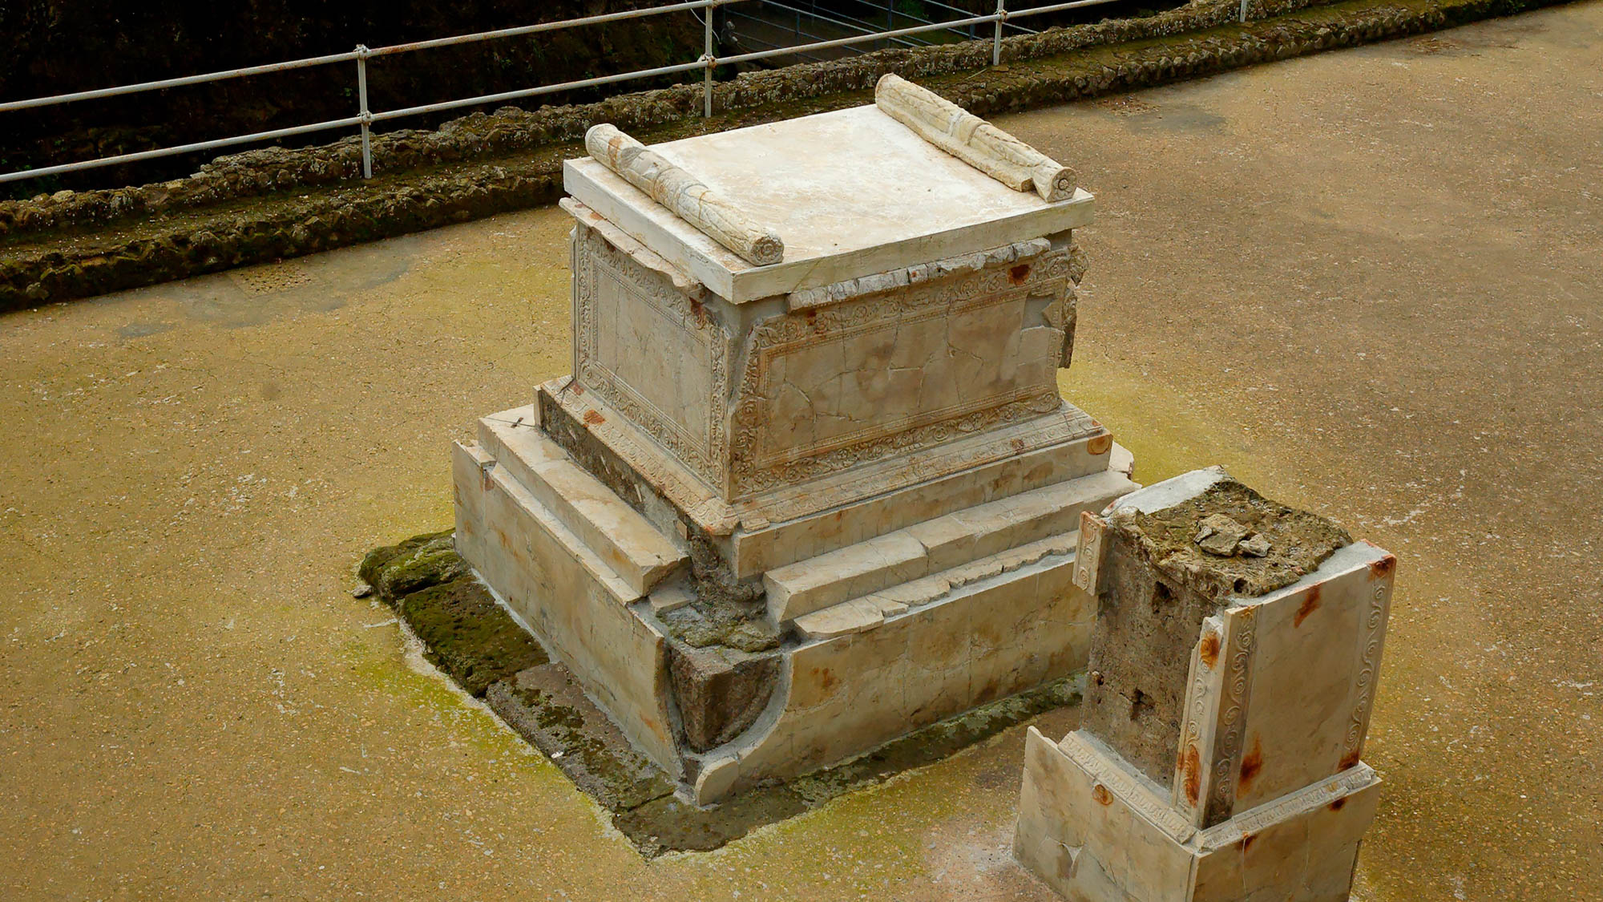
I appeal to you . . . to present your bodies as a living sacrifice, holy, acceptable to God
Altar from Herculaneum, 1st century AD
12:1
Notes:
This altar from Herculaneum was located near the city’s bath complex. It was buried, along with the rest of the city, in the volcanic eruption of Mount Vesuvius in AD 79.
tb11140h5823

Slide 8
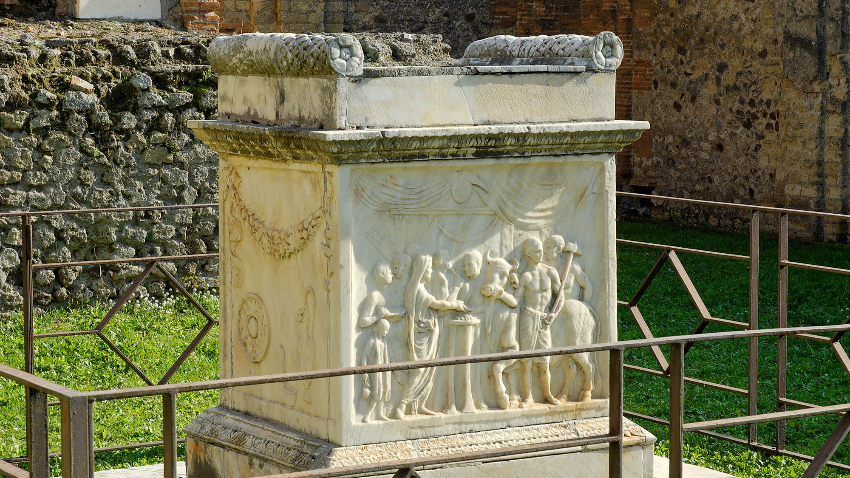
I appeal to you . . . to present your bodies as a living sacrifice, holy, acceptable to God
Altar from the Temple of Vespasian, Pompeii, 1st century AD
12:1
Notes:
This altar from Pompeii was part of the Temple of Vespasian. This altar actually pictures what took place there. A priest with a long veil performs a ceremonial offering on a tripod, aided by his assistants. Behind him are two lictors and a flute player. On the right side the executioner, carrying an axe, leads the bull to the sacrifice. This altar was buried, along with the rest of the city, in the volcanic eruption of Mount Vesuvius in AD 79.
tb111505100h

Slide 9
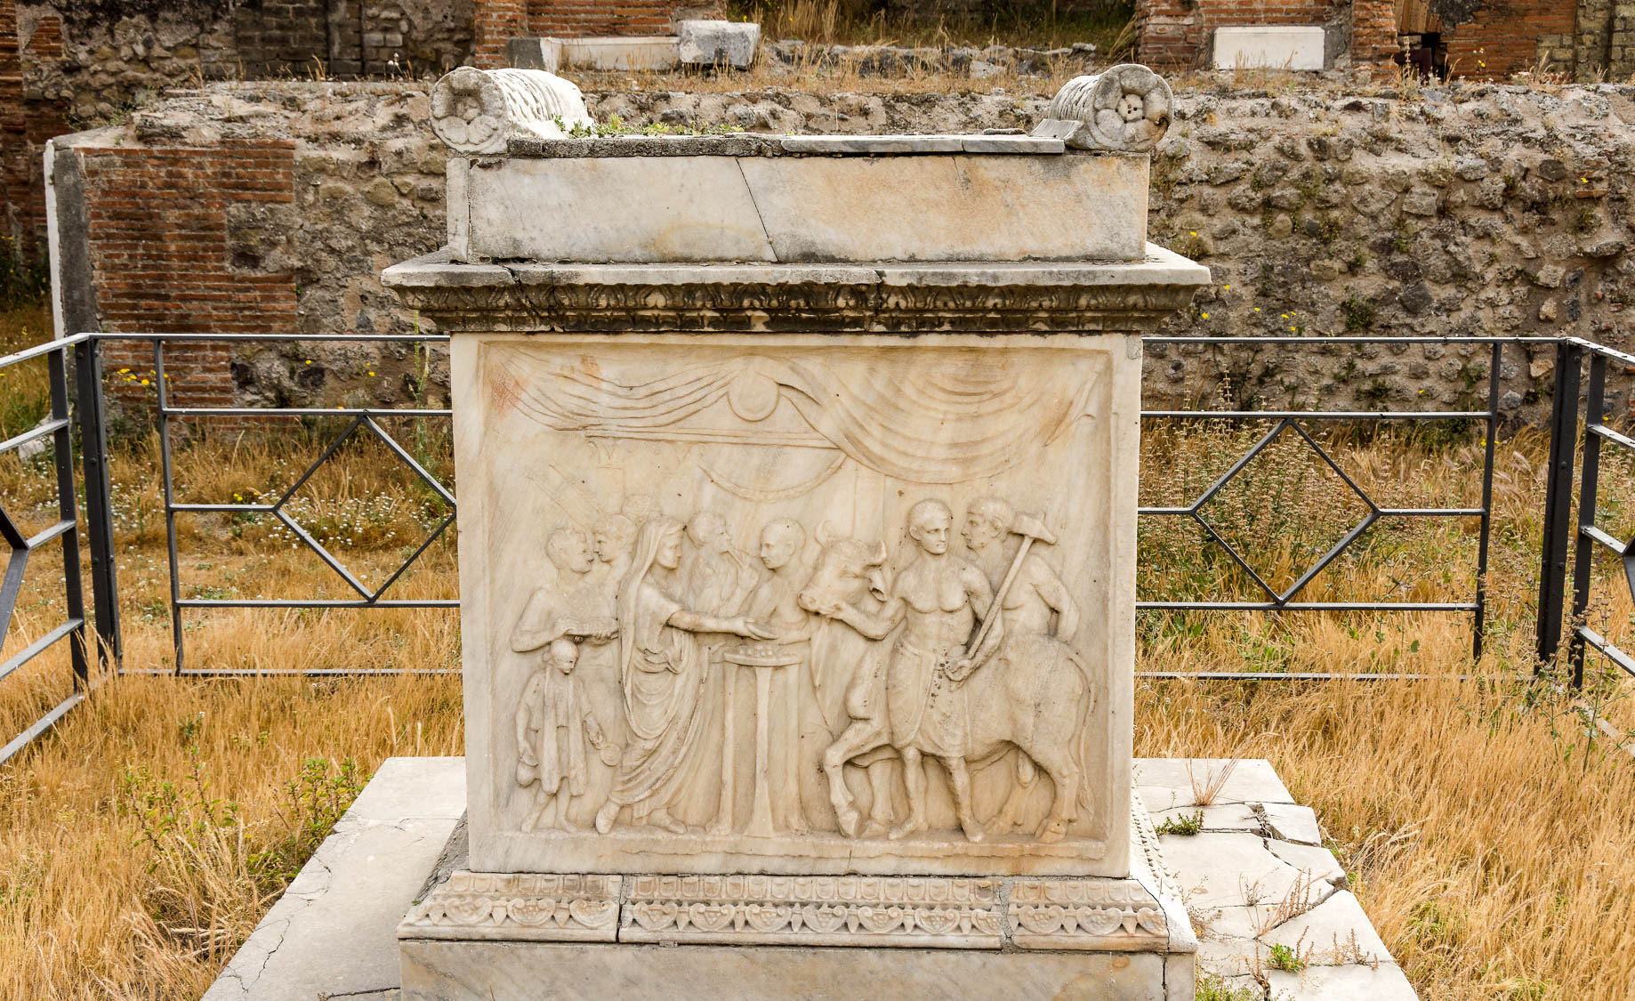
I appeal to you . . . to present your bodies as a living sacrifice, holy, acceptable to God
Altar from the Temple of Vespasian, Pompeii, 1st century AD
12:1
Notes:
The relief on this altar pictures what took place there: a priest with a long veil performs a ceremonial offering on a tripod, aided by his assistants. Behind him are two lictors and a flute player. On the right side the executioner, carrying an axe, leads the bull to the sacrifice.
tb0516171608h

Slide 10
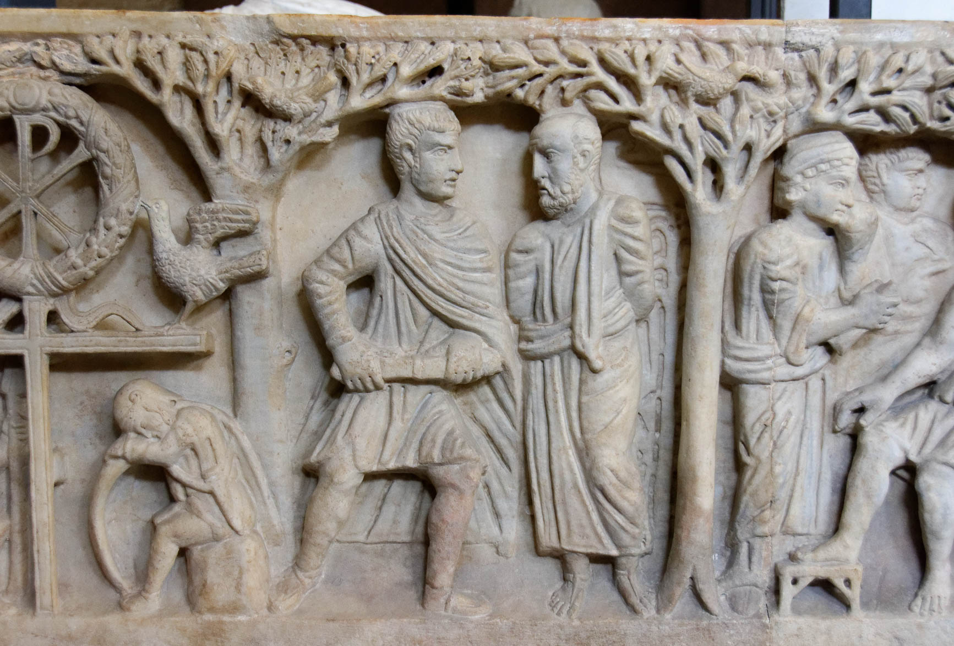
This is your spiritual service of worship
Martyrdom of Paul, from the hypogeum under St Paul Outside the Walls, 4th century AD
12:1
Notes:
The word translated here as “spiritual” is the Greek word logikos (λογικός). There is disagreement whether the word should be understood as referring to the mental or spiritual realm (i.e., “reasonable” or “spiritual” service). Greek lexicons usually associate the word with something that is genuine or true, but also with something metaphorical rather than literal. This fits with Paul’s teaching that the old system of blood sacrifice is no longer necessary or useful since it has been superseded by Christ’s ultimate sacrifice (Rom 6:10, cf. Heb 9:11-12). Paul’s endurance to the point of martyrdom, depicted on this sarcophagus, is an illustration of such “spiritual service of worship.” This is the so-called “tree sarcophagus.” It was photographed at the Vatican Museums.
tb0512175605

Slide 11
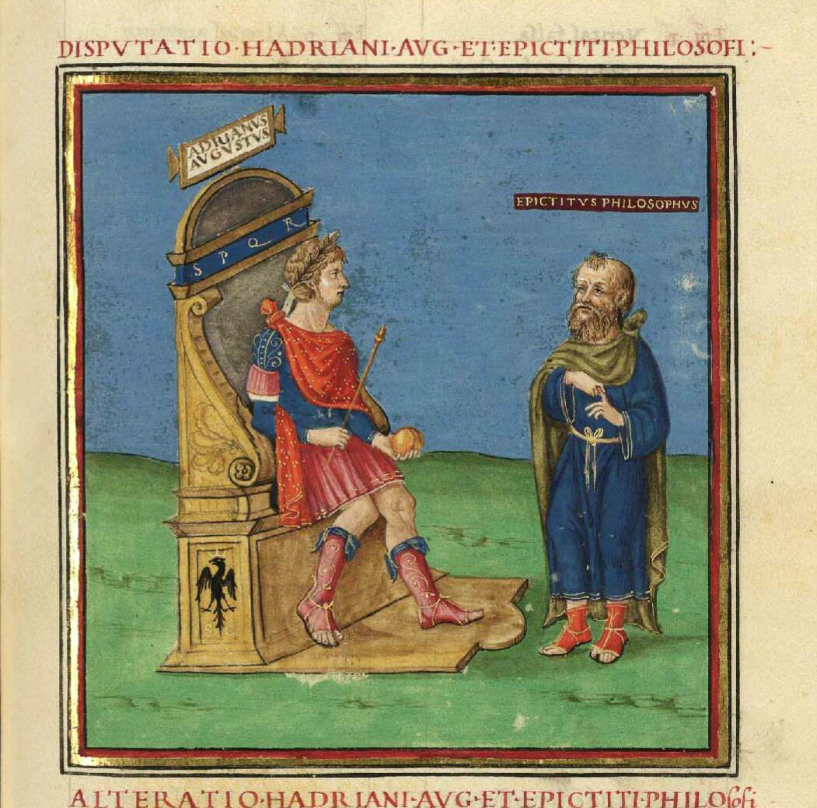
This is your spiritual service of worship
Epictetus disputing with Hadrian, from a 15th century AD manuscript
12:1
Notes:
The word translated “spiritual” (Gk. logikos, λογικός) is frequently used by Greco-Roman philosophers in the sense of “reasonable.” Many have noted the statement of Epictetus: “Were I a nightingale, I would act the part of a nightingale; were I a swan, the part of a swan; but since I am a reasonable creature [λογικός], it is my duty to praise God. This is my business; I do it; nor will I ever desert this post, so long as it is permitted me; and I call on you to join in the same song” (Epict., Disc. 1.16). The artwork shown in this photo is from a manuscript of the Biblioteca Nacional in Madrid. This image comes from Wikimedia Commons and is in the public domain, via Wikimedia Commons: https://commons.wikimedia.org/wiki/File:MS._Descriptio_orbis_terrarum_fols._79r_-_Biblioteca_Nacional_de_Espa%C3%B1a_-_Disputatio_Hadriani_Augusti_et_Epicteti_philosophi.jpg.
Reference:
Epictetus.
1890 The Works of Epictetus: His Discourses, in Four Books, the Enchiridion, and Fragments, ed. Thomas Wentworth Higginson. Medford, MA: Thomas Nelson and Sons.
wiki120420181501494h

Slide 12
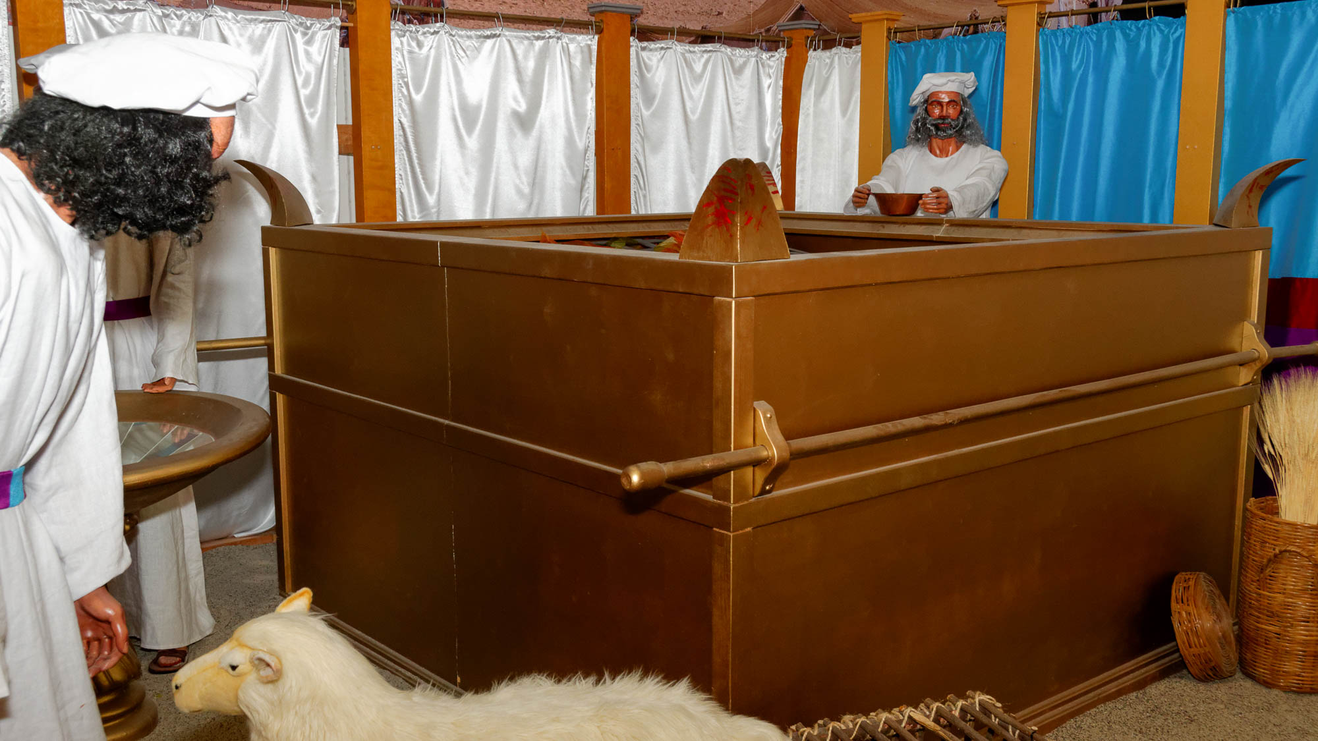
This is your spiritual service of worship
Model of altar of burnt offering at the tabernacle
12:1
Notes:
The word translated “service” (Gk. latreia , λατρεία) is used in the Greek version of the Old Testament to refer to the service in the sanctuary (e.g., 1 Chr 28:13; cf. Rom 9:4). The model above is on display at the Creation and Earth History Museum in Santee, California.
tb040816563

Slide 13
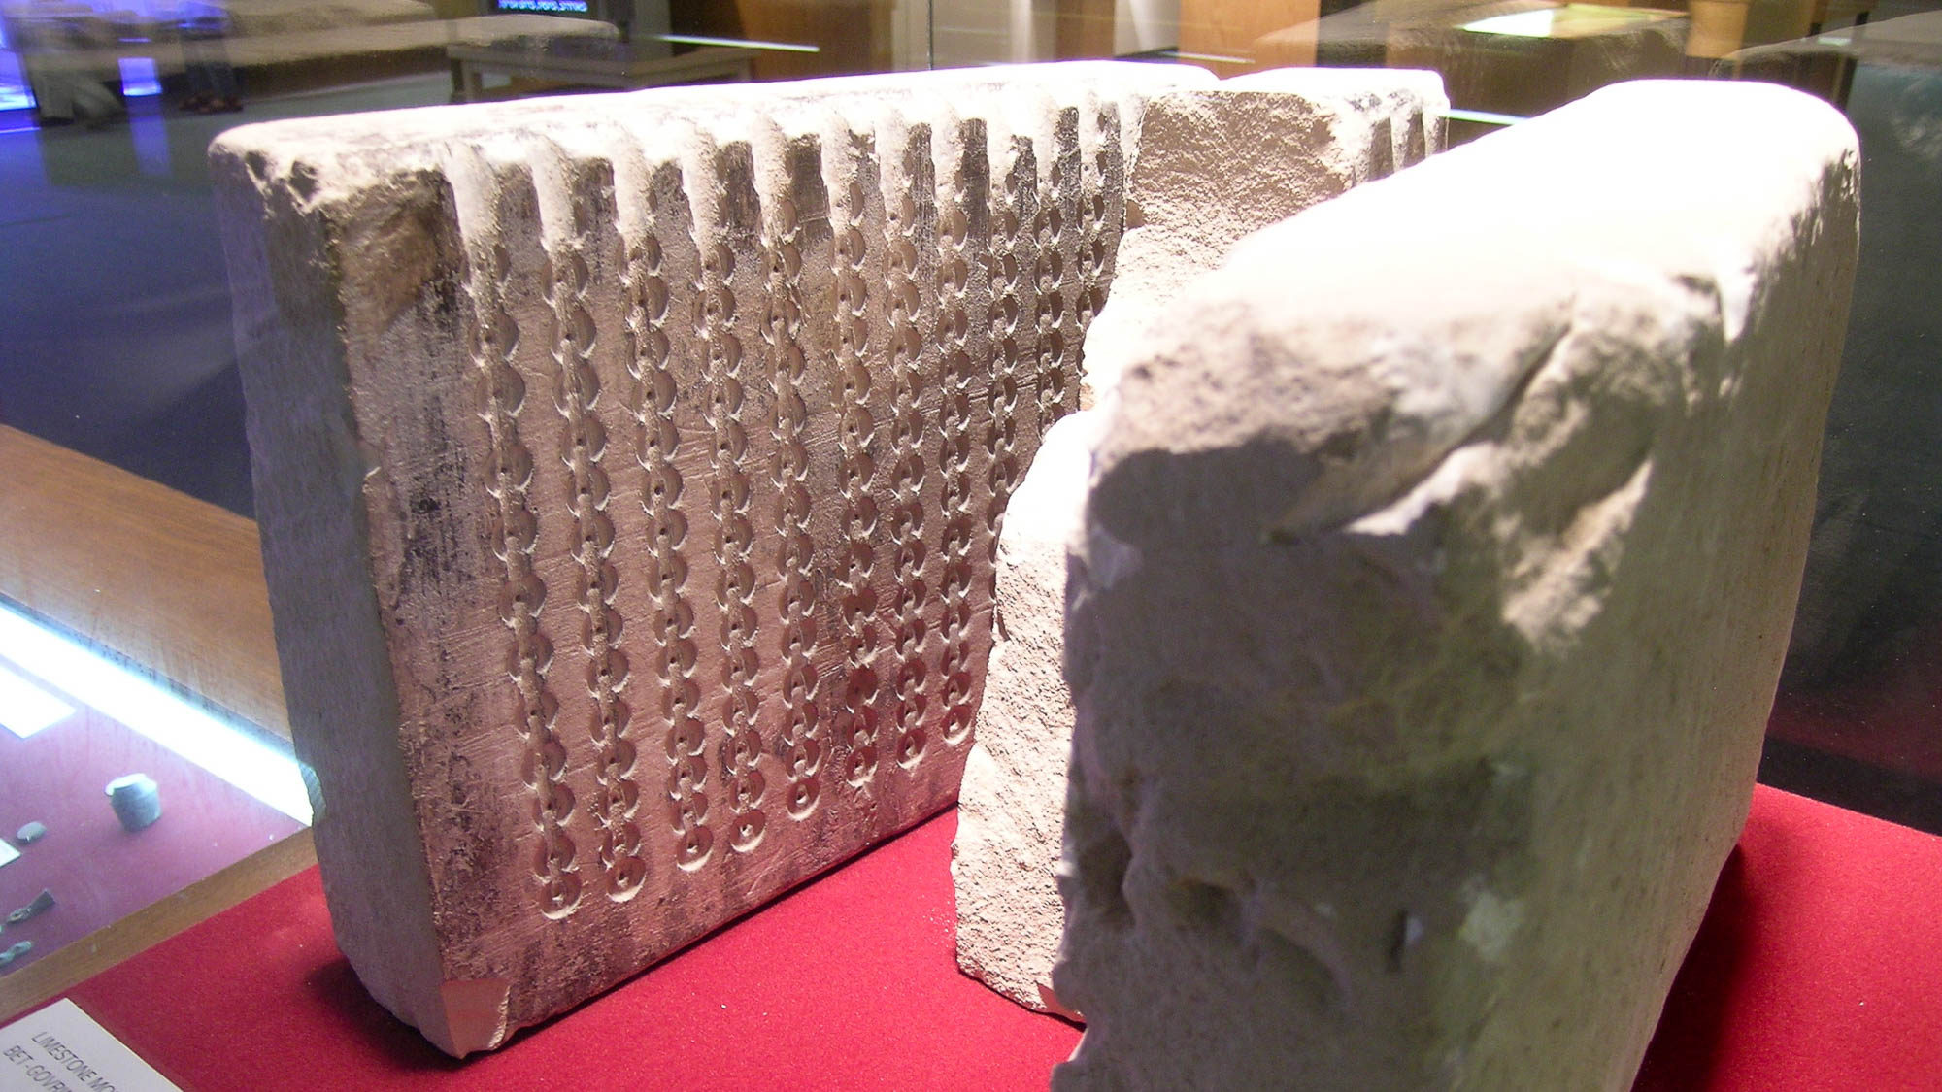
And do not be conformed to this world
Limestone mold for making coin blanks, from Bet Guvrin, 2nd–1st centuries BC
12:2
Notes:
To be “conformed” (Gk. suschēmatizō, συσχηματίζω) means to be formed according to a pattern or a mold. Molds had been used since at least the second millennium for casting items of metal as well as of clay. The Greeks and Romans continued to use molds for a wide variety of items. This stone block was used as a mold for creating coin blanks. This mold was photographed at the Eretz Israel Museum in Tel Aviv.
tb061804600h

Slide 14
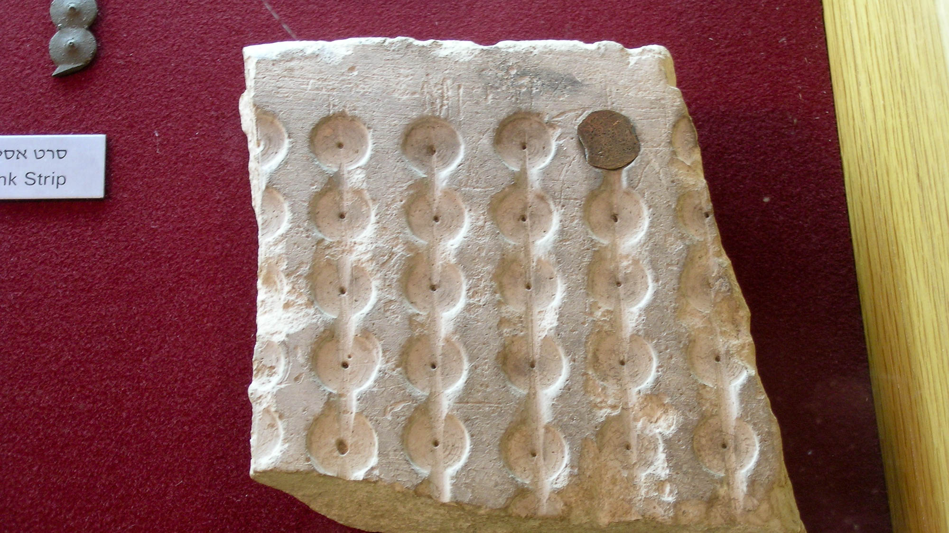
And do not be conformed to this world
Limestone mold for coin blanks, and a strip of coin blanks, 2nd–1st centuries BC
12:2
Notes:
This display includes a broken portion of a mold used for making coin blanks. A blank has been placed in the upper right depression to show how it would have been used. A strip of still-joined blanks is visible in the upper left corner of the photo. Such blanks would be cut apart and then stamped with the appropriate images using a set of dies. This mold was photographed at the Eretz Israel Museum in Tel Aviv.
tb061804602h

Slide 15
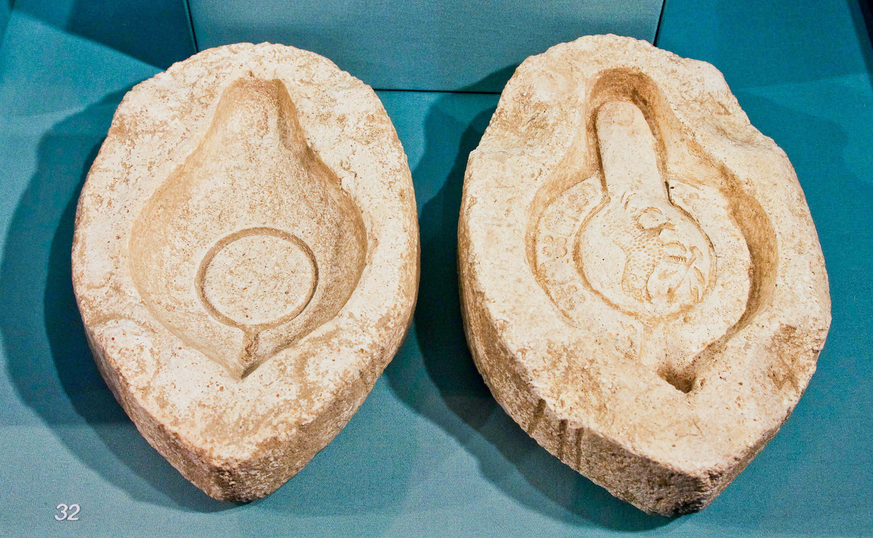
And do not be conformed to this world
Roman lamp mold, limestone, 1st–3rd centuries AD
12:2
Notes:
Molds were used by both the Greeks and Romans to make closed lamps of clay. The upper and lower molds in this photo are made of limestone. Clay would be pressed into each half and then the halves would be pressed together, creating the hollow lamp. The decoration that would have graced the upper half of the lamp is visible in the mold on the right side. These molds were photographed at the Michael C. Carlos Museum at Emory University.
adr1511209403h

Slide 16
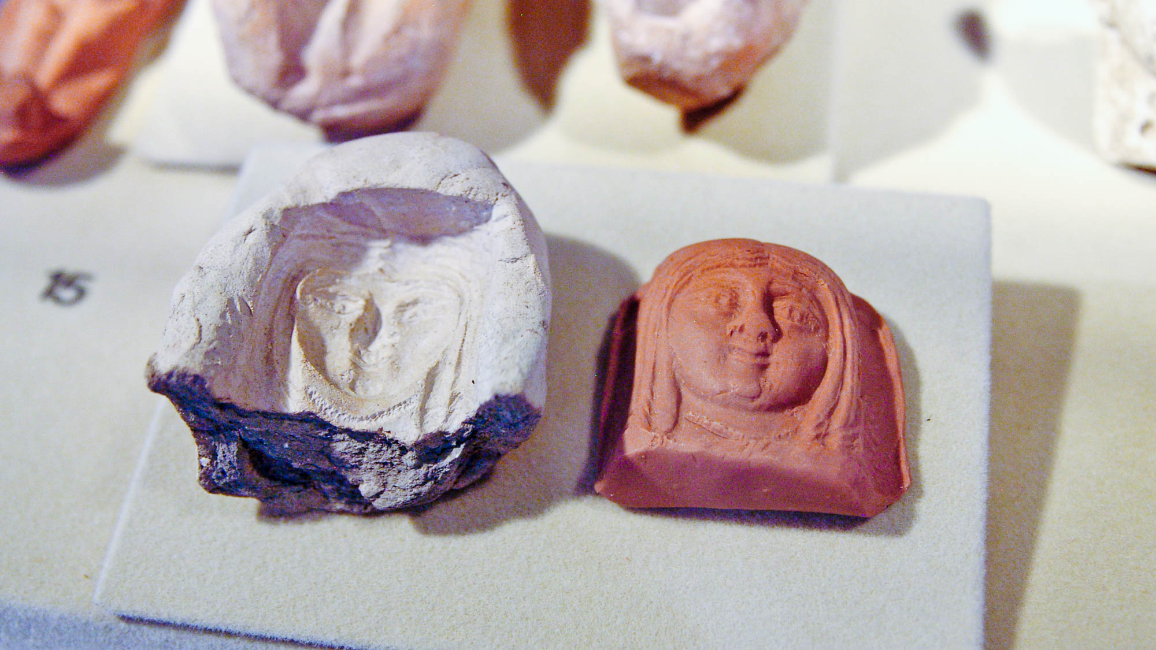
And do not be conformed to this world
Mold for figurine head from Beit Natif, 3rd–4th centuries AD
12:2
Notes:
This clay mold was intended to be used to produce a clay figurine. The molded item came out looking like the mold into which it had been pressed, of course, which is the point Paul intends to make. He urges Christians not to be molded according to the pattern of the world, not to take on its shape and form. This mold and its product were photographed at the Eretz Israel Museum in Tel Aviv.
adr080710386h

Slide 17
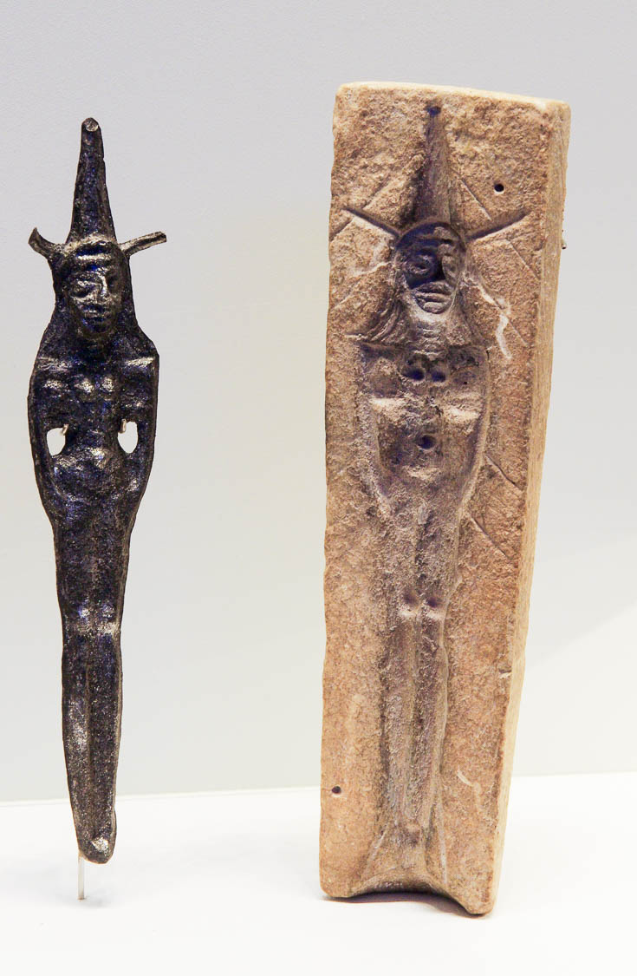
And do not be conformed to this world
Stone mold and modern cast of a goddess figurine, from Nahariya, 19th–17th centuries BC
12:2
Notes:
The use of molds for making figurines (usually associated with gods or goddesses) has a very long history. This figurine may be the Canaanite goddess Asherah, although the identity is not certain. This mold and modern cast were photographed at the Israel Museum.
adr1306212285h

Slide 18
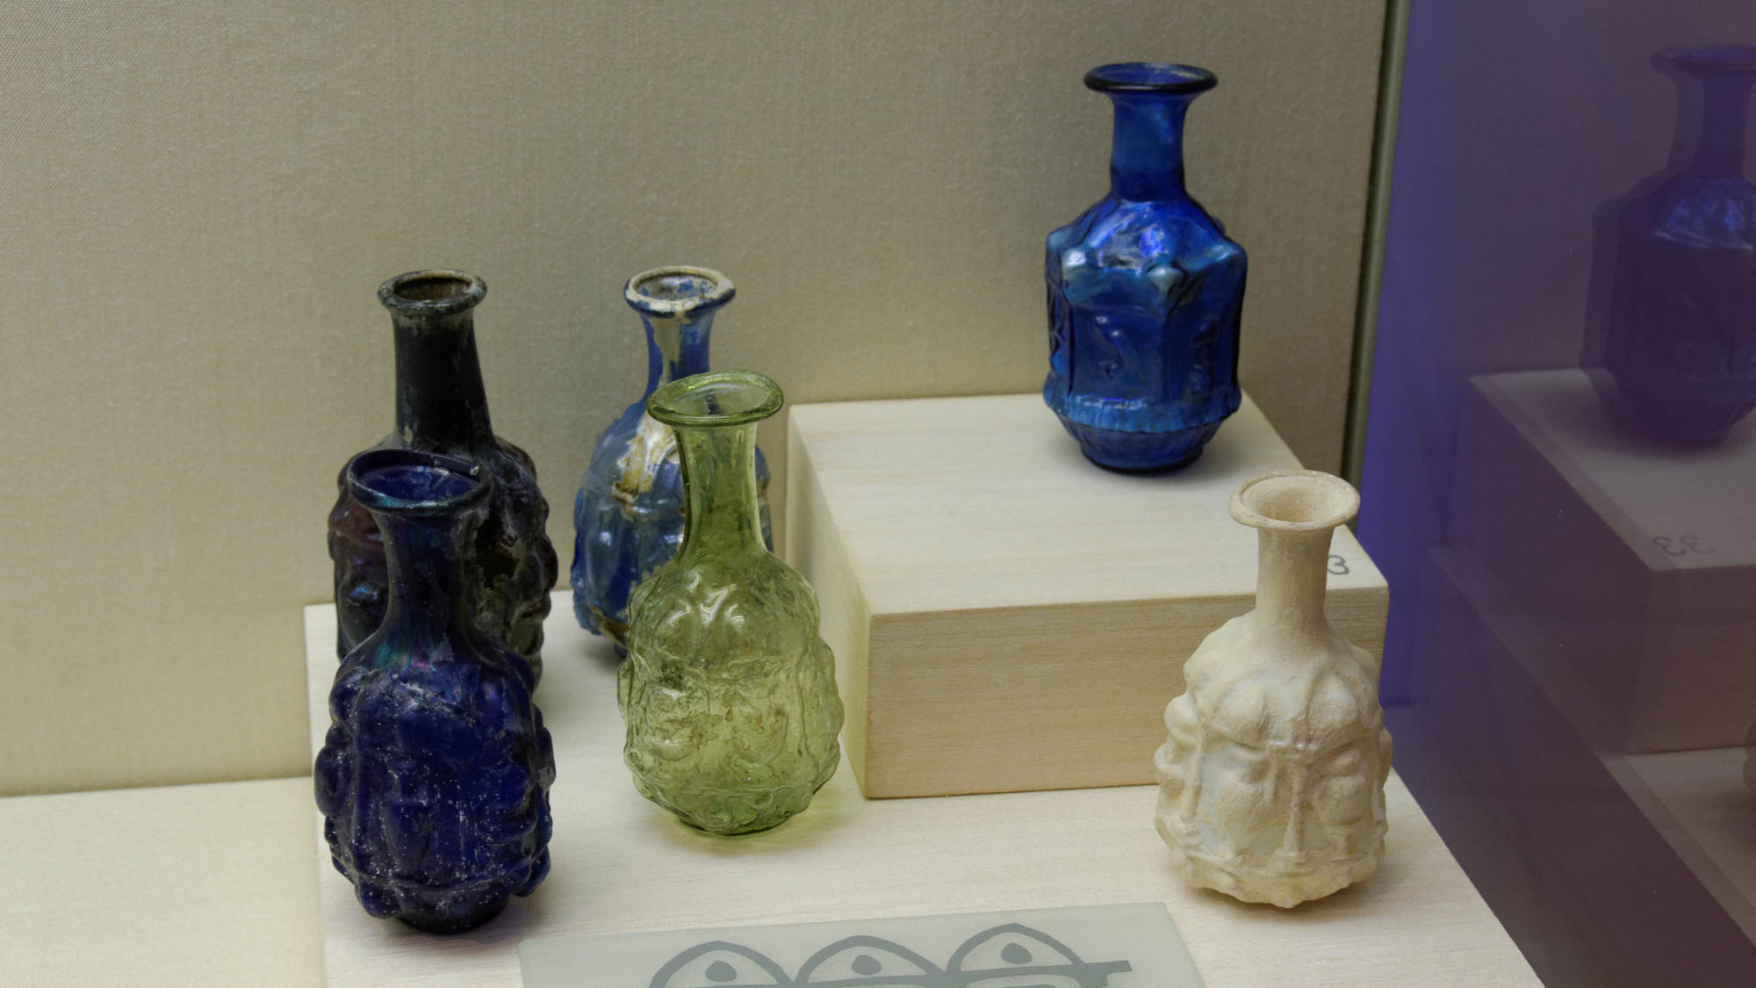
And do not be conformed to this world
Mold-blown glass vessels, Sidonian, 1st century AD
12:2
Notes:
These beautiful glass vessels were made from molds as well. The molten glass was placed on the end of a blow tube, which was then inserted into the mold. Air pressure blown down the tube expanded the glass and pressed it against the sides of the mold, creating a sculpted piece of glass. Glassblowing was invented in the 1st century BC somewhere in the area of Lebanon or Israel, so the early pieces shown here date to within about a century of the birth of this art form. This display was photographed at the Eretz Israel Museum in Tel Aviv.
tb031114553h

Slide 19
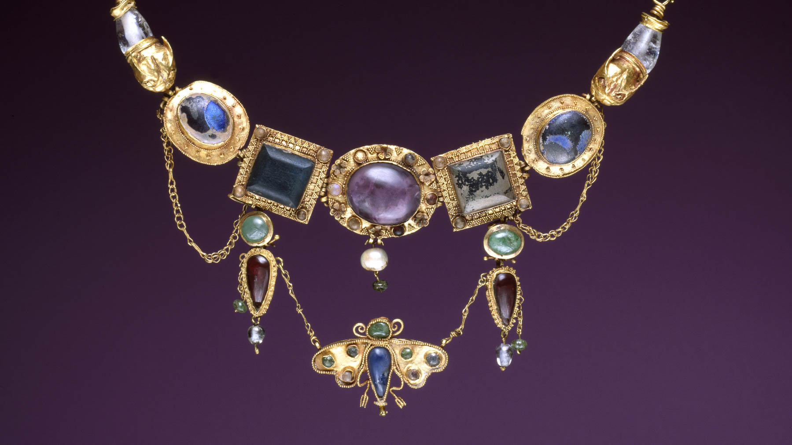
But be transformed
Necklace with butterfly pendant, 2nd–1st centuries BC
12:2
Notes:
The word “transformed” (Gk. metamorphoō, μεταμορφόω) refers to a fundamental change in character or condition. This Greek word has been borrowed to describe the transformation of a pupa into a butterfly. Such a transformation, which is easily seen wherever there are butterflies, must have been known to the people of Paul’s day. The necklace shown in this photo is from a century or two before the time of Paul and showcases a butterfly. Discovered in 1891 in a tomb near Olbia, Parutino, Ukraine, this beautiful necklace makes use of gold, amethyst, chalcedony, emerald, rock crystal, pearl, and colored glass. This image comes from the Walters Art Museum in Baltimore and is in the public domain, via Wikimedia Commons: https://commons.wikimedia.org/wiki/File:Greek_-_Necklace_with_Butterfly_Pendant_-_Walters_57386.jpg.
wiki03232012145957386h

Slide 20
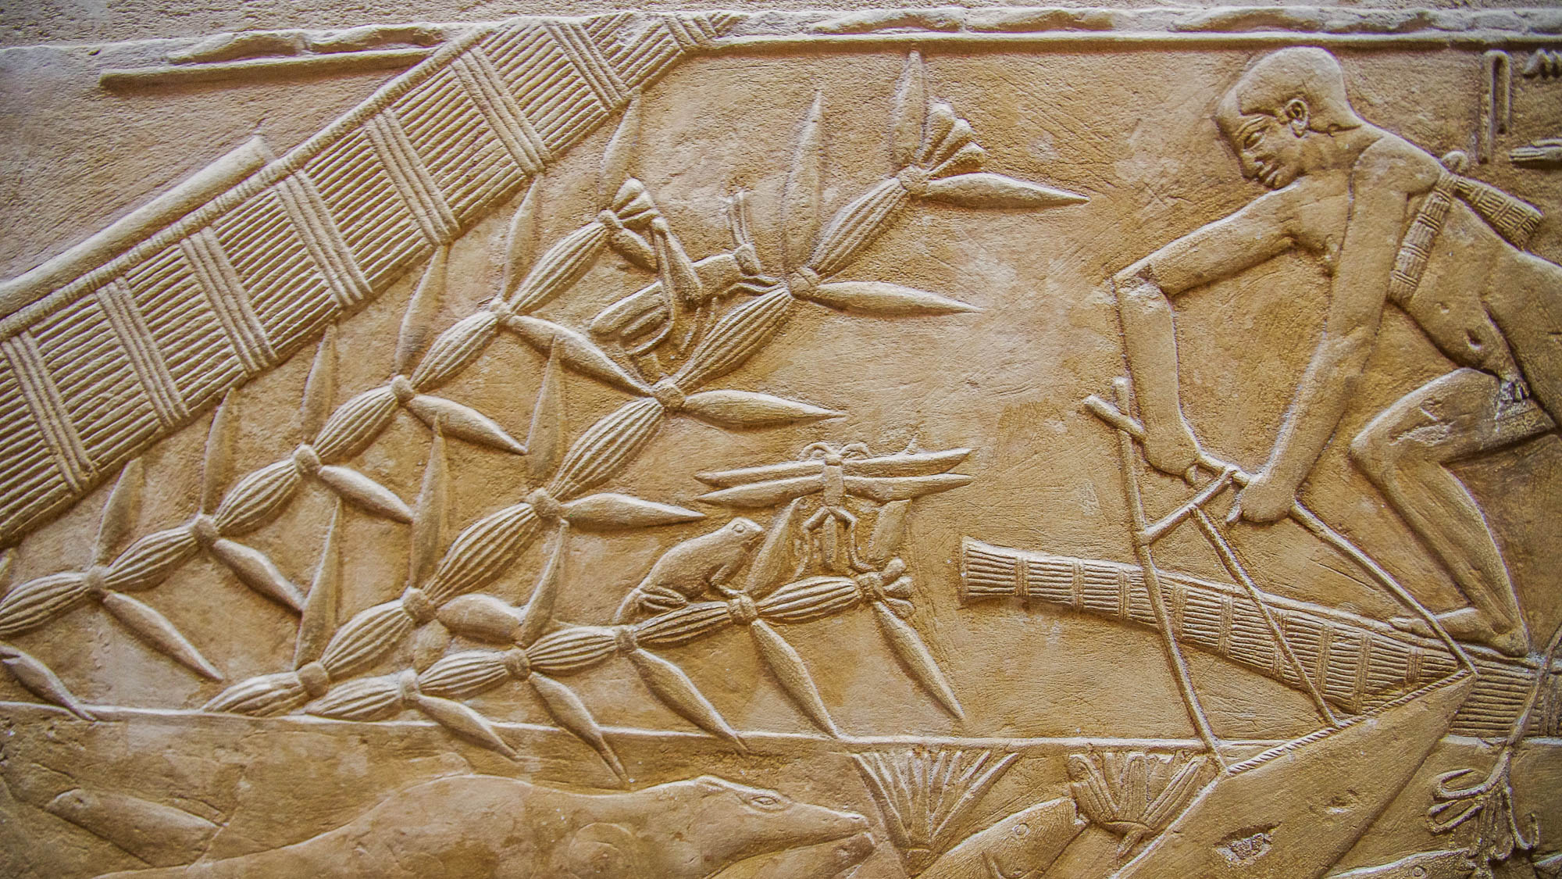
But be transformed
Frog and insects, from the mastaba of the vizier Kagemni at Saqqara, circa 2300 BC
12:2
Notes:
This relief from ancient Egypt shows a man fishing, and it also shows three different creatures that undergo metamorphosis: a frog, a grasshopper, and a dragonfly.
adr1603101205

Slide 21
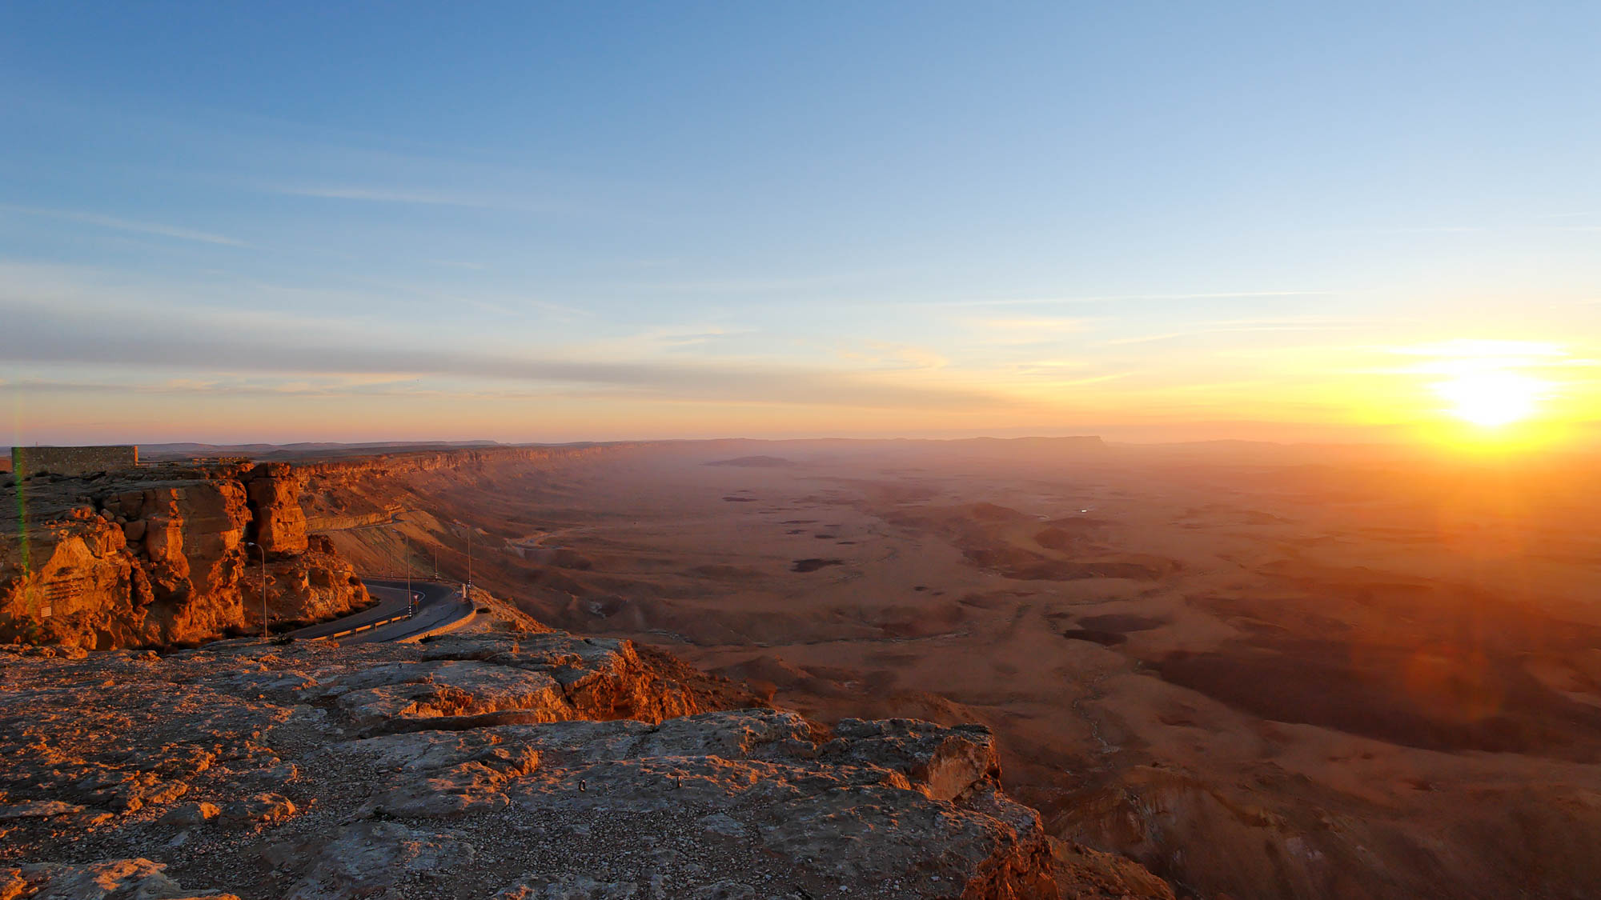
But be transformed by the renewing of your mind
Machtesh Ramon at sunrise
12:2
Notes:
The verb “to renew” (Gk. anakainōsis, ἀνακαίνωσις) is one that is not found outside of Christian literature. It carries the idea of making something new again. Perhaps Paul had in mind the words of Jeremiah when he spoke of the daily renewal of God’s compassion toward His people. “It is of Jehovah's lovingkindnesses that we are not consumed, because his compassions fail not. They are new every morning; great is thy faithfulness” (Lam 3:22-23, ASV). Many places are most beautiful in the early morning light, at the dawning of a new day. This photo is from the northern rim of Machtesh Ramon in southern Israel, looking east toward the rising sun.
tb030707933

Slide 22
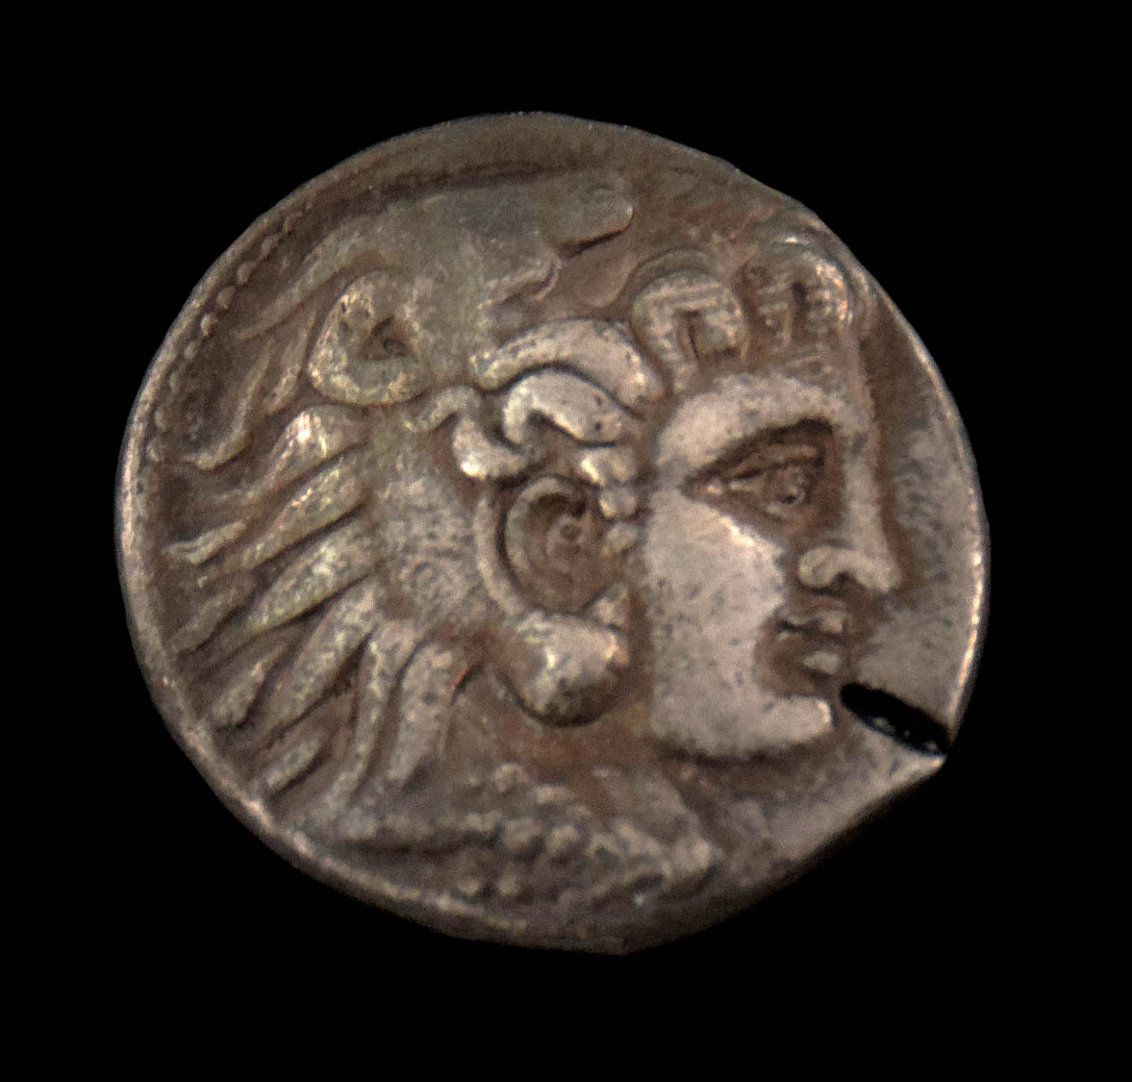
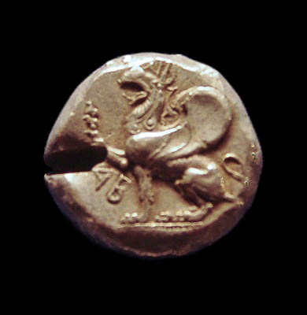
That you may test and approve what is the will of God
Silver coins with punch marks for testing authenticity, circa 500–200 BC
12:2
Notes:
The word here translated “test and approve” (Gk. dokimazō, δοκιμάζω) bears the idea of accepting the result of the examination of a thing. Sometimes in antiquity the genuineness of a coin would be tested by striking it with a punch. This cut into the coin would reveal if it was made of solid precious metal or was simply plated with the precious metal. Both coins shown here bear marks of having been so tested.
The silver coin on the left depicts Alexander the Great and was discovered in Susa. It dates to the Seleucid period, circa 200 BC, and was photographed in the National Museum of Iran. The coin on the right is from Abdera, Thrace, and depicts a griffin. It dates to 500–480 BC and was photographed in the Ashmolean Museum at the University of Oxford.
Left: tb0514184427b; right: adr1305249806b

Slide 23
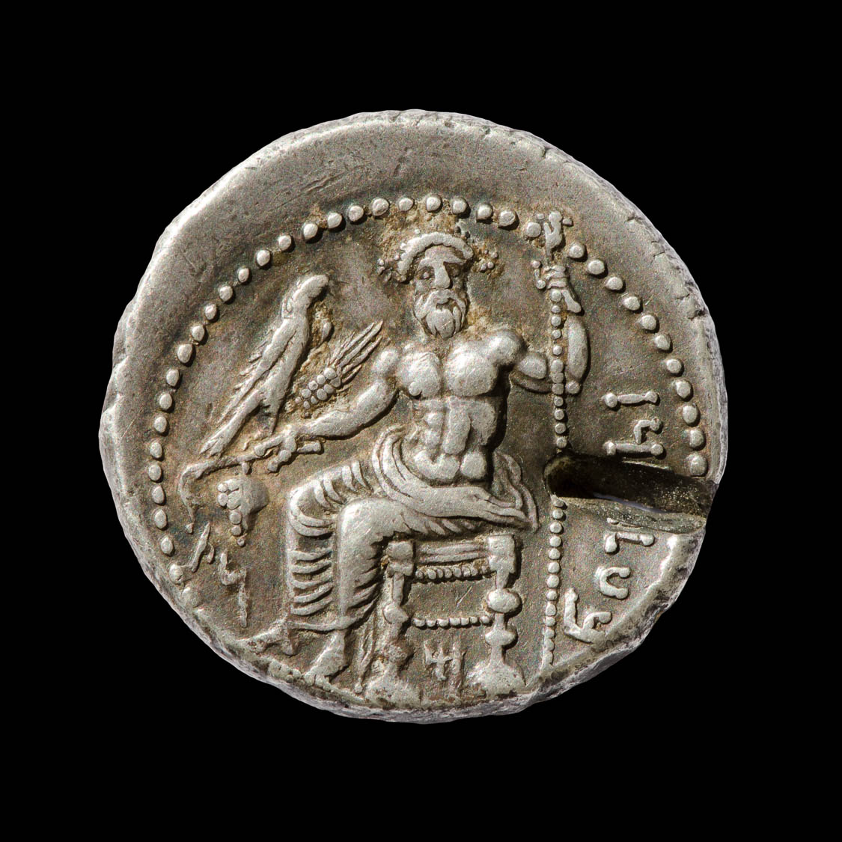
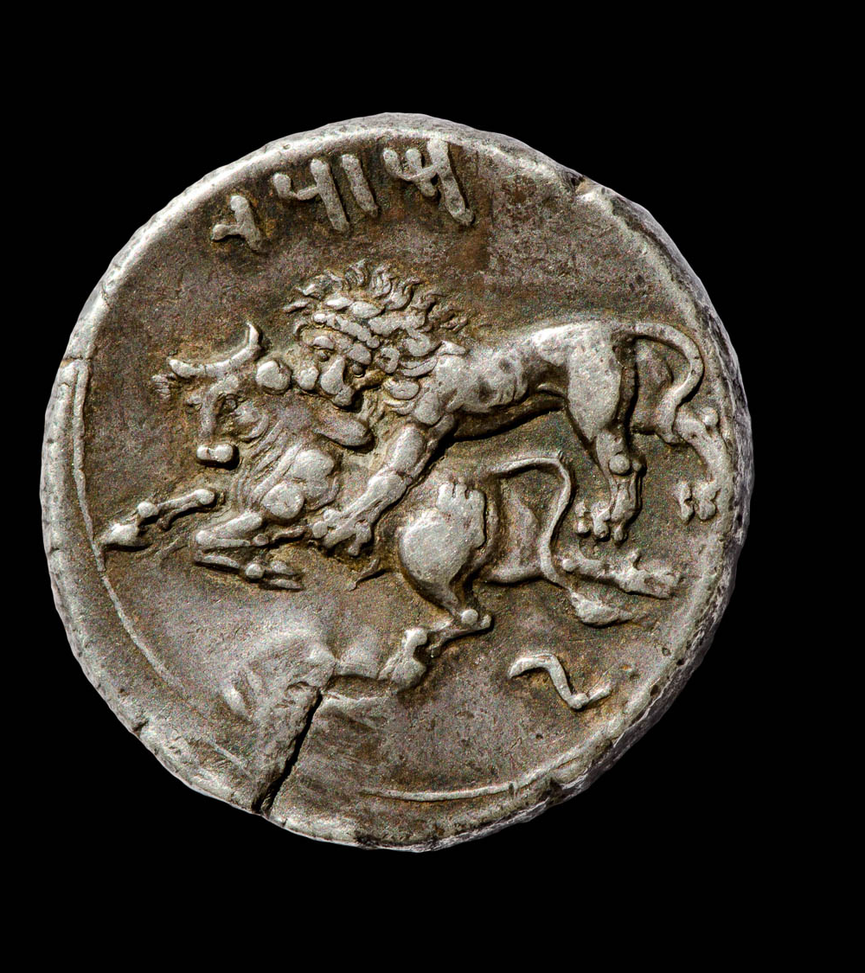
That you may test and approve what is the will of God
Silver stater with punch mark, minted in Tarsus, 361–334 BC
12:2
Notes:
Like the coins on the previous slide, this one shows a punch mark from having been tested for authenticity. The mark on the back side reveals that the punch was struck against a hard surface, enough to reveal the inside of the coin without ruining the coin. This coin from Tarsus dates to the period when it was under Persian rule. The obverse contains the Aramaic inscription “Baal of Tarsus” (בעל תרז) and depicts Baal holding grapes, an ear of grain, an eagle in his right hand, and a scepter in his left hand. Below the throne is the letter “M” (מ), and to the left are the letters “NṢ” (נצ). The reverse depicts a lion attacking a bull and is inscribed “Mazaios” (מזדי), the name of the satrap of Cilicia from 361 to 334 BC. Note that the script used here is the Imperial Aramaic script, which is very similar to an archaic Hebrew or Phoenician script. This coin is in the Jared James Clark Collection.
Obverse (left): tb0713158819b; reverse (right): tb0713158823b.

Slide 24
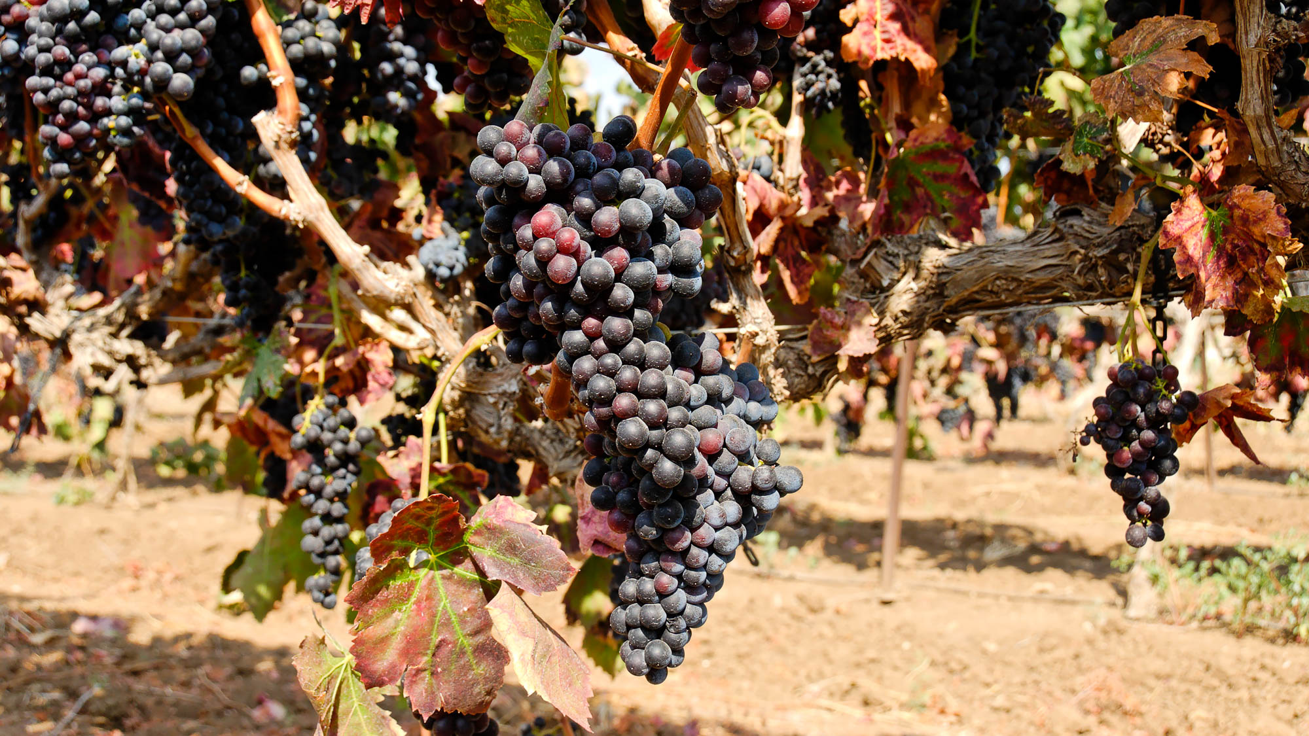
That you may test and approve what is the will of God—what is good, acceptable, and perfect
Grapes on vine and ready for harvest, near Dor
12:2
Notes:
Paul has just used the metaphor of Gentiles being grafted into the root of Jewish faith (Rom 11:17-24). Jesus said that the result of His followers abiding in Him was that they would bear much fruit (John 15:5). Surely Paul has a similar idea in mind here with his reference to doing what is good, acceptable, and perfect (cf. Gal 5:22-23).
tb090506904h

Slide 25

That you may test and approve what is the will of God—what is good, acceptable, and perfect
Pomegranate flowers near Caesarea Philippi
12:2
Notes:
The idea of God’s will being good, acceptable, and perfect is illustrated here in His creation. The beautiful flowers of the pomegranate tree are not only brightly colored and symmetrical, but eventually grow into a useful and delicious fruit.
tb052504969h

Slide 26
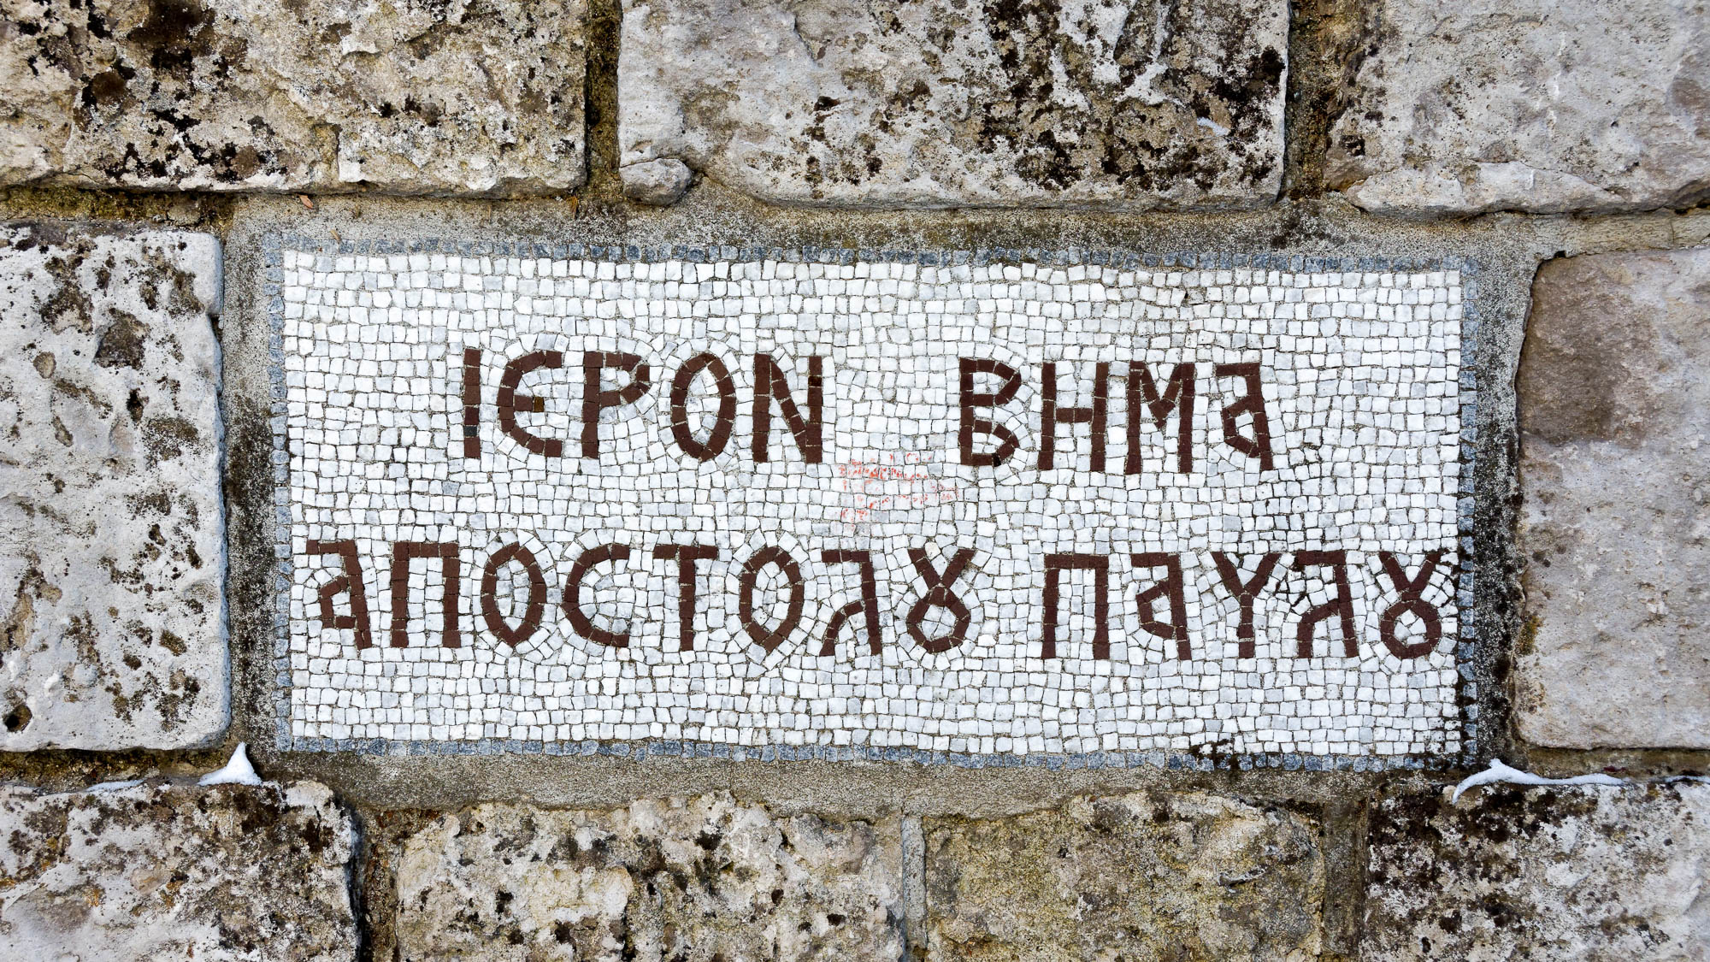
For I say, through the grace that was given me
“Sacred Step of the Apostle Paul” sign in Berea
12:3
Notes:
The “grace” to which Paul refers is his authority as an Apostle (cf. Rom 1:5; 15:15; Eph 3:7). This sign from Berea commemorates one of the places where Paul preached as an apostle. It reads “sacred step of the Apostle Paul” (Gk. hieron bēma apostolou paulou, ιερον βημα αποστολου παυλου).
tb010817400h

Slide 27
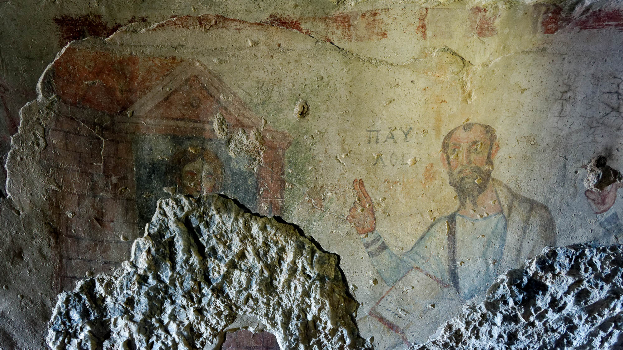
For I say, through the grace that was given me
Painting of Paul from a cave at Ephesus, late 5th or early 6th centuries AD
12:3
Notes:
The Grotto of Paul in Ephesus has been a Christian landmark since the time of the early church. Pictured on one of the walls is a depiction of the Apostle Paul preaching. He is identified with the inscription “Paul” (Gk. PAULOS, ΠΑΥΛΟΣ, the name being split over two lines).
tb010317141h

Slide 28
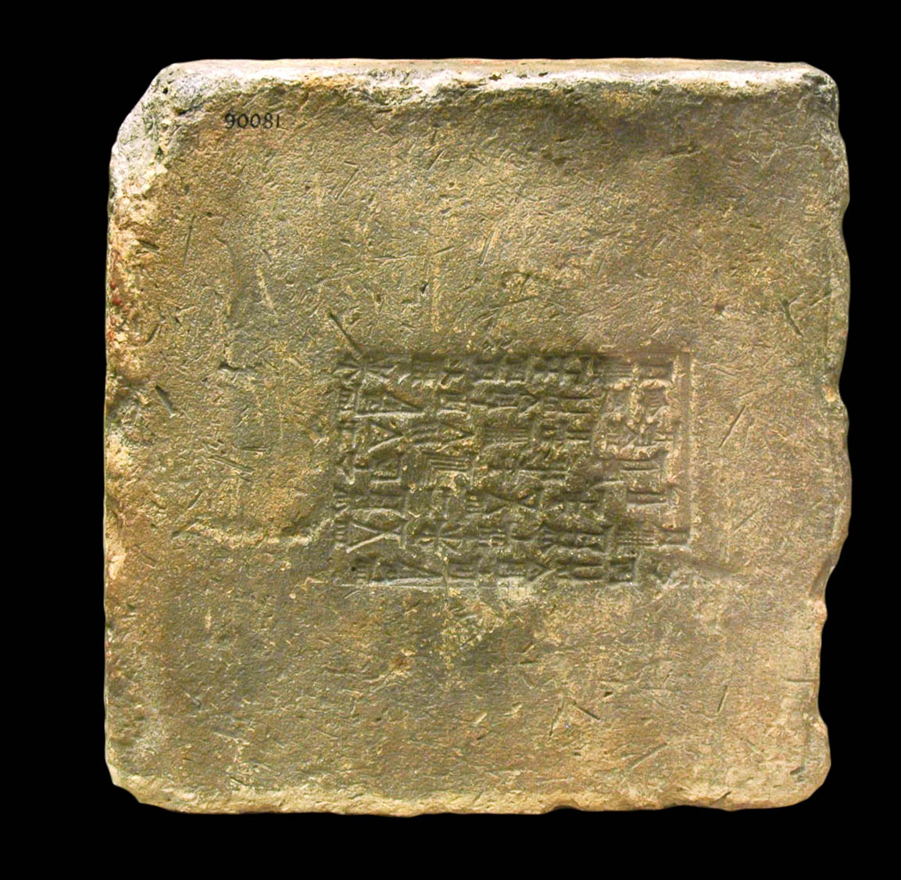
Not to think more highly of himself than he ought to think
Brick of Nebuchadnezzar, from Sippar, 6th century BC
12:3
Notes:
Nebuchadnezzar is an example of someone in the Old Testament who thought more highly of himself than he should have. As a result, God took away his kingdom for a time (Dan 4). This clay brick has been stamped with an inscription naming Nebuchadnezzar. It was photographed at the British Museum.
tb112004111b

Slide 29
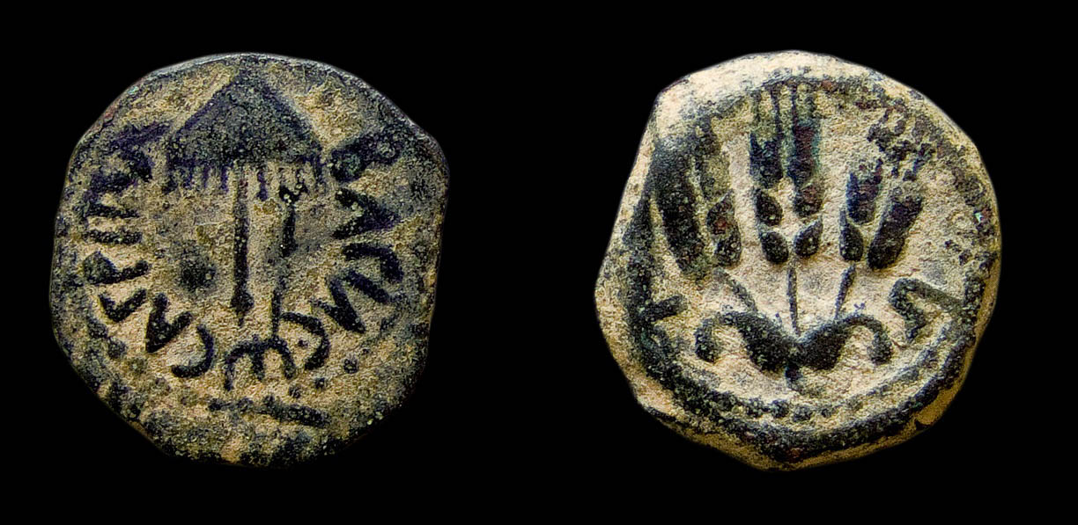
Not to think more highly of himself than he ought to think
Bronze prutah of Agrippa I, minted in Jerusalem, AD 41–42
12:3
Notes:
The coin shown here was minted by Herod Agrippa I. This is the same Herod who accepted the acclaim of the people that he was a god and was struck down by God (Acts 12:21-23). The obverse side of this coin depicts an umbrella-like canopy or sun shade with fringes (a symbol of power) and is inscribed “[a coin] of King Agrippa” (ΒΑΣΙΛΕΩΣ ΑΓΡΙΠΑ). The reverse side depicts three ears of barley, flanked with the date mark L ς (“year 6”). This image comes from the Yale University Art Gallery and is in the public domain. Source: http://artgallery.yale.edu/collections/objects/97234.
yale97234b

Slide 30
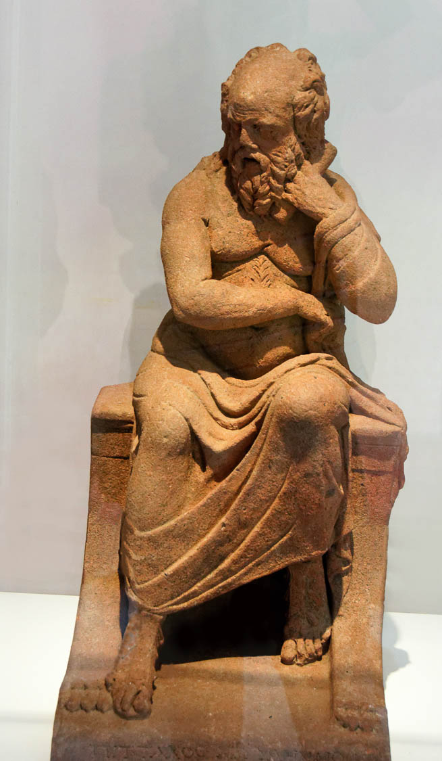
But to think so as to be of a sound mind, as God has dealt to each man a measure of faith
Clay statue of Pittacus of Mitylene, one of the Seven Sages of Greece, circa 1st century AD
12:3
Notes:
The verb “to be of a sound mind” (Gk. sōphroneō, σωφρονέω) means to be reasonable or sensible. This was one of the cardinal virtues espoused by the Seven Sages (Luck 1971: 1098–99). Pictured above is a statue of Pittacus of Mitylene, one of the Seven Sages. It was discovered at Pompeii and dates to the 1st century BC or the 1st century AD. It was photographed at the Pompeii Exhibit in Rome.
Reference:
Luck, Ulrich.
1971 Σώφρων, Σωφρονέω, Σωφρονίζω, Σωφρονισμός, Σωφροσύνη. Pp. 1097–1104 in Theological Dictionary of the New Testament, vol. 7, ed. by Gerhard Kittel, Geoffrey W. Bromiley, and Gerhard Friedrich. Grand Rapids: Eerdmans.
tb0516172219h

Slide 31
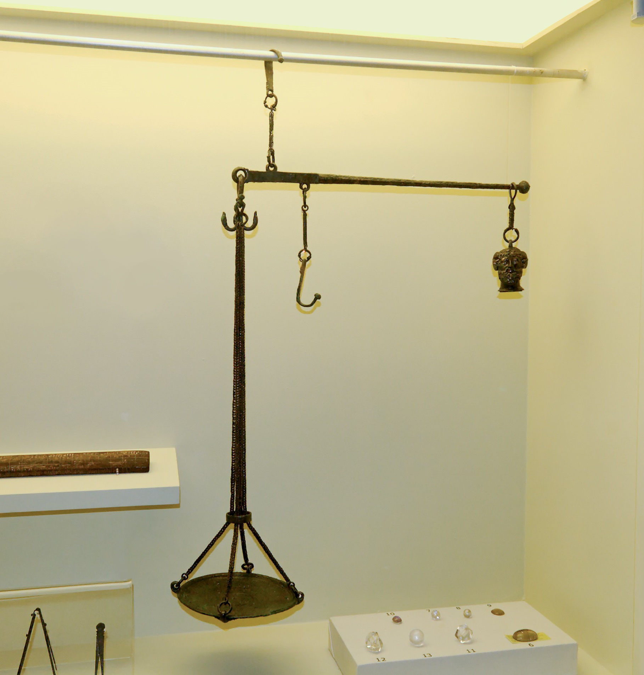
But to think so as to be of a sound mind, as God has dealt to each man a measure of faith
Bronze scale from Pompeii, 1st century AD
12:3
Notes:
The verb “to deal” (Gk. merizō, μερίζω) means to distribute or assign or apportion. In some settings, such as pay given to workmen or soldiers, such allotments were given using a scale to ensure that each portion was the correct amount. The scale in this photo comes from Pompeii and was in use about the time Paul wrote to the Romans. It was photographed at the Naples Archaeological Museum.
tb111705788c

Slide 32
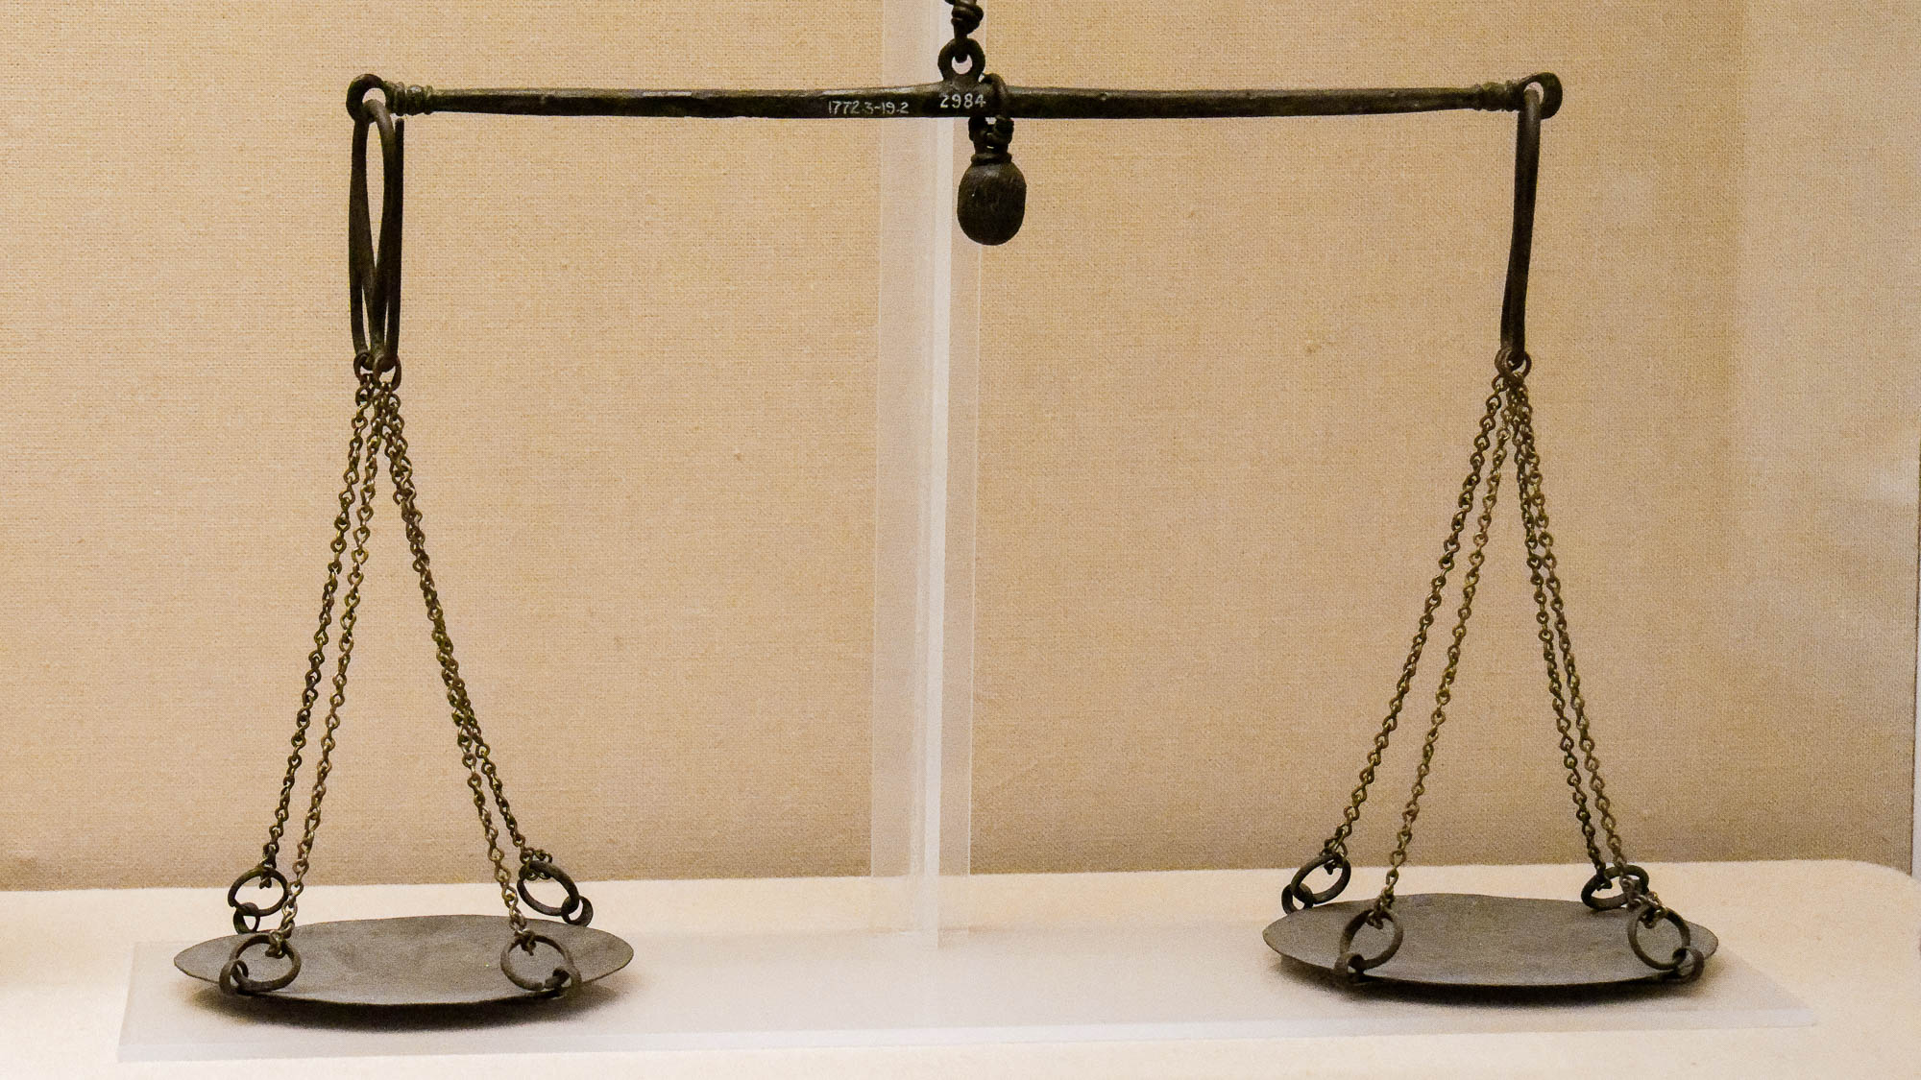
But to think so as to be of a sound mind, as God has dealt to each man a measure of faith
Roman pair of scales, made of bronze
12:3
Notes:
The chains have been reconstructed. This display was photographed at the British Museum.
tb0929198023h

Slide 33
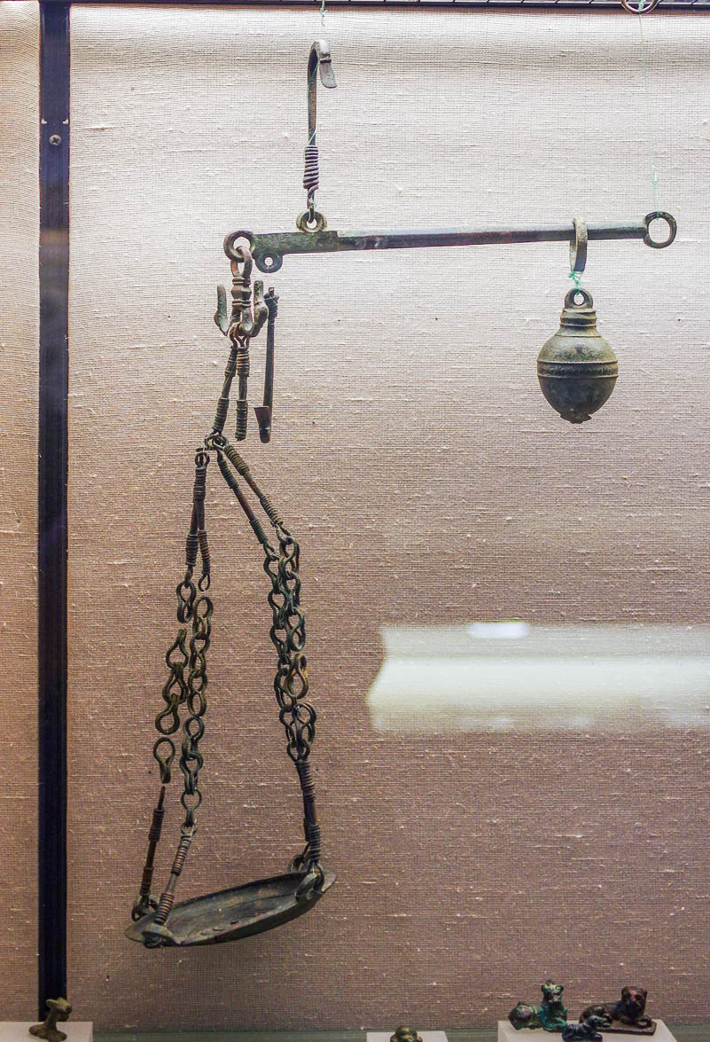
But to think so as to be of a sound mind, as God has dealt to each man a measure of faith
Steelyard-type bronze scale, 1st century AD
12:3
Notes:
This Roman period scale was photographed in the Hecht Museum at the University of Haifa.
adr1805229849

Slide 34
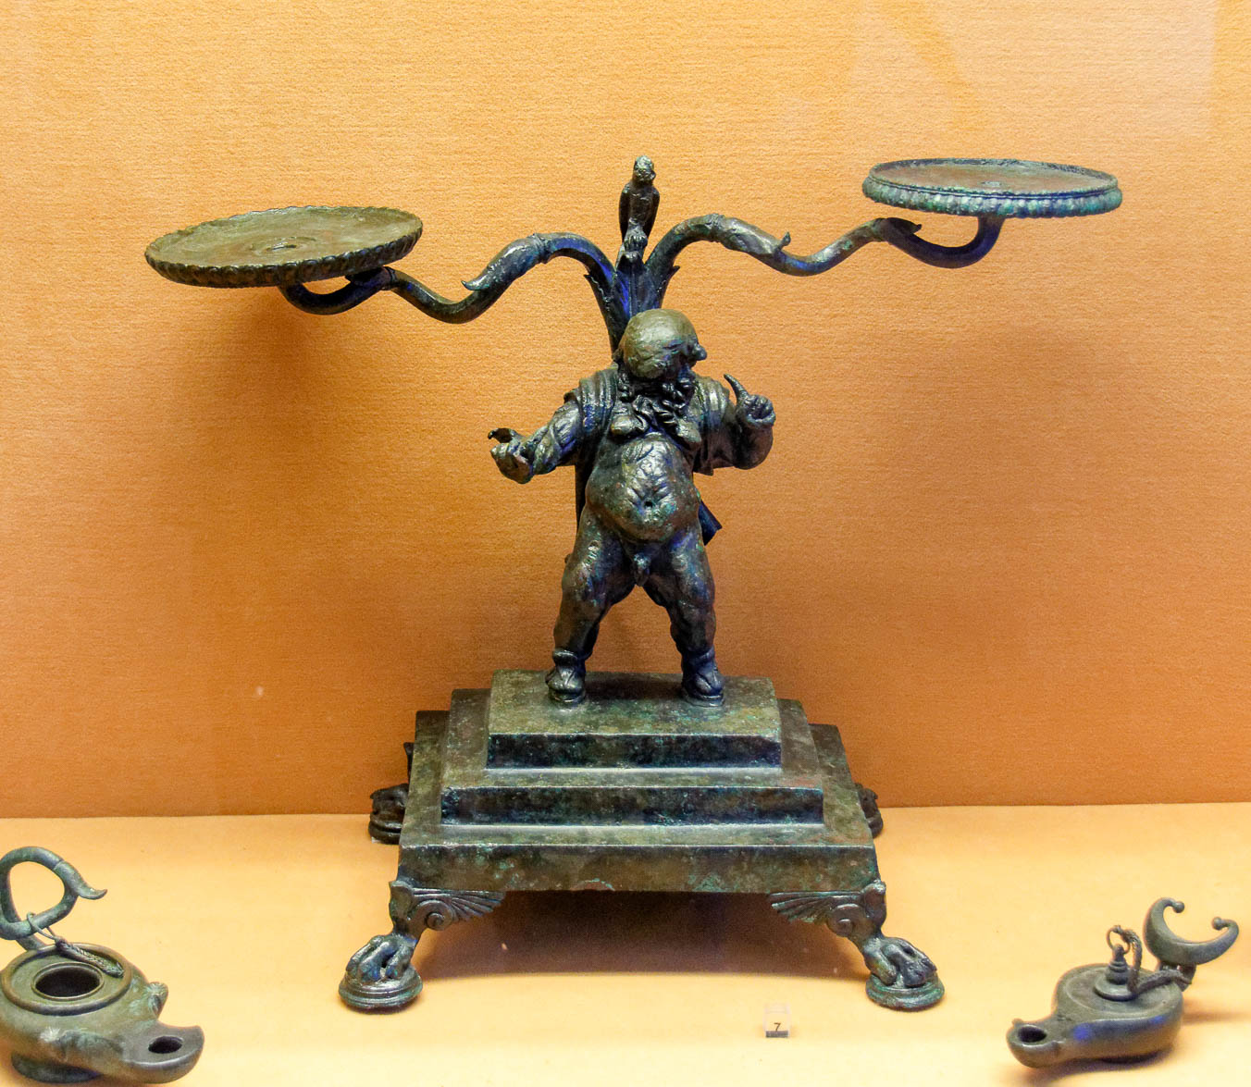
But to think so as to be of a sound mind, as God has dealt to each man a measure of faith
Bronze scales for weights
12:3
Notes:
This set of scales was photographed at the Naples Archaeological Museum. A removable graphic has been added to avoid causing offense or surprise.
tb0515170531

Slide 35
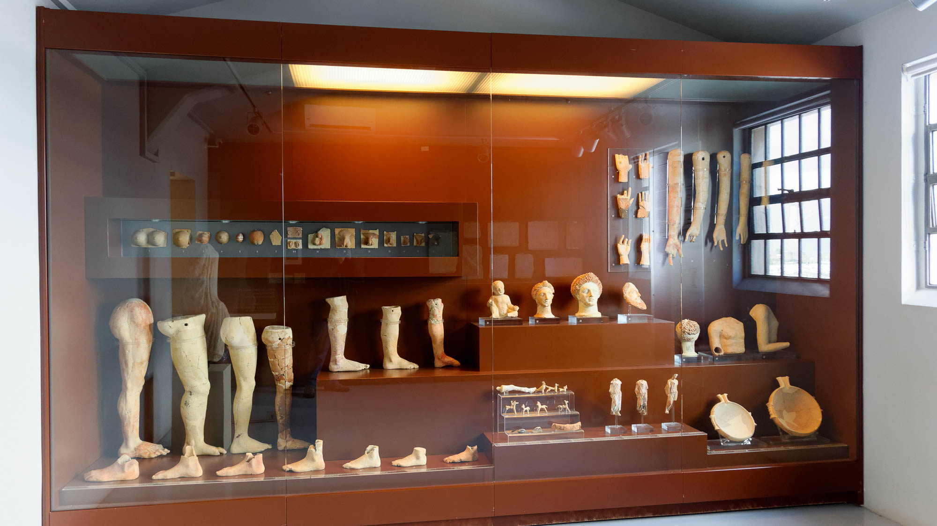
For just as we have many parts in one body and all the parts do not have the same function
Dedicatory gifts to Asclepius, from Corinth, 4th century BC
12:4
Notes:
Although the ancients did not have the modern understanding of anatomy, they clearly understood the separate function of many body parts. This display at Corinth houses clay body parts that were dedicated as gifts to the Asclepium there. It features not only external parts such as arms and legs, but also internal parts such as a heart. This display was photographed at the Corinth Museum.
tb011017047h

Slide 36
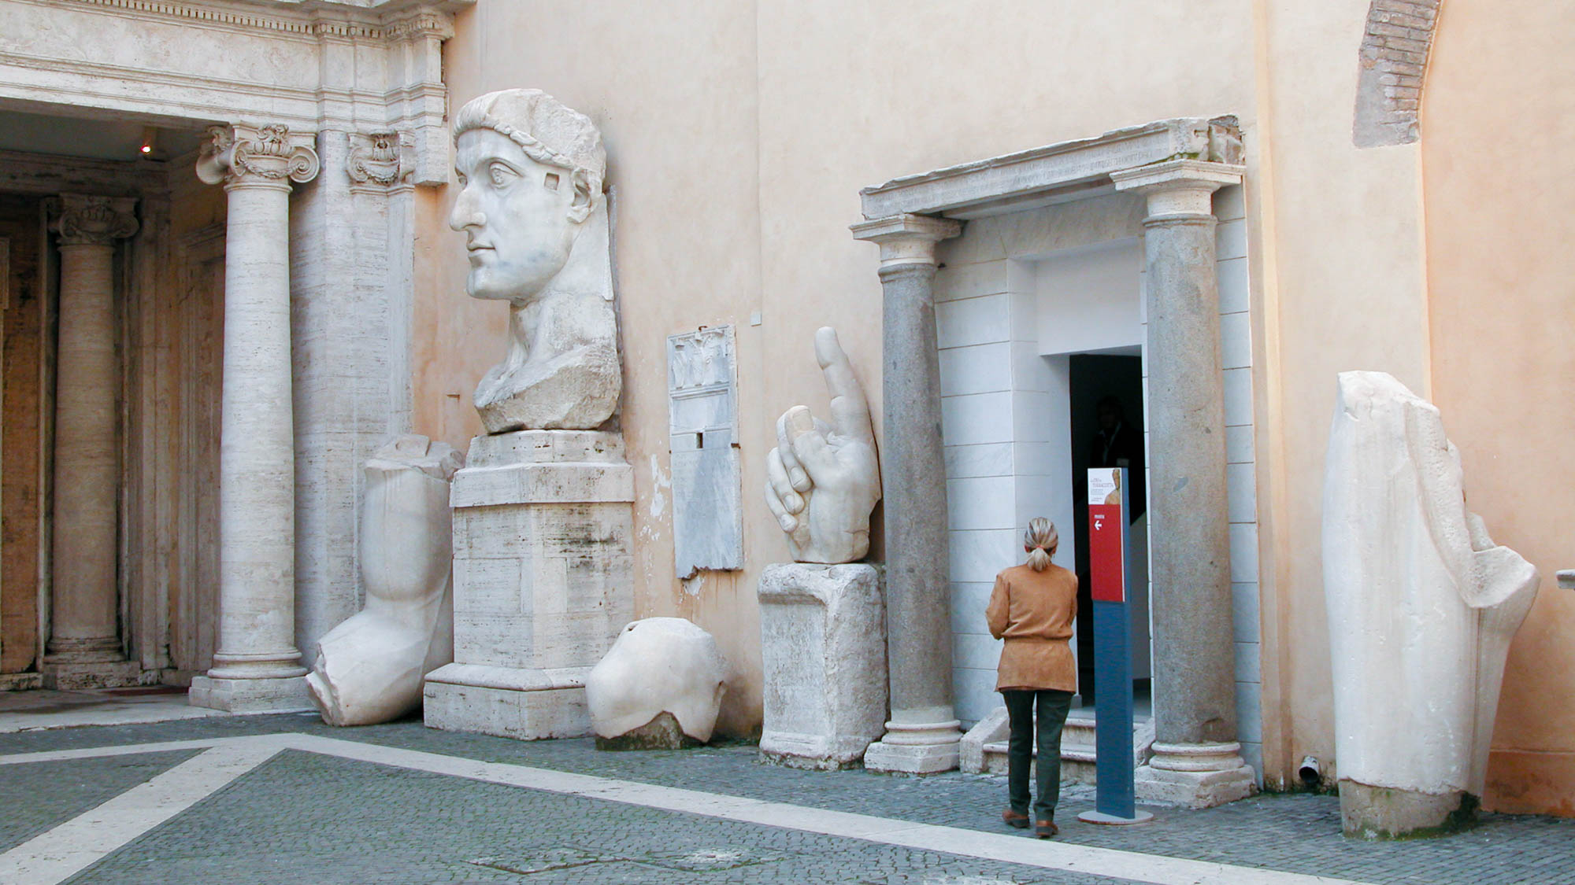
For just as we have many parts in one body and all the parts do not have the same function
Parts of a colossal statue of Constantine the Great, 4th century AD
12:4
Notes:
The various body parts shown here come from a colossal statue of Constantine the Great. From left to right are visible an elbow, head, knee, hand, and lower leg. A massive foot is located just off the right edge of the picture. Paul’s point is that the various parts of the body are different in form and function, but they should function together as one. When disassociated from one another like these parts, it is difficult to even envision what the original statue looked like. These artifacts were photographed at the Capitoline Museums in Rome.
tb112102028h

Slide 37
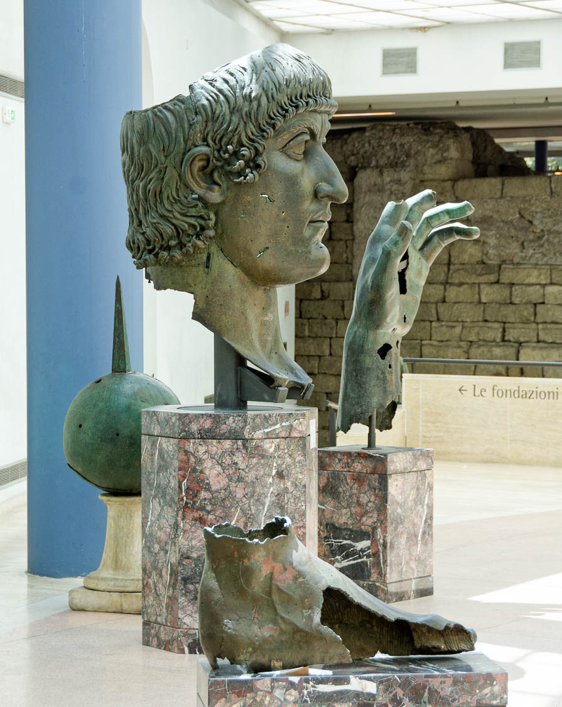
For just as we have many parts in one body and all the parts do not have the same function
Foot, head, and hand, gilded bronze, from a statue of Constantine the Great, 4th century AD
12:4
Notes:
The parts shown here are from a very large bronze statue of Constantine the Great. They illustrate the different parts of the body that have different functions, but they are intended to work harmoniously together. These artifacts were photographed at the Capitoline Museums in Rome.
tb0514179497h

Slide 38
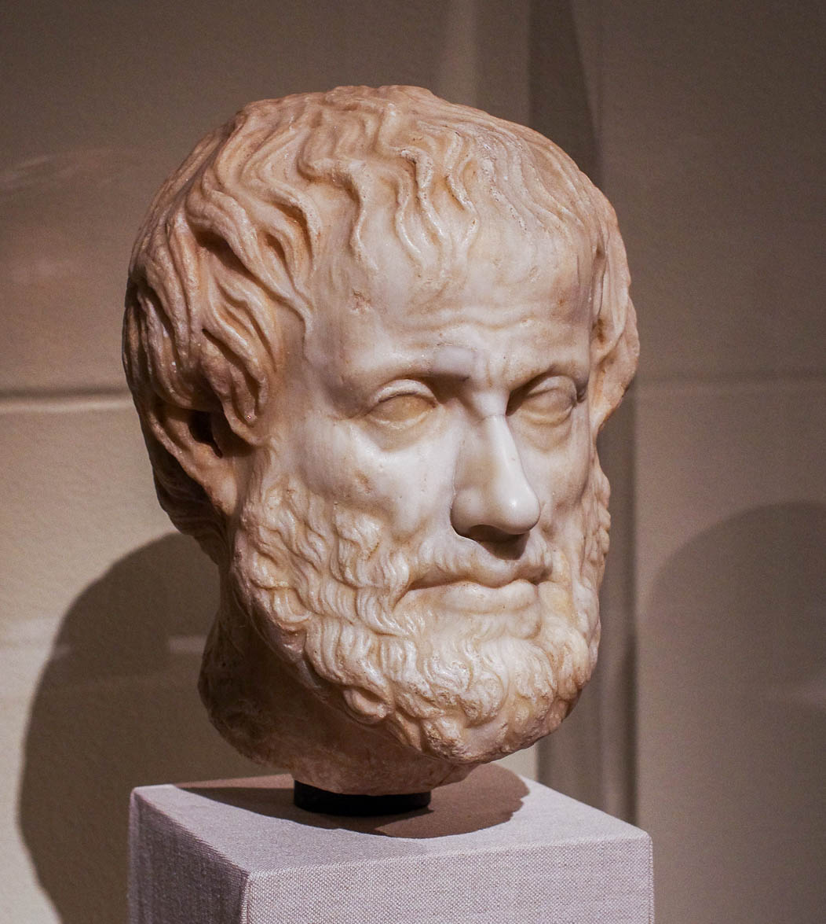
For just as we have many parts in one body and all the parts do not have the same function
Portrait of Aristotle, a pioneer in the study of human anatomy, 1st century AD
12:4
Notes:
Aristotle (384–322 BC) was a pioneer in the study of anatomy and produced some of the earliest known anatomical diagrams. While the ancient understanding of human anatomy was simplistic and filled with errors compared to modern understanding, the ancients clearly discerned that the body was composed of many distinct parts that worked in unity. This bust of Aristotle dates to the mid-1st century AD but is thought to be a copy of an earlier, Hellenistic original. It was photographed at the Metropolitan Museum of Art in New York City.
adr1605243871

Slide 39
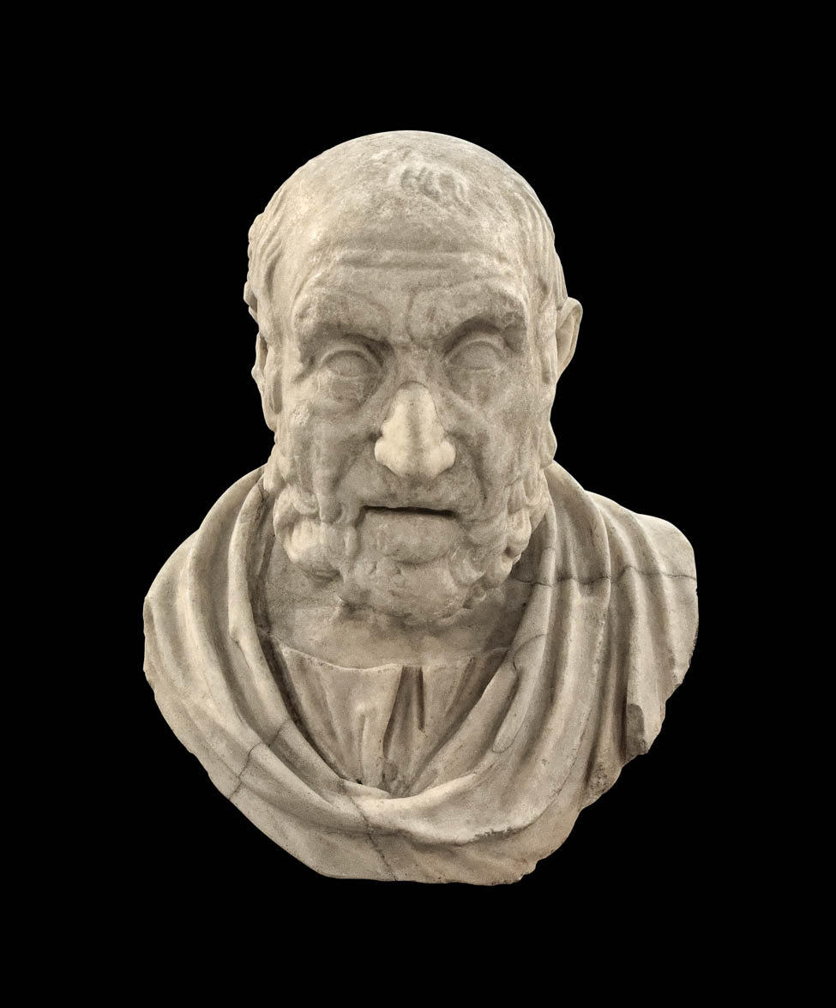
For just as we have many parts in one body and all the parts do not have the same function
Portrait of Hippocrates, the “Father of Medicine,” 1st century AD
12:4
Notes:
Though limited, Hippocrates (ca. 460–370 BC) wrote various treaties which discussed human anatomy such as skeletal structure and the circulatory system. This 1st century bust is thought to be a copy of an original that dated to the mid-2nd century BC. This bust of Hippocrates was photographed at the Naples Archaeological Museum.
tb0515171523c

Slide 40
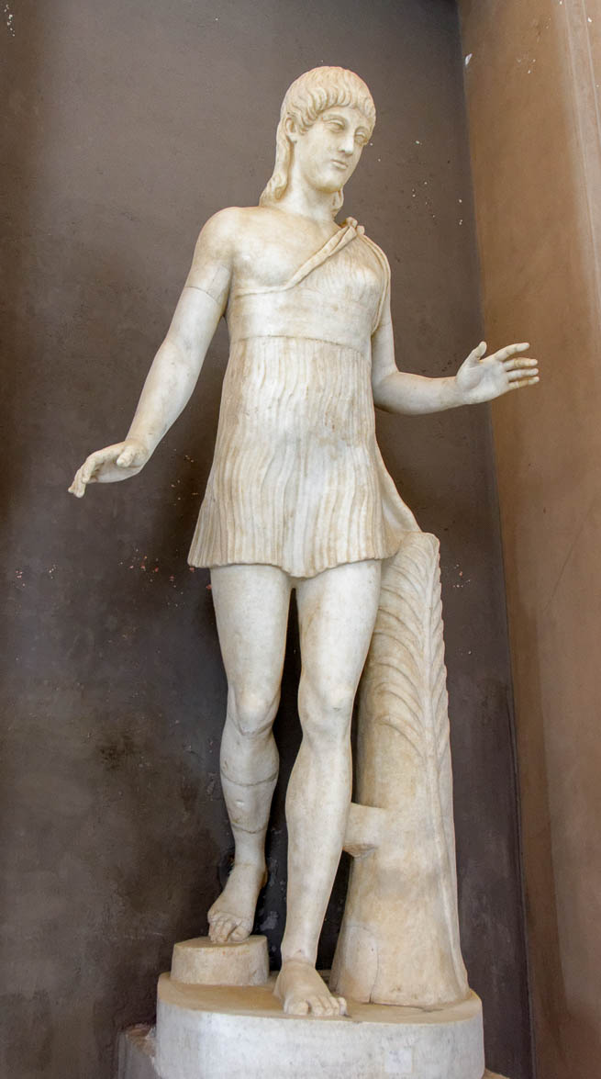
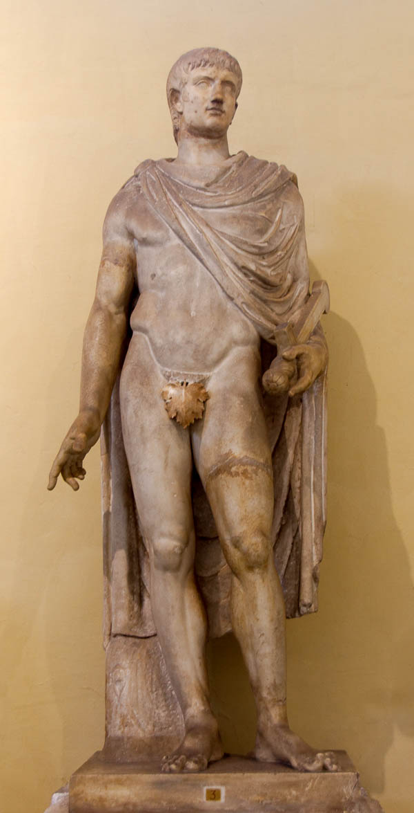
So we, who are many, are one body in Christ, and each members one of another
Female and male statues, from 1st century BC and 1st century AD
12:5
Notes:
This complete statue shows how the various parts of the body, though different from one another, fit together to create a whole, functioning body. The Greeks and Romans were quite obsessed with the human form, as seen in the countless statues and depictions they produced. Both of these statues were photographed at the Vatican Museums.
Left image: tb0512176992; right image: tb0512176590

Slide 41
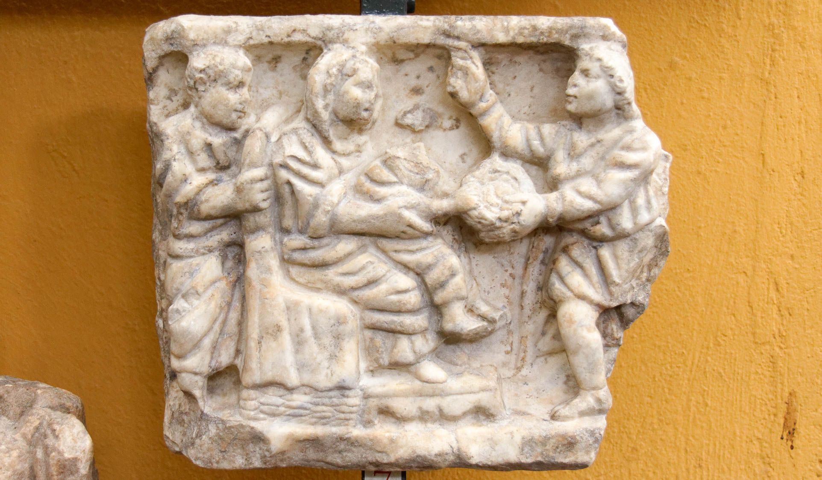
Since we each have gifts that differ according to the grace that has been given to us
Sarcophagus lid showing adoration of Magi, 4th century AD
12:6
Notes:
The word “gift” (Gk. charisma, χάρισμα) is usually understood to be a special sort of non-material thing granted by God, ranging from prophecy (Rom 12:6), to distinguishing spirits (1 Cor 12:10), to the capacity to be unmarried (1 Cor 7:7). To the extent that these things were granted by the grace of God, they can perhaps be illustrated through the giving of material gifts (Gk. dōron, δῶρον), like those given to Jesus at His birth by the wise men. This relief was photographed at the Vatican Museums.
tb0512175478h

Slide 42
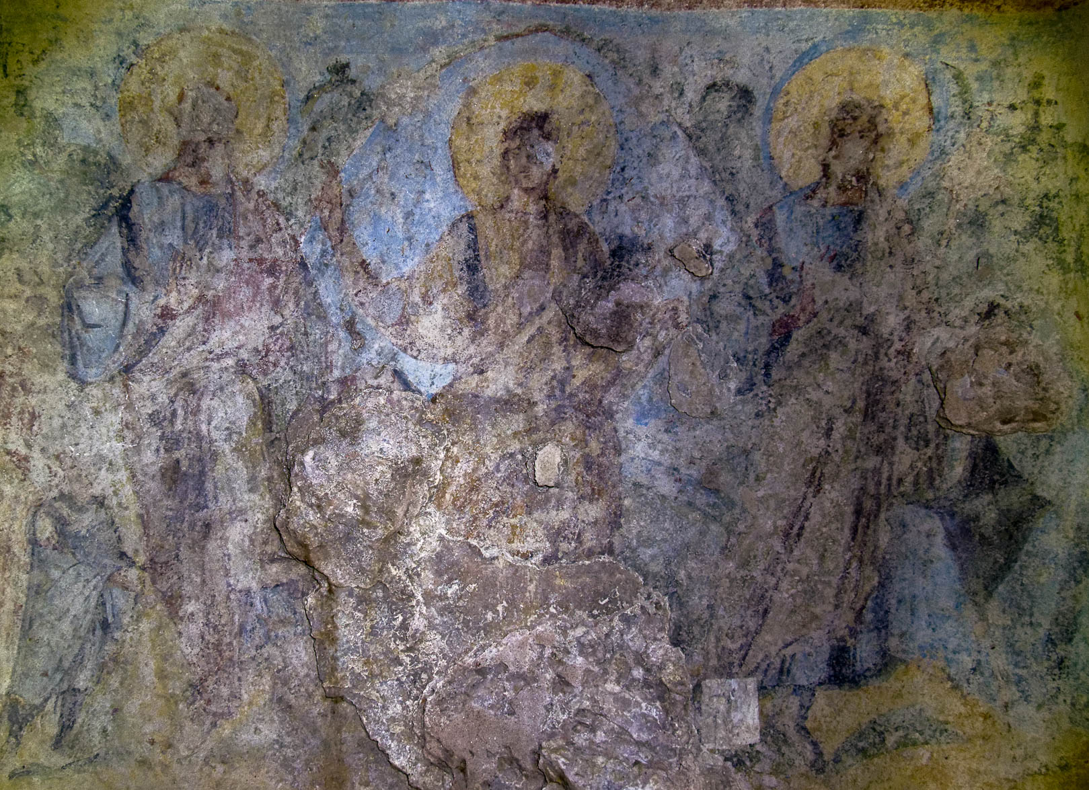
If prophecy, let us prophesy according to the proportion of our faith
Depiction of Jesus with the apostles and the prophets, late 5th or early 6th centuries AD
12:6
Notes:
The primary place given to the gift of prophecy in this list fits other Pauline texts which speak of spiritual gifts and list apostles and prophets as the foundation upon which the church is built, Jesus Himself being the chief cornerstone (1 Cor 12:28; Eph 2:20; 4:8-11). The fresco shown here is an ancient painting in the Ephesus Grotto depicting Jesus surrounded by the apostles and prophets. In Paul’s day there were also those who seemed to have been moved to prophesy on a more occasional and situation-specific basis (e.g., Acts 11:27-28; 13:1-2; 21:9-11; 1 Cor 14:1, 39).
tb010317156

Slide 43
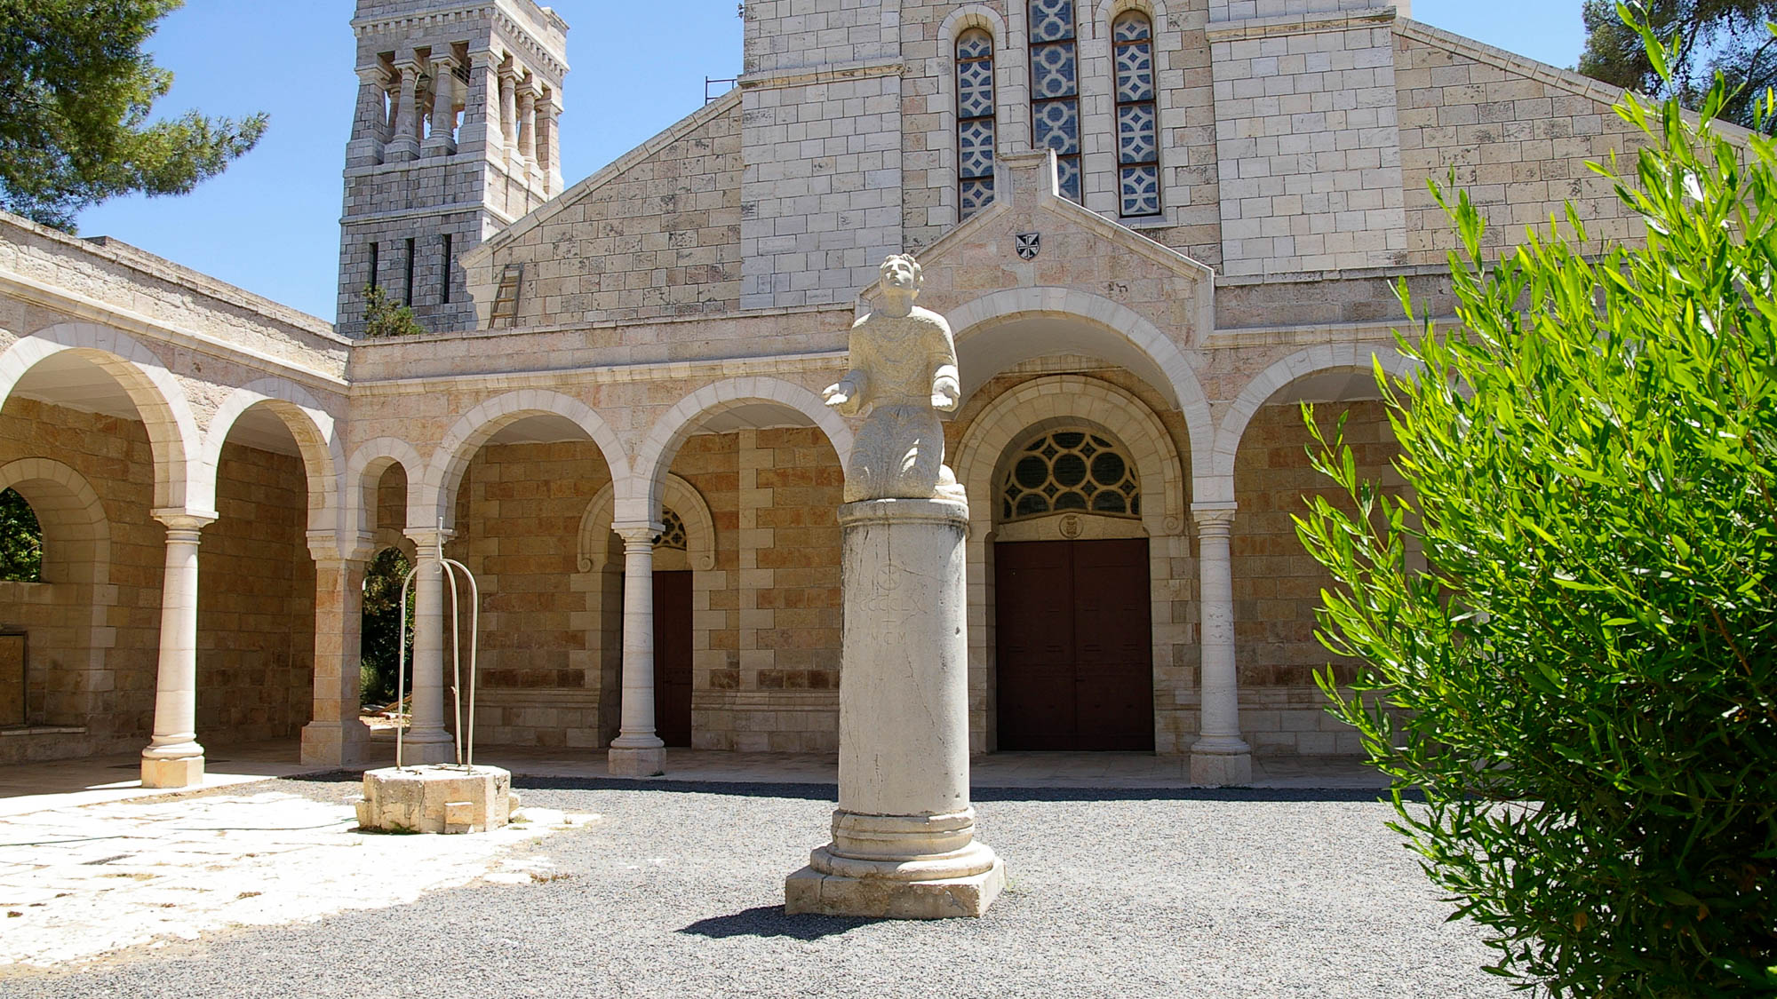
Or service, in serving
Statue of Stephen at St. Stephen’s Basilica in Jerusalem
12:7
Notes:
The word translated here as “service” (Gk. diakonia , διακονία ) is the source of the English word “deacon.” It seems likely that here it refers to the sort of helpful service that all believers are to give, but which had formally fallen under the responsibilities of the office of deacon (Acts 6). However, this word is also used to refer to “service” or “ministry” more generally. Stephen represents the passion and importance of the office of deacon as seen in the early church. The statue in this photo represents Stephen in the final moments before he was stoned to death for his Christian witness (Acts 7:54-60). It is located at the École Biblique, just north of Damascus Gate where the event likely took place.
adr0807269711

Slide 44
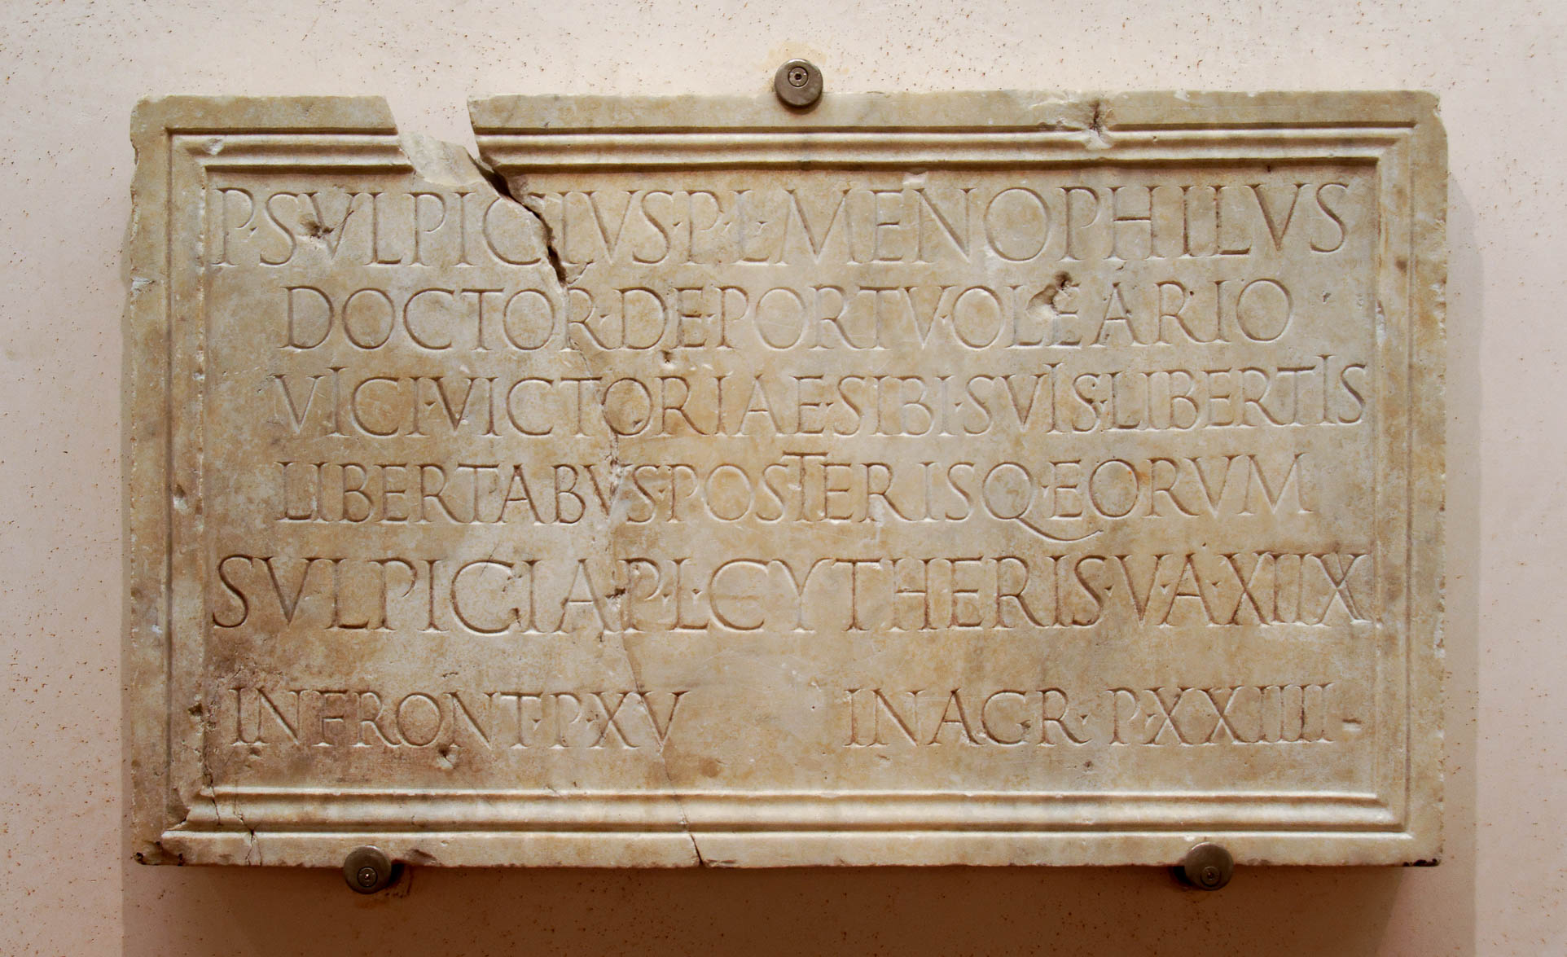
Or the one who teaches, in teaching
Sepulchral slab of a teacher, the freedman P. Sulpicius Menophilus, 1st century AD
12:7
Notes:
This funerary inscription is from the early 1st century AD. It was discovered in Rome, and once belonged to a freedman who was a teacher. The word DOCTOR in the inscription is Latin for “teacher.” This inscription was photographed at the National Museum in Rome.
tb0513178462

Slide 45
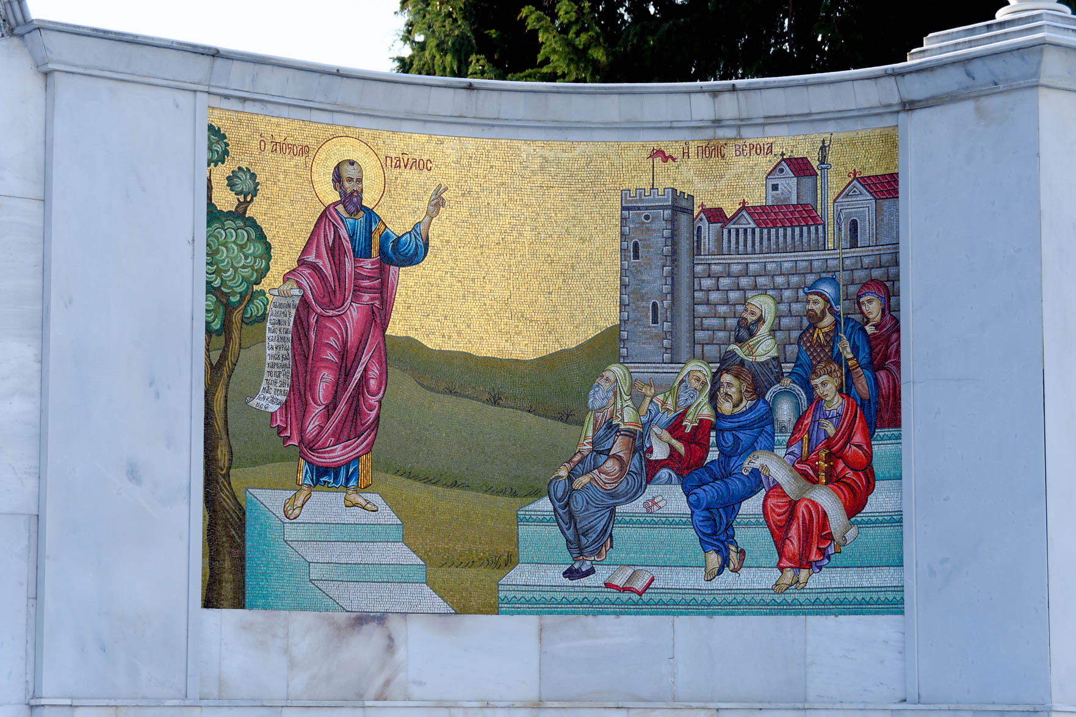
Or the one who exhorts, in exhortation
Mosaic of Paul teaching the Bereans, from Berea
12:8
Notes:
The word translated “exhortation” (Gk. paraklēsis , παράκλησις) is used in the New Testament to refer to preaching. For example, New Testament scholars recognize the genre of the Book of Hebrews to be a sermon. In Hebrews 13:22, it is called a “word of exhortation” (i.e., paraklēsis). The modern mosaic shown in this photo depicts Paul preaching to the Bereans (Acts 17:10).
tb010817380

Slide 46
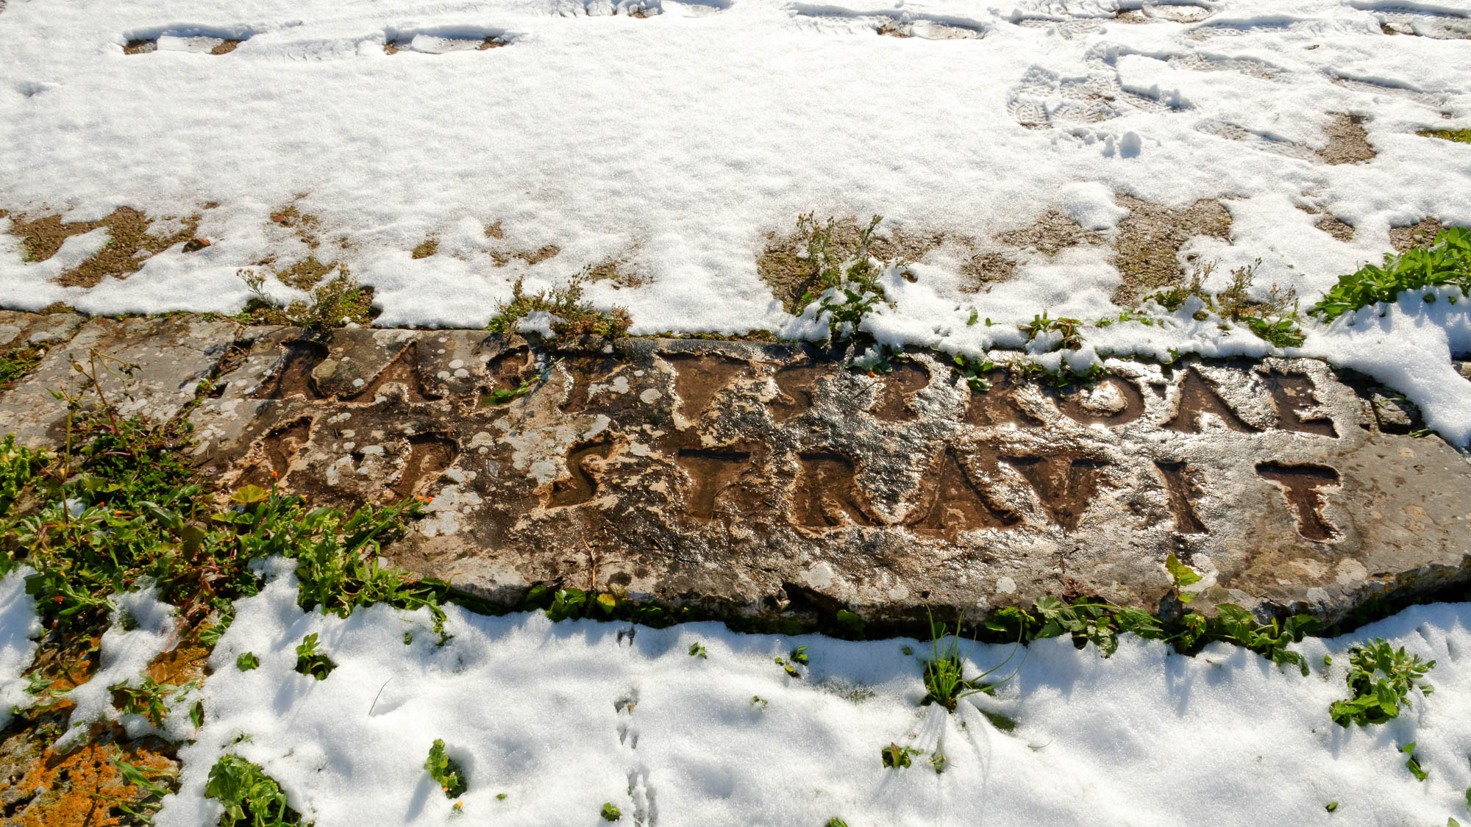
The one who gives, with generosity
Donation inscription of Erastus at Corinth, 1st century AD
12:8
Notes:
This inscription from along the main street at Corinth describes the donation of a wealthy patron. The Latin inscription reads, "Erastus, in return for his aedileship, laid (this pavement) at his own expense” (ERASTVS. PRO. AEDILITE. S. P. STRAVIT, = ERASTUS PRO AEDILITATE SUA PECUNIA STRAVIT). Erastus is an uncommon name, and many scholars identify this Erastus as the one mentioned in the New Testament (Acts 19:22; Rom 16:23; 2 Tim 4:20). Originally, the inscription had bronze lettering. Looters have left almost no remains of the bronze, but the outline of each letter is still clearly visible.
mjb011017560h

Slide 47
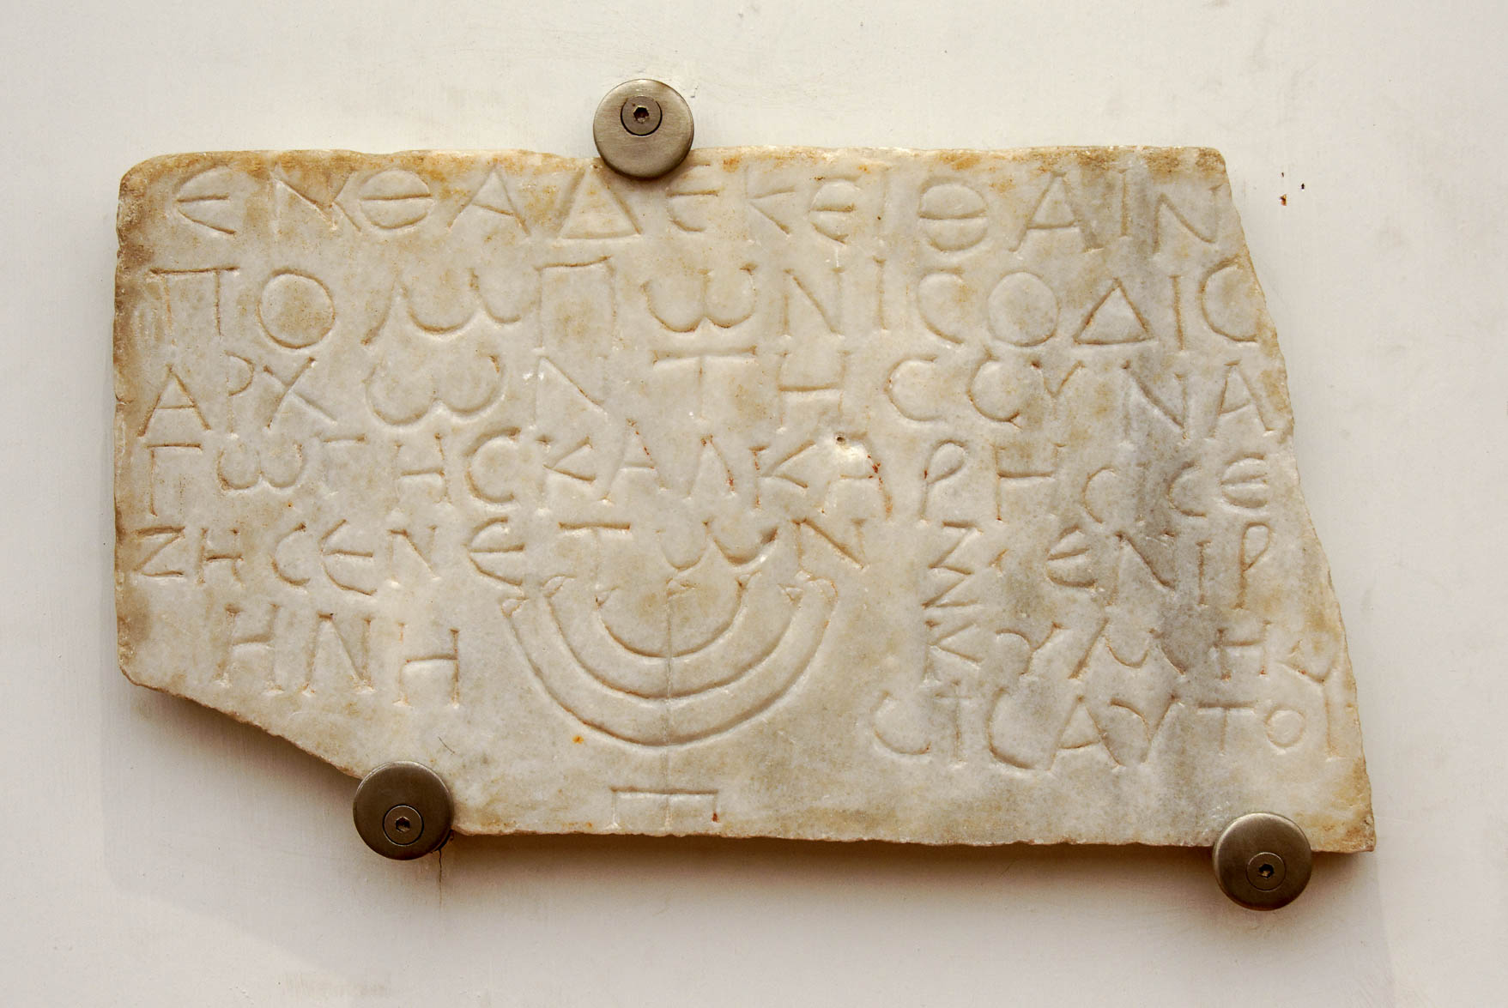
The one who rules, with diligence
Funerary inscription of Pomponis, ruler in the synagogue of Calcarenses, 3rd century AD
12:8
Notes:
The phrase translated “the one who rules” is ho proistamenos (Gk. ὁ προϊστάμενος ). Paul uses this elsewhere to refer to the office of elders within the congregation (e.g., 1 Thess 5:12; 1 Tim 5:17). Before the various congregations of the early church were structured according to the offices of elder and deacon (cf. Acts 14:23; Titus 1:5), Jewish-Christian congregations may have still been operating under the leadership of the synagogue ruler (cf. Mark 5:22; Luke 8:41; Acts 18:8). Pictured above is an inscription from the Catacomb of Monteverde in Rome. It once belonged to a man named Pomponis who was the ruler of a synagogue in Rome during the 3rd century AD. His title is listed as “ruler of the synagogue” (Gk. archon tēs sunagōgēs, ΑΡΧΩΝ ΤΗΣ ΣΥΝΑΓΩΓΗΣ). This was photographed at the National Museum in Rome. See the next slide for highlighting on the title.
tb0513178421

Slide 48
The one who rules, with diligence
Funerary inscription of Pomponis, ruler in the synagogue of Calcarenses, 3rd century AD
12:8
Notes:
The phrase translated “the one who rules” is ho proistamenos (Gk. ὁ προϊστάμενος ). Paul uses this elsewhere to refer to the office of elders within the congregation (e.g., 1 Thess 5:12; 1 Tim 5:17). Before the various congregations of the early church were structured according to the offices of elder and deacon (cf. Acts 14:23; Titus 1:5), Jewish-Christian congregations may have still been operating under the leadership of the synagogue ruler (cf. Mark 5:22; Luke 8:41; Acts 18:8). Pictured above is an inscription from the Catacomb of Monteverde in Rome. It once belonged to a man named Pomponis who was the ruler of a synagogue in Rome during the 3rd century AD. His title is listed as “ruler of the synagogue” (Gk. archon tēs sunagōgēs, ΑΡΧΩΝ ΤΗΣ ΣΥΝΑΓΩΓΗΣ). This was photographed at the National Museum in Rome. See the following slides for additional examples.
tb0513178421

Slide 49
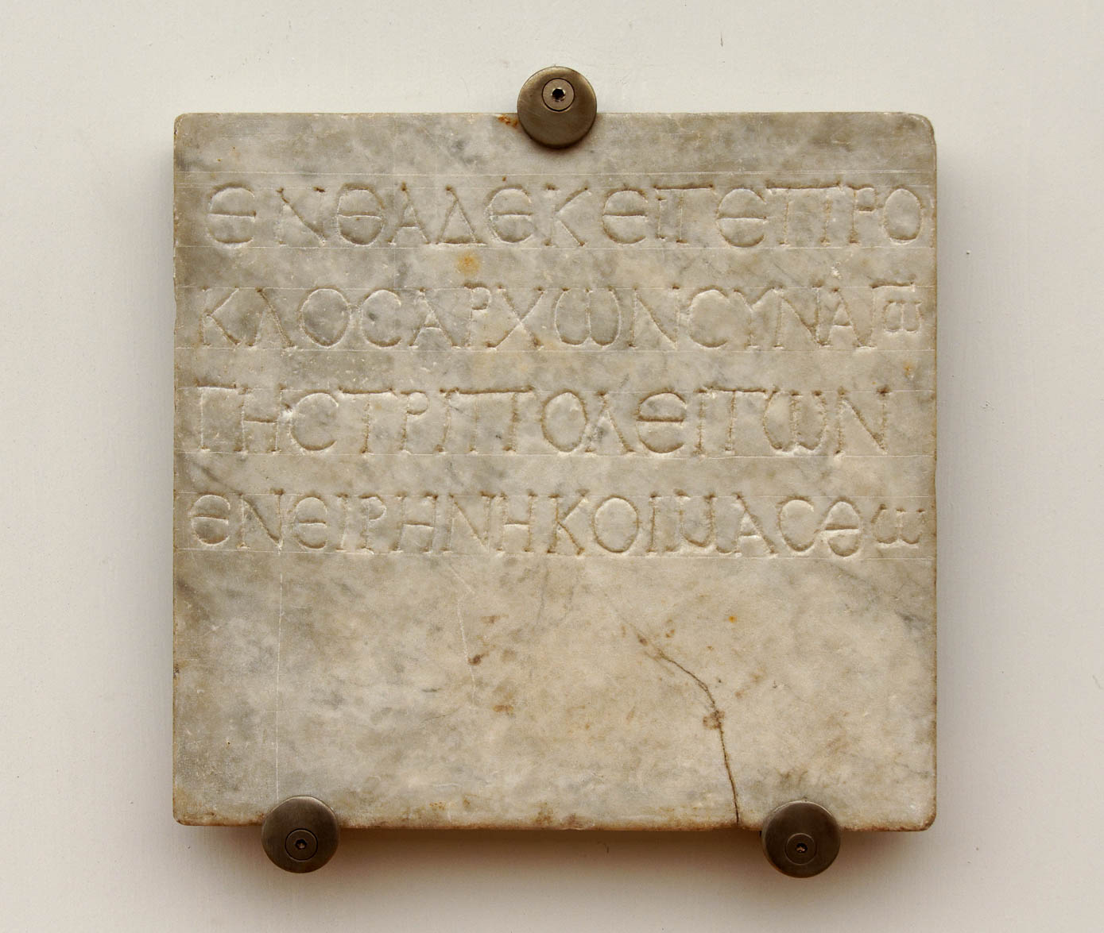
The one who rules, with diligence
Funerary inscription of Proclos, ruler of the Tripolitan synagogue, 3rd century AD
12:8
Notes:
This funerary inscription comes from the Catacomb of Monteverde in Rome. The inscription reads, “Here lies Proclos, ruler of the synagogue of those from Tripoli; may he rest in peace” (Gk. ΕΝΘΑΔΕ ΚΕΙΤΕ ΠΡΟΚΛΟΣ ΑΡΧΩΝ ΣΥΝΑΓΩΓΗΣ ΤΡΙΠΟΛΕΙΤΩΝ ΕΝ ΕΙΡΗΝΗ ΚΟΙΜΑΣΘΩ). It was photographed at the National Museum in Rome. See the next slide for highlighting on the title “ruler of the synagogue.”
tb0513178419

Slide 50
The one who rules, with diligence
Funerary inscription of Proclos, ruler of the Tripolitan synagogue, 3rd century AD
12:8
Notes:
This funerary inscription comes from the Catacomb of Monteverde in Rome. The inscription reads, “Here lies Proclos, ruler of the synagogue of those from Tripoli; may he rest in peace” (Gk. ΕΝΘΑΔΕ ΚΕΙΤΕ ΠΡΟΚΛΟΣ ΑΡΧΩΝ ΣΥΝΑΓΩΓΗΣ ΤΡΙΠΟΛΕΙΤΩΝ ΕΝ ΕΙΡΗΝΗ ΚΟΙΜΑΣΘΩ). It was photographed at the National Museum in Rome.
tb0513178419

Slide 51
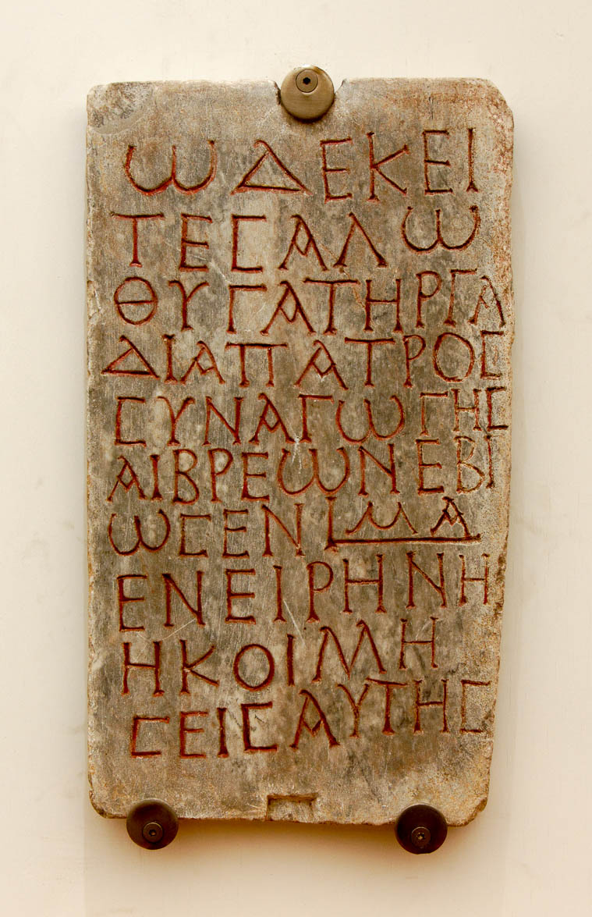
The one who rules, with diligence
Funerary inscription mentioning Gadia, “father of the synagogue of the Jews,” 3rd century AD
12:8
Notes:
This funerary inscription from the Catacombs of Monteverde in Rome belongs to a woman named Salo, the daughter of a man named Gadia who was the “father of the synagogue” (Gk. patros sunagōgēs , ΠΑΤΡΟΣ ΣΥΝΑΓΩΓΗΣ). This is probably to be understood as the equivalent to a synagogue ruler. This inscription was photographed at the National Museum in Rome. The entire inscription reads: ”Here lies Salo, daughter of Gadia, father of the synagogue of the Hebrews. She lived 41 years, in peace is her sleep” (Gk. ΩΔΕ ΚΕΙΤΕ ΣΑΛΩ ΘΥΓΑΤΗΡ ΓΑΔΙΑ ΠΑΤΡΟΣ ΣΥΝΑΓΩΓΗΣ ΑΙΒΡΕΩΝ ΕΒΙΩΣΕΝ |ΜΑ ΕΝ ΕΙΡΗΝΗ ΚΟΙΜΗΣΕΙΣ ΑΥΤΗΣ). This inscription was photographed at the National Museum of Rome at the Diocletian Baths. See the next slide for highlighting on the title.
tb0513178415

Slide 52
The one who rules, with diligence
Funerary inscription mentioning Gadia, “father of the synagogue of the Jews,” 3rd century AD
12:8
Notes:
This funerary inscription from the Catacombs of Monteverde in Rome belongs to a woman named Salo, the daughter of a man named Gadia who was the “father of the synagogue” (Gk. patros sunagōgēs , ΠΑΤΡΟΣ ΣΥΝΑΓΩΓΗΣ). This is probably to be understood as the equivalent to a synagogue ruler. This inscription was photographed at the National Museum in Rome. The entire inscription reads: ”Here lies Salo, daughter of Gadia, father of the synagogue of the Hebrews. She lived 41 years, in peace is her sleep” (Gk. ΩΔΕ ΚΕΙΤΕ ΣΑΛΩ ΘΥΓΑΤΗΡ ΓΑΔΙΑ ΠΑΤΡΟΣ ΣΥΝΑΓΩΓΗΣ ΑΙΒΡΕΩΝ ΕΒΙΩΣΕΝ |ΜΑ ΕΝ ΕΙΡΗΝΗ ΚΟΙΜΗΣΕΙΣ ΑΥΤΗΣ). This inscription was photographed at the National Museum of Rome at the Diocletian Baths.
tb0513178415

Slide 53

The one who shows mercy, with cheerfulness
Giving to a needy woman on Temple Mount
12:8
Notes:
The word translated “shows mercy” (Gk. ele’eō, ἐλεέω) refers to compassion or pity, especially when shown to the needy. The qualification that it is to be done with cheerfulness indicates that it should not be done grudgingly or out of a sense of compulsion.
tb010112108

Slide 54

The one who shows mercy, with cheerfulness
Woman giving a loaf of bread to a poor Muslim woman and two boys, 1938
12:8
Notes:
Caring for the hungry and poor is an example of showing “mercy,” as this woman is doing. This American Colony photograph was taken on October 22, 1938.
mat18872

Slide 55

The one who shows mercy, with cheerfulness
The Good Samaritan, by Aimé Morot, 1880
12:8
Notes:
In His story of the Good Samaritan, Jesus described the Samaritan man as having compassion on the stricken Jew. His cheerfulness in helping the man was further demonstrated by his willingness to pay for any further needs the man might incur while laid up at the inn (Luke 10:35). This painting was photographed at the Petit Palais, a fine arts museum in Paris. This image comes from Marc Baronnet and is in the public domain, via Wikimedia Commons: https://commons.wikimedia.org/wiki/File:Aime-Morot-Le-bon-Samaritain.JPG.
wiki0219201310052644421

Slide 56

Let love be without hypocrisy
Sarcophagus of Agape and Crescentianus, from the Vatican Necropolis, circa AD 330–360
12:9
Notes:
The word Paul uses here for “love” (Gk. agapē, ἀγάπη) occurs frequently in the New Testament (116 occurrences, 75 in Paul’s writings alone) and Apostolic Fathers (119 times). However, it is well-known that it is quite rare in secular Greek writings, perhaps because of its colloquial nature (BDAG, s.v. ἀγάπη; the same is not true of the verb ἀγαπαω). Pictured above is a sarcophagus identified (in Latin, at the beginning of the second line) as belonging to someone named Agape. It is adorned with reliefs depicting various events from the Old and New Testaments. This artifact was photographed at the Vatican Museums.
tb0512175636

Slide 57

Let love be without hypocrisy
Trojan horse replica at Troy
12:9
Notes:
An example of deception or hypocrisy from the classical Greek world is the Trojan horse. It was intended to be taken as a peace offering that signified the end of the war, but it was actually full of soldiers who opened the city gates at night and brought about the demise of Troy. This modern replica of the Trojan horse is located at ancient Troy.
tb011001963

Slide 58

Let love be without hypocrisy
Mykonos vase depicting the Trojan horse, circa 670 BC
12:9
Notes:
This decorated pithos was found at Mykonos, Greece. It is one of the earliest known depictions of the Trojan Horse. This vase was photographed at the Archaeological Museum of Mykonos. This image comes from Travelling Runes and is licensed under CC BY-SA 2.0, via Wikimedia Commons: https://commons.wikimedia.org/wiki/File:Mykonos_vase.jpg.
wiki0929201000103113670

Slide 59

Let love be without hypocrisy
Head of comic actor, late 1st century AD
12:9
Notes:
“Without hypocrisy” (Gk. anupokritos, ἀνυπόκριτος) refers to being genuine or sincere. The related word “hypocrite” (Gk. hupokritēs, ὑποκριτής) referred to an actor or pretender. The word comes from Greek theater, in which the actors wore masks in order to portray themselves as a different character. The bust shown here reveals both the wide grin of the comic mask and the pensive face of the actual actor. This artifact was photographed at the Vatican Museums.
tb0512176536

Slide 60

Let love be without hypocrisy
Female holding an actor’s mask, late 2nd century AD
12:9
Notes:
This sculpture depicts a woman (perhaps intended as a deity) holding the mask that portrays an old, bearded man. It is thought to be a 2nd century AD copy of an original from the 5th century BC. It was photographed at the Naples Archaeological Museum.
tb0515171184h

Slide 61

Abhor what is evil
Tragic theatrical mask, from Athens, circa 100 BC
12:9
Notes:
“To abhor” (Gk. apostugeō, ἀποστυγέω) means to have a vehement dislike for something, to hate something strongly. The word is used only here in the New Testament. This marble mask portrays an expression that could be taken as abhorrence. It is thought to be a copy of an original from about the 4th century BC. It was photographed at the National Archaeological Museum of Athens.
tb011117501h

Slide 62

Abhor what is evil, cling to what is good
Etruscan sarcophagus with husband and wife, circa 350–300 BC
12:9
Notes:
The word “cling” (Gk. kollaō, κολλάω) is also used in the New Testament to describe how a man should hold tightly to his wife (Matt 19:5). This Etruscan sarcophagus lid is made of travertine and was discovered at the ancient city of Vulci. It depicts a husband and wife clinging to one another. It was photographed at the Boston Museum of Fine Arts.
adr1711203030

Slide 63

In brotherly love toward one another, be tenderly affectionate
Funerary relief of a man with his wife and sons, 2nd–3rd centuries AD
12:10
Notes:
The family depicted in the relief above illustrates the familial bond in which believers are to live with each other. This relief was photographed at the Metropolitan Museum of Art in New York City.
adr1605243128h

Slide 64

In brotherly love toward one another, be tenderly affectionate
Depiction of a bearded warrior greeting his aged father and mother, 4th century BC
12:10
Notes:
This marble sculpture is a naiskos, a small temple that was usually associated with a funerary cult. This one depicts an affectionate greeting between a son and parents. It was photographed at the National Archaeological Museum of Athens.
tb011117594

Slide 65

Give preference to one another in honor
Diptych with Jesus washing feet of disciples, ivory, AD 1350–75
12:10
Notes:
One of the ways in which Jesus taught his disciples to serve one another was by washing their feet, depicted here on an ivory diptych from France or Germany. This ivory artifact was photographed at the Louvre Abu Dhabi.
tb0520184926h

Slide 66

In diligence not lazy
Statue of a sleeping satyr, from the Villa of the Papyri, Pompeii, 1st century AD
12:11
Notes:
This statue illustrates the disposition Paul says believers must not have, laziness. This sculpture was discovered at the rectangular peristyle of the Villa of the Papyri at Pompeii. It was photographed at the Naples Archaeological Museum. A removable graphic has been added to avoid causing surprise or offense.
tb0515170066c

Slide 67

In diligence not lazy, fervent in spirit
Sculpture of wrestlers, 1st century AD
12:11
Notes:
Wrestlers must be fervent (Gk. zeō, ζέω) in order to have any chance of beating their opponent. This broken sculpture was photographed at the Ostia Museum in Rome.
tb0517172810

Slide 68

Rejoicing in hope
Wine cup with Greek inscription “Rejoice!,” 1st century AD
12:12
Notes:
The word “rejoice,” (Gk. chairo, χαίρω) appears on this 1st century AD mold-made glass in a slightly extended imperative form, katachaire (καταχαιρε). The inscription on this glass continues on the reverse side; the full inscription reads “Rejoice and be glad!” (καταχαιρε και ευφραινου). The reason Paul gives for rejoicing is the hope that we have of eternal life (cf. Rom 6:22). This wine cup was photographed at the Getty Villa in California.
tb082214467

Slide 69

Rejoicing in hope, patient in tribulation
Portrait of Claudius from Priverno, AD 41–54
12:12
Notes:
In AD 49, only a few years before Paul penned the book of Romans, the Roman emperor Claudius expelled Jews from Rome because of controversy surrounding someone called “Chrestus.” Many scholars believe this to have been a misunderstanding of Christos (Gk. χριστος ), meaning “Christ.” This is the same expulsion that led Priscilla and Aquila to relocate to Corinth (Acts 18:2). Such persecution was already familiar to the Christians in Rome, and there were more to come. This statue was photographed in the Vatican Museums. For more on this, see the slides on Romans 1:8. Also see the slides on Romans 8:35 regarding tribulation.
tb0512176630

Slide 70

Rejoicing in hope, patient in tribulation, continuing steadfastly in prayer
Statue of a praying woman, from Herculaneum, 1st century (reproduction)
12:12
Notes:
This reproduction of a 1st century statue shows a prayer posture in use at the time in which the one praying would raise their hands. This was photographed at the Getty Villa in California.
tb082214110

Slide 71

Rejoicing in hope, patient in tribulation, continuing steadfastly in prayer
Dedication for a Christian named Priscus, late 4th century AD
12:12
Notes:
The central figure on this funeral plaque depicts a man (possibly the deceased) in a posture of prayer. The dove and olive branch on the left represent peace. The monogram in the upper right corner consists of the two Greek letters chi and rho (Χ,Ρ), which are the first two letters of the title Christ (ΧΡΙΣΤΟΣ, “messiah”). This plaque was photographed at the National Museum of Rome at the Diocletian Baths.
tb0513178407h

Slide 72

Rejoicing in hope, patient in tribulation, continuing steadfastly in prayer
Frieze depicting a woman in prayer on the Sarcophagus of Sabinus, early 4th century AD
12:12
Notes:
The woman depicted in the middle of this sarcophagus provides another example of a common prayer posture. Other scenes on this frieze include the marriage at Cana, the arrest of Peter, and the healing of a blind man. This was photographed at the Vatican Museums.
tb0512175789

Slide 73

Sharing in the needs of the saints, striving after hospitality
Poor family in Palestine, circa 1900
12:13
Notes:
This early photograph of a poor family illustrates the sort of needy members among the church that Paul is commanding his audience to support. This was modelled by the church in Jerusalem (Acts 2:45; 6:1-7) and by other churches giving to the church in Jerusalem in their present need (Rom 15:28). This American Colony photograph was taken between 1898 and 1911.
mat06417h

Slide 74

Sharing in the needs of the saints, striving after hospitality
Group of handicapped beggars
12:13
Notes:
The needs of the saints would no doubt also include provisions for those unable to work, such as the handicapped people pictured here. This American Colony photograph was taken between 1898 and 1946.
mat06348

Slide 75

Sharing in the needs of the saints, striving after hospitality
Temple of Zeus in Athens
12:13
Notes:
The word translated “hospitality” (Gk. philoxenia , φιλοξενία) is composed of the two words “love” (Gk. philos , φίλος) and “stranger” (Gk. xenos , ξένος). Zeus was referred to around this time as “Zeus the friend of strangers” (e.g., 2 Macc 6:2). If the pagan god Zeus had a reputation as a friend of strangers, how much more should the church strive after hospitality, toward the stranger and especially toward its own members.
tb011501061

Slide 76

Bless those who persecute you
Priestly blessing at Western Wall in Jerusalem
12:14
Notes:
The word “bless” (Gk. eulogeō, εὐλογέω) in this context means to ask God to bestow a special favor on someone. The priest in this photo is blessing another man, placing his hands on his head as he prays for him. This illustrates how Paul urged his readers to act toward their enemies.
tb041606949

Slide 77

Bless those who persecute you
Traditional prison cell of Paul and Silas in Philippi
12:14
Notes:
After Paul and Silas were unfairly flogged and imprisoned in Philippi, they were praying and singing hymns to God. Following an earthquake, Paul led his Roman jailer to salvation. This is the traditional location of that prison in Philippi. Given Paul’s close association with Luke as seen in the Book of Acts, it is quite tempting to see here a reference to Luke’s account of the Sermon on the Mount in Luke 6:28 where Jesus is recorded as saying “bless them that curse you, pray for them that despitefully use you” (ASV).
tb011201215

Slide 78

Bless those who persecute you
The Stoning of St. Stephen, by Gabriel-Jules Thomas, 1863
12:14
Notes:
Stephen set an example very early in the church age by asking God not to hold his death against those who stoned him (Acts 7:60). This sculpture is located above the main gate of the church Saint-Etienne du Mont ("St. Stephen in the Mount"), Paris. This image comes from Jebulon and is in the public domain, via Wikimedia Commons: https://commons.wikimedia.org/wiki/File:St_stephen_stoning.jpg.
wiki0117201316534850477h

Slide 79

Bless those who persecute you, bless and do not curse
Byzantine mosaic with a blessing, from Caesarea, circa AD 500
12:14
Notes:
This Byzantine mosaic inscription illustrates what it means to bless others. The inscription reads, “Peace be upon your entrance and upon your departure” (ΕΙΡΗΝΗ Η ΕΙΣΟΔΟΣ ΣΟΥ ΚΑΙ Η ΕΧΟΔΟΣ ΣΟΥ), calling down a blessing on anyone who visited the mansion where this mosaic was once located.
adr1305196256

Slide 80

Bless those who persecute you, bless and do not curse
Lead curse tablet, from the Via Latina in Rome, mid-1st century BC
12:14
Notes:
The curse inscribed on the lead tablet pictured above invokes Pluto to ruin a couple’s love. Paul here is calling the church in Rome to not conform to this culture of cursing, but to pronounce a blessing on others, even their persecutors. This item was photographed at the National Museum of Rome at the Diocletian Baths.
tb0513178228h

Slide 81

Bless those who persecute you, bless and do not curse
Lead lamina inscribed with a curse
12:14
Notes:
This item was photographed at the National Museum of Rome at the Diocletian Baths.
tb0513178161h

Slide 82

Rejoice with those who rejoice
Attic black-figure oil flask with dancers and musicians in a wedding procession, 6th century BC
12:15
Notes:
A wedding is usually an event accompanied by rejoicing. Paul’s directive to rejoice with those who rejoice calls for attention that is not self-focused but focused on others. This oil flask depicts musicians and dancers at a wedding. It was photographed at the Metropolitan Museum of Art.
adr1711139332h

Slide 83

Rejoice with those who rejoice
Wedding of Eric and Edith Matson, 1924
12:15
Notes:
This wedding in Jerusalem is a more modern version of the wedding event, and clearly a time of joy for those involved. Eric Matson was a significant contributor to the American Colony photo collection (later the Matson Photo Service), many of which are featured in the Photo Companion series. This American Colony photo was taken December 16, 1924.
mat04682h

Slide 84

Rejoice with those who rejoice
Jumping competition at a Bedouin wedding, circa 1910
12:15
Notes:
This American Colony photo was taken between 1900 and 1920.
mat01321h

Slide 85

Rejoice with those who rejoice
Bar mitzvah in Jewish Quarter plaza, Jerusalem
12:15
Notes:
A bar mitzvah is the religious initiation ceremony of a Jewish boy who has reached the age of 13 and is regarded as ready to observe religious precepts and eligible to take part in public worship.
tb042312563h

Slide 86

Weep with those who weep
Roman sarcophagus fragment with mourners grieving the deceased, mid-2nd century AD
12:15
Notes:
This relief illustrates the sort of scene that Paul’s admonition to weep with those who weep might evoke in the minds of his audience. This marble relief comes from a sarcophagus. It was photographed in the Metropolitan Museum of Art in New York City.
adr1606034429h

Slide 87

Weep with those who weep
The so-called “Sarcophagus of the Mourning Women,” from Sidon, 4th century BC
12:15
Notes:
This sarcophagus depicts a number of women in various postures of mourning, presumably for the deceased. It was recovered from the royal necropolis at Sidon and was photographed at the Istanbul Archaeological Museum. This image comes from G. dallorto and is licensed under CC BY-SA 2.5 it, via Wikimedia Commons: https://commons.wikimedia.org/wiki/File:Istanbul_-_Museo_archeol._-_Sarcofago_delle_piangenti_-_ca._350_a.C._-_Foto_G._Dall%27Orto_28-5-2006_01.jpg.
wiki052820061280960571

Slide 88

Do not think arrogantly, but associate with the lowly
Group of beggars
12:16
Notes:
This early photograph of group of beggars illustrates those Paul here says that believers are not to exclude from fellowship, but rather are called to embrace. This American Colony photograph was taken between 1900 and 1920.
mat01270

Slide 89

Do not be wise in your own estimation
Head portraying the short-lived Roman emperor Vitellius, 16th century AD
12:16
Notes:
An example of someone from Paul’s day who was wise in his own eyes was the short-lived Roman emperor Vitellius. Vitellius was proclaimed emperor by some of the western military units, and at Rome the Senate accepted him and decreed to him the usual Imperial honors. However, the eastern armies elected Vespasian as their leader, and his challenge was one that Vitellius could not meet. The rule of Vitellius lasted only 8 months during AD 69.
The bust shown here was produced in Italy in the first half of the 16th century. It is a copy of an antique head of the Hadrianic era in the Grimani Collection in Venice, once thought to represent the emperor Vitellius. This bust was photographed at the Louvre Museum. This image comes from Jastrow and the French Royal Collections and is licensed under CC BY 2.5, via Wikimedia Commons: https://commons.wikimedia.org/wiki/File:Pseudo-Vitellius_Louvre_MR684.jpg.
wiki011820081957315h

Slide 90

Do not be wise in your own estimation
Vitellius Dragged Through the Streets of Rome by the Populace, by Georges Rochegrosse, 1883
12:16
Notes:
When Vespasian attacked Rome, Vitellius realized his mistake and tried to hide (different ancient authors give varying accounts of where he hid). When he was found he was dragged to the Gemonian stairs, a place of execution that was considered extremely dishonorable. Reportedly, his last words were, “Yet I was once your Emperor.” This painting depicts his final moments. Vitellius illustrates someone who was wise in his own estimation. This image comes from Georges Rouchegrosse and is in the public domain, via Wikimedia Commons: https://commons.wikimedia.org/wiki/File:Rochegrosse_Vitellius_tra%C3%AEn%C3%A9_dans_les_rues_de_Rome_par_la_populace,_1883.jpg.
wiki0803201318442162587

Slide 91

Never pay back evil for evil to anyone
Mosaic of a cock fight, from Pompeii, 1st century AD
12:17
Notes:
Sometimes people return evil for evil and get into a vicious circle of feuding. Roosters will fight to the death to gain dominance, and Paul warns against a human version of this. Instead, he would doubtless echo the words of Jesus—“Whoever hits you on the cheek, offer him the other also” (Luke 6:29). This mosaic from Pompeii was photographed in the Santangelo Collection at the Naples Archaeological Museum.
tb0515170589

Slide 92

Respect what is right in the sight of all men
Tyrian shekel hoard from Isfiya, possibly intended for the Temple tax, 1st century AD
12:17
Notes:
One of the ways Paul certainly expected his audience to respect what was right in the sight of all men was to pay taxes. In the next chapter he will specifically address being subject to civil authorities, which includes paying taxes. This aligned with what Jesus taught, that taxes ought to be paid (Luke 20:22-25). This display was photographed at the Eretz Israel Museum in Tel Aviv.
tb031114428

Slide 93

Respect what is right in the sight of all men
Fresco with piles of coins and record books, from Pompeii, 1st century AD
12:17
Notes:
Basic principles of honesty in business, which is normally seen by the general public as right, is illustrated by this fresco from Pompeii. The piles of money and the record-keeping instruments below them suggest bookwork and accounting. The record-keeping items include an inkwell and pen, papyrus scroll, and two writing tablets with a stylus. This fresco is from the estate of Julia Felix at Pompeii. It was photographed at the Naples Archaeological Museum.
tb0515170275r

Slide 94

Respect what is right in the sight of all men
The so-called Lex Ursonensis, from the colony of Urso, 1st century AD
12:17
Notes:
In addition to national laws, the Roman Senate passed other laws that were specific to various situations or places. One example of this is the bronze tablet shown here. The Lex Ursonensis was the foundation charter of the Caesarean colony at Urso in southern Spain. It was passed as law by the Roman Senate, probably under Mark Antony; this bronze copy was made in the 1st century AD. It originally consisted of 5 tablets, and the one shown here corresponds to #5 of the original group. It was photographed at the National Archaeological Museum of Spain in Madrid. This image comes from Luis García and is licensed under CC BY-SA 3.0, via Wikimedia Commons: https://commons.wikimedia.org/wiki/File:Lex_Ursonensis_-_tabla_1_(M.A.N._16736)_01.jpg.
wiki1211200918762026

Slide 95

Respect what is right in the sight of all men
Bronze fragment of a city law from Lorch, Austria, 3rd century AD
12:17
Notes:
This Latin inscription is part of a city law from the city of Lorch in modern Austria. It comes from the reign of Antonius Pius (AD 138–161). Paul’s admonishment to respect what is right in the sight of all men would have included local laws. This inscription was photographed at the Museum of Lauriacum in Enns, Austria. This image comes from Wolfgang Sauber and is licensed under CC BY-SA 3.0, via Wikimedia Commons: https://commons.wikimedia.org/wiki/File:ML_-_Stadtrechtsurkunde_2.jpg.
wiki1105201214301156651

Slide 96

Respect what is right in the sight of all men
Inheritance law from the Law Code of Gortyn, Crete, 5th century BC
12:17
Notes:
This is a fragment of the 11th column of the law code from Gortyn. The section shown here deals with inheritance laws. This is both the oldest and most complete known example of a code of ancient Greek law. It may be of interest to note that this Greek inscription is written boustrophedon (lit. “as the ox plows”), meaning that alternating lines are written from left to right and then from right to left; even the stance of the letters is reversed. This method of writing became less and less common through the Hellenistic period, and by the time of the New Testament left to right writing had become standardized for Greek. This inscription was photographed at the Louvre Museum. This image comes from Jastrow and is in the public domain, via Wikimedia Commons: https://commons.wikimedia.org/wiki/File:Law_Code_Gortyn_Louvre_Ma703.jpg.
wiki042620061433703

Slide 97

If possible, so far as it depends on you, live peaceably with all men
Relief with a personification of Concordia shown behind the couple, from Rome, AD 270–280
12:18
Notes:
In ancient Roman mythology, Concordia was the goddess of peace and harmony, both in marriage and in society. In this relief she appears behind the couple shaking hands, illustrating the desire for a peaceable marriage. This sarcophagus relief carving from Latina Street in Rome was photographed at the National Museum of Rome.
tb0513177643

Slide 98

If possible, so far as it depends on you, live peaceably with all men
Inscription of Vespasian mentioning “Eternal Peace,” 1st century AD
12:18
Notes:
Peace was an important ideal in the Roman Empire of Paul’s day. This Latin inscription was set up on Emperor Vespasian’s birthday in AD 70 (Noreña 2003: 32). It begins with the line “To the eternal peace” (PACI AETERNAE), possibly in commemoration of Vespasian’s triumphal return to Rome after the destruction of Jerusalem. The full inscription contains the following (translation from Noreña 2003: 32).
Front:
PACI AETERNAE / DOMVS / IMP(ERATORIS) VESPASIANI / CAESARIS AVG(USTI) / LIBERORVMQ(UE) EIVS / SACRVM / TRIB(UI) SVC(VSANAE) IUNIOR(ES).
To the eternal peace of the house of the Imperator Vespasian Caesar Augustus and his children, [this memorial is] sacred. [Set up by the] inuniores of the Tribus Sucusana
Back:
DEDIC(ATVM) XV K(ALENDAS) DEC(EMBRIS) / L ANNIO BASSO / C CAECINA PAETO CO(N)S(ULIBUS)
dedicated on November 17th during the consulships of Lucius Annius Bassus and Gaius Caeina Paetus.
Reference:
Noreña, Carlos F.
2003 Medium and Message in Vespasian's Templum Pacis. Memoirs of the American Academy in Rome 48: 25–43.
tb0515170998

Slide 99

If possible, so far as it depends on you, live peaceably with all men
Column at Corinth mentioning Seneca
12:18
Notes:
Paul’s words here and in the surrounding verses appear similar to Seneca the Younger’s description of the Emperor as the essential agent of the Pax Romana. “For he is the bond by which the commonwealth is united, the breath of life which these many thousands draw, who in their own strength would only be a burden to themselves and the prey of others if the great mind of the empire should be withdrawn. If safe their king, one mind to all, bereft of him, their trust must fall. Such a calamity would be the destruction of the Roman peace, such a calamity would force the fortune of a mighty people to its downfall” (Seneca, De Clementia, 1.4.1f; translation from Wengst 1987: 9). Pictured above is an inscription at Corinth mentioning Seneca, who was also the younger brother of Gallio, the Roman official who judged Paul in Corinth (Acts 18:12-17). Since Paul wrote Romans from Corinth (cf. Rom 16:23), it is tempting to see these as converging connections that influenced Paul’s words here. Rather than the Roman Emperor, Christ is the true agent of true peace. Believers are to pursue peace by being of one mind together with Him (cf. Rom 15:5). Compare the slide on Romans 5:1.
Reference:
Wengst, Klaus.
1987 Pax Romana and the Peace of Jesus Christ. Trans. John Bowden. London: SCM Press.
tb031706115h

Slide 100

If possible, so far as it depends on you, live peaceably with all men
Silver Antoninianus of Gordian III, with Pax Augusti, 3rd century AD
12:18
Notes:
The period from about 27 BC to AD 180 is often referred to by historians as the Pax Romana, the “Peace of Rome.” This included the time when Paul lived. The period was also sometimes referred to as the “Peace of Augustus” (PAX AUGUSTA) because Augustus was the first emperor of the period. Such is the case with this coin of the Roman emperor Gordian III (AD 238–244). This illustrates the fondness with which later emperors looked back on this period, and the value they attached to the relative peace that characterized the period. The next slide includes highlights for the inscription “Peace of Augustus.” This image comes from NumisAntica and is licensed under CC BY-SA 3.0 nl, via Wikimedia Commons: https://commons.wikimedia.org/wiki/File:Romeinse_keizers_Gordianus_III_antoninianus_Antiochie_243-244.jpg.
wiki110520141523700350180

Slide 101

If possible, so far as it depends on you, live peaceably with all men
Silver Antoninianus of Gordian III, with Pax Augusti, 3rd century AD
12:18
Notes:
The period from about 27 BC to AD 180 is often referred to by historians as the Pax Romana, the “Peace of Rome.” This included the time when Paul lived. The period was also sometimes referred to as the “Peace of Augustus” (PAX AUGUSTA) because Augustus was the first emperor of the period. Such is the case with this coin of the Roman emperor Gordian III (AD 238–244). This illustrates the fondness with which later emperors looked back on this period, and the value they attached to the relative peace that characterized the period. The next slide includes highlights for the inscription “Peace of Augustus.” This image comes from NumisAntica and is licensed under CC BY-SA 3.0 nl, via Wikimedia Commons: https://commons.wikimedia.org/wiki/File:Romeinse_keizers_Gordianus_III_antoninianus_Antiochie_243-244.jpg. An editable version is included behind this graphic.
wiki110520141523700350180

Slide 102

Do not take your own revenge, beloved, but leave room for the wrath of God
Temple of Mars the Avenger in Rome (from the southwest)
12:19
Notes:
Caesar Augustus (27 BC–AD 14) created the cult of “Mars the Avenger” (Mars Ultor) to celebrate two different events in which he felt like he was able to gain vengeance. The first was his defeat of the assassins of Julius Caesar (Brutus and Cassius) in battle at Philippi in 42 BC. The second was the negotiated return of the Roman battle standards that had been lost to the Parthians in the Battle of Carrhae in 53 BC. The temple was built in 2 BC and was also home to the Roman goddess of vengeance, Ultio.
tb112105952h

Slide 103

Do not take your own revenge, beloved, but leave room for the wrath of God
Statue of Mars the Avenger, late 1st century AD
12:19
Notes:
Mars the Avenger (Mars Ultor) was depicted wearing a breastplate (cuirass) and war helmet, standing in a “martial pose,” with a lance in his upraised right hand and a shield in his left. The fact that a temple to the god of vengeance stood in Rome when Paul wrote his letter to the Romans demonstrates that they would have been well aware of revenge as a cultural value. This statue was photographed at the Naples Archaeological Museum.
tb0515171025

Slide 104

Do not take your own revenge, beloved, but leave room for the wrath of God
Statue of Mars the Avenger, late 1st century AD
12:19
Notes:
This statue of Mars Ultor was taken at the Naples Archaeological Museum.
tb0515171026h

Slide 105

For it is written, “Vengeance belongs unto Me; I will repay,” says the Lord
Torah scroll with Deuteronomy 32:35
12:19
Notes:
Paul seems to combine lines from the Hebrew text and the Septuagint version of Deuteronomy 32:35 in this quote. He uses the first line from the Hebrew version, “Vengeance is mine, and retribution,” and the second line from the Septuagint, “In the day of vengeance, I will repay.” The scroll shown here is the Hebrew text. “Vengeance is mine, and recompense, at the time when their foot shall slide: for the day of their calamity is at hand, and the things that are to come upon them shall make haste” (Deut 32:35, ASV). This Yemenite Torah scroll was photographed at The Master’s Seminary in California.
tb031416462

Slide 106

But if your enemy is hungry, feed him
Statuette of an emaciated woman from Smyrna, 1st century BC
12:20
Notes:
Rather than taking vengeance, Paul urges his listeners to do good for those who are their enemies (cf. Matt 5:44). He quotes the LXX version of Proverbs 25:21 to make his point. Food shortage and proper nutrition were common obstacles in daily life. This figurine was photographed at the Metropolitan Museum of Art in New York City.
adr1605243597h

Slide 107

But if your enemy is hungry, feed him
Fresco of a woman offering a tray of food, from Pompeii, 1st century AD
12:20
Notes:
The idea of feeding someone is illustrated here by a fresco of a young woman who appears to be offering a tray of food to the viewer. This fresco was photographed in situ at the Villa of the Mysteries at Pompeii. This image comes from Carole Raddato and is licensed under CC BY-SA 2.0, via Wikimedia Commons: https://commons.wikimedia.org/wiki/File:In_situ_wall_fresco,_Pompeii_(14857194281).jpg.
wiki14857194281070320141033

Slide 108

If he is thirsty, give him something to drink
Cup with grapevine reliefs, from Smyrna, 1st century BC
12:20
Notes:
Drinking vessels from this period came in a wide variety of shapes and styles. This cup was photographed at the Getty Villa in California.
tb082214155

Slide 109

If he is thirsty, give him something to drink
Simple stone cup from Jerusalem, 1st century BC or 1st century AD
12:20
Notes:
The type of cup shown here was common in the area of Jerusalem in Paul’s day. This clay cup was photographed in the Hecht Museum at the University of Haifa.
adr1805242668h

Slide 110

If he is thirsty, give him something to drink
Silver scyphus drinking cup with grapes and vine leaves, circa 1st century AD
12:20
Notes:
A scyphus (Latin for “cup,” from Gk. skuphos, σκῠ́φος) was a two-handled drinking cup, usually with a base, and often used for drinking wine. Although the form was much used by the poor, many examples were also very richly decorated and clearly very costly. This elaborate and expensive silver cup likely comes from the end of the 1st century BC or the early part of the 1st century AD. It was photographed at the Metropolitan Museum of Art in New York City.
adr1605243350

Slide 111

If he is thirsty, give him something to drink
Fresco of a woman handing a beggar a drink, from Pompeii, 1st century AD
12:20
Notes:
This fresco was photographed at the Naples Archaeological Museum. This image comes from Gary Todd and is in the public domain, via Wikimedia Commons: https://commons.wikimedia.org/wiki/File:Roman_fresco_Woman_handing_a_beggar_a_drink,_from_House_of_the_Dioscuri,_Pompeii_(48452588127).jpg.
wiki48452588127080220190321

Slide 112

In so doing you will heap burning coals upon his head
Burning coals
12:20
Notes:
The meaning of this phrase is uncertain and contested. Many scholars believe it was an idiom whose meaning has been obscured or lost over time. Given the context, it may refer to a change of mind brought about in the enemy on account of the loving deeds listed beforehand. This image comes from Jens Buurgaard Nielsen and is in the public domain, via Wikimedia Commons: https://commons.wikimedia.org/wiki/File:Embers_01.JPG.
wiki1029200619501269862h

Slide 113

Do not be overcome by evil, but overcome evil with good
Arch of Titus with Titus and Nike, from Rome, AD 82
12:21
Notes:
The word “overcome” (Gk. nikaō; νικάω) means to be a victor or to conquer. It is based on the same root as the name of the Greek goddess of victory, Nike. The relief shown here is from the Arch of Titus. It depicts Titus in a four-horse chariot (quadriga); the winged goddess Nike stands behind him in the chariot, illustrating his victory. Of course, Paul refers not to a military conquest but to a spiritual battle. The next slide includes a highlight of Nike on this relief.
tb0514179173

Slide 114
Do not be overcome by evil, but overcome evil with good
Arch of Titus with Titus and Nike, from Rome, AD 82
12:21
Notes:
The word “overcome” (Gk. nikaō; νικάω) means to be a victor or to conquer. It is based on the same root as the name of the Greek goddess of victory, Nike. The relief shown here is from the Arch of Titus. It depicts Titus in a four-horse chariot (quadriga); the winged goddess Nike stands behind him in the chariot, illustrating his victory. Of course, Paul refers not to a military conquest but to a spiritual battle.
tb0514179173

Slide 115

Do not be overcome by evil, but overcome evil with good
Joseph Maketh Himself Known to His Brethren, by James Tissot, circa 1899
12:21
Notes:
Joseph is an example of someone who overcame evil with good. Although he had the power to take vengeance of any sort, he showed kindness to the brothers who had badly mistreated him. He understood the principle of allowing God to work, as expressed by his statement, “You meant it for evil, but God meant it for good” (Gen 50:20). This painting was photographed at the Jewish Museum. This image comes from James Tissot and is in the public domain, via The Jewish Museum: https://thejewishmuseum.org/collection/26323-joseph-maketh-himself-known-to-his-brethren.
tjm26323h

Slide 116

More than 1,600 slides in PowerPoint format. Available now from BiblePlaces.com.
Notes:
This is a free sample of the Romans 12 presentation from the Photo Companion to the Bible. To purchase the full volume, visit https://www.bibleplaces.com/romans/
The Photo Companion to the Bible is an image-rich resource for Bible students, teachers, and researchers. Just as a librarian stocks the shelves with as many relevant materials as possible, so we have tried to provide a broad selection of images. Our goal is that you will find in this “library” whatever it is you are looking for.
Credits: The primary creators of this presentation are Christian Locatell, Steven D. Anderson, Kris Udd, and Todd Bolen. The photographs have an individual file code which usually includes the initials of the photographer. Other images have additional credit or source information.
Updates: We plan to update this collection as we are able. We welcome your suggestions for improving this resource (photocompanion@bibleplaces.com). Purchasers of the Romans volume are provided free, lifetime updates to the collection.
Copyright: This photo collection is protected by copyright law and may not be distributed without written permission from BiblePlaces.com. Slide notes should be treated as any other copyrighted written material, with credit given when quoting from these notes.
For more information, see our complete “Introduction to the Photo Companion to the Bible” online at http://www.BiblePlaces.com/Intro-Photo-Companion-Bible/. Here you will find more information about photo selection, explanatory notes, Bible translation, credit information, and copyright allowances.

