Slide 1
Galilee: Then and Now
From the creators of the Pictorial Library of Bible Lands and the Historic Views of the Holy Land
Notes:
These images are distributed with the January 2020 edition of the BiblePlaces Newsletter. They come from the collections of BiblePlaces.com and other sources. Images without source information are from the Pictorial Library of Bible Lands. This presentation is copyrighted by Todd Bolen; individual photographs may have different copyright allowances. Permission to use is granted for personal and educational purposes. Commercial use or re-distribution requires written permission.

Slide 2
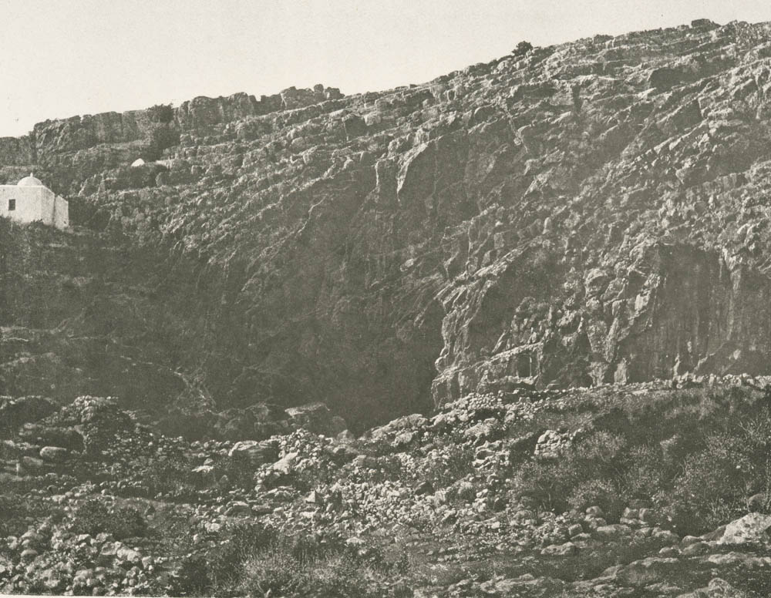
Caesarea Philippi sacred cave, 1874
Notes:
The spring of Caesarea Philippi emerges from the base of Mount Hermon. The site was sacred in the Hellenistic and Roman periods, and King Herod constructed an imperial temple in front of the cave. This photograph shows rubble surrounding the cave entrance, as well as the wely (shrine) of el-Khader, a saint sacred to Muslims and Druze, on the upper left and at least one sacred niche to the right of the cave. This photograph comes from Voyage d'exploration a la mer Morte, a Petra, et sur la rive gauche du Jourdain, by M. Le Comte De Vogüé (Paris, 1874), available via the New York Public Library at https://digitalcollections.nypl.org/items/510d47d9-5cf5-a3d9-e040-e00a18064a99
nypl76967

Slide 3
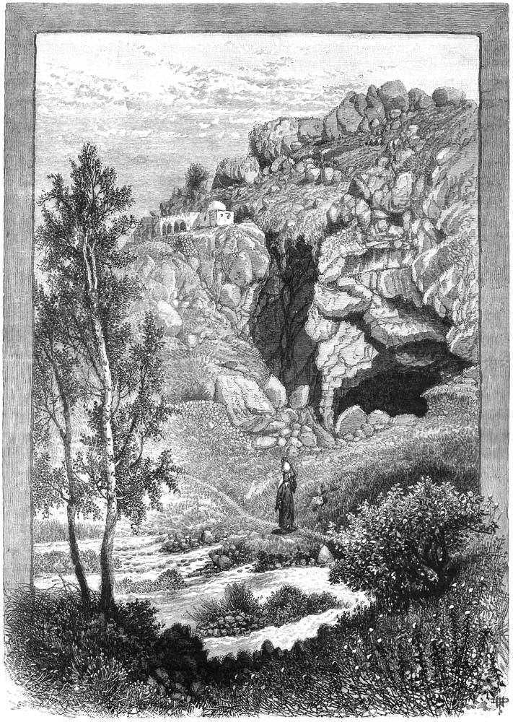
Caesarea Philippi sacred cave, 1880
Notes:
This illustration comes from Picturesque Palestine, volume 2: Samaria, Galilee, and Syria.
pp2110

Slide 4
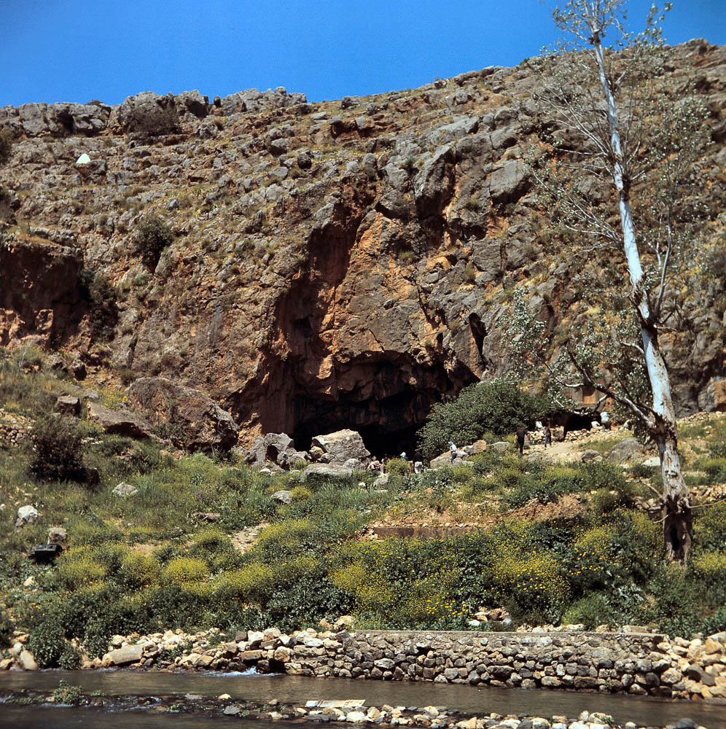
Caesarea Philippi sacred cave, 1968
Notes:
Since the site was on the Syrian side of the border until the 1967 war, little development for tourists had been done at the time of this photograph. This image comes from Views That Have Vanished: The Photographs of David Bivin.
db6804073605

Slide 5
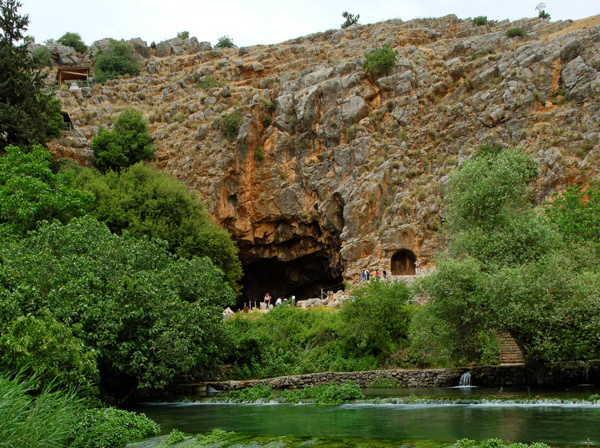
Caesarea Philippi sacred cave, 2012
Notes:
Today Caesarea Philippi (Banias) is one of Israel’s National Parks, and recent excavations are explained with signage along the tourist paths. Walkways have also been constructed to allow tourists to easily pass over the flowing water from the spring.
tb050112077

Slide 6
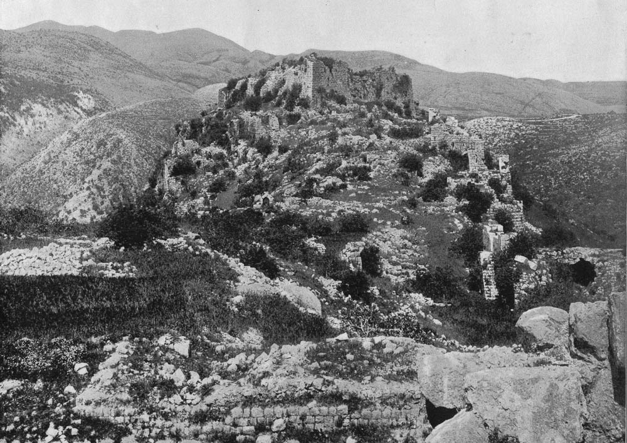
Nimrod’s Fortress and Mount Hermon, 1894
Notes:
Located on the slopes of Mount Hermon with a spectacular view of the Huleh Valley, Nimrod’s Fortress is associated in legend with the biblical figure mentioned in Genesis 10:8-9. Built by the Muslims in the 12th century, this castle changed hands several times that same century. This photograph shows the site before any reconstruction had been done. This photograph comes from Earthly Footsteps of the Man of Galilee.
ef0211

Slide 7
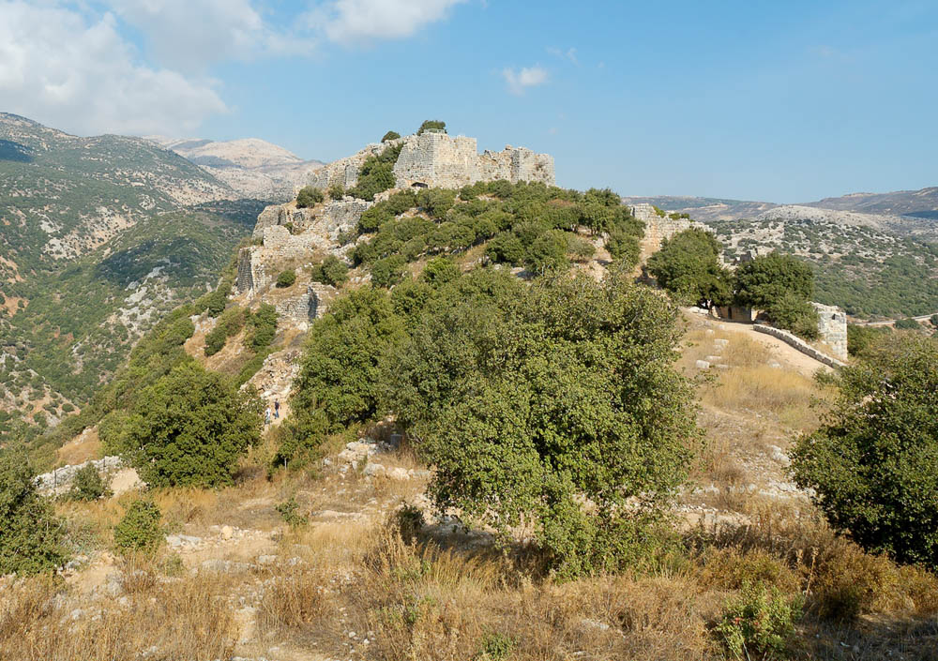
Nimrod’s Fortress and Mount Hermon, 2005
Notes:
The site is now a national park, with trails, staircases, guardrails, and lighting installed to enhance the visitors’ experience. The view shown here looks from the southern end of the castle up to the elevated keep.
tb100705576

Slide 8
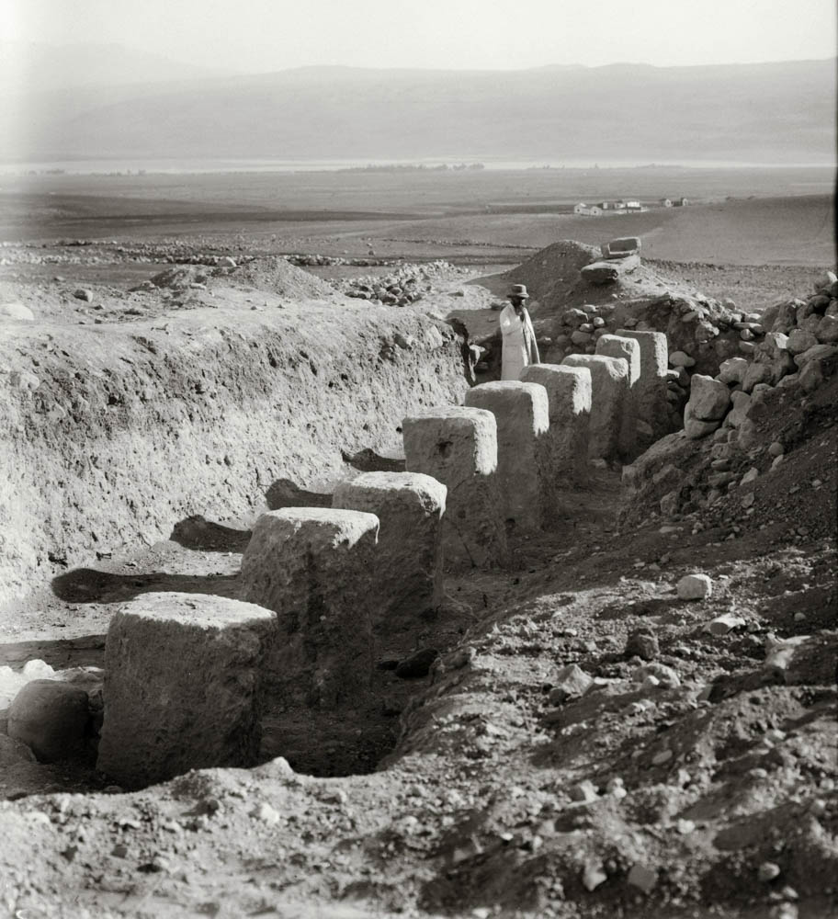
Hazor excavations of stables, 1928
Notes:
This photograph was taken during the excavations of John Garstang in 1928. This is one of two rows in a building later known as an Israelite tripartite pillared building, the function of which has been long debated. The waters of Lake Huleh are visible in the distance as are the mountains of the Golan Heights. This photograph comes from The American Colony and Eric Matson Collection, volume 1: Northern Palestine.
mat09289

Slide 9
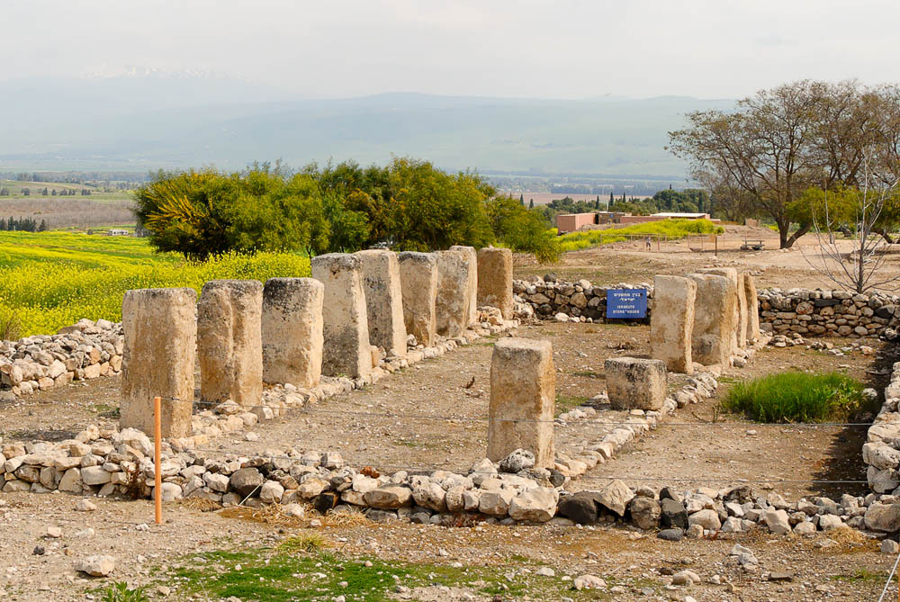
Hazor excavations of stables, 2007
Notes:
The complete building was revealed during the excavations of Yigael Yadin (1955–58); during the later excavations of Amnon Ben-Tor, the pillared building was moved and reconstructed at the present location in order to allow excavation of earlier remains. Some snow on Mount Hermon is visible in the upper left.
tb032607746

Slide 10
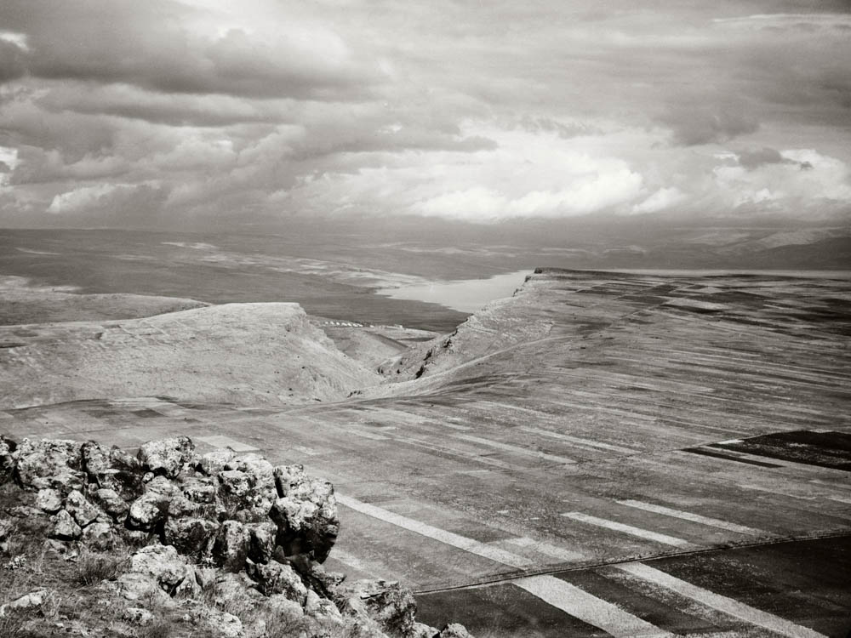
Sea of Galilee and Arbel from the Horns of Hattin, circa 1910
Notes:
The Horns of Hattin is an extinct volcano in eastern Galilee that is most famous for being the scene of the Crusaders’ defeat at the hands of Saladin on July 4, 1187. This view looks northeast from the Horns of Hattin, down to the cliffs of Arbel and the pass through the Valley of Doves below. The northwestern corner of the Sea of Galilee is visible, and the slopes of the Golan Heights rise in the distance. This photograph comes from The American Colony and Eric Matson Collection, volume 1: Northern Palestine.
mat05691

Slide 11
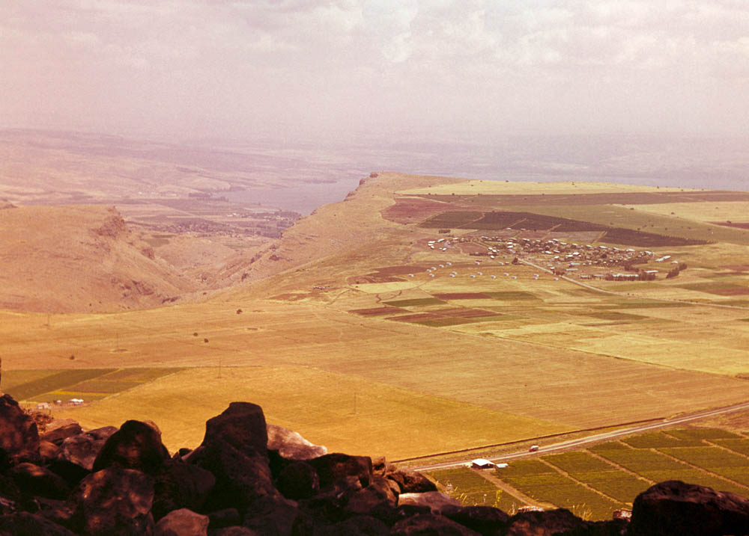
Sea of Galilee and Arbel from the Horns of Hattin, 1965
Notes:
The Israeli village of Arbel was settled in 1949 close to the site of an ancient Jewish village where a 4th-century synagogue has been discovered. This photograph comes from Views That Have Vanished: The Photographs of David Bivin.
db6505172112

Slide 12
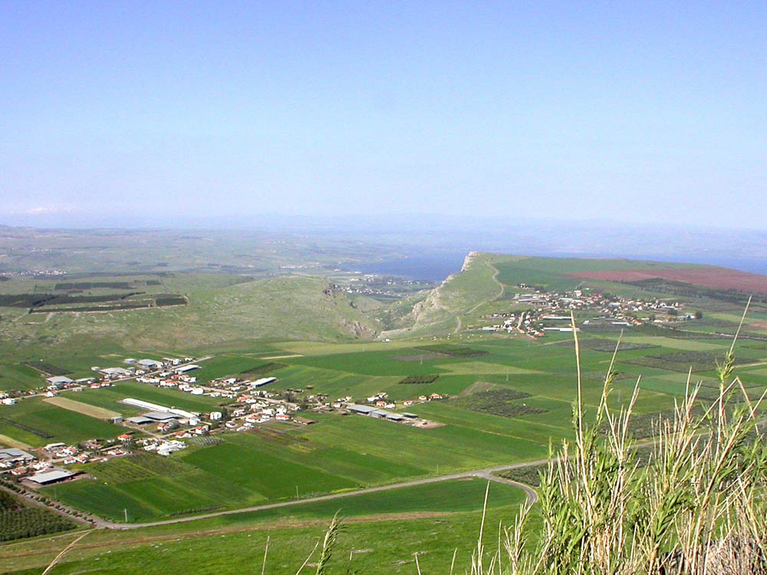
Sea of Galilee and Arbel from the Horns of Hattin, 2003
Notes:
The village of Kfar Zeitim is visible on the lower left. It was founded in 1950 by Jewish immigrants from Yemen. The snow-covered summit of Mount Hermon is visible on the far left.
tb041003204

Slide 13
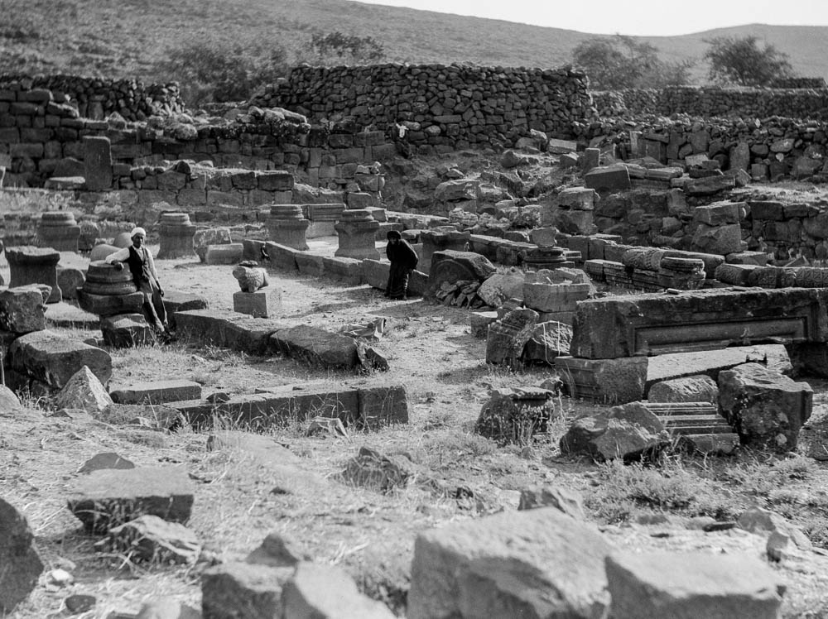
Chorazin synagogue, circa 1926
Notes:
These ruins were first identified as Chorazin by the British explorer Charles Wilson in 1869. Some initial clearing of the site took place in 1926 under the direction of the Department of Antiquities of Palestine. This photograph was probably taken at about that same time. This photograph comes from The American Colony and Eric Matson Collection, volume 1: Northern Palestine.
mat15353

Slide 14
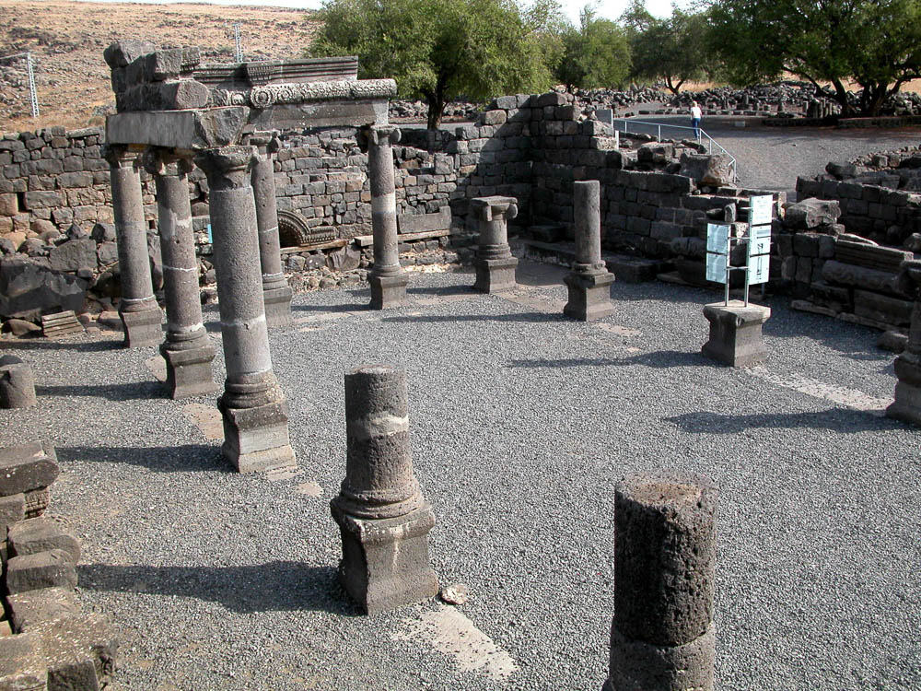
Chorazin synagogue, 2002
Notes:
Later excavations and reconstruction took place under Zeev Yeivin in 1962–65 and 1982–86. The site is now in Israel’s National Park system. This synagogue is believed to have been first built in the second century AD.
tb102502011

Slide 15
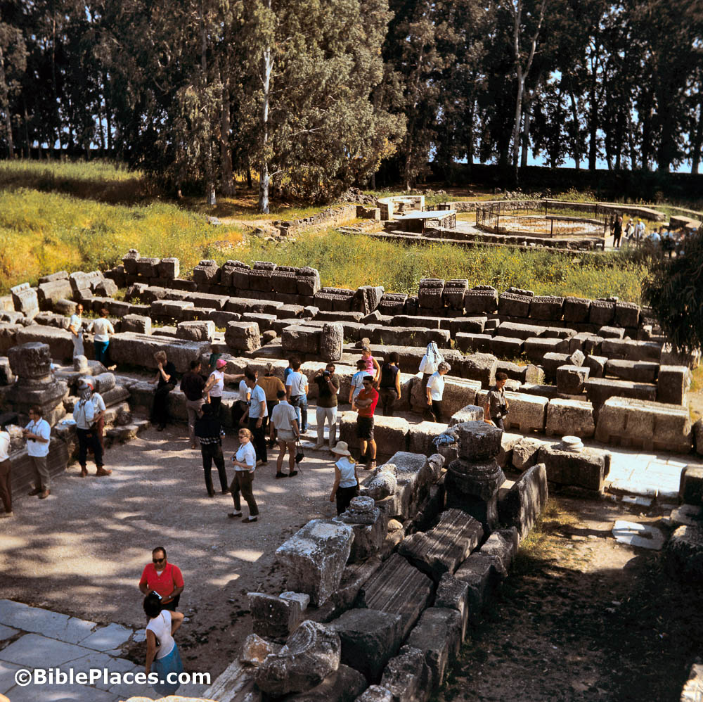
Capernaum Peter’s house from synagogue, 1968
Notes:
This rare perspective was taken from an elevated position in the partially reconstructed synagogue of Capernaum. The octagonal structure in the distance is the Byzantine church built over the traditional house of Peter. The shoreline of the Sea of Galilee is just beyond the line of trees. This photograph comes from Views That Have Vanished: The Photographs of David Bivin.
db6804063409

Slide 16
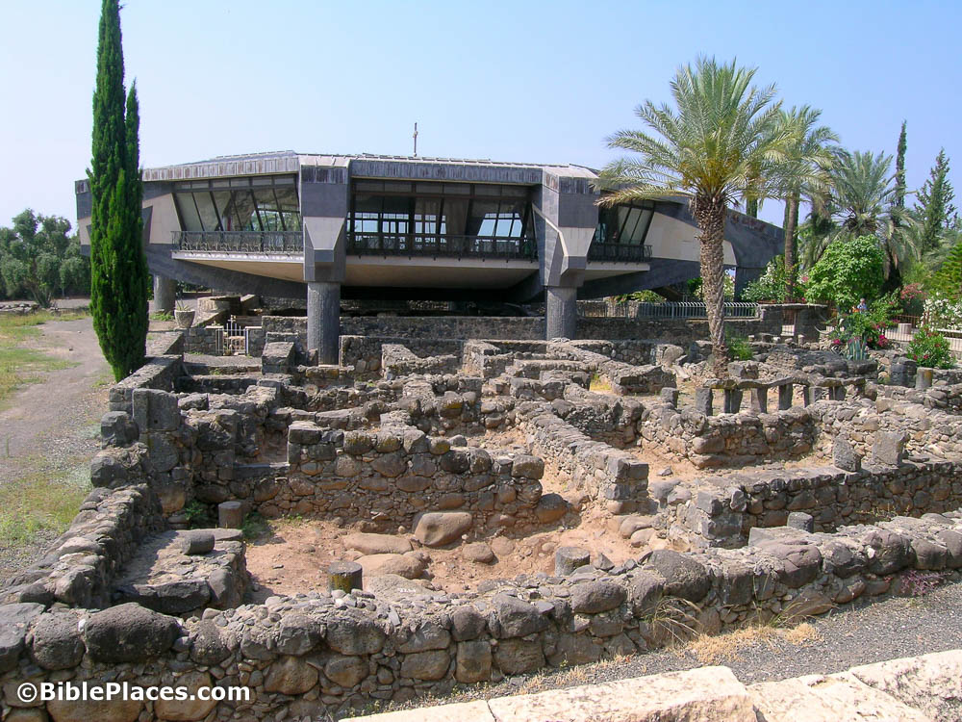
Capernaum Peter’s house from synagogue, 2004
Notes:
It is not possible to take a modern photo from the same position as the previous slide because of later reconstruction of the synagogue and rules forbidding the climbing of the ancient structures. But this similar perspective shows the excavated ruins of houses next to the synagogue as well as the modern Catholic Church, dedicated in 1990, that seems to hover over the remains of the place where early Christians gathered. A glass floor in the center of the church enables visitors to look down into the rooms identified as the first-century house of the apostle Peter.
tb052604018

Slide 17
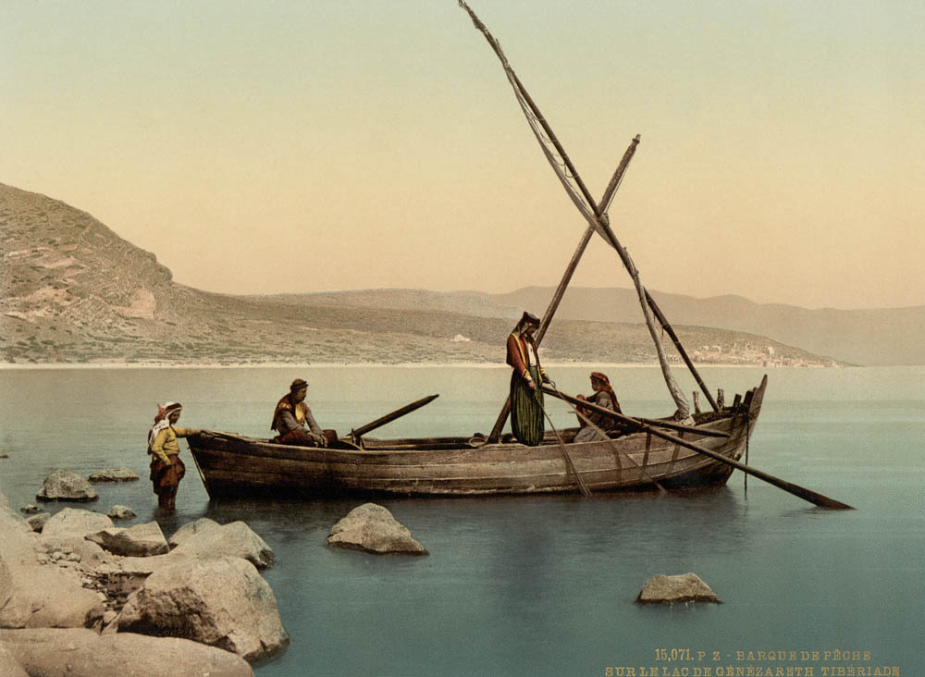
Fishing boat on the Sea of Galilee, 1890
Notes:
This and the following two slides show some of the changes in fishing over the years. This image comes from The Holy Land in Photochrom, a collection recently added to the Historic Views of the Holy Land. The original source of this image is available from the Library of Congress: https://www.loc.gov/collections/photochrom-prints/about-this-collection/.
pcm02740

Slide 18
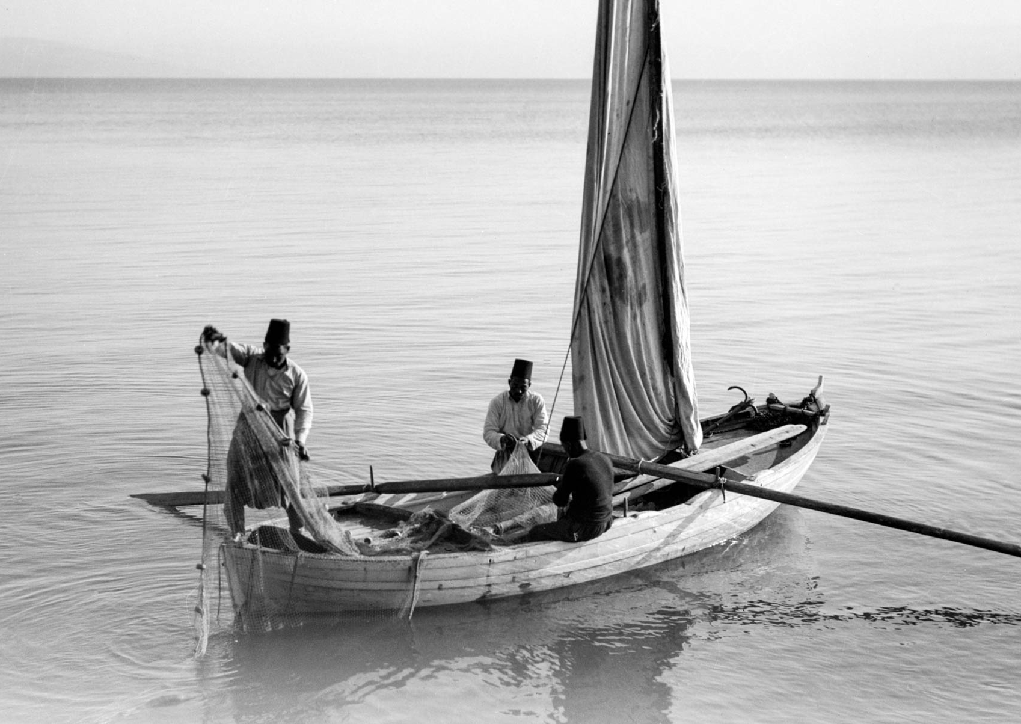
Fishing boat on the Sea of Galilee, 1945
Notes:
This photograph comes from The American Colony and Eric Matson Collection, volume 1: Northern Palestine.
mat21868

Slide 19
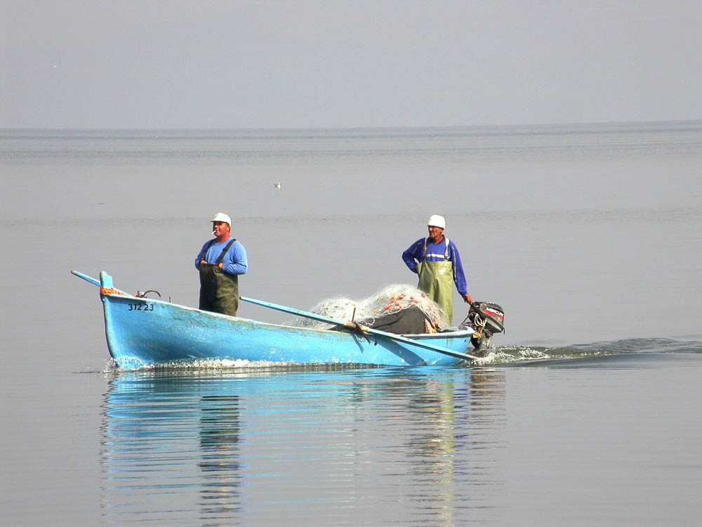
Fishing boat on the Sea of Galilee, 2003
Notes:
Overfishing has led to a great reduction in, and at times government prohibition of, fishing in the Sea of Galilee.
tb041203201

Slide 20
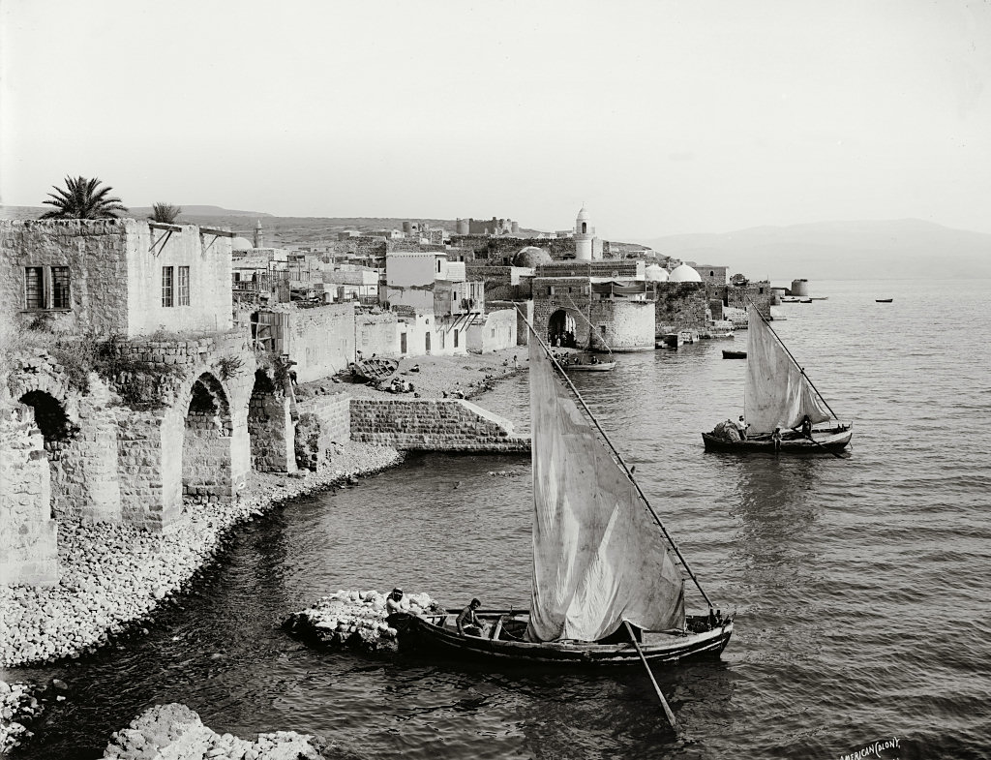
Tiberias shoreline, circa 1910
Notes:
Tiberias has been a continuously inhabited village on the western shore of the Sea of Galilee since the time of Jesus. The population included both Jews and Arabs for centuries, though since 1948, almost all of the population is Jewish. This photograph comes from The American Colony and Eric Matson Collection, volume 1: Northern Palestine.
mat07012

Slide 21
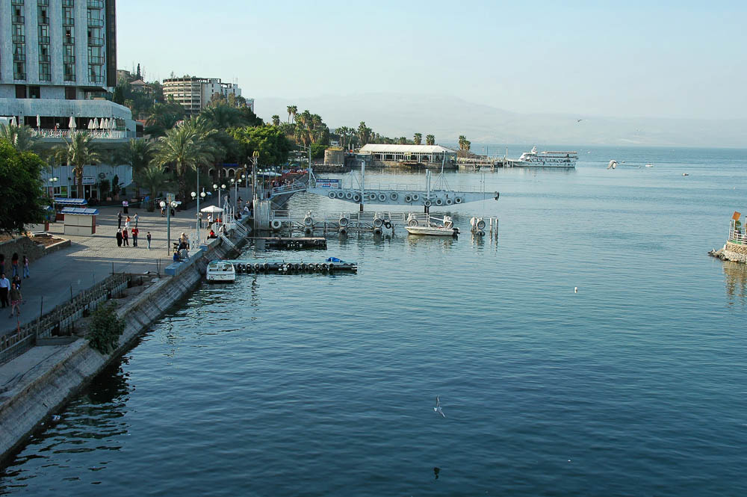
Tiberias shoreline, 2005
Notes:
The shoreline of Tiberias is today dominated by hotels, restaurants, and shops, as this city is the most popular overnight destination for tourists in Galilee.
tb032705562

Slide 22
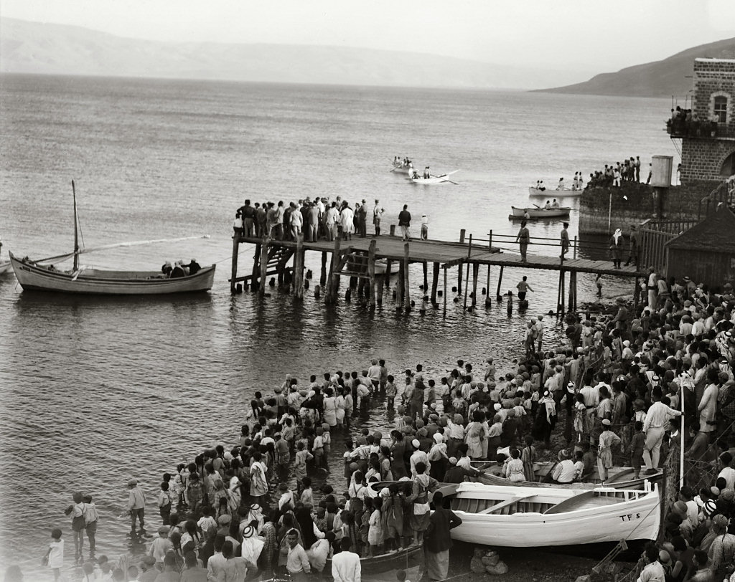
Tiberias shoreline, 1931
Notes:
The crowds are gathered on the dock and on the shoreline in anticipation of the arrival of the first seaplane on the Sea of Galilee. This photograph comes from The American Colony and Eric Matson Collection, volume 1: Northern Palestine.
mat06451

Slide 23
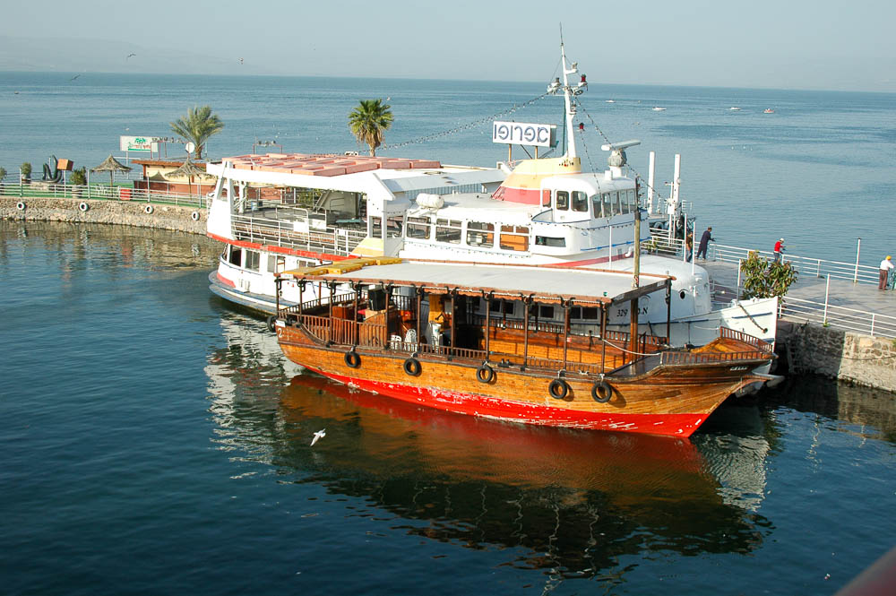
Tiberias shoreline, 2005
Notes:
No seaplanes land on the Sea of Galilee today, and most of the boat traffic consists of vessels carrying tourists to see the famous lake where Jesus calmed the storm and walked on water.
tb032705565

Slide 24
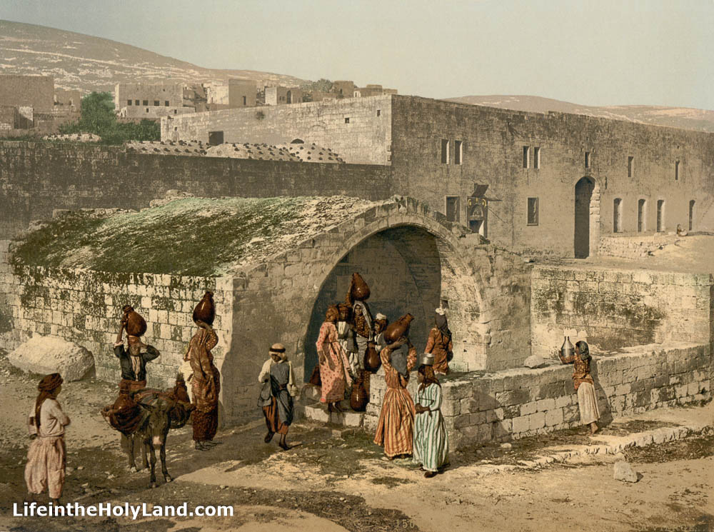
Nazareth Mary’s Well, 1890
Notes:
This is the traditional well where Mary came to get water, and the tradition makes sense as water sources usually don’t move. The town well was a popular place for women to gather and socialize. This image comes from The Holy Land in Photochrom, a collection recently added to the Historic Views of the Holy Land.
pcm02731

Slide 25
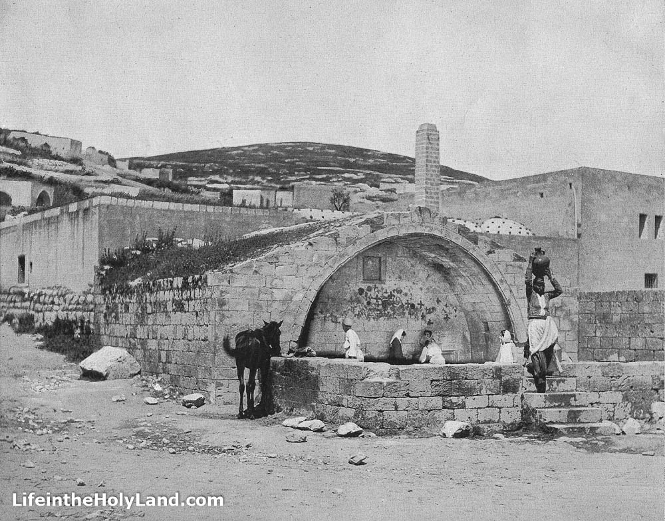
Nazareth Mary’s Well, 1890
Notes:
This photograph comes from Earthly Footsteps of the Man of Galilee. Though the given date for both photos is 1890, they clearly were not taken at the same time, as evidenced by the different access visible in each photo. We know (from comparison with a photo not included here) that this photo was taken after the previous slide but published in a book in 1894, suggesting that the previous one may date to the 1880s.
ef0105

Slide 26
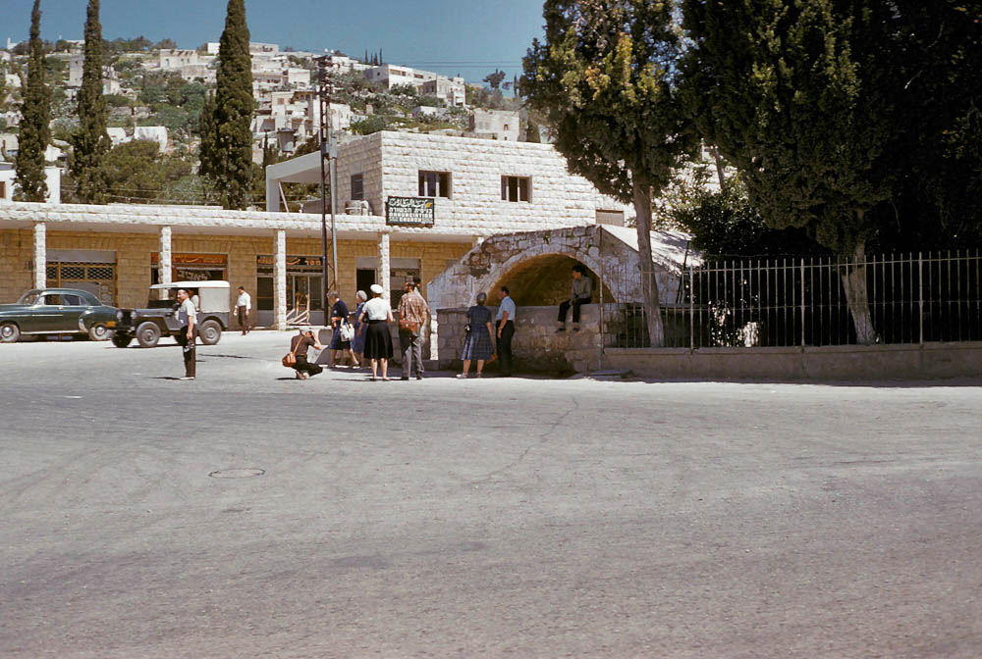
Nazareth Mary's Well
Nazareth Mary’s Well, 1961
Notes:
This photograph comes from The Photographs of Charles Lee Feinberg. With the advent of modern plumbing, the well’s purpose has changed, and it is now a tourist stop.
cf13-70

Slide 27
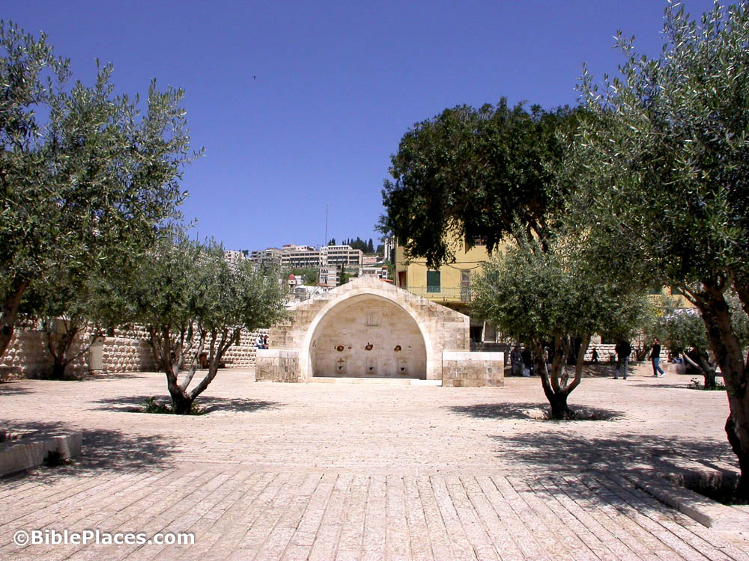
Nazareth Mary’s Well, 2003
Notes:
In order to accommodate large tourist groups, the municipality constructed a large paved plaza in front of the site.
tb041003218

Slide 28
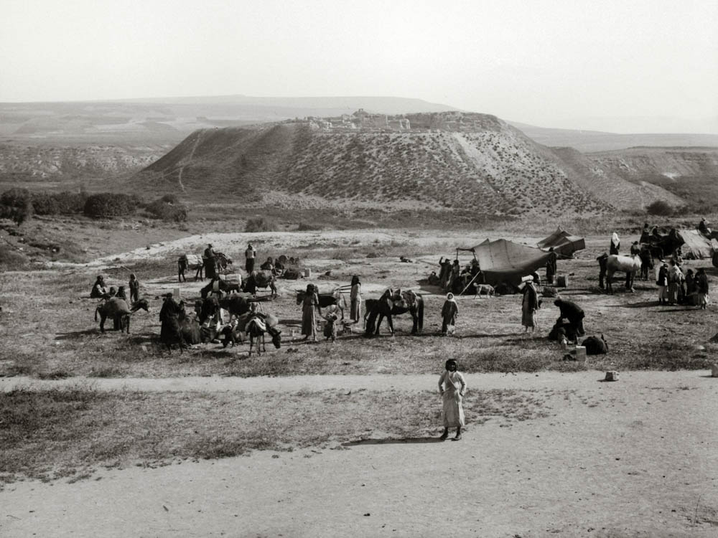
Beth Shean, circa 1925
Notes:
Beth Shean is a favorite tourist stop today, but most would be surprised to see how it looked before excavations began in the 1980s. The Greco-Roman city is completely buried at the base of the prominent tell, though part of one pillar (not visible here) was visible according to early reports. This photograph comes from The American Colony and Eric Matson Collection, volume 1: Northern Palestine.
mat02786

Slide 29
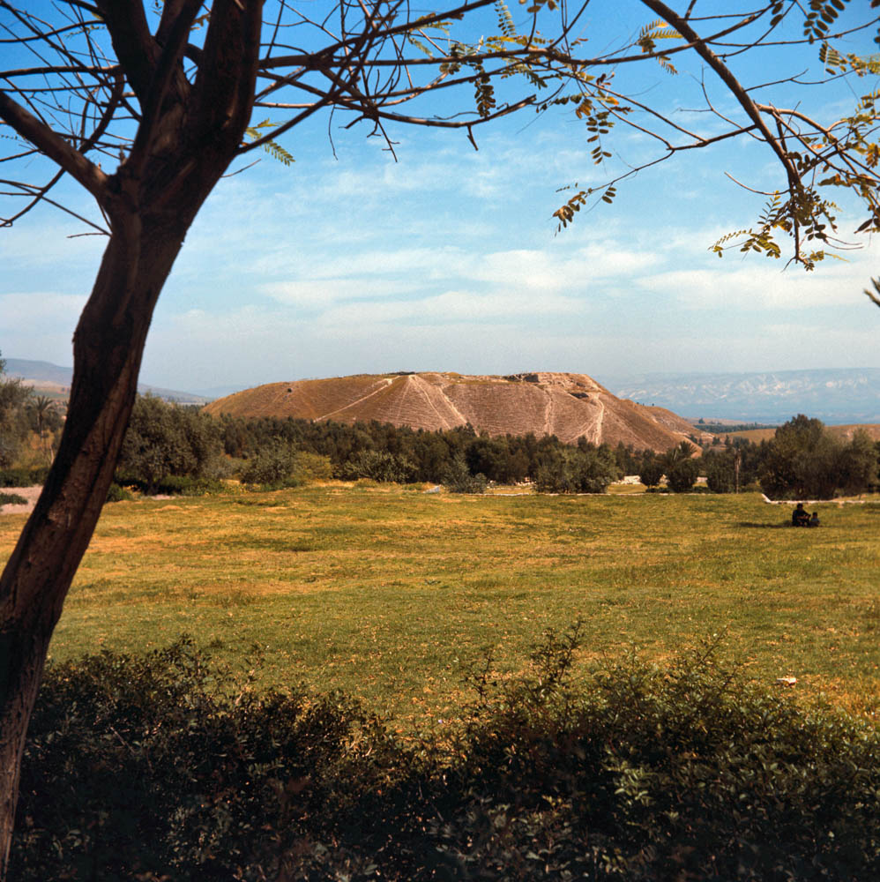
Beth Shean, 1968
Notes:
The visitor to the site in the 1960s could hardly imagine the spectacular ruins that lay buried under this field. This photograph comes from Views That Have Vanished: The Photographs of David Bivin.
db6804063302

Slide 30
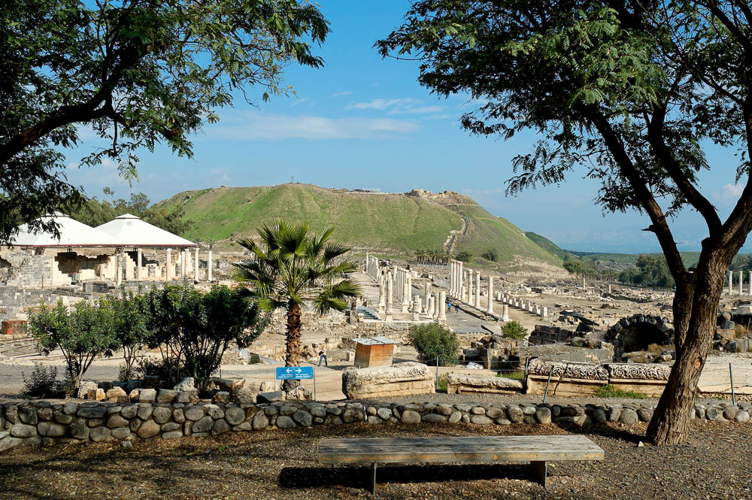
Beth Shean, 2006
Notes:
Excavations beginning in the 1980s exposed Roman and Byzantine ruins of the city of Scythopolis, including several large bathhouses (one visible on the left), colonnaded paved streets, and monumental buildings. The site has been partially reconstructed. The top of the tell has also been excavated, revealing remains from the Canaanite and Israelite periods.
tb011506672

Slide 31
Notes:
The Photo Companion to the Bible is a unique digital resource that illustrates the biblical text with modern and historic photographs of ancient sites, museum artifacts, and cultural scenes. This PowerPoint-based collection goes verse by verse through each Bible book, providing beautiful photographs, descriptive text, and explanatory notes to enhance Bible study and teaching. For more information, go to https://www.bibleplaces.com/gospels-photo-companion-to-the-bible/
The Historic Views of the Holy Land is a collection of stunning photographs, beautiful engravings, and fascinating descriptions from the early explorers of Palestine. These discs are ideal for study, research, and teaching. All of the illustrations are included as high-resolution jpg files and in ready-made PowerPoint files. The text is in edit-able, search-able, copy-able, and print-able PDF format – making it suitable for any use. All of the books preserve the original layout and pagination. https://www.bibleplaces.com/historicviews/
The Pictorial Library of Bible Lands is an extensive collection of high-quality, high-resolution photographs for use in teaching the Bible and ancient history. The complete collection includes more than 19,000 photographs in 19 volumes, making images available to Bible teachers and students without royalty fees for educational use. The photographs are illuminated by extensive annotations included in pre-made PowerPoint presentations organized by subject for easy access and use by pastors, teachers, and students. https://www.bibleplaces.com/details/

Slide 32
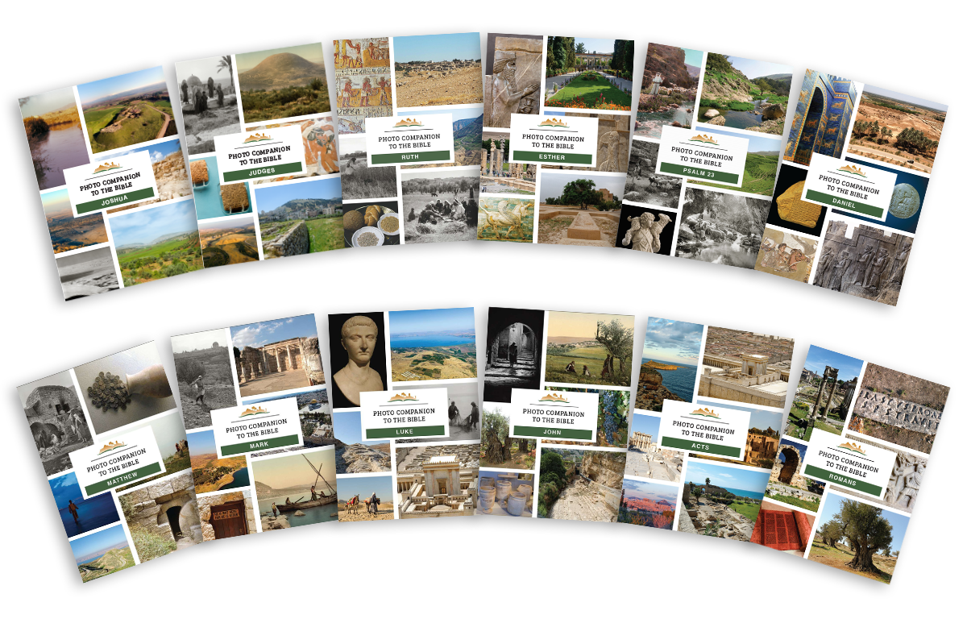
Notes:
The Photo Companion to the Bible is a unique digital resource that illustrates the biblical text with modern and historic photographs of ancient sites, museum artifacts, and cultural scenes. This PowerPoint-based collection goes verse by verse through each Bible book, providing beautiful photographs, descriptive text, and explanatory notes to enhance Bible study and teaching. For more information, go to https://www.bibleplaces.com/gospels-photo-companion-to-the-bible/

Slide 33
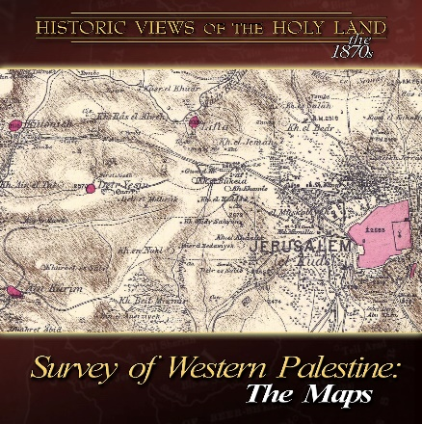
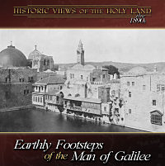
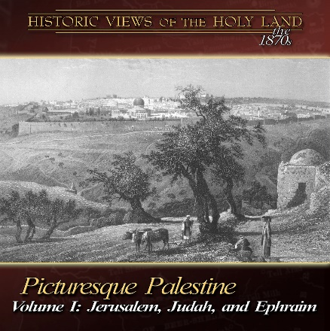
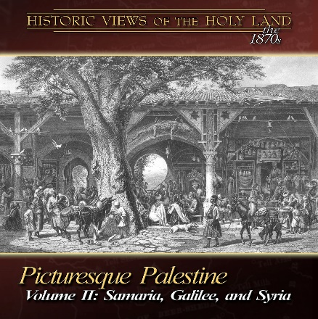
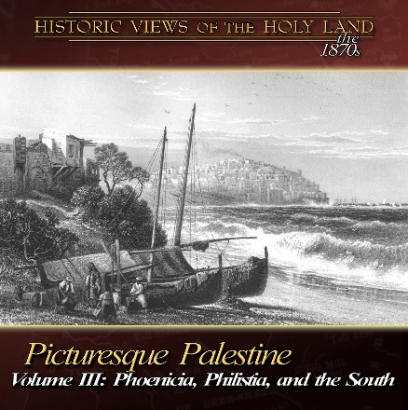
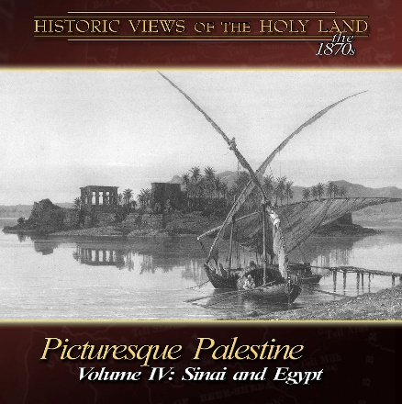
Notes:
The Historic Views of the Holy Land is a collection of stunning photographs, beautiful engravings, and fascinating descriptions from the early explorers of Palestine. These discs are ideal for study, research, and teaching. All of the illustrations are included as high-resolution jpg files and in ready-made PowerPoint files. The text is in edit-able, search-able, copy-able, and print-able PDF format—making it suitable for any use. All of the books preserve the original layout and pagination. https://www.bibleplaces.com/historicviews/

Slide 34
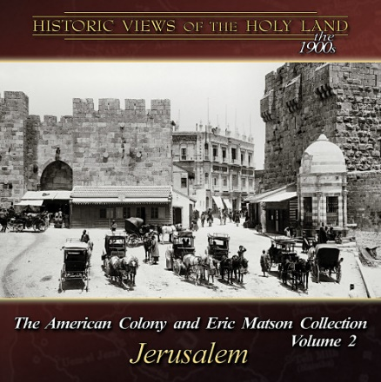
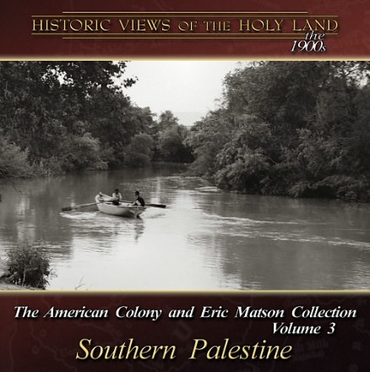
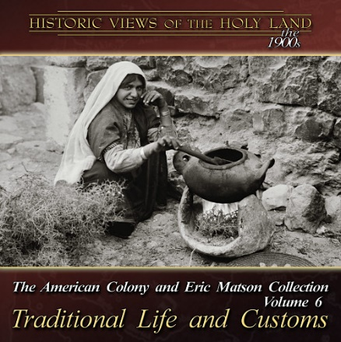
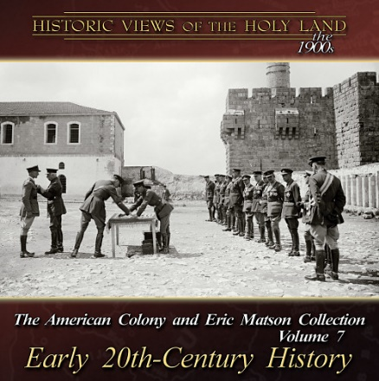
Notes:
The Historic Views of the Holy Land is a collection of stunning photographs, beautiful engravings, and fascinating descriptions from the early explorers of Palestine. These discs are ideal for study, research, and teaching. All of the illustrations are included as high-resolution jpg files and in ready-made PowerPoint files. The text is in edit-able, search-able, copy-able, and print-able PDF format—making it suitable for any use. All of the books preserve the original layout and pagination. https://www.bibleplaces.com/historicviews/

Slide 35
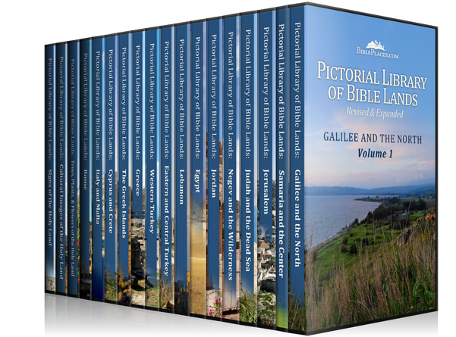
Notes:
The Pictorial Library of Bible Lands is an extensive collection of high-quality, high-resolution photographs for use in teaching the Bible and ancient history. The complete collection includes more than 19,000 photographs in 19 volumes, making images available to Bible teachers and students without royalty fees for educational use. The photographs are illuminated by extensive annotations included in pre-made PowerPoint presentations organized by subject for easy access and use by pastors, teachers, and students. https://www.bibleplaces.com/details/

