Slide 1
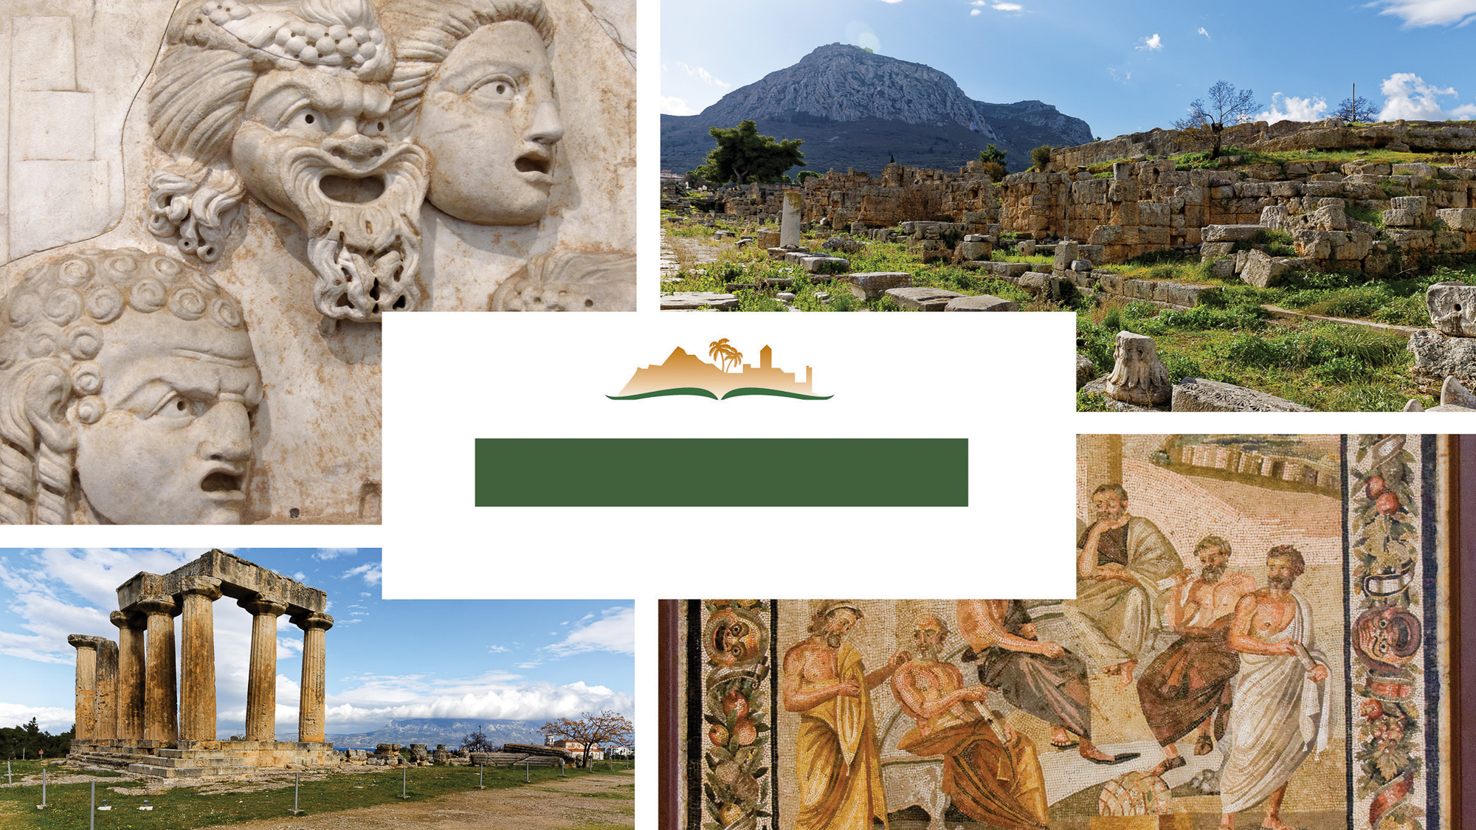
1 Corinthians 13
Notes:
This is a free sample of the 1 Corinthians 13 presentation from the Photo Companion to the Bible. To purchase the full volume, visit https://www.bibleplaces.com/1corinthians/
The Photo Companion to the Bible is an image-rich resource for Bible students, teachers, and researchers. Just as a librarian stocks the shelves with as many relevant materials as possible, so we have tried to provide a broad selection of images. Our goal is that you will find in this “library” whatever it is you are looking for.
Credits: The primary creators of this presentation are Dr. Kris Udd, Dr. Christian Locatell, Dr. Steven D. Anderson, and Dr. Todd Bolen. The photographs have an individual file code which usually includes the initials of the photographer. Other images have additional credit or source information.
Updates: We plan to update this collection as we are able. We welcome your suggestions for improving this resource (photocompanion@bibleplaces.com). Purchasers of the 1 Corinthians volume are provided free, lifetime updates to the volume.
Copyright: This photo collection is protected by copyright law and may not be distributed without written permission from BiblePlaces.com. Slide notes should be treated as any other copyrighted written material, with credit given when quoting from these notes.
For more information, see our complete “Introduction to the Photo Companion to the Bible” online at http://www.BiblePlaces.com/Intro-Photo-Companion-Bible/. Here you will find more information about photo selection, explanatory notes, Bible translation, credit information, and copyright allowances.

Slide 2
1 Corinthians 13
This is a free sample of the 1 Corinthians 13 presentation from the Photo Companion to the Bible. To purchase the full volume, visit https://www.bibleplaces.com/1corinthians/ The Photo Companion to the Bible is an image-rich resource for Bible students, teachers, and researchers. Just as a librarian stocks the shelves with as many relevant materials as possible, so we have tried to provide a broad selection of images. Our goal is that you will find in this “library” whatever it is you are looking for. For more details (for this and every slide), see the Notes section below.
Notes:
This is a free sample of the 1 Corinthians 13 presentation from the Photo Companion to the Bible. To purchase the full volume, visit https://www.bibleplaces.com/1corinthians/
The Photo Companion to the Bible is an image-rich resource for Bible students, teachers, and researchers. Just as a librarian stocks the shelves with as many relevant materials as possible, so we have tried to provide a broad selection of images. Our goal is that you will find in this “library” whatever it is you are looking for.
Credits: The primary creators of this presentation are Dr. Kris Udd, Dr. Christian Locatell, Dr. Steven D. Anderson, and Dr. Todd Bolen. The photographs have an individual file code which usually includes the initials of the photographer. Other images have additional credit or source information.
Updates: We plan to update this collection as we are able. We welcome your suggestions for improving this resource (photocompanion@bibleplaces.com). Purchasers of the 1 Corinthians volume are provided free, lifetime updates to the volume.
Copyright: This photo collection is protected by copyright law and may not be distributed without written permission from BiblePlaces.com. Slide notes should be treated as any other copyrighted written material, with credit given when quoting from these notes.
For more information, see our complete “Introduction to the Photo Companion to the Bible” online at http://www.BiblePlaces.com/Intro-Photo-Companion-Bible/. Here you will find more information about photo selection, explanatory notes, Bible translation, credit information, and copyright allowances.

Slide 3
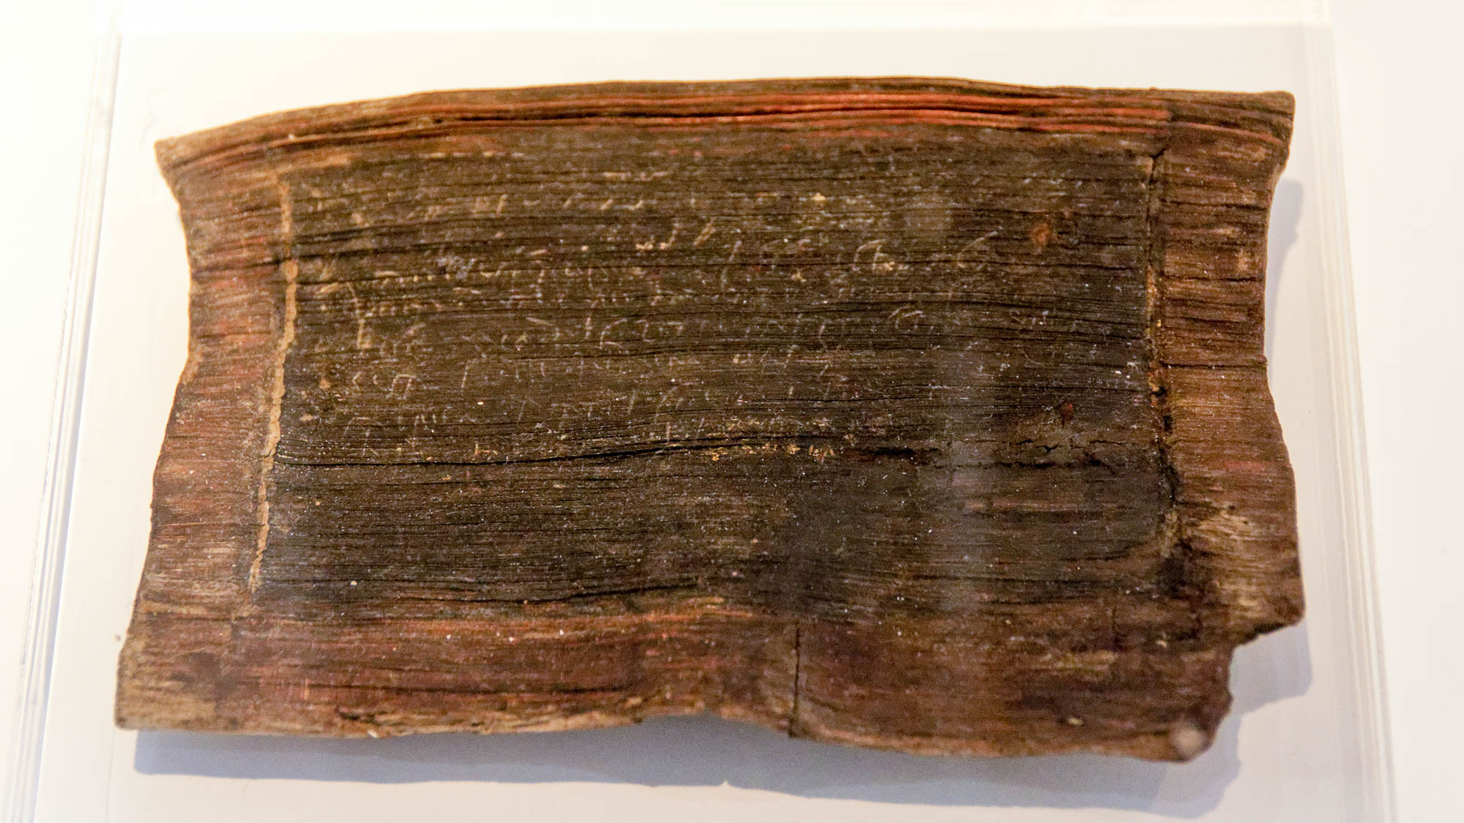
If I speak in the tongues of men
Bilingual loan agreement, Greek and Latin, from Pompeii, AD 38
13:1
Notes:
In Paul’s day, it was very desirable to know multiple languages. The Roman empire incorporated a large number of people groups with a variety of languages (cf. Acts 2:5-11). Greek was the most common language of the empire at that time, having been spread across the region centuries earlier by the conquests of Alexander the Great. Latin was second most common, being the mother tongue of the Romans themselves, and used for official Roman business. The bilingual loan agreement shown here is written in Greek and Latin. This artifact was photographed at a special exhibit at the site of Pompeii.
tb0516172223h

Slide 4
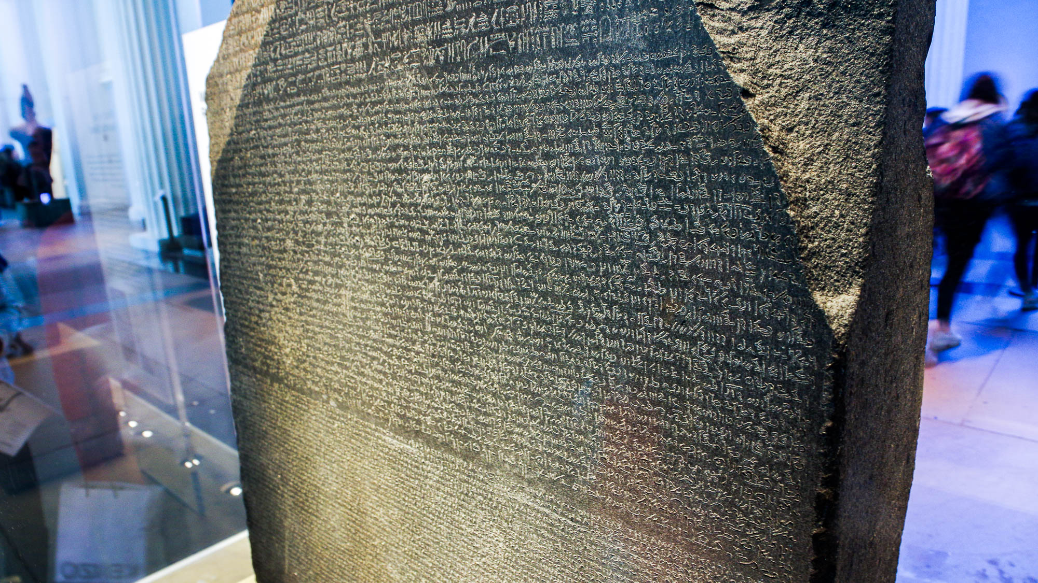
If I speak in the tongues of men
Rosetta Stone, reign of Ptolemy V Epiphanes, 196 BC
13:1
Notes:
A famous example of multilingualism is the Rosetta Stone, an inscription written in Egyptian Hieroglyphs, Demotic, and Greek. When Ptolemy V was thirteen years old, in 196 BC, he was crowned Theos Epiphanes (Θεός Ἐπιφανής, “Illustrious god”) in order to make him a king of legal capacity. This was similar to the cults established by earlier Ptolemaic kings. The Rosetta Stone records the establishment of this cult at Ptolemy V’s coronation. This inscription was photographed at the British Museum.
adr1805170144h

Slide 5
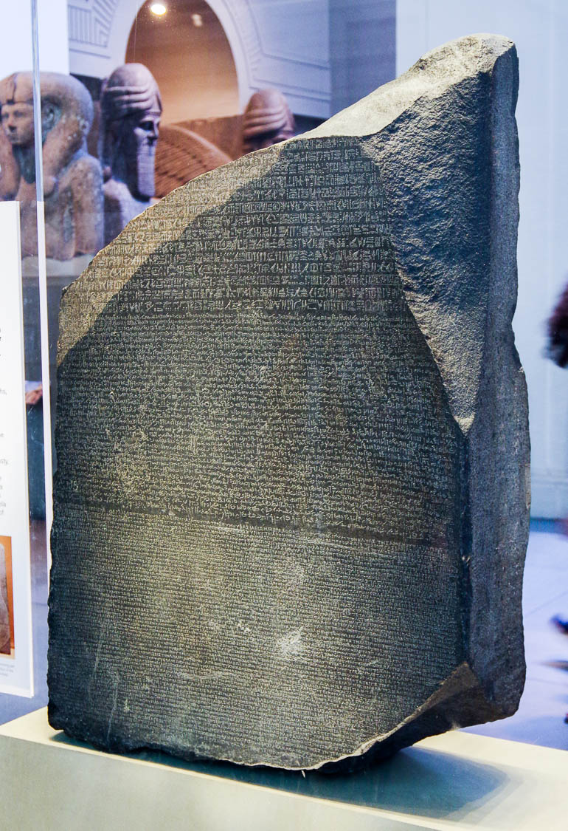
If I speak in the tongues of men
Rosetta Stone, reign of Ptolemy V Epiphanes, 196 BC
13:1
Notes:
This inscription was photographed at the British Museum.
adr1805171978h

Slide 6
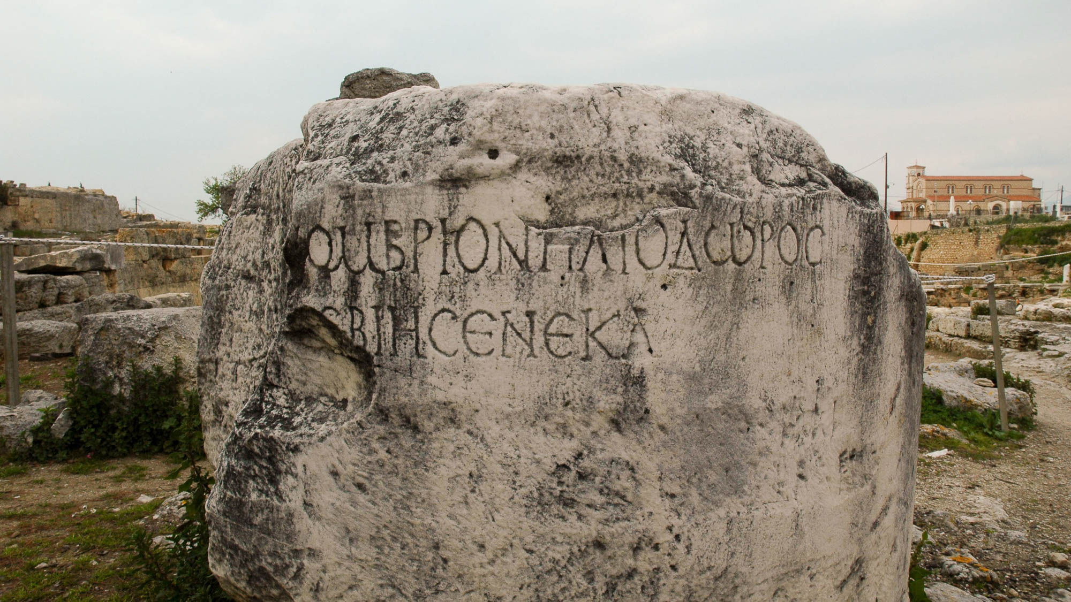
If I speak in the tongues of men
The name of Seneca on a column at Corinth, 1st century AD
13:1
Notes:
Gallio, proconsul of Asia and the one who held Paul’s trial when he was in Corinth (Acts 18:12-17), was the son of a rhetorician named Seneca (the Elder) and the brother of a philosopher named Seneca (the Younger). Seneca the Younger is the more famous of the two Senecas. The Greek inscription shown here was discovered at Corinth and preserves the name “Seneca.” Gallio was also a nephew of the poet Lucan. It is within this social context of high regard for rhetoric and philosophy that Paul now tells the Corinthians that such abilities are worthless without love.
tb031706115h

Slide 7
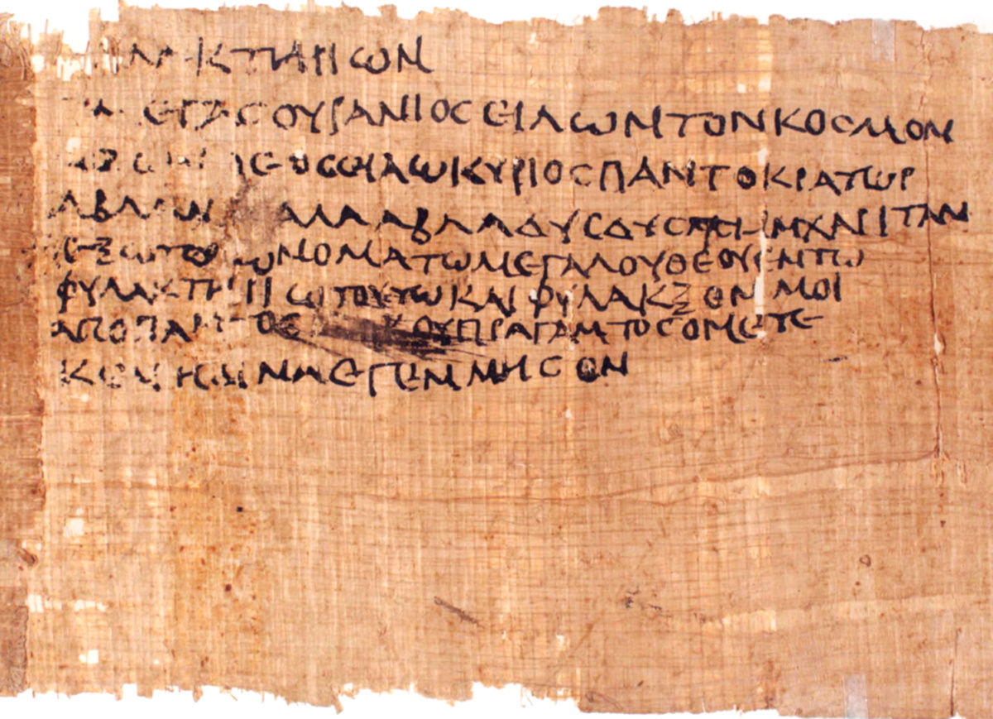
If I speak in the tongues of men and of angels
Jewish magic text used in a phylactery, from Egypt, circa AD 200
13:1
Notes:
The meaning of Paul’s reference to “the tongues of angels” is debated. Some take it to refer to an actual heavenly language spoken colloquially by angels. Support for this understanding is perhaps found in the apocryphal Testament of Job which describes Job’s daughters as being given the power to speak in the angelic language (if this text is, in fact, pre-Pauline). Others take this statement as hyperbole. The following verse, 1 Corinthians 13:2, is certainly hyperbolic. This would mean that even the most spectacular command of language, including celestial prose, is worthless without love.
In any case, it is also interesting to note the use of “unknown” or unintelligible speech in religious contexts during this time. An example is the Jewish syncretism of Paul’s day that mixed biblical concepts with pagan mysticism. Such Jewish syncretism can be seen in magic texts on papyri from Egypt during the Greco-Roman period which often employ the magical palindrome “ABLANATHANALBA.” The example shown here dates to the late 2nd or early 3rd centuries AD, but it is essentially the same as Jewish syncretistic texts dating to Paul’s day. Also see the slide on 1 Corinthians 14:14 for a text invoking angels themselves with unintelligible speech.
The first word in the text is “phylactery” (Gk. phulaktērion, φυλακτήριον), a common item used by Jews in religious activities (cf. Matt 23:4). The text goes on to invoke Iao, a syncretistic name of a super deity derived from the name of God from the Hebrew Bible, Yahweh. The name is also used to refer to lesser deities and spiritual beings. The Advanced Papyrological Information System on the University of Michigan website gives the following translation: “A phylactery: ‘Great [god] in heaven revolving the world, the true god, IAO! Lord, ruler of all, ABLANATHANALBA, grant, grant me this favor, let me have the name of the great god in this phylactery, and protect, from every evil thing, me whom NN bore, (NN) begot.’”
The word “ABLANATHANALBA” functioned in these types of texts as a magical palindrome, reading the same forward or backward. Some suggest it may derive from the Aramaic phrase “You are our father” (Aram. אב לנא את, av lana at). The next slide highlights the words “phylactery,” “Iao,” and “ABLANATHANALBA.”
This image comes from the University of Michigan, Advanced Papyrological Information System, and is in the public domain. Source: http://quod.lib.umich.edu/a/apis/x-1546/193_a.tif. University of Michigan Library Digital Collections. Accessed: Oct 15, 2019.
umapis1931546207

Slide 8
If I speak in the tongues of men and of angels
Jewish magic text used in a phylactery, from Egypt, circa AD 200
13:1
Notes:
The meaning of Paul’s reference to “the tongues of angels” is debated. Some take it to refer to an actual heavenly language spoken colloquially by angels. Support for this understanding is perhaps found in the apocryphal Testament of Job which describes Job’s daughters as being given the power to speak in the angelic language (if this text is, in fact, pre-Pauline). Others take this statement as hyperbole. The following verse, 1 Corinthians 13:2, is certainly hyperbolic. This would mean that even the most spectacular command of language, including celestial prose, is worthless without love.
In any case, it is also interesting to note the use of “unknown” or unintelligible speech in religious contexts during this time. An example is the Jewish syncretism of Paul’s day that mixed biblical concepts with pagan mysticism. Such Jewish syncretism can be seen in magic texts on papyri from Egypt during the Greco-Roman period which often employ the magical palindrome “ABLANATHANALBA.” The example shown here dates to the late 2nd or early 3rd centuries AD, but it is essentially the same as Jewish syncretistic texts dating to Paul’s day. Also see the slide on 1 Corinthians 14:14 for a text invoking angels themselves with unintelligible speech.
The first word in the text is “phylactery” (Gk. phulaktērion, φυλακτήριον), a common item used by Jews in religious activities (cf. Matt 23:4). The text goes on to invoke Iao, a syncretistic name of a super deity derived from the name of God from the Hebrew Bible, Yahweh. The name is also used to refer to lesser deities and spiritual beings. The Advanced Papyrological Information System on the University of Michigan website gives the following translation: “A phylactery: ‘Great [god] in heaven revolving the world, the true god, IAO! Lord, ruler of all, ABLANATHANALBA, grant, grant me this favor, let me have the name of the great god in this phylactery, and protect, from every evil thing, me whom NN bore, (NN) begot.’”
The word “ABLANATHANALBA” functioned in these types of texts as a magical palindrome, reading the same forward or backward. Some suggest it may derive from the Aramaic phrase “You are our father” (Aram. אב לנא את, av lana at). The two words marked in blue are “phylactery”; the word marked in yellow is “Iao”; the word marked in green is “ABLANATHANALBA.”
This image comes from the University of Michigan, Advanced Papyrological Information System, and is in the public domain. Source: http://quod.lib.umich.edu/a/apis/x-1546/193_a.tif. University of Michigan Library Digital Collections. Accessed: Oct 15, 2019.
umapis1931546207

Slide 9
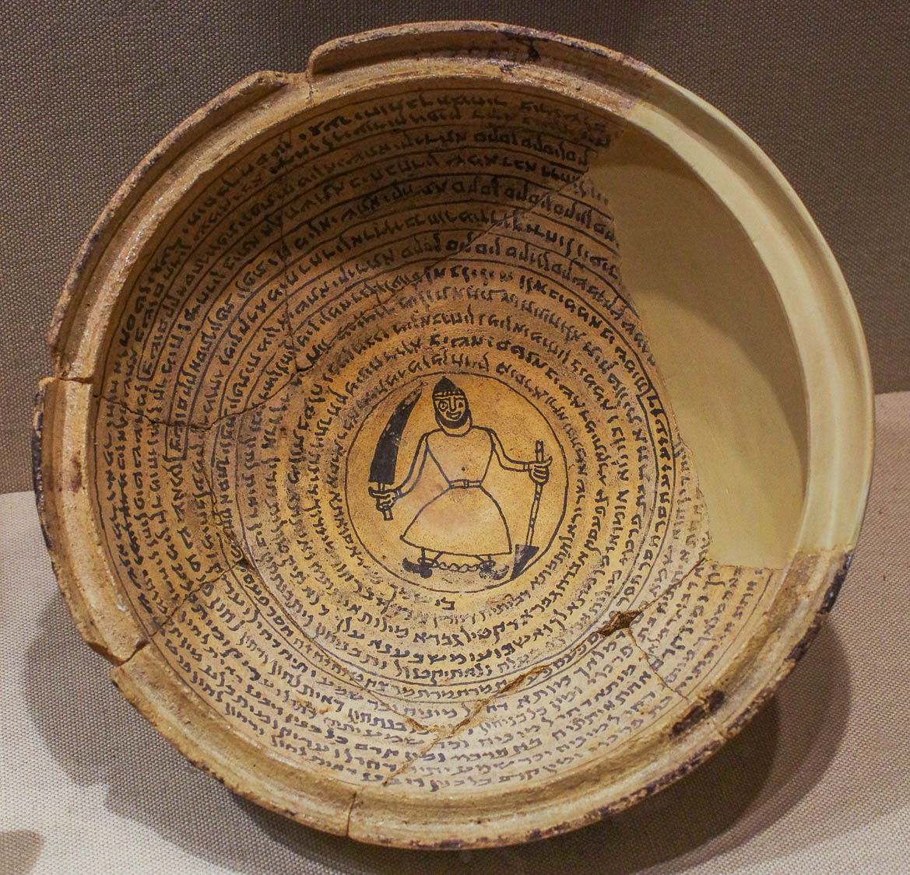
If I speak in the tongues of men and of angels
Bowl with an Aramaic incantation and a demon, from Nippur, 6th–7th centuries AD
13:1
Notes:
Another interesting case of the use of unintelligible language is found in magical bowls such as the one pictured here. While from a time much later than Paul’s day, there are close contemporary parallels (cf. Acts 13:6). Especially notable is the use of various “‘magical syllables’ constituting ‘this great name,’” such as Z‘Z‘Z‘ HSR HSR HSR P‘SP‘SP‘ TMR TMR TMR ZHZHZH etc., which were repetitiously chanted (Montgomery 1913: 128).
A large number of such Jewish Babylonian Aramaic magic texts inscribed in bowls have been found widely distributed throughout the world of late antiquity. These texts were used as magical incantations to invoke various divine beings and angels, both for various human needs and as protection from malevolent spiritual powers. The bowl pictured here contains a text asking for deliverance from a murderous demon called Tsp’sq (Aram. צפעסק) for a man named Ardoi and for his family. The demon is depicted with his feet bound by chains in the center of the bowl. The text invokes a god and a whole list of magical names that appear to be derived from the epithets of Babylonian deities at Nippur, where this magic bowl was found (Montgomery 1913: 129).
This bowl was photographed at the Metropolitan Museum of Art in New York City. A transcription and translation of the text can be found in Montgomery (1913: 126–32) available at https://archive.org/details/aramaicincantati00montuoft/page/126. See the next slide for markers highlighting the sections of magical syllables invoking the spiritual powers.
Reference:
Montgomery, James A.
1913 Aramaic Incantation Texts from Nippur. The Museum Publications of the Babylonian Section 3. Philadelphia: University of Pennsylvania Press.
adr1606035564h

Slide 10
If I speak in the tongues of men and of angels
Bowl with an Aramaic incantation and a demon, from Nippur, 6th–7th centuries AD
13:1
Notes:
Another interesting case of the use of unintelligible language is found in magical bowls such as the one pictured here. While from a time much later than Paul’s day, there are close contemporary parallels (cf. Acts 13:6). Especially notable is the use of various “‘magical syllables’ constituting ‘this great name,’” such as Z‘Z‘Z‘ HSR HSR HSR P‘SP‘SP‘ TMR TMR TMR ZHZHZH etc., which were repetitiously chanted (Montgomery 1913: 128).
A large number of such Jewish Babylonian Aramaic magic texts inscribed in bowls have been found widely distributed throughout the world of late antiquity. These texts were used as magical incantations to invoke various divine beings and angels, both for various human needs and as protection from malevolent spiritual powers. The bowl pictured here contains a text asking for deliverance from a murderous demon called Tsp’sq (Aram. צפעסק) for a man named Ardoi and for his family. The demon is depicted with his feet bound by chains in the center of the bowl. The text invokes a god and a whole list of magical names that appear to be derived from the epithets of Babylonian deities at Nippur, where this magic bowl was found (Montgomery 1913: 129).
This bowl was photographed at the Metropolitan Museum of Art in New York City. A transcription and translation of the text can be found in Montgomery (1913: 126–32) available at https://archive.org/details/aramaicincantati00montuoft/page/126.
Reference:
Montgomery, James A.
1913 Aramaic Incantation Texts from Nippur. The Museum Publications of the Babylonian Section 3. Philadelphia: University of Pennsylvania Press.
adr1606035564h

Slide 11
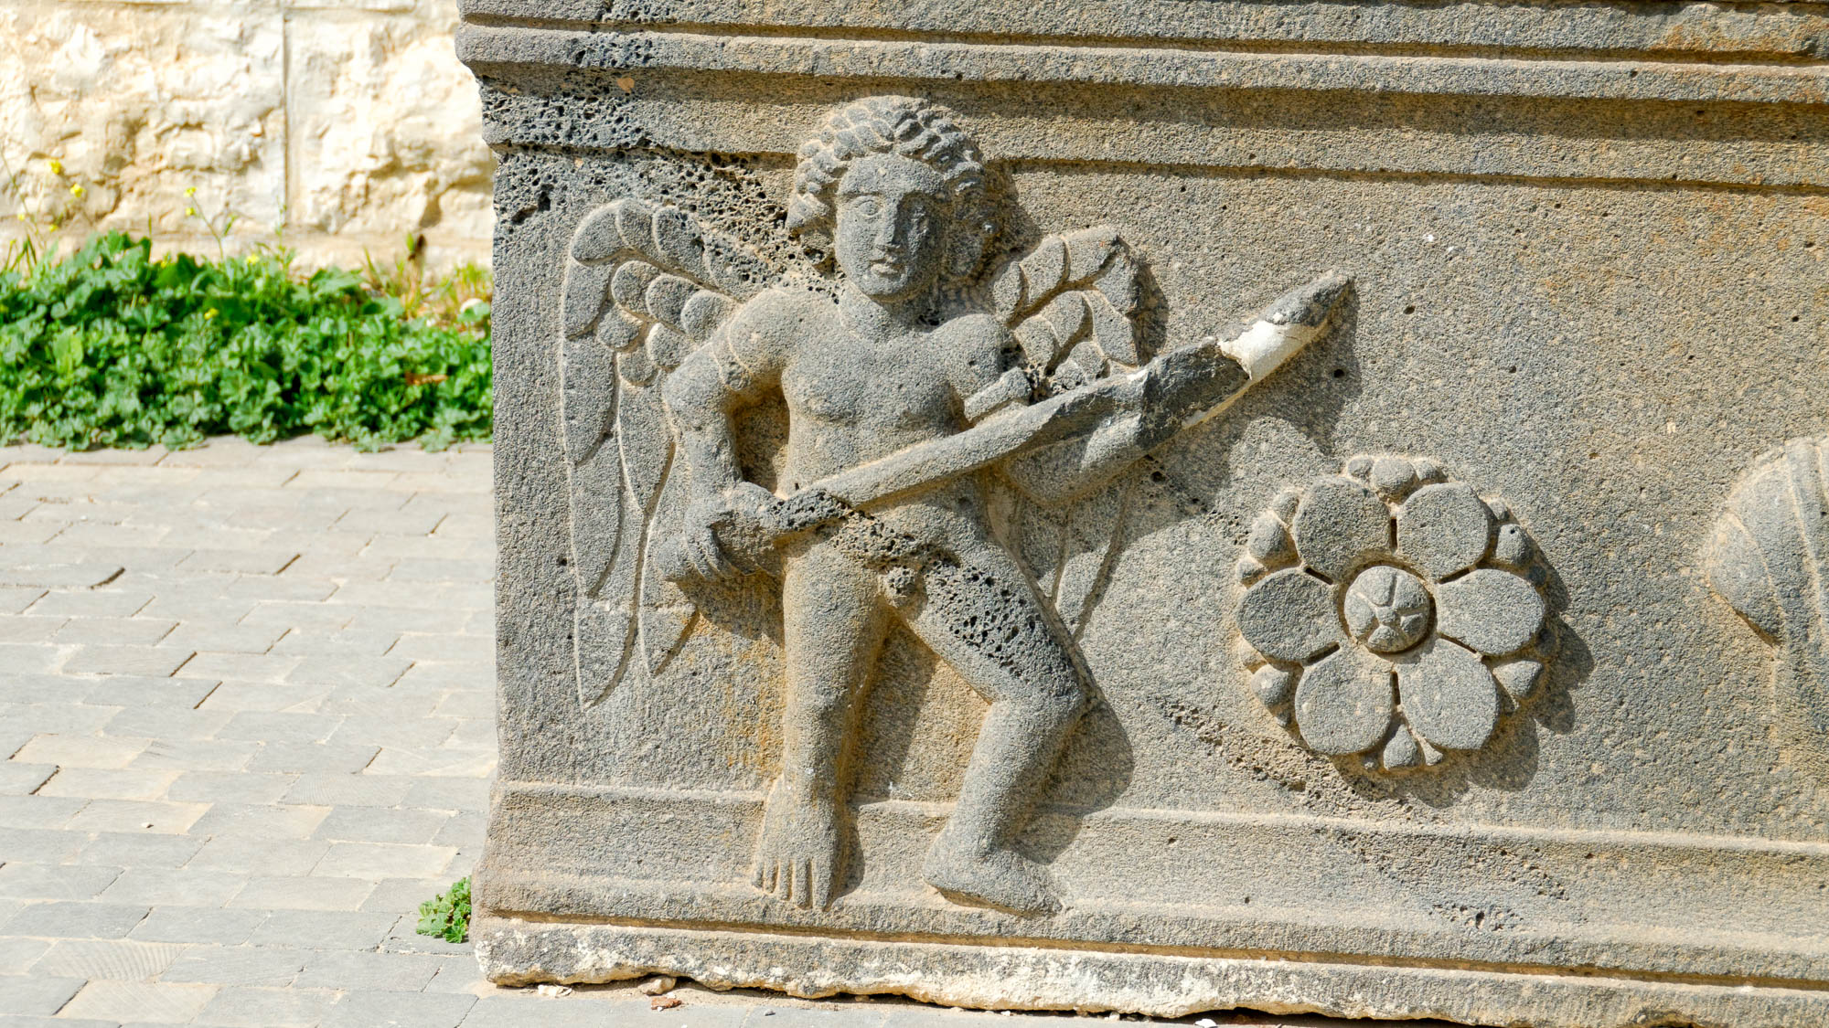
If I speak in the tongues of men and of angels
Basalt sarcophagus depicting an angel with a sword, from the Amman citadel, Roman period
13:1
Notes:
Angels were a popular subject in Jewish culture, and by this time there was a highly developed discourse surrounding the nature of angels. This can be seen in various ancient writings from this period, including texts from Qumran.
tb031115116h

Slide 12
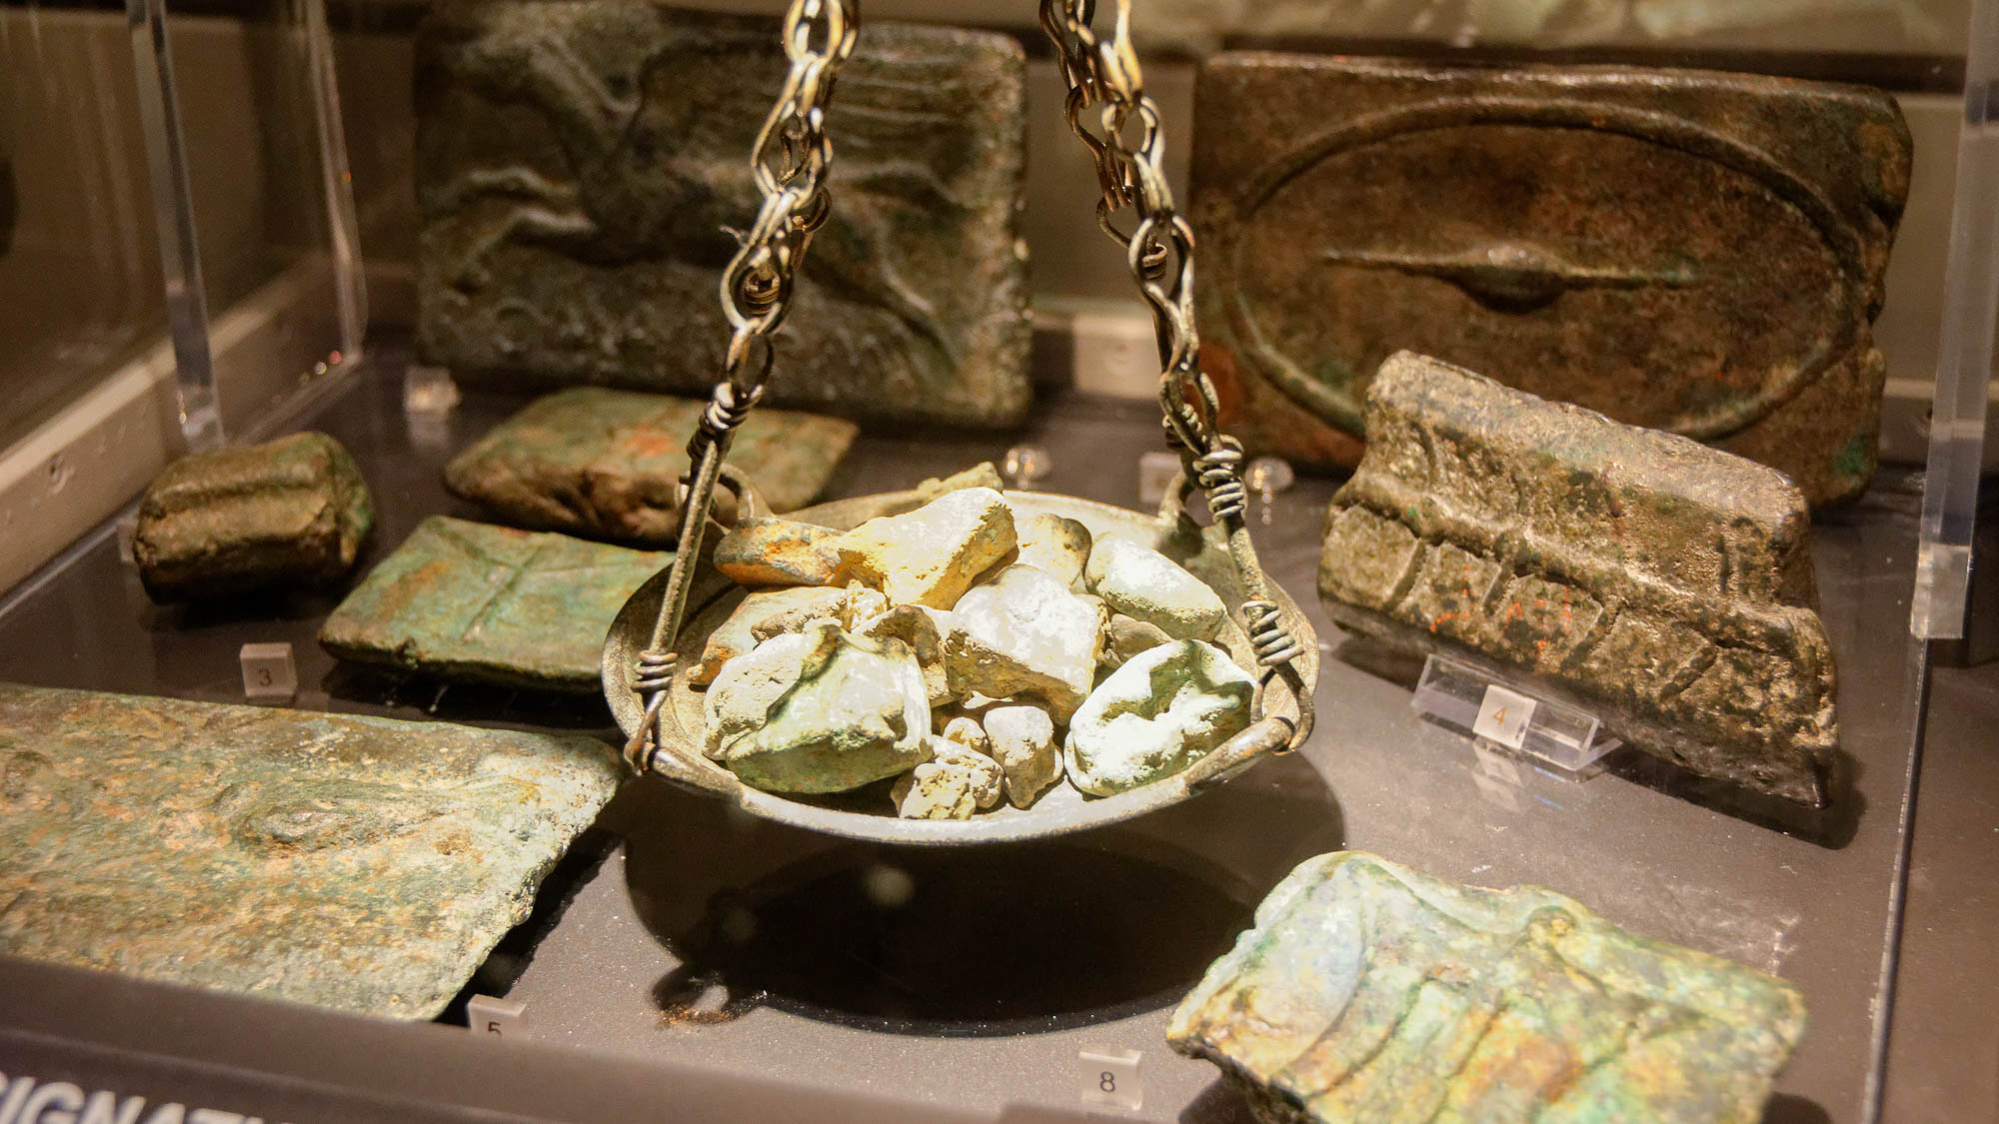
But if I do not have love, I have become a sounding brass or a clanging cymbal
Scale, weights, aes rude, bronze ingots of various varieties, Early Roman period
13:1
Notes:
There is debate about what Paul is referring to with the word rendered here as “brass” (Gr. chalkos, χαλκός). Most generally, it refers to a metallic substance itself (copper, brass, or bronze), and by extension things made up of those metals (e.g., coins, Mark 12:41). Some have pointed out that this word is nowhere used unambiguously for musical instruments and have thus suggested that Paul has in mind clanking chunks of metal (Garland 2003: 611–13). If this is what Paul intended, he would be saying that without love we would be no more than “a clanking chunk of bronze” (ibid.: 608). No intelligible or aesthetically pleasing sound would be produced from such clanking. The pan in this display includes aes rude, a sort of nugget of bronze used as a kind of proto-currency in ancient Italy, prior to the use of minted coins made from precious metals. This display was photographed at the National Museum of Rome.
Reference:
Garland, David E.
2003 1 Corinthians. Baker Exegetical Commentary on the New Testament. Grand Rapids: Baker Academic.
tb0513177978h

Slide 13
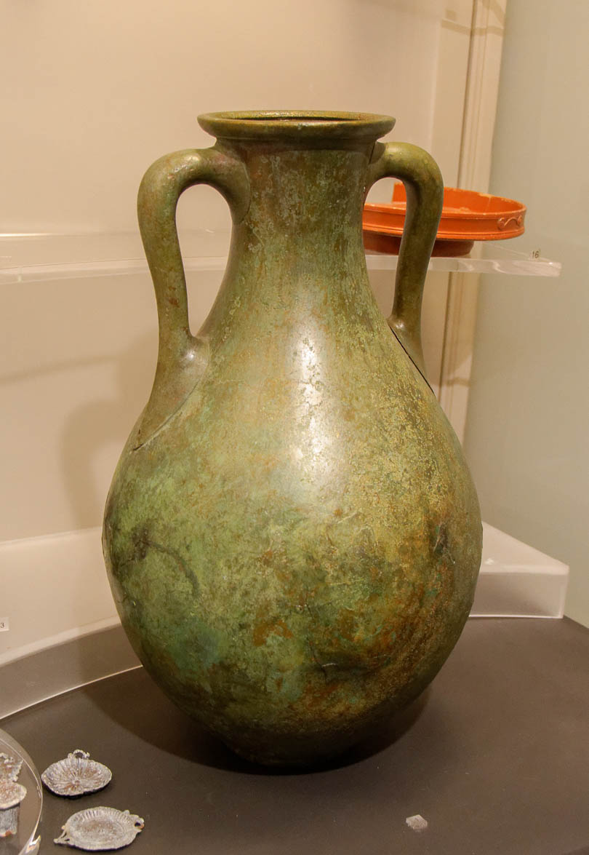
But if I do not have love, I have become a sounding brass or a clanging cymbal
Bronze amphora, 1st century AD
13:1
Notes:
Alternatively, it has been observed that bronze vases were used in theaters to amplify sound that would reverberate through them. The same word rendered here as “sounding” (Gr. ēchōn, ἠχῶν) was used to refer to these bronze vases which would amplify sound (Garland 2003: 612). The bronze vase pictured here was probably not used for theater amplification but illustrates what such a bronze vase from this time would look like. It was photographed at the National Museum of Rome.
Reference:
Garland, David E.
2003 1 Corinthians. Baker Exegetical Commentary on the New Testament. Grand Rapids: Baker Academic.
tb0513177928

Slide 14
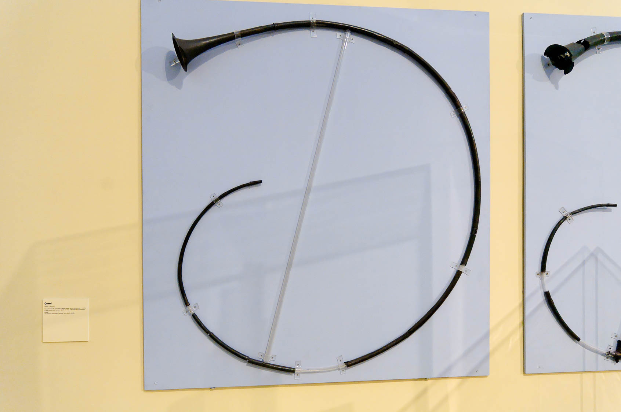
But if I do not have love, I have become a sounding brass or a clanging cymbal
Bronze horn from Pompeii, 1st century AD
13:1
Notes:
If Paul had a brass musical instrument in mind, it may have been the type of Roman horn pictured here. For a recording of a modern version of this instrument, see https://www.youtube.com/watch?v=1IlZgj2FAHA. This horn was photographed at the Naples Archaeological Museum.
tb111705751

Slide 15
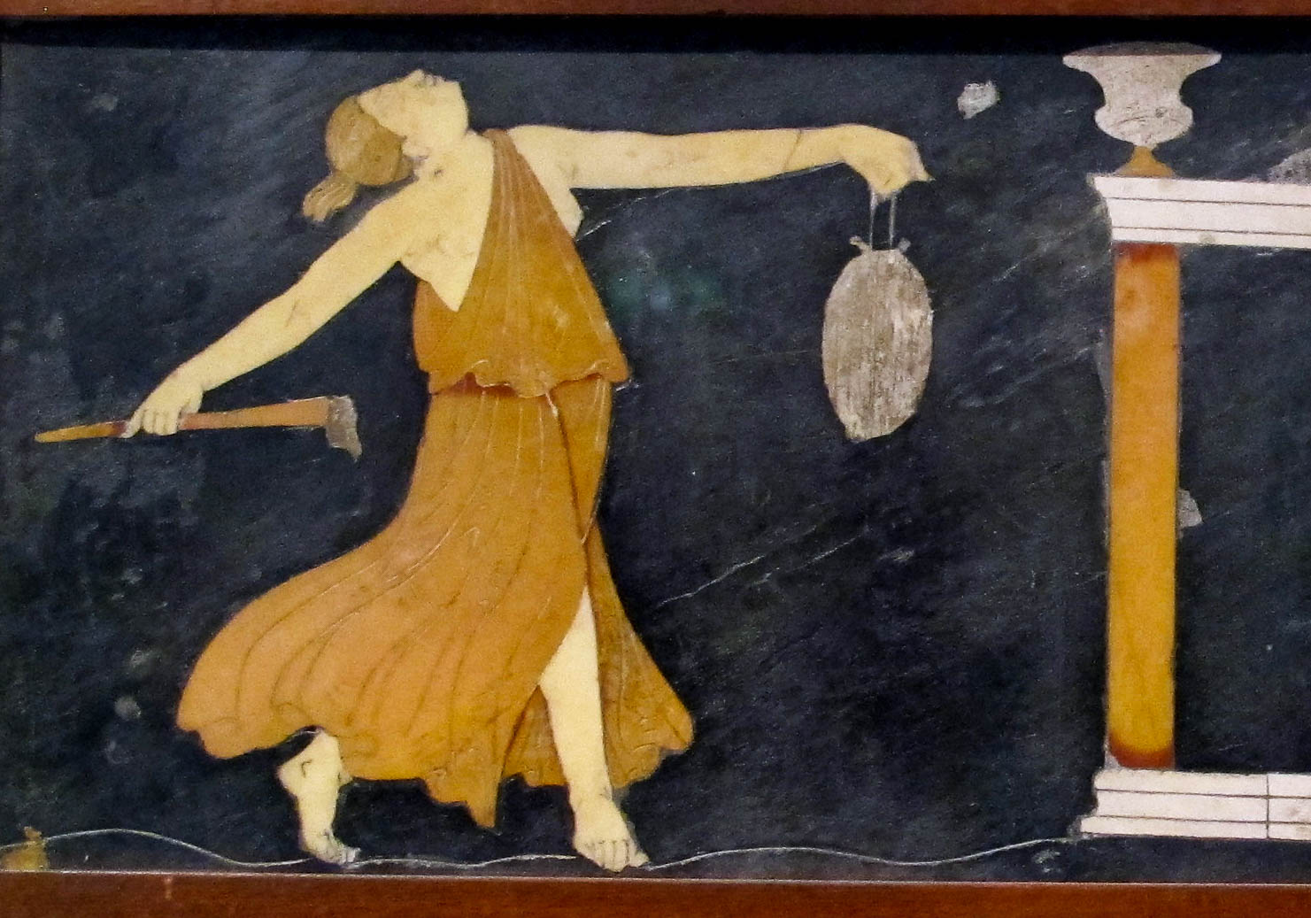
But if I do not have love, I have become a sounding brass or a clanging cymbal
Opus sectile depiction of a maenad with a torch and a gong, from Pompeii, 1st century AD
13:1
Notes:
The phrase “sounding brass” (Gk. χαλκὸς ἠχῶν) is often translated as “noisy gong.” This section of opus sectile floor from Pompeii depicts a maenad with a torch and a suspended gong. Such an instrument, like a drum, would have made a single dull sound. Opus sectile refers to flooring made of cut pieces of rock that are carefully fitted together; most often they are more simply composed of geometric shapes. This artifact was photographed at the Naples Archaeological Museum. This image comes from Sailko and is licensed under CC BY-SA 3.0, via Wikimedia Commons: https://commons.wikimedia.org/wiki/File:Scena_dionisiaca_in_opus_sectile_da_casa_dei_capitelli_colorati_a_pompei,_9977,_41-68_dc_ca.,_01.JPG.
wiki11292013112426431h

Slide 16
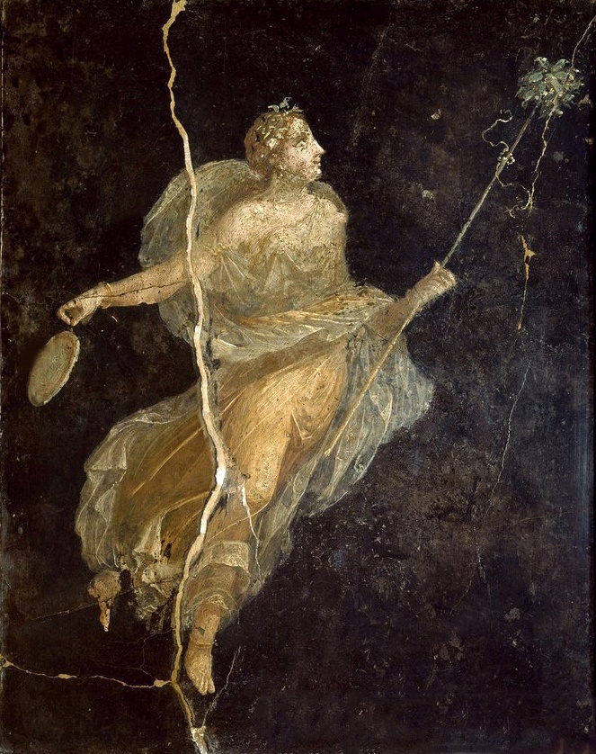
But if I do not have love, I have become a sounding brass or a clanging cymbal
Maenad in a silk dress, with a gong, from Pompeii, 1st century AD
13:1
Notes:
This fresco depicts a maenad with a staff in one hand and a gong in the other. It was photographed at the Naples Archaeological Museum. This image comes from Age Fotostock and is in the public domain, via Wikimedia Commons: https://commons.wikimedia.org/wiki/File:M%C3%A9nade_danzante,_Casa_del_Naviglio,_Pompeya.jpg.
wiki929866522045

Slide 17
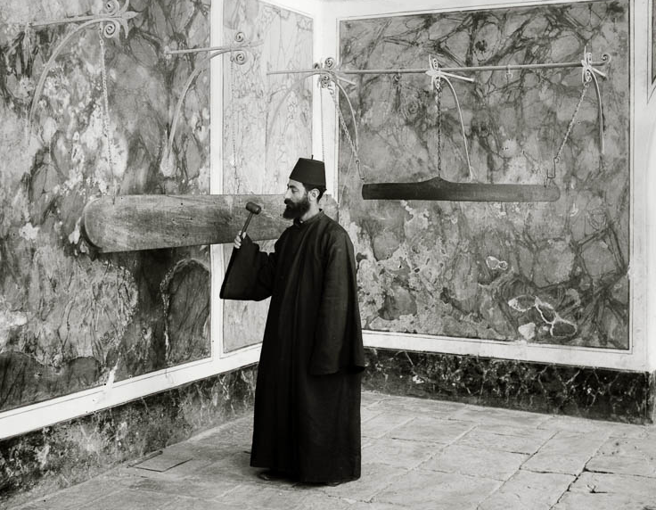
But if I do not have love, I have become a sounding brass or a clanging cymbal
Gongs in an Armenian convent, circa 1915
13:1
Notes:
The phrase χαλκὸς ἠχῶν is literally “sounding brass,” but is usually translated as “noisy gong.” At least one example of a Roman gong from the 1st or 2nd century AD has been discovered (in Wiltshire, England), though it is not known how common this instrument was in the Roman world. The gong (symandron) in this photograph is a suspended wooden plank that is struck with a wooden mallet. Though wooden, the effect would be similar to a metal gong—making noise but devoid of information. This American Colony photograph was taken between 1900 and 1920.
mat05003

Slide 18
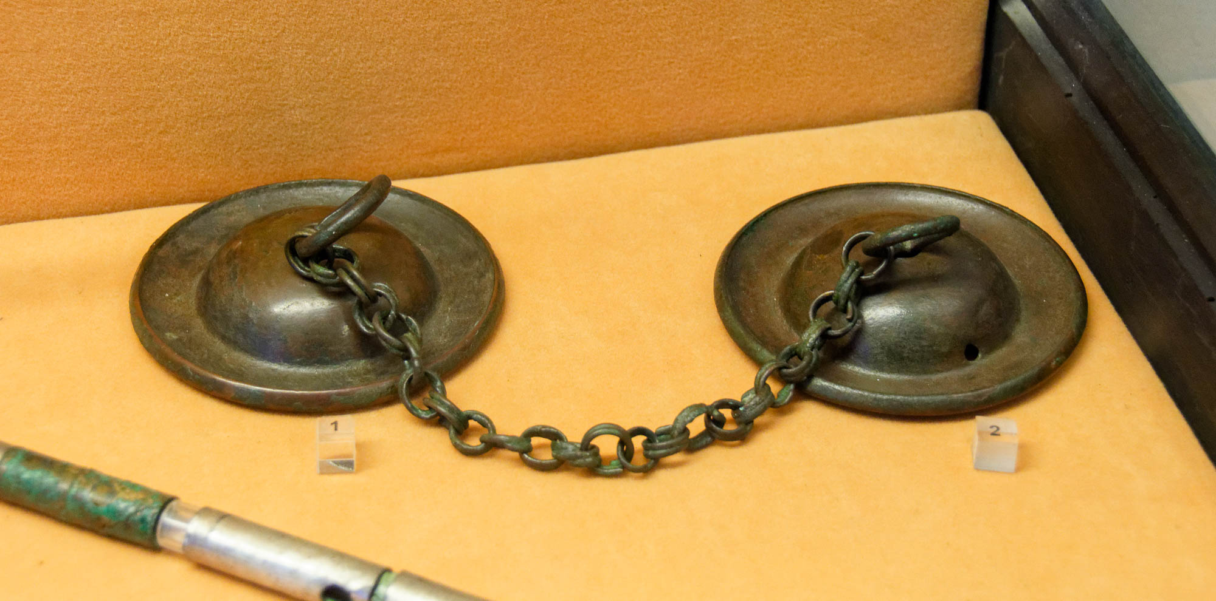
But if I do not have love, I have become a sounding brass or a clanging cymbal
Pair of cymbals, from Pompeii, 1st century AD
13:1
Notes:
The “cymbal” (Gk. kumbalon, κύμβαλον) was a small metal instrument shaped somewhat like a bowl or basin. Two were struck together to make a clanging sound. They were often used in religious ceremonies and were considered to be musical instruments. A number of 1st century examples have come from Pompeii, along with representations of them in mosaic and fresco form. These cymbals were photographed at the Naples Archaeological Museum.
tb0515170552

Slide 19
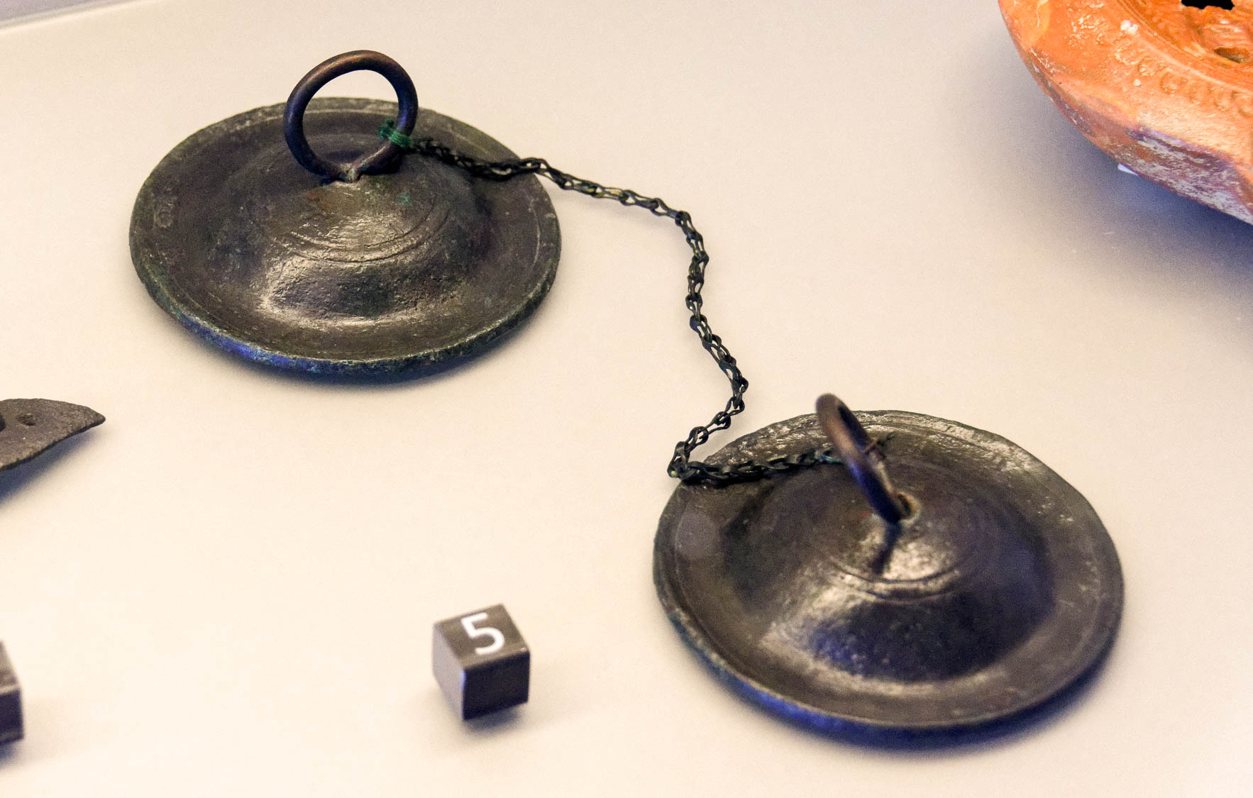
But if I do not have love, I have become a sounding brass or a clanging cymbal
Pair of cymbals, from Pompeii, 1st century AD
13:1
Notes:
Cymbals were used in antiquity in association with religious ceremonies. The set shown here were likely used in rites of Cybele, an Anatolian goddess of an Asia Minor mystery cult which made its way into Roman culture. These cymbals were photographed at the Naples Archaeological Museum.
tb0515170476h

Slide 20
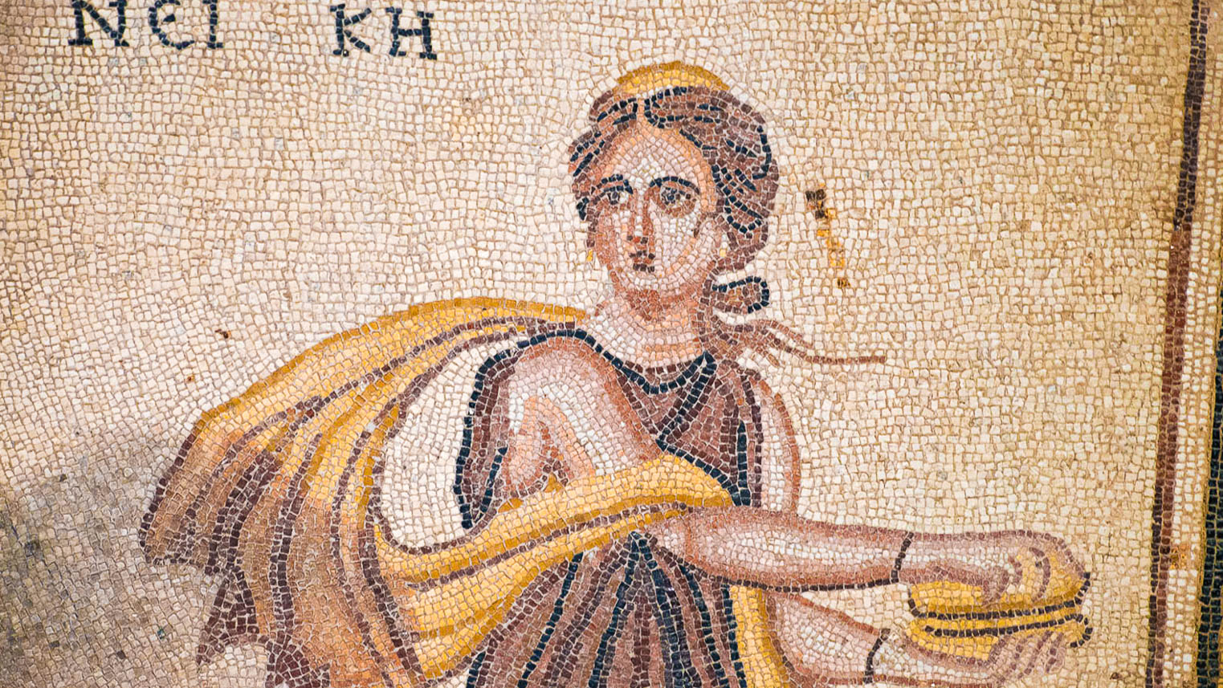
But if I do not have love, I have become a sounding brass or a clanging cymbal
Mosaic floor depicting a maenad dancing with cymbals, from Asia Minor, Roman period
13:1
Notes:
This mosaic was photographed at the Zeugma Mosaic Museum in Gaziantep, Turkey. This image comes from Dosseman and is licensed under CC BY-SA 4.0, via Wikimedia Commons: https://commons.wikimedia.org/wiki/File:Gaziantep_Zeugma_Museum_Dionysos_Triumf_mosaic_1920.jpg.
wiki121820111148141065h

Slide 21
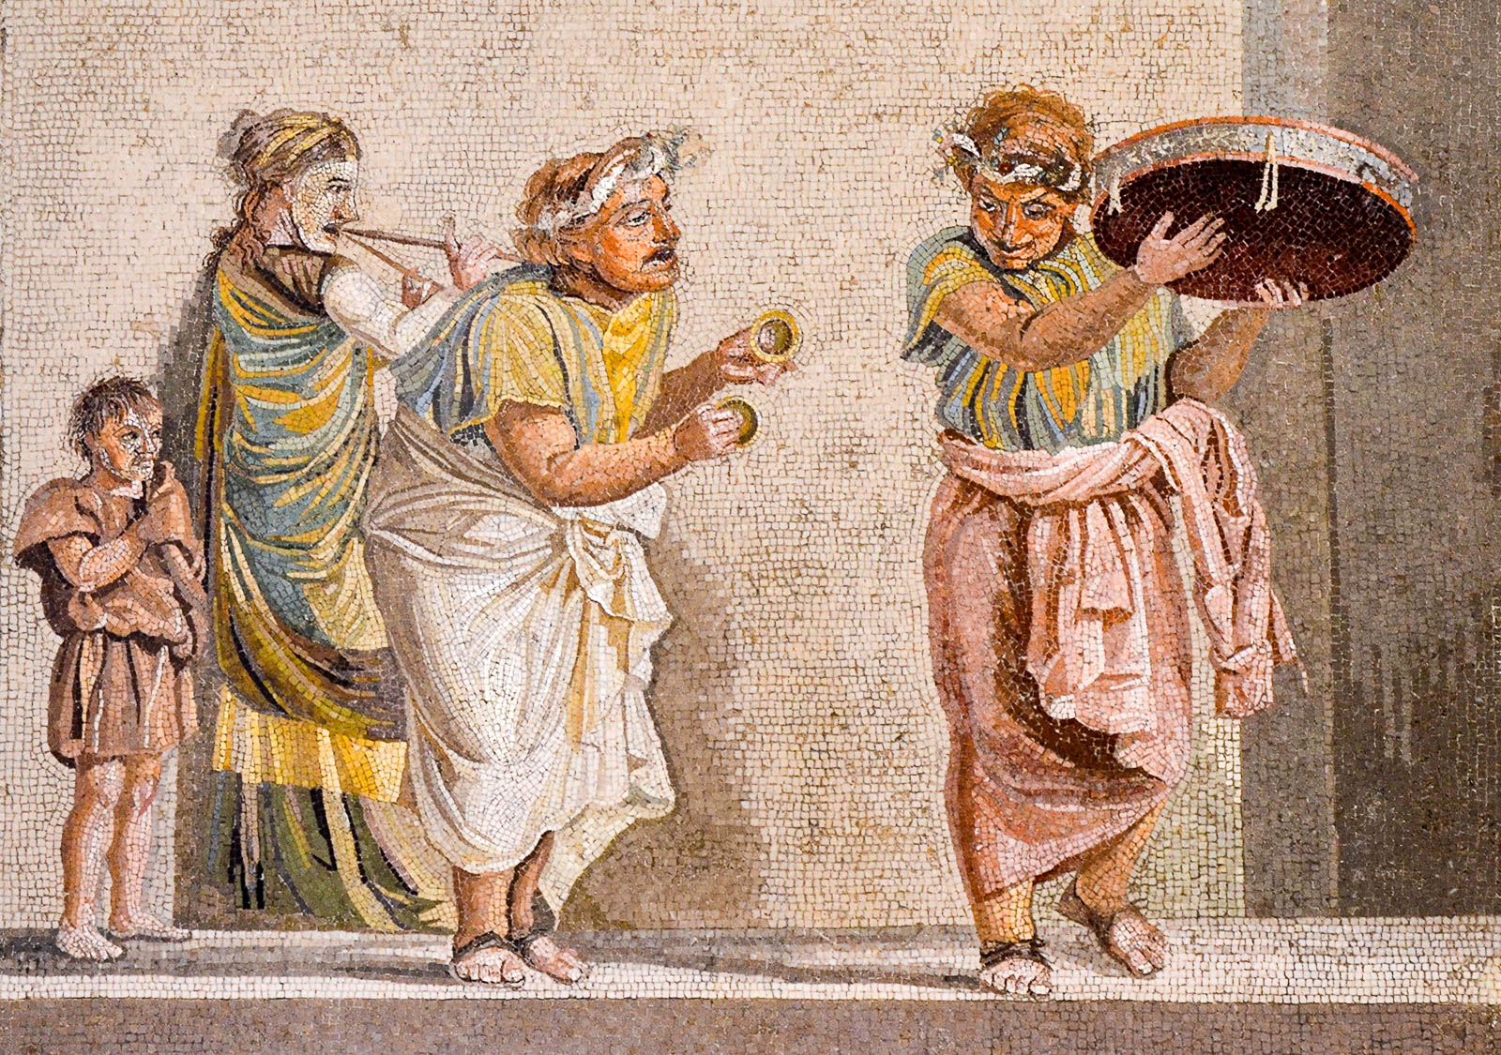
But if I do not have love, I have become a sounding brass or a clanging cymbal
Mosaic depicting street musicians, from Pompeii, 1st century BC
13:1
Notes:
The central figure in this mosaic holds a small set of hand cymbals. This mosaic, which was signed by Dioskourides of Samos, was found in the so-called Villa of Cicero near Pompeii. It was photographed at the Naples Archaeological Museum. This image comes from Carole Raddato and is licensed under CC BY-SA 2.0, via Wikimedia Commons: https://commons.wikimedia.org/wiki/File:Mosaic_depicting_street_musicians,_signed_by_Dioskourides_of_Samos,_it_was_found_in_the_so-called_Villa_of_Cicero_near_the_ancient_city_of_Pompeii,_1st_century_BC,_Naples_National_Archaeological_Museum_(17416686310).jpg.
wiki17416686310

Slide 22
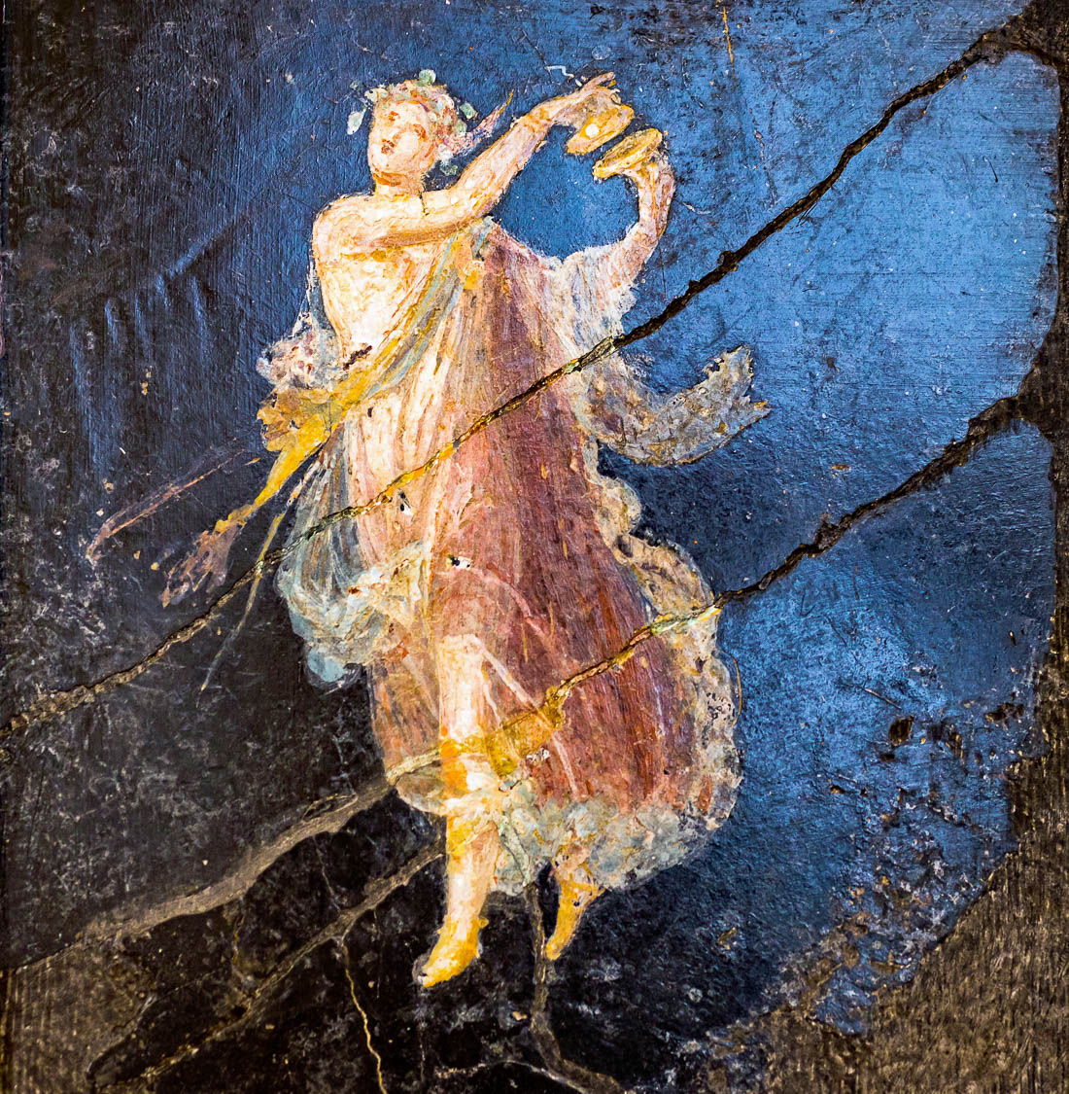
But if I do not have love, I have become a sounding brass or a clanging cymbal
Fresco of a dancing female, from Pompeii, 20 BC – AD 45
13:1
Notes:
This fresco portrays a dancing female with a set of cymbals. It was photographed at the Naples Archaeological Museum. This image comes from ArchaiOptix and is licensed under CC BY-SA 4.0, via Wikimedia Commons: https://commons.wikimedia.org/wiki/File:Wall_painting_-_dancing_maenads_-_Pompeii_(villa_of_Cicero)_-_Napoli_MAN_9297_-_02.jpg.
wiki100720181456504594h

Slide 23
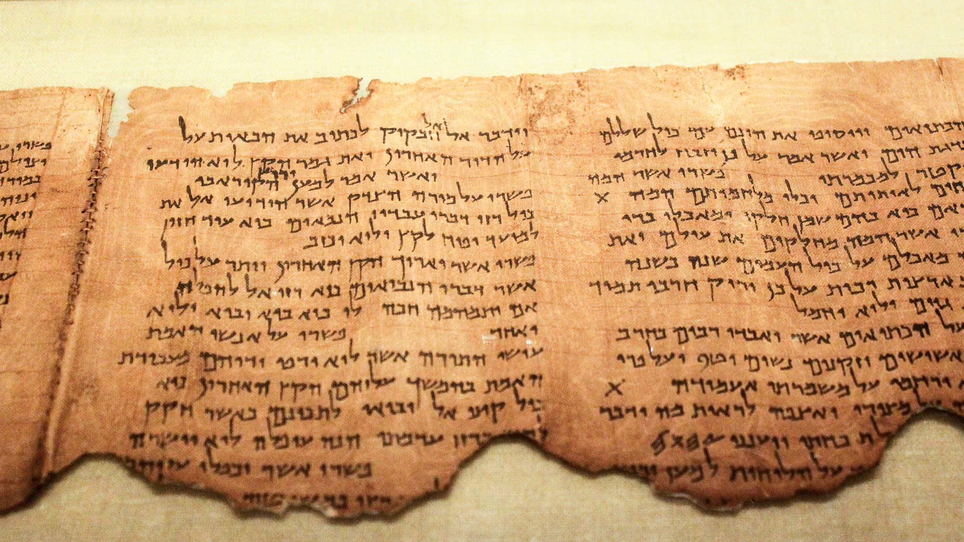
If I have the gift of prophecy, and know all mysteries and all knowledge
Commentary of the Habakkuk Scroll (1QpHab), late 1st century BC
13:2
Notes:
Both pagan mystery religions and some groups within 1st-century Judaism were concerned with ”mysteries” and secret knowledge. Paul tells the Corinthians that without love, having all mysteries, knowledge, and prophecy is worthless. An example of the concern for ”mystery” from a Jewish perspective is found in the Dead Sea Scrolls commentary (Pesher) on Habakkuk. The portion shown here includes columns six and seven of the Habakkuk Pesher; it comes from Cave 1 near Qumran. This section discusses the “mystery” which was revealed to the Teacher of Righteousness. The Teacher of Righteousness is generally understood to have been a central figure in the Jewish sect at Qumran, although his historical identity is debated.
Concerning the text of Habakkuk 2:2, the commentator writes, “Its interpretation is concerning the Teacher of Righteousness to whom God has made known all the mysteries of the words of his servants the prophets” (פשרו על מורה הצדק אשר הודיעו אל את כול רזי דברי עבדיו הנבאים). See the following slide for a highlight of the relevant text.
The image comes from Desconocido and is in the public domain, via Wikimedia Commons: https://commons.wikimedia.org/wiki/File:Pesher_Habakkuk_Scroll.JPG.
wiki0814201220394752

Slide 24
If I have the gift of prophecy, and know all mysteries and all knowledge
“Its interpretation is concerning the Teacher of Righteousness to whom God has made known all the mysteries of the words of his servants the prophets.”
Commentary of the Habakkuk Scroll (1QpHab), late 1st century BC
13:2
Notes:
Both pagan mystery religions and some groups within 1st-century Judaism were concerned with ”mysteries” and secret knowledge. Paul tells the Corinthians that without love, having all mysteries, knowledge, and prophecy is worthless. An example of the concern for ”mystery” from a Jewish perspective is found in the Dead Sea Scrolls commentary (Pesher) on Habakkuk. The portion shown here includes columns six and seven of the Habakkuk Pesher; it comes from Cave 1 near Qumran. This section discusses the “mystery” which was revealed to the Teacher of Righteousness. The Teacher of Righteousness is generally understood to have been a central figure in the Jewish sect at Qumran, although his historical identity is debated.
Concerning the text of Habakkuk 2:2, the commentator writes, “Its interpretation is concerning the Teacher of Righteousness to whom God has made known all the mysteries of the words of his servants the prophets” (פשרו על מורה הצדק אשר הודיעו אל את כול רזי דברי עבדיו הנבאים).
The image comes from Desconocido and is in the public domain, via Wikimedia Commons: https://commons.wikimedia.org/wiki/File:Pesher_Habakkuk_Scroll.JPG.
wiki0814201220394752

Slide 25
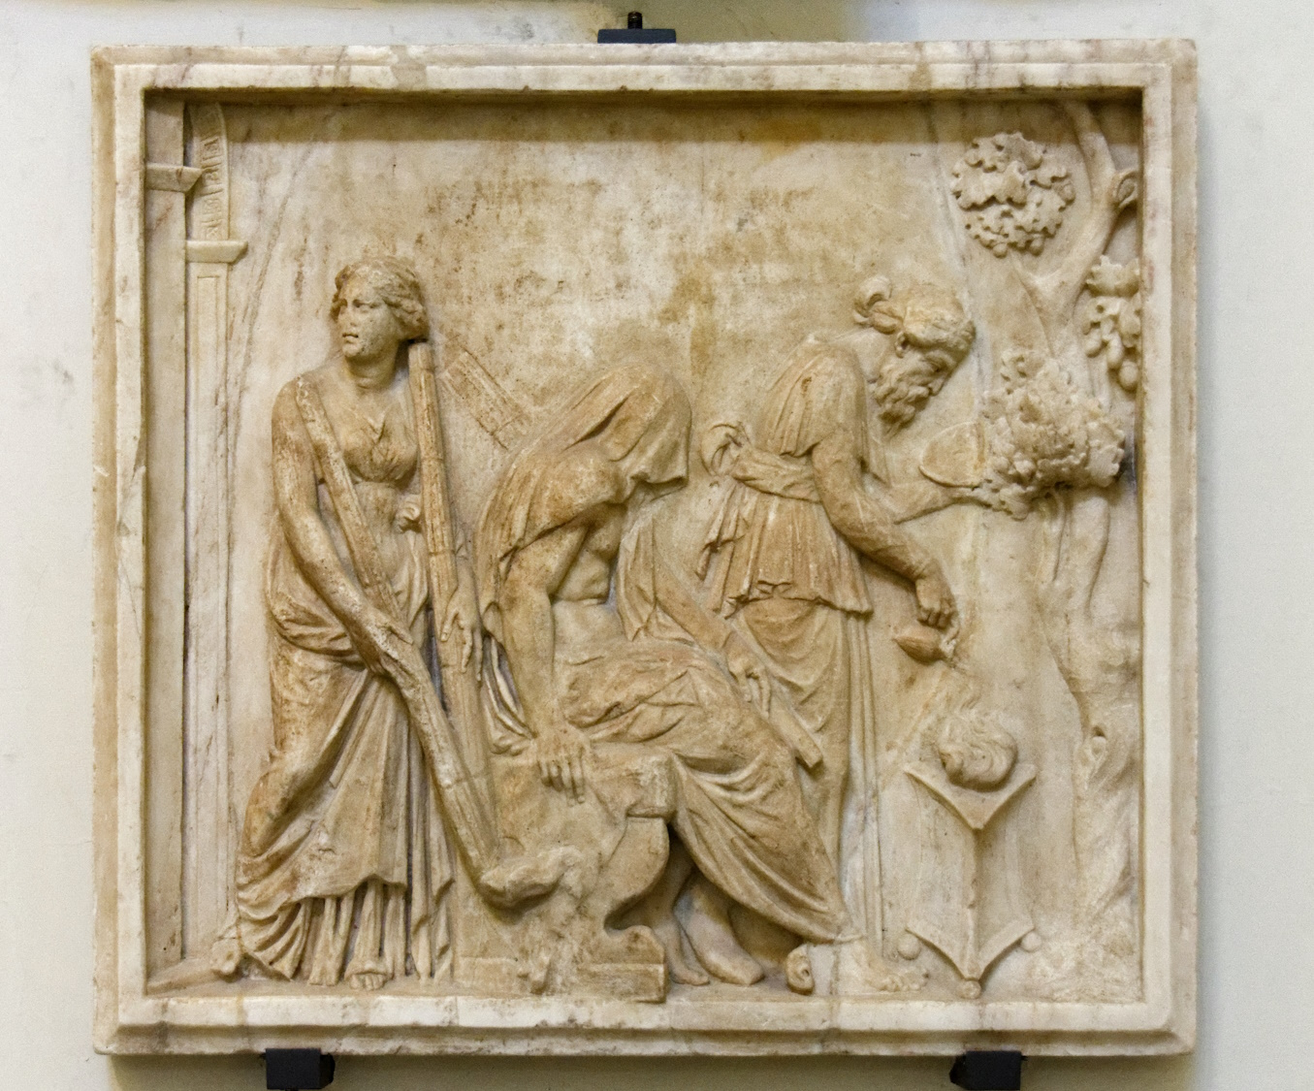
If I have the gift of prophecy, and know all mysteries and all knowledge
Relief depicting Heracles’s initiation into the Eleusinian mysteries
13:2
Notes:
There were also a number of Roman “mystery” cults in Paul’s day. Such cults promised revelation of secret knowledge to initiates. One popular mystery cult was that of Eleusis, depicted here. In the 3rd century AD, the church father Tertullian (On Baptism, 5) wrote against several mystery cults, including those of Isis, Mithras, and what he referred to as the “Apollinarian and Eleusinian games.” This relief was photographed at the Naples Archaeological Museum.
tb0515171197c

Slide 26
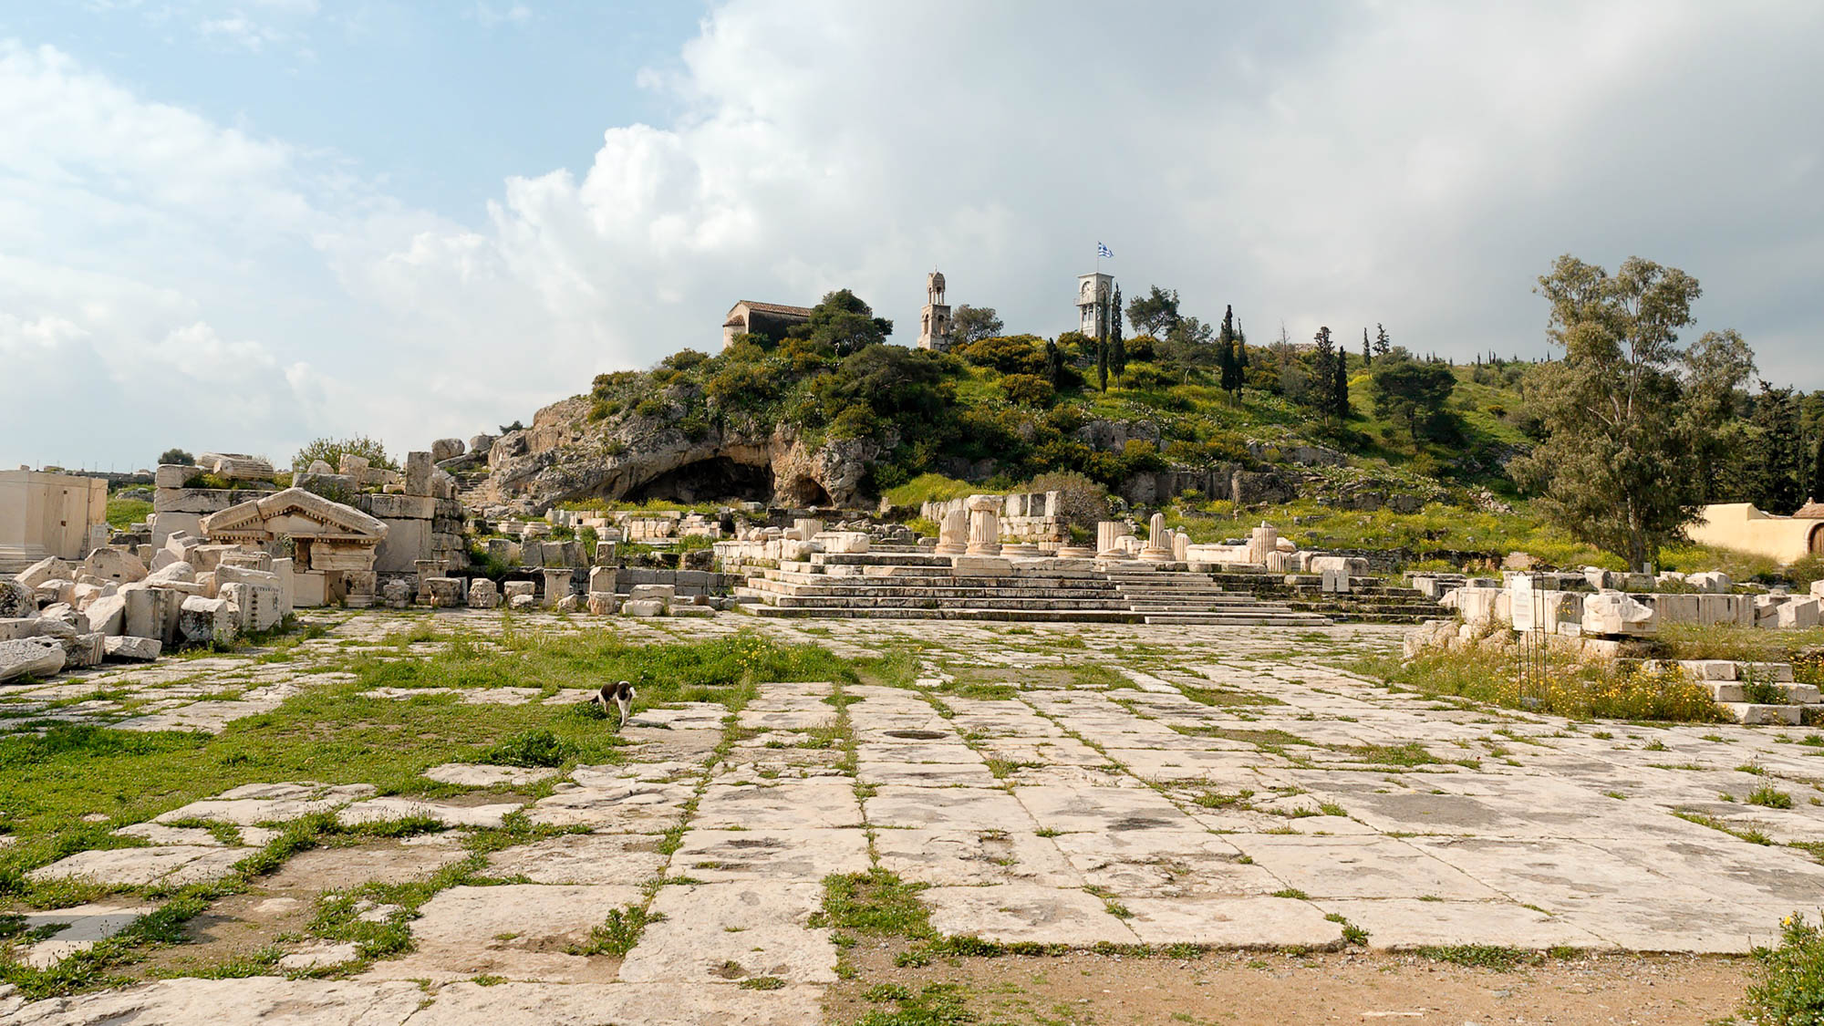
If I have the gift of prophecy, and know all mysteries and all knowledge
Sanctuary at Eleusis
13:2
Notes:
The center of the Eleusinian mystery cult was located across the Saronic Gulf from Corinth. This is where initiation rights into the Eleusinian mysteries would be conducted. The rites were also conducted in other locations across in the Roman empire.
tb031706898h

Slide 27
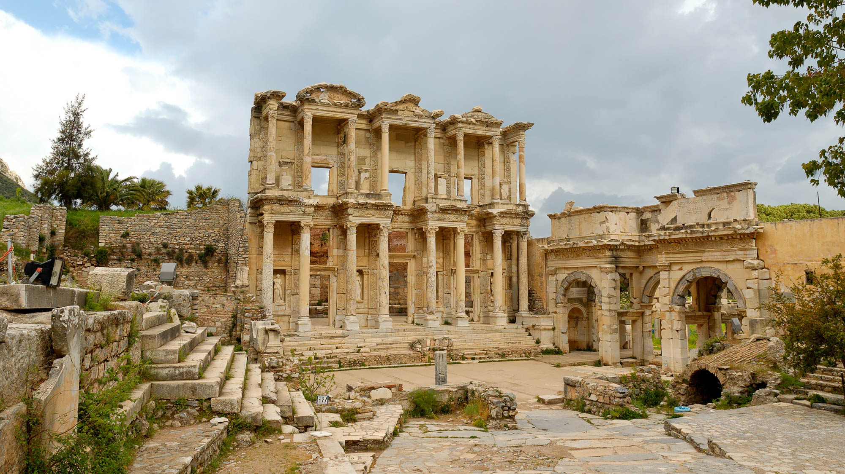
If I have the gift of prophecy, and know all mysteries and all knowledge
Library of Celsus at Ephesus
13:2
Notes:
Paul was in Ephesus when he wrote 1 Corinthians (1 Cor 16:8). The Library of Celsus, built in AD 110, once housed some 12,000 scrolls. It is noteworthy that during Paul’s stay at Ephesus (from which he wrote this letter to Corinth), a number of new followers of Jesus who had previously practiced magic brought together their books and burned them publicly (Acts 19:19).
tb041405397h

Slide 28
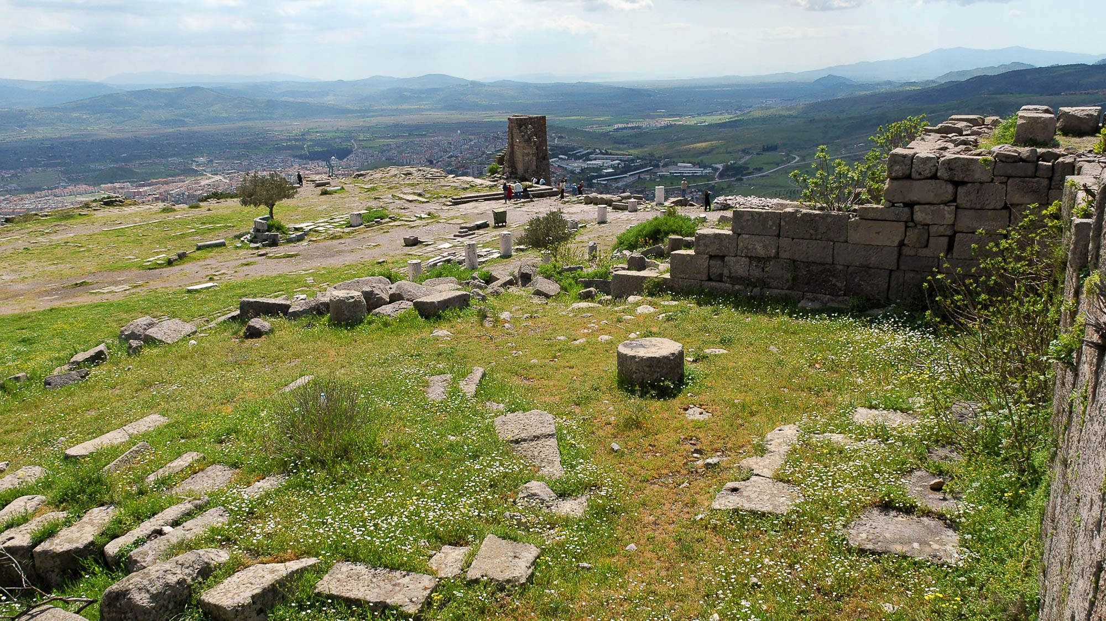
If I have the gift of prophecy, and know all mysteries and all knowledge
Library on Pergamum acropolis
13:2
Notes:
Another famous library from the time of this letter is that on the acropolis of Pergamum in western Turkey (best known to New Testament readers from its church’s mention in Revelation 2). The capacity of this library is estimated at 17,000 volumes, and readers were given books in the reading room, which is still preserved. Access to the books was prevented by a low wall, and patrons were served by librarians. Moisture was kept from the books by an air space between the wall and the shelves.
tb041505811

Slide 29
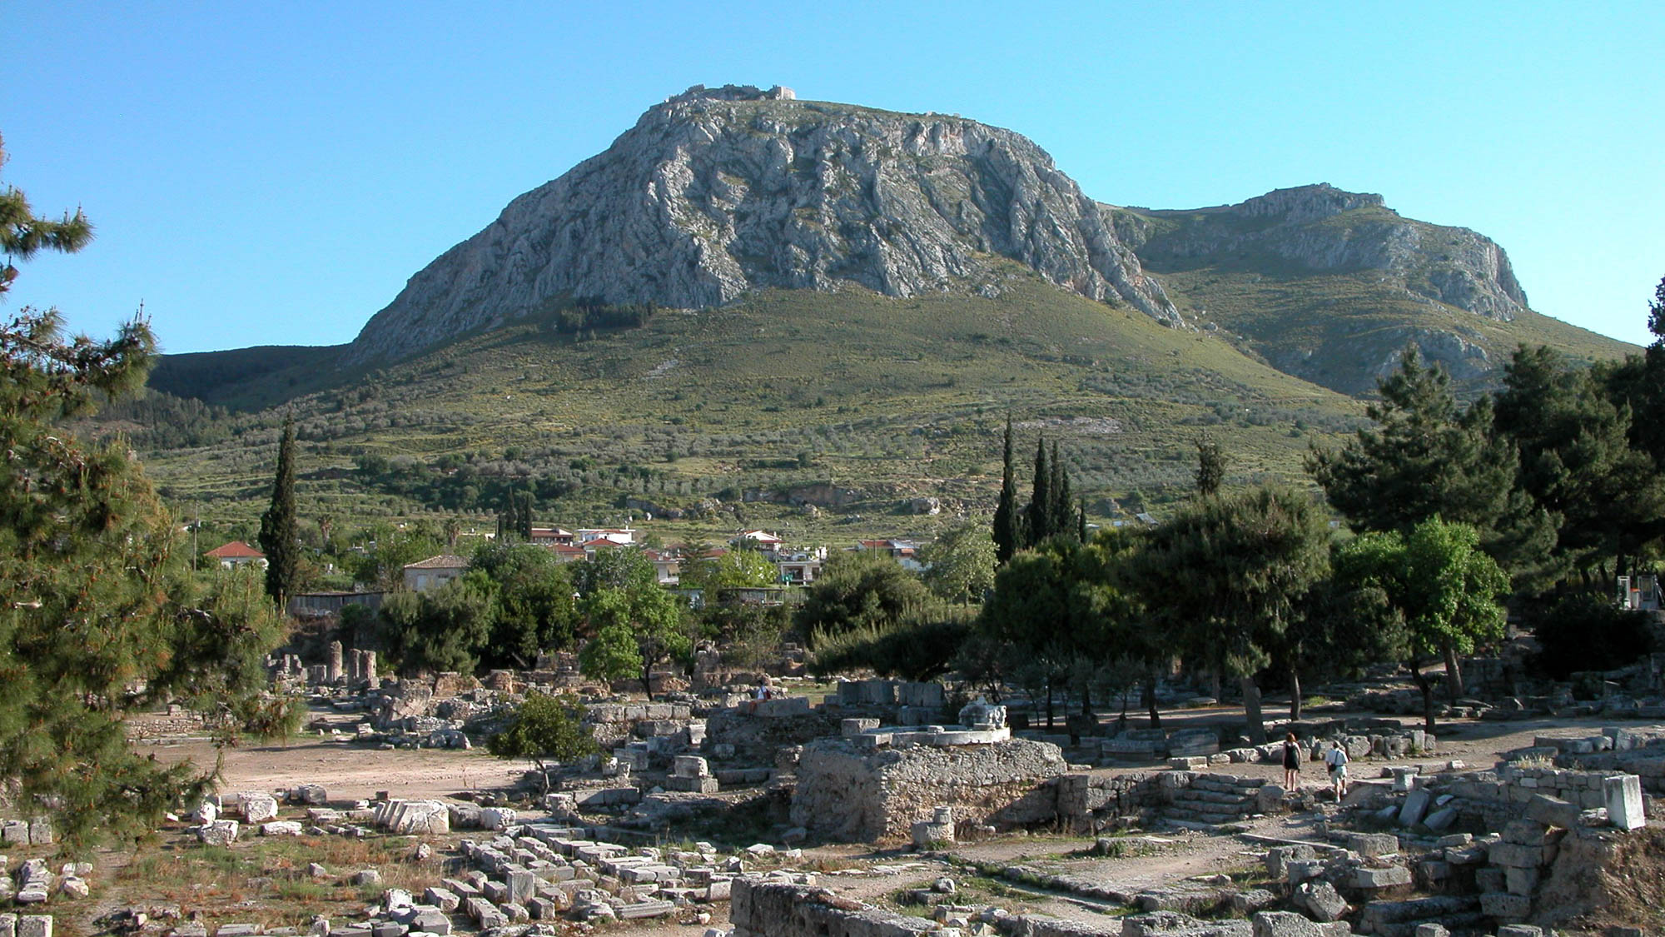
If I have all faith, so as to remove mountains, but do not have love, I am nothing
Acrocorinth as seen from the ruins of Corinth
13:2
Notes:
Paul’s comment regarding faith and the ability to move mountains may echo the words of Jesus (Matt 17:20). The Acrocorinth is a notable mountain which loomed above the New Testament city of Corinth and may have been the mountain that came to mind when this letter was read at Corinth.
tb050803002h

Slide 30
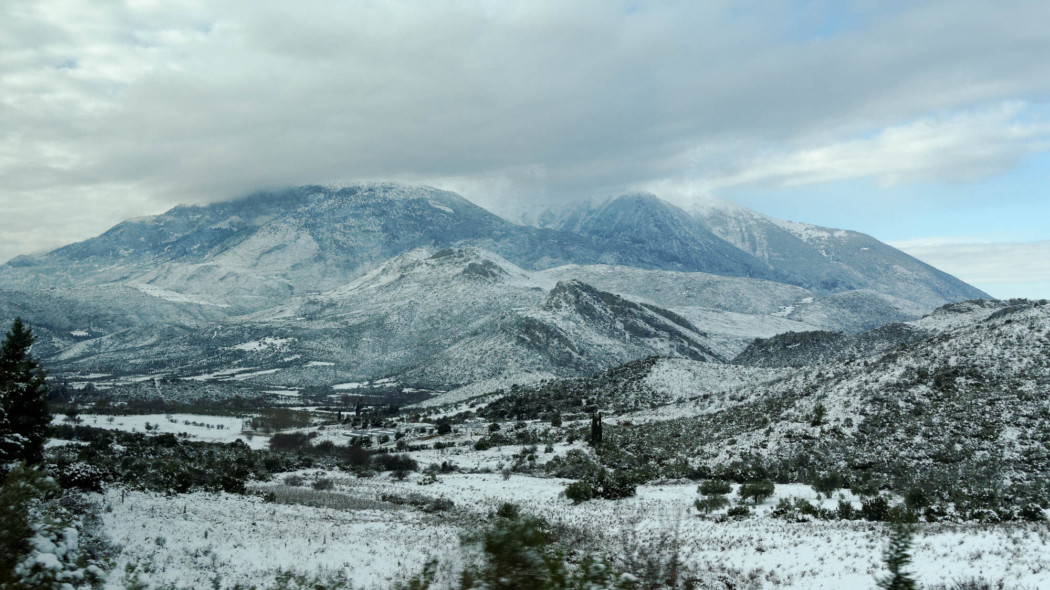
If I have all faith, so as to remove mountains, but do not have love, I am nothing
Mount Parnassus with snow
13:2
Notes:
Corinthians who had travelled to Delphi would have been familiar with Mount Parnassus, shown here with a coating of fresh snow. Mount Parnassus is located about 7 miles (11 km) northeast of ancient Delphi.
tb010917662h

Slide 31
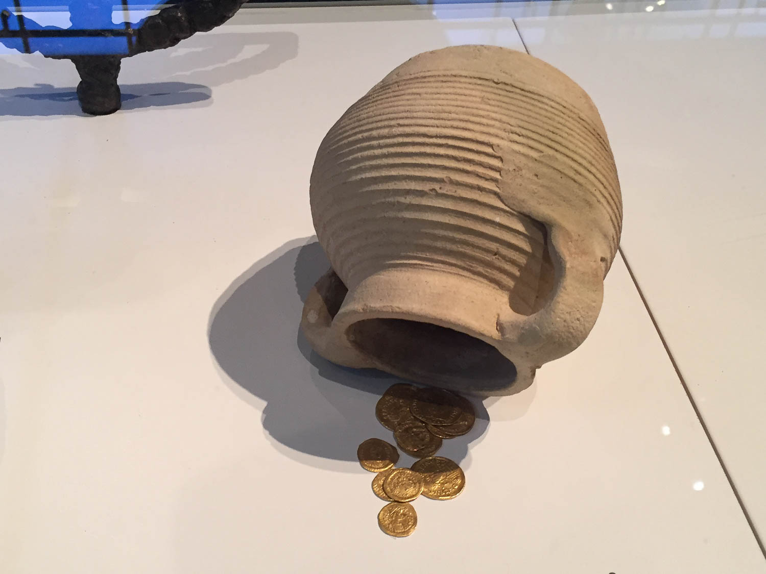
If I give all my goods to feed the poor . . . but do not have love, it profits me nothing
Synagogue collection juglet, 4th–6th centuries AD
13:3
Notes:
This collection juglet illustrates the elements that would have been familiar to Paul’s audience in the context of charitable giving. It is from a synagogue at Horvat Rimmon (Kfar Rimmon) and was found with 12 coins with the image of Christian emperors. Even though this is from several centuries after Paul, it is very similar to the same sort of vessel used to hold coins centuries earlier, as seen in the following slide. This was photographed at the Israel Museum.
cl0518191532

Slide 32
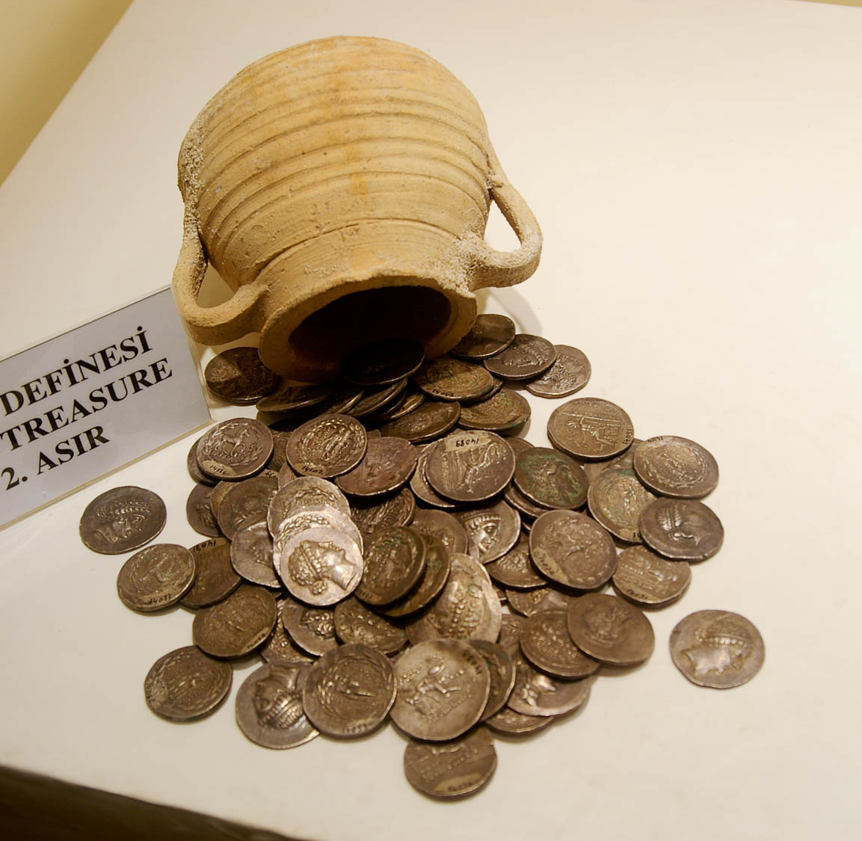
If I give all my goods to feed the poor . . . but do not have love, it profits me nothing
Hoard of coins from Bektasli, 2nd century BC
13:3
Notes:
This hoard of coins was photographed in the Antakya Museum.
adr1005169433h

Slide 33
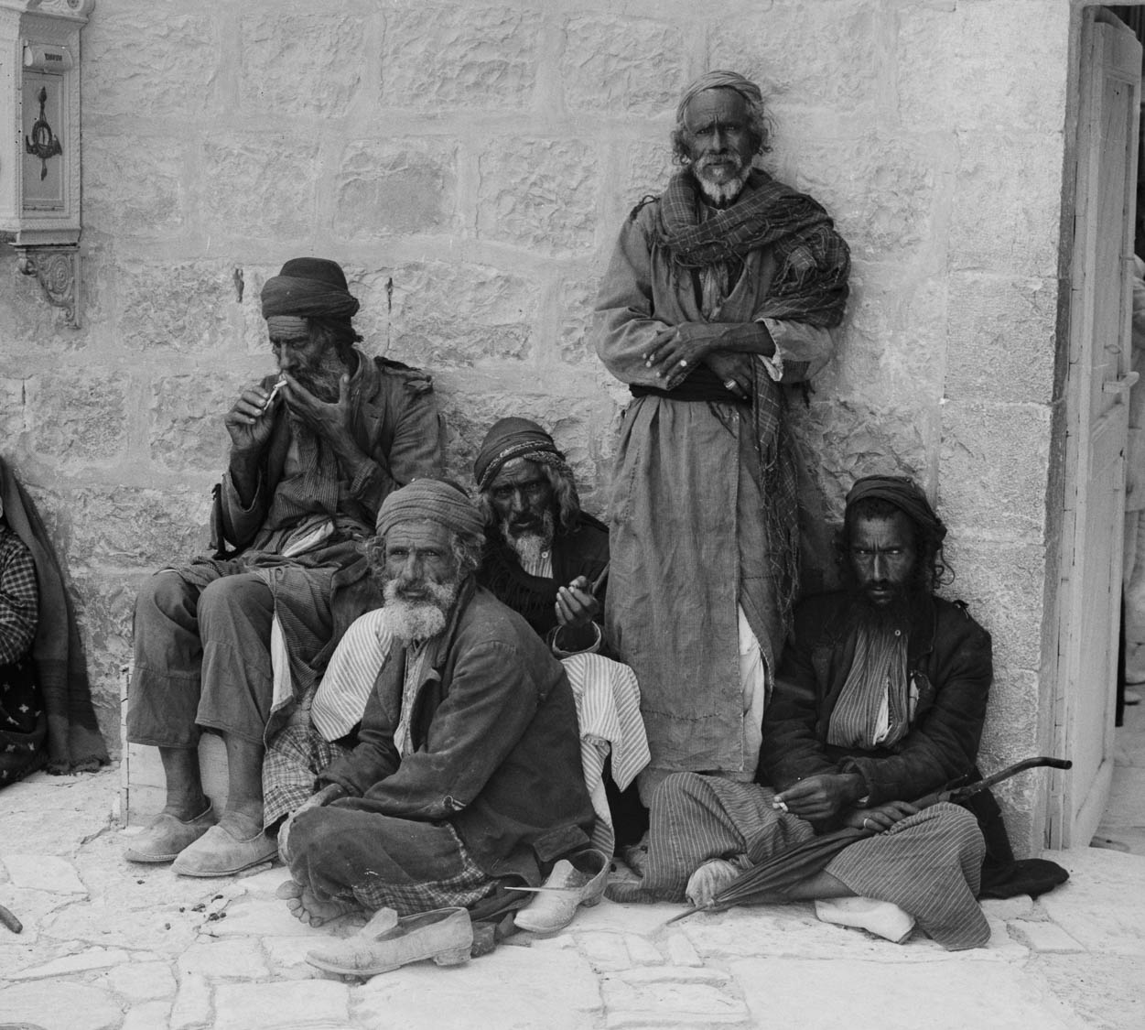
If I give all my goods to feed the poor . . . but do not have love, it profits me nothing
Poor family, circa 1900
13:3
Notes:
This American Colony photo was taken between 1898 and 1911.
mat06417

Slide 34
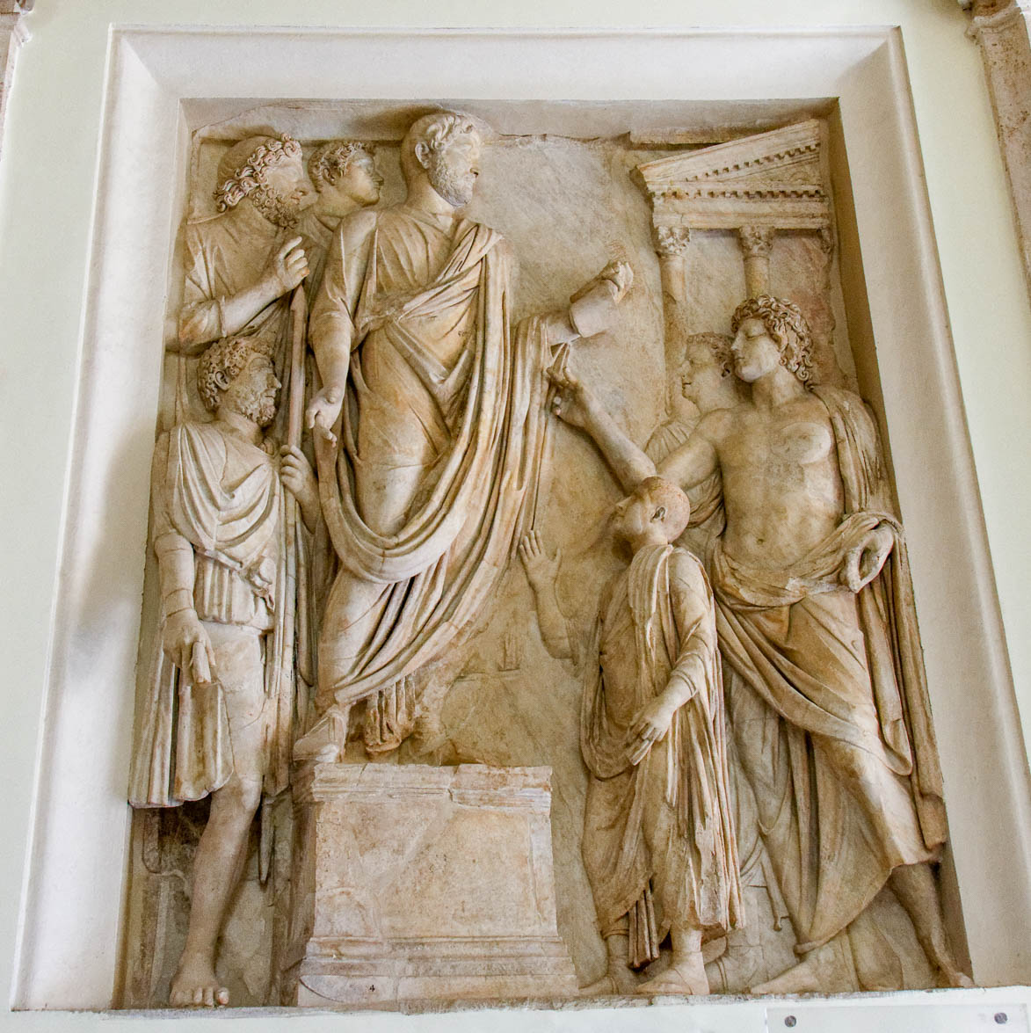
If I give all my goods to feed the poor . . . but do not have love, it profits me nothing
Emperor Hadrian distributing food to needy Roman children, from Rome, circa AD 117–138
13:3
Notes:
This relief from an honorary monument to Hadrian was photographed at the Capitoline Museums in Rome.
tb0514179443

Slide 35
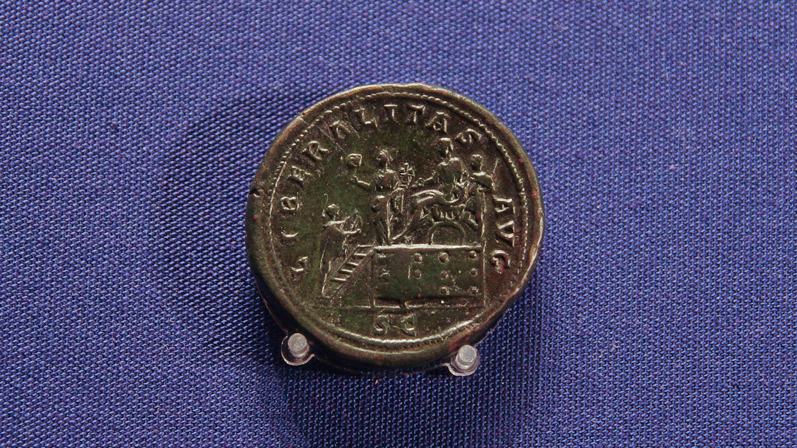
If I give all my goods to feed the poor . . . but do not have love, it profits me nothing
Roman coin depicting Commodus giving money to the poor, circa AD 172
13:3
Notes:
On the coin shown here, the inscription “LIBERALITAS” means “generosity”; “AVG” stands for “Augustus”; “SC” stands for “Senatus Consulto” and indicates that the coin was issued with the approval of the senate. Commodus, along with many other rulers in the ancient world before, during, and after the time of Paul, illustrate Paul’s point that even superficially charitable acts are actually empty without love. This coin depicts Commodus sitting on a throne on a raised platform, with a soldier standing behind him. Liberalitas, the personification of generosity, stands in front of the emperor with a coin dispenser and cornucopias. A citizen stands on the stairs in front holding out his toga to catch coins. This coin was photographed in the Ashmolean Museum at the University of Oxford.
adr1305249773

Slide 36
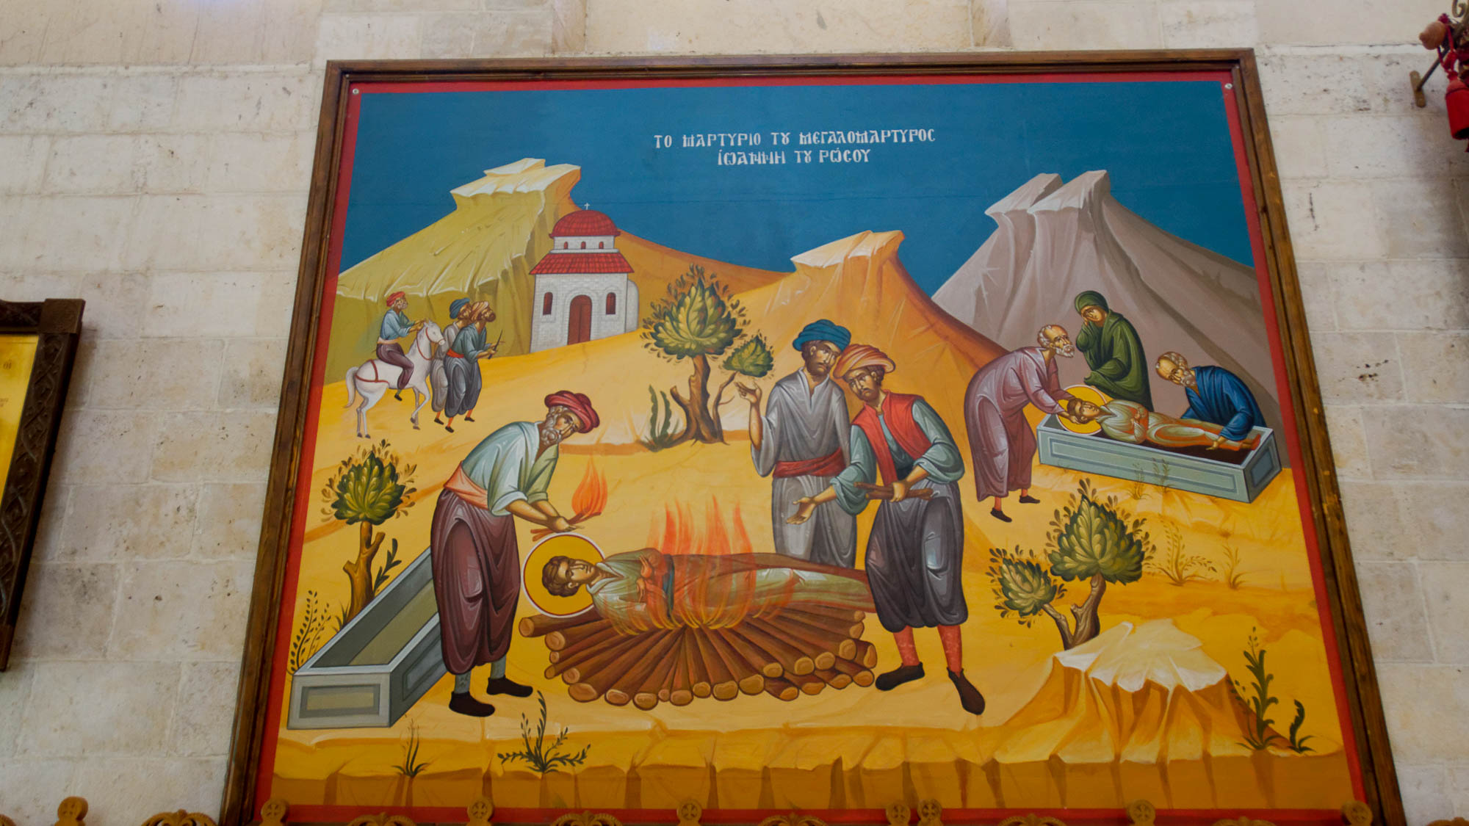
If I give up my body to be burned, but do not have love, it profits me nothing
Painting of a martyr being burned, in the Church of Jacob’s Well, Shechem
13:3
Notes:
Church tradition includes many accounts of people being burned for their faith. The church where this painting was photographed is built over the traditional well of Jacob outside Sychar in modern-day Nablus (cf. John 4:6).
tb052916553

Slide 37
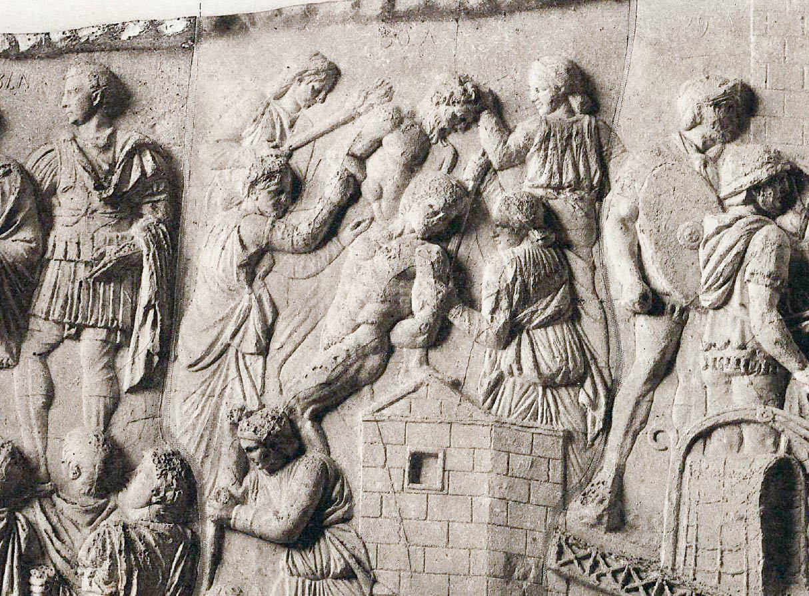
If I give up my body to be burned, but do not have love, it profits me nothing
Captive being burned with a torch, depicted on Trajan’s Column in Rome
13:3
Notes:
This relief from Trajan’s column depicting the Dacian Wars shows two captives being tortured. The uppermost captive is being tortured by two women; one is holding him by the hair and the other is burning him with a torch. This image comes from Plate XXXIV in Cichorius (1896) and is in the public domain.
Reference:
Cichorius, Conrad.
1896 Die Reliefs der Traianssäule. Herausgegeben und historisch erklärt. Erste Tafelband. Berlin: George Reimer.
cc1896ztpl34

Slide 38
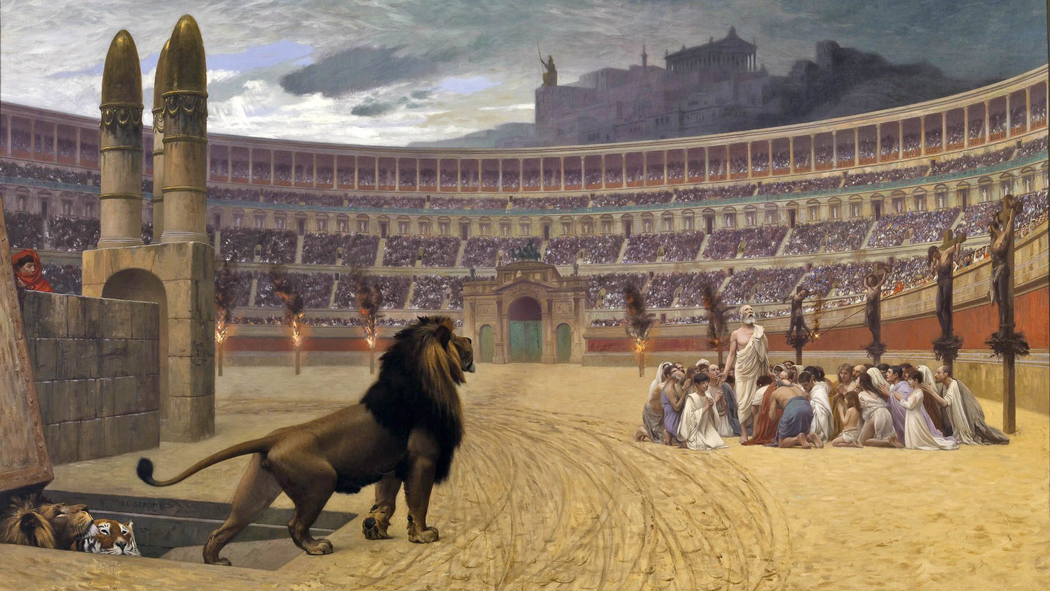
If I give up my body to be burned, but do not have love, it profits me nothing
The Christian Martyrs’ Last Prayer, by Jean-Léon Gérôme, 1883
13:3
Notes:
In the centuries following the time of Paul, and particularly prior to the conversion of Constantine the Great and the legalization of Christianity, many Christians in the Roman empire faced severe persecution. This painting depicts a group of Christians huddled in prayer before being killed by wild beasts, surrounded by others who are being burned at the stake. This image comes from Walters Art Museum in Baltimore and is in the public domain, via Wikimedia Commons: https://commons.wikimedia.org/wiki/File:Jean-L%C3%A9on_G%C3%A9r%C3%B4me_-_The_Christian_Martyrs%27_Last_Prayer_-_Walters_37113.jpg
wiki0224201423051050116

Slide 39
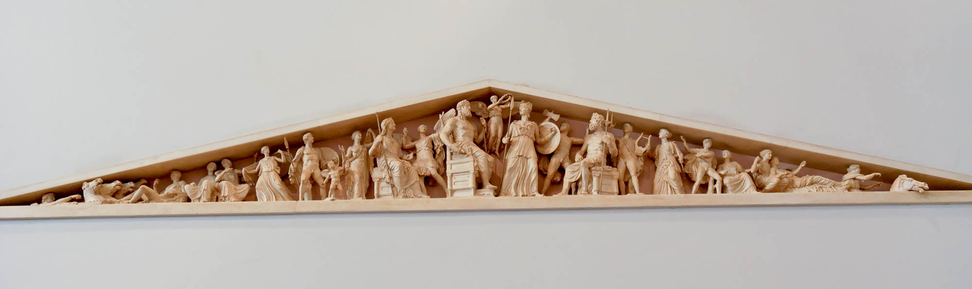
Love is patient, love is kind and is not jealous . . . endures all things
Parthenon east pediment reconstruction
13:4-7
Notes:
Chapter 13 appears to be structured in the form of a chiasm. Named after the Greek letter chi χ, this device uses inverse parallelism in order to create a memorable flow and even highlight the central point in the structure. Schematically, this can be represented as follows:
A
B
A’
Each letter represents a different point in the argument or segment of the textual flow, often with a unique central point serving as the focus (in this case verses 4-7). The form looks like half of the Greek letter chi χ, hence the term chiasm. Such structures have been widely used in literature throughout the ancient world (also known by different names or in form only). A counterpart to textual chiasm is chiasm in art (Thomas 2013). Like the literary device, an artistic scene would often be crafted in such a way as to highlight the central elements. The reconstruction of the Parthenon’s east pediment is such a visual example of this used in Greco-Roman art.
Many examples of chiasm can be found in the Bible. Ciampa and Rosner (2010: 639) argue that 1 Corinthians 13 is structured this way with the central segment being verses 3-7. They observe, “In contrast with vv. 1–3 and 8–12, which compare love with qualities of spiritual gifts, these four verses are marked by an ‘exclusive concentration’ on love’s qualities.” After some further observations they conclude, “This chapter reflects a chiastic structure with these verses serving as the centerpiece of the chiasm. These four verses also reflect a chiastic structure, with positive affirmations about love found in vv. 4a–b and v. 7 and negative affirmations in vv. 4b–6.” Using the schema above, 1 Corinthians 13 would form the chiasm as follows: A (vv. 1-3), B (vv. 4-7), and A’ (vv. 8-12). Of course, verse 13 as a summary statement also enjoys a high level of focus in this chapter.
This reconstruction was photographed at the Athens Acropolis Museum.
References:
Ciampa, R. E., and Rosner, B. S.
2010 The First Letter to the Corinthians. Grand Rapids: Eerdmans.
Thomas, E.
2013 Chiasmus in Art and Text. Greece & Rome, Second Series, 60: 50–88.
tb031806365

Slide 40
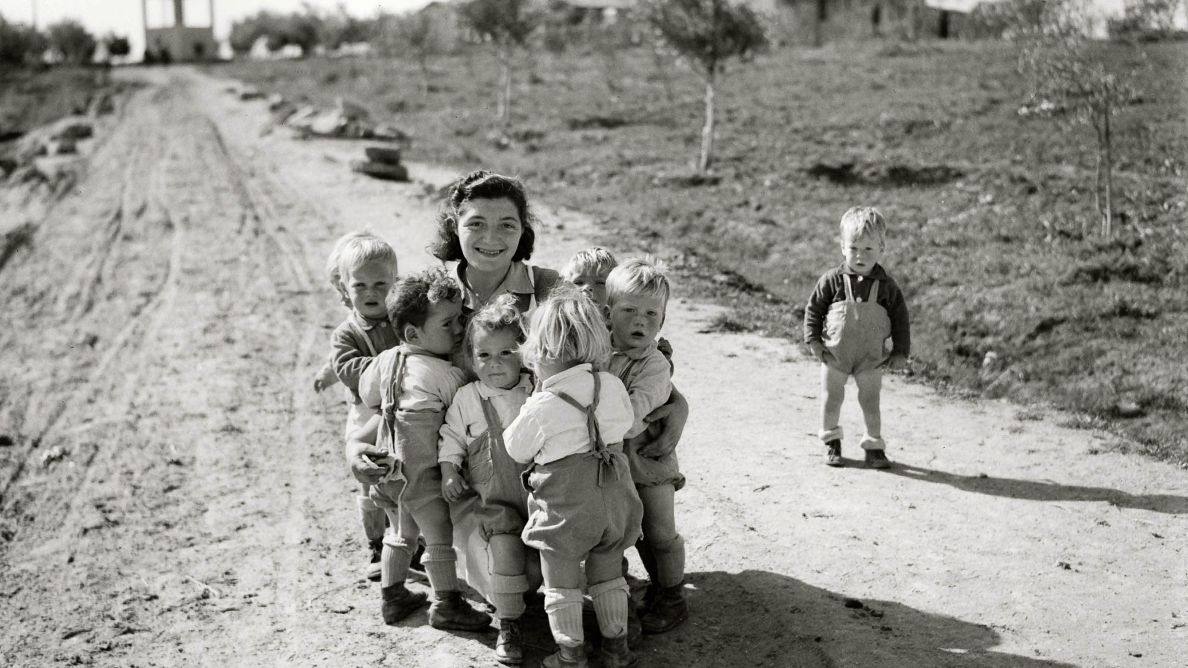
Love is patient, love is kind and is not jealous
Children at the Negba settlement in southern Israel, 1946
13:4
Notes:
Patience and kindness are necessary when working with children, illustrated here by a group of toddlers gathered around a young woman (cf. Mark 3:35; Gal 4:28; Heb 2:13; 1 John 3:10). This American Colony photograph was taken on February 12, 1946.
mat12772

Slide 41
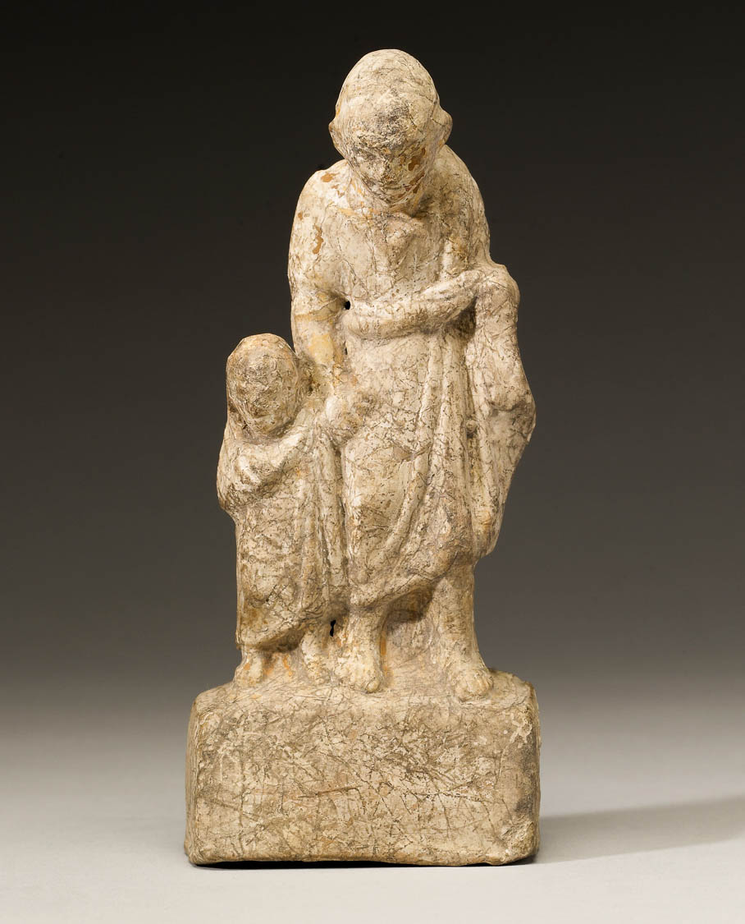
Love is patient, love is kind and is not jealous
Greek pedagogue with a boy, 3rd–2nd centuries BC
13:4
Notes:
The ideas of patience and kindness are illustrated here by a small statue of a boy and his tutor. This image comes from The Walters Art Museum and is in the public domain. Source: https://art.thewalters.org/detail/3452/pedagogue-and-boy/.
twam3452h

Slide 42
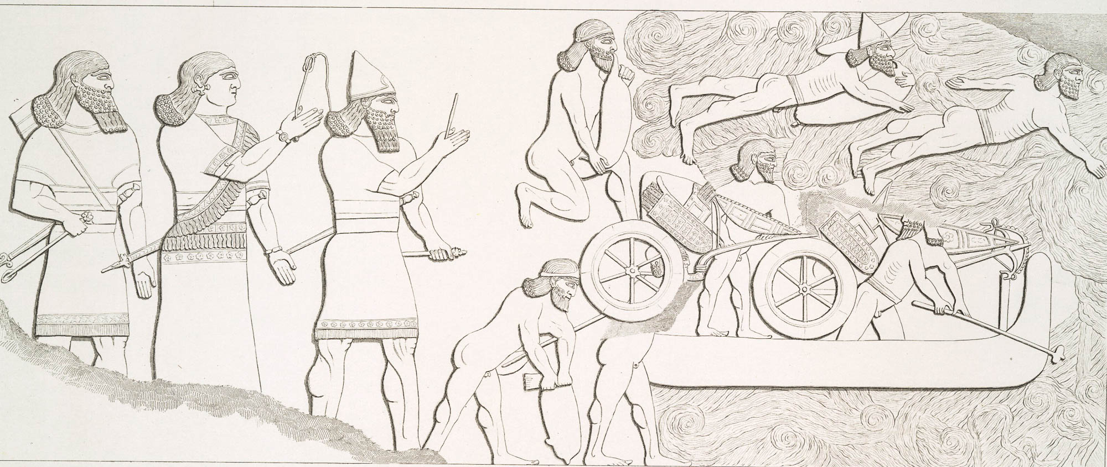
Love does not boast and is not puffed up
Assyrian soldiers preparing boat to cross river with inflated animal skins
13:4
Notes:
The word “puffed up” (Gk. fusioō, φυσιόω) means to be inflated, applied here figuratively to indicate arrogance. Inflation of animal skins has been used for millennia to give buoyancy for water crossings.
nypl494810

Slide 43
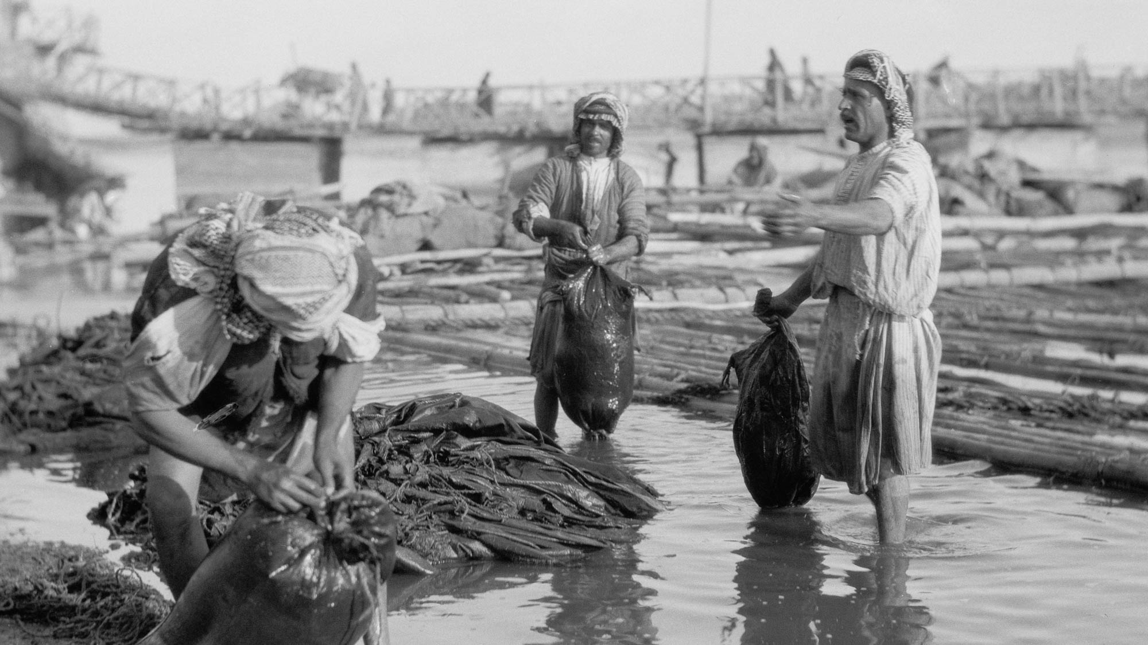
Love does not boast and is not puffed up
Construction of river rafts using inflated goatskins, along the Tigris River near Mosul
13:4
Notes:
This American Colony photo was taken in 1932.
mat16217h

Slide 44
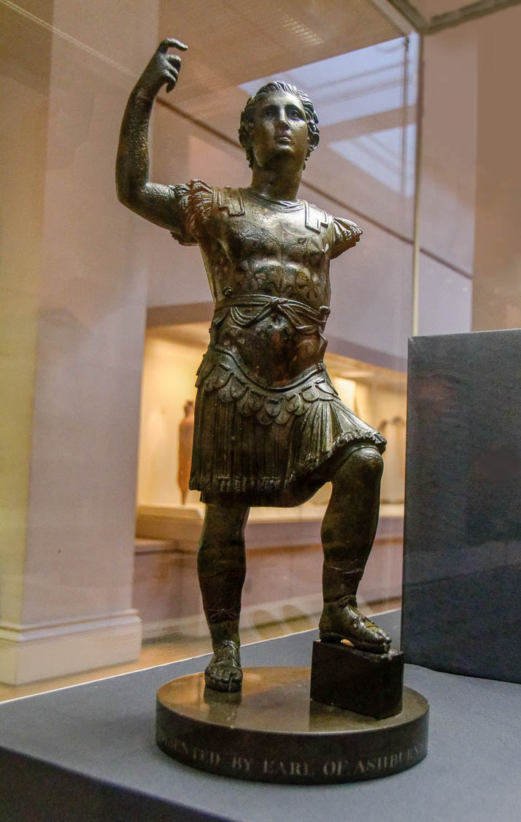
Love does not boast and is not puffed up
Statuette of Nero, possibly from Baylham Mill, 1st century AD
13:4
Notes:
The word “puffed up” (Gk. fusioō, φυσιόω) can also mean to be arrogant. Nero is an example of a leader in Paul’s day who was conceited. His rule was marked by both tyranny and extravagance. Such behavior was not compatible with love, according to Paul. This bronze statue of Nero was photographed at the British Museum.
tb1001199781c

Slide 45
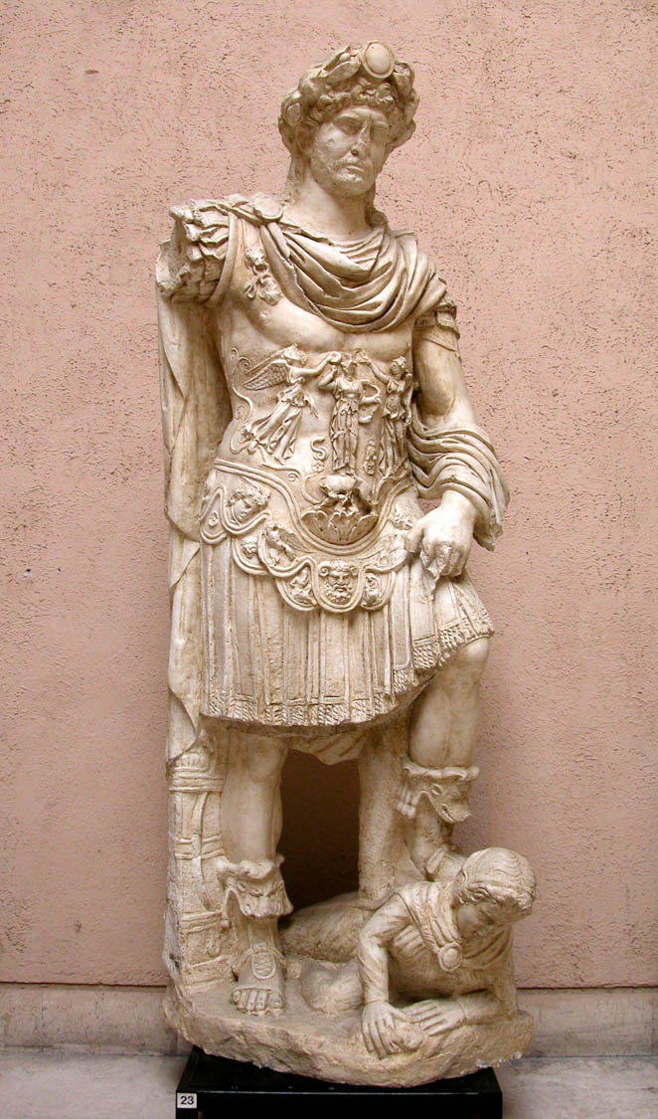
Love does not boast and is not puffed up
Statue of Hadrian with his foot on the back of an enemy, 2nd century AD
13:4
Notes:
Emperor Hadrian is shown here with his foot on an enemy, an arrogant pose meant to boast of his victories. This replica statue was photographed at the Museum of Roman Civilization in Rome.
tb111902377

Slide 46
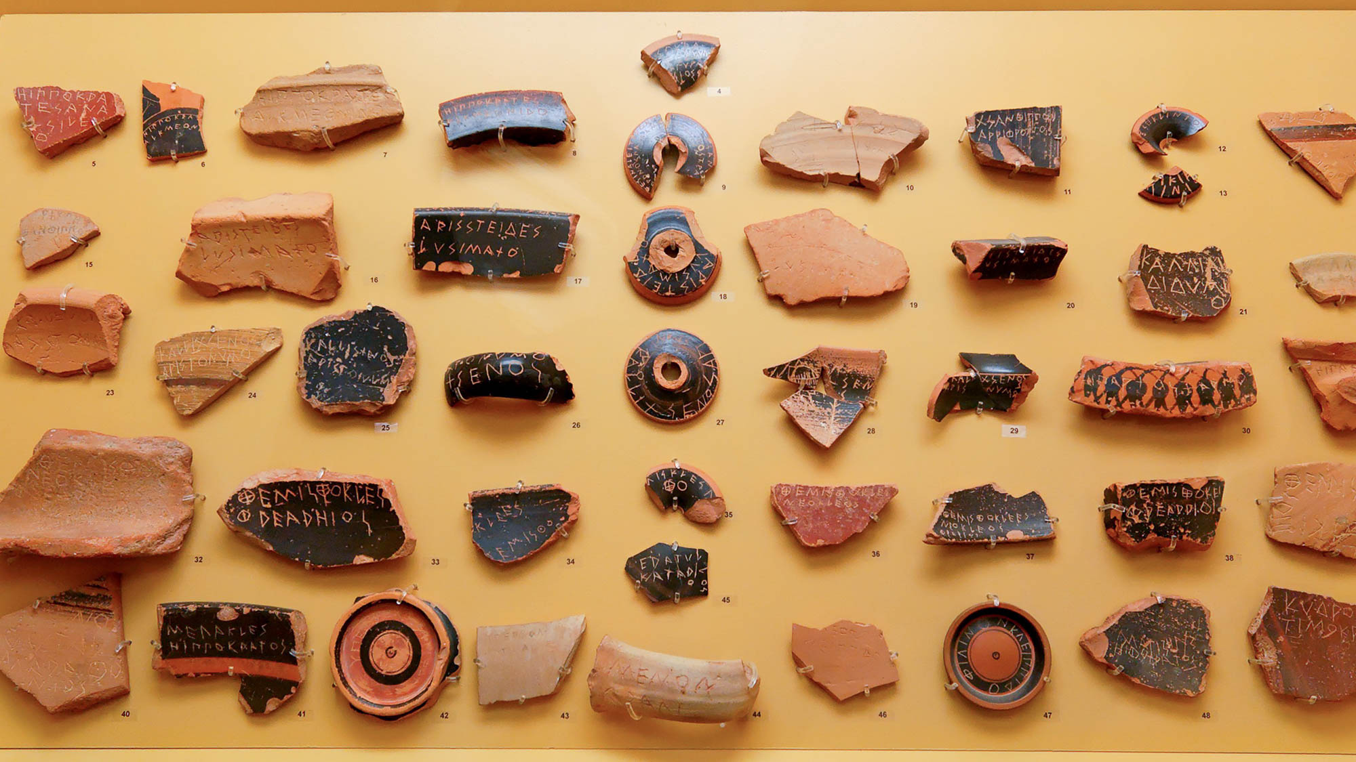
It does not act dishonorably
Ostraca used for shunning, 5th century BC
13:5
Notes:
The word “dishonorably” (Gk. aschēmoneō, ἀσχημονέω) refers to something, generally behavior, that is considered disgraceful or unacceptable, generally by the broader public. Sometimes well-known members of Greek society were exiled because of behavior that the citizens found unacceptable or potentially threatening to the public well-being. This kind of shunning was known as “ostracism.” Ostracism in ancient Greece required a minimum number of votes, recorded as names scratched on potsherds and submitted to city officials when an ostracism was under question. Numerous ostraca of this kind appear in this photo. If a person was ostracized, they were required to leave the city for 10 years, on pain of death. This illustrates a widespread sense of acceptable or unacceptable behavior. This display was photographed at the Athens Agora Museum.
tb031806407h

Slide 47
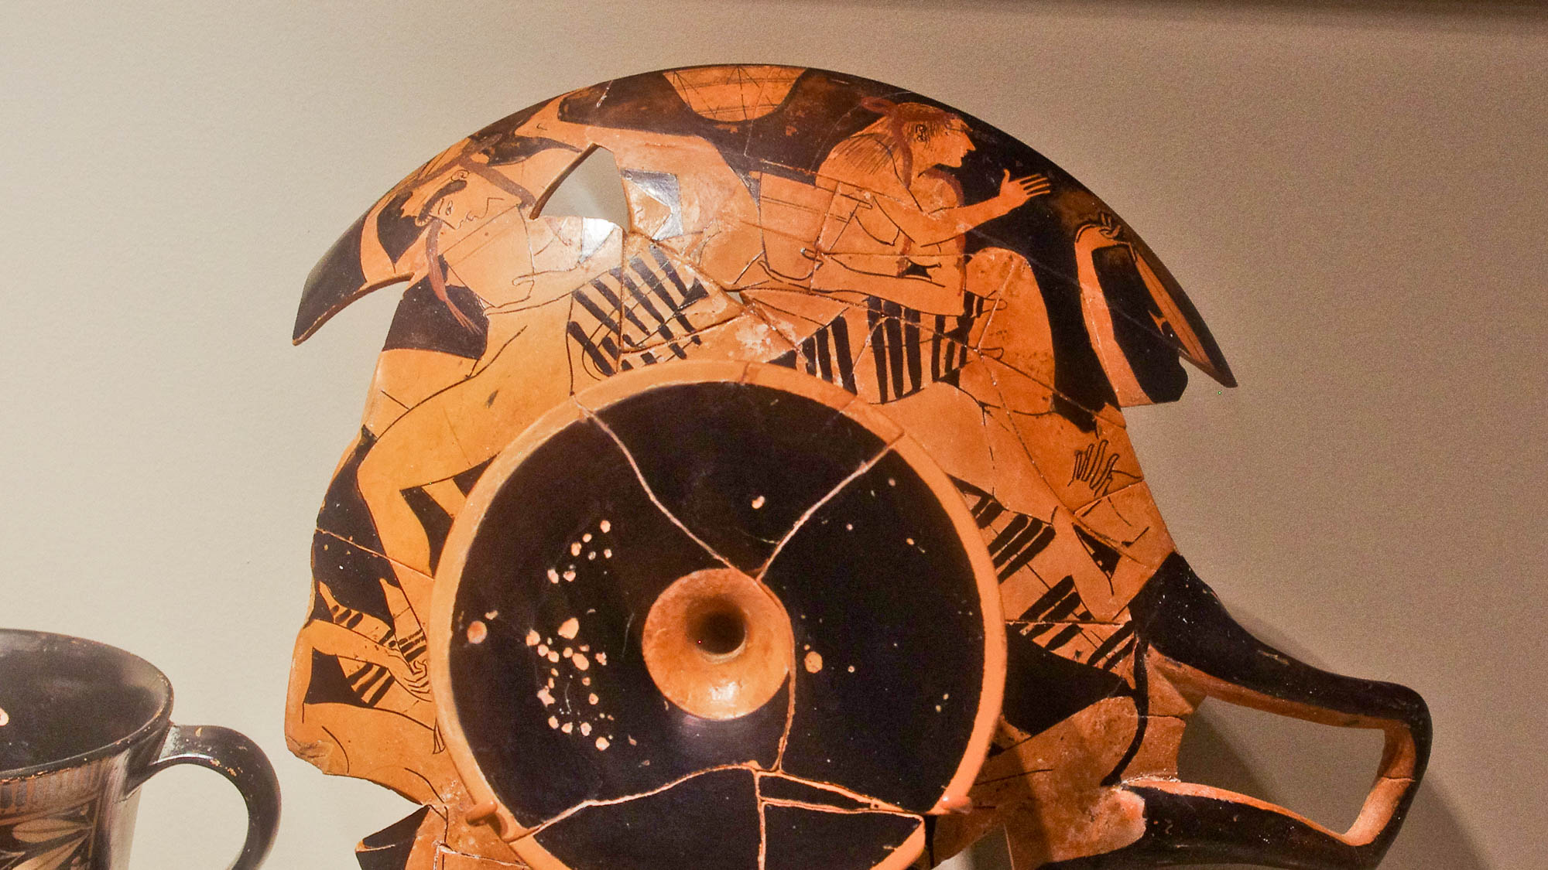
It does not act dishonorably
Attic kylix with women at a symposium, circa 490 BC
13:5
Notes:
From Paul’s perspective, some aspects of Greco-Roman culture would have Greek resulted in dishonorable behavior. An example would have been Roman drinking parties (symposia), which were common in Paul’s day. Drunkenness, nakedness, immorality, and ribald conversation appear to have been staples of these events. This kylix was photographed at the Michael C. Carlos Museum at Emory University.
adr1511209499h

Slide 48
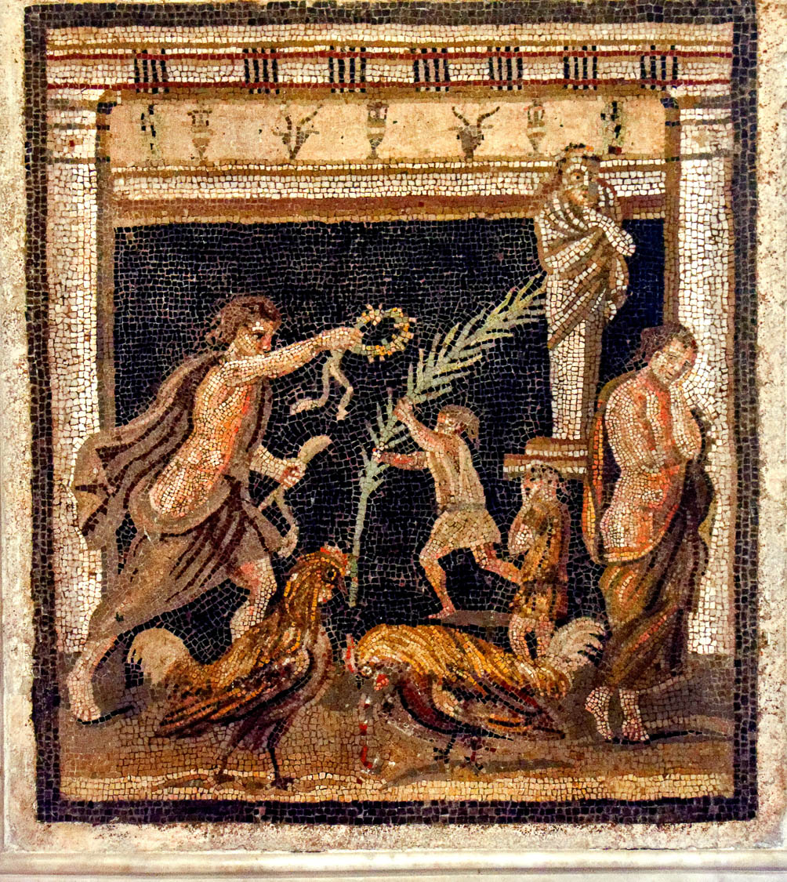
It does not act dishonorably, does not seek its own
Mosaic of a struggle between personified Victory and Defeat, from Pompeii, 1st century AD
13:5
Notes:
The natural inclination of man is to seek what is good for himself. This mosaic depicts the struggle between victory and defeat in two scenes. One is the personifications of Victory and Defeat in the background, with Victory leaning forward grasping the crown of victory, and Defeat leaning despondently against a pillar. In the foreground are two roosters from a cock fight, the left bird portrayed as the victor and the bleeding right bird as the loser. This mosaic comes from the Maze House at Pompeii and was photographed at the Naples Archaeological Museum.
tb0515170617ch

Slide 49
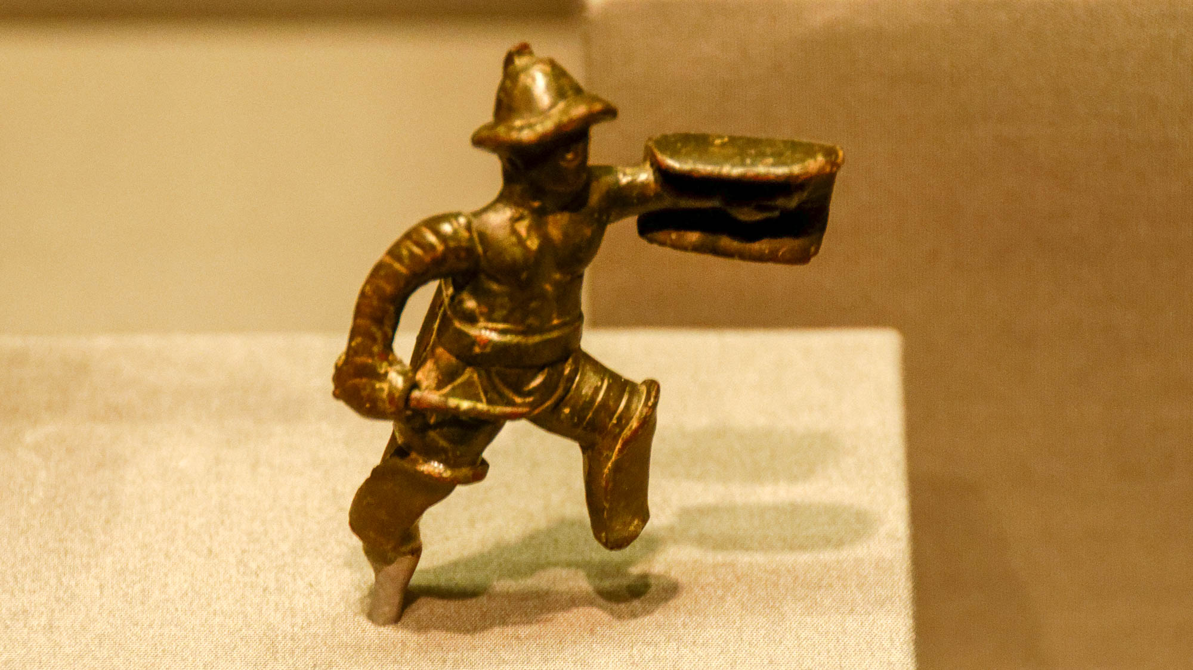
It does not act dishonorably, does not seek its own, is not provoked
Bronze statuette of gladiator, circa AD 50
13:5
Notes:
The verb “provoked” (Gk. paroxunō, παροξύνω) is derived from the root “to sharpen” (Gk. oxunō, ὀξύνω) and indicates activity that causes irritation or brings someone to anger. It is illustrated here by a gladiator, who would enter a fight in a state of provocation or quickly be brought to that state by his opponent. The heavily armed type of gladiator shown here was known as a secutor. He was armed with a heavy shield and a short sword. The secutor was typically pitted against a retiarius, who was lightly armored and armed with a net and a three-pointed trident. This statuette was photographed at the Getty Villa in southern California.
tb100919685h

Slide 50
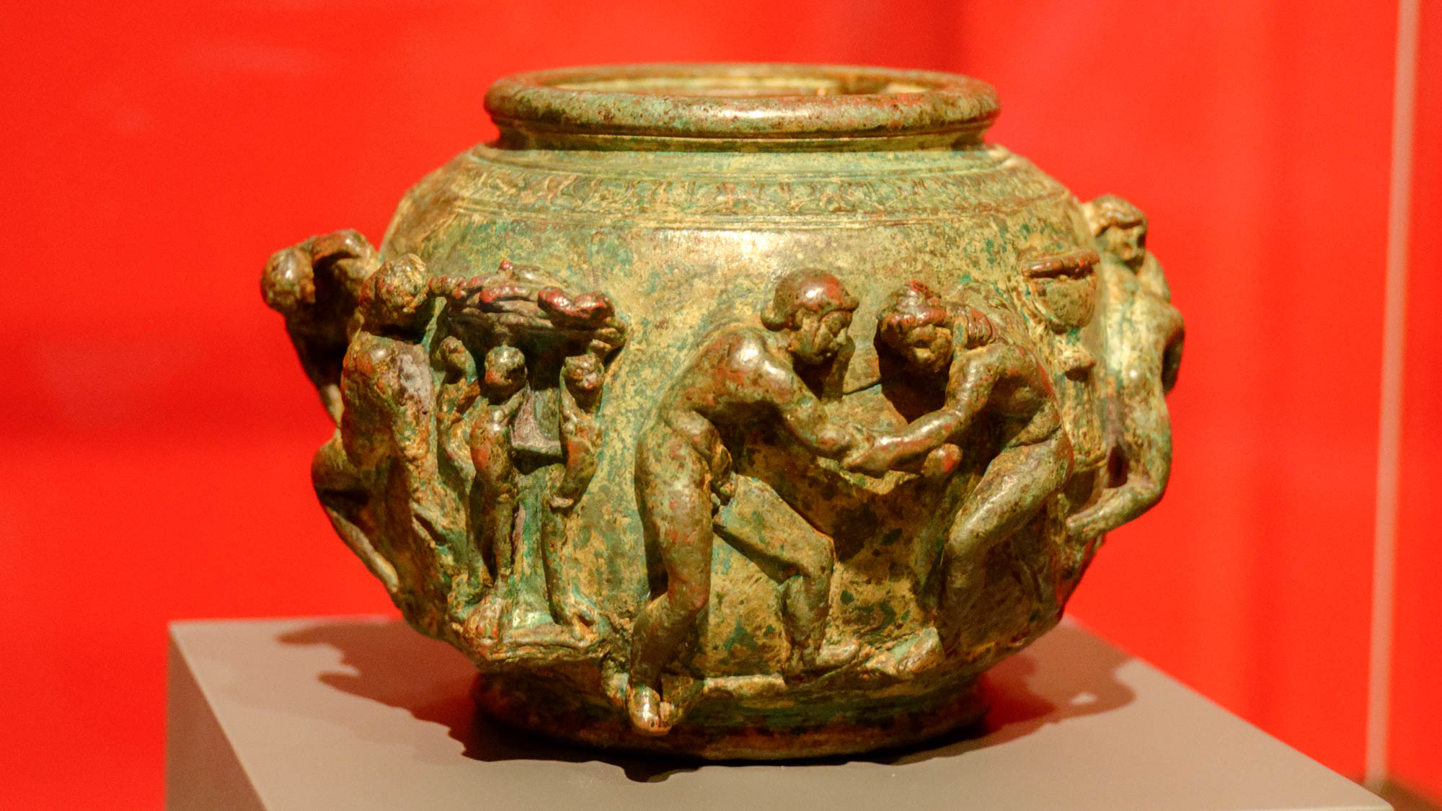
It does not act dishonorably, does not seek its own, is not provoked
Bronze bowl with wrestlers, circa AD 75–100
13:5
Notes:
Provocation is illustrated here by a depiction of men wrestling with each other. This bowl was photographed at the Getty Villa in southern California.
tb100919482h

Slide 51
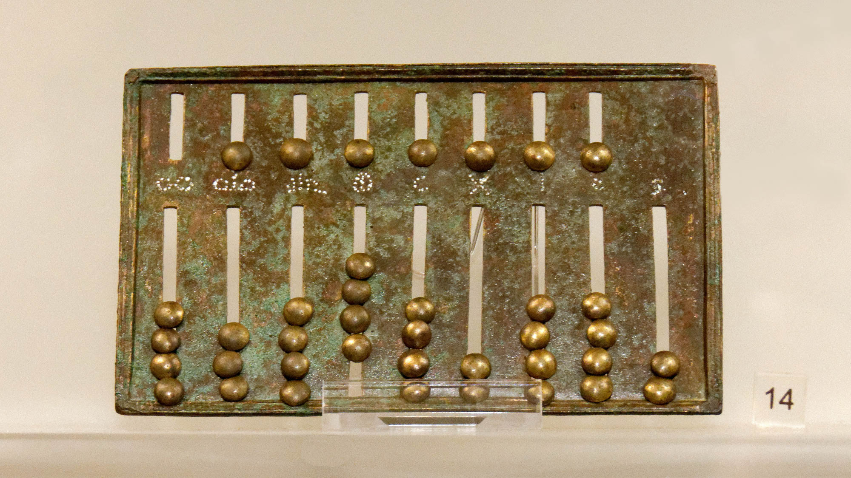
It does not take into account a wrong suffered
Small bronze abacus, Roman period
13:5
Notes:
To “take into account” (Gk. logizomai, λογίζομαι) can have the meaning of something that is calculated or determined by a mathematical process. The ancient Roman abacus pictured here was used for keeping track of addition and multiplication. Some abacuses could be used for more complicated problems, including the calculation of fractions and square roots. This abacus was photographed at the National Museum of Rome.
tb0513177932h

Slide 52
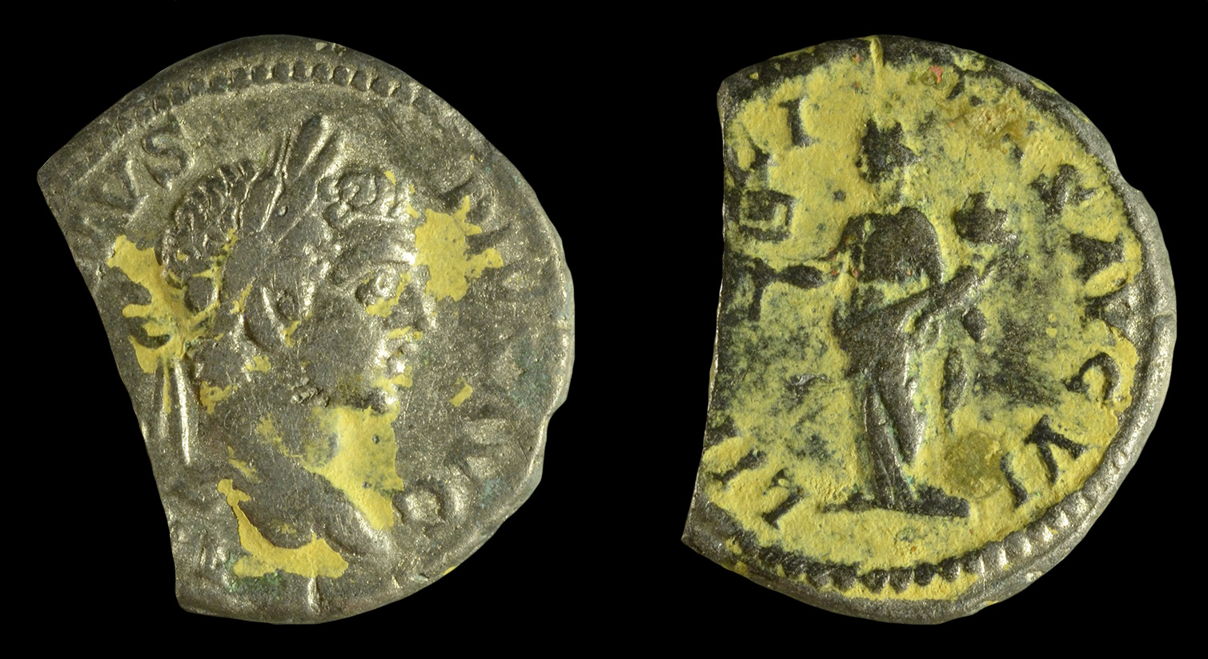
It does not take into account a wrong suffered
Silver coin of Caracalla, with Liberalitas holding an abacus, circa AD 206–210
13:5
Notes:
The reverse side of this silver denarius of the Roman emperor depicts the virtue of generosity (liberalitas), personified as a woman holding an abacus and a horn of plenty (cornucopia). The abacus appears as a small square object with a handle, held in her right hand; it probably signifies the adding up, and therefore keeping track of, her generosity to the city of Rome through programs like free bread for the poor (Cura Annonae). This image comes from Suffolk County Council and is licensed under CC BY 2.0, via Wikimedia Commons: https://commons.wikimedia.org/wiki/File:Roman_coin,_incomplete_silver_denarius_struck_for_Caracalla_(FindID_864446).jpg.
wiki864446193222b

Slide 53
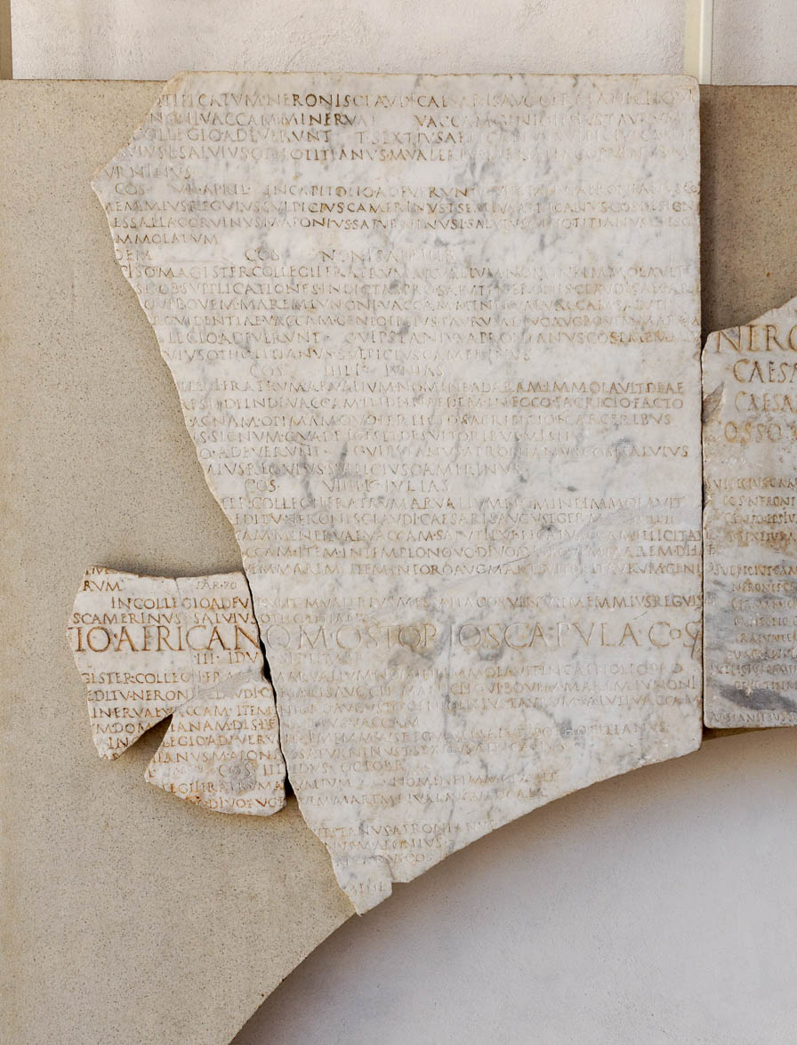
It does not rejoice in unrighteousness
Calendar from the time of Nero, in celebration of executing his mother, March–October AD 59
13:6
Notes:
Nero would come to be known as an example of one who rejoiced in unrighteousness. The inscription shown here is a calendar, and it memorializes Nero’s joy at the execution of his mother, only a few years after Paul wrote this letter to the Corinthians. The calendar also mentions other events of the time, such as sacrifices made for election, health, and the return of Nero. This inscription was photographed at the National Museum of Rome at the Diocletian Baths.
tb0513178664

Slide 54
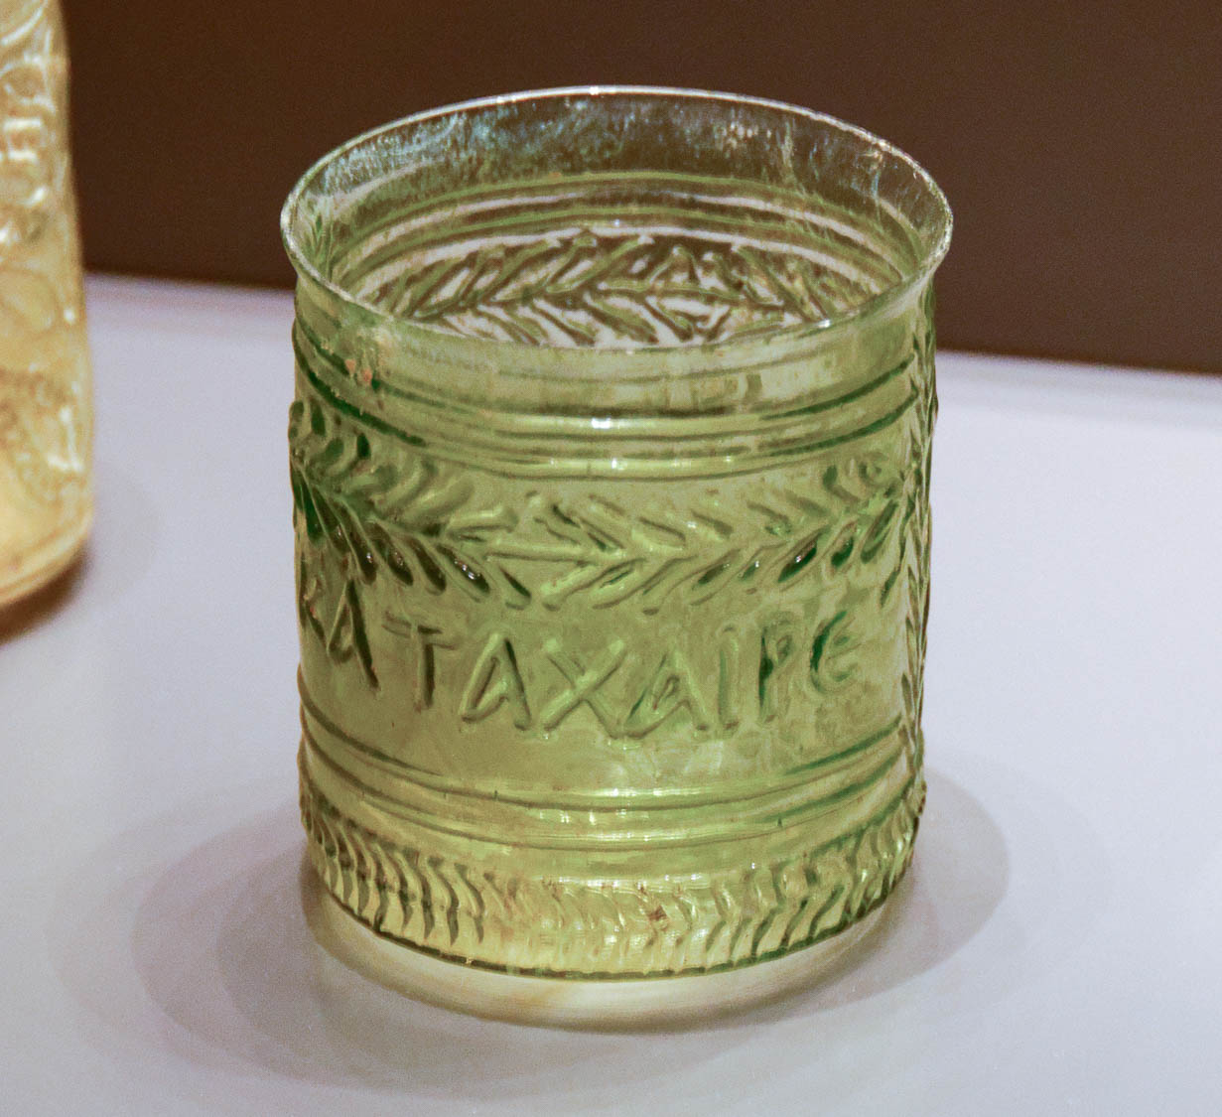
It does not rejoice in unrighteousness, but rejoices with the truth
Mold-blown glass beaker with Greek inscription, “Rejoice!,” 1st century AD
13:6
Notes:
The word “rejoice” (Gk. chairō, χαίρω) indicates a sense of happiness and well-being. The inscription on this glass beaker bears an imperative form from the same root “Rejoice!” (Gk. katachaire, ΚΑΤΑΧΑΙΡΕ). The inscription on this glass continues on the reverse side; the full inscription reads “Rejoice and be glad!” (καταχαιρε και ευφραινου). This glass cup was photographed at the Getty Villa in southern California.
tb100919690h

Slide 55

It does not rejoice in unrighteousness, but rejoices with the truth
Young man singing and playing the kithara, depicted on a terracotta amphora, circa 490 BC
13:6
Notes:
Singing and dancing were activities commonly associated with rejoicing in Greco-Roman culture. This image comes from The Metropolitan Museum of Art, public domain, Fletcher Fund, 1956, accession number 56.171.38, http://metmuseum.org/art/collection/search/254896
met254896h

Slide 56

It does not rejoice in unrighteousness, but rejoices with the truth
Red-figured astragalos with dancers, from Athens, circa 450 BC
13:6
Notes:
This ceramic object is shaped like a very large knuckle bone, a common game piece in ancient Greece and Rome. It is attributed to the Sotades Painter and was photographed at the British Museum.
tb0929197970

Slide 57

Love bears all things
Fresco with the image of Harpocrates, god of silence, from Sirmium, Serbia, 2nd century AD
13:7
Notes:
There are two ways in which the verb “to bear” (Gk. stegō, στέγω) can be understood. One is to keep a matter confidential, to pass over in silence something in another person that is displeasing. This is illustrated here by a fresco of Harpocrates, the Greek god of silence, secrets, and confidentiality. Note that he has his finger pressed to his lips. This image comes from Carole Raddato and is licensed under CC BY-SA 2.0, via Wikimedia Commons: https://commons.wikimedia.org/wiki/File:Fragment_of_fresco_with_the_image_of_Harpocrates,_2nd_century_AD,_Sirmium,_Pannonia_Inferior,_Serbia_(28422656368).jpg.
wiki03302018145328422656368h

Slide 58

Love bears all things
Relief of Roman legionaries, from Saint-Remy-de-Provence, Roman period
13:7
Notes:
It is also possible to understand the verb “to bear” (Gk. stegō, στέγω) as having the means to endure or to hold up against difficulties. This is a quality that was expected of Roman soldiers, illustrated here by a relief of well-armed Roman legionaries. This relief was photographed at the Lyon Gallo-Roman Museum.
tb091719185h

Slide 59

Love bears all things, believes all things, hopes all things
Depiction of Abraham going out to look at the stars
13:7
Notes:
Although Paul states without qualification that love “believes” (Gk. pisteuō, πιστεύω) and “hopes” (Gk. elpidzō, ἐλπίζω) all things, this should likely be understood in the context of faith in God; that is, that love believes what God has said and has hope in His promises. This is exemplified in the faith of Abraham when he believed God (Rom 4:3) and lived in hope (Heb 11:10-13). This illustration comes from Adolf Hult, Bible Primer, Old Testament, For Use in the Primary Department of Sunday Schools (1919). This image is in the public domain, via Wikimedia Commons: https://commons.wikimedia.org/wiki/File:Bible_primer,_Old_Testament,_for_use_in_the_primary_department_of_Sunday_schools_(1919)_(14779694194).jpg.
wiki0730201419192834h

Slide 60

Love bears all things, believes all things, hopes all things, endures all things
Depiction of the stoning of Stephen, from Sant Joan de Boí, circa AD 1100
13:7
Notes:
The verb “endure” (Gk. hupomenō, ὑπομένω) means to stand one’s ground or to hold out. For followers of Jesus, this was particularly required during times of distress or tribulation (Rom 12:12; Heb 10:32). James mentions Job as an example (Jas 5:11). An example from the New Testament would be Stephen, who was martyred for his faith (Acts 7:58–8:1).
This fresco of the stoning of Stephen comes from Sant Joan de Boí, a Romanesque church in Catalonia, Spain. It is thought that the church was constructed in the 11th century AD. This image comes from Museu Nacional d’Art de Catalunya and is in the public domain, via Wikimedia Commons: https://commons.wikimedia.org/wiki/File:Stoning_of_Saint_Stephen_from_Sant_Joan_de_Bo%C3%AD_-_Google_Art_Project.jpg.
wiki01595300011003615

Slide 61

Love never fails
Fresco of a fountain in a garden, from Pompeii, 1st century AD
13:8
Notes:
Fountains in Paul’s day were fed by aqueducts, which in turn were fed by regular springs or rivers. Because the supply was constant, they were never shut off, illustrating Paul’s observation that love is unending. This fresco was photographed at the Pompeii Exhibit at the Nimes Museum.
tb092019574

Slide 62

Love never fails
Water fountain at Jericho
13:8
Notes:
The spring at the Jericho oasis has run year-round for thousands of years, providing a constant water supply for drinking and irrigation. For Paul, love is expected to have the same constancy and regularity.
mjb1902211052h

Slide 63

Prophecies will pass, tongues will cease, and knowledge will come to an end
Mosaic of chariot racers crossing the finish line, from Presquile in Lyon, 2nd century AD
13:8
Notes:
Paul uses three verbs here, one of which is repeated; “to pass” (Gk. katargeō, καταργέω), “to cease” (Gk. pauō, παύω), and “to end” (Gk. katargeō, καταργέω). They are used as synonyms, indicating that these things will be used up and not remain useful or active. The idea is illustrated here by two chariots in a hippodrome, portrayed crossing the finish line. Once this line has been crossed the race has ended and the racers no longer run. Note the track official standing in the gap in the upper right, holding a palm frond that will be handed to the victor. This mosaic was photographed at the Lyon Gallo-Roman Museum.
tb091719333h

Slide 64

For we know in part and we prophesy in part
Fragmentary inscription of Senate consultation on the future heir, from Rome, AD 23
13:9
Notes:
Paul’s point in characterizing both knowing and prophesying “in part” (Gk. meros, μέρος) is that both are incomplete; the word stands in contrast to the whole. A large percentage of inscriptions from antiquity are now broken and missing various portions, as illustrated by this example from Rome. This inscription records the plans of the Senate should the heir of Tiberius, Drusus Caesar Tiberii Augusti, die prematurely. This inscription was photographed at the Vatican Museums.
tb0512177054

Slide 65


But when that which is perfect arrives, that which is partial will be set aside
A Soul Carried to Heaven, by William-Adolphe Bouguereau, circa 1880
13:10
Notes:
The word “perfect” (Gk. teleios, τέλειος) refers to something which has attained an end or purpose and is thus complete. Paul uses it elsewhere to speak of that which is full-grown or mature (1 Cor 2:6; 14:20; Eph 4:13). This statement has been the object of much debate. The main ways in which it has been taken are that it speaks of death (full knowledge when we stand in the Lord’s presence), the completion of the New Testament canon (the completion of God’s word for the church), or the new heavens and new earth. The first of these options is illustrated here, and the following two are illustrated on subsequent slides.
William-Adolphe Bouguereau was one of the most beloved realistic painters of the 19th century. A removable box has been added to the figure to avoid causing offense or surprise. This image is in the public domain, via Wikimedia Commons: https://commons.wikimedia.org/wiki/File:Mus%C3%A9e_d%27art_et_d%27arch%C3%A9ologie_du_P%C3%A9rigord_-_William-Adolphe_Bouguereau_-_Une_%C3%A2me_au_ciel.jpg.
wiki111220091913501351c

Slide 66

But when that which is perfect arrives, that which is partial will be set aside
Mosaic of Saint Paul at the Arian Baptistery, Ravenna, Italy, circa AD 500
13:10
Notes:
The second way this verse has been taken is to refer to the completion of the New Testament canon. This mosaic depicts Paul holding two scrolls, symbolizing his role as an author of Scripture. This mosaic was photographed in the Arian Baptistery, a structure built by the Ostrogothic king Theodoric the Great between the end of the 5th century and the beginning of the 6th century AD. This image comes from Ввласенко and is licensed under CC BY-SA 3.0, via Wikimedia Commons: https://commons.wikimedia.org/wiki/File:Saint_Paul._Detail_of_the_mosaic_in_Arian_Baptistery._Ravenna,_Italy.jpg.
wiki06082016164547

Slide 67

But when that which is perfect arrives, that which is partial will be set aside
The Plains of Heaven, by John Martin, circa 1851
13:10
Notes:
A third way this verse has been taken is to refer to the revelation of the new heavens and new earth. This oil on canvas painting depicts heaven as a vast sweep of beautiful country with majestic mountains, trees, and lakes where those who have gained that shore frolic and dance. The painting was photographed at Tate Britain, formerly the National Gallery of British Art. This image comes from John Martin and is in the public domain, via Wikimedia Commons: https://commons.wikimedia.org/wiki/File:John_Martin_-_The_Plains_of_Heaven_-_Google_Art_Project.jpg.
wiki0219201123592248h

Slide 68

When I was a child, I spoke like a child, I understood like a child, I reasoned like a child
Marble statue of a boy defending his bunch of grapes, circa AD 100–150
13:11
Notes:
This statue was photographed at the Getty Villa in southern California.
tb100919516h

Slide 69

When I was a child, I spoke like a child, I understood like a child, I reasoned like a child
Terracotta group of two girls playing a game known as ephedrismos, circa 300 BC
13:11
Notes:
The Metropolitan Museum of Art gives this description: “The subject of this group with one person carrying another has a long history in Greek art. It is thought to illustrate a game called ephedrismos. A stone was placed upright on the ground, and balls or pebbles were thrown at it from a distance. The loser's eyes were covered, and he had to carry the other player on his back until he found and touched the stone. There were probably a number of variations. Here the little girl carries her companion but does not have her eyes covered.” This image comes from The Metropolitan Museum of Art and is in the public domain. Source: https://www.metmuseum.org/art/collection/search/247884
met247884h

Slide 70

When I was a child, I spoke like a child, I understood like a child, I reasoned like a child
A schoolboy’s notes on an arithmetical problem, from Egypt, circa AD 200
13:11
Notes:
Ancient school texts illustrate the education of youths and the transition from childhood to adulthood. This image comes from the University of Michigan, Advanced Papyrological Information System, and is in the public domain. Source: http://quod.lib.umich.edu/a/apis/x-1074/9815o.tif. University of Michigan Library Digital Collections. Accessed: Sept 13, 2020.
umapis98151074138895

Slide 71

When I was a child, I spoke like a child, I understood like a child, I reasoned like a child
Fresco of cupids playing hide-and-seek, from Pompeii, 1st century AD
13:11
Notes:
This fresco was photographed at the Naples Archaeological Museum. This image comes from Carole Raddato and is licensed under CC BY-SA 2.0, via Wikimedia Commons: https://commons.wikimedia.org/wiki/File:Empire_of_colour._From_Pompeii_to_Southern_Gaul,_Mus%C3%A9e_Saint-Raymond_Toulouse_(16279074872).jpg.
wiki1627907487201092015h

Slide 72

When I was a child, I spoke like a child, I understood like a child, I reasoned like a child
Doll and toy dishes, Roman period
13:11
Notes:
This display was photographed at the Museum of the Forum of Caesar Augusta in Tarragona, Spain. This image comes from Ivanhercaz and is licensed under CC BY-SA 4.0, via Wikimedia Commons: https://commons.wikimedia.org/wiki/File:Museo_del_Foro_de_Caesaragusta_en_Zaragoza_44.jpg.
wiki09182016103850531h

Slide 73

When I was a child, I spoke like a child, I understood like a child, I reasoned like a child
Youth, maybe Britannicus, wearing toga with bulla, from so-called Basilica of Otricoli in Umbria
13:11
Notes:
In Greek and Roman culture, various conventions were practiced to mark different stages of life. For example, youth (up until puberty in the mid-teens) were known to wear a toga praetexta with purple band and a bulla, a round locket made of various materials depending on status and wealth, and containing an amulet for its apotropaic properties. While the use of this is known in other demographics, this was one of the markers of being a child. However, this practice seems to have fallen into disuse after the 1st century AD. An example of this can be seen in the photo shown here. At the transition to adulthood, the bulla would be dedicated to the household god and the child turned adult would begin to wear the toga virilis (Cleland et al. 2007: 26). This statue was photographed at the Vatican Museums.
Reference:
Cleland, Liza; Davies, Glenys; Llewellyn-Jones, Lloyd, eds.
2007 Greek and Roman Dress from A to Z. London: Routledge.
tb0512176981

Slide 74

When I was a child, I spoke like a child, I understood like a child, I reasoned like a child
Depiction of a youth wearing a toga praetexta
13:11
Notes:
This image comes from Nordisk familjebok and is in the public domain, via Wikimedia Commons: https://commons.wikimedia.org/wiki/File:Dr%C3%A4kt,_Romare,_Nordisk_familjebok.png.
wiki0608200613177371907

Slide 75

When I was a child, I spoke like a child, I understood like a child, I reasoned like a child
Portrait of the young teenage boy named “Eutyches,” from Egypt, circa AD 100–150
13:11
Notes:
This portrait illustrates the toga praetexta with a purple band worn by youths. The museum website provides an informative description of this portrait: “The young teenage boy in this remarkably lifelike portrait looks calmly at the viewer, his head in three-quarter view. He is dressed in a white Roman tunic with a narrow purple clavus (a vertical stripe) over the right shoulder. A mantle is draped over the left shoulder. The boy wears his dark brown hair short, with locks brushed to both sides of the forehead. The inscription in dark purple pigment below the neckline of the tunic is Greek, which was the common language of the eastern Mediterranean at the time. Scholars do not completely agree on the inscription’s translation. The boy’s name (‘Eutyches, freedman of Kasanios’) seems indisputable, then follows either ‘son of Herakleides Evandros’ or ‘Herakleides, son of Evandros.’ It is also unclear whether the ‘I signed’ at the end of the inscription refers to the painter of the portrait or to the manumission (act of freeing a slave) that would have been witnessed by Herakleides or Evandros. An artist’s signature would be unique in mummy portraits.” This image comes from The Metropolitan Museum of Art, public domain, Gift of Edward S. Harkness, 1918, accession number 18.9.2, http://metmuseum.org/art/collection/search/547951.
met547951

Slide 76

When I was a child, I spoke like a child, I understood like a child, I reasoned like a child
Statuette of guardian divinity of house, represented as child in short tunic, 1st century AD
13:11
Notes:
The short toga worn by this figure was also associated with youth. This figurine was photographed at the Naples Archaeological Museum.
tb0515170540

Slide 77

When I was a child, I spoke like a child, I understood like a child, I reasoned like a child
Red-figure vase depicting a crawling child looking at his roller, circa 400 BC
13:11
Notes:
This trefoil vase depicts a child doing childish things—crawling on the ground toward his roller toy. This vase was photographed at the International Ceramics Museum in Weiden, Germany. This image comes from ArchaiOptix and is licensed under CC BY-SA 4.0, via Wikimedia Commons: https://commons.wikimedia.org/wiki/File:Classical_miniature_chous_ARV_extra_-_naked_boy_crowling_on_the_ground_looking_at_his_toy_roller_(01).jpg.
wiki080320181606251951

Slide 78

When I became a man, I did away with childish things
Relief of a soldier with a horse greeting a woman, Roman period
13:11
Notes:
The activities of adulthood are different than those of childhood, illustrated here by both military engagement and by male/female relations. This relief was photographed at the Vatican Museums.
tb0512175975h

Slide 79

When I became a man, I did away with childish things
Red-figured kylix depicting a carpenter at work, Greek, from Athens, circa 500 BC
13:11
Notes:
This kylix was photographed at the British Museum.
tb0929198028h

Slide 80

When I became a man, I did away with childish things
Fresco with men working at a forge, from the House of Chariots in Pompeii, 1st century AD
13:11
Notes:
Metal working was another profession of Paul’s day, one that required adult strength and skill. This fresco is thought to represent the workshop of the Greek god Hephaestus, in which Cyclops and Vulcan forged armor for various Greek gods. This fresco was photographed at the Naples Archaeological Museum.
tb0515170227h2

Slide 81

When I became a man, I did away with childish things
Physician Jason with a child patient with an enlarged belly, from Athens, 2nd century AD
13:11
Notes:
Medicine was another important adult occupation in Paul’s day; it is difficult to imagine anyone consulting a child regarding an illness. One of the best-known physicians of the New Testament was Paul’s travelling companion, Luke (Col 4:14). This relief was photographed at the British Museum.
tb0929197884h

Slide 82

When I became a man, I did away with childish things
Fresco of a river boat embarking for grain transport, circa AD 250
13:11
Notes:
Commerce and transportation were also adult tasks in the Roman period. Sailing was a dangerous business, involving numerous skills that were specialized and required training over time This fresco fragment shows the river boat Isis Geminiana embarking grain for transportation. The workmen appear to be carrying grain in bags (one is labeled RES, “stuff,” while another is labeled FECI, “done”), and dumping them into a measuring container. The fresco comes from the first half of the 3rd century AD, from the Columbarium No. 31 of the Necropolis in Ostia. It was photographed in the Vatican Museums. This image comes from Carole Raddato and is licensed under CC BY-SA 2.0, via Wikimedia Commons: https://www.flickr.com/photos/carolemage/28993017561
wiki28993017561h

Slide 83

When I became a man, I did away with childish things
Bronze statue of Emperor Augustus, circa 12–10 BC
13:11
Notes:
The task of running an empire, symbolized here by a statue of Augustus, clearly required the skills and maturity of an adult. This statue was photographed at the National Archaeological Museum at Athens.
mjb011117106h

Slide 84

Now we see in a mirror indistinctly
Bronze mirror from Corinth grave, 250 BC
13:12
Notes:
In the ancient world, mirrors (Gk. esoptron, ἔσοπτρον) were generally made of polished bronze, which did not give a clear reflection like modern glass mirrors. It would be like looking at your reflection in the bottom of a cooking pot. This mirror was photographed at the Corinth Museum.
tb031706032

Slide 85

Now we see in a mirror indistinctly
Bronze mirror, from a sarcophagus from Chiliomodi, circa 600 BC
13:12
Notes:
Numerous bronze mirrors from antiquity have been recovered. They have a round face which was originally highly polished, and they typically have an integrated handle. This bronze mirror, which predates the time of Paul by a number of centuries, was discovered at Chiliomodi, a village about 13 miles (21 km) southwest of Corinth. It was photographed at the Corinth Museum.
tb011017908

Slide 86

Now we see in a mirror indistinctly
Mirror and case with Nero portrait, from Coddenham, England, 1st century AD
13:12
Notes:
This mirror was photographed at the British Museum.
tb1001199710

Slide 87

Now we see in a mirror indistinctly
Bronze hand mirror with cast handle, Etruscan, circa 300–200 BC
13:12
Notes:
This mirror was photographed at the British Museum.
tb0930198833

Slide 88

Now we see in a mirror indistinctly
Bronze mirror, from Egypt, circa 2000–1000 BC
13:12
Notes:
This mirror has been polished in the modern period, giving some idea of how it would have looked in antiquity. This display was photographed at the Louvre Museum.
tb0928196171h

Slide 89

Now we see in a mirror indistinctly
Silver mirror belonging to wife of Thutmose III, from Wadi Qubbanet el-Qirud, 15th century BC
13:12
Notes:
This 18th-dynasty mirror has been polished in the modern period, giving some idea of how it would have looked in antiquity. It was photographed at the Metropolitan Museum of Art in New York City.
adr1606035388

Slide 90

Now we see in a mirror indistinctly
Grave stele with a young woman holding a mirror, circa 400 BC
13:12
Notes:
This stele is from Athens and depicts a young woman holding a mirror while shaking hands with a youth. It was photographed at the National Archaeological Museum at Athens.
mjb011117056h

Slide 91

Now we see in a mirror indistinctly
Painted terracotta sarcophagus of an Etruscan woman with a mirror, 150 BC
13:12
Notes:
This woman, who is identified as Seianti Hanunia Tlesnasa, is depicted looking at her reflection in a mirror. The mirror has an open lid. This sarcophagus was photographed at the British Museum.
tb112004215

Slide 92

Now we see in a mirror indistinctly
Fresco of a woman with her image reflected in a shield, from Pompeii, 1st century AD
13:12
Notes:
This fresco depicts a mythological scene in which golden armor is being made by Hephaistus for Achilles. Of interest is the reflection of the seated woman, Thetis, which can be seen in the polished, mirror-like face of the shield. This fresco was photographed at the Naples Archaeological Museum.
tb0515170233

Slide 93

Now we see in a mirror indistinctly
Mosaic of a soldier with his image reflected in a shield, from Pompeii, 1st century AD
13:12
Notes:
This photo shows a detail of a larger mosaic depicting a battle between Alexander the Great and the Persian king Darius III. In this detail toward the bottom of the mosaic, a soldier has stumbled against a highly polished shield, and the artist has shown his face reflected on its surface. This illustrates the degree to which metal could be polished in the Greco-Roman period. This mosaic is usually assigned a date around 125–120 BC but is thought to be a copy of a 4th century BC painting by Philoxenos. It was discovered in the exedra of the House of the Faun at Pompeii. This mosaic was photographed at the Naples Archaeological Museum. The next slide includes a label.
tb0515170675

Slide 94
Now we see in a mirror indistinctly
Mosaic of a soldier with his image reflected in a shield, from Pompeii, 1st century AD
13:12
Notes:
This photo shows a detail of a larger mosaic depicting a battle between Alexander the Great and the Persian king Darius III. In this detail toward the bottom of the mosaic, a soldier has stumbled against a highly polished shield, and the artist has shown his face reflected on its surface. This illustrates the degree to which metal could be polished in the Greco-Roman period. This mosaic is usually assigned a date around 125–120 BC but is thought to be a copy of a 4th century BC painting by Philoxenos. It was discovered in the exedra of the House of the Faun at Pompeii. This mosaic was photographed at the Naples Archaeological Museum.
tb0515170675

Slide 95

Now we see in a mirror indistinctly
Lake Altinapa Baraji with reflection
13:12
Notes:
Mankind has always known of the reflective nature of still water, something that would have been available to even the poorest people in society. According to Paul’s analogy, we are like people who can only see the reflection and cannot yet see the actual substance of the things being reflected.
tb010201656h

Slide 96

Now we see in a mirror indistinctly, but then face to face
Etruscan sarcophagus with husband and wife, from Vulci, early Hellenistic, 350–300 BC
13:12
Notes:
Here, face-to-face interaction refers to the utmost intimacy and closeness of relationship. This sort of face-to-face intimacy is illustrated here in a sarcophagus depicting a husband and wife lovingly gazing at on another. This travertine sarcophagus was photographed at the Boston Museum of Fine Arts.
adr1711203034

Slide 97

Now we see in a mirror indistinctly, but then face to face
Crown Prince of Sweden reviewing British troops, probably in Jerusalem in 1926
13:12
Notes:
The date for this American Colony photograph is based on a notice in the Jewish Daily Bulletin on August 20, 1926 (http://pdfs.jta.org/1926/1926-08-20_554.pdf).
mat10335h

Slide 98

But now these three remain, faith, hope, and love
Mosaic of the Three Graces in Narlikuyu near Silifke, Turkey, Roman period
13:13
Notes:
The three words listed by Paul, “faith, hope, and love” (Gk. πίστις, ἐλπίς, ἀγάπη) are all grammatically feminine words. The Greeks venerated a set of three goddesses known as the Charites since at least the 6th century BC. The identities of these three varied over time, but the names centered around pleasant themes such as “Grace” (Gk. Charis, Χάρις), “Beauty” (Gk. Kalē, Καλη), “Happiness” (Gk. Eudaimonia, Εὐδαιμονία), and “Good Luck” (Gk. Eutychia, Εὐτυχία). This mosaic of the Three Graces comes from a Roman-period bathhouse. It was photographed at the Narlikuyu Museum. This image comes from Klaus-Peter Simon and is licensed under CC BY-SA 3.0, via Wikimedia Commons: https://commons.wikimedia.org/wiki/File:NarlikuyuGrazien2.jpg.
wiki0916201151842234h

Slide 99

But now these three remain, faith, hope, and love
Relief of the Three Graces, probably Early Roman Period
13:13
Notes:
This relief was photographed at the National Archaeological Museum in Sofia, Bulgaria. This image comes from Ad Meskens and is licensed under CC BY-SA 4.0, via Wikimedia Commons: https://commons.wikimedia.org/wiki/File:Sofia_Archeological_Museum_Votive_tablet_three_graces_08.jpg.
wiki07252017143004424146

Slide 100


But now these three remain, faith, hope, and love
Fresco of the Three Graces, from Pompeii, 1st century AD
13:13
Notes:
The Three Graces continued to be quite popular in Paul’s day, as illustrated by this contemporary fresco. Although temples dedicated to them were not numerous in the Roman empire, they were venerated in a variety of other ways. They appear numerous times in artwork at Pompeii, both in painting, as shown here, and in floor mosaics. This would indicate that Paul’s audience in Corinth must have also been familiar with this trio. This image comes from ArchaiOptix and is licensed under CC BY-SA 4.0, via Wikimedia Commons: https://commons.wikimedia.org/wiki/File:Wall_painting_-_the_three_Graces_-_Pompeii_(IX_2_16)_-_Napoli_MAN_9236.jpg. This fresco was photographed at the Naples Archaeological Museum. A removable graphic has been added to this photo to prevent surprise or offense.
wiki100620181120213686

Slide 101

But the greatest of these is love
Statuette of a shepherd carrying a sheep, 1st century AD
13:13
Notes:
Love (Gk. agapē, ἀγάπη) was illustrated by Jesus when He told of the shepherd who left behind his ninety-nine sheep to find the one that had gone astray (Matt 18:10-14), illustrated here by a shepherd carrying a sheep on his shoulders. This statue was photographed at the Spartacus Exhibit at the Museum of the Ara Pacis in Rome.
tb0518174071h

Slide 102

More than 1,700 slides in PowerPoint format. Available now from BiblePlaces.com.
Notes:
This is a free sample of the 1 Corinthians 13 presentation from the Photo Companion to the Bible. To purchase the full volume, visit https://www.bibleplaces.com/1corinthians/
The Photo Companion to the Bible is an image-rich resource for Bible students, teachers, and researchers. Just as a librarian stocks the shelves with as many relevant materials as possible, so we have tried to provide a broad selection of images. Our goal is that you will find in this “library” whatever it is you are looking for.
Credits: The primary creators of this presentation are Dr. Kris Udd, Dr. Christian Locatell, Dr. Steven D. Anderson, and Dr. Todd Bolen. The photographs have an individual file code which usually includes the initials of the photographer. Other images have additional credit or source information.
Updates: We plan to update this collection as we are able. We welcome your suggestions for improving this resource (photocompanion@bibleplaces.com). Purchasers of the 1 Corinthians volume are provided free, lifetime updates to the volume.
Copyright: This photo collection is protected by copyright law and may not be distributed without written permission from BiblePlaces.com. Slide notes should be treated as any other copyrighted written material, with credit given when quoting from these notes.
For more information, see our complete “Introduction to the Photo Companion to the Bible” online at http://www.BiblePlaces.com/Intro-Photo-Companion-Bible/. Here you will find more information about photo selection, explanatory notes, Bible translation, credit information, and copyright allowances.

