Slide 1
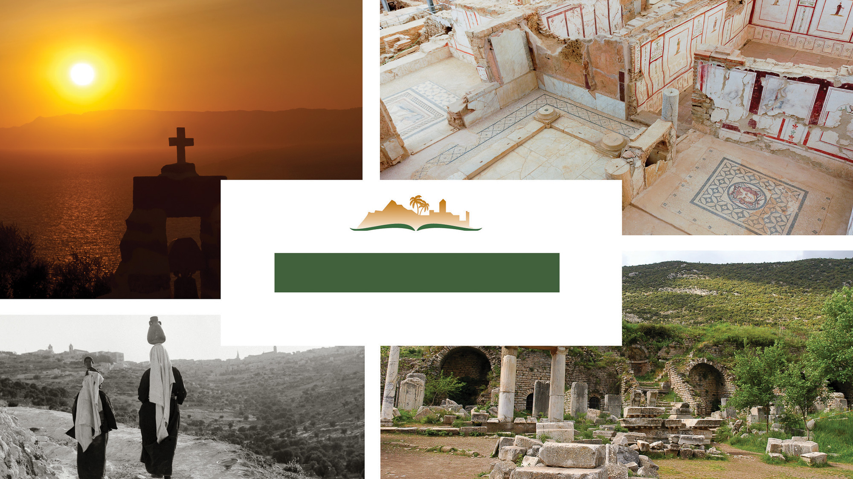
1 John 4
Notes:
This is a free sample of the 1 John 4 presentation from the Photo Companion to the Bible. To purchase the full volume, visit https://www.bibleplaces.com/123john/
The Photo Companion to the Bible is an image-rich resource for Bible students, teachers, and researchers. Just as a librarian stocks the shelves with as many relevant materials as possible, so we have tried to provide a broad selection of images. Our goal is that you will find in this “library” whatever it is you are looking for.
Credits: The primary creators of this presentation are Kai Akagi, Kris Udd, Steven D. Anderson, and Todd Bolen. The photographs have an individual file code which usually includes the initials of the photographer. Other images have additional credit or source information.
Updates: We plan to update this collection as we are able. We welcome your suggestions for improving this resource (photocompanion@bibleplaces.com). Purchasers of the 1, 2, & 3 John volume are provided free, lifetime updates to the volume.
Copyright: This photo collection is protected by copyright law and may not be distributed without written permission from BiblePlaces.com. Slide notes should be treated as any other copyrighted written material, with credit given when quoting from these notes.
For more information, see our complete “Introduction to the Photo Companion to the Bible” online at https://www.BiblePlaces.com/Intro-Photo-Companion-Bible/. Here you will find more information about photo selection, explanatory notes, Bible translation, credit information, and copyright allowances.

Slide 2
1 John 4
This is a free sample of the 1 John 4 presentation from the Photo Companion to the Bible. To purchase the full volume, visit https://www.bibleplaces.com/123john/
The Photo Companion to the Bible is an image-rich resource for Bible students, teachers, and researchers. Just as a librarian stocks the shelves with as many relevant materials as possible, so we have tried to provide a broad selection of images. Our goal is that you will find in this “library” whatever it is you are looking for.
For more details (for this and every slide), see the Notes section below.
Notes:
This is a free sample of the 1 John 4 presentation from the Photo Companion to the Bible. To purchase the full volume, visit https://www.bibleplaces.com/123john/
The Photo Companion to the Bible is an image-rich resource for Bible students, teachers, and researchers. Just as a librarian stocks the shelves with as many relevant materials as possible, so we have tried to provide a broad selection of images. Our goal is that you will find in this “library” whatever it is you are looking for.
Credits: The primary creators of this presentation are Kai Akagi, Kris Udd, Steven D. Anderson, and Todd Bolen. The photographs have an individual file code which usually includes the initials of the photographer. Other images have additional credit or source information.
Updates: We plan to update this collection as we are able. We welcome your suggestions for improving this resource (photocompanion@bibleplaces.com). Purchasers of the 1, 2, & 3 John volume are provided free, lifetime updates to the volume.
Copyright: This photo collection is protected by copyright law and may not be distributed without written permission from BiblePlaces.com. Slide notes should be treated as any other copyrighted written material, with credit given when quoting from these notes.
For more information, see our complete “Introduction to the Photo Companion to the Bible” online at https://www.BiblePlaces.com/Intro-Photo-Companion-Bible/. Here you will find more information about photo selection, explanatory notes, Bible translation, credit information, and copyright allowances.

Slide 3
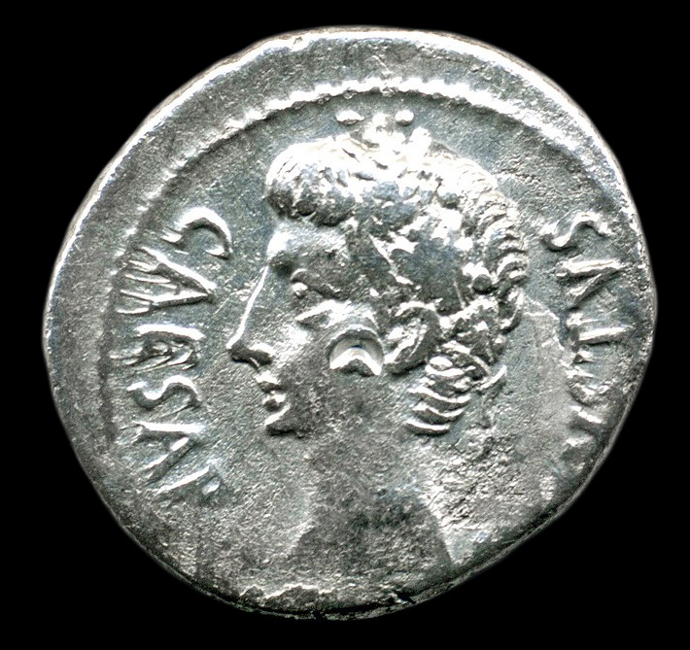
Beloved, do not believe every spirit, but test the spirits to see whether they are from God
Silver denarius of Caesar Augustus, with punch mark, from Spain, circa 18 BC
4:1
Notes:
The verb “to test” (Gk. dokimazō, δοκιμάζω) means to make a critical examination of something to determine if it is genuine. This coin shows a punch mark on the cheek of the bust of Caesar, which comes from the coin having been tested for authenticity. This coin was produced at the Caesaraugusta Mint in Spain (= modern day city of Zaragoza) in 19 to 18 BC. This image comes from James St. John and is licensed under CC BY 2.0, via Wikimedia Commons: https://commons.wikimedia.org/wiki/File:Roman_coin_(head_of_Caesar_Augustus)_3.jpg.
wiki0109202116024819721306

Slide 4
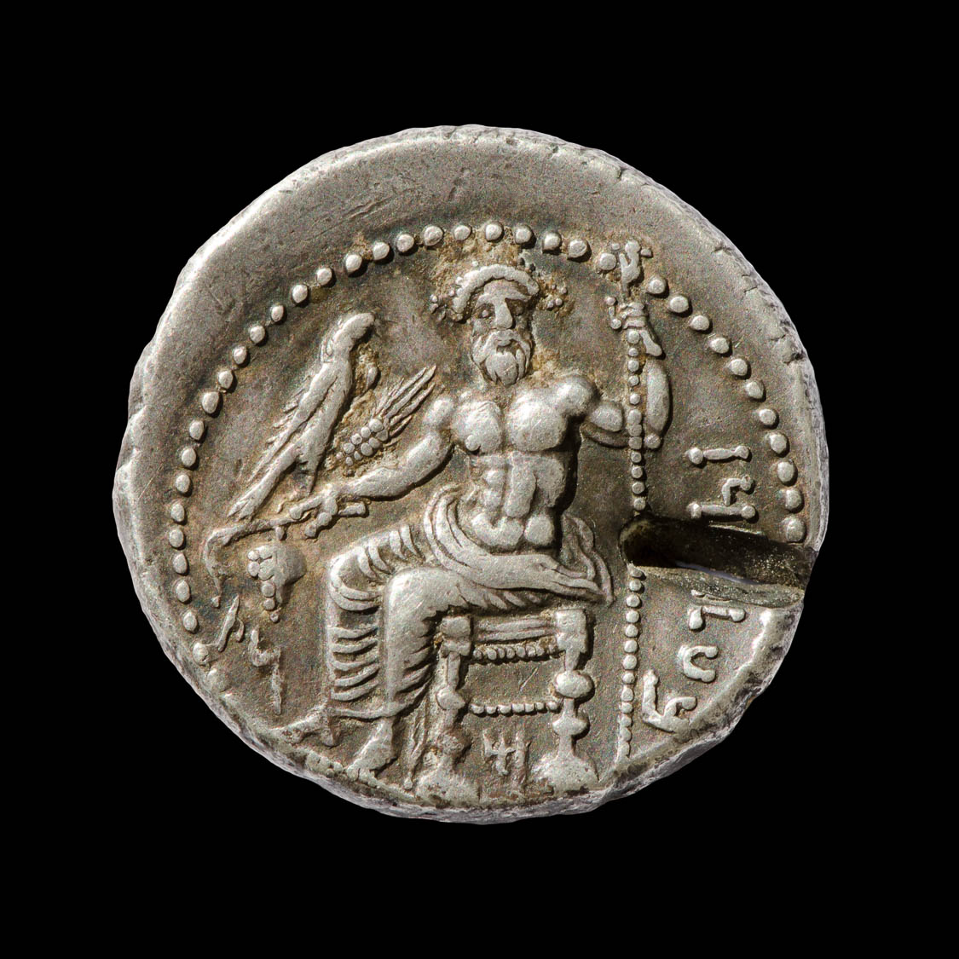
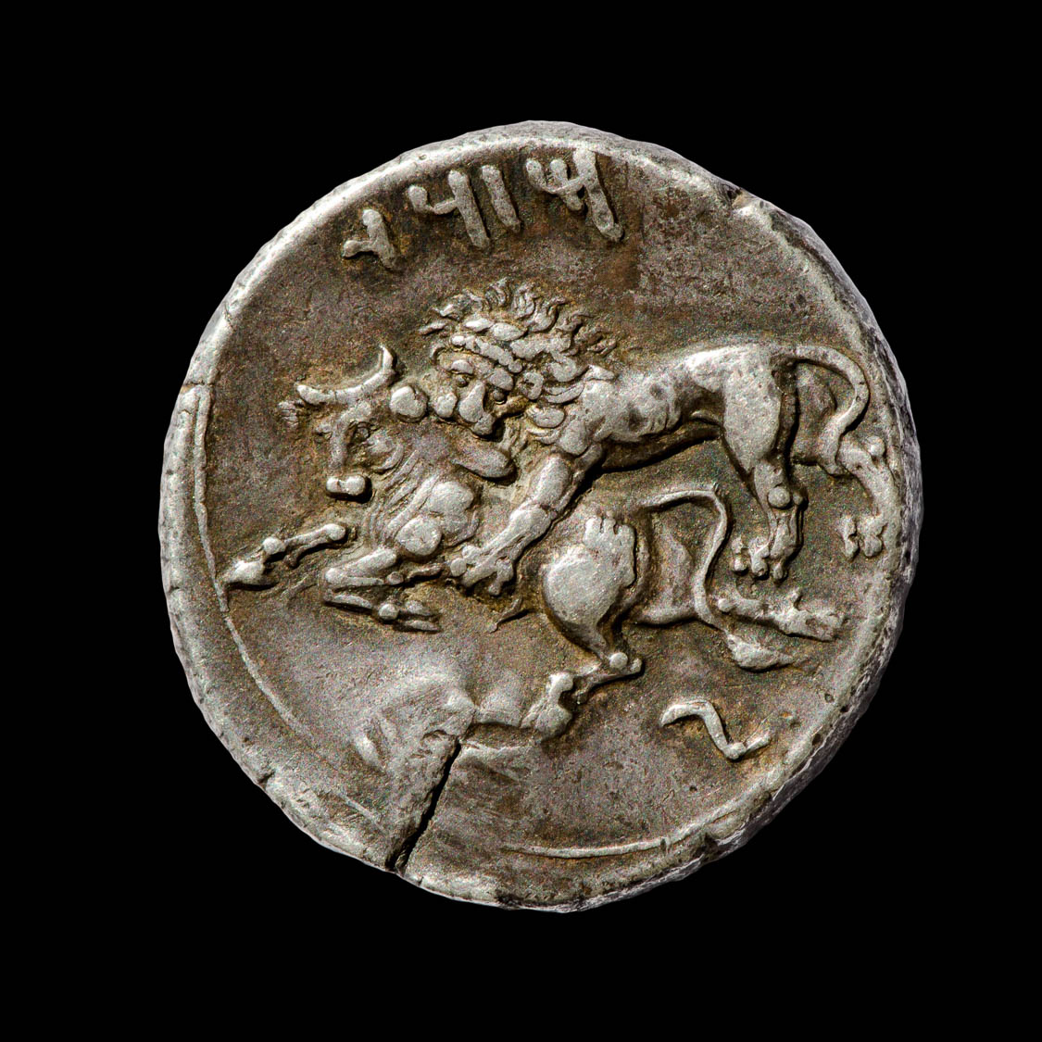
Beloved, do not believe every spirit, but test the spirits to see whether they are from God
Silver stater with punch mark, minted in Tarsus, 361–334 BC
4:1
Notes:
This coin also shows a punch mark from having been tested for authenticity. The mark on the back side (right) reveals that the punch was struck against a hard surface, enough to reveal the inside of the coin without ruining the coin. This coin from Tarsus dates to the period when it was under Persian rule. The obverse contains the Aramaic inscription “Baal of Tarsus” (Arm. בעל תרז) and depicts Baal holding grapes, an ear of grain, an eagle in his right hand, and a scepter in his left hand. Below the throne is the letter “M” (מ), and to the left are the letters “NṢ” (נצ). The reverse depicts a lion attacking a bull and is inscribed “Mazaios” (Arm. מזדי), the name of the satrap of Cilicia from 361 to 334 BC. Note that the script used here is the Imperial Aramaic script, which is very similar to an archaic Hebrew or Phoenician script. This coin is in the Jared James Clark Collection.
Obverse (left): tb0713158819b; reverse (right): tb0713158823b

Slide 5
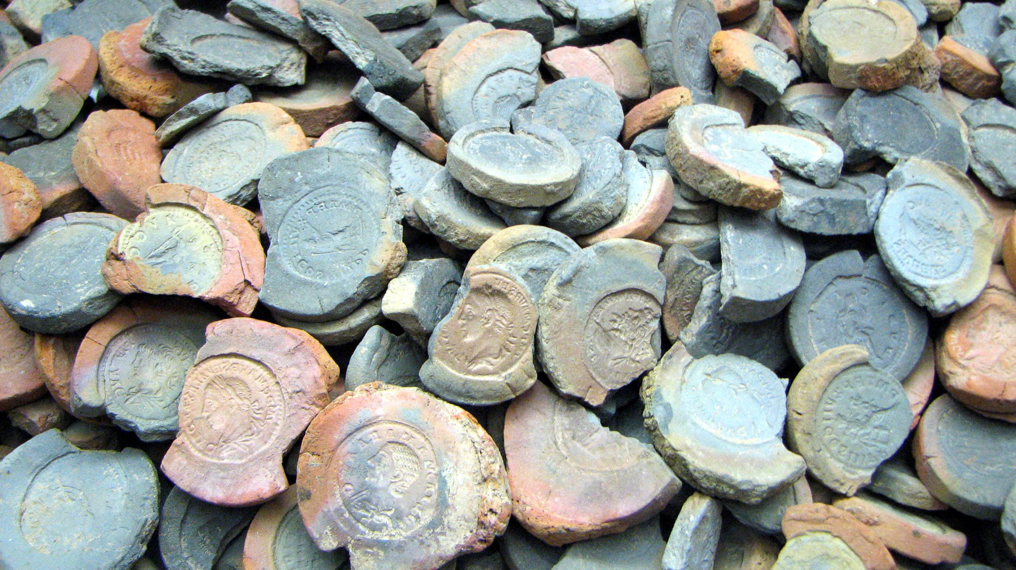
Beloved, do not believe every spirit, but test the spirits to see whether they are from God
Forms for making fake coins, 2nd or 3rd centuries AD
4:1
Notes:
Trickery and deceit were common in John’s day. Because of their inherent (and perceived) value, attempts were sometimes made to fake coins. The clay molds shown here were intended to be used to make such fake copies, probably with actual values less than their supposed face value. These molds were found in Trier, Germany. This image comes from Chris 73 and is licensed under CC BY-SA 3.0, via Wikimedia Commons: https://commons.wikimedia.org/wiki/File:Forms_for_fake_coins.JPG.
wiki0128200716221944

Slide 6
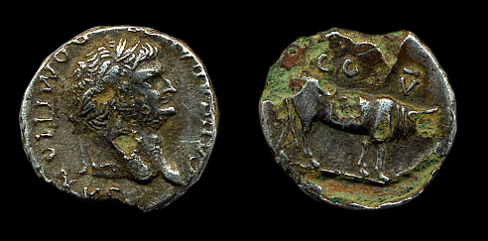
Beloved, do not believe every spirit, but test the spirits to see whether they are from God
Roman forgery of a denarius, copper core and silver plating, reign of Domitian, 1st century AD
4:1
Notes:
This Roman coin is a forgery from the 1st century AD. It has a copper core and has been plated with silver. In places, the silver has worn through and the copper underneath has begun to corrode. This coin was discovered in Essex, England, and dates to between AD 69 and 96. The image on the left comes from Caroline McDonald and is licensed under CC BY-SA 4.0, via Wikimedia Commons: https://commons.wikimedia.org/wiki/File:Roman_forgery_of_a_denarius_obverse_(FindID_66167).jpg. The image on the right comes from Caroline McDonald and is licensed under CC BY-SA 4.0, via Wikimedia Commons: https://commons.wikimedia.org/wiki/File:Roman_forgery_of_a_denarius_reverse_(FindID_66167).jpg.
Left: wiki66167114855050720046996640; right: wiki66167114855050720046996640r

Slide 7
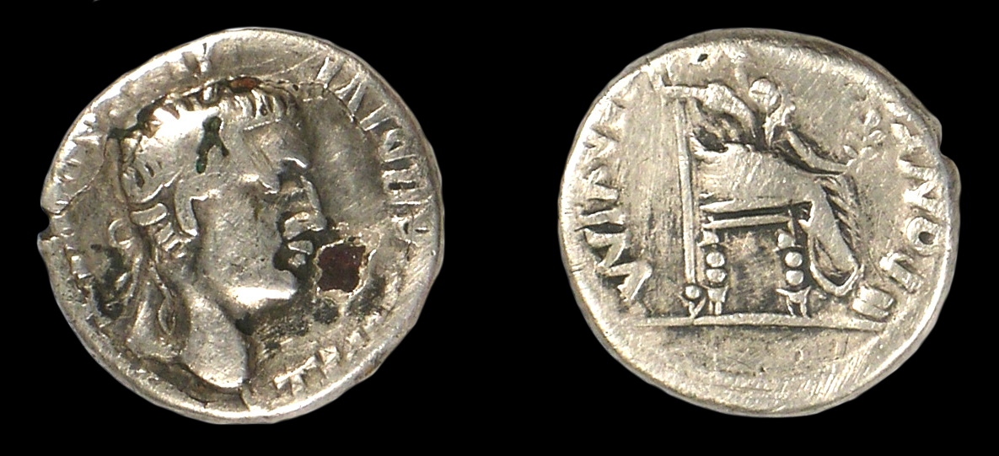
Beloved, do not believe every spirit, but test the spirits to see whether they are from God
Plated forgery of a denarius of Tiberius, from England, 1st century AD
4:1
Notes:
This coin is another forgery from the 1st century AD. It also has a copper core that has been plated with silver. The copper alloy can be seen in areas where the silver has flaked off, and in a nick on the side, possibly made to check if it was fake. This coin was discovered in East Sussex, England, and dates to sometime before AD 41. This image comes from Portable Antiquities Scheme and is licensed under CC BY-SA 4.0, via Wikimedia Commons: https://commons.wikimedia.org/wiki/File:Roman_coin,_Plated_copy_of_a_denarius_of_Tiberius_(FindID_221077).jpg.
wiki22107706092008072359

Slide 8
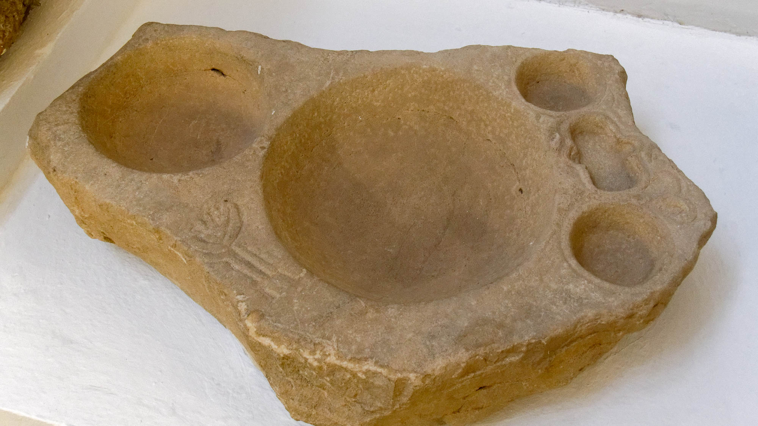
Beloved, do not believe every spirit, but test the spirits to see whether they are from God
Measuring table, from Cortijo Los Pilares, 1st–3rd centuries AD
4:1
Notes:
Romans took steps to avoid being cheated or deceived in commerce. One way in which this was accomplished was by an official set of volume measures placed by the authorities at the market. Similar objects have been recovered from numerous places across the Roman empire. Anyone with a concern about deception related to volume at the marketplace could use a set of official measures like this to determine if they were being shorted. This object was photographed at the Seville Archaeological Museum.
tb092519781h

Slide 9
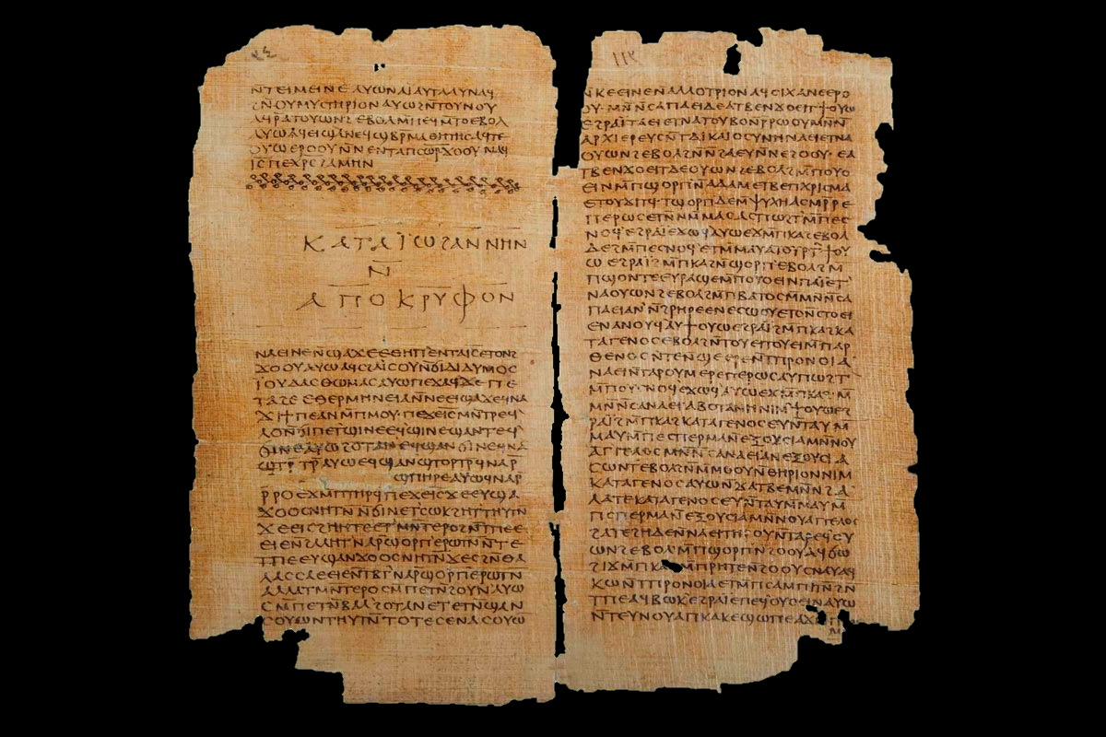
Many false prophets have gone out into the world
Nag Hammadi manuscript, end of the Secret Book of John and beginning of Gospel of Thomas
4:1
Notes:
The Secret Book of John (Apocryphon of John) is a 2nd-century AD Sethian Gnostic text of secret teachings. This copy, which is part of the Nag Hammadi library, dates to the 4th century. Although it post-dates the writing of 1 John, it may typify the sort of false teaching that John is denouncing. This image comes from Wikimedia Commons and is in the public domain. Source: https://commons.wikimedia.org/wiki/File:Apocryphon_of_John.jpg.
wiki042720111744800237

Slide 10
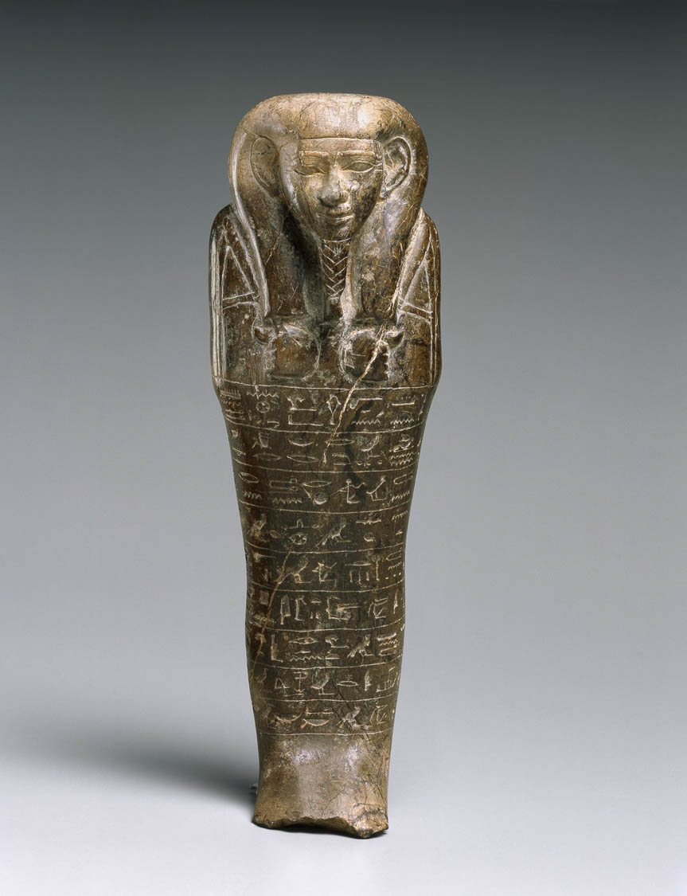
Many false prophets have gone out into the world
Steatite ushebti of the fourth prophet of Amun, from Thebes, circa 650 BC
4:1
Notes:
This picture shows a ushebti (funerary figurine) of Montuemhat, a famous Egyptian prophet of the deity Amun, from the late 25th dynasty. This image comes from the Brooklyn Museum, Charles Edwin Wilbour Fund, 60.182, Creative Commons-BY. Source: https://www.brooklynmuseum.org/opencollection/objects/3695
bmny3695

Slide 11
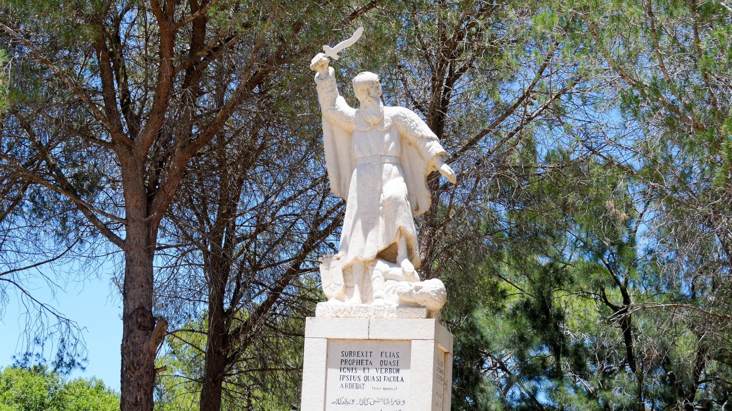
Many false prophets have gone out into the world
Elijah statue at Muhraqa, the traditional place of Elijah’s sacrifice on Mount Carmel
4:1
Notes:
The existence of false prophets was hardly anything new. This statue of Elijah on Mount Carmel commemorates his slaying of the prophets of Baal.
tb061216351h

Slide 12
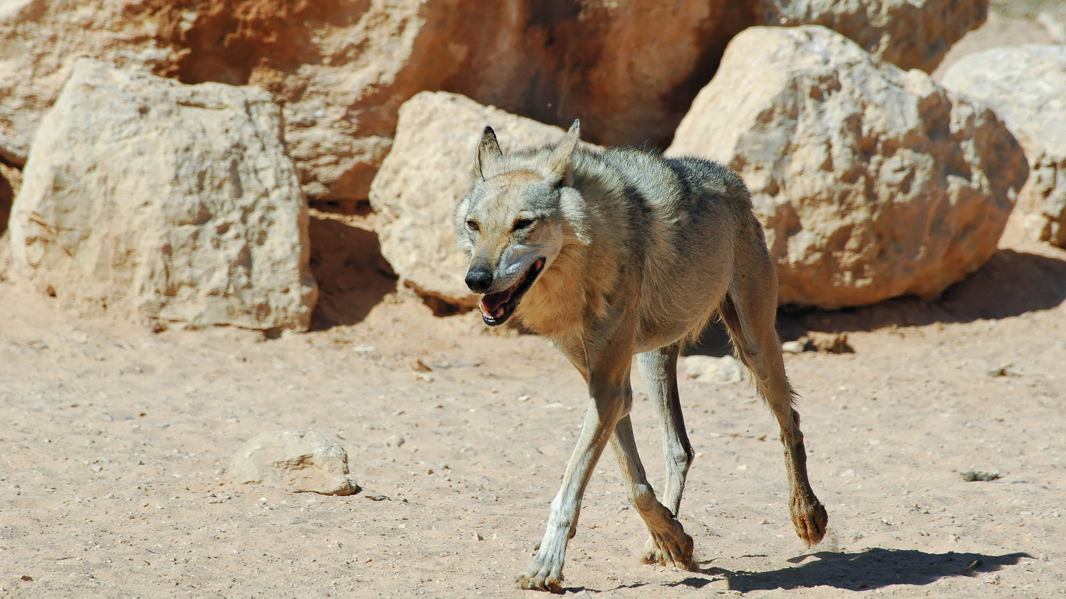
Many false prophets have gone out into the world
Gray wolf at Haibar
4:1
Notes:
Jesus warned of false prophets in the Sermon on the Mount, comparing them to wolves: “Beware of false prophets, who come to you in sheep's clothing, but inwardly are ravenous wolves” (Matt 7:15). This picture shows a wolf at Haibar Nature Reserve in the Negev.
tb052605221h

Slide 13
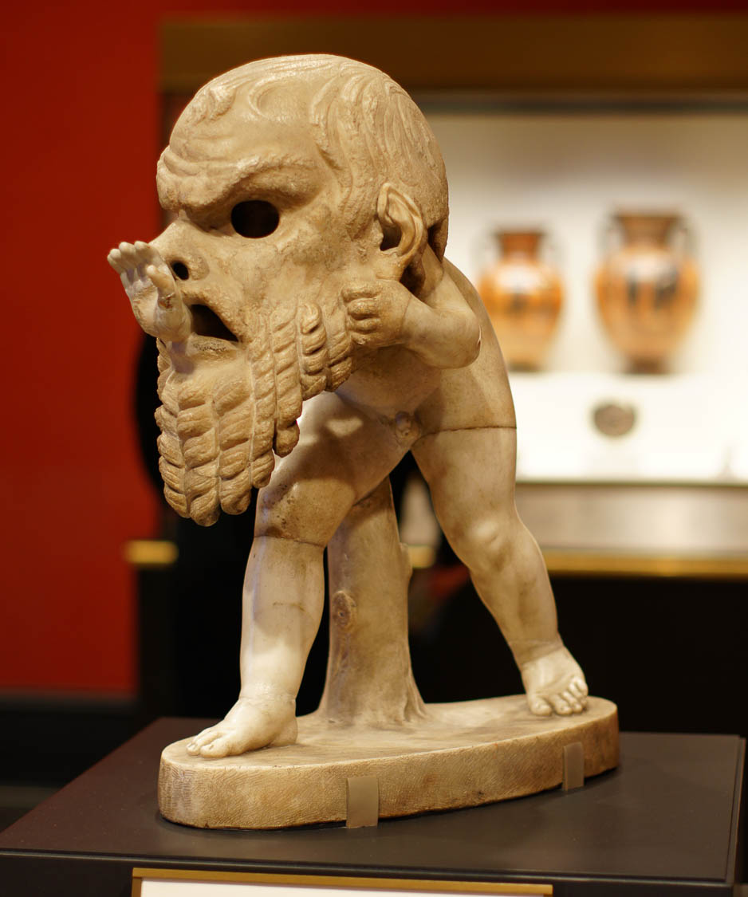
Many false prophets have gone out into the world
Young satyr wearing a theater mask, from Italy, circa AD 150
4:1
Notes:
This humorous statue depicts a young satyr who has donned a theater mask that is much too large, pushing his hand through the mouth of the mask. It illustrates in a comical way the idea of something that is false or deceptive. This photo was taken at the Getty Villa in southern California. This image comes from alijava and is licensed under CC BY-SA 2.0, via Wikimedia Commons: https://commons.wikimedia.org/wiki/File:Getty_villa_1033_(6571514287).jpg.
wiki6571514287

Slide 14
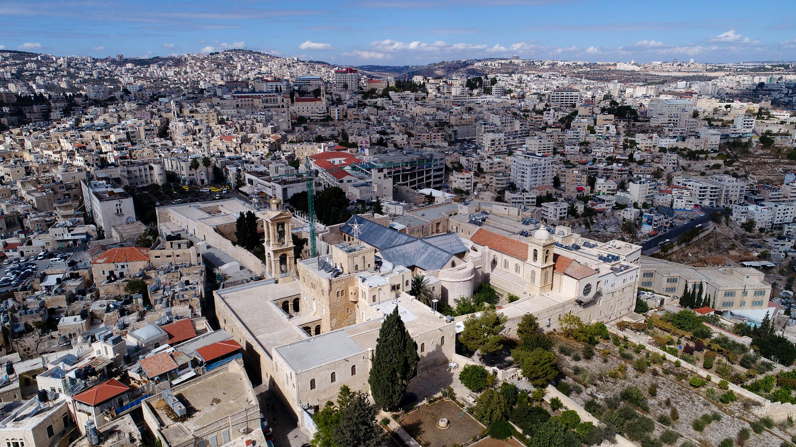
Every spirit that confesses that Jesus Christ has come in the flesh is from God
Church of the Nativity in Bethlehem (aerial view from the southeast)
4:2
Notes:
Jesus was born in the flesh in the small village of Bethlehem. This aerial view of Bethlehem shows the traditional location of that event, where a cruciform church was built in the Byzantine period.
ws110117676

Slide 15
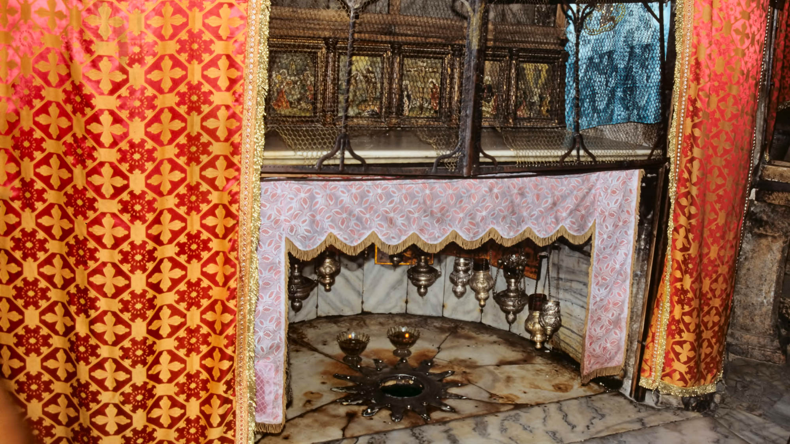
Every spirit that confesses that Jesus Christ has come in the flesh is from God
Traditional place of Jesus‘s birth in the Church of the Nativity, Bethlehem
4:2
Notes:
This photo shows the traditional place of Jesus’s birth in the Bethlehem Church of the Nativity.
tbs43339009

Slide 16
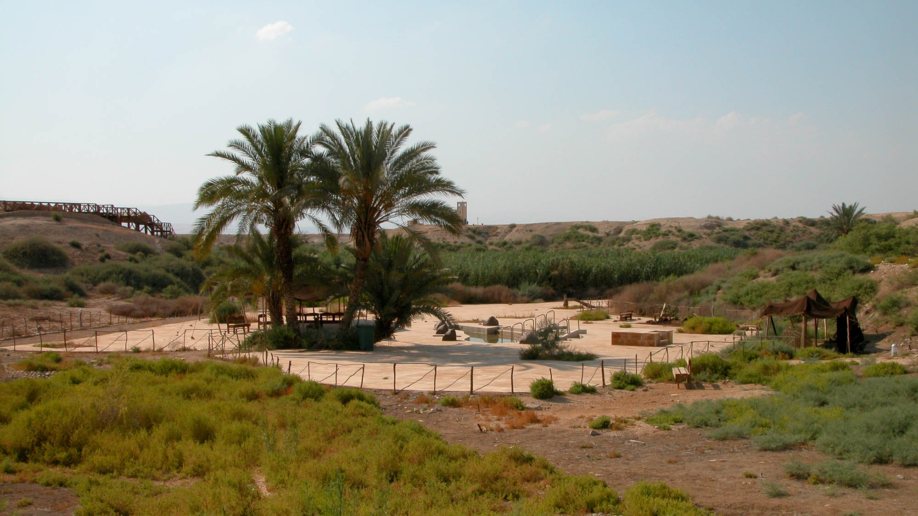
Every spirit that confesses that Jesus Christ has come in the flesh is from God
Bethany beyond the Jordan: Wadi Gharrar with baptismal area
4:2
Notes:
After John the Baptist baptized Jesus, he also made a confession of Jesus’s identity (John 1:29-34). This photograph shows the general area where the baptism may have occurred. A small tributary of the Jordan River, the Wadi Gharrar is fed by five or six springs. Tradition holds that these springs provided the water that was used by John the Baptist for baptizing. Those who support this tradition note the reference to “Bethany beyond the Jordan” as the place John was baptizing (in the Gospel of John), which was not necessarily a location on the river itself. They also question whether a swiftly flowing river would be used for frequent baptisms.
tb060303282h

Slide 17
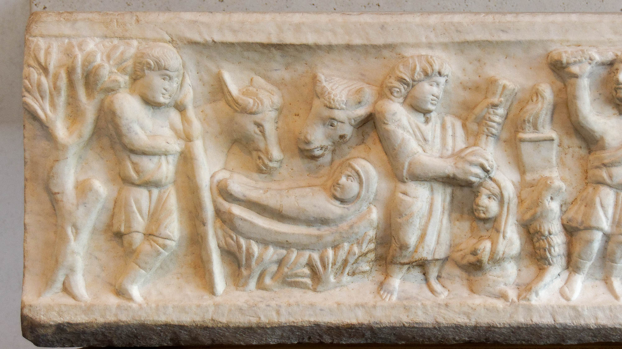
Every spirit that confesses that Jesus Christ has come in the flesh is from God
Sarcophagus of Marcus Claudianus with Nativity scene, from Rome, AD 330–335
4:2
Notes:
This sarcophagus, which includes a nativity scene, was photographed at the National Museum of Rome.
tb0513177636h

Slide 18
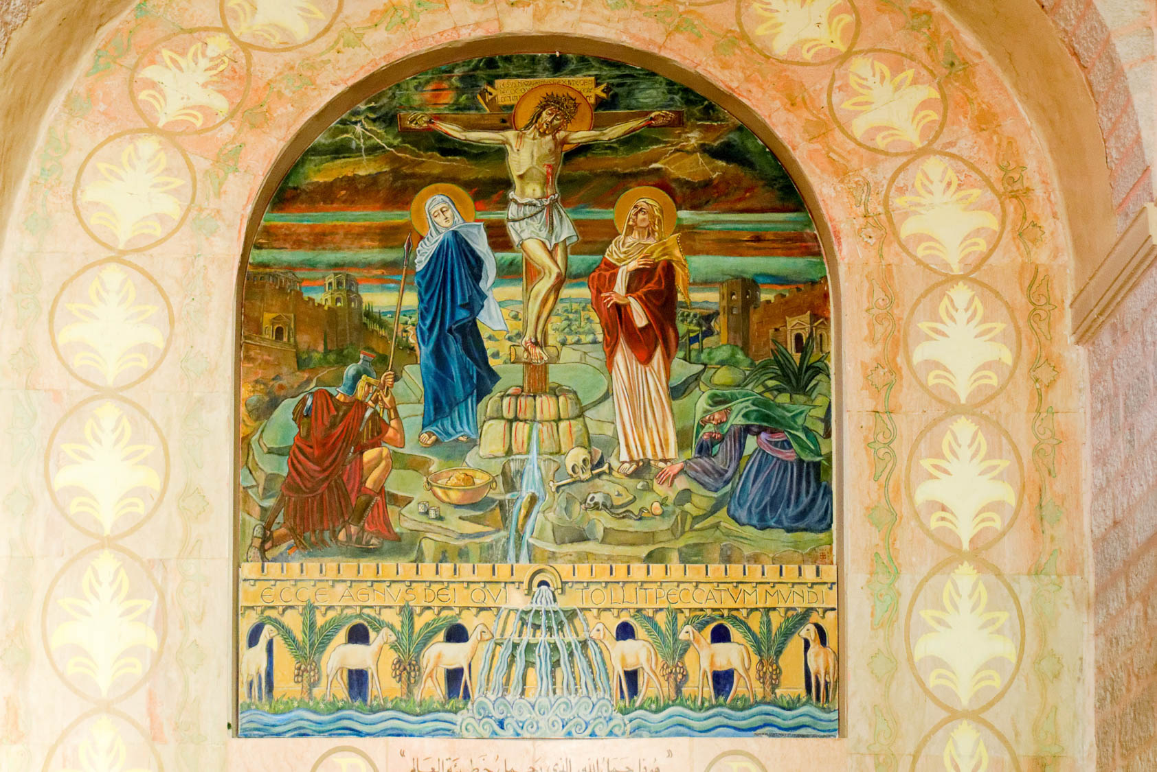
Every spirit that confesses that Jesus Christ has come in the flesh is from God
Wall painting of the crucifixion of Jesus, in the Medeba Church
4:2
Notes:
This picture shows a depiction of Jesus’s crucifixion, by which He died in the flesh and shed His blood, in the Medeba Church in Medeba, Jordan.
tb031315598c

Slide 19
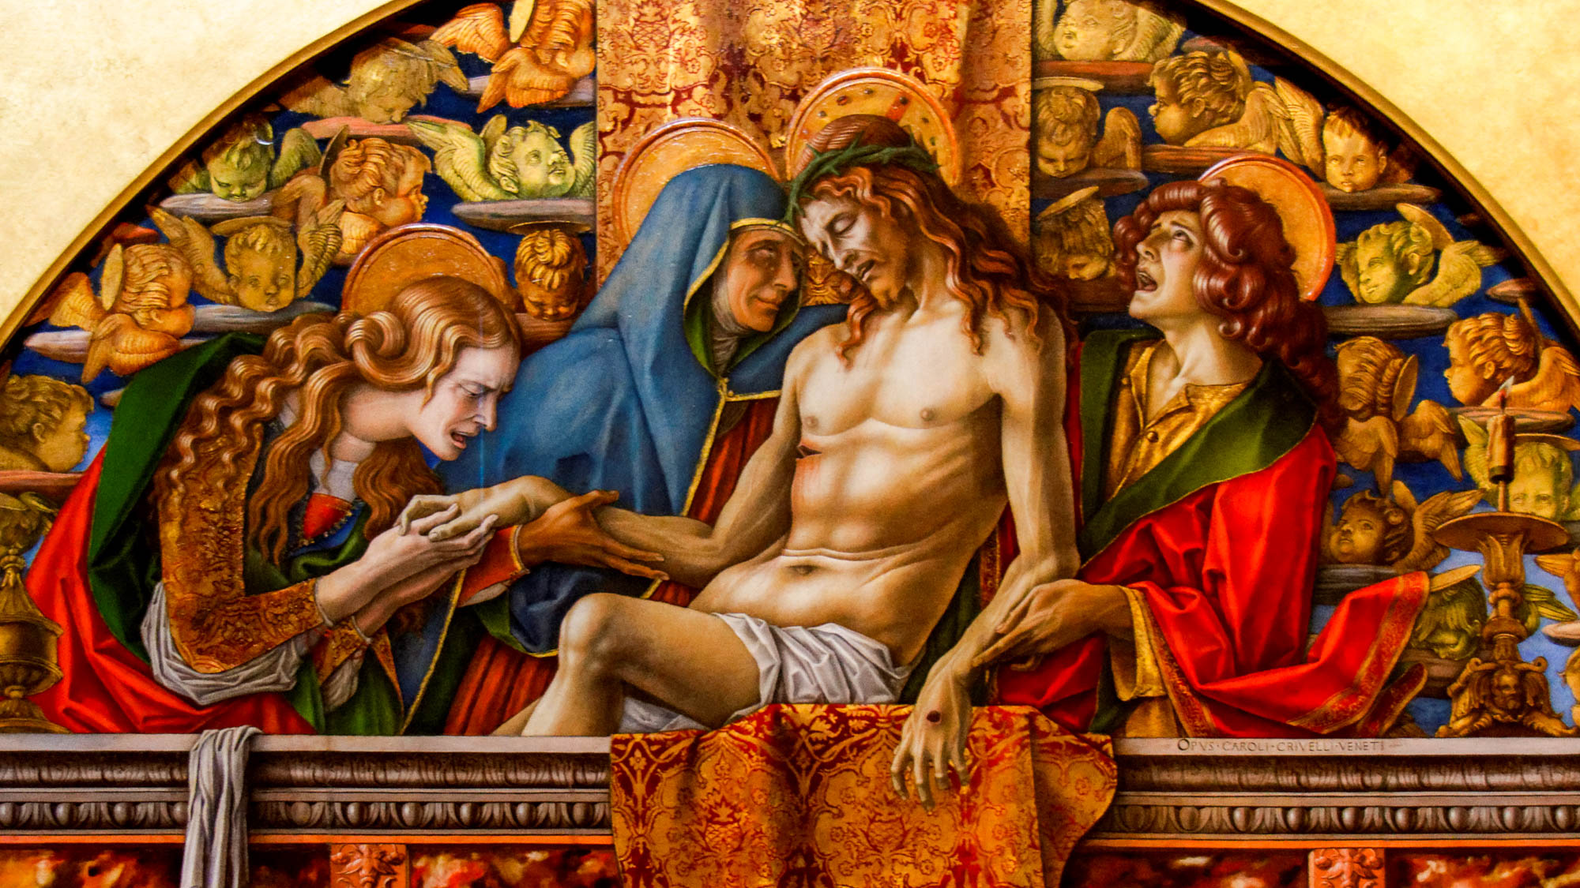
Every spirit that confesses that Jesus Christ has come in the flesh is from God
Pieta, by Carlo Crivelli, 1494–1495
4:2
Notes:
The Italian title for this painting, Pietà, means “the piety,” a term that is used for a variety of works of art depicting Mary the mother of Jesus mourning over His body after His death. This painting was photographed at the Vatican Museums.
tb0512175992h

Slide 20
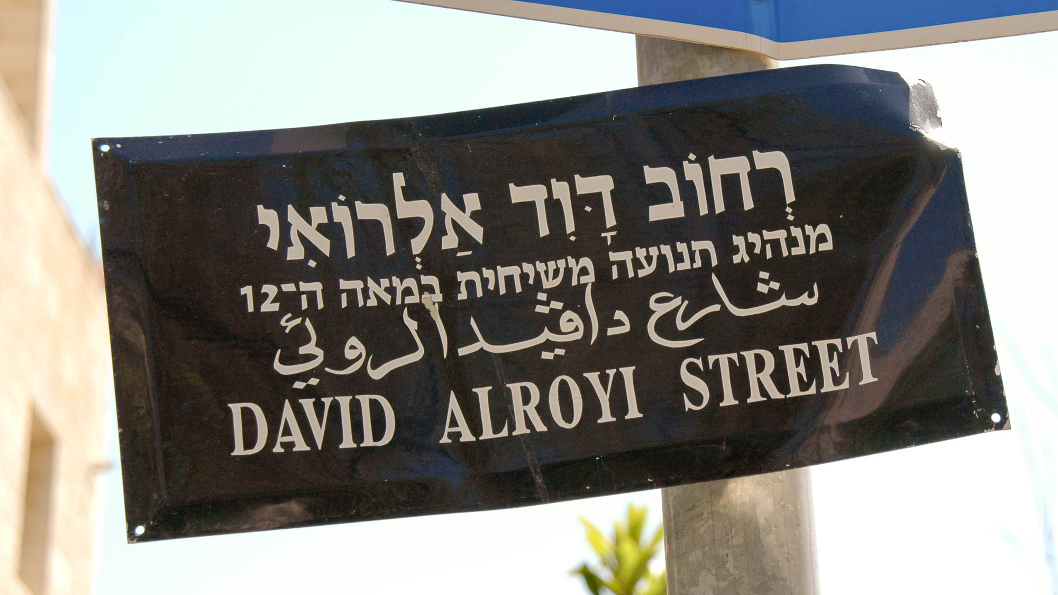
And every spirit that does not confess Jesus is not of God
“David Alroyi Street” sign, false messiah in 12th century
4:3
Notes:
Teaching that does not affirm Jesus as the Messiah come in the flesh is not of God. This sign identifies David Alroyi Street, named after a man who was thought to be the Messiah by some Jewish people in the 12th century.
tb040605722h

Slide 21
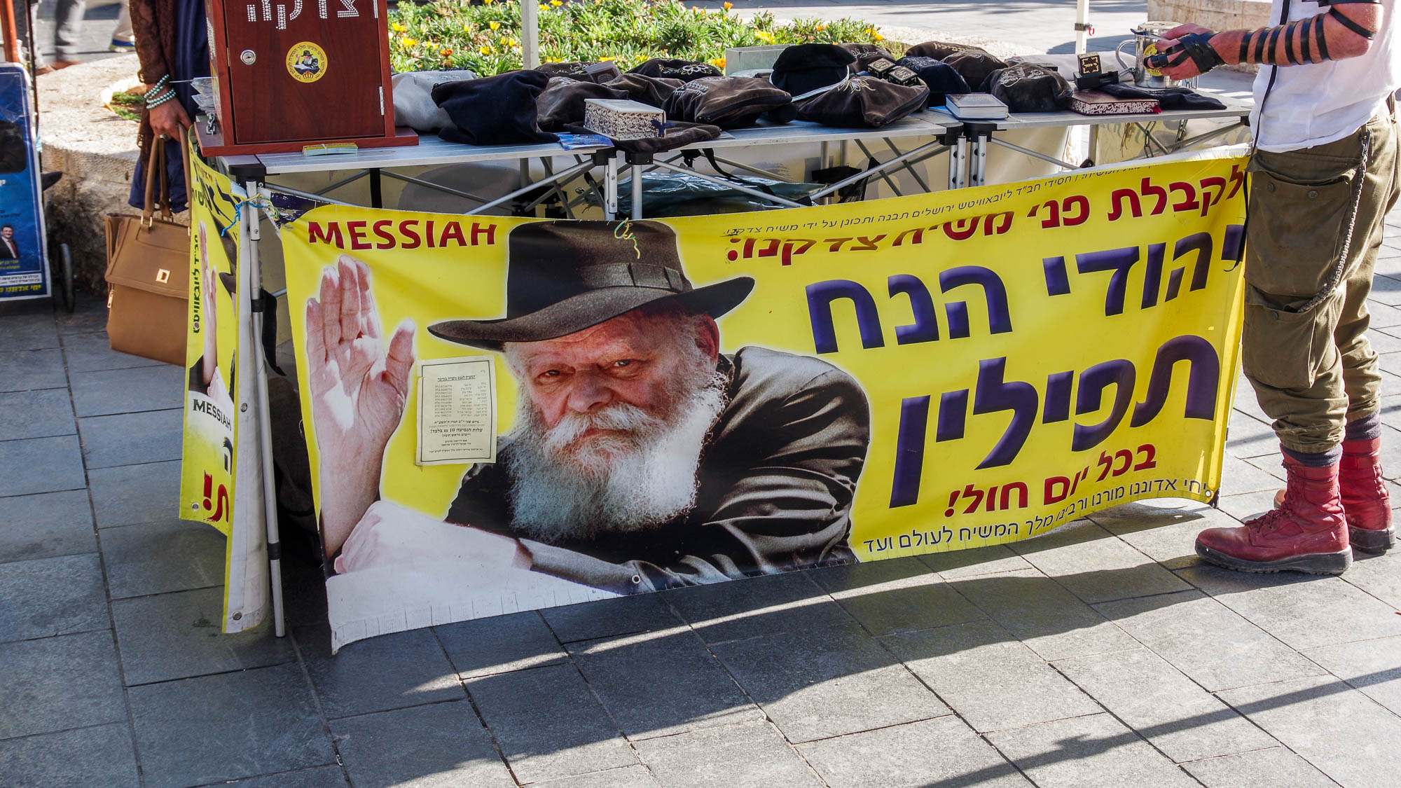
And every spirit that does not confess Jesus is not of God
Rabbi Schneerson, believed by some to be the Messiah
4:3
Notes:
The Lubavitcher Rabbi Menachem Mendel Schneerson was believed to be the Messiah by many of his followers before his death in 1994. He is still in his tomb in Queens, New York, but many continue to believe he is the Messiah, as is clear from signs regularly posted in Jerusalem. This photograph was taken in 2018.
adr1806252120h

Slide 22
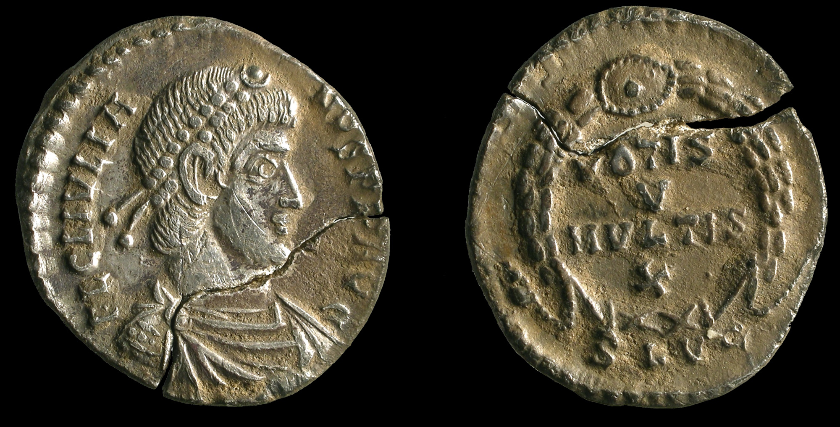
And every spirit that does not confess Jesus is not of God
Broken silver siliqua of Emperor Julian, an apostate, minted at Lyon, AD 360–363
4:3
Notes:
The Emperor Julian (r. AD 361–363) was taught Christianity while young and served as a church lector, but he later rejected Christianity, writing directly in contradiction to its teaching. As emperor, he sought to promote Greco-Roman paganism. He became known as Julian the Apostate. This coin was found in Hertforshire, England. This image comes from Portable Antiquities Scheme and is licensed under CC BY-SA 4.0, via Wikimedia Commons: https://commons.wikimedia.org/wiki/File:Roman_coin,_siliqua_of_Julian_(FindID_496605).jpg.
wiki49660534836419522712411

Slide 23
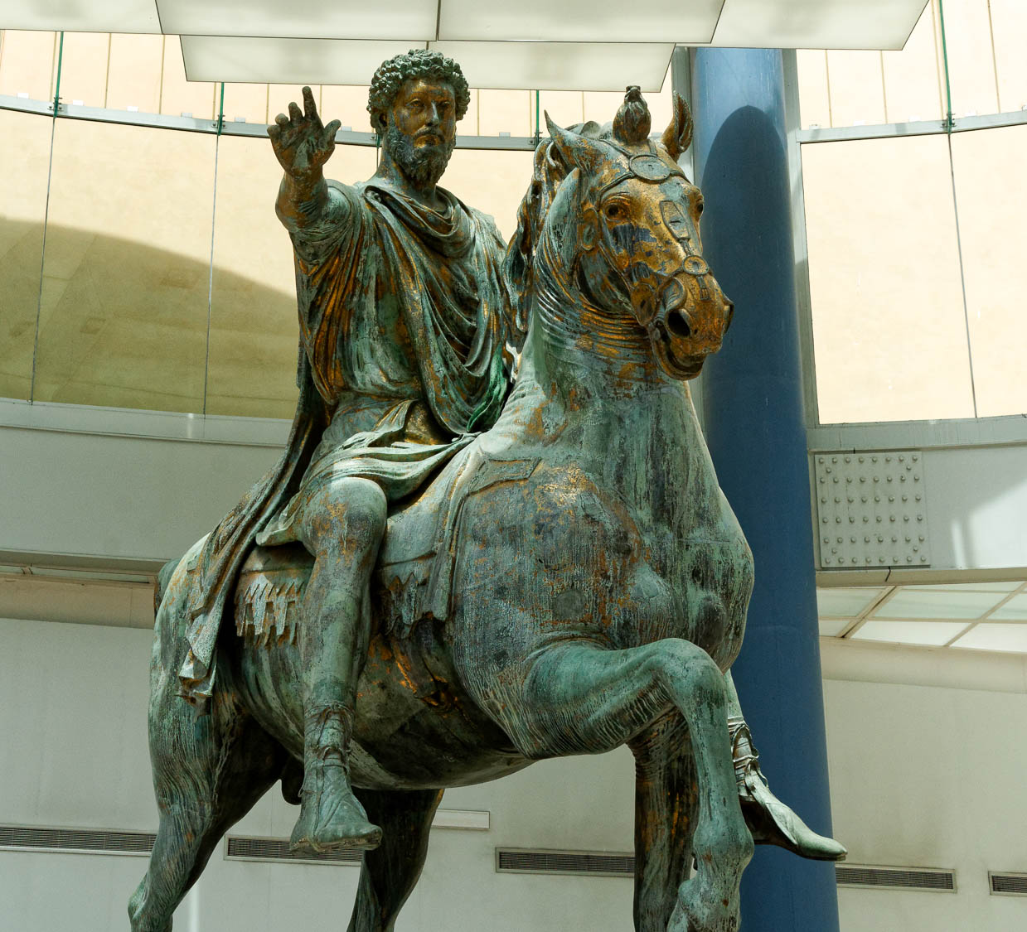
And every spirit that does not confess Jesus is not of God
Equestrian statue of Marcus Aurelius, AD 175
4:3
Notes:
Marcus Aurelius was emperor from AD 161 to 180. He was tutored by Marcus Cornelius Fronto, whose sharp criticisms of Christianity are mentioned in Christian apologist Minucius Felix’s Octavius. Fronto called the objects of Christian worship a donkey’s head and an executed criminal. This picture shows a statue of Marcus Aurelius from AD 175 in the Capitoline Museums in Rome.
tb0514179486

Slide 24
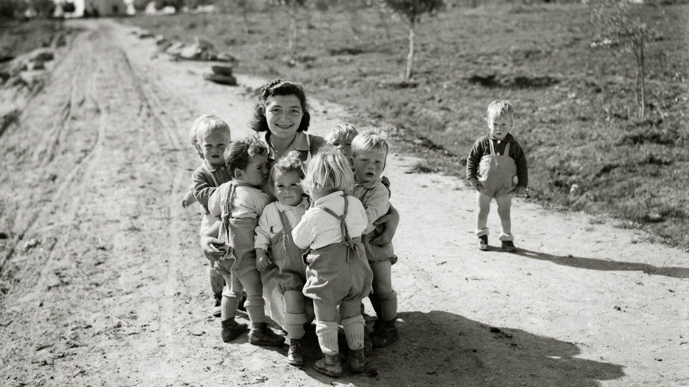
You are of God, little children
Children and their nanny at Negba settlement, 1946
4:4
Notes:
The term “little child” (Gk. teknion, τεκνίον) is a diminutive form of “child” (Gk. teknon, τέκνον). John is the only New Testament author to use this term (e.g., John 13:33; 1 John 2:12), and he always uses it as a term of endearment. This photo of a young woman surrounded by toddlers is an expression of the fondness with which John addresses his audience. Negba is located in southern Israel. This American Colony photo was taken in February of 1946.
mat12772h

Slide 25
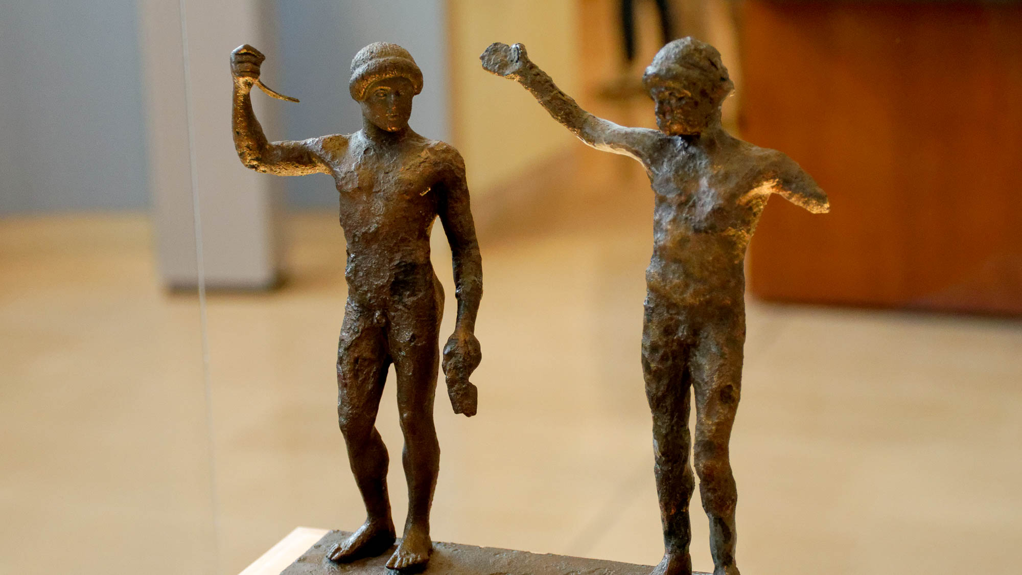
And you have overcome them
Bronze pair of athletes declaring victory, circa 460–450 BC
4:4
Notes:
The verb “to overcome” (Gk. nikaō, νικάω) means to win or be victorious in the face of obstacles. The idea is illustrated here by a pair of athletes, both of whom have received crowns to signify their victory. Their upraised arms likely once held delicate olive leaf crowns, a common prize for the winner of an athletic competition. This set of figurines was photographed at the Delphi Museum.
mjb010917294

Slide 26
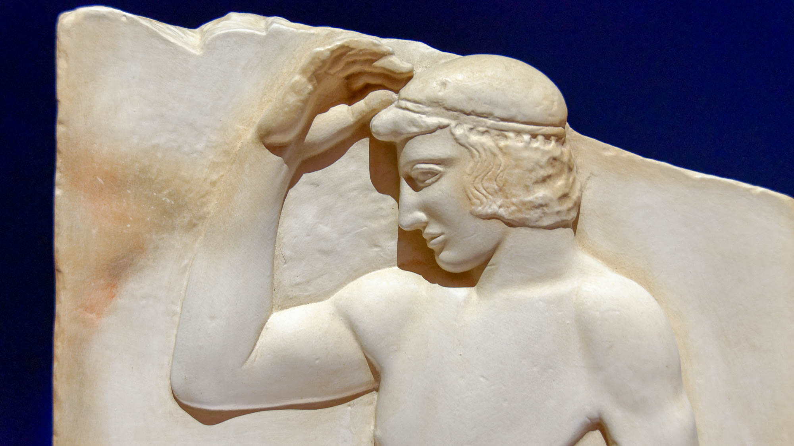
And you have overcome them
Attic votive relief of a victorious athlete with a victor’s crown, from Sounion, circa 460 BC
4:4
Notes:
This relief carving was photographed at the National Archaeological Museum in Athens.
tb011117363h

Slide 27
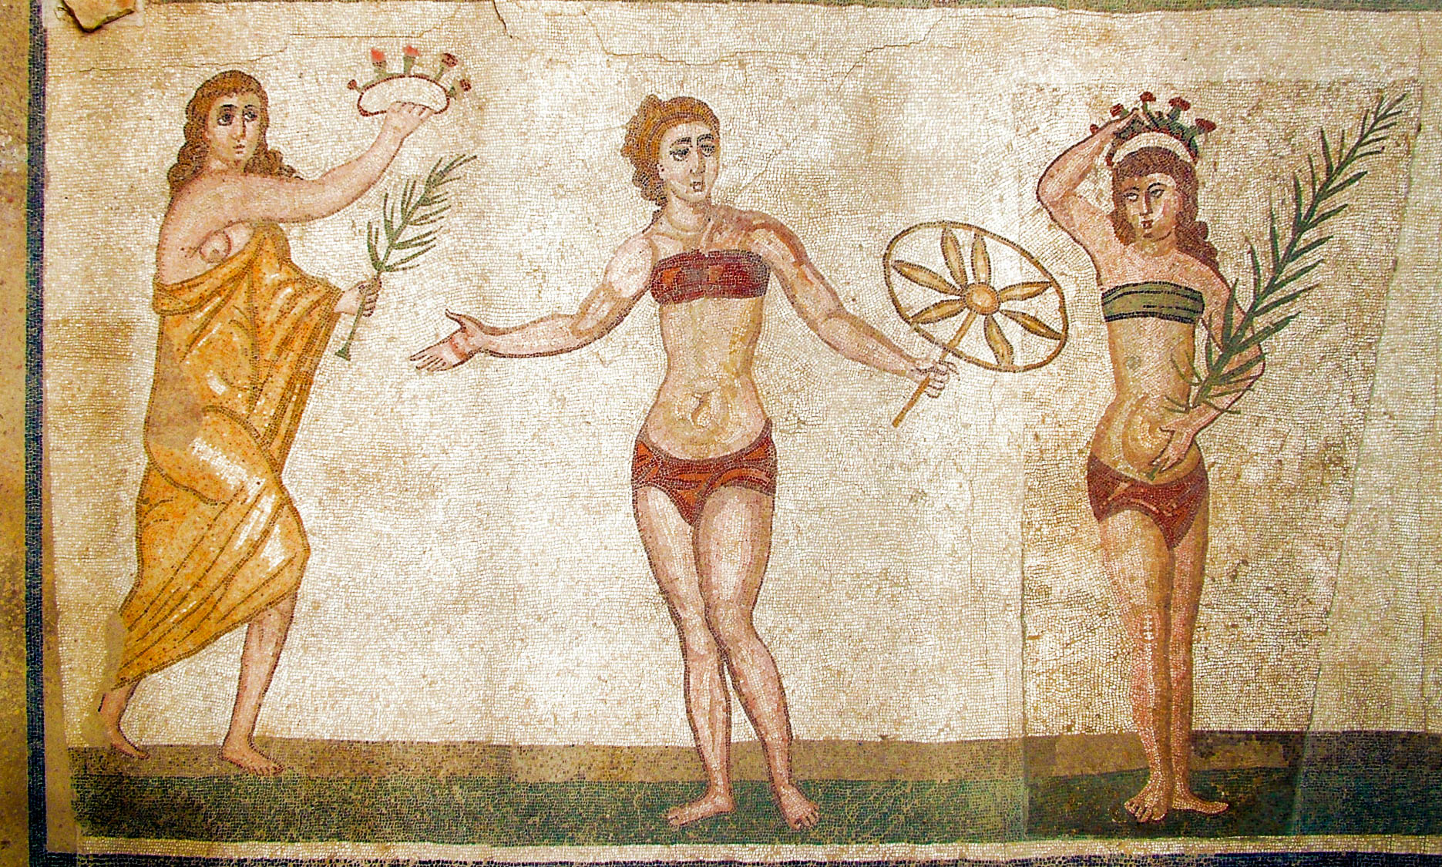
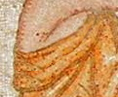
And you have overcome them
Female athletes being crowned as victors, from Villa Romana del Casale, 4th century AD
4:4
Notes:
The competitor on the right in this mosaic carries a palm frond and has a victor’s crown on her head. The woman in the center is about to be given a similar frond and crown to mark her as a victor also. This mosaic was photographed at the Roman villa del Casale near Piazza Armerina in Sicily. This image comes from Clemensfranz and is licensed under CC BY-SA 3.0, via Wikimedia Commons: https://commons.wikimedia.org/wiki/File:Villa_Romana_del_Casale_Bikini_Maedchen_modified.jpg. A removable graphic has been added to avoid causing surprise or offense.
wiki0525200630401340

Slide 28
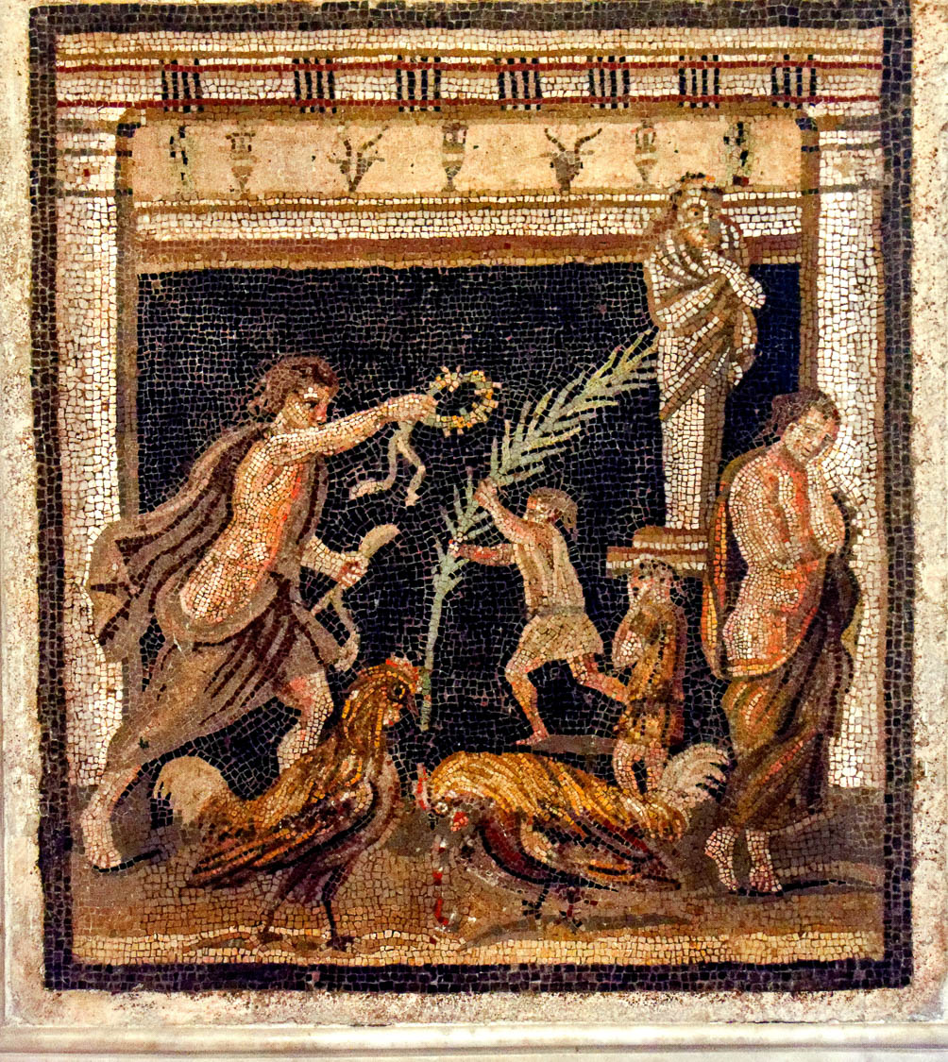
Because He who is in you is greater than he who is in the world
Mosaic of a struggle between personified Victory and Defeat, from Pompeii, 1st century AD
4:4
Notes:
This mosaic depicts the struggle between victory and defeat. Victory is shown leaning forward grasping the crown of victory, and a youth is rushing toward him with the victor’s palm branch. Defeat leans despondently against a pillar. A similar scene is played out by the two roosters in the foreground; the one on the left stands victoriously, while the one on the right is portrayed bent over and bleeding. This mosaic comes from the Maze House at Pompeii and was photographed at the Naples Archaeological Museum.
tb0515170617c

Slide 29
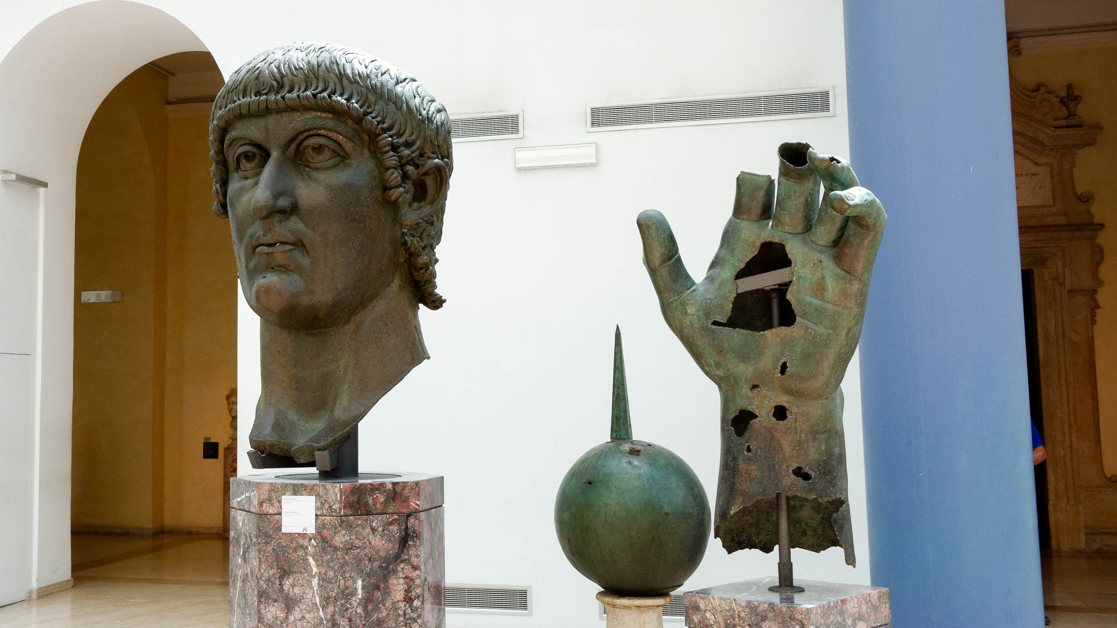
They are of the world; therefore they speak as from the world, and the world listens to them
Gilded bronze head and hand from a colossal statue of Constantine, circa AD 330
4:5
Notes:
Constantine was a worldly ruler who used Christianity for political gain while exalting himself. Many identified as Christians and Constantine’s domain officially became “Christian,” but the Christianity under his rule and subsequent generations also became increasingly syncretistic and corrupt. This picture shows parts of a large bronze statue of Constantine, likely dating to AD 330–337, an example of his self-exaltation. This picture was taken at the Capitoline Museums in Rome.
tb0514179495

Slide 30
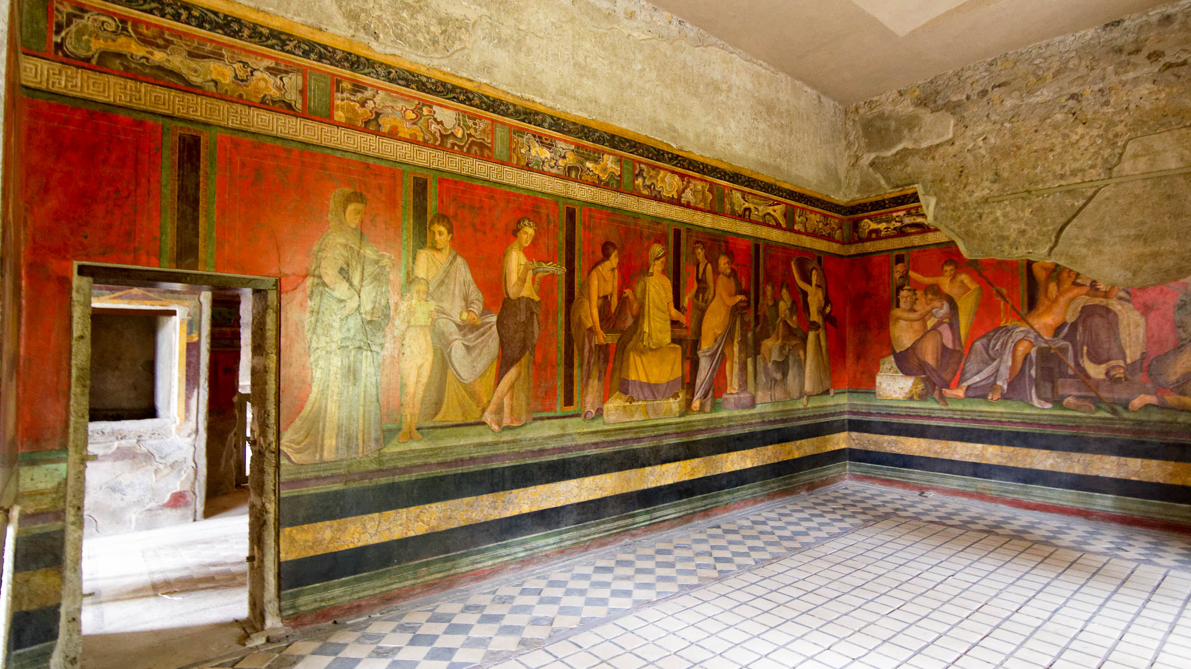
They are of the world; therefore they speak as from the world, and the world listens to them
Villa of the Mysteries room with wall paintings, in Pompeii, 1st century AD
4:5
Notes:
This picture shows the interior of a room in the Villa of the Mysteries in Pompeii. The villa is known as the Villa of the Mysteries since the wall paintings in this room are thought to depict a woman’s initiation ritual into a mystery cult. These kinds of religious practices were accepted by the world, but antithetical to Christianity.
tb0516171981h

Slide 31
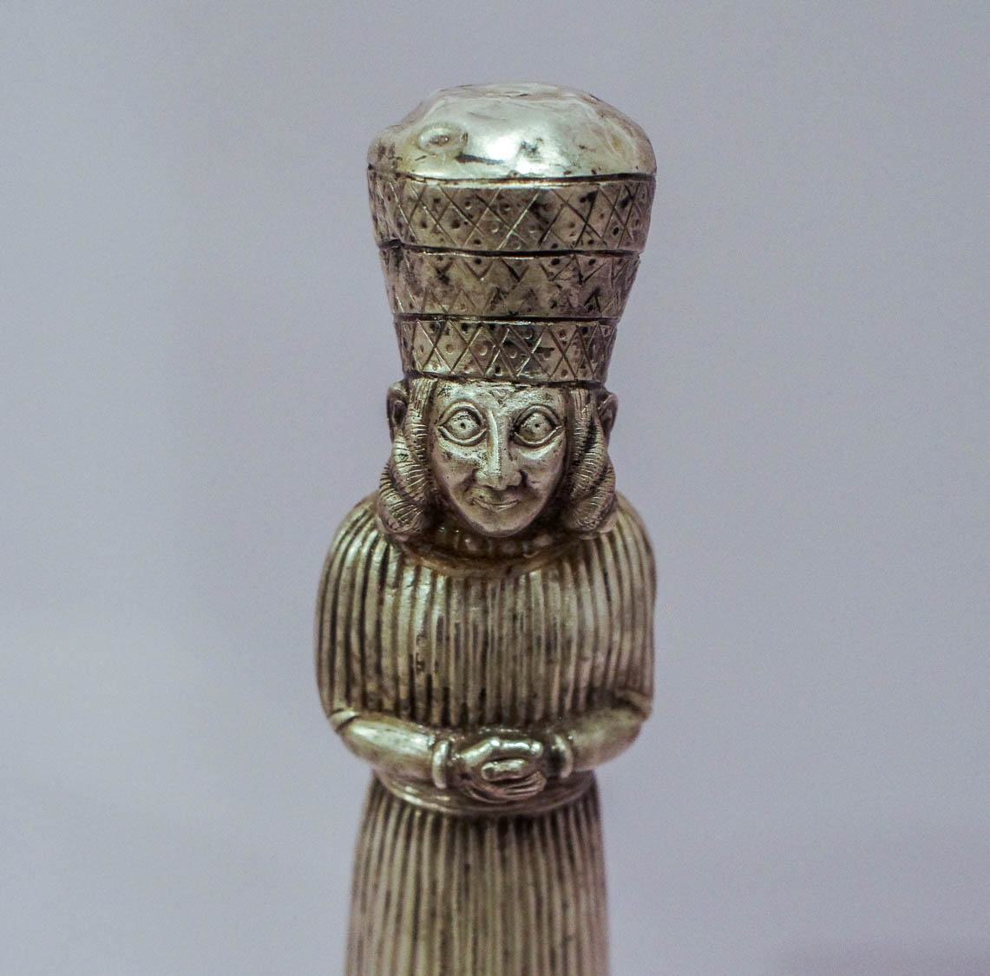
They are of the world; therefore they speak as from the world, and the world listens to them
Silver figurine of priest of Cybele or Artemis, from Turkey, late 8th–7th centuries BC
4:5
Notes:
The Greco-Roman world of John’s day included many teachings (with their teachers and prophets) that contrasted with Christianity. This figurine of a priest of Cybele or Artemis provides one example of such teachings. It was found in Tumulus D at Bayindir in Turkey. This figurine was photographed at the Museum of Archaeology and Anthropology at the University of Pennsylvania.
adr1605278936h

Slide 32
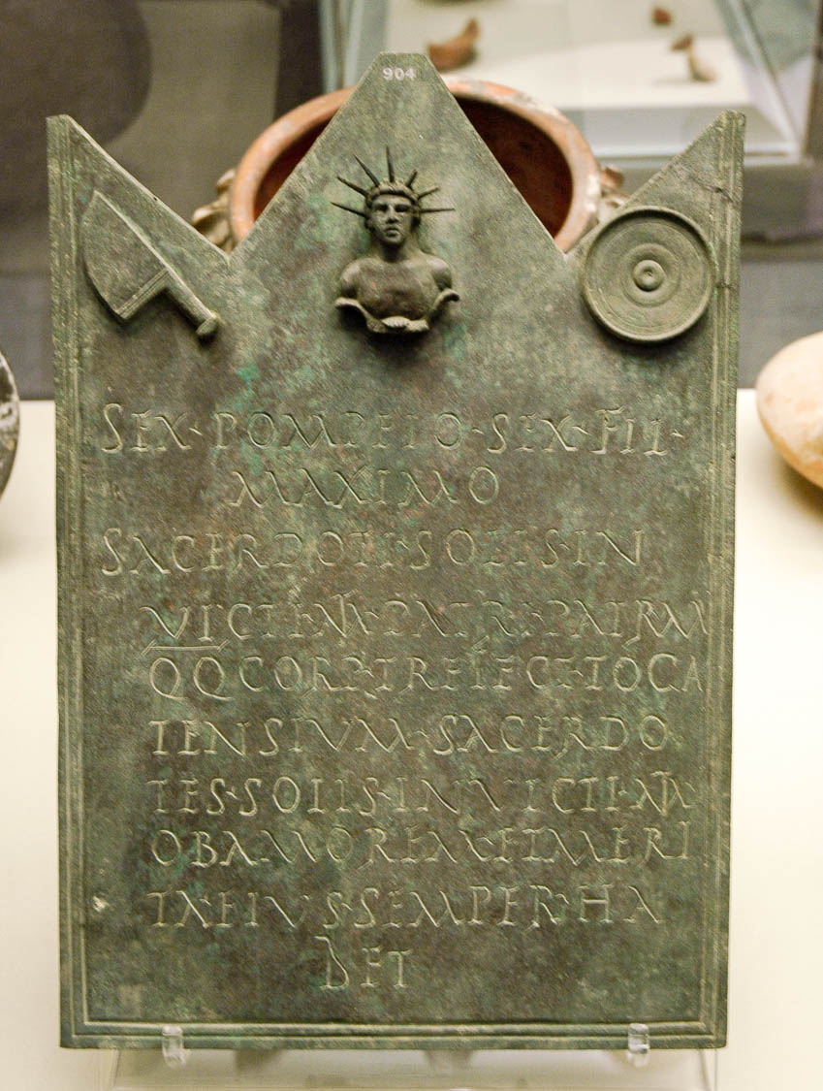
They are of the world; therefore they speak as from the world, and the world listens to them
Bronze tablet dedicated to chief priest of cult of Mithras, AD 200
4:5
Notes:
This tablet was dedicated to the chief priest (Lat. MAXIMO SACERDOTI) of the cult of Mithras, another cult that was considered acceptable in the Greco-Roman world. This tablet was photographed at the British Museum.
tb112004247h

Slide 33
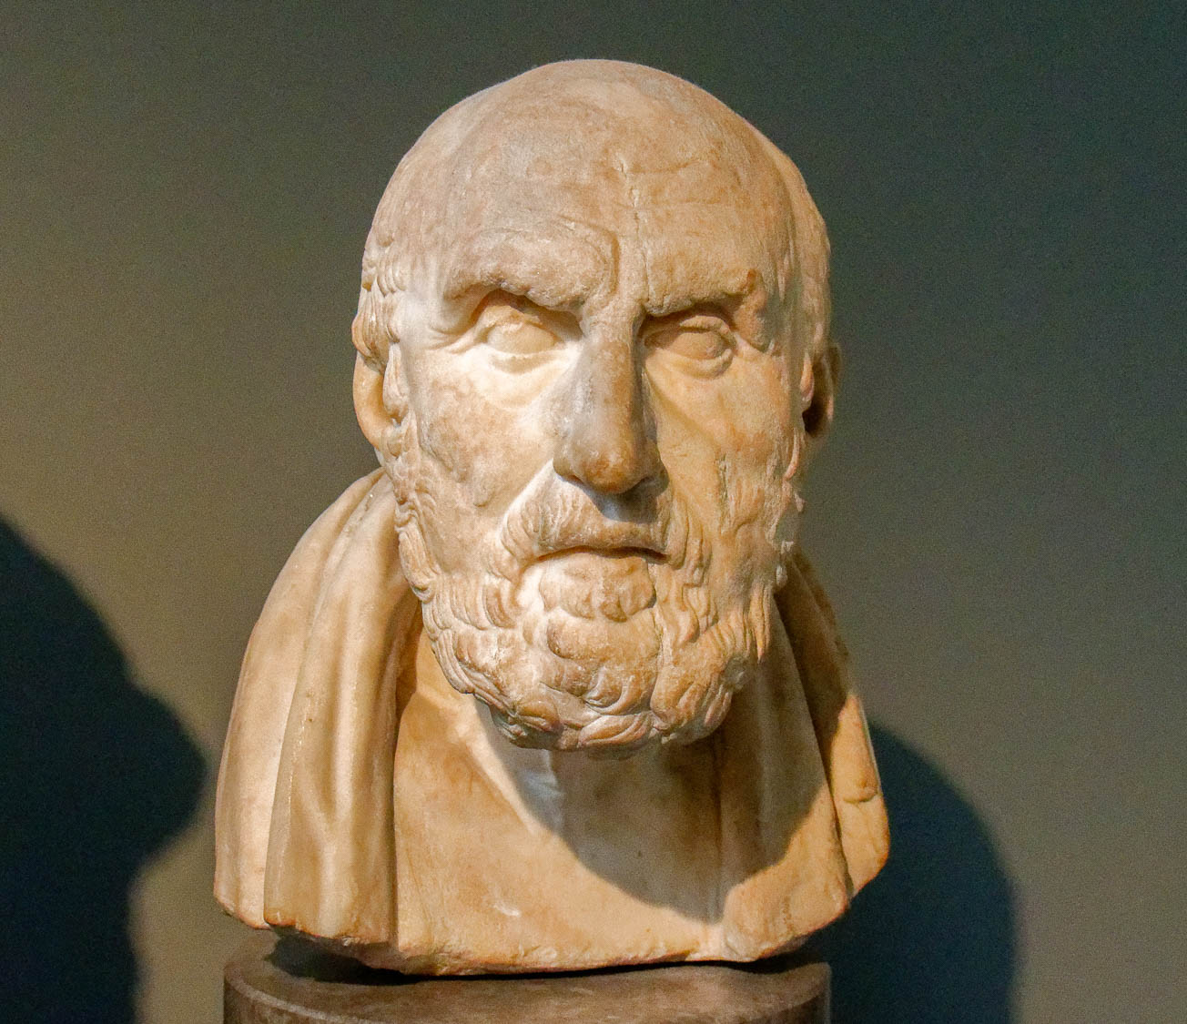
They are of the world; therefore they speak as from the world, and the world listens to them
Head of the Stoic philosopher Chrysippos, Roman era
4:5
Notes:
Knowledge and wisdom were prized in Greco-Roman culture. The wisdom of the world, however, could not lead to knowledge of God. As Paul stated, “For seeing that in the wisdom of God the world through its wisdom did not know God, it was God's good pleasure through the foolishness of the preaching to save those who believe” (1 Cor 1:21). Chrysippos, pictured here, developed the philosophical system that became known as Stoicism. Stoicism continued to be a major philosophical school at the time of the composition of the New Testament. This bust is considered to be a Roman copy of a late 3rd-century or 2nd-century BC Greek original. It was photographed at the British Museum.
tb0930199292h

Slide 34
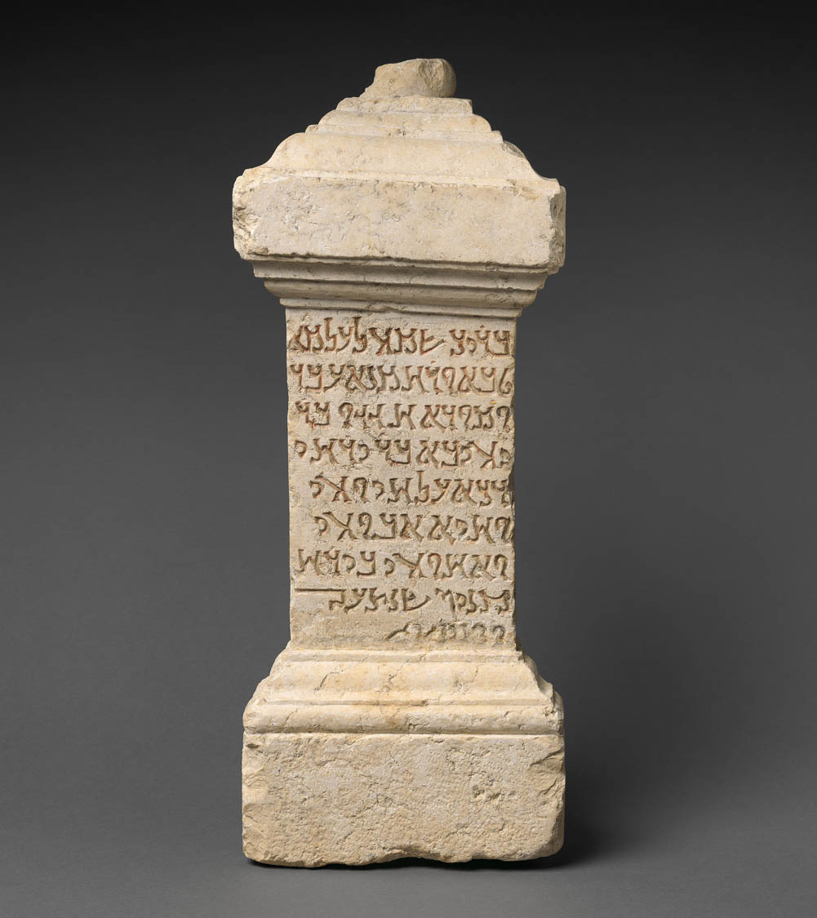
They are of the world; therefore they speak as from the world, and the world listens to them
Altar to a nameless god, from Palmyra, AD 232
4:5
Notes:
While in Athens, Paul came across an altar dedicated to “an unknown god” (Acts 17:23ff). The altar shown here is dedicated to a Palmyrene deity known as the “Nameless God.” The inscription reads as follows:
1 (For) Blessed Be His Name Forever,
2 the Good and Merciful, made
3 in thanksgiving Hagigu, son of
4 Yahiba, son of Yarhay,
5 (son of) Daka, for his life
6 and the life of his father
7 and his brothers. In the month of
8 Qinyan, the year 543. [AD 232]
This image comes from The Metropolitan Museum of Art, public domain, Purchase, 1895, accession number 95.28, https://www.metmuseum.org/art/collection/search/322265.
met322265

Slide 35
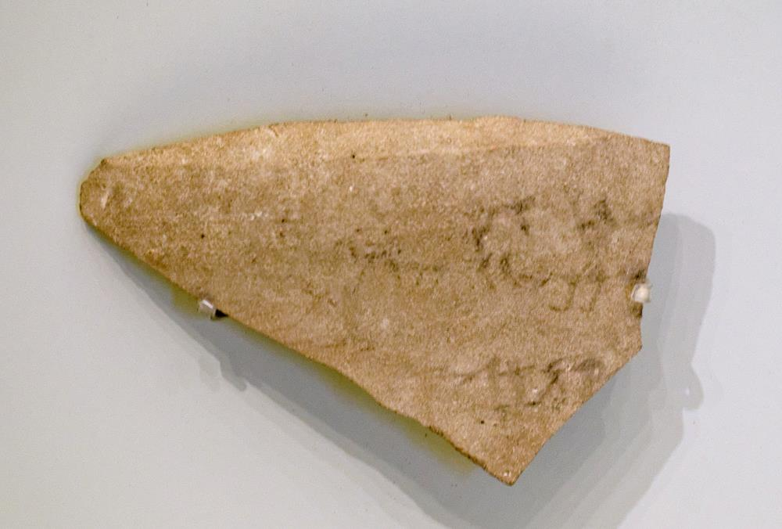
We are of God; he who knows God listens to us
“God, Creator of the earth” inscribed in Hebrew, from Jerusalem, late 8th century BC
4:6
Notes:
Paul’s response to the altar to an unknown god at Athens was to proclaim the true God. He identified that God as the One who created the world and everything in it (Acts 17:24). The last line of this inscription includes the phrase “[Go]d, creator of the earth” (ל קן ארץ[א]) which echoes texts found in Genesis 14:19 and Isaiah 40:28. The verb qanah (קָנָה) can also mean to buy or possess, thus some English versions render Genesis 14:19 as “possessor of heaven and earth.”
This ostracon was recovered in excavations in the Jewish Quarter of Jerusalem by N. Avigad in 1971. Although the inscription is broken at the beginning of the third line, the conclusion that the first word was God (“El,” אל) is “almost inescapable” (Miller 1980: 43). The jar may have once contained offerings intended for the temple in Jerusalem. Based on the style of writing it is dated to the late 8th century BC. It was photographed in the Israel Museum. The next slide includes an overlay highlighting the text of the last line.
Reference:
Miller, Patrick D.
1980 El, the Creator of Earth. Bulletin of the American Schools of Oriental Research 293: 43–46.
tb032014468

Slide 36

We are of God; he who knows God listens to us
“God, Creator of the earth” inscribed in Hebrew, from Jerusalem, late 8th century BC
4:6
Notes:
Paul’s response to the altar to an unknown god at Athens was to proclaim the true God. He identified that God as the One who created the world and everything in it (Acts 17:24). The last line of this inscription includes the phrase “[Go]d, creator of the earth” (ל קן ארץ[א]) which echoes texts found in Genesis 14:19 and Isaiah 40:28. The verb qanah (קָנָה) can also mean to buy or possess, thus some English versions render Genesis 14:19 as “possessor of heaven and earth.”
This ostracon was recovered in excavations in the Jewish Quarter of Jerusalem by N. Avigad in 1971. Although the inscription is broken at the beginning of the third line, the conclusion that the first word was God (“El,” אל) is “almost inescapable” (Miller 1980: 43). The jar may have once contained offerings intended for the temple in Jerusalem. Based on the style of writing it is dated to the late 8th century BC. It was photographed in the Israel Museum. An editable version is included beneath the graphic for those who wish to modify it.
Reference:
Miller, Patrick D.
1980 El, the Creator of Earth. Bulletin of the American Schools of Oriental Research 293: 43–46.
tb032014468

Slide 37
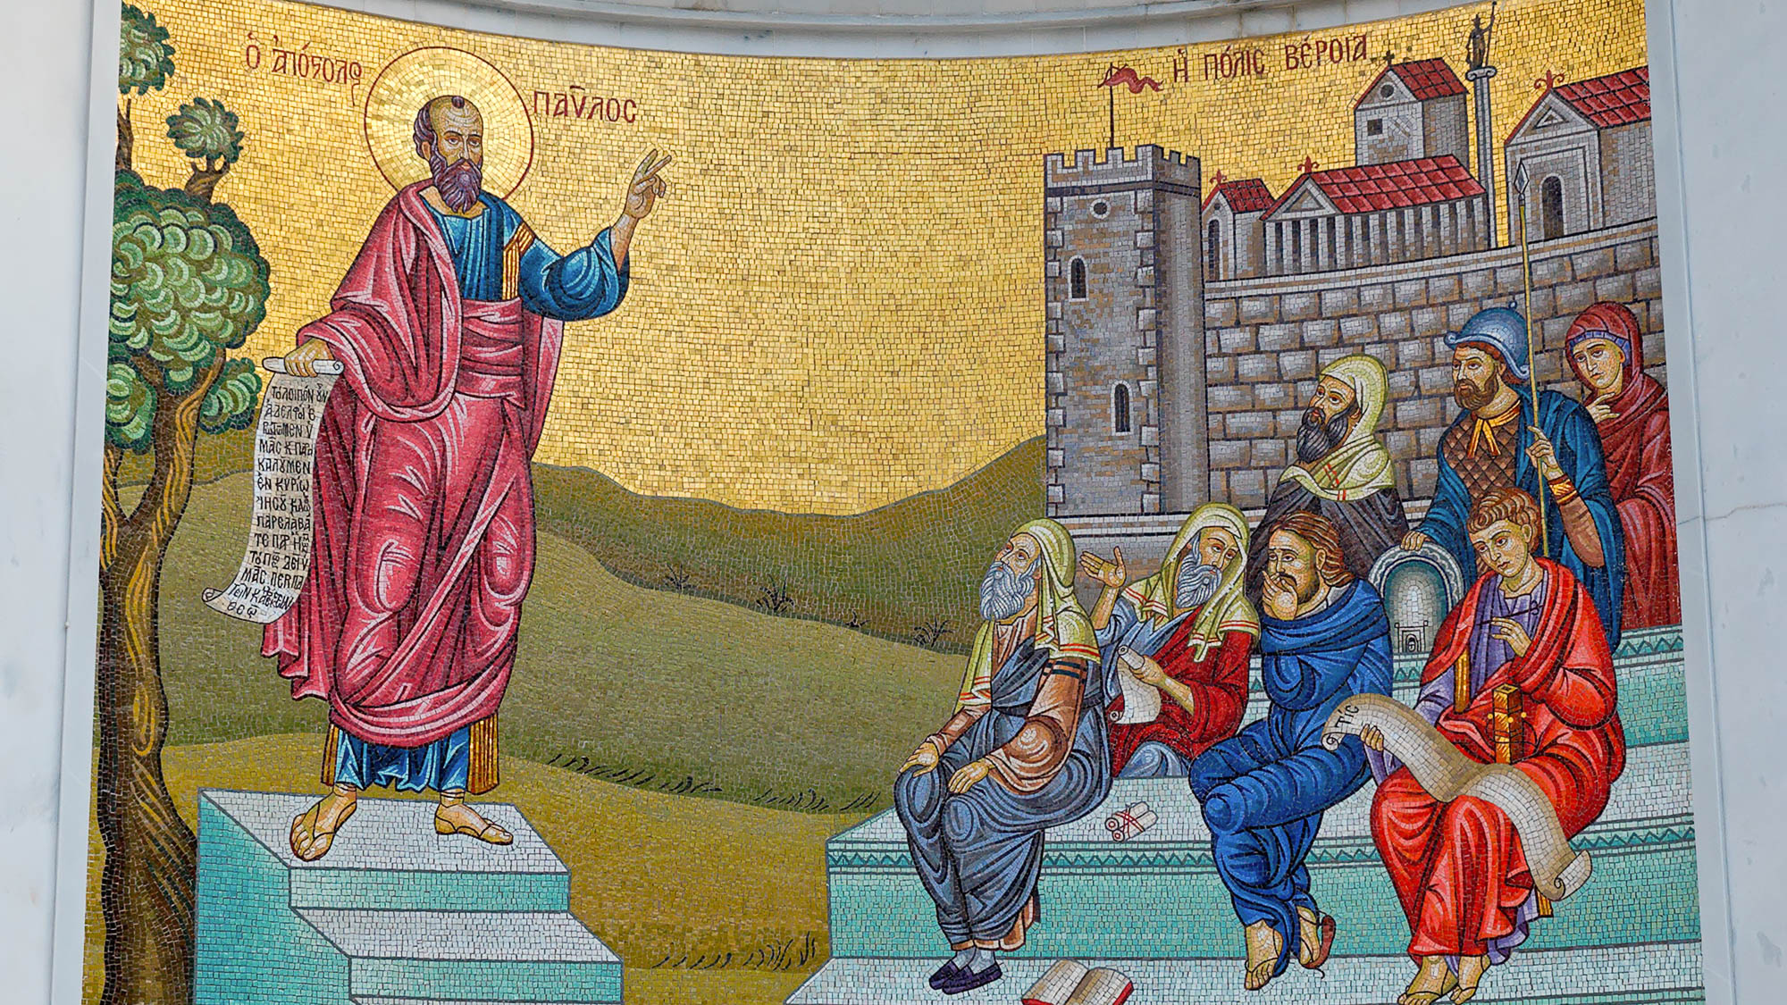
We are of God; he who knows God listens to us
Mosaic in Berea of Paul teaching the Bereans
4:6
Notes:
Paul’s ministry at Berea may be the clearest case in the New Testament of people who knew God, and thus listened to apostolic teaching about Jesus (Acts 17:10-12).
tb031406535h

Slide 38
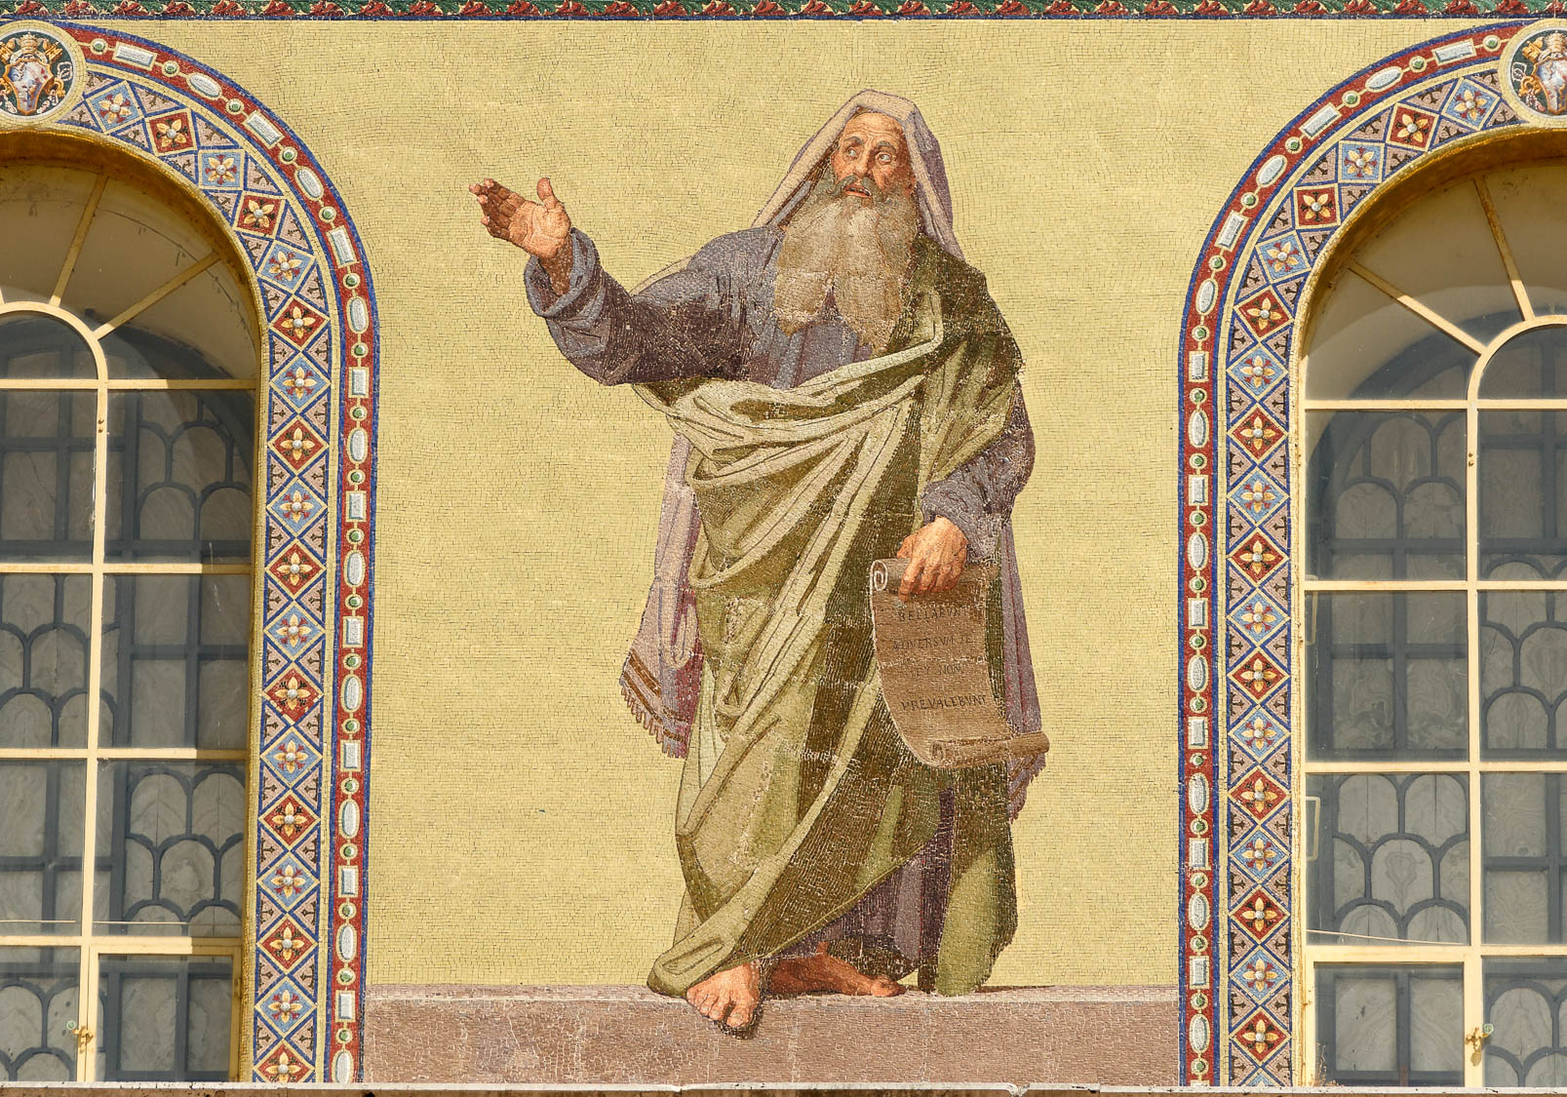
We are of God; he who knows God listens to us
Jeremiah holding his scroll, on the façade of the Basilica of St. Paul Outside the Walls in Rome
4:6
Notes:
Jeremiah spoke about knowing God when he prophesied, “This is what the Lord says: ‘Let not the wise man boast of his wisdom or the strong man boast of his strength or the rich man boast of his riches, but let him who boasts boast about this: that he understands and knows me, that I am the Lord, who exercises kindness, justice and righteousness on earth, for in these I delight,’ declares the Lord” (Jer 9:23-24; NIV). This large wall mosaic depicts Jeremiah holding a scroll in his left hand. The Latin text on his scroll reads “BELLABUNT ADVERSUM TE ET NON PREVALEBUNT” (“They will fight against you, but they will not prevail”) from Jeremiah 1:19.
tb0517173017h

Slide 39
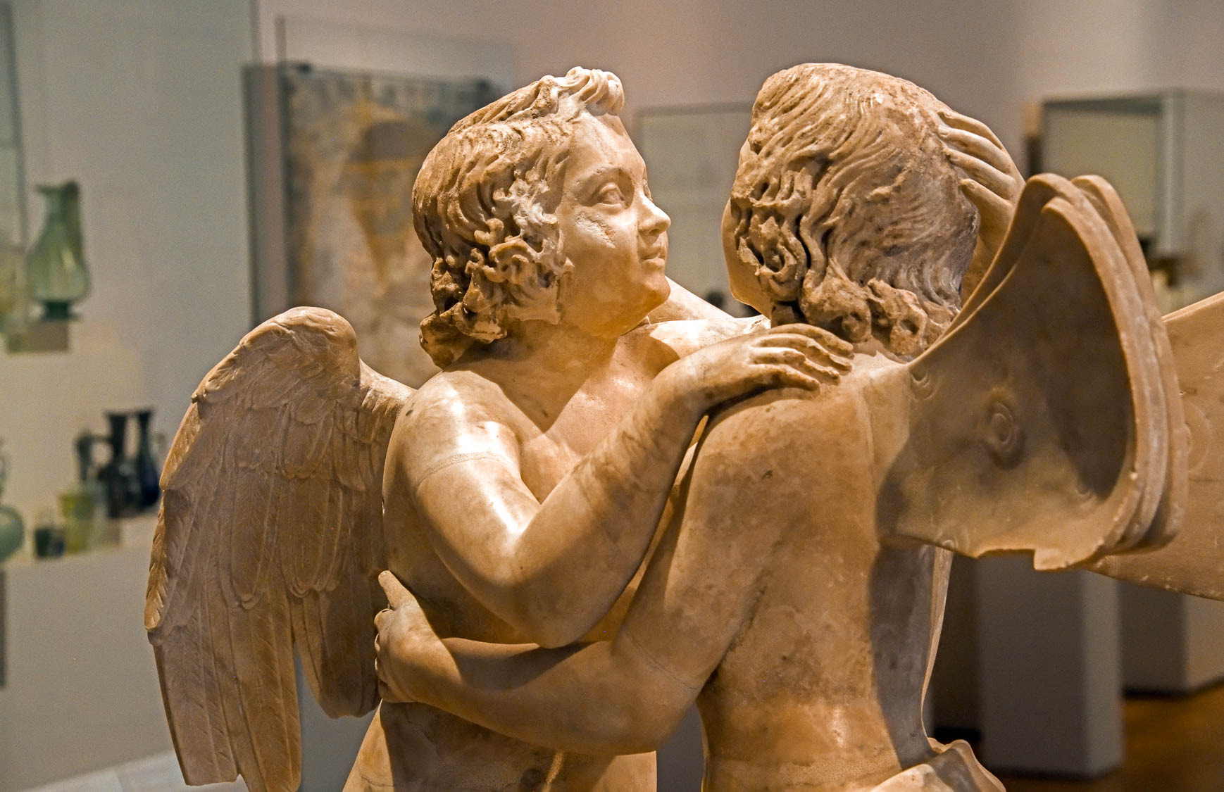
Beloved, let us love one another, for love is from God, and everyone who loves is born of God
Marble statue group with Amor and Psyche, circa AD 150
4:7
Notes:
John asserts that love is one of the defining characteristics of a follower of Jesus, because love is from God Himself. In this claim, he echoes the statement of Jesus, that His disciples would be known by their love (John 13:35). This statue depicts the Greek personifications of Love (Amor) and Soul (Psyche). Love is depicted with bird-like wings, while Soul is depicted with the wings of a butterfly. This statue was photographed at the Altes Museum in Berlin. This image comes from Dosseman and is licensed under CC BY-SA 4.0, via Wikimedia Commons: https://commons.wikimedia.org/wiki/File:Amor_and_psyche_group,_marble,_Roman_copy_from_around_150_AD_8810.jpg.
wiki0919202113240115137175504h

Slide 40
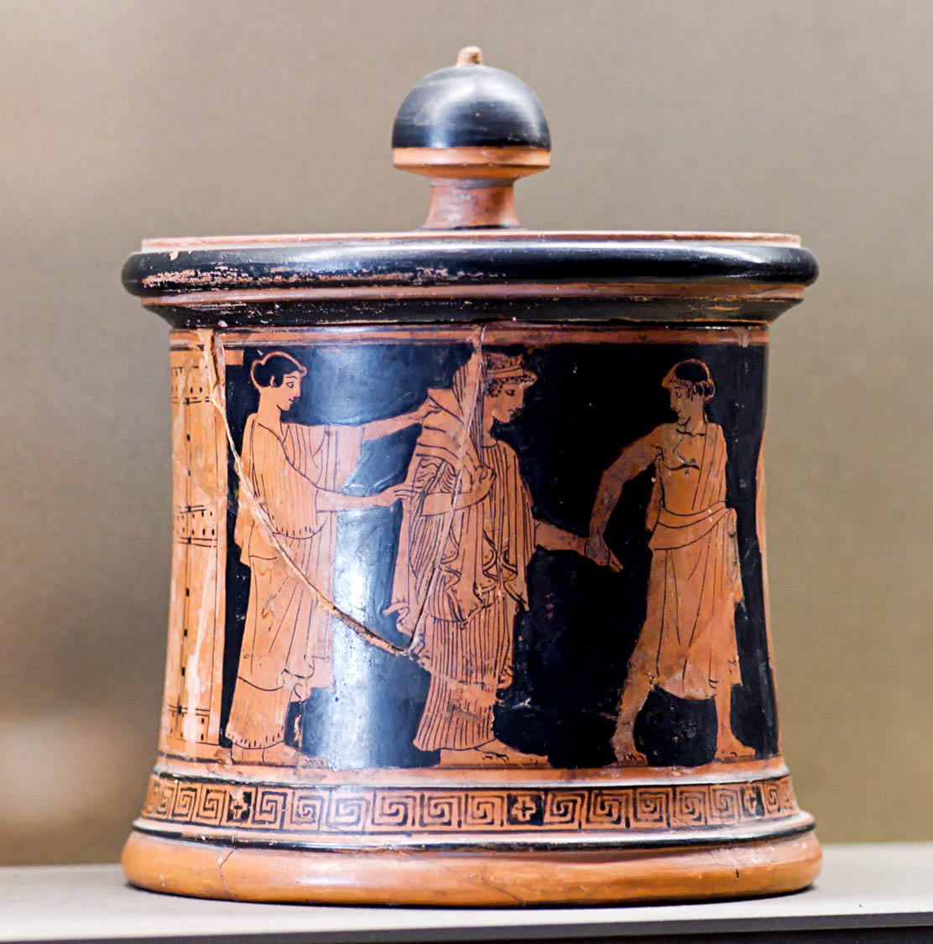
Beloved, let us love one another, for love is from God, and everyone who loves is born of God
Attic red-figure pyxis with the wedding of Thetis and Peleus, from Athens, circa 460 BC
4:7
Notes:
Marriage is another setting that was often (although not always) associated with love in the 1st century. Love was certainly an advantage in marriage, as it fostered trust and general well-being within the family. This pyxis was photographed at the Louvre Museum. This image comes from Marie-Lan Nguyen and is in the public domain, via Wikimedia Commons: https://commons.wikimedia.org/wiki/File:Pyxis_Peleus_Thetis_Louvre_L55_by_Wedding_Painter.jpg.
wiki33485518189243319632006185

Slide 41
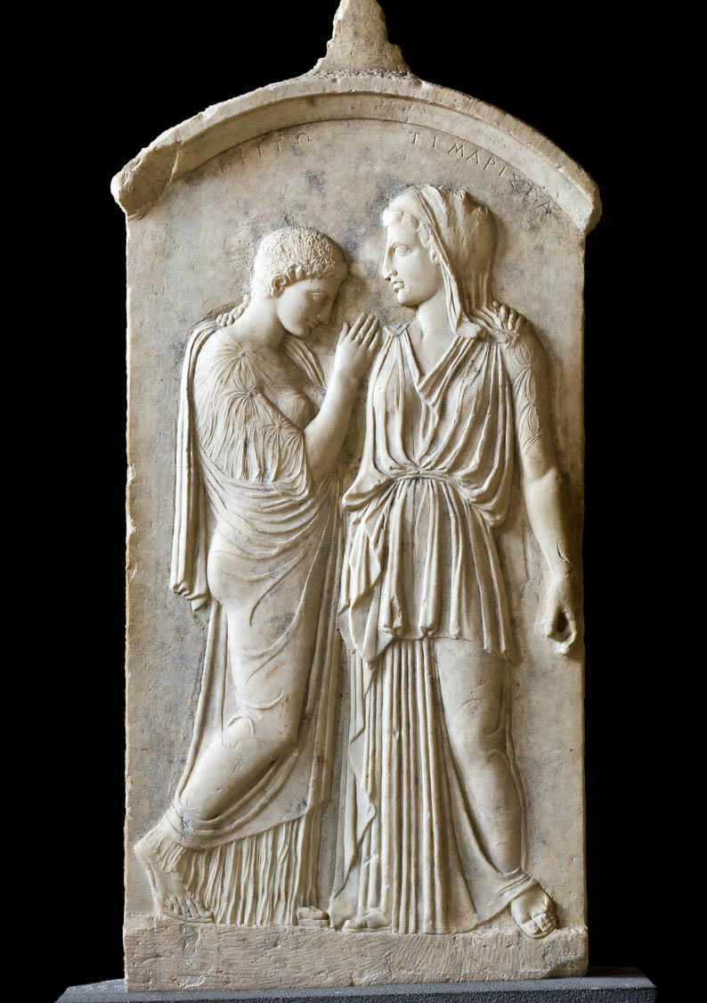
Beloved, let us love one another, for love is from God, and everyone who loves is born of God
Grave relief of two mourning women, from Rhodes, 5th century BC
4:7
Notes:
Paul taught that one way in which a believer fulfills the “law of Christ” is through sharing one another’s burdens (Gal 6:2). This funeral stele shows two mourning women tenderly embracing each other, illustrating the sharing of the burden of death. The names of the women appear above their heads: Kritō (Κριτω) and Timarista (Τιμαριστα). This stele was photographed at the Archaeological Museum of Rhodes. This image comes from Jebulon and is in the public domain, via Wikimedia Commons: https://commons.wikimedia.org/wiki/File:Krito_Timarista_stele_Rhodes.jpg.
wiki42041004142011050820111739h

Slide 42
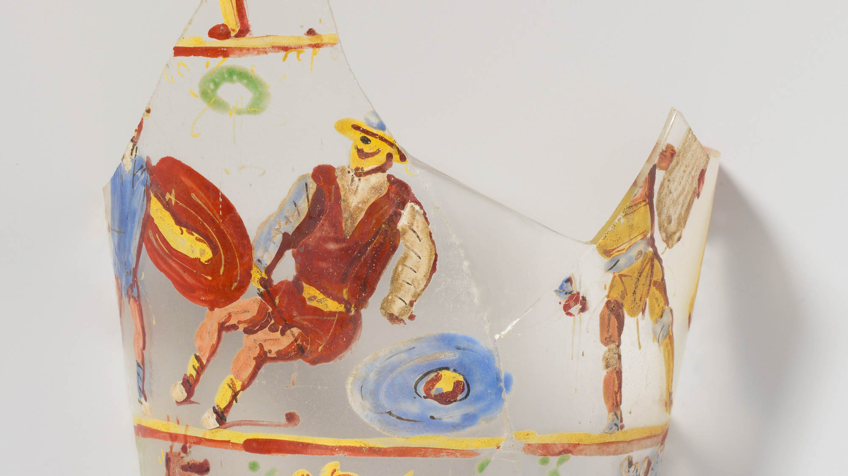
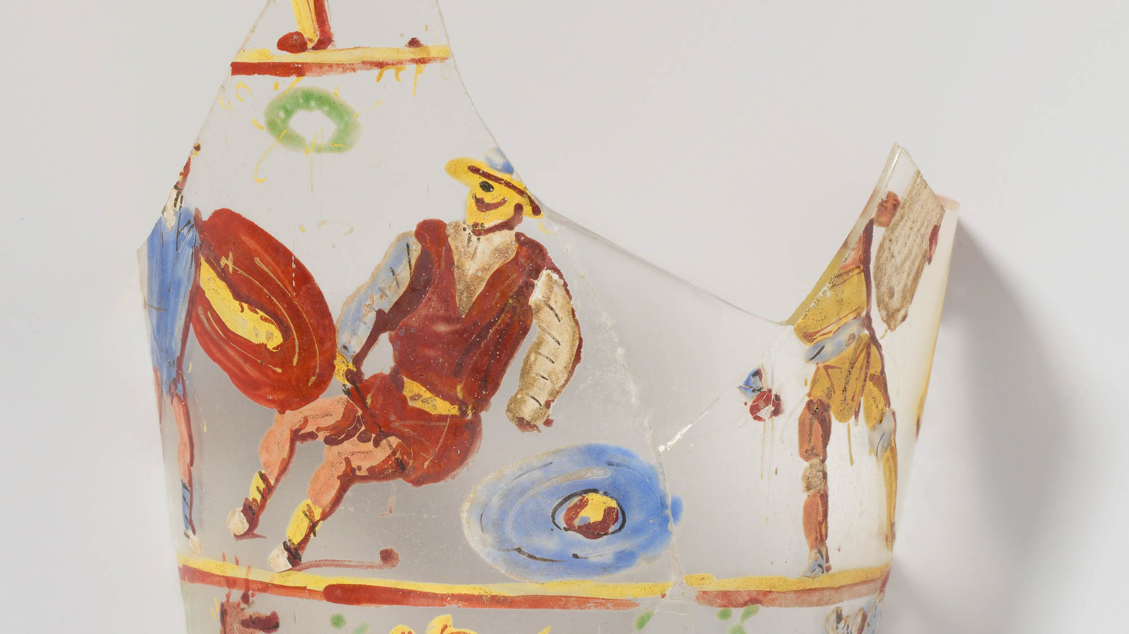
The one who does not love does not know God, for God is love
Gladiators depicted on a glass beaker, from Egypt, circa 2nd century AD
4:8
Notes:
Whoever does not love is likely to become engaged in fighting or quarreling. The idea is illustrated here by a depiction of gladiators, who treated one another as enemies. This photo of this rare Roman painting on clear glass comes from The Metropolitan Museum of Art and is in the public domain. Source: https://www.metmuseum.org/art/collection/search/251165.
met251165h

Slide 43
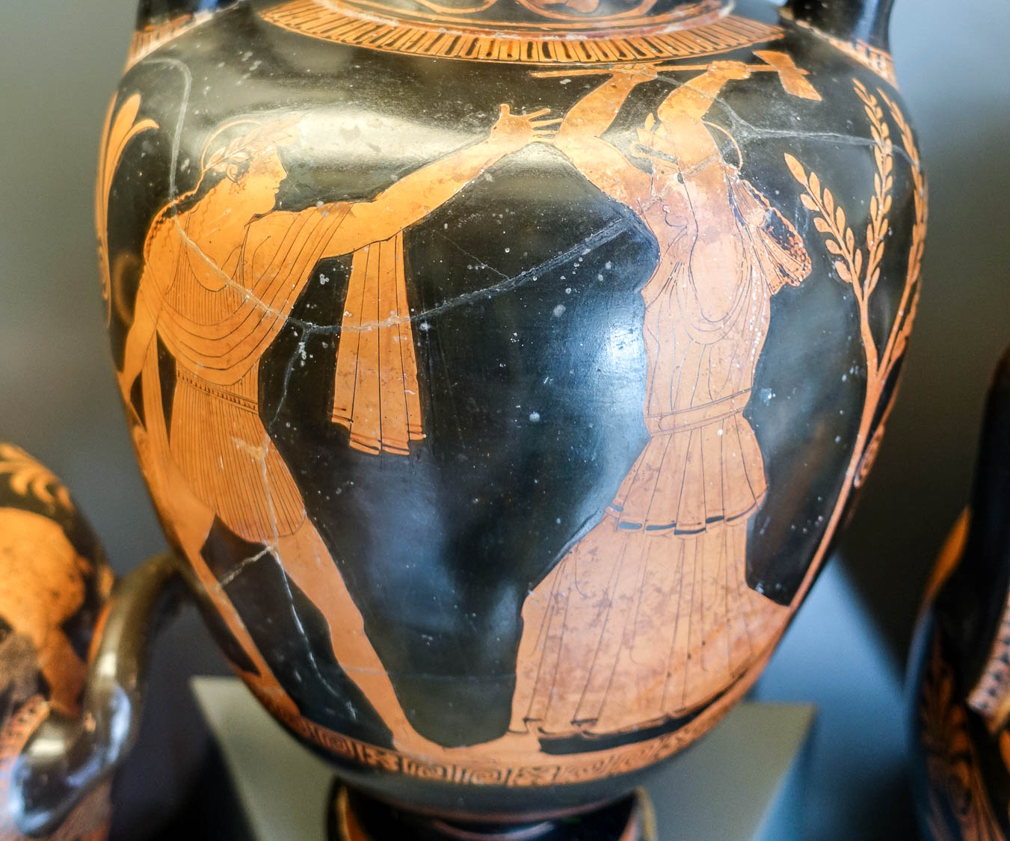
The one who does not love does not know God, for God is love
Attic red-figure neck-amphora, Orpheus fighting with a Thracian woman, circa 450 BC
4:8
Notes:
Conflict is also represented on this amphora. It depicts the mythological character Orpheus fighting with a Thracian woman. According to the legend, the women eventually killed him because of his inattention or, according to another version, because of a religious dispute. This neck-amphora was photographed at the Vatican Museums. This image comes from Daderot and is in the public domain, via Wikimedia Commons: https://commons.wikimedia.org/wiki/File:Orpheus_and_the_Thracian_woman,_Attic_red-figure_neck-amphora,_by_the_Painter_of_the_Berlin_Hydria,_460-450_BC_-_Museo_Gregoriano_Etrusco_-_Vatican_Museums_-_DSC01028.jpg.
wiki040620190440178735432h

Slide 44
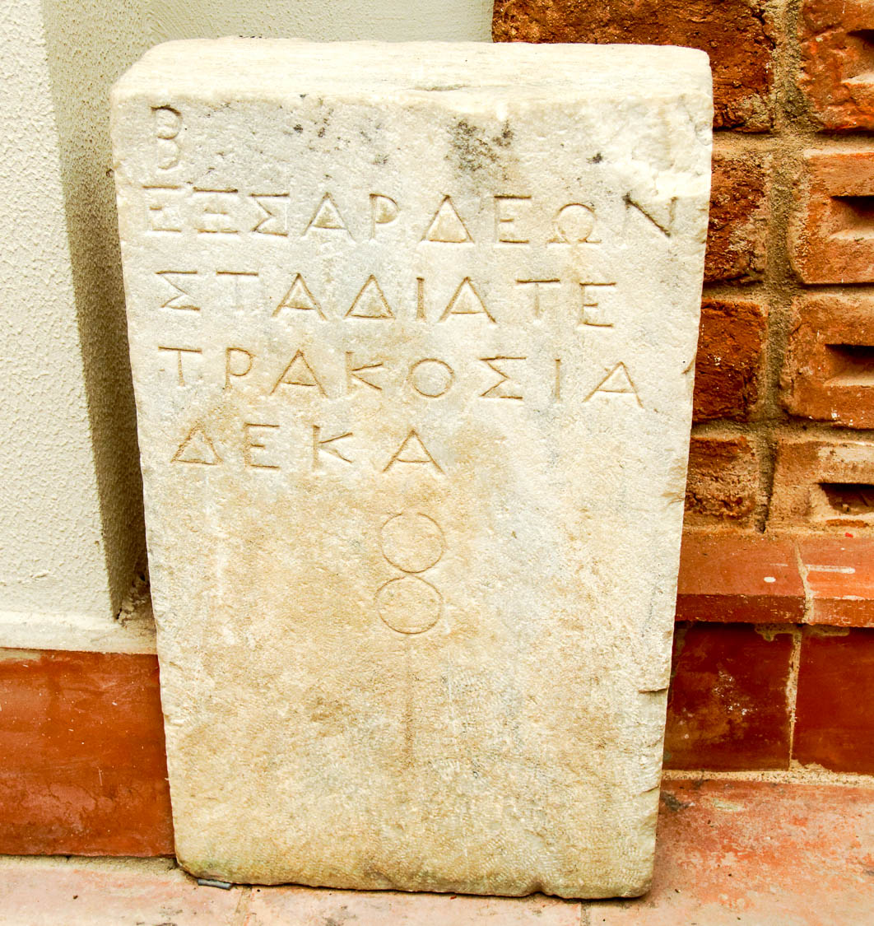
The one who does not love does not know God, for God is love
Marble milestone found between Ephesus and Sardis, Hellenistic period
4:8
Notes:
John states that love is such a distinguishing mark of those who know God that those who do not love do not know God. In Revelation 2:1-10, Jesus warns the people of the church of Ephesus that they had lost their first love, even though they persevered, did not tolerate evil, and tested false teachers. This picture shows a milestone from between Ephesus and Sardis from the Hellenistic period. The inscription on the milestone reads, “from Sardis, four hundred and ten stadia” (Gk. ΕΞ ΣΑΡΔΕΩΝ ΣΤΑΔΙΑ ΤΕΤΡΑΚΟΣΙΑ ΔΕΚΑ). A Roman “stadium” measured about 607 ft (185 m), so this milestone marked a distance of about 47 miles (76 km) from the city; the route from Sardis to Ephesus was about 60 miles (97 km) altogether. This milestone was photographed at the Ephesus Museum.
tb010317485h

Slide 45
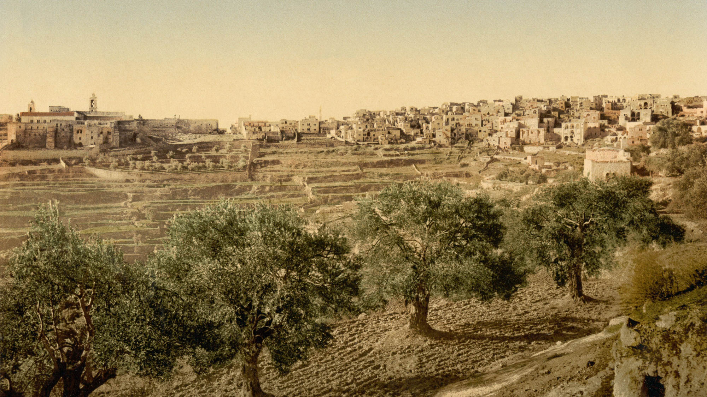
By this the love of God was revealed among us, that God sent His only Son into the world
Bethlehem (from the north), 1890s
4:9
Notes:
This photochrom image from the 1890s shows Bethlehem, the town of Jesus’s birth.
pcm02657h

Slide 46
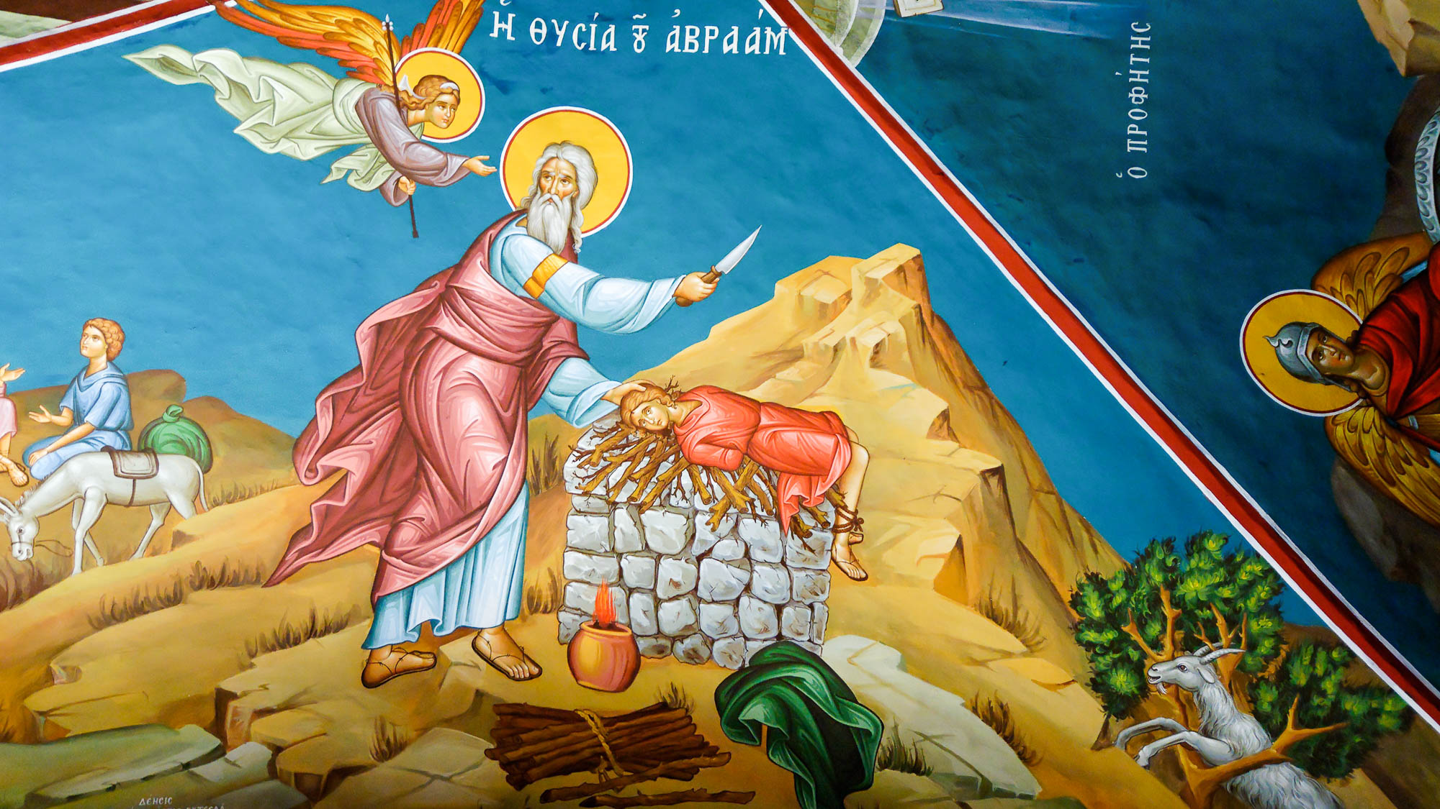
By this the love of God was revealed among us, that God sent His only Son into the world
Abraham sacrificing Isaac, portrayed in the Mar Saba Monastery
4:9
Notes:
Although Abraham earlier had a son Ishmael through Hagar, in Genesis 22, God told him to take his “only son” Isaac and sacrifice him on Mount Moriah. This event has often been interpreted in Christian tradition as anticipatory of Jesus’s sacrifice of Himself as God’s only Son. This depiction of Abraham sacrificing Isaac was photographed in the Mar Saba Monastery in the Judean wilderness east of Bethlehem.
tb010107313

Slide 47
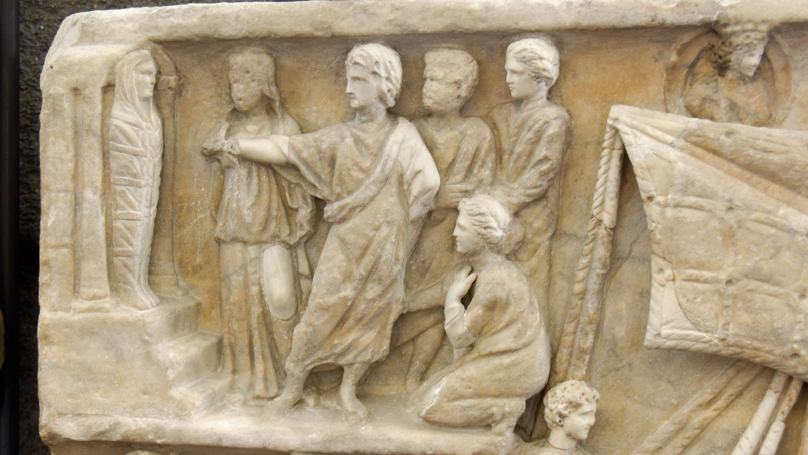
So that we might live through Him
Sarcophagus portraying the raising of Lazarus, circa AD 300
4:9
Notes:
Before raising Lazarus from the dead, Jesus said that those who believe in Him would never die. “I am the resurrection, and the life. Whoever believes on me, though he die, yet he will live. And whoever lives and believes on me will never die” (John 11:25-26). This sarcophagus was photographed at the Vatican Museums.
tb0512175854

Slide 48
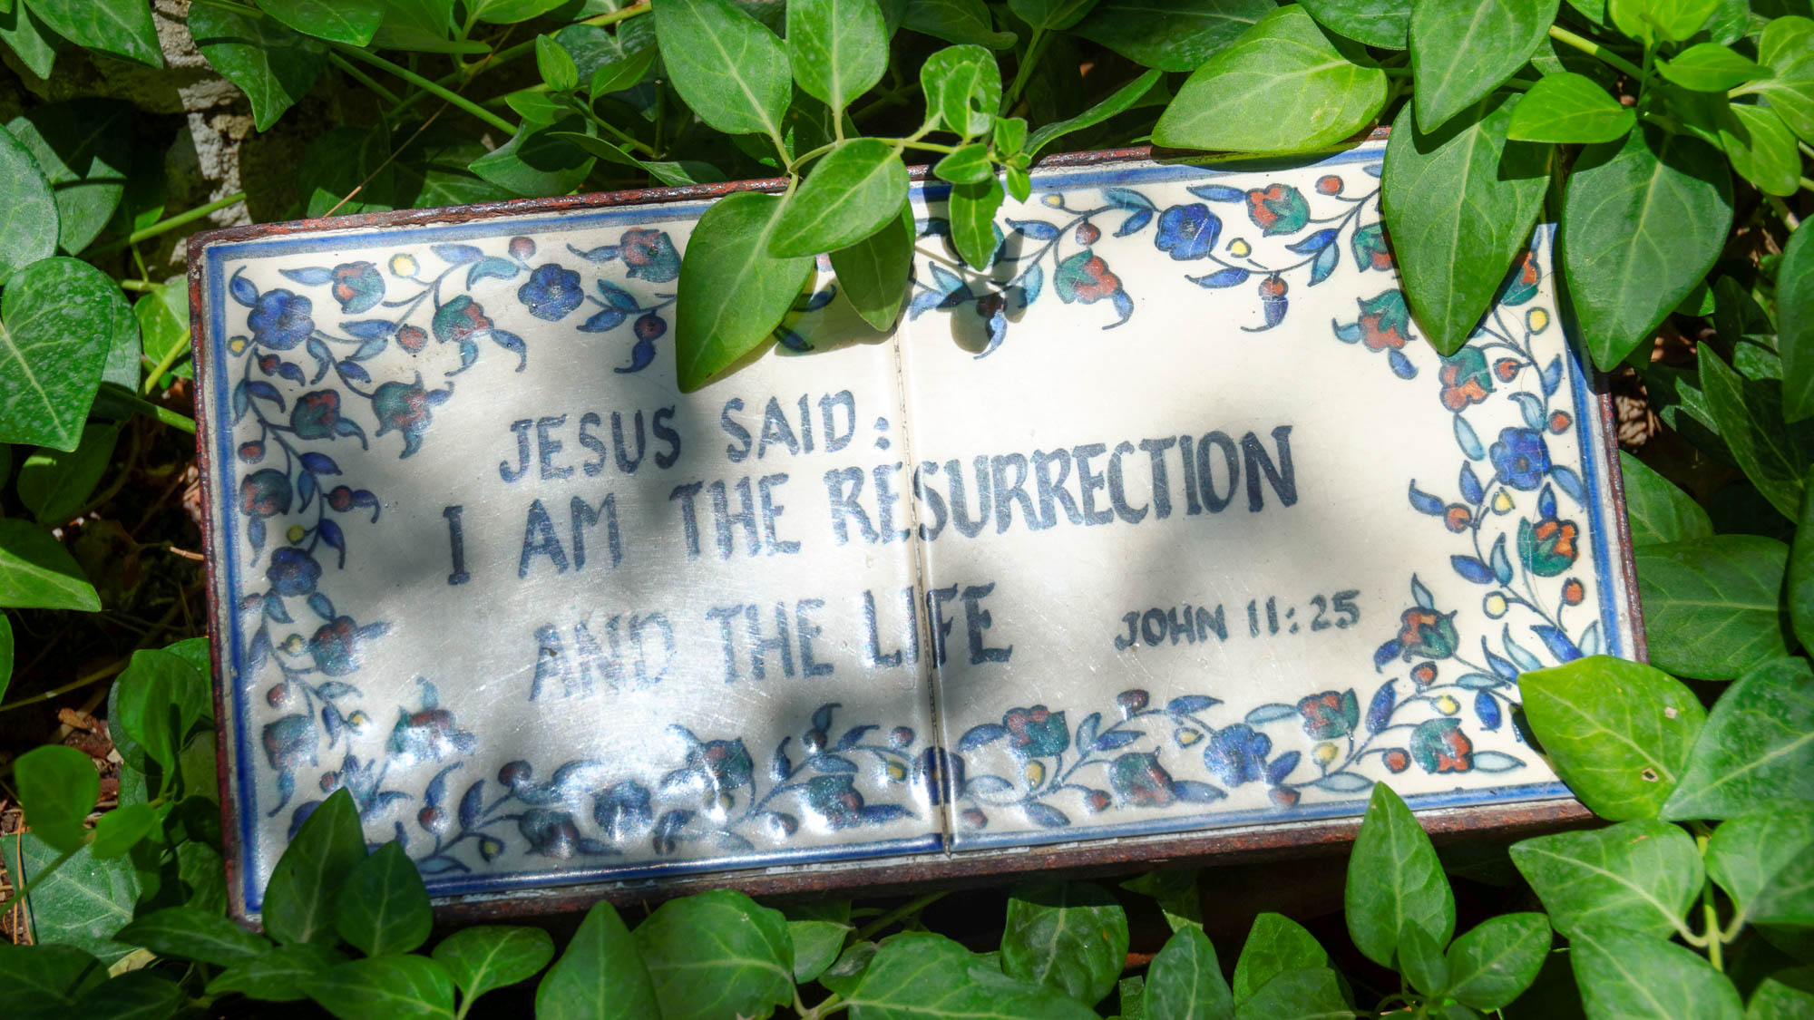
So that we might live through Him
“I am resurrection and life” sign at the Garden Tomb
4:9
Notes:
This sign was photographed at the Garden Tomb in Jerusalem.
tb061116134h

Slide 49
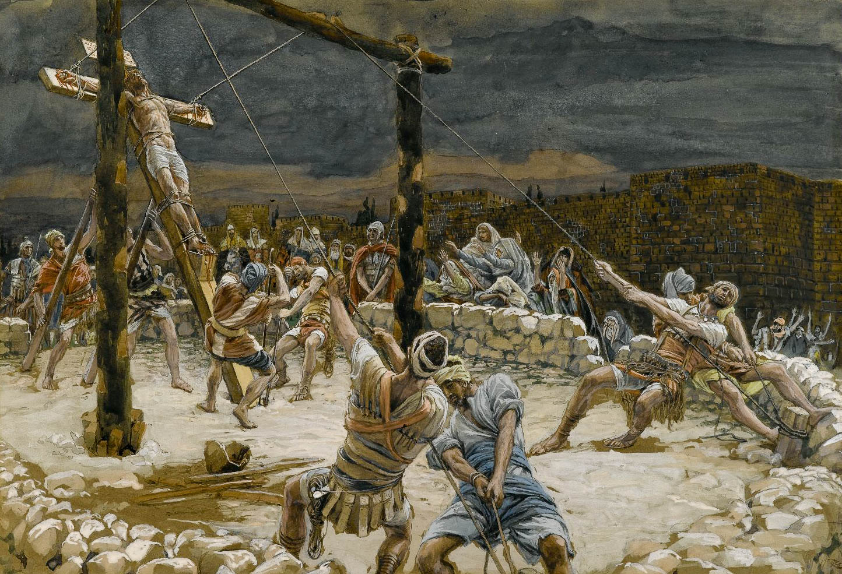
He loved us and sent His Son to be the propitiation for our sins
The Raising of the Cross, by James Tissot, circa 1890
4:10
Notes:
The term “propitiation” (Gk. hilasmos, ἱλασμός) refers to something offered as an appeasement for sin. It is used in the LXX to refer to a sin offering or a sacrifice made to atone for sin (cf. LXX Ezek 44:27). This painting by James Tissot was executed using opaque watercolor over graphite on gray wove paper. This image is in the public domain, via the Brooklyn Museum: https://www.brooklynmuseum.org/opencollection/objects/4587.
bmny001592944587

Slide 50

He loved us and sent His Son to be the propitiation for our sins
Cross painted on the wall of a tomb converted into a church, from Tell el-Amarna
4:10
Notes:
The cross, by which Jesus made propitiation, has been a symbol of Christianity since antiquity. Peter said of Jesus, “He Himself bore our sins in his body on the tree, that we, having died to sin, might live to righteousness; by his wounds you were healed” (1 Pet 2:24). This photo shows a cross painted on the wall of the tomb of Panehsy, an official under the Egyptian king Akhenaten during the 14th century BC. At a much later period the tomb was used as a Coptic church, complete with a baptismal font.
adr1603163667h

Slide 51

He loved us and sent His Son to be the propitiation for our sins
Procession to an altar to sacrifice a lamb, from Sikyon, circa 530 BC
4:10
Notes:
The awareness of sin and the need for an atoning sacrifice seems to be nearly universal. Anyone in John’s audience, whether Jew or Gentile, would have been familiar with this concept. This painted wooden plaque depicts a lamb being led to an altar, accompanied by two figures playing a flute and lyre. The dedication is to the Charites. The wooden plaque was found near ancient Sikyon, in a cave above the village Pitsa. This is about 10 miles (16 km) west of ancient Corinth. This plaque was photographed at the National Archaeological Museum in Athens. This image comes from Zde and is licensed under CC BY-SA 4.0, via Wikimedia Commons: https://commons.wikimedia.org/wiki/File:Painted_wooden_plaque,_procession_to_sacrifice,_540-530_BC,_NAMA_16464,_191289.jpg.
wiki06112019164945h

Slide 52

He loved us and sent His Son to be the propitiation for our sins
Three altars in front of the Doric Temple, Pompeii, 1st century AD
4:10
Notes:
Sacrifice was a regular part of the rites that took place at pagan temples in the 1st century. The altar was typically a central focal point in front of any temple. At least five temples have been discovered at Pompeii, giving some indication of how common they were in the 1st century AD. The three altars in the fenced area in front of this temple at Pompeii illustrate the size and placement of altars in a pagan setting, which made it relatively convenient for worshippers to bring sacrifices.
tb0516172059h

Slide 53

He loved us and sent His Son to be the propitiation for our sins
Holy of Holies in a tabernacle model
4:10
Notes:
The term “propitiation” (Gk. hilasmos, ἱλασμός) is closely related to the Greek word referring to the “mercy seat” (Gk. hilastērion, ἱλαστήριον) on the ark of the covenant (Heb. 9:5). This is an artist’s idea of what the ark of the covenant may have looked like. The long poles were used by the priests to carry the ark and prevent them from touching the object itself. This tabernacle model was photographed at Timna Park near Eilat, in southern Israel.
tb052208375h

Slide 54

He loved us and sent His Son to be the propitiation for our sins
Man waving a chicken over his head for the Yom Kippur sacrifice in Jerusalem
4:10
Notes:
The term “propitiation” (Gk. hilasmos, ἱλασμός) is rare in the LXX. Differing from other passages, it is used to render “Atonement” (Heb. Kippurim) in the phrase “Day of Atonement” (Heb. Yom Hakkippurim) in Leviticus 25:9. A modern example is the chicken sacrifice (kapparah) for Yom Kippur (the Day of Atonement), in which a chicken is swung around the head before being slaughtered.
tb092906351h

Slide 55

Beloved, if God so loved us, we also ought to love one another
Ivory diptych with Jesus washing the disciples’ feet, from France or Germany, AD 1350–1375
4:11
Notes:
After Jesus washed His disciples feet, He said to them, “When Jesus had washed their feet and put on his outer clothing, he reclined again and said to them, ‘Do you know what I have done for you? You call me Teacher and Lord—and you are speaking rightly, since that is what I am. So if I, your Lord and Teacher, have washed your feet, you also ought to wash one another's feet. For I have given you an example, that you also should do just as I have done for you’” (John 13:12-15, CSB). This ivory diptych depicts Jesus washing the feet of the disciples. It was photographed at the Louvre Abu Dhabi.
tb0520184926

Slide 56

No one has seen God at any time
Relief depicting John pointing to Jesus, from the Archbasilica of St. John in Lateran, in Rome
4:12
Notes:
The prologue of the Gospel of John concludes by saying, “No one has seen God at any time; the only begotten Son, who is in the bosom of the Father, He has declared Him” (John 1:18). The same prologue, however, says that God’s glory was seen in Jesus. “And the Word became flesh, and lived among us, and we beheld His glory, glory as of the only begotten from the Father, full of grace and truth” (John 1:14). This relief in the Archbasilica of St. John in Lateran depicts John pointing to Jesus (John 1:29).
tb0513178906h

Slide 57

If we love each other, God abides in us, and His love is perfected in us
Unfinished funerary stele in shape of cult niche with painted portrait, from Sidon, circa 100 BC
4:12
Notes:
The verb “to perfect” (Gk. teleioō, τελειόω) means to bring something to an end or to finish it. This funerary stele provides an example of a project that was never completed. It does contain a plastered and painted recess, which presumably depicts the deceased, but the majority of the stele has only been roughly carved, and it was left unfinished. This stele was photographed at the Louvre Museum.
tb0928195756

Slide 58

If we love each other, God abides in us, and His love is perfected in us
Krater depicting a man painting a statue of a god, 4th century BC
4:12
Notes:
This krater depicts a man painting a statue of the god Hercules, giving it the finishing touch needed to bring it to completion. This image comes from The Metropolitan Museum of Art, public domain, Rogers Fund, 1950, accession number 50.11.4, https://www.metmuseum.org/art/collection/search/254649. A removable graphic has been added to avoid causing offense or surprise.
met254649h

Slide 59

This is how we know that we abide in Him and He in us, because He has given us of His Spirit
Interior of the traditional Upper Room in Jerusalem
4:13
Notes:
Acts 2 narrates the Spirit being given to the disciples as they were gathered together on Pentecost. Mention of them gathering in the Upper Room in Acts 1 suggests they may have been gathered there when this occurred. Much of the current architecture in this room dates to the Crusader period, but the tradition associating it with a much earlier, Roman structure is strong.
tb061616084h

Slide 60

This is how we know that we abide in Him and He in us, because He has given us of His Spirit
Depiction of Pentecost at St. Paul Outside the Walls in Rome
4:13
Notes:
The relief on this modern bronze door depicts the Holy Spirit, symbolized as a dove, coming upon the apostles at Pentecost. It was photographed at the Basilica of Saint Paul Outside the Walls in Rome.
tb0517173033h

Slide 61

This is how we know that we abide in Him and He in us, because He has given us of His Spirit
Depiction of Pentecost, in imitation of Byzantine work, 12th–13th centuries AD
4:13
Notes:
This ivory panel depicts Pentecost, when the disciples received the Holy Spirit as an anointing. It was made in imitation of Byzantine work and was photographed at the Vatican Museums.
tb0512177041

Slide 62

This is how we know that we abide in Him and He in us, because He has given us of His Spirit
Winnowing wheat at a celebration of Shavuot in the Judean hills
4:13
Notes:
According to Acts 2, the Spirit was given on Pentecost, the 50th day after Passover. Also known as Shavuot (“weeks”), this Jewish holiday marked the end of the grain harvest. This photo shows a man winnowing wheat at Pentecost. This photograph was taken at the Yad HaShmonah Biblical Gardens.
tb060800102h

Slide 63

We have seen and bear witness
Last will and testament, early 2nd century AD
4:14
Notes:
Witness testimony was an important part of establishing truthfulness or validity in the ancient world. This will, apparently from the early 2nd century AD, is signed by six witnesses at the bottom to authenticate it. John claims to be one who was an eyewitness of the things he describes. This document is a last will and testament, and the bottom portion gives the statements of six eyewitnesses; their different styles of handwriting stand out from the upper text. Though this document is damaged, several instances can be seen of the verb “I bear witness” (Gk. marturō, μαρτύρω). See the next slide for a close-up. This image comes from the University of Michigan, Advanced Papyrological Information System, and is in the public domain. Source: http://quod.lib.umich.edu/a/apis/x-2513/5589r.tif. University of Michigan Library Digital Collections. Accessed: Dec 22, 2019.
umich55892513

Slide 64

We have seen and bear witness
Last will and testament, early 2nd century AD
4:14
Notes:
Several instances of the verb “I bear witness” (Gk. marturō, μαρτύρω) are highlighted. This image comes from the University of Michigan, Advanced Papyrological Information System, and is in the public domain. Source: http://quod.lib.umich.edu/a/apis/x-2513/5589r.tif. University of Michigan Library Digital Collections. Accessed: Dec 22, 2019.
umich55892513

Slide 65

That the Father has sent the Son to be the Savior of the world
Armenian St. Savior Convent cloister with tombs of Armenian patriarchs
4:14
Notes:
The Armenian St. Savior Convent cloister in the Old City of Jerusalem is named according to Jesus’s role as Savior.
adr1806273786

Slide 66

That the Father has sent the Son to be the Savior of the world
Nativity scene in St. Savior’s Cathedral in the Old City of Jerusalem
4:14
Notes:
This nativity scene in St. Savior’s Cathedral commemorates Jesus’s coming into the world as its Savior.
tb010312263h

Slide 67

That the Father has sent the Son to be the Savior of the world
Ichthus mosaic at the Bethlehem Church of the Nativity, Byzantine period
4:14
Notes:
The word “savior” (Gk. sōtēr, σωτήρ) refers to one who rescues or delivers. This Byzantine mosaic in the Bethlehem Church of Nativity has the word ichthus (“fish”) at its center, abbreviating “Jesus Christ, God’s Son, Savior.” The next slide includes a graphic highlighting the letters.
tb060416742h

Slide 68

That the Father has sent the Son to be the Savior of the world
Ichthus mosaic at the Bethlehem Church of the Nativity, Byzantine period
4:14
Notes:
The word “savior” (Gk. sōtēr, σωτήρ) refers to one who rescues or delivers. This Byzantine mosaic in the Bethlehem Church of Nativity has the word ichthus (“fish”) at its center, abbreviating “Jesus Christ, God’s Son, Savior.” An editable version is included behind this graphic.
tb060416742

Slide 69

That the Father has sent the Son to be the Savior of the world
Fresco of Phrixos and Helle, from Pompeii, 1st century AD
4:14
Notes:
The idea of salvation or rescue is a common theme in Greco-Roman mythology and art. This fresco depicts Phrixos and his sister Helle being rescued by a ram. Phrixos is reaching out to grasp the hand of his sister in order to rescue her. The scene combines the ideas of hope, rescue/salvation, and holding fast. This fresco was photographed at the National Archaeological Museum in Naples. This image comes from Stefano Bolognini and is in the public domain, via Wikimedia Commons: https://commons.wikimedia.org/wiki/File:Affreschi_romani_-_Pompei_-_Frisso_ed_Elle.JPG.
wiki02172008160488884579

Slide 70

That the Father has sent the Son to be the Savior of the world
Mosaic depicting the Greek goddess Soteria, from Narlica-Antakya, 5th century AD
4:14
Notes:
There are indications that even the pagan world was in some sense prepared for the appearance of a true savior, or at least had some awareness of a need for deliverance from evil. The Greek goddess Soteria was a personification of salvation. The name of the goddess (Gk. ΣΩΤΗΡΙΑ) on this mosaic identifies her as the goddess that was believed to protect health. This mosaic was found in the large square frigidarium of the Apolausis Baths at Narlica. It was photographed at the Antakya Museum.
tb122900322c

Slide 71

Whoever confesses that Jesus is the Son of God, God abides in him, and he in God
The Confession of the Centurion, by James Tissot, circa 1890
4:15
Notes:
Mark records that the centurion who attended the crucifixion of Jesus made this very confession, stating, “Truly this Man was the Son of God!” (Mark 15:39). This image of an opaque watercolor over graphite on gray wove paper comes from the Brooklyn Museum, Purchased by public subscription, 00.159.309, and has no known copyright restrictions. Source: https://www.brooklynmuseum.org/opencollection/objects/4594
bmny4594h

Slide 72

Whoever confesses that Jesus is the Son of God, God abides in him, and he in God
Sign declaring Jesus as the Son of God, at the Garden Tomb in Jerusalem
4:15
Notes:
tb051703101

Slide 73

Whoever confesses that Jesus is the Son of God, God abides in him, and he in God
Silver tetradrachm with Alexander the Great as son of god, circa 280 BC
4:15
Notes:
The claim that Jesus is the Son of God would have been heard in contrast to other figures to whom deity was attributed. One of the successors of Alexander, Lysimachus, viewed Alexander as his patron god. The Greeks considered the Egyptian ram deity Amun (Ammon) to be a form of Zeus, so Alexander is depicted with the horns of Ammon/Amun on Lysimachus’s coins. When Alexander occupied Egypt, he traveled to a temple of Amun and was told by an oracle that he was “the son of Amun,” which was the basis for Alexander’s claim to be divine. This coin was photographed at the Ashmolean Museum at the University of Oxford.
adr1305240134h

Slide 74

Whoever confesses that Jesus is the Son of God, God abides in him, and he in God
Latin dedication to Augustus, “son of a god,” in Ephesus, circa AD 40
4:15
Notes:
The Christian affirmation of Jesus as the Son of God would have been heard by many over against the claim of Caesar to be “son of a god,” as stated in the dedicatory inscription on the Gate of Mazeus and Mithridates, shown here. This Latin inscription reads, “From the Emperor Caesar Augustus, the son of the god [Lat. DIVI], the greatest of the priests, who was consul twelve and tribune twenty times; and the wife of August Livia; the son of Lucus, Marc Agrippa who was consul three times, Emperor, and tribune six times; and the daughter of Julio Caesar Augustus, Mazeus and Mythridates to their master and the people.”
tb010317245

Slide 75

Whoever confesses that Jesus is the Son of God, God abides in him, and he in God
Silver cup of wine at a Passover Seder
4:15
Notes:
Elsewhere, Paul speaks of the relationship of the believer with God as being filled with or full of God (Eph 3:19). The cup shown here is filled to the brim, illustrating a similar concept. This Passover Seder was photographed in the Judean hills west of Jerusalem.
tb041603008h

Slide 76

We have come to know and have believed the love God has for us
Relief depicting a teacher with three disciples, circa AD 180–185
4:16
Notes:
While John was an eyewitness, the way in which most of his audience came to know God’s love was through the teaching of others, whether in person or by written texts. This sandstone relief depicts a teacher and three of his students; two are seated on either side of the teacher, holding open scrolls. The third student approaches from the right, holding a set of wax tablets bound together with a leather strap. He lifts his hand in greeting but does not look particularly happy to be there. This relief was found in Neumagen near Trier, and was photographed at the Rheinisches Landesmuseum Trier, Germany. This image comes from Carole Raddato and is licensed under CC BY-SA 2.0, via Wikimedia Commons: https://commons.wikimedia.org/wiki/File:Funerary_relief_found_in_Neumagen_near_Trier,_a_teacher_with_three_discipuli,_around_180-185_AD,_Rheinisches_Landesmuseum_Trier,_Germany_(29656302165).jpg.
wiki296563021651636

Slide 77

God is love, and the one who abides in love abides in God, and God abides in him
Pebble cameo meant as a lover’s keepsake, Roman, from Cyzicus, 2nd–3rd centuries AD
4:16
Notes:
This broken pebble cameo is engraved with a right hand holding an ear, a string of beads, and a Greek inscription that reads, "Wherever you are, remember me (and) the love (I bear you)." This artifact was photographed at the British Museum.
tb0930198747

Slide 78

In this way love is perfected with us, so that we may have boldness in the day of judgment
Bema at Corinth, 1st century AD
4:17
Notes:
This photo shows the bema of Corinth, located on the south side of the marketplace. The bema was a platform used by orators but was also used for the administration of judgment. It is considered likely that it was before this very place that Paul was brought before the proconsul Gallio when they accused him of unlawful religious practices (Acts 18:12ff).
jc0111152344h

Slide 79

In this way love is perfected with us, so that we may have boldness in the day of judgment
Sign marking the bema at Corinth, 1st century AD
4:17
Notes:
tb031706105h

Slide 80

In this way love is perfected with us, so that we may have boldness in the day of judgment
Bronze boxer, from the Via IV Novembre in Rome, circa 100 BC
4:17
Notes:
The word “confidence” (Gk. parrēsia, παρρησία) refers to a spirit of boldness, courage, or fearlessness, especially in the presence of persons of high rank (cf. Acts 4:13; Heb 4:17). The word is illustrated here by the strong and unconcerned face of a boxer who has prepared himself and is confident. This statue is thought to be influenced by the work of the 4th century BC Greek sculptor Lysippos. It was photographed at the National Museum of Rome.
tb0513177306h

Slide 81

In this way love is perfected with us, so that we may have boldness in the day of judgment
A fresco of heaven, earth, and hell, in the Church of St. Joseph of Arimathea in Isfahan
4:17
Notes:
This photo shows a fresco of heaven, earth, and hell in the Church of St. Joseph of Arimathea, in the Vank Cathedral, in Isfahan, Iran. The lowest panel, depicting hell, provides vivid illustration of the sentence of judgment.
tb0511183190

Slide 82

Because as He is, even so are we in this world
Domus Galilaeae sculptures of Jesus teaching twelve apostles overlooking Mount of Beatitudes
4:17
Notes:
John states that Christians are as Jesus in the world. Jesus Himself, who claimed that He is the light of the world (John 8:12), made a similar claim at the beginning of the Sermon on the Mount. “You are the salt of the earth; but if the salt has become tasteless, how can it be made salty again? It is no longer good for anything, except to be thrown out and trampled under foot by men. You are the light of the world. A city set on a hill cannot be hidden” (Matt 5:13-14, NASB). This sculpture on the Domus Galilaeae depicts Jesus teaching the twelve apostles. The Mount of Beatitudes, the site traditionally identified as the place where Jesus delivered the Sermon on the Mount, can be seen in the background.
tb053016334h

Slide 83

There is no fear in love
Fresco of the parents of Admetus listening to an oracle, from Pompeii, 1st century AD
4:18
Notes:
This detail of a fresco from Pompeii depicts the parents of the mythological Admetus hearing that they were being given the opportunity to die in his place in order to prolong his life, an opportunity they subsequently turned down. Their expressions and posture as they hear the oracle presented to Admetus seems to express their feeling of fear. This fresco was photographed at the Naples Archaeological Museum. This image comes from ArchaiOptix and is licensed under CC BY-SA 4.0, via Wikimedia Commons: https://commons.wikimedia.org/wiki/File:Wall_painting_-_Admetos_and_Alkestis_receiving_the_oracle_-_Herculaneum_-_Napoli_MAN_9026_-_02.jpg.
wiki100720181445469026

Slide 84

There is no fear in love, but perfect love drives out fear
Fresco of a man with an obstinate donkey, from Villa Farnesina in Rome, circa 20 BC
4:18
Notes:
The verb “to drive out” (Gk. ballō, βάλλω) means to force something into or out of a place. It is illustrated here by a fresco of a man driving away a donkey with a stick. This fresco comes from the inner walkway of corridor F-G of Villa Farnesina in Rome. It was photographed at the National Museum of Rome.
tb0513177800h

Slide 85

There is no fear in love, but perfect love drives out fear
Attic red-figure calyx-krater with Odysseus chasing Circe, circa 440 BC
4:18
Notes:
In this mythological scene from Homer’s Odyssey, the hero Odysseus chases Circe after she had transformed his crew into swine with a secret potion. In her haste to get away, Circe has dropped her wand and jar of wine, suspended in mid-air behind her. This artifact was photographed at the Metropolitan Museum of Art in New York City. This image comes from Marie-Lan Nguyen and is licensed under CC BY 2.5, via Wikimedia Commons: https://commons.wikimedia.org/wiki/File:Odysseus_Circe_Met_41.83.jpg.
wiki02222011203719414183h

Slide 86

There is no fear in love, but perfect love drives out fear
Mosaic with a mask of Phobos (Fear), 4th century AD
4:18
Notes:
Fear was personified in Greek mythology as the god Phobos. Phobos was often depicted with a lion-like mane, as he is on this mosaic. This mosaic was photographed at the British Museum. This image comes from Carole Raddato and is licensed under CC BY-SA 2.0, via Wikimedia Commons: https://commons.wikimedia.org/wiki/File:4th_century_AD_Mosaic_with_mask_of_Phobos_(Fear)_within_a_radiating_petal_design,_from_Halicanassus_(Asia_Minor),_British_Museum_(14256569991).jpg.
wiki142565699910510201415472918h

Slide 87

There is no fear in love, but perfect love drives out fear, because fear involves punishment
Whipping of a student during lessons, from Pompeii, 1st century AD
4:18
Notes:
This fresco shows an example of punishment from the world of the New Testament. It depicts a schoolmaster whipping a student during a lesson. The student’s arms are held over the shoulders of another and his feet are held by someone kneeling behind. The head, whip or rod, and upraised forearm of the person meting out punishment are not preserved. This kind of punishment could easily be used to threaten not only students but also slaves. This fresco is from the atrium of the House of Julia Felix at Pompeii and was photographed at the Naples Archaeological Museum. This image comes from Gary Todd and is in the public domain, via Wikimedia Commons: https://commons.wikimedia.org/wiki/File:Roman_Fresco_from_Pompeii_(48452135271).jpg.
wiki08022019031210350307

Slide 88

We love, because He loved us first
Bronze statuette of two Roman men in togas, circa AD 50–75
4:19
Notes:
This statuette of two men standing next to each other illustrates a pleasant and positive relationship, like the one found among Christians because of God’s love. This statuette was photographed at the Getty Villa in southern California.
tb100919609

Slide 89

If someone says, “I love God,” but hates his brother, he is a liar
Head of a comic actor, late 1st century AD
4:20
Notes:
The issue John addresses is the hypocrisy of someone who claims to love God but hates someone created in His image. John calls such a person a “liar” (Gk. pseustēs, ψεύστης). Deceit is illustrated here by a beautifully rendered bust of an actor wearing a comic mask. The mask gives the impression from a distance that the actor is continually smiling, even though closer inspection reveals that the actor himself is not. This statue was photographed at the Vatican Museums.
tb0512176536h

Slide 90

If someone says, “I love God,” but hates his brother, he is a liar
Statue of a young satyr wearing a theater mask, 1st century AD
4:20
Notes:
The idea of lying or deceit is illustrated here in a humorous way by a statue of a young satyr who has donned a theater mask that is much too large, pushing his hand through the mouth of the mask. The face of the satyr is partially visible through the eyehole of the mask. This image comes from the Art Institute of Chicago and is in the public domain, via Wikimedia Commons: https://commons.wikimedia.org/wiki/File:Statue_of_a_Young_Satyr_Wearing_a_Theater_Mask_of_Silenos.jpg.
wiki111820212419125387768

Slide 91

If someone says, “I love God,” but hates his brother, he is a liar
Ostraca with “Shema Israel” mentioned four times, from Qumran, 1st century AD
4:20
Notes:
The command to love God is part of the Shema: “Hear, O Israel, Yahweh is our God, Yahweh alone. You shall love Yahweh your God with all your heart, and with all your soul, and with all your might” (Deut 6:4-5). This ostraca is inscribed with the words “Hear, O Israel” written four times. It was photographed at the Hecht Museum at the University of Haifa.
cm1706272049b

Slide 92

For he that does not love his brother whom he has seen, cannot love God whom he has not seen
Cave in rock near Jebel Musa
4:20
Notes:
Moses asked to see God’s face, but was told, “You cannot see my face, for no one can see me and live” (Exod 33:20). God then hid Moses in the rock while His glory passed by. This cave near Jebel Musa, the mountain traditionally identified as Mount Sinai, illustrates that encounter.
tb061905779h

Slide 93

This commandment we have from Him, that the one who loves God should love his brother also
Terracotta showing Aeneas helping others, from Pompeii, 1st century AD
4:21
Notes:
This 1st-century terracotta figurine expresses the piety of Aeneas, a well-known figure of Greco-Roman mythology. Aeneas was a minor figure at the siege of Troy and was warned by the gods of its impending fall. He fled, but not alone, carrying his aged father Anchises and leading his young son Ascanius. Risking his life to rescue these family members illustrates his love for them. This terracotta was photographed at the Naples Archaeological Museum. This image comes from Alphanidon and is licensed under CC BY-SA 3.0, via Wikimedia Commons: https://commons.wikimedia.org/wiki/File:Terracotta_Aeneas_MAN_Naples_110338.jpg.
wiki110338228643411033809152009h

Slide 94

This commandment we have from Him, that the one who loves God should love his brother also
Library of Celsus at Ephesus, early 2nd century AD
4:21
Notes:
According to early church tradition, John and many of the fellow-Christians he knew and loved lived in or near the city of Ephesus. This photo shows the main street of the upper city of Ephesus. The tall structure at the lower end is the partially reconstructed Library of Celsus, which was first built in the early 2nd century AD.
tb041405402h

Slide 95

More than 650 slides in PowerPoint format. Available now from BiblePlaces.com.
Notes:
This is a free sample of the 1 John 4 presentation from the Photo Companion to the Bible. To purchase the full volume, visit https://www.bibleplaces.com/123john/
The Photo Companion to the Bible is an image-rich resource for Bible students, teachers, and researchers. Just as a librarian stocks the shelves with as many relevant materials as possible, so we have tried to provide a broad selection of images. Our goal is that you will find in this “library” whatever it is you are looking for.
Credits: The primary creators of this presentation are Kai Akagi, Kris Udd, Steven D. Anderson, and Todd Bolen. The photographs have an individual file code which usually includes the initials of the photographer. Other images have additional credit or source information.
Updates: We plan to update this collection as we are able. We welcome your suggestions for improving this resource (photocompanion@bibleplaces.com). Purchasers of the 1, 2, & 3 John volume are provided free, lifetime updates to the volume.
Copyright: This photo collection is protected by copyright law and may not be distributed without written permission from BiblePlaces.com. Slide notes should be treated as any other copyrighted written material, with credit given when quoting from these notes.
For more information, see our complete “Introduction to the Photo Companion to the Bible” online at https://www.BiblePlaces.com/Intro-Photo-Companion-Bible/. Here you will find more information about photo selection, explanatory notes, Bible translation, credit information, and copyright allowances.

