Slide 1
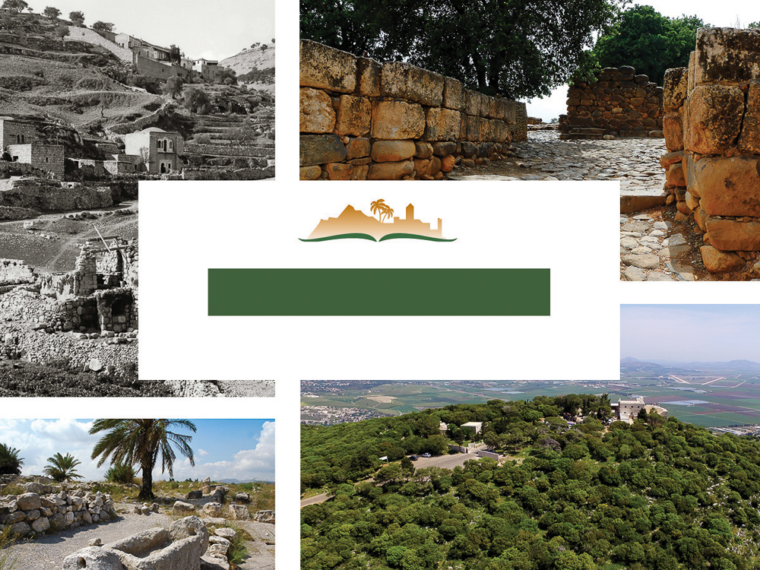
1 Kings 9
Notes:
This is a free sample of the 1 Kings 9 presentation from the Photo Companion to the Bible. To purchase the full volume, visit www.bibleplaces.com/1kings/
The Photo Companion to the Bible is an image-rich resource for Bible students, teachers, and researchers. Just as a librarian stocks the shelves with as many relevant materials as possible, so we have tried to provide a broad selection of images. Our goal is that you will find in this “library” whatever it is you are looking for.
Credits: The primary creators of this presentation are Chris McKinny, Kris Udd, and Todd Bolen. The photographs have an individual file code which usually includes the initials of the photographer. Other images have additional credit or source information.
Updates: We plan to update this collection as we are able. We welcome your suggestions for improving this resource (photocompanion@bibleplaces.com). Purchasers of the 1 Kings volume are provided free, lifetime updates to the volume.
Copyright: This photo collection is protected by copyright law and may not be distributed without written permission from BiblePlaces.com. Slide notes should be treated as any other copyrighted written material, with credit given when quoting from these notes.
For more information, see our complete “Introduction to the Photo Companion to the Bible” online at http://www.BiblePlaces.com/Intro-Photo-Companion-Bible/. Here you will find more information about photo selection, explanatory notes, Bible translation, credit information, and copyright allowances.

Slide 2
1 Kings 9
This is a free sample of the 1 Kings 9 presentation from the Photo Companion to the Bible. To purchase the full volume, visit www.bibleplaces.com/1kings/
The Photo Companion to the Bible is an image-rich resource for Bible students, teachers, and researchers. Just as a librarian stocks the shelves with as many relevant materials as possible, so we have tried to provide a broad selection of images. Our goal is that you will find in this “library” whatever it is you are looking for.
For more details (for this and every slide), see the Notes section below.
Notes:
This is a free sample of the 1 Kings 9 presentation from the Photo Companion to the Bible. To purchase the full volume, visit www.bibleplaces.com/1kings/
The Photo Companion to the Bible is an image-rich resource for Bible students, teachers, and researchers. Just as a librarian stocks the shelves with as many relevant materials as possible, so we have tried to provide a broad selection of images. Our goal is that you will find in this “library” whatever it is you are looking for.
Credits: The primary creators of this presentation are Chris McKinny, Kris Udd, and Todd Bolen. The photographs have an individual file code which usually includes the initials of the photographer. Other images have additional credit or source information.
Updates: We plan to update this collection as we are able. We welcome your suggestions for improving this resource (photocompanion@bibleplaces.com). Purchasers of the 1 Kings volume are provided free, lifetime updates to the volume.
Copyright: This photo collection is protected by copyright law and may not be distributed without written permission from BiblePlaces.com. Slide notes should be treated as any other copyrighted written material, with credit given when quoting from these notes.
For more information, see our complete “Introduction to the Photo Companion to the Bible” online at http://www.BiblePlaces.com/Intro-Photo-Companion-Bible/. Here you will find more information about photo selection, explanatory notes, Bible translation, credit information, and copyright allowances.

Slide 3
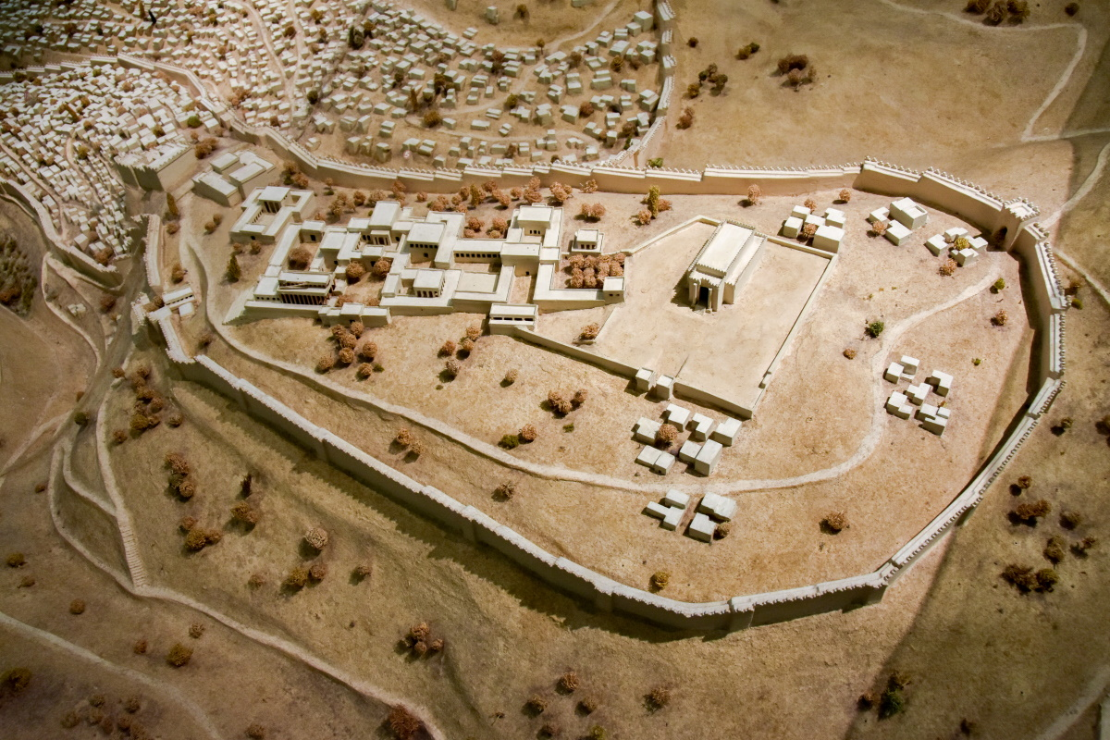
When Solomon had finished the building of the house of Yahweh and the king’s house
Model of Jerusalem with Solomon’s temple and palace (from the east)
9:1
Notes:
Solomon’s temple was located in approximately the same location as today’s Dome of the Rock, although the size and shape of the structures differ considerably. Solomon’s palace was located near the temple, probably to the south. This model depicts Jerusalem from a slightly later period, after the city was expanded to include the western hill in the days of Hezekiah (8th century BC). This model was photographed at the Bible Lands Museum in Jerusalem. The next slide includes labels.
mjb1904256983c

Slide 4
When Solomon had finished the building of the house of Yahweh and the king’s house
City of David
Palace of David
Palace of
Solomon
Temple of Solomon
Kidron Valley
Model of Jerusalem with Solomon’s temple and palace (from the east)
9:1
Notes:
Solomon’s temple was located in approximately the same location as today’s Dome of the Rock, although the size and shape of the structures differ considerably. Solomon’s palace was located near the temple, probably to the south. This model depicts Jerusalem from a slightly later period, after the city was expanded to include the western hill in the days of Hezekiah (8th century BC). This model was photographed at the Bible Lands Museum in Jerusalem.
mjb1904256983c

Slide 5
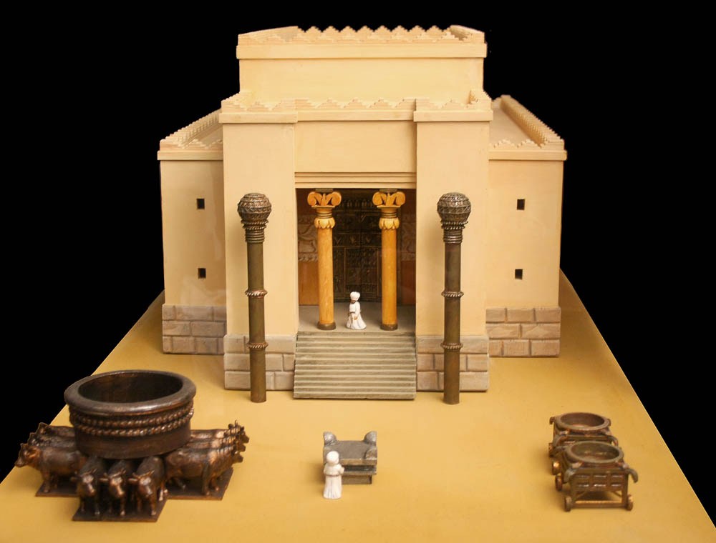
When Solomon had finished the building of the house of Yahweh and the king’s house
Model of Solomon’s Temple
9:1
Notes:
This model of Solomon’s temple reflects an artist’s conception of what it may have looked like. It was photographed by Alexander Schick in the Canstein Bible Institute in the Francke Foundations in Halle, Germany.
as041208500

Slide 6
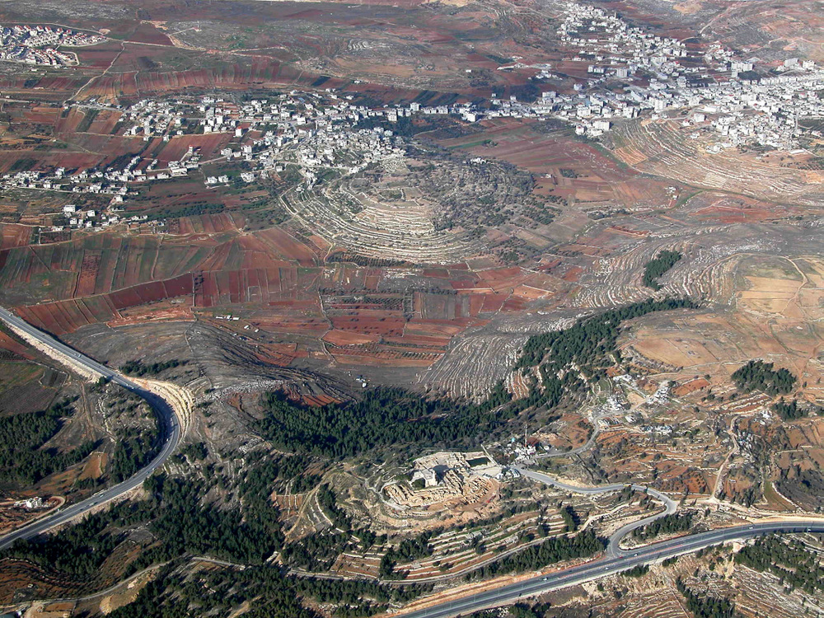
Yahweh appeared to Solomon the second time, as He had appeared to him at Gibeon
Gibeon and Nebi Samwil (aerial view from the south)
9:2
Notes:
God first appeared to Solomon when Solomon went to Gibeon to sacrifice (1 Kgs 3:5; 2 Chr 1:13). The tabernacle was located at Gibeon at that time (2 Chr 1:3,13). This aerial view shows the ancient mound of Gibeon, located next to the modern Arab village of El-Jib. The photo also shows Nebi Samwil, a sister city that may have been ancient Beeroth (Josh 9:17); the two cites are only a mile (1.6 km) apart. The next slide includes labels.
tb010703106

Slide 7
Yahweh appeared to Solomon the second time, as He had appeared to him at Gibeon
Gibeon
Nebi Samwil
Gibeon and Nebi Samwil (aerial view from the south)
9:2
Notes:
God first appeared to Solomon when Solomon went to Gibeon to sacrifice (1 Kgs 3:5; 2 Chr 1:13). The tabernacle was located at Gibeon at that time (2 Chr 1:3,13). This aerial view shows the ancient mound of Gibeon, located next to the modern Arab village of el-Jib. The photo also shows Nebi Samwil, a sister city that may have been ancient Beeroth (Josh 9:17); the two cites are only a mile (1.6 km) apart.
tb010703106

Slide 8
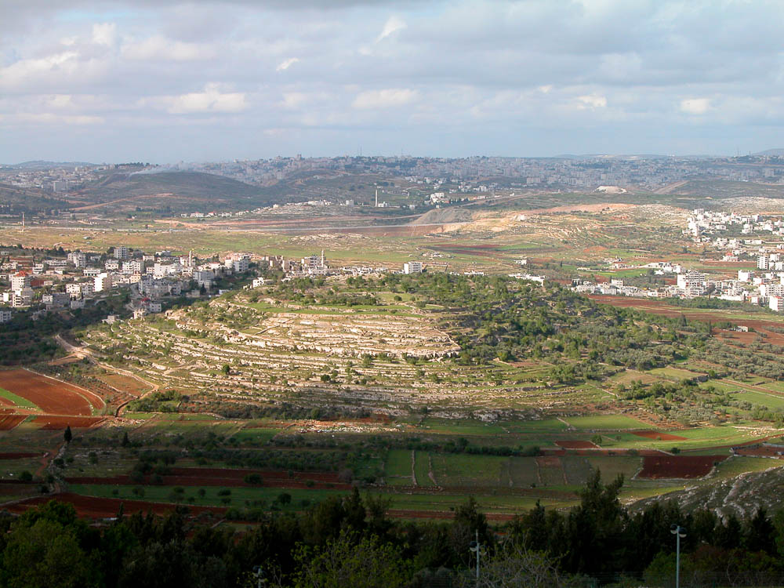
Yahweh appeared to Solomon the second time, as He had appeared to him at Gibeon
Gibeon (from Nebi Samwil)
9:2
Notes:
The biblical site of Gibeon is to be identified with the modern Arab village of el-Jib. The ancient site is the mound in the upper center of this photo. The first modern scholar to propose this identification was Edward Robinson in 1838. Gibeon was excavated by James B. Pritchard in the 1950s and 1960s. A survey of late Iron Age burial caves near Gibeon was done by Hanan Eshel in 1983–84.
tb040304296

Slide 9
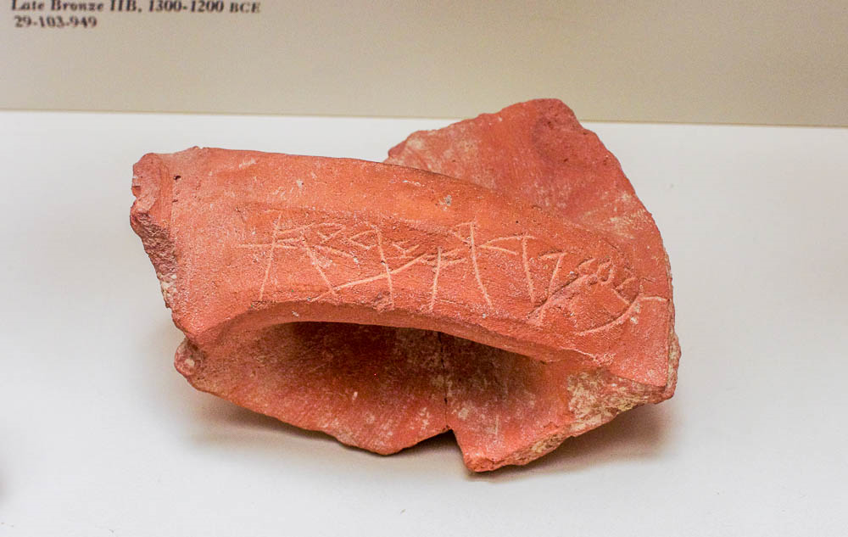
Yahweh appeared to Solomon the second time, as He had appeared to him at Gibeon
“Gibeon, vineyard of Ameryahu” inscribed on a jar handle from Gibeon, 7th century BC
9:2
Notes:
The identification of el-Jib as Gibeon was confirmed when the name “Gibeon” (Heb. gb‘n , גבענ) was found inscribed on 31 jar handles recovered there. The inscription scratched into this handle reads, “Gibeon, vineyard of Ameryahu” (גבען גדר אמריהו). The jar dates to the Iron Age IIC (701–586 BC). It was photographed at the University of Pennsylvania Museum of Archaeology and Anthropology.
adr1605267162

Slide 10
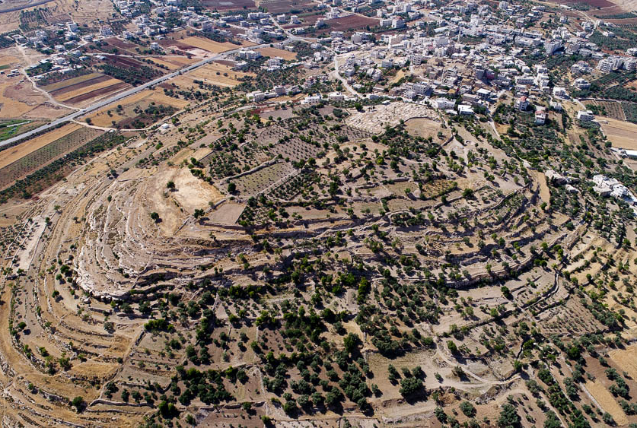
Yahweh appeared to Solomon the second time, as He had appeared to him at Gibeon
Gibeon (aerial view from the southeast)
9:2
Notes:
Archaeological work has been carried out at Gibeon by several expeditions in the 20th century. Discoveries include a series of shaft tombs from the Bronze Age, a city wall from the Iron Age, a wine cellar from the Iron Age, and later occupation in the Roman period. However, most of the ancient site of Gibeon has not been excavated; some of it is under cultivation today.
ws053017153

Slide 11
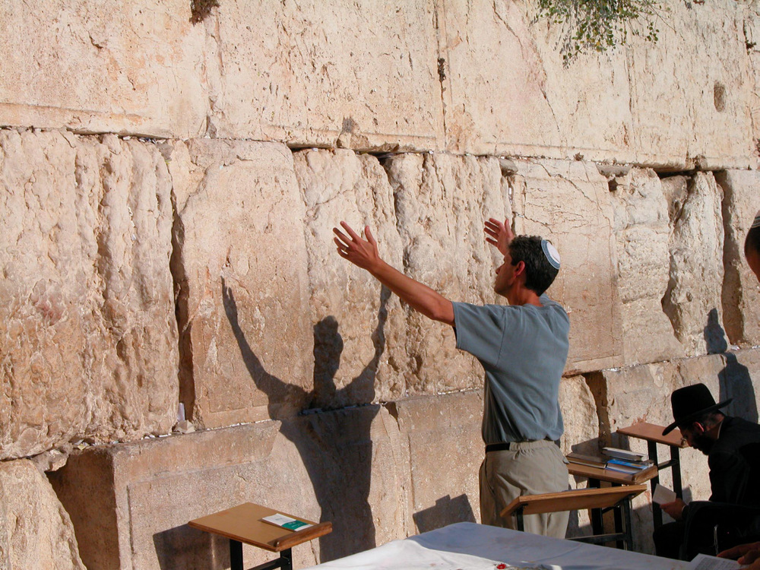
Then Yahweh said, “I have heard your prayer and your supplication”
Man with arms upraised at Western Wall
9:3
Notes:
Solomon’s lengthy prayer is recorded in 1 Kings 8:22-61.
tb092603064

Slide 12
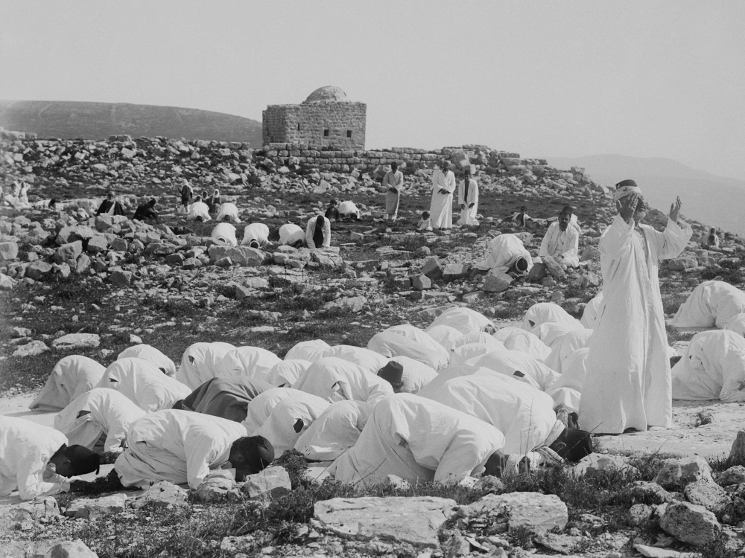
Then Yahweh said, “I have heard your prayer and your supplication”
Samaritans praying on Mount Gerizim during Passover
9:3
Notes:
This American Colony photo was taken between 1900 and 1920.
mat01870

Slide 13
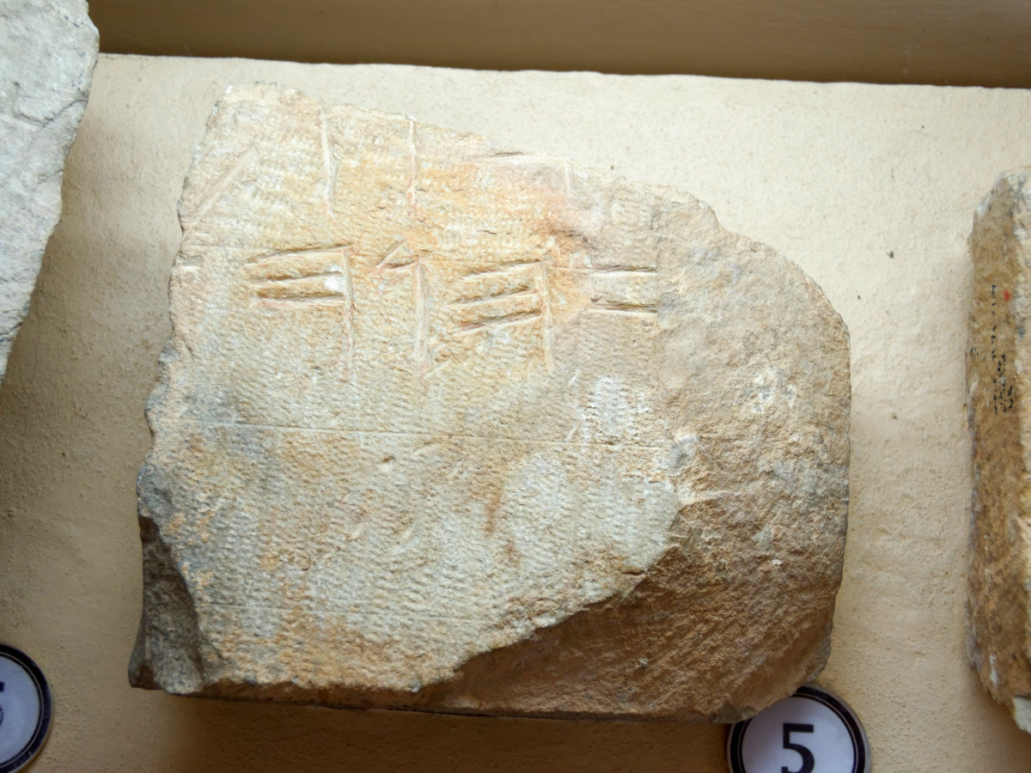
I have put My name there forever, and My eyes and My heart will be there forever
Paleo-Hebrew inscription from Mount Gerizim with the name “Yahweh”
9:3
Notes:
The personal name of Israel’s God, Yahweh, has been preserved in numerous inscriptions. The date of this inscription is uncertain, although it may come from the Hellenistic period (circa 200 BC). The name appears here in an archaic form, using letter shapes of an earlier period. This inscription was photographed at the Good Samaritan Museum in Israel, on the road between Jerusalem and Jericho. The next slide includes highlights that identify the divine name.
tb053116635

Slide 14
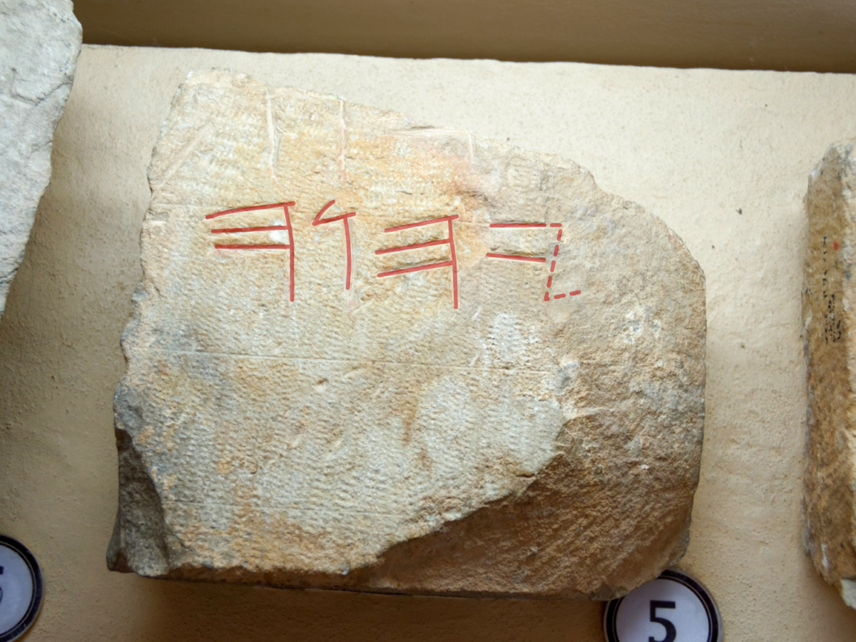
I have put My name there forever, and My eyes and My heart will be there forever
Paleo-Hebrew inscription from Mount Gerizim with the name “Yahweh”
9:3
Notes:
The personal name of Israel’s God, Yahweh, has been preserved in numerous inscriptions. The date of this inscription is uncertain, although it may come from the Hellenistic period (circa 200 BC). The name appears here in an archaic form, using letter shapes of an earlier period. This inscription was photographed at the Good Samaritan Museum in Israel, on the road between Jerusalem and Jericho. An editable version of this graphic is included for those who may wish to change it.
tb053116635

Slide 15
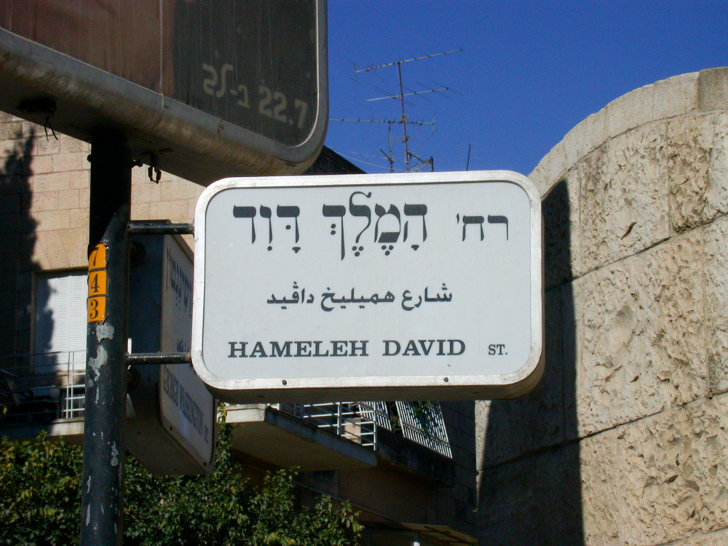
If you will walk before Me as David your father walked, in integrity of heart
“King David Street” sign in Jerusalem
9:4
Notes:
King David Street is located west of the Old City of Jerusalem.
df072404972

Slide 16
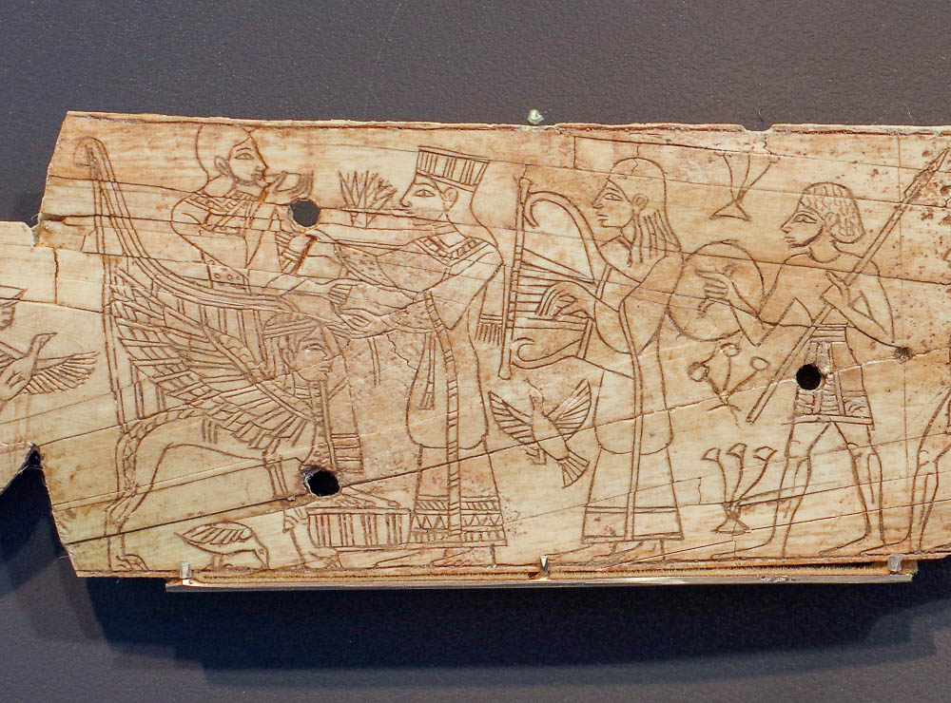
Then I will establish the throne of your kingdom over Israel forever
Ivory furniture inlay with a Canaanite ruler on his throne, from Megiddo, 13th century BC
9:5
Notes:
This ivory object was photographed at the Israel Museum.
adr1806199276

Slide 17
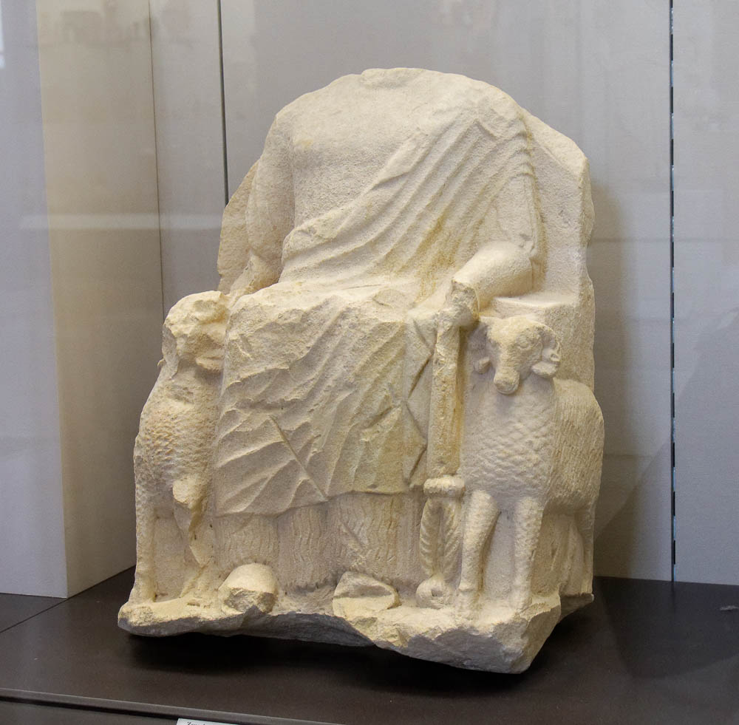
Then I will establish the throne of your kingdom over Israel forever
Statue of Zeus Ammon on a throne with ram armrests, from Cyprus, 5th century BC
9:5
Notes:
This statue was photographed at the Louvre Museum.
tb0928195858

Slide 18
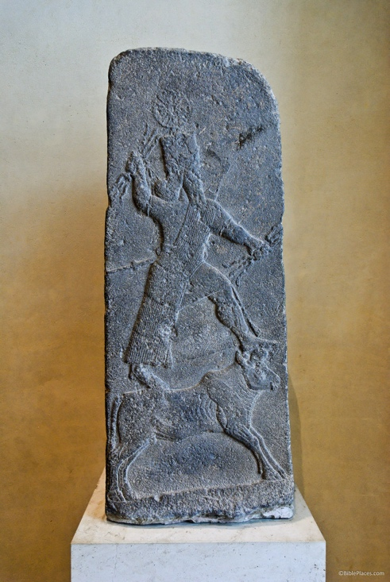
But if you or your sons turn away . . . and serve other gods and worship them
Stele with the storm god Hadad, from Arslan Tash, 8th century BC
9:6
Notes:
This stele depicts the Canaanite storm god Hadad standing on a bull and grasping lightning bolts in both hands. It dates to the reign of the Assyrian king Tiglath-pileser III (745–727 BC). Arslan Tash, ancient Hadātu, is an archaeological site in northern Syria, about 19 miles (30 km) east of Carchemish and the Euphrates. The stele was photographed at the Louvre Museum.
tb060408583

Slide 19
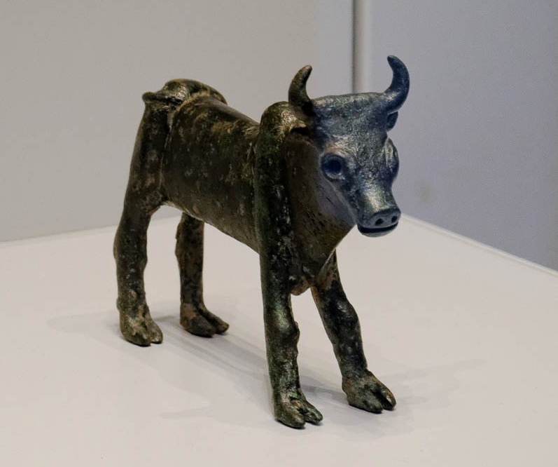
But if you or your sons turn away . . . and serve other gods and worship them
Bronze calf from the hill country of Samaria, 12th–11th centuries BC
9:6
Notes:
This bronze figurine of a bull is a Canaanite symbol of fertility, sometimes associated with the worship of the storm god Baal. It was found at an open-air ritual site in the Israelite heartland, most likely built by Israelites. It is reminiscent of the golden calves installed at the worship centers of Dan and Bethel by the Israelite king Jeroboam I (1 Kgs 12:28-29). This figurine was photographed at the Israel Museum.
tb032014207

Slide 20
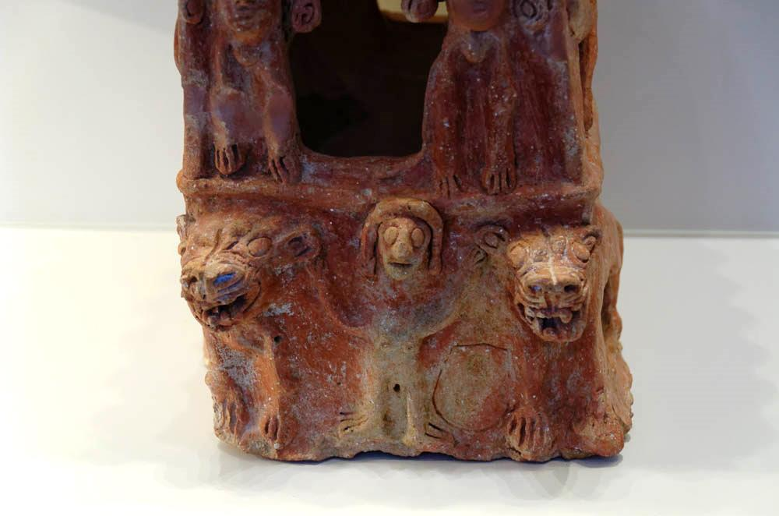
But if you or your sons turn away . . . and serve other gods and worship them
Cult stand depicting Asherah, from Taanach, 10th century BC
9:6
Notes:
The depiction of a woman on the lowest register of this cult stand is widely agreed to be a depiction of Asherah. Asherah is commonly thought to refer generally to female Canaanite goddesses, and the name is mentioned often in passages that describe how the Israelites fell away from worship of the true God (1 Kgs 16:33; 18:19; 2 Kgs 21:7). This artifact was photographed in the Israel Museum.
tb032014203

Slide 21
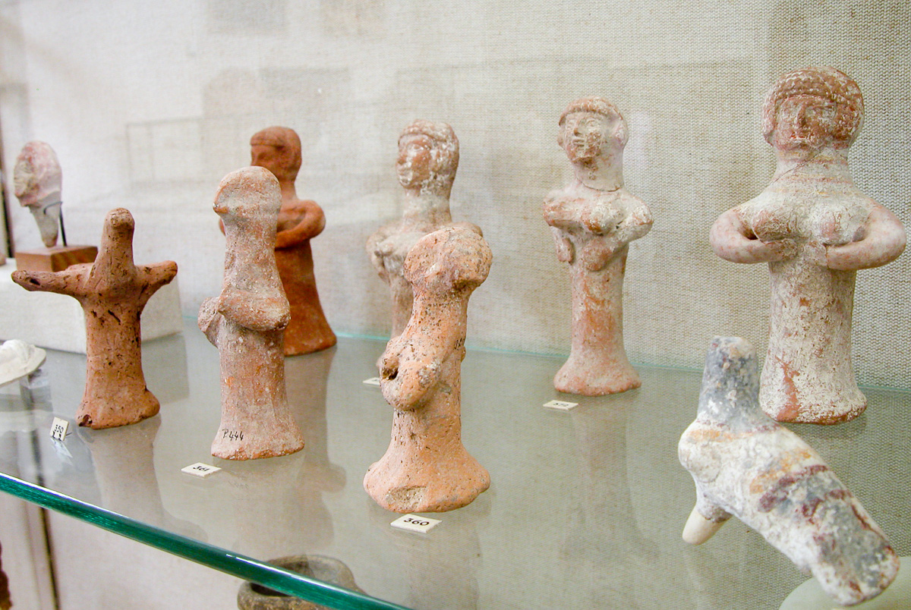
But if you or your sons turn away . . . and serve other gods and worship them
Pillar figurines, Iron Age II, circa 800–586 BC
9:6
Notes:
The clay figurines shown here are commonly referred to as “pillar figurines” because of the plain pillar base that constitutes the lower portion of their bodies. There are two generally categories: those with a detailed face created from a mold, and those with a very simple “pinched” face. Both kinds are represented in this collection. These are commonly thought to have been fertility figurines, although whether they represented a specific goddess (such as Asherah) or not is unknown. Thousands of these figurines have been found at Judean sites from the Iron Age IIB–C (800–586 BC), and they represent the kind of worship that Joshua warned about. These pillar figurines were photographed at the Rockefeller Museum in Jerusalem.
tb042403046

Slide 22
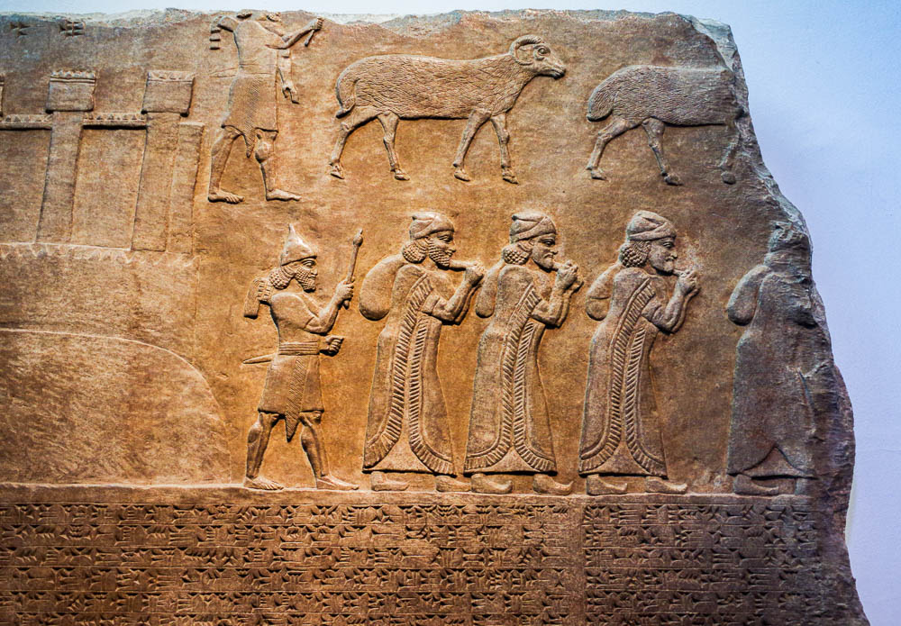
Then I will cut off Israel from the land I have given them
Israelites deported from Astartu in Transjordan, from Nimrud, 8th century BC
9:7
Notes:
God did in fact cut off Israel and Judah from the land when they abandoned Him for other gods. The ten tribes of Israel were finally conquered and deported in about 723 BC, and the people of Judah were deported in several waves, of which the three largest were in 605, 597, and 586 BC. This relief shows deportees being taken away from their city; each carries a sack of belongings over his shoulder. This relief comes from the reign of Tiglath-pileser III. It was photographed at the British Museum.
adr1805194066

Slide 23
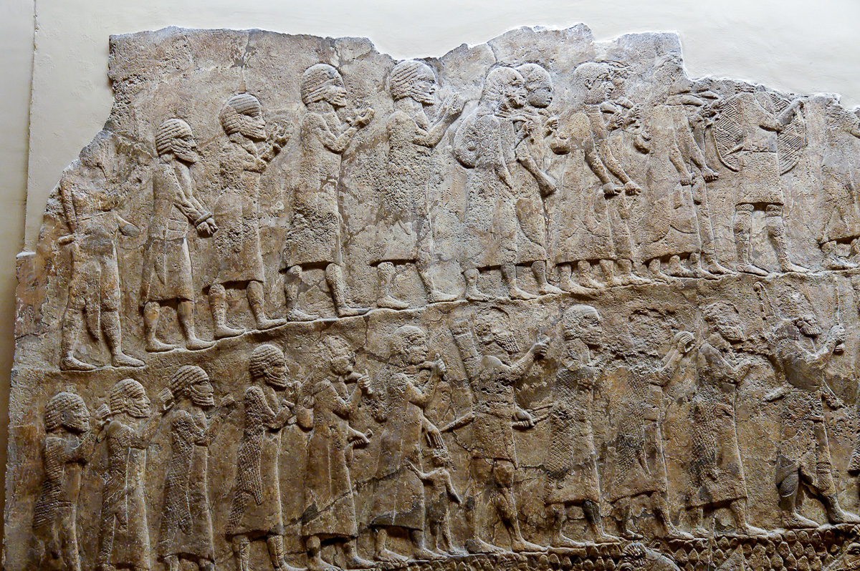
Then I will cut off Israel from the land I have given them
Deportees and Assyrian soldiers, from Nineveh, 7th century BC
9:7
Notes:
This relief comes from Nineveh and dates to the reign of the Assyrian king Sennacherib. It shows lines of deportees being taken to their new homes. A number of them are depicted with hands bound, and others hold their hands up in a gesture indicating a plea for mercy. This is the end promised by God for the Israelites if they were to forsake their duty to the covenant with Him. This relief comes from the palace of Sennacherib at Nineveh. It was photographed at the British Museum.
tb112004285

Slide 24
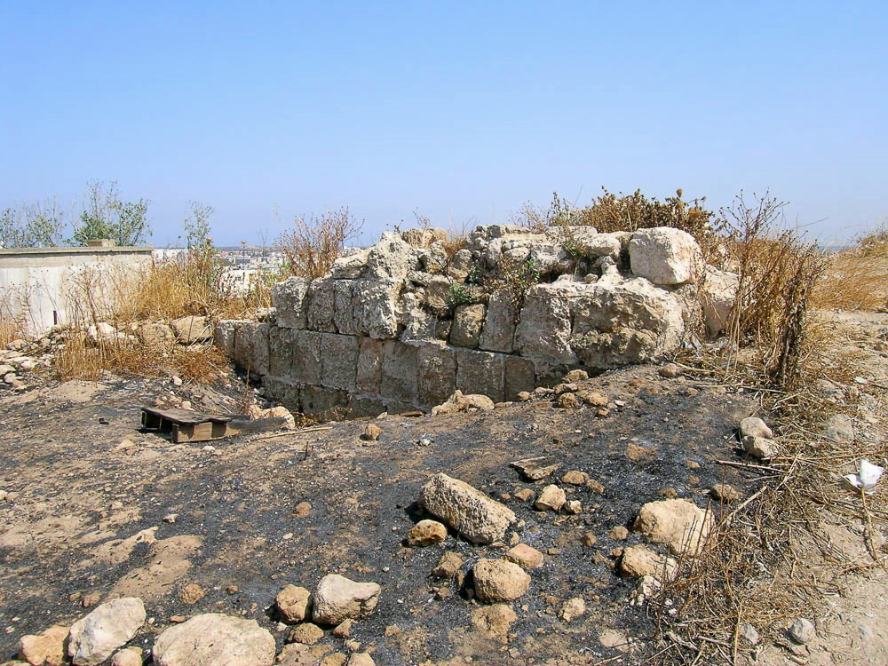
And the house I have consecrated for My name I will abandon
Ruined building at Tel Jabneh
9:7
Notes:
The ruined state of the structure in this photo illustrates the condition of the very temple Solomon built that would result if the people proved unfaithful. The foreground in this photo has also been burned, a common practice when archaeologists wish to clear weeds and other growth from a site.
tb060804352

Slide 25
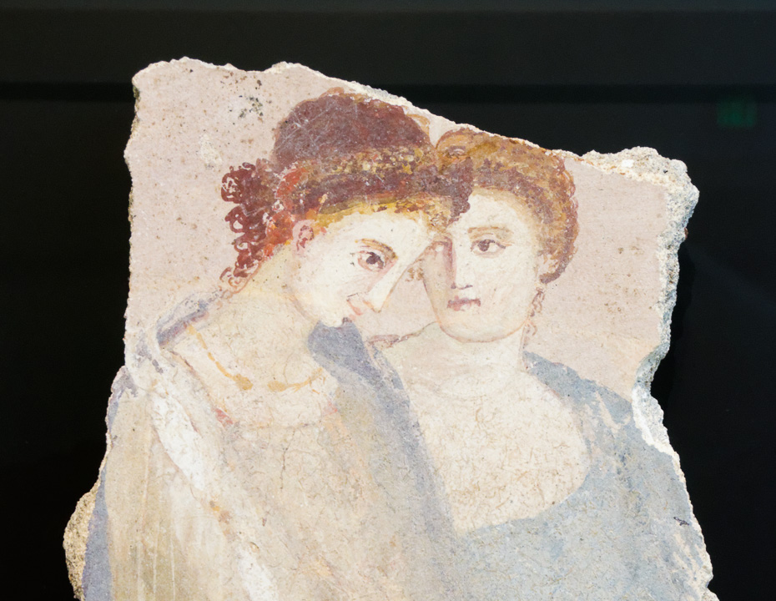
So Israel will become a proverb and a byword among all the nations
Fresco of two women, Roman, 1st century AD
9:7
Notes:
This Roman fresco was photographed at the Getty Villa in southern California.
tb082214838

Slide 26
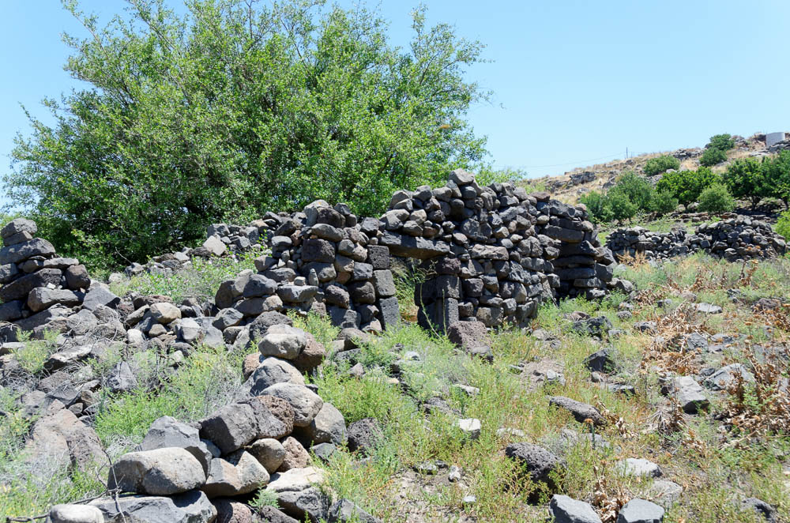
And this house will become a heap of ruins, and everyone who passes by will be astonished
Teetering wall at Umm el-Qanatir
9:8
Notes:
Though the Lord’s warning was fulfilled in 586 BC, no remains have been preserved archaeologically because of later construction in the area, including Zerubbabel’s temple, Herod’s temple mount, and the Muslim construction in the 7th century. The ruins shown here are located at Umm el-Qanatir, a site about 5 miles (8 km) east of the Sea of Galilee.
tb053016912

Slide 27
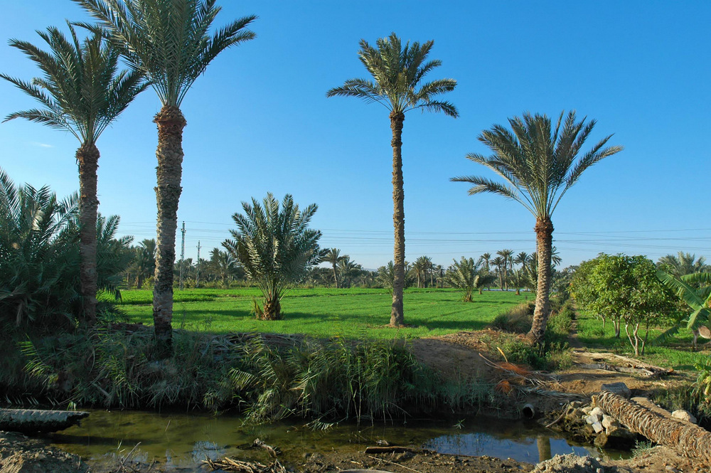
Because they forsook Yahweh their God who brought their fathers out of the land of Egypt
Fields in Egypt near the Great Bitter Lake
9:9
Notes:
The Israelites lived in Goshen, believed to be in the eastern Delta where this photograph was taken.
tb010605522

Slide 28
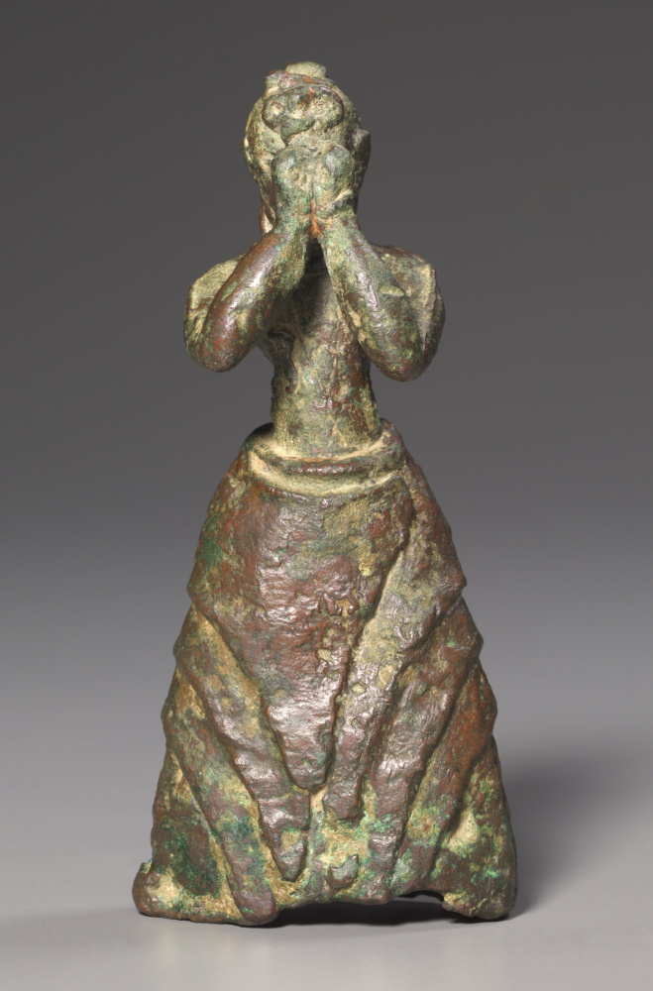
And they adopted other gods and worshiped and served them
Bronze statue of a female worshiper, from Crete, circa 1500 BC
9:9
Notes:
This bronze figurine depicts an adolescent girl with her hands raised as she worships a Minoan deity. Although it predates the time of Solomon by several centuries, it illustrates the worship of false gods in a way that may have been imitated in Iron Age Israel. This image comes from The Cleveland Museum of Art, public domain, Purchase from the J. H. Wade Fund, 2002.89, https://www.clevelandart.org/art/2002.89.
tcma200289141134

Slide 29
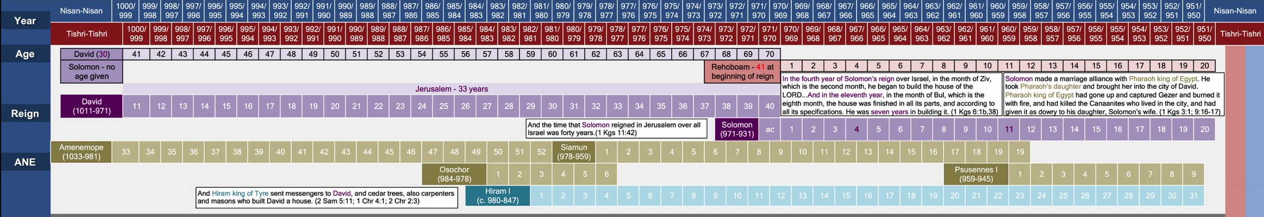
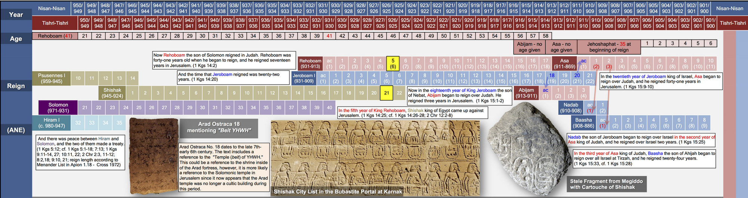
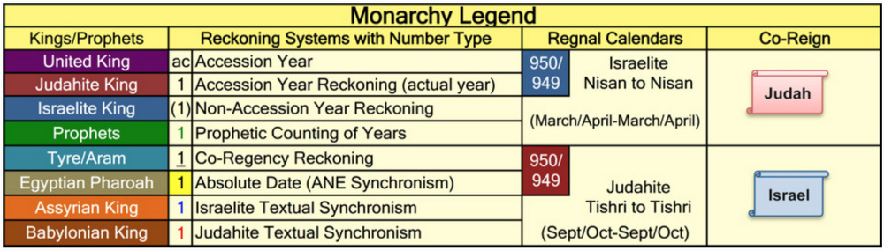
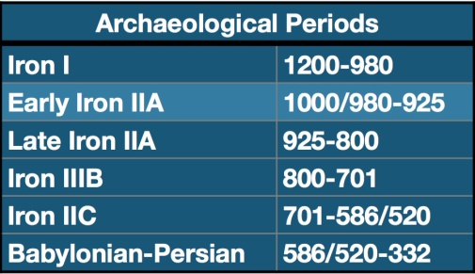
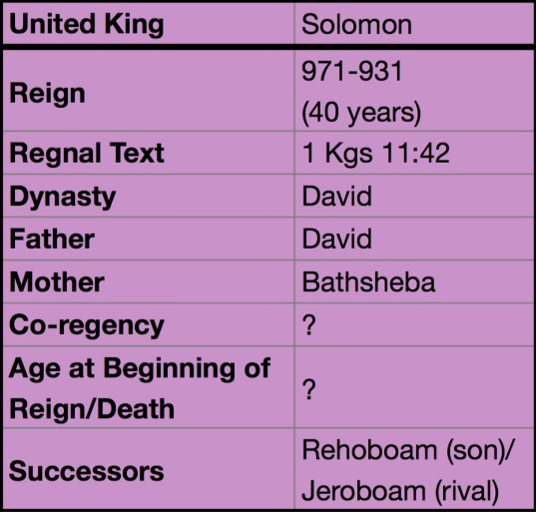
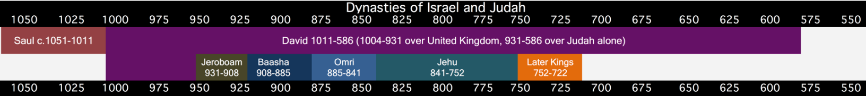
At the end of twenty years, Solomon had built . . . the house of Yahweh and the king’s house
Regnal Chronology of the United Monarchy
9:10
Notes:
Solomon was occupied with building the temple of Yahweh for seven years, from the 4th year of his reign to the 11th year (c. 967–960 BC—1 Kgs 6:37-38). He spent thirteen years building his own house, from the 11th–24th years of his reign (c. 960–947 BC). The total length of time for his building projects (the temple and his palace) was 20 years (967–947 BC; 1 Kgs 9:10; 2 Chr 8:1). This chart comes from The Regnal Chronology of the Kings of Judah and Israel: An Illustrated Guide, by Chris McKinny, available from BiblePlaces.com.

Slide 30
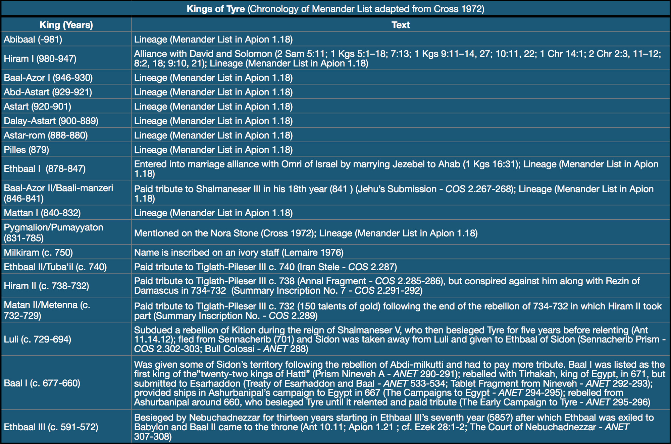
Hiram the king of Tyre had furnished Solomon with cedar trees, cypress trees, and gold
Chronology of the known kings of Tyre
9:11
Notes:
This chart comes from The Regnal Chronology of the Kings of Judah and Israel: An Illustrated Guide, by Chris McKinny, available from BiblePlaces.com.

Slide 31
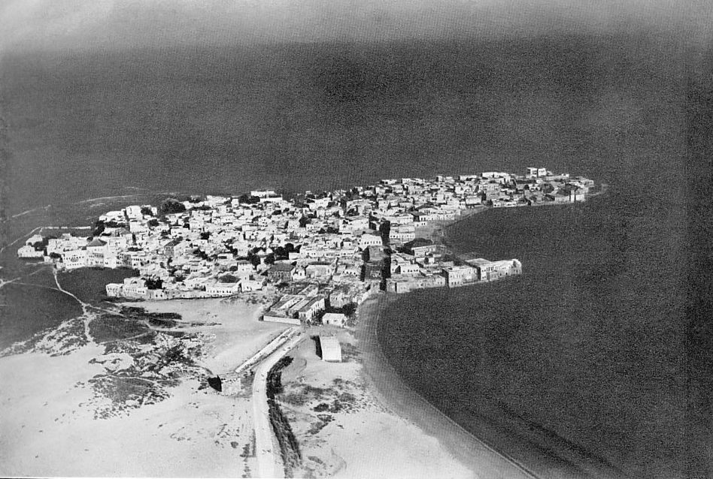
Hiram the king of Tyre had furnished Solomon with cedar trees, cypress trees, and gold
Tyre (aerial view from the east), 1925
9:11
Notes:
In Solomon’s day, Tyre was an island city, situated about a half mile (0.8 km) off the coast. It wasn’t until Alexander the Great built a mole from the mainland to the island in the 4th century BC that the two were connected. Over the millennia, sand has washed up along the mole built by Alexander, with the result that Tyre is now connected to the mainland by a wide sandy beach. This image comes from Gustaf Dalman, Hundert deutsche Fliegerbilder aus Palaestina (1925); an English edition is forthcoming from BiblePlaces.com. This photograph was taken from the east in the morning.
gd0059

Slide 32
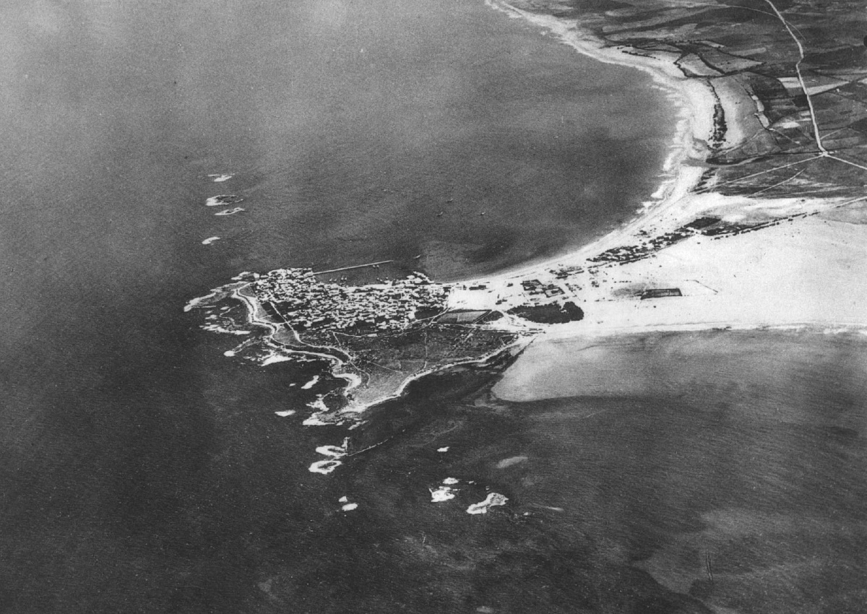
Hiram the king of Tyre had furnished Solomon with cedar trees, cypress trees, and gold
Tyre (from the south), circa 1934
9:11
Notes:
This aerial photo of Tyre was taken before 1934. It was published in the French book "UN GRAND PORT DISPARU TYR" in 1939. This image comes from the French Air Force and is in the public domain, via Wikimedia Commons: https://commons.wikimedia.org/wiki/File:Tyre-aerial-photo-by-France-Military-1934.jpg.
wiki0912200609149726681934

Slide 33
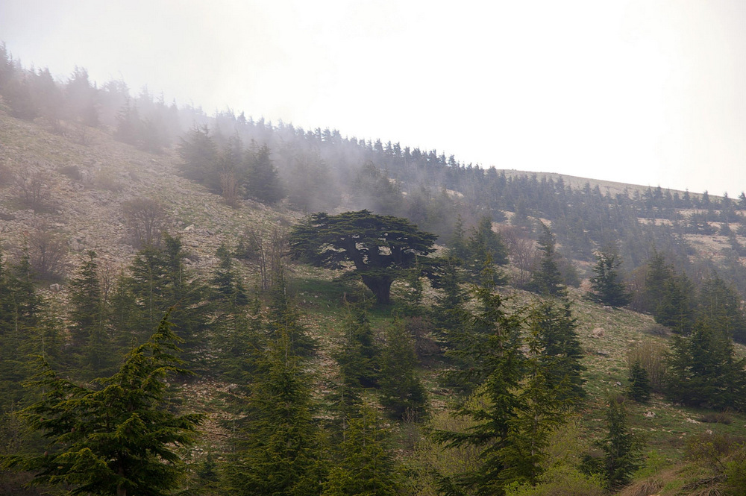
Hiram the king of Tyre had furnished Solomon with cedar trees, cypress trees, and gold
Cedar of Lebanon
9:11
Notes:
The cedar of Lebanon was prized throughout the ancient Near East. The Palermo Stone indicates cedar was imported to Egypt as early as the 4th-dynasty pharaoh Sneferu, circa 2600 BC. One of its primary uses in ancient Egypt was for boat construction. The Egyptian Tale of Wen-Amun, from about the 11th century BC, recounts the travels of an Egyptian official to Byblos to negotiate for cedar wood. One of the earliest references to cedar in Mesopotamia comes from the reign of Sargon of Akkad, around 2300 BC.
adr090510667

Slide 34
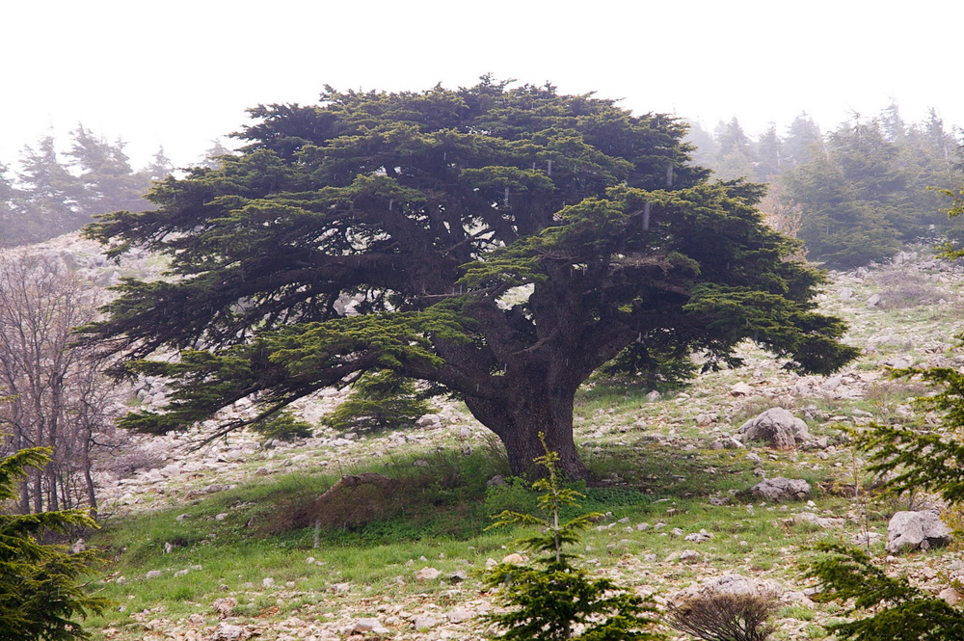
Hiram the king of Tyre had furnished Solomon with cedar trees, cypress trees, and gold
Cedar of Lebanon
9:11
Notes:
Commonly referred to in Scripture as the cedars of Lebanon, this aromatic, durable wood was highly desirable for building in Iron Age Israel. David used in it building his house (2 Sam 5:11; 1 Chr 17:1), and Solomon used it in the constructing the temple and a palace for himself (2 Chr 2:3-8). He was said to make the cedar as plentiful in Jerusalem as sycamore-fig trees in the Shephelah (2 Chr 1:15). The second temple was also constructed from cedars (Ezra 3:7). The cedar tree is used as a picture of strength and security. Psalm 29:5 speaks of the mighty voice of Lord breaking the strong cedars. Another psalm speaks of the righteous prospering like the palm tree and growing like a cedar of Lebanon (Ps 92:12).
adr090510668

Slide 35
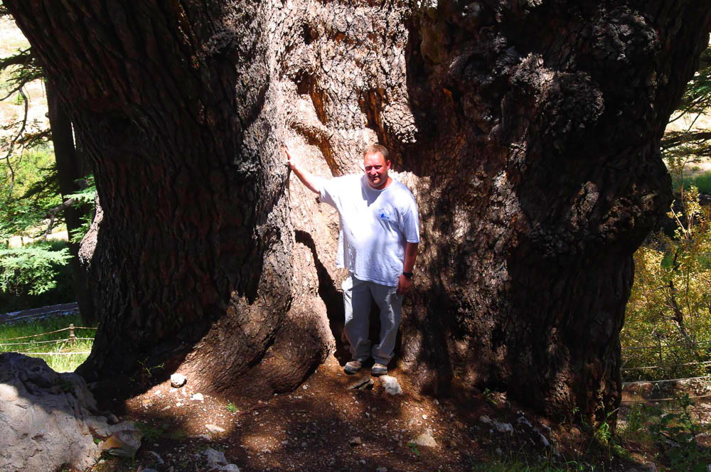
Hiram the king of Tyre had furnished Solomon with cedar trees, cypress trees, and gold
Ancient cedar tree at Arz ar-Rab cedar forest
9:11
Notes:
This photo of the base of an ancient cedar tree in Lebanon illustrates the massive size that these trees could attain.
adr1307118168

Slide 36
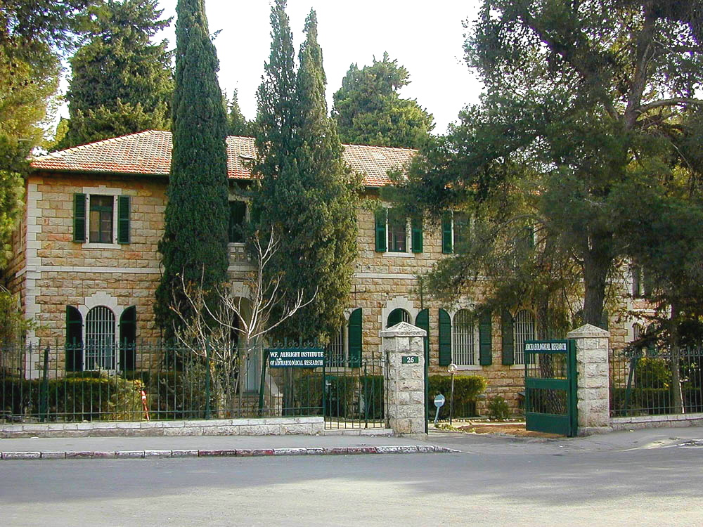
Hiram the king of Tyre had furnished Solomon with cedar trees, cypress trees, and gold
Cypress trees in front of the Albright Institute, Jerusalem
9:11
Notes:
It is generally thought that the “cypress” (Heb. berosh, בְּרוֹשׁ) is the Juniperus phoenicea. Two such trees are seen here growing in front of the Albright Institute in Jerusalem.
tb010200202

Slide 37
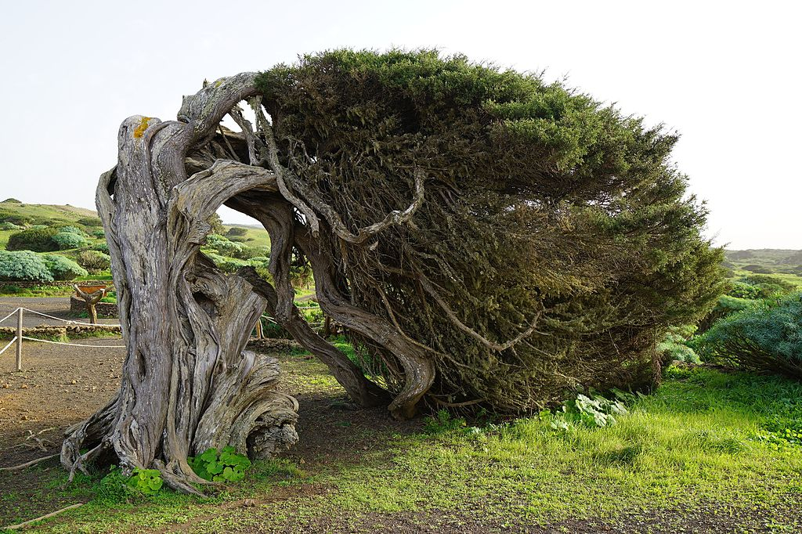
Hiram the king of Tyre had furnished Solomon with cedar trees, cypress trees, and gold
Juniperus phoenicea on the island of El Hierro
9:11
Notes:
This cypress tree was photographed on El Hierro, an island in the Atlantic, off the coast of Africa. El Hierro is the second-smallest of the eight main islands of the Canaries. This illustrates that the cypress is much more widespread and adaptable than the Lebanese cedar, although the prime habitat of the Lebanese mountains may have been more ideal for the production of lumber from cypress trees. This image comes from Areuland and is licensed under CC BY-SA 4.0, via Wikimedia Commons: https://commons.wikimedia.org/wiki/File:Ph%C3%B6nizischer_Wacholder.jpg.
wiki1227201617533038014

Slide 38
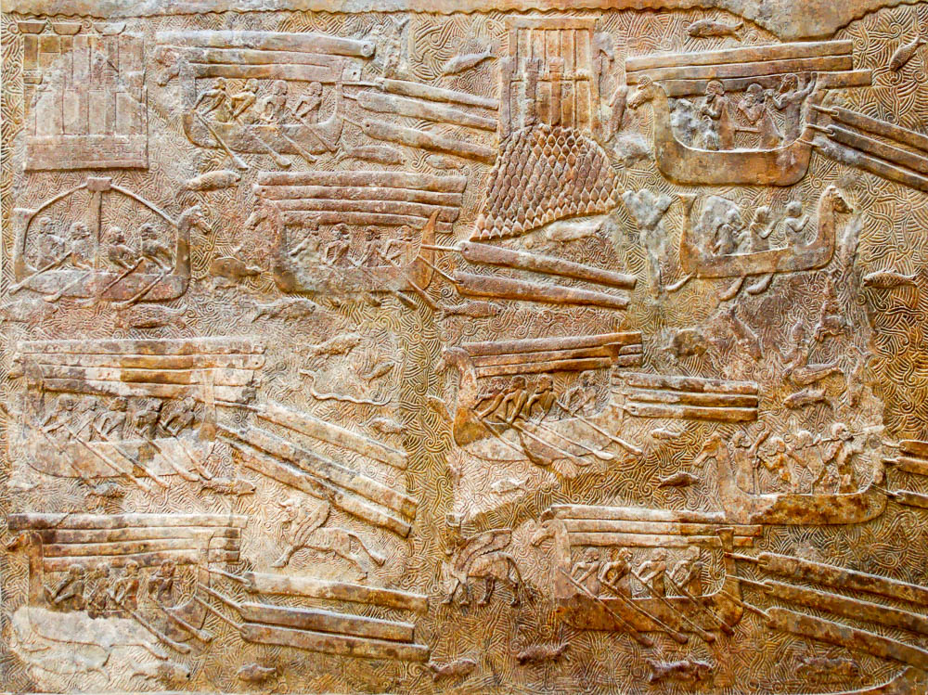
Hiram the king of Tyre had furnished Solomon with cedar trees, cypress trees, and gold
Assyrians transporting timber with ships, from the palace at Khorsabad, circa 710 BC
9:11
Notes:
This relief comes from the palace of Sargon II at Khorsabad (ancient Dur Sharrukin). This panel shows timbers being transported by ships. Some timbers are towed behind the ships, while others appear to be loaded on board. All of the boats are shown powered by oars, not sails. The water teems with life, which includes fish, turtles, snakes, and mythical creatures. Two fortified cities are also shown toward the top of the relief; the one at center-right appears to stand on an island, like the city of Tyre. This relief was photographed at the Louvre Museum.
tb060408233c

Slide 39
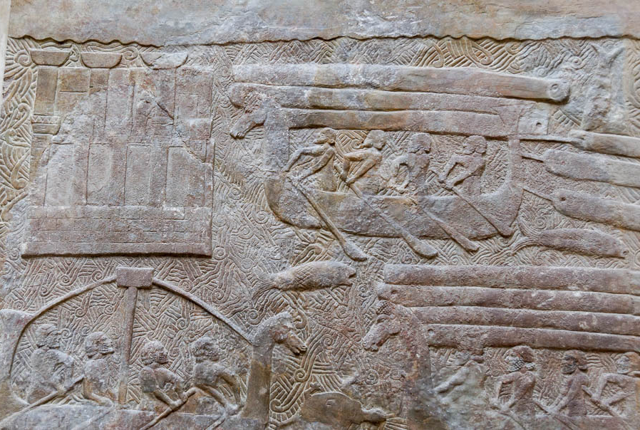
Hiram the king of Tyre had furnished Solomon with cedar trees, cypress trees, and gold
Assyrians transporting timber with ships, from the palace at Khorsabad, circa 710 BC
9:11
Notes:
This relief was photographed at the Louvre Museum.
tb0927194405

Slide 40
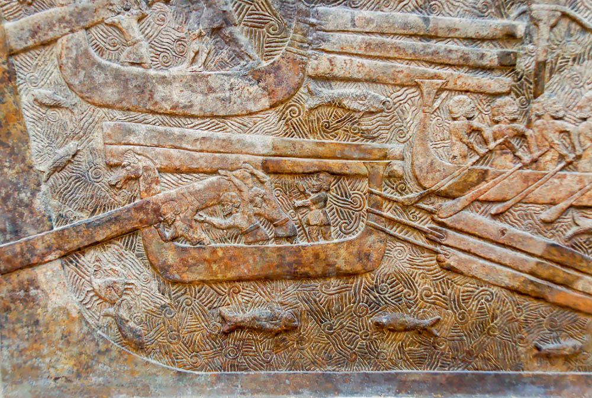
Hiram the king of Tyre had furnished Solomon with cedar trees, cypress trees, and gold
Assyrians transporting timber with ships, from the palace at Khorsabad, circa 710 BC
9:11
Notes:
This relief depicts a ship that is unloading its timber on the shore. Additional timbers can be seen on board the ship, above the heads of the workers, and three additional timbers are attached by ropes to the stern of the vessel, having been towed through the water. The prow of this ship, like the others in this set of reliefs, is decorated with a horse-like head. This relief was photographed at the Louvre Museum.
tb060408231

Slide 41
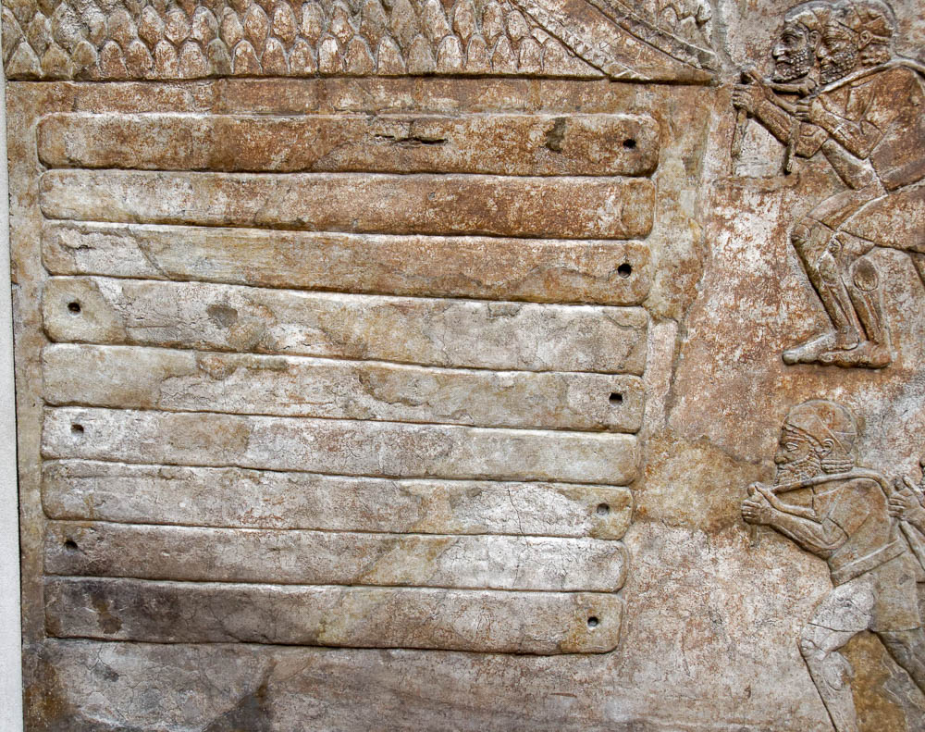
Hiram the king of Tyre had furnished Solomon with cedar trees, cypress trees, and gold
Relief with a stack of hewn cedar logs, from the palace at Khorsabad, circa 710 BC
9:11
Notes:
This relief was photographed at the Louvre Museum.
tb0927194428

Slide 42
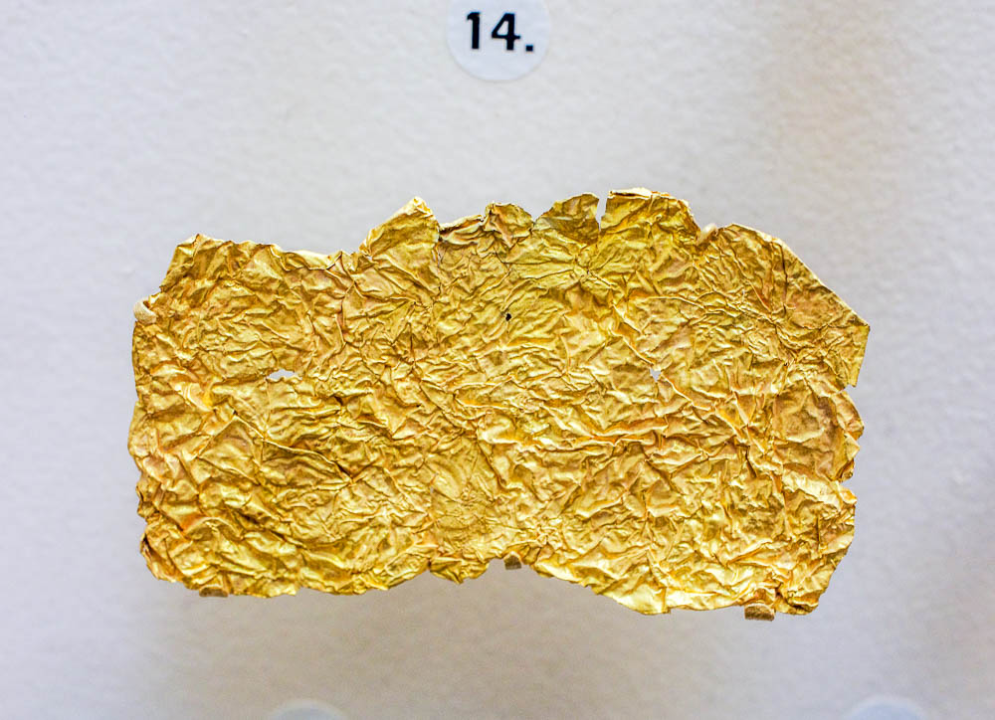
Hiram the king of Tyre had furnished Solomon with cedar trees, cypress trees, and gold
Sheet of gold foil, from Beth-shean, circa 1150–1000 BC
9:11
Notes:
Much of the gold used by Solomon for the temple was used to overlay the interior of the structure. Gold is a relatively soft metal, and the ancients mastered the skill required to beat it into very thin sheets in order to cover other materials. The wrinkled sheet of gold foil shown here predates the time of Solomon by perhaps a century. This display was photographed at the Museum of Archaeology and Anthropology at the University of Pennsylvania.
adr1605266539

Slide 43
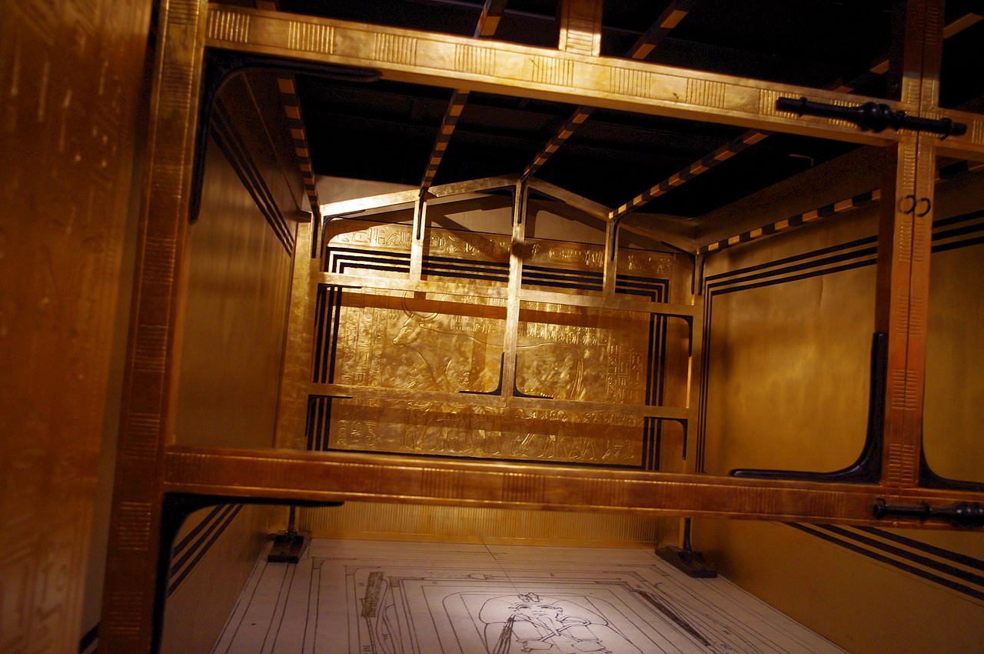
Hiram the king of Tyre had furnished Solomon with cedar trees, cypress trees, and gold
Interior of the outer shrine of Tutankhamun, 14th century BC
9:11
Notes:
This wooden shrine of Tutankhamun is the outermost of several that were nested together to protect the mummy. The wood was overlaid with sheet gold, which illustrates the look of a golden room, and also testifies to the skill of gold-workers a number of centuries before the time of Solomon. This display was photographed at the Treasure of Tutankhamun Exposition in Paris, 2012. This image comes from Traumrune and is licensed under CC BY 3.0, via Wikimedia Commons: https://commons.wikimedia.org/wiki/File:Toutankamon-expo_18_1e-chap.JPG.
wiki0814201242882848531

Slide 44
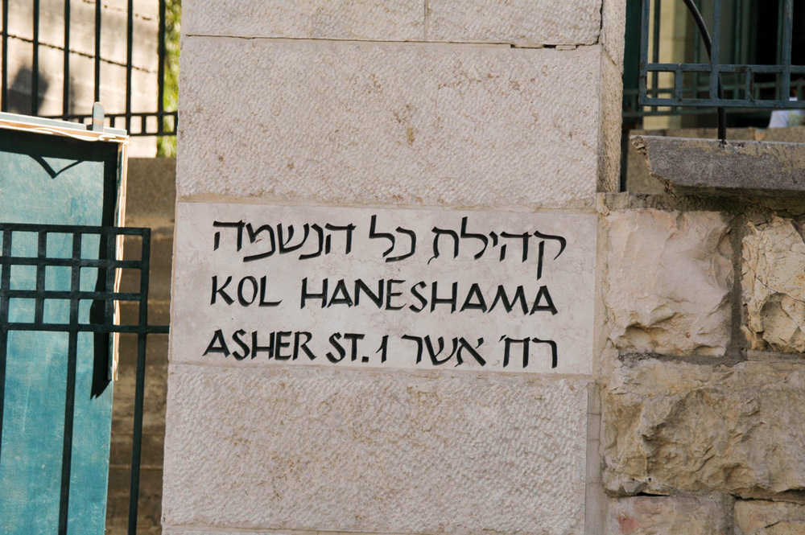
Then King Solomon gave Hiram twenty cities in the land of Galilee
“Asher Street” sign in Jerusalem
9:11
Notes:
The subsequent reference to the “land of Cabul” (1 Kgs 9:13) indicates that these cities were likely from the allotment of Asher, which included 22 cities (cf. Josh 19:24-31). “Asher Street” is located in the Baka neighborhood, south of the Old City.
tb072404786

Slide 45
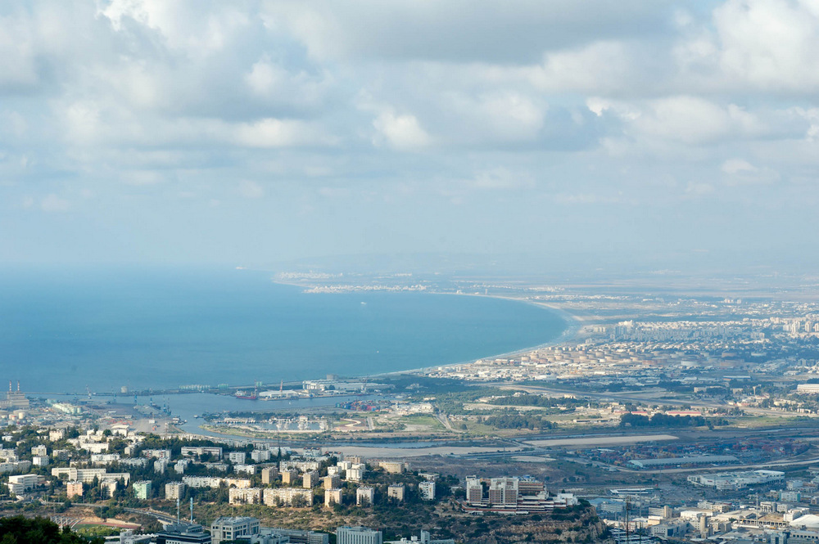
Then King Solomon gave Hiram twenty cities in the land of Galilee
Haifa and Plain of Asher (from the south)
9:11
Notes:
Asher’s territory included the Plain of Asher, stretching from the Carmel Range in the south up to the rougher country around Rosh HaNikra in the north. The photo shown here was taken from atop the Carmel mountains in the south. The point of land at the top of the bay, visible where the bay curves back around toward the west in the distance, is the location of Acco/Acre, one of the important cities of Asher. The next slide includes labels.
tb100505534

Slide 46
Then King Solomon gave Hiram twenty cities in the land of Galilee
Rosh HaNiqra
Acco
Bay of Haifa
Kishon River
Haifa and Plain of Asher (from the south)
9:11
Notes:
Asher’s territory included the Plain of Asher, stretching from the Carmel Range in the south up to the rougher country around Rosh HaNikra in the north. The photo shown here was taken from atop the Carmel mountains in the south. The point of land at the top of the bay, visible where the bay curves back around toward the west in the distance, is the location of Acco/Acre, one of the important cities of Asher.
tb100505534

Slide 47
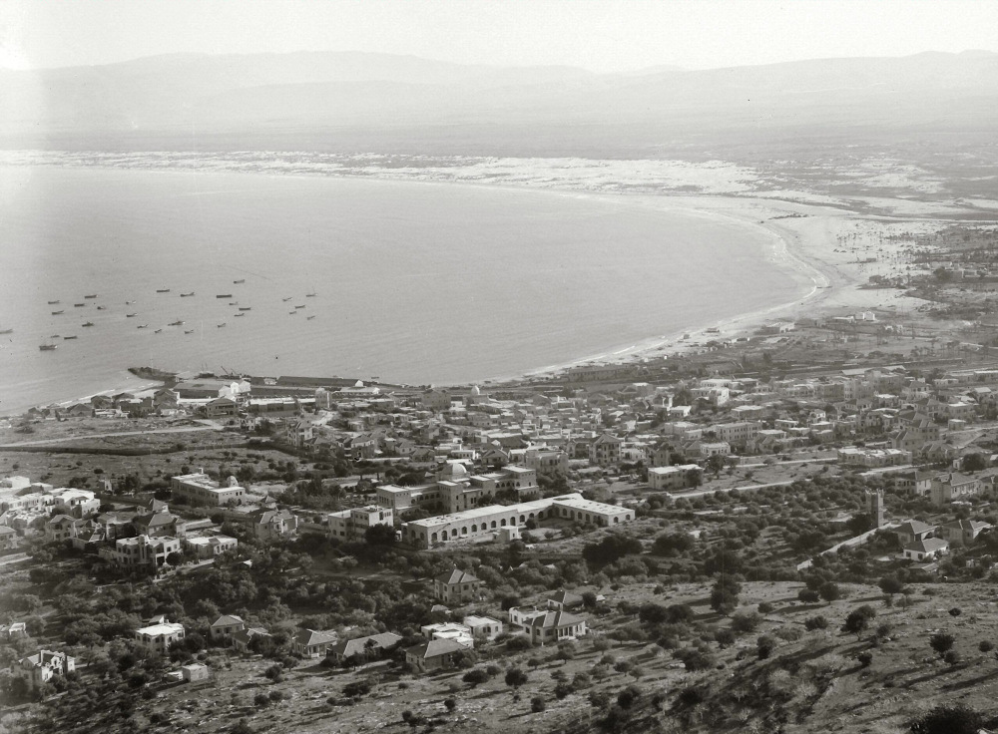
Then King Solomon gave Hiram twenty cities in the land of Galilee
Haifa and the Bay of Haifa, near Tell Abu Hawam
9:11
Notes:
This American Colony photo was taken between 1900 and 1920.
mat05576

Slide 48
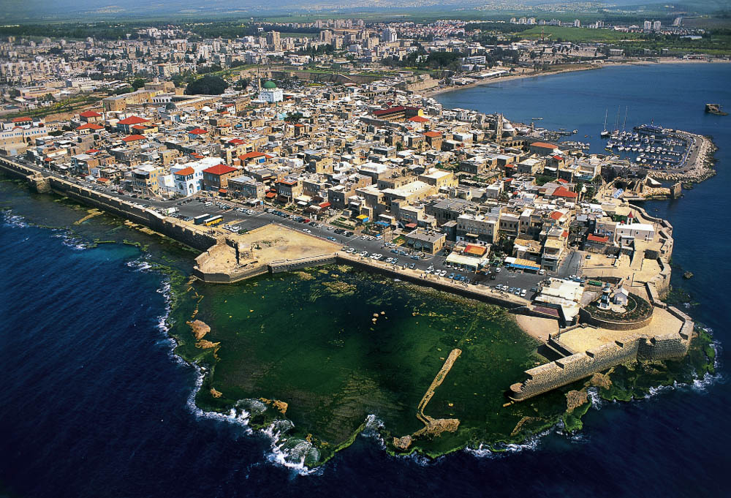
Then King Solomon gave Hiram twenty cities in the land of Galilee
Old city of Acre and Tel Acco, possible location of Ummah (aerial view from the west)
9:11
Notes:
Acco/Acre is among the oldest continuously inhabited cities in Israel. This view shows the old city of Acre in the foreground and the more ancient Tel Acco in the background. The earliest remains discovered so far in the area of the old city of Acre date to the Persian period, about 400 BC. Prior to that it appears that habitation was centered at Tel Acco. This image comes from Itamar Grinberg and is licensed under CC BY-SA 2.0, via Wikimedia Commons: https://en.wikipedia.org/wiki/Acre,_Israel#/media/File:Aerial_view_of_Acre_1.jpg. See the next slide for labels.
wiki072520121624

Slide 49
Then King Solomon gave Hiram twenty cities in the land of Galilee
Tel Acco
Acre/’Akka
Old city of Acre and Tel Acco, possible location of Ummah (aerial view from the west)
9:11
Notes:
Acco/Acre is among the oldest continuously inhabited cities in Israel. This view shows the old city of Acre in the foreground and the more ancient Tel Acco in the background. The earliest remains discovered so far in the area of the old city of Acre date to the Persian period, about 400 BC. Prior to that it appears that habitation was centered at Tel Acco. This image comes from Itamar Grinberg and is licensed under CC BY-SA 2.0, via Wikimedia Commons: https://en.wikipedia.org/wiki/Acre,_Israel#/media/File:Aerial_view_of_Acre_1.jpg
wiki072520121624

Slide 50
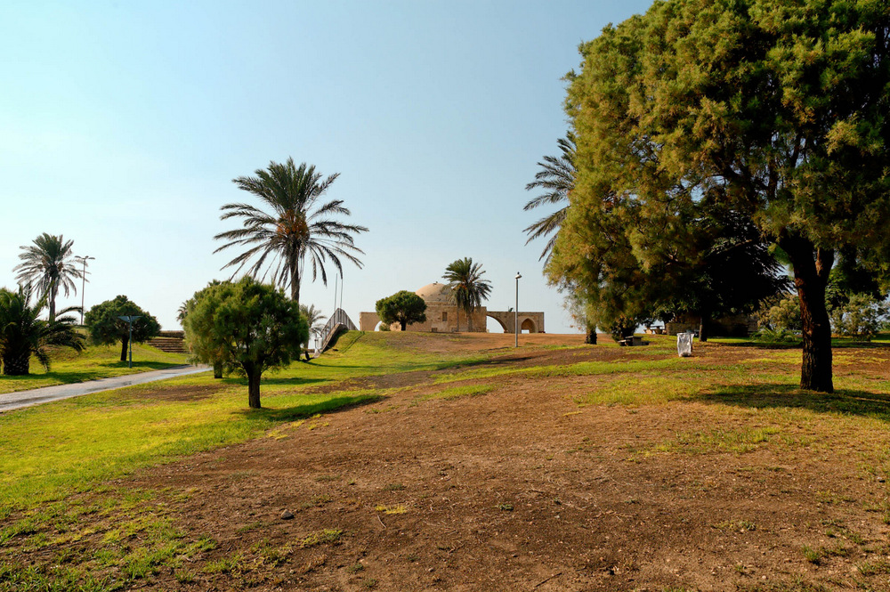
Then Hiram came out from Tyre to see the cities
Tell Achzib in the allotment of Asher
9:12
Notes:
A list of the particular cities is not given, leaving their identity as the object of speculation. The city of Achzib was allotted to the tribe of Asher (Josh 19:29), but they were unable to subdue the Canaanites and inhabit the site (Judg 1:31). Achzib is located 9 miles (14 km) north of Acco at the site known today as ez-Zib. Archaeological excavation has revealed that Achzib was built and destroyed many times between the Middle Bronze and Crusader periods. In the Middle Bronze Age (2000–1550 BC), a trench was cut in the kurkar ridge east of the site in order to turn the peninsula into an island. The city was destroyed at the end of the Middle Bronze Age (circa 1550 BC) and again at the end of the Late Bronze Age (circa 1200 BC). The city expanded during the Iron Age II and was destroyed by Sennacherib in 701 BC.
tb100905729

Slide 51

Then Hiram came out from Tyre to see the cities
Aphek, modern Tell Kurdanah (from the southeast)
9:12
Notes:
Aphek of Asher is named in Joshua 19:30 and Judges 1:31. It is to be distinguished from the Aphek much further south along the Yarkon River. Aphek of Asher is usually identified with Tell Kurdanah, which sits above the perennial spring that flows into Nahr Nahamieh. This Aphek is likely the one mentioned in the Execration Texts from Egypt.
dad0481

Slide 52

Then Hiram came out from Tyre to see the cities
Tell el-Bir el-Gharbi (Tel Bira), ancient Rehob (from the south)
9:12
Notes:
The name Rehob is listed twice in the Asher allotment (Josh 19:28; 30) and again as a Levitical town within Asher (Josh 21:31). The first reference is part of Asher’s northeastern boundary that included the towns of Cabul (Kabul), Ebron/Abdon (Khirbet Abde’), Rehob, Hammon (Khirbet Umm el-Awamid), Kanah (Qana), and Sidon (Saïda). The northern Rehob may possibly be identified with Tell Rahib or Khirbet el-Belat, but nothing is known concerning the archaeology of either of these sites as the former has not yet been surveyed and the latter is just inside the Lebanese border.
The second reference to Rehob is within a group of towns that are not part of a boundary line. These include the following: Mahalab (Khirbet el-Mahalib), Achzib (Tell ʾAchzib), Ummah (LXX Acco = el-Fukhkhar), Aphek (Khirbet Kurdaneh), and Rehob. The context of this latter group would seem to indicate that the second Rehob was in the central section of the plain of Asher near Acco. It is unclear which Rehob should be related to the Levitical Rehob of Asher, but in light of the southern location of Abdon, Helkath, and Mishal (Josh 21:30-31) it seems plausible that the second Rehob is the latter Rehob in the Asher allotment (Josh 19:30). This Rehob is usually identified with Tell el-Bir el-Gharbi (Tel Bira), which is located east of Acco on the eastern edge of the Plain of Asher. Archaeological work at the site has shown that the site was large (approximately 17 acres [7 ha]) and continuously occupied from the Early Bronze Age through the Iron Age II (circa 3150–586 BC).
dad1122

Slide 53

Then Hiram came out from Tyre to see the cities . . . but they did not please him
Round marble relief with portraits of Silenus and a satyr, circa AD 100
9:12
Notes:
The scowling faces on this relief illustrate the discontent Hiram expressed over the cities given to him by Solomon. This relief was photographed at the Nimes Museum.
tb092019526

Slide 54

So they are called the land of Cabul to this day
Kabul and coastal plain from Horvat Rosh Zayit, possibly biblical Cabul
9:13
Notes:
Besides the reference in 1 Kings 9:13, the name “Cabul” is also mentioned in Josh 19:27, where it appears in the allotment of the tribe of Asher. Cabul has been preserved in the name Kabul until modern times, however, no pre-Persian remains were found at the site, which is buried beneath the modern Arab village (Lehmann and Peilstöcker 2012: site 129). Gal suggests that biblical Cabul was located at the nearby site of Horvat Rosh Zayit (Raz es-Zaytun), which is a single-period fortress that dates to the 10th–9th centuries BC (Gal 1992: 47–53). Josephus states that Cabul means “unpleasant” in Phoenician, which underscores Hiram’s dissatisfaction with Solomon’s payment (Ant 8.5.3).
References:
Gal, Z.
1992 Lower Galilee during the Iron Age. Winona Lake, IN: Eisenbrauns.
Lehmann, G. and Peilstöcker, M.
2012 Map of Ahihud – 20. Jerusalem: Israel Antiquities Authority.
adr1305099922

Slide 55

So they are called the land of Cabul to this day
Israelite four-room house with olive press at Horvat Rosh Zayit, possibly biblical Cabul
9:13
Notes:
Located 10 miles (16 km) east of Acco, Horvat Rosh Zayit (Kh. Ras ez-Zeitun) has been proposed as a possible location for biblical Cabul (Josh 19:27). The site was excavated by Zvi Gal who identified a (25 x 25 m) fortress from the 10th–9th centuries along with a settlement established after the fortress was destroyed.
adr1305092471

Slide 56

So they are called the land of Cabul to this day
Phoenician fortress at Horvat Rosh Zayit, possibly biblical Cabul
9:13
Notes:
Whatever the ancient name of Horvat Rosh Zayit, the site played an important role in the relations between the Israelites and the Phoenicians. The pottery assemblage included both Israelite and Phoenician wares, indicating that the site served as a meeting point between the two cultures.
adr1305092447

Slide 57

Hiram sent to the king 120 talents of gold
Bronze lion weight, about one Babylonian talent, from Abydus near Troy, circa 450 BC
9:14
Notes:
Estimates for the weight of one talent vary between 50–100 pounds (23–45 kg), approximately the weight which a single man can carry. If the average weight of 75 pounds (34 kg) is allowed, then this amount of gold was roughly 9,000 pounds (4,082 kg) or 4.5 tons (4 t). Conversion into modern currencies is notoriously difficult, but if given the spot price of about $1,900 US per troy ounce (January 2021), this amount of gold would be worth about $1.35 billion US. At any rate, 120 talents of gold is a very large amount. This artifact was photographed at the British Museum.
tb0929196910

Slide 58

Hiram sent to the king 120 talents of gold
Relief of two Neo-Assyrian officials weighing talents of precious metal, from Khorsabad (sketch)
9:14
Notes:
This illustration comes from Paul Emile Botta and Eugène Flandin, Monument de Ninive, published in 1849–50. Public domain, from The New York Public Library, http://digitalcollections.nypl.org/items/510d47e2-72d7-a3d9-e040-e00a18064a99
nypl1534838

Slide 59

And this is the account of the forced labor that Solomon raised
Prisoners of war hauling a sledge, from Nineveh, reign of Sennacherib, circa 700 BC
9:15
Notes:
First Kings 5:13-16 records that Solomon required forced labor from among the inhabitants of Israel. He sent 30,000 in shifts to Lebanon, and had an additional 70,000 transporters and 80,000 who cut stone. This relief shows men using ropes to haul a large stone statue; some of the workers are engaged in continually supplying rollers to place under the statue to ease its movement. This relief was photographed at the British Museum.
adr1805195377

Slide 60

And this is the account of the forced labor that Solomon raised
Obelisk or stone in boat with forced labor, from Sennacherib’s palace in Nineveh
9:15
Notes:
This illustration comes from Sir Austen Henry Layard, Second Series of the Monuments of Nineveh, published in 1853. Public domain, from The New York Public Library, http://digitalcollections.nypl.org/items/510d47dc-472b-a3d9-e040-e00a18064a99
nypl494729

Slide 61

And this is the account of the forced labor that Solomon raised
Assyrians moving a winged bull on a sledge, from Sennacherib's palace in Nineveh
9:15
Notes:
This illustration comes from Sir Austen Henry Layard, Second Series of the Monuments of Nineveh, published in 1853. Public domain, from The New York Public Library, http://digitalcollections.nypl.org/items/510d47dc-472e-a3d9-e040-e00a18064a99
nypl494732

Slide 62

And this is the account of the forced labor that Solomon raised
Slaves carrying wooden posts used for moving a human-headed bull colossus, circa 700 BC
9:15
Notes:
This relief comes from the palace of Sennacherib at Nineveh. It was photographed at the Vatican Museums.
tb0512176431r

Slide 63

And this is the account of the forced labor that Solomon raised
Prisoners clear rocks in baskets from a quarry, from Nineveh, circa 700 BC
9:15
Notes:
This relief comes from the palace of Sennacherib at Nineveh. It was photographed at the British Museum.
adr1805195408

Slide 64

To build the house of Yahweh, and his own house, and the Millo, and the wall of Jerusalem
Model of Jerusalem with Solomon’s temple and palace (from the southeast)
9:15
Notes:
House of Yahweh
The temple built by Solomon, also known as the First Temple, was located at the high point of the eastern hill. This would be in the vicinity of the current Dome of the Rock, and probably at the same location. Very little, if any, archaeological evidence of this temple has been recovered. This is due in part to the fact that the area has been destroyed and rebuilt a number of times, and due in part to the fact that the area is still revered as a holy site by several religions and excavation is not currently feasible.
Solomon’s Palace
To date, there is no archaeological evidence of Solomon’s palace. It would logically be located beneath the Temple Mount, south of the first temple and between the temple and the City of David. The issues that prevent exploration of the area of the temple have also prevented exploration of the area that may be assumed as the location of Solomon’s Temple.
Millo
The Millo of the City of David is mentioned six times in the biblical text (2 Sam 5:9; 1 Kgs 9:15, 24; 11:27; 1 Chr 11:8; 2 Chr 32:5) and most understand it to be reference to a rebuilding or refilling of the revetment wall along the steep eastern side of the City of David.
Wall of Jerusalem
Jerusalem’s Iron Age fortifications developed in three main stages. The Jebusite fortifications enclosed the City of David with walls on the eastern/Kidron Valley side, for which there is abundant archaeological evidence. The Jebusite wall also protected the western/Central Valley side, for which there is some archaeological evidence, and northern side, for which there is currently no evidence. These were the existing fortifications when David conquered the city (2 Sam 5). In the mid-10th century BC, Solomon expanded the fortifications to enclose the eastern hill and his newly built temple (1 Kgs 3:1). From the 10th century onward, Jerusalem grew to the west, eventually expanding to cover the more prominent western hill. During the reign of Hezekiah, this part of Jerusalem was enclosed with a massive wall that connected the temple area and enclosed the entire western hill with a wall above the Hinnom Valley (2 Kgs 18:13–19:37; 2 Chr 32:1-23; Isa 36:1–37:38).
This model depicts Jerusalem from the period of Hezekiah, after the city was expanded to include the western hill (8th century BC). This model was photographed at the Bible Lands Museum in Jerusalem. The next slide includes labels.
mjb1904257002

Slide 65
To build the house of Yahweh, and his own house, and the Millo, and the wall of Jerusalem
Temple of Solomon
Palace of
Solomon
Western Hill
(later expansion
by Hezekiah)
Millo?
City of David
Palace of David
Model of Jerusalem with Solomon’s temple and palace (from the southeast)
9:15
Notes:
House of Yahweh
The temple built by Solomon, also known as the First Temple, was located at the high point of the eastern hill. This would be in the vicinity of the current Dome of the Rock, and probably at the same location. Very little, if any, archaeological evidence of this temple has been recovered. This is due in part to the fact that the area has been destroyed and rebuilt a number of times, and due in part to the fact that the area is still revered as a holy site by several religions and excavation is not currently feasible.
Solomon’s Palace
To date, there is no archaeological evidence of Solomon’s palace. It would logically be located beneath the Temple Mount, south of the first temple and between the temple and the City of David. The issues that prevent exploration of the area of the temple have also prevented exploration of the area that may be assumed as the location of Solomon’s Temple.
Millo
The Millo of the City of David is mentioned six times in the biblical text (2 Sam 5:9; 1 Kgs 9:15, 24; 11:27; 1 Chr 11:8; 2 Chr 32:5) and most understand it to be reference to a rebuilding or refilling of the revetment wall along the steep eastern side of the City of David.
Wall of Jerusalem
Jerusalem’s Iron Age fortifications developed in three main stages. The Jebusite fortifications enclosed the City of David with walls on the eastern/Kidron Valley side, for which there is abundant archaeological evidence. The Jebusite wall also protected the western/Central Valley side, for which there is some archaeological evidence, and northern side, for which there is currently no evidence. These were the existing fortifications when David conquered the city (2 Sam 5). In the mid-10th century BC, Solomon expanded the fortifications to enclose the eastern hill and his newly built temple (1 Kgs 3:1). From the 10th century onward, Jerusalem grew to the west, eventually expanding to cover the more prominent western hill. During the reign of Hezekiah, this part of Jerusalem was enclosed with a massive wall that connected the temple area and enclosed the entire western hill with a wall above the Hinnom Valley (2 Kgs 18:13–19:37; 2 Chr 32:1-23; Isa 36:1–37:38).
This model depicts Jerusalem from the period of Hezekiah, after the city was expanded to include the western hill (8th century BC). This model was photographed at the Bible Lands Museum in Jerusalem.
mjb1904257002

Slide 66

To build the house of Yahweh, and his own house, and the Millo, and the wall of Jerusalem
Temple Mount (aerial view from the south)
9:15
Notes:
This aerial view shows the location of at least a part of Solomon’s building projects, including the area of the temple, his palaces, and the defensive walls of Jerusalem. The next slide includes labels.
tb010703231

Slide 67
To build the house of Yahweh, and his own house, and the Millo, and the wall of Jerusalem
Location of Temple
Area of Solomon’s Palace?
Ophel Excavations and
Iron Age IIA(?) fortifications
Temple Mount (aerial view from the south)
9:15
Notes:
This aerial view shows the location of at least a part of Solomon’s building projects, including the area of the temple, his palaces, and the defensive walls of Jerusalem.
tb010703231

Slide 68

To build the house of Yahweh, and his own house, and the Millo, and the wall of Jerusalem
City of David (from the northeast)
9:15
Notes:
The “Millo” (Heb. מִלּוֹא) of the City of David is mentioned six times in the biblical text (2 Sam 5:9; 1 Kgs 9:15, 24; 11:27; 1 Chr 11:8; 2 Chr 32:5). Most biblical scholars understand it to be reference to a rebuilding or refilling of the revetment wall along the steep eastern side of the City of David, but a more precise identification has remained elusive. The next slide includes labels.
tb012603203

Slide 69
To build the house of Yahweh, and his own house, and the Millo, and the wall of Jerusalem
Area of David’s Palace
Stepped Stone Structure
Iron Age city wall
Modern terracing
Iron Age city wall
Gihon Spring
City of David (from the northeast)
9:15
Notes:
The “Millo” (Heb. מִלּוֹא) of the City of David is mentioned six times in the biblical text (2 Sam 5:9; 1 Kgs 9:15, 24; 11:27; 1 Chr 11:8; 2 Chr 32:5). Most biblical scholars understand it to be reference to a rebuilding or refilling of the revetment wall along the steep eastern side of the City of David, but a more precise identification has remained elusive.
tb012603203

Slide 70

To build the house of Yahweh, and his own house, and the Millo, and the wall of Jerusalem
City of David, area of David’s palace (from the southeast)
9:15
Notes:
Some scholars have suggested identifying the Stepped Stone Structure with the Millo. This photo shows the relationship of the Stepped Stone Structure, which must have supported some large building, to the very large structure uncovered by Mazar that she identifies as possibly being the palace of David. The next slide includes labels.
tb091306304

Slide 71
To build the house of Yahweh, and his own house, and the Millo, and the wall of Jerusalem
Palace of David
Stepped Stone Structure
House of Ahiel
City of David, area of David’s palace (from the southeast)
9:15
Notes:
Some scholars have suggested identifying the Stepped Stone Structure with the Millo. This photo shows the relationship of the Stepped Stone Structure, which must have supported some large building, to the very large structure uncovered by Mazar that she identifies as possibly being the palace of David.
tb091306304

Slide 72

To build the house of Yahweh, and his own house, and the Millo, and the wall of Jerusalem
Middle Bronze and Iron Age walls on the eastern side of the City of David
9:15
Notes:
Kenyon suggested that the Millo simply referred to stone terraces on the eastern side of the City of David that supported the structures on that side of the city (Kenyon 1974: 100), a suggestion that has been followed by many scholars. Such terrace walls are still used in this area today to help stabilize the hillside. The walls in this photo include modern walls, walls from the Iron Age (1000–586 BC), and even walls from the Middle Bronze Age (2000–1550 BC). The next slide includes labels.
Reference:
Kenyon, Kathleen.
1974 Digging Up Jerusalem. New York: Praeger.
tb031003204

Slide 73
To build the house of Yahweh, and his own house, and the Millo, and the wall of Jerusalem
Middle Bronze wall
Iron Age wall
Middle Bronze and Iron Age walls on the eastern side of the City of David
9:15
Notes:
Kenyon suggested that the Millo simply referred to stone terraces on the eastern side of the City of David that supported the structures on that side of the city (Kenyon 1974: 100), a suggestion that has been followed by many scholars. Such terrace walls are still used in this area today to help stabilize the hillside. The walls in this photo include modern walls, walls from the Iron Age (1000–586 BC), and even walls from the Middle Bronze Age (2000–1550 BC).
Reference:
Kenyon, Kathleen.
1974 Digging Up Jerusalem. New York: Praeger.
tb031003204

Slide 74

To build the house of Yahweh, and his own house, and the Millo, and the wall of Jerusalem
Middle Bronze and Iron Age walls on the eastern side of the City of David
9:15
Notes:
The next slide includes labels.
tb042306032

Slide 75
To build the house of Yahweh, and his own house, and the Millo, and the wall of Jerusalem
Modern terraces
Iron Age wall
Middle Bronze wall
Middle Bronze and Iron Age walls on the eastern side of the City of David
9:15
Notes:
tb042306032

Slide 76

To build the house of Yahweh, and his own house, and the Millo, and the wall of Jerusalem
North wall of the Spring Tower in the City of David
9:15
Notes:
Recently, Tavger and McKinny (2019) have argued that the Millo should be connected with the Spring Tower and its accompanying structures that surround and protect the Gihon Spring.
Reference:
Tavger, A. and McKinny, C.
2019 What Connects the Ninth Century BCE Fortifications by the Gihon Spring and the Murder of King Joash in the House of Millo? New Studies in the Archaeology of Jerusalem and its Region XIII: 135–150 (Hebrew).
tb022304573

Slide 77

To build the house of Yahweh, and his own house, and the Millo, and the wall of Jerusalem
Southern Temple Mount excavations (aerial view from the south)
9:15
Notes:
The “wall of Jerusalem” refers to the wall that was built around the new extension to the north of the City of David (Mazar 2011: 149). Excavations on the south side of the Temple Mount have revealed a number of structures from the First Temple period, including a gatehouse, a royal structure, and a length of wall referred to by the excavators as the “Straight Wall.” Beneath a later tower of the Byzantine period, a First Temple tower was also discovered, associated with the gatehouse. The next slide includes labels.
Reference:
Mazar, Eilat.
2011 Discovering the Solomonic Wall in Jerusalem. Jerusalem: Shoham Academic Research.
ws020517352

Slide 78
To build the house of Yahweh, and his own house, and the Millo, and the wall of Jerusalem
Straight Wall
Royal Structure
Gatehouse
Byzantine Ophel Tower
Southern Temple Mount excavations (aerial view from the south)
9:15
Notes:
The “wall of Jerusalem” refers to the wall that was built around the new extension to the north of the City of David (Mazar 2011: 149). Excavations on the south side of the Temple Mount have revealed a number of structures from the First Temple period, including a gatehouse, a royal structure, and a length of wall referred to by the excavators as the “Straight Wall.” Beneath a later tower of the Byzantine period, a First Temple tower was also discovered, associated with the gatehouse.
Reference:
Mazar, Eilat.
2011 Discovering the Solomonic Wall in Jerusalem. Jerusalem: Shoham Academic Research.
ws020517352

Slide 79

To build the house of Yahweh, and his own house, and the Millo, and the wall of Jerusalem
Iron Age tower and wall in the Ophel area
9:15
Notes:
Only a portion of one face of the “Extra Tower” is visible today, as most is buried underneath the modern street (left). This wall, with its impressive ashlar stones, dates to the Iron Age and is part of the fortifications of Jerusalem. Mazar believes that it is part of the outer gatehouse complex, although probably added in the 8th century BC by Uzziah (Mazar 2011: 119). A Byzantine tower was later built on top of the Extra Tower. The Royal Structure is located to the right of the Extra Tower. The next slide includes labels.
Reference:
Mazar, Eilat.
2011 Discovering the Solomonic Wall in Jerusalem. Jerusalem: Shoham Academic Research.
tb010112136

Slide 80
To build the house of Yahweh, and his own house, and the Millo, and the wall of Jerusalem
Byzantine Ophel Tower
Extra Tower
Royal Structure
Iron Age tower and wall in the Ophel area
9:15
Notes:
Only a portion of one face of the “Extra Tower” is visible today, as most is buried underneath the modern street (left). This wall, with its impressive ashlar stones, dates to the Iron Age and is part of the fortifications of Jerusalem. Mazar believes that it is part of the outer gatehouse complex, although probably added in the 8th century BC by Uzziah (Mazar 2011: 119). A Byzantine tower was later built on top of the Extra Tower. The Royal Structure is located to the right of the Extra Tower.
Reference:
Mazar, Eilat.
2011 Discovering the Solomonic Wall in Jerusalem. Jerusalem: Shoham Academic Research.
tb010112136

Slide 81

To build the house of Yahweh, and his own house, and the Millo, and the wall of Jerusalem
Straight Wall in the Ophel area
9:15
Notes:
The “Straight Wall” begins as an outer wall of the Royal Structure. It has been exposed for a distance of about 220 feet (70 m). The dating of this wall, as well as the Royal Structure, to the time of Solomon (10th century BC) is based on meager remains including an intact black juglet, a frog-shaped scaraboid, and a few 10th-century rim and handle fragments (Mazar 2011: 70, 111–13).
Reference:
Mazar, Eilat.
2011 Discovering the Solomonic Wall in Jerusalem. Jerusalem: Shoham Academic Research.
tb010112126

Slide 82

And he built Hazor, Megiddo, and Gezer
Hazor (aerial view from the southeast)
9:15
Notes:
Known in Joshua’s day as “the head of all those kingdoms” (Josh 11:10), the 200-acre (80-ha) tell of Hazor is the largest tell in Israel. At its height, in the Canaanite period, the city encompassed the entire tell, including both the lower and upper sections. When it was later inhabited by the Israelites, the fortified area included only the Upper City. Hazor sat along the route of the International Highway. The next slide includes labels.
tbs112120011

Slide 83
And he built Hazor, Megiddo, and Gezer
upper city
lower city
lower city
Hazor (aerial view from the southeast)
9:15
Notes:
Known in Joshua’s day as “the head of all those kingdoms” (Josh 11:10), the 200-acre (80-ha) tell of Hazor is the largest tell in Israel. At its height, in the Canaanite period, the city encompassed the entire tell, including both the lower and upper sections. When it was later inhabited by the Israelites, the fortified area included only the Upper City. Hazor sat along the route of the International Highway.
tbs112120011

Slide 84

And he built Hazor, Megiddo, and Gezer
Hazor (aerial view from the south)
9:15
Notes:
The mound in the foreground of this aerial photo is the upper city of Hazor. Archaeologists have determined that occupation of Hazor in Solomon’s day was limited to this part of the mound. The snow-capped peak of Mount Hermon is visible in the upper right of this photo.
ws011315095

Slide 85

And he built Hazor, Megiddo, and Gezer
Hazor upper city (aerial view from the east)
9:15
Notes:
John Garstang identified this site as Hazor, though he was unaware that it had previously been identified as such by an earlier explorer. He was able to make the identification without the use of Egyptian sources. Hazor was first excavated by Yigael Yadin and the Hebrew University from 1955 to 1958, and in 1969. A tourist in the 1960s found a lump of clay with writing on it at Hazor and took it back to the United States. He later showed the piece to Shalom Paul, who recognized it as a cuneiform tablet with the name “Hazor” written on it. That piece of pottery confirmed that this tell was indeed the mound of biblical Hazor. Since 1990, excavations have been conducted by Amnon Ben-Tor of Hebrew University.
tbs112280011

Slide 86

And he built Hazor, Megiddo, and Gezer
Hazor upper city (aerial view from the west)
9:15
Notes:
Hazor is mentioned in the second set of Egyptian Execration Texts and in the Egyptian Amarna letters, as well as in letters from the Mari palace in Mesopotamia. Hazor was at the end of a major trade route and was the Canaanite stronghold of the Fertile Crescent. Several Canaanite temples and religious artifacts have been found at the site. During the 10th century BC, Solomon rebuilt Hazor (1 Kgs 9:15). Hazor was captured by Tiglath-pileser III, king of Assyria, in the late 8th century BC (2 Kgs 15:29). The next slide includes labels.
tbs112040011

Slide 87
And he built Hazor, Megiddo, and Gezer
lower city
Solomonic
gate
Canaanite
palace
lower city
Israelite
water system
tripartite
building
four-room
house
Israelite
tower
Hazor upper city (aerial view from the west)
9:15
Notes:
Hazor is mentioned in the second set of Egyptian Execration Texts and in the Egyptian Amarna letters, as well as in letters from the Mari palace in Mesopotamia. Hazor was at the end of a major trade route and was the Canaanite stronghold of the Fertile Crescent. Several Canaanite temples and religious artifacts have been found at the site. During the 10th century BC, Solomon rebuilt Hazor (1 Kgs 9:15). Hazor was captured by Tiglath-pileser III, king of Assyria, in the late 8th century BC (2 Kgs 15:29).
tbs112040011

Slide 88

And he built Hazor, Megiddo, and Gezer
Iron Age gate at Hazor (aerial view from the east)
9:15
Notes:
Archaeologists have uncovered a six-chambered gate at Hazor that is nearly identical in size and design to the gates at Megiddo and Gezer. The best explanation for this similarity is that these gates were all built by the same government. They are a remarkable testimony to Solomon's building activity as described in this verse. The gate system shown here features two projecting towers as well as six chambers, which would allow for four sets of wooden gates. The gate structure is adjoined on either side by a casemate wall. The next slide includes labels.
ws040616013

Slide 89
And he built Hazor, Megiddo, and Gezer
gate chambers
casemate wall
projecting towers
Iron Age gate at Hazor (aerial view from the east)
9:15
Notes:
Archaeologists have uncovered a six-chambered gate at Hazor that is nearly identical in size and design to the gates at Megiddo and Gezer. The best explanation for this similarity is that these gates were all built by the same government. They are a remarkable testimony to Solomon's building activity as described in this verse. The gate system shown here features two projecting towers as well as six chambers, which would allow for four sets of wooden gates. The gate structure is adjoined on either side by a casemate wall.
ws040616013

Slide 90

And he built Hazor, Megiddo, and Gezer
Solomonic gate at Hazor, 10th century BC
9:15
Notes:
tb040903218

Slide 91

And he built Hazor, Megiddo, and Gezer
Solomonic gate at Hazor, 10th century BC
9:15
Notes:
tb032607741

Slide 92

And he built Hazor, Megiddo, and Gezer
Solomonic casemate wall at Hazor (from the north)
9:15
Notes:
Except for the early forts in the Negeb and some later walls in outlying towns, casemate walls have standard measurements (Aharoni 1982: 198). The outer wall is thicker (usually about 5 feet [1.5 m]) than the inner wall (about 3 feet [1 m]). The parallel walls were partitioned, forming small compartments (or cases). This width varied from 4.5 feet (1.4 m) to more than 10 feet (about 3 m). The total thickness of a casemate wall thus varies from 13 feet (4 m) to 20 feet (6 m). The casemate wall at Hazor was built in a straight line, but others were built with zigzags, having corners and salients to a depth of 12–19 inches (about 30–50 cm) in order to break the straight line and give the wall more stability (Aharoni 1982: 198).
Reference:
Aharoni, Yohanan.
1982 The Archaeology of the Land of Israel. Translated by Anson F. Rainey. Philadelphia: Westminster.
tb032704194

Slide 93

And he built Hazor, Megiddo, and Gezer
Section of the Solomonic casemate wall at Hazor
9:15
Notes:
tb052907050

Slide 94

And he built Hazor, Megiddo, and Gezer
Solomonic gate at Hazor
9:15
Notes:
Hazor was destroyed by the Arameans in 885 BC. Under Ahab’s rule, the city expanded to twice the size it was under Solomon. The city was destroyed by an earthquake around 760 BC (found in Stratum VI), but it was rebuilt again before being destroyed by Tiglath-pileser III in 733 BC (2 Kgs 15:29). The city did not recover after its destruction in 733, but was simply a small fort during the following centuries.
tb040903217

Slide 95

And he built Hazor, Megiddo, and Gezer
Megiddo and the Jezreel Valley (aerial view from the west)
9:15
Notes:
Megiddo was a key city on the southern side of the Jezreel Valley. It guarded the main pass through the Carmel Range and thus was key for controlling traffic along the coastal highway. The next slide includes labels.
tb121704968

Slide 96
And he built Hazor, Megiddo, and Gezer
Mt Tabor
Hill of Moreh
Jezreel Valley
Megiddo
Megiddo and the Jezreel Valley (aerial view from the west)
9:15
Notes:
Megiddo was a key city on the southern side of the Jezreel Valley. It guarded the main pass through the Carmel Range and thus was key for controlling traffic along the coastal highway.
tb121704968

Slide 97

And he built Hazor, Megiddo, and Gezer
Megiddo (aerial view from the southeast)
9:15
Notes:
The earliest fortified city of Megiddo dates to the Early Bronze Age (3150–2300 BC). Like other cities at the time, Megiddo in the Middle Bronze period (2000–1550 BC) had a lower city at the foot of the tell. Not much is known about it because the American excavators unknowingly placed their excavation camp on top of the lower city. During the Late Bronze Age (1550–1200 BC), the kings of Megiddo were wealthy, as attested to by a collection of gold implements, ivory ornaments, and necklaces of gold and lapis lazuli found in Level VIII. A collection of more than 200 ivory plaques without parallel in the archaeology of this country were found in Level VII (13th–12th centuries BC). The next slide includes labels.
tb121704999

Slide 98
And he built Hazor, Megiddo, and Gezer
gate area
watersystem
northern stables
southern stables
Early Bronze
temples
grain silo
Megiddo (aerial view from the southeast)
9:15
Notes:
The earliest fortified city of Megiddo dates to the Early Bronze Age (3150–2300 BC). Like other cities at the time, Megiddo in the Middle Bronze period (2000–1550 BC) had a lower city at the foot of the tell. Not much is known about it because the American excavators unknowingly placed their excavation camp on top of the lower city. During the Late Bronze Age (1550–1200 BC), the kings of Megiddo were wealthy, as attested to by a collection of gold implements, ivory ornaments, and necklaces of gold and lapis lazuli found in Level VIII. A collection of more than 200 ivory plaques without parallel in the archaeology of this country were found in Level VII (13th–12th centuries BC).
tb121704999

Slide 99

And he built Hazor, Megiddo, and Gezer
Megiddo gate area (aerial view from the north)
9:15
Notes:
Only half of the Solomonic gate at Megiddo can be seen today, as the other half was removed to allow excavation of the underlying levels, including the four-chambered gate of the earlier Middle Bronze Age. The next slide includes labels.
tb121704010

Slide 100
And he built Hazor, Megiddo, and Gezer
Solomonic gate
Middle Bronze gate
Megiddo gate area (aerial view from the north)
9:15
Notes:
Only half of the Solomonic gate at Megiddo can be seen today, as the other half was removed to allow excavation of the underlying levels, including the four-chambered gate of the earlier Middle Bronze Age.
tb121704010

Slide 101

And he built Hazor, Megiddo, and Gezer
Solomonic gate at Megiddo
9:15
Notes:
The excavators of Megiddo identified a six-chambered gate with the reign of Solomon (half of the gatehouse was removed in excavations). Because similar ones have been found at Gezer and Hazor, and because the Bible states that Solomon fortified these three cities (1 Kgs 9:15), it was concluded that these were all built under the administration of Solomon. More recently scholars have disputed this identification, in particular that of the Megiddo gate. They argue that the “Solomonic Gate” is in fact connected to a solid offset-inset wall. This solid wall clearly runs above buildings from the time of Solomon, thus demanding a post-Solomonic date for the wall. If the wall was built at the same time as the gate, the gate must therefore be later than the time of Solomon. Yadin believed that there was an earlier (casemate) wall that was connected to the gate, but many scholars today reject the identification of this structure as a casemate wall.
If the conclusion is adopted that the gate and wall is post-Solomonic, then it appears that the city was not fortified during the reign of Solomon, apparently contradicting 1 Kings 9:15. There is nothing in the text of 1 Kings 9:15 to indicate that this passage was written later to glorify Solomon. More likely, the city was fortified during the reign of Solomon.
tb032604116

Slide 102

And he built Hazor, Megiddo, and Gezer
Solomonic gate at Megiddo
9:15
Notes:
After the time of Solomon and Ahab, the middle guardroom of the gate was filled in and another gate was built above it.
tb032507606

Slide 103

And he built Hazor, Megiddo, and Gezer
Casemate wall at Megiddo, circa 10th century BC
9:15
Notes:
Yadin argued that this structure was a casemate wall defending Megiddo during the 10th century BC, that is, the time of Solomon.
tb011400106

Slide 104

And he built Hazor, Megiddo, and Gezer
Gezer (aerial view from the northwest)
9:15
Notes:
Gezer was one of the most important Canaanite cities in the Middle Bronze period (2000–1500 BC), as attested by its significant archaeological remains. The city was protected by a large wall which included a massive tower, measuring 52 feet (16 m) wide, making it the largest structure in any defensive system of this period. These fortifications likely continued in use in the Late Bronze Age when the Canaanites continued to live here after Joshua’s conquest. It was only in the time of Solomon that the city became truly Israelite. The next slide includes labels.
tbs136170112

Slide 105
And he built Hazor, Megiddo, and Gezer
Solomonic gate
High place
Middle Bronze gate
Gezer (aerial view from the northwest)
9:15
Notes:
Gezer was one of the most important Canaanite cities in the Middle Bronze period (2000–1500 BC), as attested by its significant archaeological remains. The city was protected by a large wall which included a massive tower, measuring 52 feet (16 m) wide, making it the largest structure in any defensive system of this period. These fortifications likely continued in use in the Late Bronze Age when the Canaanites continued to live here after Joshua’s conquest. It was only in the time of Solomon that the city became truly Israelite.
tbs136170112

Slide 106

And he built Hazor, Megiddo, and Gezer
Gezer (aerial view from the west)
9:15
Notes:
R. A. S. Macalister excavated Gezer between 1902–9, for the Palestine Exploration Fund. He subdivided the site into bands, numbering from 1–30. He excavated the first strip down to the bedrock. Then he took the debris from the second strip and filled in the first strip, a very destructive practice. Brief excavations were conducted in the summer of 1934 by the Palestine Exploration Fund under A. Rowe. He opened an area just west of the acropolis and quickly reached bedrock; the excavations were soon abandoned. Beginning in 1964, Americans excavated Gezer under the direction of G. E. Wright, W. G. Dever, and J. D. Seger. Steven Ortiz of Southwestern Baptist Theological Seminary and Sam Wolff of the Israel Antiquities Authority directed excavations from 2006 to 2017. The next slide includes labels.
tbs136350112

Slide 107
And he built Hazor, Megiddo, and Gezer
Solomonic gate
standing stones
Middle Bronze gate and tower
watersystem
Gezer (aerial view from the west)
9:15
Notes:
R. A. S. Macalister excavated Gezer between 1902–9, for the Palestine Exploration Fund. He subdivided the site into bands, numbering from 1–30. He excavated the first strip down to the bedrock. Then he took the debris from the second strip and filled in the first strip, a very destructive practice. Brief excavations were conducted in the summer of 1934 by the Palestine Exploration Fund under A. Rowe. He opened an area just west of the acropolis and quickly reached bedrock; the excavations were soon abandoned. Beginning in 1964, Americans excavated Gezer under the direction of G. E. Wright, W. G. Dever, and J. D. Seger. Steven Ortiz of Southwestern Baptist Theological Seminary and Sam Wolff of the Israel Antiquities Authority directed excavations from 2006 to 2017.
tbs136350112

Slide 108

And he built Hazor, Megiddo, and Gezer
Iron Age gate at Gezer (aerial view from the north)
9:15
Notes:
This gate complex at Gezer is very similar to the Iron Age gate at Hazor, except that it lacks the projecting towers. It also adjoins a casemate wall and features six chambers. In addition to their protective use, gates such as this also functioned as a meeting place for business transactions and for city elders to convene and make decisions (cf. Ruth 4:1-3; 2 Sam 19:8; Jer 39:3). The chambers often featured benches that facilitated these functions. Such benches are visible around the sides of several of the gate chambers in this aerial photo.
There are three destruction layers in the Solomonic Gate area:
The first destruction is from the unnamed pharaoh of Egypt (probably Siamun, or perhaps Psusenes II) who gave Gezer to Solomon (circa 970 BC).
The second destruction is from the Egyptian pharaoh Shishak (circa 925 BC).
The third destruction is from Tiglath-pileser III (circa 734 BC).
The next slide includes highlights.
ws073114042

Slide 109
And he built Hazor, Megiddo, and Gezer
casemate wall
gate chambers
Iron Age gate at Gezer (aerial view from the north)
9:15
Notes:
This gate complex at Gezer is very similar to the Iron Age gate at Hazor, except that it lacks the projecting towers. It also adjoins a casemate wall and features six chambers. In addition to their protective use, gates such as this also functioned as a meeting place for business transactions and for city elders to convene and make decisions (cf. Ruth 4:1-3; 2 Sam 19:8; Jer 39:3). The chambers often featured benches that facilitated these functions. Such benches are visible around the sides of several of the gate chambers in this aerial photo.
There are three destruction layers in the Solomonic Gate area:
The first destruction is from the unnamed pharaoh of Egypt (probably Siamun, or perhaps Psusenes II) who gave Gezer to Solomon (circa 970 BC).
The second destruction is from the Egyptian pharaoh Shishak (circa 925 BC).
The third destruction is from Tiglath-pileser III (circa 734 BC).
ws073114042

Slide 110

And he built Hazor, Megiddo, and Gezer
Solomonic three-chambered gate at Gezer, 10th century BC
9:15
Notes:
Because of his work at Megiddo, Yigael Yadin was not surprised to discover a similar gate in his excavations of Hazor. When Yadin studied Macalister’s report of Gezer, he recognized that Macalister had confused a 10th-century BC Solomonic gate with the Hasmonean remains, calling Solomon’s gate a “Maccabean castle.” William Dever then re-excavated the area and determined that it was in fact a gate. “The most significant biblical reference to Gezer ― and now confirmed as the most reliable historically ― is 1 Kings 9:15-17, where it is recorded that the city was ceded to Solomon by the Pharaoh as a dowry in giving his daughter to the Israelite king in marriage. Thereafter, Solomon fortified Gezer, along with Jerusalem, Megiddo, and Hazor” (Dever 1993: 497). Dever also observed that, “The parallels between the three Solomonic gates alluded to in 1 Kings 9 and those brought to light by excavation are so close that we must posit royal supervision in the construction of fortified, provincial administrative centers in the 10th century BC. Here is a rare, dramatic instance of archaeology turning up actual structures mentioned specifically in the Bible” (1990: 106).
References:
Dever, William G.
1990 Recent Archaeological Discoveries and Biblical Research. Seattle: University of Washington Press.
1993 Gezer. The New Encyclopedia of Archaeological Excavations in the Holy Land, vol. 2, ed. E. Stern. New York: Simon and Schuster.
tbs44259009

Slide 111

And he built Hazor, Megiddo, and Gezer
Solomonic gate chambers at Gezer, 10th century BC
9:15
Notes:
The date of this Iron Age II gate at Gezer is confirmed by the presence of a destruction level underneath it (from the pharaoh who gave the city to Solomon), and a destruction level from not long after its construction (by Shishak in 925 BC).
tb010412768

Slide 112

And he built Hazor, Megiddo, and Gezer
Casemate wall at Gezer (from the east)
9:15
Notes:
tb070506136

Slide 113
Pharaoh king of Egypt had taken Gezer, burned it with fire, and killed the Canaanites
Regnal Chronology of the reign of Solomon
9:16
Notes:
The Pharaoh of Solomon’s marriage alliance is unnamed; however, Siamun I reigned from 978–959 BC (Kitchen 1986: 466). This appears to be the best fit for early part of the reign of Solomon (971–931 BC). This chart comes from The Regnal Chronology of the Kings of Judah and Israel: An Illustrated Guide, by Chris McKinny, available from BiblePlaces.com.
Reference:
Kitchen, Kenneth A.
1986 The Third Intermediate Period in Egypt. 2nd edition. Warminster: Aris & Phillips.

Slide 114

Pharaoh king of Egypt had taken Gezer, burned it with fire, and killed the Canaanites
Sphinx of the Egyptian Pharaoh Siamun, 10th century BC
9:16
Notes:
This sphinx is one of a small number of items inscribed with the name of the Egyptian king Siamun. It was photographed at the Louvre Museum.
tb060408115

Slide 115

Pharaoh king of Egypt had taken Gezer, burned it with fire, and killed the Canaanites
The names of Siamun on the lintel of a temple doorway, from Memphis, 10th century BC
9:16
Notes:
Both names of Siamun are presented here, each in a cartouche. The prenomen appears on the left, Netjerkheperre Setepenamun, and means "Divine is The Manifestation of Ra, Chosen of Amun.“ The nomen is on the right, Siamun, “son of Amun.” Flanking these on the far left and far right are his Horus name, Kanakht Merimaat, “Strong bull, beloved of Maat.” This inscription comes from the Temple of Siamun at Memphis and was photographed at the British Museum. This image comes from rowanwindwhistler and is licensed under CC BY-SA 2.0, via Wikimedia Commons: https://commons.wikimedia.org/wiki/File:DintelDeAnjefenmutNombresDeSiam%C3%B3n_(45288070975).jpg.
wiki45288070975120520181339

Slide 116

Pharaoh king of Egypt had taken Gezer, burned it with fire, and killed the Canaanites
Solomonic gate at Gezer (from the northeast)
9:16
Notes:
tb040607306

Slide 117

Pharaoh king of Egypt had taken Gezer, burned it with fire, and killed the Canaanites
Burning village in the Shephelah of Judah
9:16
Notes:
The smoke in this American Colony photo comes from the village of Artuf, as it burned during the 1929 riots.
mat03043

Slide 118

Pharaoh king of Egypt had taken Gezer, burned it with fire, and killed the Canaanites
Assyrians besieging and burning an Urartian city, reign of Shalmaneser III, 9th century BC
9:16
Notes:
This depiction of a burning city comes from the bronze bands that once decorated the city gates of Balawat. Soldiers approach the city from either side with burning torches, and the city is depicted with flames leaping up from the walls. This relief was photographed at the British Museum.
adr1805194217

Slide 119

Pharaoh king of Egypt had taken Gezer, burned it with fire, and killed the Canaanites
City set on fire, from Khorsabad, reign of Sargon II
9:16
Notes:
This image comes from Paul Emile Botta and Eugène Flandin, Monument de Nineve, published in 1849-1850. Public domain, from The New York Public Library, https://digitalcollections.nypl.org/items/510d47e2-7285-a3d9-e040-e00a18064a99.
nypl1534755

Slide 120

Pharaoh king of Egypt had taken Gezer, burned it with fire, and killed the Canaanites
Asiatic soldiers trampled by royal chariot, from el-Asasif, 15th century BC
9:16
Notes:
This Egyptian painted relief shows Asiatic soldiers who are being struck down by the forces of the Egyptian king. This image comes from The Metropolitan Museum of Art and is in the public domain. Source: https://www.metmuseum.org/art/collection/search/544720
met544720

Slide 121

Pharaoh king of Egypt had taken Gezer, burned it with fire, and killed the Canaanites
Assyrian soldier killing enemies, from the central palace at Nimrud, circa 730–727 BC
9:16
Notes:
This relief was photographed at the Getty Villa in southern California while on loan from the British Museum.
tb100919410

Slide 122

And he gave it as a dowry to his daughter, Solomon’s wife
Two young women of Ramallah wearing dowry headdress
9:16
Notes:
A dowry (Heb. shilluchim, שִׁלֻּחִים) was given to the bride by her father, so that she would have something to live on if she was divorced by her husband. Following the death of Solomon, Pharaoh Shishak reclaimed Gezer (i.e., the dowry) from Israel in his campaign (926/925 BC). This American Colony photo was taken between 1898 and 1914.
mat06845

Slide 123

And he gave it as a dowry to his daughter, Solomon’s wife
Stele fragment of Sheshonq I (Shishak) from Megiddo, 10th century BC
9:16
Notes:
This stele fragment confirms that Shishak attacked both Israel and Judah following the death of Solomon. Shishak destroyed Gezer during this campaign (926/925 BC). This inscription was photographed at the Rockefeller Museum.
tb042403133bl

Slide 124

Then Solomon rebuilt Gezer and Lower Beth-horon
Beth-horon Ridge Route, looking toward Gezer (aerial view from the east)
9:17
Notes:
By building Gezer and Lower Beth-horon, Solomon established this natural highway (i.e., the Beth-horon Ridge Route) as the primary gateway into Jerusalem, the capital of the united kingdom of Israel. The modern highway visible on this photo follows essentially the same route. Lower Beth-horon is just off the right edge of the photo. The next slide includes labels.
ws092414324

Slide 125
Then Solomon rebuilt Gezer and Lower Beth-horon
Lower
Beth-horon
Gezer
Beth-horon Ridge Route, looking toward Gezer (aerial view from the east)
9:17
Notes:
By building Gezer and Lower Beth-horon, Solomon established this natural highway (i.e., the Beth-horon Ridge Route) as the primary gateway into Jerusalem, the capital of the united kingdom of Israel. The modern highway visible on this photo follows essentially the same route. Lower Beth-horon is just off the right edge of the photo.
ws092414324

Slide 126

Then Solomon rebuilt Gezer and Lower Beth-horon
Beth-horon ridge (aerial view from the west)
9:17
Notes:
The Beth-horon Ridge Route connects the Central Benjamin Plateau with the Aijalon Valley. Because the descent is long and gradual, the Beth-horon ridge is the best route down from the Benjamin Plateau toward the west or from the coastal plain to the Benjamin Plateau (north side of Jerusalem). The next slide includes labels.
tb010703102

Slide 127
Then Solomon rebuilt Gezer and Lower Beth-horon
Gibeon
Upper Beth-horon
Lower Beth-horon
Aijalon
Valley
Beth-horon ridge (aerial view from the west)
9:17
Notes:
The Beth-horon Ridge Route connects the Central Benjamin Plateau with the Aijalon Valley. Because the descent is long and gradual, the Beth-horon ridge is the best route down from the Benjamin Plateau toward the west or from the coastal plain to the Benjamin Plateau (north side of Jerusalem).
tb010703102

Slide 128

Then Solomon rebuilt Gezer and Lower Beth-horon
Lower Beth-horon (aerial view)
9:17
Notes:
The next slide includes a label.
tb010703129

Slide 129
Then Solomon rebuilt Gezer and Lower Beth-horon
Lower Beth-horon (aerial view)
9:17
Notes:
tb010703129

Slide 130

Then Solomon rebuilt Gezer and Lower Beth-horon
Beth-horon ridge (from Nebi Samwill)
9:17
Notes:
This view shows the upper end of the Beth-horon Ridge Route as it arrives on the Central Benjamin Plateau and turns toward Jerusalem. The next slide includes labels.
tb121501100

Slide 131
Then Solomon rebuilt Gezer and Lower Beth-horon
Beth-horon ridge
to Jerusalem
Gibeon
Beth-horon ridge (from Nebi Samwill)
9:17
Notes:
This view shows the upper end of the Beth-horon Ridge Route as it arrives on the Central Benjamin Plateau and turns toward Jerusalem.
tb121501100

Slide 132

Then Solomon rebuilt Gezer and Lower Beth-horon
Gezer
Beth-horon
Shishak campaign to Canaan, Bubastite Portal, Karnak Temple, circa 925 BC
9:17
Notes:
Both Gezer and Beth-horon appear in Shishak’s conquered city list from Karnak. The upper register has three rows of 13 cities each (right to left, reading into the faces). The first row begins with the nine bows (one of which is missing completely); the next to last city is Gezer. The third from last in the second row is Beth-horon. Rainey provides the following reconstruction (Rainey 2014: 186):
11 = Ga[zatu] (GAZA)
12 = Gazru (GEZER)
13 = Rubboti (RABBAH)
14 = Taan(a)kfi (TAANACH)
15 = Shanema (SHUNEM)
16 = Biti-sanra
17 = Ruhaba (REHOB)
18 = Hapuruma (HAPHARAIM)
19 = Ad(e)rumam (?)
20 (damnatio memoriae)
21 = Shawad(i)
22 = Mahan(ai)ma (MAHANAIM)
23 = K(e)ba'ana (GIBEON)
24 = Biti-hwarun (BETH-HORON)
25 = Karit(e)m (KIRIATHAIM)
26 = A(i)yulun (AIJALON)
27 = Mak(e)do (MEGIDDO)
28 = Adir(u)
29 = Yud-h(a)maruk (Yad-ham-melek?)
30 (damnatio memoriae)
31 Ha-u-n(e)-m
Reference:
Rainey, A. F., and Notley, S.
2014 The Sacred Bridge: Carta’s Atlas of the Biblical World. 2nd edition. Jerusalem: Carta.
tb011105945r

Slide 133

And Solomon built . . . Baalath and Tamar in the wilderness, in the land of Judah
Tel Malhata, possible Baalath (from the north)
9:18
Notes:
Baalath is probably to be identified with Baalath-beer (Josh 19:8; 1 Chr 4:33—Simeon’s eastern boundary description). Balah (Josh 19:2; 1 Chr 4:29—Simeon town list) is probably identical to Baalah (Josh 15:29—Judah town list), Baalath-beer, and perhaps Ramah of the Negev (Josh 19:8), which may be translated as an alternate name to Baalath-beer (i.e., “Baalath-beer, that is Ramah of the Negev”). This interpretation is substantiated by the fact that Ramah of the Negev (or an alternate form) does not occur in Simeon or Judah’s town lists.
Kochavi’s suggestion to identify Baalath-beer with Tell el-Milh (Tel Malhata) seems to fit this framework. During the 10th century BC, Tel Malhata was the largest site in the Beersheba Basin. In light of this, it seems possible to connect the site with the “Baalath” of 1 Kings 9:18. If this can be sustained then the building of Baalath and Tamar should be understood as Solomon fortifying the Negev trade routes, in order to control the copper trade coming from the Timna and Feinan regions of the Aravah and his maritime trade in the Red Sea. Recent excavations in Timna and Feinan have conclusively demonstrated that the sites were very active in the 10th–9th centuries BC.
tb032107262

Slide 134

And Solomon built . . . Baalath and Tamar in the wilderness, in the land of Judah
Tel Malhata, possible Baalath (from the north)
9:18
Notes:
Tel Malhata was only excavated for two seasons in the late 1960s by Moshe Kochavi and again in the 1990s by Itzhaq Beth-Arieh. Most of the remains discovered at the site date to the Iron Age, although some evidence was also found of Middle Bronze and even Chalcolithic activity. This photograph was taken by David Dorsey in the 1970s.
dad0473

Slide 135

And Solomon built . . . Baalath and Tamar in the wilderness, in the land of Judah
Tamar, modern Ein Hatzeva (aerial view from the south)
9:18
Notes:
Since Tamar does not appear in the Negev town list (Josh 15) and is related to the Kenites in Judges 1:16, it may be suggested that Kinah was an alternate name for Tamar and both sites should be related to Ein Hatzeva (En-Hazeva, Mezad Hazeva). Ein Hatzeva was fortified throughout the Iron Age II. The site features both Iron Age and Roman fortresses. The Iron II fortress at Tamar (1 Kgs 9:18) may have been directed at controlling and accessing the copper trade from the Feinan and Timna regions of the Arabah. The next slide includes labels.
ws110615224

Slide 136
And Solomon built . . . Baalath and Tamar in the wilderness, in the land of Judah
Roman fortress
gate
Judahite fortress
Tamar, modern Ein Hatzeva (aerial view from the south)
9:18
Notes:
Since Tamar does not appear in the Negev town list (Josh 15) and is related to the Kenites in Judges 1:16, it may be suggested that Kinah was an alternate name for Tamar and both sites should be related to Ein Hatzeva (En-Hazeva, Mezad Hazeva). Ein Hatzeva was fortified throughout the Iron Age II. The site features both Iron Age and Roman fortresses. The Iron II fortress at Tamar (1 Kgs 9:18) may have been directed at controlling and accessing the copper trade from the Feinan and Timna regions of the Arabah.
ws110615224

Slide 137

And Solomon built . . . Baalath and Tamar in the wilderness, in the land of Judah
Iron Age gate at Tamar, modern Ein Hatzeva
9:18
Notes:
The Iron Age gate at Ein Hatzeva/Tamar has four chambers, which could have incorporated three sets of gates. With walls preserved to a height of 15 feet (4.5 m) in places, the Iron Age fortress located at Ein Hatzeva (300 x 300 feet [90 x 90 m]) was much larger than the Roman fortress (150 x 150 feet [46 x 46 m]; Cohen 1993: 593–94). Six levels are identifiable at Ein Hatzeva, ranging from the 10th century BC to the 7th century AD.
Reference:
Cohen, Rudolf.
1993 Hazeva, Mezad. New Encyclopedia of Archaeological Excavations in the Holy Land, vol. 2. Ed. E. Stern. Jerusalem: Carta.
tb022804727

Slide 138

And Solomon built . . . Baalath and Tamar in the wilderness, in the land of Judah
Ruins at Tamar, modern Ein Hatzeva
9:18
Notes:
Among the ruins of the ancient city of Tamar, many religious artifacts were discovered which could be completely restored. While all of the vessels were broken, every piece was present, having been deliberately crushed after being placed in a pit. Ashlar stones had been dropped upon them, suggesting that the destruction of these religious artifacts was part of a religious reform like that of King Josiah. Excavators, however, disagree as to whether or not these artifacts were destroyed under Josiah’s reform. Among the 75 objects found in a pit at Ein Hatzeva were 7 limestone incense altars, 15 bowls on attached pedestals, 11 chalices (vessels used for the offering of incense), and a stone sculpture with stylized human features.
tb010710939

Slide 139

And Solomon built . . . Baalath and Tamar in the wilderness, in the land of Judah
Khirbet en-Nahas overview (from the southeast)
9:18
Notes:
Solomon’s fortification of Baalath and Tamar may have been motivated by his desire to control the trade route to the copper mines at Feinan and Timna. Recent excavations have shown that these mines were active in the 10th–9th centuries BC. In light of the biblical references to Edom’s vassalhood to Judah (1 Kgs 22:47; 2 Kgs 8:20), it seems logical that this activity was carried out at the behest of the Judahite kingdom.
df080207179

Slide 140

And Solomon built . . . Baalath and Tamar in the wilderness, in the land of Judah
Interior of the Iron Age fortress at Khirbet en-Nahas (from the north)
9:18
Notes:
Khirbet en-Nahas was the largest mining operation during this period. According to 14C readings, copper mining at Khirbet en-Nahas ceased around the middle of the 9th century BC, which could theoretically be connected with Edom’s revolt from Jehoram of Judah.
df080207173

Slide 141

And Solomon built . . . Baalath and Tamar in the wilderness, in the land of Judah
Khirbet en-Nahas slag remains on surface
9:18
Notes:
Slag is the leftovers once the copper has been removed (smelted in a furnace).
df080207332

Slide 142

And Solomon built . . . Baalath and Tamar in the wilderness, in the land of Judah
Mining outpost in the Timna Valley
9:18
Notes:
Recent excavations at site 30 and 34 (also known as “Slaves’ Hill,” above the bus in this photo) have shown that the Timna mines were primarily in operation from the 10th–9th centuries BC, a dating confirmed by 14C readings. This may have been one of the major sources of the copper used by Solomon. The term “Slaves’ Hill” was applied in the 1930s to the campsite where the smelters worked. Today it is considered a misnomer, since subsequent excavations have shown that the artisans at work there were fed some of the best cuts of meat, as well as fish imported from the Mediterranean. Shishak’s invasion of Israel may have briefly interrupted production at this site. The next slide includes labels.
tb010612884

Slide 143
And Solomon built . . . Baalath and Tamar in the wilderness, in the land of Judah
Site 34 – Slave’s Hill
Mining outpost in the Timna Valley
9:18
Notes:
Recent excavations at site 30 and 34 (also known as “Slaves’ Hill,” above the bus in this photo) have shown that the Timna mines were primarily in operation from the 10th–9th centuries BC, a dating confirmed by 14C readings. This may have been one of the major sources of the copper used by Solomon. The term “Slaves’ Hill” was applied in the 1930s to the campsite where the smelters worked. Today it is considered a misnomer, since subsequent excavations have shown that the artisans at work there were fed some of the best cuts of meat, as well as fish imported from the Mediterranean. Shishak’s invasion of Israel may have briefly interrupted production at this site.
tb010612884

Slide 144

All the storage cities of Solomon, the cities for his chariots and the cities for his horsemen
Beersheba (aerial view from the south)
9:19
Notes:
The storerooms at Tel Sheva date to the 9th–8th centuries BC (i.e., later than the time of Solomon); however, their presence at the site illustrates what an Israelite “store city” would have looked like. The next slide includes labels.
tb010703528

Slide 145
All the storage cities of Solomon, the cities for his chariots and the cities for his horsemen
Four-room
houses
Basement
building
Governor’s house
Ring Road
Water System
Four-chambered
gate
Storehouses
Beersheba (aerial view from the south)
9:19
Notes:
The storerooms at Tel Sheva date to the 9th–8th centuries BC (i.e., later than the time of Solomon); however, their presence at the site illustrates what an Israelite “store city” would have looked like.
tb010703528

Slide 146

All the storage cities of Solomon, the cities for his chariots and the cities for his horsemen
Tripartite pillared buildings and storehouses at Beersheba
9:19
Notes:
Three tripartite-pillared buildings were excavated in Beersheba. These buildings are similar to those identified as stables at Megiddo and Hazor. Inside these buildings at Beersheba, archaeologists discovered large amounts of ceramics. Among them were storage jars, holemouth jars, and many kinds of domestic vessels, including cooking pots, kraters, dipper juglets, jugs, lamps, and flasks. Excavators and many scholars believe that these buildings were used as storehouses. They are smaller than those of the same type found at other sites.
tb122304351

Slide 147

All the storage cities of Solomon, the cities for his chariots and the cities for his horsemen
Tripartite pillared buildings and storehouses at Beersheba
9:19
Notes:
There was initially an exterior entrance to each room, but that was later changed so that there was only one entrance to the central room.
tb122304352

Slide 148

All the storage cities of Solomon, the cities for his chariots and the cities for his horsemen
Tripartite pillared buildings and storehouses at Beersheba
9:19
Notes:
tb122304360

Slide 149

All the storage cities of Solomon, the cities for his chariots and the cities for his horsemen
Lachish (aerial view from the south)
9:19
Notes:
The strategic city of Lachish included horse facilities in the centuries after the time of Solomon. Excavations next to the Iron Age palace, visible in this aerial photo as a raised platform in the center of the tell, revealed a series of stables on the north side. The excavators also concluded that a large courtyard to the east of the platform was used as a horse exercise and training facility. Remnants of a gate that led from the main city to the inside of this courtyard were discovered on its southern side. The existence of this complex may even be referred to by the prophet Micah when he exclaims, “Harness the chariot to the team of horses, O inhabitant of Lachish!” (Mic 1:13). The next slide includes labels.
tb010703291

Slide 150
All the storage cities of Solomon, the cities for his chariots and the cities for his horsemen
Solar shrine
Stables
Iron Age palace
Horse training courtyard
Fosse temples
Outer city gate
Courtyard gate
Inner city gate
Assyrian siege ramp
Approach ramp
Lachish (aerial view from the south)
9:19
Notes:
The strategic city of Lachish included horse facilities in the centuries after the time of Solomon. Excavations next to the Iron Age palace, visible in this aerial photo as a raised platform in the center of the tell, revealed a series of stables on the north side. The excavators also concluded that a large courtyard to the east of the platform was used as a horse exercise and training facility. Remnants of a gate that led from the main city to the inside of this courtyard were discovered on its southern side. The existence of this complex may even be referred to by the prophet Micah when he exclaims, “Harness the chariot to the team of horses, O inhabitant of Lachish!” (Mic 1:13).
tb010703291

Slide 151

All the storage cities of Solomon, the cities for his chariots and the cities for his horsemen
Chariot depicted on the Lachish reliefs, circa 700 BC
9:19
Notes:
The Bible (2 Kgs 14:20; Mic 1:13), Assyrian iconography (photo), and archaeological evidence (stables and courtyard) all demonstrate that Lachish was both the second largest city of Judah and one of the main locations for Judah’s chariots and horses. This relief from Sennacherib’s conquest of Lachish shows soldiers using a Judean chariot to haul away booty from the city. This relief was photographed at the British Museum.
tb112004307

Slide 152

All the storage cities of Solomon, the cities for his chariots and the cities for his horsemen
Megiddo (aerial view from the east)
9:19
Notes:
Horse facilities from the Iron Age II (1000–586 BC) were also discovered at Megiddo. They include both stables and a courtyard for training and exercise. The next slide includes labels, and the following slides include a closer view of these facilities.
tb121704995

Slide 153
All the storage cities of Solomon, the cities for his chariots and the cities for his horsemen
water system
gate area
southern stables
northern stables
grain silo
Early Bronze
temples
Megiddo (aerial view from the east)
9:19
Notes:
Horse facilities from the Iron Age II (1000–586 BC) were also discovered at Megiddo. They include both stables and a courtyard for training and exercise.
tb121704995

Slide 154

All the storage cities of Solomon, the cities for his chariots and the cities for his horsemen
Megiddo southern stables (aerial view from the south)
9:19
Notes:
Excavators initially believed they had found the remains of a stable complex from Solomon’s period, but these buildings were later determined to date to the time of Ahab. For many years, scholars debated whether these buildings were used as stables or storehouses, but the evidence now strongly supports their identification as stables (Cantrell 2011). To date, 35 of these building types have been found at 12 different sites, including Megiddo, Hazor, Beersheba, Lachish, Tell el-Hesi, Tell Qasile, and Tell Abu Hawam (Kochavi 1999: 45). In fact, after common domestic houses, these buildings are the most prevalent structure to be uncovered (Holladay 1992: 179). Similar structures were in use in Israel from the late 12th century to the 7th century BC (Currid 1992: 52).
Many references (1 Kgs 4:26, 10:26; 2 Chr 1:14, 8:6, 9:25) indicate that Solomon built chariot cities to house his numerous horses and chariots. The two stable complexes at Megiddo are estimated to have had a capacity for about 450 horses, and they covered one-fifth the area of the walled city (Vos 1977: 191). See the next slide for labels.
References:
Cantrell, Deborah O’Daniel.
2011 The Horsemen of Israel: Horses and Chariotry in Monarchic Israel (Ninth-Eighth Centuries B.C.E.). Winona Lake, IN: Eisenbrauns, 2011.
Currid, J. D.
1992 Puzzling Public Buildings. Biblical Archaeology Review 18/1: 52–61.
Holladay, J. S., Jr.
1992 Stable, Stables. The Anchor Bible Dictionary, vol. 6, ed. D. N. Freedman. New York: Doubleday.
Kochavi, M.
1999 Divided Structures Divide Scholars. Biblical Archaeology Review 25/3: 44–50.
Vos, H. F.
1977 Archaeology in Bible Lands. Chicago: Moody.
tb121704001

Slide 155
All the storage cities of Solomon, the cities for his chariots and the cities for his horsemen
Horse training area
southern stables
Megiddo southern stables (aerial view from the south)
9:19
Notes:
Excavators initially believed they had found the remains of a stable complex from Solomon’s period, but these buildings were later determined to date to the time of Ahab. For many years, scholars debated whether these buildings were used as stables or storehouses, but the evidence now strongly supports their identification as stables (Cantrell 2011). To date, 35 of these building types have been found at 12 different sites, including Megiddo, Hazor, Beersheba, Lachish, Tell el-Hesi, Tell Qasile, and Tell Abu Hawam (Kochavi 1999: 45). In fact, after common domestic houses, these buildings are the most prevalent structure to be uncovered (Holladay 1992: 179). Similar structures were in use in Israel from the late 12th century to the 7th century BC (Currid 1992: 52).
Many references (1 Kgs 4:26, 10:26; 2 Chr 1:14, 8:6, 9:25) indicate that Solomon built chariot cities to house his numerous horses and chariots. The two stable complexes at Megiddo are estimated to have had a capacity for about 450 horses, and they covered one-fifth the area of the walled city (Vos 1977: 191).
References:
Cantrell, Deborah O’Daniel.
2011 The Horsemen of Israel: Horses and Chariotry in Monarchic Israel (Ninth-Eighth Centuries B.C.E.). Winona Lake, IN: Eisenbrauns, 2011.
Currid, J. D.
1992 Puzzling Public Buildings. Biblical Archaeology Review 18/1: 52–61.
Holladay, J. S., Jr.
1992 Stable, Stables. The Anchor Bible Dictionary, vol. 6, ed. D. N. Freedman. New York: Doubleday.
Kochavi, M.
1999 Divided Structures Divide Scholars. Biblical Archaeology Review 25/3: 44–50.
Vos, H. F.
1977 Archaeology in Bible Lands. Chicago: Moody.
tb121704001

Slide 156

All the storage cities of Solomon, the cities for his chariots and the cities for his horsemen
Megiddo (aerial view from the north)
9:19
Notes:
This phase at Megiddo may be dated to the 9th century (Ahab) or perhaps as late as the 8th century (Jeroboam II), but may have replaced an earlier facility of a similar kind. The northern stable complex was originally composed of three or four buildings; much of this complex was subsequently removed to reveal the lower levels. The southern stables included two training and exercise courtyards. It is estimated that this facility could have easily housed a squadron of 20 to 50 chariots and hundreds of horses (Franklin 2017: 99). The next slide includes labels.
Reference:
Franklin, Norma.
2017 Entering the Arena: The Megiddo Stables Reconsidered. Pp. 87–101 in Rethinking Israel: Studies in the History and Archaeology of Ancient Israel in Honor of Israel Finkelstein, ed. Oded Lipschits, Yuval Gadot, and Matthew J. Adams. Winona Lake, IN: Eisenbrauns.
ws101815101

Slide 157
All the storage cities of Solomon, the cities for his chariots and the cities for his horsemen
southern stables
Horse training areas
northern stables
Megiddo (aerial view from the north)
9:19
Notes:
This phase at Megiddo may be dated to the 9th century (Ahab) or perhaps as late as the 8th century (Jeroboam II), but may have replaced an earlier facility of a similar kind. The northern stable complex was originally composed of three or four buildings; much of this complex was subsequently removed to reveal the lower levels. The southern stables included two training and exercise courtyards. It is estimated that this facility could have easily housed a squadron of 20 to 50 chariots and hundreds of horses (Franklin 2017: 99).
Reference:
Franklin, Norma.
2017 Entering the Arena: The Megiddo Stables Reconsidered. Pp. 87–101 in Rethinking Israel: Studies in the History and Archaeology of Ancient Israel in Honor of Israel Finkelstein, ed. Oded Lipschits, Yuval Gadot, and Matthew J. Adams. Winona Lake, IN: Eisenbrauns.
ws101815101

Slide 158

All the storage cities of Solomon, the cities for his chariots and the cities for his horsemen
Southern stables at Megiddo
9:19
Notes:
About 65 pillars were found in situ in the northern stables; this is estimated to be about a quarter of the number that once existed (Franklin 2017: 91). Large stone mangers were located between some of these pillars, and the floors were cobbled with small stones. This portion of the southern stables has been reconstructed to provide an idea of how the buildings would have looked originally.
Reference:
Franklin, Norma.
2017 Entering the Arena: The Megiddo Stables Reconsidered. Pp. 87–101 in Rethinking Israel: Studies in the History and Archaeology of Ancient Israel in Honor of Israel Finkelstein, ed. Oded Lipschits, Yuval Gadot, and Matthew J. Adams. Winona Lake, IN: Eisenbrauns.
tb032507596

Slide 159

All the storage cities of Solomon, the cities for his chariots and the cities for his horsemen
Southern stables with manger and tethering posts at Megiddo
9:19
Notes:
This stone manger is flanked by stones that have been pierced at their tops by holes, presumably for securing the animals that were feeding at the mangers.
tb053005430

Slide 160

All the storage cities of Solomon, the cities for his chariots and the cities for his horsemen
Horses at a trough with groomsman, from Nimrud, reign of Ashurnasirpal II, 9th century BC
9:19
Notes:
Maintaining a large number of chariots and horses required a large investment in infrastructure and resources. This relief shows a horse facility at a mobile Assyrian military camp. The scene is likely similar to what must have taken place at Solomon’s various stables. This relief was photographed at the British Museum.
adr1805194404

Slide 161

All the storage cities of Solomon, the cities for his chariots and the cities for his horsemen
Model of a chariot, from the Apollo sanctuary at Pera Frangissa, circa 750–500 BC
9:19
Notes:
This model of a four-horse chariot with two riders was photographed at the British Museum.
tb0930199374

Slide 162

All the storage cities of Solomon, the cities for his chariots and the cities for his horsemen
Relief of Tiglath-pileser III and his chariot, from the southwest palace at Nimrud, 8th century BC
9:19
Notes:
Solomon’s accumulation of chariots and horses appears to flagrantly violate the command given by God concerning this very issue (Deut 17:16). This relief was photographed at the British Museum.
tb0929197091

Slide 163

All the storage cities of Solomon, the cities for his chariots and the cities for his horsemen
Ashurbanipal and his servants on horseback, from Nineveh, 7th century BC
9:19
Notes:
This relief was photographed at the British Museum.
adr1805194731

Slide 164

All the storage cities of Solomon, the cities for his chariots and the cities for his horsemen
Horsemen battle scene in mountainous country, from Sennacherib’s palace in Nineveh
9:19
Notes:
This illustration comes from Sir Austen Henry Layard, Second Series of the Monuments of Nineveh, published in 1853. Public domain, from The New York Public Library, http://digitalcollections.nypl.org/items/510d47dc-4746-a3d9-e040-e00a18064a99
nypl494756

Slide 165

So he built in Jerusalem, in Lebanon, and throughout his kingdom
The City of David (aerial view from the southwest)
9:19
Notes:
tb010703234

Slide 166

So he built in Jerusalem, in Lebanon, and throughout his kingdom
Lebanon Mountains between Baalbek and Rayak (from Beqa)
9:19
Notes:
adr090512229

Slide 167

As for all the people that were left of the Amorites, Hittites, Perizzites, Hivites, and Jebusites
“Joshua son of Nun Street” sign in Jerusalem
9:20
Notes:
By listing the subjugation of these five of the seven nations of Canaan (cf. Josh 3:10), 1 Kings 9:21-22 seems to be claiming that the conquest of Canaan, which was started under Joshua, was (finally) completed. The biblical Joshua is still revered in modern Israel, as shown by this sign of a street named in his honor. The description of Joshua on the sign, translated from Hebrew, reads “Commander of the armies of the sons of Israel, leader of the people after Moses.” This street is located near Emek Refaim Street, southwest of the Old City, in the German Colony neighborhood.
tb040605745

Slide 168

Their descendants that were left . . . Solomon drafted as forced labor
Workmen transport ropes and rollers on wheeled cart, from Nineveh, 7th century BC
9:21
Notes:
This relief depicts men transporting large coils of rope and rollers on a cart, indicating that they are part of a workgroup involved with moving heavy stones or timber. This is the kind of forced labor in which the non-Israelites may have been employed. This relief comes from the palace of Sennacherib at Nineveh. It was photographed at the British Museum.
adr1805195435

Slide 169

Their descendants that were left . . . Solomon drafted as forced labor
Workmen carrying ropes for the transportation of a colossus, from Nineveh, 7th century BC
9:21
Notes:
This relief also comes from the palace of Sennacherib at Nineveh and shows workmen with similar equipment. It was photographed at the Vatican Museums.
tb0512176433

Slide 170

Their descendants that were left . . . Solomon drafted as forced labor
Assyrians moving a winged bull on a sledge, from Sennacherib’s palace in Nineveh, circa 700 BC
9:21
Notes:
This illustration comes from Sir Austen Henry Layard, Second Series of the Monuments of Nineveh, published in 1853. Public domain, from The New York Public Library, http://digitalcollections.nypl.org/items/510d47dc-472e-a3d9-e040-e00a18064a99
nypl494732

Slide 171

But the Israelites were soldiers, officials, commanders, captains, chariot captains, and horsemen
Relief of a horseman, from Zincirli, 9th century BC
9:22
Notes:
This relief comes from the west side of the Outer Citadel Gate. It was photographed at the Istanbul Museum of the Ancient Orient.
adr1006065268

Slide 172

But the Israelites were soldiers, officials, commanders, captains, chariot captains, and horsemen
Shalmaneser III receiving a prize horse from Gilzanu, from the Black Obelisk, 9th century BC
9:22
Notes:
Horses were a prized military commodity during the Iron Age. This relief was photographed at the British Museum.
tb0929197047

Slide 173

But the Israelites were soldiers, officials, commanders, captains, chariot captains, and horsemen
Clay horse, from Khirbet al-Mukhayyat, Iron Age II, 8th–6th centuries BC
9:22
Notes:
This clay figurine of a horse was photographed at the Terra Sancta Museum in Jerusalem.
mjb1903031734

Slide 174

But the Israelites were soldiers, officials, commanders, captains, chariot captains, and horsemen
Horse and rider figurines, from Israel, 8th–6th centuries BC
9:22
Notes:
This display was photographed at the Israel Museum.
tb032014330

Slide 175

These were the chief officers that were over Solomon’s work, five hundred and fifty
Shalmaneser III and a military commander, from Nimrud, 9th century BC
9:23
Notes:
This scene is part of a long relief that appears on the throne dais of the Assyrian king Shalmaneser III. The king is shown taller than the other figures; he grasps the top of his bow with one hand and holds two arrows in the other. Facing him is Musallim-Marduk, son of Ukani, a Chaldean who has brought tribute to Shalmaneser. This relief was photographed at the Iraq Museum in Baghdad. This image comes from Osama Shukir Muhammed Amin and is licensed under CC BY-SA 4.0, via Wikimedia Commons: https://commons.wikimedia.org/wiki/File:Shalmaneser_III,_detail,_south_face,_west_end,_Throne_Dais_of_Shalmaneser_III_from_Nimrud,_Iraq.jpg.
wiki031420191150261962845

Slide 176

They were in charge of the people doing the work
Workman towing a boat containing an obelisk or a block of stone, from Sennacherib’s palace
9:23
Notes:
This illustration comes from Sir Austen Henry Layard, Second Series of the Monuments of Nineveh, published in 1853. Public domain, from The New York Public Library, http://digitalcollections.nypl.org/items/510d47dc-472c-a3d9-e040-e00a18064a99
nypl494730

Slide 177

Pharaoh’s daughter came up out of the city of David to the house which Solomon built for her
House altar with Akhenaten, Nefertiti, and three daughters, 14th century BC
9:24
Notes:
The name of the Egyptian princess is not given. The Egyptian king shown here, Akhenaten, was one of the few Pharaohs to depict his children (daughters) in relief. Pharaohs often married their daughters and sons to foreign rulers to make treaties. This relief was photographed at Berlin Egyptian Museum and Papyrus Collection. This image comes from Neoclassicism Enthusiast and is licensed under CC BY-SA 4.0, via Wikimedia Commons: https://commons.wikimedia.org/wiki/File:Relief_depicting_Akhenaton_and_Nefertiti_with_three_of_their_daughters_under_the_rays_of_Aton_01_(cropped).jpg.
wiki122020141613388239

Slide 178

Pharaoh’s daughter came up out of the city of David to the house which Solomon built for her
Relief of an Egyptian woman, from Tell el-Amarna, 14th century BC
9:24
Notes:
The account of Solomon taking an Egyptian princess as a wife is given in 1 Kings 3:1. This image comes from the Brooklyn Museum and is in the public domain. Source: https://www.brooklynmuseum.org/opencollection/objects/124818
bmny124818

Slide 179

Pharaoh’s daughter came up out of the city of David to the house which Solomon built for her
Model of Jerusalem with Solomon’s temple and palace (from the south)
9:24
Notes:
Solomon’s palace complex, which included a house specifically for his Egyptian wife, was probably located between the old palace of David and the newly built temple. The straight-line distance between these is only about 500 yards (460 m), so the distance of this move was not great. Neither the size nor the exact location of Solomon’s palace and the house of Pharaoh’s daughter is known. The model shown here is perhaps as good a guess as any that can be made with our present knowledge. It seems that the importance of the move was largely to remove her from the old residence of David because of the fact that the ark of God had once been there (2 Chr 8:11). This model was photographed at the Bible Lands Museum in Jerusalem. The next slide includes labels.
mjb1904257009

Slide 180
Pharaoh’s daughter came up out of the city of David to the house which Solomon built for her
Temple
Palace of
Solomon
House of Pharaoh’s Daughter?
Palace of David
City of David
Model of Jerusalem with Solomon’s temple and palace (from the south)
9:24
Notes:
Solomon’s palace complex, which included a house specifically for his Egyptian wife, was probably located between the old palace of David and the newly built temple. The straight-line distance between these is only about 500 yards (460 m), so the distance of this move was not great. Neither the size nor the exact location of Solomon’s palace and the house of Pharaoh’s daughter is known. The model shown here is perhaps as good a guess as any that can be made with our present knowledge. It seems that the importance of the move was largely to remove her from the old residence of David because of the fact that the ark of God had once been there (2 Chr 8:11). This model was photographed at the Bible Lands Museum in Jerusalem.
mjb1904257009

Slide 181

Then he built the Millo
City of David and Kidron Valley (from the north)
9:24
Notes:
The exact nature of the “Millo” is uncertain. It is commonly thought to refer to some kind of terracing or retaining wall(s) along the steep eastern side of the City of David, which is the area on the center right in this photo. For additional discussion on this question, see the slides for 1 Kings 9:15 above.
tb042306047

Slide 182

Three times a year Solomon offered burnt offerings and peace offerings on the altar
Cattle brought for sacrifice, from the south frieze of the Elgin Marbles, 5th century BC
9:25
Notes:
This relief was photographed at the British Museum.
tb0930198916

Slide 183

Three times a year Solomon offered burnt offerings and peace offerings on the altar
March
February
April
12
1
Flax
gathering
11
Late
seedtime
2
January
Adar
Nisan
Barley harvest
May
Shebat
Ziv
10
14th: Passover
Wheat harvest
3
Tebeth
Sivan
6th: Shavuot (Pentecost)
December
Seedtime
June
Chislev
15th: Sukkot (Tabernacles)
Tammuz
9
Pruning
4
Bul
Ab
November
Tishri
Elul
Pruning
July
8
Ingathering
Summer fruits
5
October
7
6
August
September
Hebrew calendar with the three major festivals
9:25
Notes:
The “three times a year” is a reference to the three high feasts—The Feast of Unleavened Bread/Passover (Pesach), Pentecost (Shavuot), and the Feast of Tabernacles (Sukkot). An editable version is included beneath the graphic for those who wish to modify it.

Slide 184

Three times a year Solomon offered burnt offerings and peace offerings on the altar
Feast of Passover (Pesach) at the Western Wall in Jerusalem
9:25
Notes:
This photo was taken when crowds were gathered during the priestly blessing given during Passover (Pesach).
tb042605548

Slide 185

Three times a year Solomon offered burnt offerings and peace offerings on the altar
Feast of Pentecost (Shavuot) at the Western Wall in Jerusalem
9:25
Notes:
This photo was taken at sunrise on Pentecost (Shavuot), which occurs fifty days after Passover.
tb060900204

Slide 186

Three times a year Solomon offered burnt offerings and peace offerings on the altar
Feast of Tabernacles (Sukkot) at the Western Wall
9:25
Notes:
This photo was taken during the Feast of Tabernacles (Sukkot). The women’s section of the Western Wall is in the center of the photo; the men’s section is at the far left.
tb1009069619

Slide 187

Solomon made a fleet of ships in Ezion-geber, beside Eloth on the shore of the Red Sea, in Edom
Boat-building scene, from Thebes, Late Period, late 7th century BC
9:26
Notes:
This early 26th Dynasty relief was photographed at the Brooklyn Museum.
adr1606021546r

Slide 188

Solomon made a fleet of ships in Ezion-geber, beside Eloth on the shore of the Red Sea, in Edom
Relief of a ship, from the palace of Sargon II at Khorsabad, circa 710 BC
9:26
Notes:
Although this relief is a couple of centuries later than the time of Solomon, it is likely a good representation of the kind of ships he would have used. Note that the ship is equipped with both a mast and oars. The prow is shaped like the head of a horse, and the stern is also a tall post. This relief was photographed at the Louvre Museum.
tb0927194417

Slide 189

Solomon made a fleet of ships in Ezion-geber, beside Eloth on the shore of the Red Sea, in Edom
Terracotta relief of shipbuilders working on a new boat, probably 1st century AD
9:26
Notes:
It is thought that this scene may depict Athena supervising the building of the Argo for Jason and the Argonauts. Although nearly a millennium later than the time of Solomon, there are also similarities in the methods of construction and use of the ships these periods. This relief was photographed at the British Museum.
tb0929198026c

Slide 190

Solomon made a fleet of ships in Ezion-geber, beside Eloth on the shore of the Red Sea, in Edom
Egyptian ship on an expedition to Punt, from Deir el-Bahari, 15th century BC
9:26
Notes:
Solomon’s seafaring excursions may be compared to those of the Egyptian queen Hatshepsut, who sent ships to gather gold, incense, and exotic animals from Punt. This photo shows one of the ships, which is equipped with both a sail and oarsmen. It is loaded with crates that are being returned to Egypt. This photo was taken at the temple of Hatshepsut at Deir el-Bahari.
adr1603132714

Slide 191

Solomon made a fleet of ships in Ezion-geber, beside Eloth on the shore of the Red Sea, in Edom
Model of a Phoenician merchantman “Hippos” ship, circa 8th century BC
9:26
Notes:
Ships of this style were known as “hippos” ships because of the horse-head prow. This model was photographed at the National Maritime Museum in Haifa.
adr1805230603

Slide 192

Solomon made a fleet of ships in Ezion-geber, beside Eloth on the shore of the Red Sea, in Edom
Arabah and Red Sea (from the west)
9:26
Notes:
The modern city at the southern end of Israel, on the northern tip of the Red Sea, is Eilat. Eilat is located in the general vicinity of biblical Eloth/Elath and Ezion-geber, although the exact locations of the biblical cities have not yet been determined. The modern city is spelled “Eilat,” and the biblical city is usually spelled “Elath,” though here it is spelled as “Eloth.” These two sites were outside the prescribed boundaries of the Promised Land for the children of Israel, but it was one of the stops on their wilderness travels (Num 33:35; cf. Deut 2:8). The relationship of Elath to Ezion-geber is unclear. The Bible says they were near each other, by the Red Sea, but little else is clear.
tb052505130

Slide 193

Solomon made a fleet of ships in Ezion-geber, beside Eloth on the shore of the Red Sea, in Edom
Eilat and the Red Sea (from Mount Zephahot, from the southwest)
9:26
Notes:
Although Elath/Eloth was outside the territory denoted by the phrase "Dan to Beersheba," this southern port on the Red Sea was the envy of several kings of Judah. Its strategic value was immense. Solomon built a fleet of ships in Elath which departed and returned every three years (1 Kgs 9–10). Later, Jehoshaphat built a fleet in Elath that was destroyed before it ever set out to sea (1 Kgs 22). Uzziah is noted in the Bible for being the one who rebuilt Elath and restored it to Judah (2 Kgs 14:22). This territory was lost again in the days of Ahaz (2 Kgs 16:6).
tb102005132

Slide 194

Solomon made a fleet of ships in Ezion-geber, beside Eloth on the shore of the Red Sea, in Edom
Modern hotels at Eilat (from the southwest)
9:26
Notes:
Today the city of Eilat is popular with Israelis and Europeans as a resort town.
tb110802448

Slide 195

Solomon made a fleet of ships in Ezion-geber, beside Eloth on the shore of the Red Sea, in Edom
Red Sea with a boat
9:26
Notes:
tb110802482

Slide 196

Solomon made a fleet of ships in Ezion-geber, beside Eloth on the shore of the Red Sea, in Edom
Coral Island, possibly Ezion-geber (from the west)
9:26
Notes:
Some scholars have suggested identifying Ezion-geber with Jezirat-Fauran, also known as Coral Island. The Coral Island harbor was obviously a busy port at one time, as shown by the large buildings near the harbor and a slipway now located under the water on the harbor’s northeast edge. Remains of two “dolphins” (building stones used as offshore piers) are located underwater just outside the harbor. Goods were then ferried across to jetties on the mainland, from which they could be sent northward by land. In 1840, David Roberts drew what appears to be a lighthouse located on the southern end of the island. Its remains are no longer visible.
tb030300264

Slide 197

Solomon made a fleet of ships in Ezion-geber, beside Eloth on the shore of the Red Sea, in Edom
Coral Island, possibly Ezion-geber (from the west)
9:26
Notes:
Most of the pottery found on the sea bottom at Coral Island is from the late Roman and Byzantine periods, and an area located just offshore has medieval pottery. In 1972, Rothenberg found some pottery on the island that dated to Iron I (circa 1200–930 BC; Flinder 1989: 41). Rothenberg believes that the island was an Egyptian mining harbor of the Ramesside pharaohs. This island provides the only natural anchorage along the entire northern part of the gulf. The modern ports of Eilat and Aqaba, by contrast, are artificial.
Reference:
Flinder, Alexander.
1989 Is This Solomon’s Seaport? Biblical Archaeology Review 15/4: 30-43.
tb032306434

Slide 198

Solomon made a fleet of ships in Ezion-geber, beside Eloth on the shore of the Red Sea, in Edom
Coral Island, possibly Ezion-geber harbor
9:26
Notes:
The harbor of Coral Island is relatively small, measuring 180 x 90 feet (55 x 27 m). This small bay was converted into a protected anchorage in the past, but today the bay is blocked off from the ocean by the breakwater. A casemate wall and its nine towers going around the perimeter may date to Phoenicia/Solomonic times, but some scholars date them to the Byzantine Age. The average thickness of the entire wall is 20 feet (6 m).
tbs102349812

Slide 199

Solomon made a fleet of ships in Ezion-geber, beside Eloth on the shore of the Red Sea, in Edom
Tower with ancient foundations on Coral Island, possibly Ezion-geber
9:26
Notes:
The foundation of the tower depicted here is the only architectural evidence that may date to the time of Solomon. The desire to identify this island with Ezion-geber in the biblical period is partially due to the lack of a better alternative.
tbs102329812

Slide 200

Solomon made a fleet of ships in Ezion-geber, beside Eloth on the shore of the Red Sea, in Edom
Aqaba (from Eilat)
9:26
Notes:
Ezion-geber is most likely located at Jezirat-Fauran (Coral Island—see previous slides). The identification of Elath/Eloth is uncertain, but later sources point to a location in the vicinity of Aqaba, a city near Eilat but on the Jordanian side of the border.
tb110802401

Slide 201

Hiram sent his servants with the fleet, shipmen that had knowledge of the sea
Enemies of the Assyrians taking refuge in ships, from Sennacherib’s palace in Nineveh
9:27
Notes:
This illustration comes from Sir Austen Henry Layard, Monuments of Nineveh, published in 1849. Public domain, from The New York Public Library, http://digitalcollections.nypl.org/items/510d47dc-4773-a3d9-e040-e00a18064a99
nypl494865

Slide 202

Hiram sent his servants with the fleet, shipmen that had knowledge of the sea
Phoenician merchantman Hippos model, 8th century BC
9:27
Notes:
This model was photographed in the National Maritime Museum in Haifa.
adr1805230601

Slide 203

Hiram sent his servants with the fleet, shipmen that had knowledge of the sea
Boat inscription near Serabit el-Khadim
9:27
Notes:
The date of this rock art is uncertain. It depicts an Egyptian ship with a furled sail and a large rudder. Serabit el-Khadim is located in the Sinai desert; it was a source of turquoise which the Egyptians exploited for centuries, beginning at least as early as the 12th Dynasty (circa 1900 BC), and perhaps much earlier. The Egyptians crossed the Red Sea by ship to access the site, which may explain inscriptions like the one shown here.
tb032406685

Slide 204

Hiram sent his servants with the fleet, shipmen that had knowledge of the sea
Limestone model boat, from Byblos, possibly Middle Bronze Age, circa 1900–1500 BC
9:27
Notes:
This model boat was photographed at the National Museum of Beirut.
adr1307180284

Slide 205

And they came to Ophir and brought from there 420 talents of gold to King Solomon
Hebrew ostracon mentioning “Ophir gold,” from Tell Qasile, circa 700 BC
9:28
Notes:
Ophir is mentioned thirteen times in the Bible (Gen 10:29; 1 Kgs 9:28; 10:11; 22:48; 1 Chr 1:23; 29:4; 2 Chr 8:18) and each reference is related to gold. The exact location of Ophir is uncertain, but it seems to have either been located in south Arabia (Yemen?) or east Africa (Nubia?). This inscription, which was found at Tell Qasile near the port of Jaffa, refers to “Ophir gold.” The entire inscription reads, “Gold of Ophir, to/for Beth Horon, 30 shekels” (Heb. ///זהב אפר לבית חרן ש ; Aḥtuv 2008: 155–56). This inscription was photographed at the Eretz Israel Museum in Tel Aviv. The next slide includes highlights for the phrase “gold of Ophir.”
Reference:
Aḥtuv, Shmuel.
2008 Echoes from the Past: Hebrew and Cognate Inscriptions from the Biblical Period. Jerusalem: Carta.
tb061804633

Slide 206

And they came to Ophir and brought from there 420 talents of gold to King Solomon
Hebrew ostracon mentioning “Ophir gold,” from Tell Qasile, circa 700 BC
9:28
Notes:
Ophir is mentioned thirteen times in the Bible (Gen 10:29; 1 Kgs 9:28; 10:11; 22:48; 1 Chr 1:23; 29:4; 2 Chr 8:18) and each reference is related to gold. The exact location of Ophir is uncertain, but it seems to have either been located in south Arabia (Yemen?) or east Africa (Nubia?). This inscription, which was found at Tell Qasile near the port of Jaffa, refers to “Ophir gold.” The entire inscription reads, “Gold of Ophir, to/for Beth Horon, 30 shekels” (Heb. ///זהב אפר לבית חרן ש ; Aḥtuv 2008: 155–56). This inscription was photographed at the Eretz Israel Museum in Tel Aviv. An editable graphic is included behind this image for those who may wish to change it.
Reference:
Aḥtuv, Shmuel.
2008 Echoes from the Past: Hebrew and Cognate Inscriptions from the Biblical Period. Jerusalem: Carta.
tb061804633

Slide 207

And they came to Ophir and brought from there 420 talents of gold to King Solomon
Men unloading ships, from the tomb of Meryneith at Saqqara, circa 1325 BC
9:28
Notes:
This relief depicts a group of men (far right) who are offloading the cargo from ships (sails visible to the left) using smaller boats (middle). This image comes from The Metropolitan Museum of Art and is in the public domain. Source: https://www.metmuseum.org/art/collection/search/553213
met553213

Slide 208

And they came to Ophir and brought from there 420 talents of gold to King Solomon
Expedition to Punt, weighing gold from Punt on scales, from Deir el-Bahari, 15th century BC
9:28
Notes:
Four hundred and twenty talents is an immense amount of gold. Estimates for the weight of one talent vary between 50–100 pounds (23–45 kg), approximately the weight which a single man can carry. If the average weight of 75 pounds (34 kg) is allowed, then this amount of gold was roughly 31,500 pounds (14,288 kg) or 15.75 tons (14.3 t). Conversion into modern currencies is notoriously difficult, but if given the spot price of about $1,900 US per troy ounce (January 2021) this amount of gold would be worth about $1.05 trillion US. At any rate, 420 talents of gold is a very large amount.
One of the commodities brought back by Hatshepsut’s expedition to Punt was gold. This section of her portrayal of the expedition shows gold in the form of rings being weighed on a set of balance scales. The objects on the other side of the scale, some of which resemble animals, are probably figure-shaped weights. This photo was taken at the temple of Hatshepsut at Deir el-Bahari. Because the scales and gold rings are somewhat difficult to pick out on this relief, the next slide includes highlights.
adr1603132723

Slide 209

And they came to Ophir and brought from there 420 talents of gold to King Solomon
Expedition to Punt, weighing gold from Punt on scales, from Deir el-Bahari, 15th century BC
9:28
Notes:
Four hundred and twenty talents is an immense amount of gold. Estimates for the weight of one talent vary between 50–100 pounds (23–45 kg), approximately the weight which a single man can carry. If the average weight of 75 pounds (34 kg) is allowed, then this amount of gold was roughly 31,500 pounds (14,288 kg) or 15.75 tons (14.3 t). Conversion into modern currencies is notoriously difficult, but if given the spot price of about $1,900 US per troy ounce (January 2021) this amount of gold would be worth about $1.05 trillion US. At any rate, 420 talents of gold is a very large amount.
One of the commodities brought back by Hatshepsut’s expedition to Punt was gold. This section of her portrayal of the expedition shows gold in the form of rings being weighed on a set of balance scales. The objects on the other side of the scale, some of which resemble animals, are probably figure-shaped weights. This photo was taken at the temple of Hatshepsut at Deir el-Bahari. An editable image is included behind this image for those who may wish to change it.
adr1603132723

Slide 210

More than 3,400 slides in PowerPoint format. Available now from BiblePlaces.com.
Notes:
This is a free sample of the 1 Kings 9 presentation from the Photo Companion to the Bible. To purchase the full volume, visit www.bibleplaces.com/1kings/
The Photo Companion to the Bible is an image-rich resource for Bible students, teachers, and researchers. Just as a librarian stocks the shelves with as many relevant materials as possible, so we have tried to provide a broad selection of images. Our goal is that you will find in this “library” whatever it is you are looking for.
Credits: The primary creators of this presentation are Chris McKinny, Kris Udd, and Todd Bolen. The photographs have an individual file code which usually includes the initials of the photographer. Other images have additional credit or source information.
Updates: We plan to update this collection as we are able. We welcome your suggestions for improving this resource (photocompanion@bibleplaces.com). Purchasers of the 1 Kings volume are provided free, lifetime updates to the volume.
Copyright: This photo collection is protected by copyright law and may not be distributed without written permission from BiblePlaces.com. Slide notes should be treated as any other copyrighted written material, with credit given when quoting from these notes.
For more information, see our complete “Introduction to the Photo Companion to the Bible” online at http://www.BiblePlaces.com/Intro-Photo-Companion-Bible/. Here you will find more information about photo selection, explanatory notes, Bible translation, credit information, and copyright allowances.

