Slide 1
1 Peter 2
Notes:
This is a free sample of the 1 Peter 2 presentation from the Photo Companion to the Bible. To purchase the full volume, visit https://www.bibleplaces.com/peter-jude/
The Photo Companion to the Bible is an image-rich resource for Bible students, teachers, and researchers. Just as a librarian stocks the shelves with as many relevant materials as possible, so we have tried to provide a broad selection of images. Our goal is that you will find in this “library” whatever it is you are looking for.
Credits: The primary creators of this presentation are Kris Udd, Kai Akagi, Steven D. Anderson, and Todd Bolen. The photographs have an individual file code which usually includes the initials of the photographer. Other images have additional credit or source information.
Updates: We plan to update this collection as we are able. We welcome your suggestions for improving this resource (photocompanion@bibleplaces.com). Purchasers of the 1 & 2 Peter, Jude volume are provided free, lifetime updates to the volume.
Copyright: This photo collection is protected by copyright law and may not be distributed without written permission from BiblePlaces.com. Slide notes should be treated as any other copyrighted written material, with credit given when quoting from these notes.
For more information, see our complete “Introduction to the Photo Companion to the Bible” online at https://www.BiblePlaces.com/Intro-Photo-Companion-Bible/. Here you will find more information about photo selection, explanatory notes, Bible translation, credit information, and copyright allowances.

Slide 2
1 Peter 2
This is a free sample of the 1 Peter 2 presentation from the Photo Companion to the Bible. To purchase the full volume, visit https://www.bibleplaces.com/peter-jude/ The Photo Companion to the Bible is an image-rich resource for Bible students, teachers, and researchers. Just as a librarian stocks the shelves with as many relevant materials as possible, so we have tried to provide a broad selection of images. Our goal is that you will find in this “library” whatever it is you are looking for. For more details (for this and every slide), see the Notes section below.
Notes:
This is a free sample of the 1 Peter 2 presentation from the Photo Companion to the Bible. To purchase the full volume, visit https://www.bibleplaces.com/peter-jude/
The Photo Companion to the Bible is an image-rich resource for Bible students, teachers, and researchers. Just as a librarian stocks the shelves with as many relevant materials as possible, so we have tried to provide a broad selection of images. Our goal is that you will find in this “library” whatever it is you are looking for.
Credits: The primary creators of this presentation are Kris Udd, Kai Akagi, Steven D. Anderson, and Todd Bolen. The photographs have an individual file code which usually includes the initials of the photographer. Other images have additional credit or source information.
Updates: We plan to update this collection as we are able. We welcome your suggestions for improving this resource (photocompanion@bibleplaces.com). Purchasers of the 1 & 2 Peter, Jude volume are provided free, lifetime updates to the volume.
Copyright: This photo collection is protected by copyright law and may not be distributed without written permission from BiblePlaces.com. Slide notes should be treated as any other copyrighted written material, with credit given when quoting from these notes.
For more information, see our complete “Introduction to the Photo Companion to the Bible” online at https://www.BiblePlaces.com/Intro-Photo-Companion-Bible/. Here you will find more information about photo selection, explanatory notes, Bible translation, credit information, and copyright allowances.

Slide 3
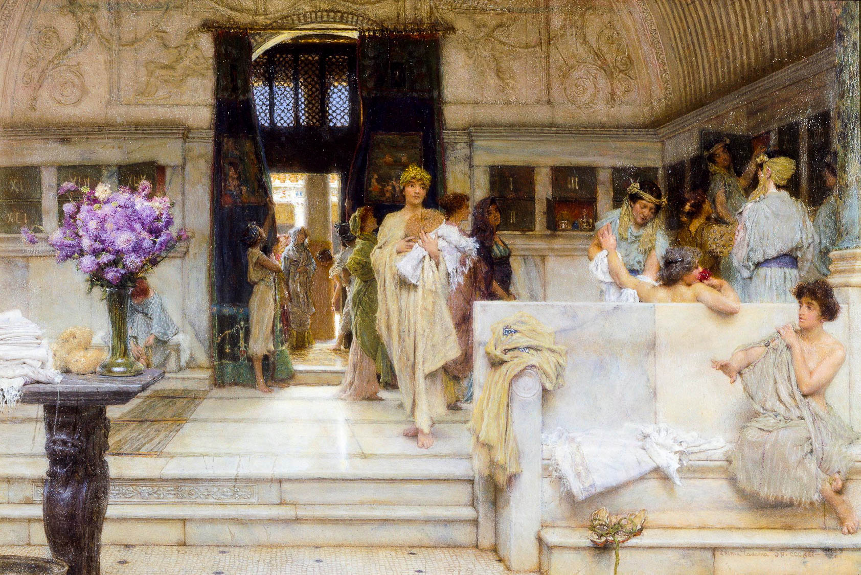
Therefore, put aside all malice
A Favourite Custom, by Lawrence Alma-Tadema, 1909
2:1
Notes:
To “put aside” (Gk. apotithēmi, ἀποτίθημι) means to take off or strip off clothing (cf. Acts 7:58). Peter uses the term here figuratively to speak of no longer practicing those things that are associated with sin. The Greeks and Romans were fond of bathing, and nearly every city of any size had a public bath. Bathing was an activity that usually began with the removal of clothing, as illustrated in this painting. This oil on canvas painting was photographed at Tate Britain in London. This image comes from Wikimedia Commons and is in the public domain. Source: https://commons.wikimedia.org/wiki/File:Alma-Tadema_A_Favourite_Custom_1909_Tate_Britain.jpg.
wiki0111201909521920

Slide 4
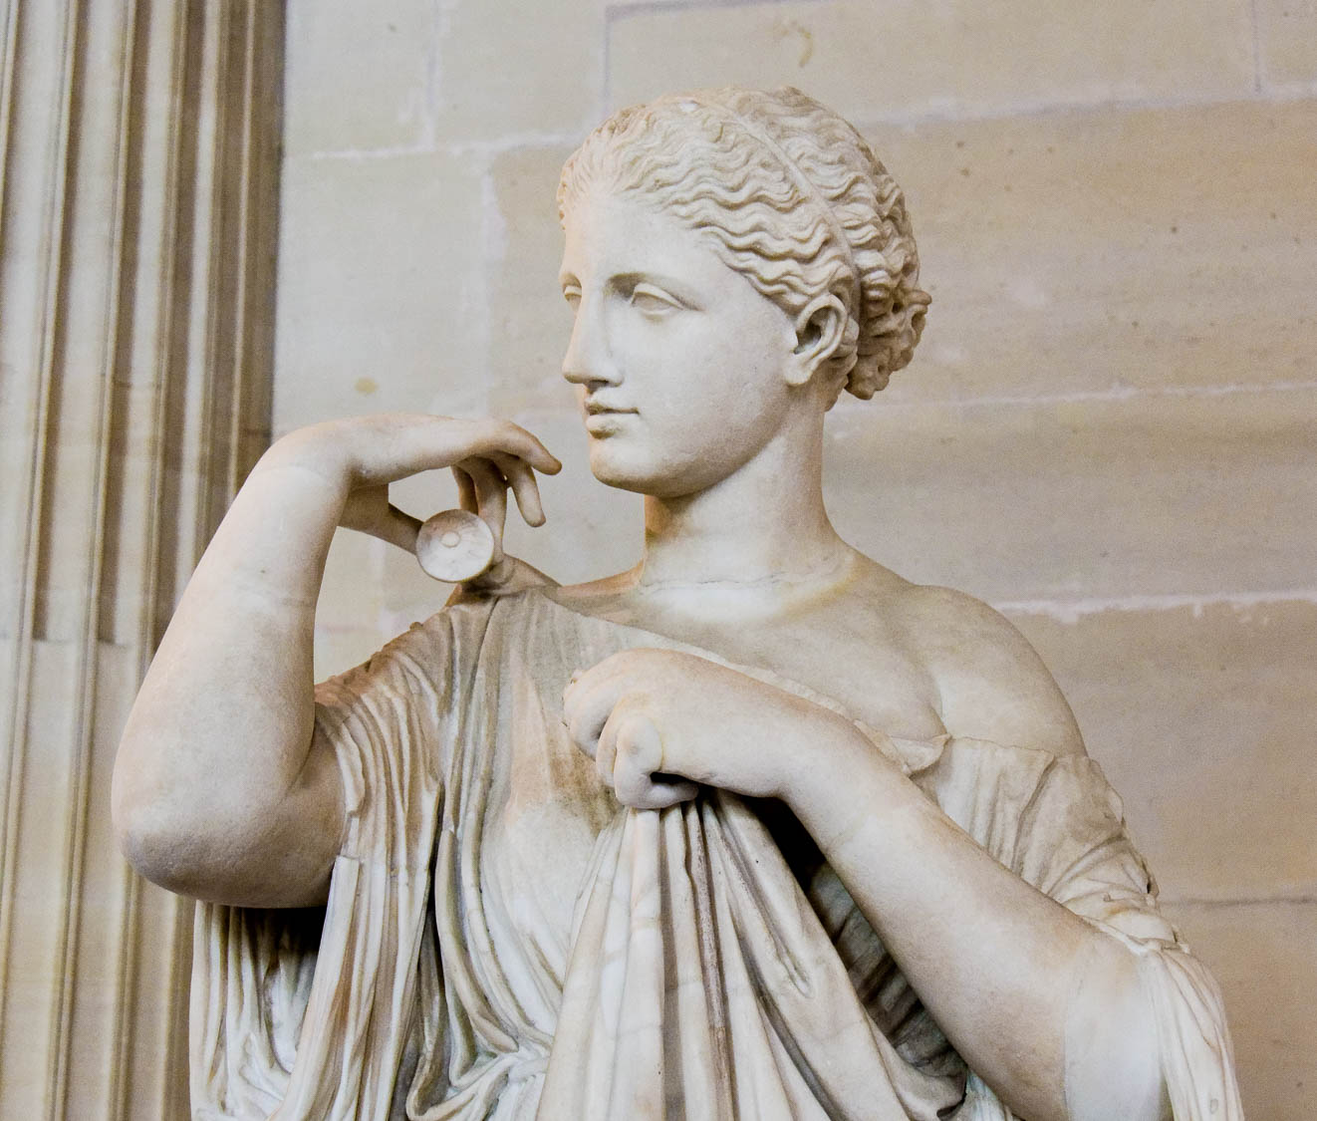
Therefore, put aside all malice
So-called “Diana of Gabii” dressing herself, from Gabii, Italy, 1st century AD
2:1
Notes:
The metaphor is illustrated here by a statue of a woman pulling clothing over herself, preparing to attach the final clasp. This statue dates to the 1st century AD but is thought to be a copy of an original of the 3rd century BC. It was photographed at the Louvre Museum.
tb0928196627

Slide 5
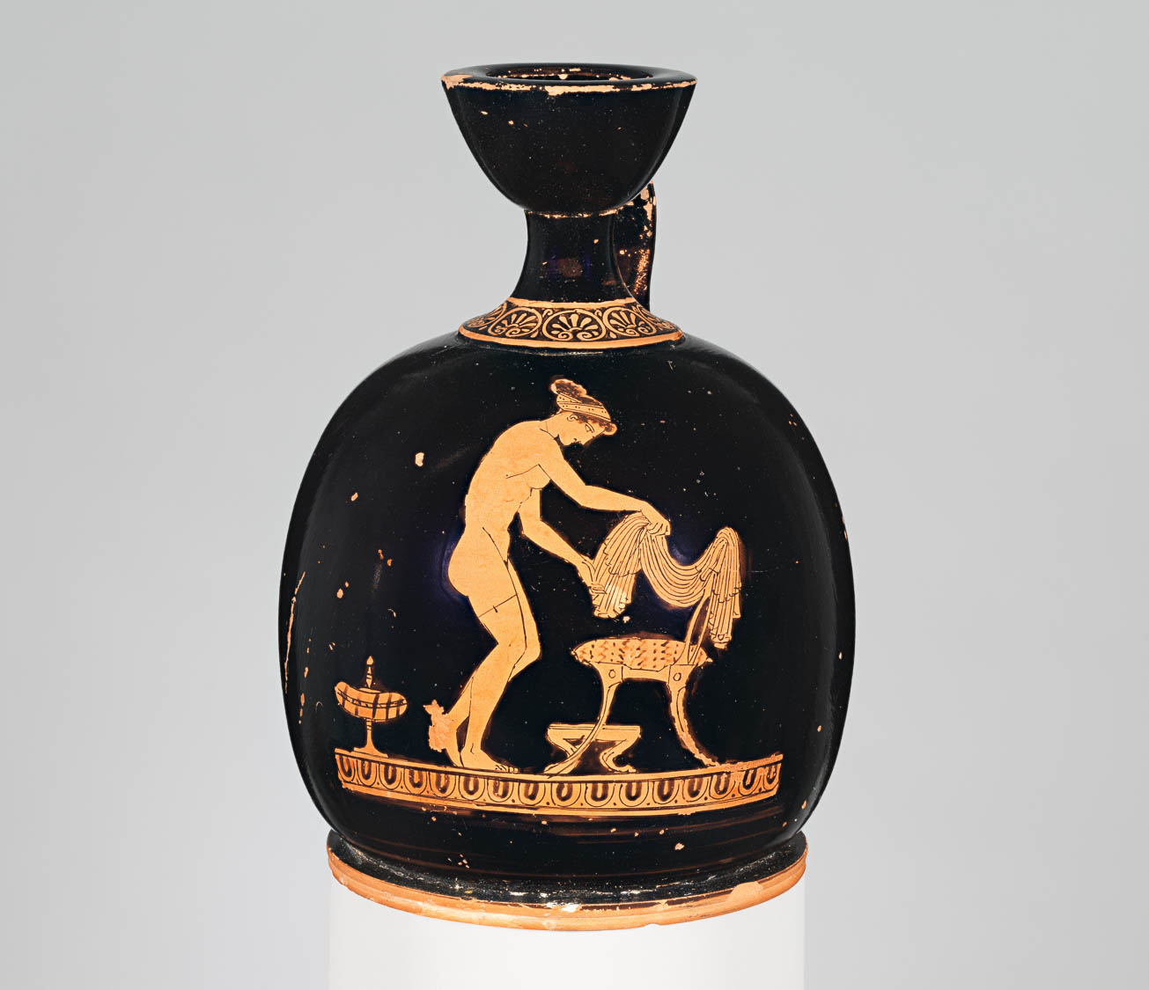
Therefore, put aside all malice
Terracotta squat lekythos (oil flask) with a woman dressing after washing, circa 430 BC
2:1
Notes:
The woman depicted on this lekythos is either putting off clothing as she is preparing to bath, or she has just finished bathing and is clothing herself again. The garment in her hands is a chiton, the typical Greek tunic. Behind her stands a large plemochoe, a vase for scented oil. This image comes from The Metropolitan Museum of Art and is in the public domain. Source: https://www.metmuseum.org/art/collection/search/253052
met253052h

Slide 6
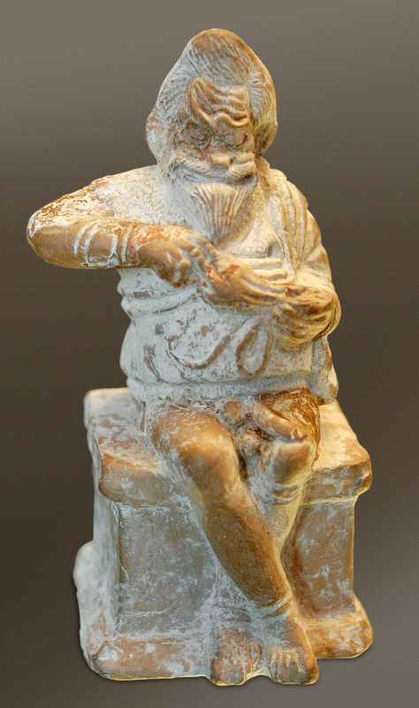
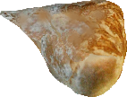
Therefore, put aside all malice
Actor playing a slave and thief, made in Boeotia, 4th century BC
2:1
Notes:
The word “malice” (Gk. kakia, κακία) is a common word that refers to nearly any kind of vice, evil, or depravity. It is illustrated here by a figurine that portrays an actor dressed as a slave, sitting on an altar, and emptying a purse he just stole. A removable graphic has been added to this photo to avoid causing surprise or offense. This image come from Jastrow and is in the public domain, via Wikimedia Commons: https://commons.wikimedia.org/wiki/File:Actor_slave_Louvre_CA265.jpg.
wiki1215200500291760

Slide 7
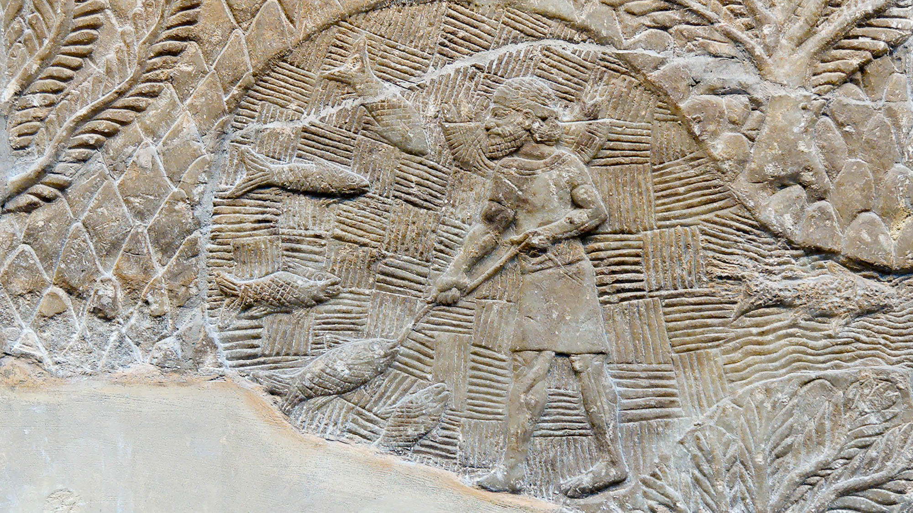
Therefore, put aside all malice, and all guile
Assyrian fisherman depicted on a relief at Nineveh, circa 700 BC
2:1
Notes:
The word “guile” (Gk. dolos, δόλος) was originally used to refer to bait for fish; it refers to cunning, deceit, or treachery. This relief comes from the palace of the Assyrian king Sennacherib at Nineveh. It was photographed at the British Museum.
tb112004896h

Slide 8
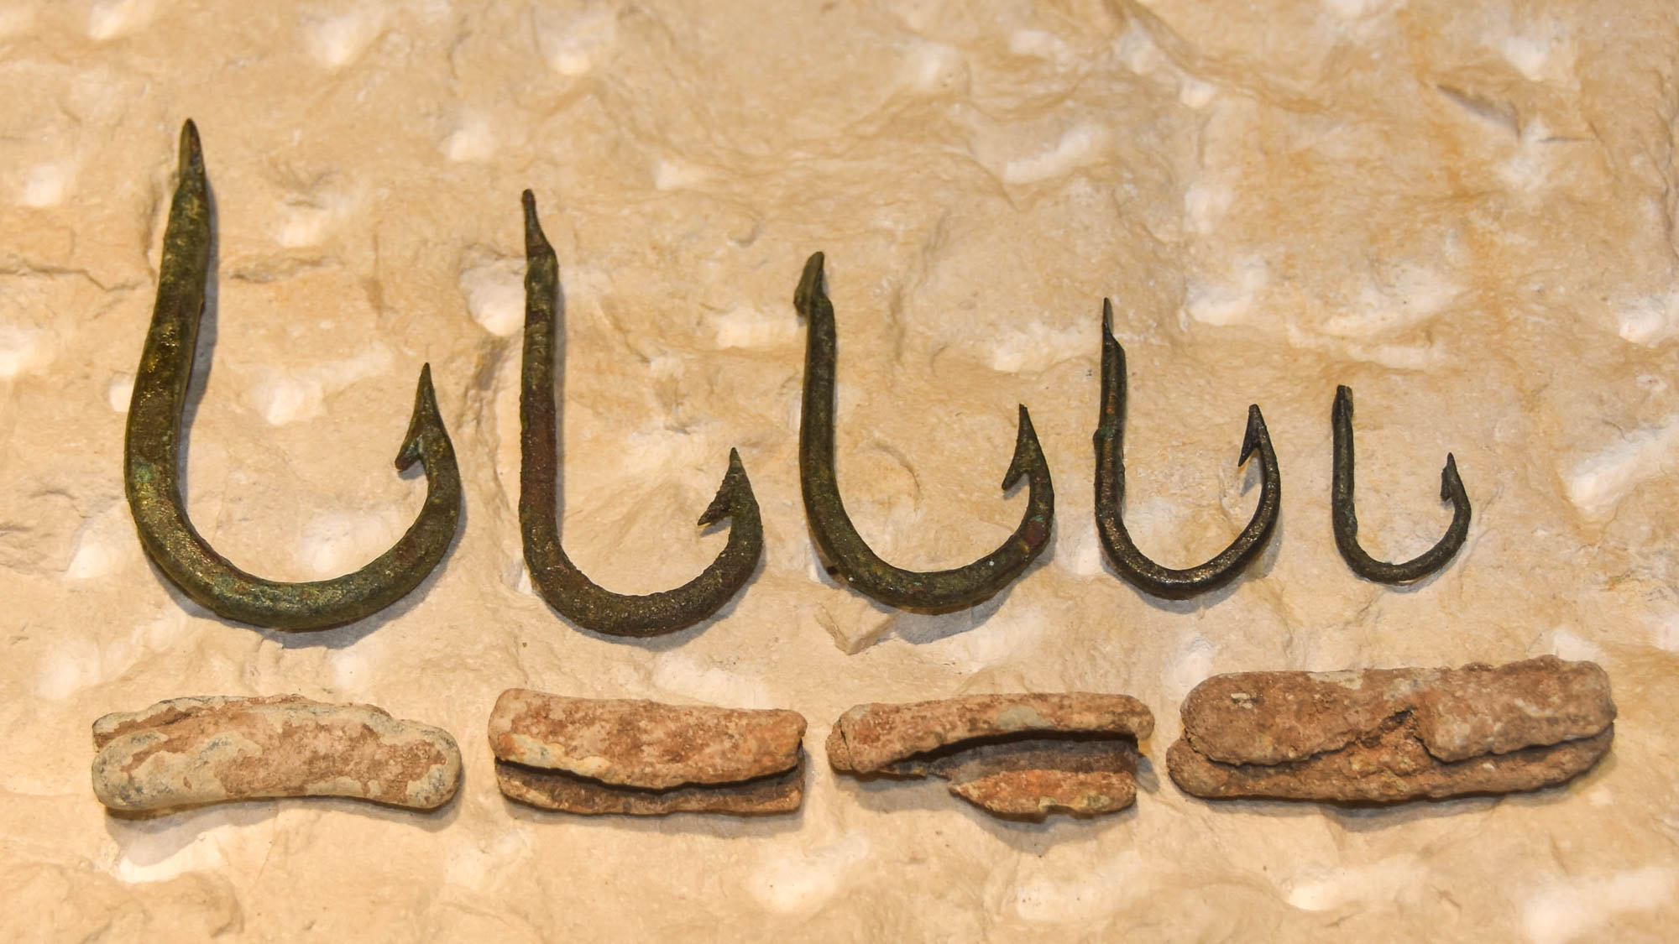
Therefore, put aside all malice, and all guile
Bronze fishhooks and net weights, from Peter’s House in Capernaum, 1st century AD
2:1
Notes:
These fishing hooks, along with a set of lead weights, illustrate the guile or trickery associated with fishing in the 1st century. This display was photographed at the Terra Sancta Museum in Jerusalem.
mjb1903032005h

Slide 9
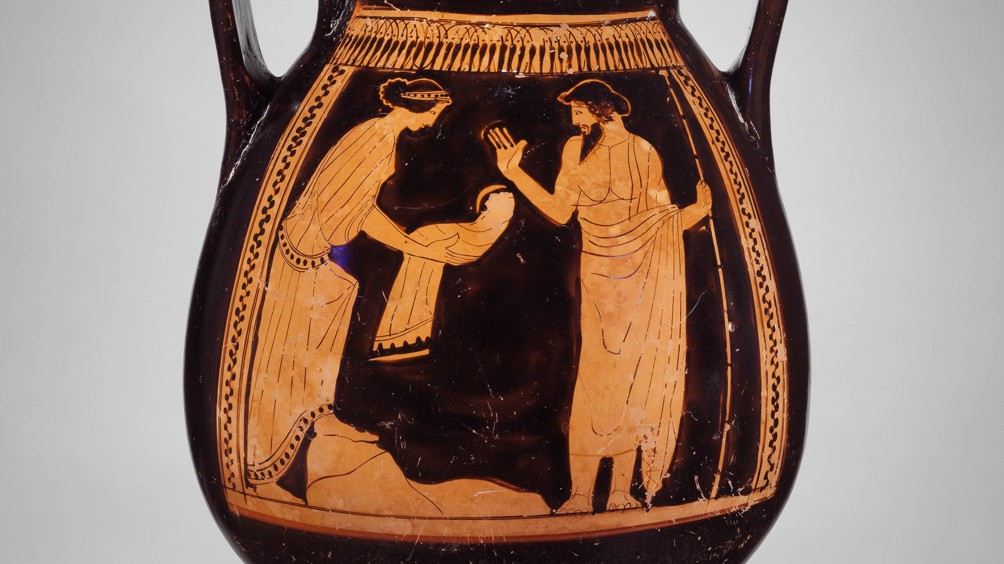
Therefore, put aside all malice, and all guile
Terracotta pelike with Rhea deceiving Cronus, circa 450 BC
2:1
Notes:
Greek mythology was full of deception. The scene on this pelike is from a story of the Greek goddess Rhea and her husband Cronus. According to the myth, Cronus was told that he would be deposed by one of his children; his reaction was to swallow each child that was born to them. His wife hid one (Zeus), and instead gave her husband a stone wrapped in swaddling clothes (the scene shown here), which Cronus promptly swallowed. This image comes from The Metropolitan Museum of Art and is in the public domain. Source: https://www.metmuseum.org/art/collection/search/247308
met247308h

Slide 10
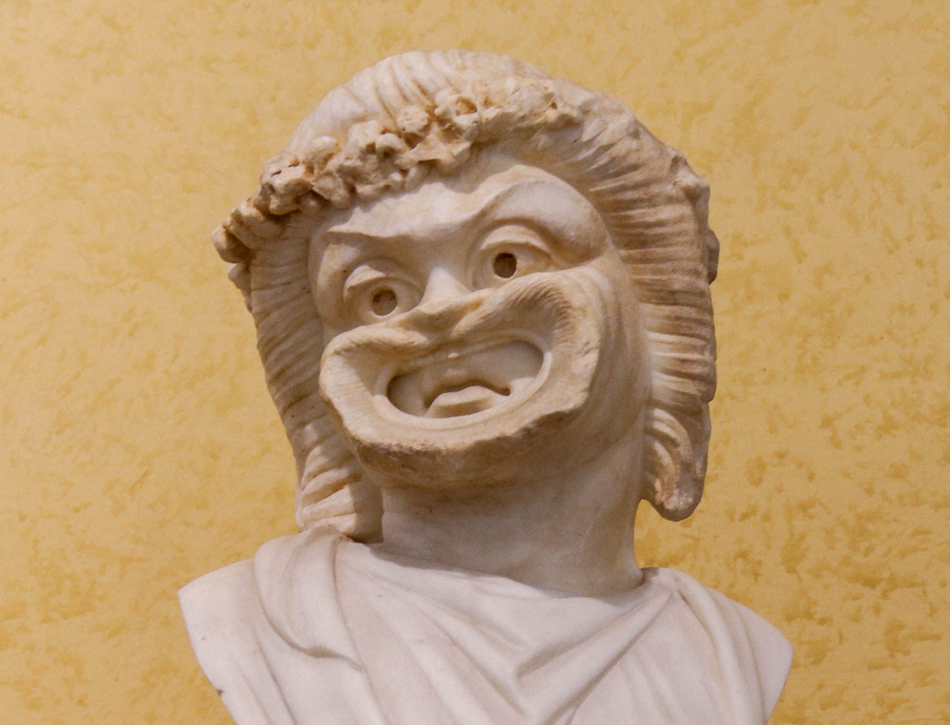
Therefore, put aside all malice, and all guile, and hypocrisy
Head of a comic actor, late 1st century AD
2:1
Notes:
The word “hypocrisy” (Gk. hupokrisis, ὑπόκρισις) was also used of an actor who pretended to be someone else on a stage. This beautifully rendered bust portrays an actor wearing a comic mask. The mask gives the impression from a distance that the actor is continually smiling, even though closer inspection reveals that the actor himself is not. This statue was photographed at the Vatican Museums.
tb0512176536

Slide 11
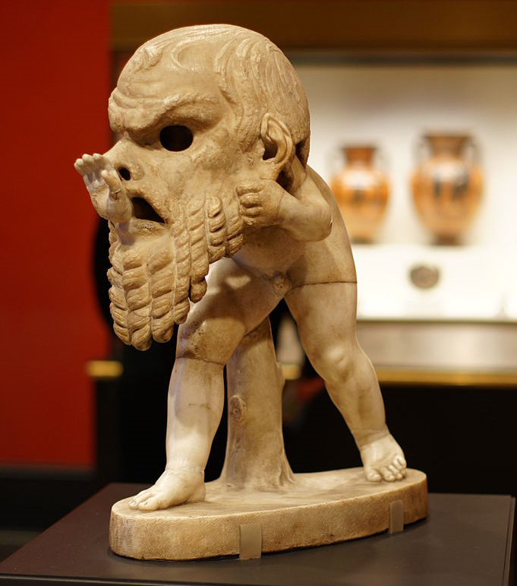
Therefore, put aside all malice, and all guile, and hypocrisy
Young satyr wearing a theater mask, from Italy, circa AD 150
2:1
Notes:
This humorous statue depicts a young satyr who has donned a theater mask that is much too large, pushing his hand through the mouth of the mask. It illustrates hypocrisy in a comical way. This photo was taken at the Getty Villa in southern California. This image comes from alijava and is licensed under CC BY-SA 2.0, via Wikimedia Commons: https://commons.wikimedia.org/wiki/File:Getty_villa_1033_(6571514287).jpg.
wiki6571514287

Slide 12
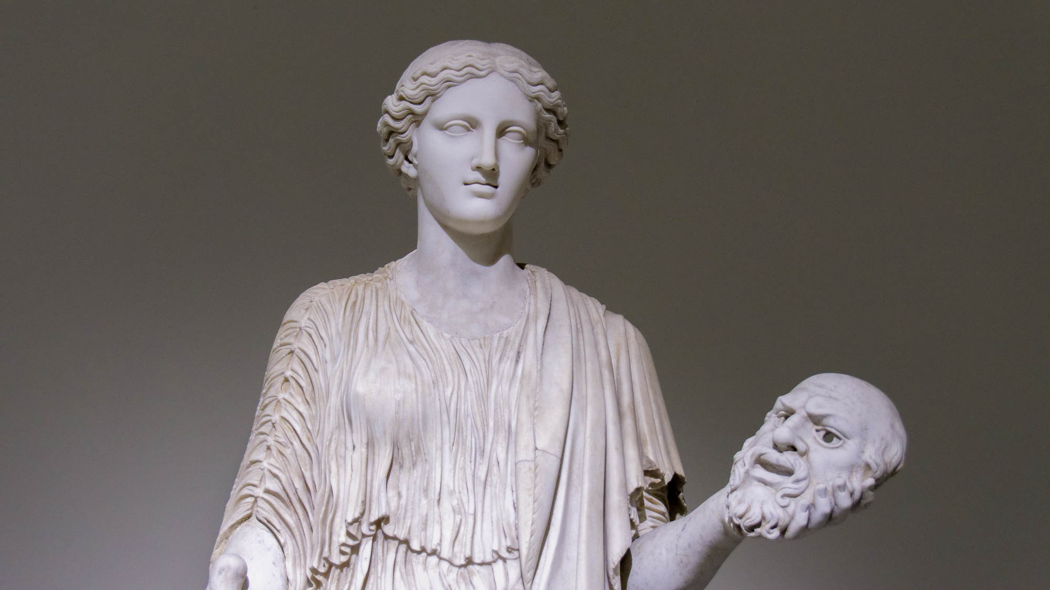
Therefore, put aside all malice, and all guile, and hypocrisy
Female holding a theater mask, late 2nd century AD
2:1
Notes:
This statue illustrates the idea of “putting aside” hypocrisy, in that she has removed her mask to reveal her true face. This statue is considered to be a copy of an original from the 5th century BC. It was photographed at the Naples Archaeological Museum.
tb0515171184

Slide 13
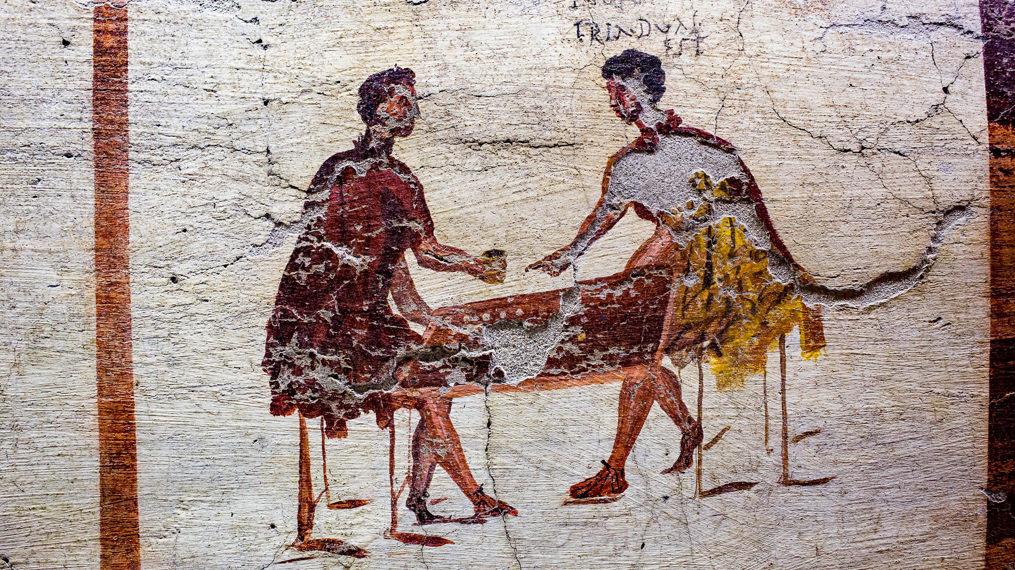
Therefore, put aside all malice, and all guile, and hypocrisy, and envy
Fresco of two dice players arguing over a game, from Pompeii, 1st century AD
2:1
Notes:
The word “envy” (Gk. phthonos, φθόνος) indicates jealousy for what someone else possesses. This fresco comes from the north wall of the pub (taberna) of Salvius at Pompeii. The scene illustrates an argument over a game of chance, something which could easily lead to envy, or perhaps started from envy. This fresco was photographed at the Naples Archaeological Museum. This image comes from ArchaiOptix and is licensed under CC BY-SA 4.0, via Wikimedia Commons: https://commons.wikimedia.org/wiki/File:Wall_painting_-_scenes_around_the_pub_-_Pompeii_(VI_14_35-36)_-_Napoli_MAN_111482_-_04.jpg.
wiki1006201809452840h

Slide 14
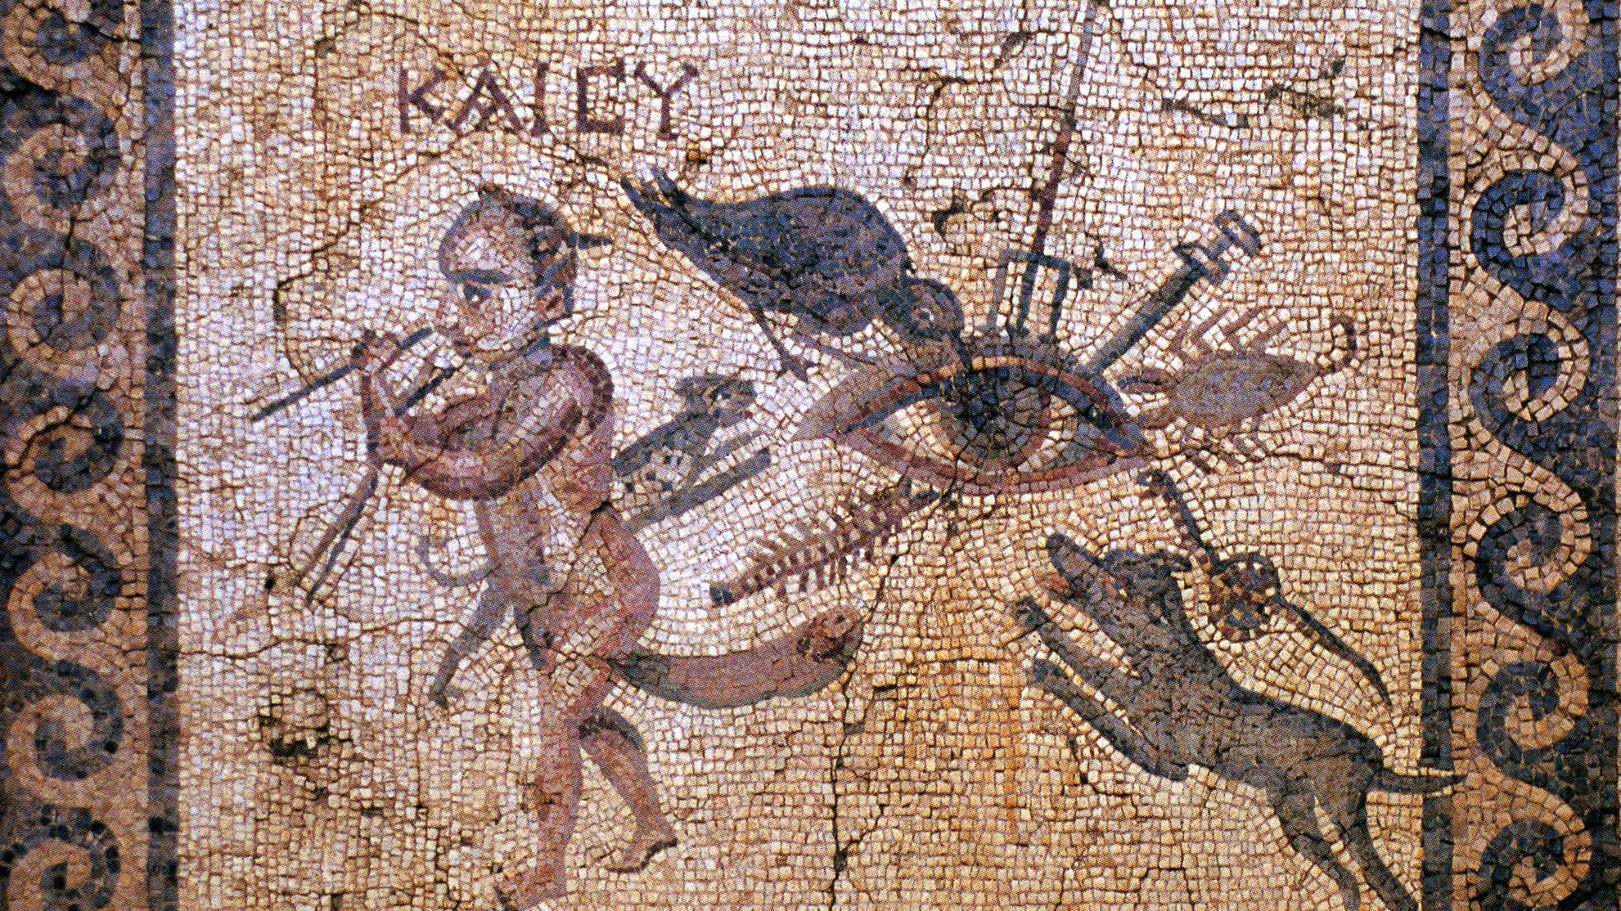
Therefore, put aside all malice, and all guile, and hypocrisy, and envy
Mosaic depicting the evil eye, from Antioch on the Orontes, 2nd century AD
2:1
Notes:
In ancient Greco-Roman literature, envy is often associated with the evil eye. This mosaic shows the evil eye being attacked in several different ways: the eye is pierced by a trident and sword, pecked by a raven, barked at by a dog and attacked by a centipede, scorpion, cat, and a snake. A horned dwarf crosses two sticks to ward off its power. Spitting was also a method used to ward off the evil eye. The Greek annotation in this mosaic reads “and you" (και συ). This Roman mosaic was discovered at the House of the Evil Eye in Antiochia. It was photographed at the Antakya Museum in Turkey. This image comes from WolfgangRieger and is in the public domain, via Wikimedia Commons: https://commons.wikimedia.org/wiki/File:Antiochia_-_House_of_the_Evil_Eye.jpg.
wiki072120102009

Slide 15
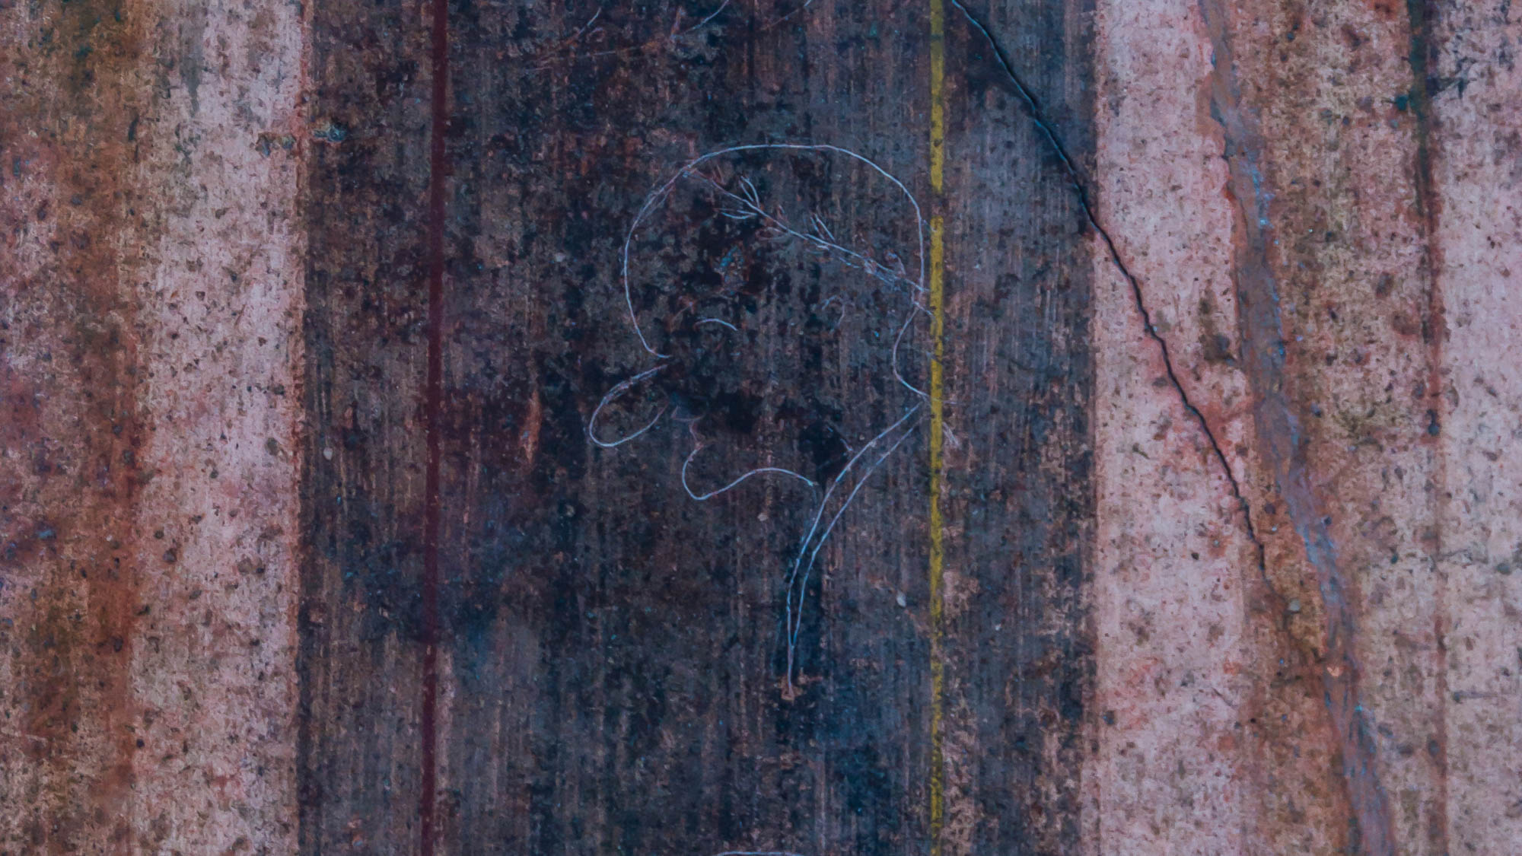
Therefore, put aside all malice, and all guile, and hypocrisy, and envy, and slander
Caricature from the Villa of Mysteries at Pompeii, 1st century AD
2:1
Notes:
The word “slander” (Gk. katalalia, καταλαλιά) refers to speaking ill of someone else. This caricature is one of the oldest known. Scratched onto the wall of the Villa of Mysteries at Pompeii, it is accompanied by an inscription reading “This is Rufus” (Lat. Rufus est). This would have likely qualified in Peter’s view as slander. This image comes from Jebulon and is in the public domain, via Wikimedia Commons: https://commons.wikimedia.org/wiki/File:Rufus_est_caricature_villa_misteri_Pompeii.jpg.
wiki072420151617493886h

Slide 16
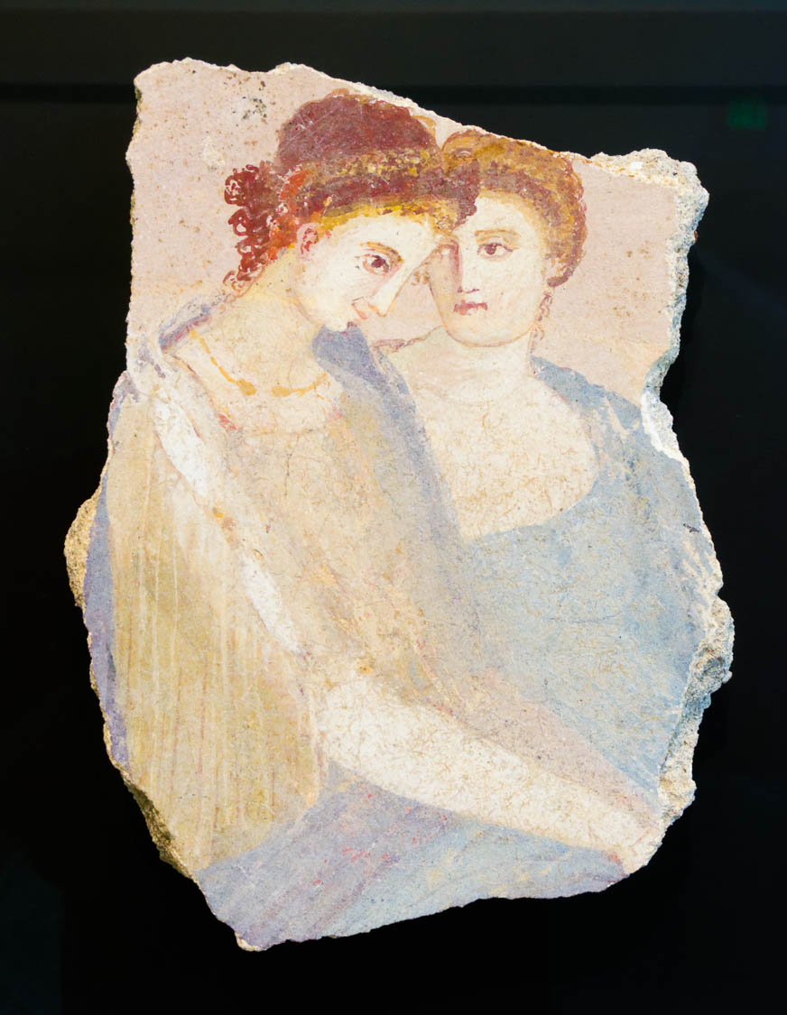
Therefore, put aside all malice, and all guile, and hypocrisy, and envy, and slander
Fresco of two women in close conversation, 1st century AD
2:1
Notes:
The word “slander” (Gk. katalalia, καταλαλιά) is conceptually similar to “gossip” (Gk. psithurismos, ψιθυρισμός) in that both involve malicious talk, one publicly and the other more furtively. This fresco depicts two women who appear to be in intimate conversation, reminiscent of gossip and the passing of secrets that are not edifying. This artifact was photographed at the Getty Villa in southern California.
tb082214838h

Slide 17
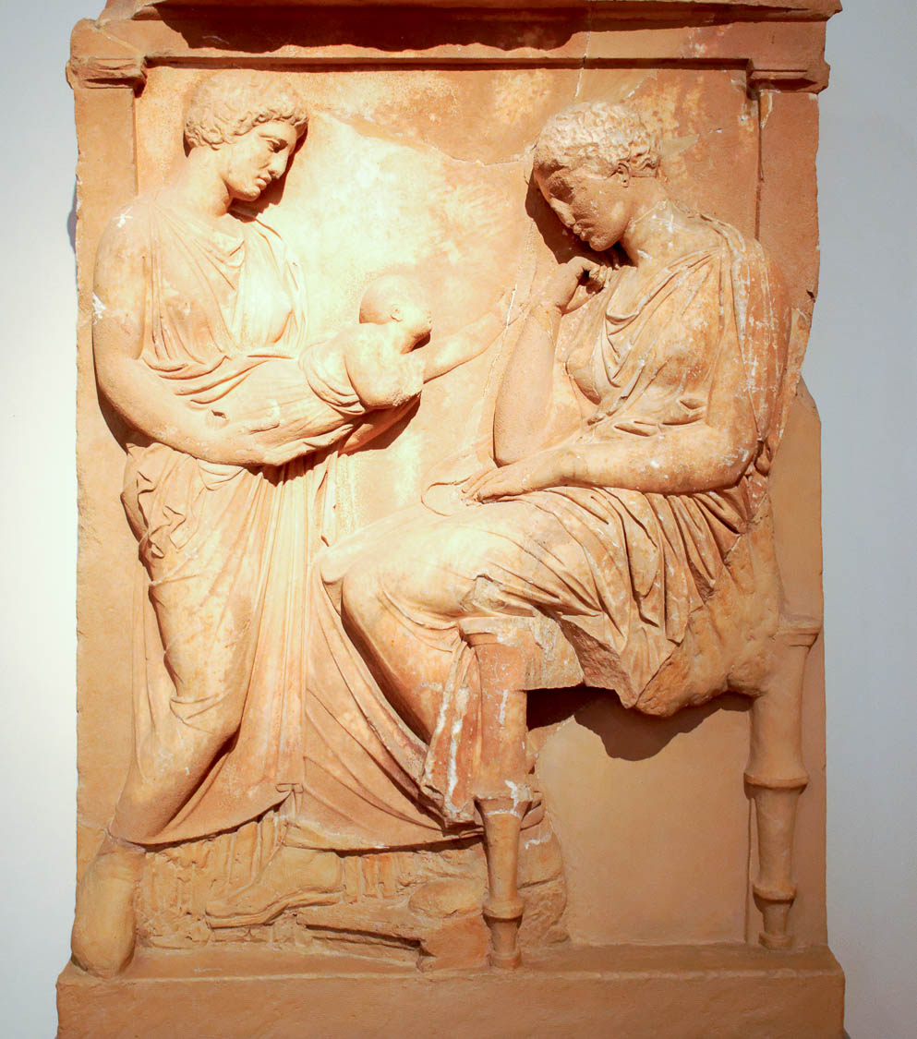
Like newborn babies, long for pure spiritual milk
Grave stele with young mother and baby, from Athens area, circa 400 BC
2:2
Notes:
This picture shows a grave stele from Athens on which is depicted a young mother looking at a baby. The stele was photographed at the National Archaeological Museum in Athens.
mjb011117048

Slide 18
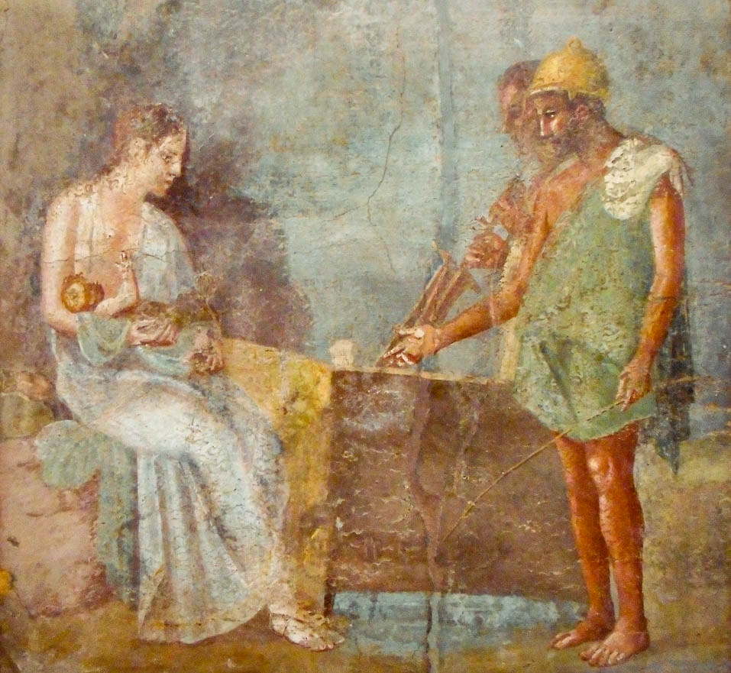
Like newborn babies, long for pure spiritual milk
Fresco of a woman and her infant, from Pompeii, 1st century AD
2:2
Notes:
This fresco is thought to depict the princess Danae with her infant son Perseus, shortly after being rescued from the sea by some fisherman. This image comes from Wikimedia Commons and is in the public domain. Source: https://commons.wikimedia.org/wiki/File:Danae_with_infant_Perseus_and_Fishermen.jpg
wiki0614201918049571023h

Slide 19
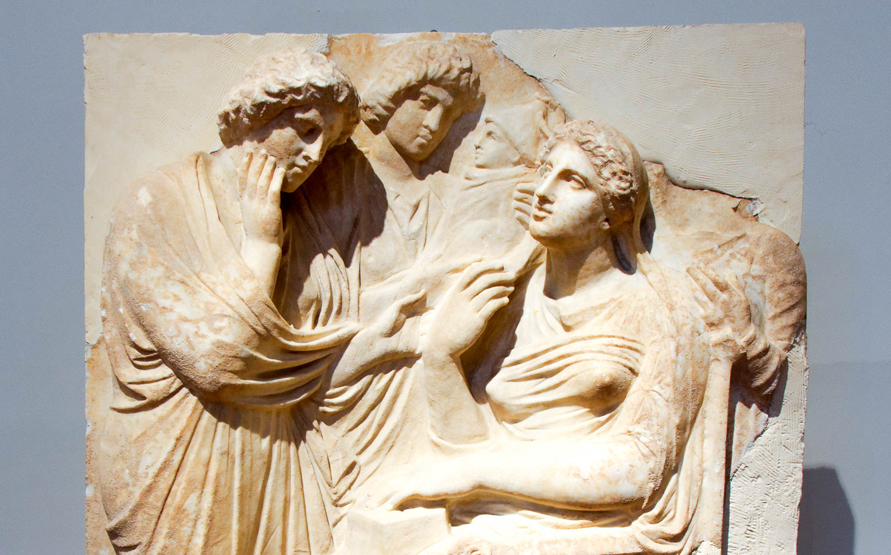
Like newborn babies, long for pure spiritual milk
Marble grave relief showing woman with newborn baby, circa 350 BC
2:2
Notes:
This grave stele depicts two young women bringing an infant to its mother. The stele was photographed at the National Archaeological Museum in Athens.
tb011117596h

Slide 20
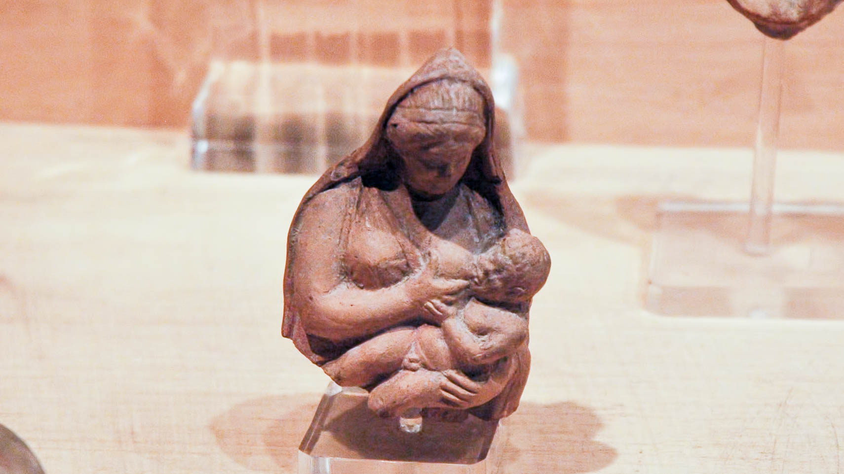
Like newborn babies, long for pure spiritual milk
Figure of a woman nursing a child, from Gezer, Hellenistic or Roman period
2:2
Notes:
The word translated here as “spiritual” (Gk. logikos, λογικός) occurs only one other time in the New Testament (Rom 12:1). In this context, it may be intended to contrast with “literal” milk, should probably be understood as metaphorical (and thus spiritual) milk. This figurine was photographed at the Istanbul Archaeological Museum.
tb041705848h

Slide 21
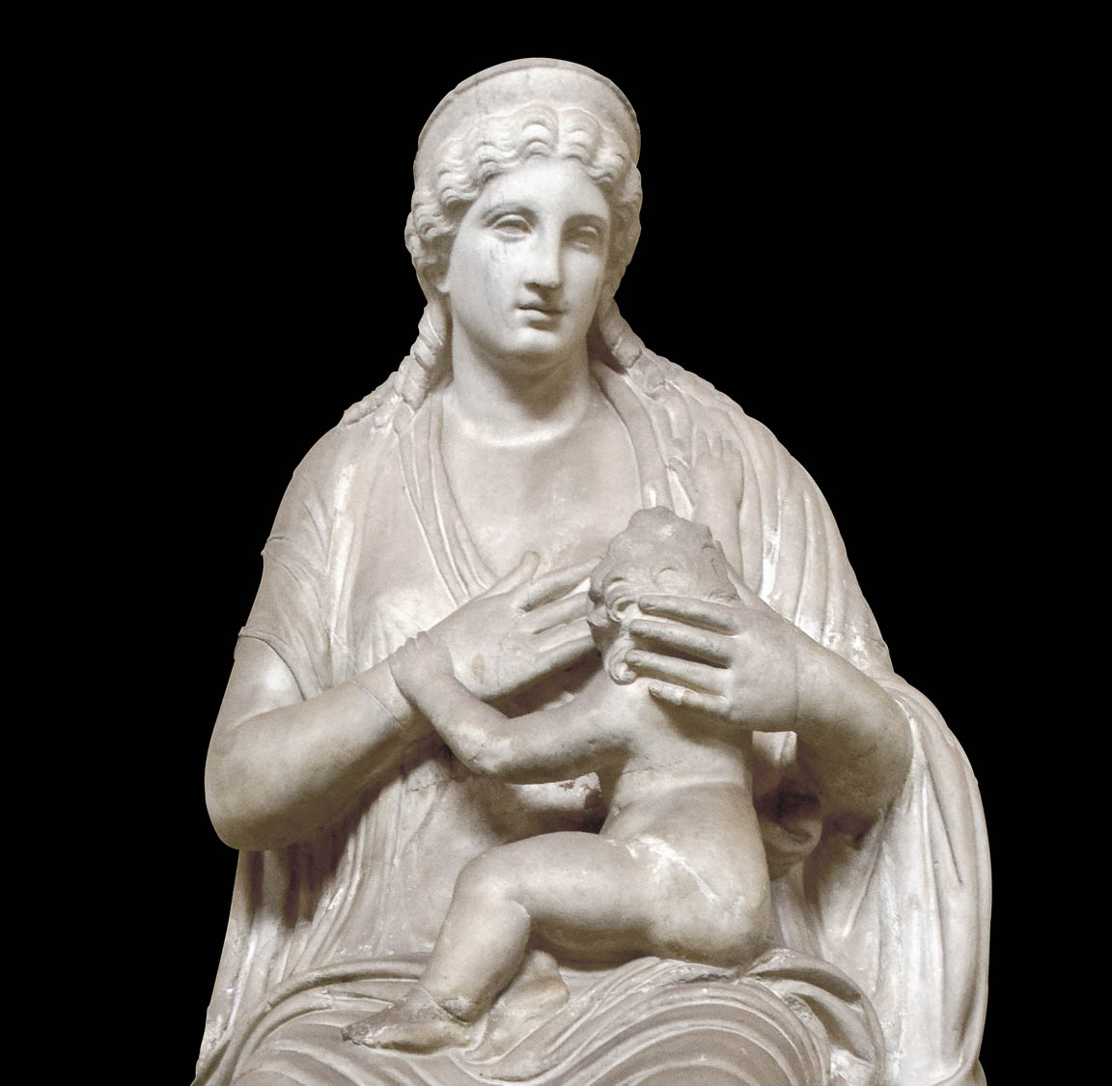
Like newborn babies, long for pure spiritual milk
Statue of a woman breastfeeding her baby, from Quirinal, early 1st century AD
2:2
Notes:
In this context, “milk” (Gk. gala, γάλα) should be understood figuratively to refer to the Word of God, without the negative nuance of elementary Christian instruction that applies in the context of Hebrews 5:12-14. This statue was probably originally intended to portray a goddess, although which one is uncertain. It was photographed at the Vatican Museums.
tb0512176800h

Slide 22
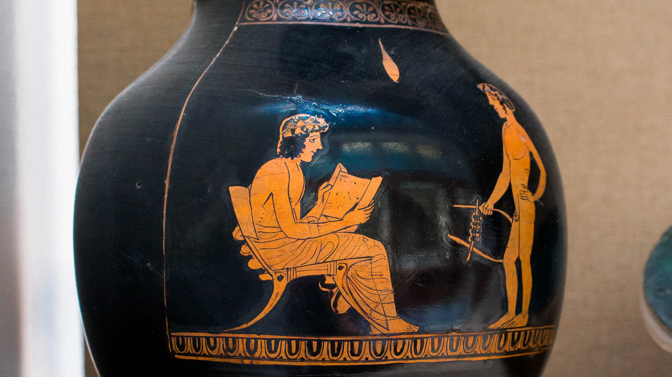
That by it you may grow in respect to salvation
Red-figure oinochoe depicting a seated youth reading from a scroll, circa 400 BC
2:2
Notes:
To mix two metaphors used by Peter, this vase painting depicts a young man (who has grown and is no longer an infant) reading from a scroll (representative of instruction in Christian principles). This vase was photographed at the British Museum. This image comes from ArchaiOptix and is licensed under CC BY-SA 4.0, via Wikimedia Commons: https://commons.wikimedia.org/wiki/File:Shuvalov_Painter_ARV_1208_38_youth_reading_and_boy_with_lyra.jpg.
wiki070720181541493247h

Slide 23
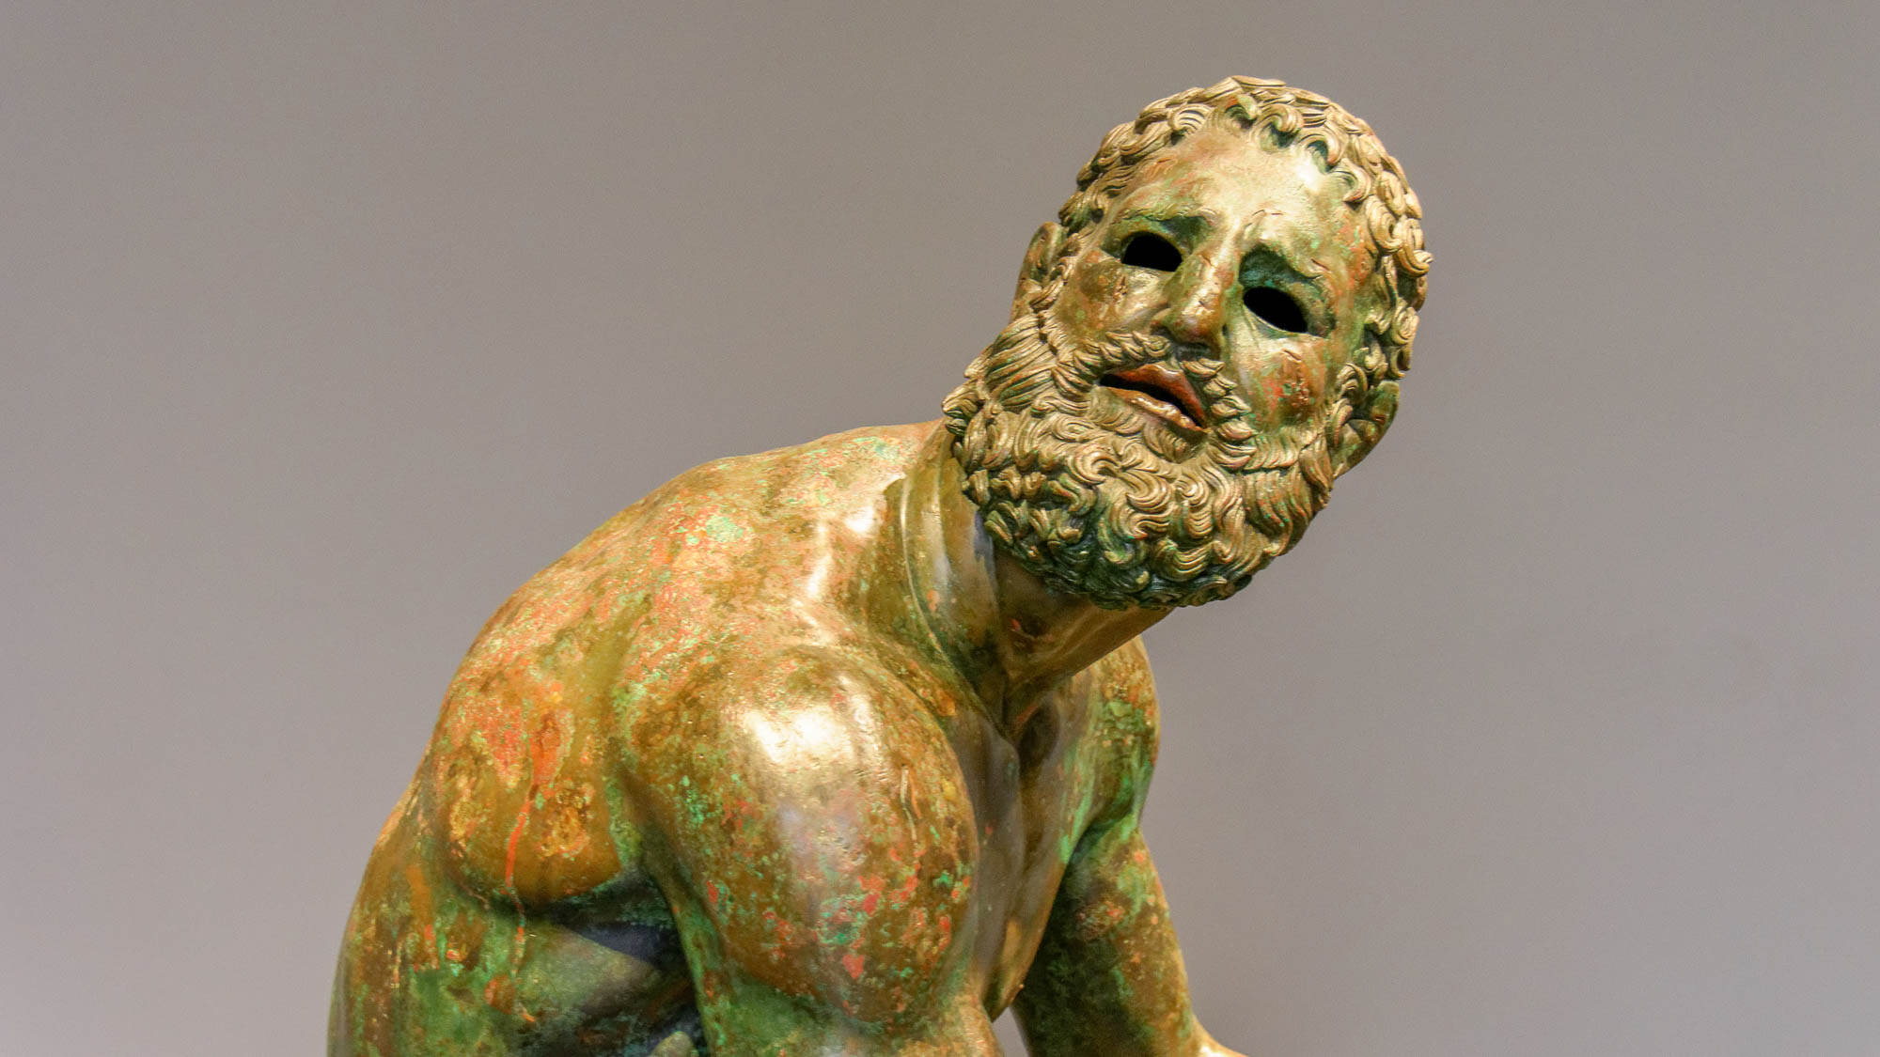
That by it you may grow in respect to salvation
Bronze boxer, from the Via IV Novembre in Rome, circa 100 BC
2:2
Notes:
The verb “grow” (Gk. auxanō, αὐξάνω) is illustrated here by a bronze statue of a well-muscled boxer. This statue is thought to be influenced by the work of the 4th century BC Greek sculptor Lysippos. It was photographed at the National Museum of Rome.
tb0513177306h

Slide 24
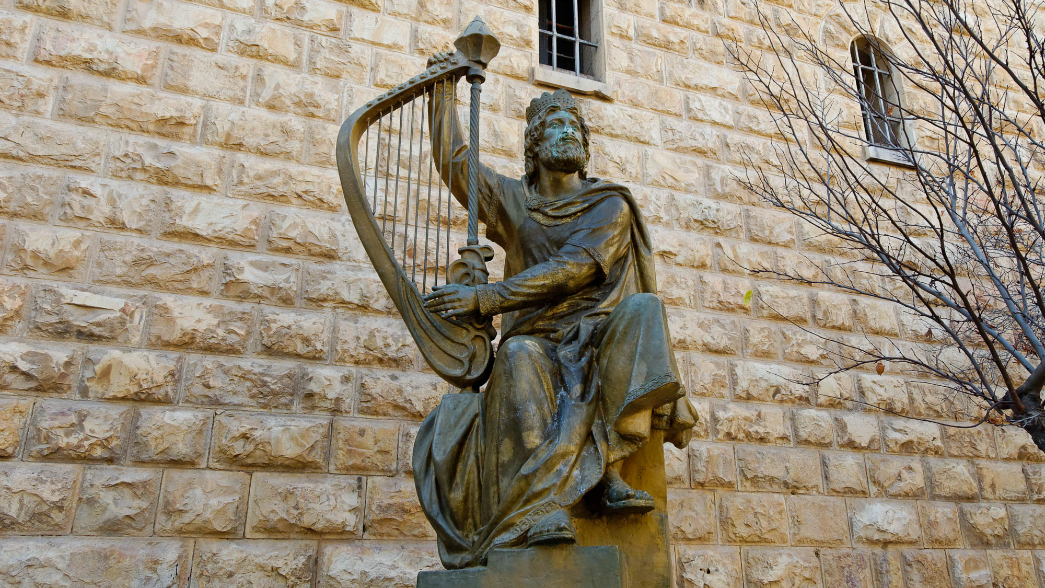
If you have tasted that the Lord is gracious
King David statue on Mount Zion
2:3
Notes:
Peter alludes to Psalm 34:8: “Oh taste and see that Yahweh is good; blessed is the man who takes refuge in him.” Psalm 34:8 in the Septuagint uses the same word, "gracious“ (Gk. chrēstos, χρηστός) rather than the “good” of the Hebrew text (Heb. tov, טוֹב = Gk. kalos, καλός). Psalm 34 is attributed to David by its superscript. This statue on Mount Zion portrays David as a king playing a harp.
tb010312629

Slide 25
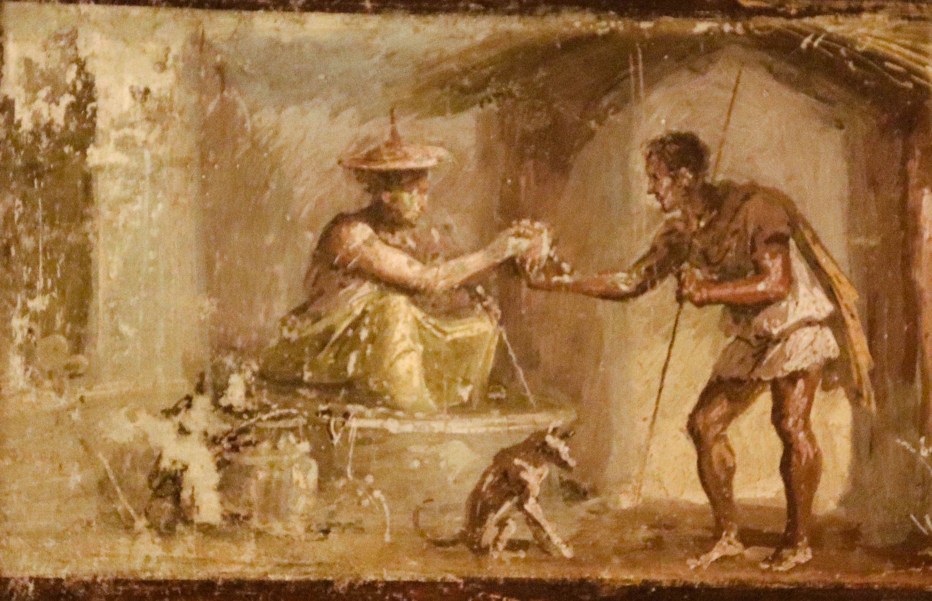
If you have tasted that the Lord is gracious
Fresco of a woman handing a beggar a drink, from Pompeii, 1st century AD
2:3
Notes:
The verb “taste” (Gk. geuomai, γεύομαι) means to partake of something by mouth (cf. John 2:9). Here it is used figuratively to indicate experiencing something (cf. John 8:52; Heb 2:9). The idea is illustrated here by a fresco of a woman handing a drink to a man. This fresco was photographed at the Naples Archaeological Museum. This image comes from Gary Todd and is in the public domain, via Wikimedia Commons: https://commons.wikimedia.org/wiki/File:Roman_fresco_Woman_handing_a_beggar_a_drink,_from_House_of_the_Dioscuri,_Pompeii_(48452588127).jpg.
wiki48452588127080220190321

Slide 26
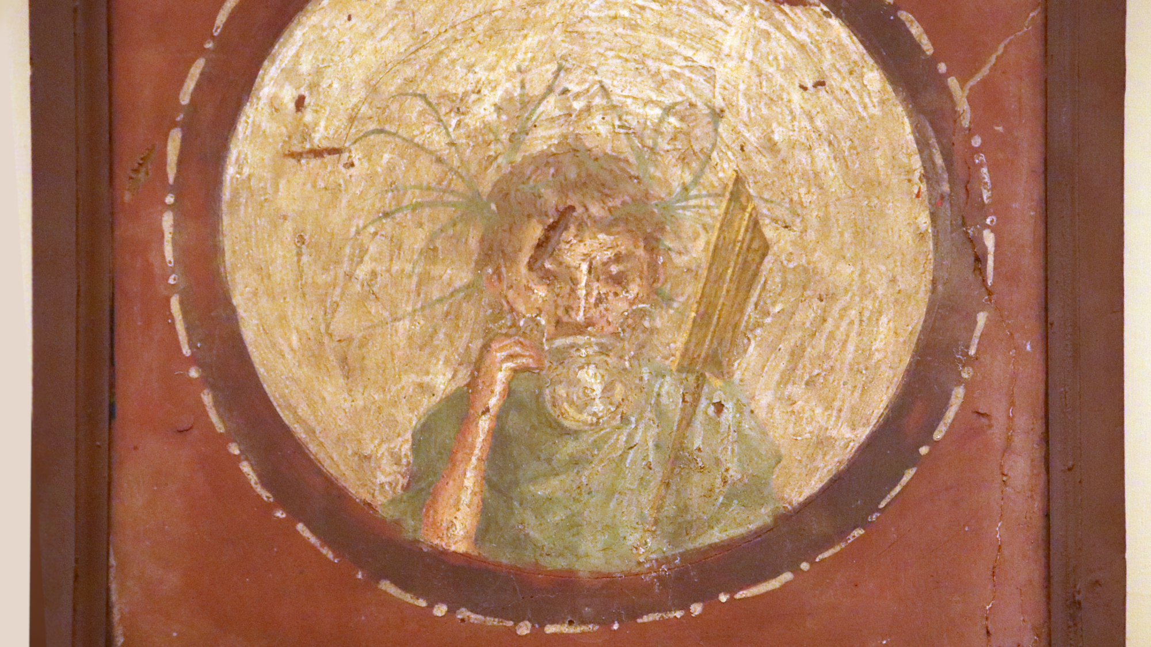
If you have tasted that the Lord is gracious
Fresco of a young man drinking from a cup, from Pompeii, 1st century AD
2:3
Notes:
This fresco depicts a young man drinking from a two-handled glass or silver cup. He is clad in a green toga, wears a leafy crown, and holds a plaque or standard. This fresco was photographed at the Naples Archaeological Museum. This image comes from Gary Todd and is in the public domain, via Wikimedia Commons: https://commons.wikimedia.org/wiki/File:Roman_Fresco_from_Pompeii_(48452069701).jpg.
wiki484520697010802201903101083

Slide 27
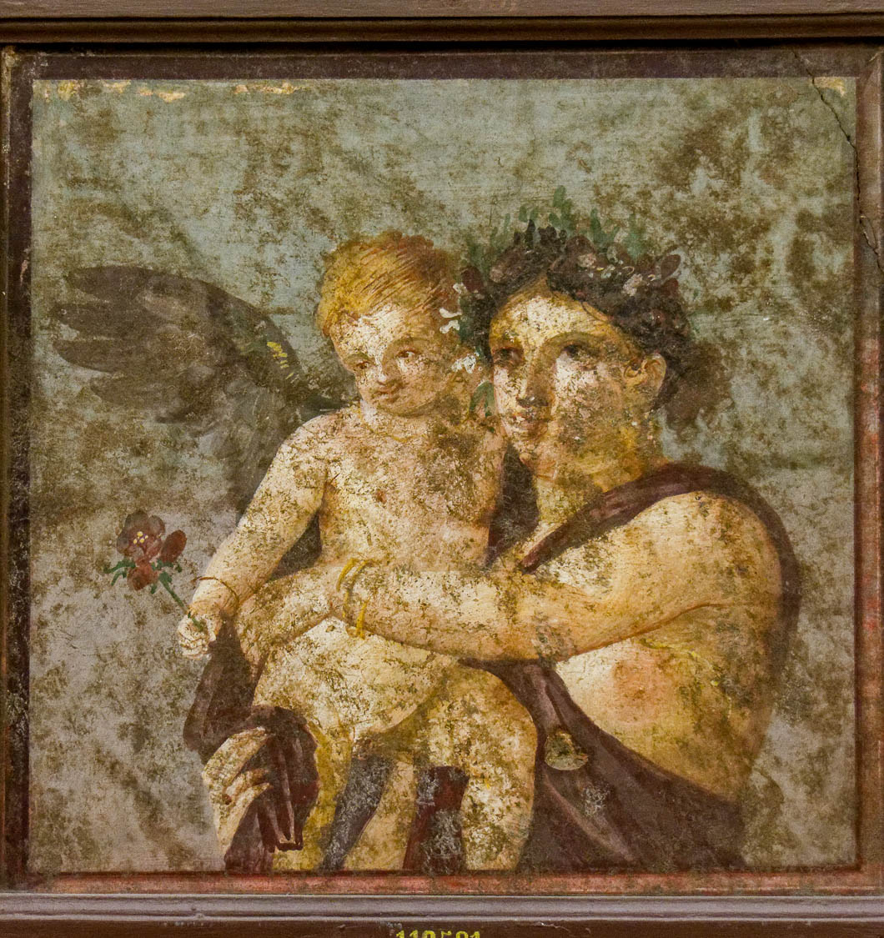
If you have tasted that the Lord is gracious
Fresco of a maenad holding a cupid, from Pompeii, 1st century AD
2:3
Notes:
The word “gracious” (Gk. chrēstos, χρηστός) refers to being morally good, kind, and benevolent. It is illustrated here by a fresco of a maenad holding a cupid in a gentle and loving embrace. This fresco comes from the House of Lucius Cecilius Jucundus at Pompeii, and was photographed at the Naples Archaeological Museum.
tb0515170200h

Slide 28
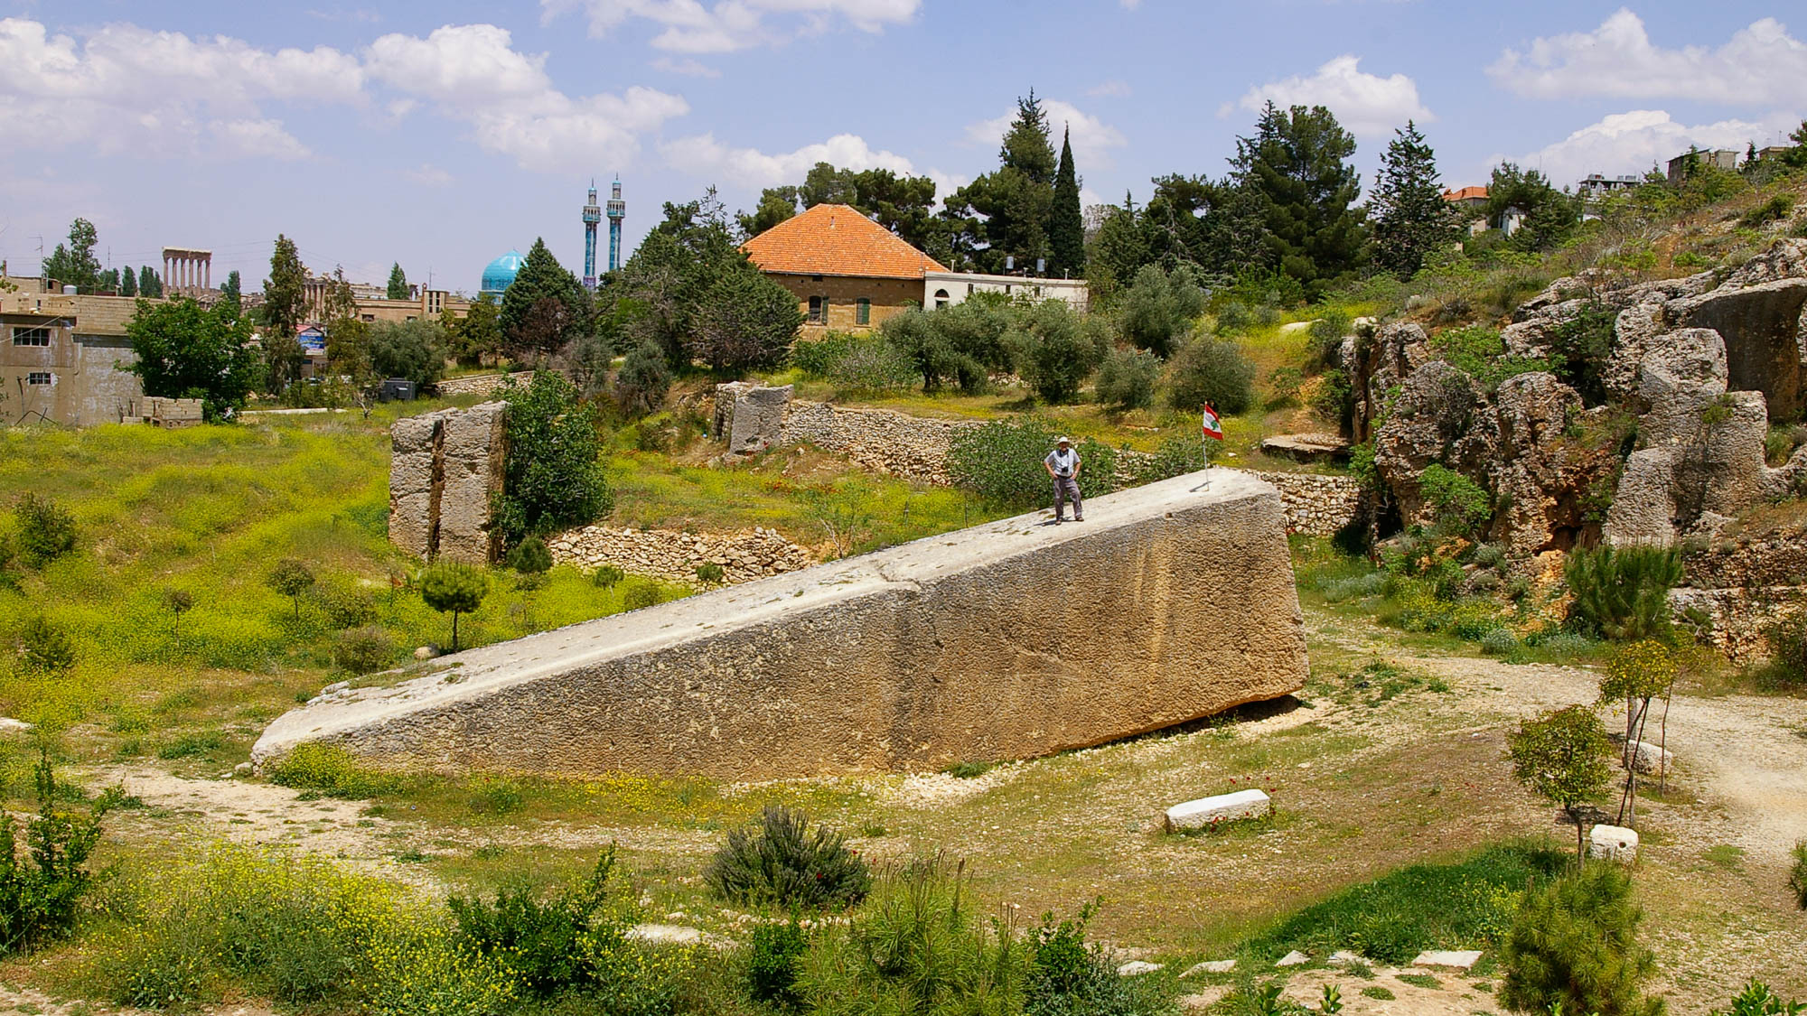
You come to Him as to a living stone that has been rejected by men
Stone of the Pregnant Woman in Baalbek (from the southwest)
2:4
Notes:
The term “living stone” (Gk. lithon zōnta, λίθον ζῶντα) in the modern era sometimes brings to mind either bedrock or rock that is still attached to bedrock. This is not the case with this phrase. The word “stone” (Gk. lithos, λίθος) refers to individual stones, either worked and shaped stones (Matt 24:2; Luke 21:5) or unshaped field stones (Mark 5:5; Luke 4:3). The word “living” (Gk. zaō, ζάω) should be understood in the same sense as Jesus’s statement that He was the living bread (John 6:51) or the living water (John 4:10). This understanding is supported by Peter’s subsequent statement, that followers of Jesus are also “living stones” who are being built into a spiritual house, followed by a more specific statement that Jesus is the “precious cornerstone” (2 Pet 2:6-7).
The massive stone in this photo is known locally as Hajjar el-Hibla, “Stone of the Pregnant Woman.” It is 65.5 feet (20 m) long, 13 feet (4 m) wide, and 13 feet (4 m) tall. It weighs over 1,000 tons and would have made an ideal, immovable cornerstone. It is not known why this stone was left in the quarry.
adr090511053h

Slide 29
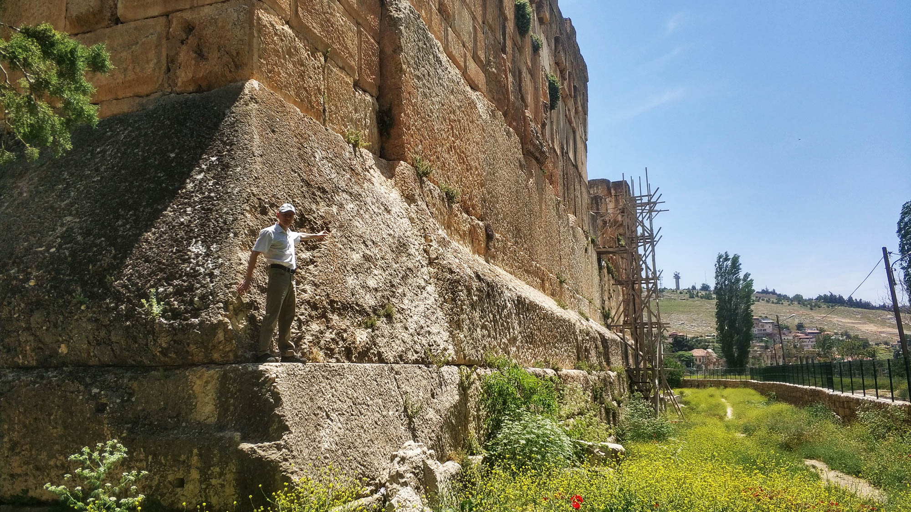
As to a living stone . . . rejected by men but choice and precious in the sight of God
Foundation stones in the Temple of Jupiter at Baalbek
2:4
Notes:
In this context, the word “choice” (Gk. eklektos, ἐκλεκτός) pertains to being the best in the course of a selection, indicating that the object is excellent or elite (cf. Rom 16:13). The word “precious” (Gk. entimos, ἔντιμος) indicates something that is considered to be of considerable worth or value. Because of the critical role played by foundation stones, and particularly the cornerstone, ancient builders were quite careful about the stones they chose for those positions. This is illustrated by the massive stones that make up the foundation of the Temple of Jupiter at Baalbek, shown here. Known as the trilithon, the set of three stones above the one where the man is standing in this photo are the largest. Each one of these stones is 70 feet (21 m) long, 14 feet (4 m) high, and 10 feet (3 m) thick. The supporting stone layer beneath features a number of stones which weigh an estimated 350 tons (318 t) and are 35 feet (11 m) long. Each of these stones would have been considered both “choice” and “precious.” This temple was begun by Julius Caesar and completed by Augustus. This image comes from Lodo27 and is licensed under CC BY-SA 3.0, via Wikimedia Commons: https://commons.wikimedia.org/wiki/File:Temple_of_Jupiter,_West_wall,_Trilithon,_Baalbek_20422.jpg.
wiki0515201920422h

Slide 30
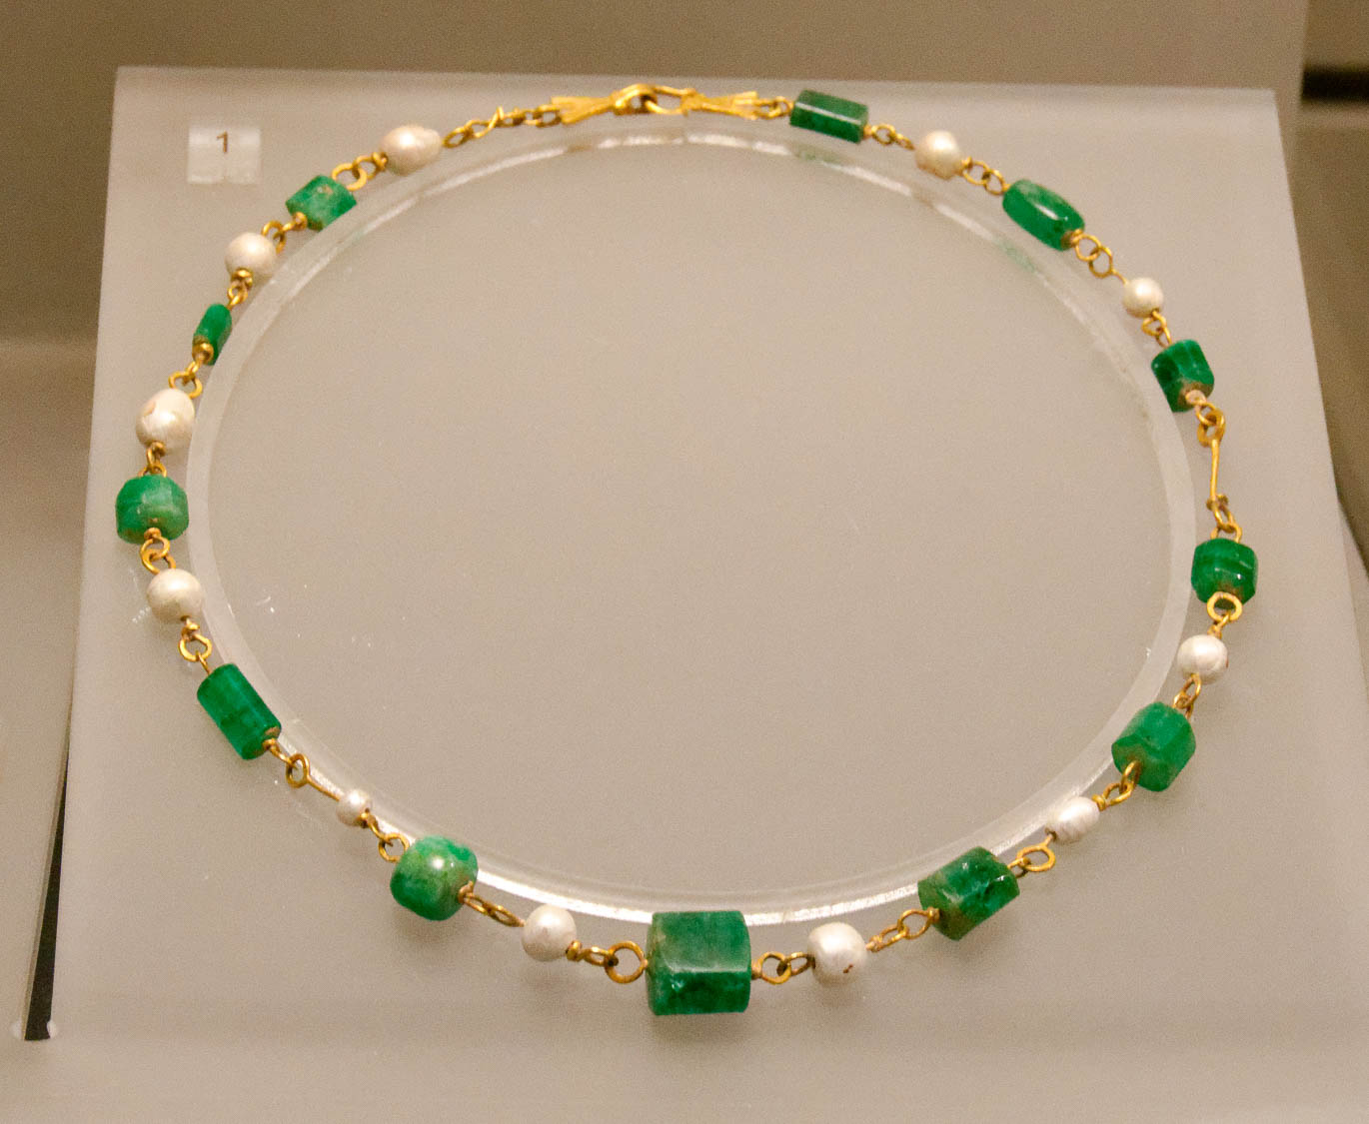
As to a living stone . . . rejected by men but choice and precious in the sight of God
Gold necklace with pearls and emeralds, from Mentana, 3rd century AD
2:4
Notes:
Although the preciousness of the stone in this metaphor seems to primarily concern its function as the foundation of a temple for God, preciousness of material and function are not mutually exclusive. Tobit 13:16 anticipates emerald and sapphire gates of Jerusalem, similar to the later image in Revelation 21:18-21. This pearl, emerald, and gold necklace from Mentana dates to the 3rd century AD. It was photographed at the National Museum of Rome.
tb0513177967h

Slide 31
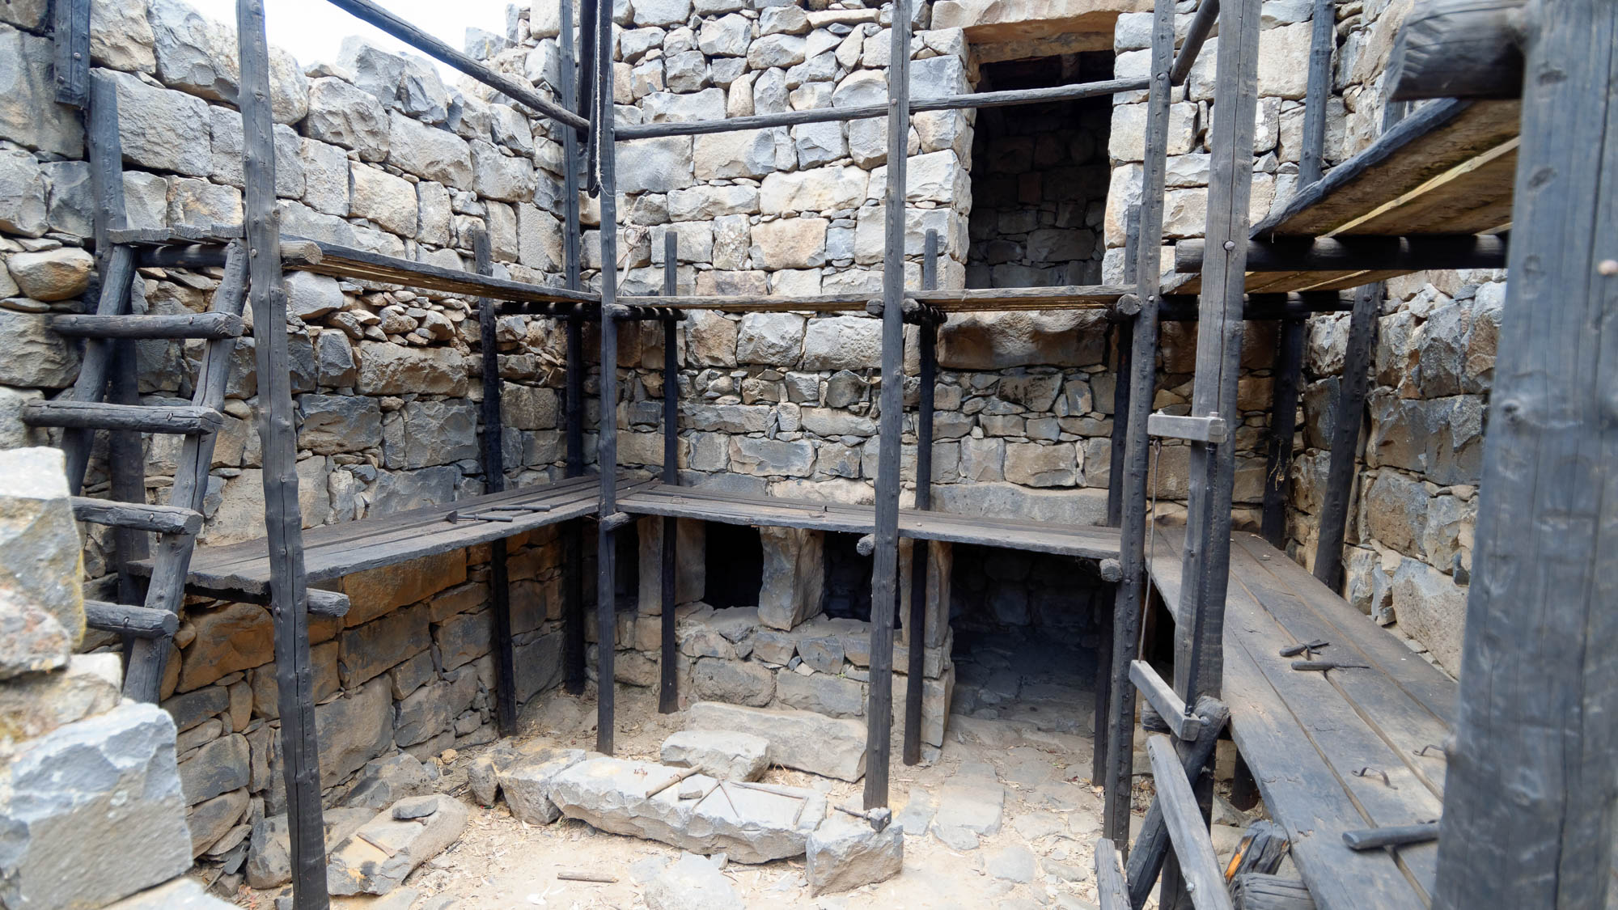
You also, as living stones, are being built up as a spiritual house
Multi-level house at Qatzrin with construction scaffolding
2:5
Notes:
Peter applies the same description to his audience as he did to Christ, “living stones.” This metaphor is explained by his description of the result, a “spiritual house.” It can be understood, then, that his audience as living stones are those who are spiritually alive, who work righteousness and not wickedness. The display in this photo shows part of the process of assembling the stone walls of a house out of individual stones, with the use of scaffolding.
tb053016950h

Slide 32
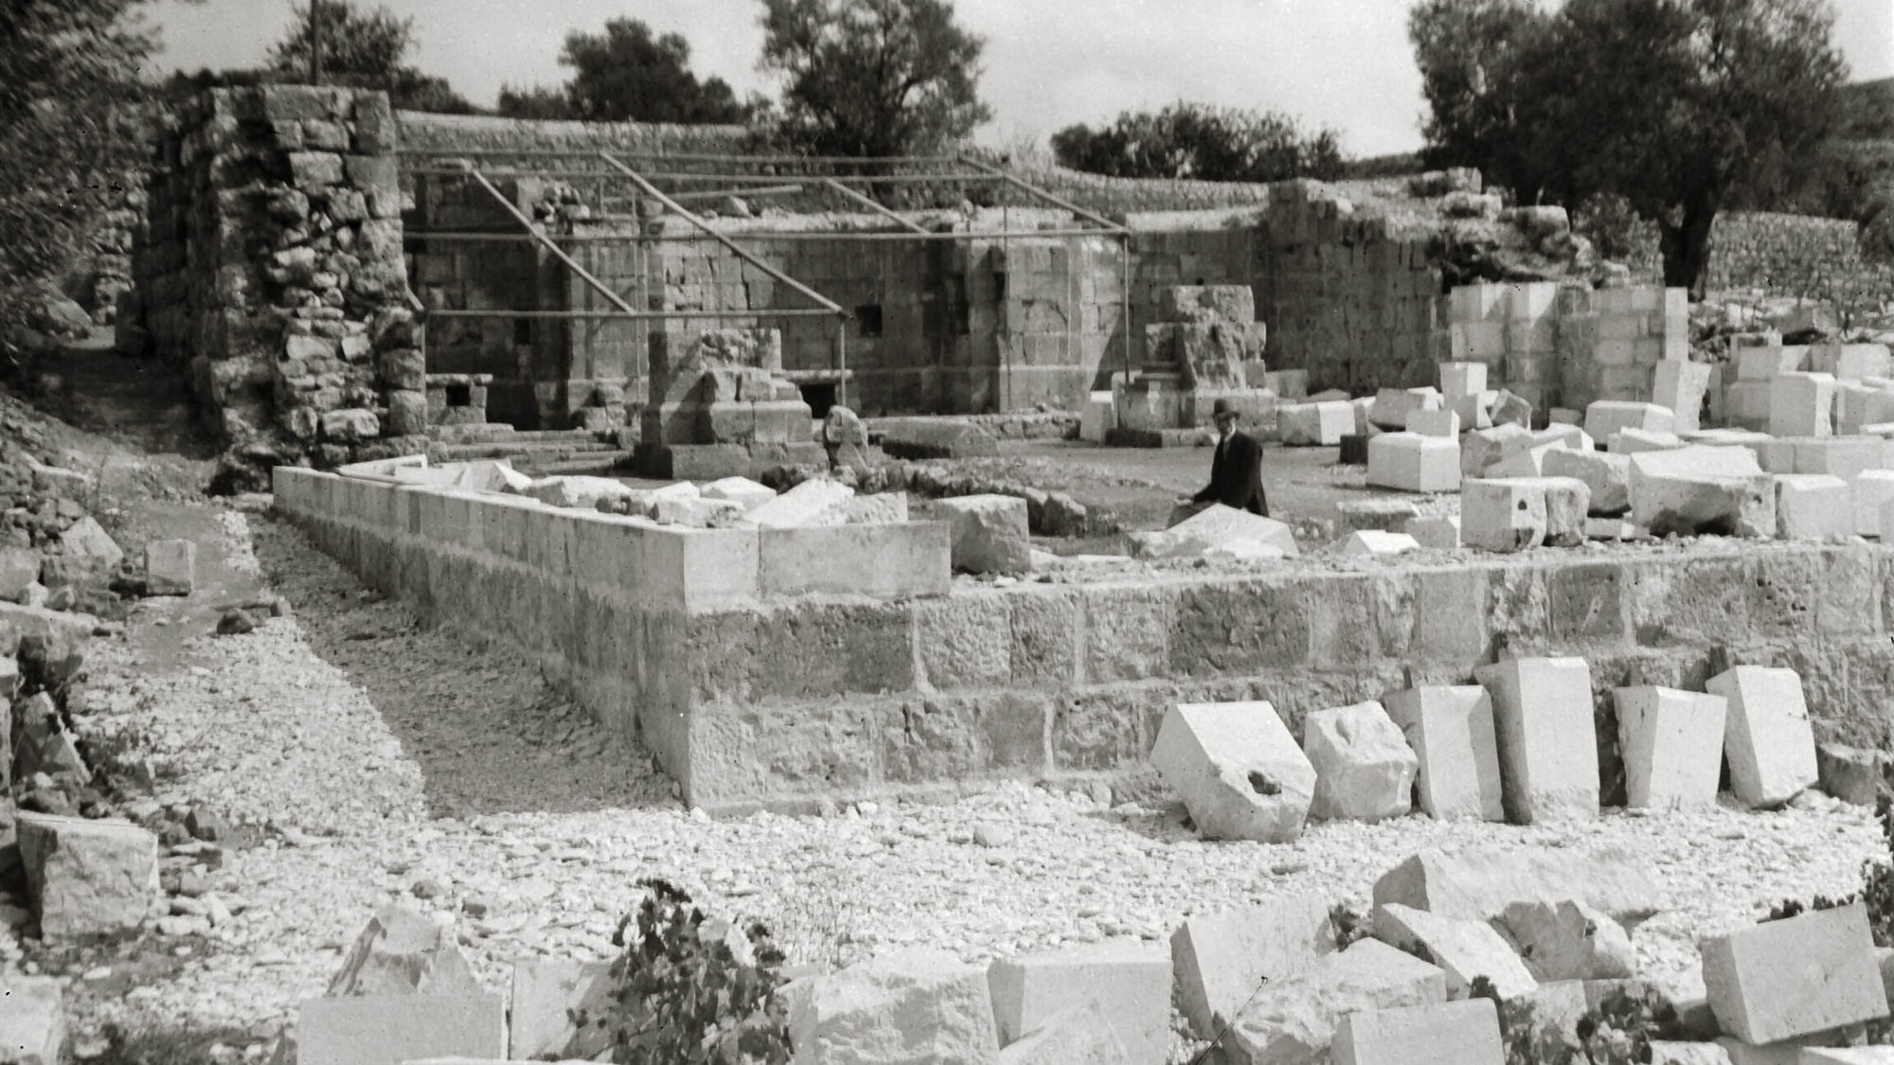
You also, as living stones, are being built up as a spiritual house
Construction work on the Church of St. Cleopas at el-Qubeibeh, circa 1902
2:5
Notes:
The Church of Saint Cleopas was built at el-Qubeibeh, a village northwest of Jerusalem, by the Franciscans in AD 1335. In the 19th century, the church was in ruins. Permission to rebuild the church was granted in 1902. This photo shows the original apses at the far end of the church, as well as walls in the foreground which are in the process of being rebuilt. This American Colony photo was taken around 1902. El-Qubeibeh is one of the candidates for the location of the Emmaus mentioned in Luke 24.
mat06274

Slide 33
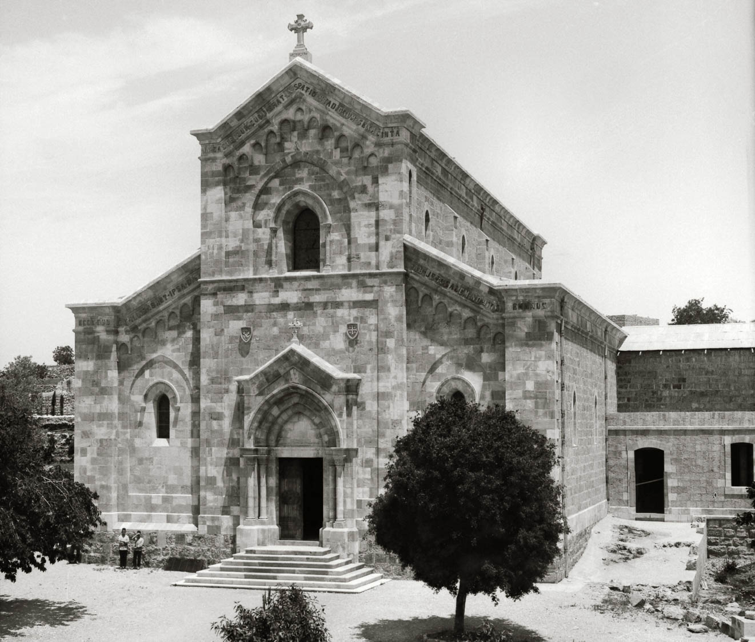
You also, as living stones, are being built up as a spiritual house
Completed Church of St. Cleopas at el-Qubeibeh, circa 1910
2:5
Notes:
This photo shows the completed Church of St. Cleopas. In Peter’s metaphor, the individual stones are like believers in Christ who are built into “a spiritual house” (cf. Eph 2:22). This American Colony photo was taken between 1902 and 1911.
mat00963h

Slide 34
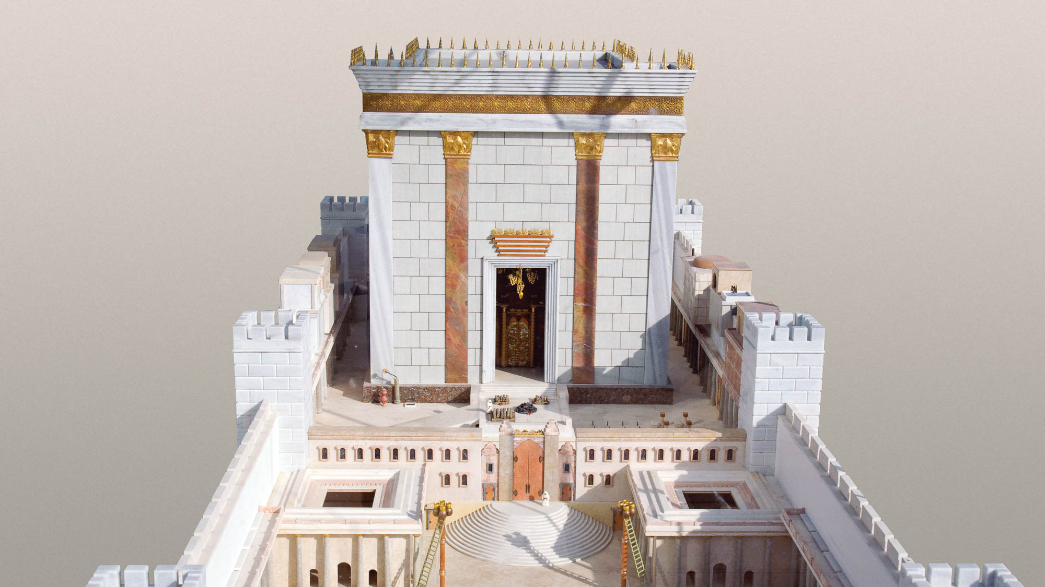
You also, as living stones, are being built up as a spiritual house
Model of Herod’s temple overlooking the Temple Mount
2:5
Notes:
If the “spiritual house” is God’s dwelling place, then it can be conceived as a temple. This model is located on top of the Aish HaTorah World Center overlooking the Western Wall prayer plaza. It was built by Michael Osanis and installed in August 2009. The 1.2-ton (1.1-t) model was constructed with gold, silver, wood, and stone and features a hydraulic elevator that lifts the temple building so visitors can view the interior. The model is built on a scale of 1:60 and faces west, opposite the orientation of the temple it represents.
tb010312508w

Slide 35
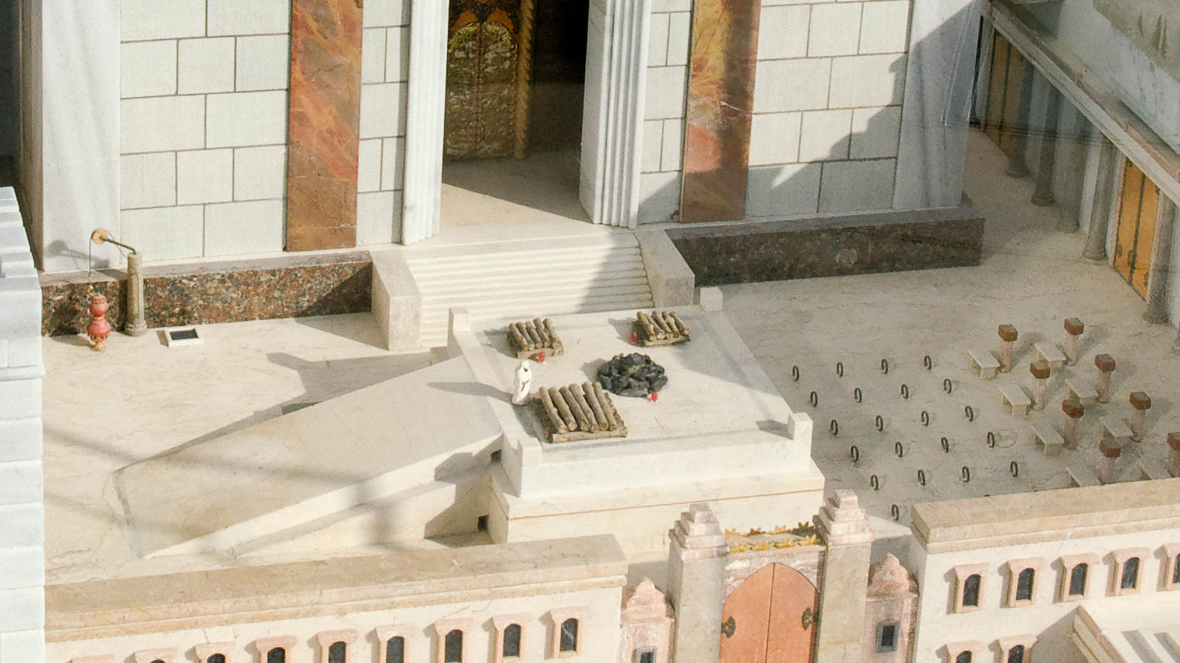
In order to be a holy priesthood, to offer up spiritual sacrifices
Model of the Second Temple, with altar
2:5
Notes:
This temple model, which illustrates the temple in the days of Jesus, shows woodpiles on which to burn sacrifices, along with a pile of coals in the center of the altar. This model of the temple was photographed on the roof of the Aish HaTorah building in the Jewish Quarter of the Old City in Jerusalem.
tb010312509h

Slide 36
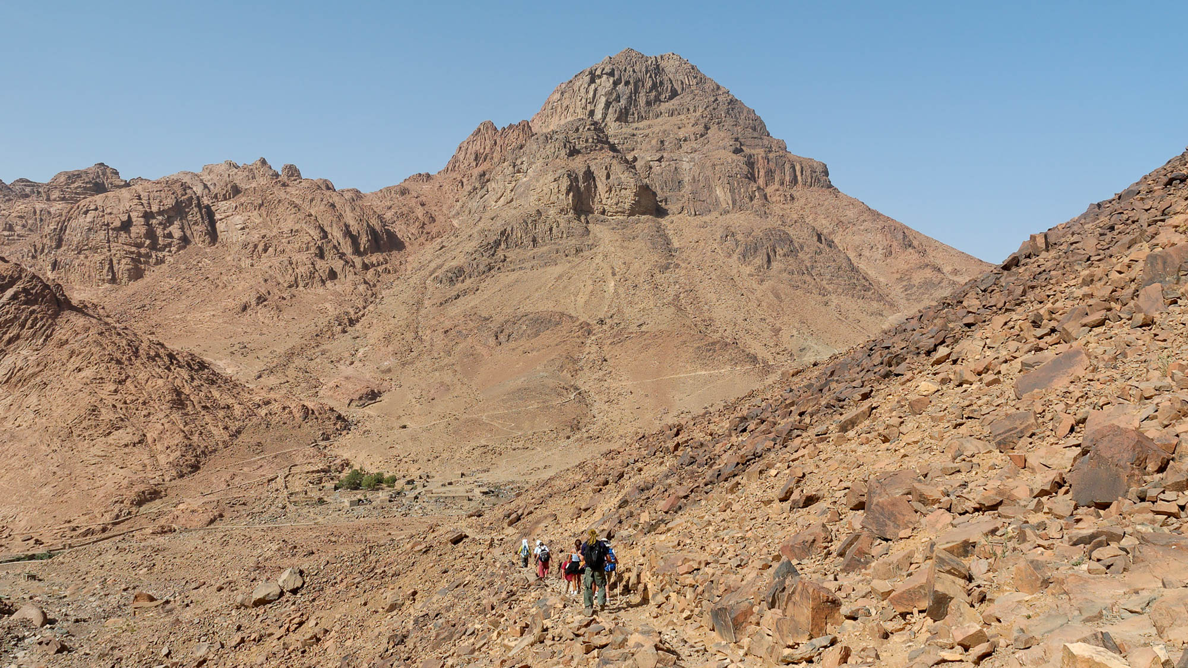
In order to be a holy priesthood, to offer up spiritual sacrifices
Jebel Musa, the traditional Mount Sinai (from the west)
2:5
Notes:
Peter’s wording recalls God’s statement to Moses at Mount Sinai: “And you will be to me a kingdom of priests, and a holy nation" (Exod 19:6). Jebel Musa, shown in this photo, is the traditional location of Mount Sinai.
tb062105071h

Slide 37
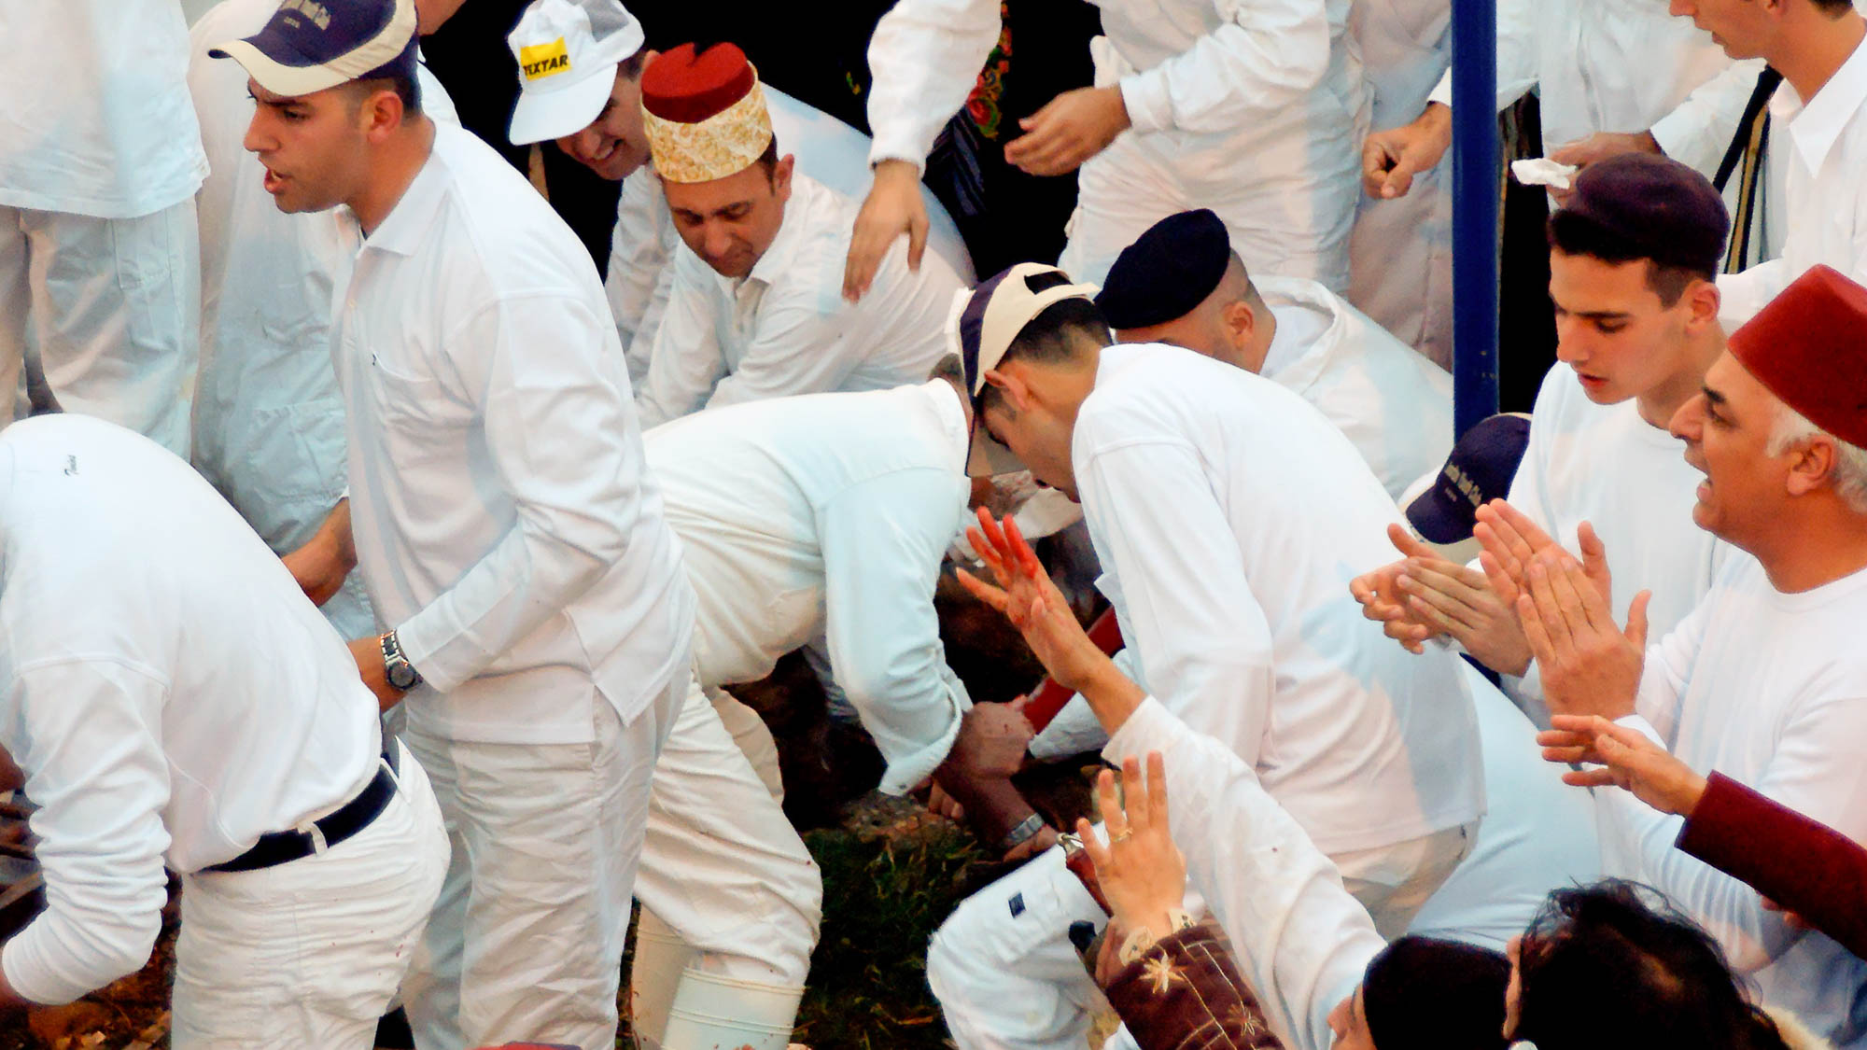
In order to be a holy priesthood, to offer up spiritual sacrifices
Slaying of lambs at the Samaritan Passover on Mount Gerizim
2:5
Notes:
The slaying of lambs at the Samaritan Passover provides some idea of what Old Testament sacrifices were like.
tb041106679h

Slide 38
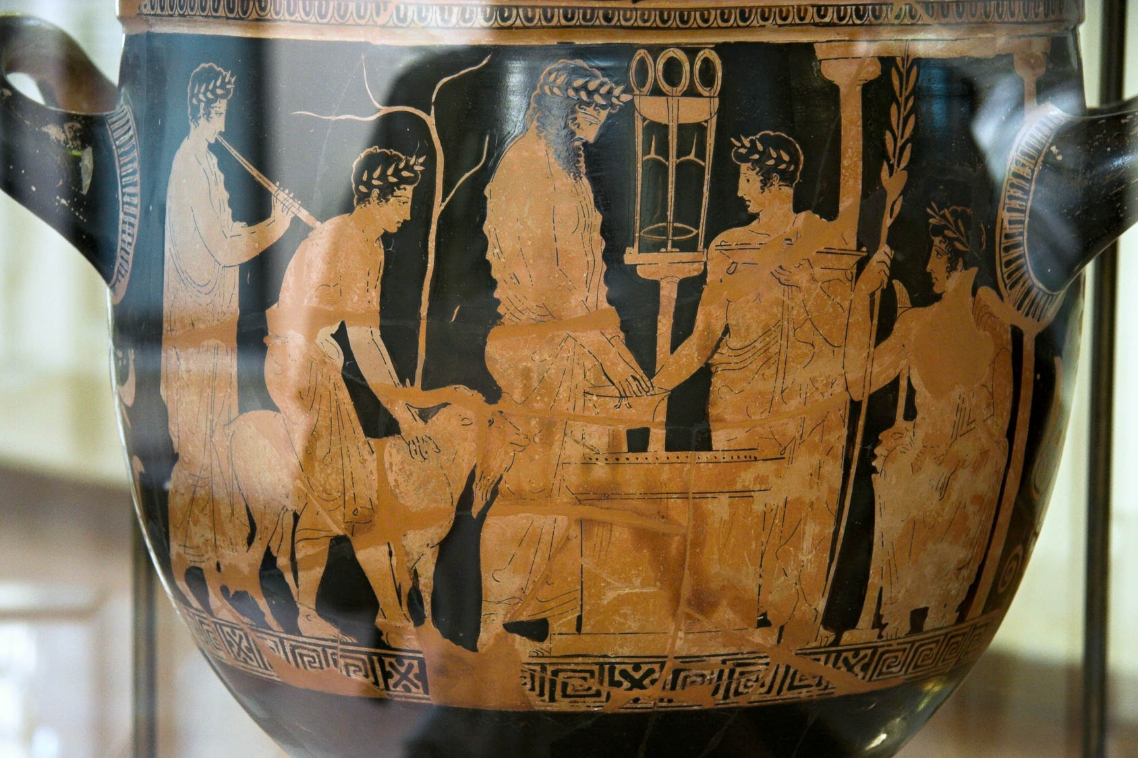
In order to be a holy priesthood, to offer up spiritual sacrifices
Krater with sacrificial scene at Delphi, from Agrigento, circa 420 BC
2:5
Notes:
This red-figure bell krater depicts Greek worshippers bringing a ram to the altar of Apollo at Delphi in order to sacrifice it. The bearded priest is shown washing his hands in a basin to purify himself prior to the sacrifice. Even Gentiles in Peter’s audience would have understood the metaphor of priesthood and sacrifice. This krater was photographed at the Archaeological Museum of Agrigento. This image comes from Zde and is licensed under CC BY-SA 4.0, via Wikimedia Commons: https://commons.wikimedia.org/wiki/File:Red_figure_bell_crater,_sacrificial_scene_at_Delphi,_420_BC,_AM_Agrigento,_120968.jpg.
wiki090820121645504204688

Slide 39
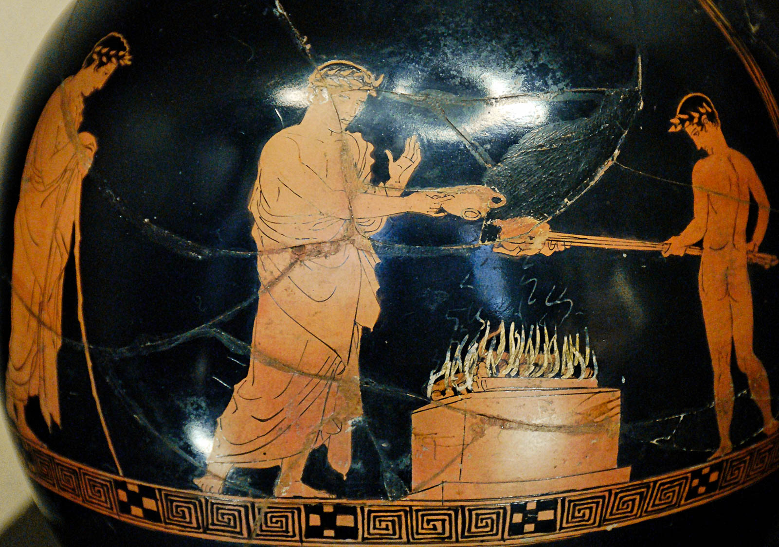
In order to be a holy priesthood, to offer up spiritual sacrifices
Sacrificial scene with meat and drink offerings, circa 425 BC
2:5
Notes:
This oinochoe depicts two men offering sacrifices on an altar. The man on the left holds a drink offering, while the youth on the right holds meat on a skewer. An oinochoe (oenochoe) was a wine-pouring jug, often formed in a graceful shape. This object was photographed at the Louvre Museum. This image comes from Jastrow and is in the public domain, via Wikimedia Commons: https://commons.wikimedia.org/wiki/File:Sacrifice_scene_Louvre_G402.jpg.
wiki0113200710411879h

Slide 40
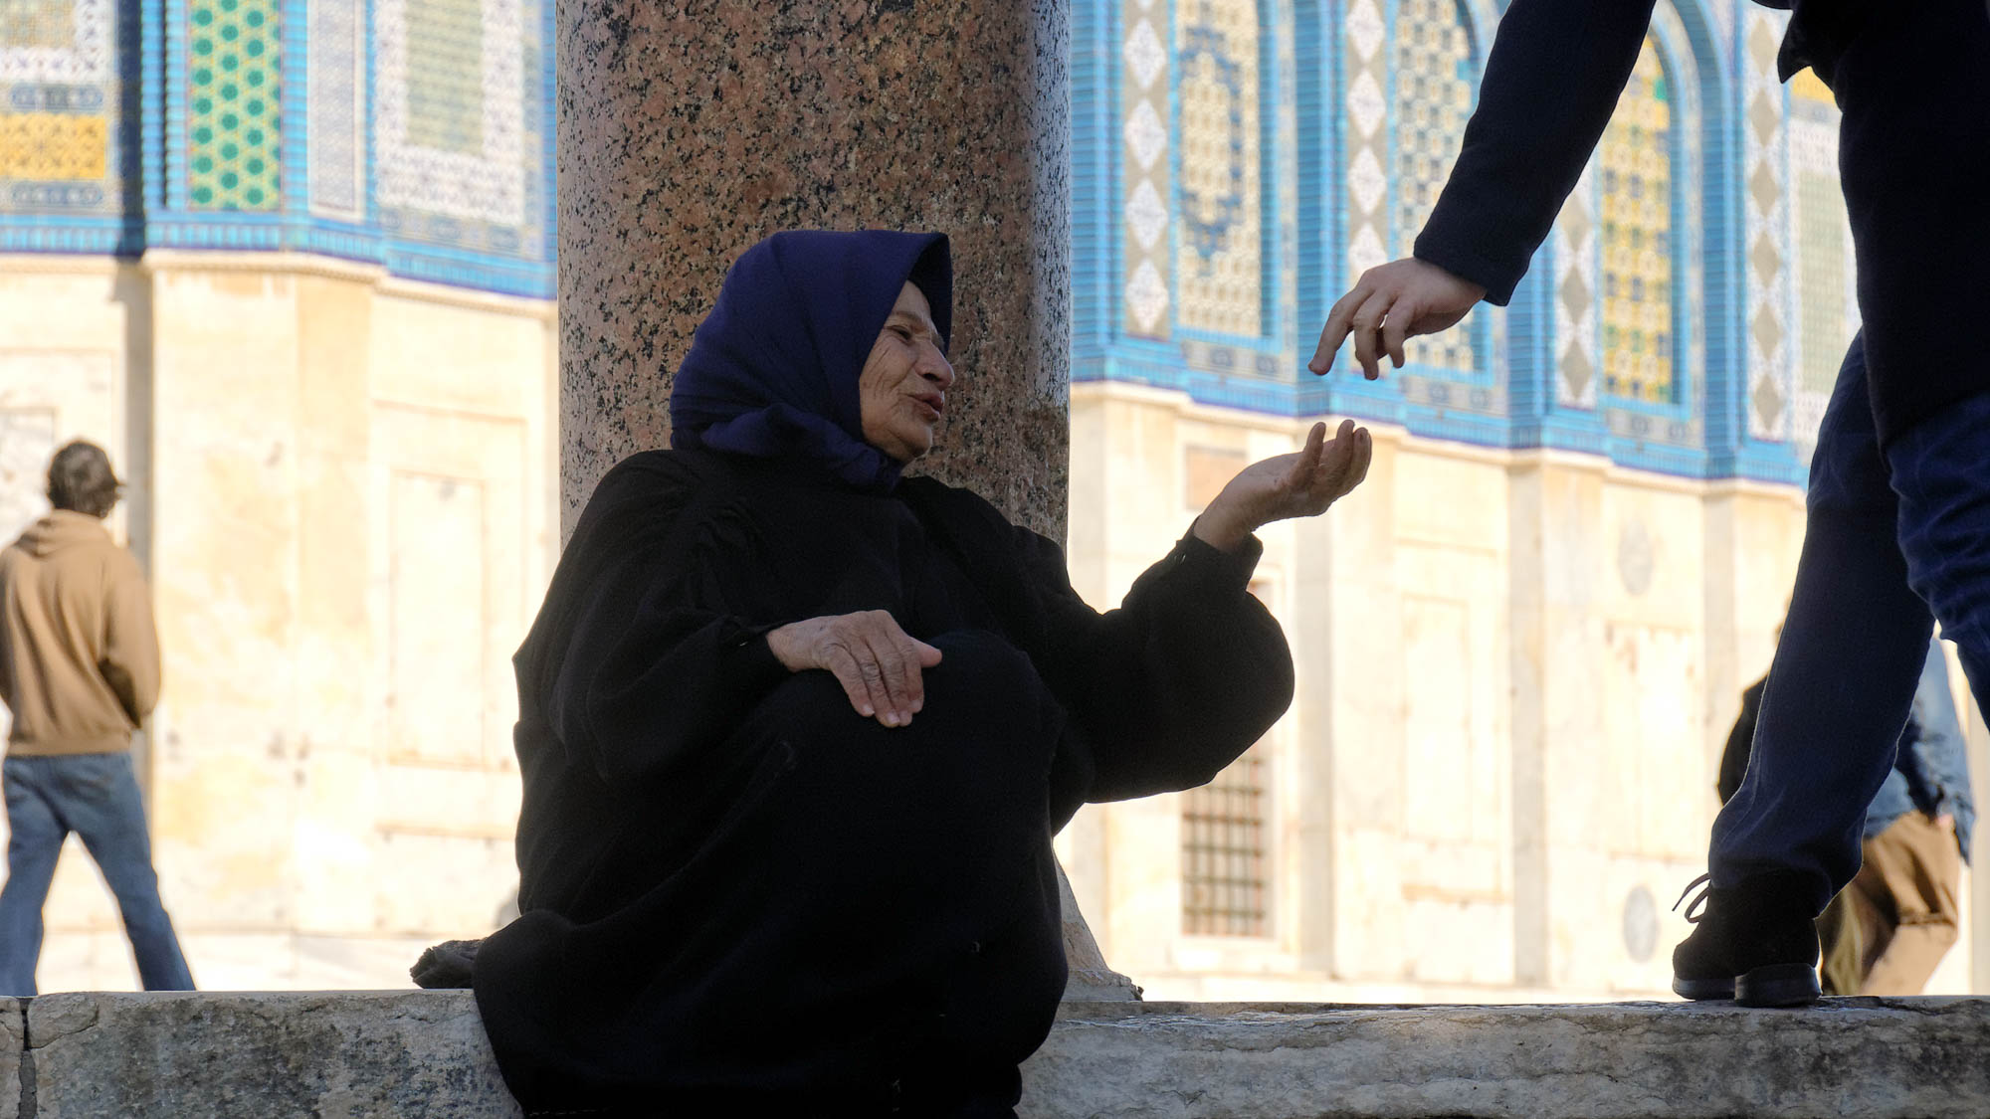
In order to be a holy priesthood, to offer up spiritual sacrifices
Man giving alms to a woman on the Temple Mount in Jerusalem
2:5
Notes:
The figure of speech used by Peter, “to offer up spiritual sacrifices,” can be understood more literally through things such as doing good works such as generosity and sharing (1 Tim 6:18) or helping orphans and widows in their distress (Jas 1:27).
tb010112108h

Slide 41
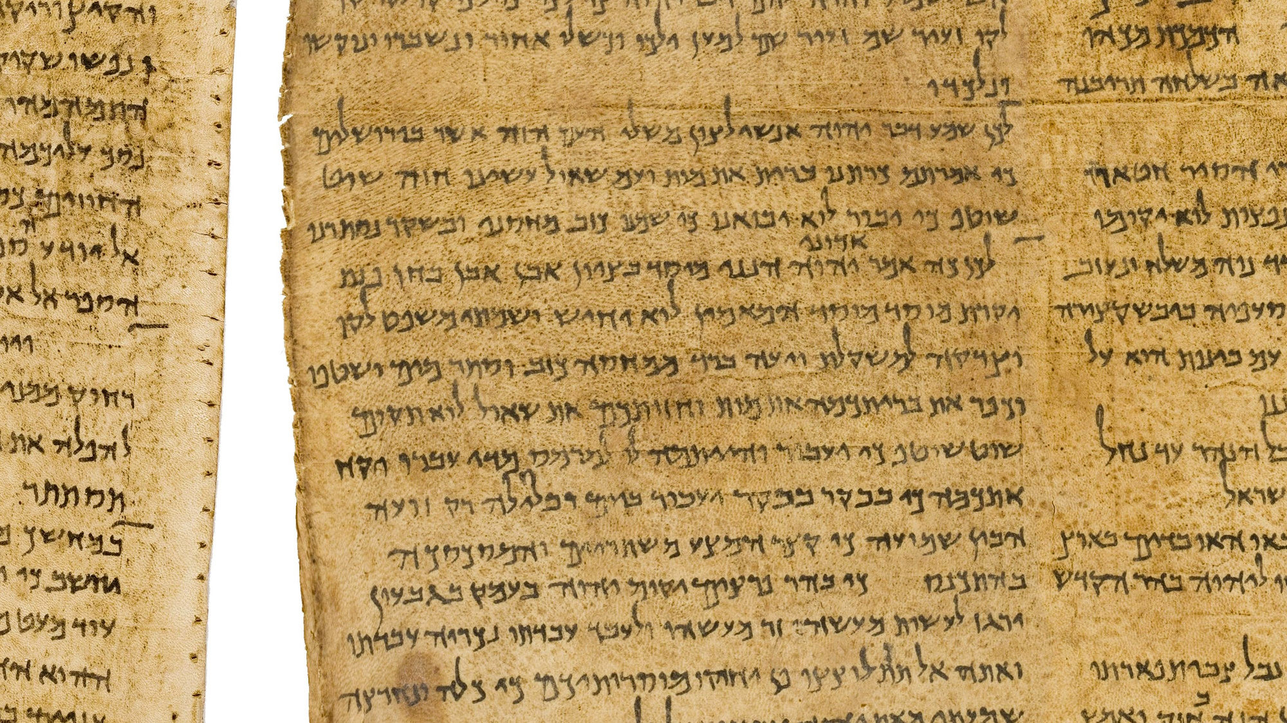
For it says in Scripture, “Behold, I lay in Zion a stone, a choice and precious cornerstone”
Isaiah 28:16 on the Great Isaiah Scroll, 2nd century BC
2:6
Notes:
Peter quotes here from Isaiah: “Therefore thus says the Lord God, ‘Behold, I lay in a stone in Zion, a tested and precious cornerstone for a firm foundation. Whoever believes in him will not be shaken” (Isa 28:16). The Great Isaiah Scroll is owned by the Israel Museum. This image is public domain, from Wikimedia: https://commons.wikimedia.org/wiki/File:The_Great_Isaiah_Scroll_MS_A_(1QIsa)_-_Google_Art_Project-x2-y0.jpg
isax2y0b

Slide 42
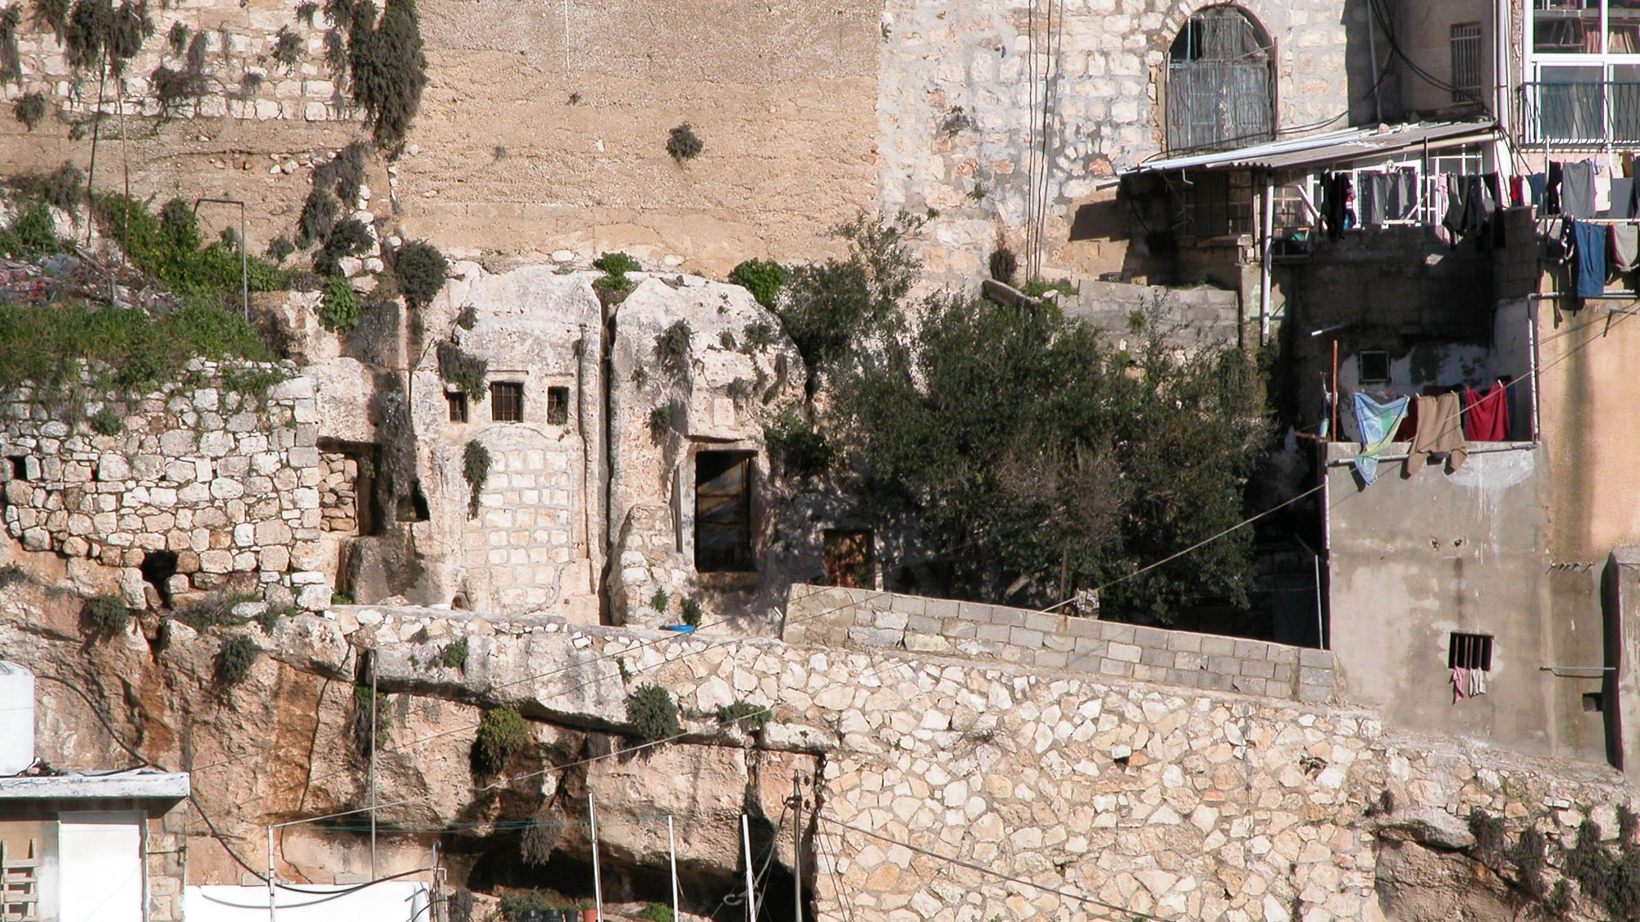
For it says in Scripture, “Behold, I lay in Zion a stone, a choice and precious cornerstone”
Traditional tomb of Isaiah in Silwan necropolis in Jerusalem
2:6
Notes:
First Peter 2:6 quotes Isaiah 28:16. The traditional tomb of Isaiah in Silwan in Jerusalem may be seen in the center of this picture.
tb030103202h

Slide 43
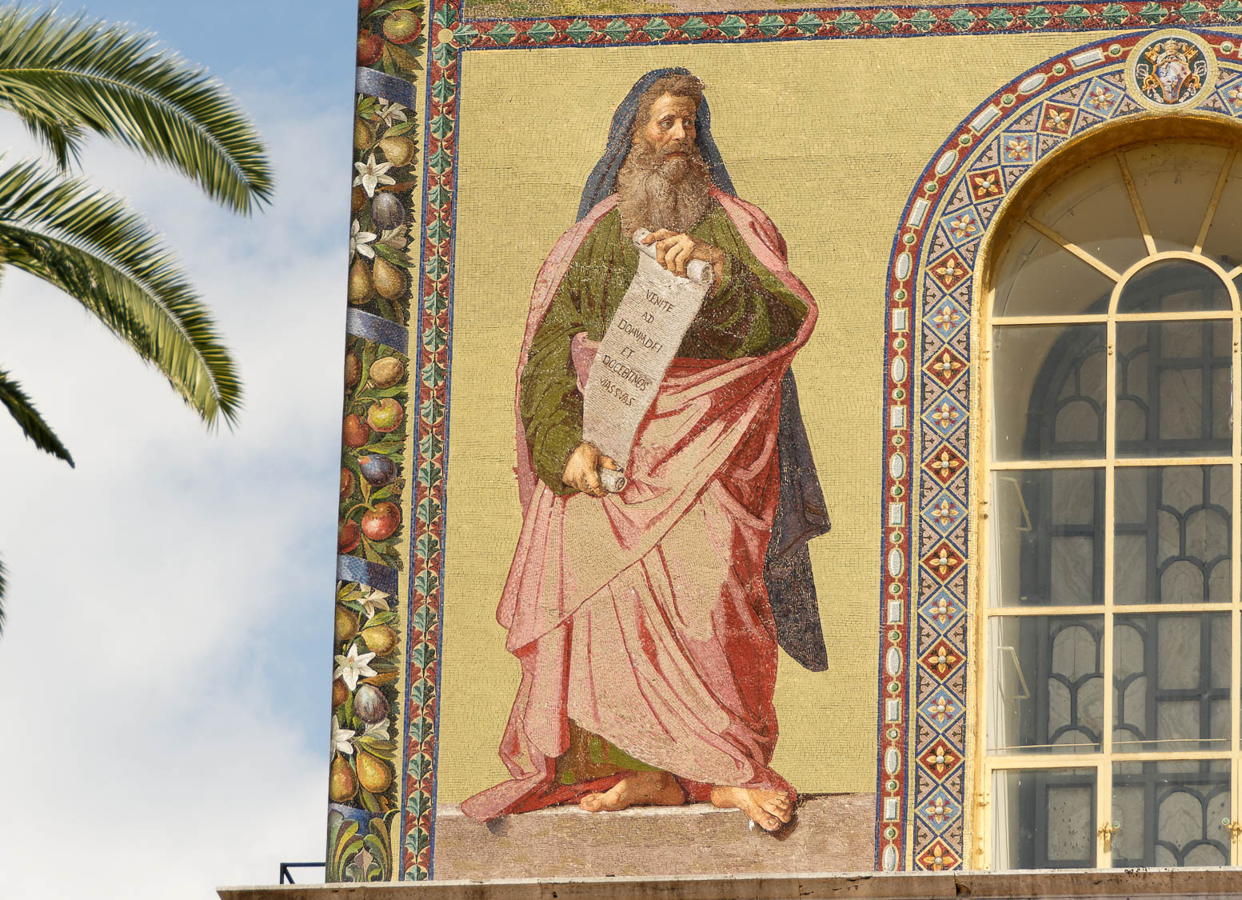
For it says in Scripture, “Behold, I lay in Zion a stone, a choice and precious cornerstone”
Depiction of Isaiah on the façade of the Basilica of St. Paul Outside the Walls in Rome
2:6
Notes:
tb0517173016h

Slide 44
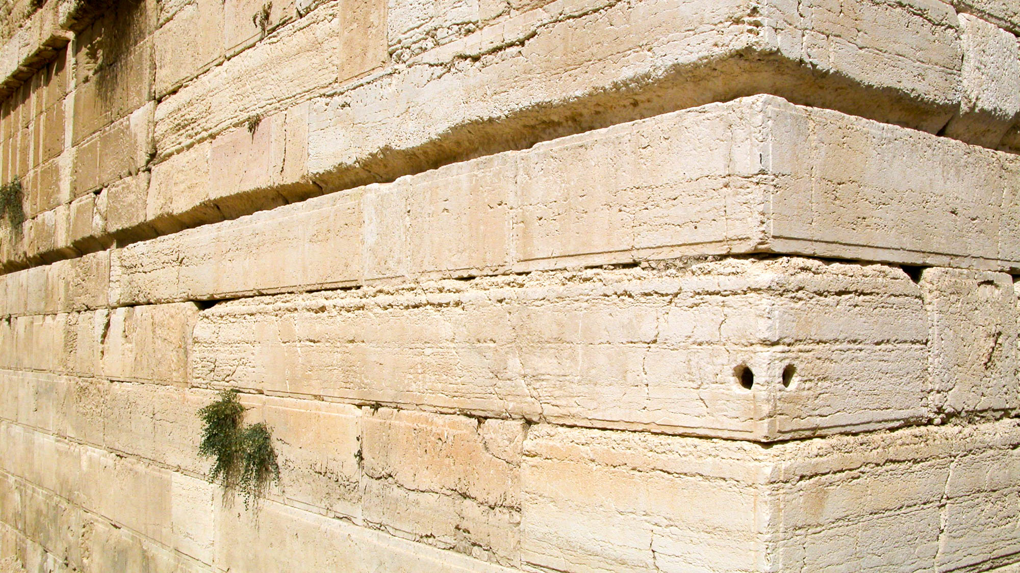
For it says in Scripture, “Behold, I lay in Zion a stone, a choice and precious cornerstone”
Large stones at the southwestern corner of the Temple Mount
2:6
Notes:
Like Peter, Paul also referred to Jesus as the foundation or cornerstone (e.g., Rom 9:33; 1 Cor 3:11). God refers to the foundation stone which He will place on Mount Zion, who will accomplish salvation for those who believe in Him. Paul explicitly identifies this foundation as Christ (Rom 10:10-11; cf. 1 Pet 2:4-8). The massive interlocking foundation stones shown in this photo are located on the southwest corner of the Temple Mount. Placed there by the workmen of King Herod, this very large foundation would have been familiar to Peter, and to any of his audience who had traveled to Jerusalem. Most of the stones used in the wall around the Temple Mount weigh 2–4 tons (1.8–3.6 t). Some of the stones weigh up to 10 tons (9 t), and a few on the southwestern corner (shown here) weigh about 50 tons (45 t).
tb091702210h

Slide 45
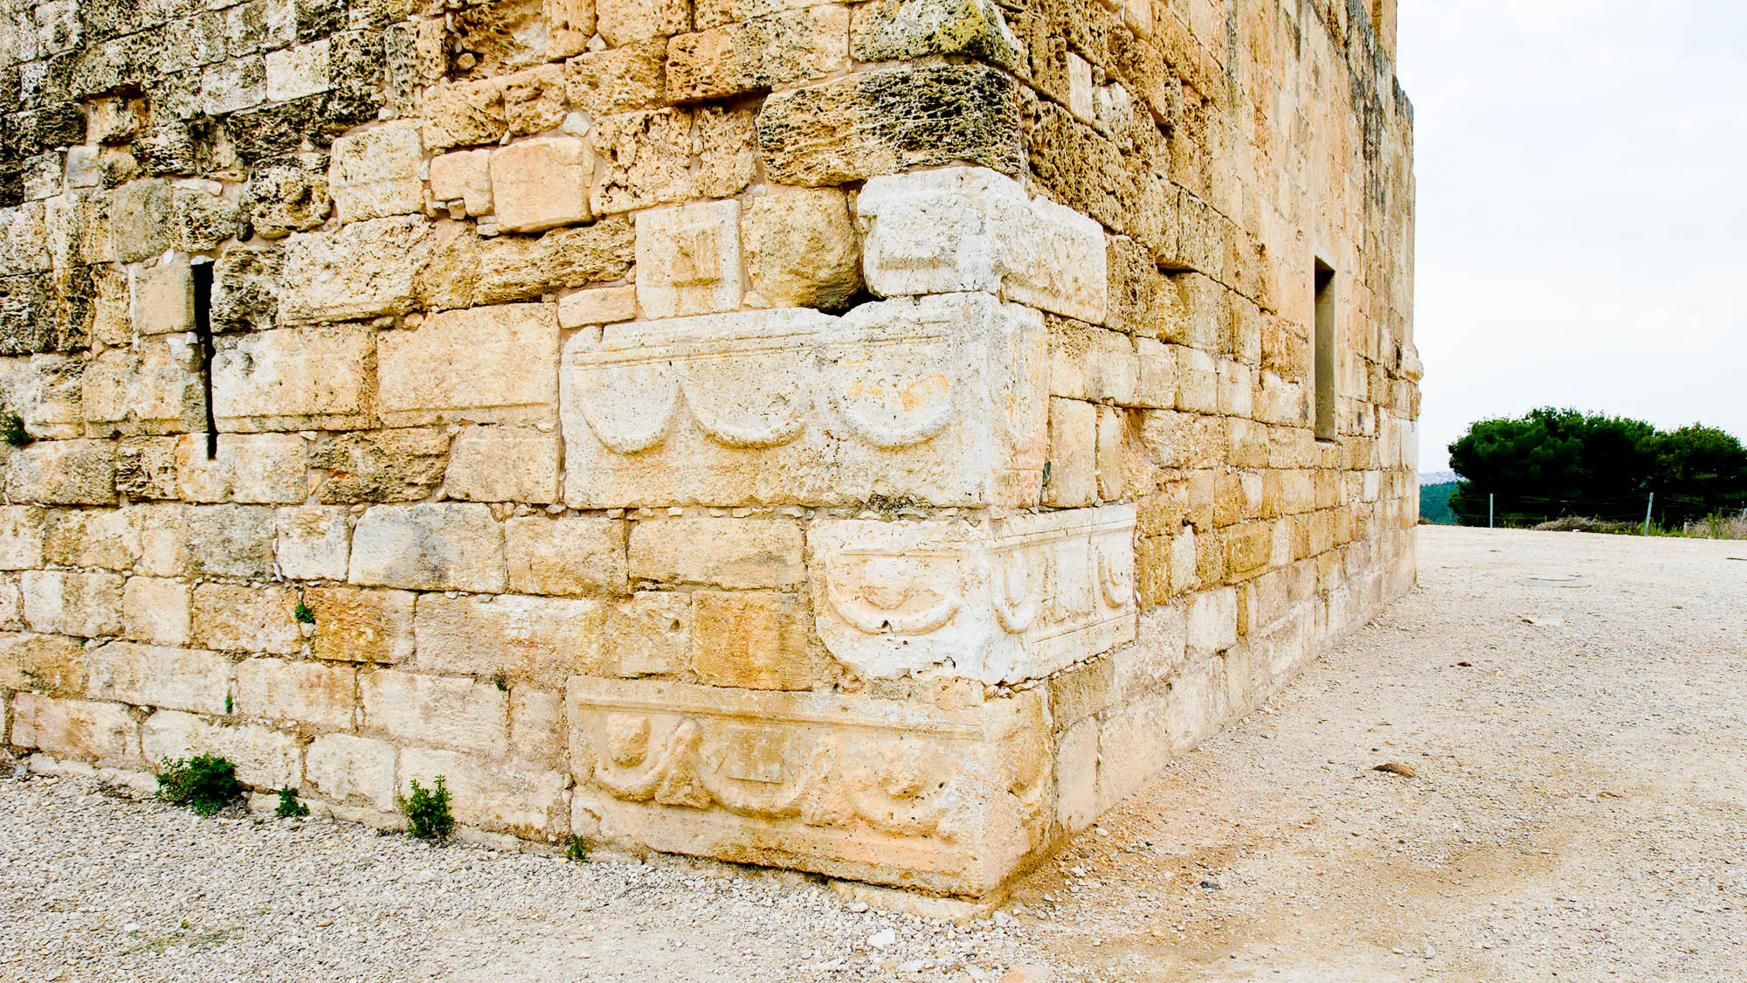
For it says in Scripture, “Behold, I lay in Zion a stone, a choice and precious cornerstone”
Roman sarcophagi used as cornerstones in a Crusader building at Sepphoris
2:6
Notes:
Several Roman sarcophagi were reused in this Crusader building at Sepphoris, including one at the bottom corner.
tb110106507h

Slide 46
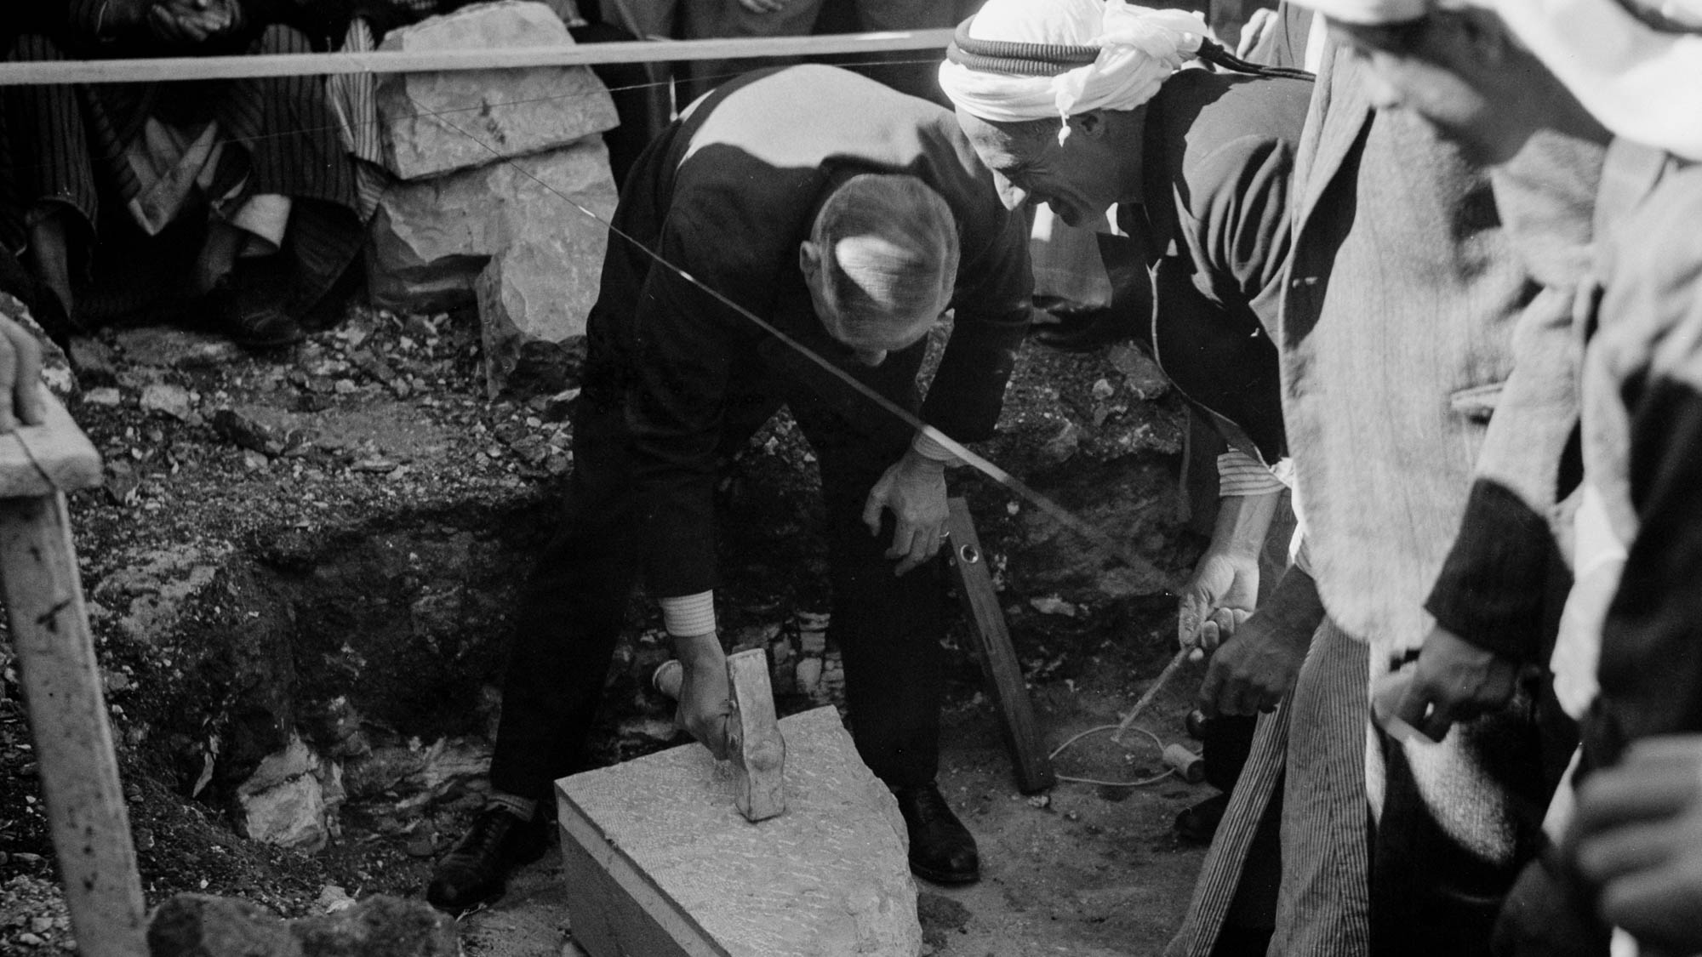
For it says in Scripture, “Behold, I lay in Zion a stone, a choice and precious cornerstone”
Laying of the cornerstone for a municipal school in Ramallah, 1940
2:6
Notes:
This American Colony photograph was taken on November 23, 1940. Ramallah is a large Arab city north of Jerusalem.
mat20921h

Slide 47
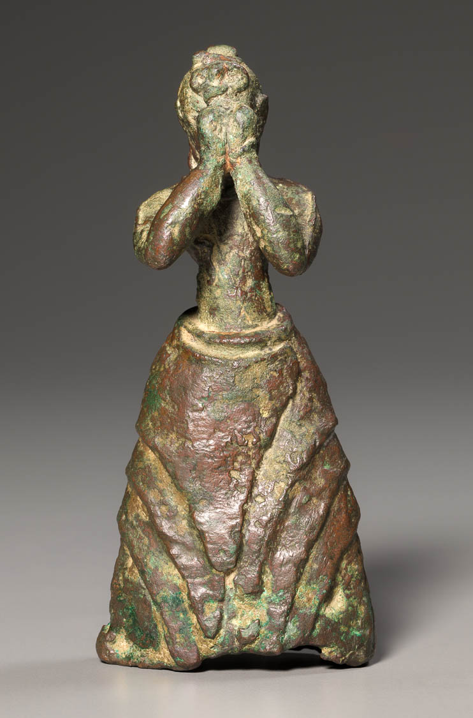
The one who believes in him will not be put to shame
Bronze statue of a female worshiper, from Crete, circa 1500 BC
2:6
Notes:
This bronze figurine depicts an adolescent girl with her hands raised to cover her face, an act often associated with shame. This image comes from The Cleveland Museum of Art, public domain, Purchase from the J. H. Wade Fund, 2002.89, https://www.clevelandart.org/art/2002.89.
tcma200289141134h

Slide 48
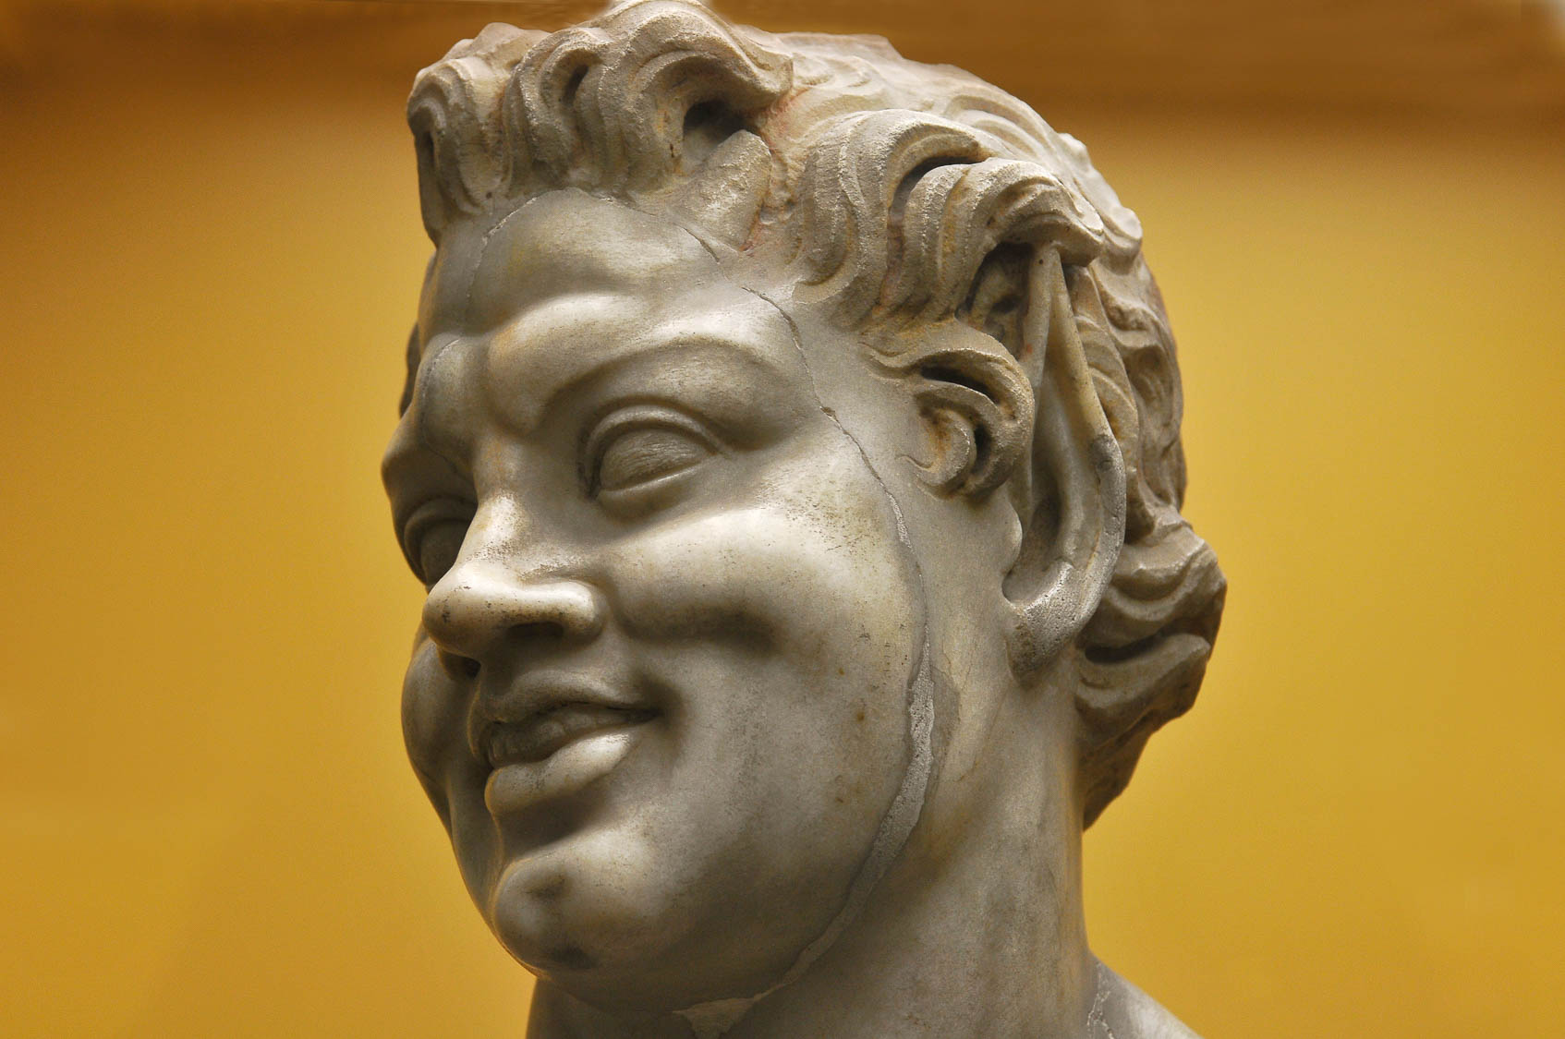
The one who believes in him will not be put to shame
Smiling statue from the Stoa of Attalos, Athens, 2nd century BC
2:6
Notes:
This statue head of a smiling man (the long, pointed ears indicate that the statue was intended to portray a satyr) illustrates joy, the opposite of shame or disappointment. This statue comes from the Stoa of Attalos, a large covered walkway that was located next to the marketplace (agora) in Athens. This image comes from LBM1948 and is licensed under CC BY-SA 4.0, via Wikimedia Commons: https://commons.wikimedia.org/wiki/File:Atenas,_Estoa_de_%C3%81talo_05.jpg.
wiki04092013130859

Slide 49
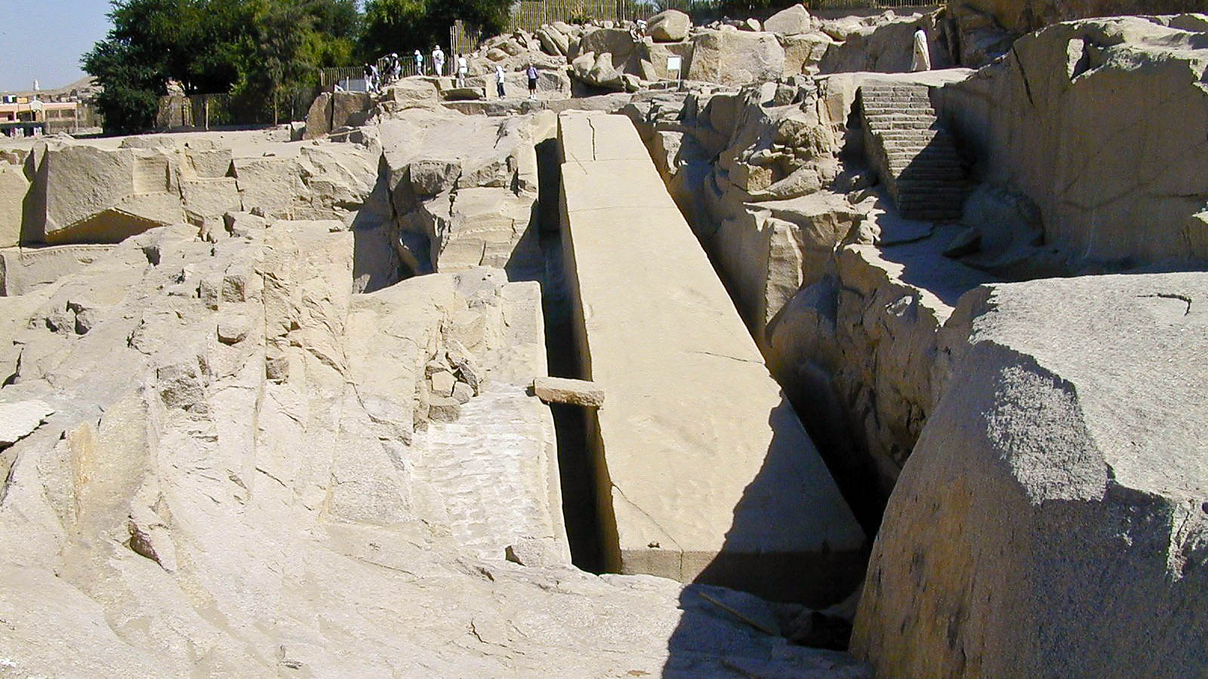
The stone which the builders rejected, this became the very cornerstone
Unfinished obelisk in Aswan
2:7
Notes:
An unfinished obelisk is located in Egypt’s only granite quarry. The length of this obelisk is 138 feet (42 m), which makes it one of longest obelisks ever discovered. Its weight is estimated at 1,200 tons (1090 t), which is four times the weight of the next largest known obelisk (300 tons; 272 t). The reason the obelisk was not completed is unknown. Perhaps a crack developed in it, or the ruling government was replaced or changed its plans.
tb110700524h

Slide 50
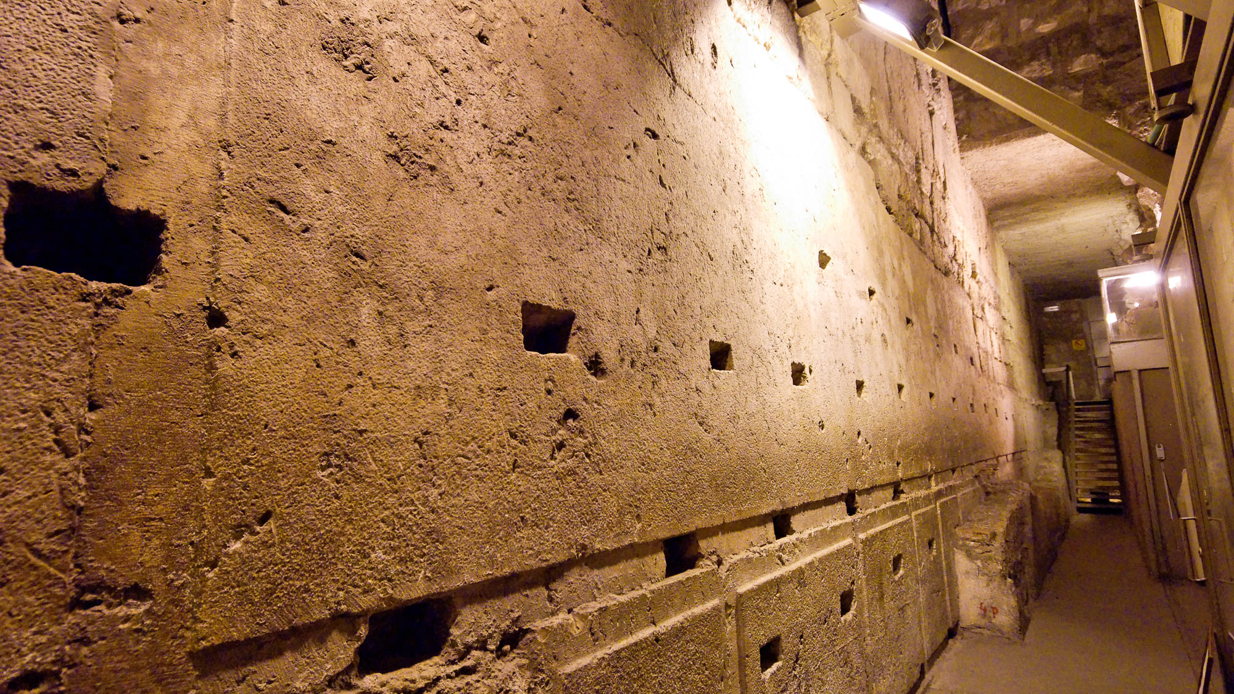
The stone which the builders rejected, this became the very cornerstone
Largest Herodian stone in the Western Wall of the Temple Mount
2:7
Notes:
This stone is the largest known in the Temple Mount construction. It measures 43.4 feet (13.2 m) long, 10.2 feet (3.1 m) tall, and an estimated 13.4–15.7 feet (4.0–4.8 m) deep. It is located along the western wall, north of the prayer plaza and Wilson’s Arch, and south of Warren’s Gate. See the next slide for lines marking the stone’s edges.
tb123109463h

Slide 51
The stone which the builders rejected, this became the very cornerstone
Largest Herodian stone in the Western Wall of the Temple Mount
2:7
Notes:
This stone is the largest known in the Temple Mount construction. It measures 43.4 feet (13.2 m) long, 10.2 feet (3.1 m) tall, and an estimated 13.4–15.7 feet (4.0–4.8 m) deep. It is located along the western wall, north of the prayer plaza and Wilson’s Arch, and south of Warren’s Gate. The lines mark the approximate edges of the stone.
tb123109463h

Slide 52
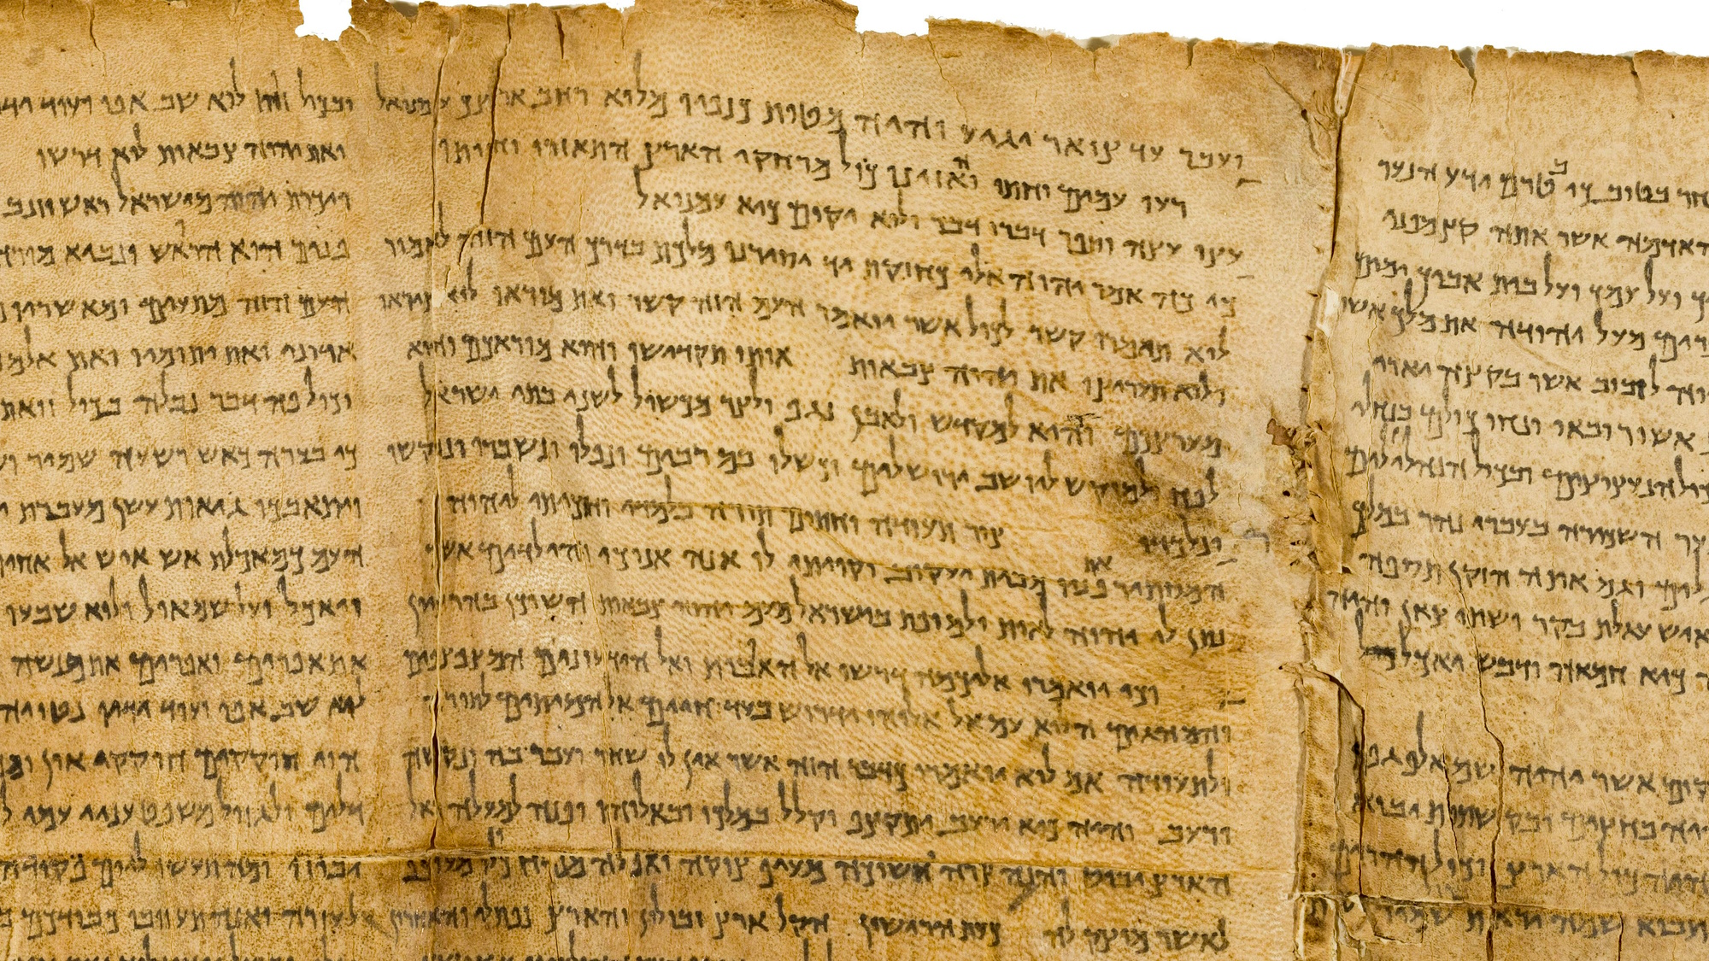
A stone of stumbling, and a rock of offense
Isaiah 8:14 on the Great Isaiah Scroll
2:8
Notes:
Peter once again quotes from Isaiah: “And he will be a sanctuary; but for both houses of Israel he will be a stone of stumbling and a rock of offense, like a trap and for a snare to the inhabitants of Jerusalem” (Isa 8:14). The Great Isaiah Scroll is owned by the Israel Museum. This image is public domain, from Wikimedia: https://commons.wikimedia.org/wiki/File:The_Great_Isaiah_Scroll_MS_A_(1QIsa)_-_Google_Art_Project-x3-y0.jpg
isax3y0

Slide 53
A stone of stumbling, and a rock of offense
Dirt path with rocks, near Kanaf
2:8
Notes:
The word “offense” (Gk. skandalon, σκάνδαλον) refers to something that causes offense or revulsion and results in opposition, disapproval, or hostility. Paul uses the same word in Romans 9:32-33 when he also cites Isaiah 8:14 to identify Jesus as a “rock of offense” (Gk. petran skandalou, πέτραν σκανδάλου). This aligns with what Jesus said of Himself (cf. Matt 11:6; Luke 7:23). The path shown in this photo is strewn with rocks that could easily cause someone to stumble, a literal illustration of Peter’s metaphor. The Sea of Galilee is visible in the background of this photo.
tb053016713h

Slide 54
A stone of stumbling, and a rock of offense
Mountain path leading toward Bethlehem, circa 1926
2:8
Notes:
Although rocks were often removed from ancient footpaths, stones over which one could stumble were often present, as is the case with the path in this photo. This American Colony photo was taken between 1920 and 1933.
mat02610

Slide 55
A stone of stumbling, and a rock of offense
Roman road and steps at the Ascent of Scorpions (Maale Aqrabbim)
2:8
Notes:
This photo shows what remains of the Roman road at the Ascent of Scorpions. Steps have been cut into the path at some points to ease travel, but even these steps could cause the absent-minded traveler to stumble.
tb010712170h

Slide 56
They stumble because they disobey the word
Fragment of the Gospel of Matthew, 5th–6th centuries AD
2:8
Notes:
The “word” (Gk. logos, λόγος) in this context refers to the Christian gospel, illustrated here by an early manuscript fragment of the Gospel of Matthew. This fragment, known as Majuscule 071, contains portions of Matthew 1:25–2:2. This image comes from Wikimedia Commons and is in the public domain. Source: https://commons.wikimedia.org/wiki/File:Uncial_071_(Harvard10651397).JPG
wiki106513975932350h

Slide 57
This is the fate to which they were consigned
Figurine of a slave, from Alexandria in Egypt, 2nd century BC
2:8
Notes:
Those who refuse to obey the word, Peter argues, will inevitably be caused to stumble by it. This bronze figure’s struggle, probably against the strain of a heavily laden cart, puts him in a position where he could easily stumble. His struggle is eloquently communicated by his posture. This image comes from Walters Art Museum in Baltimore and is in the public domain, via Wikimedia Commons: https://commons.wikimedia.org/wiki/File:Egyptian_-_Slave_-_Walters_542372.jpg.
wiki0325201217051190

Slide 58
You are a chosen people, a royal priesthood, a holy nation, a people for God’s own possession
Torah scroll with Exodus 19:5-6
2:9
Notes:
“Now therefore, if ye will obey my voice indeed, and keep my covenant, then ye shall be mine own possession from among all peoples: for all the earth is mine: and ye shall be unto me a kingdom of priests, and a holy nation. These are the words which thou shalt speak unto the children of Israel” (Exod 19:5-6, ASV).
This Yemenite Torah scroll was photographed at The Master’s Seminary in California.
tb031416390

Slide 59
You are a chosen people, a royal priesthood, a holy nation, a people for God’s own possession
Torah scroll with Deuteronomy 7:6
2:9
Notes:
“For thou art a holy people unto Jehovah thy God: Jehovah thy God hath chosen thee to be a people for his own possession, above all peoples that are upon the face of the earth” (Deut 7:6, ASV).
This Yemenite Torah scroll was photographed at The Master’s Seminary in California.
tb031416451

Slide 60
You are a chosen people, a royal priesthood, a holy nation, a people for God’s own possession
Torah scroll with Deuteronomy 14:2
2:9
Notes:
“For thou art a holy people unto Jehovah thy God, and Jehovah hath chosen thee to be a people for his own possession, above all peoples that are upon the face of the earth” (Deut 14:2, ASV).
This Yemenite Torah scroll was photographed at The Master’s Seminary in California.
tb031416452

Slide 61
You are a chosen people, a royal priesthood, a holy nation, a people for God’s own possession
Jewish men gathered for the priestly blessing during the Feast of Sukkot (Tabernacles)
2:9
Notes:
These descriptions of the body of Christ are taken from the Old Testament, where they describe Israel.
tb101303093

Slide 62
The excellencies of Him who called you out of darkness into His marvelous light
View from inside Qumran Cave 4
2:9
Notes:
This photograph shows the approach of someone moving from the dark world of a cave to the larger world of light outside.
tb051106103h

Slide 63
For at one time you were not a people, but now you are the people of God
Warning inscription from the temple in Jerusalem, 1st century AD
2:10
Notes:
This warning inscription once stood on the Temple Mount at the fence between the Court of the Gentiles and the temple proper. It forbade foreigners from entering, which illustrates that Gentiles were not considered the people of God prior to the cross. It reads, “No foreigner is to enter the balustrade and enclosure around the temple. Whoever is caught will himself be the cause for [his] following death.”
Josephus records the following exchange concerning these warnings: “Now Titus was deeply affected with this state of things, and reproached John and his party, and said to them, “Have not you, vile wretches that you are, by our permission, put up this partition-wall before your sanctuary? Have not you been allowed to put up the pillars thereto belonging at due distances, and on it to engrave in Greek, and in your own letters, this prohibition, that no foreigner should go beyond that wall? Have not we given you leave to kill such as go beyond it, though he were a Roman?” (Josephus, War 6.4.2). This inscription was discovered in Jerusalem in 1871 by Charles Clermont-Ganneau and was photographed at the Istanbul Archaeological Museum.
tb041705456gr

Slide 64
For at one time you were not a people, but now you are the people of God
“Hosea Street” sign in Jerusalem
2:10
Notes:
Peter alludes to passages from Hosea, including at least Hosea 2:23: “And I will sow her for myself in the land. I will have mercy upon her who had not obtained mercy. I will say to those who were not my people, ‘You are my people;’ and they shall say, ‘You are my God.’” This picture shows a sign for Hoshea (Hosea) Street near the Mea Shearim neighborhood north of the Old City of Jerusalem.
lbd061919775h

Slide 65
For at one time you were not a people, but now you are the people of God
Group in slave market of Cairo
2:10
Notes:
In the narrative of Hosea, God tells Hosea to buy an adulterous wife (perhaps from a slave market) as an illustration of God having mercy on Israel and bringing them back to Himself as His people. This picture shows a drawing of a group in a slave market in Cairo.
nypl83206h

Slide 66
You had not obtained mercy, but now you have obtained mercy
Captives chained to cart in a triumphal procession, circa AD 100
2:10
Notes:
After a successful battle the Romans were fond of parading captives, especially important ones, through the city of Rome in a procession called a triumph. Often the prisoners paraded through the city were subsequently killed at the temple where the procession ended. It was not customary for them to be shown mercy, but to receive the death sentence as representatives of their defeated people. This relief, from circa AD 100, shows two chained captives being displayed on a cart during a triumph. This terracotta panel was photographed in the British Museum.
tb0929197870h

Slide 67
You had not obtained mercy, but now you have obtained mercy
Fresco of a man pleading, from Triclinium C of Villa Farnesina in Rome, circa 20 BC
2:10
Notes:
The central figure in this scene holds out his hands toward a seated figure, who might represent a judge or some ruler. The posture of holding out the hands may communicate a heartfelt plea for mercy. This fresco was photographed at the National Museum of Rome.
tb0513177787

Slide 68
Beloved, I urge you as foreigners and sojourners
Relief of a family of foreign prisoners, Roman era
2:11
Notes:
A “foreigner” (Gk. paroikos, πάροικος) refers to someone who lives in a place that is not one’s home. A “sojourner” (Gk. parepidēmos, παρεπίδημος) is nearly a synonym, referring to a resident alien or someone living in a strange or foreign place. These ideas are illustrated here by a depiction of a family of foreigners, perhaps Gauls. The bearded man stands beside a small heap of armor consisting of shields topped by a helmet. His crossed wrists indicate that his hands are tied, confirming that he is a prisoner. The woman and child stand in seemingly remorseful poses. This relief was photographed at the Corinth Museum.
tb011017989h

Slide 69
Beloved, I urge you as foreigners and sojourners
Model of a Judean village occupied by exiles in Babylonia
2:11
Notes:
The Jewish people had spent many generations living in foreign places, including their time in exile in Babylon. This model was photographed at the Bible Lands Museum in Jerusalem.
mjb1903102911h

Slide 70
Beloved, I urge you as foreigners and sojourners
Synagogue at Dura-Europos along the Euphrates River, 3rd century AD
2:11
Notes:
A large proportion of the Jewish population in the 1st century lived outside of their homeland (cf. Jas 1:1). One of the distinct evidences of their presence in a place was the synagogue, a place Paul often made his first stop when visiting a new city (e.g., Acts 13:14; 14:1; 17:1; etc.). The synagogue at Dura Europos was quite short-lived; it was built in AD 244–245 and destroyed in the Sassanid attack on the city in AD 256. The city was never rebuilt, which helped to preserve the spectacular frescoes of the synagogue, now located at the National Museum of Damascus in Syria. Some of the painted tiles that decorated the ceiling of the synagogue are held by the Yale University Art Gallery, with a few also at the Metropolitan Museum of Art in New York City, the Jewish Museum in New York City, and the Louvre Museum. This image comes from Marsyas and is licensed under CC BY-SA 3.0, via Wikimedia Commons: https://commons.wikimedia.org/wiki/File:Doura_Europos_Synagogue_W_portico.jpg.
wiki080920081600768h

Slide 71
Beloved, I urge you as foreigners and sojourners
Relief of horse pulling cart with riders, Roman era
2:11
Notes:
It was probably the ease of travel in the Greco-Roman period that led to such an increase in the movement of people groups. This relief of people travelling in a horse-drawn cart was photographed at the Vatican Museums.
tb0512176831h

Slide 72
To abstain from fleshly lusts, which war against the soul
Kylix with a man vomiting at a symposium, from Athens, circa 480 BC
2:11
Notes:
The phrase “fleshly lusts” (Gk. sarkikē epithumia, σαρκική ἐπιθυμία) is quite broad and could refer to nearly any craving or desire associated with the material or physical realm. The Greek symposium was infamous for its indulgence in all sorts of fleshly lusts, from sex to entertainment to food and drink. This drinking cup (kylix) depicts a symposiast vomiting into a bowl on the ground, presumably to make room for more food and wine. His head is held by a servant. On the wall hang a lyre (barbitos) and a flute case. This kylix was photographed at the Baden State Museum at Karlsruhe Palace in Germany. This image comes from ArchaiOptix and is licensed under CC BY-SA 4.0, via Wikimedia Commons: https://commons.wikimedia.org/wiki/File:Douris_ARV_432_58extra_symposiast_vomiting_-_symposion_-_komos_(01).jpg. A removable graphic has been added to avoid causing surprise or offense.
wiki03082019145919171112

Slide 73
To abstain from fleshly lusts, which war against the soul
Singers at a banquet in a triclinium, from Pompeii, 1st century AD
2:11
Notes:
The idea of the Greek symposium was adopted by the Romans as well. The inscription over the head of the banqueters in this scene reads “Make yourself comfortable; I sing; yes, be well!” (Lat. FACITIS VOBIS SUAVITER EGO CANTO EST ITA VALEAS). This fresco was photographed at the Naples Archaeological Museum. This image comes from ArchaiOptix and is licensed under CC BY-SA 4.0, via Wikimedia Commons: https://commons.wikimedia.org/wiki/File:Wall_painting_-_banquet_scene_in_triclinium_-_Pompeii_(V_2_4)_-_Napoli_MAN_120031_-_01.jpg.
wiki10062018094402h

Slide 74
To abstain from fleshly lusts, which war against the soul
Young men soliciting prostitutes (hetairai), from Poggio Sommavilla, 5th century BC
2:11
Notes:
This cup depicts numerous young men soliciting the service of upper-class prostitutes known as hetairai. Such activity would certainly have qualified as the fulfillment of “fleshly lust.” This cup was photographed at the Fitzwilliam Museum at Cambridge. This image comes from ArchaiOptix and is licensed under CC BY-SA 4.0, via Wikimedia Commons: https://commons.wikimedia.org/wiki/File:Makron_ARV_468_144_hetaira_and_youth_-_hetairai_and_youths_(03).jpg.
wiki070820181624423345

Slide 75
To abstain from fleshly lusts, which war against the soul
Pentelic marble statue of an Amazon on a horse, pursuing a barbarian, Roman period
2:11
Notes:
The verb “war” (Gk. strateuō, στρατεύω) means to engage in conflict; it is closely related to the word “soldier” (Gk. stratiōtēs, στρατιώτης). In this case, Peter uses the term figuratively to describe the conflict in the spiritual realm between sin and the soul of a person struggling to be righteous. This statue is thought to be a mid-2nd century AD work based on late 2nd-century BC Pergamene models. It comes from the imperial villa in Anziohis and was photographed at the National Museum of Rome. A removable graphic has been added to prevent surprise or offense.
tb0513177479h

Slide 76
To abstain from fleshly lusts, which war against the soul
Bronze relief of a Roman soldier killing a barbarian, circa AD 200
2:11
Notes:
The Romans were fond of depicting themselves as victorious over their enemies in battle. It was not long before a similar attitude sprung up against the new Christian communities spreading throughout the empire, resulting in the outward persecution. Here, however, Peter’s concern is with the inward struggle against sin. This image comes from The Metropolitan Museum of Art and is in the public domain. Source: https://www.metmuseum.org/art/collection/search/248494
met248494

Slide 77
To abstain from fleshly lusts, which war against the soul
Mosaic depicting the Persians fleeing from Alexander the Great, from Pompeii, 2nd century BC
2:11
Notes:
This mosaic shows the last king of Persia, Darius III, fleeing in his chariot from Alexander the Great. Although this mosaic dates to the late 2nd century BC (125–120 BC), it is thought to be a copy of an earlier, 4th century BC painting by Philoxenos. It comes from the exedra of the House of the Faun at Pompeii. It was photographed in the Naples Archaeological Museum.
tb0515170676h

Slide 78
To abstain from fleshly lusts, which war against the soul
Amphora with a Greek warrior killing a Persian archer, 5th century BC
2:11
Notes:
This red-figure Nolan amphora depicts a Greek warrior using a spear to kill a Persian archer. The unexpected Greek victory over the superior Persian army spawned a whole new genre of Greek art during the first half of the 5th century BC. This image comes from The Metropolitan Museum of Art, public domain, Rogers Fund, 1906, accession number 06.1021.117, https://www.metmuseum.org/art/collection/search/247283.
met247283h

Slide 79
To abstain from fleshly lusts, which war against the soul
Relief of a Greek warrior pursuing a wounded Amazon, from Piraeus, circa AD 150
2:11
Notes:
This relief depicts a Roman soldier pursuing a wounded Amazon. The fact that she carries a shield in her left hand indicates that the setting is one of war. This relief is one of a set that was recovered from a shipwreck at Piraeus, the harbor of Athens. It was probably headed for Rome, where other reliefs from the same workshop have been found. This relief was photographed at the Archaeological Museum of Piraeus. A removable graphic has been added to this image to prevent surprise or offense. This image comes from George E. Koronaios and is licensed under CC BY-SA 2.0, via Wikimedia Commons: https://commons.wikimedia.org/wiki/File:Two_plaques_with_identical_representations_in_relief_of_a_pursued_Amazon._2nd_cent._A.D.jpg.
wiki04192018125041h

Slide 80
To abstain from fleshly lusts, which war against the soul
Greek funnel vase relief with Greeks and Gauls in combat, late 3rd–early 2nd centuries BC
2:11
Notes:
This vase was photographed at the Metropolitan Museum of Art in New York City.
adr1606034465h

Slide 81
Keep your conduct excellent among the unbelievers
Monument of C. Julius Zoilos honored by Bravery and Honor, from Aphrodisias, circa 30 BC
2:12
Notes:
Peter urges his audience to conduct themselves in a way that is “excellent” (Gk. kalos, καλός), which in this context refers to behavior that is morally good, noble, or praiseworthy. This relief shows the (now headless) freedman C Julius Zoilos receiving honors from personifications of Bravery and Honor. Inscriptions identify both personifications (Bravery as ΑΝΔΡΕΙΑ, and Honor as ΤΙΜΗ). Bravery is shown handing Zoilos a shield, while Honor presents him with a wreath or crown. Zoilos was born as a slave, but he eventually gained his freedom and became a trusted agent of Augustus, the first emperor of Rome. The reliefs shown here come from his tomb at Aphrodisias, where he was a well-known benefactor. Similarly, Paul urges his audience to become known (and hopefully sought out) for their virtue and faith, not for becoming enslaved to the law. This relief was photographed at the Aphrodisias Museum near Geyre, Turkey.
shs031215194

Slide 82
Keep your conduct excellent among the unbelievers
Mummy portrait of a girl, circa AD 120–150
2:12
Notes:
This encaustic painting on sycamore wood portrays a young woman who is beautiful without being ostentatious. Significantly, she is portrayed with a wreath of olive leaves, but otherwise has no jewelry. Many of the mummy portraits of this period included the depiction of expensive jewelry with gold, pearls, and precious stones. This portrait was photographed at the Liebieghaus sculpture collection, Frankfurt am Main. This image comes from Carole Raddato and is licensed under CC BY-SA 2.0, via Wikimedia Commons: https://commons.wikimedia.org/wiki/File:Mummy_portrait_of_a_girl,_AD_120-150,_Roman_Egypt,_wax_encaustic_painting_on_sycamore_wood,_Liebieghaus,_Frankfurt_am_Main_(14304151412).jpg.
wiki05252014121514304151412h

Slide 83
Keep your conduct excellent among the unbelievers
Priests of Isis perform a water ritual before the temple, from Herculaneum, 1st century AD
2:12
Notes:
The word “unbeliever” (Gk. ethnos, ἔθνος) is sometimes used to refer to non-Jews (e.g., Acts 14:5; Rom 3:29), but in this context is more likely refers to those who do not hold to the faith of the God of Israel, and by extension Christianity. Many English versions render the word as “pagan” or “unbeliever” here, taking it as a term relating to faith rather than ethnicity (so NIV, NLT, NET, CEB), which is probably correct. The idea is illustrated here by a fresco of pagan religious ceremony. The priest in the foreground tends a fire on an altar, while another behind him holds up a vessel of sacred water at the door of a temple flanked by sphinxes. Devotees of the cult line the steps of the goddess’s temple and chant during the ceremony. This image comes from Wikimedia Commons and is in the public domain. Source: https://commons.wikimedia.org/wiki/File:Isiac_water_ceremony.jpg
wiki04062013220358897h

Slide 84
Keep your conduct excellent among the unbelievers
Tomb of Daniel at Susa, from the royal palace
2:12
Notes:
The monument visible between the trees in this photo marks the traditional tomb of Daniel in Susa. Daniel provides an example of good conduct among the Gentiles in his uncompromising faith, excellence in his work for the kings under whom he served, and his prayer and confession of God. Those who sought to accuse him admitted among themselves, "We will not find any occasion against this Daniel, unless we find it against him concerning the law of his God" (Dan 6:5).
tb0508182240h

Slide 85
Keep your conduct excellent among the unbelievers
Fragment of sarcophagus depicting three youths in furnace, 4th century AD
2:12
Notes:
This relief depicts Daniel’s three friends in the fiery furnace. Daniel’s friends kept their conduct good among the pagans to the point that, had not God intervened, it would have cost them their lives. This relief was discovered near St. Sebastian in Rome. It was photographed at the Vatican Museums.
tb0512175500

Slide 86
So that even though they slander you as evildoers
Round marble relief with portraits of Silenus and satyr, late 1st–2nd century AD
2:12
Notes:
The verb “slander” (Gk. katalaleō, καταλαλέω) refers to speaking ill of someone, in the sense of speaking against or degrading them. This marble relief depicts Silenus (foreground) and a satyr. Silenus accompanies Dionysius in Greek mythology and is often portrayed drunk. Whether or not the person who made this relief intended for Silenus and the satyr to appear angry, their expressions may easily be understood to express anger, an emotion that naturally accompanies slander. This relief was photographed at the Nimes Museum.
tb092019526h

Slide 87
So that even though they slander you as evildoers
Graffiti mocking a Christian and his crucified Savior, from Rome, 3rd century AD
2:12
Notes:
This pagan graffito depicts a man worshipping his Savior in the form of a crucified donkey. It is inscribed “Alexamenos worships his God” (Gk. ΑΛΕΞΑΜΕΝΟΣ ΣΕΒΕΤΕ ΘΕΟΝ). It is presumed to be mocking a Christian soldier. This could have been prompted by the messianic connection to a donkey (e.g., Zech 9:9; Matt 21:5; John 12:15). The accusation of worshiping a donkey, a man with the head of a donkey, or simply a donkey head is known from ancient texts. For example, Josephus writes, “for Apion hath the impudence to pretend, that ’the Jews placed an ass’s head in their holy place;’ and he affirms that this was discovered when Antiochus Epiphanes spoiled our temple, and found that ass’s head there made of gold, and worth a great deal of money” (Against Apion 2.80). The Roman historian Tacitus (History 5.3–4) wrote that Moses instituted donkey worship after a donkey led the Israelites to water in the wilderness. This then was also applied to Christians. The Christian apologist Tertullian wrote, “For, like some others, you are under the delusion that our god is an ass’s head. Cornelius Tacitus first put this notion into people’s minds” (Apology 16). Another inscription in the same building reads “Alexamenos faithful” (Gk./Lat. ΑΛΕΞΑΜΕΝΟΣ FIDELIS), further suggesting that he was a Christian and was being mocked in this graffito.
If this indeed is meant to ridicule Christianity, it is a vivid illustration of the mockery and shame with which Christians would be viewed. The inscription comes from a room on Palatine Hill and was photographed at the Palatine Museum. The next slide includes labels.
References:
Josephus.
1987 The Works of Josephus: Complete and Unabridged. Trans. W. Whiston. Peabody: Hendrickson.
Thelwall, S. (trans.)
1885 The Apology. In Latin Christianity: Its Founder, Tertullian, ed. A. Roberts, J. Donaldson, & A. C. Coxe. The Ante-Nicene Fathers, vol. 3. Buffalo, NY: Christian Literature Company.
ku0619231009567

Slide 88
So that even though they slander you as evildoers
Graffiti mocking a Christian and his crucified Savior, from Rome, 3rd century AD
2:12
Notes:
This pagan graffito depicts a man worshipping his Savior in the form of a crucified donkey. It is inscribed “Alexamenos worships his God” (Gk. ΑΛΕΞΑΜΕΝΟΣ ΣΕΒΕΤΕ ΘΕΟΝ). It is presumed to be mocking a Christian soldier. This could have been prompted by the messianic connection to a donkey (e.g., Zech 9:9; Matt 21:5; John 12:15). The accusation of worshiping a donkey, a man with the head of a donkey, or simply a donkey head is known from ancient texts. For example, Josephus writes, “for Apion hath the impudence to pretend, that ’the Jews placed an ass’s head in their holy place;’ and he affirms that this was discovered when Antiochus Epiphanes spoiled our temple, and found that ass’s head there made of gold, and worth a great deal of money” (Against Apion 2.80). The Roman historian Tacitus (History 5.3–4) wrote that Moses instituted donkey worship after a donkey led the Israelites to water in the wilderness. This then was also applied to Christians. The Christian apologist Tertullian wrote, “For, like some others, you are under the delusion that our god is an ass’s head. Cornelius Tacitus first put this notion into people’s minds” (Apology 16). Another inscription in the same building reads “Alexamenos faithful” (Gk./Lat. ΑΛΕΞΑΜΕΝΟΣ FIDELIS), further suggesting that he was a Christian and was being mocked in this graffito.
If this indeed is meant to ridicule Christianity, it is a vivid illustration of the mockery and shame with which Christians would be viewed. The inscription comes from a room on Palatine Hill and was photographed at the Palatine Museum.
References:
Josephus.
1987 The Works of Josephus: Complete and Unabridged. Trans. W. Whiston. Peabody: Hendrickson.
Thelwall, S. (trans.)
1885 The Apology. In Latin Christianity: Its Founder, Tertullian, ed. A. Roberts, J. Donaldson, & A. C. Coxe. The Ante-Nicene Fathers, vol. 3. Buffalo, NY: Christian Literature Company.
ku0619231009567

Slide 89
So that even though they slander you as evildoers
Silver plate with David’s confrontation with Eliab, from Constantinople, AD 629–630
2:12
Notes:
Eliab accused his younger brother David of wrongdoing when he bravely volunteered to fight Goliath (1 Sam 17:28-29). This image comes from The Metropolitan Museum of Art, public domain, accession number 17.190.395, Gift of J. Pierpont Morgan, 1917, https://www.metmuseum.org/art/collection/search/464376
met464376h

Slide 90
They may see your good deeds and glorify God in the day of visitation
Mosaic of the triumph of Bacchus, from Plaza de Santiago at Ecija, 2nd century AD
2:12
Notes:
The day of “visitation” (Gk. episkopē, ἐπισκοπή) refers to a day of divine activity, although in this case, it is debated whether it refers to a time of gracious opportunity (cf. Luke 19:44) or a day of judgment. The idea of divine visitation is illustrated here from a Greco-Roman perspective by a mosaic depicting a triumph of the Greek god Bacchus. He is depicted in a chariot (partially missing) that is pulled by four centaurs, reminiscent of the other-worldly movement of God’s throne by means of four cherubim (Ezek 1; 10:11-20). This mosaic comes from the 2nd half of the 2nd century AD and was photographed at the Astigi Museum in Spain.
tb092619909h

Slide 91
They may see your good deeds and glorify God in the day of visitation
Woman giving a bread loaf to a poor Muslim woman and two boys, 1938
2:12
Notes:
Good works include things like generosity and sharing (1 Tim 6:18) or helping orphans and widows in their distress (Jas 1:27). This American Colony photograph was taken on October 22, 1938.
mat18872

Slide 92
They may see your good deeds and glorify God in the day of visitation
Fresco of fruit, wine, and raisins, from Pompeii, 1st century AD
2:12
Notes:
Paul uses fruit as a metaphor for good works (Gal 5:22-23). Fresh fruit was enjoyed and appreciated in the ancient world just like it is today. This fresco from the House of Julia Felix in Pompeii shows fresh fruit in a large glass bowl, a jar of wine, and a jar of raisins. It was photographed at the Naples Archaeological Museum. This image comes from Carole Raddato and is licensed under CC BY-SA 2.0, via Wikimedia Commons: https://commons.wikimedia.org/wiki/File:Fresco_showing_fruit_bowl,_jar_of_wine,_jar_of_raisins,_from_the_House_of_Julia_Felix_in_Pompeii,_Naples_National_Archaeological_Museum_(14843192524).jpg.
wiki070420141337968c

Slide 93
They may see your good deeds and glorify God in the day of visitation
Inscription of Erastus, who “laid the pavement at his own expense,” 1st century AD
2:12
Notes:
In the Greco-Roman world, those who performed civic good works were applauded. Those who had sufficient means were expected to act as benefactors that helped the whole community. The Latin inscription from Corinth shown here reads, "Erastus, in return for his aedileship, laid (this pavement) at his own expense” (Gk. ERASTVS. PRO. AEDILITE. S. P. STRAVIT, = ERASTUS PRO AEDILITATE SUA PECUNIA STRAVIT).
Many scholars consider it quite likely that the man named in this inscription is the same man to whom Paul refers in Romans 16:23 and 2 Timothy 4:20. Aediles were elected officials who were primarily city business managers, responsible for city property such as streets, public buildings, and especially the marketplaces (hence their Greek title, agoranomoi [Gk. ἀγορανόμοι]), as well as the public revenue from these things. They also served as judges, particularly in cases of commercial and financial litigation, and they were responsible for public games. Originally, this inscription had bronze lettering. Looters have left almost no remains of the bronze, but the outline of each letter is still clearly visible.
mjb011017560h

Slide 94
They may see your good deeds and glorify God in the day of visitation
Isaiah 10:3 on the Great Isaiah Scroll, 2nd century BC
2:12
Notes:
Peter alludes to a statement from the prophet Isaiah: “And what will you do in the day of visitation, and in the desolation that come from afar? To whom will you flee for help, and where will you leave your riches?” (Isa 10:3). The Great Isaiah Scroll is owned by the Israel Museum. This image is public domain, from Wikimedia: https://commons.wikimedia.org/wiki/File:The_Great_Isaiah_Scroll_MS_A_(1QIsa)_-_Google_Art_Project-x3-y0.jpg
isax3y0

Slide 95
Be subject to every human institution for the Lord’s sake
Gold aureus of Nero, from Rome, AD 55
2:13
Notes:
The minting of coinage was a prerogative of the government, and the coins themselves contained expressions of the government’s authority. This coin was minted about a decade before the writing of 1 Peter. The obverse side (right) portrays Nero and Agrippina the Younger and is inscribed “Nero, Son of the Divine Claudius, Caesar Augustus Germanicus, Imperator, Tribunician Power, Consul” (Lat. NERO CLAVD DIVI F CAES AVG GERM IMP TR P COS). The reverse side (right) depicts cult statues of Divus Claudius and Divus Augustus on a cart (quadriga) drawn by elephants. This is a depiction of a scene at the funeral of Emperor Claudius, who was poisoned by Agrippina on October 13, AD 54, in order to secure the throne for her son Nero. The inscription on the reverse reads “Agrippina, [wife of] Augustus Divine Claudius, Mother of Nero Caesar” (Lat. AGRIPP AVG DIVI CLAVD NERONIS CAES MATER). The letters inside, “EX S C,” mean “by a decree of the Senate [this coin was minted].” This coin was photographed at the Naples Archaeological Museum. For more information on this type of coin, see http://www.numismatics.org/ocre/id/ric.1(2).ner.6.
tb0515170924h

Slide 96
Be subject to every human institution for the Lord’s sake
Building where the Gortyn Law Code is displayed
2:13
Notes:
Constructing legal codes and ordinances are one of the fundamental practices of human society. One such example of a legal code is the Gortyn Code. The Gortyn Code is a 5th-century civil law code from Gortyn, Crete. The stones on which it was written were reused in the 1st-century BC in the construction of the Roman building in this picture. The following slides show portions of the text of the inscription on the stones of the building.
tb041204603h

Slide 97
Be subject to every human institution for the Lord’s sake
Gortyn Law Code, 5th century BC
2:13
Notes:
The stones on the walls pictured here contain the text of the Gortyn Law Code. It is the longest extant ancient Greek inscription, known as the “Queen of Inscriptions.” It was chiseled into four courses of ashlar blocks. These ashlars originally belonged to a circular wall approximately 100 feet (30 m) in diameter. This circular wall was probably part of the ekklesiasterion (assembly building). The inscribed blocks were discovered in 1884 by Halbherr and were in tertiary use. When the ekklesiasterion was disassembled, the inscription blocks were carefully marked according to their original placement. They were used to build the foundations of a Hellenistic building, and then reused a third time for the Roman odeum. They can be seen today in a restored section of the odeum, which was built over the same spot as the ancient ekklesiasterion.
The Gortyn Code is approximately 5 feet (1.5 m) high and 30 feet (9 m) long and consists of 12 columns of text, each column having between 53 and 56 lines, for a total of over 600 lines. It is inscribed in boustrophedon style; that is, the lines alternate between left-to-right and right-to-left. Some of the columns appear to be incomplete, so the original inscription may have included a fifth course of ashlars.
tb041204595

Slide 98
Be subject to every human institution for the Lord’s sake
Gortyn Law Code, 5th century BC
2:13
Notes:
The law code dates to circa 480–460 BC, based on its Doric-Cretan dialect. The inscription’s alphabet had 18 letters (including the archaic digamma which looks like an “F,” several of which can be seen in this photo; Willetts 1967: 5). The Gortyn Code records legal rulings which appear to supplement earlier written laws. In this sense, it is not properly a systematic body of law. Within the Code, three classes of people are distinguished: citizens, serfs, and slaves. The rulings touch on issues “relating to property in respect of marriage and divorce, the sale and mortgage of property, the rights of heirs and the division of property among children, including adopted children. It deals with the procedure for adoption. It covers cases of seduction, rape and adultery, as well as general assault, also the position of slaves, and much else besides” (Cameron 2003: 168). Willetts (1967) includes the full text, transliteration, and English translation of the Gortyn Law Code, as well as plates, drawings, and commentary on the inscription and its contents.
References:
Cameron, Pat.
2003 Crete. 7th edition. Blue Guide. New York: W. W. Norton & Co.
Willetts, Ronald F.
1967 The Law Code of Gortyn. Berlin: Walter de Gruyter.
tb041204587

Slide 99
Be subject to every human institution for the Lord’s sake
Bronze plaque with municipal law, from Emporiae, 1st century AD
2:13
Notes:
Many laws were instituted by local authorities, and often posted where those entering a community could see them. This artifact was photographed at the Emporiae Museum.
tb092219119h

Slide 100
Whether to a king as the one in authority
Man shown receiving submission on the Portonaccio sarcophagus, circa AD 180
2:13
Notes:
This relief gives a sense of how the Romans conceptualized submission. As the sovereign (likely a king or general) sits on a chair, he is approached by a man on bended knee with hands clasped, both signs of submission. He appears to be kissing the hand of the seated man. The sarcophagus was discovered near the Via Tiburtina, and its style seems to have been inspired by the Antonine Column. It was photographed at the National Museum of Rome.
tb0513177605h

Slide 101
Whether to a king as the one in authority
Silver cup depicting Priam begging Achilles to release the body of Hector, 1st century AD
2:13
Notes:
This silver cup depicts the Greek legendary figure Priam making a request from Achilles; his approach on bended knee and act of kissing the hand of Achilles illustrates submission and showing honor for one who is considered a superior. This silver cup was found in 1920 in the grave of a roughly 30-year-old man in Hoby, Lolland, Denmark. It was made in Capua, south Italy, in the early 1st century AD. It was photographed at the National Museum of Denmark. This image comes from Marie-Lan Nguyen and is licensed under CC BY-SA 4.0, via Wikimedia Commons: https://commons.wikimedia.org/wiki/File:Silver_cup_Hoby_Priam_Nationalmuseet_n1.jpg.
wiki071720173004680847

Slide 102
Whether to a king as the one in authority
“King Herod” on a prutah, circa 38 BC
2:13
Notes:
The Romans avoided the title “king” for those who ruled over them, but the name was allowed for some of the authorities who ruled various foreign regions under them. This coin was minted by Herod, one of the men allowed to use the title “king.” The Greek legend on this coin reads “(coin) of King Herod” (Gk. ΒΑΣΙΛΕΩΣ ΗΡΩΔΟΥ). The same title was used a few years later by Herod Agrippa I (Acts 12:1) and Herod Agrippa II. This coin is in the Jared James Clark Collection.
tb0713158536b

Slide 103
Whether to a king as the one in authority
Statuette of Nero, possibly from Baylham Mill, 1st century AD
2:13
Notes:
Although they tended to avoid the title, Roman emperors certainly took on the powers of kingship to themselves, and they would certainly have qualified as “kings” for Peter’s purposes in writing this instruction. Nero, pictured here, was quite likely the Roman emperor at the time Peter was writing. This figurine was photographed at the British Museum.
tb1001199781c

Slide 104
Whether to a king as the one in authority
Coin of Emperor Nero, circa AD 60
2:13
Notes:
If 1 Peter was written circa 65, Nero was the emperor when the apostle penned these words. Nero was an almost unbelievably wicked and despicable man, yet Peter commanded obedience to him as head of state. This coin depicts a laureate bust of Nero. The inscription reads “Nero Claudius Caesar Augustus Germanicus Pontifex Maximus [high priest] Tribuncia Potestas Imperator Pater Patriae [father of the country]” (Lat. NERO CLAVD CAESAR AVG GER PM TR P IMP P P). This coin was photographed at the Eretz Israel Museum.
ku0617231112291

Slide 105
Whether to a king as the one in authority
Bust of Nero, AD 54–68
2:13
Notes:
Peter would have been well aware that the Roman emperor was cruel and capricious, yet he still instructed his audience to put themselves in subjection to him. This bust of Nero was discovered in fragments and was restored in the 17th century. It was photographed at the Capitoline Museums.
tb0514179816

Slide 106
Or to governors
Bronze prutah minted under Felix in Jerusalem, AD 54
2:14
Notes:
The word “governor” (Gk. hēgemōn, ἡγεμών) refers to a ruler with lesser status than the supreme leader (cf. Matt 2:6). Two Roman provincial rulers are specifically referred to in the New Testament with this term, the procurator Felix (Acts 23:24; r. AD 52–58) and his successor Festus (Acts 26:30; r. AD 58–62). The lesser but still important status of these rulers is illustrated by their coins. The fact that they were allowed to mint coins points to their authority, at least locally. However, the fact that their coins are small denominations, and that they do not even give their own names but the names of persons with greater civic status, illustrates that they operated under a higher authority.
This coin was minted by command of Felix in AD 54. The obverse of this coin contains the legend “Julia Agrippina” (ΙΟΥΛΙΑ ΑΓΡΙΠΠΙΝΑ), referring to the wife of Claudius, within a wreath. The reverse depicts two crossed palm fronds and is inscribed “[a coin] of Tiberius Claudius Caesar Germanicus” (ΤΙ ΚΛΑΥΔΙΟϹ ΚΑΙϹΑΡ ΓΕΡΜ) with the date L (“year”) ΙΔ (“14”), which equates to the year AD 54. This coin is in the Jared James Clark Collection.
Obverse (left): tb030117600b
Reverse (right): tb030117606b

Slide 107
Or to governors
Bronze coin of Antonius Felix, honoring Nero and Britannicus, minted in Jerusalem, AD 54
2:14
Notes:
The obverse of this coin (left) depicts two oblong shields and spears crossed, and is inscribed “Nero Claudius Caesar” (ΝΕΡΩ ΚΛΑΥ ΚΑΙΣΑΡ). The reverse (right) depicts a six-branched palm tree with two bunches of dates and is inscribed “Britannicus” (ΒΡ[ΙΤ]), a reference to the younger son of Claudius. It also includes the letters L [ΙΔ] Κ[ΑΙ] (“year14 of Caesar”). This image comes from the Yale University Art Gallery and is in the public domain. Source: http://artgallery.yale.edu/collections/objects/143586
yale143586h

Slide 108
Or to governors
Bronze prutah of Procurator Antonius Felix or Porcius Festus, from Judea, AD 58/59
2:14
Notes:
It is generally thought that Porcius Festus succeeded Felix as governor of Judea around AD 59. This coin is part of a series of coins that were possibly minted by Festus. Since scholars do not agree upon the year when Festus succeeded Felix, there is some uncertainty as to which procurator minted this coin. The obverse of this coin bears the inscription “[coin] of Nero” (ΝΕΡΩΝΟΣ) within a wreath. The reverse depicts a palm branch and is inscribed “of Caesar” (ΚΑΙΣΑΡΟΣ) with the date L (“year”) Ε (“5”). The fifth year of Nero was AD 58/59. This coin is in the Jared James Clark Collection.
Obverse (left): tb0713158594eb
Reverse (right): tb0713158598eb

Slide 109
Or to governors, sent by him to punish evildoers
Fresco of a judgment scene, from triclinium C of the Villa Farnesina in Rome, 1st century BC
2:14
Notes:
One of the roles of a governor was to act as a judge. This is clear in the New Testament in the case of Paul, who was brought before both Felix and Festus to plead his case. The mural paintings in this triclinium depict a variety of judgment scenes. Some are thought to represent the pharaoh Bocchoris (735–728 BC), known for his jurisprudence and for his knowledge of legal matters, and another scene may represent Solomon. However, most cannot be associated with any known event. In the scene shown here, several bound men are brought in from the left, while two women appear to appeal to the seated ruler. This fresco was photographed at the National Museum of Rome.
tb0513177784

Slide 110
Or to governors, sent by him to punish evildoers and reward those who do right
Red-figure hydria depicting a judge crowning a victorious youth with a tainia, circa 500 BC
2:14
Notes:
Governors also had the opportunity to reward those who were model citizens and did praiseworthy things. This idea is illustrated here by a judge placing a victor’s headband (tainia) on a youth, a way of granting recognition for some accomplishment. This vase painting was photographed at the State Collections of Antiquities in Munich. This image comes from ArchaiOptix and is licensed under CC BY-SA 4.0, via Wikimedia Commons: https://commons.wikimedia.org/wiki/File:Pezzino_Group_ARV_32_3_Amazons_harnessing_a_quadriga_-_athletes_(12).jpg.
wiki071520201803222420323

Slide 111
For such is the will of God, that by doing right you might silence the ignorance of foolish men
Harpocrates, the god of silence, from Alexandria, Ptolemaic period, circa 200 BC
2:15
Notes:
The verb “to silence” (Gk. phimoō, φιμόω) means to cease from speaking (cf. Mark 1:25). Harpocrates was the Greek god of silence, secrets, and confidentiality. His name is a Hellenized form of his Egyptian namesake, the Horus child Har-pa-khered. Figurines and statues of Harpocrates were quite common in the Roman world. Augustine of Hippo commented on their iconic gesture of holding a finger to the lips, “And since in practically all the temples where Serapis and Isis were worshiped there was also a figure that seemed to enjoin silence by a finger pressed against its lips, Varro thinks this had the same meaning, that no mention should be made of their having been human beings” (The City of God, XVIII). This bronze statue was photographed at the Alexandria National Museum.
adr1603268111

Slide 112
For such is the will of God, that by doing right you might silence the ignorance of foolish men
Fresco with the image of Harpocrates, god of silence, from Sirmium, Serbia, 2nd century AD
2:15
Notes:
This fresco of Harpocrates shows him with his finger pressed to his lips, enjoining silence. This image comes from Carole Raddato and is licensed under CC BY-SA 2.0, via Wikimedia Commons: https://commons.wikimedia.org/wiki/File:Fragment_of_fresco_with_the_image_of_Harpocrates,_2nd_century_AD,_Sirmium,_Pannonia_Inferior,_Serbia_(28422656368).jpg.
wiki03302018145328422656368h

Slide 113
For such is the will of God, that by doing right you might silence the ignorance of foolish men
Krater portraying a comic actor in the role of a fool, 4th century BC
2:15
Notes:
The adjective “foolish” (Gk. aphrōn, ἄφρων) indicates someone who lacks prudence or good judgment. The fool was a stock character in Greco-Roman theater. The comic actor portrayed here wears a short garment that is padded behind and in front, a slave mask with large mouth and crossed eyes, and brandishes a torch. This image comes from The Metropolitan Museum of Art and is in the public domain. Source: https://www.metmuseum.org/art/collection/search/254667. A removable graphic has been added to this photo to avoid causing surprise or offense.
met254667h

Slide 114
For such is the will of God, that by doing right you might silence the ignorance of foolish men
Figures of actors from Middle and New Comedy, circa 350–100 BC
2:15
Notes:
These terracotta figures provide further examples of the grotesque masks worn by actors portraying fools. Such characters were ridiculed in Greco-Roman theater. This display was photographed at the British Museum.
cl0712191642h

Slide 115
For such is the will of God, that by doing right you might silence the ignorance of foolish men
Dedication of hand to Asclepius, from Corinth, 4th century BC
2:15
Notes:
Jesus’s actions in Luke 6 provide an example of doing what is right with the result that fools are silenced. Although the scribes and Pharisees considered healing to be a Sabbath violation, Jesus healed a man’s withered hand on the Sabbath. Immediately before the healing, Jesus asked, "Is it lawful on the sabbath to do good, or to do harm; to save a life, or to destroy it?" (Luke 6:9). Although Jesus’s question and actions incited rage in the scribes and Pharisees, they had no response for Him. This picture shows a votive hand dedicated to Asclepius, the god of healing, as an appeal for healing of a hand. This artifact was photographed at the Corinth Museum.
tb011017837h

Slide 116
Act as free men
Man wearing the pileus (conical hat), plate decoration, late 4th century BC
2:16
Notes:
A slave who had been freed in the Greco-Roman world would signal the transition by wearing a conical hat known as a pileus, illustrated here by a man shown wearing such a hat. This red-figure plate was photographed at the Louvre (accession number MNE 1330). This image comes from Marie-Lan Nguyen and is licensed under CC BY 2.5, via Wikimedia Commons: https://commons.wikimedia.org/wiki/File:Man_pilos_Louvre_MNE1330.jpg.
wiki1115200911282450h

Slide 117
Act as free men
Coin of Trebonianus Gallus and “Libertas Publica,” AD 251–253
2:16
Notes:
The obverse of this coin depicts the Roman emperor Trebonianus Gallus (r. AD 251–253) wearing a crown. The inscription reads “Imperator Gaius Vibius Trebonianus Gallus Augustus” (Lat. IMP C G VIB TREB GALLVS AUG). The reverse depicts Libertas, the Roman goddess of liberty and freedom, with the inscription “Public Liberty” (Lat. LIBERTAS PUBLICA). She holds a pileus in her right hand, signifying freedom, and a scepter. This coin was minted at Mediolanum (modern Milan). Coins with similar inscriptions related to Libertas are known from at least as early as the 1st century AD. This image comes from CNG and is licensed under CC BY-SA 2.5, via Wikimedia Commons: https://commons.wikimedia.org/wiki/File:TREBONIANUS_GALLUS-RIC_IV_70-1930231.jpg.
wiki1207201216225725121

Slide 118
Act as free men
Manumission inscriptions on the Polygonal Wall at the Sanctuary of Apollo at Delphi
2:16
Notes:
The concept of freedom would have been understood and valued by the Peter’s audience. A large percentage of the population throughout the Roman empire of the 1st century AD were slaves, but there were ways for freedom to be attained. Manumission, the liberation of a slave, was a well-known practice in the Greco-Roman world. In Peter’s day, manumission had to be guaranteed by a god, most commonly Apollo, so that the liberation could not be retracted. The slave would present their money (the purchase price) to the temple treasury; the priests would then give the money to the slave owner (the “lord” or “master,” Gk. kurios, κύριος). Thus the slave was considered to be the property of the god; he was not considered a slave of the temple, but a protégé of the god. He was then under the patronage, protection, and care of his god. From a civil perspective, he was a completely free man.
The rite of manumission took place before witnesses, and at Delphi it was recorded in stone. Some 1,300 such inscriptions may be found at Delphi, most dating between 200 BC and AD 100. Many of them are recorded on the polygonal stones that form the base of the Temple of Apollo. The next slide includes a close-up view of one of these inscriptions.
tb031606631h

Slide 119
Act as free men
Manumission inscriptions on the Polygonal Wall at the Sanctuary of Apollo at Delphi
2:16
Notes:
This photo is of a manumission inscription on the polygonal stones that form the base of the Temple of Apollo. The slave is mentioned in all of these manumission inscriptions simply as “the body” (Gk. sōma, σῶμα). The inscriptions usually include the names of witnesses and also often the names of priests of the temple. The price paid varied according to the value of the slave. As one example, a young girl was manumitted (perhaps by her parents, who were also slaves) for the price of two silver minas, which amounts to about 2.5 pounds (1.14 kg) of silver. This is one of the lowest prices recorded at Delphi.
tb010917458h

Slide 120
Do not use your freedom as a covering for wickedness
Bronze statuette of a family Genius, from Italica, 1st century AD
2:16
Notes:
The word “covering” (Gk. epikalumma, ἐπικάλυμμα) is used only here in the New Testament (but see LXX 2 Sam 17:19). It is based on the root word “veil” (Gk. kalumma, κάλυμμα), and refers to that which covers up or conceals something else. It is illustrated here by a bronze statue of a man wearing a cloak and veil, covering nearly his entire body. This statuette was probably originally placed in a household lararium as a protective idol. This statue was photographed at the Seville Archaeological Museum.
tb092519572h

Slide 121
Do not use your freedom as a covering for wickedness
Sicilian pyxis depicting bridal preparations, Centuripe Ware, 3rd century BC
2:16
Notes:
This painting shows a bride preparing for her wedding; she holds her veil away from her face with her left hand. This pyxis belongs to a rare type of Sicilian polychrome vessels known as Centuripe ware. Only some 50 examples are known. This specimen was photographed at the Michael C. Carlos Museum at Emory University.
adr1511188705h

Slide 122
Do not use your freedom as a covering for wickedness
Fresco of a woman holding a wedding veil, from Pompeii, 1st century AD
2:16
Notes:
A veil was sometimes worn over the face in the Greco-Roman world. This fresco depicts a mythological scene in which the god Zeus sits on a rock while extending his arm to take one end of the wedding veil carried by Hera. Behind Hera’s shoulder is a winged genius. This fresco was photographed at the Naples Archaeological Museum. This image comes from Carole Raddato and is licensed under CC BY-SA 2.0, via Wikimedia Commons: https://commons.wikimedia.org/wiki/File:Fourth_Style_fresco_depicting_the_wedding_of_Zeus_and_Hera,_from_the_House_of_the_Tragic_Poet,_Naples_National_Archaeological_Museum_(16772440713).jpg.
wiki07042014132516772440713

Slide 123
Do not use your freedom as a covering for wickedness
Bronze statuette of veiled and masked dancer, perhaps from Alexandria, circa 200 BC
2:16
Notes:
This bronze statuette depicts a dancer wearing a veil and clothing that cover both face and body. This image comes from The Metropolitan Museum of Art and is in the public domain. Source: https://www.metmuseum.org/art/collection/search/255408
met255408h

Slide 124
Do not use your freedom as a covering for wickedness
Melpomene, Greek muse, holding mask of Pan or Satyr, from Petra, 1st century AD
2:16
Notes:
The use of freedom as a potential “covering” for evil is illustrated here by a young woman with a grotesque theater mask of an older, bearded male. The mask would function as a covering for her face, allowing her to conceal her true identity in a theatrical setting. It is thought that the young woman represents Melpomene, the Greek muse of Tragedy. This sculpture comes from Petra and was photographed at the Jordan Museum in Amman.
tb031115484r

Slide 125
But use your freedom as slaves of God
Fresco of a servant girl putting shoes on her master, from Pompeii, 1st century AD
2:16
Notes:
Peter urges his audience to voluntarily become slaves (Gk. doulos, δοῦλος) to God. This idea is illustrated here by a fresco of a servant girl with the lowly task of putting shoes on her master. This fresco was photographed at the Naples Archaeological Museum. This image comes from ArchaiOptix and is licensed under CC BY-SA 4.0, via Wikimedia Commons: https://commons.wikimedia.org/wiki/File:Wall_painting_-_man_on_throne_with_maid_and_mistress_-_Pompeii_(VI_9_2)_-_Napoli_MAN_9543.jpg.
wiki10072018144650922h

Slide 126
But use your freedom as slaves of God
Ivory diptych with Jesus washing feet of disciples, AD 1350–1375
2:16
Notes:
Jesus had urged His followers to serve one another, setting the example by washing the feet of His disciples (John 13:5-17). Willingness to follow this kind of example would demonstrate that Peter’s audience truly loved one another and valued others above themselves. This ivory diptych from France or Germany was photographed at the Louvre Abu Dhabi.
tb0520184926

Slide 127
But use your freedom as slaves of God
Terracotta plaque depicting Eurycleia washing Odysseus’s feet, circa 450 BC
2:16
Notes:
The idea of serving in the role of a slave is illustrated here by a depiction of a scene from Homer’s Odyssey, in which the old nurse Eurycleia washes the feet of Odysseus. This image comes from The Metropolitan Museum of Art and is in the public domain. Source: https://www.metmuseum.org/art/collection/search/251812.
met251812h

Slide 128
Honor all people
Fresco of a judgment scene, from triclinium C of Villa Farnesina in Rome, 1st century BC
2:17
Notes:
The verb “honor” (Gk. timaō, τιμάω) means to show high regard for someone. It is illustrated here by a scene that is probably related to some kind of judgment. The person in authority sits on a chair on an elevated platform; the person in front of him appears to be showing deference and honor by approaching with an outstretched arm and stooped slightly forward. This is one of several similar scenes that appear in triclinium C of the Villa Farnesina in Rome. This fresco was photographed at the National Museum of Rome.
tb0513177785h

Slide 129
Love the brotherhood
Samaritans greeting each other with a kiss, circa 1910
2:17
Notes:
The verb “love” (Gk. agapaō, ἀγαπάω) means to have a warm regard for and interest in another. It is illustrated here by two Samaritan men greeting one another with a kiss. This American Colony photograph was taken between 1900 and 1920.
mat01874h

Slide 130
Love the brotherhood
Worship service at the Kasr el-Dobara Coptic Evangelical Church, Cairo
2:17
Notes:
The word “brotherhood” (Gk. adelphotēs, ἀδελφότης) is used only by Peter in the New Testament and refers to a group of fellow-believers. Christians have commonly referred to each other in familial terms from the beginning of Christianity, probably taking over a Jewish practice of referring to each other in this way due to their common Jewish ancestry.
adr1603111478

Slide 131
Fear God
Fragment of a marble sarcophagus with Roman worshippers in Greek dress, circa AD 250
2:17
Notes:
Although the verb “fear” (Gk. phobeō, φοβέω) can describe a state of apprehension, in many contexts, including this one, it indicates having a profound measure of respect for someone (cf. Acts 10:35; Col 3:22). The idea is illustrated here by a relief of Roman worshippers; their body language, with hands upraised and faces peering expectantly (toward the divinity) indicates their sense of awe and respect for the deity. The fear of God had long been understood as fundamental to Judaism (Lev 25:17; Deut 6:13; 10:20; etc.). This relief was photographed at the British Museum.
tb0930198773h

Slide 132
Fear God
Pillar recording the names of God-fearers and of a Jewish community, 4th century AD
2:17
Notes:
Gentiles who were sympathetic to Judaism but did not actually become Jews were referred to as “God-fearers” (Gk. theosebēs, θεοσεβής). Compare Acts 10:2 which calls the God-fearing centurion Cornelius “devout” (Gk. eusebēs, εὐσεβής). The inscription shown here mentions God-fearers among a Jewish community in Aphrodisias, in modern-day Turkey. This inscription was photographed at the Aphrodisias Museum in Turkey. The next slide includes labels.
Left: shs031215315; right: shs031215316h

Slide 133
Fear God
Pillar recording the names of God-fearers and of a Jewish community, 4th century AD
2:17
Notes:
Gentiles who were sympathetic to Judaism but did not actually become Jews were referred to as “God-fearers” (Gk. theosebēs, θεοσεβής). Compare Acts 10:2 which calls the God-fearing centurion Cornelius “devout” (Gk. eusebēs, εὐσεβής). The inscription shown here mentions God-fearers among a Jewish community in Aphrodisias, in modern-day Turkey. This inscription was photographed at the Aphrodisias Museum in Turkey.
Left: shs031215315; right: shs031215316h

Slide 134
Fear God
Mosaic inscription in the Sardis synagogue naming a “Godfearer”
2:17
Notes:
Jesus used this same term to describe any follower of the true God (John 9:31; cf. Acts 10:22; 13:26; 17:17). The term is also attested in inscriptions of the time, as seen in the third line of this mosaic inscription at Sardis.
shs031115517

Slide 135
Honor the king
Bronze coin of Nero, giving his titles and likeness, AD 65
2:17
Notes:
The verb “honor” (Gk. timaō, τιμάω) means to show high regard or reverence for someone. In this case, Peter instructs his audience that they were to honor the “king” (Gk. basileus, βασιλεύς). As noted above (v. 13), the Romans avoided the use of the word “king” for their highest leader for historical reasons, preferring to use titles such as Caesar for their emperor/dictator. The title “Caesar” evolved from a surname of the Julian gens in Rome and became the basic designation for the Roman emperor (cf. Acts 25:11-12).
The coin shown here depicts a laureate bust of the Roman emperor Nero. It was issued right around the time of the writing of 1 Peter, and thus illustrates the “king” who ruled at that time. The inscription reads “Nero Claudius Caesar Augustus Germanicus Pontifex Maximus [high priest] Tribunicia Potestas [with tribune power] Imperator [emperor] Pater Patriae [father of the country]” (Lat. NERO CLAVD CAESAR AVG GER PM TR P IMP P P). This coin was photographed at the Ashmolean Museum at the University of Oxford.
adr1305249758

Slide 136
Honor the king
Portrait of Emperor Nero, from the Julian Basilica in Corinth, AD 60
2:17
Notes:
This portrait bust of Nero depicts him with a veil over his head, a sign of his role as high priest (Pontifex Maximus) of the Roman empire. This bust was photographed at the Corinth Museum.
tb011017877

Slide 137
Household slaves, be subject to your masters with all respect
House-slaves serving at a family banquet, from Pompeii, 1st century AD
2:18
Notes:
A “household slave” (Gk. oiketēs, οἰκέτης) was one who served domestically. This fresco shows three young house-slaves engaged in various activities; one assists with the removal of shoes, another offers drinks, and a third helps an older man walk. This fresco was photographed at the Naples Archaeological Museum.
ku0924212049c

Slide 138
Household slaves, be subject to your masters with all respect
Fresco wall fragment showing slaves butchering an animal, AD 50–75
2:18
Notes:
One of the many positions held by household slaves was food preparation. The two men shown in this fresco are cooks in a wealthy household and therefore are likely household slaves. This fresco was photographed at the Getty Villa in southern California.
tb100919649c

Slide 139
Household slaves, be subject to your masters with all respect
Relief of a household slave with writing tablets, circa AD 320
2:18
Notes:
Slaves were also employed in larger households as scribes and record keepers, sometimes entrusted to administer large amounts of money. This detail from a Roman sarcophagus depicts such a slave with a large set of writing tablets. An inscription on this sarcophagus identifies the reclining master as the lawyer Valerius Petronianus. This relief was photographed at the Archaeological Museum of Milan. This image comes from Giovanni Dall’Orto and is in the public domain, via Wikimedia Commons: https://commons.wikimedia.org/wiki/File:Sarcofago_avvocato_Valerius_Petrnianus-optimized.jpg.
wiki032120051141246954

Slide 140
Household slaves, be subject to your masters with all respect
Statuette of a kneeling youth, 2nd–3rd centuries AD
2:18
Notes:
The verb “be subject” (Gk. hupotassō, ὑποτάσσω) means to act as a subordinate or to be submissive. The word translated here as “respect” is a word commonly translated as “fear” (Gk. phobos, φόβος). As noted above (v. 17), in a context such as this is should likely be understood as expressing reverence and respect rather than apprehension. One way of expressing such a relationship of subjection and respect was to bow, as illustrated by this bronze figurine. This statuette was photographed at the Spartacus Exhibit, a temporary exhibition at the Ara Pacis Museum in Rome.
tb0518174003

Slide 141
Not only to good and gentle masters
Marble relief depicting the manumission of two slaves, 1st century BC
2:18
Notes:
Some masters in the Roman world were kind and thoughtful, and thus more pleasant to work for. In some cases, this eventually led to the emancipation of a slave, an act which Paul seems to request for Onesimus from the master Philemon (Phil 10). The relief shown here depicts two slaves being freed by their master. It was common for the master who wished to free a slave to bring his slave before the local magistrate. After appropriate pronouncements by the master, the lictor of the magistrate would lay a rod on the head of the slave and would declare him to be free. In the Roman period, the head would be shaved and the former slave would be given a brimless, felt cap (pileus) to wear as a sign of liberty.
The two newly-freed men in this relief both wear a pileus as a sign of their manumission; the lictor can be seen in the background with his rod over his shoulder. This marble relief was photographed at the Musée Royal de Mariemont in Belgium. This image comes from Ad Meskens and is licensed under CC BY-SA 4.0, via Wikimedia Commons: https://commons.wikimedia.org/wiki/File:Mariemont_manumission_relief_02.JPG.
wiki07312015114745h

Slide 142
But also to harsh masters
Funerary relief of slave-dealer Aiacius, AD 20–30
2:18
Notes:
The word “harsh” (Gk. skolios, σκολιός) refers to something that is bent or crooked; in this case, it refers to one who is morally bent or twisted (cf. Acts 2:40; Phil 2:15). This photo depicts a slave dealer from the time of Peter. The Latin “MANGO” of the second line refers to a dealer or “monger,” especially of slaves. Such men were known for their harshness. Elsewhere in Scripture, those who oppose Christ and lead others in the same are described as those who traffic in slaves (Rev 18:13). This rare inscription was photographed at the Spartacus Exhibit, a temporary exhibition at the Ara Pacis Museum in Rome.
tb0518173946h

Slide 143
But also to harsh masters
Fresco of a female slave being sold, from Pompeii, 1st century AD
2:18
Notes:
One of the harsh realities of slavery in the Roman world was that sometimes slaves were sold. This could result in the break-up of family units, which surely would have been very difficult to endure. While Peter does not affirm such harshness, he does instruct slaves in his audience to subject themselves even under such difficult masters. This fresco from Pompeii was photographed at the Spartacus Exhibit at the Museum of the Ara Pacis in Rome.
tb0518173972

Slide 144
But also to harsh masters
Iron chains worn by slaves, 1st century AD
2:18
Notes:
Masters were given wide latitude to treat their slaves as they wished, even to the point of killing them. Although it was probably reserved for slaves who tended to be rebellious, disruptive, or to run away, slaves were sometimes forced to wear manacles or chains. This set of slave chains was photographed at the Spartacus Exhibit, a temporary exhibition at the Ara Pacis Museum in Rome.
tb0518174080h

Slide 145
But also to harsh masters
Slave collar tag, inscribed “Hold me, lest I flee,” circa AD 400
2:18
Notes:
Masters could also threaten slaves with the penalties that were legal under Roman civil law, which allowed a master even the right of life and death over a slave. Forcing a slave to wear a tag such as the one shown here would have been humiliating to any slave. The Latin inscription on this ivory slave tag reads “Hold me lest I flee” (Lat. TENI ME NE FUGIA[M]). This item was photographed at the Spartacus Exhibit, a temporary exhibition at the Ara Pacis Museum in Rome.
tb0518173953

Slide 146
If one bears up under sorrows when suffering unjustly, this finds favor
Painting with figures from Cryptoporticus A of Villa Farnesina in Rome, 1st century AD
2:19
Notes:
The verb “bear up” (Gk. hupopherō, ὑποφέρω) refers to submitting to and enduring something difficult (cf. 1 Cor 10:13). The idea is illustrated here figuratively by a fresco of a man and woman, both of whom are carrying burdens. This painting was photographed at the National Museum of Rome.
tb0513177742h

Slide 147
If one bears up under sorrows when suffering unjustly, this finds favor
Porter with a heavy load, circa 1910
2:19
Notes:
This photograph comes from The Miriam and Ira D. Wallach Division of Art, Prints and Photographs: Photography Collection, public domain, from The New York Public Library, https://digitalcollections.nypl.org/items/510d47d9-77e4-a3d9-e040-e00a18064a99.
nypl112614

Slide 148
If one bears up under sorrows when suffering unjustly, this finds favor
Inscription mentioning the martyr Timothy, from Rome, 8th century AD
2:19
Notes:
It is not inconceivable that in some situations, bearing up under unjust suffering for the sake of conscience toward God could lead to physical death. Martyrdom became increasingly common in the 2nd and 3rd centuries AD. The Latin inscription shown here venerates an 8th-century martyr by the name of Timothy. The name Timothy (Lat. TYMOTHEI) is broken across the third and fourth lines, and the word “martyr” (Lat. MARTYR) is visible at the end of the fourth line. This inscription was recovered near the Basilica of St. Paul Outside the Walls in Rome and was photographed at the Vatican Museums.
tb0512175686

Slide 149
For if you are harshly treated because of sin, and you bear it patiently, what credit is that?
Whipping of a student during lessons, from Pompeii, 1st century AD
2:20
Notes:
This fresco shows an example of punishment from the world of the New Testament. It depicts a schoolmaster whipping a student during a lesson. The student’s arms are held over the shoulders of another and his feet are held by someone kneeling behind. The head, whip or rod, and upraised forearm of the person meting out punishment are not preserved. This fresco is from the atrium of the House of Julia Felix at Pompeii and was photographed at the Naples Archaeological Museum. This image comes from Gary Todd and is in the public domain, via Wikimedia Commons: https://commons.wikimedia.org/wiki/File:Roman_Fresco_from_Pompeii_(48452135271).jpg.
wiki08022019031210350307

Slide 150
For if you are harshly treated because of sin, and you bear it patiently, what credit is that?
Painted wood lid of reliquary, from Treasury of Sancta Sanctorum, 6th century AD
2:20
Notes:
One of the thieves crucified with Jesus illustrates the acceptance of punishment in recognition of one’s own sin. “But the other criminal rebuked him. ‘Don’t you fear God,’ he said, ‘since you are under the same sentence? We are punished justly, for we are getting what our deeds deserve. But this man has done nothing wrong’” (Luke 23:40-41, NIV). This painted wood lid of a reliquary depicts Jesus crucified between the two thieves. It was photographed at the Vatican Museums.
tb0512175667

Slide 151
For if you are harshly treated because of sin, and you bear it patiently, what credit is that?
Royal edict against disturbing tombs, from Nazareth, circa 50 BC – AD 50
2:20
Notes:
This inscription, which has been attributed to a variety of rulers (including Augustus, Claudius, and Nero, among others) stipulates the death penalty for anyone who disturbs tombs. Laws such as this dictated punishment for lawbreakers, and no special merit was granted to those who took their punishment without complaint. This inscription was photographed at the Cabinet des médailles, Paris. This photo was taken by Poulpy and is licensed under CC BY-SA 3.0, via Wikimedia Commons: https://commons.wikimedia.org/wiki/File:Cabinet_des_M%C3%A9dailes,_Paris_-_Nazareth_Edict.JPG.
wiki051920122921338h

Slide 152
For if you are harshly treated because of sin, and you bear it patiently, what credit is that?
Attic kylix with a maenad whipping a satyr, circa 490 BC
2:20
Notes:
Jesus said, “And that servant, who knew his master’s will but did not prepare or do as he had commanded, will receive many lashes” (Luke 12:47). This kylix (a shallow drinking cup) depicts a maenad (a woman who accompanied Dionysus, the god of wine) whipping a satyr. This kylix was photographed at the Michael C. Carlos Museum at Emory University. A removable graphic has been added to avoid causing surprise or offense.
adr1511188945h

Slide 153
But if you do what is right and suffer, yet endure patiently, this finds favor with God
Statue of St. Stephen at the Ecole Biblique, Jerusalem
2:20
Notes:
Stephen provides an example of patiently suffering punishment that is unjust (Acts 7:60). The statue in this photo represents Stephen in the final moments before he was stoned to death for his faith. It is located at the École Biblique, just north of Damascus Gate, in the area where the event likely took place.
adr0807269711h

Slide 154
Christ also suffered for you, leaving an example for you to follow in His steps
Display of three crosses at Tantur
2:21
Notes:
This display was photographed at the Biblical Gardens formerly located at Tantur, midway between Jerusalem and Bethlehem.
tbs80019402h

Slide 155
Christ also suffered for you, leaving an example for you to follow in His steps
Jesus Falls Beneath the Cross, by James Tissot, circa 1899
2:21
Notes:
This painting was photographed at the Brooklyn Museum in New York City. This image comes is in the public domain, via the Brooklyn Museum: https://www.brooklynmuseum.org/opencollection/objects/4578.
bmny4578h

Slide 156
Christ also suffered for you, leaving an example for you to follow in His steps
Israeli kids hiking at Nahal Bokek in the Judean wilderness
2:21
Notes:
The idea of following in someone’s steps is illustrated here by a line of hikers following a leader.
tb030106472h

Slide 157
Christ also suffered for you, leaving an example for you to follow in His steps
Wall painting of the 48 martyrs of Lugdunum, in the L'Antiquaille crypt of the mosaics, Lyon
2:21
Notes:
An early example of Christians following in Jesus’s steps of suffering, even to the point of death, is provided by the 48 martyrs of Lugdunum (Lyon, France). This persecution occurred in AD 177. This wall painting in the Lyon L’Antiquaille crypt of the mosaics commemorates their martyrdom.
tb091719514h

Slide 158
He committed no sin, nor was deceit found in his mouth
Isaiah 53:5-12 on the Great Isaiah Scroll
2:22
Notes:
This verse is an allusion to Isaiah 53:9. The verses which follow also allude to verses in Isaiah 53:5-12.
“But he was wounded for our transgressions, he was bruised for our iniquities; the chastisement of our peace was upon him; and with his stripes we are healed. All we like sheep have gone astray; we have turned every one to his own way; and Jehovah hath laid on him the iniquity of us all. He was oppressed, yet when he was afflicted he opened not his mouth; as a lamb that is led to the slaughter, and as a sheep that before its shearers is dumb, so he opened not his mouth. By oppression and judgment he was taken away; and as for his generation, who [among them] considered that he was cut off out of the land of the living for the transgression of my people to whom the stroke [was due]? And they made his grave with the wicked, and with a rich man in his death; although he had done no violence, neither was any deceit in his mouth. Yet it pleased Jehovah to bruise him; he hath put him to grief: when thou shalt make his soul an offering for sin, he shall see [his] seed, he shall prolong his days, and the pleasure of Jehovah shall prosper in his hand. He shall see of the travail of his soul, [and] shall be satisfied: by the knowledge of himself shall my righteous servant justify many; and he shall bear their iniquities. Therefore will I divide him a portion with the great, and he shall divide the spoil with the strong; because he poured out his soul unto death, and was numbered with the transgressors: yet he bare the sin of many, and made intercession for the transgressors” (Isa 53:5-12, ASV).
The Great Isaiah Scroll is owned by the Israel Museum. This image is public domain, from Wikimedia: https://commons.wikimedia.org/wiki/File:The_Great_Isaiah_Scroll_MS_A_(1QIsa)_-_Google_Art_Project-x0-y0.jpg
isax0y0

Slide 159
He committed no sin, nor was deceit found in his mouth
Ivory casket panel with the crucifixion and hanging Judas, from Rome, early 5th century AD
2:22
Notes:
According to Matthew 27:4, Judas recognized Jesus’s innocence and his own guilt. He said to the chief priests and elders, "I have sinned in that I have betrayed innocent blood." The narrative in Matthew continues by recounting the suicide of Judas, depicted on this Roman ivory casket panel from the 5th century. This panel was photographed at the British Museum.
tb1001199671h

Slide 160
He committed no sin, nor was deceit found in his mouth
Cast of sarcophagus with Christ before Pilate, from the Vatican Necropolis, circa AD 350
2:22
Notes:
Pilate washed his hands before the crowds to demonstrate his own innocence in sentencing Jesus, whom he knew was righteous, to death in spite of Jesus’s innocence (Matt 27:24). This relief shows Christ before Pilate, who puts his hand into a bowl of water to wash it. This cast was photographed at the Vatican Museums.
tb0512175624h

Slide 161
He committed no sin, nor was deceit found in his mouth
Ivory casket panel with Pilate condemning Christ, from Rome, early 5th century AD
2:22
Notes:
This casket panel shows Pilate, recognizing Jesus’s innocence, washing his own hands as Jesus is taken away with the cross. This casket is from Rome and was photographed at the British Museum.
tb1001199670h

Slide 162
When He was reviled, He did not revile in return
Bronze coin of Herod Antipas, from the Tiberias mint, AD 30/31
2:23
Notes:
To revile (Gk. loidoreō, λοιδορέω) is to mock someone or abuse them verbally (cf. John 9:28). At His trial, Jesus was mocked by Herod Antipas and his soldiers (Luke 23:8-12). The coin shown here is one minted by Herod Antipas. The obverse of this coin is inscribed “Tiberias” (Gk. ΤΙΒΕΡΙΑϹ), and the word is surrounded by a laurel wreath. The reverse depicts an upright palm branch surrounded by the inscription “[a coin of] Herod the Tetrarch” (Gk. ΗΡΩΔΟΥ ΤΕΤΡΑΡΧΟΥ). The reverse also includes the date L (“year”) ΛΔ (34 = AD 30/31). This coin is in the Jared James Clark Collection.
Obverse (left): tb0713158746c; reverse (right): tb0713158738c

Slide 163
While suffering, he did not threaten anyone
Via Dolorosa Station 2: Jesus takes up the cross (Ecce Homo Arch)
2:23
Notes:
The Roman arch in this photo is known as the Ecce Homo ("Behold, the man") Arch. It is located near the 2nd station of the Via Dolorosa. The words Ecce Homo come from the Latin version of John 19:5: ”Then Jesus came out wearing the crown of thorns and the purple garment, and Pilate said to them, ‘Behold, the man!’”
adr1305134101

Slide 164
While suffering, he did not threaten anyone
Via Dolorosa Station 2: Cross placed on Jesus
2:23
Notes:
The 2nd station of the Via Dolorosa marks the spot where, according to tradition, the cross was placed on Jesus.
tb011612924

Slide 165
While suffering, he did not threaten anyone
Via Dolorosa Station 3: Jesus falls for the first time
2:23
Notes:
This arch marks the 3rd station of the Via Dolorosa, where, according to tradition, Jesus fell for the first of three times while carrying the cross.
adr0807194651

Slide 166
While suffering, he did not threaten anyone
Via Dolorosa Station 10: Jesus is stripped of His garments
2:23
Notes:
This arch marks the 10th station of the Via Dolorosa, which commemorates Jesus’s being stripped for crucifixion.
adr1305134232

Slide 167
While suffering, he did not threaten anyone
Via Dolorosa Station 11: Jesus is nailed to the cross
2:23
Notes:
This picture shows the 11th station of the Via Dolorosa, the traditional location where Jesus was nailed to the cross.
dg051101211

Slide 168
But committed Himself to Him that judges righteously
Mosaic depiction of Jesus praying in Gethsemane, in the Church of All Nations, Jerusalem
2:23
Notes:
Peter recalls for his audience that Jesus committed Himself to the Father, even as He was reviled and in great suffering. Anticipating this suffering, He prayed in the Garden of Gethsemane for the Father’s will to be done (Matt 26:39). This picture shows a depiction of Jesus praying in the Garden of Gethsemane in the Church of All Nations.
tb060316725

Slide 169
He Himself bore our sins in His body on the tree
Impaled men outside a town besieged by Tiglath-pileser III, 8th century BC
2:24
Notes:
Peter uses the word “tree” (Gk. xulon, ξύλον) rather than the word “cross” (Gk. stauros, σταυρός), although in the context, it is clearly a reference to Jesus’s crucifixion on the cross. This word choice recalls Deuteronomy 21:22-23, which proclaims that anyone hung on a tree is accursed (cf. Gal 3:13). This picture shows an 8th-century BC Assyrian relief depicting a form of hanging on trees/wood, specifically, impalement. This relief was photographed at the Getty Villa in southern California.
tb100919399

Slide 170
He Himself bore our sins in His body on the tree
Jesus Alone on the Cross, by James Tissot, circa 1890
2:24
Notes:
This painting of the crucifixion was created with opaque watercolor over graphite on gray wove paper. This image comes from the Brooklyn Museum and is in the public domain. Source: https://www.brooklynmuseum.org/opencollection/objects/4600
bmny4600h

Slide 171
He Himself bore our sins in His body on the tree
Crucifixion of Jesus, portrayed on the St. Mary of Maggiore Basilica commemorative doors
2:24
Notes:
tb0513177067h

Slide 172
He Himself bore our sins in His body on the tree
Golgotha, by Ilya Repin, 1922
2:24
Notes:
This dark and unconventional depiction of the crucifixion shows Golgotha after the body of Christ had already been removed to the tomb. The two dead thieves remain tied to their crosses, as dogs move through the area, sniffing the blood. The feeling of emptiness and death is countered by the pinpoint of light coming from the tomb in the background. This image of an oil-on-linoleum painting comes from Princeton University Art Museum and is in the public domain, gift of Christian Aall, via Wikimedia Commons: https://commons.wikimedia.org/wiki/File:Golgotha_by_Repin.jpg.
wiki04152013230016251979h

Slide 173
He Himself bore our sins in His body on the tree
John 19:16-18 on a sign at the Garden Tomb
2:24
Notes:
This sign includes the text of John 19:16-18 in English, Hebrew, and Greek. It was photographed at the Garden Tomb, north of Jerusalem.
dm020105002

Slide 174
He Himself bore our sins in His body on the tree
Calvary Greek Chapel of the Crucifixion in the Church of the Holy Sepulcher
2:24
Notes:
The Greek Chapel of the Crucifixion in the Church of the Holy Sepulcher, shown in this picture, includes text from Luke 23:33: "And when they came unto the place which is called the skull, there they crucified him" (ASV).
adr1305134269

Slide 175
For you were going astray like sheep
Sheep in wilderness near Serabit el-Khadim
2:25
Notes:
This photo was taken near Serabit el-Khadim, an ancient Egyptian turquoise mine in the Sinai Peninsula.
tb032506725h

Slide 176
But now you have returned to the Shepherd
Shepherd leading sheep down a road at Makkedah (Khirbet el-Qom)
2:25
Notes:
Sheep are dependent on a shepherd to guide them down the right paths—paths that lead to food, water, and shelter, while staying away from danger (cf. Ps 23:3).
tb030407764h

Slide 177
But now you have returned to the Shepherd
Shepherd carrying a ram, on a polychrome sarcophagus, circa AD 300
2:25
Notes:
This sarcophagus relief was photographed at the Vatican Museums. For more information, see http://www.museivaticani.va/content/museivaticani/en/collezioni/musei/museo-pio-cristiano/buon-pastore-e-giona/sarcofago-_a-grandi-pastorali.html.
tb0512175838h

Slide 178
But now you have returned to the Shepherd and Guardian of your souls
Fragment of a sarcophagus with pastoral scene, late 3rd or early 4th centuries AD
2:25
Notes:
The word “guardian” (Gk. episkopos, ἐπίσκοπος) refers to someone who has the responsibility of safeguarding, protecting, or overseeing. In the Greco-Roman world, it was sometimes used to refer to an official at a temple who ensured that things were done correctly. Here it is illustrated by a depiction of a shepherd leaning on his staff as he watches over his sheep. This sarcophagus fragment was photographed at the Vatican Museums.
tb0512175877

Slide 179
But now you have returned to the Shepherd and Guardian of your souls
Terracotta lamp portraying the Good Shepherd, from Rome, 5th century AD
2:25
Notes:
This oil lamp was photographed at the British Museum.
tb0930198473c

Slide 180
But now you have returned to the Shepherd and Guardian of your souls
Lekythos with a youth at a tomb, from Eretria, circa 440 BC
2:25
Notes:
The reference here to the “soul” (Gk. psuche, ψυχή) can stand for life itself, or by extension to the body, but in this context probably refers to the immaterial center of transcendent life (cf. Matt 10:28). The Greeks recognized the existence of the soul, and on occasion would include depictions of it in their artwork. It typically appeared as a small, wispish being that floated in the air, as illustrated on this white-ground lekythos. This vessel was photographed at the British Museum. This image comes from ArchaiOptix and is licensed under CC BY-SA 4.0, via Wikimedia Commons: https://commons.wikimedia.org/wiki/File:Achilles_Painter_ARV_1000_193_two_youths_standing_at_tomb_stele.jpg.
wiki02122016155540972h

Slide 181
More than 1,400 slides in PowerPoint format. Available now from BiblePlaces.com.
Notes:
This is a free sample of the 1 Peter 2 presentation from the Photo Companion to the Bible. To purchase the full volume, visit https://www.bibleplaces.com/peter-jude/
The Photo Companion to the Bible is an image-rich resource for Bible students, teachers, and researchers. Just as a librarian stocks the shelves with as many relevant materials as possible, so we have tried to provide a broad selection of images. Our goal is that you will find in this “library” whatever it is you are looking for.
Credits: The primary creators of this presentation are Kris Udd, Kai Akagi, Steven D. Anderson, and Todd Bolen. The photographs have an individual file code which usually includes the initials of the photographer. Other images have additional credit or source information.
Updates: We plan to update this collection as we are able. We welcome your suggestions for improving this resource (photocompanion@bibleplaces.com). Purchasers of the 1 & 2 Peter, Jude volume are provided free, lifetime updates to the volume.
Copyright: This photo collection is protected by copyright law and may not be distributed without written permission from BiblePlaces.com. Slide notes should be treated as any other copyrighted written material, with credit given when quoting from these notes.
For more information, see our complete “Introduction to the Photo Companion to the Bible” online at https://www.BiblePlaces.com/Intro-Photo-Companion-Bible/. Here you will find more information about photo selection, explanatory notes, Bible translation, credit information, and copyright allowances.

