Slide 1
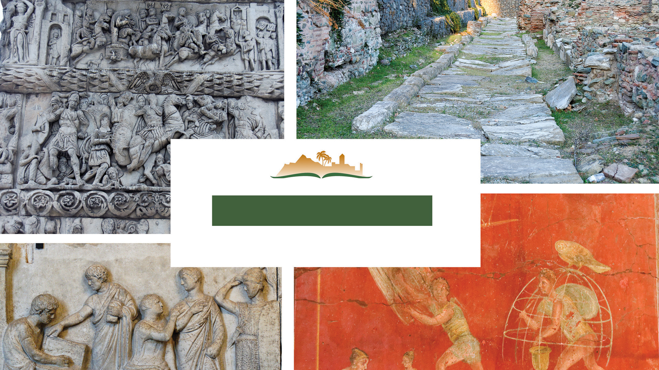
1 Thessalonians 5
Notes:
This is a free sample of the 1 Thessalonians 5 presentation from the Photo Companion to the Bible. To purchase the full volume, visit https://www.bibleplaces.com/thessalonians/
The Photo Companion to the Bible is an image-rich resource for Bible students, teachers, and researchers. Just as a librarian stocks the shelves with as many relevant materials as possible, so we have tried to provide a broad selection of images. Our goal is that you will find in this “library” whatever it is you are looking for.
Credits: The primary creators of this presentation are Christian Locatell, Kris Udd, Steven D. Anderson, and Todd Bolen. The photographs have an individual file code which usually includes the initials of the photographer. Other images have additional credit or source information.
Updates: We plan to update this collection as we are able. We welcome your suggestions for improving this resource (photocompanion@bibleplaces.com). Purchasers of the 1 & 2 Thessalonians volume are provided free, lifetime updates to the volume.
Copyright: This photo collection is protected by copyright law and may not be distributed without written permission from BiblePlaces.com. Slide notes should be treated as any other copyrighted written material, with credit given when quoting from these notes.
For more information, see our complete “Introduction to the Photo Companion to the Bible” online at https://www.BiblePlaces.com/Intro-Photo-Companion-Bible/. Here you will find more information about photo selection, explanatory notes, Bible translation, credit information, and copyright allowances.

Slide 2
1 Thessalonians 5
This is a free sample of the 1 Thessalonians 5 presentation from the Photo Companion to the Bible. To purchase the full volume, visit https://www.bibleplaces.com/thessalonians/
The Photo Companion to the Bible is an image-rich resource for Bible students, teachers, and researchers. Just as a librarian stocks the shelves with as many relevant materials as possible, so we have tried to provide a broad selection of images. Our goal is that you will find in this “library” whatever it is you are looking for.
For more details (for this and every slide), see the Notes section below.
Notes:
This is a free sample of the 1 Thessalonians 5 presentation from the Photo Companion to the Bible. To purchase the full volume, visit https://www.bibleplaces.com/thessalonians/
The Photo Companion to the Bible is an image-rich resource for Bible students, teachers, and researchers. Just as a librarian stocks the shelves with as many relevant materials as possible, so we have tried to provide a broad selection of images. Our goal is that you will find in this “library” whatever it is you are looking for.
Credits: The primary creators of this presentation are Christian Locatell, Kris Udd, Steven D. Anderson, and Todd Bolen. The photographs have an individual file code which usually includes the initials of the photographer. Other images have additional credit or source information.
Updates: We plan to update this collection as we are able. We welcome your suggestions for improving this resource (photocompanion@bibleplaces.com). Purchasers of the 1 & 2 Thessalonians volume are provided free, lifetime updates to the volume.
Copyright: This photo collection is protected by copyright law and may not be distributed without written permission from BiblePlaces.com. Slide notes should be treated as any other copyrighted written material, with credit given when quoting from these notes.
For more information, see our complete “Introduction to the Photo Companion to the Bible” online at https://www.BiblePlaces.com/Intro-Photo-Companion-Bible/. Here you will find more information about photo selection, explanatory notes, Bible translation, credit information, and copyright allowances.

Slide 3
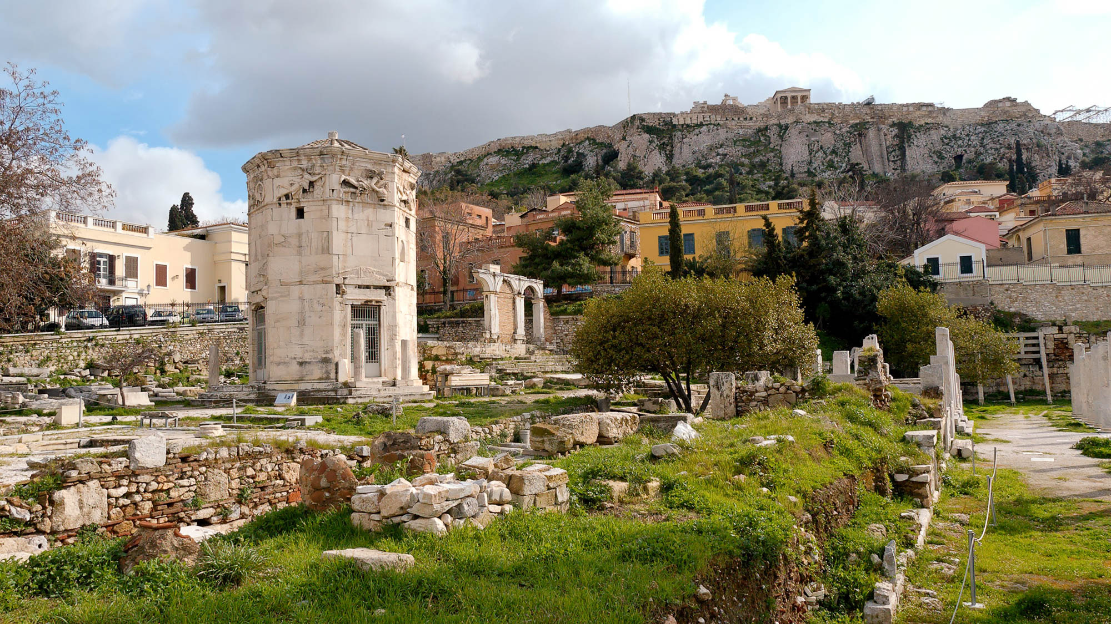
But concerning the times and the seasons, brothers . . .
Tower of the Winds in the Roman forum in Athens
5:1
Notes:
The word “time” (Gk. chronos, χρόνος) refers generally to the sequential occurrence of events. Paul’s specific reference, revealed in the following verse, is to the day of the Lord. Time was marked in the Greco-Roman world in a variety of ways. The Tower of the Winds, also called the Horologion of Andronikos Kyrrhestes, dates to the 2nd or 1st century BC and is located in the forum of Athens. This octagonal structure was used as a combination sundial, water clock, and weathervane. The tower was designed by the Macedonian astronomer, Andronikos Kyrrhestes. This sophisticated structure illustrates the ancients’ concern for tracing time.
tb030806108h

Slide 4
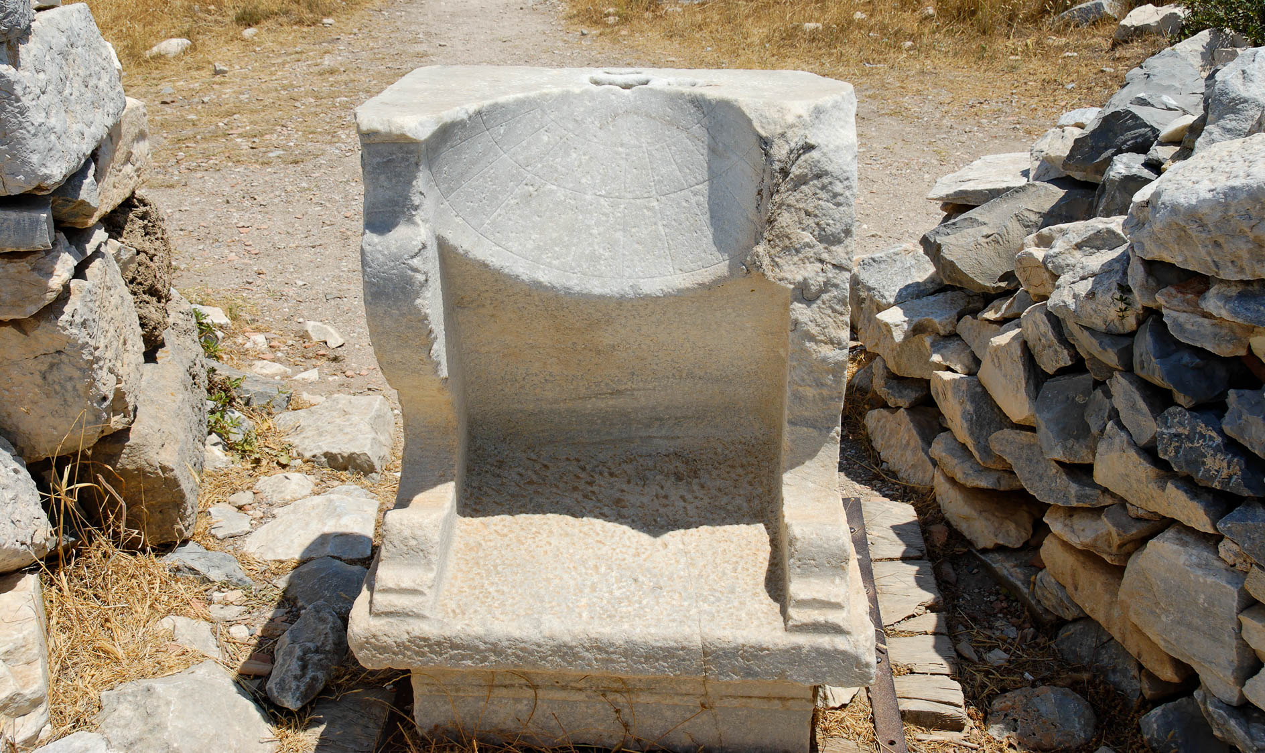
But concerning the times and the seasons, brothers . . .
Roman sundial at Cnidus
5:1
Notes:
Sundials were commonly used throughout the 1st century world to mark the various hours of the day. The typical Roman sundial consisted of a hemispherical bowl with lines incised within it. A short stick (gnomon) was attached to the top, projecting out over the bowl, and its shadow moved across the lines to indicate the time.
tb062206438h

Slide 5
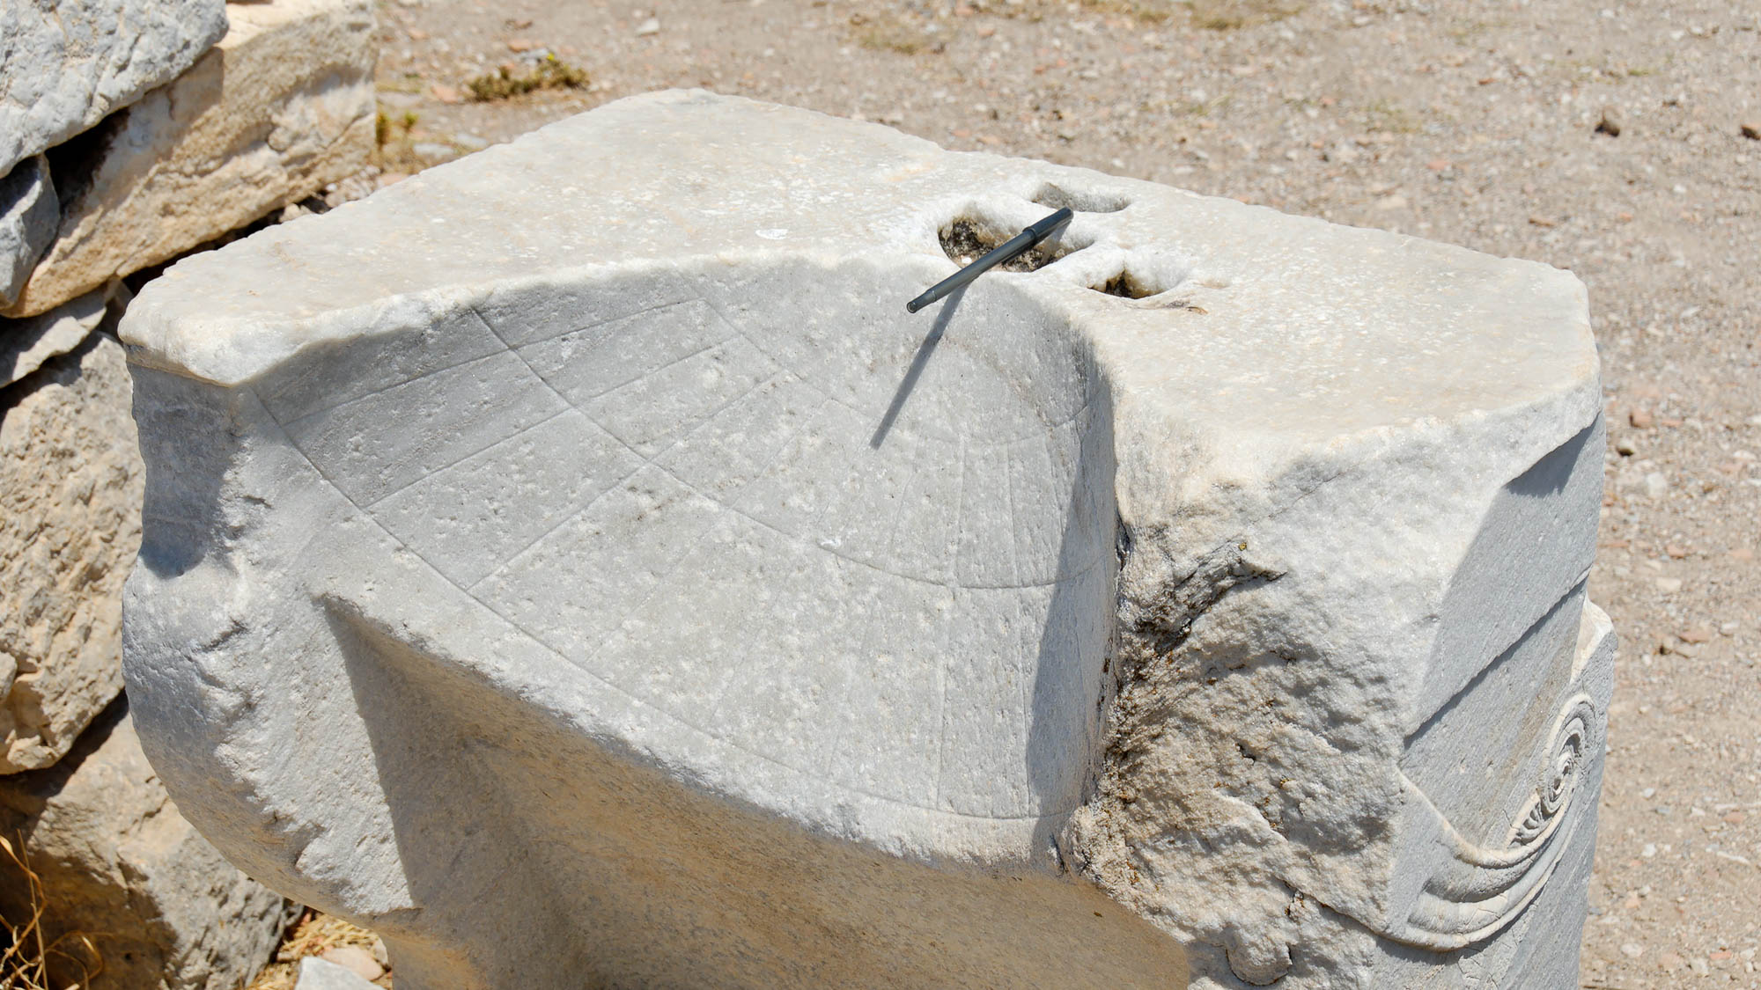
But concerning the times and the seasons, brothers . . .
Roman sundial at Cnidus
5:1
Notes:
This large sundial from Cnidus in southwestern Turkey has an ink pen placed atop it where the gnomon would have been placed.
tb062206444h

Slide 6
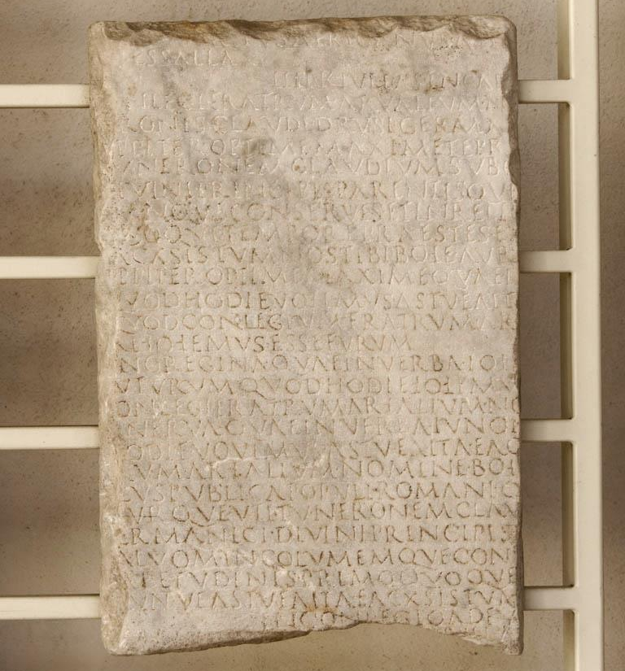
But concerning the times and the seasons, brothers . . .
Calendar from time of Claudius, from Rome, June of AD 54
5:1
Notes:
This calendar dates to approximately the time that Paul wrote 1 Thessalonians, and it includes vows for the health of the heir of Claudius, Nero. It was photographed at the National Museum at the Diocletian Baths in Rome.
tb0513178659

Slide 7
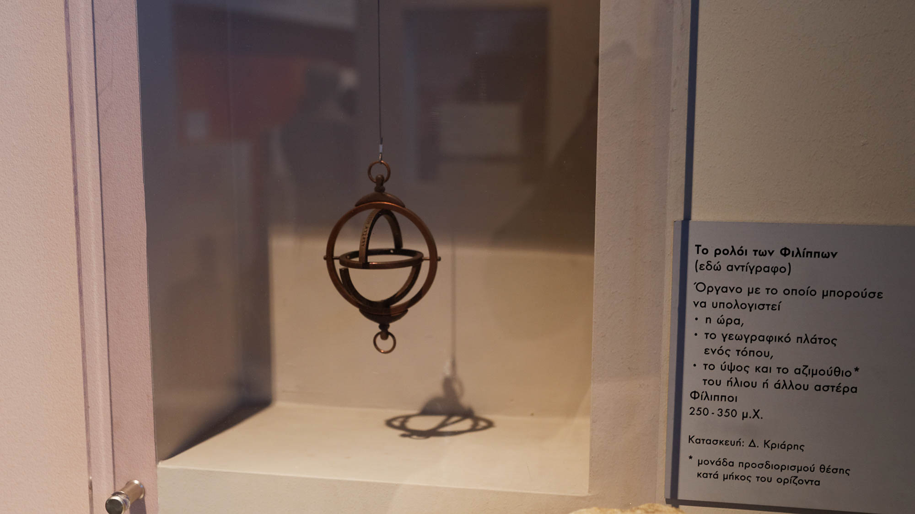
But concerning the times and the seasons, brothers . . .
Replica of the clock of Philippi (AD 250–350)
5:1
Notes:
The clock of Philippi was an instrument used to calculate time, latitude, and the position of the sun and stars in the sky. This replica was photographed in the Thessaloniki Archaeological Museum.
jc0107151510h

Slide 8
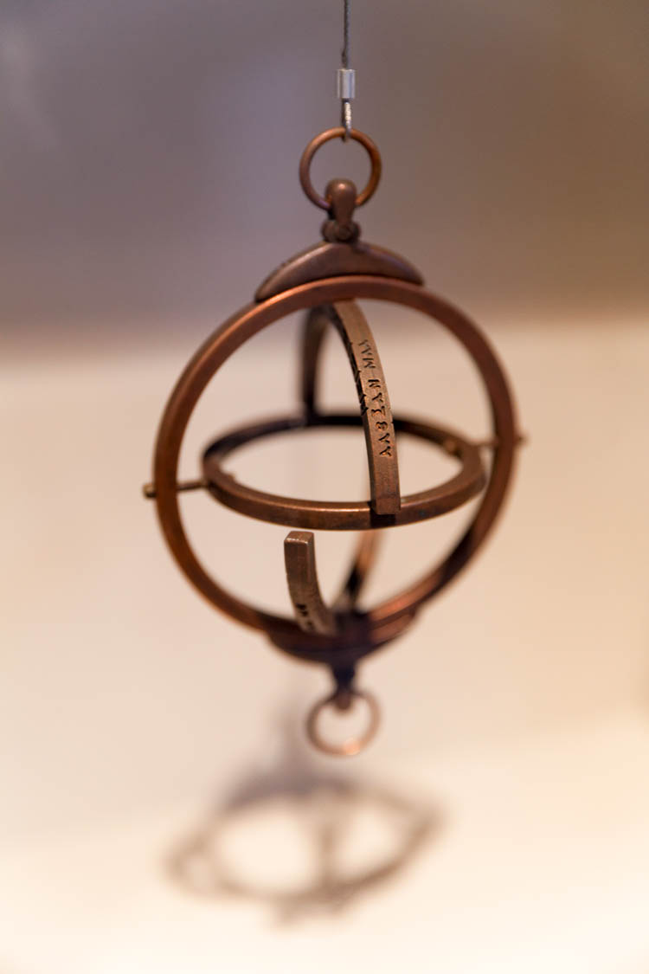
But concerning the times and the seasons, brothers . . .
Replica of the clock of Philippi (AD 250–350)
5:1
Notes:
This replica was photographed in the Thessaloniki Archaeological Museum.
jc0107151511

Slide 9
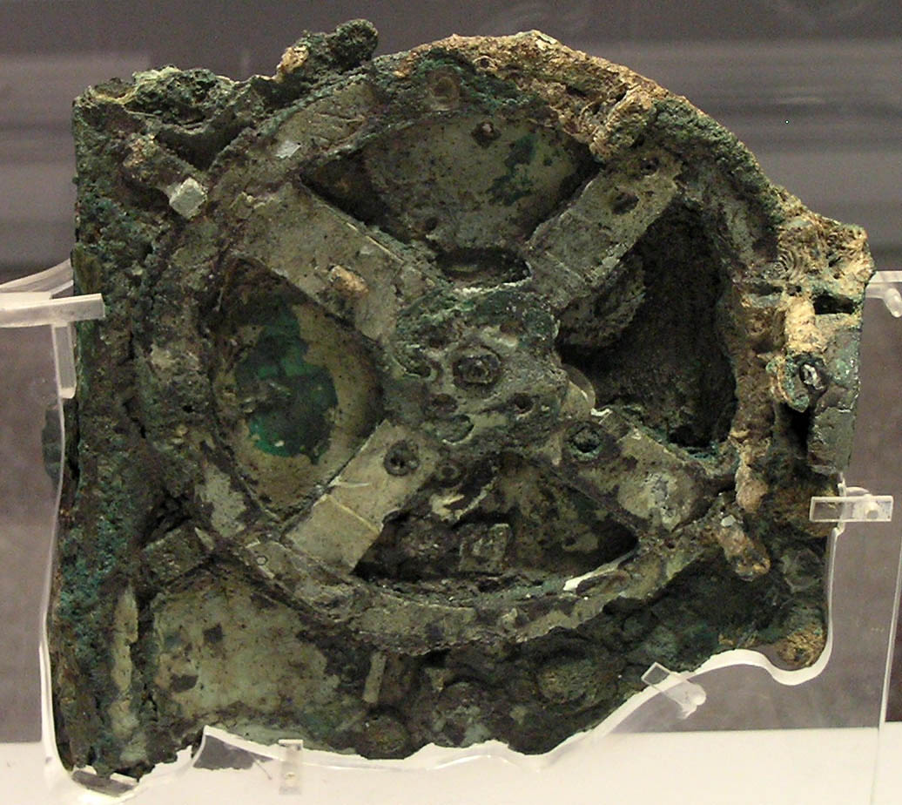
But concerning the times and the seasons, brothers . . .
Antikythera Mechanism, Fragment A, circa 130–70 BC
5:1
Notes:
The Antikythera Mechanism was an incredibly sophisticated analog computer that could calculate many different astronomical events. Detailed imaging of the mechanism suggests that it had 37 gear wheels, enabling it to calculate the movements of the moon and the sun through the zodiac, to predict eclipses, and even to model the irregular orbit of the moon. It was likely made by Hipparchus or Posidonius on the island of Rhodes. Its technology was later forgotten. The Antikythera Mechanism is on display at the National Archaeological Museum in Athens. This image comes from Marsyas and is licensed under CC BY-SA 3.0, via Wikimedia Commons: https://commons.wikimedia.org/wiki/File:NAMA_Machine_d%27Anticyth%C3%A8re_1.jpg
wiki122020051048h

Slide 10
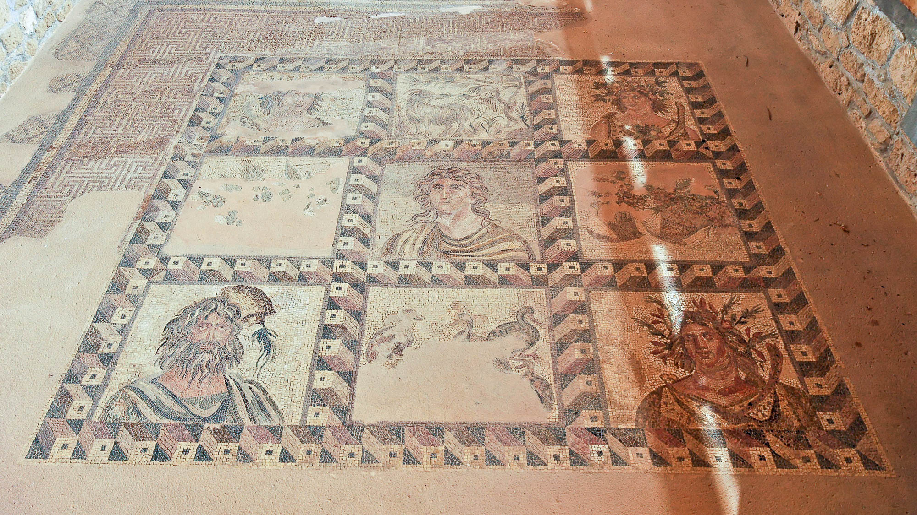
But concerning the times and the seasons, brothers . . .
Representation of the Four Seasons, Cyprus, 2nd century AD
5:1
Notes:
In Galatians 4:10, the same word “season” (Gk. kairos, καιρός) is used with reference to the four seasons of the year. Elsewhere it is used more generally to refer periods of time (e.g., 2 Tim 4:3; Eph 6:18) or especially to times of crisis (e.g., Mark 13:33; 1 Cor 4:5), which appears to be its intended meaning here as well. The four seasons of the year are represented at the four corners of this floor mosaic from the House of Dionysus at Paphos on the island of Cyprus. The figure in the lower left represents winter; moving clockwise the other corners represent spring, summer, and fall. The figure in the center has not been identified. By analogy, Paul states that the Thessalonian believers are well aware of the spiritual “seasons” that are approaching. This mosaic comes from the House of Dionysus, Room 3, in Paphos, Cyprus.
tb030505440h

Slide 11
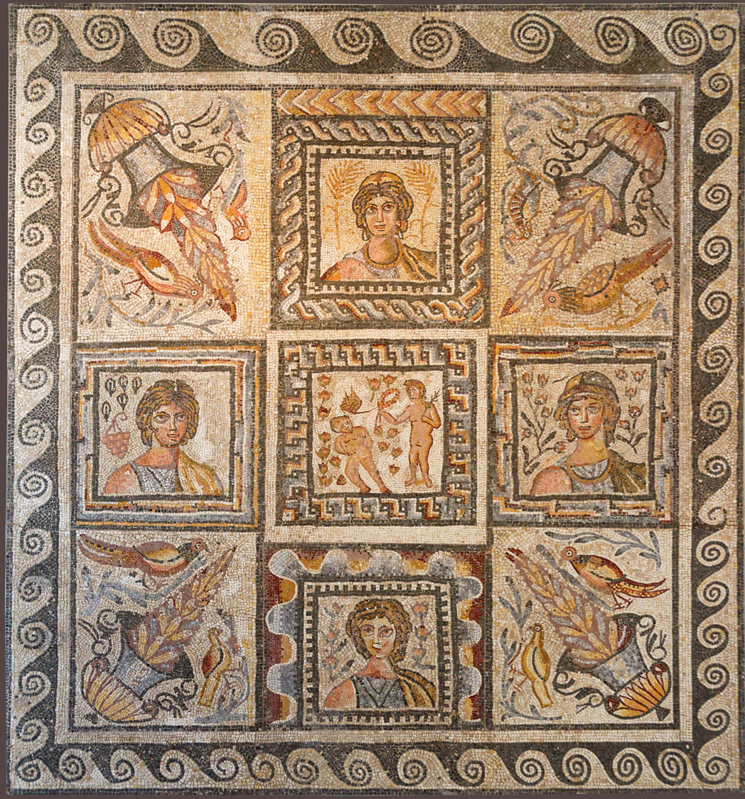
But concerning the times and the seasons, brothers . . .
Floor mosaic with representations of the four seasons, from Rome, 4th or 5th century AD
5:1
Notes:
This mosaic also represents the four seasons. The figure at the top represents summer; moving counter-clockwise the viewer encounters fall, winter, and spring. This mosaic may come from Le Capannelle on the Via Appia Nuova in Rome. It was photographed at the National Museum of Rome.
tb0513177881h

Slide 12
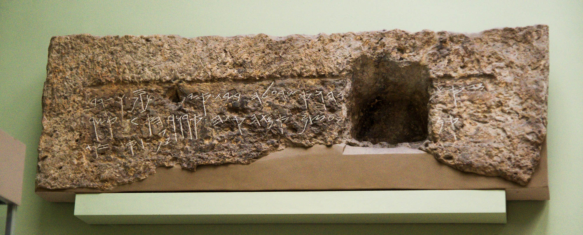
For you yourselves well know that the day of the Lord is coming as a thief in the night
Tomb lintel with a warning to thieves, from Jerusalem, 7th century BC
5:2
Notes:
It is well known that thieves prefer the cover of night for carrying out their nefarious activities. A common practice of ancient thieves was to rob graves, since sometimes valuable items were buried with the deceased. The inscription shown here, known as the Royal Steward Inscription, was taken from the stone over the entrance to a tomb in the Silwan neighborhood in the Kidron Valley, east of the Old City of Jerusalem. It reads, “This is [the tomb of …]-yahu who was over the house. There is no silver or gold [here, on]ly [his bones] and the bone[s of] his maidservant with him. Cursed is the man who would open this” (Aḥituv 2008: 44–48). From what can be seen of the name in this inscription (only the theophoric element “yahu”), it is quite possible that it refers to Shebeniah (Heb. ševanyahu, שְׁבַנְיָהוּ) mentioned in Isaiah 22:15 and 1 Chronicles 15:24 as the “steward” who is “over the house.”
Reference:
Aḥituv, Shmuel.
2008 Echoes from the Past. Jerusalem: Carta.
adr1305251347h

Slide 13
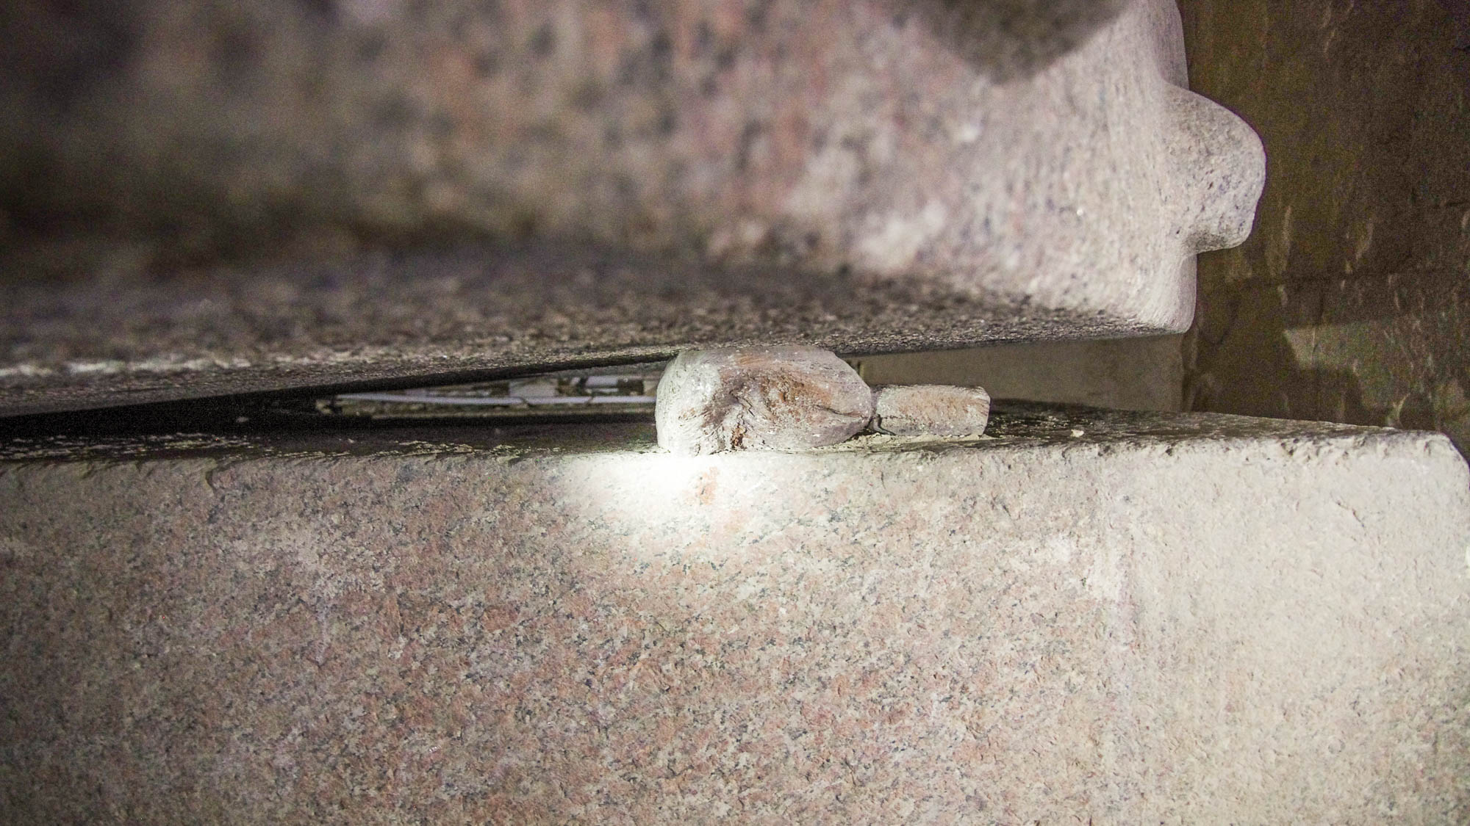
For you yourselves well know that the day of the Lord is coming as a thief in the night
Wooden mallet used by ancient tomb robbers to open a sarcophagus, Meidum, circa 2500 BC
5:2
Notes:
This illustrates the activities of ancient grave robbers, who pried open a coffin in Mastaba 17 at Meidum. The tomb was thoroughly robbed in antiquity, possibly by the very workmen that finished its construction. The sarcophagus weighs an estimated 8.5 tons (7.7 t), and the lid 3.5 tons (3.2 t), but it was pried off using a couple of mason’s mallets and an acacia branch.
adr1603173867h

Slide 14
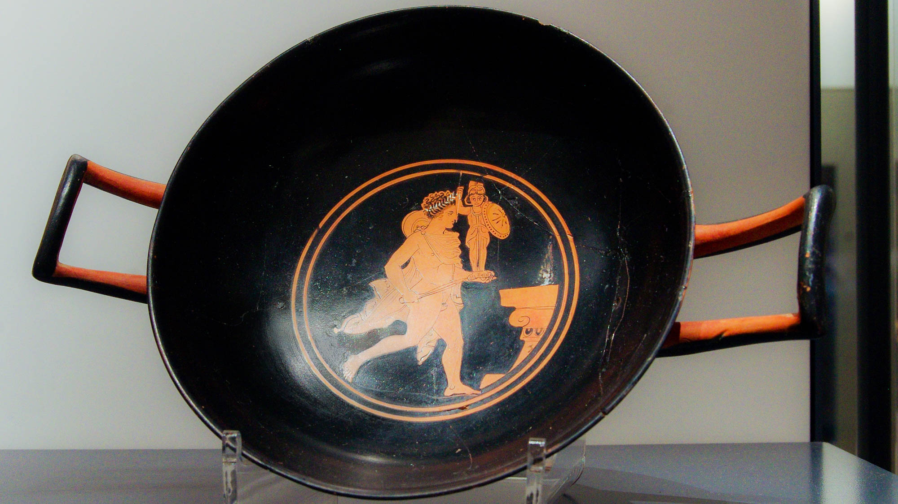
For you yourselves well know that the day of the Lord is coming as a thief in the night
Greek cup with Diomedes stealing Palladium during Trojan War
5:2
Notes:
The scene on this Greek drinking cup depicts one of the best-known thieves of antiquity, Diomedes, stealing an idol known as the Palladium (= Palladion) during the legendary Trojan War (which was believed to date over a millennia before Paul’s time). The Roman story is related in Virgil's Aeneid and in other works. This cup was photographed at the Ashmolean Museum at the University of Oxford.
adr130524985h

Slide 15
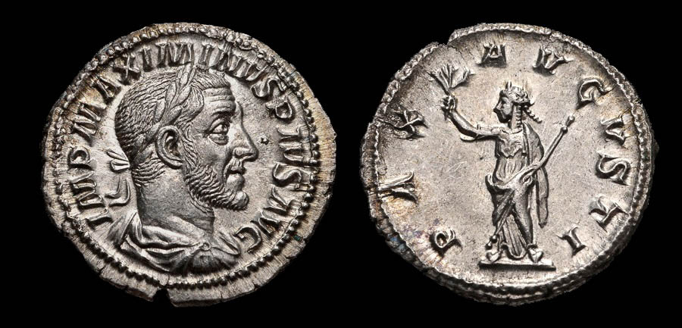
When they are saying, “Peace and safety,” then sudden destruction will overtake them
Silver denarius depicting the “Peace of Augustus,” Roman mint, AD 236
5:3
Notes:
It seems clear that here Paul is alluding to the similar warnings giving by the Old Testament prophets (e.g., Jer 6:14; 8:11; Ezek 13:10). However, it is hard to imagine that this would not also bring to mind the boast of peace perpetuated throughout the Roman empire at this time. The Romans had great pride in the Pax Romana (“Roman Peace”), a period of relative peace beginning with the reign of Augustus (27 BC – AD 14). The coin shown here illustrates the importance of peace to the Romans. The obverse depicts the Roman emperor Maximinus I and reads “Imperator Maximinus Pius Augustus” (IMP MAXIMINUS PIUS AUG). The reverse depicts a figure with a laurel wreath, draped, and wearing a cuirass, holding an olive branch and scepter. It reads “Peace of Augustus” (PAX AUGUSTI). According to Paul, such peace would not last. This image comes from Classical Numismatic Group and is licensed under CC-BY-SA-2.5, via Wikimedia Commons: https://commons.wikimedia.org/wiki/File:MAXIMINUS_I-RIC_IV_12-876901.jpg
wiki876901b

Slide 16
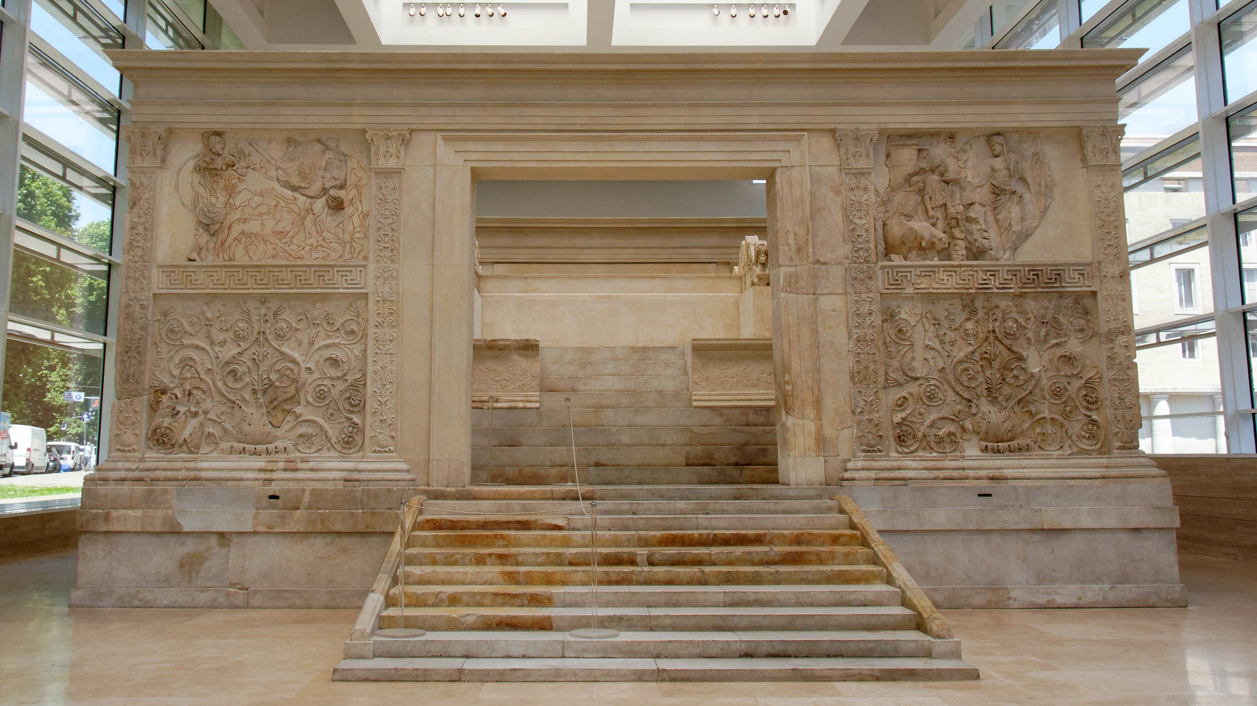
When they are saying, “Peace and safety,” then sudden destruction will overtake them
Western side of the Ara Pacis Augustae
5:3
Notes:
On January 30, 9 BC, the citizens of Rome dedicated the altar pictured here to Pax, the goddess of peace. It was built in honor of the emperor Augustus. Every year, a ram and two oxen would be sacrificed on the altar. It was originally located on the northern outskirts of Rome. Situated on a former flood plain of the Tiber River, it was gradually buried under 13 feet (4 m) of silt. Built to celebrate the national peace brought about by Augustus, it demonstrates the value the Romans placed on peace. However, such boasts of peace would not ultimately succeed.
tb0518173867h

Slide 17
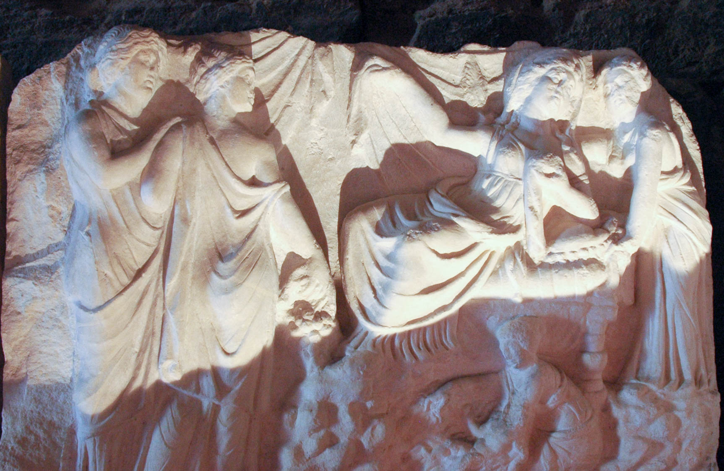
As the birth pains of a woman with child, and they shall certainly not escape
Relief of the Birth of Apollon, decorative element from a theater, 2nd century AD
5:3
Notes:
The emphasis of Paul’s metaphor is the quickness and perhaps unexpectedness of the coming day of the Lord. Just as birth pains come suddenly at the appointed time, so Paul states that destruction will come suddenly on those who do not know the Lord. This relief was photographed at the Hierapolis Museum in Turkey.
tb041305039h

Slide 18
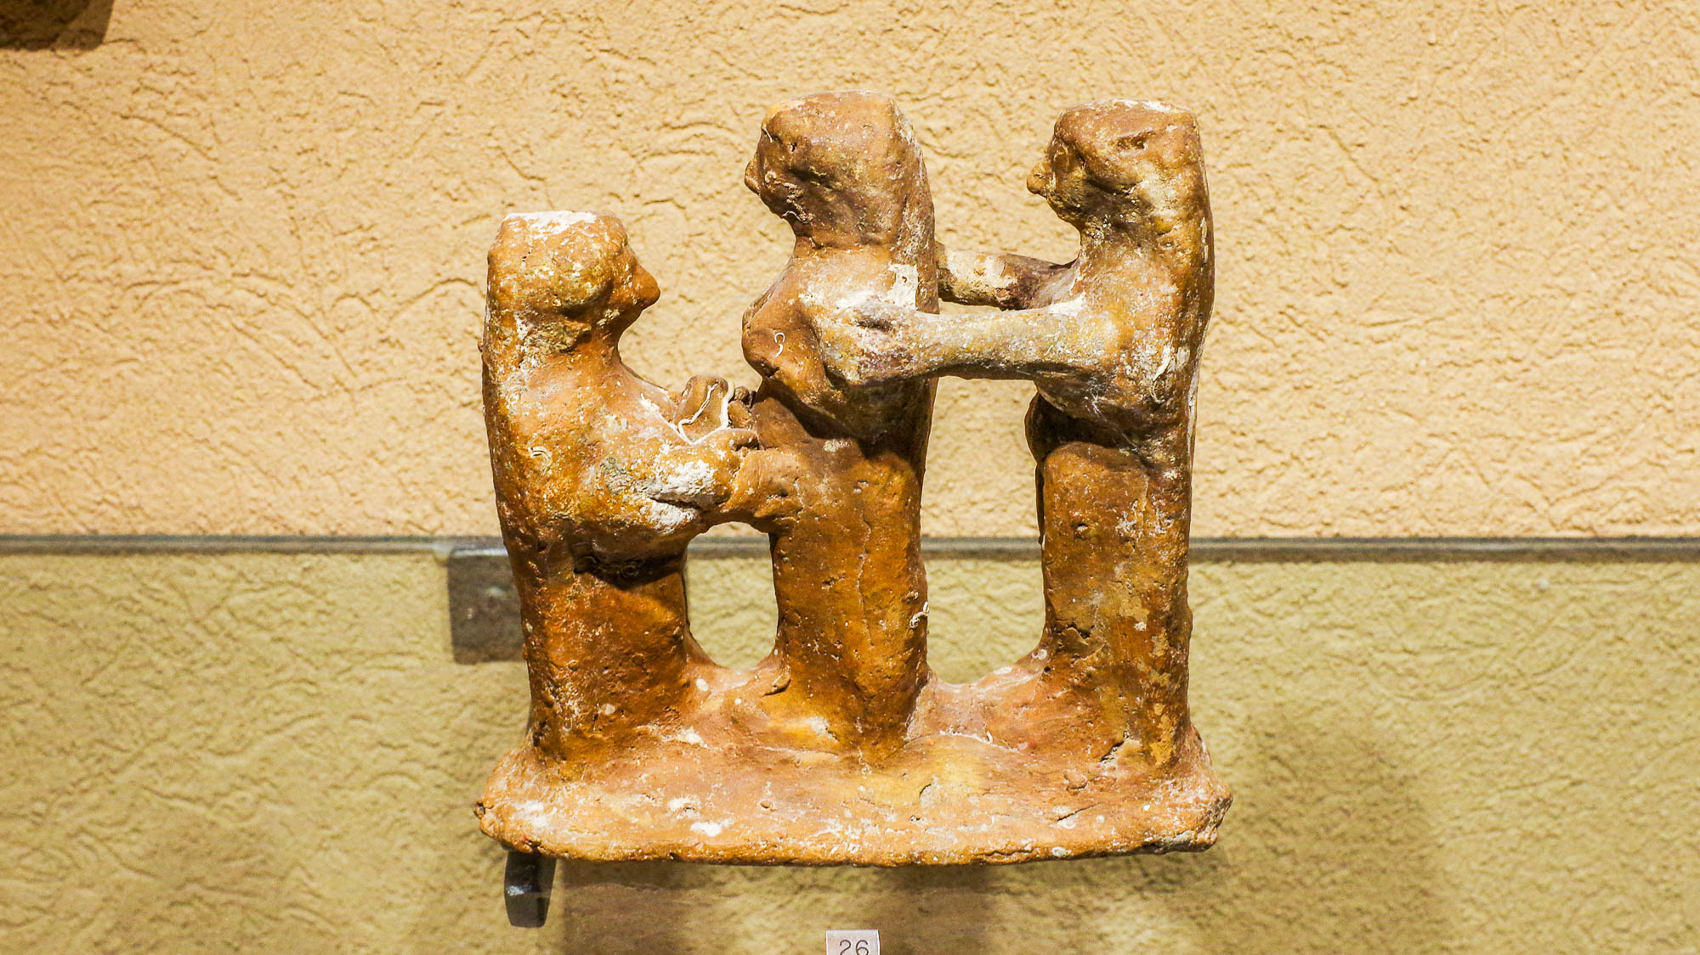
As the birth pains of a woman with child, and they shall certainly not escape
Midwives with a woman giving birth, from off the Phoenician coast, 6th–5th centuries BC
5:3
Notes:
This clay model was photographed at the Hecht Museum at the University of Haifa.
adr1805228348h

Slide 19
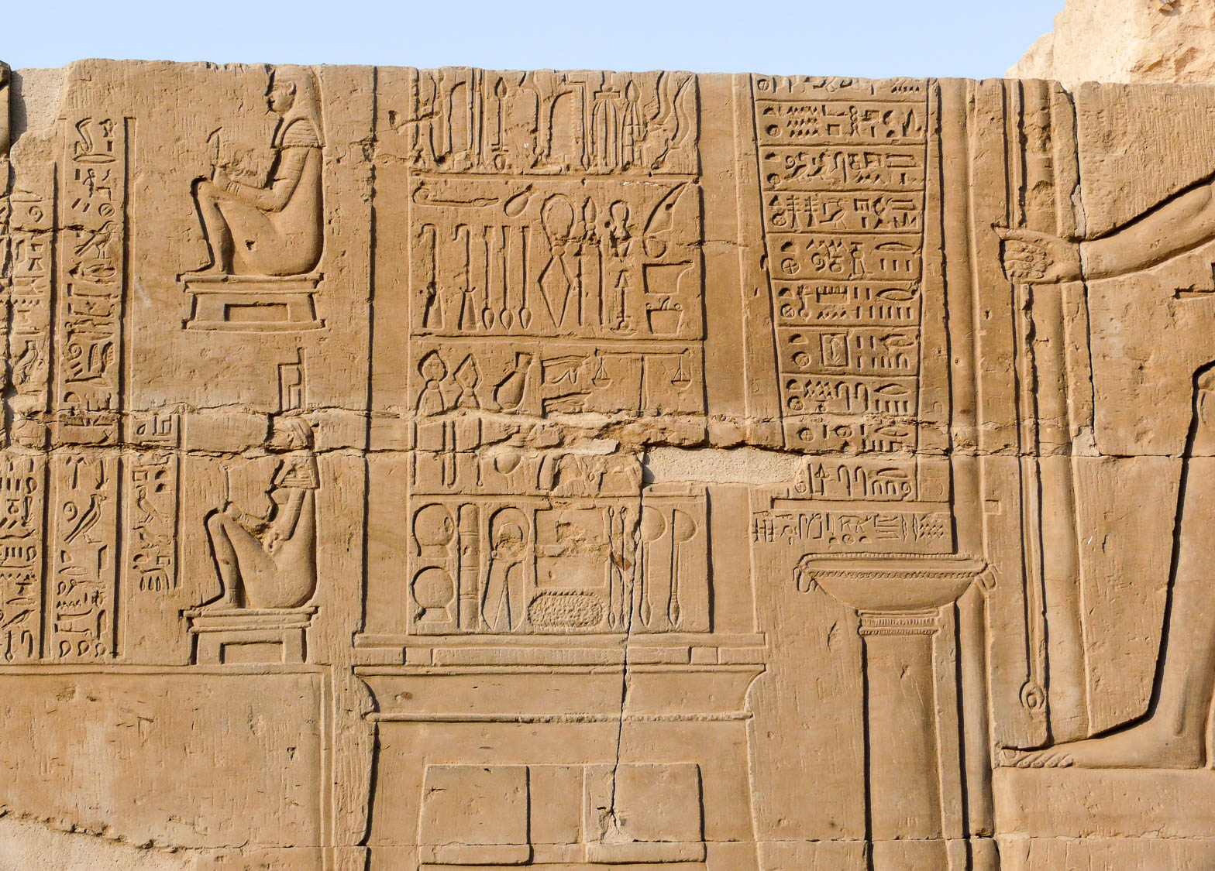
As the birth pains of a woman with child, and they shall certainly not escape
Depiction of women on birthing stools, from Kom Ombo, circa 332–30 BC
5:3
Notes:
This relief dates to the Ptolemaic period. This image was taken by Ad Meskens and is licensed under CC-BY-SA-3.0, via Wikimedia Commons, https://commons.wikimedia.org/wiki/File:Kom_Ombo_Temple_Surgical_instruments.JPG.
wiki080620113648h

Slide 20
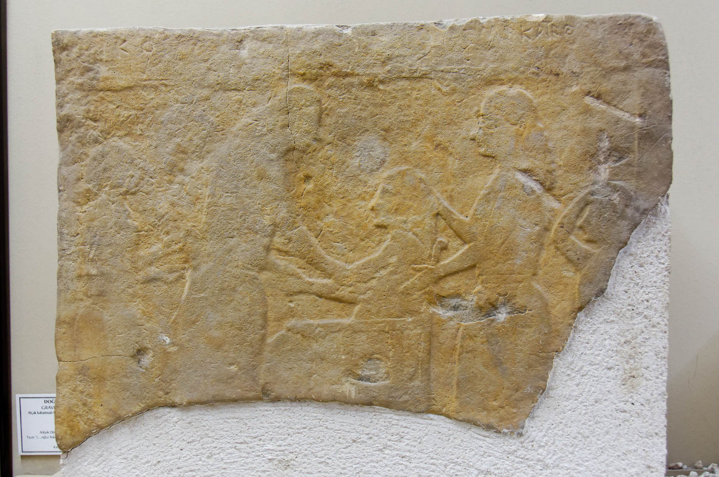
As the birth pains of a woman with child, and they shall certainly not escape
Gravestone with a birth scene, from Yeldegirmeni, 6th century BC
5:3
Notes:
This marble relief was photographed at the Istanbul Archaeological Museum.
tb122916541h

Slide 21
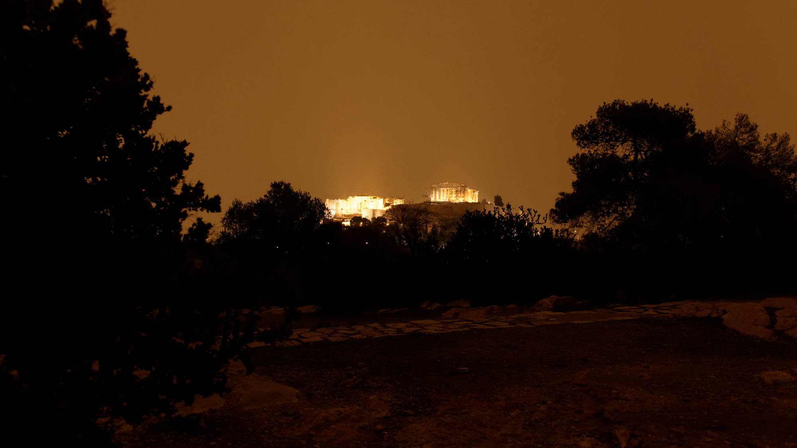
You, brothers, are not in darkness
Athens acropolis at night
5:4
Notes:
This photo shows the acropolis at Athens at night. The ancient structures are illuminated by artificial light, as is the whole night sky (modern Athens has a population of over three million).
tb010917670h

Slide 22
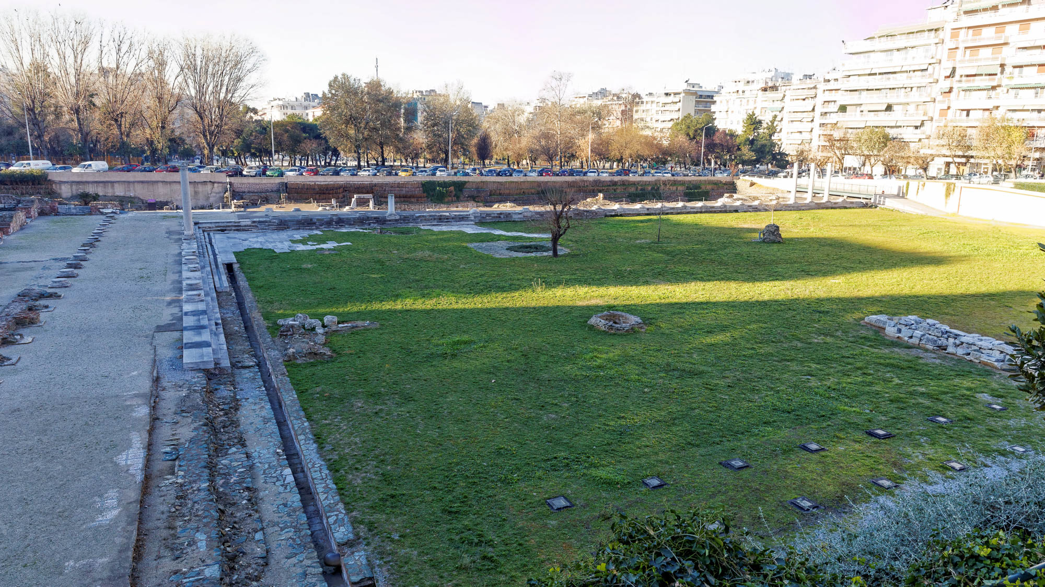
You, brothers, are not in darkness, that the day should overtake you like a thief
Sunlight splitting shadows in the agora at Thessalonica
5:4
Notes:
jc0107151445h

Slide 23
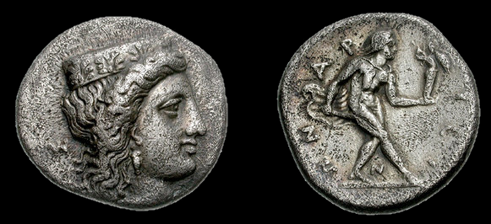
You, brothers, are not in darkness, that the day should overtake you like a thief
Greek drachma with a depiction of the thief Diomedes stealing the Palladium, circa 370–350 BC
5:4
Notes:
This silver drachma depicts the thief Diomedes stealing the Palladium. The obverse (left) shows the head of Hera wearing a stephane (crown) ornamented with palmettes, and single-pendant earring. The reverse depicts Diomedes, nude but for a chlamys (a short cloak worn around the neck), holding a dagger and carrying the Palladium. His stance indicates the surreptitious way in which he stole the wooden idol. This image comes from CNGCoins and is used by permission. Source: https://www.cngcoins.com/photos/big/790016.jpg
cng7900016

Slide 24
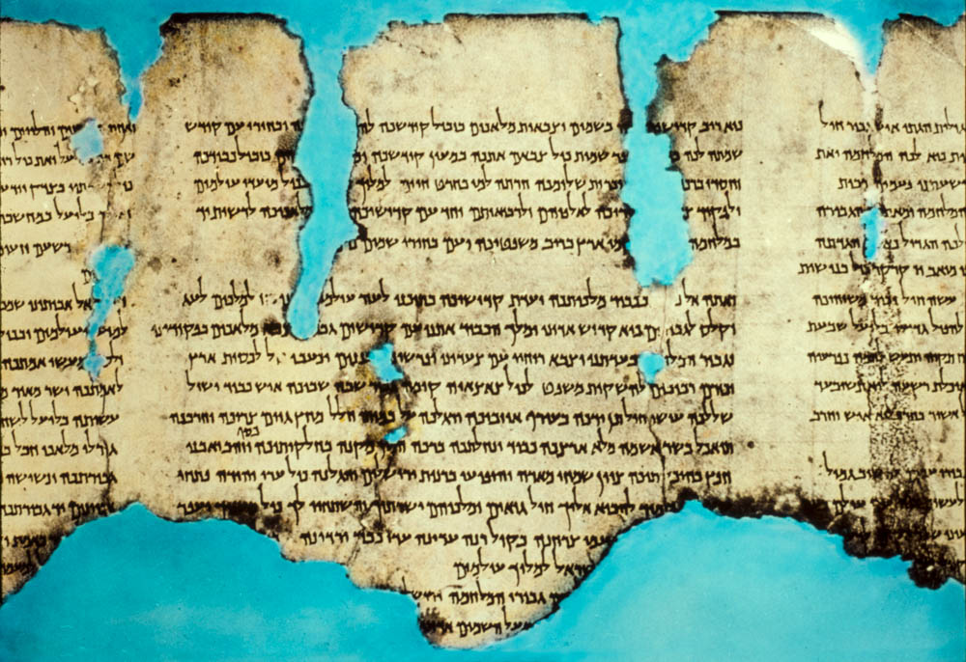
For you are all sons of light and sons of the day. We are neither of the night nor of darkness
Dead Sea Scroll, War of the Sons of Light against the Sons of Darkness, 1st century BC or AD
5:5
Notes:
This is a photograph of column 12 of the so-called War Scroll (1QM) found in Cave 1 near Qumran. It is also referred to as the “Rule of the War between the Sons of Darkness and the Sons of Light” because it describes an end-days battle between the sons of light and the sons of darkness. The use of the metaphors of light and darkness to describe good and evil is pervasive throughout Scripture (e.g., Isa 9:2; Luke 11:36; 1 John 1:5) and can be seen among Jewish sects of Paul’s day in documents like the one shown here. The phrase “Prince of light” (Heb. sar ma’or, שר מאור) is visible in column 13 near the bottom left side of the photo. This is a reference to a God-appointed leader of the forces of light against those of darkness. The next slide highlights this. This American Colony photograph was taken around 1948.
mat22899

Slide 25
For you are all sons of light and sons of the day. We are neither of the night nor of darkness
Dead Sea Scroll, War of the Sons of Light against the Sons of Darkness, 1st century BC or AD
5:5
Notes:
This is a photograph of column 12 of the so-called War Scroll (1QM) found in Cave 1 near Qumran. It is also referred to as the “Rule of the War between the Sons of Darkness and the Sons of Light” because it describes an end-days battle between the sons of light and the sons of darkness. The use of the metaphors of light and darkness to describe good and evil is pervasive throughout Scripture (e.g., Isa 9:2; Luke 11:36; 1 John 1:5) and can be seen among Jewish sects of Paul’s day in documents like the one shown here. The phrase “Prince of light” (Heb. sar ma’or, שר מאור) is visible in column 13 near the bottom left side of the photo. This is a reference to a God-appointed leader of the forces of light against those of darkness. This American Colony photograph was taken around 1948.
mat22899

Slide 26
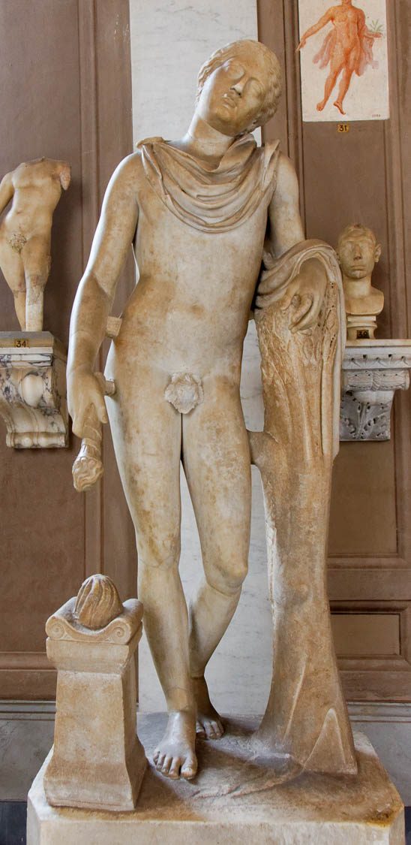
So then let us not sleep as do the rest
Statue of Thanatos, portrayed in eternal sleep, early 2nd century AD
5:6
Notes:
This statue is from the so-called Villa of Cassius near Tivoli and was photographed at the Vatican Museums. A removable graphic has been added to this photo to avoid causing surprise or offense.
tb0512176970

Slide 27
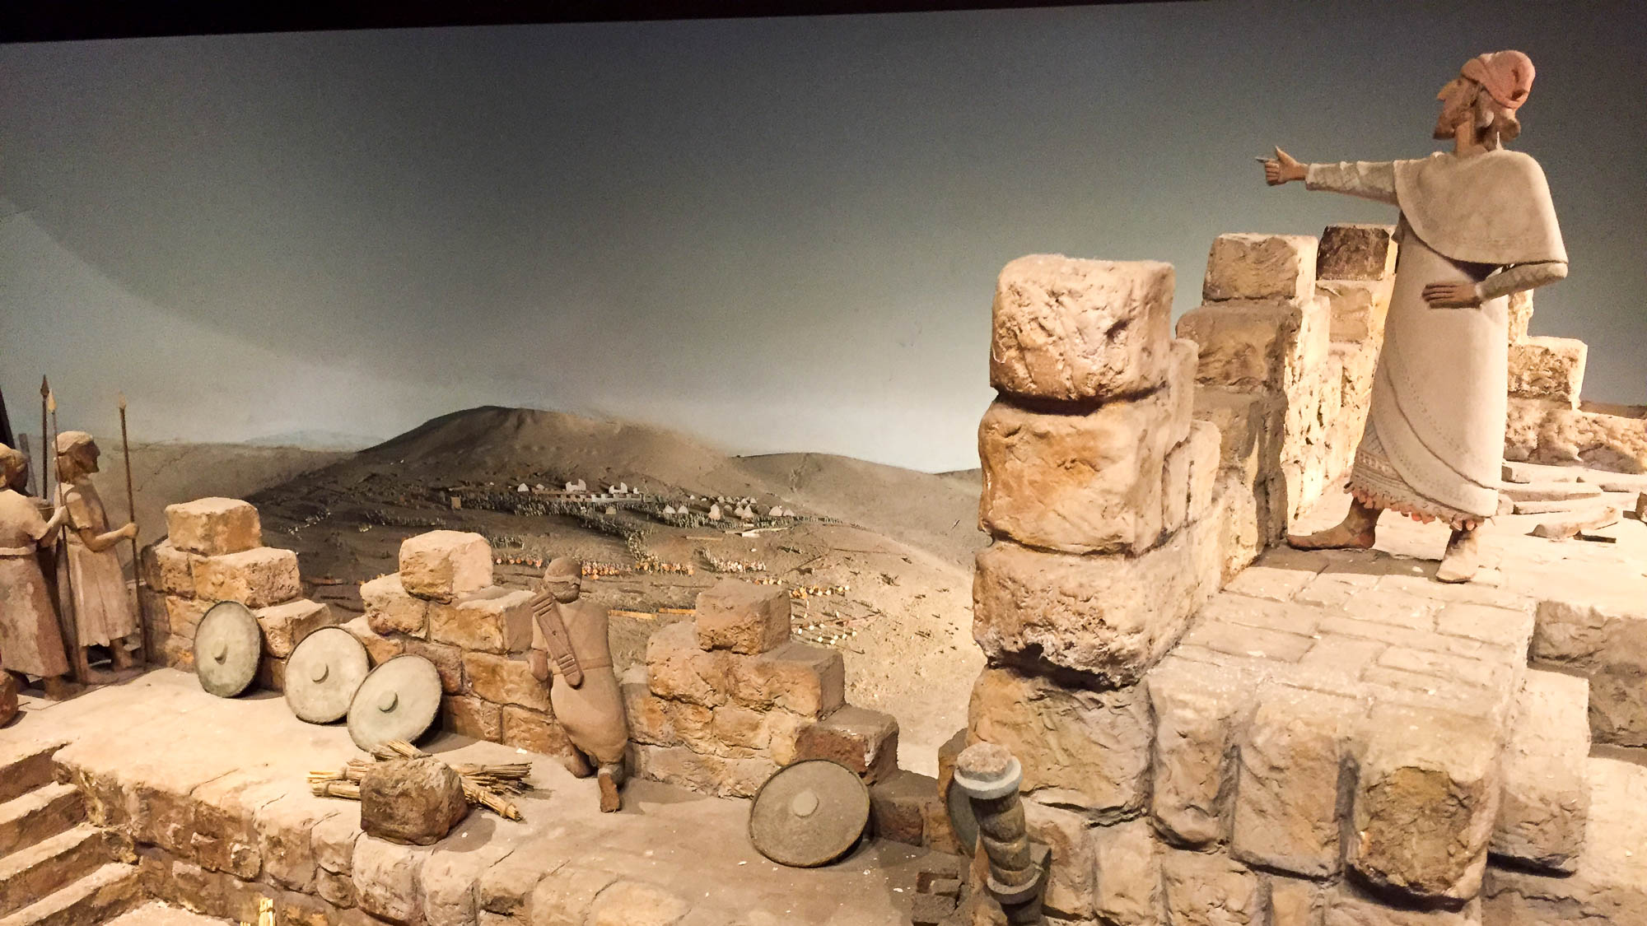
So then let us not sleep as do the rest, but let us watch and be sober
Model of watchmen on Jerusalem’s walls and an approaching Assyrian army
5:6
Notes:
A city watchman was tasked with alerting the city to any threat. It was especially important that they remain diligently watchful at night when the city was vulnerable to a surprise attack. This model depicts the approaching Assyrian army and illustrates the fortification projects of Hezekiah against impending Assyrian invasion (2 Chr 32:5). Paul here says that we must likewise watch for the return of Christ, which will be welcomed by believers, but will overtake unbelievers in judgment. This model was photographed at the Tower of David Museum in Jerusalem.
cl080218962h

Slide 28
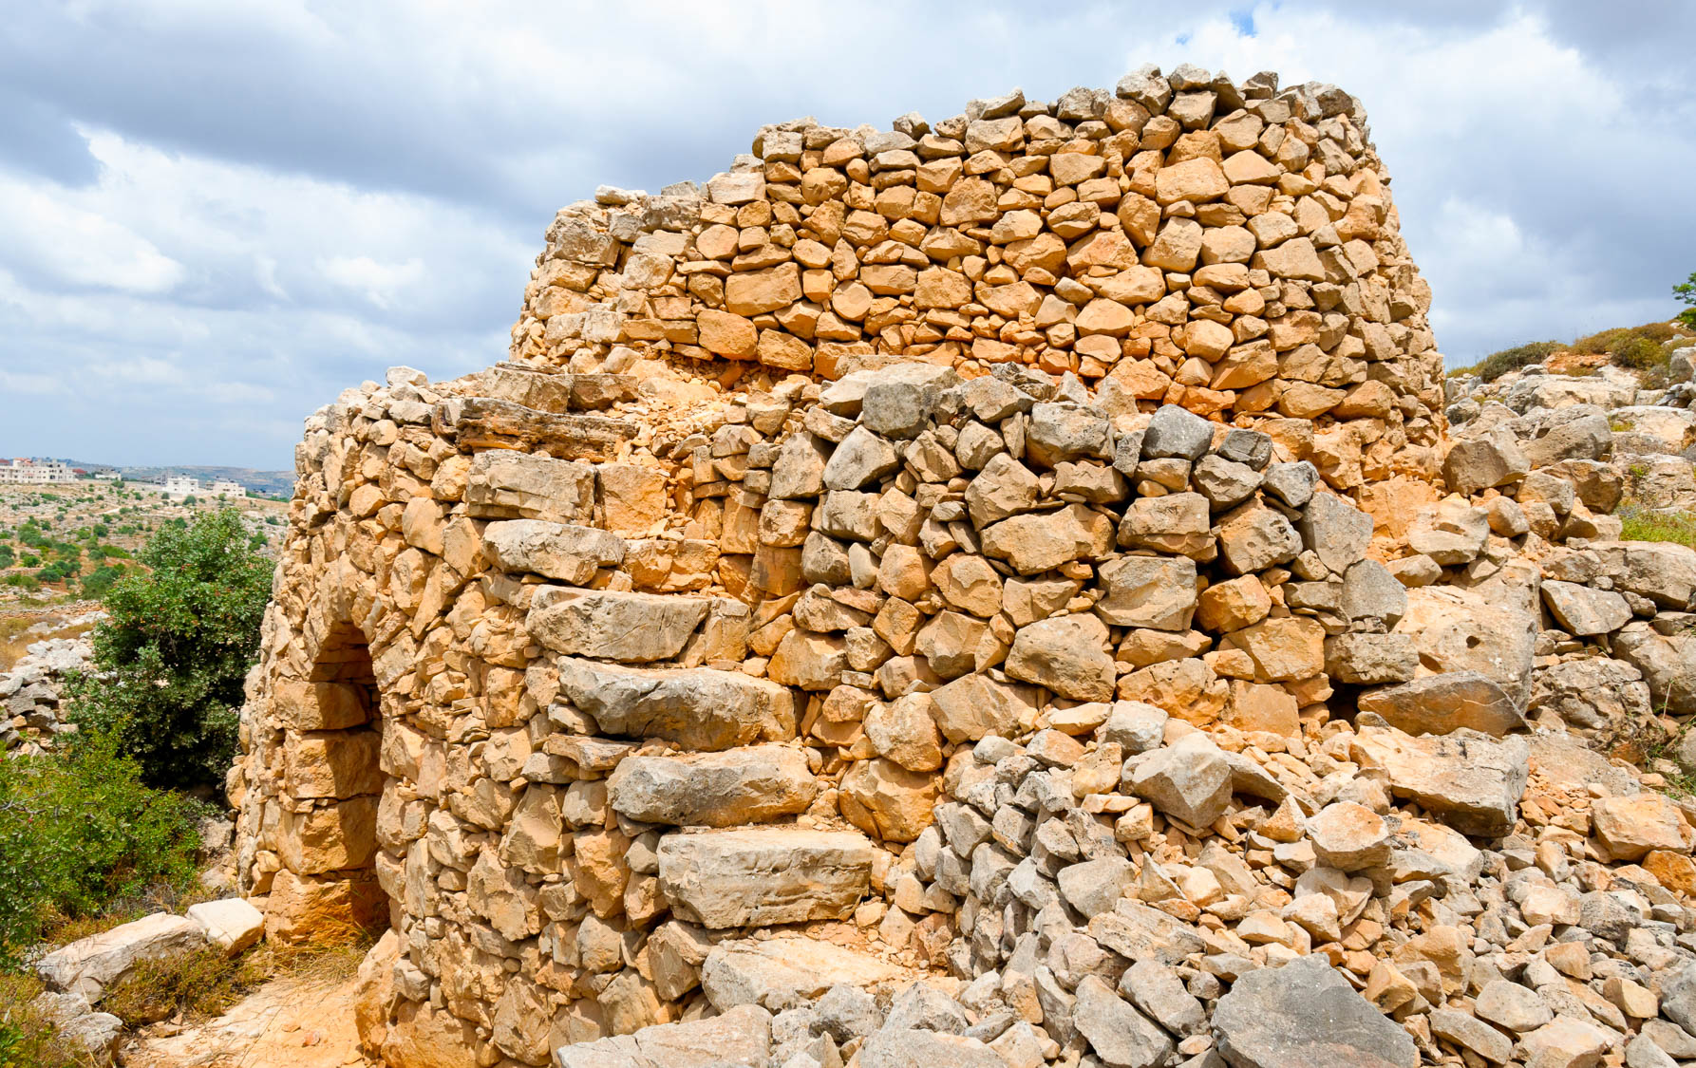
So then let us not sleep as do the rest, but let us watch and be sober
Watchtower near Baal Hazor
5:6
Notes:
From a tower like this one at Baal Hazor, a watchman would keep a lookout to protect the city from danger.
tb052916349h

Slide 29
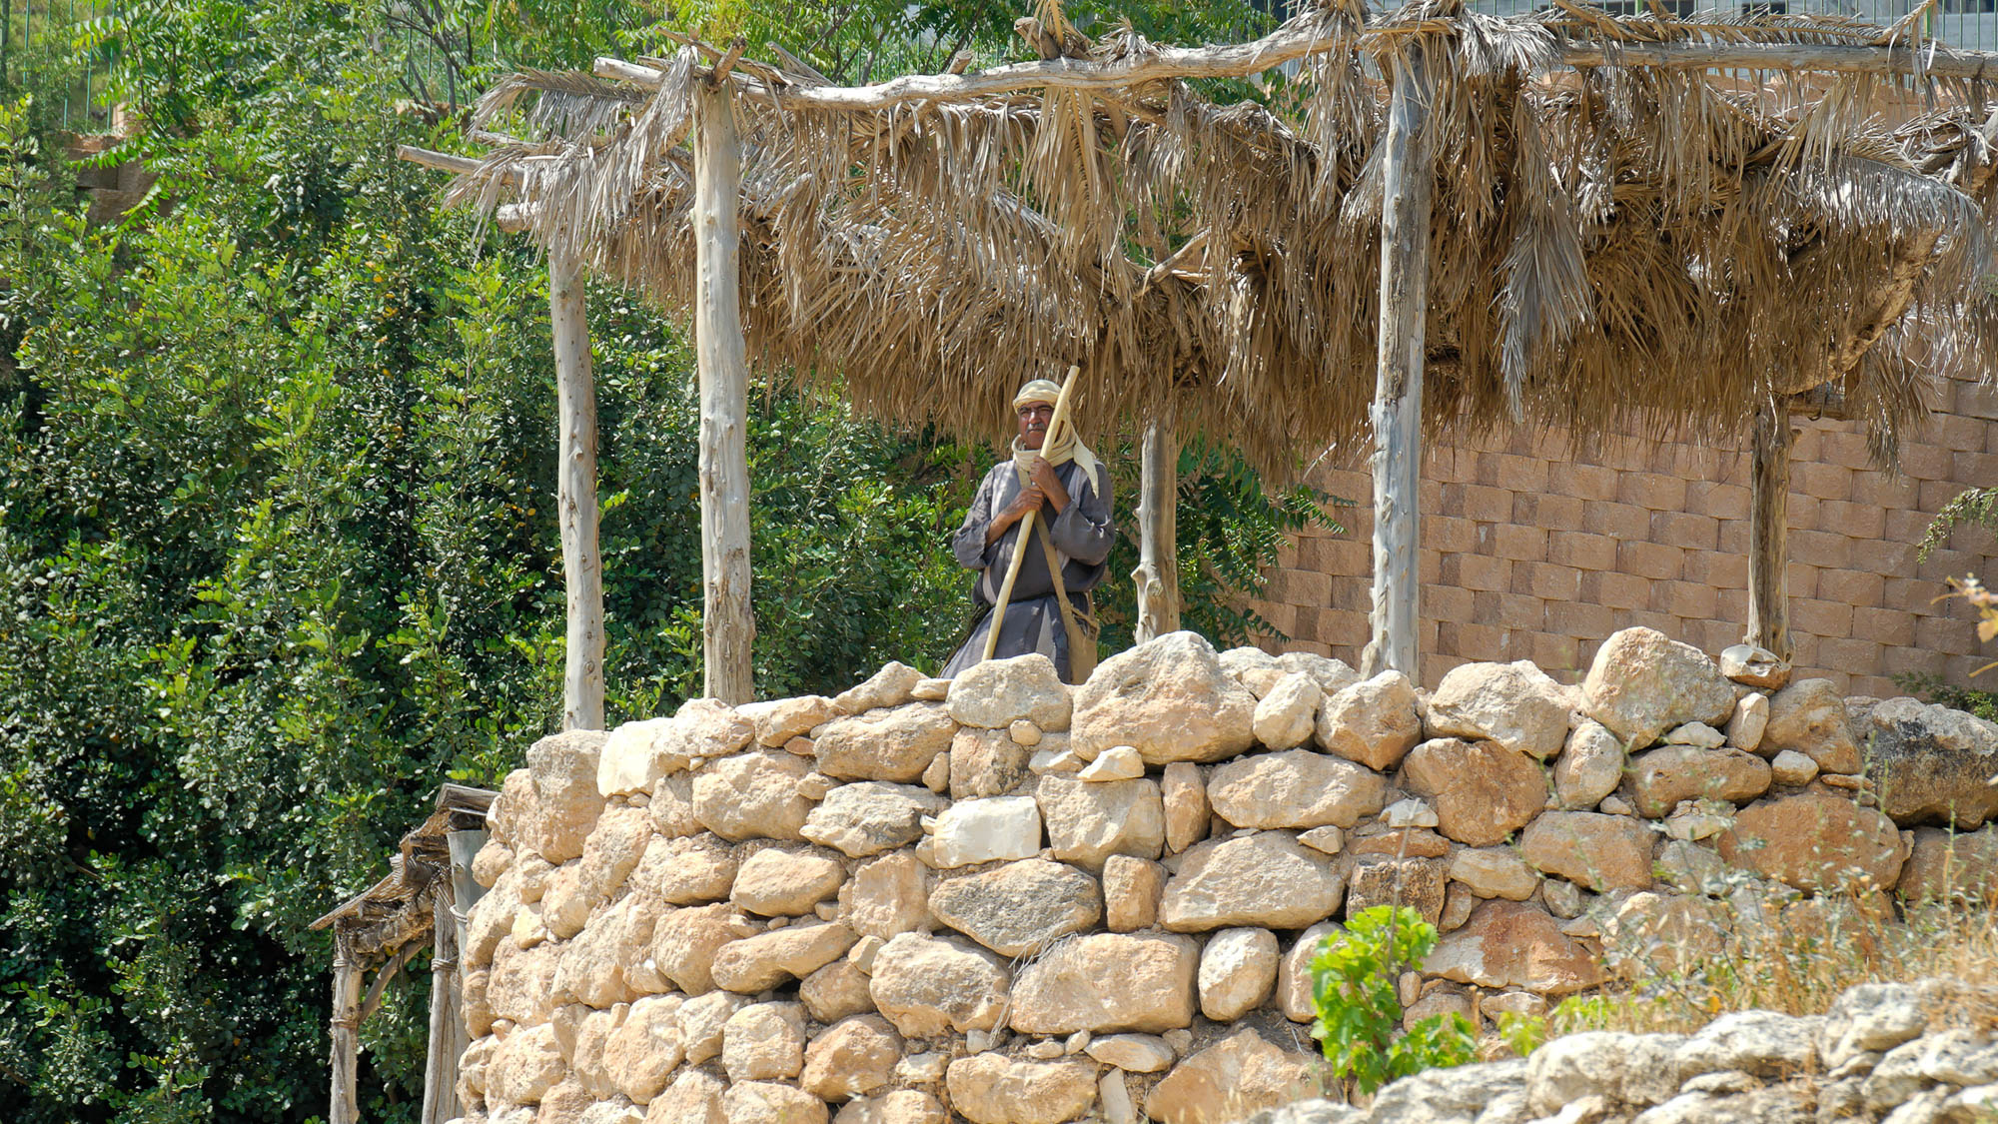
So then let us not sleep as do the rest, but let us watch and be sober
Shepherd on a watchtower at Nazareth Village
5:6
Notes:
tb052608481

Slide 30
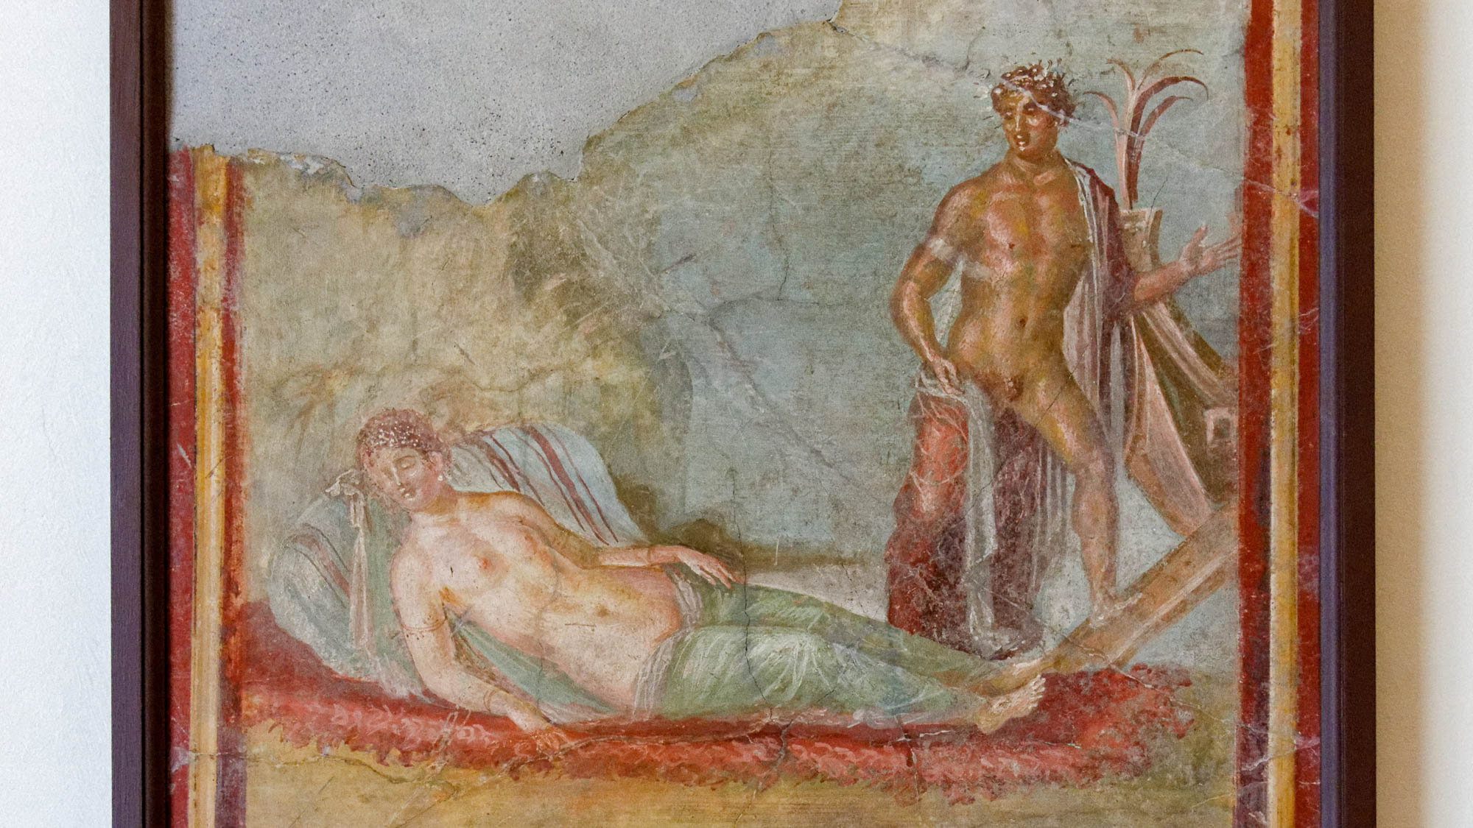
For those who sleep sleep at night
Fresco of Ariadne sleeping on seaweed, with Theseus sailing to Athens, 1st century AD
5:7
Notes:
Sleeping is an essential part of everyday life. However, via the association of night with sleep, Paul extends the night = evil metaphor to include sleep = evil and alert = good. This fresco comes from the House of Colored Capitals in Pompeii and was photographed at the Naples Archaeological Museum. (Note: Using small caps is the standard convention in literature on conceptual metaphor to represent the “source” and “goal” concepts in the metaphor. It marks off those terms as not simply words in the text but components of a conceptual metaphor.)
tb0515170214h

Slide 31
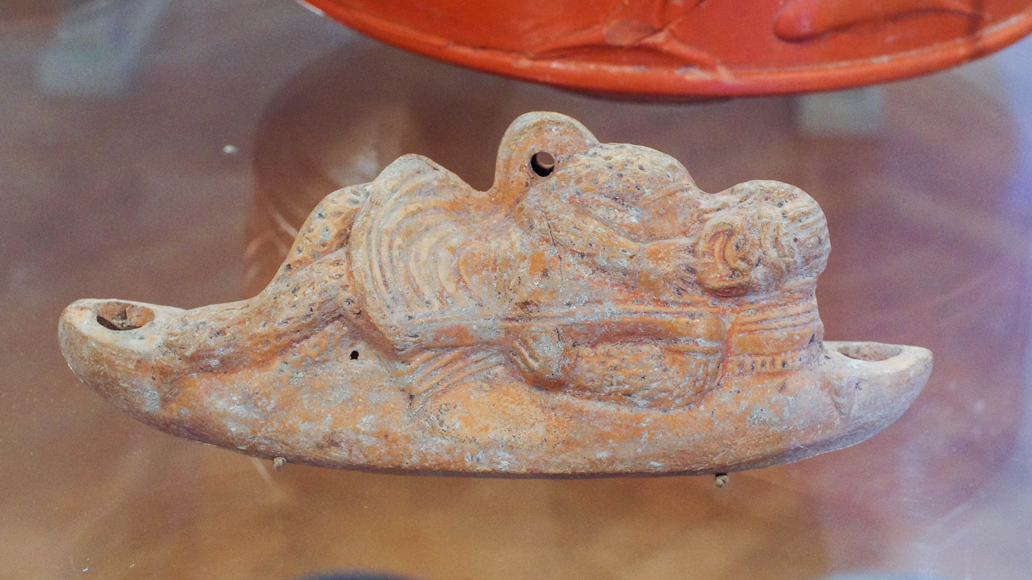
For those who sleep sleep at night
Roman hanging lamp with a sleeping comic actor, 2nd century AD
5:7
Notes:
This was photographed at the Johns Hopkins Archaeological Museum.
adr1711139147h

Slide 32
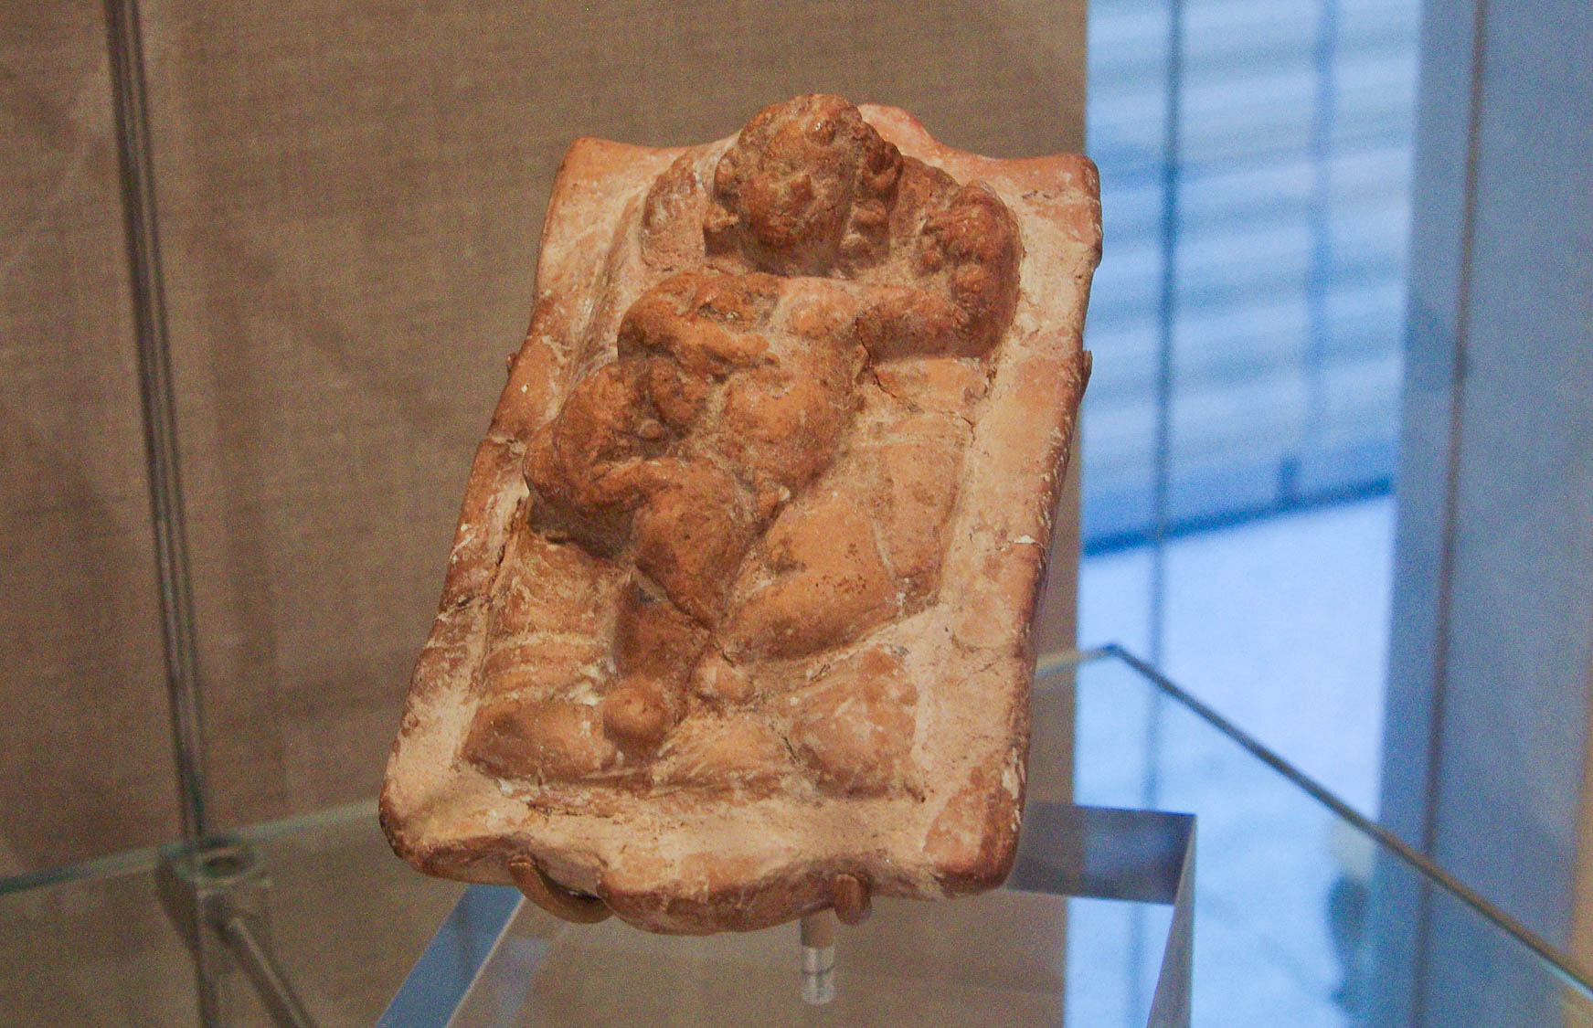
For those who sleep sleep at night
Greco-Roman figurine of a child sleeping with a dog, 1st century BC – 4th century AD
5:7
Notes:
This terracotta figurine was photographed at the The Metropolitan Museum of Art in New York City.
adr1311223955h

Slide 33
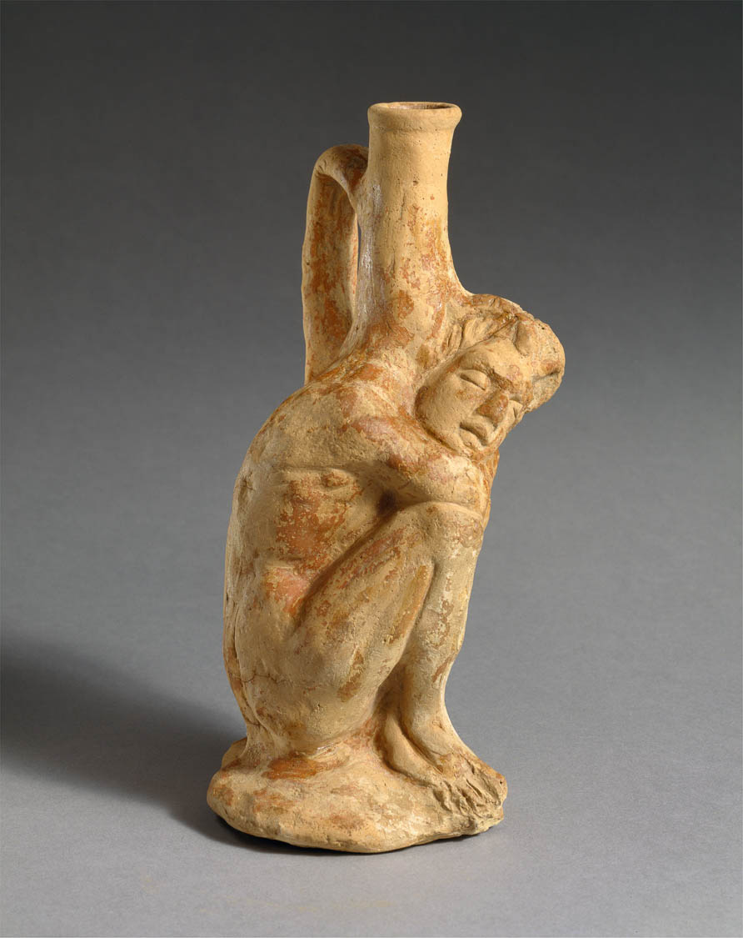
For those who sleep sleep at night
Vase in the form of a sleeping African boy, possibly from Cyprus, circa 3rd–2nd centuries BC
5:7
Notes:
This image of a terracotta vase comes from The Metropolitan Museum of Art and is in the public domain. Source: https://www.metmuseum.org/art/collection/search/241816.
met241816

Slide 34
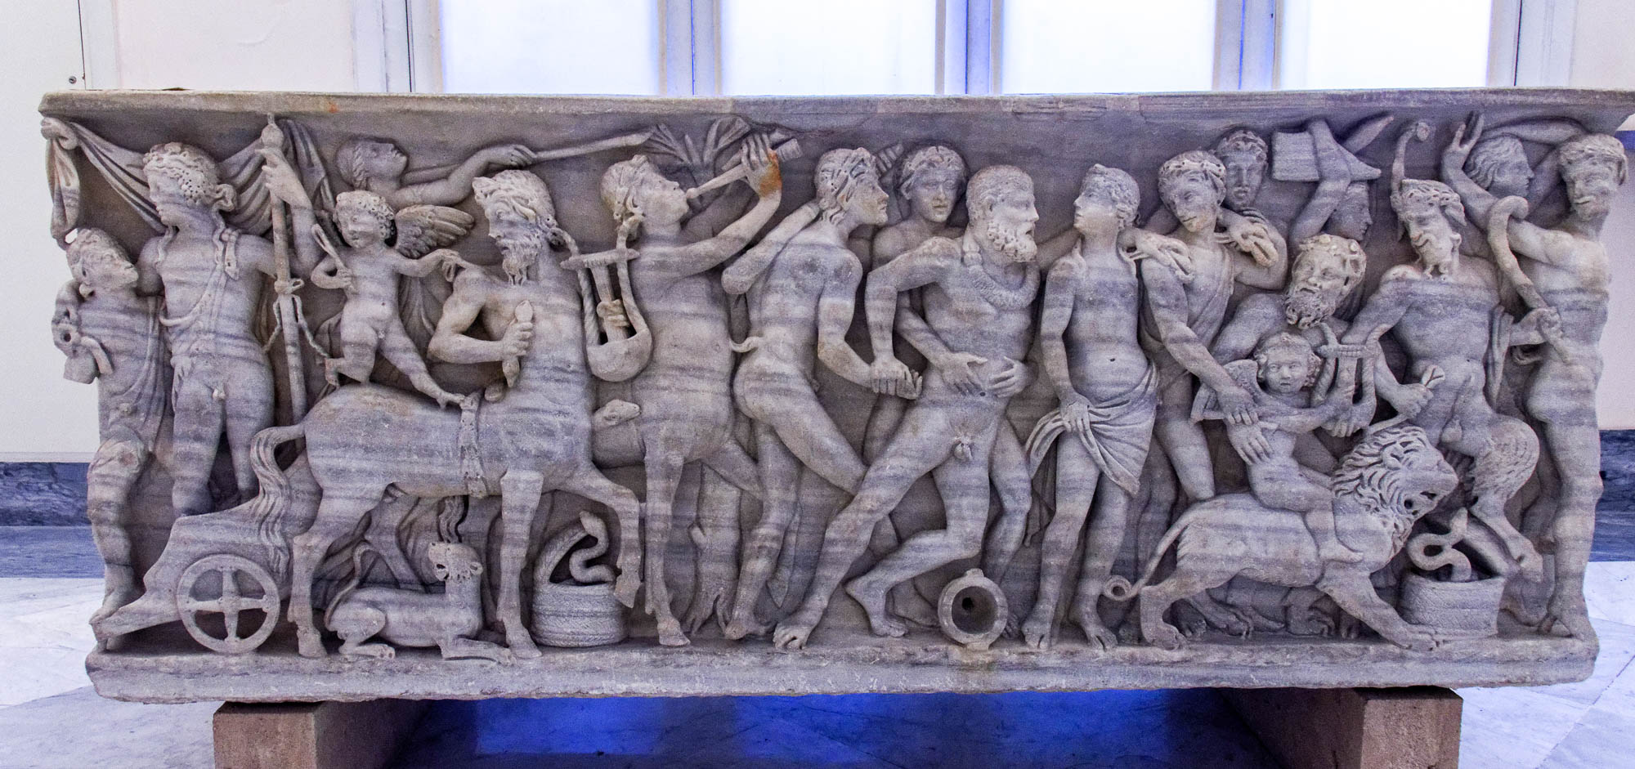
Those who get drunk are drunk at night
Sarcophagus depicting a drunken Hercules joining Dionysus in procession
5:7
Notes:
For more illustrations of drunkenness in the ancient world, see the slides on 1 Thessalonians 4:5. Removable graphics have been added to this photo to avoid causing surprise or offense.
tb0515171562h

Slide 35
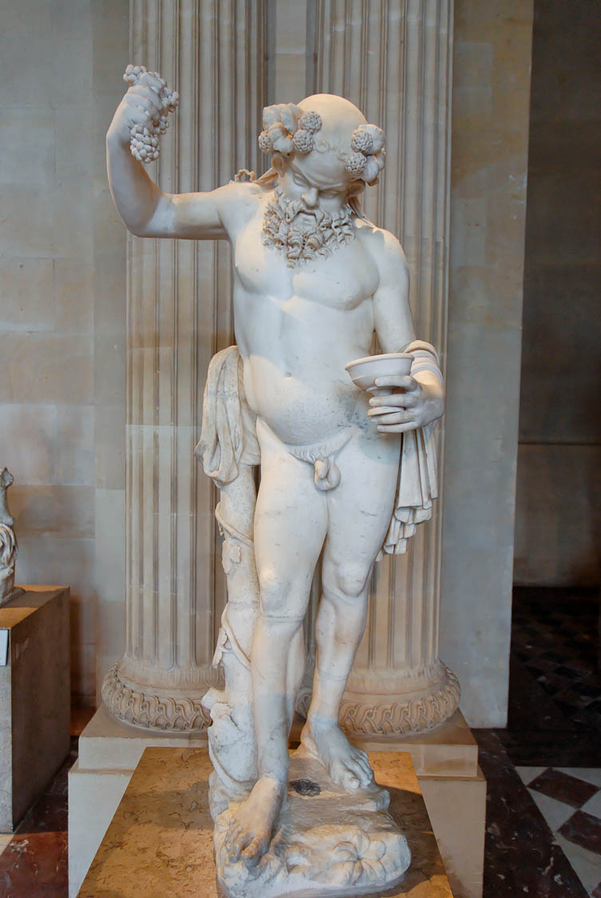
Those who get drunk are drunk at night
Drunk satyr, Roman period
5:7
Notes:
This statue was photographed at the Louvre Museum. A removable graphic has been added to this photo to avoid causing surprise or offense.
tb060408933

Slide 36
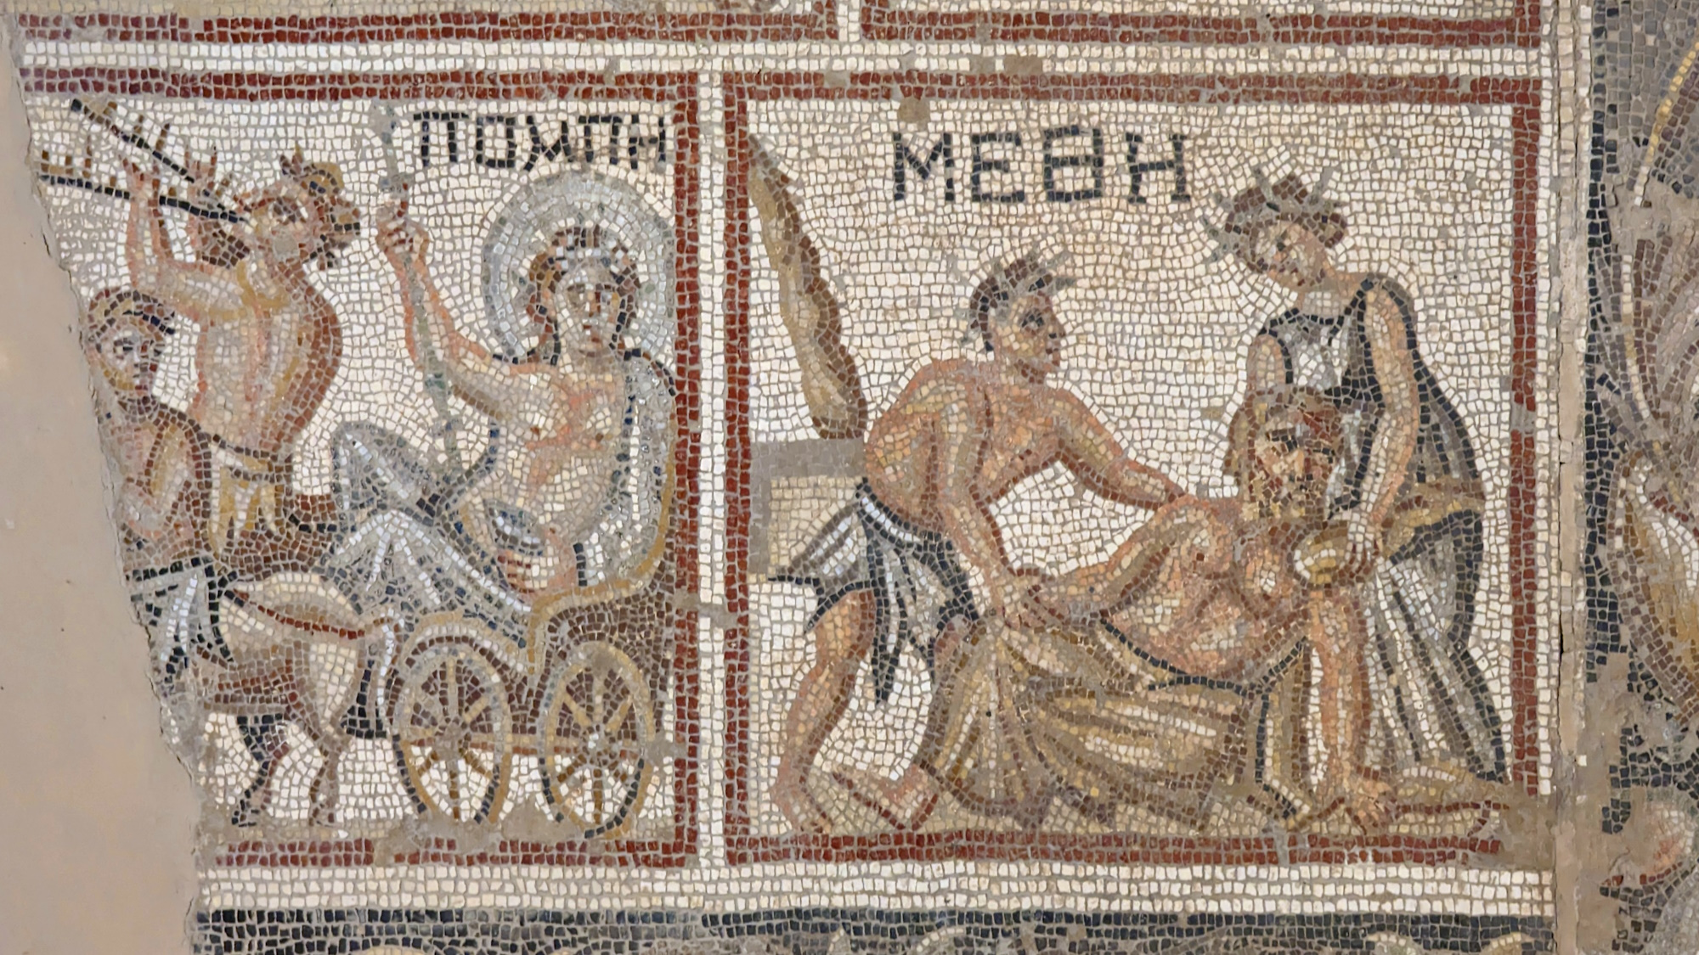
Those who get drunk are drunk at night
Mosaic of the drunken Hercules, from Sepphoris, Late Roman period
5:7
Notes:
This mosaic depicts the god Hercules in a drunken state, unable to stand. The Greek inscription above him reads “drunk” (Gk. ΜΕΘΗ). The same Greek word is used by Paul elsewhere to describe drunkenness as one of the “deeds of the flesh” (Gal 5:21). This mosaic was photographed at Sepphoris National Park.
ku0601230627524

Slide 37
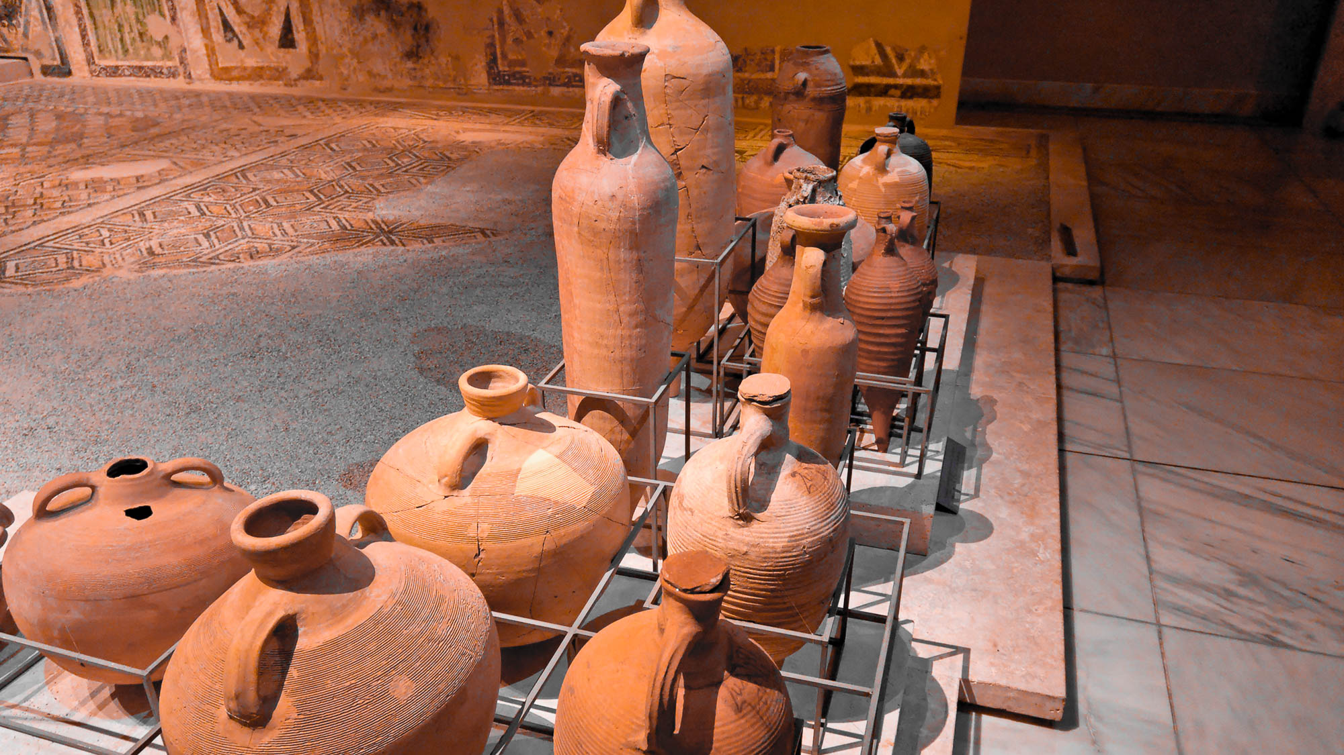
Those who get drunk are drunk at night
Amphorae used in the oil and wine trade, 3rd–6th centuries AD
5:7
Notes:
These amphorae are on display in the Museum of Byzantine Culture at Thessalonica.
tb031306293h

Slide 38
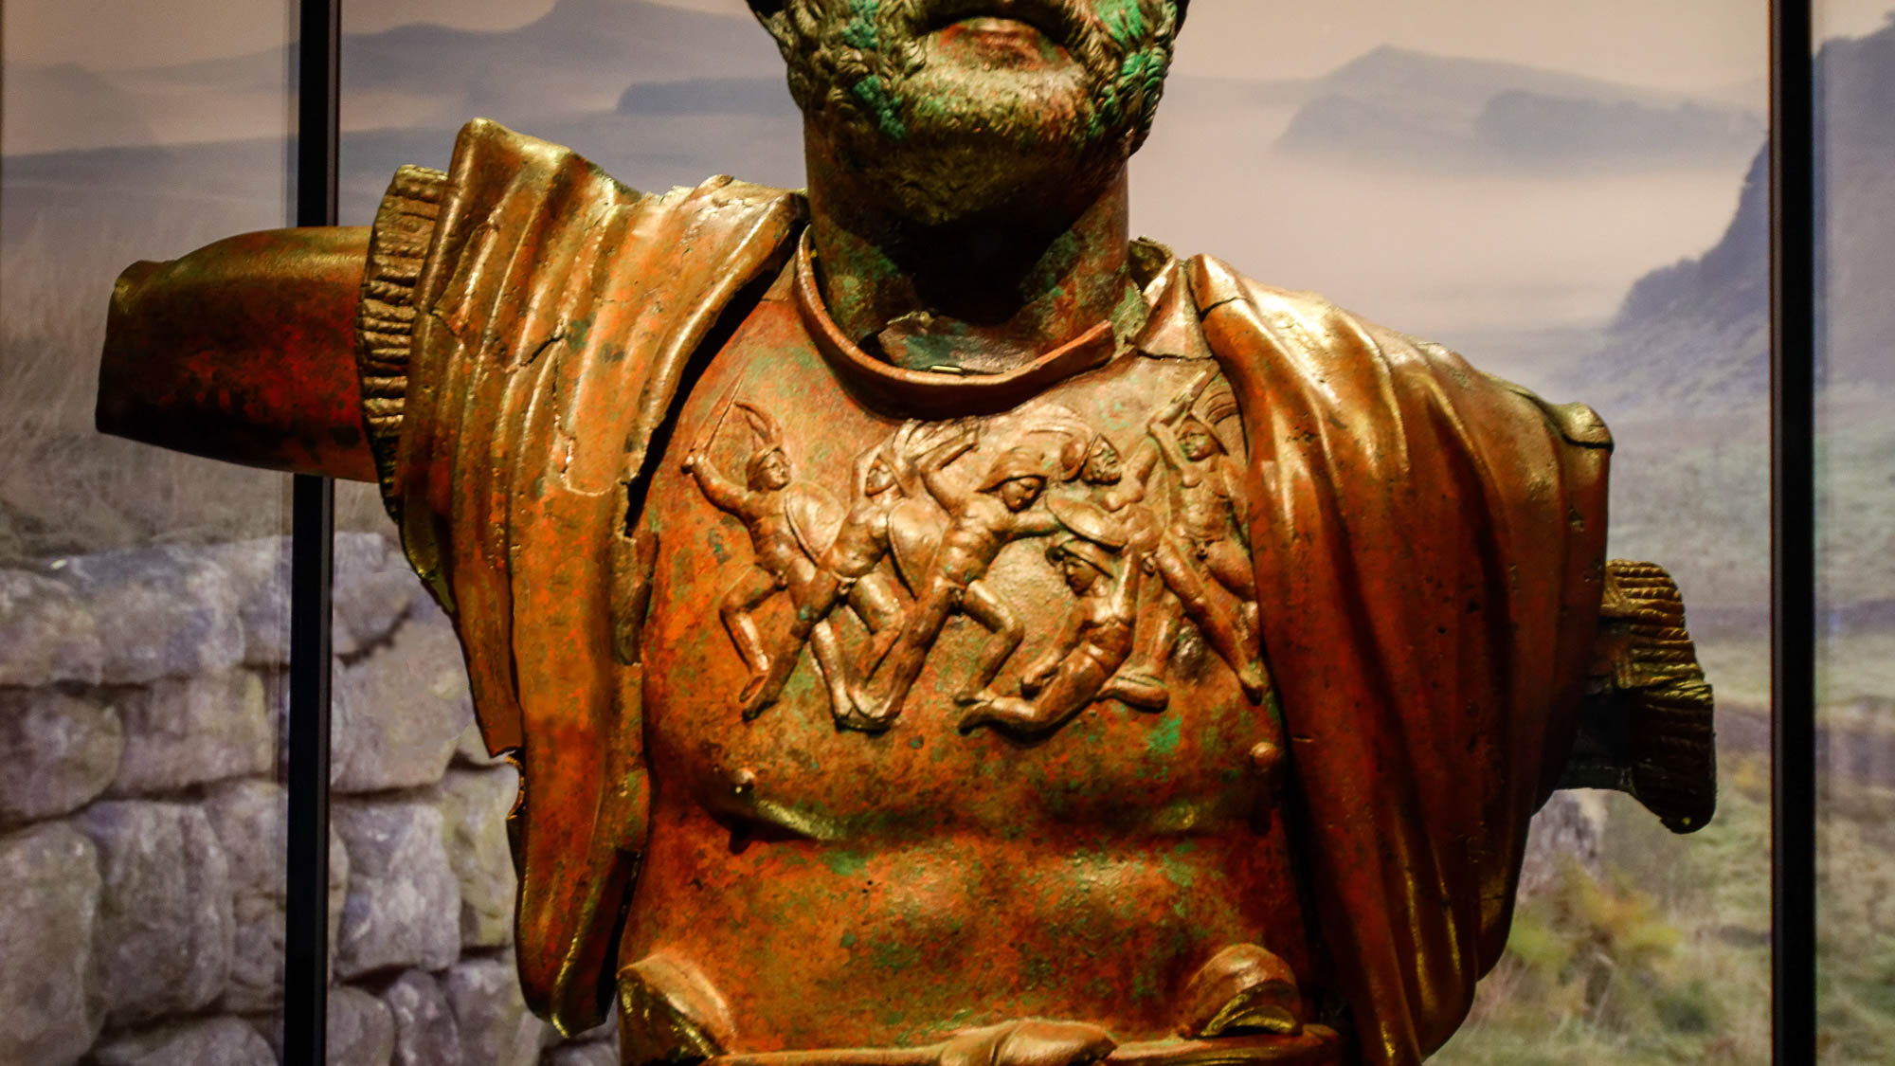
Having put on the breastplate of faith and love
Cuirassed bronze statue of Hadrian, from Beth Shean Valley, circa AD 130
5:8
Notes:
This verse is reminiscent of Paul’s longer description of the “full armor of God” (Gal 6:13-17). In this case, he only mentions the breastplate and helmet, whereas in Galatians he mentions six different items (belt, breastplate, sandals, shield, helmet, and sword). It may also be noted that in Galatians 6, Paul refers to the breastplate of righteousness rather than faith and love, demonstrating that the armor metaphor was not a fixed figure of speech. This bronze statue of the Roman emperor Hadrian depicts his upper body in a muscled cuirass, with the addition of embossed figures across the chest. This shows that the muscled cuirass continued to be used more than a century after the time of Paul. This bronze statue was photographed in the Israel Museum.
tb061616666h

Slide 39
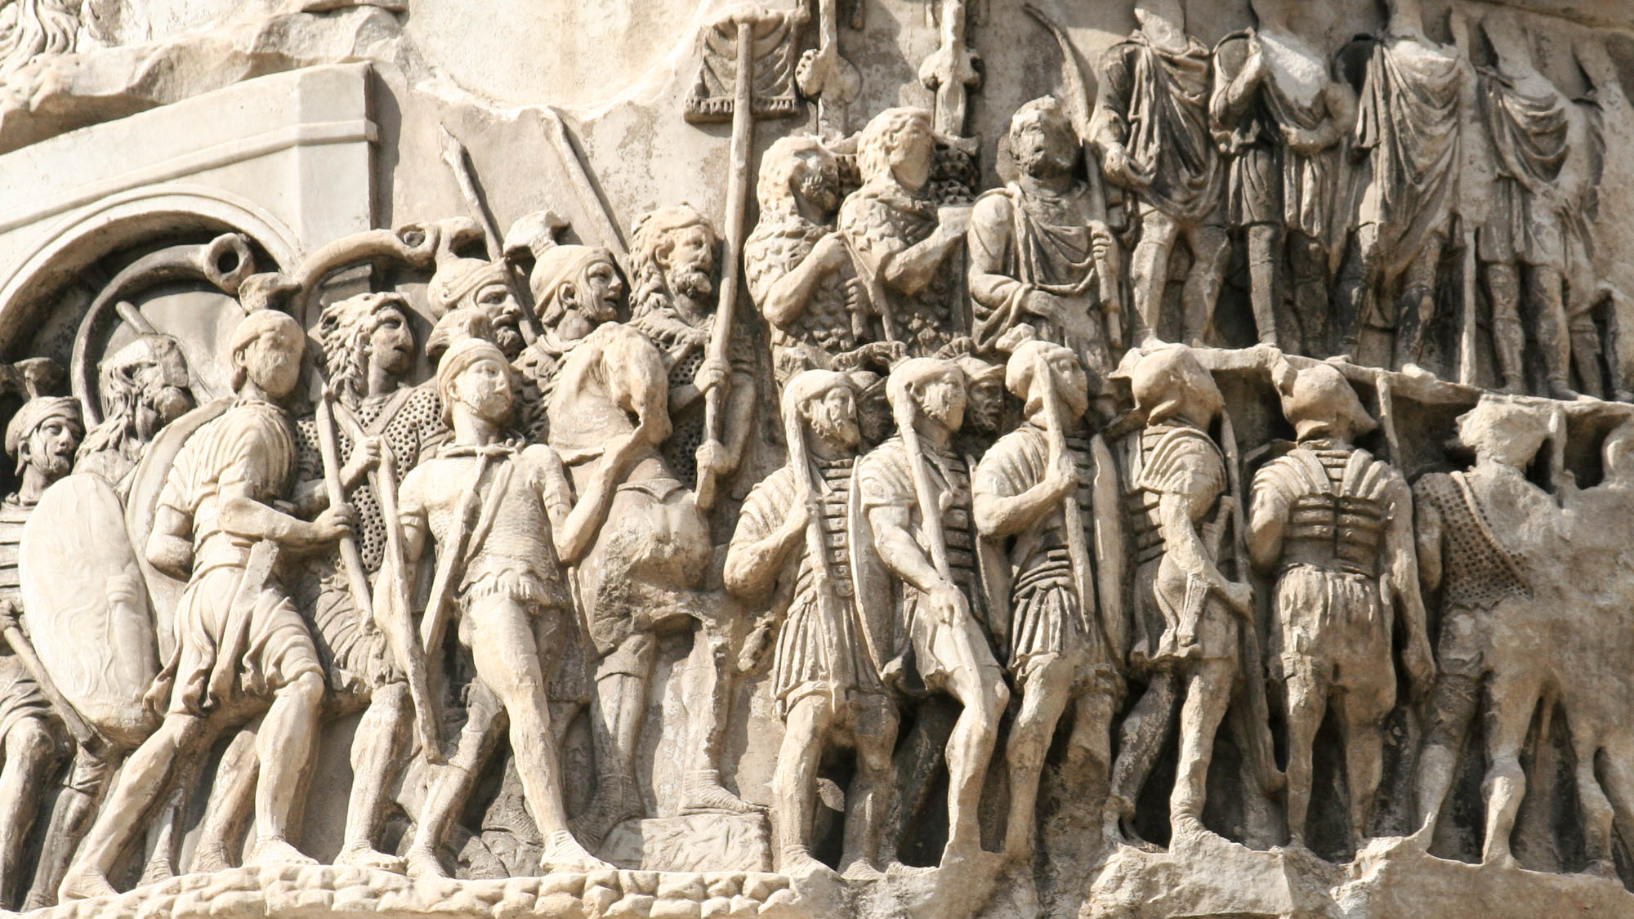
Having put on the breastplate of faith and love
Detail from the Column of Marcus Aurelius in Rome, 2nd century AD
5:8
Notes:
Although the form of a breastplate (Gk. thōrax, θώραξ) might seem obvious, there was quite a variety of armor used to protect the upper body in Paul’s day, and it is difficult to determine if Paul had a specific form in mind. This sculpture from the 2nd century AD depicts Roman soldiers with at least three different kinds of armor for the torso. Several, including those in the lower right, wear plate armor (lorica segmentata); several others, including two in the upper register, wear scale armor (lorica squamata); at least two others, including one at the far right and one in the background on the left, wear chain mail (lorica hamata). All three of these types of chest armor were in use by the Roman army already in Paul’s day. Not shown in this group is a fourth type, the muscle cuirass (lorica musculata), which was likely the most expensive type. See the following slides for examples of this latter type.
This relief is part of the Column of Marcus Aurelius in Rome. It is modelled after the Column of Trajan. Marcus Aurelius was the Roman emperor from AD 161–180; the dedicatory inscription of the column has been lost, so it is not certain whether it was constructed during his lifetime or afterward. However, it is known from another inscription to have been standing already by AD 193. The next slide includes labels.
This image come from Barosaurus Lentus and is licensed under CC BY 3.0, via Wikimedia Commons: https://commons.wikimedia.org/wiki/File:Column_of_Marcus_Aurelius_-_detail1.jpg.
wiki070720093456362h

Slide 40
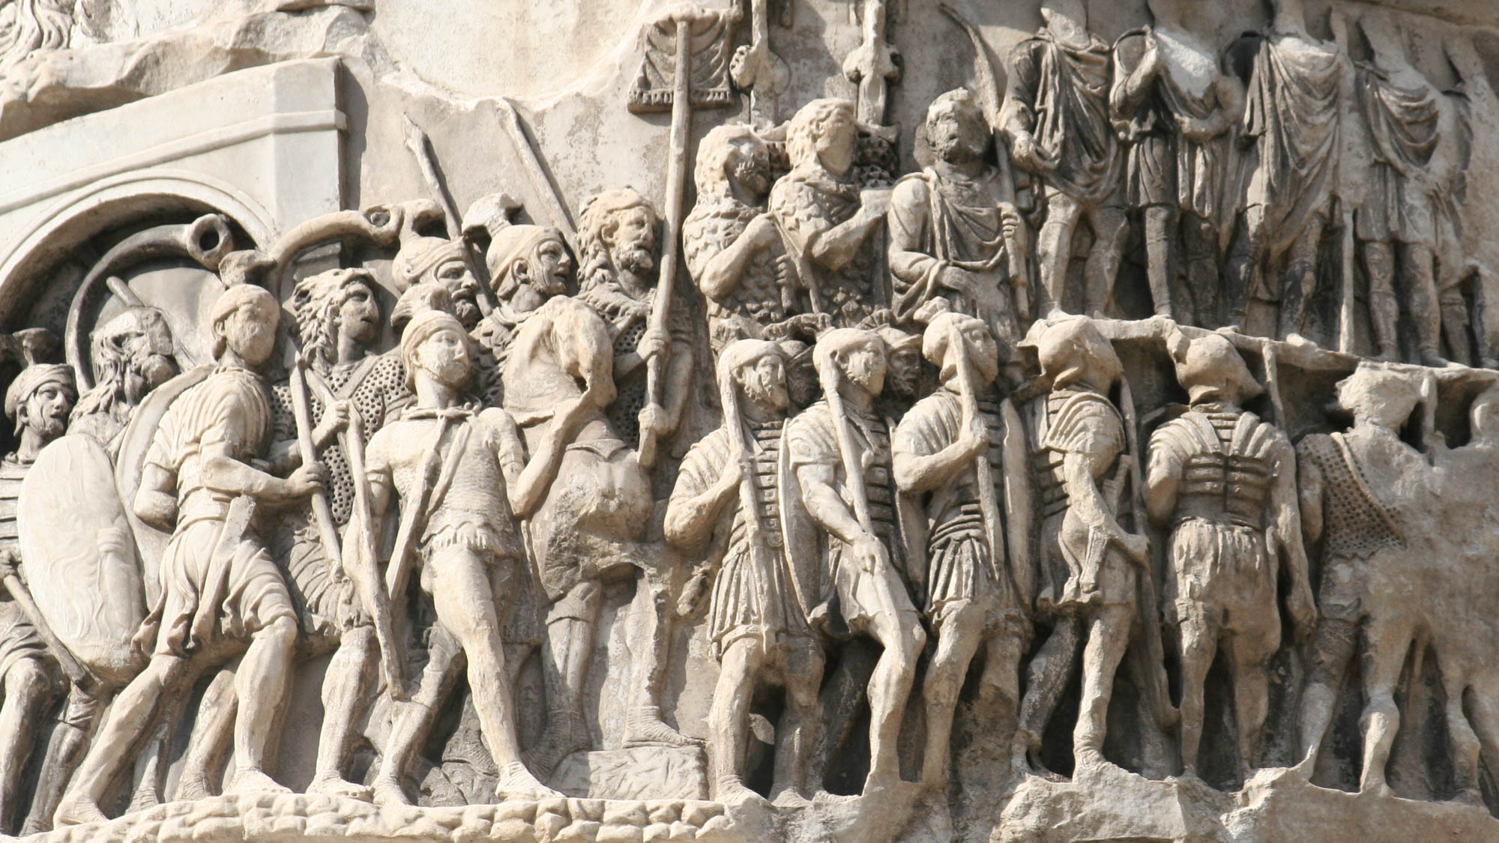
Having put on the breastplate of faith and love
scale armor
(lorica squamata)
chain mail
(lorica hamata)
segmented plate armor
(lorica segmentata)
Detail from the Column of Marcus Aurelius in Rome, 2nd century AD
5:8
Notes:
Although the form of a breastplate (Gk. thōrax, θώραξ) might seem obvious, there was quite a variety of armor used to protect the upper body in Paul’s day, and it is difficult to determine if Paul had a specific form in mind. This sculpture from the 2nd century AD depicts Roman soldiers with at least three different kinds of armor for the torso. Several, including those in the lower right, wear plate armor (lorica segmentata); several others, including two in the upper register, wear scale armor (lorica squamata); at least two others, including one at the far right and one in the background on the left, wear chain mail (lorica hamata). All three of these types of chest armor were in use by the Roman army already in Paul’s day. Not shown in this group is a fourth type, the muscle cuirass (lorica musculata), which was likely the most expensive type. See the following slides for examples of this latter type.
This relief is part of the Column of Marcus Aurelius in Rome. It is modelled after the Column of Trajan. Marcus Aurelius was the Roman emperor from AD 161–180; the dedicatory inscription of the column has been lost, so it is not certain whether it was constructed during his lifetime or afterward. However, it is known from another inscription to have been standing already by AD 193.
This image come from Barosaurus Lentus and is licensed under CC BY 3.0, via Wikimedia Commons: https://commons.wikimedia.org/wiki/File:Column_of_Marcus_Aurelius_-_detail1.jpg.
wiki070720093456362h

Slide 41
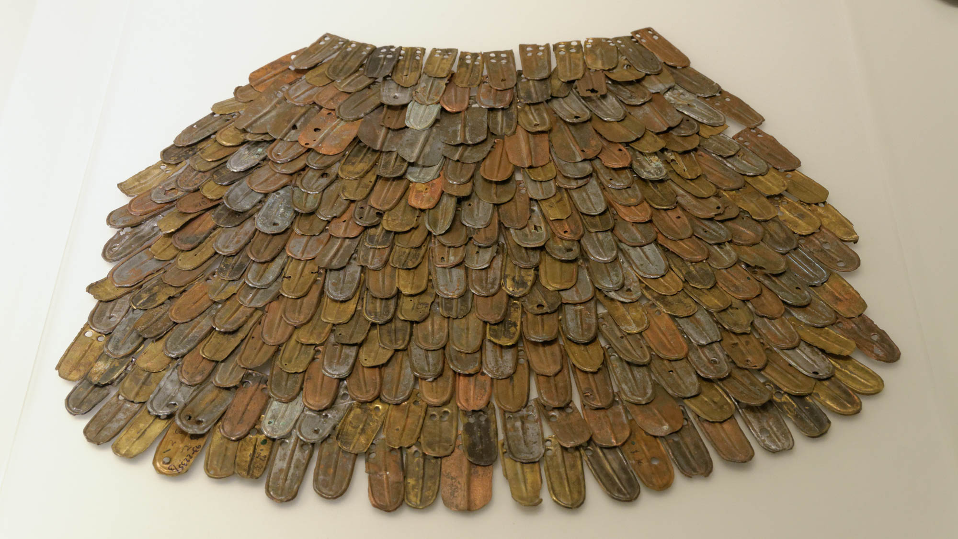
Having put on the breastplate of faith and love
Armor scales, from the northern palace at Masada, 1st century AD
5:8
Notes:
Scale armor (lorica squamata) was used for protecting the chest and upper body. Individual scales were attached to a cloth backing and provided a flexible kind of armor that was also fairly light-weight. These scales were photographed at the Israel Museum.
tb032014663h

Slide 42
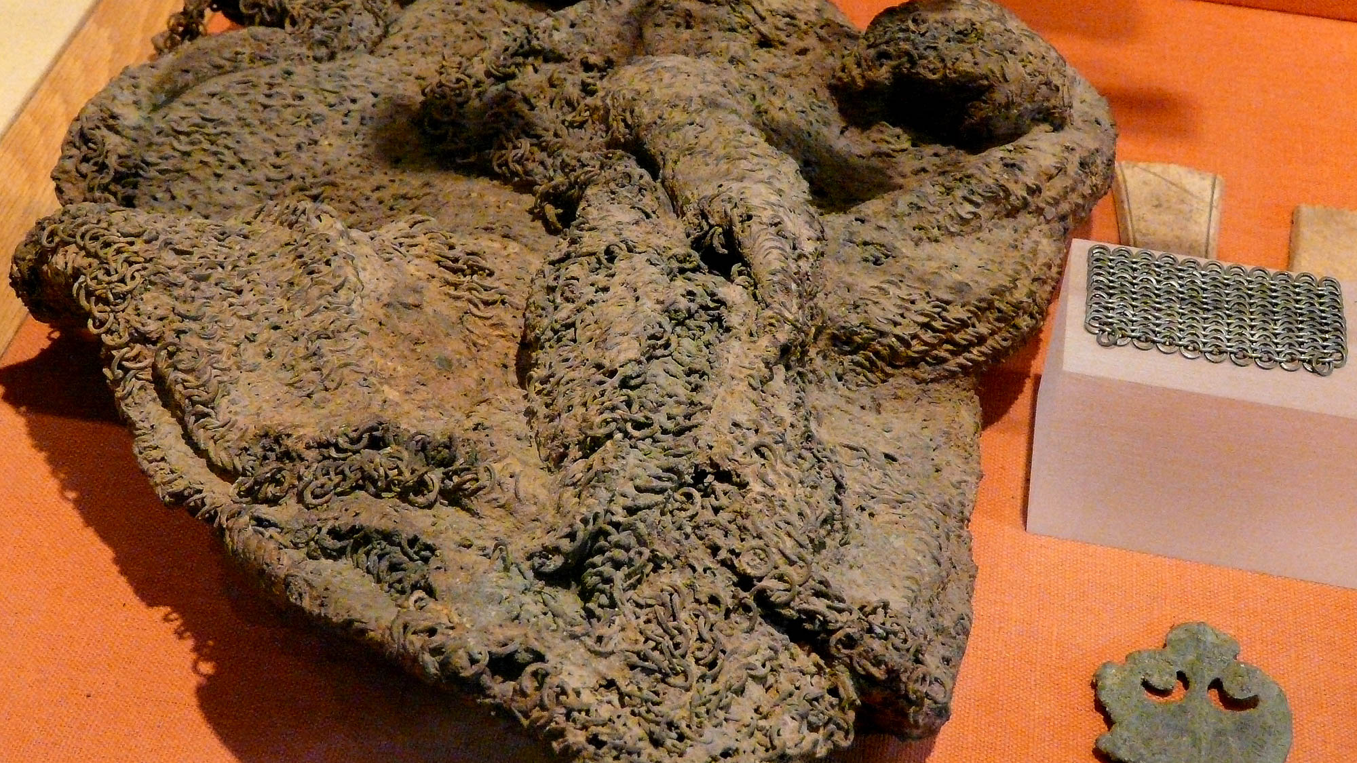
Having put on the breastplate of faith and love
Mass of Roman chain mail
5:8
Notes:
Heavy mail shirts (lorica hamata) were commonly worn by Roman legionaries. They appear at least as early as the 1st century BC and continued in use for many centuries after that. Such a shirt could weigh 25–35 pounds (11–16 kg). It is also known that the front of such a mail shirt was sometimes augmented by a metal plate that gave extra protection to the chest. This exhibit was photographed at the Hall Castle Museum. This image comes from Hartmann Linge and is licensed under CC BY-SA 3.0, via Wikimedia Commons: https://commons.wikimedia.org/wiki/File:200910311136MEZ_Saalburg-Museum,_Kettenhemd.jpg.
wiki1031200922392187h

Slide 43
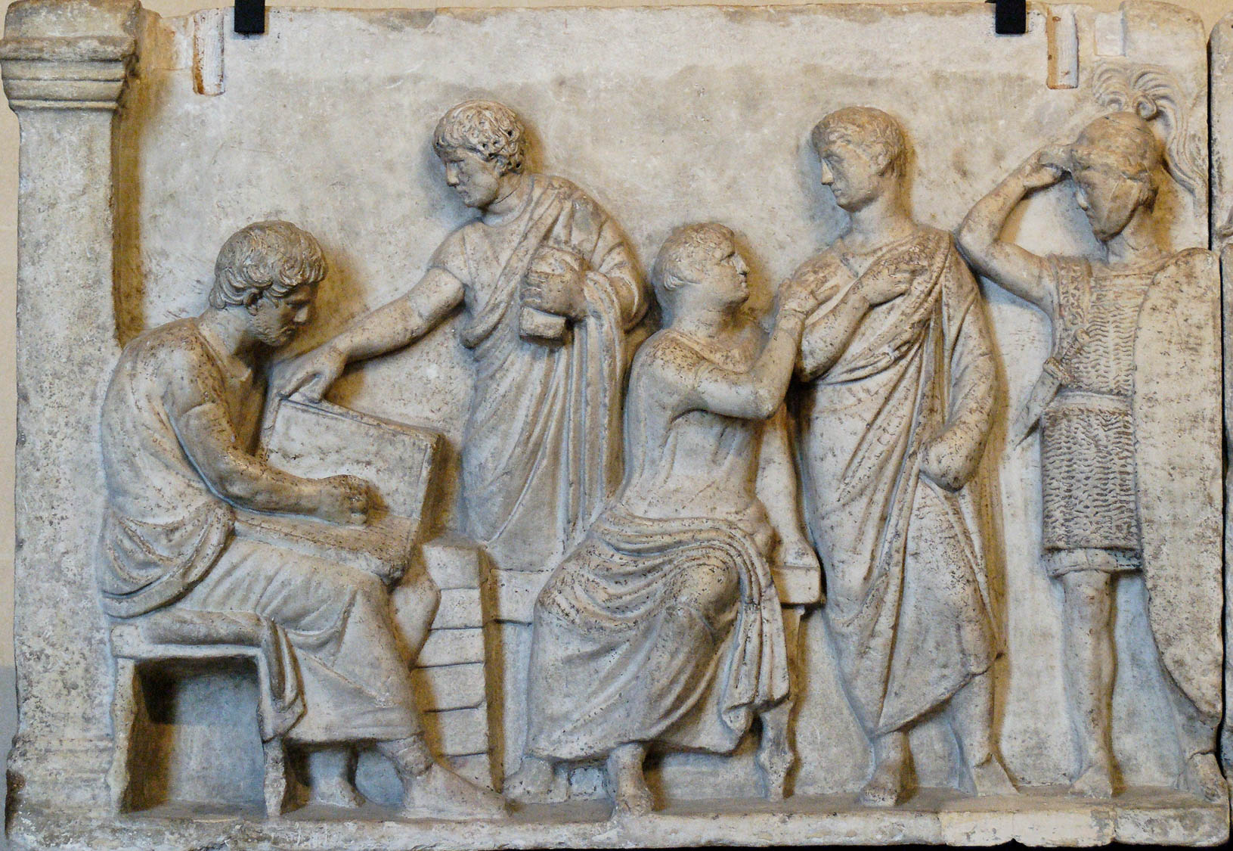
Having put on the breastplate of faith and love
Soldier in chain mail, detail of the altar of Domitius Ahenobarbus, circa 100 BC
5:8
Notes:
The soldier at the far left of this relief is depicted wearing chain mail. His chain mail shirt hangs down almost to his knees, providing significant coverage of the body. His helmet is topped with a horse-hair plume. This relief was photographed at the Louvre Museum. This image comes from Jastrow and is in the public domain, via Wikimedia Commons: https://commons.wikimedia.org/wiki/File:Altar_Domitius_Ahenobarbus_Louvre_n1.jpg.
wiki040220070755388

Slide 44
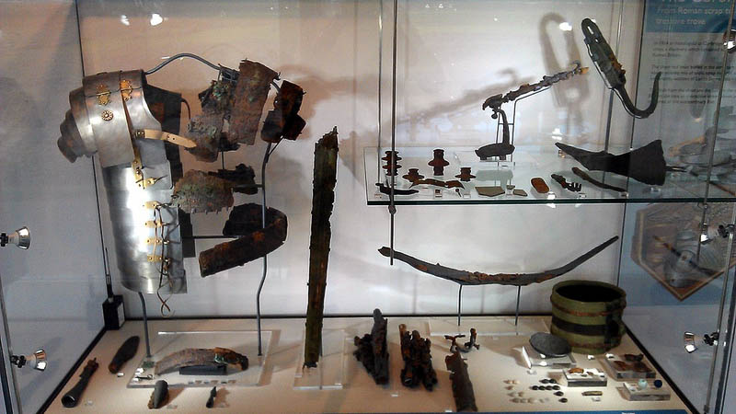
Having put on the breastplate of faith and love
Plate armor (lorica segmentata) from Corbridge, England, circa AD 125
5:8
Notes:
Articulated or segmented plate armor (lorica segmentata) began to be used in about the middle of the 1st century AD. The plates, often of iron, were connected by leather strapping on the interior, and the sections were joined at front and back by brass hooks. Remains of such armor have been found at various places across the Roman empire. It is thought that a complete set of such armor weighed about 20 pounds (9 kg). The display shown in this photo includes portions of an ancient set along with a reconstructed half. All of the items in this display were discovered buried in a wooden box at Corbridge near Hadrian’s Wall. This image comes from Mike Bishop and is licensed under CC BY-SA 3.0, via Wikimedia Commons: https://commons.wikimedia.org/wiki/File:Lorica_segmentata_Corbridge_museum.jpg.
wiki12202018478205h

Slide 45
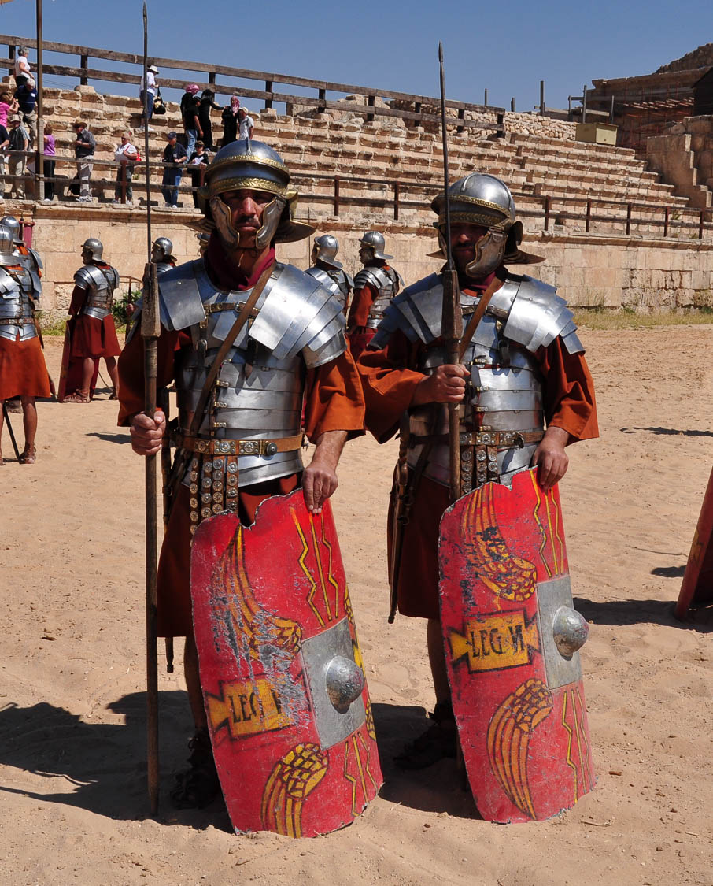
Having put on the breastplate of faith and love
“Roman soldiers” in the hippodrome at Gerasa
5:8
Notes:
The chest armor worn by these re-enactors (lorica segmentata) was one of several types of armor used in the 1st century AD to protect the upper body. The Roman Army and Chariot Experience, pictured here, takes place daily during most of the year at Jerash (Gerasa).
fj0503100062h

Slide 46
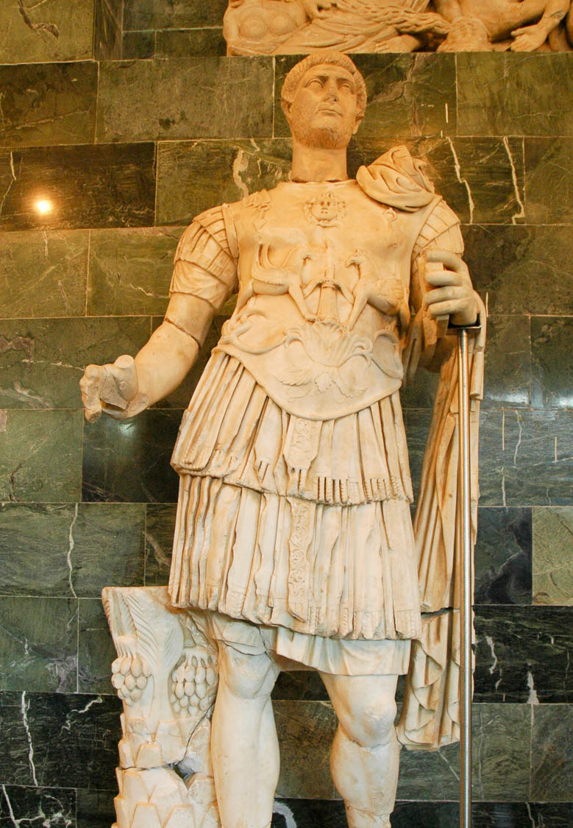
Having put on the breastplate of faith and love
Statue of Hadrian in armor, from Perga, 2nd century AD
5:8
Notes:
Another kind of breastplate of the 1st century AD was the muscle cuirass (lorica musculata), made from two solid pieces of metal, one for the front and the other for the back. Such armor had to be sized to fit a particular person, making it an expensive and personalized option. For this reason, such armor was reserved for the elite, such as Emperor Hadrian depicted in the statue above. This statue was photographed at the Antalya Museum.
tb040905097h

Slide 47
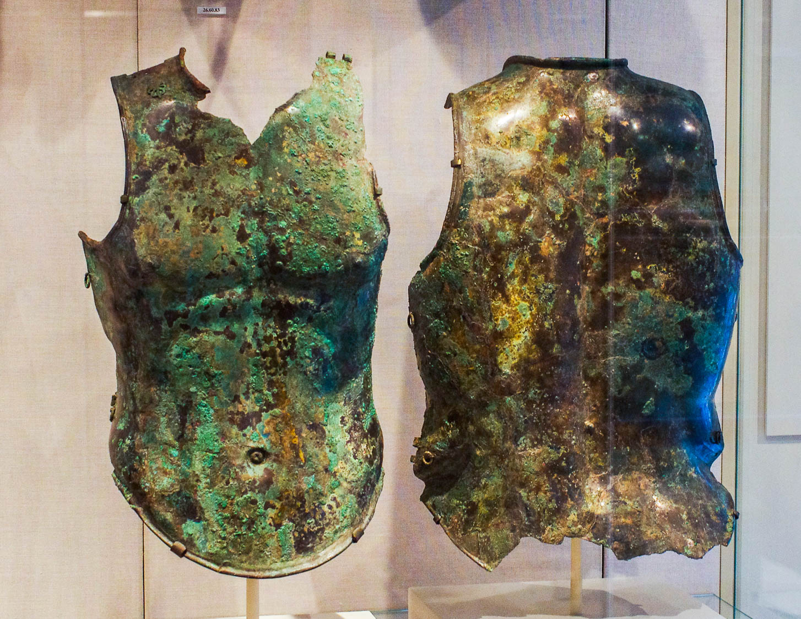
Having put on the breastplate of faith and love
Etruscan breastplate and backplate, bronze, 5th–4th centuries BC
5:8
Notes:
Although the armor shown here is several centuries earlier than the time of Paul, similar armor continued to be used by the Roman army in his day and later. These pieces of armor were photographed at the Metropolitan Museum of Art in New York City.
adr1606034339h

Slide 48
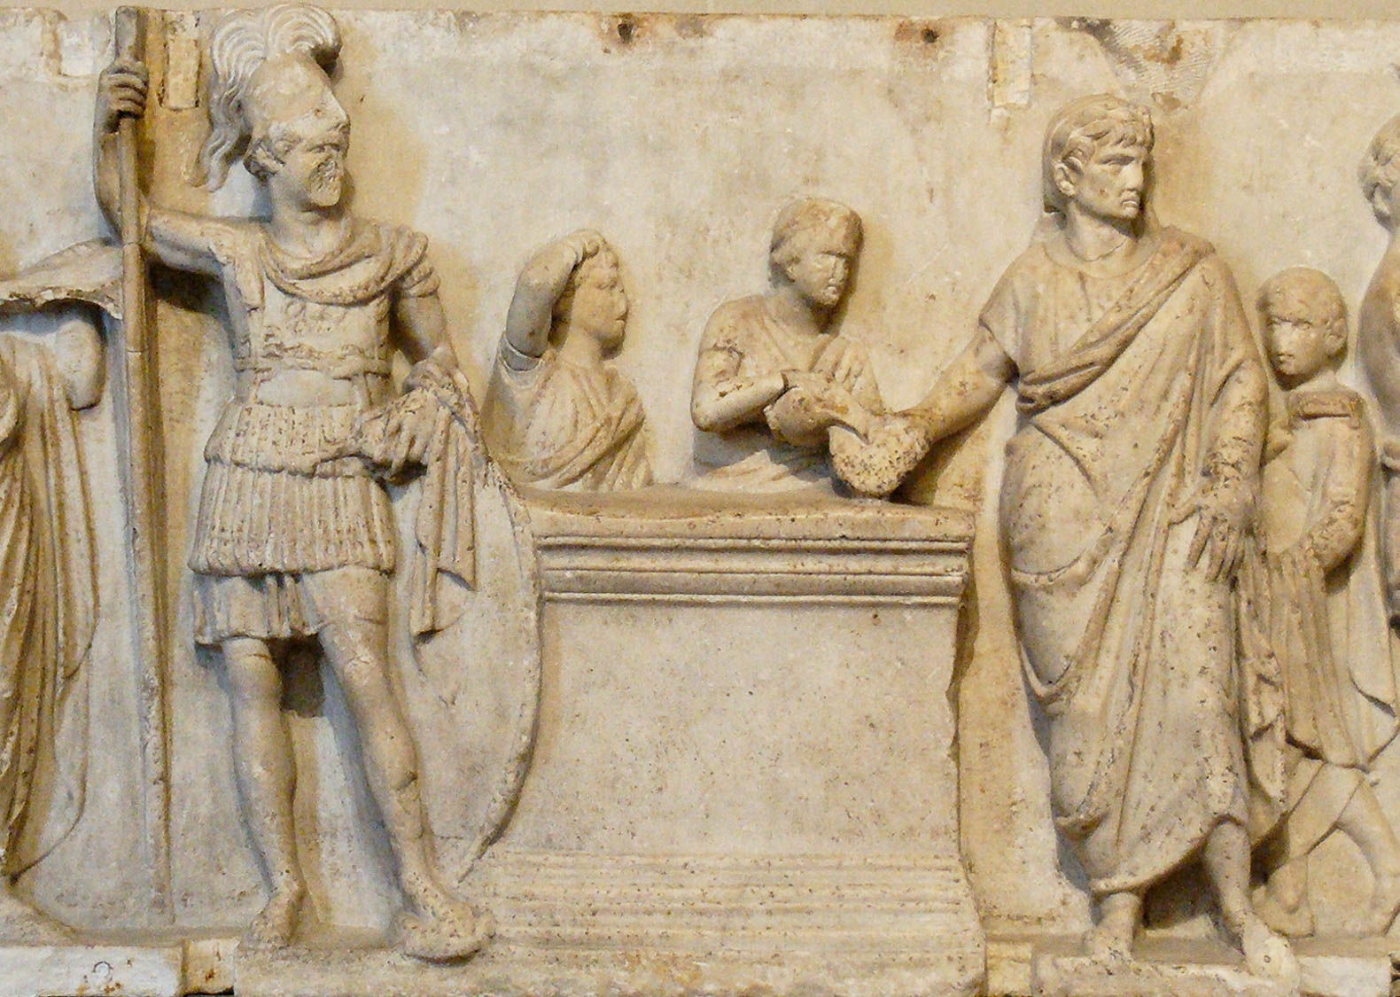
Having put on the breastplate of faith and love
Tribune in a muscle cuirass, detail of the altar of Domitius Ahenobarbus, late 2nd century BC
5:8
Notes:
The officer depicted on the frieze shown here, standing to the left of the altar, is almost certainly a tribune. He wears a short-muscled cuirass (lorica musculata), greaves that extend slightly above the knee, and a helmet. He is armed with a spear, sword, and shield. The sash around his waist indicates his rank as a tribune. This frieze probably decorated a base which supported cult statues in the Temple of Neptune in Rome. This image comes from Jastrow (2007) and is in the public domain, via Wikimedia Commons: https://commons.wikimedia.org/wiki/File:Altar_Domitius_Ahenobarbus_Louvre_n2.jpg
wiki040220070746h

Slide 49
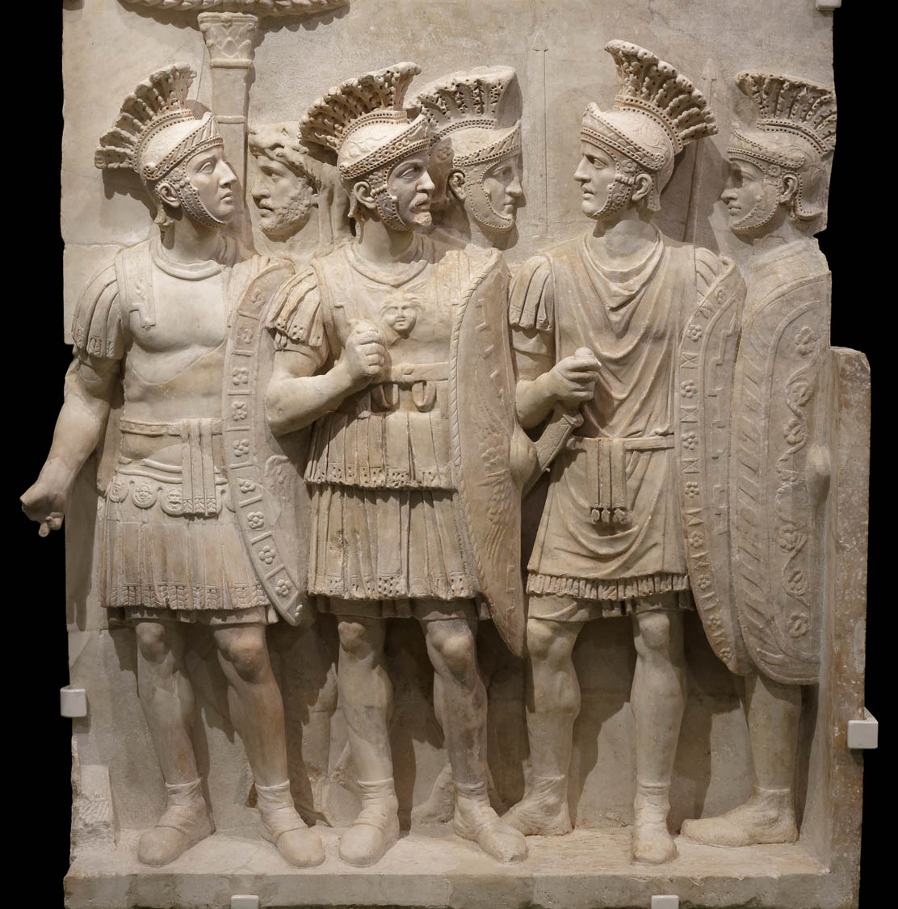
Having put on the breastplate of faith and love, and for a helmet the hope of salvation
Praetorians Relief, from Rome, circa AD 51–52
5:8
Notes:
The soldiers on this relief have been identified as members of the Praetorian Guard due to the richness of their apparel, particularly the helmets, and their ceremonial dress and oval shields. This relief was once part of the Arch of Claudius, a triumphal arch built in honor of the emperor Claudius's successful invasion of Britain. The fancy, looped sash around the waist of the central figure likely identifies him as a tribune. This relief was photographed at the Louvre-Lens in France.
This image comes from Christophe Jacquand and is licensed under CC BY-SA 4.0, via Wikimedia Commons: https://commons.wikimedia.org/wiki/File:MBALyon2018_-_Expo_Claude_-_Relief_Pretoriens_-_cropped_foreground.jpg.
wiki12182018164527h

Slide 50
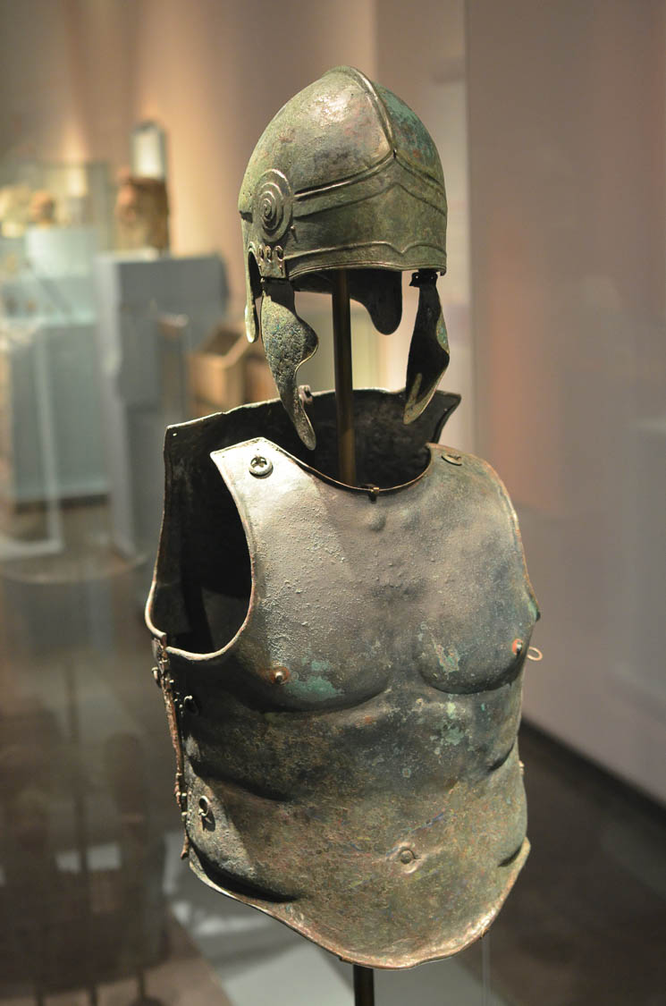
Having put on the breastplate of faith and love, and for a helmet the hope of salvation
Greek panoply of helmet and muscle cuirass, 4th century BC
5:8
Notes:
This set was photographed at the National Museum of Antiquities in Leiden, the Netherlands. This image comes from AlexanderVanLoon and is licensed under CC BY-SA 4.0, via Wikimedia Commons: https://commons.wikimedia.org/wiki/File:Greek_bronze_panoply_in_RMO_AvL.JPG.
wiki080420151040340

Slide 51
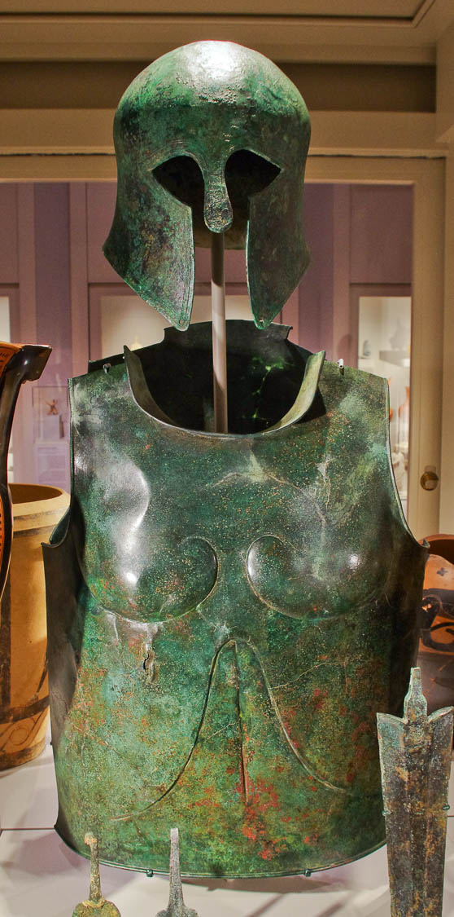
Having put on the breastplate of faith and love, and for a helmet the hope of salvation
Bronze cuirass from Crete, 7th century BC, and Corinthian-type bronze helmet, 6th century BC
5:8
Notes:
This was photographed at the Michael C. Carlos Museum at Emory University.
adr1511209514

Slide 52
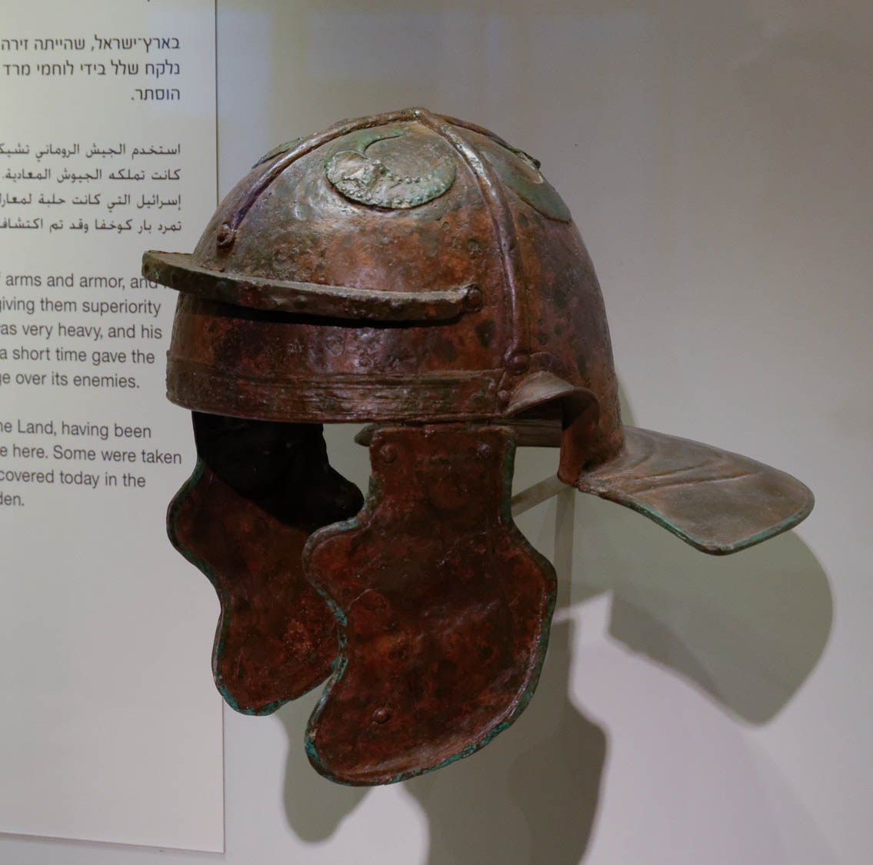
Having put on the breastplate of faith and love, and for a helmet the hope of salvation
Roman helmet of iron and bronze, from Israel, early 2nd century AD
5:8
Notes:
Roman military helmets in Paul’s day were most often made of iron, although they sometimes had bronze fittings. The flap on either side was used to protect the face, and a neck guard was attached to the back. Ear guards, visible on this example, were added by the second quarter of the 1st century AD. This helmet was photographed at the Israel Museum. For additional information on the development of the Roman military helmet, see Connolly 1998: 228.
Reference:
Connolly, Peter.
1998 Greece and Rome at War. Greenhill Books: London.
tb032014716

Slide 53

Having put on the breastplate of faith and love, and for a helmet the hope of salvation
Mask from a Roman cavalry helmet, AD 75–125
5:8
Notes:
The cavalry helmet was constructed somewhat differently, since there was less concern to protect from sword strikes but more concern about arrow strikes. This bronze helmet was photographed at the Getty Villa in southern California.
tb082214713

Slide 54

Having put on the breastplate of faith and love, and for a helmet the hope of salvation
Head of a helmeted Roman soldier, circa AD 69–79
5:8
Notes:
This marble helmeted head was photographed at the Metropolitan Museum of Art in New York City.
adr1605243261

Slide 55

Having put on the breastplate of faith and love, and for a helmet the hope of salvation
Athena with a Corinthian helmet, 1st century AD
5:8
Notes:
This bust was photographed at the Ostia Museum.
tb0517172829h

Slide 56

Having put on the breastplate of faith and love, and for a helmet the hope of salvation
Sarcophagus facade with helmet, 1st century BC
5:8
Notes:
This relief is somewhat earlier than the time of Paul. Note the horsehair plume, which was also used by Roman legionaries in Paul’s day, as well as the cheek guards hanging down on either side. This relief was photographed at the Istanbul Archaeological Museum.
tb041705242h

Slide 57

Having put on the breastplate of faith and love, and for a helmet the hope of salvation
Bronze coin of Herod the Great depicting a war helmet, from the Samaria mint, circa 37 BC
5:8
Notes:
Large numbers of this bronze eight prutot coin were minted by Herod the Great, this one in 38 or 37 BC. In deference to the Jews, Herod did not put faces on his coins. The object on the obverse (left) is an ornate helmet, complete with cheek guards. The reverse (left) depicts a tripod and bears the Greek inscription “of King Herod” (Gk. HPΩΔOY BAΣIΛEΩΣ). This image comes from Classical Numismatic Group and is used by permission. Source: https://www.cngcoins.com/Coin.aspx?CoinID=246623.
cng246623

Slide 58

Having put on the breastplate of faith and love, and for a helmet the hope of salvation
Silver tetradrachm of Eucratides with helmeted bust of Eucratides I, from Bactria, 171–145 BC
5:8
Notes:
This coin was photographed at the San Antonio Museum of Art.
tb111716909h

Slide 59

Having put on the breastplate of faith and love, and for a helmet the hope of salvation
Corinthian bronze helmet with inscription of dedication, from Olympia, 5th century BC
5:8
Notes:
This helmet was photographed at an exhibit at Pompeii.
tb0516172198

Slide 60


Having put on the breastplate of faith and love, and for a helmet the hope of salvation
“And he put on righteousness as a breastplate, and a helmet of salvation upon his head; ”
“and he put on garments of vengeance for clothing, and was clad with zeal as with a mantle. ”
Isaiah 59:17 on the Great Isaiah Scroll
5:8
Notes:
Paul’s words allude to key Messianic texts in Isaiah. “And he put on righteousness as a breastplate, and a helmet of salvation on his head; and he put on garments of vengeance for clothing, and was clad with zeal as though it were a mantle” (Isa 59:17). Compare Isaiah 11:5 where it is explicitly the shoot from the stump of Jesse, the Messiah, who will wear the belt of righteousness and faithfulness. In the contexts of these Isaianic passages, the Lord Messiah comes to the deliverance of His people, saves them from their enemies, and brings them into His kingdom. Thus, Paul here points to the fact that not only are believers clothed with Christ’s righteousness, they are defended by and clothed with His armor as well, which the Lord Messiah Himself dons on behalf of His people to vanquish darkness and bring them into His glorious kingdom of light. This is precisely the encouragement the burgeoning but beleaguered Thessalonian believers need to hear.
The Great Isaiah Scroll is owned by the Israel Museum in Jerusalem. This image is public domain, from Wikimedia: https://commons.wikimedia.org/wiki/File:The_Great_Isaiah_Scroll_MS_A_(1QIsa)_-_Google_Art_Project-x0-y0.jpg
isax0y0

Slide 61

For God has not destined us for wrath, but for obtaining salvation
Fresco of a judgment scene, from triclinium C of the Villa Farnesina in Rome, 1st century BC
5:9
Notes:
The mural paintings in this triclinium depict a variety of judgment scenes. Some are thought to represent the pharaoh Bocchoris (735–728 BC), known for his jurisprudence and for his knowledge of legal matters, and another scene may represent Solomon. However, most cannot be associated with any known event. In the scene shown here, several bound men are brought in from the left, while two women appear to plead their case before the seated judge. Paul’s words imply that God would be justified in passing a sentence of wrath, but in grace has appointed believers to salvation instead, somewhat like a human judge who decides the fate of those brought before him. This fresco was photographed at the National Museum of Rome.
tb0513177784

Slide 62

He died for us, that whether we are awake or asleep we may live with Him
Three crosses at Tantur
5:10
Notes:
Paul’s reference to the death of Jesus recalls His crucifixion. These crosses are a more historically accurate representation of ancient crosses than what is typically found in medieval and modern art. They were photographed when on display at the Biblical Gardens at Tantur, midway between Jerusalem and Bethlehem. For slides on the possible place of Jesus’s death, burial, and resurrection, see the slides on 1 Thessalonians 4:14.
tbs80019402h

Slide 63

He died for us, that whether we are awake or asleep we may live with Him
Sign at the Garden Tomb in Jerusalem
5:10
Notes:
The sign on the door of the so-called Garden Tomb quotes from the words of the angel to the women who discovered the empty tomb (Matt 28:6).
tb061116120h

Slide 64

Therefore encourage one another and build each other up
Reconstruction of a wheel method for moving stones
5:11
Notes:
The Greeks and Romans were masters at building large structures using very large and heavy stones. One of the most amazing buildings of the ancient world was Herod’s temple, renowned for its beauty and sheer size. The large stones used to build it were moved with implements such as the one pictured here. This was photographed at the Davidson Center south of the Temple Mount in Jerusalem.
tb091702219

Slide 65

Therefore encourage one another and build each other up
Reconstruction of a wheel method for moving stones
5:11
Notes:
Smaller stones were probably moved by wagons and oxen. While it remains unknown how the largest stones were transported, many of them were found with projections on their sides, and it is thought that ropes may have been attached to these projections. A pulley could then have been used to place the stones on log rollers. The Romans are also known to have used cranes, although cranes would not have worked with the weight of the largest stones. Because of this, it has been proposed that the builders may have built one row at a time and then raised the level of the earthen fill around it (somewhat like a scaffolding system). It has also been suggested that round stones were quarried and then rolled down to the site. After reaching the site, the builders would have cut the bottoms off of the stones and then set them in place, after which other rounded edges would have been cut off. The 1st-century BC Roman architect Vitruvius describes three main types of devices: wheels, sleds, and cranes (Reich, Avni, and Winter 1999: 30).
Reference:
Reich, Ronny; Avni, Gideon; and Winter, Tamar.
1999 The Jerusalem Archaeological Park. Jerusalem: Israel Antiquities Authority.
tb091702218

Slide 66

Therefore encourage one another and build each other up
Terracotta relief of a general with trophies and machines, 1st century BC – 1st century AD
5:11
Notes:
The central scene on the plaque shown here depicts a victorious general. He is flanked by a kneeling warrior paying homage and by a stand bearing trophies (mostly shields and armor). What is perhaps more interesting are the two machines on the outer ends of the plaque. Both employ a system of levers and pulleys to allow the worker to lift a very large stone, used in constructing the strong walls depicted at the outer edges of the plaque. This illustrates the idea of building up. This plaque was photographed at the National Museum of Rome.
tb0513177939

Slide 67

Therefore encourage one another and build each other up
Reconstruction of a Roman heavy-duty crane
5:11
Notes:
This machine is a modern version of a Roman pentaspastos, a heavy-duty crane. It is capable of lifting loads of up to 5 tons (4.5 t) to a height of 26 feet (8 m). It is built according to a Roman relief from about AD 200, although there is evidence that such machines were used centuries earlier. It was demonstrated during a historic fest of the Bonn-Castell district committee. This image comes from Jochen Teufel and is licensed under CC BY-SA 3.0, via Wikimedia Commons: https://commons.wikimedia.org/wiki/File:Roman_crane_Bonn-Castell_(2010).jpg.
wiki071020103511661h

Slide 68

Therefore encourage one another and build each other up
Construction site at Qatzrin
5:11
Notes:
This modern reconstruction of an ancient building uses scaffolding to help move the stones into place, a technique that was also used by the Greeks and Romans, and which would have been familiar to Paul’s audience. This photograph was taken at the Qatzrin Talmudic Village in the Golan Heights.
tb041103214h

Slide 69

Therefore encourage one another and build each other up
Stone house being built in a hill country village
5:11
Notes:
This American Colony photo was taken between 1898 and 1946.
mat06014h

Slide 70

Recognize those who labor among you and are over you in the Lord and admonish you
Statuette of a Good Shepherd, reworked fragment of a large sarcophagus, circa AD 300
5:12
Notes:
It is noteworthy that of the various words used in the New Testament for church leaders (e.g., pastor, elder, bishop, teacher, deacon), Paul uses none of them here, choosing rather to describe such persons by the roles they fulfill. This has the effect of being inclusive, covering anyone who so labors rather than restricting the recognition to one with a particular title.
The word translated as “pastor” in the New Testament is literally “shepherd” (Gk. poimēn, ποιμήν). This word and the related verb “to shepherd” (Gk. poimainō, ποιμαίνω) are used for elders and overseers generally (cf. Acts 20:28; Eph 4:11; 1 Pet 5:2). Both words are used figuratively to represent the one who watches over a local body of believers. This sculpture was photographed at the Vatican Museums.
tb0512175648

Slide 71

Recognize those who labor among you and are over you in the Lord and admonish you
Sheep with their shepherd
5:12
Notes:
This American Colony photo was taken between 1900 and 1920.
mat01285h

Slide 72

Recognize those who labor among you and are over you in the Lord and admonish you
Shepherd leading sheep near Ein Farah in the Judean wilderness
5:12
Notes:
The word translated here as ”are over you” literally means “stand in front, at the head” (Gk. proistēmi, προΐστημι). This intersects well with the designation of pastors as “shepherds.” Faithful undershepherds of the Lord’s sheep are to lovingly lead by walking before them and guiding the way. This American Colony photograph was taken between 1900 and 1920.
mat00962h

Slide 73

Recognize those who labor among you and are over you in the Lord and admonish you
Sepulchral slab of P Sulpicius Menophilus, a teacher in Rome, early 1st century AD
5:12
Notes:
A central function of pastors/overseers is teaching (1 Tim 3:2). This Latin inscription was a funerary plaque for a freedman who was a teacher (Lat. DOCTOR) near an oil warehouse. This inscription may originally have been located near the Forum Boarium in Rome. This slab was photographed at the National Museum at the Diocletian Baths in Rome.
tb0513178462h

Slide 74

Recognize those who labor among you and are over you in the Lord and admonish you
Inscription from the tomb of deacon Andrew, from Thessalonica, 6th century AD
5:12
Notes:
An ecclesiastical office established in the New Testament was that of deacon (e.g., Phil 1:1; 1 Tim 3:8ff). This inscription mentions a deacon named Andrew from Thessalonica. The title “deacon” (Gk. diakonos, διάκονος) has been abbreviated in this inscription to ΔΙΑΚ^{ο}. This inscription was photographed at the Museum of Byzantine Culture in Thessalonica.
tb031306287h

Slide 75

You should esteem them very highly in love on account of their work
Inscription honoring Aristoxenos, from Athens, circa 200 BC
5:13
Notes:
Paul’s exhortation here is uncommon and thus worth noting. The more common view of leadership in the New Testament is that the leader is the servant (cf. Mark 9:35; John 13:12-15; 1 Pet 5:2-3). In this case, Paul calls on the Thessalonian believers to think “very highly” of their leaders. This word (Gk. huperekperissou, ὑπερεκπερισσοῦ) indicates the highest form of comparison imaginable, an esteem that is so high as to be beyond measure. In the Roman world of the 1st century, such high regard was often expressed in honorary inscriptions like the one shown here. The inscription reads: "the people and the young [honor] Aristoxenos, son of Demophon“ (Ο ΔΗΜΟΣ ΟΙ ΝΕΟΙ ΑΡΙΣΤΟΞΕΝΟΝ ΔΗΜΟΦΩΝΤΟΣ), along with two laurel wreaths that also indicate public approbation. This inscription was photographed at the Louvre Museum. This image comes from Jastrow and is in the public domain, via Wikimedia Commons: https://commons.wikimedia.org/wiki/File:Honorific_inscription_Athens_Louvre_Ma156.jpg.
wiki020220060904368h

Slide 76

Live in peace with one another
Grave relief depicting a harmonious domestic scene, marble, circa 340 BC
5:13
Notes:
The scene depicted on this grave stele is one of peace and harmony, illustrated by the handshake between two women as a man and child look on. This stele was photographed at the National Archaeological Museum of Athens.
tb011117601h2

Slide 77

And we exhort you, brothers, admonish the disorderly
Fresco of a riot in and around the amphitheater of Pompeii, AD 59
5:14
Notes:
The word “disorderly” (Gk. ataktos, ἄτακτος) refers generally to improper behavior, such as being irresponsible or undisciplined. This would certainly include more outwardly unruly activities, such the rioting depicted in the fresco shown here. Mobs and riots often found their beginnings in public places like a forum, theater, or amphitheater. In the fresco from Pompeii shown here, fighting has broken out at the amphitheater and spilled into the surrounding streets. This fresco was photographed in the Naples Museum. See the next slide for labels.
tb0515170287

Slide 78
And we exhort you, brothers, admonish the disorderly
fighting in the upper seats
elite section emptied
man being beaten
man being beaten
fighting in the arena
staircases
Fresco of a riot in and around the amphitheater of Pompeii, AD 59
5:14
Notes:
The word “disorderly” (Gk. ataktos, ἄτακτος) refers generally to improper behavior, such as being irresponsible or undisciplined. This would certainly include more outwardly unruly activities, such the rioting depicted in the fresco shown here. Mobs and riots often found their beginnings in public places like a forum, theater, or amphitheater. In the fresco from Pompeii shown here, fighting has broken out at the amphitheater and spilled into the surrounding streets. This fresco was photographed in the Naples Museum.
tb0515170287

Slide 79

Encourage the fainthearted, support the weak
Statue of a boy carrying a ram, from the Eastern Roman Empire, 1st–2nd centuries AD
5:14
Notes:
As a loving shepherd takes up a weak and fainthearted sheep, so too must believers bear up one another when they are struggling. This figurine was photographed at the Michael C. Carlos Museum at Emory University.
adr1511188732

Slide 80

Encourage the fainthearted, support the weak
Young girl leading a blind man at Scots Mission Hospital, Tiberias
5:14
Notes:
The word rendered “support” (Gk. antechō, ἀντέχω) expresses the idea of taking a strong interest in someone, and thus to help them. This photo of a young girl leading a blind man illustrates the idea of helping others. This American Colony photo was taken between 1934 and 1939.
mat03622h

Slide 81

See to it that no one repays evil for evil
Boxers depicted on an Attic black-figure Panathenaic amphora, circa 520 BC
5:15
Notes:
The idea of repaying evil for evil is illustrated here in the sport of boxing, where each contestant trades blows in an attempt to injure and disable their opponent. Boxing was a celebrated form of fighting in Paul’s day, depicted here on a Greek vase of an earlier time. In Roman times, leather was wrapped around the hands and wrists, and it was not uncommon for boxers to fight to the death. Boxing was eventually abolished in AD 393 due to excessive brutality. This vase was photographed at the Metropolitan Museum of Art in New York City. This image comes from Marie-Lan Nguyen and is licensed under CC BY 2.5, via Wikimedia Commons: https://commons.wikimedia.org/wiki/File:Boxers_Panathenaic_Met_06.1021.51.jpg. A removable graphic has been added to avoid causing surprise or offense.
wiki0217201107232067

Slide 82

But seek what is good for one another and for all men
The Good Samaritan Heals the Traveller, by Nicolaes Roosendael, 1665
5:15
Notes:
When Jesus was asked, “Who is my neighbor,” He replied with the story of the Good Samaritan (Luke 10:25-37). The story illustrated a man who sought the good of someone else, even one who was traditionally considered to be an enemy. This painting was photographed at the Frans Hals Museum in Haarlem, the Netherlands. This image comes from Geheugen van Nederland and is in the public domain, via Wikimedia Commons: https://commons.wikimedia.org/wiki/File:Nicolaes_Roosendael_-_The_good_Samaritan_heals_the_traveller_1665_FHM01_OS-I-297.jpg.
wiki1019201211501325h

Slide 83

Rejoice always
Mold-blown glass beaker with Greek inscription, “Rejoice!,” 1st–2nd centuries AD
5:16
Notes:
The word “rejoice” (Gk. chairō, χαίρω) indicates a sense of happiness and well-being. The inscription on this glass beaker bears an imperative form from the same root “Rejoice!” (Gk. katachaire, ΚΑΤΑΧΑΙΡΕ). The inscription on this glass continues on the reverse side; the full inscription reads “Rejoice and be glad!” (καταχαιρε και ευφραινου). This glass wine cup was photographed at the Getty Villa in California.
tb082214467h

Slide 84


Pray without ceasing
Statue of a woman in prayer, from Herculaneum, 1st century AD
5:17
Notes:
This statue (left) and a reproduction of it (right) show the posture of prayer that was common in Paul’s day. This statue was discovered in 1754 in the northwest corner of the garden of the Villa of the Papyri at Herculaneum. For more slides on this, see 1 Thessalonians 1:2. The image on the left comes from Sailko and is licensed under CC BY SA 3.0, via Wikimedia Commons: https://commons.wikimedia.org/wiki/File:Peplophoros,_da_villa_dei_papiri,_peristilio_rettangolare.JPG. The replica on the right was photographed at the Getty Villa in Los Angeles.
Left: wiki11292013123211; right: tb082214110

Slide 85

Pray without ceasing
Statue of a Fate, from Tivoli, early 2nd century AD
5:17
Notes:
In contrast to the fatalistic view of Greco-Roman philosophy, illustrated here by a statue one of the three Fates, Paul affirms the value of prayer to the powerful God who acts. The exhortation to pray without ceasing implies that God listens to our prayers. As James said, “The effective prayer of a righteous man can accomplish much” (5:16). This statue is thought to be a 2nd century AD copy of a 4th century BC original. It was photographed at the Vatican Museums.
tb0512176527

Slide 86

Give thanks in everything, since this is God’s will for you
Sarcophagus depicting a woman in prayer, circa AD 300
5:18
Notes:
Although there are various ways in which thankfulness to God could be expressed, including in the ways mentioned above (helping others, rejoicing, praying always), perhaps the most common form of giving thanks to God is through prayer. The woman on this sarcophagus has her hands raised in the posture commonly associated with prayer in the Roman world. This depiction comes from the polychrome sarcophagus known as the “Great Pastoral Sarcophagus.” It was photographed in the Vatican Museums.
tb0512175842

Slide 87

Do not quench the Spirit
Burning oil lamp at Nazareth Village
5:19
Notes:
The word “quench” (Gk. sbennumi, σβέννυμι) is used literally to refer to extinguishing a wick or fire (e.g., Matt 12:20; Heb 11:34). Paul uses the word figuratively to admonish the Thessalonian believers against stifling or suppressing the Spirit. It is uncertain if his reference is to the Holy Spirit or to the spirit of the believer (i.e., that part of man which is sensitive to God). Most English versions favor the former.
adr0807091941h

Slide 88

Do not quench the Spirit
Krater depicting two women working to quench a funeral pyre, 4th century BC
5:19
Notes:
This krater depicts two women pouring large jars of water on a funeral pyre in order to put out the fire, attempting to quench it. It is part a mythical scene in which Herakles threw himself on a burning pyre to die. He left behind on the fire a corselet (visible in the center of the pyre), signifying the husk of his mortal self. This image comes from The Metropolitan Museum of Art, public domain, Purchase, Joseph Pulitzer Bequest, 1952, accession number 52.11.18, https://www.metmuseum.org/art/collection/search/254710.
met254710h

Slide 89

Do not despise prophecies
Altar dedicated to Silvanus by Tiberius Claudius Onesimus, from Rome, 1st century AD
5:20
Notes:
A number of men and women of the New Testament are identified as prophets. Acts 15:32 names Judas and Silas as prophets; this inscription bears the name Silas in Latin. The name Silas (Gk. Σίλας/Σιλουανός) was a Hellenized form of the Latin name Silvanus. Silvanus was the Roman god of the forest, thus the name is well-attested in inscriptions. The altar shown here was dedicated to Silvanus by a certain Tiberius Claudius Onesimus. The name is given in the dative form, “to Silvanus” (SILVANO). This altar was photographed at the National Museum of Rome at the Diocletian Baths.
tb0513178619

Slide 90

Test all things, hold fast what is good
Traditional synagogue steps and shrine at Berea
5:21
Notes:
An example of this which would have been relatively fresh on Paul’s mind was his experience in Berea, just after his visit to Thessalonica. Acts 17:11-12 praises the Berean Jews because after examining Paul’s teaching in light of the Scriptures, many believed. The mosaics displayed at this monument to the Apostle Paul surround the traditional steps from the synagogue in which Paul preached. The monument was built in 1961. The only basis for connecting these steps to the ancient synagogue is tradition.
tb031406533h

Slide 91

Test all things, hold fast what is good
Dead Sea Psalms Scroll 11Q5, circa AD 30–50
5:21
Notes:
Paul praised the Bereans for checking his message against the Hebrew Scriptures. The Dead Sea Scrolls manuscript shown here is the Great Psalms Scroll. Scholars believe it was copied between AD 30 and AD 50, making it a copy that would have been contemporary with Paul. In the epistle of Romans alone, Paul quotes from various Psalms about 17 times, an indication of his reliance on the Old Testament. This was also the kind of message that could be checked against the Hebrew Scriptures.
as110515049

Slide 92


Avoid every form of evil
Painting of lovers, from bedroom D of Villa Farnesina in Rome, 1st century AD
5:22
Notes:
In Galatians 5:19-21, Paul lists a variety of “deeds of the flesh” that he exhorts his audience to avoid. The list is extensive, but a major grouping is sin related to sexual immorality. This cinnabar red fresco from the Villa Farnesina in Rome depicts lovers on a bed. Much more graphic frescoes and statuary have been recovered from the first-century cities of Pompeii and Herculaneum, an indication of the depravity of Roman culture in Paul’s day. This fresco was photographed at the National Museum of Rome. A removable graphic has been added to this painting to avoid causing offense or surprise.
tb0513177771h

Slide 93

Avoid every form of evil
Marble depiction of wrestlers, from Athens, 6th century BC
5:22
Notes:
Various forms of evil that Paul warns against in Galatians 5 are those related to fighting (“enmities, strife, jealousy, outbursts of anger, disputes, dissensions, factions, envyings”). These are illustrated here by a relief of two wrestlers struggling with each other. This marble relief was photographed at the National Archaeological Museum of Athens.
tb011117667h

Slide 94

Avoid every form of evil
Vomiting young man at a symposium, head held by a blonde hetaira, circa 4th century BC
5:22
Notes:
Finally, Paul also includes “drunkenness, carousings, and things like these” in his list of fleshly deeds (Gal 5:21), illustrated here by a kylix (a wine drinking vessel) that depicts a drunk man vomiting. In this case, the drunken man’s head is held by a hetaira, a high-class prostitute. This kylix was photographed at the Martin von Wagner Museum, University of Würzburg, Germany. This image comes from Marcus Cyron and is licensed under CC BY-SA 3.0, via Wikimedia Commons: https://commons.wikimedia.org/wiki/File:W%C3%BCrzburger_Brygosschale_1.jpg
wiki0115201500023698h

Slide 95

May your spirit and soul and body be kept complete
Free-blown glass perfume vessels, 1st century AD
5:23
Notes:
Paul speaks elsewhere of believers as those made by God as “vessels for honorable use” (Rom 9:21ff). Perhaps he has a similar metaphor in mind here when he speaks of the spirit, soul, and body being kept complete. In Romans 9, Paul speaks of ceramic vessels, but Roman artisans also mastered the glasswork. The four beautiful specimens shown here were certainly expensive vessels, and they have somehow survived the centuries unbroken. They illustrate figuratively Paul’s desire that they Thessalonians would be preserved intact, blameless, until the coming of Christ. This display was photographed at the Eretz Israel Museum in Tel Aviv.
tb031114549h

Slide 96

May your spirit and soul and body be kept complete
Letter from a man to his mother regarding his journey, from Egypt, 2nd century AD
5:23
Notes:
Paul concludes his letter with both greetings and with wishes for well-being and peace on the recipients of the letter. This was not an unusual way to end a letter, as illustrated by the document shown here. According to the University website, the text of the letter may be translated as follows: “Apollinarius to Taesis, his mother and lady, many greetings. Before all else I pray for your health. I myself am well, and I make obeisance on your behalf before the gods of this place. I wish you to know, mother, that I arrived in Rome in good health on the 25th of the month Pachon and was assigned to Misenum. But I have not yet learned my century, for I had not gone to Misenum when I wrote you this letter. I beg you then, mother, take care of yourself, and do not worry about me, for I have come into a fine place. Please write to me about your welfare and that of my brothers and all your kinsfolk. And for my part, if I find someone <to carry the letters>, I will write to you; I will not delay to write to you. I salute my brothers often, and Apollinarius and his children, and Karalas and his children. I salute Ptolemaios, and Ptolemais and her children, and Heraklous and her children. I salute all your friends, each by name. I pray for your health.”
This image comes from the University of Michigan, Advanced Papyrological Information System, and is in the public domain. Source: http://quod.lib.umich.edu/a/apis/x-2221/4528r.tif-2
umapis452866844912

Slide 97

May you be without blame at the coming of our Lord Jesus Christ
Sunrise over the Mount of Olives
5:23
Notes:
According to Zechariah 14:4, the Lord will return to the Mount of Olives (cf. Acts 1:11-12). The tall tower in the distance marks one of the traditional sites of Jesus’s ascension to heaven.
tb100906808h

Slide 98

Faithful is He who calls you, and He will surely bring it to pass
Unfinished bust of Socrates, Roman period
5:24
Notes:
The emphasis of Paul’s statement is that God will complete what he began. This can be contrasted to many human projects that are never completed, illustrated here by an unfinished bust of the Greek philosopher Socrates. Progress on this bust was clearly interrupted and the work was never finished, unlike the promise Paul gives for the work of God in his people. This bust was photographed at the National Archaeological Museum of Athens.
tb011117370

Slide 99

Faithful is He who calls you, and He will surely bring it to pass
Unfinished bronze arrowheads, from Saruq Al-Hadid, Iron Age
5:24
Notes:
These unfinished arrowheads were cast in a mold that produced two arrowheads that needed to be cut apart. The final step was never taken with these, leaving them in an unfinished and useless state. They were photographed at the Saruq Al-Hadid Museum in Dubai.
tb051017171h

Slide 100

Faithful is He who calls you, and He will surely bring it to pass
Unfinished bust of Queen Nefertiti, from Amarna, 14th century BC
5:24
Notes:
From an even older period comes this unfinished bust of the Egyptian queen Nefertiti. Although much of the face has been completed, black paint has been used to mark areas that still need work, especially the eyes, nose, and brow. A number of similarly unfinished works were discovered at Amarna, perhaps a sign of the interruption caused by the death of Akhenaten. This bust was photographed at the Neues Museum in Berlin. This image comes from Miguel Hermoso Cuesta and is licensed under CC BY-SA 4.0, via Wikimedia Commons: https://commons.wikimedia.org/wiki/File:Berl%C3%ADn_cabeza_Nefertiti_03.JPG.
wiki041920141352164991

Slide 101

Brothers, pray for us
Marble head of a man veiled for prayer, 1st century AD
5:25
Notes:
This bust of a male head, possibly intended to represent a Roman emperor, portrays him with a fold of his toga pulled over his head as a mark of piety. The larger statue probably depicted him either in prayer or offering a sacrifice. This image comes from The Metropolitan Museum of Art and is in the public domain. Source: https://www.metmuseum.org/art/collection/search/255979.
met255979h

Slide 102

Greet all the brothers
Letter from Diogenes to his mother, 1st century AD
5:26
Notes:
Paul’s greeting uses some of the most common language found in letters of his day. Paul’s phrase “Greet all the brothers” (Gk. Ἀσπάσασθε τοὺς ἀδελφοὺς πάντας) is mirrored almost exactly in the closing of this letter, when Diogenes states, “Greet all those at home” (Gk. ασπαζου τους εν οικω παντες). This image comes from the University of Michigan, Advanced Papyrological Information System, and is in the public domain. Source: http://quod.lib.umich.edu/a/apis/x-1257/c2_7r.tif. University of Michigan Library Digital Collections. Accessed: Feb 12, 2020.
umich1257125222

Slide 103

Greet all the brothers with a holy kiss
Bedouins greeting each other with a kiss
5:26
Notes:
A kiss of salutation is often commended in the New Testament (cf. Rom 16:16; 1 Cor 16:20; 2 Cor 13:12; 1 Pet 5:14). This continues to be a common way of greeting in the Middle Eastern world. This American Colony photograph was taken between 1898 and 1946.
mat23092

Slide 104

Greet all the brothers with a holy kiss
Samaritans greeting each other with a kiss on Mount Gerizim
5:26
Notes:
This American Colony photograph was taken between 1900 and 1920.
mat01874h

Slide 105

Greet all the brothers with a holy kiss
Two Samaritan men greeting with a kiss on Mount Gerizim
5:26
Notes:
This photograph was taken during the celebration following the slaying of the lambs during Passover.
sj041800108h

Slide 106

Greet all the brothers with a holy kiss
Oscillum depicting a couple kissing, from Tarsus, Roman period
5:26
Notes:
Kissing was also used as a romantic gesture in Greco-Roman culture, as illustrated on this lamp fragment (notice the arm of the man wrapped behind and over the head of the woman). This likely explains Paul’s qualification that the greeting is to be with a “holy” (Gk. hagios, ἅγιος) kiss, that is, one that is not carnal or profane, but that reflects the godly love that should exist among believers. This depiction appears on an oscillum. Oscilla were clay disks that were hung up as offerings to various deities, most commonly depicting masks or faces. This example comes from Tarsus. It was photographed at the Louvre Museum. This image comes from Jastrow and is in the public domain, via Wikimedia Commons: https://commons.wikimedia.org/wiki/File:Oscillum_kiss_Louvre_Tarse92a.jpg.
wiki0101200717532006

Slide 107

I adjure you by the Lord
Document with an oath by the emperor, from Philadelphia in Egypt, AD 47
5:27
Notes:
Paul’s language here is quite strong. To “adjure” (Gk. enorkizō, ἐνορκίζω) is to cause someone to swear or to place them under an oath. It is closely related to the noun “oath” (Gk. horkos, ὅρκος). Oaths were common in a variety of situations in the 1st century; citizens were often required to swear when filling out things like census forms or other documents that concerned the state. The document shown here is a death certificate, necessary to remove the deceased from the tax roll. The wife of the deceased swears to his death by the name of the emperor Claudius; it was actually quite common at this time for the testator to swear by the name of the Roman emperor.
This image comes from the University of Michigan, Advanced Papyrological Information System, and is in the public domain. Source: http://quod.lib.umich.edu/a/apis/x-3141/853r.tif. University of Michigan Library Digital Collections. Accessed: Feb 12, 2020.
umich3141853795

Slide 108

I adjure you by the Lord that this epistle be read to all the brothers
Depiction of Christ teaching, with a disciple holding an unrolled scroll, 3rd–4th centuries AD
5:27
Notes:
The reason that Paul can command that this letter be read in the context of the church is because it was written with apostolic authority as the very word of God (1 Thess 2:3). When the scriptures are read, it is the means by which God speaks to his people. This sepulchral slab from the Catacomb of Praetextatus in Rome depicts Jesus seated and teaching. This artifact was photographed at the Vatican Museums.
tb0512175608h

Slide 109

I adjure you by the Lord that this epistle be read to all the brothers
Boy reading from a scroll, painting on a kylix fragment, from Athens, 5th century BC
5:27
Notes:
Reading in the 1st century was always done aloud, whether publicly or privately (Gamble 1995: 203). In part, this was because literacy in Greco-Roman societies was only about 10 percent (Gamble 1995: 4). This digital image is courtesy of the Getty’s Open Content Program, via http://www.getty.edu/art/collection/objects/12138/akestorides-painter-attic-red-figure-cup-fragment-greek-attic-about-470-450-bc/.
Reference:
Gamble, Harry Y.
1995 Books and Readers in the Early Church: A History of Early Christian Texts. New Haven, CT: Yale University Press.
getty01423301h

Slide 110

I adjure you by the Lord that this epistle be read to all the brothers
Gravestone of Menios, shown reading from a scroll, from Yeldegirmeni, 3rd century BC
5:27
Notes:
This ancient marble depiction of a man reading from a scroll was photographed at the Istanbul Archaeological Museum.
tb122916539h

Slide 111

The grace of our Lord Jesus Christ be with you
Funerary slab of Cleopatra, “remembered for grace,” 1st century AD
5:28
Notes:
The word “grace” (Gk. charis, χάρις) can refer to a winning quality or attractiveness that invites a favorable reaction, which is probably the sense intended in the inscription shown in this photo. The word can also be used to refer to a beneficent disposition toward someone in the sense of favor or good will, which is likely the sense intended by Paul here. This funerary slab reads “This is the resting place of Cleopatra Phlegon, remembered for grace.” It comes from the Via Nomentana or Via Salaria in Rome. It was photographed at the National Museum of the Diocletian Baths in Rome.
tb0513178512h

Slide 112

The grace of our Lord Jesus Christ be with you
Eastern and southern stoa of the Thessalonica forum
5:28
Notes:
This photo shows the ancient marketplace of Thessalonica, representing the city and her people, and by extension the church that was there in the 1st century.
tb031306144h

Slide 113

More than 650 slides in PowerPoint format. Available now from BiblePlaces.com.
Notes:
This is a free sample of the 1 Thessalonians 5 presentation from the Photo Companion to the Bible. To purchase the full volume, visit https://www.bibleplaces.com/thessalonians/
The Photo Companion to the Bible is an image-rich resource for Bible students, teachers, and researchers. Just as a librarian stocks the shelves with as many relevant materials as possible, so we have tried to provide a broad selection of images. Our goal is that you will find in this “library” whatever it is you are looking for.
Credits: The primary creators of this presentation are Christian Locatell, Kris Udd, Steven D. Anderson, and Todd Bolen. The photographs have an individual file code which usually includes the initials of the photographer. Other images have additional credit or source information.
Updates: We plan to update this collection as we are able. We welcome your suggestions for improving this resource (photocompanion@bibleplaces.com). Purchasers of the 1 & 2 Thessalonians volume are provided free, lifetime updates to the volume.
Copyright: This photo collection is protected by copyright law and may not be distributed without written permission from BiblePlaces.com. Slide notes should be treated as any other copyrighted written material, with credit given when quoting from these notes.
For more information, see our complete “Introduction to the Photo Companion to the Bible” online at https://www.BiblePlaces.com/Intro-Photo-Companion-Bible/. Here you will find more information about photo selection, explanatory notes, Bible translation, credit information, and copyright allowances.

