Slide 1
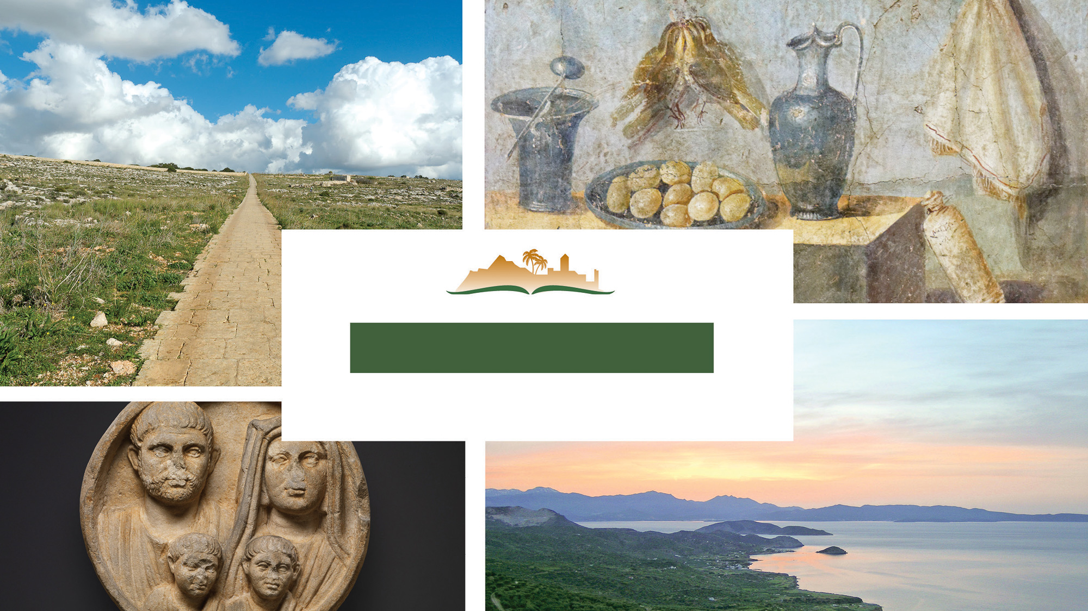
1 Timothy 4
Notes:
This is a free sample of the 1 Timothy 4 presentation from the Photo Companion to the Bible. To purchase the full volume, visit https://www.bibleplaces.com/timothy-titus/
The Photo Companion to the Bible is an image-rich resource for Bible students, teachers, and researchers. Just as a librarian stocks the shelves with as many relevant materials as possible, so we have tried to provide a broad selection of images. Our goal is that you will find in this “library” whatever it is you are looking for.
Credits: The primary creators of this presentation are Kris Udd, Steven D. Anderson, Christian Locatell, and Todd Bolen. The photographs have an individual file code which usually includes the initials of the photographer. Other images have additional credit or source information.
Updates: We plan to update this collection as we are able. We welcome your suggestions for improving this resource (photocompanion@bibleplaces.com). Purchasers of the 1 & 2 Timothy, Titus volume are provided free, lifetime updates to the volume.
Copyright: This photo collection is protected by copyright law and may not be distributed without written permission from BiblePlaces.com. Slide notes should be treated as any other copyrighted written material, with credit given when quoting from these notes.
For more information, see our complete “Introduction to the Photo Companion to the Bible” online at https://www.BiblePlaces.com/Intro-Photo-Companion-Bible/. Here you will find more information about photo selection, explanatory notes, Bible translation, credit information, and copyright allowances.

Slide 2
1 Timothy 4
This is a free sample of the 1 Timothy 4 presentation from the Photo Companion to the Bible. To purchase the full volume, visit https://www.bibleplaces.com/timothy-titus/
The Photo Companion to the Bible is an image-rich resource for Bible students, teachers, and researchers. Just as a librarian stocks the shelves with as many relevant materials as possible, so we have tried to provide a broad selection of images. Our goal is that you will find in this “library” whatever it is you are looking for.
For more details (for this and every slide), see the Notes section below.
Notes:
This is a free sample of the 1 Timothy 4 presentation from the Photo Companion to the Bible. To purchase the full volume, visit https://www.bibleplaces.com/timothy-titus/
The Photo Companion to the Bible is an image-rich resource for Bible students, teachers, and researchers. Just as a librarian stocks the shelves with as many relevant materials as possible, so we have tried to provide a broad selection of images. Our goal is that you will find in this “library” whatever it is you are looking for.
Credits: The primary creators of this presentation are Kris Udd, Steven D. Anderson, Christian Locatell, and Todd Bolen. The photographs have an individual file code which usually includes the initials of the photographer. Other images have additional credit or source information.
Updates: We plan to update this collection as we are able. We welcome your suggestions for improving this resource (photocompanion@bibleplaces.com). Purchasers of the 1 & 2 Timothy, Titus volume are provided free, lifetime updates to the volume.
Copyright: This photo collection is protected by copyright law and may not be distributed without written permission from BiblePlaces.com. Slide notes should be treated as any other copyrighted written material, with credit given when quoting from these notes.
For more information, see our complete “Introduction to the Photo Companion to the Bible” online at https://www.BiblePlaces.com/Intro-Photo-Companion-Bible/. Here you will find more information about photo selection, explanatory notes, Bible translation, credit information, and copyright allowances.

Slide 3
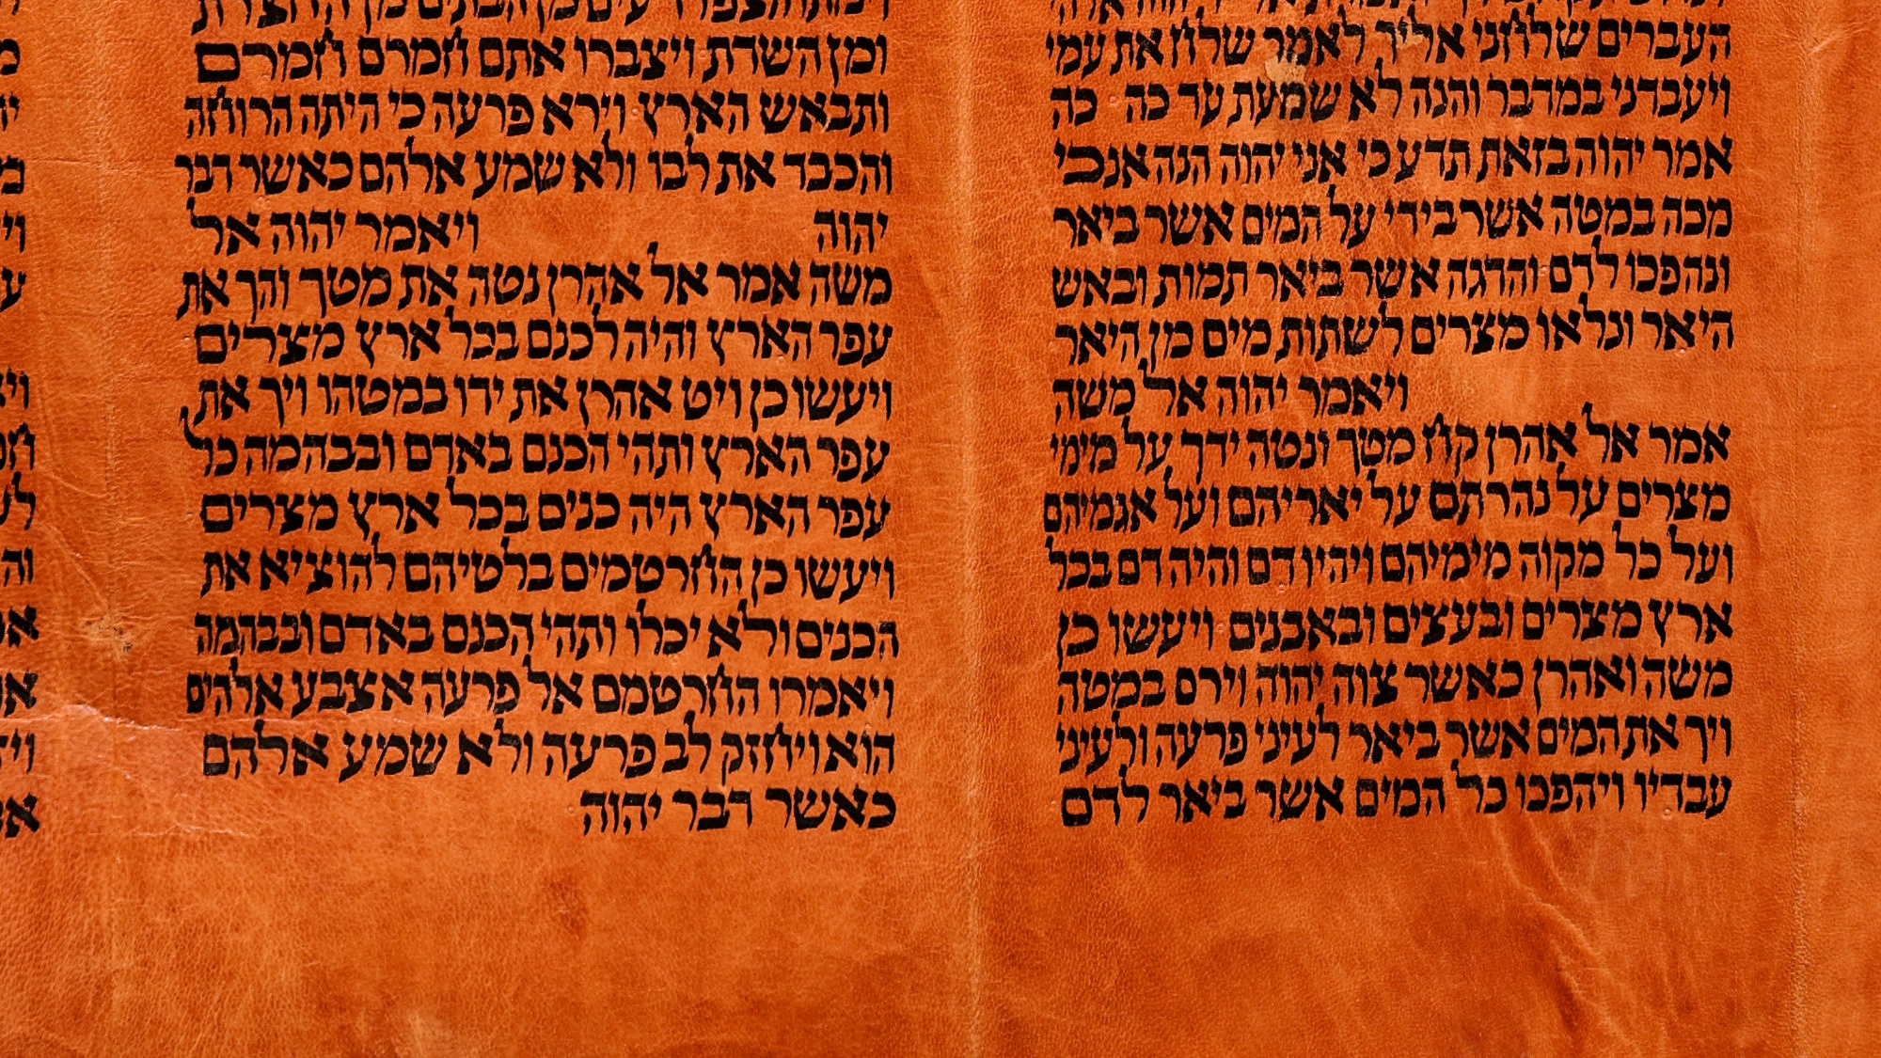
The Spirit expressly says that in the latter times some will fall away from the truth
“Thus says Yahweh”
“just as Yahweh has said”
Portion of Torah Scroll showing Exodus 7 and 8
4:1
Notes:
The phrase “The Spirit says” highlights the divine authority of Paul’s words. It is equivalent to the phrase in the Old Testament, ”Thus says Yahweh,” which prophets would use to preface their words from God, as can be seen in the highlighted text above from Exodus 7:17. A similar phrase is “just as Yahweh has said” in Exodus 8:19 [Heb 8:15]. This Yemenite Torah scroll was photographed at The Master’s Seminary in California.
tb031416384

Slide 4
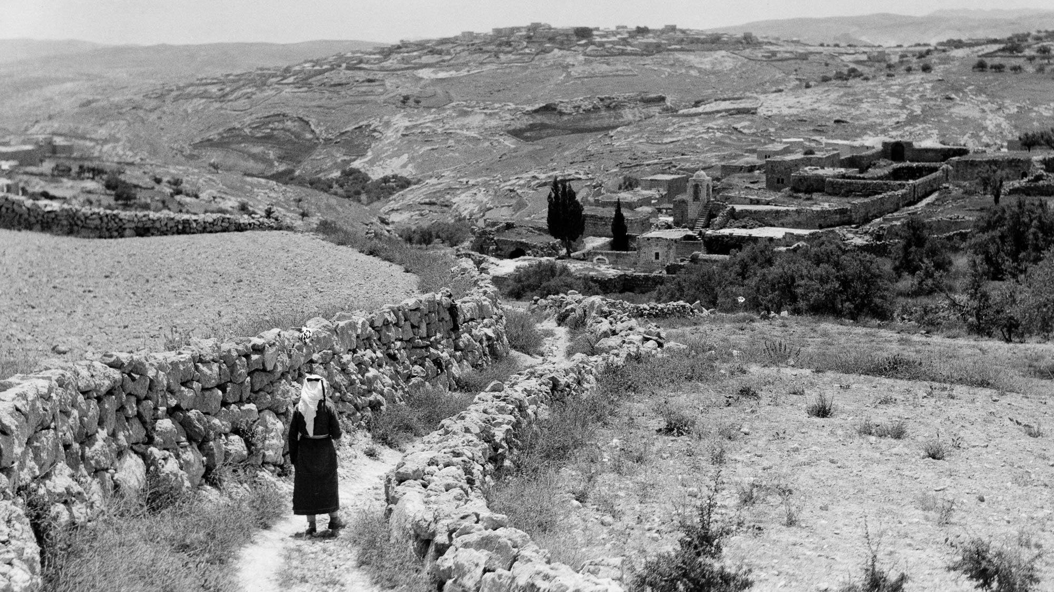
The Spirit expressly says that in the latter times some will fall away from the truth
Man walking down a path between Bethany and the Mount of Olives
4:1
Notes:
The word “fall away” (Gk. aphistēmi, ἀφίστημι) means to withdraw or depart. It is used in a non-pejorative way to describe Jesus’s ascension (Luke 24:51). It is illustrated here by a photo of a man walking away from the camera. On the other hand, it is used in a very negative sense by Paul to describe John Mark who “deserted” the missionary team (Acts 15:38). This American Colony photo was taken between 1934 and 1939.
mat16343h

Slide 5
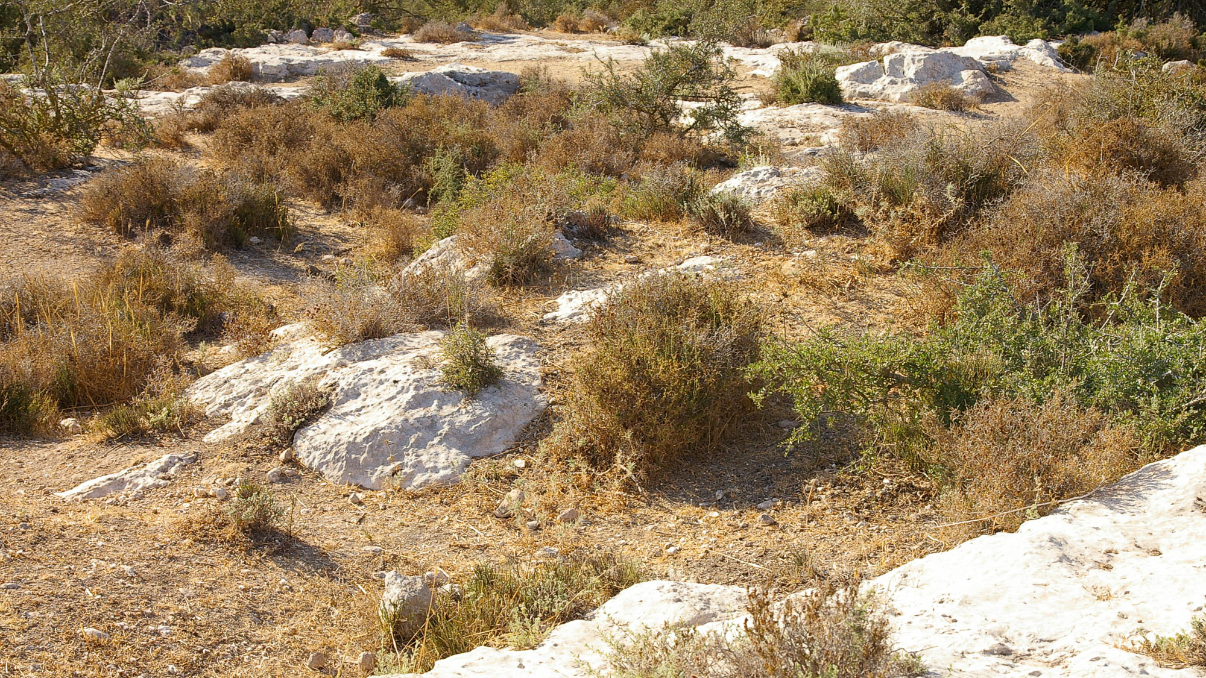
The Spirit expressly says that in the latter times some will fall away from the truth
Rocky ground near the ancient Philistine city of Gath
4:1
Notes:
In His parable of the soils, Jesus used this same word (Gk. aphistēmi, ἀφίστημι) in the example of seeds that fell on rocky soil, sprang up, and withered away; these represented ones who believed for a while, but then fell away (Luke 8:13). This photo shows dried-up plants on rocky soil, none of which are fruitful or useful.
adr08072470311

Slide 6
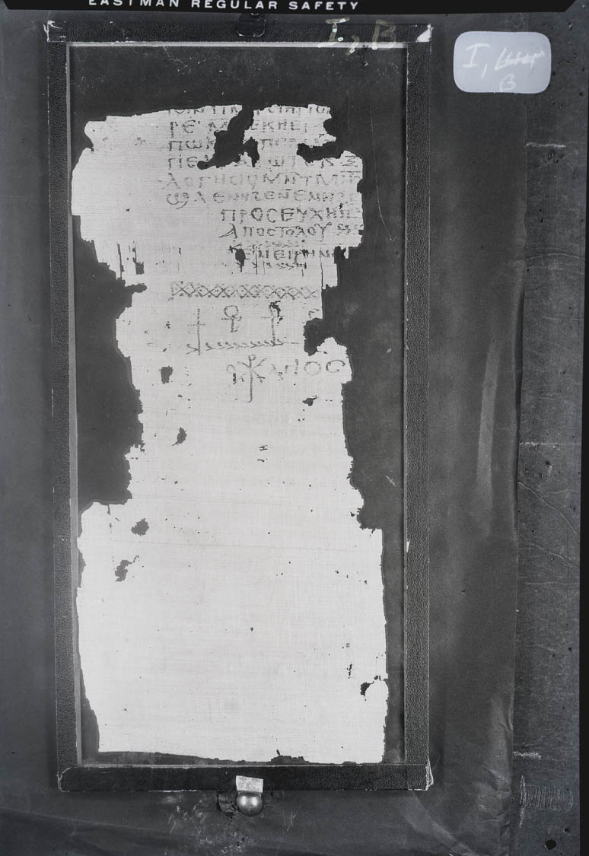
Paying attention to deceitful spirits and doctrines of demons
Gnostic text, “The Prayer of the Apostle Paul,” from Nag Hammadi, circa AD 200
4:1
Notes:
One of the most nefarious and disastrous examples of the sort of deceitful doctrine that would later arise was the Gnostic movement, which produced many works claiming to be written by an apostle or someone close to Jesus. The manuscript shown here is a fragment of a Gnostic text (originally written in Greek but only preserved in a Coptic translation) that claims to be from the Apostle Paul. This is seen in the title at the end of the text which reads in Greek “Prayer of Paul the Apostle” (Gk. προσευχη πα[ουλου] αποστολου). However, it is clearly a later forgery infused with Gnostic concepts and likely dating from the mid-second to third centuries AD. This image comes from the Nag Hammadi Archive in The Claremont Colleges Digital Library (CCDL) where it is made available under the "Fair Use" portion of the US Copyright Act at http://ccdl.libraries.claremont.edu/cdm/ref/collection/nha/id/2136. See the next slide for a close-up.
ccdl2136

Slide 7
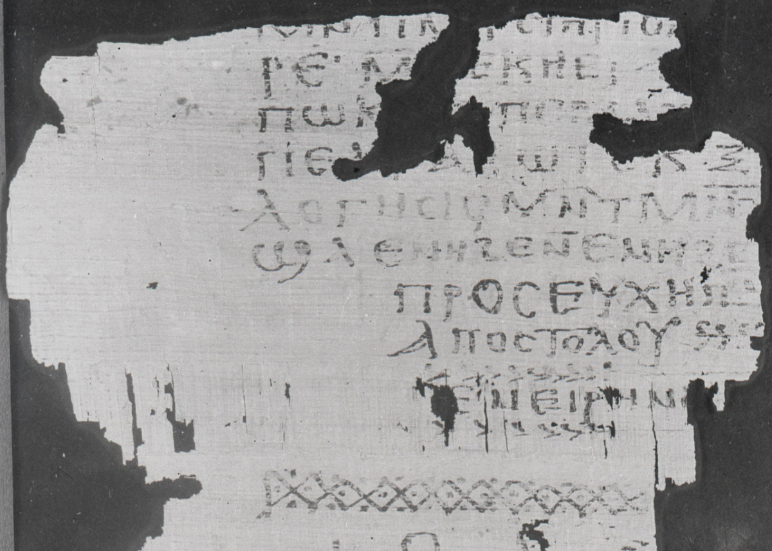
Paying attention to deceitful spirits and doctrines of demons
Gnostic text, “The Prayer of the Apostle Paul,” from Nag Hammadi, circa AD 200
4:1
Notes:
One of the most nefarious and disastrous examples of the sort of deceitful doctrine that would later arise was the Gnostic movement, which produced many works claiming to be written by an apostle or someone close to Jesus. The manuscript shown here is a fragment of a Gnostic text (originally written in Greek but only preserved in a Coptic translation) that claims to be from the Apostle Paul. This is seen in the title at the end of the text which reads in Greek “Prayer of Paul the Apostle” (Gk. προσευχη πα[ουλου] αποστολου). However, it is clearly a later forgery infused with Gnostic concepts and likely dating from the mid-second to third centuries AD. This image comes from the Nag Hammadi Archive in The Claremont Colleges Digital Library (CCDL) where it is made available under the "Fair Use" portion of the US Copyright Act at http://ccdl.libraries.claremont.edu/cdm/ref/collection/nha/id/2136.
ccdl2136

Slide 8
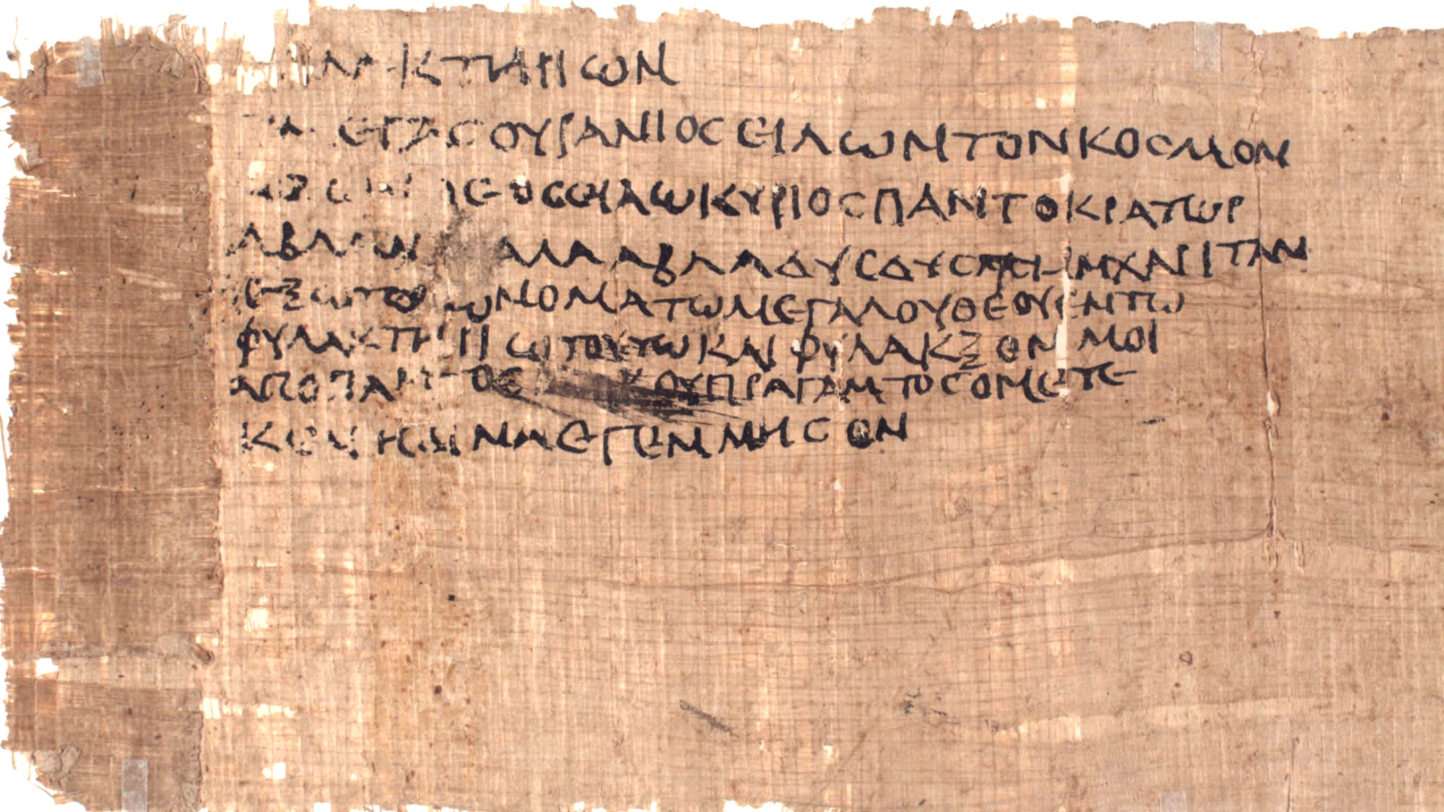
Paying attention to deceitful spirits and doctrines of demons
Jewish magic text used in a phylactery, from Egypt, circa AD 200
4:1
Notes:
This warning could apply to Jewish syncretism that mixed biblical concepts with pagan mysticism. Such Jewish syncretism can be seen in magic texts on papyri from Egypt during the Greco-Roman period. The example shown here dates to the late-second or early-third century AD, but it is essentially the same as Jewish syncretistic texts dating around Paul’s day.
The first word in the text is “phylactery” (Gk. phulaktērion, φυλακτήριον), a common implement used by Jews in religious activities (cf. Matt 23:4). The text goes on to invoke Iao, a syncretistic name of a super deity derived from the name of God from the Hebrew Bible, Yahweh. The name is also used to refer to lesser deities and spiritual beings. The Advanced Papyrological Information System on the University of Michigan website gives the following translation: “A phylactery: ‘Great [god] in heaven revolving the world, the true god, IAO! Lord, ruler of all, ABLANATHANALBA, grant, grant me this favor, let me have the name of the great god in this phylactery, and protect, from every evil thing, me whom NN bore, (NN) begot.’”
The word “ABLANATHANALBA” functioned in these types of texts as a magical palindrome. Some suggest it derives from the Aramaic phrase “You are our father” (Aram. אב לנא את, av lana at). For more on such texts, see the slides on Colossians 2:18.
This image comes from the University of Michigan, Advanced Papyrological Information System, and is in the public domain. Source: http://quod.lib.umich.edu/a/apis/x-1546/193_a.tif. University of Michigan Library Digital Collections. Accessed: Oct 15, 2019. The next slide highlights the words “phylactery,” “Iao,” and “ABLANATHANALBA.”
umapis1931546207

Slide 9
Paying attention to deceitful spirits and doctrines of demons
Jewish magic text used in a phylactery, from Egypt, circa AD 200
4:1
Notes:
This warning could apply to Jewish syncretism that mixed biblical concepts with pagan mysticism. Such Jewish syncretism can be seen in magic texts on papyri from Egypt during the Greco-Roman period. The example shown here dates to the late-second or early-third century AD, but it is essentially the same as Jewish syncretistic texts dating around Paul’s day.
The first word in the text is “phylactery” (Gk. phulaktērion, φυλακτήριον), a common implement used by Jews in religious activities (cf. Matt 23:4). The text goes on to invoke Iao, a syncretistic name of a super deity derived from the name of God from the Hebrew Bible, Yahweh. The name is also used to refer to lesser deities and spiritual beings. The Advanced Papyrological Information System on the University of Michigan website gives the following translation: “A phylactery: ‘Great [god] in heaven revolving the world, the true god, IAO! Lord, ruler of all, ABLANATHANALBA, grant, grant me this favor, let me have the name of the great god in this phylactery, and protect, from every evil thing, me whom NN bore, (NN) begot.’”
The word “ABLANATHANALBA” functioned in these types of texts as a magical palindrome. Some suggest it derives from the Aramaic phrase “You are our father” (Aram. אב לנא את, av lana at). For more on such texts, see the slides on Colossians 2:18. The two occurrences of the word “phylactery” (Gk. φυλακτήριον, phulaktērion) are highlighted in blue, “Iao” (Gk. Ιαω) is highlighted in yellow, and “ABLANATHANALBA” (Gk. Αβλαναθαλβα, misspelled here) is highlighted in green.
This image comes from the University of Michigan, Advanced Papyrological Information System, and is in the public domain. Source: http://quod.lib.umich.edu/a/apis/x-1546/193_a.tif. University of Michigan Library Digital Collections. Accessed: Oct 15, 2019.
umapis1931546207

Slide 10
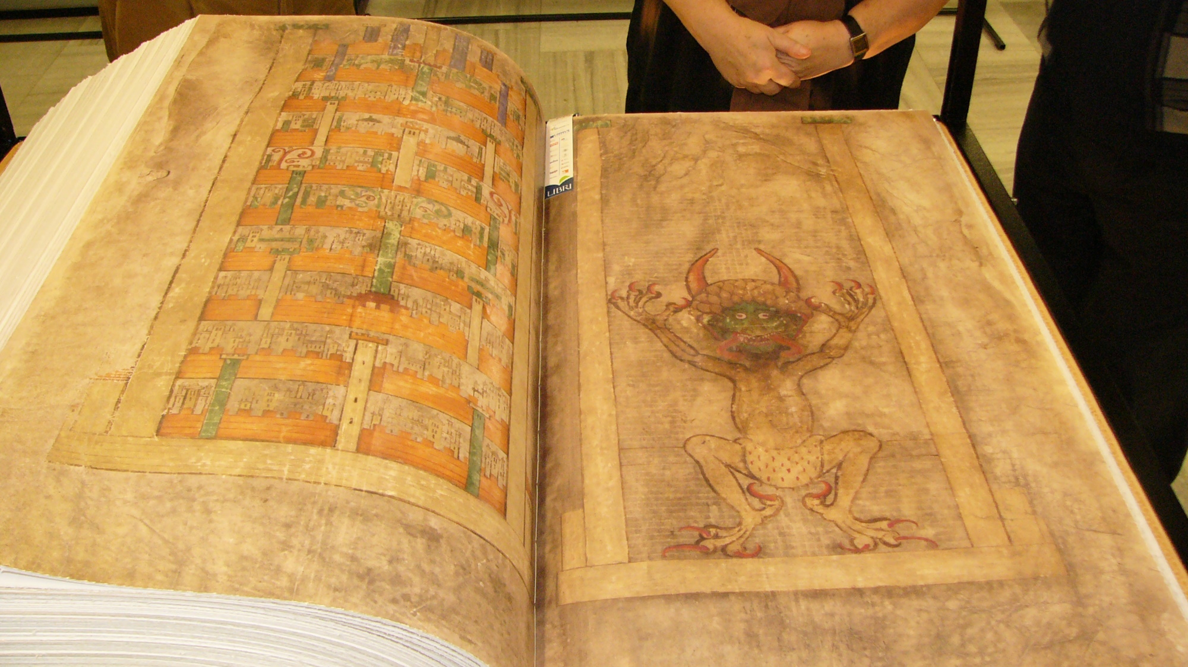
Paying attention to deceitful spirits and doctrines of demons
Depiction of the devil in a facsimile of Codex Gigas, circa AD 1225
4:1
Notes:
Codex Gigas is the largest extant medieval manuscript in the world. It is also known as the Devil’s Bible because of a large illustration of the devil on folio 290 (recto). It is thought to have been created in the early 13th century in the Benedictine monastery of Podlažice in Bohemia (modern Czech Republic). It contains the Vulgate Bible as well as other historical works written in Latin. During the Thirty Years' War in 1648, the entire collection was taken by the Swedish army as plunder, and it is now preserved at the National Library of Sweden in Stockholm, though it is not normally on display. This image comes from Michal Maňas and is licensed under CC BY 2.5, via Wikimedia Commons: https://commons.wikimedia.org/wiki/File:Codex_Gigas_facsimile.jpg.
wiki1123200723041728h

Slide 11
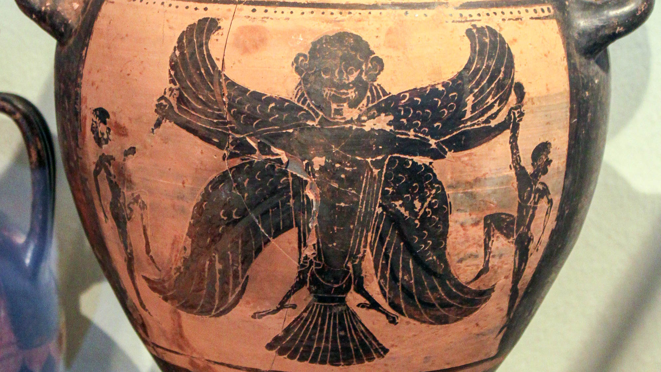
Paying attention to deceitful spirits and doctrines of demons
Hydria depicting the Demon of Death, from Italy, 530–500 BC
4:1
Notes:
The mythological creature shown on this vase, sometimes referred to as a harpy, was an agent of punishment who abducted people and tortured them on their way to Tartarus. These creatures are mentioned in the poems of Homer, many centuries before the time of Paul, and they remained a fixture in popular thought long after the time of Paul, even appearing in works like Dante’s Inferno. This image is depicted on a hydria, a water-carrying vessel with three handles. This hydria comes from Vulci, Italy, and was photographed at the Altes Museum in Berlin. This image comes from Anagoria and is licensed under CC BY 3.0, via Wikimedia Commons: https://commons.wikimedia.org/wiki/File:-0515_Hydria_with_Demon_of_Death_Altes_Museum_anagoria.JPG.
wiki012620140515

Slide 12
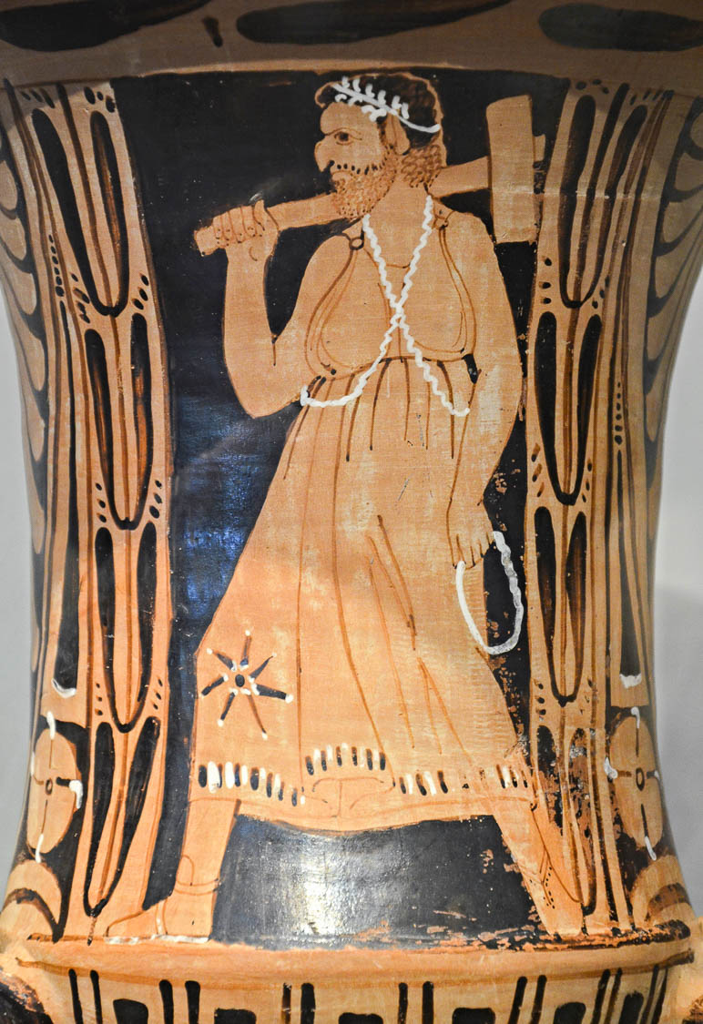
Paying attention to deceitful spirits and doctrines of demons
Red-figured krater with Charon, the Etruscan death demon, circa 300 BC
4:1
Notes:
This Etruscan krater comes from Vulci, Italy, and was photographed at the Altes Museum in Berlin. This image comes from Carole Raddato and is licensed under CC BY-SA 2.0, via Wikimedia Commons: https://commons.wikimedia.org/wiki/File:Etruscan_red-figured_krater_with_Charon,_the_Etruscan_death_demon,_from_Vulci_(Italy),_around_300_BC,_Altes_Museum,_Berlin_(16246984190).jpg.
wiki16246984190h

Slide 13
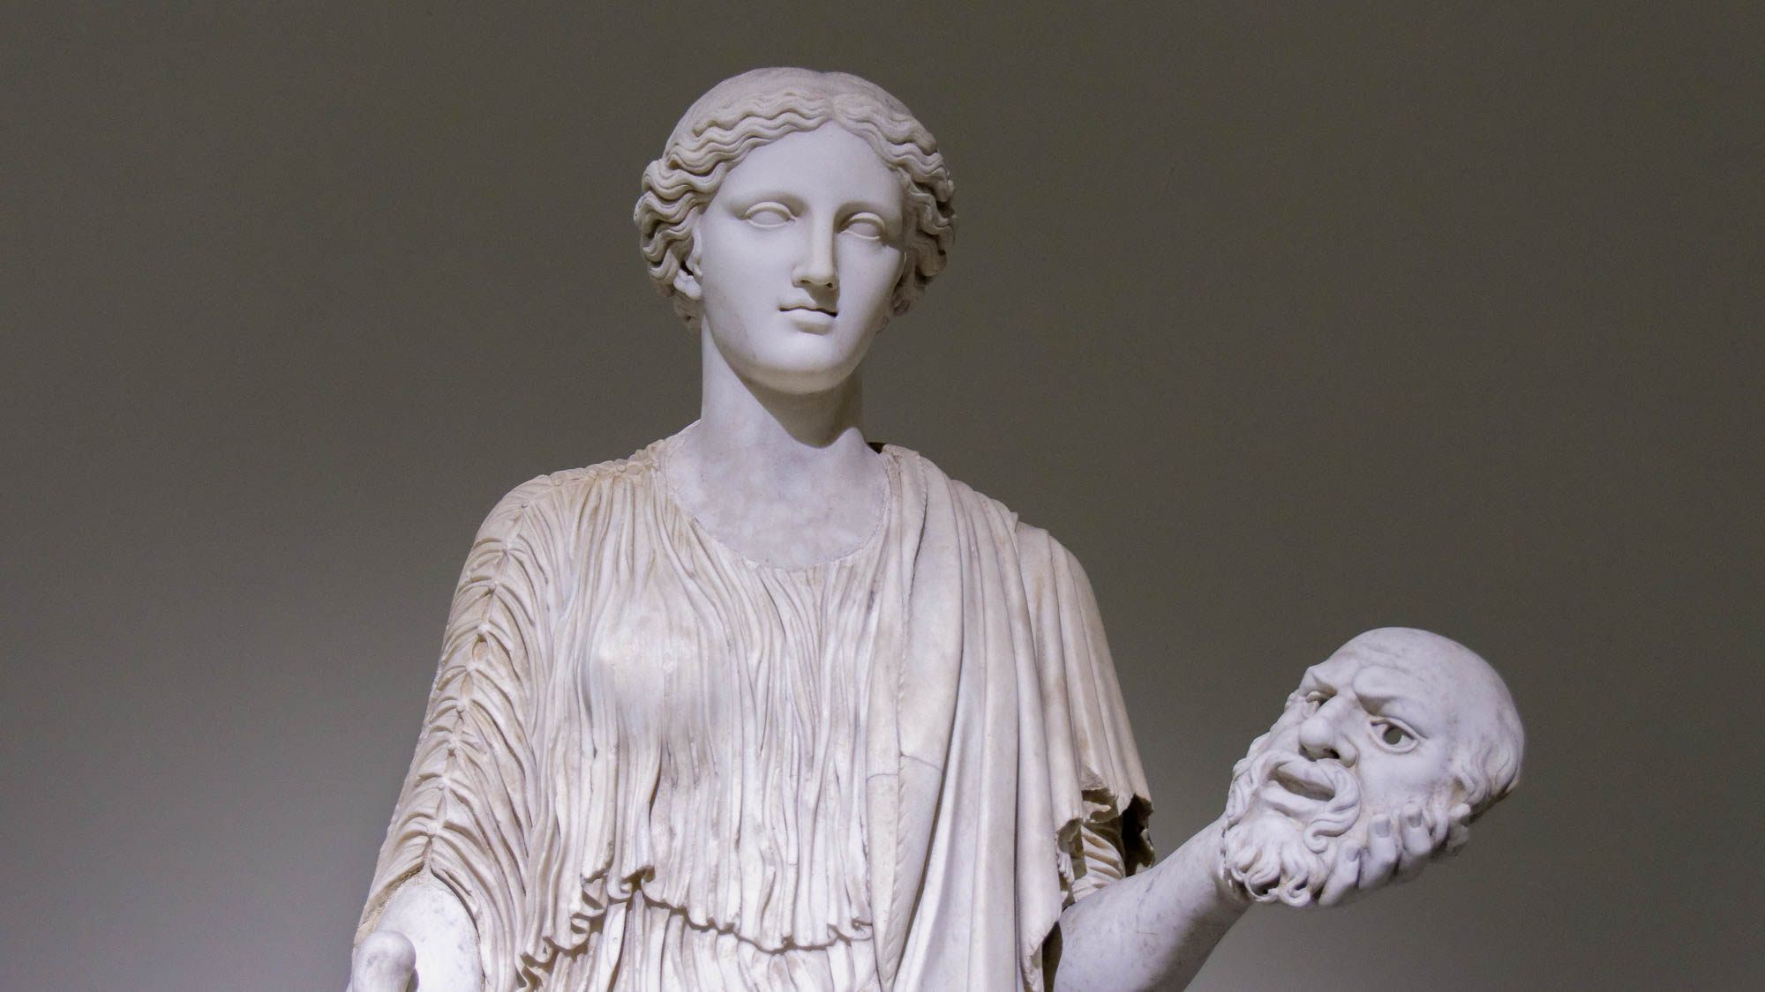
Through the hypocrisy of men that speak lies
Female holding a bearded mask, late 2nd century AD
4:2
Notes:
The term “hypocrisy” (Gk. hupokrisis, ὑπόκρισις) refers to play-acting, putting on a face that is not genuine. The term originated in Attic Greek as a description of one who plays a stage role, but by the time of the New Testament, it is used only in a negative sense. This statue is thought to be a 2nd century AD copy of a 5th century BC original. It was photographed at the Naples Archaeological Museum.
tb0515171184h

Slide 14
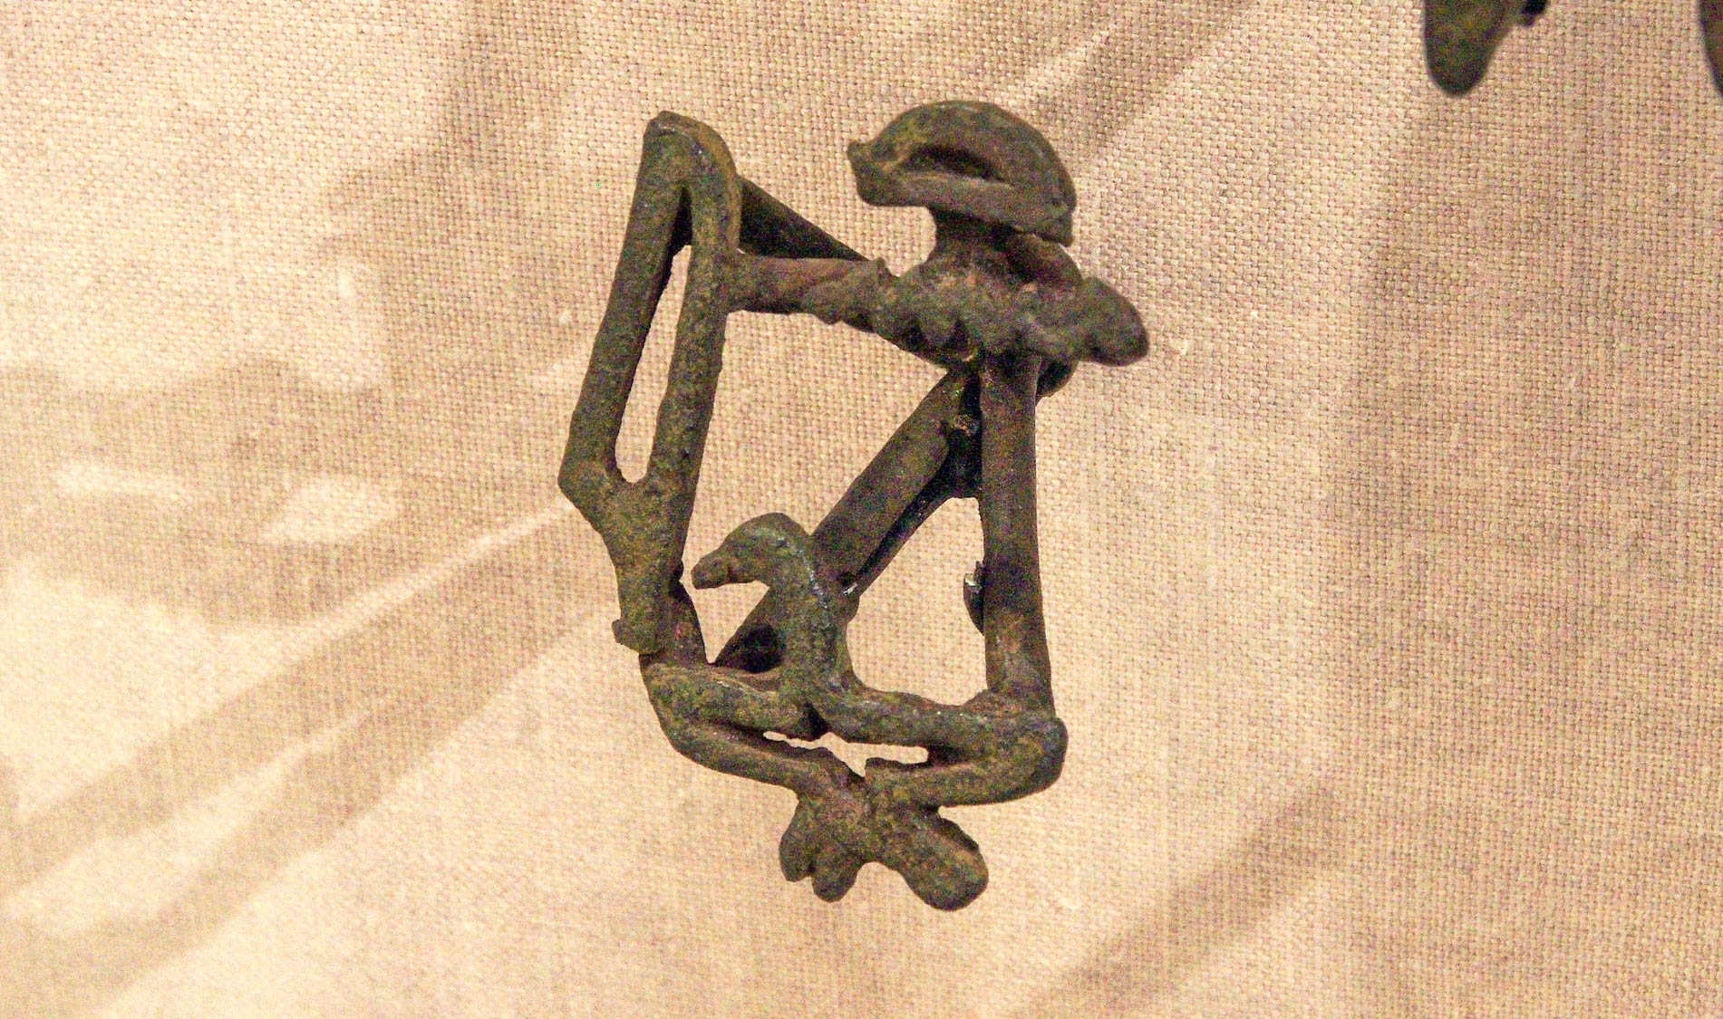
Seared in their own conscience as with a branding iron
Egyptian cattle brand with hieroglyphs, from the reign of Akhenaten, 14th century BC
4:2
Notes:
The phrase “seared . . . as with a branding iron” represents the participial form of the Greek word kaustēriazw (Gk. καυστηριάζω). The Greek historian Strabo used this same word in his description of a man who branded his horses with the figure of a wolf (Strabo, Geog 5.1.9). This ancient bronze cattle brand was photographed at the Johns Hopkins Archaeological Museum.
adr1311224030h

Slide 15
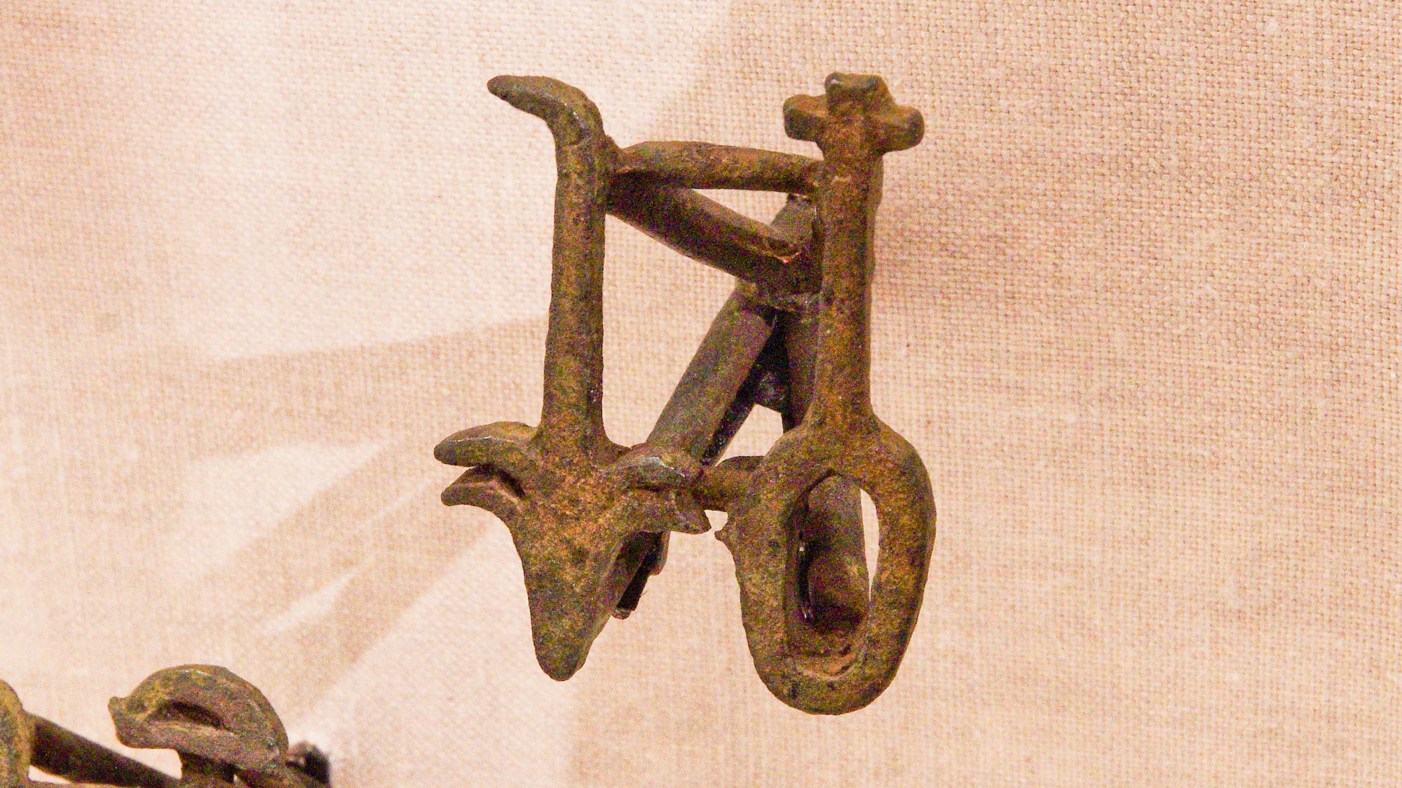
Seared in their own conscience as with a branding iron
Egyptian cattle brand with hieroglyphs, from the reign of Akhenaten, 14th century BC
4:2
Notes:
This ancient bronze cattle brand was photographed at the Johns Hopkins Archaeological Museum.
adr1311224029h

Slide 16
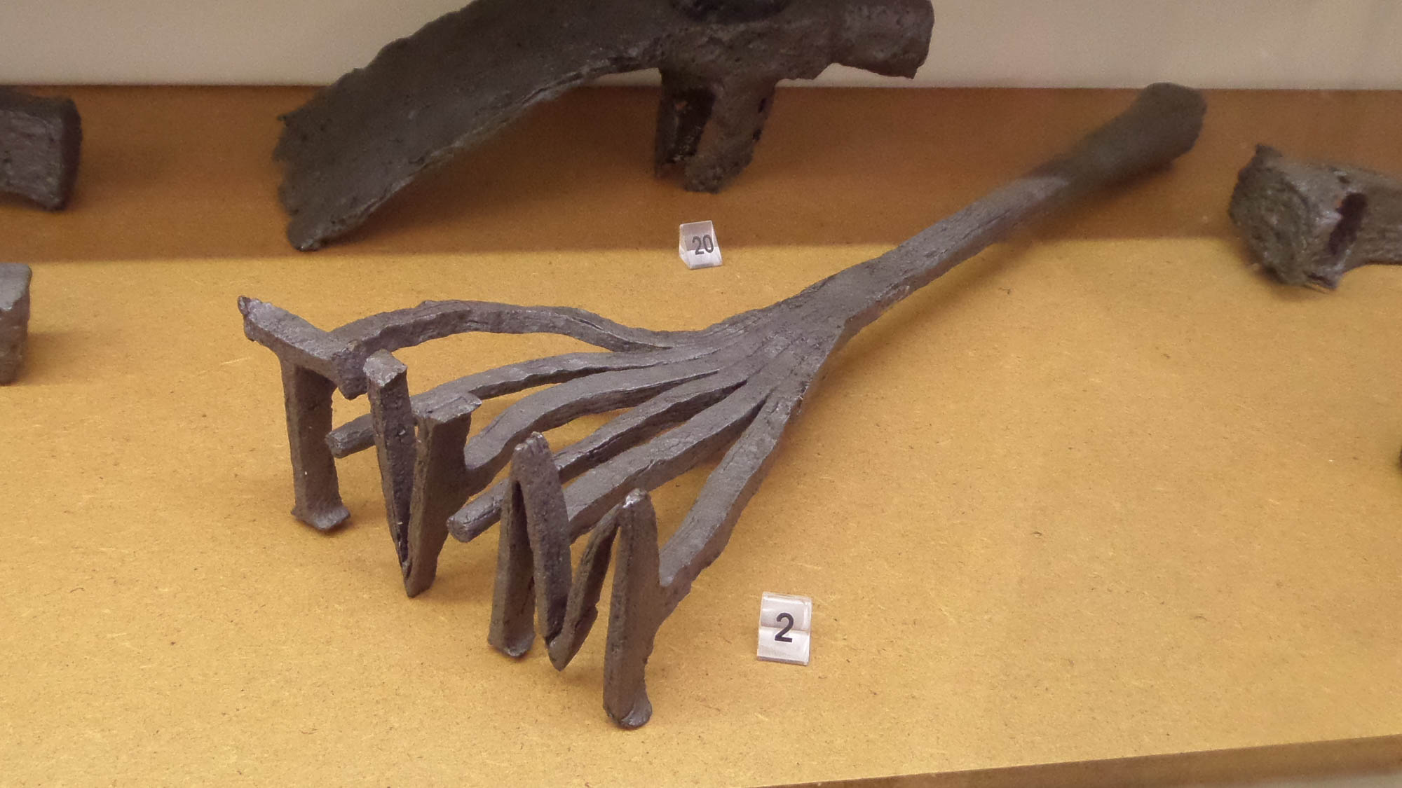
Seared in their own conscience as with a branding iron
Roman cattle brand, from Croatia
4:2
Notes:
This Roman brand used three Latin letters (Lat. MVT) which are of unknown significance. This artifact was photographed at the Archaeological Museum in Split, Croatia. This image comes from Gaius Cornelius and is licensed under CC BY-SA 4.0, via Wikimedia Commons: https://commons.wikimedia.org/wiki/File:Roman_cattle_brand,_iron.jpg.
wiki040920181137063240

Slide 17
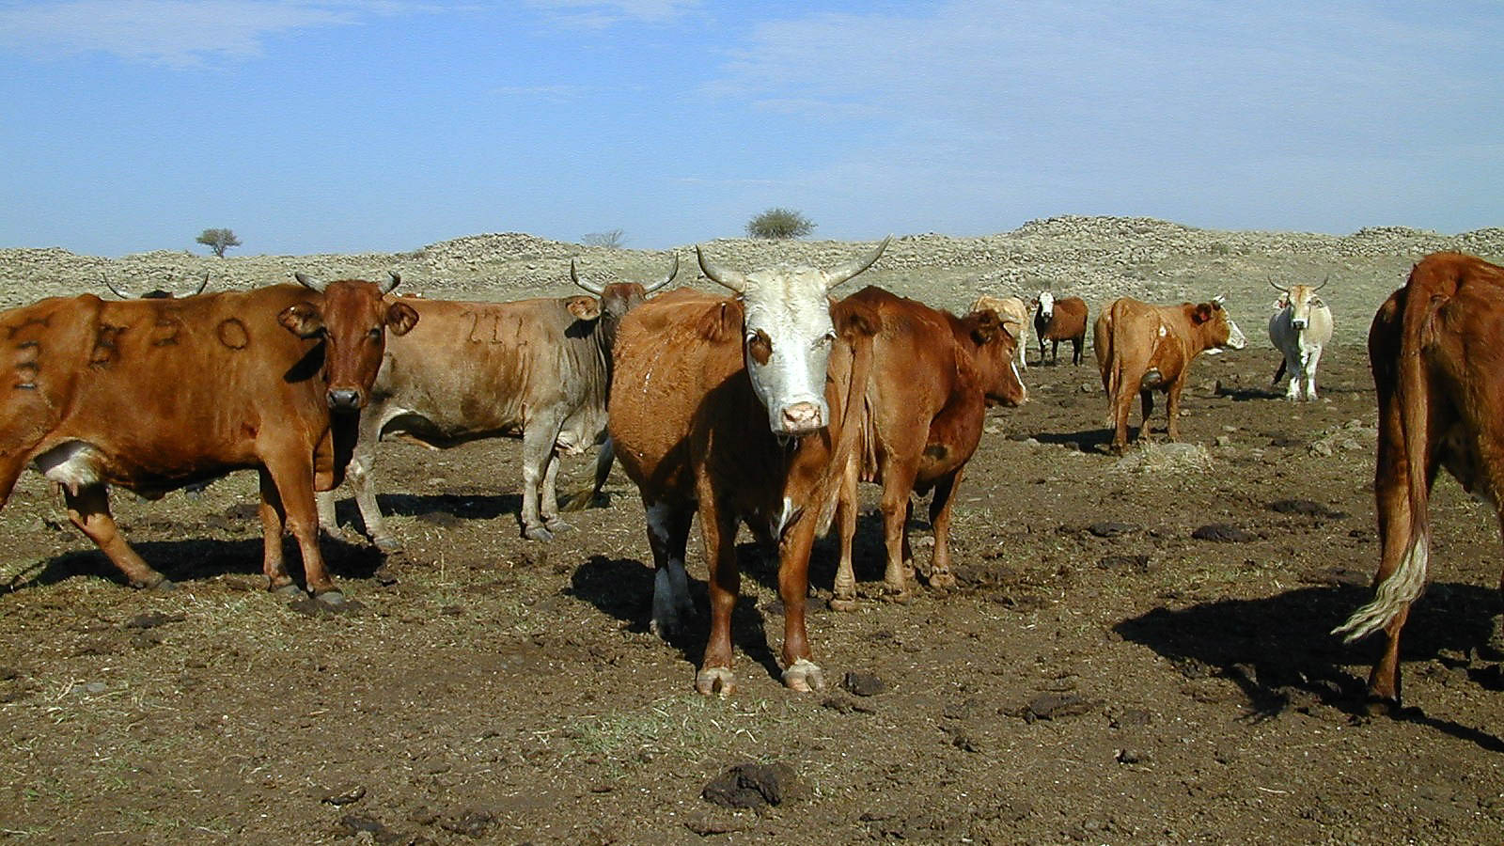
Seared in their own conscience as with a branding iron
Branded cattle in Bashan
4:2
Notes:
Branding cauterizes skin where it is touched by the branding iron, killing nerve endings and creating an area that is no longer sensitive to touch. The cattle in this photo have been branded with very large brands.
tb111700201

Slide 18
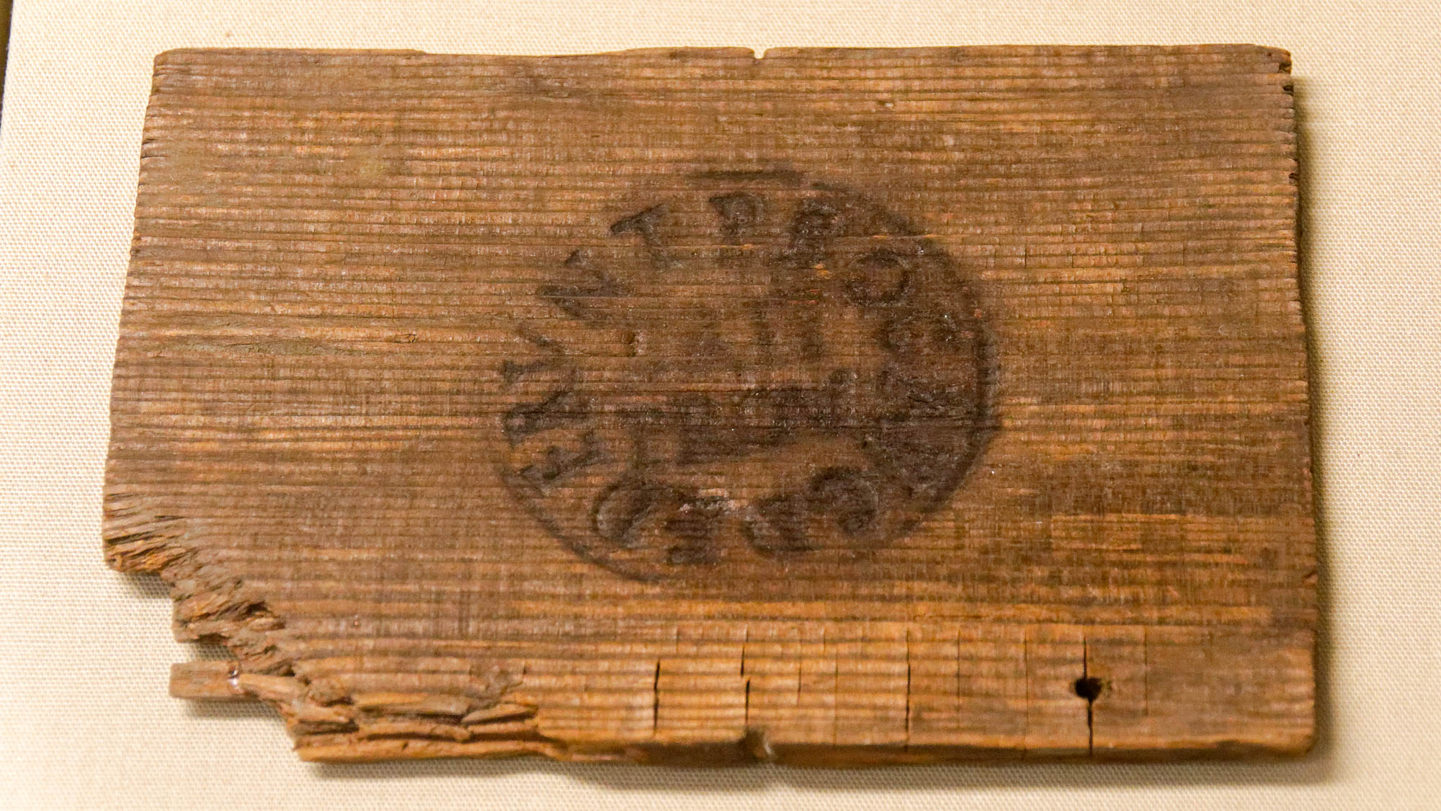
Seared in their own conscience as with a branding iron
Wood writing tablet, government issue, from Walbrook, London, 1st–2nd centuries AD
4:2
Notes:
This wooden writing tablet was marked as government property by being stamped with a branding iron. It was photographed at the British Museum.
tb1001199721

Slide 19
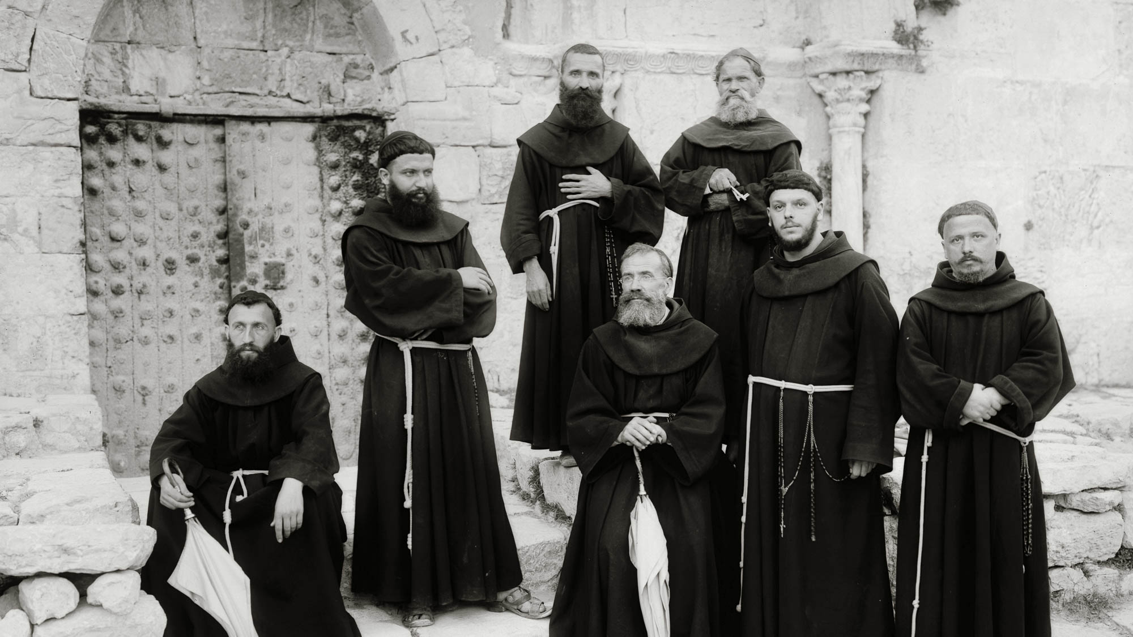
Forbidding marriage
Franciscan monks in front of the Church of the Virgin in Jerusalem
4:3
Notes:
Celibacy was considered a virtue by a variety of early believers seeking a godly lifestyle. The practice has become a requirement of numerous religious orders, including the Franciscans shown here. This American Colony photo was taken between 1898 and 1914.
mat06806h

Slide 20
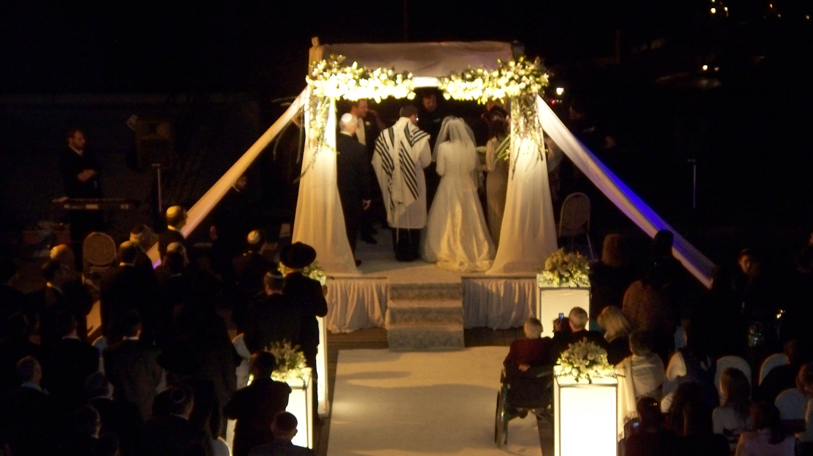
Forbidding marriage
Jewish wedding under a chuppah, in Jerusalem
4:3
Notes:
Paul elsewhere upholds marriage as a good and proper part of life for believers (e.g., 1 Cor 7:1-9).
cd091227601

Slide 21
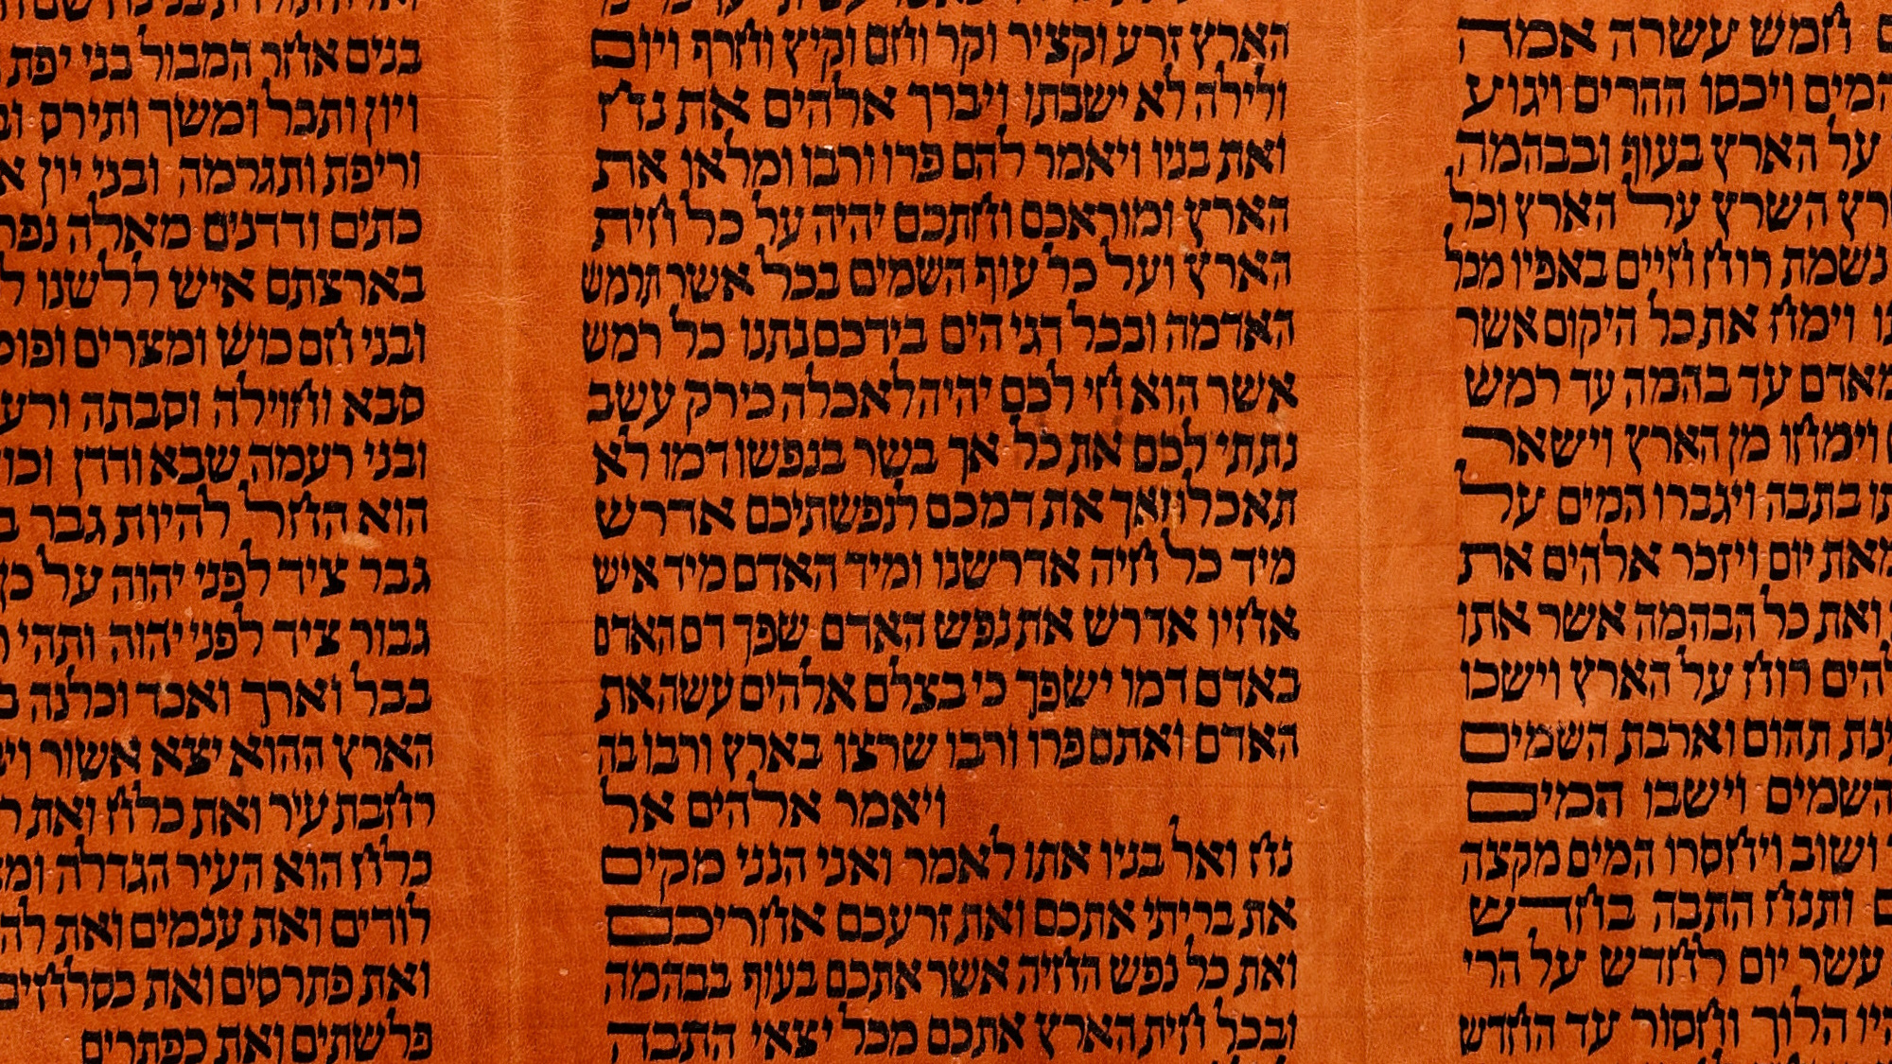
Commanding to abstain from foods which God created to be received with thanksgiving
“Every moving thing that lives shall be food for you; I give all to you, as I gave the green plant.”
Torah scroll with Genesis 9:3
4:3
Notes:
Food was given to mankind as a gift from God. Although man was initially given only grains and fruit to eat (Gen 1:29), following the Flood, God gave man permission to eat meat as well (Gen 9:3). The Mosaic law restricted what meat could be eaten by the Israelites (e.g., Lev 11), but this restriction was removed shortly after the start of the church age (Acts 10:10-15; Rom 14:6, 14; 1 Cor 10:30-31; Col 2:16-22). This Yemenite Torah scroll was photographed at The Master’s Seminary in California.
tb031416360

Slide 22

Commanding to abstain from foods which God created to be received with thanksgiving
Kosher McDonald’s in Jerusalem
4:3
Notes:
In Paul’s day, those who commanded others to abstain from certain foods were usually Judaizers who taught adherence to the dietary restrictions in the Mosaic Law. Today, people in Western societies are more likely to insist on dietary restrictions such as eating vegan.
mf090302903

Slide 23
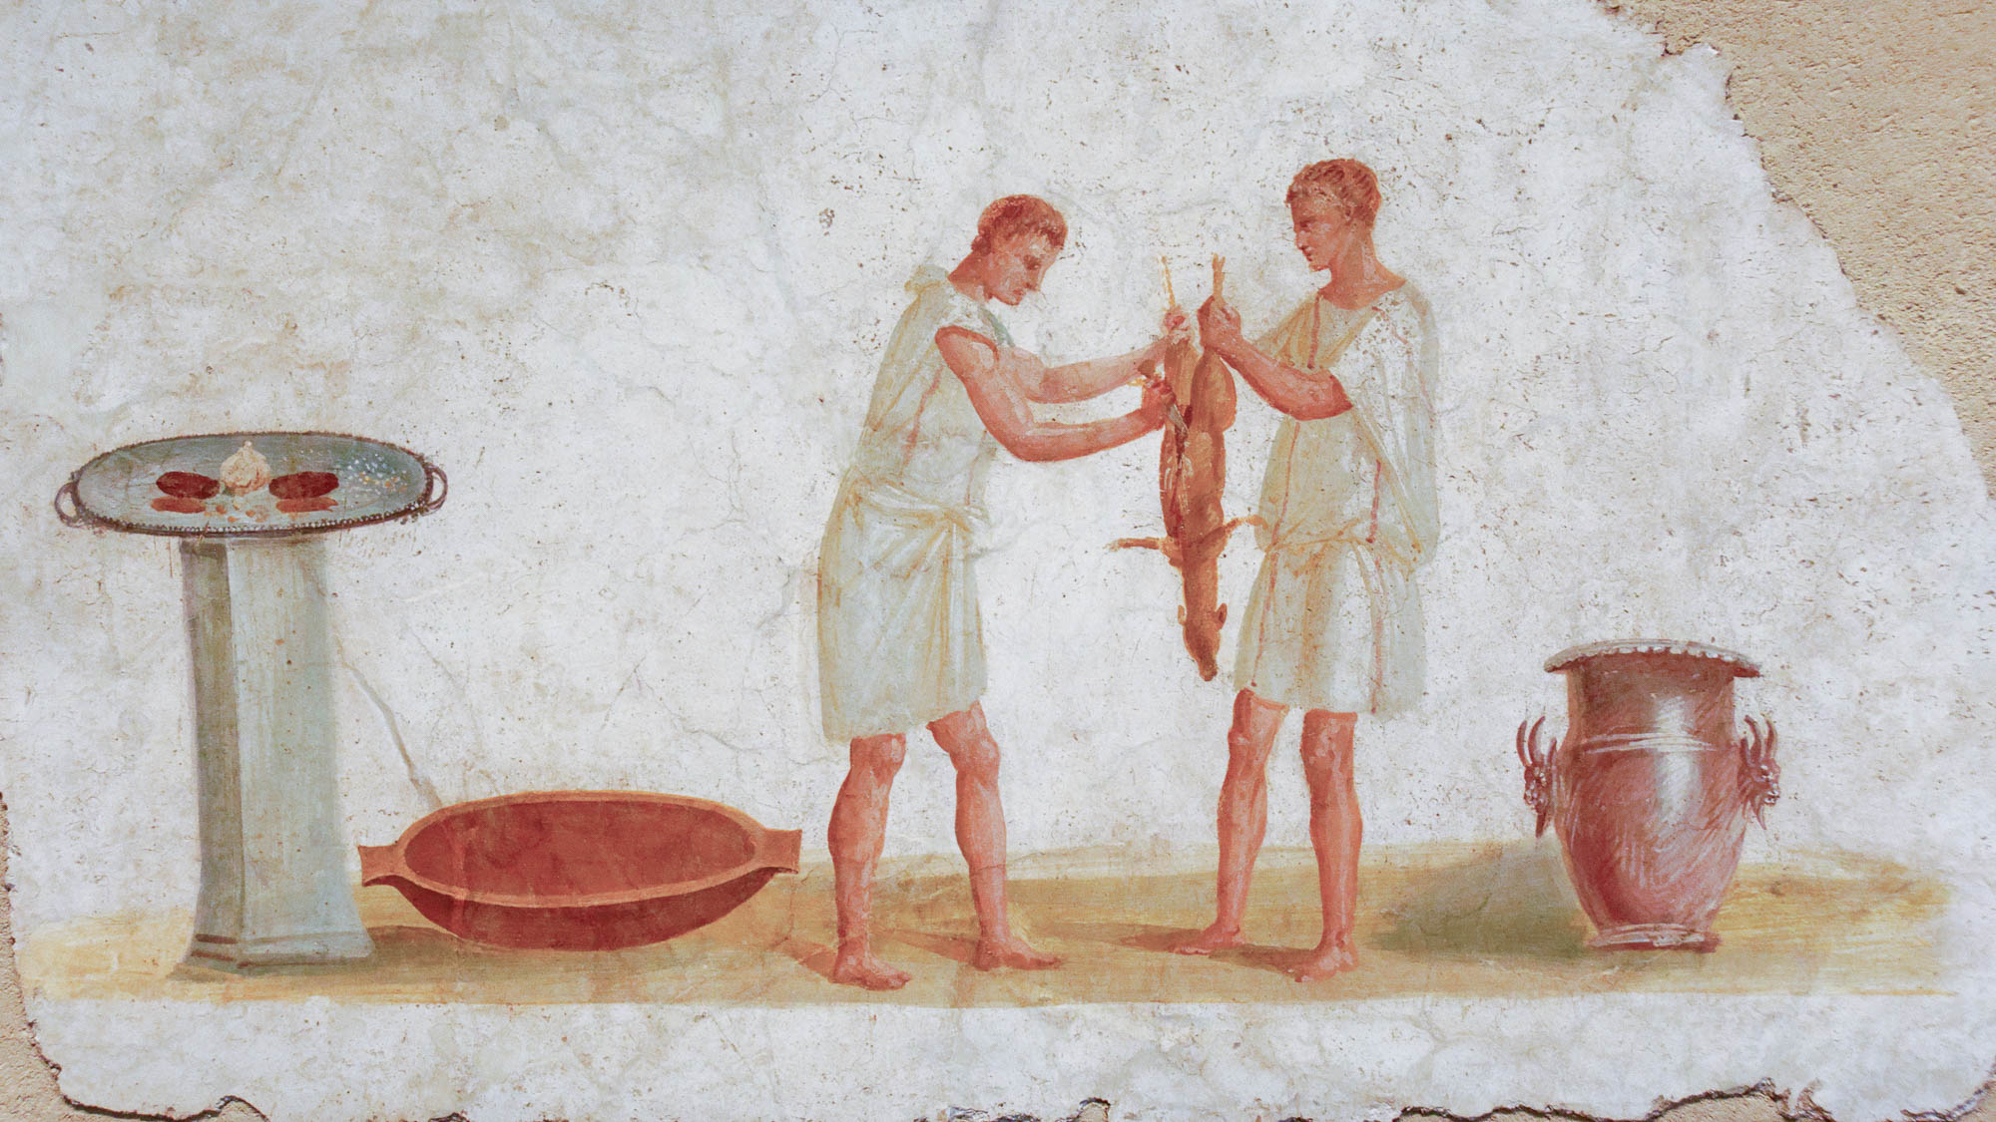
Commanding to abstain from foods which God created to be received with thanksgiving
Roman wall fresco of a meal being prepared, AD 50–75
4:3
Notes:
This fresco which shows two Roman slaves preparing a meal was photographed at the Getty Villa in southern California.
tb100919649

Slide 24
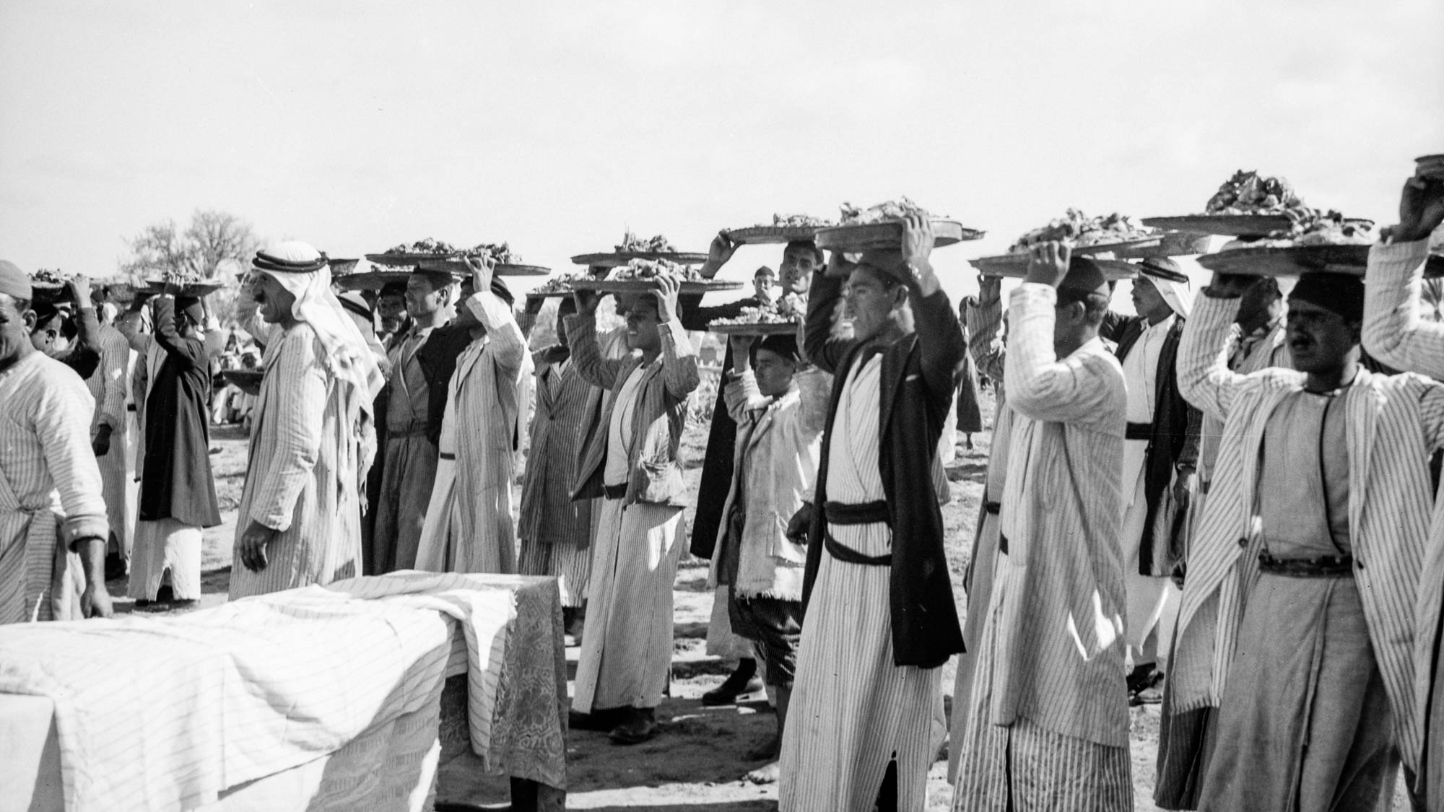
Commanding to abstain from foods which God created to be received with thanksgiving
Platters of food for a great feast near Ashkelon
4:3
Notes:
This photograph was taken in 1943.
mat21720

Slide 25
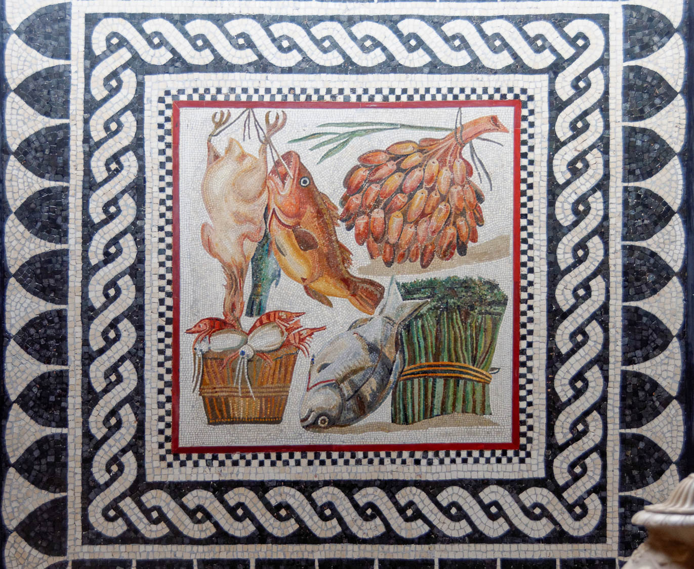
For everything created by God is good, and nothing is to be rejected
Mosaic with still life, gifts of food, mid-2nd century AD
4:4
Notes:
The mosaic shown here illustrates some of the good foods available about the time of Paul, including poultry, fresh fish, shrimp, dates, and fresh asparagus. This mosaic comes from the Villa of Numisia Procula on Via Ardeatina, and it was photographed at the Vatican Museums.
tb0512176976

Slide 26
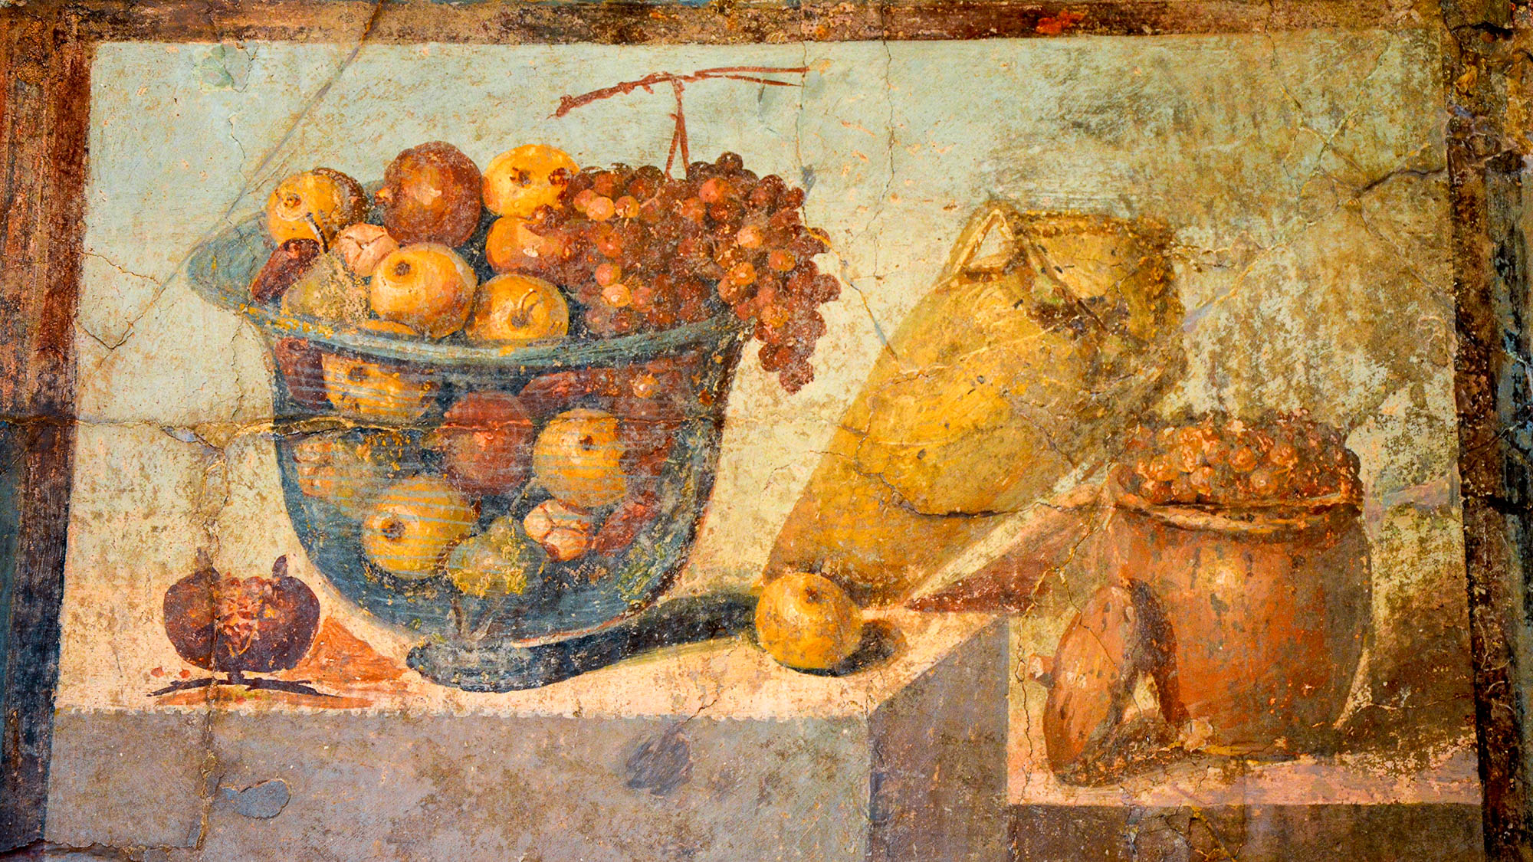
For everything created by God is good, and nothing is to be rejected
Fresco of fruit, wine, and raisins, from Pompeii, 1st century AD
4:4
Notes:
This fresco from the House of Julia Felix in Pompeii shows fresh fruit in a large glass bowl, a jar of wine, and a jar of raisins. It was photographed at the Naples National Archaeological Museum. This image comes from Carole Raddato and is licensed under CC BY-SA 2.0, via Wikimedia Commons: https://commons.wikimedia.org/wiki/File:Fresco_showing_fruit_bowl,_jar_of_wine,_jar_of_raisins,_from_the_House_of_Julia_Felix_in_Pompeii,_Naples_National_Archaeological_Museum_(14843192524).jpg.
wiki070420141337968c

Slide 27
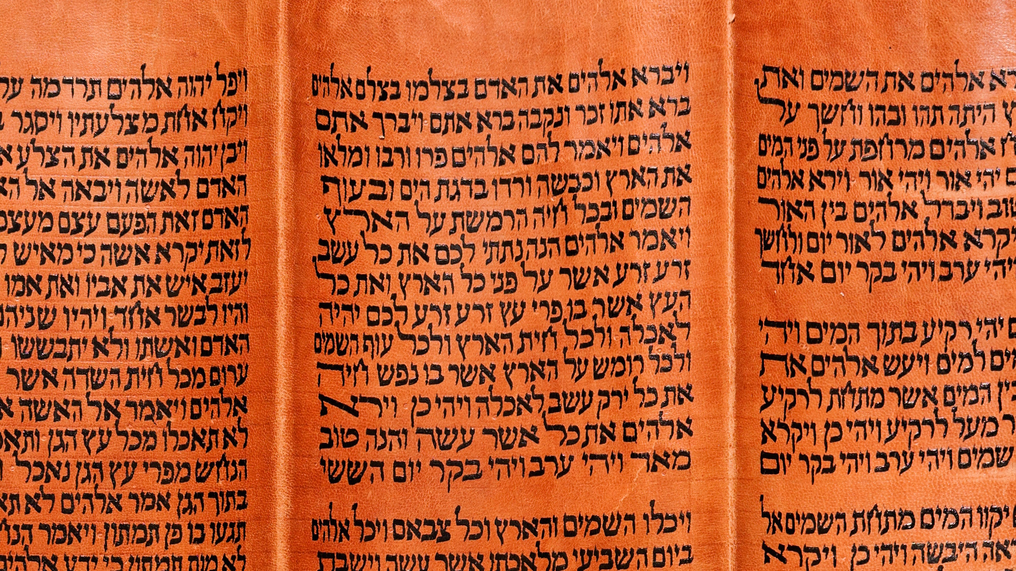
For everything created by God is good, and nothing is to be rejected
Torah scroll with Genesis 1:29-31
4:4
Notes:
“Then God said, “I give you every seed-bearing plant on the face of the whole earth and every tree that has fruit with seed in it. They will be yours for food. And to all the beasts of the earth and all the birds of the air and all the creatures that move on the ground—everything that has the breath of life in it—I give every green plant for food.” And it was so. God saw all that he had made, and it was very good. And there was evening, and there was morning—the sixth day” (Gen 1:29-31). This Yemenite Torah scroll was photographed at The Master’s Seminary in California.
tb031416331

Slide 28
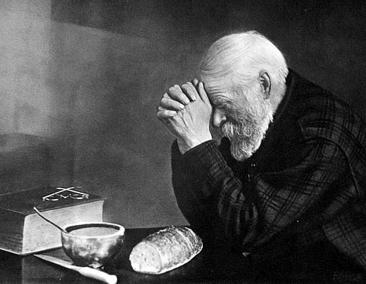
It is sanctified by the word of God and by prayer
Grace, by Eric Enstrom, 1918
4:5
Notes:
Statements like this one by Paul have developed into the common practice of praying before a meal, typically in thanksgiving for what is about to be eaten. This photo was taken by Eric Enstrom in 1918 and has become an American icon. It depicts the travelling salesman Charles Wilden praying before a meal. This image comes from Eric Enstrom and is in the public domain, via Wikimedia Commons: https://commons.wikimedia.org/wiki/File:Eric_Enstrom_-_Grace_-_bw.jpg.
wiki0120201509171918

Slide 29
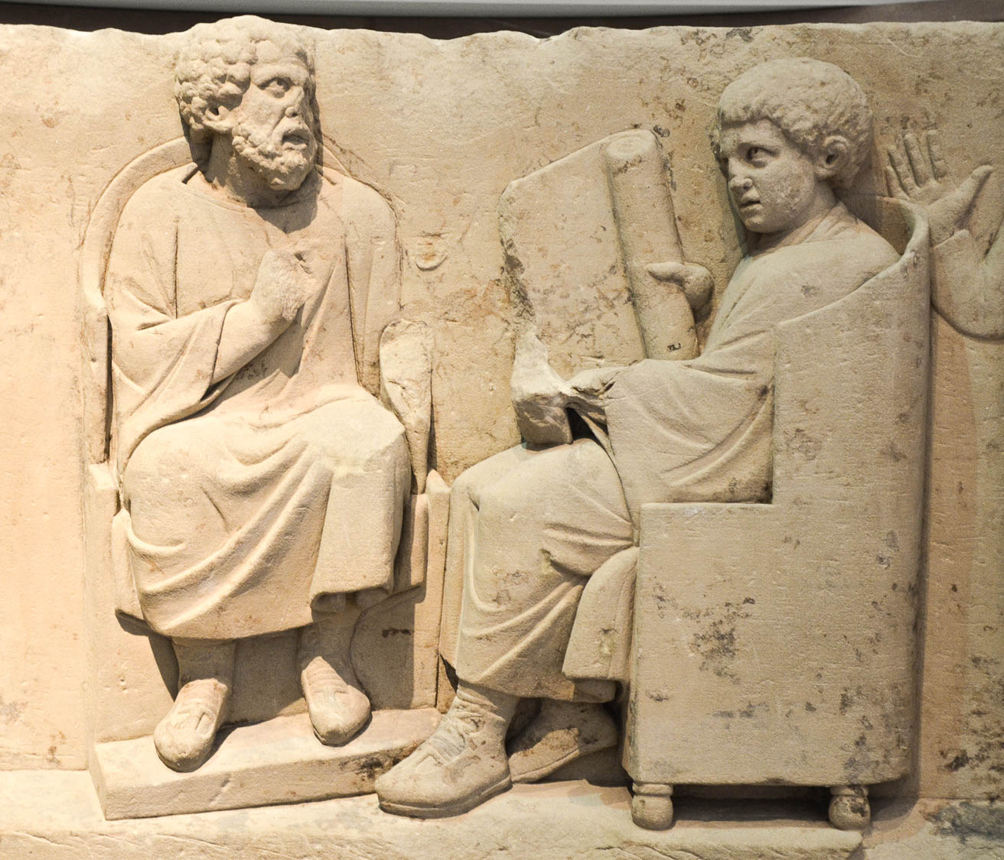
As you point out these things to the brothers, you will be a good servant of Christ Jesus
Funerary relief of a teacher with a disciple, 2nd century AD
4:6
Notes:
Timothy was to “point out” (Gk. hupotithēmi, ὑποτίθημι) these things to other believers, a term that suggests instruction of others as a service to them. This relief depicting a teacher with a disciple was found in Neumagen near the Roman city of Trier and is housed at the Rheinisches Landesmuseum in Trier, Germany. This image comes from Carole Raddato and is licensed under CC BY-SA 2.0, via Flickr: https://www.flickr.com/photos/carolemage/29029881804.
flkr29029881804h

Slide 30
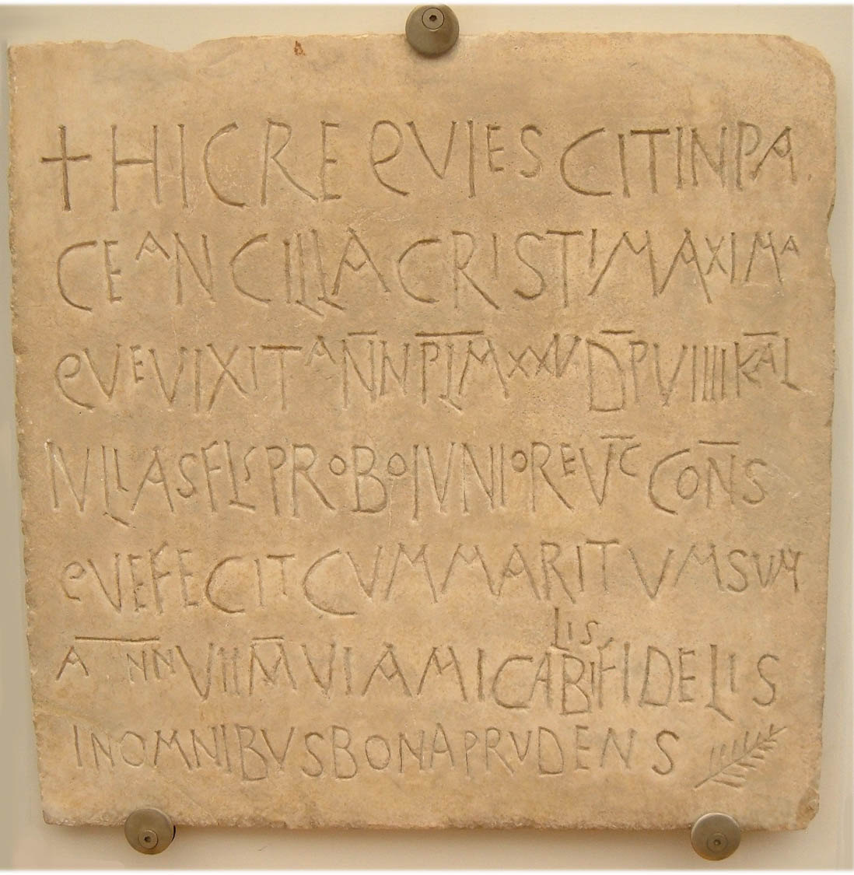
As you point out these things to the brothers, you will be a good servant of Christ Jesus
Funerary inscription of Maxima, “a servant of Christ,” AD 525
4:6
Notes:
This Latin inscription memorializes a woman who, among other things, is referred to on the second line as a “servant of Christ” (Lat. ancilla Cristi). Note also the cross and the (now common) phrase hic requiescit in pace (here rests in peace), both Christian elements. The entire inscription reads: "Here rests in peace, Maxima a servant of Christ who lived about 25 years and (was) laid (to rest) 9 days before the Kalends of July of the year when the senator Flavius Probus the younger was consul [modern: June 23, 525]. She lived with her husband (for) seven years and six months. (She was) most friendly, loyal in everything, good and prudent.“ This image comes from Kleuske and is licensed under CC BY 3.0, via Wikimedia Commons: https://commons.wikimedia.org/wiki/File:Early_Christian_Funerary_inscription.jpg.
wiki06235251561h

Slide 31
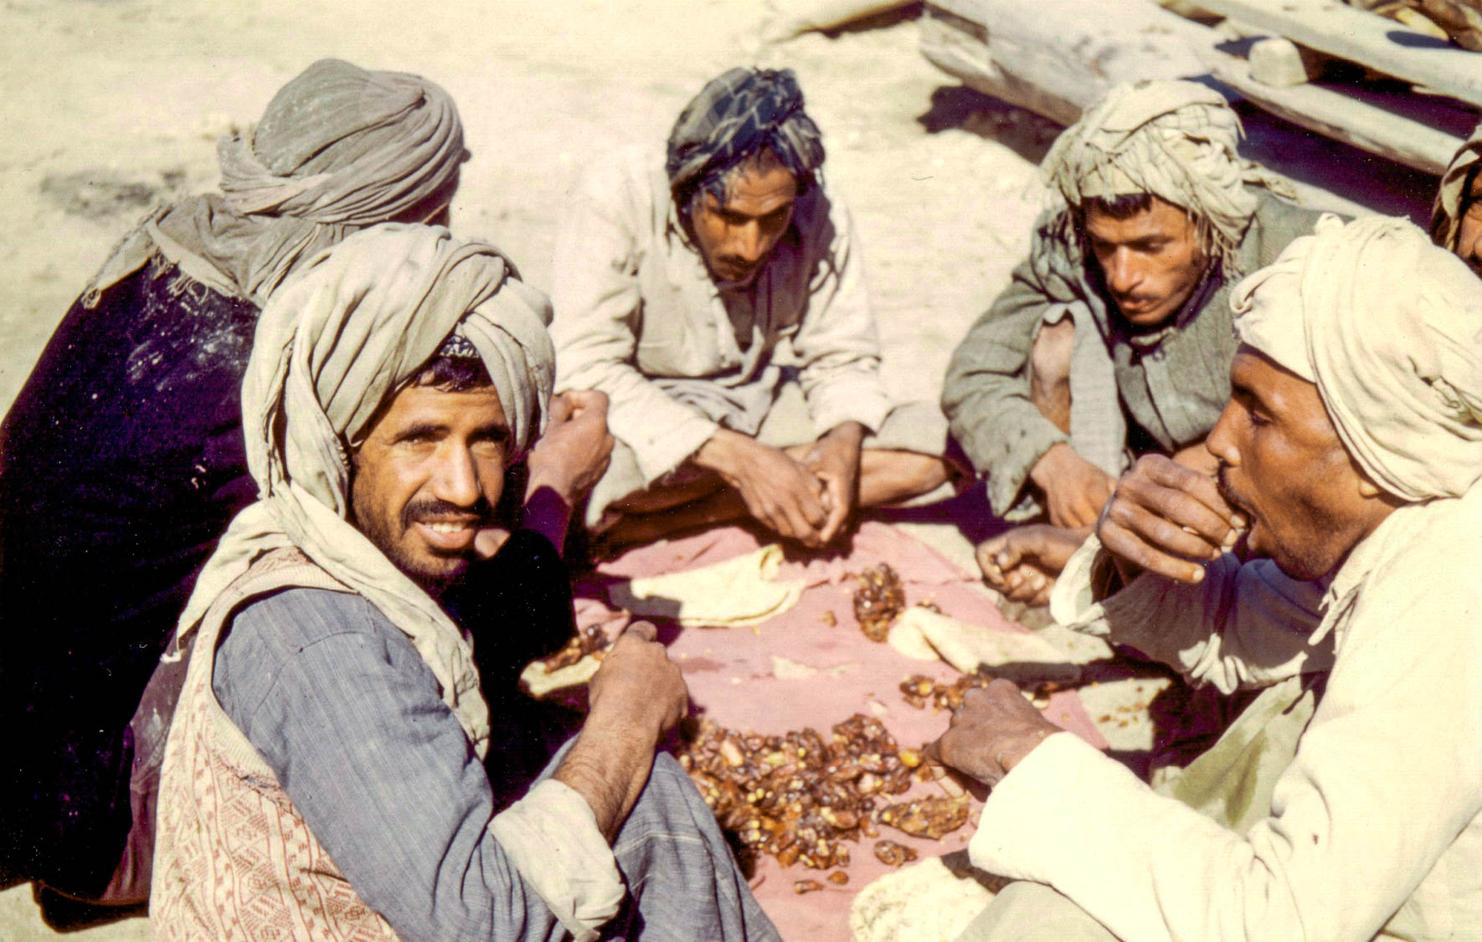
Being nourished on the words of the faith and sound doctrine
Kuwait workers sharing a midday meal of dates and khubz (flat bread)
4:6
Notes:
The word “nourished” (Gk. entrephō, ἐντρέφω) is used only here in the New Testament. It is related to the word trephō (Gk. τρέφω), which means to feed or nourish (cf. Matt 6:26; Jas 5:5; Rev 12:6). Paul uses the term metaphorically to describe taking in words of faith and good doctrine in a way that enriches the soul. This photo was taken by Christine VandeKerk, possibly in the 1970s.
cvv018h

Slide 32
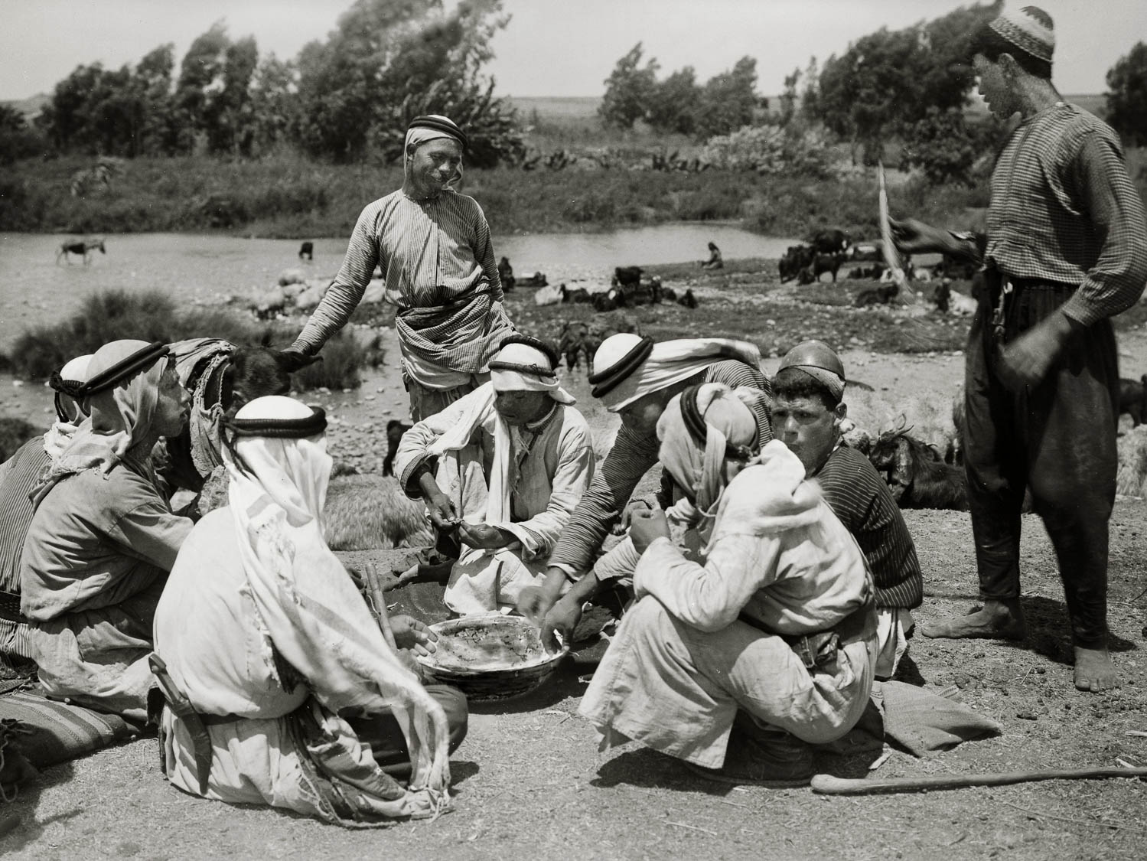
Being nourished on the words of the faith and sound doctrine
Shepherds sharing their noonday meal
4:6
Notes:
This American Colony photograph was taken between 1920 and 1933.
mat02984

Slide 33
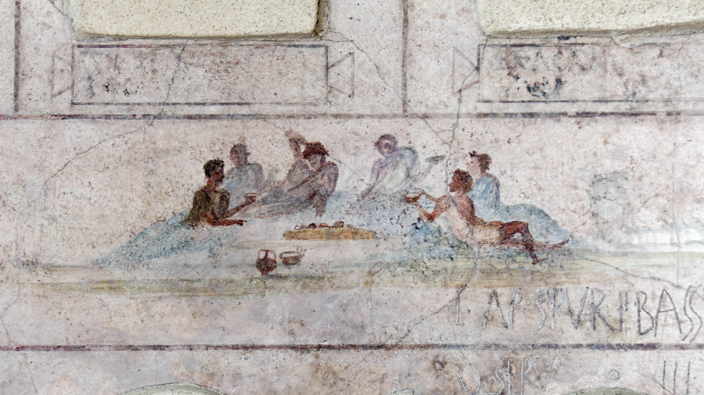
Being nourished on the words of the faith and sound doctrine
Fresco with a banquet scene, from Villa Doria Pamphili in Rome, circa 30–20 BC
4:6
Notes:
This scene from a fresco found at Rome depicts a small group of people eating and drinking together, illustrating the way we naturally “nourish” our own bodies with food. This fresco was photographed at the National Museum of Rome.
tb0513177686

Slide 34
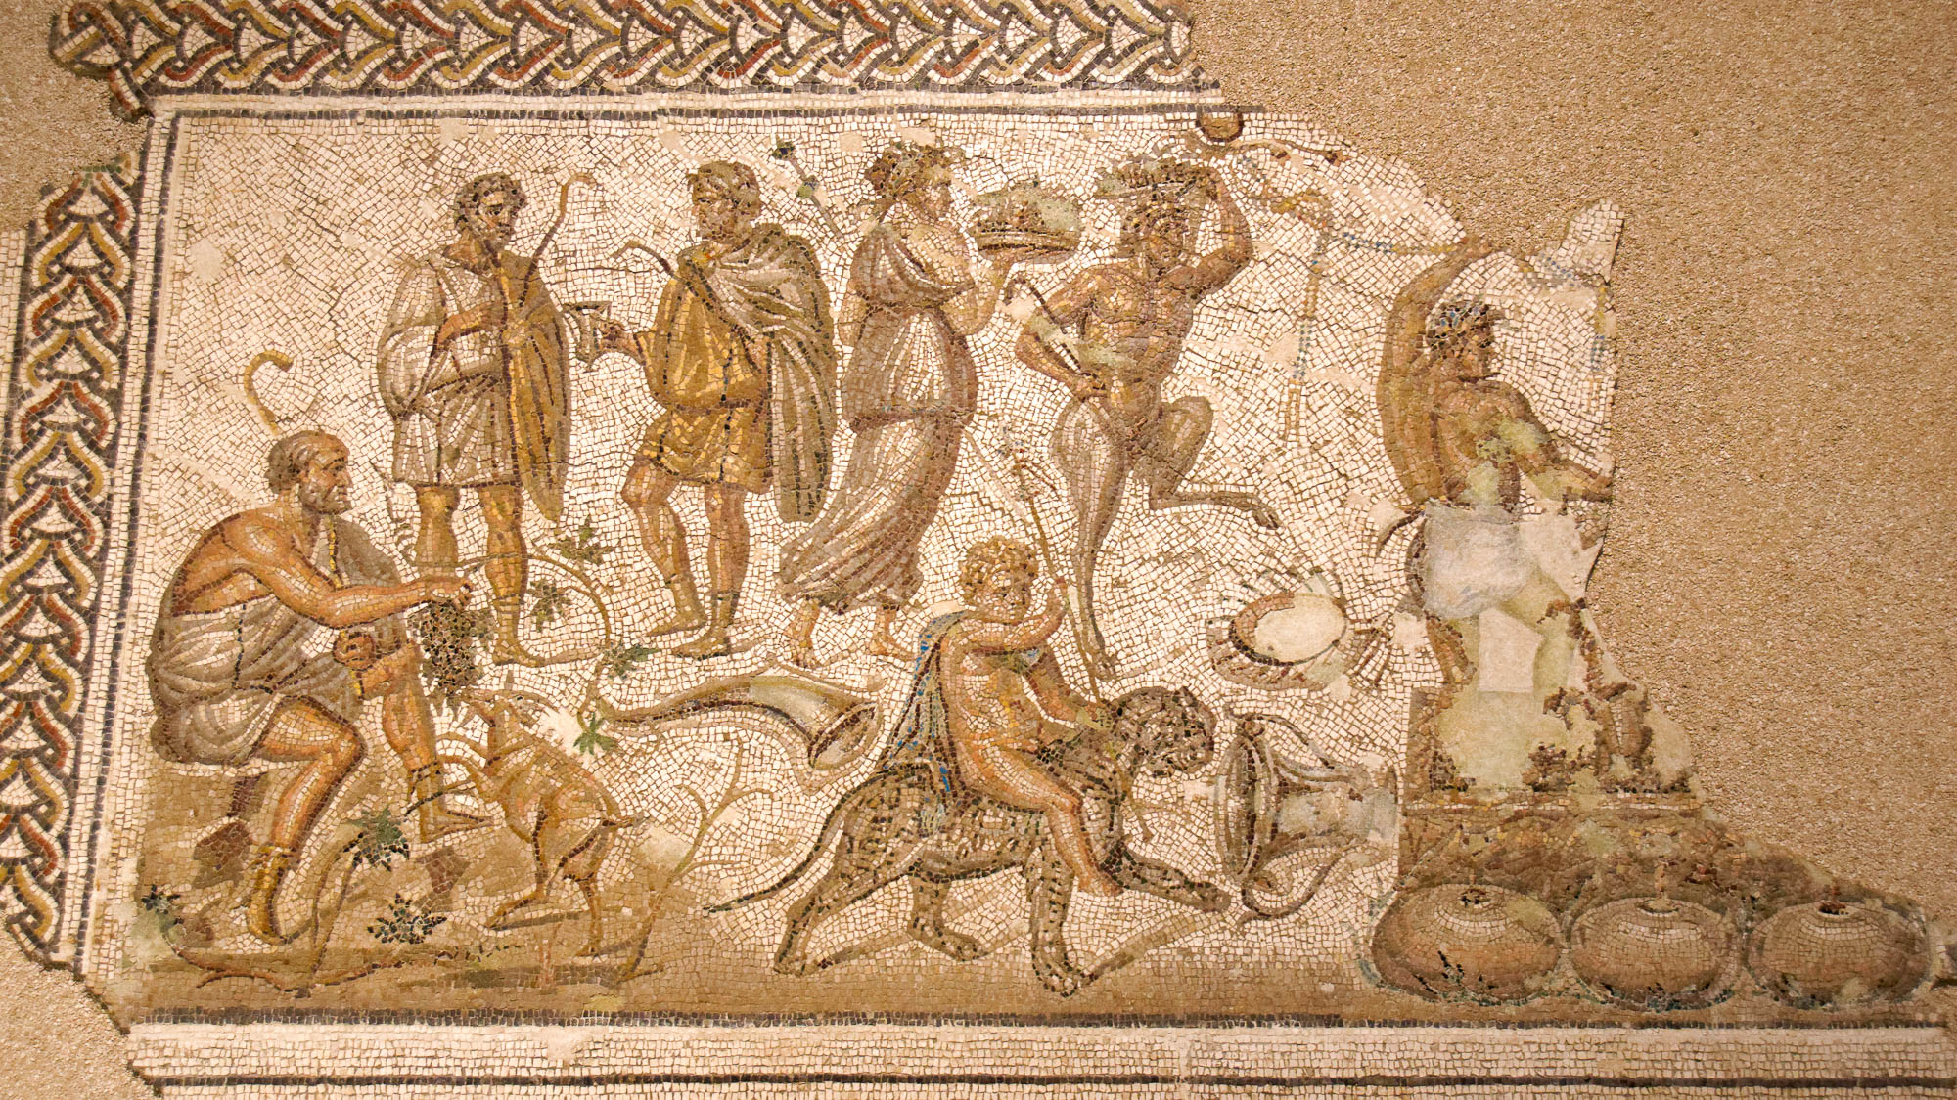
Have nothing to do with worldly fables
Mosaic of Bacchus bringing wine to mankind, from Ecija, Spain, circa AD 200
4:7
Notes:
The Greek god Dionysus, known to the Romans as Bacchus, was the god of wine. He also functioned as one who communicated between the living and the dead. This mosaic, which depicts Dionysus bringing wine to mankind, also depicts other mythological elements like a fawn and child riding a leopard. Paul would have regarded all such myths as “worldly fables” to which no attention should be paid. This mosaic was photographed at the Astigi Museum in Spain.
tb092619897h

Slide 35
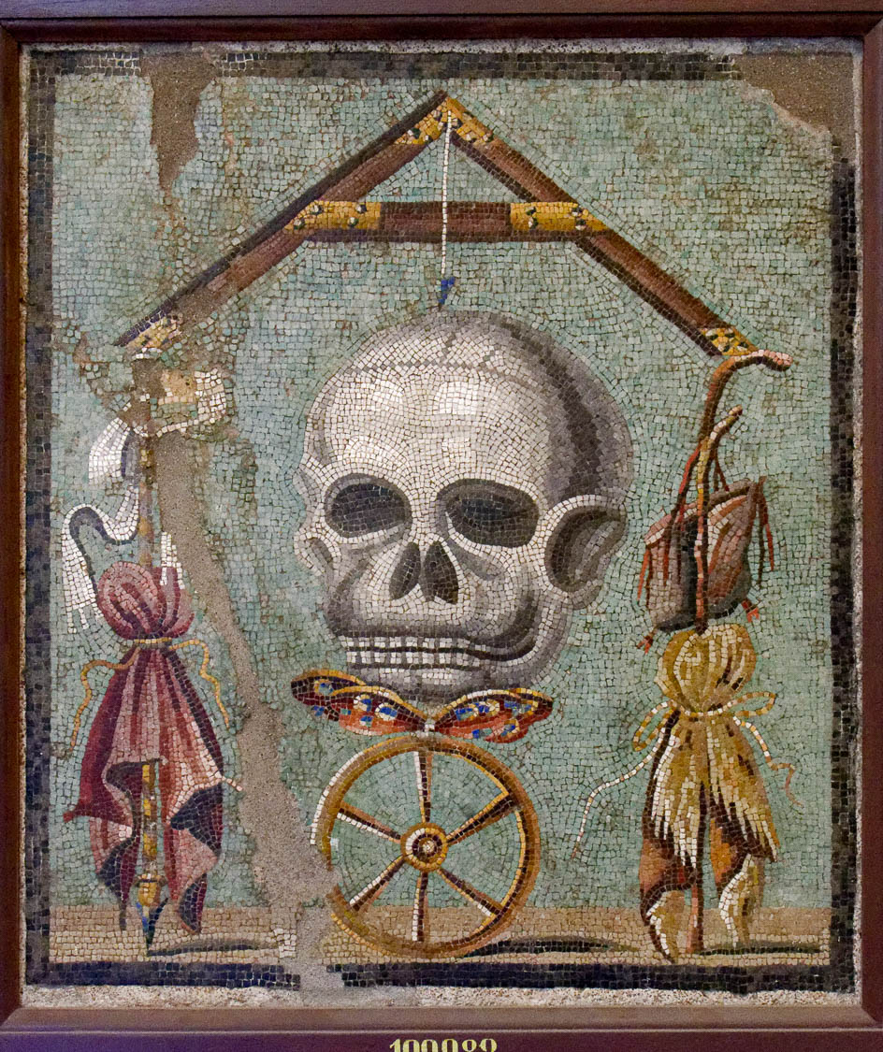
Have nothing to do with worldly fables
Mosaic memento mori with a skull and level, from Pompeii, 1st century AD
4:7
Notes:
This mosaic from Pompeii is one of a genre known as memento mori, “reminders of death.” They often included a depiction of a skull; the intent was to curb pleasure by the reminder of mortality. While Paul spoke often and freely of death, it was from a completely different perspective than that of the Greco-Roman culture at large. This mosaic was photographed at the Naples Archaeological Museum.
tb0515170809h

Slide 36
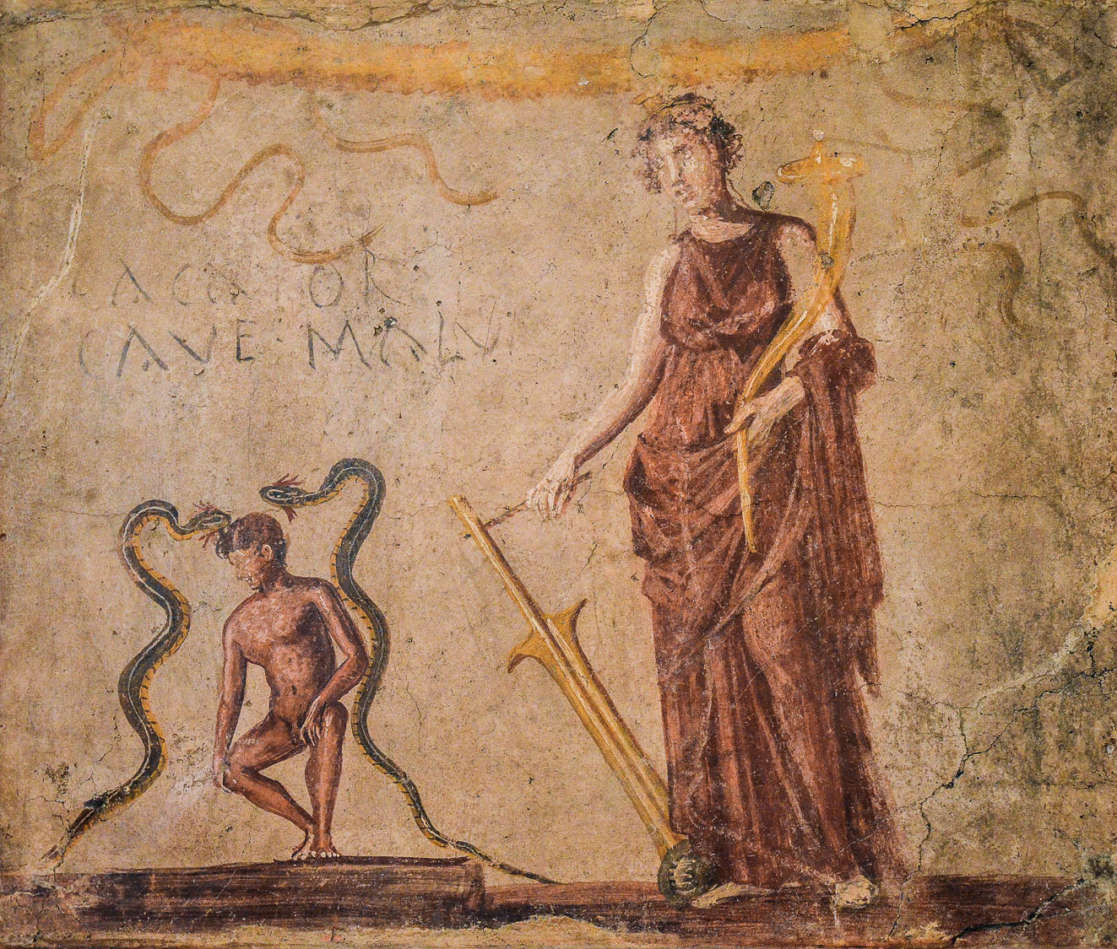
Have nothing to do with worldly fables
Fresco of Isis protecting a man from the Evil Eye, from Pompeii, 1st century AD
4:7
Notes:
This fresco comes from a corridor leading to a latrine in Regio IX at Pompeii. It depicts Isis protecting a man relieving himself, accompanied by the Latin inscription CACATOR CAVE MALU(M) (“Let the one relieving himself beware the evil eye”). It illustrates both the needless fear of the Evil Eye and the futile belief that a man-made deity like Isis could offer protective powers. This fresco was photographed at the Naples Archaeological Museum. This image comes from Carole Raddato and is licensed under CC BY-SA 2.0, via Wikimedia Commons: https://commons.wikimedia.org/wiki/File:Fresco_from_a_corridor_leading_to_a_latrine_with_Isis_protecting_a_man_relieving_himself_and_the_words_Cacator_cave_malu(m)_(Shitter_beware_the_evil_eye),_Naples_Archaeological_Museum_(14673176079).jpg.
wiki14673176079h

Slide 37
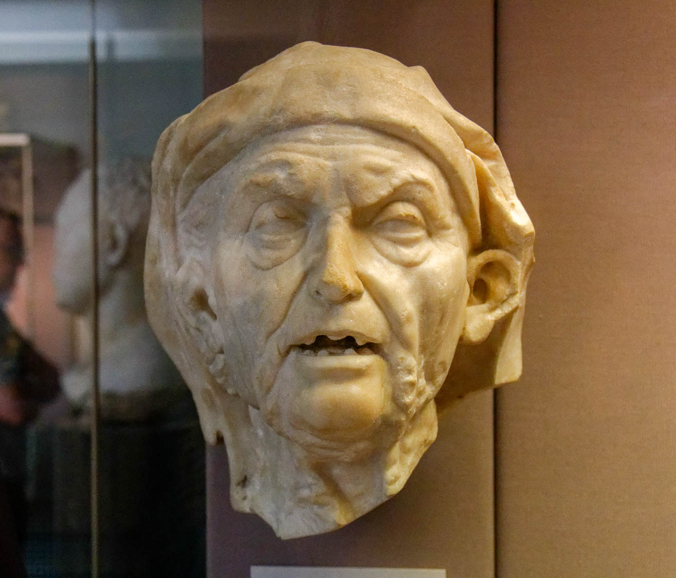
Have nothing to do with worldly fables and old wives’ tales
Marble head of an old woman, Roman era
4:7
Notes:
The phrase “old wives’ tales” represents the Greek word graōdēs (Gk. γραώδης), which refers to something characteristic of elderly women. Like the modern phrase “old wives’ tales,” it seems to suggest things that are superstitious or simply gossip. This bust is thought to be a Roman copy of a Greek original of about 200 BC. It was photographed at the British Museum.
tb1001199802h

Slide 38
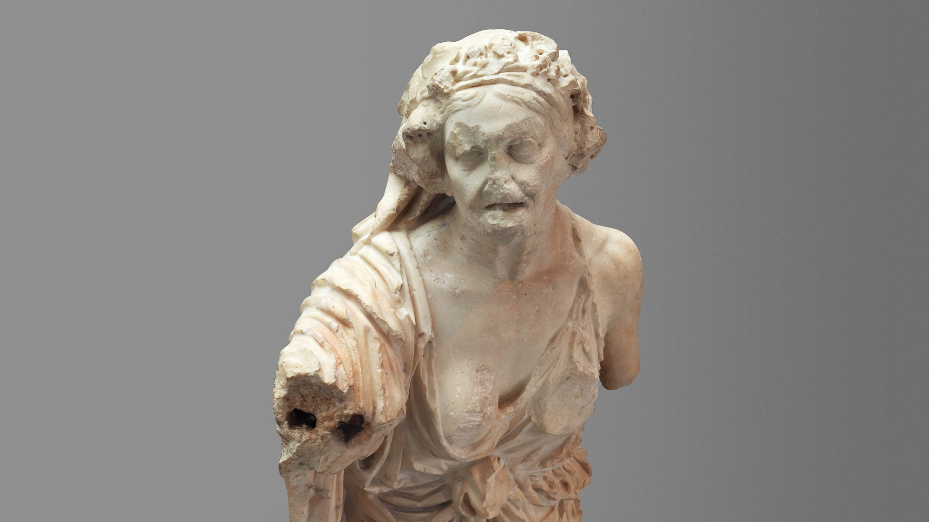
Have nothing to do with worldly fables and old wives’ tales
Statue of an old woman, 1st century AD
4:7
Notes:
This statue is thought to be a copy of a Greek original of the 2nd century BC. This image comes from The Metropolitan Museum of Art and is in the public domain. Source: https://www.metmuseum.org/art/collection/search/248132
met248132h

Slide 39
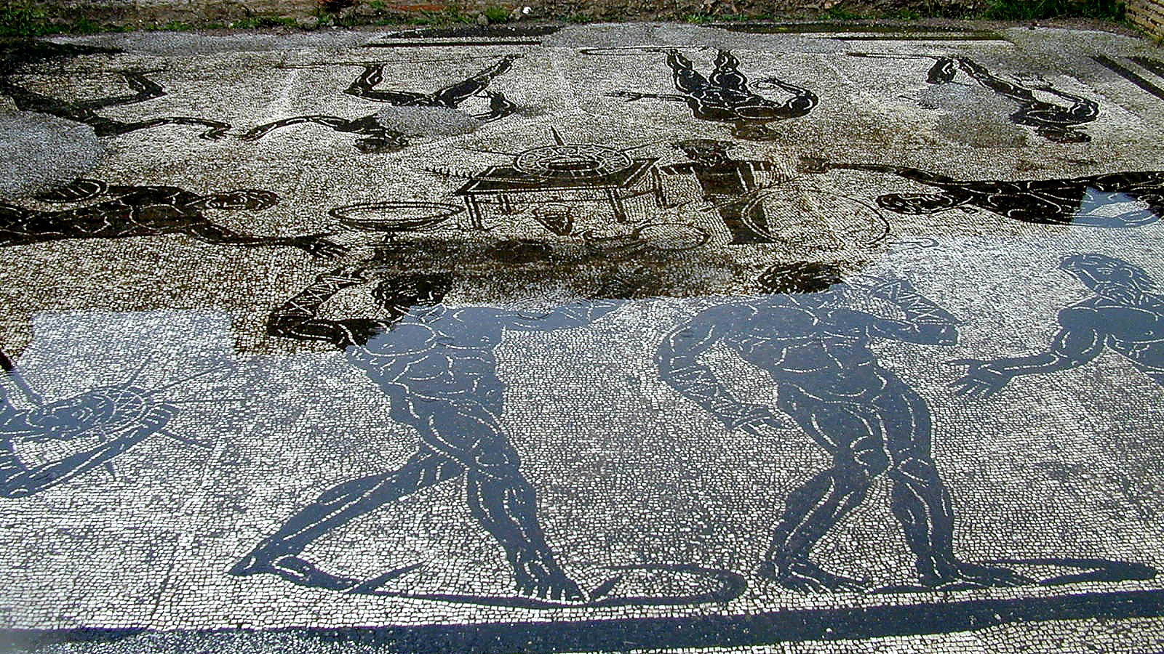
But discipline yourself for the purpose of godliness
Mosaic depicting men exercising, from a gymnasium at Ostia, Roman period
4:7
Notes:
The word “discipline” (Gk. gumnazō, γυμνάζω) is a term that was commonly used in Paul’s day to refer to gymnastic exercises in the nude. The word actually derives from the word “naked” (Gk. gumnos, γυμνός; cf. 2 Cor 5:3). This mosaic from Ostia, near Rome, depicts unclothed men undertaking a variety of exercises. Paul uses the term as a metaphor for exercise in the spiritual disciplines.
tb011701684

Slide 40
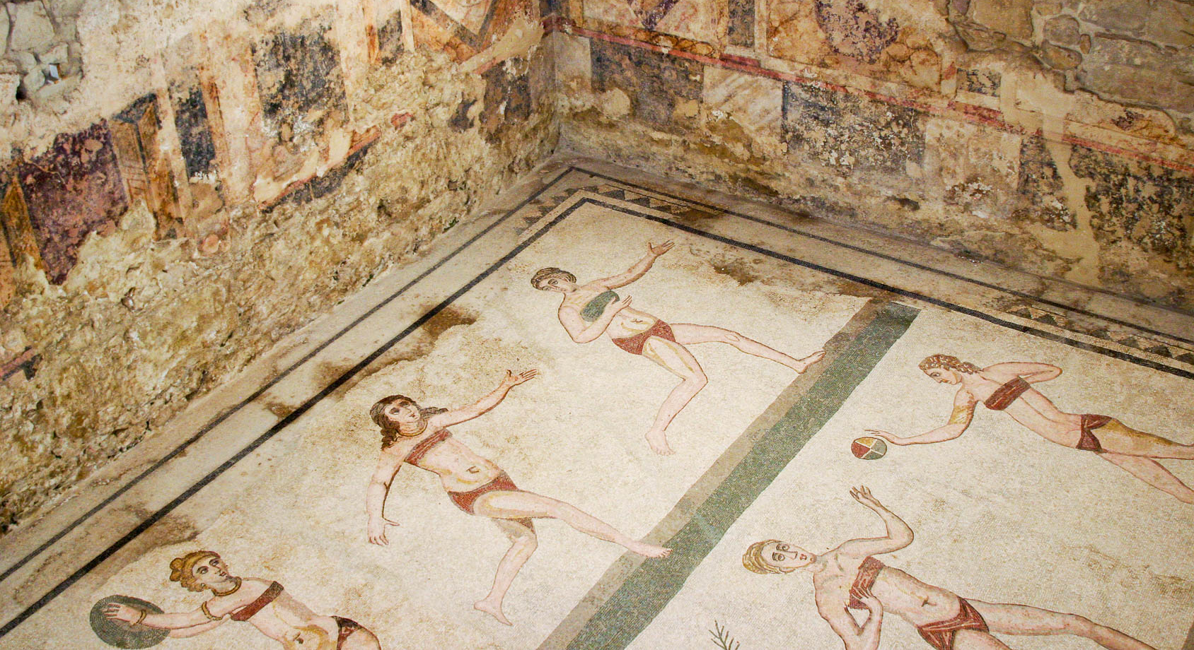
But discipline yourself for the purpose of godliness
Mosaic depicting women exercising, from the Villa Romana del Casale, 4th century AD
4:7
Notes:
This gymnasium scene depicts several female athletes competing in sports that include weight-lifting, discus throwing, running, and ball-games. This image comes from José Luiz Bernardes Ribeiro and is licensed under CC BY-SA 4.0, via Wikimedia Commons: https://commons.wikimedia.org/wiki/File:Bikini_girls_room_-_Villa_Romana_del_Casale_-_Italy_2015.JPG.
wiki01302015110021

Slide 41
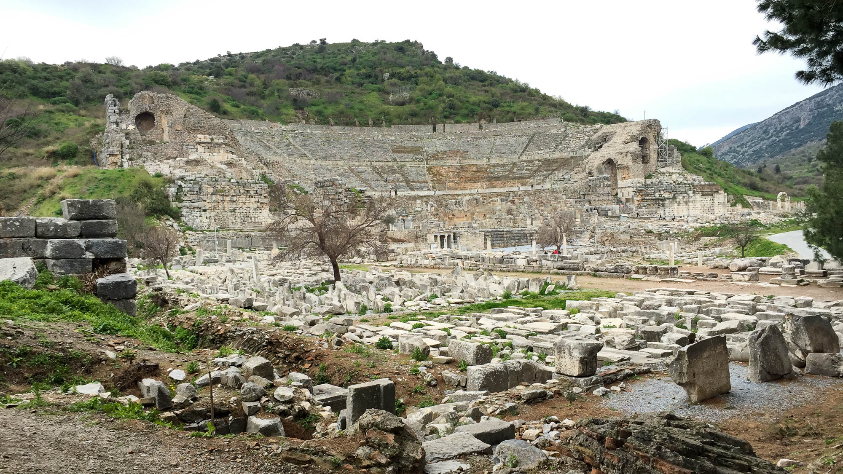
But discipline yourself for the purpose of godliness
Gymnasium at Ephesus
4:7
Notes:
Timothy was living at Ephesus when Paul wrote this letter. The ruins of the gymnasium are in the foreground of this picture, and the theater looms in the background. This particular gymnasium was built at the beginning of the 2nd century AD, a generation after the time of Timothy and Paul, but similar structures would have been well-known to them.
shs031315599

Slide 42
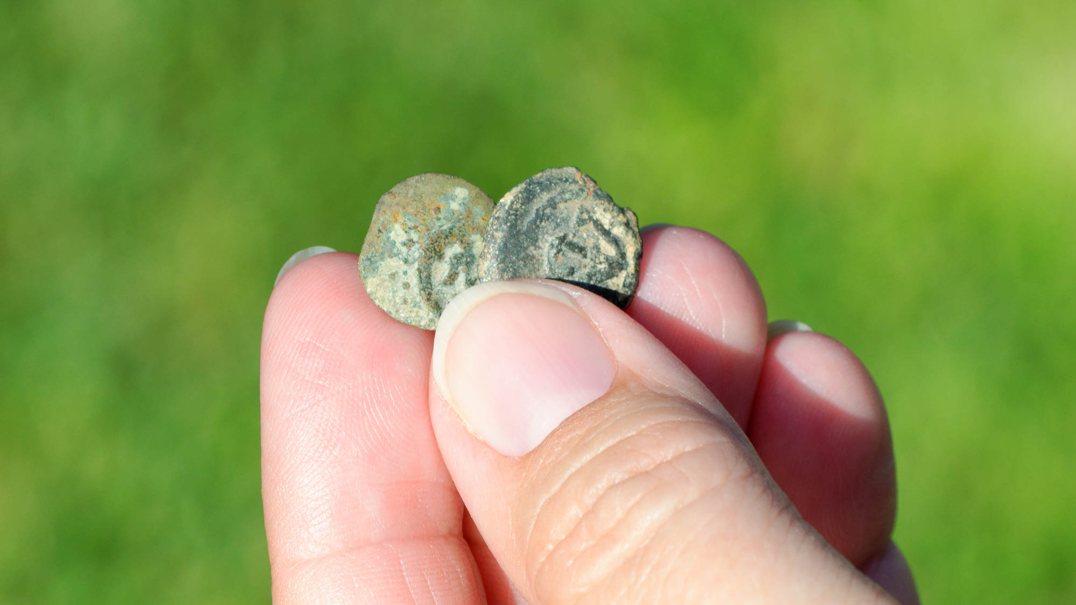
Bodily exercise is of little benefit
Two “widow’s mites”
4:8
Notes:
Paul characterized physical exercise as being of little “benefit” (Gk. ōphelimos, ὠφέλιμος), a word that can refer to usefulness, benefit, or value. The smallest and least valuable coin of Paul’s day was the prutah, the equivalent of the Greek lepton. These coins were minted in great numbers by Alexander Jannaeus and were still the most common coins during the time of Jesus’s ministry by a ratio of 1,000 to 1 (Hendin 2010: 475). This coin was worth $1/{64}$ of a day’s wage ($1/{64}$ of a denarius). Many of these coins weighed about 2.5 grams (0.09 oz), although some weighed as little as 1 gram (0.03 oz). The smallest US coin, the dime, weights 2.268 grams (0.08 oz), a rough equivalent to the prutah except that the prutah was made of less valuable bronze. The coins shown in this photograph are of the most common variety of “widow’s mites,” a crudely minted design which depicts an inverted anchor within a circle on one side (shown here) and an eight-rayed star on the other side.
Reference:
Hendin, David and Kreindler, Herbert.
2010 Guide to Biblical Coins. 5th ed. New York: Amphora Books.
tb090516167

Slide 43
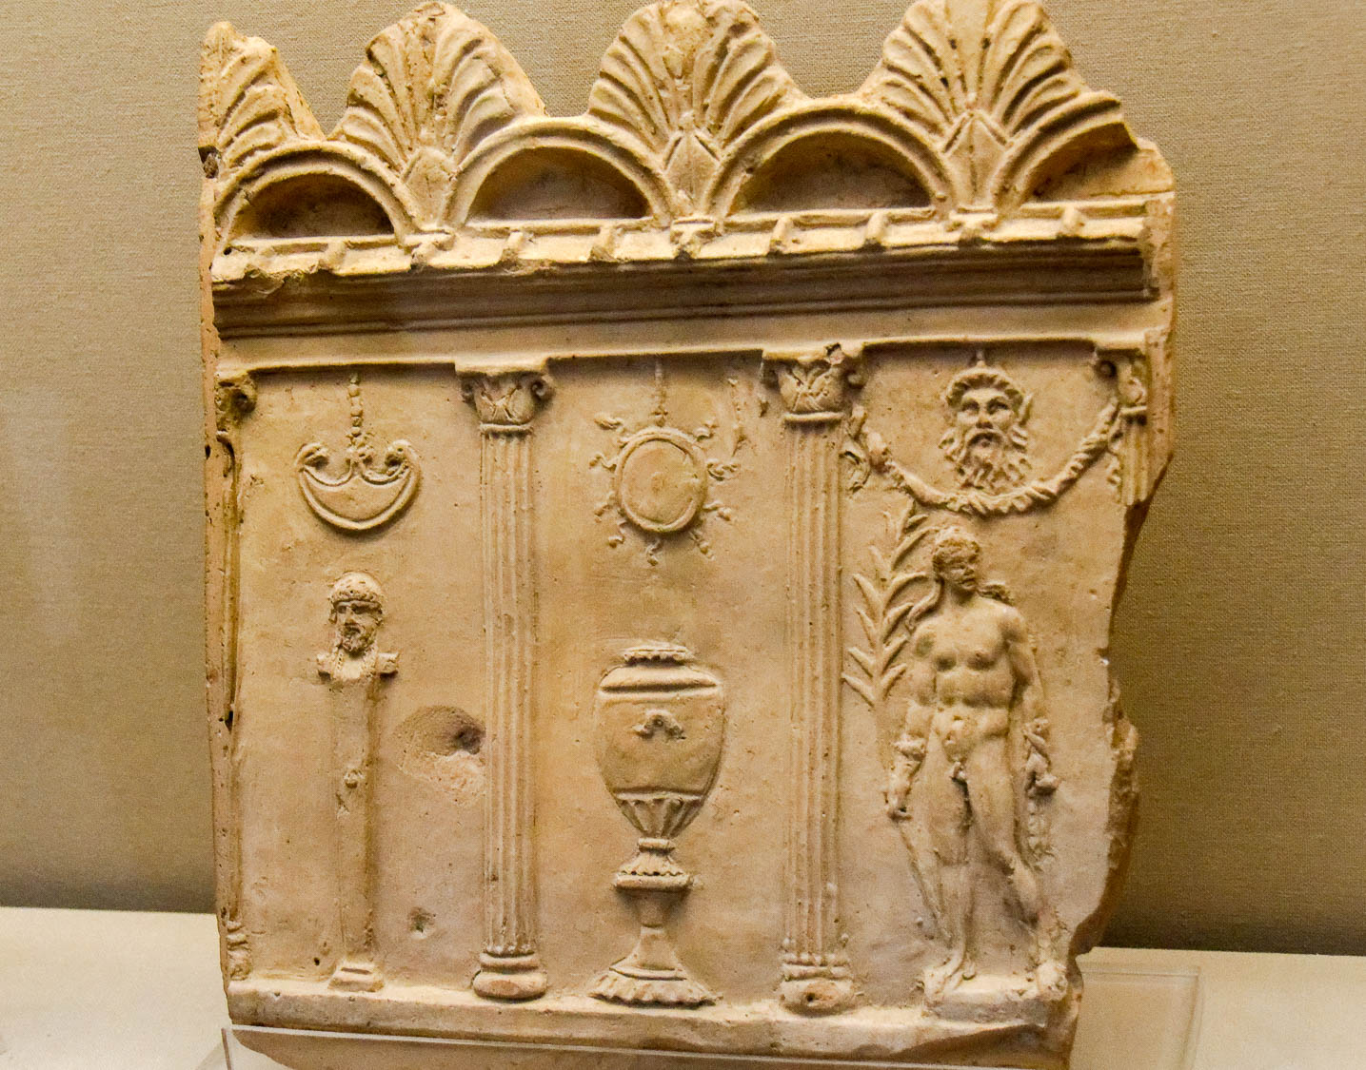
Bodily exercise is of little benefit
Terracotta scene in wrestling school, Roman, from Italy, 1st c AD
4:8
Notes:
Exercise and physical fitness was highly valued in the Greco-Roman society of Paul’s day, as seen in the many depictions of athletes from this time. This depiction shows a member of a wrestling school. While certainly of value psychosomatic creatures like us, the importance of physical exercise must be tempered relative to the far greater value of godliness. This was photographed at the British Museum.
tb0929197894

Slide 44
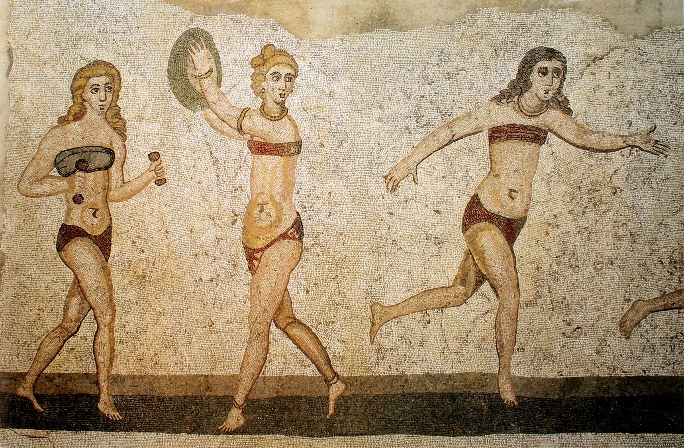
Bodily exercise is of little benefit
Mosaic depicting women exercising, from the Villa Romana del Casale, 4th century AD
4:8
Notes:
This detail of the mosaic at the Villa Romana del Casale depicts a woman training with weights, one with a discus, and a third running. This image comes from Yann Forget and is in the public domain, via Wikimedia Commons: https://commons.wikimedia.org/wiki/File:Mosa%C3%AFque_des_bikinis,_Piazza_Armerina.jpg.
wiki0115201511201897

Slide 45
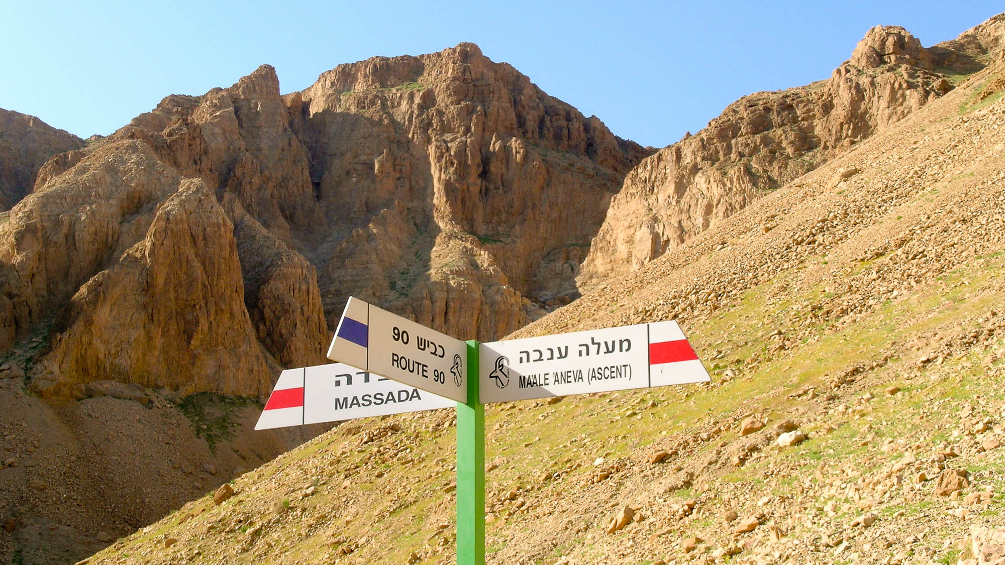
Bodily exercise is of little benefit
Hiking trail signs in Nahal Tseelim
4:8
Notes:
An enjoyable way to get bodily exercise is by hiking on the marked trails throughout the land of Israel. This photograph shows a signpost identifying two trails in the Judean wilderness. The red trail is particularly beneficial for physical exercise because of the rugged nature of the climb, with various ascents, some up to 2,000 feet (600 m) in elevation. But all of this, Paul would say, is of less value than training in godliness.
tb031504940h

Slide 46
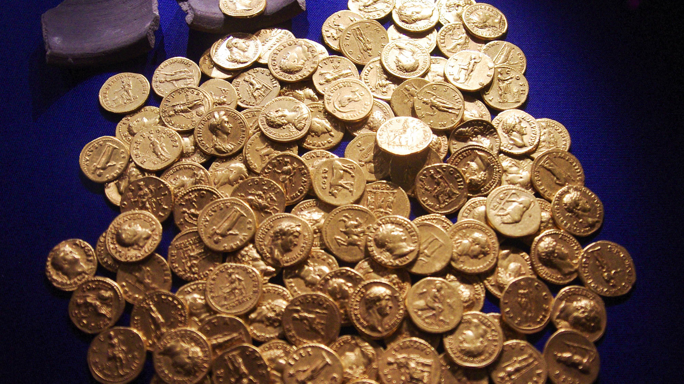
Bodily exercise is of little benefit, but godliness is profitable for all things
Hoard of Roman gold coins, AD 54–160
4:8
Notes:
If physical exercise can be compared to a coin of very little value, godliness (Gk. eusebeia, εὐσέβεια) might be compared in value to a hoard of gold coins. This hoard of Roman gold coins was discovered in Didcot, England. It is now on display in the Ashmolean Museum at the University of Oxford. A gold aureus was equivalent in value to 25 silver denarii, so the hoard of coins shown in this photograph was worth thousands of denarii.
adr1305249723h

Slide 47
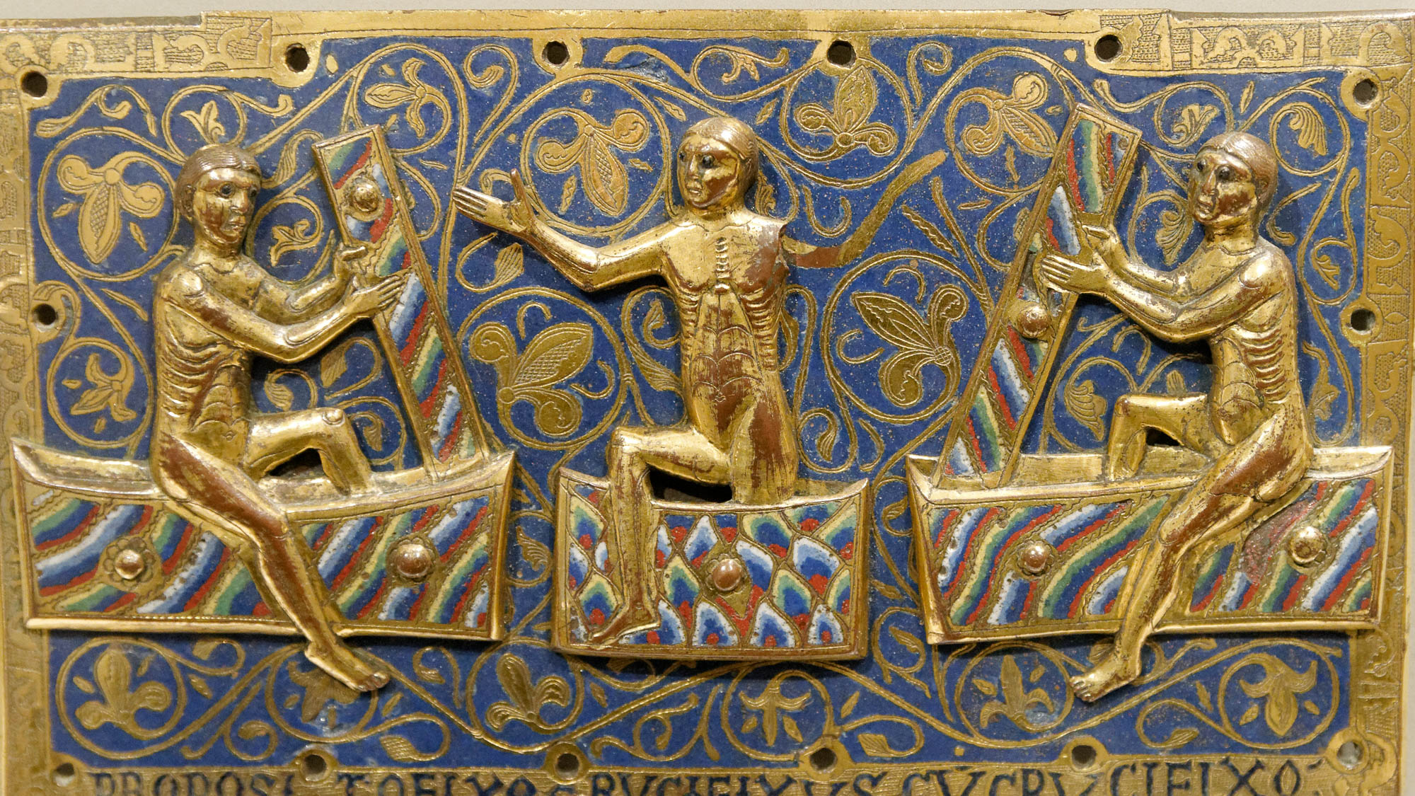
Godliness holds promise for the present life and for the life to come
Limoges artwork plaque depicting three saints rising from the dead, circa AD 1250
4:8
Notes:
If physical exercise has any benefit, it is limited to the duration of life on earth. Godliness, by contrast, has value both here and beyond the grave. This champlevé enamel on copper plaque captures the joy of resurrection as believers are raised from their tombs into glory. This plaque was photographed at the Victoria and Albert Museum in London. This image comes from Marie-Lan Nguyen and is licensed under CC BY 2.5, via Wikimedia Commons: https://commons.wikimedia.org/wiki/File:Plaque_resurrection_dead_VandA_M.104-1945.jpg.
wiki03032012181734881994

Slide 48
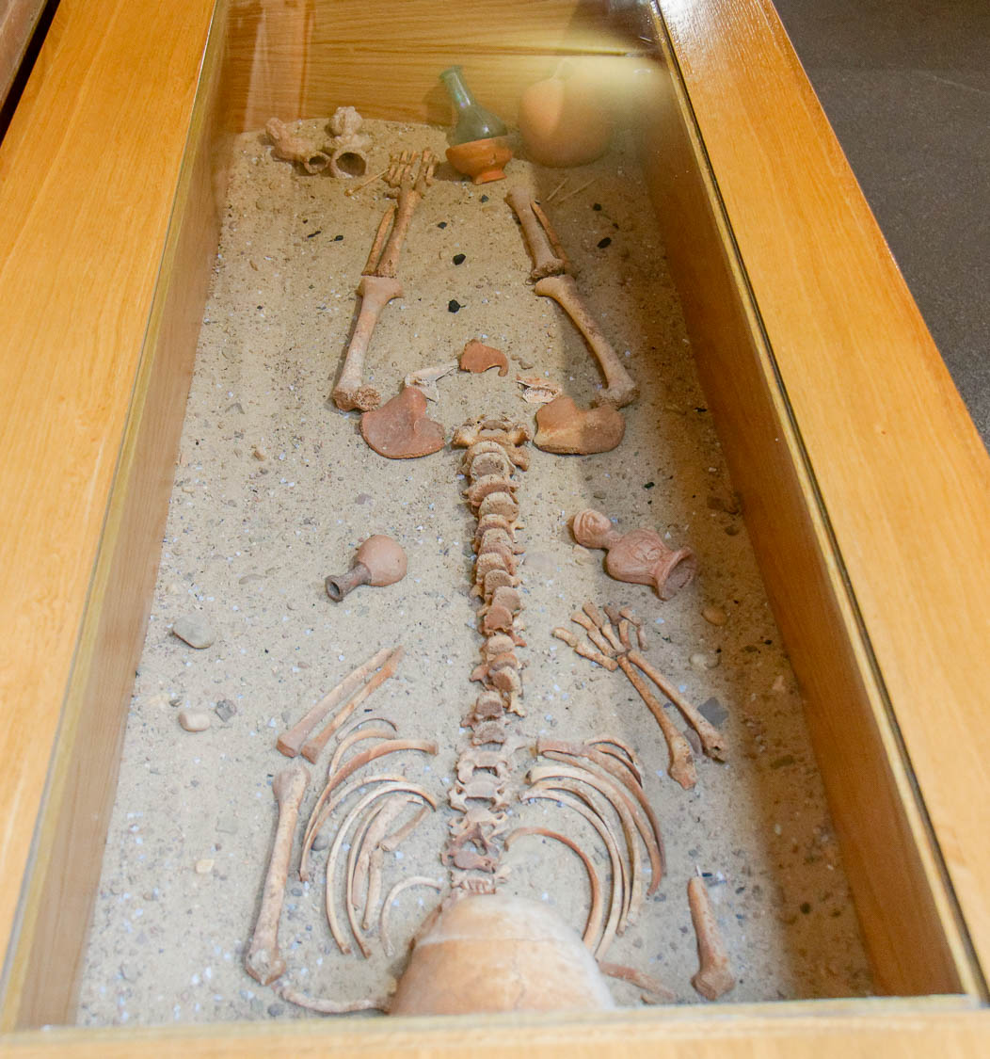
Godliness holds promise for the present life and for the life to come
Reconstruction of Roman burial, deceased with grave goods, from Merida
4:8
Notes:
In contrast to the biblical view that the material goods of this life are not taken to the next, the practice of interring the dead with burial goods may indicate the opposite perspective in the prevailing culture of Paul’s day and the ancient world more broadly. This Roman burial was photographed at the Merida Archaeological Museum in Spain.
tb092519154

Slide 49
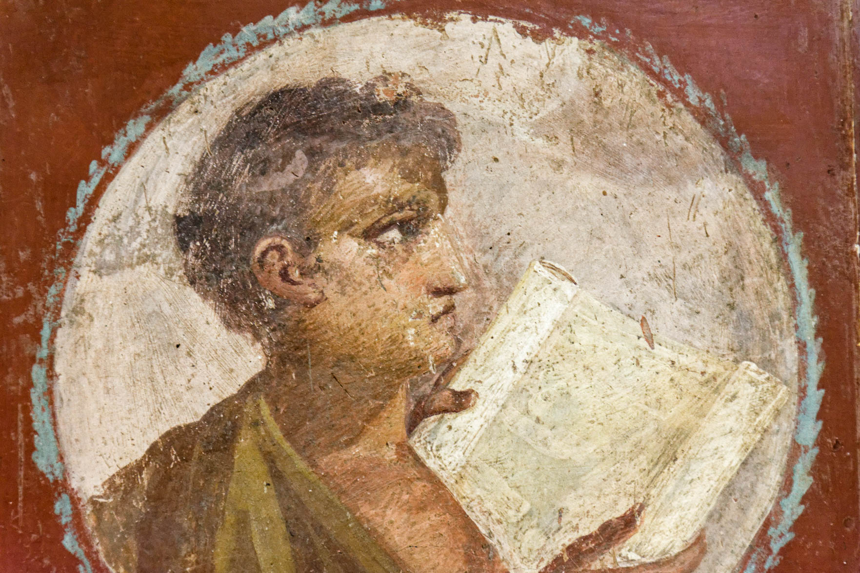
It is a trustworthy statement and worthy of complete acceptance
Fresco of a young man holding a parchment roll, from Herculaneum, 1st century AD
4:9
Notes:
Paul was confident enough in his statement to provide it to Timothy in written form. He certainly expected it to be accepted and may even have had in mind that it should be committed to memory. This fresco was photographed at the Naples Archaeological Museum.
tb0515170294

Slide 50
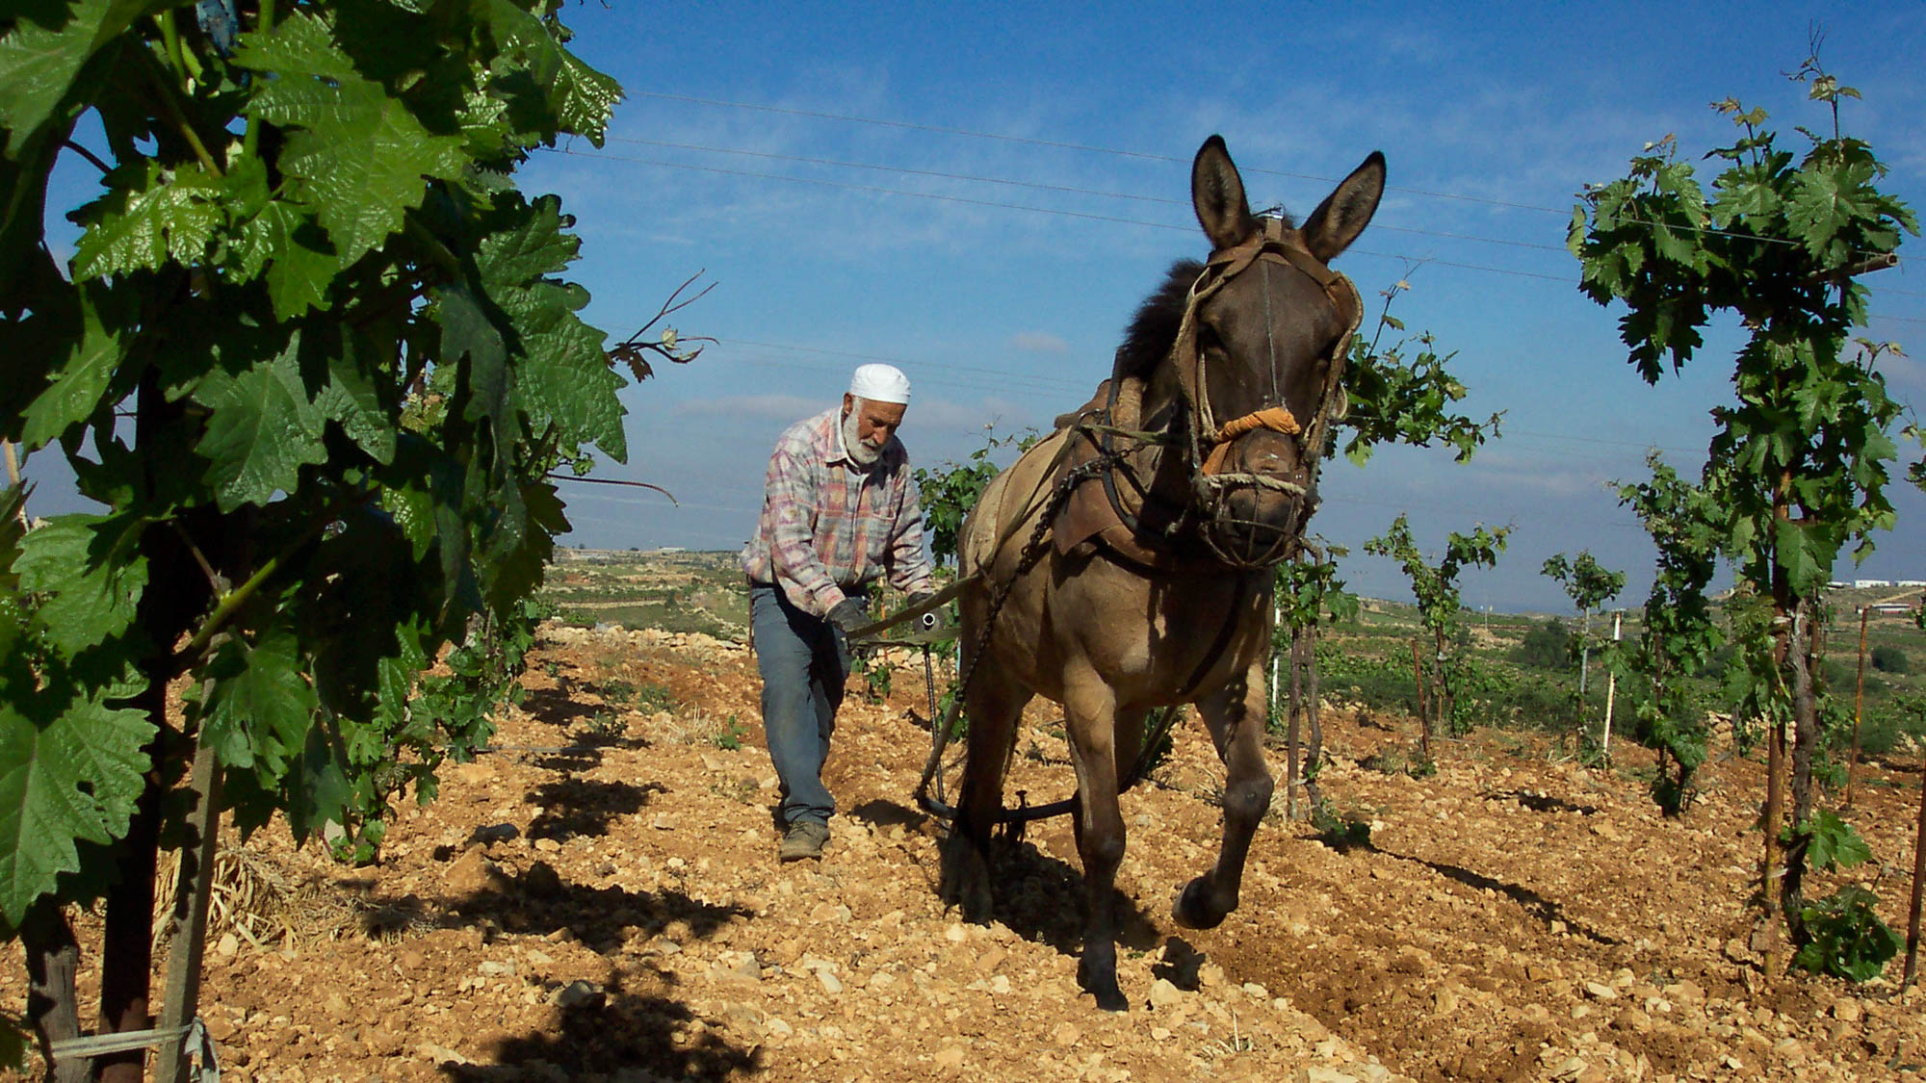
This is what we labor and strive for, having fixed our hope on the living God
Man plowing his vineyard with a horse, near Mizpah
4:10
Notes:
The word “labor” (Gk. kopiaō, κοπιάω) carries the idea of working hard to the point of growing weary. It is illustrated here by a photo of a farmer turning over the soil between the rows of plants in his vineyard, a measure necessary to prevent weeds from overtaking the vineyard.
nf050906002

Slide 51
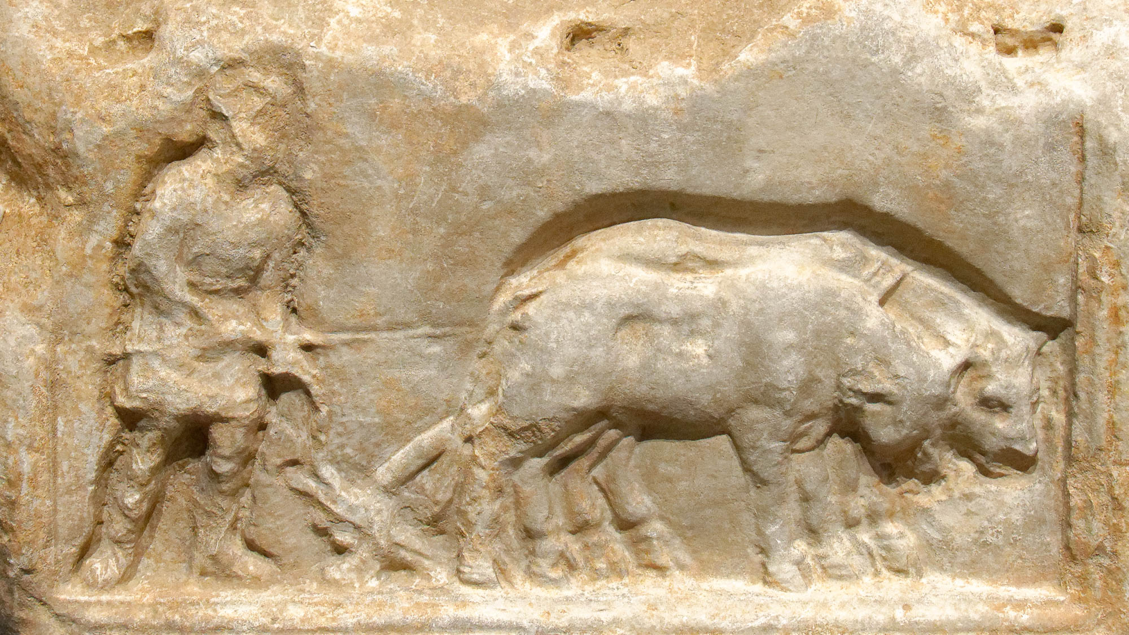
This is what we labor and strive for, having fixed our hope on the living God
Plowing scene on a Roman funerary stela, 1st century AD
4:10
Notes:
Plowing in Paul’s day was nearly identical to what was pictured on this previous slide. This relief was photographed at the Nimes Museum.
tb092019434h

Slide 52
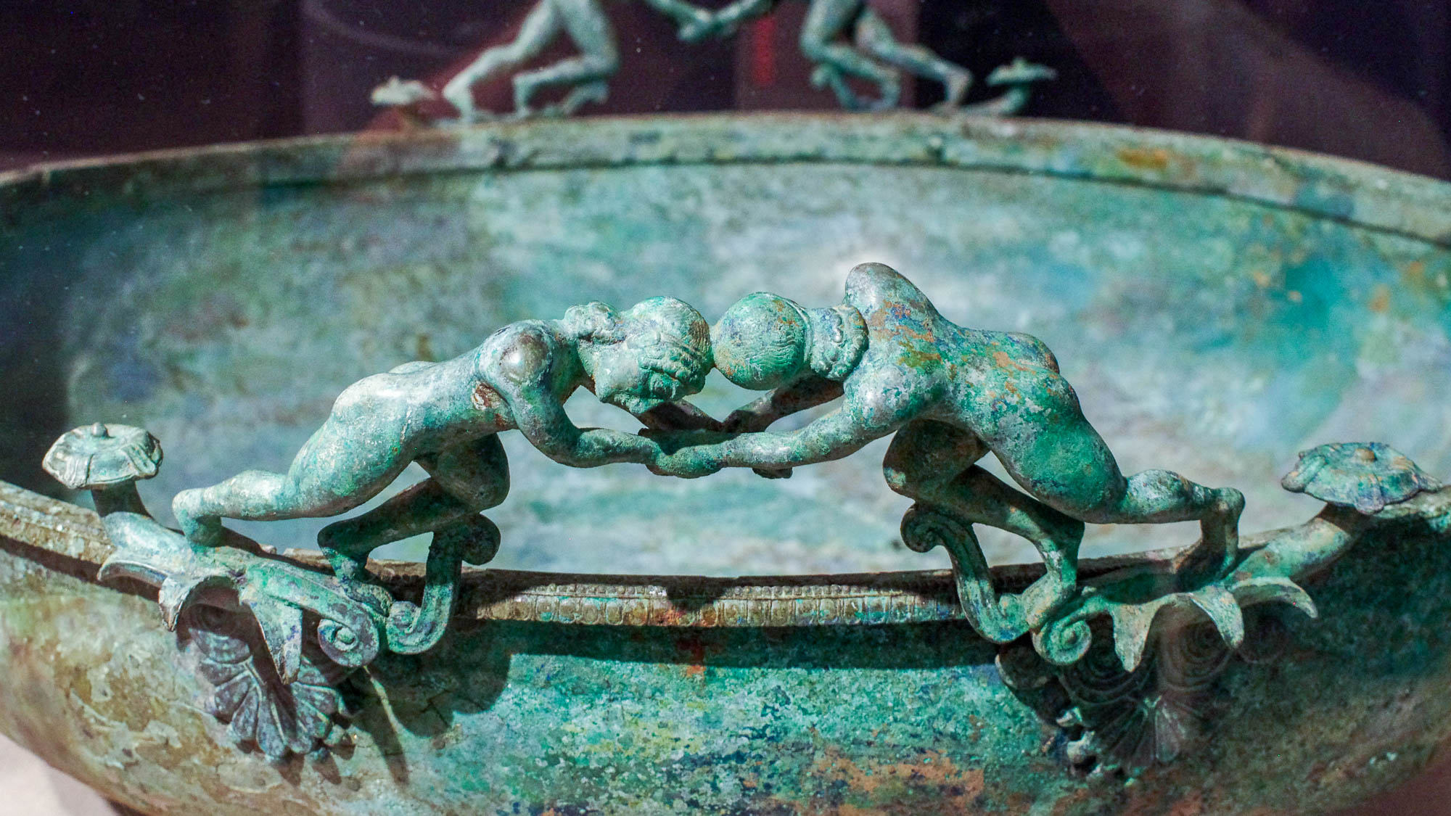
This is what we labor and strive for, having fixed our hope on the living God
Bronze Greek basin with wrestlers on the rim, Late Archaic period, circa 500 BC
4:10
Notes:
The second word used here by Paul, “strive” (Gk. agōnizomai, ἀγωνίζομαι), is suggestive of an athletic contest or struggle (e.g., 1 Cor 9:25). This bronze basin was photographed at the Boston Museum of Fine Arts.
adr1711203023

Slide 53
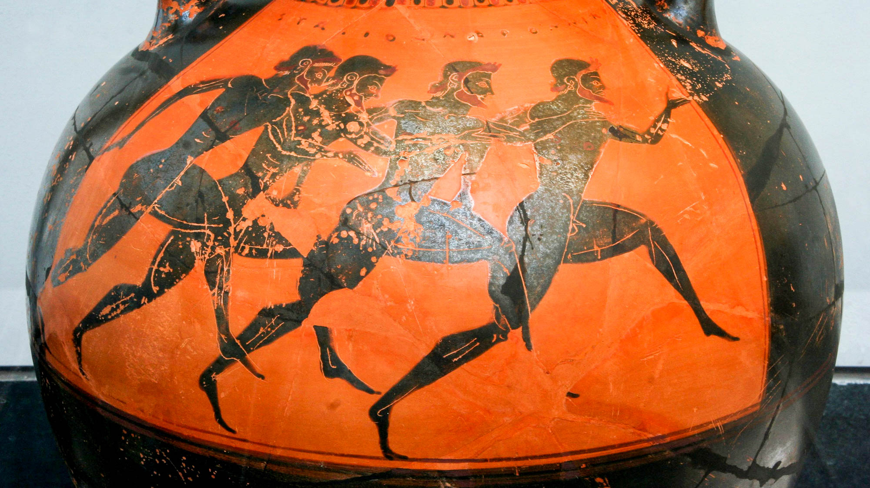
This is what we labor and strive for, having fixed our hope on the living God
Attic Greek black-figure Panathenaic prize amphora with runners, circa 530 BC
4:10
Notes:
Every four years in Athens, the Panathenaic games would be held in honor of Athena. One of the most ancient competitions was the foot race, held at the Panathenaic Stadium. The vessel pictured here is a Panathenaic prize amphora, which would be filled with 42 quarts (40 l) of olive oil from the sacred groves of Athena. On one side was pictured the event for which the prize was awarded; the other side typically depicted Athena. This amphora was photographed at the State Collections of Antiquities in Munich. This image comes from MatthiasKabel and is licensed under CC BY 2.5, via Wikimedia Commons: https://commons.wikimedia.org/wiki/File:Greek_vase_with_runners_at_the_panathenaic_games_530_bC.jpg.
wiki01282006530h

Slide 54

This is what we labor and strive for, having fixed our hope on the living God
Roman soldiers fighting in Gerasa hippodrome
4:10
Notes:
The word “strive” (Gk. agōnizomai, ἀγωνίζομαι) is also used more literally with reference to a fight with weapons (cf. John 18:36). This photo captures a demonstration of some Roman military hand-to-hand combat by re-enactors at Gerasa. The Roman Army and Chariot Experience, pictured here, takes place daily during most of the year at Jerash (Gerasa).
dp041108650h

Slide 55

He is the Savior of all men, especially of those who believe
Mosaic with the “Ichthus” symbol, from Beth Shean
4:10
Notes:
The symbol shown here, which resembles an eight-spoked wheel, symbolized the word ICHTHUS (Gk. ΙΧΘΥΣ) because all of the letters in that word can be drawn over this symbol, so it “contains” them all. The word means “fish” (Gk. ichthus, ΙΧΘΥΣ), and was used as an acronym. The five letters that make up the word are also the first letters of the words “Jesus Christ, God’s Son, Savior” (ΙΗΣΟΥΣ ΧΡΙΣΤΟΣ ΘΕΟΥ ΥΙΟΣ ΣΩΤΗΡ). The word “Savior” is the same as that to which Paul refers in this verse.
tb061516603

Slide 56

He is the Savior of all men, especially of those who believe
Christian inscription for a young woman
4:10
Notes:
This inscription comes from the sarcophagus of a certain Livia Primitiva. The text reads, “Livia Primitiva, dead at 24 years and 9 months old, regretted by her sister Livia Nicarus.” A number of Christian symbols appear below the inscription: the image of the Good Shepherd surrounded by His sheep, a fish, and an anchor. This inscription was photographed at the Louvre Museum. This image comes from Tangopaso and is in the public domain, via Wikimedia Commons: https://commons.wikimedia.org/wiki/File:Plaque_du_sarcophage_de_Livia_Primitiva.jpg.
wiki030320162816

Slide 57

These things command and teach
Sarcophagus with a depiction of Christ as a teacher, late 4th century AD
4:11
Notes:
Paul had received his gospel from Jesus (Gal 1:11-12) and felt compelled to proclaim it. He here passes along that same responsibility to Timothy. In emulating Paul and passing along his teachings, he was really an imitator of Christ. This relief was photographed at the Vatican Museums.
tb0512175692

Slide 58

Let no one have contempt for your youthfulness
Portrait of Antinous, a companion of Emperor Hadrian, AD 130–138
4:12
Notes:
It is thought that the young man portrayed in this bust died around the age of 18–20 years. Timothy was probably not this young, as he had been accompanying Paul for about 15 years by the time this letter was written. This marble portrait of a young man was photographed at the San Antonio Museum of Art.
tb111716722h

Slide 59

Until I come, devote yourself to reading, to exhortation, to teaching
Gravestone of Menios, who is shown with a scroll, from Yeldegirmeni, 3rd century BC
4:13
Notes:
The reference here to Timothy “reading” (Gk. anagnōsis, ἀνάγνωσις) is almost certainly a reference to the public reading of scripture, not to private reading (cf. Acts 13:15). Gamble observes that virtually all reading in antiquity was done aloud, and that given the general illiteracy of the period, reading in public was the only way that most in the church were able to access Scripture (Gamble 1995: 203–4). Justin Martyr described church gatherings in the mid-second century, stating that “the memoirs of the apostles or the writings of the prophets are read for as long as time permits” (Gamble 1995: 205). This was followed by exhortation to follow the examples heard in the reading, by prayer, and by sharing in bread and wine. The relief shown in this slide was almost certainly intended, then, to depict a man reading aloud. This marble gravestone was photographed at the Istanbul Archaeological Museum.
Reference:
Gamble, Harry.
1995 Books and Readers in the Early Church. London: Yale.
tb122916539h

Slide 60

Until I come, devote yourself to reading, to exhortation, to teaching
Leaf from Papyrus P46, preserving Romans 13:2-11, circa AD 200
4:13
Notes:
The documents that Timothy was to read present another interesting question. It is possible that he was expected to read from the Hebrew Scriptures, particularly if they had access to them. It is commonly thought that some of the four Gospels may also have been in circulation by this date, and Timothy might have had access to one or more of them. In fact, only a little further on in this letter, in 1 Tim 5:18, Paul quotes Luke 10:7 exactly (cf. Matt 10:10) and calls it Scripture. Finally, Trobisch has argued, based on broader literary practices at the time of Paul, that he likely collected and edited his own letters for publication, and may have even put together an edition especially for the church at Ephesus (Trobisch 1994: 94). The codex leaf shown in this photo comes from the papyrus P46, a collection of Paul’s letters from about AD 200. The codex preserves portions of Romans, Hebrews, 1 & 2 Corinthians, Ephesians, Galatians, Philippians, Colossians, and 1 Thessalonians. It is estimated that the missing final sheets could have also included 2 Thessalonians, 1 & 2 Timothy, and Titus, although they have been lost. This image comes from the University of Michigan, Advanced Papyrological Information System, and is in the public domain. Source: http://quod.lib.umich.edu/a/apis/x-3555/6238_32.tif.
Reference:
Trobisch, David.
1994 Paul’s Letter Collection: Tracing the Origins. Minneapolis: Fortress Press.
umapis6238355532

Slide 61

Do not neglect the gift within you, bestowed on you by prophecy and the laying on of hands
Man laying a hand on his son during a priestly blessing at the Western Wall in Jerusalem
4:14
Notes:
Paul indicates that Timothy had been called to his leadership position in the church, referred to here as a “gift” (Gk. charisma, χάρισμα), through a prophetic event which was confirmed outwardly and publicly by the laying on of hands.
tb042605525

Slide 62

Work carefully in these things, so that your progress may be evident to all
Brick mason working in Tel Aviv, circa 1925
4:15
Notes:
The admonition to “work carefully” (Gk. meletaō, μελετάω) suggests improvement through care and study. This idea is illustrated here by a worker carefully laying brick. This American Colony photo was taken between 1920 and 1930.
mat05829

Slide 63

Pay close attention to yourself and to your teaching
Olive-wood carver in Bethlehem
4:16
Notes:
“Pay close attention” (Gk. epechō, ἐπέχω) means to be especially mindful or observant, suggesting that the work is to be done carefully and not in a slip-shod fashion. The idea of careful work is illustrated here by an artisan in Bethlehem who carefully inspects his work. This image comes from Antoine Taveneaux and is licensed under CC BY-SA 3.0, via Wikimedia Commons: https://commons.wikimedia.org/wiki/File:Wood_sculptor_Bethlehem.jpg.
wiki092010011620110116

Slide 64

Pay close attention to yourself and to your teaching
Misfired clay lamps, from Ephesus, circa AD 50–120
4:16
Notes:
This photo of misshapen lamps ruined in the process of firing illustrates the danger of not paying careful attention to one’s work. This display was photographed at the British Museum.
tb0929198031h

Slide 65

Persevere in these things
Farmer with a goad in hand, plowing a rocky field with an ox and a donkey
4:16
Notes:
Jesus spoke of the need for perseverance using the metaphor of a plowman. He said, "No one, after putting his hand to the plow and looking back, is fit for the kingdom of God" (Luke 9:62, NASB), reaffirming the need to continue on in faith. This is illustrated here by a man plowing with a pair of cattle; his work does not have an immediate reward but is a necessary step in gaining the harvest. This American Colony photo was taken between 1898 and 1946.
mat06027

Slide 66

In so doing you will ensure salvation both for yourself and for those who hear you
Representation of Abraham’s bosom, 13th century AD
4:16
Notes:
Paul views salvation as a future event, something in which to hope, something not yet attained (cf. Rom 8:24; Col 1:5). Such a view should spur on Timothy to persevere in his work and in the faith. This contrasts with those in the first verse of the chapter whom Paul warns will fall away (1 Tim 4:1). This carved sandstone capital illustrates the happy state of those who follow the Savior and meet Him in paradise. This artifact was photographed in the Unterlinden Museum in Colmar, France. This image comes from Wikimedia user Joergens.mi and is licensed under CC-BY-SA-3.0, via Wikimedia Commons: https://commons.wikimedia.org/wiki/File:Kapitell,Die_Gerechten_in_Abrahams_Scho%C3%9F_(Unterlindenmuseum_Colmar)_jm01423.jpg.
wiki05062016132704h

Slide 67

More than 1,100 slides in PowerPoint format. Available now from BiblePlaces.com.
Notes:
This is a free sample of the 1 Timothy 4 presentation from the Photo Companion to the Bible. To purchase the full volume, visit https://www.bibleplaces.com/timothy-titus/
The Photo Companion to the Bible is an image-rich resource for Bible students, teachers, and researchers. Just as a librarian stocks the shelves with as many relevant materials as possible, so we have tried to provide a broad selection of images. Our goal is that you will find in this “library” whatever it is you are looking for.
Credits: The primary creators of this presentation are Kris Udd, Steven D. Anderson, Christian Locatell, and Todd Bolen. The photographs have an individual file code which usually includes the initials of the photographer. Other images have additional credit or source information.
Updates: We plan to update this collection as we are able. We welcome your suggestions for improving this resource (photocompanion@bibleplaces.com). Purchasers of the 1 & 2 Timothy, Titus volume are provided free, lifetime updates to the volume.
Copyright: This photo collection is protected by copyright law and may not be distributed without written permission from BiblePlaces.com. Slide notes should be treated as any other copyrighted written material, with credit given when quoting from these notes.
For more information, see our complete “Introduction to the Photo Companion to the Bible” online at https://www.BiblePlaces.com/Intro-Photo-Companion-Bible/. Here you will find more information about photo selection, explanatory notes, Bible translation, credit information, and copyright allowances.

