Slide 1
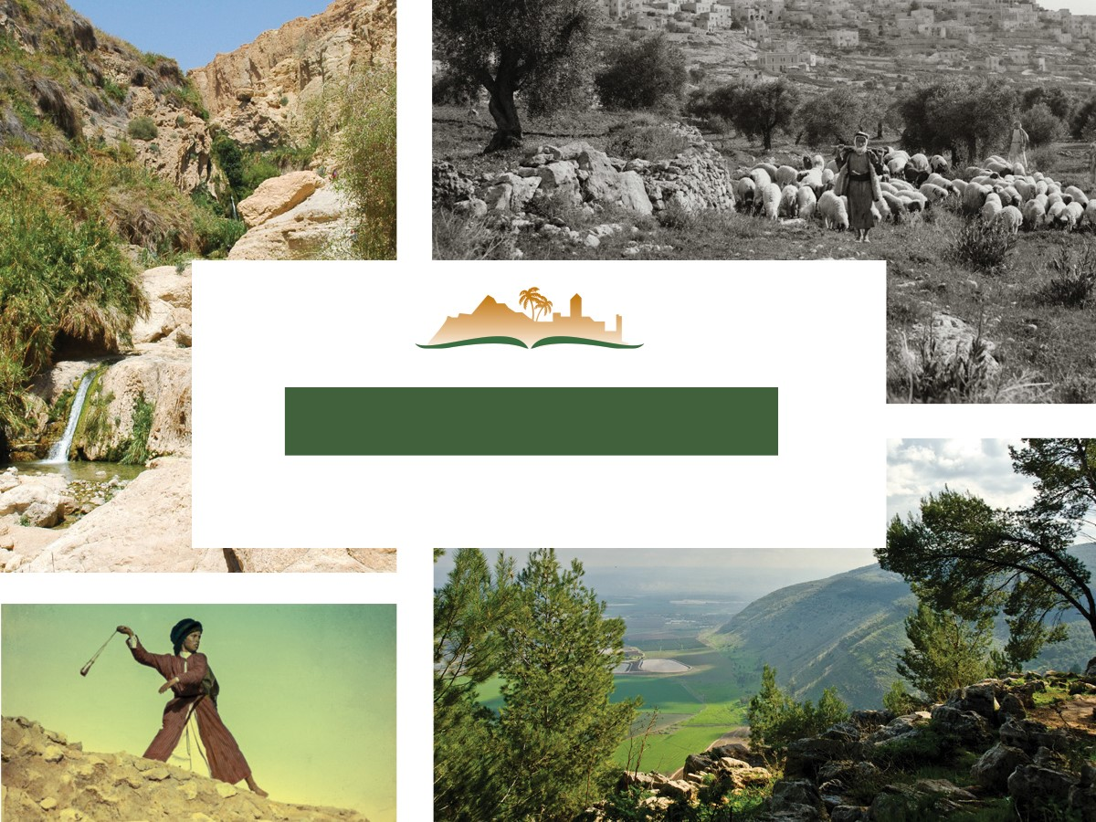
1 Samuel 4
Notes:
This is a free sample of the 1 Samuel 4 presentation from the Photo Companion to the Bible. To purchase the full volume, visit https://www.bibleplaces.com/1samuel/
The Photo Companion to the Bible is an image-rich resource for Bible students, teachers, and researchers. Just as a librarian stocks the shelves with as many relevant materials as possible, so we have tried to provide a broad selection of images. Our goal is that you will find in this “library” whatever it is you are looking for.
Credits: The primary creators of this presentation are Chris McKinny, Kris Udd, Steven Anderson, and Todd Bolen. The photographs have an individual file code which usually includes the initials of the photographer. Other images have additional credit or source information.
Updates: We plan to update this collection as we are able. We welcome your suggestions for improving this resource (photocompanion@bibleplaces.com). Purchasers of the 1 Samuel volume are provided free, lifetime updates to the collection.
Copyright: This photo collection is protected by copyright law and may not be distributed without written permission from BiblePlaces.com. Slide notes should be treated as any other copyrighted written material, with credit given when quoting from these notes.
For more information, see our complete “Introduction to the Photo Companion to the Bible” online at http://www.BiblePlaces.com/Intro-Photo-Companion-Bible/. Here you will find more information about photo selection, explanatory notes, Bible translation, credit information, and copyright allowances.

Slide 2
1 Samuel 4
This is a free sample of the 1 Samuel 4 presentation from the Photo Companion to the Bible. To purchase the full volume, visit https://www.bibleplaces.com/1samuel/ The Photo Companion to the Bible is an image-rich resource for Bible students, teachers, and researchers. Just as a librarian stocks the shelves with as many relevant materials as possible, so we have tried to provide a broad selection of images. Our goal is that you will find in this “library” whatever it is you are looking for. For more details (for this and every slide), see the Notes section below.
Notes:
This is a free sample of the 1 Samuel 4 presentation from the Photo Companion to the Bible. To purchase the full volume, visit https://www.bibleplaces.com/1samuel/
The Photo Companion to the Bible is an image-rich resource for Bible students, teachers, and researchers. Just as a librarian stocks the shelves with as many relevant materials as possible, so we have tried to provide a broad selection of images. Our goal is that you will find in this “library” whatever it is you are looking for.
Credits: The primary creators of this presentation are Chris McKinny, Kris Udd, Steven Anderson, and Todd Bolen. The photographs have an individual file code which usually includes the initials of the photographer. Other images have additional credit or source information.
Updates: We plan to update this collection as we are able. We welcome your suggestions for improving this resource (photocompanion@bibleplaces.com). Purchasers of the 1 Samuel volume are provided free, lifetime updates to the collection.
Copyright: This photo collection is protected by copyright law and may not be distributed without written permission from BiblePlaces.com. Slide notes should be treated as any other copyrighted written material, with credit given when quoting from these notes.
For more information, see our complete “Introduction to the Photo Companion to the Bible” online at http://www.BiblePlaces.com/Intro-Photo-Companion-Bible/. Here you will find more information about photo selection, explanatory notes, Bible translation, credit information, and copyright allowances.

Slide 3
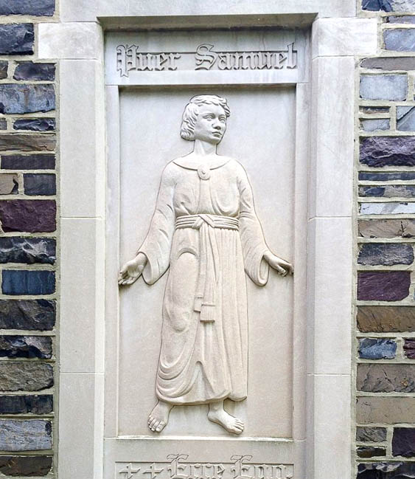
And the word of Samuel came to all Israel
Relief of Samuel, at St. Joseph’s Seminary, Princeton, New Jersey
4:1
Notes:
From a literary standpoint, this phrase belongs with the previous section, at the end of 1 Samuel 3. This image comes from Djkeddie and is licensed under CC BY-SA 4.0, via Wikimedia Commons: https://commons.wikimedia.org/wiki/File:St._Joseph%27s_Seminary_(Princeton,_New_Jersey)_Samuel_relief.jpg.
wiki06082015085600

Slide 4
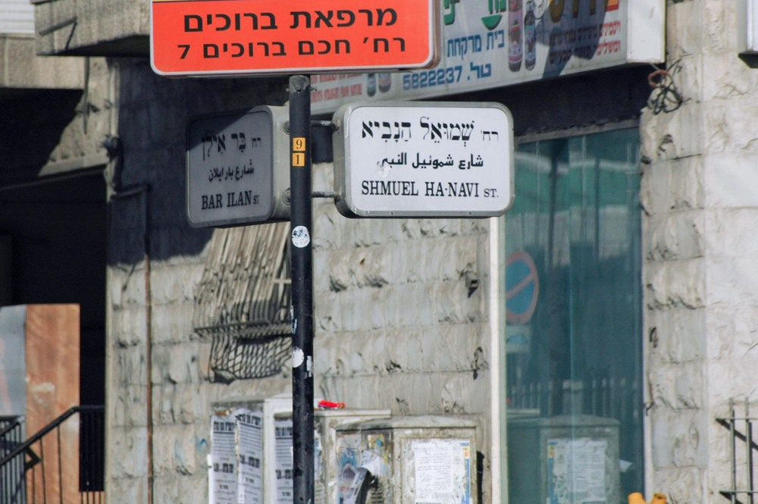
And the word of Samuel came to all Israel
“Samuel the Prophet Street” sign in Jerusalem
4:1
Notes:
The street sign shown here identifies a street named after Samuel, “Shmuel Ha-Navi,” “Samuel the Prophet.” This street is located in the Kerem Avraham neighborhood of Jerusalem.
tb072404721

Slide 5
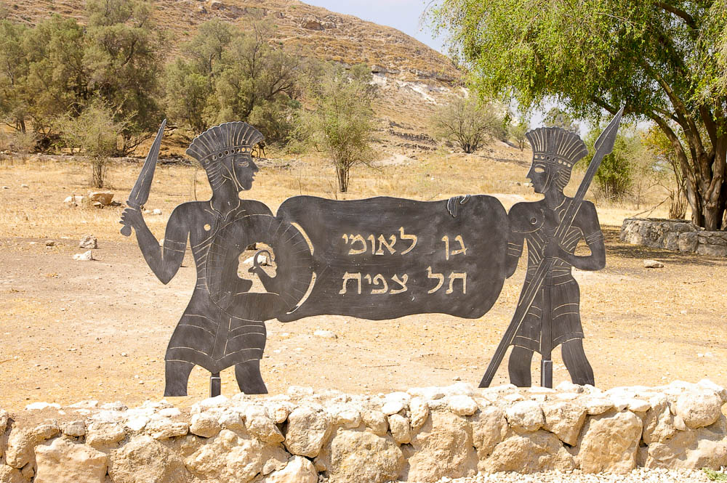
Israel went out to meet the Philistines in battle
Philistine silhouettes sign at Gath
4:1
Notes:
This modern depiction of Philistines is based on relief carvings of Philistine soldiers from ancient Egypt. Although the time of year is not given in this passage, it can be deduced from the later narrative. The ark, which was shortly to be captured, was in Philistine territory for seven months (1 Sam 6:1); it was returned during the wheat harvest (1 Sam 6:13), which in this region occurs in late April or early May. This implies that the battle of Aphek took place in the fall, around late October or early November.
adr08071304511

Slide 6
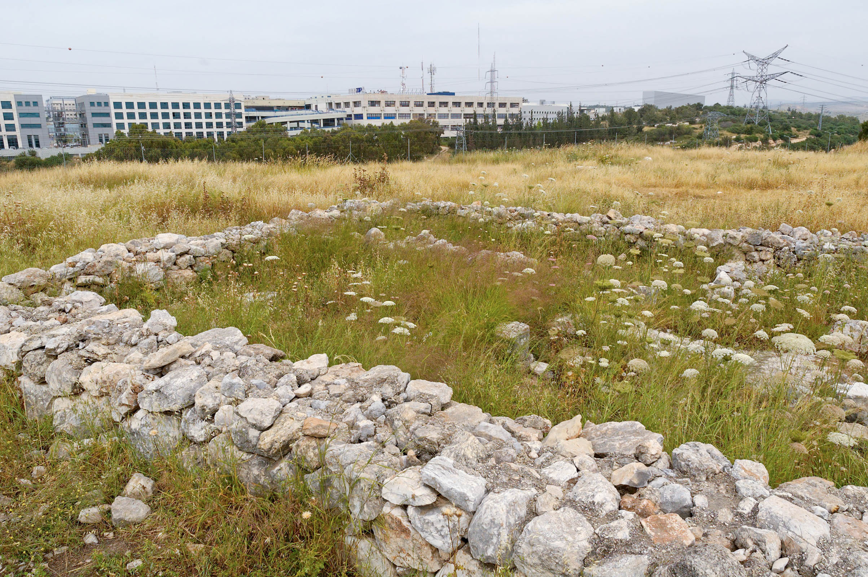
Israel went out to meet the Philistines in battle and encamped beside Ebenezer
Israelite four-room house at Ebenezer (Izbet Sartah)
4:1
Notes:
Ebenezer (1 Sam 4:1; 5:1) is typically identified with Izbet Sartah, which fits the geographical context of 1 Samuel 4 (which mentions Aphek) and the archaeological setting of the early Israelite-Philistine conflict (Iron Age I Israelite remains). The reference to Ebenezer in 1 Samuel 7:12 may indicate either that there were two distinct sites named Ebenezer or simply that the latter recalled the earlier conflict with the Philistines. In any event, the literary connection between the two Ebenezers is strong.
tb050106606

Slide 7
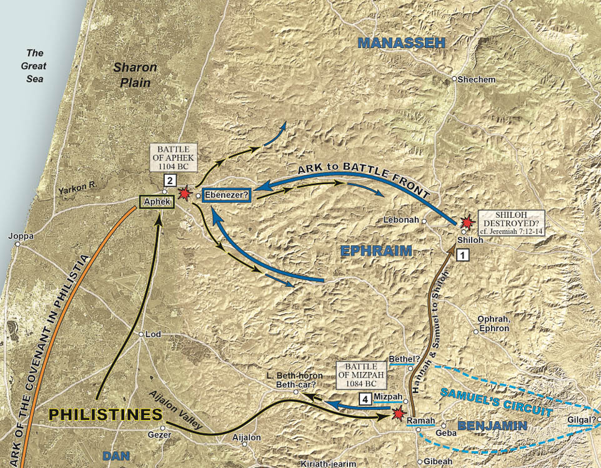
Israel went out to meet the Philistines in battle and encamped beside Ebenezer
Map of the battle of Aphek, 1104 BC
4:1
Notes:
The distance from Shiloh to Ebenezer (Izbet Sartah) is about 20 miles (32 km). Izbet Sartah is only 2 miles (3.2 km) from the Philistine camp at Aphek. This is a detail of map 5-1 from the Satellite Bible Atlas, by William Schlegel; it is used with permission.

Slide 8
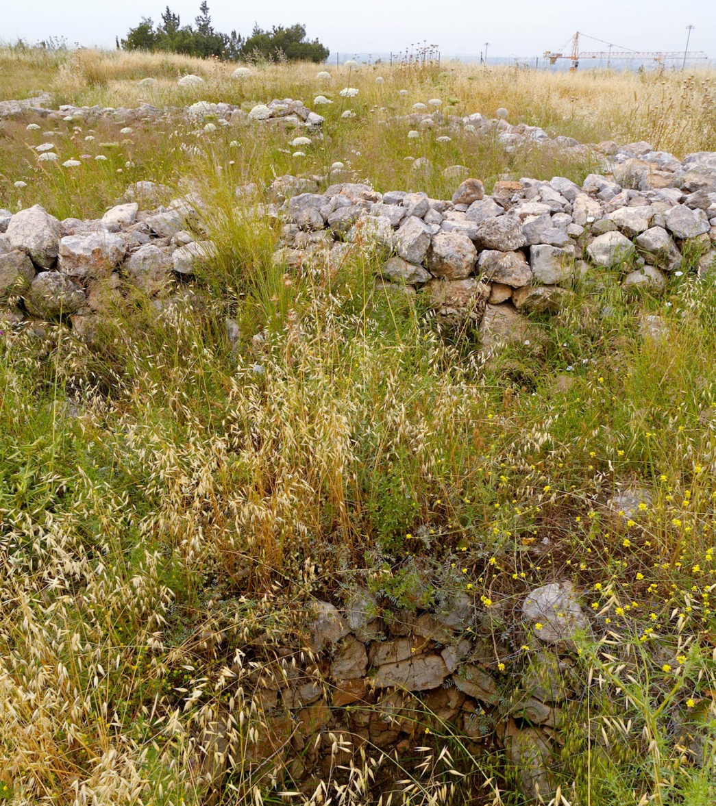
Israel went out to meet the Philistines in battle and encamped beside Ebenezer
Israelite grain silo and four-room house at Izbet Sartah (Ebenezer)
4:1
Notes:
Located at the edge of the Ephraim foothills, Ebenezer (Izbet Sartah) is within view of the city of Aphek. It was while the Israelites were encamped at Ebenezer, and the Philistines were based at Aphek, that the battle took place which resulted in the capture of the ark of the covenant. Izbet Sartah was a small village. Excavations revealed only one substantial building—a typical “Israelite four room house,” located in the middle; poorer farm buildings surrounded it to form a protective belt.
tb050106616

Slide 9
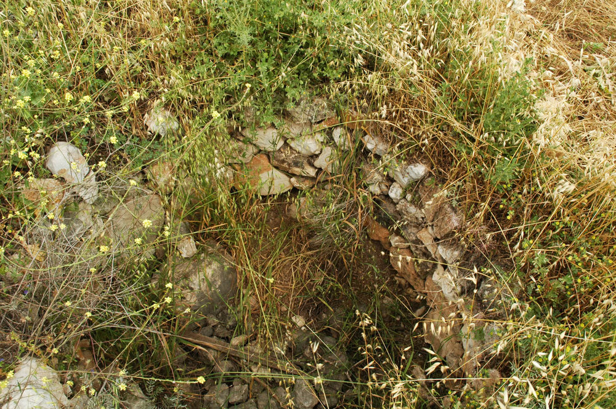
Israel went out to meet the Philistines in battle and encamped beside Ebenezer
Israelite grain silo at Izbet Sartah (Ebenezer)
4:1
Notes:
Israel Finkelstein was the field director for excavations at this site from 1976 to 1978, and during that time identified 43 small, stone-lined, underground grain silos that filled the area in between the buildings. He also found a few crude, rock-cut cisterns, showing that the ancient Israelites had to rely on stored rainwater because the only nearby living source of water, the Yarkon River springs, was controlled by Canaanite (and later Philistine) Aphek. The (overgrown) stone-lined pit in this photo is one of the Israelite grain silos.
tb050106615

Slide 10
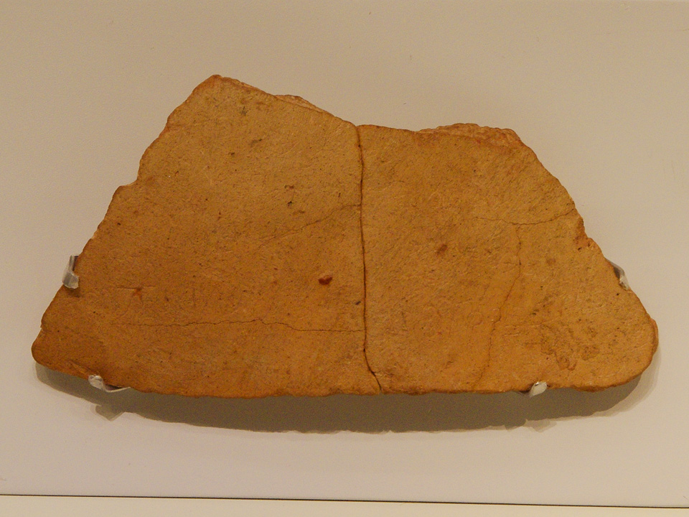
Israel went out to meet the Philistines in battle and encamped beside Ebenezer
Ostracon with abecedary from Izbet Sartah, 12th century BC
4:1
Notes:
This inscribed potsherd (ostracon) is one of the earliest known Hebrew inscriptions. It dates to approximately the time of 1 Samuel 4. It was discovered at Izbet Sartah, and it has five lines of text scratched onto it. The top four lines are lightly written and quite difficult to read. The bottom line is etched more deeply by a firmer hand and is clearly an abecedary of the Hebrew alphabet. The writing is from left to right, and a couple of letters are indistinct (such as the mem) or not in the modern order (zayin and chet are reversed, as are ayin and pe). Shea has suggested that this inscription records the same events as 1 Samuel 4 (Shea 1990), but the inscription is very difficult to make out and Shea’s reading has not generally been accepted (Mykytiuk 1998; cf. Kochavi 1977). This artifact was photographed in the Israel Museum. The next slide includes labels for the letters of the abecedary, the clearest line of the inscription and one on which most scholars are generally agreed.
References:
Kochavi, M.
1977 An Ostracon of the Period of the Judges from ‘Izbet Ṣarṭah. Tel Aviv 4: 1–13.
Mykytiuk, Lawrence J.
1998 Is Hophni in the Izbet Sartah Ostracon? Andrews University Seminary Studies 36, 69–80.
Shea, William H.
1990 The Izbet Sartah Ostracon. Andrews University Seminary Studies 28: 59–86.
adr1306213219

Slide 11
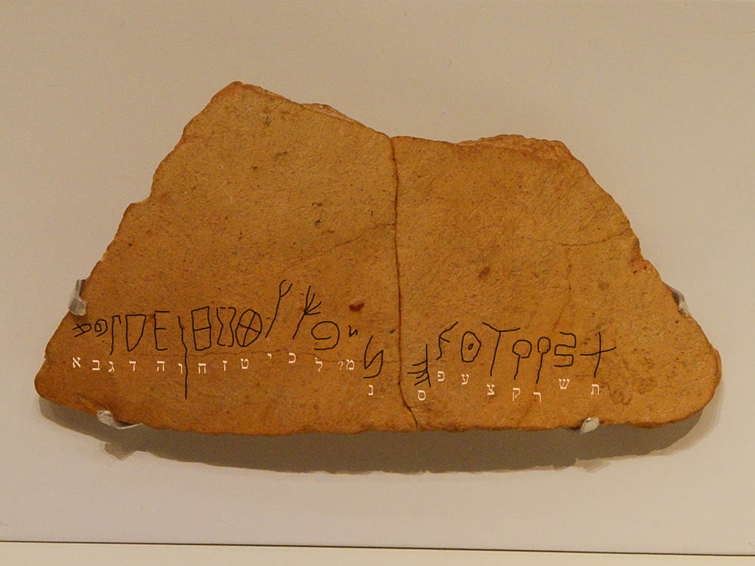
Israel went out to meet the Philistines in battle and encamped beside Ebenezer
א
ב
ג
ד
ה
ו
ח
ז
ט
י
כ
ל
? מ
פ
ע
ש
נ
ס
צ
ק
ר
ת
Ostracon with abecedary from Izbet Sartah, 12th century BC
4:1
Notes:
This inscribed potsherd (ostracon) is one of the earliest known Hebrew inscriptions. It dates to approximately the time of 1 Samuel 4. It was discovered at Izbet Sartah, and it has five lines of text scratched onto it. The top four lines are lightly written and quite difficult to read. The bottom line is etched more deeply by a firmer hand and is clearly an abecedary of the Hebrew alphabet. The writing is from left to right, and a couple of letters are indistinct (such as the mem) or not in the modern order (zayin and chet are reversed, as are ayin and pe). Shea has suggested that this inscription records the same events as 1 Samuel 4 (Shea 1990), but the inscription is very difficult to make out and Shea’s reading has not generally been accepted (Mykytiuk 1998; cf. Kochavi 1977). This artifact was photographed in the Israel Museum. An editable version is included behind this graphic for those who may wish to change it.
References:
Kochavi, M.
1977 An Ostracon of the Period of the Judges from ‘Izbet Ṣarṭah. Tel Aviv 4: 1–13.
Mykytiuk, Lawrence J.
1998 Is Hophni in the Izbet Sartah Ostracon? Andrews University Seminary Studies 36, 69–80.
Shea, William H.
1990 The Izbet Sartah Ostracon. Andrews University Seminary Studies 28: 59–86.
adr1306213219

Slide 12
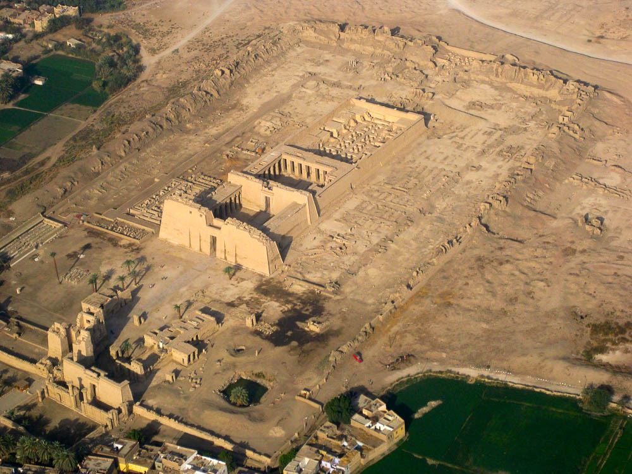
Israel went out to meet the Philistines in battle . . . and the Philistines encamped in Aphek
Mortuary temple of Ramses III at Medinet Habu (aerial view from the east)
4:1
Notes:
Most historians believe that the Sea Peoples (of whom the Philistines are the best-known tribe) arrived in the Levant around 1200 BC, about a century before the events recorded in 1 Samuel 4. It seems that they came from the west, somewhere in the Aegean. They may have travelled down the coast of Israel by both land and sea, confronting the Egyptians during the reign of Ramesses III. The Egyptians were able to repulse the Sea Peoples, who then settled along the coast of Israel. Ramesses III commemorated his victory by inscribing scenes from the battle on the north wall of his mortuary temple at Medinet Habu. These scenes comprise our best source of what the Philistines looked like at about the time of Eli and Samuel. The next slide includes labels. This image comes from Steve F-E-Cameron and is licensed under CC BY 3.0, via Wikimedia Commons: https://commons.wikimedia.org/wiki/File:SFEC_AEH_-ThebesNecropolis-2010-RamsesIII036.jpg.
wiki0219201020413264

Slide 13
Israel went out to meet the Philistines in battle . . . and the Philistines encamped in Aphek
hypostyle
hall
north wall
Ramesses III’s
palace
second pylon
first pylon
Mortuary temple of Ramses III at Medinet Habu (aerial view from the east)
4:1
Notes:
Most historians believe that the Sea Peoples (of whom the Philistines are the best-known tribe) arrived in the Levant around 1200 BC, about a century before the events recorded in 1 Samuel 4. It seems that they came from the west, somewhere in the Aegean. They may have travelled down the coast of Israel by both land and sea, confronting the Egyptians during the reign of Ramesses III. The Egyptians were able to repulse the Sea Peoples, who then settled along the coast of Israel. Ramesses III commemorated his victory by inscribing scenes from the battle on the north wall of his mortuary temple at Medinet Habu. These scenes comprise our best source of what the Philistines looked like at about the time of Eli and Samuel. This image comes from Steve F-E-Cameron and is licensed under CC BY 3.0, via Wikimedia Commons: https://commons.wikimedia.org/wiki/File:SFEC_AEH_-ThebesNecropolis-2010-RamsesIII036.jpg.
wiki0219201020413264

Slide 14
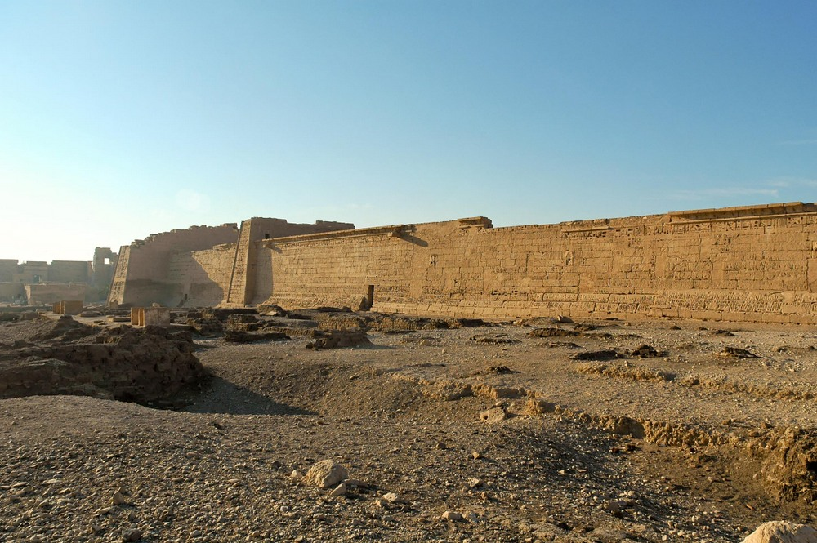
Israel went out to meet the Philistines in battle . . . and the Philistines encamped in Aphek
North wall of Ramses III’s mortuary temple at Medinet Habu, circa 1185 BC
4:1
Notes:
This is a view of the north wall of the mortuary temple of Ramesses III at Medinet Habu. The scenes of the battle with the Sea Peoples run from right to left, and includes preparation for battle, the march to battle, land and sea battles, and the victory celebration. The next slide includes labels.
tb011105873

Slide 15
Israel went out to meet the Philistines in battle . . . and the Philistines encamped in Aphek
preparing
for battle with
Sea Peoples
Sea Peoples’
Sea Battle
Sea Peoples’
Land Battle
celebrating
victory over
Sea Peoples
celebrating
victory over
Libyans
march to
battle
lion
hunt
First
Pylon
Second
Pylon
North wall of Ramses III’s mortuary temple at Medinet Habu, circa 1185 BC
4:1
Notes:
This is a view of the north wall of the mortuary temple of Ramesses III at Medinet Habu. The scenes of the battle with the Sea Peoples run from right to left, and includes preparation for battle, the march to battle, land and sea battles, and the victory celebration.
tb011105873

Slide 16
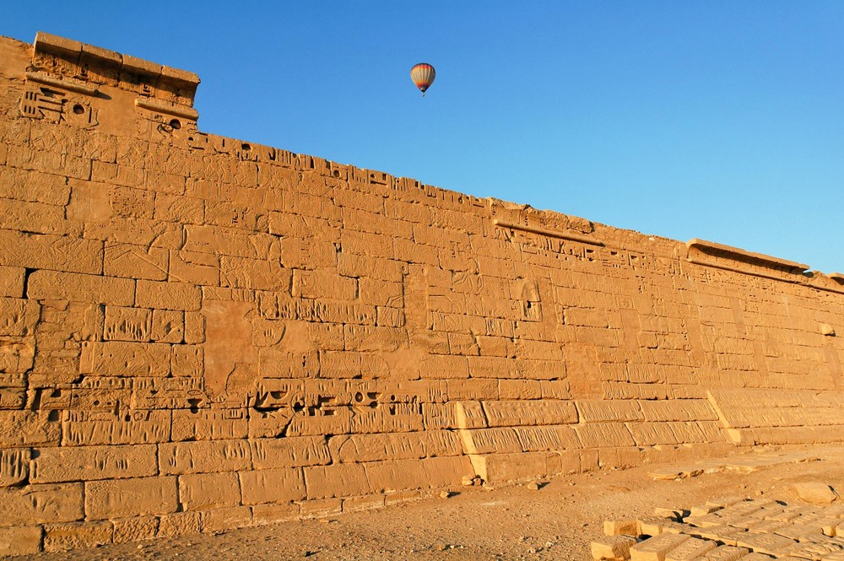
Israel went out to meet the Philistines in battle . . . and the Philistines encamped in Aphek
North wall of Ramses III’s mortuary temple at Medinet Habu, circa 1185 BC
4:1
Notes:
This is a general view of the north wall at Medinet Habu.
tb011105828

Slide 17
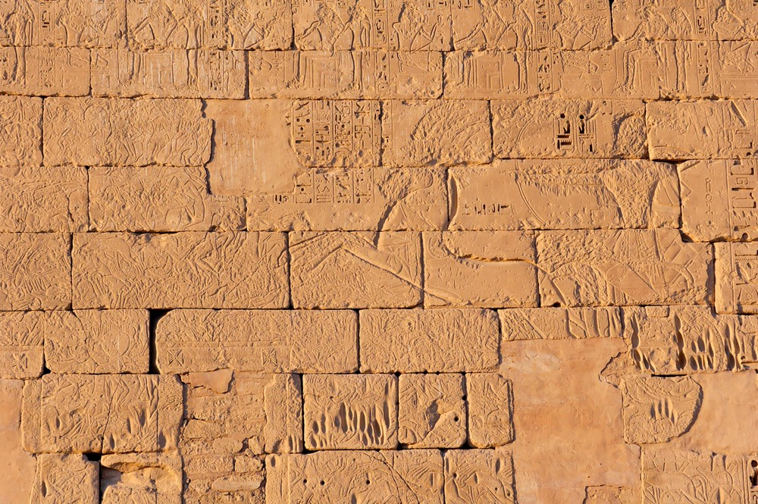
Israel went out to meet the Philistines in battle . . . and the Philistines encamped in Aphek
Relief of the Sea Peoples’ land battle on the north wall at Medinet Habu, circa 1185 BC
4:1
Notes:
The most prominent figure visible in this photo is the Egyptian king, Ramesses III, driving his chariot toward the Sea Peoples who attacked Egypt by land.
tb011105823

Slide 18
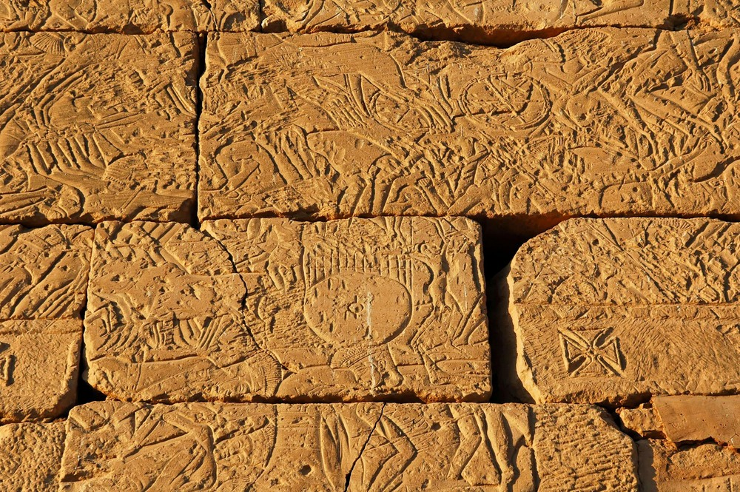
Israel went out to meet the Philistines in battle . . . and the Philistines encamped in Aphek
Relief of the Sea Peoples’ land battle on the north wall at Medinet Habu, circa 1185 BC
4:1
Notes:
In this view the Sea Peoples are shown fleeing before Ramesses III and his army. The central block in this photo shows oxen pulling a cart with large wooden wheels. A similar kind of cart was likely used by the Philistines when they returned the ark of God to the Israelites (1 Sam 6:7-11).
tb011105838

Slide 19
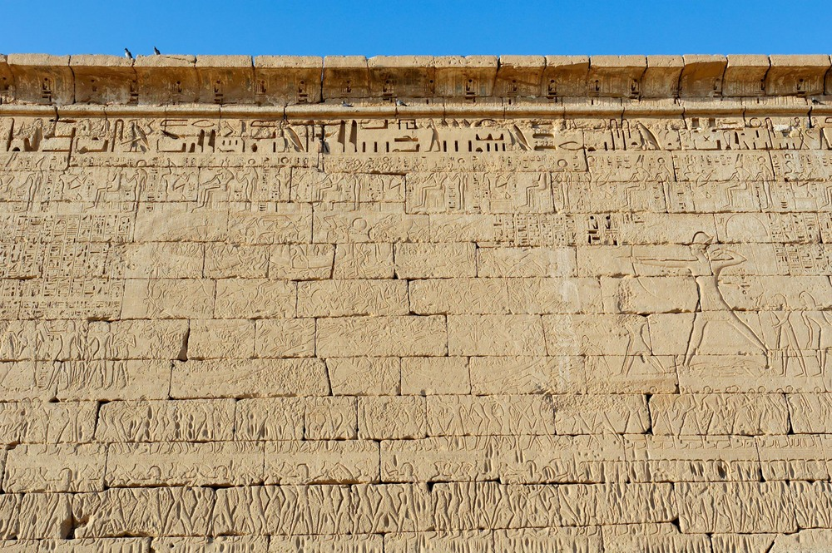
Israel went out to meet the Philistines in battle . . . and the Philistines encamped in Aphek
Relief of the Sea Peoples’ sea battle on the north wall at Medinet Habu, circa 1185 BC
4:1
Notes:
Ramesses III had three famous military campaigns. In years 5 and 11 of his reign, he fought the Libyans, and in year 8 (circa 1175 BC) he successfully stopped the Sea Peoples from invading Egypt. The Sea Peoples attacked the Egyptians both from the sea and from the land. The sea portion of the battle must have occurred in the branches of the Nile and the Delta. Ramesses claimed that he “capsized and overwhelmed the naval fleet.” The problem with this Egyptian declaration of victory is that it does not explain certain key outcomes. For example, how did the Philistines survive, and not only that, but how did they settle in some of the best land in Canaan? Was the victory actually a crushing defeat, or was the advance simply stopped?
tb011105866

Slide 20
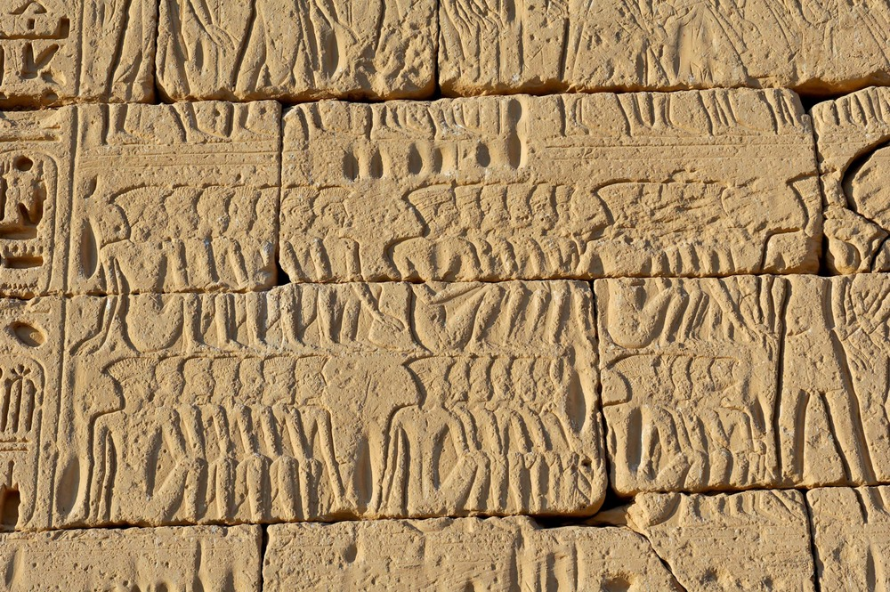
Israel went out to meet the Philistines in battle . . . and the Philistines encamped in Aphek
Philistine captives at celebration of victory over Sea Peoples, from Medinet Habu, circa 1185 BC
4:1
Notes:
The Egyptians did not portray their enemies in stances of strength, but nearly always showed them in the tumult of battle or as captives. One of the distinctive ways in which the Egyptians portrayed the Philistines was their tall headdresses. These are typically shown with vertical lines, perhaps indicating that they were made of feathers.
tb011105848

Slide 21
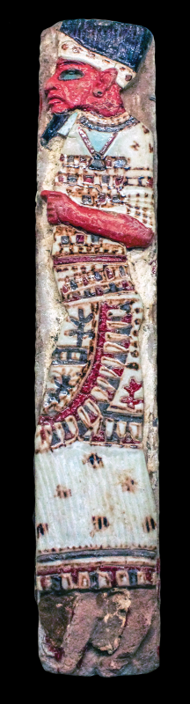
Israel went out to meet the Philistines in battle . . . and the Philistines encamped in Aphek
Depiction of a Philistine chief, from Medinet Habu, circa 1180 BC
4:1
Notes:
This full-color faience depiction of a Philistine was recovered from the palace of Ramesses III at Medinet Habu. In addition to the colorful robe, note the beard and the tall headdress. This depiction comes from only a generation or two before the time of 1 Samuel 4. This artifact was photographed at the Boston Museum of Fine Arts. For more information on this artifact, see http://www.mfa.org/collections/object/tile-with-philistine-chief-130485.
adr1711203216b

Slide 22
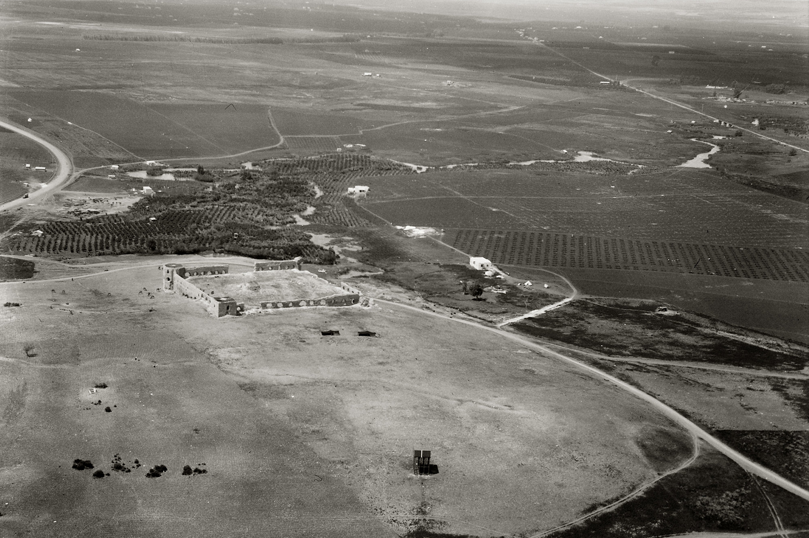
Israel went out to meet the Philistines in battle . . . and the Philistines encamped in Aphek
Aphek (aerial view from the east, from the direction of Ebenezer)
4:1
Notes:
The site of Aphek is to be identified with Tell Ras el-Ain, which means “Head of the Spring,” a reference to this site being at the head of a water source. The large spring at the foot of the tell forms the headwaters of the Yarkon River. This was a strategic location, not just because of the plentiful water source, but because it was located at a crossroads of the major north-south international highway.
The Ottoman fortress visible in this photo was built in the 16th century, shortly after the Old City walls of Jerusalem. It was then called Binar Bashi and was one of a series of Turkish forts in the area. The remains of an earlier Turkish fort are inside the present walls. This American Colony photograph was taken between 1925 and 1946. The next slide includes labels.
mat14389

Slide 23
Israel went out to meet the Philistines in battle . . . and the Philistines encamped in Aphek
Yarkon River
Aphek
Aphek (aerial view from the east, from the direction of Ebenezer)
4:1
Notes:
The site of Aphek is to be identified with Tell Ras el-Ain, which means “Head of the Spring,” a reference to this site being at the head of a water source. The large spring at the foot of the tell forms the headwaters of the Yarkon River. This was a strategic location, not just because of the plentiful water source, but because it was located at a crossroads of the major north-south international highway.
The Ottoman fortress visible in this photo was built in the 16th century, shortly after the Old City walls of Jerusalem. It was then called Binar Bashi and was one of a series of Turkish forts in the area. The remains of an earlier Turkish fort are inside the present walls. This American Colony photograph was taken between 1925 and 1946.
mat14389

Slide 24
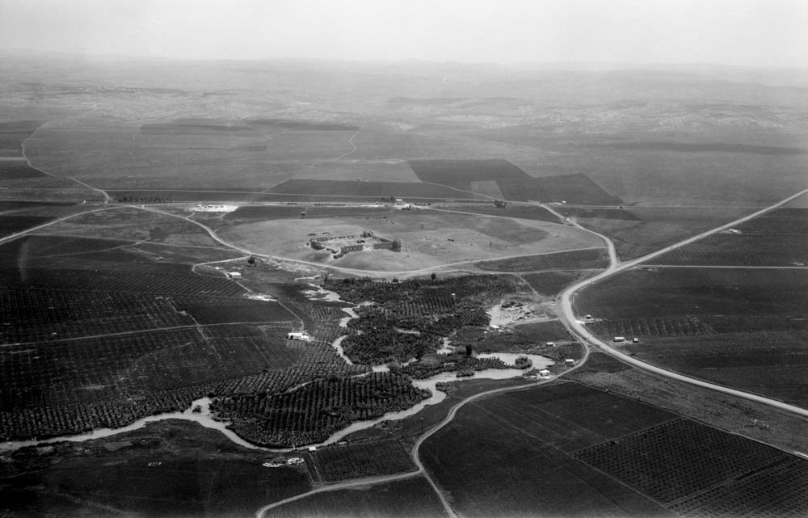
Israel went out to meet the Philistines in battle . . . and the Philistines encamped in Aphek
Aphek (aerial from the west, looking toward Ebenezer)
4:1
Notes:
This view looks from Aphek toward Ebenezer, a mere 2 miles (3.2 km) away. This view also illustrates a significant reason why Aphek had become such an important city. The city is located at the head of the Yarkon River. The river runs toward the west, to the Mediterranean Sea, and poses a barrier to travel between Aphek and the coast. For this reason the international highway through this region skirted Aphek. As can be seen, travel around the east side of Aphek (in the background of this photo) was clear. This allowed Aphek to control travel along the highway and made it a very strategically important city.
During the preceding Late Bronze Age, Aphek was under the control of Egypt, as evidenced by the Egyptian governor’s palace that was discovered there. The city was destroyed in battle, probably in the 13th century BC, as indicated by the arrowheads found in its debris and the conflagration that consumed it. It was controlled by the Philistines until finally being conquered by David around 1000 BC (Beck and Kochavi 1993: 68–69). This American Colony photograph was taken in 1932. The next slide includes labels.
Reference:
Beck, Pirhiya, and Kochavi, Moshe.
1993 Aphek. New Encyclopedia of Archaeological Excavations in the Holy Land, vol. 1, ed. E. Stern. Jerusalem: Carta.
mat22182

Slide 25
Israel went out to meet the Philistines in battle . . . and the Philistines encamped in Aphek
Ebenezer
(Izbet Sartah)
Aphek
Aphek (aerial from the west, looking toward Ebenezer)
4:1
Notes:
This view looks from Aphek toward Ebenezer, a mere 2 miles (3.2 km) away. This view also illustrates a significant reason why Aphek had become such an important city. The city is located at the head of the Yarkon River. The river runs toward the west, to the Mediterranean Sea, and poses a barrier to travel between Aphek and the coast. For this reason the international highway through this region skirted Aphek. As can be seen, travel around the east side of Aphek (in the background of this photo) was clear. This allowed Aphek to control travel along the highway and made it a very strategically important city.
During the preceding Late Bronze Age, Aphek was under the control of Egypt, as evidenced by the Egyptian governor’s palace that was discovered there. The city was destroyed in battle, probably in the 13th century BC, as indicated by the arrowheads found in its debris and the conflagration that consumed it. It was controlled by the Philistines until finally being conquered by David around 1000 BC (Beck and Kochavi 1993: 68–69). This American Colony photograph was taken in 1932.
Reference:
Beck, Pirhiya, and Kochavi, Moshe.
1993 Aphek. New Encyclopedia of Archaeological Excavations in the Holy Land, vol. 1, ed. E. Stern. Jerusalem: Carta.
mat22182

Slide 26
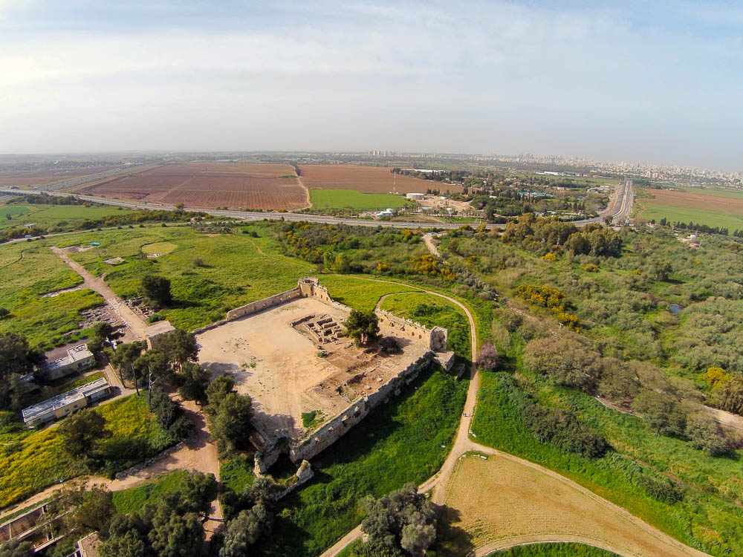
Israel went out to meet the Philistines in battle . . . and the Philistines encamped in Aphek
Turkish fort and Late Bronze Egyptian fort at Aphek (aerial view from the northeast)
4:1
Notes:
Aphek is only about 9 miles (15 km) from the Mediterranean Sea. In this aerial photo, which looks toward the southwest, the outer edge of Tel Aviv can be seen along the horizon. The marshy area on the right is where the headwaters of the Yarkon River are located.
ws032715903

Slide 27
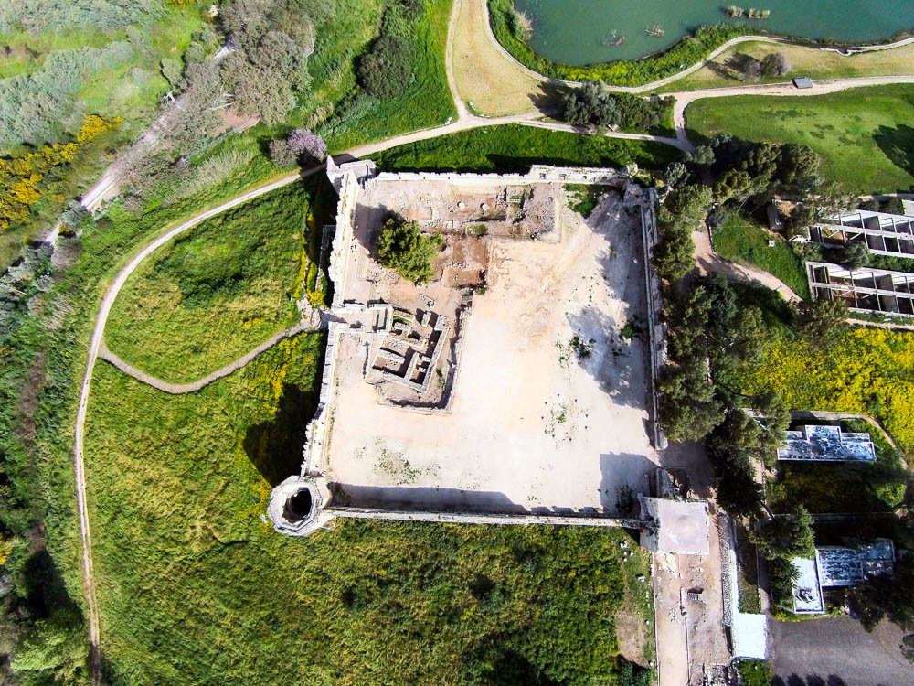
Israel went out to meet the Philistines in battle . . . and the Philistines encamped in Aphek
Turkish fort and Late Bronze Egyptian fort at Aphek (aerial view from the south)
4:1
Notes:
Aphek has been excavated a number of times in the last century. In 1923, Albright’s survey confirmed identification of the site as Aphek. From 1935 to 1936, J. Ory, an employee of the British Department of Antiquities, dug test pits in two areas on the north side of the site, in connection with the British pumping station. The Palestine Department of Antiquities excavated in 1946. In 1961, A. Eitan excavated for the Israel Department of Antiquities. From 1972 to 1985, a major excavation was carried out by Moshe Kochavi of Tel Aviv University. This aerial photo shows some of the excavations within the Turkish fort.
ws032715897

Slide 28
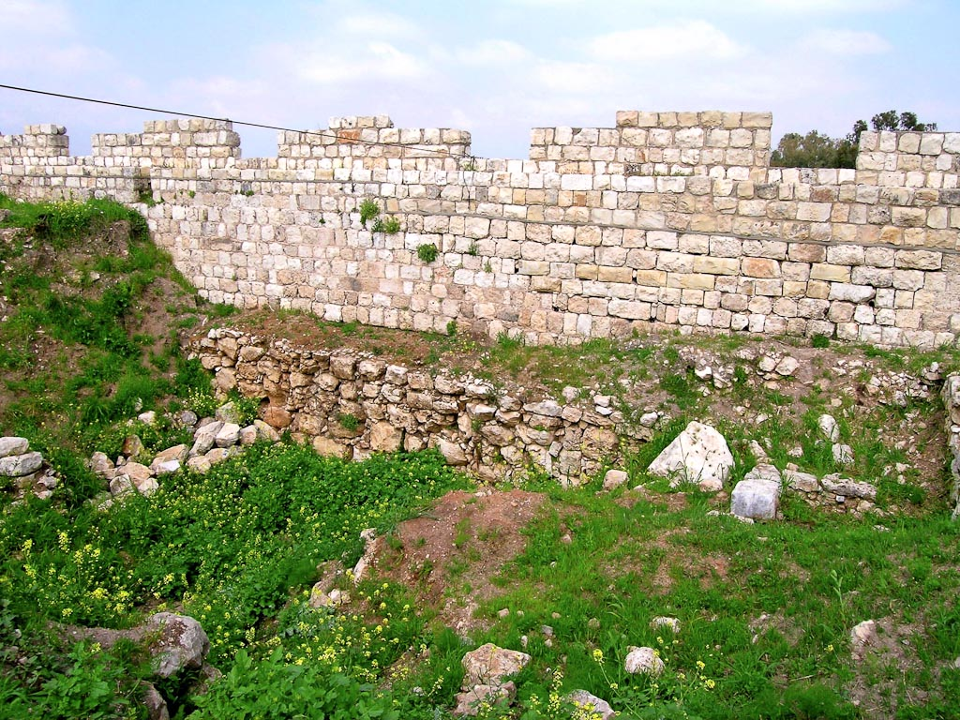
Israel went out to meet the Philistines in battle . . . and the Philistines encamped in Aphek
Earlier wall visible beneath the Turkish fort at Aphek
4:1
Notes:
Excavations have shown that the site was inhabited from the Chalcolithic period. An Early Bronze broad-house was found in a residential quarter in Area A. The entire mound was occupied in Early Bronze I. This was followed by a long occupation gap until Aphek was resettled in Middle Bronze IIA. The Middle Bronze IIA was undoubtedly Aphek’s high point as an urban center of the central coastal plain. There were four phases of development in Middle Bronze IIA. In phase B, a new city wall was constructed and the first palace was built on the acropolis. The walls of the palace were uniformly thick (3.9 feet [1.2 m]) and built of a single, stone course with bricks on top. The city wall was cleared by archaeologists for 82 feet (25 m), and two watch towers were found. Palace II of Phase C (Middle Bronze IIA) was built almost 330 feet (100 m) west of the earlier palace.
tb032504023

Slide 29
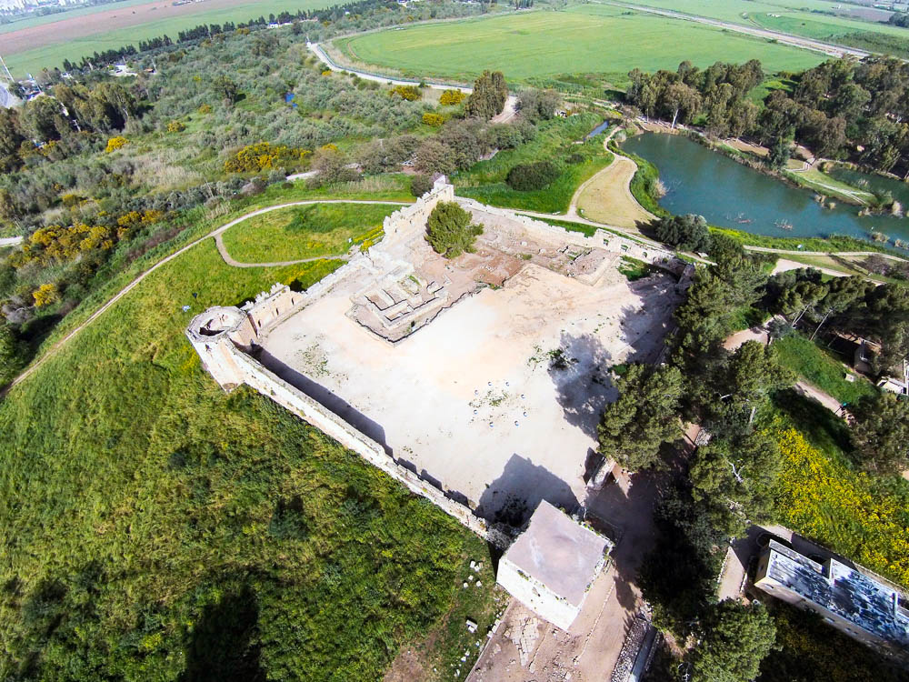
Israel went out to meet the Philistines in battle . . . and the Philistines encamped in Aphek
Turkish fort and Late Bronze Egyptian fort at Aphek (aerial view from the southeast)
4:1
Notes:
The Late Bronze (circa 1500–1200 BC) settlement occupied only the acropolis and its immediate vicinity, and it seems to have consisted of only the Egyptian governor’s residence. “Instead of a spacious palace with courtyards, halls, and rooms, it was a public, fortress-like structure only about 400 sq m [4,300 sq ft]. Its walls were uniformly thick (1.4 m [4.6 ft]), and it had at least two stories. Its walls were built of stone up to 2 m [6.5 ft] in height, above which bricks were used. A paved ramp led to the building from the north toward a well-defended gate….The upper story was apparently residential. This was a typical fortified palace, similar to other Egyptian governors’ residences built at key locations in Canaan during the period of Egyptian rule (at Beth-Shean, Tell el-Far’ah [South], Tel Sera’, Tel Mor, and Deir el-Balah). The structure was destroyed in a violent conflagration; its debris rises to a height of 2 m [6.5 feet]. ‘Canaanite’ storage jars and a collared-rim pithos were found on the ground floor. Egyptian bowls were found in the debris of the second story” (Beck and Kochavi 1993: 68). Eleven written documents were also found—two Egyptian, one Hittite, two lexicons in cuneiform script, two administrative documents, two letters, and two fragments in Akkadian. No other Late Bronze buildings were found on the tell.
Reference:
Beck, Pirhiya, and Kochavi, Moshe.
1993 Aphek. New Encyclopedia of Archaeological Excavations in the Holy Land, vol. 1, ed. E. Stern. Jerusalem: Carta.
ws032715899

Slide 30
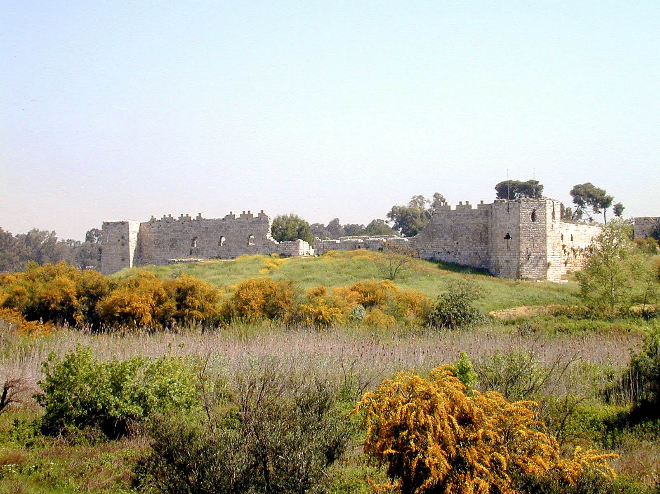
Israel went out to meet the Philistines in battle . . . and the Philistines encamped in Aphek
Turkish fort at Aphek (from the west)
4:1
Notes:
This ground-level view of Aphek illustrates how the tell is situated on a rise above the swampy area to the north and west.
tb032801101

Slide 31
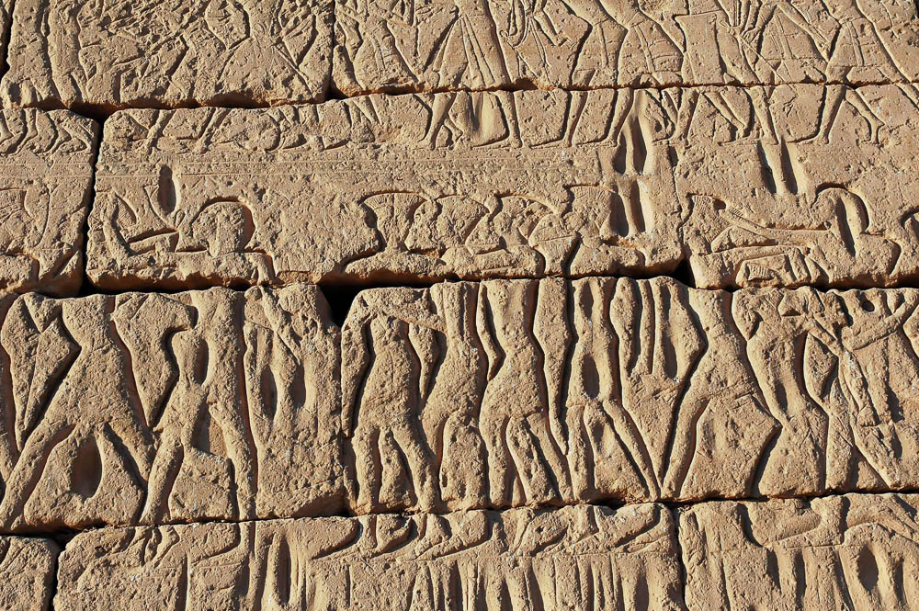
And the Philistines put themselves in array against Israel
Relief of Philistine captives at the Sea Peoples’ sea battle on the north wall at Medinet Habu
4:2
Notes:
As noted above, one of the most common and easily recognizable ways in which the Egyptians depicted the Philistines was wearing tall headdresses. The Philistines can also be recognized because of their use of swan decorations, two-edged swords, spears, and rounded shields. The Egyptians on the other hand, used sickle swords and tombstone shaped shields. Philistine women and children are shown in ox-driven carts, indicating that the Sea Peoples were not only military invaders, but migrants. The majority of the Sea Peoples are clean-shaven, but some Philistines are depicted with beards.
tb011105856

Slide 32
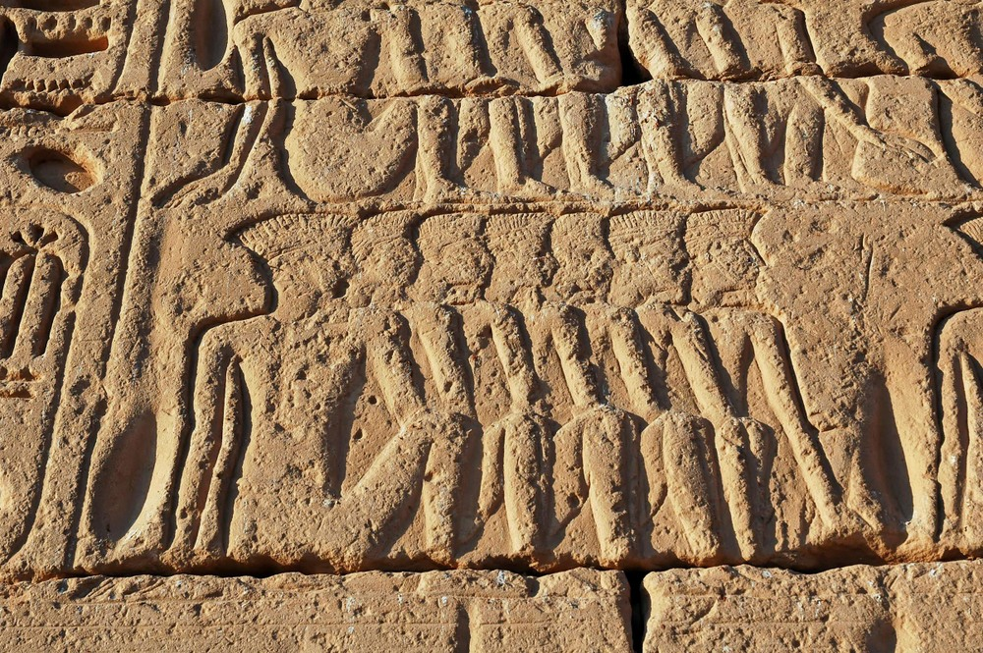
And the Philistines put themselves in array against Israel
Philistine captives shown at the celebration of victory over the Sea Peoples, from Medinet Habu
4:2
Notes:
This close-up view of Philistine captives illustrates their distinctive head gear.
tb011105849

Slide 33
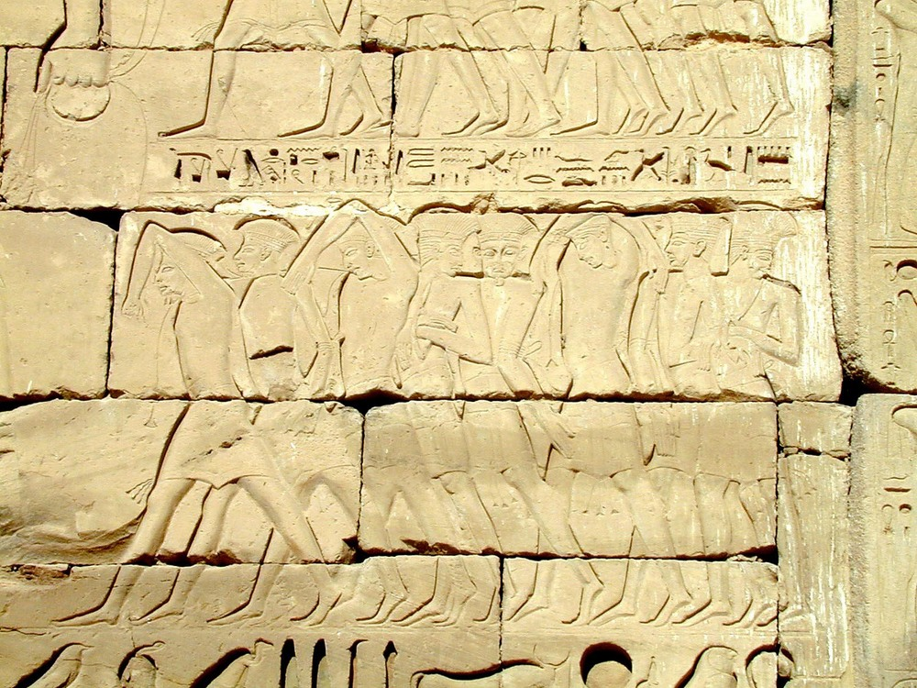
And the Philistines put themselves in array against Israel
Relief of Philistines captured by Egyptians, from Medinet Habu, 12th century BC
4:2
Notes:
This photo provides a side view, and a few rare front views, of the Philistines. They are shown in contorted positions with their hands and arms tied behind them or even above them. They are also being led by a rope, which is held by the oversized hand in the upper left corner of this photo.
tb110600434

Slide 34
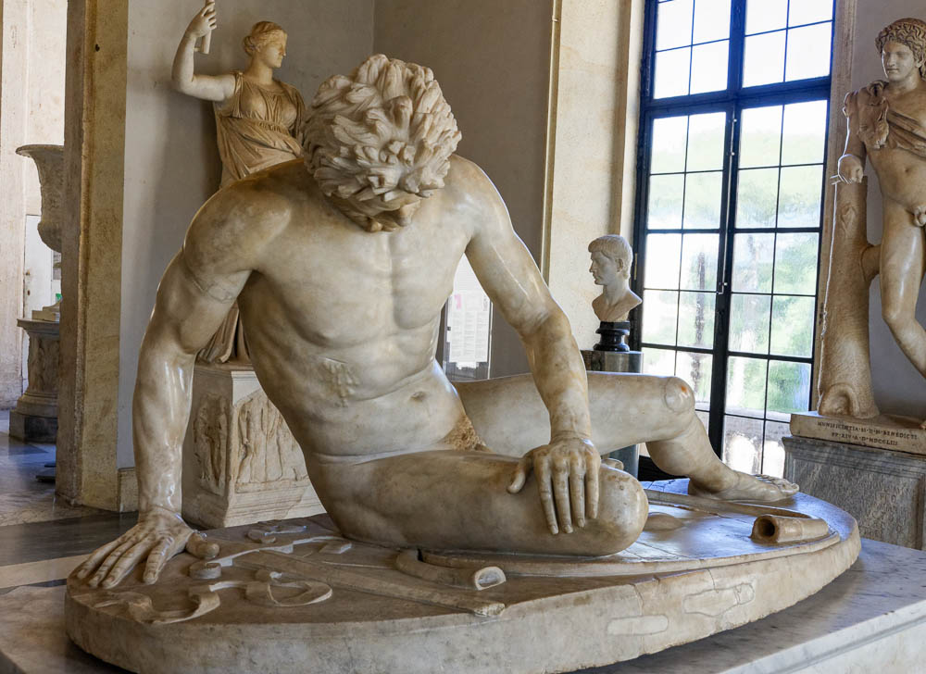
And when they joined battle, Israel was defeated before the Philistines
Statue of a wounded and dying Gaul, 1st century BC
4:2
Notes:
This statue of a dying Gaul illustrates the defeat that Israel suffered. The Gaul has been wounded in the chest; he is shown resting on his shield with his sword beside him. The statue is considered to be a 1st century BC copy of a 3rd century BC original that had been commissioned by Attalus I, king of Pergamon. This copy was recovered from the Gardens of Sallust in Rome. It was photographed at the Capitoline Museums in Rome.
tb0514179918

Slide 35
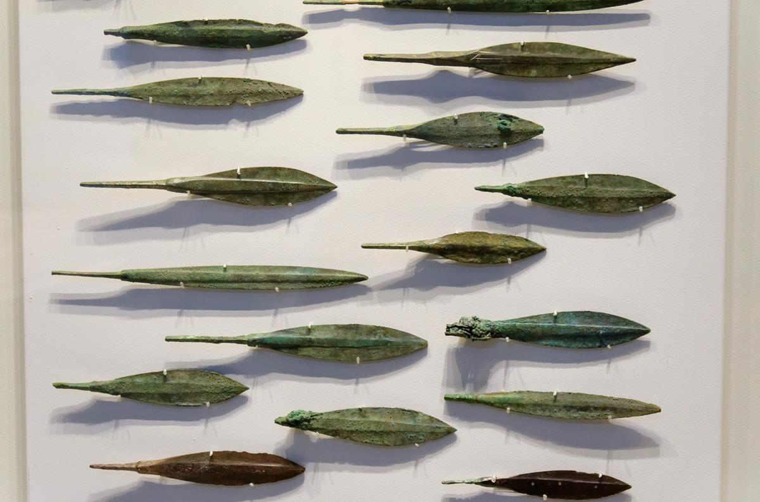
And when they joined battle, Israel was defeated before the Philistines
Arrowheads from Acco, circa 14th century BC
4:2
Notes:
Bow and arrow technology did not change significantly from the Late Bronze Age to the Iron Age. Although these arrowheads predate the battle at Aphek by a couple of centuries, they are similar to what would have been used by archers during the battle. These bronze arrowheads were photographed in the Israel Museum.
tb032014141

Slide 36
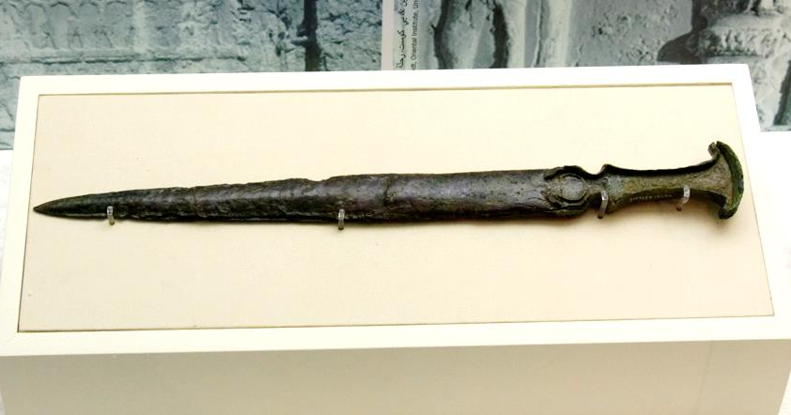
And when they joined battle, Israel was defeated before the Philistines
Bronze short sword, from an Iron Age tomb at Jebel al-Buhais, 1100–300 BC
4:2
Notes:
Based on its style this sword could date as early as the events of 1 Samuel 4, although it is likely somewhat later. It is known that the Philistines carried double-edged swords of this kind. Although this sword was discovered some distance from Aphek, it is likely a close approximation of the type of sword carried by the Philistines. This sword was photographed in the Sharjah Museum of Islamic Civilization in the United Arab Emirates.
tb050217432

Slide 37
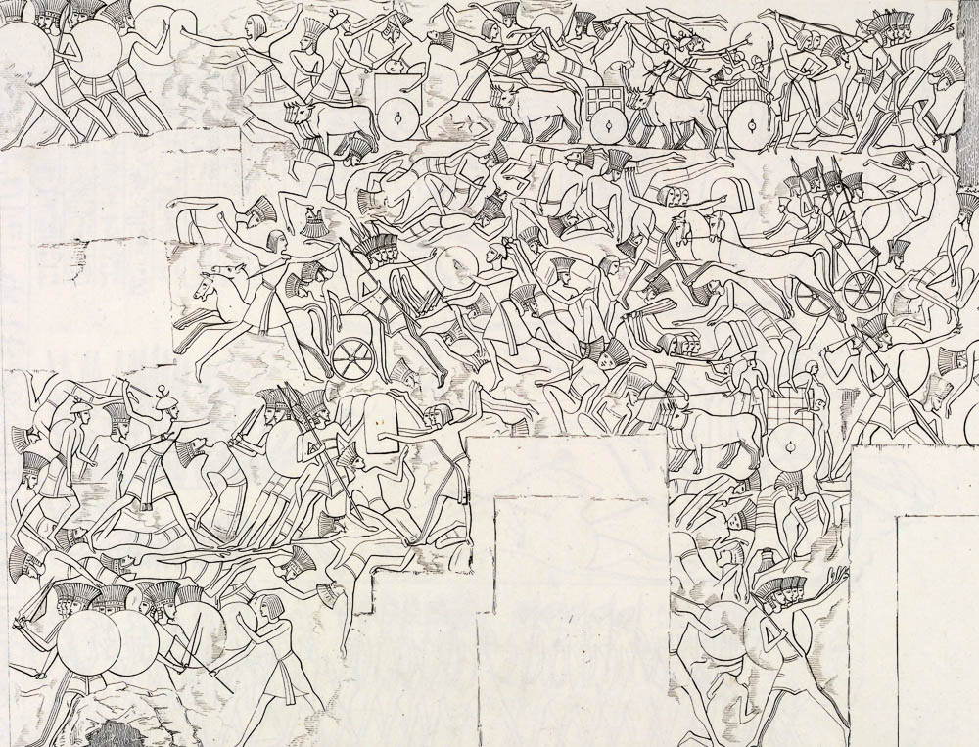
And the elders of Israel said, “Why has Yahweh struck us this day before the Philistines?”
Relief of the Sea Peoples’ land battle on the north wall at Medinet Habu (sketch)
4:3
Notes:
This drawing of one of the battle scenes from Medinet Habu illustrates the tumult of war. In the scenes at Medinet Habu, the Philistines are portrayed as defeated, whereas in 1 Samuel 4 they were the victors and Israel was defeated. This illustration comes from Carlo Lasinio and Giuseppe Angelelli, I Monumenti dell'Egitto, published in 1832–44. Public domain, from The New York Public Library, http://digitalcollections.nypl.org/items/510d47d9-47fc-a3d9-e040-e00a18064a99
nypl425620

Slide 38
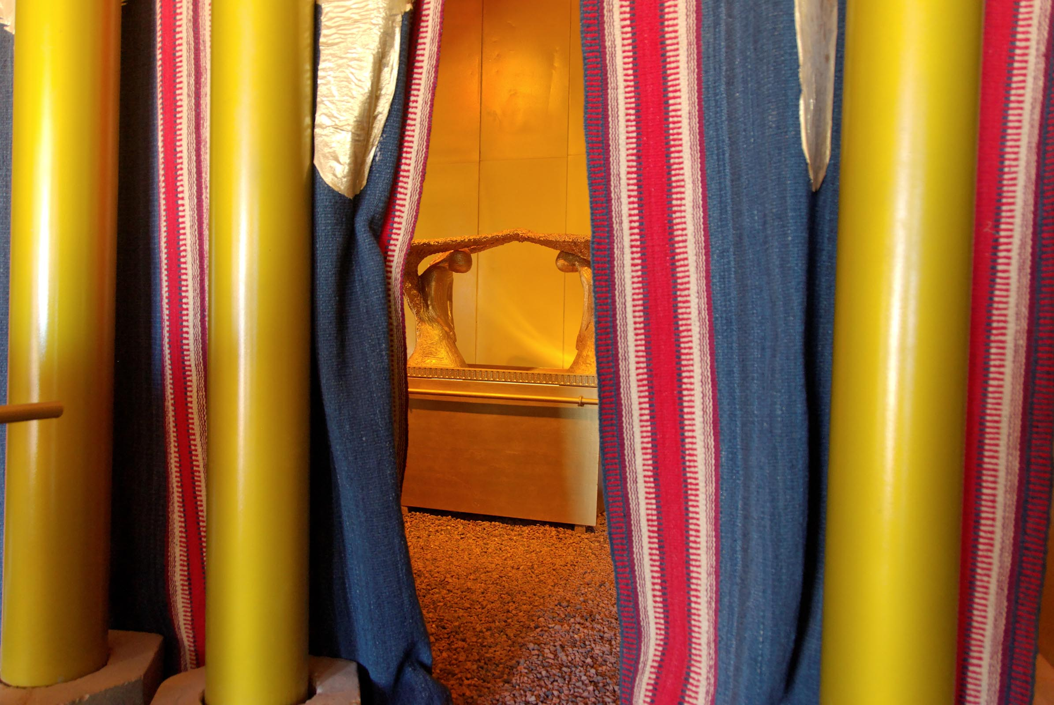
Let us bring the ark of the covenant of Yahweh to us here, from Shiloh
Model of the ark of the covenant, visible behind the curtain
4:3
Notes:
This model of the tabernacle and ark were photographed at Timna Park in southern Israel.
tb010710938

Slide 39
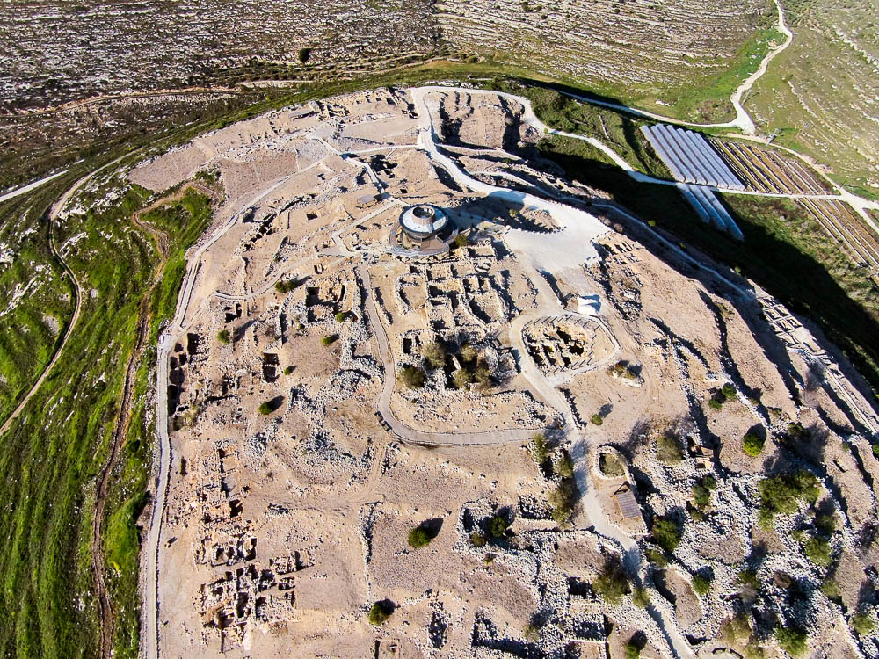
Let us bring the ark of the covenant of Yahweh to us here, from Shiloh
Excavations at Shiloh (aerial view from the south)
4:3
Notes:
The tabernacle and ark were located at Shiloh in central Israel, some 20 miles (32 km) from the Israelite camp at Ebenezer. One possibility for the place where the tabernacle was located at Shiloh is the flat bench located at the northern end of the site.
ws030515644

Slide 40
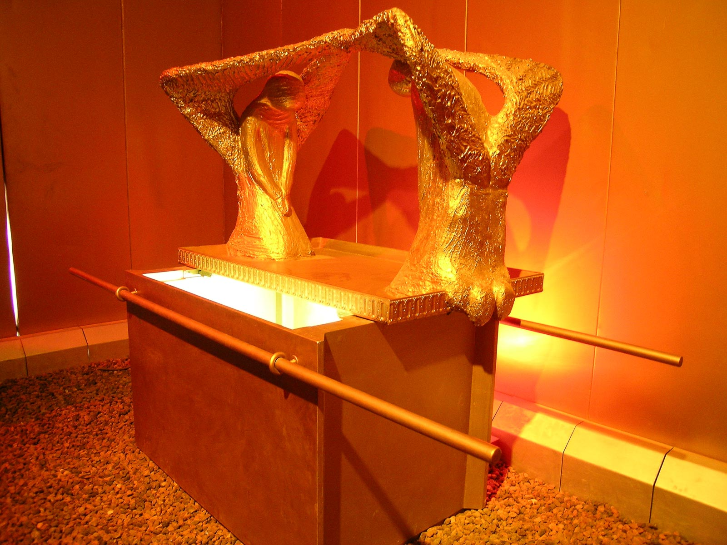
They brought the ark of the covenant of Yahweh of hosts, who sits above the cherubim
Model of the ark of the covenant
4:4
Notes:
This model of the ark of the covenant was photographed at Timna Park in southern Israel.
tb022804706

Slide 41
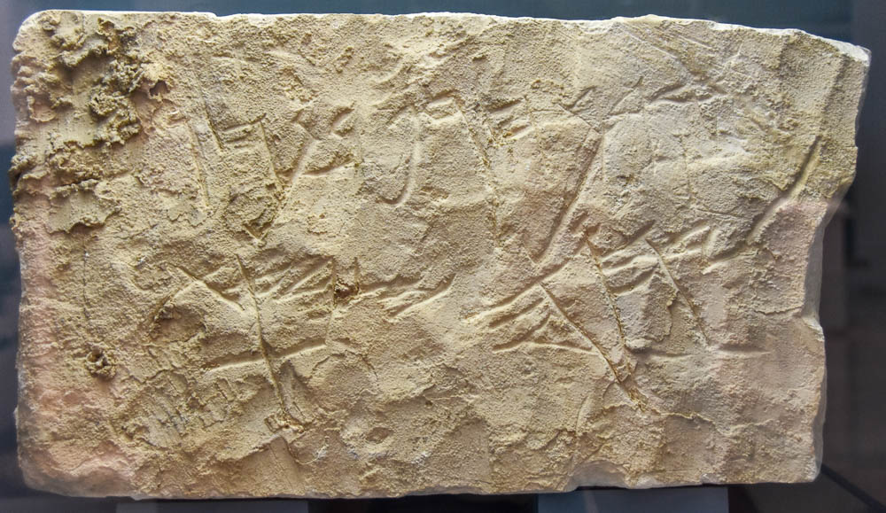
They brought the ark of the covenant of Yahweh of hosts, who sits above the cherubim
Hebrew inscription mentioning “Yahweh of Armies,” 8th century BC
4:4
Notes:
The name “Yahweh of Hosts” (Heb. Yahweh Sabaot, יהוה צְבָאוֹת) could as easily be rendered “Yahweh of Armies.” This name highlights the fact that the Israelites hoped to move their God to action and bring them victory in battle against the Philistines. The inscription shown here refers to God by that name. The full inscription on this limestone slab reads, “Cursed be Ḥagap son of Ḥagab, by Yahweh Ṣabaot” (ארר חגף בן חגב ליהוה צבאת). This inscription was photographed at the Bible Lands Museum in Jerusalem. The next slide includes labels for this name.
mjb1904257031

Slide 42
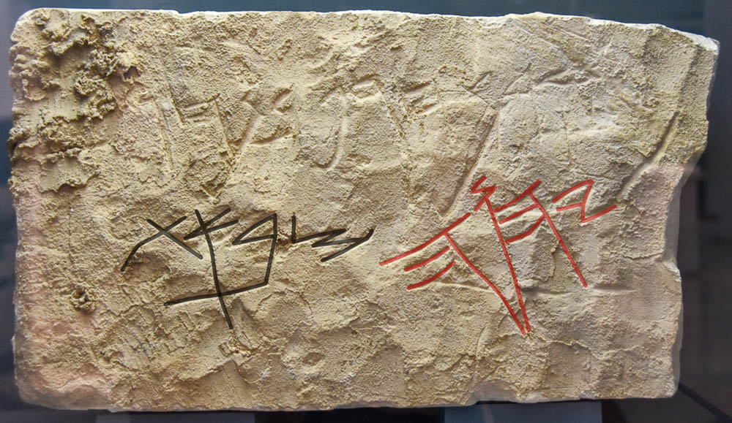
They brought the ark of the covenant of Yahweh of hosts, who sits above the cherubim
Hebrew inscription mentioning “Yahweh of Armies,” 8th century BC
4:4
Notes:
The name “Yahweh of Hosts” (Heb. Yahweh Sabaot, יהוה צְבָאוֹת) could as easily be rendered “Yahweh of Armies.” This name highlights the fact that the Israelites hoped to move their God to action and bring them victory in battle against the Philistines. The inscription shown here refers to God by that name. The full inscription on this limestone slab reads, “Cursed be Ḥagap son of Ḥagab, by Yahweh Ṣabaot” (ארר חגף בן חגב ליהוה צבאת). This inscription was photographed at the Bible Lands Museum in Jerusalem. The word “Yahweh” is highlighted in red, and “Sabaoth” (hosts, or armies, צְבָאוֹת) is highlighted in black. An editable version is included behind this graphic for those who may wish to change it.
mjb1904257031

Slide 43
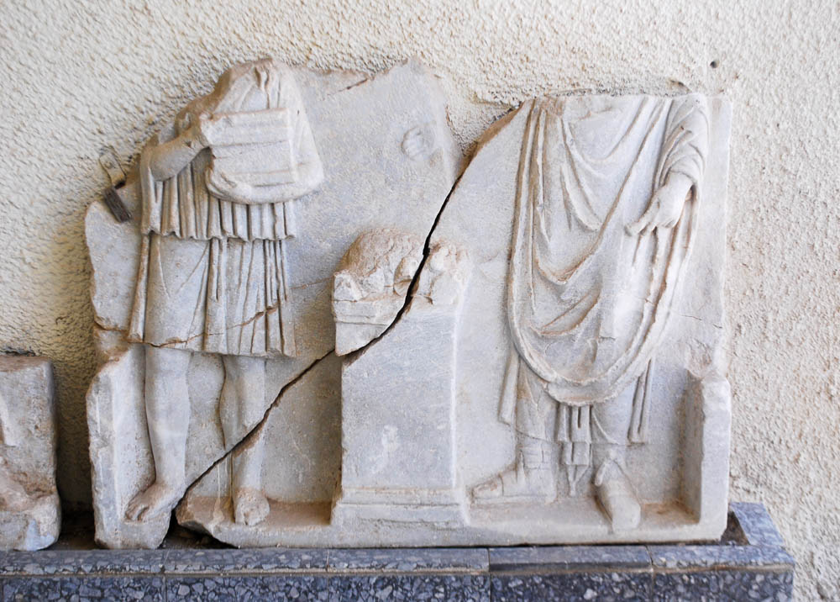
And the two sons of Eli, Hophni and Phinehas, were there with the ark of the covenant of God
Two priests with offerings, from Caesarea, Roman period
4:4
Notes:
Despite their misbehavior as priests (1 Sam 2:12-17), Hophni and Phinehas were the two leading religious figures at this time. This marble relief was photographed at the Caesarea Maritima Museum.
cm1706250717

Slide 44
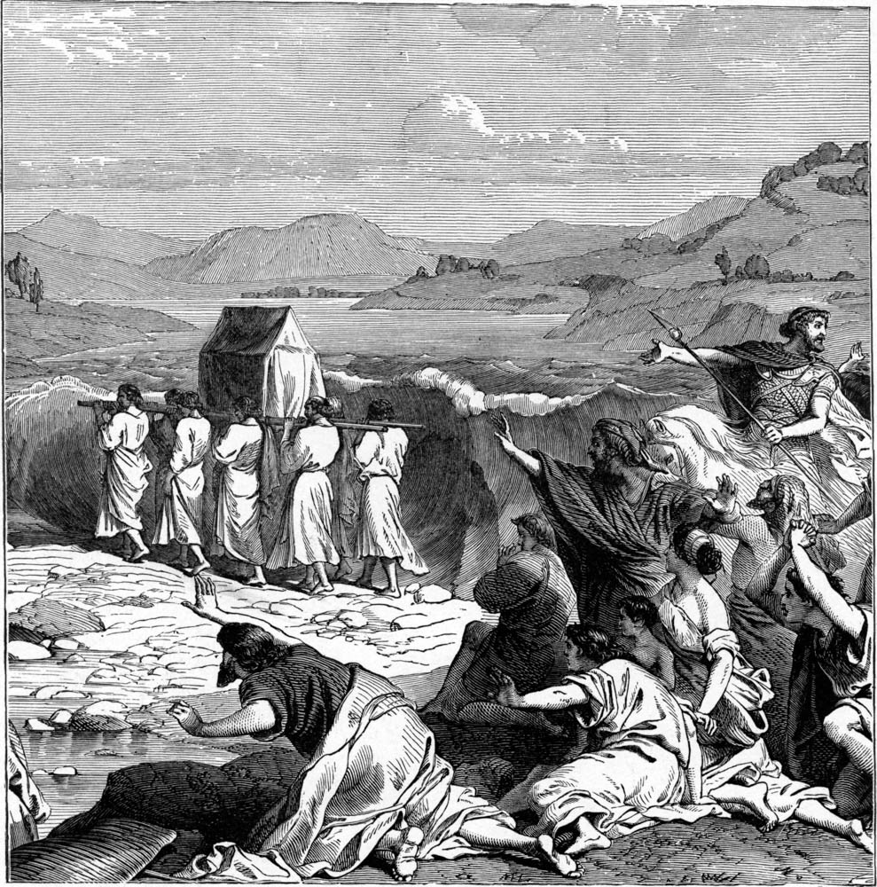
And the two sons of Eli, Hophni and Phinehas, were there with the ark of the covenant of God
Illustration of the Israelites crossing the Jordan River
4:4
Notes:
Presumably the priests carried the ark of the covenant to Ebenezer on their shoulders, as depicted in this drawing of the crossing of the Jordan River in the days of Joshua (cf. Josh 3). This illustration comes from Charles Foster, Bible Pictures and What They Teach Us (1886, 1914).
fbp086

Slide 45
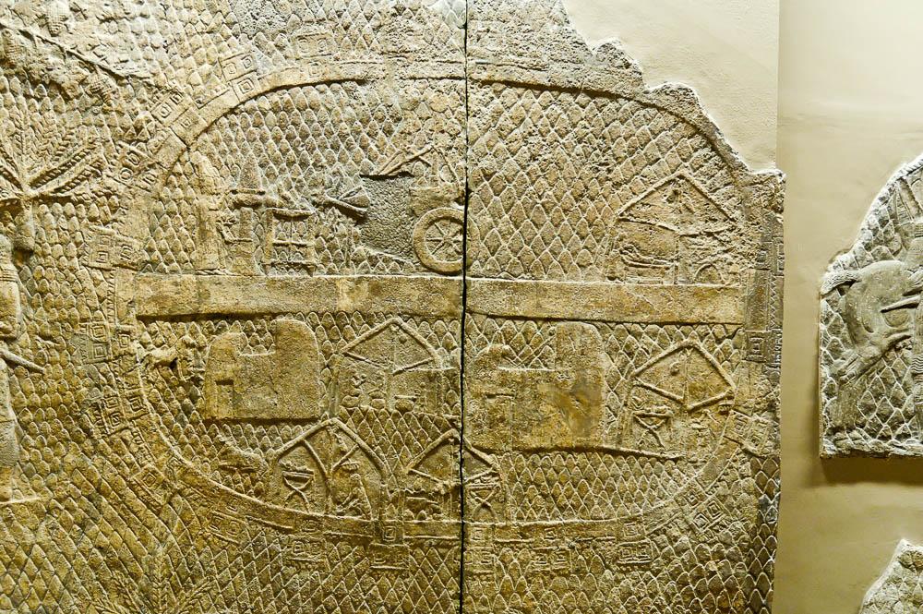
When the ark of the covenant of Yahweh came into the camp, all Israel shouted with a shout
Depiction of a siege camp, from the Lachish reliefs, 7th century BC
4:5
Notes:
Assuming that the Israelite army was fairly large, it would have been located somewhere outside of the small village of Ebenezer (Izbet Sartah). Sometimes army camps were fortified, like the one shown in this photo, particularly when a protracted battle or siege was expected. This depiction of a military camp comes from the Lachish Reliefs in the palace of Sennacherib at Nineveh. Sennacherib’s relief depicts two priests offering incense as well as other cultic related objects (upper left quadrant). This relief was photographed at the British Museum.
tb112004338

Slide 46
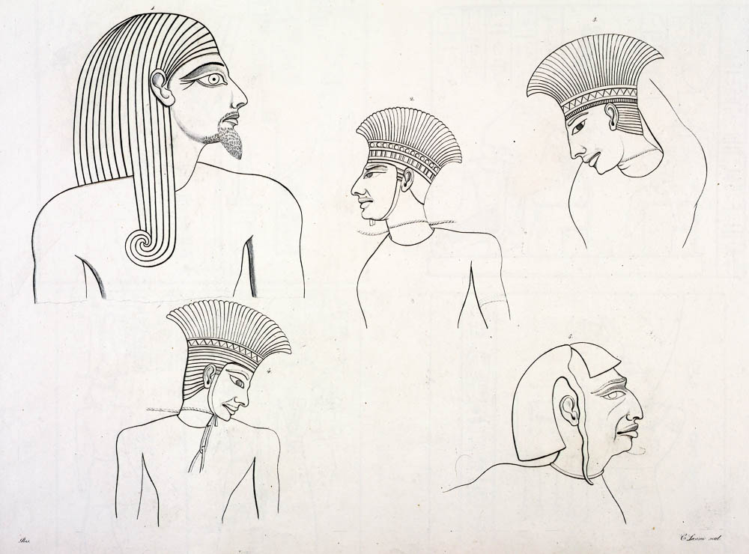
When the Philistines heard the shout, they said, “What does the noise mean?”
Sketched relief depictions of bound Sea Peoples
4:6
Notes:
This illustration comes from Carlo Lasinio and Giuseppe Angelelli, I Monumenti dell'Egitto, published in 1832–44. Public domain, from The New York Public Library, http://digitalcollections.nypl.org/items/510d47d9-47e5-a3d9-e040-e00a18064a99
nypl425597

Slide 47
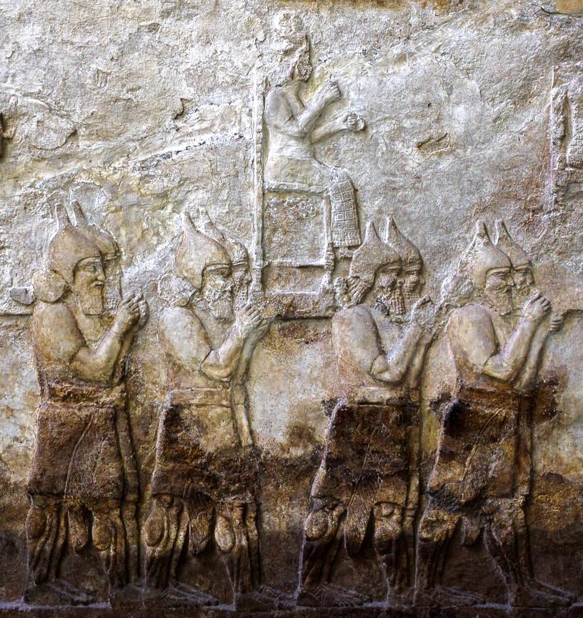
Then the Philistines were afraid, saying, “God has come into the camp”
Assyrian soldiers carrying the god of a defeated enemy, from Nimrud, 8th century BC
4:7
Notes:
Like the surrounding nations, the Philistines likely envisioned the Israelite God as a personified deity, one who took on human form like the god shown in this photo. This relief was discovered in the ruins of the palace of Tiglath-pileser III at Nimrud; it was photographed at the British Museum.
adr1805171968

Slide 48
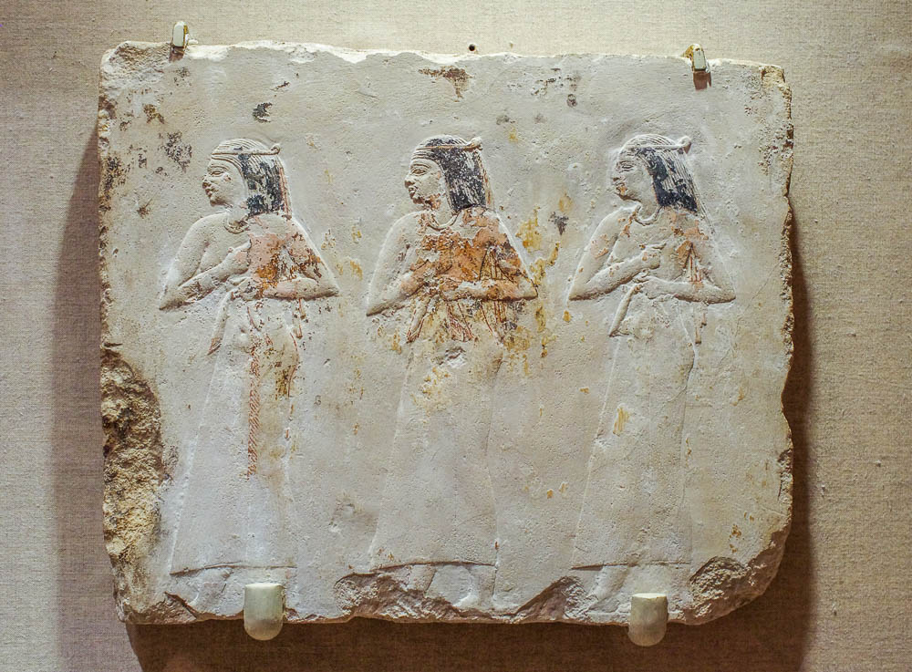
Woe to us! Who will deliver us from the hand of these mighty gods?
Relief of mourning women beating their breasts, from Egypt, 4th century BC
4:8
Notes:
The Philistines appear to have been truly afraid of the Israelite God, considering themselves at a severe disadvantage. Their cry of “Woe to us!” is a cry of desperation, almost of grief. This limestone relief of Egyptian women in mourning was photographed at the Brooklyn Museum in New York City.
adr1606021598

Slide 49
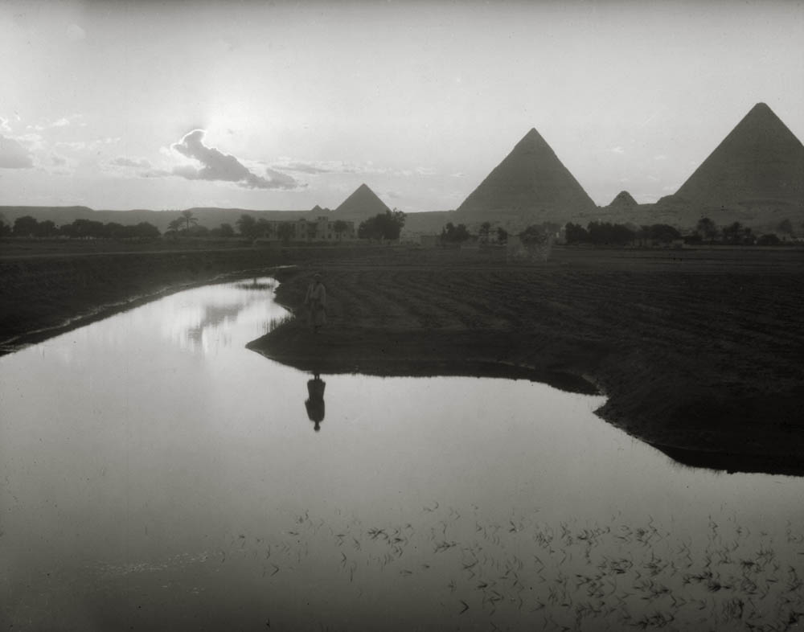
These are the gods that struck the Egyptians with all manner of plagues in the wilderness
Nile overflow near the pyramids at Giza
4:8
Notes:
This American Colony photograph was taken in 1936.
mat00274

Slide 50
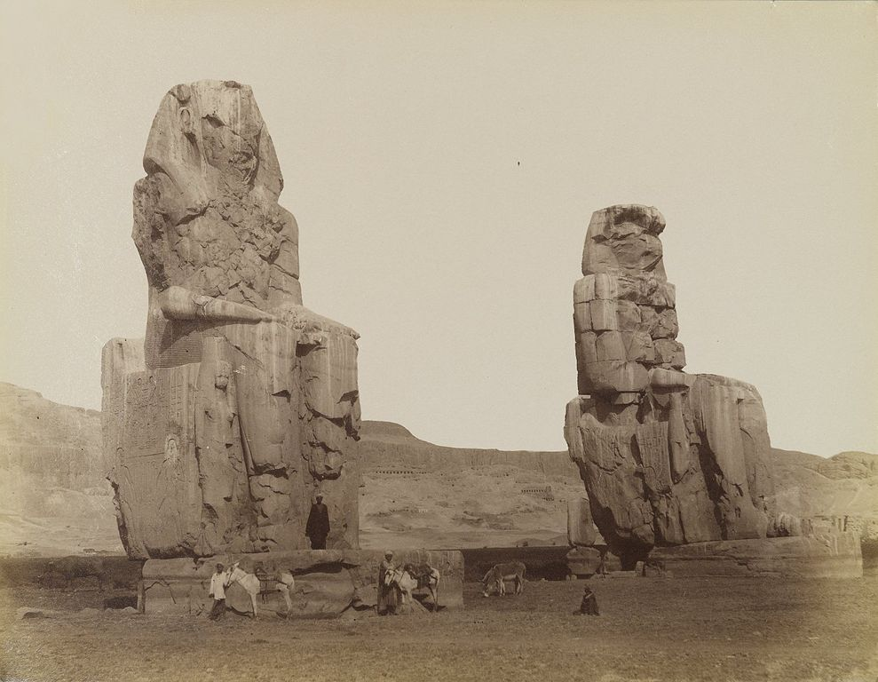
These are the gods that struck the Egyptians with all manner of plagues in the wilderness
The Colossi of Memnon, 14th century BC
4:8
Notes:
The Colossi of Memnon are one of the iconic remains of ancient Egypt. They were constructed during the reign of Amenhotep III to guard his mortuary temple at Thebes. This photo was taken in the 19th century by Antonio Beato. It is part of the collection of the Brooklyn Museum. This image comes from Antonio Beato and is in the public domain, via Wikimedia Commons: https://commons.wikimedia.org/wiki/File:Antonio_Beato,_Colosses_de_Memnon,_19th_century.jpg.
wiki062620140813561536

Slide 51
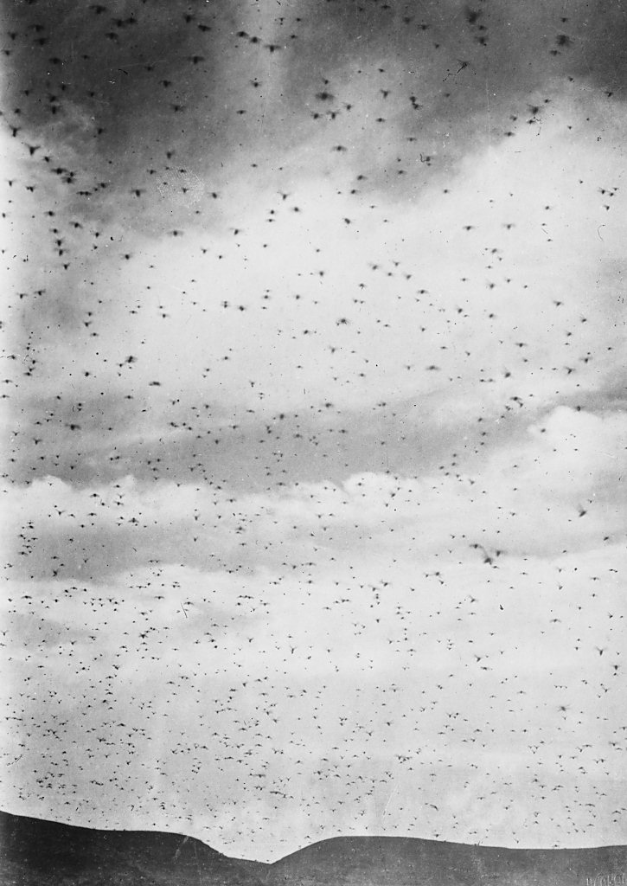
These are the gods that struck the Egyptians with all manner of plagues in the wilderness
Cloud of locusts from the locust plague of 1915
4:8
Notes:
It is noteworthy that the Philistines were aware of the mighty acts of Yahweh in bringing his people out of Egypt more than three centuries earlier. In this statement they seem to get some of the facts confused (the plagues took place in Egypt, not in the wilderness), but are duly impressed with the power of the God of Israel. The plague of locusts was just one of the plagues in Egypt (Exod 10:1-20). An interesting description of the locust swarms of 1915 was given by John Whiting: “Attention was drawn to them by sudden darkening of the bright sunshine, and then by a veritable shower of their excretions, which fell thick and fast and resembled those of mice, especially noticeable on the white macadam roads. At times their elevation was in the hundreds of feet; at other times they came down quite low, detached members alighting. The clouds of them would be so dense as to appear quite black with the edges vignettes till they thinned down and faded away into the clear blue sky around” (Whiting 1915: 513).
“They can migrate enormous distances between breedings; recorded instances of swarms travelling 1000–3000 miles are common. Wind tunnel tests have shown that a locust can fly continuously for 17 hours. . . . Locusts in general fly at about 10 or 12 miles per hour and tend to move down-wind. They can rise to heights of several hundred meters on up-currents of air in hot conditions” (Harris 1979).
This American Colony photograph was taken in 1915.
References:
Harris, Tony.
1979 The Desert Locust. Bulletin of the Abu Dhabi Natural History Group. http://www.enhg.org/bulletin/b07/07_09.htm (15 Aug. 2007).
Whiting, John.
1915 Jerusalem’s Locust Plague. National Geographic 28: 511–50.
mat01889

Slide 52
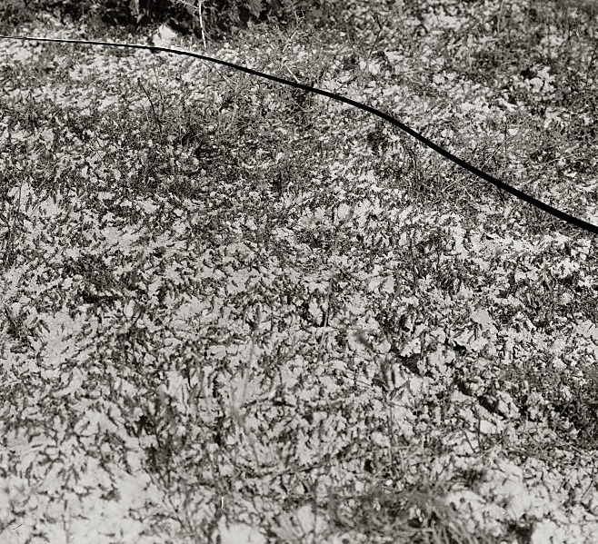
These are the gods that struck the Egyptians with all manner of plagues in the wilderness
Locusts foraging during the locust plague of 1915
4:8
Notes:
“Predictions were rampant as to the terrible results which would accrue, but now we can see that not even the worst pictured the actual ravages as severe as we now see them” (Whiting 1915: 513). This American Colony photograph was taken in 1915.
Reference:
Whiting, John.
1915 Jerusalem's Locust Plague. National Geographic 28: 511–50.
mat00136

Slide 53
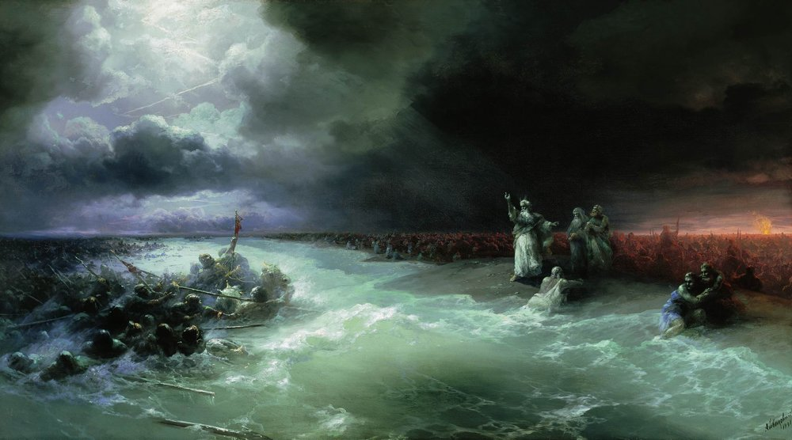
These are the gods that struck the Egyptians with all manner of plagues in the wilderness
Passage of the Jews Through the Red Sea, by Ivan Aivazovsky, 1891
4:8
Notes:
Although it is not specifically mentioned in this verse, the most significant and relevant episode in the Exodus was the destruction of Pharaoh’s army in the Red Sea. This event is depicted here in oil on canvas. Knowledge of such an event would have certainly struck fear in the hearts of the Philistines. This painting is in a private collection. This image comes from Ivan Aivazovsky and is in the public domain, via Wikimedia Commons: https://commons.wikimedia.org/wiki/File:Aivazovsky_Passage_of_the_Jews_through_the_Red_Sea.jpg.
wiki0730201301281891

Slide 54
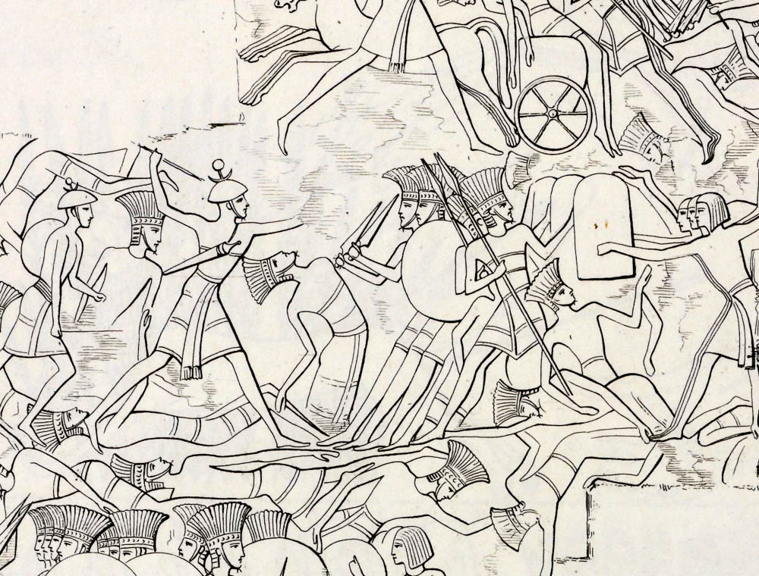
Be strong, and act like men, O you Philistines, that you may not be servants to the Hebrews
Relief of the Sea Peoples’ land battle on the north wall at Medinet Habu (sketch)
4:9
Notes:
This illustration comes from Carlo Lasinio and Giuseppe Angelelli, I Monumenti dell'Egitto, published in 1832–44. Public domain, from The New York Public Library, http://digitalcollections.nypl.org/items/510d47d9-47fc-a3d9-e040-e00a18064a99
nypl425620

Slide 55
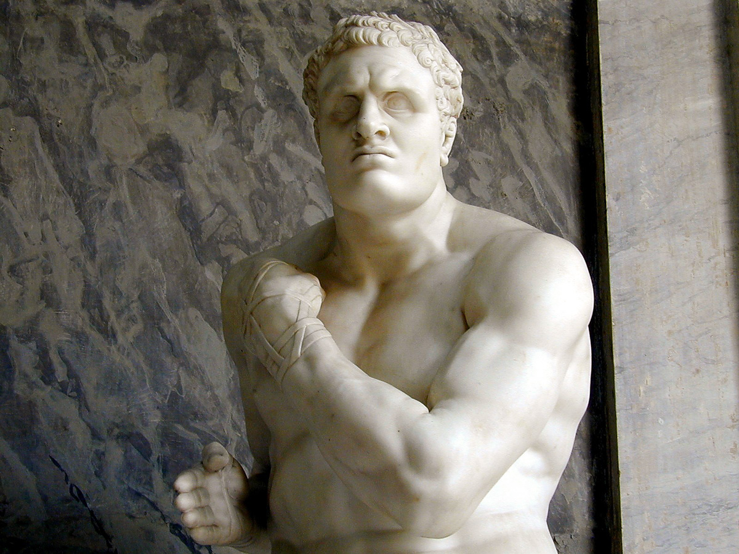
Be strong, and act like men, O you Philistines, that you may not be servants to the Hebrews
Statue of the Greek boxer Damoxenes with a wrapped hand
4:9
Notes:
Depictions of actual Philistine warriors from the Iron Age I are rare, and they are usually executed by their enemies and not themselves. This depiction of a Greek wrestler conveys the sense of determination and resolve that the Philistines seem to have ginned up for themselves in the face of the Israelites’ new tactic. Inspired by classical art, the Italian artist Antonio Canova created this piece in 1801, and it was purchased by Pope Pius VII to replace statuary stolen from the Vatican by Napoleon. It was photographed at the Vatican Museums. Additional information on this statue can be found at http://www.patronsvaticanmuseums.org/en/projects/classical-pugilists-creugas-and-damoxenos/.
tb011801013

Slide 56

And the Philistines fought, and Israel was defeated and they fled
Relief of the Sea Peoples’ land battle on the north wall at Medinet Habu (sketch)
4:10
Notes:
This illustration comes from Carlo Lasinio and Giuseppe Angelelli, I Monumenti dell'Egitto, published in 1832–44. Public domain, from The New York Public Library, http://digitalcollections.nypl.org/items/510d47d9-47fc-a3d9-e040-e00a18064a99
nypl425620

Slide 57

And the Philistines fought, and Israel was defeated and they fled, every man to his tent
Bedouin tents near Beersheba
4:10
Notes:
This verse seems to indicate that there was still a part (majority?) of the Israelite population that lived in tents. This may explain some of the paucity of evidence for a widespread Israelite presence in the centuries leading up to kingship.
db6904196706

Slide 58

And there was a very great slaughter, for there fell of Israel 30,000 foot soldiers
Relief of an Assyrian battle with men and horses being driven into a river
4:10
Notes:
This illustration comes from Sir Austen Henry Layard, Second Series of the Monuments of Nineveh, published in 1853. Public domain, from The New York Public Library, http://digitalcollections.nypl.org/items/510d47dc-474f-a3d9-e040-e00a18064a99
nypl494765

Slide 59

And the ark of God was taken
The Battle of Ebenezer, by Gerrit Claesz Bleker, 1640
4:11
Notes:
Assuming that the ark was being carried by the priests, Hophni and Phinehas, the capture of the ark would almost certainly entail their deaths. This image comes from The Yorck Project and is in the public domain, via Wikimedia Commons: https://commons.wikimedia.org/wiki/File:Gerrit_Claesz._Bleker_001.jpg.
wiki0519200503241329

Slide 60

And the ark of God was taken, and the two sons of Eli, Hophni and Phinehas, were killed
Asiatic soldiers trampled by royal chariot, from el-Asasif, 15th century BC
4:11
Notes:
This Egyptian painted relief shows Asiatic soldiers who are being struck down by the forces of the Egyptian king. This image comes from The Metropolitan Museum of Art and is in the public domain. Source: https://www.metmuseum.org/art/collection/search/544720
met544720

Slide 61

A man of Benjamin ran from the battle line
“Benjamin Street” sign in Jerusalem
4:12
Notes:
“Benjamin Street” is located in the Baka neighborhood, south of the Old City. This sign identifies the street in Hebrew, Arabic, and English.
lbd102218465

Slide 62

A man of Benjamin ran from the battle line
Medeba map, with Jerusalem and the region of Benjamin, 6th century AD
4:12
Notes:
The tribe of Benjamin was located south of Ephraim (the tribe within which both Ebenezer and Shiloh were located). In this mosaic map, which is oriented toward the east, it can be seen just to the left (north) of the central feature, which is the city of Jerusalem. The labels on this mosaic are written in Greek. The Medeba Map is the earliest known map of the Holy Land, and it depicts the sites as they were known circa AD 580. It is located in a church building in the city of Medeba in Jordan. The next slide includes labels.
tb031315496

Slide 63
A man of Benjamin ran from the battle line
Tribe of Benjamin
Medeba map, with Jerusalem and the region of Benjamin, 6th century AD
4:12
Notes:
The tribe of Benjamin was located south of Ephraim (the tribe within which both Ebenezer and Shiloh were located). In this mosaic map, which is oriented toward the east, it can be seen just to the left (north) of the central feature, which is the city of Jerusalem. The labels on this mosaic are written in Greek. The Medeba Map is the earliest known map of the Holy Land, and it depicts the sites as they were known circa AD 580. It is located in a church building in the city of Medeba in Jordan.
tb031315496

Slide 64

A man of Benjamin ran from the battle line and came to Shiloh the same day
Shiloh (from the west)
4:12
Notes:
This would have been the messenger’s view as he approached Shiloh. The distance from the battlefield at Aphek to Shiloh was about 20 miles (32 km), and much of it would have been uphill. To run this distance in a day, following whatever time it would have taken for the outcome of the battle to become clear, would have been a significant feat. In this view of Shiloh, taken from the ridge to the west, Tel Shiloh blends into the taller hill behind it. The next slide includes a label identifying Shiloh.
tb120806860

Slide 65
A man of Benjamin ran from the battle line and came to Shiloh the same day
possible area of the tabernacle
Shiloh
Shiloh (from the west)
4:12
Notes:
This would have been the messenger’s view as he approached Shiloh. The distance from the battlefield at Aphek to Shiloh was about 20 miles (32 km), and much of it would have been uphill. To run this distance in a day, following whatever time it would have taken for the outcome of the battle to become clear, would have been a significant feat. In this view of Shiloh, taken from the ridge to the west, Tel Shiloh blends into the taller hill behind it.
tb120806860

Slide 66

A man of Benjamin ran from the battle line and came to Shiloh the same day
Shiloh (aerial view from the south)
4:12
Notes:
Some scholars believe that the most likely location for the tabernacle was on the bench located at the northern end of Tel Shiloh. This makes sense given the details in the next verse, where the messenger first informs the city and then tells Eli. This indicates that the messenger entered the city from the south and then continued to the northern end to the tabernacle. The next slide includes labels.
ws030515634

Slide 67
A man of Benjamin ran from the battle line and came to Shiloh the same day
possible area of the tabernacle
to Ebenezer
Tel Shiloh
Shiloh (aerial view from the south)
4:12
Notes:
Some scholars believe that the most likely location for the tabernacle was on the bench located at the northern end of Tel Shiloh. This makes sense given the details in the next verse, where the messenger first informs the city and then tells Eli. This indicates that the messenger entered the city from the south and then continued to the northern end to the tabernacle.
ws030515634

Slide 68

With his clothes rent, and dirt on his head
Statue of an anguished man rending his garment
4:12
Notes:
Torn clothing and dust or ashes on the head were classic signs of mourning (e.g., Josh 7:6, 2 Sam 1:2). This sculpture was photographed at the Yad HaShmonah Biblical Gardens in the Judean hills.
tb052816718

Slide 69

Eli was sitting on his seat by the road, watching; for his heart trembled for the ark of God
Ruins of Shiloh (from the north)
4:13
Notes:
Eli himself was fearful of what had happened. He probably knew that God had declared that His people would suffer defeat if they turned away from his commands (Deut 28:25-26). This view of the northern end of Shiloh takes in the approximate area where Eli must have waited, assuming that the tabernacle was situated in this vicinity.
tb051808075

Slide 70

Eli was sitting on his seat by the road, watching; for his heart trembled for the ark of God
Stone seat from Poros, Heraklion, 16th century BC
4:13
Notes:
Eli’s seat may have been a permanent sort of seat like this stone stool from Heraklion. This example predates the time of Eli by a few centuries. It was photographed at the Heraklion Museum on the island of Crete.
tb041504225

Slide 71

Eli was sitting on his seat by the road, watching; for his heart trembled for the ark of God
Tutankhamun stool, wood painted white, from King Tutankhamun’s tomb, 14th century BC
4:13
Notes:
It is also possible that Eli used a lighter-weight seat like this stool of Tutankhamun. This ornate example was photographed at the Egyptian Museum in Cairo.
adr1603194845

Slide 72

Then the man came to tell it in the city, and all the city cried out
Shiloh (aerial view from the northeast)
4:13
Notes:
With valleys surrounding Shiloh on three sides, the entrance to the city was on the south. The messenger likely entered this way and informed the people. Eli was sitting near the tabernacle, at the far end of the city, and when he heard the outcry, he feared its significance. The messenger then continued north through Shiloh to inform Eli of the bad news. The next slide includes labels.
ws042016046

Slide 73
Then the man came to tell it in the city, and all the city cried out
Tel Shiloh
possible area of the tabernacle
Shiloh (aerial view from the northeast)
4:13
Notes:
With valleys surrounding Shiloh on three sides, the entrance to the city was on the south. The messenger likely entered this way and informed the people. Eli was sitting near the tabernacle, at the far end of the city, and when he heard the outcry, he feared its significance. The messenger then continued north through Shiloh to inform Eli of the bad news.
ws042016046

Slide 74

Then the man came to tell it in the city, and all the city cried out
Crowd gathered in the Old City of Jerusalem, Good Friday, 1942
4:13
Notes:
The inhabitants of the city of Shiloh would have quickly gathered to hear the news from the battlefield. They had recently watched as the ark was taken from Shiloh, and they would have been anxious to hear news from the front lines. This American Colony photograph was taken April 3, 1942.
mat21206

Slide 75

Then the man came hurriedly and told Eli
Old man at the Western Wall in Jerusalem, circa 1935
4:14
Notes:
The messenger would have known that Eli should be informed as well. This American Colony photo was taken between 1934 and 1939.
mat16534

Slide 76

Now Eli was ninety-eight years old; and his eyes were set, so that he could not see
Jewish men in Jerusalem
4:15
Notes:
This photochrom image was taken in the 1890s.
pcm02756

Slide 77


And the man said, “I am the one who came from the battle line; I escaped from it today”
Greek statuette of a runner, circa 100 BC
4:16
Notes:
No detail is given as to how this man escaped, but this bronze figurine of a running man illustrates the idea of escaping from a disastrous defeat. This image comes from The Metropolitan Museum of Art and is in the public domain. Source: https://www.metmuseum.org/art/collection/search/255406. A removable box has been added to avoid causing surprise or offense.
met255406

Slide 78

Israel has fled from before the Philistines . . . and Hophni and Phinehas are dead
Small Pergamene Votive Offering, 2nd century AD
4:17
Notes:
The messenger had no good news to share. The Israelite forces had been defeated, and Eli’s two sons had been killed. One would expect that the two priests were with the ark when it was taken, and that hearing of their deaths Eli would have immediately known that the ark was doomed. The statue of a dying soldier shown here is part of a collection of such statues from Pergamon that are thought to have been part of a votive offering. Scholars consider them to be 2nd century AD copies of 2nd century BC originals. This statue was photographed at the Naples Archaeological Museum.
tb0515171472

Slide 79

And also the ark of God has been taken
Tribute bearers carrying a box on poles, from Arslan Tash, 8th century BC
4:17
Notes:
The ark of the covenant was carried on poles on the shoulders of the priests, which presumably was the way that the Philistines also carried it from the battlefield. This orthostat from the Hittite city of Arslan Tash shows two men carrying a box suspended from poles in a similar manner. This artifact was photographed at the Bible Lands Museum in Jerusalem.
adr1806251447

Slide 80

When he made mention of the ark of God
Ark of the covenant replica in the Augusta Victoria Church, Jerusalem
4:18
Notes:
This is another artist’s idea of what the ark of the covenant may have looked like. The long poles were used by the priests to carry the ark and prevent them from touching the object itself. This replica is located in the Augusta Victoria Church on the Mount of Olives.
tb060116172

Slide 81

When he made mention of the ark of God, Eli fell off his seat backward by the side of the gate
City gate of Dan with podium for ruler
4:18
Notes:
City gates were often places where city elders convened and where judges heard their cases. Given his age and frailty, it is difficult to imagine that Eli travelled far from the tabernacle. Perhaps this reference to a gate, beside the road (1 Sam 4:13), is another indicator of a more permanent structure for the tabernacle and its precinct at Shiloh (cf. 1 Sam 1:7; 1:9; 3:14). The small platform in this photo, situated next to the entrance to the city at Dan, is thought by some to have been a seat where a judge or ruler once sat. This may be analogous to Eli’s seat at Shiloh.
tb052907098

Slide 82

And his neck broke, and he died, for he was an old man, and heavy
Samaritan elder before the Passover service
4:18
Notes:
Given Eli’s age, ninety-eight, it is probably more surprising that he had not died already. As it was, he lived to see the curse of God begin to unfold within his family, a curse that was due at least in part to his own unwillingness to discipline his sons (1 Sam 2:27-36). It may also be noted that God had previously accused Eli of making himself “fat” (Heb. barah, בָּרָא) by taking the choicest of the sacrifices (1 Sam 2:29), a description repeated here by the narrator.
tb043007027

Slide 83

And his neck broke, and he died, for he was an old man, and heavy
Illustration of Eli falling over dead
4:18
Notes:
There may be a play on words in this phrase. Eli was heavy (Heb. kabed, כָבֵד), and when his grandson was born he was named Ichabod (Heb. I-kabod, אִי־כָבוֹד), because the glory (Heb. kabod, כָבוֹד) of Yahweh had departed (cf. 1 Sam 4:18-22). In this drawing, the artist has shown not only the death of Eli before the messenger, but also the birth of Ichabod (note the women behind the messenger). The artist has also portrayed the people of the city in a state of grief or panic. This illustration comes from Charles Foster, Bible Pictures and What They Teach Us (1886, 1914).
fbp101

Slide 84

And his daughter-in-law, Phinehas’s wife, was with child, near delivery
Pregnant Phoenician female figurine, 6th–5th centuries BC
4:19
Notes:
This figurine shows a seated pregnant woman with her hand over her belly. This figurine was photographed in the Hecht Museum at the University of Haifa.
cm1706260766

Slide 85

And his daughter-in-law, Phinehas’s wife, was with child, near delivery
Relief of an Egyptian woman giving birth with the aid of midwives, Ptolemaic period, 305–30 BC
4:19
Notes:
This stylized scene shows an Egyptian woman, supported from behind by a midwife, giving birth to a child who is being pulled from her by another midwife. The woman at the far right is shown breastfeeding her newborn. This illustration comes from Richard Lepsius and Ernst Weidenbach, Denkmaeler aus Aegypten und Aethiopien, published in 1849–56. Public domain, from The New York Public Library, http://digitalcollections.nypl.org/items/510d47d9-5a60-a3d9-e040-e00a18064a99
nypl44080

Slide 86

She kneeled down and gave birth, for her pains came upon her
Midwives with a woman giving birth, Persian period, 6th–5th century BC
4:19
Notes:
The stress of the combined events of her husband’s death, the death of her father-in-law, the loss of the ark of the covenant, and the possibility that the Philistines could be approaching Shiloh itself caused the woman to go into labor. This model was recovered from the sea off the Phoenician coast, which explains some of the encrustation. This artifact was photographed in the Hecht Museum at the University of Haifa.
adr1805228347

Slide 87

The women who stood by her said, “Do not be afraid, for you have given birth to a son”
Statue of a woman breastfeeding a baby, from Quirinal, 1st century AD
4:20
Notes:
This statue was photographed at the Vatican Museums.
tb0512176801

Slide 88

And she called the boy Ichabod, saying, “The glory has departed from Israel”
A beggar in Jerusalem, circa 1964
4:21
Notes:
The verse goes on to state that she was mourning the loss of the ark, the death of her father-in-law Eli, and the death of her husband Phinehas. This also marked the start of the curse against the house of Eli, which would lead to them begging (1 Sam 2:36). This image comes from Willem van de Poll and is in the public domain, via Wikimedia Commons: https://commons.wikimedia.org/wiki/File:Bedelares_zit_tegen_de_muur_in_de_looproute_van_bezoekers_naar_de_markt,_Bestanddeelnr_255-2277.jpg.
wiki010119642552277

Slide 89

She said, “The glory had departed from Israel, for the ark of God was taken”
Model of the ark of the covenant
4:22
Notes:
The daughter-in-law of Eli recognized that the real loss for the nation was the loss of the ark of God.
tb022804707

Slide 90

She said, “The glory had departed from Israel, for the ark of God was taken”
Burning village in the Shephelah of Judah
4:22
Notes:
The defeat of Israel would have allowed the Philistines access into the central hill country, including the region around Shiloh. Although it is never mentioned in any historical narrative, Jeremiah records that Shiloh was indeed destroyed about this time (Jer 7:12; cf. Ps 78:60-61). It should also be observed that neither the ark nor tabernacle is ever mentioned again in connection with Shiloh. In fact the ark, when returned by the Philistines seven months after its capture, settled at Kiriath-jearim rather than at Shiloh. This would be easily explained if Shiloh had been destroyed. If this is correct, it does seem that the tabernacle was hurriedly taken down and spirited away, as it eventually found its way to the high place of Gibeon (1 Chr 21:29) and later to the storerooms of the temple built by Solomon (1 Kings 8:4). The smoke in this American Colony photo comes from the village of Artuf, burned during the 1929 riots, illustrating the likely fate of Shiloh. Artuf was located north of Beth-shemesh.
mat03043

Slide 91

More than 3,000 slides in PowerPoint format. Available now from BiblePlaces.com.
Notes:
This is a free sample of the 1 Samuel 4 presentation from the Photo Companion to the Bible. To purchase the full volume, visit https://www.bibleplaces.com/1samuel/
The Photo Companion to the Bible is an image-rich resource for Bible students, teachers, and researchers. Just as a librarian stocks the shelves with as many relevant materials as possible, so we have tried to provide a broad selection of images. Our goal is that you will find in this “library” whatever it is you are looking for.
Credits: The primary creators of this presentation are Chris McKinny, Steven Anderson, Kris Udd, and Todd Bolen. The photographs have an individual file code which usually includes the initials of the photographer. Other images have additional credit or source information.
Updates: We plan to update this collection as we are able. We welcome your suggestions for improving this resource (photocompanion@bibleplaces.com). Purchasers of the 1 Samuel volume are provided free, lifetime updates to the collection.
Copyright: This photo collection is protected by copyright law and may not be distributed without written permission from BiblePlaces.com. Slide notes should be treated as any other copyrighted written material, with credit given when quoting from these notes.
For more information, see our complete “Introduction to the Photo Companion to the Bible” online at http://www.BiblePlaces.com/Intro-Photo-Companion-Bible/. Here you will find more information about photo selection, explanatory notes, Bible translation, credit information, and copyright allowances.

