Slide 1
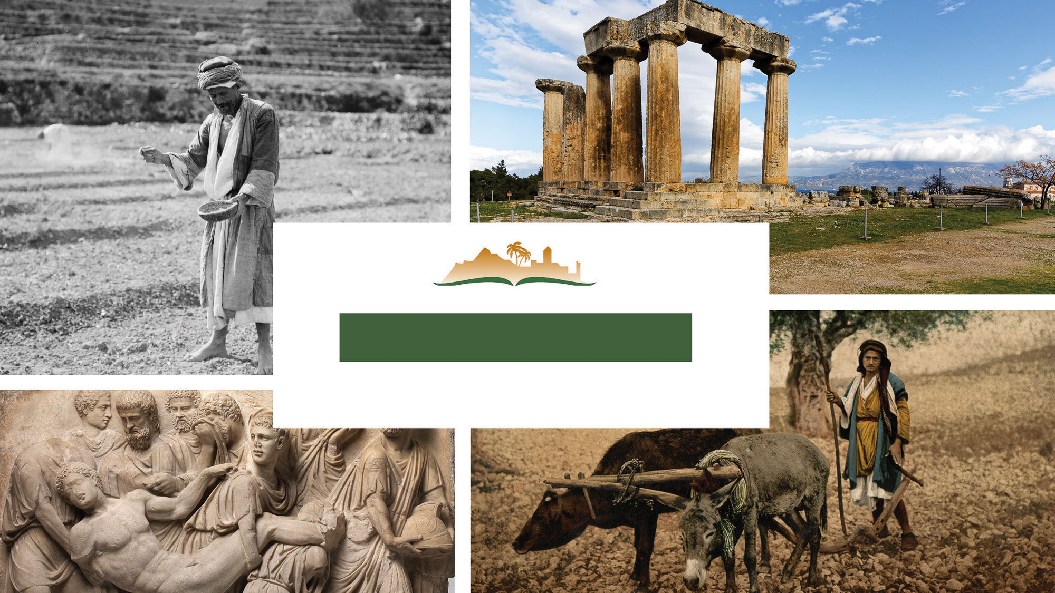
2 Corinthians 4
Notes:
This is a free sample of the 2 Corinthians 4 presentation from the Photo Companion to the Bible. To purchase the full volume, visit https://www.bibleplaces.com/2corinthians/
The Photo Companion to the Bible is an image-rich resource for Bible students, teachers, and researchers. Just as a librarian stocks the shelves with as many relevant materials as possible, so we have tried to provide a broad selection of images. Our goal is that you will find in this “library” whatever it is you are looking for.
Credits: The primary creators of this presentation are Dr. Kris Udd, Dr. Christian Locatell, Dr. Steven D. Anderson, and Dr. Todd Bolen. The photographs have an individual file code which usually includes the initials of the photographer. Other images have additional credit or source information.
Updates: We plan to update this collection as we are able. We welcome your suggestions for improving this resource (photocompanion@bibleplaces.com). Purchasers of the 2 Corinthians volume are provided free, lifetime updates to the volume.
Copyright: This photo collection is protected by copyright law and may not be distributed without written permission from BiblePlaces.com. Slide notes should be treated as any other copyrighted written material, with credit given when quoting from these notes.
For more information, see our complete “Introduction to the Photo Companion to the Bible” online at http://www.BiblePlaces.com/Intro-Photo-Companion-Bible/. Here you will find more information about photo selection, explanatory notes, Bible translation, credit information, and copyright allowances.

Slide 2
2 Corinthians 4
This is a free sample of the 2 Corinthians 4 presentation from the Photo Companion to the Bible. To purchase the full volume, visit https://www.bibleplaces.com/2corinthians/
The Photo Companion to the Bible is an image-rich resource for Bible students, teachers, and researchers. Just as a librarian stocks the shelves with as many relevant materials as possible, so we have tried to provide a broad selection of images. Our goal is that you will find in this “library” whatever it is you are looking for.
For more details (for this and every slide), see the Notes section below.
Notes:
This is a free sample of the 2 Corinthians 4 presentation from the Photo Companion to the Bible. To purchase the full volume, visit https://www.bibleplaces.com/2corinthians/
The Photo Companion to the Bible is an image-rich resource for Bible students, teachers, and researchers. Just as a librarian stocks the shelves with as many relevant materials as possible, so we have tried to provide a broad selection of images. Our goal is that you will find in this “library” whatever it is you are looking for.
Credits: The primary creators of this presentation are Dr. Kris Udd, Dr. Christian Locatell, Dr. Steven D. Anderson, and Dr. Todd Bolen. The photographs have an individual file code which usually includes the initials of the photographer. Other images have additional credit or source information.
Updates: We plan to update this collection as we are able. We welcome your suggestions for improving this resource (photocompanion@bibleplaces.com). Purchasers of the 2 Corinthians volume are provided free, lifetime updates to the volume.
Copyright: This photo collection is protected by copyright law and may not be distributed without written permission from BiblePlaces.com. Slide notes should be treated as any other copyrighted written material, with credit given when quoting from these notes.
For more information, see our complete “Introduction to the Photo Companion to the Bible” online at http://www.BiblePlaces.com/Intro-Photo-Companion-Bible/. Here you will find more information about photo selection, explanatory notes, Bible translation, credit information, and copyright allowances.

Slide 3
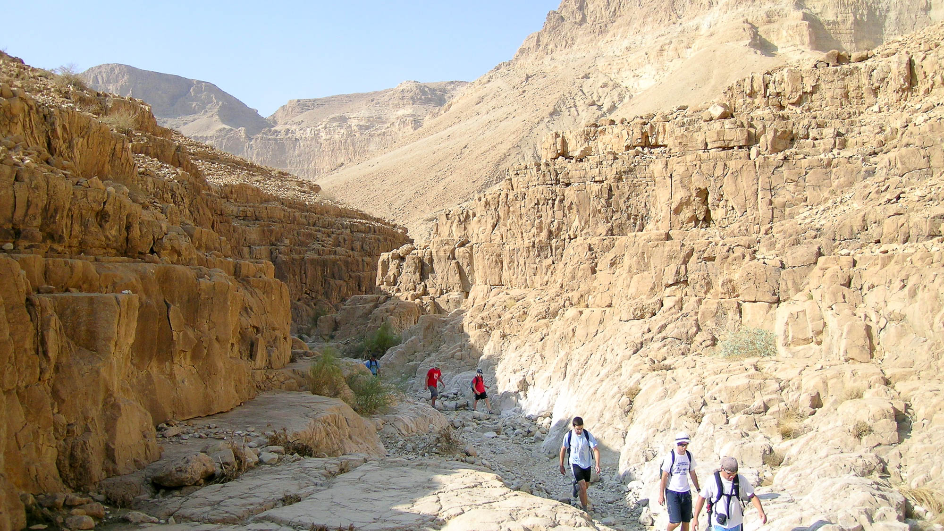
Therefore, seeing we have this ministry, even as we received mercy, we do not faint
Hikers in Nahal Mishmar in the Judean wilderness
4:1
Notes:
The verb “to faint” (Gk. ekkakeō, ἐκκακέω) means to lose heart, become weary, or become discouraged. It is illustrated here by a line of hikers working their way along the dry, hot Nahal Mishmar in the Judean desert of Israel. A hike like this takes determination and much effort to complete.
tb120703066h

Slide 4
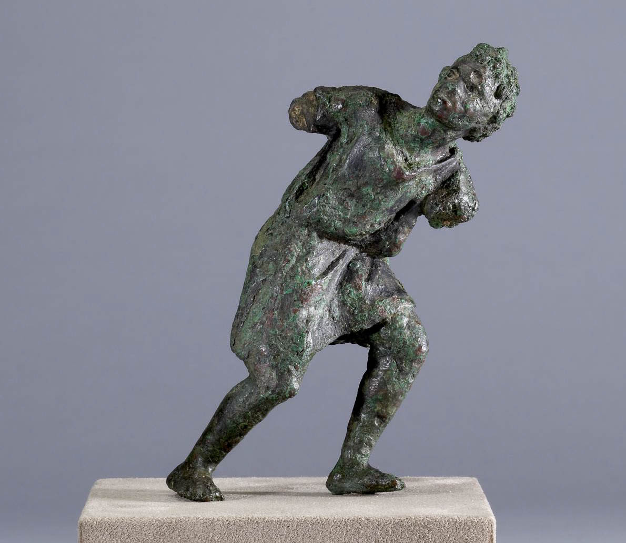
Therefore, seeing we have this ministry, even as we received mercy, we do not faint
Bronze figurine of a slave, probably pulling a cart, from Alexandria, Egypt, 2nd century BC
4:1
Notes:
This photo of a bronze figurine illustrates a figure struggling, probably against the strain of a heavily laden cart, eloquently communicated by his posture. This image comes from Walters Art Museum in Baltimore and is in the public domain, via Wikimedia Commons: https://commons.wikimedia.org/wiki/File:Egyptian_-_Slave_-_Walters_542372.jpg.
wiki0325201217051190h

Slide 5
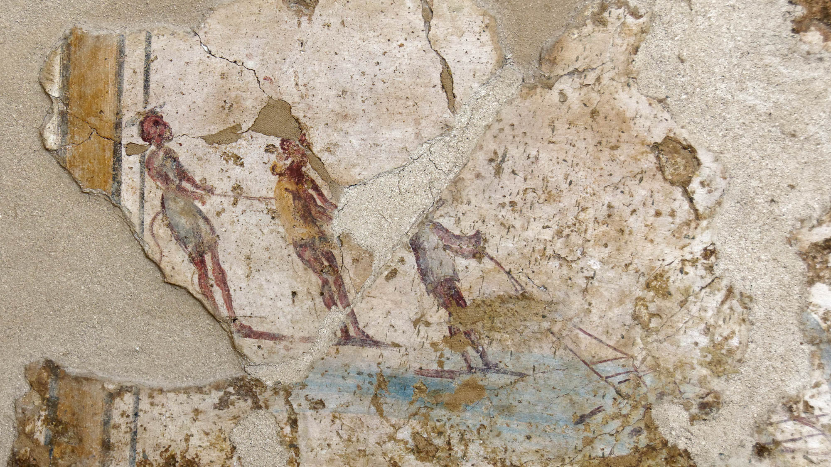
Therefore, seeing we have this ministry, even as we received mercy, we do not faint
Wall painting of fishermen, from a Roman tomb, AD 100–150
4:1
Notes:
This fresco shows men straining to pull in a heavy fishing net. Paul’s determination to press on in ministry exhibits a similar kind of resolve. This fresco was photographed at the Corinth Museum.
tb011017032h

Slide 6
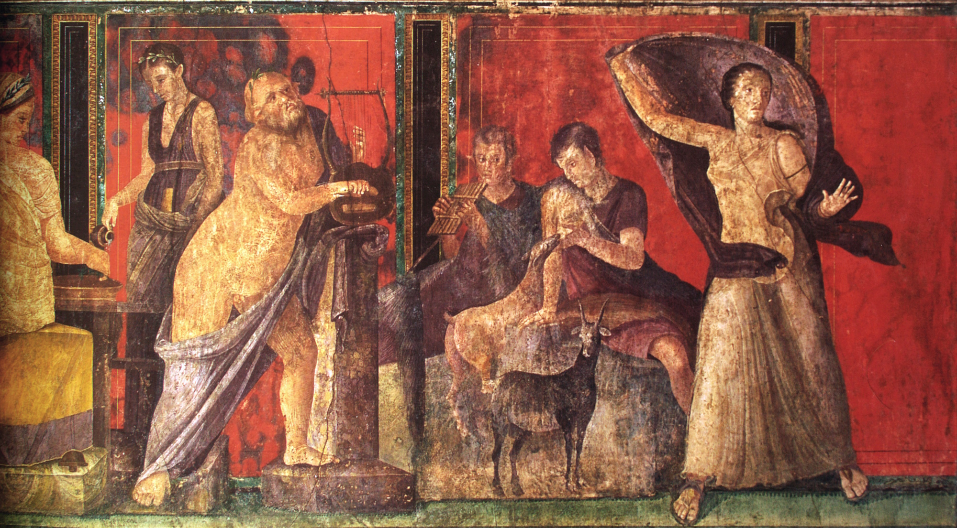
But we have renounced secret and shameful things
Fresco depicting initiation into a mystery cult, Villa of the Mysteries, Pompeii, circa 50 BC
4:2
Notes:
Paul claims that his message is not in “secret” (Gk. kruptos, κρυπτός). Mystery cults were popular in the 1st century, and the beliefs and rituals practiced by many of them are still unknown. This fresco from Pompeii is interpreted to depict stages in the initiation process of a mystery cult. It is thought that the section shown here includes the Greek god Silenus holding a lyre (left), the demi-god Pan and a nymph sitting on a rock, and a woman with coat who may be the initiate (right). By contrast, Paul claims that his message was plain and open (cf. 2 Cor 3:12). This image comes from Yann Forget and is in the public domain, via Wikimedia Commons: https://commons.wikimedia.org/wiki/File:Fresque_des_myt%C3%A8res,_Pomp%C3%A9i.jpg.
wiki1028201416091948383

Slide 7
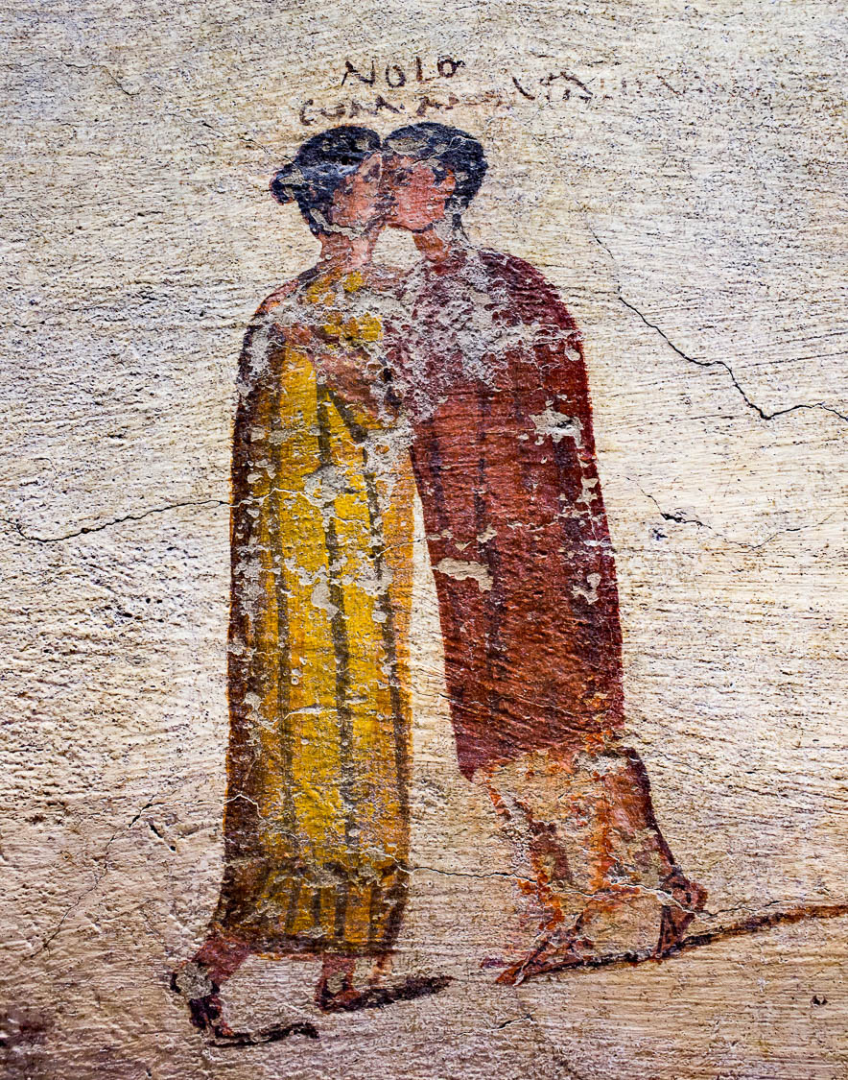
But we have renounced secret and shameful things
Fresco depicting the hetaira Myrtale and a man kissing, from Pompeii, 1st century AD
4:2
Notes:
That which is “shameful” (Gk. aischunē, αἰσχύνη) likely refers, in this context, to a lack of modesty. Although many depictions of the 1st century AD were quite explicit in depicting sexual acts, a few seem to still reflect some sense of modesty. This fresco depicts a man kissing a hetaira (a Roman upper-class prostitute) named Myrtale, but in an unusual twist both are depicted fully clothed. This fresco was photographed at the Naples Archaeological Museum. This image comes from ArchaiOptix and is licensed under CC BY-SA 4.0, via Wikimedia Commons: https://commons.wikimedia.org/wiki/File:Wall_painting_-_scenes_around_the_pub_-_Pompeii_(VI_14_35-36)_-_Napoli_MAN_111482_-_02.jpg.
wiki100620180945165472h

Slide 8
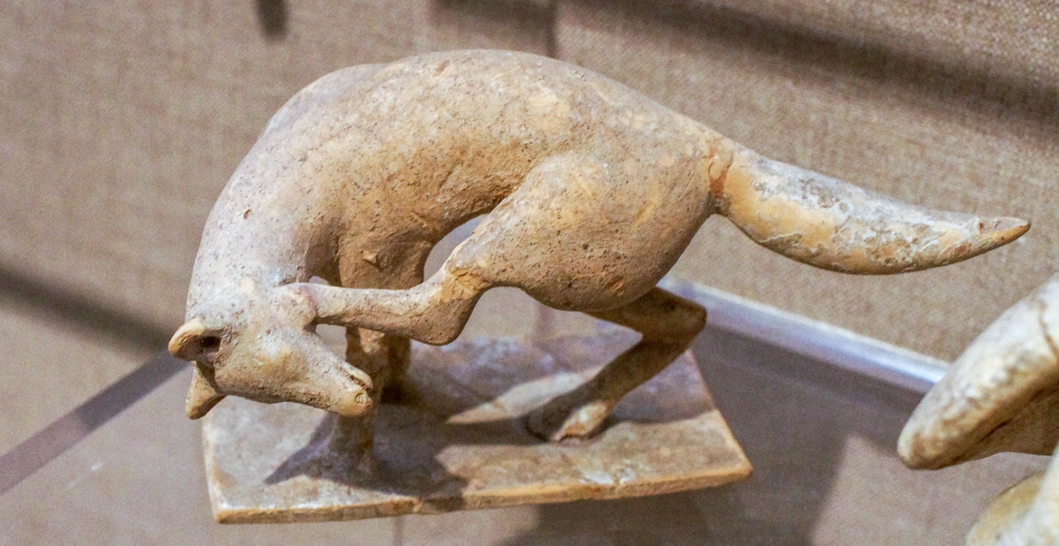
Not walking in craftiness
Figurine of a fox scratching its head, perhaps from Tanagra, Greece, circa 450 BC
4:2
Notes:
The word “craftiness” (Gk. panourgia, πανουργία) refers to trickery or cunning; it is always used in an unfavorable sense in the New Testament (cf. Luke 20:23; Eph 4:14). The fox was considered a crafty creature and referred to metaphorically in contemporary literature (cf. Luke 13:32). This figurine of a fox was photographed at the Boston Museum of Fine Arts.
adr1711203069c

Slide 9
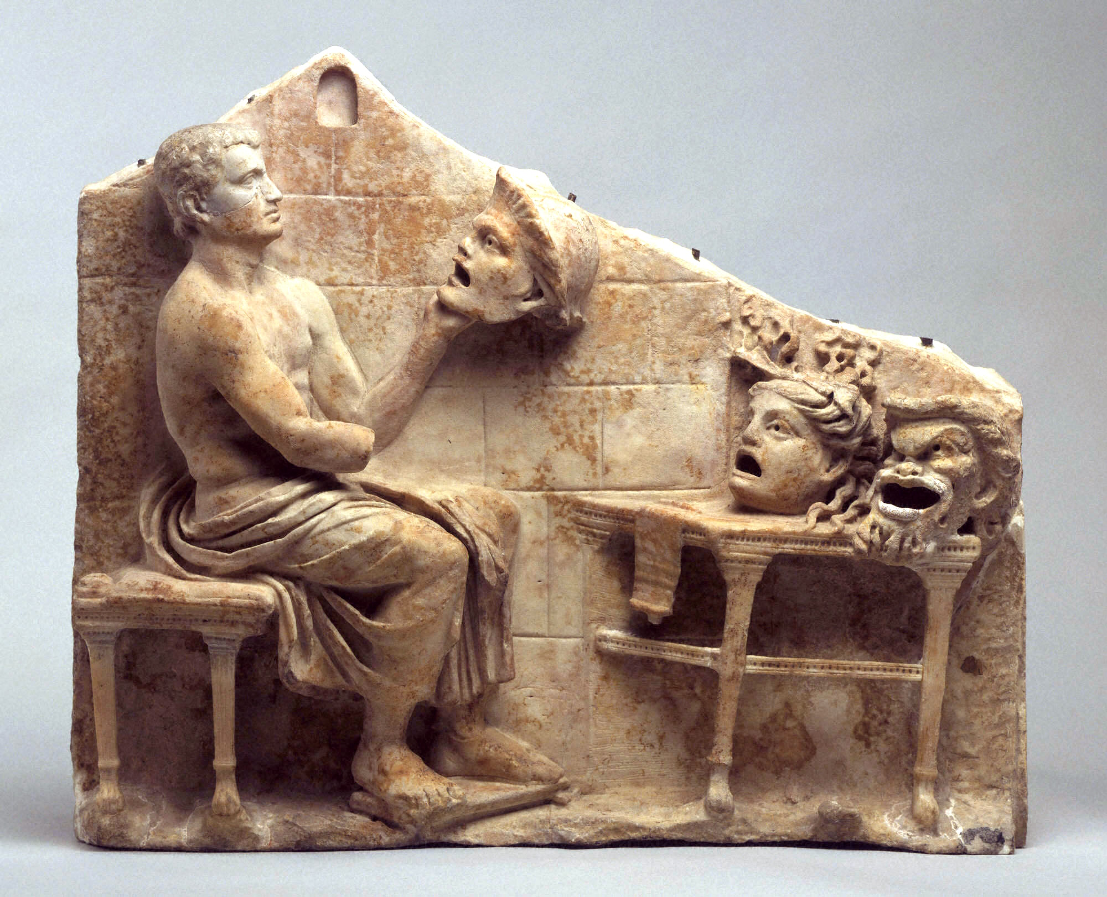
Not walking in craftiness
Relief of Menander with masks of New Comedy, 1st century BC – 1st century AD
4:2
Notes:
One popular form of craftiness in the 1st century was the use of masks in theater. This allowed nearly anyone to play a particular role in a convincing fashion because their true face was hidden by the mask. The masks in this relief show three of the typical New Comedy characters: a youth, the false maiden, and the old man. All three are portrayed with exaggerated features. This relief was photographed at the Princeton University Art Museum. This image comes from Dave and Margie Hill / Kleerup and is in the public domain, via Wikimedia Commons: https://commons.wikimedia.org/wiki/File:Relief_with_Menander_and_New_Comedy_Masks_-_Princeton_Art_Museum.jpg.
wiki12272010153037410c

Slide 10
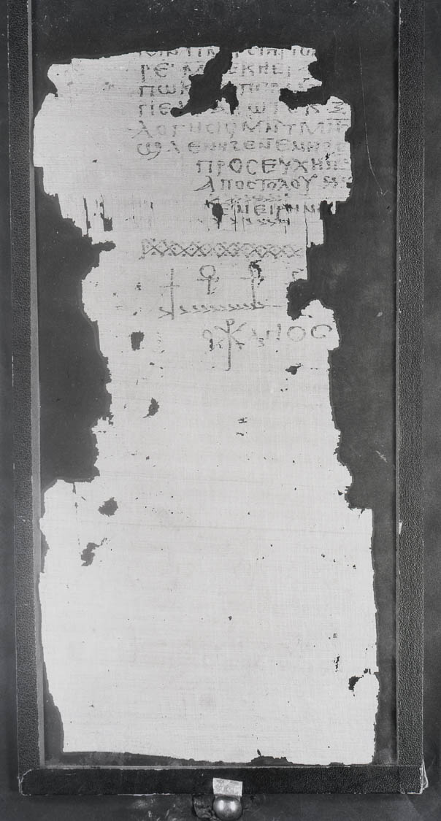
Not walking in craftiness or distorting God’s word
Gnostic text, “The Prayer of the Apostle Paul,” from Nag Hammadi, circa 2nd century AD
4:2
Notes:
One of the earliest examples of distorting God’s word in the early church was the heresy of Gnosticism. Among other things, it denied the incarnation and bodily resurrection of Jesus. This stemmed from a dualism which taught that physical reality is a lower and even sinful form of being. From this perspective, it was unthinkable that Jesus took on bodily form. Apparently early forms of this heresy were already around in Paul’s day. Many Gnostic texts claimed to be written either by an apostle or someone close to Jesus. The document shown in this photo is a fragment of a Gnostic text (originally written in Greek but only preserved in a Coptic translation) that claims to be from the Apostle Paul. The subscript at the end of the document reads “Prayer of Paul the Apostle” (Gk. proseuchē paulou apostolou, προσευχη πα[υλου] αποστολου). However, the document is clearly a later forgery infused with Gnostic concepts, likely dating from the mid-2nd or early 3rd centuries AD. This image comes from the Nag Hammadi Archive in The Claremont Colleges Digital Library (CCDL) where it is made available under the "Fair Use" portion of the US Copyright Act at http://ccdl.libraries.claremont.edu/cdm/ref/collection/nha/id/2136. See the next slide for a close-up.
ccdl2136h

Slide 11
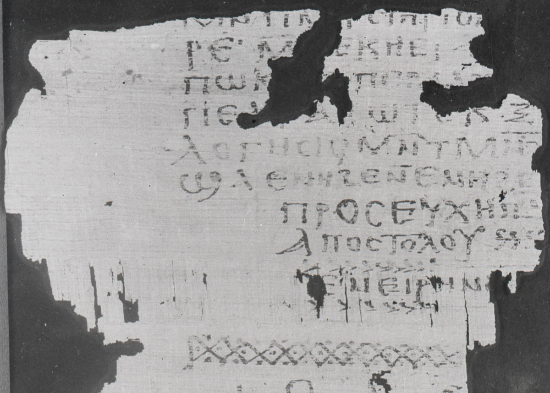
Not walking in craftiness or distorting God’s word
Gnostic text, “The Prayer of the Apostle Paul,” from Nag Hammadi, circa 2nd century AD
4:2
Notes:
One of the earliest examples of distorting God’s word in the early church was the heresy of Gnosticism. Among other things, it denied the incarnation and bodily resurrection of Jesus. This stemmed from a dualism which taught that physical reality is a lower and even sinful form of being. From this perspective, it was unthinkable that Jesus took on bodily form. Apparently early forms of this heresy were already around in Paul’s day. Many Gnostic texts claimed to be written either by an apostle or someone close to Jesus. The document shown in this photo is a fragment of a Gnostic text (originally written in Greek but only preserved in a Coptic translation) that claims to be from the Apostle Paul. The subscript at the end of the document reads “Prayer of Paul the Apostle” (Gk. proseuchē paulou apostolou, προσευχη πα[υλου] αποστολου). However, the document is clearly a later forgery infused with Gnostic concepts, likely dating from the mid-2nd or early 3rd centuries AD. This image comes from the Nag Hammadi Archive in The Claremont Colleges Digital Library (CCDL) where it is made available under the "Fair Use" portion of the US Copyright Act at http://ccdl.libraries.claremont.edu/cdm/ref/collection/nha/id/2136.
ccdl2136

Slide 12
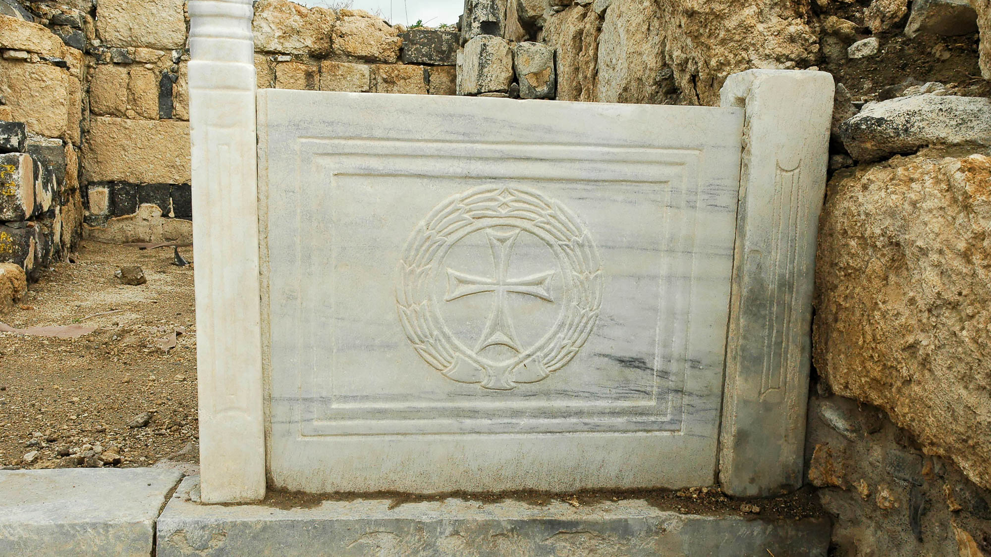
Even if our gospel is veiled, it is veiled to those who are perishing
Chancel screen of the northwest church at Hippos
4:3
Notes:
The reference to the “veil” looks back to the veil over Moses’s face, as described in the previous chapter. The above photo shows a stone “screen” that was designed to restrict access to the chancel of a Byzantine church in Hippos, on the eastern side of the Sea of Galilee. For depictions of veiled faces from the ancient world, see the slides on 2 Corinthians 3:13.
tb040606133h

Slide 13
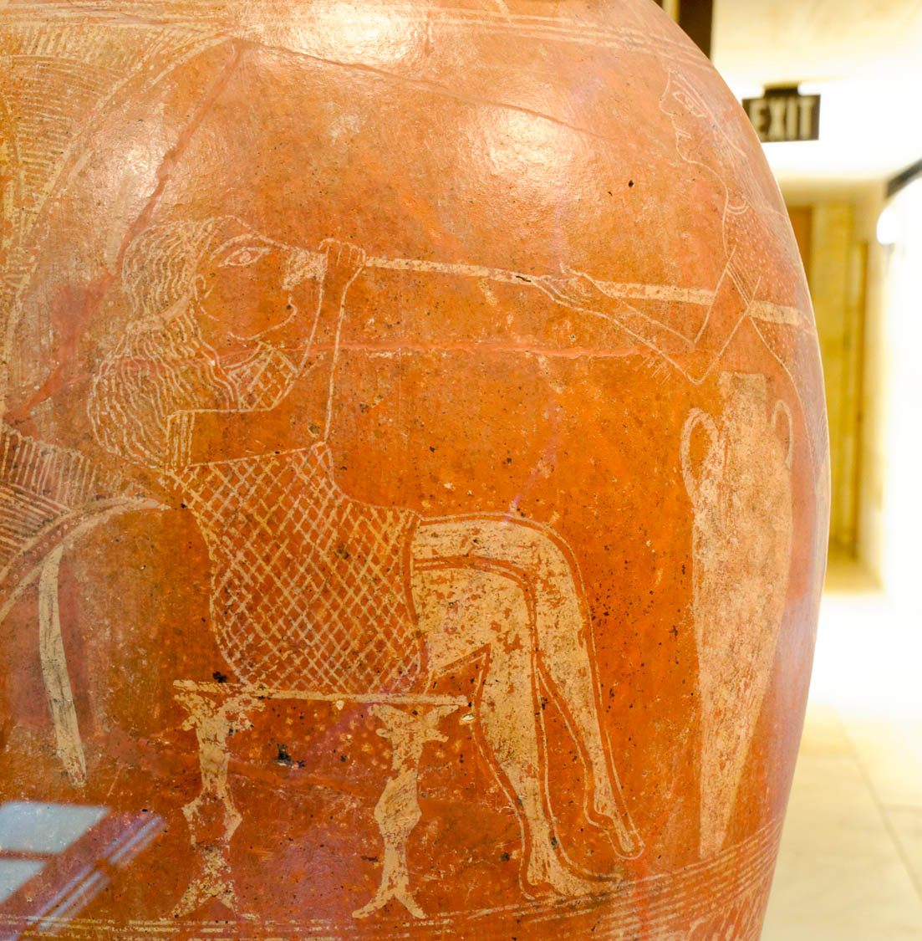
The god of this world has blinded the minds of unbelievers
Etruscan storage jar depicting the blinding of Polyphemos, circa 650 BC
4:4
Notes:
In Homer’s Odyssey, Odysseus and his men blind the cyclops Polyphemos so that he would not be able to see them. This scene from the story has been painted on an Etruscan storage jar. It provides an example of blinding from the ancient world. Blinding is a malicious act against an enemy to take from them the necessary senses needed for defense. This is the opposite of the gracious illumination of the Spirit (see slides on 2 Cor 3:10). This jar was photographed at the Getty Villa in southern California. See the next slide for a wider angle of the scene.
tb082214382

Slide 14
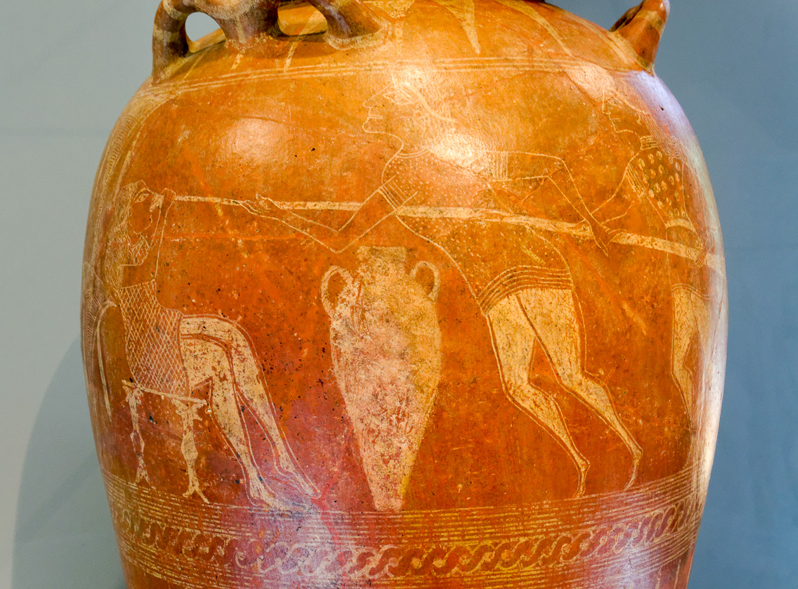
The god of this world has blinded the minds of unbelievers
Etruscan storage jar depicting the blinding of Polyphemos, circa 650 BC
4:4
Notes:
In Homer’s Odyssey, Odysseus and his men blind the cyclops Polyphemos so that he would not be able to see them. This scene from the story has been painted on an Etruscan storage jar. It provides an example of blinding from the ancient world. Blinding is a malicious act against an enemy to take from them the necessary senses needed for defense. This is the opposite of the gracious illumination of the Spirit (see slides on 2 Cor 3:10). This jar was photographed at the Getty Villa in southern California.
tb082214383

Slide 15
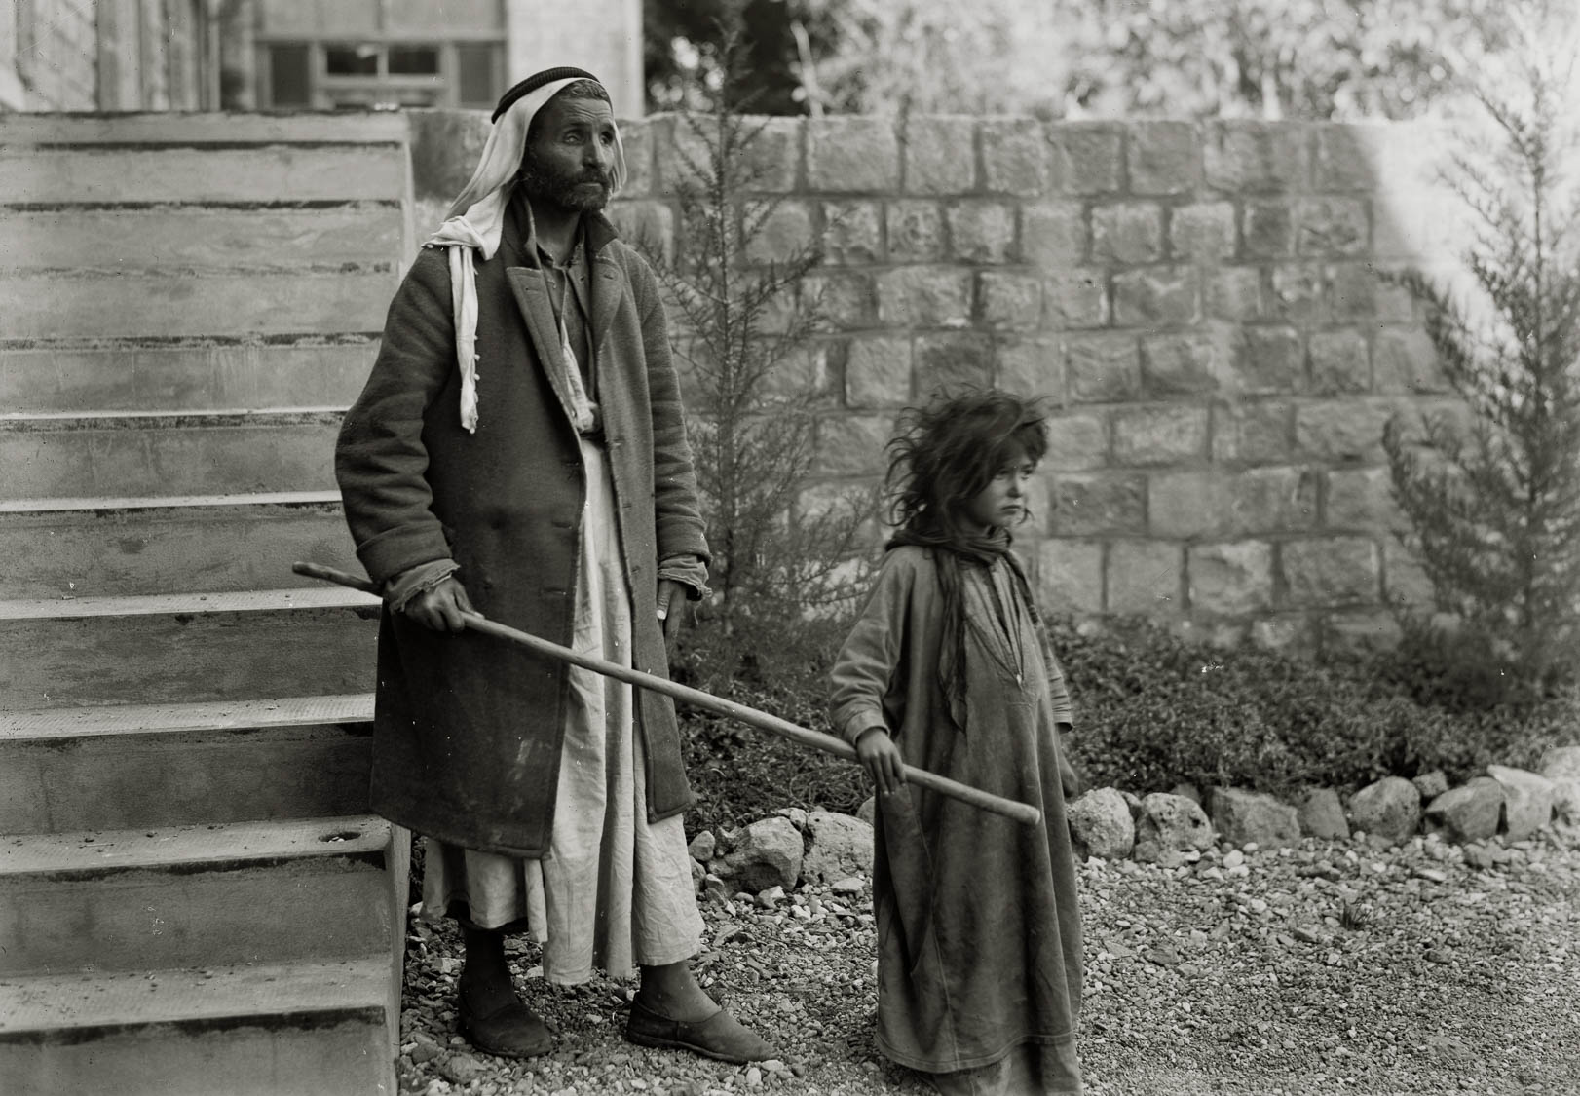
The god of this world has blinded the minds of unbelievers
Young girl leading a blind man at Scots Mission Hospital, Tiberias, circa 1935
4:4
Notes:
This American Colony photo was taken between 1934 and 1939.
mat03622

Slide 16
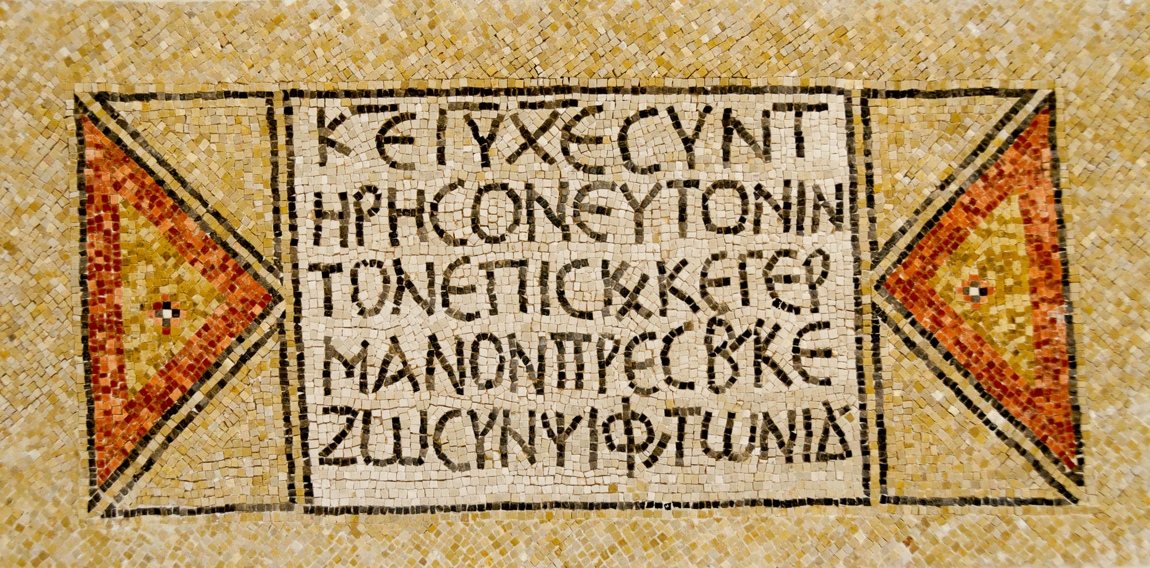
We do not preach ourselves but Christ Jesus as Lord
Greek inscription from a Byzantine church at Shiloh
4:5
Notes:
Christian mosaics of the Byzantine period were often addressed to “The Lord Jesus Christ,” as is the case with the inscription shown here. The sacred names “Lord,” “Jesus,” and “Christ” are abbreviated in typical early Christian fashion, where ΚΕ = ΚΥΡΙΕ, KURIE, “LORD;” ΙΥ = ΙΗΣΟΥ, IESOU, “Jesus;” and ΧΕ = ΧΡΙΣΤΕ, CHRISTE, “Christ.” All three words occur in the vocative case, which is used when addressing someone directly. The lines above these three words indicate that they are being abbreviated as sacred names (nomina sacra). This mosaic was photographed at the Good Samaritan Museum along the Jerusalem-Jericho road.
tb053116660h

Slide 17
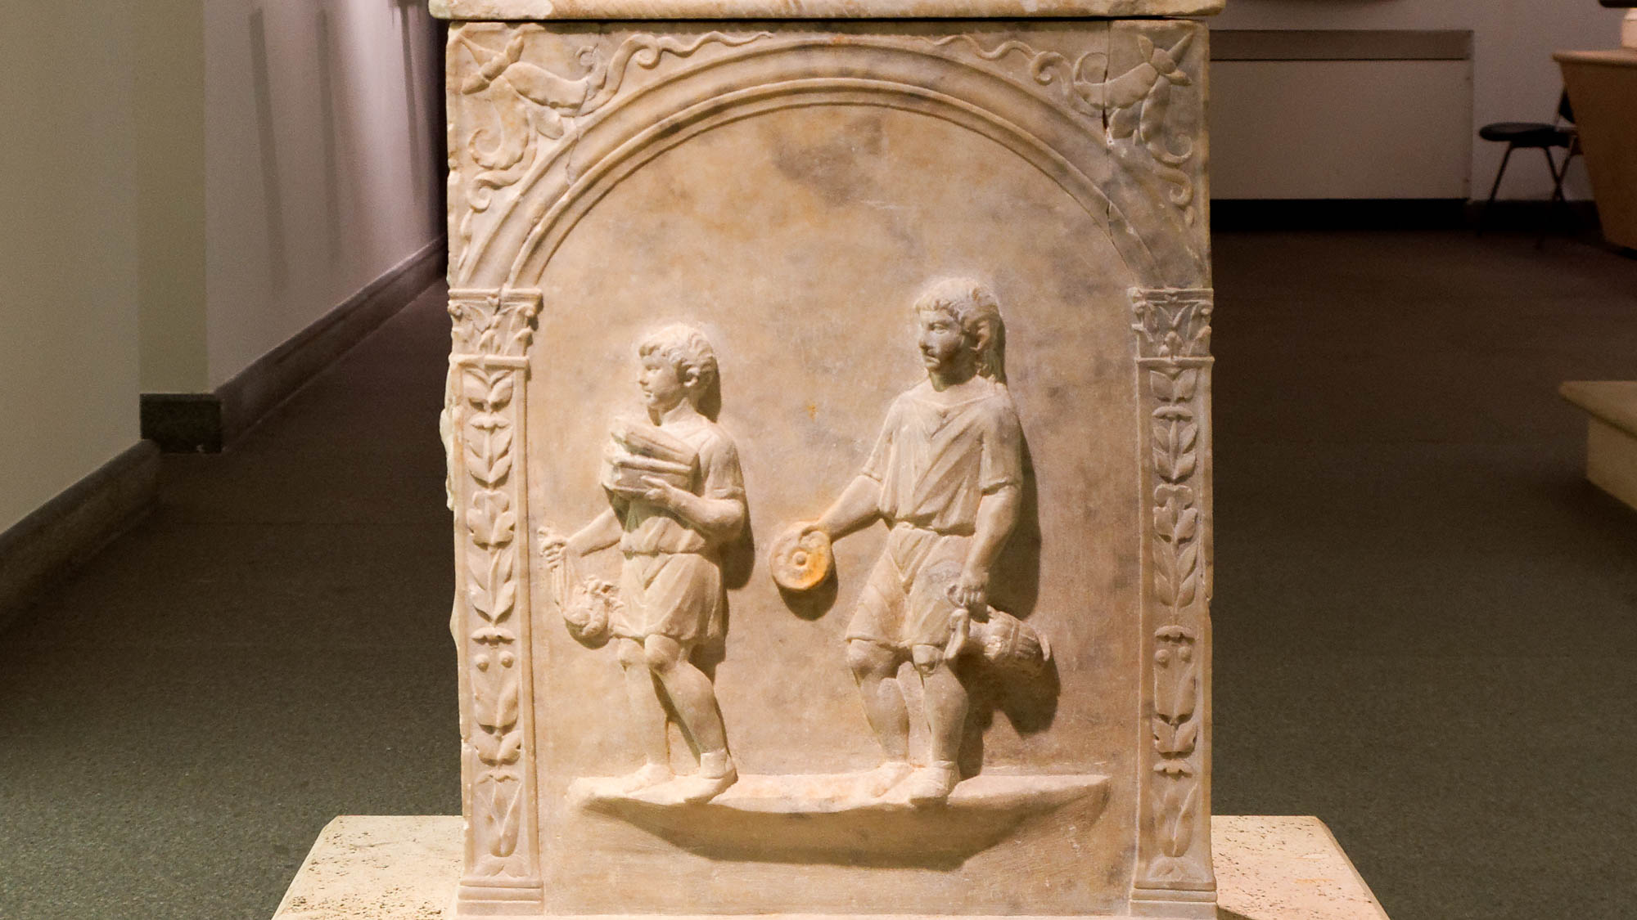
And we ourselves are your slaves for the sake of Jesus
Funerary altar with depiction of slave boys, mid-1st century AD
4:5
Notes:
Paul characterizes himself and the other ministers of the gospel as slaves (Gk. doulos, δοῦλος) of the church. This was a humble position that involved serving others, not amassing fame or material goods for oneself. The two slave boys shown here are carrying vessels and clothing, presumably for their master. This relief was photographed at the National Museum of Rome at the Diocletian Baths.
tb0513178357h

Slide 18
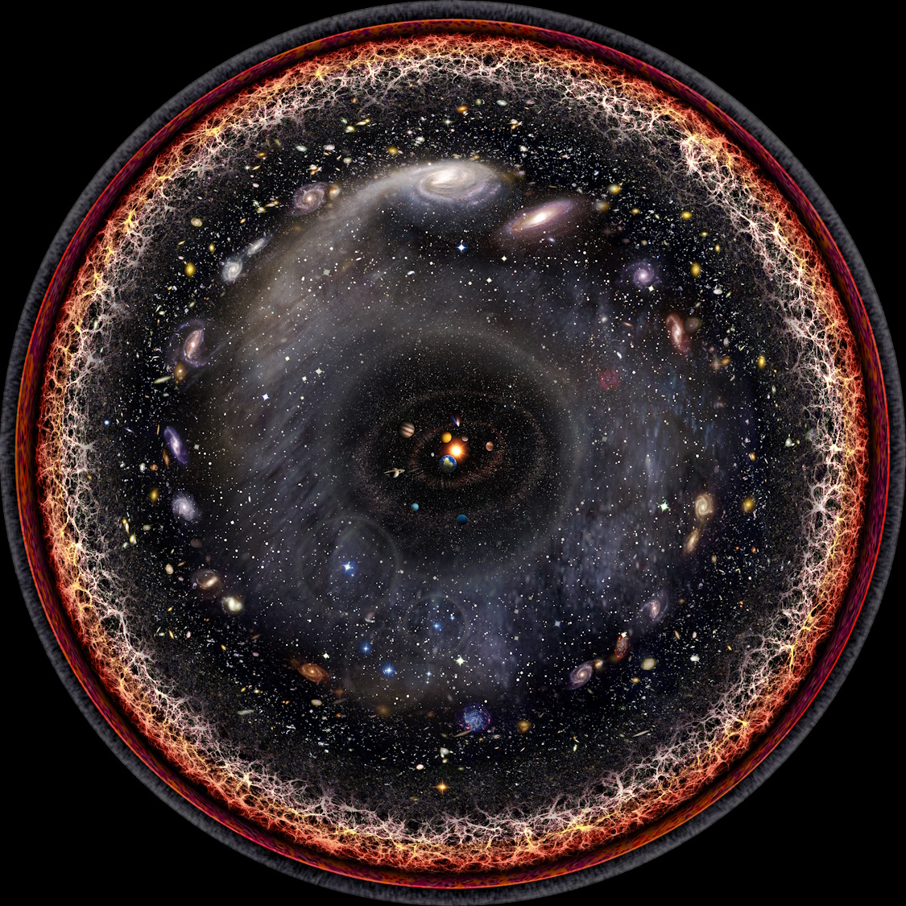
Because God, who said, “Light shall shine out of darkness”
Artist’s logarithmic scale conception of the observable universe, by Pablo Carlos Budassi
4:6
Notes:
Paul alludes here to the text of Genesis 1:3, which describes the creation of light on Day One of the creation narrative. This image comes from Pablo Carlos Budassi and is licensed under CC-BY-SA-3.0, via Wikimedia Commons, https://commons.wikimedia.org/wiki/File:Observable_universe_logarithmic_illustration.png.
wiki030720172021b

Slide 19
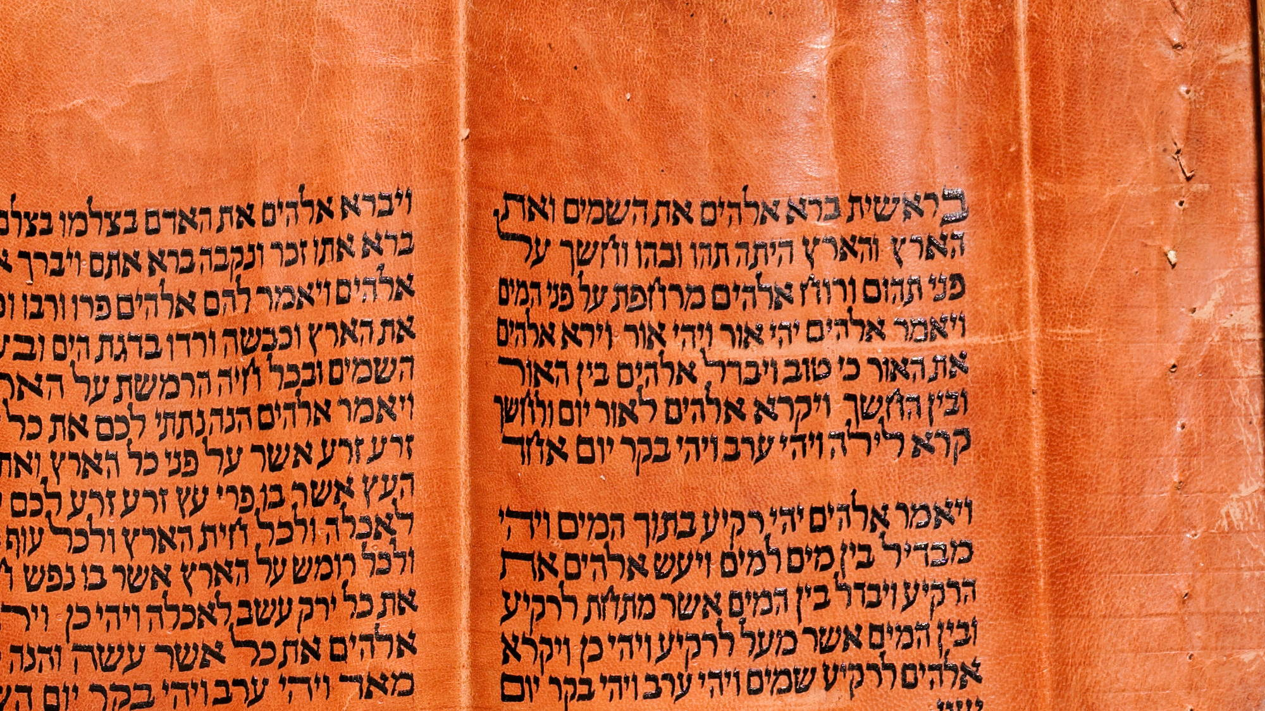
Because God, who said, “Light shall shine out of darkness”
“Then God said, ‘Let there be light,’ and there was light.’”
Torah scroll with Genesis 1:3
4:6
Notes:
“Then God said, ‘Let there be light,’ and there was light” (Gen 1:3). This Yemenite Torah scroll was photographed at The Master’s Seminary in California.
tb031416331

Slide 20
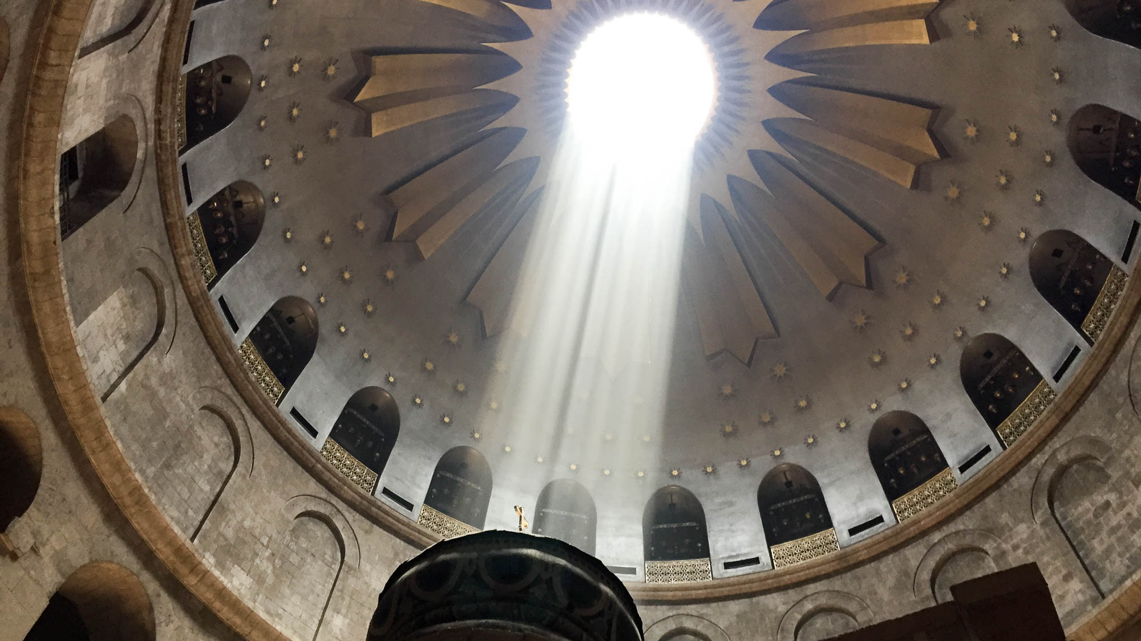
The one who has shone in our hearts the light of the knowledge of the glory of God
Church of the Holy Sepulcher Edicule with light shining down
4:6
Notes:
Here, Paul describes the regeneration of believers in creational language from Genesis 1. Indeed, in the next chapter, he explicitly says this (2 Cor 5:17). Christ’s resurrected body was the first physical element of the New Creation. This picture shows the rotunda in the Church of the Holy Sepulcher, the likely location of Jesus’s tomb where He rose from the dead. The light shining down on the Edicule built around the ancient tomb is reminiscent of the imagery Paul uses here to describe the new life believers have in Christ (cf. Eph 5:8).
cl053120138h

Slide 21
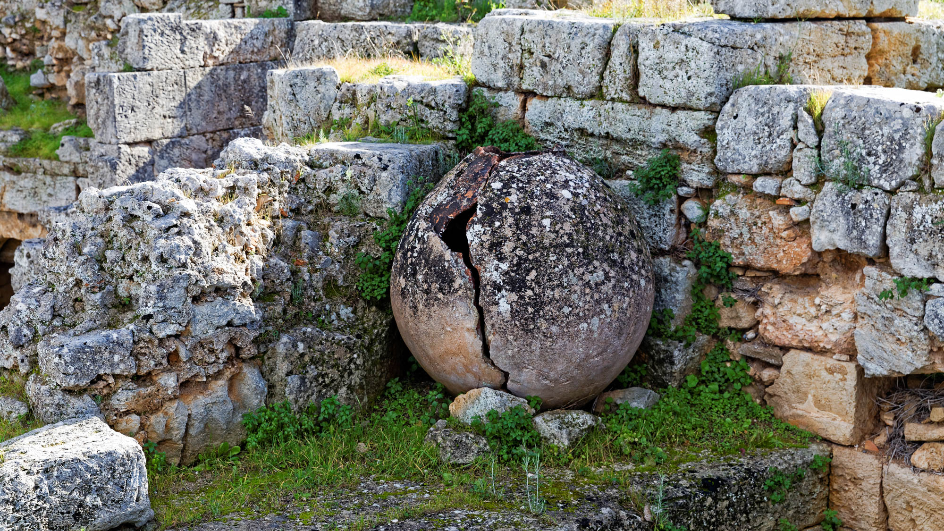
But we have this treasure in clay jars
Large clay storage jar in the Corinth commercial agora
4:7
Notes:
Earthen vessels, or clay jars, were both common and easily broken. They are found in virtually every archeological dig in the ancient world. When they are found, they are rarely intact, but are usually broken in pieces, or at least are cracked. Unless they are painted, they appear quite unremarkable. Paul’s point is that the treasure of the knowledge of Christ is conveyed in humble containers, that is, frail and corruptible humans.
jc0111152396h

Slide 22
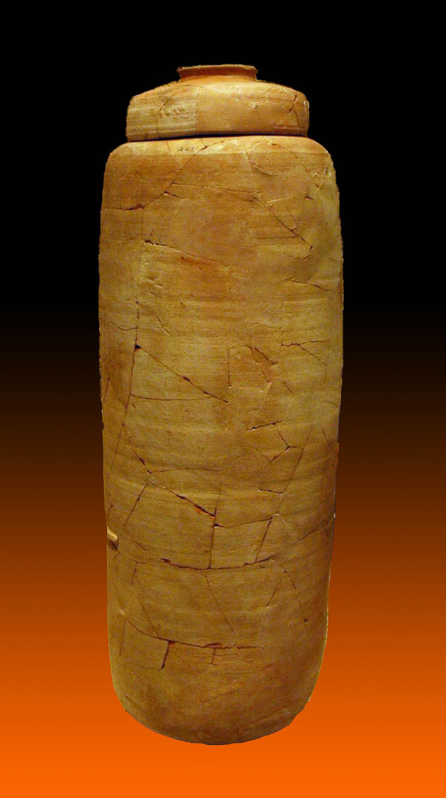
But we have this treasure in clay jars
Scroll jar from Qumran Cave 1
4:7
Notes:
This clay jar once held one of the most significant archaeological treasures ever discovered—an ancient scroll from Qumran. It was photographed at the Oriental Institute Museum at the University of Chicago.
tb072705018gr

Slide 23
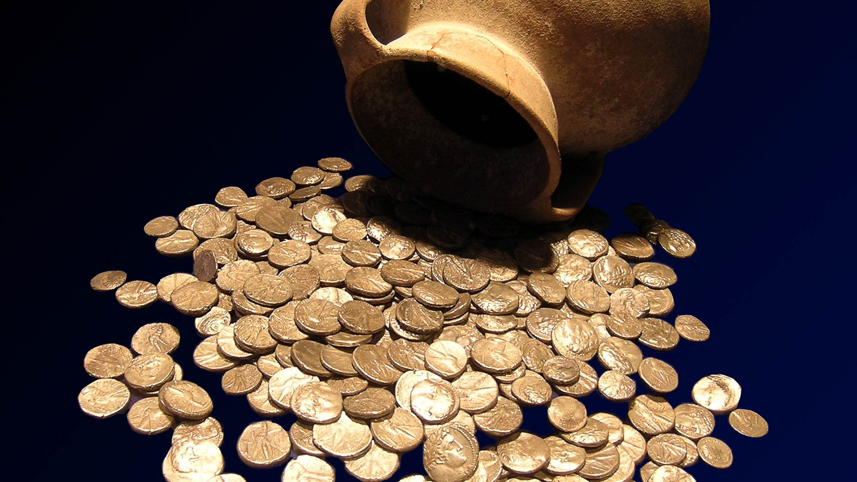
But we have this treasure in clay jars
Tyrian shekel hoard from Mount Carmel, 1st century AD
4:7
Notes:
This hoard of Tyrian silver shekels (and half-shekels) was found in Isfiya and may have been collected for the temple tax in Jerusalem. It was photographed at the Eretz Israel Museum in Tel Aviv.
tb061804589gr

Slide 24
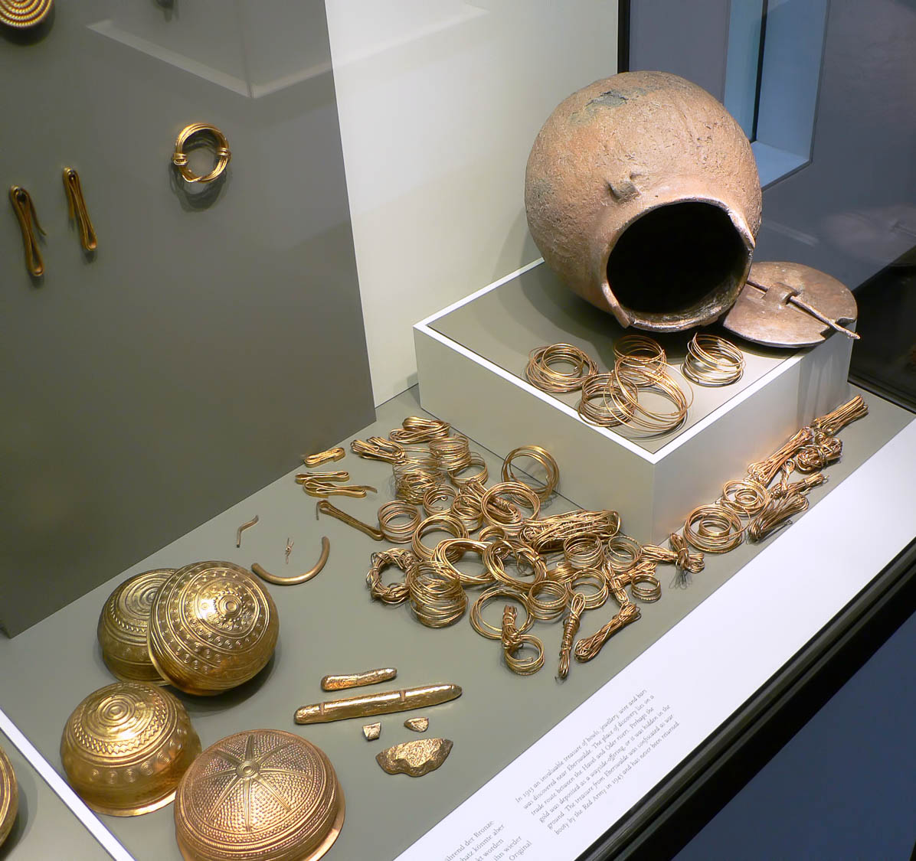
But we have this treasure in clay jars
Display of a jar and gold hoard from Eberswalde, Germany, Bronze Age (3rd–2nd millennia BC)
4:7
Notes:
Clay pots, after having been fired, are not susceptible to rot or decay, and thus were a common container in which the ancients stored valuables, particularly if they were buried in the ground. This display was photographed at the Museum of Prehistory and Early History in Berlin.
adr070513726

Slide 25
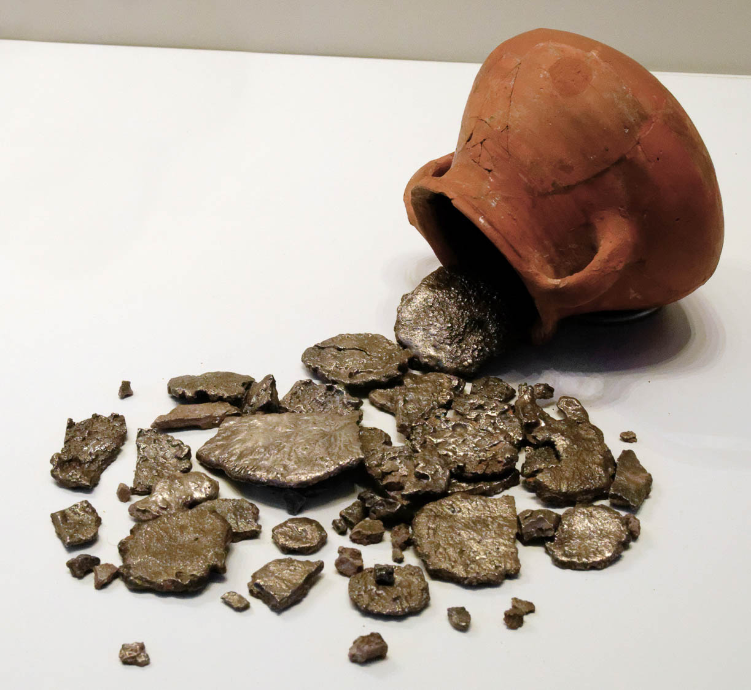
But we have this treasure in clay jars
Silver hoard from En Gedi, 8th–7th centuries BC
4:7
Notes:
This display was photographed at the Israel Museum.
tb032014361w

Slide 26
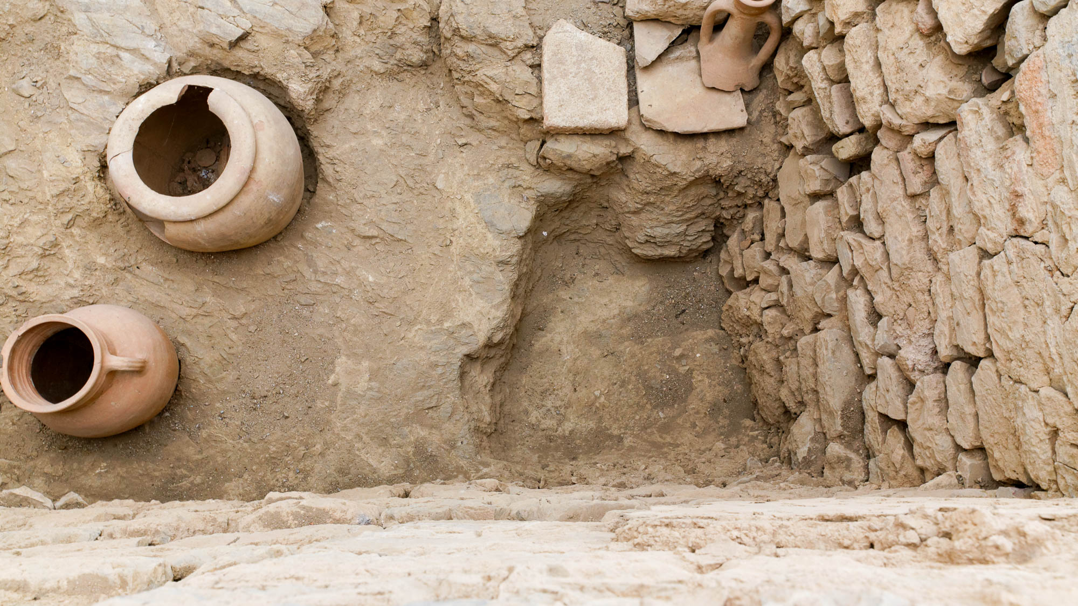
But we have this treasure in clay jars
Pots in terrace houses at Ephesus, circa 1st century AD
4:7
Notes:
These clay pots come from houses in the city of Ephesus, where Paul had just spent three years ministering.
jc0102150344h

Slide 27
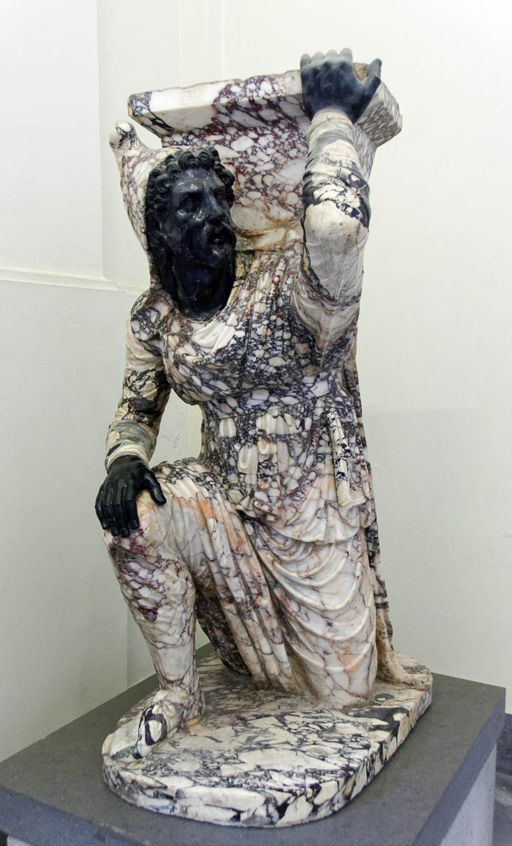
We are pressed on every side
Column base in the form of a kneeling barbarian, early 1st century AD
4:8
Notes:
The word “afflicted” (Gk. thlibō, θλίβω) is used in Greek literature to refer to being under great pressure, such as a person subject to a heavy load. This concept is illustrated here by a kneeling barbarian serving as a weight-bearing pedestal, pressed down, yet not crushed. This column base was photographed at the Naples Archaeological Museum in Rome.
tb0515171201

Slide 28
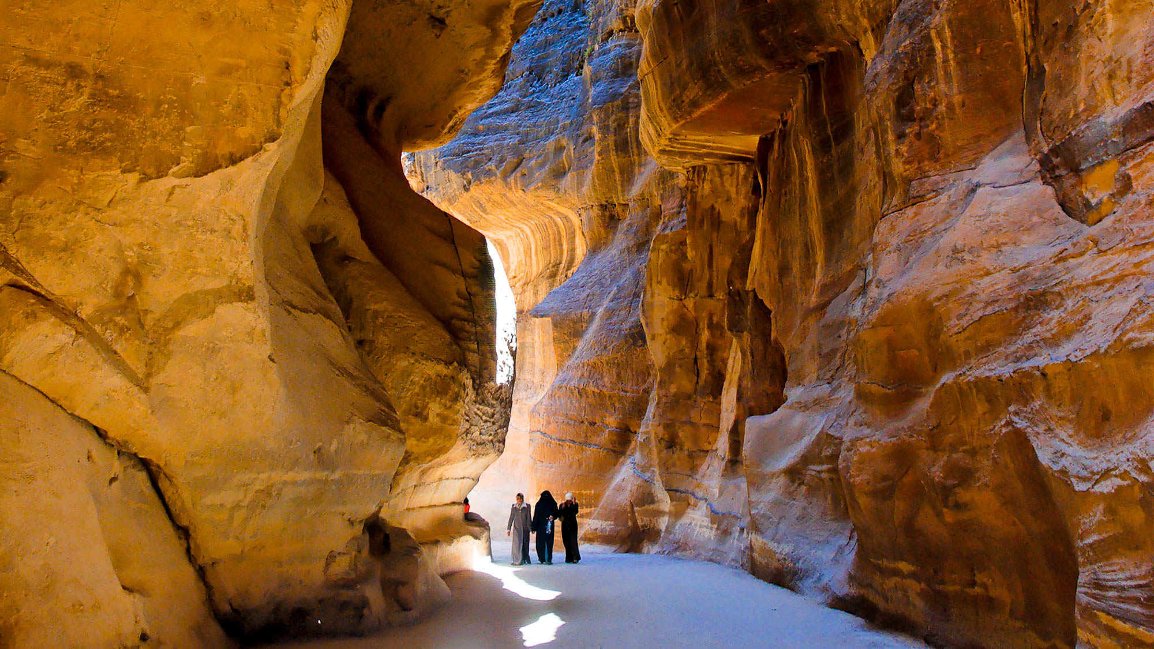
We are pressed on every side
The “Siq,” the narrow entryway to Petra
4:8
Notes:
The word “afflicted” (Gk. thlibō, θλίβω) is also used in Greek literature to refer to being hemmed in, to being in a constricted or narrow place. Petra was a Nabatean stronghold that was near the height of its power in Paul’s day. Access to the hidden valley was only by a narrow canyon, known as the Siq, making the city easily defensible. Walking down this narrow gorge can give the sense of being constricted or pressed upon.
tb053008759h

Slide 29
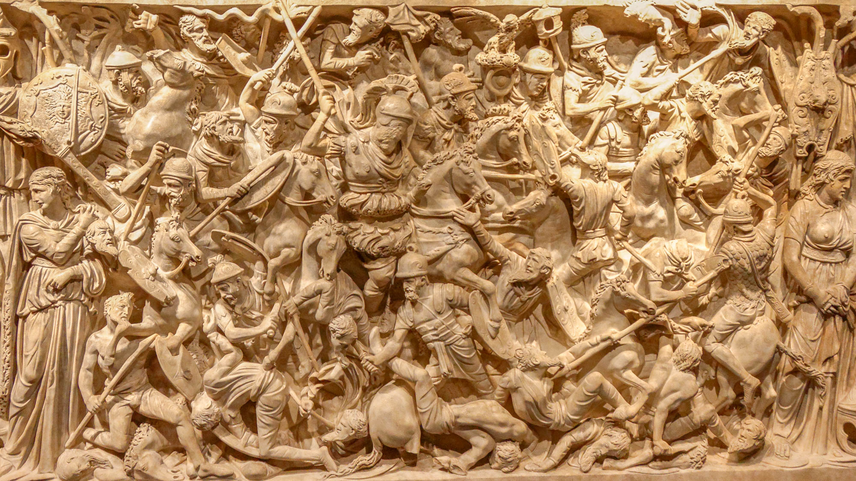
We are pressed on every side
Relief of Roman horsemen in a melee of soldiers, from Italy, circa AD 180
4:8
Notes:
The same word mentioned in the slide above is also used to refer to being pressed on all sides by a crowd. Such imagery is depicted on this sarcophagus in which Romans and Barbarians are pressed together in a melee of mortal combat. This sort of scene was inspired by the Antonine Column. This was photographed at the National Museum of Rome. See the next slide for a close-up.
tb0513177595

Slide 30
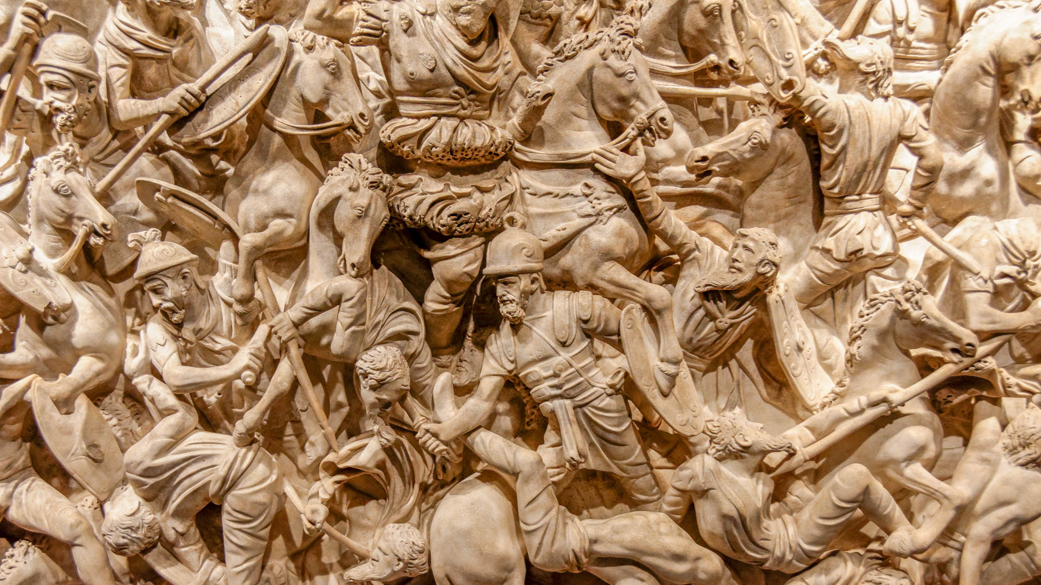
We are pressed on every side
Relief of Roman horsemen in a melee of soldiers, from Italy, circa AD 180
4:8
Notes:
This extraordinary sarcophagus was discovered along the via Tiburtina, a road that leads from Rome to Tivoli. It was photographed at the National Museum of Rome.
tb0513177600

Slide 31
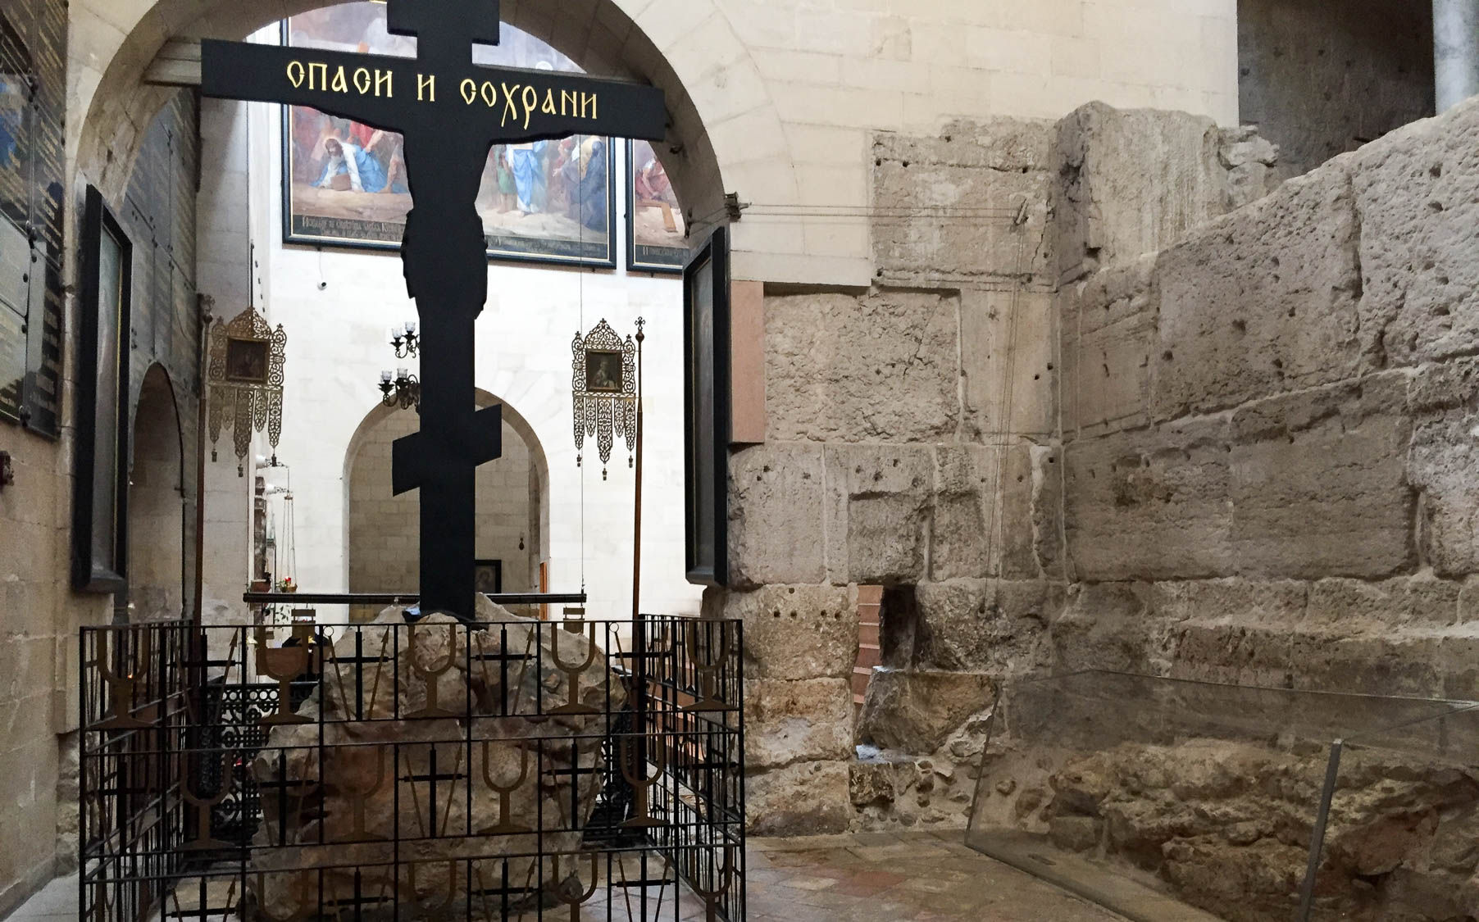
We are pressed on every side
Gate at Hadrianic western forum with “eye of the needle”
4:8
Notes:
Another situation described by this word is pressing one’s shoulders against a narrow passageway as one squeezes through. This would often be the case when passing through the so-called “eye of the needle,” a small passageway near a gate that a single person could squeeze through when the gate was closed. This photo shows such a narrow opening next to the Hadrianic gate of the western forum of Jerusalem. This area was built after the city was razed in AD 70, when it was rebuilt as the Roman colony Aelia Capitolina. This was photographed at the Alexander Nevsky Church. See the next slide for a close-up from the other side.
cl081020126h

Slide 32
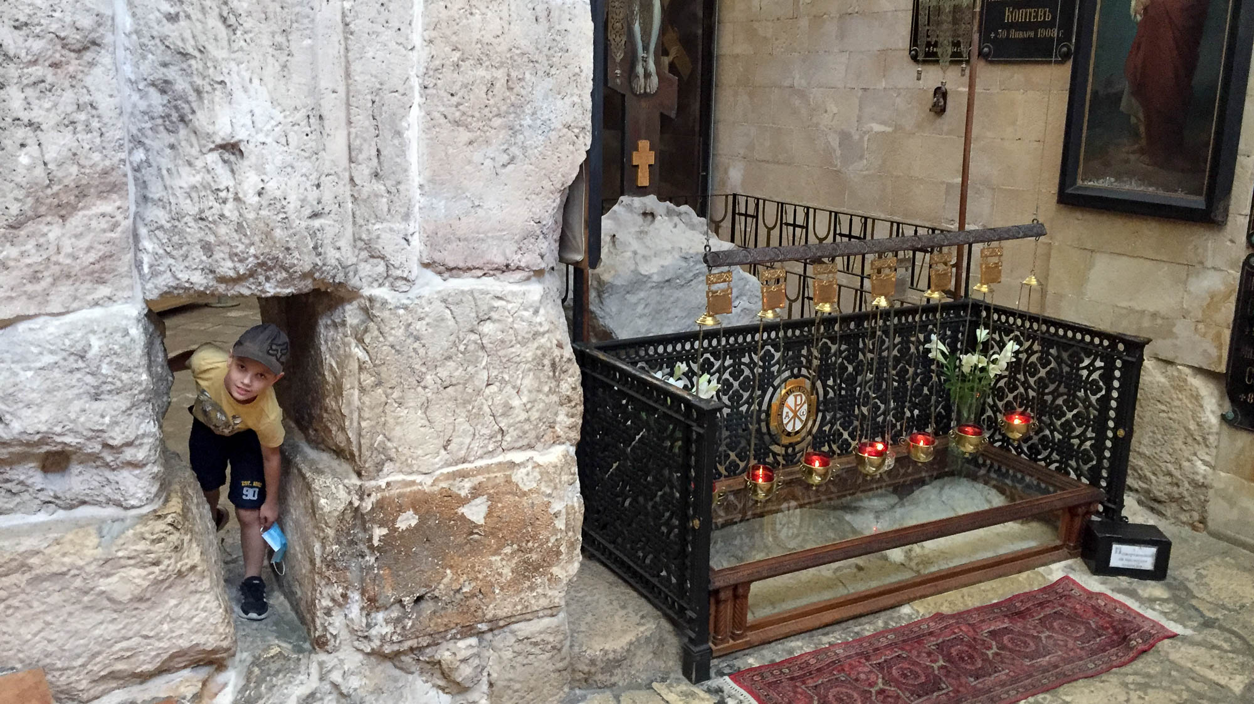
We are pressed on every side
Gate at Hadrianic western forum with traveler squeezing through the “eye of the needle”
4:8
Notes:
This illustrates how even a small child would have to slowly make his way through such a tight passageway.
cl081820312h

Slide 33
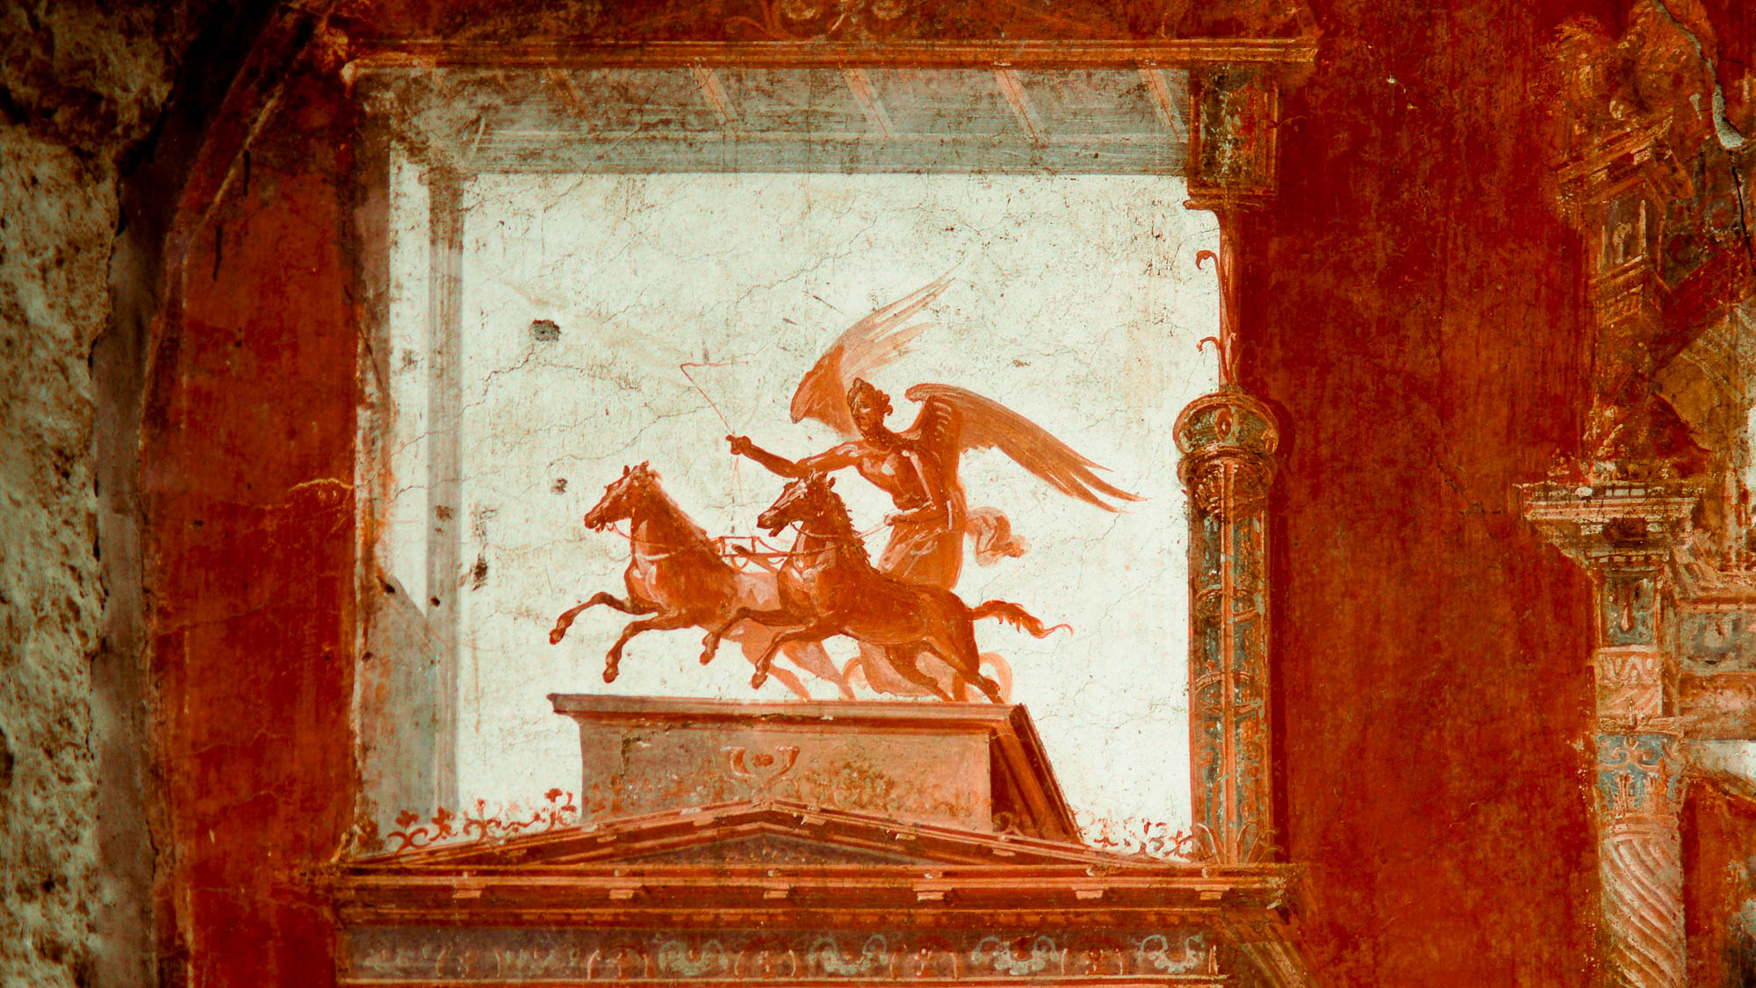
We are pressed on every side, yet not distressed
Fresco with personification of winged victory in a chariot, from Herculaneum, 1st century AD
4:8
Notes:
The word “distressed” (Gk. stenochōreō, στενοχωρέω) refers to being in a circumstance that seems to offer no way out. By contrast, Paul is confident of eventual rescue from any trying situation he finds himself in. This fresco depicts victory personified as a winged woman driving a chariot, illustrating the “not distressed” attitude of Paul. This fresco was photographed at Herculaneum. This image comes from Mboesch and is licensed under CC BY-SA 3.0, via Wikimedia Commons: https://commons.wikimedia.org/wiki/File:Herculaneum-sede-dei-augustali-fresko.JPG.
wiki06062013101759126h

Slide 34
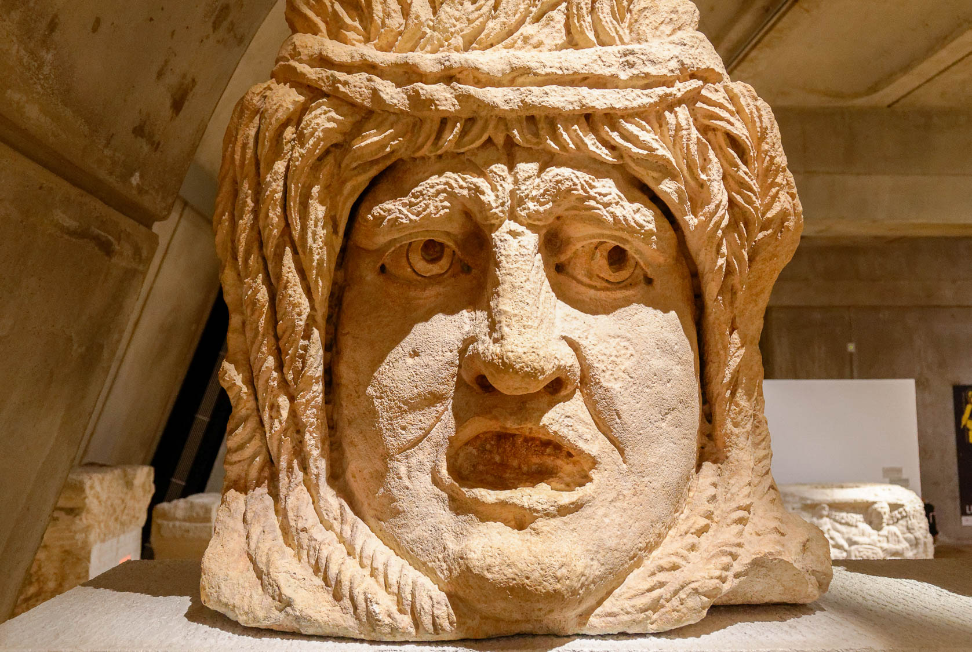
We are perplexed
Decorative mask from a funeral monument in Lyon, France, Roman period
4:9
Notes:
The word “perplexed” (Gk. aporeō, ἀπορέω) means to be in a confused state of mind, to have uncertainty. This mask portrays a feeling of uncertainty and even anxiety. This artifact comes from the Massues neighborhood in Lyon and was photographed at the Lyon Roman-Gallo Museum in Lyon, France.
tb091719491h

Slide 35
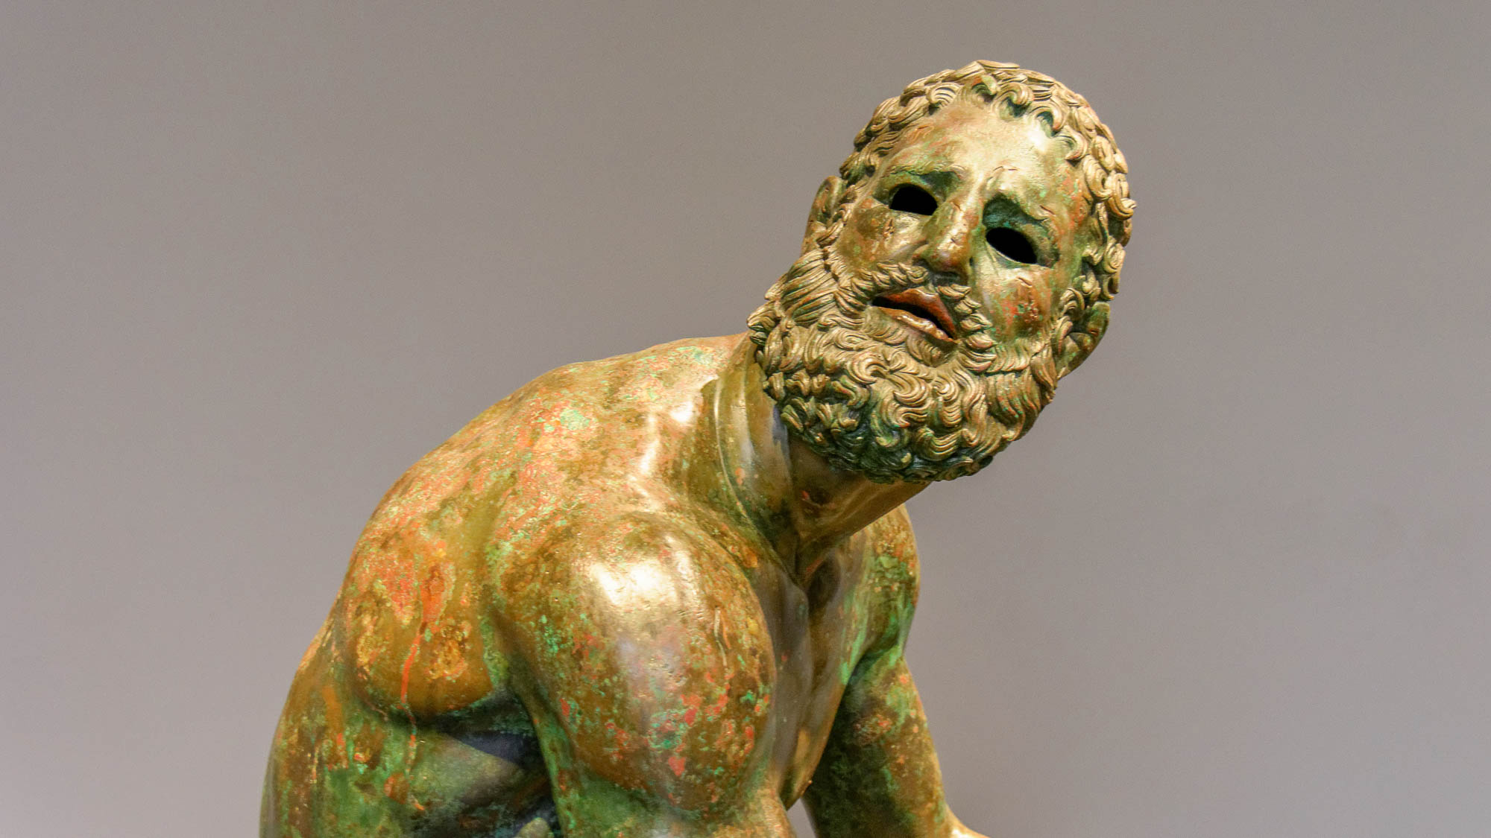
We are perplexed, but not despairing
Bronze boxer, from the Via IV Novembre in Rome, circa 100 BC
4:9
Notes:
To “despair” (Gk. exaporeō, ἐξαπορέω) means to be in doubt or to be at a loss psychologically. The sculpted boxer shown here has been given a face that depicts a quiet confidence, even in the face of fierce struggle. This statue is thought to be influenced by the work of the 4th century BC Greek sculptor Lysippos. It was photographed at the National Museum of Rome.
tb0513177306h

Slide 36
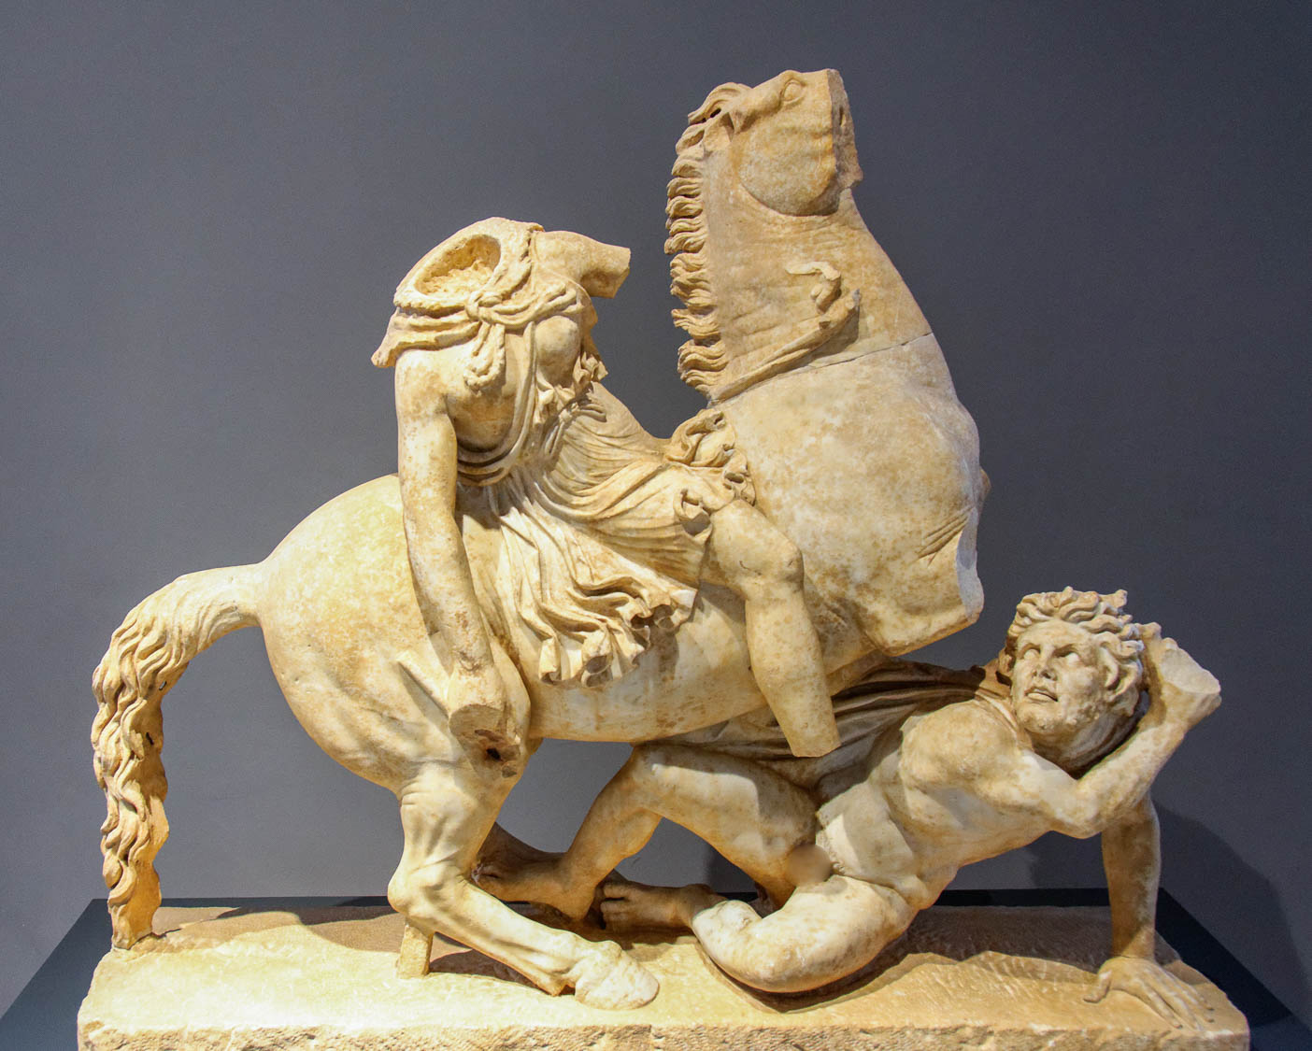
We are pursued
Pentelic marble statue of an Amazon on a horse, pursuing a barbarian, Roman period
4:9
Notes:
This statue is thought to be a mid-2nd century AD work based on late 2nd century BC Pergamene models. It comes from the imperial villa in Anziohis. It was photographed at the National Museum of Rome.
tb0513177479h

Slide 37
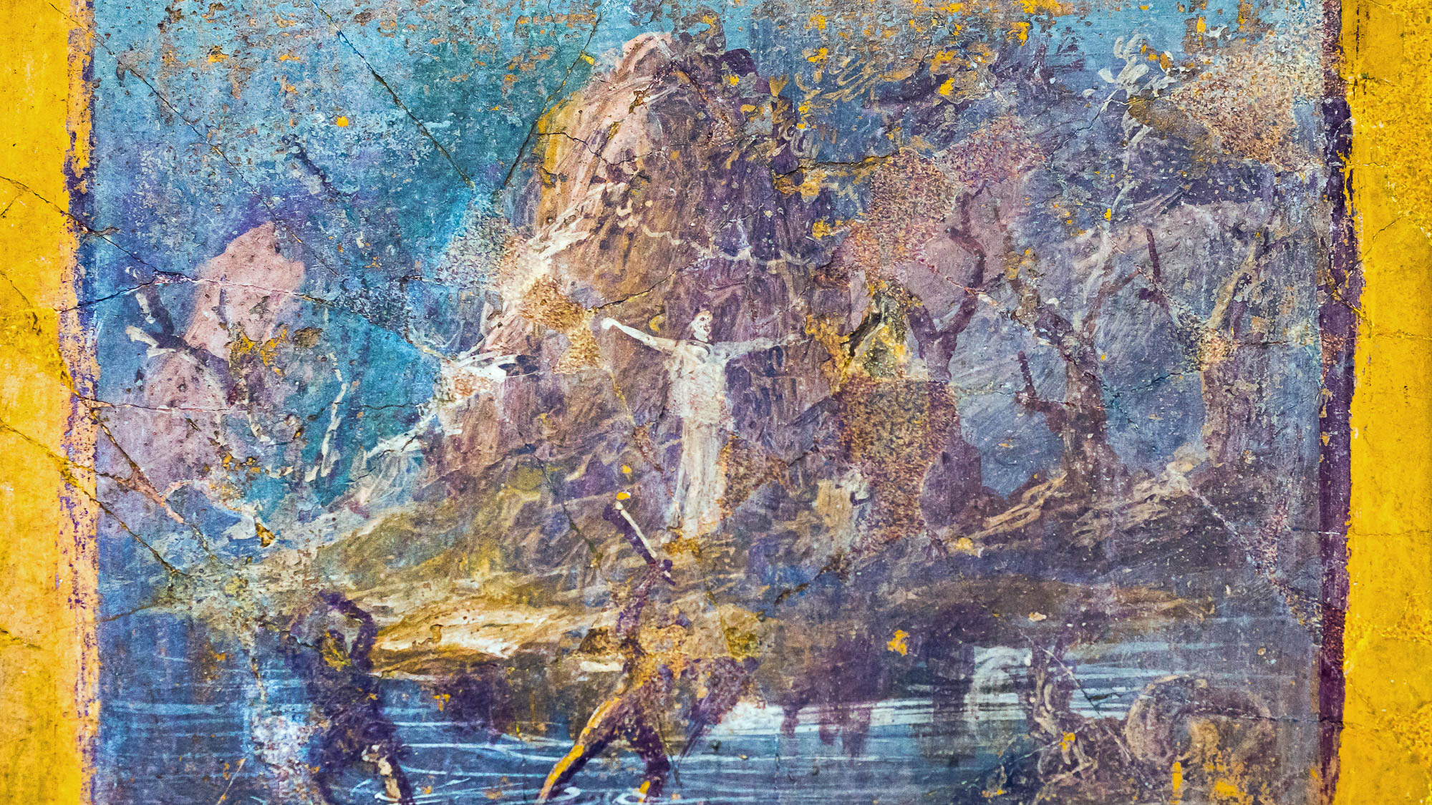
We are pursued, yet not forsaken
Fresco of Perseus saving Andromeda, from Pompeii, 1st century AD
4:9
Notes:
Two popular and very similar myths that the Corinthians would have been familiar with were the stories of Perseus saving Andromeda and of Herakles saving Hesione. In both stories, the woman was punished for the sin of a parent by being chained to a rock as a sacrifice for a monster, only to be rescued by the hero. It is uncertain which of the two this fresco is intended to portray. Either way, it illustrates Paul’s concept of not being “forsaken” (Gk. enkataleipō, ἐγκαταλείπω), abandoned, or left behind. This fresco was photographed at the Naples Archaeological Museum. This image comes from ArchaiOptix and is licensed under CC BY-SA 4.0, via Wikimedia Commons: https://commons.wikimedia.org/wiki/File:Wall_painting_-_Perseus_saving_Andromeda_-_Pompeii_(VI_17_ins_occ)_-_Napoli_MAN_9477.jpg.
wiki100720181444169477h

Slide 38
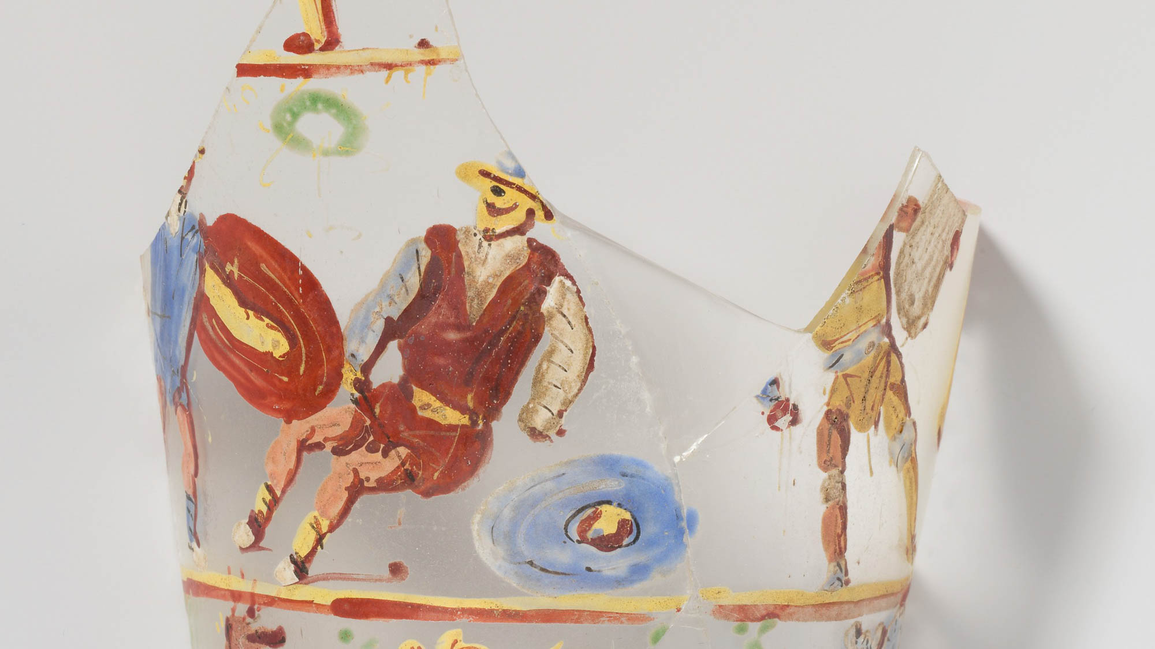
We are struck down
Gladiators depicted on a glass beaker, from Egypt, circa 2nd century AD
4:9
Notes:
To be “struck down” (Gk. kataballō, καταβάλλω) is to be hit with sufficient force that one is knocked down. The idea is illustrated here by a depiction of a falling gladiator. This photo of this rare Roman painting on clear glass comes from The Metropolitan Museum of Art and is in the public domain. Source: https://www.metmuseum.org/art/collection/search/251165
met251165h

Slide 39
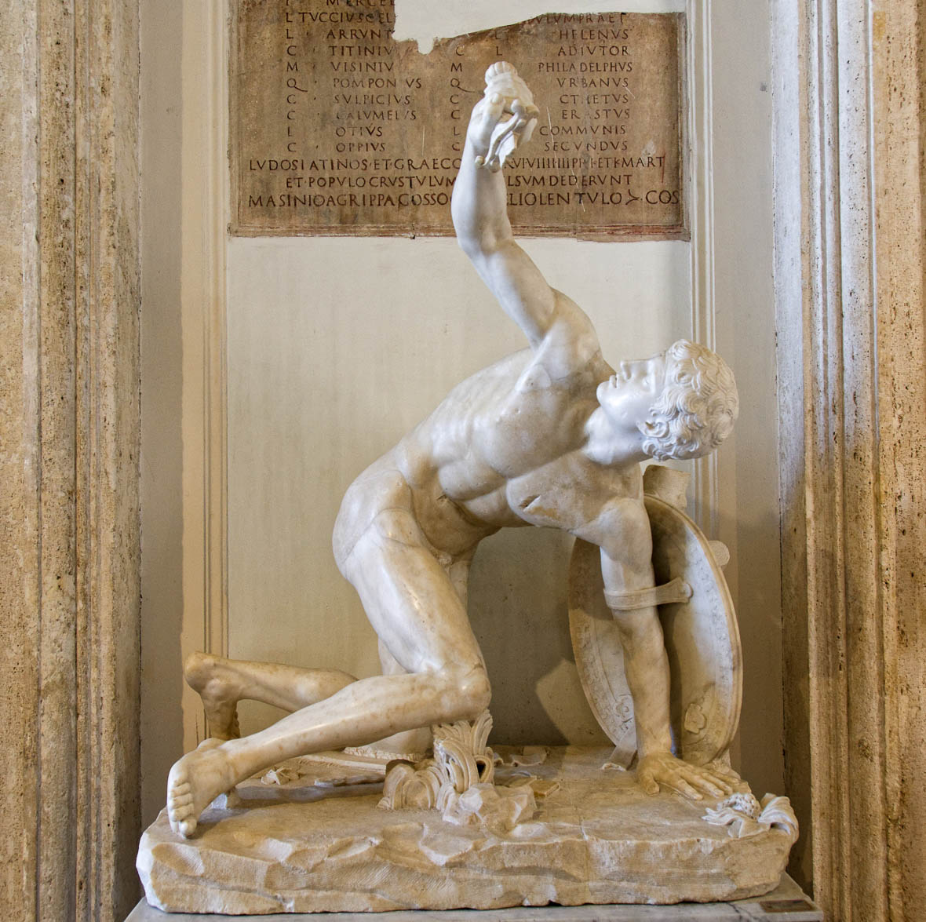
We are struck down
Torso of Discobolus, known as the Monnot Gladiator, 1st century AD
4:9
Notes:
This statue depicts a gladiator in a defensive position. Only the torso of this statue was recovered, and the other parts have been restored. It is thought to be a copy of an original from the 5th century BC that was first created by the sculptor Myron. This statue was photographed at the Capitoline Museums in Rome.
tb0514179774

Slide 40
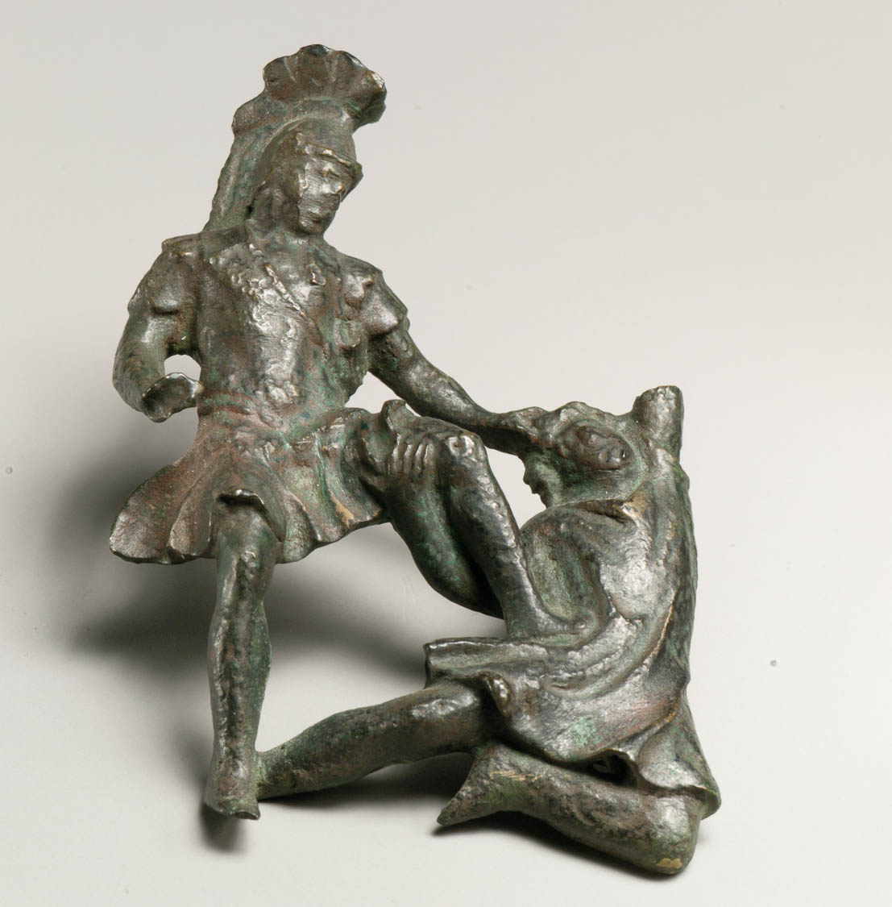
We are struck down, but not destroyed
Bronze relief of a Roman soldier killing a barbarian, circa AD 200
4:9
Notes:
To be “destroyed” (Gk. apollumi, ἀπόλλυμι) means to be ruined; the word is often associated with death (Matt 2:13; 8:25). This image comes from The Metropolitan Museum of Art and is in the public domain. Source: https://www.metmuseum.org/art/collection/search/248494
met248494h

Slide 41
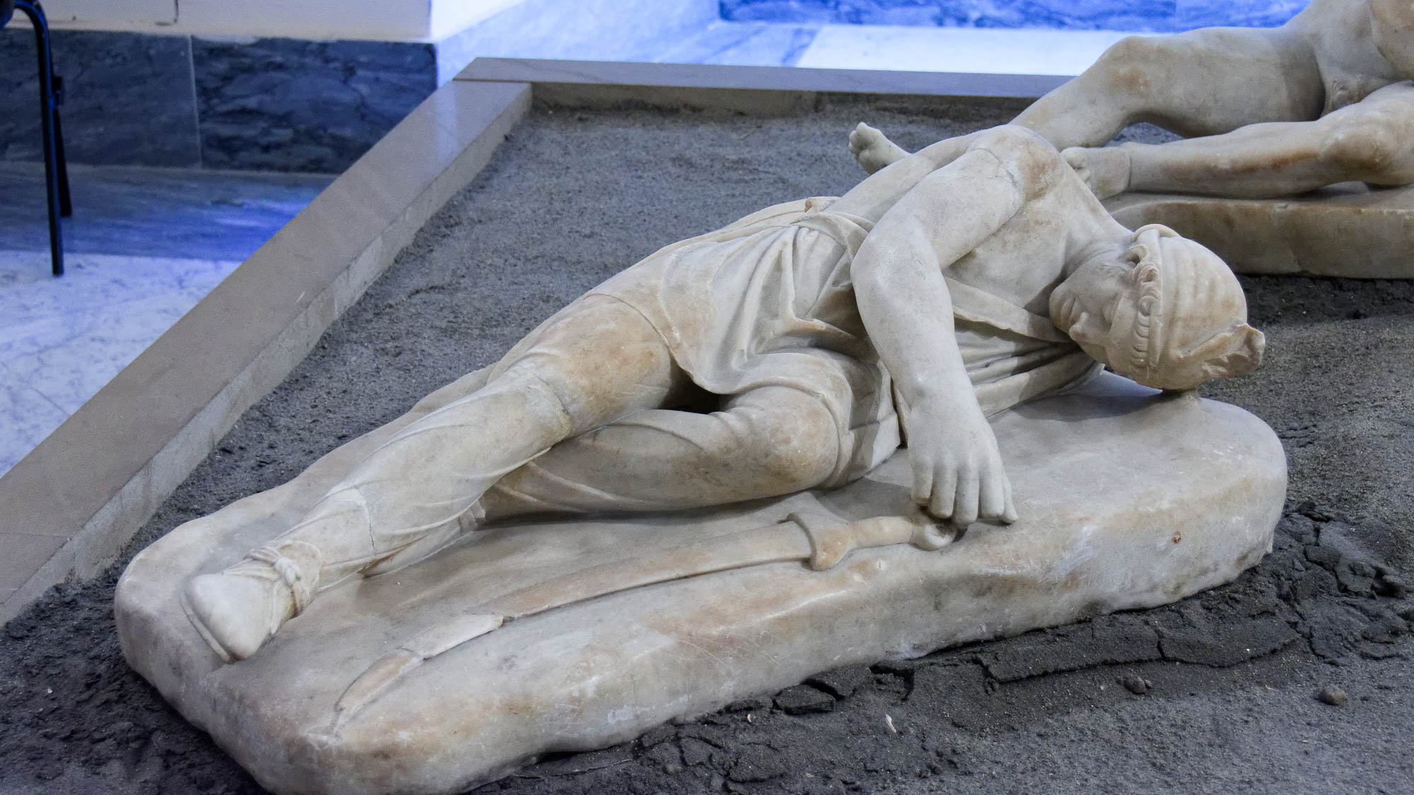
We are struck down, but not destroyed
Dead warrior portrayed in the Small Pergamene Votive Offering, 2nd century AD
4:9
Notes:
This sculpture is thought to be a Roman copy of an original Greek exemplar from the 2nd century BC. It was photographed at the Naples Archaeological Museum.
tb0515171472

Slide 42
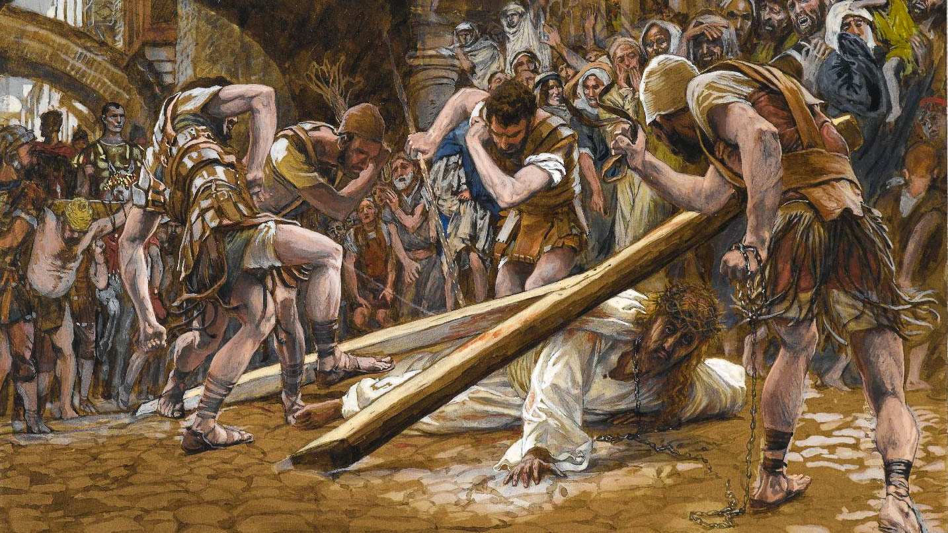
Through this suffering our bodies continue to share in the death of Jesus
Jesus Falls Beneath the Cross, by James Tissot, circa 1899
4:10
Notes:
Paul considers the suffering he experiences, just described in the previous verses, to be a participation in the suffering and death of Jesus. This painting was photographed at the Brooklyn Museum in New York City. This image comes is in the public domain, via the Brooklyn Museum: https://www.brooklynmuseum.org/opencollection/objects/4578.
bmny4578h

Slide 43
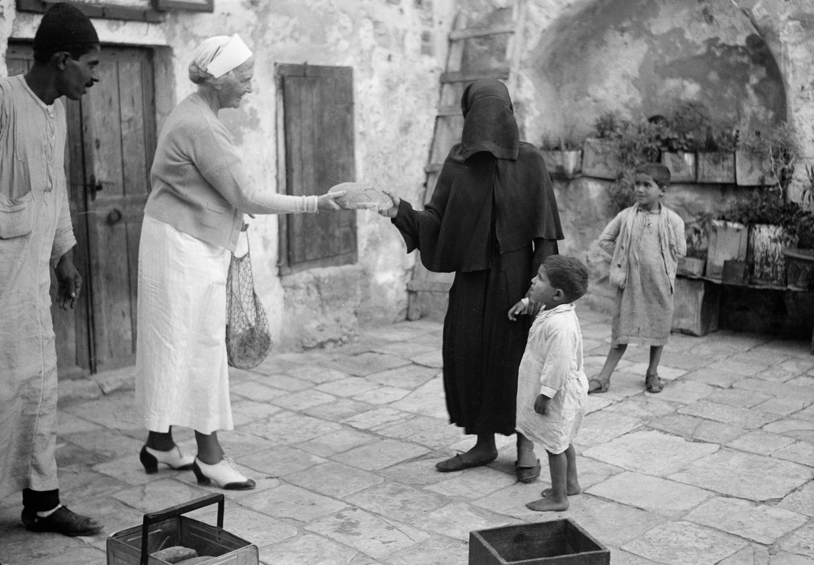
So that the life of Jesus might also be seen in our bodies
Woman giving a bread loaf to a poor Muslim woman and two boys, 1938
4:10
Notes:
Paul’s argument seems to be that the life he and other followers of Jesus live should exhibit aspects of the life of Jesus. One way this might be expressed is by sharing and generosity for those who are poor. This American Colony photograph was taken on October 22, 1938.
mat18872

Slide 44
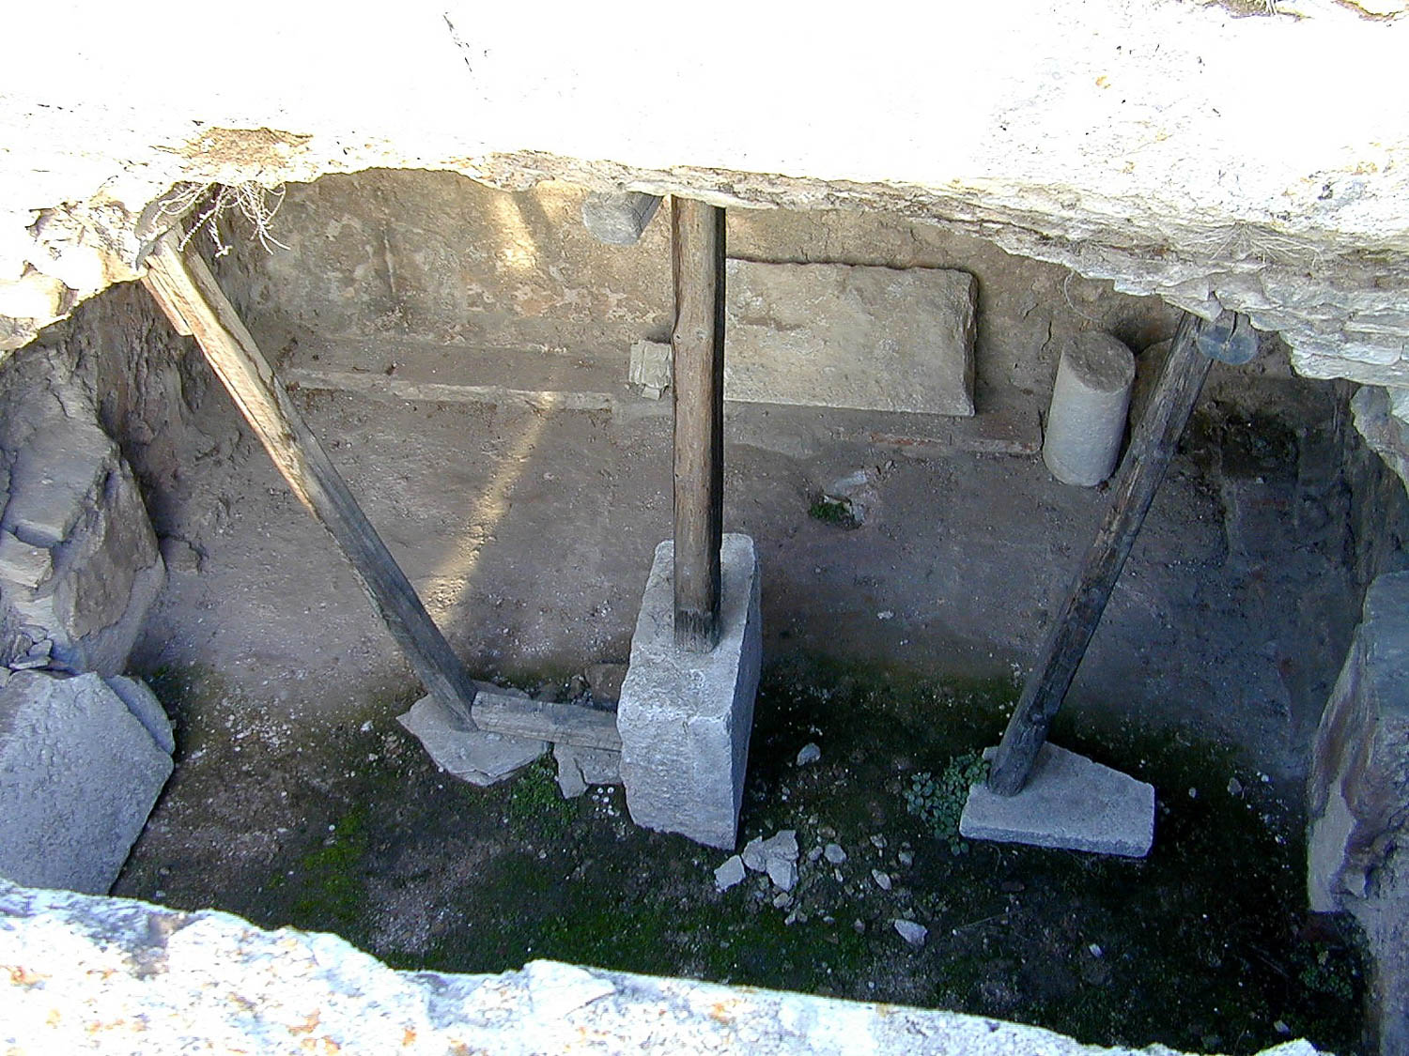
We who live are always being handed over to death for Jesus’s sake
Interior of the traditional prison of Paul at Philippi
4:11
Notes:
Wherever Paul went, he constantly felt the threat of death. At Philippi, he and Silas were savagely beaten and jailed (Acts 16:22ff).
tb011201215

Slide 45
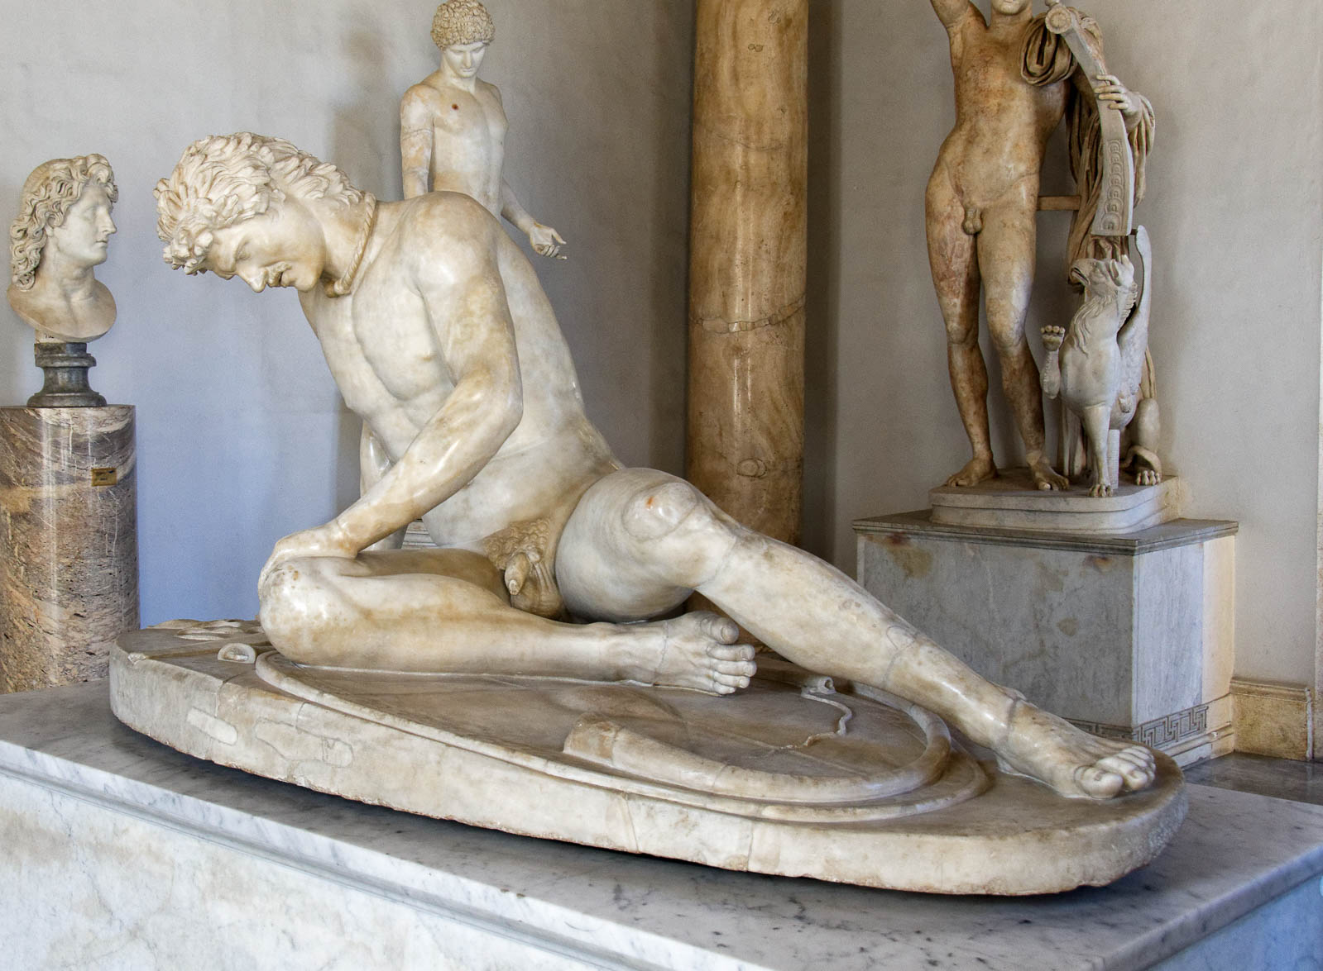

So death works in us
Capitoline Galatian, known as Dying Gaul, from Rome, 1st century BC
4:12
Notes:
Paul considered his life to be worthless for the sake of Christ, dying to self in order to live to Christ (cf. Rom 8:13). This is illustrated here by a marble statue of a wounded and dying man. This sculpture is a copy of a monument erected by the Greek king of Pergamum, Attalus I, circa 230–220 BC. This copy was recovered from the Gardens of Sallust in Rome. It was photographed at the Capitoline Museums in Rome. Removable graphics have been added to avoid causing offense or surprise.
tb0514179916

Slide 46
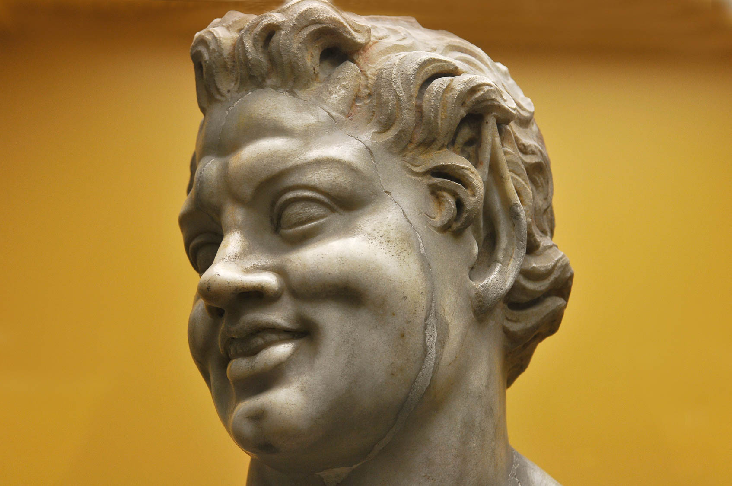
So death works in us, but life works in you
Smiling statue from the Stoa of Attalos, Athens, 2nd century BC
4:12
Notes:
This statue head of a smiling man (the long, pointed ears indicate it was intended to portray a satyr) illustrates the inner joy that Paul taught should come from knowledge that death will be conquered for those who belong to Christ. This statue comes from the Stoa of Attalos, a large covered walkway that was located next to the marketplace (agora) in Athens. This image comes from LBM1948 and is licensed under CC BY-SA 4.0, via Wikimedia Commons: https://commons.wikimedia.org/wiki/File:Atenas,_Estoa_de_%C3%81talo_05.jpg.
wiki04092013130859

Slide 47
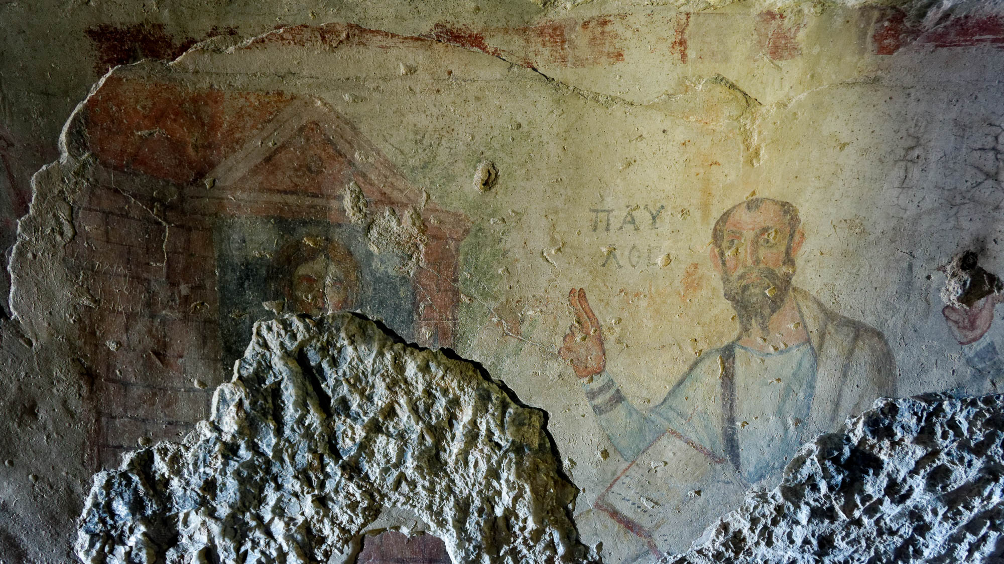
As it is written, “I believed, therefore I spoke,” so also we believe and speak
Painting of Paul from a cave at Ephesus, late 5th or early 6th centuries AD
4:13
Notes:
Paul’s quote comes from Psalm 116:10. The argument he makes is that faith in the message of the gospel is what motivates him to speak, the very thing for which he has suffered. This is one of the earliest known depictions of Paul. This fresco is located in a cave known as the Grotto of Saint Paul in the foothills on the southern side of ancient Ephesus. It depicts the apostle with upraised hand, two fingers extended. This gesture indicates that he is teaching. His name is inscribed beside him, “Paul” (Gk. ΠΑΥΛΟΣ).
tb010317141h

Slide 48
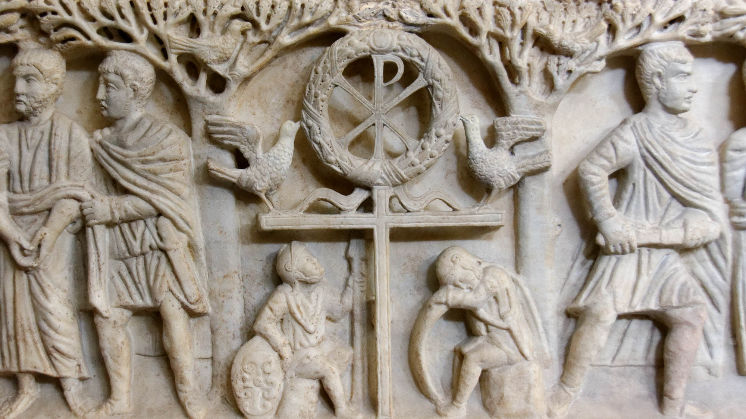
Knowing that He who raised the Lord Jesus will raise us also with Jesus
“Tree Sarcophagus” with a symbol of Christ’s resurrection, from Rome, circa AD 340–350
4:14
Notes:
This relief from the so-called tree sarcophagus was photographed at the Vatican Museums. It depicts two soldiers guarding the tomb of Christ, flanking a highly symbolic group of items related to the resurrection. It originally comes from the hypogeum under the Basilica of St. Paul Outside the Walls in Rome.
tb0512175602h

Slide 49
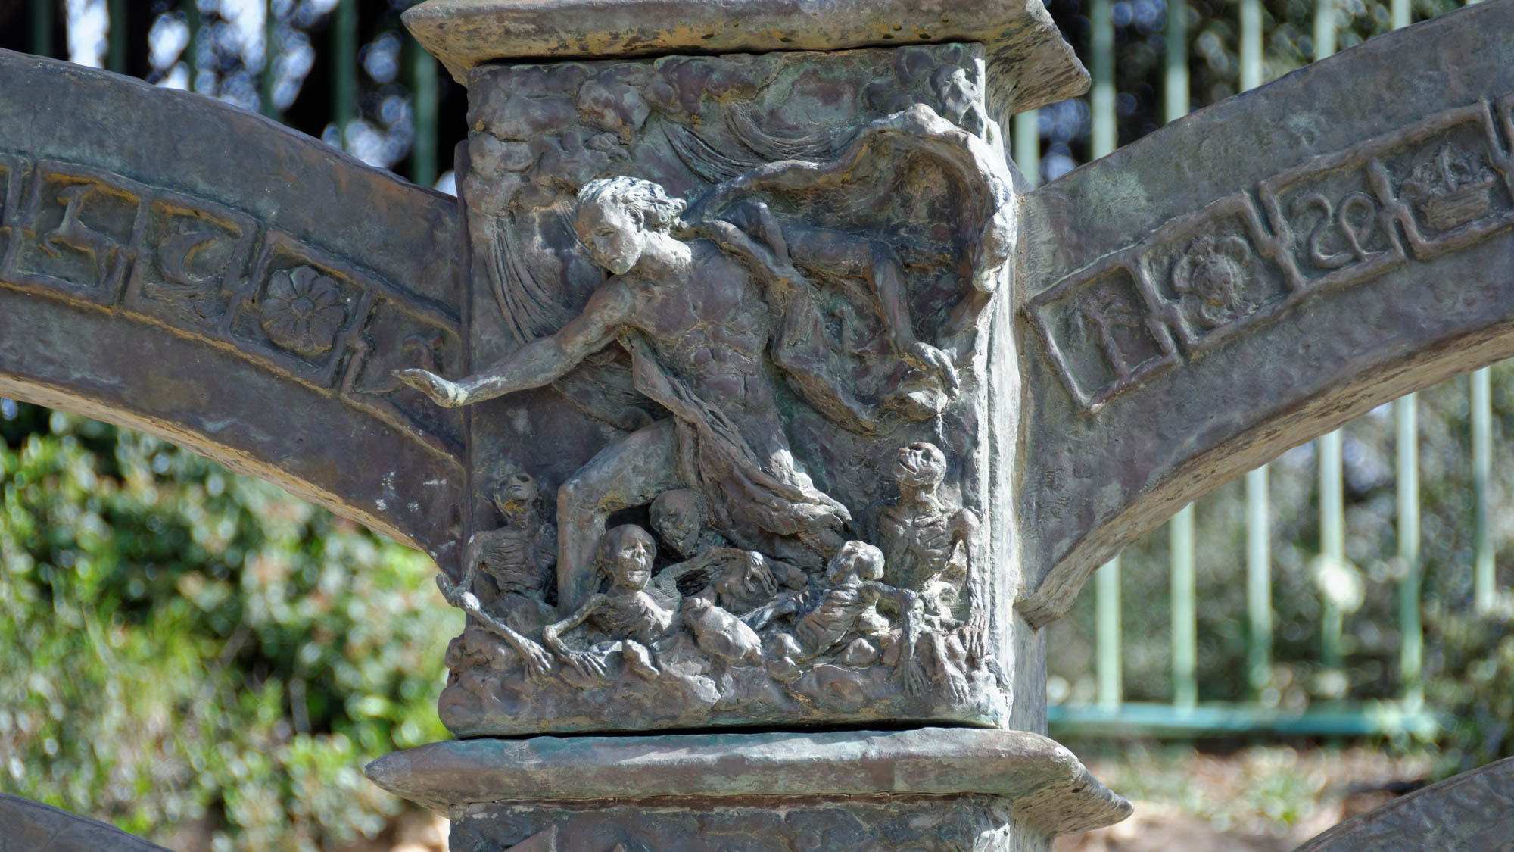
Knowing that He who raised the Lord Jesus will raise us also with Jesus
Depiction of the valley of dry bones on the Knesset menorah
4:14
Notes:
Ezekiel’s vision of the valley of dry bones that are raised to life (Ezek 37:1-14) is a fitting illustration of Paul’s claim that God will raise to life those who belong to Christ. In this modern depiction of Ezekiel’s vision, once lifeless bones spring into joyful life at the command of God.
tb031914034h

Slide 50
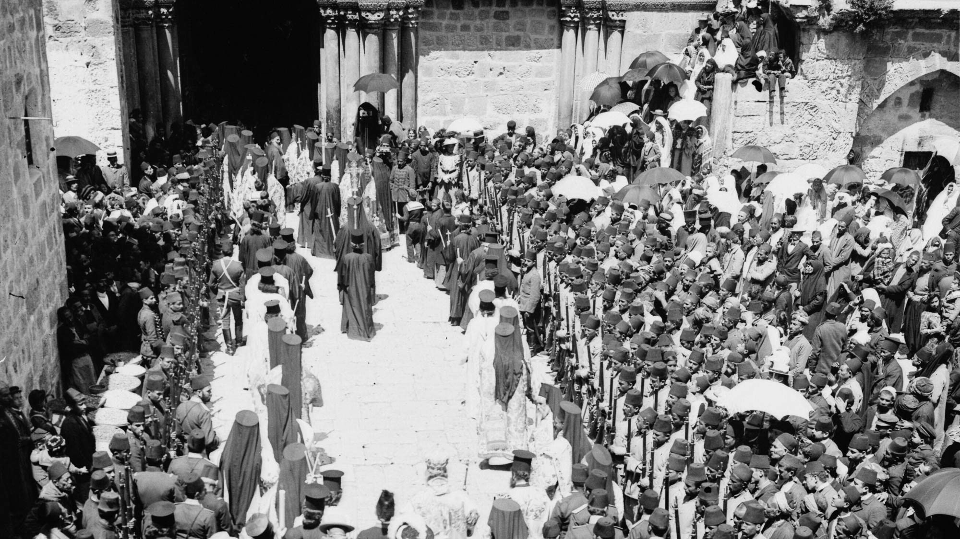
So that the grace which is spreading to more and more people might cause thanksgiving
Easter procession at the Church of the Holy Sepulcher, circa 1910
4:15
Notes:
The spread of the gospel message resulted in peoples from many different regions coming to faith in Christ. The idea is illustrated here by an Easter celebration at the Church of the Holy Sepulcher, which draws people from around the world. This American Colony photo was taken between 1900 and 1920.
mat05016h

Slide 51
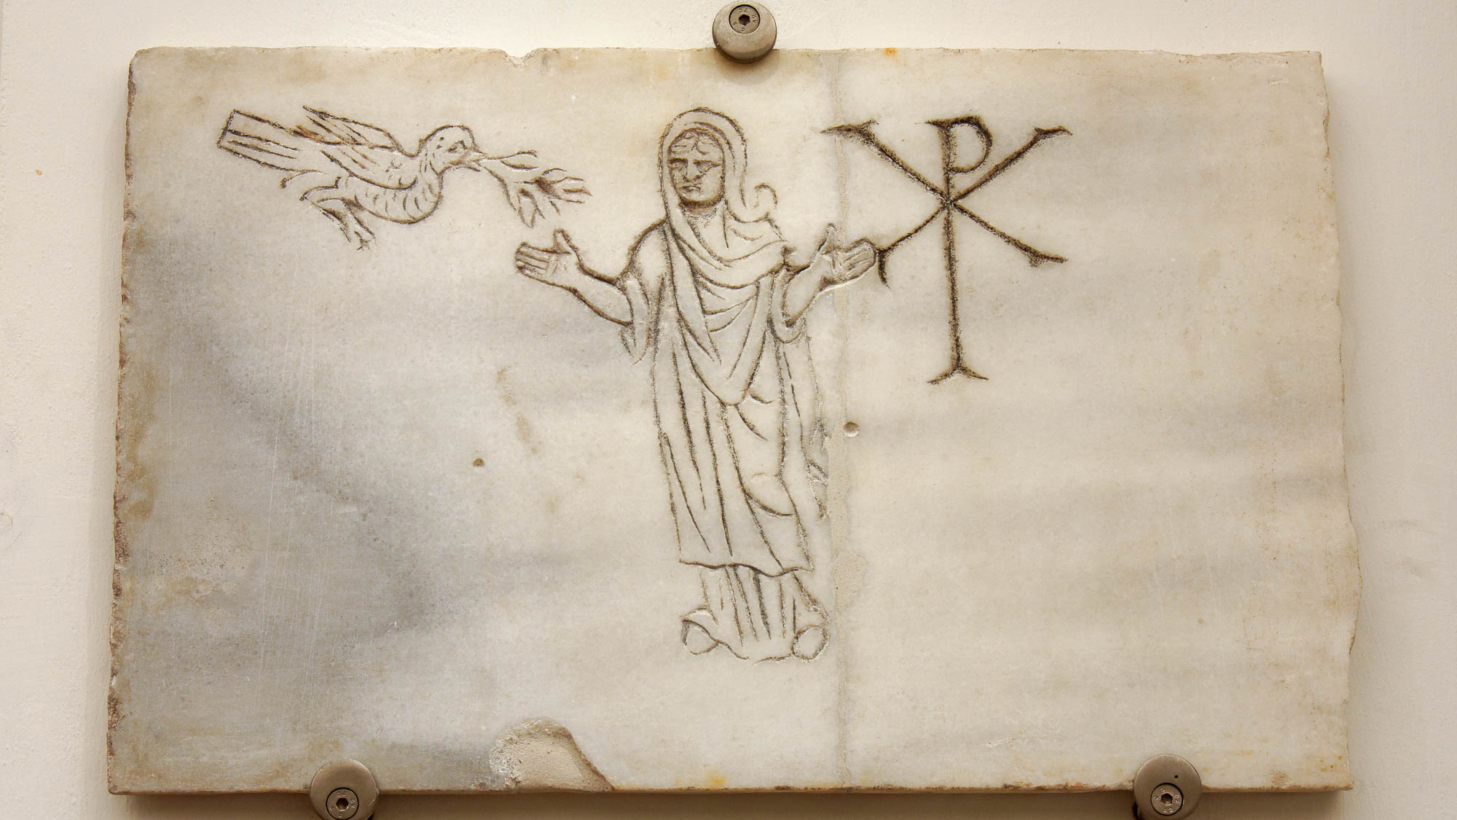
So that the grace which is spreading to more and more people might cause thanksgiving
Relief of a man in prayer, with a dove and the Christogram
4:15
Notes:
Thanksgiving (Gk. eucharistia, εὐχαριστία) is often associated by Paul with prayer (e.g., Eph 1:16; Col 1:3; 1 Tim 2:1; Phlm 1:4). This funerary plaque depicts a man praying, flanked on one side by a dove with an olive branch and on the other by the Christogram. The stance with arms bent at the elbow and hands uplifted was a standard way in Paul’s day to represent a person in prayer. This inscription was photographed at the National Museum of Rome at the Diocletian Baths.
tb0513178395

Slide 52

So that the grace which is spreading to more and more people might cause thanksgiving
Western Greek votive plaque with ritual procession, circa 460 BC
4:15
Notes:
Although the giving of thanks to God is a staple of both the Old and New Testament writers (e.g., Lev 22:29; Ps 136:1-3; John 2:9), it was not an unknown activity in the pagan world. The Greeks and Romans were also accustomed to expressing thanks to their gods. This plaque depicts worshippers bringing various items as gifts to some unknown deity. This artifact was photographed at the Michael C. Carlos Museum at Emory University.
adr1511209467h

Slide 53

Therefore we do not lose heart
Sarcophagus with representation of scenes from the Iliad, circa AD 160
4:16
Notes:
The verb “to lose heart” (Gk. ekkakeō, ἐκκακέω) indicates becoming discouraged to the point of giving up. It is illustrated here by a depiction of two men in mourning, both with their hands to their heads. This relief was photographed at the Ostia Museum.
tb0517172804h

Slide 54

Therefore we do not lose heart
Mosaic depicting the Persians fleeing from Alexander the Great, from Pompeii, 2nd century BC
4:16
Notes:
A well-known example in Paul’s day of someone who lost heart was the Persian king Darius III. He met Alexander the Great in battle several times and fled each time. This mosaic from Pompeii depicts Darius fleeing; both his posture and the look on his face indicate he has lost heart. Although this mosaic dates to the late 2nd century BC (125–120 BC), it is thought to be a copy of an earlier, 4th century BC painting by Philoxenos. It comes from the exedra of the House of the Faun at Pompeii. It was photographed in the Naples Archaeological Museum.
tb0515170671h

Slide 55

Therefore we do not lose heart
Roman soldiers in the hippodrome at Gerasa
4:16
Notes:
The opposite of losing heart is the expression of courage and resolve to stand firm, illustrated here by a group of Roman soldier re-enactors who have taken on a strong defensive posture. The Roman Army and Chariot Experience, pictured here, takes place daily during most of the year at Jerash (Gerasa).
dp041108623

Slide 56

Although our outer man is decaying
Marble head of an old man, possibly the poet Hesiod, Roman period
4:16
Notes:
This bust of an older man illustrates the effect of the accumulated worries and strain that come with the passing of years. This bust is thought to be a copy of an original from about the 2nd century BC. It was photographed at the British Museum.
tb0930199308

Slide 57

Although our outer man is decaying
Old woman wearing a chiton, with an ivy wreath on her head, circa 1st century AD
4:16
Notes:
This marble statue portrays an elderly woman; it is thought to be modeled after an original of the 2nd century BC. It was photographed at the Metropolitan Museum of Art in New York City. This image comes from Marie-Lan Nguyen and is licensed under CC BY 2.5, via Wikimedia Commons: https://commons.wikimedia.org/wiki/File:Old_woman_Met_09.39.jpg.
wiki022520111111623h

Slide 58

Yet our inner man is renewed day by day
Cupid with basket of fruit, Roman period
4:16
Notes:
“Renewal” (Gk. anakainoō, ἀνακαινόω) speaks of spiritual rebirth and youthfulness, illustrated here by a statue of a smiling youth with a basket full of fruit. This statue was photographed at the Vatican Museums.
tb0512176984

Slide 59

Yet our inner man is renewed day by day
Dedicatory inscription commemorating the repairs of Domitian to the temple of Apollo, AD 84
4:16
Notes:
Sometimes building were repaired and renewed. When the Roman emperor Domitian repaired the temple of Apollo, he commissioned this commemorative inscription to mark the event. As the living temple of the living God (2 Cor 6:16), believers are renewed day by day through the indwelling Spirit. This inscription was photographed at the Delphi Museum in Greece.
jc0109152020

Slide 60

Our light momentary affliction produces for us an eternal weight of glory beyond all comparison
Fresco of injured Aeneas treated by the surgeon Japix, from Pompeii, 1st century AD
4:17
Notes:
This fresco shows a surgeon working on a leg wound. It illustrates a different kind of temporary pain that, if successful, produces long life and health. This fresco comes from the House of Siricus at Pompeii; it was photographed at the Naples Archaeological Museum.
tb0515170226h

Slide 61

Our light momentary affliction produces for us an eternal weight of glory beyond all comparison
Bronze lever-scale with weight shaped like woman’s head, from Lyon, Roman period
4:17
Notes:
The word “weight” (Gk. baros, βάρος) refers to something full or heavy, at the high point in a scale of evaluation. The highest weight setting of the scale pictured here would be achieved by sliding the head-shaped counterweight to the far right end of the bar. The weight of glory in Christ stored up for believers would tip the scales against anything else. This scale was photographed at the Lyon Roman-Gallo Museum in France.
tb091719410

Slide 62

Our light momentary affliction produces for us an eternal weight of glory beyond all comparison
Steelyard-type bronze scale, Roman period
4:17
Notes:
This scale was photographed at the Hecht Museum at the University of Haifa.
adr1805229849

Slide 63

Our light momentary affliction produces for us an eternal weight of glory beyond all comparison
Stone at Corinth with 2 Corinthians 4:17
4:17
Notes:
This verse is one of the better-known verses of the epistle. It appears here on a modern inscription at Corinth, written in Greek and in English.
jc0111152363h

Slide 64


We do not look at the things which are seen but at the things which are not seen
Silver and gold coins of Nero, AD 54–68
4:18
Notes:
Paul was not working to obtain the visible the riches of this world, such as the coins pictured here, but was rather working to obtain a heavenly reward. The coin on the left is a silver denarius, and the one on the right is a gold aureus. Nero became emperor partway through Paul’s three years of ministry in Ephesus. These coins are part of the Trinity Evangelical Divinity School Biblical Coin Collection.
Left: adr1410091047bh; right: adr1410091048bh

Slide 65

For the things that are seen are temporal
Bronze jug, from Merida, Roman period
4:18
Notes:
This object was once a beautiful, shiny bronze jug, probably highly polished and of high value. Its temporal nature is clear from the corrosion and deformation it has experienced over the centuries. This jug was photographed at the Merida Archaeological Museum.
tb092519116

Slide 66

For the things that are seen are temporal
Deformed sword and scabbard, from the tomb of Ranquette Road at Nimes, circa 100 BC
4:18
Notes:
This iron sword was once straight and strong, useful for battle, and likely highly prized by some soldier. It is now rusted and deformed, nearly unrecognizable and certainly useless as a fighting weapon. This display was photographed at the Nimes Museum.
tb092019389

Slide 67

But the things that are not seen are eternal
The Plains of Heaven, by John Martin, circa 1851
4:18
Notes:
A third way this verse has been taken is to refer to the revelation of the new heavens and new earth. This oil on canvas painting depicts heaven as a vast sweep of beautiful country with majestic mountains, trees, and lakes where those who have gained that shore frolic and dance. The painting was photographed at Tate Britain, formerly the National Gallery of British Art. This image comes from John Martin and is in the public domain, via Wikimedia Commons: https://commons.wikimedia.org/wiki/File:John_Martin_-_The_Plains_of_Heaven_-_Google_Art_Project.jpg.
wiki0219201123592248h

Slide 68

More than 800 slides in PowerPoint format. Available now from BiblePlaces.com.
Notes:
This is a free sample of the 2 Corinthians 4 presentation from the Photo Companion to the Bible. To purchase the full volume, visit https://www.bibleplaces.com/2corinthians/
The Photo Companion to the Bible is an image-rich resource for Bible students, teachers, and researchers. Just as a librarian stocks the shelves with as many relevant materials as possible, so we have tried to provide a broad selection of images. Our goal is that you will find in this “library” whatever it is you are looking for.
Credits: The primary creators of this presentation are Dr. Kris Udd, Dr. Christian Locatell, Dr. Steven D. Anderson, and Dr. Todd Bolen. The photographs have an individual file code which usually includes the initials of the photographer. Other images have additional credit or source information.
Updates: We plan to update this collection as we are able. We welcome your suggestions for improving this resource (photocompanion@bibleplaces.com). Purchasers of the 2 Corinthians volume are provided free, lifetime updates to the volume.
Copyright: This photo collection is protected by copyright law and may not be distributed without written permission from BiblePlaces.com. Slide notes should be treated as any other copyrighted written material, with credit given when quoting from these notes.
For more information, see our complete “Introduction to the Photo Companion to the Bible” online at http://www.BiblePlaces.com/Intro-Photo-Companion-Bible/. Here you will find more information about photo selection, explanatory notes, Bible translation, credit information, and copyright allowances.

