Slide 1
2 Samuel 2
Notes:
This is a free sample of the 2 Samuel 2 presentation from the Photo Companion to the Bible. To purchase the full volume, visit https://www.bibleplaces.com/2samuel/
The Photo Companion to the Bible is an image-rich resource for Bible students, teachers, and researchers. Just as a librarian stocks the shelves with as many relevant materials as possible, so we have tried to provide a broad selection of images. Our goal is that you will find in this “library” whatever it is you are looking for.
Credits: The primary creators of this presentation are Chris McKinny, Kris Udd, and Todd Bolen. The photographs have an individual file code which usually includes the initials of the photographer. Other images have additional credit or source information.
Updates: We plan to update this collection as we are able. We welcome your suggestions for improving this resource (photocompanion@bibleplaces.com). Purchasers of the 2 Samuel volume are provided free, lifetime updates to the collection.
Copyright: This photo collection is protected by copyright law and may not be distributed without written permission from BiblePlaces.com. Slide notes should be treated as any other copyrighted written material, with credit given when quoting from these notes.
For more information, see our complete “Introduction to the Photo Companion to the Bible” online at http://www.BiblePlaces.com/Intro-Photo-Companion-Bible/. Here you will find more information about photo selection, explanatory notes, Bible translation, credit information, and copyright allowances.

Slide 2
2 Samuel 2
This is a free sample of the 2 Samuel 2 presentation from the Photo Companion to the Bible. To purchase the full volume, visit https://www.bibleplaces.com/2samuel/ The Photo Companion to the Bible is an image-rich resource for Bible students, teachers, and researchers. Just as a librarian stocks the shelves with as many relevant materials as possible, so we have tried to provide a broad selection of images. Our goal is that you will find in this “library” whatever it is you are looking for. For more details (for this and every slide), see the Notes section below.
Notes:
This is a free sample of the 2 Samuel 2 presentation from the Photo Companion to the Bible. To purchase the full volume, visit https://www.bibleplaces.com/2samuel/
The Photo Companion to the Bible is an image-rich resource for Bible students, teachers, and researchers. Just as a librarian stocks the shelves with as many relevant materials as possible, so we have tried to provide a broad selection of images. Our goal is that you will find in this “library” whatever it is you are looking for.
Credits: The primary creators of this presentation are Chris McKinny, Kris Udd, and Todd Bolen. The photographs have an individual file code which usually includes the initials of the photographer. Other images have additional credit or source information.
Updates: We plan to update this collection as we are able. We welcome your suggestions for improving this resource (photocompanion@bibleplaces.com). Purchasers of the 2 Samuel volume are provided free, lifetime updates to the collection.
Copyright: This photo collection is protected by copyright law and may not be distributed without written permission from BiblePlaces.com. Slide notes should be treated as any other copyrighted written material, with credit given when quoting from these notes.
For more information, see our complete “Introduction to the Photo Companion to the Bible” online at http://www.BiblePlaces.com/Intro-Photo-Companion-Bible/. Here you will find more information about photo selection, explanatory notes, Bible translation, credit information, and copyright allowances.

Slide 3
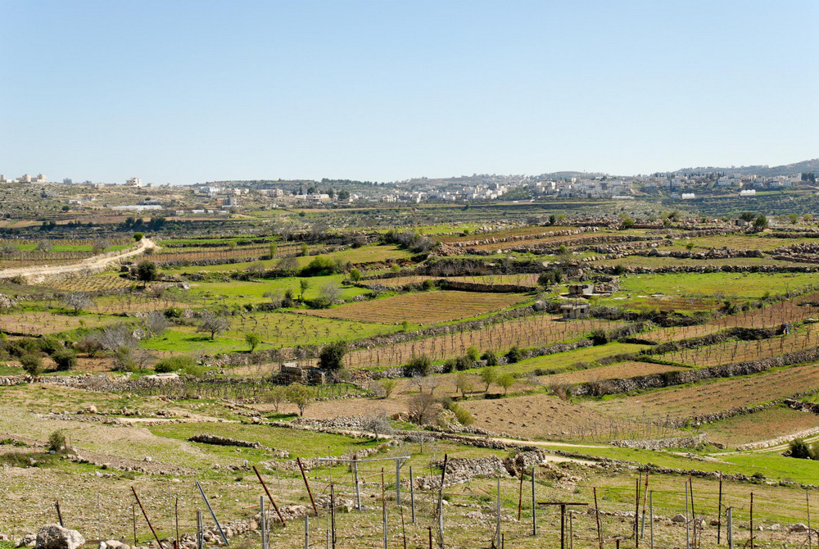
Then David inquired of Yahweh, saying, “Shall I go up into any of the cities of Judah?”
Judean hills and vineyards near Hebron
2:1
Notes:
At this time David and his men were still living in Ziklag (2 Sam 1:1), a city given to him by Achish the king of Gath (1 Sam 27:6). The bulk of the territory inhabited by the tribe of Judah was to the east and north of Ziklag, in the hills of Judah. From Ziklag, David literally would have had to go “up” to reach the heartland, including his hometown of Bethlehem.
tb030407761

Slide 4
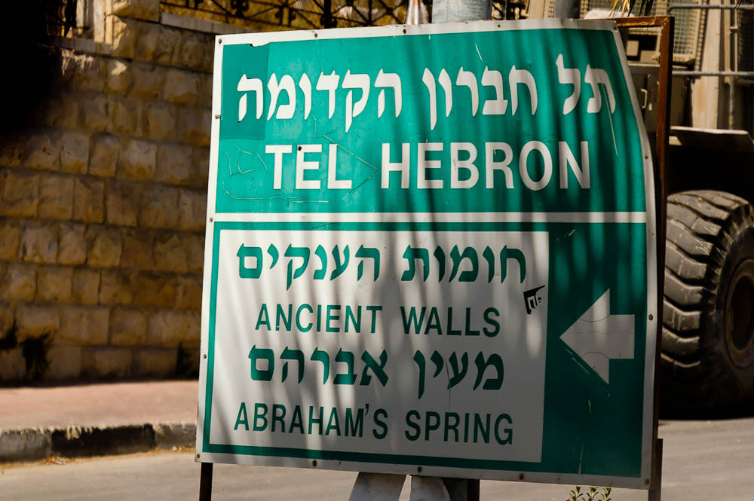
And David said, “Where shall I go up?” And He said, “To Hebron”
“Tel Hebron” sign
2:1
Notes:
This sign in the modern city of Hebron points tourists to some of the major sites in the area. Because of the political situation, few tourists have visited Hebron for many decades.
tb092204937

Slide 5
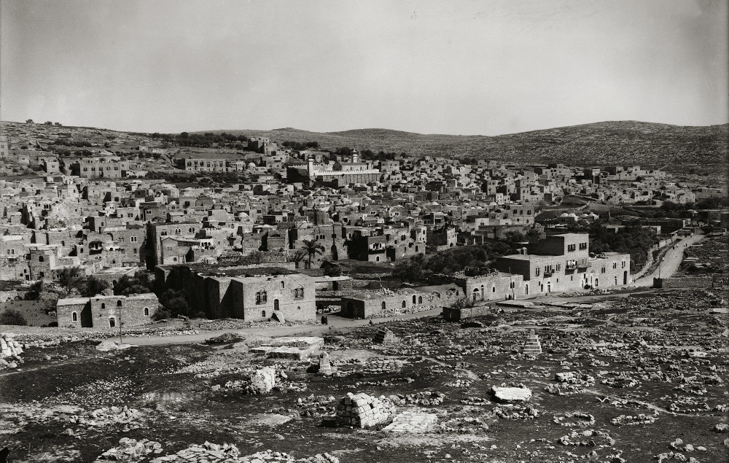
And David said, “Where shall I go up?” And He said, “To Hebron”
Hebron (from the west)
2:1
Notes:
Hebron was an ideal location for David to live, given its significance within the tribe of Judah. This importance went back to patriarchal days, when Abraham purchased a burial plot for his wife (Gen 23:7-19). Later he and some of his descendants were buried in the same tomb (Gen 25:8-10; 50:12-14). The largest feature in the center distance of this photo is a monumental structure built by King Herod in the 1st century BC to honor the tombs of the patriarchs. This American Colony photograph was taken between 1898 and 1946.
mat05912

Slide 6
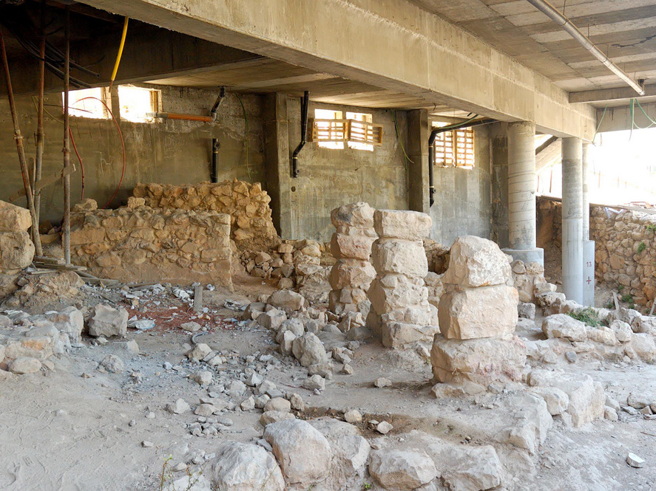
And David said, “Where shall I go up?” And He said, “To Hebron”
Israelite four-room house under Beit Menachem at Tell Rumeida in Hebron
2:1
Notes:
Although the floor-plan is difficult to make out from this photo, the remains shown here are from an Israelite four-room house. This architectural plan is typical of the Israelites during the Iron Age, and hardly found elsewhere (Faust 2006: 71–84).
Reference:
Faust, Avraham
2006 Israel’s Ethnogenesis, London: Routledge.
tb092204944

Slide 7
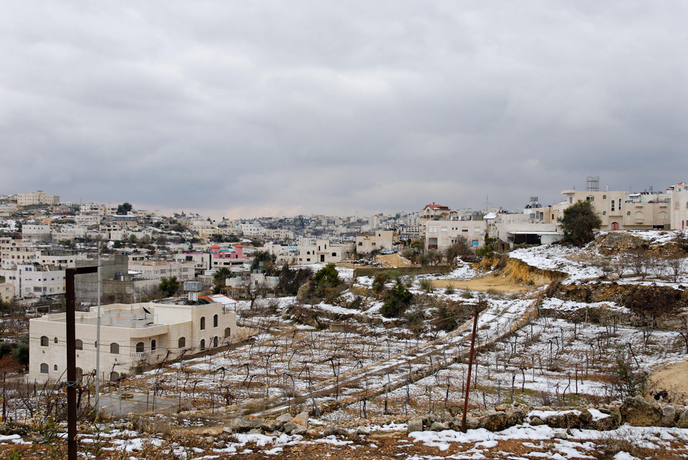
And David said, “Where shall I go up?” And He said, “To Hebron”
Hebron area with snow (from the north)
2:1
Notes:
Hebron has long been a strategic city in the hill country of Israel because it is situated on the southern end of the ridge route, controlling traffic coming from the south. Hebron is one of the highest cities in Israel’s hill country, and this photograph was taken one December after a recent snowfall.
tb122906179

Slide 8
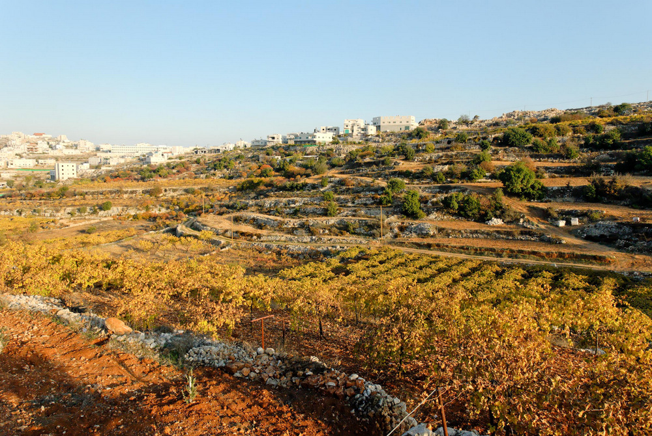
And David said, “Where shall I go up?” And He said, “To Hebron”
Vineyards and a terraced hillside near Hebron
2:1
Notes:
The Hebron area is very well suited for vineyards and olive groves, as well as livestock. In antiquity, wine and olive oil were produced in such abundance that they were considered something of a cash crop. Perhaps the most lucrative market was Egypt, where neither grapes nor olives thrive. These vineyards recall the visit of the twelve spies, as well as Caleb’s request to live in this desirable area (Num 13; Josh 14). When the Lord directed David to Hebron, he was directing him to an agriculturally productive area, though it was only to be temporary.
tb111706185

Slide 9
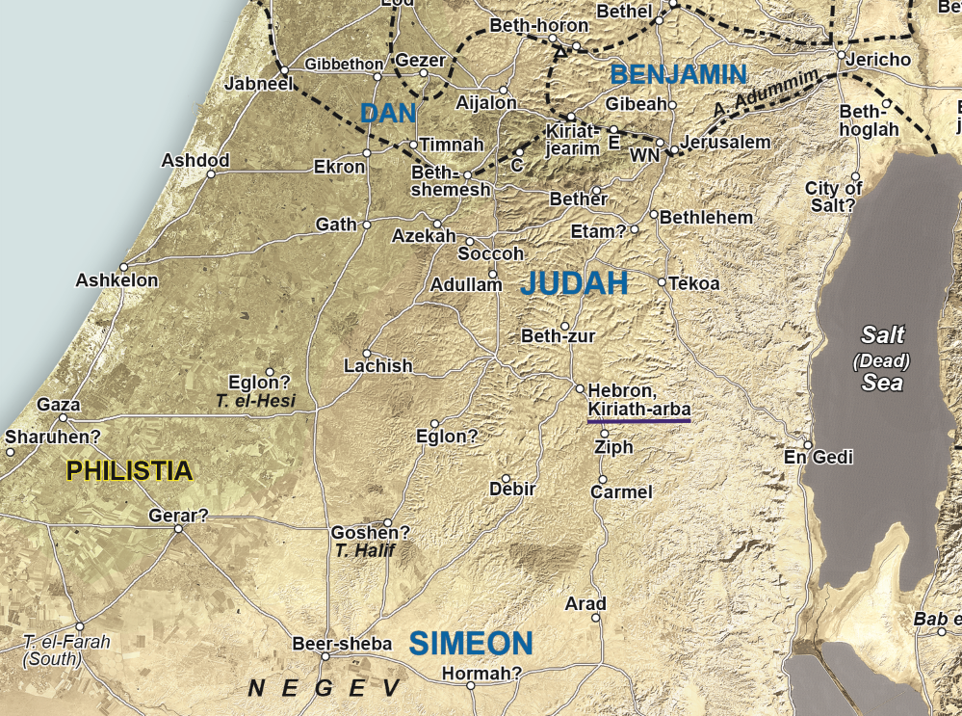
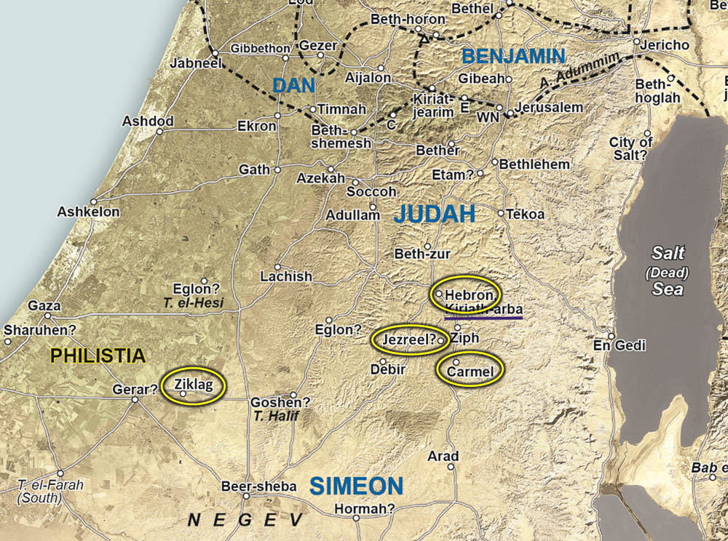
David went and his two wives . . . Ahinoam of Jezreel and Abigail the wife of Nabal the Carmelite
Jezreel?
Ziklag
Map of Philistia and the territory of Judah
2:2
Notes:
This map shows the relative locations of David’s temporary home at Ziklag, the hometowns of his two wives, and the location of Hebron, the city that was to become his home and capital city for the next seven years (cf. 2 Sam 2:11). Ahinoam is probably from Jezreel of Judah and not the northern more prominent Jezreel (cf. 2 Kgs 9). Jezreel of Judah is mentioned several other times in the Bible (1 Sam 25:43; 27:2; 30:5; 2 Sam. 3:2; 1 Chr 3:1, cf. Onom 108.4, 8) and may be located at Khirbet el-Kufeir near Juttah (Yatta), which has remains from throughout the Iron II (circa 1000–586 BC). Carmel (hometown of Nabal and Abigail) is located at Khirbet Karmil, which was inhabited during the Iron II. These marriages indicate close ties between David and the Judahite heartland near Hebron. This map adapted from a detail of map 4-1 from the Satellite Bible Atlas, by William Schlegel. Used by permission. An editable version is included behind this graphic for those who may wish to change portions of it.

Slide 10
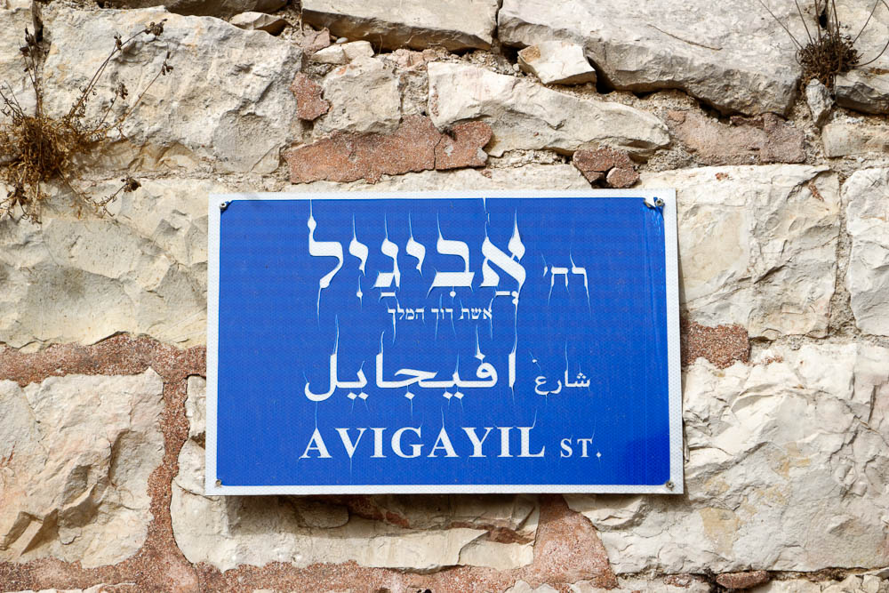
David went and his two wives . . . Ahinoam of Jezreel and Abigail the wife of Nabal the Carmelite
“Abigail Street” sign in Jerusalem
2:2
Notes:
David’s wife is honored today by a street named after her in the Abu Tor neighborhood of Jerusalem, south of the Old City. The sign is written in Hebrew (top), Arabic (middle), and English. Below Abigail’s name in Hebrew is written “wife of King David.”
lbd102318720

Slide 11
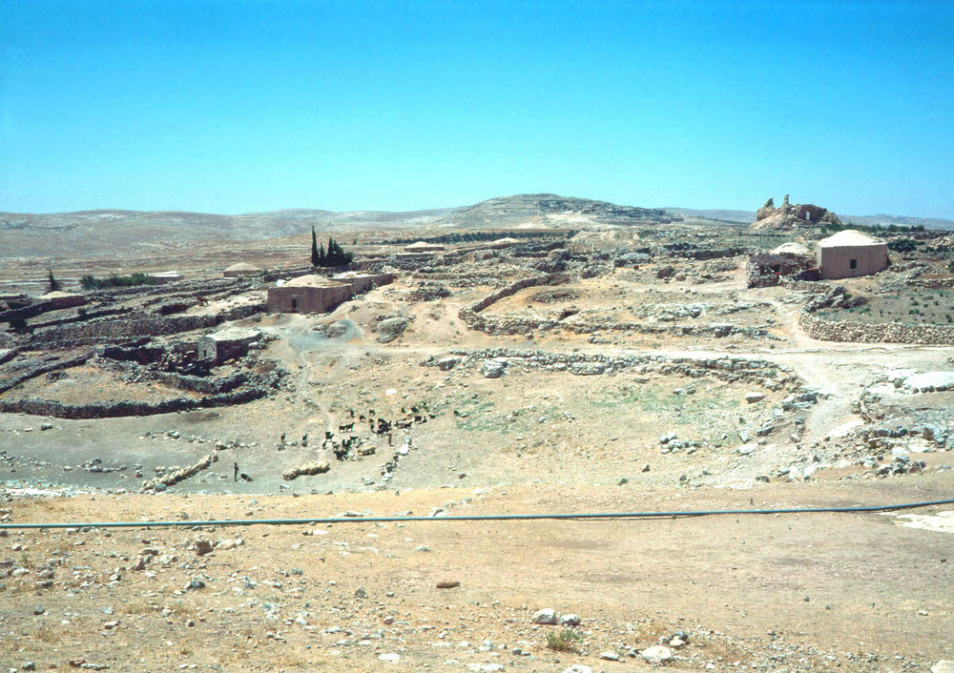
David went and his two wives . . . Ahinoam of Jezreel and Abigail the wife of Nabal the Carmelite
Carmel, with a view to Maon (from the north)
2:2
Notes:
David’s wife Abigail was from Carmel, the location of which is preserved today by its Arabic name. Here Nabal had a sheep-sheering business while apparently living in Maon (1 Sam 25:2). Nabal is known as the Carmelite because this is where he conducted his profitable occupation. Saul had previously erected a victory stele in Carmel, after defeating the Amalekites (1 Sam 15:12).
dad2153

Slide 12
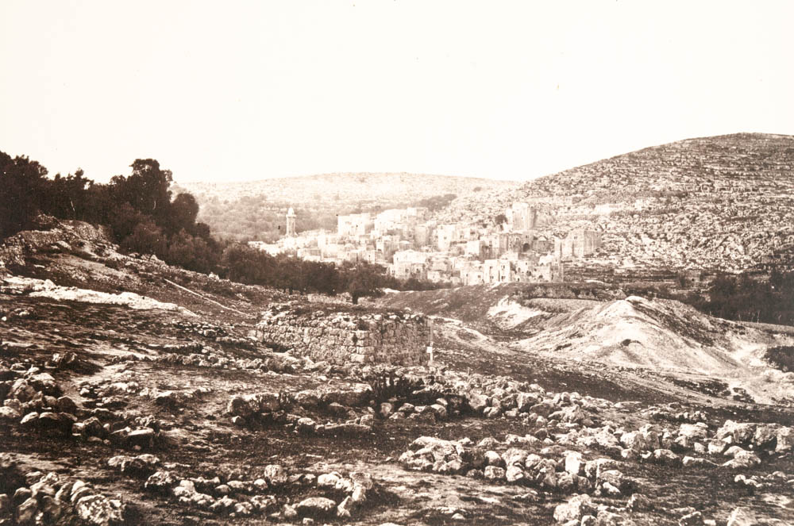
Then David and his men and their households lived in the cities of Hebron
Hebron (from the northwest)
2:3
Notes:
The “cities of Hebron” is a reference to the villages surrounding the larger city; such towns were considered to fall under the protection of the larger city and to be, in a sense, daughter cities (cf. Josh 15:41-47, etc.).
This photograph was taken by Francis Firth in about 1862. Public domain, from The New York Public Library, https://digitalcollections.nypl.org/items/510d47d9-60be-a3d9-e040-e00a18064a99
nypl85257

Slide 13
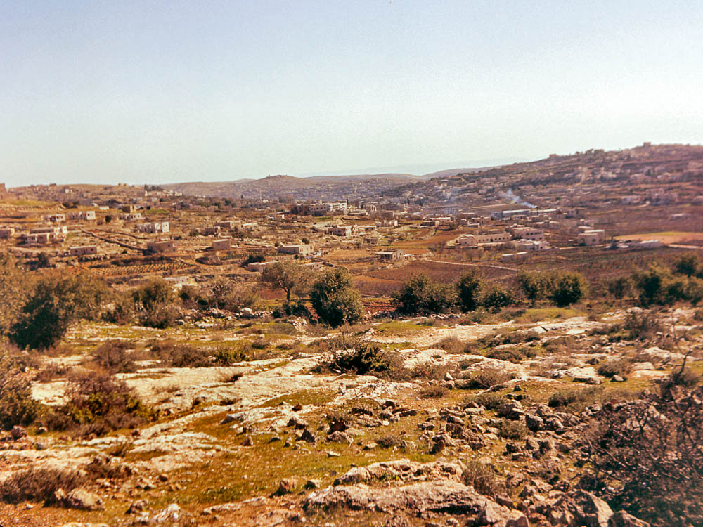
Then David and his men and their households lived in the cities of Hebron
The area of Hebron, looking to Jebel Jalis (from the northwest)
2:3
Notes:
This photo shows the terrain that is typical of the Hebron area, in which David’s men would have settled. With David’s entourage numbering 600 men or more, plus women and children, it is not surprising that they could not all reside in the city of Hebron. This photograph was taken by David Bivin in 1966.
db6601060209

Slide 14
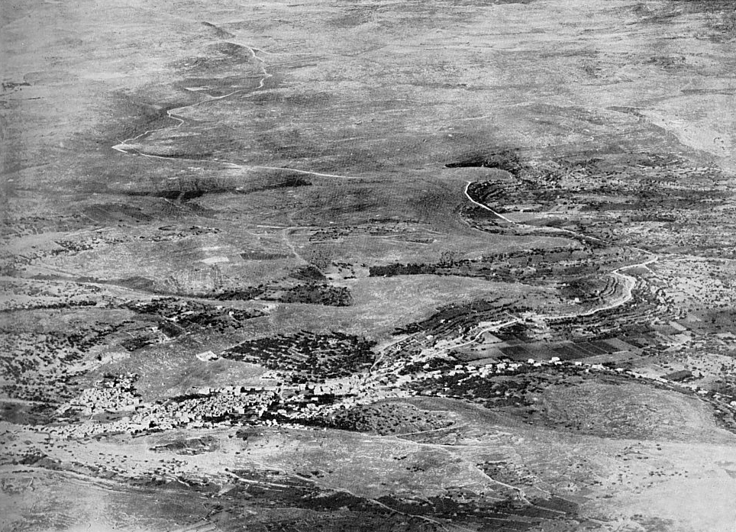
Then David and his men and their households lived in the cities of Hebron
Area around Hebron (aerial view from the northeast)
2:3
Notes:
One of the cities belonging to Hebron was likely Humtah (Josh 15:54), which may be identified with the ruins of Tell el-Hadab, seen near the top right of this photo. Surveys at the site revealed significant occupation from throughout the Iron Age II. Another is Zior (Josh 15:54), preserved in Si’ir (not pictured), which has remains from throughout the Iron II. Si’ir is located 4.5 miles (7 km) northeast of Hebron. Hebron itself is located at er-Rumeida, which is the largest tell in the southern hill country. This image comes from Gustaf Dalman, Hundert deutsche Fliegerbilder aus Palaestina (1925); an English edition is forthcoming from BiblePlaces.com. This photograph was taken in the morning in approximately 1918. The next slide includes labels for Hebron and Humtah.
gd0036

Slide 15
Then David and his men and their households lived in the cities of Hebron
Humtah?
(el-Hadab)
Supposed location of Dura-Adoraim
Road to Beersheba at Wadi Sel
ed-Dilbe
Road to
Beer Sheba
Vineyards
Hebron
(er-Rumeida)
Machpelah
Area around Hebron (aerial view from the northeast)
2:3
Notes:
One of the cities belonging to Hebron was likely Humtah (Josh 15:54), which may be identified with the ruins of Tell el-Hadab, seen near the top right of this photo. Surveys at the site revealed significant occupation from throughout the Iron Age II. Another is Zior (Josh 15:54), preserved in Si’ir (not pictured), which has remains from throughout the Iron II. Si’ir is located 4.5 miles (7 km) northeast of Hebron. Hebron itself is located at er-Rumeida, which is the largest tell in the southern hill country. This image comes from Gustaf Dalman, Hundert deutsche Fliegerbilder aus Palaestina (1925); an English edition is forthcoming from BiblePlaces.com. This photograph was taken in the morning in approximately 1918.
gd0036

Slide 16
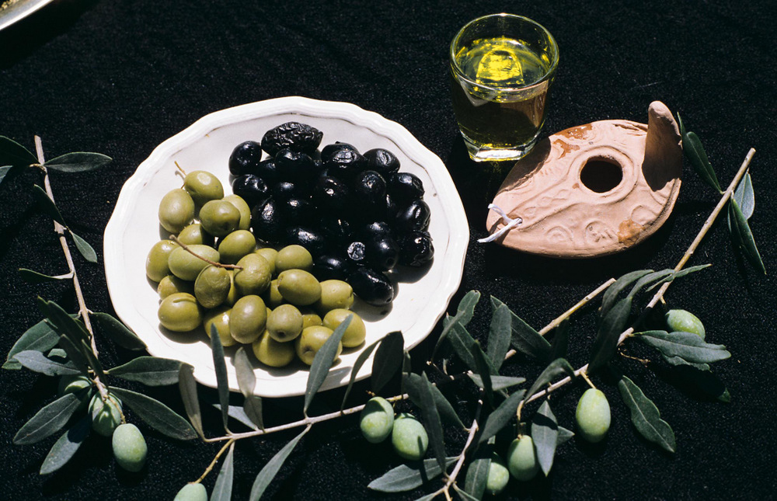
And the men of Judah came, and there they anointed David king over the house of Judah
Display of olives and olive oil at Moza Illit
2:4
Notes:
Kings of Israel were anointed with olive oil, as seen in the cup in this display. The oil was poured from a horn (cf. 1 Sam 16:1; see slides below).
gs080094c26

Slide 17
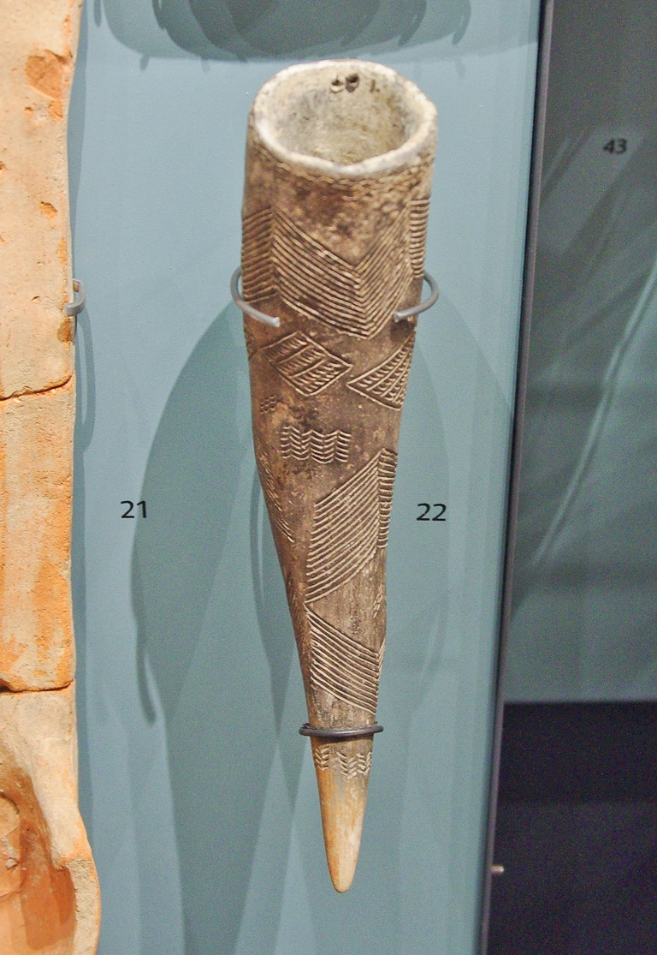
And the men of Judah came, and there they anointed David king over the house of Judah
Polished horn with incised decoration, from Cyprus, 2600–2000 BC
2:4
Notes:
The horn (Heb. qeren, קֶרֶן, cf. 1 Sam 16:1) would have been an animal horn that had been cleaned, hollowed out, and affixed with a stopper. Such a horn could have come from a sheep, goat, cow, or a wild animal. It is uncertain why horns were used in this way, although perhaps the fact that they were impervious and difficult to break were factors. This artifact was photographed at the Ashmolean Museum at the University of Oxford.
adr1305240961

Slide 18
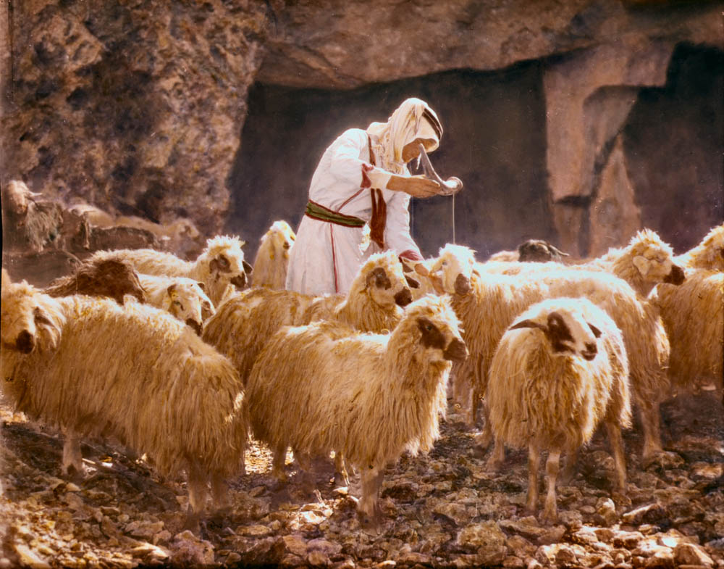
And the men of Judah came, and there they anointed David king over the house of Judah
Shepherd anointing sheep with oil
2:4
Notes:
This American Colony photograph was taken between 1900 and 1920 and later colorized.
mat14932

Slide 19
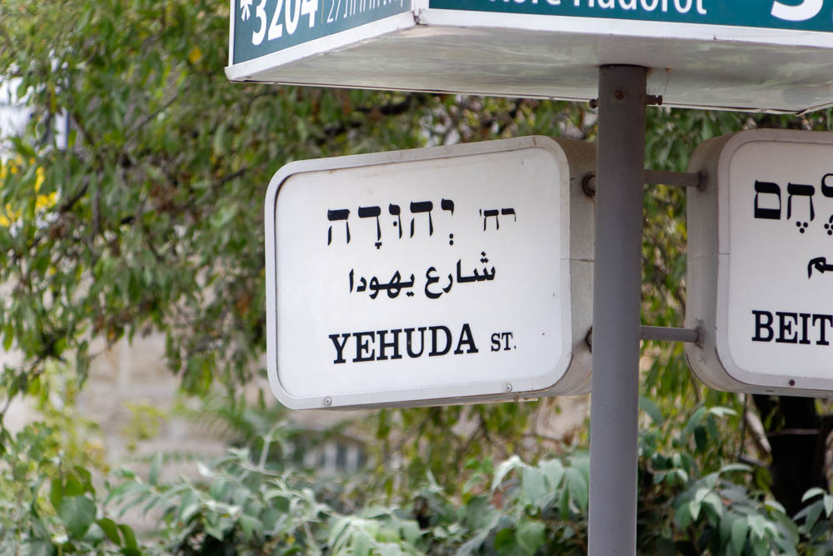
And the men of Judah came, and there they anointed David king over the house of Judah
“Judah Street” sign in Jerusalem
2:4
Notes:
David was first anointed king by Samuel (1 Sam 16); the context implies that Samuel anointed him king over all Israel (cf. 1 Sam 16:1). In 1 Samuel 2:4, David is anointed by the men of Judah as the king of Judah only. It would be another seven and a half years before David was anointed for a third time, as king over all Israel (2 Sam 5:1-3). Incidentally, 2 Samuel 5:4-5 records that David was 30 years old when he was anointed king of Judah at Hebron. “Judah Street” is located in the Baka neighborhood, south of the Old City.
lbd102218486

Slide 20
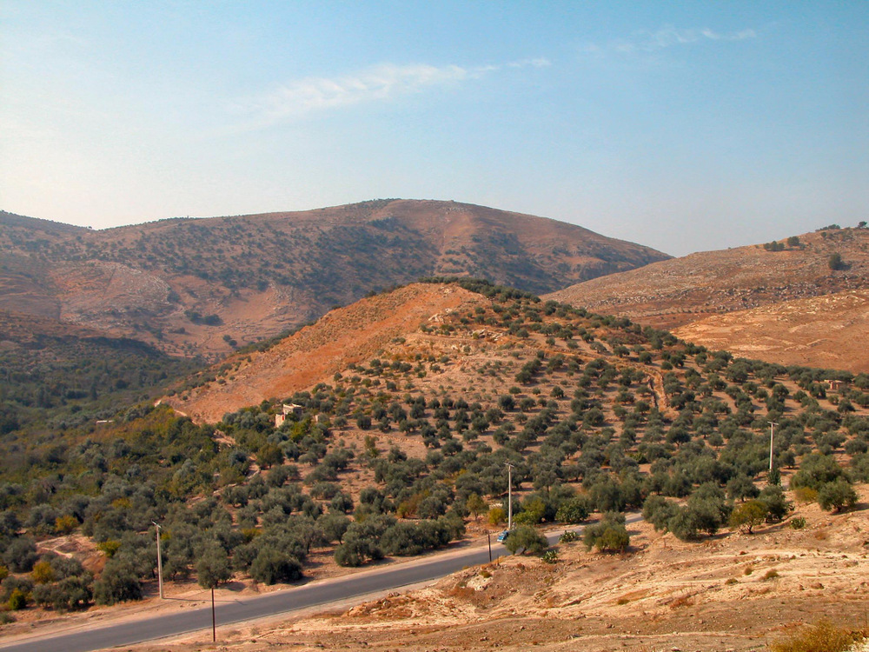
Then they told David, “The men of Jabesh-gilead were the ones that buried Saul”
Tell Maqlub, a possible location of Jabesh-gilead (from the northeast)
2:4
Notes:
Jabesh-gilead is most likely to be identified with Tell Maqlub. Eusebius locates Jabesh-gilead in the mountains near the 6th milestone from Pella on the road to Gerasa. This description fits with Tell Maqlub. A surface survey of the site revealed Iron Age pottery; it has not been excavated.
tb110703083

Slide 21
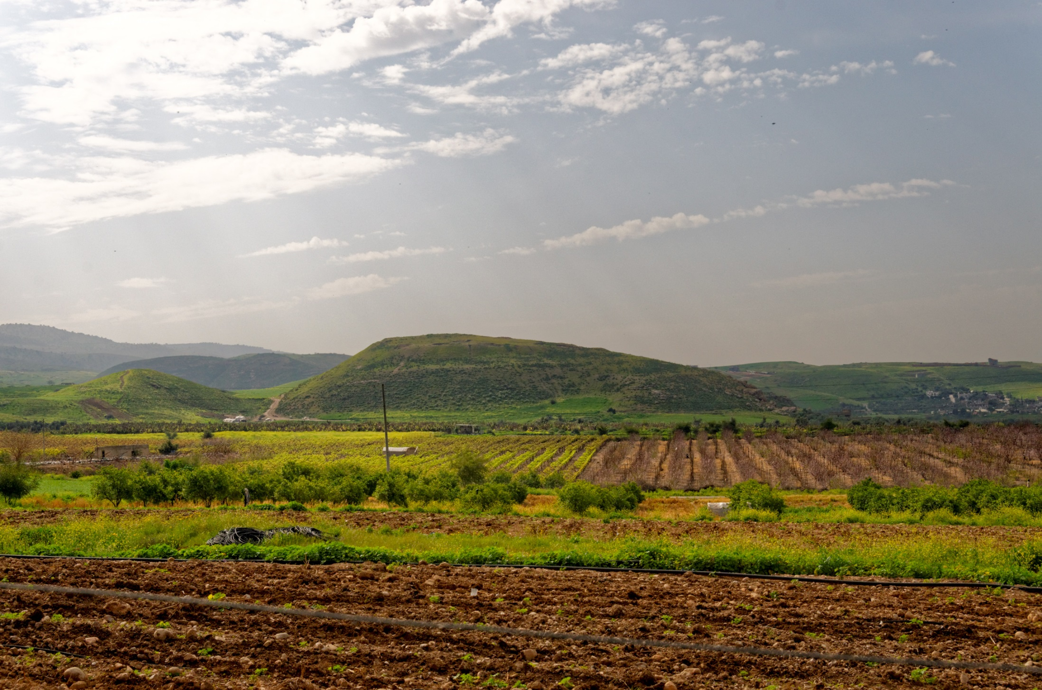
Then they told David, “The men of Jabesh-gilead were the ones that buried Saul”
Tell Abu el-Kharaz, a possible location of Jabesh-gilead (from the north)
2:4
Notes:
Another candidate for Jabesh-gilead is Tell Abu el-Kharaz. The site’s name means “the mound of the father of beads.” Nelson Glueck first proposed this location in 1951. The site is 30 acres (12 ha) in size and was settled in the Bronze (3150–1200 BC) and Iron (1200–586 BC) Ages. The site has a commanding view over the Central Jordan Valley, and it is located 9 miles (15 km) southeast of Beth-shean.
tb030915520

Slide 22
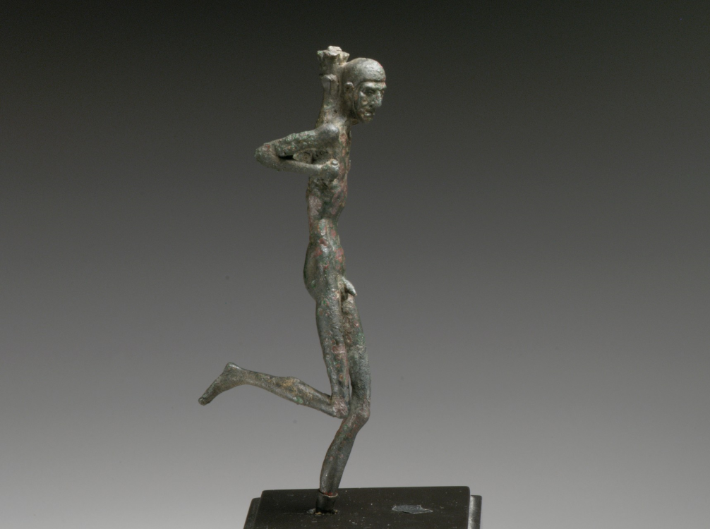
Then David sent messengers to the men of Jabesh-gilead
Greek statuette of a runner, circa 100 BC
2:5
Notes:
The distance from Hebron to Jabesh-gilead was approximately 85 miles (135 km). Messengers typically travelled on foot (cf. 2 Sam 18:19-23); this group was travelling such a distance that they may have also taken pack animals with food and supplies. This image comes from The Metropolitan Museum of Art and is in the public domain. Source: https://www.metmuseum.org/art/collection/search/255406. A removable graphic has been added to avoid causing surprise or offense.
met255406

Slide 23
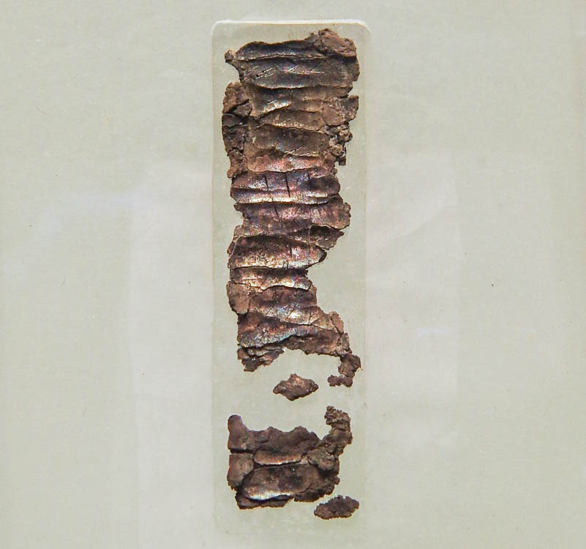
He said to them, “May you be blessed by Yahweh“
Silver amulet with priestly blessing from Ketef Hinnom in Jerusalem, circa 600 BC
2:5
Notes:
The amulet shown here is inscribed with the text of the priestly blessing recorded in Numbers 6:24-26, and it is the oldest known portion of Scripture found to date. It originally had the phrase “May Yahweh bless you” (יברכך יהוה), thus preserving both the verb “to bless” and the divine name. However, some of the letters along the edges have eroded away. It was discovered in a tomb at the site of Ketef Hinnom on the western slope of the Hinnom Valley in Jerusalem. This artifact was photographed in the Israel Museum. The next slide includes highlights for the relevant words.
adr1806199661c

Slide 24
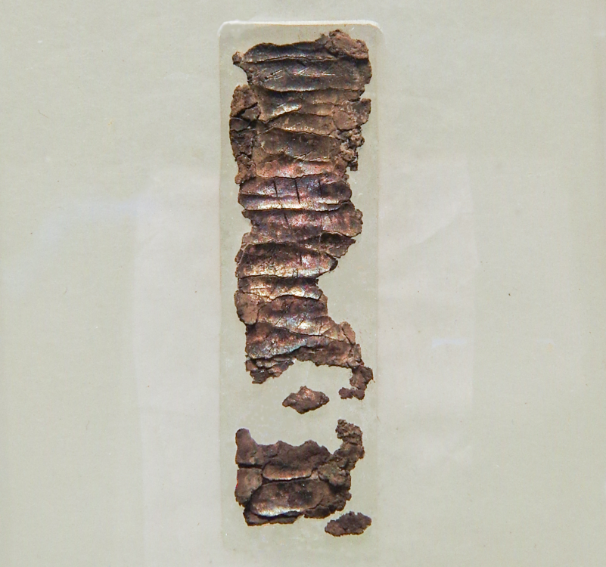
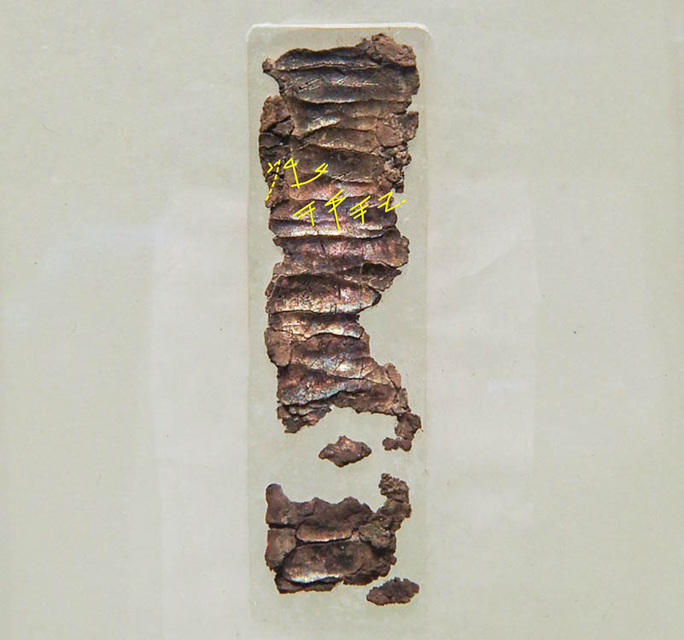
He said to them, “May you be blessed by Yahweh“
Silver amulet with priestly blessing from Ketef Hinnom in Jerusalem, circa 600 BC
2:5
Notes:
The amulet shown here is inscribed with the text of the priestly blessing recorded in Numbers 6:24-26, and it is the oldest known portion of Scripture found to date. It originally had the phrase “May Yahweh bless you” (יברכך יהוה), thus preserving both the verb “to bless” and the divine name. However, some of the letters along the edges have eroded away. It was discovered in a tomb at the site of Ketef Hinnom on the western slope of the Hinnom Valley in Jerusalem. This artifact was photographed in the Israel Museum. The partially preserved upper word that has been highlighted is the verb “to bless” (barak, ברך), while the highlighted word on the next line is the divine name Yahweh. An editable version is included beneath the graphic for those who wish to modify it.
adr1806199661c

Slide 25
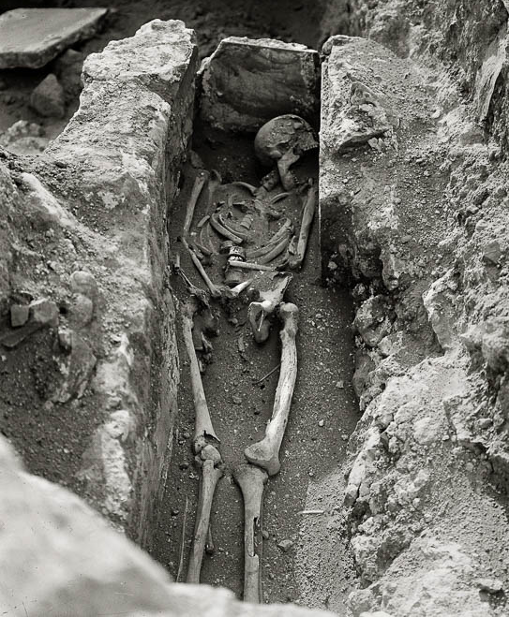
Since you have shown this kindness to Saul your master and have buried him
Skeleton in an excavated tomb at Beth-shean
2:5
Notes:
Burial practices in the Iron I (1200–1000 BC) and early Iron II (1000–900 BC) are not as well-known as the Iron IIB–C (900–586 BC), when rock-cut burials were used in Judah and Israel. During the earlier period, some scholars believe that the Israelites used simple ground burials for their deceased, similar to the one shown here. This American Colony photograph was taken between 1921 and 1933.
mat05149

Slide 26
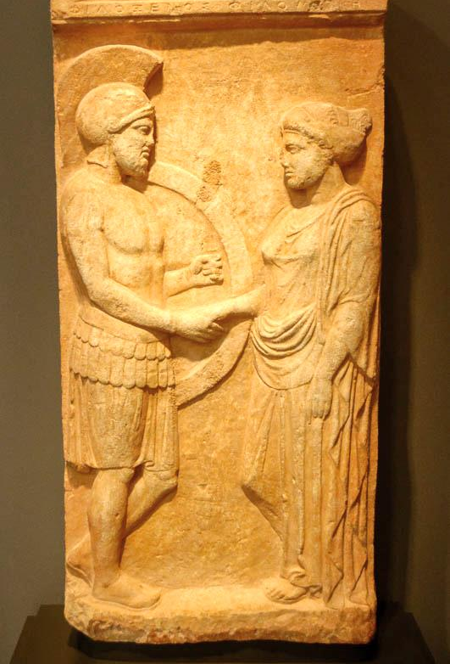
May Yahweh show lovingkindness and truth to you
Marble gravestone of a man and wife, from Athens, circa 400 BC
2:6
Notes:
The word “lovingkindness” (Heb. hesed, חֶסֶד) indicates loyalty or faithfulness that is due to a pledge or obligation. The idea is illustrated here by a handshake between a man and his wife (named on the gravestone as Philoxenos and Philoumene), a sign that at that time was often used to symbolize the marriage covenant. A number of the prophets also used the metaphor of marriage to describe God’s relationship to Israel (e.g., Isa 54:5-7; Jer 3:6-11). This tombstone was photographed at the Getty Villa in southern California.
tb100919769

Slide 27
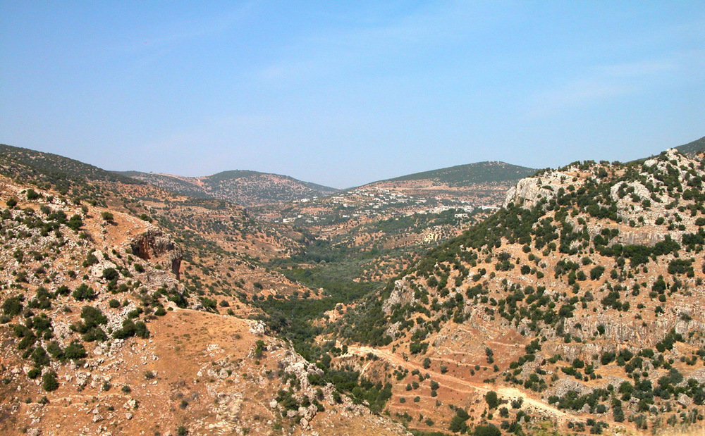
For Saul your master is dead, and also the house of Judah has anointed me king over them
Wadi Yabes, near a possible location of Jabesh-gilead
2:7
Notes:
David’s diplomatic statement may in part have been directed at making Jabesh-gilead (an important city in Transjordan) part of his newly founded kingdom. The Wadi Yabes (Wadi al-Rayan) is located in the region of Jabesh-gilead. The Hebrew name of this wadi, Wadi Yabes, means “dry,” which doesn’t make sense since the valley is very lush today. Thus the name properly preserves an ancient name (i.e., Jabesh-gilead).
tb060403159

Slide 28
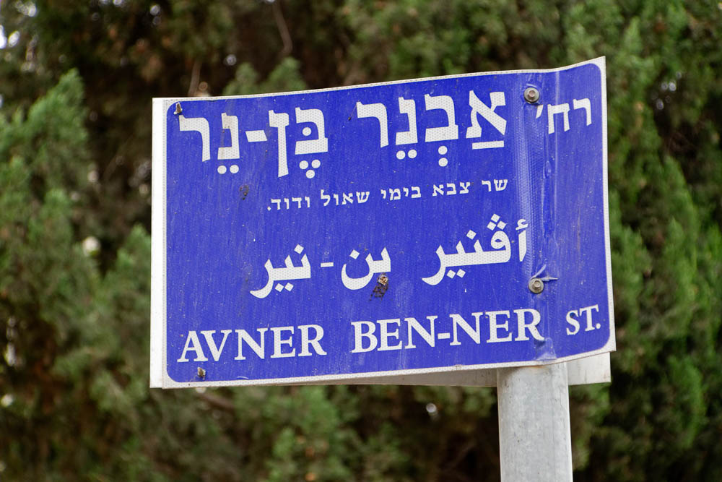
Now Abner the son of Ner was commander over Saul’s army
”Abner son of Ner Street” sign
2:8
Notes:
“Abner son of Ner Street” is located in the German Colony neighborhood, southwest of the Old City. The description line in Hebrew reads “commander of the army in the days of Saul and David” (cf. 1 Sam 14:50).
lbd102318973

Slide 29
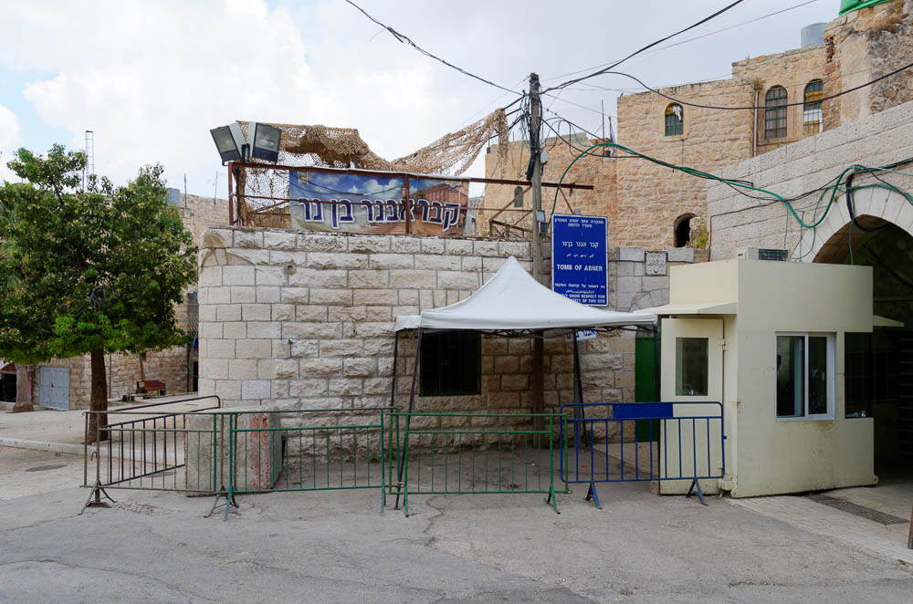
Now Abner the son of Ner was commander over Saul’s army
Entrance to the traditional tomb of Abner in Hebron
2:8
Notes:
As will be clear in the next chapter, Abner was buried in Hebron (2 Sam 3:32). In post-biblical history, the earliest references to the existence of this tomb come from the 12th century AD.
tb052816021

Slide 30
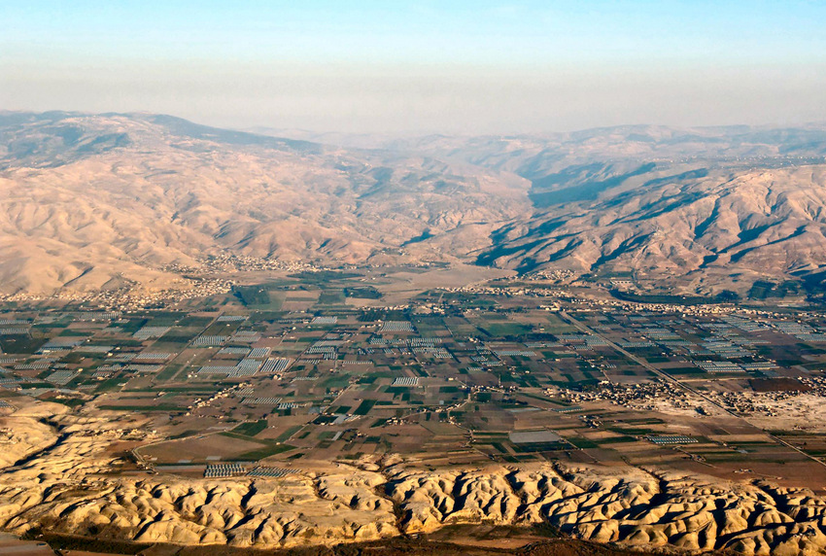
He had taken Ish-bosheth the son of Saul and brought him over to Mahanaim
Jabbok River (aerial view from the west)
2:8
Notes:
Abner sought to continue Saul’s line by installing and protecting his son, Ish-bosheth. The name “Ish-bosheth” (Heb. אִישׁ־בֹּשֶׁת) means “man of shame.” The alternative name “Esh-baal” (Heb. אֶשְׁבַּ֫עַל, 1 Chr 8:33) means “man of Baal.” Abner’s action in moving the capital across the Jordan Valley from Gibeah to Mahanaim was likely intended to distance it from the land controlled by the Philistines (cf. 1 Sam 31:7). It is noteworthy that David himself went to the same place when he fled from Absalom, suggesting that Mahanaim was a secure retreat (2 Sam 17:24). The route from Gibeah and the Jerusalem area to Mahanaim is about 50 miles (80 km). This aerial photo views Mahanaim from the west, across the Jordan River Valley and up the valley of the Jabbok River. The next slide includes labels.
tb121704102

Slide 31
He had taken Ish-bosheth the son of Saul and brought him over to Mahanaim
Jabbok River
Penuel and
Mahanaim?
Succoth? (Tell Deir Alla)
Jordan River
Jabbok River (aerial view from the west)
2:8
Notes:
Abner sought to continue Saul’s line by installing and protecting his son, Ish-bosheth. The name “Ish-bosheth” (Heb. אִישׁ־בֹּשֶׁת) means “man of shame.” The alternative name “Esh-baal” (Heb. אֶשְׁבַּ֫עַל, 1 Chr 8:33) means “man of Baal.” Abner’s action in moving the capital across the Jordan Valley from Gibeah to Mahanaim was likely intended to distance it from the land controlled by the Philistines (cf. 1 Sam 31:7). It is noteworthy that David himself went to the same place when he fled from Absalom, suggesting that Mahanaim was a secure retreat (2 Sam 17:24). The route from Gibeah and the Jerusalem area to Mahanaim is about 50 miles (80 km). This aerial photo views Mahanaim from the west, across the Jordan River Valley and up the valley of the Jabbok River.
tb121704102

Slide 32
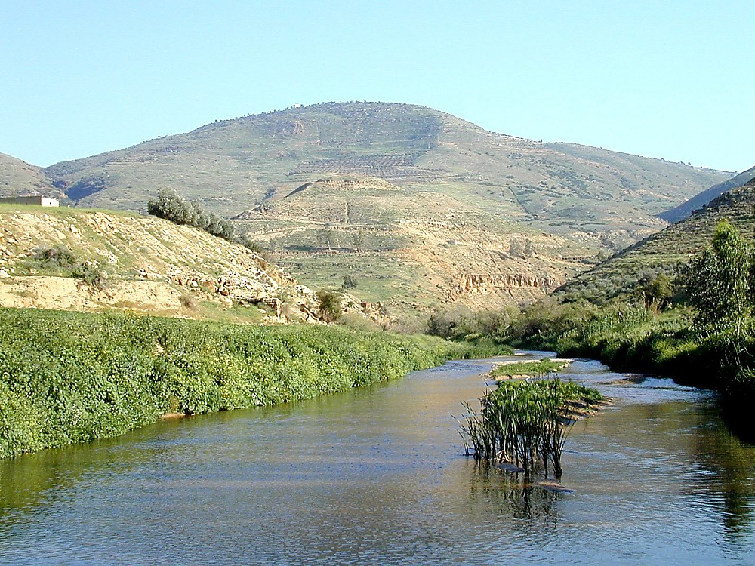
He had taken Ish-bosheth the son of Saul and brought him over to Mahanaim
Jabbok River and Penuel (from the west)
2:8
Notes:
The site identification of Mahanaim is difficult and debated. Based on biblical evidence, it is likely that Mahanaim is to be found east of Penuel, near the fords of the Jabbok. Mahanaim and Penuel are likely in relatively close proximity. Mahanaim and Penuel have therefore been identified with the twin sites of Tulul adh-Dhahab. Mahanaim is identified with Tell adh-Dhahab ash-Sharqiyya (east), and Penuel is believed to be Tell adh-Dhahab al-Garbiyya (west). The latter is shown in this photo. The next slide includes a circle around the site.
For more discussion and a different conclusion, see Burton MacDonald, East of the Jordan (American Schools of Oriental Research, 2000), pp. 140–42.
tb031701145

Slide 33
He had taken Ish-bosheth the son of Saul and brought him over to Mahanaim
Jabbok River and Penuel (from the west)
2:8
Notes:
The site identification of Mahanaim is difficult and debated. Based on biblical evidence, it is likely that Mahanaim is to be found east of Penuel, near the fords of the Jabbok. Mahanaim and Penuel are likely in relatively close proximity. Mahanaim and Penuel have therefore been identified with the twin sites of Tulul adh-Dhahab. Mahanaim is identified with Tell adh-Dhahab ash-Sharqiyya (east), and Penuel is believed to be Tell adh-Dhahab al-Garbiyya (west). The latter is shown in this photo.
For more discussion and a different conclusion, see Burton MacDonald, East of the Jordan (American Schools of Oriental Research, 2000), pp. 140–42.
tb031701145

Slide 34
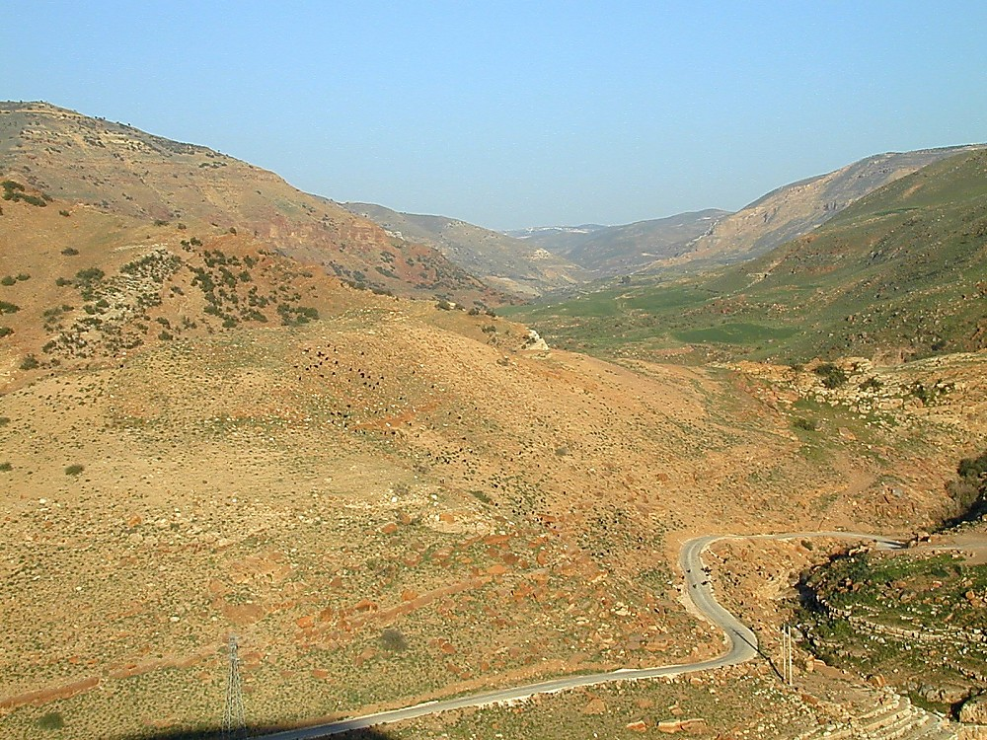
He had taken Ish-bosheth the son of Saul and brought him over to Mahanaim
Tell adh-Dhahab ash-Sharqiyya, possible location of Mahanaim, in Nahal Jabbok (from west)
2:8
Notes:
This view of Tell adh-Dhahab ash-Sharqiyya is from Penuel (Tell adh-Dhahab al-Garbiyya). The bed of the Jabbok River is visible at the lower right. The next slide includes a label for the site.
tb031701143

Slide 35
He had taken Ish-bosheth the son of Saul and brought him over to Mahanaim
Tell adh-Dhahab ash-Sharqiyya, possible location of Mahanaim, in Nahal Jabbok (from west)
2:8
Notes:
This view of Tell adh-Dhahab ash-Sharqiyya is from Penuel (Tell adh-Dhahab al-Garbiyya). The bed of the Jabbok River is visible at the lower right.
tb031701143

Slide 36
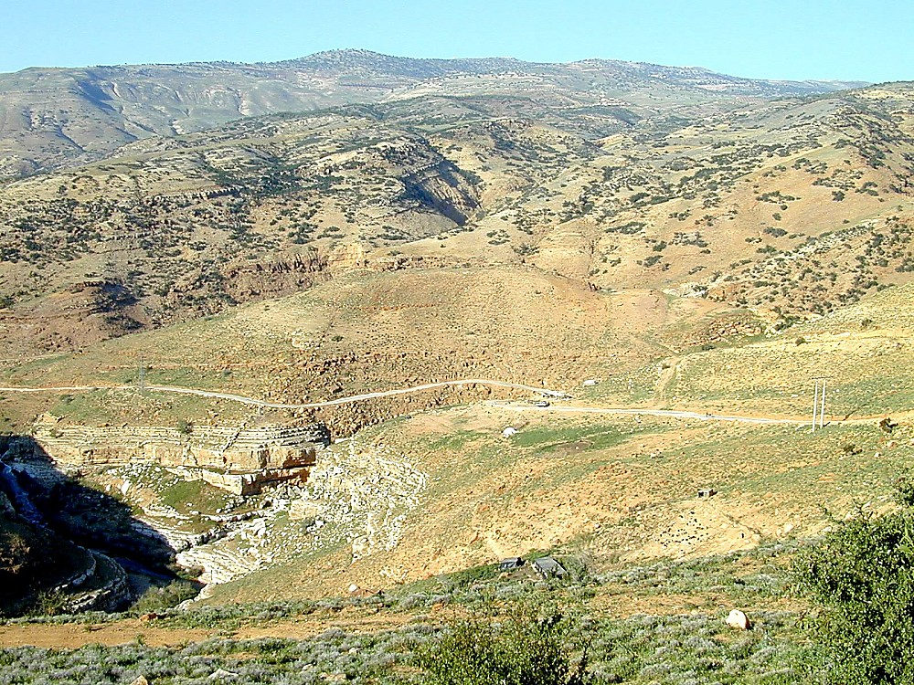
He had taken Ish-bosheth the son of Saul and brought him over to Mahanaim
Tell adh-Dhahab ash-Sharqiyya, possible location of Mahanaim (from the south)
2:8
Notes:
In this view, the site of Mahanaim (Tell adh-Dhahab ash-Sharqiyya) is seen from the south. The Jabbok River is visible on the left. The next slide includes a circle around the site.
tb031701147

Slide 37
He had taken Ish-bosheth the son of Saul and brought him over to Mahanaim
Tell adh-Dhahab ash-Sharqiyya, possible location of Mahanaim (from the south)
2:8
Notes:
In this view, the site of Mahanaim (Tell adh-Dhahab ash-Sharqiyya) is seen from the south. The Jabbok River is visible on the left.
tb031701147

Slide 38
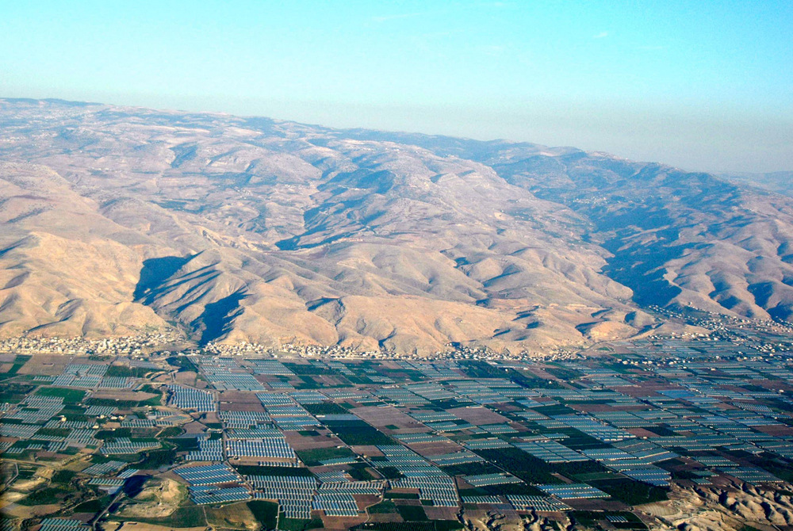
He made him king over Gilead
Mountains of Gilead to the south of Pella (aerial view from the west)
2:9
Notes:
Gilead is the mountainous region east of the Jordan Valley, both north and south of the Jabbok River. It thus refers to the region surrounding the new capital at Mahanaim. This view of Gilead is about 20 miles (32 km) north of the Jabbok River.
tb121704089

Slide 39
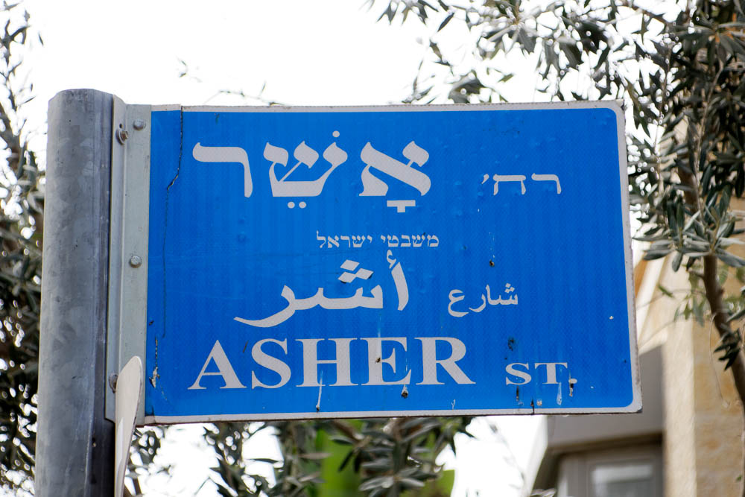
He made him king over Gilead, the Ashurites
“Asher Street” sign in Jerusalem
2:9
Notes:
The “Ashurites” are probably to be identified with the tribe of Asher. This area would have been the farthest from Mahanaim to the northwest. This and the subsequent places named in this description seem to be situated in an arc that swings from the northern regions to the south, encompassing all of Israelite territory north of the tribe of Judah, demonstrating that Ish-bosheth retained (or at least claimed) all of the elements of Saul’s kingdom outside of Judah. “Asher Street” is located in the Baka neighborhood, south of the Old City.
lbd102218483

Slide 40
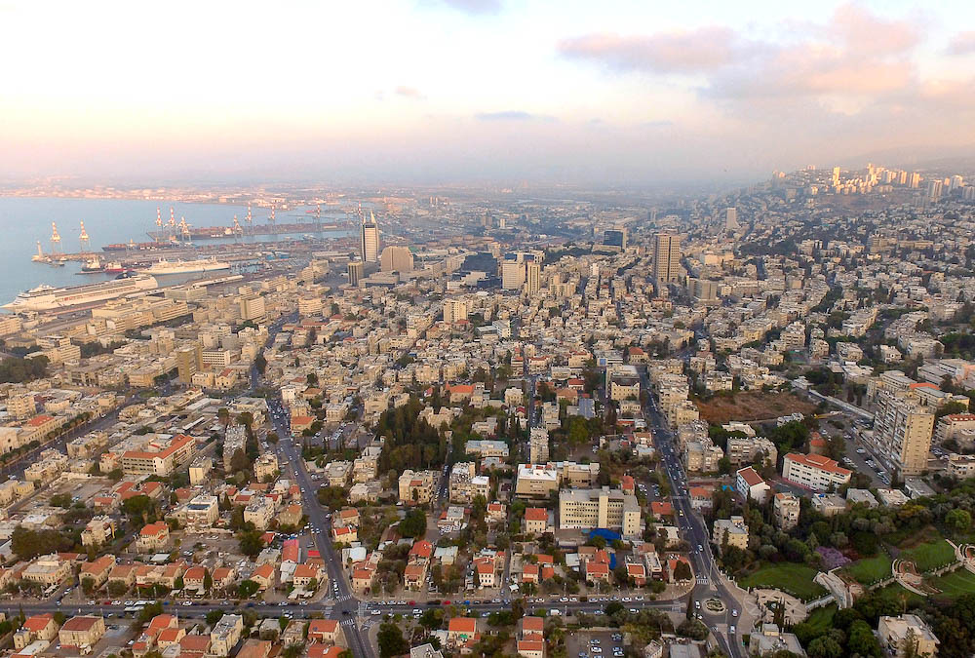
He made him king over Gilead, the Ashurites
Haifa with Mount Carmel and the Plain of Asher (aerial view from the northwest)
2:9
Notes:
The territory of Asher encompassed the Bay of Acco and the coastal plain north of Mount Carmel. In this aerial photo, the Bay of Acco is visible to the left, and the western end of the Carmel Range is visible to the right. Today the modern city of Haifa is located here.
ws101715051

Slide 41
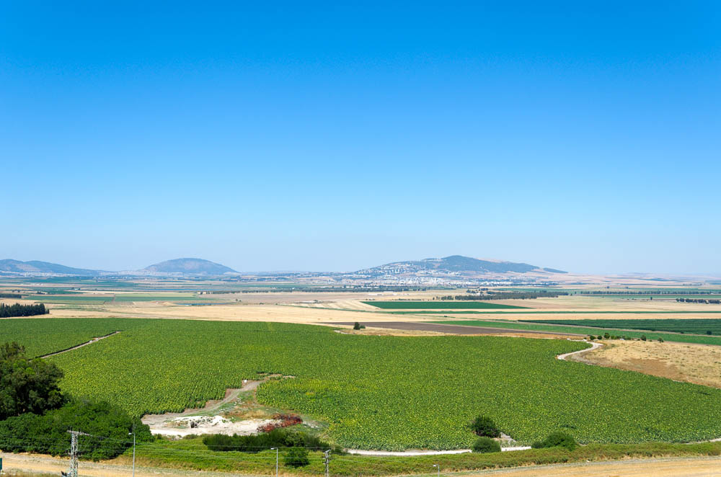
He made him king over Gilead, the Ashurites, Jezreel
Jezreel Valley, from Megiddo
2:9
Notes:
The reference here to Jezreel could refer to the Valley of Jezreel or to the city of Jezreel. The former seems more likely, as the valley is referred to by this name in earlier texts (e.g., 1 Sam 29:11; cf. Josh 17:16). Also, the other referents in this list all seem to be territories, not cities.
tb061216377

Slide 42
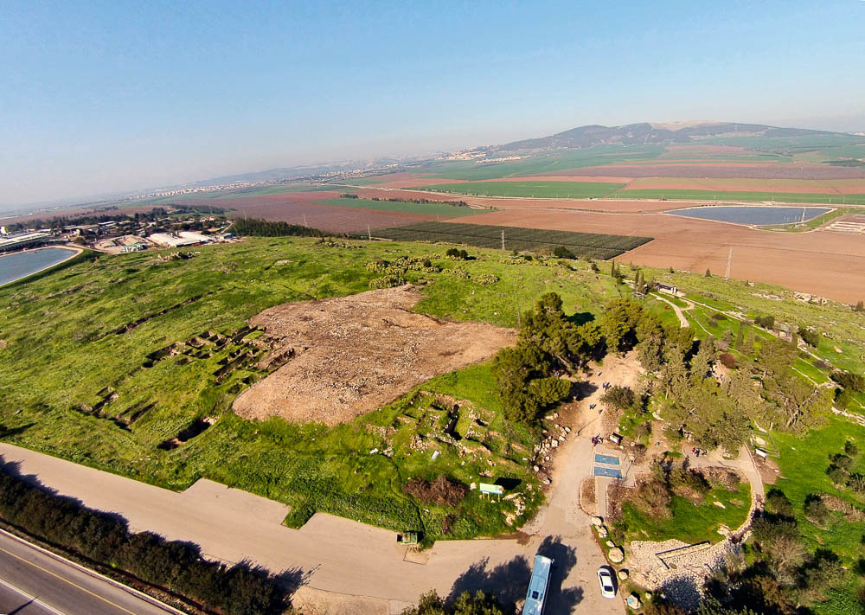
He made him king over Gilead, the Ashurites, Jezreel
Jezreel, the Harod Valley, and the Hill of Moreh (aerial view from the southeast)
2:9
Notes:
The city of Jezreel does not seem to have been a significant city at this time, although it is mentioned in earlier texts (Josh 15:56). It became much more significant in the Iron Age IIA (circa 1000–800 BC), particularly as a royal city of Ahab. Excavations of Tel Jezreel were conducted by John Woodhead of the British School of Archaeology and David Ussishkin of Tel Aviv University in 1990–95. There were high expectations for this site because it was the last royal site to be excavated, but the results were disappointing because the stones had been robbed out in previous periods.
In the 9th century BC, it is clear that the site was developed under a new plan. The headers and stretchers found here are like those at Samaria. This type of masonry was typical of Ahab’s construction projects. A moat protected the site on the south side, where the elevation was the lowest. Excavations revealed that the site was deserted shortly after its reconstruction by Ahab, and not because of a military destruction. There are remains of later, poor Iron Age habitation. Since 2013, Jezreel and the nearby spring have been excavated by Norma Franklin and Jenny Ebeling. So far, the project has focused mainly on the area of the spring and the nearby area, where evidence of winepresses attest to the ancient presence of vineyards.
ws011215039

Slide 43
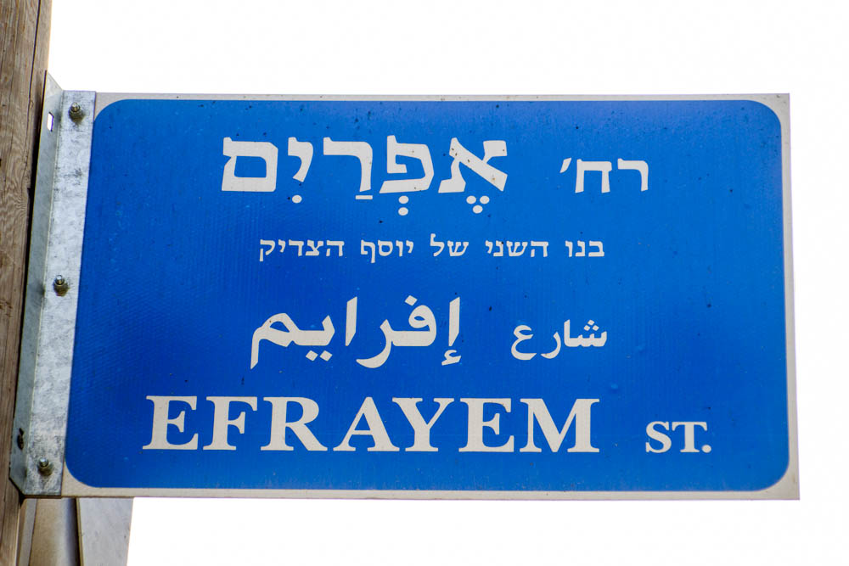
He made him king over Gilead, the Ashurites, Jezreel, Ephraim
“Ephraim Street” sign in Jerusalem
2:9
Notes:
“Ephraim Street” is located in the Baka neighborhood, south of the Old City.
lbd102218343

Slide 44
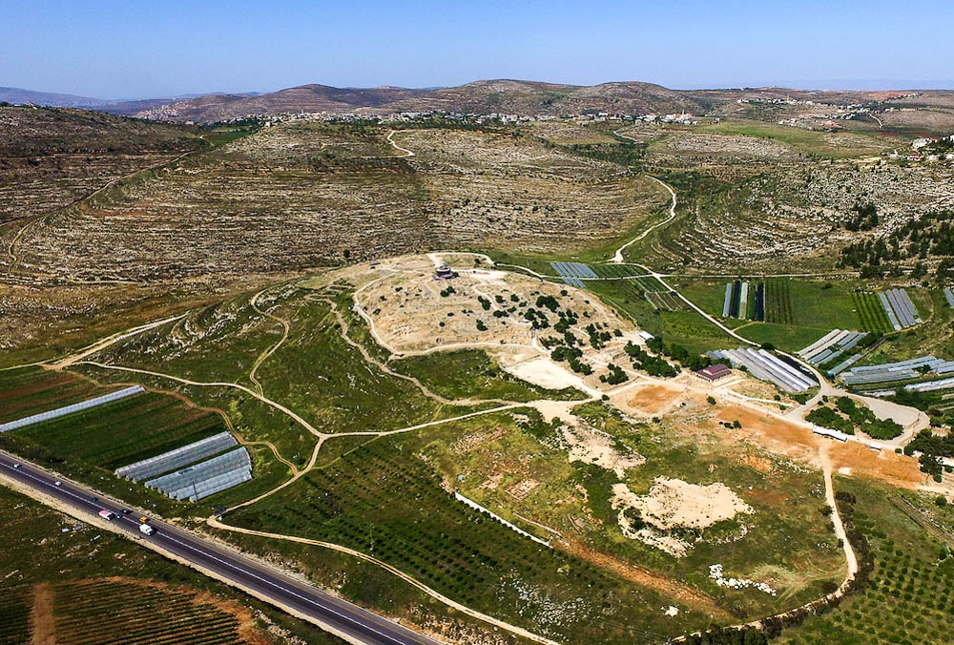
He made him king over Gilead, the Ashurites, Jezreel, Ephraim
Shiloh, in the heartland of Ephraim (aerial view from the southwest)
2:9
Notes:
Ephraim was located in the hill country between Manasseh (to the north) and Benjamin (to the south). Shiloh, which was for several centuries the home of the tabernacle and ark, was located in the center of the territory of Ephraim.
ws042016014

Slide 45
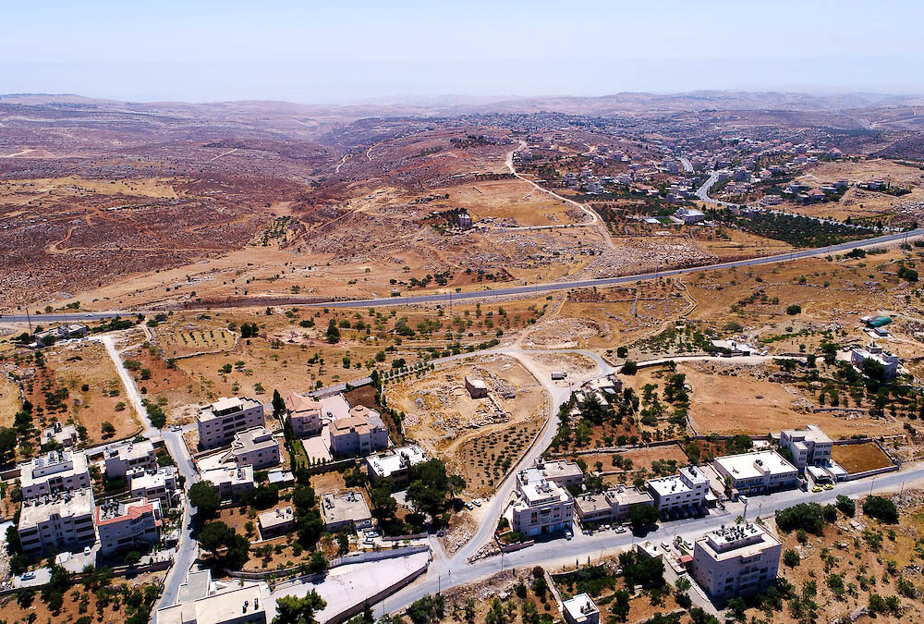
He made him king over Gilead, the Ashurites, Jezreel, Ephraim
Burj Beitin (aerial view from the west)
2:9
Notes:
Burj Beitin, shown in this photo, is located near the central ridge route at the southern edge of Ephraim.
ws071617243

Slide 46
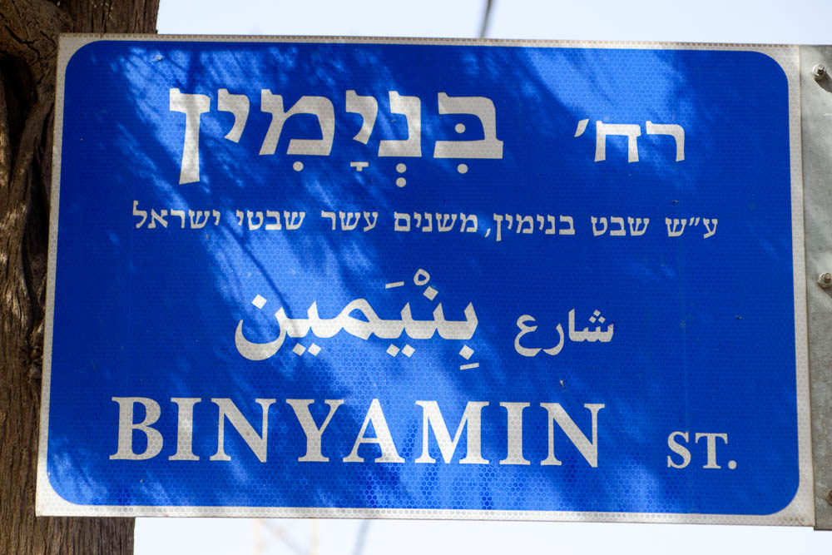
He made him king over Gilead, the Ashurites, Jezreel, Ephraim, Benjamin
“Benjamin Street” sign in Jerusalem
2:9
Notes:
“Benjamin Street” is located in the Baka neighborhood, south of the Old City. The description lines reads, “Named after the tribe of Benjamin, one of the twelve tribes of Israel.”
lbd102218466

Slide 47
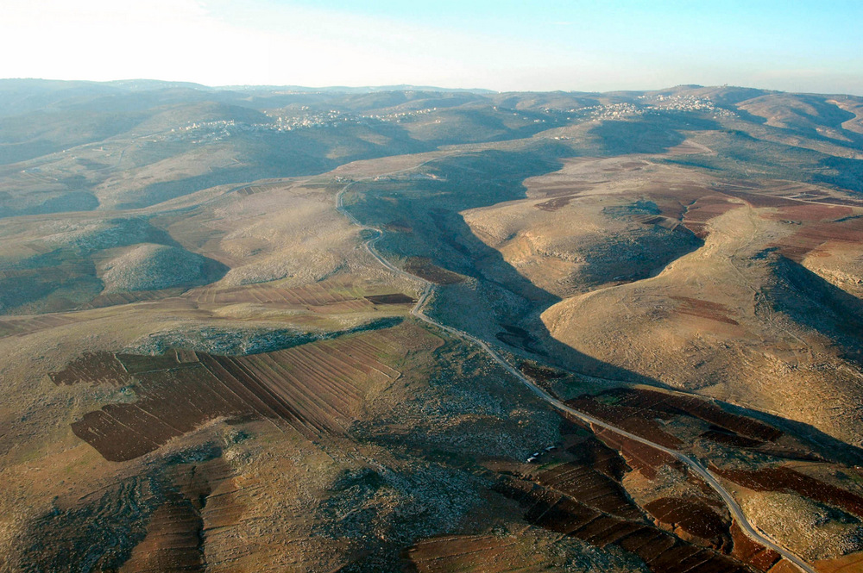
He made him king over Gilead, the Ashurites, Jezreel, Ephraim, Benjamin
Road between Ephraim and Jericho (aerial view from the east)
2:9
Notes:
The ridge route followed by the modern road in this photo may have been the border between Ephraim and Benjamin.
tb121704146

Slide 48
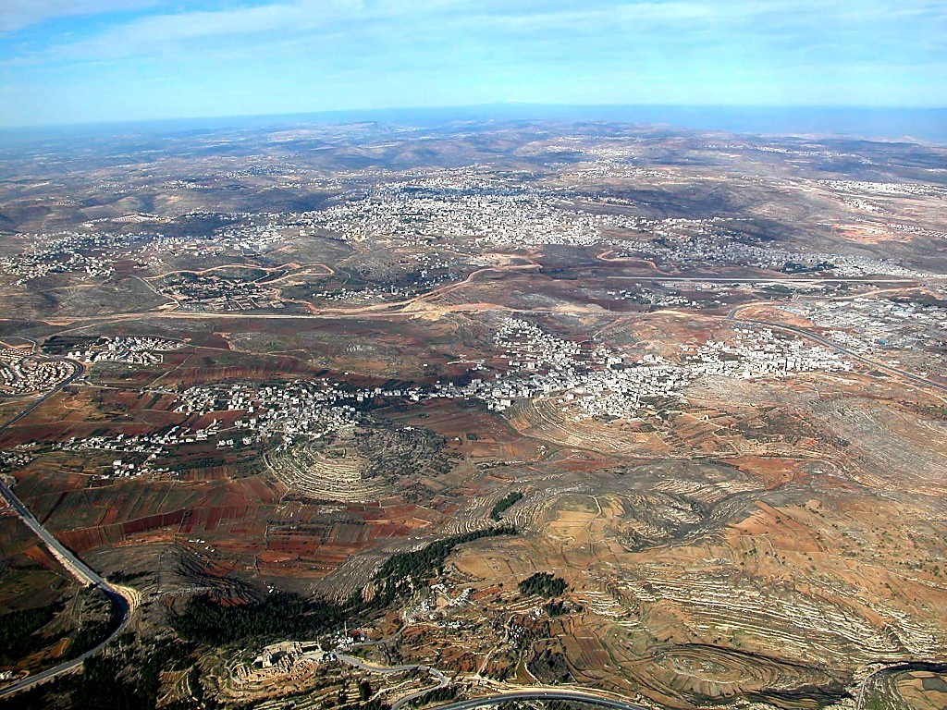
He made him king over Gilead, the Ashurites, Jezreel, Ephraim, Benjamin
Central Benjamin Plateau (aerial view from the south)
2:9
Notes:
At the heart of the small territory of Benjamin is the central Benjamin Plateau. Two of the prominent cities shown in this photo are Ramah and Gibeon. The next slide includes labels.
tb010703103

Slide 49
He made him king over Gilead, the Ashurites, Jezreel, Ephraim, Benjamin
Bethel
Ai
EPHRAIM
Ramah
BENJAMIN
Mizpah
Gibeon
Central Benjamin Plateau (aerial view from the south)
2:9
Notes:
At the heart of the small territory of Benjamin is the central Benjamin Plateau. Two of the prominent cities shown in this photo are Ramah and Gibeon.
tb0107031030

Slide 50
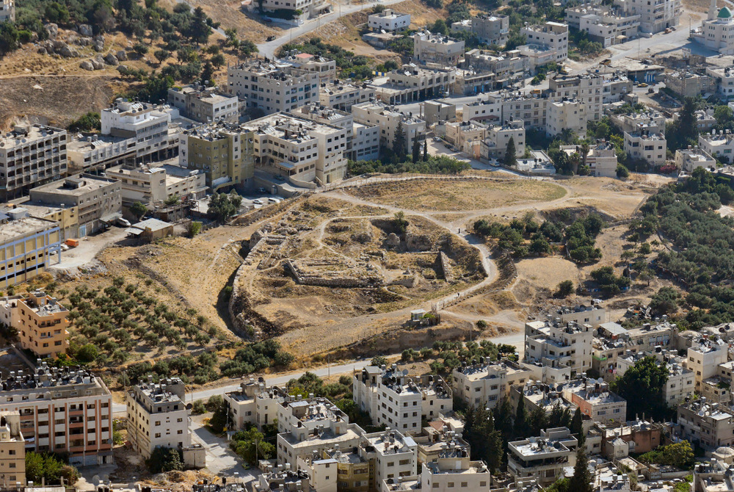
He made him king over Gilead, the Ashurites, Jezreel, Ephraim, Benjamin, and over all Israel
Shechem, modern Tell Balata (from Mount Gerizim)
2:9
Notes:
Shechem here is used to illustrate “all Israel,” given the site’s prominence from the days of Abraham through the covenant ceremony in the time of Joshua and beyond (Gen 12; Josh 8, 24).
tb070507673

Slide 51
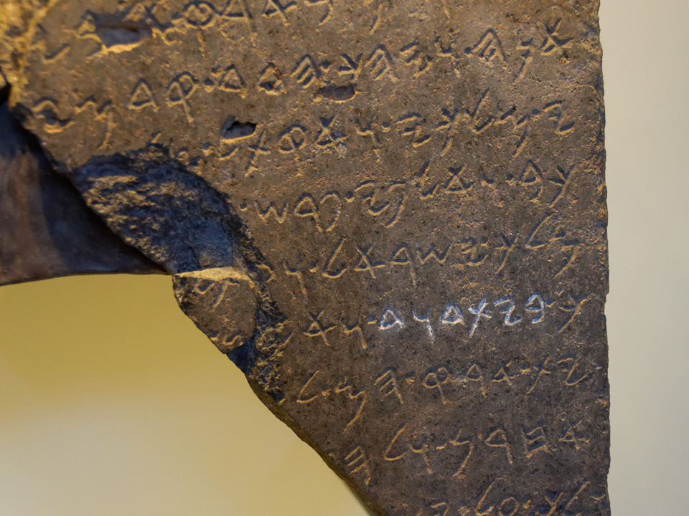
Ish-bosheth, Saul’s son, was forty years old when he became king over Israel
Tel Dan Inscription, close-up of “King of Israel,” circa 830 BC
2:10
Notes:
For many years, the earliest known extra-biblical reference to Israel was the Merneptah Stele, dating to about 1210 BC. More recently the name has been discovered on the so-called Berlin Statue Pedestal Relief 21687, which may date as early as the 18th dynasty, or roughly 1400 BC (see discussion in van der Veen et al. 2010). The inscription shown here is later but was found in Israel. The phrase highlighted in white chalk is “house of David” (בית דוד), for which the inscription has become well known. The line above, however, includes the phrase “king of Israel” (Heb. מלך ישראל). See the next slide for labels marking these words. This inscription was photographed at the Israel Museum.
Reference:
van der Veen, Peter; Theis, Christopher; and Görg, Manfred.
2010 Israel in Canaan (Long) Before Pharaoh Merneptah? A Fresh Look at Berlin Pedestal Base Inscription 21687. Journal of Egyptian Interconnections 2: 15–25.
tb032014247

Slide 52
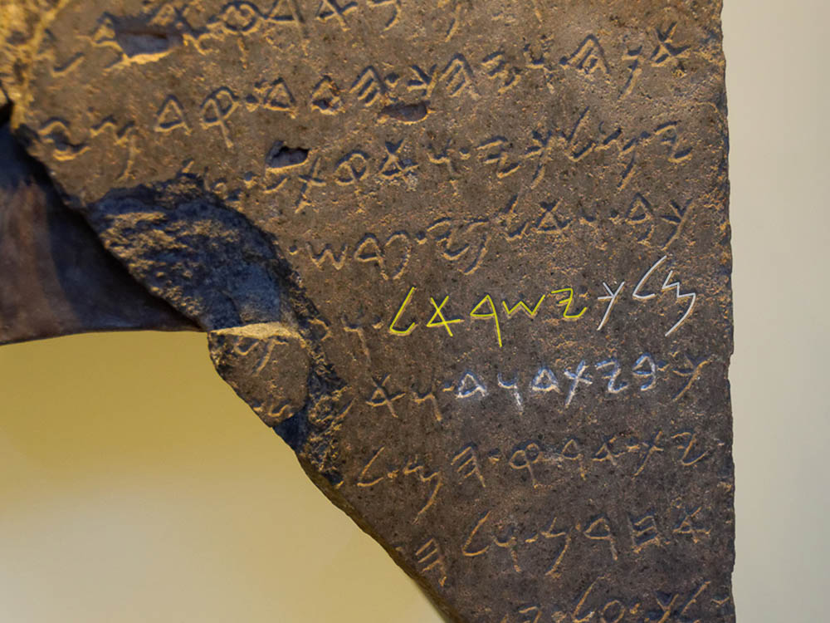
Ish-bosheth, Saul’s son, was forty years old when he became king over Israel
Tel Dan Inscription, close-up of “King of Israel,” circa 830 BC
2:10
Notes:
For many years, the earliest known extra-biblical reference to Israel was the Merneptah Stele, dating to about 1210 BC. More recently the name has been discovered on the so-called Berlin Statue Pedestal Relief 21687, which may date as early as the 18th dynasty, or roughly 1400 BC (see discussion in van der Veen et al. 2010). The inscription shown here is later but was found in Israel. The phrase highlighted in white chalk is “house of David” (בית דוד), for which the inscription has become well known. The line above, however, includes the phrase “king of Israel” (Heb. מלך ישראל). This inscription was photographed at the Israel Museum. An editable version is included beneath the graphic for those who wish to modify it.
Reference:
van der Veen, Peter; Theis, Christopher; and Görg, Manfred.
2010 Israel in Canaan (Long) Before Pharaoh Merneptah? A Fresh Look at Berlin Pedestal Base Inscription 21687. Journal of Egyptian Interconnections 2: 15–25.
tb032014247

Slide 53
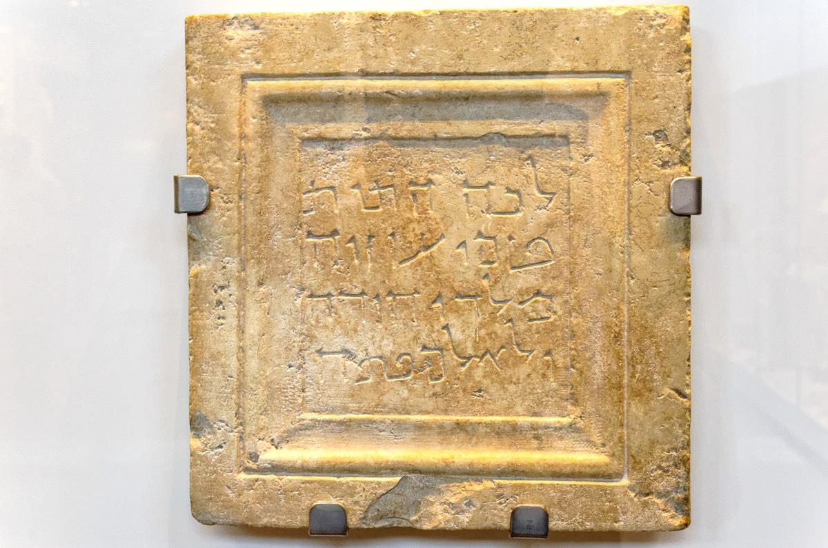
David was king in Hebron over the house of Judah for seven years and six months
Grave marker of Uzziah with the title “King of Judah,” 1st century BC
2:11
Notes:
The inscription shown here once marked the tomb of Uzziah, king of Judah. The Aramaic inscription reads, “To this place were brought the bones of Uzziah, king of Judah. Do not open” (Heb. לכה התות בזמו עזזיה מלך יהודה ולא למ פתח). Apparently the bones of Uzziah, who was not buried in the royal tombs because of his leprosy (2 Chr 26:23), were moved when the city of Jerusalem expanded in the 1st century BC, and this plaque marked the spot of the new burial. This artifact was photographed at the Israel Museum. The next slide includes highlights.
tb032014277

Slide 54
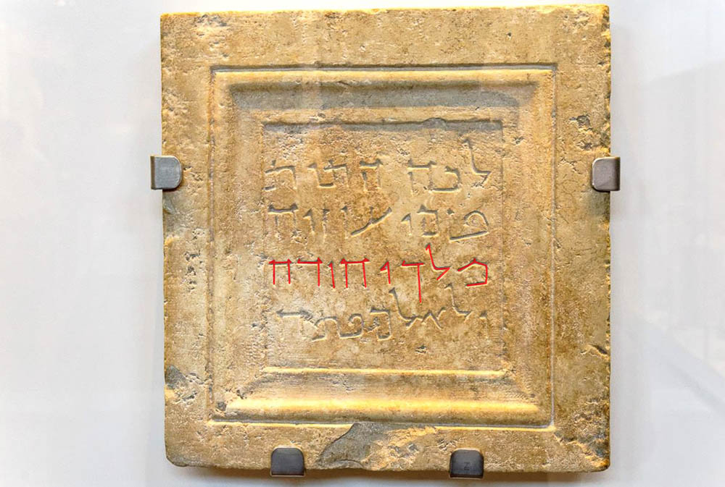
David was king in Hebron over the house of Judah for seven years and six months
Grave marker of Uzziah with the title “King of Judah,” 1st century BC
2:11
Notes:
The inscription shown here once marked the tomb of Uzziah, king of Judah. The Aramaic inscription reads, “To this place were brought the bones of Uzziah, king of Judah. Do not open” (Heb. לכה התות בזמו עזזיה מלך יהודה ולא למ פתח). Apparently the bones of Uzziah, who was not buried in the royal tombs because of his leprosy (2 Chr 26:23), were moved when the city of Jerusalem expanded in the 1st century BC, and this plaque marked the spot of the new burial. This artifact was photographed at the Israel Museum. The title “King of Israel” (Heb. מלך יהודה) is highlighted; the previous word (at the left end of the second line) is the name of the king, Uzziah (Heb. עזזיה). An editable version is included beneath the graphic for those who wish to modify it.
tb032014277

Slide 55
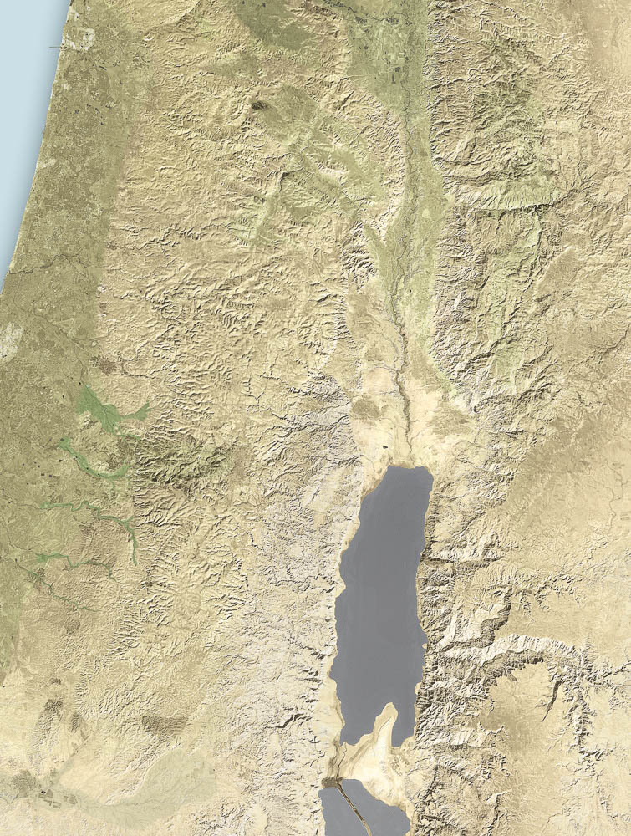
Then Abner the son of Ner and the servants of Ish-bosheth went out from Mahanaim to Gibeon
Mahanaim
Gibeon
Hebron
Map showing the areas of Mahanaim, Gibeon, and Hebron
2:12
Notes:
This map adapted from a detail of map 4-1 from the Satellite Bible Atlas, by William Schlegel.

Slide 56
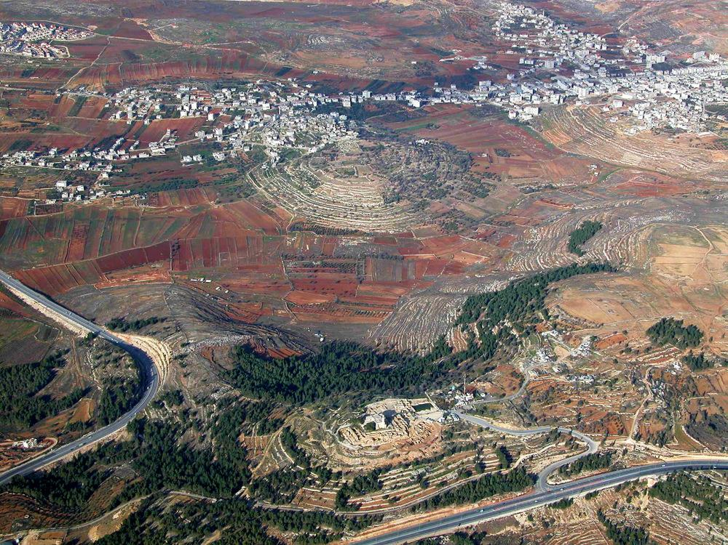
Then Abner the son of Ner and the servants of Ish-bosheth went out from Mahanaim to Gibeon
Gibeon (aerial view from the south)
2:12
Notes:
The biblical site of Gibeon is to be identified with the modern Arab village of el-Jib. The first modern scholar to propose this identification was Edward Robinson in 1838. Gibeon was excavated by James B. Pritchard in 1956, 1957, 1959, 1960 and 1962. The identification was confirmed when the name gb‘n stamped on 31 jar handles was excavated by Pritchard. Albrecht Alt previously had rejected this identification because of information from Eusebius’s Onomasticon. A survey of late Iron Age burial caves near Gibeon was conducted by Hanan Eshel in 1983–84. The next site includes labels.
tb010703106

Slide 57
Then Abner the son of Ner and the servants of Ish-bosheth went out from Mahanaim to Gibeon
Gibeon
Gibeon (aerial view from the south)
2:12
Notes:
The biblical site of Gibeon is to be identified with the modern Arab village of el-Jib. The first modern scholar to propose this identification was Edward Robinson in 1838. Gibeon was excavated by James B. Pritchard in 1956, 1957, 1959, 1960 and 1962. The identification was confirmed when the name gb‘n stamped on 31 jar handles was excavated by Pritchard. Albrecht Alt previously had rejected this identification because of information from Eusebius’s Onomasticon. A survey of late Iron Age burial caves near Gibeon was conducted by Hanan Eshel in 1983–84.
tb010703106

Slide 58
Then Abner the son of Ner and the servants of Ish-bosheth went out from Mahanaim to Gibeon
Gibeon (from Nebi Samwil)
2:12
Notes:
The choice of this location for battle is not clear. Perhaps Abner was trying to gain more territory to the south, in what was ruled by David. Perhaps the people of Gibeon were friendly to David, given Saul’s treatment of them (cf. 2 Sam 21:1). Perhaps the fact that it was a city inhabited by Canaanites/Hivites was a factor, since damage to the city would not have the same political repercussions as damage to an ethnically Israelite city.
tb040304296

Slide 59
Then Abner the son of Ner and the servants of Ish-bosheth went out from Mahanaim to Gibeon
“Gibeon, vineyard of Ameryahu” inscribed on a jar handle, from Gibeon, 7th century BC
2:12
Notes:
The inscription scratched into this handle reads, “Gibeon, vineyard of Ameryahu” (Heb. גבען גדר אמריהו). The jar dates to the Iron Age IIC (701–586 BC). This is one of the jar handles that confirmed the identification of el-Jib as Gibeon. It was photographed at the University of Pennsylvania Museum of Archaeology and Anthropology.
adr1605267162

Slide 60
So Joab the son of Zeruiah and the servants of David went out and met them
“Joab Street” sign in Jerusalem
2:13
Notes:
“Joab Street” is located in the German Colony neighborhood, southwest of the Old City. The Hebrew description line reads, “Commander of the army in the days of King David.”
lbd102318964

Slide 61
They met them by the pool of Gibeon and sat down opposite each other
Gibeon (aerial view from the east)
2:13
Notes:
The “pool at Gibeon” may refer to a pool outside of the city near one of the several springs located at the base of the tell. This pool is most likely the same as the “great pool in Gibeon” mentioned in Jeremiah 41:12. Pritchard’s excavations at Gibeon revealed two large water systems that seem to date to the Iron Age, which some scholars have related to the “pool of Gibeon” mentioned in the battle between Abner and David’s servants. The striking discovery of such a massive water system at a biblical site that speaks of a “pool” with a dramatic event makes the connection attractive. It should be noted, however, that a recent re-analysis of Pritchard’s excavation by Shimon Gibson seems to indicate that the “large pool” was first used as a granary and only later turned into a water system. The next slide includes labels.
ws053017166

Slide 62
They met them by the pool of Gibeon and sat down opposite each other
water shaft
spring
Gibeon (aerial view from the east)
2:13
Notes:
The “pool at Gibeon” may refer to a pool outside of the city near one of the several springs located at the base of the tell. This pool is most likely the same as the “great pool in Gibeon” mentioned in Jeremiah 41:12. Pritchard’s excavations at Gibeon revealed two large water systems that seem to date to the Iron Age, which some scholars have related to the “pool of Gibeon” mentioned in the battle between Abner and David’s servants. The striking discovery of such a massive water system at a biblical site that speaks of a “pool” with a dramatic event makes the connection attractive. It should be noted, however, that a recent re-analysis of Pritchard’s excavation by Shimon Gibson seems to indicate that the “large pool” was first used as a granary and only later turned into a water system.
ws053017166

Slide 63
They met them by the pool of Gibeon and sat down opposite each other
Area of water systems at Gibeon (aerial view from the east)
2:13
Notes:
This is a close-up of the photo on the previous slide. The modern village of el-Jib (on the right) is built over part of the ancient city. The next slide includes labels.
ws053017166

Slide 64
They met them by the pool of Gibeon and sat down opposite each other
water shaft
spring
Area of water systems at Gibeon (aerial view from the east)
2:13
Notes:
This is a close-up of the photo on the previous slide. The modern village of el-Jib (on the right) is built over part of the ancient city.
ws053017166

Slide 65
They met them by the pool of Gibeon and sat down opposite each other
Gibeon with water shaft (aerial view from the east)
2:13
Notes:
This aerial view shows nicely the relationship between the water shaft and the spring. An additional feature revealed in excavations, the wine cellars, is visible to the right of the water shaft. The next slide includes labels.
ws022217013

Slide 66
They met them by the pool of Gibeon and sat down opposite each other
water shaft
wine cellars
spring
Gibeon with water shaft (aerial view from the east)
2:13
Notes:
This aerial view shows nicely the relationship between the water shaft and the spring. An additional feature revealed in excavations, the wine cellars, is visible to the right of the water shaft.
ws022217013

Slide 67
They met them by the pool of Gibeon and sat down opposite each other
Water shaft at Gibeon
2:13
Notes:
Gibeon had two separate water systems, both of which were apparently built during the Iron Age. The first was in the shape of a large cylinder, cut into bedrock. It has a diameter of 38 feet (11.6 m) and is 35 feet (10.7 m) deep. At the bottom, a stairway continues further into a tunnel to provide access to a water chamber which is 44 feet (13 m) below the floor of the pool. The inhabitants were able to get fresh water by descending the 79 steps to 79 feet (24 m) below the level of the city. Approximately 3,000 tons (2,700 t) of limestone were removed to create this system.
tb051407492

Slide 68
They met them by the pool of Gibeon and sat down opposite each other
Water systems at Gibeon (aerial view)
2:13
Notes:
At a later time the step tunnel was built, possibly because the water flow into the first water system (the water shaft) was inadequate. This stepped tunnel has 93 steps that descend to a water chamber which is connected to a spring by means of a feeding tunnel. The next slide includes a label marking the tunnel.
ws053017138

Slide 69
They met them by the pool of Gibeon and sat down opposite each other
tunnel to spring
Water systems at Gibeon (aerial view)
2:13
Notes:
At a later time the step tunnel was built, possibly because the water flow into the first water system (the water shaft) was inadequate. This stepped tunnel has 93 steps that descend to a water chamber which is connected to a spring by means of a feeding tunnel.
ws053017138

Slide 70
They met them by the pool of Gibeon and sat down opposite each other
Water shaft at Gibeon (aerial view)
2:13
Notes:
The striking nature of this shaft, and the potential correspondence of it with the event described in 2 Samuel, inclines us to include a larger number of photographs. This may also be helpful because few tourists are able to visit Gibeon today due to the political situation and the difficulty of access to the area.
ws053017124

Slide 71
They met them by the pool of Gibeon and sat down opposite each other
Water shaft at Gibeon
2:13
Notes:
James Pritchard dated the tunnel to later than the shaft, in part because the 90-degree turn seems to avoid the cylindrical water shaft. Amihai Mazar disagrees and reverses the construction order of these two systems (1992: 481).
Reference:
Mazar, Amihai.
1992 Archaeology of the Land of the Bible 10,000–586 B.C.E. The Anchor Bible Reference Library. New York: Doubleday.
tb051407455

Slide 72
They met them by the pool of Gibeon and sat down opposite each other
Water shaft at Gibeon
2:13
Notes:
The people standing on the staircase provide some perspective of the size of this massive shaft. For a photo without people, see the next slide.
tb051407434

Slide 73
They met them by the pool of Gibeon and sat down opposite each other
Water shaft at Gibeon
2:13
Notes:
tb051407433

Slide 74
They met them by the pool of Gibeon and sat down opposite each other
Staircase in the water shaft at Gibeon
2:13
Notes:
tb051407438

Slide 75
They met them by the pool of Gibeon and sat down opposite each other
Staircase in the water shaft at Gibeon
2:13
Notes:
tb051407440

Slide 76
They met them by the pool of Gibeon and sat down opposite each other
Water systems at Gibeon
2:13
Notes:
This photo reveals the opening to the tunnel (foreground) that leads to the spring, along with the water shaft (fenced in).
tb051407477

Slide 77
They met them by the pool of Gibeon and sat down opposite each other
Tunnel in the water system at Gibeon
2:13
Notes:
tb051407474

Slide 78
They met them by the pool of Gibeon and sat down opposite each other
Staircase in the water shaft at Gibeon
2:13
Notes:
tb051407446

Slide 79
They met them by the pool of Gibeon and sat down opposite each other
Tunnel in the water system at Gibeon
2:13
Notes:
tb051407459

Slide 80
They met them by the pool of Gibeon and sat down opposite each other
Pool at the bottom of the water tunnel at Gibeon
2:13
Notes:
Today the water from the spring collects at the base of the tunnel. Perhaps in antiquity, the spring water flowed out the hillside and was collected in a built pool. If so, that could be the pool mentioned in this account.
tbs72309212

Slide 81
Abner said to Joab, “Let the young men arise and compete before us”
Relief of Assyrian soldiers, from Nineveh, reign of Sennacherib, early 7th century BC
2:14
Notes:
This relief was photographed in the British Museum.
tb112004287

Slide 82
Twelve for Benjamin, and for Ish-bosheth the son of Saul, and twelve for the servants of David
Relief with Assyrian soldiers, with two groups of 12 facing each other (sketch)
2:15
Notes:
This illustration comes from Sir Austen Henry Layard, Second Series of the Monuments of Nineveh, published in 1853. Public domain, from The New York Public Library, http://digitalcollections.nypl.org/items/510d47dc-472f-a3d9-e040-e00a18064a99
nypl494733

Slide 83
Then each of them grabbed his opponent by his head and thrust his sword into his side
Relief showing simultaneous killing, from temple-palace at Tell Halaf, 10th–9th centuries BC
2:16
Notes:
This orthostat was photographed in the Berlin Museum of the Ancient Near East.
adr070513273

Slide 84
Then each of them grabbed his opponent by his head and thrust his sword into his side
Greek basin with wrestlers on the rim, Late Archaic period, circa 500 BC
2:16
Notes:
This bronze basin was photographed at the Boston Museum of Fine Arts.
adr1711203023

Slide 85
Then each of them grabbed his opponent by his head and thrust his sword into his side
The Valiant of Gibeon, by James Tissot, circa 1899
2:16
Notes:
This image is in the public domain, via The Jewish Museum: https://thejewishmuseum.org/collection/26524-the-valiant-of-gibeon.
tjm26524

Slide 86
So all of them fell down together
Dead warriors portrayed in the Small Pergamene Votive Offering, 2nd century AD
2:16
Notes:
This sculpture is thought to be a Roman copy of an original Greek exemplar from the 2nd century BC. It was photographed at the Naples Archaeological Museum. A removable graphic has been added to avoid causing offense or surprise.
tb0515171470

Slide 87
So that place was called Helkath-hazzurim; it is in Gibeon
Bronze sword with inscription of a Babylonian king or official, from Luristan, circa 1000 BC
2:16
Notes:
Helkath-hazzurim may mean “field of sword edges,” but this meaning is not certain (Kobayashi 1992: 127). These swords were photographed at the Israel Museum.
Reference:
Kobayashi, Y.
1992 Helkath-Hazzurim. Anchor Bible Dictionary, vol. 3, ed. D. N. Freedman. New York: Doubleday.
adr1306212513

Slide 88
Then the battle was very severe, and Abner and the men of Israel were beaten before David
Assyrian soldiers in battle with enemy, from Nimrud, reign of Ashurnasirpal II, 9th century BC
2:17
Notes:
This relief was photographed at the British Museum.
adr1805194387

Slide 89
The three sons of Zeruiah were there, Joab, Abishai, and Asahel
“Zeruiah Street” sign in Jerusalem
2:18
Notes:
Zeruiah was one of David’s sisters (1 Chr 2:16). She and her sons are all honored today by streets named after them in Jerusalem. (Two of her sons are shown in the following slides; for Joab see a slide for 2:13.) “Zeruiah Street” is located in the Abu Tor neighborhood, south of the Old City.
lbd102318794

Slide 90
The three sons of Zeruiah were there, Joab, Abishai, and Asahel
“Abishai Street” sign in Jerusalem
2:18
Notes:
“Abishai Street” is located in the German Colony neighborhood, southwest of the Old City. The description line on the sign identifies Abishai as “from the mighty men in the days of King David.”
lbd102318970

Slide 91
The three sons of Zeruiah were there, Joab, Abishai, and Asahel
“Asahel Street” sign in Jerusalem
2:18
Notes:
“Asahel Street” is located in the Abu Tor neighborhood, south of the Old City. The description line on the sign identifies Asahel as “commander of the army of King David.”
lbd102318757

Slide 92
Now Asahel was as swift as a wild gazelle
Gazelle in el-Qubeibeh in Judean hills
2:18
Notes:
The Palestine mountain gazelle (Gazella gazella) is most abundant in the West Bank and Golan Heights, although populations also exist in Jordan and Turkey. A wild male gazelle can range from 40–65 lbs (18–30 kg), while females are usually 35–55 lbs (16–25 kg) in weight.
tb021705552

Slide 93
Now Asahel was as swift as a wild gazelle
Gazelle near the Jordan River, north of the Sea of Galilee
2:18
Notes:
tb032807070

Slide 94
Now Asahel was as swift as a wild gazelle
Gazelles in the Judean wilderness
2:18
Notes:
Mountain gazelles can reach running speeds up to 50 mph (80 kph).
tb113006660

Slide 95
Now Asahel was as swift as a wild gazelle
Orthostat with a man and a gazelle, from Samal (Zincirli), 9th–7th centuries BC
2:18
Notes:
This artifact, from the north hall of the citadel at Zincirli, was photographed in the Berlin Museum of the Ancient Near East.
adr070513182

Slide 96
Then Asahel pursued after Abner and would not turn to the right or the left
Hoplitodromos on an Attic black-figure Panathenaic amphora, 323–322 BC
2:19
Notes:
The hoplitodromos was a Greek foot race in which the competitors were required to wear a battle helmet, greaves, and to carry a shield. The name of the race comes from a combination of the words for a heavily armored foot soldier (Gk. hoplitēs, ὁπλίτης) and the word for a foot race (Gk. dromos, δρόμος). Presumably Asahel and Abner were both still in possession of whatever equipment they had when they began the battle. This amphora was photographed at the Louvre Museum. This image comes from Marie-Lan Nguyen and is licensed under CC BY 2.5, via Wikimedia Commons: https://commons.wikimedia.org/wiki/File:Hoplitodromos_Louvre_MN704.jpg.
wiki0802201223012175

Slide 97
Abner looked behind and said, “Is that you, Asahel?”
Roman sarcophagus fragment with a grieving soldier, marble, mid-2nd century AD
2:20
Notes:
This image comes from The Metropolitan Museum of Art and is in the public domain. Source: https://www.metmuseum.org/art/collection/search/250926
met250926

Slide 98
Abner said to him, “Turn aside, take hold of one of the young men and take his gear”
Helmet, weapons, and armor scales, from Samal (Zincirli), 9th–7th centuries BC
2:21
Notes:
Abner tried to dissuade Asahel from attacking him by telling him to fight someone who was a lesser fighter and take his “gear” (Heb. chalitsah, חֲלִיצָה), likely a reference to weapons, armor, and clothing. This implies that Asahel was attempting to kill Abner for his own glory. This display was photographed in the Berlin Museum of the Ancient Near East.
adr070513215

Slide 99
Why should I strike you to the ground? How could I lift up my face to Joab your brother?
Baal as a smiting god with a spear, from Syria, circa 1400 BC
2:22
Notes:
Abner likely held his spear in a threatening manner while he spoke to Asahel, much like this figurine of the Syrian god Baal (whose spear has been broken off). This figurine was photographed at the Bible Lands Museum in Jerusalem.
adr1806274280

Slide 100
Abner struck him in the belly with the butt end of his spear, so that the spear came out his back
Relief of a fight in mountainous territory, from Sennacherib’s palace in Nineveh (sketch)
2:23
Notes:
This passage clearly implies that Abner’s spear was sharp on both ends. This illustration comes from Sir Austen Henry Layard, Second Series of the Monuments of Nineveh, published in 1853. Public domain, from The New York Public Library, http://digitalcollections.nypl.org/items/510d47dc-4746-a3d9-e040-e00a18064a99
nypl494756

Slide 101
Abner struck him in the belly with the butt end of his spear, so that the spear came out his back
Iron spearhead from Beth Shemesh, 10th–7th centuries BC
2:23
Notes:
This spear point was photographed in the University of Pennsylvania Museum of Archaeology and Anthropology.
tb072311485

Slide 102
Abner struck him in the belly with the butt end of his spear, so that the spear came out his back
Pelike with Dionysus fighting giant, discovered in Nola, 5th century BC
2:23
Notes:
This pelike was photographed at the Louvre exhibit at the National Museum of Iran in Tehran.
tb0514184540

Slide 103
Abner struck him in the belly with the butt end of his spear, so that the spear came out his back
Assyrian officer killing a fallen enemy, from the palace of Ashurbanipal at Nineveh, 648–631 BC
2:23
Notes:
This relief was photographed at the Vatican Museums.
tb0512176440

Slide 104
Abner struck him in the belly with the butt end of his spear, so that the spear came out his back
Abner and Asahel, by James Tissot, circa 1899
2:23
Notes:
This gouache on board painting was photographed at The Jewish Museum in New York City. This image is in the public domain, via The Jewish Museum: https://thejewishmuseum.org/collection/26525-abner-and-asahel.
tjm26525

Slide 105
Joab and Abishai pursued Abner, but the sun went down as they came to the hill of Ammah
Sunset over the Mediterranean
2:24
Notes:
tb102806251

Slide 106
They came to the hill of Ammah, that lies before Giah by the way of the wilderness of Gibeon
Central Benjamin Plateau (aerial view from the south)
2:24
Notes:
The location of the hill of Ammah is unknown, but must have been located to the east of Gibeon and perhaps near Wadi es-Suwenit since the MT’s Giah may be a reference to a valley (the LXX reads gai in place of Giah) and Wadi es-Suwenit is the largest and deepest valley in the vicinity. The next slide includes labels.
References:
Dyck, E.
1992 Giah. Anchor Bible Dictionary, vol. 2, ed. D. N. Freedman. New York: Doubleday.
McGarry, S. E.
1992 Ammah. Anchor Bible Dictionary, vol. 1, ed. D. N. Freedman. New York: Doubleday.
tb010703103

Slide 107
They came to the hill of Ammah, that lies before Giah by the way of the wilderness of Gibeon
Mt. Hermon
Baal Hazor
et-Tell
Bethel
Beth Horon
Ridge
Ramah
Mizpah
Gibeon
Nebi
Samwil
Central Benjamin Plateau (aerial view from the south)
2:24
Notes:
The location of the hill of Ammah is unknown, but must have been located to the east of Gibeon and perhaps near Wadi es-Suwenit since the MT’s Giah may be a reference to a valley (the LXX reads gai in place of Giah) and Wadi es-Suwenit is the largest and deepest valley in the vicinity.
References:
Dyck, E.
1992 Giah. Anchor Bible Dictionary, vol. 2, ed. D. N. Freedman. New York: Doubleday.
McGarry, S. E.
1992 Ammah. Anchor Bible Dictionary, vol. 1, ed. D. N. Freedman. New York: Doubleday.
tb010703103

Slide 108
They came to the hill of Ammah, that lies before Giah by the way of the wilderness of Gibeon
Geba and Michmash (from the southwest)
2:24
Notes:
Alternatively, some believe that the “wilderness of Gibeon” should be emended to the wilderness of Geba or Gibeah since the wilderness is east of Tell el-Ful (Gibeah) and Geba (Jeba’). The next slide includes labels.
tb092706191

Slide 109
They came to the hill of Ammah, that lies before Giah by the way of the wilderness of Gibeon
Michmash
Geba
Geba and Michmash (from the southwest)
2:24
Notes:
Alternatively, some believe that the “wilderness of Gibeon” should be emended to the wilderness of Geba or Gibeah since the wilderness is east of Tell el-Ful (Gibeah) and Geba (Jeba’).
tb092706191

Slide 110
They came to the hill of Ammah, that lies before Giah by the way of the wilderness of Gibeon
Michmash and the Pass (aerial view from the southeast)
2:24
Notes:
tb010703130

Slide 111
They came to the hill of Ammah, that lies before Giah by the way of the wilderness of Gibeon
Michmash
The Pass
Geba
Wadi es-Suwenit
Michmash and the Pass (aerial view from the southeast)
2:24
Notes:
tb010703130

Slide 112
Then the Benjamites gathered together with Abner on top of a certain hill
Relief of the invasion of a mountainous country (sketch)
2:25
Notes:
This illustration comes from Sir Austen Henry Layard, Monuments of Nineveh, published in 1849. Public domain, from The New York Public Library, http://digitalcollections.nypl.org/items/510d47dc-4771-a3d9-e040-e00a18064a99
nypl494863

Slide 113
And Abner called to Joab and said, “Shall the sword devour forever?”
Bronze swords and daggers, from Lorestan, early 1st millennium BC
2:26
Notes:
These weapons were photographed at the National Museum of Iran in Tehran.
tb0514183987

Slide 114
Do you not know that it will be bitter in the end?
Bitter herbs eaten at a Passover Seder
2:26
Notes:
That which is bitter (Heb. marah, מָרָה) leaves a bad taste in the mouth. Traditionally the bitter herbs served at Passover include grated horseradish, lettuce, and beets. It is considered a reminder of the bitterness of the slavery experienced by the Israelites in Egypt. Abner suggests that the continuation of this battle will, at best, lead to a bitter victory.
tb042305384

Slide 115
So Joab blew the trumpet, and all the people stopped, and they no longer pursued Israel
Priest blowing a shofar
2:28
Notes:
This photo was taken near the tabernacle model in Timna Park in southern Israel.
tb052201370

Slide 116
So Joab blew the trumpet, and all the people stopped, and they no longer pursued Israel
Yemenite Jew blowing a shofar
2:28
Notes:
This American Colony photograph was taken between 1934 and 1939.
mat03283

Slide 117
Abner and his men travelled all that night through the Arabah and passed over the Jordan
Jordan Rift near the Dead Sea (aerial view from the west)
2:29
Notes:
It is unclear if Abner and his men would have crossed the Jordan River at the fords of Jericho or further upstream at Adam. Either way, their journey from the vicinity of Jericho to the mouth of the Jabbok River, where they would have turned eastward to ascend into the hills of Gilead, would have been roughly 25 miles (40 km). Such a journey would have taken all night, especially since travel at night is necessarily slower.
tb010703748

Slide 118
Abner and his men travelled all that night through the Arabah and passed over the Jordan
Jordan Rift (aerial view from the southwest)
2:29
Notes:
This aerial view looks up the Arabah in the direction that Abner and the Israelites would have travelled. In modern Israel today, the term Arabah refers to the Jordan Rift south of the Dead Sea (and on to the Red Sea). But this passage is one of several that proves that the biblical usage of the term Arabah refers to the Jordan Rift north of the Dead Sea.
tb010703125

Slide 119
Abner and his men travelled all that night through the Arabah and passed over the Jordan
Jordan River (aerial view from the south)
2:29
Notes:
This view, taken from the general area of the traditional “Bethany” opposite Jericho, shows a view straight up the Arabah. The travelers would have surely taken a good path and avoided the rugged landscape around the Jordan, choosing to cross at a suitable ford, such as at Adam.
ws082718493

Slide 120
Abner and his men travelled all that night through the Arabah and passed over the Jordan
“Adam Bridge” sign
2:29
Notes:
This sign in modern Hebrew points to a bridge that crosses over the Jordan River into the country of Jordan. The bridge has served in the past for agricultural vehicles, but it has since been closed due to security reasons.
tb032505869

Slide 121
Abner and his men travelled all that night through the Arabah and passed over the Jordan
Fords of Adam (aerial view from the west)
2:29
Notes:
Adam is traditionally identified with the ruin of ed-Damieh, which seems to preserve the ancient name of the site. Ed-Damieh sits on the Transjordan side of the Jordan River opposite Wadi Farah. Wadi Farah was an important route that brought traffic from the central hill country sites (e.g., Shechem, Tirzah, Dothan) into the Jordan Valley at which point travelers could head north towards Beth-shean, south towards Jericho, or continue east into Transjordan.
tb121704120

Slide 122
Abner and his men travelled all that night through the Arabah and passed over the Jordan
Fords of Adam (aerial view from the west)
2:29
Notes:
With no fords between Jericho and Adam, these fords are the best candidate for where Abner’s men crossed over, able to wait no longer in order to head east up the Jabbok River to Mahanaim.
tb121704117

Slide 123
And marching the whole morning, they came to Mahanaim
Jabbok River and possible area of Mahanaim (aerial view from the west)
2:29
Notes:
If Mahanaim is to be associated with Tell adh-Dhahab ash-Sharqiyya as suggested earlier (see slides for 2 Sam 2:8), there would have been an additional 5 miles (8 km) of travel up the Jabbok River or over the nearby hills to get from the Jordan Valley to the city. The next slide includes labels.
tb121704102

Slide 124
And marching the whole morning, they came to Mahanaim
Jabbok River
Penuel and
Mahanaim?
Succoth? (Tell Deir Alla)
Tell el-Ahsas
Jordan River
Jabbok River and possible area of Mahanaim (aerial view from the west)
2:29
Notes:
If Mahanaim is to be associated with Tell adh-Dhahab ash-Sharqiyya as suggested earlier (see slides for 2 Sam 2:8), there would have been an additional 5 miles (8 km) of travel up the Jabbok River or over the nearby hills to get from the Jordan Valley to the city.
tb121704102

Slide 125
When Joab gathered the people together, nineteen were missing, aside from Asahel
Soldiers fallen in battle, from the central palace at Nimrud, 8th century BC
2:30
Notes:
This relief, which is part of the British Museum collection, was photographed at the Getty Villa in southern California.
tb100919330

Slide 126
But of the Benjamites and Abner’s men, three hundred and sixty died
Relief with hands being piled to count the dead, from Medinet Habu, 12th century BC
2:31
Notes:
It was not uncommon for body parts to be used to count the dead in antiquity. In the relief shown here, hands have been collected as a way to calculate the number killed. Behind each pile and counter stands a scribe with pen and scroll, recording the number.
tb011105877

Slide 127
They took up Asahel and buried him in the tomb of his father, which was in Bethlehem
“Asahel Street” sign in Jerusalem
2:32
Notes:
“Asahel Street” is located in the Abu Tor neighborhood, south of the Old City.
lbd102318763

Slide 128
They took up Asahel and buried him in the tomb of his father, which was in Bethlehem
Bethlehem (from the north)
2:32
Notes:
Bethlehem was, of course, the hometown of David as well. Nothing is known of the burial site of Asahel.
tb111106895

Slide 129
They took up Asahel and buried him in the tomb of his father, which was in Bethlehem
Bethlehem (from the north)
2:32
Notes:
This photo provides a closer view of the historic center of Bethlehem, with the bell tower of the Church of Nativity visible in the center. The church was built on the edge of where the city was located in the time of David.
tb030103225

Slide 130
They took up Asahel and buried him in the tomb of his father, which was in Bethlehem
Bethlehem, 1918 (aerial view from the southeast)
2:32
Notes:
A survey in 1969 by Berman and Gutman produced Iron Age pottery in the area to the east and south of the Church of the Nativity, suggesting that this area was the tell of ancient Bethlehem. The present town extends to the northwest. This image comes from Gustaf Dalman, Hundert deutsche Fliegerbilder aus Palaestina (1925); an English edition is forthcoming from BiblePlaces.com. This photograph was taken by the German Airforce Division 302 on July 13, 1918, at around 6:30 a.m., from a height of 9,600 feet (3,000 m). See the next slide for labels.
gd0032

Slide 131
They took up Asahel and buried him in the tomb of his father, which was in Bethlehem
Old Bethlehem
Church of the Nativity
Wadi
es-Samur
Wadi Umm el Kala
approximate area
of Iron Age village
Road to Tekoa
Bethlehem, 1918 (aerial view from the southeast)
2:32
Notes:
A survey in 1969 by Berman and Gutman produced Iron Age pottery in the area to the east and south of the Church of the Nativity, suggesting that this area was the tell of ancient Bethlehem. The present town extends to the northwest. This image comes from Gustaf Dalman, Hundert deutsche Fliegerbilder aus Palaestina (1925); an English edition is forthcoming from BiblePlaces.com. This photograph was taken by the German Airforce Division 302 on July 13, 1918, at around 6:30 a.m., from a height of 9,600 feet (3,000 m).
gd0032

Slide 132
They took up Asahel and buried him in the tomb of his father, which was in Bethlehem
Bethlehem, 1931 (aerial view from the east)
2:32
Notes:
This view of Bethlehem shows the location of the Iron Age town. The road in the distance is the central ridge route that leads to Hebron, also known as the “Road of the Patriarchs.” Together with the previous photograph taken by the German Airforce, this photo is very useful in seeing the area of the ancient village, given that so much of this land is covered by modern construction today. This American Colony photograph was taken in 1931. See the next slide for labels.
mat22177

Slide 133
They took up Asahel and buried him in the tomb of his father, which was in Bethlehem
Road to Hebron
Road to Jerusalem
Church of Nativity
approximate area
of Iron Age village
Bethlehem, 1931 (aerial view from the east)
2:32
Notes:
This view of Bethlehem shows the location of the Iron Age town. The road in the distance is the central ridge route that leads to Hebron, also known as the “Road of the Patriarchs.” Together with the previous photograph taken by the German Airforce, this photo is very useful in seeing the area of the ancient village, given that so much of this land is covered by modern construction today. This American Colony photograph was taken in 1931.
mat22177

Slide 134
And Joab and his men travelled all night, and they reached Hebron at daybreak
Bethlehem (aerial view from the north)
2:32
Notes:
The route from Bethlehem to Hebron is approximately 15 miles (24 km). Sometimes referred to as the “Road of the Patriarchs,” the road in the center of the photo follows the line of the central ridge through the hill country. Mar Elias is the location of a monastery that commemorates a resting spot of the prophet Elijah in his flight from Jezebel. The original monastery was built in the 6th century AD and was rebuilt during the Crusader period. Tantur Ecumenical Institute for Theological Studies intends to foster dialogue between the religious faiths of the country. The modern Israeli road that bypasses Bethlehem is visible beginning on the right side of Tantur. The next slide includes labels.
df010703221

Slide 135
And Joab and his men travelled all night, and they reached Hebron at daybreak
Hebron
Solomon’s
Pools
Bethlehem
“Rachel’s Tomb”
Tantur
Mar Elias
Ramat Rahel
Bethlehem (aerial view from the north)
2:32
Notes:
The route from Bethlehem to Hebron is approximately 15 miles (24 km). Sometimes referred to as the “Road of the Patriarchs,” the road in the center of the photo follows the line of the central ridge through the hill country. Mar Elias is the location of a monastery that commemorates a resting spot of the prophet Elijah in his flight from Jezebel. The original monastery was built in the 6th century AD and was rebuilt during the Crusader period. Tantur Ecumenical Institute for Theological Studies intends to foster dialogue between the religious faiths of the country. The modern Israeli road that bypasses Bethlehem is visible beginning on the right side of Tantur.
df010703221

Slide 136
And Joab and his men travelled all night, and they reached Hebron at daybreak
Hebron (from the south)
2:32
Notes:
Hebron was a major city of Judah. It was an important site for the Israelites, not only due to its strategic location but also because it was the location where a number of the patriarchs and their wives were buried. The tombs of the patriarchs, known as the Cave of Machpelah is visible on the right side of the photo between two minarets. This photochrom image was taken in the 1890s. It shows Hebron prior to the modern urbanization of the city.
pcm02677

Slide 137
And Joab and his men travelled all night, and they reached Hebron at daybreak
Hebron (aerial view from the west)
2:32
Notes:
The remains of the ancient city, partially excavated, can be seen in the foreground of this photo. The location venerated as the Tomb of the Patriarchs (the Machpelah) is located further to the east, marked by a large edifice built over it in later years by King Herod. See the next slide for labels.
ws120616728

Slide 138
And Joab and his men travelled all night, and they reached Hebron at daybreak
Tomb of the Patriarchs
Hebron
Hebron (aerial view from the west)
2:32
Notes:
The remains of the ancient city, partially excavated, can be seen in the foreground of this photo. The location venerated as the Tomb of the Patriarchs (the Machpelah) is located further to the east, marked by a large edifice built over it in later years by King Herod.
ws120616728

Slide 139
More than 2,900 slides in PowerPoint format. Available now from BiblePlaces.com.
Notes:
This is a free sample of the 2 Samuel 2 presentation from the Photo Companion to the Bible. To purchase the full volume, visit https://www.bibleplaces.com/2samuel/
The Photo Companion to the Bible is an image-rich resource for Bible students, teachers, and researchers. Just as a librarian stocks the shelves with as many relevant materials as possible, so we have tried to provide a broad selection of images. Our goal is that you will find in this “library” whatever it is you are looking for.
Credits: The primary creators of this presentation are Chris McKinny, Kris Udd, and Todd Bolen. The photographs have an individual file code which usually includes the initials of the photographer. Other images have additional credit or source information.
Updates: We plan to update this collection as we are able. We welcome your suggestions for improving this resource (photocompanion@bibleplaces.com). Purchasers of the 2 Samuel volume are provided free, lifetime updates to the collection.
Copyright: This photo collection is protected by copyright law and may not be distributed without written permission from BiblePlaces.com. Slide notes should be treated as any other copyrighted written material, with credit given when quoting from these notes.
For more information, see our complete “Introduction to the Photo Companion to the Bible” online at http://www.BiblePlaces.com/Intro-Photo-Companion-Bible/. Here you will find more information about photo selection, explanatory notes, Bible translation, credit information, and copyright allowances.

