Slide 1
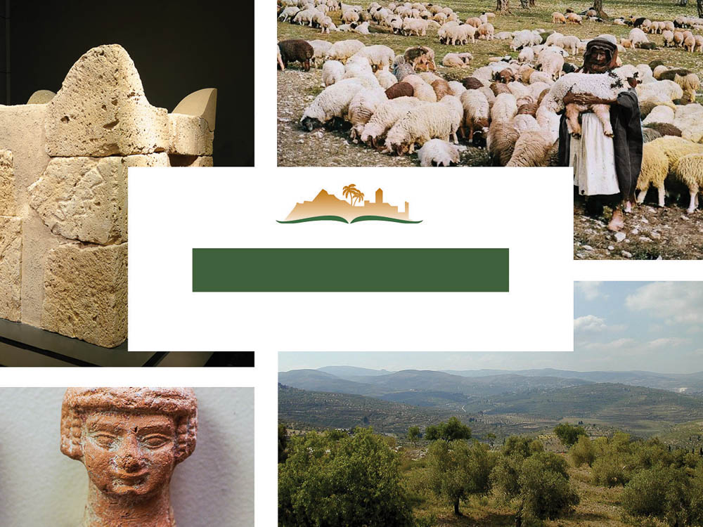
Amos 3
Notes:
This is a free sample of the Amos 3 presentation from the Photo Companion to the Bible. To purchase the full volume, visit www.bibleplaces.com/amos/
The Photo Companion to the Bible is an image-rich resource for Bible students, teachers, and researchers. Just as a librarian stocks the shelves with as many relevant materials as possible, so we have tried to provide a broad selection of images. Our goal is that you will find in this “library” whatever it is you are looking for.
Credits: The primary creators of this presentation are Chris McKinny, Kris Udd, Steven D. Anderson, and Todd Bolen. The photographs have an individual file code which usually includes the initials of the photographer. Other images have additional credit or source information.
Updates: We plan to update this collection as we are able. We welcome your suggestions for improving this resource (photocompanion@bibleplaces.com). Purchasers of the Amos volume are provided free, lifetime updates to the volume.
Copyright: This photo collection is protected by copyright law and may not be distributed without written permission from BiblePlaces.com. Slide notes should be treated as any other copyrighted written material, with credit given when quoting from these notes.
For more information, see our complete “Introduction to the Photo Companion to the Bible” online at https://www.BiblePlaces.com/Intro-Photo-Companion-Bible/. Here you will find more information about photo selection, explanatory notes, Bible translation, credit information, and copyright allowances.

Slide 2
Amos 3
This is a free sample of the Amos 3 presentation from the Photo Companion to the Bible. To purchase the full volume, visit www.bibleplaces.com/amos/
The Photo Companion to the Bible is an image-rich resource for Bible students, teachers, and researchers. Just as a librarian stocks the shelves with as many relevant materials as possible, so we have tried to provide a broad selection of images. Our goal is that you will find in this “library” whatever it is you are looking for.
For more details (for this and every slide), see the Notes section below.
Notes:
This is a free sample of the Amos 3 presentation from the Photo Companion to the Bible. To purchase the full volume, visit www.bibleplaces.com/amos/
The Photo Companion to the Bible is an image-rich resource for Bible students, teachers, and researchers. Just as a librarian stocks the shelves with as many relevant materials as possible, so we have tried to provide a broad selection of images. Our goal is that you will find in this “library” whatever it is you are looking for.
Credits: The primary creators of this presentation are Chris McKinny, Kris Udd, Steven D. Anderson, and Todd Bolen. The photographs have an individual file code which usually includes the initials of the photographer. Other images have additional credit or source information.
Updates: We plan to update this collection as we are able. We welcome your suggestions for improving this resource (photocompanion@bibleplaces.com). Purchasers of the Amos volume are provided free, lifetime updates to the volume.
Copyright: This photo collection is protected by copyright law and may not be distributed without written permission from BiblePlaces.com. Slide notes should be treated as any other copyrighted written material, with credit given when quoting from these notes.
For more information, see our complete “Introduction to the Photo Companion to the Bible” online at https://www.BiblePlaces.com/Intro-Photo-Companion-Bible/. Here you will find more information about photo selection, explanatory notes, Bible translation, credit information, and copyright allowances.

Slide 3
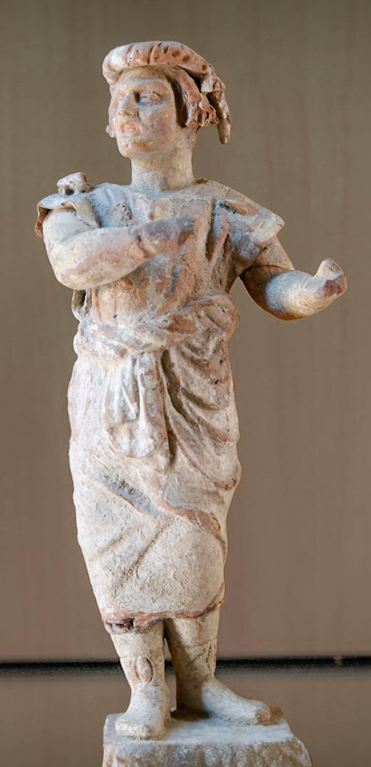
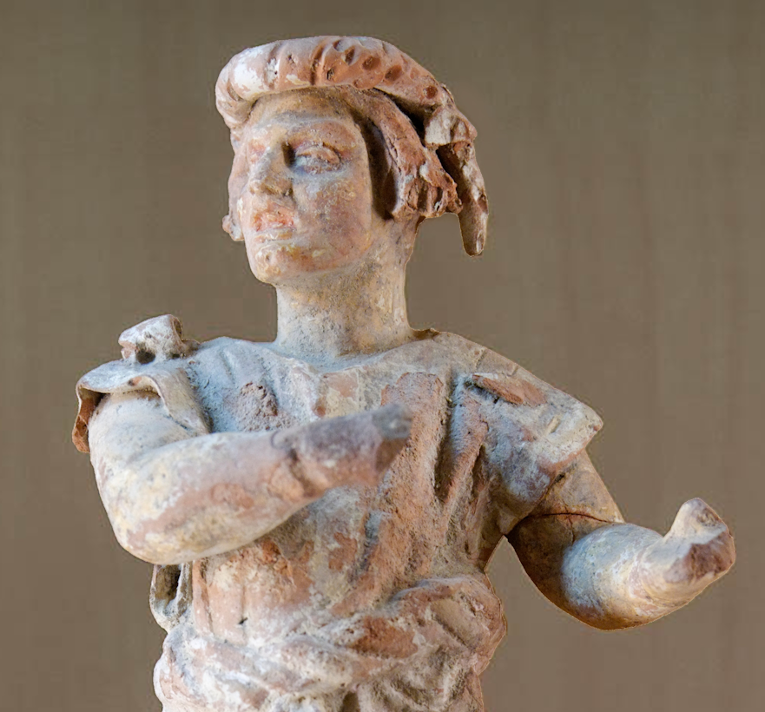
Hear this word that Yahweh has spoken against you, O people of Israel
Terracotta figurine of a man speaking, from Myrina, late 3rd century BC–2nd century BC
3:1
Notes:
One of the most surprising feature of Amos’s prophetic career is that it was devoted to Israel and not his native Judah. This figurine was photographed at the Museum of Fine Arts of Lyon. This image comes from Marie-Lan Nguyen and is licensed under CC BY 3.0, via Wikimedia Commons: https://commons.wikimedia.org/wiki/File:New_Comedy_actor_MBA_Lyon_E272-54.jpg.
wiki201022004050557

Slide 4
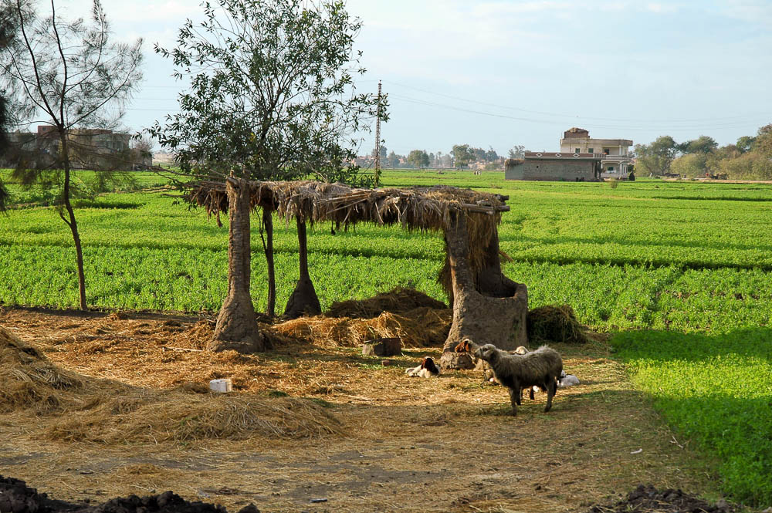
It is against the entire family that I brought up out of the land of Egypt
A shelter in the land of Goshen in the Eastern Delta near Tanis
3:1
Notes:
This is believed to be the area where the Israelites lived prior to the exodus.
tb010605737

Slide 5
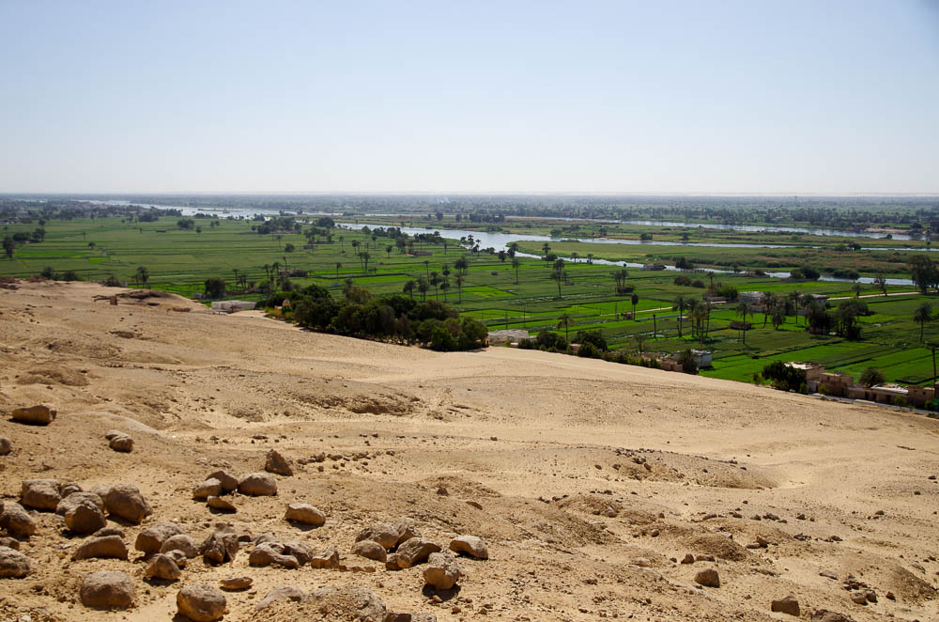
It is against the entire family that I brought up out of the land of Egypt
Nile Valley from the tombs of the nobles in Beni Hasan
3:1
Notes:
This photo shows a typical scene in Egypt, with the fertile Nile Valley flowing through what is otherwise desert land.
adr1603163784

Slide 6
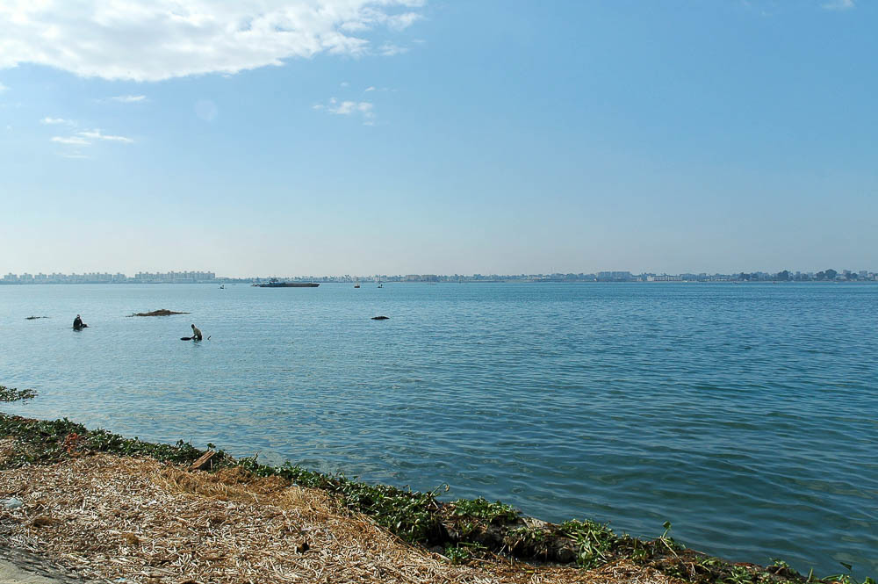
It is against the entire family that I brought up out of the land of Egypt
Lake Timsah (from the northeast)
3:1
Notes:
The Israelites finally left Egypt for good when they crossed the Red Sea, which God parted for them. The location of this event is not known with certainty. One possibility is Lake Timsah, shown here. There is a chain of small lakes and marshes on the Isthmus of Suez, between the modern Gulf of Suez and the Mediterranean Sea. From north to south, they are Lake Manzala, the Ballah Lakes, Lake Timsah, and the Bitter Lakes. Today, the lakes are linked by the Suez Canal which joins Port Taufiq with Port Said.
tb010605563

Slide 7

It is against the entire family that I brought up out of the land of Egypt
Southern end of the Great Bitter Lake
3:1
Notes:
Another possibility for the place where the Israelites crossed the Red Sea is the Great Bitter Lake. There is some evidence that at the time of the exodus, the Gulf of Suez may have included the Great Bitter Lake and Lake Timsah.
tb010605516

Slide 8
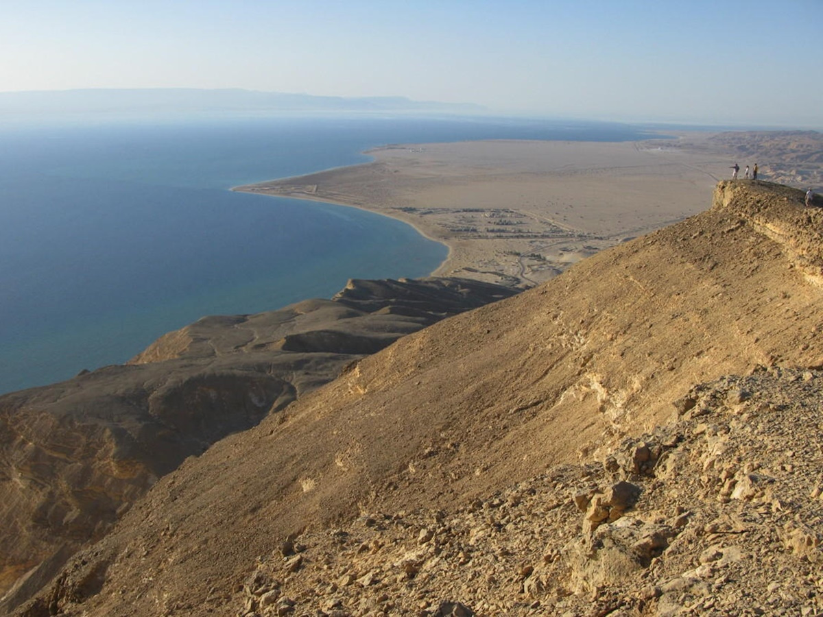
It is against the entire family that I brought up out of the land of Egypt
View of the Red Sea from above Pharaoh Spring and Ras Sedr
3:1
Notes:
The crossing of the Red Sea may also have taken place at the relatively shallow northern end of the Gulf of Suez. This photo provides a view of the Red Sea from a high elevation. The town on the flat below this promontory is Ras Sedr (Ra’s Sudr). The Gulf of Suez is visible on the horizon at the upper right.
This image comes from Christian Heine and is in the public domain. Source: https://scx2.b-cdn.net/gfx/news/hires/2014/asymmetricco.jpg
scx22014

Slide 9
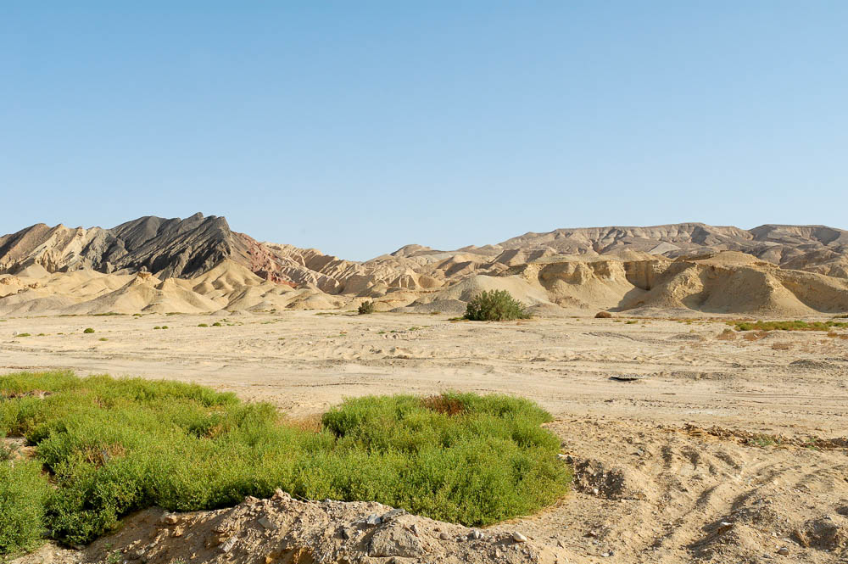
It is against the entire family that I brought up out of the land of Egypt
Possible Israelite encampment area in Abu Zenima, near the Red Sea (Gulf of Suez)
3:1
Notes:
After crossing the Red Sea, the Israelites headed south along the eastern shore of the Red Sea (the modern Gulf of Suez) toward Mount Sinai. The area shown in this photograph is a possible area where they may have camped. Archaeologists have found evidence of Egyptian use of this area in the New Kingdom period, which would match the time of the exodus.
tb032406492

Slide 10
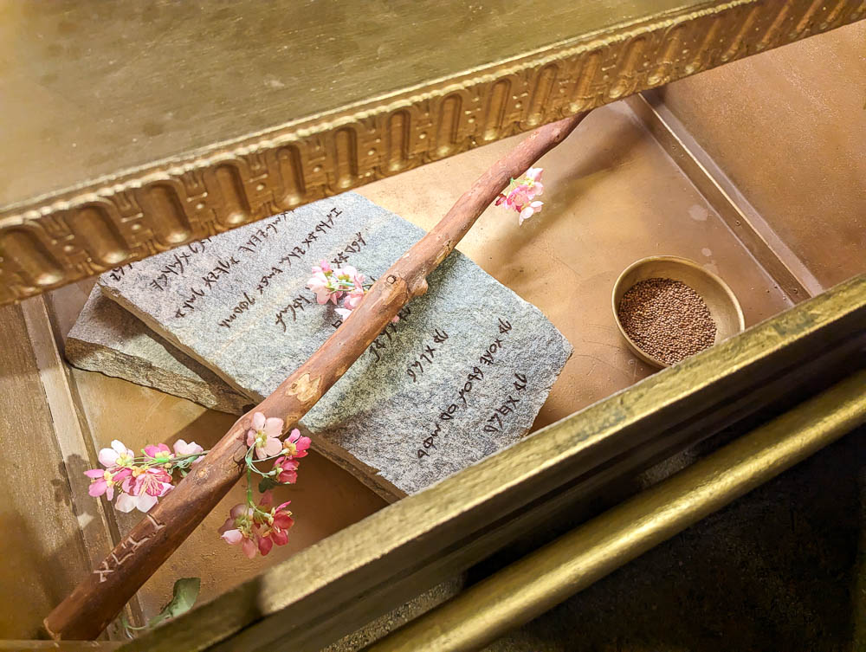
You alone I have chosen from all the families of the earth
Model of the stone tablets in the ark of the covenant
3:2
Notes:
God’s covenant with the Israelite nation was symbolized by the Ten Commandments, which were recorded on stone and kept in the ark of the covenant. The ark of the covenant also contained Aaron’s rod that budded and a gold pot of manna (Heb 9:4). This full-size model of the contents of the ark was photographed at the model of the tabernacle in Timna Park in southern Israel.
ku0613231210224

Slide 11
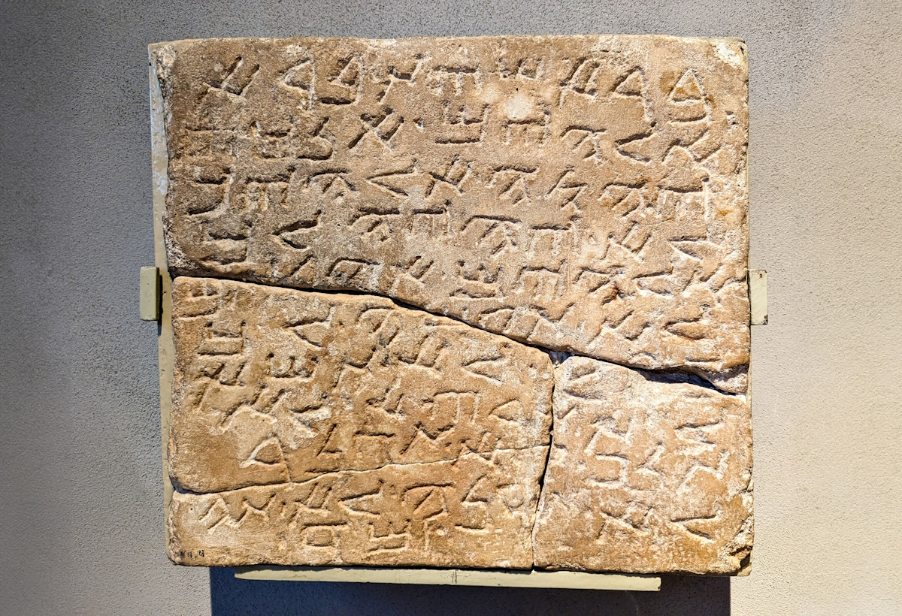
You alone I have chosen from all the families of the earth
Samaritan mezuzah with the Ten Commandments, from Kefar Bilu, 6th–7th centuries AD
3:2
Notes:
This stone artifact is inscribed with excerpts from the Ten Commandments, including the commands not to have other gods, to take the Lord’s name in vain, to murder, commit adultery, steal, or covet. Kefar Bilu is located near Rehovot on Israel’s coastal plain. These inscribed words from Scripture were photographed at the Israel Museum.
ku0607231104574c

Slide 12
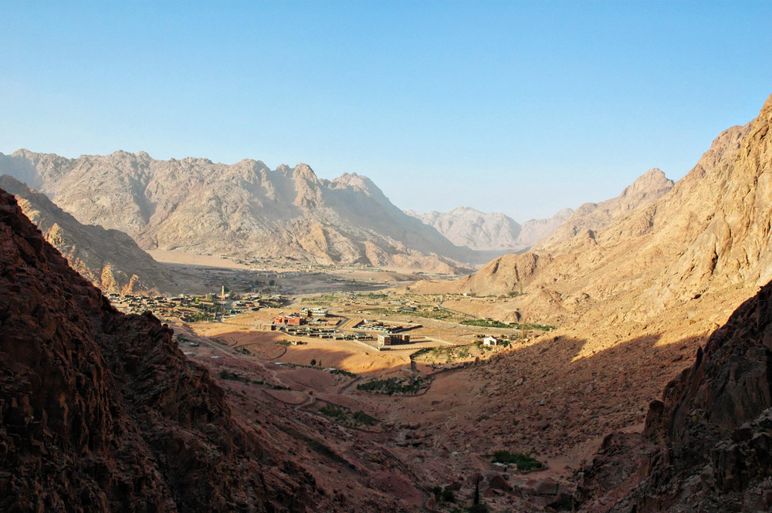
You alone I have chosen from all the families of the earth
Plain of er-Raha, at the base of Jebel Musa, traditional Mount Sinai (from the west)
3:2
Notes:
God appeared before the Israelites at Mount Sinai (Exod 19:16). This photo shows the traditional area where the Israelites encamped at the base of Mount Sinai (Exod 19).
tb061905784

Slide 13
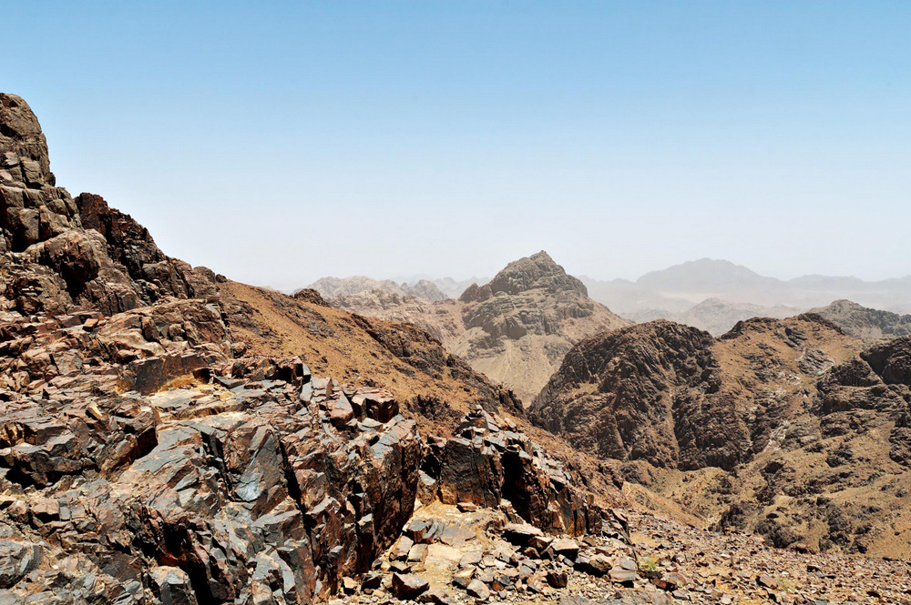
You alone I have chosen from all the families of the earth
Jebel Musa, traditional Mount Sinai (from the southwest)
3:2
Notes:
The dark mountain in the center of this photo is the traditional Mount Sinai (Jebel Musa).
tb062105021

Slide 14
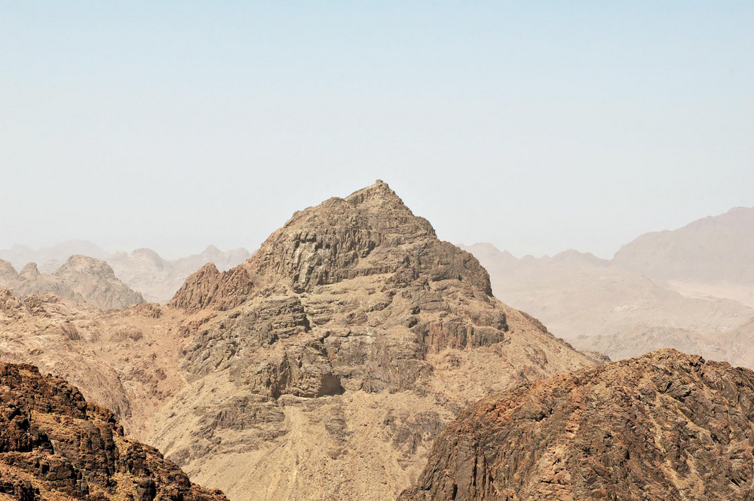
You alone I have chosen from all the families of the earth
Jebel Musa, traditional Mount Sinai (from the southwest)
3:2
Notes:
tb062105050

Slide 15
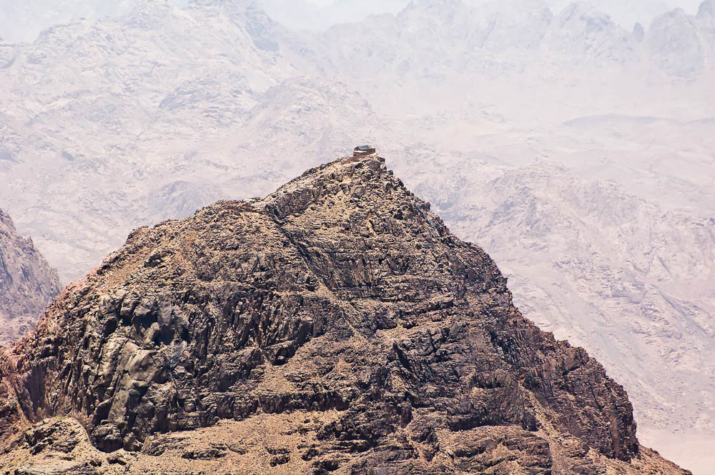
You alone I have chosen from all the families of the earth
Jebel Musa, traditional Mount Sinai (from Jebel Catherine)
3:2
Notes:
Today a chapel is located on the summit of Jebel Musa.
tb062105037

Slide 16
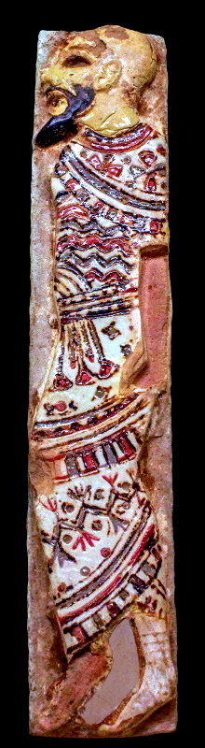
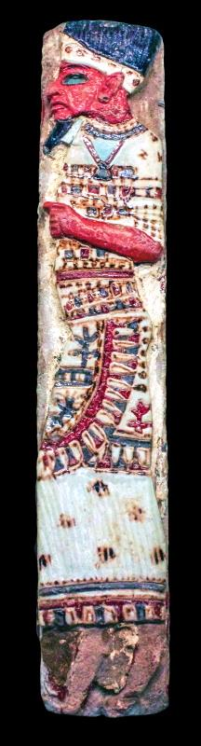
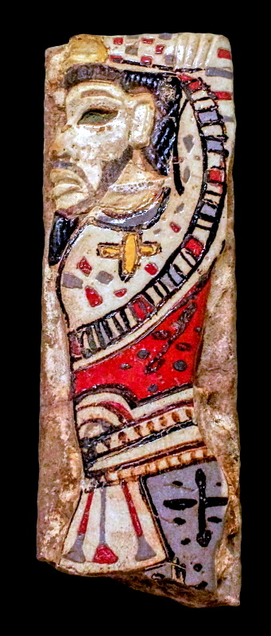
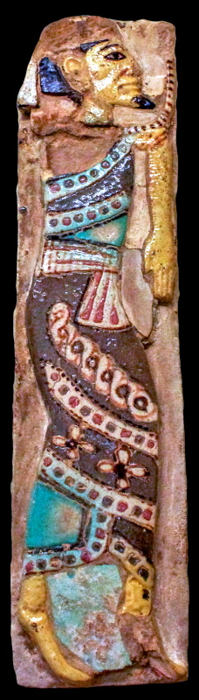
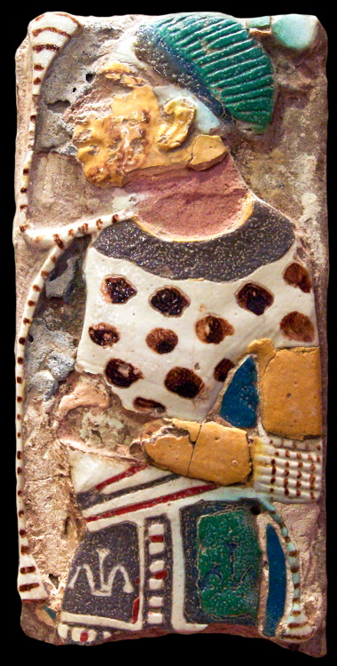
You alone I have chosen from all the families of the earth
Egyptian depictions of an Amorite, Philistine, Hittite, Syrian, and Canaanite, 12th century BC
3:2
Notes:
Many different “families of the earth” were known to the ancient Egyptians. The faience plaques shown here and on the next slide illustrate some of them. Each is shown with arms bound, whether behind them, in front of them, or over their head, which was how the Egyptians typically portrayed their enemies. Each has a distinctive combination of things like facial hair, skin color, and clothing. These plaques were recovered from Medinet Habu. The four on the left were photographed at the Boston Museum of Fine Arts, and the one at the far right was photographed at the Oriental Institute Museum at the University of Chicago.
Photo numbers (L to R): adr1711203217b; adr1711203216b; adr1711203219b; adr1711203218b; adr1206169211b

Slide 17
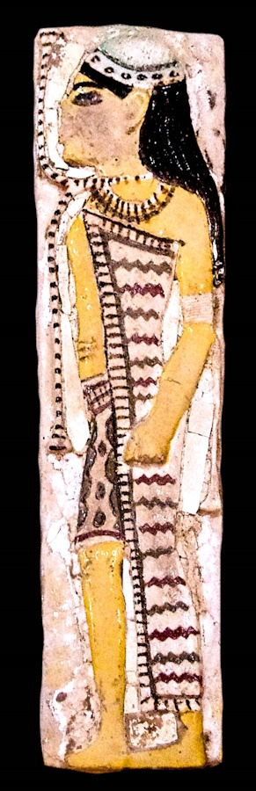
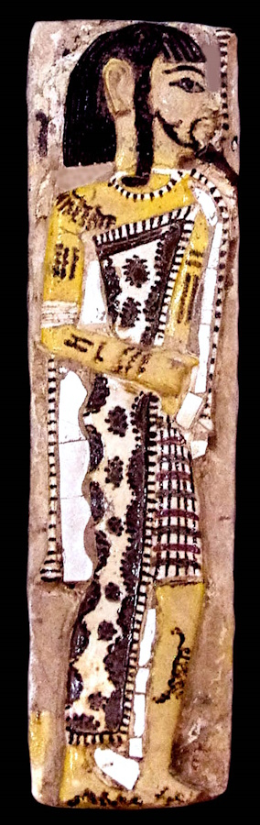
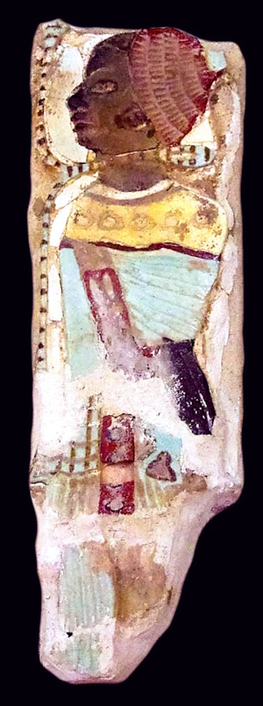
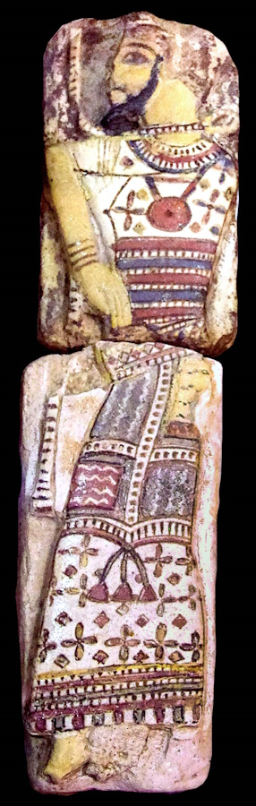
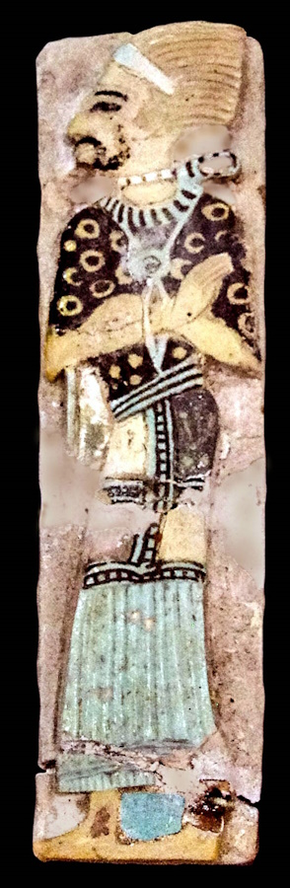
You alone I have chosen from all the families of the earth
Egyptian depictions of a Hittite, Libyan, Nubian, and two Shasu Bedouin, 12th century BC
3:2
Notes:
These faience depictions of foreign prisoners of the Egyptians were photographed at the Egyptian Museum in Cairo.
Photo numbers (L to R): adr1603194484b; adr1603194482b; adr1603194485b; adr1603194475b; adr1603194480b

Slide 18
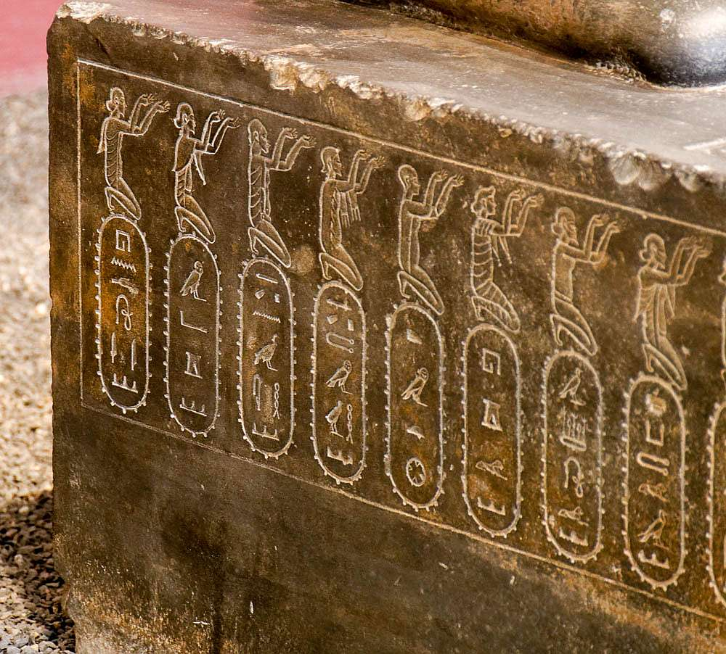
You alone I have chosen from all the families of the earth
Representations of peoples in the empire, on a statue of Darius I, with Egyptian hieroglyphs
3:2
Notes:
This pedestal base belongs to a statue of Darius the Great. Both sides of the base list people groups who were subjected to the Persians. The people groups shown here, from left to right, are India, Maka, Nubia, Libya, Egypt, Arabia, Assyria, and Skudra. This statue base was photographed at the National Museum of Iran. The next slide includes labels.
India (Old Persian “Hindush” or more often “Hidush”) was the easternmost province.
Nubia (Kush) was in southern Egypt.
Libya (Old Persian “Putaya”) was the westernmost province. Under Cambyses, the region was taken as far west as Benghazi.
Maka was the province corresponding to Greek Gedrosia, in the barren coastal areas of modern Pakistan and Iranian Baluchistan.
Skudra was the province of Thrace/Macedon.
tb0514184157

Slide 19
You alone I have chosen from all the families of the earth
India
Maka
Nubia
Libya
Egypt
Arabia
Assyria
Skudra
Representations of peoples in the empire, on a statue of Darius I, with Egyptian hieroglyphs
3:2
Notes:
This pedestal base belongs to a statue of Darius the Great. Both sides of the base list people groups who were subjected to the Persians. The people groups shown here, from left to right, are India, Maka, Nubia, Libya, Egypt, Arabia, Assyria, and Skudra. This statue base was photographed at the National Museum of Iran.
India (Old Persian “Hindush” or more often “Hidush”) was the easternmost province.
Nubia (Kush) was in southern Egypt.
Libya (Old Persian “Putaya”) was the westernmost province. Under Cambyses, the region was taken as far west as Benghazi.
Maka was the province corresponding to Greek Gedrosia, in the barren coastal areas of modern Pakistan and Iranian Baluchistan.
Skudra was the province of Thrace/Macedon.
tb0514184157

Slide 20
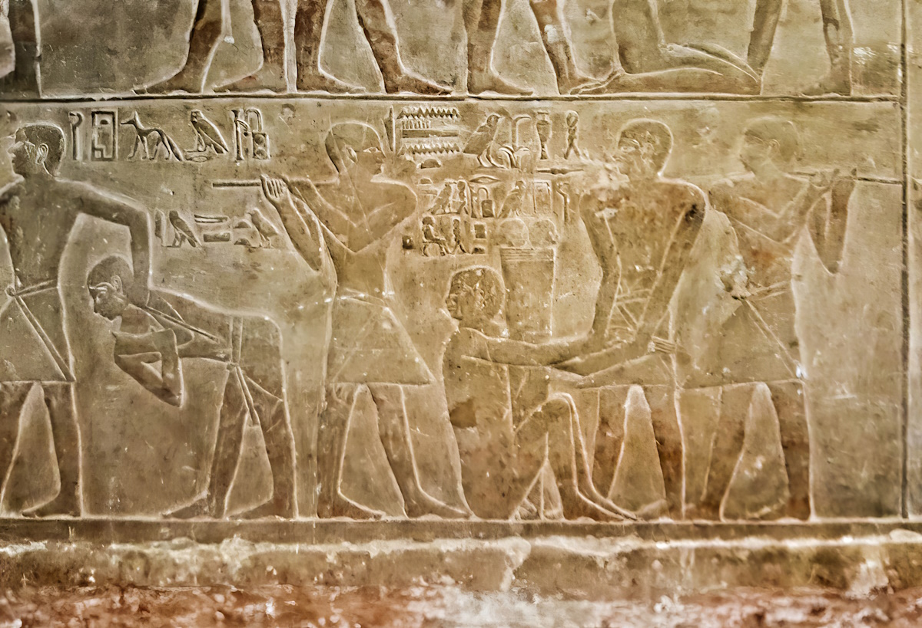
Therefore I will punish you for your sin
Prisoners beaten, from the mastaba of the vizier Mereruka, circa 2200 BC
3:2
Notes:
Punishment for sin was part of the covenant God made with Israel (e.g., Deut 28). This relief from the tomb of the vizier Mereruka, second in command only to the king during the 6th dynasty, shows one man being beaten and another being hauled away after a beating, perhaps to a prison. This image comes from Ovedc and is licensed under CC BY-SA 4.0, via Wikimedia Commons: https://commons.wikimedia.org/wiki/File:By_ovedc_-_Mastaba_of_Mereruka_-10.jpg.
wiki1005171415495312

Slide 21
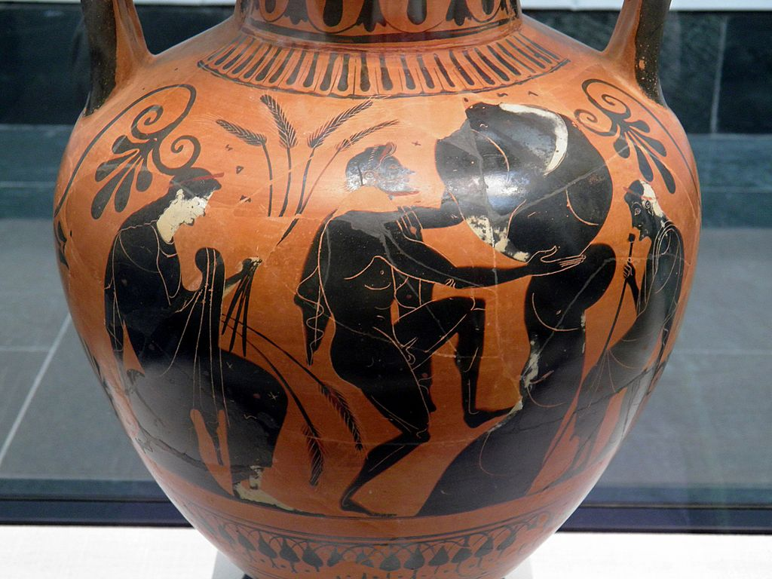

Therefore I will punish you for your sin
Black-figured amphora with Sisyphus pushing a rock uphill, circa 6th century BC
3:2
Notes:
In later Greco-Roman mythology, the criminal Sisyphus was condemned to roll a rock up a hill for eternity in the Land of the Dead. The rock continually rolled back on him, making his task endless. In this depiction, he is flanked by the gods Hades and Persephone, one holding stalks of wheat, the other a royal scepter.
This amphora was photographed at the State Collection of Antiquities in Munich. This image comes from Carole Raddato and is licensed under CC BY-SA 2.0, via Wikimedia Commons: https://commons.wikimedia.org/wiki/File:Attic_Black_Figured_amphora_depicting_the_punishment_of_Sisyphus_in_Hades,_Staatliche_Antikensammlungen,_Munich_(8958117338).jpg. A removable graphic has been added to avoid causing surprise or offense.
wiki8958117338053120131135

Slide 22
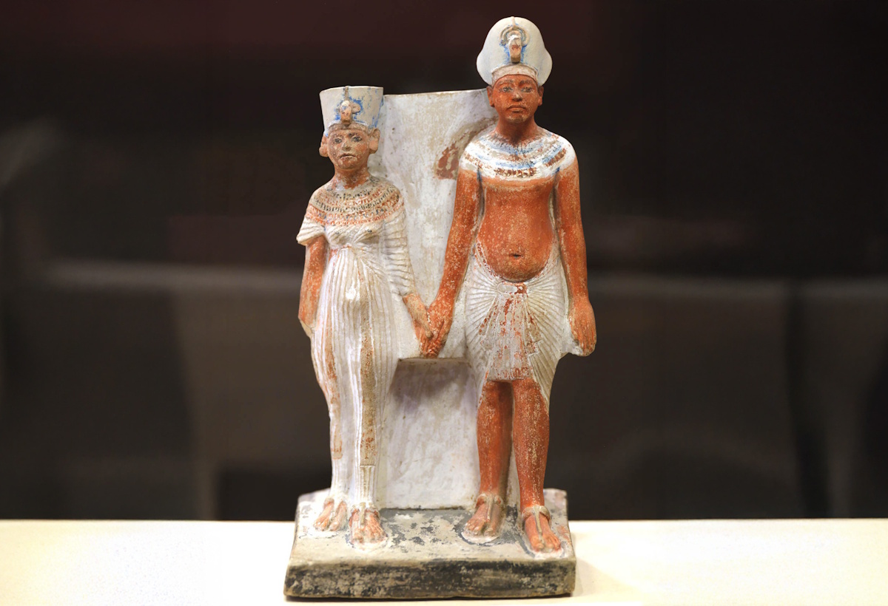
Do two people walk together, unless they have agreed to do so?
Standing statue of Akhenaten and Queen Nefertiti, from Amarna, circa 1350 BC
3:3
Notes:
This statue was photographed at the Louvre Museum. This image comes from Shonagon and is licensed under CC0, via Wikimedia Commons: https://commons.wikimedia.org/wiki/File:Akhenaton_et_Nefertiti_-_Mus%C3%A9e_du_Louvre_Antiquit%C3%A9s_%C3%A9gyptiennes_E_15593_;_E_22746.jpg.
wiki030124659689601577c

Slide 23
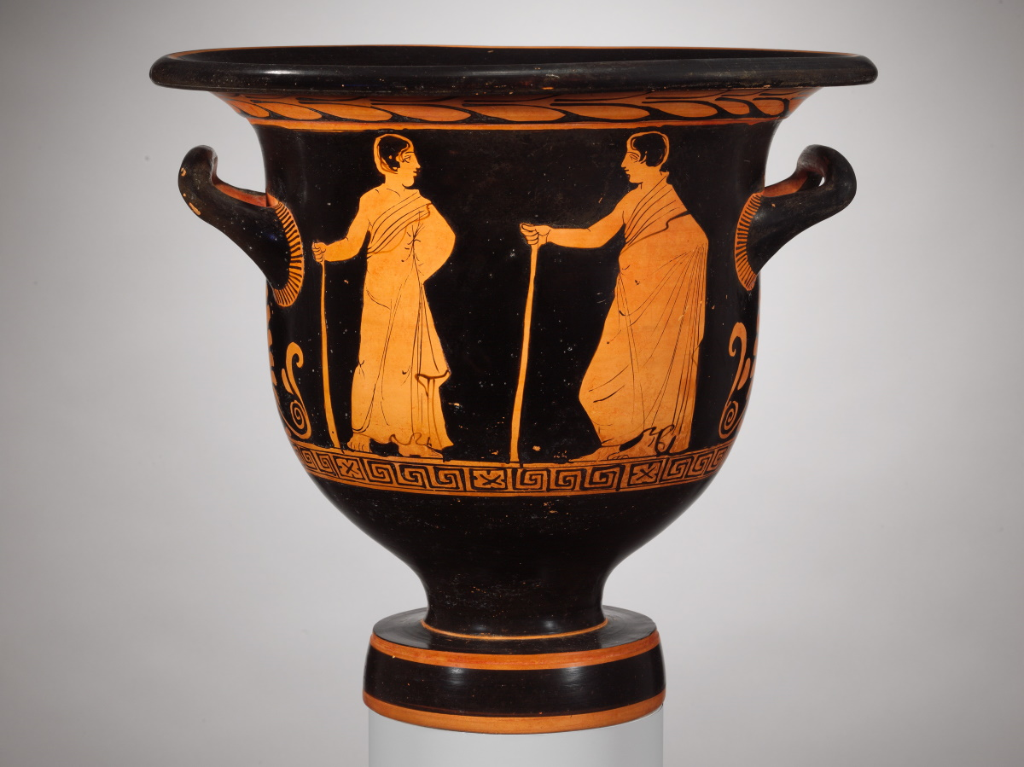
Do two people walk together, unless they have agreed to do so?
Bell krater depicting two youths walking together, 4th century BC
3:3
Notes:
This image comes from the Metropolitan Museum of Art, public domain, Gift of David Nelson, in memory of Mark L. Davison, 1984, accession number 1984.323.2, https://www.metmuseum.org/art/collection/search/255815.
met255815

Slide 24
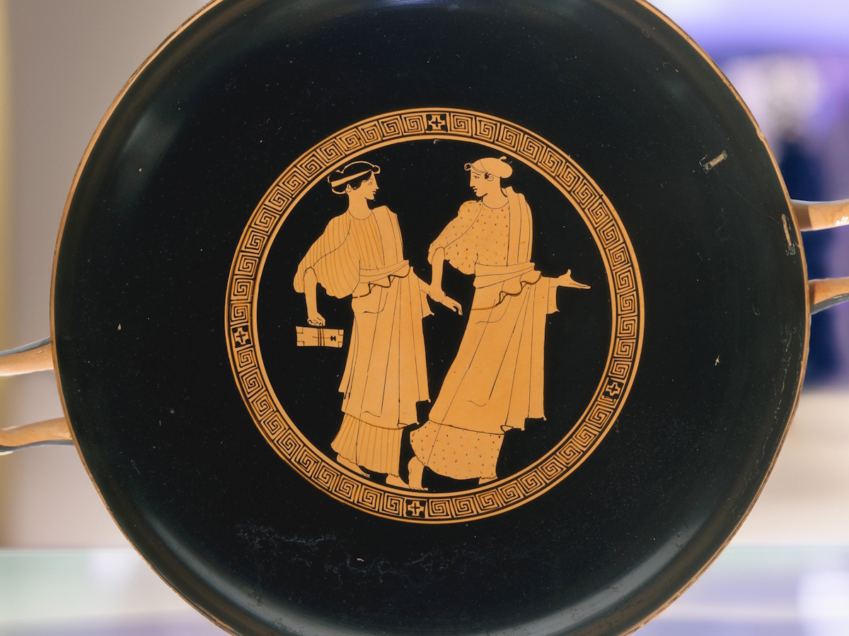
Do two people walk together, unless they have agreed to do so?
Kylix with two women in friendly conversation, circa 500 BC
3:3
Notes:
This kylix depicts two women walking together, in conversation with each other. The woman on the left carries a writing board and stylus. This image comes from The Metropolitan Museum of Art, public domain, Rogers Fund, 1906, accession number 06.1021.167, https://www.metmuseum.org/art/collection/search/247330. Generative AI has been used to modify the background.
met247330

Slide 25
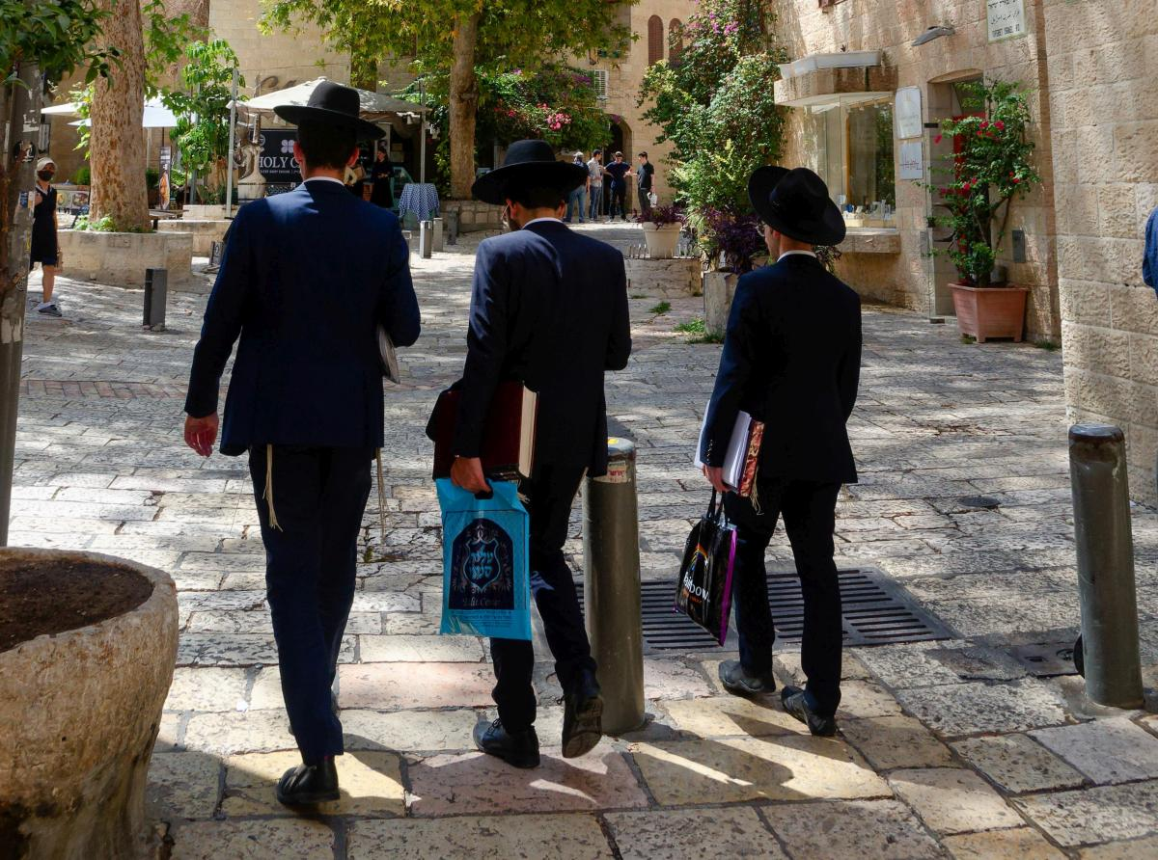
Do two people walk together, unless they have agreed to do so?
Orthodox Jewish men walking in the Jewish Quarter of the Old City of Jerusalem
3:3
Notes:
bjb090121890

Slide 26
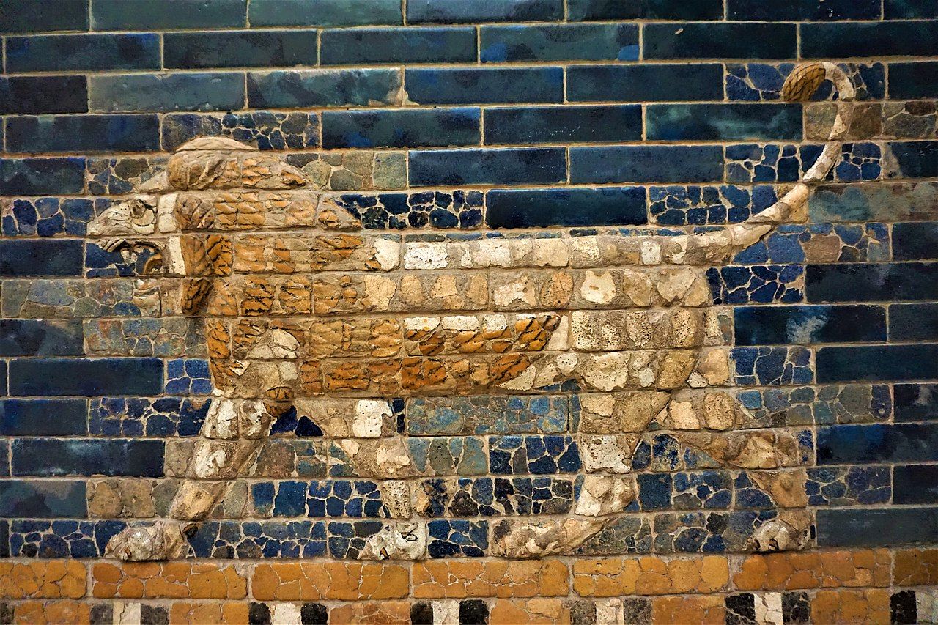
Does a lion roar in the thicket when it has no prey?
Lion from the Ishtar Gate at Babylon, circa 600 BC
3:4
Notes:
This glazed brick depiction of a lion was photographed at the Museum of the Ancient Near East in Berlin. This image comes from Joyofmuseums and is licensed under CC BY-SA 4.0, via Wikimedia Commons: https://commons.wikimedia.org/wiki/File:Ishtar_Gate_-_Pergamon_Museum_-_Joy_of_Museums_-_2.jpg.
wiki08301864000609

Slide 27

Does a lion roar in the thicket when it has no prey?
Roaring African lion
3:4
Notes:
The word used here for “lion” (Heb. aryeh, אַרְיֵה) is the general term (along with ari, אֲרִי) for “lion,” referring to an adult male. The Asiatic lion was the type which roamed the Middle East in biblical times. Skeletal remains of lions have been discovered in excavations at the sites of Ekron and Jaffa. This image was taken by Eric Kilby and is licensed under CC-BY-SA-2.0, via Wikimedia Commons: https://commons.wikimedia.org/wiki/File:Two_Lions_Roaring_-_Closeup_(20842585554).jpg.
wiki091320151442

Slide 28
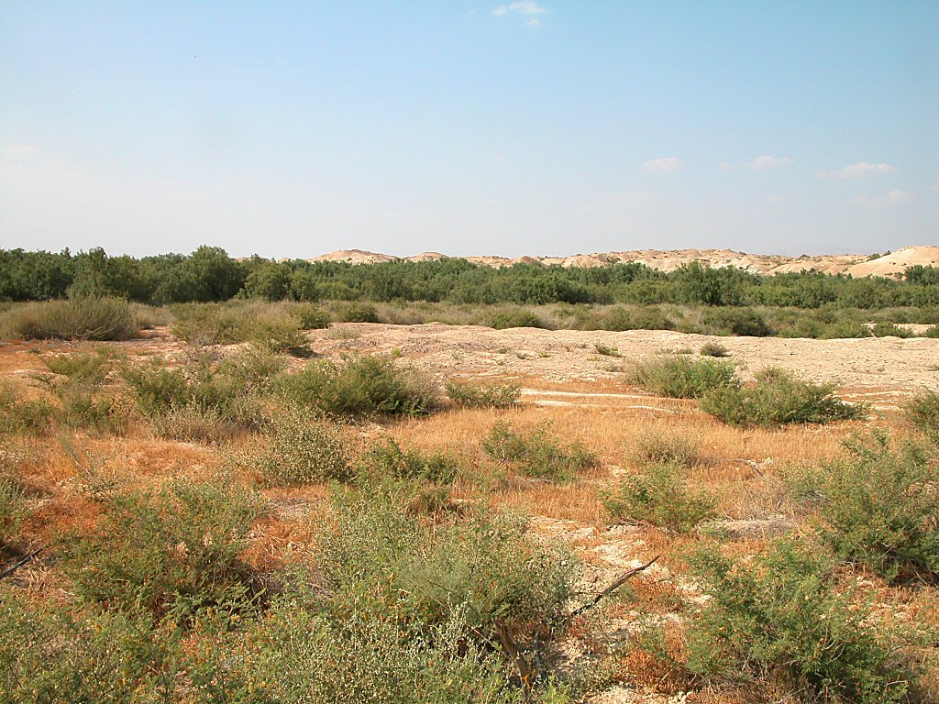
Does a lion roar in the thicket when it has no prey?
Pride of the Jordan, thickets by river
3:4
Notes:
A thicket (Heb. yaar, יַעַר) refers to an area that is dense or overgrown with vegetation. It could refer to a heavily forested area or to a thickly overgrown environment like the thickets that still persist along the Jordan River.
The Jordan Rift consists of three plateaus descending from the surrounding mountains to the Jordan River. The upper terrace is known as the Ghor, and the roads, both ancient and modern, are on this level. The middle terrace is known as the Qattara and consists of a rugged marl terrain. The lowest level is known as the Zor and is the floodplain of the river. Ranging from 200 yards (183 m) to 1 mile (1.6 km) in width, the Zor has thickly overgrown since antiquity. Especially prevalent in this growth are tamarisk, willow, and Euphrates poplar. Consequently, wild animals have found refuge in this area. Nineteenth-century explorers reported seeing lions, tigers, bears, hyenas, jackals, and otters in this environment.
tb060303276

Slide 29
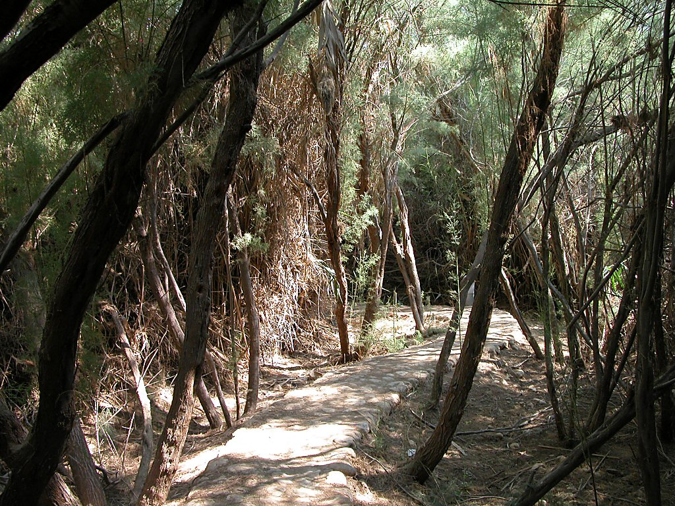
Does a lion roar in the thicket when it has no prey?
Pride of the Jordan, thickets by river
3:4
Notes:
There are a number of references in the Hebrew Bible to the thickets of the Jordan, and a number of them feature lions.
Jeremiah 12:5 (ESV): “If you have raced with men on foot, and they have wearied you, how will you compete with horses? And if in a safe land you are so trusting, what will you do in the thicket of the Jordan?”
Jeremiah 49:19 (ESV): “Behold, like a lion coming up from the jungle of the Jordan against a perennial pasture, I will suddenly make him run away from her. And I will appoint over her whomever I choose. For who is like me? Who will summon me? What shepherd can stand before me?” (cf. Jer 50:44)
Zechariah 11:3 (ESV): “The sound of the wail of the shepherds, for their glory is ruined! The sound of the roar of the lions, for the thicket of the Jordan is ruined!”
tb060303246

Slide 30
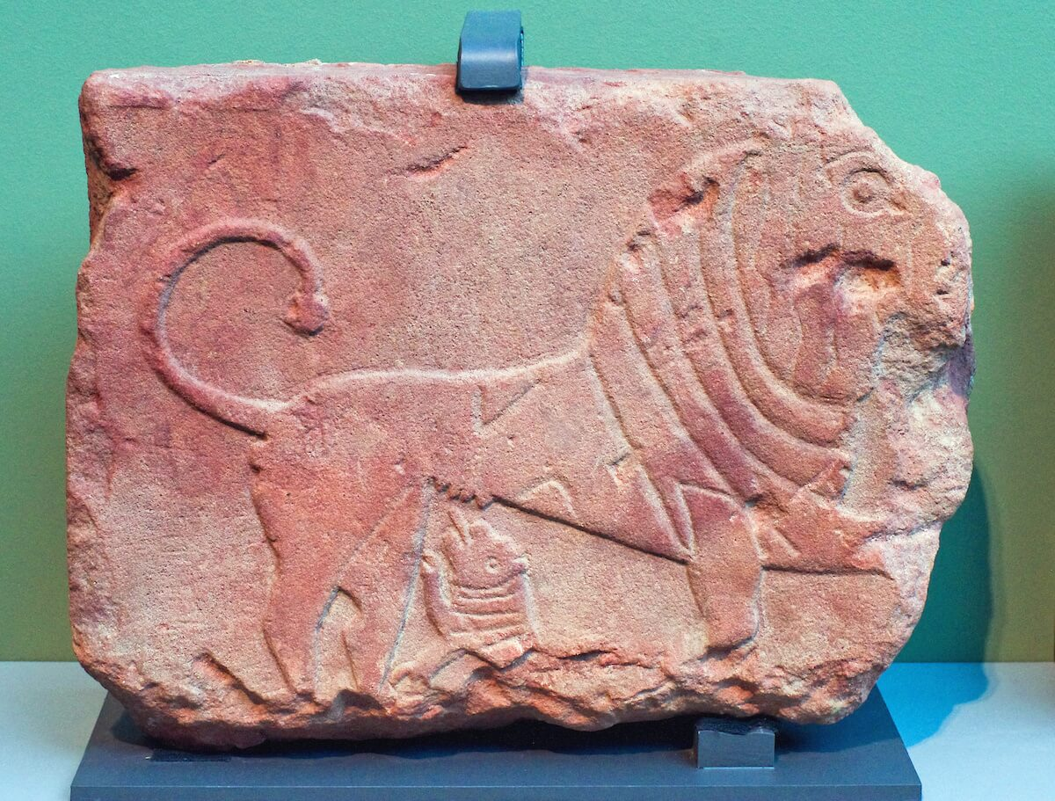
Does a young lion growl from its den unless it has captured something?
Lihyanite relief of a lioness suckling her cub, from al-ʿUla, 6th–4th centuries BC
3:4
Notes:
This sandstone relief was photographed at the Roads of Arabia exhibit at Nelson-Atkins Museum of Art.
adr1405297903

Slide 31

Does a young lion growl from its den unless it has captured something?
Male lion and a cub feeding on a water buffalo carcass in South Africa
3:4
Notes:
This image was taken by Luca Galuzzi and is licensed under CC-BY-SA-2.5, via Wikimedia Commons: https://commons.wikimedia.org/wiki/File:Male_Lion_and_Cub_Chitwa_South_Africa_Luca_Galuzzi_2004.JPG.
wiki0706200485169

Slide 32
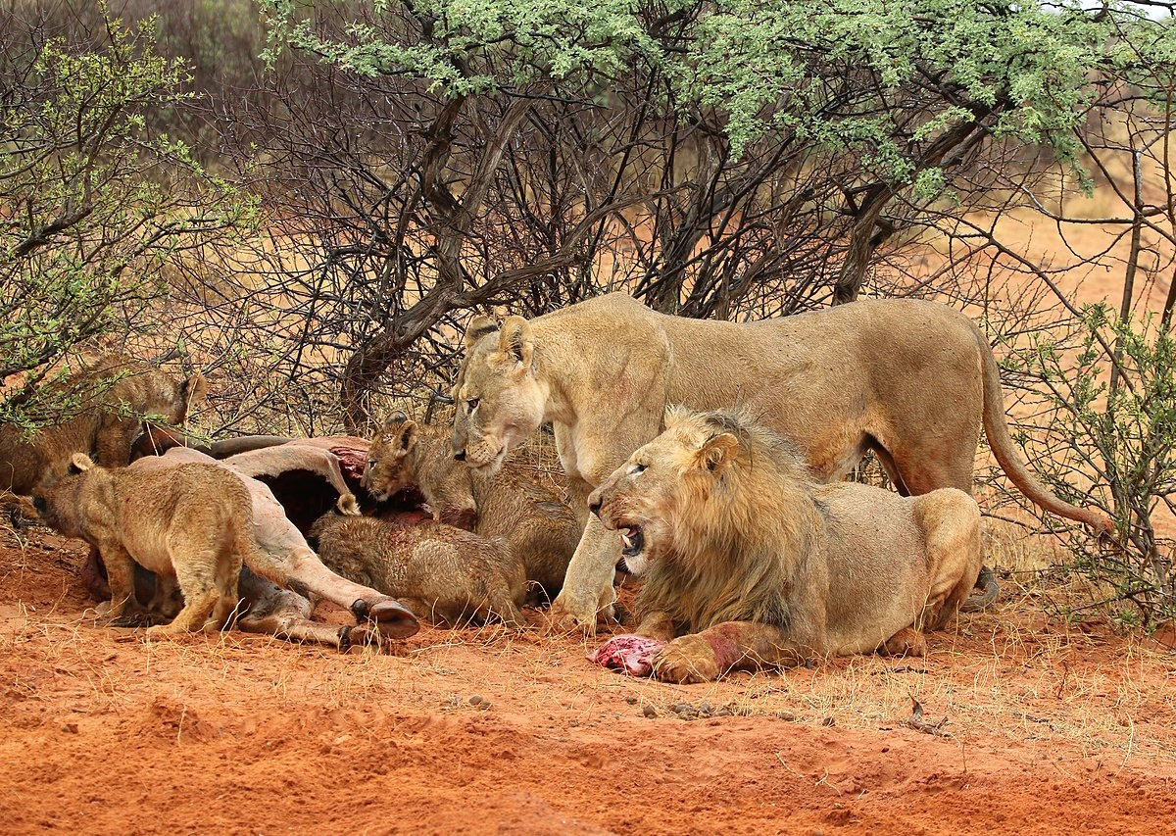
Does a young lion growl from its den unless it has captured something?
Family of lions feeding on an eland, Tswalu Kalahari Reserve, South Africa
3:4
Notes:
This image comes from Charles J. Sharp and is licensed under CC BY-SA 4.0, via Wikimedia Commons: https://commons.wikimedia.org/wiki/File:Lion_(Panthera_leo)_female_4_cubs_4m_male_2yr_eland_2.jpg.
wiki110214547236481559

Slide 33
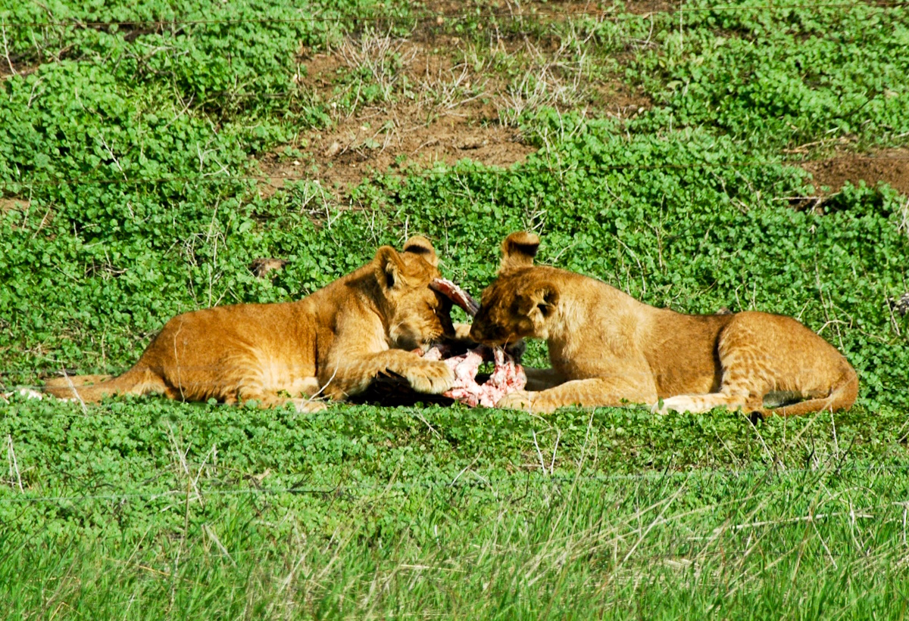
Does a young lion growl from its den unless it has captured something?
Young African lions eating prey
3:4
Notes:
This photograph was taken at the Ramat Gan Safari in Tel Aviv.
tb121404739c

Slide 34
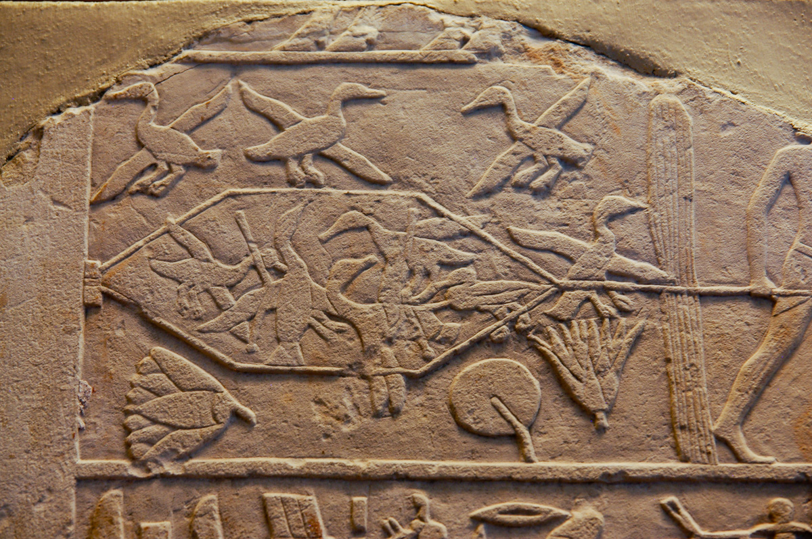
Does a bird swoop down into a trap when there is no bait?
Relief of men trapping waterfowl, from Saqqara, circa 2100 BC
3:5
Notes:
This painted relief wall fragment depicts Egyptian men using a net to trap waterfowl in a marshy area. It was photographed at the Art Institute of Chicago.
adr110810291

Slide 35
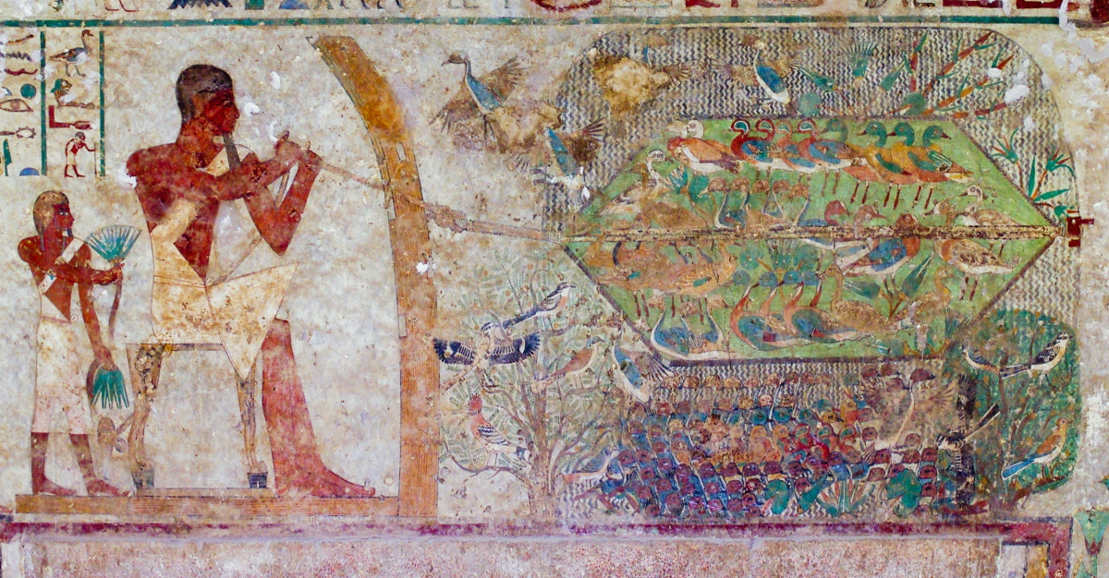
Does a bird swoop down into a trap when there is no bait?
Man trapping waterfowl in a net, from a tomb in Beni Hasan, circa 1870 BC
3:5
Notes:
This tomb painting depicts a seated man trapping waterfowl. Note that he has concealed himself behind a reed wall in order to keep from frightening his prey. This wall painting was photographed in the tomb of Khnumhotep II at Beni Hasan in Egypt.
adr1603247514

Slide 36
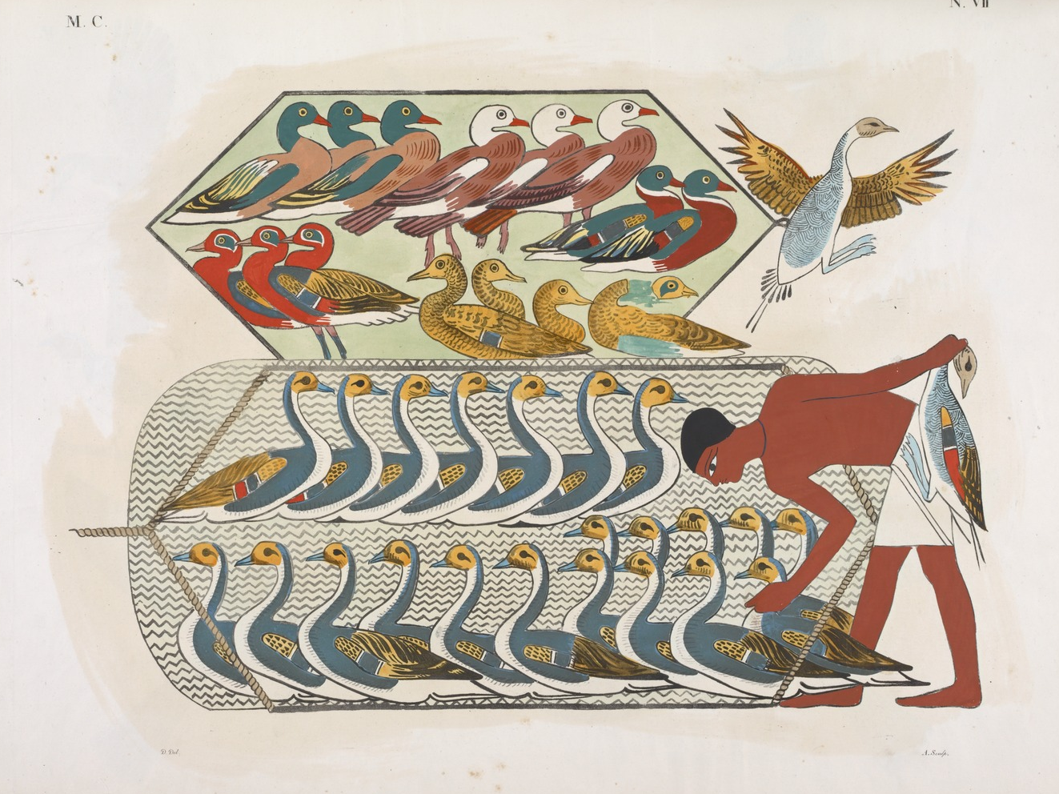
Does a bird swoop down into a trap when there is no bait?
Painting from Egypt depicting birds trapped in a net
3:5
Notes:
Public domain, from the New York Public Library, https://digitalcollections.nypl.org/items/510d47d9-47c1-a3d9-e040-e00a18064a99.
nypl425561

Slide 37
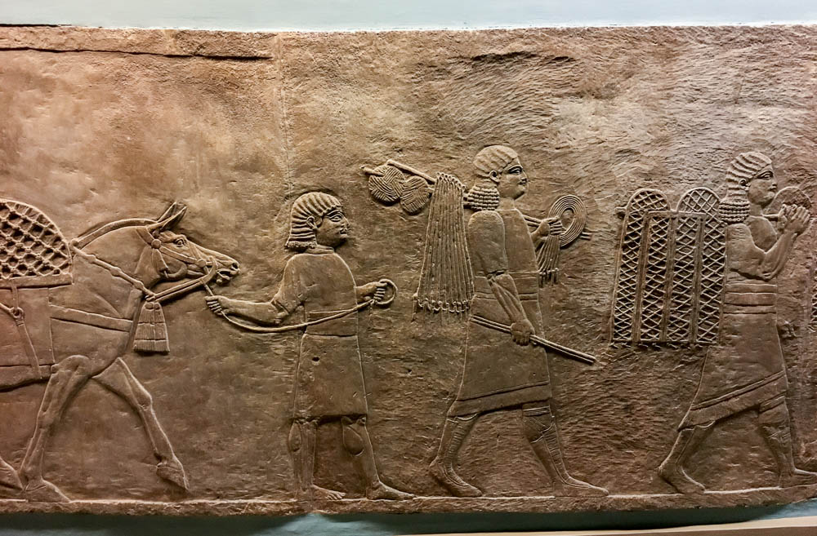
Does a snare spring shut when it has caught nothing at all?
Assyrian hunters with nets and traps, relief from Nineveh, 7th century BC
3:5
Notes:
The Assyrians trapped a variety of animals, including large and dangerous animals like lions. It is not known how all of their snares and traps worked, but even children can learn to set a spring-loaded snare using a branch or sapling as a spring. Such devices are typically triggered by the movement of an animal, so it would be expected that they would not be sprung unless disturbed by an animal.
This relief depicts royal servants with a variety of traps and nets, and materials to secure them. This relief comes from the North Palace of Ashurbanipal at Nineveh. It was photographed at the British Museum.
cm170512473

Slide 38
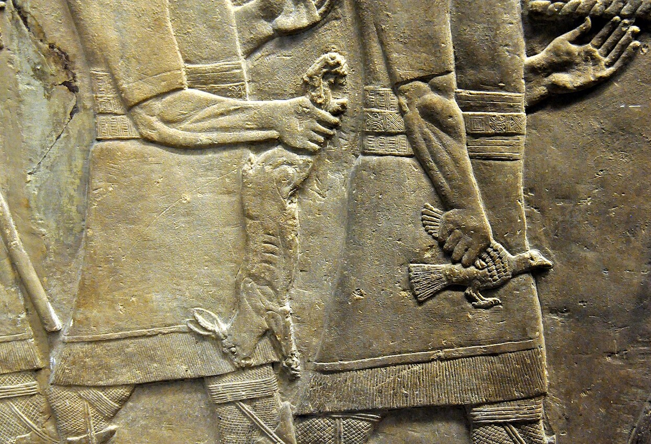
Does a snare spring shut when it has caught nothing at all?
Men returning from a hunt with various animals, including a rabbit, from Nineveh, circa 640 BC
3:5
Notes:
This relief depicts Assyrian men returning from a lion hunt, carrying back additional animals including a rabbit. A small snare is one of the most likely contraptions to have been used to catch such a creature.
This relief was photographed at the British Museum. This image comes from Osama Shukir Muhammed Amin and is licensed under CC BY-SA 4.0, via Wikimedia Commons: https://commons.wikimedia.org/wiki/File:Detail._Ashurbanipal%27s_men_after_returning_from_the_hunt,_carrying_a_bird_and_a_hare._Alabaster-bas_relief._From_Room_R,_North_Palace_at_Nineveh,_Iraq._645-635_BCE._British_Museum,_London.jpg.
wiki01291442882848292

Slide 39
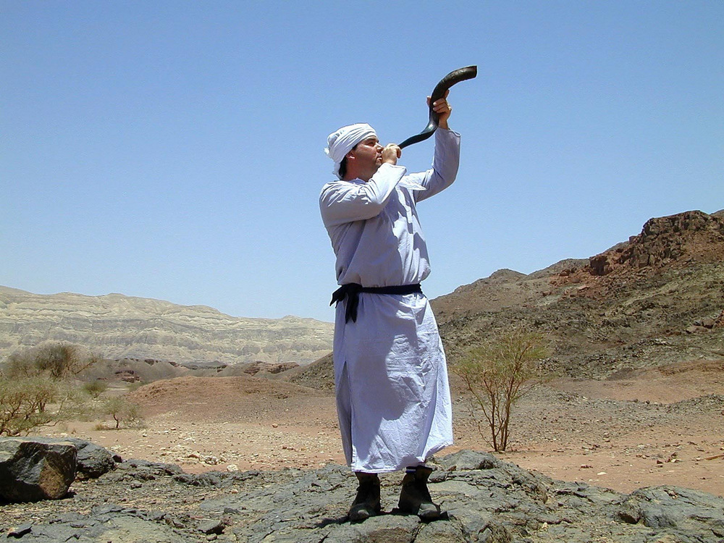
If a trumpet is blown in a city, will not the people be afraid?
Reenactment of a priest blowing a shofar
3:6
Notes:
This photograph was taken at the tabernacle model at Timna Park in southern Israel.
tb052201370

Slide 40
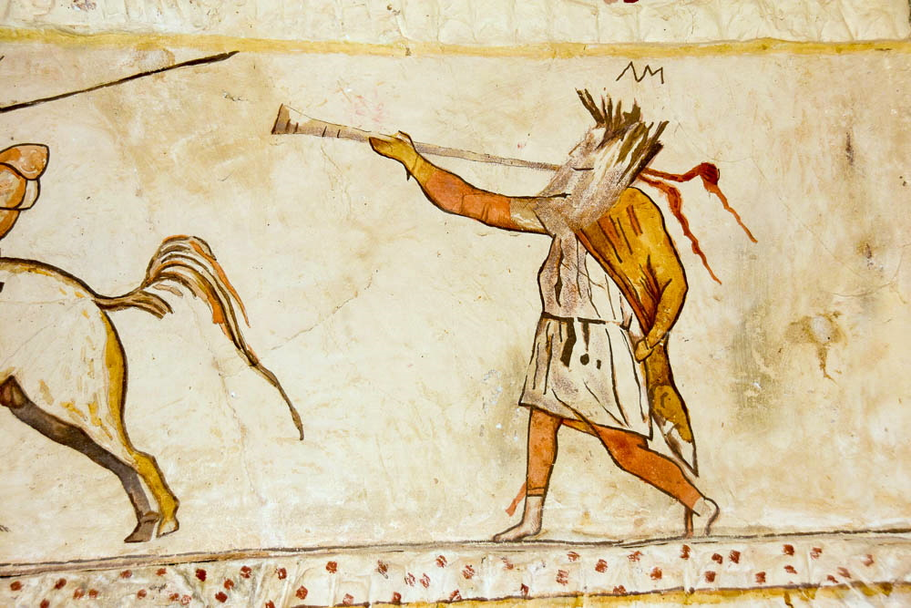
If a trumpet is blown in a city, will not the people be afraid?
Painting of a herald sounding his trumpet, from Maresha, circa 2nd century BC
3:6
Notes:
This tomb painting of a man blowing a trumpet was photographed in the burial caves at Maresha, a Late Hellenistic site in the Shephelah of Judah.
mjb1902271378

Slide 41
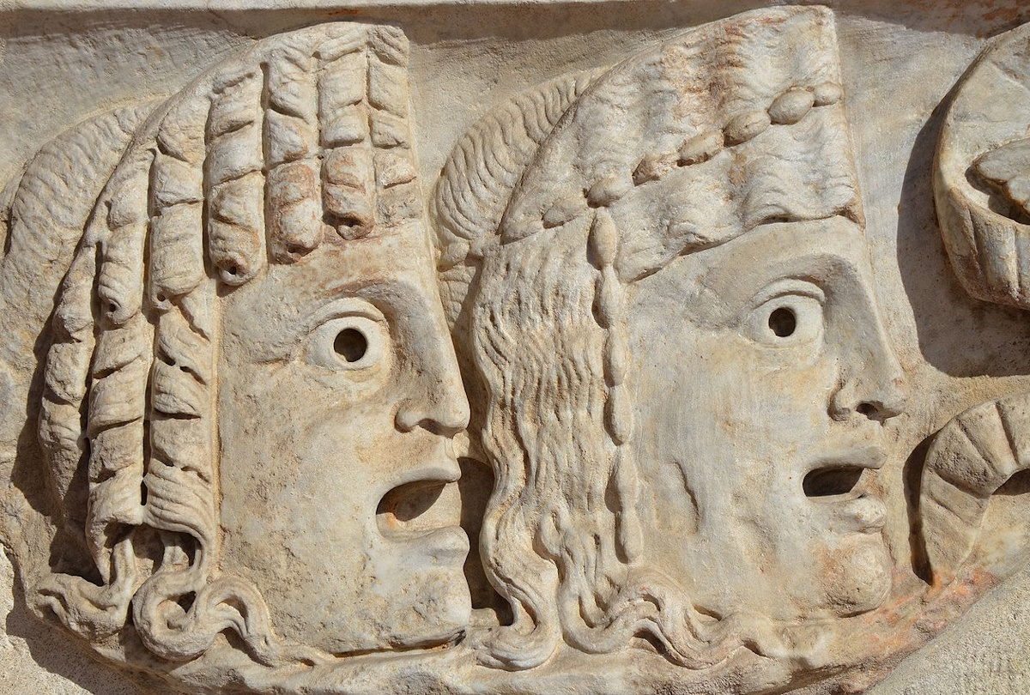
If a trumpet is blown in a city, will not the people be afraid?
Tragic masks on a sarcophagus, from Rome, circa AD 150
3:6
Notes:
The masks portrayed on this Roman sarcophagus illustrate a sense of fear, dread, or dismay. This artifact was discovered at the Baths of Diocletian in Rome and was photographed at the National Museum of Rome. This image comes from Carol Raddato and is licensed under CC BY-SA 2.0, via Wikimedia Commons: https://commons.wikimedia.org/wiki/File:Detail_of_a_sarcophagus_decorated_with_tragic_masks,_150-160_AD,_National_Museum_of_Rome,_Baths_of_Diocletian_(13271446864).jpg.
wiki020914135149281229

Slide 42
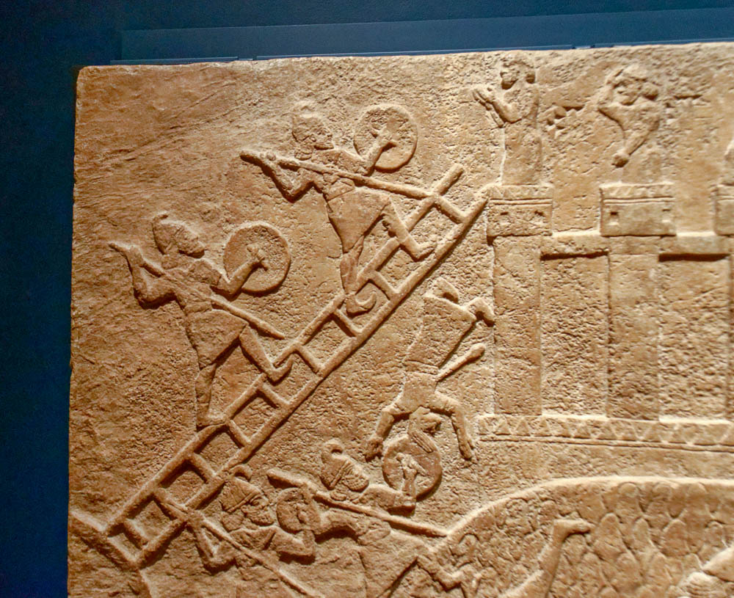
Does disaster occur in a city, unless Yahweh has done it?
Relief of Assyrians besieging a city, from Nimrud, circa 730 BC
3:6
Notes:
The idea of disaster in a city is illustrated here by a depiction of an Assyrian siege. One of the defenders, pierced by an arrow, can be seen falling headlong to his death at the foot of the city wall. Others who are stationed on the city wall hold up their hands in a gesture of helplessness.
This relief comes from the central palace of Tiglath-pileser III at Nimrud. It was photographed at the Getty Villa in southern California while on loan from the British Museum.
tb100919404

Slide 43
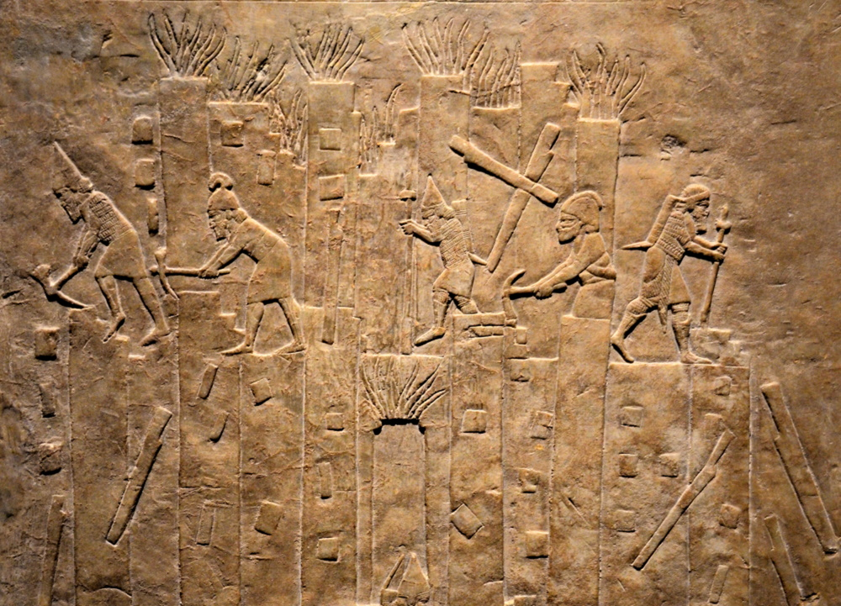
Does disaster occur in a city, unless Yahweh has done it?
Relief depicting the destruction of the city of Hamanu in Elam by Ashurbanipal, 645–640 BC
3:6
Notes:
The Assyrian soldiers depicted in this relief are dismantling the defenses of a city after its conquest. Some use pickaxes and others use pry bars as they toss stones and timbers to the ground. The sculptor also depicted flames coming from the city gate and from the towers in the background.
This relief was photographed at the British Museum. This image comes from Carole Raddato and is licensed under CC BY-SA 2.0, via Wikimedia Commons: https://commons.wikimedia.org/wiki/File:Relief_depicting_the_destruction_of_Hamanu_of_Elam_by_Ashurbanipal,_645-640_BC,_North_Palace,_Nineveh,_Exhibition-_I_am_Ashurbanipal_king_of_the_world,_king_of_Assyria,_British_Museum.jpg.
wiki1118201814302547703

Slide 44
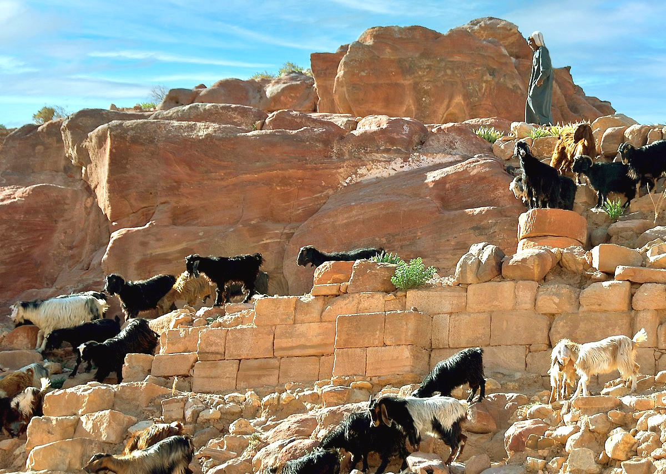
Does disaster occur in a city, unless Yahweh has done it?
Goats among ruined buildings at Petra
3:6
Notes:
The idea of disaster is illustrated here by a herd of goats clambering among the ruins of a once fine structure at Petra, which is situated in the region of ancient Edom. This image comes from BriYYZ and is licensed under CC BY-SA 2.0, via Wikimedia Commons: https://commons.wikimedia.org/wiki/File:Petra_%D8%A7%D9%84%D8%A8%D8%AA%D8%B1%D8%A7%D8%A1_(2475501063).jpg.
wiki032808185032202153231

Slide 45
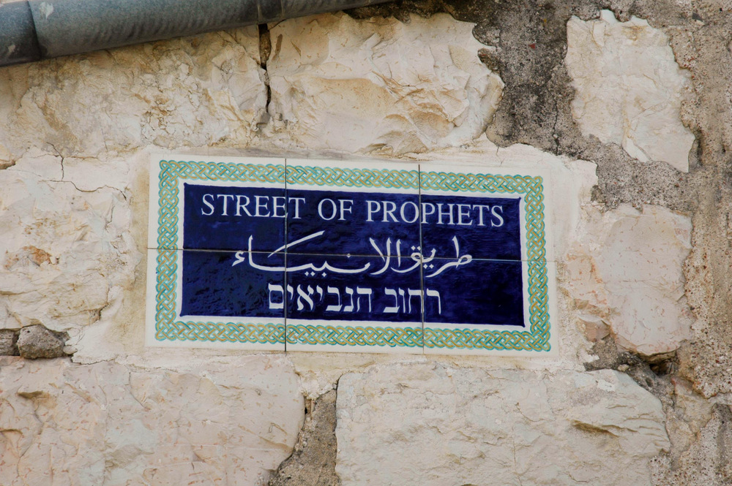
For the Lord Yahweh does not act without revealing His secret to His servants, the prophets
“Street of the Prophets” sign in Jerusalem
3:7
Notes:
The Street of the Prophets is located north of the Old City of Jerusalem.
tb081004128

Slide 46
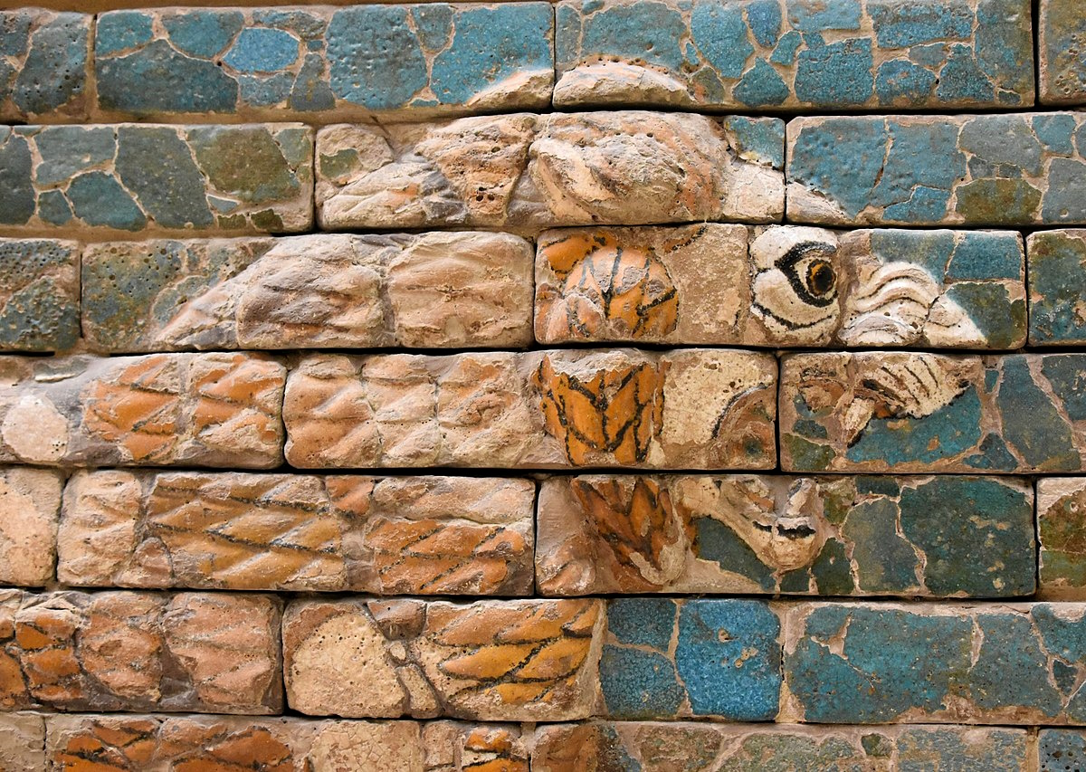
A lion has roared; who will not fear?
Lion from the Processional Way, Babylon, circa 600 BC
3:8
Notes:
This glazed brick portrayal of a roaring lion is one of many that once adorned the walls of the Processional Way that led to the massive Ishtar Gate at Babylon. It is attributed to Nebuchadnezzar II, the Babylonian king who destroyed Jerusalem in 586 BC. The lions were intended to be both beautiful and intimidating.
This display was photographed at the Vorderasiatisches Museum Berlin. This image comes from Richard Mortel and is licensed under CC BY 2.0, via Wikimedia Commons: https://commons.wikimedia.org/wiki/File:Processional_Way,_Babylon,_ca._575_BCE,_built_by_Nebuchadnezzar_II,_detail;_Pergamon_Museum,_Berlin_(4)_(26369761128).jpg.
wiki011618125360001516

Slide 47


A lion has roared; who will not fear? The Lord Yahweh has spoken; who can but prophesy?
Skyphos with an athlete receiving instruction, circa 420 BC
3:8
Notes:
This image comes from the Metropolitan Museum of Art, public domain, Rogers Fund, 1906, accession number 06.1021.174, https://www.metmuseum.org/art/collection/search/247337. A removable graphic has been added to avoid causing surprise or offense.
met247337a

Slide 48

Proclaim it on the citadels at Ashdod
Ashdod tell (aerial view from the west)
3:9
Notes:
Tell Isdud has been identified as the Philistine city of Ashdod. It is located about 10 miles (16 km) north of Ashkelon and about 3 miles (4.8 km) from the sea, east of the dune belt along the shore. The International Coastal Highway (also the Great Trunk Route or Via Maris) runs just east of tell. The acropolis is at least 20 acres (8 ha) in size. The size of the lower city is at least 70 acres (28 ha), although its exact size is uncertain because it is partially covered by sand dunes.
In this aerial view, Ashdod is the light colored area on the far edge of the sand dunes. The hills of Judea are visible in the hazy distance.
tb121704852

Slide 49

Proclaim it on the citadels at Ashdod
Ashdod tell (aerial view from the west)
3:9
Notes:
Ashdod was excavated by Moshe Dothan in nine seasons between 1962 and 1972, uncovering twenty‑three layers on the acropolis, with the upper ten also exposed in the lower city. The city was occupied from the Middle Bronze through the Byzantine periods. In Middle Bronze III (Stratum XXIII), the city was fortified with walls, an earthen glacis, and an unusual two‑entryway gate (rather than the standard three-entry). The Late Bronze Age is represented by five phases (Strata XVIII–XXII). Excavators also uncovered a possible Egyptian‑style residence, including a doorpost inscription that may bear the name of the Egyptian governor. Stratum XIV was destroyed by fire at the end of the 13th century, apparently at the hands of the Sea Peoples.
tbs130260112

Slide 50

Proclaim it on the citadels at Ashdod
Ashdod six-chambered gate
3:9
Notes:
The first Philistine settlement at Ashdod (Stratum XIII) is unfortified but well-planned and densely built. Mycenaean IIIC1b Ware was made locally, along with other pottery of the Canaanite traditions. The next two levels (Strata XII–XI) show successive rebuilding in the 12th and 11th centuries BC, during which the destroyed fortifications of the last Canaanite Late Bronze II city were used as a foundation for a city wall. Near the end of the 11th century (Stratum X), Ashdod expanded to about 100 acres, becoming one of the largest cities in the country. This city had a solid wall with a four-chambered gate. Stratum XA is believed to have been destroyed in the early 10th century campaigns of David. The site bears some remains from the Persian and Hellenistic periods. Following the First Jewish Revolt (Stratum III–I; Roman, Byzantine, and Early Arab), Ashdod was not a significant settlement.
The six-chambered gate is similar to others found at Hazor, Megiddo, and Gezer, though this one is obviously in Philistine territory and dates to about a century after Solomon. The gate was first discovered in Moshe Dothan’s excavations in the 1960s and is being re-excavated and restored in the current project led by Itzhaq Shai of Ariel University.
bjb0411259550

Slide 51

Proclaim it on the citadels at Ashdod
Relief of the siege of Ashdod by Sargon, circa 715 BC (sketch)
3:9
Notes:
Sargon II led a campaign against Ashdod in 714 BC. This illustration comes from Paul Emile Botta and Eugène Flandin, Monument de Ninive, published in 1849–50. Public domain, from the New York Public Library, http://digitalcollections.nypl.org/items/510d47e2-72a3-a3d9-e040-e00a18064a99.
nypl1534786

Slide 52

And proclaim it on the citadels in the land of Egypt
Rameses III’s palace with window at Medinet Habu
3:9
Notes:
tb110600450

Slide 53

And proclaim it on the citadels in the land of Egypt
Three Pyramids of Giza
3:9
Notes:
tbs58099012

Slide 54

And proclaim it on the citadels in the land of Egypt
Relief of Assyrians attacking Memphis, from the north palace at Nineveh, circa 645–635 BC
3:9
Notes:
This relief depicts the Assyrian victory over Taharka in 667 BC. The well-fortified city that is portrayed is the city of Memphis, located about 11 miles (17.7 km) south of Giza. This relief was photographed at the British Museum.
tb0929197311

Slide 55

Assemble yourselves on the mountains of Samaria
Samaria and nearby mountains (from the north)
3:9
Notes:
“The mountains of Samaria” is a term for the mountains of central Israel, where the capital of the northern kingdom, Samaria, is situated. Unlike the northern kingdom's first two capitals, Shechem and Tirzah, Samaria was located on a prominent and defensible hill. The city first achieved biblical significance when Omri established Israel's capital here (1 Kgs 16:24). Only 160 years later, the city was conquered by the Assyrians, who carried the northern tribes away into captivity (2 Kgs 17). See the next slide for labels.
tb050800104

Slide 56
Assemble yourselves on the mountains of Samaria
Mt. Ebal
Samaria
Samaria and nearby mountains (from the north)
3:9
Notes:
“The mountains of Samaria” is a term for the mountains of central Israel, where the capital of the northern kingdom, Samaria, is situated. Unlike the northern kingdom's first two capitals, Shechem and Tirzah, Samaria was located on a prominent and defensible hill. The city first achieved biblical significance when Omri established Israel's capital here (1 Kgs 16:24). Only 160 years later, the city was conquered by the Assyrians, who carried the northern tribes away into captivity (2 Kgs 17).
tb050800104

Slide 57

Assemble yourselves on the mountains of Samaria
Samaria (from the north)
3:9
Notes:
Samaria was strategically located on the primary east-west route to the coast, giving the city easy access to shipping trade with the Phoenicians. The ancient city was located on the crest of the hill located at the center of this photo.
tb050800105

Slide 58

Assemble yourselves on the mountains of Samaria
Lebonah Valley (from the south)
3:9
Notes:
The Lebonah Valley is situated just to the west of Shiloh in the mountains of Samaria.
tb051207325

Slide 59

Assemble yourselves on the mountains of Samaria
Timnath-serah (Khirbet Tibnah), from the east
3:9
Notes:
Another mountain in the region of Samaria is the hometown of Joshua (Josh 19:50).
tb071304492

Slide 60

See the great tumults within her, and the oppressed in her midst
Two men fighting with sticks, from Medinet Habu, 12th century BC
3:9
Notes:
This relief depicts two men fighting with sticks as a group of onlookers watch. It was photographed in the first court of the Main Temple at Medinet Habu.
adr1603143148c

Slide 61

See the great tumults within her, and the oppressed in her midst
Red-figure stamnos depicting two boxers, from Orvieto, circa 480 BC
3:9
Notes:
The idea of a tumult is illustrated here by a depiction on a stamnos of two men fighting. A stamnos was a squat vessel used to hold liquids, perhaps for mixing water and wine. This example is decorated with a depiction of two boxers, one of whom is in the process of hitting the other in the face as the loser falls backward.
This vessel was photographed at the National Archaeological Museum in Florence. This image comes from ArchaiOptix and is licensed under CC BY-SA 4.0, via Wikimedia Commons: https://commons.wikimedia.org/wiki/File:Troilos_Painter_ARV_296_9_boxers_-_women_washing_(03).jpg. Removable graphics have been added to avoid causing surprise or offense.
wiki09012016101022480

Slide 62

See the great tumults within her, and the oppressed in her midst
Fresco of a riot at the amphitheater of Pompeii, from Pompeii, circa AD 60
3:9
Notes:
This fresco depicts a riot that took place in and around the amphitheater at Pompeii in AD 59. The fighting was between the residents of Pompeii and those of the nearby town of Nuceria. When Rome was made aware of the riot at these games, the Roman Emperor Nero removed the head of the city and his family from office and politics, and the city was forbidden to hold gladiatorial games for the next ten years. This fresco was photographed at the Naples Archaeological Museum.
ku0622230901300

Slide 63

See the great tumults within her, and the oppressed in her midst
Bronze statue of a wrestler subduing his opponent, from Kharbia, early 2nd century BC
3:9
Notes:
Oppression is illustrated here by a bronze statue of one man overpowering another. According to the museum website, “Although the group seems to represent two wrestlers, the victor's diadem (headband) identifies him as a Ptolemaic king whose victim probably symbolizes unsuccessful Asian or native Egyptian resistance.”
This image comes from Acquired by Henry Walters, 1909, accession number 54.1050, and is in the public domain: https://art.thewalters.org/object/54.1050/.
twam541050

Slide 64

See the great tumults within her, and the oppressed in her midst
Group of beggars, circa 1910
3:9
Notes:
This American Colony photograph was taken between 1900 and 1920. The next slide includes a colorized version of this photo.
mat01270

Slide 65

See the great tumults within her, and the oppressed in her midst
Group of beggars, circa 1910
3:9
Notes:
This American Colony photograph was taken between 1900 and 1920. Generative AI was used to colorize this photo.
mat01270col

Slide 66

“They do not know how to do what is right,” says Yahweh
Terracotta figurine of two comic actors as fools, circa 2nd century BC
3:10
Notes:
This figurine was photographed at the Altes Museum, Berlin. This image comes from Gary Todd and is licensed under CC0, via Wikimedia Commons: https://commons.wikimedia.org/wiki/File:Ancient_Greece_Terracotta_Theater_Figures_(28454110120).jpg.
wiki08021619345184345626

Slide 67


“They do not know how to do what is right,” says Yahweh
Apulian krater with a parody of Greek mythology, circa 370 BC
3:10
Notes:
This Apulian krater is decorated with a scene that is a parody of the birth of Helena from the egg of Zeus and Leda. The wild theater masks and exaggerated actions of the characters indicate their mockery of the religious myth they loosely imitate. It seems that much of Greek theater involved such humorous and derisive scenes, in which the humor of the actors and the entertainment of the crowd took precedence over respect for the ancient religious teachings.
This krater was photographed at the Archaeological Museum of Santa Scholastica. This image comes from Sailko and is licensed under CC BY-SA 4.0, via Wikimedia Commons: https://commons.wikimedia.org/wiki/File:Cratere_apulo,_con_attori_fliaci_che_fanno_parodia_della_nascita_di_elena_dall%27uovo_di_zeus_e_leda,_380-370_ac._ca,_dalla_necr._peucezia_di_c.so_v._emanuele_a_bari,_04.jpg. A removable graphic has been added to avoid causing surprise or offense.
wiki0816201913342841075561

Slide 68

They store up violence and robbery in their strongholds
Egyptian workman carrying a sack of grain on his shoulder, from Egypt, circa 2000 BC
3:10
Notes:
The verb “to store up” (Heb. atzar, אָצַר) refers to something that is kept or stockpiled. In this case, what is being stored up is not grain or some other valuable item, but violence and robbery. The idea is illustrated here by a relief that depicts a workman carrying a sack of grain on his shoulder as he ascends a flight of stairs, probably to the top of a granary where it will be stored.
This display was photographed at an exhibit in the Albany Institute of History and Art, Albany, New York. This image comes from Daderot and is in the public domain, via Wikimedia Commons: https://commons.wikimedia.org/wiki/File:Granary_relief,_Egypt,_Middle_Kingdom,_Dynasty_11,_limestone_-_Albany_Institute_of_History_and_Art_-_DSC08203.JPG.
wiki061313112932

Slide 69

They store up violence and robbery in their strongholds
Model of a granary with scribes, Middle Kingdom, 12th dynasty, circa 1980 BC
3:10
Notes:
This Egyptian model shows men storing up grain in an Egyptian granary. This image comes from The Metropolitan Museum of Art, public domain, Rogers Fund and Edward S. Harkness Gift, 1920, accession number 20.3.11, https://www.metmuseum.org/art/collection/search/545281.
met545281

Slide 70

They store up violence and robbery in their strongholds
Assyrian soldiers with booty of Levant town, from Sennacherib’s palace at Nineveh, 705–681 BC
3:10
Notes:
The literal wealth stored in Israel’s strongholds (sometimes rendered “palaces” or “citadels”) likely consisted of loot from military campaigns and robbery of the poor. This relief carving was photographed at the Vatican Museums.
tb111802009

Slide 71

They store up violence and robbery in their strongholds
Armed men attacking an enemy, from Nimrud, reign of Tiglath-pileser III, 8th century BC
3:10
Notes:
This relief depicts Assyrian soldiers killing an enemy. This image comes from the Dutch National Museum of Antiquities (Rijksmuseum van Oudheden), A 1952/12.1, Creative Commons-BY. Source: https://www.rmo.nl/en/collection/search-collection/collection-piece/?object=33878.
rmo33878

Slide 72


They store up violence and robbery in their strongholds
Kylix depicting Theseus fighting Prokrustes, from Vulci, circa 430 BC
3:10
Notes:
The scene shown here comes from Greek mythology. The bearded older man, Prokrustes, was a notorious bandit known for forcibly stretching people (to death) or cutting them off to make them fit a bed. In this scene, his attacker is Theseus, who according to the legend, inflicted his own torture on him, killing him.
This kylix was photographed at the British Museum. This image comes from Marie-Lan Nguyen and is licensed under CC BY 2.5, via Wikimedia Commons: https://commons.wikimedia.org/wiki/File:Theseus_Minotaur_BM_Vase_E84_n3.jpg. A removable graphic has been added to avoid causing surprise or offense.
wiki185032319842007080716212250

Slide 73

Therefore, thus says the Lord Yahweh, “An adversary will overrun your land”
Tiglath-pileser III receiving homage, probably from Nimrud, circa 745–727 BC
3:11
Notes:
The “adversary” spoken of in this verse is apparently Tiglath-pileser III (r. 745–727 BC). According to 2 Kings 15:19-21, Menahem paid Tiglath-pileser III 1,000 talents of silver and “the king of Assyria pulled back and did not remain in the land.” It is unclear if this tribute is identical to the tribute offered in the annal fragment or the Iran Stele (Cogan 2008: 52). “Menahem of Samaria” is mentioned in both of these texts as a tribute bearer. This relief depicts the Assyrian king Tiglath-pileser III receiving homage from a helmeted soldier and several courtiers.
The reign of Tiglath-pileser III was marked by an unparalleled Neo-Assyrian expansion into the west and a fundamental shift in Neo-Assyrian involvement in the southern Levant that would pave the way for successive campaigns against Israel (Tiglath-pileser III, Shalmaneser V, Sargon II), Philistia (Tiglath-pileser III, Sargon II, Sennacherib), and Judah (Sargon II [?] and Sennacherib). From a historical perspective, it is clear that Assyria desired to control the entire Levant in order to gain access to the various trade routes (e.g., Stern 2001: 10–13; Bagg 2013: 119). Over the course of the reigns of Assyrian kings from Tiglath-pileser III until Ashurbanipal in the mid-7th century BC, the southern Levant witnessed a steady Assyrian territorial expansion that began with the conquest of Aram-Damascus and Transjordan (732 BC) and ended with the campaigns of Esarhaddon and Ashurbanipal that brought northern Egypt into the realm of Assyrian control. Significantly, Tiglath-pileser III reformed Neo-Assyrian policy regarding disloyal vassal states. This reformation had huge consequences for the nation-states of Israel and Aram-Damascus, which were both eventually conquered and turned into provinces.
This image comes from the Detroit Institute of Arts, Founders Society Purchase, Ralph Harman Booth Bequest Fund, accession number 50.32, and is in the public domain: https://dia.org/collection/assyrian-king-tukul-apil-esharra-iii-also-called-tiglath-pileser-iii-receiving-homage-33256.
References:
Bagg, A. M.
2013 Palestine under Assyrian Rule: A New Look at the Assyrian Imperial Policy in the West. Journal of the American Oriental Society 133: 119–44.
Cogan, Mordechai.
2008 The Raging Torrent: Historical Inscriptions from Assyria and Babylonia Relating to Ancient Israel. Jerusalem: Carta.
Stern, E.
2001 Archaeology of the Land of the Bible, Volume II: The Assyrian, Babylonian, and Persian Periods (732–332 B.C.E.). New York: Yale University Press.
dia33256

Slide 74

Therefore, thus says the Lord Yahweh, “An adversary will overrun your land”
Relief of Tiglath-pileser III, from the Central Palace at Nimrud, circa 728 BC
3:11
Notes:
This relief was photographed at the British Museum.
tb112004892

Slide 75

He will pull down your strongholds
Map of the invasions of Tiglath-pileser III in the Levant, 734–732 BC
3:11
Notes:
Tiglath-pileser III’s campaign from 734 to 732 BC resulted in the loss of Israel’s territory in Transjordan, Galilee, and the Plains (Sharon, Dor, and northern Shephelah), and Israel became a vassal state of the Assyrian Empire. The kingdom was largely centered around Samaria, because the Assyrians began to deport Israelites and import non-Israelites into their conquered regions and also create fortified positions/administrative posts at former Israelite administrative centers (e.g., Hazor, Megiddo, Dor, etc.).
This map shows the areas taken from Israel by the Assyrians in the late 8th century BC. The regions underlined in red are mentioned in either 2 Kings 15:29 or in Assyrian records. The much-reduced territory of Israel, with its capital at Samaria, is outlined with a dotted red line. This map is adapted from map 7-5 from the Satellite Bible Atlas, by William Schlegel. Used by permission.

Slide 76

He will pull down your strongholds
Siege of a Syrian town, from the central palace of Tiglath-pileser III in Nimrud, 728 BC
3:11
Notes:
This relief depicts the contemporary siege of a Syrian town by the army of Tiglath-pileser III. Notice that the Assyrian soldiers on the right are prying apart the defensive walls of the city (individual stones that have been loosened are visible). At the lower left, two Assyrian soldiers are setting fire to the city gate; behind them is a stack of corpses, presumably defenders of the city. This relief was photographed at the British Museum.
mb120901046c

Slide 77

He will pull down your strongholds
Abel-beth-maacah (aerial view from the south)
3:11
Notes:
One of the major cities taken by Tiglath-pileser III as he moved into Israel territory was Abel-beth-maacah. Abel-beth-maacah is identified with Tell Abil al-Qamh and is currently being excavated by R. Mullins and N. Panitz-Cohen. They have already exposed significant Middle Bronze, Late Bronze, and Iron I–II ruins. The site is large (34 ac; 13.8 ha) and clearly a significant city in the northern Huleh Valley. This photo was taken in early April, when the ruin was covered with beautiful wildflowers. The tell is easily demarcated today by the agricultural fields surrounding it. The modern Israeli town of Metula is visible to the north, beyond which is the country of Lebanon.
ws040416906

Slide 78

He will pull down your strongholds
Tel Kedesh
Tel Kedesh (from the west)
3:11
Notes:
Another city taken by the Assyrians at this time was Kedesh. In this view, Kedesh can be seen in the near distance; behind it is the Huleh Valley, and in the far distance are the hills of the Golan Heights (biblical Bashan).
tb032807964

Slide 79

He will pull down your strongholds
Hazor (aerial view from the west)
3:11
Notes:
Megiddo was another major Israelite city conquered and taken by Tiglath-pileser III, probably in 733 BC. Although the city of Hazor was once the largest city in the Levant, at this time, the city was restricted to the acropolis, the higher level visible in this photo.
ws012317027

Slide 80

And he will plunder your fortresses
Israelites deported from Astartu in Transjordan, from Nimrud, 8th century BC
3:11
Notes:
This relief shows deportees being taken away from their city; each carries a sack of belongings over his shoulder. Note that the city behind them, situated on a mound with its walls and towers, is bereft of people. This relief comes from the reign of Tiglath-pileser III. It was photographed at the British Museum.
adr1805194066

Slide 81

And he will plunder your fortresses
Assyrian soldiers taking plunder from Lachish, from Nineveh, circa 700 BC
3:11
Notes:
To plunder (Heb. bazaz, בָּזַז) is to collect and carry off valuables, usually in the aftermath of a battle. This relief depicts Assyrian soldiers carrying off a variety of items including a bundle of swords, a small bundle of spears, two tall incense stands, and other items, some loaded on a hand cart. The spoil in this relief was most likely located in the Judahite governor’s palace at Lachish. This relief was photographed at the British Museum.
tb112004304

Slide 82

And he will plunder your fortresses
Assyrian soldiers taking incense stands from Lachish, sketch of relief from Nineveh, circa 700 BC
3:11
Notes:
This illustration comes from Sir Austen Henry Layard, Second Series of the Monuments of Nineveh, published in 1853. Public domain, from the New York Public Library, http://digitalcollections.nypl.org/items/510d47dc-4737-a3d9-e040-e00a18064a99.
nypl494741

Slide 83

As the shepherd rescues from the mouth of the lion two legs, or a piece of an ear
Shepherd guarding the entrance of a sheepfold, circa 1927
3:12
Notes:
This American Colony photograph was taken between 1920 and 1933. The next slide includes a colorized version of this photo.
mat02987

Slide 84

As the shepherd rescues from the mouth of the lion two legs, or a piece of an ear
Shepherd guarding the entrance of a sheepfold, circa 1927
3:12
Notes:
This American Colony photograph was taken between 1920 and 1933. Generative AI was used to colorize this photo.
mat02987col

Slide 85

As the shepherd rescues from the mouth of the lion two legs, or a piece of an ear
Sheep in a field near Bethlehem, circa 1926
3:12
Notes:
The shepherd tended his flock outside of the settled areas and in more remote regions where wild animals were searching for food. One of the main jobs of the shepherd was to protect his sheep from such predators. This American Colony photograph was taken between 1920 and 1933.
mat02612

Slide 86

As the shepherd rescues from the mouth of the lion two legs, or a piece of an ear
David e Il Leone (David and the Lion), by Pietro da Cortona, 17th century
3:12
Notes:
This painting was photographed at the Vatican Museums.
tb0512176041

Slide 87

As the shepherd rescues from the mouth of the lion two legs, or a piece of an ear
Silver plate with David slaying a lion, from Constantinople, AD 629–30
3:12
Notes:
This image comes from the Metropolitan Museum of Art, public domain, Gift of J. Pierpont Morgan, 1917, accession number 17.190.394, http://metmuseum.org/art/collection/search/464375.
met464375

Slide 88

So will the Israelites of Samaria be rescued, like the corner of a bed or the cover of a couch
Ivory furniture inlays with Egyptian motifs, from Samaria, 9th–8th centuries BC
3:12
Notes:
Samaria was defeated twice by the Assyrians. The first time was in 723 BC, by Shalmaneser V after a three-year siege (725–723 BC) when the region of Samaria was turned into an Assyrian province. Samaria was defeated again by Sargon II in 720 BC after a provincial rebellion.
The point of this comparison (with the torn parts that are rescued from the mouth of a lion) is that only fragmentary portions would possibly be rescued. The restored ivory inlays shown here once adorned luxury furniture. They date to approximately the time of Amos and may even have been in use in the royal residence at Samaria when it was attacked by the Assyrians. This display was photographed at the Israel Museum.
tb052723316

Slide 89

So will the Israelites of Samaria be rescued, like the corner of a bed or the cover of a couch
Urartian bronze furniture fitting with a winged bull, from Toprakkale, late 8th century BC
3:12
Notes:
This bronze furniture fitting is missing its inlays, both on the wing and for the face. The inlays were probably made of stone or ivory, although perhaps of a precious metal. It illustrates a part or fragment of a larger piece of furniture, the rest of which was destroyed. This fitting was photographed at the British Museum.
adr1305251431

Slide 90

So will the Israelites of Samaria be rescued, like the corner of a bed or the cover of a couch
Wooden bed with lion’s legs from Tutankhamun’s tomb, circa 1323 BC
3:12
Notes:
This wooden bed is surely a luxury item, since it comes from the tomb of an Egyptian king. This artifact was photographed at the Luxor Museum.
tb110500233

Slide 91

So will the Israelites of Samaria be rescued, like the corner of a bed or the cover of a couch
Sackcloth mummy shroud from Egypt, with eye openings
3:12
Notes:
Presumably the “cover of a couch” would be a cloth or fabric of some sort. Given the context, it probably does not refer in this case to a very valuable item. Ancient fabrics are rarely preserved over thousands of years. This example of ancient sackcloth was photographed at the Egyptian Museum in Cairo.
adr1603194652

Slide 92

So will the Israelites of Samaria be rescued, like the corner of a bed or the cover of a couch
Rough linen cloth, from Hatshepsut’s valley temple at Thebes, circa 1475 BC
3:12
Notes:
This image comes from the Metropolitan Museum of Art, public domain, Rogers Fund and Edward S. Harkness Gift, 1922, accession number 22.3.254, https://www.metmuseum.org/art/collection/search/548756.
met548756c

Slide 93

So will the Israelites of Samaria be rescued, like the corner of a bed or the cover of a couch
Ashurbanipal and his wife drinking wine in a garden, from Nineveh, 7th century BC
3:12
Notes:
This relief depicts the slightly later Assyrian king Ashurbanipal reclining on a cushioned couch. It was photographed at the Getty Villa in southern California while on loan from the British Museum.
tb100919348

Slide 94

So will the Israelites of Samaria be rescued, like the corner of a bed or the cover of a couch
Funerary stele with a man reclining beside his wife, from Sidon, circa 100 BC
3:12
Notes:
This painting was photographed at the Louvre Museum.
tb0928195766

Slide 95

Hear this and testify against the house of Jacob
Skyphos with a youth and a man in conversation, circa 450 BC
3:13
Notes:
This image comes from the Metropolitan Museum of Art, public domain, Purchase by subscription, 1896, accession number 96.18.73, https://www.metmuseum.org/art/collection/search/246588. A removable graphic has been added to avoid causing surprise or offense.
met246588b

Slide 96

Says the Lord Yahweh, the God of armies
Hebrew inscription mentioning “Yahweh of Armies,” 8th century BC
3:13
Notes:
The name or title “Yahweh of armies” (Heb. Yahweh Sabaoth, יְהוָה צְבָאוֹת) is more common in the Hebrew Bible, but related forms include “Yahweh God of armies” (e.g., 2 Sam 5:10) or just “God of armies” (e.g., Ps 80:7,14). These names are suggestive of God’s role as leader of a heavenly army, against which earthly armies have no chance. The inscription shown here refers to God as “Yahweh of armies.” The full inscription on this limestone slab reads, “Cursed be Ḥagap son of Ḥagab, by Yahweh of armies” (ארר חגף בן חגב ליהוה צבאת). This inscription was photographed at the Bible Lands Museum in Jerusalem. The next slide includes highlights for the name “Yahweh of Armies.”
mjb1904257031c

Slide 97

Says the Lord Yahweh, the God of armies
Hebrew inscription mentioning “Yahweh of Armies,” 8th century BC
3:13
Notes:
The name or title “Yahweh of armies” (Heb. Yahweh Sabaoth, יְהוָה צְבָאוֹת) is more common in the Hebrew Bible, but related forms include “Yahweh God of armies” (e.g., 2 Sam 5:10) or just “God of armies” (e.g., Ps 80:7,14). These names are suggestive of God’s role as leader of a heavenly army, against which earthly armies have no chance. The inscription shown here refers to God as “Yahweh of armies.” The full inscription on this limestone slab reads, “Cursed be Ḥagap son of Ḥagab, by Yahweh of armies” (ארר חגף בן חגב ליהוה צבאת). This inscription was photographed at the Bible Lands Museum in Jerusalem. The word “Yahweh” is highlighted in red, and “armies” (Heb sabaoth, צְבָאוֹת) is highlighted in black. An editable version is included behind this graphic for those who may wish to change it.
mjb1904257031c

Slide 98

On that day I will punish Israel for its crimes
Captives deported from the city of Hamath, reign of Shalmaneser III, 9th century BC
3:14
Notes:
A major way in which God punished the northern kingdom of Israel was through the conquest and deportation of the population by the Assyrians. This relief shows captives from the Syrian town of Hamath being led away by the victorious Assyrians. The captives are stripped naked and have their arms bound behind their backs. This bronze panel was once part of the city gate at Balawat. It was photographed at the British Museum.
adr1805194239c

Slide 99

On that day I will punish Israel for its crimes
Black Obelisk of Shalmaneser III, receiving tribute from Israel, circa 840 BC
3:14
Notes:
This panel on the Black Obelisk depicts Israelites carrying tribute to the Assyrian king. This occurred about a century before the time of Amos, in the days of Jehu. This obelisk was photographed at the British Museum.
tb0929197048

Slide 100

I will also punish the altars of Bethel, and the horns of the altar will be cut off
Sacrificial altar from Beersheba, 8th century BC
3:14
Notes:
The large size of this altar from Beersheba is usually interpreted as evidence that it was used for sacrifice. Note the horns that are located at each corner, as well as the snake figures that are etched on the face of the corner block. The blocks of this altar, including its horns, were recovered in secondary use from the walls of a storeroom; the excavators suggested that it was dismantled by Hezekiah as part of his religious reforms (Herzog 1993: 172), indicating that it may come from the 8th century BC. Later excavations at Lachish (2016) have revealed a small shrine in the gate complex, which included a small altar with horns that were shaved off. This altar was photographed at the Israel Museum.
Reference:
Herzog, Ze’ev.
1993 Tel Beersheba. The New Encyclopedia of Archaeological Excavations in the Holy Land, vol. 1, ed. E. Stern. Jerusalem: Carta.
tb032014048

Slide 101

I will also punish the altars of Bethel, and the horns of the altar will be cut off
Desecrated altar in the gate shrine at Lachish, circa 700 BC
3:14
Notes:
The top two blocks in this installation were incense altars, part of a shrine or high place that was built into one of the gate chambers at Lachish. The horns at each corner of both blocks were knocked off in antiquity. The excavators believed this was a way to desecrate the shrine, and that it was probably done during the religious reforms of Hezekiah (2 Kgs 18:4; Ganor and Kreimerman 2017: 60).
Reference:
Ganor, Saar and Kreimerman, Igor.
2017 Going to the Bathroom at Lachish. Biblical Archaeology Review 43/6: 56–60.
ku0615230701571

Slide 102

I will also punish the altars of Bethel, and the horns of the altar will be cut off
Horned limestone altar, with two horns broken off, from Megiddo, circa 975–925 BC
3:14
Notes:
This altar was photographed at the Oriental Institute Museum at the University of Chicago.
adr1605120741c

Slide 103

I will also punish the altars of Bethel, and the horns of the altar will be cut off
Large sacrificial altar in the sacred precinct at Tel Dan, circa 930–730 BC
3:14
Notes:
Dan is not mentioned in this verse; it was destroyed by the Assyrians before Bethel, though it was still functioning during the time of Amos’s prophecy. Most of the remains in this photo, including a huge sacrificial altar with steps, and an enclosure made of finely carved ashlars, dates to the reign of Jeroboam II, roughly the time of Amos. The large metal frame is a reconstruction of the altar in those days, based on the dimensions of the foundations and one large, original horn that was discovered nearby. The smaller base of the altar from the days of Jeroboam I is visible behind the standing man. The next slide includes highlights.
tb102502017

Slide 104
I will also punish the altars of Bethel, and the horns of the altar will be cut off
sacrificial altar
Large sacrificial altar in the sacred precinct at Tel Dan, circa 930–730 BC
3:14
Notes:
Dan is not mentioned in this verse; it was destroyed by the Assyrians before Bethel, though it was still functioning during the time of Amos’s prophecy. Most of the remains in this photo, including a huge sacrificial altar with steps, and an enclosure made of finely carved ashlars, dates to the reign of Jeroboam II, roughly the time of Amos. The large metal frame is a reconstruction of the altar in those days, based on the dimensions of the foundations and one large, original horn that was discovered nearby. The smaller base of the altar from the days of Jeroboam I is visible behind the standing man.
tb102502017

Slide 105

I will also punish the altars of Bethel, and the horns of the altar will be cut off
Large sacrificial altar in the sacred precinct at Tel Dan, circa 930–730 BC
3:14
Notes:
The metal frame shown here was reconstructed based on the layout of the foundation and on the size of the single horn that was recovered. The next slide includes a photo of the single surviving horn.
bjb102021533

Slide 106

I will also punish the altars of Bethel, and the horns of the altar will be cut off
Horn from the large sacrificial altar at Dan, 8th century BC
3:14
Notes:
This very large curved stone once functioned as one of the four horns atop the large sacrificial altar at Tel Dan. Its dimensions helped archaeologists estimate the original size of the altar. This stone was photographed at the Skirball Museum in Jerusalem.
as030810500

Slide 107

I will also punish the altars of Bethel, and the horns of the altar will be cut off
Broken four-horned altar, from Tel Dothan, Iron Age II, circa 1000–586 BC
3:14
Notes:
This stone is from the top of a four-horned altar. This altar was small enough that it was more likely an incense altar than a sacrificial altar. Three of the horns have been removed or badly damaged, probably as part of a religious reform in the days of Hezekiah or Josiah (Elitzur 2023: 66–67; cf. Gibson, Kennedy, and Kramer 2013).
This image comes from Netanel h and is licensed under CC BY-SA 4.0, via Wikimedia Commons: https://commons.wikimedia.org/wiki/File:Tel_Dotan4.jpg.
References:
Elitzur, Yoel.
2023 The Altar at Tel Dothan—A Trace of Josiah's Reform. Journal of the Ancient Near Eastern Society 36: 62–89.
Gibson, Shimon; Kennedy, Titus; and Kramer, Joel.
2013 A Note on an Iron Age Four-Horned Altar from Tel Dothan. Palestine Exploration Quarterly 145: 306–19.
wiki0417161236324000499

Slide 108

I will also punish the altars of Bethel, and the horns of the altar will be cut off
Israel
Judah
Map of proposed locations for Bethel
3:14
Notes:
The general location of Bethel is known, but the specific identification is disputed. The main contenders for the location of Bethel are Beitin and el-Bira, which are only about 2.5 miles (4 km) apart from each other. This area is about 11 miles (18 km) north of Jerusalem. The border between the kingdoms of Israel and Judah ran just south of Bethel.
The map shown on this slide is adapted from map 1-8 from the Satellite Bible Atlas, by William Schlegel. Used by permission.

Slide 109

I will also punish the altars of Bethel, and the horns of the altar will be cut off
El-Bireh (Ras et-Tahuneh), possible location of Bethel (aerial view from the north)
3:14
Notes:
David Livingston has argued that Bethel should be identified with el-Bireh (center of photo), largely based on the counting of the Roman miles. Several milestones have been found along the road, some of which have numbers. Livingston argues that 12 Roman miles (just over 11 miles [18 km]) from Jerusalem is el-Bireh. Several surveys of Ras et-Tahuneh produced remains from the Middle Bronze II and Iron II, but remains from the Late Bronze have not been found. The site has not been excavated.
Reference:
Livingston, David.
1970 Location of Biblical Bethel and Ai Reconsidered. Westminster Theological Journal 33: 20–44.
ws071617276

Slide 110

I will also punish the altars of Bethel, and the horns of the altar will be cut off
Beitin, a possible location of Beth-aven or Bethel (aerial view from the northwest)
3:14
Notes:
Another option for the identification of Bethel is Beitin, located at the center of this photo. Although Beitin has been excavated a number of times, it was poorly excavated and poorly published. Excavations did confirm, however, the existence of a small fortress at the site in both the Middle Bronze and Late Bronze Ages (ca. 2000–1200 BC).
ws071617275

Slide 111

I will demolish the winter house along with the summer house
Samaria acropolis excavations (aerial view from the east)
3:15
Notes:
Some wealthy Israelites had not just one house, but two houses—one at a higher elevation for greater comfort during the hot summer months, and one at a lower elevation for greater comfort during the cool winter months. Samaria was the location of the king of Israel’s summer palace. It was also the location of houses decorated with ivory, mentioned in the latter part of the verse.
The royal enclosure at Samaria was surrounded by a well-planned casemate wall. At 6.5 acres (2.6 ha), it equaled the size of an average town. The royal palace was constructed within this compound and was the lodging place of the kings of Israel (1 Kgs 20:43; 21:1-2; 22:39; 2 Kgs 1:2; 15:25). This palace and the so-called “Inner Wall” were constructed by Omri, while the much stronger casemate wall is attributed to his son Ahab (Avigad 1993: 1303). The presence of a strong tower at the southwestern corner (upper left in this aerial photo) prompted the excavators to suggest that perhaps a gate was once located in this area as well, although no remains of a gate were found.
Two other notable Iron Age structures were discovered on the acropolis. One was the “House of the Ostraca,” where archaeologists discovered a hoard of more than sixty legible Hebrew inscriptions. They are typically dated to the early 8th century BC. The other notable structure was the “House of the Ivories,” in which archaeologists discovered a group of ivory objects, many of which show a mixture of Phoenician and Egyptian influence. They were probably used as furniture inlays in the palace of the Israelite kings and illustrate the “ivory house” that Ahab built (1 Kgs 22:39) and the charge against the Israelite kings that they used “beds of ivory” (Amos 6:4). The next slide includes labels.
Reference:
Avigad, Nahman.
1993 Samaria (City). The New Encyclopedia of Archaeological Excavations in the Holy Land, vol. 4, ed. E. Stern. New York: Simon and Schuster.
ws030515592

Slide 112

I will demolish the winter house along with the summer house
“House of
the Ostraca”
Gate area?
Tower
Pool
Royal palace
Possible Temple
Throne room
Casemate
wall
“House of
the Ivories”
“Inner wall”
Samaria acropolis excavations (aerial view from the east)
3:15
Notes:
Some wealthy Israelites had not just one house, but two houses—one at a higher elevation for greater comfort during the hot summer months, and one at a lower elevation for greater comfort during the cool winter months. Samaria was the location of the king of Israel’s summer palace. It was also the location of houses decorated with ivory, mentioned in the latter part of the verse.
The royal enclosure at Samaria was surrounded by a well-planned casemate wall. At 6.5 acres (2.6 ha), it equaled the size of an average town. The royal palace was constructed within this compound and was the lodging place of the kings of Israel (1 Kgs 20:43; 21:1-2; 22:39; 2 Kgs 1:2; 15:25). This palace and the so-called “Inner Wall” were constructed by Omri, while the much stronger casemate wall is attributed to his son Ahab (Avigad 1993: 1303). The presence of a strong tower at the southwestern corner (upper left in this aerial photo) prompted the excavators to suggest that perhaps a gate was once located in this area as well, although no remains of a gate were found.
Two other notable Iron Age structures were discovered on the acropolis. One was the “House of the Ostraca,” where archaeologists discovered a hoard of more than sixty legible Hebrew inscriptions. They are typically dated to the early 8th century BC. The other notable structure was the “House of the Ivories,” in which archaeologists discovered a group of ivory objects, many of which show a mixture of Phoenician and Egyptian influence. They were probably used as furniture inlays in the palace of the Israelite kings and illustrate the “ivory house” that Ahab built (1 Kgs 22:39) and the charge against the Israelite kings that they used “beds of ivory” (Amos 6:4). An editable version is included behind this graphic for those who may wish to change it.
Reference:
Avigad, Nahman.
1993 Samaria (City). The New Encyclopedia of Archaeological Excavations in the Holy Land, vol. 4, ed. E. Stern. New York: Simon and Schuster.
ws030515592

Slide 113

I will demolish the winter house along with the summer house
Tel Jezreel (aerial view from the west)
3:15
Notes:
Some decades before the time of Amos, Ahab had a winter palace at Jezreel (1 Kgs 21:1), but it was abandoned at the end of the Omride dynasty and was not reinhabited. The next slide includes labels.
tb121704015

Slide 114
I will demolish the winter house along with the summer house
Mt. Gilboa
Ein Harod
Tel Jezreel
Tel Jezreel (aerial view from the west)
3:15
Notes:
Some decades before the time of Amos, Ahab had a winter palace at Jezreel (1 Kgs 21:1), but it was abandoned at the end of the Omride dynasty and was not reinhabited.
tb121704015

Slide 115

I will demolish the winter house along with the summer house
Iron Age remains at Tel Rehov (from the west)
3:15
Notes:
Another place where a winter house might have been located was at Tel Rehov, which is located down in the Jordan Valley. Like Jezreel, Tel Rehov is warmer year-round because of its low elevation.
ku0604231319315

Slide 116

I will demolish the winter house along with the summer house
Herodian winter palace along Wadi Qilt, Jericho
3:15
Notes:
The Israelite king might have had a winter palace at Jericho (cf. 1 Kgs 16:34). This area would have been one of the warmest in the land during winter, and it was a favorite place for winter palaces in many different eras. The remains visible across the wadi in this photo are the remains of a Hasmonean palace that was later renovated and expanded by Herod the Great.
tb051923417

Slide 117

The houses of ivory will also be destroyed
Ivory furniture inlay, from Samaria, 9th–8th centuries BC
3:15
Notes:
A large group of ivory objects, including a great number of ivory plaques and hundreds of ivory fragments, were uncovered during excavations at Samaria. Most were found in disturbed locations and were quite difficult to date; some were found in the same context as an alabaster jar incised with the name of the Egyptian king Osorkon II (r. 872–842 BC), providing an important connection to the 9th century BC. The ivory inlay shown here was photographed at the Israel Museum.
adr1306213096

Slide 118

The houses of ivory will also be destroyed
Ivory furniture inlays in high relief, from Samaria, 9th‒8th centuries BC
3:15
Notes:
“Many of the ivory plaques bear letters in Hebrew script. The ivories are considered products of Phoenician art, and they were probably used as inlays in the palace furniture of the Israelite kings. . . . The excavators attributed all of the ivories to the time of Ahab. Other scholars, however, tend to ascribe to Ahab only those carved in high relief. They show a similarity to ninth-century ivory objects discovered at Arslan Tash (ancient Hadatu) in Syria” (Avigad 1993: 1306).
This display was photographed at the Israel Museum. This image comes from Gary Todd and is in the public domain, via Wikimedia Commons: https://commons.wikimedia.org/wiki/File:Furniture_Inlays,_9th-8th_Century_BC_(43218922881).jpg.
Reference:
Avigad, Nahman.
1993 Samaria (City). The New Encyclopedia of Archaeological Excavations in the Holy Land, vol. 4, ed. E. Stern. New York: Simon and Schuster.
wiki43218922881070520181655

Slide 119

The houses of ivory will also be destroyed
Ivory furniture inlays, from Samaria, 9th‒8th centuries BC
3:15
Notes:
A second set of ivories from Samaria are cut in low relief and date to around the time of Amos. “The second group, which is very close in style and technique to the ivories from Nimrud, is considered to date to the eighth century BCE” (Avigad 1993: 1306). This display was photographed at the Israel Museum.
Reference:
Avigad, Nahman.
1993 Samaria (City). The New Encyclopedia of Archaeological Excavations in the Holy Land, vol. 4, ed. E. Stern. New York: Simon and Schuster.
tb032014279

Slide 120

The houses of ivory will also be destroyed
Ivory furniture inlays, from Samaria, 9th‒8th centuries BC
3:15
Notes:
Ivory in the Levant came from the tusks of elephants or hippopotamus, imported from Egypt or other parts of Africa. It was a luxury good that was as expensive as it was beautiful. A “house of ivory” was a house of ostentatious luxury. This display was photographed at the Israel Museum.
adr1306213082

Slide 121

The houses of ivory will also be destroyed
Ivory furniture inlay, from Samaria, 9th‒8th centuries BC
3:15
Notes:
Many of the ivories from Samaria were inlaid with precious stones, colored glass, and gold foil. A small piece of gold foil is still visible on the ivory in this photo. Many of these ivories show strong Egyptian influence, as does this example with Egyptian style figures and the ankh symbol. “The motifs are taken, as a rule, from Egyptian mythology: the infant Horus seated on a lotus blossom, Isis and Nephthys flanking the djed pillar; the god Rah holding the image of Maat, the goddess of truth; the god Hah holding palm branches; and figures of winged creatures, among others” (Avigad 1993: 1306). This ivory plaque was photographed at the Israel Museum.
Reference:
Avigad, Nahman.
1993 Samaria (City). The New Encyclopedia of Archaeological Excavations in the Holy Land, vol. 4, ed. E. Stern. New York: Simon and Schuster.
tb032014285

Slide 122

The houses of ivory will also be destroyed
Ivory furniture inlay, from Samaria, 9th‒8th centuries BC
3:15
Notes:
Many of these ivories came from a structure in Samaria that was subsequently dubbed the “Ivory House,” although these ivories are not considered to have originated in this building. “The largest concentration of ivories was found in the rubbish deposit of the building (‘Ivory House’) near the inner wall in the north. Since this debris had been accumulated from various conflagration layers and was probably moved from place to place, it was impossible to ascribe it with certainty to definite building phases” (Avigad 1993: 1304–5). This ivory plaque was photographed at the Israel Museum.
Reference:
Avigad, Nahman.
1993 Samaria (City). The New Encyclopedia of Archaeological Excavations in the Holy Land, vol. 4, ed. E. Stern. New York: Simon and Schuster.
tb032014288

Slide 123

The houses of ivory will also be destroyed
Ivory furniture inlays, from Samaria, 9th‒8th centuries BC
3:15
Notes:
Numerous flower-shaped inlays were recovered from Samaria, a sampling of which is shown here. This display was photographed at the Israel Museum.
tb032014284

Slide 124

The houses of ivory will also be destroyed
Ivory furniture inlay, from Samaria, 9th‒8th centuries BC
3:15
Notes:
This set of ivories still retain some of the original inset glass, hinting at their original beauty. Ivory objects similar to these have been recovered from Arslan Tash and Nimrud. “The ivory objects found at these two sites were probably booty taken by the Assyrian kings from Damascus, Phoenicia, and perhaps also from Samaria” (Avigad 1993: 1306).
This display was photographed at the Israel Museum. This image comes from Gary Todd and is in the public domain, via Wikimedia Commons: https://commons.wikimedia.org/wiki/File:Furniture_Inlays,_9th-8th_Century_BC_(41408535330).jpg.
Reference:
Avigad, Nahman.
1993 Samaria (City). The New Encyclopedia of Archaeological Excavations in the Holy Land, vol. 4, ed. E. Stern. New York: Simon and Schuster.
wiki41408535330070520181655

Slide 125

The houses of ivory will also be destroyed
Ivory furniture inlays, with blue glass, from Samaria, 9th‒8th centuries BC
3:15
Notes:
This display was photographed at the British Museum.
tb112004972c

Slide 126

The houses of ivory will also be destroyed
Burned ivory furniture, from Abydos (Umm el-Qaab), reign of Djer, 3rd millennium BC
3:15
Notes:
These pieces of ivory furniture that show evidence of destruction in a fire are from the 1st Egyptian dynasty. They were photographed at the Metropolitan Museum of Art in New York City.
adr1711140296

Slide 127

And the mansions will be demolished
Hellenistic-era mansion on Mount Gerizim
3:15
Notes:
This photo shows a large residence that was built in the former territory of the northern kingdom during the Hellenistic Period.
tb060616022

Slide 128

Notes:
This is a free sample of the Amos 3 presentation from the Photo Companion to the Bible. To purchase the full volume, visit www.bibleplaces.com/amos/
The Photo Companion to the Bible is an image-rich resource for Bible students, teachers, and researchers. Just as a librarian stocks the shelves with as many relevant materials as possible, so we have tried to provide a broad selection of images. Our goal is that you will find in this “library” whatever it is you are looking for.
Credits: The primary creators of this presentation are Chris McKinny, Kris Udd, Steven D. Anderson, and Todd Bolen. The photographs have an individual file code which usually includes the initials of the photographer. Other images have additional credit or source information.
Updates: We plan to update this collection as we are able. We welcome your suggestions for improving this resource (photocompanion@bibleplaces.com). Purchasers of the Amos volume are provided free, lifetime updates to the volume.
Copyright: This photo collection is protected by copyright law and may not be distributed without written permission from BiblePlaces.com. Slide notes should be treated as any other copyrighted written material, with credit given when quoting from these notes.
For more information, see our complete “Introduction to the Photo Companion to the Bible” online at https://www.BiblePlaces.com/Intro-Photo-Companion-Bible/. Here you will find more information about photo selection, explanatory notes, Bible translation, credit information, and copyright allowances.

