Slide 1
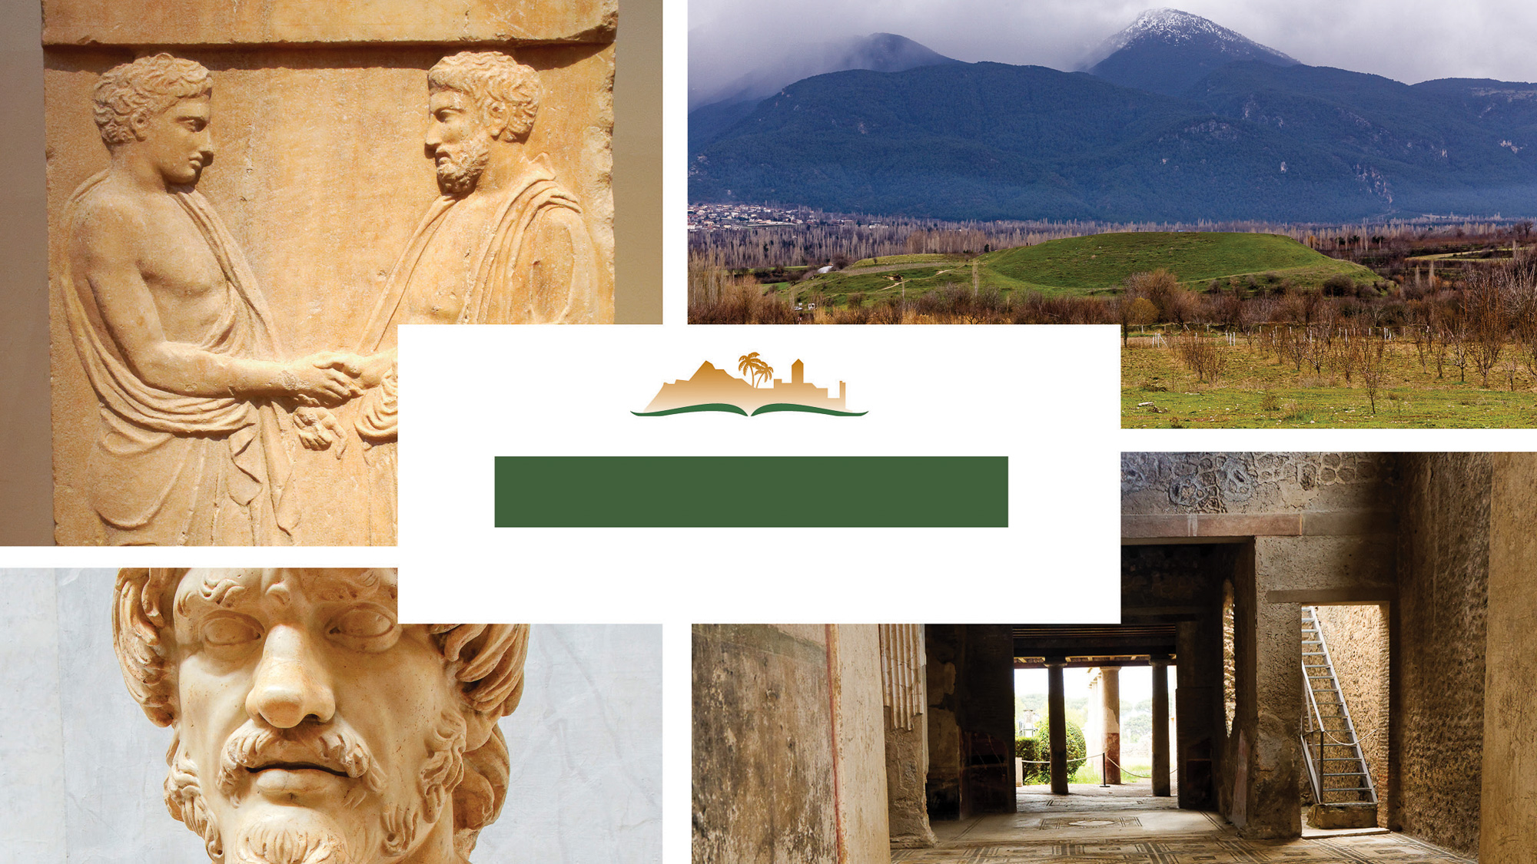
Colossians 2
Notes:
This is a free sample of the Colossians 2 presentation from the Photo Companion to the Bible. To purchase the full volume, visit https://www.bibleplaces.com/colossians/
The Photo Companion to the Bible is an image-rich resource for Bible students, teachers, and researchers. Just as a librarian stocks the shelves with as many relevant materials as possible, so we have tried to provide a broad selection of images. Our goal is that you will find in this “library” whatever it is you are looking for.
Credits: The primary creators of this presentation are Christian Locatell, Steven D. Anderson, Kris Udd, and Todd Bolen. The photographs have an individual file code which usually includes the initials of the photographer. Other images have additional credit or source information.
Updates: We plan to update this collection as we are able. We welcome your suggestions for improving this resource (photocompanion@bibleplaces.com). Purchasers of the Colossians volume are provided free, lifetime updates to the volume.
Copyright: This photo collection is protected by copyright law and may not be distributed without written permission from BiblePlaces.com. Slide notes should be treated as any other copyrighted written material, with credit given when quoting from these notes.
For more information, see our complete “Introduction to the Photo Companion to the Bible” online at https://www.BiblePlaces.com/Intro-Photo-Companion-Bible/. Here you will find more information about photo selection, explanatory notes, Bible translation, credit information, and copyright allowances.

Slide 2
Colossians 2
This is a free sample of the Colossians 2 presentation from the Photo Companion to the Bible. To purchase the full volume, visit https://www.bibleplaces.com/colossians/ The Photo Companion to the Bible is an image-rich resource for Bible students, teachers, and researchers. Just as a librarian stocks the shelves with as many relevant materials as possible, so we have tried to provide a broad selection of images. Our goal is that you will find in this “library” whatever it is you are looking for. For more details (for this and every slide), see the Notes section below.
Notes:
This is a free sample of the Colossians 2 presentation from the Photo Companion to the Bible. To purchase the full volume, visit https://www.bibleplaces.com/colossians/
The Photo Companion to the Bible is an image-rich resource for Bible students, teachers, and researchers. Just as a librarian stocks the shelves with as many relevant materials as possible, so we have tried to provide a broad selection of images. Our goal is that you will find in this “library” whatever it is you are looking for.
Credits: The primary creators of this presentation are Christian Locatell, Steven D. Anderson, Kris Udd, and Todd Bolen. The photographs have an individual file code which usually includes the initials of the photographer. Other images have additional credit or source information.
Updates: We plan to update this collection as we are able. We welcome your suggestions for improving this resource (photocompanion@bibleplaces.com). Purchasers of the Colossians volume are provided free, lifetime updates to the volume.
Copyright: This photo collection is protected by copyright law and may not be distributed without written permission from BiblePlaces.com. Slide notes should be treated as any other copyrighted written material, with credit given when quoting from these notes.
For more information, see our complete “Introduction to the Photo Companion to the Bible” online at https://www.BiblePlaces.com/Intro-Photo-Companion-Bible/. Here you will find more information about photo selection, explanatory notes, Bible translation, credit information, and copyright allowances.

Slide 3
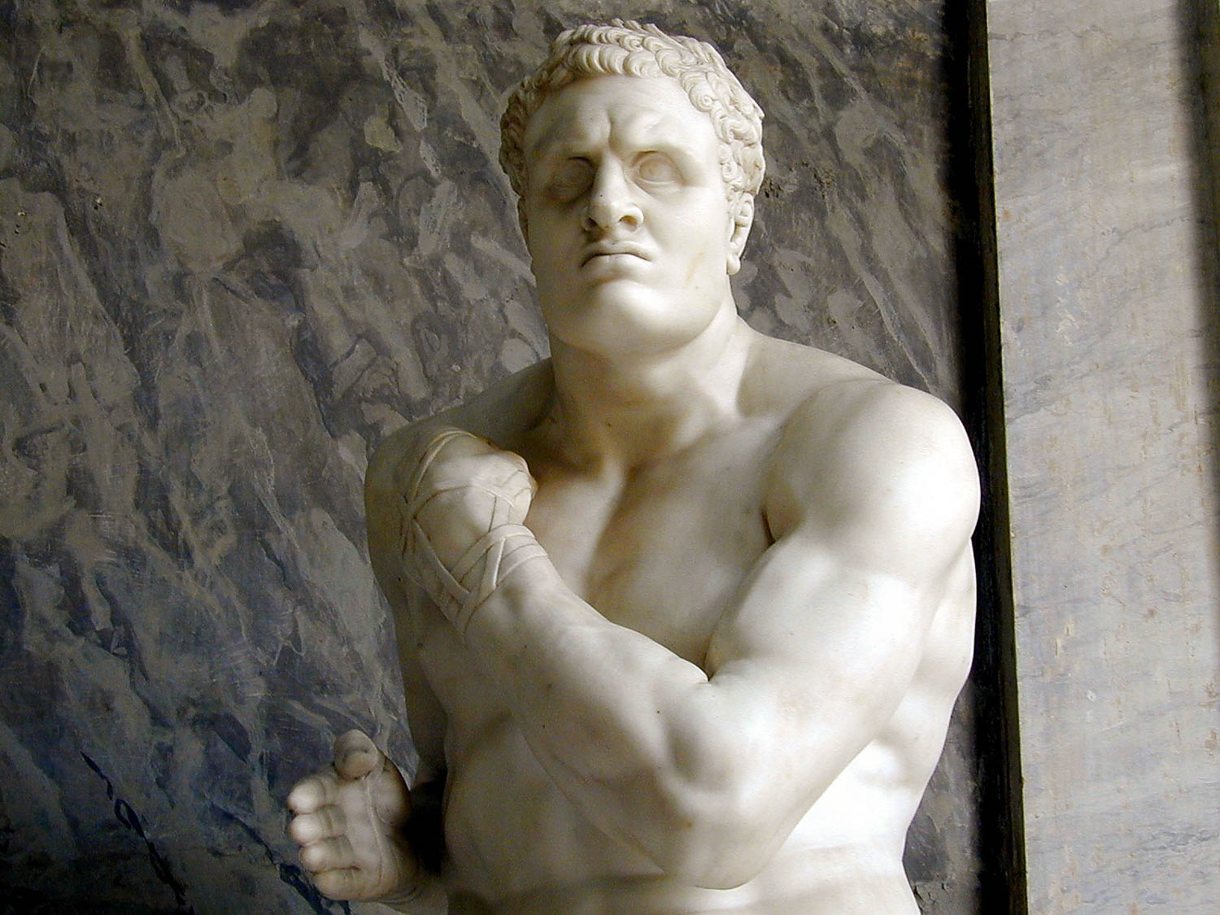
I want you to know how great a struggle I have for you
Statue of the Greek boxer Damoxenes with a wrapped hand
2:1
Notes:
The word “struggle” (Gk. agōn, ἀγών) refers to a struggle or fight against opposition. It can refer to an athletic contest (Heb 12:1) or a physical fight (2 Tim 4:7). Inspired by classical art, the Italian artist Antonio Canova created this piece in 1801, and it was purchased by Pope Pius VII to replace statuary stolen from the Vatican by Napoleon. It was photographed at the Vatican Museums. Additional information on this statue can be found at http://www.patronsvaticanmuseums.org/en/projects/classical-pugilists-creugas-and-damoxenos/.
tb011801013

Slide 4
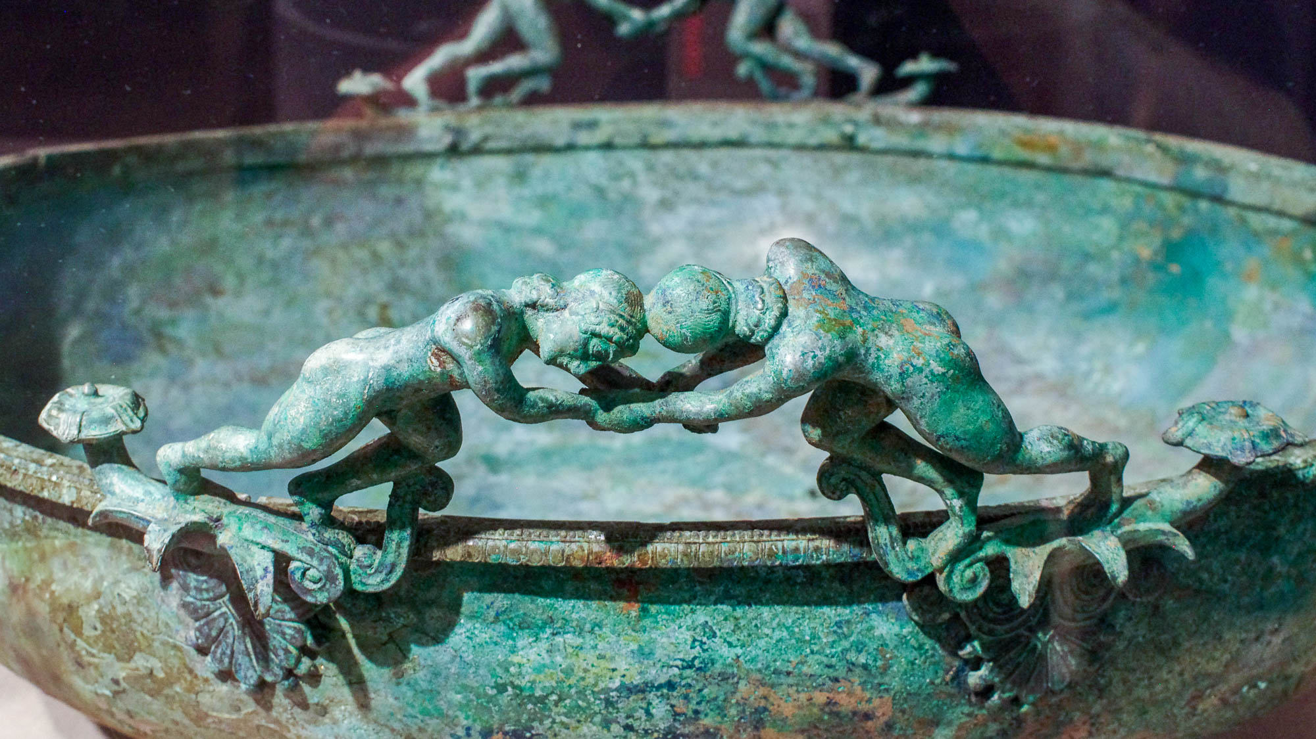
I want you to know how great a struggle I have for you
Greek basin with wrestlers on the rim, Late Archaic period, circa 500 BC
2:1
Notes:
One competition particularly suited to this word was the popular sport of wrestling, which required immense physical exertion from both participants. This bronze basin was photographed at the Boston Museum of Fine Arts.
adr1711203023

Slide 5
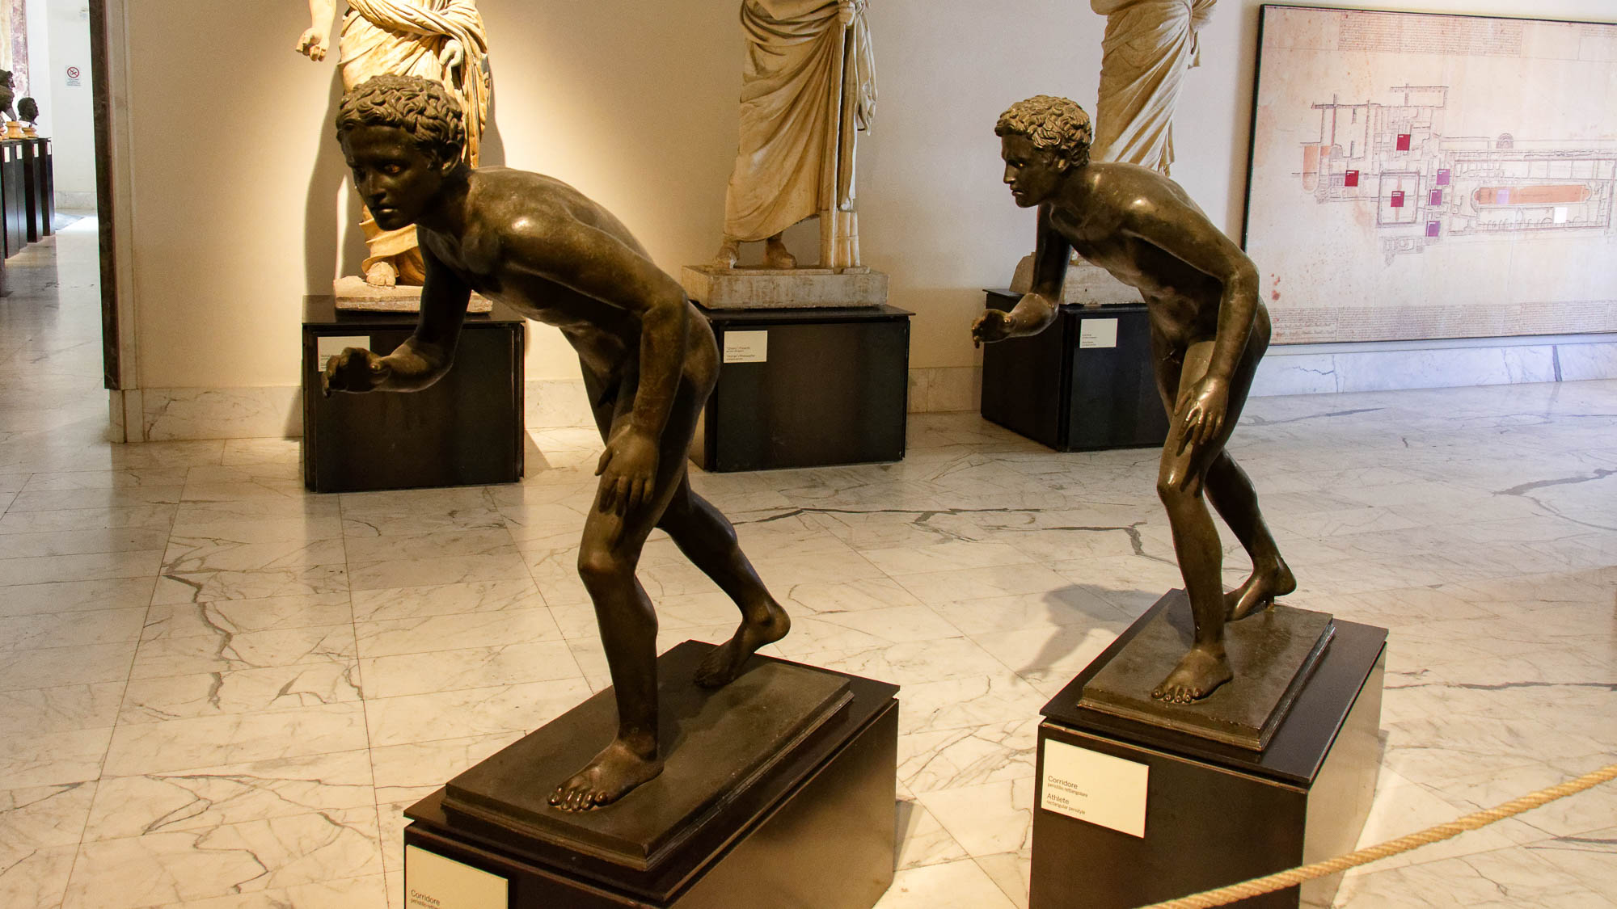
I want you to know how great a struggle I have for you
Young athletes ready to run, from the Villa of the Papyri, Pompeii, 1st century AD
2:1
Notes:
Hebrews 12:1 uses the word translated here as “struggle” (Gk. agōn, ἀγών) to refer to the exertion of a runner in a race. Running was a popular sport in the Greco-Roman world, as attested by the many depictions of running athletes and the construction of stadiums for competition. Paul utilizes the activity of running as a metaphor for the enduring struggle of his ministry. These statues were photographed at the Naples Archaeological Museum.
tb0515170102

Slide 6
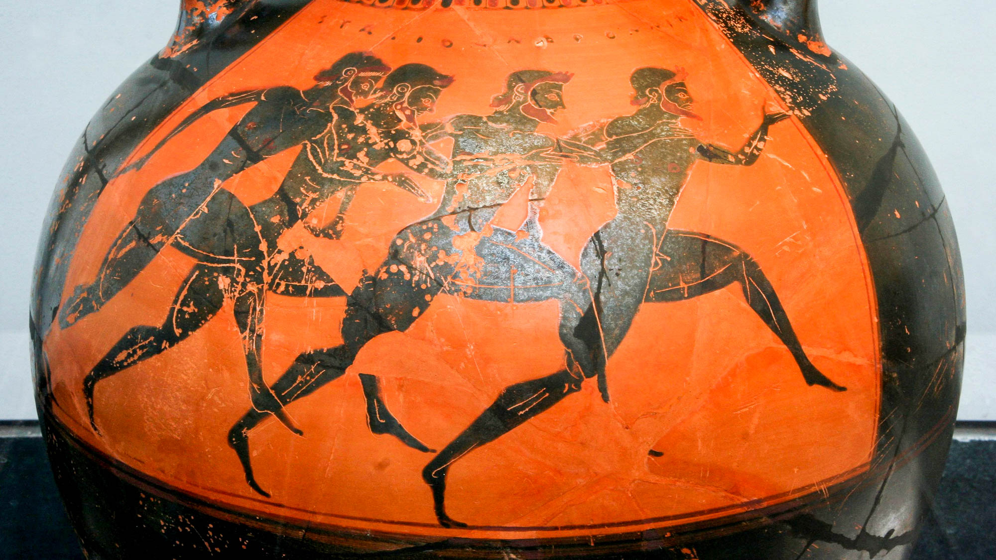
I want you to know how great a struggle I have for you
Attic Greek black-figure Panathenaic prize amphora with runners, circa 530 BC
2:1
Notes:
Every four years in Athens, the Panathenaic games would be held in honor of Athena. One of the most ancient competitions was the foot race, held at the Panathenaic Stadium. The vessel pictured here is a Panathenaic prize amphora, which would be filled with 42 quarts (40 l) of olive oil from the sacred groves of Athena. On one side was pictured the event for which the prize was awarded; the other side typically depicted Athena. This amphora was photographed at the State Collections of Antiquities in Munich. This image comes from MatthiasKabel and is licensed under CC BY 2.5, via Wikimedia Commons: https://commons.wikimedia.org/wiki/File:Greek_vase_with_runners_at_the_panathenaic_games_530_bC.jpg. Removable graphics have been added to avoid causing surprise or offense.
wiki01282006530

Slide 7
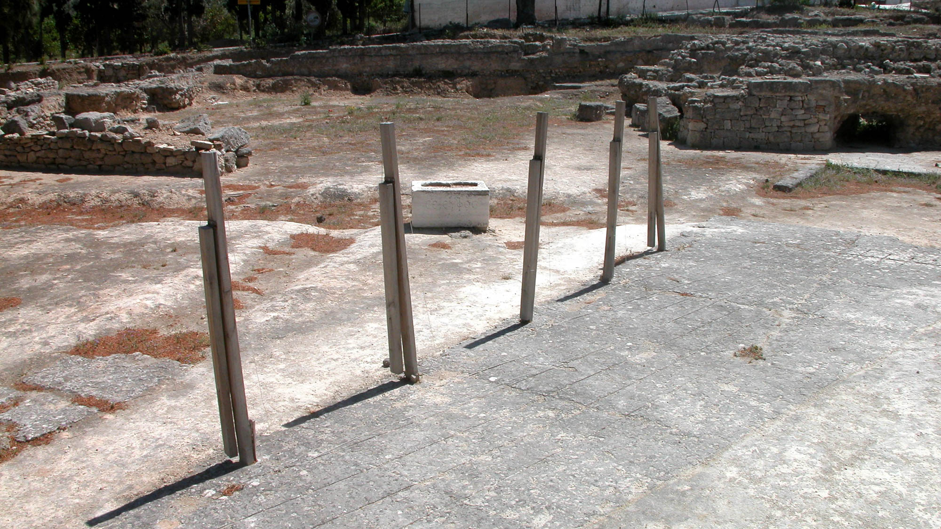
I want you to know how great a struggle I have for you
Starting line at the Classical stadium at Isthmia, circa 5th century BC
2:1
Notes:
One of the most important athletic events in the Hellenistic world was the Olympic Games held at the Olympia Stadium in Greece. This photo shows the starting line for runners at a similar racecourse in southern Greece.
tb050803180

Slide 8
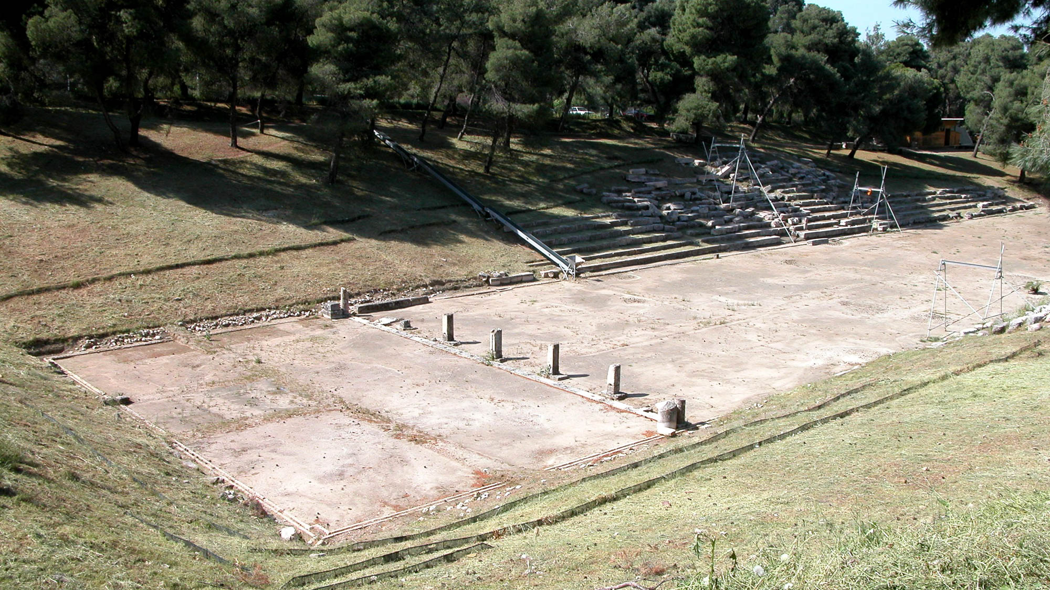
I want you to know how great a struggle I have for you
Stadium at Epidaurus
2:1
Notes:
The starting line for racers, marked by the pillars, can be seen in this photo of the stadium at Epidauras in southern Greece.
tb050903078

Slide 9
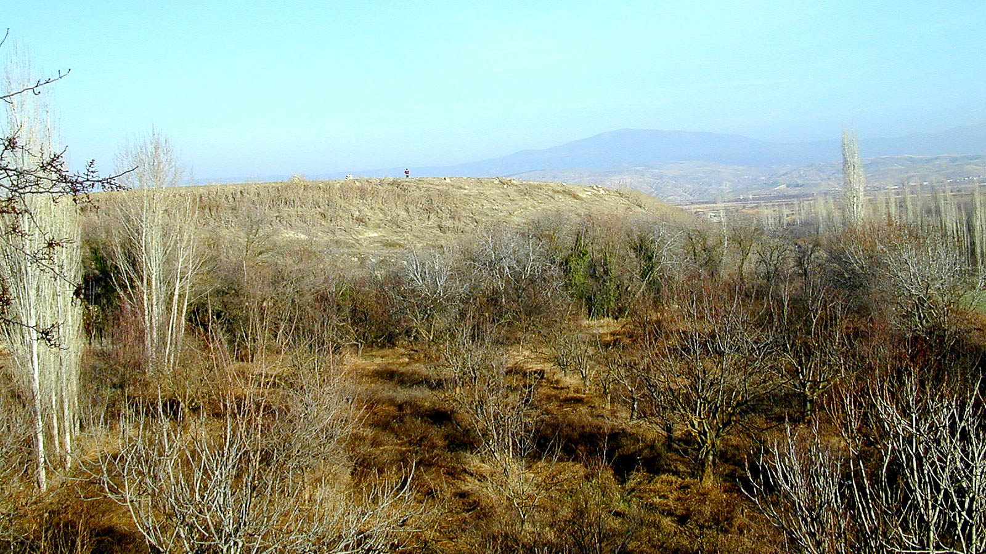
I want you to know how great a struggle I have for you
Colossae (from the south)
2:1
Notes:
Paul’s letter is addressed to the believers at Colossae; they formed the church that is the “you” of this verse. The ancient city of Colossae has not been excavated.
tb010301448h

Slide 10
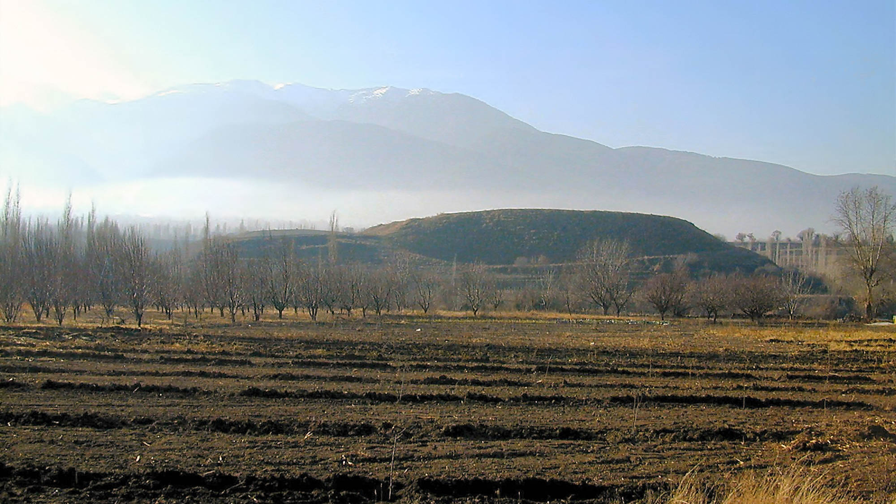
I want you to know how great a struggle I have for you
Colossae (from the north)
2:1
Notes:
This view of the mound of Colossae illustrates its situation on the valley floor, not far from the mountain range to the south.
tb010301501

Slide 11
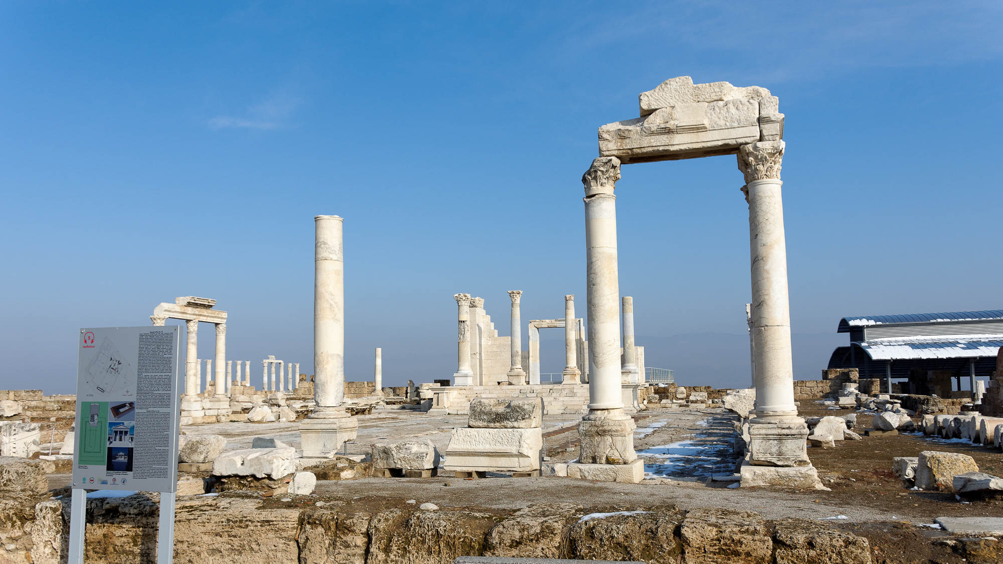
I want you to know how great a struggle I have for you, and for those at Laodicea
Imperial cult temple at Laodicea
2:1
Notes:
Laodicea was a nearby city, located only 9 miles (14.5 km) to the west of Colossae. Apparently Paul was concerned that the churches in both cities faced some of the same dangers. Significant remains of the Roman period are visible at Laodicea.
tb010117317

Slide 12
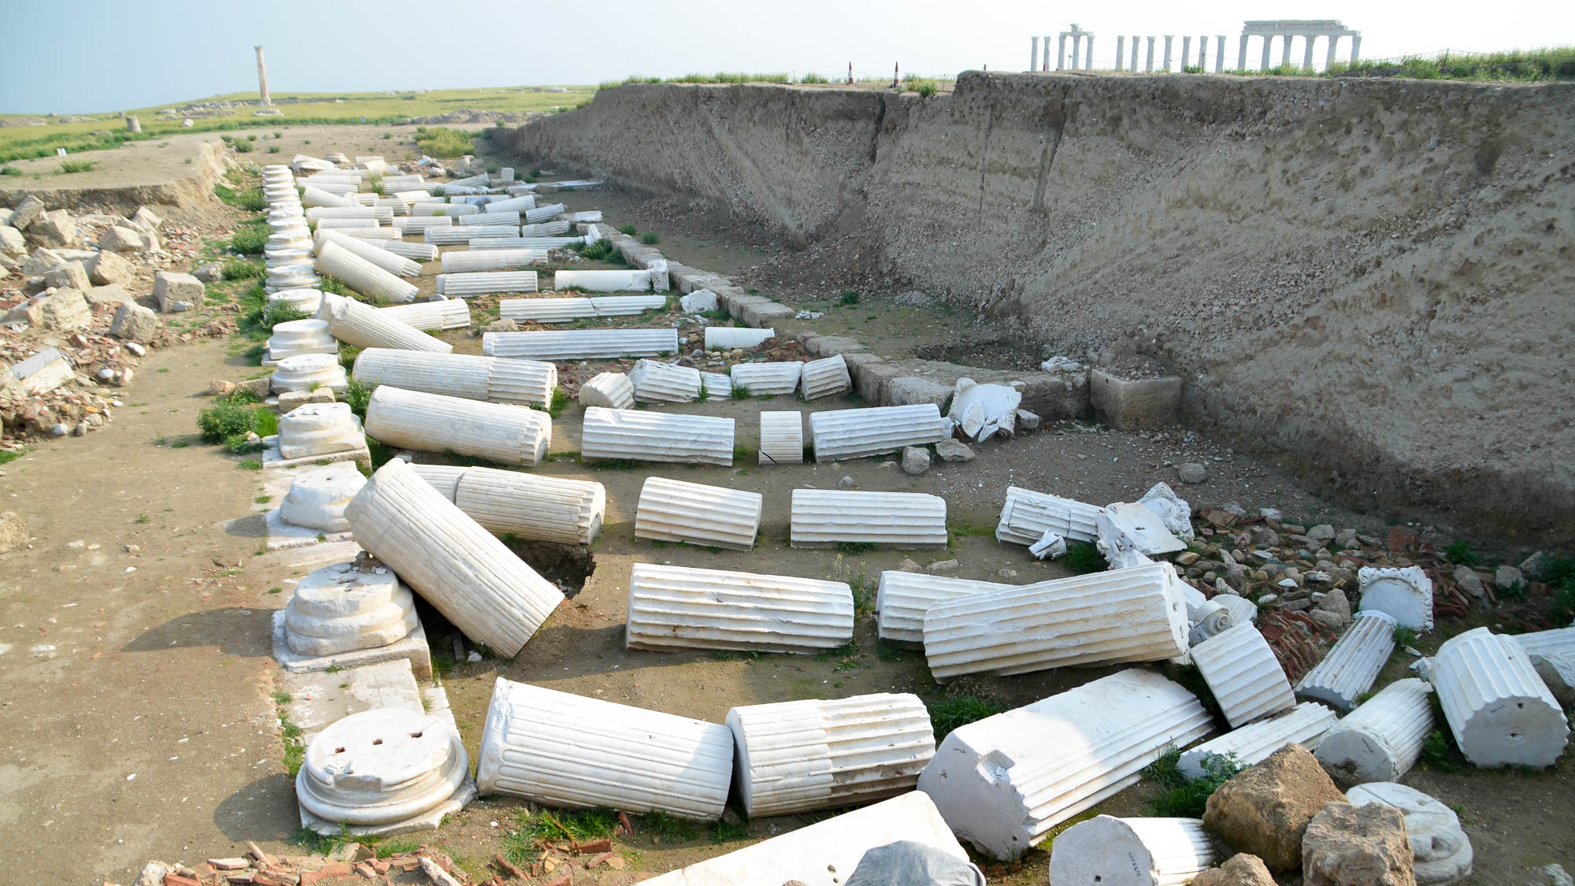
I want you to know how great a struggle I have for you, and for those at Laodicea
Recently excavated street at Laodicea
2:1
Notes:
Excavations at Laodicea are ongoing and have produced significant remains from the Roman period. This colonnaded street appears to have been destroyed by an earthquake, as all the columns lie at nearly the same angle.
shs031215709

Slide 13
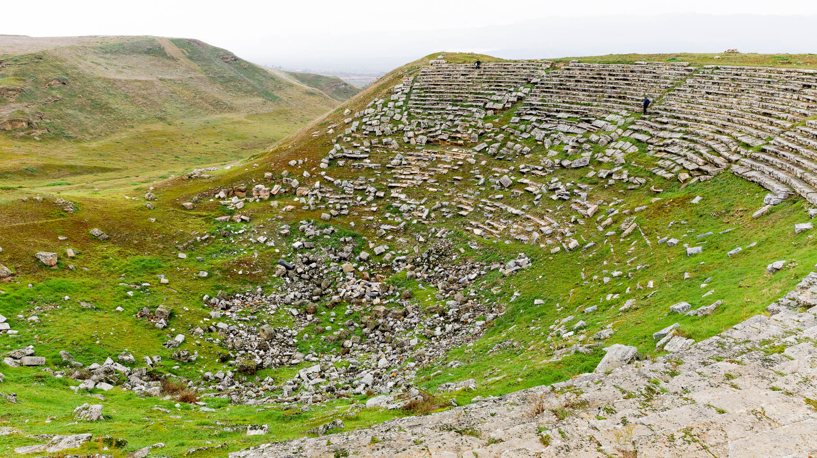
I want you to know how great a struggle I have for you, and for those at Laodicea
Small Roman theater at Laodicea
2:1
Notes:
The city of Laodicea was regarded as an extremely wealthy city in antiquity. Evidence of this may be seen in the remains of this theater, which is the smaller of two at Laodicea.
jc1231149755

Slide 14
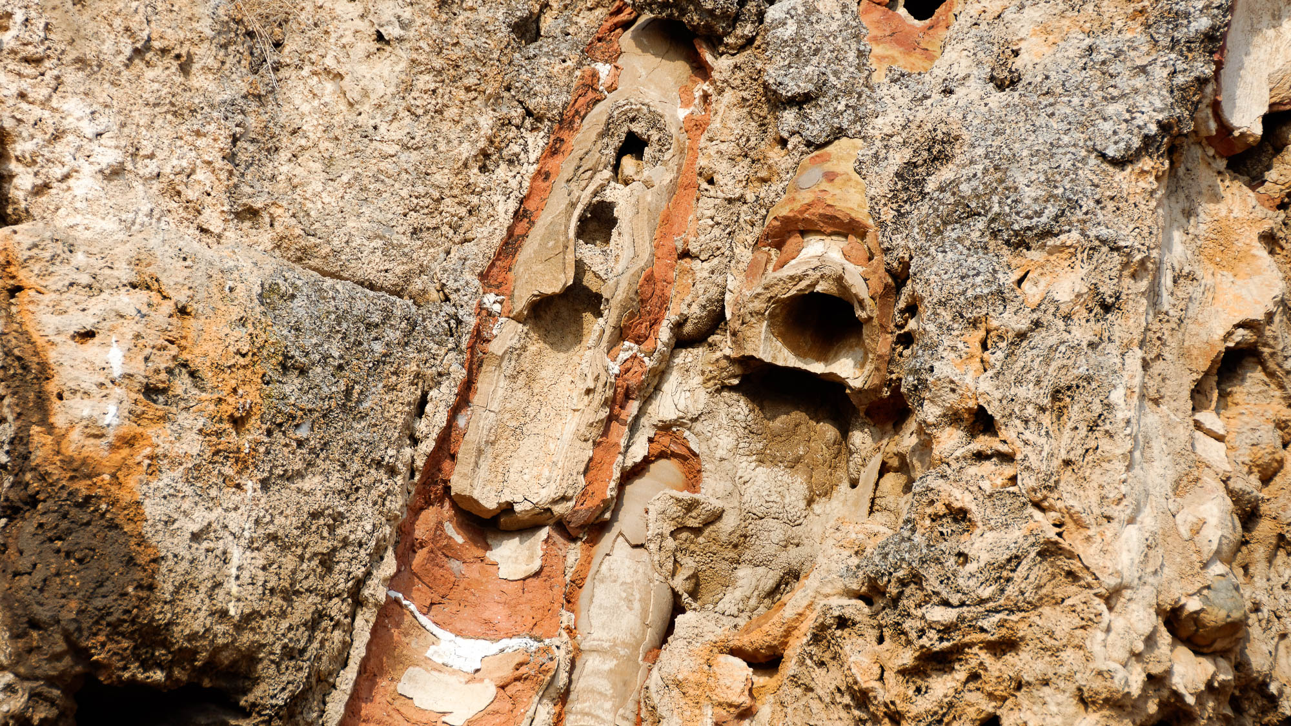
I want you to know how great a struggle I have for you, and for those at Laodicea
Laodicea south water distribution center with heavily mineralized pipes
2:1
Notes:
One of the water sources for Laodicea was the hot springs at Hierapolis, some 6 miles (10 km) to the north. This water was brought across the valley to Laodicea utilizing pipes and an aqueduct. The hot spring water was heavily mineralized, a nuisance that caused the pipes themselves to become blocked over time, as evidenced in this photo. Also, by the time the water arrived at Laodicea, it was tepid and unpalatable, something that Jesus alluded to when he described the church there as neither hot nor cold, but lukewarm (Rev 3:16).
tb010117421

Slide 15
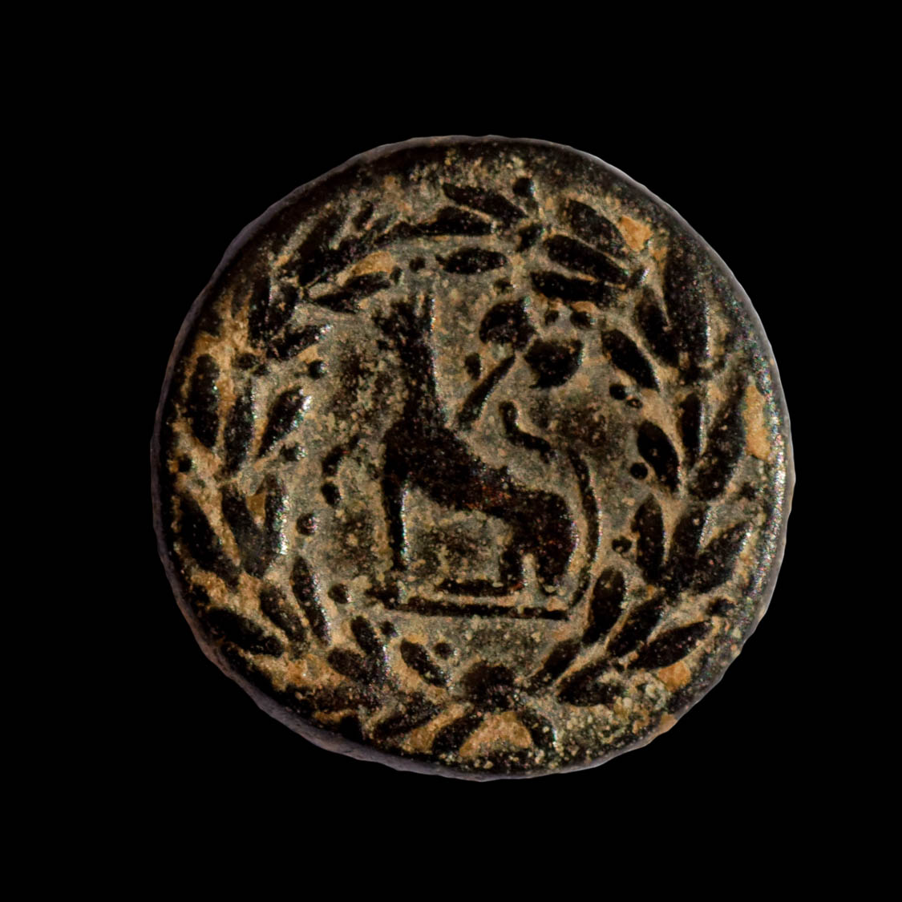
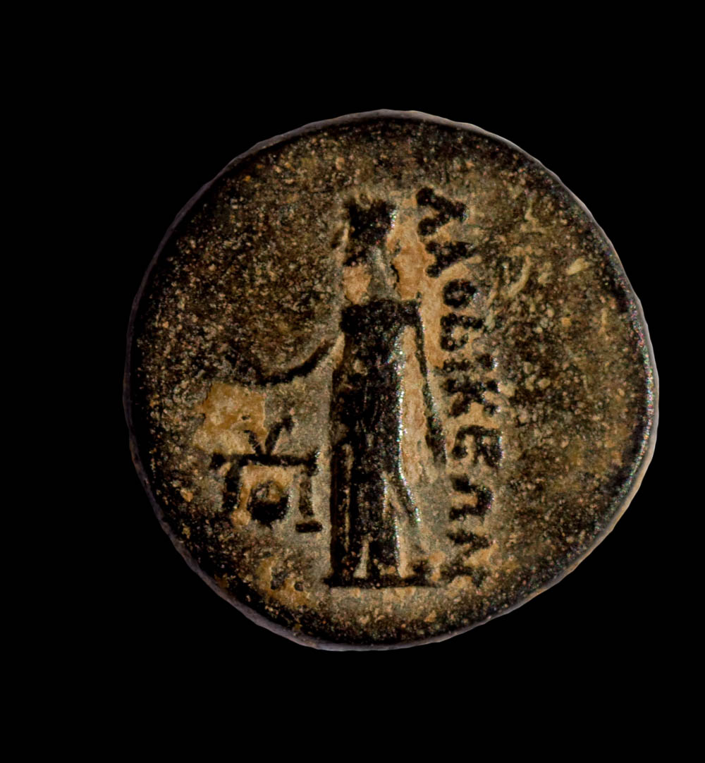
I want you to know how great a struggle I have for you, and for those at Laodicea
Bronze coin of Laodicea ad Lycum, from the reign of Tiberius, AD 14–37
2:1
Notes:
The obverse side (left) shows Aphrodite holding a dove. It is inscribed “of the Laodiceans” (Gk. ΛΑΟΔΙΚΕΩΝ). The reverse side (right) shows a wolf below a double axe, surrounded by a wreath. This coin could well have been circulating at the time when Paul wrote this letter. This coin is in the Jared James Clark Collection.
Left (obverse): tb030117653b; right (reverse): tb030117657b

Slide 16
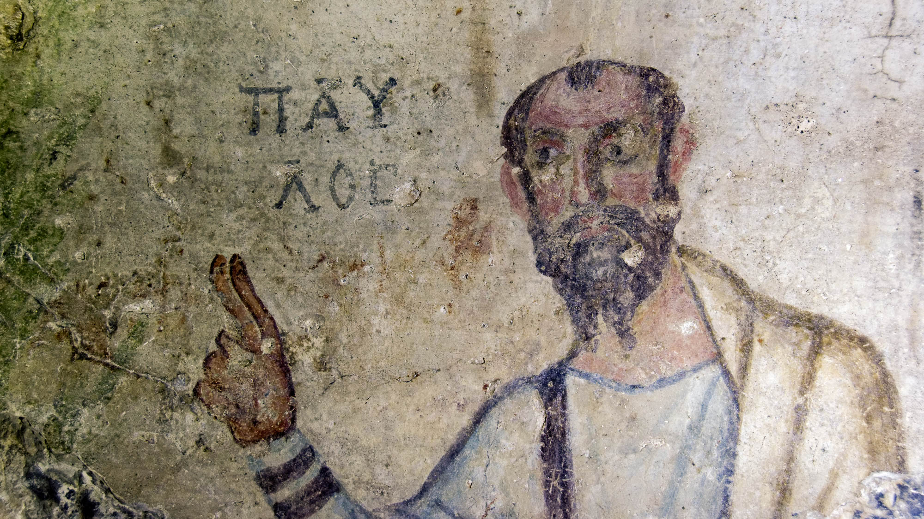
And for all those who have not seen personally seen me
Fresco of Paul in the Grotto of Paul at Ephesus, circa 5th century AD
2:1
Notes:
This fresco from the 5th century AD is one of the earliest depictions of Paul. His name is written in Greek above his hand (ΠΑΥΛΟΣ). The cave in which this fresco is located is on the hill above the ruins of ancient Ephesus. Paul had spent more than two years at Ephesus during his third missionary journey (Acts 19:10), but apparently did not visit Colossae or Laodicea.
tb010317169

Slide 17
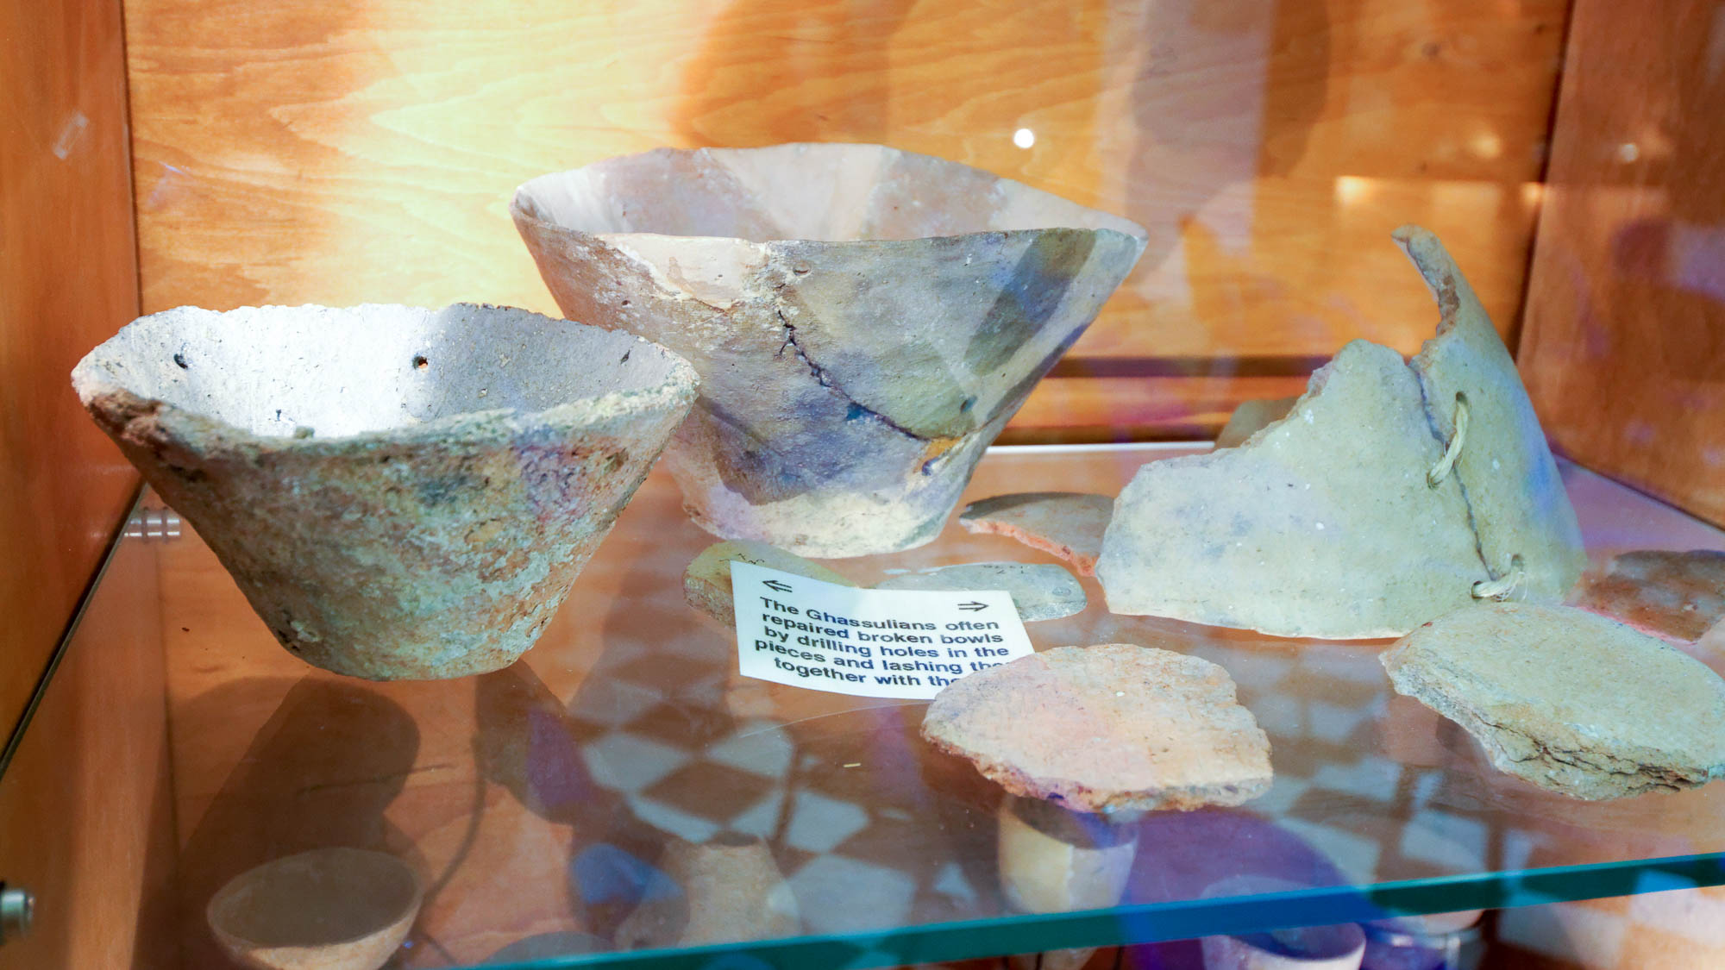
That their hearts may be encouraged, having been knit together in love
Broken bowl repaired by rope
2:2
Notes:
The idea of being “knit together” (Gk. sumbibazō, συμβιβάζω) is to bring parts together into a single unit. The word is used by Paul in the body metaphor to describe the unity of the church, with Christ as the head (Eph 4:16). He also uses this metaphor elsewhere in Colossians (1:18-24; 2:19; 3:15). The word is sometimes used in Greek literature to refer to reconciliation. An example from Paul’s day of pieces being joined together in unity is the repair of pottery. When valuable or useful pottery broke, the pieces were sometimes fitted back together by drilling holes on either side of the break and then using rope or metal fasteners to rebind them. This can be clearly seen in the vessel on the right of this photo. The piece in the center back also exhibits holes used to repair a large break. This exhibit was photographed at the Pontifical Biblical Institute Museum in Jerusalem. See the following slides for additional examples. Compare the slides on Colossians 3:14.
tb061116896

Slide 18
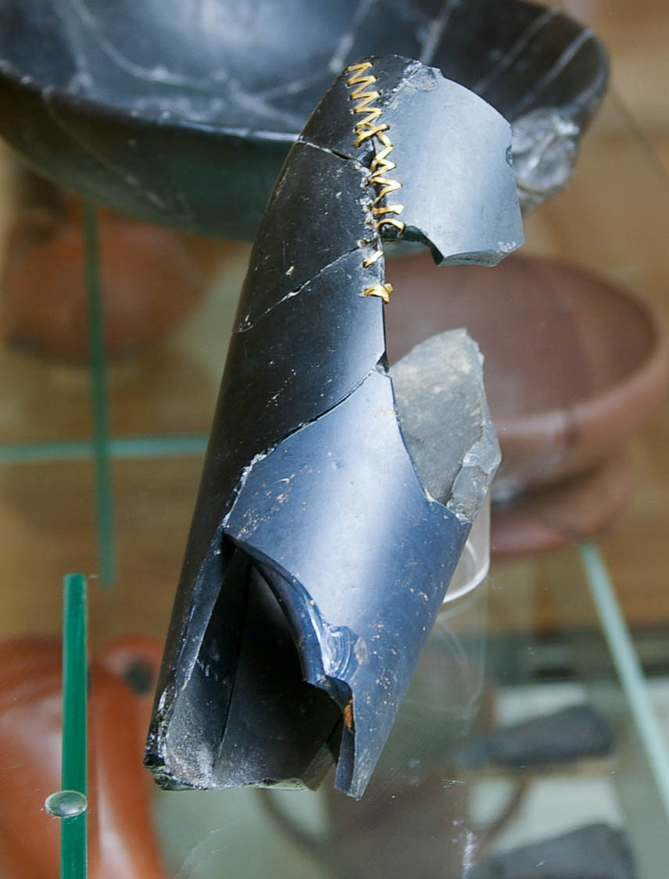
That their hearts may be encouraged, having been knit together in love
Obsidian vessel repaired with gold, from the Assyrian trade colony at Acemhoyuk
2:2
Notes:
This vessel would have been unusually expensive, as it had been carved of glass-like obsidian stone. This may also be seen in the fact that gold wire was used for the repair. This artifact was photographed at the Ankara Museum of Anatolian Civilizations in Turkey.
adr1006039567

Slide 19
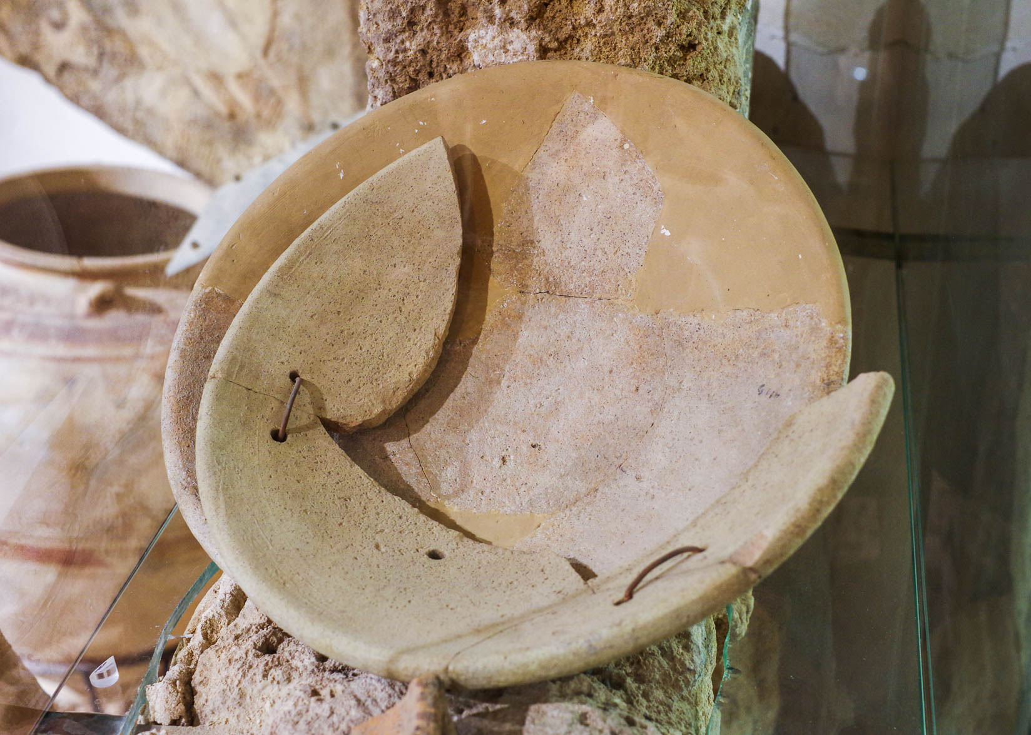
That their hearts may be encouraged, having been knit together in love
Cypro-Phoenician mortaria with ancient repair, from Tel Acco, 5th century BC
2:2
Notes:
In this example not all the original pieces of the original dish have been recovered. The string used to bind them back together is modern, but the holes are evidence of ancient repair. This dish was photographed at the Hecht Museum at the University of Haifa.
adr1805241884

Slide 20
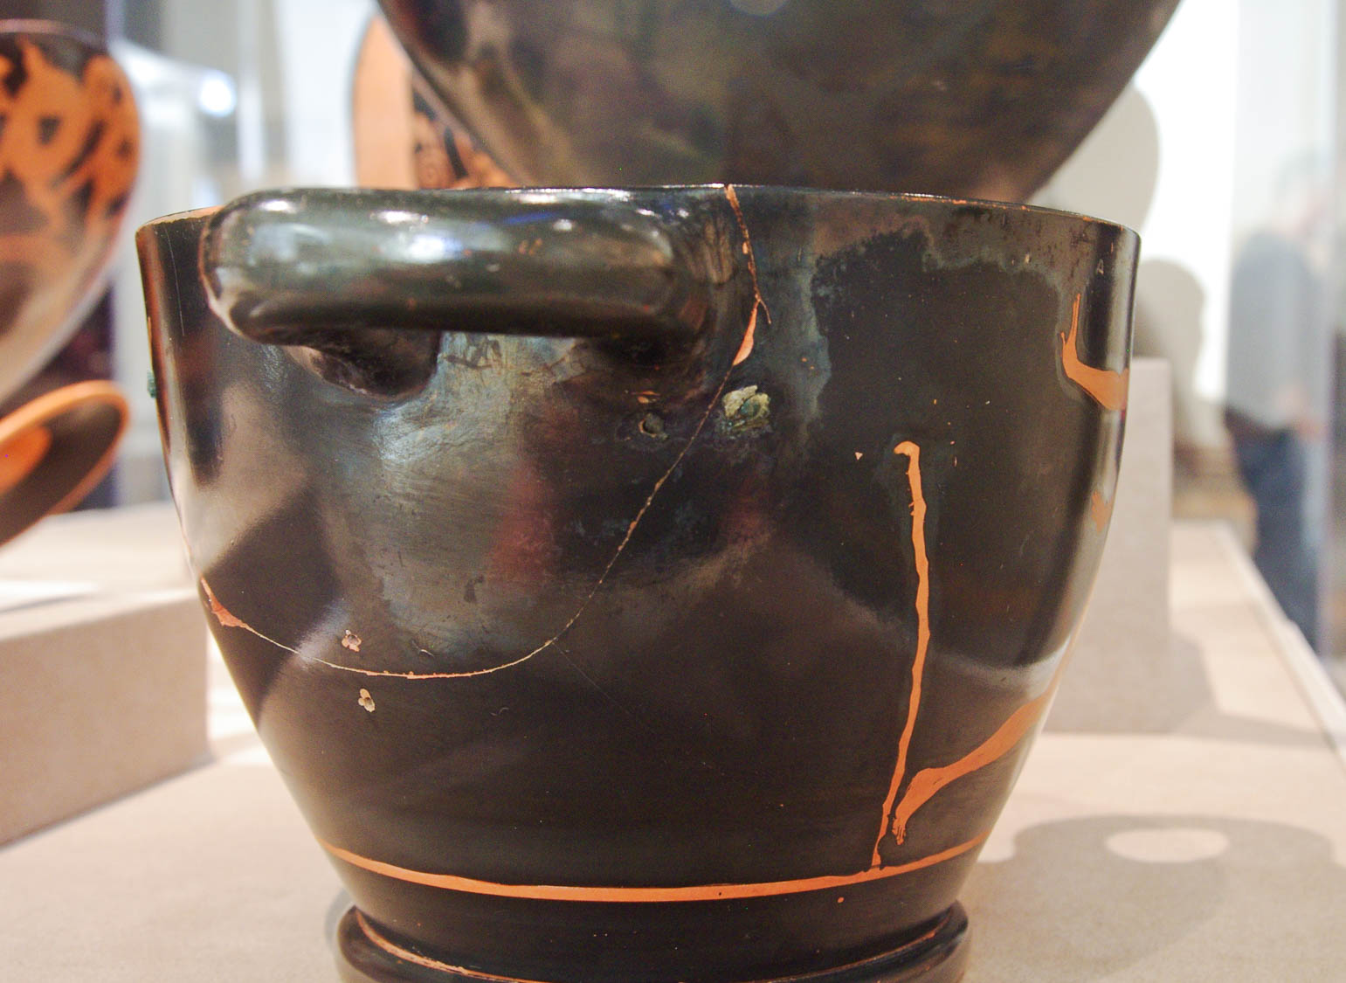
That their hearts may be encouraged, having been knit together in love
Attic red-figure skyphos with ancient repairs using copper alloy clamps, 475–450 BC
2:2
Notes:
The handle and a large piece of the side of this skyphos broke in antiquity. Three points of repair, where holes were drilled and copper clamps were attached to “knit” the pieces back together, are visible in this photo. The clamp on the far left can only be seen in profile. This was photographed at the Walters Art Museum in Baltimore. The next slide includes labels highlighting these repairs.
adr1311245686

Slide 21
That their hearts may be encouraged, having been knit together in love
Attic red-figure skyphos with ancient repairs using copper alloy clamps, 475–450 BC
2:2
Notes:
The handle and a large piece of the side of this skyphos broke in antiquity. Three points of repair, where holes were drilled and copper clamps were attached to “knit” the pieces back together, are visible in this photo. The clamp on the far left can only be seen in profile. This was photographed at the Walters Art Museum in Baltimore.
adr1311245686

Slide 22
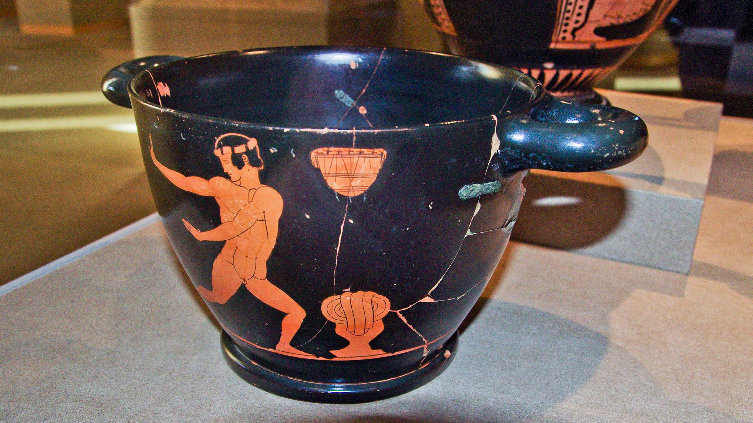
That their hearts may be encouraged, having been knit together in love
Attic red-figure skyphos with ancient repairs using copper alloy clamps, 475–450 BC
2:2
Notes:
This skyphos has been repaired in a way very similar to the vessel on the previous slide. The clamp on the front right is still intact. Skyphoi such as this were hand painted and presumably quite expensive, which explains why such pains were taken to repair them. This vessel was photographed at the Walters Art Museum in Baltimore. The next slide includes arrows to highlight the repair areas.
adr1311245689

Slide 23
That their hearts may be encouraged, having been knit together in love
Attic red-figure skyphos with ancient repairs using copper alloy clamps, 475–450 BC
2:2
Notes:
This skyphos has been repaired in a way very similar to the vessel on the previous slide. The clamp on the front right is still intact. Skyphoi such as this were hand painted and presumably quite expensive, which explains why such pains were taken to repair them. This vessel was photographed at the Walters Art Museum in Baltimore.
adr1311245689h

Slide 24
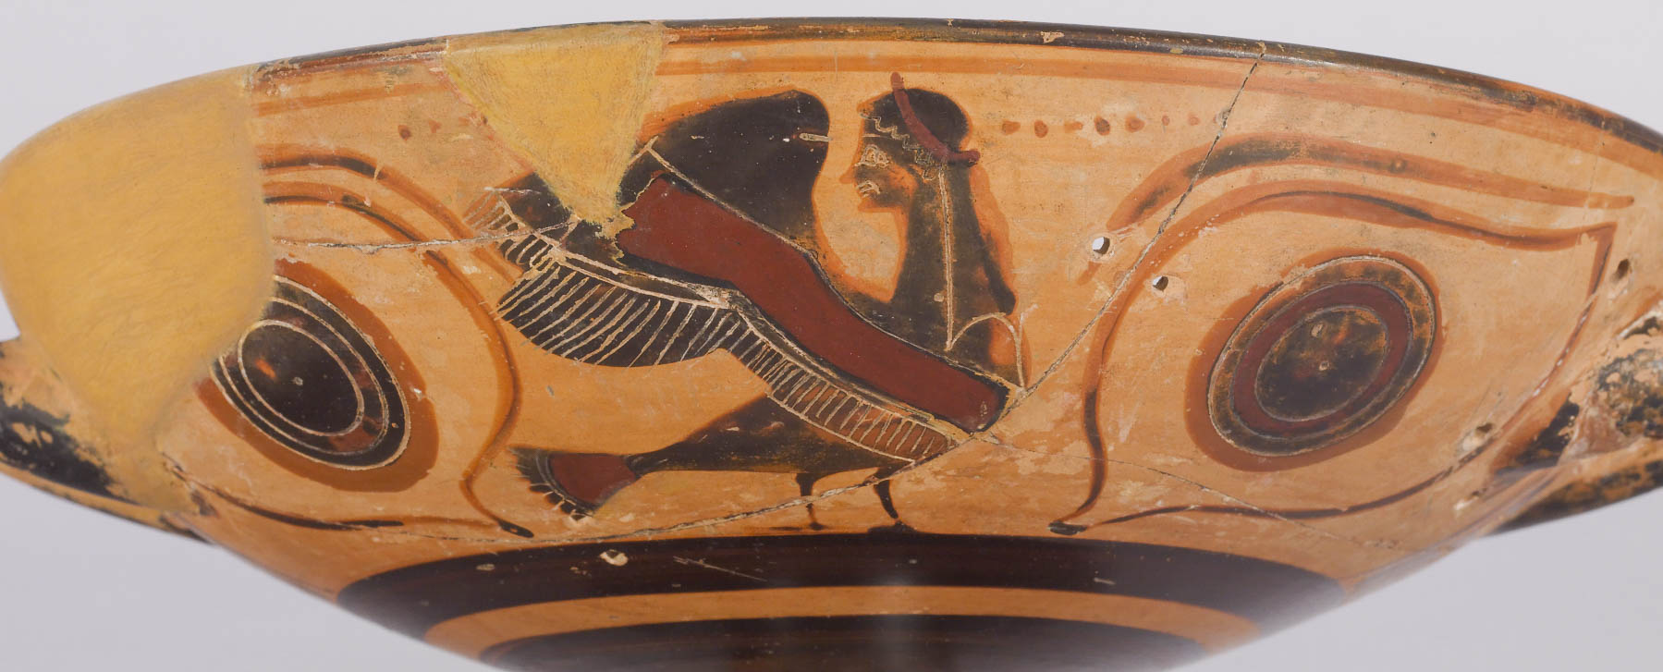
That their hearts may be encouraged, having been knit together in love
Black-figure kylix with sirens, with ancient repairs, 6th century BC
2:2
Notes:
Several sets of repair holes are visible on this Greek kylix. Repairs on such a beautiful dish were made with only a minimum of holes in an attempt to preserve the original look of the dish as much as possible. This image comes from Walters Art Museum and is in the public domain, via Wikimedia Commons: https://commons.wikimedia.org/wiki/File:Greek_-_Black-figure_Kylix_with_Sirens_-_Walters_4837_-_Detail_B.jpg. The next slide includes arrows to highlight the repair areas.
wiki032420120058727h

Slide 25
That their hearts may be encouraged, having been knit together in love
Black-figure kylix with sirens, with ancient repairs, 6th century BC
2:2
Notes:
Several sets of repair holes are visible on this Greek kylix. Repairs on such a beautiful dish were made with only a minimum of holes in an attempt to preserve the original look of the dish as much as possible. This image comes from Walters Art Museum and is in the public domain, via Wikimedia Commons: https://commons.wikimedia.org/wiki/File:Greek_-_Black-figure_Kylix_with_Sirens_-_Walters_4837_-_Detail_B.jpg.
wiki032420120058727

Slide 26
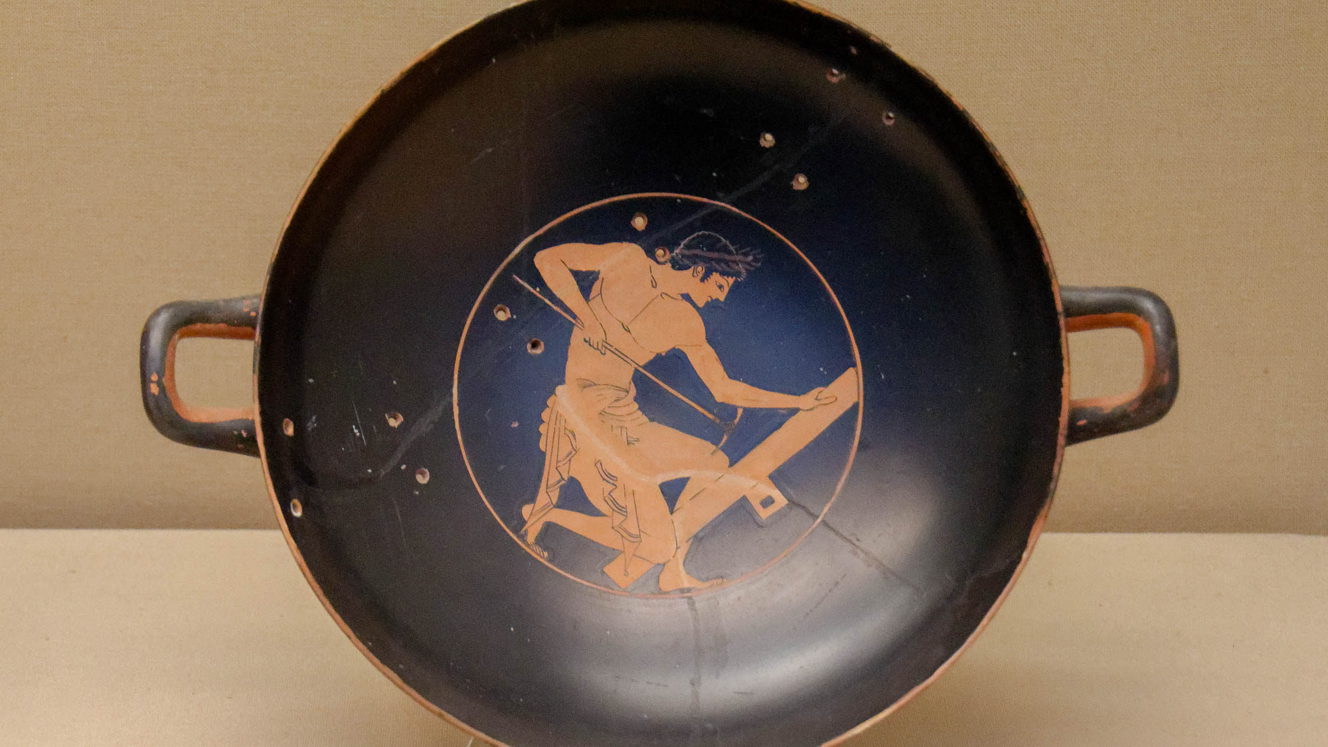
That their hearts may be encouraged, having been knit together in love
Red-figure kylix with carpenter at work, repaired in antiquity, from Athens, circa 500 BC
2:2
Notes:
This kylix was broken and repaired in antiquity, as is evident from the line of holes used to bind the pieces back together. This kylix was photographed at the British Museum.
tb0929198028h

Slide 27
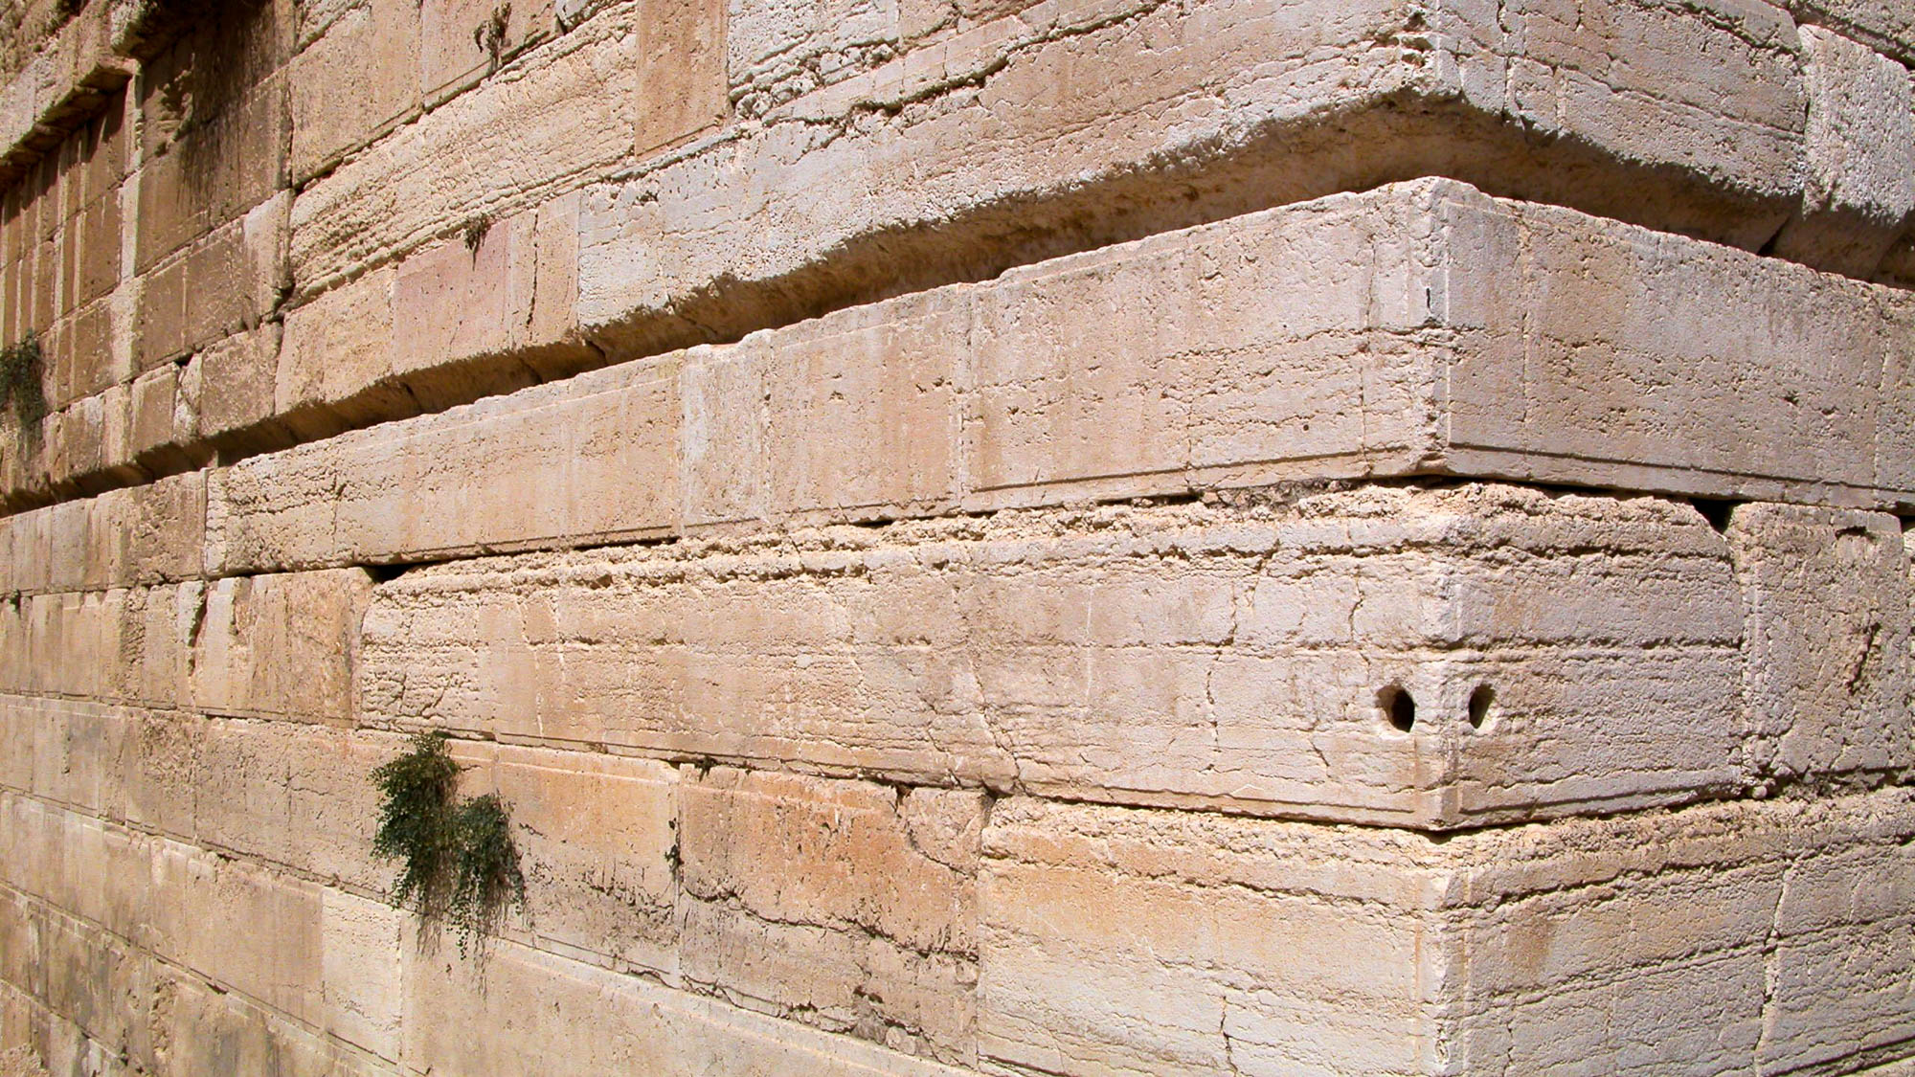
That their hearts may be encouraged, having been knit together in love
Large stones at the southwest corner of the Temple Mount
2:2
Notes:
Another example of being “knit together” in a physical way would have been the interlocking method of construction. This can be seen in the Temple Mount foundation stones pictured here, right next to a major entrance into the temple of Jerusalem in Paul’s day. This interlocking method ensured very tight construction that made the structure extremely strong. Paul mixes the body and building metaphors in the same way in Ephesians 2, where he describes believers as being one body as well as being the temple of God with Christ as the cornerstone. See the next slide for highlights which show the interlocking technique of construction.
tb091702210

Slide 28
That their hearts may be encouraged, having been knit together in love
Large stones at the southwest corner of the Temple Mount
2:2
Notes:
Another example of being “knit together” in a physical way would have been the interlocking method of construction. This can be seen in the Temple Mount foundation stones pictured here, right next to a major entrance into the temple of Jerusalem in Paul’s day. This interlocking method ensured very tight construction that made the structure extremely strong. Paul mixes the body and building metaphors in the same way in Ephesians 2, where he describes believers as being one body as well as being the temple of God with Christ as the cornerstone.
tb091702210

Slide 29
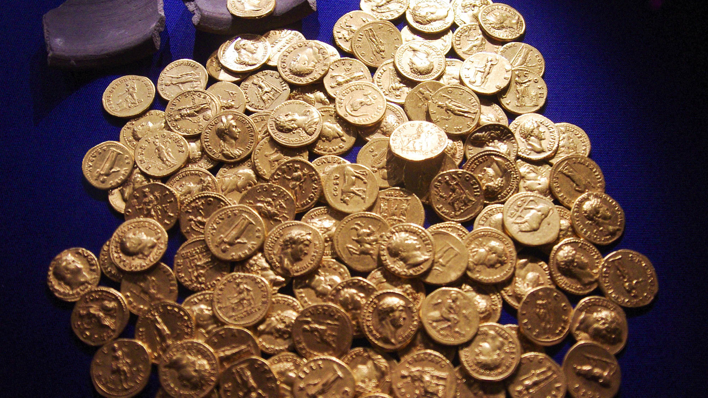
To all the riches of the full assurance of understanding
Hoard of Roman gold coins, AD 54–160
2:2
Notes:
This hoard was discovered in Didcot, England. It was photographed at the Ashmolean Museum at the University of Oxford. A gold aureus was equivalent in value to 25 silver denarii, so the hoard of coins shown in this photograph was worth thousands of denarii.
adr1305249723h

Slide 30
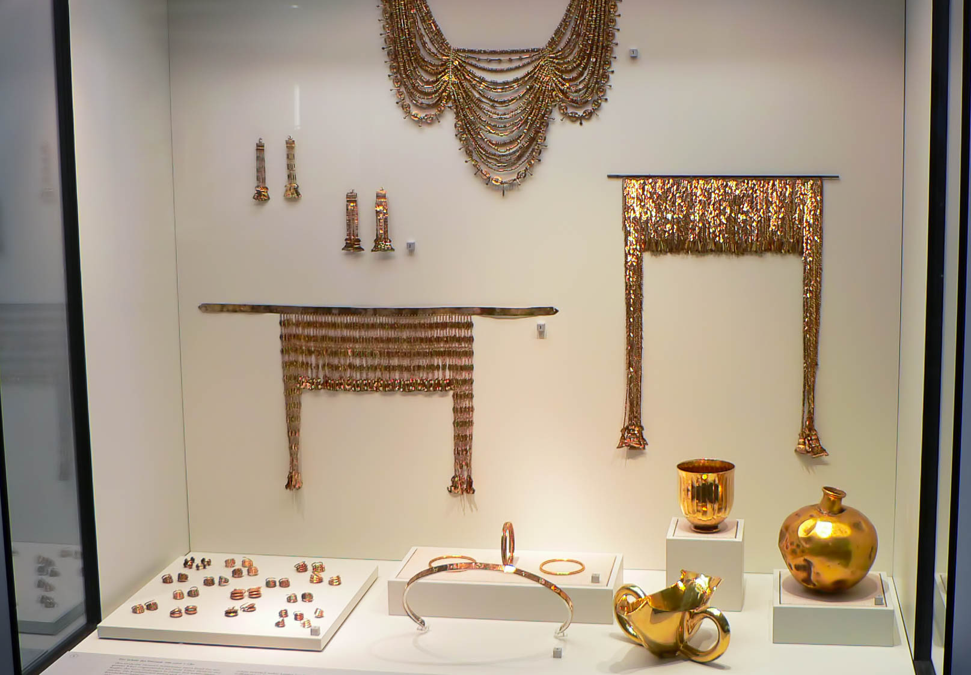
In whom are hidden all the treasures of wisdom and knowledge
Copies of Priam’s Treasure, from Troy, circa 3100–2200 BC
2:3
Notes:
Priam's Treasure is a cache of gold and other artifacts discovered by Heinrich Schliemann at ancient Troy. Most of the artifacts are now in the Pushkin Museum in Moscow. This collection of Early Bronze golden items is now dated to centuries before the time of Priam, although the treasure is still known by his name. This display was photographed at the Berlin Museum of Prehistory and Early History.
adr070513636h

Slide 31
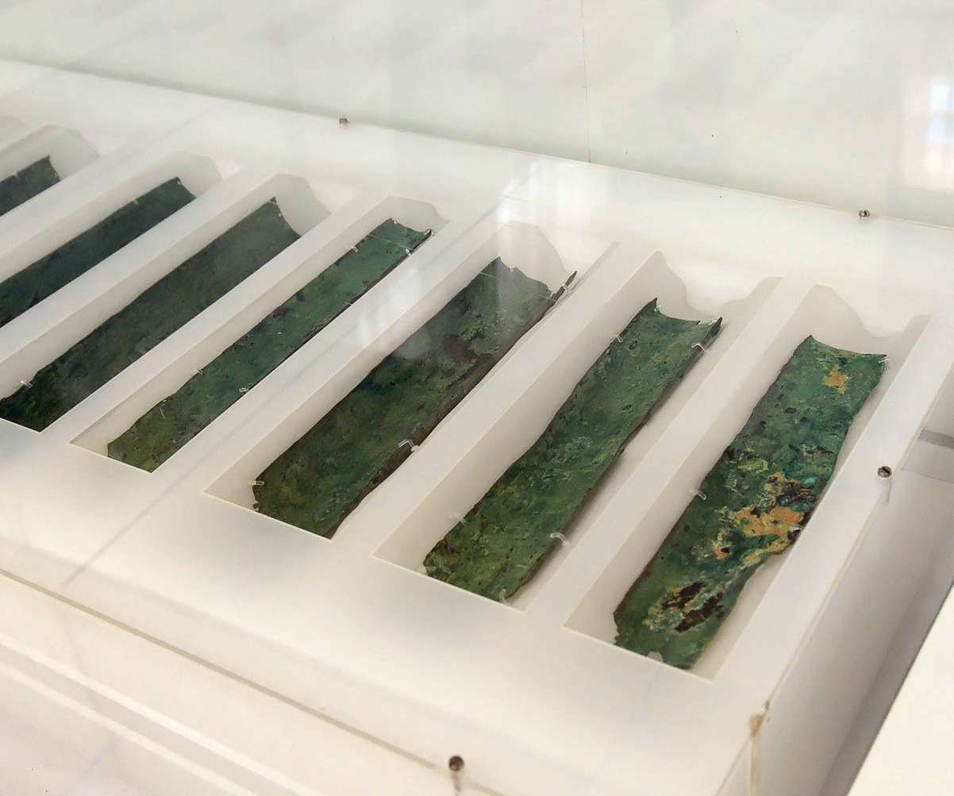
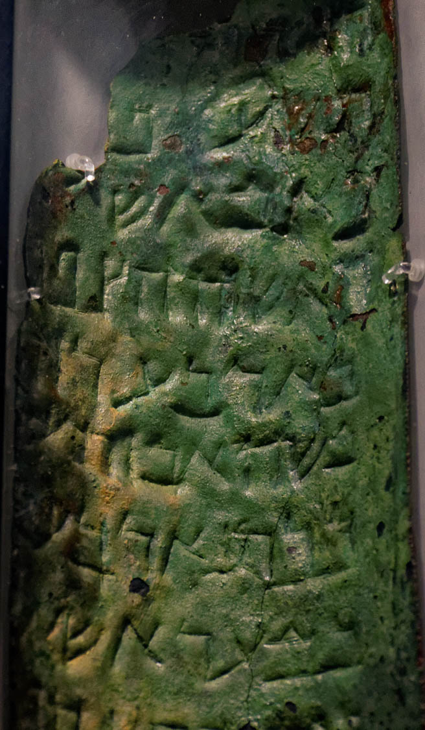
In whom are hidden all the treasures of wisdom and knowledge
Copper Scroll listing treasures hidden in the Judean wilderness, 1st century AD
2:3
Notes:
Paul describes wisdom and knowledge using the metaphor of treasure (Gk. thēsauros, θησαυρός). Ancient treasures would often include precious metals and would be hidden or buried in a safe place. The Copper Scroll is one of the most famous of the Dead Sea Scrolls. Inscribed on sheets of copper, it provides a list of 64 underground hiding places in Jerusalem and the Judean wilderness. It describes treasures belonging to the Qumran community that total about 4,500 talents of precious objects. In 1956, the total value of the treasures, were they to be discovered as described, was appraised at $60 million (with inflation, this would be roughly $570 million in 2020). Based on paleographic examination, the scroll has been dated to some time in the middle of the 1st century AD, around the time of Paul’s ministry. The Copper Scroll is now on display in the Jordan Museum in Amman.
Left: tb060108060h; right: tb031115555h

Slide 32
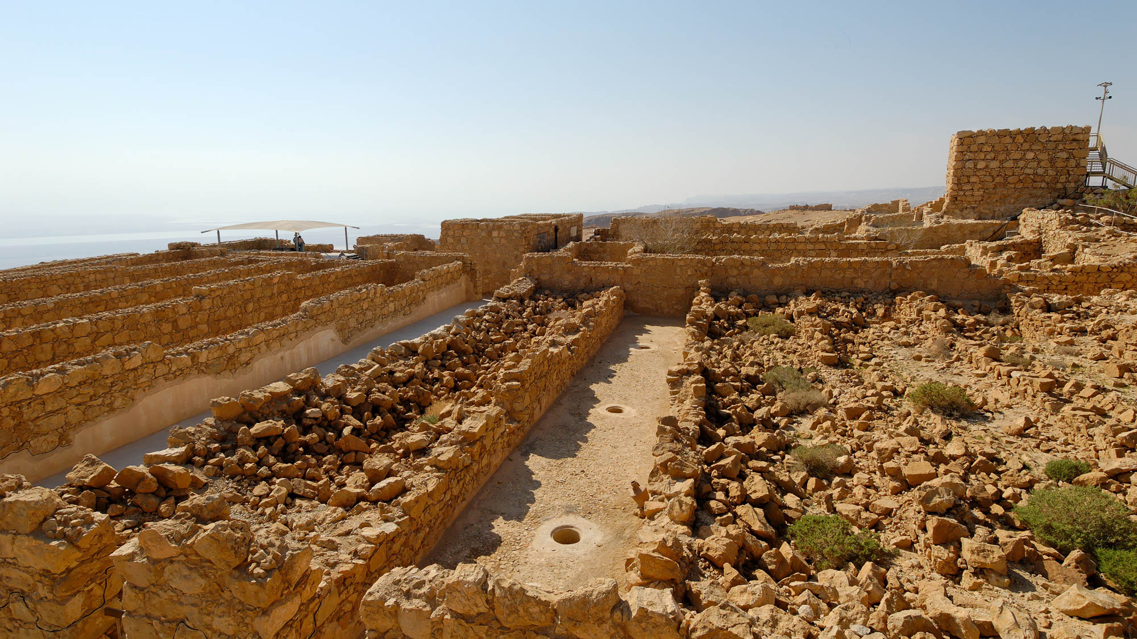
In whom are hidden all the treasures of wisdom and knowledge
Storehouses at Masada, 1st century BC – 1st century AD
2:3
Notes:
In this verse, Paul describes Christ as the great storehouse of all wisdom and knowledge. Several massive storehouses from the 1st century are known. One example is the storehouses constructed by King Herod at his mountain fortress of Masada, pictured here. The complex included 15 long storerooms that Herod filled with supplies, including food and weapons. Each storeroom held a different commodity. This was attested by the different storage jars and the inscriptions on the jars in the rooms. The excavators found wine bottles that had been sent to Herod from Italy. The excavators restored some of the storehouses using the stones that had collapsed over the centuries. Other storehouses were left as they were found.
tb030907203

Slide 33
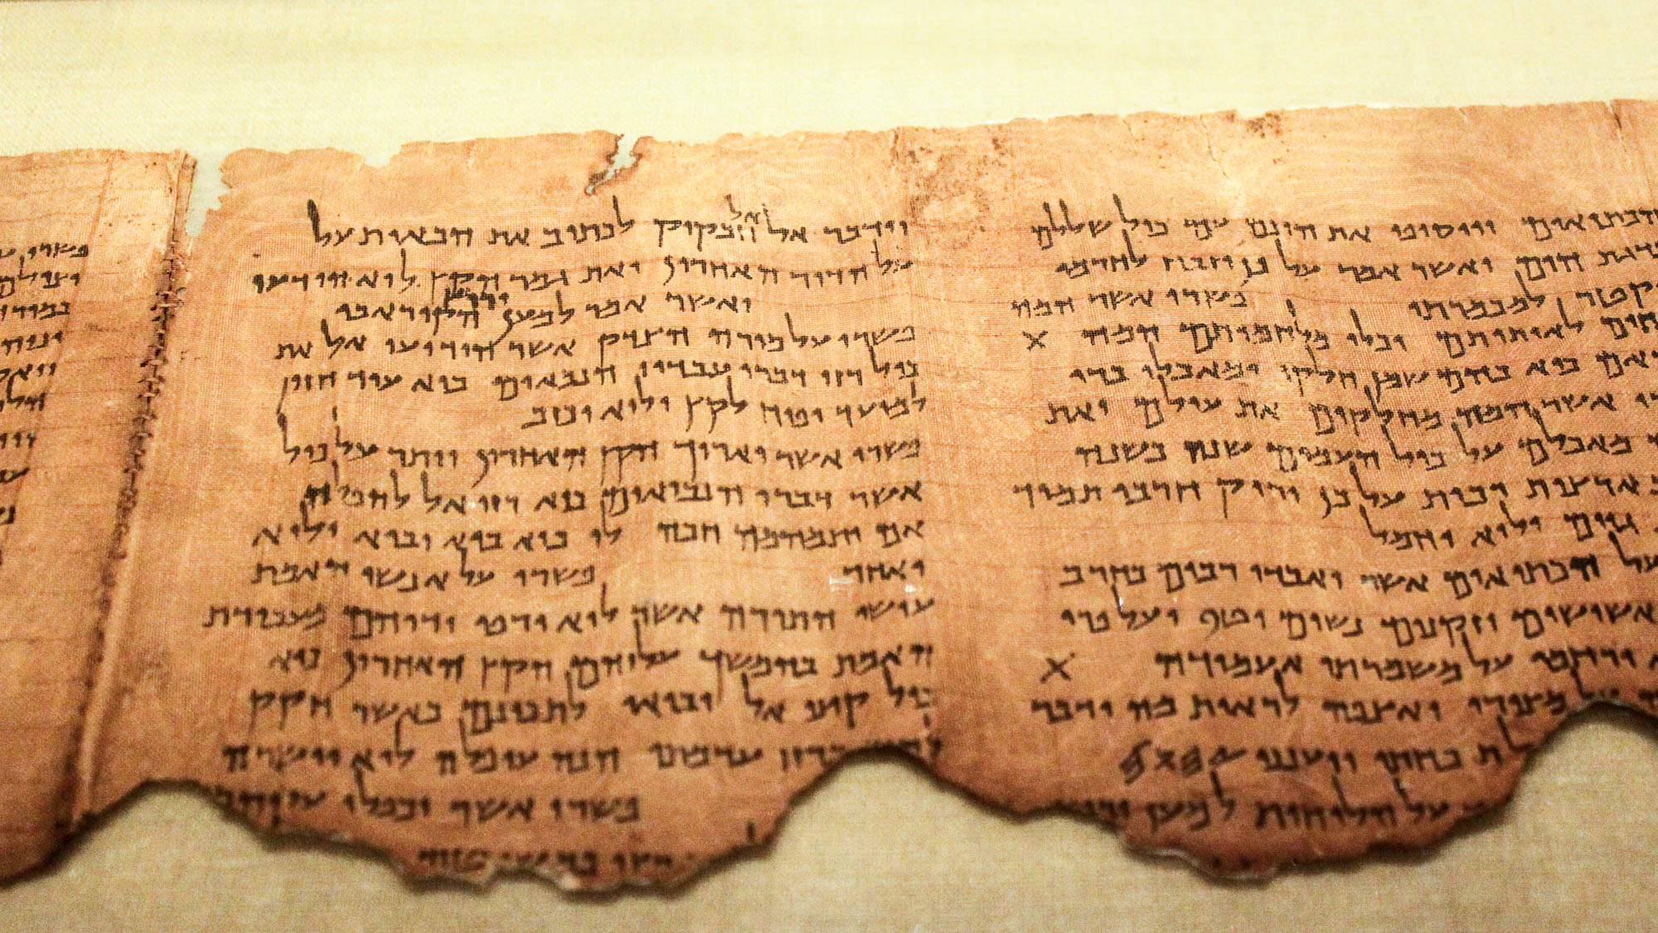
In whom are hidden all the treasures of wisdom and knowledge
Commentary of Habakkuk scroll (1QpHab), late 1st century BC
2:3
Notes:
As pointed out in the slides on Colossians 1:26, the concept of a hidden “mystery” was quite well-known in Paul’s day. An example of this may be found in the commentary (pesher) on Habakkuk among the Dead Sea Scrolls. It discusses the “mystery” which was revealed to the Teacher of Righteousness. The Teacher of Righteousness is generally understood to have been a central figure in the Jewish sect at Qumran, though his identity is debated. Here Paul tells the Colossians that Christ is the one in whom the mystery and hidden treasures of wisdom and knowledge are found. For more on this background, see the slides on Colossians 1:26. The image comes from Desconocido and is in the public domain, via Wikimedia Commons: https://commons.wikimedia.org/wiki/File:Pesher_Habakkuk_Scroll.JPG.
wiki0814201220394752

Slide 34
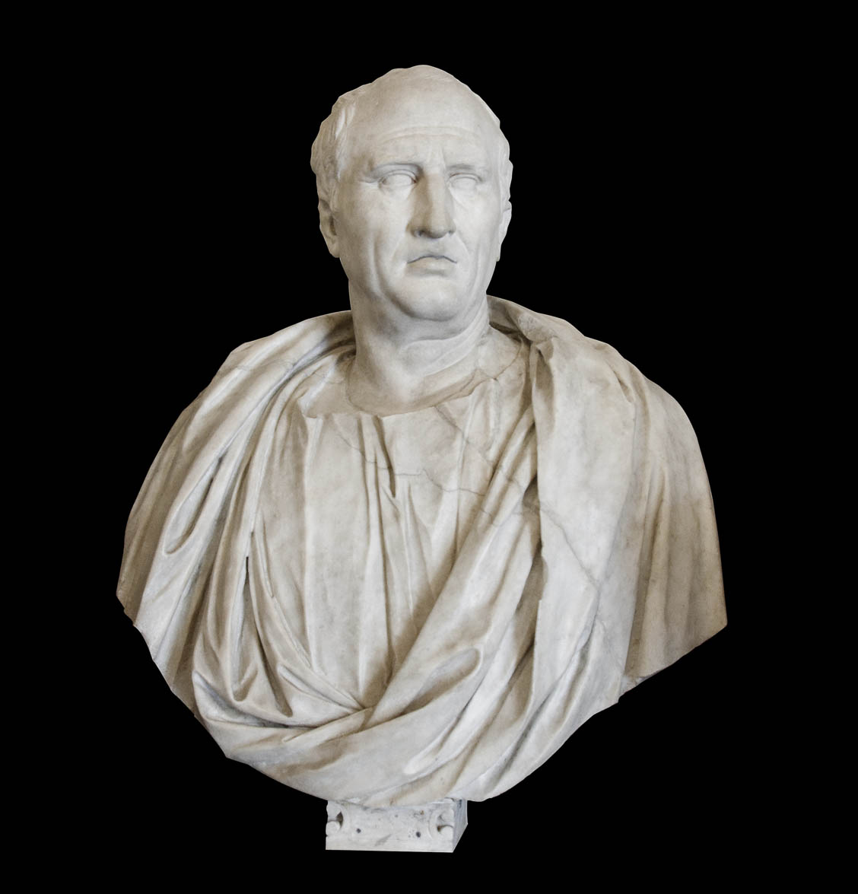
I say this so that no one may delude you with persuasiveness of speech
Bust of Cicero, mid-1st century BC
2:4
Notes:
In Paul’s day, “sophists” were professional rhetoricians whose goal was to win in debate, rather than to seek absolute truth. Their arguments were often clever but fallacious. In popular thought, they were often associated with moral skepticism and false reasoning. This bust of a famous orator was photographed at the Capitoline Museums in Rome.
tb0514179859c

Slide 35
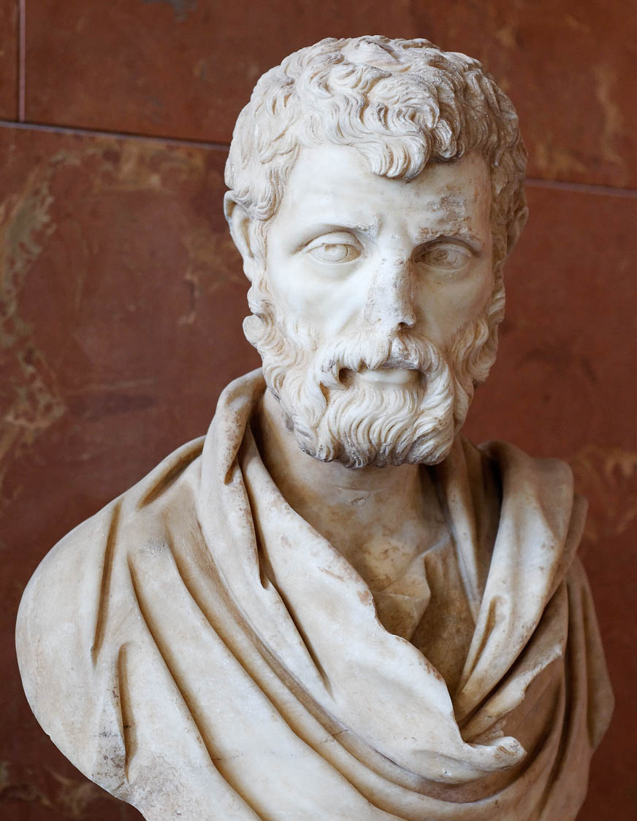
I say this so that no one may delude you with persuasiveness of speech
Bust of the sophist Herodes Atticus, circa AD 160
2:4
Notes:
The issue Paul warns of continued to be a danger long after his letter was written. Herodes Atticus, pictured here, was a sophist (and a Roman senator) about a century later. This bust was photographed at the Louvre Museum. This image comes from Marie-Lan Nguyen and is licensed under CC BY 3.0, via Wikimedia Commons: https://commons.wikimedia.org/wiki/File:Herodes_Atticus_Louvre_Ma1164_n2.jpg.
wiki0205201008302010h

Slide 36
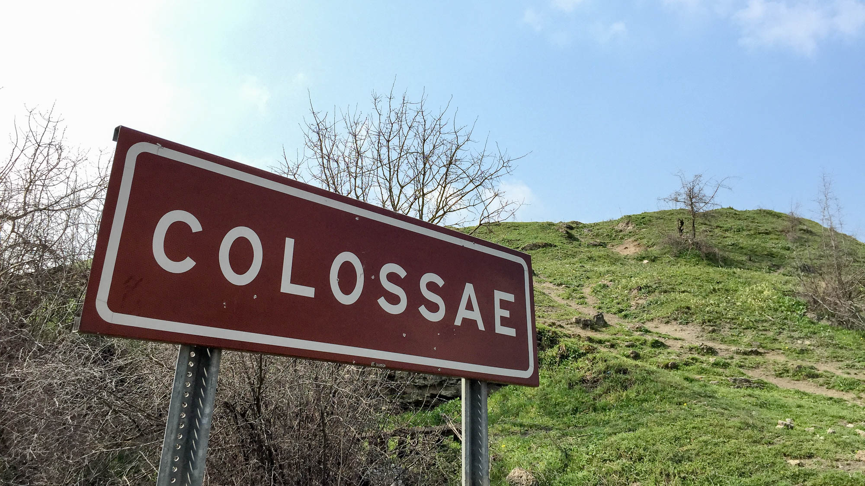
For though I am absent in the flesh, yet I am with you in spirit
“Colossae” sign with the tell in the background
2:5
Notes:
Although Paul was not physically present with the believers at Colossae, yet he was with them in spirit. He apparently thought of them often and was concerned with their well-being.
shs031215345

Slide 37
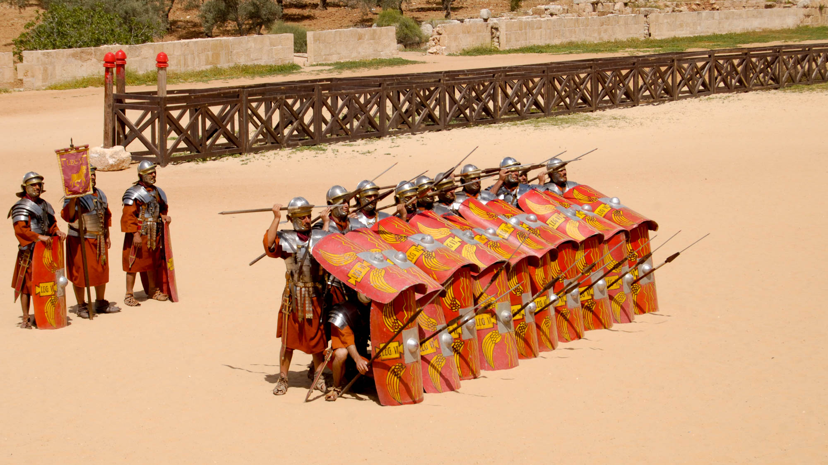
I rejoice to see your good discipline
Roman soldiers in formation at the Gerasa hippodrome
2:5
Notes:
“Good discipline” (Gk. taxis, τάξις) is a word that describes a state of good order and proper procedure. This kind of training and self-control was essential in military settings, where soldiers who maintained order under stress were usually victorious over those who did not. It required significant training and discipline to create a formation like the one seen in this photo, especially under battlefield conditions, but doing so could be the difference between life and death. These re-enactors are performing in the hippodrome in Gerasa, Jordan. The Roman Army and Chariot Experience, pictured here, takes place daily during most of the year.
dp041108623

Slide 38
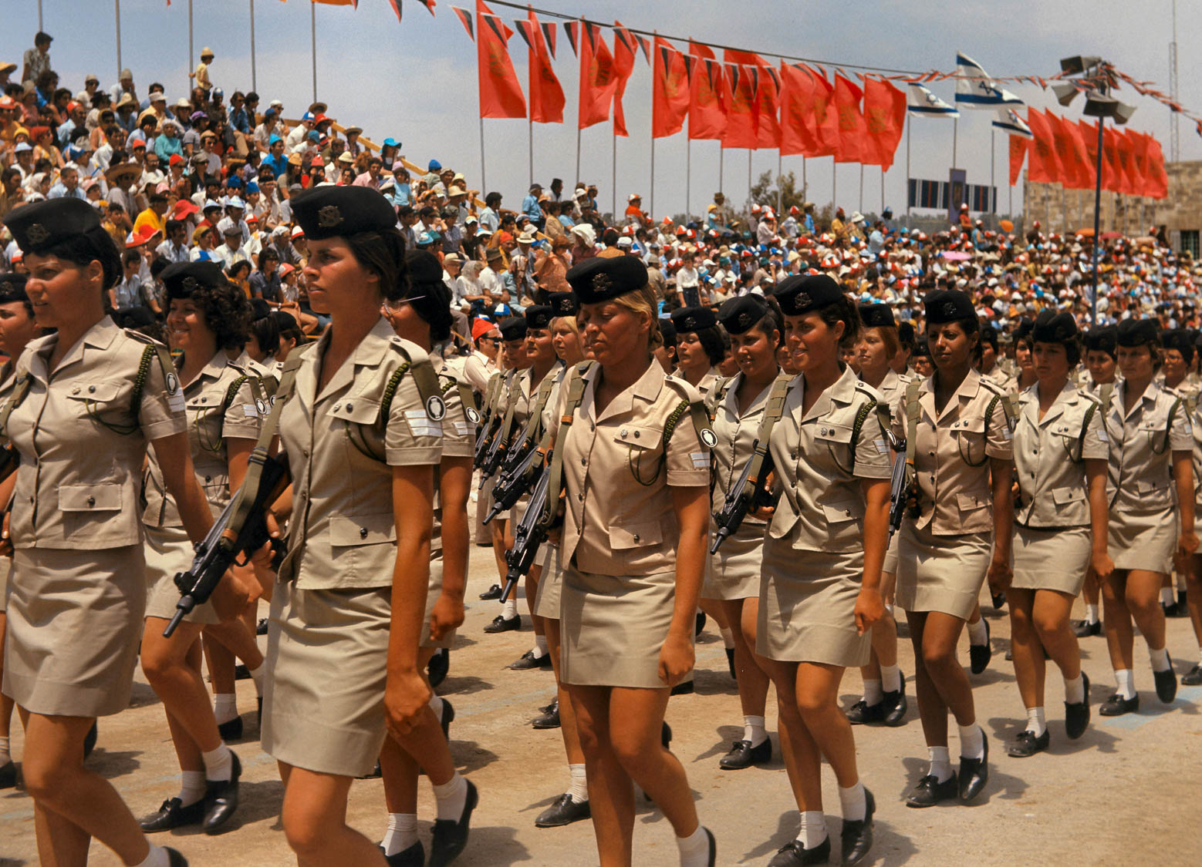
I rejoice to see your good discipline
Israeli soldiers marching in an Independence Day parade, 1973
2:5
Notes:
Military units around the world train to instill good discipline, expressed in this photo by orderly marching in a military parade.
db7305070702h

Slide 39
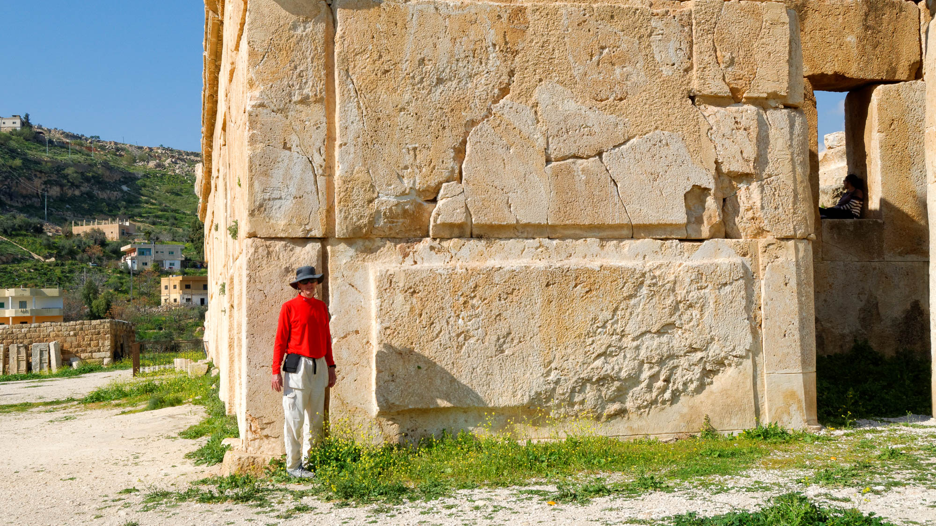
I rejoice to see your good discipline and your stable faith in Christ
Large foundation stones in the southern façade of the Iraq el-Emir palace, circa 200 BC
2:5
Notes:
The word “stable” (Gk. stereōma, στερέωμα) refers to a condition of firm commitment or steadfastness. It can also be used in a military sense to refer to strength or firmness (cf. 1 Macc 9:14). It is illustrated here by the massive stones that form the foundation of Qasr al-Abd, a Tobiad palace in Jordan. The largest of the stones used in this structure are 23 by 10 feet (7x3 m), although they are not extraordinarily thick.
tb031315399h

Slide 40
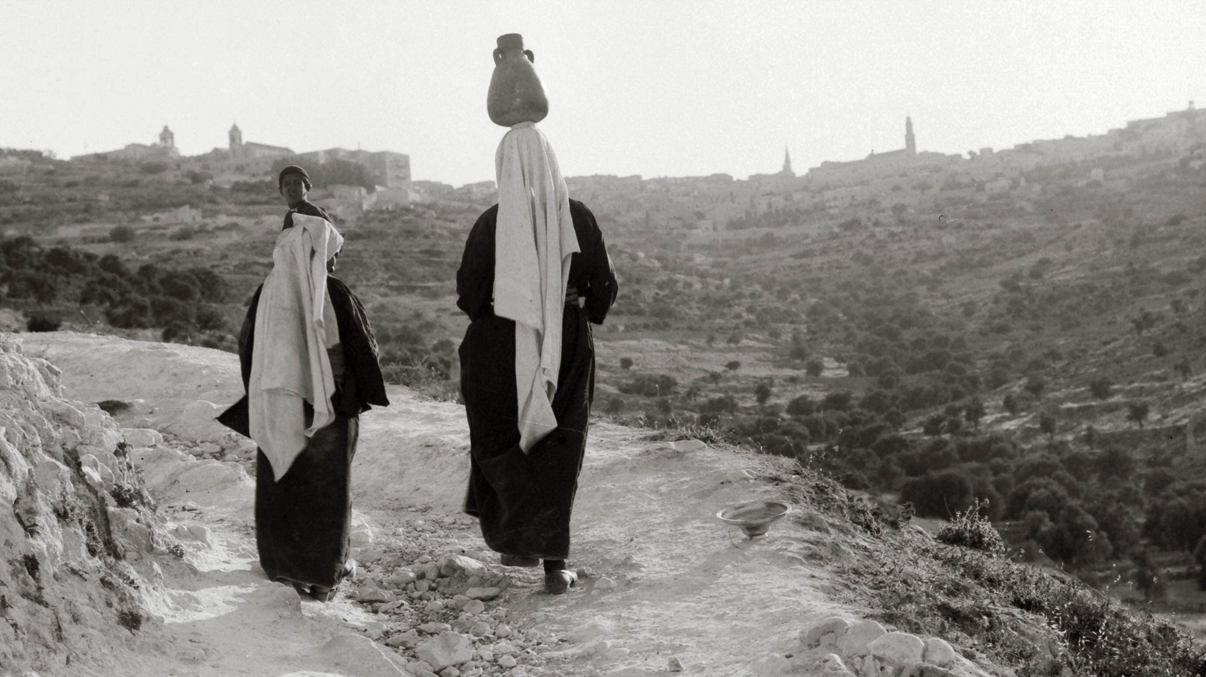
Therefore, as you received Christ Jesus the Lord, walk in him
Women walking along a mountain path leading toward Bethlehem
2:6
Notes:
The word “walk” (Gk. peripateō, περιπατέω) was often used metaphorically to describe one’s manner of life, how one lived. This American Colony photo was taken between 1920 and 1933.
mat02610h

Slide 41
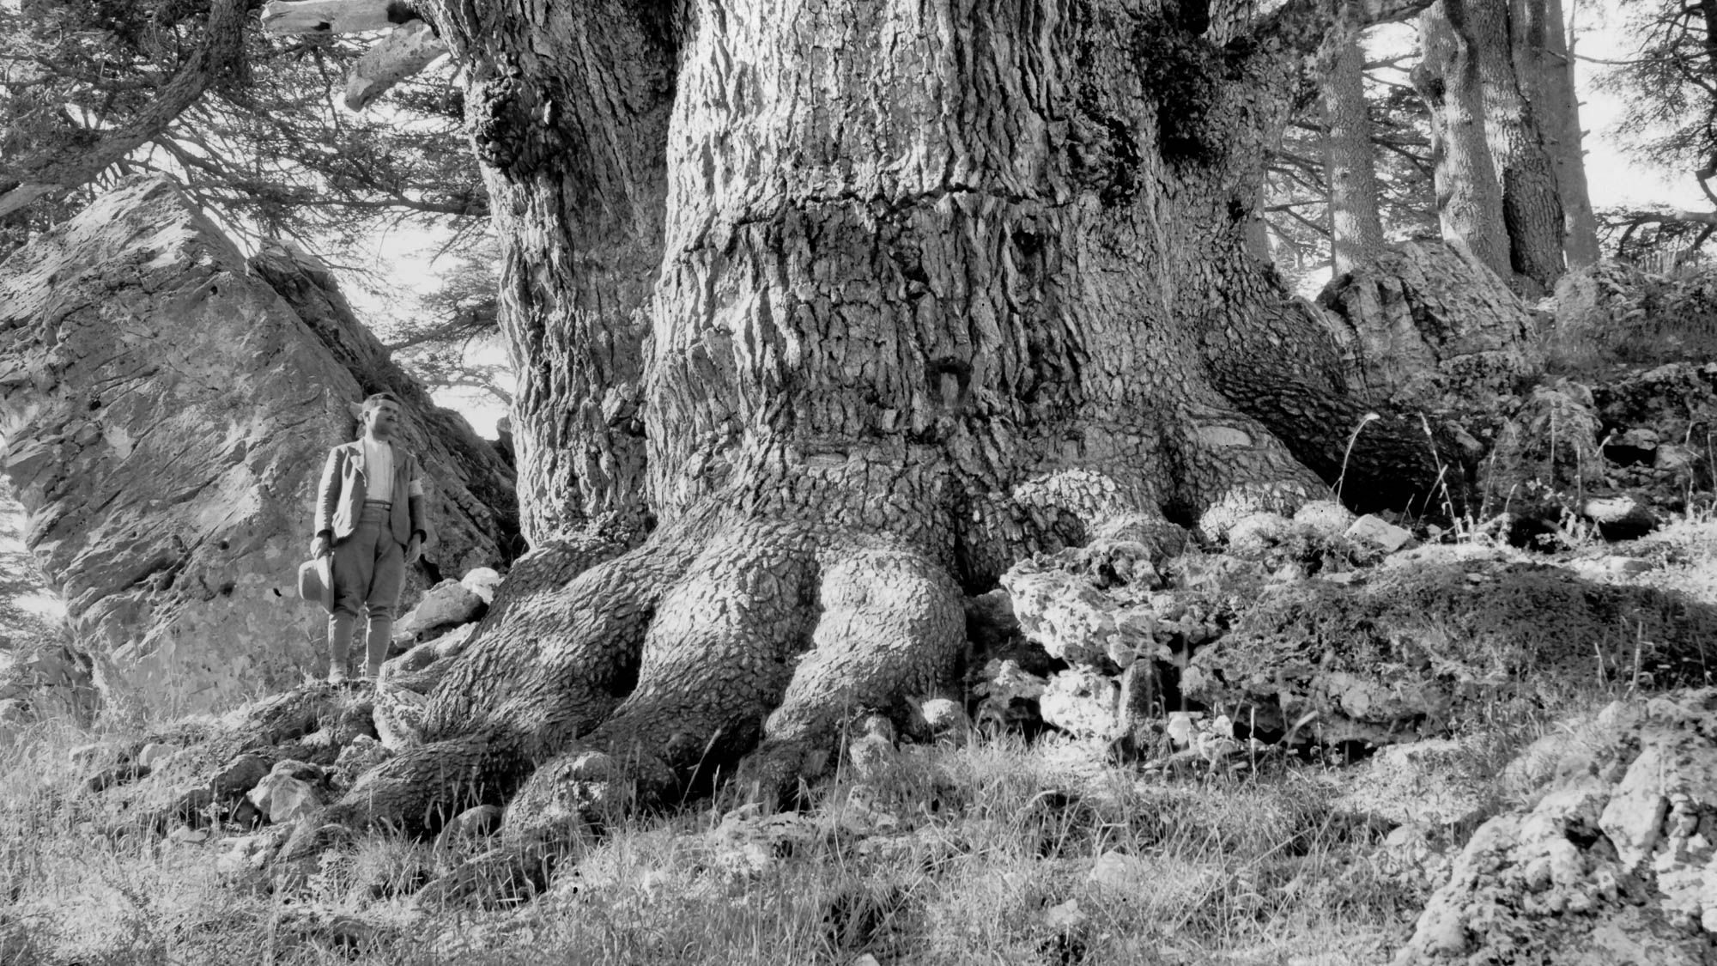
Having been firmly rooted
Man standing at the base of a Cedar of Lebanon
2:7
Notes:
To be “rooted” (Gk. rizoō, ῥιζόω) means to take root, like a tree or other plant (e.g., Jer 12:2). The word is mostly used figuratively, referring to one who is firmly fixed or who has a strong foundation. This photo of a cedar of Lebanon illustrates the large and robust root system that is necessary to hold up such a large tree. This American Colony photo was taken between 1898 and 1946.
mat06183h

Slide 42
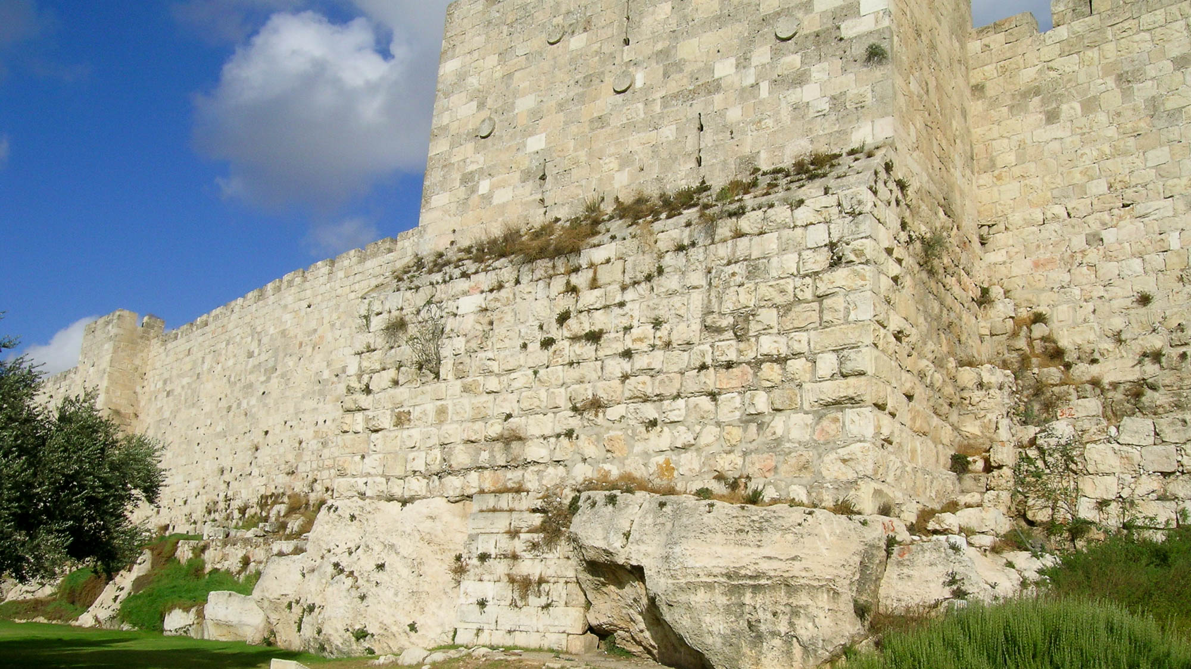
Having been firmly rooted
Western wall of the Old City of Jerusalem, with earlier foundations
2:7
Notes:
To be “rooted” (Gk. rizoō, ῥιζόω) was more often used figuratively, either to refer to a structural foundation or to a person. The section of wall shown in this photo is firmly “rooted” on bedrock. This section of wall is on the west side of the Old City of Jerusalem. The lowest section of wall, situated between the two outcroppings of bedrock, dates to the 1st century AD.
tb102903684

Slide 43
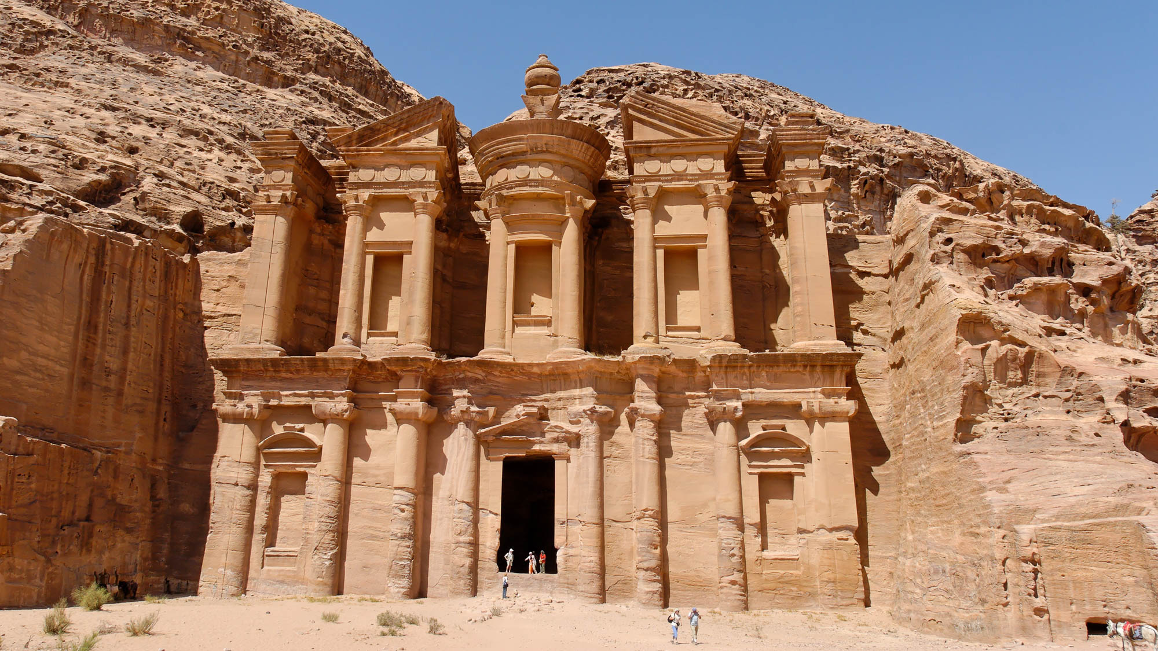
Having been firmly rooted
The Monastery, a tomb carved of living bedrock at Petra, 1st century BC
2:7
Notes:
This magnificent tomb façade at Petra was carved in its entirety from the living bedrock. No structure could be more firmly “rooted” than this, which explains the astounding state of preservation. Archaeologists believe the structure was cut from the rock in 3 BC, intended to honor the Nabatean king Obodas I (r. 96–85 BC).
tb053008899

Slide 44
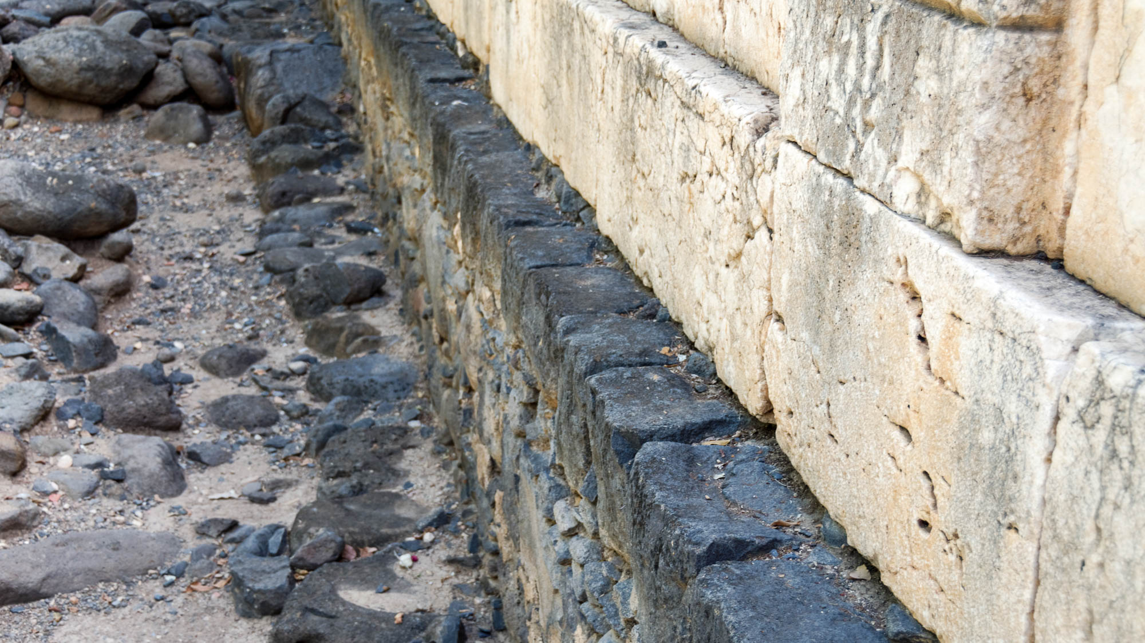
And being built up in Him and established in your faith
Capernaum synagogue with 1st century wall
2:7
Notes:
The word “built up” (Gk. epoikodomeō, ἐποικοδομέω) refers to continued construction on top of something previously built. This photo of the synagogue at Capernaum shows a later building, built of white limestone, that has been constructed atop the wall of an earlier synagogue, built of black basalt. The later synagogue dates to approximately the 5th century AD, while the lower foundation is believed to belong to the 1st century AD synagogue where Jesus taught.
tb061516521

Slide 45
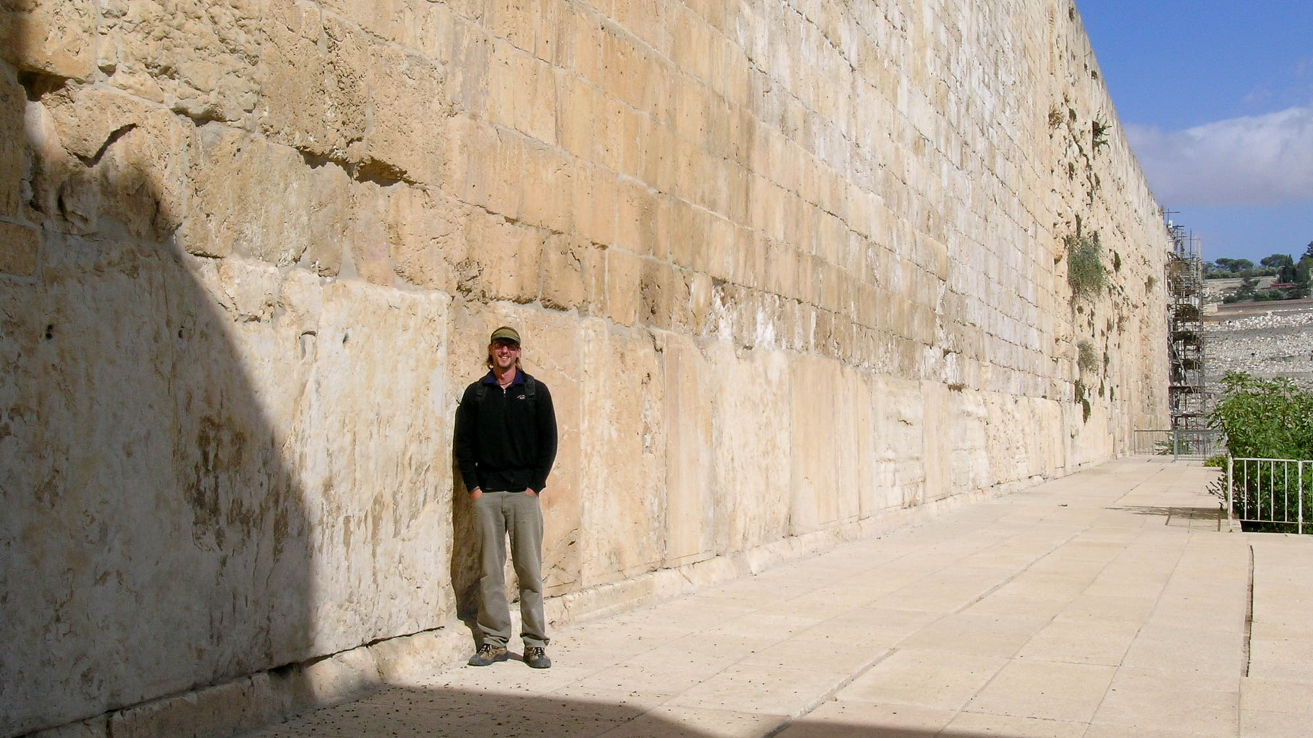
And being built up in Him and established in your faith
Southern Temple Mount wall with the Herodian “Master Course” and later construction
2:7
Notes:
The row of huge stones shown in this photo, known as the Master Course, is located along the southern side of the Temple Mount in Jerusalem. These stones are part of the original construction of the Temple Mount undertaken by King Herod in the 1st century BC. The smaller stones above them are “built up” on the earlier foundation; they date to the Umayyad period (ca. AD 650–750).
tb102903640

Slide 46
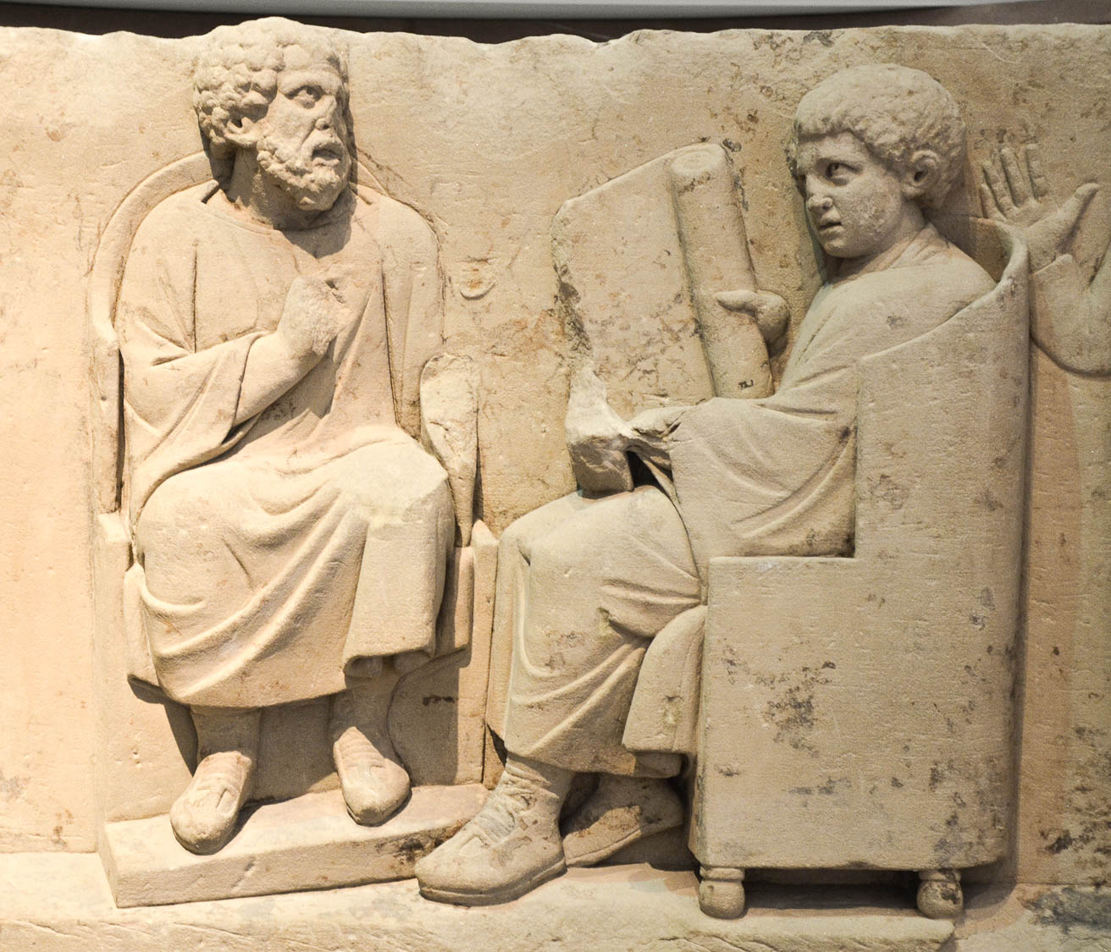
And being built up in Him and established in your faith, just as you were taught
Funerary relief of a teacher with a disciple, 2nd century AD
2:7
Notes:
This relief was found in Neumagen near the Roman city of Trier and is housed at the Rheinisches Landesmuseum in Trier, Germany. This image comes from Carole Raddato and is licensed under CC BY-SA 2.0, via Flickr: https://www.flickr.com/photos/carolemage/29029881804.
flkr29029881804

Slide 47
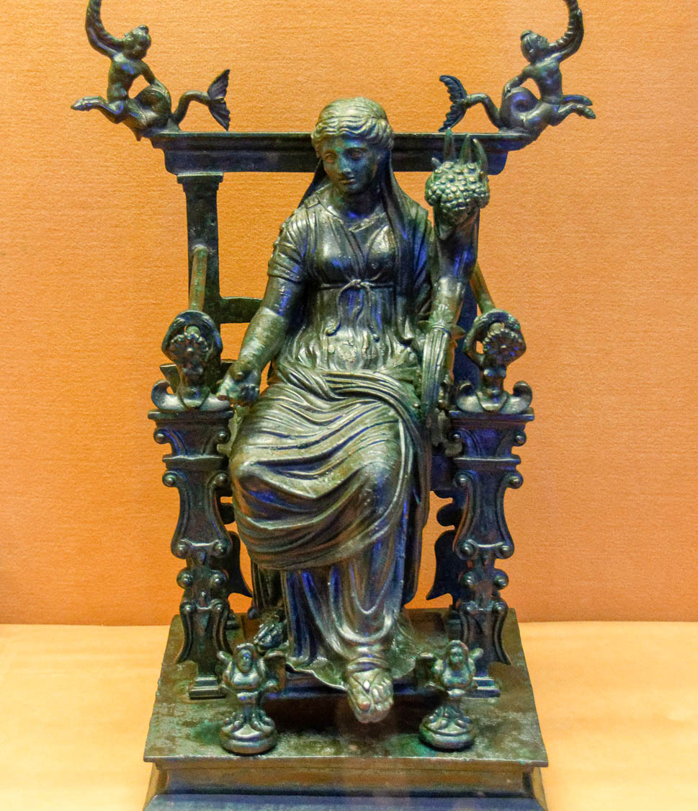
Abounding in thanksgiving
Statuette of Fortuna on throne, holding cornucopia, from Pompeii, 1st century AD
2:7
Notes:
The Greeks and Romans were familiar with the concept of thanksgiving (Gk. eucharistia, εὐχαριστία). The statuette shown here depicts the Roman goddess Fortuna, who is often depicted with a cornucopia like the goddess Abundantia. Both were associated with the blessing of having plenty, which naturally leads to the giving of thanks. This artifact was photographed at the Naples Archaeological Museum.
tb0515170544h

Slide 48
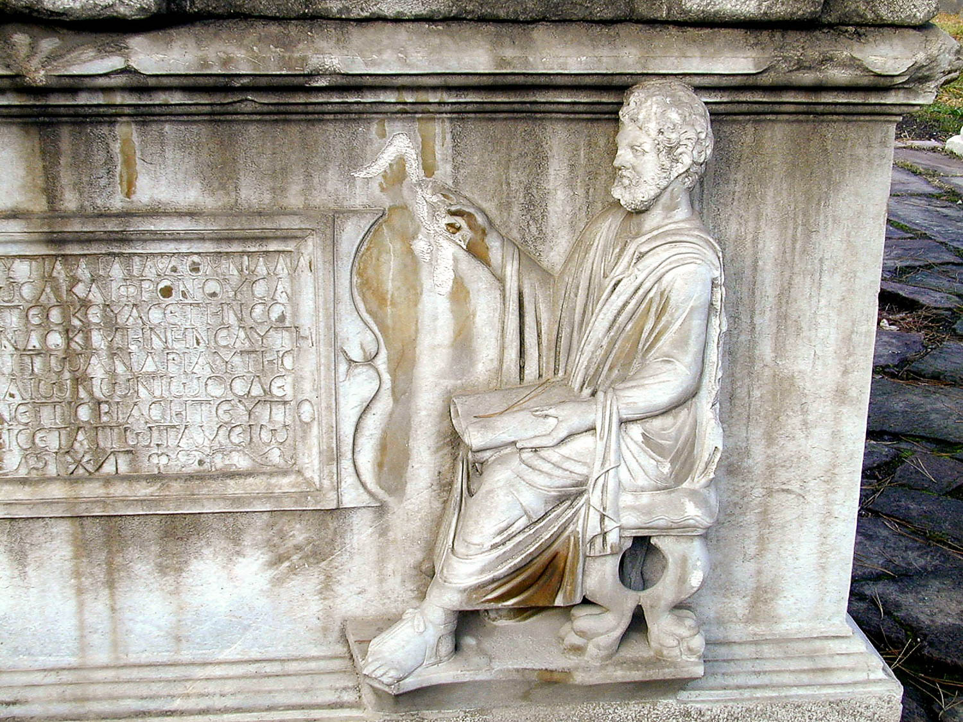
See to it that no one takes you captive through his philosophy and empty deceit
Greek philosopher depicted on a sarcophagus
2:8
Notes:
This is the only occurrence of the word “philosophy” (Gk. philosophia, φιλοσοφία) in the New Testament. From the context, it is clear that the word is used pejoratively as a reference to the teaching of error. This relief of a Greek philosopher was photographed at the Konya Museum in Turkey.
tb010201594

Slide 49
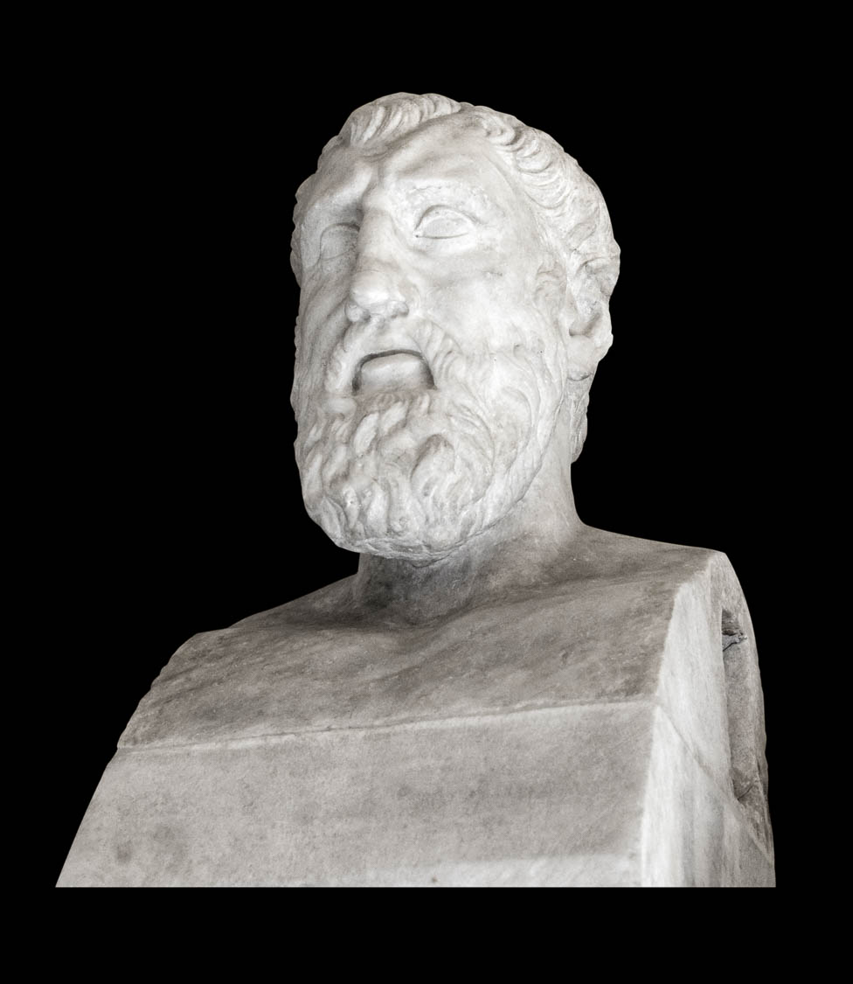
See to it that no one takes you captive through his philosophy and empty deceit
Bust of the Greek philosopher Zeno
2:8
Notes:
It is widely acknowledged that an idea can sound logical yet be clearly false. Zeno of Elea was a 5th century BC Greek philosopher who was especially well-known for his puzzling and perplexing paradoxes. Many of his paradoxes, which suggest that motion is an illusion, rely on a method of proof that is now known as reductio ad absurdum. This bust is considered to be an Augustan copy of a 3rd century BC original. This bust was photographed at the Capitoline Museums.
tb0514179864c

Slide 50
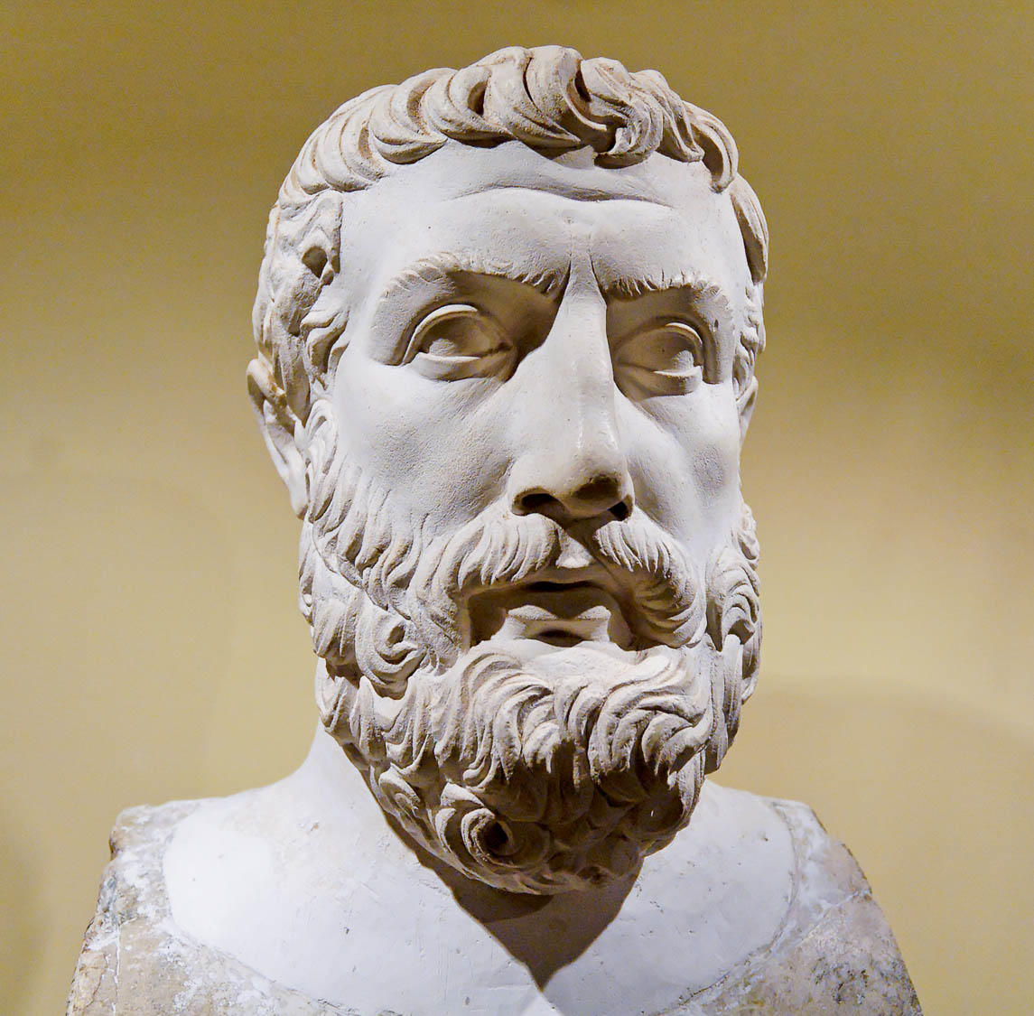
See to it that no one takes you captive through his philosophy and empty deceit
Bust of Parmenides of Elea, 1st century AD
2:8
Notes:
Parmenides was a contemporary of Zeno. He rejected the epistemological validity of the senses, and instead argued that the logical standards of clarity and necessity should be the criteria of truth. It is thought that much of Zeno’s work was intended to support the theories of Parmenides. In the end their philosophy was clearly “empty deceit.” This bust is from the first century AD; the Greek philosopher Parmenides himself lived from about 515 to 450 BC. This bust was photographed at the Naples Archaeological Museum.
tb111705758h

Slide 51
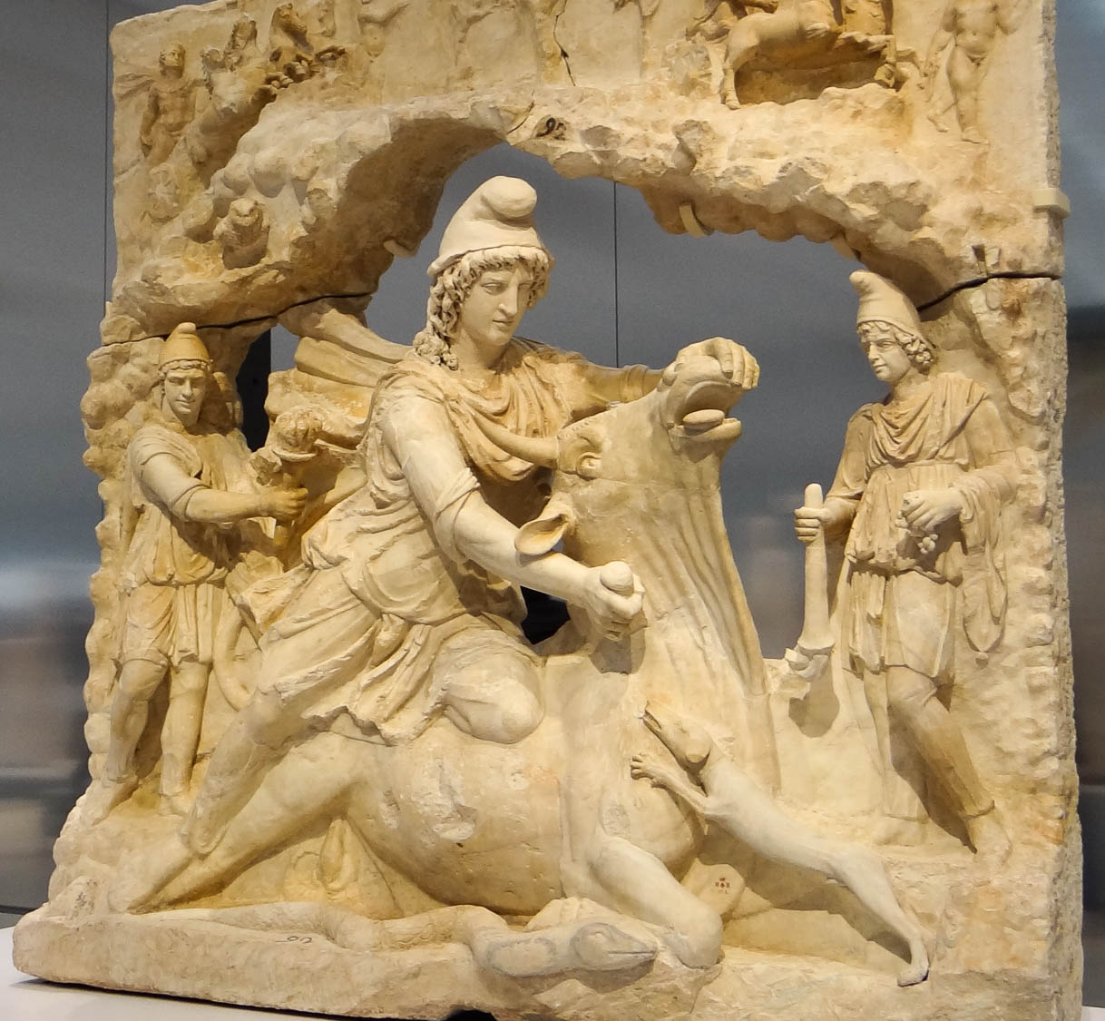
See to it that no one takes you captive through his philosophy and empty deceit
Statue of Mithras slaying a bull, 2nd century AD
2:8
Notes:
Mithraism was a mystery cult that was restricted to males and developed out of Old Persian religion. It is not well documented in ancient sources and its teachings are largely unknown. Some scholars believe it sought to imitate Christianity in certain respects during the early centuries of church history, perhaps in the sacred meal that participants shared. This statue of Mithras was photographed at the Louvre Museum. This image comes from Serge Ottaviani and is licensed under CC BY-SA 3.0, via Wikimedia Commons: https://commons.wikimedia.org/wiki/File:Mithra_sacrifiant_le_Taureau-005.JPG.
wiki041320131704482452

Slide 52
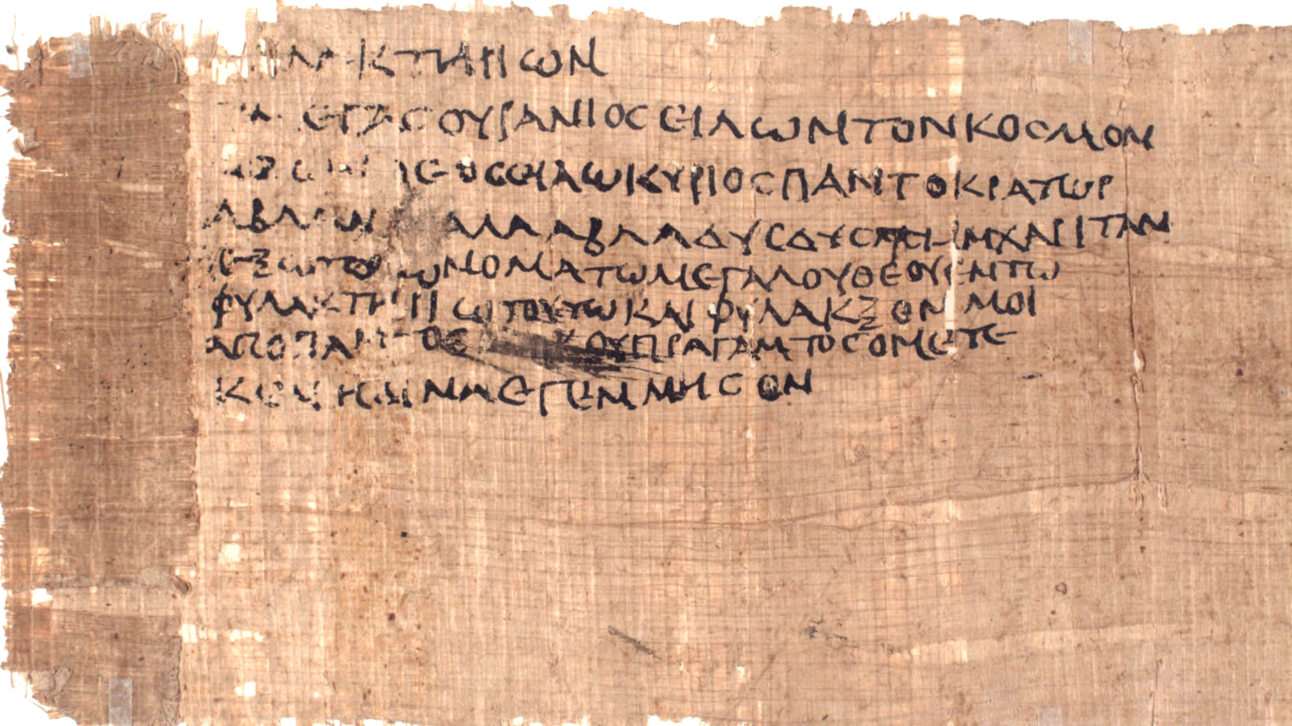
According to the elemental principles of the world, and not according to Christ
Jewish magic text used in a phylactery, from Egypt, circa AD 200
2:8
Notes:
Like the “dominion, rulers, authorities” referred to in Colossians 1:16 (cf. Col 2:10, 15), the “elemental principles of the world” (Gk. τὰ στοιχεῖα τοῦ κόσμου) can refer to spiritual beings (cf. Col 2:20). Some scholars think that Paul may have been taking aim at a Jewish syncretism that mixed biblical concepts with pagan mysticism. Jewish syncretism can be seen in magic texts from Egypt during the Greco-Roman period. While the text shown here dates to the late 2nd or early 3rd centuries AD, it is essentially the same as Jewish syncretistic texts dating to the 1st century.
The first word in the text is “phylactery” (Gk. phulaktērion, φυλακτήριον), a common implement used by Jews in religious activities (cf. Matt 23:4). The text goes on to invoke Iao, a syncretistic name of a super deity derived from the name of God from the Hebrew Bible, Yahweh. The name is also used to refer to lesser deities and spiritual beings. The Advanced Papyrological Information System on the University of Michigan website gives the following translation: “A phylactery: ‘Great [god] in heaven revolving the world, the true god, IAO! Lord, ruler of all, ABLANATHANALBA, grant, grant me this favor, let me have the name of the great god in this phylactery, and protect, from every evil thing, me whom NN bore, (NN) begot.’”
The word “ABLANATHANALBA” functioned in these types of texts as a magical palindrome. Some suggest it derives from the Aramaic phrase “You are our father” (Aram. אב לנא את, av lana at). For more on such texts, see the slides on Colossians 2:18.
This image comes from the University of Michigan, Advanced Papyrological Information System, and is in the public domain. Source: http://quod.lib.umich.edu/a/apis/x-1546/193_a.tif. University of Michigan Library Digital Collections. Accessed: Oct 15, 2019. The next slide highlights the words “phylactery,” “Iao,” and “ABLANATHANALBA.”
umapis1931546207

Slide 53
According to the elemental principles of the world, and not according to Christ
Jewish magic text used in a phylactery, from Egypt, circa AD 200
2:8
Notes:
Like the “dominion, rulers, authorities” referred to in Colossians 1:16 (cf. Col 2:10, 15), the “elemental principles of the world” (Gk. τὰ στοιχεῖα τοῦ κόσμου) can refer to spiritual beings (cf. Col 2:20). Some scholars think that Paul may have been taking aim at a Jewish syncretism that mixed biblical concepts with pagan mysticism. Jewish syncretism can be seen in magic texts from Egypt during the Greco-Roman period. While the text shown here dates to the late 2nd or early 3rd centuries AD, it is essentially the same as Jewish syncretistic texts dating to the 1st century.
The first word in the text is “phylactery” (Gk. phulaktērion, φυλακτήριον), a common implement used by Jews in religious activities (cf. Matt 23:4). The text goes on to invoke Iao, a syncretistic name of a super deity derived from the name of God from the Hebrew Bible, Yahweh. The name is also used to refer to lesser deities and spiritual beings. The Advanced Papyrological Information System on the University of Michigan website gives the following translation: “A phylactery: ‘Great [god] in heaven revolving the world, the true god, IAO! Lord, ruler of all, ABLANATHANALBA, grant, grant me this favor, let me have the name of the great god in this phylactery, and protect, from every evil thing, me whom NN bore, (NN) begot.’”
The word “ABLANATHANALBA” functioned in these types of texts as a magical palindrome. Some suggest it derives from the Aramaic phrase “You are our father” (Aram. אב לנא את, av lana at). For more on such texts, see the slides on Colossians 2:18. The two occurrences of the word “phylactery” (Gk. φυλακτήριον, phulaktērion) are highlighted in blue, “Iao” (Gk. Ιαω) is highlighted in yellow, and “ABLANATHANALBA” (Gk. Αβλαναθαλβα, misspelled here) is highlighted in green.
This image comes from the University of Michigan, Advanced Papyrological Information System, and is in the public domain. Source: http://quod.lib.umich.edu/a/apis/x-1546/193_a.tif. University of Michigan Library Digital Collections. Accessed: Oct 15, 2019.
umapis1931546207

Slide 54
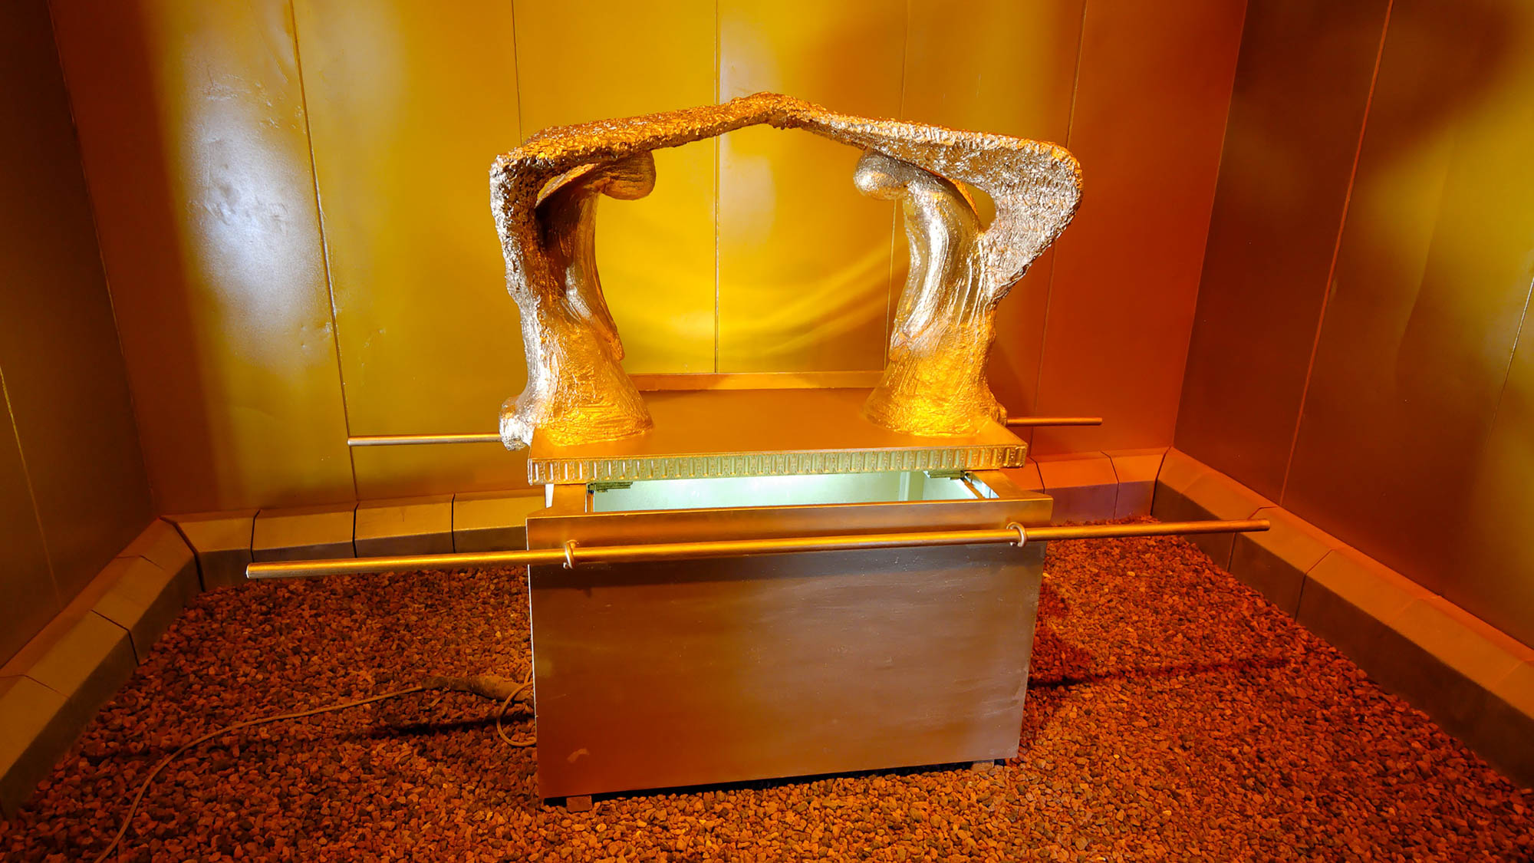
For in Him dwells all the fullness of the Godhead bodily
Ark of the covenant in a model of the tabernacle
2:9
Notes:
Paul’s language here recalls God’s dwelling among His people in the Holy of Holies of the Tabernacle, and later in the Temple. As Immanuel (“God with us”), Jesus perfected this idea as God incarnate who dwelt (lit. “tabernacled”) among us (John 1:14). The verb “to dwell” (Gk. katoikeō, κατοικέω) is used in the Septuagint to describe God dwelling in both earthly and heavenly temples (e.g., 2 Kgs 7:6; 11:11; 1 Chr 17:5; Isa 40:22). The life-sized model of the ark pictured here was photographed at Timna National Park in southern Israel.
tb052208369

Slide 55

For in Him dwells all the fullness of the Godhead bodily
Holy place in a model of the tabernacle
2:9
Notes:
This model was photographed at Timna National Park in the Negev, Israel.
tb052208399

Slide 56

For in Him dwells all the fullness of the Godhead bodily
Model of the tabernacle (aerial view)
2:9
Notes:
This 1:1 model of the tabernacle was photographed at Timna National Park in the Negev, Israel.
ws031215730c

Slide 57

For in Him dwells all the fullness of the Godhead bodily
Temple on a model of Jerusalem in the First Temple period
2:9
Notes:
The place where God chose to dwell among His people underwent significant changes throughout Israel’s history. When Israel settled in the Promised Land, the mobile temple of the tabernacle, which accompanied Israel in the wilderness, was permanently placed at Shiloh. Several centuries later, the tabernacle was replaced by Solomon’s Temple. The model shown here illustrates how Solomon’s Temple may have looked. This model was photographed at the Bible Lands Museum in Jerusalem.
mjb1903102467

Slide 58

For in Him dwells all the fullness of the Godhead bodily
Temple on a model of 1st century AD Jerusalem (from the east)
2:9
Notes:
The Temple reached its most grandiose form following the expansion project of Herod the Great in the 1st century BC. This model depicts how it would have looked in Paul’s day. This model was photographed at the Israel Museum in Jerusalem. It is noteworthy that Jesus referred to His body as the Temple (John 2:21).
tb060316631

Slide 59

And in Him you are complete, who is the head of every ruler and authority
Mosaic of Jesus at Berea
2:10
Notes:
Paul states that Jesus is the ultimate ruler, head over every “ruler” (Gk. archē, ἀρχή) and “authority” (Gk. exousia, ἐξουσία). This modern mosaic from Berea pictures Jesus as the ruler of all. On the concepts of “ruler” and “authority” as references to spiritual beings, see the slides on Colossians 1:16 and 2:8.
tb010817391h

Slide 60

In Him you were also circumcised with a circumcision not made with hands
Egyptian men shown undergoing circumcision, from Saqqara, circa 2300 BC
2:11
Notes:
Paul here uses circumcision as a metaphor. Literal circumcision of the foreskin was the sign of the covenant for Jews and was practiced by some other ancient cultures as well (as demonstrated by this Egyptian relief). Paul, however, argues that for followers of Christ, the more important “circumcision” is the removal of the “body of the flesh.” For Paul, the word “flesh” (Gk. sarx, σάρξ) often refers to the sinful nature (e.g., Rom 7:18, 25; Gal 5:16, 24), which seems to be his point here as well. This image comes from Wellcome Images and is licensed under CC-BY-4.0, via Wikimedia Commons, https://commons.wikimedia.org/wiki/File:Egypt,_wall_carving_showing_a_circumcision_scene,_Sakkara_Wellcome_M0005235.jpg.
m0005235h

Slide 61

In Him you were also circumcised with a circumcision not made with hands
Egyptian scene of circumcision, from Luxor, reign of Amenhotep III, circa 1360 BC
2:11
Notes:
In describing this as a circumcision “not made with hands,” Paul is clearly advocating something other than the standard practice of circumcision practiced by the Jewish community of his day. Rather, the circumcision “not made with hands” is the stripping away of sinfulness from the one who follows Jesus. The scene of circumcision shown here was carved on the inner northern wall of the Temple of Khonspekhrod at the Precinct of Mut in Luxor, Egypt. This photograph was taken by Lasse Jensen and is licensed under CC-BY-2.5, via Wikimedia Commons: https://commons.wikimedia.org/wiki/File:Circumcision_Precinct_of_Mut.png.
wiki020520051081703

Slide 62

In Him you were also circumcised with a circumcision not made with hands
Tools of a mohel for circumcision
2:11
Notes:
Circumcision continues to be an important practice in modern Judaism. By contrast, Paul argues that the true reality to which physical circumcision pointed is the removal of sin from the life of the believer by Christ.
tb092006652

Slide 63

In Him you were also circumcised with a circumcision not made with hands
Circumcision ceremony in the Judean hills
2:11
Notes:
tb092006640

Slide 64

Having been buried with Him in baptism, in which you were also raised with Him through faith
Jordan River baptism at Yardenit baptismal site
2:12
Notes:
In Paul’s theology, the “circumcision without hands” of verse 11 can be identified with baptism in this verse for the following reasons. Circumcision was given in the Abrahamic Covenant as a sign of covenant membership (Gen 17:14; Acts 7:8), as well as a sign of the judgment against those who were not part of the covenant (Gen 17:14; compare Rom 9:3; 11:22). Christ ultimately endured the cutting off of sin on our behalf, pictured in circumcision, through His death on the cross (cf. Gal 3:13). In the New Covenant, baptism is also a sign of Christ’s redemptive suffering by picturing His death and resurrection, as Paul explains here. In light of this, it makes sense that here Paul describes ”the circumcision of Christ” in which believers participate as baptism (cf. Rom 6:3-4). This is why circumcision served as a sign of the seal of righteousness by faith in the Abrahamic Covenant (Rom 4:11), because it pointed to the redemptive work of Christ.
cd081002001

Slide 65

Having been buried with Him in baptism, in which you were also raised with Him through faith
Edicule over the traditional tomb of Jesus in the Church of the Holy Sepulcher
2:12
Notes:
This is the traditional location of Jesus’s tomb in the Church of the Holy Sepulcher. The Edicule (Latin for “small house”) in the center of the picture covers the remains of the 1st century limestone burial cave. The original structure built here in AD 326 was destroyed when the deranged Caliph al-Hakim of Egypt ordered the tomb to be hacked down to bedrock in AD 1006. In 2016, a team from the National Technical University of Athens removed for the first time in approximately 500 years the marble cladding inside the Edicule. They confirmed it does indeed contain remains of the original limestone bedrock. This provided strong confirmation that the traditional location of Jesus’s tomb has not moved over the centuries.
wk031019326

Slide 66

Having been buried with Him in baptism, in which you were also raised with Him through faith
Burial bench venerated at the traditional tomb of Christ in the Church of Holy Sepulcher
2:12
Notes:
This photo inside the Edicule was taken before the 2016 renovations. The marble slab on which the kneeling person is resting their hand covers the limestone bench that is venerated as the burial bench of Jesus.
adr1306234904

Slide 67

Having been buried with Him in baptism, in which you were also raised with Him through faith
Nuzi tablet recording a court case involving a river ordeal
2:12
Notes:
An ancient Near Eastern counterpart to baptism was the “river ordeal.” The tablet above describes the proceedings of such a water ordeal. In these judicial proceedings, the accused would vindicate themselves by braving a potentially deadly river. If they survived, they were vindicated. At the cross, Jesus braved the depths of death which we deserve as guilty sinners and through His resurrection brought us to the other side, now justified and clothed in His own righteousness. This tablet was photographed in the Harvard Semitic Museum.
tb072811194h

Slide 68


Having been buried with Him in baptism, in which you were also raised with Him through faith
Code of Hammurabi, 1792–1750 BC
2:12
Notes:
The Code of Hammurabi prescribes a river ordeal in cases where someone is accused of witchcraft. This basalt inscription was photographed at the Louvre.
tb0927194288

Slide 69

Through faith in the working of God, who raised Him from the dead
Open tomb and blocking stone at Jason’s Tomb in Jerusalem, 1st century AD
2:12
Notes:
The resurrection of Jesus was evidenced by the open tomb (Matt 28:2). Baptism shows this symbolically when the one being baptized is raised up out of the water. The tomb in this photo is one from which the blocking stone had been removed. Although the tomb of Jesus is traditionally shown as a round, disc-shaped stone, some argue that it was instead a square stone like the one in this photo (Kloner 1999; von Wahlde 2015). The open tomb shown here is part of the burial complex known as Jason’s Tomb, located in the neighborhood of Rehavia.
References:
Kloner, Amos.
1999 Did a Rolling Stone Close Jesus’ Tomb? Biblical Archaeology Review 25/5: 22–29, 76.
von Wahlde, Urban.
2015 A Rolling Stone that Was Hard to Roll. Biblical Archaeology Review 41/2: 26, 72.
tb100102203

Slide 70

Through faith in the working of God, who raised Him from the dead
Garden Tomb, north of the Old City of Jerusalem
2:12
Notes:
The Garden Tomb by Gordon’s Calvary outside the walls of the Old City of Jerusalem is revered by some visitors as the empty tomb of Jesus. Though archaeological investigation indicates that this was not a “new tomb” in the first century, the tomb is now located in a serene garden that is inviting to visitors (McRay 1991: 206–17).
Reference:
McRay, John.
1991 Archaeology and the New Testament. Grand Rapids: Baker.
tb061116132

Slide 71

And you, who were dead . . . He made alive together with Him
“Tree Sarcophagus” with a symbol of Christ’s resurrection, from Rome, circa AD 340–350
2:13
Notes:
This sarcophagus comes from the hypogeum under the Basilica of St. Paul Outside the Walls. It was photographed at the Vatican Museums. For more information about this object, see http://www.museivaticani.va/content/museivaticani/en/collezioni/musei/museo-pio-cristiano/sarcofagi-_a-colonne/sarcofago-_ad-alberi-del-tipo-dellanastasis.html.
tb0512175602h

Slide 72

Forgiving all our trespasses by cancelling the certificate of debt against us
Receipt for a sum of money issued to Cecilio Giocondo, written by the debtor, 1st century AD
2:14
Notes:
The charred wooden tablet in this photo is an example of a record of debt from Paul’s day. It was recovered from a house in Pompeii. The owner, Cecilio Giocondo, was a banker in Pompeii. It is believed that he became very rich by lending money to people who had to repair their houses due to the earthquake of AD 62. This document was photographed at the Naples Archaeological Museum.
tb0515170897

Slide 73

Forgiving all our trespasses by cancelling the certificate of debt against us
Cancelled loan contract, from Oxyrhynchus in Egypt, AD 17
2:14
Notes:
This document dated to AD 17 is a loan contract for 480 drachmas, to be paid back with interest. It records that a man named Dionysius, and his wife Thasos, signed as sureties for each other to guarantee that the debt would be repaid. When the debt was satisfied, the record of debt was crossed out. This illustrates Paul’s claim that Christ has fully satisfied the debt we owe to God. Christ becomes the surety (Heb 7:22) of those united to Him by faith, satisfying all their debts before God.
This image comes from the University of Michigan, Advanced Papyrological Information System, and is in the public domain. Source: https://quod.lib.umich.edu/a/apis/x-1256/c2_5r.tif. University of Michigan Library Digital Collections. Accessed: Oct 22, 2019.
umapis12561312

Slide 74


Forgiving all our trespasses by cancelling the certificate of debt against us
Loan contract cancelled upon payment, May 11, AD 129, from Theadelphia, Egypt
2:14
Notes:
This document is a loan contract for 100 drachmas. When the debt was paid, the record of debt was cancelled by drawing slashes through the writing.
This image comes from the University of Michigan, Advanced Papyrological Information System, and is in the public domain. Source: http://quod.lib.umich.edu/a/apis/x-3136/829r.tif. University of Michigan Library Digital Collections. Accessed: Oct 1, 2020.
umapis82931367518129

Slide 75

Forgiving all our trespasses by cancelling the certificate of debt against us
Cancelled loan document, from Oxyrhynchus in Egypt, December 27, AD 73–January 25, AD 74
2:14
Notes:
This document is another example of a certificate of debt that has been cancelled upon payment, as indicated by the crossed-out text. According to the University of Michigan Advanced Papyrological Information System website, this is a “receipt in which Pausiris acknowledges the loan of three hundred drachmai of Augustan silver coinage.”
This image comes from the University of Michigan, Advanced Papyrological Information System, and is in the public domain. Source: http://quod.lib.umich.edu/a/apis/x-3158/92r.tif. University of Michigan Library Digital Collections. Accessed: Oct 22, 2019.
umapis3158926406

Slide 76

Forgiving all our trespasses by cancelling the certificate of debt against us
Private letter from Achillas (to his wife?), 2nd–3rd centuries AD
2:14
Notes:
The word “cancelling” (Gk. exaleiphō, ἐξαλείφω) refers to wiping something away (cf. Rev 7:17) and was used as a technical term for washing off the text of a papyrus document. The document pictured here illustrates the practice of erasing text by wiping it away with something like a moist sponge that would dissolve the ink. This can be seen in the next to last line of the body of the letter. This image comes from the University of Michigan, Advanced Papyrological Information System, and is in the public domain. Source: http://quod.lib.umich.edu/a/apis/x-1496/1641r.tif. University of Michigan Library Digital Collections. Accessed: Oct 22, 2019.
umapis1641149623

Slide 77

Forgiving all our trespasses by cancelling the certificate of debt against us
Papyrus with writing washed away, AD 25–26
2:14
Notes:
This document illustrates a document from which the entire text has been washed away. According to the University of Michigan Advanced Papyrological Information System website, “The ink is effaced at all written areas of the papyrus. It looks like it was washed out deliberately.” The other side of the papyrus is some sort of land document. This image comes from the University of Michigan, Advanced Papyrological Information System, and is in the public domain. Source: http://quod.lib.umich.edu/a/apis/x-8562/1433v.tif. University of Michigan Library Digital Collections. Accessed: Oct 22, 2019.
umapis14338562164

Slide 78

Forgiving all our trespasses by cancelling the certificate of debt against us
Inscription at Ephesus with Domitian’s name removed, 1st century AD
2:14
Notes:
Cancellation or erasure on more permanent materials required chiseling away the unwanted text. Domitian was the emperor who exiled John to Patmos, and this inscription was erected in his honor in John’s adopted hometown of Ephesus. The Roman Senate damned the memory of Domitian after his death, and his name was erased from monuments. See the next slide for boxes marking the erasures.
tb010501535

Slide 79
Forgiving all our trespasses by cancelling the certificate of debt against us
Inscription at Ephesus with Domitian’s name removed, 1st century AD
2:14
Notes:
Cancellation or erasure on more permanent materials required chiseling away the unwanted text. Domitian was the emperor who exiled John to Patmos, and this inscription was erected in his honor in John’s adopted hometown of Ephesus. The Roman Senate damned the memory of Domitian after his death, and his name was erased from monuments.
tb010501535

Slide 80

Forgiving all our trespasses by cancelling the certificate of debt against us
Greek inscription with the emperor’s name erased, from Ephesus
2:14
Notes:
This is another example at a city not far from Colossae where an emperor’s name was removed from an inscription because of the Senate decree of damnatio memoriae. The three Roman emperors so condemned in the first century were Caligula, Nero, and Domitian.
tb010317969

Slide 81


Forgiving all our trespasses by cancelling the certificate of debt against us
Erased honorary inscription for Domitian, from Puteoli, AD 95–96
2:14
Notes:
This inscription was photographed at the University of Pennsylvania Museum of Archaeology and Anthropology.
tb072311719c

Slide 82

The record of debt . . . He has taken out of the way, nailing it to the cross
Replica of the heel bone of a crucified man with an iron nail, from Jerusalem, 1st century AD
2:14
Notes:
The only archaeological artifact from an ancient crucifixion that has been recovered is this heel bone with a bent nail. It was discovered in a tomb north of ancient Jerusalem. A replica (pictured here) is on display in the Israel Museum. A replica is displayed in order to avoid offending the religious sensibilities of some Jews who believe that body parts must be immediately reburied upon discovery.
adr1305113340c

Slide 83

The record of debt . . . He has taken out of the way, nailing it to the cross
Roman iron nail, from Galilee
2:14
Notes:
This artifact is in the Jared James Clark Collection.
tb0713159020

Slide 84

The record of debt . . . He has taken out of the way, nailing it to the cross
Roman iron nails, from Inchuthill (Pinnata Castra) in Scotland, 1st century AD
2:14
Notes:
These iron nails from the time of the New Testament were photographed in the Michael C. Carlos Museum at Emory University.
adr1511188750h

Slide 85

The record of debt . . . He has taken out of the way, nailing it to the cross
Iron nails, 4th–7th centuries AD
2:14
Notes:
These nails were photographed in the Museum of Byzantine Culture in Thessaloniki, Greece.
tb031306307h

Slide 86

The record of debt . . . He has taken out of the way, nailing it to the cross
The Nail for the Feet, by James Tissot, circa 1890
2:14
Notes:
This image is in the public domain, via the Brooklyn Museum: https://www.brooklynmuseum.org/opencollection/objects/13505.
bmny13505h

Slide 87

He disarmed the rulers and authorities
Glossary of Greek and Roman gods, 2nd–3rd centuries AD
2:15
Notes:
Many commentators see in the terms “rulers” (Gk. archē, ἀρχή) and “authorities” (Gk. exousia, ἐξουσία) a reference to satanic spiritual forces which Christ defeated at the cross. This Greek papyrus illustrates some of the spiritual “rulers” that the Romans thought controlled the world. It lists Greek gods and their Roman counterparts. According to the University of Michigan Advanced Papyrological Information System website, this papyrus was probably a school text.
Religion in the Roman empire was highly syncretistic. Greek, Egyptian, and Near Eastern gods were freely adapted and incorporated into the Roman pantheon. It may have been just such a syncretistic impulse that Paul was warning against in this letter. As noted in the slides on Colossians 1:6, some of the pagan gods which ancient Israel incorporated into their worship (e.g., Asherah; see Deut 16:21; 1 Kgs 15:13; 16:33; 2 Kgs 17:16; Mic 5:14) were later adopted into the Roman pantheon. Such thinking may well have threatened the faith of the Colossian Christians, many of whom may have come out of just such a system (cf. Col 2:20; 3:7). This image comes from the University of Michigan, Advanced Papyrological Information System, and is in the public domain. Source: http://quod.lib.umich.edu/a/apis/x-1596/2458r.tif. University of Michigan Library Digital Collections. Accessed: Oct 23, 2019. See the next slide for labels.
umapis2458159628

Slide 88
He disarmed the rulers and authorities
Glossary of Greek and Roman gods, 2nd–3rd centuries AD
2:15
Notes:
Many commentators see in the terms “rulers” (Gk. archē, ἀρχή) and “authorities” (Gk. exousia, ἐξουσία) a reference to satanic spiritual forces which Christ defeated at the cross. This Greek papyrus illustrates some of the spiritual “rulers” that the Romans thought controlled the world. It lists Greek gods and their Roman counterparts. According to the University of Michigan Advanced Papyrological Information System website, this papyrus was probably a school text.
Religion in the Roman empire was highly syncretistic. Greek, Egyptian, and Near Eastern gods were freely adapted and incorporated into the Roman pantheon. It may have been just such a syncretistic impulse that Paul was warning against in this letter. As noted in the slides on Colossians 1:6, some of the pagan gods which ancient Israel incorporated into their worship (e.g., Asherah; see Deut 16:21; 1 Kgs 15:13; 16:33; 2 Kgs 17:16; Mic 5:14) were later adopted into the Roman pantheon. Such thinking may well have threatened the faith of the Colossian Christians, many of whom may have come out of just such a system (cf. Col 2:20; 3:7). This image comes from the University of Michigan, Advanced Papyrological Information System, and is in the public domain. Source: http://quod.lib.umich.edu/a/apis/x-1596/2458r.tif. University of Michigan Library Digital Collections. Accessed: Oct 23, 2019. The names highlighted here are Artemis (ΑΡΤΕΜΙΣ) and Diana (ΔΙΑΝΑ), and Aphrodite (ΑΦΡΟΔΕΙΤΙ) and Venus (ΟΥΕΝΥΣ).
umapis2458159628

Slide 89

He disarmed the rulers and authorities
Bowl with an Aramaic incantation and a demon, from Nippur, 6th–7th centuries AD
2:15
Notes:
Some segments of Judaism adopted the pagan model of controlling spiritual beings through magic (cf. Acts 13:6). A continuation of this Jewish syncretism can be seen in the large number of Jewish Babylonian Aramaic magic texts inscribed in bowls, widely distributed throughout the ancient world in late antiquity. These texts were used as magical incantations to invoke various divine beings and angels, both for various human needs and as protection from malevolent spiritual powers. The bowl pictured here contains a text asking for deliverance from a murderous demon called Tsp‘sq (Aram. צפעסק) for a man named Ardoi and for his family. The demon is depicted bound by chains in the center of the bowl. The text invokes a god and a whole list of magical names that appear to be derived from the epithets of Babylonian deities at Nippur, where this magic bowl was found (Montgomery 1913: 129). Paul’s declaration of Christ’s disarming of all spiritual powers arrayed against Christ and His people renders such practices pointless. This bowl was photographed at the Metropolitan Museum of Art in New York City. A transcription and translation of the text can be found here at https://archive.org/details/aramaicincantati00montuoft/page/126. See the next slide for markers highlighting the sections of names invoking the spiritual powers.
Reference:
Montgomery, James A.
1913 Aramaic Incantation Texts from Nippur. The Museum Publications of the Babylonian Section 3. Philadelphia: University of Pennsylvania Press.
adr1606035564

Slide 90
He disarmed the rulers and authorities
Bowl with an Aramaic incantation and a demon, from Nippur, 6th–7th centuries AD
2:15
Notes:
Some segments of Judaism adopted the pagan model of controlling spiritual beings through magic (cf. Acts 13:6). A continuation of this Jewish syncretism can be seen in the large number of Jewish Babylonian Aramaic magic texts inscribed in bowls, widely distributed throughout the ancient world in late antiquity. These texts were used as magical incantations to invoke various divine beings and angels, both for various human needs and as protection from malevolent spiritual powers. The bowl pictured here contains a text asking for deliverance from a murderous demon called Tsp ‘sq (Aram. צפעסק) for a man named Ardoi and for his family. The demon is depicted bound by chains in the center of the bowl. The text invokes a god and a whole list of magical names that appear to be derived from the epithets of Babylonian deities at Nippur, where this magic bowl was found (Montgomery 1913: 129). Paul’s declaration of Christ’s disarming of all spiritual powers arrayed against Christ and His people renders such practices pointless. This bowl was photographed at the Metropolitan Museum of Art in New York City. A transcription and translation of the text can be found here at https://archive.org/details/aramaicincantati00montuoft/page/126.
Reference:
Montgomery, James A.
1913 Aramaic Incantation Texts from Nippur. The Museum Publications of the Babylonian Section 3. Philadelphia: University of Pennsylvania Press.
adr1606035564

Slide 91

He disarmed the rulers and authorities
Bowl with an Aramaic incantation, from Nippur, circa 3rd–8th centuries AD
2:15
Notes:
This is another example of a syncretistic Jewish text that seeks to use charms to control spiritual forces. At the center is a depiction of a stringy haired demon bound by chains. It dates to the Sassanian or Early Islamic Period. This bowl was photographed at the Oriental Institute Museum of the University of Chicago.
adr1605120194h

Slide 92

He disarmed the rulers and authorities
Sassanian amulet of a demon with wild hair, from Iran, 4th century AD
2:15
Notes:
This amulet also invokes the name of Jesus, making it a clear example of syncretistic practices. This object was photographed at the Metropolitan Museum of Art in New York City.
adr1606035555h

Slide 93

He disarmed the rulers and authorities
Glass amulets of Phoenician gods or demons, from Al Mina, 600–300 BC
2:15
Notes:
Seeking to control spiritual beings by the use of magic was a widespread practice throughout the history of the ancient world. Another example is these glass amulets depicting Phoenician gods or demons. These were photographed at the Ashmolean Museum at the University of Oxford.
adr1305227624h

Slide 94

He disarmed the rulers and authorities
Amulet meant to guard against demons, from Assur, 8th–7th centuries BC
2:15
Notes:
The figure on this stone amulet is a mythical dragon or griffin, likely intended to represent a demonic being from Assyrian religion. This artifact was photographed at the Berlin Museum of the Ancient Near East.
adr070512822h

Slide 95

He disarmed the rulers and authorities
Bronze figurine of the demon Pazuzu, from Iraq, Neo-Assyrian period, 900–612 BC
2:15
Notes:
This figurine was photographed at the Oriental Institute Museum at the University of Chicago.
adr1509026016c

Slide 96

He shamed them publicly
Captives shown chained to a cart in a triumphal procession, 1st–early 2nd centuries AD
2:15
Notes:
To “shame” (Gk. deigmatizō, δειγματίζω) is to expose or disgrace someone, subjecting them to contempt by the community. The same word is used of Joseph, who did not want to shame or disgrace Mary publicly, seeking instead to divorce her secretly (Matt 1:19). The Romans were fond of holding a procession after a victory in war, referred to as a triumph. In addition to showing off wealth and loot gained in battle, chained prisoners were often paraded through the city on a cart, as shown here, publicly disgracing them. This terracotta panel from Italy was photographed at the British Museum.
tb0929197870

Slide 97

He shamed them publicly
Arch of Titus Temple treasures scene, AD 71
2:15
Notes:
Not many decades after Paul wrote this letter the Romans sacked Jerusalem. In his triumphal arch, Titus gave a large panel to a depiction of utensils from the temple in Jerusalem being paraded through the city of Rome. The items include the table of showbread and the large menorah. This act was a boast of victory for Titus, but also an act of shaming for the Jewish rebels, whose temple had been emptied and destroyed. The triumph represented here was held in AD 71. The Arch of Titus was erected by Emperor Domitian following Titus’s death in AD 81.
tb112105076

Slide 98

He shamed them publicly, triumphing over them through Him
Triumphal scene, part of a late 1st century AD imperial monument
2:15
Notes:
To “triumph” (Gk. thriambeuō, θριαμβεύω) was to lead a victorious military parade through the streets of Rome. The Romans had been holding triumphs for centuries before the time of Paul, and the triumph would have been a well-known phenomenon to Paul’s audience. This depiction of a Roman triumph was photographed at the Vatican Museums.
tb0512176074

Slide 99

He shamed them publicly, triumphing over them through Him
Relief with a scene of Trajan’s posthumous Parthian triumph, AD 118
2:15
Notes:
The victorious general at a triumph was customarily dressed in a purple toga and crowned with a wreath of laurels. The combination indicated near-divinity. The general was also pulled in a four-horse chariot (quadriga), typically following the prisoners and loot, but ahead of the troops. This depiction of a Roman triumph was photographed at the National Archaeological Museum of Palestrina.
This image comes from Carole Raddato and is licensed under CC BY-SA 2.0, via Wikimedia Commons: https://commons.wikimedia.org/wiki/File:Relief_with_scene_of_Trajan%27s_posthumous_Parthian_triumph_in_118_AD,_from_Praeneste,_Palestrina,_Museo_Archeologico_(29474922718).jpg
wiki29474922718h

Slide 100

He shamed them publicly, triumphing over them through Him
Segment XX of the Fasti Triumphales, a portion recording triumphs during the First Punic War
2:15
Notes:
The Fasti Traimphales is a list of some 200 triumphs held in Rome from the earliest times down to 18 BC. It begins with the legendary triumphs of Romulus, the founder of Rome, and ends with the triumph of Lucius Cornelius Balbus in 19 BC. The formula typically records the full name of the honoree, their title, and the date. The records were engraved in marble and set up in the forum in Rome during the reign of Augustus. It is quite possible that Paul saw this monument at some point while he was in Rome. This image comes from Rossignol Benoît and is licensed under CC-BY-SA-3.0, via Wikimedia Commons: https://commons.wikimedia.org/wiki/File:CILI(2)p47fgtXXFastitriumphales.jpg.
wiki1028201111071197h

Slide 101

He shamed them publicly, triumphing over them through Him
Triumphal procession of a victorious general, 4th century AD
2:15
Notes:
This cameo is a few centuries later than the time of Paul but it is a particularly fine illustration of the long-lasting tradition of the victorious general parading in his triumph in a four-horse chariot. This chalcedony cameo was photographed at the Museo Correr in Venice. This image comes from Vassil and is in the public domain, via Wikimedia Commons: https://commons.wikimedia.org/wiki/File:Cameo_Victorious_general_Museo_Correr_03032015.jpg.
wiki03032015125113h

Slide 102

Therefore let no one judge you regarding food or drink
Depiction of a pig over a cooking pot, from Lowther Castle, 1st–2nd centuries AD
2:16
Notes:
God had made it clear to the apostle Peter that the ceremonial food laws were no longer in force (Acts 10). This was the fulfillment of what Jesus had said, that it is not what enters a man’s mouth that defiles him, but what comes out of the mouth (Matt 15:11). This marble artifact was photographed at the San Antonio Museum of Art.
tb111716826h

Slide 103


Therefore let no one judge you regarding food or drink
Attic kylix fragment with a youth offering meat, circa 480 BC
2:16
Notes:
An issue for the early church was the consumption of meat that had been offered to idols. The Jerusalem Council forbade it (Acts 21:25), and Paul was adamant that believers should not eat it if it caused someone else to stumble. At the same time, Paul acknowledged that the food itself was not objectionable and could be eaten in settings where it would not otherwise pose a problem (1 Cor 10:25-30; cf. Rom 14:14). The scene on this kylix fragment depicts a young man offering a leg of meat to a seated figure, an act that could be offensive under certain circumstances. This sherd was photographed at the Michael C. Carlos Museum at Emory University. A removable box has been added to this photo to avoid causing offense or surprise.
adr1511209501h

Slide 104

Therefore let no one judge you . . . regarding a feast day
Herbs being dipped at a Passover Seder
2:16
Notes:
Passover is one of the great feast days on the Jewish calendar. Paul argues that such observances are mere shadows that point to the Messiah, and as such are no longer required to be observed.
tb042305355h

Slide 105

Therefore let no one judge you . . . regarding a feast day or a new moon
Sliver of the new moon
2:16
Notes:
The new moon is a very thin crescent that appears just above the setting sun. It marked the beginning of the month in the Jewish calendar. It was marked by a particular offering at the temple (Num 29:6; cf. Neh 10:33). This image comes from Vishalnagula and is licensed under CC BY-SA 4.0, via Wikimedia Commons: https://commons.wikimedia.org/wiki/File:Crescent_moon_on_ramzan.jpg.
wiki06062016185126

Slide 106

Therefore let no one judge you . . . regarding a feast day or a new moon
Full moon over the Pillars of Solomon at Timna Park
2:16
Notes:
In addition to feast days that occurred at the new moon each month (e.g., Ps 81:3), the feasts of Passover and Tabernacles fell on the full moon in the first and seventh months of the year. This photo of a full moon was taken near a rock formation known as Solomon’s Pillars at Timna Park in southern Israel. This area was heavily used in antiquity for producing copper due to the rocks being rich in copper ore.
cl022521916h

Slide 107

Therefore let no one judge you . . . regarding a feast day or a new moon or Sabbath
Jewish man blowing a shofar to announce the Sabbath
2:16
Notes:
The observance of the Sabbath originated within Judaism and was marked by the blowing of a horn (Ps 81:3). The man in this photo is blowing the traditional shofar, an instrument made from the horn of a sheep or goat. By Paul’s day, the Jewish observance of the Sabbath was highly regulated, a tradition that Paul characterizes as useless and unnecessary. This American Colony photo was taken between 1934 and 1939.
mat19302

Slide 108

Which are a shadow of the things to come, but the substance belongs to Christ
Shadows in the Sahara desert
2:17
Notes:
The word “shadow” (Gk. skia, σκιά) refers to the outline or shape of a thing that is cast by an object as it blocks rays of light. Although it bears some resemblance to whatever is casting the shadow, the shadow itself has no substance. This photo of shadows on sand dunes illustrates the point that shadows have no substance of their own, but mimic what actually does have substance. In this case it is clear from the shadows that the photographer and his companions are atop camels, even though neither the people nor the beasts are visible in the photo. This image comes from mtsrs and is licensed under CC BY 2.0, via Wikimedia Commons: https://commons.wikimedia.org/wiki/File:Sahara-shadows.jpg.
wiki01102001

Slide 109

Which are a shadow of the things to come, but the substance belongs to Christ
Bust of Plato, author of the “Allegory of the Cave”
2:17
Notes:
It is possible that Paul’s audience would have been familiar with Plato’s “Allegory of the Cave.” In the allegory, people chained in a cave with their backs to the cave mouth know of the outside world only by the shadows of various figures. When they break their bonds one day, they discover that reality is not what they had thought it was, although they had been able to perceive something of reality by means of the shadows. Paul uses something of a similar argument to suggest that rules about food and observation of special days on the calendar have no substance in and of themselves. Instead, it is the work done by Christ that has substance and meaning; it is eternal matters that should consume our thoughts and energy, not the “elementary principles of the world” (Col 2:20). This bust of Plato is thought to be a Roman copy of a 4th century BC original. It was photographed at the Capitoline Museums in Rome.
tb0514179853h

Slide 110

Which are a shadow of the things to come, but the substance belongs to Christ
Temple Mount on a model of Jerusalem in AD 66 (from the east)
2:17
Notes:
The author of Hebrews used this same word “shadow” to describe the tabernacle and the priestly activities associated with it, arguing that they are merely a shadow of the heavenly reality (Heb 8:5). This photo shows a model of the temple in Jerusalem as it looked in Paul’s day. Although it was the center of Jewish worship, Paul considered it to point to something greater.
tb060316625

Slide 111

Which are a shadow of the things to come, but the substance belongs to Christ
Samaritan home on Mount Gerizim with Passover blood on the doorpost
2:17
Notes:
Many aspects of the Mosaic Law were mere shadows, signs of what was to come. Paul says that these aspects of the Law prefigured Christ, just like the blood of the Passover lamb being smeared on the doorposts prefigured Christ’s obedient sacrifice as the Passover Lamb of believers (1 Cor 5:7).
tb041106866

Slide 112

Let no one rob you of your prize
Fighters depicted on a red-figure Attic kylix, from Vulci, Italy, circa 480 BC
2:18
Notes:
The Greek word “rob” (Gk. katabrabeuō, καταβραβεύω) used here is not related to theft; rather, it refers to an umpire taking the prize of victory away from a contestant through disqualification. It comes from brabeus (Gk. βραβεύς), an arbitrator or umpire. Thus Paul seems to be warning against committing a foul or becoming disqualified through error, as opposed to vigilance against some kind of theft. The two fighters shown here are engaged in a brutal kind of fighting known as pankration. A mixture of wrestling and boxing, the sport had very few rules. The only things not acceptable were biting, striking the groin, and gouging out the opponent's eyes. In this scene the fighter on the right tries to gouge his opponent's eye; the umpire is about to strike him for this foul. This vase was photographed at the British Museum. This image comes from Marie-Lan Nguyen and is in the public domain, via Wikimedia Commons: https://commons.wikimedia.org/wiki/File:Foul_pankration_at_Kylix_by_the_Foundry_Painter_BM_VaseE78.jpg. Removable boxes have been added to avoid causing surprise or offense.
wiki0821200710102105

Slide 113

Let no one rob you of your prize
Judge watching over two pankration contestants, from Athens, 332–331 BC
2:18
Notes:
The man on the right in this photo is the judge. In his right hand, he holds a rod known as a rhabdos (cf. 1 Cor 4:21; Rev 2:27), and in his left hand he holds a wreath to crown the victor. Paul elsewhere refers to Jesus as the “righteous Judge” who will award the crown of righteousness (2 Tim 4:8). In light of this, Paul warns the Colossians not to act in a way that might disqualify them. This amphora was photographed at the British Museum.
cl071219002

Slide 114

Let no one rob you of your prize
Roman relief fragment showing athletic prizes, 2nd century AD
2:18
Notes:
This marble relief fragment was photographed at the Metropolitan Museum of Art in New York City. The museum provides this description: “On this dedicatory relief are representations of the standard prizes awarded at four venues in Greece: an amphora of olive oil from the Panathenaic games at Athens, a shield from the games at Argos, and two wreaths (of pine and celery) from the prestigious Panhellenic games at Isthmia and Nemea respectively. Such games, which were very much part of the Greek tradition, flourished in Roman times. Many cities continued to host them, and individuals—the winner from Rhamnous who commissioned this relief, for example—gained much fame and fortune from their victories.” This image comes from The Metropolitan Museum of Art and is in the public domain. Source: https://www.metmuseum.org/art/collection/search/255013.
met255013h

Slide 115

Let no one rob you of your prize
Fresco fragment of a large table with prizes for an athletic competition
2:18
Notes:
A variety of prizes were awarded for athletic victory. The fresco pictured above depicts (from left to right) a palm of victory, a metal pitcher, and silver bucket as prizes for winning an athletic competition. This was photographed at the Naples Archaeological Museum.
tb0515170154c

Slide 116

Let no one rob you of your prize
Boxer with an olive-leaf crown, from Olympia, circa 320 BC
2:18
Notes:
Winners would often receive a laurel wreath as a token of their victory in an event. This certainly stood behind the metaphor here in Paul’s mind (cf. Phil 4:1; 1 Thess 2:19; 2 Tim 2:5; 4:8). Also see the slides on Philippians 4:1. The bust above depicts a victorious boxer wearing a wreath made of olive leaves. This bust was photographed at the National Archaeological Museum in Athens.
tb030806074c

Slide 117

Let no one rob you of your prize
Gold wreath from Egypt, circa 3rd–2nd centuries BC
2:18
Notes:
The golden wreath pictured here illustrates one of the more lavish prizes endowed upon victorious athletes in antiquity. According to the museum description, ”Wreaths like this one formed to resemble flowers and leaves were used to crown athletic victors throughout the ancient Greek world. The Egyptian-born Greek writer Athenaeus of Nitocris (circa late second century to third century C.E.) tells of guests wearing gold wreaths on their heads at lavish dinner parties in Alexandria, the Egyptian capital of this period. This wreath is one of four preserved from the ancient world in modern museum collections.” This was photographed at the Brooklyn Museum in New York City. See the next slide for a close-up.
adr1606021893h

Slide 118

Let no one rob you of your prize
Gold wreath from Egypt, circa 3rd–2nd centuries BC
2:18
Notes:
This artifact was photographed at the Brooklyn Museum in New York City.
adr1606021886

Slide 119

Let no one rob you of your prize by insisting on asceticism and worship of the angels
Cave where St. John of Asyiut lived as a hermit at Deir Durunka, Egypt
2:18
Notes:
The expression translated “asceticism” (Gk. tapeinophrosunē, ταπεινοφροσύνη) here refers to humility, but in a pejorative sense. Compare the use of the word at the end of the chapter (Col 2:23), where the context indicates it is a false humility that has only the appearance of wisdom. St. John of Asyiut, also known as John the Hermit, is a good example of such asceticism. He began life as a hermit around the age of twenty-five. At about age 40, he moved to the site shown here, near Nycopolis, Egypt, and walled himself in to a residence in the rock with only three small cells. He was fed by outsiders who brought food twice a week, but he otherwise avoided all human contact for the last fifty years of his life.
adr1603237019h

Slide 120

Let no one rob you of your prize by insisting on asceticism and worship of the angels
Jewish syncretistic magical text invoking the god Iao and angels for healing, 4th century AD
2:18
Notes:
Many syncretistic Jewish texts have been found which illustrate the practice of revering and praying to angels and entreating them through magic spells for protection or healing. Only two angels are mentioned by name in Scripture, Michael (Dan 10:13, Rev 12:7) and Gabriel (Dan 8:16, Luke 1:19). Many more are named in apocryphal texts (e.g., Enoch mentions Raguel, Raphael, Remiel, Uriel, Zerachiel, etc.), but Paul warns against such speculation and the revering of such beings. The papyrus shown here includes an appeal to numerous angelic beings for help in healing.
The University of Michigan Advanced Papyrological Information System website describes the text of this papyrus as follows: “Talisman invoking the Hebrew deity, seven archangels and two personified magical words, beseeching them all to cure a certain Sarapion of fevers of all kinds; there are possible Gnostic influence[s].” The website offers the following translation: “Iao, Sabaoth, Adonai! I beseech Anatiel, Raphael, Gabriel, Suriel, Azariel, Uriel, . . . aubrael, Ablanathanalba, Sesengembarpharanges. These are the Potentates of God and (the) Powers of the cure. Cure Sarapion, whom Allous bore, from every three-day fever-chill, every-other-day (fever-chill), quotidian (fever-chill) and from every sickness every day(?) . . .” While this specific text comes from later than the time when Paul wrote Colossians, the language of such magic texts is largely the same as those found in Egypt from the 1st century BC, showing a long period of time in which these sort of texts were in use. For another Jewish syncretistic text invoking Iao, see the slide for Col 2:8 above. This image comes from the University of Michigan, Advanced Papyrological Information System, and is in the public domain. Source: http://quod.lib.umich.edu/a/apis/x-2433/5302ar.tif-2. University of Michigan Library Digital Collections. Accessed: Oct 23, 2019. The next slide includes highlights of several angel names.
umapis530224332250

Slide 121
Let no one rob you of your prize by insisting on asceticism and worship of the angels
Raphael
Gabriel
Suriel
Azriel
Uriel
Jewish syncretistic magical text invoking the god Iao and angels for healing, 4th century AD
2:18
Notes:
Many syncretistic Jewish texts have been found which illustrate the practice of revering and praying to angels and entreating them through magic spells for protection or healing. Only two angels are mentioned by name in Scripture, Michael (Dan 10:13, Rev 12:7) and Gabriel (Dan 8:16, Luke 1:19). Many more are named in apocryphal texts (e.g., Enoch mentions Raguel, Raphael, Remiel, Uriel, Zerachiel, etc.), but Paul warns against such speculation and the revering of such beings. The papyrus shown here includes an appeal to numerous angelic beings for help in healing.
The University of Michigan Advanced Papyrological Information System website describes the text of this papyrus as follows: “Talisman invoking the Hebrew deity, seven archangels and two personified magical words, beseeching them all to cure a certain Sarapion of fevers of all kinds; there are possible Gnostic influence[s].” The website offers the following translation: “Iao, Sabaoth, Adonai! I beseech Anatiel, Raphael, Gabriel, Suriel, Azariel, Uriel, . . . aubrael, Ablanathanalba, Sesengembarpharanges. These are the Potentates of God and (the) Powers of the cure. Cure Sarapion, whom Allous bore, from every three-day fever-chill, every-other-day (fever-chill), quotidian (fever-chill) and from every sickness every day(?) . . .” While this specific text comes from later than the time when Paul wrote Colossians, the language of such magic texts is largely the same as those found in Egypt from the 1st century BC, showing a long period of time in which these sort of texts were in use. For another Jewish syncretistic text invoking Iao, see the slide for Col 2:8 above. This image comes from the University of Michigan, Advanced Papyrological Information System, and is in the public domain. Source: http://quod.lib.umich.edu/a/apis/x-2433/5302ar.tif-2. University of Michigan Library Digital Collections. Accessed: Oct 23, 2019.
umapis530224332250

Slide 122

Let no one rob you of your prize by insisting on asceticism and worship of the angels
]
Coptic magical invocation of angelic beings and Iao Sabbaoth, 4th century AD
2:18
Notes:
Syncretism between Judaism and pagan practices is well-attested in ancient documents. An example of this can be seen in the 4th century AD document from Abydos in Upper Egypt pictured here. The text takes the form of a spell, and magical signs and unintelligible strings of letters accompany the spell. Various sections call on different angels. The portion here calls on “the seven archangels,” beginning with Michael and Gabriel (both mentioned in the Bible) and followed by the apocryphal Uriel, Rakuel, Suriel, Asuel, and Salafuel. The names of Michael and Gabriel are highlighted.
This image comes from the University of Michigan, Advanced Papyrological Information System, and is in the public domain. Source: http://quod.lib.umich.edu/a/apis/x-1328/1190v.tif. University of Michigan Library Digital Collections. See the next slide for a close-up of the strings of letters that appear at the lower right of this photo.
umapis11901328299296

Slide 123

Let no one rob you of your prize by insisting on asceticism and worship of the angels
Bowl with an Aramaic incantation and a demon, from Nippur, circa AD 700
2:18
Notes:
Jewish worship of angels and syncretism with pagan rituals can be seen in the large number of Jewish Babylonian Aramaic magic texts inscribed in bowls. These were widely distributed throughout the ancient world in late antiquity. They contain charms very similar to those found as early as the 1st century BC. These incantations invoke divine beings and angels for both human needs and for protection from malevolent spiritual powers. The center of this bowl contains a depiction of the sorcerer waving a wand. This Sassanian period bowl was photographed at the Metropolitan Museum of Art in New York City. See the next slide for highlighting of the phrase “holy angels.”
adr1606035562

Slide 124
Let no one rob you of your prize by insisting on asceticism and worship of the angels
Bowl with an Aramaic incantation and a demon, from Nippur, circa AD 700
2:18
Notes:
Jewish worship of angels and syncretism with pagan rituals can be seen in the large number of Jewish Babylonian Aramaic magic texts inscribed in bowls. These were widely distributed throughout the ancient world in late antiquity. They contain charms very similar to those found as early as the 1st century BC. These incantations invoke divine beings and angels for both human needs and for protection from malevolent spiritual powers. The center of this bowl contains a depiction of the sorcerer waving a wand. This Sassanian period bowl was photographed at the Metropolitan Museum of Art in New York City. The phrase “holy angels” (Aram. malachin qadoshin, מלאכין קדושין) is highlighted.
adr1606035562

Slide 125

Let no one rob you of your prize by insisting on asceticism and worship of the angels
Statue of St. Michael the Archangel at Castel Sant'Angelo, AD 1544
2:18
Notes:
Veneration of angels has not ceased even in the modern day, as evidenced by this statue of “St. Michael the Archangel” in Rome.
tb0514170029h

Slide 126

Such a person goes on at length about visions he has seen
Relief of Mithras, from Tor Cervara in Rome, circa AD 200
2:18
Notes:
A claimed visionary experience was a key feature of initiation rites into the mystery cults, including Mithraism. This relief carving was photographed at the National Museum of Rome at the Diocletian Baths.
tb0513178781h

Slide 127

Such a person goes on at length about visions he has seen, vainly puffed up by his fleshly mind
Man using a bellows to work a forge, 1st century AD
2:18
Notes:
The word “puffed up” (Gk. phusioō, φυσιόω) originally referred to a bellows, used to force air into a forge or smelter. This image comes from Wolfgang Sauber and is licensed under CC BY-SA 3.0, via Wikimedia Commons: https://commons.wikimedia.org/wiki/File:MANA_-_Schmiede_3.jpg.
wiki0420201125601712h

Slide 128

Such a person goes on at length about visions he has seen, vainly puffed up by his fleshly mind
Depiction of a bronzer holding a bellows, from Athens, circa 400 BC
2:18
Notes:
At the very top of this stele is an inscription: “Sosinos from Gortyne, bronzer.” Sosinos is depicted holding a bellows in his right hand. This relief was photographed at the Louvre Museum. This image comes from Tangopaso and is in the public domain, via Wikimedia Commons: https://commons.wikimedia.org/wiki/File:St%C3%A8le_fun%C3%A9raire_de_Sosinos_(Louvre,_Ma_769).jpg.
wiki031320192112152h

Slide 129

Such a person goes on at length about visions he has seen, vainly puffed up by his fleshly mind
Sail of a battleship puffed up with wind, from Herodium, 20–15 BC
2:18
Notes:
From the original idea of a bellows, “puffed up” came to be used more generally of a blast of wind, such as that which fills a sail. This fresco from the Royal Room of King Herod at Herodium was photographed at the Israel Museum.
adr1806199931h

Slide 130

Such a person goes on at length about visions he has seen, vainly puffed up by his fleshly mind
Fisherman on an inflated goatskin in the Tigris River next to a boat with supplies, 700–692 BC
2:18
Notes:
From an even earlier time comes this depiction of several men on the Tigris River. While several men are rowing a round boat filled with supplies, one man atop an inflated goatskin uses a line to fish. This relief carving comes from the southwest palace of Sennacherib at Nineveh. It was photographed at the British Museum.
adr1805195364h

Slide 131

Such a person goes on at length about visions he has seen, vainly puffed up by his fleshly mind
Assyrian soldiers with goatskins crossing the Euphrates River, 9th century BC
2:18
Notes:
This relief shows two Assyrian soldiers using inflated goatskins to cross a large river. This relief carving comes from the palace of Ashurnasirpal II at Nimrud. It was photographed at the British Museum.
adr1805194351h

Slide 132

Such a person goes on at length about visions he has seen, vainly puffed up by his fleshly mind
Statuette of Narcissus, from Palazzo Accoramboni, early 2nd century AD
2:18
Notes:
The word “puffed up” (Gk. phusioō, φυσιόω) eventually came to refer to one with an exaggerated self-conception, someone who thought more of themselves than was right. This is illustrated here by a statue of Narcissus, a Greek god known for his self-love. This statue was photographed at the Vatican Museums.
tb0512176593h

Slide 133

Not holding fast to the head, from whom the entire body grows
Depiction of Christ teaching, from the cemetery of St. Hermes in Rome, 4th century AD
2:19
Notes:
The “head” of whom Paul speaks is, of course, Jesus the Messiah. This relief comes from a sarcophagus discovered in the cemetery of St. Hermes in Rome. It was photographed at the Vatican Museums.
tb0512175523h

Slide 134

Being supplied and held together by the joints and ligaments
Bronze boxer at rest, from Rome, circa 100 BC
2:19
Notes:
The word translated “ligaments” (Gk. sundesmos, σύνδεσμος) is literally a fastener or something that holds things together. In this context it refers to ligaments that hold joints together. This bronze statue of a boxer gives evidence that its sculptor had a good knowledge human anatomy, including at least some of the ligaments that held together the various joints. Some of these are visible, particularly around the knees and feet. This statue comes from the Via IV Novembre on the Quirinal slopes in Rome. It was photographed at the National Museum of Rome.
tb0513177296

Slide 135

Being supplied and held together by the joints and ligaments
Marble statue of drunken old woman, 2nd century AD
2:19
Notes:
Ligaments are tough, fibrous tissues that connect bones to other bones, especially around joints. They are particularly important along the spine and neck, which are made up of many small bones. Several neck muscles and ligaments are visible on this statue of a drunken woman. This statue is thought to be a copy of an original from the 3rd century BC. This statue was photographed at the Capitoline Museums in Rome.
tb0514179780h

Slide 136

If you died with Christ to the elementary principles of the world
Pilgrim’s ampulla depicting the crucifixion, circa AD 600
2:20
Notes:
Paul here echoes words he wrote to the Galatians: “I have been crucified with Christ; and it is no longer I that live, but Christ living in me: and that life which I now live in the flesh I live in faith, the faith which is in the Son of God, who loved me, and gave himself up for me” (Gal 2:19, ASV). This pilgrim’s flask is among the earliest depictions of the crucifixion of Jesus, which are rare prior to the 6th century AD. It depicts Jesus in the center of the scene, flanked by the two other men who were crucified with Him. At His feet are two Roman soldiers. The back side of this ampulla bears a scene of the ascension. The earliest depiction of the crucifixion of Jesus is probably the Alexamenos graffito, which was actually intended to ridicule the event. This image comes from The Cleveland Museum of Art and is in the public domain. Source: https://www.clevelandart.org/art/1999.46.a
tcma199946h

Slide 137

If you died with Christ to the elementary principles of the world
The Raising of the Cross, by James Tissot, circa 1890
2:20
Notes:
This painting by James Tissot was executed using opaque watercolor over graphite on gray wove paper. This image is in the public domain, via the Brooklyn Museum: https://www.brooklynmuseum.org/opencollection/objects/4587.
bmny001592944587h

Slide 138

If you died with Christ to the elementary principles of the world
Reliquary cross with a piece of the “True Cross,” from Limousin, AD 1250–1275
2:20
Notes:
Eventually the cross became a symbol of Christianity. The mother of Constantine the Great, Helena, purportedly discovered the “True Cross” in the 4th century BC, and small pieces of wood were dispersed across the Christian world as relics. The jewel-encrusted cross shown here encases such a shard of wood. Scholars generally view such claims as without foundation. This cross was photographed at the Louvre Abu Dhabi.
tb0520184907

Slide 139

Why . . . do you submit to regulations—“Do not handle, do not taste, do not touch”
Men washing their hands near the Western Wall in Jerusalem
2:20-21
Notes:
Observant Jews followed strict guidelines about what could be touched or what would defile the hands. This led to various rules about washing, mentioned in the Gospels (Matt 15:20; Mark 7:2). The two orthodox men in this photo are washing their hands at a ceremonial hand-washing station near the Western Wall in Jerusalem.
tb092603022

Slide 140

Why . . . do you submit to regulations—“Do not handle, do not taste, do not touch”
Kosher certificate in Jerusalem
2:20-21
Notes:
In Paul’s day, as now, observant Jews closely followed strict rules about cleanliness. This sign announces that the establishment has been approved by Jewish authorities as kosher, that is, it follows Jewish food laws.
cd102309101

Slide 141

Which are all things destined to perish with use
Challah bread vendor at Mahane Yehuda outdoor market in Jerusalem
2:22
Notes:
Paul’s point seems to be simply that things like food are consumable and thus of no lasting value. Like bread, they are here for a short time and then gone, having no lasting, much less eternal, value.
tb091502201

Slide 142

In accordance with the commandments and teachings of men
Fragments from Qumran Cave 4 describing halakhic debates, 4Q396(MMTc), ca. 1st century BC
2:22
Notes:
These Qumran fragments found in Cave 4 are from a document called Miqsat Ma’ase ha-Torah (“some works of the Torah”), so-called because this phrase is used near the end of the text itself as the topic of the document. The document lays out twenty-two laws (halakhah) that concern sacrificial laws, priestly gifts, ritual purity, and other religious matters. It seems to be precisely this kind of thing that Paul here describes as useless for those who have died with Christ. This image comes from Wikimedia Commons and is in the public domain. Source: https://commons.wikimedia.org/wiki/File:4Q396.png.
wiki12232012112543406

Slide 143

In accordance with the commandments and teachings of men
Library near Western Wall with sacred books
2:22
Notes:
Jewish laws regulating behavior have only increased since the time of Jesus and Paul. This library, located near Wilson’s Arch by the Western Wall, illustrates some of the rabbinic teaching that was condemned by the apostle.
tb091306137

Slide 144

Which things indeed have an appearance of wisdom in self-made religion
Statue of Mithras slaying the bull, 1st century AD
2:23
Notes:
This statue of Mithras exemplifies “self-made religion.” Like all pagan religions, it was invented by someone and then foisted upon others as a true religion. This statue was photographed at the Ostia Museum in Rome.
tb0517172862h

Slide 145

And in self-abasement and severe treatment of the body
St George’s Monastery in Wadi Qilt, east of Jerusalem
2:23
Notes:
Part of the intent of monasteries is to deprive or injure the physical body with the intent of helping the soul. Such practices can actually hinder, rather than help, spiritual growth, particularly when they are separated from Christ, the true source of spiritual life. This Greek Orthodox monastery was built in the late 5th century AD by John of Thebes, who became a hermit and moved here from Egypt in 480. The monastery was named St. George after the most famous monk who lived at the site, Gorgias of Coziba. Destroyed in 614 by the Persians, the monastery was rebuilt in the Crusader Period but fell into disuse after the expulsion of the Crusaders. In 1878 a Greek monk by the name of Kalinikos settled here and restored the monastery, finishing it in 1901.
tb052006460

Slide 146

And in self-abasement and severe treatment of the body
Mar Saba monastery in the Judean wilderness (from the east)
2:23
Notes:
The most famous of the Judean desert monasteries is Mar Saba, founded in the year 483 by Sabas. This became the largest of these monasteries and its golden age was in the 8th and 9th centuries. Much of the monastery was rebuilt following an earthquake in 1834.
tb010107346

Slide 147


But they are of no value in curbing self-indulgence
Depiction of a drunk man vomiting, on a Greek wine cup from Athens, circa 500 BC
2:23
Notes:
Paul refers to drunkenness as one of the behaviors that should not characterize a Christian. This follows a long tradition in the Bible of viewing drunkenness as sinful and foolish behavior (cf. Gen 9:21, Prov 20:1, 1 Cor 6:9-10, etc.). Conformation to outward rules or laws of men, argues Paul, are not effective in curing issues such as these. The cup shown here is on display at the Getty Villa in California, and the digital image is courtesy of the Getty's Open Content Program. A removable box has been added to avoid causing offense or surprise.
getty01415701

Slide 148

More than 600 slides in PowerPoint format. Available now from BiblePlaces.com.
Notes:
This is a free sample of the Colossians 2 presentation from the Photo Companion to the Bible. To purchase the full volume, visit https://www.bibleplaces.com/colossians/
The Photo Companion to the Bible is an image-rich resource for Bible students, teachers, and researchers. Just as a librarian stocks the shelves with as many relevant materials as possible, so we have tried to provide a broad selection of images. Our goal is that you will find in this “library” whatever it is you are looking for.
Credits: The primary creators of this presentation are Christian Locatell, Steven D. Anderson, Kris Udd, and Todd Bolen. The photographs have an individual file code which usually includes the initials of the photographer. Other images have additional credit or source information.
Updates: We plan to update this collection as we are able. We welcome your suggestions for improving this resource (photocompanion@bibleplaces.com). Purchasers of the Colossians volume are provided free, lifetime updates to the volume.
Copyright: This photo collection is protected by copyright law and may not be distributed without written permission from BiblePlaces.com. Slide notes should be treated as any other copyrighted written material, with credit given when quoting from these notes.
For more information, see our complete “Introduction to the Photo Companion to the Bible” online at https://www.BiblePlaces.com/Intro-Photo-Companion-Bible/. Here you will find more information about photo selection, explanatory notes, Bible translation, credit information, and copyright allowances.

