Slide 1
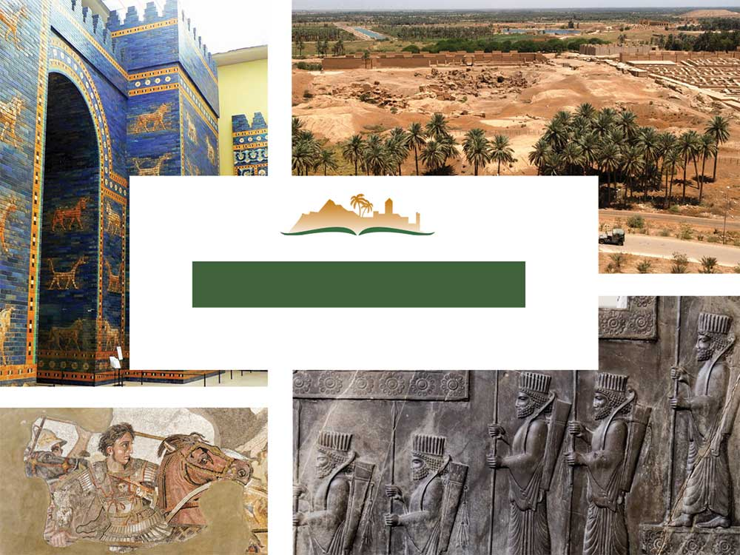
DANIEL 3
Notes:
This is a free sample of the Daniel 3 presentation from the Photo Companion to the Bible. To purchase the full volume, visit https://www.bibleplaces.com/daniel/
The Photo Companion to the Bible is an image-rich resource for Bible students, teachers, and researchers. Just as a librarian stocks the shelves with as many relevant materials as possible, so we have tried to provide a broad selection of images. Our goal is that you will find in this “library” whatever it is you are looking for.
Credits: The primary creators of this presentation are Steven D. Anderson, Kris Udd, and Todd Bolen. The photographs have an individual file code which usually includes the initials of the photographer. Other images have additional credit or source information.
Updates: We plan to update this collection as we are able. We welcome your suggestions for improving this resource (photocompanion@bibleplaces.com). Purchasers of the Daniel volume are provided free, lifetime updates to the volume.
Copyright: This photo collection is protected by copyright law and may not be distributed without written permission from BiblePlaces.com. Slide notes should be treated as any other copyrighted written material, with credit given when quoting from these notes.
For more information, see our complete “Introduction to the Photo Companion to the Bible” online at http://www.BiblePlaces.com/Intro-Photo-Companion-Bible/. Here you will find more information about photo selection, explanatory notes, Bible translation, credit information, and copyright allowances.

Slide 2
DANIEL 3
This is a free sample of the Daniel 3 presentation from the Photo Companion to the Bible. To purchase the full volume, visit https://www.bibleplaces.com/daniel/
The Photo Companion to the Bible is an image-rich resource for Bible students, teachers, and researchers. Just as a librarian stocks the shelves with as many relevant materials as possible, so we have tried to provide a broad selection of images. Our goal is that you will find in this “library” whatever it is you are looking for.
For more details (for this and every slide), see the Notes section below.
Notes:
This is a free sample of the Daniel 3 presentation from the Photo Companion to the Bible. To purchase the full volume, visit https://www.bibleplaces.com/daniel/
The Photo Companion to the Bible is an image-rich resource for Bible students, teachers, and researchers. Just as a librarian stocks the shelves with as many relevant materials as possible, so we have tried to provide a broad selection of images. Our goal is that you will find in this “library” whatever it is you are looking for.
Credits: The primary creators of this presentation are Steven D. Anderson, Kris Udd, and Todd Bolen. The photographs have an individual file code which usually includes the initials of the photographer. Other images have additional credit or source information.
Updates: We plan to update this collection as we are able. We welcome your suggestions for improving this resource (photocompanion@bibleplaces.com). Purchasers of the Daniel volume are provided free, lifetime updates to the volume.
Copyright: This photo collection is protected by copyright law and may not be distributed without written permission from BiblePlaces.com. Slide notes should be treated as any other copyrighted written material, with credit given when quoting from these notes.
For more information, see our complete “Introduction to the Photo Companion to the Bible” online at http://www.BiblePlaces.com/Intro-Photo-Companion-Bible/. Here you will find more information about photo selection, explanatory notes, Bible translation, credit information, and copyright allowances.

Slide 3
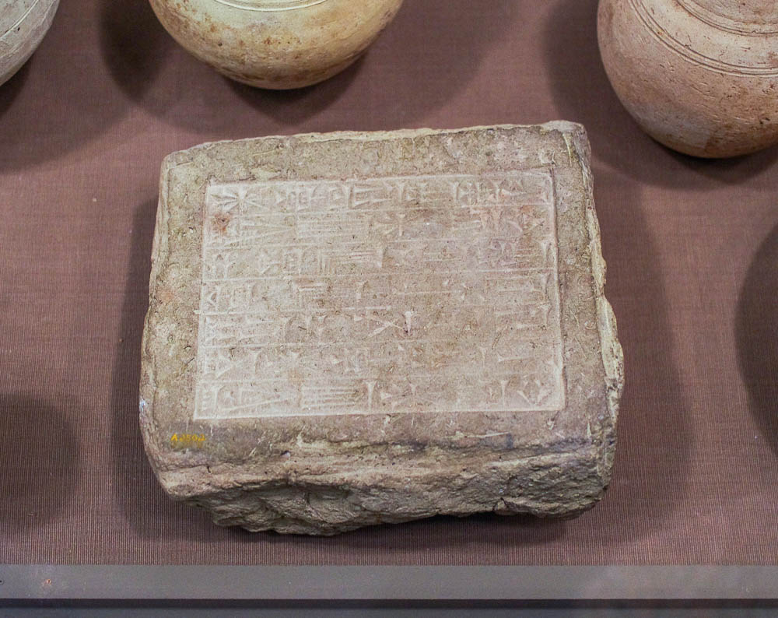
Nebuchadnezzar the king made a statue of gold
Stamped brick of Nebuchadnezzar son of Nabopolassar, from Babylon
3:1
Notes:
Nebuchadnezzar was one of the greatest kings of the ancient world. He was a great general and conqueror, a great builder, and one of history’s ablest administrators. This brick, on which his name is stamped, was photographed at the Oriental Institute Museum at the University of Chicago.
adr1605120040

Slide 4
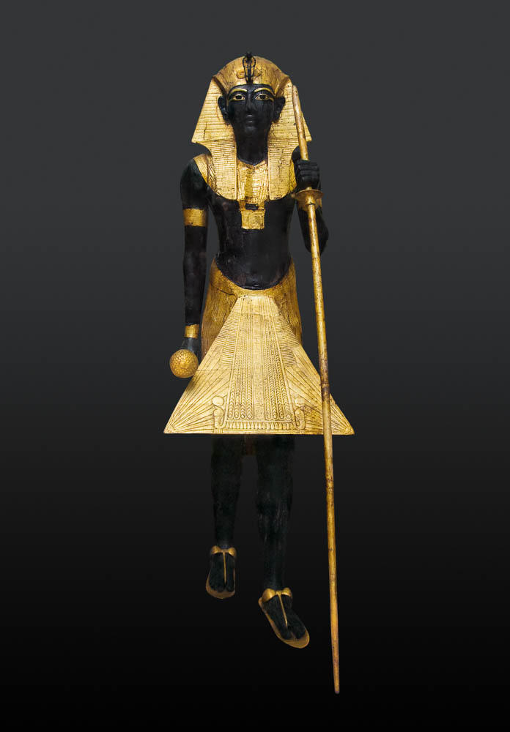
Nebuchadnezzar the king made a statue of gold
Tutankhamun’s ka statue, made of wood, gesso, and gold, from the Valley of the Kings
3:1
Notes:
A ka statue was intended to be the resting place of the soul (ka) after death. The statue described in Daniel 3 is usually assumed to have been human in form, an assumption which is probably correct. The text seems to imply that it was an image of Nebuchadnezzar’s god (3:12, 14, 18, 28). A “statue of gold” could mean “a gold-plated statue,” although the Greek historian Herodotus (5th century BC) was convinced it was solid gold: “In the Babylonian temple there is another shrine below, where there is a great golden image of Zeus, sitting at a great golden table, and the footstool and the chair are also gold; the gold of the whole was said by the Chaldeans to be eight hundred talents’ weight” (Herodotus, Herodotus, with an English Translation by A. D. Godley, ed. A. D. Godley [Medford, MA: Harvard University Press, 1920], 1.183.1). This statue was photographed at the Egyptian Museum in Cairo.
adr1603194466c

Slide 5
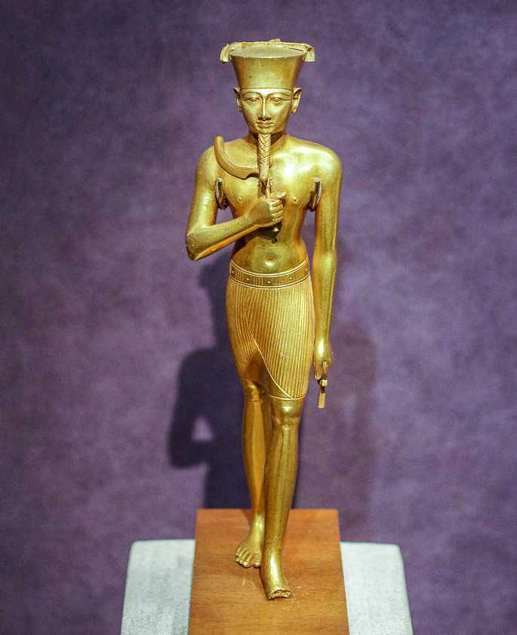
Nebuchadnezzar the king made a statue of gold
Gold statuette of the god Amun, possibly from Karnak, circa 800 BC
3:1
Notes:
This statuette is from the Egyptian 22nd Dynasty and was photographed at The Metropolitan Museum of Art.
adr1605244523

Slide 6
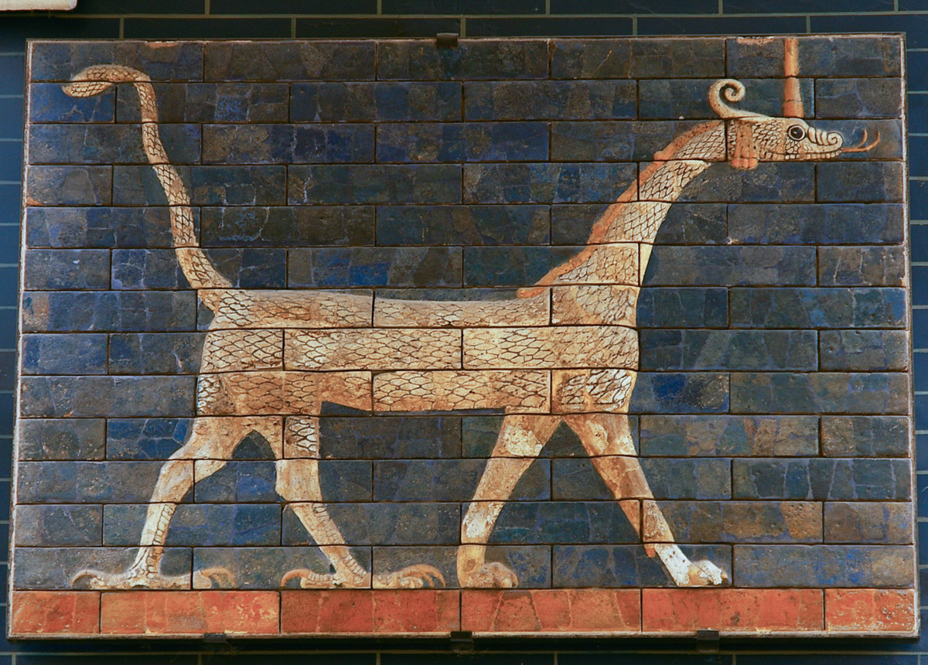
Nebuchadnezzar the king made a statue of gold
Glazed brick dragon, from the Ishtar Gate of Nebuchadnezzar at Babylon
3:1
Notes:
If Nebuchadnezzar’s statue was not human in form, it may have been shaped like a dragon. This was the typical form of Marduk, or Bel (= “Baal,” “lord”), the chief god of the Babylonian pantheon at the time of Nebuchadnezzar. This depiction of Marduk as a dragon was photographed at the Istanbul Museum of the Ancient Orient.
adr1006053705

Slide 7
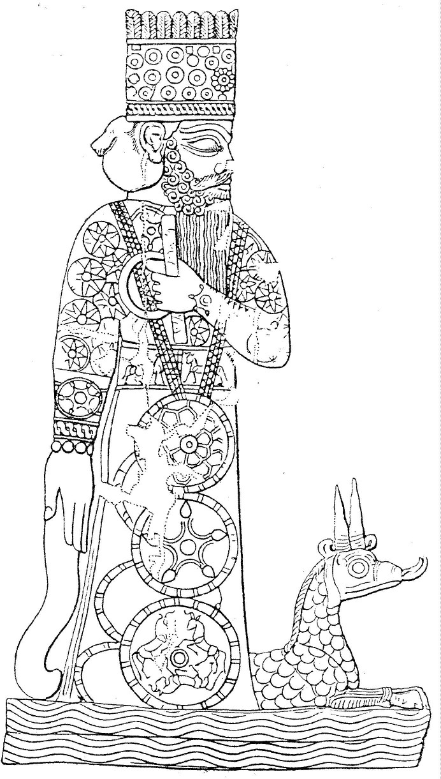
Nebuchadnezzar the king made a statue of gold
Drawing of Marduk and his dragon, from a Babylonian cylinder seal
3:1
Notes:
This drawing from a Babylonian cylinder seal shows Marduk and his dragon above water. This image comes from Wikimedia Commons and is in the public domain. Source: https://commons.wikimedia.org/wiki/File:Marduk_and_pet.jpg
wiki042420050001

Slide 8
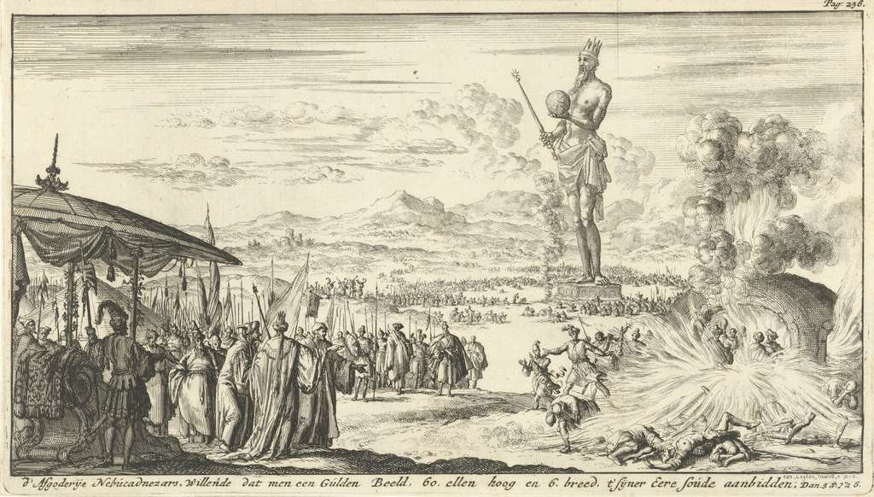
Nebuchadnezzar the king made a statue of gold
Three Young Men in the Burning Oven, by Jan Luyken, 1684
3:1
Notes:
This print is from an etching made by Jan Luyken in 1684. It is included to illustrate the way many Christians have imagined the scene in this chapter, although it is archaeologically inaccurate. This image comes from The Museum of the Netherlands in Amsterdam, RP-P-1896-A-19368-471, public domain. Source: http://hdl.handle.net/10934/RM0001.COLLECT.143036
ria143036

Slide 9
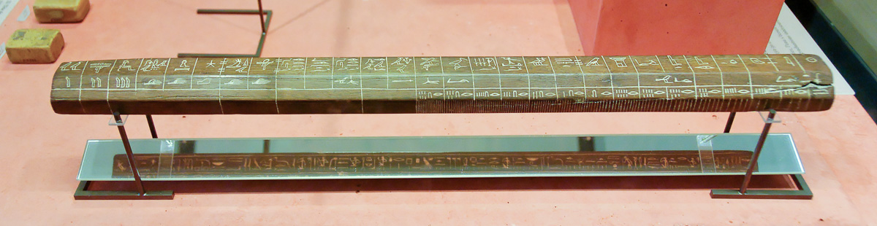
Its height was sixty cubits and its width six cubits
Cubit rod of an official of Tutankhamun, circa 1330 BC
3:1
Notes:
The Egyptian cubit rod pictured here is the “long cubit” of slightly over 20 inches (51 cm), not the “short cubit” of about 18 inches (46 cm). If the short cubit was used, Nebuchadnezzar’s statue would have been about 90 feet (27 m) tall by 9 feet (2.7 m) wide. Since only one dimension is given for the width, it may be assumed to have had a square or circular base. This cubit rod was photographed in the Louvre Museum.
tb060408901

Slide 10
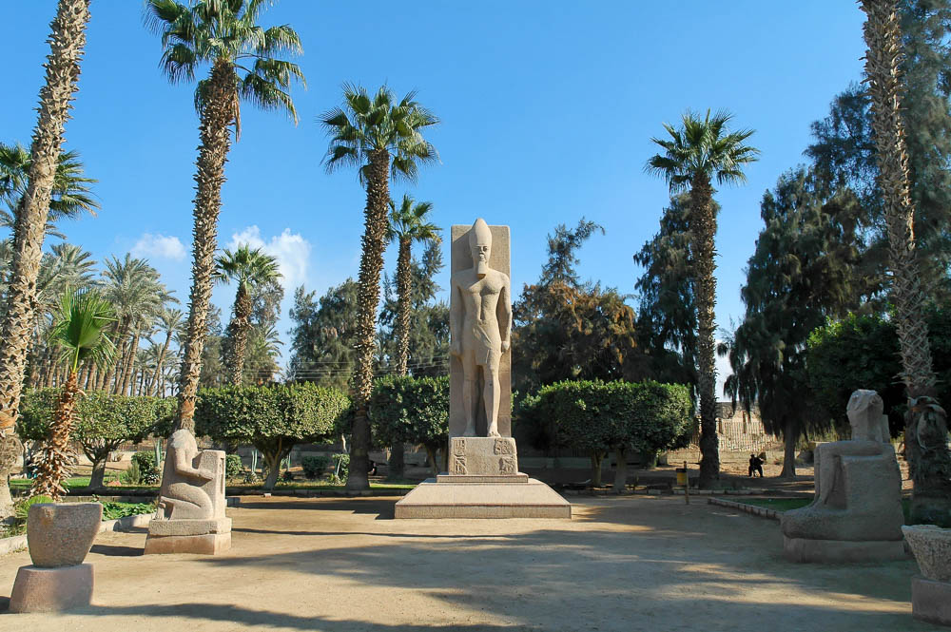
Its height was sixty cubits and its width six cubits
Statue of Ramesses II at Memphis, 13th century BC
3:1
Notes:
Note that this colossal granite statue was mounted on a base, as was typical in antiquity. The dimensions of the statue given in Daniel 3:1 are difficult to imagine for a statue alone, without a base, since its overall ratio of height to width is 60:6 (= 10:1), which is the common height-width ratio of Egyptian obelisks. For a normal human the height-width ratio would be about 3.5:1, so this statue may have had a significant base.
tb010705947

Slide 11
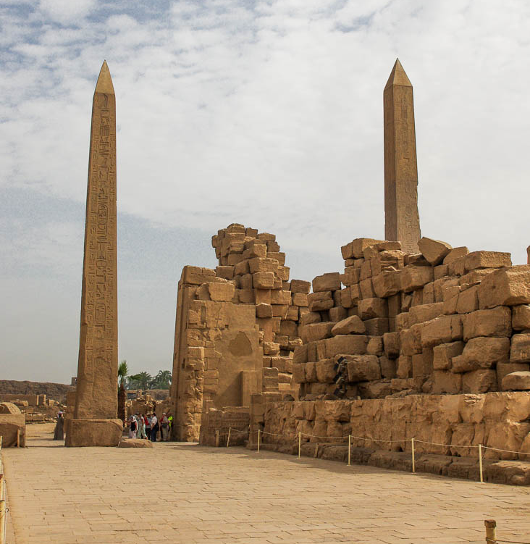
Its height was sixty cubits and its width six cubits
Obelisks of Hatshepsut and Thutmose I with the fourth pylon at the Karnak Temple
3:1
Notes:
These twin obelisks are very close to the dimensions given for Nebuchadnezzar’s statue. They stand 97 feet (30 meters) tall, and are built on a 10:1 height-width ratio. The people standing by the base of the obelisk give perspective for its size.
adr1603122186

Slide 12
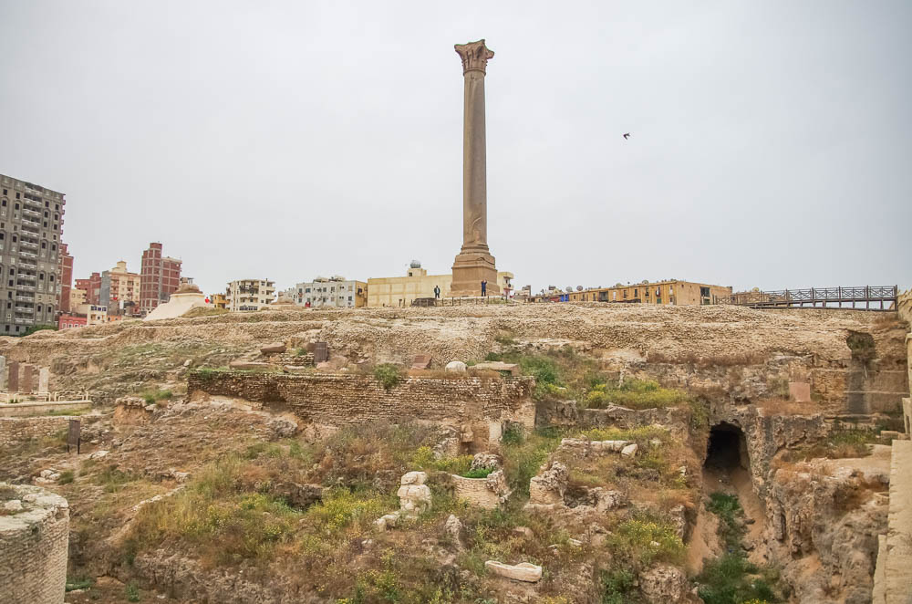
Its height was sixty cubits and its width six cubits
“Pompey’s Pillar” in Alexandria; the pillar is actually that of Publius, prefect under Diocletian
3:1
Notes:
Possibly Nebuchadnezzar constructed a large pillar or column and mounted a statue on top of it. Pompey’s Pillar is an 80 foot (24 m) tall red Aswan granite column with a diameter of about 9.5 feet (3 m). It was originally made in honor of Emperor Diocletian at the end of the third century AD. After Julius Caesar defeated Pompey in the Civil War, Pompey fled to Egypt and died in 48 BC. Accordingly, a legend arose claiming that Pompey was born there and that his head was in the capital on top of the pillar. However, this pillar was actually raised in AD 297 to commemorate the victory of Emperor Diocletian against a revolt in Alexandria. This pillar is the largest ancient monument in Alexandria.
adr1603267818

Slide 13
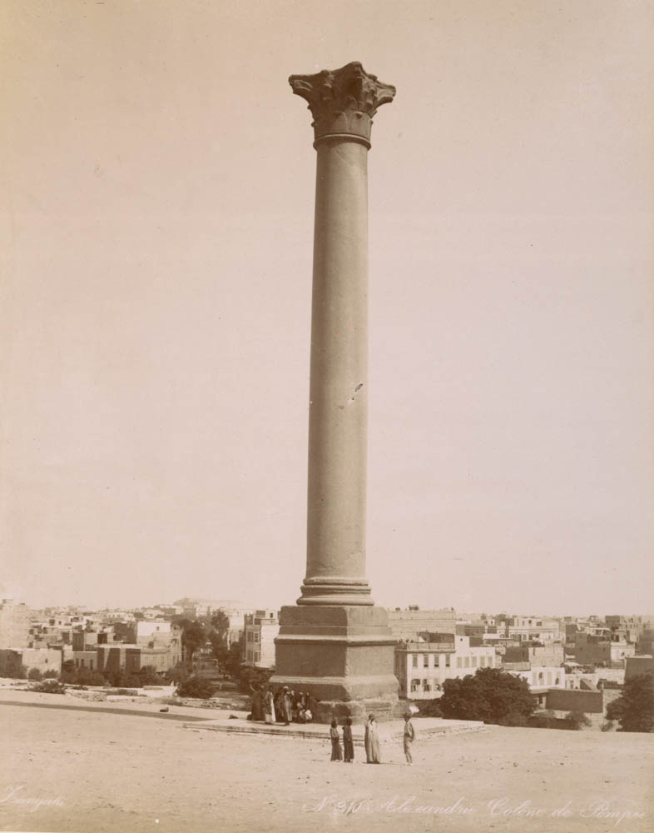
Its height was sixty cubits and its width six cubits
“Pompey’s Pillar” in Alexandria; the pillar is actually that of Publius, prefect under Diocletian
3:1
Notes:
This image comes from Zangaki, Palestine and Egypt, March 1894, published in 1894. Public domain, from The New York Public Library, https://digitalcollections.nypl.org/items/510d47d9-6511-a3d9-e040-e00a18064a99
nypl85380

Slide 14
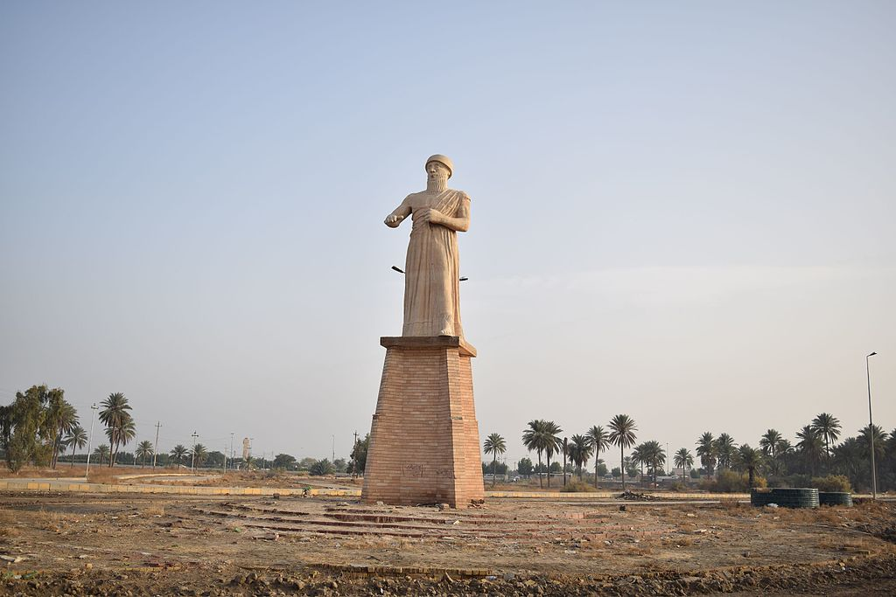
He set it up on the plain of Dura, in the province of Babylon
Statue of Hammurabi in Babil Province, Iraq
3:1
Notes:
The location of the plain of Dura is a subject of debate. Wiseman and Cook suggest based on the Akkadian word dūru (city wall) that the site was near the city wall of Babylon (Wiseman 1985: 111; Cook 1989: 115–16). This view would follow the LXX (OG), which does not have Dura as a place name, but relates the location to a fortification. However, Miller argues that “More likely is the site about sixteen miles [26 km] south of Babylon called Tulûl Dûra (tells of Dura), where Oppert thought he had discovered the base of the statue” (1994: 111). This image comes from Hamody al-Iraqi and is licensed under CC-BY-SA-4.0, via Wikimedia Commons, https://commons.wikimedia.org/wiki/File:Statue_of_Hammurabi_3.jpg
References:
Cook, Edward M.
1989 ‘In the Plain of the Wall’ (Dan 3:1). Journal of Biblical Literature 108: 115–16.
Miller, Stephen R.
1994 Daniel. The New American Commentary. Nashville: Broadman & Holman Publishers.
Wiseman, D. J.
1985 Nebuchadrezzar and Babylon. London: Oxford University Press.
wiki010320171700

Slide 15
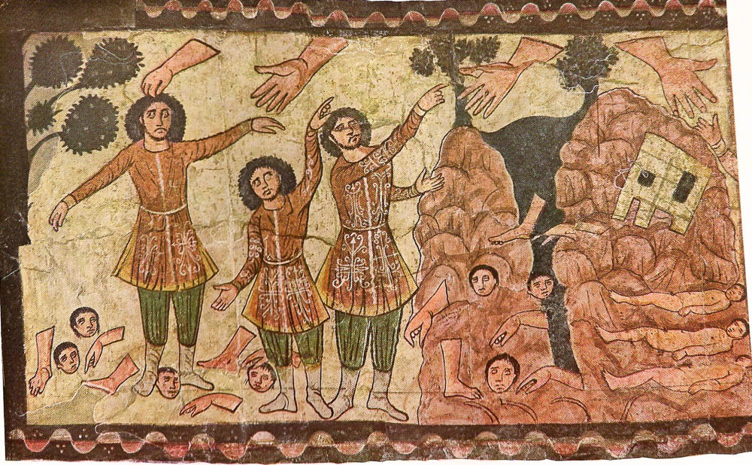
He set it up on the plain of Dura, in the province of Babylon
Ezekiel’s Valley of Dry Bones, depicted on wall painting in Dura-Europos synagogue
3:1
Notes:
The Dura-Europos synagogue (3rd century AD) is an extremely well-preserved building with a number of very interesting wall frescoes that depict biblical scenes. Some have suggested that the Jewish inhabitants of Dura-Europos connected their settlement with the Dura in Daniel 3:1. While an actual connection between Dura in Daniel 3:1 and Dura-Europos is unlikely, it is interesting that the scenes from the synagogue included biblical stories from the exile such as elements from the book of Esther and the vision of the Valley of Dry Bones from Ezekiel 37, shown here. This image comes from Dura Europos and is in the public domain, via Wikimedia Commons: https://commons.wikimedia.org/wiki/File:Ezekiel_1.jpeg.
wiki04112013201120

Slide 16
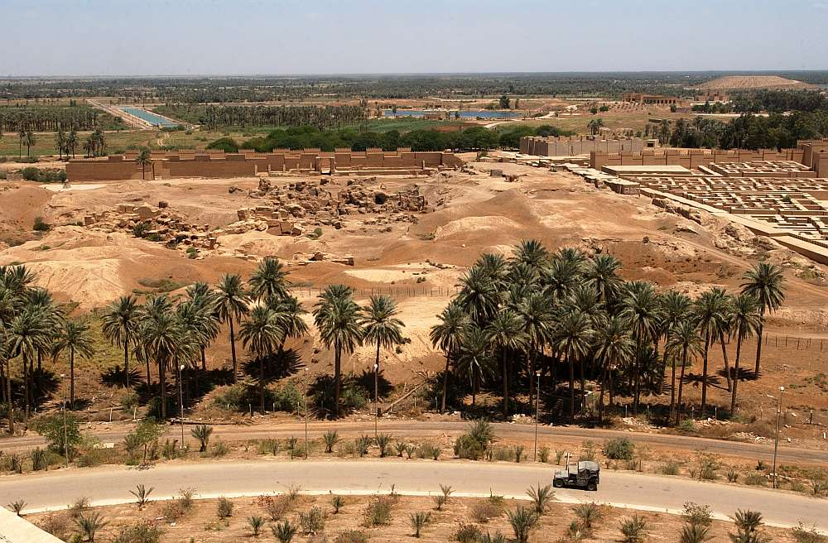
He set it up on the plain of Dura, in the province of Babylon
Ruins of ancient Babylon, from Saddam Hussein’s former summer palace
3:1
Notes:
It can be seen from this photograph that Babylon was built on a broad, flat plain. The partially reconstructed palace of Nebuchadnezzar is visible on the far right of the photo. This photo was taken by a member of the United States Armed Forces in 2003 and is in the public domain. U.S. Navy photo by Photographer's Mate 1st Class Arlo K. Abrahamson. Source: http://www.navy.mil/view_image.asp?id=7742. “The appearance of U.S. Department of Defense (DoD) visual information does not imply or constitute DoD endorsement.”
navy7742

Slide 17
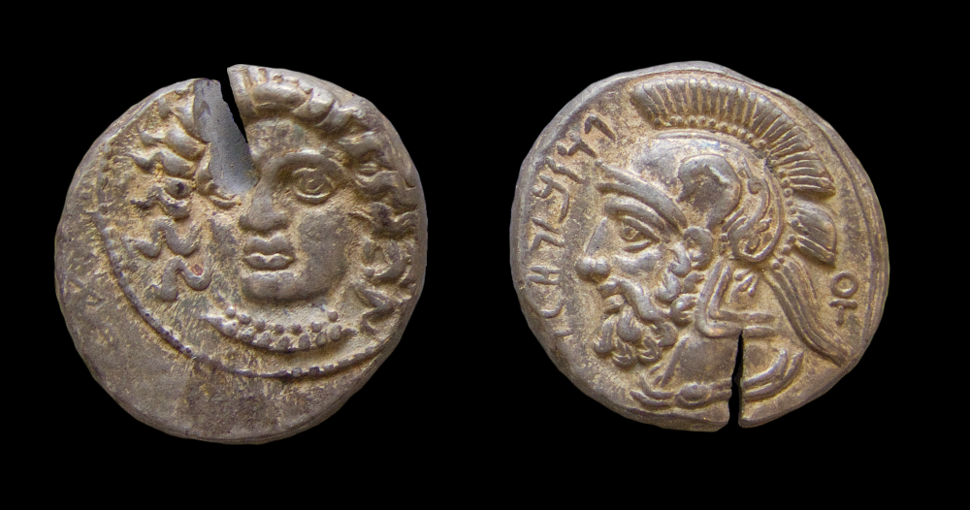
Then Nebuchadnezzar the king sent an order to gather together the satraps
Silver stater of satraps Pharnabazus and Datames, from Tarsus, 379–372 BC
3:2
Notes:
The seven classes of officials identified in this verse are evidently listed in order of rank. The first group of officials ruled over the largest administrative divisions (provinces) in the Babylonian Empire. We have illustrated many of these classes of officials with their Persian equivalents, due to a lack of extant depictions of Neo-Babylonian officials. The female head on the left (obverse) side may be Arethusa or Aphrodite, wearing a sphendone and a necklace. The bearded male head with a crested Athenian helmet and Aramaic inscription on the right (reverse) side is probably Ares, the Greek god of war, although some suggest it depicts the satrap Pharnabazus or his fellow satrap Datames. The inscription reads “Pharnabazus Cilicia” (פרנבזו חלך). A monogram is inscribed on the lower right. Encyclopaedia Iranica gives more information: “A number of Cilician and other silver coins (mostly from Tarsus) bearing the names Pharnabazus and Datames (in Aramaic or Greek forms) and apparent likenesses survive; they were minted for payment of mercenaries and crews (cf. Sekunda, pp. 41–42; Alram, pp. 109–10; Moysey, with further references)” (http://www.iranicaonline.org/articles/datames). This image comes from the Yale University Art Gallery and is in the public domain. Source: https://artgallery.yale.edu/collections/objects/140978
yale140978b

Slide 18
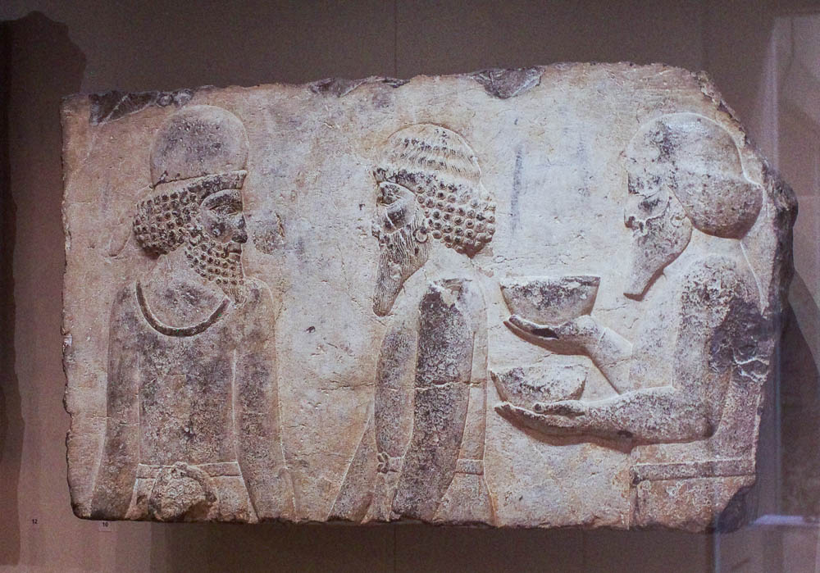
Then Nebuchadnezzar the king sent an order to gather together . . . the deputies
Relief of a Median courtier with tribute bearers, from Persepolis, reign of Darius I, 518–486 BC
3:2
Notes:
The second group of officials in the list are ones who were subordinate to the satraps. This term is often translated “prefects.” This relief of a Median court official with tribute bearers was photographed at the Boston Museum of Fine Arts.
adr1711201851

Slide 19
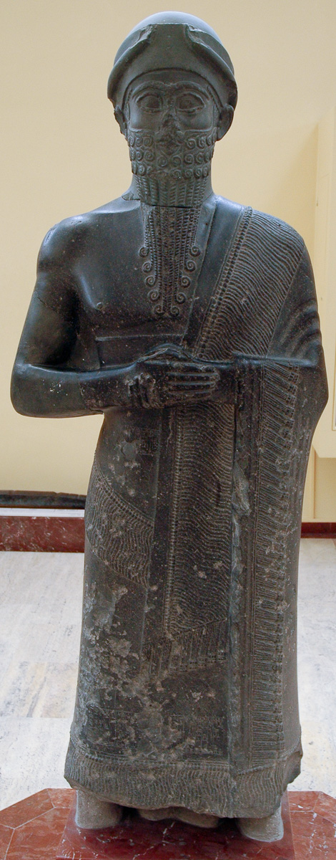
Then Nebuchadnezzar the king sent an order to gather together . . . the governors
Statue of the governor Puzur-Ishtar, from Mari, Old Babylonian period, early 2nd millennium BC
3:2
Notes:
This diorite statue was photographed at the Istanbul Museum of the Ancient Orient.
tb041705529

Slide 20
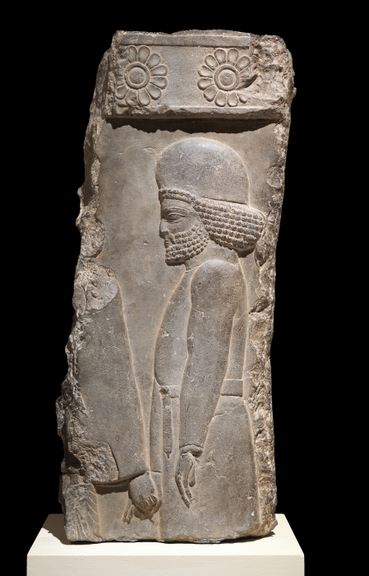
Then Nebuchadnezzar the king sent an order to gather together . . . the advisors
Relief with a Median palace servant, from Persepolis, circa 405–359 BC
3:2
Notes:
The fourth group of officials consisted of advisors. This term is also translated “counselors” or “judges.” This image comes from The Metropolitan Museum of Art, public domain, Fletcher Fund, 1939, accession number 39.133, https://metmuseum.org/art/collection/search/323723
met323723b

Slide 21
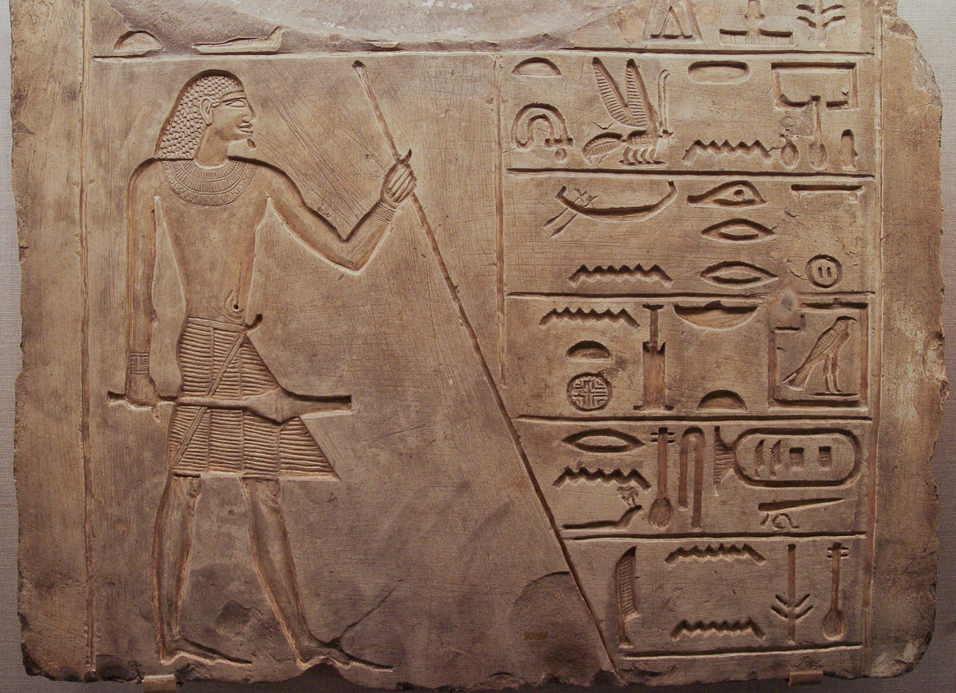
Then Nebuchadnezzar the king sent an order to gather together . . . the treasurers
Tomb relief of a treasurer and priest, from Dendera in Egypt, circa 2200 BC
3:2
Notes:
The fifth group of officials were the treasurers—the men who managed the empire’s finances. This scene of an Egyptian treasurer is from the 7th to 8th Dynasty, late in the Old Kingdom. It was photographed at the Oriental Institute Museum at the University of Chicago.
adr1309252215

Slide 22
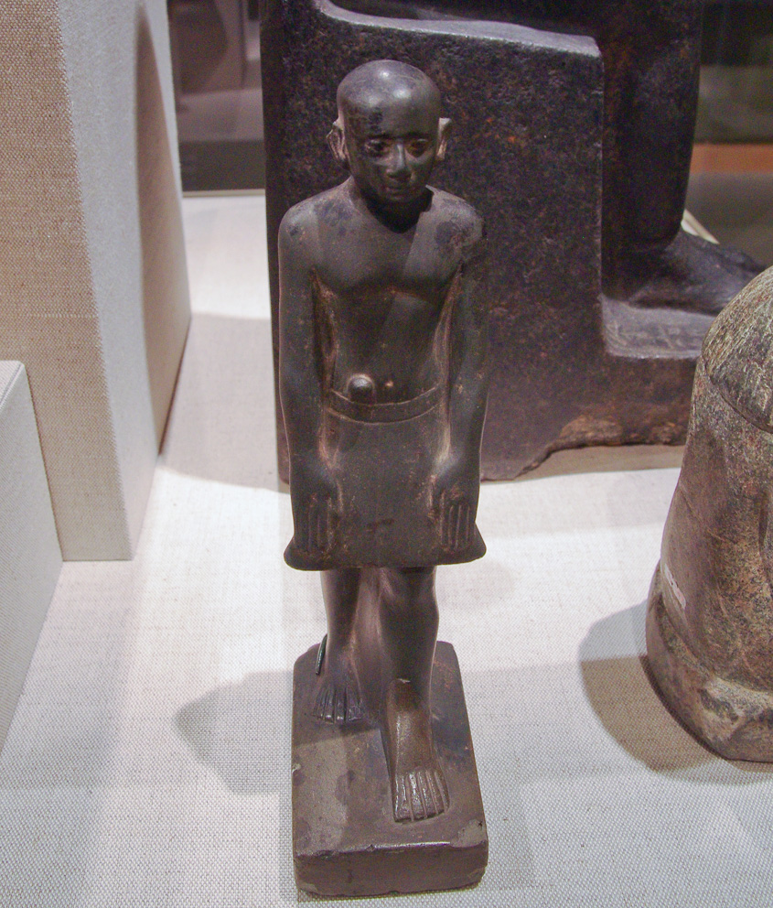
Then Nebuchadnezzar the king sent an order to gather together . . . the judges
Egyptian statuette of a senior judge of Hierakonpolis, Middle Kingdom, circa 1700 BC
3:2
Notes:
The sixth group of officials were judges. Some translations render this term as “counselors,” and have “judges” for the fourth group. This greywacke statue of an Egyptian judge is from the 13th Dynasty and was photographed at the Walters Art Museum.
adr1311203332

Slide 23
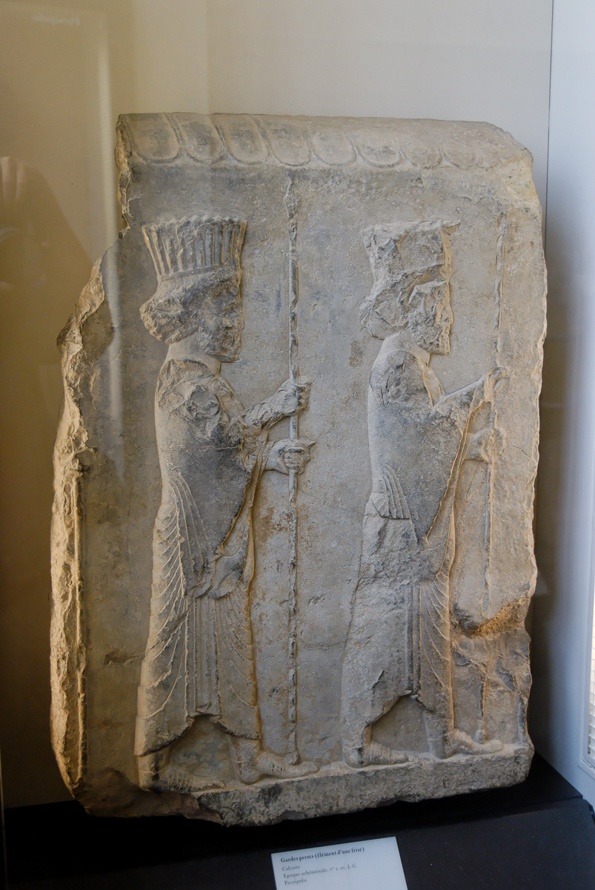
Then Nebuchadnezzar the king sent an order to gather together . . . the magistrates
Frieze with Persian guards, from Persepolis, 5th century BC
3:2
Notes:
The seventh group consisted of law enforcement officials—police magistrates or sheriffs. This depiction of Persian guards was photographed at the Louvre Museum.
tb060408690

Slide 24
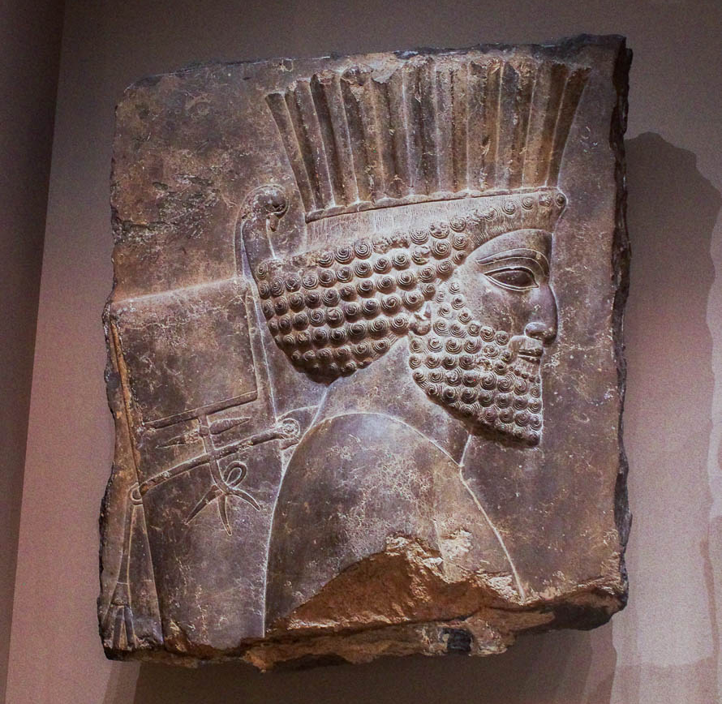
Then Nebuchadnezzar the king sent an order to gather together . . . the magistrates
Relief of a Persian guard, from the Palace of Xerxes at Persepolis, 485–464 BC
3:2
Notes:
Notice the closed quiver carried by this guard on his back, and the helmet/headdress. This image of a Persian guard was photographed at the Boston Museum of Fine Arts.
adr1711201840

Slide 25
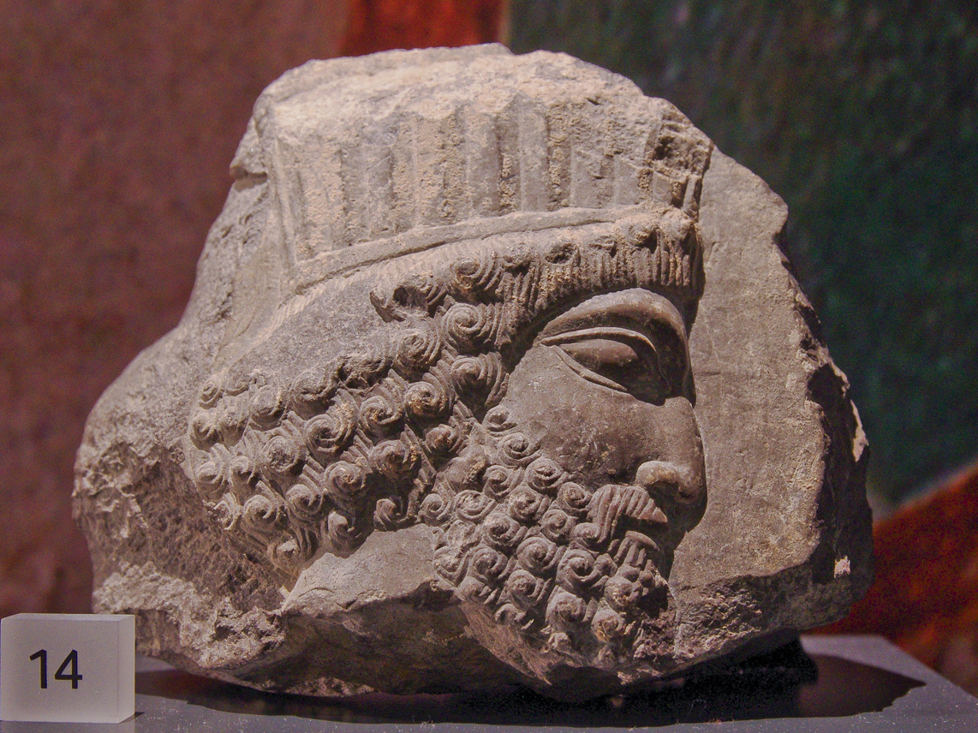
Then Nebuchadnezzar the king sent an order to gather together . . . all the rulers of the provinces
Relief of a Persian guard or official, from Persepolis, 500–450 BC
3:2
Notes:
“All the rulers of the provinces” is evidently a summary term for the seven groups of officials in the list. It indicates that the order was all-inclusive. This limestone relief of a Persian official was photographed at the Ashmolean Museum at the University of Oxford.
adr1305240899

Slide 26
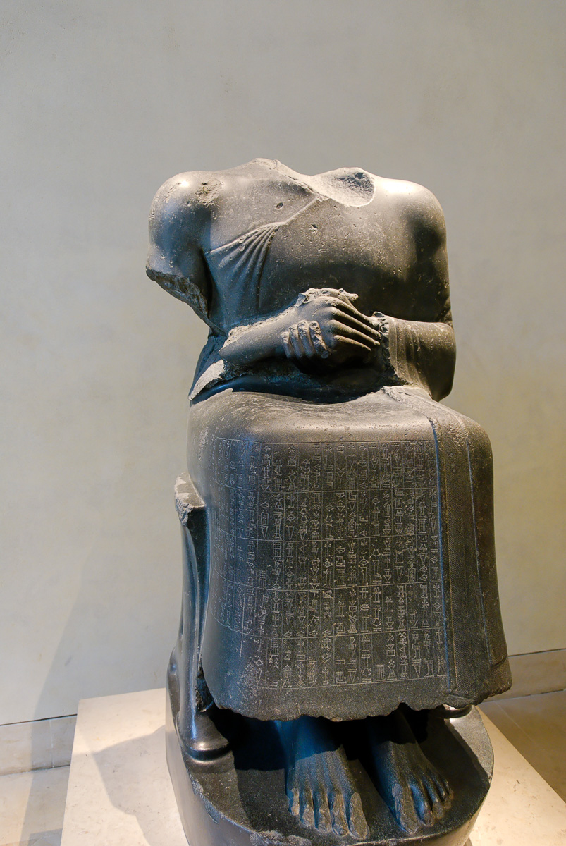
Then Nebuchadnezzar the king sent an order . . . to come to the dedication of the statue
Statue of Gudea, dedicated to Ningirsu, 2120 BC
3:2
Notes:
This Mesopotamian statue was dedicated by the king Gudea to the god Ningirsu, just as Nebuchadnezzar desired to dedicate his statue to his gods. It was photographed in the Louvre Museum.
tb060408493

Slide 27
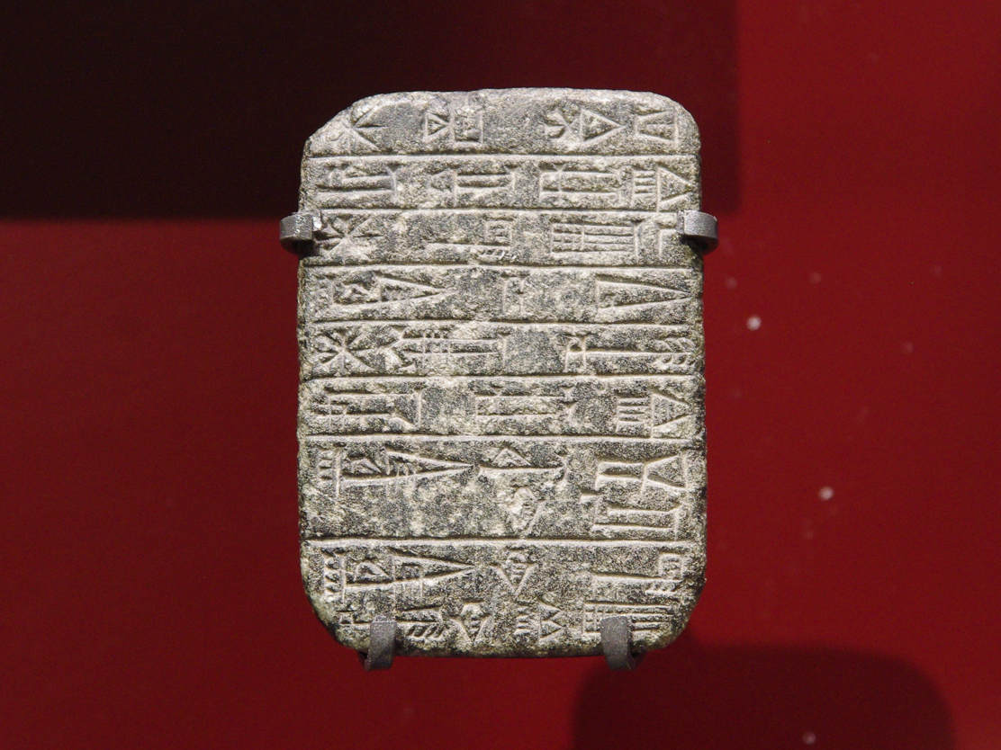
Then Nebuchadnezzar the king sent an order . . . to come to the dedication of the statue
Tablet of Shulgi with a dedication of the Baga temple, from Lagash, circa 21st century BC
3:2
Notes:
Mesopotamia had a long history of formal dedications of temples and statues. This dedicatory steatite plaque was photographed at the Ashmolean Museum at the University of Oxford.
adr1305226969

Slide 28
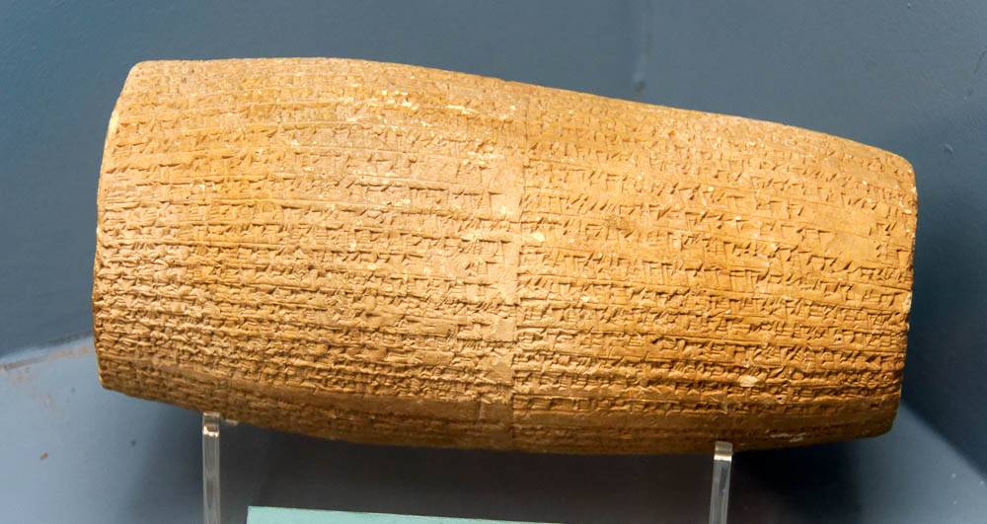
Then Nebuchadnezzar the king sent an order . . . to come to the dedication of the statue
Cylinder of Nabonidus with a dedicatory inscription, from Babylon, 555–539 BC
3:2
Notes:
In the Neo-Babylonian period, dedicatory inscriptions were often written on baked clay cylinders. This cylinder is on display in the Istanbul Museum of the Ancient Orient.
tb122916375

Slide 29
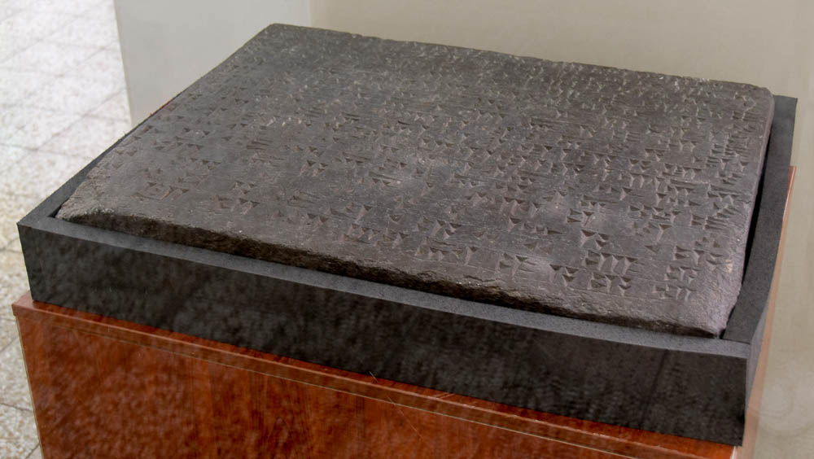
Then Nebuchadnezzar the king sent an order . . . to come to the dedication of the statue
Temple dedicatory inscription with curse for destroying, from Bastam in Iran, 9th century BC
3:2
Notes:
This cuneiform inscription on a slab was photographed at the National Museum of Iran. This is earlier than the time of Nebuchadnezzar but provides another example of a dedicatory inscription.
tb0514183895

Slide 30
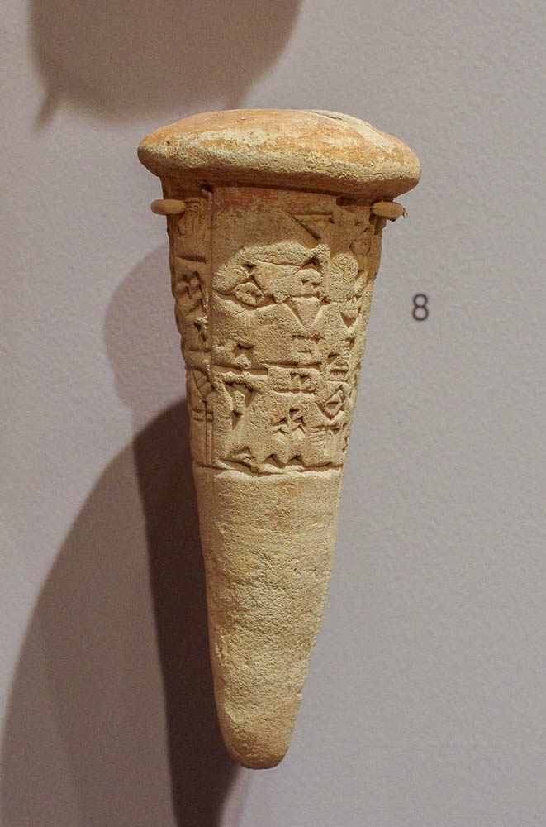
Then Nebuchadnezzar the king sent an order . . . to come to the dedication of the statue
Cuneiform dedication cone of Gudea, from Mesopotamia, circa 21st century BC
3:2
Notes:
This dedication cone dates to the Lagash period and was photographed at the Harvard Semitic Museum.
adr1711181297

Slide 31
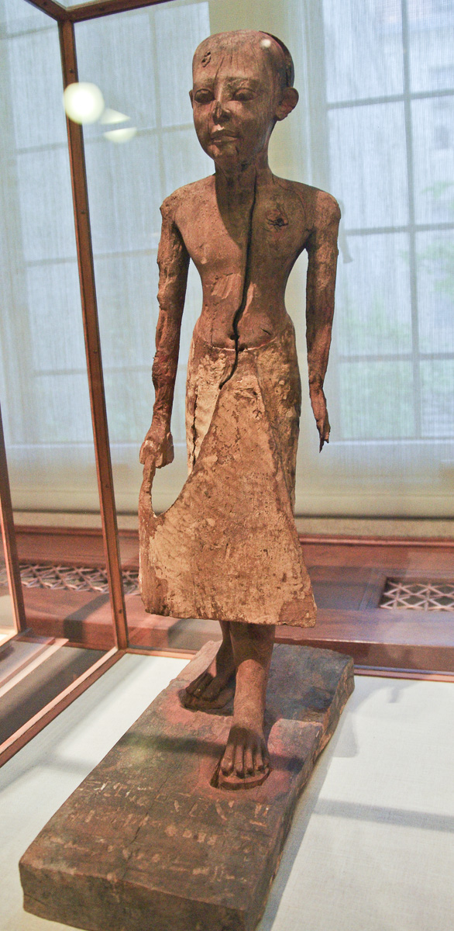
Then the herald proclaimed aloud
Wood statue of the royal herald Neni, from Sedment el-Gebel, Old Kingdom, circa 2250 BC
3:4
Notes:
This statue of a royal herald from ancient Egypt, Dynasty 6, was photographed at the Oriental Institute Museum at the University of Chicago.
adr1206169205

Slide 32
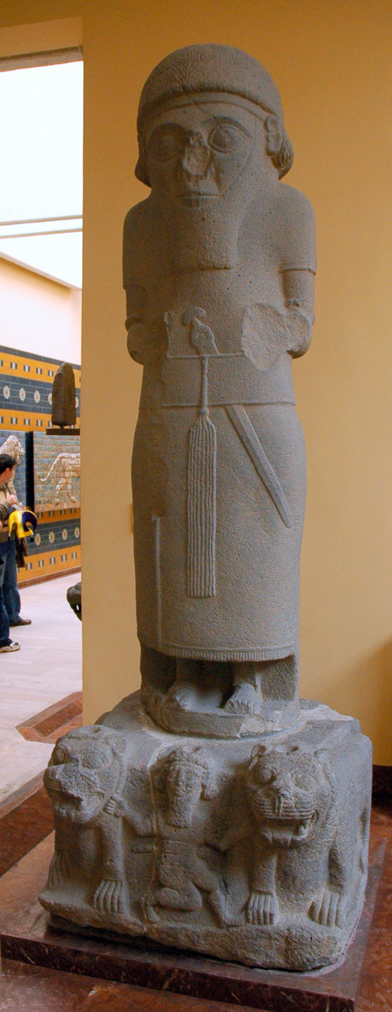
To you it is commanded, O peoples, nations, and languages
Statue of a Hittite ruler, from Building J in Zincirli, 9th century BC
3:4
Notes:
This and the following slides illustrate some of the variety of nations and languages that would have been included in Nebuchadnezzar’s empire, and thus addressed in this verse. The site where this statue of a non-Babylonian, Hittite ruler came from was incorporated into the Assyrian Empire in the seventh century BC. Note the portion of a wall from Babylon in the background of this photograph. This basalt statue was photographed at the Istanbul Museum of the Ancient Orient.
tb041705686

Slide 33
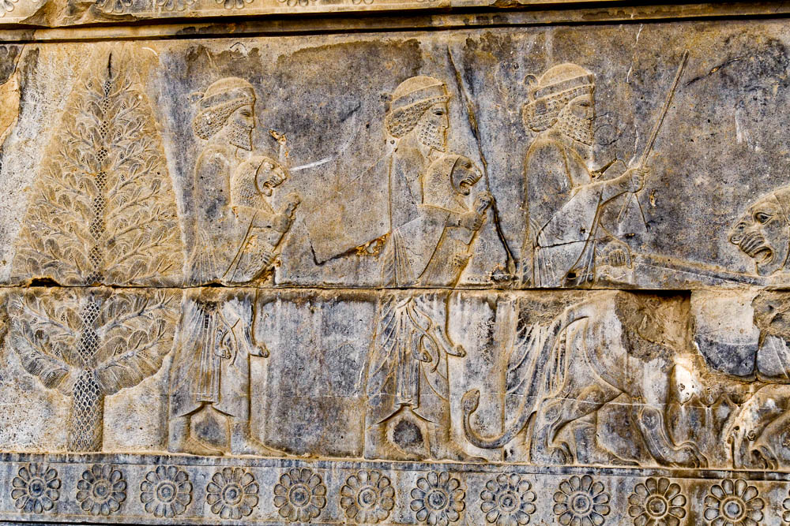
To you it is commanded, O peoples, nations, and languages
Elamite delegation depicted on Persepolis apadana east stairs
3:4
Notes:
The kings of Elam are mentioned in Jeremiah 25:25 as among the peoples who served Nebuchadnezzar (cf. Jer 49:34-39). The Babylonian Chronicle Series (apparently) records a campaign of Nebuchadnezzar against Elam in his ninth regnal year (spring 595–spring 594 BC). The photograph shown here depicts Elamites who served the Persian Empire about a century after the time of Daniel 3.
tb0506180952

Slide 34
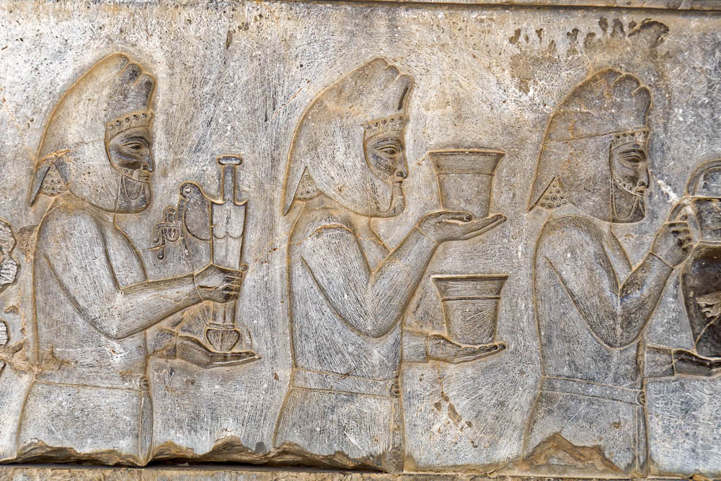
To you it is commanded, O peoples, nations, and languages
Median delegation depicted on Persepolis apadana east stairs
3:4
Notes:
The kings of the Medes are noted in Jeremiah 25:25 as among the peoples who served Nebuchadnezzar. The Medes were allies of the Babylonians against Assyria, though they later concluded an anti-Babylonian alliance with the Persians. The delegation here is shown wearing turbans and carrying a sword, bowls, and a pitcher.
tb0506180963

Slide 35
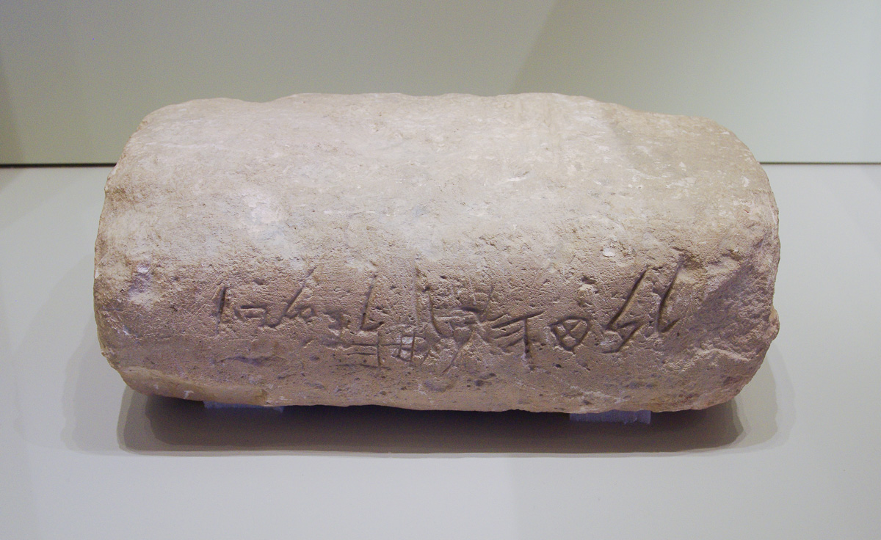
To you it is commanded, O peoples, nations, and languages
Limestone block with a Hebrew inscription, from Jerusalem, late 7th or early 6th century BC
3:4
Notes:
Shadrach, Meshach, and Abednego were from the nation of Judah, and spoke the Hebrew language. This Hebrew inscription was photographed at the Israel Museum.
adr1306213259

Slide 36
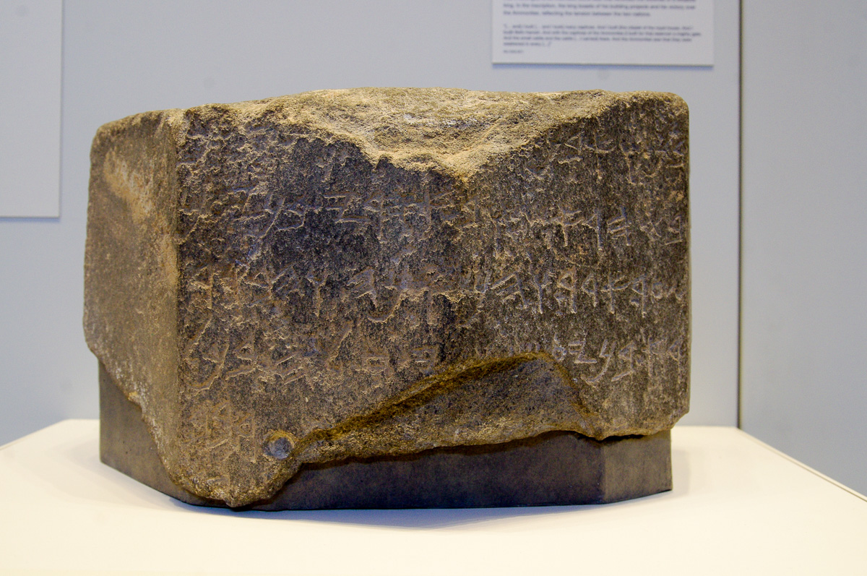
To you it is commanded, O peoples, nations, and languages
Moabite royal inscription, from Moab, mid-8th century BC
3:4
Notes:
This basalt inscription is Moabite, although it uses the same alphabet as ancient Hebrew. Nebuchadnezzar likely had taken captives and a pledge of submission from Moab as well as from Judah (cf. Jer 27:3). This inscription is on display in the Israel Museum.
adr1305113269

Slide 37
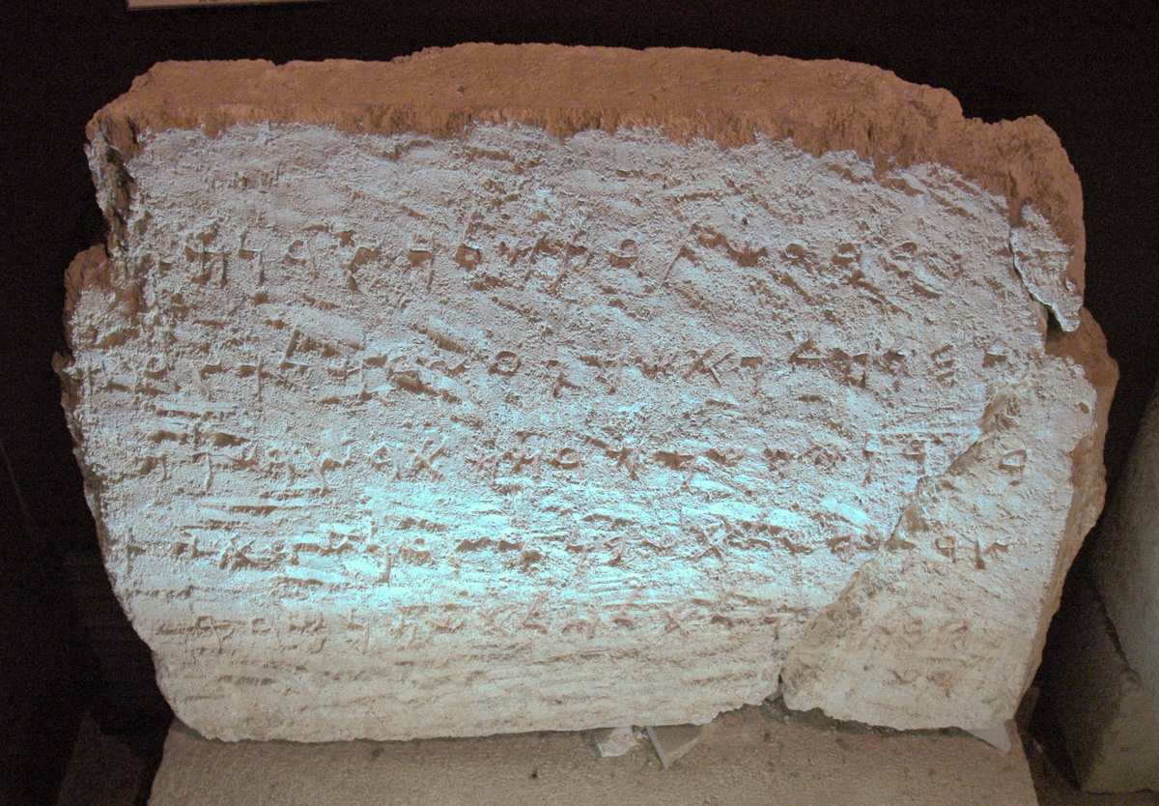
To you it is commanded, O peoples, nations, and languages
Phoenician inscription from the Eshmun Temple at Sidon, 6th century BC
3:4
Notes:
This inscription is attributed to Bodastarte, the son of Eshmunazar, the king of Sidon. The major Phoenician city of Sidon was subjugated by Nebuchadnezzar (cf. Jer 27:3). This inscription dates to the second half of the 6th century BC, about the time of Daniel 3. It was photographed at the Istanbul Archaeological Museum.
tb041705838

Slide 38
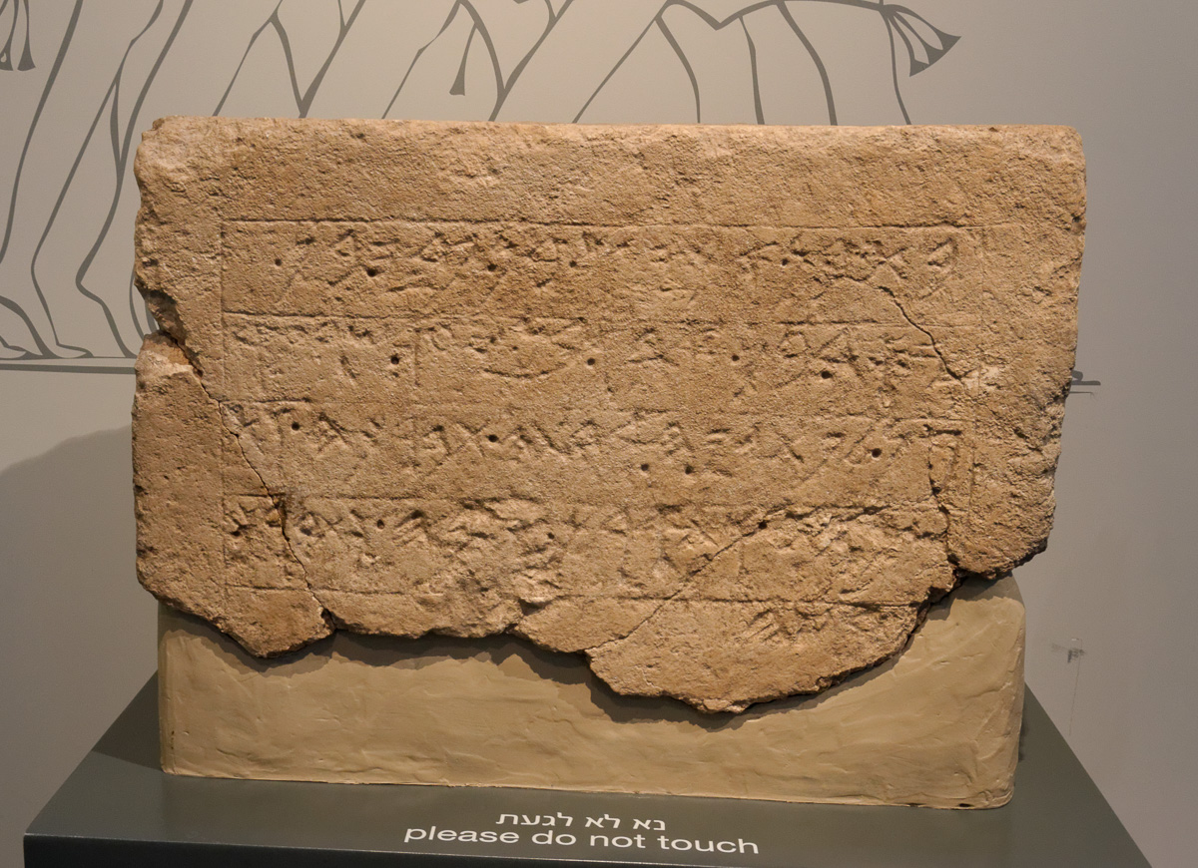
To you it is commanded, O peoples, nations, and languages
Philistine inscription from the temple at Ekron, 7th century BC
3:4
Notes:
There may well have been some Philistines in Nebuchadnezzar’s cosmopolitan government (cf. Jer 25:20). This inscription from the Philistine city of Ekron was photographed at the Israel Museum.
tb032014209

Slide 39
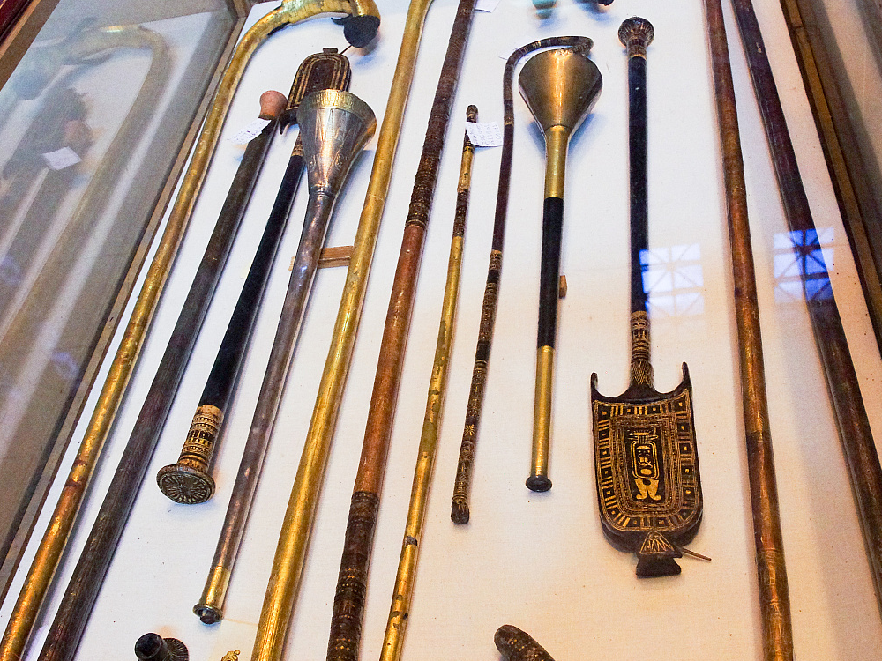
When you hear the sound of the trumpet
Silver and bronze horns of Tutankhamun, from the Valley of the Kings
3:5
Notes:
An alternate translation of the Aramaic word qeren (קֶרֶן) is “horn,” as this word is also used of animal horns; however, as a musical term, it is equivalent to the Hebrew shophar (שׁוֹפָר), which is typically translated “trumpet.” In modern musical terminology, these instruments were like bugles. They could be made of animal horns, but King Nebuchadnezzar’s royal orchestra must have had silver or bronze trumpets, such as the ones shown here from the tomb of Tutankhamun. These ancient silver and bronze (or copper) trumpets were photographed at the Egyptian Museum in Cairo. These are the oldest playable trumpets in the world. See the next slide for another view of the silver trumpet.
For a recording of these trumpets, which are played like bugles, see https://www.youtube.com/watch?v=Qt9AyV3hnlc, and for further background information see http://www.bbc.co.uk/programmes/b010dp0s.
adr1603111806

Slide 40
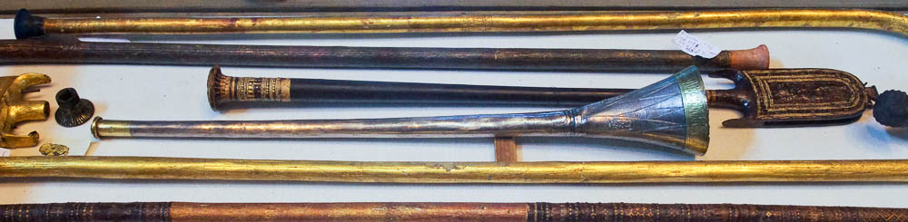
When you hear the sound of the trumpet
Silver trumpet of Tutankhamun, from the Valley of the Kings, 14th century BC
3:5
Notes:
This ancient silver trumpet was photographed at the Egyptian Museum in Cairo. For a recording of these trumpets, which are played like bugles, see https://www.youtube.com/watch?v=Qt9AyV3hnlc, and for further background information see http://www.bbc.co.uk/programmes/b010dp0s.
adr1603111812

Slide 41
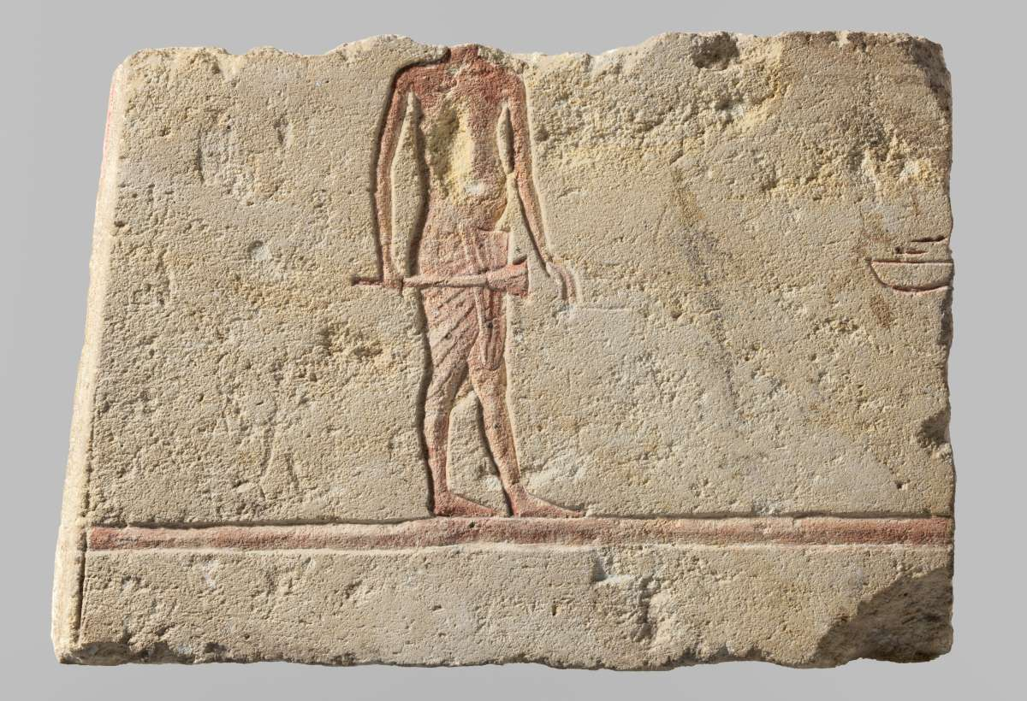
When you hear the sound of the trumpet
Relief of a man with a trumpet, possibly from Amarna, reign of Akhenaten, circa 1350 BC
3:5
Notes:
The Egyptians were well acquainted with trumpets, as depicted on this carving from the time of Akhenaten. Akhenaten was the 18th dynasty “heretic king” who banned the worship of all gods other than the sun god Aten. This image comes from The Metropolitan Museum of Art, public domain, Purchase, Lila Acheson Wallace Gift and Louis V. Bell Fund, 1991, accession number 1991.240.14, http://metmuseum.org/art/collection/search/545020
met545020

Slide 42
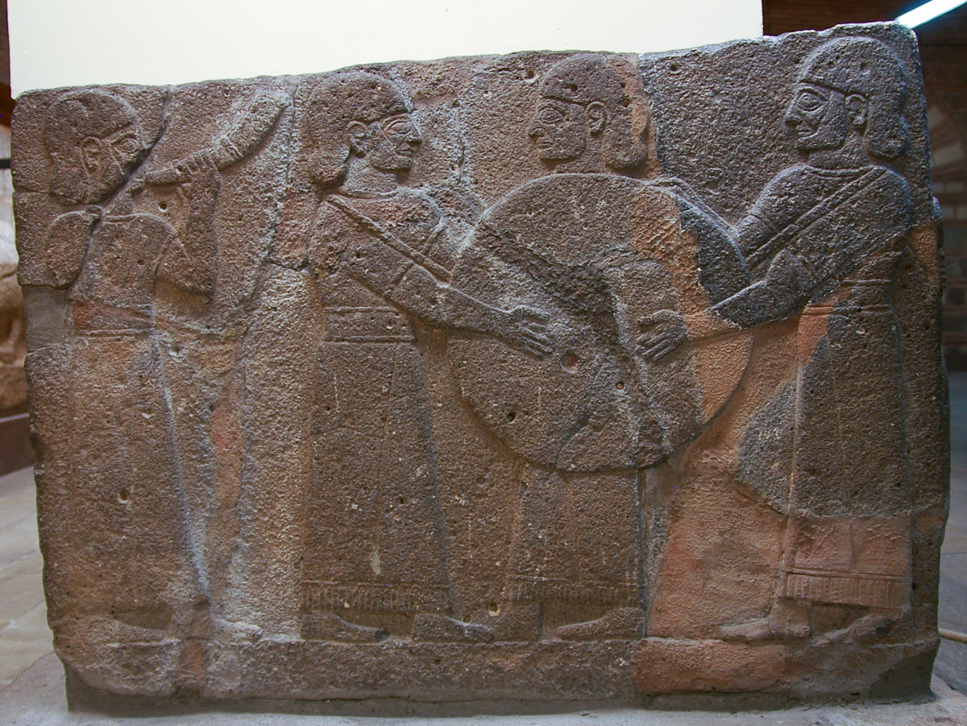
When you hear the sound of the trumpet
Relief of Hittite musicians, from the King’s Gate at Carchemish
3:5
Notes:
Note the horn player on the left. This Hittite basalt relief carving is thought to date to the reign of King Katuwas, in the late 10th or early 9th century BC. It was photographed at the Ankara Museum of Anatolian Civilizations.
adr1006031764

Slide 43
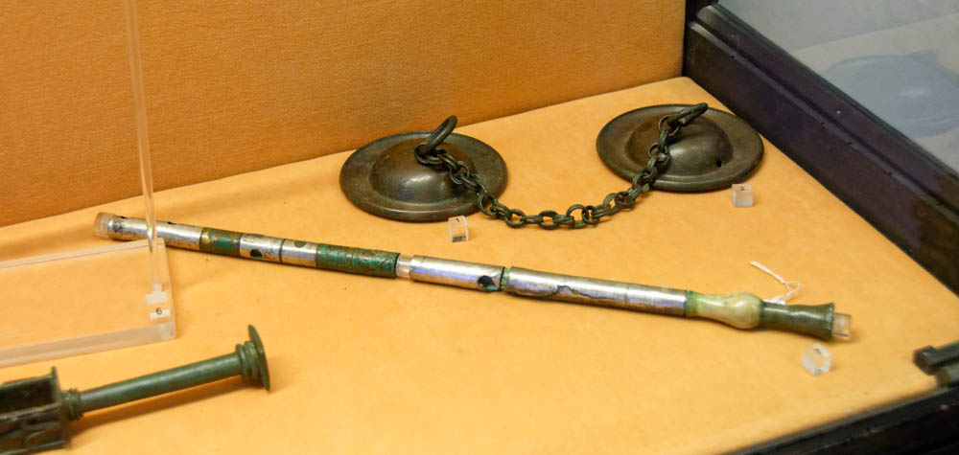
When you hear the sound of the . . . pipe
Bronze and silver flute
3:5
Notes:
“Flute” is an alternate translation of the Aramaic term mashroqi (מַשְׁרוֹקִי), which comes from a root meaning “to whistle”; the English terms “pipe” and “flute” are both used to refer to the same type of ancient musical instrument. This instrument could be made of various materials, but for Nebuchadnezzar’s orchestra was likely metal. It was essentially a long, narrow tube with holes and some sort of mouthpiece, producing high-pitched notes. This ancient flute was photographed at the Naples Archaeological Museum.
tb0515170551

Slide 44
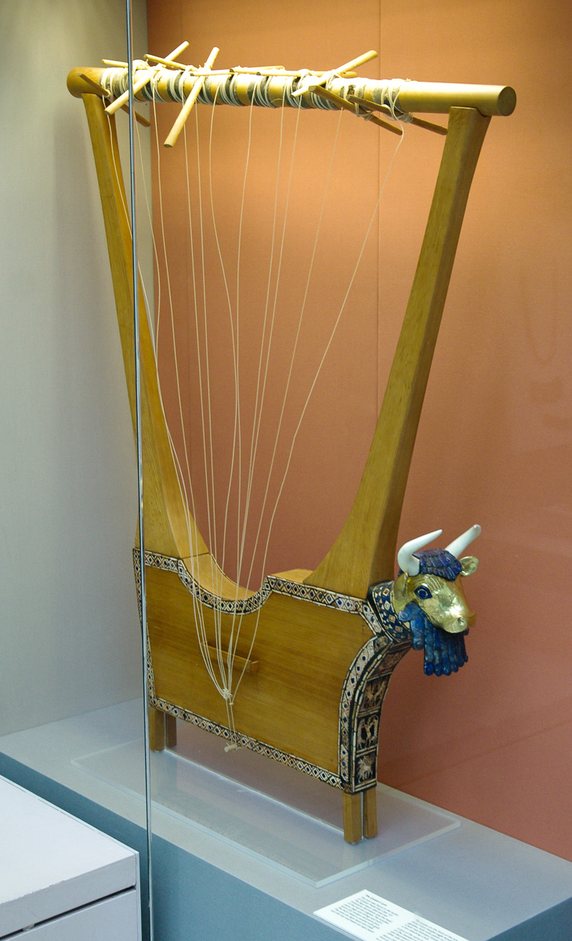
When you hear the sound of the . . . lyre
Lyre from the tomb of Queen Puabi in Ur, circa 2500 BC
3:5
Notes:
The Aramaic term qitharos (קִיתָרֹס) is given many different translations: “zither,” “psaltery,” “kithara,” “lyre,” and “harp.” Everyone agrees that this was a plucked string instrument, but there is disagreement as to its exact form. Since this term is a Greek loanword (from kithara [κιθάρα]), it would appear to be something similar to a Greek kithara, i.e., a lyre. (The English word “zither” comes from the Latin “cithara,” which comes from the Greek kithara, but the modern zither is different than the ancient Greek kithara.) The exquisite lyre shown here, decorated with gold and lapis lazuli, comes from Mesopotamia and is similar in style to Neo-Babylonian art, though it dates to a much earlier period. It is on display in the British Museum.
adr1305251362

Slide 45
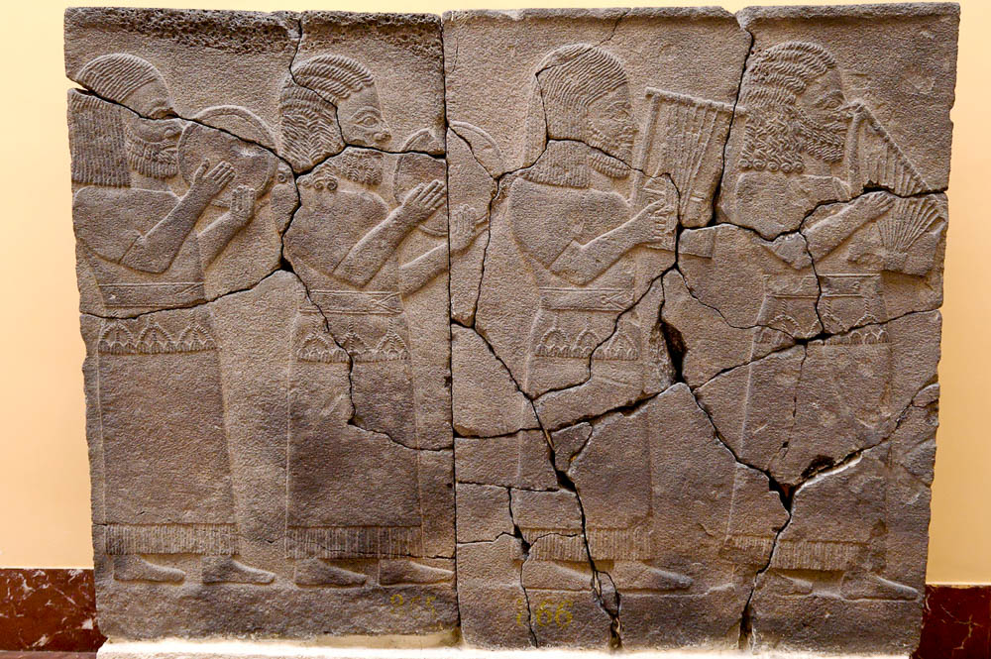
When you hear the sound of the . . . lyre
Relief of Hittite musicians, from the Northern Hall at Zincirli, 8th century BC
3:5
Notes:
This basalt relief carving depicts the sorts of instruments that were probably used in Nebuchadnezzar’s orchestra. The two stringed instruments on the right side of this relief are two kinds of lyres. See the next slide for a closer view. This relief is on display in the Istanbul Museum of the Ancient Orient.
tb041705697

Slide 46
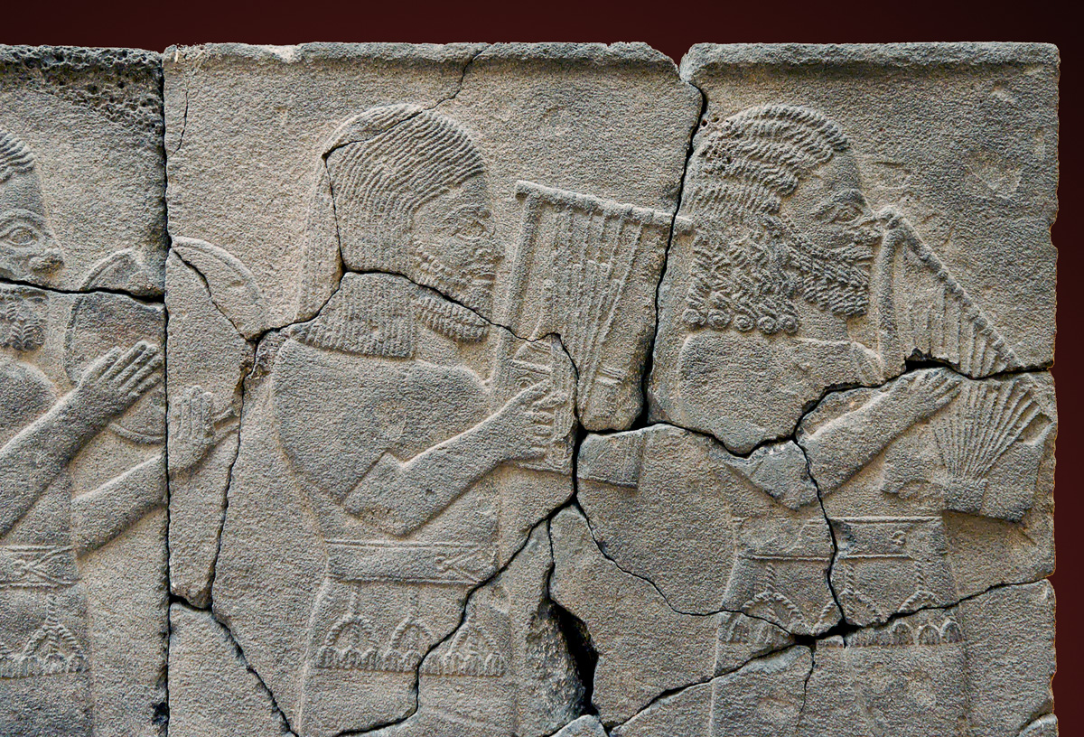
When you hear the sound of the . . . lyre
Relief of Hittite musicians, from the Northern Hall at Zincirli, 8th century BC
3:5
Notes:
This basalt relief carving is on display in the Istanbul Museum of the Ancient Orient.
tb041705698

Slide 47
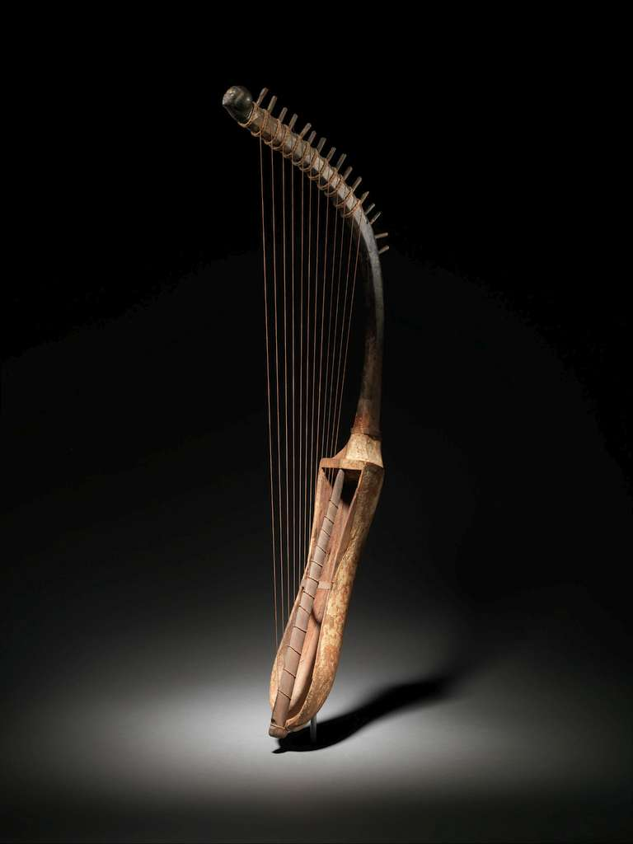
When you hear the sound of the . . . harp
Arched harp (shoulder harp), from Egypt, circa 1350 BC
3:5
Notes:
Some suggest that the fourth and fifth terms in the list refer to two different types of harps. The Greek lexicon Liddell-Scott-Jones (LSJ) states that the Greek term sambuke (σαμβύκη), which the Aramaic sabbeka (סַבְּכָא) transliterates, refers to a small arched harp (according to the Supplement; the original entry in LSJ states that sambuke refers to a triangular musical instrument with four strings). This image comes from The Metropolitan Museum of Art, public domain, Rogers Fund, 1943, accession number 43.2.1, http://metmuseum.org/art/collection/search/546194.
From the Met website: “Egyptian arched harps from Dynasty 4 onward coexisted with a great variety of harps in different shapes and sizes. Two harp types were most common—the arched harp with a curved neck, like this one, and the angled harp with a neck sharply perpendicular to the body. Unlike most European versions, ancient Egyptian harps have no forepillars to strengthen and support the neck. Older forms of arched harps had four or five strings, this harp has twelve strings. Skin once covered the open, slightly waisted sound box. Rope tuning rings under each string gave a buzzing sound to the soft-sounding tone produced. Topping the arched frame of the harp is a carved human head.”
Some believe that the presence of Greek words for the instruments here supports a 2nd-century BC date for the Book of Daniel, but there is clear evidence that Greek terminology for instruments was widespread before arrival of Alexander the Great in the 4th century BC. For more information, see Edwin M. Yamauchi, “Greek Words in Daniel in the Light of Greek Influence in the Near East,” in New Perspectives on the Old Testament, ed. J. Barton Payne (Waco, TX: Word, 1970), 170–200.
met546194

Slide 48
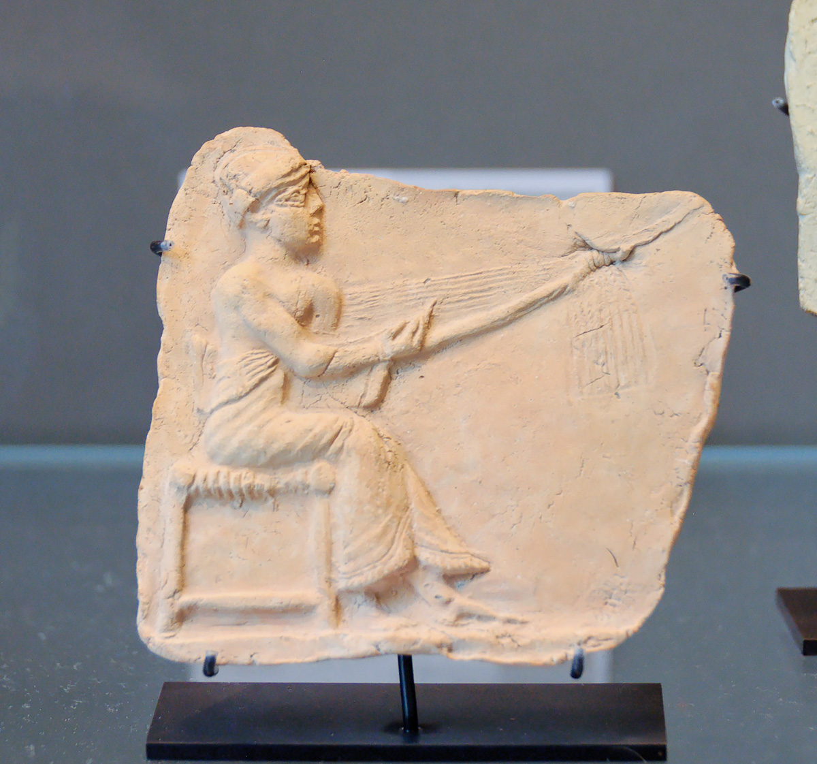
When you hear the sound of the . . . harp
Relief of a harpist, from Eshnunna, 2nd–1st millennium BC
3:5
Notes:
The harp depicted here looks similar to the one shown on the previous slide. This ancient Sumerian or Akkadian harpist is using a plectrum to pluck the strings; for this reason, some would prefer to call this instrument a “dulcimer” or a “psaltery.” This depiction of a harpist was photographed at the Louvre Museum. For more information about this artifact, see https://www.louvre.fr/en/oeuvre-notices/plaque-harpist.
tb060408507

Slide 49
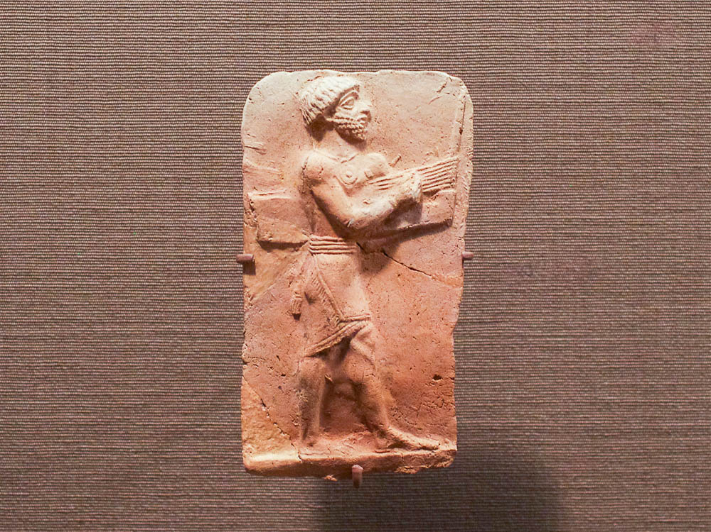
When you hear the sound of the . . . harp
Plaque with a male musician playing a harp, from Eshnunna
3:5
Notes:
This plaque depicts a harp that is played with a plectrum. Eshnunna was inhabited during the 3rd and 2nd millennia BC. This plaque was photographed at the Oriental Institute Museum at the University of Chicago.
adr1605120271

Slide 50
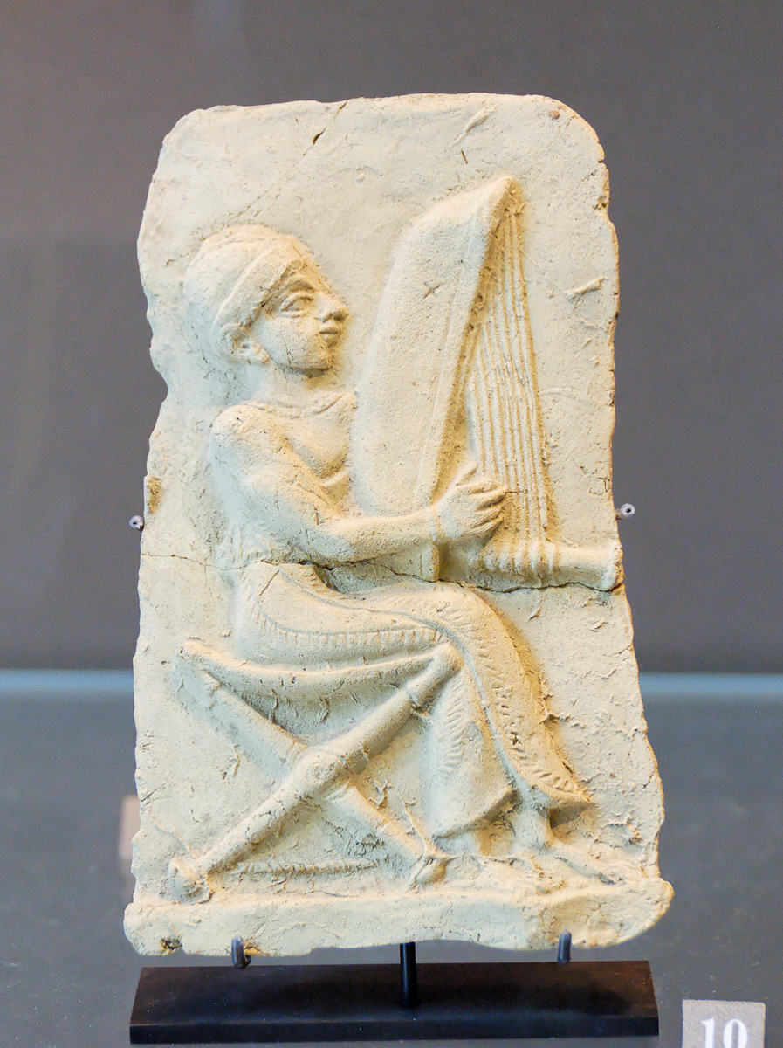
When you hear the sound of the . . . psaltery
Relief of a harpist, from Eshnunna
3:5
Notes:
The Aramaic term pesanterin (פְּסַנְתֵּרִין) is a loanword from Greek psalterion (ψαλτήριον). This term can be transliterated as “psaltery” or “psalterion,” but, according to the Hebrew-Aramaic lexicon HALOT, this instrument was like a harp or a dulcimer. The Greek lexicon BDAG says the Greek word probably refers to some form of a harp, but possibly also refers to a psaltery. Some texts use the word trigonon (τρίγωνον) in parallel with psalterion (ψαλτήριον), which leads some to suggest the translation “trigon” (a type of triangular harp). Another possible identification of this instrument is an epigonian (ἐπιγόνειον), a board zither with forty strings. This ancient depiction of a harpist was photographed at the Louvre Museum.
tb060408506

Slide 51
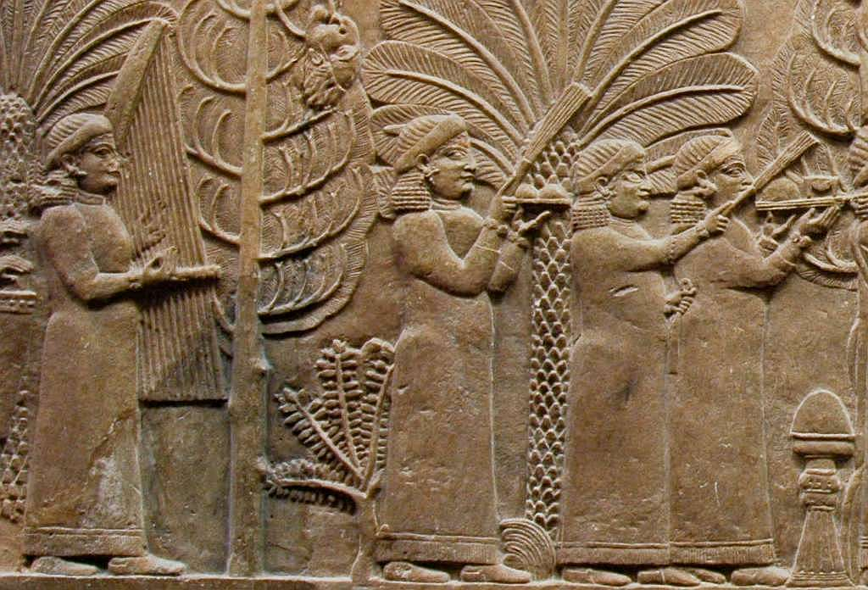
When you hear the sound of the . . . psaltery
Relief showing a harpist and other servants in Ashurbanipal’s garden at Nineveh
3:5
Notes:
This relief which depicts a harpist dates to just a few decades before the events of Daniel 3. Ashurbanipal ruled from 669 to 627 BC. Note the human head hanging from the tree as a decoration—the Assyrians were notorious for their cruelty. This relief was photographed in the British Museum.
tb112004724

Slide 52

When you hear the sound of the . . . double flute
Figurine of a man playing a double flute, from Achzib, 8th–7th centuries BC
3:5
Notes:
The identification of the last musical instrument in the list is the most debated. It has been translated “pipe,” “bagpipe,” “dulcimer,” “drum,” or understood as a general word for a symphony of music. According to HALOT and BDB, the term refers to a double-barreled flute, which was a common instrument in the ancient world. The Aramaic term sumponeyah (סוּמְפֹּנְיָה) is a loanword from Greek; the English term “symphony” comes from the same word. While in Greek the word sumphonia (συμφωνία) is often a general term for music (cf. Luke 15:25), it is occasionally used of individual instruments; it is used of a wind instrument by Pliny, Polybius, and some other authors. According to BDAG, sumphonia is used in rabbinic sources with the meaning of “double flute.” This figurine playing a double flute was photographed at the Israel Museum.
adr1306213111

Slide 53

When you hear the sound of the . . . double flute
Figurine of a man playing a double flute, from Tel Malhata in Israel, 7th century BC
3:5
Notes:
This figurine was photographed at the Israel Museum.
adr1306213112

Slide 54

When you hear the sound of the . . . double flute
Relief of a Hittite musician playing a double flute, from Sam’al (Zincirli)
3:5
Notes:
This relief carving of a man playing a double flute was photographed at the Berlin Museum of the Ancient Near East.
adr070513292

Slide 55

When you hear the sound of the . . . double flute
Greek drinking cup with youth wearing a lip band and holding a double flute, circa 490 BC
3:5
Notes:
This Greek kylix (drinking cup), attributed to the Antiphon Painter, dates to about 490 BC. It shows a youth who is wearing a lip band (phorbeia) to support the flute, and holding a double flute (aulos) in his left hand. This image comes from The Metropolitan Museum of Art, public domain, Purchase, 1896, accession number 96.9.36, http://metmuseum.org/art/collection/search/246136
met246136

Slide 56

When you hear the sound of the . . . double flute
Young Bedouin man blowing a bagpipe-like instrument
3:5
Notes:
It is sometimes suggested that the term used here refers to a type of bagpipe. Jeffery in The Interpreter’s Bible describes this as “a wind instrument composed of a goatskin bag with two reed pipes, one for filling the bag with wind from the mouth, the other pierced with holes for the fingers to provide various notes” (“Daniel,” 397). This American Colony photograph illustrating the instrument Jeffery describes was taken between 1898 and 1946.
mat04647

Slide 57

When you hear the sound of the . . . double flute
Harps and a drum from ancient Egypt
3:5
Notes:
This last instrument is also sometimes understood as a type of drum. According to the Liddell-Scott-Jones lexicon, the word sumphonia (συμφωνία) was used of a type of drum by Isidorus in the 6th/7th century AD. This is also suggested by T. C. Mitchell and R. Joyce, “The Musical Instruments in Nebuchadrezzar’s Orchestra,” in Notes on Some Problems in the Book of Daniel (London: Tyndale, 1965), 26–27. The ancient musical instruments shown here are on display in the Egyptian Museum in Cairo. Note the different types of harp in the case—the triangle-shaped harp on the left and the two bow harps on the right.
adr1603194626

Slide 58

When you hear the sound of the . . . double flute
Drum from Egypt, Late Period, circa 500 BC
3:5
Notes:
This wood and leather drum from Egypt is roughly contemporary with the time of Daniel. It comes from the 26th–30th Dynasty, a period that covers about 665–333 BC. It was photographed at The Metropolitan Museum of Art.
adr1711128296

Slide 59

When you hear the sound of the . . . double flute
Figurine of a woman playing a tambourine or hand-drum, 8th–7th centuries BC
3:5
Notes:
There were various types of percussion instruments in the ancient world. This figurine from ancient Israel of a woman playing a tambourine or hand drum was photographed at the Harvard Semitic Museum.
tb072811131

Slide 60

When you hear the sound of . . . all kinds of musical instruments
Depictions of various musicians and musical instruments from ancient Mesopotamia
3:5
Notes:
There were evidently more instruments in the orchestra than the six primary ones that are listed in Daniel 3. Perhaps only six are listed because six was a sacred number in the religion of ancient Mesopotamia. This may also be the reason why the dimensions of the statue were 60 x 6 cubits. The two depictions at the top of this slide are of male harpists. In the middle are two female harpists and a double pipe or double flute player. On the bottom are two lute players. This display was photographed at the Oriental Institute Museum at the University of Chicago.
adr071011965

Slide 61

When you hear the sound of . . . all kinds of musical instruments
Relief with various Hittite musicians and a dancer, from the King’s Gate at Carchemish
3:5
Notes:
The large-figure musicians are playing a lute and a double flute. This limestone relief carving probably dates to the 10th–9th centuries BC. It was photographed at the Ankara Museum of Anatolian Civilizations.
adr1006031967

Slide 62

Whoever does not . . . will immediately be thrown into the midst of a burning fiery furnace
Brick kiln near Kadimain in Iraq
3:6
Notes:
This American Colony photograph was taken in 1932. The Babylonians had huge kilns for firing tens of thousands of mud bricks at a time, with which they built their city and its walls. Remains of numerous such brick kilns have been found in the plains around Babylon. These kilns had an opening at the top for smoke to escape, and one or more openings at the bottom to insert bricks or to control the heat of the furnace. Beaulieu notes that while there are many cuneiform texts which prescribe burning to death as a punishment for a crime, there are only three texts in which the exact method of burning is also prescribed. In all three of these texts, the death sentence is to be executed by throwing the condemned into an oven or furnace. See Paul-Alain Beaulieu, “The Babylonian Background of the Motif of the Fiery Furnace in Daniel 3,” Journal of Biblical Literature 128/2 (2009): 280–84.
mat07383

Slide 63

Whoever does not . . . will immediately be thrown into the midst of a burning fiery furnace
Thorns being burned in a lime kiln at Homs
3:6
Notes:
The lime kiln in this photograph (at Homs, Syria) is of a smaller variety. Note the platform around the kiln that allows access from the top. This may be similar to the kind of structure used to get Daniel’s friends up to where they could be thrown into the furnace. This American Colony photograph was taken between 1910 and 1920.
mat02208

Slide 64

Whoever does not . . . will immediately be thrown into the midst of a burning fiery furnace
Illustration of the burning fiery furnace
3:6
Notes:
This print is from an etching made by Jan Luyken in 1708. The image comes from The Museum of the Netherlands in Amsterdam, RP-P-OB-67.900, public domain. Source: http://hdl.handle.net/10934/RM0001.COLLECT.337032
ria337032

Slide 65

All the peoples, nations, and languages fell down and worshiped the golden image
Egyptian figurine of a man worshipping
3:7
Notes:
Worship took different forms at different times and places. This bronze statuette shows an Egyptian man in a posture of worship. It was photographed at the Louvre Museum.
tb060408104

Slide 66

All the peoples, nations, and languages fell down and worshiped the golden image
Egyptian relief with bowing courtiers, 14th century BC
3:7
Notes:
This sandstone relief from ancient Egypt probably depicts obeisance before a king, rather than worship of an idol. This artifact was photographed in the Israel Museum.
adr1306212590

Slide 67

All the peoples, nations, and languages fell down and worshiped the golden image
Farming supervisors shown prostrate before the deceased, from the tomb of Renni at El-Kab
3:7
Notes:
Bowing down with knees, hands, and face to the ground is a stance that conveys worship or submission across many cultures. This tomb painting dates to the reign of Amenhotep I (1514–1494 BC).
adr1603226728

Slide 68

At that time certain Chaldeans came forward
Relief of Chaldean prisoners, from Ashurbanipal’s palace at Nineveh, 648–631 BC
3:8
Notes:
This Assyrian relief shows how Chaldeans were depicted. Notice that in this relief they are prisoners, with wrists tied together. This relief was photographed at the Vatican Museums.
tb0512176449

Slide 69

They answered and said to Nebuchadnezzar the king
Stele of Nabonidus, King of Babylon, 556–539 BC
3:9
Notes:
There are only four known portraits of Nebuchadnezzar II, all of which are difficult to access. Thus, this image of Nabonidus is used to illustrate a Neo-Babylonian king. This stele is on display in the British Museum. The known contemporary depictions of Nebuchadnezzar II include two reliefs on cliff faces at Wadi Brisa in Lebanon, another outdoor relief at Shir es-Sanam, and a stele in the Schøyen Collection. For photos of the Nebuchadnezzar stele, see
http://www.schoyencollection.com/history-collection-introduction/babylonian-history-collection/tower-babel-stele-ms-2063 and http://eprints.soas.ac.uk/12831/
tb112004138g

Slide 70

You, O king, have made a decree
Brick fragment with an inscription of Nebuchadnezzar, 6th century BC
3:10
Notes:
This inscribed brick is the kind often used to build temples, palaces, and other important structures. It was photographed at the Vatican Museums.
tb0512177045

Slide 71

Certain Jews . . . do not serve your gods, nor worship the golden image which you have set up
Illustration of the golden image
3:12
Notes:
This print is from an etching made by Jan Luyken in 1698. The image comes from The Museum of the Netherlands in Amsterdam, RP-P-1896-A-19368-1345, public domain. Source: http://hdl.handle.net/10934/RM0001.COLLECT.144414
ria144414

Slide 72

Certain Jews . . . do not serve your gods, nor worship the golden image which you have set up
Illustration of Shadrach, Meshach, and Abednego refusing to bow down to the image
3:12
Notes:
This illustration comes from Charles Foster, Bible Pictures and What They Teach Us (1886, 1914).
fbp151

Slide 73

Then they brought these men before the king
Judean captives presented to Sennacherib, from panel 12 of the Lachish reliefs
3:13
Notes:
The Judean captives are shown in humble stances with their hands held out in supplication, as though begging for mercy. The Lachish reliefs date to about 700 BC and are on display in the British Museum.
tb112004327

Slide 74

If . . . you fall down and worship the image I have set up, well
Worshipper of Larsa, from Larsa, 2nd millennium BC
3:15
Notes:
This statuette of a pagan worshipper was photographed in the Louvre. This image comes from Rama and is licensed under CC BY-SA 3.0 FR, via Wikimedia Commons: https://commons.wikimedia.org/wiki/File:Worshipper_of_Larsa-AO_15704-IMG_4061-black.jpg.
wiki071320181404

Slide 75

Be it known to you, O king, that we will not serve your gods
Deuteronomy 5:6-10 in a Torah Scroll
3:18
Notes:
See the next slide for a box around Deuteronomy 5:6-10, the first two commandments. It was on the basis of these two commandments that the three young Jewish men refused to serve Nebuchadnezzar’s gods. This Yemenite Torah scroll was donated to The Master’s Seminary in California.
tb031416446

Slide 76
Be it known to you, O king, that we will not serve your gods
Deuteronomy 5:6-10 in a Torah Scroll
3:18
Notes:
This box frames Deuteronomy 5:6-10, the first two commandments. It was on the basis of these two commandments that the three young Jewish men refused to serve Nebuchadnezzar’s gods. This Yemenite Torah scroll was donated to The Master’s Seminary in California.
tb031416446

Slide 77

Be it known to you, O king, that we will not serve your gods
Plaque of a worshipper and the Akkadian god Shamash, 2000–1600 BC
3:18
Notes:
Shamash was one of Nebuchadnezzar’s gods. This plaque, which depicts worship of Shamash, may be from the city of Larsa. It was photographed at the Ashmolean Museum at the University of Oxford.
adr1305226979

Slide 78

Be it known to you, O king, that we will not serve your gods
Stele of the goddess Ishtar, from Til Barsip, 8th century BC
3:18
Notes:
The goddess Ishtar was another of the deities worshipped by Nebuchadnezzar. She was often associated with lions and the eight-pointed star, and she was known as the “Queen of Heaven.” On this stele she is shown standing on a lion. The stele comes from the 8th century BC and was photographed in the Louvre Museum.
tb060408208

Slide 79

Then Nebuchadnezzar was filled with fury, and the form of his face was changed
Roman coin with a stern portrait of Nero, AD 65
3:19
Notes:
This coin depicts a laureate bust of Nero near the end of his life, when he became almost unbelievably cruel and angry. The inscription reads “Nero Claudius Caesar Augustus Germanicus Pontifex Maximus [high priest] Tribuncia Potestas Imperator Pater Patriae [father of the country]” (NERO CLAVD CAESAR AVG GER PM TR P IMP P P”. This coin was photographed at the Ashmolean Museum at the University of Oxford.
adr1305249758

Slide 80

He commanded to heat the furnace seven times more than it was customarily heated
Furnace air hole, used to control interior temperature
3:19
Notes:
For Nebuchadnezzar’s giant furnace, there were likely large vents at the bottom that were drawn fully open to increase the heat, which is why Nebuchadnezzar could see the three Jews after they were thrown in. This artifact was photographed at the Saruq Al-Hadid Museum.
tb051017169

Slide 81

He commanded certain mighty men in his army to bind Shadrach, Meshach, and Abednego
Assyrian warrior armed with a bow, from the palace of Sargon at Khorsabad, 713–706 BC
3:20
Notes:
This relief carving is on display in the Louvre Museum. This image comes from Jastrow and is in the public domain, via Wikimedia Commons, https://commons.wikimedia.org/wiki/File:Warrior_Dur-Sharrukin_Louvre_AO19877.jpg
wiki19877

Slide 82

He commanded certain mighty men in his army to bind Shadrach, Meshach, and Abednego
Relief of a lion hunt, from the northern palace of Ashurbanipal in Nineveh
3:20
Notes:
The king’s mightiest warriors would be the ones beside him in his chariot during a lion hunt. The Assyrian soldiers depicted here lived only a few decades before the events of Daniel 3. This relief carving was photographed at the British Museum.
adr090506000

Slide 83

He commanded certain mighty men in his army to bind Shadrach, Meshach, and Abednego
Assyrian soldier depicted with a Judean prisoner on the Lachish reliefs
3:20
Notes:
The Lachish reliefs are on display in the British Museum. They date to about 700 BC.
tb112004323

Slide 84

He commanded certain mighty men in his army to bind Shadrach, Meshach, and Abednego
Statue of a bound captive foreigner, from the reign of Pepi II, circa 2200 BC
3:20
Notes:
This statue of a bound captive may have come from Saqqara, Egypt. It was photographed at the Metropolitan Museum of Art.
adr1605231796

Slide 85

These three men were bound in their cloaks, their tunics, their headgear, and their other clothes
Procession of Median and Persian dignitaries, Persepolis, circa 500 BC
3:21
Notes:
This depiction of Median and Persian dignitaries comes from slightly later than the events recorded in Daniel 3. The figure shown here, second from the left, is dressed most similarly to how we believe Daniel’s three friends were dressed. He wears a loose, draped, outer garment, a close-fitting hat, and foot-gear. He would also have on a tunic, not visible beneath the outer garment. It is worth noting the trousers worn by the figure third from the right. Trousers seem to have been commonly associated with Median dress, and were almost certainly not worn by Daniel’s friends. This relief carving is located on the eastern staircase of the apadana of Persepolis.
tb0506180787

Slide 86

These three men were bound in their cloaks, their tunics, their headgear, and their other clothes
Relief showing a delegation from Syria, Persepolis, circa 500 BC
3:21
Notes:
Normally prisoners would be stripped before being executed. But the king’s command was so urgent, he did not wait even for that. This relief shows a Syrian delegation, also representing Lebanon and Israel, which gives some idea of the traditional dress of Daniel’s homeland. This includes a long, draped outer garment, a tight-fitting cap, a belt or sash, and footwear. This relief carving is located on the eastern staircase of the apadana of Persepolis. For detailed descriptions of the clothing of the Median and Persian periods (which post-dates Daniel 3, but of which Daniel himself was eventually a part), see http://www.iranicaonline.org/articles/clothing-ii.
tb0506180985

Slide 87

These three men were bound in their cloaks, their tunics, their headgear, and their other clothes
Tutankhamun’s linen tunic with collar
3:21
Notes:
It was expected that the men’s clothing would ignite immediately, providing fuel for the fire. This linen tunic from the tomb of Tutankhamun was photographed at the Egyptian Museum in Cairo.
adr1603111794

Slide 88

These three men were bound in their cloaks, their tunics, their headgear, and their other clothes
Bound captives depicted on the footstool of Tutankhamun
3:21
Notes:
The enemies of Egypt were traditionally called the “Nine Bows.” This footstool from the tomb of Tutankhamun depicts them as bound captives. Note the varying hair styles and even skin tones, intended to show different cultures and ethnic groups. This footstool was photographed at the Egyptian Museum in Cairo.
adr1603194567

Slide 89

These three men were bound in their cloaks, their tunics, their headgear, and their other clothes
Painted plaster floor showing a bound enemy, from the palace of Akhenaten at Amarna
3:21
Notes:
Binding, of course, was intended to force submission, mitigate threat, and inhibit attempts to escape. This depiction of a bound captive once graced the palace floor of the Egyptian king Akhenaten (1353–1336 BC) at Amarna. It was photographed at the Egyptian Museum in Cairo.
adr1603111571

Slide 90

These three men were bound in their cloaks, their tunics, their headgear, and their other clothes
Carving of an Asiatic bound captive, from Egypt, circa 1200 BC
3:21
Notes:
This depiction of a bound captive, made of ivory, shows a man with his hands bound behind his neck. It dates to the 18th–19th Dynasties in Egypt. It was photographed at the Metropolitan Museum of Art in New York City.
adr1711139697

Slide 91

Because the king’s command was urgent and the furnace extremely hot
Fire at a Roman fort in Judean hills
3:22
Notes:
tb120702932

Slide 92

The flame of the fire killed those men who brought up Shadrach, Meshach, and Abednego
Fire at Lag BaOmer
3:22
Notes:
Lag BaOmer is a minor Jewish holiday that occurs on the 33rd day of the Omer, the 49-day period between Passover and Shavuot. It is often celebrated by holding weddings, lighting bonfires, and getting haircuts.
tb051506283

Slide 93

The flame of the fire killed those men who brought up Shadrach, Meshach, and Abednego
Corpses floating on river, from Nineveh palace of Ashurbanipal, 648–631 BC
3:22
Notes:
This relief carving of slain men comes from about half a century before the events of Daniel 3. It was photographed at the Vatican Museums.
tb0512176443

Slide 94

These three men . . . fell down bound into the midst of the burning fiery furnace
Sarcophagus relief of the three youths in the fiery furnace, early 4th century AD
3:23
Notes:
The account of the fiery furnace is compelling and has been depicted many times through the centuries, as seen on this slide and those that follow. Although they are not historically or archaeologically accurate, they demonstrate the popularity of this story over many generations. The artifact shown here is made of marble. This image comes from The Metropolitan Museum of Art, public domain, Gift of Josef and Marsy Mittlemann, 1991, accession number 1991.366, http://metmuseum.org/art/collection/search/466220.
met466220

Slide 95

These three men . . . fell down bound into the midst of the burning fiery furnace
Relief of the three youths in the furnace, from near St. Sebastian in Rome, 4th century AD
3:23
Notes:
This relief is from a sarcophagus fragment. It was photographed in the Vatican Museums.
tb0512175499

Slide 96

These three men . . . fell down bound into the midst of the burning fiery furnace
Three youths in the furnace, from a sarcophagus in the Vatican necropolis, circa AD 330–360
3:23
Notes:
This relief is from the sarcophagus lid of Agape and Crescentianus. An inscription on the sarcophagus indicates that it was prepared by Crescentianus for his late wife Agape, and that he himself was later buried there. It dates to the 4th century AD. It is on display in the Vatican Museums.
tb0512175645

Slide 97

These three men . . . fell down bound into the midst of the burning fiery furnace
Early Christian painting of three men in the fiery furnace, circa AD 300
3:23
Notes:
This painting is located in the Catacombs of Priscilla in Rome. This image comes from Wikimedia Commons and is in the public domain. Source: https://commons.m.wikimedia.org/wiki/File:Fiery_furnace_01.jpg
wiki0113061944

Slide 98

He said to his advisors, “Did we not cast three men bound into the midst of the fire?”
Relief of three bound Asiatic captives with name-rings, in the Ramesses II temple at Abydos
3:24
Notes:
The arms of captives were often bound behind them, as was the common Egyptian practice depicted here.
adr1603153440

Slide 99

I see four men unbound, walking in the midst of the fire without harm
Fire in Judean hills during Lag BaOmer
3:25
Notes:
tb051506247

Slide 100

I see four men unbound, walking in the midst of the fire without harm
Deified Ramesses II with gods, in the Great Temple of Ramesses II at Abu Simbel
3:25
Notes:
A fourth “man” appeared in the fire to protect the three Jews. The KJV mistranslated בַר־אֱלָהִין as “the Son of God.” The correct translation is “a son of the gods,” since there is no plural of majesty in Aramaic (עֶלְיוֹנִין in 7:25 is exceptional). Nebuchadnezzar simply recognizes the supernatural quality of the fourth “man” in the fire. Whether “His angel” (3:28; cf. 6:22) is the divine Messenger of Yahweh or a created angel is a question which cannot be resolved on linguistic grounds alone.
adr1603215725

Slide 101

I see four men unbound, walking in the midst of the fire without harm
Illustration of the three youths in the furnace, plus one
3:25
Notes:
This print is from an etching made by Jan Luyken in 1698. The image comes from The Museum of the Netherlands in Amsterdam, RP-P-1896-A-19368-1345, public domain. Source: http://hdl.handle.net/10934/RM0001.COLLECT.144414
ria144414

Slide 102

Then Nebuchadnezzar came near to the door of the burning fiery furnace
Pottery kiln
3:26
Notes:
This photograph shows on a small scale what the “door of the furnace” may have looked like. It was taken at the Eretz Israel Museum.
kg100500106

Slide 103

You servants of the Most High God, come out and come here!
Jasper seal of “Miqneyaw Servant of YHWH,” early 8th century BC
3:26
Notes:
Nebuchadnezzar’s reference to the three youths as “servants of the Most High God” is similar to the Israelite phrase “servant of Yahweh.” The word “servant” was commonly used for someone who was high-ranking in a political or religious setting, much like “secretary” can be used today (e.g., “Secretary of Defense”). Moses, the leader of the Israelites for many years, was often referred to as “the servant of Yahweh” (Deut 34:5). The seal depicted here employs the same title, and may indicate a person who held a priestly or other significant office in the worship of Yahweh. This seal was photographed at the Harvard Semitic Museum. The next slide includes labels for the lettering on this seal.
adr081125824

Slide 104

You servants of the Most High God, come out and come here!
Jasper seal of “Miqneyaw Servant of YHWH,” early 8th century BC
3:26
Notes:
Nebuchadnezzar’s reference to the three youths as “servants of the Most High God” is similar to the Israelite phrase “servant of Yahweh.” The word “servant” was commonly used for someone who was high-ranking in a political or religious setting, much like “secretary” can be used today (e.g., “Secretary of Defense”). Moses, the leader of the Israelites for many years, was often referred to as “the servant of Yahweh” (Deut 34:5). The seal depicted here employs the same title, and may indicate a person who held a priestly or other significant office in the worship of Yahweh. This seal was photographed at the Harvard Semitic Museum. Seals such as this were always inscribed in reverse so that the impression they would leave on a bulla was correct. The photo on this slide has been reversed so that the inscription reads in the proper direction. An editable version is included beneath the graphic for those who wish to modify it.
adr081125824

Slide 105

The smell of fire had not passed onto them
Fresco blackened with soot, from the Palatial Mansion in Jerusalem, AD 70
3:27
Notes:
This fresco shows the effects of having been in an intense fire. It is on display in the Herodian Quarter Wohl Museum in Jerusalem.
adr1305134652

Slide 106

So that they might not serve or worship any god but their own God
“Yahweh is God of the whole earth” inscribed in Hebrew, from Beth Loya, 6th century BC
3:28
Notes:
This inscription was found in an Iron Age II tomb at Beth Loya (Khirbet Beit Lei). The reading of the full inscription is difficult and contested. The epigrapher Joseph Naveh read it as, “Yahweh is God of the whole earth; the mountains of Judah belong to him, to the God of Jerusalem.” This reflects the sentiments of Daniel’s three friends, who believed that their God was not regional but ruled everywhere, and must be obeyed even in a foreign land. This inscription may have been written by a refugee fleeing the Babylonian sack of Jerusalem in 586 BC. It is now on display in the Israel Museum.
A description of the cave and inscription, as well as Naveh’s interpretation, may be found in Joseph Naveh, "Old Hebrew Inscriptions in a Burial Cave," Israel Exploration Journal 13/2 (1963): 74–92.
tb061616985

Slide 107

Therefore I make a decree
The Cyrus Cylinder, from Babylon, circa 533 BC
3:29
Notes:
The Cyrus Cylinder a typical example of an imperial decree, although it comes from the following Persian period. This cylinder was photographed in the British Museum. The British Museum also owns fragments of the same text recorded on a tablet, rather than a cylinder.
tb112004172

Slide 108

Therefore I make a decree, that any people, nation, or language
Relief of Syrians bearing tribute to Assyria, from Aslantas, during the reign of Tiglath-pileser III
3:29
Notes:
This basalt relief carving shows one of the people groups included in Nebuchadnezzar’s decree. Other photos that can be used to illustrated this phrase can be found at verse 4. The carving is on display in the Istanbul Museum of the Ancient Orient.
adr1006054607

Slide 109

Any people . . . that speaks anything against the God of Shadrach, Meshach, and Abednego
“God, Creator of the earth,” inscribed in Hebrew, from Jerusalem, late 8th century BC
3:29
Notes:
The last line of this inscription includes the phrase “[Go]d, creator of the earth” (ל קן ארץ[א]) which echoes texts found in Genesis 14:19 and Isaiah 40:28. The verb qanah (קָנָה) can also mean to buy or possess, thus some English versions render Genesis 14:19 as “possessor of heaven and earth.” This ostracon was recovered in excavations in the Jewish Quarter of Jerusalem by Nahman Avigad in 1971. Although the inscription is broken at the beginning of the third line, the conclusion that the first word was God (“El,” אל) is “almost inescapable” (Miller 1980: 43). The jar may have once contained offerings intended for the temple in Jerusalem. Based on the style of writing it is dated to the late 8th century BC. It was photographed in the Israel Museum. The next slide includes an overlay highlighting the text of the last line.
Reference:
Miller, Patrick D.
1980 El, the Creator of Earth. Bulletin of the American Schools of Oriental Research 293: 43–46.
tb032014468

Slide 110

Any people . . . that speaks anything against the God of Shadrach, Meshach, and Abednego
“God, Creator of the earth,” inscribed in Hebrew, from Jerusalem, late 8th century BC
3:29
Notes:
The last line of this inscription includes the phrase “[Go]d, creator of the earth” (ל קן ארץ[א]) which echoes texts found in Genesis 14:19 and Isaiah 40:28. The verb qanah (קָנָה) can also mean to buy or possess, thus some English versions render Genesis 14:19 as “possessor of heaven and earth.” This ostracon was recovered in excavations in the Jewish Quarter of Jerusalem by Nahman Avigad in 1971. Although the inscription is broken at the beginning of the third line, the conclusion that the first word was God (“El,” אל) is “almost inescapable” (Miller 1980: 43). The jar may have once contained offerings intended for the temple in Jerusalem. Based on the style of writing it is dated to the late 8th century BC. It was photographed in the Israel Museum.
Reference:
Miller, Patrick D.
1980 El, the Creator of Earth. Bulletin of the American Schools of Oriental Research 293: 43–46.
tb032014468

Slide 111

Will be torn limb from limb and their houses made a rubbish heap
Left arm of a boxer statue, late 2nd or early 1st century BC
3:29
Notes:
The Aramaic text is literally, “he will be made into limbs.” This bronze statue fragment from the Antikythera shipwreck was photographed at the Metropolitan Museum of Art in New York City.
adr1605244121

Slide 112

Will be torn limb from limb and their houses made a rubbish heap
Left leg of a male statue, late 3rd century BC
3:29
Notes:
This bronze statue fragment, which is somewhat earlier than the one shown on the previous slide, was also recovered from the Antikythera shipwreck. It was photographed at the Metropolitan Museum of Art in New York City.
adr1605244136

Slide 113

Will be torn limb from limb and their houses made a rubbish heap
Rubbish heap on the Temple Mount in Jerusalem
3:29
Notes:
This rubbish heap comes from a major construction project in which the Muslim authorities constructed a new entrance to an underground area that was converted into a mosque. There was significant controversy about this because it was done without archaeological supervision. Piles of this rubble remain on the Temple Mount today because the Muslim authorities do not want Israeli archaeologists to study the material. In this context, the photo simply illustrates the destruction referred to by Nebuchadnezzar.
tb083104490

Slide 114

There is no other god who is able to deliver like this
Chalcedony cylinder seal with deities, from Mesopotamia, 9th–8th centuries BC
3:29
Notes:
This cylinder seal, which depicts Mesopotamian gods, is on display in the Harvard Art Museums. Nebuchadnezzar knew that none of the Mesopotamian gods had ever done anything like what he had just witnessed.
adr1711203466

Slide 115

There is no other god who is able to deliver like this
Bulla of “Hezekiah son of Ahaz king of Judah,” 8th century BC
3:29
Notes:
Nebuchadnezzar probably knew the stories of how the God of Israel had prevented Sennacherib from capturing Jerusalem during the reign of Hezekiah, 100 years earlier. This seal impression, which comes from one of King Hezekiah’s seals and bears his name, is on display in the Israel Museum in Jerusalem.
tb032014271

Slide 116

Then the king promoted Shadrach, Meshach, and Abednego in the province of Babylon
Relief of Sargon II and a high Assyrian dignitary, from the palace at Khorsabad, circa 720 BC
3:30
Notes:
This relief carving was photographed at the Louvre Museum.
tb060408226

Slide 117

More than 1,000 slides in PowerPoint format. Available now from BiblePlaces.com.
Notes:
This is a free sample of the Daniel 3 presentation from the Photo Companion to the Bible. To purchase the full volume, visit https://www.bibleplaces.com/daniel/
The Photo Companion to the Bible is an image-rich resource for Bible students, teachers, and researchers. Just as a librarian stocks the shelves with as many relevant materials as possible, so we have tried to provide a broad selection of images. Our goal is that you will find in this “library” whatever it is you are looking for.
Credits: The primary creators of this presentation are Steven D. Anderson, Kris Udd, and Todd Bolen. The photographs have an individual file code which usually includes the initials of the photographer. Other images have additional credit or source information.
Updates: We plan to update this collection as we are able. We welcome your suggestions for improving this resource (photocompanion@bibleplaces.com). Purchasers of the Daniel volume are provided free, lifetime updates to the volume.
Copyright: This photo collection is protected by copyright law and may not be distributed without written permission from BiblePlaces.com. Slide notes should be treated as any other copyrighted written material, with credit given when quoting from these notes.
For more information, see our complete “Introduction to the Photo Companion to the Bible” online at http://www.BiblePlaces.com/Intro-Photo-Companion-Bible/. Here you will find more information about photo selection, explanatory notes, Bible translation, credit information, and copyright allowances.

