Slide 1
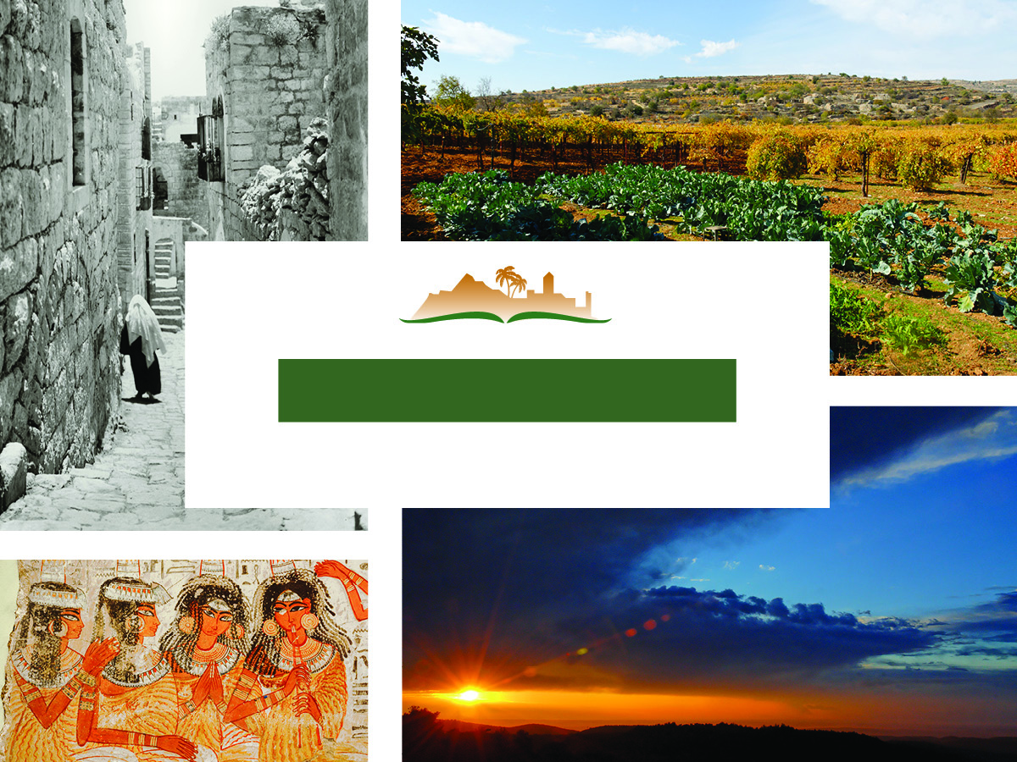
Ecclesiastes 2
Notes:
The Photo Companion to the Bible is an image-rich resource for Bible students, teachers, and researchers. Just as a librarian stocks the shelves with as many relevant materials as possible, so we have tried to provide a broad selection of images. Our goal is that you will find in this “library” whatever it is you are looking for.
Credits: The primary creators of this presentation are Kris Udd, Chris McKinny, Kai Akagi, and Todd Bolen. The photographs have an individual file code which usually includes the initials of the photographer. Other images have additional credit or source information.
Updates: We plan to update this collection as we are able. We welcome your suggestions for improving this resource (photocompanion@bibleplaces.com). Purchasers of the Ecclesiastes volume are provided free, lifetime updates to the volume.
Copyright: This photo collection is protected by copyright law and may not be distributed without written permission from BiblePlaces.com. Slide notes should be treated as any other copyrighted written material, with credit given when quoting from these notes.
For more information, see our complete “Introduction to the Photo Companion to the Bible” online at https://www.BiblePlaces.com/Intro-Photo-Companion-Bible/. Here you will find more information about photo selection, explanatory notes, Bible translation, credit information, and copyright allowances.

Slide 2
Ecclesiastes 2
This is a free sample of the Ecclesiastes 2 presentation from the Photo Companion to the Bible. To purchase the full volume, visit https://www.bibleplaces.com/ecclesiastes/ The Photo Companion to the Bible is an image-rich resource for Bible students, teachers, and researchers. Just as a librarian stocks the shelves with as many relevant materials as possible, so we have tried to provide a broad selection of images. Our goal is that you will find in this “library” whatever it is you are looking for. For more details (for this and every slide), see the Notes section below.
Notes:
The Photo Companion to the Bible is an image-rich resource for Bible students, teachers, and researchers. Just as a librarian stocks the shelves with as many relevant materials as possible, so we have tried to provide a broad selection of images. Our goal is that you will find in this “library” whatever it is you are looking for.
Credits: The primary creators of this presentation are Kris Udd, Chris McKinny, Kai Akagi, and Todd Bolen. The photographs have an individual file code which usually includes the initials of the photographer. Other images have additional credit or source information.
Updates: We plan to update this collection as we are able. We welcome your suggestions for improving this resource (photocompanion@bibleplaces.com). Purchasers of the Ecclesiastes volume are provided free, lifetime updates to the volume.
Copyright: This photo collection is protected by copyright law and may not be distributed without written permission from BiblePlaces.com. Slide notes should be treated as any other copyrighted written material, with credit given when quoting from these notes.
For more information, see our complete “Introduction to the Photo Companion to the Bible” online at https://www.BiblePlaces.com/Intro-Photo-Companion-Bible/. Here you will find more information about photo selection, explanatory notes, Bible translation, credit information, and copyright allowances.

Slide 3
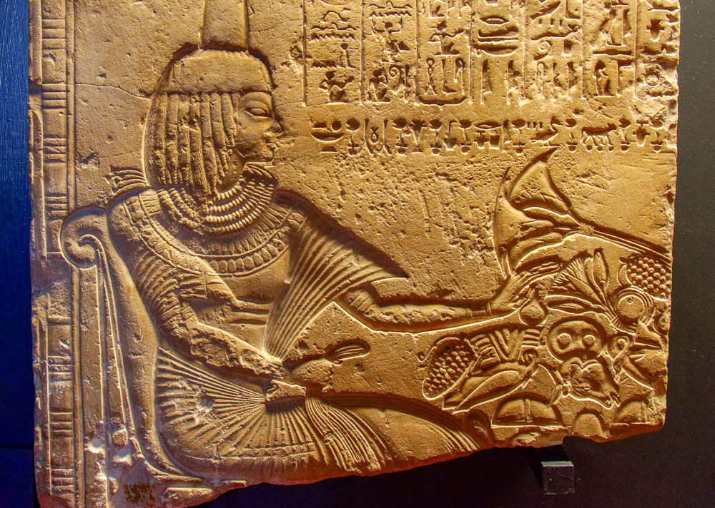
I said to myself, “Come, I will test you with pleasure, so enjoy yourself!”
Relief of a woman at a banquet, from Memphis, 18th dynasty, circa 1450 BC
2:1
Notes:
This relief depicts a woman at a banquet, facing a table piled high with food. This relief was photographed at the Vatican Museums.
tb0512176227

Slide 4
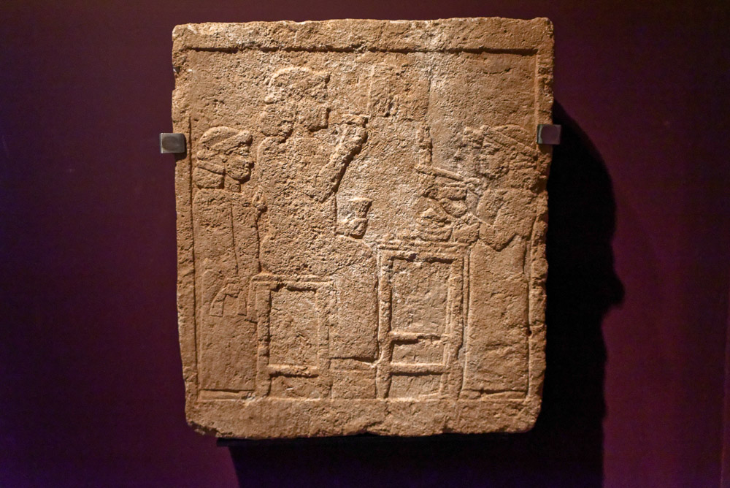
I said to myself, “Come, I will test you with pleasure, so enjoy yourself!”
Stele of a royal banquet, with a king and servants, from Urartu, 8th century BC
2:1
Notes:
This limestone relief was photographed at the Israel Museum.
tb052723307

Slide 5
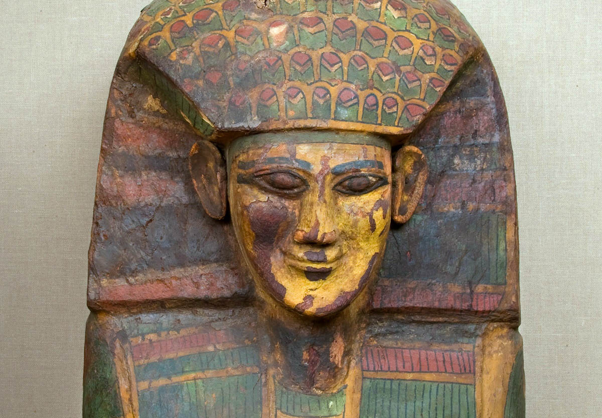
I said of laughter, “It is madness,” and of pleasure, “What use is it?”
Sycamore-wood coffin with creepy smile, from el-Asasif, circa 1600 BC
2:2
Notes:
The irony of the smiling face on this coffin from el-Asasif may be considered an illustration of the vanity of laughter. This coffin dates to the 18th dynasty of Egypt. This image comes from The Metropolitan Museum of Art, public domain, Rogers Fund, 1912, accession number 12.181.301a, b, https://www.metmuseum.org/art/collection/search/546956.
met546956

Slide 6
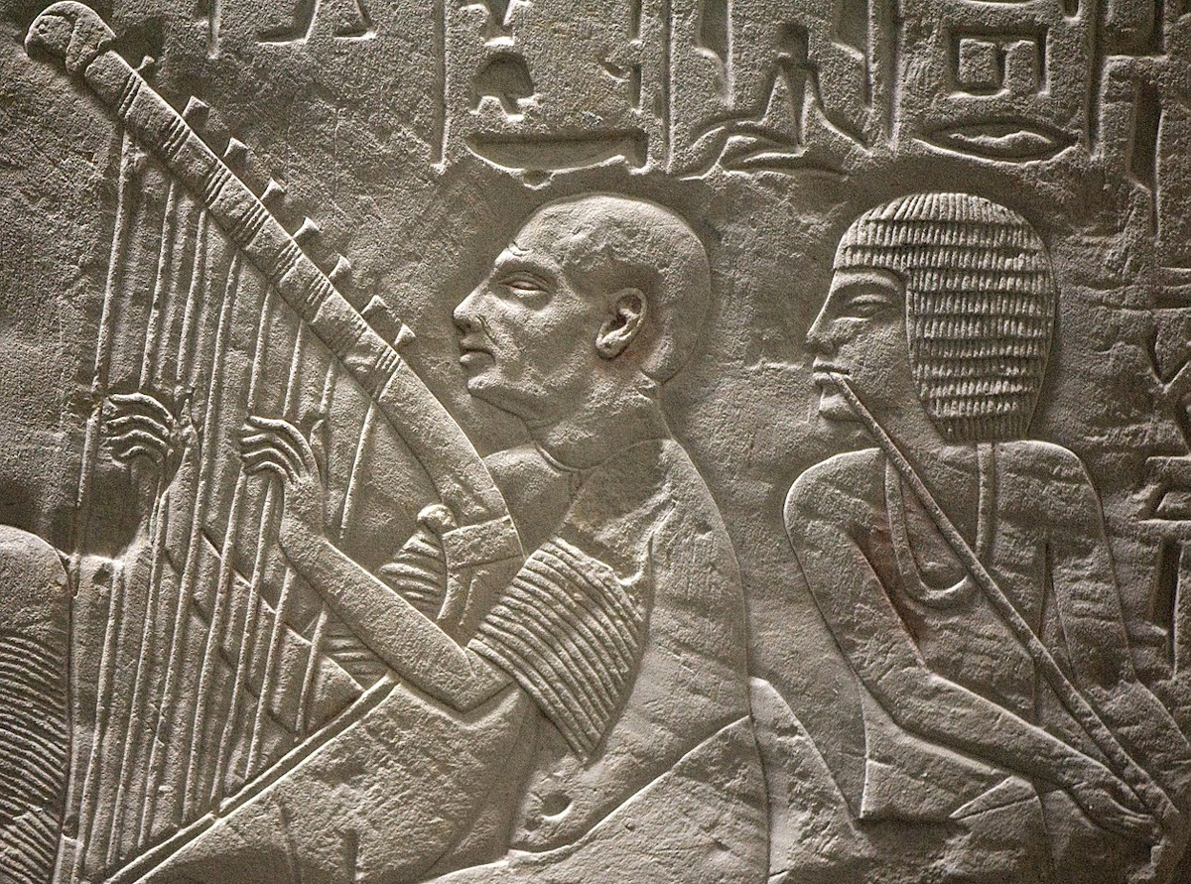
I said of laughter, “It is madness,” and of pleasure, “What use is it?”
Relief of musicians, from the tomb-chapel of Paätenemheb at Saqqara, late 14th century BC
2:2
Notes:
This relief depicts one man playing a harp and another playing a flute. This image comes from rob koopman and is licensed under CC BY-SA 2.0, via Wikimedia Commons: https://commons.wikimedia.org/wiki/File:Tomb_chapel_of_pa%C3%A4tenemheb_(RMO_Leiden_egypt_saqqara_1333-1307bc)_(3970065130).jpg.
wiki09300914183259409

Slide 7
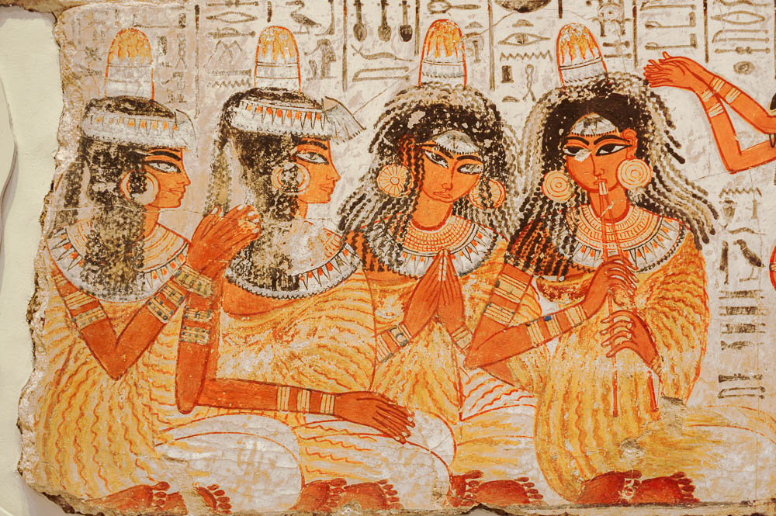
I said of laughter, “It is madness,” and of pleasure, “What use is it?”
Female musicians and clappers, from the tomb-chapel of Nebamun at Thebes, circa 1350 BC
2:2
Notes:
This tomb painting illustrates the practice of clapping associated with music (the woman at the far right plays a double flute). Each woman also has a perfume cone on her head, indicating that the larger scene is one of celebration, such as a banquet. This painting was photographed at the British Museum.
adr1805170572

Slide 8
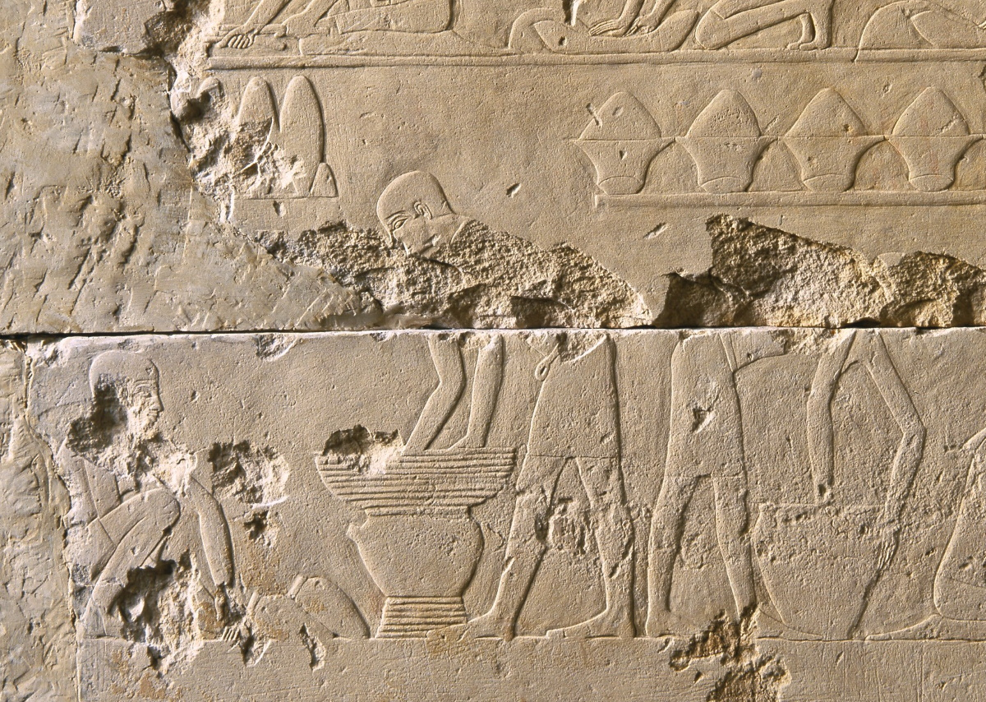
I explored with my mind how to cheer my body with wine while being wise
Relief of men making beer, from the tomb chapel of Raemkai at Saqqara, circa 2400 BC
2:3
Notes:
This image comes from the Metropolitan Museum of Art and is in the public domain. Source: https://www.metmuseum.org/art/collection/search/577368.
met577368

Slide 9
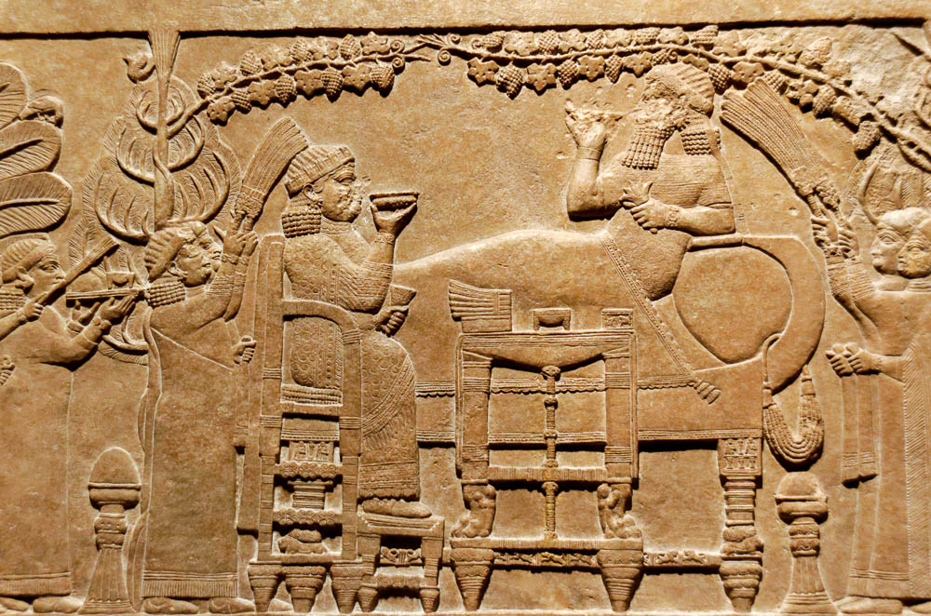
I explored with my mind how to cheer my body with wine while being wise
Relief of Ashurbanipal dining with his wife, from Nineveh, 7th century BC
2:3
Notes:
This relief depicts a king enjoying a banquet, presumably with the queen and other attendants. He is drinking wine from a shallow bowl, as was the custom. This relief was photographed at the Getty Villa in southern California while on loan from the British Museum.
tb100919348

Slide 10
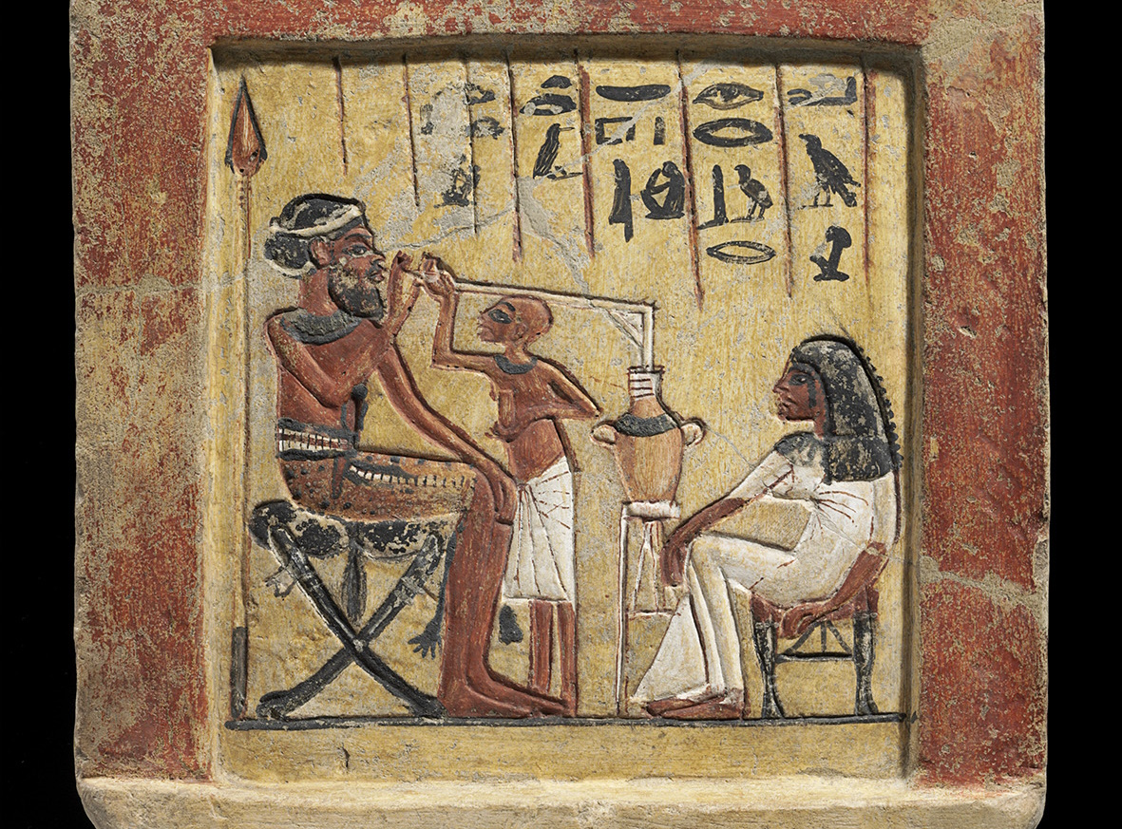
I explored with my mind how to cheer my body with wine while being wise
Stele depicting a Syrian mercenary drinking beer, from Amarna, 14th century BC
2:3
Notes:
This painted stele depicts a Syrian mercenary (identifiable by his beard and the spear behind him) drinking beer from an amphora through a long straw. This image comes from Staatliche Museen zu Berlin and is licensed under CC BY-SA 4.0. Source: https://recherche.smb.museum/detail/607112.
smb607112c

Slide 11
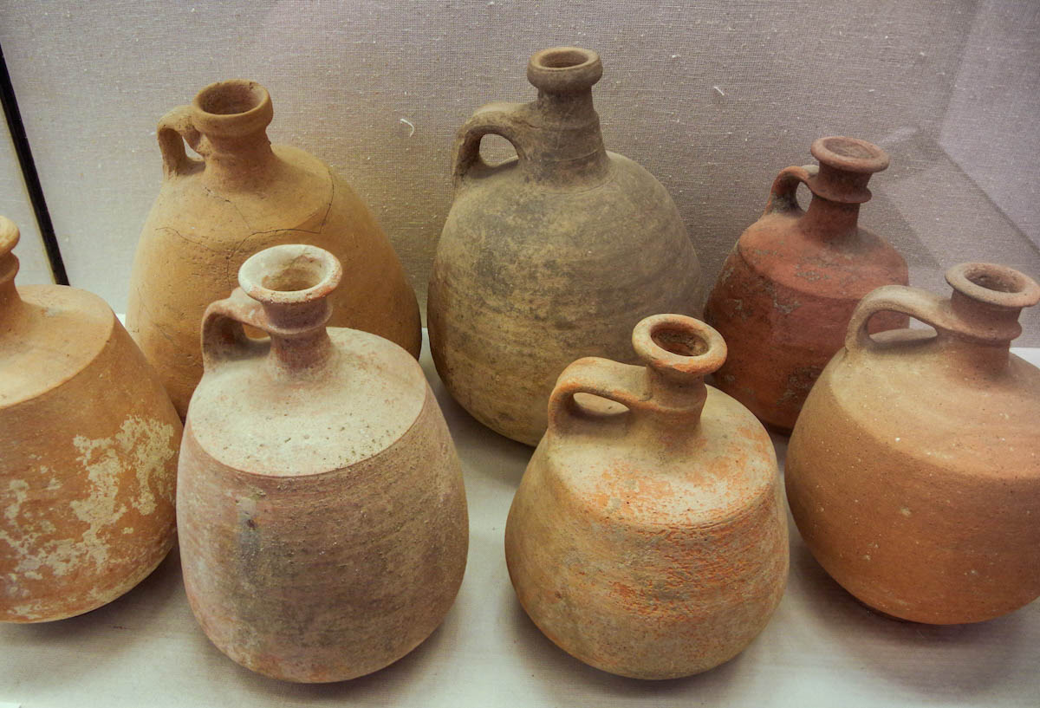
I explored with my mind how to cheer my body with wine while being wise
Judean-type wine jugs, 8th–7th centuries BC
2:3
Notes:
Jugs of the type shown here are thought to have been used for wine. This photograph was taken at the Hecht Museum at the University of Haifa.
adr1805259354

Slide 12
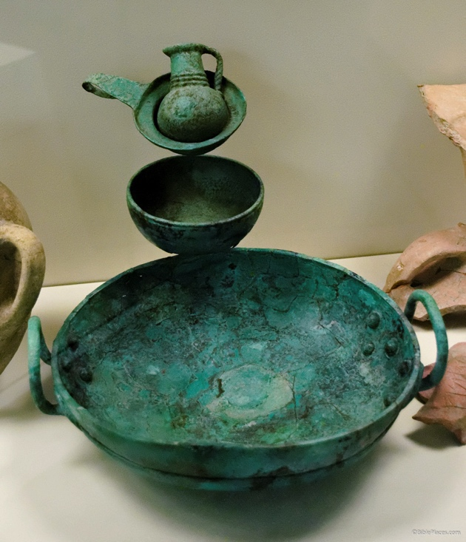
I explored with my mind how to cheer my body with wine while being wise
Bronze wine set, from a tomb at Tell es-Saidiyeh, circa 1300 BC
2:3
Notes:
This expensive bronze drinking set includes a large bowl for mixing and smaller bowls for dipping, pouring, and drinking. Tell es-Saidiyeh is located in the Jordan Valley, north of Jericho. These vessels, which date to the Late Bronze IIB (13th century BC), were photographed at the Museum of Archaeology and Anthropology at the University of Pennsylvania.
tb072311588

Slide 13
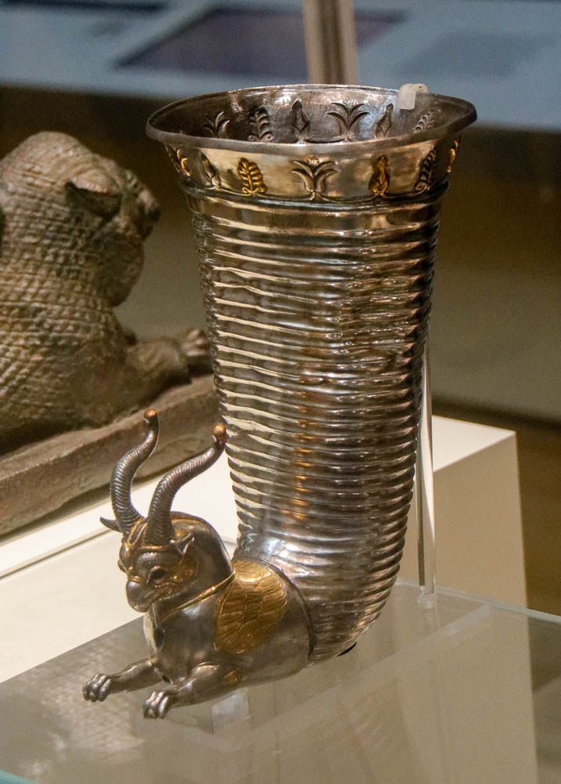
I explored with my mind how to cheer my body with wine while being wise
Silver wine cup, perhaps from Altintepe, mid 6th–5th centuries BC
2:3
Notes:
This silver rhyton is decorated with a winged griffin and plant motifs. As luxurious as such a silver vessel as this may appear, 1 Kings 10:21 says, “And all king Solomon's drinking vessels were of gold, and all the vessels of the house of the forest of Lebanon were of pure gold: none were of silver; it was nothing accounted of in the days of Solomon” (ASV). This photograph was taken at the British Museum.
tb0929196906

Slide 14
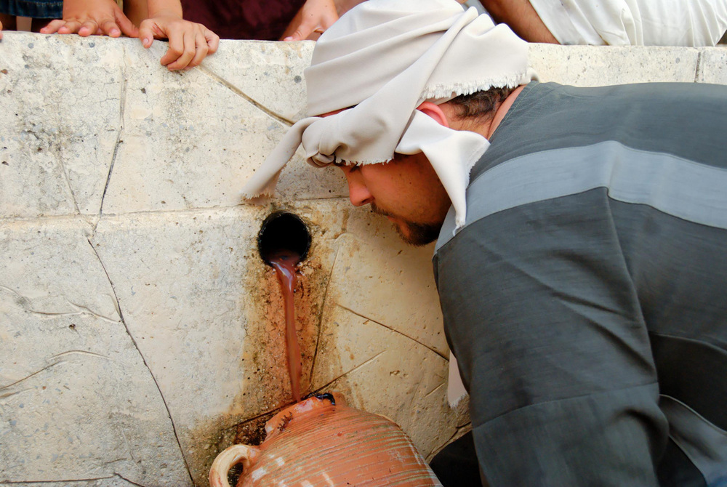
I explored with my mind how to cheer my body with wine while being wise
Collecting juice from a winepress
2:3
Notes:
tb100806734

Slide 15
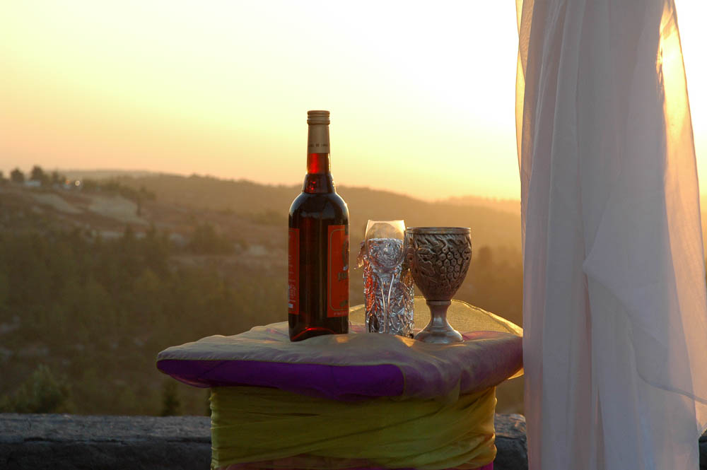
I explored with my mind how to cheer my body with wine while being wise
Wine bottle and goblet for a wedding
2:3
Notes:
tb081605418

Slide 16
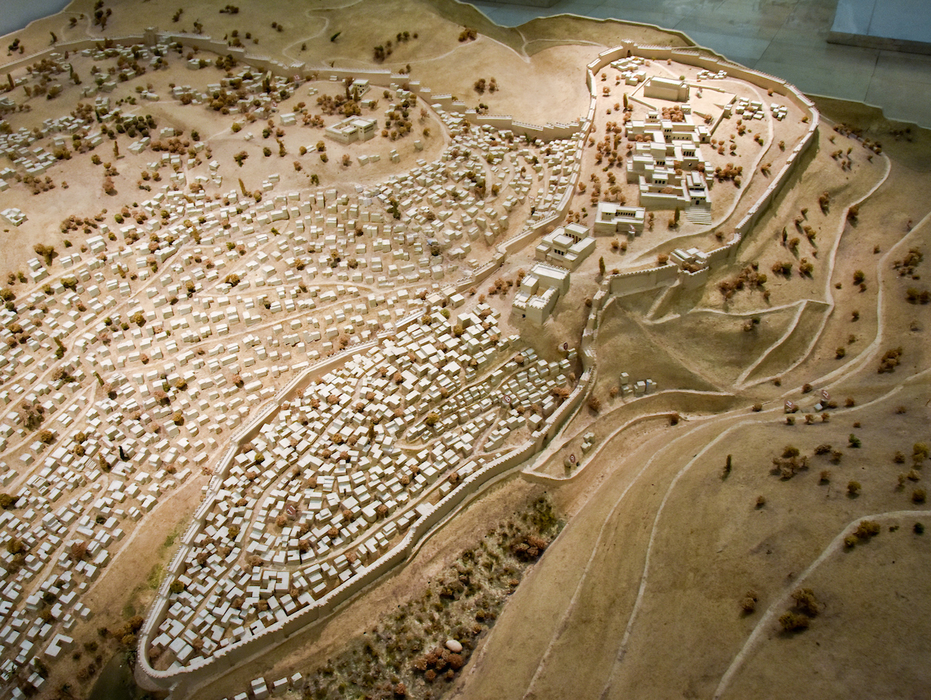
I undertook great projects, building houses and planting vineyards
A model of Jerusalem in Old Testament times
2:4
Notes:
One of the great projects accomplished by Solomon was his expansion of the city of Jerusalem to the north. He roughly doubled the size of the city, using the newly walled area to house the temple of Yahweh and a number of other buildings that comprised the royal compound (1 Kgs 7).
Solomon’s Palace
To date, there is no archaeological evidence of Solomon’s palace. Most scholars believe that it was located beneath the Temple Mount in close proximity to the first temple, which was built at the high point of the eastern hill.
House of Yahweh
The first temple built by Solomon was located at the high point of the eastern hill. There is no direct archaeological evidence for the first temple, because it was covered over by the Herodian Temple Mount and several later structures.
Wall of Jerusalem
Jerusalem’s Iron Age fortifications developed in three main stages. The Jebusite fortifications enclosed the City of David with walls on the eastern/Kidron Valley side (abundant archaeological evidence), the western/Central Valley side (some archaeological evidence), and northern side (no evidence). These were the existing fortifications when David conquered the city (2 Sam 5). In the mid-10th century BC, Solomon expanded the fortifications to enclose the eastern hill and his newly built temple (1 Kgs 2:4). From the 10th century onward, Jerusalem continued to grow in population to the west on the more prominent Western Hill. During the reign of Hezekiah, this part of Jerusalem was enclosed with a massive wall that connected the temple area and enclosed the entire Western Hill with a wall above the Hinnom Valley (2 Kgs 18:13–19:37; 2 Chr 32:1-23; Isa 36:1–37:38). The next slide includes labels.
This model was photographed at the Bible Lands Museum in Jerusalem.
mjb1904257002

Slide 17
I undertook great projects, building houses and planting vineyards
Temple of Yahweh
Palace of Solomon
Later expansion under Hezekiah (Western Hill)
Palace of David
City of David
A model of Jerusalem in Old Testament times
2:4
Notes:
One of the great projects accomplished by Solomon was his expansion of the city of Jerusalem to the north. He roughly doubled the size of the city, using the newly walled area to house the temple of Yahweh and a number of other buildings that comprised the royal compound (1 Kgs 7).
Solomon’s Palace
To date, there is no archaeological evidence of Solomon’s palace. Most scholars believe that it was located beneath the Temple Mount in close proximity to the first temple, which was built at the high point of the eastern hill.
House of Yahweh
The first temple built by Solomon was located at the high point of the eastern hill. There is no direct archaeological evidence for the first temple, because it was covered over by the Herodian Temple Mount and several later structures.
Wall of Jerusalem
Jerusalem’s Iron Age fortifications developed in three main stages. The Jebusite fortifications enclosed the City of David with walls on the eastern/Kidron Valley side (abundant archaeological evidence), the western/Central Valley side (some archaeological evidence), and northern side (no evidence). These were the existing fortifications when David conquered the city (2 Sam 5). In the mid-10th century BC, Solomon expanded the fortifications to enclose the eastern hill and his newly built temple (1 Kgs 2:4). From the 10th century onward, Jerusalem continued to grow in population to the west on the more prominent Western Hill. During the reign of Hezekiah, this part of Jerusalem was enclosed with a massive wall that connected the temple area and enclosed the entire Western Hill with a wall above the Hinnom Valley (2 Kgs 18:13–19:37; 2 Chr 32:1-23; Isa 36:1–37:38). The area colored blue represents the city as it existed in the days of David, and the green area represents the expansion of the city under Solomon.
This model was photographed at the Bible Lands Museum in Jerusalem.
mjb1904257002

Slide 18
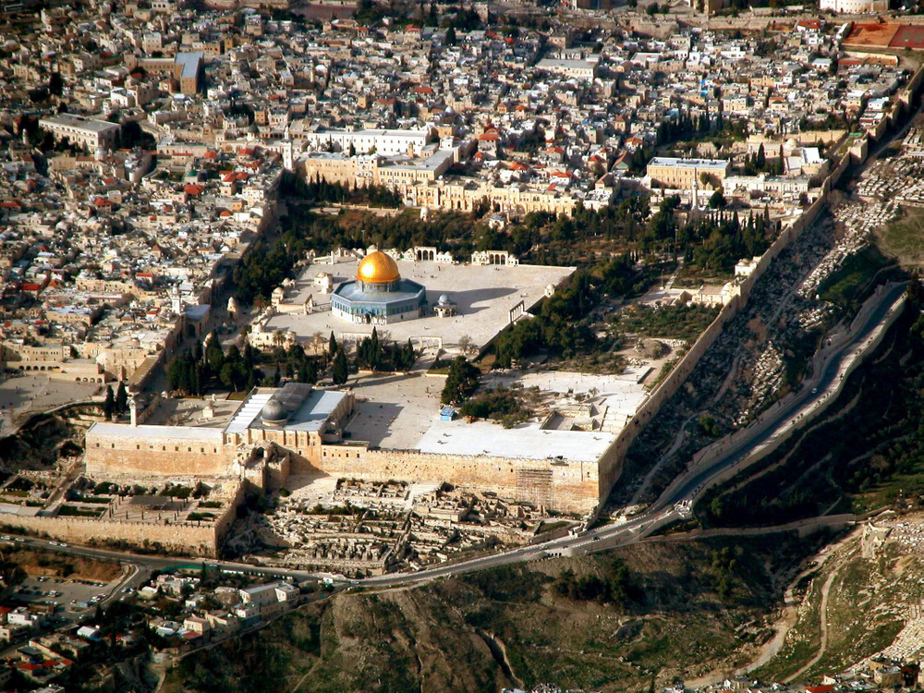
I undertook great projects, building houses and planting vineyards
Temple Mount (aerial view from the south)
2:4
Notes:
Evidence of construction from the time of Solomon has been uncovered in the Ophel Excavations south of the Temple Mount. The next slide includes labels.
tb010703231

Slide 19
I undertook great projects, building houses and planting vineyards
Location of Temple
Ophel Excavations
Iron IIA(?) fortifications
Temple Mount (aerial view from the south)
2:4
Notes:
Evidence of construction from the time of Solomon has been uncovered in the Ophel Excavations south of the Temple Mount.
tb010703231

Slide 20
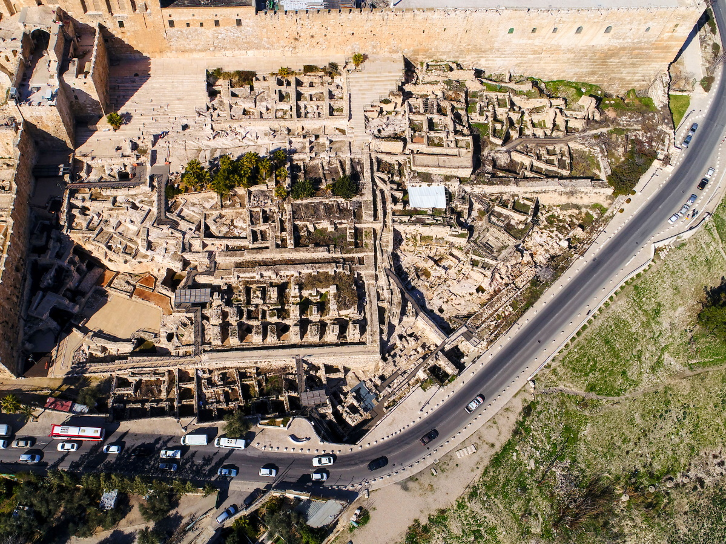
I undertook great projects, building houses and planting vineyards
Southern Temple Mount excavations (aerial view from the south)
2:4
Notes:
A summary of some of Solomon’s construction work in Jerusalem appears in 1 Kings 9:15, which credits him with building “the house of Yahweh, and his own house, and the Millo, and the wall of Jerusalem.” The “wall of Jerusalem” refers to the wall that was built around the new extension to the north of the City of David (Mazar 2011: 149). Excavations on the south side of the Temple Mount have revealed a number of structures from the First Temple period, including a gatehouse, a royal structure, and a length of wall referred to by the excavators as the “Straight Wall.” Beneath a later tower of the Byzantine period, a First Temple tower was also discovered, associated with the gatehouse. The next slide includes labels.
Reference:
Mazar, Eilat.
2011 Discovering the Solomonic Wall in Jerusalem. Jerusalem: Shoham Academic Research.
ws020517352

Slide 21
I undertook great projects, building houses and planting vineyards
Straight Wall
Royal Structure
Gatehouse
Byzantine Ophel Tower
Southern Temple Mount excavations (aerial view from the south)
2:4
Notes:
A summary of some of Solomon’s construction work in Jerusalem appears in 1 Kings 9:15, which credits him with building “the house of Yahweh, and his own house, and the Millo, and the wall of Jerusalem.” The “wall of Jerusalem” refers to the wall that was built around the new extension to the north of the City of David (Mazar 2011: 149). Excavations on the south side of the Temple Mount have revealed a number of structures from the First Temple period, including a gatehouse, a royal structure, and a length of wall referred to by the excavators as the “Straight Wall.” Beneath a later tower of the Byzantine period, a First Temple tower was also discovered, associated with the gatehouse.
Reference:
Mazar, Eilat.
2011 Discovering the Solomonic Wall in Jerusalem. Jerusalem: Shoham Academic Research.
ws020517352

Slide 22
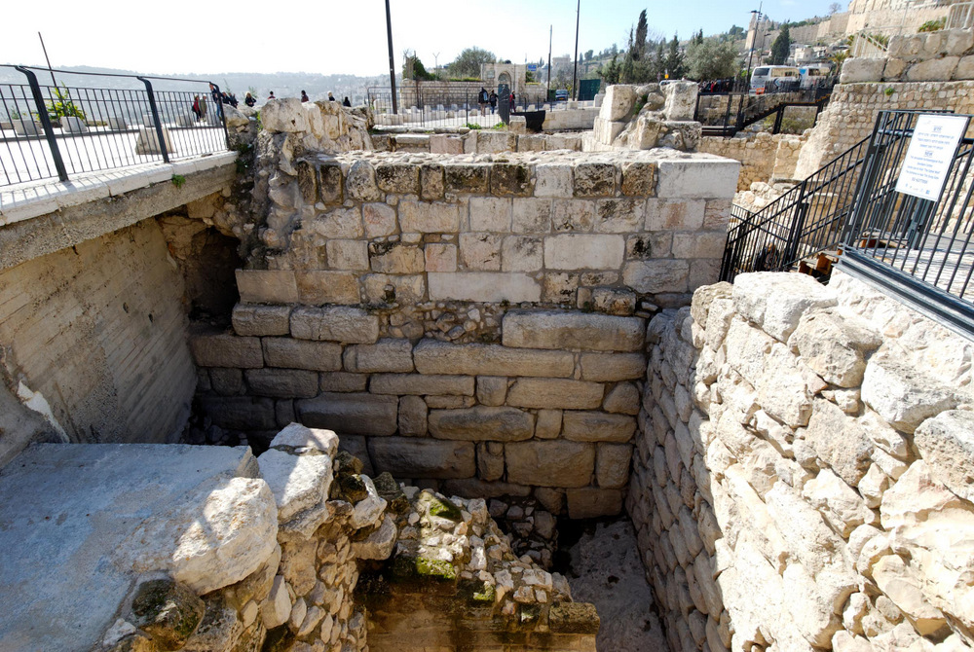
I undertook great projects, building houses and planting vineyards
Iron Age tower and wall in the Ophel area
2:4
Notes:
Only a portion of one face of the “Extra Tower” is visible today, as most is buried underneath the modern street (left). This wall, with its impressive ashlar stones, dates to the Iron Age and is part of the fortifications of Jerusalem. Mazar believes that it is part of the outer gatehouse complex, although probably added in the 8th century BC by Uzziah (Mazar 2011: 119). A Byzantine tower was later built on top of the Extra Tower. The Royal Structure is located to the right of the Extra Tower. The next slide includes labels.
Reference:
Mazar, Eilat.
2011 Discovering the Solomonic Wall in Jerusalem. Jerusalem: Shoham Academic Research.
tb010112136

Slide 23
I undertook great projects, building houses and planting vineyards
Byzantine Ophel Tower
Extra Tower
Royal Structure
Iron Age tower and wall in the Ophel area
2:4
Notes:
Only a portion of one face of the “Extra Tower” is visible today, as most is buried underneath the modern street (left). This wall, with its impressive ashlar stones, dates to the Iron Age and is part of the fortifications of Jerusalem. Mazar believes that it is part of the outer gatehouse complex, although probably added in the 8th century BC by Uzziah (Mazar 2011: 119). A Byzantine tower was later built on top of the Extra Tower. The Royal Structure is located to the right of the Extra Tower.
Reference:
Mazar, Eilat.
2011 Discovering the Solomonic Wall in Jerusalem. Jerusalem: Shoham Academic Research.
tb010112136

Slide 24
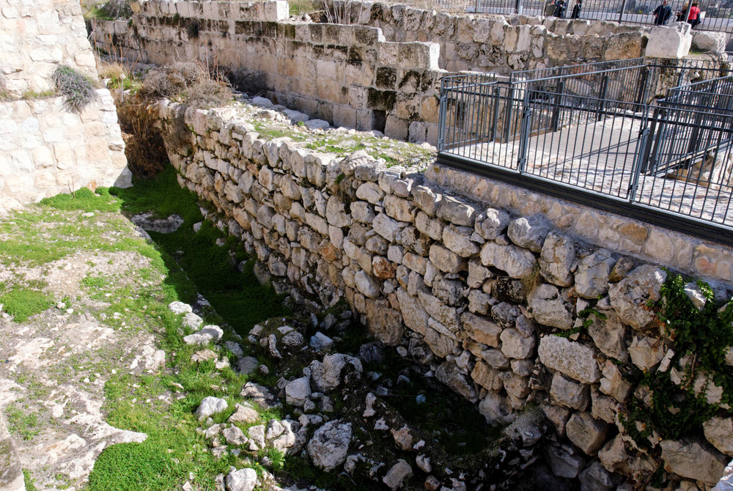
I undertook great projects, building houses and planting vineyards
Straight Wall in the Ophel area
2:4
Notes:
The “Straight Wall” begins as an outer wall of the Royal Structure. It has been exposed for a distance of about 220 feet (67 m). The dating of this wall, as well as the Royal Structure, to the time of Solomon (10th c. BC) is based on meager remains including an intact black juglet, a frog-shaped scaraboid, and a few 10th-century rim and handle fragments (Mazar 2011: 70, 111–13).
Reference:
Mazar, Eilat.
2011 Discovering the Solomonic Wall in Jerusalem. Jerusalem: Shoham Academic Research.
tb010112126

Slide 25
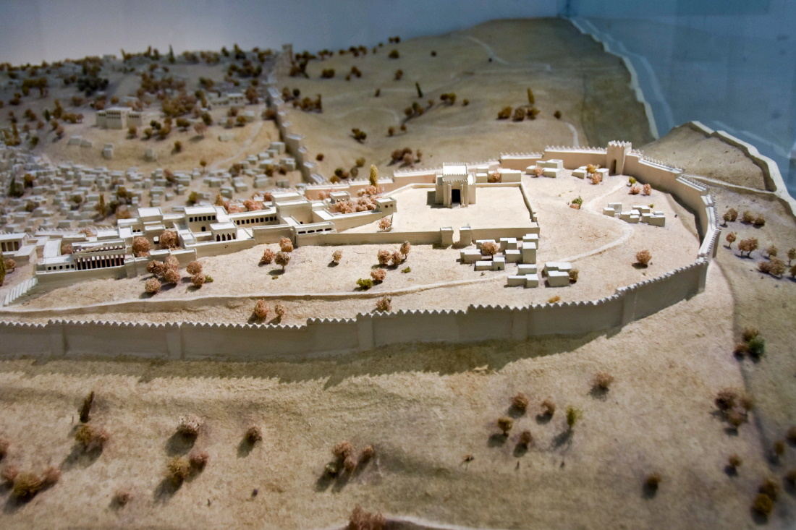
I undertook great projects, building houses and planting vineyards
Solomon’s Temple on a model of Jerusalem during the Divided Monarchy (from the east)
2:4
Notes:
Among the many “houses” built by Solomon was the Temple of Yahweh. A detailed description of this structure may be found in 1 Kings 6. The temple built by Solomon was located on the hill to the north of the City of David, where the threshing floor of Araunah had previously been located (2 Chr 3:1; cf. 2 Sam 24:21). This is approximately the same location as the present Dome of the Rock, which was built by the Umayyad Caliph Abd al-Malik in about AD 690. This model was photographed at the Bible Lands Museum in Jerusalem.
mjb1903102466c

Slide 26
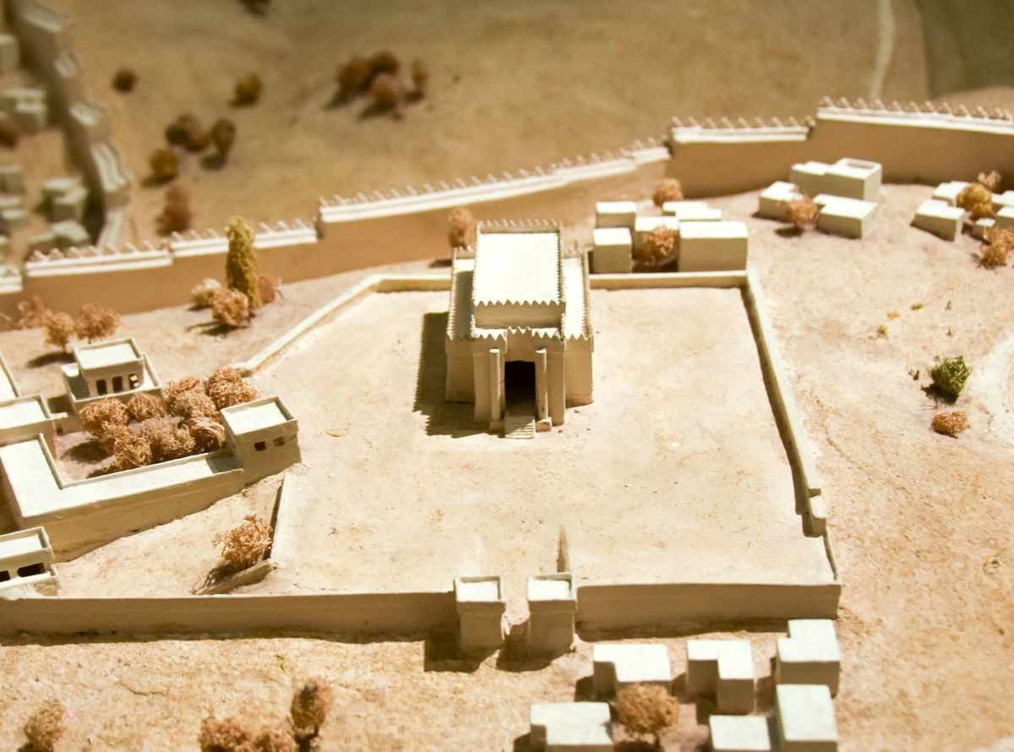
I undertook great projects, building houses and planting vineyards
Solomon’s Temple on a model of Jerusalem during the Divided Monarchy (from the east)
2:4
Notes:
Despite the measurements given in 1 Kings 6, the exact shape of the temple built by Solomon continues to be the subject of debate. This model represents one artist’s conception. This model was photographed at the Bible Lands Museum in Jerusalem.
mjb1903102467c

Slide 27
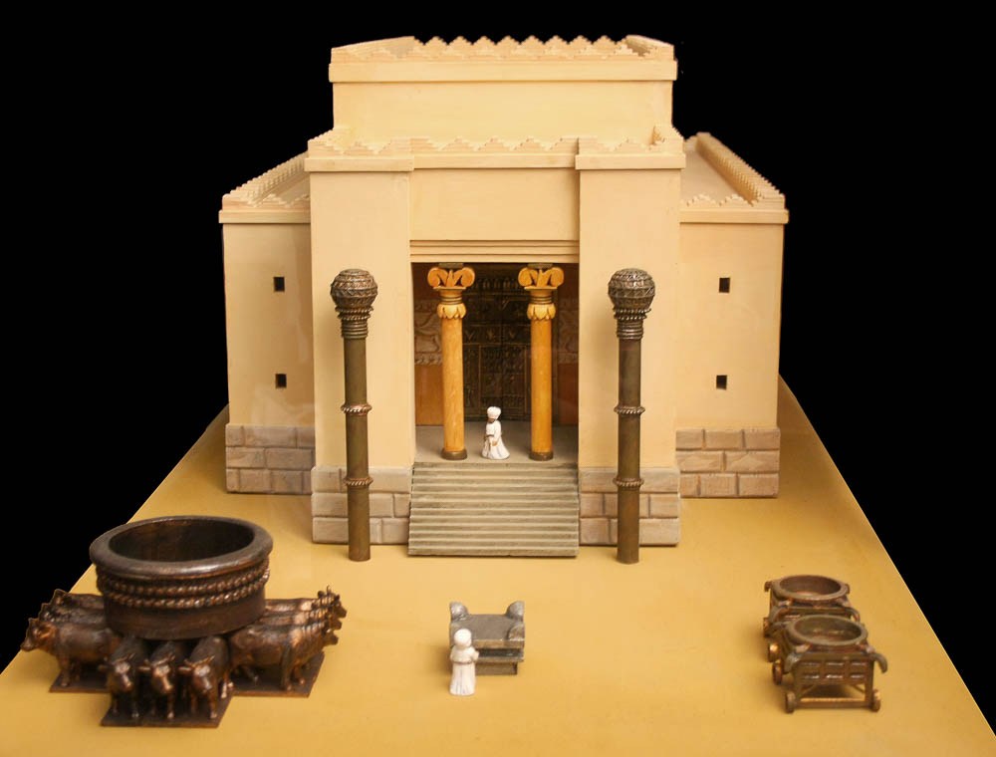
I undertook great projects, building houses and planting vineyards
Model of Solomon’s Temple
2:4
Notes:
This model of Solomon’s temple reflects an artist’s conception of what it may have looked like. It was photographed by Alexander Schick in the Canstein Bible Institute in the Francke Foundations in Halle, Germany.
as041208500

Slide 28
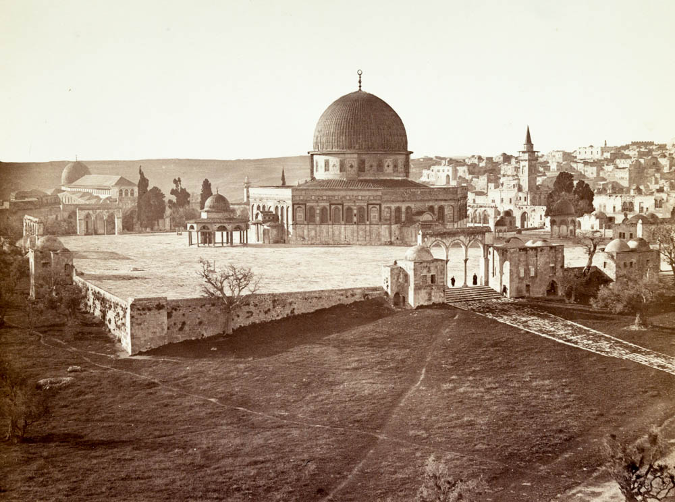
I undertook great projects, building houses and planting vineyards
Temple Mount, circa 1865 (from the northeast)
2:4
Notes:
Most scholars believe that the temple built by Solomon was located in approximately the place where the Dome of the Rock now stands. This illustration comes from James McDonald and Sir Charles William Wilson, Ordnance Survey of Jerusalem, published in 1865. Public domain, from the New York Public Library, https://digitalcollections.nypl.org/items/510d47d9-642d-a3d9-e040-e00a18064a99.
nypl87133a

Slide 29
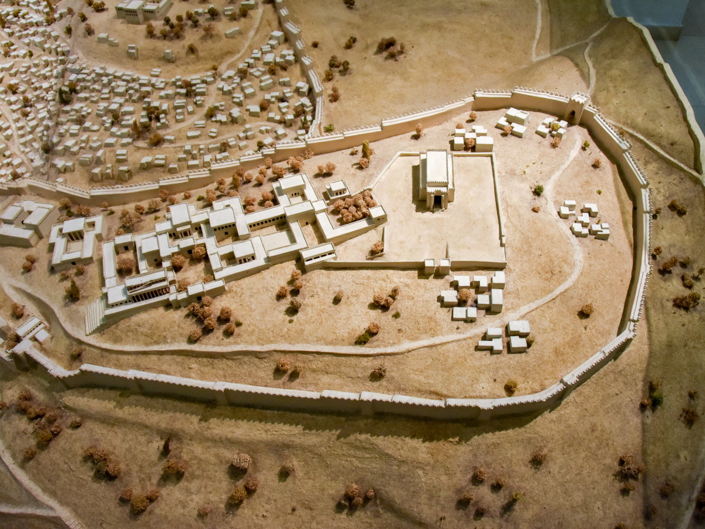
I undertook great projects, building houses and planting vineyards
Model of Jerusalem with Solomon’s temple and palace (from the east)
2:4
Notes:
Solomon also built a number of magnificent buildings as part of the royal compound in Jerusalem. A detailed description is available in 1 Kings 7. These included the “house of the forest of Lebanon,” a “hall of pillars,” the “hall of the throne,” a house where he himself lived, and a house for pharaoh’s daughter (one of his wives). This model depicts Jerusalem from a slightly later period, after the city was expanded to include the western hill in the days of Hezekiah (8th c. BC). This model was photographed at the Bible Lands Museum in Jerusalem. The next slide includes labels.
mjb1904256992c

Slide 30
I undertook great projects, building houses and planting vineyards
Temple of Yahweh
Palace of
Solomon
Model of Jerusalem with Solomon’s temple and palace (from the east)
2:4
Notes:
Solomon also built a number of magnificent buildings as part of the royal compound in Jerusalem. A detailed description is available in 1 Kings 7. These included the “house of the forest of Lebanon,” a “hall of pillars,” the “hall of the throne,” a house where he himself lived, and a house for pharaoh’s daughter (one of his wives). This model depicts Jerusalem from a slightly later period, after the city was expanded to include the western hill in the days of Hezekiah (8th c. BC). This model was photographed at the Bible Lands Museum in Jerusalem.
mjb1904256983c

Slide 31
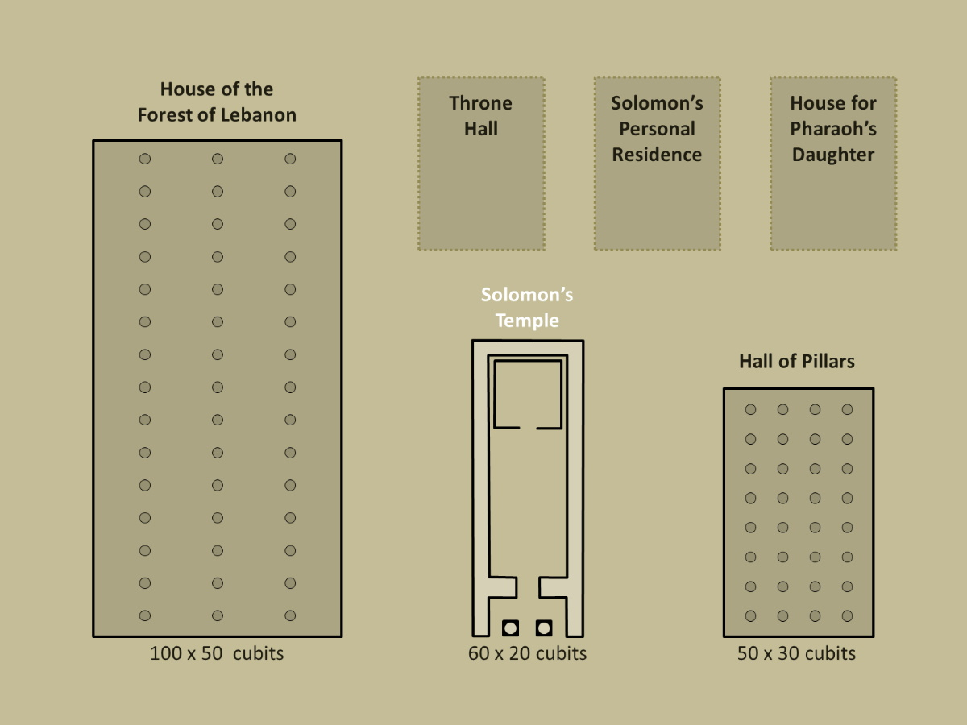
I undertook great projects, building houses and planting vineyards
House of the
Forest of Lebanon
Throne
Hall
Solomon’s Personal Residence
House for Pharaoh’s Daughter
Solomon’s
Temple
Hall of Pillars
100 x 50 cubits
60 x 20 cubits
50 x 30 cubits
Comparison of Solomon’s temple and his other palace structures
2:4
Notes:
The dimensions for two of the buildings in Solomon’s palace compound are given in 1 Kings 7. The House of the Forest of Lebanon is described as 100 x 50 cubits (1 Kgs 7:2) and the Hall of Pillars was 50 x 30 cubits (1 Kgs 7:6). This may be compared to the temple, which was 60 x 20 cubits, not counting the storage rooms around its perimeter (1 Kgs 6:2). Both of these buildings were larger (covered more area) than the temple.
In addition, Solomon built at least three other structures: his throne hall (1 Kgs 7:7), his personal residence (1 Kgs 7:8), and a residence for his Egyptian wife (1 Kgs 7:8). No dimensions are given for these three structures, so they were likely smaller than the ones previously named. This plan shows the comparative size of the structures for which measurements are given, illustrating the grand scale of the structures incorporated into Solomon’s palatial compound. An editable version is included beneath the graphic for those who wish to modify it.
Plan by Kris Udd.

Slide 32
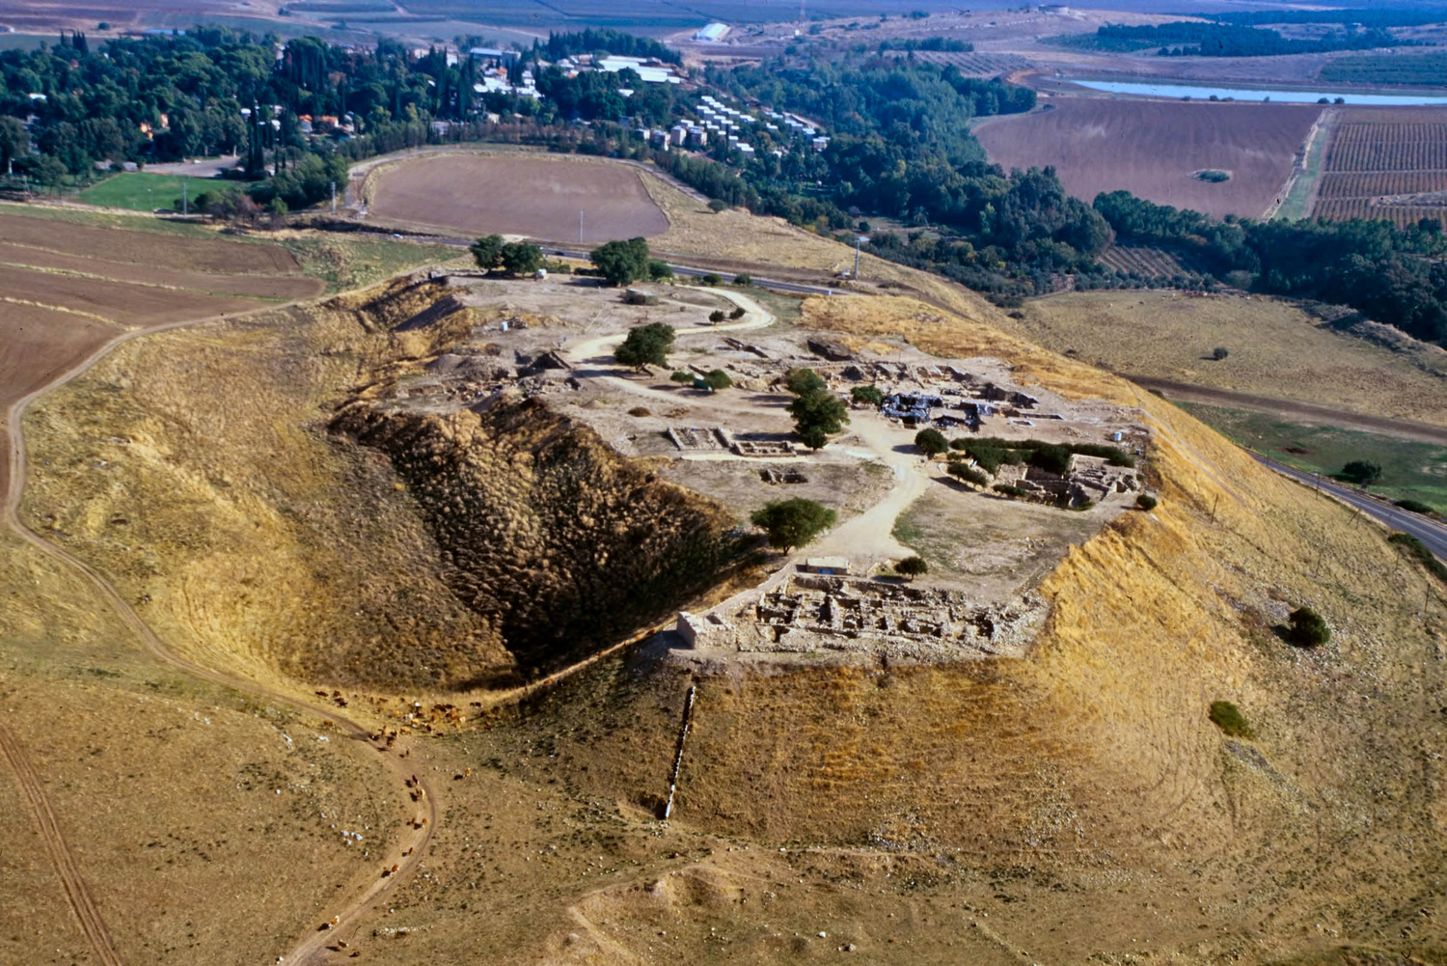
I undertook great projects, building houses and planting vineyards
Upper city of Hazor (aerial view from the west)
2:4
Notes:
Special note is made in 1 Kings 9:15 of Solomon’s building projects at Hazor, Megiddo, and Gezer. Archaeological evidence has been discovered at each of these three cities that supports Solomon’s building and fortification projects there. Each has a large, six-chambered gate of similar design, and these are usually assigned to Solomon’s reign.
Hazor is mentioned in the second set of Egyptian Execration Texts and in the Egyptian Amarna letters, as well as in letters from the Mari palace in Mesopotamia. Hazor was at the end of a major trade route and was the Canaanite stronghold of the Fertile Crescent. Several Canaanite temples and religious artifacts have been found at the site. During the 10th century BC, Solomon rebuilt Hazor (1 Kgs 9:15). Hazor was captured by Tiglath-pileser III, king of Assyria, in the late 8th century BC (2 Kgs 15:29). The next slide includes labels.
tbs112040011

Slide 33
I undertook great projects, building houses and planting vineyards
lower city
Solomonic
gate
Canaanite
palace
lower city
Israelite
water system
tripartite
building
four-room
house
Israelite
tower
Upper city of Hazor (aerial view from the west)
2:4
Notes:
Special note is made in 1 Kings 9:15 of Solomon’s building projects at Hazor, Megiddo, and Gezer. Archaeological evidence has been discovered at each of these three cities that supports Solomon’s building and fortification projects there. Each has a large, six-chambered gate of similar design, and these are usually assigned to Solomon’s reign.
Hazor is mentioned in the second set of Egyptian Execration Texts and in the Egyptian Amarna letters, as well as in letters from the Mari palace in Mesopotamia. Hazor was at the end of a major trade route and was the Canaanite stronghold of the Fertile Crescent. Several Canaanite temples and religious artifacts have been found at the site. During the 10th century BC, Solomon rebuilt Hazor (1 Kgs 9:15). Hazor was captured by Tiglath-pileser III, king of Assyria, in the late 8th century BC (2 Kgs 15:29).
tbs112040011

Slide 34
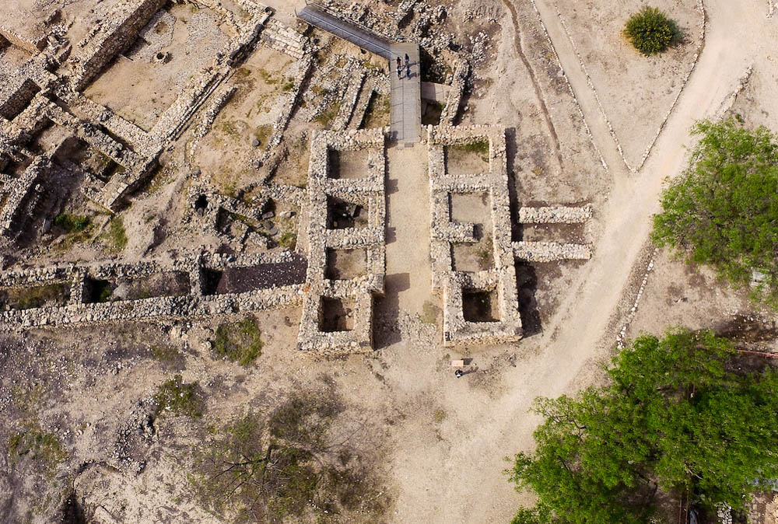
I undertook great projects, building houses and planting vineyards
Solomonic gate at Hazor, 10th century BC (aerial view from the east)
2:4
Notes:
Archaeologists have uncovered a six-chambered gate at Hazor that is nearly identical in size and design to the gates at Megiddo and Gezer. The best explanation for this similarity is that these gates were all built by the same government. They are a remarkable testimony to Solomon's building activity as described in this verse. The gate system shown here features two projecting towers as well as six chambers, which would allow for four sets of wooden gates. The gate structure is adjoined on either side by a casemate wall. The next slide includes labels.
ws040616013

Slide 35
I undertook great projects, building houses and planting vineyards
gate chambers
casemate wall
projecting towers
Solomonic gate at Hazor, 10th century BC (aerial view from the east)
2:4
Notes:
Archaeologists have uncovered a six-chambered gate at Hazor that is nearly identical in size and design to the gates at Megiddo and Gezer. The best explanation for this similarity is that these gates were all built by the same government. They are a remarkable testimony to Solomon's building activity as described in this verse. The gate system shown here features two projecting towers as well as six chambers, which would allow for four sets of wooden gates. The gate structure is adjoined on either side by a casemate wall.
ws040616013

Slide 36
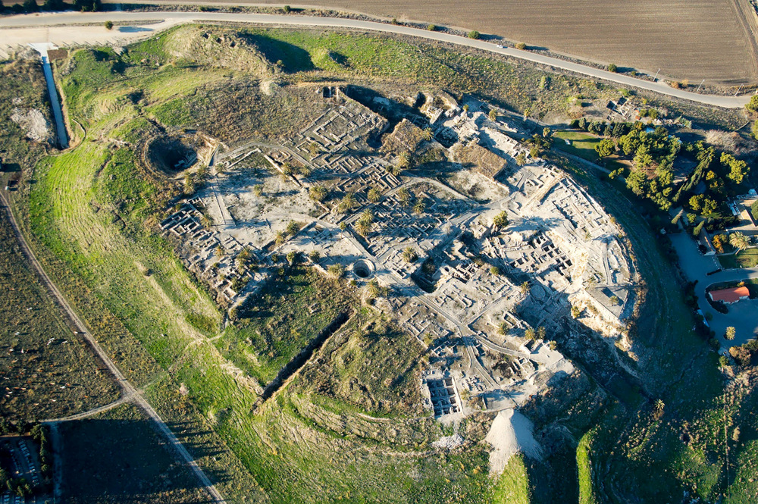
I undertook great projects, building houses and planting vineyards
Megiddo (aerial view from the southeast)
2:4
Notes:
Megiddo is another city with significant construction by Solomon. The remains visible in this aerial photo include a Solomonic six-chambered gate as well as two stable areas for horses. The stable areas are ascribed by some to Solomon, although others assign them to the time of Ahab. The next slide includes labels.
tb121704999

Slide 37
I undertook great projects, building houses and planting vineyards
Solomonic gate
water system
northern stables
southern stables
Early Bronze
temples
grain silo
Megiddo (aerial view from the southeast)
2:4
Notes:
Megiddo is another city with significant construction by Solomon. The remains visible in this aerial photo include a Solomonic six-chambered gate as well as two stable areas for horses. The stable areas are ascribed by some to Solomon, although others assign them to the time of Ahab.
tb121704999

Slide 38
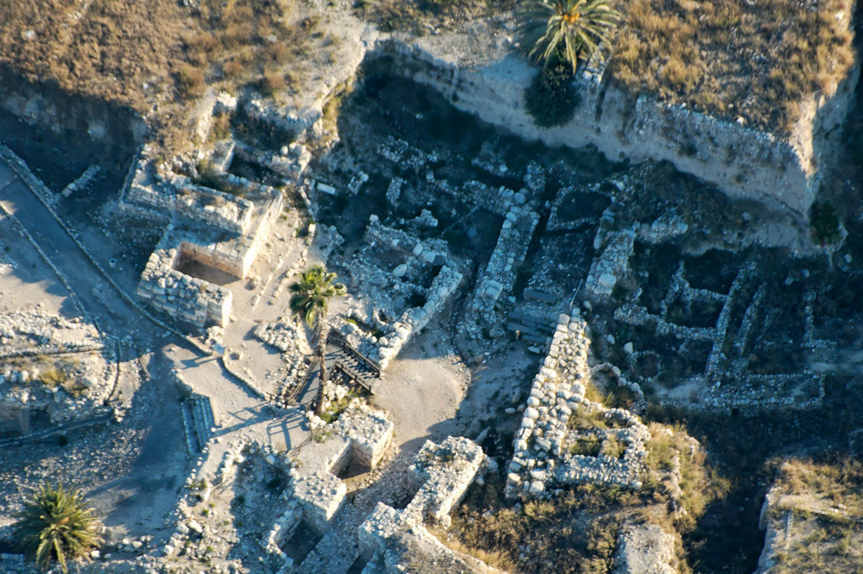
I undertook great projects, building houses and planting vineyards
Megiddo gate area (aerial view from the north)
2:4
Notes:
Only half of the Solomonic gate at Megiddo is visible in this aerial photo, as the other half was removed to allow excavation of the underlying levels, including the four-chambered gate of the earlier Middle Bronze Age. Since this photograph was taken in 2004, the western half of the gate complex has been reconstructed (see photograph below). The next slide includes labels.
tb121704010

Slide 39
I undertook great projects, building houses and planting vineyards
Solomonic gate
Middle Bronze gate
Megiddo gate area (aerial view from the north)
2:4
Notes:
Only half of the Solomonic gate at Megiddo is visible in this aerial photo, as the other half was removed to allow excavation of the underlying levels, including the four-chambered gate of the earlier Middle Bronze Age. Since this photograph was taken in 2004, the western half of the gate complex has been reconstructed (see photograph below).
tb121704010

Slide 40
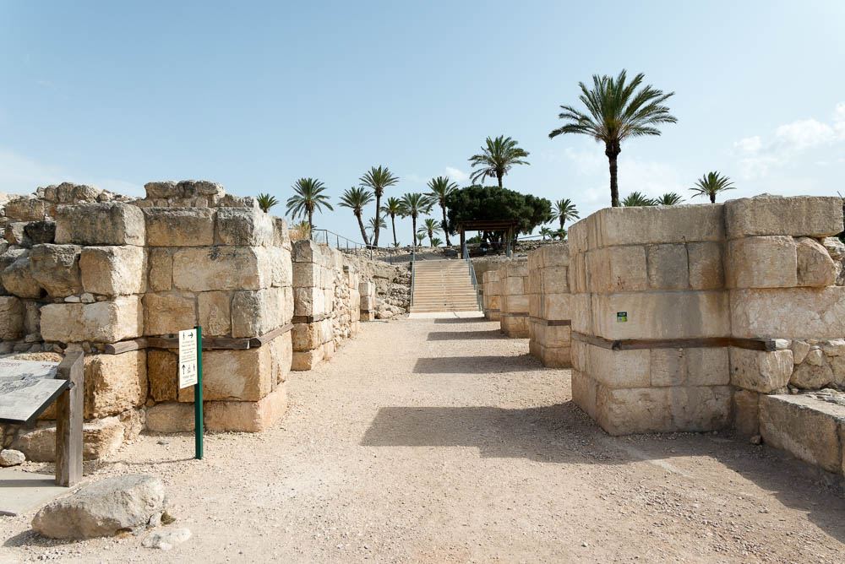
I undertook great projects, building houses and planting vineyards
Solomonic gate at Megiddo, 10th century BC (partially reconstructed)
2:4
Notes:
The three chambers on the west (right) side of the Solomonic gate were reconstructed by the Israel Nature and Parks Authority and the Israel Antiquities Authority in 2021.
tb052823976

Slide 41
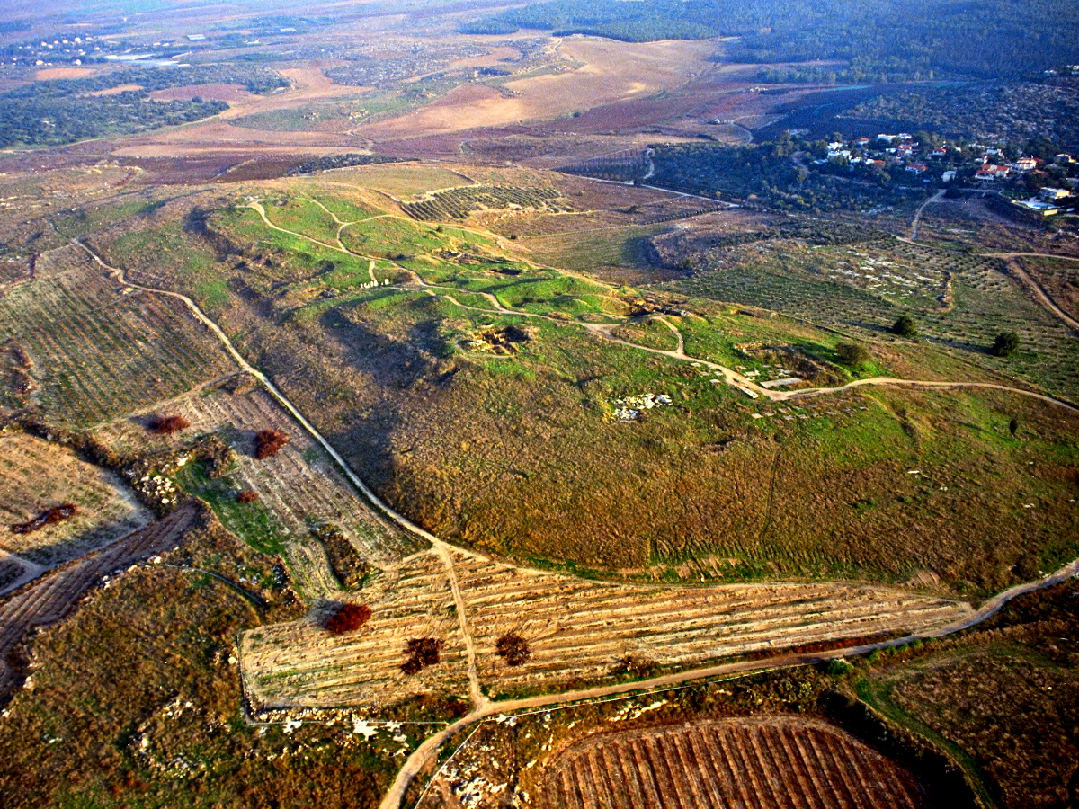
I undertook great projects, building houses and planting vineyards
Gezer (aerial view from the northwest)
2:4
Notes:
Gezer was another strategic city fortified by Solomon (1 Kgs 9:15). Prior to Solomon’s reign, the city had been occupied by the Canaanites and conquered by the pharaoh of Egypt. The next slide includes labels.
tbs136170112

Slide 42
I undertook great projects, building houses and planting vineyards
Solomonic gate
High place
Middle Bronze gate
Gezer (aerial view from the northwest)
2:4
Notes:
Gezer was another strategic city fortified by Solomon (1 Kgs 9:15). Prior to Solomon’s reign, the city had been occupied by the Canaanites and conquered by the pharaoh of Egypt.
tbs136170112

Slide 43
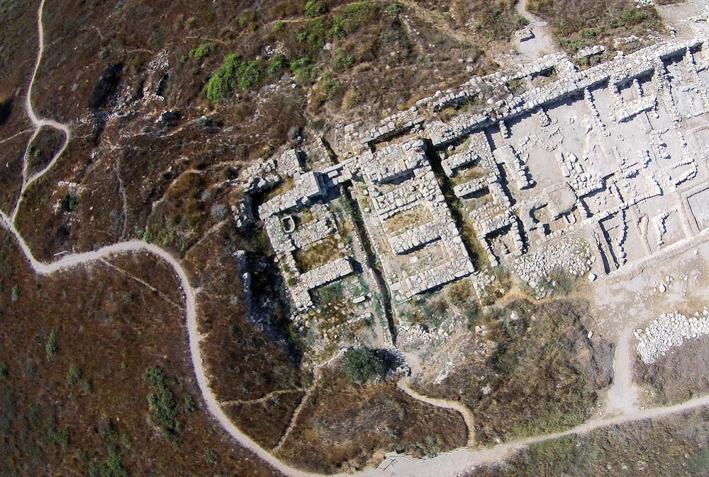
I undertook great projects, building houses and planting vineyards
Solomonic gate at Gezer, 10th century BC (aerial view from the north)
2:4
Notes:
This gate complex at Gezer is very similar to the Iron Age gate at Hazor, except that it lacks the projecting towers. It also adjoins a casemate wall and features six chambers. In addition to their protective use, gates such as this also functioned as a meeting place for business transactions and for city elders to convene and make decisions (cf. Ruth 4:1-3; 2 Sam 19:8; Jer 39:3). The chambers often featured benches that facilitated these functions. Such benches are visible around the sides of several of the gate chambers in this aerial photo.
There are three destruction layers in the Solomonic Gate area:
The first destruction is from the unnamed pharaoh of Egypt (probably Siamun, or perhaps Psusenes II) who gave Gezer to Solomon (ca. 970 BC).
The second destruction is from the Egyptian pharaoh Shishak (ca. 925 BC).
The third destruction is from Tiglath-pileser III (ca. 734 BC).
The next slide includes highlights.
ws073114042

Slide 44
I undertook great projects, building houses and planting vineyards
casemate wall
gate chambers
Solomonic gate at Gezer, 10th century BC (aerial view from the north)
2:4
Notes:
This gate complex at Gezer is very similar to the Iron Age gate at Hazor, except that it lacks the projecting towers. It also adjoins a casemate wall and features six chambers. In addition to their protective use, gates such as this also functioned as a meeting place for business transactions and for city elders to convene and make decisions (cf. Ruth 4:1-3; 2 Sam 19:8; Jer 39:3). The chambers often featured benches that facilitated these functions. Such benches are visible around the sides of several of the gate chambers in this aerial photo.
There are three destruction layers in the Solomonic Gate area:
The first destruction is from the unnamed pharaoh of Egypt (probably Siamun, or perhaps Psusenes II) who gave Gezer to Solomon (ca. 970 BC).
The second destruction is from the Egyptian pharaoh Shishak (ca. 925 BC).
The third destruction is from Tiglath-pileser III (ca. 734 BC).
ws073114042

Slide 45
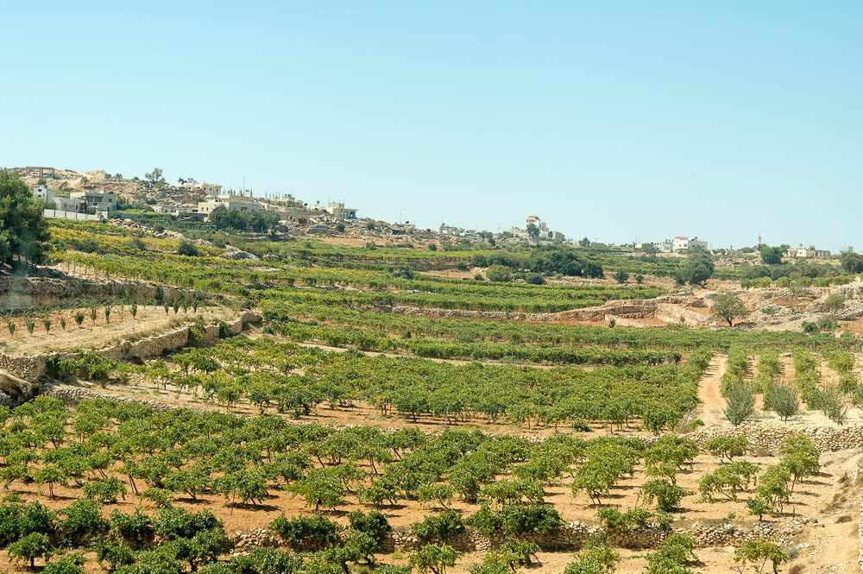
I undertook great projects, building houses and planting vineyards
Vineyards north of Hebron
2:4
Notes:
The text does not identify the location of these vineyards. The one shown here is in the area of Hebron, famous for its vineyards (Num 13:23).
tb092204926

Slide 46
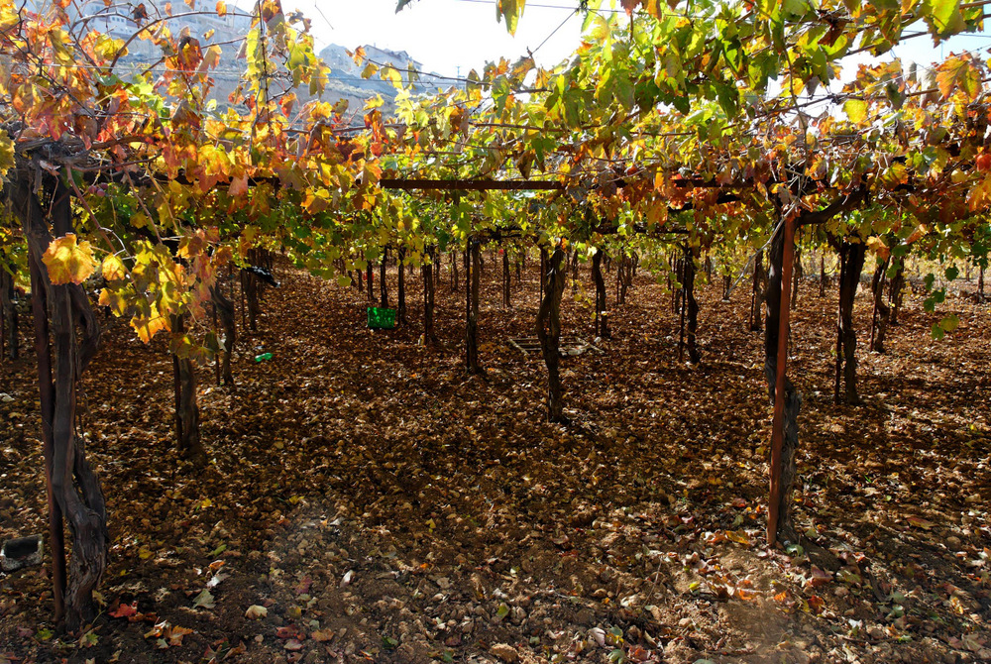
I undertook great projects, building houses and planting vineyards
Vineyards in Wadi Biyar
2:4
Notes:
It is likely that Solomon’s vineyards were in the hill country of Judah surrounding Jerusalem. The vineyard shown here is located south of Bethlehem.
tb112406321

Slide 47
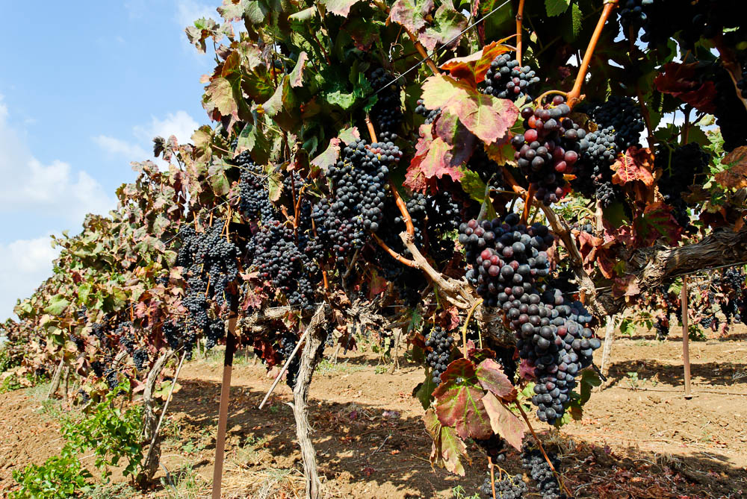
I undertook great projects, building houses and planting vineyards
Grapes on the vine near Dor
2:4
Notes:
Dor is located on the coast north of Caesarea.
tb090506907

Slide 48
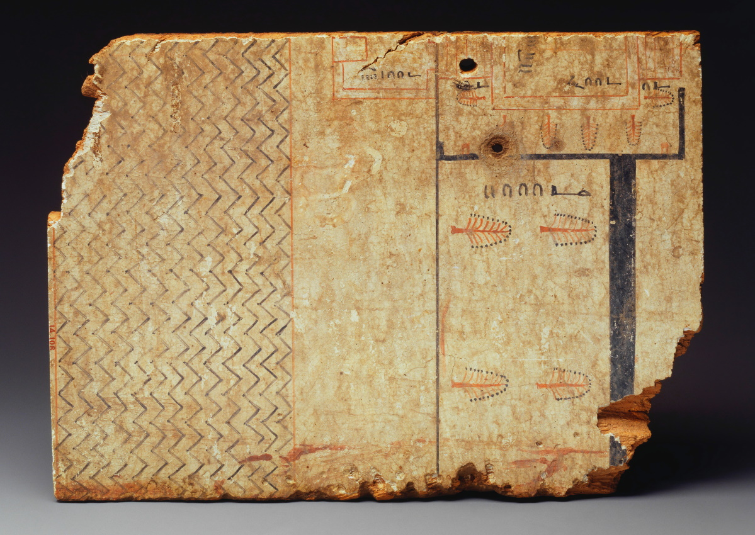
I made gardens and parks
Architectural drawing of a garden, from Egypt, circa 1400 BC
2:5
Notes:
The drawing on this plastered and painted wooden plank shows a garden enclosure (upper right) near a body of water (left). The length of the wall is written below it. Reading from right to left, it begins with a hieroglyph in the shape of a forearm, which means "cubit.” This symbol is followed by a set of numbers. An elongated semicircle stands for ten, and a stroke stands for one; thus, the length of the garden wall is thirty-two cubits. This image comes from the Metropolitan Museum of Art and is in the public domain. Source: https://www.metmuseum.org/art/collection/search/544801.
met544801

Slide 49
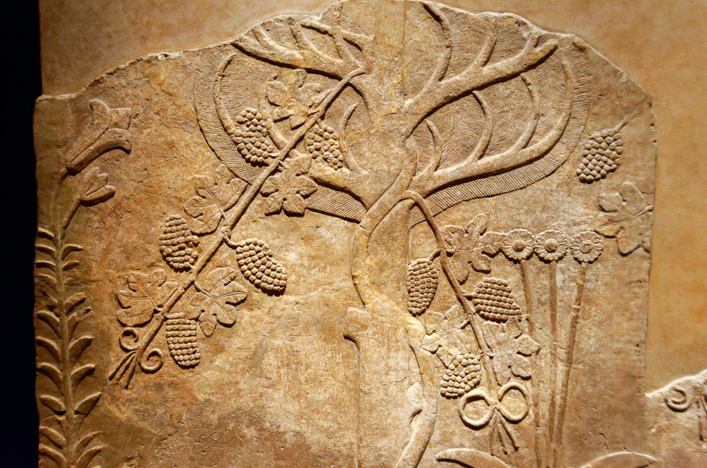
I made gardens and parks
Relief of a garden with grapevines, from the north palace at Nineveh, circa 640 BC
2:5
Notes:
This relief was photographed at the Getty Villa in southern California while on loan from the British Museum.
tb100919366

Slide 50
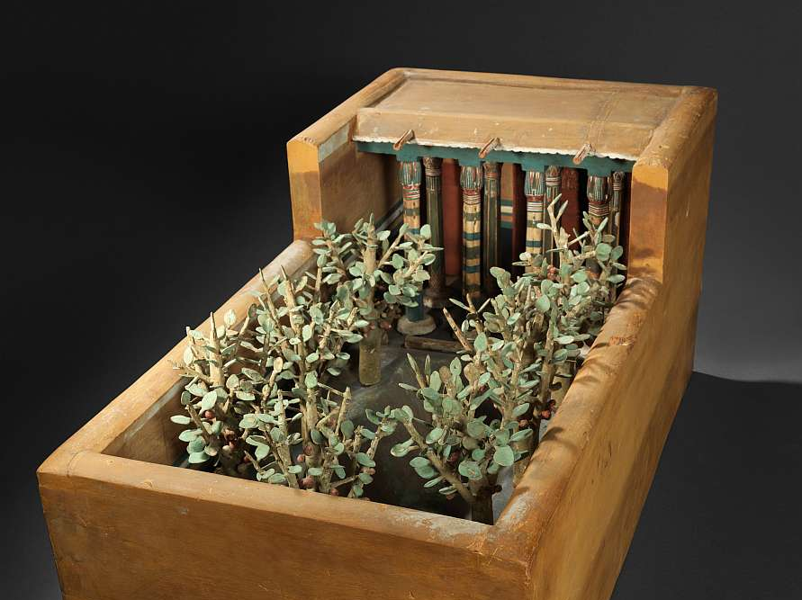
I made gardens and parks
Model of a porch and garden, from Thebes, circa 2000 BC
2:5
Notes:
This model was photographed at the Metropolitan Museum of Art, public domain, Rogers Fund and Edward S. Harkness Gift, 1920, http://metmuseum.org/art/collection/search/544256.
met544256

Slide 51
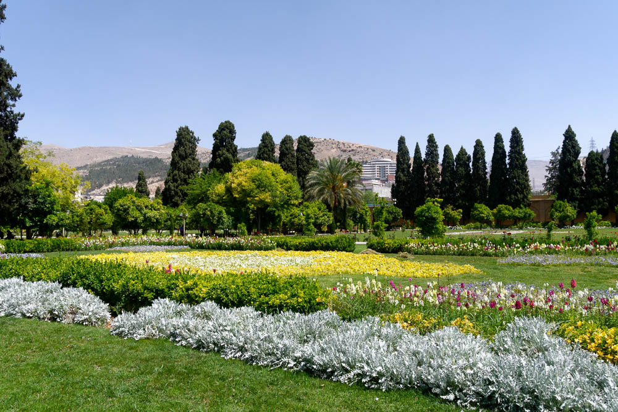
I made gardens and parks
Shiraz Jahan Nama Garden, Iran
2:5
Notes:
The Persians were famous in the ancient world for their gardens. The English word “paradise” comes from the Persian word meaning “enclosed garden.” This image provides a modern illustration of what Solomon’s gardens may have looked like.
tb0505180103

Slide 52
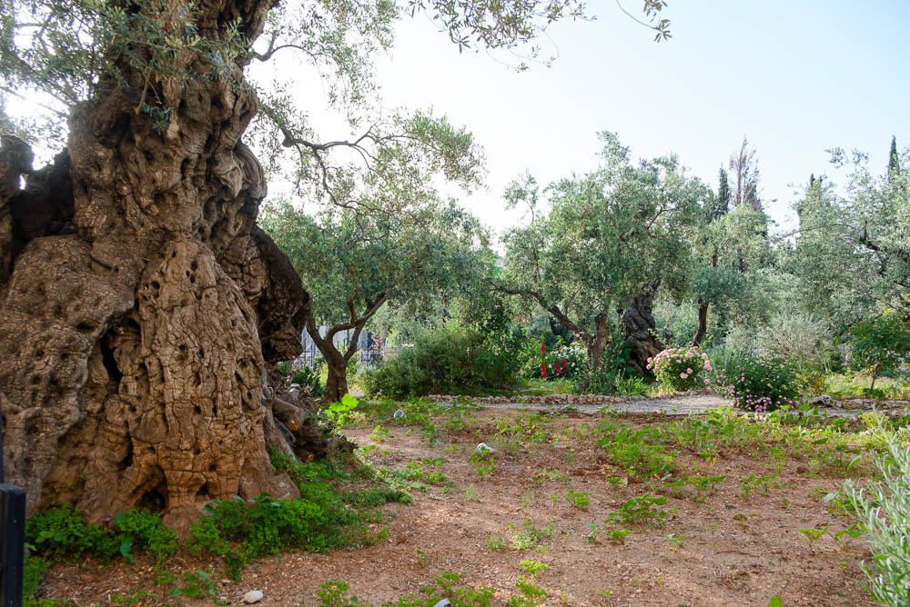
I made gardens and parks
Olive trees growing in the Garden of Gethsemane near Jerusalem
2:5
Notes:
tb051223897

Slide 53
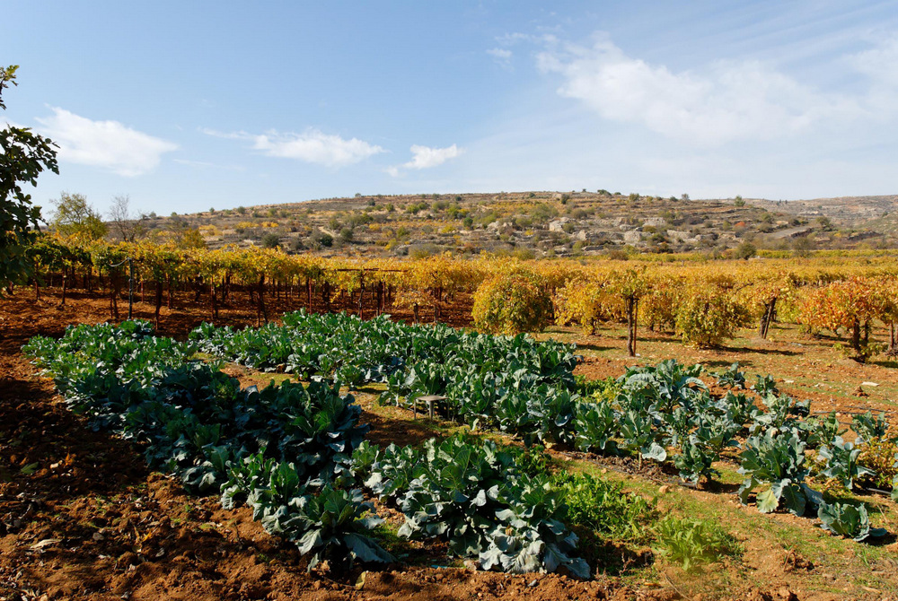
I made gardens and parks
Private garden and vineyards in Wadi Biyar
2:5
Notes:
tb112406336

Slide 54
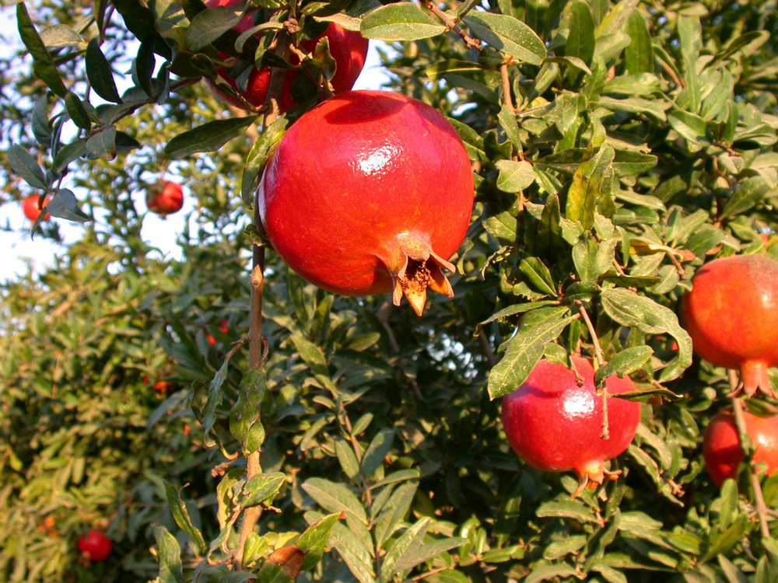
And I planted all kinds of fruit trees in them
Pomegranates on a tree at Lachish
2:5
Notes:
df100902004

Slide 55
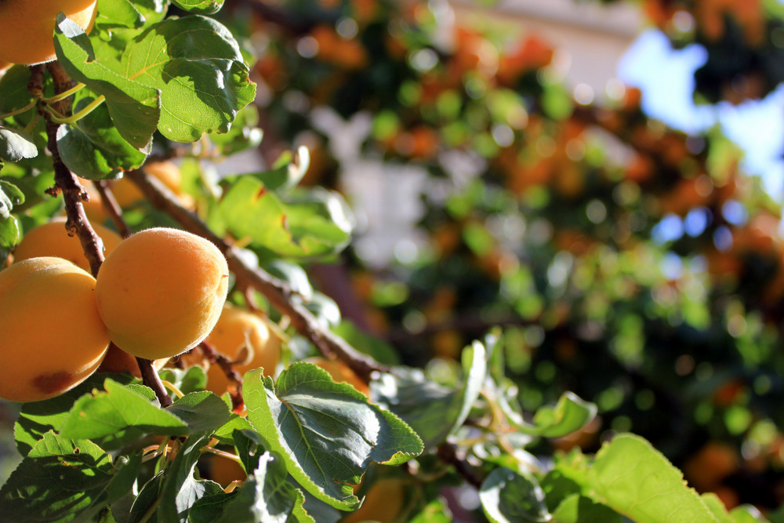
And I planted all kinds of fruit trees in them
Apricot tree in Israel
2:5
Notes:
This image comes from Yair Aronshtam and is licensed under CC BY-SA 2.0, via Wikimedia Commons: https://commons.wikimedia.org/wiki/File:Flora_of_Israel_Apricot_tree_(14532103685).jpg.
wiki06181416265184398

Slide 56
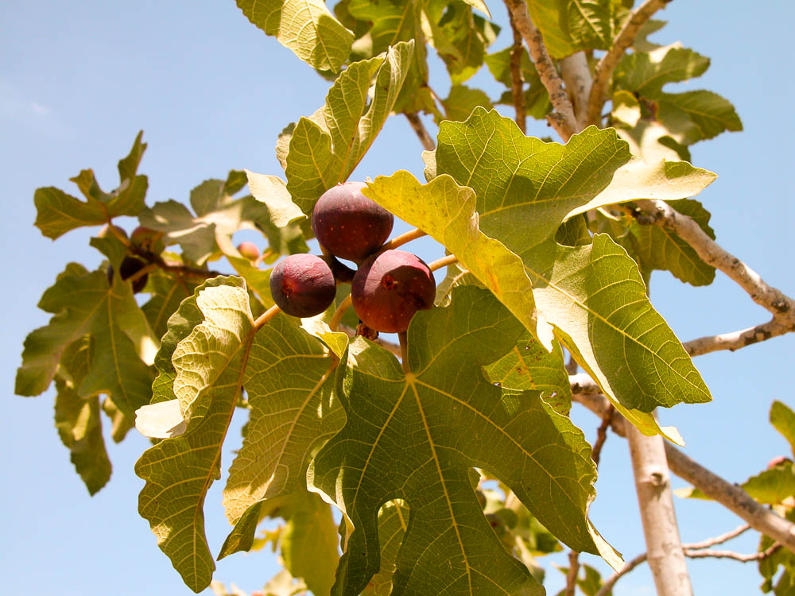
And I planted all kinds of fruit trees in them
Fig tree, Neot Kedumim
2:5
Notes:
tb091403081

Slide 57
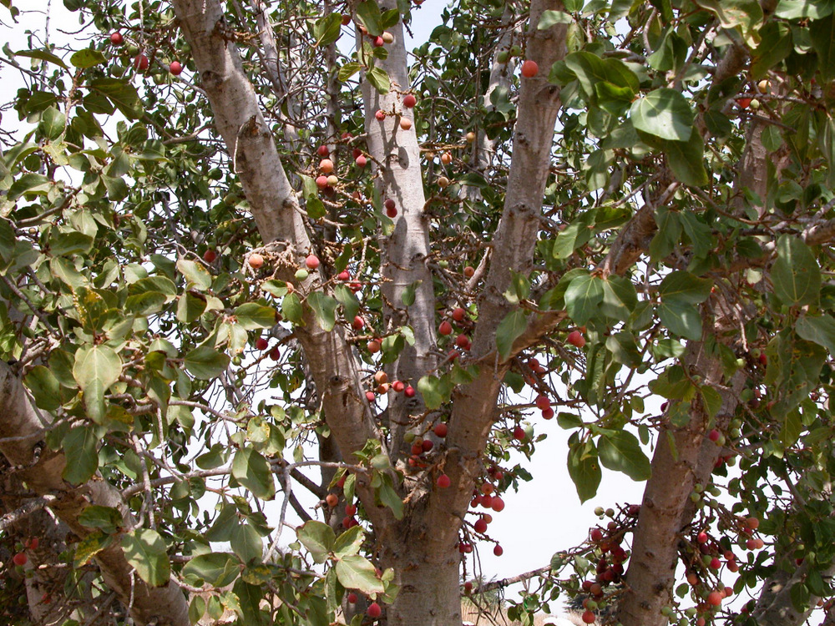
And I planted all kinds of fruit trees in them
Sycamore-fig tree with fruit, Neot Kedumim
2:5
Notes:
tb101302839

Slide 58
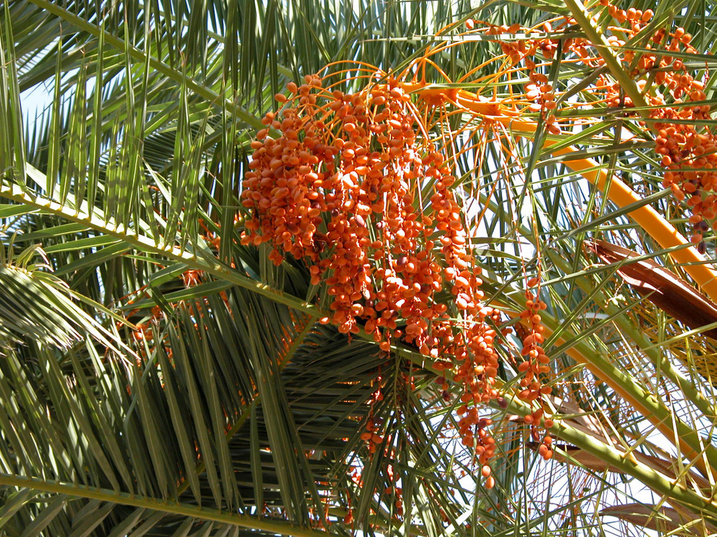
And I planted all kinds of fruit trees in them
Ripe dates on a palm, Tabgha
2:5
Notes:
tb102602856

Slide 59
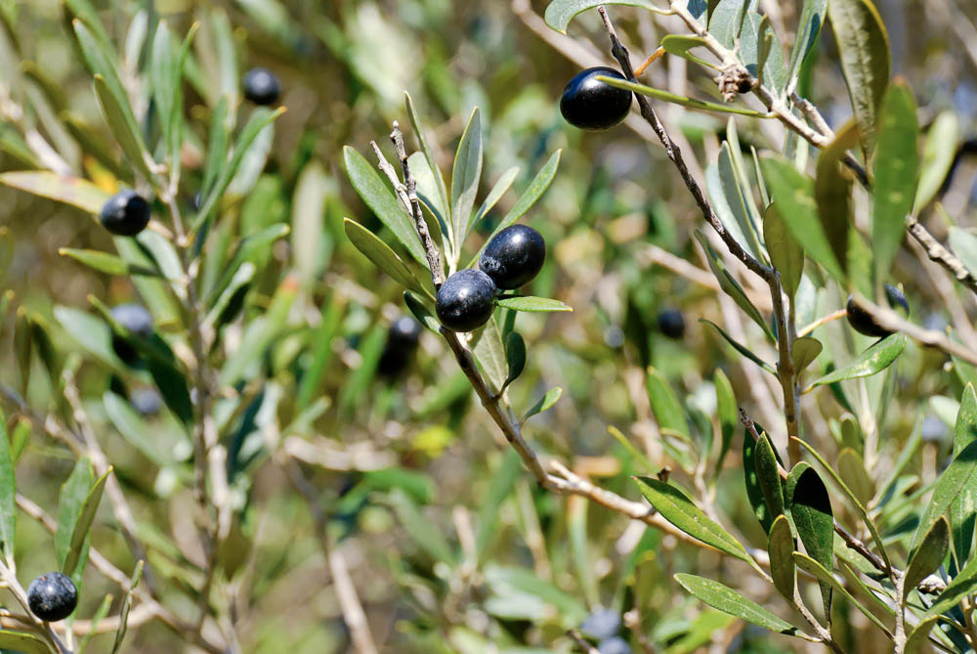
And I planted all kinds of fruit trees in them
Olives on a tree in the Judean hills
2:5
Notes:
Olives were not only eaten as food, but they were a source of olive oil, and thus served as a cash crop.
tb011007408

Slide 60
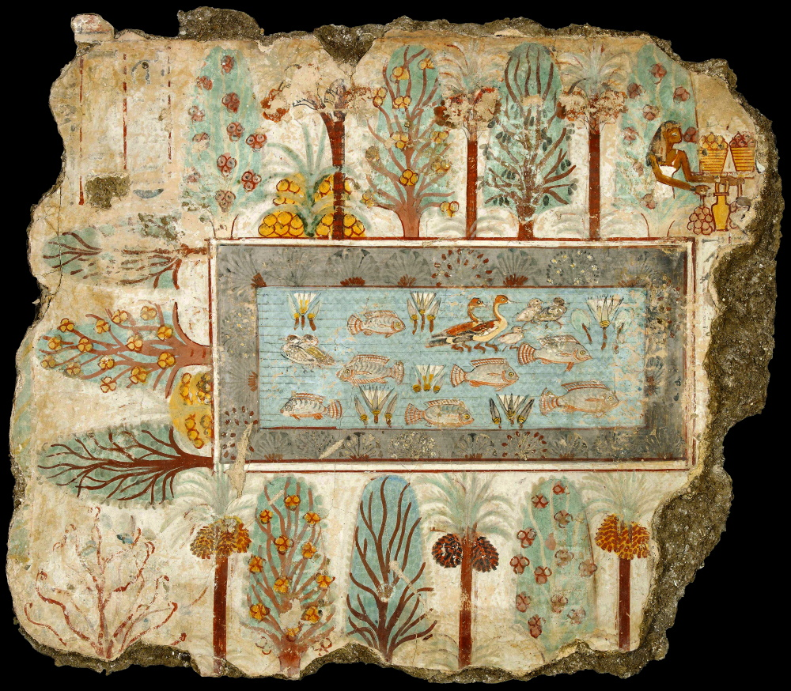
I made myself pools to water the forest where the trees grew
Garden with pool from tomb-chapel of Nebamun, from Thebes, circa 1350 BC
2:6
Notes:
This wall painting shows a garden that has rows of trees surrounding a pool. The trees include date palms, sycamore-figs, and an unidentified fruitless species. The sycamore-fig trees are represented as having clusters of three fruits among their branches.
This painting comes from the tomb-chapel of Nebamun at Thebes. It was photographed at the British Museum. This image comes from Yann Forget and is in the public domain, via Wikimedia Commons: https://commons.wikimedia.org/wiki/File:Le_Jardin_de_N%C3%A9bamoun.jpg.
wiki3798372621380102012

Slide 61
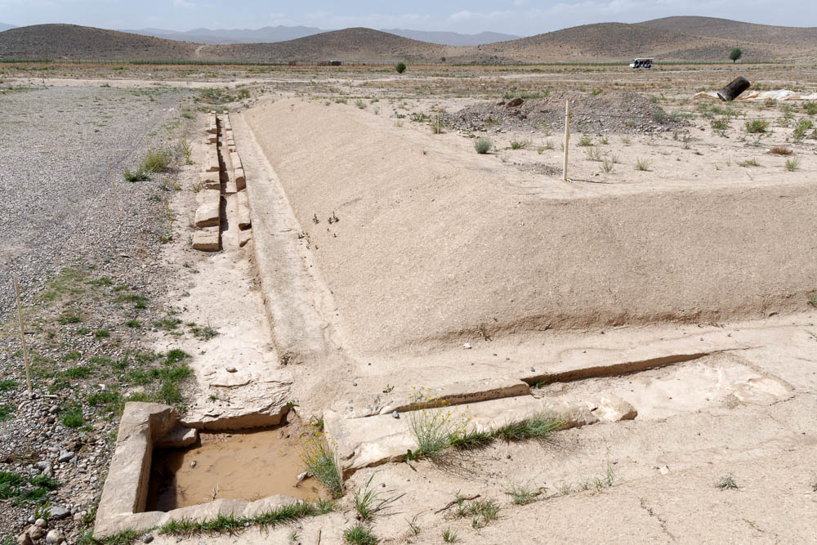
I made myself pools to water the forest where the trees grew
Irrigation channels for the ancient Persian gardens at Pasargadae
2:6
Notes:
The irrigation channels at Pasargadae are about 400 years later than the time of Solomon. The Persian king Cyrus the Gate made Pasargadae his capital in 550 BC.
tb0505180224

Slide 62
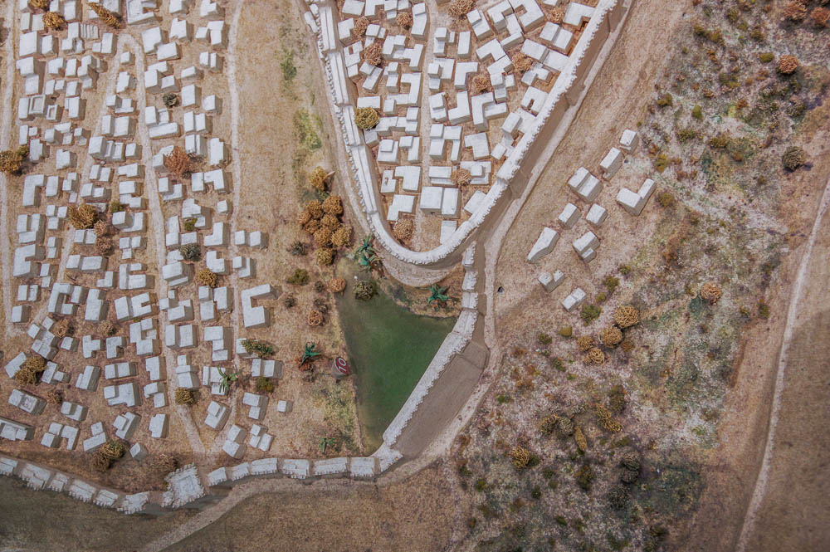
I made myself pools to water the forest where the trees grew
Model of the Siloam Pool in the First Temple period
2:6
Notes:
This model shows the location of a pool at the south end of the City of David. This may have been in existence as early as the time of Solomon. If so, it would have been fed by the waters of the Gihon Spring, through a channel along the eastern side of the city. This model was photographed at the Bible Lands Museum in Jerusalem.
adr1806251289

Slide 63

I made myself pools to water the forest where the trees grew
Fin Garden, Kashan
2:6
Notes:
Fin Garden is a historic Persian garden located in Kashan, Iran.
tb0513183348

Slide 64

I made myself pools to water the forest where the trees grew
Solomon’s Pools (aerial view from the north)
2:6
Notes:
While these three massive pools are known as “Solomon’s Pools,” they were actually built much later, during the Hasmonean era (2nd c. BC). They are located south of Bethlehem and once fed an aqueduct that channeled the water to Jerusalem.
ws100816587

Slide 65

I made myself pools to water the forest where the trees grew
Remains of an aqueduct and pools at Hyrcania, 2nd century BC
2:6
Notes:
tb051323031

Slide 66

I bought male servants and female servants and had servants that were born in my house
Model kitchen with oven, servants making bread and beer, from Saqqara, circa 1900 BC
2:7
Notes:
This model of an Egyptian kitchen depicts two of the most common tasks associated with food—making bread and beer. As is typical in Egyptian art, the female is portrayed with lighter skin (yellow, on the left), while the men are portrayed with darker skin (red, on the right). This image comes from State Museums of Berlin, Egyptian Museum and Papyrus Collection / Sandra Steiß and is licensed under CC BY-SA 4.0. Source: https://recherche.smb.museum/detail/590407.
smb590407

Slide 67

I bought male servants and female servants and had servants that were born in my house
Making mudbricks, stacking and carrying blocks, tomb painting in Thebes, 15th century BC
2:7
Notes:
The men in this painting are engaged in various construction tasks, including the fabrication of mudbricks and carrying supplies with the assistance of a yoke. This painting was photographed at the tomb of Rekhmire at Thebes.
adr1603142962

Slide 68

I bought male servants and female servants and had servants that were born in my house
Model of a man plowing with oxen, from Egypt, circa 1950 BC
2:7
Notes:
This model shows an Egyptian farmer using two cattle to pull his hook-shaped plow. According to the museum website, “It is not possible to turn the soil with such plows, they only serve to open the ground. The ultimate aim of this kind of plowing was, therefore, to place the seeds well into the soil.” This image comes from the Metropolitan Museum of Art, public domain, Gift of Valdemar Hammer, Jr., in memory of his father, 1936, http://metmuseum.org/art/collection/search/544255.
met544255

Slide 69

I bought male servants and female servants and had servants that were born in my house
Painting of a weaver’s shop, from the Tomb of Khnumhotep, circa 1900 BC
2:7
Notes:
Another task of servants of the royal house was likely the production of fine clothing. This image comes from the Metropolitan Museum of Art, public domain, Rogers Fund, 1933, accession number 33.8.16, https://www.metmuseum.org/art/collection/search/548575.
met548575

Slide 70

I bought male servants and female servants and had servants that were born in my house
Model of an Egyptian weaving shop
2:7
Notes:
Given the white color of the woven sheets being produced in this model, and the Egyptian disdain for sheep (and thus wool), this shop is likely producing linen sheets. Note that the model figures themselves are wearing tiny swatches of linen as clothing. This model was photographed in the Egyptian Museum in Cairo.
as012813200

Slide 71

I also possessed herds and flocks, more than all there were before me in Jerusalem
Herd of cattle, from the tomb of Khety at Beni Hasan, circa 2100 BC
2:7
Notes:
This wall painting was photographed in the tomb of Khety at Beni Hasan.
adr1603247491

Slide 72

I also possessed herds and flocks, more than all there were before me in Jerusalem
Herdsmen with cattle, from the tomb-chapel of Nebamun at Thebes, circa 1350 BC
2:7
Notes:
This tomb painting from Thebes in Egypt depicts a variety of Egyptian cattle. It was photographed at the British Museum.
tb0930199463

Slide 73

I also possessed herds and flocks, more than all there were before me in Jerusalem
Cows grazing on Mount Gilboa
2:7
Notes:
tb032505936

Slide 74

I also possessed herds and flocks, more than all there were before me in Jerusalem
Shepherd with flock of sheep in eastern Samaria
2:7
Notes:
This picture shows a shepherd with a flock of sheep in Samaria. Second Chronicles 7:5 says that Solomon sacrificed 120,000 sheep at the dedication of the temple.
tb031405447

Slide 75

I also possessed herds and flocks, more than all there were before me in Jerusalem
Flocks in the Dothan Valley
2:7
Notes:
tb070507915

Slide 76

I gathered for myself silver and gold
Silver scrap from a hoard at Tell el-Amarna, 14th century BC
2:8
Notes:
Coinage had not yet been invented and thus it was customary to pay using silver that was weighed out to reach the desired amount. Randomly shaped pieces like those shown here, referred to as hacksilver, could be sorted until the desired amount was reached. Some portion of Solomon’s revenue likely came in this form. This display was photographed at the British Museum.
tb0929197592

Slide 77

I gathered for myself silver and gold
Gold and silver vessels from Tell Basta (Bubastis), circa 1070–712 BC
2:8
Notes:
Tribute was likely paid to Solomon in other forms as well. Beautifully worked silver and gold, like the dishes shown here, would have had value beyond the simple weight of the metal, and would have been considered to be prestige items. This image of items from Dynasties 21–22 comes from the Metropolitan Museum of Art, public domain, Rogers Fund, 1907, https://www.metmuseum.org/art/collection/search/548221.
met590950

Slide 78

I gathered for myself silver and gold
Silver rhyton shaped like a bull, Hittite, circa 1300 BC
2:8
Notes:
This silver drinking vessel is of Hittite origin and was probably associated with the storm god Teshub. This image comes from the Metropolitan Museum of Art, public domain, Gift of Norbert Schimmel Trust, 1989, accession number 1989.281.11, https://www.metmuseum.org/art/collection/search/327400.
met327400

Slide 79

I gathered for myself silver and gold
Gold pebbles from alluvial deposits
2:8
Notes:
As with the silver, Solomon most likely received gold both as bullion and in the form of worked objects. The gold pebbles shown here were also collected from alluvial deposits in Washington State.
This display was photographed at the Field Museum of Natural History, Chicago. This image comes from James St. John and is licensed under CC BY 2.0, via Wikimedia Commons: https://commons.wikimedia.org/wiki/File:Gold_fluvial_pebbles_(placer_gold)_(Washington_State,_USA)_3_(16846570129).jpg.
wiki082110162831052458667

Slide 80

I gathered for myself silver and gold
Gold nuggets, from Amathus, Cyprus, circa 900–700 BC
2:8
Notes:
Coinage had not yet been invented, and precious metals were traded by weight. This display was photographed at the British Museum.
tb0929198058

Slide 81

I gathered for myself silver and gold
Gold earrings with rams’ heads, from Egypt, circa 1200–1100 BC
2:8
Notes:
These beautiful gold earrings are roughly contemporary with the time of Solomon. Items like this would have had value because of the metal from which they were made, but they also could have been used as jewelry within the royal house. This display was photographed at the National Museum of Antiquities (Rijksmuseum van Oudheden) in Leiden.
adr1805205986

Slide 82

I gathered for myself silver and gold
Gold bowl used as a strainer, from the Temple of Bastet at Bubastis, 13th century BC
2:8
Notes:
This golden bowl, which was pierced to function as a strainer, was recovered from a cache of vessels made of precious metals discovered at the Temple of Bastet at Bubastis, Egypt. It was likely used to strain beer or wine. This image comes from the Metropolitan Museum of Art, public domain, Theodore M. Davis Collection, Bequest of Theodore M. Davis, 1915, accession number 30.8.369, https://www.metmuseum.org/art/collection/search/545169.
met545169

Slide 83

And the treasures of kings and of provinces
Pendants of lapis lazuli, silver, and carnelian, from Tell Asmar, circa 2900–2350 BC
2:8
Notes:
The “treasure of kings and of provinces” is a catch-all that would include nearly any kind of precious thing. The pendant shown here are made of lapis lazuli, carnelian, and silver. These pendants illustrate the widespread use of lapis lazuli in Egypt in the early 3rd millennium BC. The nearest source of lapis lazuli was Afghanistan, so this was all acquired by trade. This display was photographed at the Oriental Institute Museum at the University of Chicago.
adr1503110835c

Slide 84

And the treasures of kings and of provinces
Necklace of gold and lapis lazuli, from southern Mesopotamia, circa 2600 BC
2:8
Notes:
Lapis lazuli was transported along trade routes all over the ancient Near East and was as popular in Mesopotamia as it was in Egypt. This necklace consists of lapis lazuli beads and gold triangles. It was photographed at the Bible Lands Museum in Jerusalem.
ku0606231217384

Slide 85

And the treasures of kings and of provinces
String of amethyst beads and an uninscribed scarab, from Egypt, circa 2100–1750 BC
2:8
Notes:
Amethyst was a prized gemstone in ancient Egypt. This display was photographed at the Petrie Museum of Egyptian Archaeology. This image comes from Osama Shukir Muhammed Amin and is licensed under CC BY-SA 4.0, via Wikimedia Commons: https://commons.wikimedia.org/wiki/File:Uninscribed_amethyst_scarab_at_the_center_of_a_string_of_amethyst_ball_beads._Middle_Kingdom._From_Egypt._The_Petrie_Museum_of_Egyptian_Archaeology,_London.jpg.
wiki0311161903362965383

Slide 86

And the treasures of kings and of provinces
Relief of Israel giving silver and gold as tribute to Shalmaneser III, on the Black Obelisk, 841 BC
2:8
Notes:
This obelisk displays men bringing various metals as tribute to the Assyrian king Shalmaneser III. It was photographed at the British Museum.
tb112004851r

Slide 87

I acquired male and female singers for myself
Relief of musicians, from the Northern Hall at Zincirli, 8th century BC
2:8
Notes:
This relief depicts musicians with their instruments. The two men on the left are playing a hand drum or tambourine (Heb. toph, תֹּף). The two men on the right are playing stringed instruments (Heb. nebel, נֵבֶל). There are two references in the Psalms to harps with ten strings (Pss 33:2; 144:9), perhaps indicating that they had more strings than a lyre. The two stringed instruments on this relief have 6 and 12 strings respectively. This relief was photographed at the Istanbul Museum of the Ancient Orient.
jc1229149050

Slide 88

I acquired male and female singers for myself
Relief of female singers and tambourine players, circa 1350 BC
2:8
Notes:
This image comes from Museo Egizio and is in the public domain. Source: https://collezioni.museoegizio.it/en-GB/material/S_18060.
czme18060

Slide 89

I acquired male and female singers for myself
Tomb painting of a harp player and a lute player, from Thebes, circa 1400 BC
2:8
Notes:
This tomb painting depicts men playing a bow harp (left) and a lute (center). It was photographed in the tomb of Rekhmire, an Egyptian official during the 18th dynasty. The tomb is located in Sheikh Abd el-Qurna, part of the Theban Necropolis. This image is in the public domain, via Wikimedia Commons: https://commons.wikimedia.org/wiki/File:Harp_player_and_lute_player,_Rekhmire_tt100_bs_38716.jpg.
wiki0918180905711155

Slide 90

And I acquired many concubines—the pleasures of men
Paintings of a feast for Nebamun, from tomb-chapel of Nebamun, from Thebes, circa 1350 BC
2:8
Notes:
The word “concubine” (Heb. pilegesh, פִּלֶגֶשׁ) refers to a consort that for cultural or religious reasons cannot be legally married. Solomon’s proliferation of marriages and other female relationships was in direct disobedience to the command of God (Deut 17:17), and the text is quick to condemn his immoderate behavior (1 Kgs 11:3-4). This wall painting was photographed at the British Museum.
tb0930199467b

Slide 91

And I acquired many concubines—the pleasures of men
Paintings of a feast for Nebamun, from tomb-chapel of Nebamun, from Thebes, circa 1350 BC
2:8
Notes:
It is well-known that Solomon had an Egyptian wife, and it would not be surprising if he also had Egyptian concubines. The women in this tomb painting are attending a banquet. They hold lotus flowers, and each has a perfumed cone on her head. Note also the large gold earrings that each woman has. This wall painting was photographed at the British Museum.
tb0930199467

Slide 92

And I acquired many concubines—the pleasures of men
Painting of women at a banquet, served by girls and musicians, from Thebes, 15th century BC
2:8
Notes:
This tomb painting shows Egyptian women playing a variety of instruments. On the bottom row, from left to right, are a harp player, a woman playing a lute, a woman playing a rectangular tambourine, and two women who are clapping. The other women portrayed in this painting are either participants in the banquet or servants. This painting comes from the tomb of Rekhmire at Thebes (Luxor).
adr1603142974c

Slide 93

And I acquired many concubines—the pleasures of men
Reconstructed hall of the harem of Xerxes at Persepolis
2:8
Notes:
According to 1 Kings 11:3, Solomon had 700 wives and 300 concubines. This reconstructed hall of the harem in Persepolis provides an illustration of an ancient Persian harem.
tb0506181579

Slide 94

And I acquired many concubines—the pleasures of men
Reconstructed harem of Xerxes at Persepolis
2:8
Notes:
This building at Persepolis has been constructed to resemble the harem of the Persian king Xerxes.
tb0506181124

Slide 95

And I acquired many concubines—the pleasures of men
Solomon and His Harem, by James Tissot, circa 1899
2:8
Notes:
This image of a gouache on board painting is in the public domain, via The Jewish Museum: https://thejewishmuseum.org/collection/26553-solomon-and-his-harem.
tjm26553

Slide 96

So I was great and increased more than all who preceded me in Jerusalem
Old City of Jerusalem (aerial view from the north)
2:9
Notes:
tb010703223

Slide 97

Then I considered all the works of my hands, and all the things I had accomplished
King Solomon instructs on the building of the temple
2:11
Notes:
This illustration of Solomon giving instruction comes from Charles Foster, Bible Pictures and What They Teach Us (1886, 1914).
fbp119

Slide 98

And behold, it was all vanity and striving after wind, with no profit under the sun
Dust devil near Jabal Sayid, Saudi Arabia
2:11
Notes:
This image comes from darrylkeith and is licensed under CC BY-SA 3.0, via Wikimedia Commons: https://commons.wikimedia.org/wiki/File:Willy-Willy_near_Jabal_Sayid_-_panoramio.jpg.
wiki10181232642448201

Slide 99

So I turned to consider wisdom, madness, and folly
Fresco of a man thinking, from the Farm of Irace in Pompeii, 1st century AD
2:12
Notes:
Solomon’s realization that his vast works and possessions were meaningless led him to question where meaning and satisfaction might be found in life. This fresco is part of a larger scene illustrating the story of Admetus and Alcestis, in which the wife of Admetus volunteers to give her life for his. It was photographed at a special exhibit at the Oklahoma City Museum of Art.
ku0924210225

Slide 100

So I turned to consider wisdom, madness, and folly
Terracotta figurine of an actor with a mask, possibly from Canino, circa 2nd century BC
2:12
Notes:
Wisdom, madness, and folly appear together three times in Ecclesiastes (Eccl 1:17; 2:12; 7:25). The grimace on the face of this Hellenistic figurine illustrates what one might expect from madness or folly. Characters such as this often represented the fool in Greco-Roman theater. This figurine was photographed at the British Museum.
tb0929197957

Slide 101

I saw that wisdom excels folly just as light excels darkness
Jerusalem at night (from the south)
2:13
Notes:
tb091103092

Slide 102

I saw that wisdom excels folly just as light excels darkness
Sunset over Jerusalem
2:13
Notes:
This picture of a sunset over Jerusalem shows the contrast of light and darkness.
tb123109454

Slide 103

I saw that wisdom excels folly just as light excels darkness
Sunrise in Wadi Rum
2:13
Notes:
This image comes from Hashem sabbagh and is licensed under CC BY-SA 4.0, via Wikimedia Commons: https://commons.wikimedia.org/wiki/File:Wadi_Rum_Sunrise.jpg.
wiki0530161711276000519

Slide 104

I saw that wisdom excels folly just as light excels darkness
War of Sons of Light Against the Sons of Darkness, Dead Sea Scroll, circa 2nd century BC
2:13
Notes:
This Dead Sea Scrolls manuscript, 1QM, is known as The War of the Sons of Light Against the Sons of Darkness. It uses the contrast of light and darkness figuratively to describe an apocalyptic war between Israelites and their enemies. This scroll was photographed by the Matson Photo Service between 1947 and 1961.
mat22899

Slide 105

The wise man’s eyes are in his head
Mummy portrait of a man, painted plaster with inlaid glass eyes, early 2nd century AD
2:14
Notes:
The statement that the eyes of the wise man are “in his head” is usually taken to indicate that he sees clearly and contemplates what is going on about him. Unlike the fool, he does not walk blindly into death (Garrett 1993: 294). This bust was photographed at the San Antonio Museum of Art.
Reference:
Garrett, Duane A.
1993 Proverbs, Ecclesiastes, Song of Songs. New American Commentary. Nashville: Broadman.
tb111716762c

Slide 106

The wise man’s eyes are in his head
“Caution: Road!” sign at Haibar
2:14
Notes:
This statement is phrased differently, but echoes the proverb, “The prudent sees the evil and hides himself, But the naive go on, and are punished for it” (Prov 22:3, NASB).
tb010712038

Slide 107

But the fool walks in darkness
Krater portraying a comic actor in the role of a fool, 4th century BC
2:14
Notes:
The word “fool” (Heb. kesil, כְּסִיל) indicates someone who lacks prudence or good judgment. The fool was a stock character in Greco-Roman theater. The comic actor portrayed here wears a short garment that is padded behind and in front, a slave mask with large mouth and crossed eyes, and brandishes a torch.
This image comes from the Metropolitan Museum of Art and is in the public domain. Source: https://www.metmuseum.org/art/collection/search/254667. A removable graphic has been added to this photo to avoid causing surprise or offense.
met254667

Slide 108

But the same fate happens to both of them
Relief of the death of Meleager, from Rome, 2nd century AD
2:14
Notes:
This relief of the death of Meleager illustrates mourning over death, the same thing that happens to all people, wise and foolish, that is mentioned in this verse. This photograph was taken at the Louvre Museum.
tb0928196766

Slide 109

For the wise man, just as for the fool, there is no remembrance of him forever
St. Etienne’s Cave 1 burial chamber, in Jerusalem, circa 1000–586 BC
2:16
Notes:
The impressive Iron Age burial complexes at St. Etienne’s are located north of Damascus Gate of the Old City of Jerusalem and quite close to the Garden Tomb.
tb062907546

Slide 110

So I hated life, because the work that is done under the sun was grievous to me
Sunset over Mount Nebo
2:17
Notes:
The word “grievous” (Heb. ra’, רַע) is a very common Hebrew word that refers to evil, in the sense of that which is not good. In this context, it is something that caused displeasure or distress.
df110801702

Slide 111

Everything was futility and striving after wind
Pair of dust devils in the Black Rock desert, Nevada
2:17
Notes:
This image comes from Steve Jurvetson and is licensed under CC BY 2.0, via Wikimedia Commons: https://commons.wikimedia.org/wiki/File:Dust_Devils.jpg.
wiki0721071415152901334

Slide 112

I hated all my work . . . seeing that I must leave it to the man that shall be after me
Man plowing with horse in eastern Samaria
2:18
Notes:
tb031405406

Slide 113

And who knows whether he will be a wise man or a fool?
The high place of Jeroboam at Dan
2:19
Notes:
Solomon’s successor was his son Rehoboam, who is described as a foolish king. His foolishness triggered the division of the monarchy into the Northern Kingdom of Israel and the Southern Kingdom of Judah. Jeroboam I became the king of the Northern Kingdom. Although Jeroboam’s ability to unite the northern tribes in rebellion against the Davidic dynasty and his successful establishment of alternatives to the temple in Bethel and Dan shows his political savviness, these actions also show his foolishness in exchanging the worship of Yahweh for his own idols. This picture shows the high place of Jeroboam in Dan, which was expanded during the time of Ahab.
tb011310469

Slide 114

For what does a man gain from all his labor and striving under the sun?
Relief of prisoners clearing rocks in baskets from a quarry, from Nineveh, circa 700 BC
2:22
Notes:
This relief comes from the palace of Sennacherib at Nineveh. It was photographed at the British Museum.
adr1805195408

Slide 115

For what does a man gain from all his labor and striving under the sun?
Carpenters making a bed and wooden furniture, from a tomb at Thebes, circa 15th century BC
2:22
Notes:
The two main figures in the center are using a bow drill to create holes for latticework on a bedframe. Above these two figures, a seated man is sawing a long thin plank down its length. To the left of him are several men working to smooth and sand a larger board. This painting was photographed in the tomb of Rekhmire at Thebes.
adr1603142979c

Slide 116

For what does a man gain from all his labor and striving under the sun?
Limestone stele with a carpenter’s workshop, circa 1500–1100 BC
2:22
Notes:
This relief, which is roughly contemporary with the time of Moses, depicts activities in a carpenter’s shop. In the upper register, the man at the left is using a saw to cut planks from a log that is tied to an upright post; the next man is using an adze to shape a board; the next man is using a smaller adze to finish a pole that appears to hold a fabric banner; the man at the right end is using a hammer and chisel to cut a hole (perhaps for a mortise and tenon joint) in a board.
This image comes from the Museum of the Netherlands in Amsterdam, public domain, AP 40. Source: https://hdl.handle.net/21.12126/21189
ria21189

Slide 117

For what does a man gain from all his labor and striving under the sun?
Tomb depiction of carpenters building furniture and a boat, from Beni Hasan, circa 1900 BC
2:22
Notes:
This tomb painting is from the burial place of Khnumhotep II, an official in the early part of the 12th dynasty (ca. 1900 BC). His tomb is located at Beni Hasan in Middle Egypt.
adr1603247542c

Slide 118

For what does a man gain from all his labor and striving under the sun?
Men hoeing dirt to make bricks, from Tel Amarna, circa 1350 BC
2:22
Notes:
This image comes from the Cleveland Museum of Art, Purchase from the J. H. Wade Fund, accession number 1959.187, public domain: https://www.clevelandart.org/art/1959.187.
tcma1959187

Slide 119

For what does a man gain from all his labor and striving under the sun?
Fresco with men working at a forge, from the House of Chariots in Pompeii, 1st century AD
2:22
Notes:
Working with metals required a highly specialized set of skills and knowledge. This fresco is thought to represent the workshop of the Greek god Hephaestus, in which Cyclops and Vulcan forged armor for various Greek gods. The figure on the left is using a hammer and tongs to shape a piece of hot metal that has just been pulled from the furnace behind him. This fresco was photographed at the Naples Archaeological Museum.
tb0515170227

Slide 120

For what does a man gain from all his labor and striving under the sun?
Arab workers cutting stone on Mount Zion, 1968
2:22
Notes:
db6804154101

Slide 121

Every day his work is laborious and distressing; even at night his mind does not rest
Man sleeping near a campfire, reign of Akhenaten, 14th century BC
2:23
Notes:
This simple relief, probably from Tell el-Amarna in Egypt, shows a man sleeping near a campfire. This image comes from the Metropolitan Museum of Art, public domain, Purchase, Lila Acheson Wallace Gift and Louis V. Bell Fund, 1991, accession number 1991.240.11, https://www.metmuseum.org/art/collection/search/545017.
met545017

Slide 122

There is nothing better for a man than to eat, drink, and find enjoyment in his work
Banquet scene on a fragment of a Cypriot grave relief, circa 450–425 BC
2:24
Notes:
This photograph comes from the Metropolitan Museum of Art, public domain, The Cesnola Collection, Purchased by subscription, 1874–1876, http://metmuseum.org/art/collection/search/242394.
met242394

Slide 123

There is nothing better for a man than to eat, drink, and find enjoyment in his work
Limestone votive relief with worship and banquet scenes, from Cyprus, 4th century BC
2:24
Notes:
This plaque depicts people eating and drinking, as well as participating in some sort of dance or celebration. This image comes from the Metropolitan Museum of Art in New York City and is in the public domain. Source: https://www.metmuseum.org/art/collection/search/241892.
met241892

Slide 124

There is nothing better for a man than to eat, drink, and find enjoyment in his work
Fresco of men enjoying a banquet, from Pompeii, 1st century AD
2:24
Notes:
This fresco depicts men enjoying a banquet together. The Latin inscription above the man on the right says “Yes, be well!” (Lat. EST ITA VALEAS).
This fresco was photographed at the Naples Archaeological Museum. This image comes from ArchaiOptix and is licensed under CC BY-SA 4.0, via Wikimedia Commons: https://commons.wikimedia.org/wiki/File:Wall_painting_-_banquet_scene_in_triclinium_-_Pompeii_(V_2_4)_-_Napoli_MAN_120031_-_03.jpg.
wiki10061809441654722258

Slide 125

This also I saw was from the hand of God
Burial inscription mentioning “YHWH,” from Khirbet el-Qom, 8th century BC
2:24
Notes:
This tomb inscription from the 8th century BC invokes the blessing of Yahweh upon the deceased, a man named Uriah. The inscription is accompanied by a depiction of a hand reaching down, as if for provision or blessing. The first line of the inscription reads, “Uriah the wealthy man had it written” (אריהו הדשר כתבה). The second line reads, “Blessed be Uriah by Yahweh” (ברך אריהו ביהוה). This inscription was photographed at the Israel Museum. The next slide includes labels for the words of the second line.
ku0607231009050

Slide 126

This also I saw was from the hand of God
Burial inscription mentioning “YHWH,” from Khirbet el-Qom, 8th century BC
2:24
Notes:
This tomb inscription from the 8th century BC invokes the blessing of Yahweh upon the deceased, a man named Uriah. The inscription is accompanied by a depiction of a hand reaching down, as if for provision or blessing. The first line of the inscription reads, “Uriah the wealthy man had it written” (אריהו הדשר כתבה). The second line reads, “Blessed be Uriah by Yahweh” (ברך אריהו ביהוה). In the second line, the red word to the far right is the verb “blessed” (barak, ברך), the black word in the center is the personal name Uriah (Uryahu, אריהו), and the word in red to the left is the preposition and noun “by Yahweh” (beyahweh, ביהוה). This inscription was photographed at the Israel Museum. An editable version is included behind this graphic for those who may wish to change it.
ku0607231009050

Slide 127

For who can eat, or who can enjoy life apart from Him?
Banquet scene from the tomb of the Royal Cup-Bearer Tjawy, 14th century BC
2:25
Notes:
This relief shows various stages of a banquet. A pile of food is set before the three ladies on the center right. Note also the perfume cones on the heads of the women. This relief comes from the reign of Amenhotep III. It was photographed at the Boston Museum of Fine Arts.
adr1711202744

Slide 128

For who can eat, or who can enjoy life apart from Him?
Relief of a banquet of Ashurbanipal, with attendants, from Nineveh, circa 640 BC
2:25
Notes:
This relief comes from the north palace at Nineveh. It was photographed at the Getty Villa in southern California while on loan from the British Museum.
tb100919345

Slide 129

For who can eat, or who can enjoy life apart from Him?
Pleasure boats with cabins, from Thebes, 20th century BC
2:25
Notes:
This verse mentions not only the ability to enjoy food as desired but also the ability to have other forms of enjoyment. This model was photographed at the Egyptian Museum in Cairo.
adr1603195091c

Slide 130

For who can eat, or who can enjoy life apart from Him?
Queen of Sheba presents King Solomon with many gifts
2:25
Notes:
This illustration comes from Charles Foster, Bible Pictures and What They Teach Us (1886, 1914).
fbp120b

Slide 131

To one who is good in His sight He has given wisdom, knowledge, and joy
Wooden head of a smiling woman, circa 1400–1200 BC
2:26
Notes:
The reward of “joy” (Heb. simḥah, שִׂמְחָה) is illustrated here by a smiling woman. Smiles are rare in artistic representations prior to the Greco-Roman period, but this wooden bust appears to be an exception. The eyebrows and eyes of this wooden head, which once functioned as a stopper for a canopic jar, were originally inlaid.
This image comes from the Brooklyn Museum, Gift of the Ernest Erickson Foundation, Inc., 86.226.35, Creative Commons-BY. Source: https://www.brooklynmuseum.org/opencollection/objects/4252.
bmny4252

Slide 132

To one who is good in His sight He has given wisdom, knowledge, and joy
Relief of Akhenaten and Nefertiti, from Tell el-Amarna, circa 1340 BC
2:26
Notes:
In a similar vein, Ecclesiastes 9:9 recommends that the hearer “enjoy life with the woman you love,” describing this as God’s reward. This relief depicts the Egyptian king Akhenaten and his primary queen Nefertiti in a tender, loving pose. It may be noted that Nefertiti holds lotus flowers in her left hand.
This relief was photographed at the Egyptian Museum in Berlin. This image comes from Gary Todd and is licensed under CC0, via Wikimedia Commons: https://commons.wikimedia.org/wiki/File:Amarna_Period_Carved_Limestone_Relief_of_(probably)_Pharaoh_Akhnaton_%26_Wife_Nefertiti,_New_Kingdom,_18th_Dynasty,_c._1340_BC_(28465728740).jpg.
wiki08031619525184335c

Slide 133

He has given the sinner the task of gathering and collecting, to give to the one who is good
Bringing in sheaves, circa 1925
2:26
Notes:
This American Colony photograph was taken between 1898 and 1946. The next slide includes a colorized version of this photo.
mat06020

Slide 134

He has given the sinner the task of gathering and collecting, to give to the one who is good
Bringing in sheaves, circa 1925
2:26
Notes:
This American Colony photograph was taken between 1898 and 1946. Generative AI was used to colorize this photo.
mat06020col

Slide 135

He has given the sinner the task of gathering and collecting, to give to the one who is good
Men measuring wheat, circa 1935
2:26
Notes:
This American Colony photograph was taken between 1934 and 1939.
mat04166c

Slide 136

He has given the sinner the task of gathering and collecting, to give to the one who is good
Tripartite pillared building at Hazor, likely used as stable or storehouse, 10th century BC
2:26
Notes:
This tripartite pillared building at Hazor is thought to have been a storage building. Such buildings have been excavated at Beersheba, Hazor, and Megiddo, and appear to date to the time of Solomon. Suggestions concerning their purpose vary, but common views are that they were stables or storehouses. Whether stables or storehouses, they were places for keeping wealth. The following two slides show tripartite pillar buildings in Beersheba and Megiddo.
tb011500043

Slide 137

He has given the sinner the task of gathering and collecting, to give to the one who is good
Tripartite pillared building at Beersheba, likely used as stable or storehouse, 10th century BC
2:26
Notes:
This tripartite pillared building in Beersheba has been identified as a storehouse or a stable.
tb122304352

Slide 138

He has given the sinner the task of gathering and collecting, to give to the one who is good
Tripartite pillared building at Megiddo, partially reconstructed, 10th century BC
2:26
Notes:
This reconstructed tripartite pillared building in Megiddo has been understood to be either a storehouse or a stable.
tb011106363

Slide 139

He has given the sinner the task of gathering and collecting, to give to the one who is good
Silver hoard from Ekron, 7th century BC
2:26
Notes:
The idea of gathering and collecting things that are precious is illustrated here by a hoard of silver and jewelry. The pieces of silver are random shapes and sizes, which appears to have been the form in which silver usually changed hands at this time. Such pieces could more easily be weighed out or even cut up if the right weights were not at hand. The beads that appear with this silver hoard, made of semi-precious stones, also had monetary value. This display was photographed at the Israel Museum.
tb032014405

Slide 140

He has given the sinner the task of gathering and collecting, to give to the one who is good
Hoards of hacksilver, from En Hofez, 10th–9th centuries BC
2:26
Notes:
These three jars full of randomly shaped pieces of silver, often referred to as hacksilver, combine to form a rather large hoard. This display was photographed at the Hecht Museum at the University of Haifa.
cm17062709822c

Slide 141


This also is vanity and striving after wind
Dust devil at Tzalim in the Negev
2:26
Notes:
Dust devils are ephemeral, empty and without concreteness. They have no real substance, are short-lived, and bring no profit. This dust devil was photographed in the Negev of southern Israel.
This image comes from צחי מירלה and is licensed under CC BY 2.5, via Wikimedia Commons: https://commons.wikimedia.org/wiki/File:PikiWiki_Israel_30722_Geography_of_Israel.jpg. This image has been enhanced using generative AI; the original photo is available behind this image.
wiki2013130181661282

Slide 142

More than 1,200 slides in PowerPoint format. Available now from BiblePlaces.com.
Notes:
This is a free sample of the Ecclesiastes 2 presentation from the Photo Companion to the Bible. To purchase the full volume, visit https://www.bibleplaces.com/ecclesiastes/
The Photo Companion to the Bible is an image-rich resource for Bible students, teachers, and researchers. Just as a librarian stocks the shelves with as many relevant materials as possible, so we have tried to provide a broad selection of images. Our goal is that you will find in this “library” whatever it is you are looking for.
Credits: The primary creators of this presentation are Kris Udd, Chris McKinny, Kai Akagi, and Todd Bolen. The photographs have an individual file code which usually includes the initials of the photographer. Other images have additional credit or source information.
Updates: We plan to update this collection as we are able. We welcome your suggestions for improving this resource (photocompanion@bibleplaces.com). Purchasers of the Ecclesiastes volume are provided free, lifetime updates to the volume.
Copyright: This photo collection is protected by copyright law and may not be distributed without written permission from BiblePlaces.com. Slide notes should be treated as any other copyrighted written material, with credit given when quoting from these notes.
For more information, see our complete “Introduction to the Photo Companion to the Bible” online at https://www.BiblePlaces.com/Intro-Photo-Companion-Bible/. Here you will find more information about photo selection, explanatory notes, Bible translation, credit information, and copyright allowances.

