Slide 1
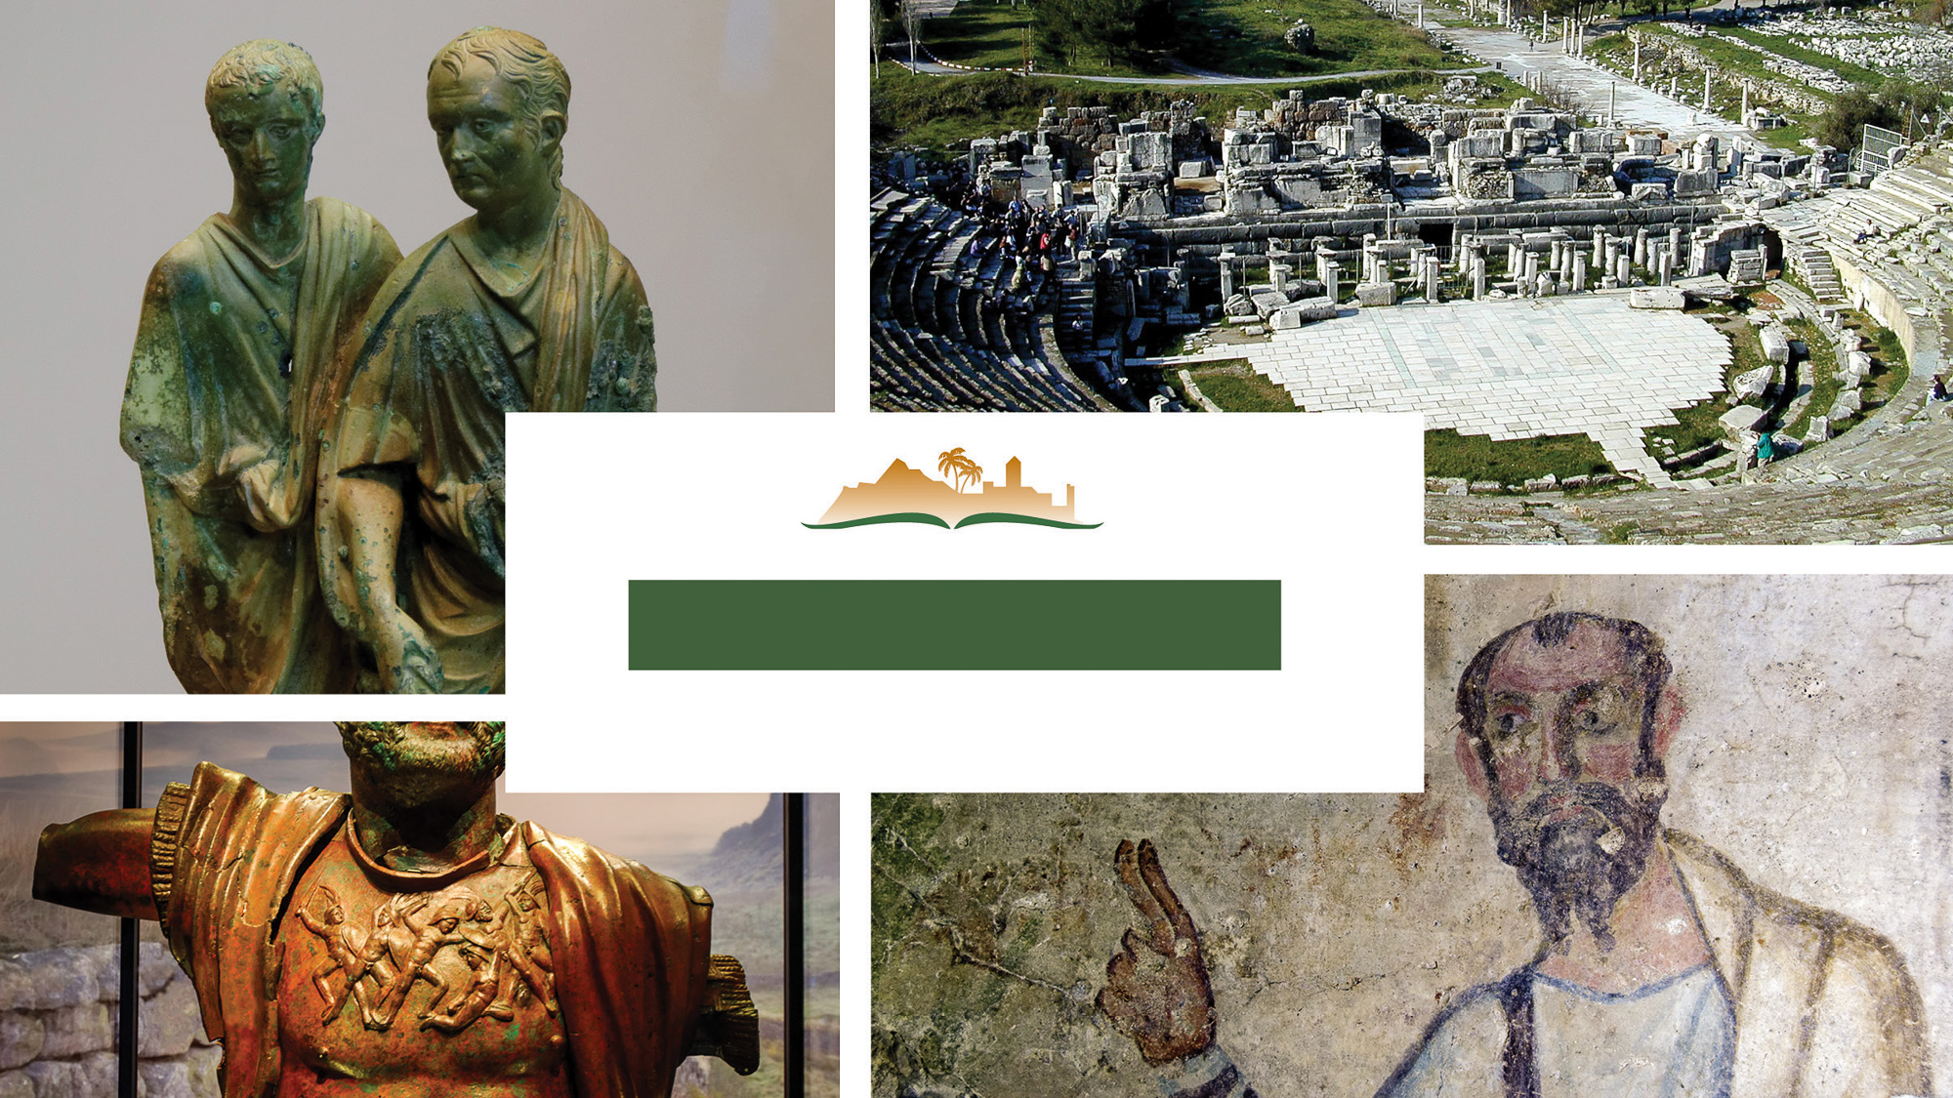
Ephesians 3
Notes:
This is a free sample of the Ephesians 3 presentation from the Photo Companion to the Bible. To purchase the full volume, visit https://www.bibleplaces.com/ephesians/
The Photo Companion to the Bible is an image-rich resource for Bible students, teachers, and researchers. Just as a librarian stocks the shelves with as many relevant materials as possible, so we have tried to provide a broad selection of images. Our goal is that you will find in this “library” whatever it is you are looking for.
Credits: The primary creators of this presentation are Kris Udd, Steven D. Anderson, Christian Locatell, and Todd Bolen. The photographs have an individual file code which usually includes the initials of the photographer. Other images have additional credit or source information.
Updates: We plan to update this collection as we are able. We welcome your suggestions for improving this resource (photocompanion@bibleplaces.com). Purchasers of the Ephesians volume are provided free, lifetime updates to the volume.
Copyright: This photo collection is protected by copyright law and may not be distributed without written permission from BiblePlaces.com. Slide notes should be treated as any other copyrighted written material, with credit given when quoting from these notes.
For more information, see our complete “Introduction to the Photo Companion to the Bible” online at https://www.BiblePlaces.com/Intro-Photo-Companion-Bible/. Here you will find more information about photo selection, explanatory notes, Bible translation, credit information, and copyright allowances.

Slide 2
Ephesians 3
This is a free sample of the Ephesians 3 presentation from the Photo Companion to the Bible. To purchase the full volume, visit https://www.bibleplaces.com/ephesians/ The Photo Companion to the Bible is an image-rich resource for Bible students, teachers, and researchers. Just as a librarian stocks the shelves with as many relevant materials as possible, so we have tried to provide a broad selection of images. Our goal is that you will find in this “library” whatever it is you are looking for. For more details (for this and every slide), see the Notes section below.
Notes:
This is a free sample of the Ephesians 3 presentation from the Photo Companion to the Bible. To purchase the full volume, visit https://www.bibleplaces.com/ephesians/
The Photo Companion to the Bible is an image-rich resource for Bible students, teachers, and researchers. Just as a librarian stocks the shelves with as many relevant materials as possible, so we have tried to provide a broad selection of images. Our goal is that you will find in this “library” whatever it is you are looking for.
Credits: The primary creators of this presentation are Kris Udd, Steven D. Anderson, Christian Locatell, and Todd Bolen. The photographs have an individual file code which usually includes the initials of the photographer. Other images have additional credit or source information.
Updates: We plan to update this collection as we are able. We welcome your suggestions for improving this resource (photocompanion@bibleplaces.com). Purchasers of the Ephesians volume are provided free, lifetime updates to the volume.
Copyright: This photo collection is protected by copyright law and may not be distributed without written permission from BiblePlaces.com. Slide notes should be treated as any other copyrighted written material, with credit given when quoting from these notes.
For more information, see our complete “Introduction to the Photo Companion to the Bible” online at https://www.BiblePlaces.com/Intro-Photo-Companion-Bible/. Here you will find more information about photo selection, explanatory notes, Bible translation, credit information, and copyright allowances.

Slide 3
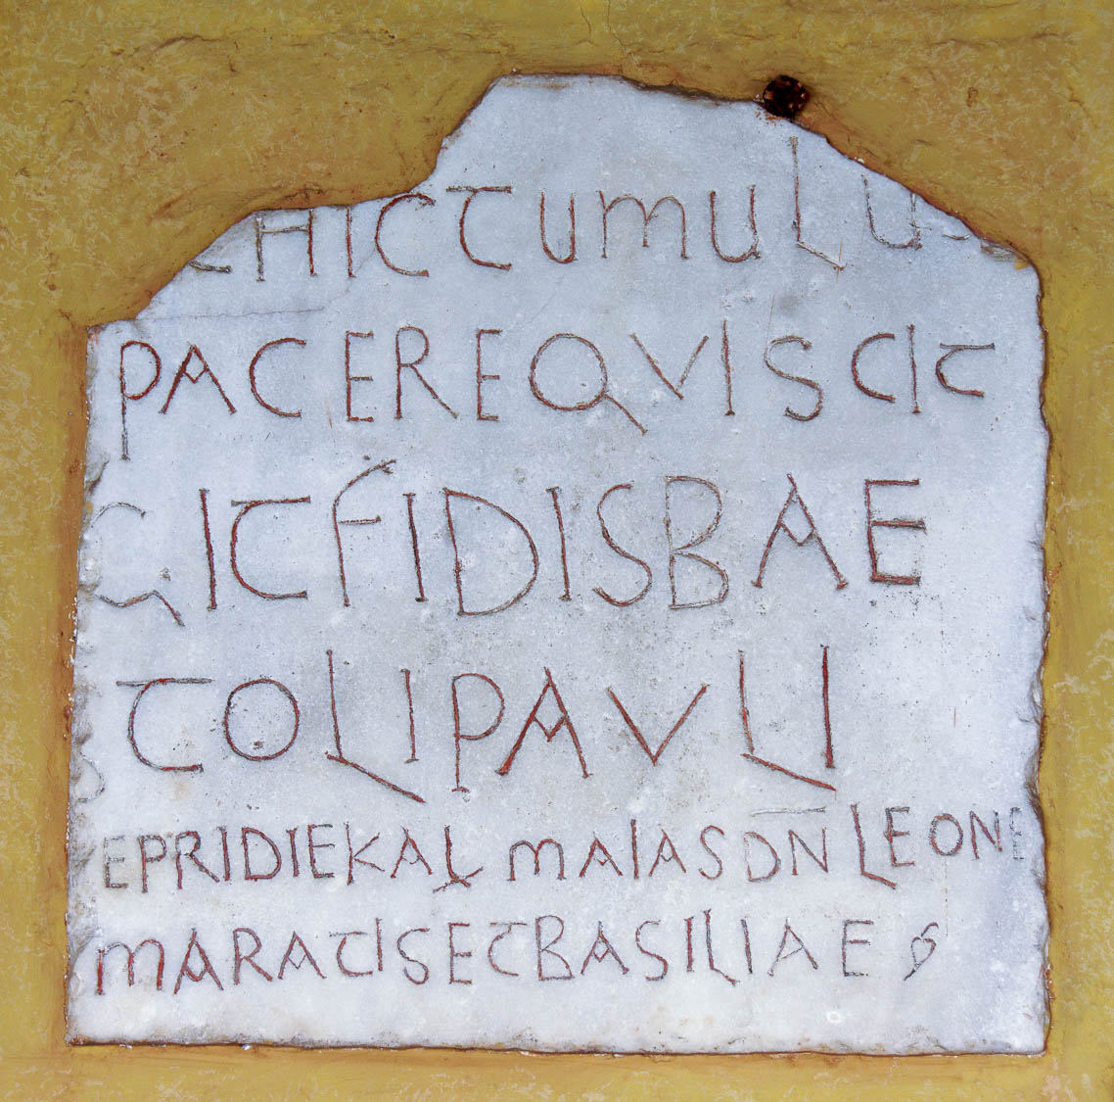
For this reason I, Paul
Latin inscription mentioning Paul, from Saint Paul Outside the Walls, Rome
3:1
Notes:
Paul begins this section with a reference to himself by name, eventually emphasizing that fact that he was the conduit for the gospel to the Gentiles (cf. Eph 3:3). This Latin inscription mentions the name “Paul” (Lat. PAVLI). It was photographed at Saint Paul Outside the Walls, a basilica in Rome that commemorates the traditional burial place of Paul.
tb0517173264h

Slide 4
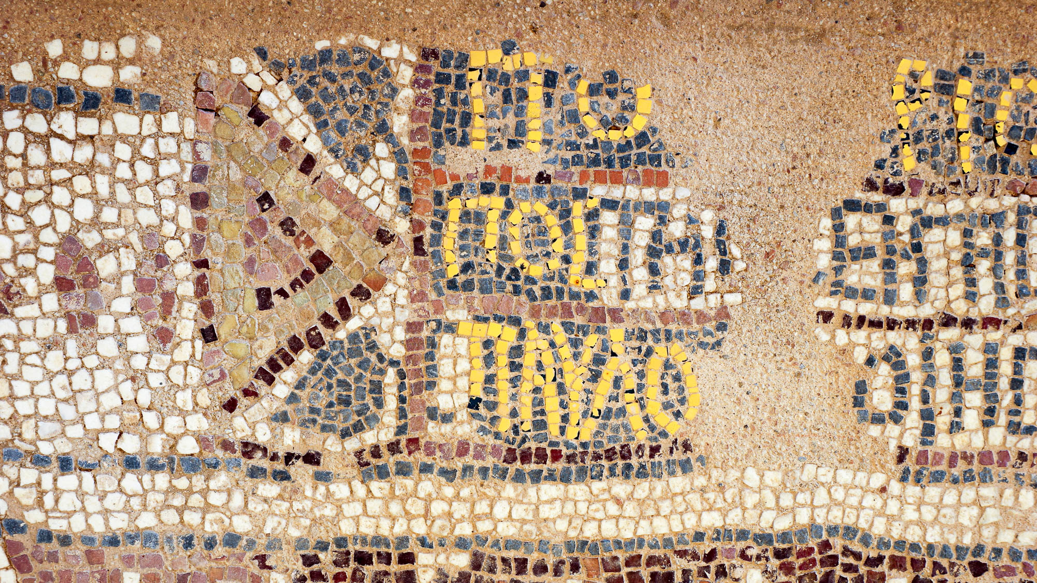
For this reason I, Paul
Floor mosaic with the name of St. Paul, Philippi, 5th century AD
3:1
Notes:
This mosaic from the Octagonal Basilica at Philippi is fragmentary, but it preserves the name of Paul in Greek (Gk. paulo[s], ΠΑΥΛΟ[Σ]). This image comes from Berthold Werner and is licensed under CC BY-SA 3.0, via Wikimedia Commons: https://commons.wikimedia.org/wiki/File:Archaeological_site_of_Philippi_BW_2017-10-05_12-54-40.jpg.
wiki10052017125440

Slide 5
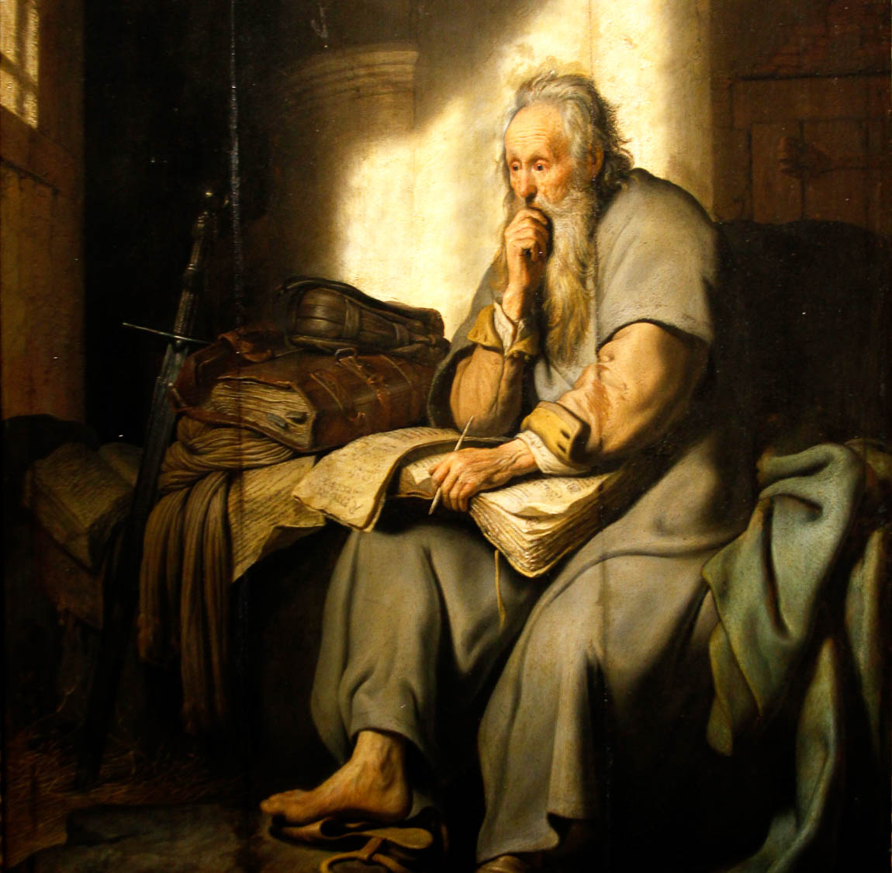
For this reason I, Paul, the prisoner of Christ Jesus on behalf of you Gentiles
St. Paul in Prison, by Rembrandt, 1627
3:1
Notes:
Paul more often refers to himself in his letters as either an apostle or a slave of Jesus Christ. His reference to himself here as a prisoner (Gk. desmios, δέσμιος) is less common (other occurrences are in Eph 4:1, 2 Tim 1:8, Phlm 1:1, and Phlm 1:9). This painting of Paul in prison depicts him with several books and with a sword. The sword is an indication of his (traditional) manner of death. This oil on panel painting of Paul in prison was photographed at the Staatsgalerie Stuttgart in Stuttgart, Germany. This image comes from Jose Luiz and is licensed under CC BY-SA 4.0, via Wikimedia Commons: https://commons.wikimedia.org/wiki/File:St._Paul_in_Prison_by_Rembrandt_-_Staatsgalerie_-_Stuttgart_-_Germany_2017.jpg.
wiki071920171001023328h

Slide 6
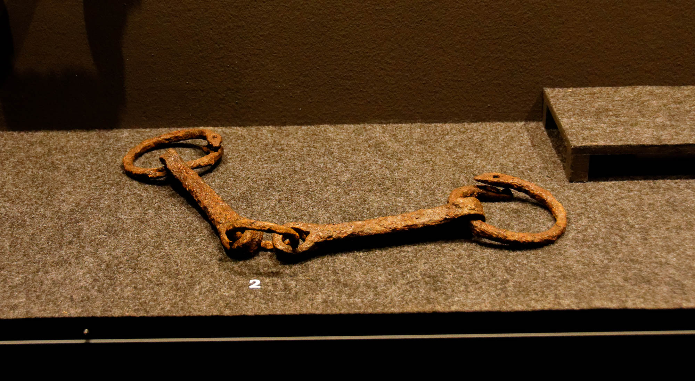
For this reason I, Paul, the prisoner of Christ Jesus on behalf of you Gentiles
Iron chains worn by slaves, 1st century AD
3:1
Notes:
These shackles from the 1st century AD were photographed at the Spartacus Exhibit, a temporary exhibition at the Ara Pacis Museum in Rome.
tb0518174081

Slide 7
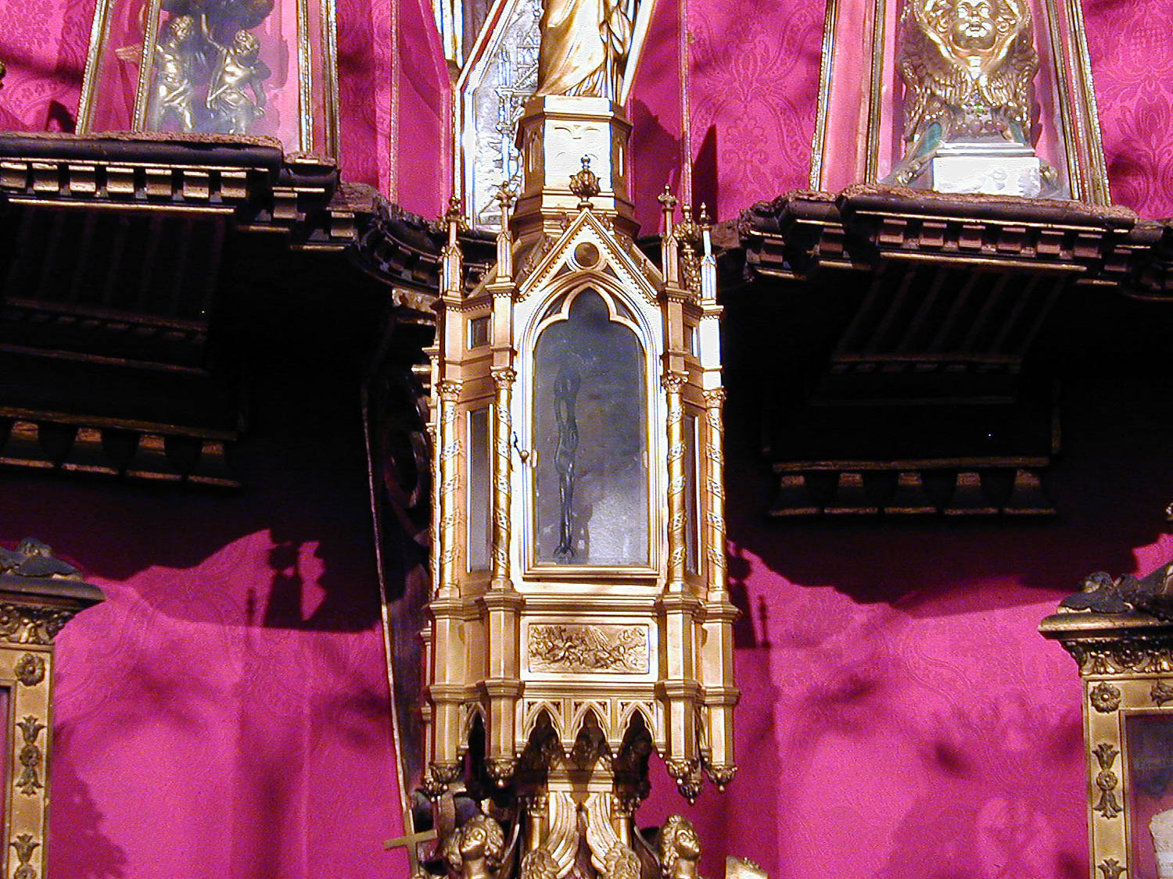
For this reason I, Paul, the prisoner of Christ Jesus on behalf of you Gentiles
So-called “Chains of St. Paul,” relic in the Basilica of St. Paul Outside the Walls in Rome
3:1
Notes:
These chains are venerated by some as the chains that bound the Apostle Paul during his imprisonment.
tb011901748

Slide 8
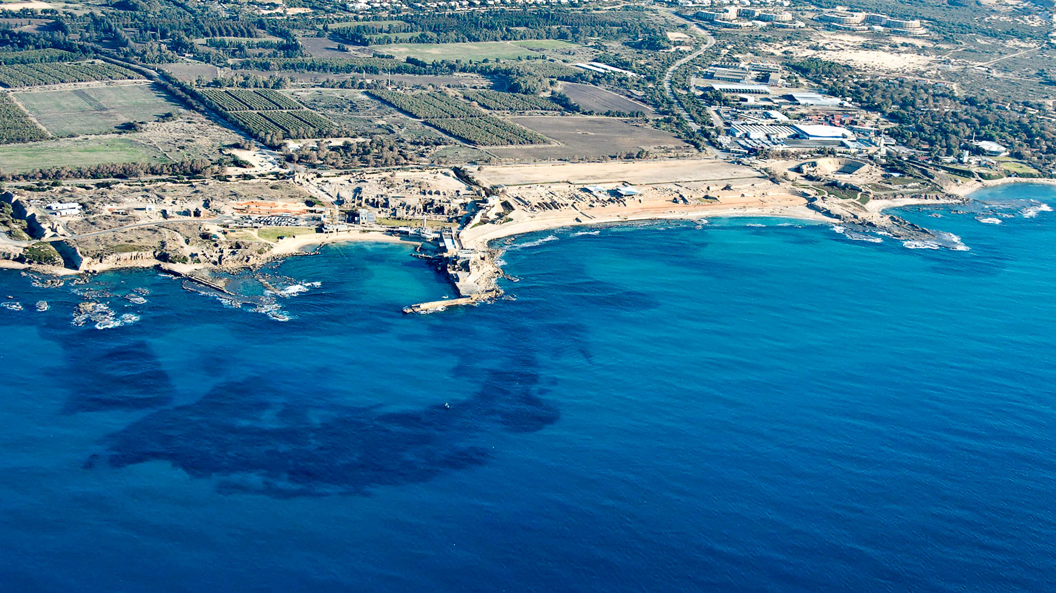
For this reason I, Paul, the prisoner of Christ Jesus on behalf of you Gentiles
Caesarea (aerial view from the west)
3:1
Notes:
It is commonly believed that Paul wrote the letter to the Ephesian church during his imprisonment in Rome. That was not, however, his only imprisonment. Paul was unjustly imprisoned for two years at Caesarea, prior to his trip to Rome (Acts 24:27). This aerial photo of Caesarea shows the harbor, several major features of the city, and the palace of the governor, where Paul was likely imprisoned. See the next slide for labels.
tb121704931h

Slide 9
For this reason I, Paul, the prisoner of Christ Jesus on behalf of you Gentiles
hippodrome
Byzantine
bathhouse
theater
hippodrome
temple
Crusader
castle
Herod’s
Promontory Palace
Herodian harbor
harbor
entrance
Herodian breakwater
(submerged)
Caesarea (aerial view from the west)
3:1
Notes:
It is commonly believed that Paul wrote the letter to the Ephesian church during his imprisonment in Rome. That was not, however, his only imprisonment. Paul was unjustly imprisoned for two years at Caesarea, prior to his trip to Rome (Acts 24:27). This aerial photo of Caesarea shows the harbor, several major features of the city, and the palace of the governor, where Paul was likely imprisoned.
tb121704931h

Slide 10
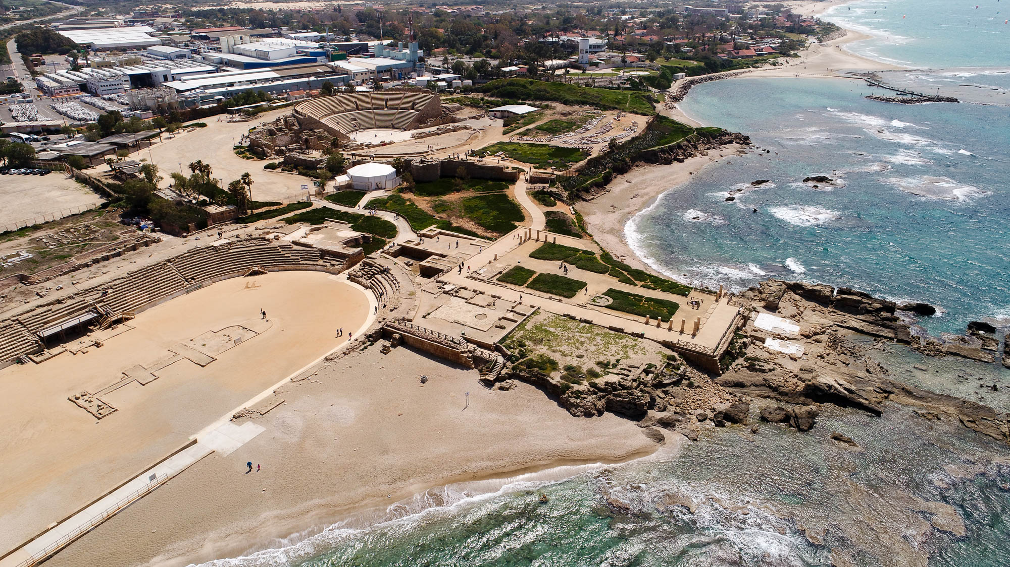
For this reason I, Paul, the prisoner of Christ Jesus on behalf of you Gentiles
Theater, hippodrome, and the palace of Herod in Caesarea (aerial view from the northwest)
3:1
Notes:
The structure in the center of this photo was initially built as a seaside palace by Herod the Great. The rectangle in the center includes several grassy squares was part of the Upper Palace of Herod. Paul was likely kept somewhere in this area, as it had accommodations for soldiers, palace guards, other workers, and probably a prison. The next slide includes labels.
ws040117105

Slide 11
For this reason I, Paul, the prisoner of Christ Jesus on behalf of you Gentiles
theater
Upper Palace
peristyle courtyard
hippodrome
Lower Palace
offices & administration
audience Hall
bathhouse
and mikveh
Theater, hippodrome, and the palace of Herod in Caesarea (aerial view from the northwest)
3:1
Notes:
The structure in the center of this photo was initially built as a seaside palace by Herod the Great. The rectangle in the center includes several grassy squares was part of the Upper Palace of Herod. Paul was likely kept somewhere in this area, as it had accommodations for soldiers, palace guards, other workers, and probably a prison.
ws040117105

Slide 12
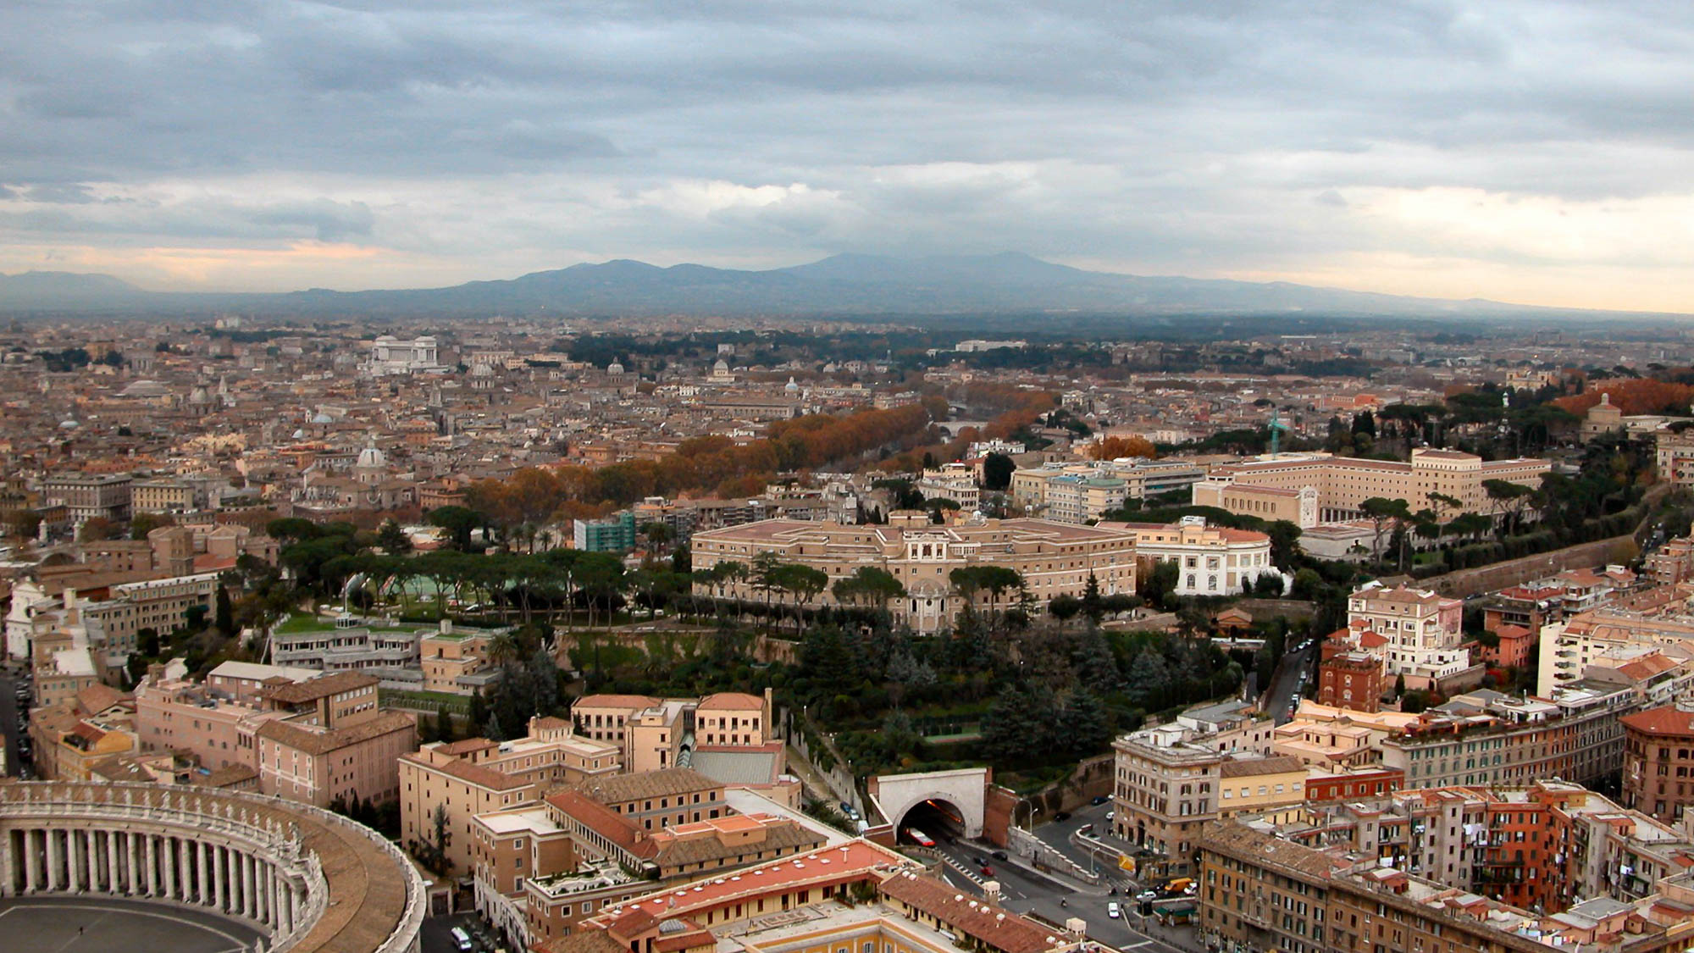
For this reason I, Paul, the prisoner of Christ Jesus on behalf of you Gentiles
Rome from St. Peter’s Basilica (from the north)
3:1
Notes:
The traditional view is that Paul wrote Ephesians during his imprisonment in Rome sometime around AD 61. Philippians 1:13 indicates that he was under guard (cf. Acts 28:16). This photo provides a bird’s-eye perspective of the modern city of Rome, looking in the direction from which Paul approached the city. In Paul’s day, the population of Rome is estimated to have been one million people. Today the population of Rome is just under three million.
tb112002518

Slide 13
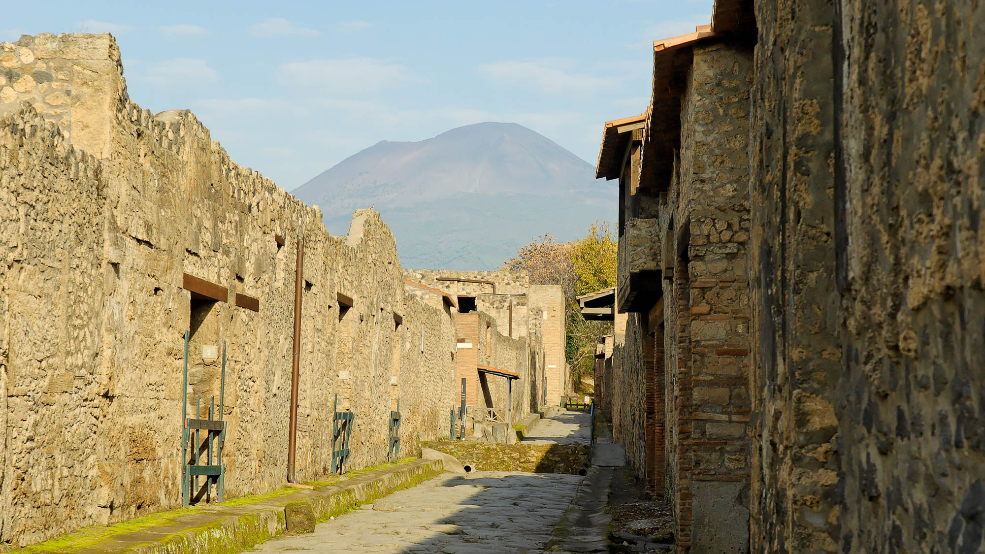
For this reason I, Paul, the prisoner of Christ Jesus on behalf of you Gentiles
Nuceria Street in Pompeii, 1st century AD
3:1
Notes:
While in Rome, Paul was kept under house arrest, meaning he was able to stay in his own rented quarters (Acts 28:16, 30). These houses excavated at Pompeii, a 1st-century town south of Rome, illustrate what the housing of a typical city may have looked like in the time of Paul. A view along a street like this one may have been quite familiar to him. Pompeii was buried in the eruption of Mt. Vesuvius in AD 79, preserving much of the city. Paul’s stay in Rome would have left him intimately familiar with the hustle and bustle of the great city. Ancient authors complained of the noise at night, as merchants took advantage of the lighter foot traffic to haul wares in and out on rickety carts. The street shown here illustrates the relatively tight confines within even a large town.
tb111505886

Slide 14
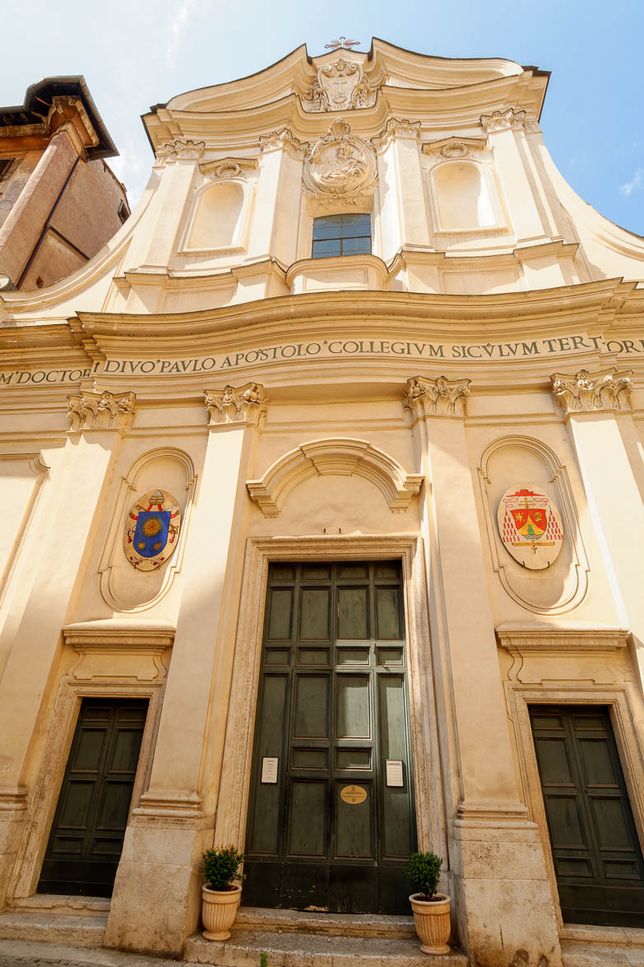
For this reason I, Paul, the prisoner of Christ Jesus on behalf of you Gentiles
Church of San Paolo Alla Regola, traditional place of Paul’s house imprisonment
3:1
Notes:
According to church tradition, the Church of San Paolo Alla Regola was built over the house where Paul was confined during his first visit to Rome. Believers met at this location for worship in the early Christian centuries. The first church was built here on the 11th century.
tb0518173736

Slide 15
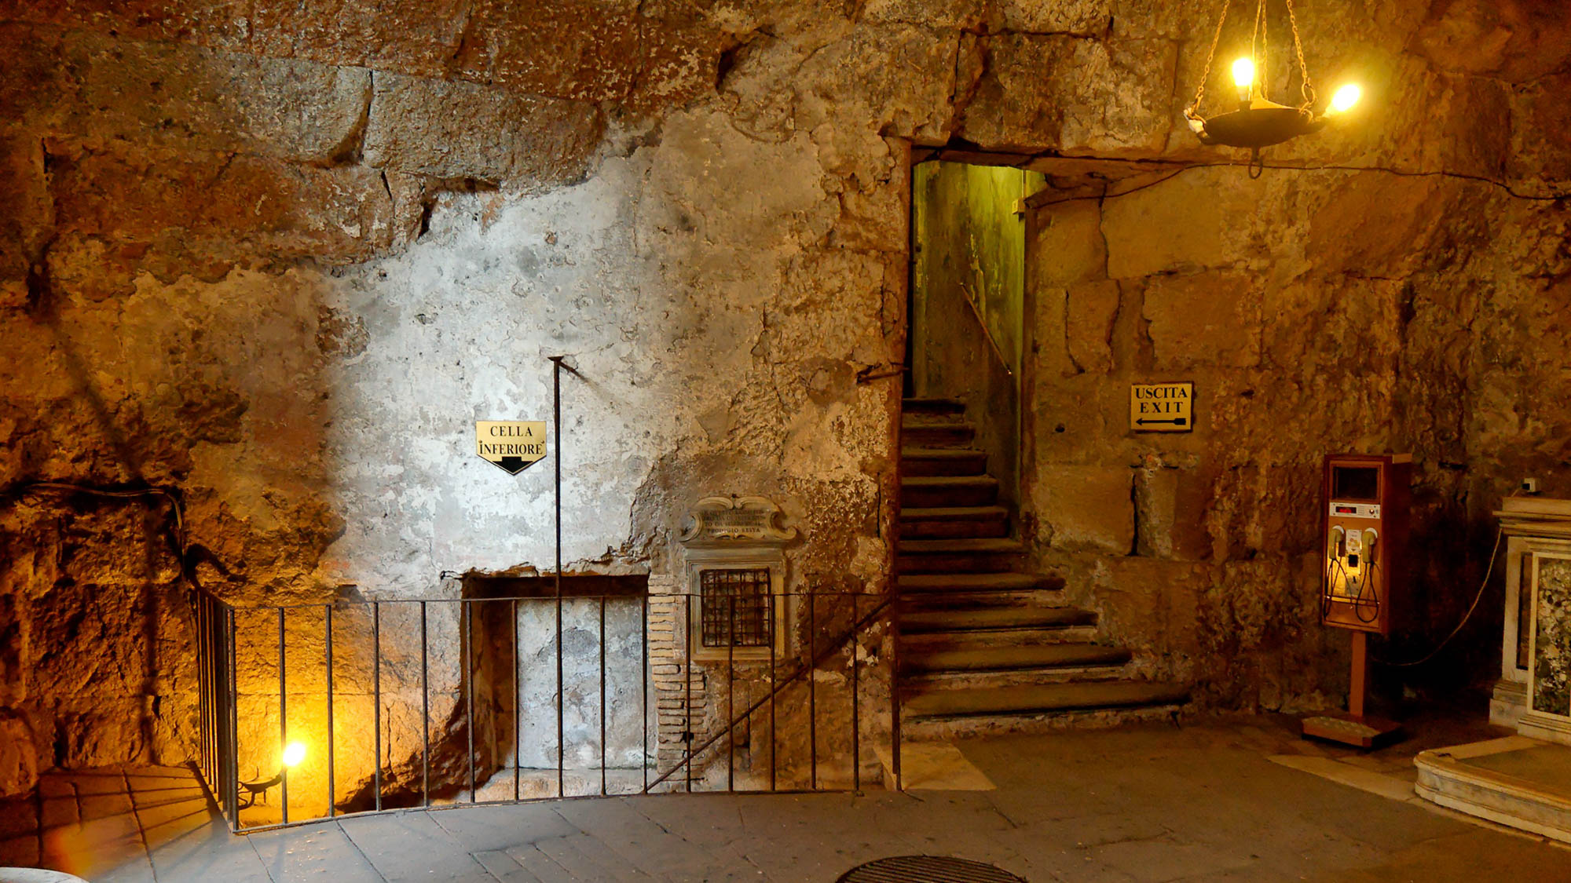
For this reason I, Paul, the prisoner of Christ Jesus on behalf of you Gentiles
Entrance of the Mamertine Prison
3:1
Notes:
According to tradition, Paul was eventually incarcerated and executed in Rome. The state rarely incarcerated common criminals but kept the Mamertine Prison for political prisoners doomed for execution by being thrown off the Tarpeian Rock. Enemies of the state, such as Jugurtha and Vercingetorix, were often strangled. Sallust, a Roman writer in 40 BC, described the prison, known to him as the Tullianum, as “about twelve feet deep, closed all round by strong walls and a stone vault. Its aspect is repugnant and fearsome from its neglect, darkness, and stench.”
tb112105002

Slide 16
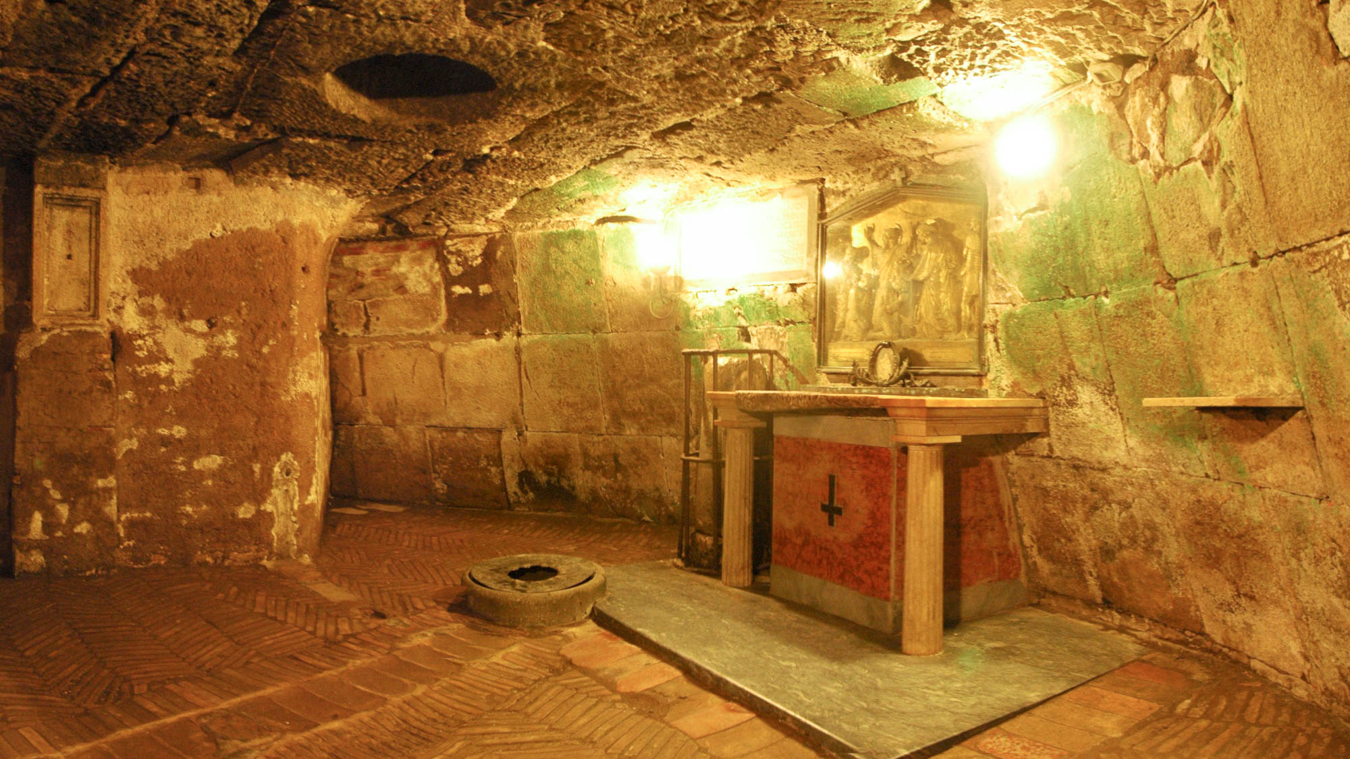
For this reason I, Paul, the prisoner of Christ Jesus on behalf of you Gentiles
Cell in the Mamertine Prison
3:1
Notes:
This photo, taken before the recent renovations, includes the traditional altar.
tb11210598p

Slide 17
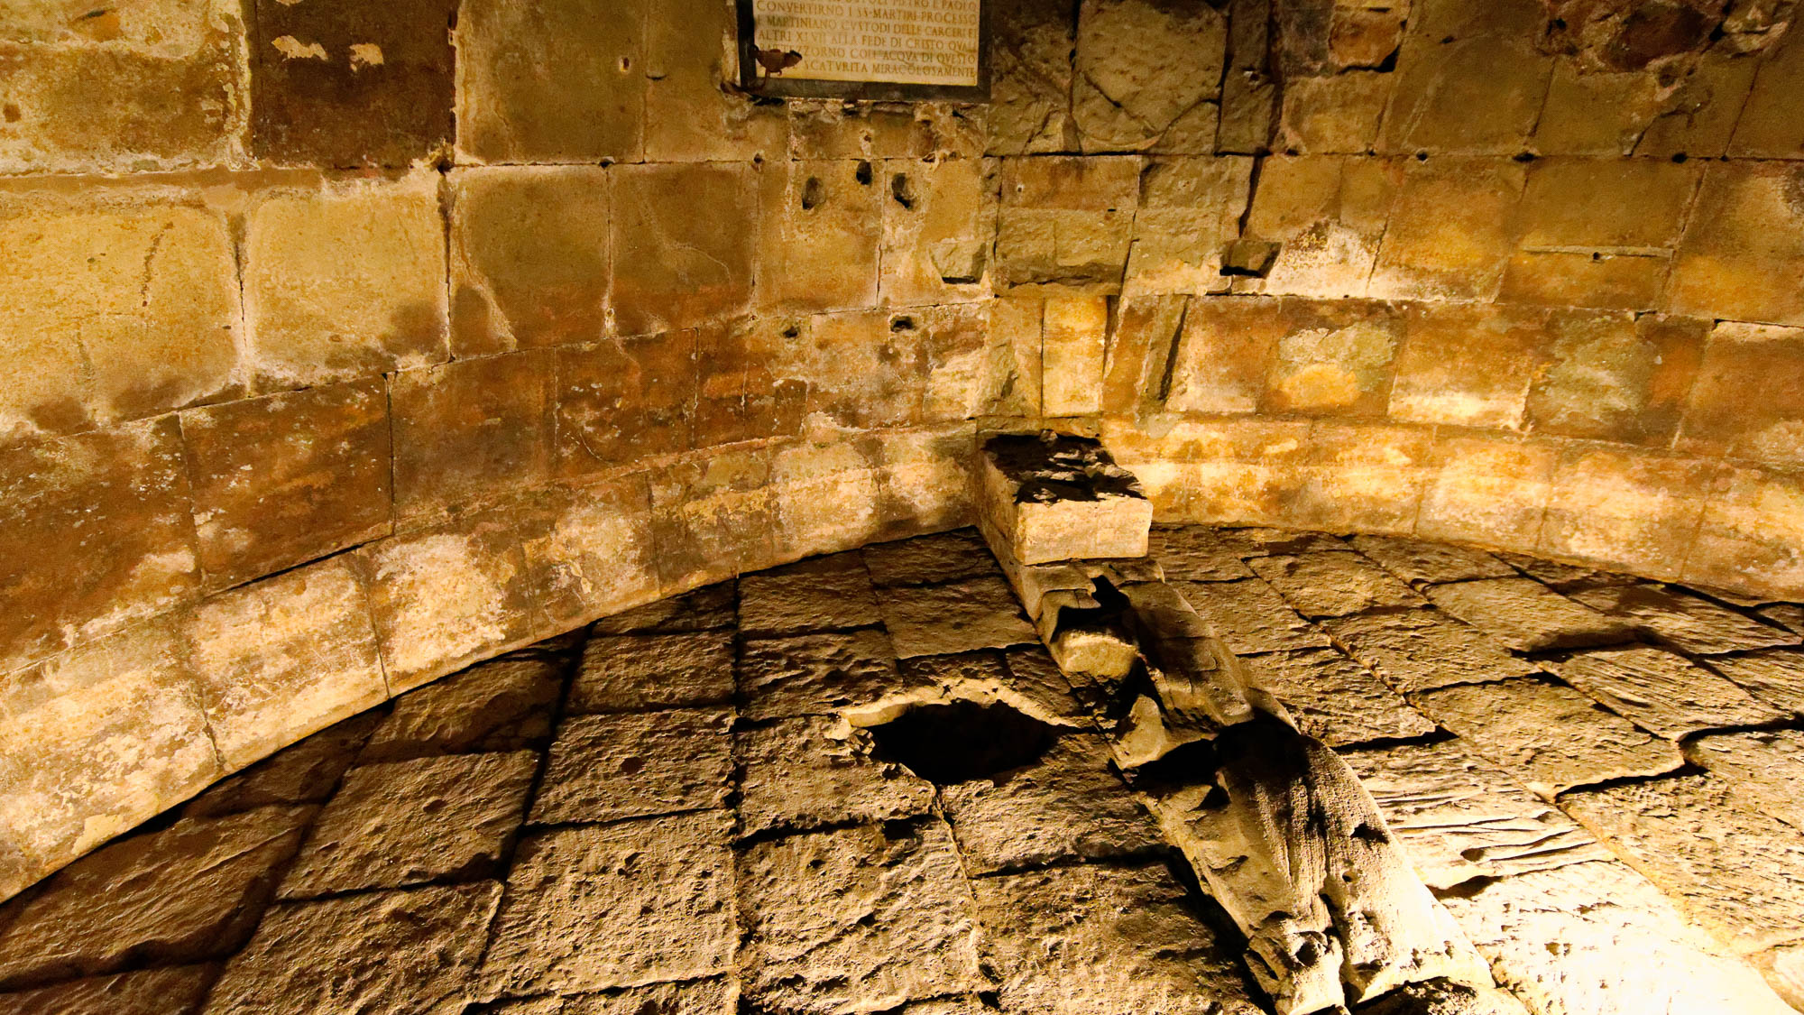
For this reason I, Paul, the prisoner of Christ Jesus on behalf of you Gentiles
Cell in the Mamertine Prison
3:1
Notes:
Tradition holds that Paul was incarcerated in this cell before his execution. This photograph shows the cell after recent renovations.
tb0517173513h

Slide 18
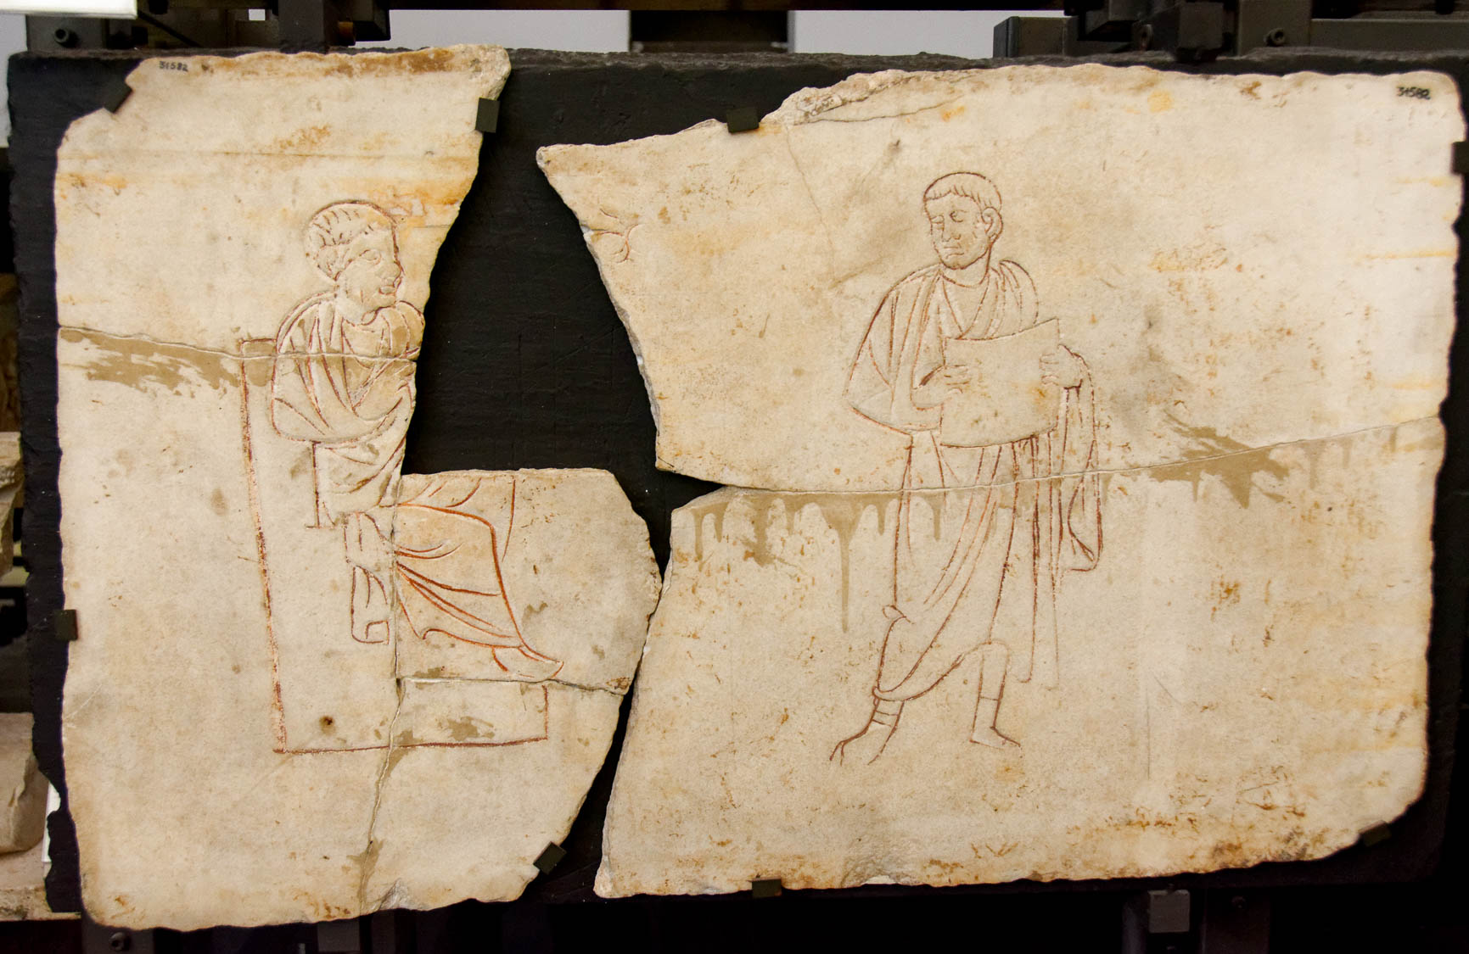
The stewardship of God’s grace that was given to me for you
Depiction of Christ teaching, with a disciple holding an unrolled scroll, 3rd–4th centuries AD
3:2
Notes:
Paul’s task was to preach the good news of God wherever he was able but particularly to the Gentiles. This sepulchral slab from the Catacomb of Praetextatus in Rome depicts Jesus seated and teaching, perhaps to a disciple. Paul sought to emulate Jesus as he taught the good news in places outside the land of Israel. This artifact was photographed at the Vatican Museums.
tb0512175608h

Slide 19
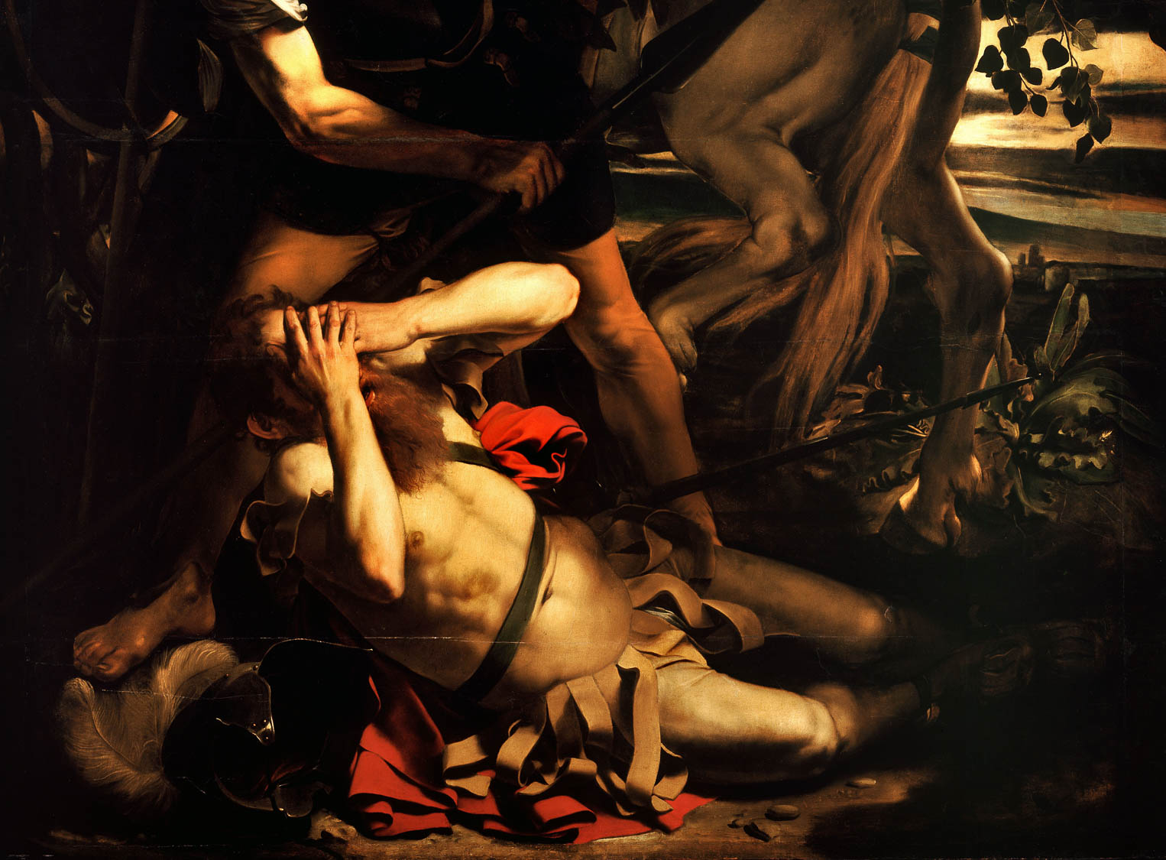
The stewardship of God’s grace that was given to me for you
Conversion of Saint Paul, by Caravaggio, 1601 (detail)
3:2
Notes:
Paul may have in mind the events surrounding his conversion (Acts 9). Already at that time, God designated him as a “chosen instrument” to carry the gospel to the Gentiles and also to suffer for God (Acts 9:15-16). The story of Saul’s conversion on the road to Damascus is captivating and has been portrayed many times in various art forms through the centuries. This painting is by the Italian artist Michelangelo Merisi da Caravaggio. His dramatic use of lighting, seen in this painting, had a formative influence on Baroque painting. This image comes from Wikimedia Commons and is in the public domain. Source: https://commons.wikimedia.org/wiki/File:The_Conversion_of_Saint_Paul-Caravaggio_(c._1600-1).jpg
wiki051620110836h

Slide 20
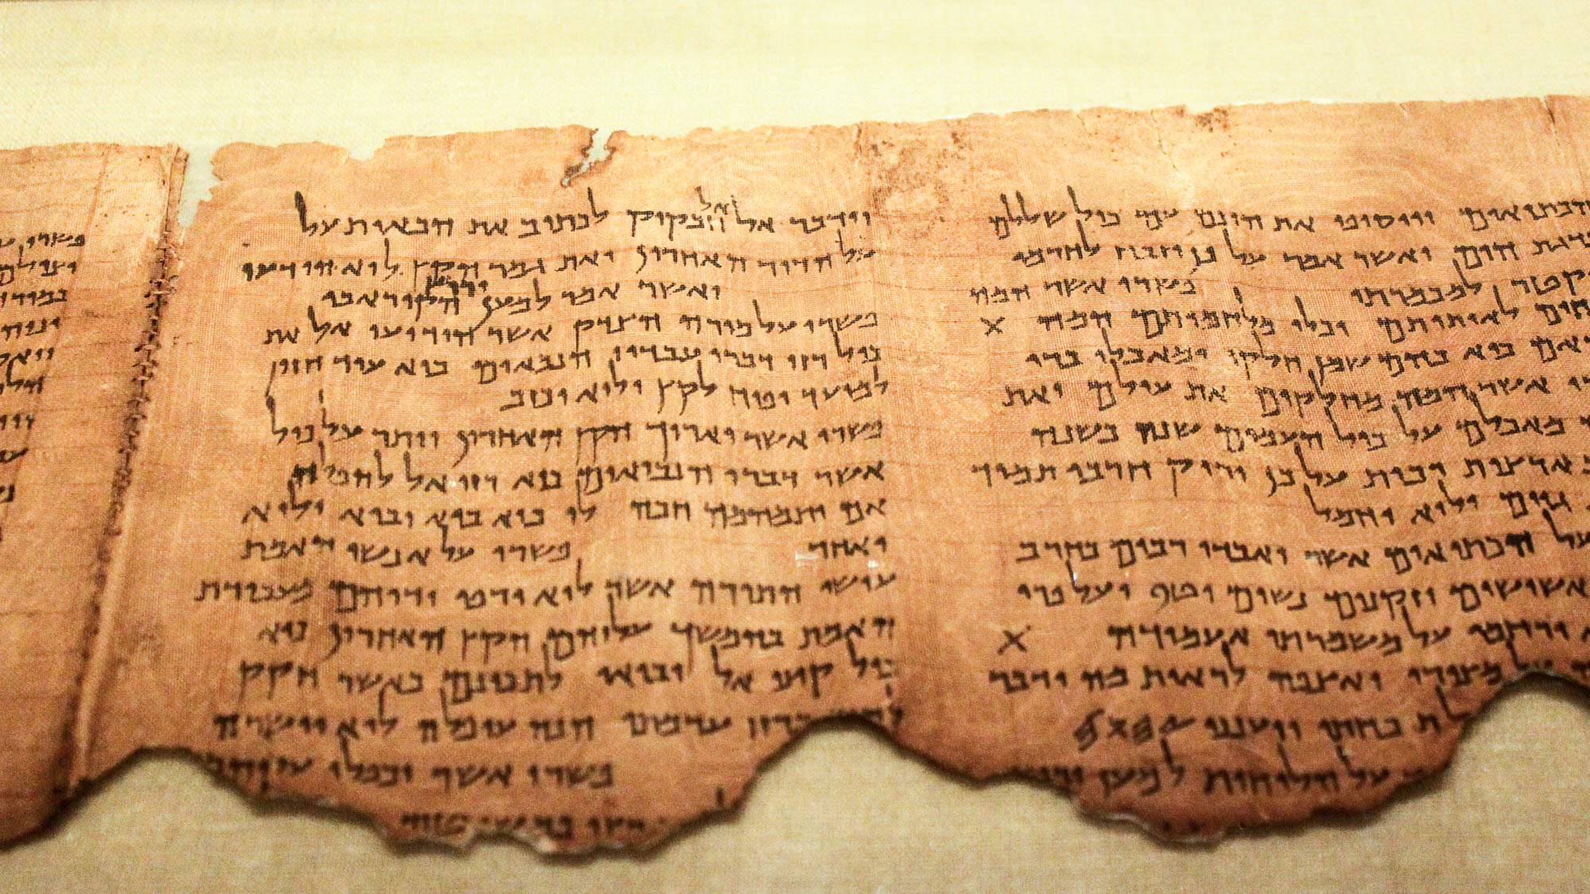
By revelation the mystery was made known to me, as I wrote before briefly
The Commentary of the Habakkuk Scroll (1QpHab), late 1st century BC
3:3
Notes:
The concept of “mystery” was well-known in Paul’s day. An example from a Jewish context is found in Dead Sea Scrolls commentary (pesher) on Habakkuk. The portion shown here includes columns six and seven of the Habakkuk Pesher; it comes from Cave 1 near Qumran. This section discusses the “mystery,” which was revealed to the Teacher of Righteousness. The Teacher of Righteousness is generally understood to have been a central figure in the Jewish sect at Qumran, although his identity is debated. See the following slide for a highlight of the relevant text.
Concerning the text of Habakkuk 2:2, the commentator writes, “Its interpretation is concerning the Teacher of Righteousness to whom God has made known all the mysteries of the words of his servants the prophets” (פשרו על מורה הצדק אשר הודיעו אל את כול רזי דברי עבדיו הנבאים).
The image comes from Desconocido and is in the public domain, via Wikimedia Commons: https://commons.wikimedia.org/wiki/File:Pesher_Habakkuk_Scroll.JPG.
wiki0814201220394752

Slide 21
By revelation the mystery was made known to me, as I wrote before briefly
“Its interpretation is concerning the Teacher of Righteousness to whom God has made known all the mysteries of the words of his servants the prophets.”
The Commentary of the Habakkuk Scroll (1QpHab), late 1st century BC
3:3
Notes:
The concept of “mystery” was well-known in Paul’s day. An example from a Jewish context is found in Dead Sea Scrolls commentary (pesher) on Habakkuk. The portion shown here includes columns six and seven of the Habakkuk Pesher; it comes from Cave 1 near Qumran. This section discusses the “mystery,” which was revealed to the Teacher of Righteousness. The Teacher of Righteousness is generally understood to have been a central figure in the Jewish sect at Qumran, although his identity is debated.
Concerning the text of Habakkuk 2:2, the commentator writes, “Its interpretation is concerning the Teacher of Righteousness to whom God has made known all the mysteries of the words of his servants the prophets” (פשרו על מורה הצדק אשר הודיעו אל את כול רזי דברי עבדיו הנבאים).
The image comes from Desconocido and is in the public domain, via Wikimedia Commons: https://commons.wikimedia.org/wiki/File:Pesher_Habakkuk_Scroll.JPG.
wiki0814201220394752

Slide 22
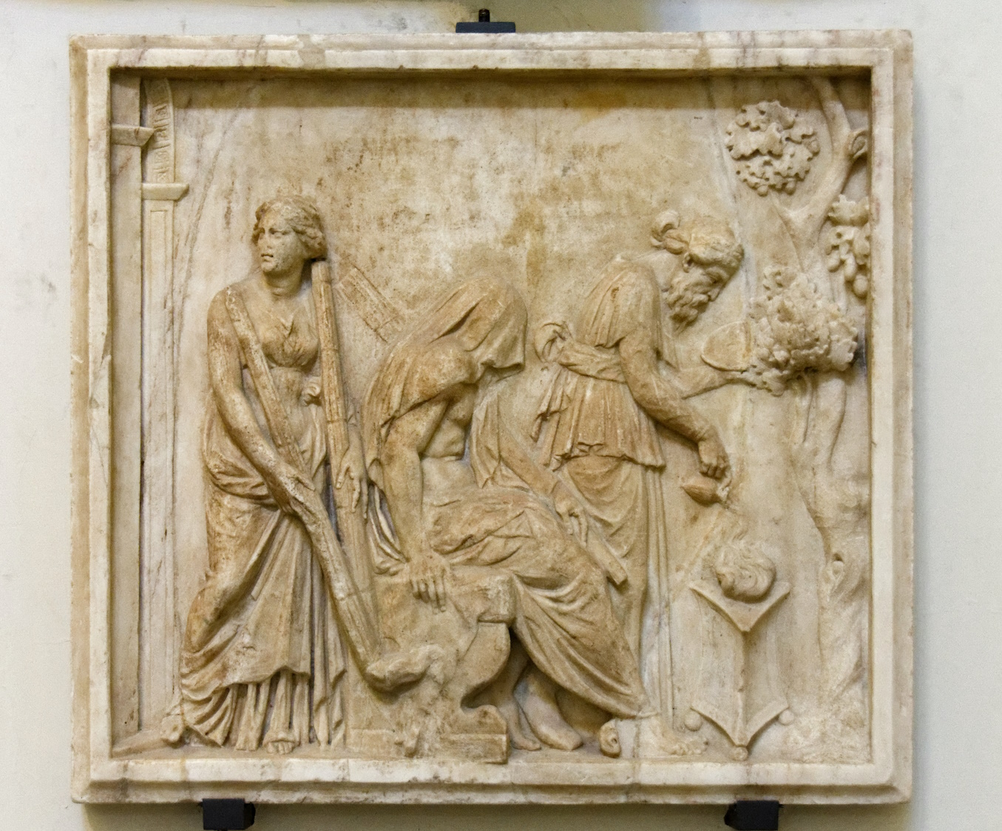
By revelation the mystery was made known to me, as I wrote before briefly
Relief depicting Heracles’s initiation into the Eleusinian mysteries
3:3
Notes:
There were also several Roman “mystery” cults in Paul’s day. Such cults promised revelation of secret knowledge to initiates. One popular mystery cult was that of Eleusis, depicted here. In the 3rd century AD, the church father Tertullian (On Baptism, 5) wrote against several mystery cults, including those of Isis, Mithras, and what he referred to as the “Apollinarian and Eleusinian games.” In Ephesians, Paul explains that the Lord chose to share the mystery of the church through his apostleship. This relief was photographed at the Naples Archaeological Museum.
tb0515171197c

Slide 23
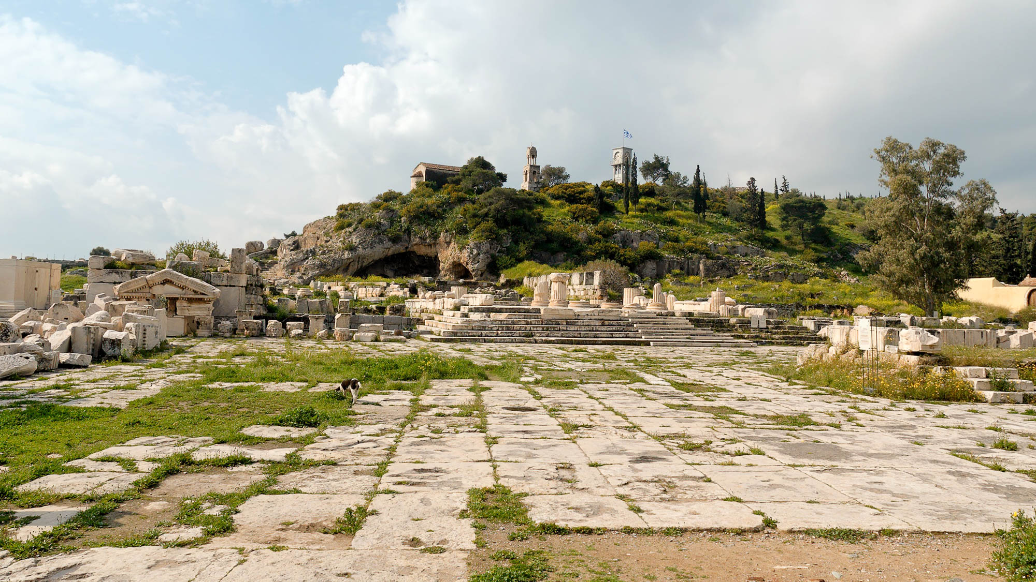
By revelation the mystery was made known to me, as I wrote before briefly
Sanctuary at Eleusis
3:3
Notes:
The center of the Eleusinian mystery cult was located across the Saronic Gulf from Corinth. This is where initiation rights into the Eleusinian mysteries would be conducted. The rites were also conducted in other locations across in the Roman Empire.
tb031706898

Slide 24
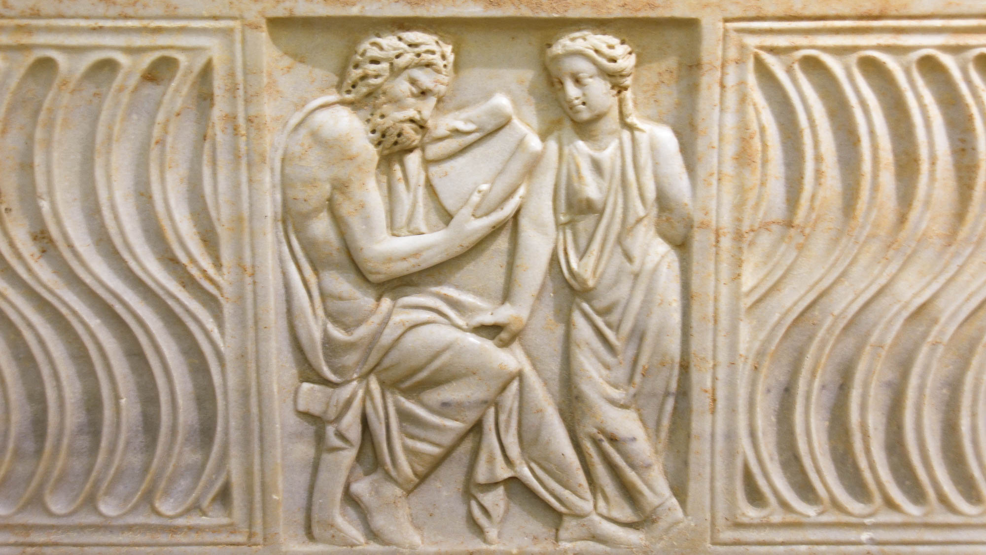
When you read it, you can understand my insight into the mystery of Christ
Sarcophagus with a man reading, from Rome, 3rd century AD
3:4
Notes:
This ancient marble sarcophagus relief was photographed at the Capitoline Museums in Rome.
tb0514179608

Slide 25
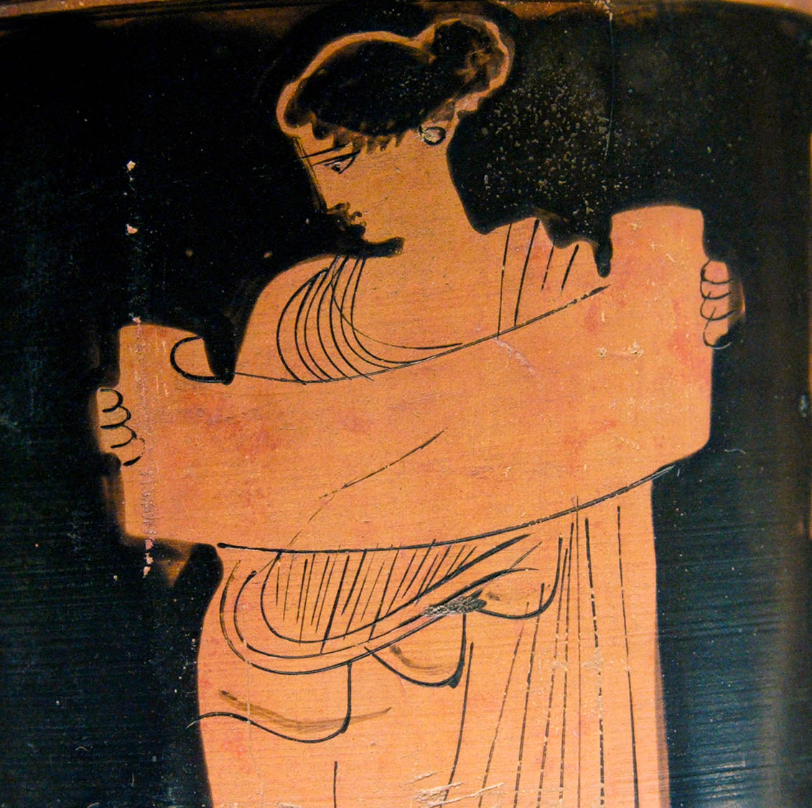
When you read it, you can understand my insight into the mystery of Christ
Woman reading a scroll, from Boeotia, circa 5th century BC
3:4
Notes:
Reading in the first century was always done aloud, whether publicly or privately (Gamble 1995: 203). In part, this was because literacy rates in Greco-Roman societies were about 10 percent (Gamble 1995: 4). This depiction on a lekythos shows a woman reading from a papyrus roll. The artist is identified as the Klügmann Painter. This lekythos was photographed at the Louvre Museum. This image comes from Jastrow and is in the public domain, via Wikimedia Commons: https://commons.wikimedia.org/wiki/File:Musa_reading_a_volumen_(scroll)-cropped-2.png.
Reference:
Gamble, Harry Y.
1995 Books and Readers in the Early Church: A History of Early Christian Texts. New Haven, CT: Yale University Press.
wiki011520142035092008h

Slide 26
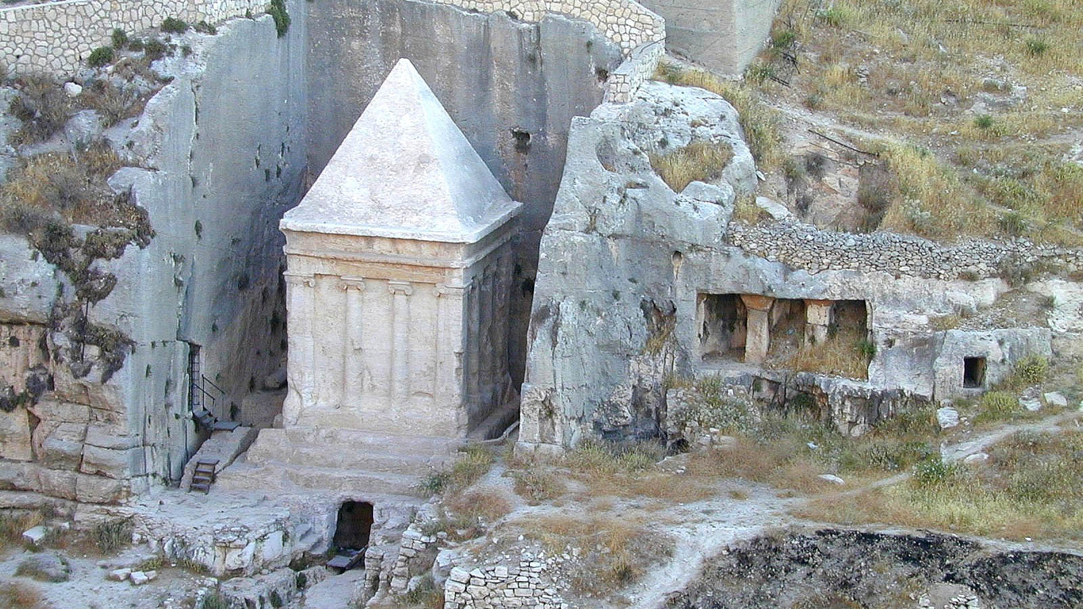
Which in other generations was not made known to the sons of men as it has now been revealed
So-called “Tomb of Zechariah” in the Kidron Valley
3:5
Notes:
Zechariah was a prophet from generations earlier who prophesied many things about the Messiah but did not clearly reveal how the Messiah would unite Jews and Gentiles into one body. Although the tomb pictured above is called “the tomb of Zechariah,” it was built in the mid-1st century BC, and likely is not to be associated with any biblical figure.
tb060900205h

Slide 27
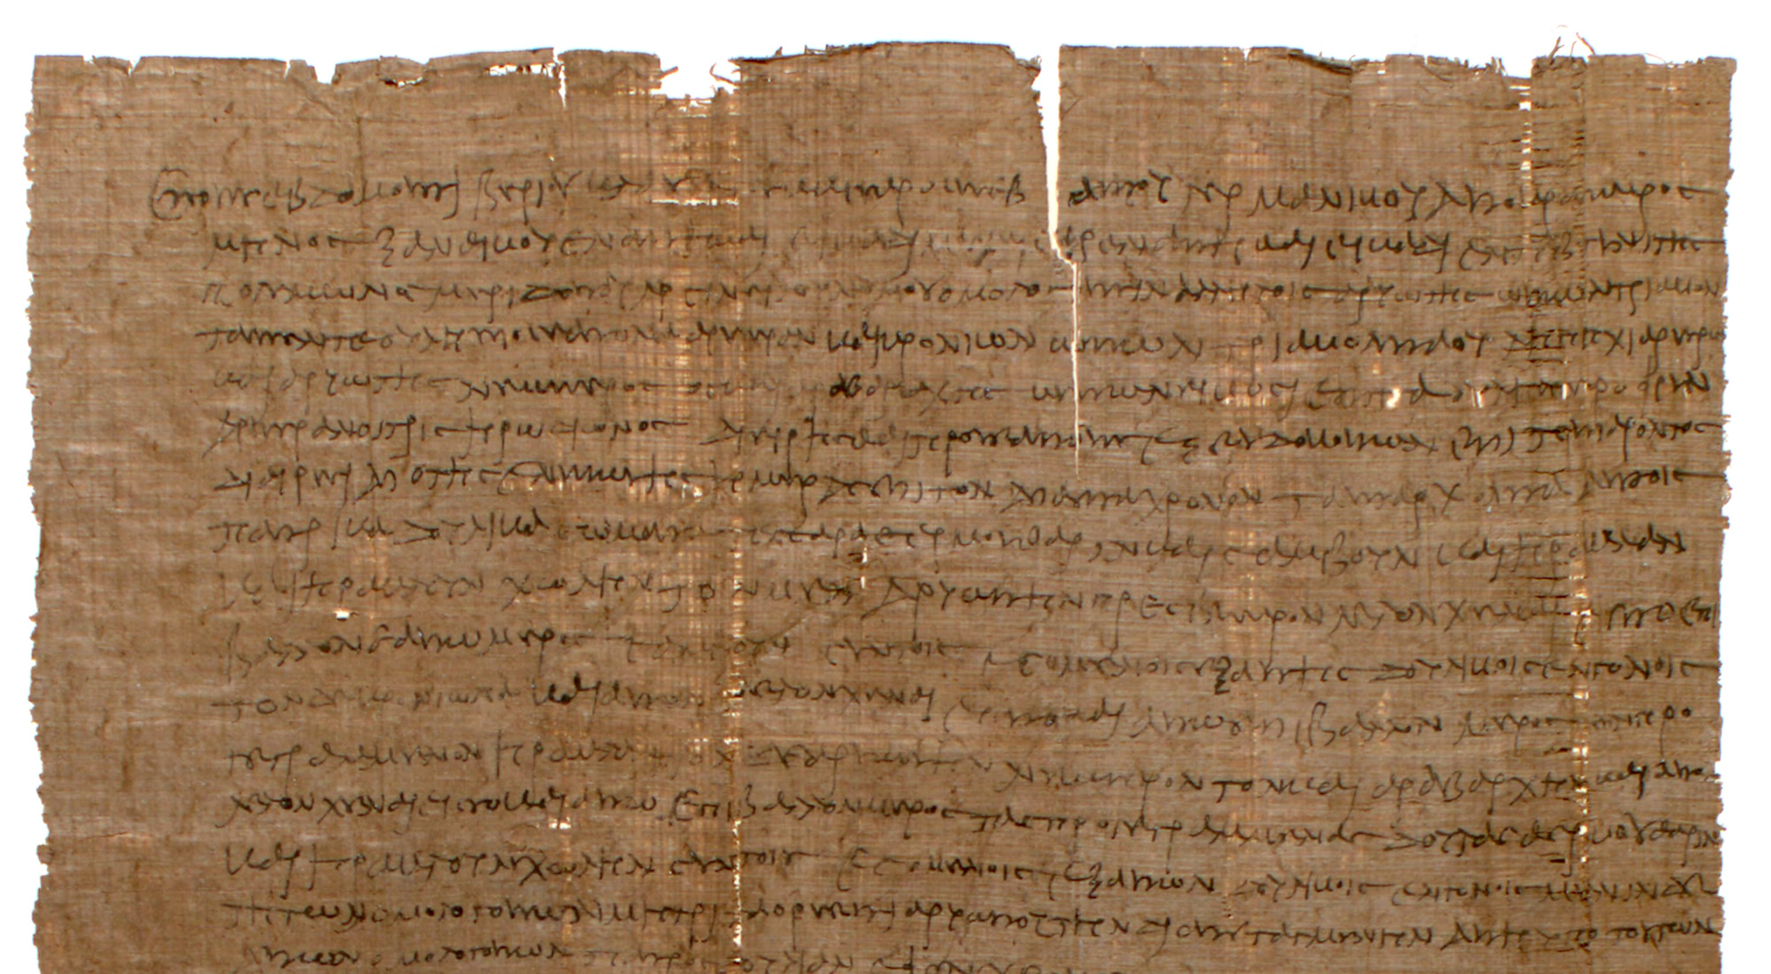
That the Gentiles are co-heirs and fellow-members of the body of Christ
Will of Herodion, February 23, AD 47
3:6
Notes:
Paul’s reference to Gentiles as “co-heirs” (Gk. sunklēronomos, συγκληρονόμος) with the Jews indicates that both stand to inherit from God. The papyrus document shown here is the will of a first century Egyptian man named Herodion. In it, he states that each of his three sons will inherit a particular slave, and a fourth slave will remain with his widow until she also passes away. It reads, in part, “Haryotes the elder has received as his share Sambous with the slave offspring that shall come from her, and Kronion has received as his share the aforesaid Heraklas . . .” This sort of document expresses the idea of multiple heirs who each receive inheritance from the testator, making them co-heirs. This image comes from the University of Michigan, Advanced Papyrological Information System, and is in the public domain. Source: http://quod.lib.umich.edu/a/apis/x-1347/1264r.tif. Accessed: Jan 1, 2020.
umapis12641347137

Slide 28
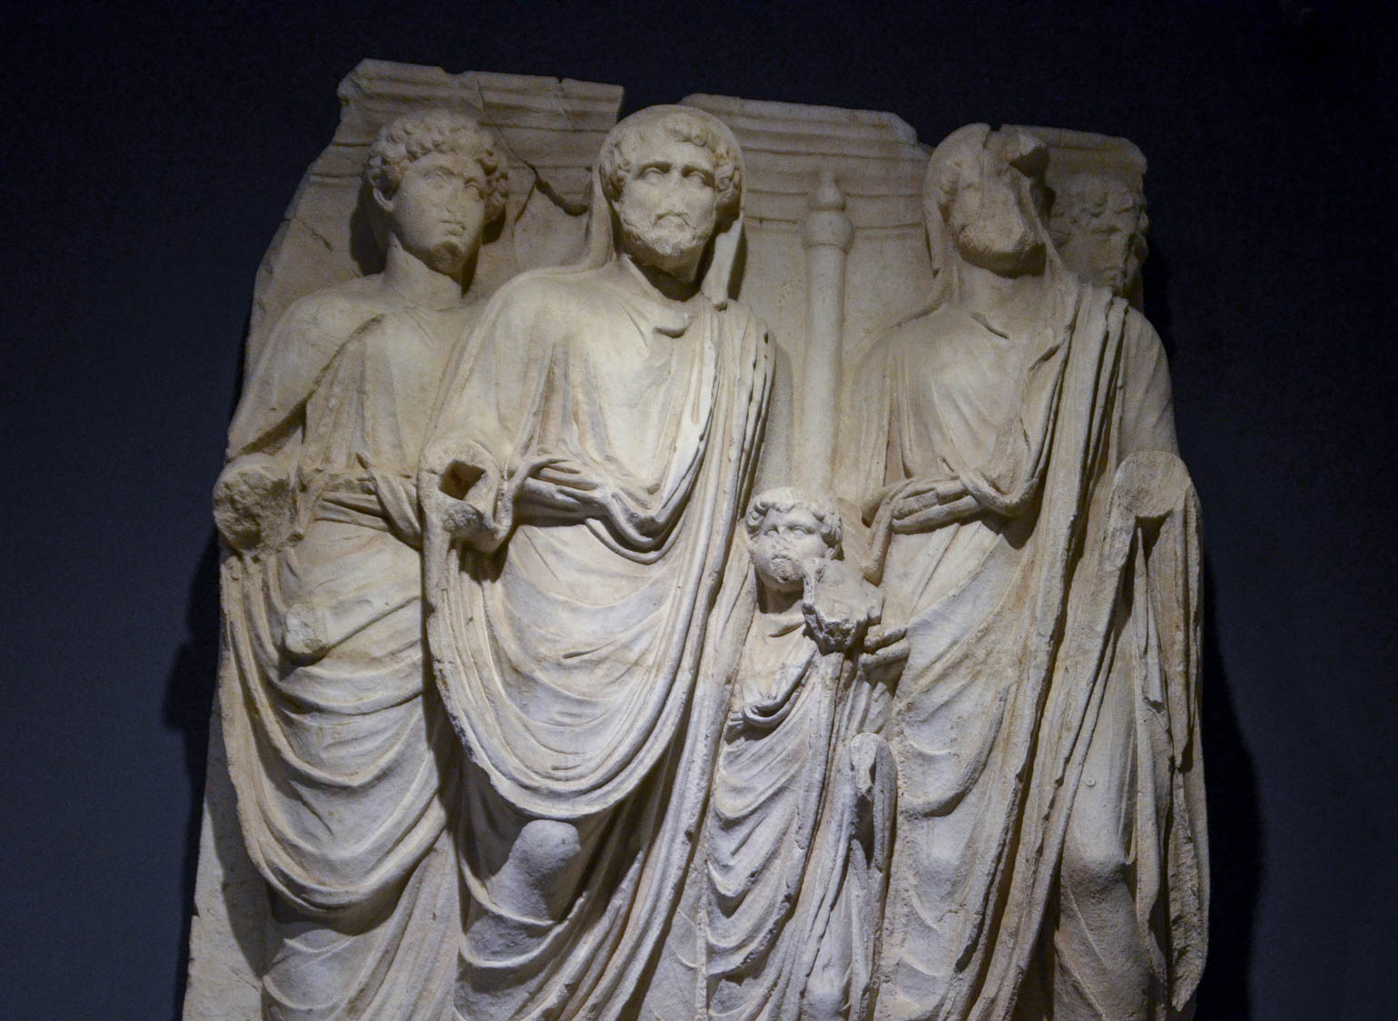
They are fellow-partakers of the promise in Christ Jesus through the gospel
Antonius Pius with sons Marcus Aurelius and Lucius Verus, from Parthian Monument, AD 170
3:6
Notes:
“Fellow-partakers” (Gk. summetochos, συμμέτοχος) is a word that refers to those who share the possession of something. The relief in this photo shows the Roman emperor Antonius Pius (center; ruled AD 138–161) with his adopted sons Marcus Aurelius and Lucius Verus. These two adopted sons eventually shared the throne when Antonius Pius died, becoming co-emperors. This arrangement lasted until Lucius Verus died (perhaps of smallpox) in AD 169. This sculpture was photographed at the Ephesus Museum.
shs031315731h

Slide 29
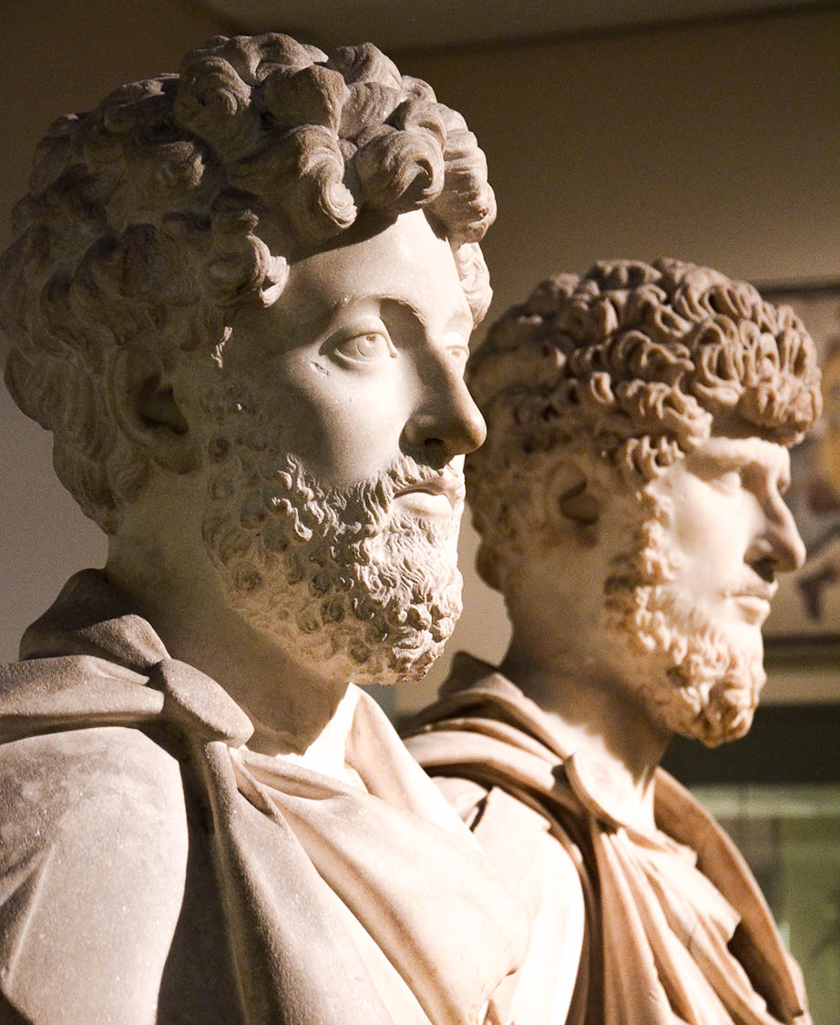
They are fellow-partakers of the promise in Christ Jesus through the gospel
Co-emperors Marcus Aurelius and Lucius Verus, circa AD 175
3:6
Notes:
This is reminiscent of Paul’s statement elsewhere that “if we endure, we will also reign with Him” (2 Tim 2:12). These side-by-side busts of Marcus Aurelius and Lucius Verus were photographed at the British Museum. This image comes from Carole Raddato and is in the public domain, via Wikimedia Commons: https://commons.wikimedia.org/wiki/File:Co-emperors_Marcus_Aurelius_and_Lucius_Verus,_British_Museum_(23455313842).jpg.
wiki23455313842h

Slide 30
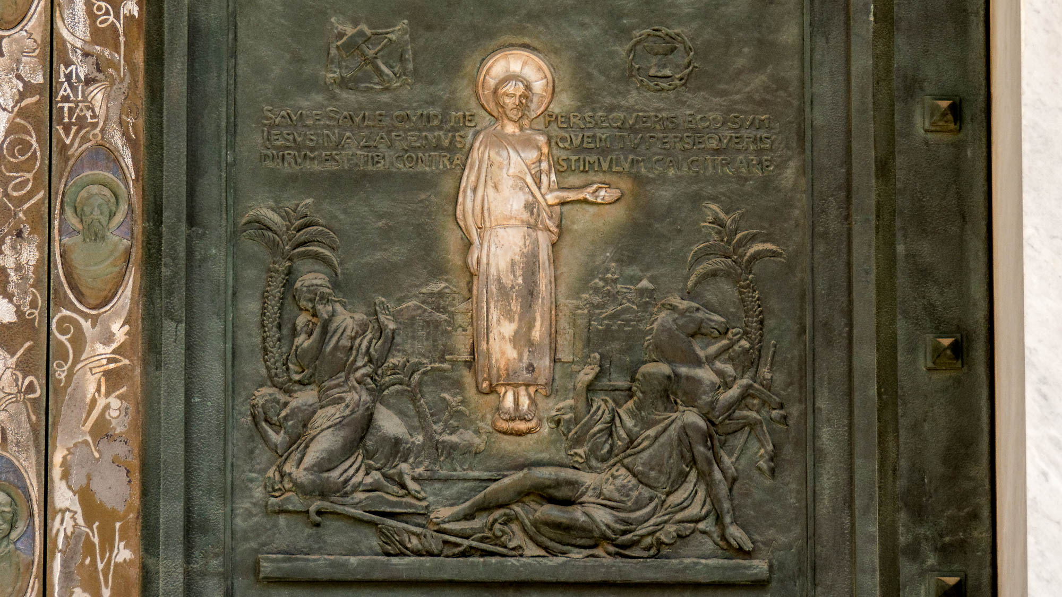
Of which I was made a minister, according to the gift of God’s grace
Paul’s conversion depicted on the main door of the Basilica of St. Paul Outside the Walls
3:7
Notes:
Paul’s initial call to the ministry of the gospel was while he was on his way to Damascus in pursuit of Christians (Acts 9). His encounter with Jesus along that road is the subject of the door panel shown here. This artwork was created in 1929–31.
tb0517173052h

Slide 31
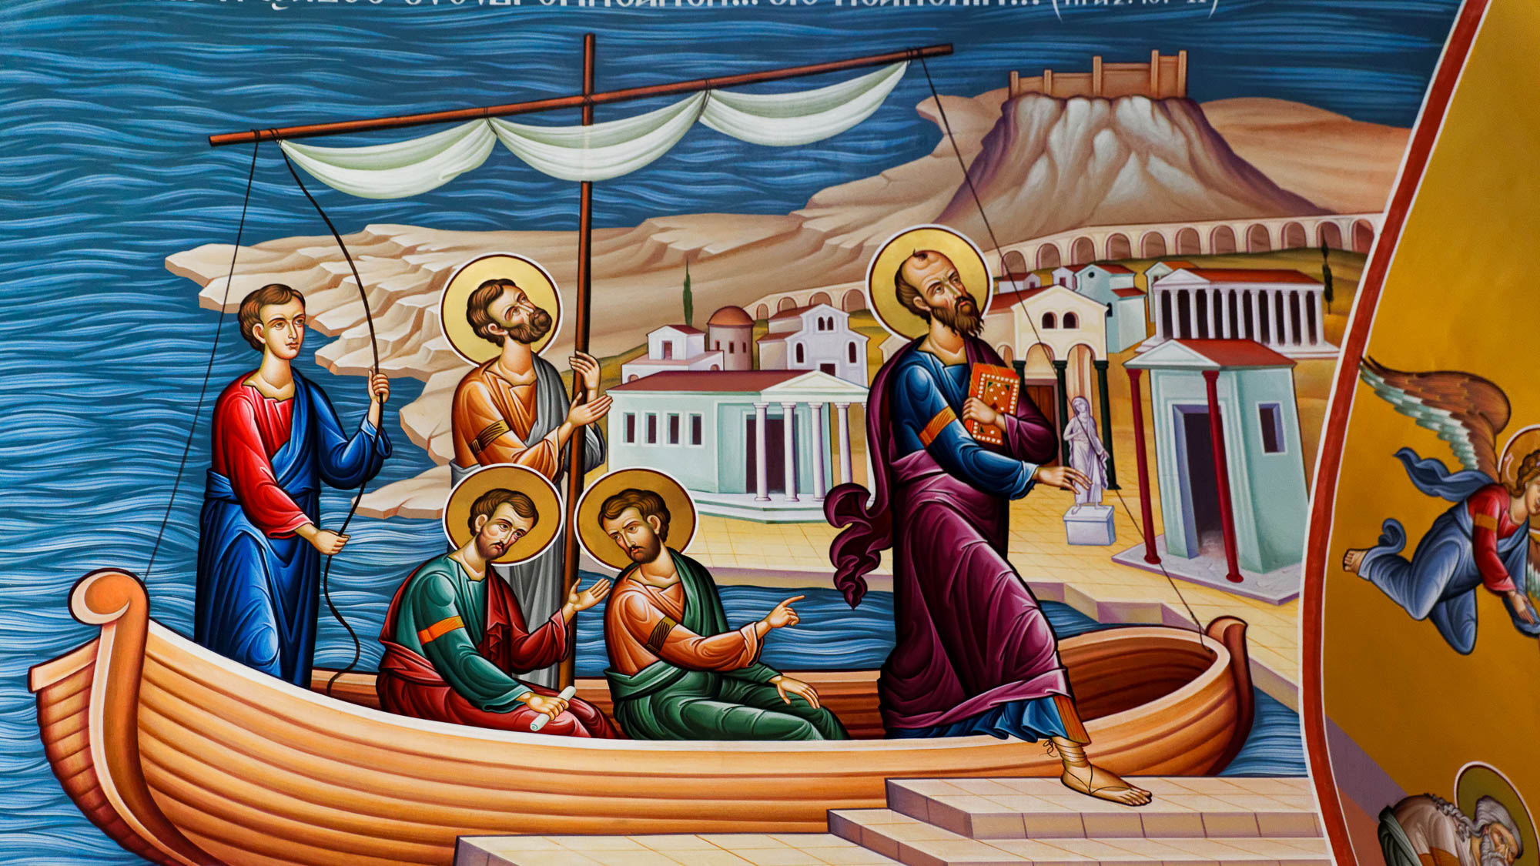
To me . . . this grace was given, to preach to the Gentiles
Painting of Paul arriving at Neapolis, from the St. Lydia Chapel in Philippi
3:8
Notes:
Paul travelled extensively as he worked to preach the gospel. He first stepped foot in Europe at Neapolis, the port city of Philippi (Acts 16:9-12).
jc0106151312

Slide 32
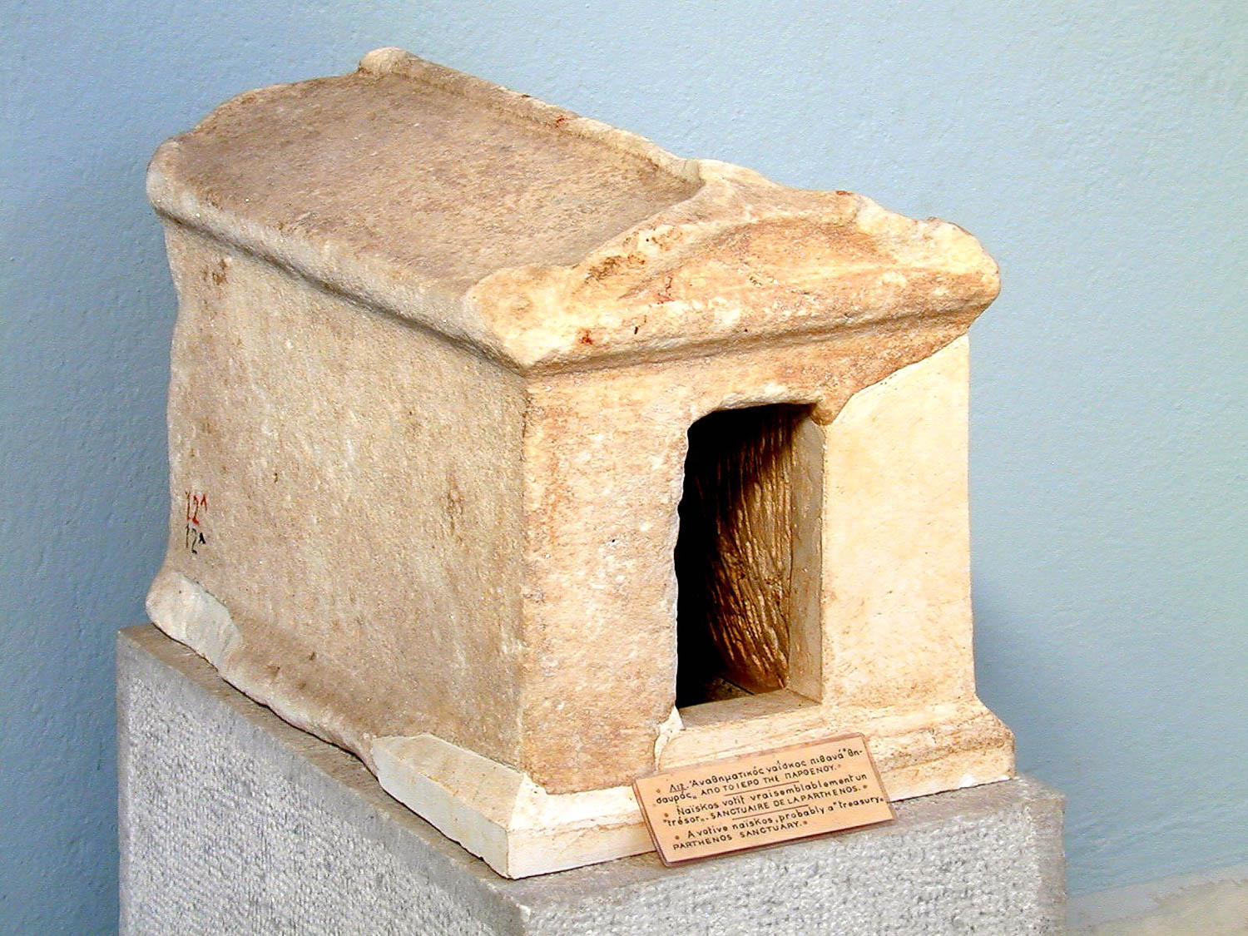
To me . . . this grace was given, to preach to the Gentiles the unsearchable riches of Christ
Neapolis treasury from Parthenos
3:8
Notes:
The “riches” (Gk. ploutos, πλοῦτος) of Christ surely revolves primarily around the promise of eternal life (cf. Rom 6:22; 1 Tim 6:12; Gal 6:8). The concept of great riches is illustrated here by a small votive shrine that is thought to represent a treasury. This artifact was photographed at the Kavala Museum (biblical Neapolis) in Greece.
tb011201196

Slide 33
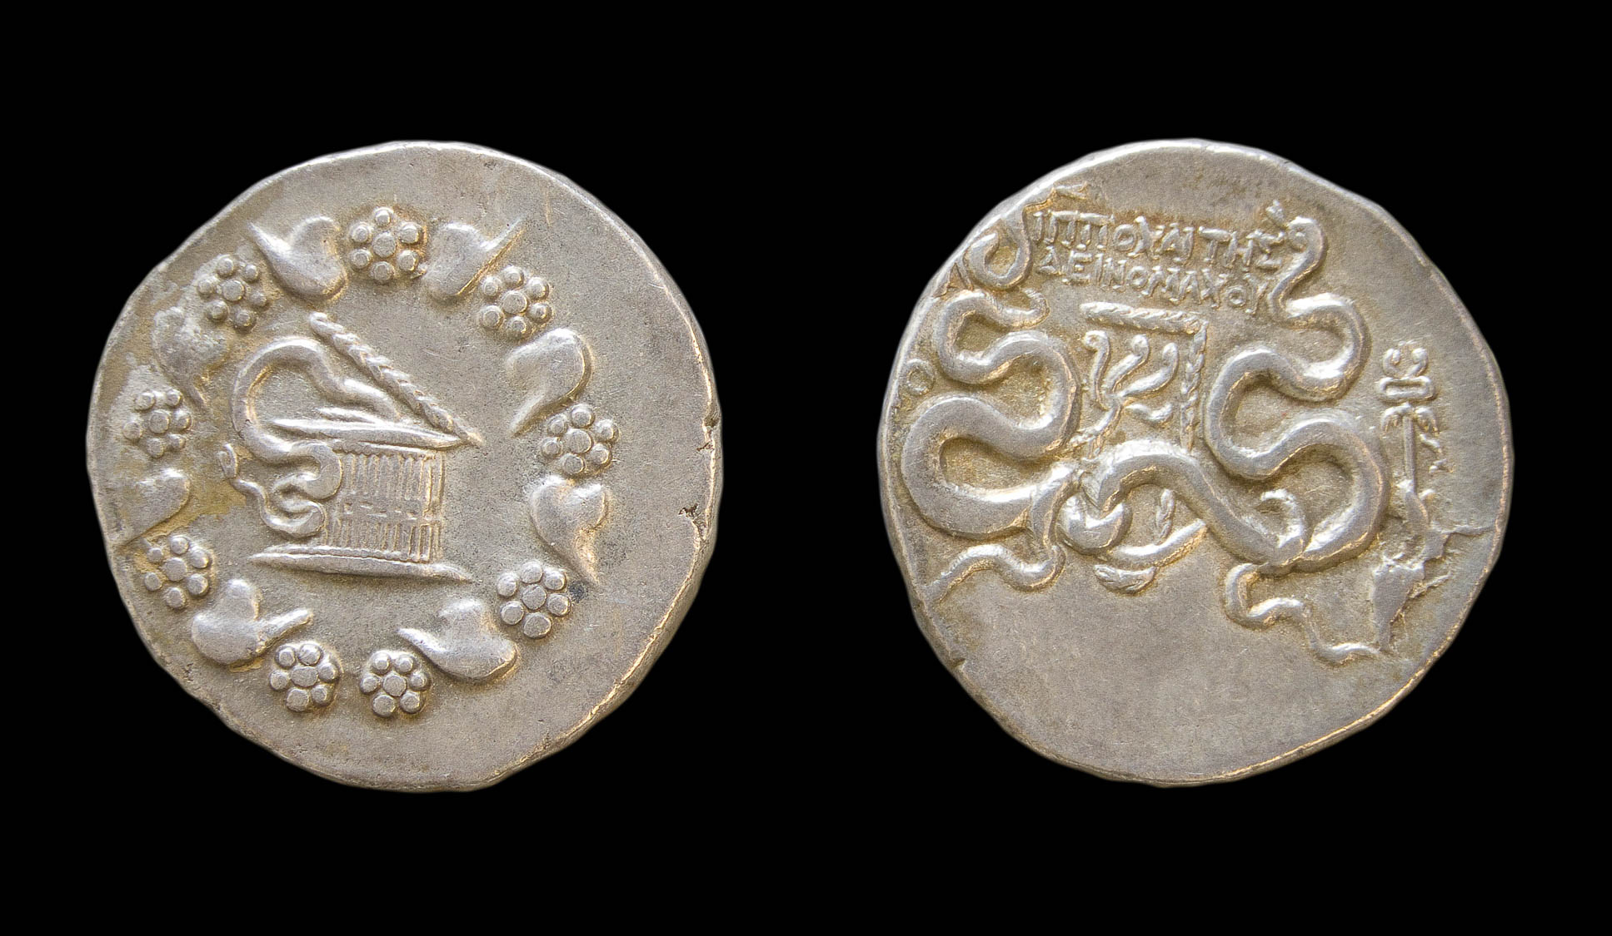
To me . . . this was grace given, to preach to the Gentiles the unsearchable riches of Christ
Silver cistophorus from Laodicea ad Lycum, 49–48 BC
3:8
Notes:
Laodicea, which was located about 100 miles (160 km) east of Ephesus, was a wealthy banking center, changing money and minting its own coins since before the 1st century AD. The coin pictured here was minted at Laodicea under the magistrate Hippochaites Deinomachou. The obverse shows a cista mystica with a serpent, surrounded by an ivy wreath. The reverse shows serpents entwined around a bow case with an aplustre and is inscribed with the name of the magistrate between them. To the left is an abbreviation of Laodicea, [ΛΑ]Ο; to the right is a winged caduceus. This image is from the Yale University Art Gallery and is in the public domain. Source: http://artgallery.yale.edu/collections/objects/113569
yale113569

Slide 34
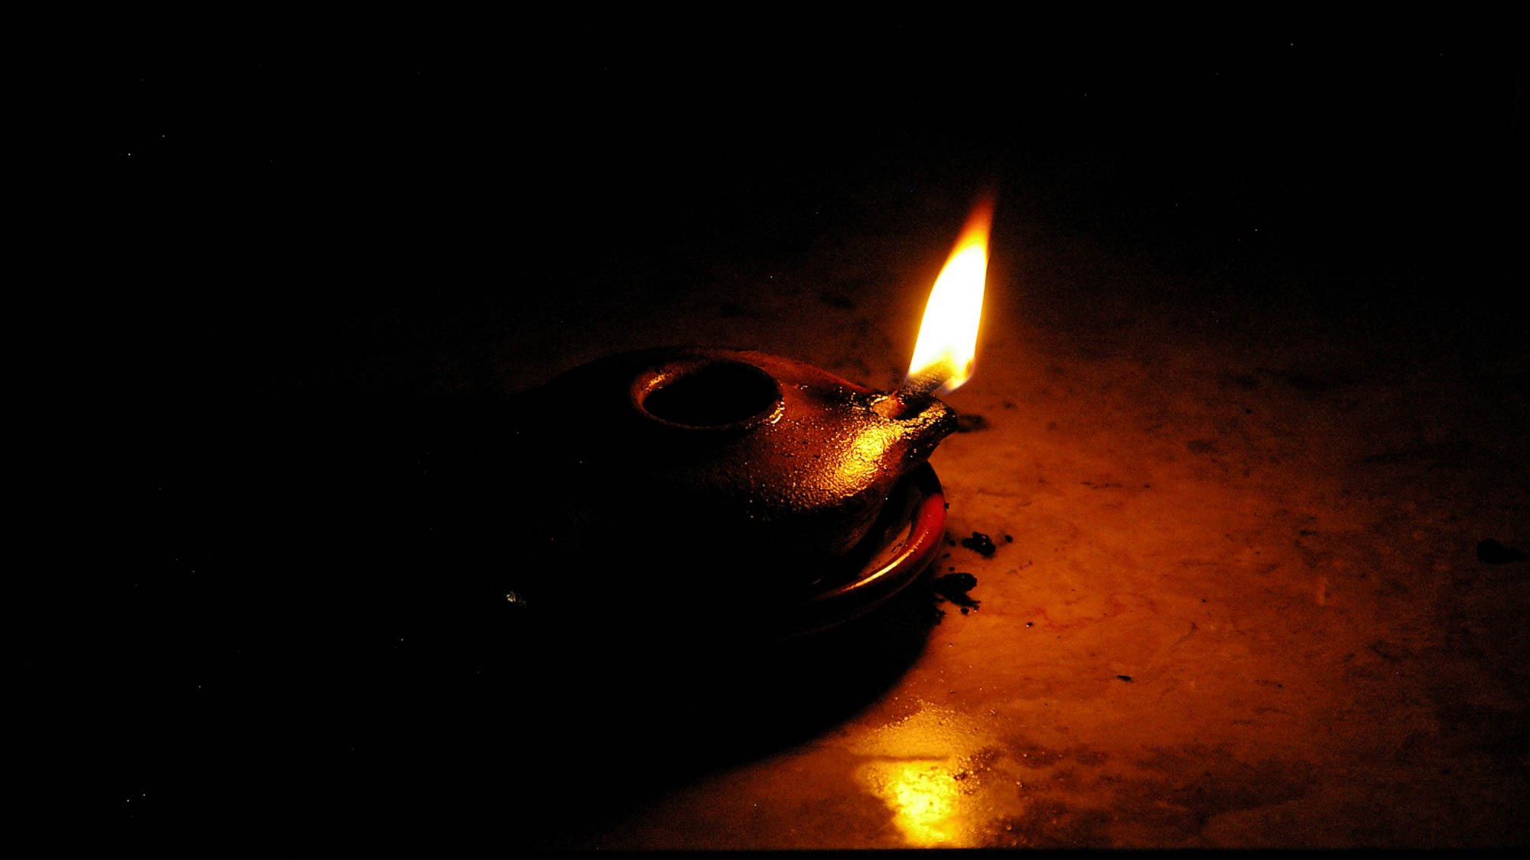
To bring to light the plan of the mystery
Roman-style lamp with burning wick
3:9
Notes:
To “bring to light” (Gk. phōtizō, φωτίζω) is to cause something to be illuminated. Paul uses the word here figuratively to describe the revelation of something which had previously not been revealed.
adr0807091941

Slide 35
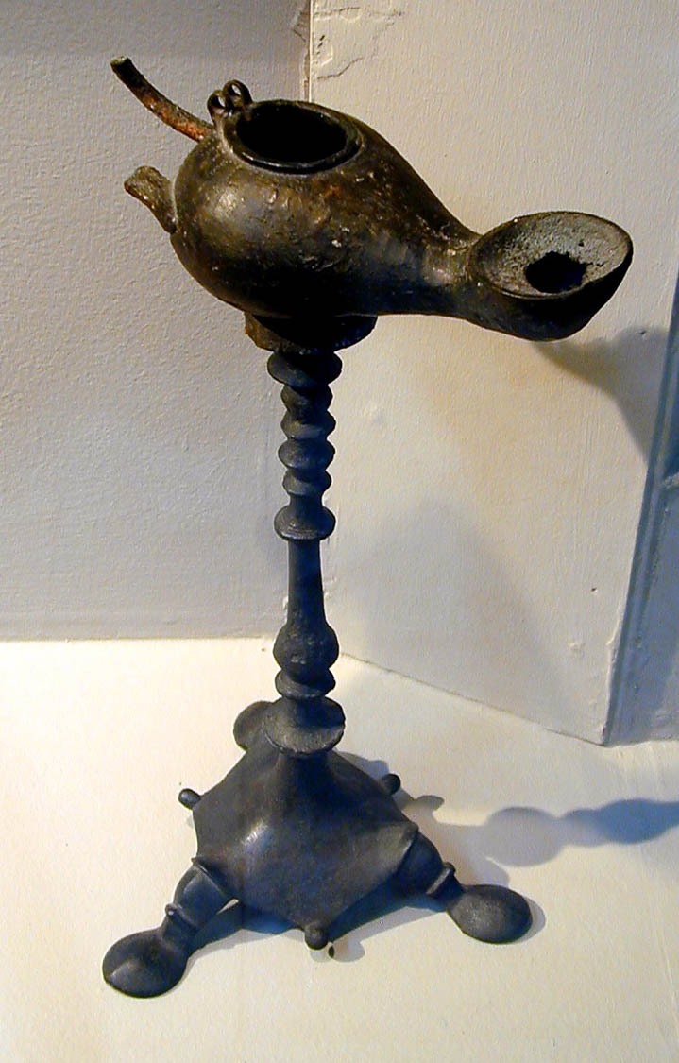
To bring to light the plan of the mystery
Bronze lamp and lampstand, from Ephesus, 1st century AD
3:9
Notes:
Paul’s audience at Ephesus would have been quite familiar with lamps as sources of light. Although a bronze lamp and lampstand like the one shown here would have been unusual (and quite expensive), it was recovered from Ephesus and could have even been seen by some of the people at Ephesus to whom Paul wrote. This artifact was photographed in the Ephesus Museum.
tb010501660

Slide 36
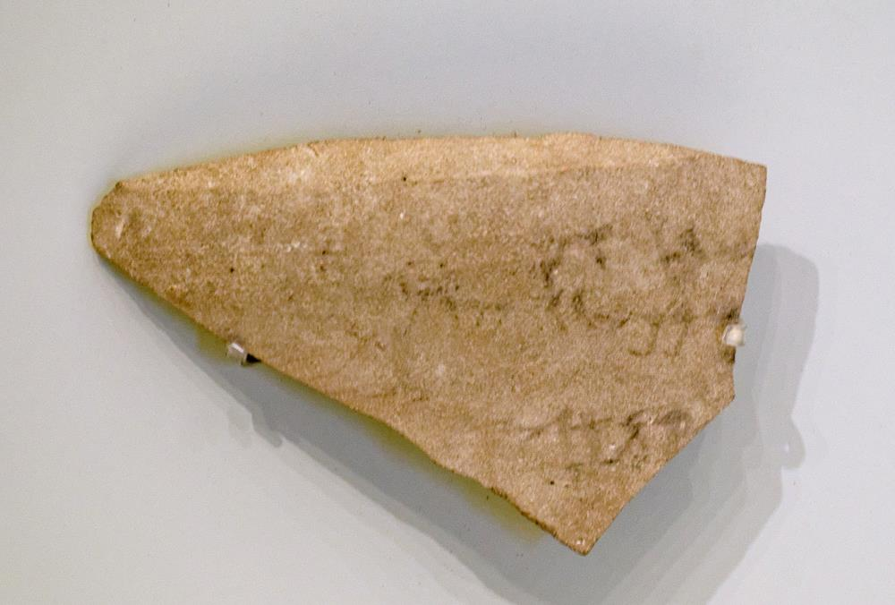
Which for ages past has been hidden in God, who created all things
“God, Creator of the earth,” Hebrew inscription from Jerusalem, late 8th century BC
3:9
Notes:
The last line of this inscription includes the phrase “[Go]d, creator of the earth” (ל קן ארץ[א]) which echoes texts found in Genesis 14:19 and Isaiah 40:28. The verb qanah (קָנָה) can also mean to buy or possess; thus, some English versions render Genesis 14:19 as “possessor of heaven and earth.” This ostracon was recovered in excavations in the Jewish Quarter of Jerusalem by Nahman Avigad in 1971. Although the inscription is broken at the beginning of the third line, the conclusion that the first word was God (“El,” אל) is “almost inescapable” (Miller 1980: 43). The jar may have once contained offerings intended for the temple in Jerusalem. Based on the style of writing, it is dated to the late 8th century BC. It was photographed in the Israel Museum. See the next slide for a label.
Reference:
Miller, Patrick D.
1980 El, the Creator of Earth. Bulletin of the American Schools of Oriental Research 293: 43–46.
tb032014468

Slide 37

Which for ages past has been hidden in God, who created all things
“God, Creator of the earth,” Hebrew inscription from Jerusalem, late 8th century BC
3:9
Notes:
The last line of this inscription includes the phrase “[Go]d, creator of the earth” (ל קן ארץ[א]) which echoes texts found in Genesis 14:19 and Isaiah 40:28. The verb qanah (קָנָה) can also mean to buy or possess; thus, some English versions render Genesis 14:19 as “possessor of heaven and earth.” This ostracon was recovered in excavations in the Jewish Quarter of Jerusalem by Nahman Avigad in 1971. Although the inscription is broken at the beginning of the third line, the conclusion that the first word was God (“El,” אל) is “almost inescapable” (Miller 1980: 43). The jar may have once contained offerings intended for the temple in Jerusalem. Based on the style of writing, it is dated to the late 8th century BC. It was photographed in the Israel Museum. An editable version is included beneath the graphic for those who wish to modify it.
Reference:
Miller, Patrick D.
1980 El, the Creator of Earth. Bulletin of the American Schools of Oriental Research 293: 43–46.
tb032014468

Slide 38
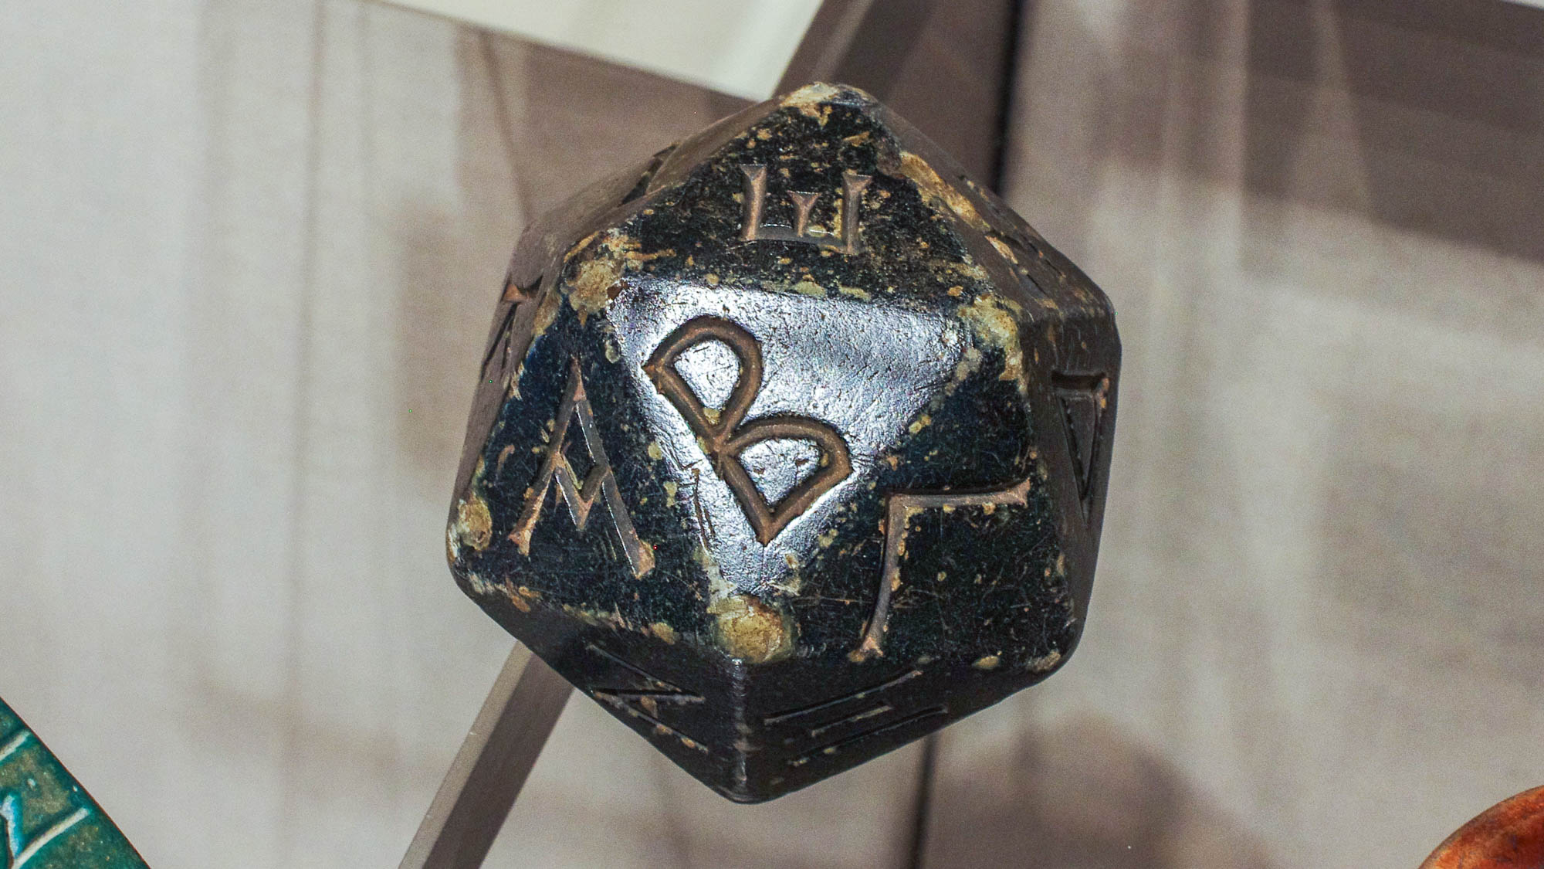
That the multifaceted wisdom of God might be made known
Hellenistic polyhedron with letters of Greek alphabet, faience, 2nd–1st centuries BC
3:10
Notes:
The word “multifaceted” (Gk. polupoikilos, πολυποίκιλος) pertains to being diversified or to having very many sides. Paul may simply be referring to the fact that God’s plan was very complex, something that could not have been discovered or even guessed beforehand. This faience polyhedron contains the letters of the Greek alphabet. The first three letters, Α, Β, Γ, appear across the middle of the object. This display was photographed at the Metropolitan Museum of Art in New York City.
adr1606034554h

Slide 39
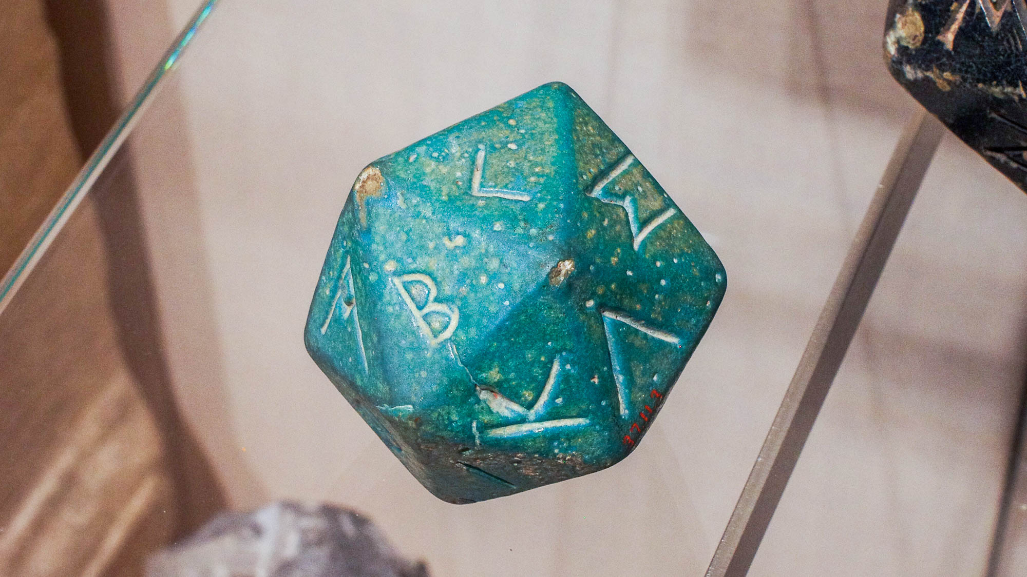
That the multifaceted wisdom of God might be made known
Roman polyhedron with letters of Greek alphabet, faience, 2nd–3rd centuries AD
3:10
Notes:
This faience polyhedron contains the letters of the Greek alphabet. The first three letters, Α, Β, Γ, appear on the upper left side. This display was photographed at the Metropolitan Museum of Art in New York City.
adr1606034555

Slide 40
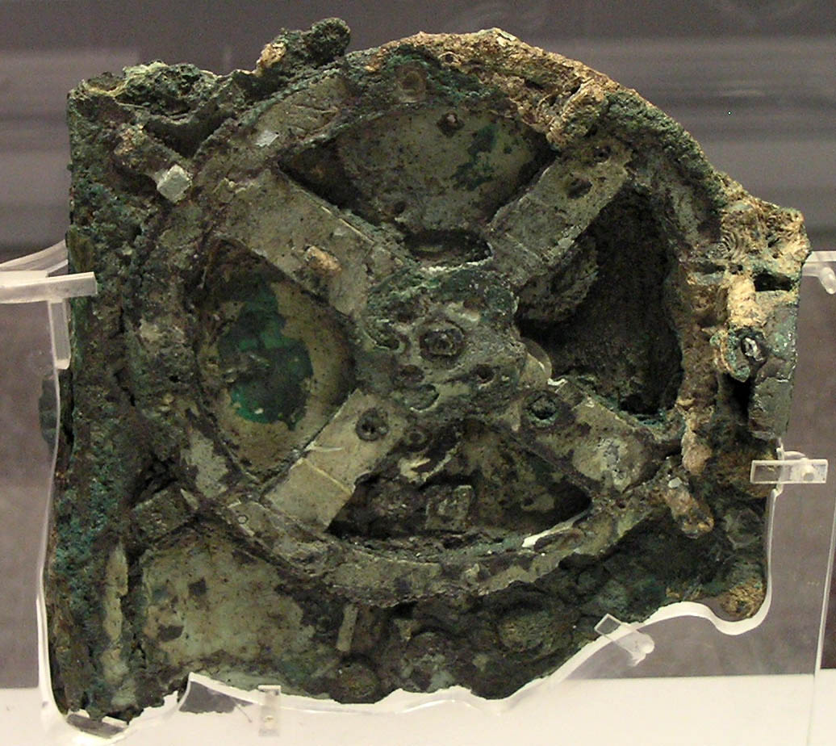
That the multifaceted wisdom of God might be made known
Antikythera Mechanism, Fragment A, circa 130–70 BC
3:10
Notes:
Another example of a “multifaceted” object from antiquity is the so-called Antikythera Mechanism. This geared instrument was an incredibly sophisticated analog computer that could calculate many different astronomical events. Detailed imaging of the mechanism suggests that it had 37 gear wheels, enabling it to calculate the movements of the moon and the sun through the zodiac, to predict eclipses, and even to model the irregular orbit of the moon. It was likely made by Hipparchus or Posidonius on the island of Rhodes. Its technology was forgotten in antiquity.
The Antikythera Mechanism is on display at the National Archaeological Museum in Athens. This image comes from Marsyas and is licensed under CC BY-SA 3.0, via Wikimedia Commons: https://commons.wikimedia.org/wiki/File:NAMA_Machine_d%27Anticyth%C3%A8re_1.jpg
wiki122020051048

Slide 41
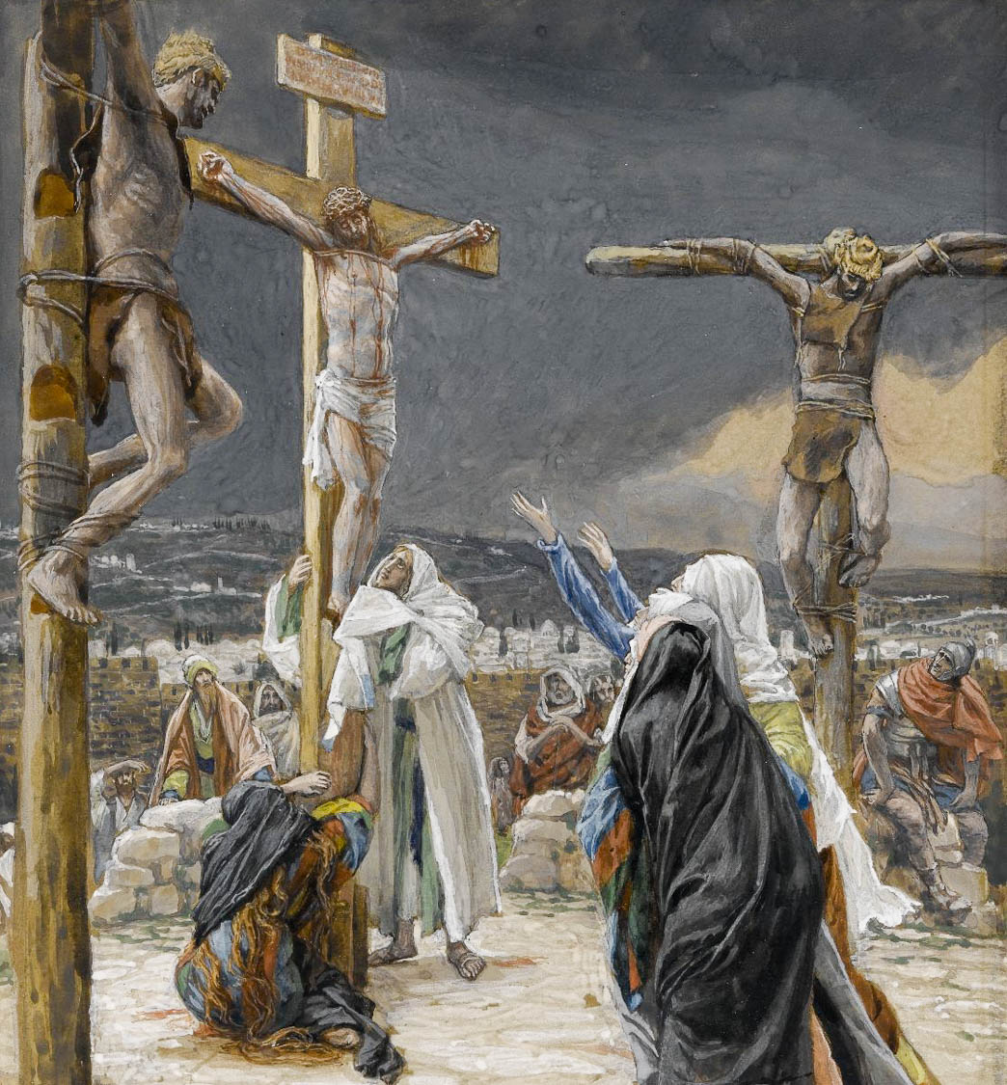
According to the eternal purpose which He accomplished through Christ Jesus
The Death of Jesus, by James Tissot, circa 1890
3:11
Notes:
Paul argues that God’s eternal purpose was the redemption of mankind through the death and resurrection of Jesus. This image comes from the Brooklyn Museum and is in the public domain. Source: https://www.brooklynmuseum.org/opencollection/objects/4592
bmyn4592

Slide 42
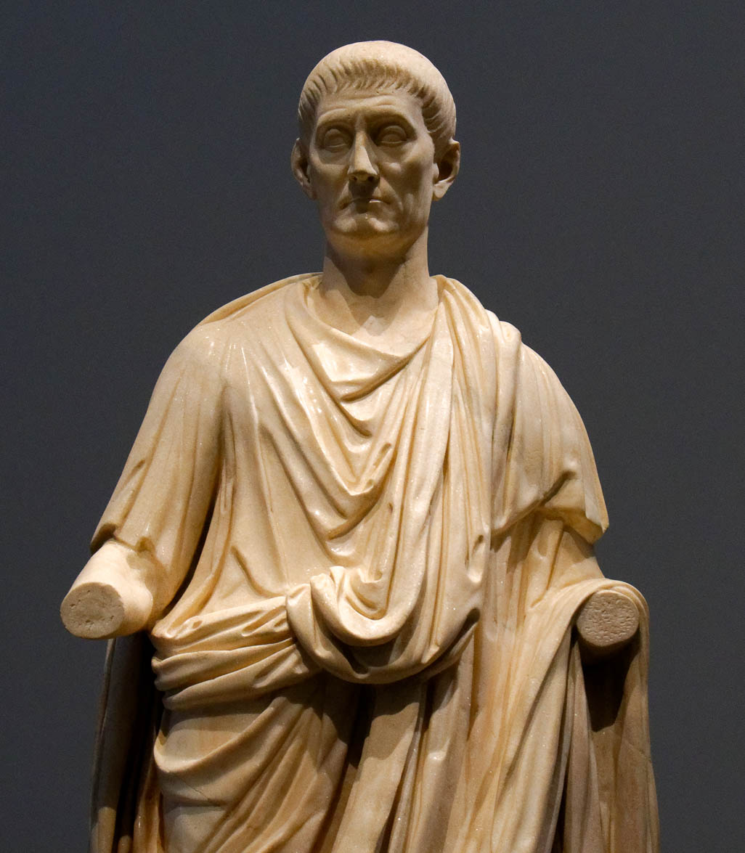
In Him we have boldness
Statue of a man in a Roman toga, called The Orator, from Italy, AD 100–150
3:12
Notes:
“Boldness” (Gk. parrēsia, παρρησία) is most often related to openness and frankness in speech, although it is also used to describe courage in relation to God (e.g., 1 John 2:28; 4:17). Probably the nearest New Testament parallel is Hebrews 10:19, which uses the same word to describe boldness in approaching God. Orators were known in Paul’s day for their ability to speak boldly in public, illustrated here by a statue of an orator. This marble statue was photographed at the Louvre Abu Dhabi.
tb0520184885

Slide 43
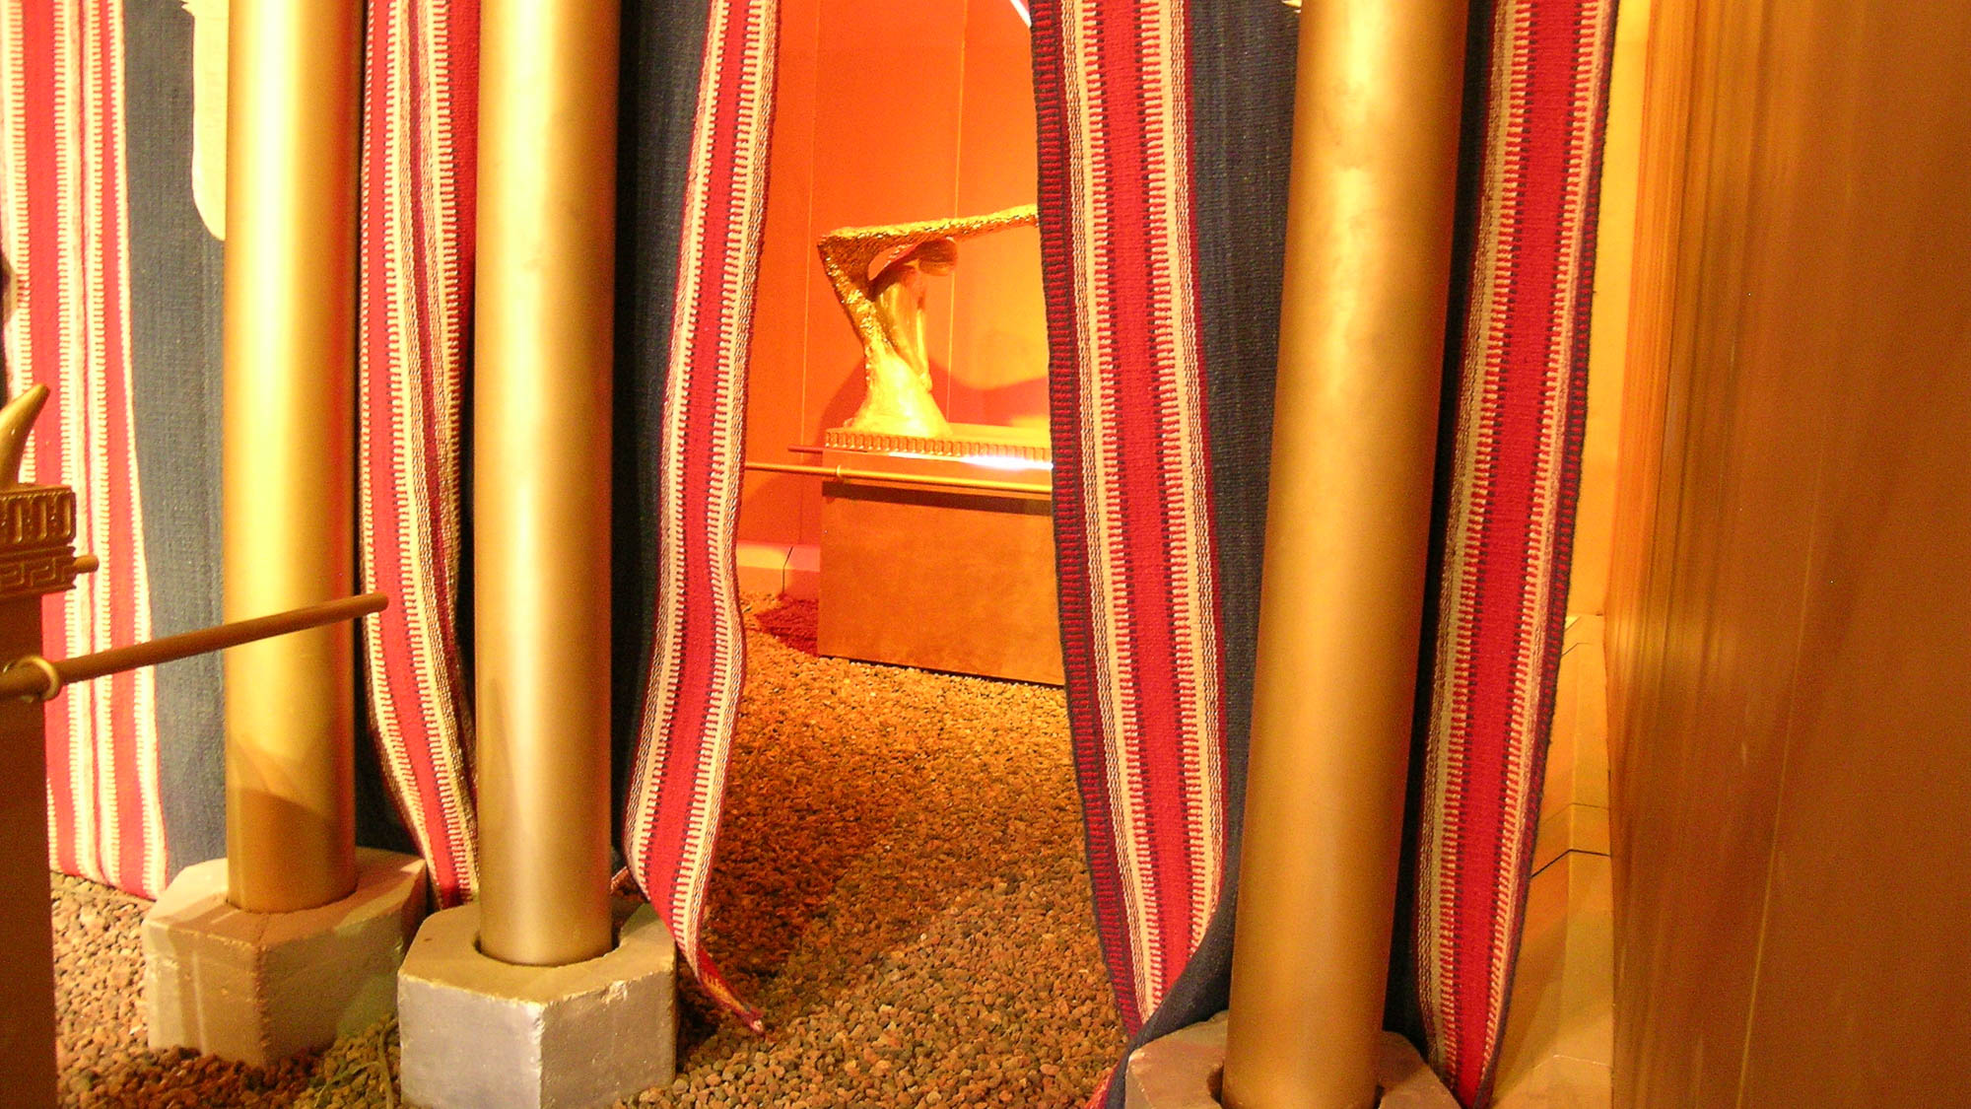
In Him we have boldness and confident access through faith
Model of Ark of the Covenant in the tabernacle, through the veil
3:12
Notes:
The word “access” (Gk. prosagōgē, προσαγωγή) refers to a way of approach. In the Old Testament tabernacle, the Holy of Holies could only be entered by the high priest, and even he could only enter once a year. This changed at the crucifixion of Christ when the curtain that hid the Holy of Holies was torn in two from top to bottom (Matt 27:51). The author of Hebrews speaks of this at length (Heb 9), describing how access to God was once restricted, but now “we have confidence to enter the holy place by the blood of Jesus” (Heb 10:19). This model of the tabernacle was photographed at Timna Park in southern Israel.
tb022804719

Slide 44
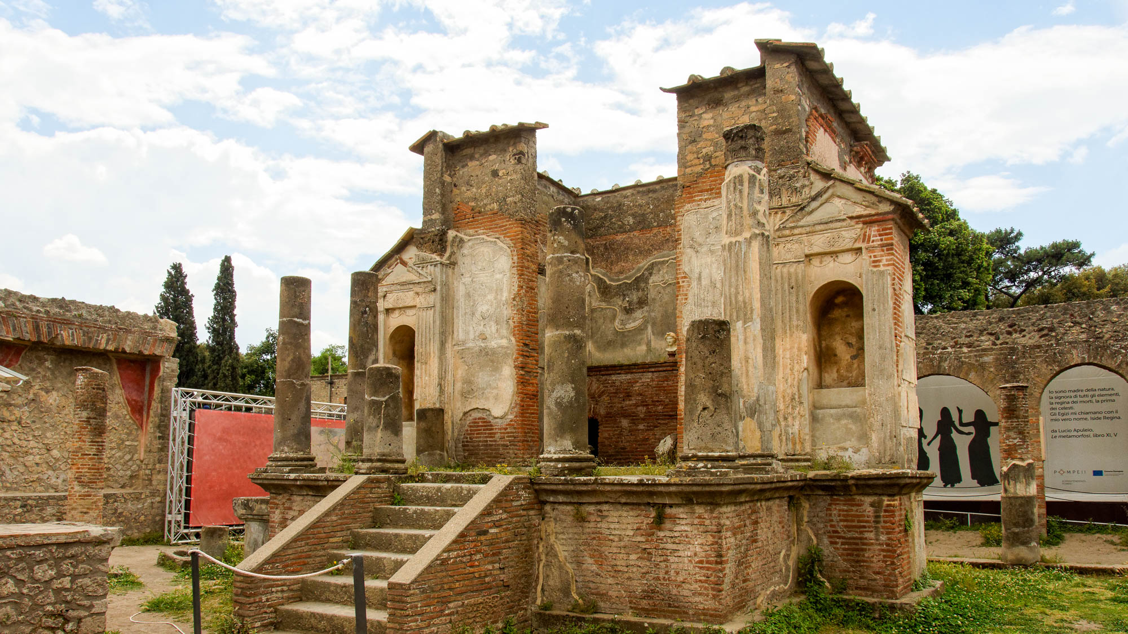
In Him we have boldness and confident access through faith
Temple of Isis at Pompeii, 1st century AD
3:12
Notes:
Like most pagan temples of the first century, this one is built on a raised platform and accessed by a flight of stairs. This restricted access to the structure and made it easier to limit those who wished to enter.
tb0516172099

Slide 45
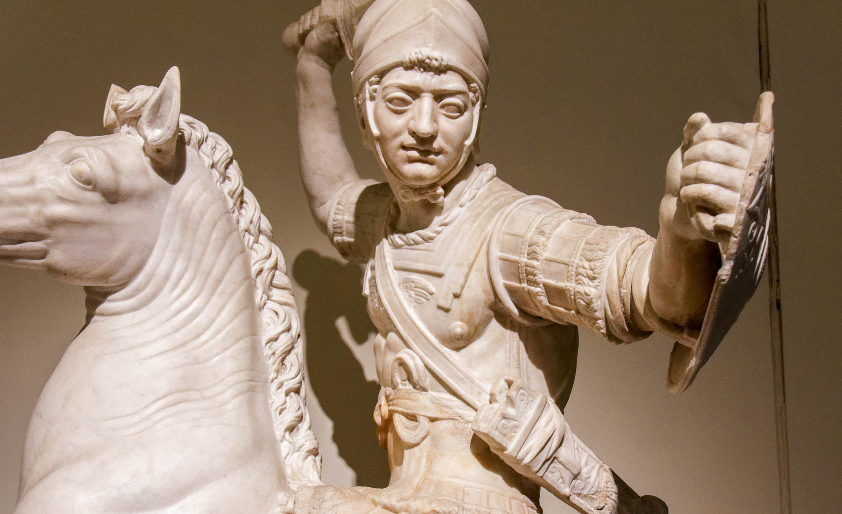
Therefore I ask you not to lose heart
Roman soldier on horseback, 2nd century AD
3:13
Notes:
To “lose heart” (Gk. enkakeō, ἐγκακέω) is to become discouraged or even to become afraid. This is the negative way of calling the Ephesian believers to bravery and courage, illustrated here by a statue of a soldier on horseback. This statue is thought to be a 2nd century AD copy of an original from the 2nd century BC. It was photographed at the Naples Archaeological Museum.
tb0515171139h

Slide 46
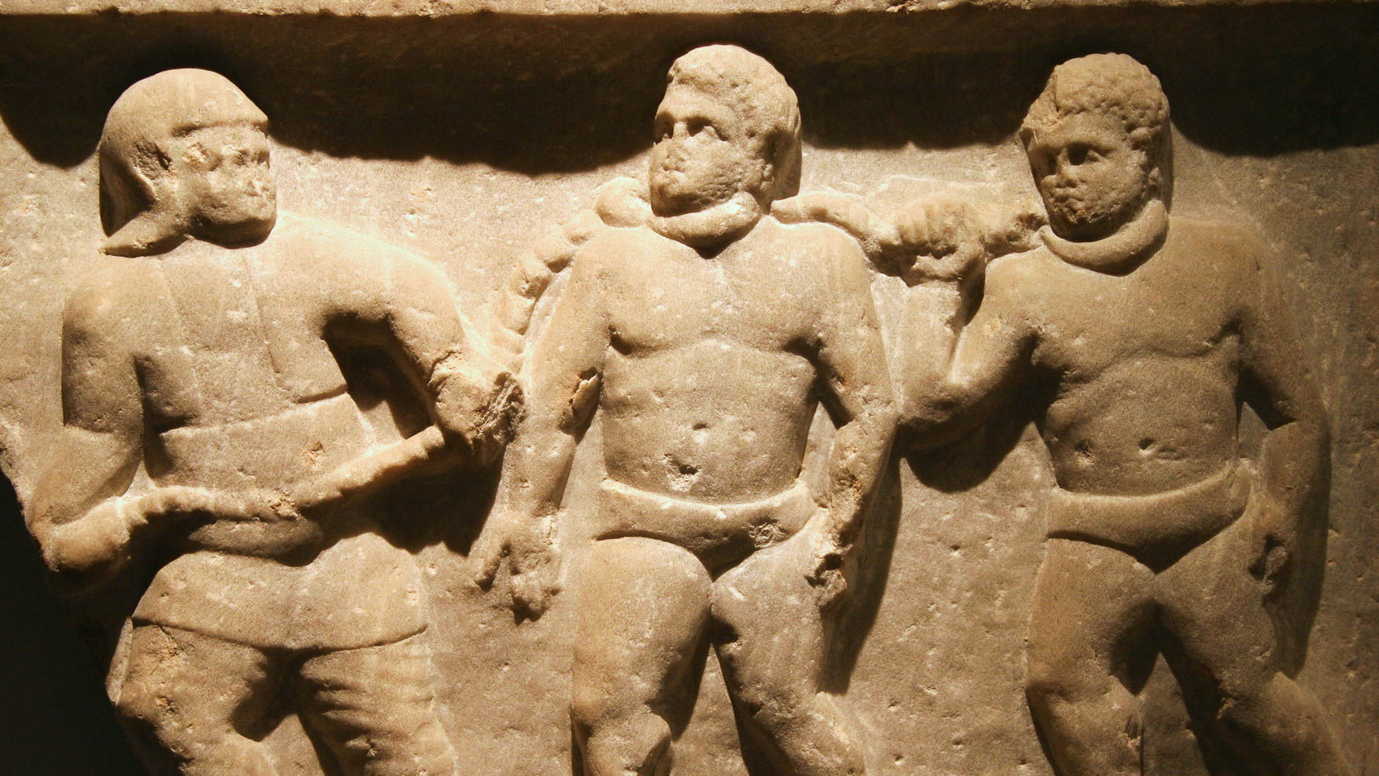
Therefore I ask you not to lose heart at my tribulations on your behalf
Roman collared slaves, marble relief, from Smyrna, circa AD 200
3:13
Notes:
This depiction of two slaves being led by chains that are attached to collars around their necks illustrates Paul’s tribulation. Although it is thought that his imprisonment in Rome granted him a certain amount of freedom (cf. Acts 28:30-31), he had certainly experienced incarceration and even chains (cf. Acts 21:33). This relief was photographed at the Ashmolean Museum at the University of Oxford. This image comes from Jun and is licensed under CC BY-SA 2.0, via Wikimedia Commons: https://commons.wikimedia.org/wiki/File:Roman_collared_slaves_-_Ashmolean_Museum.jpg.
wiki02072010153136h

Slide 47
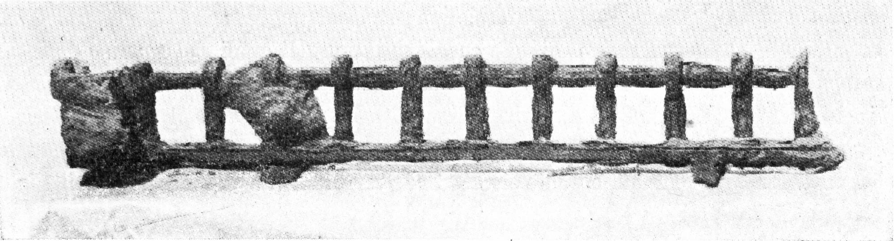
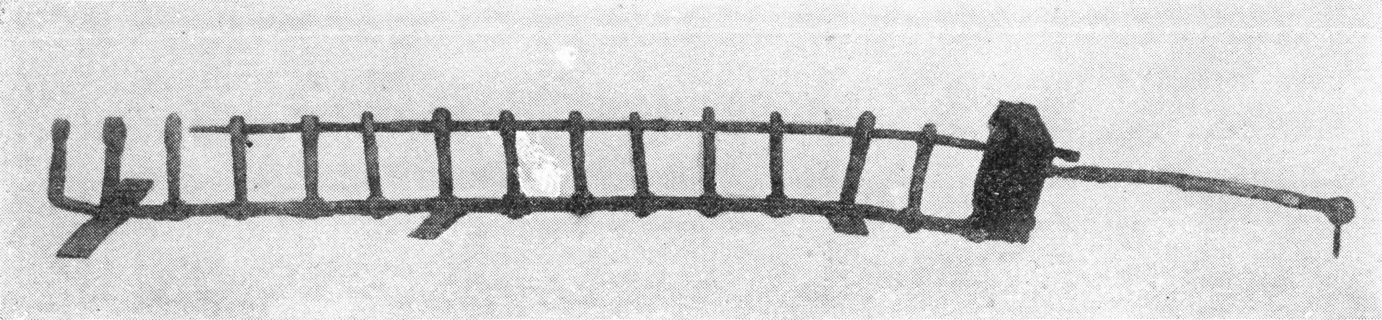
Therefore I ask you not to lose heart at my tribulations on your behalf
Iron leg stocks from Pompeii, one with fragment of leg bone, AD 79
3:13
Notes:
When he was imprisoned for the gospel at Philippi, Paul was locked into a set of stocks (Acts 16:24). These photos show contemporary examples of leg stocks that were found at Pompeii. The upper image shows that the fragment of a leg bone still attached to the stocks. The upper image comes from M. Della Corte, “Pompei: Scavi eseguiti da private nel territorio di Pompei (secondo rapporto),” Notizie degli scavi di antichità, Serie V (1922), 19: 459–88; p. 463, fig. 3. The lower image comes from M. Della Corte, “Pompei: Scavi eseguiti da private nel territorio Pompeiano,” Notizie degli scavi di antichità, Serie V (1923), 20: 277; p. 277, fig. 4.
top: mdc19224633c; bottom: mdc19232774c

Slide 48
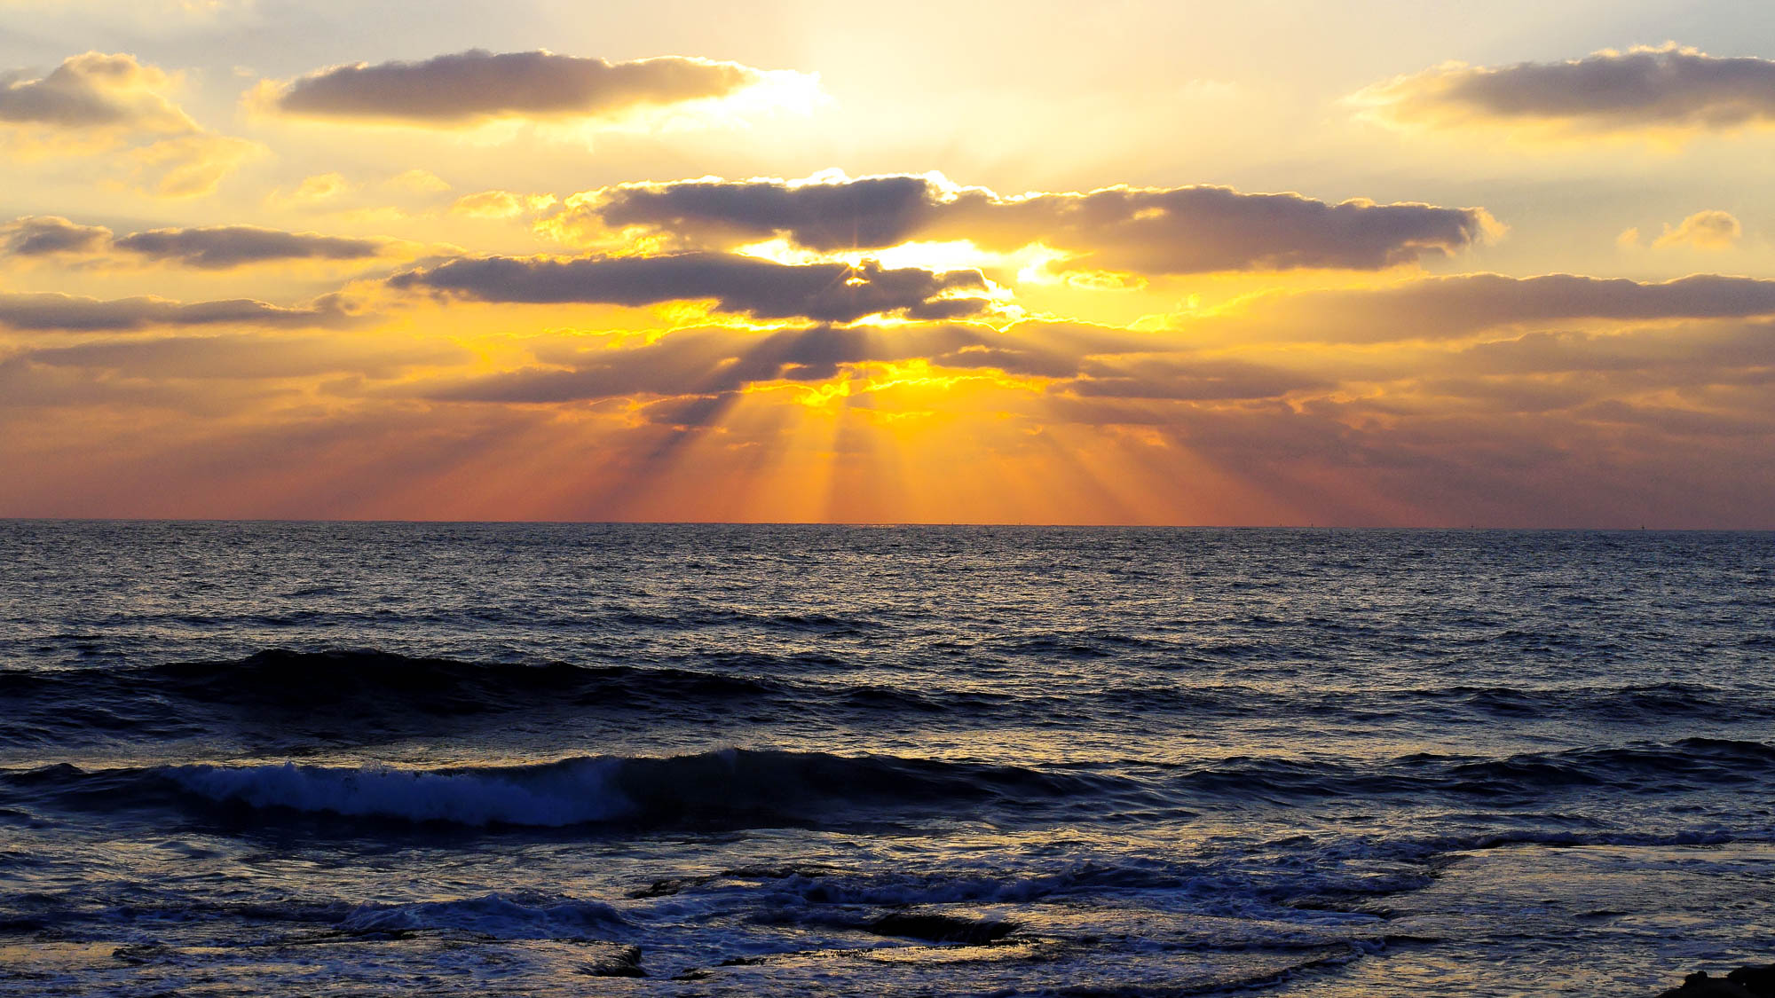
Therefore I ask you not to lose heart at my tribulations on your behalf, for they are your glory
Sunset on the Mediterranean, from south of Rosh HaNiqra
3:13
Notes:
The word “glory” (Gk. doxa, δόξα) is a word that often conveys the idea of being bright or shining. It is illustrated here by rays of the setting sun spread across the Mediterranean Sea along the coast of northern Israel.
adr1307066311h

Slide 49
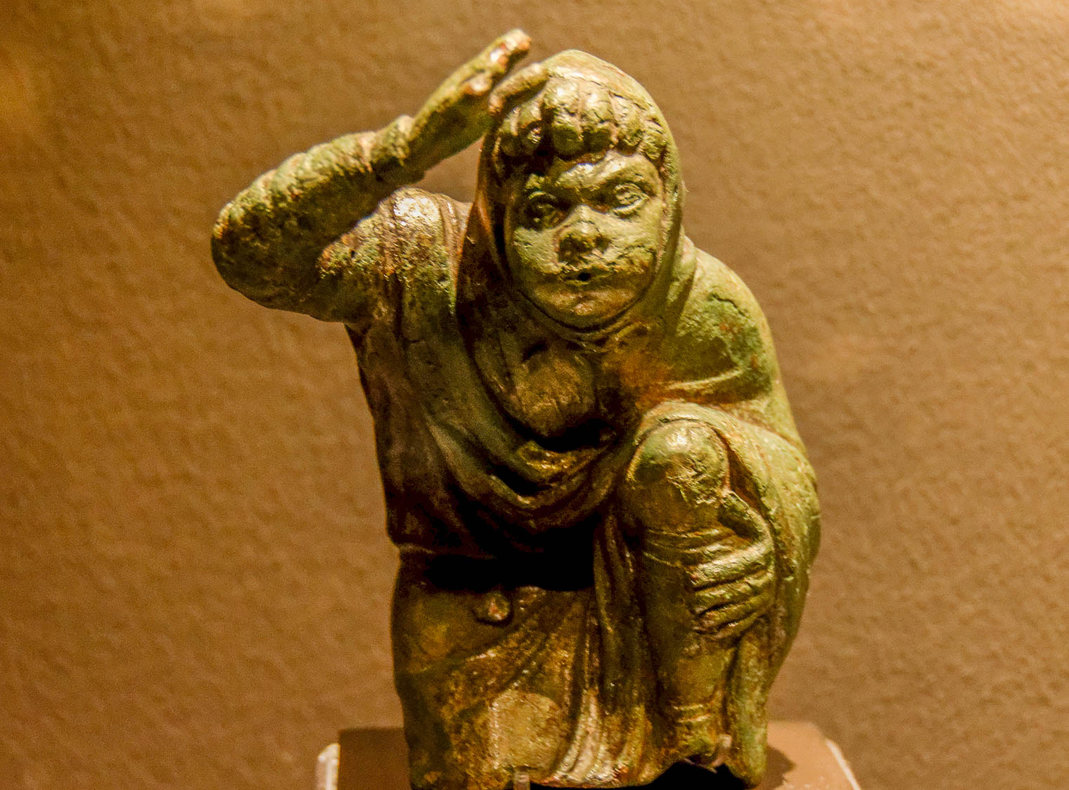
Because of this I bow my knees before the Father
Statuette of a kneeling youth, 2nd–3rd centuries AD
3:14
Notes:
Bowing or kneeling is a gesture of reverence or obeisance, which seems to be what Paul has in mind here. It may also be associated with a formal request to a person in power, which would fit this context. This figurine was photographed at the Spartacus Exhibit, a temporary exhibition at the Ara Pacis Museum in Rome.
tb0518174003h

Slide 50
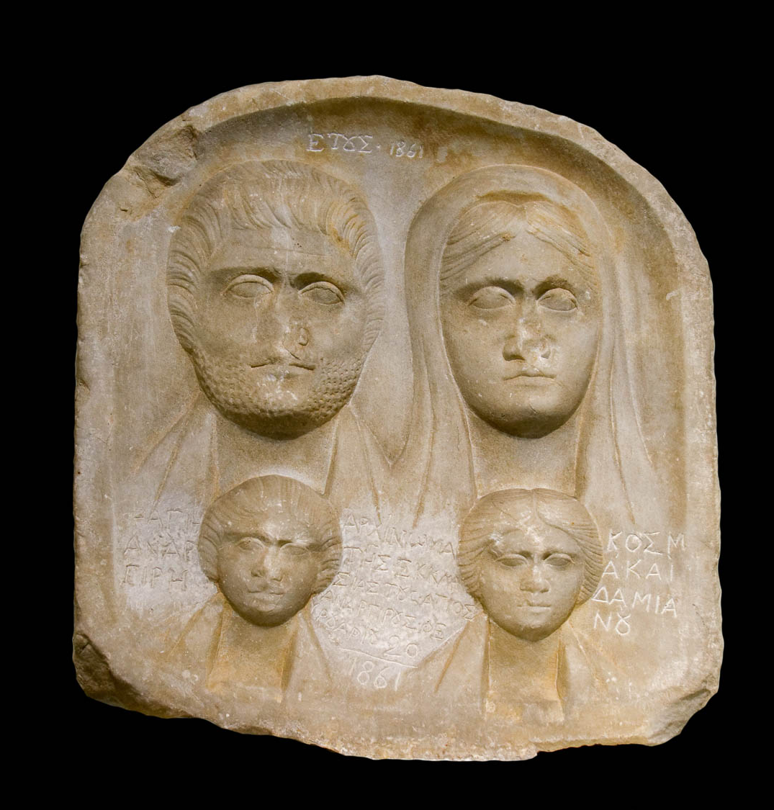
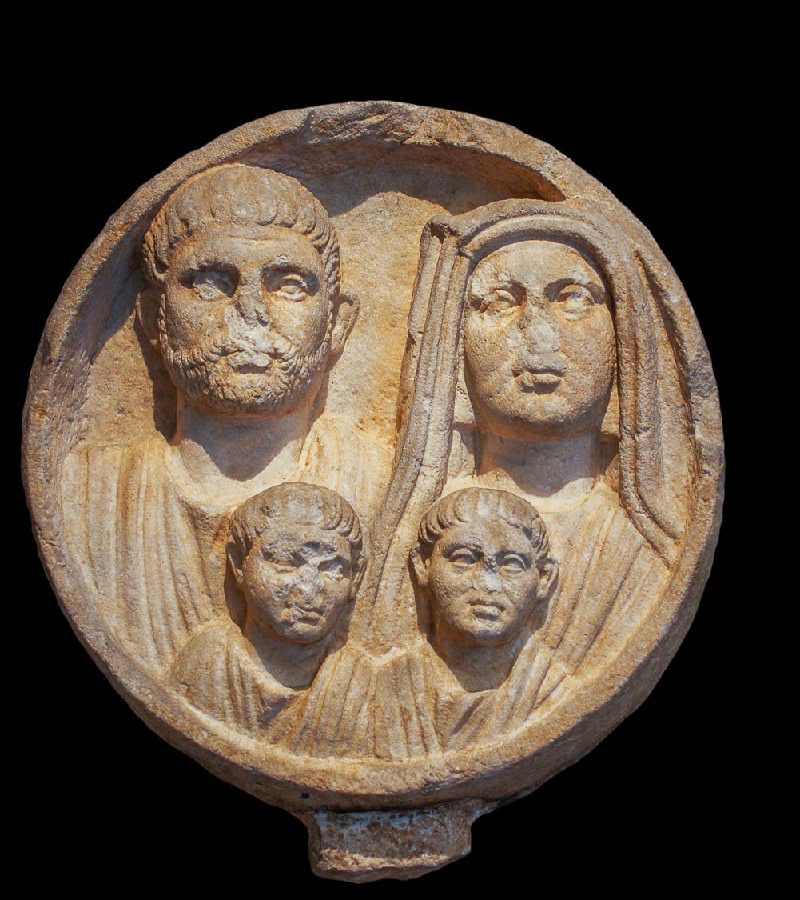
The Father, from whom every family in heaven and on earth is named
Funerary plaques for two families, circa 3rd century AD
3:15
Notes:
There is apparently a play on words between “family” (Gk. patria, πατριὰ) and “father” (Gk. patēr, πατήρ). This provides a linguistic link between the “father” (πατήρ) and the “family” (πατριὰ) that is named. “Every family” seems to mean “each group,” presumably referring to the various people groups of the earth. The left image shown here is the funerary stele of a family of four, dating to the 3rd century AD, and photographed at the National Archaeological Museum in Athens. The right image shows another family of four, dating to the 2nd or 3rd centuries AD, and photographed at the Metropolitan Museum of Art in New York City.
Left: tb011117415b; right: adr1605243128b

Slide 51
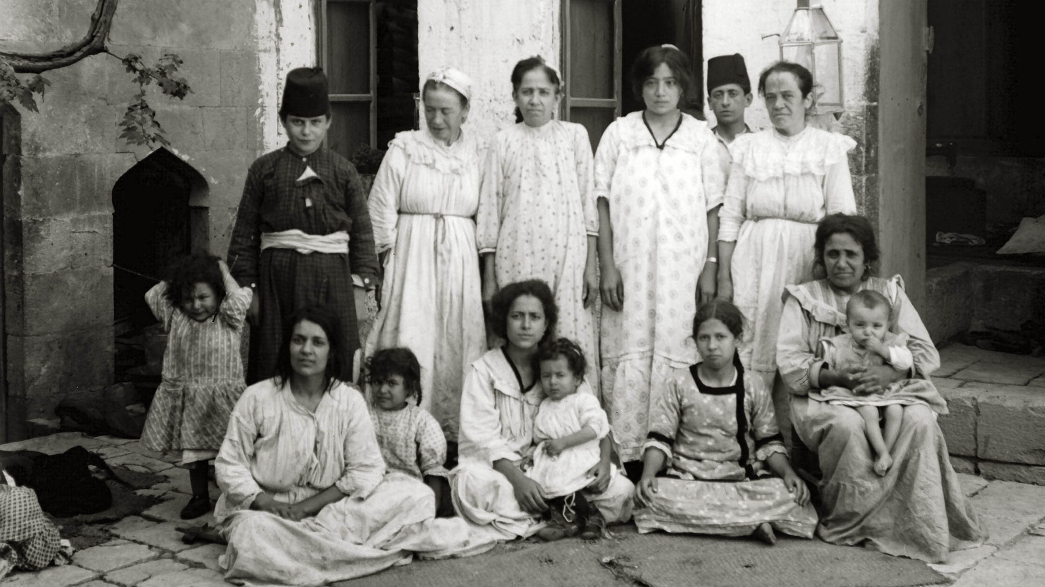
The Father, from whom every family in heaven and on earth is named
Poor Jewish family in Aleppo, circa 1910
3:15
Notes:
This American Colony photo was taken between 1900 and 1920.
mat02214h

Slide 52
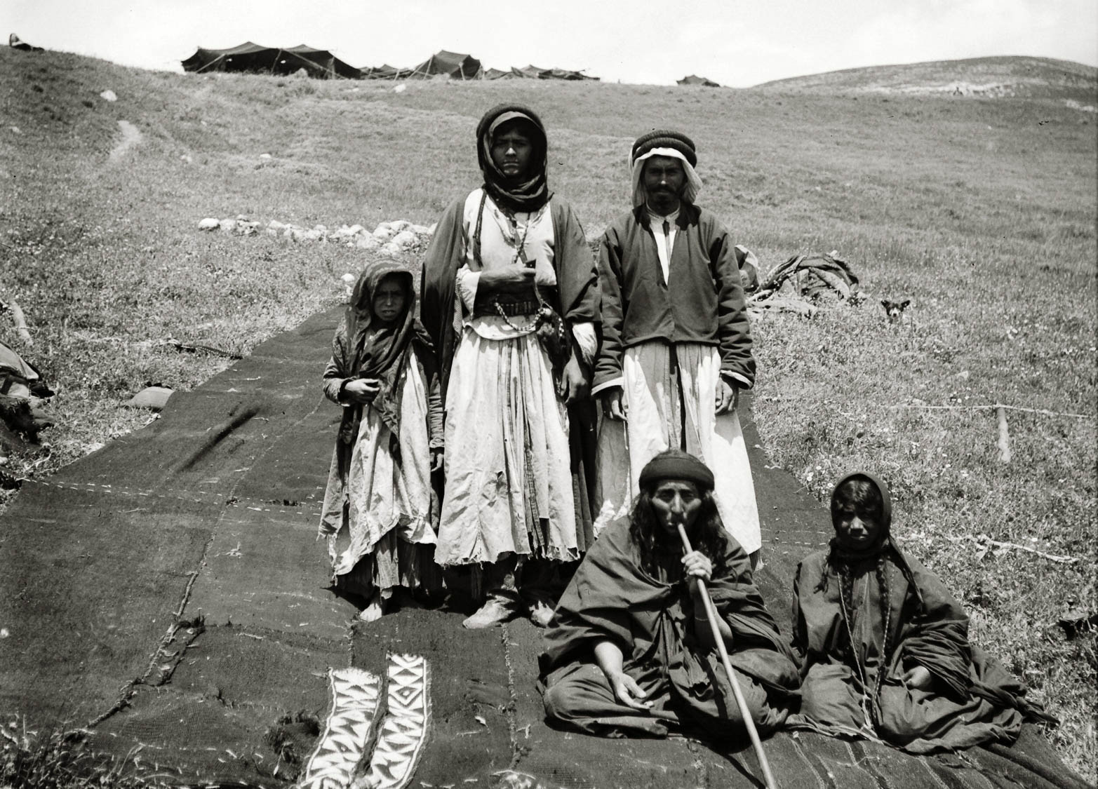
The Father, from whom every family in heaven and on earth is named
Bedouin family, ready to raise their tent, circa 1910
3:15
Notes:
This American Colony photo was taken between 1900 and 1920.
mat05269h

Slide 53
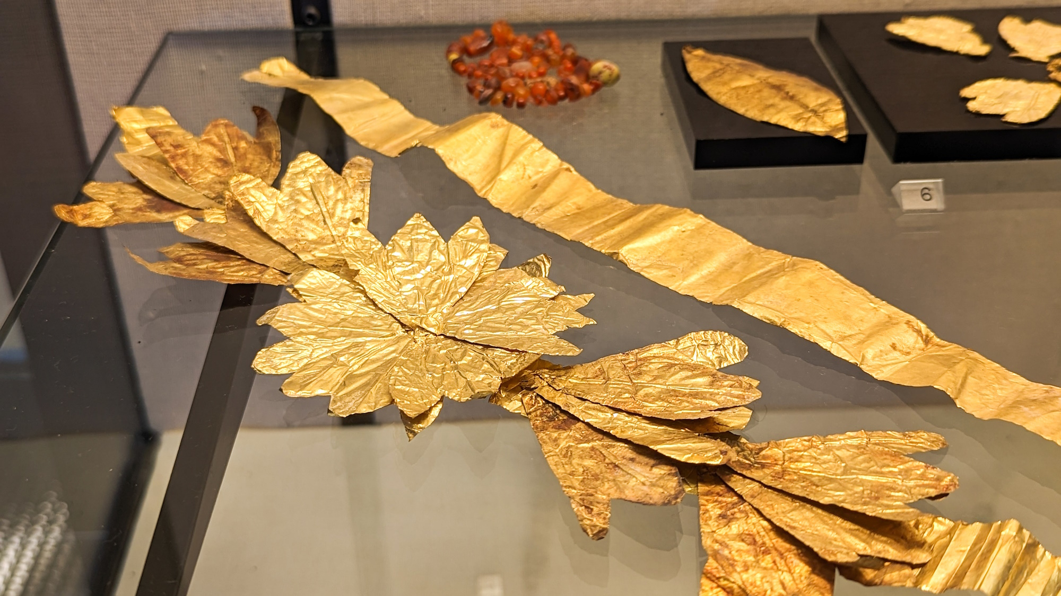
That He would grant you, according to the riches of His glory
Gold diadem for the deceased, Roman period
3:16
Notes:
This display of golden items from the Roman period was photographed at the Hecht Museum in Haifa.
ku0531231110316

Slide 54

That He would grant you, according to the riches of His glory, to be strengthened with power
Hand of Hercules from a temple statue in Amman (Philadelphia)
3:16
Notes:
Hercules was a hero in Greek mythology who was famous for his superhuman strength. This artifact was photographed at the Amman Citadel Museum.
tb060303075h

Slide 55

So that Christ may dwell in your hearts through faith
Houses on terraces at Ephesus
3:17
Notes:
To “dwell in” (Gk. katoikeō, κατοικέω) means to live in a place or to reside there. Paul uses the word figuratively here to speak of the relationship of Christ with the believers at Ephesus. The house shown here is one in a series of six luxurious residences located on terraces on the side of the hill south of the Library of Celsus at Ephesus. The oldest building dates to the 1st century BC and continued in use as a residence until the 7th century AD. Some of what is preserved here is older than Paul, and some had not been constructed yet in his day; many also underwent renovation through the centuries.
jc0102150339

Slide 56

So that Christ may dwell in your hearts through faith
Model of a clay heart dedicated to Asclepius, from Corinth, 4th century BC
3:17
Notes:
Paul uses the word “heart” (Gk. kardia, καρδία) figuratively concerning the human seat of spiritual and mental life. The central object shown in the display in this photo is a clay model of a heart. It was a common practice in the Greco-Roman world to bring such models to a temple of the healing god, Asclepius, either as part of a petition for the affected organ or as a gift of thanks for healing. This display was photographed at the Corinth Museum.
tb011017826

Slide 57

So that you, being rooted and grounded in love
Olive tree in the Garden of Gethsemane
3:17
Notes:
The word “rooted” (Gk. hrizō, ῥιζόω) when used literally means to take root, with reference to a plant or tree. This ancient olive tree in the traditional Garden of Gethsemane has developed a massive trunk and root system, illustrating Paul’s figurative use of the word. This and several other olive trees in this area have been dated by radiocarbon to about AD 1100, making them some of the oldest broad-leaved plants in the world.
tb051906421

Slide 58

So that you, being rooted and grounded in love
Foundation stones in the Temple of Jupiter at Baalbek
3:17
Notes:
The word “grounded” (Gk. themelioō, θεμελιόω) carries the idea of a well-built base or foundation. The ancient Greeks and Romans were well aware of the importance of a good foundation for a building. The massive stones that make up the foundation of the Temple of Jupiter at Baalbek are a good example. Known as the trilithon, the set of three stones above the one where the man is standing in this photo are the largest. Each one of these stones is 70 feet (21 m) long, 14 feet (4 m) high, and 10 feet (3 m) thick. The supporting stone layer beneath features several stones which weigh an estimated 350 tons (318 t) and are 35 feet (11 m) long. The temple was begun by Julius Caesar and completed by Augustus. This image comes from Lodo27 and is licensed under CC BY-SA 3.0, via Wikimedia Commons: https://commons.wikimedia.org/wiki/File:Temple_of_Jupiter,_West_wall,_Trilithon,_Baalbek_20422.jpg.
wiki0515201920422

Slide 59

So that you, being rooted and grounded in love
Foundation stones in the Temple of Jupiter at Baalbek
3:17
Notes:
This earlier view of the trilithon includes only two of the large stones. For perspective, note the presence of a man above the seam between the two stones, as well as a man dangling just above the ground below him. This American Colony photo was taken between 1900 and 1920.
mat01161h

Slide 60

So that you, being rooted and grounded in love
Foundation and remnants of the Temple of Domitian at Ephesus, 1st century AD
3:17
Notes:
Little is left of the 1st-century temple of Domitian at Ephesus other than the foundation. A couple of pillars have been erected again, partly with the use of modern materials, to give some sense of the once great edifice that stood here.
mjb010317155

Slide 61

To apprehend with all the saints what is the breadth and length and height and depth
Fragment of a Roman measuring rod
3:18
Notes:
The Roman measuring rod was 10 Roman feet long (9.7 modern ft, 3.0 m), referred to as a decempeda (Latin for ‘ten feet’). It was usually of square section, capped at both ends by a metal shoe, and painted in alternating colors. In early periods, there was variation in the length of the foot, but Agrippa standardized the length in 29 BC, replacing all previous measurements by a Roman foot of 11.65 inches (29.6 cm), which became the foot of Imperial Rome. This measuring rod was photographed at the Roman Museum of Lausanne-Vidy in Switzerland. This image comes from Rama and is licensed under CC BY-SA 2.0 fr, via Wikimedia Commons: https://commons.wikimedia.org/wiki/File:Measurement_instrument_IMG_4398-2.jpg.
wiki0831201019075616643h

Slide 62

To apprehend with all the saints what is the breadth and length and height and depth
Mosaic with a Roman foot measurement, house of Eustolios at Kourion, Cyprus, 4th century AD
3:18
Notes:
This mosaic from the House of Eustolios at Kourion, on the southern coast of Cyprus, depicts a woman with a measuring stick that is one Roman foot in length. It may have been used locally as a standard by which to judge lengths accurately.
tb030405100

Slide 63

To apprehend with all the saints what is the breadth and length and height and depth
Forum of Appius Roman milestone at mile 43
3:18
Notes:
The Romans were highly capable when it came to measuring distance. All of their main roads were lined by mile markers, many of which have survived the centuries. The example shown here is situated south along the Via Appius near the Forum of Appius. It marks the 43rd mile from Rome. Paul traveled this road when he was taken to Rome (Acts 28:15), and it is not inconceivable that he saw this very milestone.
tb111805977

Slide 64

To apprehend with all the saints what is the breadth and length and height and depth
Roman milestone near Ephesus, 2nd century BC
3:18
Notes:
This milestone bears the name of Manius Aquillius, the first governor of Asia. He built a road from Ephesus to Laodicea where it met a branch from Pergamum, and this milestone was placed 5 Roman miles (4.59 modern mi, 7.39 km) from Ephesus.
Reference:
Wilson, Mark.
2013 The Ephesian Elders Come to Miletus: An Annaliste Reading of Acts 20:15-18a. Verbum et Ecclesia 34: 1–9.
tb010317294h

Slide 65

To apprehend with all the saints what is the breadth and length and height and depth
Fallen Roman milestones along the Via Nova Traiana, King’s Highway, in Jordan
3:18
Notes:
These fallen milestones bear witness to how widespread was the Roman practice of marking major roads with milestones. They are located along a barren stretch of desert road in modern Jordan.
tb061504272

Slide 66

To apprehend with all the saints what is the breadth and length and height and depth
Roman aqueduct in Segovia, Spain
3:18
Notes:
The Romans used their ability to calculate both distance and elevation when they built aqueducts. Before starting, they had to calculate the distance from the water source to the intended destination, how much difference there was in elevation, and whether there was sufficient drop to allow the water to move. The Aqua Marcia of Rome was over 56 miles (90 km) in length. The Roman aqueduct in Segovia, shown here, is 94 feet (29 m) tall. Even taller is the Pont du Gard aqueduct, measuring 160 feet (49 m). This image comes from Jebulon and is in the public domain, via Wikimedia Commons: https://commons.wikimedia.org/wiki/File:Aqueduct_Segovia_dusk.jpg.
wiki07212012459

Slide 67

To apprehend with all the saints what is the breadth and length and height and depth
Pont du Gard, Roman aqueduct bridge (from northwest)
3:18
Notes:
Even taller than the aqueduct in Segovia, Spain, is the Pont du Gard aqueduct in France, measuring 160 feet (49 m). The lower arches are each about 72 feet (22 m) high. Often considered the greatest standing example of a Roman aqueduct, the Pont du Gard was built in the 1st century AD as part of an aqueduct system bringing water to Nemausus (modern Nîmes). The total system covers a distance of 35 miles (56 km).
tb091919922h

Slide 68

And to know the love of Christ which is beyond knowledge
Bust of the philosopher Democritus, from Pompeii, 1st century AD
3:19
Notes:
Most pagans of Paul’s day likely would have pointed to the various philosophers as sources of knowledge and wisdom. Democritus, shown here, lived circa 460–370 BC and believed that the universe could be explained from an atomist or mechanist viewpoint. Such a philosopher would have had no knowledge of the most important thing in life, the love of Christ. This bust was photographed at the Naples Archaeological Museum.
tb0515170091h

Slide 69

That you may be filled to all the fullness of God
Public measuring table, from Pompeii, 1st century AD
3:19
Notes:
The measuring table shown here, known as a mensa ponderaria, was used to provide a standard unit of measurement against which the measurement of dealers could be gauged. It could be used by wary buyers to ascertain whether or not they were getting the full measure of a product (such as grain) from a seller. Paul’s prayer for the Ephesians is that they would not be shorted but would be full even to overflowing with the goodness of God.
tb111505054

Slide 70

That you may be filled to all the fullness of God
Man measuring wheat
3:19
Notes:
This American Colony photo was taken between 1900 and 1920.
mat05923

Slide 71

That you may be filled to all the fullness of God
Parapet decorated with a cornucopia, from the acropolis at Pergamum
3:19
Notes:
The cornucopia was an ancient symbol of abundance, illustrating the “fullness” of which Paul speaks. This relief is on display in the Bergama Museum.
tb041505875

Slide 72

That you may be filled to all the fullness of God
Cornucopia relief at Aphrodisias
3:19
Notes:
shs031215829

Slide 73

To Him who is able to do far more abundantly than we ask or think
Return of the spies from Canaan depicted on a mosaic from a synagogue in Acco
3:20
Notes:
The reference to “far more abundantly than we ask or think” is reminiscent of the way God provided for the Israelites. The men who spied out the land in the days of Moses carried a single cluster of grapes on a pole between two men, indicating the productivity of the land into which God was bringing them (cf. Num 13:23). The legend on this modern mosaic from a synagogue in Acre, Israel, reads “the spies” (המרגלימ). This image comes from FLLL and is licensed under CC-BY-SA-4.0, via Wikimedia Commons: https://commons.wikimedia.org/wiki/File:Syna_Acco_-_Mosaic_of_the_Land_of_grapes_-Below_coins._(cropped).JPG
wiki120920152309h

Slide 74

To Him who is able to do far more abundantly than we ask or think
Tomato crates in the Eastern Delta, Egypt
3:20
Notes:
These overflowing crates of tomato fruits illustrate the idea of plenty and abundance. This fruit originated in western South America and Central America, but is now grown widely in Egypt, Jordan, and Israel.
adr1603257630

Slide 75

To Him be the glory in the church and in Christ Jesus to all generations
Arum palaestinum, or “Solomon’s Lily”
3:21
Notes:
Jesus said that even Solomon “in all his glory” was not arrayed as beautifully as one of the lilies of the field. This flower, also known as a Black Calla, is native to coastal Israel and Lebanon. It is used here as a symbol of glory. This image comes from berichard and is licensed under CC BY 2.0, via Wikimedia Commons: https://commons.wikimedia.org/wiki/File:Arum_palaestinum_flower.jpg.
wiki04022009091637521764

Slide 76

More than 500 slides in PowerPoint format. Available now from BiblePlaces.com.
Notes:
This is a free sample of the Ephesians 3 presentation from the Photo Companion to the Bible. To purchase the full volume, visit https://www.bibleplaces.com/ephesians/
The Photo Companion to the Bible is an image-rich resource for Bible students, teachers, and researchers. Just as a librarian stocks the shelves with as many relevant materials as possible, so we have tried to provide a broad selection of images. Our goal is that you will find in this “library” whatever it is you are looking for.
Credits: The primary creators of this presentation are Kris Udd, Steven D. Anderson, Christian Locatell, and Todd Bolen. The photographs have an individual file code which usually includes the initials of the photographer. Other images have additional credit or source information.
Updates: We plan to update this collection as we are able. We welcome your suggestions for improving this resource (photocompanion@bibleplaces.com). Purchasers of the Ephesians volume are provided free, lifetime updates to the volume.
Copyright: This photo collection is protected by copyright law and may not be distributed without written permission from BiblePlaces.com. Slide notes should be treated as any other copyrighted written material, with credit given when quoting from these notes.
For more information, see our complete “Introduction to the Photo Companion to the Bible” online at https://www.BiblePlaces.com/Intro-Photo-Companion-Bible/. Here you will find more information about photo selection, explanatory notes, Bible translation, credit information, and copyright allowances.

