Slide 1
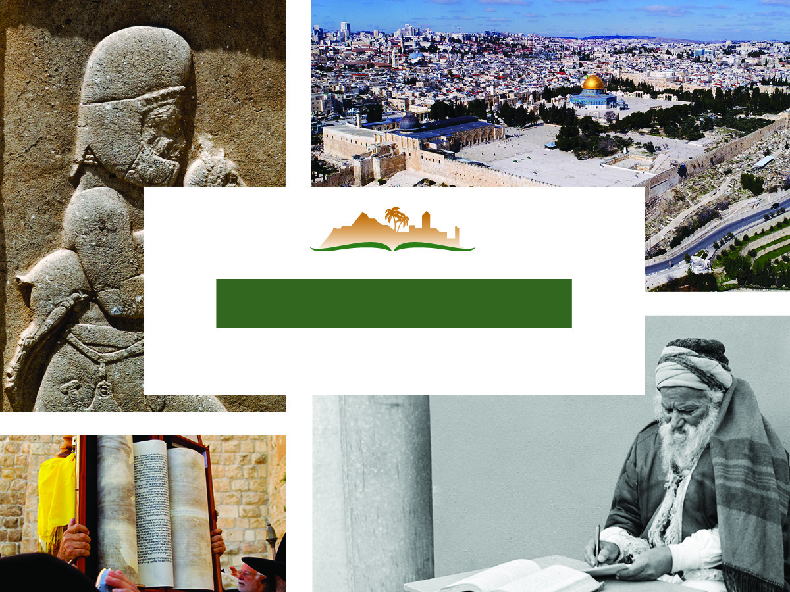
Ezra 3
Notes:
This is a free sample of the Ezra 3 presentation from the Photo Companion to the Bible. To purchase the full volume, visit https://www.bibleplaces.com/ezra/
The Photo Companion to the Bible is an image-rich resource for Bible students, teachers, and researchers. Just as a librarian stocks the shelves with as many relevant materials as possible, so we have tried to provide a broad selection of images. Our goal is that you will find in this “library” whatever it is you are looking for.
Credits: The primary creators of this presentation are Kris Udd, Steven D. Anderson, Chris McKinny, Kai Akagi, and Todd Bolen. The photographs have an individual file code which usually includes the initials of the photographer. Other images have additional credit or source information.
Updates: We plan to update this collection as we are able. We welcome your suggestions for improving this resource (photocompanion@bibleplaces.com). Purchasers of the Ezra volume are provided free, lifetime updates to the volume.
Copyright: This photo collection is protected by copyright law and may not be distributed without written permission from BiblePlaces.com. Slide notes should be treated as any other copyrighted written material, with credit given when quoting from these notes.
For more information, see our complete “Introduction to the Photo Companion to the Bible” online at https://www.BiblePlaces.com/Intro-Photo-Companion-Bible/. Here you will find more information about photo selection, explanatory notes, Bible translation, credit information, and copyright allowances.

Slide 2
Ezra 3
This is a free sample of the Ezra 3 presentation from the Photo Companion to the Bible. To purchase the full volume, visit https://www.bibleplaces.com/ezra/ The Photo Companion to the Bible is an image-rich resource for Bible students, teachers, and researchers. Just as a librarian stocks the shelves with as many relevant materials as possible, so we have tried to provide a broad selection of images. Our goal is that you will find in this “library” whatever it is you are looking for. For more details (for this and every slide), see the Notes section below.
Notes:
This is a free sample of the Ezra 3 presentation from the Photo Companion to the Bible. To purchase the full volume, visit https://www.bibleplaces.com/ezra/
The Photo Companion to the Bible is an image-rich resource for Bible students, teachers, and researchers. Just as a librarian stocks the shelves with as many relevant materials as possible, so we have tried to provide a broad selection of images. Our goal is that you will find in this “library” whatever it is you are looking for.
Credits: The primary creators of this presentation are Kris Udd, Steven D. Anderson, Chris McKinny, Kai Akagi, and Todd Bolen. The photographs have an individual file code which usually includes the initials of the photographer. Other images have additional credit or source information.
Updates: We plan to update this collection as we are able. We welcome your suggestions for improving this resource (photocompanion@bibleplaces.com). Purchasers of the Ezra volume are provided free, lifetime updates to the volume.
Copyright: This photo collection is protected by copyright law and may not be distributed without written permission from BiblePlaces.com. Slide notes should be treated as any other copyrighted written material, with credit given when quoting from these notes.
For more information, see our complete “Introduction to the Photo Companion to the Bible” online at https://www.BiblePlaces.com/Intro-Photo-Companion-Bible/. Here you will find more information about photo selection, explanatory notes, Bible translation, credit information, and copyright allowances.

Slide 3
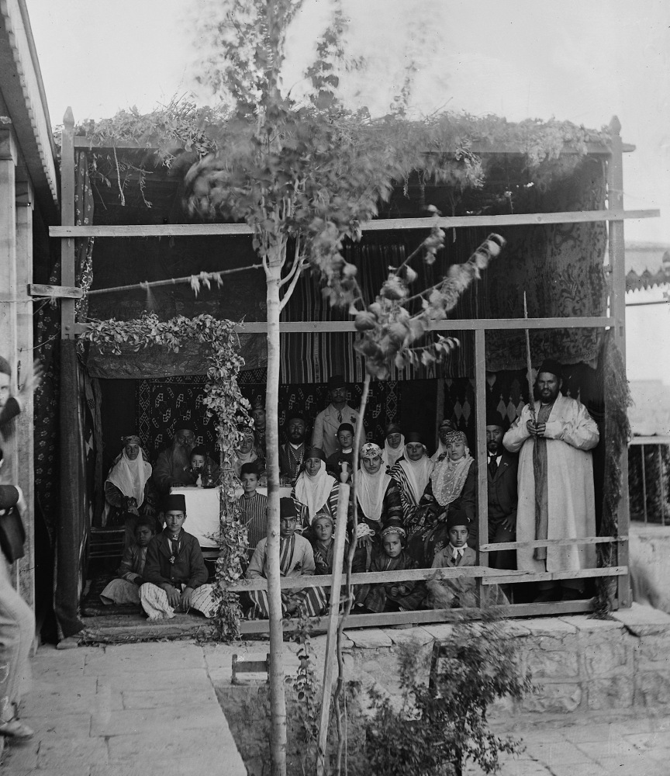
When the seventh month came
Bukharan Jews celebrating the Feast of Tabernacles (Sukkot), circa 1910
3:1
Notes:
The seventh month (September–October) was called Ethanim (1 Kgs 8:2) or Tishri. Three feasts were celebrated during this month: the Feast of Trumpets (Rosh HaShana), the Day of Atonement (Yom Kippur), and the Feast of Tabernacles/Booths (Sukkot). This American Colony photograph was taken between 1900 and 1920.
mat05650

Slide 4
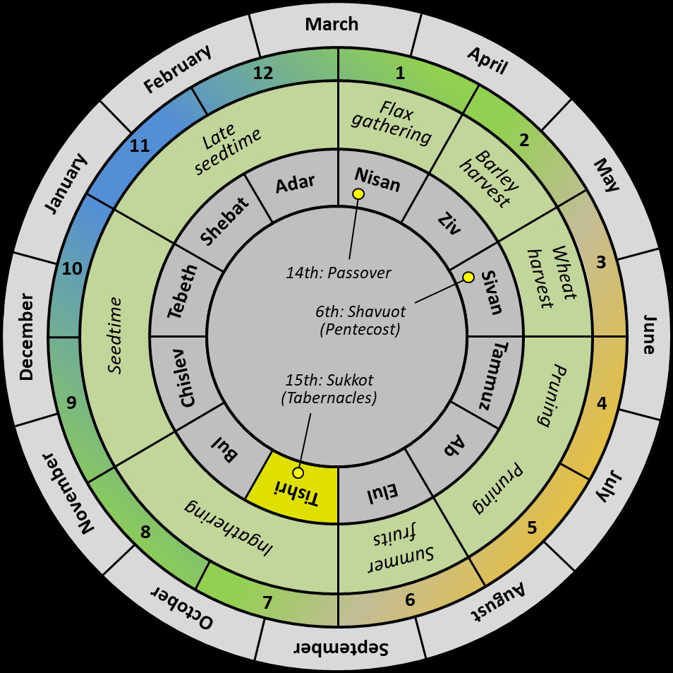
When the seventh month came
March
February
April
12
1
Flax
gathering
11
Late
seedtime
2
January
Adar
Nisan
Barley harvest
May
Shebat
Ziv
10
14th: Passover
Wheat harvest
3
Tebeth
Sivan
6th: Shavuot (Pentecost)
December
Seedtime
June
Chislev
15th: Sukkot (Tabernacles)
Tammuz
9
Pruning
4
Bul
Ab
November
Tishri
Elul
Pruning
July
8
Ingathering
Summer fruits
5
October
7
6
August
September
Hebrew calendar with the three major festivals
3:1
Notes:
In the Hebrew Bible, the seventh month is called “Ethanim” (Heb. אֵיתָנִים, 1 Kgs 8:2). This month falls in September/October of the Gregorian calendar. In the late period, during the Babylonian captivity, the Babylonian name “Tishri” was adopted for this month. An editable version is included beneath the graphic for those who wish to modify it.

Slide 5
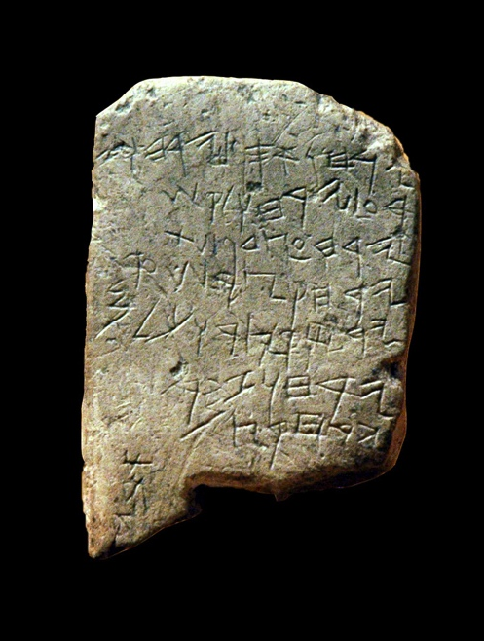
When the seventh month came
Two months gathering (September, October)
Two months planting (November, December)
Two months late sowing (January, February)
One month cutting flax (March)
One month reaping barley (April)
One month reaping and measuring grain (May)
Two months pruning (June, July)
One month summer fruit (August)
Gezer Calendar, 10th century BC
3:1
Notes:
The Gezer Calendar dates to about the time of Solomon. It lists the different types of crops that were planted and harvested by month of the year. It begins with the seventh month. This inscription was photographed at the Istanbul Archaeological Museum.
tb041705445bl

Slide 6
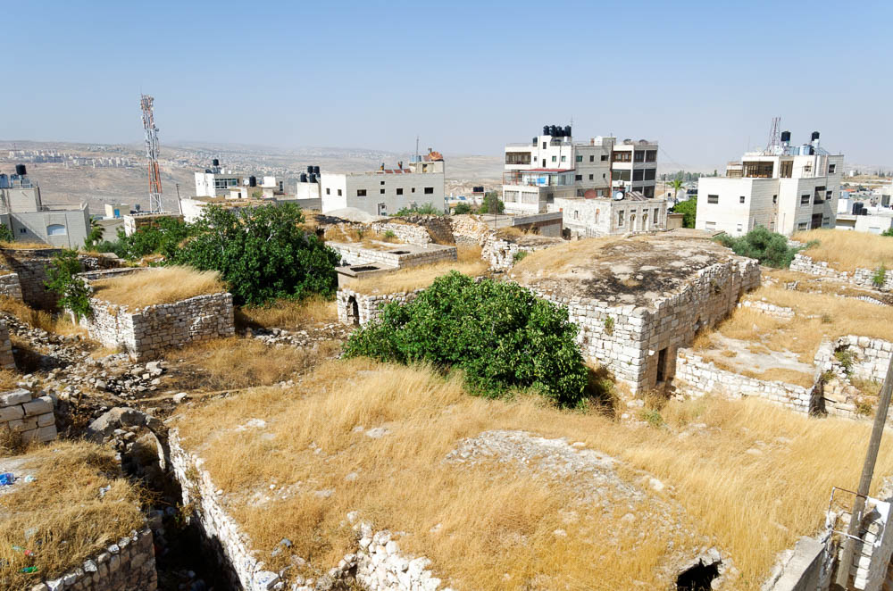
And the Israelites were settled in their cities
Old buildings at Ramah
3:1
Notes:
The Bible does not say in which month the exiles returned to the land, but it must have been in the summer, between the dates of the major feasts. By the seventh month, all the families had successfully resettled in their ancestral cities, and the people were ready to go up to Jerusalem for a national assembly. A photo of Ramah is shown here, because Ezra 2:26 specifies that some of the exiles were returning to Ramah.
tb060116459

Slide 7
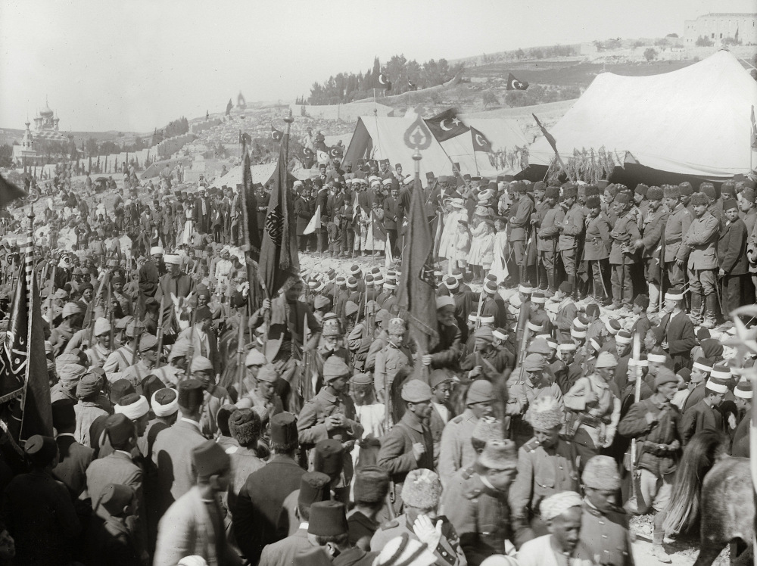
The people gathered together as one man to Jerusalem
Crowds gathered for the last Turkish celebration of Nebi Musa Feast, 1917
3:1
Notes:
This American Colony photograph was taken in 1917.
mat00757

Slide 8
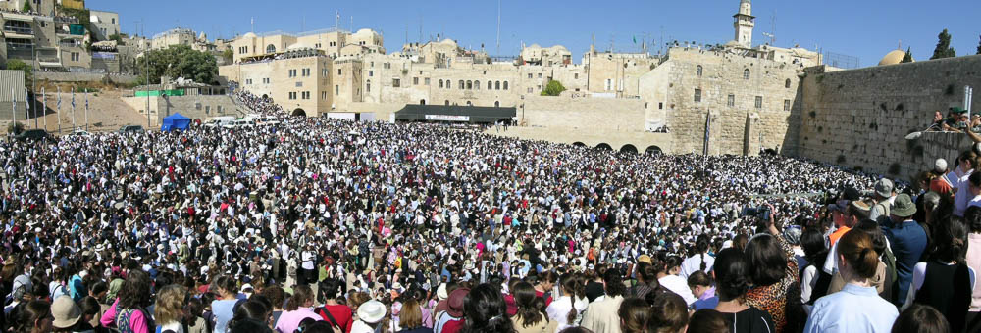
The people gathered together as one man to Jerusalem
Jews gathered at the Western Wall for the priestly blessing at the Feast of Tabernacles
3:1
Notes:
Jews still gather in Jerusalem in large numbers during the Feast of Tabernacles.
tb101303501

Slide 9
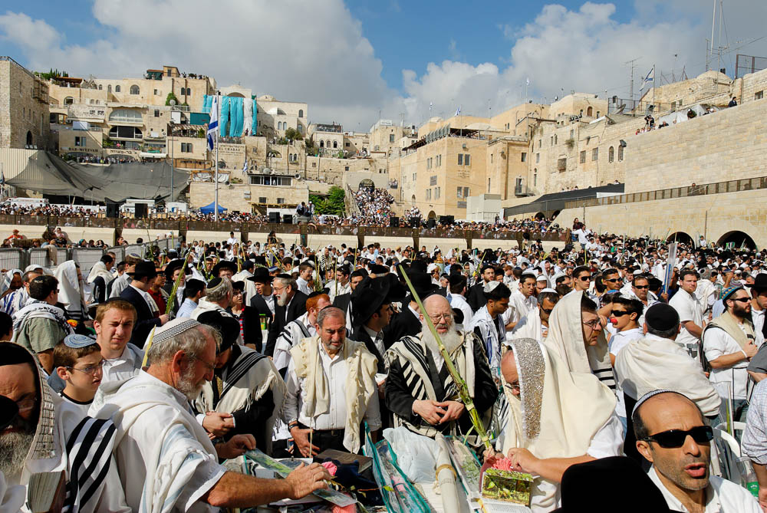
The people gathered together as one man to Jerusalem
Men praying at the Western Wall during the Feast of Tabernacles
3:1
Notes:
tb100906912

Slide 10
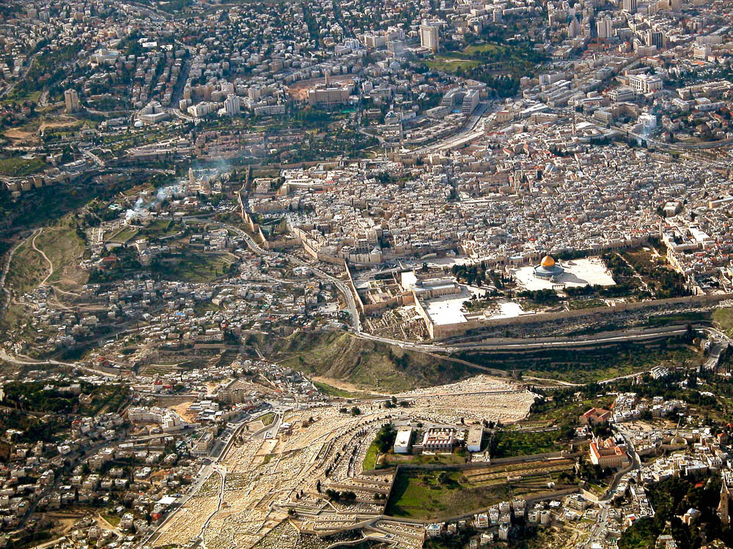
The people gathered together as one man to Jerusalem
Jerusalem (aerial view from the east)
3:1
Notes:
tb010703232

Slide 11
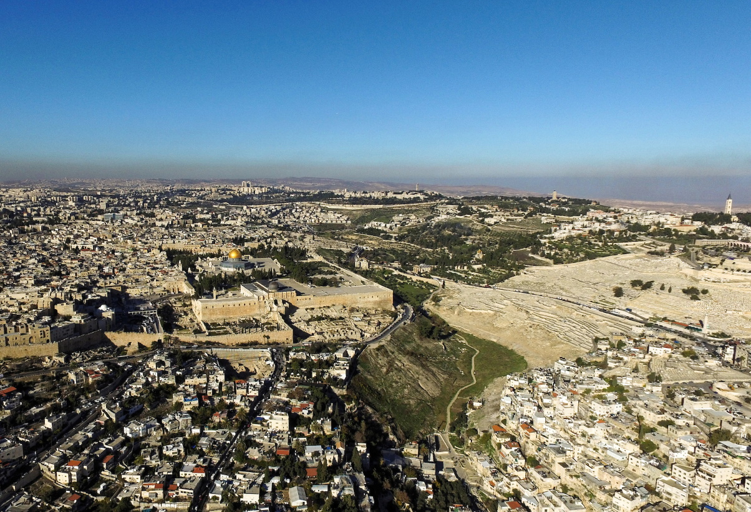
The people gathered together as one man to Jerusalem
Temple Mount, Mount of Olives, and City of David (aerial view from the south)
3:1
Notes:
ws120915358

Slide 12
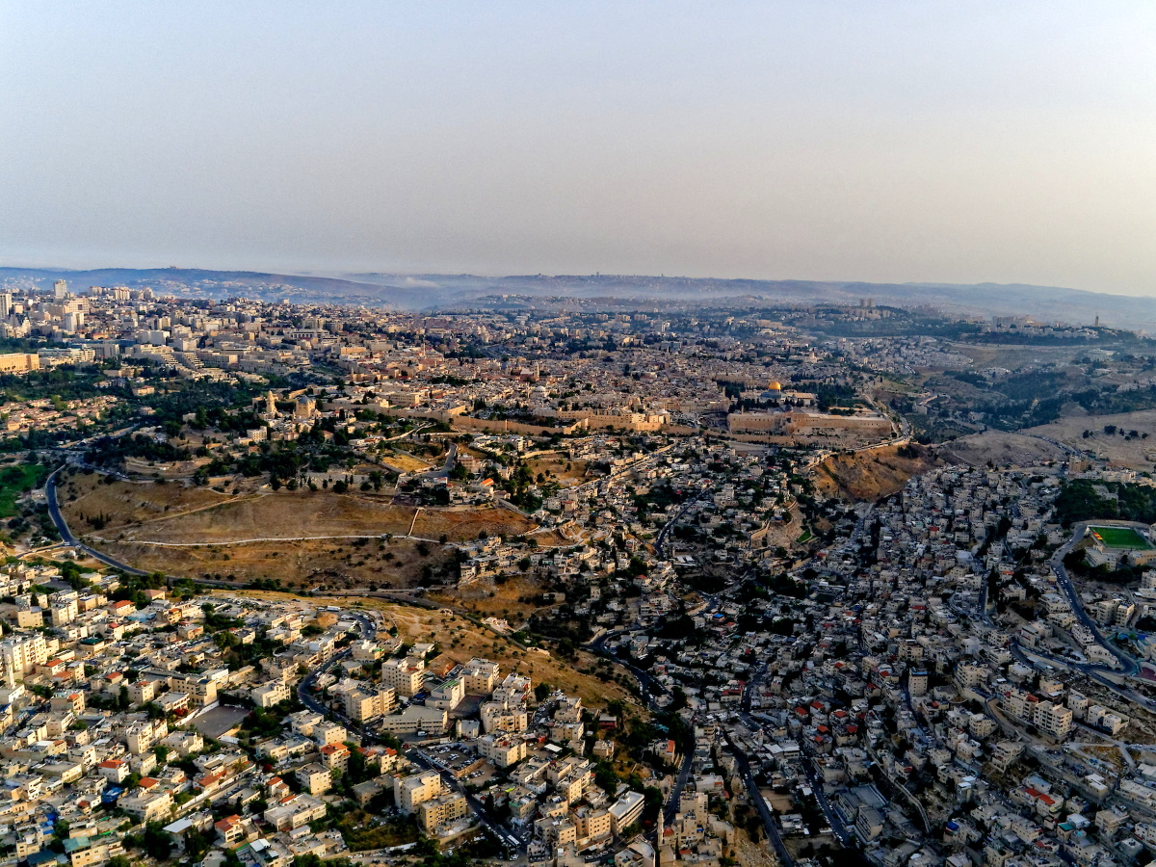
The people gathered together as one man to Jerusalem
Jerusalem (aerial view from the south)
3:1
Notes:
In David’s day, the city of Jerusalem (then known as Jebus) was located on a ridge to the south of where the temple would later be built. David renamed Jebus as the City of David. Solomon extended the city northward to gain enough space for the new temple and the new royal palace complex. The size of the city swelled considerably when the Assyrians conquered Judah’s northern neighbor, Israel (723 BC), and Hezekiah built a new city wall to encompass the Western Hill, where most of the refugees seem to have settled. When the returnees arrived, the entire city was still in a state of ruin. The rebuilding of the city that took place in these years seems to have been largely confined to the older area known as the City of David. The next slide includes labels.
ws060718018

Slide 13
The people gathered together as one man to Jerusalem
House of Yahweh
Western Hill
Mount of Olives
Kidron Valley
Hinnom Valley
City of David
Jerusalem (aerial view from the south)
3:1
Notes:
In David’s day, the city of Jerusalem (then known as Jebus) was located on a ridge to the south of where the temple would later be built. David renamed Jebus as the City of David. Solomon extended the city northward to gain enough space for the new temple and the new royal palace complex. The size of the city swelled considerably when the Assyrians conquered Judah’s northern neighbor, Israel (723 BC), and Hezekiah built a new city wall to encompass the Western Hill, where most of the refugees seem to have settled. When the returnees arrived, the entire city was still in a state of ruin. The rebuilding of the city that took place in these years seems to have been largely confined to the older area known as the City of David.
ws060718018

Slide 14
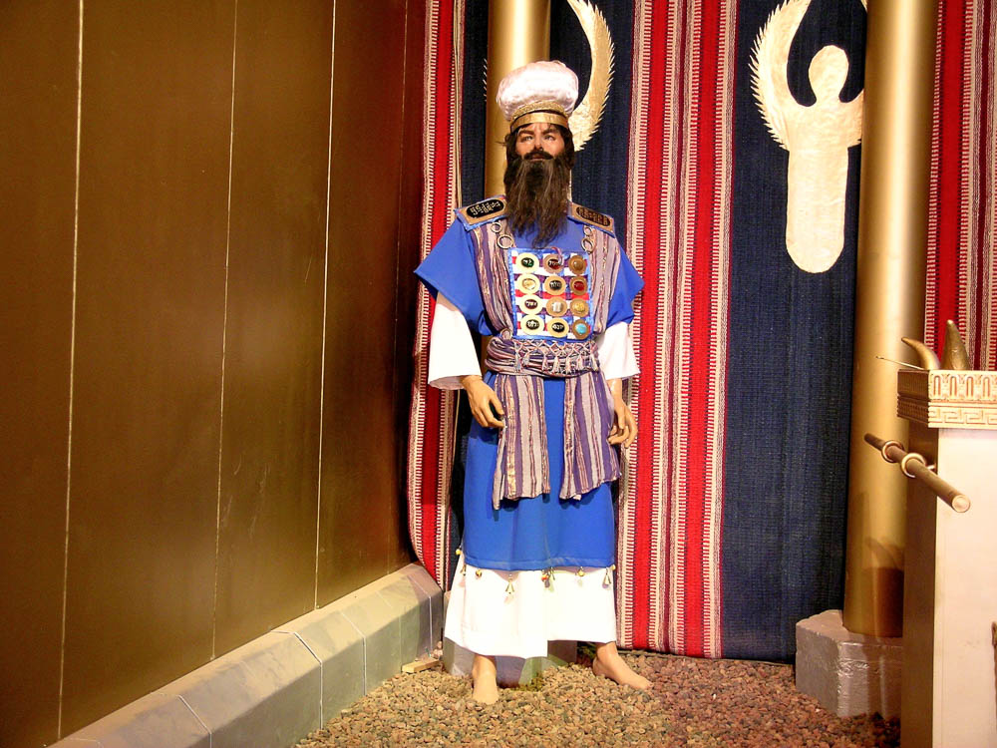
Then Jeshua the son of Jozadak and his brothers the priests . . . arose
High priest in a model tabernacle
3:2
Notes:
Jeshua (Joshua) the son of Jehozadak was the high priest of Israel at the time of the building of the Second Temple (cf. Hag 1:1). This model was photographed at the full-size replica of the tabernacle in Timna Valley in southern Israel.
tb022804700

Slide 15
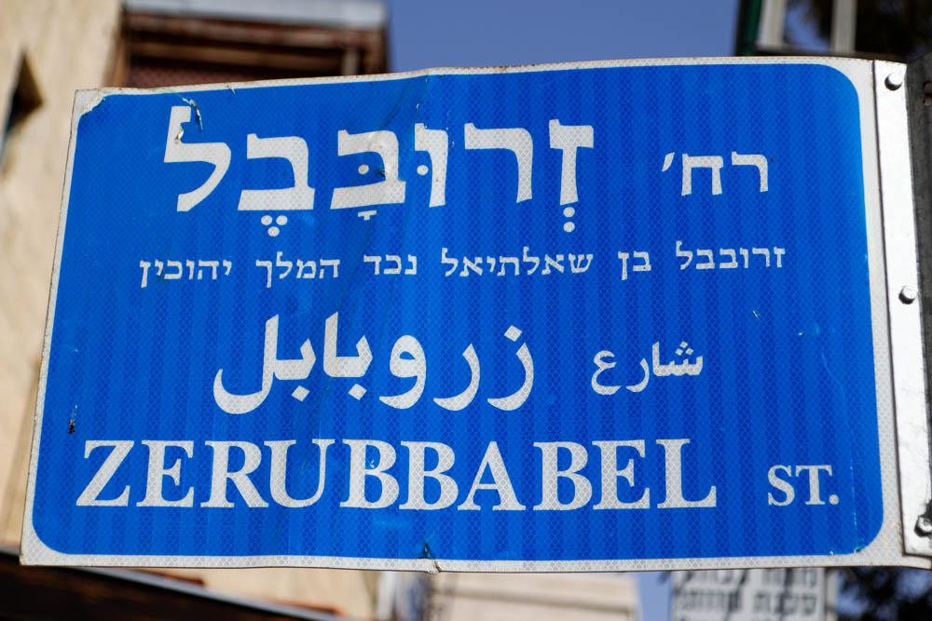
And Zerubbabel the son of Shealtiel and his brothers arose
“Zerubbabel Street” sign in Jerusalem
3:2
Notes:
Sheshbazzar has disappeared from the narrative, and a Jew named Zerubbabel is now governor of the Persian province of Judah/Yehud. Though some have claimed that Sheshbazzar and Zerubbabel are the same person, this is unlikely (cf. Ezra 5:14). Zerubbabel Street is located in the Baka neighborhood, southwest of the Old City. The Hebrew subtitle identifies the individual as “Zerubbabel son of Shealtiel, grandson of King Jehoiachin.”
lbd102218413

Slide 16
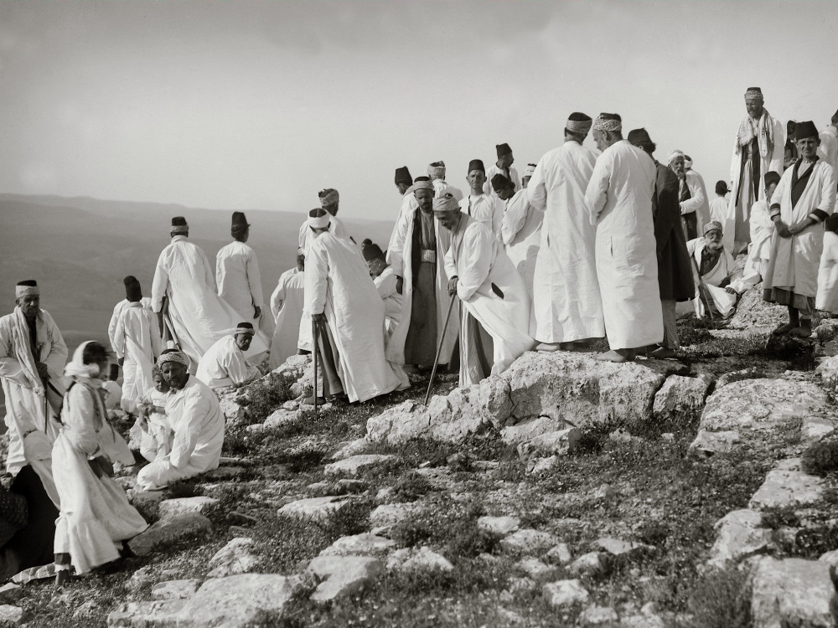
And they built the altar of the God of Israel to offer burnt offerings on it
Going to Abraham’s altar during Samaritan Passover, circa 1910
3:2
Notes:
This American Colony photograph was taken between 1900 and 1920.
mat01877

Slide 17
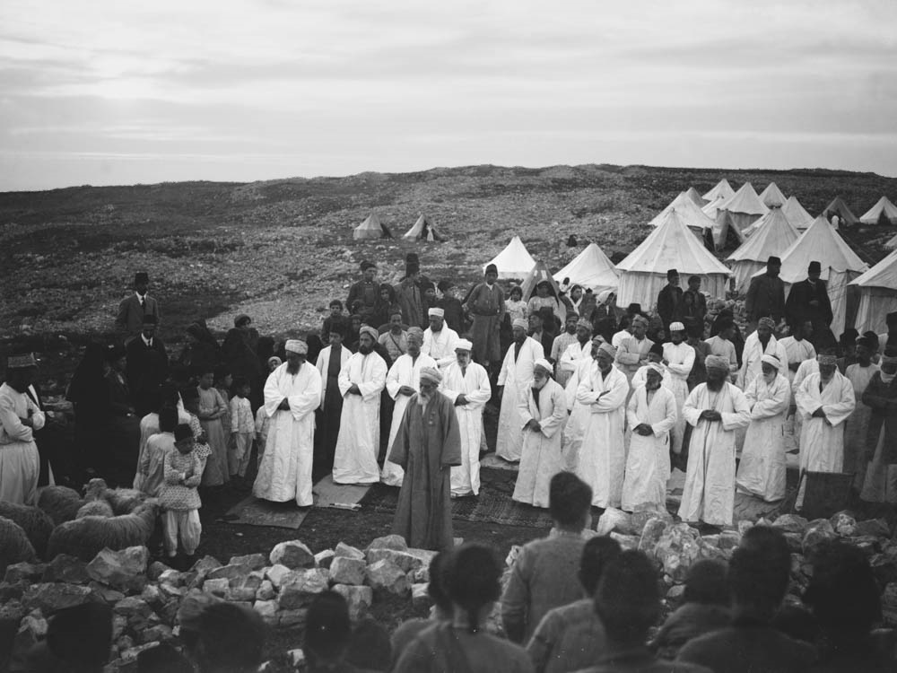
And they built the altar of the God of Israel to offer burnt offerings on it
High priest praying during the Samaritan Passover, circa 1910
3:2
Notes:
This American Colony photograph was taken between 1900 and 1920.
mat01845

Slide 18
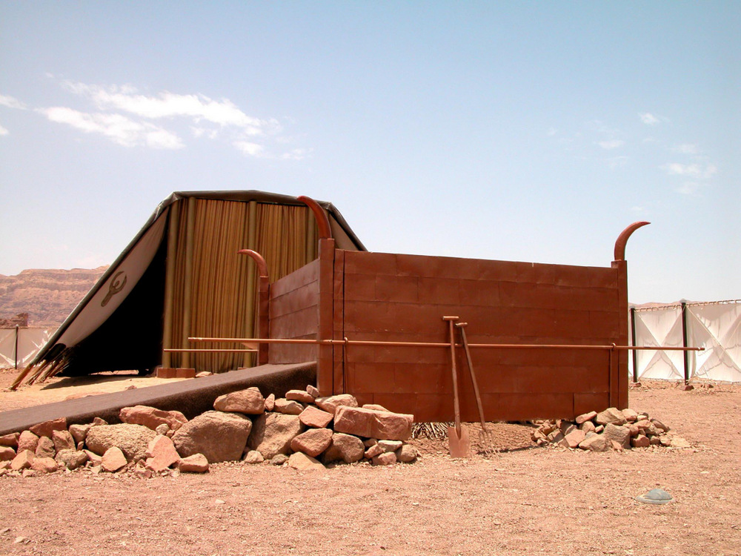
And they built the altar of the God of Israel to offer burnt offerings on it
Sacrificial altar in a model tabernacle
3:2
Notes:
This model of the altar of burnt offerings in the tabernacle is made to scale, but it contains some inaccuracies in design. The altar of burnt offering in the Second Temple, however, was made of stone.
tb052403623

Slide 19
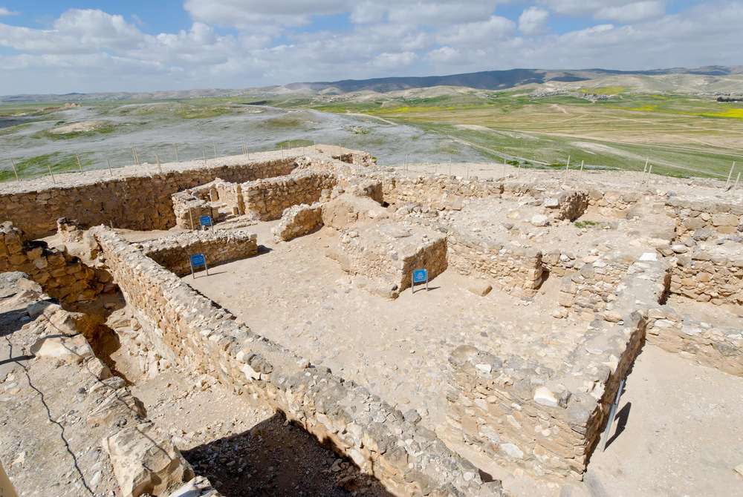
And they built the altar of the God of Israel to offer burnt offerings on it
Israelite temple at Arad with sacrificial altar
3:2
Notes:
A small temple was incorporated within the Israelite Iron Age fortress of Arad. This temple has several features that are similar to the Jerusalem temple including a holy of holies, a holy place (the broad room), and a courtyard with an altar. This temple was illegitimate and was destroyed by either Hezekiah or Josiah. See the next slide for labels.
tb030607848

Slide 20
And they built the altar of the God of Israel to offer burnt offerings on it
broad room
Holy of Holies
altar
courtyard
Israelite temple at Arad with sacrificial altar
3:2
Notes:
A small temple was incorporated within the Israelite Iron Age fortress of Arad. This temple has several features that are similar to the Jerusalem temple including a holy of holies, a holy place (the broad room), and a courtyard with an altar. This temple was illegitimate and was destroyed by either Hezekiah or Josiah.
tb030607848

Slide 21
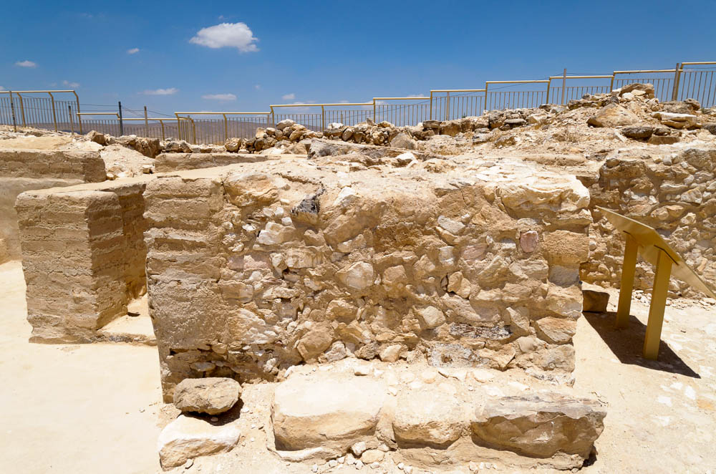
And they built the altar of the God of Israel to offer burnt offerings on it
Sacrificial altar in the Israelite temple at Arad
3:2
Notes:
The altar in the Second Temple was likely made of stones with an earthen fill, similar to this sacrificial altar at Arad.
tb060916654

Slide 22
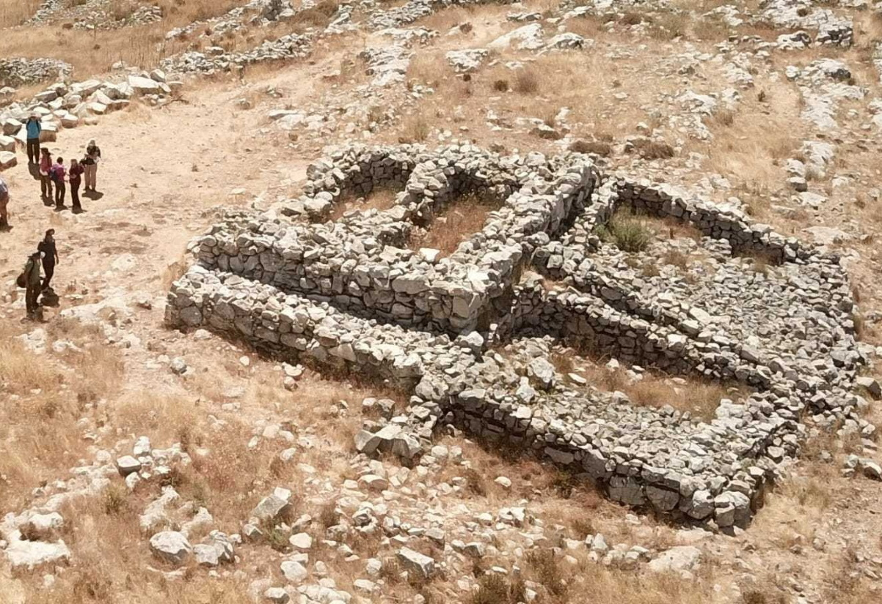
And they built the altar of the God of Israel to offer burnt offerings on it
Sacrificial altar on Mount Ebal
3:2
Notes:
Another stone altar that may be similar to the altar the returnees built in Jerusalem is the altar on Mount Ebal shown in this photo. This altar is associated by some scholars with the altar built on Mount Ebal by Joshua. It has been partially reconstructed by the excavators, based on the foundations that were discovered. It is square, built of uncut and unworked fieldstones, and features a ramp leading up to the top. The cavities visible in the center of the structure (left) were likely originally filled with dirt. This image comes from zstadler and is licensed under CC BY-SA 4.0, via Wikimedia Commons: https://commons.wikimedia.org/wiki/File:IHM_%D7%9E%D7%96%D7%91%D7%97_%D7%94%D7%A8_%D7%A2%D7%99%D7%91%D7%9C.jpeg.
wiki062920201158912354

Slide 23
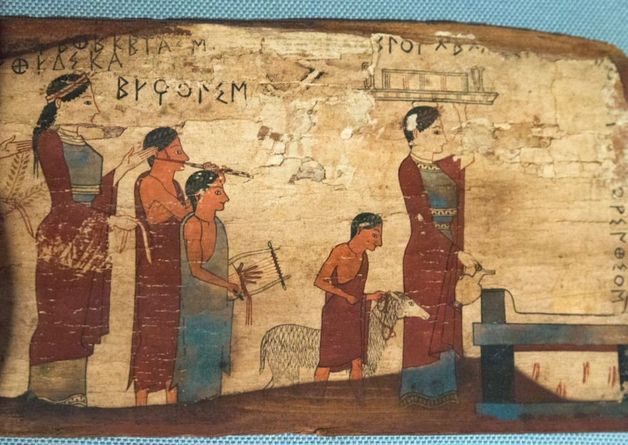
And they built the altar of the God of Israel to offer burnt offerings on it
Procession to an altar to sacrifice a lamb, from Sikyon, circa 530 BC
3:2
Notes:
Sheep were commonly used for sacrifice, not only in the Jewish tradition but also in the Greco-Roman world. This painted wooden plaque is from approximately the same time as the events described in Ezra 3. It depicts a lamb being led to an altar, accompanied by two figures playing a flute and lyre. The dedication is to the Charites. The wooden plaque was found near ancient Sikyon, in a cave above the village Pitsa. This is about 10 miles (16 km) due west of ancient Corinth. This plaque was photographed at the National Archaeological Museum in Athens. This image comes from Zde and is licensed under CC BY-SA 4.0, via Wikimedia Commons: https://commons.wikimedia.org/wiki/File:Painted_wooden_plaque,_procession_to_sacrifice,_540-530_BC,_NAMA_16464,_191289.jpg.
wiki06112019164945

Slide 24
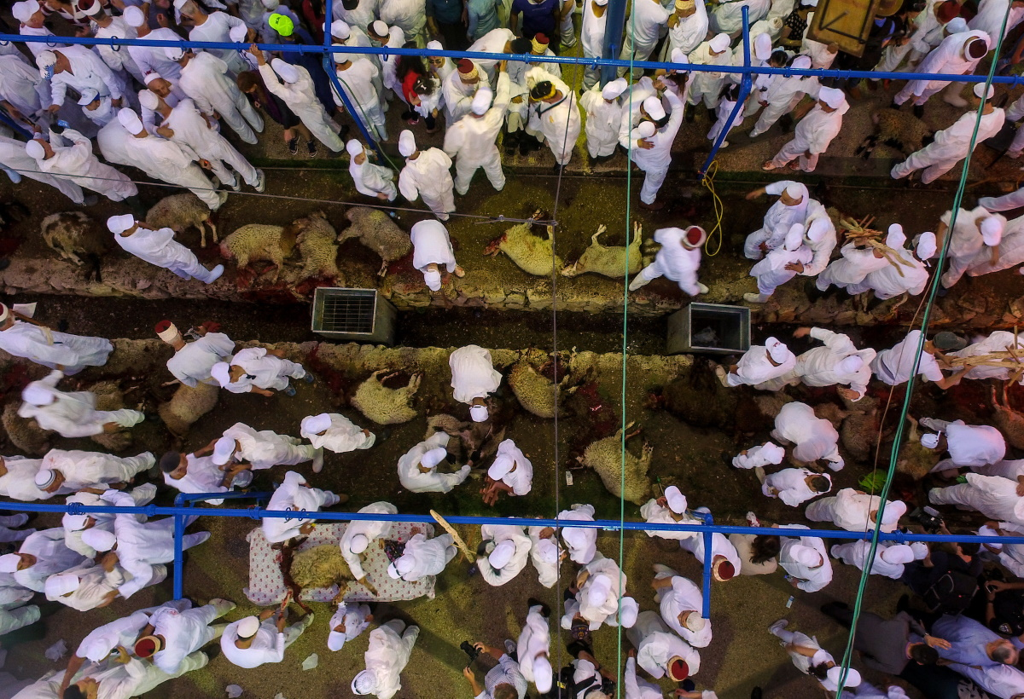
And they built the altar of the God of Israel to offer burnt offerings on it
Samaritan Passover sacrifice on Mount Gerizim (from above)
3:2
Notes:
ws042016091

Slide 25
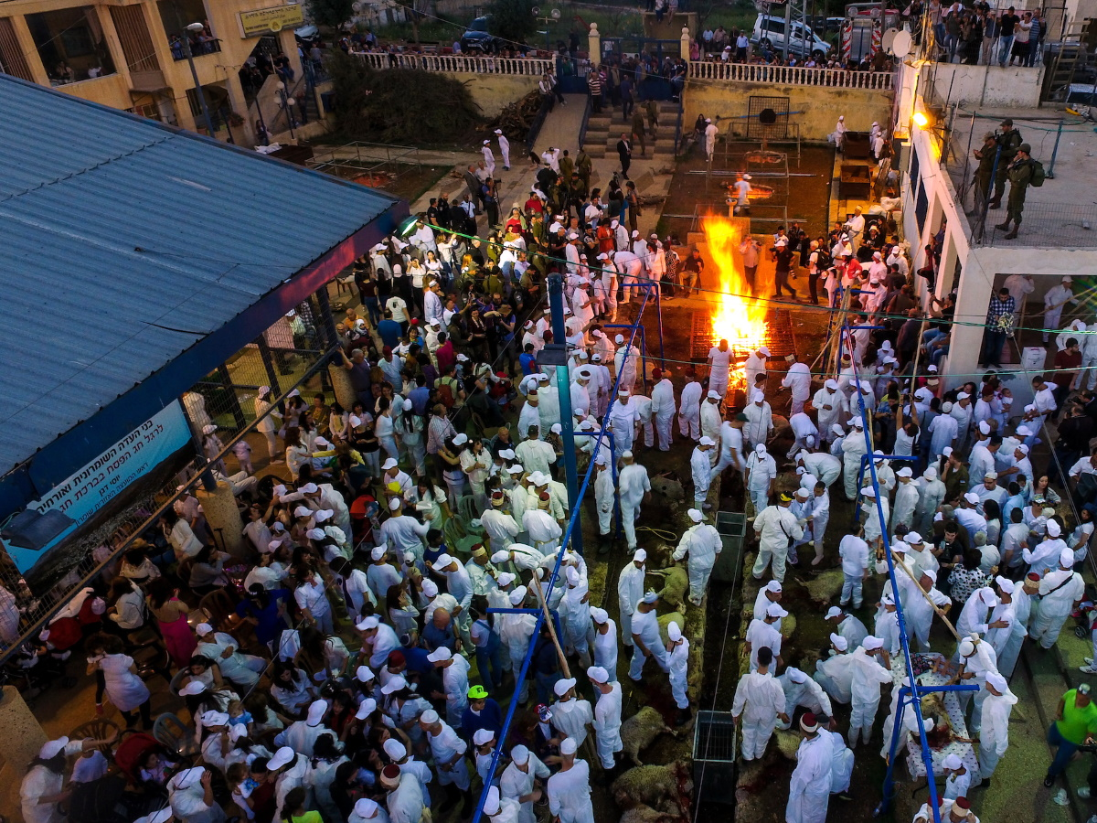
And they built the altar of the God of Israel to offer burnt offerings on it
Samaritan Passover sacrifice on Mount Gerizim (from above)
3:2
Notes:
ws042016098

Slide 26
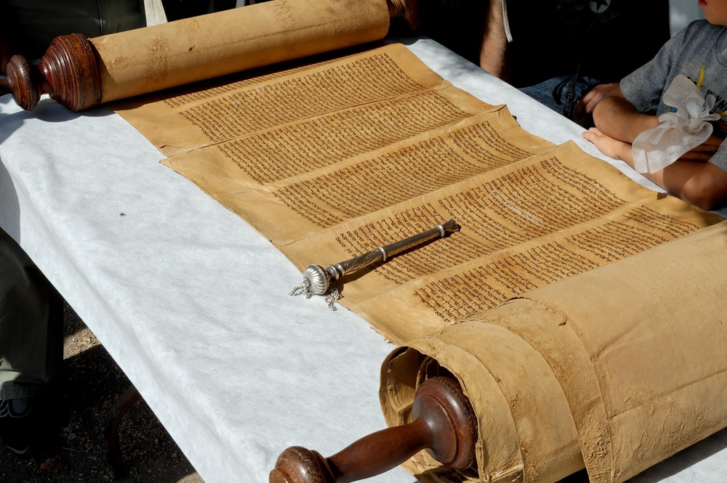
As it is written in the law of Moses the man of God
Torah Scroll
3:2
Notes:
The regulations regarding the daily sacrifices may be found in Exodus 29:38, Numbers 28:3-31, and Deuteronomy 12:5-7.
tb102605484

Slide 27
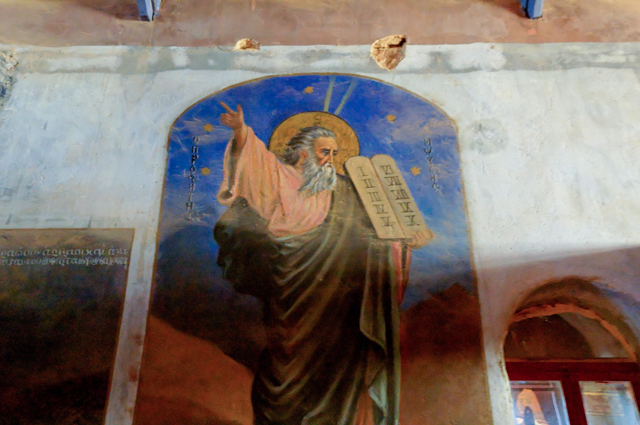
As it is written in the law of Moses the man of God
Moses portrayed in the chapel on Jebel Musa (traditional Mount Sinai)
3:2
Notes:
The golden disk around the head of Moses in this depiction is intended to portray his glory, as are the two “horns” or shafts of light that radiate from the top of his head.
tb062205218

Slide 28
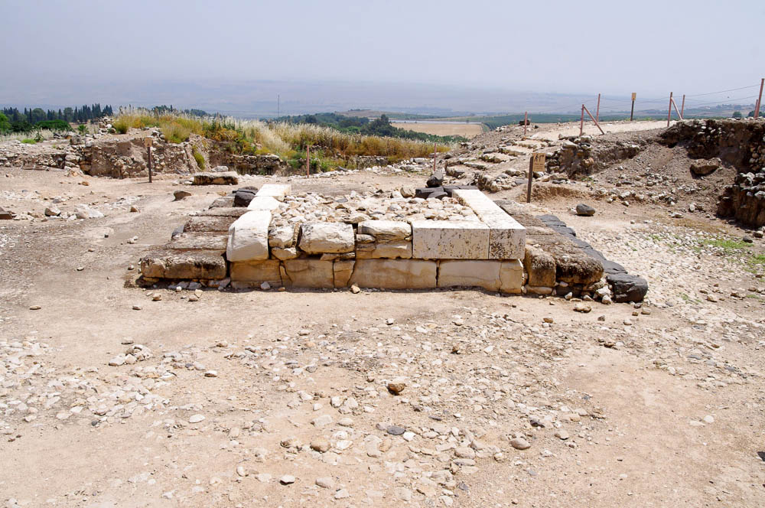
So they set up the altar on its foundation
Canaanite altar at Hazor, Late Bronze period, circa 1500–1200 BC
3:3
Notes:
The foundation of the altar might have looked something like the remains of this Canaanite altar uncovered by archaeologists.
adr1305061598

Slide 29
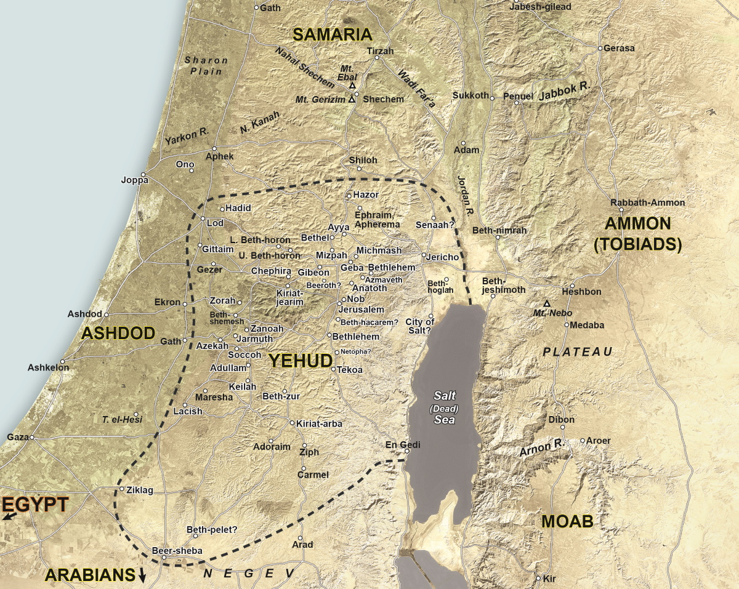
For they were terrified because of the peoples of the lands
Map of the Persian province of Yehud, with surrounding provinces
3:3
Notes:
The “peoples of the lands” may be taken to refer to the people of the surrounding provinces. These included the Samaritans on the north, the province of Ashdod to the west (ancient Philistia), the Idumeans to the south, and the Moabites and Ammonites (Tobiads) to the east. This map is a detail adapted from map 8-2 in the Satellite Bible Atlas, by William Schlegel. Used by permission.

Slide 30
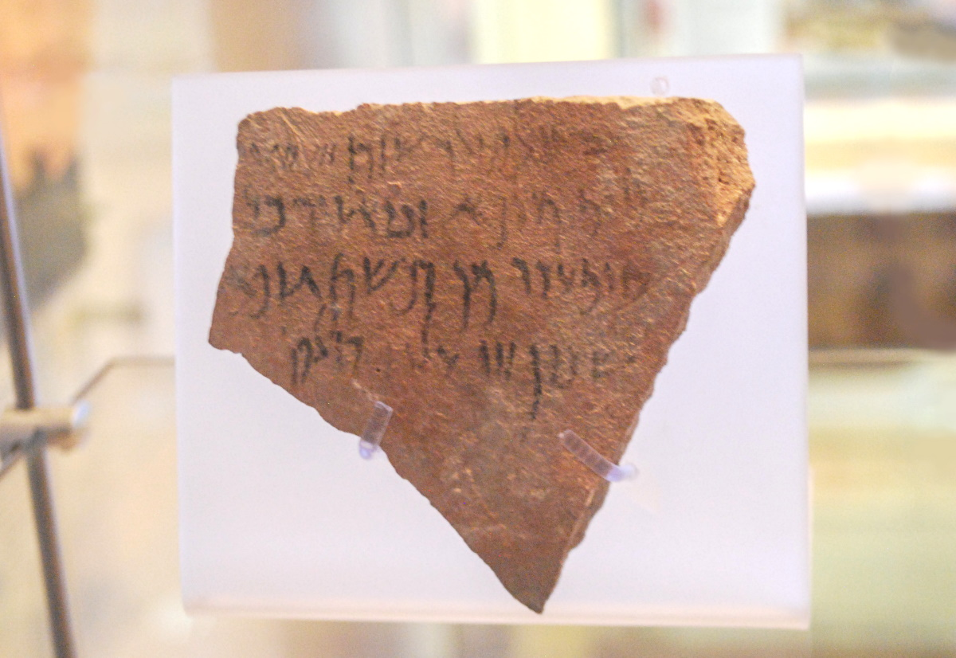
For they were terrified because of the peoples of the lands
Ostraca with an Aramaic inscription, from Idumea, 4th century BC
3:3
Notes:
The Idumeans were descendants of the Edomites. They moved into southern Judea during the Babylonian exile. These and other peoples of the surrounding pagan nations (e.g., Ashdod, Samaria, Ammon, Arabia) opposed the Jews and did not wish for their successful reestablishment in the land. Thus, the altar was rebuilt immediately in order to seek God’s favor and protection. This inscription was photographed at the Hecht Museum at the University of Haifa.
cm17062701423

Slide 31
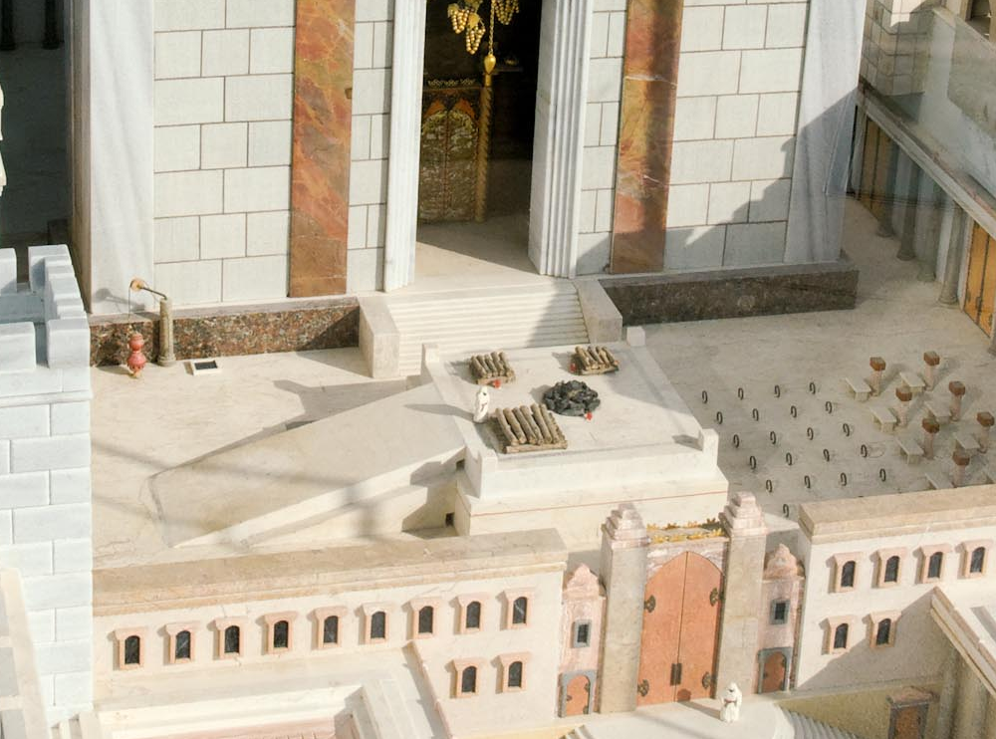
They offered burnt offerings on it to Yahweh morning and evening
Second Temple model with altar
3:3
Notes:
The Law mandated that a lamb be sacrificed on the altar in the morning and in the evening every day (Exod 29:38). This temple model shows woodpiles on which to burn sacrifices, along with a pile of coals at the center of the altar. This model of the temple is located on the roof of the Aish HaTorah building in Jerusalem.
tb010312509

Slide 32
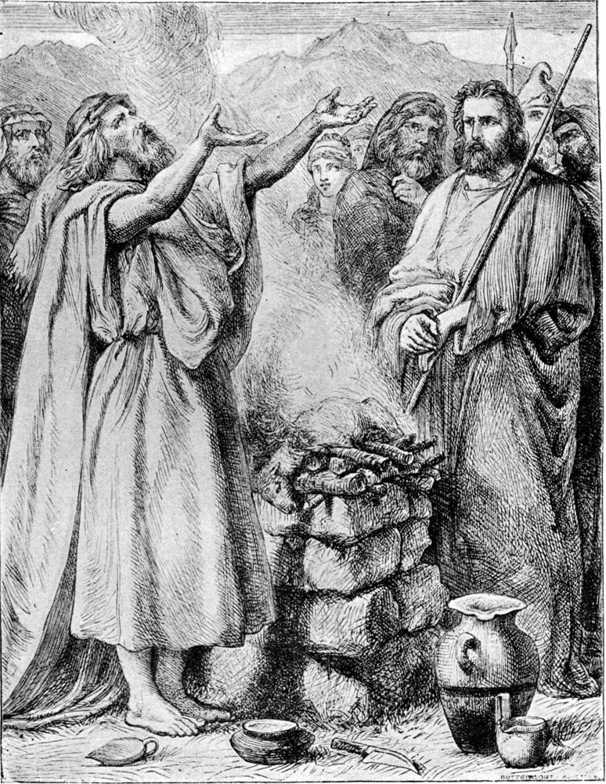
They offered burnt offerings on it to Yahweh morning and evening
Illustration of a burnt offering
3:3
Notes:
The altar shown in this illustration is much smaller than the altar on the Temple Mount. This illustration comes from Charles Foster, Bible Pictures and What They Teach Us (1886, 1914).
fbp073

Slide 33
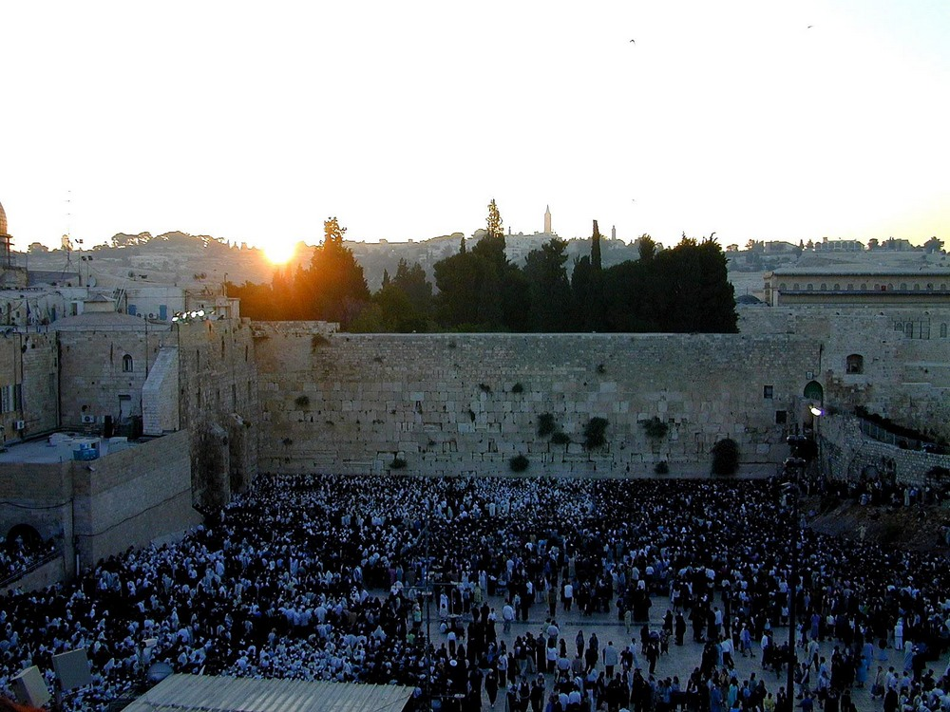
They offered burnt offerings on it to Yahweh morning and evening
Western Wall in Jerusalem at sunrise on the Feast of Pentecost (Shavuot)
3:3
Notes:
tb060900204

Slide 34
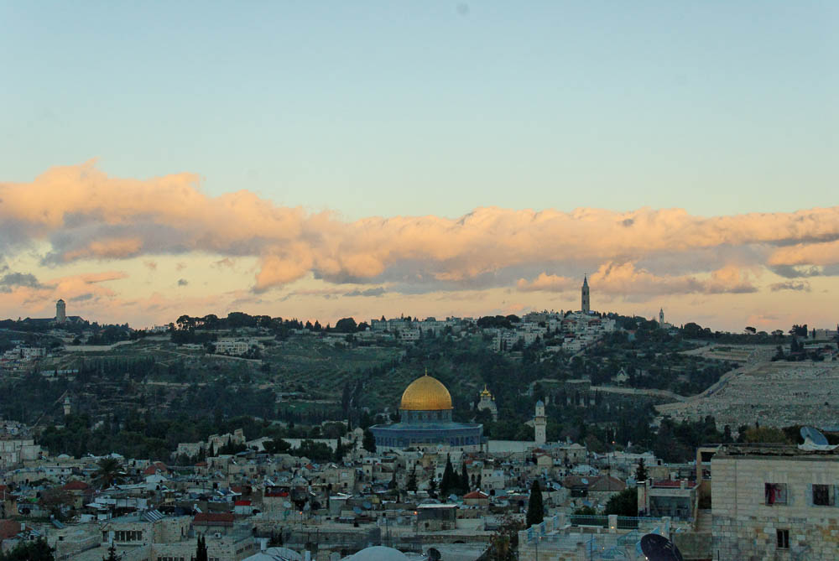
They offered burnt offerings on it to Yahweh morning and evening
Dome of the Rock at sunset (from the west)
3:3
Notes:
tb123109457

Slide 35
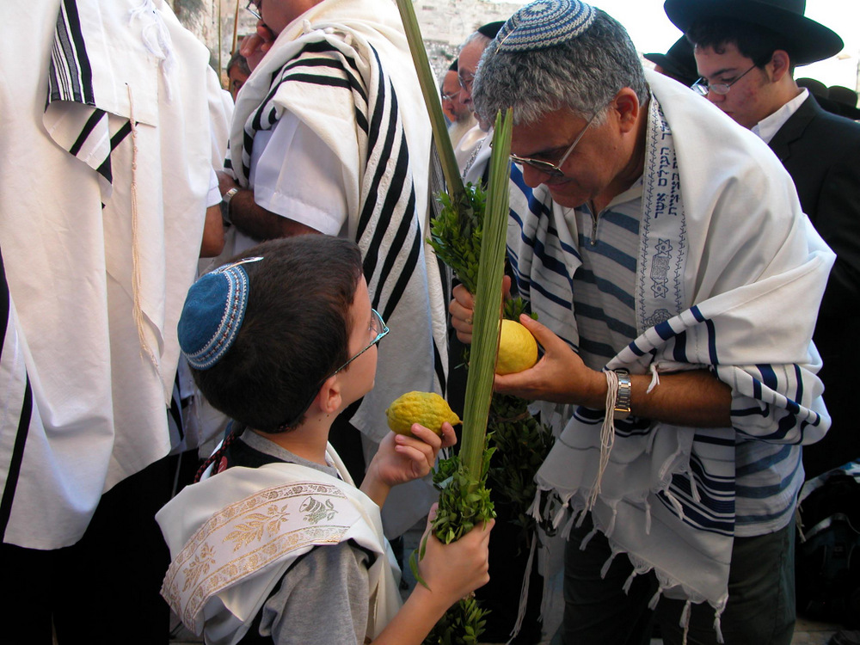
And they kept the Feast of Tabernacles, as it is written
Priestly blessing at the Western Wall during the Feast of Tabernacles (Sukkot)
3:4
Notes:
The Hebrew name for “Tabernacles” or “Booths” is “Sukkot” (Heb. סֻּכּ֖וֹת). Celebrants traditionally carry a citron and branches of a palm, myrtle, and willow tree, a custom derived from Leviticus 23:40.
tb101303019

Slide 36
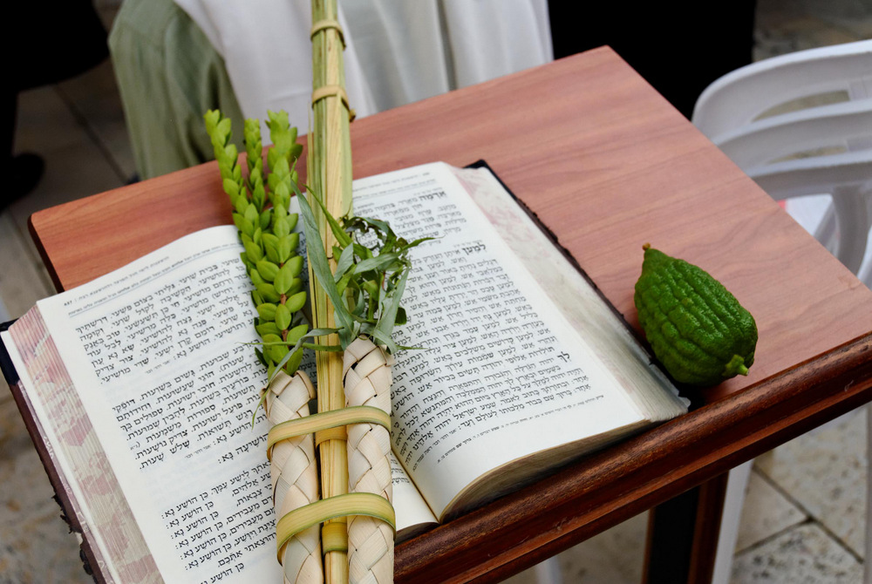
And they kept the Feast of Tabernacles, as it is written
Four species of Sukkot
3:4
Notes:
cd091006020

Slide 37
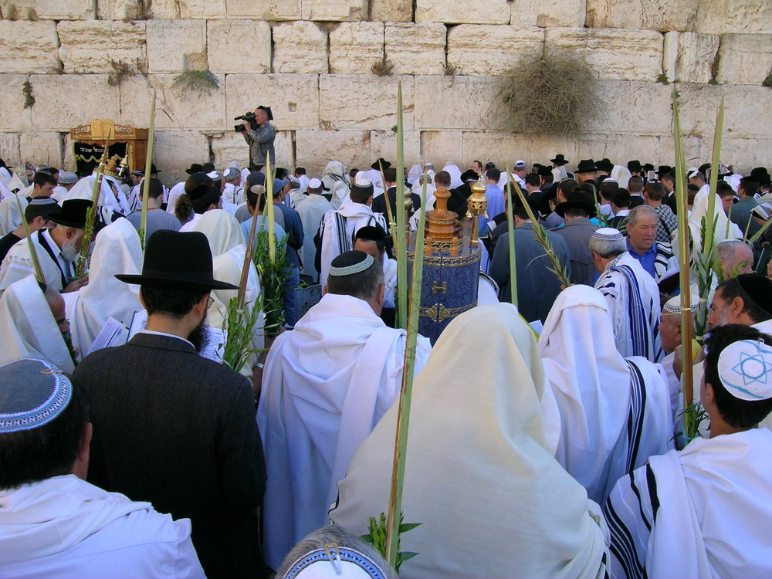
And they kept the Feast of Tabernacles, as it is written
Priestly blessing at the Western Wall during the Feast of Tabernacles
3:4
Notes:
This photograph illustrates one of the ceremonies during the modern Jewish celebration of this feast.
tb101303002

Slide 38
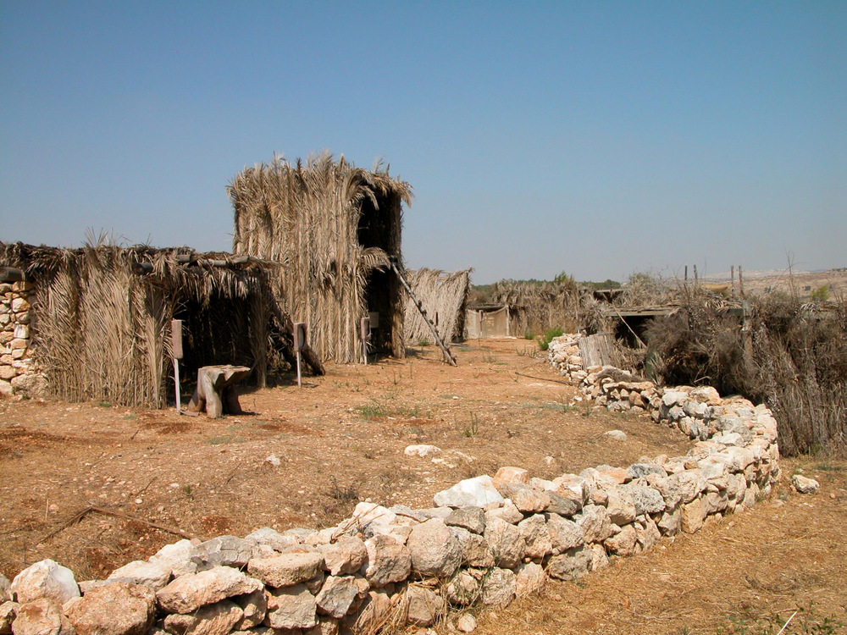
And they kept the Feast of Tabernacles, as it is written
Sukkot (booths) at Neot Kedumim
3:4
Notes:
One purpose of the feast was to recall the temporary quarters in which the Israelites lived when God brought them out of Egypt (Lev 23:42-43). Nehemiah 8:14-17 indicates, however, that the Israelites did not actually build booths (temporary shelters) for themselves at this celebration.
tb091403233

Slide 39
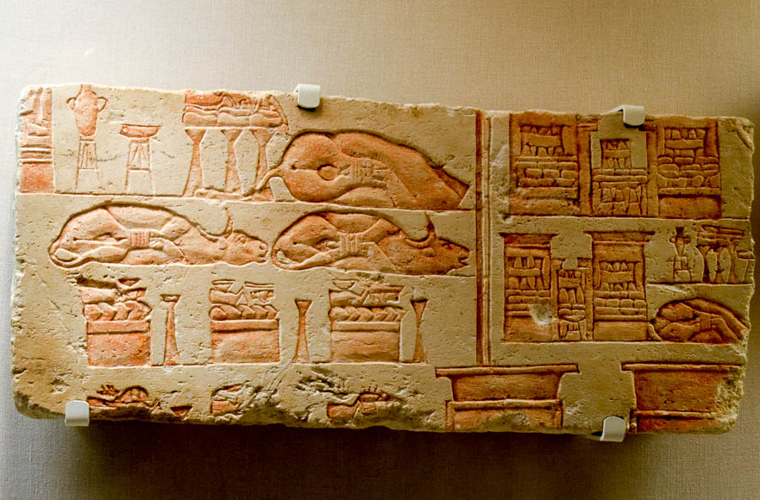
And they offered the daily burnt offerings as was required each day, according to the ordinance
Relief of offerings, including trussed cattle, from the reign of Akhenaten, 14th century BC
3:4
Notes:
The detailed series of offerings that were to be offered during the week of the Feast of Booths is found in Numbers 29:12-38. Each day had its specific set of sacrifices of bulls, rams, and lambs, along with grain and drink offerings. In addition to the trussed cattle, this relief includes depictions of wine, oil, breads, and cakes. The relief, which comes from Heliopolis in Egypt, was photographed at the San Antonio Museum of Art.
tb111716934

Slide 40
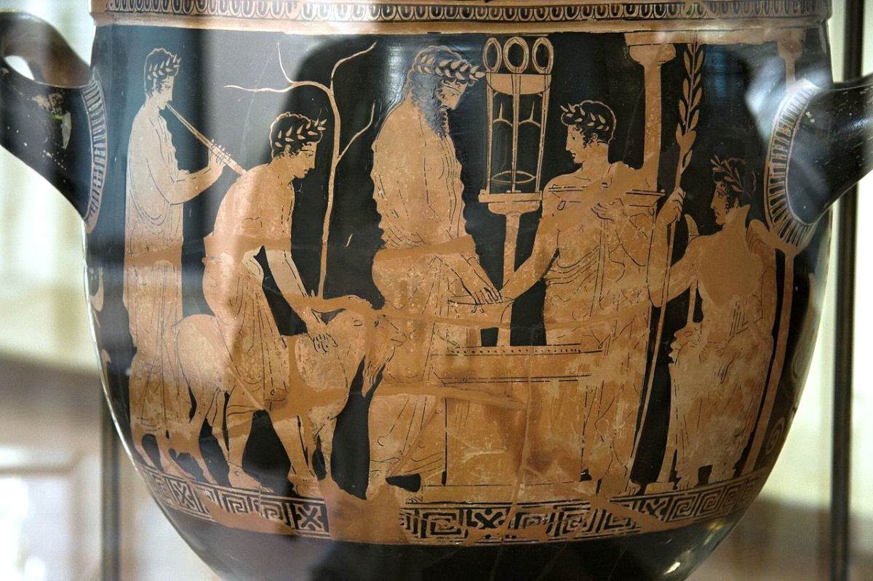
And they offered the daily burnt offerings as was required each day, according to the ordinance
Red-figure bell krater depicting a sacrificial scene at Delphi, circa 420 BC
3:4
Notes:
This krater depicts a sacrificial scene about a century later than the sacrifices of Ezra 3. This scene is situated at the sanctuary of Apollo at Delphi. The youth at the left brings a goat toward the altar; a bearded priest holds a libation basin; and to the right, a servant holds a large sacrificial plate. The seated figure at the far right is an image of the god Apollo, to whom the sacrifice is being made. This krater was photographed at the Archaeological Museum of Agrigento in Italy. This image comes from Zde and is licensed under CC BY-SA 4.0, via Wikimedia Commons: https://commons.wikimedia.org/wiki/File:Red_figure_bell_crater,_sacrificial_scene_at_Delphi,_420_BC,_AM_Agrigento,_120968.jpg.
wiki12096809082012164550482

Slide 41
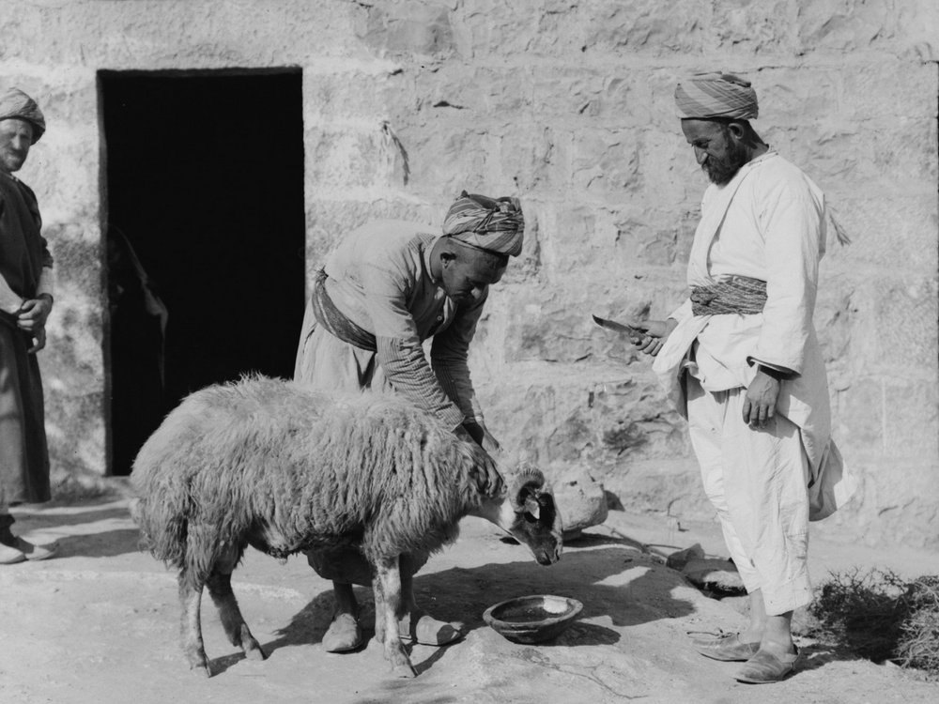
And they offered the daily burnt offerings as was required each day, according to the ordinance
Watering sheep before a sacrifice by the Weli of Budrieh, circa 1910
3:4
Notes:
This series of photos was taken at Sharafat, an Arab neighborhood in east Jerusalem. Sharafat was home to the Budrieh (Badriyya), a renowned family of weli (awliya, Muslim saints) to whom the village was dedicated as a waqf (Islamic trust) by the viceroy of Damascus in the 14th century. The sheep shown here is being sacrificed in a custom that has similarities with the Jewish Passover. This American Colony photograph was taken between 1900 and 1926.
mat01415

Slide 42
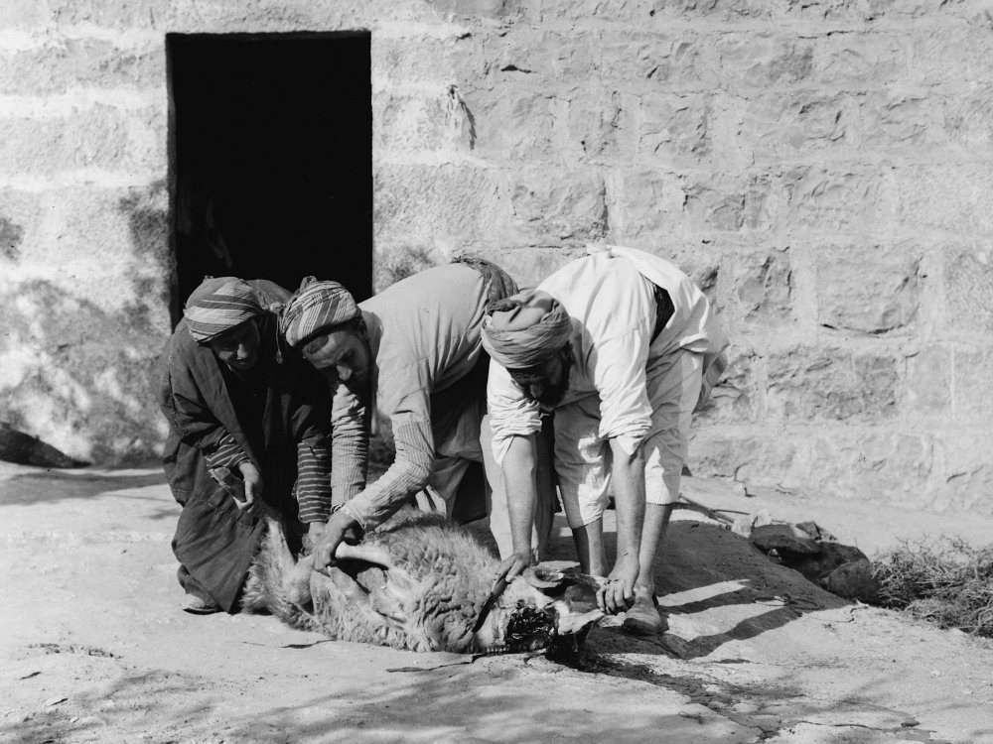
And they offered the daily burnt offerings as was required each day, according to the ordinance
Weli of Budrieh with a sacrificed sheep, circa 1910
3:4
Notes:
This American Colony photo was taken between 1900 and 1926.
mat01416

Slide 43
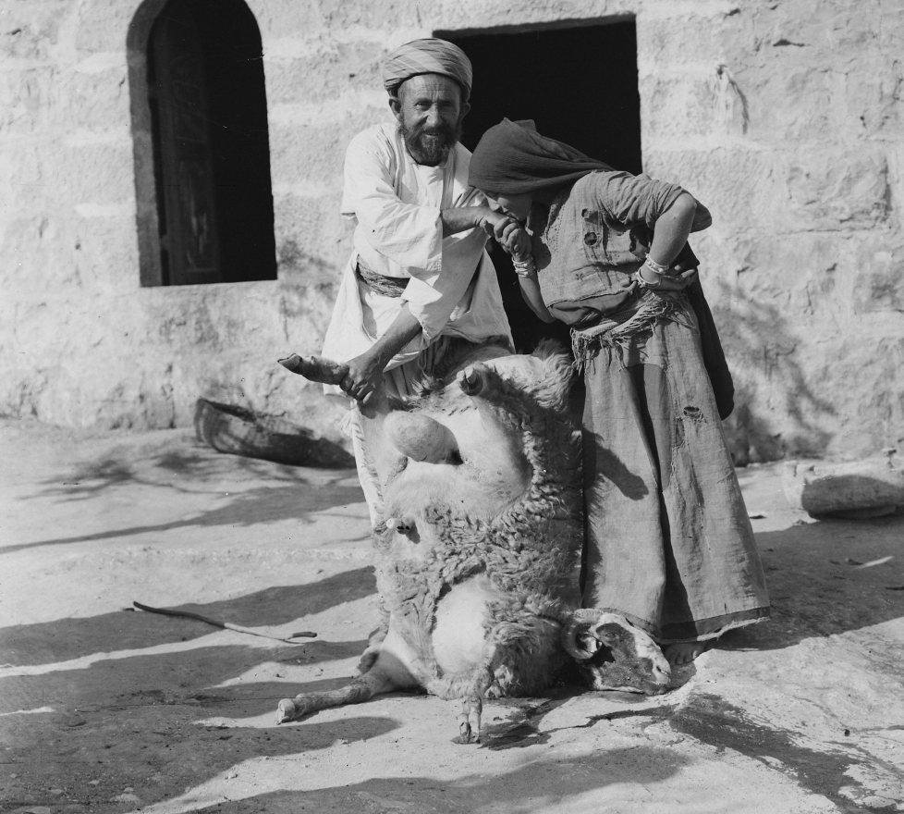
And they offered the daily burnt offerings as was required each day, according to the ordinance
Oriental salutation after a sacrifice by the Weli of Budrieh, circa 1910
3:4
Notes:
This American Colony photograph was taken between 1900 and 1926.
mat01421

Slide 44
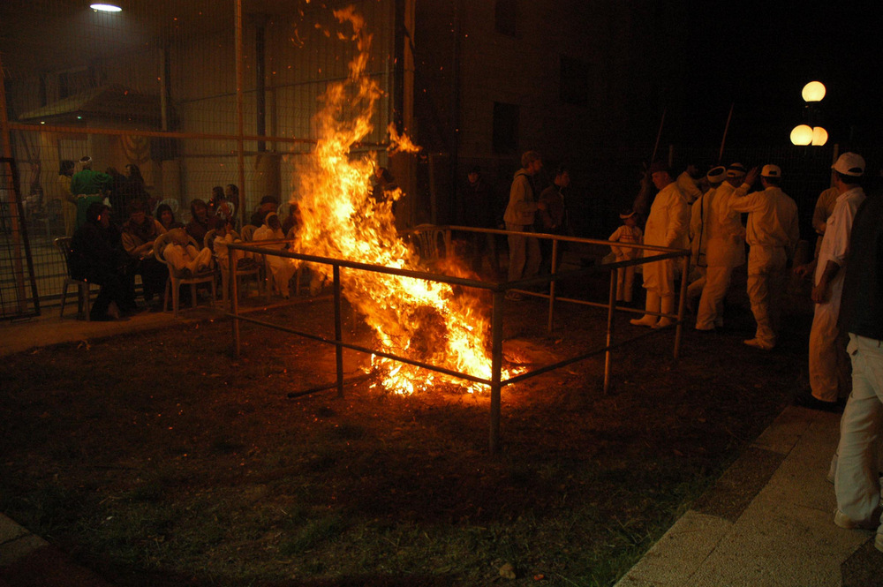
Afterward there was a continual burnt offering
Roasting pit with fire at the Samaritan Passover celebration on Mount Gerizim
3:5
Notes:
tb041106855

Slide 45
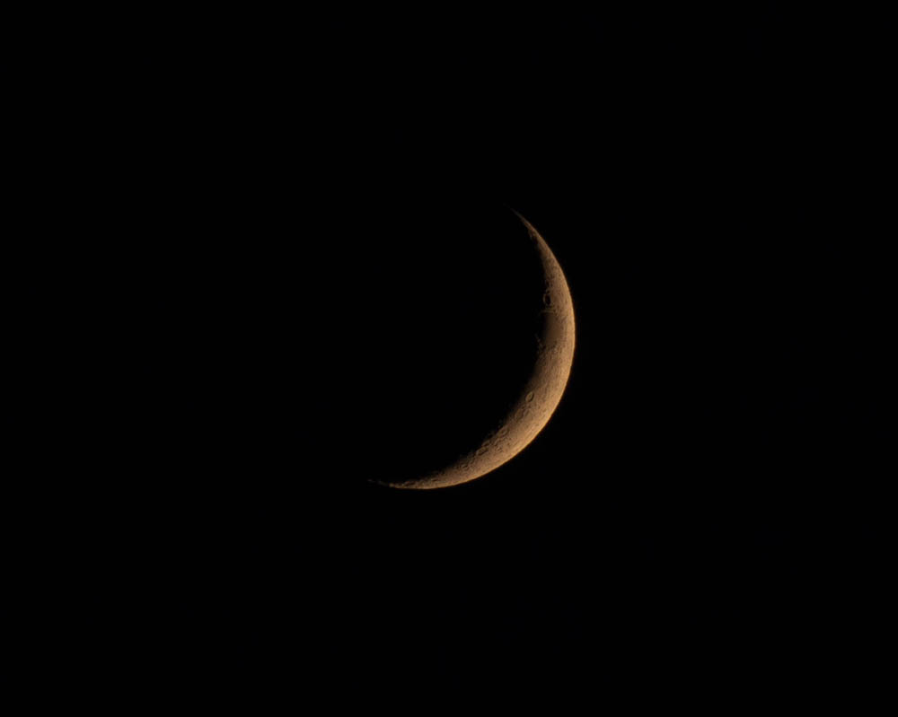
And also for the new moons
Waxing crescent moon
3:5
Notes:
The new moon marked the beginning of each month and was an occasion for special sacrifice (Num 28:11). The new moon is marked by the first, thin, lunar crescent that is visible just after the sun has gone down in the evening.
adr1708245838

Slide 46
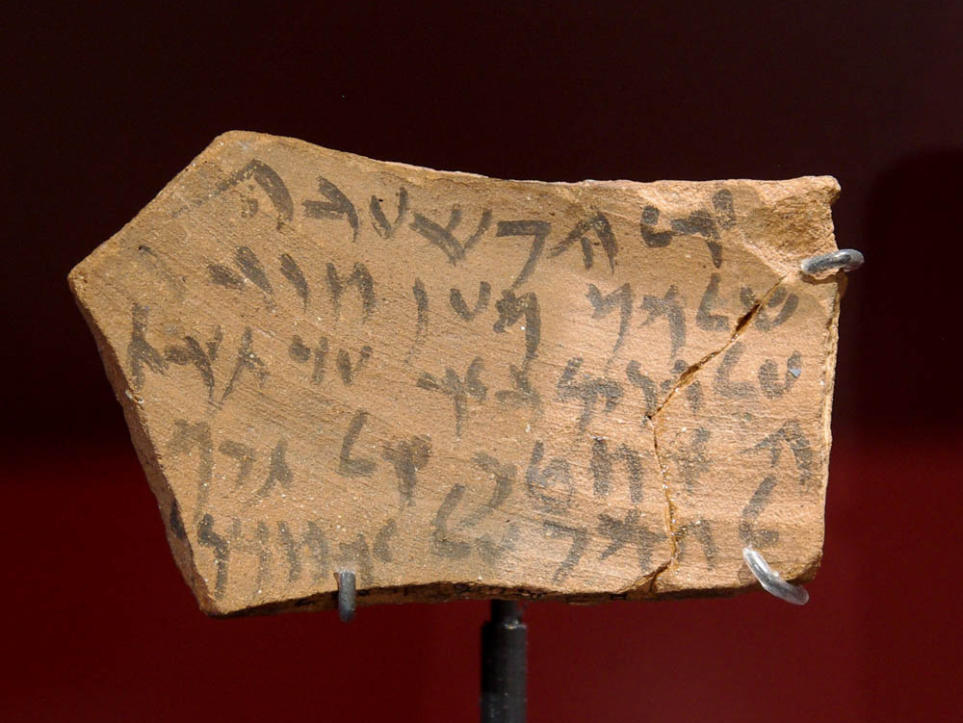
And at all the appointed feasts of Yahweh
Aramaic letter from Elephantine, mentioning Passover, 5th century BC
3:5
Notes:
The first two feasts in the Israelite calendar year were Unleavened Bread and Passover. This letter attests to the ancient celebration of Passover. According to the museum website, this ostracon reads as follows: “To Hoshaya. Greetings! Take care of the children until Ahutab gets there. Don’t trust anyone else with them! If the flour for your bread has been ground, make a small portion of dough to last until their mother gets there. Let me know when you will be celebrating Pascha (Passover). Tell me how the baby is doing!” This ostracon was photographed at the Ashmolean Museum at the University of Oxford.
adr1305226783

Slide 47
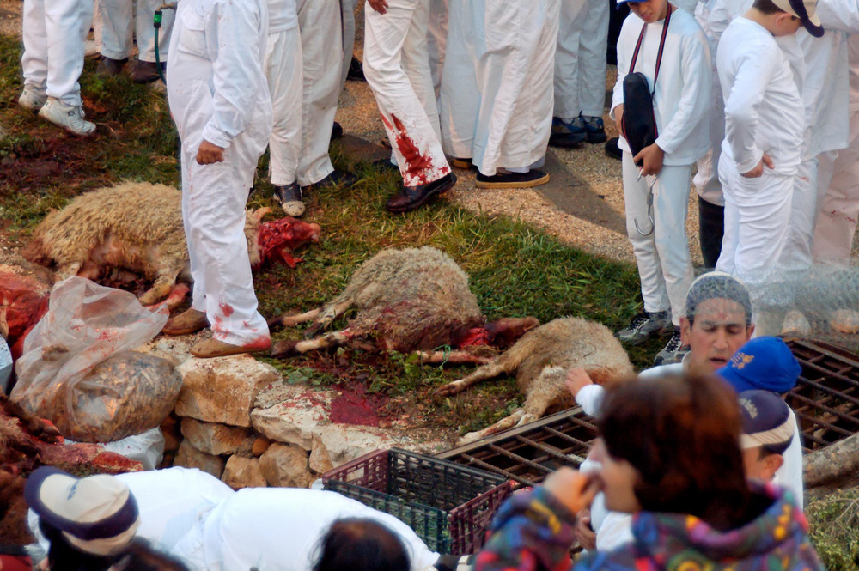
And at all the appointed feasts of Yahweh
Slain lambs at the Samaritan Passover celebration on Mount Gerizim
3:5
Notes:
tb041106729

Slide 48
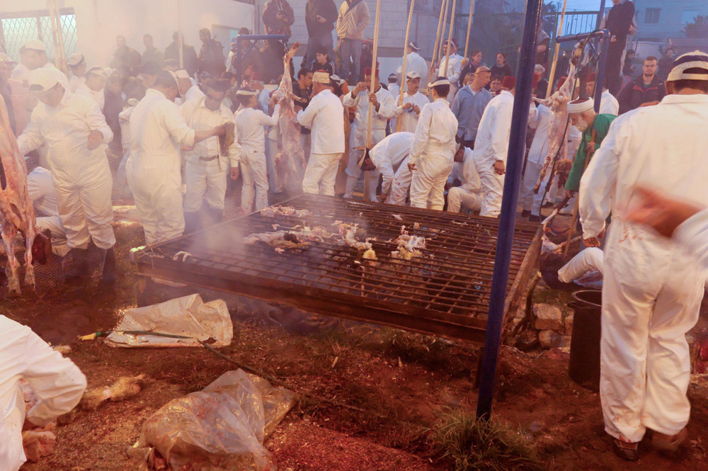
And at all the appointed feasts of Yahweh
Entrails on grill at the Samaritan Passover celebration on Mount Gerizim
3:5
Notes:
tb041106774

Slide 49
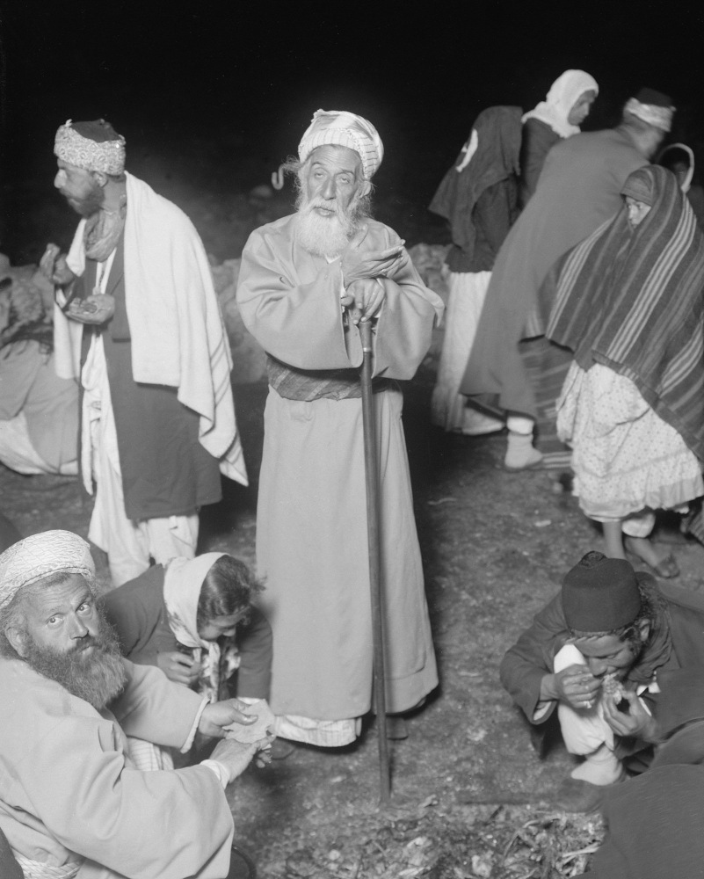
And at all the appointed feasts of Yahweh
High priest leaning on his staff during the Samaritan Passover, circa 1910
3:5
Notes:
This American Colony photograph was taken between 1900 and 1920.
mat01861

Slide 50
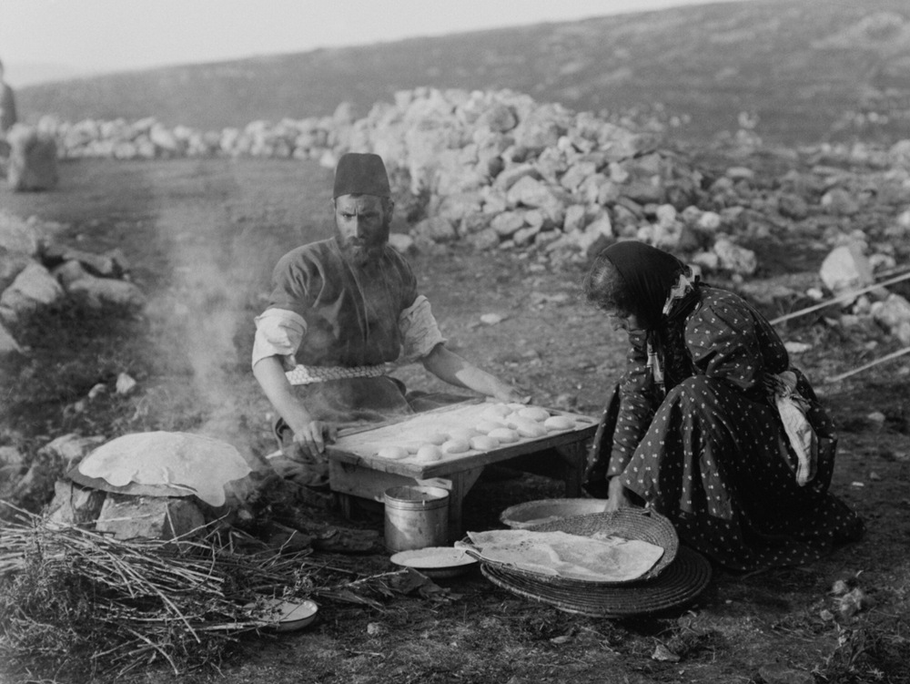
And at all the appointed feasts of Yahweh
Baking unleavened bread for the Samaritan Passover, circa 1910
3:5
Notes:
This American Colony photograph was taken between 1900 and 1920.
mat01842

Slide 51
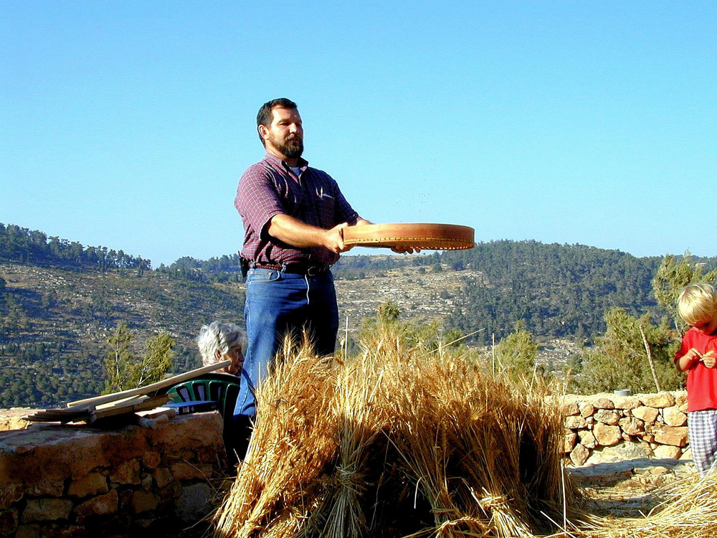
And at all the appointed feasts of Yahweh
Winnowing wheat during the Feast of Pentecost
3:5
Notes:
The third of the major Jewish feasts, Firstfruits (Lev 23:9-14), is not celebrated by modern Jews. The fourth feast is called Shavuot in Hebrew, and Weeks or Pentecost in English. The regulations for celebrating this feast are described in Leviticus 23:15-21. This photograph was taken at the Yad HaShmonah Biblical Gardens.
tb060800102

Slide 52
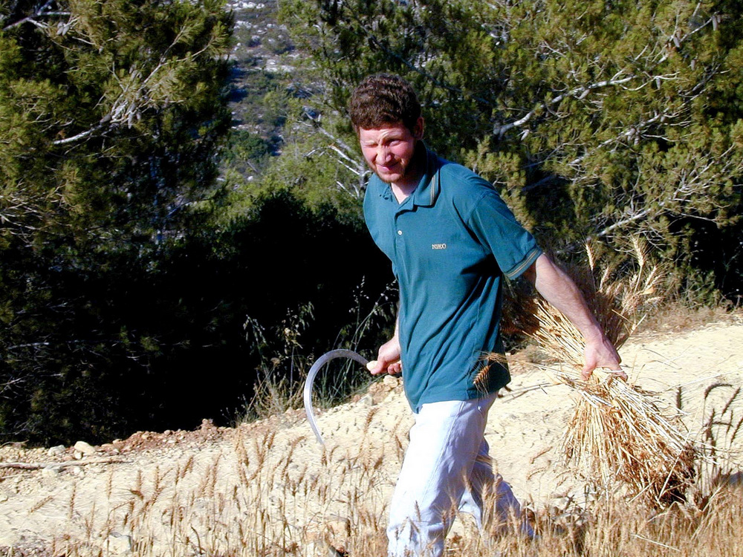
And at all the appointed feasts of Yahweh
Harvesting wheat with sickle during the Feast of Pentecost
3:5
Notes:
tb060800101

Slide 53
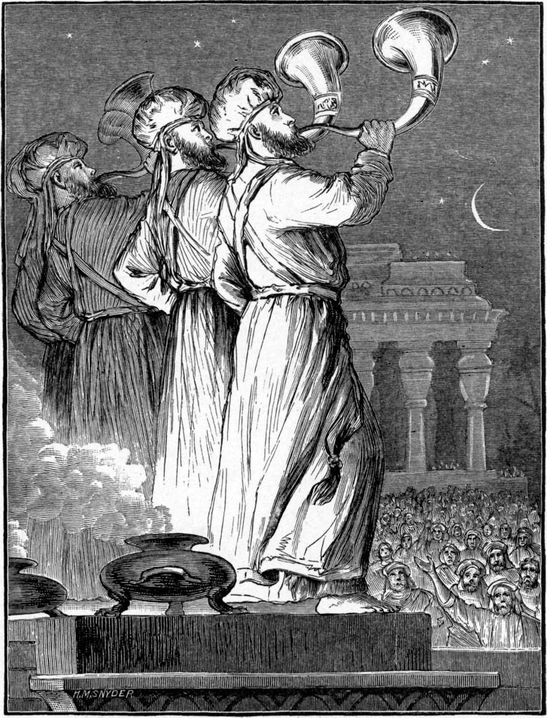
And at all the appointed feasts of Yahweh
Feast of Trumpets at the new moon
3:5
Notes:
The fifth of the seven major annual feasts is the Feast of Trumpets (Lev 23:23-25). This illustration comes from Charles Foster, Bible Pictures and What They Teach Us (1886, 1914).
fbp166

Slide 54

And at all the appointed feasts of Yahweh
Women’s prayer area at the Western Wall filled during the Feast of Tabernacles
3:5
Notes:
The seventh major feast of the Jewish year, as ordained in Leviticus 23, was the Feast of Tabernacles/Booths, known in Hebrew as Sukkot (Lev 23:33-36).
tb1009069619

Slide 55

But the foundation of the temple of Yahweh was not yet laid
Ruins of Qasr Antar, on the summit of Mount Hermon, circa 1910
3:6
Notes:
Although the altar had been rebuilt, the temple still lay in ruins. The site was probably little more than a jumble of stones, similar to the ruins in this photo. About thirty different Roman temples are scattered across the summit and sides of Mount Hermon. Qasr Antar, pictured here, was the highest temple of the ancient world, situated at 9,232 feet (2,814 m) above sea level. This American Colony photograph was taken between 1900 and 1920.
mat05562

Slide 56

Then they gave money to the masons and the carpenters
Silver hoard from Ekron, 7th century BC
3:7
Notes:
The word “money” (Heb. keseph, כֶּסֶף) is often rendered “silver” (e.g., Ezra 2:69). Hacksilver, randomly sized pieces of silver that would be weighed to determine a specified amount, was still the most common form of money at this time. Such pieces could easily be weighed out, or even cut up if the right weights were not at hand. The beads that appear with this silver hoard, made of semi-precious stones, also had monetary value. This display was photographed at the Israel Museum.
tb032014405

Slide 57

Then they gave money to the masons and the carpenters
Scale with balancing weights
3:7
Notes:
Silver was weighed using a balance beam with items of pre-determined weight. This set of scales was photographed at the Eretz Israel Museum in Tel Aviv.
tb031114259

Slide 58

Then they gave money to the masons and the carpenters
Persian coins from the area of Abar Nahara (“Across the River”), 4th century BC
3:7
Notes:
It is possible that some portion of the money paid to the workers was in the form of coins, although the coin was still relatively new and was probably not yet in widespread use. The silver coins shown here are from the Persian period; most are likely about a century later than the time of the return, but they illustrate the kinds of coins that were most likely in circulation during this period. This display was photographed at the Eretz Israel Museum in Tel Aviv.
tb031114290

Slide 59

Then they gave money to the masons and the carpenters
Coins depicting Persian kings, 4th century BC
3:7
Notes:
These Persian coins were photographed at the Louvre Museum.
tb060408675

Slide 60

Then they gave money to the masons and the carpenters
Workers building a shrine, from Karnak, reign of Akhenaten, 14th century BC
3:7
Notes:
The word “mason” (Heb. chotsabim, חֹצְבִים) refers to stone masons who cut out and shaped stone for building construction. This relief was photographed at the Brooklyn Museum.
adr1606020763

Slide 61

Then they gave money to the masons and the carpenters
Stoneworkers sculpting granite colossal statues and sphinx, from Thebes, 15th century BC
3:7
Notes:
This painting was photographed in the tomb of Rekhmire at Thebes, Egypt.
adr1603142968

Slide 62

Then they gave money to the masons and the carpenters
Jewish mason at work in Tel Aviv, circa 1925
3:7
Notes:
This American Colony photograph was taken between 1920 and 1930.
mat05829

Slide 63

Then they gave money to the masons and the carpenters
Stone mason at Gerasa
3:7
Notes:
This stone mason was photographed while at work in reconstruction of the Roman city of Gerasa (modern Jerash).
tb031701152

Slide 64

Then they gave money to the masons and the carpenters
Mason’s set square from ancient Egypt
3:7
Notes:
This tool from ancient Egypt was photographed at the Egyptian Museum in Cairo.
adr1603194705

Slide 65

Then they gave money to the masons and the carpenters
Stone-working tools at Qatzrin
3:7
Notes:
Excavations at Qatzrin from 1983 to 1990 revealed a village from the Byzantine and early Arab periods (4th–8th centuries). This village has been restored and is situated about 0.6 miles (1 km) southeast of the modern city of Qatzrin. Because the site was Jewish, the site’s management prefers to reference it as a Talmudic-period site rather than a Byzantine-era site.
tb053016942

Slide 66

Then they gave money to the masons and the carpenters
Multi-level house at Qatzrin with construction scaffolding
3:7
Notes:
This photo illustrates the use of scaffolding for the construction of stone walls.
tb053016952

Slide 67

Then they gave money to the masons and the carpenters
Multi-level house at Qatzrin with construction scaffolding
3:7
Notes:
tb053016939

Slide 68

Then they gave money to the masons and the carpenters
Israelite wall with ashlar masonry at Ramat Rahel
3:7
Notes:
Ashlar masonry (dressed stones) in Israel was influenced by Phoenician culture and became a hallmark of Israelite/Judahite royal construction during the Iron II period.
tb113002567

Slide 69

Then they gave money to the masons and the carpenters
Ashlar masonry on the Samaria acropolis, 9th-8th centuries BC
3:7
Notes:
tb050106520

Slide 70

Then they gave money to the masons and the carpenters
Ashlar masonry at the high place at Dan, from the time of Jeroboam I and Ahab
3:7
Notes:
These stones are part of the main platform at the sanctuary at Dan. The upper courses of finely dressed header-and-stretcher stones were attributed by the excavators to renovations undertaken at the time of Ahab (r. 874–853 BC), while the lower courses, which are dressed but not so finely, are from the original platform built by Jeroboam I (Biran 1994: 168, 184).
Reference:
Biran, Dan.
1994 Biblical Dan. Jerusalem: Israel Exploration Society.
tb011500030

Slide 71

Then they gave money to the masons and the carpenters
Red-figure kylix with carpenter at work, repaired in antiquity, from Athens, circa 500 BC
3:7
Notes:
The word “carpenters” (Heb. chorashim, חָרָשִׁים) could refer to a craftsman of nearly any sort; given the context, it likely refers to woodworkers, although it should not be restricted to this alone. This kylix is nearly contemporaneous with the time of the return and depicts a carpenter working to smooth and square a board. The dish was broken and repaired in antiquity, as is evident from the line of holes used to bind the pieces back together. This kylix was photographed at the British Museum.
tb0929198028

Slide 72

Then they gave money to the masons and the carpenters
Carpenters making a bed and wooden furniture, Thebes, 15th century BC (facsimile)
3:7
Notes:
This tomb painting shows carpenters working on various pieces of furniture. The two workers standing in the center are using a bow drill, but the seated figure above them and the seated figure at the lower left are both using saws to cut wood. This is a facsimile of the original tomb painting from the tomb of Rekhmire at Thebes, which dates to the 15th century BC. This image comes from Nina de Garis Davies and is in the public domain, via Wikimedia Commons: https://commons.wikimedia.org/wiki/File:Carpenters_at_Work,_Tomb_of_Rekhmire_MET_35.101.1_detail.jpg
wiki123020172349

Slide 73

Then they gave money to the masons and the carpenters
Bronze saws from Zakros, 15th century BC
3:7
Notes:
Saws have been used at least since the 4th millennium BC. These bronze saws are from the Minoan site of Zakros on the eastern side of the island of Crete. They date to the 15th century BC. Note that the lower saw shown here is in its original flat shape, whereas the two shown above it have been folded, probably in anticipation of melting them down for other uses. These saws were photographed at the Heraklion Museum on Crete.
tb041504268

Slide 74


Then they gave money to the masons and the carpenters
Model Egyptian pull saw for wood, 15th century BC
3:7
Notes:
This model saw comes from about 1479–1458 BC. It has no teeth, since it was intended to be part of a mortuary offering rather than be used for actual wood cutting, but it illustrates the general size and shape of a pull saw intended for cutting wood. The upper image comes from the Metropolitan Museum of Art and is in the public domain, via Wikimedia Commons: https://commons.wikimedia.org/wiki/File:Model_Saw_MET_30.8.2_view.1.jpg. The lower image comes from the Metropolitan Museum of Art and is in the public domain, via Wikimedia Commons: https://commons.wikimedia.org/wiki/File:Model_Saw_MET_30.8.2_view.2.jpg
Upper: wiki071220170339; lower: wiki071220170340

Slide 75

Then they gave money to the masons and the carpenters
Carpenters with bow drill and adze, tomb painting at Tuna el-Gebel, circa 300 BC
3:7
Notes:
This relief is in the Petosiris temple-tomb at Tuna el-Gebel. It depicts carpentry work from about 200 years after the construction of the Second Temple.
adr1603247182

Slide 76

Then they gave money to the masons and the carpenters
Model of carpenters with tools, from Thebes, Middle Kingdom, 20th century BC
3:7
Notes:
This model from the Tomb of Meketre in Thebes dates to the late 11th–early 12th dynasties, making it a more than a thousand years older than the events in Ezra. It is a model of a wood-working shop and illustrates some of the tools and methods that were likely also used by the Jewish returnees to shape and work wood. This model was photographed at the Egyptian Museum in Cairo.
adr1603195080

Slide 77

Then they gave money to the masons and the carpenters
Model of carpenters with tools, from Thebes, Middle Kingdom, 20th century BC
3:7
Notes:
This model from the Tomb of Meketre in Thebes was photographed at the Egyptian Museum in Cairo. It dates to the late 11th–early 12th dynasties.
adr1603195082

Slide 78

Then they gave money to the masons and the carpenters
Roof with wooden beams at the Qatzrin Talmudic Village
3:7
Notes:
Among other things, wooden beams were used for spanning buildings to create a roof. This modern reconstruction illustrates how larger beams support smaller sticks, which would eventually be plastered and smoothed. It seems likely that a similar method would eventually be used for the roof of the temple.
tb053016003

Slide 79

Then they gave money to the masons and the carpenters
Roof with wooden beams at the Qatzrin Talmudic Village
3:7
Notes:
tb053016021

Slide 80

And they gave food, drink, and oil to the men of Sidon and Tyre
Barley field near Kiriath Gat
3:7
Notes:
When Solomon sent food to Hiram, king of Tyre, in exchange for cedars to construct the temple, the food included both wheat and barley (2 Chr 2:10). Presumably a grain was also part of the “food” (Heb. me’akal, מַאֲכָל; lit. edibles) included in the payment for the men of Tyre and Sidon in exchange for wood.
tb052203999

Slide 81

And they gave food, drink, and oil to the men of Sidon and Tyre
Wheatfield at harvest time by Bet Guvrin
3:7
Notes:
It seems unlikely that the Jews who returned would have brought enough surplus food from Babylon to be able to pay for imported cedar wood. If this is correct, they would have needed to purchase the food from their neighbors, or else they would have needed time to plant and harvest food before purchasing the wood.
tb050701101

Slide 82

And they gave food, drink, and oil to the men of Sidon and Tyre
Measuring wheat after harvest, circa 1935
3:7
Notes:
This American Colony photograph was taken between 1934 and 1939.
mat04166

Slide 83

And they gave food, drink, and oil to the men of Sidon and Tyre
Measuring wheat after harvest, circa 1910
3:7
Notes:
This American Colony photograph was taken between 1900 and 1920.
mat05923

Slide 84

And they gave food, drink, and oil to the men of Sidon and Tyre
Treading grapes and filling pithoi, tomb painting at Tuna el-Gebel, circa 300 BC
3:7
Notes:
The “drink” (Heb. mishteh, מִשְׁתֶּה) that was used to barter for cedar would have been wine made from grapes. As with the food, the wine would have had to be purchased by the Jews, or else sufficient time would have been required for them to establish their own vines and harvest surplus grapes. This relief shows the process of treading grapes and filling wine jars at harvest time. It was photographed in the Petosiris temple-tomb at Tuna el-Gebel, Egypt.
adr1603247193

Slide 85

And they gave food, drink, and oil to the men of Sidon and Tyre
Recording vintage of pithoi, from a tomb at Tuna el-Gebel, circa 300 BC
3:7
Notes:
This relief was photographed in the Petosiris temple-tomb at Tuna el-Gebel, Egypt.
adr1603247194

Slide 86

And they gave food, drink, and oil to the men of Sidon and Tyre
Ancient winepress in Ein Kerem, circa 1930
3:7
Notes:
This photo shows a reenactment of how an ancient winepress functioned. Grapes were dumped into the large, flat area, and as they were tread out, the juice ran into the lower catchment basin where the youth is sitting. A small jar was then used to scoop up the wine and fill the larger pithoi. The large pithoi shown here are of a kind that was typical in the Middle Bronze Age, circa 1700 BC. Ein Kerem is a village on the outskirts of Jerusalem, to the southwest. This American Colony photograph was taken between 1920 and 1939.
mat03410

Slide 87

And they gave food, drink, and oil to the men of Sidon and Tyre
Ancient winepress in Ein Kerem, with Middle Bronze jars, circa 1930
3:7
Notes:
This American Colony photograph was taken between 1920 and 1939.
mat03013

Slide 88

And they gave food, drink, and oil to the men of Sidon and Tyre
Collecting juice from a winepress
3:7
Notes:
Wine was the form of “drink” which Solomon sent to the king of Tyre in exchange for cedars (2 Chr 2:10). This photo shows freshly tread grape juice being collected in a large jar. This photograph was taken at the Yad HaShmonah Biblical Gardens.
tb100806734

Slide 89

And they gave food, drink, and oil to the men of Sidon and Tyre
Jar from Shiqmona with Phoenician inscription, “Wine of Gath Carmel,” 4th century BC
3:7
Notes:
This kind of jar, or a similar type, was probably used to ship wine and olive oil to Phoenicia. This jar was photographed at the Israel Museum.
adr1306213290

Slide 90

And they gave food, drink, and oil to the men of Sidon and Tyre
Olive press with mash
3:7
Notes:
The word “oil” (Heb. shemen, שֶׁמֶן) refers to olive oil. The first step in processing olives into oil was to crush the fruits. This process was most efficiently done using a large rolling stone that swung around a pivot and crushed the fruit in a circular trough. The resulting mash can be seen in this photo.
tb112802809

Slide 91

And they gave food, drink, and oil to the men of Sidon and Tyre
Scooping mash into a basket at an olive press
3:7
Notes:
The olive mash was then collected into woven baskets for pressing, as seen here.
tb112802815

Slide 92

And they gave food, drink, and oil to the men of Sidon and Tyre
Olive screw press with baskets dripping oil
3:7
Notes:
The baskets of olive mash were then stacked, and a weight was applied to press out the oil.
tb112802821

Slide 93

And they gave food, drink, and oil to the men of Sidon and Tyre
Olive oil press in a four-room Israelite house at Hazor, 8th century BC
3:7
Notes:
This oil press installation was reconstructed from parts found in an Iron Age house at Hazor. The perishable items (wooden beam, ropes, and baskets) are modern.
tb053006650

Slide 94

And they gave food, drink, and oil to the men of Sidon and Tyre
“Olive oil” written on a Phoenician ostracon, circa 800 BC
3:7
Notes:
Olive oil was a lucrative cash crop for those living in ancient Judea. Olive trees grew well in this area, and some of the large markets such as Egypt and Mesopotamia relied on imports for their oil since olive trees do not grow well in those places. The ostracon in this photo has an inscription in red ink that reads “(olive) oil” (Heb. shemen, שֶׁמֶן), likely indicating the original contents of the jar. This inscription was photographed at the American University of Beirut Archaeology Museum.
adr1307191341

Slide 95

And they gave food, drink, and oil to the men of Sidon and Tyre
Olives, olive oil, and lamp display at Moza Illit
3:7
Notes:
Olive oil was used extensively for things like cooking, medicine, cosmetics, and as a fuel for lamps.
gs080094c26

Slide 96

And they gave food, drink, and oil to the men of Sidon and Tyre
Sidon with the harbor and gardens (aerial view from the southwest), circa 1910
3:7
Notes:
In the pre-exilic books, “Sidonians” is the generic term for “Phoenicians” (Deut 3:9; Josh 13:4, 6; Judg 3:3; 10:12; 18:7; 1 Kgs 5:6; 11:1, 5, 33; 16:31; 2 Kgs 23:13). The gentilic “Tyrians” only occurs in post-exilic contexts (1 Chr 22:4; Ezra 3:7) and only once without the accompanying designation of Sidonians (Neh 13:16). Therefore, the biblical term of Sidonian is the equivalent of the historical designation “Phoenician,” which does not appear in the Bible.
Ancient Sidon lies buried beneath the modern city. Around 1965, the Lebanese Directorate General of Antiquities (DGA) purchased three sites in downtown Sidon: Castle site (the Castle of St. Louis), College site (named for a school that stood on the site), and Sandikli site. Earlier excavations concentrated on cemeteries outside the city proper and on the Eshmun Temple at Bustan esh-Sheikh. Only since 1998 have excavations made significant progress in exposing the remains within the ancient city. This image comes from Gustaf Dalman, Hundert deutsche Fliegerbilder aus Palaestina (1925); an English edition is forthcoming from BiblePlaces.com.
dalman058

Slide 97

And they gave food, drink, and oil to the men of Sidon and Tyre
The Sea Castle at Sidon (from the south)
3:7
Notes:
The Greek geographer Strabo called Sidon one of the most ancient Phoenician cities (16.2.22). Sidon is mentioned as a leader of city-states rebelling against Egypt in the Amarna Letters during the 14th century BC. The city of Sidon increased in prominence with the arrival of the Sea Peoples in the 12th century.
Ancient writers used the term “Sidonian” to refer to Phoenicians in general. This is evident also in 1 Kings 16:31 when the king of Tyre, Ethbaal, is called the “king of the Sidonians.” Sidon’s fortunes suffered a decline during the years of Assyrian and Babylonian ascendancy. Sennacherib conquered the city in his invasion in 701 BC, replacing King Luli with Ittobaal. Sidon regained some of her former glory during the Persian period. This included control of the coastal plain from Dor to Joppa, granted by Darius I (522–486 BC).
Sidon was considered the northern limit of the land of the Canaanites (Gen 10:19). Jacob predicted that the northern border of Zebulun would be at Sidon (Gen 49:13). Joshua and the Israelites defeated the Canaanites after the battle at Hazor as far as the area of Sidon (Josh 11:8), but Asher failed to drive out the inhabitants of Sidon in order to inhabit its territory (Judg 1:31). Consequently, the Israelites worshiped the gods of Sidon (Judg 10:6).
adr090508654

Slide 98

And they gave food, drink, and oil to the men of Sidon and Tyre
Castle of St. Louis at Sidon, built over the ancient tell
3:7
Notes:
The Castle of St. Louis is also known as the Land Castle, to differentiate it from the smaller Sea Castle. The Castle of St. Louis is built over the site of the ancient tell. This may have been the site of the Roman theater.
adr090508703

Slide 99

And they gave food, drink, and oil to the men of Sidon and Tyre
Fishing Harbor at Sidon from the Sea Castle
3:7
Notes:
adr090508670

Slide 100

And they gave food, drink, and oil to the men of Sidon and Tyre
View of Lebanon mountains and coast from Mount Hermon
3:7
Notes:
The Lebanon and Anti-Lebanon mountain ranges run parallel to each other, in a north-south direction, through the modern country of Lebanon. In ancient times, these mountains were famous for their trees (e.g., Isa 2:13; 10:34). The cedar trees were cut down and then brought to the port cities (e.g., Tyre and Sidon) where they were loaded onto ships or crafted into rafts and brought to their destination (e.g., Joppa). For millennia, timber was one of Lebanon/Phoenicia’s most important exports. This American Colony photograph was taken between 1920 and 1933. The next slide includes labels.
mat02827

Slide 101
And they gave food, drink, and oil to the men of Sidon and Tyre
Rosh HaNiqra
Tyre
Lebanon Mountains
Beqa Valley
Anti-Lebanon Mountains
View of Lebanon mountains and coast from Mount Hermon
3:7
Notes:
The Lebanon and Anti-Lebanon mountain ranges run parallel to each other, in a north-south direction, through the modern country of Lebanon. In ancient times, these mountains were famous for their trees (e.g., Isa 2:13; 10:34). The cedar trees were cut down and then brought to the port cities (e.g., Tyre and Sidon) where they were loaded onto ships or crafted into rafts and brought to their destination (e.g., Joppa). For millennia, timber was one of Lebanon/Phoenicia’s most important exports. This American Colony photograph was taken between 1920 and 1933.
mat02827

Slide 102

And they gave food, drink, and oil to the men of Sidon and Tyre
Tyre (aerial view from the south), circa 1934
3:7
Notes:
Tyre was originally located on an island almost a mile from the mainland. In the late 4th century BC, Alexander the Great built a causeway or mole from the mainland to the island city in order to attack it. In the ensuing centuries, the waves deposited increasing amounts of sand on either side of the causeway, creating the peninsula that it is today. This aerial photo of Tyre was taken before 1934, before the peninsula was covered with modern buildings. This photo was published in the French book Un Grand Port Disparu Tyr in 1939. This image comes from the French Air Force and is in the public domain, via Wikimedia Commons: https://commons.wikimedia.org/wiki/File:Tyre-aerial-photo-by-France-Military-1934.jpg.
wiki0912200609149726681934

Slide 103

And they gave food, drink, and oil to the men of Sidon and Tyre
Tyre (aerial view from the east), 1925
3:7
Notes:
Excavations have been carried out at al-Mina site (or City site) on the southern part of the former island, and at al-Bass site where the isthmus joins the mainland. The majority of exposed remains date to the Roman period. Tyre was designated a UNESCO World Heritage Site in 1984. This image comes from Gustaf Dalman, Hundert deutsche Fliegerbilder aus Palaestina (1925); an English edition is forthcoming from BiblePlaces.com.
dalman059

Slide 104

And they gave food, drink, and oil to the men of Sidon and Tyre
View along southern side of isthmus at Tyre
3:7
Notes:
Although most of Tyre is still covered by the modern city, excavations have been conducted in several places. Ernest Renan accompanied the expedition of Napoleon III in 1860. He opened several trenches at Tyre. In 1921, Denyse Le Lasseur excavated on behalf of the French archaeological mission. Maurice Chéhab, the Director General of Antiquities of Lebanon, conducted excavations from 1947 to 1978. The al-Mina and al-Bass sites were cleared, and restoration work was carried out. The project was resumed in 1995 at the end of the Lebanese Civil War.
In 1973–1974, Patricia Bikai of the Lebanese Department of Antiquities excavated to bedrock in an area west of al-Mina site. Her excavations provided the only occupational profile for pre-Hellenistic Tyre. In 1997–2008, María Eugenia Aubet excavated a Phoenician cemetery next to the al-Bass Roman cemetery. The cemetery dates to the 10th–7th centuries BC.
adr090508586

Slide 105

And they gave food, drink, and oil to the men of Sidon and Tyre
Roman baths and palestra at the al-Mina site at Tyre (from the northeast)
3:7
Notes:
adr090508598

Slide 106

To bring cedar trees from Lebanon to the sea, to Joppa
Lebanon Mountains from Beqa between Baalbek and Rayak
3:7
Notes:
The name “Lebanon” (Heb. לְבָנוֹן) refers here to the mountain range, not to be confused with the modern country of Lebanon. Cedars of Lebanon grow at high elevations in the mountains.
adr090512229

Slide 107


To bring cedar trees from Lebanon to the sea, to Joppa
Sidon
Lebanon Mountains
Damascus
Tyre
Joppa
Jerusalem
Map of the trade route for cedar from Lebanon
3:7
Notes:
The cedar trees were cut in the mountains of Lebanon, brought down to the ports of Sidon and Tyre, shipped by sea to Joppa, and hauled overland to Jerusalem. The land road from Joppa to Jerusalem was about 35 miles (56 km), the route by sea was roughly 100 miles (161 km), and the distance from the place of cutting to the Phoenician ports might have averaged around 30 miles (48 km). Although this was a significant distance, it should be remembered that similar cedars were also exported to Egypt and Mesopotamia, much longer distances. This image was taken by Jacques Descloitres and is public domain, via NASA, https://visibleearth.nasa.gov/view.php?id=65114. An editable version is included behind the graphic.
nasa65114

Slide 108

To bring cedar trees from Lebanon to the sea, to Joppa
Princes of Lebanon felling cedars for Seti I, from the Karnak Temple, circa 1280 BC
3:7
Notes:
The Egyptians imported most of their timber since Egypt’s hot, dry climate is not conducive to growing trees that can be used for construction. The Palermo Stone indicates cedar was imported to Egypt as early as the 4th-dynasty king Sneferu, circa 2613–2589 BC. One of its primary uses was for boat construction. The Egyptian Tale of Wen-Amun, from about the 11th century BC, recounts the travels of an Egyptian official to Byblos to negotiate for cedar wood. This relief depicts men cutting cedars in the mountains of Lebanon for the Egyptian king Seti I. This relief was photographed at the Great Hypostyle Hall at Karnak.
adr1603122167

Slide 109

To bring cedar trees from Lebanon to the sea, to Joppa
Assyrian soldiers cutting down trees next to a city, reign of Shalmaneser III, 9th century BC
3:7
Notes:
Cedar and similar woods were also imported into Mesopotamia. One of the earliest references to cedar in Mesopotamia comes from the reign of Sargon of Akkad, circa 2334–2279 BC. This bronze band was once part of the city gate at ancient Balawat. It depicts men cutting down trees with axes (numerous features in this depiction are not to scale). This relief was photographed at the British Museum.
adr1805194244

Slide 110

To bring cedar trees from Lebanon to the sea, to Joppa
Cedars of Lebanon, circa 1910
3:7
Notes:
The cedar of Lebanon (Cedrus libani) grows at altitudes of 3,200–6,400 feet (1,000–2,000 m) and is found in Lebanon, south-central Turkey, and Cyprus. Commonly referred to in Scripture as the cedars of Lebanon, this aromatic, durable wood was highly desirable for building in Iron Age Israel. David used in it building his house (2 Sam 5:11; 1 Chr 17:1), and Solomon used it in the constructing the temple and a palace for himself (2 Chr 2:3-8). It was said he made the cedar as plentiful in Jerusalem as sycamore-fig trees in the Shephelah (2 Chr 1:15). The Second Temple was also constructed from cedars (Ezra 3:7). The cedar tree is used as a picture of strength and security. Psalm 29:5 speaks of the mighty voice of Lord breaking the strong cedars. Another psalm speaks of the righteous prospering like the palm tree and growing like a cedar of Lebanon (Ps 92:12). This American Colony photograph was taken between 1900 and 1920.
mat11450

Slide 111

To bring cedar trees from Lebanon to the sea, to Joppa
Cedars of Lebanon near Tripoli, Lebanon, 1945
3:7
Notes:
These giant, beautiful, evergreen trees grow in mountainous regions and produce cones and bluish-green needles on their long branches. They can attain a height of 100 feet (30 m) and the trunk may reach 6 feet (2 m) in diameter. Compared with the trees of Israel, the cedar is indeed a mighty tree. It is no wonder that the beautifully grained, savory smelling, sturdy wood was imported. Cedars can live two to three millennia and are highly praised in Scripture. Cedar translates the word erez in Hebrew. This American Colony photograph was taken in July 1945.
mat12726

Slide 112

To bring cedar trees from Lebanon to the sea, to Joppa
Grove of straight Cedars of Lebanon, circa 1910
3:7
Notes:
Trees that grow more closely together are straighter and have fewer branches. The stand shown here includes several younger trees of that sort. This is the type of tree that would have been harvested for export. This American Colony photo was taken between 1900 and 1920.
mat02138

Slide 113

To bring cedar trees from Lebanon to the sea, to Joppa
Cedar of Lebanon
3:7
Notes:
Over the centuries, the cedar forests of Lebanon were severely diminished. The government is taking steps to counter the deforestation and replenish the forests. The cedar forests in the Esh-Shouf Cedar Reserve make up about 25 percent of all remaining cedars in Lebanon. Some of the trees are estimated to be 2,000 years old.
adr090510670

Slide 114

To bring cedar trees from Lebanon to the sea, to Joppa
Cedars of Lebanon at Arz ar-Rab cedar forest
3:7
Notes:
Most of the cedar forests of Lebanon have disappeared, but a few pockets are still preserved, such as the area shown here.
adr1307118149

Slide 115

To bring cedar trees from Lebanon to the sea, to Joppa
Ancient cedar tree at Arz ar-Rab cedar forest
3:7
Notes:
This photo of the base of an ancient cedar tree in Lebanon illustrates the massive size that these trees could attain. It is no wonder that Solomon desired that Hiram provide skilled craftsmen for felling the trees and that the returning exiles desired to use the same high-quality wood.
adr1307118168

Slide 116

To bring cedar trees from Lebanon to the sea, to Joppa
Carved wooden beams from the Al Aqsa Mosque in Jerusalem
3:7
Notes:
Many Lebanese cedar beams are still located inside of the Al Aqsa Mosque (part of which overlaps the location of Herod’s Royal Stoa) or were moved from the building in recent years. Recent analysis indicated that some of the beams date to the Second and even First Temple periods, and their location on the Temple Mount is even more suggestive as to their potential use in one of the ancient temples (Liphschitz et al. 1997; Reuven 2013). This illustrates both the longevity of the Lebanese cedars and the importance of these beams for monumental building projects. These beams were photographed at the Rockefeller Museum in Jerusalem.
References:
Liphschitz, N.; Biger, G.; Bonani, G.; and Wolfli, W.
1997 Comparative Dating Methods: Botanical Identification and ¹⁴C Dating of Carved Panels and Beams from the Al-Aqsa Mosque in Jerusalem. Journal of Archaeological Science 24: 1045–50.
Reuven, Peretz.
2013 Wooden Beams from Herod's Temple Mount: Do They Still Exist? Biblical Archaeology Review 39/3: 40–47.
tb042403006

Slide 117

To bring cedar trees from Lebanon to the sea, to Joppa
Carved wooden beam from the Al Aqsa Mosque in Jerusalem
3:7
Notes:
This beam was photographed at the Rockefeller Museum in Jerusalem.
tb042403001

Slide 118

To bring cedar trees from Lebanon to the sea, to Joppa
Carved wooden beams from the Al Aqsa Mosque in Jerusalem
3:7
Notes:
These beams were photographed at the Rockefeller Museum in Jerusalem.
tb042403005

Slide 119

To bring cedar trees from Lebanon to the sea, to Joppa
Cedar beams in the Al Aqsa Mosque in Jerusalem, circa 1910
3:7
Notes:
This American Colony photograph was taken between 1900 and 1920. The next slide includes labels.
mat00901

Slide 120
To bring cedar trees from Lebanon to the sea, to Joppa
Cedar beams
Cedar beams in the Al Aqsa Mosque in Jerusalem, circa 1910
3:7
Notes:
This American Colony photograph was taken between 1900 and 1920.
mat00901

Slide 121

To bring cedar trees from Lebanon to the sea, to Joppa
Assyrians transporting timber with ships, from the palace at Khorsabad, circa 710 BC
3:7
Notes:
This relief comes from the palace of Sargon II at Khorsabad (ancient Dur Sharrukin). This panel shows timbers being transported by ships. Some timbers are towed behind the ships, while others appear to be loaded on board. All of the boats are shown powered by oars, not sails. The water teems with life, which includes fish, turtles, snakes, and mythical creatures. Two fortified cities are also shown toward the top of the relief; the one at center-right appears to stand on an island, like the city of Tyre. This relief was photographed at the Louvre Museum.
tb060408233c

Slide 122

To bring cedar trees from Lebanon to the sea, to Joppa
Assyrians transporting timber with ships, from the palace at Khorsabad, circa 710 BC
3:7
Notes:
This relief depicts a ship that is unloading its timber on the shore. Additional timbers can be seen on board the ship, above the heads of the workers, and three additional timbers are attached by ropes to the stern of the vessel, having been towed through the water. The prow of this ship, like the others in this set of reliefs, is decorated with a horse-like head. This relief was photographed at the Louvre Museum.
tb060408231

Slide 123

To bring cedar trees from Lebanon to the sea, to Joppa
Men hauling cedar logs ashore, from the palace at Khorsabad, circa 710 BC
3:7
Notes:
In this relief, teams of men are depicted hauling and stacking cedar beams from Lebanon. A road through a mountainous region is also visible angling upward and to the left. This relief was photographed at the Louvre Museum.
tb0927194426

Slide 124

To bring cedar trees from Lebanon to the sea, to Joppa
Men steering a log raft on the Holston River in Tennessee, 1937
3:7
Notes:
In 1 Kings 5:9 and 2 Chronicles 2:16, the method of sea transport was specifically said to be by log rafts. In Ezra 3:7, it is simply by way of the sea. This image comes from the National Archives and Records Administration and is in the public domain, via Wikimedia Commons: https://commons.wikimedia.org/wiki/File:Log_raft_on_Holston_River_-_NARA_-_280210.jpg.
wiki280210

Slide 125

To bring cedar trees from Lebanon to the sea, to Joppa
Timber rafts on the Loisach River in Germany
3:7
Notes:
Timber rafts were once commonly used to transport logs on rivers, relying on the current of the river to carry the logs downstream to a sawmill. Logs were cut to a standard length and joined together by ropes, chains, or timber crosspieces. Rivermen would use oars or a rudder to guide the rafts downstream. For long journeys, living quarters could be constructed on the rafts. To transport logs by sea, a mast and sail could have been added. This image comes from Mummelgrummel and is licensed under CC-BY-SA-3.0, via Wikimedia Commons: https://commons.wikimedia.org/wiki/File:Commons_-_Flo%C3%9F_%26_Details_006.jpg.
wiki061420150821

Slide 126

To bring cedar trees from Lebanon to the sea, to Joppa
Timber rafts on the Loisach River in Germany
3:7
Notes:
This photo shows how the timber rafts are constructed—logs are rolled down an incline into place in the river. This image comes from Mummelgrummel and is licensed under CC-BY-SA-3.0, via Wikimedia Commons: https://commons.wikimedia.org/wiki/File:Commons_-_Flo%C3%9F_%26_Details_021.jpg.
wiki061420150834

Slide 127

To bring cedar trees from Lebanon to the sea, to Joppa
Joppa (aerial view from the west)
3:7
Notes:
Joppa was a seaport that was part of the original allotment assigned to the tribe of Dan (Josh 19:40-46). Since it was not part of the province of Yehud, it would have been necessary for the returnees to gain permission and make arrangements for shipping to the port and across the coastal plain.
tb121704877

Slide 128

To bring cedar trees from Lebanon to the sea, to Joppa
Joppa (aerial view from the west)
3:7
Notes:
The green area with trees in the upper center of this photo is the location of the ancient city of Joppa. A monumental city gate found in this area was built and rebuilt toward the end of the Late Bronze Age (1550–1200 BC) and at the beginning of the Iron Age (1200–1000 BC). The door jambs were inscribed with the name of Ramses II, indicating Egyptian presence here during that time.
tb121704879

Slide 129

According to the grant that they had from Cyrus king of Persia
Relief carving of Cyrus as a winged figure at Pasargadae
3:7
Notes:
This slide shows the only known historical depiction of Cyrus, also known as Cyrus the Great. This carving was originally accompanied by an inscription above the figure, which read, “I am Cyrus the King, an Achaemenian” in three languages (Old Persian, Elamite, and Akkadian). The term Achaemenian means “of the family of the Achaemenes.” Achaemenes was a minor 7th century BC ruler of the kingdom of Anshan in southwestern Iran, and a vassal of Assyria. The first Persian empire is often referred to in scholarly circles as the Achaemenid empire, to differentiate it from the neo-Persian empire of the Sasanians (AD 224–661). The inscription on this relief was destroyed within the last century. Pasargadae was the capital established by Cyrus. For further information on the reign of Cyrus, see the notes for Ezra 1:1.
This image comes from Nima Boroumand and is licensed under CC BY-SA 4.0, via Wikimedia Commons: https://commons.wikimedia.org/wiki/File:Cyrus_the_great.jpg.
wiki011520161612242664

Slide 130

According to the grant that they had from Cyrus king of Persia
The Cyrus Cylinder, from Babylon, circa 533 BC
3:7
Notes:
The grant mentioned here by Ezra must have been related to his more general proclamation that foreigners who had been deported by the Babylonians could return to their home countries and cities. A copy of this sort of proclamation, now known as the Cyrus Cylinder, was discovered in the ruins of Babylon in 1879. Although it does not mention the Jews specifically, the proclamation does claim to have returned all the peoples and gods/sacred objects which the Babylonians took from their homelands, and to have supported the worship of each nation’s God/gods.
It says, in part, “I am Cyrus, king of the world, great king, mighty king, king of Babylon, king of Sumer and Akkad, king of the four quarters, son of Cambyses, great king, king of Anshan, grandson of Cyrus, great king, king of Anshan, descendant of Teispes, great king, king of Anshan, (of an) eternal line of kingship, whose rule Bel (i.e., Marduk) and Nabu love, whose kingship they desire for their hearts’ pleasure” (Cogan 2003: 315). This cylinder was photographed at the British Museum.
Reference: Cogan, Mordechai.
2003 Cyrus Cylinder. Context of Scripture, vol. 2, eds. W. W. Hallo and K. L. Younger Jr. Leiden: Brill.
adr1805171125

Slide 131

According to the grant that they had from Cyrus king of Persia
Brick with cuneiform inscription, “Cyrus, king of the world,” 6th century BC
3:7
Notes:
This inscription was photographed at the British Museum.
tb112004175

Slide 132

In the second year after their arrival at the house of God at Jerusalem
Temple Mount and City of David (aerial view from the south)
3:8
Notes:
If it is granted that the return took place in 537 BC (a date that is widely held, but is still approximate), the second year afterward would have been 535 BC. This would have been five years before the death of Cyrus, who died in 530 BC.
ws120915386

Slide 133

In the second year after their arrival at the house of God at Jerusalem
Old City of Jerusalem and the Mount of Olives (aerial view from the west)
3:8
Notes:
It is widely believed that the temple built by Solomon, and on whose foundations the Second Temple was built, was located in approximately the same place as the golden-domed Dome of the Rock is situated today.
ws120915442

Slide 134

In the second month
March
February
April
12
1
Flax
gathering
11
Late
seedtime
2
January
Adar
Nisan
Barley harvest
May
Shebat
Ziv
10
14th: Passover
Wheat harvest
3
Tebeth
Sivan
6th: Shavuot (Pentecost)
December
Seedtime
June
Chislev
15th: Sukkot (Tabernacles)
Tammuz
9
Pruning
4
Cheshvan
Ab
November
Tishri
Elul
Pruning
July
8
Ingathering
Summer fruits
5
October
7
6
August
September
Hebrew calendar
3:8
Notes:
The second month, Ziv (1 Kgs 6:1; also known as Iyyar), falls in April/May on the Gregorian calendar. An editable version is included beneath the graphic for those who wish to modify it.

Slide 135

Zerubbabel . . . Jeshua . . . and all who had come from the captivity to Jerusalem
Modern relief of the return to Zion
3:8
Notes:
This relief was photographed at the Tower of David Museum in Jerusalem.
tb060716336

Slide 136

Zerubbabel . . . Jeshua . . . the priests . . . the Levites, from twenty years old and upward
Priestly Blessing during the Feast of Tabernacles, at the Western Wall in Jerusalem
3:8
Notes:
tb101303093

Slide 137

Began the work and appointed Levites . . . to oversee the work of the house of Yahweh
Construction site at Qatzrin
3:8
Notes:
This photograph shows a reconstruction of scaffolding from the Byzantine period. This photograph was taken at the Qatzrin Talmudic Village.
tb041103214

Slide 138

Then Jeshua with his sons and his brothers
Ossuary of “James, son of Joseph, brother of Jesus,” 1st century AD
3:9
Notes:
The name Jeshua (Heb. יֵשׁוּעַ) means “Yahweh is salvation.” The name Jeshua/Joshua/Yeshua continued to be common in the following centuries. The Greek form of the name Jeshua is Iesous (Gk. Ἰησοῦς), commonly rendered in English versions as “Jesus.” The Aramaic inscription shown here reads “Jacob (i.e., James), son of Joseph, brother of Jeshua (Jesus)” (Arm. יעקוב בר יוסף אחוי דישוע). This inscription is scratched into the side of an ossuary of the 1st century AD.
The authenticity of this inscription has been questioned because of the persons it mentions, although two studies of the patina have shown that it is consistent across the face of the letters and the rest of the surface, indicating the inscription is authentic (Fruen 2006: 10; Rosenfeld et al. 2014). This image comes from Paradiso and is in the public domain, via Wikimedia Commons, https://commons.wikimedia.org/wiki/File:JamesOssuaryInscription-1-.jpg.
References:
Fruen, Lois.
2006 Real or Fake? The James Ossuary Case. ChemMatters 24: 8–10. PDF accessible online: https://www.acs.org/content/dam/acsorg/education/resources/highschool/chemmatters/articlesbytopic/atomictheory/chemmatters-feb2006-ossuary.pdf
Rosenfeld, Amnon; Feldman, Howard R.; and Krumbein, Wolfgang E.
2014 The Authenticity of the James Ossuary. Open Journal of Geology 4: 69–78. PDF accessible online: https://file.scirp.org/pdf/OJG_2014031213484587.pdf
wiki0105200523171885

Slide 139

Then Jeshua with his sons and his brothers
Ossuary of “James, son of Joseph, brother of Jesus,” 1st century AD
3:9
Notes:
The name Jeshua (Heb. יֵשׁוּעַ) means “Yahweh is salvation.” The name Jeshua/Joshua/Yeshua continued to be common in the following centuries. The Greek form of the name Jeshua is Iesous (Gk. Ἰησοῦς), commonly rendered in English versions as “Jesus.” The Aramaic inscription shown here reads “Jacob (i.e., James), son of Joseph, brother of Jeshua (Jesus)” (Arm. יעקוב בר יוסף אחוי דישוע). This inscription is scratched into the side of an ossuary of the 1st century AD.
The authenticity of this inscription has been questioned because of the persons it mentions, although two studies of the patina have shown that it is consistent across the face of the letters and the rest of the surface, indicating the inscription is authentic (Fruen 2006: 10; Rosenfeld et al. 2014). This image comes from Paradiso and is in the public domain, via Wikimedia Commons, https://commons.wikimedia.org/wiki/File:JamesOssuaryInscription-1-.jpg. The next slide includes highlights for the name Jeshua.
References:
Fruen, Lois.
2006 Real or Fake? The James Ossuary Case. ChemMatters 24: 8–10. PDF accessible online: https://www.acs.org/content/dam/acsorg/education/resources/highschool/chemmatters/articlesbytopic/atomictheory/chemmatters-feb2006-ossuary.pdf
Rosenfeld, Amnon; Feldman, Howard R.; and Krumbein, Wolfgang E.
2014 The Authenticity of the James Ossuary. Open Journal of Geology 4: 69–78. PDF accessible online: https://file.scirp.org/pdf/OJG_2014031213484587.pdf
wiki0105200523171885

Slide 140

Then Jeshua with his sons and his brothers
Model of the high priest in the tabernacle
3:9
Notes:
Jeshua (Joshua) the son of Jehozadak was the high priest of Israel at the time of the building of the Second Temple. This model of the high priest was photographed at the full-size replica of the tabernacle in Timna Park in southern Israel.
tb010710921

Slide 141

Then Jeshua with his sons and his brothers, Kadmiel and his sons
Sculpture of an angry Roman theater mask, from Rome
3:9
Notes:
The name Kadmiel (Heb. קַדְמִיאֵל) may mean “God is the ancient one.” This theater mask of an older, bearded man was photographed at the National Museum of Rome at the Diocletian Baths. This image comes from Livioandronico2013 and is licensed under CC BY-SA 4.0, via Wikimedia Commons: https://commons.wikimedia.org/wiki/File:Sculptures_of_Roman_theater_masks_in_Baths_of_Diocletian3.jpg.
wiki01042015182806

Slide 142

Then Jeshua with his sons and his brothers, Kadmiel and his sons
Ostracon with the name Hodaviah, from Lachish, circa 586 BC (replica)
3:9
Notes:
According to Ezra 2:40, the clans of Jeshua and Kadmiel were both Levitical groups that were descendants of a certain Hodaviah. The name Hodaviah/Hodavyah (Heb. הוֹדַוְיָה) means “praise Yahweh.” It is known from a number of ancient inscriptions, including Lachish Letter #3 (shown here) and an ostracon from Horvat Uzza that gives a list of troops (Ahituv 2008: 63, 177). The photo on this slide shows the reverse of Lachish Letter #3; the first word on the first line is the name Hodaviah, with a slightly fuller spelling (Heb. הודויהו). The next slide includes a label for the name.
Reference:
Ahituv, Shmuel.
2008 Echoes from the Past. Jerusalem: Carta.
ku070622259

Slide 143
Then Jeshua with his sons and his brothers, Kadmiel and his sons
Ostracon with the name Hodaviah, from Lachish, circa 586 BC (replica)
3:9
Notes:
According to Ezra 2:40, the clans of Jeshua and Kadmiel were both Levitical groups that were descendants of a certain Hodaviah. The name Hodaviah/Hodavyah (Heb. הוֹדַוְיָה) means “praise Yahweh.” It is known from a number of ancient inscriptions, including Lachish Letter #3 (shown here) and an ostracon from Horvat Uzza that gives a list of troops (Ahituv 2008: 63, 177). The photo on this slide shows the reverse of Lachish Letter #3; the first word on the first line is the name Hodaviah, with a slightly fuller spelling (Heb. הודויהו).
Reference:
Ahituv, Shmuel.
2008 Echoes from the Past. Jerusalem: Carta.
ku070622259

Slide 144

The sons of Judah
Yehud (“Judah”) impression on a jar handle, circa 5th century BC
3:9
Notes:
The name Judah (Heb. Yehudah, יְהוּדָה) probably means “praised.” The name was best known as one of the twelve sons of Jacob, from whom came a tribe of the same name. The name was also used to designate the southern kingdom after the nation was divided at the death of Solomon. During the Persian period the province of Judah was referred to using the Aramaic version of the name, “Yehud.” On this stamped jar handle, only the first three letters (יהו) are preserved. Numerous jar handles bearing similar inscriptions and dating to this time have been found in the region. They were likely part of the administrative system of Persia in Judah, perhaps used for the collection of grain, oil, or wine as a way of paying taxes. This artifact from ancient Israel was photographed at the Eretz Israel Museum in Tel Aviv. The next slide includes labels for the letters on this inscription.
tb031114324

Slide 145

The sons of Judah
Yehud (“Judah”) impression on a jar handle, circa 5th century BC
3:9
Notes:
The name Judah (Heb. Yehudah, יְהוּדָה) probably means “praised.” The name was best known as one of the twelve sons of Jacob, from whom came a tribe of the same name. The name was also used to designate the southern kingdom after the nation was divided at the death of Solomon. During the Persian period the province of Judah was referred to using the Aramaic version of the name, “Yehud.” On this stamped jar handle, only the first three letters (יהו) are preserved. Numerous jar handles bearing similar inscriptions and dating to this time have been found in the region. They were likely part of the administrative system of Persia in Judah, perhaps used for the collection of grain, oil, or wine as a way of paying taxes. This artifact from ancient Israel was photographed at the Eretz Israel Museum in Tel Aviv. An editable version is included beneath the graphic for those who wish to modify it.
tb031114324

Slide 146


The sons of Judah and the sons of Henadad
Stele with the storm god Hadad standing on the back of a bull, from Arslan Tash, circa 730 BC
3:9
Notes:
The name Henadad (Heb. חֵנָדָד) means “the grace of Hadad,” Hadad being the Aramean storm god (cf. Ben-hadad of Syria, 1 Kgs 15:18). This relief depicts Hadad/Adad holding lightning bolts in each hand, standing on the back of a bull. It was photographed at the Louvre Museum.
Left: tb0927194601; right: tb0927194602

Slide 147

The sons of Judah and the sons of Henadad with their sons and their brothers the Levites
“Levi Street” sign in Jerusalem
3:9
Notes:
“Levi Street” is located in the Baka neighborhood, south of the Old City.
lbd102218460

Slide 148

They began to oversee the workmen in the temple of God
Conversation between two men, from Tell el-Amarna, circa 1350 BC
3:9
Notes:
The rebuilding of a large structure like the temple in Jerusalem would have required a significant amount of planning, coordination, and oversight. This image comes from the Brooklyn Museum and is in the public domain. Source: https://www.brooklynmuseum.org/opencollection/objects/3713.
bmny3713

Slide 149

When the builders laid the foundation of the temple of Yahweh
Jerusalem (aerial view from the southeast)
3:10
Notes:
Solomon’s temple was located in approximately the same location as the Dome of the Rock, although the size and shape of the structures differ considerably. Masonry on the eastern side of the Temple Mount, particularly around the Golden Gate, is considered to be from the Iron Age, and would have been reused in the days of Ezra, as it continued to be in later periods. During the 2nd century BC, the Hasmoneans extended the Temple Mount to the south; in the late 1st century BC, Herod the Great extended it even further to the south, as well as on the west. The next slide includes labels.
ws012917287

Slide 150
When the builders laid the foundation of the temple of Yahweh
Location of the Temple
Platform of the First Temple
Hasmonean extension
Herodian extension
Jerusalem (aerial view from the southeast)
3:10
Notes:
Solomon’s temple was located in approximately the same location as the Dome of the Rock, although the size and shape of the structures differ considerably. Masonry on the eastern side of the Temple Mount, particularly around the Golden Gate, is considered to be from the Iron Age, and would have been reused in the days of Ezra, as it continued to be in later periods. During the 2nd century BC, the Hasmoneans extended the Temple Mount to the south; in the late 1st century BC, Herod the Great extended it even further to the south, as well as on the west.
ws012917287

Slide 151

When the builders laid the foundation of the temple of Yahweh
Tripartite temple at Tell Tayinat, 9th century BC
3:10
Notes:
Solomon’s temple was made up of three main parts (tripartite)—the porch, the holy place, and the holy of holies. This type of structure is somewhat common during the Late Bronze–Iron II and include examples from Moza, Dan, Arad, Shechem, Ain Dara, and Tell Tayinat. This photo shows one of two Iron II temples that were excavated at Tell Tayinat that have a similar tripartite division. Given the similarity of the Tel Tayinat temple to the Solomonic temple, perhaps the foundation of the Second Temple in Jerusalem looked similar this, although this temple is smaller than the Jerusalem temple. This image was taken by Stephen Batiuk and is licensed under CC-BY-SA-4.0, via Wikimedia Commons, https://commons.wikimedia.org/wiki/File:Iron_Age_Temple_(photo_credit_Stephen_Batiuk).jpg. See the next slide for labels.
wiki1001091344

Slide 152
When the builders laid the foundation of the temple of Yahweh
Holy of
Holies
Holy Place
Porch
Pillar
Stairs
Tripartite temple at Tell Tayinat, 9th century BC
3:10
Notes:
Solomon’s temple was made up of three main parts (tripartite)—the porch, the holy place, and the holy of holies. This type of structure is somewhat common during the Late Bronze–Iron II and include examples from Moza, Dan, Arad, Shechem, Ain Dara, and Tell Tayinat. This photo shows one of two Iron II temples that were excavated at Tell Tayinat that have a similar tripartite division. Given the similarity of the Tel Tayinat temple to the Solomonic temple, perhaps the foundation of the Second Temple in Jerusalem looked similar this, although this temple is smaller than the Jerusalem temple. This image was taken by Stephen Batiuk and is licensed under CC-BY-SA-4.0, via Wikimedia Commons, https://commons.wikimedia.org/wiki/File:Iron_Age_Temple_(photo_credit_Stephen_Batiuk).jpg.
wiki1001091344

Slide 153

When the builders laid the foundation of the temple of Yahweh
Temple of Ain Dara (from the southeast)
3:10
Notes:
Excavated between 1980 and 1985, the Ain Dara temple is “the most significant parallel to Solomon’s Temple ever discovered” (Monson 2000: 22; cf. Monson 1999). The temple was in use from circa 1300 to 740 BC, and three structural phases have been identified. This photograph was taken by George King and is used by permission.
References:
Monson, John M.
1999 The Temple of Solomon: Heart of Jerusalem. Pp. 1–22 in Zion, City of our God, ed. Richard S. Hess and Gordon J. Wenham. Grand Rapids: Eerdmans.
2000 The New ‘Ain Dara Temple: Closest Solomonic Parallel. Biblical Archaeology Review 26/3: 20–35, 67.
gk1221c

Slide 154

When the builders laid the foundation of the temple of Yahweh
Ain Dara Temple
Solomon’s Temple
Tell Tayinat Temple
shrine
shrine
shrine
main hall
main hall
main hall
antechamber
portico
portico
portico
columns
columns
columns
Comparison of Solomon’s Temple with those at Ain Dara and Tell Tayinat
3:10
Notes:
This plan shows the layout of two temples discovered in the ancient Near East along with the plan for Solomon’s temple. Although there are differences between each, the major components are quite similar. These drawings are not to scale. The Ain Dara temple is 98 feet (30 m) long and 65 feet (20 m) wide. Solomon’s temple was 90 feet (27 m) long and 30 feet (9 m) wide (plus the width of the walls). The Tell Tayinat temple was 81 feet (25 m) long. An editable version is included beneath the graphic for those who wish to modify it.
Plan by Kris Udd.

Slide 155

When the builders laid the foundation of the temple of Yahweh
Foundation charter of a palace of Darius I, in Elamite, 522–486 BC
3:10
Notes:
Ezra 3 indicates that the foundation of the temple had been built during the initial return, but both Haggai and Zechariah indicate that the rebuilding process had halted. This inscription was photographed at the Louvre Museum.
tb0927195438

Slide 156

When the builders laid the foundation of the temple of Yahweh
Israelite wall with ashlar masonry at Ramat Rahel, circa 700–586 BC
3:10
Notes:
It is not certain how much of the foundation of Solomon’s temple remained when the Jews returned from Babylon. The first task would have been to clear away the rubble, keeping as much useable material as possible, before the lower courses were again laid down.
tb113002566

Slide 157

When the builders laid the foundation of the temple of Yahweh
Bedrock used as foundation at the Western Wall
3:10
Notes:
It is possible that, at least in some areas, the rubble had to be cleared down to bedrock in order to re-establish the foundations of the temple.
tb010112189

Slide 158

When the builders laid the foundation of the temple of Yahweh
Laying the cornerstone for Ramallah municipal school, 1940
3:10
Notes:
This American Colony photograph was taken on November 23, 1940.
mat20921

Slide 159

When the builders laid the foundation of the temple of Yahweh
Illustration of laying the foundation of the Second Temple
3:10
Notes:
This illustration comes from Charles Foster, Bible Pictures and What They Teach Us (1886, 1914).
fbp158

Slide 160

The priests stood in their apparel with trumpets
Silver- and gold-plated trumpet and wooden mute, from Egypt, 14th century BC
3:10
Notes:
The word “trumpet” used here is not the familiar shofar (שֹׁפָר), made of an animal horn, but the less common hatsotsrah (חֲצֹצִרָה), which is thought to have been a long, straight, metallic instrument. The trumpet and mute shown here are of that type and come from the tomb of Tutankhamun. The trumpet includes the engraving of the name and image of Tutankhamun and those of three gods. The wooden mute (below) was used to modulate the sound of the trumpet. This display was photographed at the Exposition of Tutankhamun Treasure in Paris in 2019. This image comes from Suaudeau and is licensed under CC BY-SA 4.0, via Wikimedia Commons: https://commons.wikimedia.org/wiki/File:Trompette_d%27argent_et_sa_sourdine_en_bois_du_tombeau_de_Tout%C3%A2nkhamon_2.jpg.
wiki042920191922222727

Slide 161

The priests stood in their apparel with trumpets
Silver- and gold-plated trumpet and wooden mute, from Egypt, 14th century BC
3:10
Notes:
This display was photographed at the Exposition of Tutankhamun Treasure in Paris in 2019. This image comes from Suaudeau and is licensed under CC BY-SA 4.0, via Wikimedia Commons: https://commons.wikimedia.org/wiki/File:Trompette_d%27argent_et_sa_sourdine_en_bois_du_tombeau_de_Tout%C3%A2nkhamon.jpg.
wiki0429201919234413261336

Slide 162

The priests stood in their apparel with trumpets
Relief with a trumpeter, from Egypt, 14th century BC
3:10
Notes:
This relief shows a similar type of straight metallic horn. This image comes from the Metropolitan Museum of Art and is in the public domain. Source: https://www.metmuseum.org/art/collection/search/545020
met545020

Slide 163

The priests stood in their apparel with trumpets
Statue of a priest blowing the trumpet
3:10
Notes:
The type of trumpet depicted in this statue is one of the silver trumpets made by Moses (Num 10:2).
tb060716509

Slide 164

And the Levites, the sons of Asaph
Basalt relief of musicians, from the Northern Hall at Zincirli, 8th century BC
3:10
Notes:
The descendants of Asaph were temple singers and musicians (1 Chr 6:39; 25:1-2; 2 Chr 5:12), and were credited with a dozen Psalms by the headings. The musicians on this relief play two hand drums and two stringed instruments, perhaps a harp and lyre. This relief was photographed at the Istanbul Museum of the Ancient Orient.
adr1006054787

Slide 165

And the Levites, the sons of Asaph, with cymbals, to praise Yahweh
Bronze cymbals, from Megiddo, 11th century BC
3:10
Notes:
“Cymbals” (Heb. metsiltayim, מְצִלְתַּיִם) were small metal discs or pans that were clashed together from a short distance. These bronze cymbals are from an earlier period, but the general shape of the instruments remained largely unchanged for many centuries. This display was photographed at the Israel Museum.
adr1306213115

Slide 166

And the Levites, the sons of Asaph, with cymbals, to praise Yahweh
Three sets of bronze cymbals, from Jerusalem, circa 1300 BC
3:10
Notes:
These cymbals were photographed at the Vatican Museums.
tb0512176394

Slide 167

According to the directions of David king of Israel
“House of David” on the Tel Dan Inscription, circa 830 BC
3:10
Notes:
The Tel Dan Inscription is best known for its reference to the “House of David” (Heb. בית דוד), faintly highlighted with white chalk on the 4th line visible in this photo. This detailed view of the Tel Dan Inscription was photographed at the Israel Museum.
mjb1904166298

Slide 168

According to the directions of David king of Israel
Synagogue mosaic depicting David with a harp, from Gaza, AD 508
3:10
Notes:
The mosaic shown here comes from the floor of a Byzantine-era synagogue uncovered at Gaza. David’s name (Heb. דויד) appears above the harp. The mosaic was discovered by Egyptian archaeologists in 1965 and publicized by them as a church mosaic depicting a female saint. The face and hand of the figure were gouged out shortly after. When Israel captured Gaza in the 1967 Six-Day War, the mosaic was moved to the Israel Museum for restoration. It was photographed at the Israel Museum. This image comes from the Google Cultural Institute and is in the public domain, via Wikimedia Commons: https://commons.wikimedia.org/wiki/File:King_David_as_Orpheus_in_a_synagogue_mosaic_-_Google_Art_Project.jpg.
wiki8134105084501327

Slide 169

According to the directions of David king of Israel
Illustration of David playing a harp before King Saul
3:10
Notes:
David was Israel’s master musician and paradigmatic king. This illustration comes from Charles Foster, Bible Pictures and What They Teach Us (1886, 1914).
fbp010

Slide 170

And they sang, praising and giving thanks to Yahweh
Inscription mentioning Yahweh, from Beth Loya, 6th century BC
3:11
Notes:
This Hebrew burial inscription was discovered at Beth Loya (Beit Lei) in the Judean foothills. It dates to the 6th century BC. Three lines of text were inscribed on a section of the wall, part of which is shown here. Because many of the letters etched into the limestone are faint, and some even appear to be incomplete, the inscription has been subject to a variety of interpretations. According to Joseph Naveh, who excavated the tomb and who was an expert paleographer, the first line of the inscription reads: “Yahweh (is) the God of the whole earth; the mountains of Judah belong to him, to the God of Jerusalem” (יהוה אלהי כל הארץ הרי יהד לאלהי ירשלם). The line of text at the bottom, according to Naveh, reads: “The (mount of) Moriah you have favored, the dwelling of Yah, Yahweh” (המוריה אתה חננת יה יהוה). The text has been studied and published by Joseph Naveh (1963), F. M. Cross (1970), Andre Lemaire (1976), and Ziony Zevit (2001). Although each has rendered the inscription differently, all are in agreement that the first word of the first line and the last word of the last line are both the divine name. This inscription was photographed at the Israel Museum. The next slide includes labels for the divine name.
tb032014421

Slide 171

And they sang, praising and giving thanks to Yahweh
Inscription mentioning Yahweh, from Beth Loya, 6th century BC
3:11
Notes:
This Hebrew burial inscription was discovered at Beth Loya (Beit Lei) in the Judean foothills. It dates to the 6th century BC. Three lines of text were inscribed on a section of the wall, part of which is shown here. Because many of the letters etched into the limestone are faint, and some even appear to be incomplete, the inscription has been subject to a variety of interpretations. According to Joseph Naveh, who excavated the tomb and who was an expert paleographer, the first line of the inscription reads: “Yahweh (is) the God of the whole earth; the mountains of Judah belong to him, to the God of Jerusalem” (יהוה אלהי כל הארץ הרי יהד לאלהי ירשלם). The line of text at the bottom, according to Naveh, reads: “The (mount of) Moriah you have favored, the dwelling of Yah, Yahweh” (המוריה אתה חננת יה יהוה). The text has been studied and published by Joseph Naveh (1963), F. M. Cross (1970), Andre Lemaire (1976), and Ziony Zevit (2001). Although each has rendered the inscription differently, all are in agreement that the first word of the first line and the last word of the last line are both the divine name. This inscription was photographed at the Israel Museum. An editable version is included behind this graphic for those who may wish to change it.
tb032014421

Slide 172

For He is good, for His lovingkindness endures forever toward Israel
Southern Temple Mount steps with people reciting Psalms of Ascent
3:11
Notes:
The words of the song given here are very similar to phrases in a number of the psalms, although it does not exactly quote any known psalm. One of the purposes of the psalms was to be sung in temple celebrations, including by those going up to the temple (songs of ascent, Psalms 120–134).
tb090705062

Slide 173

But many of the priests and Levites and heads of fathers’ houses, the old men . . . wept
Modern bronze sculpture of a prophet weeping and rending garment, in Judean hills
3:12
Notes:
This sculpture was photographed at Yad HaShmonah Biblical Gardens.
tb052816713

Slide 174

The old men who had seen the first house
Templo de Salomão in São Paulo, Brazil
3:12
Notes:
The “Temple of Solomon” shown here is a larger than life-size “replica” of Solomon’s temple built in Sao Paulo, Brazil, by the Universal Church of the Kingdom of God. This photo comes from José Marques de Oliv… and is licensed under CC-BY-SA-3.0, via Wikimedia Commons: https://commons.wikimedia.org/wiki/File:Br%C3%A1s,_S%C3%A3o_Paulo_-_State_of_S%C3%A3o_Paulo,_Brazil_-_panoramio_(5).jpg
wiki060720171415

Slide 175

The old men who had seen the first house
Entrance to Templo de Salomão in São Paulo, Brazil
3:12
Notes:
This photo comes from Governo do Estado de São Paulo and is licensed under CC-BY-2.0, via Wikimedia Commons: https://commons.wikimedia.org/wiki/File:Entrada_do_Templo_de_Salom%C3%A3o.jpg
wiki07072017093529

Slide 176

And many shouted aloud for joy
Man singing during Simchat Torah celebration at the Western Wall
3:12
Notes:
The holiday of Simchat Torah (“rejoicing in the Torah”) commemorates the completion of the annual cycle of Torah readings and the beginning of a new one.
tb092802007

Slide 177

The people could not distinguish the sound of the shout of joy from the sound of the weeping
Crowds gathered at the Dome of the Rock to celebrate Nebi Musa, 1918
3:13
Notes:
This American Colony photograph was taken in 1918.
mat05604

Slide 178

The people shouted with a loud shout, and the sound was heard far away
Women acclaiming a new king, from Thebes, 14th century BC
3:13
Notes:
This relief depicts women acclaiming the new king, with their hands upraised in praise and honor. The woman in the center wears a perfume cone on her head, and flowers on her forehead. This image comes from the Brooklyn Museum and is licensed under CC BY 3.0. Source: https://www.brooklynmuseum.org/opencollection/objects/85884
bmny85884

Slide 179

The people shouted with a loud shout, and the sound was heard far away
Crowd shouting for joy at the declaration of the State of Israel, May 14, 1948
3:13
Notes:
A crowd of cheering citizens of Tel Aviv and the surroundings stands across the road opposite the Tel Aviv Museum during the ceremony of the declaration of the State of Israel. Author: Hans Pinn; License: CC-BY-SA-3.0 by Government Press Office (Israel), via Wikimedia Commons: https://commons.wikimedia.org/wiki/File:Flickr_-_Government_Press_Office_(GPO)_-_A_CROWD_OF_CHEERING_CITIZENS.jpg
wiki05141948092650

Slide 180

More than 1,800 slides in PowerPoint format. Available now from BiblePlaces.com.
Notes:
This is a free sample of the Ezra 3 presentation from the Photo Companion to the Bible. To purchase the full volume, visit https://www.bibleplaces.com/ezra/
The Photo Companion to the Bible is an image-rich resource for Bible students, teachers, and researchers. Just as a librarian stocks the shelves with as many relevant materials as possible, so we have tried to provide a broad selection of images. Our goal is that you will find in this “library” whatever it is you are looking for.
Credits: The primary creators of this presentation are Kris Udd, Steven D. Anderson, Chris McKinny, Kai Akagi, and Todd Bolen. The photographs have an individual file code which usually includes the initials of the photographer. Other images have additional credit or source information.
Updates: We plan to update this collection as we are able. We welcome your suggestions for improving this resource (photocompanion@bibleplaces.com). Purchasers of the Ezra volume are provided free, lifetime updates to the volume.
Copyright: This photo collection is protected by copyright law and may not be distributed without written permission from BiblePlaces.com. Slide notes should be treated as any other copyrighted written material, with credit given when quoting from these notes.
For more information, see our complete “Introduction to the Photo Companion to the Bible” online at https://www.BiblePlaces.com/Intro-Photo-Companion-Bible/. Here you will find more information about photo selection, explanatory notes, Bible translation, credit information, and copyright allowances.

