Slide 1
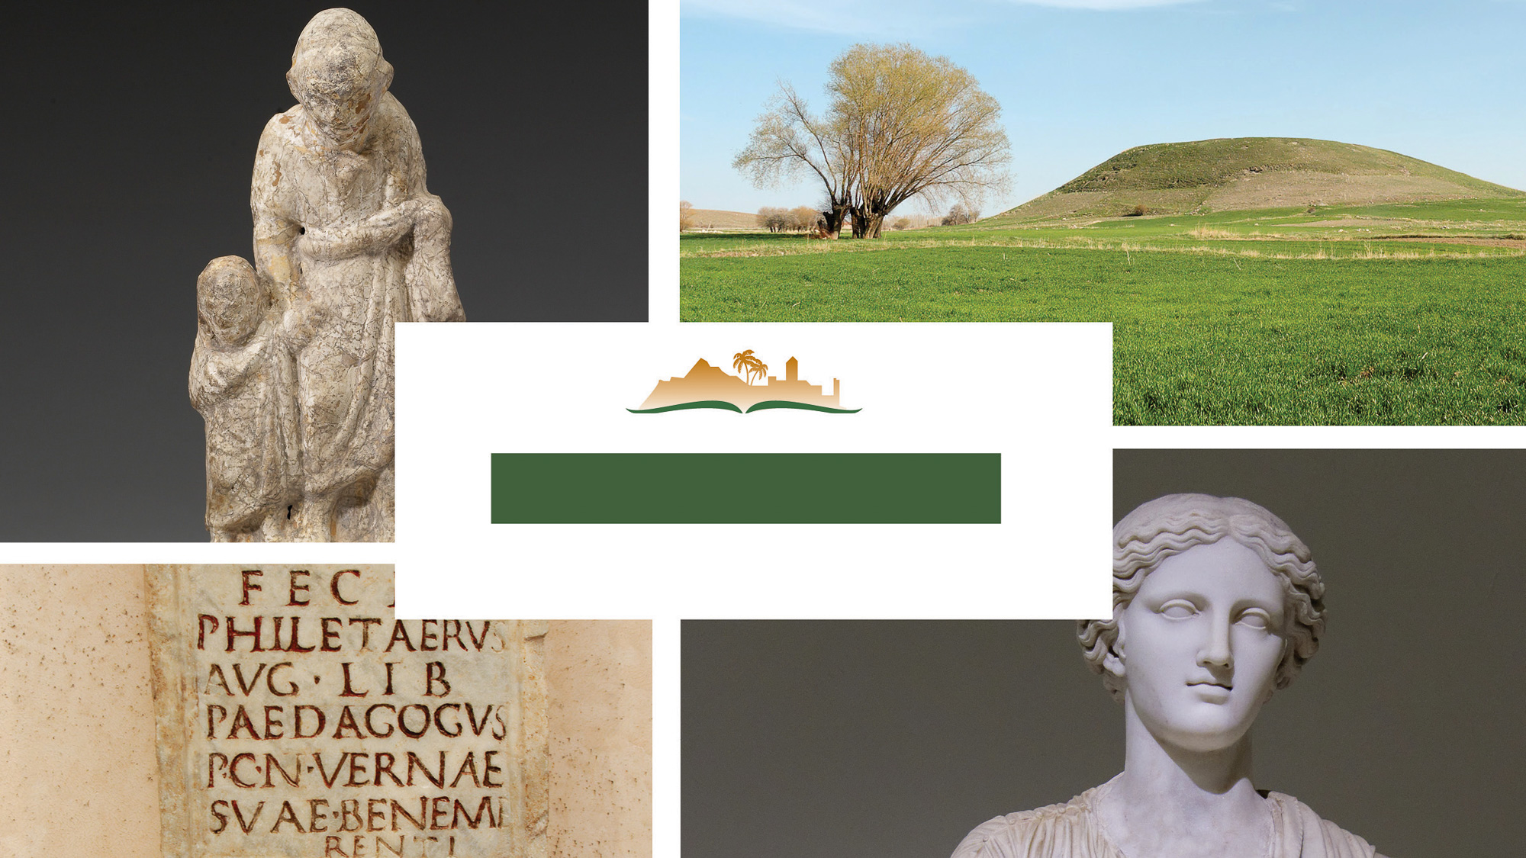
Galatians 5
Notes:
This is a free sample of the Galatians 5 presentation from the Photo Companion to the Bible. To purchase the full volume, visit https://www.bibleplaces.com/galatians/
The Photo Companion to the Bible is an image-rich resource for Bible students, teachers, and researchers. Just as a librarian stocks the shelves with as many relevant materials as possible, so we have tried to provide a broad selection of images. Our goal is that you will find in this “library” whatever it is you are looking for.
Credits: The primary creators of this presentation are Steven D. Anderson, Christian Locatell, Kris Udd, and Todd Bolen. The photographs have an individual file code which usually includes the initials of the photographer. Other images have additional credit or source information.
Updates: We plan to update this collection as we are able. We welcome your suggestions for improving this resource (photocompanion@bibleplaces.com). Purchasers of the Galatians volume are provided free, lifetime updates to the volume.
Copyright: This photo collection is protected by copyright law and may not be distributed without written permission from BiblePlaces.com. Slide notes should be treated as any other copyrighted written material, with credit given when quoting from these notes.
For more information, see our complete “Introduction to the Photo Companion to the Bible” online at https://www.BiblePlaces.com/Intro-Photo-Companion-Bible/. Here you will find more information about photo selection, explanatory notes, Bible translation, credit information, and copyright allowances.

Slide 2
Galatians 5
This is a free sample of the Galatians 5 presentation from the Photo Companion to the Bible. To purchase the full volume, visit https://www.bibleplaces.com/galatians/ The Photo Companion to the Bible is an image-rich resource for Bible students, teachers, and researchers. Just as a librarian stocks the shelves with as many relevant materials as possible, so we have tried to provide a broad selection of images. Our goal is that you will find in this “library” whatever it is you are looking for. For more details (for this and every slide), see the Notes section below.
Notes:
This is a free sample of the Galatians 5 presentation from the Photo Companion to the Bible. To purchase the full volume, visit https://www.bibleplaces.com/galatians/
The Photo Companion to the Bible is an image-rich resource for Bible students, teachers, and researchers. Just as a librarian stocks the shelves with as many relevant materials as possible, so we have tried to provide a broad selection of images. Our goal is that you will find in this “library” whatever it is you are looking for.
Credits: The primary creators of this presentation are Steven D. Anderson, Christian Locatell, Kris Udd, and Todd Bolen. The photographs have an individual file code which usually includes the initials of the photographer. Other images have additional credit or source information.
Updates: We plan to update this collection as we are able. We welcome your suggestions for improving this resource (photocompanion@bibleplaces.com). Purchasers of the Galatians volume are provided free, lifetime updates to the volume.
Copyright: This photo collection is protected by copyright law and may not be distributed without written permission from BiblePlaces.com. Slide notes should be treated as any other copyrighted written material, with credit given when quoting from these notes.
For more information, see our complete “Introduction to the Photo Companion to the Bible” online at https://www.BiblePlaces.com/Intro-Photo-Companion-Bible/. Here you will find more information about photo selection, explanatory notes, Bible translation, credit information, and copyright allowances.

Slide 3
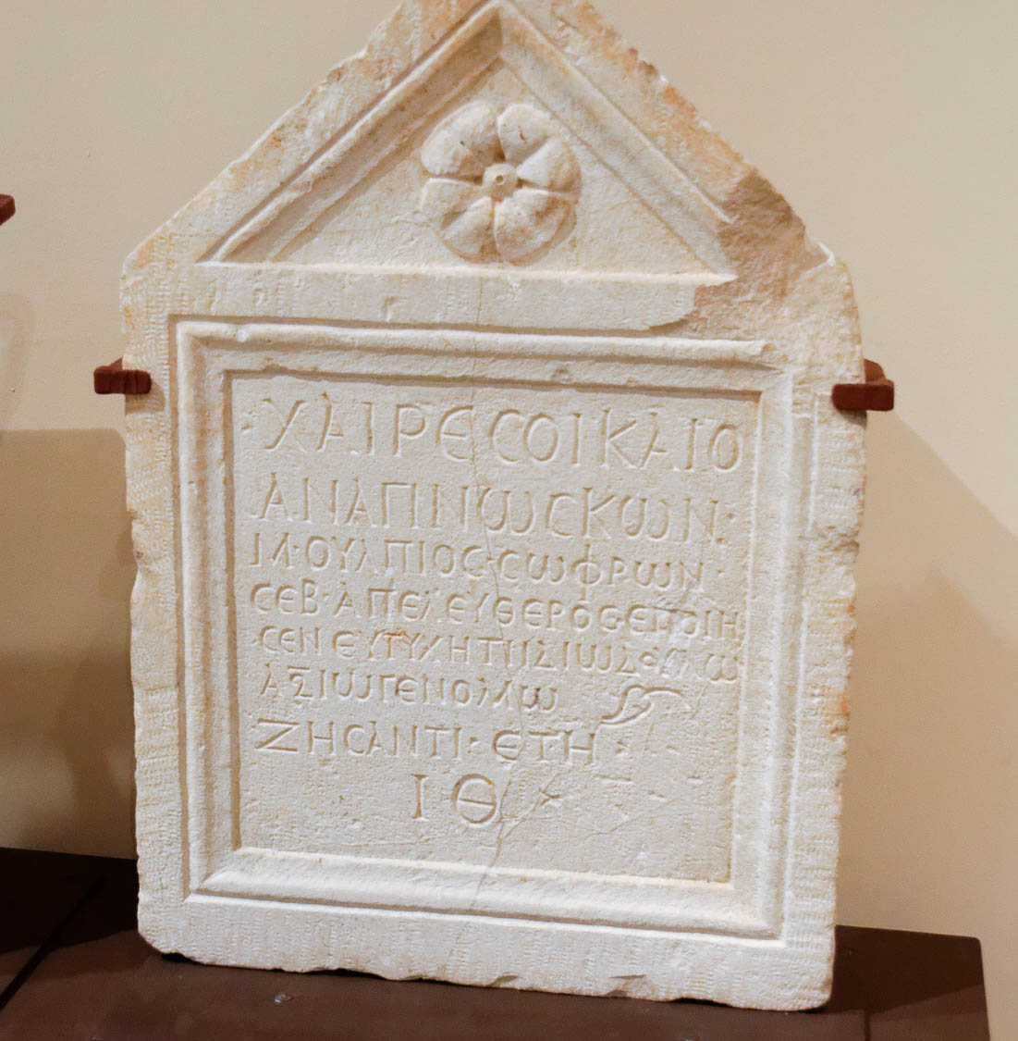
It was for freedom that Christ set us free
Tombstone of a “freedman of the emperor,” from Gerasa, circa AD 100
5:1
Notes:
The word Paul uses here for “freedom” (Gk. eleutheria, ἐλευθερία) has the same root as the word “freedman” (Gk. apeleutheros, ἀπελευθερος) in the inscription shown here. The idea of freedom from bondage would have been very familiar to Paul’s Galatian audience, since freedmen were well-known in the Roman Empire. The tombstone pictured here belonged to a slave who was freed by the Roman emperor. This inscription was photographed at the Amman Archaeology Museum in Jordan. The next slide includes a label for the Greek word “freedman.”
tb031115514

Slide 4
It was for freedom that Christ set us free
Tombstone of a “freedman of the emperor,” from Gerasa, circa AD 100
5:1
Notes:
The word Paul uses here for “freedom” (Gk. eleutheria, ἐλευθερία) has the same root as the word “freedman” (Gk. apeleutheros, ἀπελευθερος) in the inscription shown here. The idea of freedom from bondage would have been very familiar to Paul’s Galatian audience, since freedmen were well-known in the Roman Empire. The tombstone pictured here belonged to a slave who was freed by the Roman emperor. This inscription was photographed at the Amman Archaeology Museum in Jordan.
tb031115514

Slide 5
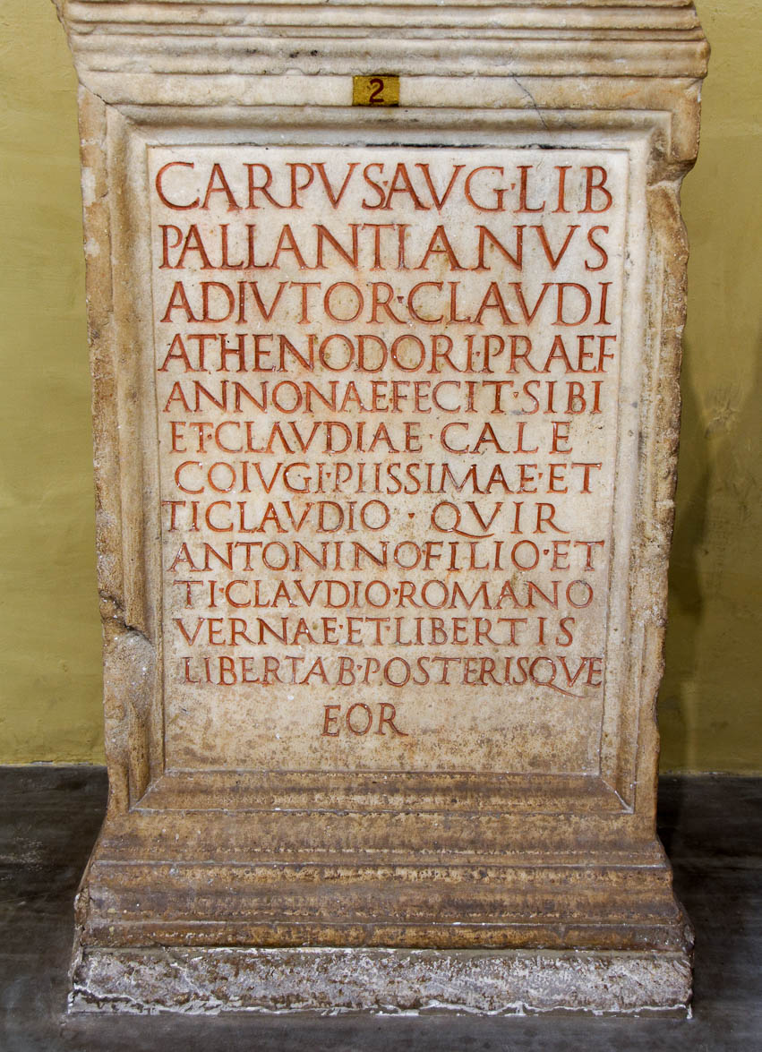
It was for freedom that Christ set us free
Altar of the Imperial Freedman Carpus Pallantianus, late 1st century AD
5:1
Notes:
This inscription contains the Latin term for freedman, LIBERTIS. The word appears in the second full line from the bottom. This inscription was photographed at the Vatican Museums. The next slide includes a label.
tb0512176494

Slide 6
It was for freedom that Christ set us free
Altar of the Imperial Freedman Carpus Pallantianus, late 1st century AD
5:1
Notes:
This inscription contains the Latin term for freedman, LIBERTIS. The word appears in the second full line from the bottom. This inscription was photographed at the Vatican Museums.
tb0512176494

Slide 7
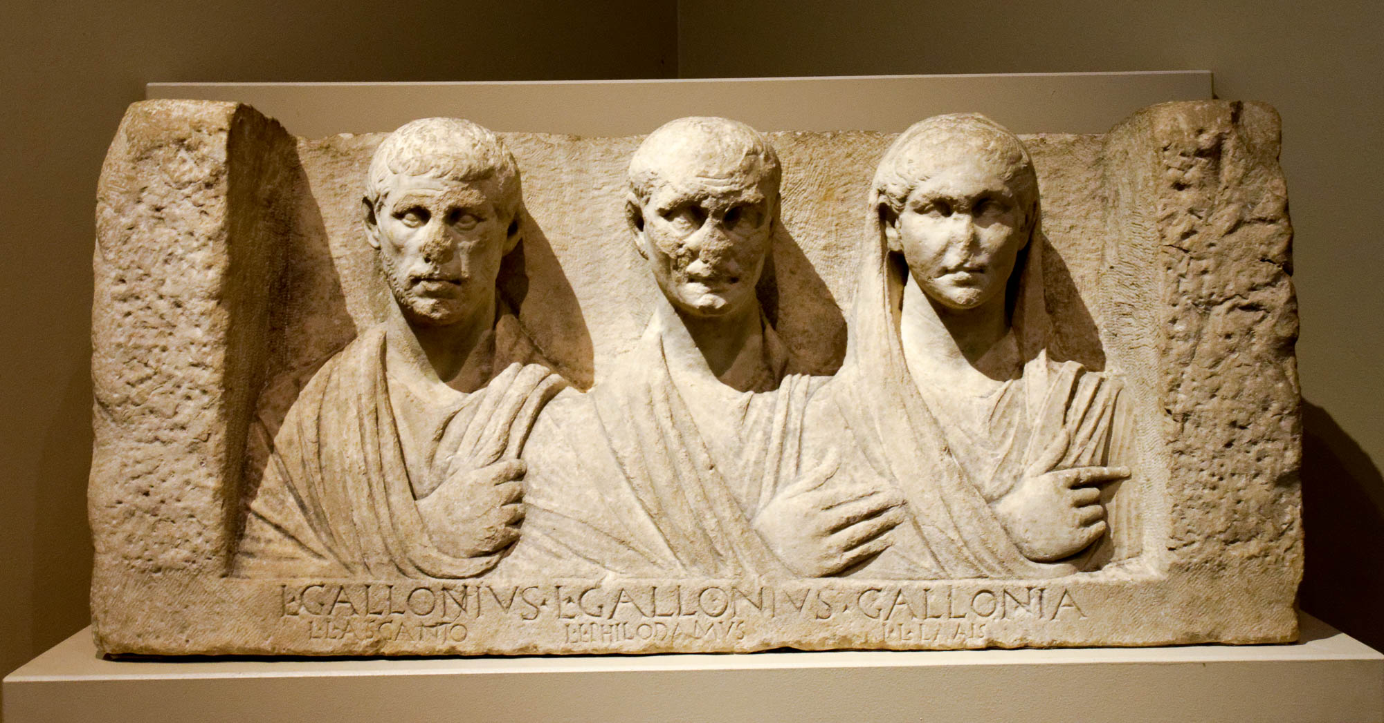
It was for freedom that Christ set us free
Funerary relief of former slaves who took their master’s name, circa 1st century AD
5:1
Notes:
The individuals in this portrait (from left to right) are identified as Lucius Gallonius Ascanto, Lucius Gallonius Philodamus, and Gallonia Lais. The practice of taking on the name of the one who freed you was not uncommon in the ancient Roman world. Another possible example of this is seen in Romans 16:11 where a man named Herodion is mentioned, who may have been a freedman of the house of Herod. This marble relief likely comes from the late 1st century BC or the early 1st century AD. It was photographed at the San Antonio Museum of Art.
tb111716771

Slide 8
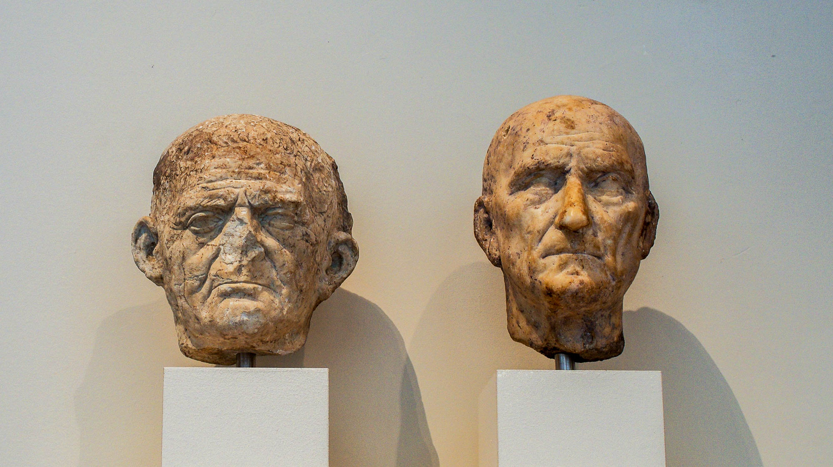
It was for freedom that Christ set us free
Roman portrait heads of freedmen, circa 50 BC–AD 90
5:1
Notes:
The important status of freedmen is attested to by the fact that they would be commemorated by busts, such as those pictured above. These marble heads were photographed at the Metropolitan Museum of Art in New York City.
adr1605243004h

Slide 9
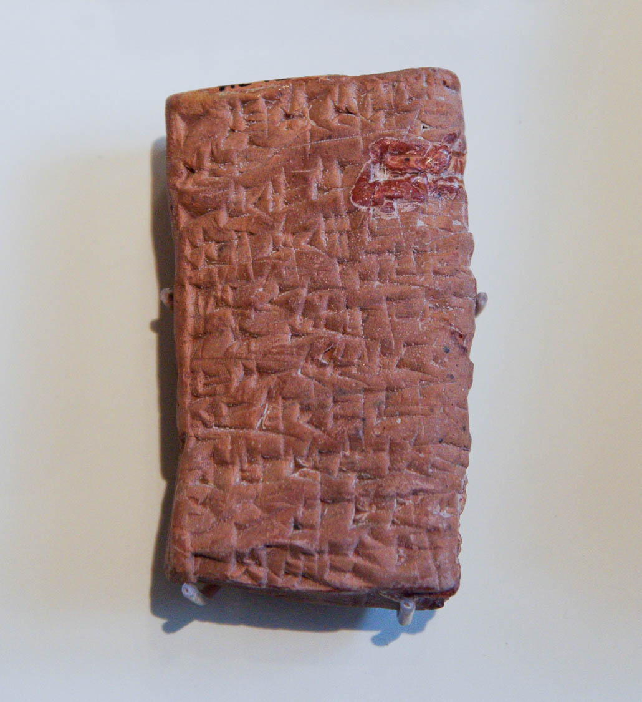
It was for freedom that Christ set us free
Old Babylonian Akkadian sealed contract freeing a slave, from Ishchali, 2000–1600 BC
5:1
Notes:
Emancipation from slavery was practiced throughout the history of the ancient world. This tablet of a contract for the freedom of a slave from Ishchali (modern day Iraq) was photographed at the Oriental Institute Museum at the University of Chicago.
adr1403076365

Slide 10
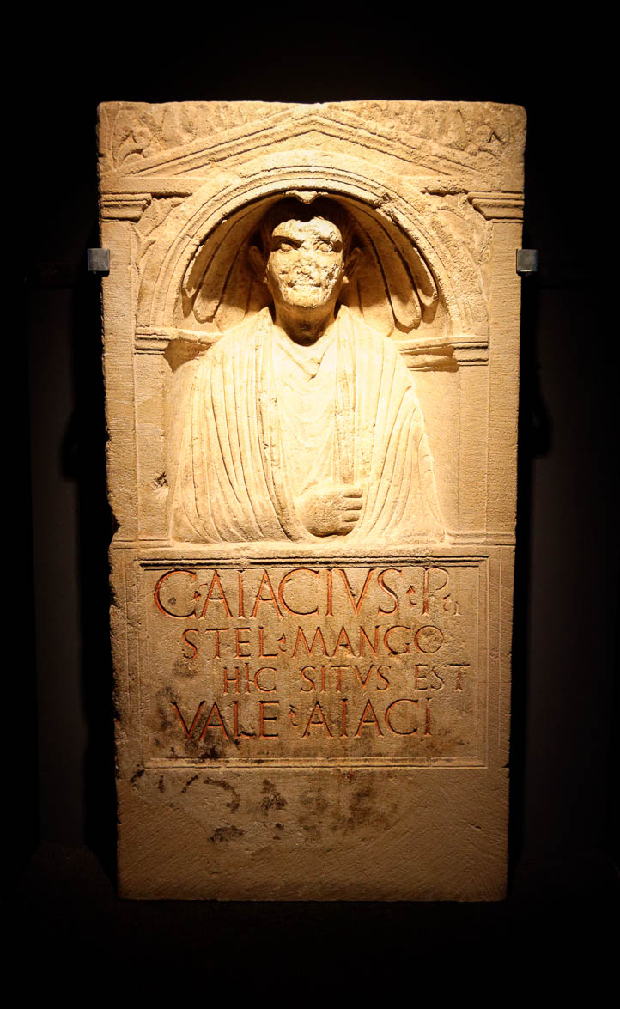
Do not be subject again to a yoke of slavery
Funerary relief of the slave-dealer Aiacius, AD 20–30
5:1
Notes:
According to Paul, the Judaizers threatening the faith of the Galatians could be compared to slave-dealers who wanted to place on them a yoke of bondage to the Law rather than freedom in Christ (cf. Acts 15:10). Pictured above is a funerary relief of a first-century slave-dealer. This relief is part of the Spartacus Exhibit, a temporary exhibition at the Ara Pacis Museum in Rome.
tb0518173946

Slide 11
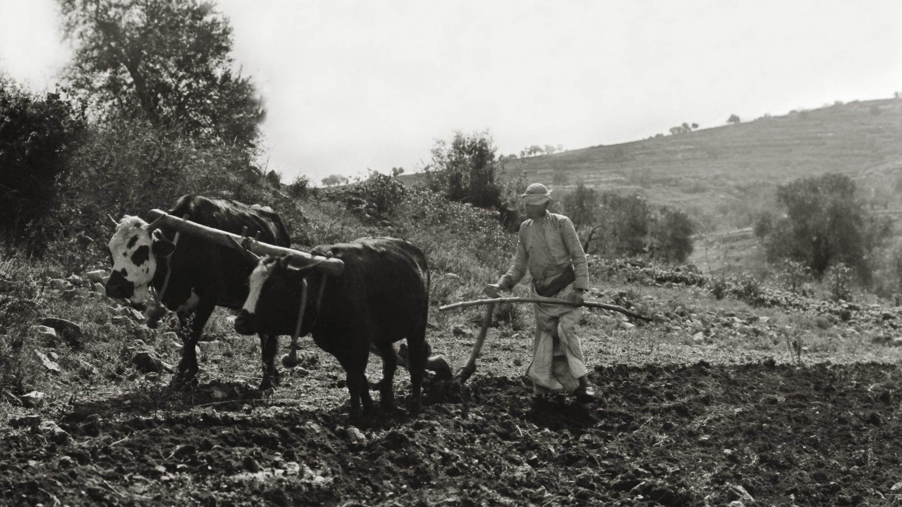
Do not be subject again to a yoke of slavery
Man plowing with a yoke of cattle
5:1
Notes:
Paul uses the imagery of a yoke to describe the burden of the Law. The yokes used in the Middle East in the early 20th century approximate the same agricultural technology of plows in use in the first century AD. This American Colony photograph was taken between 1898 and 1946.
mat05921

Slide 12
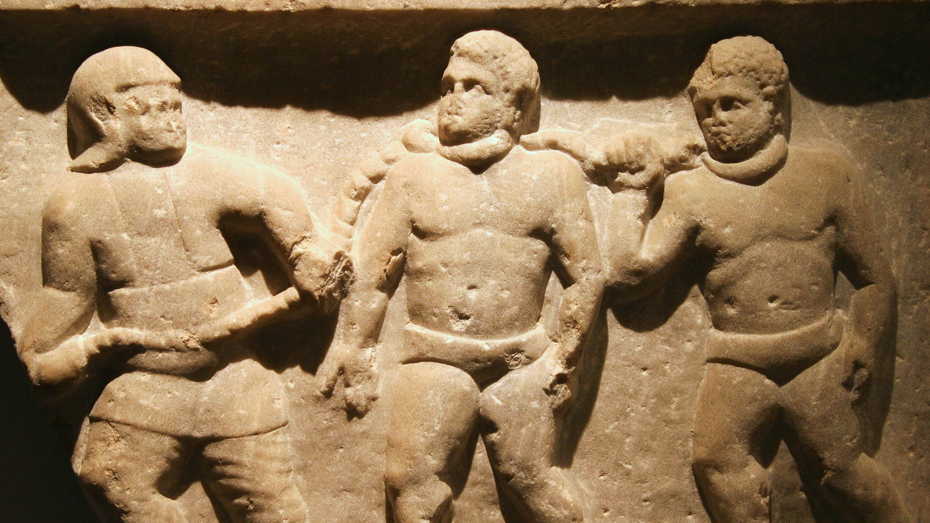
Do not be subject again to a yoke of slavery
Roman collared slaves, marble relief, from Smyrna, circa AD 200
5:1
Notes:
Slaves in the Roman world were sometimes restrained by chains, or even a metal collar around the neck, as is the case with the two men in this relief. This relief was photographed at the Ashmolean Museum at the University of Oxford. This image comes from Jun and is licensed under CC BY-SA 2.0, via Wikimedia Commons: https://commons.wikimedia.org/wiki/File:Roman_collared_slaves_-_Ashmolean_Museum.jpg.
wiki02072010153136h

Slide 13
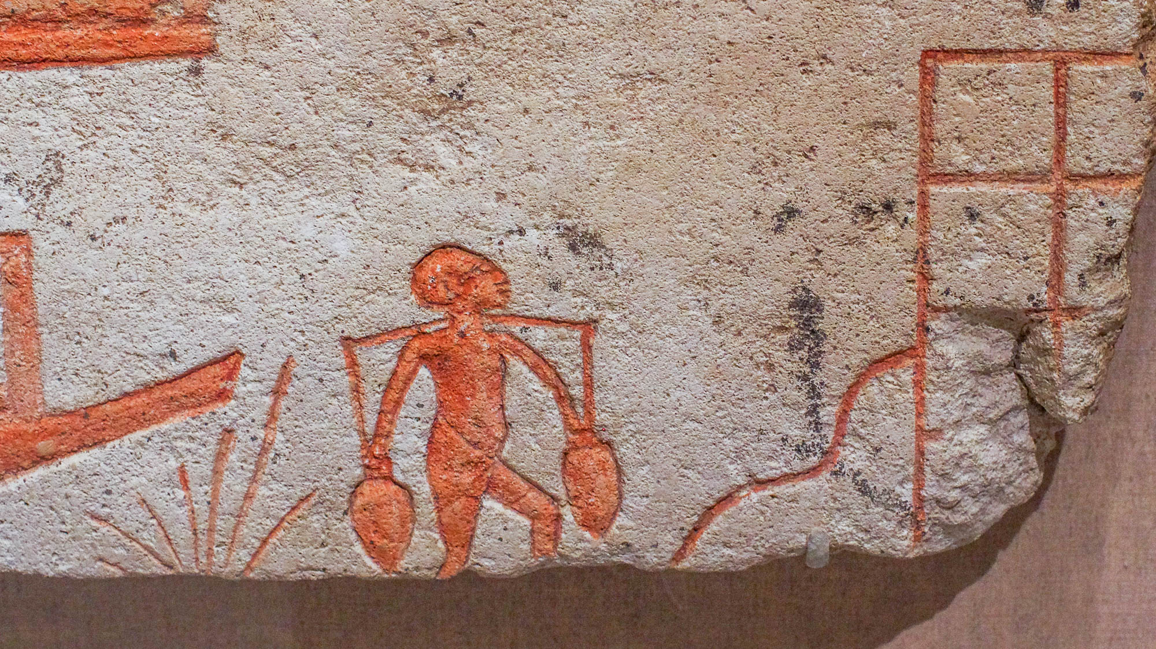
Do not be subject again to a yoke of slavery
Egyptian worker transporting water jars with a yoke, from Tell el-Amarna, 14th century BC
5:1
Notes:
Yokes were also used by common workers, some of whom were compelled to work for others. This wall painting is from the Egyptian town of Amarna. It was photographed at the Brooklyn Museum in New York City.
adr1606020767

Slide 14
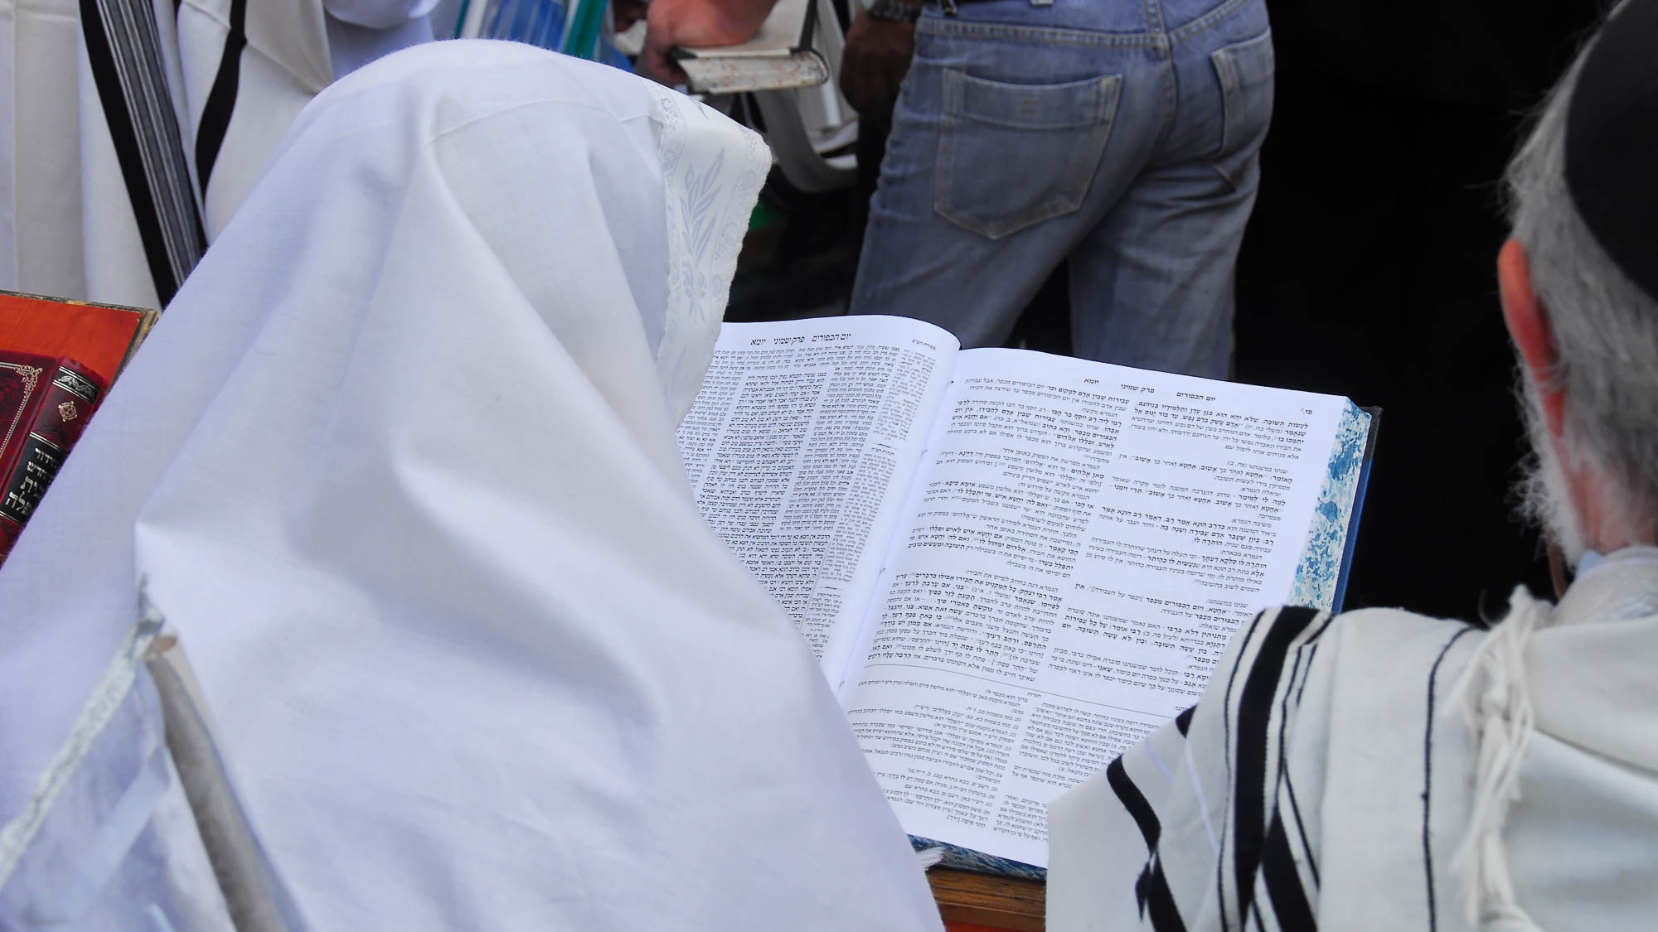
Do not be subject again to a yoke of slavery
Man reading the Talmud at the Western Wall in Jerusalem
5:1
Notes:
The Babylonian Talmud, a 5th-century compilation of rabbinic commentary on the Mishna, positively refers to the Law as a “yoke.” Modern-day Orthodox Judaism traces its roots back to the Pharisees of Paul’s day.
tb100906874

Slide 15
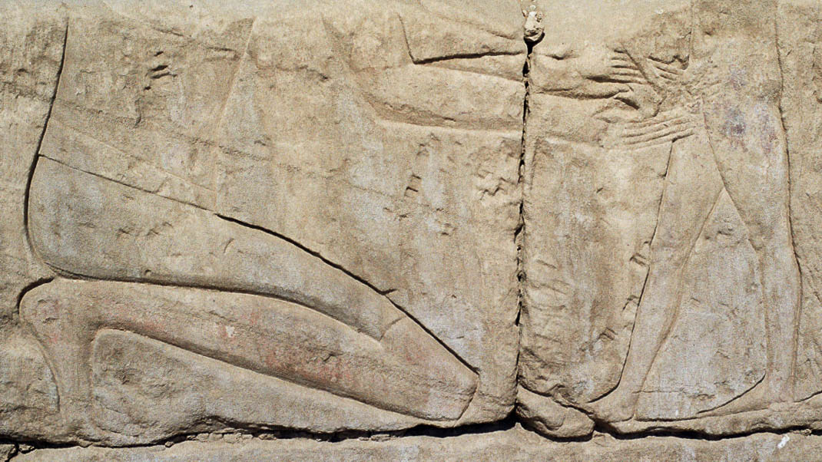
Behold! I, Paul, say to you, that if you receive circumcision, Christ will profit you nothing
Egyptian scene of circumcision, from Luxor, reign of Amenhotep III, circa 1360 BC
5:2
Notes:
Paul argues that those who seek to add circumcision as a requirement annul the work of Christ. Jesus fulfilled the Law, liberating His children from its burden. To take up that burden again is to deny the Messiah Himself. The scene of circumcision shown here was carved in the northern inner wall of the Temple of Khonspekhrod at the Precinct of Mut in Luxor, Egypt. This photograph was taken by Lasse Jensen and is licensed under CC-BY-2.5, via Wikimedia Commons: https://commons.wikimedia.org/wiki/File:Circumcision_Precinct_of_Mut.png.
wiki020520051081703h

Slide 16
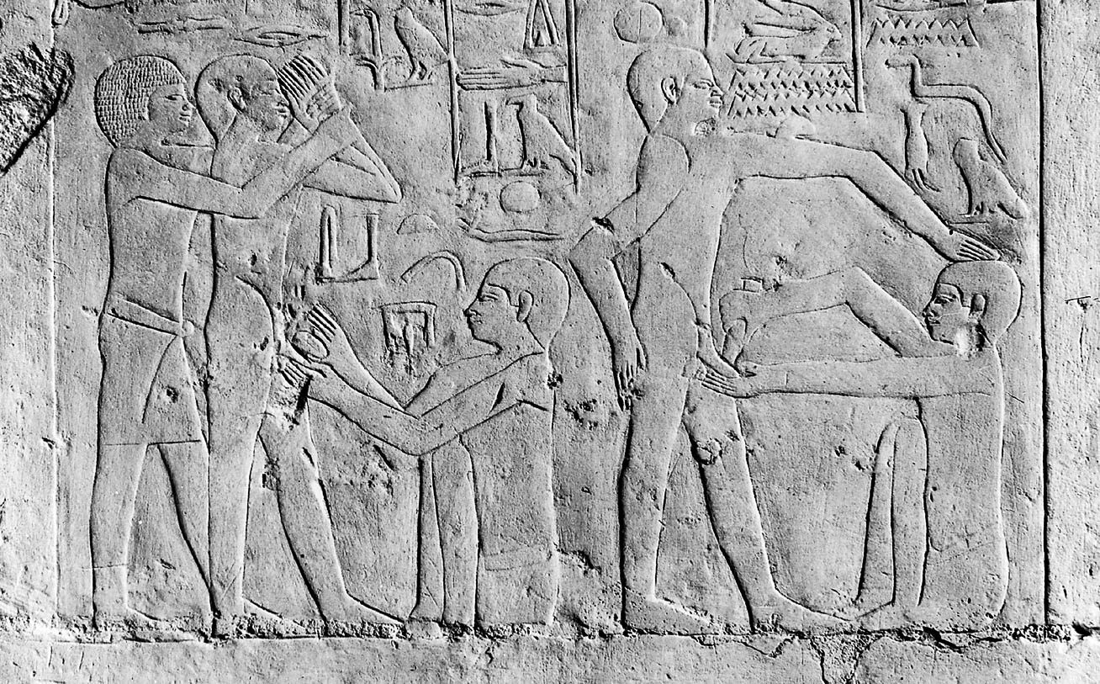
Behold! I, Paul, say to you, that if you receive circumcision, Christ will profit you nothing
Egyptian men shown undergoing circumcision, from Saqqara, circa 2300 BC
5:2
Notes:
This Egyptian relief illustrates the antiquity and widespread practice of circumcision. Someone in the Galatian area was urging the Gentile believers to become circumcised, a sign that they were under the requirements of the Mosaic Law. Paul objects to this strenuously. This image comes from Wellcome Images and is licensed under CC-BY-4.0, via Wikimedia Commons, https://commons.wikimedia.org/wiki/File:Egypt,_wall_carving_showing_a_circumcision_scene,_Sakkara_Wellcome_M0005235.jpg.
m0005235h

Slide 17
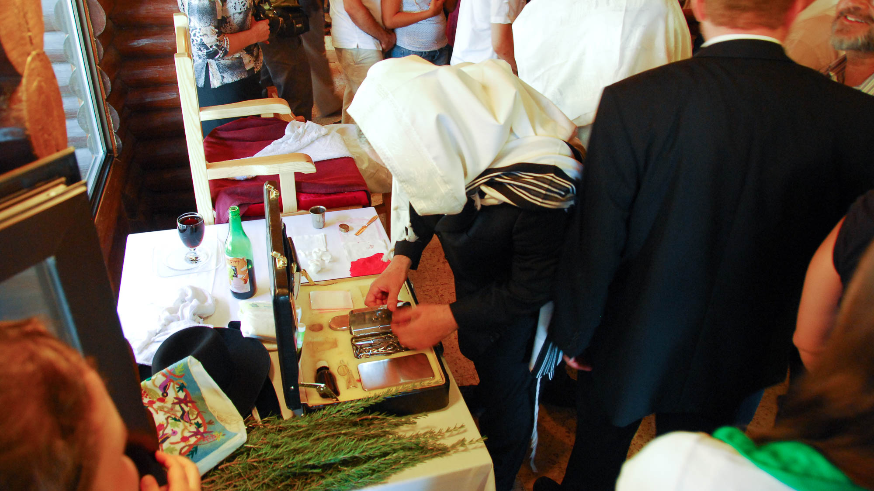
Behold! I, Paul, say to you, that if you receive circumcision, Christ will profit you nothing
Tools of a mohel used for circumcision
5:2
Notes:
Circumcision continues to be an extremely important and highly ritualized practice required by modern Jewish custom. In the photo above, the mohel who conducts the ceremony is preparing the tools for circumcision.
tb092006652

Slide 18
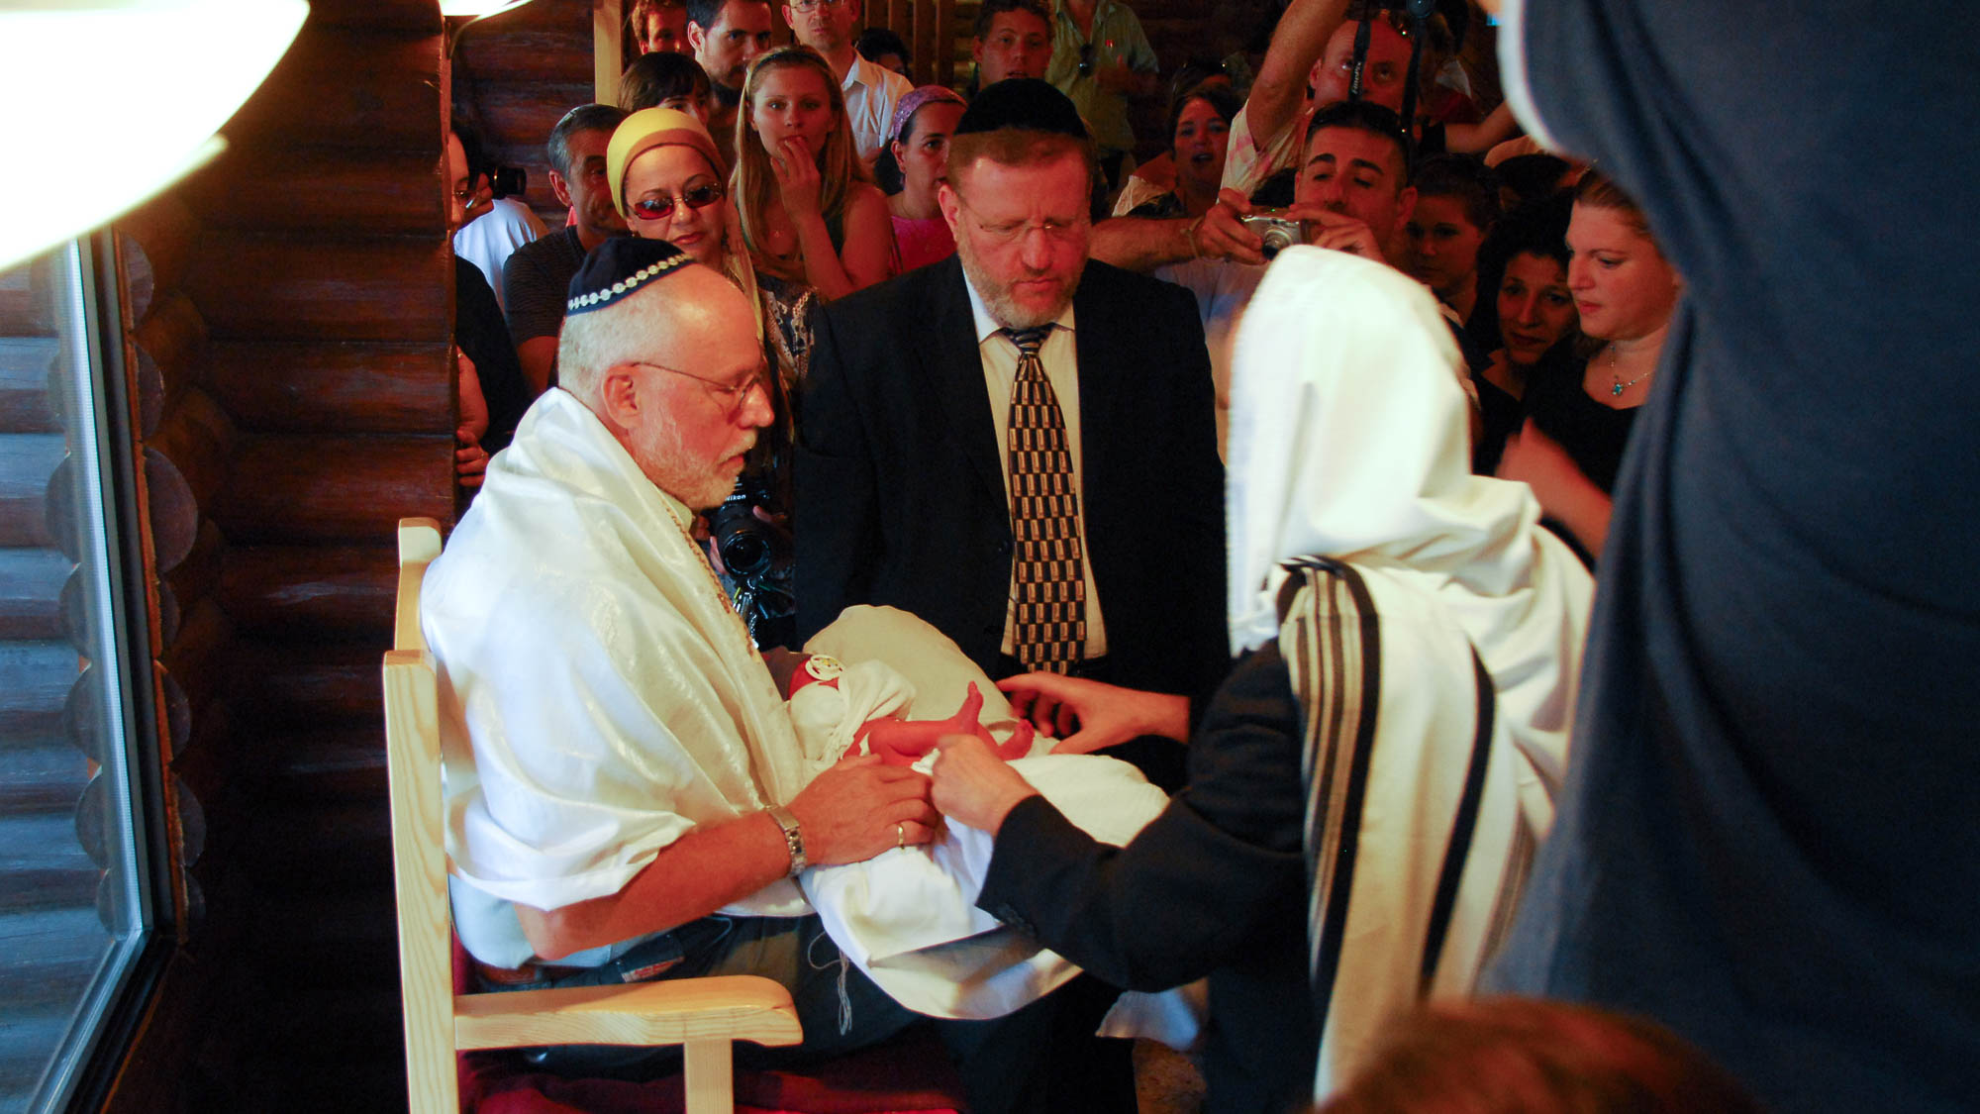
Behold! I, Paul, say to you, that if you receive circumcision, Christ will profit you nothing
Circumcision ceremony in a village in the Judean hills
5:2
Notes:
tb092006640

Slide 19
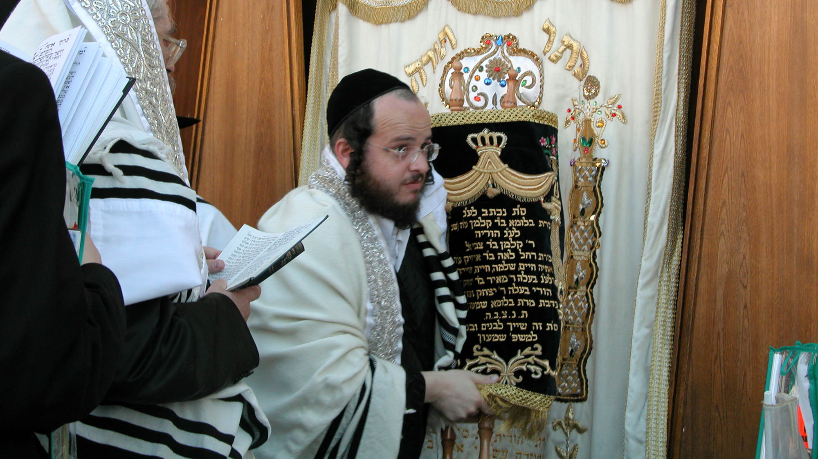
I testify again to every man who becomes circumcised, that he is obligated to keep the whole law
Man carrying a Torah scroll at the priestly blessing during Tabernacles at the Western Wall
5:3
Notes:
One who would take on some of the requirements of the Law, such as circumcision, is then obligated to take on the whole Law, Paul argues. The Mosaic Law stands or falls as a whole, illustrated here by a Torah scroll. Keeping only one part would be pointless since it is viewed as a unit (cf. Jas 2:10).
tb092302004

Slide 20
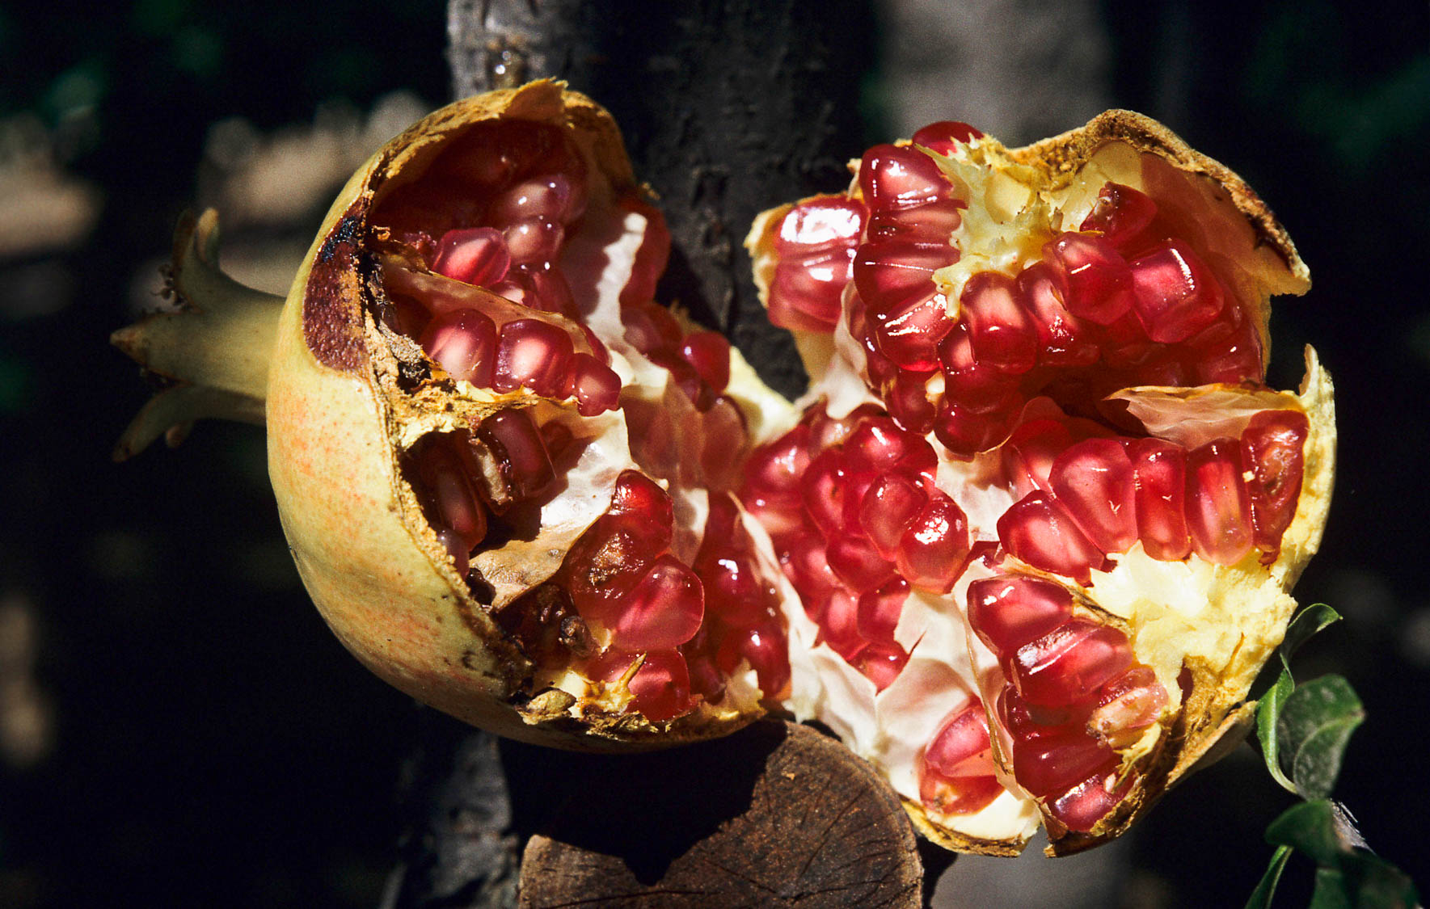
I testify again to every man who becomes circumcised, that he is obligated to keep the whole law
Ripe pomegranate fruit in Jerusalem
5:3
Notes:
Jews of the first century considered it sufficient for Gentile “god fearers” to keep the basic Noahic laws. However, an actual convert would be required to keep all the laws. By the time of the New Testament, the “works of the Law” had become a complex set of rules. The Babylonian Talmud has many references comparing the obedience of Israel to the seeds of a pomegranate. This seems to be based on a tradition that there are as many seeds in the pomegranate as there are commandments in the Law (613). Consider the following quote: “The sinner in Israel who has fulfilled as many commandments as a pomegranate has seeds escapes the fires of hell” (Rodkinson 1918: 43; cf. Frankel and Teutsch 1992: 128).
References:
Frankel, Ellen, and Platkin Teutsch, Betsy.
1992 The Encyclopedia of Jewish Symbols. New Jersey: Jason Aronson.
Rodkinson, Michael, ed.
1918 New Edition of the Babylonian Talmud. Vol. 3. Boston: New Talmud Society.
gs110090c48h

Slide 21
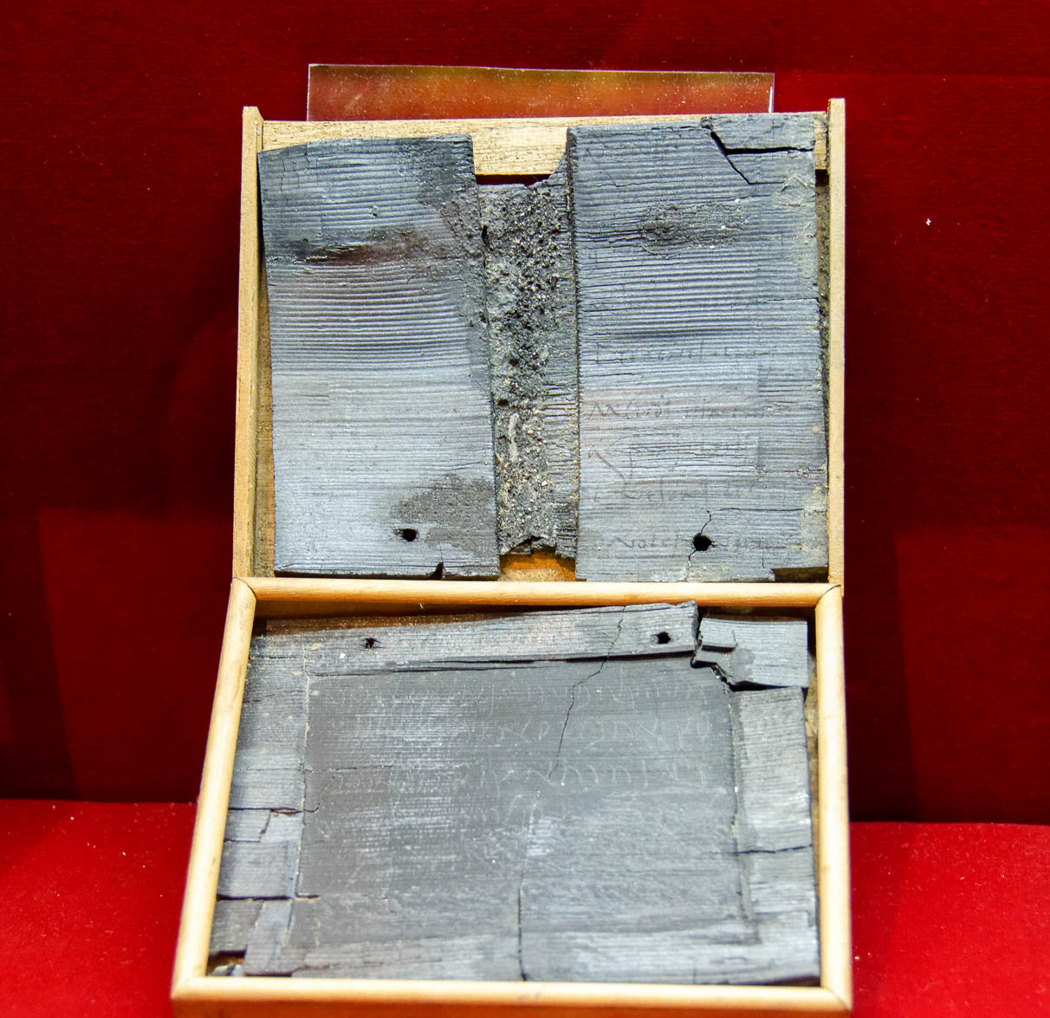
I testify again to every man who becomes circumcised, that he is obligated to keep the whole law
Receipt for a sum of money issued to Cecilio Giocondo, written by the debtor, from Pompeii
5:3
Notes:
The Mosaic Law is a comprehensive covenantal arrangement. This may be compared to the binding agreement between a debtor and loaner. Those who are under the Law cannot pick and choose which part they keep, any more than a debtor can choose how much he repays. Records of debt and repayment have been recovered from all over the ancient world, including this document from the Roman city of Pompeii, pictured here. This document, transcribed on wood, was burnt in the eruption of Mount Vesuvius in AD 79, but ultimately preserved by its ash. It was recovered from the house of Cecilio Giocondo. This display was photographed at the Naples Archaeological Museum.
tb0515170896

Slide 22
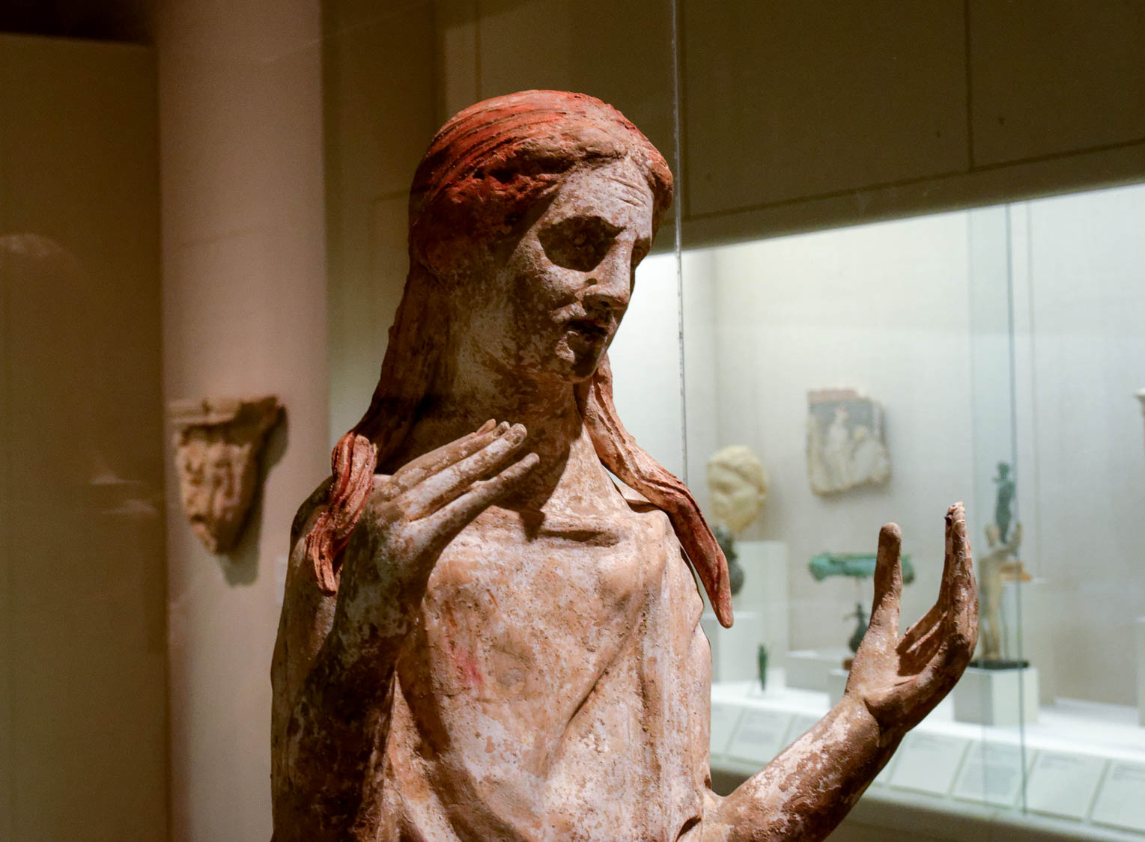
You are estranged from Christ, you who are trying to be justified by the law
Statue of a mourning woman, South Italian, 3rd century BC
5:4
Notes:
The word “estranged” (Gk. katargeō, καταργέω) is used by Paul elsewhere to refer to a woman “released” from her husband upon his death (Rom 7:2). The dissolution of the marriage relationship brought about by death, illustrated here by a statue of a woman in mourning, is similar to the “estrangement” from Christ that Paul describes for those who sought to be justified by the Law. This statue was photographed at the San Antonio Museum of Art.
tb111716835

Slide 23

You have fallen away from grace
Wilted flowers
5:4
Notes:
The word “to fall away” (Gk. ekpiptō, ἐκπίπτω) is used literally elsewhere to describe short-lived flowers that fall apart (Jas 1:11; 1 Pet 1:24; cf. Isa 40:7). Paul uses the word metaphorically here to describe changing for the worse from a once-favorable condition (cf. 2 Pet 3:17). This photograph comes from Benson Kua from Toronto, Canada and is licensed under CC BY-SA 2.0, via Wikimedia Commons: https://commons.wikimedia.org/wiki/File:Fallen_Comrade_(2736418852).jpg.
wiki2736418852

Slide 24
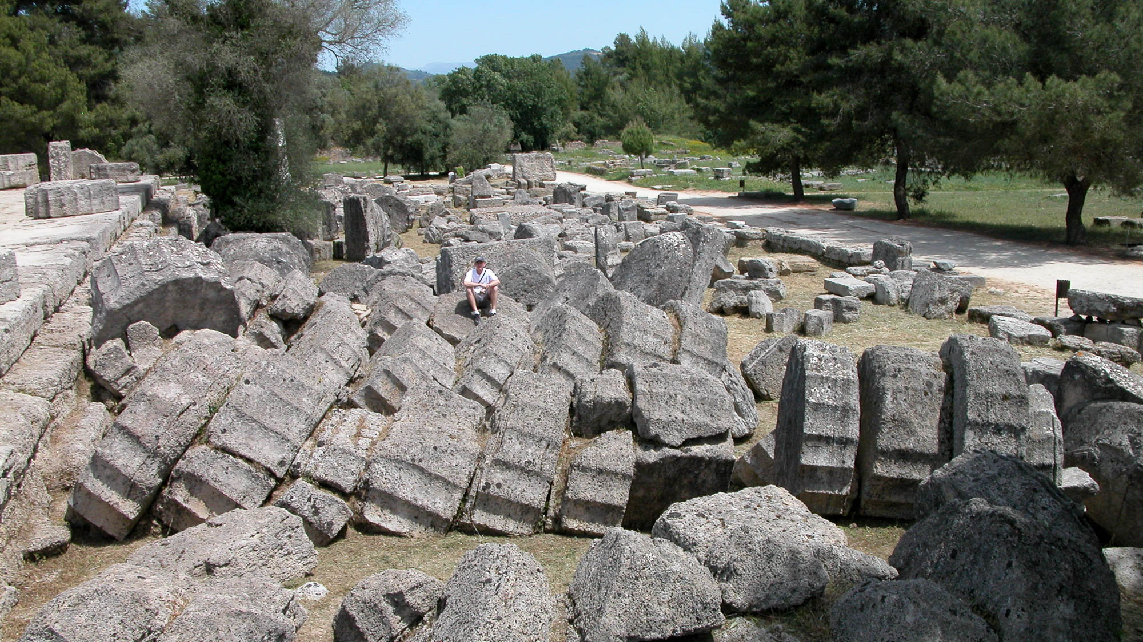
You have fallen away from grace
Fallen columns at the Temple of Zeus at Olympia, 5th century BC
5:4
Notes:
The columns of the Temple of Zeus at Olympia were built of stacked discs. The temple was built in the second quarter of the 5th century BC and continued in use for nearly a thousand years. The Byzantine emperor Theodosius II ordered the temple to be destroyed in AD 426, although many scholars believe the columns shown here may not have fallen until the earthquakes of AD 522 or 551.
tb051003112

Slide 25
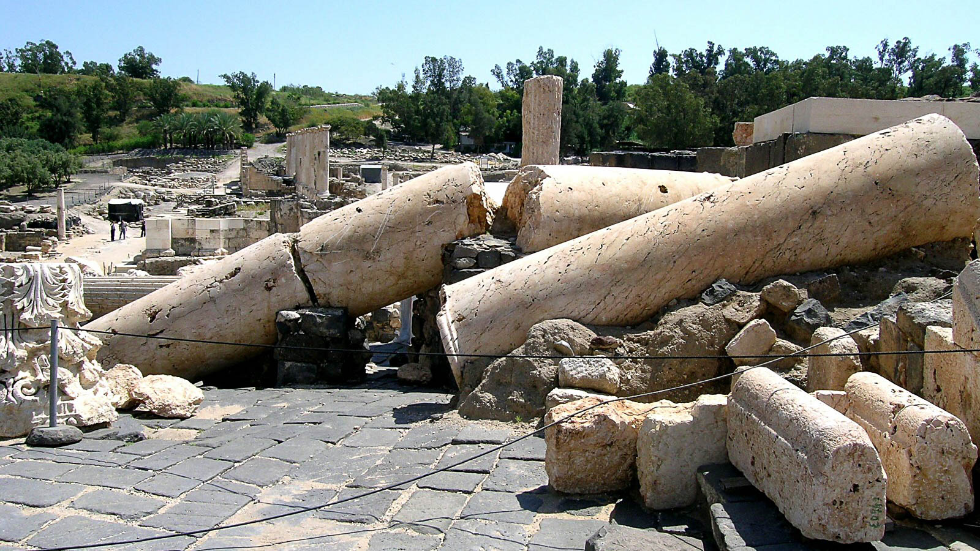
You have fallen away from grace
Fallen columns at Beth Shean, toppled by an earthquake
5:4
Notes:
Many things that appear to be stable are susceptible to falling, including virtually all of the man-made structures of Paul’s day. The massive columns shown here were likely toppled in the earthquake of 749.
tb040104520h

Slide 26
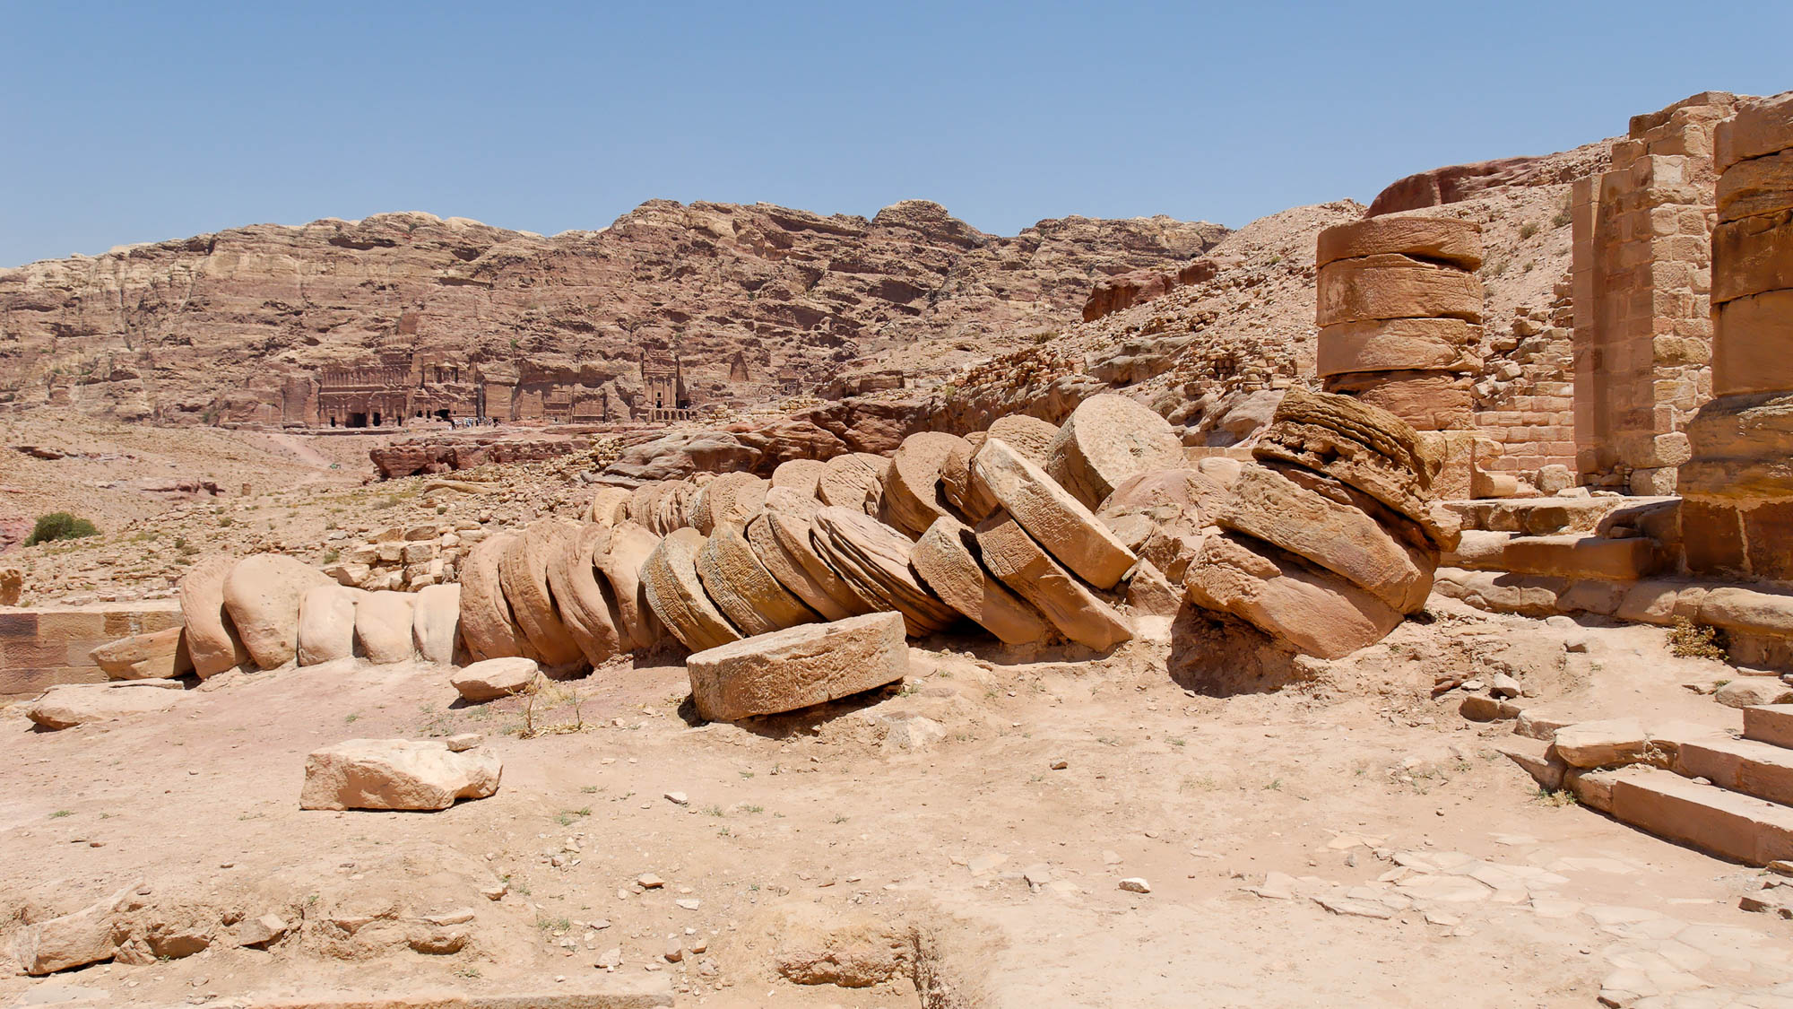
You have fallen away from grace
Toppled columns at the Great Temple of Petra, 1st century AD
5:4
Notes:
The fallen drums in this photo were once stacked to form columns at the Great Temple in Petra. The temple was completed in the 1st century AD and was likely destroyed by the massive earthquake of 363.
tb053008860

Slide 27
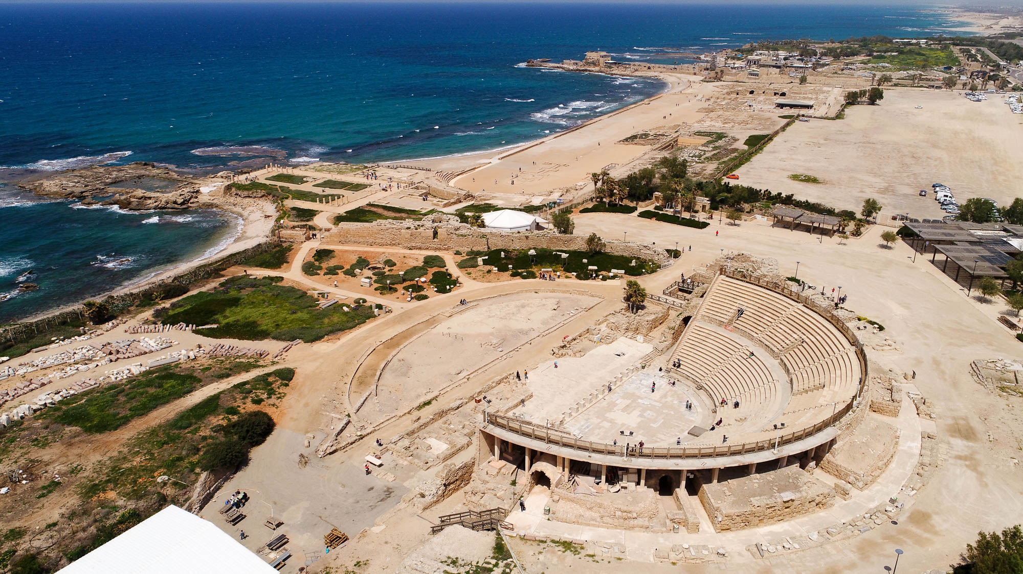
For through the Spirit, by faith, we wait for the hope of righteousness
Caesarea, city of the “Gentile Pentecost” (aerial view from the southeast)
5:5
Notes:
The so-called Gentile Pentecost recorded in Acts 10, especially verse 44, was when God publicly poured out the Holy Spirit on Gentile believers as the seal and guarantee of salvation (Eph 1:13-14). Caesarea was the location of the Gentile Pentecost, specifically the household of the Gentile Cornelius. This was the beginning of the fulfillment of the gospel going out to the ends of the earth (Acts 1:8) since the Gentiles include all those outside of Israel. This is especially relevant for the context of Paul’s letter to the Galatians since the Gentile Pentecost was crucial in the decision of the Jerusalem Council (Acts 15) to reject the Judaizing heresy (Acts 15:1; 22–29). On the chronology of the Jerusalem Council relative to Galatians, see the slides on Galatians 1:1-2. See next slide for labels.
ws040117092

Slide 28
For through the Spirit, by faith, we wait for the hope of righteousness
Harbor
Promontory
Palace
Aqueduct
Hippodrome
Theater
Caesarea, city of the “Gentile Pentecost” (aerial view from the southeast)
5:5
Notes:
The so-called Gentile Pentecost recorded in Acts 10, especially verse 44, was when God publicly poured out the Holy Spirit on Gentile believers as the seal and guarantee of salvation (Eph 1:13-14). Caesarea was the location of the Gentile Pentecost, specifically the household of the Gentile Cornelius. This was the beginning of the fulfillment of the gospel going out to the ends of the earth (Acts 1:8) since the Gentiles include all those outside of Israel. This is especially relevant for the context of Paul’s letter to the Galatians since the Gentile Pentecost was crucial in the decision of the Jerusalem Council (Acts 15) to reject the Judaizing heresy (Acts 15:1; 22–29). On the chronology of the Jerusalem Council relative to Galatians, see the slides on Galatians 1:1-2.
ws040117092

Slide 29
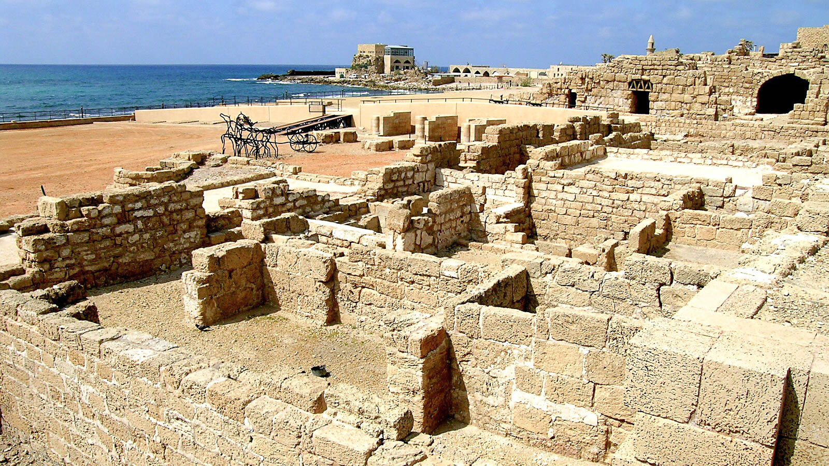
For through the Spirit, by faith, we wait for the hope of righteousness
Excavations at Caesarea, city of the “Gentile Pentecost”
5:5
Notes:
Most of the structures of Caesarea are built with local kurkar stone, likely also the construction method used for Cornelius’s home.
tb032504057h

Slide 30
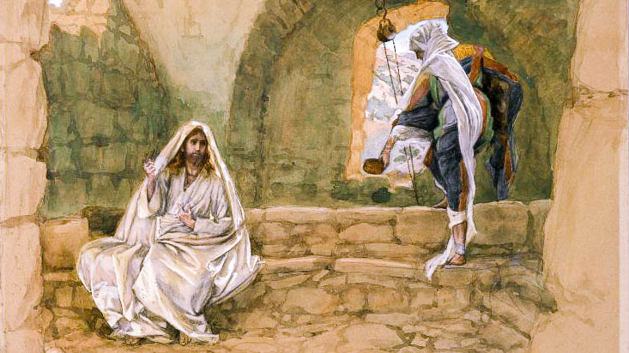
For in Christ neither circumcision nor uncircumcision is anything, but faith working through love
The Woman of Samaria at the Well, by James Tissot, circa 1890
5:6
Notes:
Paul reflects the teaching of Jesus in this statement. In the well-known incident with the Samaritan woman at the well (John 4:1-42), pictured here, the Samaritan woman queried Jesus about the right place to worship, Mount Gerizim or Jerusalem. Jesus responded that “a time is coming when you will not worship the Father in this mountain or in Jerusalem . . . God is Spirit, and those who worship Him must worship Him in spirit and in truth” (John 4:21, 24). This answer drew attention away from the questions of physical expressions of worship to spiritual expressions. Paul’s emphasis on faith and love is quite similar. This image is from the Brooklyn Museum and is in the public domain, via Wikimedia Commons: https://commons.wikimedia.org/wiki/File:Brooklyn_Museum_-_The_Woman_of_Samaria_at_the_Well_(La_Samaritaine_%C3%A0_la_fontaine)_-_James_Tissot_-_overall.jpg.
wiki0429201014080015969h

Slide 31
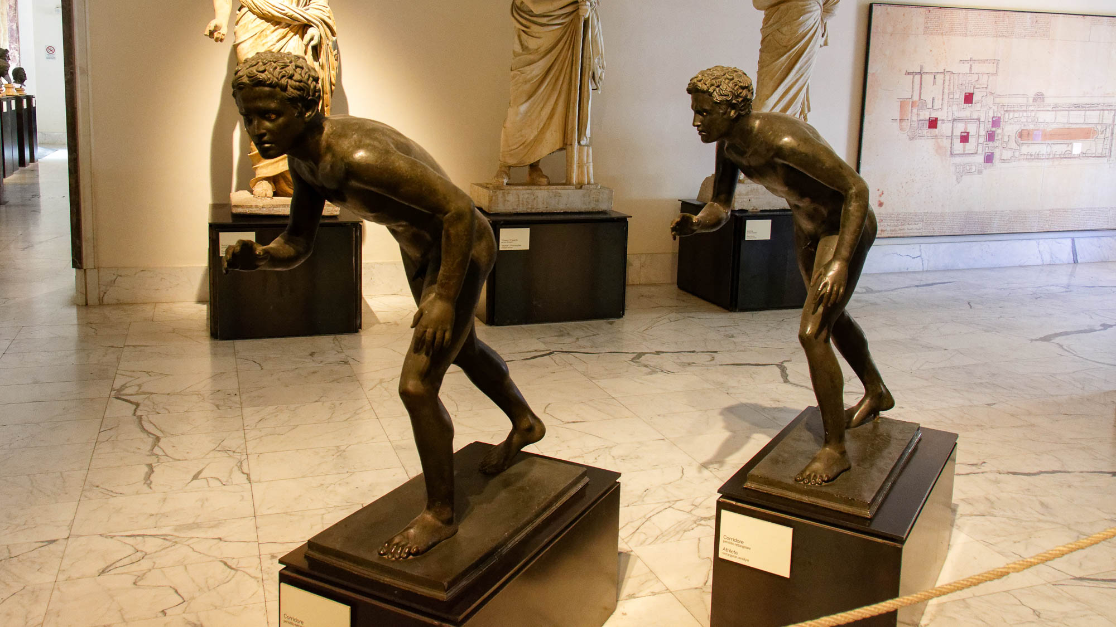
You were running well; who hindered you from obeying the truth?
Young athletes ready to run, from a rectangular peristyle at Herculaneum, 1st century AD
5:7
Notes:
Running was a popular sport in the Greco-Roman world, as attested by the many depictions of running athletes and the construction of stadiums for competition. Paul utilizes the activity of running as a metaphor for the Christian life. These statues were photographed at the Naples Archaeological Museum.
tb0515170102

Slide 32
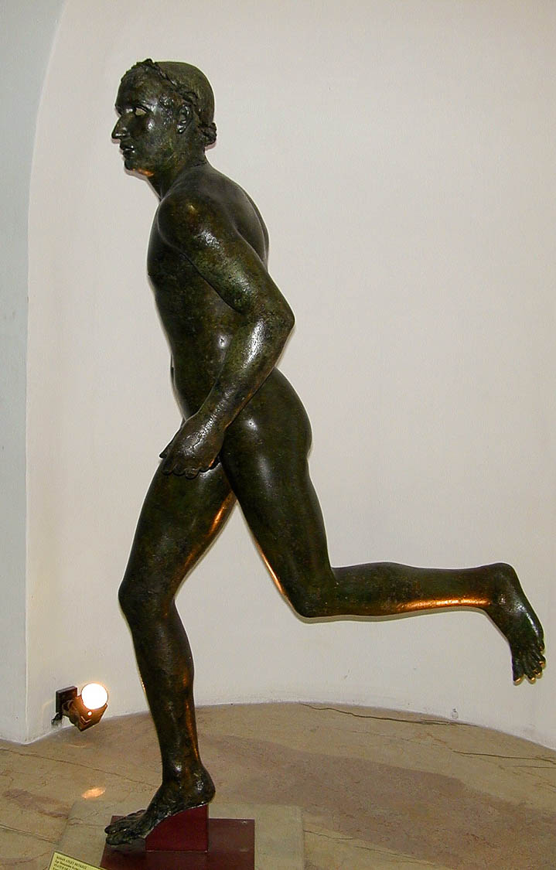
You were running well; who hindered you from obeying the truth?
Running athlete, from the Aegean Sea, Late Hellenistic
5:7
Notes:
This bronze statue was photographed at the Izmir Museum (biblical Smyrna in the modern country of Turkey).
tb010601884

Slide 33
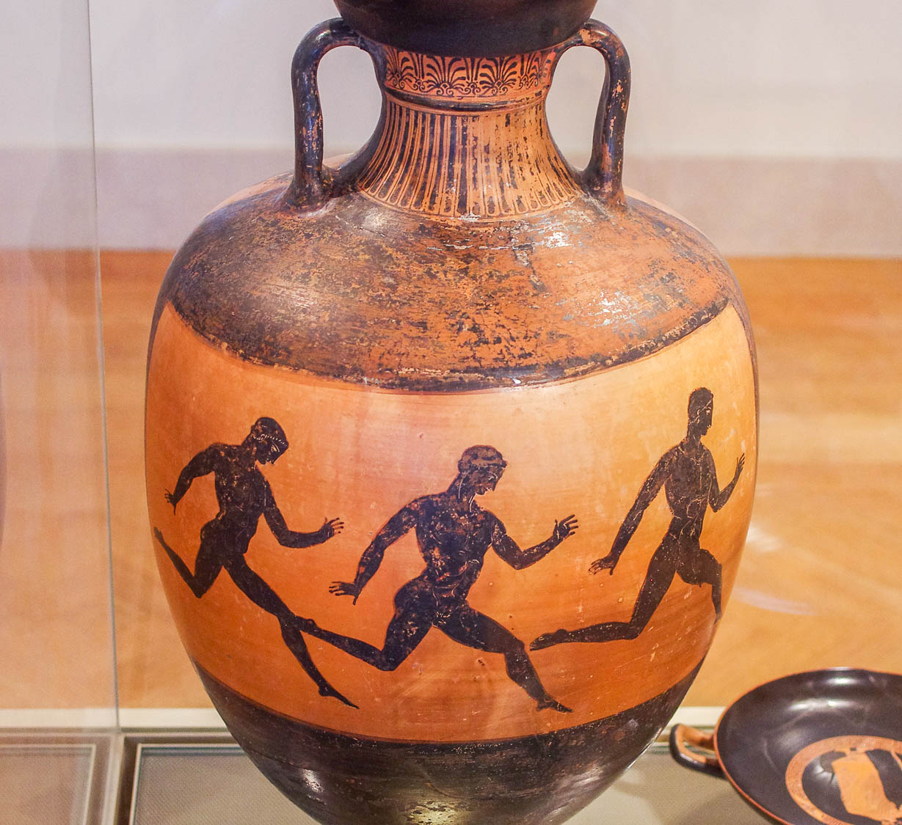
You were running well; who hindered you from obeying the truth?
Runners on a Greek Black-Figure Panathenaic prize amphora, Attic, circa 366–365 BC
5:7
Notes:
This was photographed at the Metropolitan Museum of Art in New York City.
adr1606034486h

Slide 34
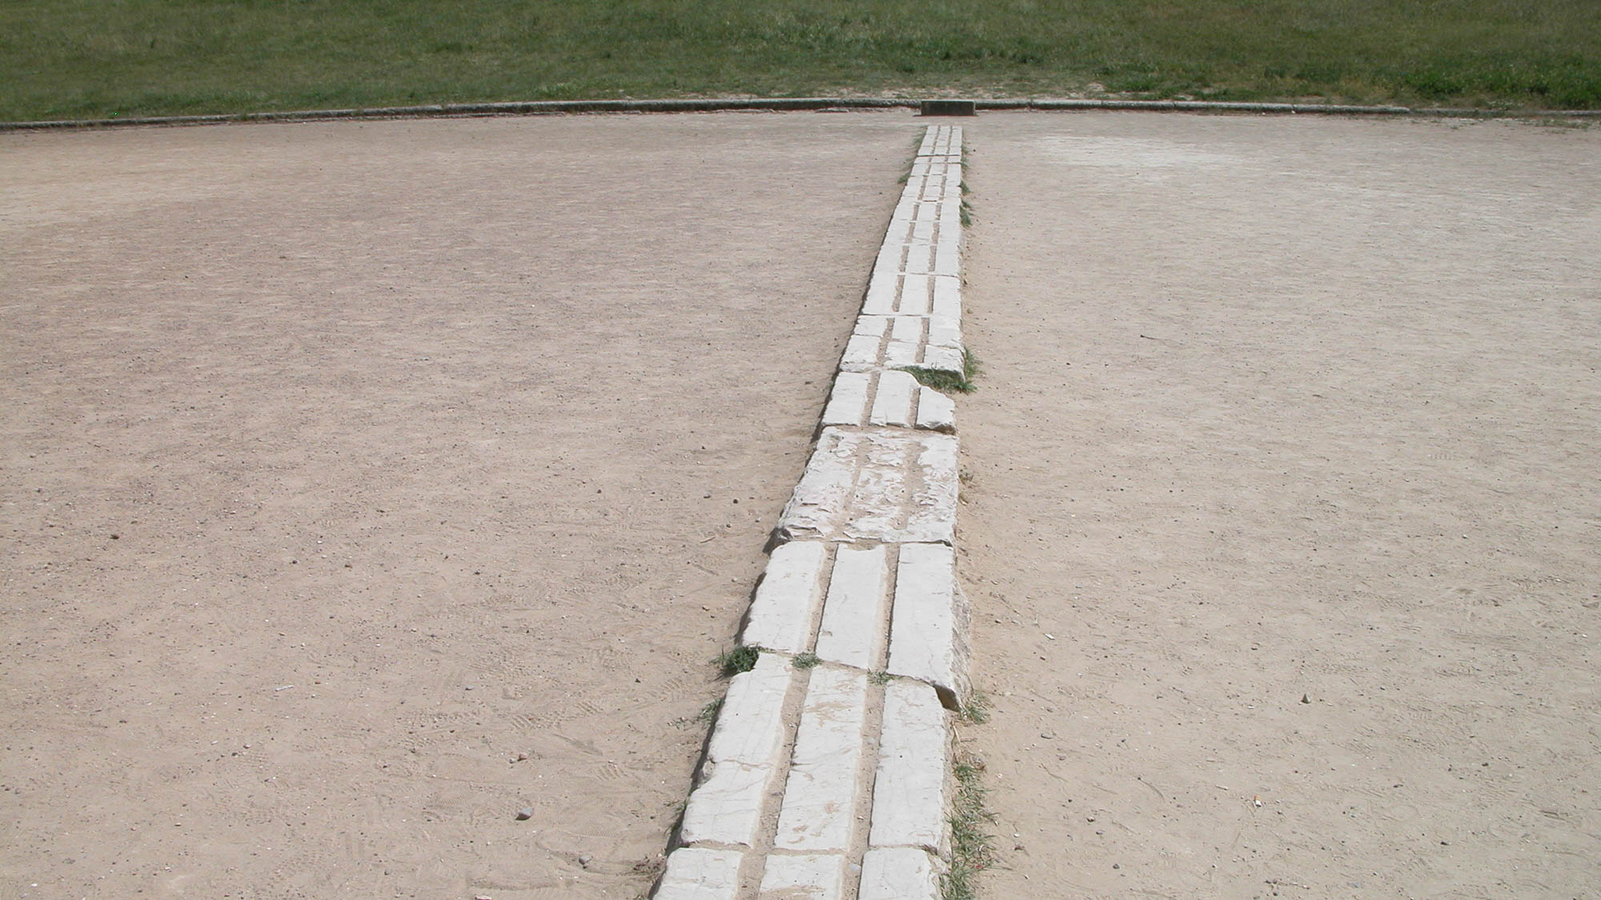
You were running well; who hindered you from obeying the truth?
Runners’ starting line in the stadium at Olympia, Greece
5:7
Notes:
One of the most important events in the Hellenistic world was that of the Olympic games held at Olympia stadium in Greece. The photo above shows the starting line for runners. Paul uses the metaphor of running to point out that they started well, but they were now being hindered.
tb051003132

Slide 35
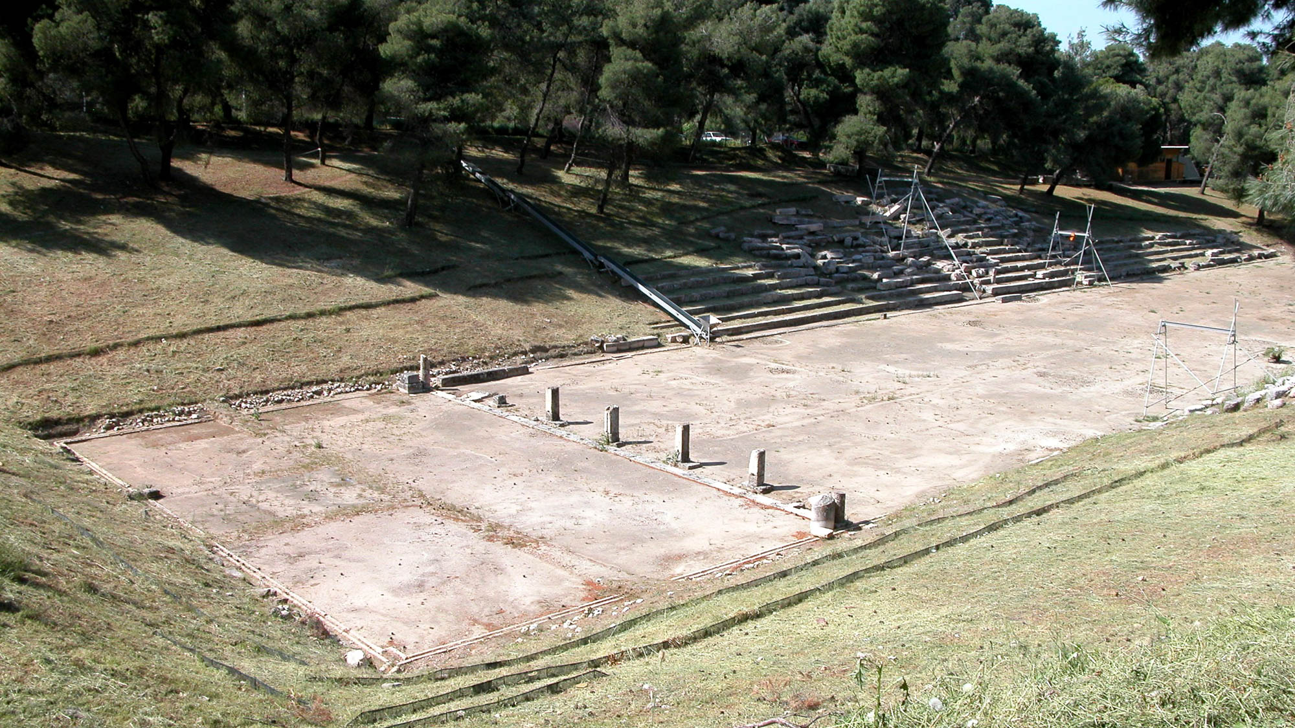
You were running well; who hindered you from obeying the truth?
Runners’ starting line in the stadium at Epidaurus, Greece
5:7
Notes:
The starting line for racers, marked by pillars, can be seen in this photo of the stadium at Epidaurus. Epidaurus is located about 25 miles (40 km) southeast of Corinth.
tb050903078

Slide 36
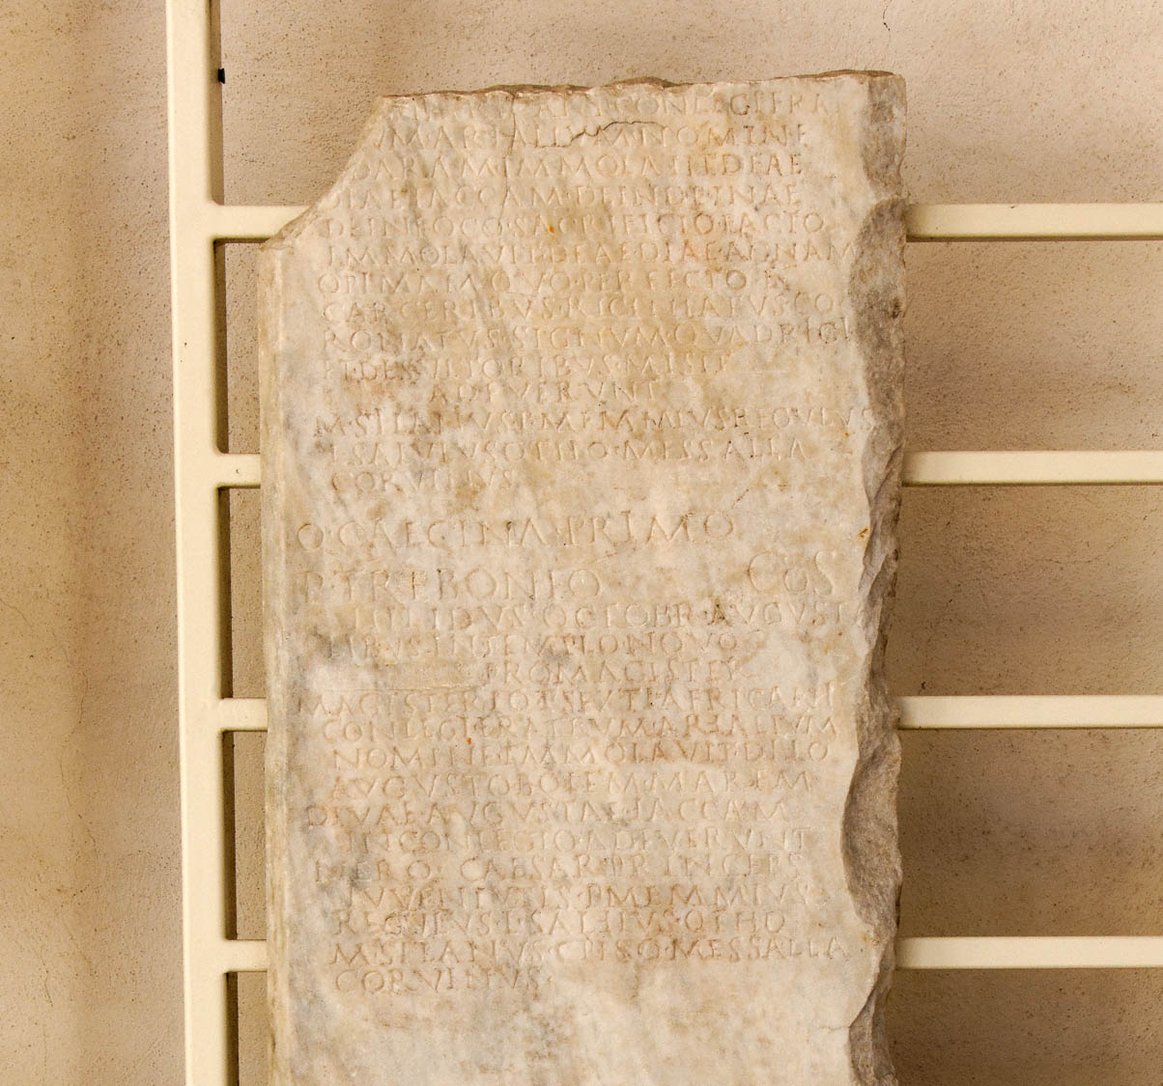
You were running well; who hindered you from obeying the truth?
Calendar from the time of Claudius, including foot races, May–October of AD 53
5:7
Notes:
The importance of races within first-century Roman culture can be seen from this calendar roughly contemporary to Paul’s writing Galatians. It records an account of races, acrobatic performances, and sacrifices for Augustalia. This was photographed at the National Museum of Rome at the Diocletian Baths.
tb0513178658h

Slide 37
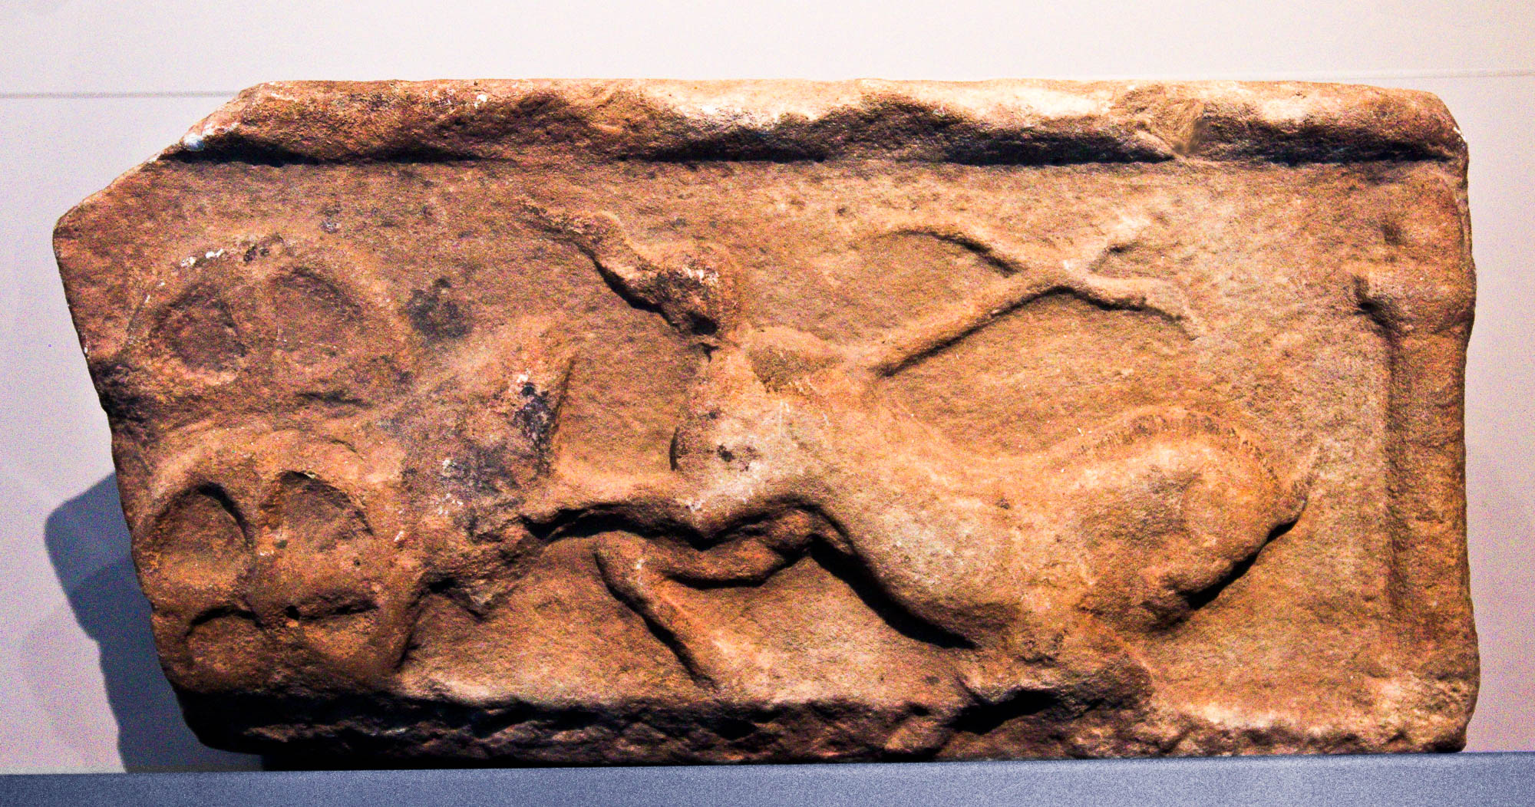
You were running well; who hindered you from obeying the truth?
Relief of a chariot race accident, AD 100–200
5:7
Notes:
This marble relief was photographed at the Ashmolean Museum at the University of Oxford.
adr1305240087h

Slide 38
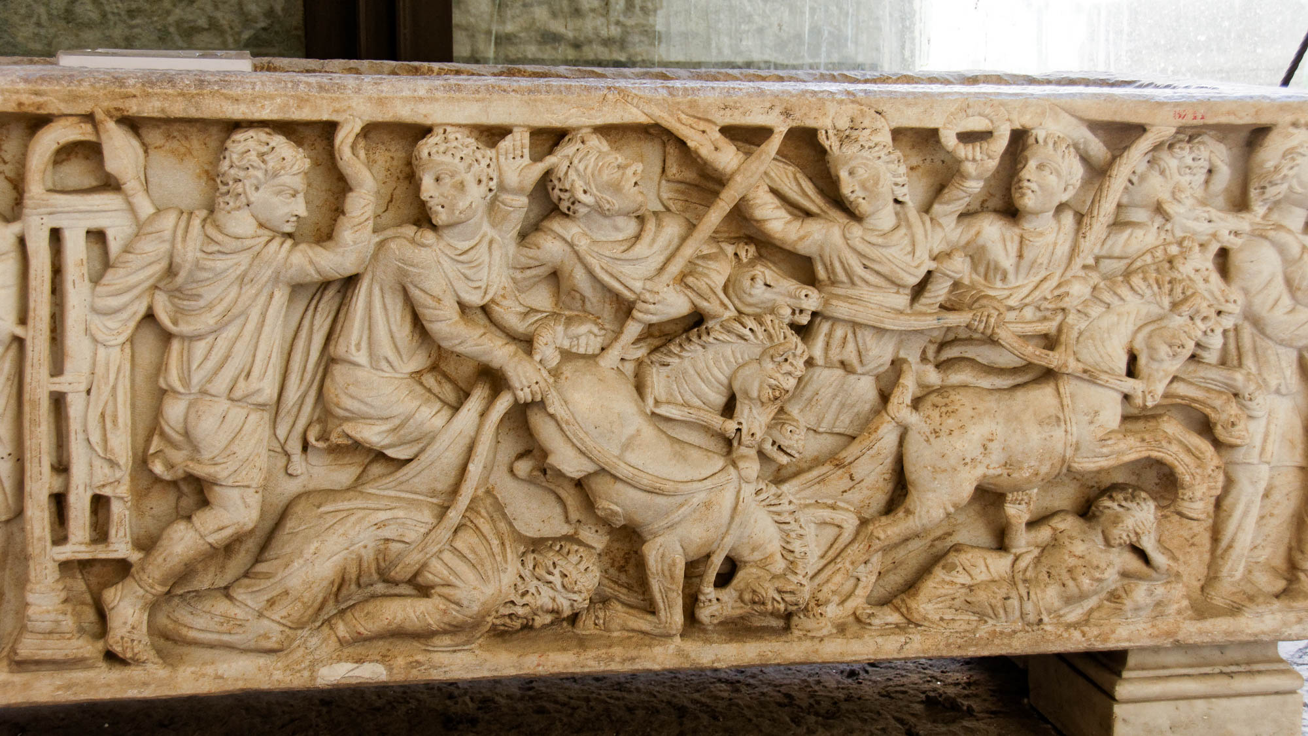
You were running well; who hindered you from obeying the truth?
Sarcophagus depicting a chariot race, 4th century AD
5:7
Notes:
This frieze depicts a race from Greek mythology, between Pelops of Lydia and Oenomaus of Pisa. In the race, Pelops replaced the bronze lynchpins on the axle of Oenomaus’s chariot with lynchpins made of beeswax. This caused the wheels of Oenomaus’s chariot to fly off, and Oenomaus was dragged to death, although his charioteer survived. The moment of the disaster is depicted on this sarcophagus. By analogy, Paul might have argued that the Galatians were considering replacing a critical piece of their faith with something that would bring them to a disastrous end. This sarcophagus was photographed at the Naples Archaeological Museum.
tb0515171035h

Slide 39
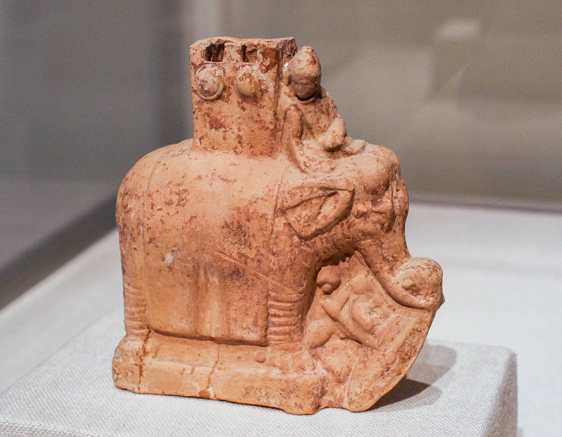
You were running well; who hindered you from obeying the truth?
Galatian warrior crushed by an elephant, from the Necropolis of Myrina, 2nd century BC
5:7
Notes:
“To hinder” (Gk. enkoptō, ἐγκόπτω) carries the idea of making progress slow or difficult. Although the parallel is not exact, this clay model shows a military elephant that has grasped a Galatian warrior with its trunk and tusk, preparing to crush him. Paul seems concerned that the Galatians have been drawn into a false belief that would ultimately lead to death. This clay model was photographed at the Metropolitan Museum of Art in New York City.
adr1605243927

Slide 40
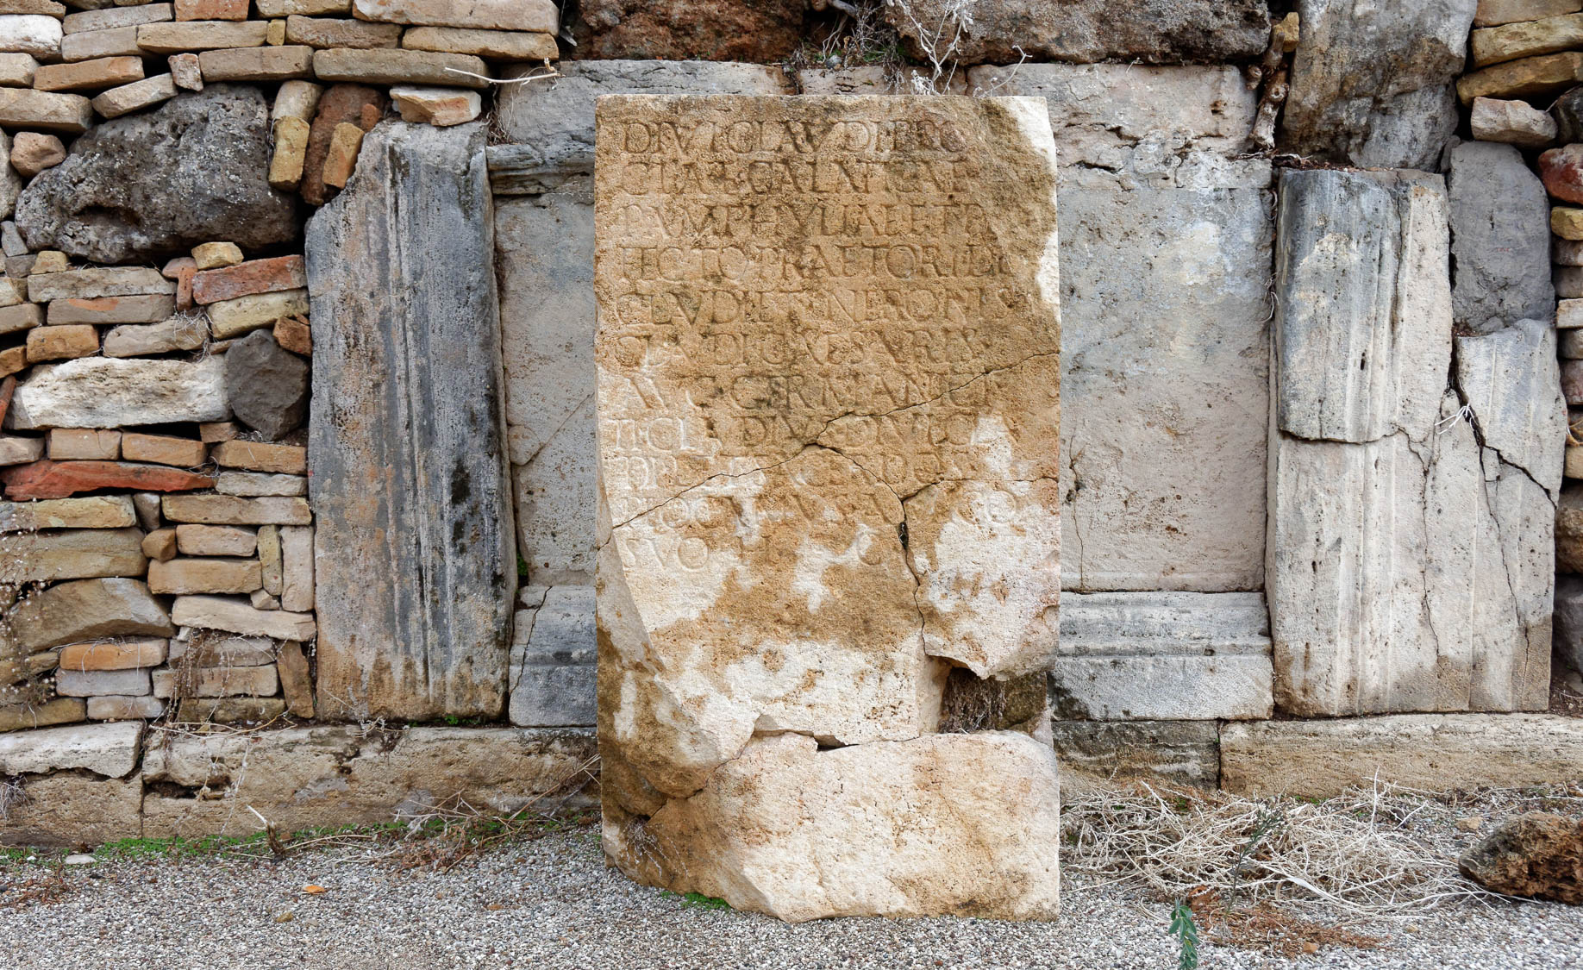
You were running well; who hindered you from obeying the truth?
Inscription mentioning Galatia, Pamphylia, and Divine Claudius, from Perga, mid-1st century AD
5:7
Notes:
The word “hinder” (Gk. enkoptō, ἐγκόπτω) literally means “to cut in” or “incise.” This literal meaning is not used in the New Testament, but it is illustrated here by an inscription from Perga that includes a reference to Galatia. Paul uses the word metaphorically to refer to preventing, interrupting, or slowing down some action. Paul’s choice of this metaphor may also be a word play connecting the “in-cutting/hindering” of the Judaizers with their insistence on circumcision (i.e., cutting in the flesh) as a requirement for salvation (cf. Acts 15:1). The Latin inscription shown here, found at Perga and dating to the mid-first century AD, honors Sextus Afranius Burrus, the governor of Galatia and Pamphylia (Lat. GALATICAE and PAMPHVLIAE). See the next slide for a close-up highlighting “Galatia.”
tb123016688h

Slide 41
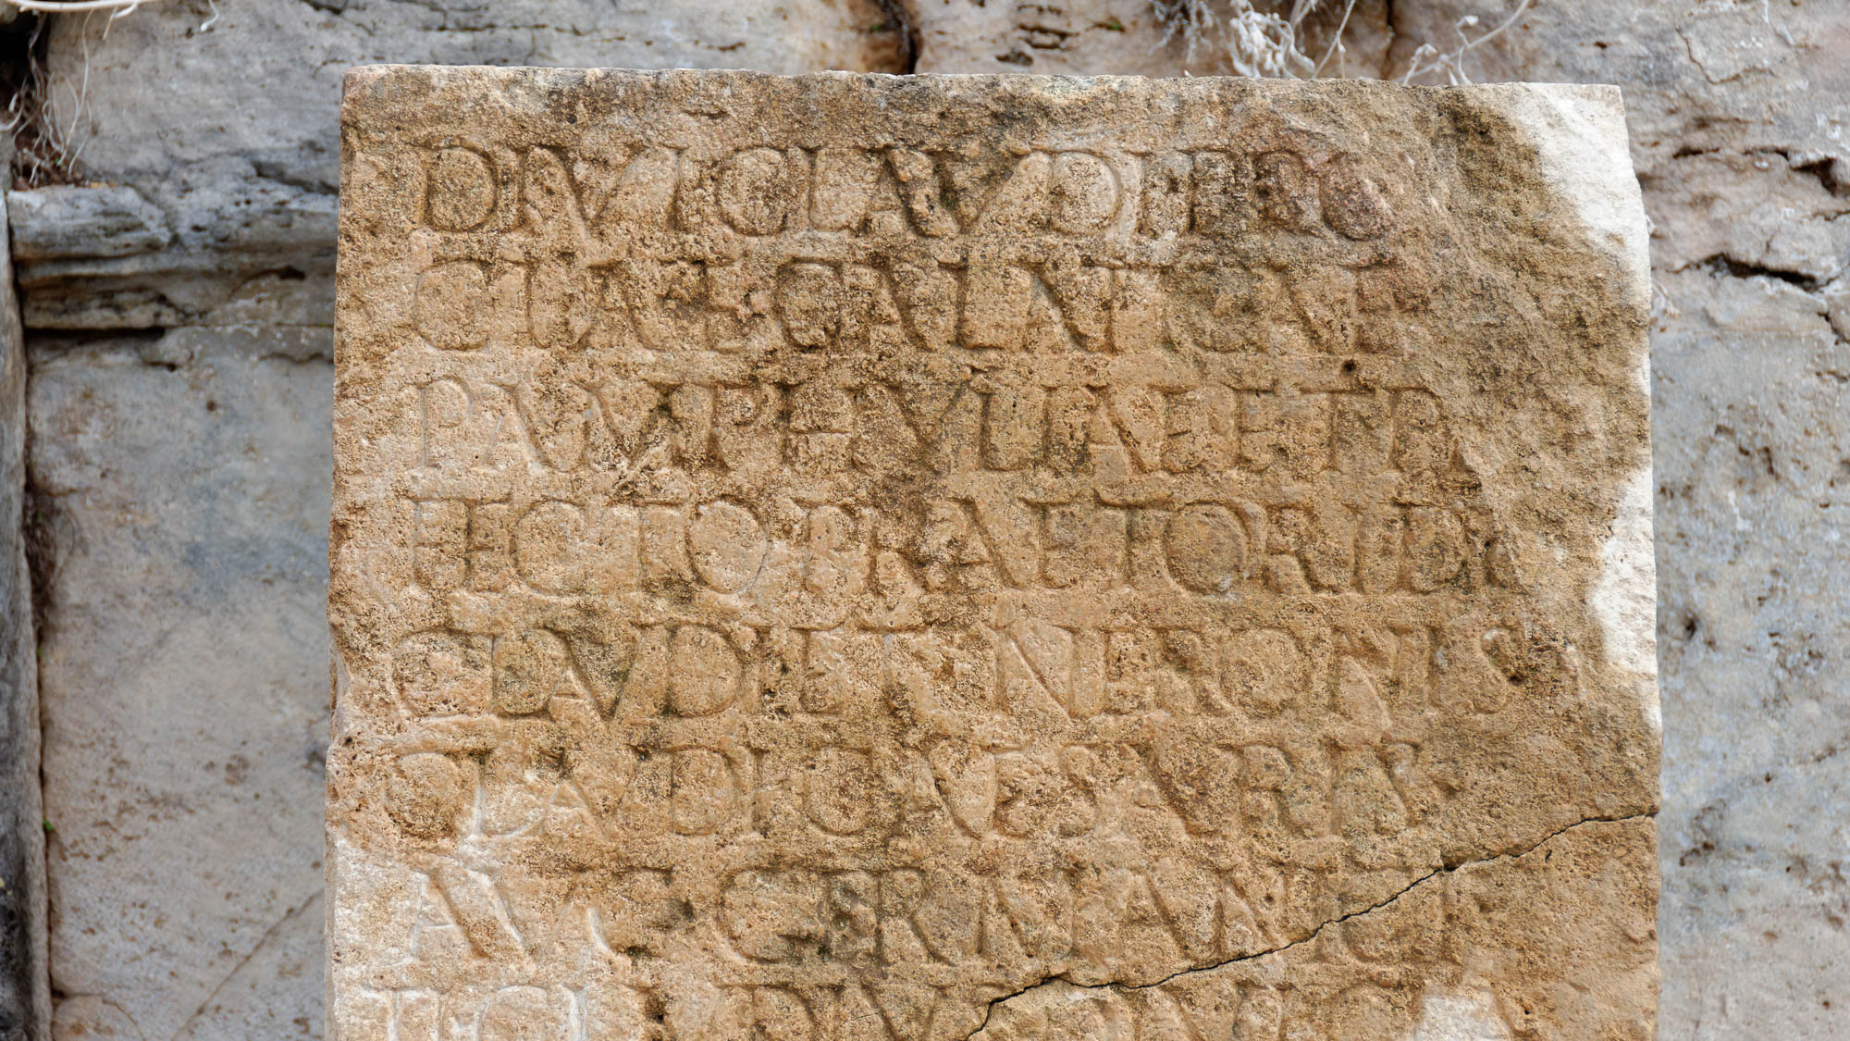
You were running well; who hindered you from obeying the truth?
Inscription mentioning Galatia, from Perga, mid-1st century AD
5:7
Notes:
The word “hinder” (Gk. enkoptō, ἐγκόπτω) literally means “to cut in” or “incise.” This literal meaning is not used in the New Testament, but it is illustrated here by an inscription from Perga that includes a reference to Galatia. Paul uses the word metaphorically to refer to preventing, interrupting, or slowing down some action. Paul’s choice of this metaphor may also be a word play connecting the “in-cutting/hindering” of the Judaizers with their insistence on circumcision (i.e., cutting in the flesh) as a requirement for salvation (cf. Acts 15:1). The Latin inscription shown here, found at Perga and dating to the mid-first century AD, honors Sextus Afranius Burrus, the governor of Galatia and Pamphylia (Lat. GALATICAE and PAMPHVLIAE). The next slide includes highlights for the word “Galatia.”
tb123016691

Slide 42

You were running well; who hindered you from obeying the truth?
Inscription mentioning Galatia, from Perga, mid-1st century AD
5:7
Notes:
The word “hinder” (Gk. enkoptō, ἐγκόπτω) literally means “to cut in” or “incise.” This literal meaning is not used in the New Testament, but it is illustrated here by an inscription from Perga that includes a reference to Galatia. Paul uses the word metaphorically to refer to preventing, interrupting, or slowing down some action. Paul’s choice of this metaphor may also be a word play connecting the “in-cutting/hindering” of the Judaizers with their insistence on circumcision (i.e., cutting in the flesh) as a requirement for salvation (cf. Acts 15:1). The Latin inscription shown here, found at Perga and dating to the mid-first century AD, honors Sextus Afranius Burrus, the governor of Galatia and Pamphylia (Lat. GALATICAE and PAMPHVLIAE). An editable version is included behind this graphic for those who may wish to change it.
tb123016691

Slide 43
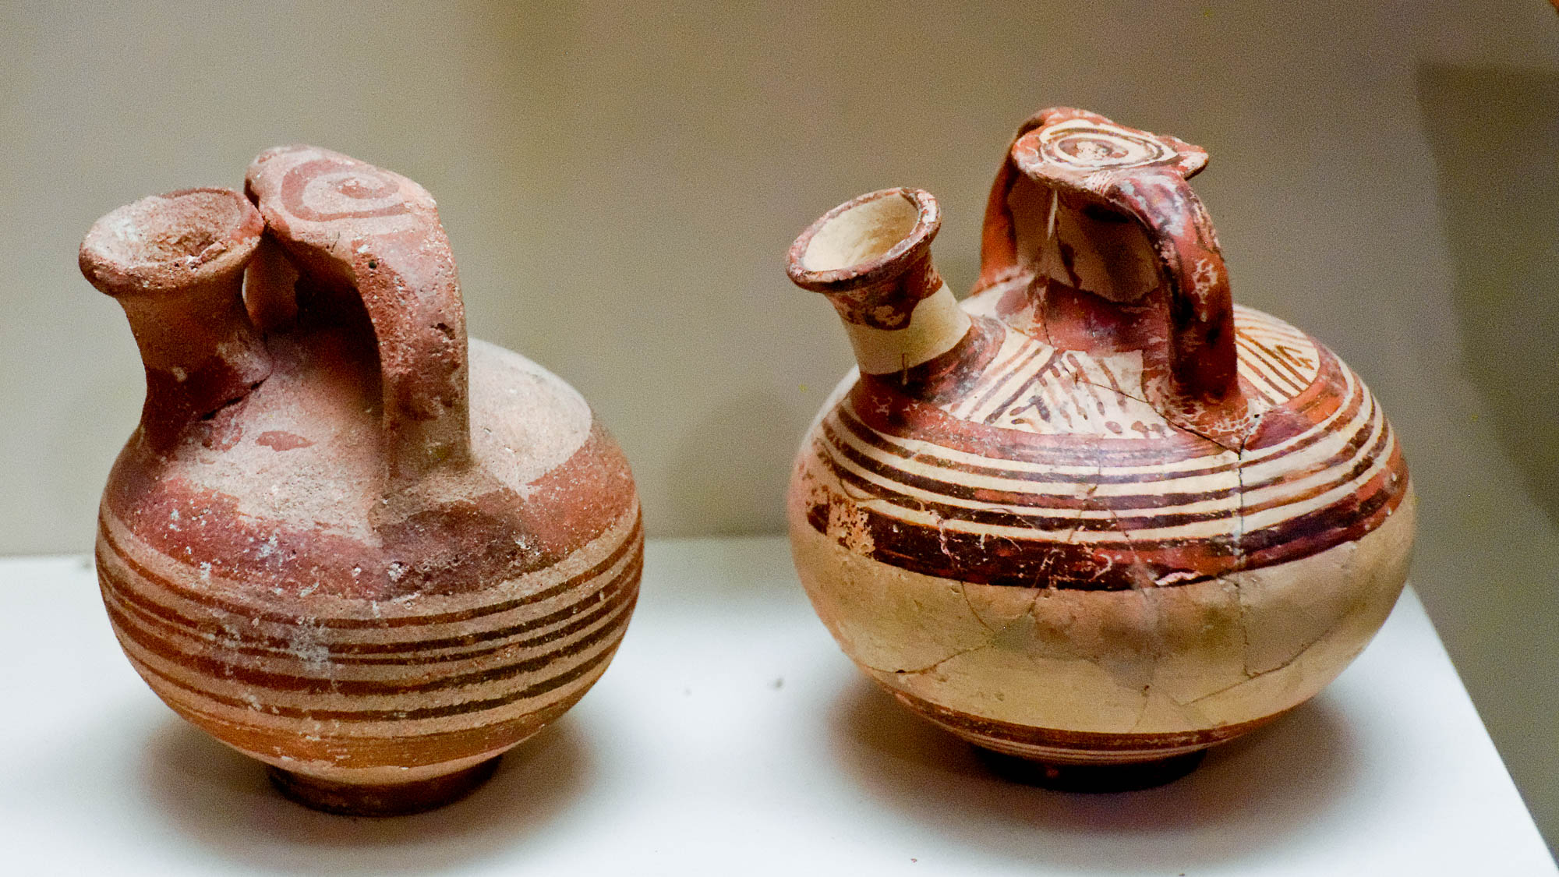
This persuasion did not originate with Him who calls you
Mycenaean stirrup jar and imitation, Late Bronze IIB–Iron IA, circa 1200 BC
5:8
Notes:
Although Paul’s adversaries were attempting to convince the Galatians that their teaching was the way that leads to life, Paul argues that it is a false way that did not originate with God. This is illustrated here by two Mycenaean stirrup jars; the one on the right is an authentic jar, while the one on the left is an ancient imitation. Although they share similarities, when placed side-by-side, it becomes evident that both are not authentic.
It may be further noted that these jars are sometimes referred to as “false-neck jars,” since the neck attached to the handles is actually solid. Paul has previously argued in the letter to the Galatians that the Mosaic Law, although part of Jewish history, never provided freedom from sin, but was only a “schoolmaster” to lead to the real solution, Jesus Christ (Gal 3:21-26). Similarly, both necks on a stirrup jar are attached to the body of the vessel, but only one provides access to the contents. These jars were photographed at the University of Pennsylvania Museum of Archaeology and Anthropology.
tb072311685h

Slide 44
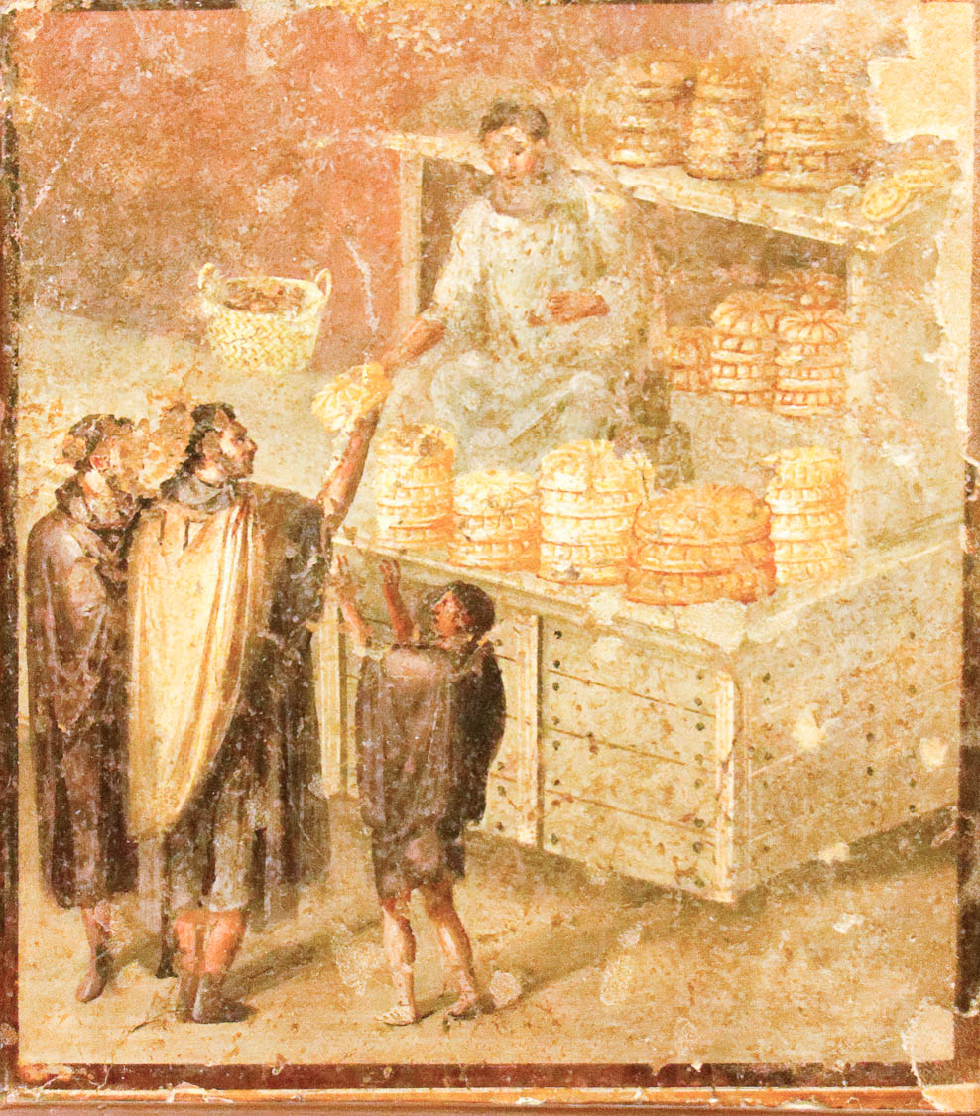
A little leaven leavens the whole lump
Painting of a baker’s shop in Pompeii, 1st century AD
5:9
Notes:
Paul uses the word picture of leaven in bread to again argue that the Law is a whole, and requiring adherence to one part of it will inevitably lead to the requirement to follow all of it. Leavened bread was a staple of the Roman diet in Paul’s day. This fresco depicts a baker’s shop in the Roman city of Pompeii; the baker is selling the typical round loaves that were common at that time. About 34 bakeries have been discovered so far in Pompeii, some large enough to bake 80 loaves at a time in a single oven. This fresco was photographed at the Naples Archaeological Museum.
tb0515170859h

Slide 45
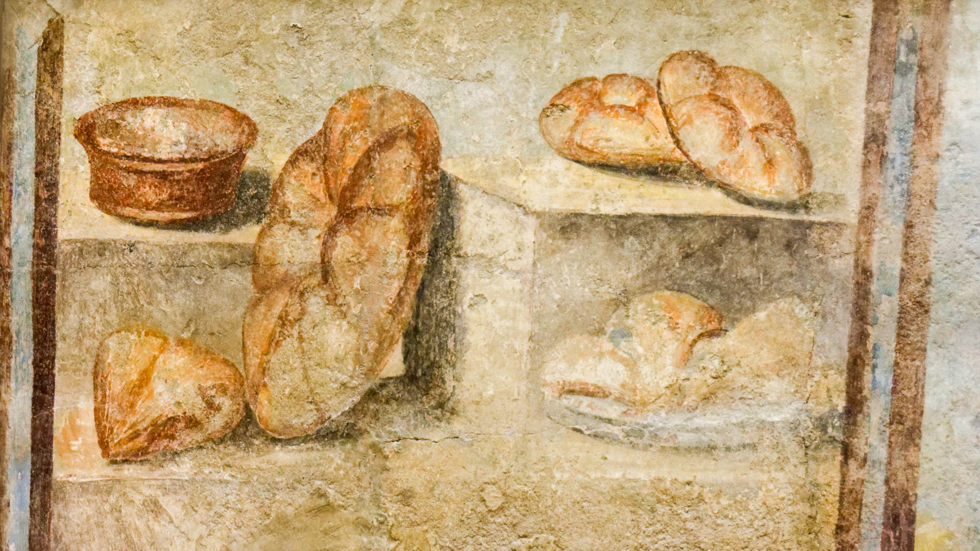
A little leaven leavens the whole lump
Bread depicted on a fresco, from the estate of Julia Felix in Pompeii, 1st century AD
5:9
Notes:
The bread portrayed on this fresco from Pompeii is typical of the kinds of loaves that were commonly eaten in this region. Actual carbonized loaves of bread recovered from Pompeii have this same basic shape (see the following slide). This fresco was photographed at the Naples Archaeological Museum.
tb0515170271h

Slide 46
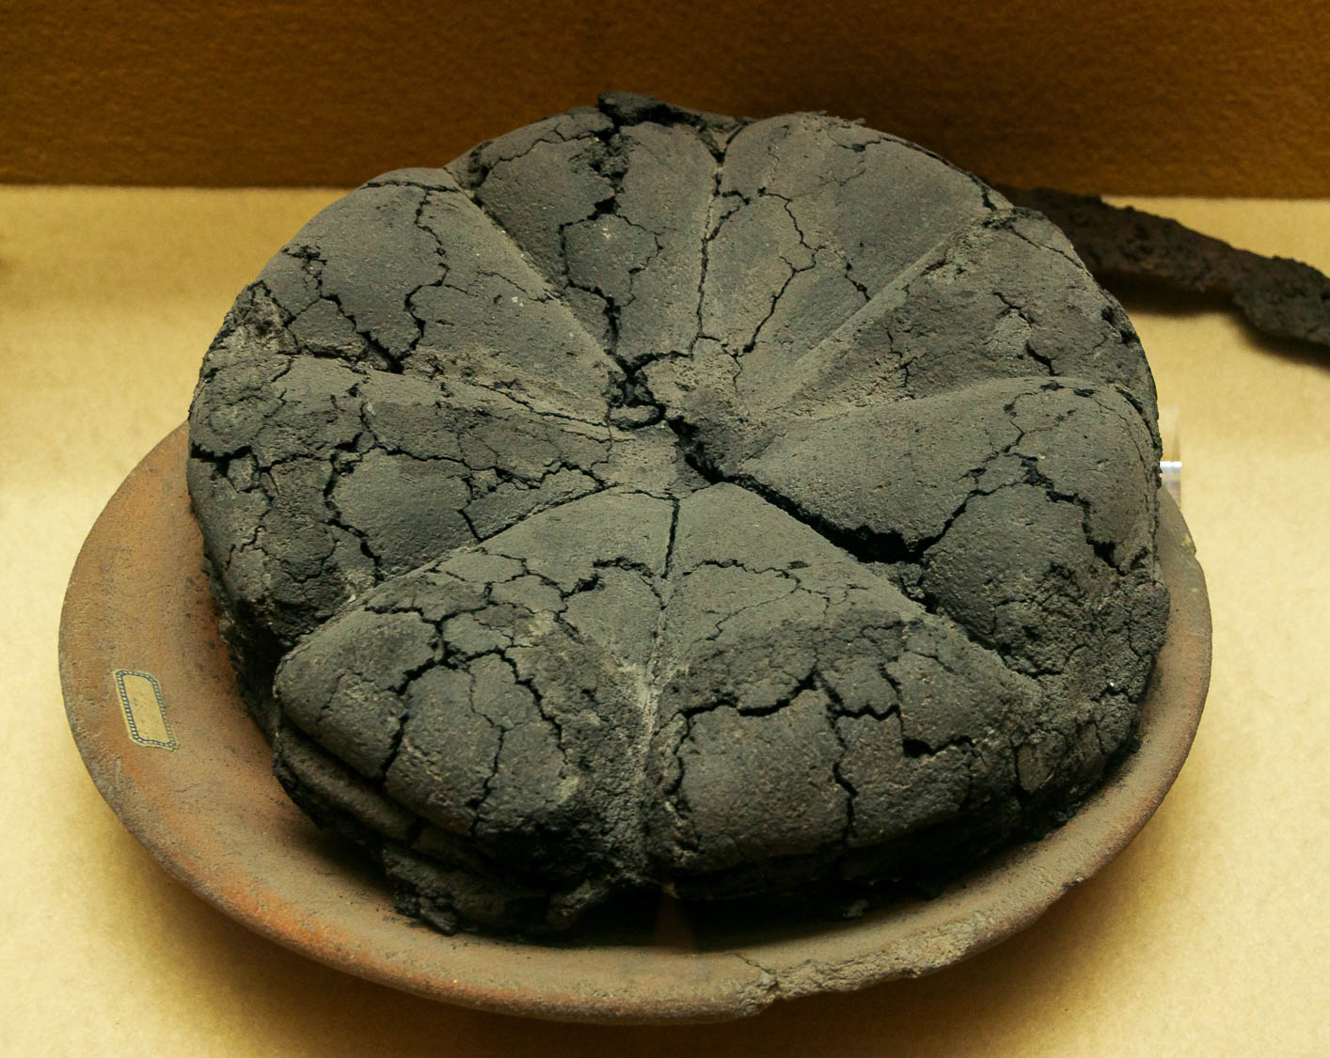
A little leaven leavens the whole lump
Loaf of carbonized bread, from Pompeii, AD 79
5:9
Notes:
This loaf of carbonized bread was recovered from Pompeii, the Roman city that was destroyed by the volcanic eruption of Mount Vesuvius in AD 79. Loaves like this were baked in a mold that allowed them to be segmented and literally “broken” into triangle-shaped pieces. The thickness of this loaf clearly shows that it was leavened bread. This ancient bread was photographed at the Pompeii Museum Boscoreale. This image comes from Jebulon and is in the public domain, via Wikimedia Commons: https://commons.wikimedia.org/wiki/File:Ancient_roman_bread_Pompeii_Museum_Boscoreale.jpg.
wiki07232015131926h

Slide 47
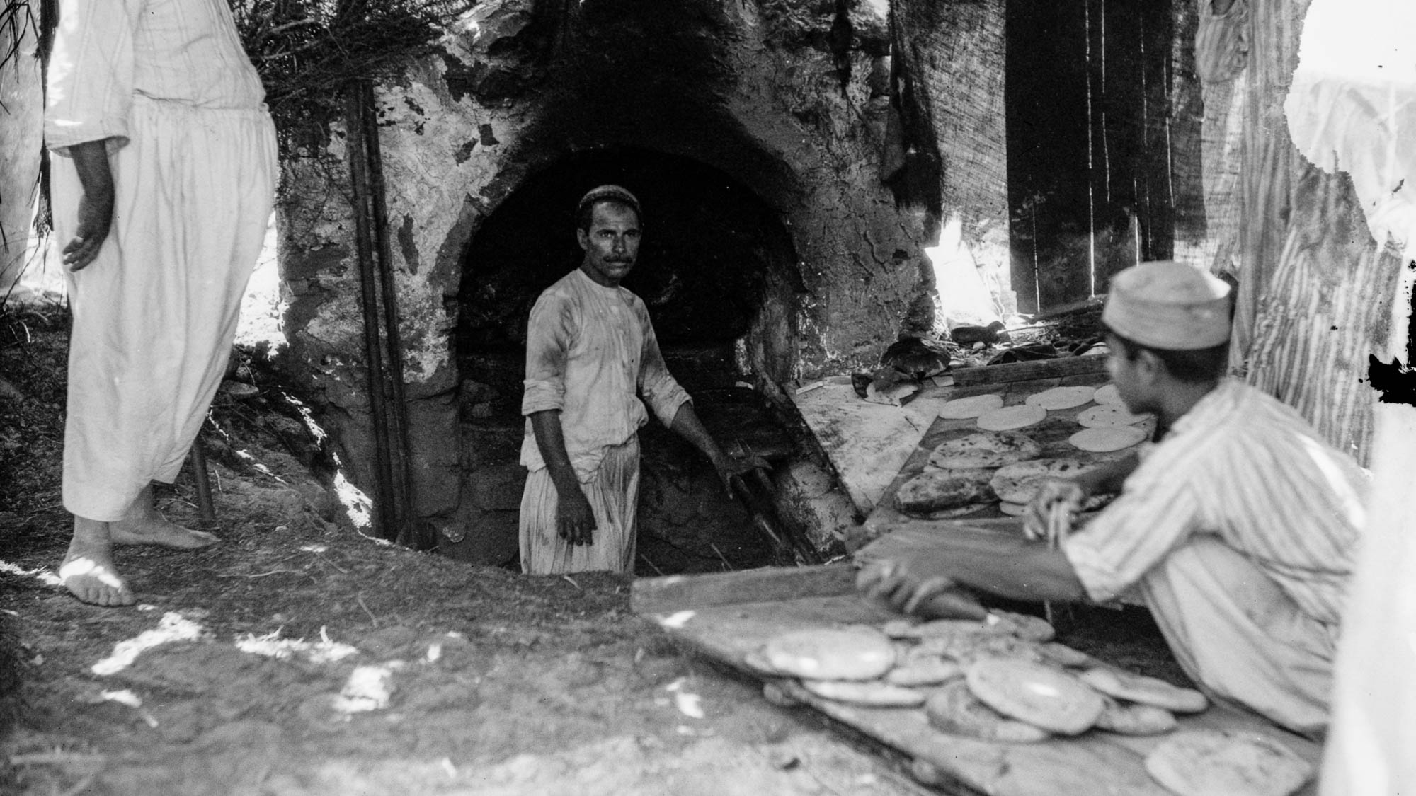
A little leaven leavens the whole lump
Men baking bread at Nebi Ruben near Jaffa
5:9
Notes:
This scene of men making fresh bread approximates what Paul and his audience would have witnessed in their daily lives. This American Colony photograph was taken in 1930.
mat21959

Slide 48
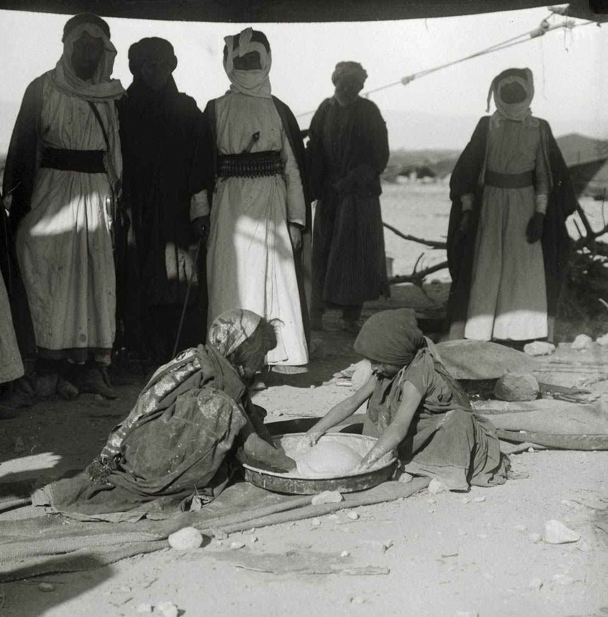
A little leaven leavens the whole lump
Girls kneading dough at a Bedouin wedding, circa 1910
5:9
Notes:
A lump of bread could be leavened by kneading a lump of fermented dough from a previous batch into a new one (cf. Matt 13:33). This American Colony photo was taken between 1900 and 1920.
mat01334

Slide 49
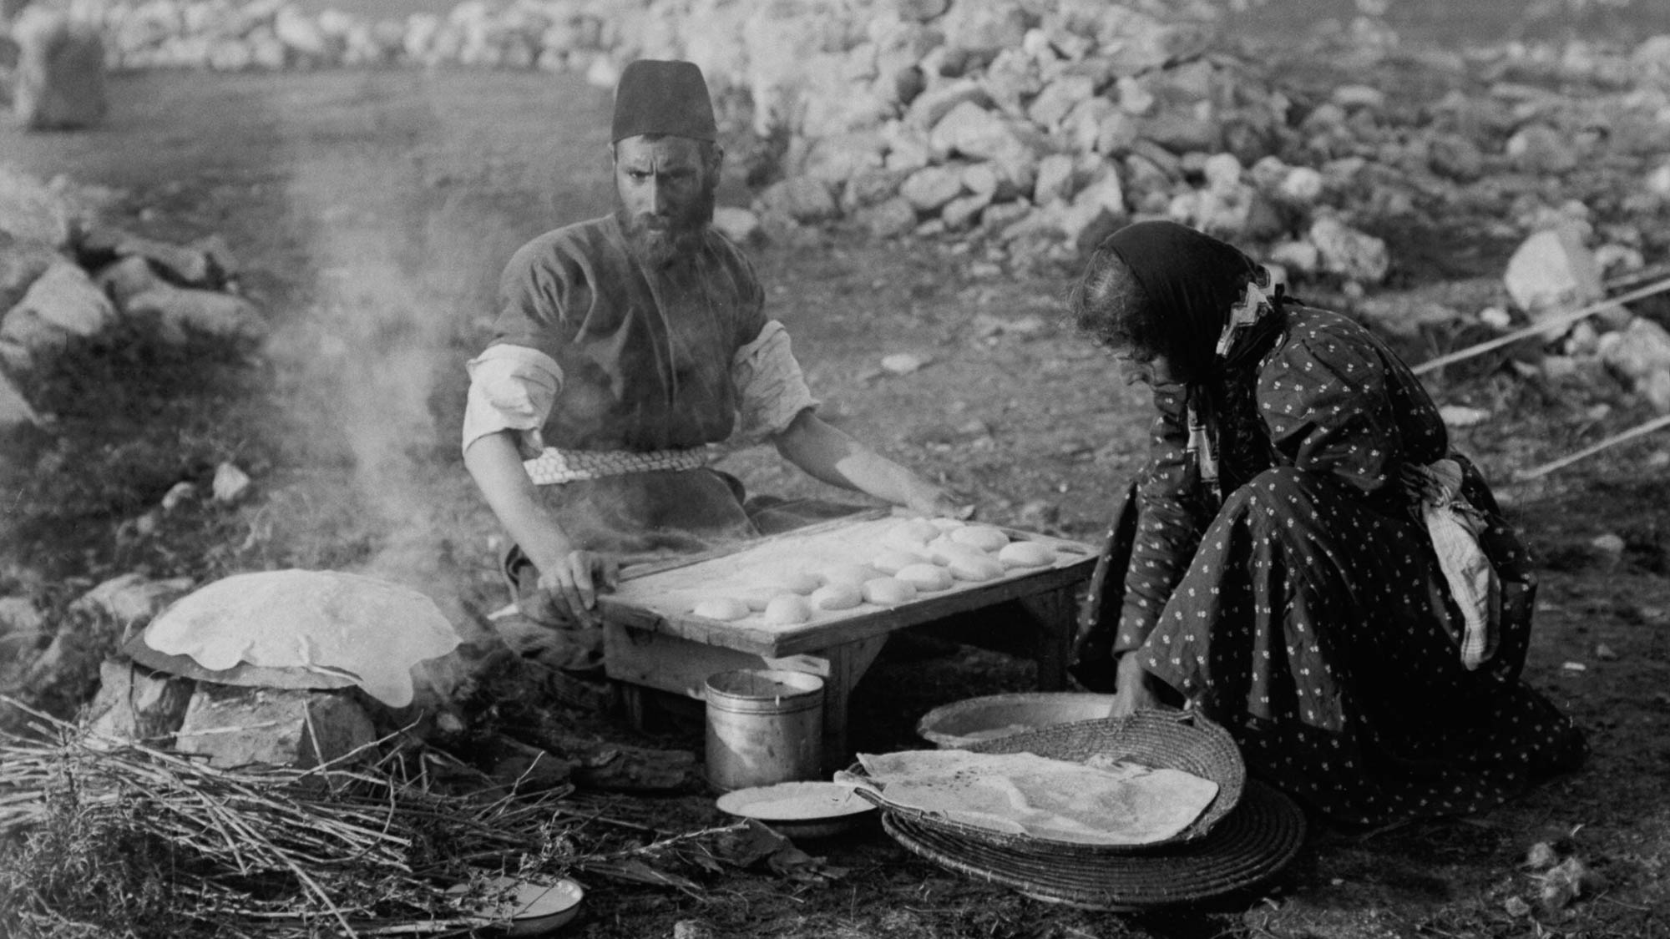
A little leaven leavens the whole lump
Unleavened bread being baked for the Samaritan Passover
5:9
Notes:
The command to eat unleavened bread for Passover signified haste and affliction (Exod 12:11, 34; Deut 16:3). However, the ability of even a small amount of leaven to permeate an entire lump of dough makes it a useful metaphor for sin. Paul used a similar metaphor when he referred to the unleavened bread of Passover in 1 Corinthians 5:6-8.
mat01842

Slide 50
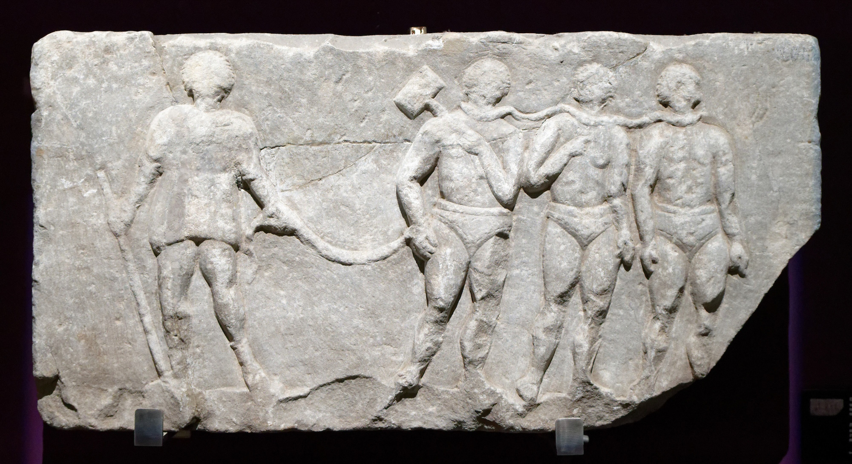
The one who is disturbing you will bear his judgment, whoever he is
Relief of prisoners, from Miletus, 2nd–3rd centuries AD
5:10
Notes:
Paul voices his conviction that whoever is attempting to mislead the Galatian believers will be brought to justice, illustrated here by prisoners being led by their warden. Paul clearly believed that although justice had not yet been served, it would be eventually; in time his teaching would be shown to be correct, while the words of his adversaries would prove false. This relief was photographed at the Istanbul Archaeological Museum.
tb122922407

Slide 51
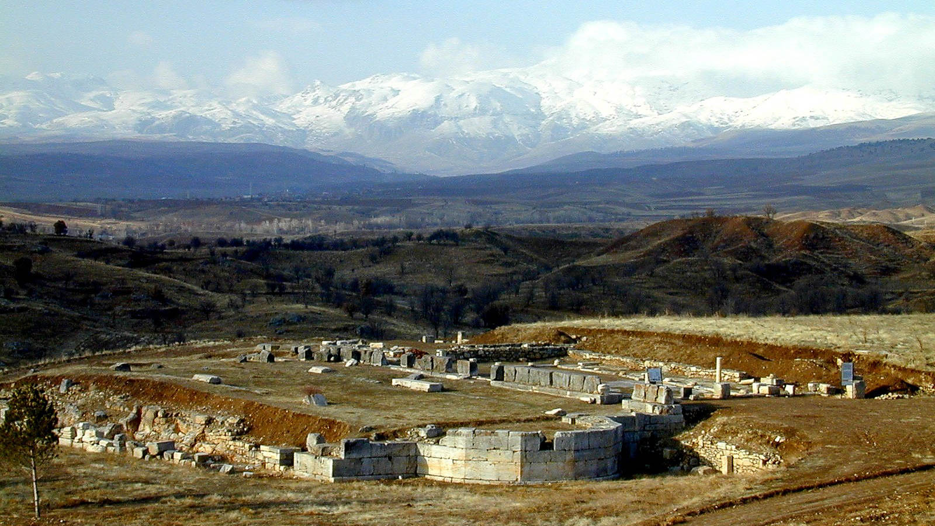
But I, brethren, if I still preach circumcision, why am I still persecuted?
Church of St. Paul in Pisidian Antioch, 4th century AD
5:11
Notes:
Paul makes reference to persecution he suffered as one who rejected the requirement of circumcision. On the southern Galatian theory (see slides on Gal 1:1-2), the persecution to which Paul refers may be the events recorded in Acts 13–14. An episode of Jewish resistance to the gospel occurred in Pisidian Antioch (Acts 13:14, 45-50). The Church of St. Paul, constructed in the 4th century AD, was possibly built over a synagogue from the first century AD. If this was the synagogue mentioned in Acts 13:14, this could be one of the very locations he had in mind when he wrote of his persecution at the hand of Jewish opponents who were troubling the Galatians.
tb010201820

Slide 52
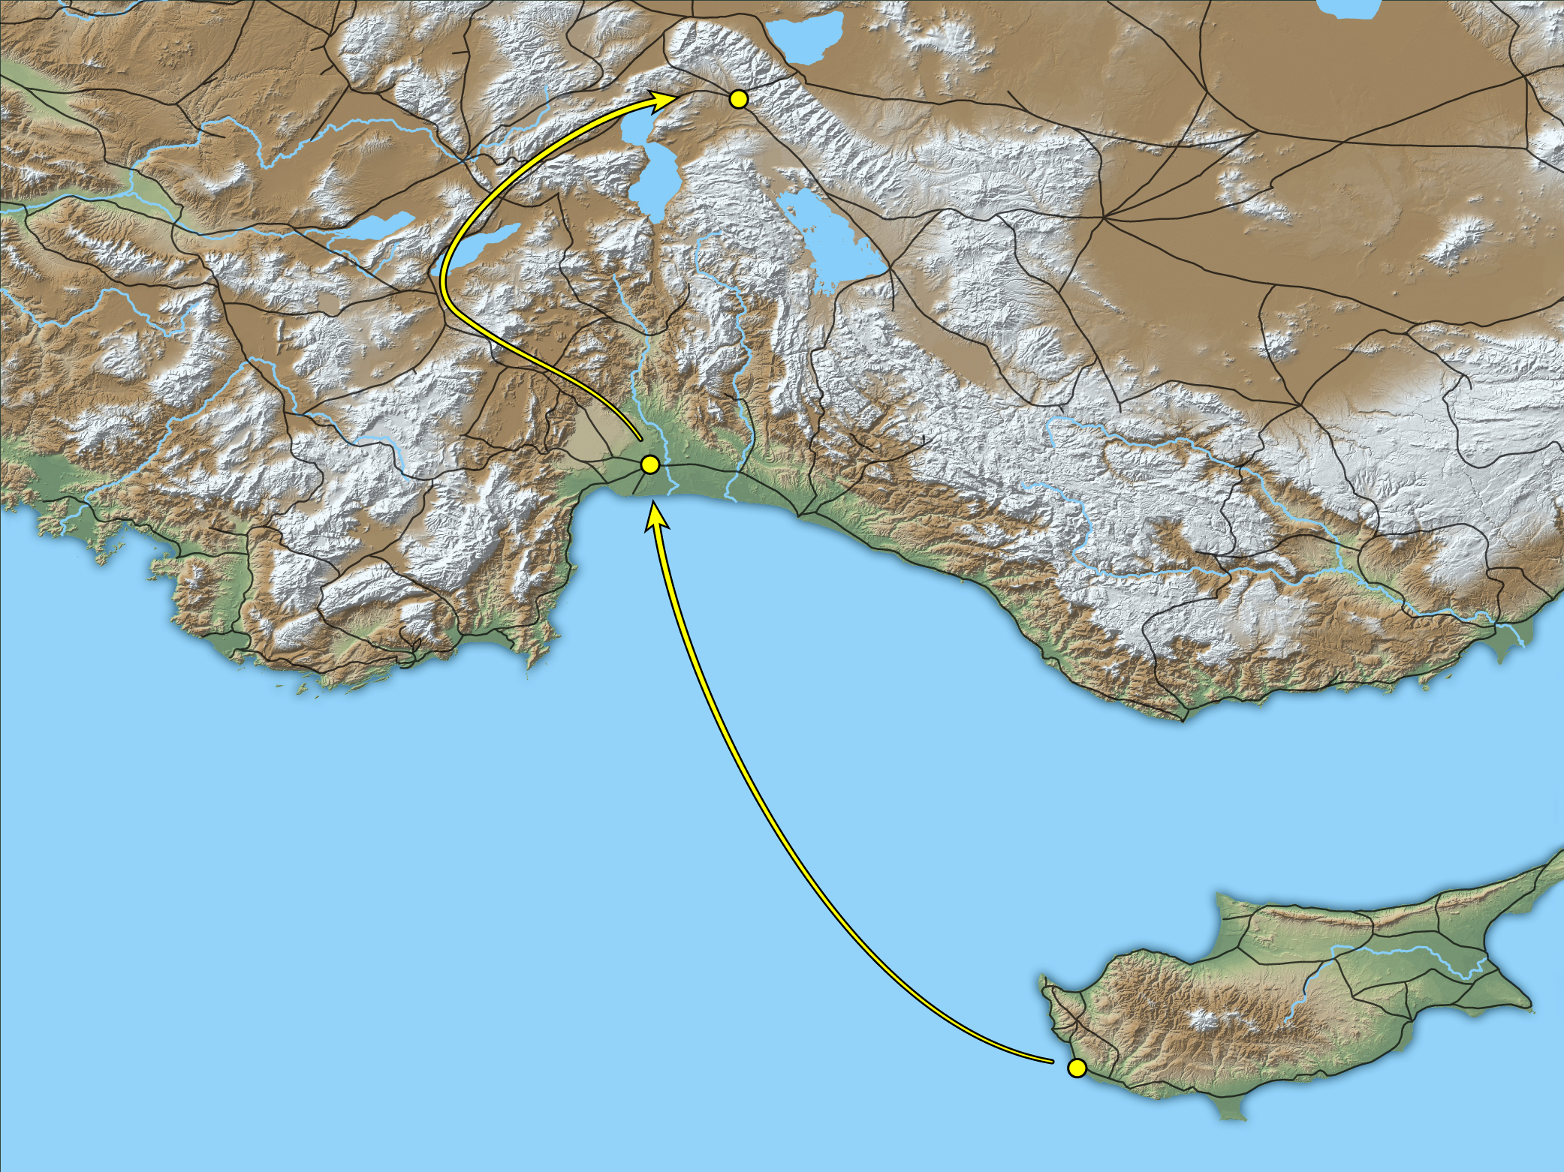
But I, brethren, if I still preach circumcision, why am I still persecuted?
Pisidian Antioch
Perga
Paphos
Map showing the route from Perga to Pisidian Antioch
5:11
Notes:
This map shows Paul’s likely route to Pisidian Antioch on the Via Sebaste. For more details about this route, see the following slides. This map was created by A.D. Riddle, RiddleMaps.com. Data sources: Ancient World Mapping Center shapefiles were used for road lines, under Open Database License (ODbL 1.0; http://awmc.unc.edu/wordpress/map-files/). ASTER-GDEM 2 or SRTM data were used to render the terrain (https://asterweb.jpl.nasa.gov/gdem.asp and https://www2.jpl.nasa.gov/srtm/). Natural Earth was used for streams and inland water bodies. Their data have been placed in the public domain. https://www.naturalearthdata.com/about/terms-of-use/.

Slide 53
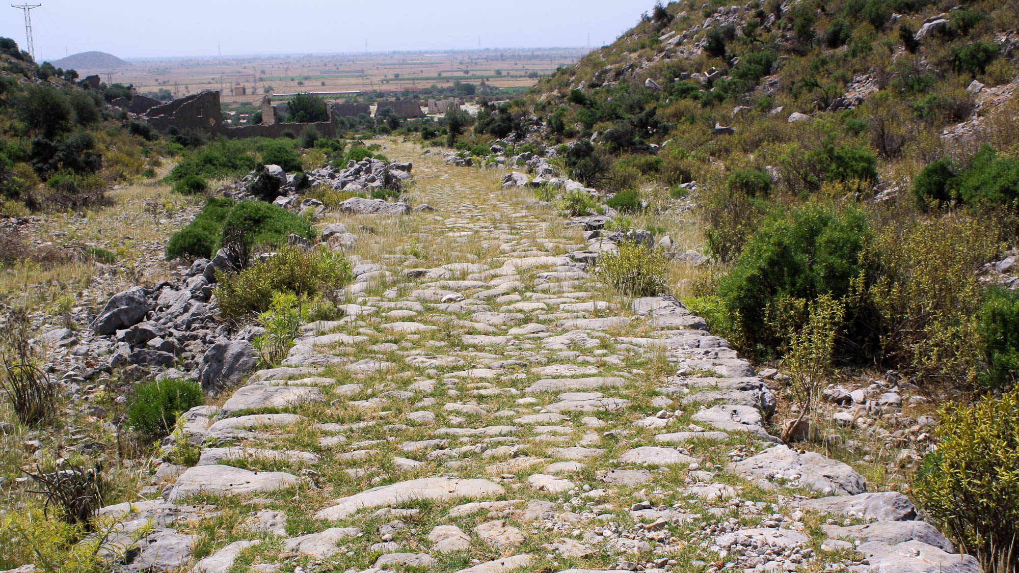
But I, brethren, if I still preach circumcision, why am I still persecuted?
Via Sebaste ascending from the Pamphylian plain, northwest of Perga
5:11
Notes:
Since Galatians was most likely written after Paul’s first missionary journey, the persecution mentioned here refers to his opposition on that trip. This photograph shows the most likely route Paul traveled on his way from Perga to Pisidian Antioch, the Via Sebaste. Though at 156 miles (251 km) it is longer than the central (114 miles; 183 km) and eastern (149 miles; 240 km) routes, it was the easiest, fastest, and probably the safest route. For more details on these three routes, see Mark Wilson, “The Route of Paul’s First Journey to Pisidian Antioch,” New Testament Studies 55 (2009): 471–83. This photo was provided by Mark Wilson.
mw061310023

Slide 54
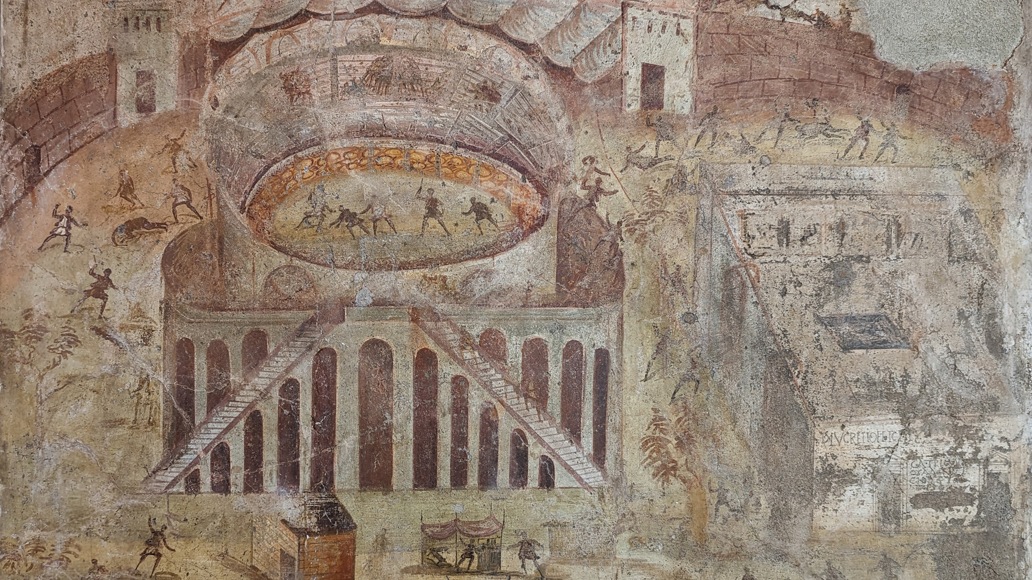
But I, brethren, if I still preach circumcision, why am I still persecuted?
Fresco of a riot in the amphitheater of Pompeii, from Pompeii, AD 59
5:11
Notes:
According to Acts 13:50, Paul’s opponents stirred up persecution against Paul and Barnabas because of the gospel. This fresco depicts a riot in the city of Pompeii. Though it is not depicting persecution against Christians, it provides an illustration of the kind of violence sometimes occurred in Greco-Roman cities. In later years, many Christians faced death at the hands of men and wild beasts in Roman amphitheaters. This fresco was photographed at the Naples Archaeological Museum.
ku0622230900450

Slide 55
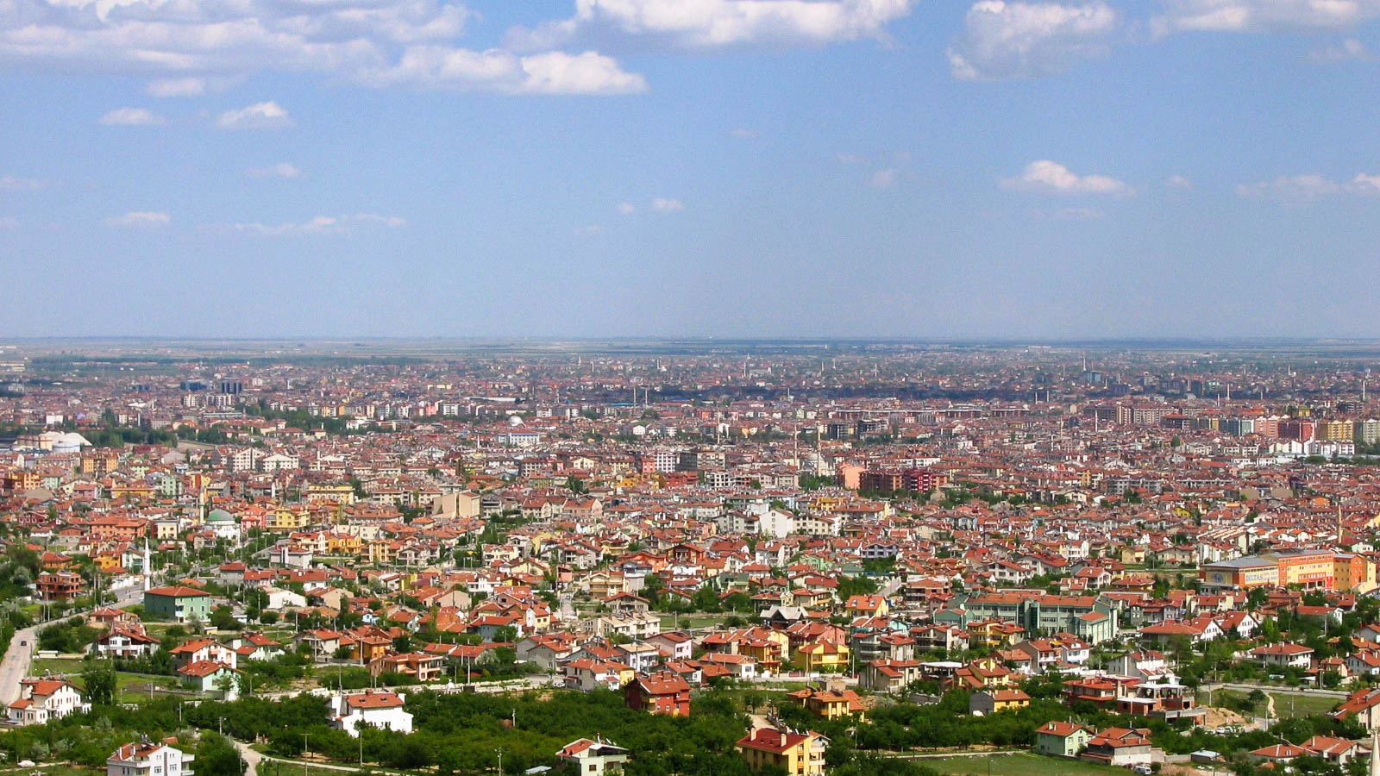
But I, brethren, if I still preach circumcision, why am I still persecuted?
Iconium, modern Konya
5:11
Notes:
Another location where Paul faced persecution during his ministry in Galatia was Iconium. It was here that Paul once again faced unbelieving Jews who threatened to stone him (Acts 14:2, 5-6). This was during Paul’s first visit to Iconium, a city with the distinction of being visited by Paul on all three of his known missionary journeys. By the end of the first century AD, Iconium had a Christian population. Unfortunately, there is little to see there archaeologically today, since the ancient city’s remains are covered by the modern city of Konya.
mw051106105h

Slide 56
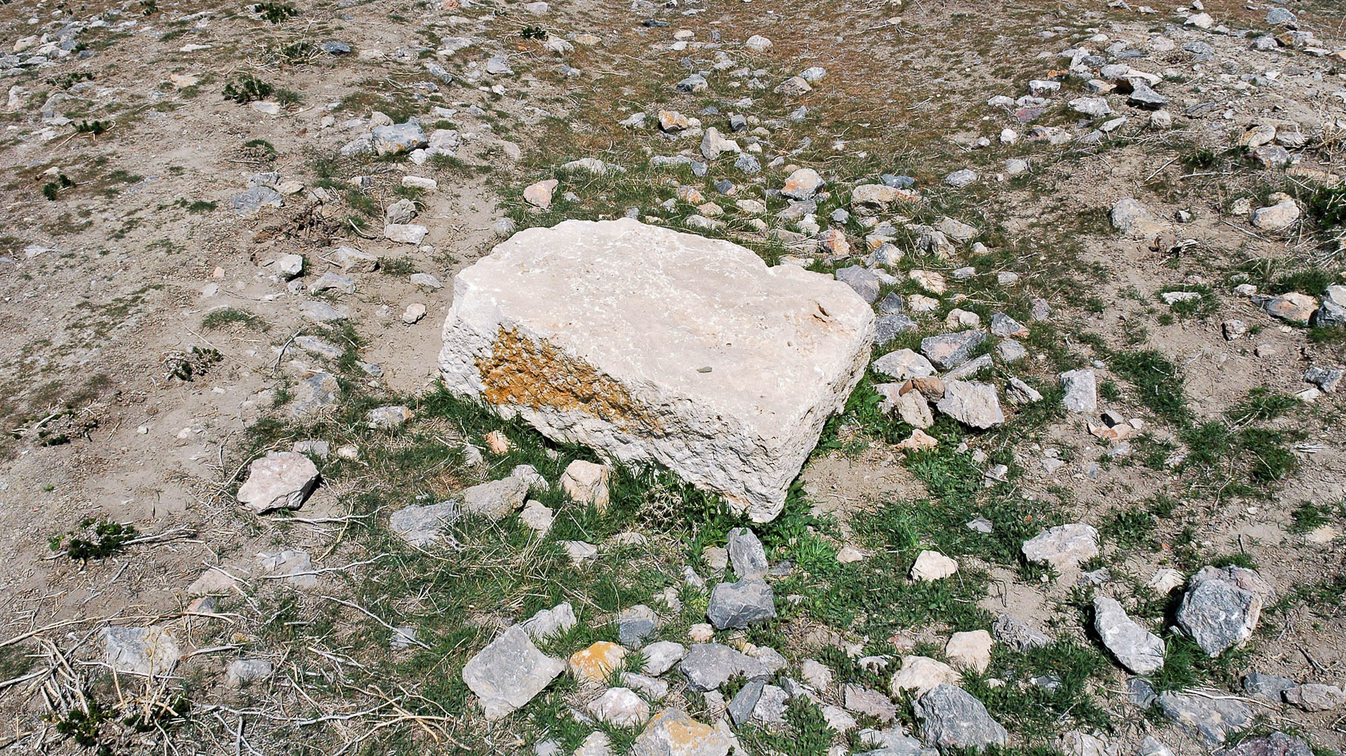
But I, brethren, if I still preach circumcision, why am I still persecuted?
Stones on the surface at Derbe
5:11
Notes:
The city of Derbe is two stops further from Iconium on Paul and Barnabas’s journey through Galatia. This image provides an illustration of what the scene might have looked like as the people of Iconium plotted to stone the apostle and his companions (Acts 14:5).
tb041105412

Slide 57

But I, brethren, if I still preach circumcision, why am I still persecuted?
Lystra (from the northwest)
5:11
Notes:
Paul’s Jewish opposition finally succeeded in stoning him in Lystra (Acts 14:17). Lystra was a market-town in the region of Lycaonia. In 25 BC, Augustus made Lystra a Roman colony in order to protect routes into the Taurus Mountains, and he decided that a Roman road (called the “Imperial Road”) should be built between Lystra and Pisidian Antioch. During this time, a temple to Zeus was also constructed at Lystra, and it would have been standing when Paul was there—indeed, it is referenced in Acts 14:13.
tb041105496

Slide 58

But I, brethren, if I still preach circumcision, why am I still persecuted?
Sling stones from either Herodium or Jerusalem, AD 70
5:11
Notes:
These sling stones illustrate the ancient use of stones to inflict physical harm. With a slinger who knew how to handle his sling, these small stones were quite deadly. They could be used in hunting or in battle. While the text does not mention the use of slings in the stoning of Paul, the stones may have been similar in size. This display was photographed at the Israel Museum.
tb061616963

Slide 59

But I, brethren, if I still preach circumcision, why am I still persecuted?
Stones on the surface at Lystra
5:11
Notes:
This photo shows some of the stones lying on the surface at Lystra where Paul was stoned.
tb041105516

Slide 60

But I, brethren, if I still preach circumcision, why am I still persecuted?
Mourners carrying a dead man, depicted on a sarcophagus fragment, mid-2nd century AD
5:11
Notes:
The man being carried in this relief is dead; Paul also appeared to be dead after he was stoned at Lystra (Acts 14:19). Remarkably, this was not Paul’s only near-death experience; he mentions another in 2 Corinthians 1:8. Nevertheless, nothing could stifle his joy in Jesus and his anticipation of God’s kingdom. At the same time, this persecution was so traumatic that Paul even recalled it near the end of his life (2 Tim 3:11). This image comes from The Metropolitan Museum of Art and is in the public domain. Source: https://www.metmuseum.org/art/collection/search/250926
met250926h

Slide 61

Then the offense of the cross has been abolished
Display of three crosses at Tantur
5:11
Notes:
Paul argued that the work of Christ on the cross was not necessary if salvation had come through the Mosaic Law. The “offense” of the cross was, at least in part, that it showed the requirements of the Law to be insufficient for salvation. This idea provoked hostility and opposition from those who believed that the Law itself could provide life. The crosses shown in this photo may be a more historically accurate representation of ancient crosses than what is typically found in medieval and modern art. They were photographed at the Biblical Gardens at Tantur, midway between Jerusalem and Bethlehem.
tbs80019402e

Slide 62

Then the offense of the cross has been abolished
Dirt path with rocks, near Kanaf
5:11
Notes:
The word “offense” (Gk. skandalon, σκάνδαλον) refers to something that causes offense or revulsion and results in opposition, disapproval, or hostility. Paul uses the same word in Romans 9:32-33 when he cites Isaiah 8:14 to identify Jesus as a “rock of offense” (Gk. petran skandalou, πέτραν σκανδάλου). This aligns with what Jesus said of Himself (cf. Matt 11:6; Luke 7:23). The path shown in this photo is strewn with rocks that could easily cause someone to stumble, a literal illustration of Paul’s metaphor. The Sea of Galilee is visible in the background of this photo.
tb053016713

Slide 63

Then the offense of the cross has been abolished
Mountain path leading toward Bethlehem
5:11
Notes:
Although rocks were often removed from ancient footpaths, stones over which one could stumble were often present, as is the case with the path in this photo. This American Colony photo was taken between 1920 and 1933.
mat02610h

Slide 64

Then the offense of the cross has been abolished
Roman road and steps at the Ascent of Scorpions (Maale Aqrabbim)
5:11
Notes:
This photo shows what remains of the Roman road at the Ascent of Scorpions. Steps have been cut into the path at some points to ease travel, but even these steps could cause the absent-minded traveler to stumble.
tb010712170

Slide 65

Then the offense of the cross has been abolished
Isaiah 8:14 on the Great Isaiah Scroll
5:11
Notes:
The section of Isaiah to which Paul alludes in Romans 9:33, and probably also in this verse, is shown here on the Great Isaiah Scroll. The Great Isaiah Scroll is one of the oldest and most complete of the Dead Sea Scrolls. It dates to the 2nd century BC. “And he shall be for a sanctuary; but for a stone of stumbling and for a rock of offence to both the houses of Israel, for a gin and for a snare to the inhabitants of Jerusalem” (Isa 8:14, ASV). The Great Isaiah Scroll is owned by the Israel Museum in Jerusalem. This image is in the public domain, from Wikimedia: https://commons.wikimedia.org/wiki/File:The_Great_Isaiah_Scroll_MS_A_(1QIsa)_-_Google_Art_Project-x3-y0.jpg
isax3y0

Slide 66

Then the offense of the cross has been abolished
Pendant with wood from the “True Cross,” from Jerusalem, 7th century AD
5:11
Notes:
Unlike their Jewish counterparts, followers of Jesus found comfort and encouragement in the cross. The cross became one of the best-known signs of Christianity. In some cases, it even took on an unhealthy aspect when pilgrims sought pieces of the cross that they could take home to revere. This Byzantine cross was purportedly made of wood from the true cross, illustrating both the great significance of the cross for Christianity as well as excessive veneration for it as a physical talisman. This pendant was photographed at the Israel Museum.
tb061616921h

Slide 67

Oh that those who trouble you would cut off themselves
Attis statuette, from Palazzo Altieri
5:12
Notes:
Most commentators see in Paul’s use of the phrase “cut off themselves” (Gk. apokoptō, ἀποκόπτω) the implication of castration. This word was sometimes used to refer to eunuchs who have been castrated (e.g., LXX Deut 23:2). Gentiles in the ancient Roman Empire viewed circumcision as mutilation. Paul appears to utilize that background as a springboard to affirm that requiring circumcision would be just as profitable for salvation as mutilating oneself to the point of castration. This photo shows a Roman period marble statue of Attis, the consort of Cybil, who was worshiped in the Roman period by certain cults, particularly in Phrygia, the same general area as Paul’s Galatian audience. Worshipers of Attis were sometimes known to castrate themselves as part of their cultic ritual, and the priests of Attis were eunuchs. These practices would have likely been known to Paul’s audience. This statue was photographed at the Vatican Museums.
tb0512176545

Slide 68

Oh that those who trouble you would cut off themselves
Relief showing eunuchs flanking the Assyrian king Ashurnasirpal II, from Nimrud, 9th century BC
5:12
Notes:
Paul’s Judaizing opponents would have taken exception to being associated with castration, since those with mutilated genitalia (such as eunuchs) would be excluded from temple worship (Deut 23:1). Perhaps this is the very implication Paul wanted them to infer. Eunuchs were commonly used in the Assyrian royal court; they can be identified in reliefs such as the one shown here by their beardless faces. This relief was photographed at the British Museum.
adr1805194587

Slide 69

Oh that those who trouble you would cut off themselves
Painted relief of eunuchs, from the façade of the throne room in Dur-Sharrukin, circa 710 BC
5:12
Notes:
This depiction of Assyrian court eunuchs was photographed at the Oriental Institute Museum at the University of Chicago.
adr060218016

Slide 70

For you, brothers, were called for freedom
Manumission inscriptions on the Polygonal Wall at the Sanctuary of Apollo at Delphi
5:13
Notes:
Manumission, the liberation of a slave, was a well-known practice in the Greco-Roman world. In Paul’s day, manumission had to be guaranteed by a god, most commonly Apollo, so that the liberation could not be retracted. The slave would present their money (the purchase price) to the temple treasury; the priests would then give the money to the slave owner (the “lord” or “master,” Gk. kurios, κύριος). Thus the slave was considered to be the property of the god; he was not considered a slave of the temple, but a protégé of the god. He was then under the patronage, protection, and care of his god. From a civil perspective, he was a completely free man.
The rite of manumission took place before witnesses, and at Delphi it was recorded in stone. Some 1,300 such inscriptions may be found at Delphi, most dating between 200 BC and AD 100. Many of them are recorded on the polygonal stones that form the base of the Temple of Apollo. The next slide includes a close-up view of one of these inscriptions.
tb031606631

Slide 71

For you, brothers, were called for freedom
Manumission inscriptions on the Polygonal Wall at the Sanctuary of Apollo at Delphi
5:13
Notes:
This photo is of a manumission inscription on the polygonal stones that form the base of the Temple of Apollo. The slave is mentioned in all of these manumission inscriptions simply as “the body” (Gk. sōma, σῶμα). The inscriptions usually include the names of witnesses and also often the names of priests of the temple. The price paid varied according to the value of the slave. As one example, a young girl was manumitted (perhaps by her parents, who were also slaves) for the price of two silver minas, which amounts to about 2.5 pounds (1.14 kg) of silver. This is one of the lowest prices recorded at Delphi.
tb031606633h

Slide 72

For you, brothers, were called for freedom
Relief depicting the manumission of two slaves, 1st century BC
5:13
Notes:
Slaves across the Roman world were freed for a variety of reasons, and they were not required to visit Delphi to receive manumission. In another common form of manumission, the master brought his slave before the local magistrate. After appropriate pronouncements by the master, the lictor of the magistrate would lay a rod on the head of the slave and would declare him to be free. In the Roman period, the head would be shaved and the former slave would be given a brimless, felt cap (pileus) to wear as a sign of liberty. The two newly-freed men in this relief both wear a pileus as a sign of their manumission; the lictor can be seen in the background with his rod over his shoulder. This marble relief was photographed at the Musée Royal de Mariemont in Belgium. This image comes from Ad Meskens and is licensed under CC BY-SA 4.0, via Wikimedia Commons: https://commons.wikimedia.org/wiki/File:Mariemont_manumission_relief_02.JPG.
wiki07312015114745h

Slide 73

Through love serve one another
Fresco of a banquet scene with servants carrying trays, from Pompeii, 1st century AD
5:13
Notes:
This fresco from the House of Joseph at Pompeii depicts acts of service in a domestic setting. This fresco was photographed at the Naples Archaeological Museum.
tb0515170192

Slide 74

Through love serve one another
Fresco wall fragment showing the butchering of an animal, AD 50–75
5:13
Notes:
The two men shown in this fresco are cooks in a wealthy household and therefore are likely slaves. This fresco was photographed at the Getty Villa in southern California.
tb100919649c

Slide 75

Through love serve one another
Italic statuette of a running servant, 300–200 BC
5:13
Notes:
This bronze figurine was photographed at the Getty Villa in southern California.
tb100919748

Slide 76

Through love serve one another
Funerary stele of C Vibius Threptus, son of a public servant, from Rome, late 1st century AD
5:13
Notes:
The function of servant was quite important in the ancient world and often came with a significant level of prestige, as attested by the numerous stelae and statuary depicting servants in the ancient world. The first century AD stele pictured here belonged to a certain C Vibius Threptus, who worked in the office of census. As honorable as the position of a civil servant was, it always entailed the humility of considering another above oneself. This inscription was photographed at the National Museum of Rome at the Diocletian Baths.
tb0513178526h

Slide 77

For the whole law is fulfilled in one statement, “You shall love your neighbor as yourself”
Torah scroll with Leviticus 19:18, “You shall love your neighbor as yourself”
5:14
Notes:
“Thou shalt not take vengeance, nor bear any grudge against the children of thy people; but thou shalt love thy neighbor as thyself: I am Jehovah” (Lev 19:18, ASV). This Yemenite Torah scroll was photographed at The Master’s Seminary in California.
tb031416425

Slide 78

For the whole law is fulfilled in one statement, “You shall love your neighbor as yourself”
The Good Samaritan, by Aimé Morot, 1880
5:14
Notes:
When Jesus identified this commandment as one of the greatest in the Hebrew Scriptures, He was asked “Who is my neighbor?” by one hoping to justify himself (Luke 10:29). Jesus responded by telling the story of the Good Samaritan, demonstrating a concrete way in which “love your neighbor as yourself” might be expressed. This painting of the Good Samaritan was photographed at the Petit Palais, a fine arts museum in Paris. This image comes from Marc Baronnet and is in the public domain, via Wikimedia Commons: https://commons.wikimedia.org/wiki/File:Aime-Morot-Le-bon-Samaritain.JPG.
wiki0219201310052644421h

Slide 79

But if you bite and devour one another, watch out lest you be consumed by one another
Lion attacking a horse, Hellenistic period
5:15
Notes:
This marble statue was photographed at the Capitoline Museums in Rome.
tb0514179479c

Slide 80

But if you bite and devour one another, watch out lest you be consumed by one another
House of the Deer statue at Herculaneum
5:15
Notes:
This statue was photographed at the Herculaneum in Italy. This city was buried in ash from the eruption of Mount Vesuvius just as Pompey in AD 79.
tb111405828

Slide 81

But if you bite and devour one another, watch out lest you be consumed by one another
Mosaic of a lion and a leopard, from the House of Doves in Pompeii, 1st century AD
5:15
Notes:
This mosaic was photographed at the Naples Archaeological Museum.
tb0515170806h

Slide 82

But if you bite and devour one another, watch out lest you be consumed by one another
Lion devouring a deer, from Building G at Xanthos, circa 460 BC
5:15
Notes:
This relief was photographed at the British Museum.
cl071219454h

Slide 83

But if you bite and devour one another, watch out lest you be consumed by one another
Lioness hunting a boar, from Building G at Xanthos, circa 460 BC
5:15
Notes:
This relief was photographed at the British Museum.
cl071219455h

Slide 84

But if you bite and devour one another, watch out lest you be consumed by one another
Model of the Roman destruction of Jerusalem in AD 70
5:15
Notes:
Paul’s reference to “consuming one another” could be understood as using cannibalism as a metaphor to describe how appalling it is for Christians to fight with one another. Cannibalism was not unknown in ancient siege warfare. Not many years after Paul wrote Galatians, the Roman laid siege to Jerusalem. Josephus, Wars, 6.3.4, tells of a women in besieged Jerusalem who killed her own nursing child, cooked him, and ate half of him. When others came to investigate the smell, she offered the other half to them. Josephus recounts their reaction as follows: “After which those men went out trembling, being never so much aftrighted at any thing as they were at this, and with some difficulty they left the rest of that meat to the mother. Upon which the whole city was full of this horrid action immediately; and while every body laid this miserable case before their own eyes, they trembled, as if this unheard of action had been done by themselves. So those that were thus distressed by the famine were very desirous to die, and those already dead were esteemed happy, because they had not lived long enough either to hear or to see such miseries” (translation by William Whiston). This photograph was taken at the Tower of David Museum.
Reference:
Josephus, Flavius.
1895 The Works of Flavius Josephus. Trans. William Whiston and A. M. Auburn. Buffalo, NY: John E. Beardsley. Accessed from: http://data.perseus.org/citations/urn:cts:greekLit:tlg0526.tlg004.perseus-eng1:6.3.4
tb042403517c

Slide 85

Walk by the Spirit and you will not fulfill the desire of the flesh
Fragments from Qumran Cave 4 describing halakic debates, 4Q396(MMTc)
5:16
Notes:
Paul uses the metaphor of ”walking” to describe a way of life. This may draw on a genre of Jewish law called Halakhah which comes from the Hebrew word meaning “walk,” which later became codified in the Talmud. Disputes about Halakhah were already present in the Judaism of Paul’s day, as seen in the manuscript pictured here. These fragments were found in Cave 4 at Qumran. They are from a document called Miqsat Ma’ase ha-Torah (“some works of the Torah”), so-called because this phrase is used near the end of text itself as the topic of the document. Coincidentally, it also mentions the prohibition against anyone with mutilated genitals serving in temple worship (Deut 23:1). This scroll was copied during the late 1st century BC or early 1st century AD. Paul admonished his audience to walk (i.e., halak) by the Spirit rather than according to the Judaizers who opposed the Gospel. Paul’s admonition to walk by the Spirit may also be an allusion to the New Covenant promise of Ezekiel 36:27. This image comes from Wikimedia Commons and is in the public domain. Source: https://commons.wikimedia.org/wiki/File:4Q396.png.
wiki12232012112543406

Slide 86

Walk by the Spirit and you will not fulfill the desire of the flesh
Jewish men with prayer shawls walking on Shabbat near Damascus Gate in Jerusalem
5:16
Notes:
These Orthodox Jewish men are walking with outward signs (clothing) that identify their religious beliefs. By contrast, Paul states that inward alignment with and obedience to the Spirit is sufficient to prevent sinful behavior.
tb061116079

Slide 87

The flesh desires what is opposed to the Spirit, and the Spirit is opposed to the flesh
Melee of soldiers and a horseman, from near Via Tiburtina, circa AD 180
5:17
Notes:
Paul describes the opposition between fleshly desires and spiritual desires in terms that are almost war-like. This depiction of soldiers fighting comes from the Portonaccio sarcophagus, which was inspired by the Antonine Column. It was photographed at the National Museum of Rome.
tb0513177599

Slide 88

The flesh desires what is opposed to the Spirit, and the Spirit is opposed to the flesh
“Roman soldiers” fighting in the hippodrome at Jerash
5:17
Notes:
The Roman Army and Chariot Experience, pictured here, takes place daily during most of the year at Jerash (Gerasa). The mock battles that take place in this reenactment illustrate the internal war between the desire to sin and the desire to do good.
dp041108660

Slide 89

So that you do not do the things you want to
Slaves carrying wooden posts used for moving a human-headed bull colossus, 7th century BC
5:17
Notes:
Paul’s words here are very similar to those he used in Romans 7:15. Even though freed from bondage to sin, believers continually struggle to live in that reality. Forgetting their freedom in Christ, believers sometimes resume their place in the line of slaves as if they were still in bondage to sin. This relief comes from the palace of Sennacherib at Nineveh and dates to 704–681 BC. It was photographed at the Vatican Museums.
tb0512176431r

Slide 90

So that you do not do the things you want to
Portrait of the Greek philosopher Plato, circa 1st century AD
5:17
Notes:
Paul’s words here are similar to those of several Greek writers, such as Plato (e.g., Protagoras 152ff). However, while Greek philosophers offer various explanations for why people do that which they know to be evil (including ignorance and lack of rational thinking), Paul argues that it is due to sin that lives within us (cf. Rom 7:18), not lack of knowledge (cf. Rom 1:32; 2:14-16). He further argues that delivery only comes from God (Gal 5:16; Rom 7:25). For additional information, see Kruse (2012: 312–14), who discusses Paul’s similar argument in Romans 7:16. This bust is considered a Roman copy of a 4th century BC original. It was photographed at the Athens Archaeological Museum.
Reference:
Kruse, Colin G.
2012 Paul’s Letter to the Romans. Pillar New Testament Commentary. Grand Rapids: Eerdmans.
tb011601257h

Slide 91

So that you do not do the things you want to
Portrait of Euripides, 1st century AD
5:17
Notes:
Euripides is another ancient author whose works (e.g., Hippolytus 379–83) bear some stylistic similarities to Paul’s words here. Euripides lived in the 5th century BC and is best known for writing tragedies. This first century AD bust of Euripides is thought to be a copy of a 4th century BC original. It was photographed at the Naples Archaeological Museum.
tb111705740

Slide 92

But if you are led by the Spirit, you are not under the Law
Relief of Amenhotep III being led by Horus during his coronation, from Luxor, 14th century BC
5:18
Notes:
The Egyptian pantheon consisted of various gods who were often depicted as leading the pharaohs. In the relief shown here, the falcon-headed god Horus (on the left) leads Amenhotep III at his coronation. He is holding the ankh, symbol of life, to Amenhotep’s mouth. Egyptians believed that the pharaohs became Horus incarnate, son of the sun god Re, at their coronation (Hoffmeier 1997). Nero, who was emperor over Roman-controlled Egypt around the time Paul wrote Galatians, took this same status on himself. Here Paul tells his audience that those who are led by the Spirit are not under the Law, because the Spirit testifies that they are sons and heirs, not slaves (Gal 4:6-7; cf. Rom 8:9, 15).
Reference:
Hoffmeier, James K.
1997 Son of God. Bible Review 13: 44–49, 54.
adr1603122562h

Slide 93

But if you are led by the Spirit, you are not under the Law
Shepherd leading sheep near Ein Farah in the Judean wilderness
5:18
Notes:
This American Colony photograph was taken between 1900 and 1920.
mat00962h

Slide 94

Now the works of the flesh are evident: sexual immorality . . .
Wine cup with a reclining man and a prostitute at a symposium, from Athens, 5th century BC
5:19
Notes:
The first “work of the flesh” cited by Paul is sexual immorality (Gk. porneia, πορνεία), a generic term that could refer to nearly any unlawful sexual sin. Prostitution was one way of engaging in sexual immorality, as depicted on the wine cup shown here. Rebellion against God is pictured throughout Scripture as spiritual prostitution (e.g., Isa 23:17; Ezek 16:30; Rev 17:1, 5). This wine cup was photographed at the Boston Museum of Fine Arts.
There is a textual variant in this verse; the Byzantine text adds the word “adultery” (Gk. moicheia, μοιχεία) to the beginning of the list.
adr1711203385h

Slide 95


Now the works of the flesh are evident: sexual immorality . . .
Statuette of lovers on a couch, from Myrina, circa 100 BC
5:19
Notes:
This terracotta figurine is from the necropolis of Myrina in Greece. Myrina was a city located on the Greek island of Limnos. It was photographed at the Metropolitan Museum of Art in New York City. A removable box has been added to the central figure to avoid causing offense or surprise.
adr1605243594h

Slide 96

Now the works of the flesh are evident: sexual immorality . . .
Advertisement for a brothel on the sidewalk of Ephesus
5:19
Notes:
It has been suggested that this inscription on the sidewalk of a street in Ephesus, showing a foot, a heart, and a woman’s head, was an advertisement for a brothel. There is known to have been a brothel in the city, located just across and down the street from this stone, behind the Baths of Scholastica. Built in the first century AD, the brothel had cubicles on the first floor, a reception room with mosaics of the four seasons, and a well beside the building.
tb010501508h

Slide 97

Now the works of the flesh are evident: sexual immorality . . .
Bedroom in a brothel at Pompeii, 1st century AD
5:19
Notes:
Brothels were dedicated to the kind of activities Paul urged his listeners to avoid. Known in Latin as a lupanar, these kinds of establishments could be found in every city of any size. Pompeii had about a dozen such establishments, most with only a single room, although one had 10 rooms. A mattress on the stone or brick platform would have functioned as a bed. The small size of these rooms points to their utilitarian nature.
tb0516171782h

Slide 98

Now the works of the flesh are evident: sexual immorality . . .
Bedroom in a brothel at Pompeii, 1st century AD
5:19
Notes:
Brothels are identified by their architecture and by the erotic art and graffiti that was left on their walls. Historians believe that they catered mostly to the lower classes, since the wealthy had mistresses or concubines.
tb0516171788

Slide 99


Now the works of the flesh are evident: sexual immorality . . .
Painting of lovers, from bedroom D of Villa Farnesina in Rome, 1st century AD
5:19
Notes:
This cinnabar red fresco from the Villa Farnesina in Rome depicts lovers on a bed. Much more graphic frescoes and statuary have been recovered from the first century cities of Pompeii and Herculaneum, an indication of the depravity of Roman culture in Paul’s day. This fresco was photographed at the National Museum of Rome. A removable box has been added to this painting to avoid causing offense or surprise.
tb0513177771h

Slide 100

Now the works of the flesh are evident: sexual immorality, uncleanness, licentiousness
Greek wine cup with a man kissing a youth, 6th century BC
5:19
Notes:
“Uncleanness” (Gk. akatharsia, ἀκαθαρσία) is most often associated with immorality or vileness of a sexual nature. “Licentiousness” (Gk. aselgeia, ἀσέλγεια) refers to violating the bounds of what is socially acceptable. In a number of other contexts it appears alongside sexual immorality (Gk. porneia, πορνεία). In this context it also refers to sexual perversion and excess. This attic red-figure kylix is attributed to the Carpenter Painter, whose real name is unknown. This late 6th-century BC vessel is on display at the Getty Villa in California. The website provides this description: “On the interior of this Athenian red-figure kylix or cup, a seated youth pulls his older male lover down toward him for a kiss. In Athenian aristocratic circles in the Archaic period, older men often courted youths. Such homosexual relationships were viewed as a key element in the socialization of youths, involving strong elements of mentoring as well as eroticism.”
getty01290601

Slide 101

Now the works of the flesh are evident: . . . idolatry
Pantheon in Rome
5:20
Notes:
Another example of the “works of the flesh” is idolatry, which would have been well-known to Paul’s audience. The columned structure shown here is the Pantheon in Rome. The name means “of all the gods,” although most scholars are doubtful that the temple was actually dedicated to all the gods. The building was constructed by Marcus Agrippa during the reign of Augustus (27 BC – AD 14), so would have been standing when Paul wrote this letter. It was rebuilt in some fashion by Hadrian in the 2nd century AD, but the original inscription referring to Agrippa was retained and is still visible above the columns. The building is quite unique in being round but having a rectangular porch. Although some portions of the building pre-date Paul, it is uncertain exactly what it looked like in his day.
tb111902413h

Slide 102

Now the works of the flesh are evident: . . . idolatry
Interior of the Pantheon in Rome
5:20
Notes:
The five rows of 28 coffers, or sunken decorative panels, in the dome, which decrease in size nearer the top, provide the appearance of decreased mass (of the dome) and increased space and light. The dome itself is immense, larger even than St. Peter’s Basilica. At 142 feet (43 m) in diameter and height from the floor, it was the largest dome in the world until 1958. In AD 609 the Pantheon was converted from a temple to a church (St. Mary of the Martyrs, by Boniface IV); this set the precedent for innumerable other Roman temples to be converted to churches. Despite later destruction and reconstruction, the Pantheon’s conversion to a church preserved it over the centuries. There are several alcoves in the wall surrounding the interior of the rotunda, each having two Corinthian columns. These small rooms once held cult statues but were later adapted as chapels and even tombs.
tb11210515p

Slide 103

Now the works of the flesh are evident: . . . idolatry
Fresco of a priestess wearing mask of Anubis, from the Isis Temple at Pompeii, 1st century AD
5:20
Notes:
This fresco portrays a woman dressed as the Egyptian god Anubis. This fresco comes from the left part of the west wall of the Ekklesiasterion of the Isis temple at Pompeii. The Ekklesiasterion was a room at the back of a temple that functioned as a gathering place for members of the cult to participate in rituals. This fresco was photographed at the Naples Archaeological Museum.
tb0515170392h

Slide 104

Now the works of the flesh are evident: . . . idolatry
Roman votive altar dedicated to “everlasting gods,” late 3rd or early 4th century AD
5:20
Notes:
This Roman votive altar provides another example of idolatry. It was photographed in the Metropolitan Museum of Art in New York City.
adr1606034606h

Slide 105

Now the works of the flesh are evident: . . . idolatry
Portrait of Augustus, possibly from Rome, 27 BC–AD 100
5:20
Notes:
In addition to the Roman pantheon of gods, the Roman imperial cult promoted the deification and worship of living and deceased emperors, such as Augustus, pictured here. This bust was photographed at the Louvre Abu Dhabi.
tb0520184872h

Slide 106

Now the works of the flesh are evident: . . . idolatry, sorcery
Statuette of Hekate and the three Graces, 1st–2nd centuries AD
5:20
Notes:
Sorcery is illustrated here by a marble sculpture of the Greek goddess Hekate. According to the Metropolitan Museum of Art description, “Hekate presided over pathways and crossroads, especially at night. She was the goddess of the moon and of nocturnal sorcery. Like Hermes, she could travel to and from the underworld and the earth.” This image comes from The Metropolitan Museum of Art, public domain, The Bothmer Purchase Fund, 1987, accession number 1987.11.2, https://www.metmuseum.org/art/collection/search/255881.
met255881

Slide 107

Now the works of the flesh are evident: . . . idolatry, sorcery
Roman North African Red-Ware platter with the goddess Circe, 3rd century AD
5:20
Notes:
This pottery fragment contains the name “Circe” in Greek letters (ΚΙΡΚΗ). Circe was a goddess of magic and a sorceress. The word translated “sorcery” (Gk. pharmakeia, φαρμακεία) is closely associated with rituals facilitated by the use of drugs. In the depiction shown here, Circe appears to be preparing a magic potion, perhaps using some sort of drugs. This artifact was photographed at the Michael C. Carlos Museum at Emory University.
adr1511188756h

Slide 108

. . . enmities, strife, jealousies, outburst of wrath, contentiousness, divisions, factions
Marble depiction of wrestlers, from Athens, 6th century BC
5:20
Notes:
The list of words given here nearly all relate to fighting or divisions of various kinds. All are in opposition to Jesus’s prayer that His followers “may be one, even as We are one” (John 17:11). This marble relief was photographed at the National Archaeological Museum of Athens.
tb011117667

Slide 109

. . . enmities, strife, jealousies, outburst of wrath, contentiousness, divisions, factions
Boxers depicted on an Attic black-figure Panathenaic amphora, circa 520 BC
5:20
Notes:
Boxing was a celebrated form of fighting in Paul’s day, depicted here on a Greek vase of an earlier time. In Roman times leather was wrapped around the hands and wrists, and it was not uncommon for boxers to fight to the death. Boxing was eventually abolished in AD 393 due to excessive brutality. This vase was photographed at the Metropolitan Museum of Art in New York City. A removable box has been added to avoid causing surprise or offense. This image comes from Marie-Lan Nguyen and is licensed under CC BY 2.5, via Wikimedia Commons: https://commons.wikimedia.org/wiki/File:Boxers_Panathenaic_Met_06.1021.51.jpg.
wiki0217201107232067

Slide 110

. . . enmities, strife, jealousies, outburst of wrath, contentiousness, divisions, factions
Fighters depicted on a red-figure Attic kylix, from Vulci, Italy, circa 480 BC
5:20
Notes:
The two fighters shown here are engaged in a brutal kind of fighting known as pankration. A mixture of wrestling and boxing, the sport had very few rules. The only things not acceptable were biting, striking the groin, and gouging out the opponent's eyes. In this scene the fighter on the right tries to gouge his opponent's eye; the umpire is about to strike him for this foul. This vase was photographed at the British Museum. Removable boxes have been added to avoid causing surprise or offense. This image comes from Marie-Lan Nguyen and is in the public domain, via Wikimedia Commons: https://commons.wikimedia.org/wiki/File:Foul_pankration_at_Kylix_by_the_Foundry_Painter_BM_VaseE78.jpg.
wiki0821200710102105

Slide 111

. . . enmities, strife, jealousies, outburst of wrath, contentiousness, divisions, factions
Amphora with depiction of wrestlers competing against each other, from Athens, 367–366 BC
5:20
Notes:
Pictured above is a Panathenaic prize amphora signed by the potter Kittos. This depiction of wrestlers engaging in brutal and unfair combat illustrates the concept of enmity that Paul says cannot characterize Christians. The museum plaque description reads as follows: “The event from the Panathenaic Games shown here is the pankration, a rather brutal mixture of wrestling and boxing. On the left is a judge with his stick; on the right another contestant points out the ‘foul’ (no gouging of eyes was allowed), as he waits his turn.” This was photographed at the British Museum in London.
cl071219001h

Slide 112


Drunkenness, carousing, and things like these
Depiction of a drunk man vomiting, on a Greek wine cup from Athens, circa 500 BC
5:21
Notes:
Paul refers to drunkenness as one of the behaviors that should not characterize a Christian. This follows a long tradition in the Bible of viewing drunkenness as sinful and foolish behavior (cf. Gen 9:21, Prov 20:1, 1 Cor 6:9-10, etc.). The cup shown here is on display at the Getty Villa in California, and the digital image is courtesy of the Getty's Open Content Program. A removable box has been added to avoid causing offense or surprise.
getty01415701

Slide 113

Drunkenness, carousing, and things like these
A drunken man vomiting while a young slave holds up his forehead, circa 500–470 BC
5:21
Notes:
This kylix portrays the typical result of a Greek drinking party (symposium). Of interest is not only the portrayal of drunkenness, but also the fact that such a depiction was considered desirable by the artist and purchaser. This decorated kylix is attributed to the Brygos Painter; it was photographed at the National Museum of Denmark. This image comes from Stefano Bolognini and is licensed under CC BY-SA 3.0, via Wikimedia Commons: https://commons.wikimedia.org/wiki/File:Nationalmuseet_-_Cophenaghen_-_brygos_vomiting1.jpg.
wiki0802200820481536

Slide 114

Drunkenness, carousing, and things like these
Public bar with amphora for wine at Pompeii, 1st century AD
5:21
Notes:
A thermopolium like the one shown here served hot fast food and drinks in antiquity. Ancient writers often associated them with vagrancy and drunkenness, and the upper classes generally avoided them.
wk030902420

Slide 115

Drunkenness, carousing, and things like these
Satyr with an infant Dionysus holding a grape cluster, 2nd century AD
5:21
Notes:
This sculpture portrays a scene from Greek mythology in which the infant Dionysus, god of wine and drunkenness, dances with a satyr, a drunken and lustful woodland god. The satyr holds cymbals in either hand, instruments of celebration and merry-making. Such fulfillment of fleshly desires, which is accompanied by a disregard for the things of the Spirit, is the very thing Paul claims does not characterize the life of the believer. This sculpture is thought to be a Roman copy of a Late Hellenistic original. It was photographed at the Naples Archaeological Museum.
tb0515171107h

Slide 116

Drunkenness, carousing, and things like these
Statue of a drunken satyr, from the Villa of the Papyri at Herculaneum, 1st century BC
5:21
Notes:
This sculpture of a drunken Satyr was recovered from the Villa of the Papyri at Herculaneum in 1754. Recently conserved at the Getty Villa in California, it was photographed at the Naples Archaeological Museum. A removable box has been added to avoid causing offense or surprise.
tb0515170064

Slide 117

Drunkenness, carousing, and things like these
Statue of a drunken old woman, 2nd century AD
5:21
Notes:
This 2nd century AD sculpture of a drunken old woman is thought to be a copy of an original from about the 3rd century BC. It was recovered from the Via Nomentana, an ancient road leading northeast from Rome to Nomentum (modern Mentana). It was photographed at the Capitoline Museums in Rome.
tb0514179780h

Slide 118

Those who do such things will not inherit the kingdom of God
Persephone supervising Sisyphus pushing his rock in the Underworld, from Vulci, circa 530 BC
5:21
Notes:
The painting on this vase depicts Sisyphus, a figure from Greek mythology who was doomed for eternity to push a large rock uphill. This laborious and futile task was punishment for his deceitfulness and self-centered craftiness. This illustrates a belief even among pagans that the enduring consequences of sin are dire. This vase was photographed at the State Collection of Antiquities in Munich. This image comes from Bibi Saint-Pol and is in the public domain, via Wikimedia Commons: https://commons.wikimedia.org/wiki/File:Nekyia_Staatliche_Antikensammlungen_1494.jpg.
wiki1020200720281848

Slide 119

But the fruit of the Spirit is love, joy, peace, patience, kindness, goodness, faithfulness . . .
Pomegranate fruit and blossom on a tree in the Judean hills
5:22
Notes:
Paul uses the metaphor of sweet, nourishing, life-giving fruit to describe the work of the Spirit in the lives of believers. Throughout the ancient cultures of the Mediterranean, the pomegranate was associated with life and divine blessing, even being depicted sometimes as the tree of life. Its numerous seeds, the blood-red color of its juice, and even its medicinal properties contributed to its use as a symbol of life. In the Bible, the pomegranate is associated with the blessings of God in His kingdom (e.g., Num 13:23; Deut 8:8), and their absence is associated with curse (e.g., Joel 1:2; Hag 2:19). Pomegranates even adorned the holy sanctuary of God’s presence (1 Kgs 7:18, 20, 42; cf. Jer 52:22-23; 2 Chr 3:16; 4:13) and the garments of the priests who served in the temple (Exod 28:33-34; 39:24-26). This photograph was taken at Yad HaShmonah in the Judean hills west of Jerusalem.
tb052816757

Slide 120

But the fruit of the Spirit is love, joy, peace, patience, kindness, goodness, faithfulness . . .
Grapes ready for harvest in the Judean hills
5:22
Notes:
Grapes were another well-known and valuable fruit in the promised land. It was one of the three types of fruit brought back by the men who spied out the promised land. “And they came unto the valley of Eshcol, and cut down from thence a branch with one cluster of grapes, and they bare it upon a staff between two; they brought also of the pomegranates, and of the figs” (Num 13:23, ASV). The next slide includes the third kind of fruit brought back by the spies, figs.
tb092506898

Slide 121

But the fruit of the Spirit is love, joy, peace, patience, kindness, goodness, faithfulness . . .
Figs on a tree at Neot Kedumim
5:22
Notes:
Figs were one of the good fruits that were included in the description of the lushness of the Promised Land. “For the Lord your God is bringing you into a good land—a land with streams and pools of water, with springs flowing in the valleys and hills; a land with wheat and barley, vines and fig trees, pomegranates, olive oil and honey” (Deut 8:7-8, NIV).
tb091403081

Slide 122

But the fruit of the Spirit is love, joy, peace, patience, kindness, goodness, faithfulness . . .
Floor mosaic with birds, fish, and a bowl of fruit, late 1st century BC or early 1st century AD
5:22
Notes:
This mosaic is from the Grotte Celoni on via Casilina in Rome. It was photographed at the National Museum of Rome.
tb0513177847h

Slide 123

But the fruit of the Spirit is love, joy, peace, patience, kindness, goodness, faithfulness . . .
Fresco of fruit, wine, and raisins, from Pompeii, 1st century AD
5:22
Notes:
Fresh fruit was enjoyed and appreciated in the ancient world just like it is today. This fresco from the House of Julia Felix in Pompeii shows fresh fruit in a large glass bowl, a jar of wine, and a jar of raisins. It was photographed at the Naples Archaeological Museum. This image comes from Carole Raddato and is licensed under CC BY-SA 2.0, via Wikimedia Commons: https://commons.wikimedia.org/wiki/File:Fresco_showing_fruit_bowl,_jar_of_wine,_jar_of_raisins,_from_the_House_of_Julia_Felix_in_Pompeii,_Naples_National_Archaeological_Museum_(14843192524).jpg.
wiki070420141337968c

Slide 124

But the fruit of the Spirit is . . . ; against such things there is no law
Fruit vendor near the market in Nablus
5:23
Notes:
The fruit of the Spirit described by Paul are character traits that are generally valued throughout the world, both ancient and modern. His statement that there is no law against such behavior illustrates that such things are generally viewed as good and positive, even by those who do not acknowledge the true God. This photo of a man with a cart full of fruit illustrates metaphorically a life overflowing with the fruit of the Spirit.
tb052916526

Slide 125

Those who belong to Christ Jesus have crucified the flesh with its passions and desires
Heel bone with an iron crucifixion nail (replica), from Jerusalem, 1st century AD
5:24
Notes:
Paul again uses a metaphor to describe an internal, spiritual reality. He draws on the practice of crucifixion to describe the way in which followers of Jesus should put to death the sinful passions and desires that come naturally. His use of crucifixion as a form of capital punishment alludes to the death of Jesus, the ultimate model of selflessness and self-sacrifice.
Although crucifixion is well-known from ancient literary sources, the physical evidence for it is quite scarce. One notable exception is the heel bone shown here. It was discovered in an ossuary (bone box) discovered in Giv'at ha-Mivtar, a Jewish neighborhood in northern East Jerusalem. The ossuary had an inscription identifying the deceased as “Jehohanan the son of Hagkol.” This man had been crucified (for reasons unknown); it appears that the iron nail driven through this heel bone hit a knot and curled back on itself, preventing it from being removed. The replica shown here was photographed at the Israel Museum. For religious and political reasons, the Israel Museum does not display actual human remains.
tb032014591h

Slide 126

Those who belong to Christ Jesus have crucified the flesh with its passions and desires
Place of the crucifixion in the Church of the Holy Sepulcher
5:24
Notes:
This painting shows the chapel in the Church of the Holy Sepulcher that marks the traditional place of Jesus’s crucifixion. The raised platform at the back of the room covers the bedrock that has been venerated since the 4th century AD as Golgotha. This painting was created by David Roberts in 1838.
nypl82992

Slide 127

If we live by the Spirit, let us also walk by the Spirit
Woman giving a bread loaf to a poor Muslim woman and two boys, 1938
5:25
Notes:
Paul’s argument here seems to be that it is the Spirit who gives us life, so our “walk” (way of life, behavior) should reflect that and be in keeping with things the Spirit would produce. One of the ways Jesus taught His followers to behave was to take care of those in need; in fact, He taught that this kind of behavior could be used to distinguish between those who were His followers and those who were not. This American Colony photograph was taken on October 22, 1938.
mat18872

Slide 128

Let us not become arrogant, provoking one another, envying one another
Augustus of Prima Porta, from the Villa of Livia, 20–17 BC
5:26
Notes:
The behaviors listed here were typical of pagans, and particularly of those who vied for power in the upper echelons of the empire. Gaius Octavius, shown here, was the first emperor of the Roman Empire. Although he did not accept the title of “king” for political reasons, he gladly accepted the title Princeps Civitatis ("First Citizen of the State"). This statue was photographed at the Vatican Museums.
tb0512176625h

Slide 129

More than 650 slides in PowerPoint format. Available now from BiblePlaces.com.
Notes:
This is a free sample of the Galatians 5 presentation from the Photo Companion to the Bible. To purchase the full volume, visit https://www.bibleplaces.com/galatians/
The Photo Companion to the Bible is an image-rich resource for Bible students, teachers, and researchers. Just as a librarian stocks the shelves with as many relevant materials as possible, so we have tried to provide a broad selection of images. Our goal is that you will find in this “library” whatever it is you are looking for.
Credits: The primary creators of this presentation are Steven D. Anderson, Christian Locatell, Kris Udd, and Todd Bolen. The photographs have an individual file code which usually includes the initials of the photographer. Other images have additional credit or source information.
Updates: We plan to update this collection as we are able. We welcome your suggestions for improving this resource (photocompanion@bibleplaces.com). Purchasers of the Galatians volume are provided free, lifetime updates to the volume.
Copyright: This photo collection is protected by copyright law and may not be distributed without written permission from BiblePlaces.com. Slide notes should be treated as any other copyrighted written material, with credit given when quoting from these notes.
For more information, see our complete “Introduction to the Photo Companion to the Bible” online at https://www.BiblePlaces.com/Intro-Photo-Companion-Bible/. Here you will find more information about photo selection, explanatory notes, Bible translation, credit information, and copyright allowances.

