Slide 1
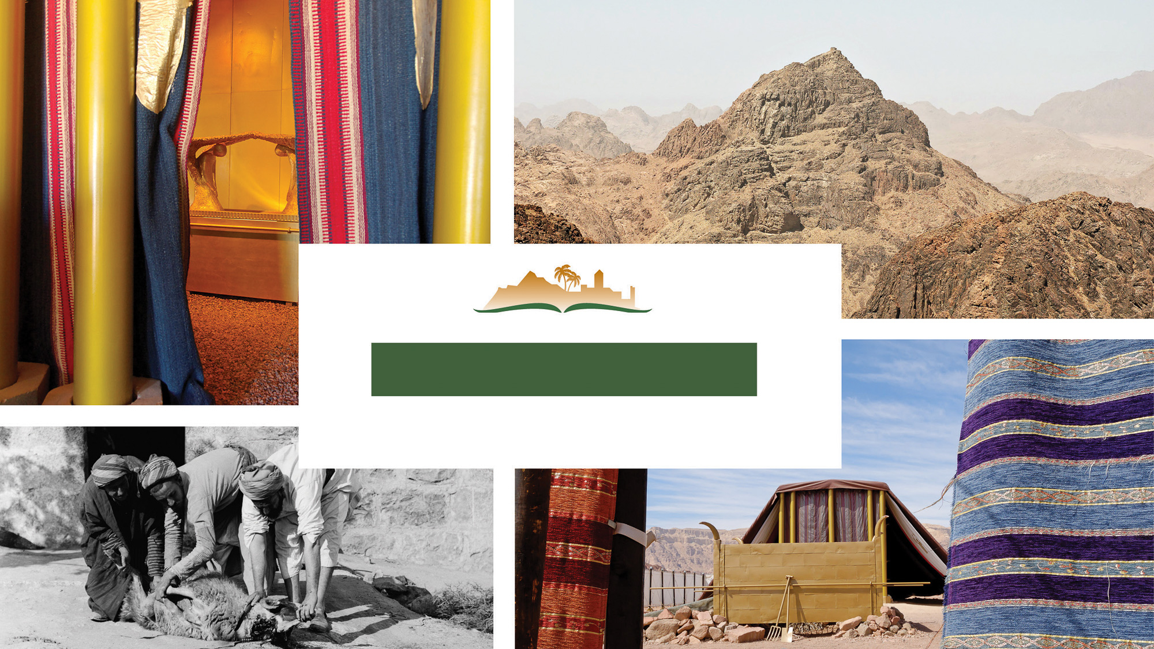
Hebrews 7
Notes:
This is a free sample of the Hebrews 7 presentation from the Photo Companion to the Bible. To purchase the full volume, visit https://www.bibleplaces.com/hebrews/
The Photo Companion to the Bible is an image-rich resource for Bible students, teachers, and researchers. Just as a librarian stocks the shelves with as many relevant materials as possible, so we have tried to provide a broad selection of images. Our goal is that you will find in this “library” whatever it is you are looking for.
Credits: The primary creators of this presentation are Steven D. Anderson, Kai Akagi, Kris Udd, Christian Locatell, and Todd Bolen. The photographs have an individual file code which usually includes the initials of the photographer. Other images have additional credit or source information.
Updates: We plan to update this collection as we are able. We welcome your suggestions for improving this resource (photocompanion@bibleplaces.com). Purchasers of the Hebrews volume are provided free, lifetime updates to the volume.
Copyright: This photo collection is protected by copyright law and may not be distributed without written permission from BiblePlaces.com. Slide notes should be treated as any other copyrighted written material, with credit given when quoting from these notes.
For more information, see our complete “Introduction to the Photo Companion to the Bible” online at https://www.BiblePlaces.com/Intro-Photo-Companion-Bible/. Here you will find more information about photo selection, explanatory notes, Bible translation, credit information, and copyright allowances.

Slide 2
Hebrews 7
This is a free sample of the Hebrews 7 presentation from the Photo Companion to the Bible. To purchase the full volume, visit https://www.bibleplaces.com/hebrews/ The Photo Companion to the Bible is an image-rich resource for Bible students, teachers, and researchers. Just as a librarian stocks the shelves with as many relevant materials as possible, so we have tried to provide a broad selection of images. Our goal is that you will find in this “library” whatever it is you are looking for. For more details (for this and every slide), see the Notes section below.
Notes:
This is a free sample of the Hebrews 7 presentation from the Photo Companion to the Bible. To purchase the full volume, visit https://www.bibleplaces.com/hebrews/
The Photo Companion to the Bible is an image-rich resource for Bible students, teachers, and researchers. Just as a librarian stocks the shelves with as many relevant materials as possible, so we have tried to provide a broad selection of images. Our goal is that you will find in this “library” whatever it is you are looking for.
Credits: The primary creators of this presentation are Steven D. Anderson, Kai Akagi, Kris Udd, Christian Locatell, and Todd Bolen. The photographs have an individual file code which usually includes the initials of the photographer. Other images have additional credit or source information.
Updates: We plan to update this collection as we are able. We welcome your suggestions for improving this resource (photocompanion@bibleplaces.com). Purchasers of the Hebrews volume are provided free, lifetime updates to the volume.
Copyright: This photo collection is protected by copyright law and may not be distributed without written permission from BiblePlaces.com. Slide notes should be treated as any other copyrighted written material, with credit given when quoting from these notes.
For more information, see our complete “Introduction to the Photo Companion to the Bible” online at https://www.BiblePlaces.com/Intro-Photo-Companion-Bible/. Here you will find more information about photo selection, explanatory notes, Bible translation, credit information, and copyright allowances.

Slide 3
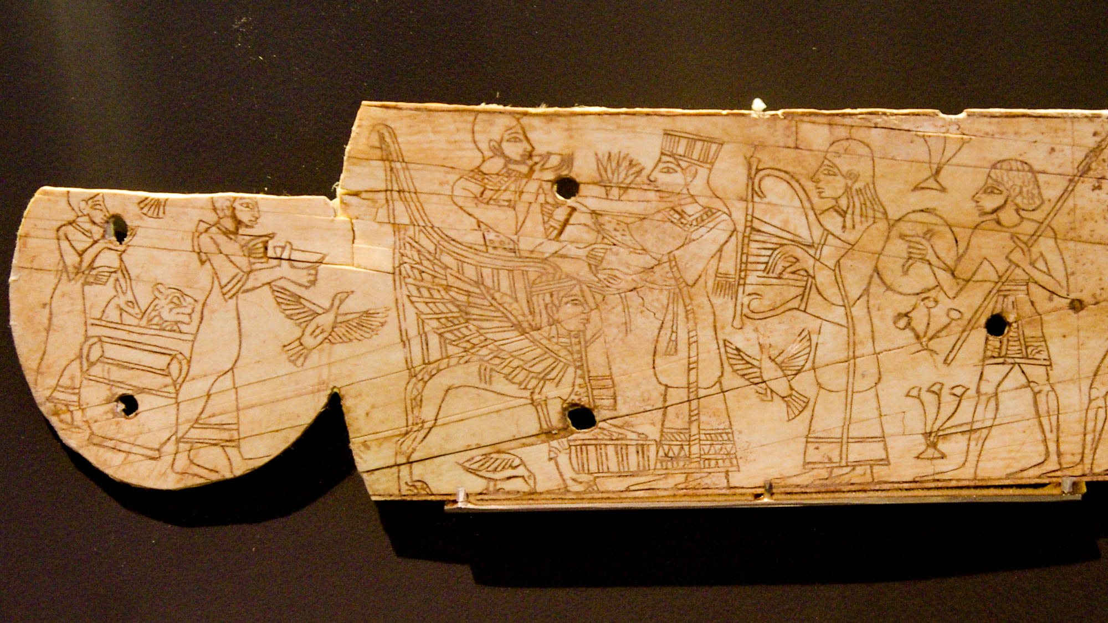
For this Melchizedek, king of Salem, priest of God Most High
Ivory furniture inlay portraying a Canaanite ruler on a throne, from Megiddo, 13th century BC
7:1
Notes:
This remarkable depiction of an ancient Canaanite king was photographed at the Israel Museum. The king is depicted drinking wine, one of the items Melchizedek brought out to Abraham (Gen 14:18).
adr1305113213h

Slide 4
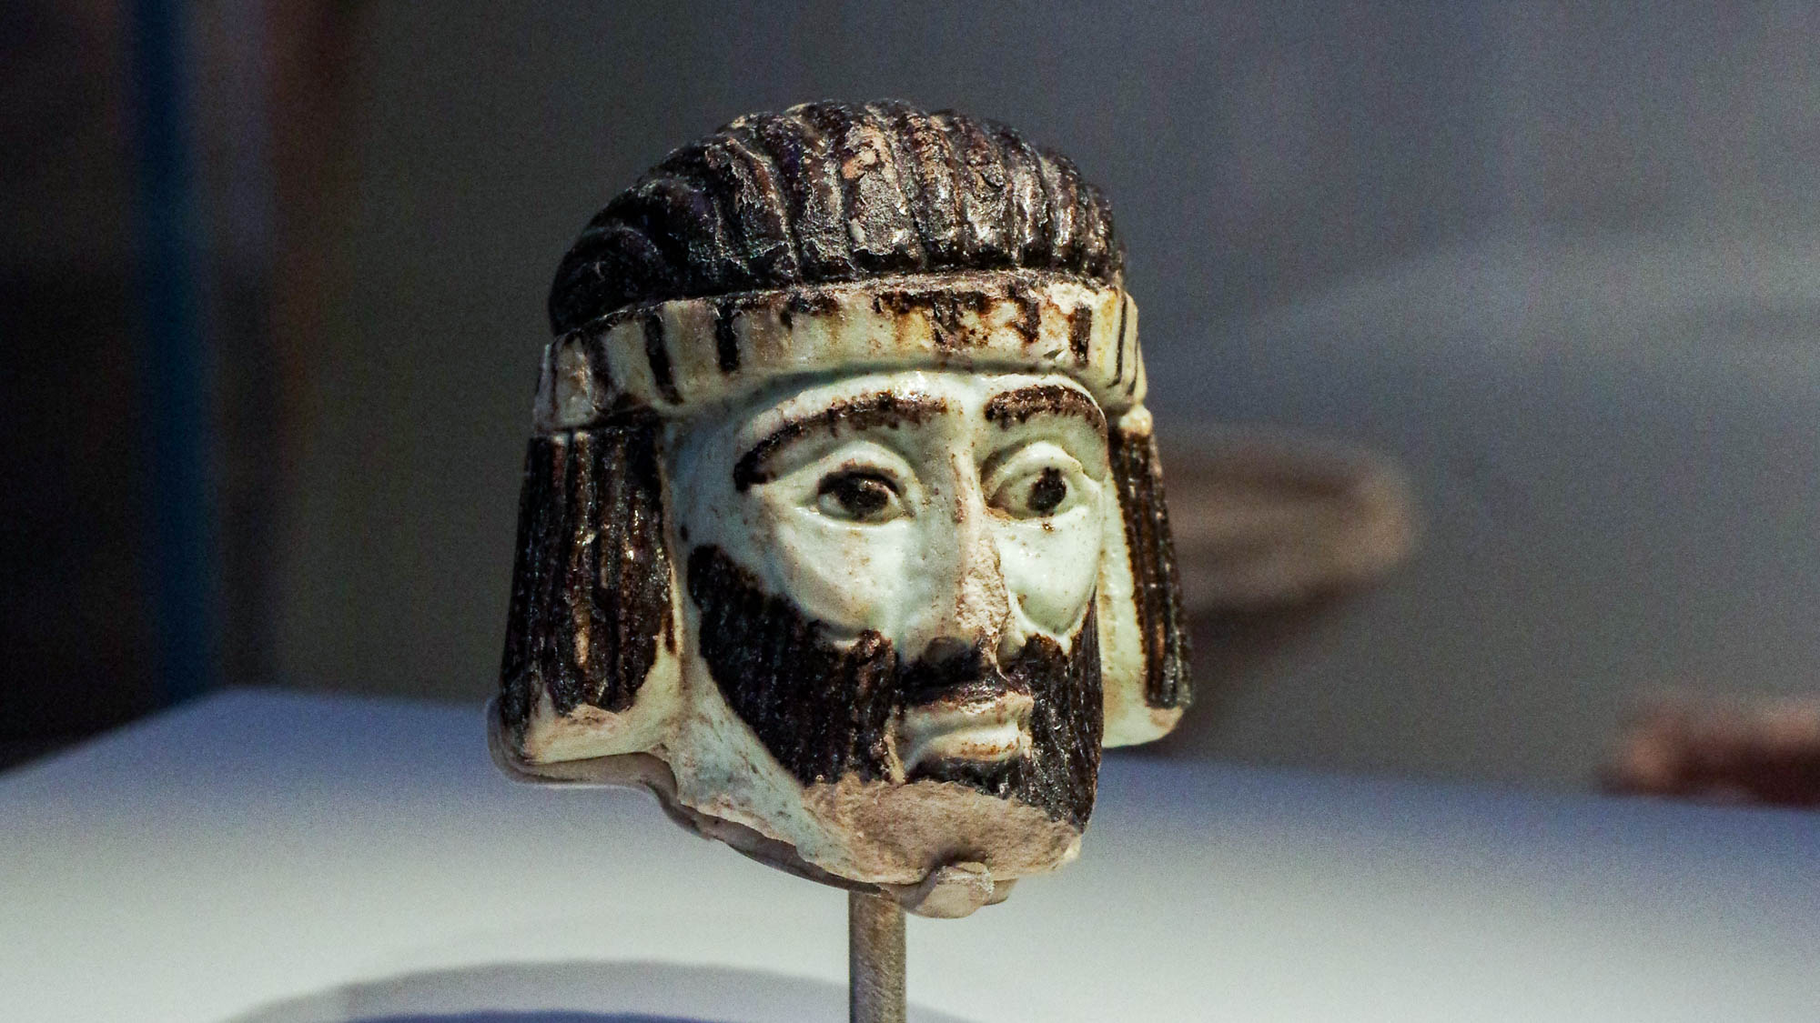
For this Melchizedek, king of Salem, priest of God Most High
Faience statue head of ruler, from Abel-beth-maacah, 9th century BC
7:1
Notes:
Ancient depictions of kings in the land of Israel are quite rare. The small faience head shown here was discovered at Abel-beth-maacah, a site on the northern edge of the modern state of Israel. It is about 2 inches (50 mm) tall and is thought to be a depiction of an Israelite ruler, perhaps a king of ancient Israel. The display at the Israel Museum describes this artifact as follows: “This unique statue head has not ceased to raise questions since it was discovered in 2017 in a fortress at the summit of Tel Abel Beth Maacah, in northern Israel. Its elegant style leaves no doubt that it portrays a distinguished personage, probably a king, but since it was found on the border of three different ancient kingdoms, we do not know whether it depicts King Ahab of Israel, King Hazael of Aram Damascus, or King Ithobaal of Tyre, rulers known from the Bible and other sources. Additional questions regarding the statue's material and style only heighten the mystery.” It was photographed at the Israel Museum.
adr1806199379h

Slide 5
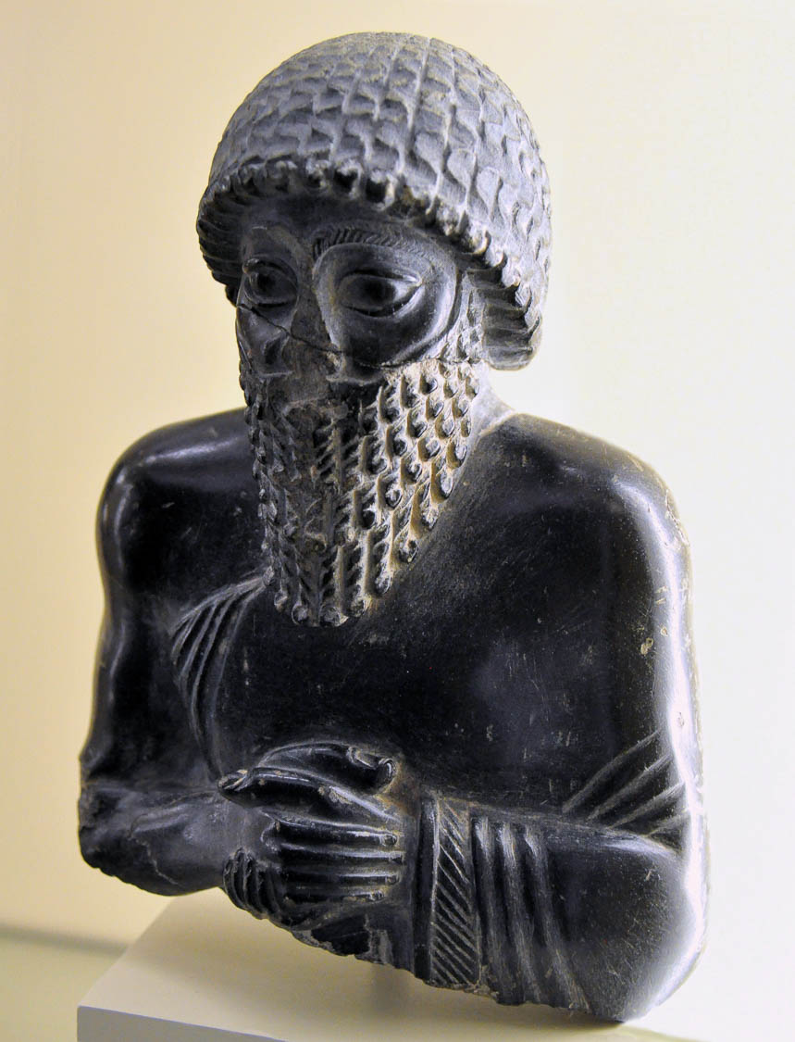
For this Melchizedek, king of Salem, priest of God Most High
Diorite statue of Ur-Ningirsu II, priest and ruler of Lagash, circa 2100 BC
7:1
Notes:
This statue depicts Ur-Ningirsu II, who was both a ruler and priest in the ancient city of Lagash. An inscription on the statue reads, “For Ningishzida, his god, Ur-Ningirsu, ruler of Lagash, son of Gudea, ruler of Lagash . . .” The clasped hands signify the piety of the worshipper. This statue was photographed at the Vorderasiatisches Museum in Berlin. This image comes from Osama Shukir Muhammed Amin and is licensed under CC BY-SA 4.0, via Wikimedia Commons: https://commons.wikimedia.org/wiki/File:Ur-Ningirsu_II_Vorderasiatisches_Museum,_Berlin_VA_8790.jpg.
wiki051120201851861187

Slide 6
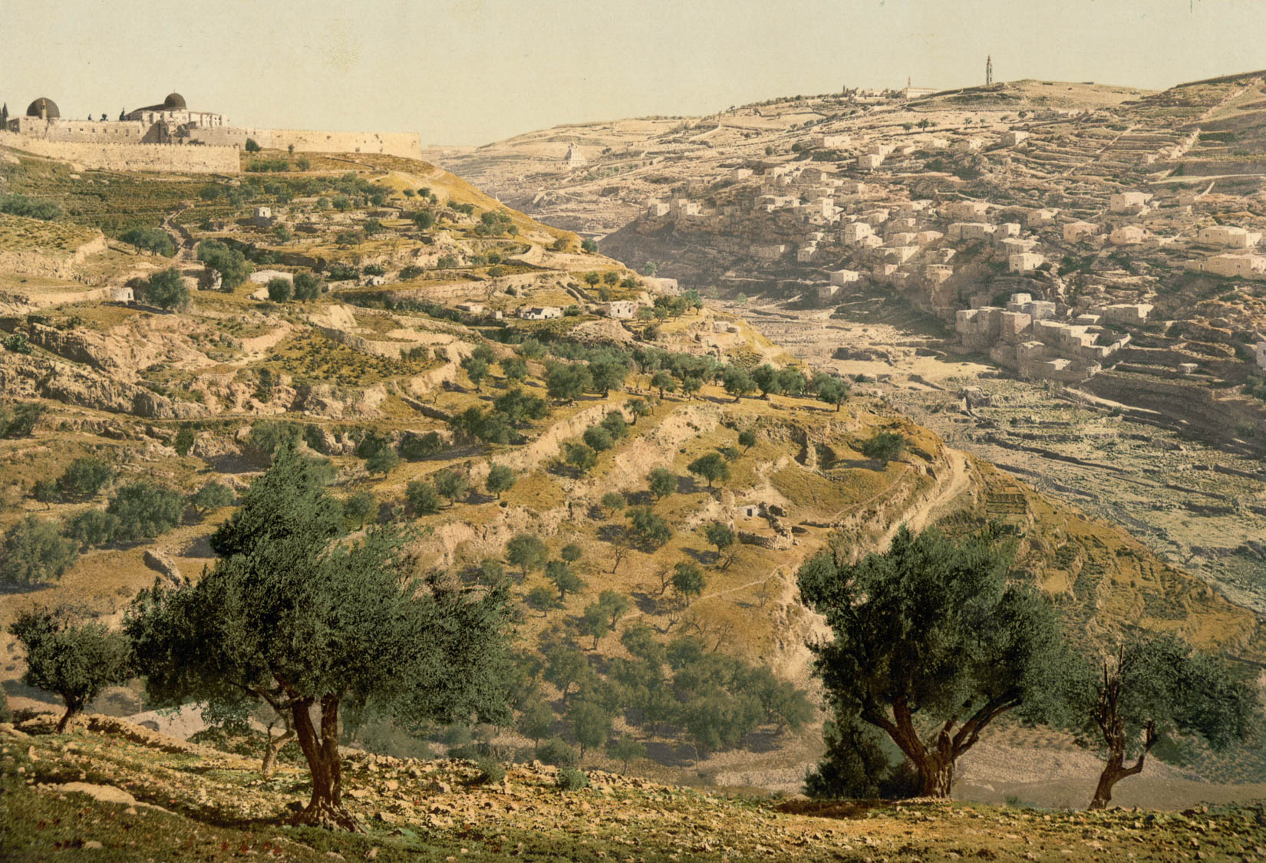
For this Melchizedek, king of Salem, priest of God Most High
The City of David and the Mount of Olives
7:1
Notes:
Salem is identified with Jerusalem in Psalm 76:2, and this identification is implied in Joshua 10:1, which records a name similar to “Melchizedek” for the king of Jerusalem. Melchizedek would have reigned over a city on the location that later became known as the City of David. This photochrom image was taken in the 1890s. The Dome of the Rock and the Al-Aqsa Mosque are visible in the upper left corner of the image. The slope that descends from them toward the center of the photo is the location of the ancient city of Salem.
pcm02712

Slide 7
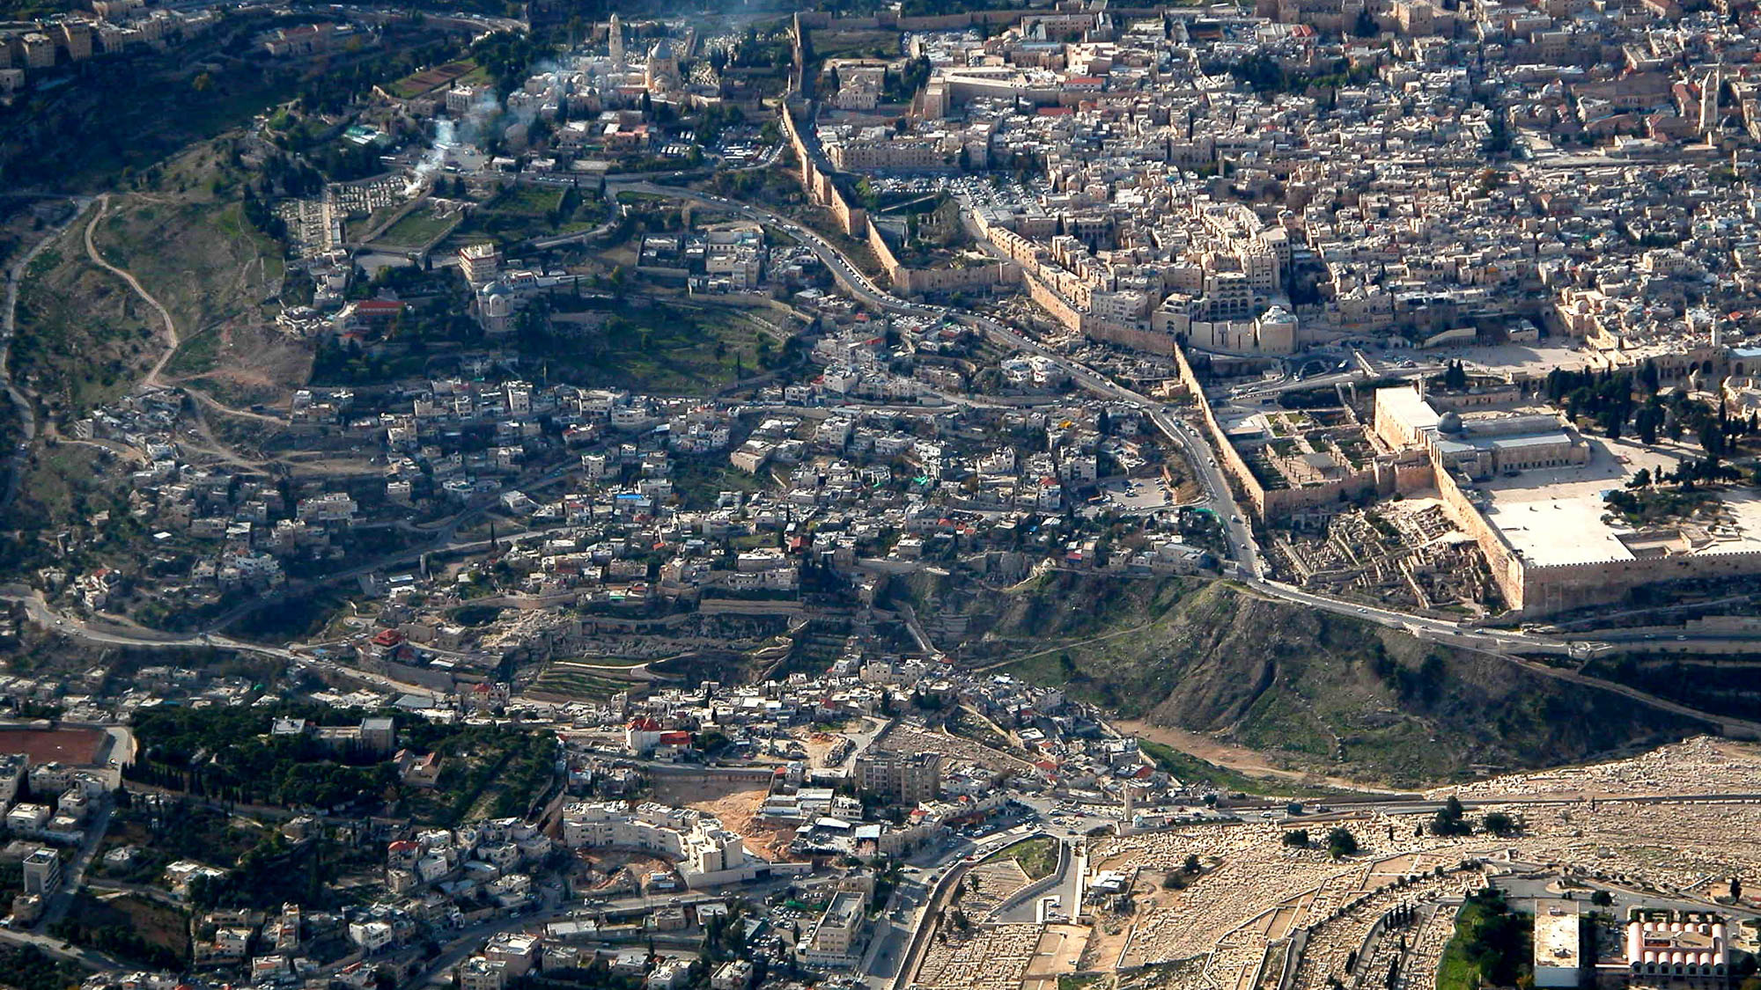
For this Melchizedek, king of Salem, priest of God Most High
The City of David (aerial view from the east)
7:1
Notes:
Salem is identified with Zion (Ps 76:2), which is also known as the City of David (2 Sam 5:7). As excavations have confirmed, this city was located on the spur south of the Herodian Temple Mount. See the next slide for labels.
tb010703202

Slide 8
For this Melchizedek, king of Salem, priest of God Most High
City of David
The City of David (aerial view from the east)
7:1
Notes:
Salem is identified with Zion (Ps 76:2), which is also known as the City of David (2 Sam 5:7). As excavations have confirmed, this city was located on the spur south of the Herodian Temple Mount. See the next slide for a closer view of the City of David.
tb010703202

Slide 9
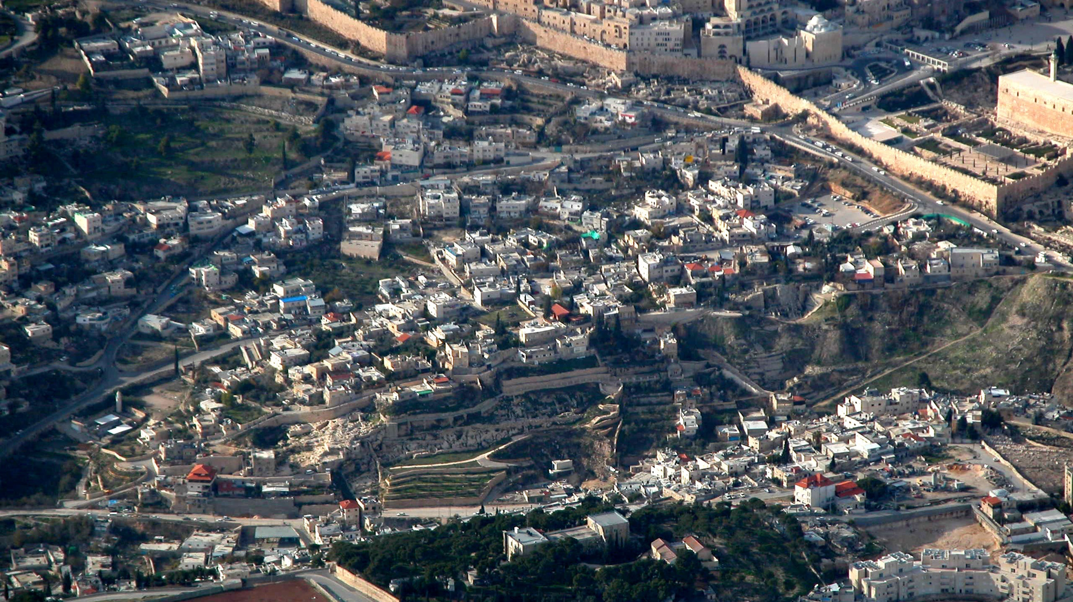
For this Melchizedek, king of Salem, priest of God Most High . . .
The City of David (aerial view from the east)
7:1
Notes:
tb010703201

Slide 10
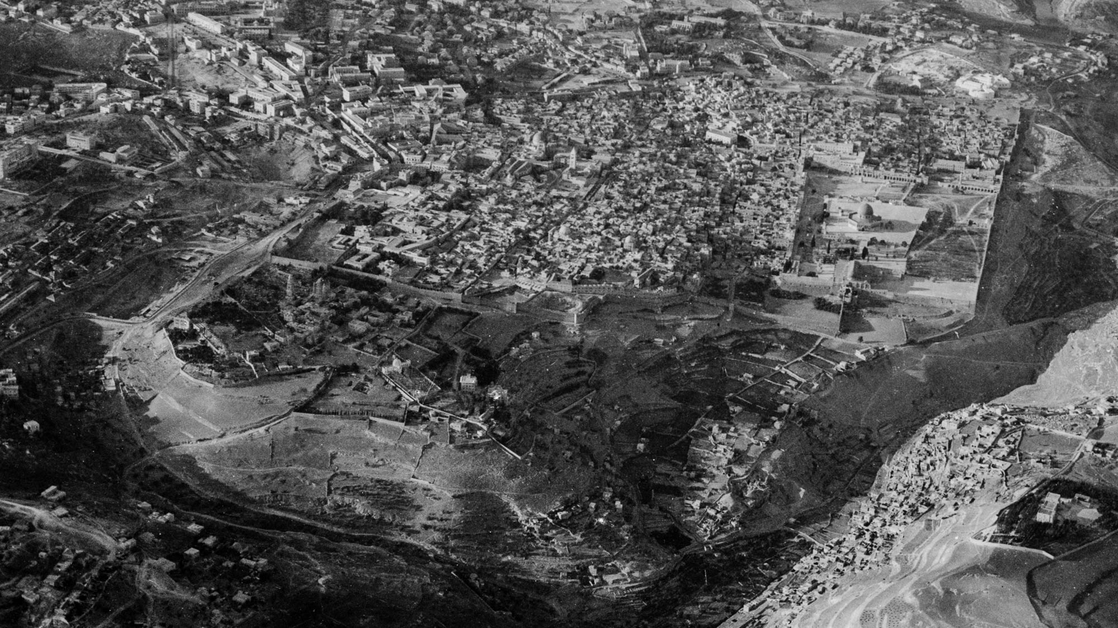
For this Melchizedek, king of Salem, priest of God Most High
Jerusalem, 1931 (aerial view from the south)
7:1
Notes:
This American Colony photo was taken in the late afternoon. The shadows indicate the location of the valleys, which highlights the spur on which ancient Salem was situated. The Gihon Spring, which was the water source for the ancient city, issued from the slope on the eastern side of the city, along the Kidron Valley. The next slide includes labels.
mat15844

Slide 11
For this Melchizedek, king of Salem, priest of God Most High
Central Valley
Kidron Valley
Salem
Gihon Spring
Hinnom Valley
Mount of Olives
Jerusalem, 1931 (aerial view from the south)
7:1
Notes:
This American Colony photo was taken in the late afternoon. The shadows indicate the location of the valleys, which highlights the spur on which ancient Salem was situated. The Gihon Spring, which was the water source for the ancient city, issued from the slope on the eastern side of the city, along the Kidron Valley.
mat15844

Slide 12
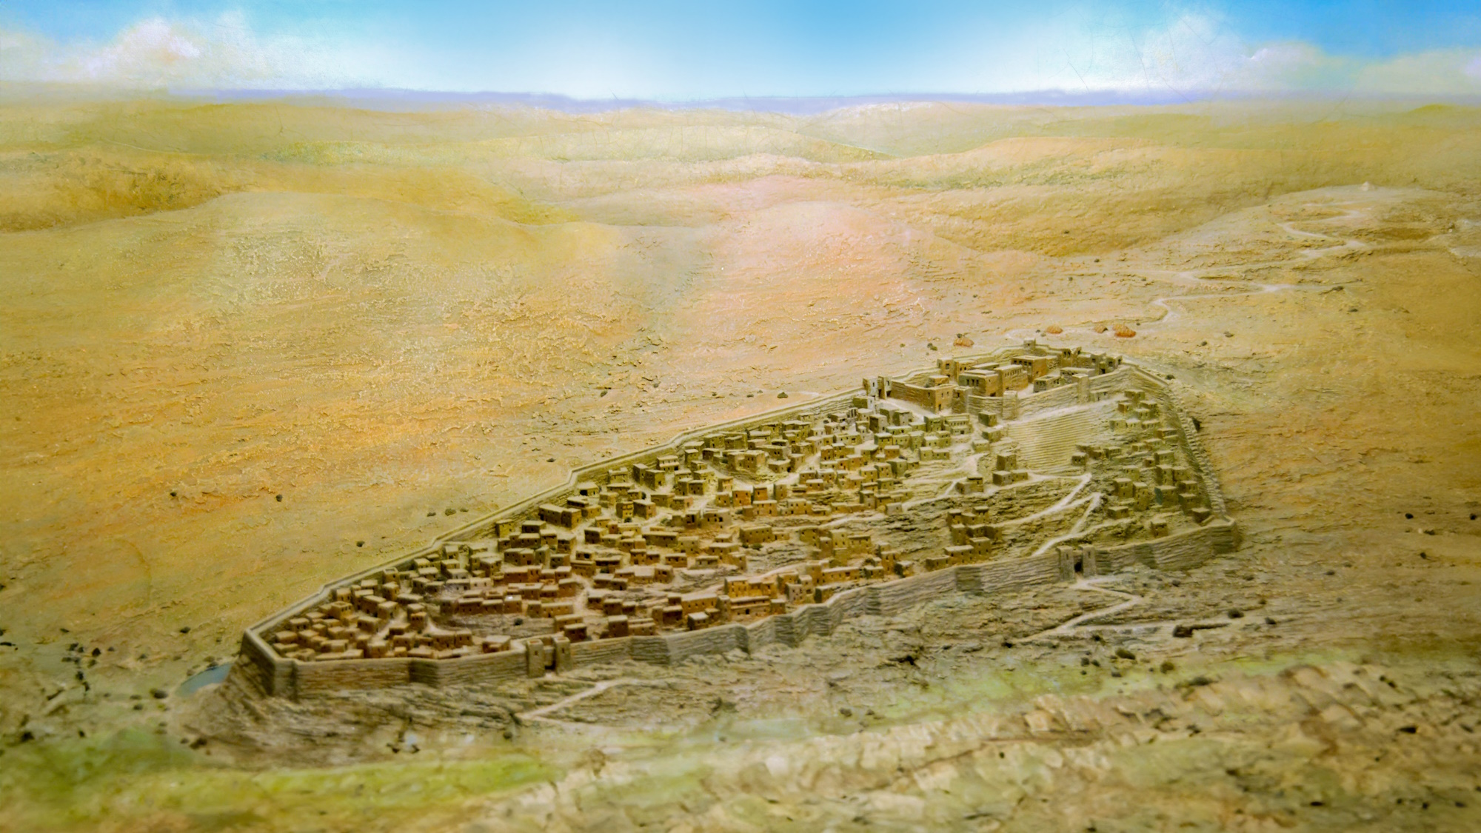
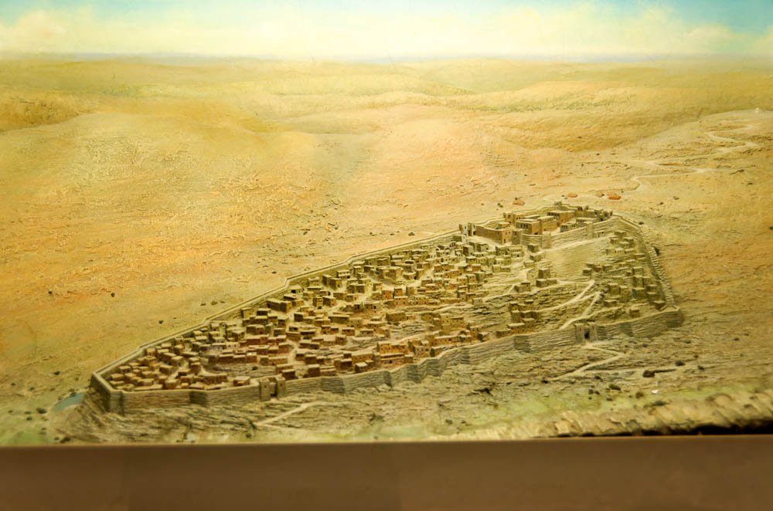
For this Melchizedek, king of Salem, priest of God Most High
Model of Jerusalem at the time of David (from the southeast)
7:1
Notes:
This model of Jerusalem during the Iron Age is probably a good approximation of what the city looked like in the days of Abraham and Melchizedek as well. Generative AI was used to extend this image; the original photo is available behind this image. This model was photographed at the Tower of David Museum in Jerusalem.
tb060716341psai

Slide 13
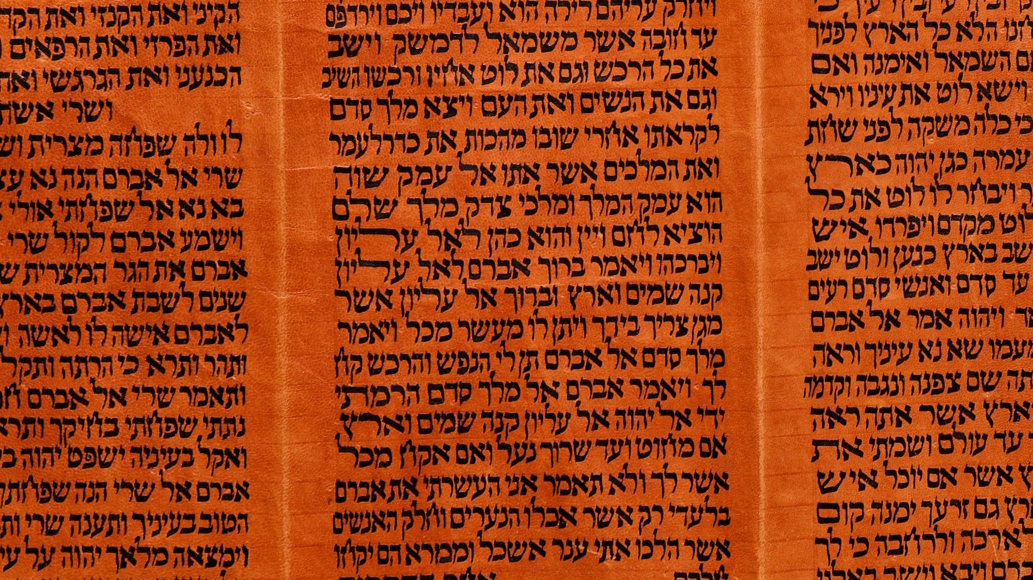
He met Abraham returning from the slaughter of the kings
“And the king of Sodom went out to meet him, after his return from the slaughter of Chedorlaomer and the kings that were with him, at the valley of Shaveh (that is, the King’s Valley). And Melchizedek king of Salem brought out bread and wine: and he was priest of God Most High. And he blessed him, and said, ‘Blessed be Abram of God Most High, possessor of heaven and earth: and blessed be God Most High, who has delivered your enemies into your hand.’ Then Abraham gave him a tenth of everything.”
Torah scroll with Genesis 14:17-20
7:1
Notes:
“And the king of Sodom went out to meet him, after his return from the slaughter of Chedorlaomer and the kings that were with him, at the valley of Shaveh (that is, the King’s Valley). And Melchizedek king of Salem brought out bread and wine: and he was priest of God Most High. And he blessed him, and said, ‘Blessed be Abram of God Most High, possessor of heaven and earth: and blessed be God Most High, who has delivered your enemies into your hand.’ Then Abraham gave him a tenth of everything” (Gen 14:17-20). This Yemenite Torah scroll was photographed at The Master’s Seminary in California.
tb031416364

Slide 14
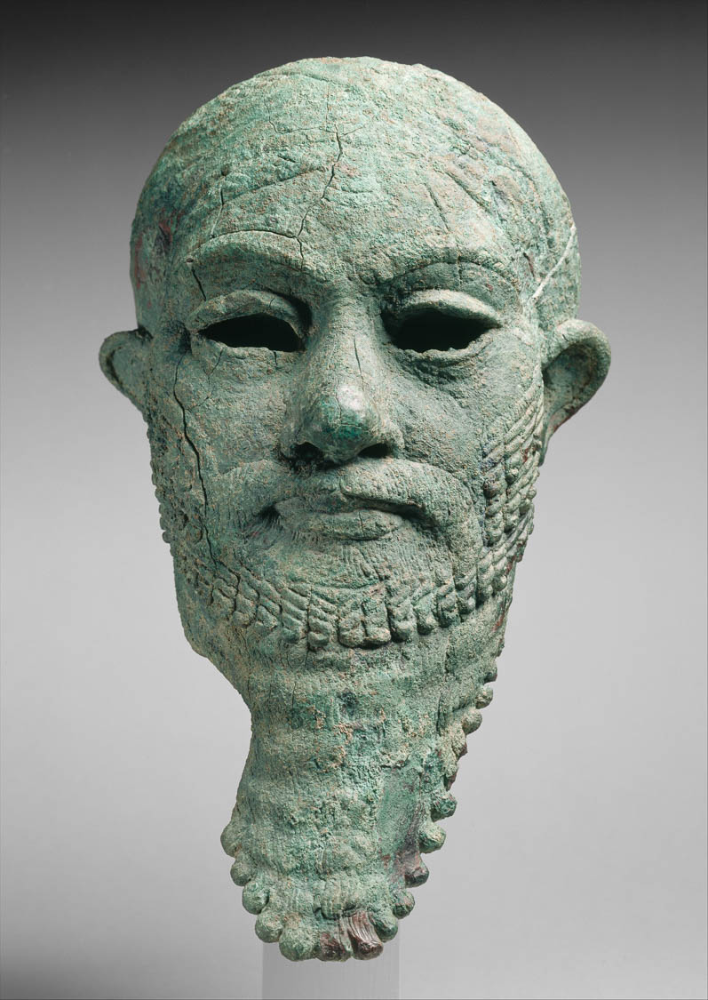
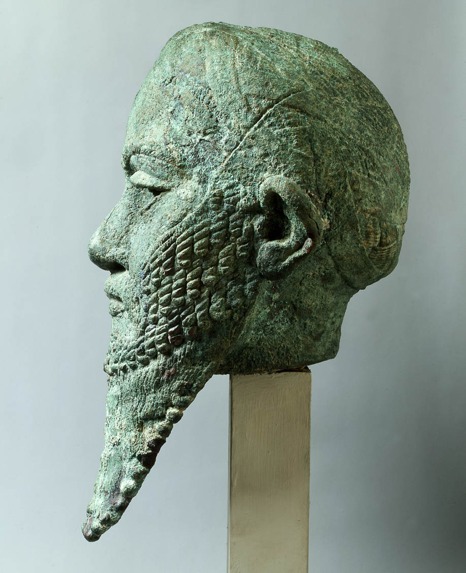
He met Abraham returning from the slaughter of the kings
Copper alloy head of an unidentified Mesopotamian ruler, Early Bronze Age
7:1
Notes:
The names of the kings that were defeated by Abraham are given in Genesis 14:1. The bust shown in this photo is approximately contemporaneous with the time of Abraham. These images come from The Metropolitan Museum of Art, public domain, Rogers Fund, 1947, accession number 47.100.80, http://metmuseum.org/art/collection/search/329077
Left: met329077
Right: met329077b

Slide 15
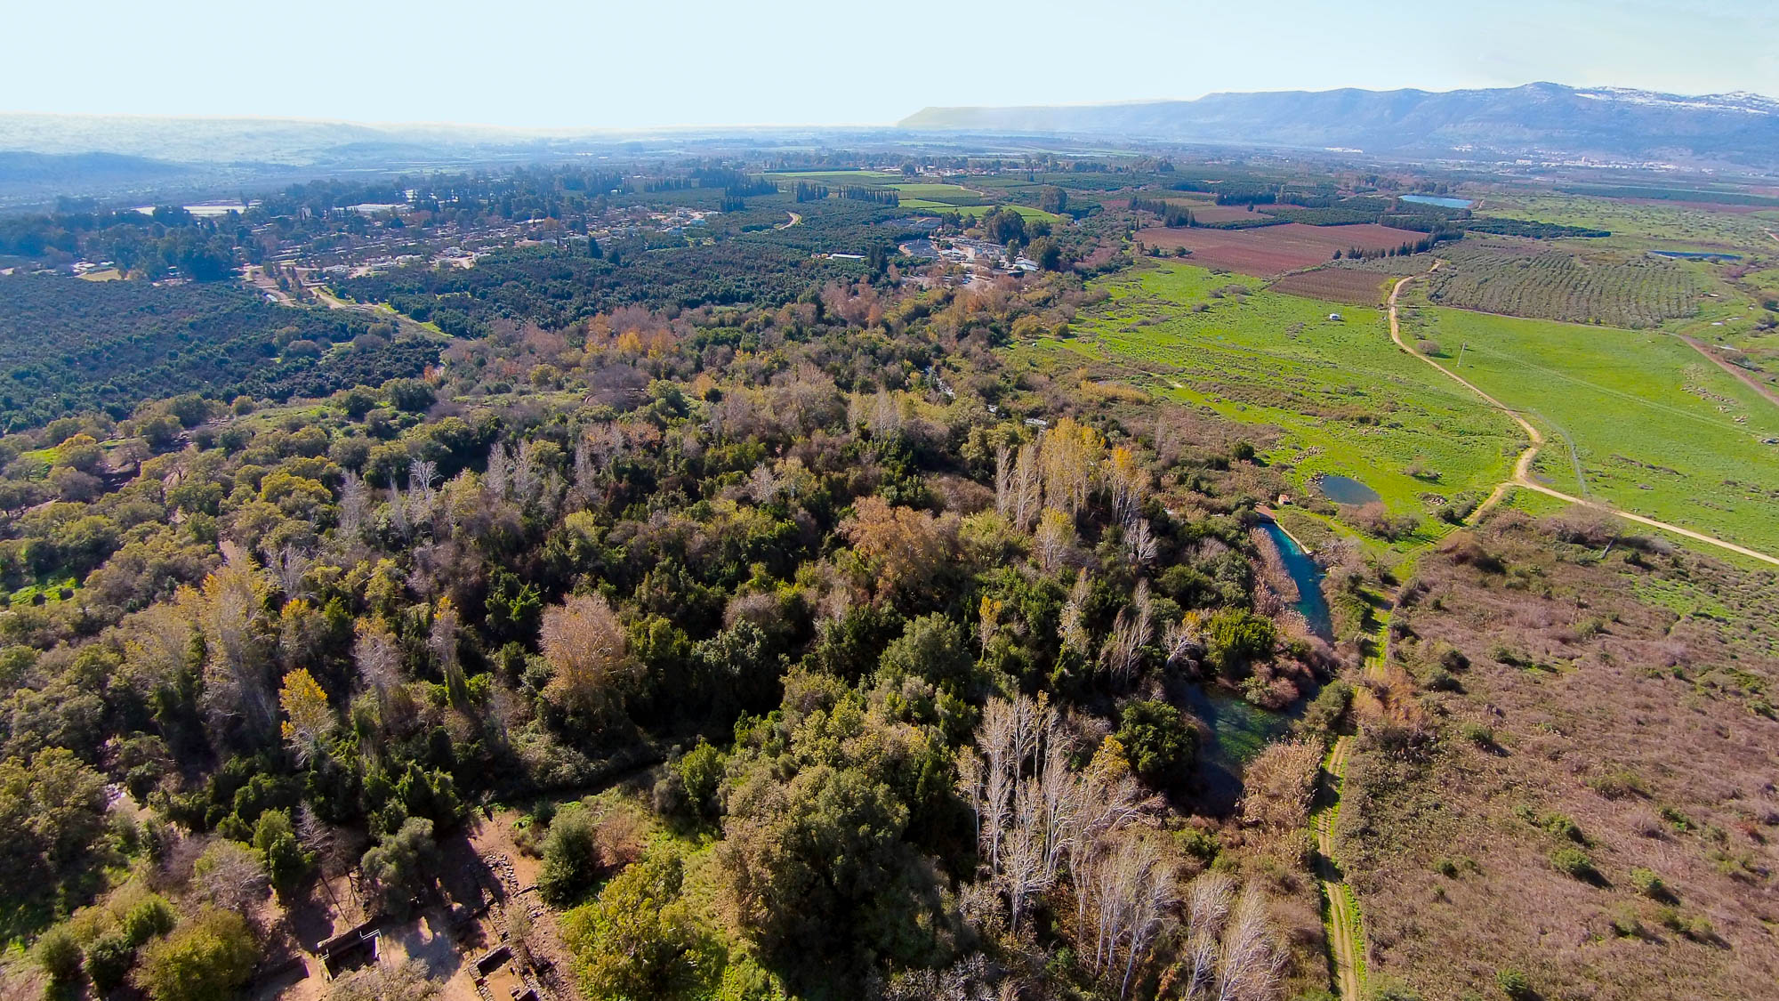
He met Abraham returning from the slaughter of the kings
Dan and the source of the Jordan River (aerial view from the northeast)
7:1
Notes:
According to Genesis 14:14, the battle between Abraham and the kings of the north began in the vicinity of the city of Dan, formerly known as Laish (Judg 18:29). This city was located in the fertile valley north of the Sea of Galilee, not far from the foot of Mount Hermon. It is situated on one of the major springs that forms the headwaters of the Jordan River. The partially excavated religious center at Dan is visible in the lower left portion of this aerial photo. The waters of the spring can be seen in the center right, flowing off toward the west and south.
ws011315119

Slide 16
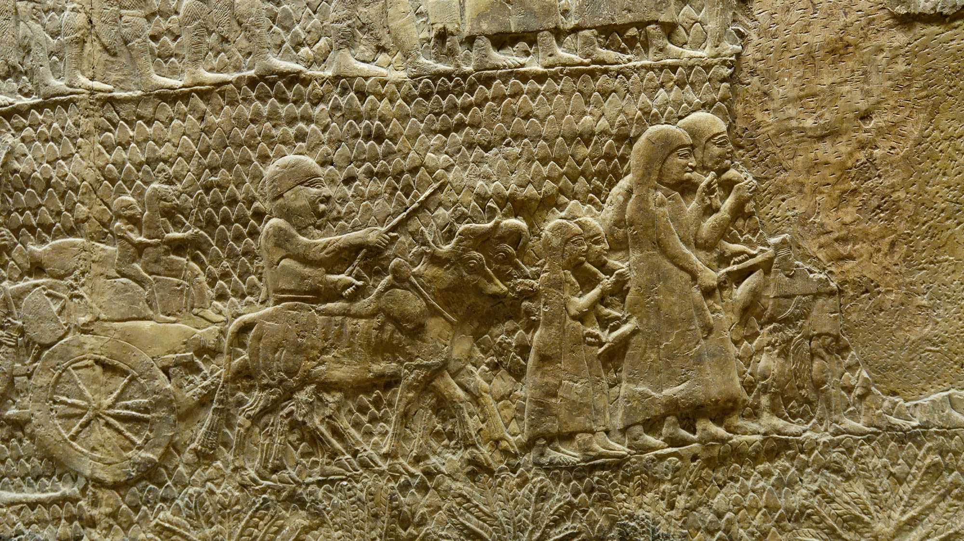
He met Abraham returning from the slaughter of the kings
A family going into exile, from the Lachish reliefs at Nineveh, circa 700 BC
7:1
Notes:
This relief dates to about 700 BC, more than a thousand years after the time of Abraham. It illustrates a family traveling after being captured in battle, which was the situation faced by the population that had been defeated by the kings of the north (Gen 14:11-12). This relief was photographed at the British Museum.
tb112004314

Slide 17
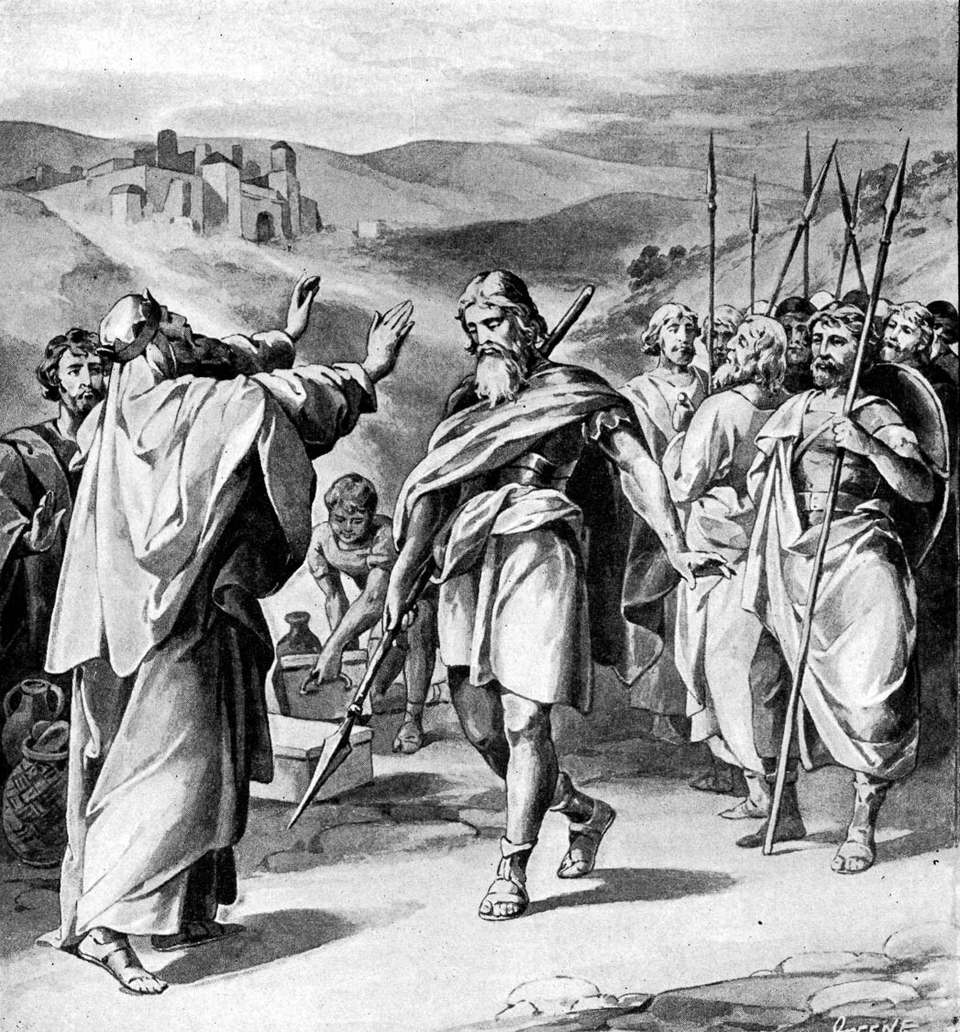
And he blessed him
King Melchizedek blesses Abraham
7:1
Notes:
This illustration comes from Charles Foster, Bible Pictures and What They Teach Us (1886, 1914).
fbp028

Slide 18
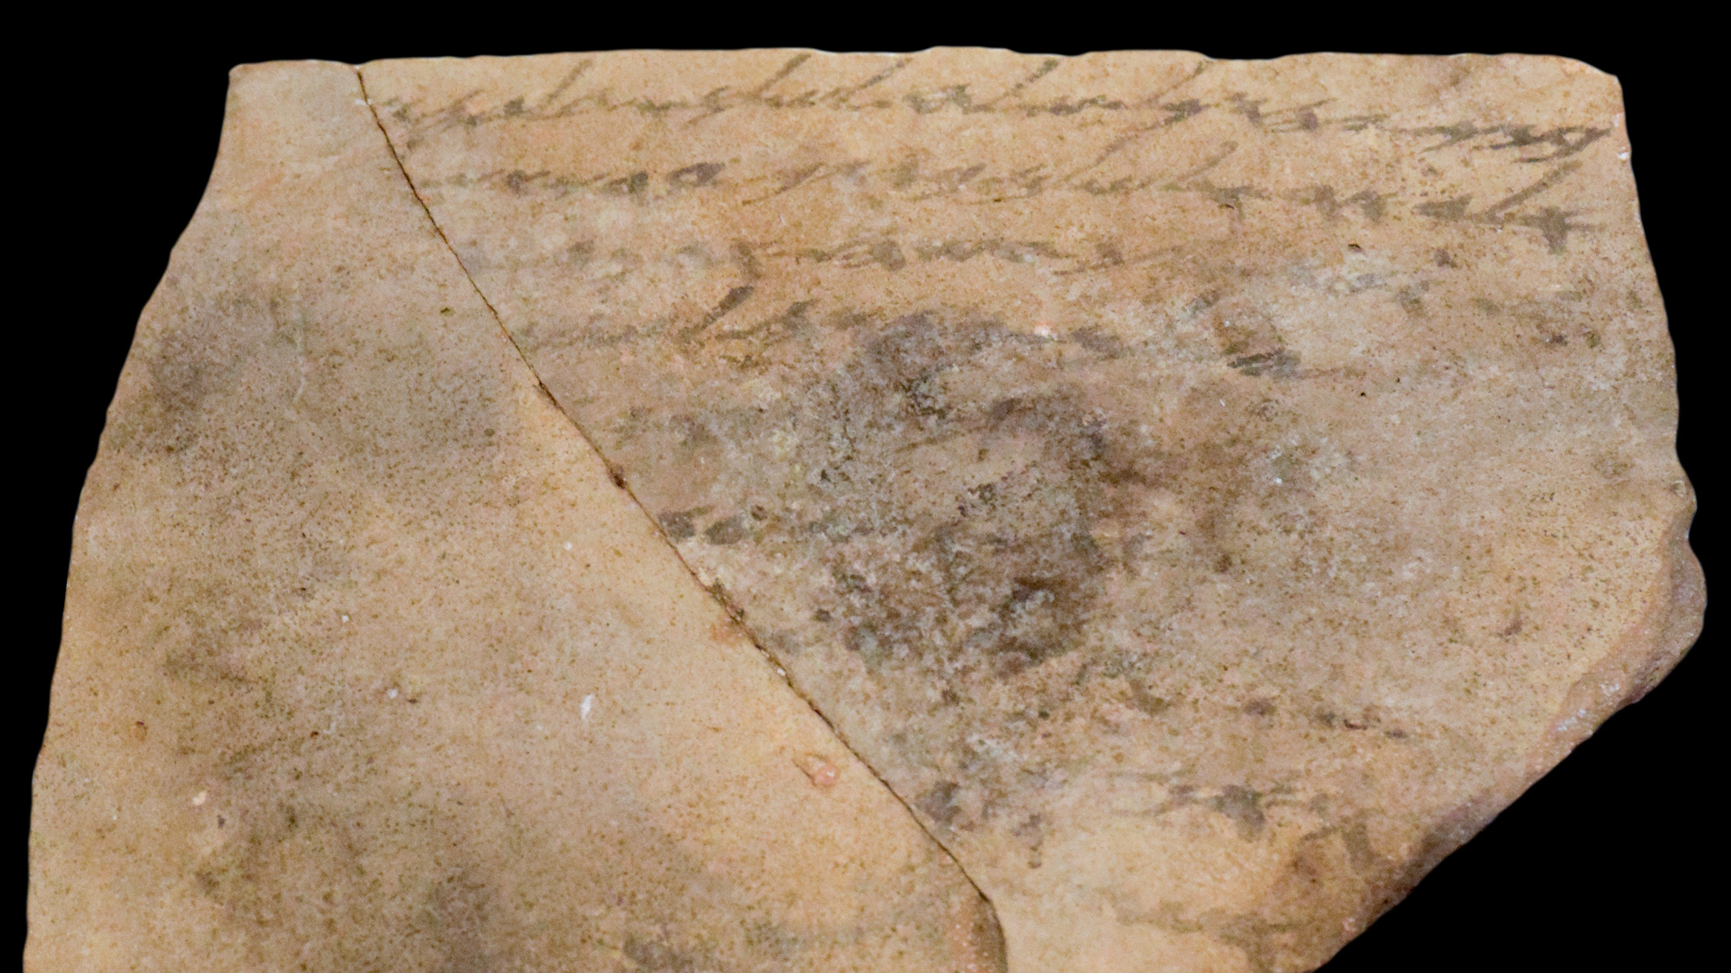
And he blessed him
Letter with the phrase “I bless you,” Arad Ostracon 21, circa 600 BC
7:1
Notes:
The letter shown here, written on a potsherd in ink, includes the phrase “I bless you” (Heb. beraktika, ברכתך). The initial lines may be translated, “Your son, Yehukal, sent concerning the peace (i.e., welfare) of Gedaliah, son of Elyair, and the peace of your house. I bless you by [Yahwe]h” (see Ahituv 2008: 124).
The author of Hebrews will shortly make a connection between the name of Melchizedek’s city, “Salem” (Gk. Σαλήμ, Heb. Shalem, שָׁלֵם), and the word “peace” (Gk. eirēnē, εἰρήνη; Heb. shalom, שָׁלֹם). The ostracon shown here includes the word “peace” twice in the first two lines.
This ostracon was photographed at the Eretz Israel Museum in Tel Aviv. The next slide includes highlights for the two occurrences of the word “peace” and the phrase “I bless you.”
Reference:
Ahituv, Shmuel.
2008 Echoes from the Past. Jerusalem: Carta.
tb031114479b

Slide 19
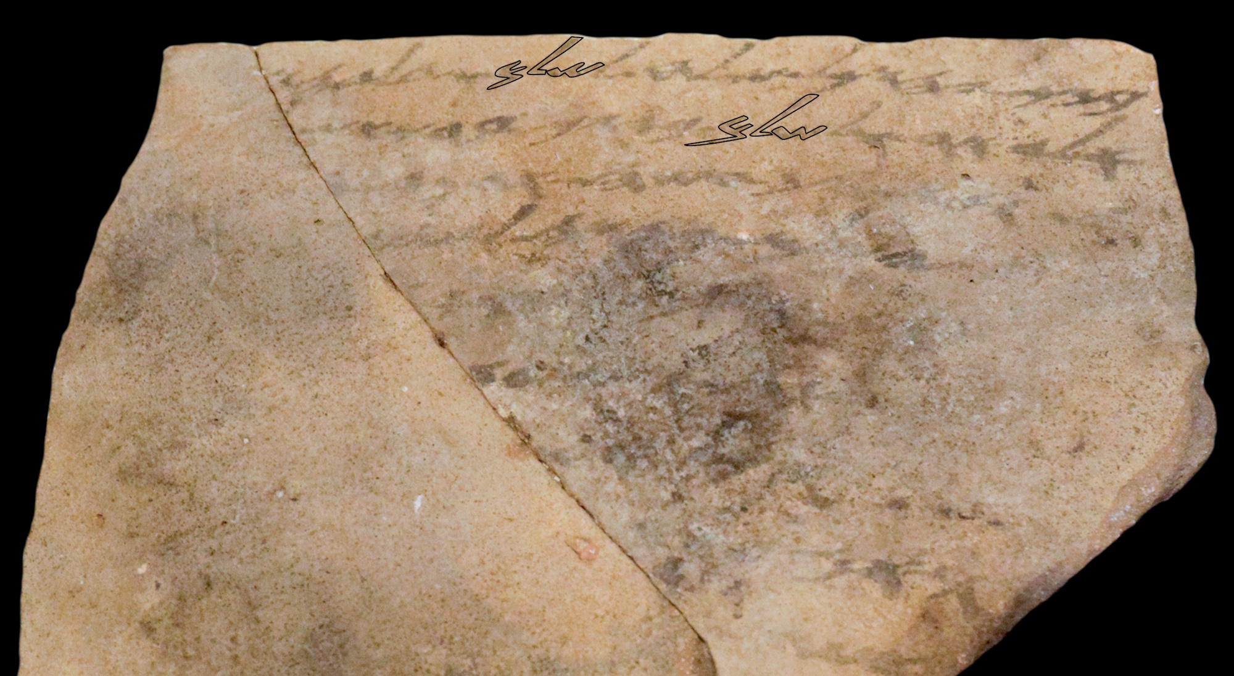
And he blessed him
Letter with the phrase “I bless you,” Arad Ostracon 21, circa 600 BC
7:1
Notes:
The letter shown here, written on a potsherd in ink, includes the phrase “I bless you” (Heb. beraktika, ברכתך). The initial lines may be translated, “Your son, Yehukal, sent concerning the peace (i.e., welfare) of Gedaliah, son of Elyair, and the peace of your house. I bless you by [Yahwe]h” (see Ahituv 2008: 124).
The author of Hebrews will shortly make a connection between the name of Melchizedek’s city, “Salem” (Gk. Σαλήμ, Heb. Shalem, שָׁלֵם), and the word “peace” (Gk. eirēnē, εἰρήνη; Heb. shalom, שָׁלֹם). The ostracon shown here includes the word “peace” twice in the first two lines.
This ostracon was photographed at the Eretz Israel Museum in Tel Aviv. An editable version is included behind this graphic.
Reference:
Ahituv, Shmuel.
2008 Echoes from the Past. Jerusalem: Carta.
tb031114479b

Slide 20
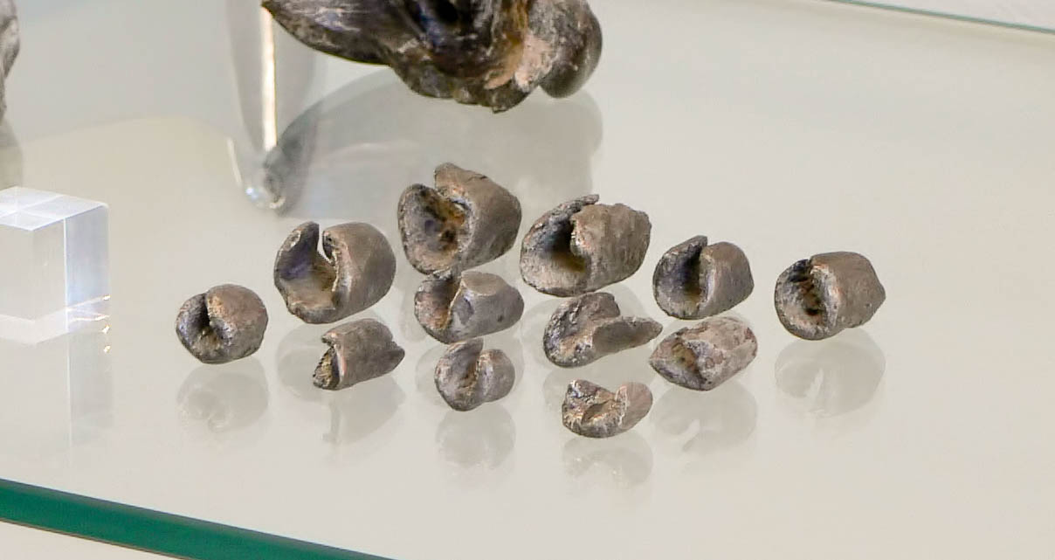
To whom also Abraham gave a tenth of all the spoil
Hacksilver, from Samal (Zincirli), 9th–7th centuries BC
7:2
Notes:
Hacksilver consisted of randomly shaped pieces that could be weighed and used as money. Some of the spoil taken by Abraham may have come in this form. This display was photographed at the Berlin Museum of the Ancient Near East.
adr070513220

Slide 21
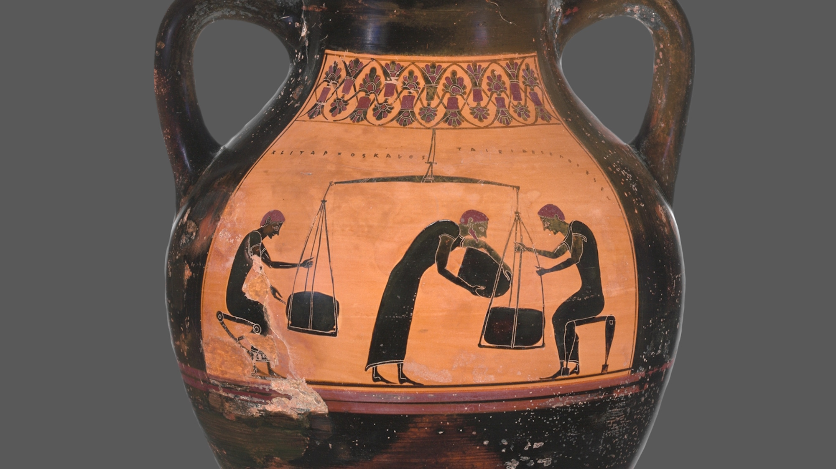
To whom also Abraham gave a tenth of all the spoil
Black-figure amphora depicting men weighing merchandise, 6th century BC
7:2
Notes:
One of the ways in which Abraham may have measured out a tenth of the spoil was by using a balance beam and scales. This method is illustrated here by a depiction of men using a large balance-beam scale to weigh out merchandise. This amphora was discovered at Agrigento in Sicily. This image comes from The Metropolitan Museum of Art and is in the public domain. Source: https://www.metmuseum.org/art/collection/search/254578.
met254578c

Slide 22
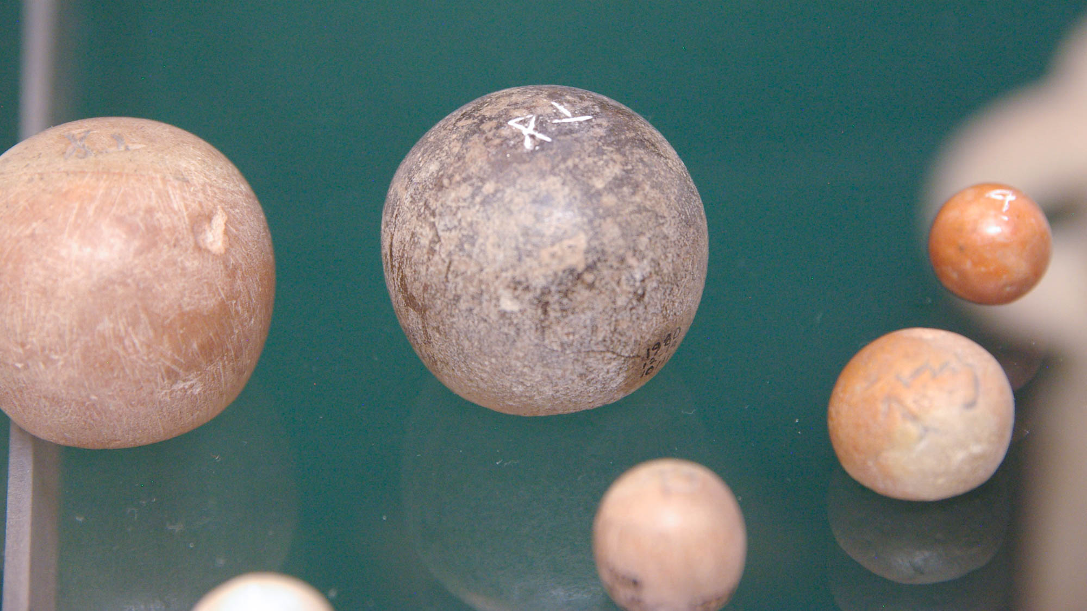
To whom also Abraham gave a tenth of all the spoil
Hebrew weights from Lachish, 9th–8th centuries BC
7:2
Notes:
Weights like these would be used with a scale to measure out various commodities. These weights were photographed at the British Museum.
adr090506908

Slide 23
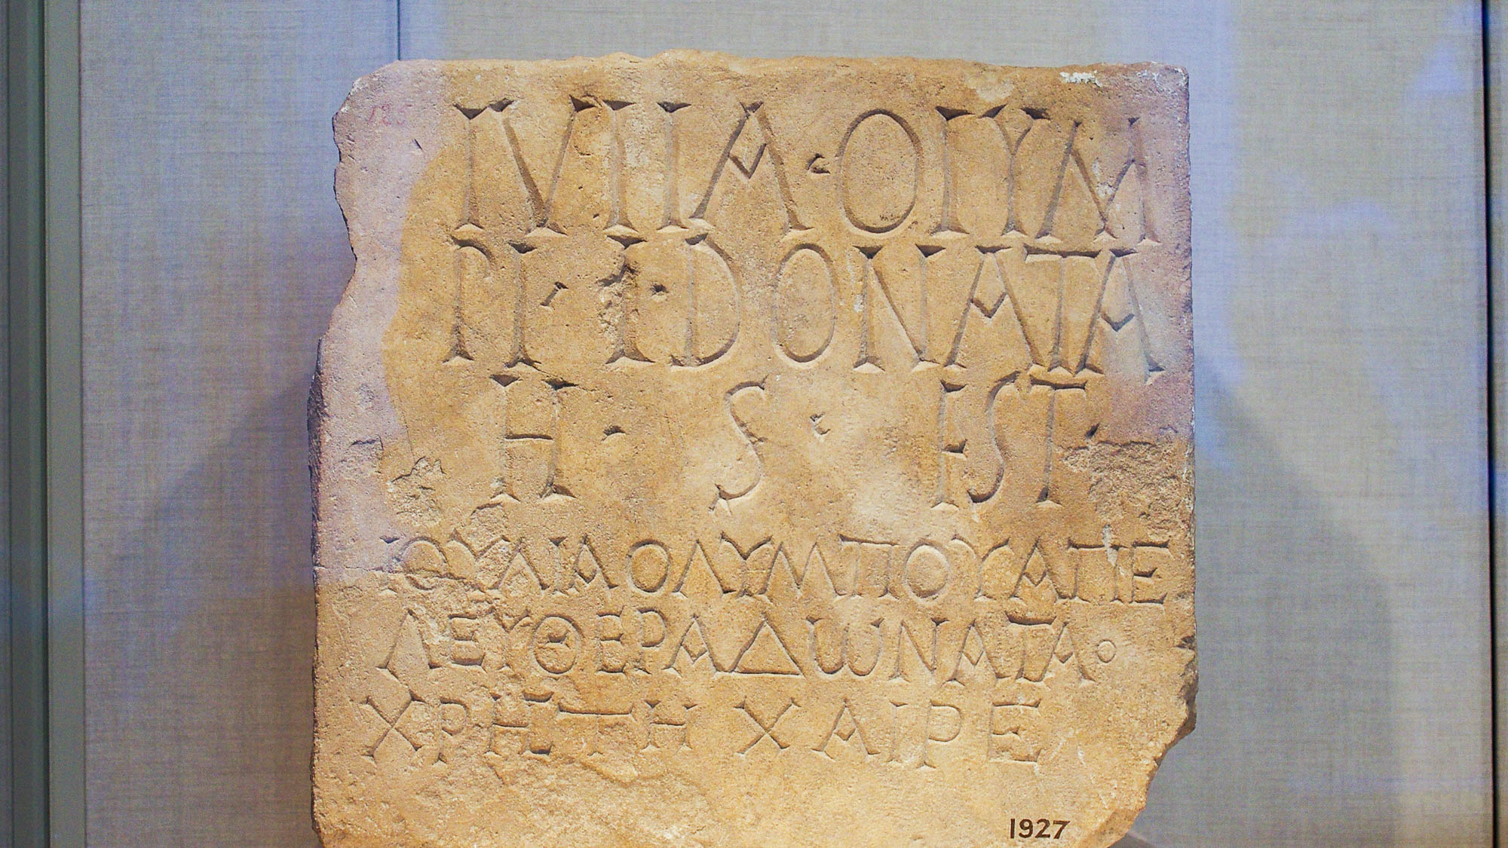
The translation of his name is “king of righteousness”
Cypriot plaque with Greek and Latin bilingual inscription, 1st century AD
7:2
Notes:
The author of Hebrews wished for his audience to understand the meaning of two words that he found significant, but the meaning would not have been immediately clear to an audience who did not understand Hebrew. Therefore he translated for them, observing that the Hebrew name Melchizedek, which has no meaning in Greek (Gk. Μελχισέδεκ) is composed of two Hebrew words that together mean “King of Righteousness” (Heb. melek, מלך, “king,” and tsedek, צדק, “righteous”). In Greek the phrase “king of righteousness” is basileus dikaiosunēs (Gk. βασιλεὺς δικαιοσύνης), which would have borne no auditory similarity to the name Melchizedek in the Greek language.
The issue of multiple languages and the need for translation was common in the 1st century AD. The inscription shown here has three lines in Latin, followed by three lines in Greek. The texts are similar, and the names are very close, although following standard practice much of the Latin inscription consists of abbreviated words. The Latin portion reads, “Julia Donata, the freedwoman of Olympus, lies here,” and the Greek lines read “Good Ioulia Donata, the freedwoman of Olympos, farewell.” This limestone inscription was photographed at the Metropolitan Museum of Art in New York City.
adr1605243061

Slide 24
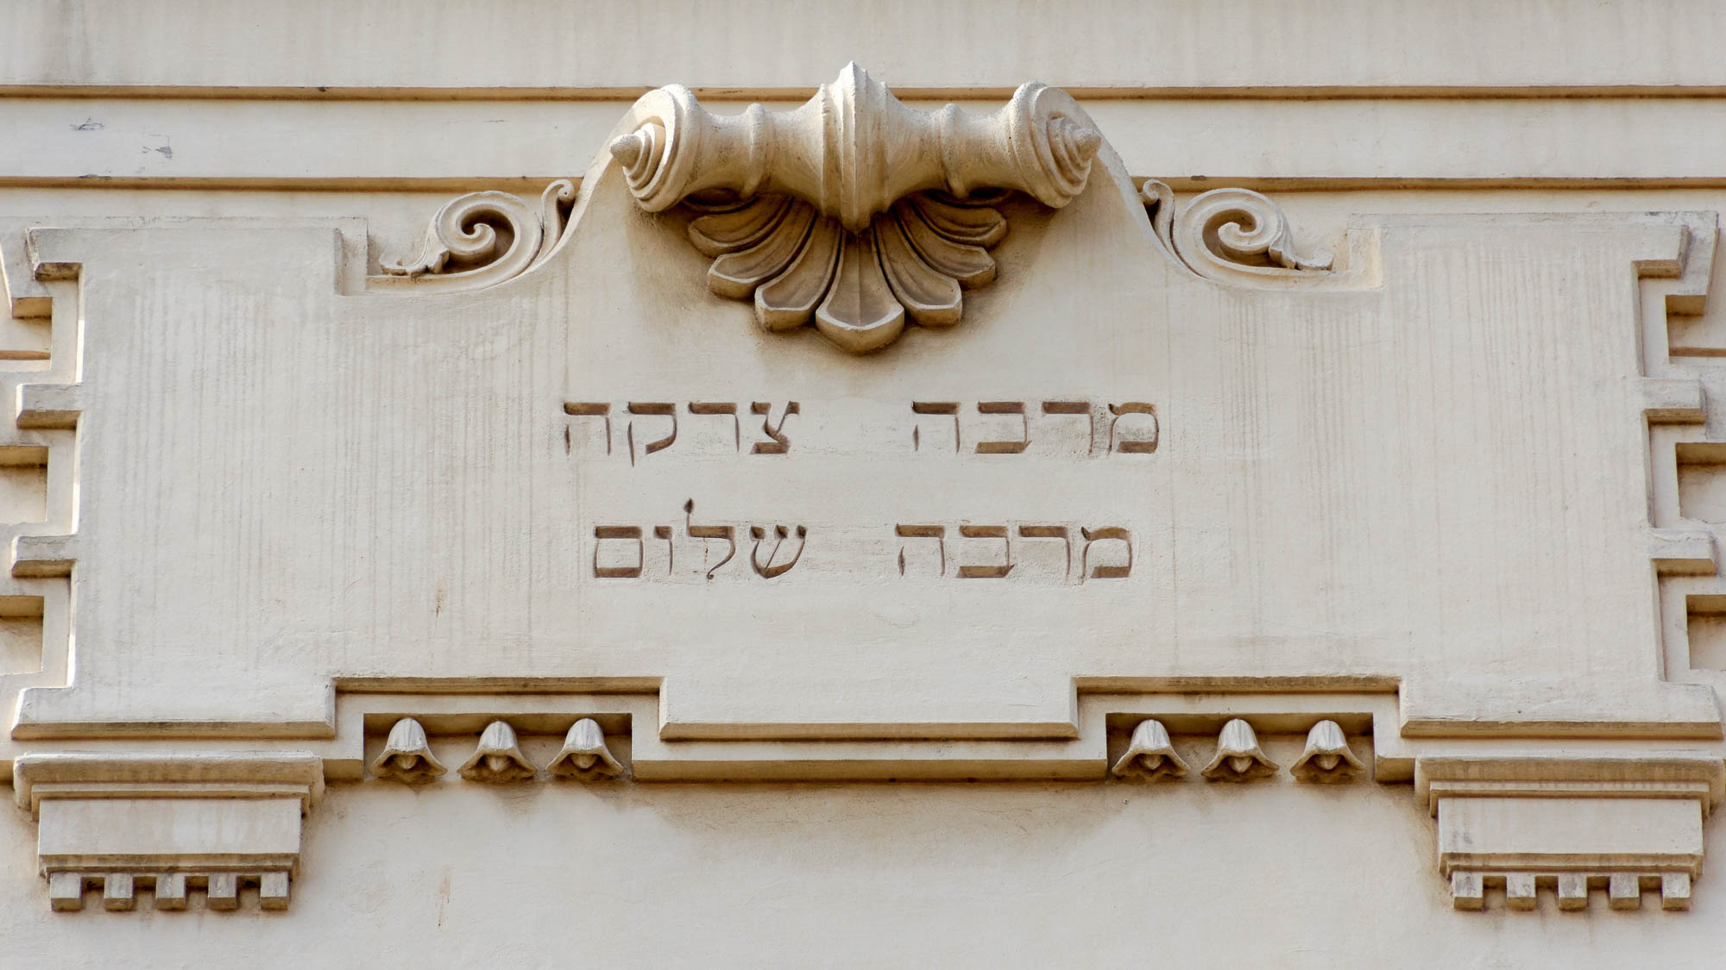
The translation of his name is “king of righteousness”
Inscription on the Great Synagogue of Rome
7:2
Notes:
Righteousness and peace are frequent words in the Old Testament and emphasized in Judaism. The author of Hebrews notes that Melchizedek is both king of righteousness and, as king of Salem, he is king of peace. This inscription on the Great Synagogue of Rome reads “Much righteousness, much peace“ (Heb. marbe tzedakah, marbe shalom, מרבה צדקה, מרבה שלום). This phrase comes from the Mishneh, where it may be translated, “the more charity (giving), the more peace” (Pirkei Avot 2.7).
tb0518173747

Slide 25
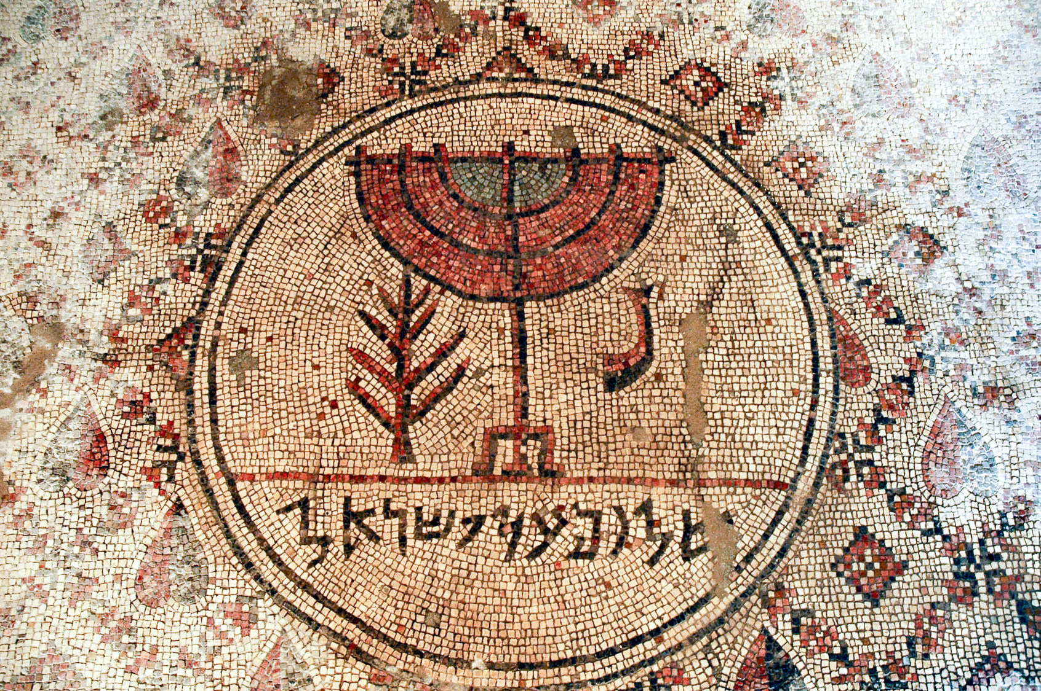
And then also king of Salem, that is, “king of peace”
“Peace upon Israel” mosaic, from the Jericho synagogue, 6th century AD
7:2
Notes:
Once again the author plays on the Hebrew words, noting that the city name “Salem” (Gk. Σαλήμ, Heb. Shalem, שָׁלֵם) means “peace” (Gk. eirēnē, εἰρήνη) in the Hebrew language (Heb. shalom, שָׁלֹם). The Hebrew inscription on this mosaic design reads “Peace be upon Israel” (Heb. shalom al yisrael, שלום על ישראל). It comes from a synagogue that was built in Jericho in the 6th century AD. A yeshiva was established at the site in the early 1990s, but the building was damaged in a riot in 2000 and access today is restricted.
tb051106788

Slide 26

And then also king of Salem, that is, “king of peace”
“Pray for the peace of Jerusalem,” Psalm 122:6 sign at Christ Church in Jerusalem
7:2
Notes:
This sign at Christ Church in Jerusalem bears a quotation of Psalm 122:6, offering a prayer for the peace of Jerusalem.
tb011612803

Slide 27
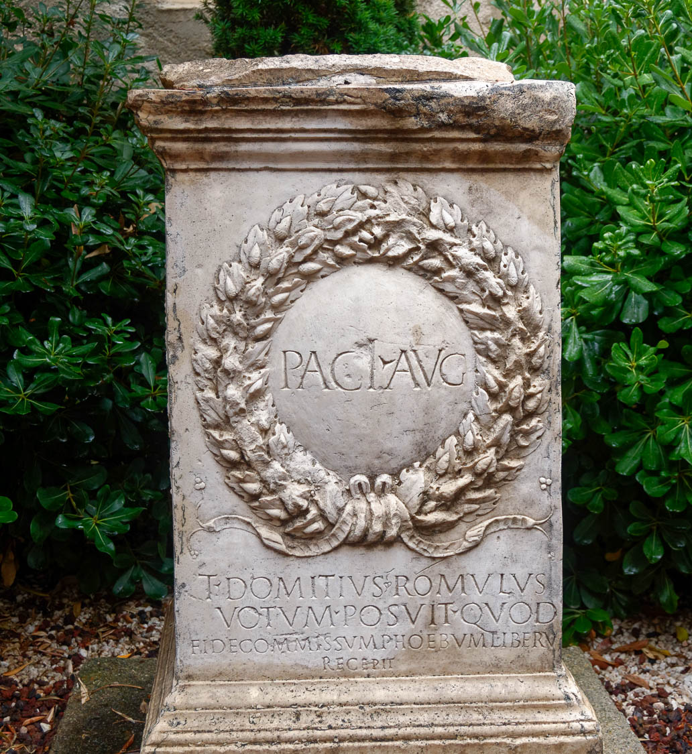
And then also king of Salem, that is, “king of peace”
Altar dedicated to Augustan Peace, Pax Augusta, 26–25 BC (replica)
7:2
Notes:
In Rome, pax, “peace,” was personified and deified as a goddess. This replica altar was dedicated to Pax for the Augustan Peace following Augustus’s return to Rome from battle in Gaul. It presents Augustus as a king of peace, but a peace that did not last. This replica was photographed in Narbonne, France.
tb092119937h

Slide 28
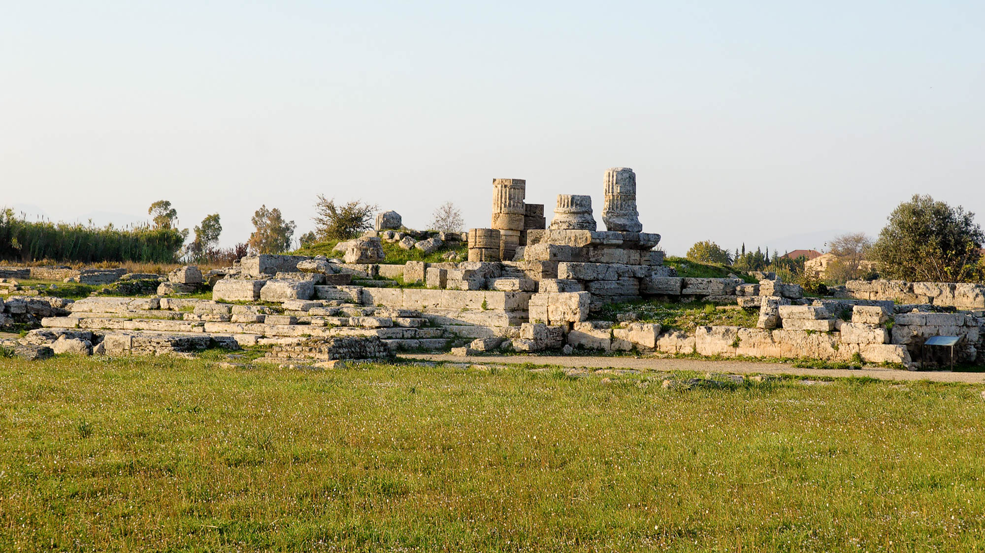
And then also king of Salem, that is, “king of peace”
Temple of Peace at Paestum
7:2
Notes:
The ruins shown here are from the Temple of Peace in Paestum, Italy. The temple was constructed around the 2nd century BC.
tb111505323h

Slide 29
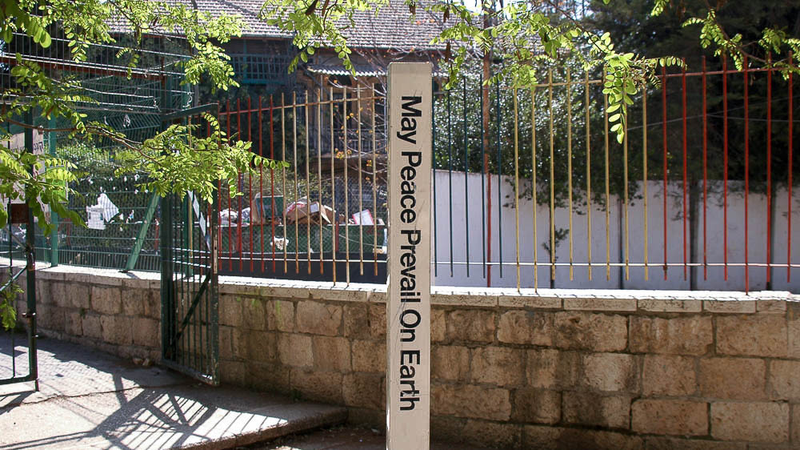
And then also king of Salem, that is, “king of peace”
“May Peace Prevail on Earth” sign in Jerusalem
7:2
Notes:
This sign in Jerusalem expresses a prayer for peace on earth.
tb040605772

Slide 30
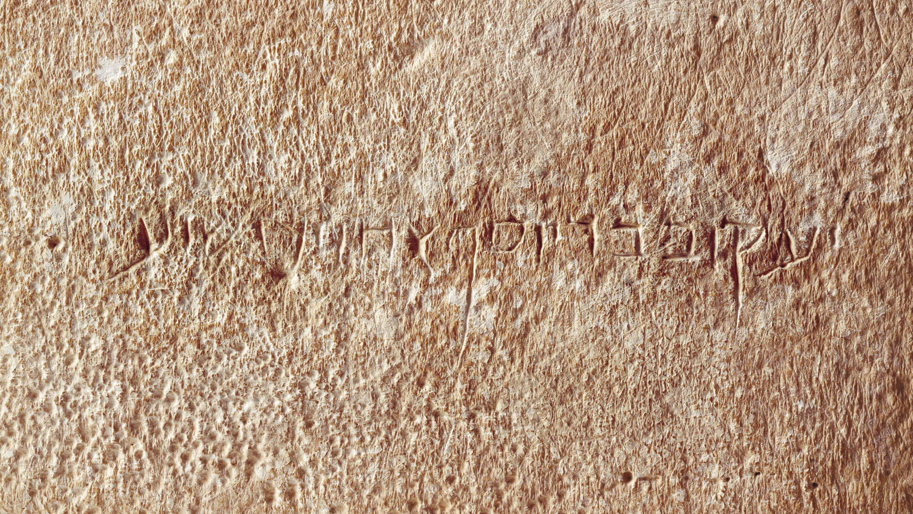
Without father, without mother, without genealogy
Inscription on ossuary of “James, son of Joseph, brother of Jesus,” 1st century AD
7:3
Notes:
In Hebrew, it was common to refer to a man as the son of his father, using the formula, NAME + “son of” + NAME OF FATHER. The name of Melchizedek's father, however, is unknown, a fact that is significant to the author of Hebrews because it demonstrates that Melchizedek’s priesthood was not dependent on lineage (in contrast to the Aaronic priesthood).
The Aramaic inscription on this ossuary identifies the deceased with relation to his father and brother. It reads “James, son of Joseph, brother of Jesus” (יעכוב בר יוסף אחוי ישׁוע). Because this ossuary originated on the antiquities market, its claim to authenticity has been disputed. In 2003 the Israel Antiquities Authority argued that the inscription was a forgery and took the owner, Oded Golan, to court. After a seven-year trial, Golan was acquitted of all forgery charges, although the judge in the case did not rule on the authenticity of the ossuary. Archaeologists, epigraphers, and other specialists are still divided over the authenticity of the inscription. Two studies of the patina have shown that it is consistent across the face of the letters and the rest of the surface, indicating the inscription is authentic (Fruen 2006: 10; Rosenfeld et al. 2014). This image comes from Paradiso and is in the public domain, via Wikimedia Commons, https://commons.wikimedia.org/wiki/File:JamesOssuaryInscription-1-.jpg. The next slide includes labels.
References:
Fruen, Lois.
2006 Real or Fake? The James Ossuary Case. ChemMatters 24: 8–10. PDF accessible online: https://www.acs.org/content/dam/acsorg/education/resources/highschool/chemmatters/articlesbytopic/atomictheory/chemmatters-feb2006-ossuary.pdf
Rosenfeld, Amnon; Feldman, Howard R.; and Krumbein, Wolfgang E.
The Authenticity of the James Ossuary. Open Journal of Geology 4: 69–78. PDF accessible online: https://file.scirp.org/pdf/OJG_2014031213484587.pdf
wiki0105200523171885

Slide 31
Without father, without mother, without genealogy
(inscribed right to left)
Jesus
brother of
Joseph
son of
James
ישוע
אחוי
יוסף
בר
יעכוב
Inscription on ossuary of “James, son of Joseph, brother of Jesus,” 1st century AD
7:3
Notes:
In Hebrew, it was common to refer to a man as the son of his father, using the formula, NAME + “son of” + NAME OF FATHER. The name of Melchizedek's father, however, is unknown, a fact that is significant to the author of Hebrews because it demonstrates that Melchizedek’s priesthood was not dependent on lineage (in contrast to the Aaronic priesthood).
The Aramaic inscription on this ossuary identifies the deceased with relation to his father and brother. It reads “James, son of Joseph, brother of Jesus” (יעכוב בר יוסף אחוי ישׁוע). Because this ossuary originated on the antiquities market, its claim to authenticity has been disputed. In 2003 the Israel Antiquities Authority argued that the inscription was a forgery and took the owner, Oded Golan, to court. After a seven-year trial, Golan was acquitted of all forgery charges, although the judge in the case did not rule on the authenticity of the ossuary. Archaeologists, epigraphers, and other specialists are still divided over the authenticity of the inscription. Two studies of the patina have shown that it is consistent across the face of the letters and the rest of the surface, indicating the inscription is authentic (Fruen 2006: 10; Rosenfeld et al. 2014). This image comes from Paradiso and is in the public domain, via Wikimedia Commons, https://commons.wikimedia.org/wiki/File:JamesOssuaryInscription-1-.jpg.
References:
Fruen, Lois.
2006 Real or Fake? The James Ossuary Case. ChemMatters 24: 8–10. PDF accessible online: https://www.acs.org/content/dam/acsorg/education/resources/highschool/chemmatters/articlesbytopic/atomictheory/chemmatters-feb2006-ossuary.pdf
Rosenfeld, Amnon; Feldman, Howard R.; and Krumbein, Wolfgang E.
The Authenticity of the James Ossuary. Open Journal of Geology 4: 69–78. PDF accessible online: https://file.scirp.org/pdf/OJG_2014031213484587.pdf
wiki0105200523171885

Slide 32
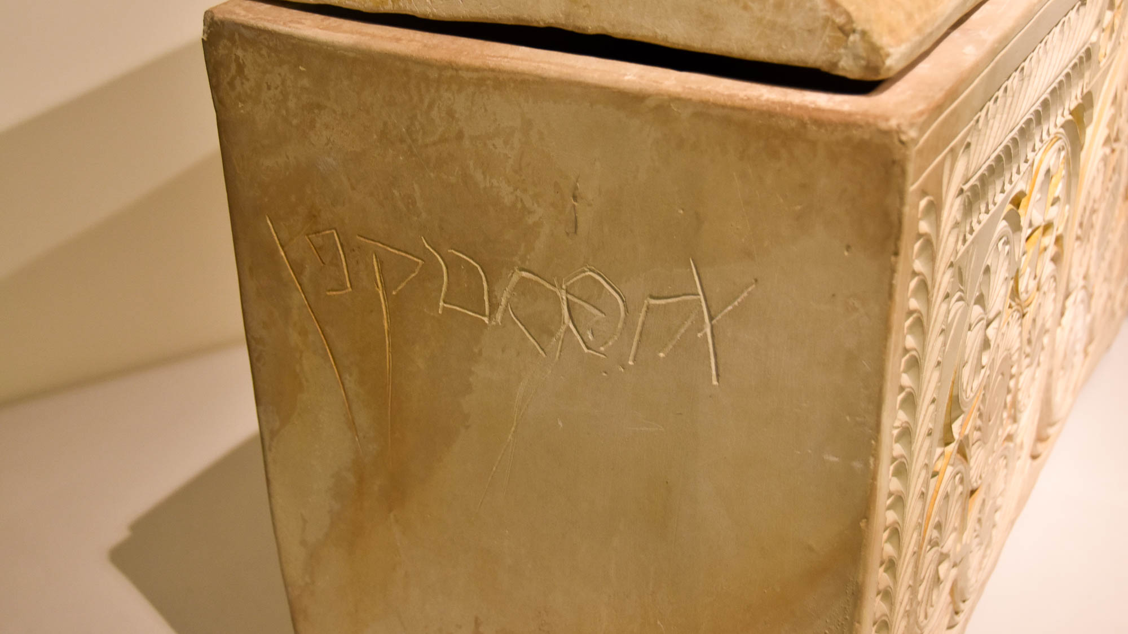
Without father, without mother, without genealogy
Ossuary of “Joseph son of Caiaphas,“ from Jerusalem, 1st century AD
7:3
Notes:
The inscription on this ossuary identifies the deceased as “Joseph son of Caiaphas” (Heb. יהוסף בר קפא). This ossuary is generally considered to have belonged to the high priest in the days of Jesus. Josephus identifies the high priest who presided at the trial of Jesus as “Joseph who was called Caiaphas” (Ant. 18.95). Interestingly enough, the New Testament consistently refers to him simply as Caiaphas (Matt 26:3; John 11:49), which illustrates the importance of the patronymic. This ossuary was photographed at the Israel Museum.
mjb1904166341h

Slide 33
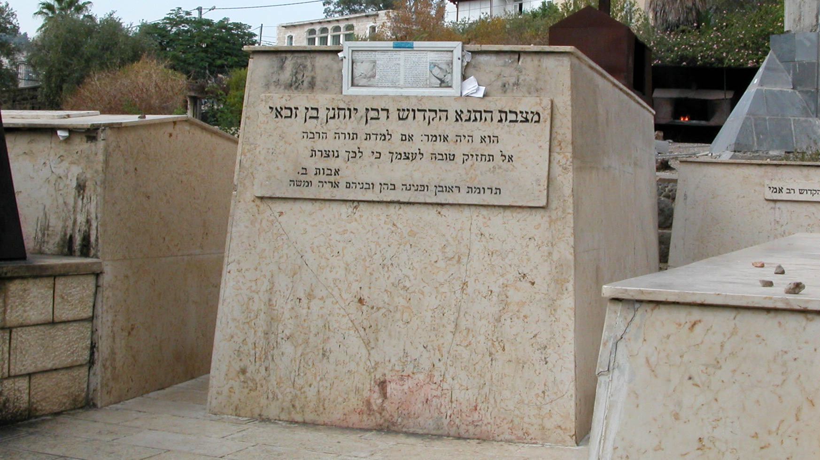
Without father, without mother, without genealogy
Tomb of Rabbi Yohanan ben Zakkai, at Tiberias
7:3
Notes:
The tomb of Rabbi Yohanan ben Zakkai, a rabbi who, like many others, is known by the name of his father, is located in Tiberias. Yohanan ben Zakkai was a Pharisee during the 1st century AD.
tb102802902h

Slide 34
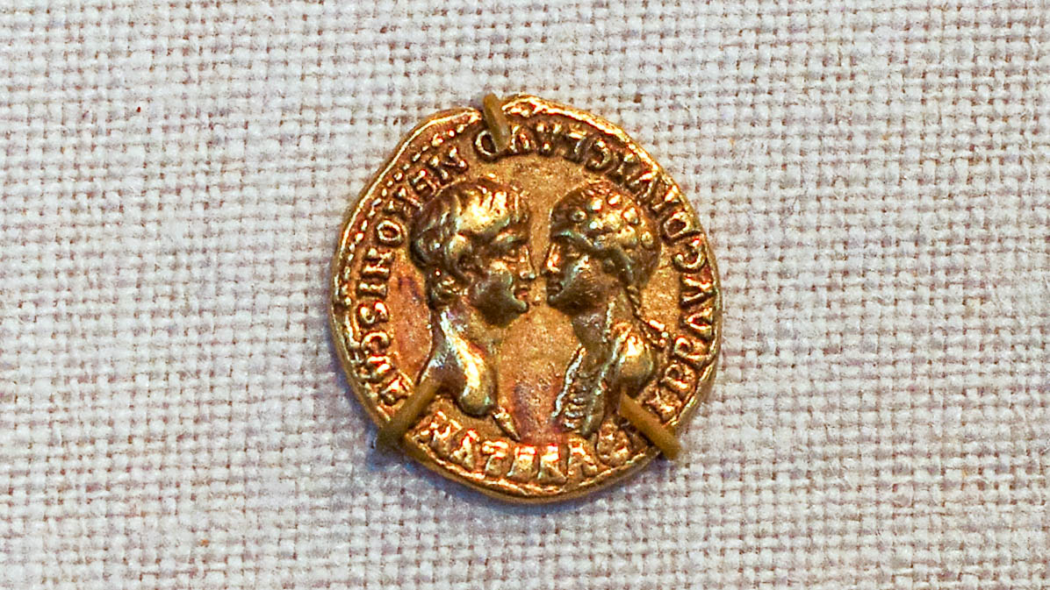
Without father, without mother, without genealogy
Gold aureus of Nero with his mother, from Lugdunum, AD 54
7:3
Notes:
Mothers of kings are often well-known (e.g., 1 Kgs 14:21, 31; 2 Kgs 23:31; 2 Chr 13:12, etc.). This coin depicts Nero, likely the emperor at the time Hebrews was written, with his mother Agrippina the Younger. While ancient historians differ concerning the details of Agrippina’s death, all agree that she was killed by Nero. This gold aureus was photographed at the Metropolitan Museum of Art in New York City.
adr1605243491h

Slide 35
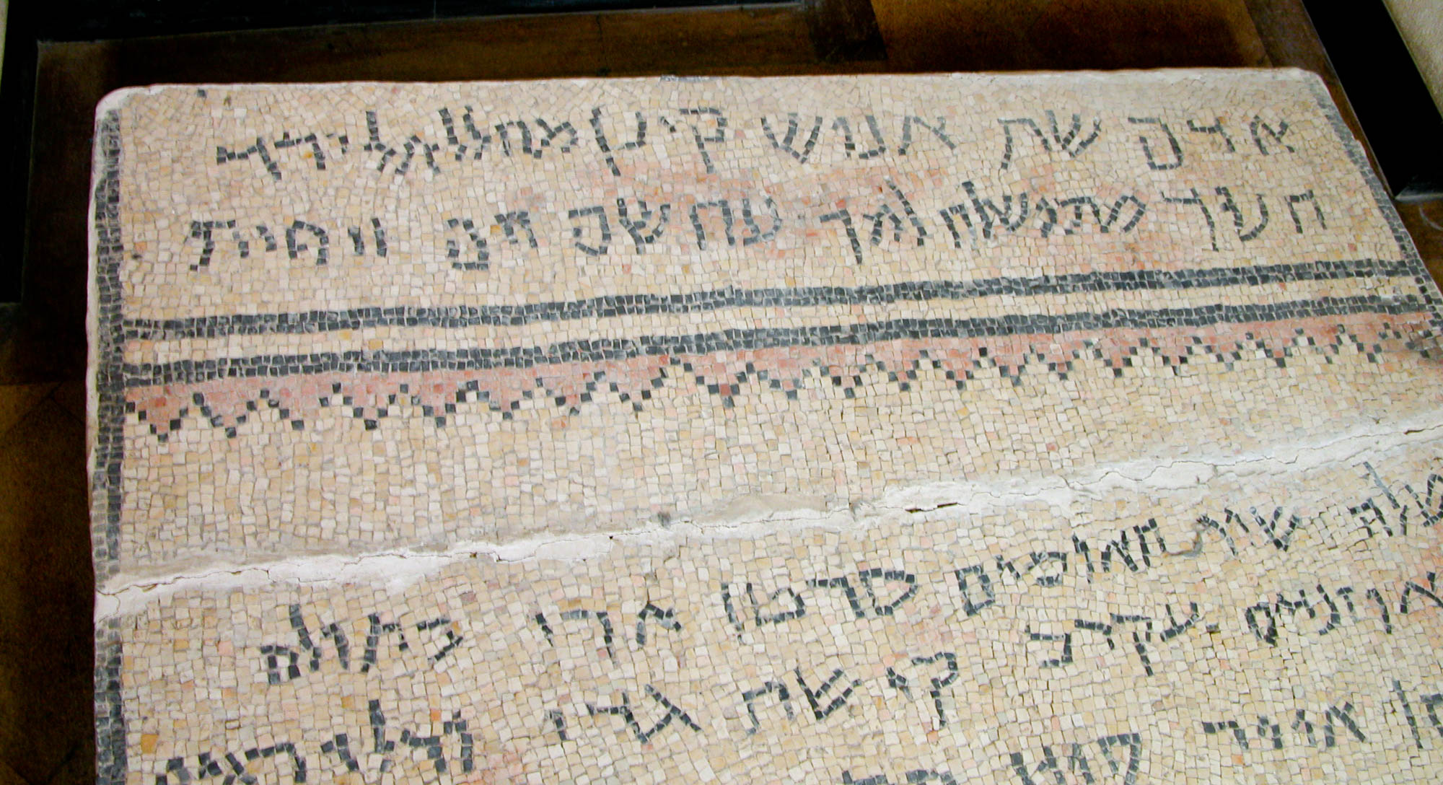
Without father, without mother, without genealogy
Genealogy mosaic from the En Gedi synagogue, 6th century AD
7:3
Notes:
The author stresses that Melchizedek was “without genealogy” because genealogy was so important for the priesthood ordained by the Law. However, the priesthood of Melchizedek was not based on genealogy. The mosaic inscription shown here gives a genealogy from 1 Chronicles 1. The first line reads “Adam, Seth, Enosh, Kenan, Mahalalel, Jared.” The second line: “Enoch, Methuselah, Lamech, Noah, Shem, Ham, and Japheth.” The lengthy list of names in the genealogy of the Levites in 1 Chronicles 6 reflects the essential role of lineage in determining one’s qualification to be a priest in ancient Israel. This mosaic was photographed in the Rockefeller Museum in Jerusalem.
tb042403039

Slide 36
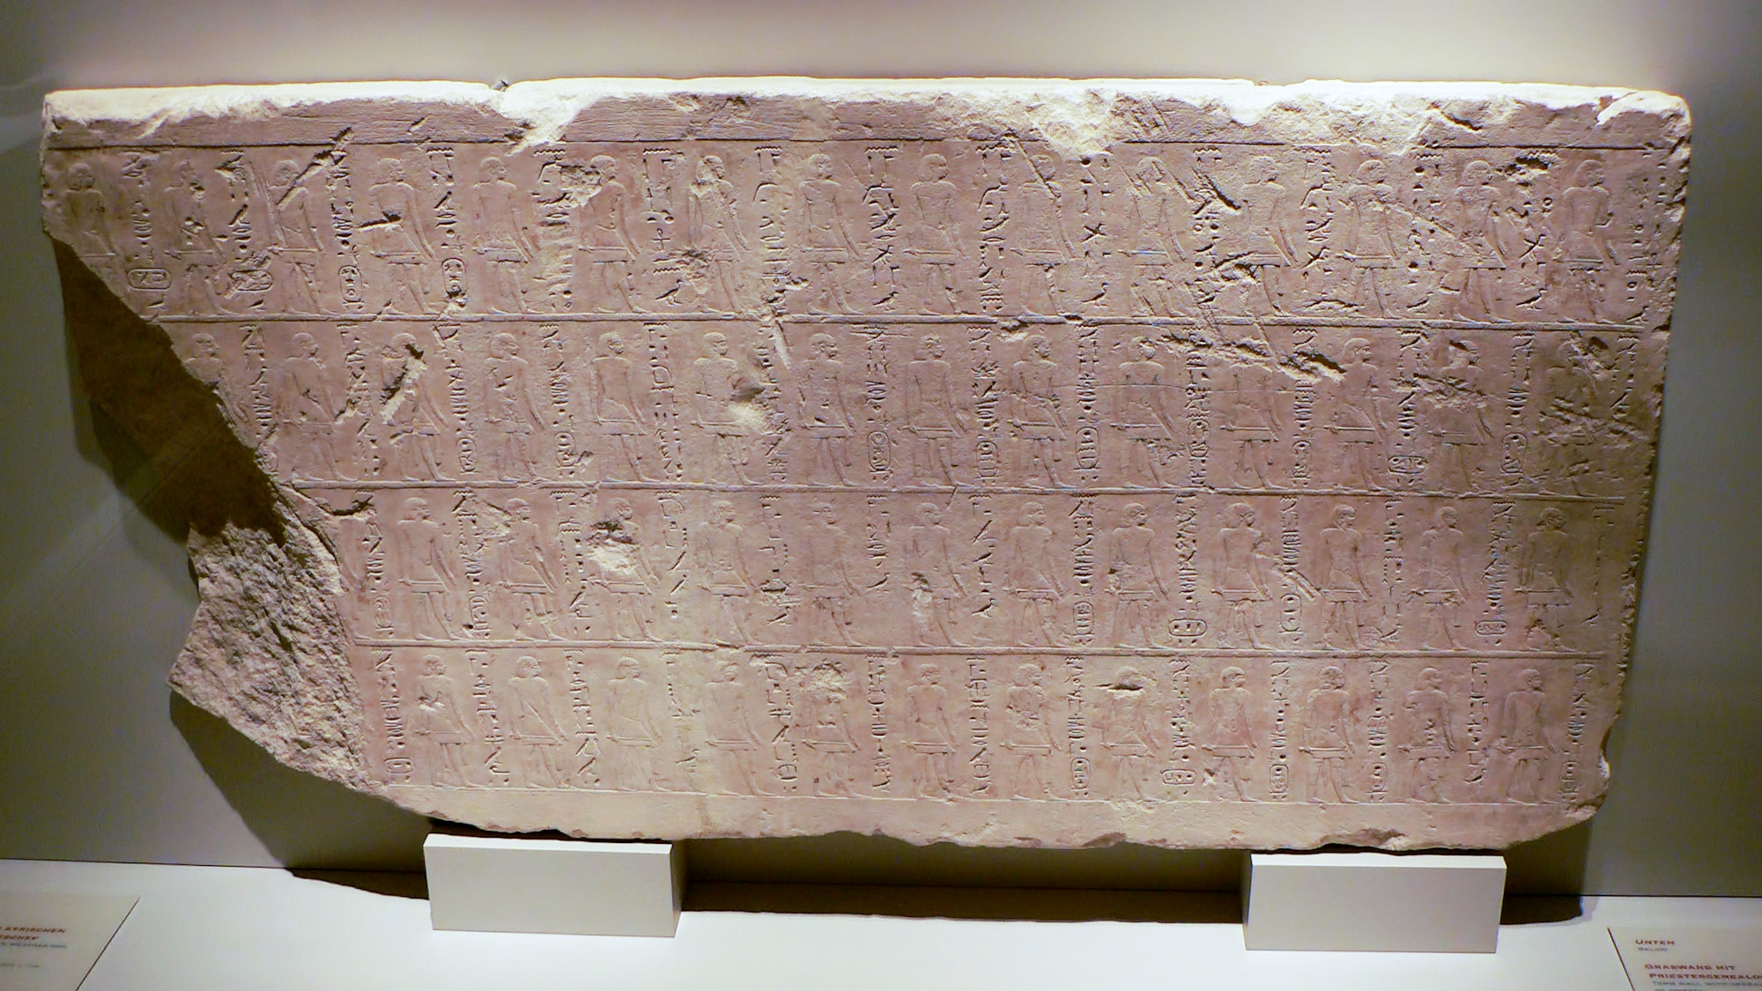
Without father, without mother, without genealogy
Limestone tomb wall with genealogy of priests, from Memphis, Egypt, 11th–10th centuries BC
7:3
Notes:
The genealogy of priests was important not only among Jews, but also in other cultures. This picture shows a tomb wall from Memphis dating to the 21st dynasty (11th–10th centuries BC) that records the genealogy of priests. This artifact was photographed at the Berlin Egyptian Museum and Papyrus Collection.
adr070511818

Slide 37
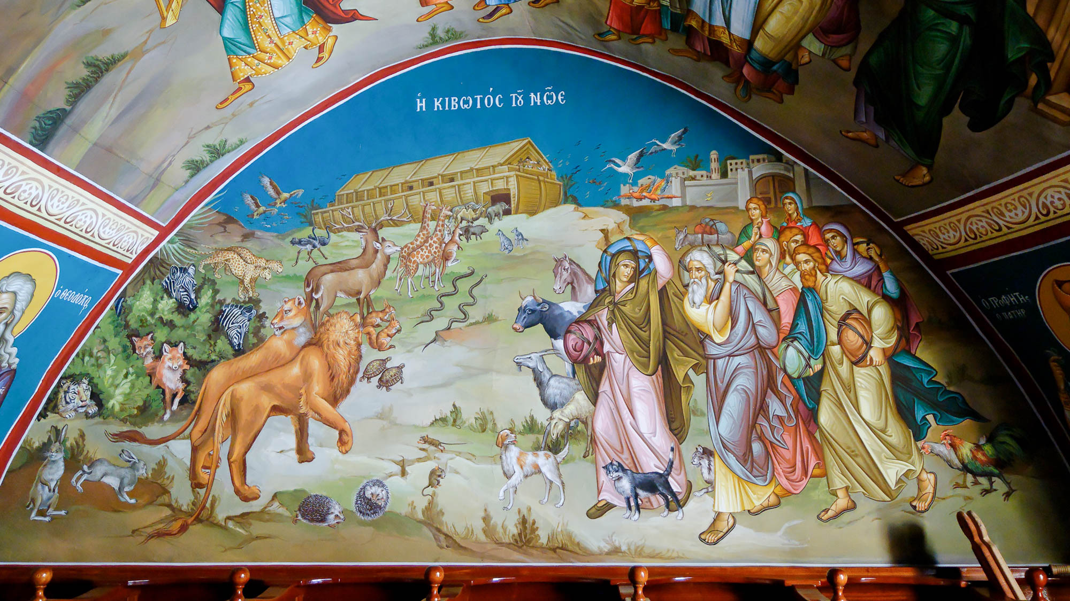
Having neither beginning of days nor end of life, but made like the Son of God
Fresco of Noah’s Ark, at the Mar Saba monastery
7:3
Notes:
Nothing about the birth or ancestry of Melchizedek appears in the Bible. A story of the birth of Melchizedek appears, however, in 2 Enoch 71. A woman, Sothonim, conceives without intercourse and is suspected of adultery by her husband, the priest Nir, the brother of Noah. Sothonim dies when accused by her husband, and the child is born as she dies. Nir and Noah name him Melchizedek. This picture shows a depiction of Noah’s ark in the Mar Saba monastery, located in the Judean wilderness east of Bethlehem.
tb010107310

Slide 38
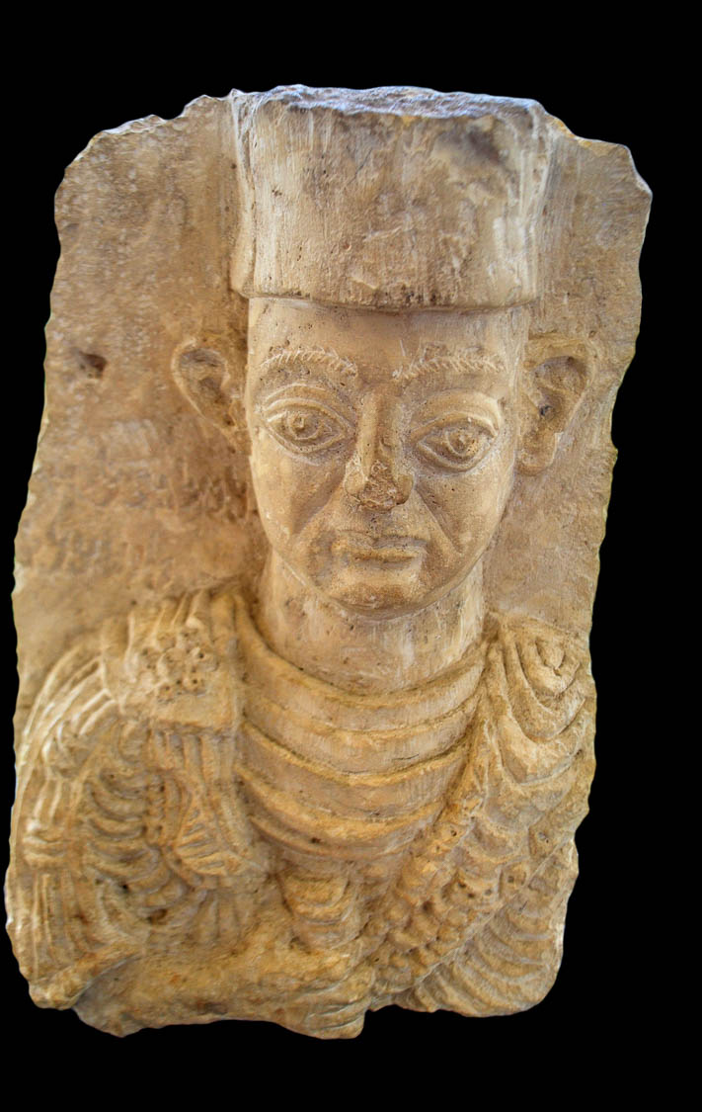
Having neither beginning of days nor end of life, but made like the Son of God
Tombstone of a priest, from Palmyra, 1st century AD
7:3
Notes:
Nothing is known about the death of Melchizedek. By contrast, this tombstone of a priest from the 1st century testifies to this priest’s death. This tombstone bears an inscription dedicated to “Malkibaal bar Malkibaal.” It was photographed at the Hecht Museum at the University of Haifa.
cm17062707452b

Slide 39
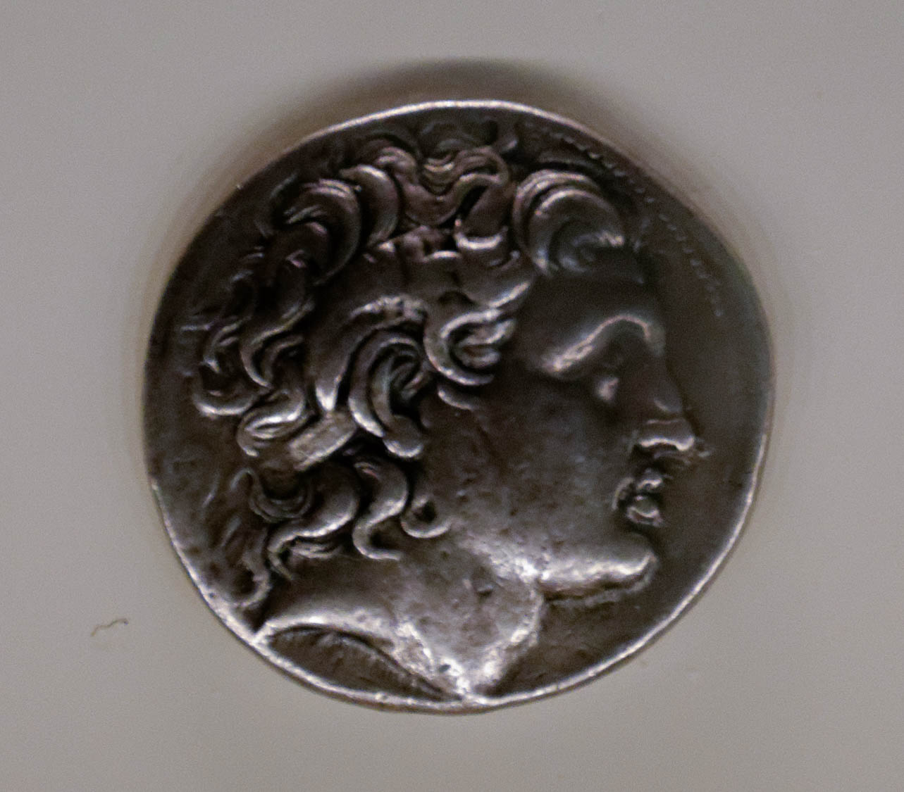
Now consider how great this man was
Silver tetradrachm with Alexander the Great, from Amphipolis, 323–281 BC
7:4
Notes:
Various rulers have been recognized as “great” throughout history. One example is Alexander III of Macedon, also known as Alexander the Great. This appellative was earned on account of his conquest of virtually the entire civilized world. Hebrews speaks of Melchizedek’s greatness, however, not in terms of great conquests or the extent of his dominion, but rather that Abraham, the patriarch of the people of Israel, recognized Melchizedek as greater than himself. This coin from the 4th century BC depicts Alexander the Great’s face. It was photographed at the Getty Villa in southern California.
tb082214602

Slide 40
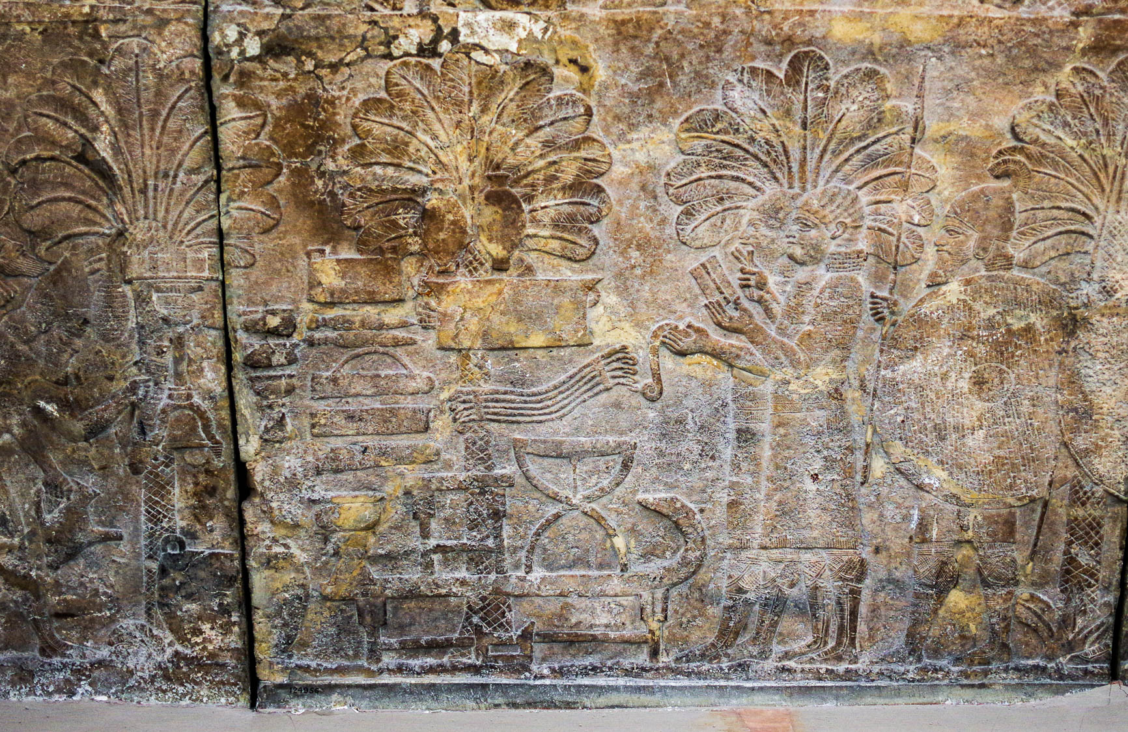
Abraham, the patriarch, gave him a tenth of the choicest spoils
Assyrian scribes recording items taken in war, from Nineveh, 7th century BC
7:4
Notes:
This relief shows a pile of goods taken as booty in war. On the far left, a figure is adding items to the pile, while to the center-left, two scribes are making a record of what is there. Items include furniture, vessels of various kinds, and even arms (a quiver and a stack of bows). This relief came from the palace of Ashurbanipal at Nineveh and was photographed at the British Museum.
adr1805195294h

Slide 41
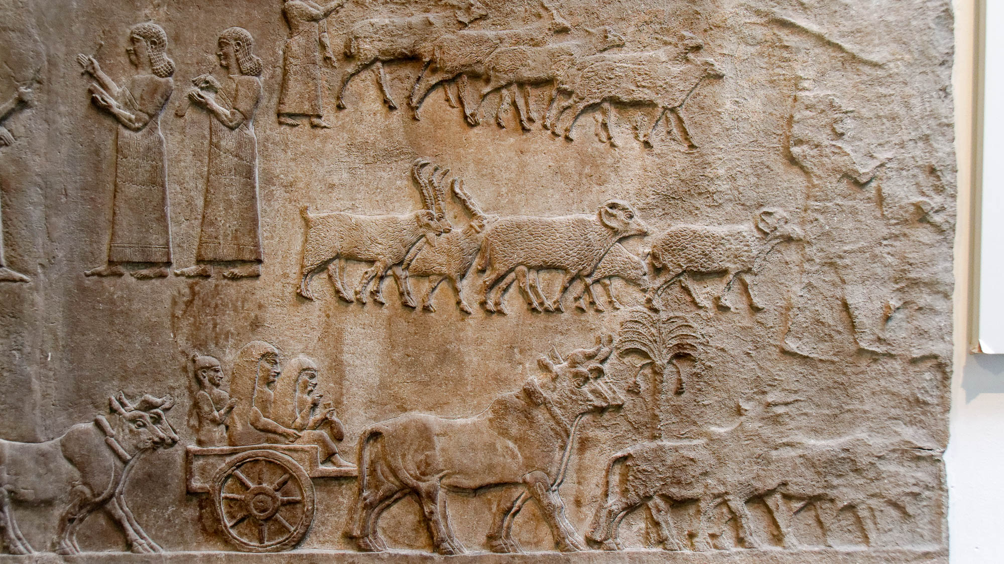
Abraham, the patriarch, gave him a tenth of the choicest spoils
Relief of prisoners and captured livestock, from Central Palace at Nimrud, circa 728 BC
7:4
Notes:
Various forms of livestock may have also been included in the spoil. This relief comes from the palace of Tiglath-pileser III at Nimrud. It depicts two Assyrian scribes taking a tally as groups of captured livestock and prisoners are driven past. This relief was photographed at the British Museum.
tb0929196984h

Slide 42
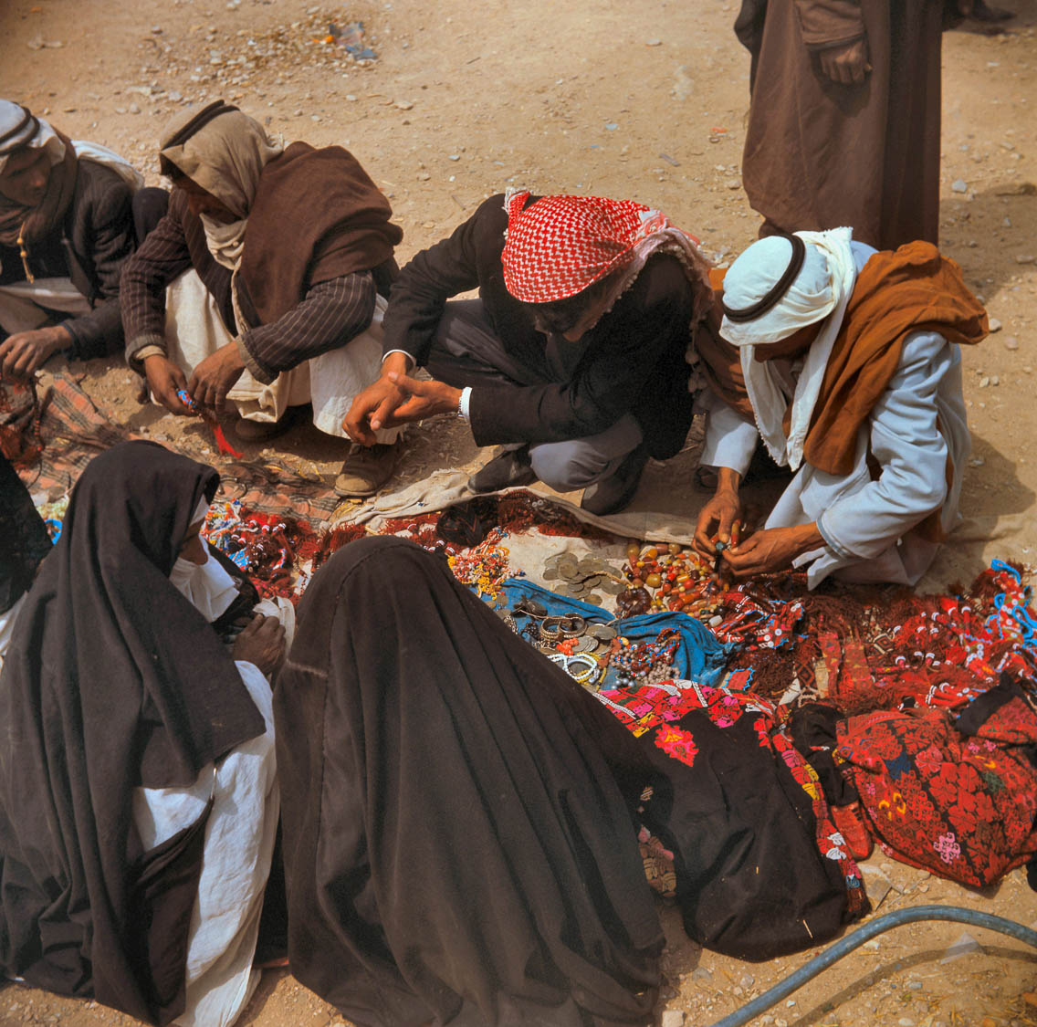
Abraham, the patriarch, gave him a tenth of the choicest spoils
Bedouin market at Beersheba
7:4
Notes:
The spoil would have also included jewelry, clothing, or other small but valuable objects. This photograph was taken by David Bivin in 1968.
db6804042908

Slide 43
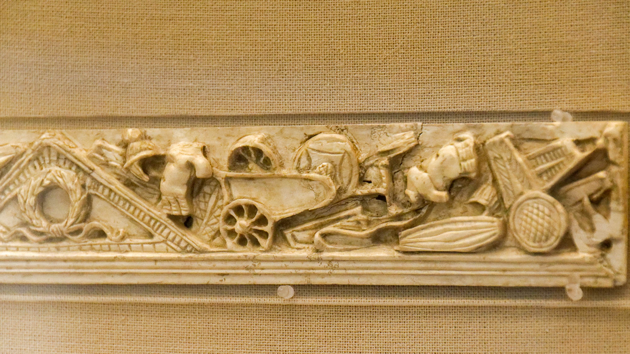
Abraham, the patriarch, gave him a tenth of the choicest spoils
Ivory plaque with battle spoils, Roman, probably 100 BC – AD 100
7:4
Notes:
This Roman plaque made of ivory depicts spoils from battle, including a chariot, body armor, shields, and weapons. It was photographed at the British Museum.
tb0929197873h

Slide 44
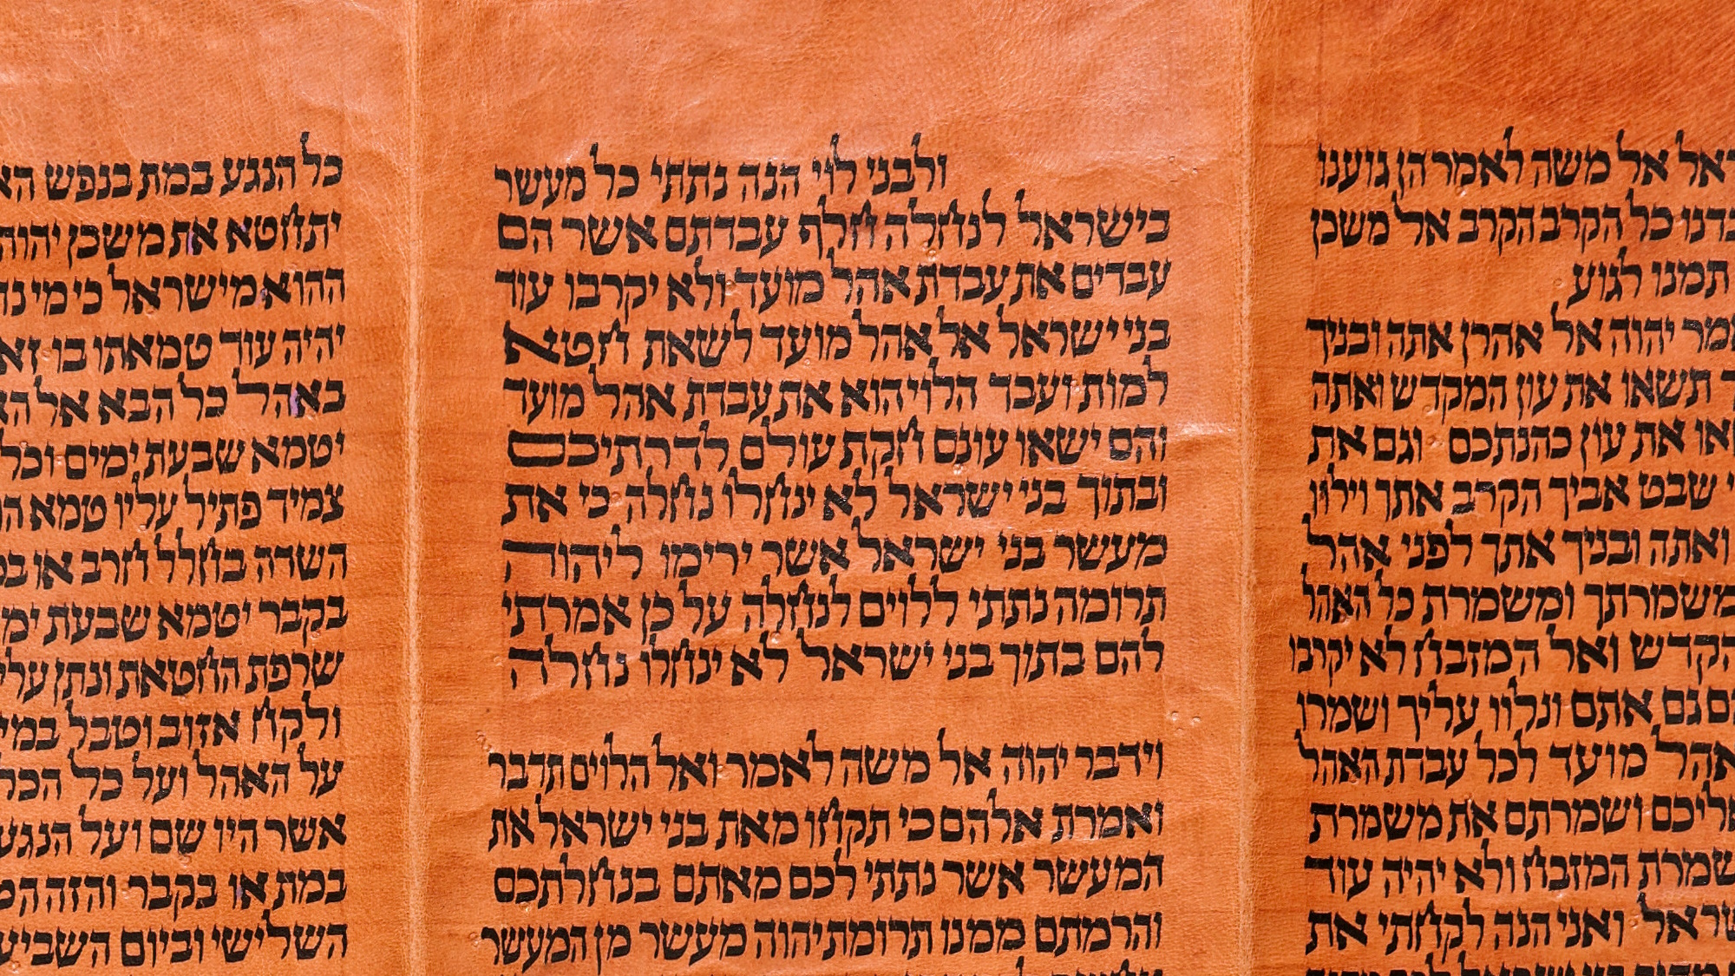
Now certainly the Levites who are priests collect a tithe from the people according to the Law
“And to the children of Levi, behold, I have given all the tithe in Israel for an inheritance, in return for their service, even the service of the tent of meeting”
Torah scroll with Numbers 18:21
7:5
Notes:
“And to the children of Levi, behold, I have given all the tithe in Israel for an inheritance, in return for their service, even the service of the tent of meeting” (Num 18:21). This Yemenite Torah scroll was photographed at The Master’s Seminary in California.
tb031416438

Slide 45
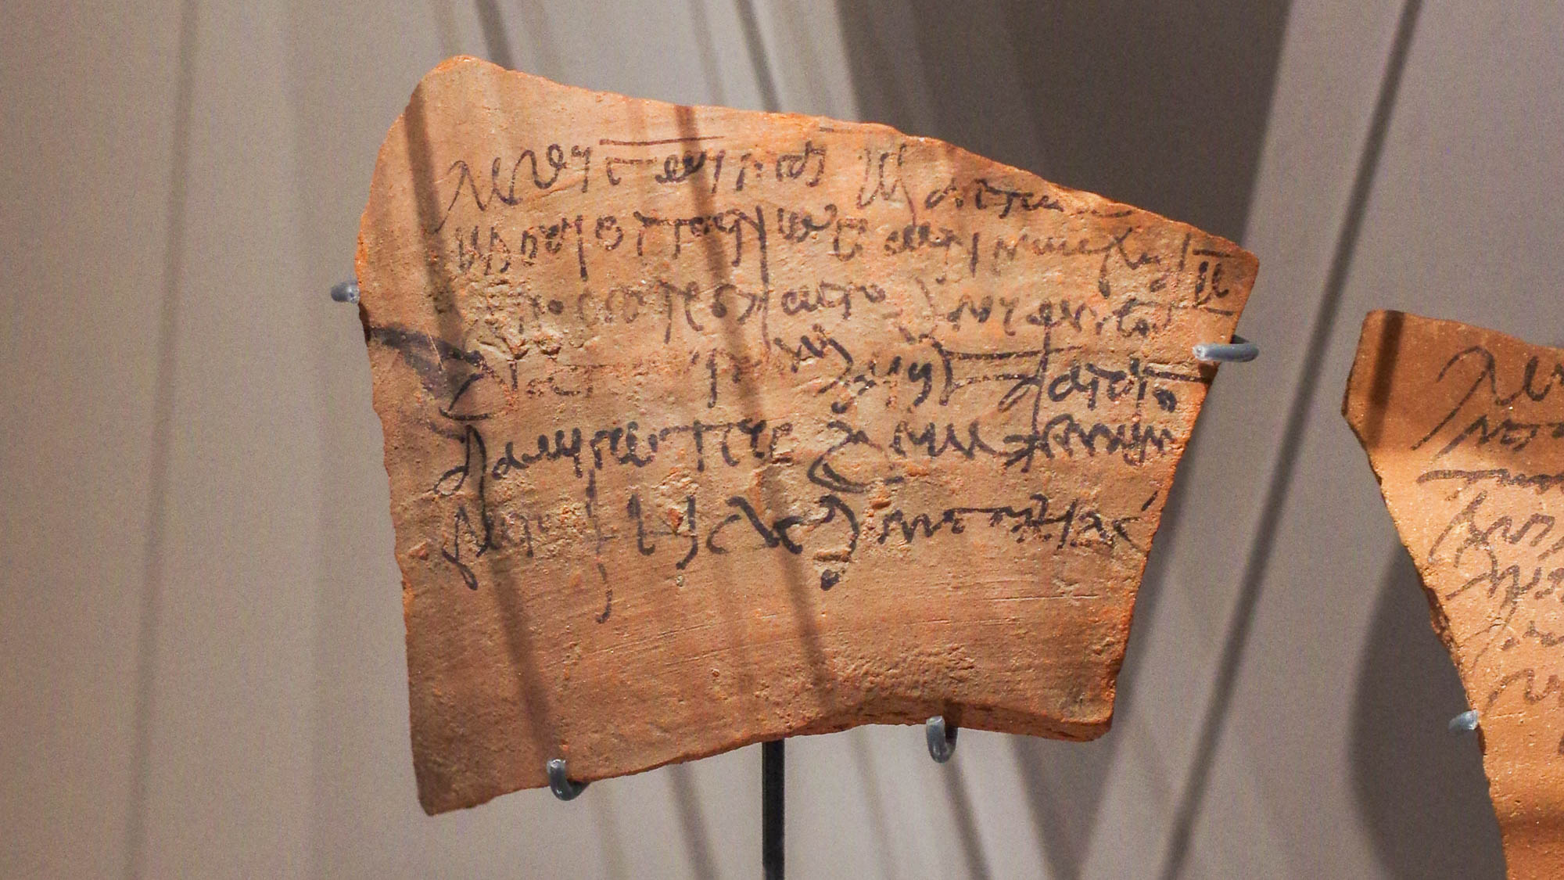
Now certainly the Levites who are priests collect a tithe from the people according to the Law
Receipt for a tithe payment in wheat by land tenants to a city granary, from Thebes, AD 162
7:5
Notes:
Tithing is an ancient custom which is also attested outside of the Bible. This ostracon was photographed at the Ashmolean Museum at the University of Oxford.
adr1805183074h

Slide 46
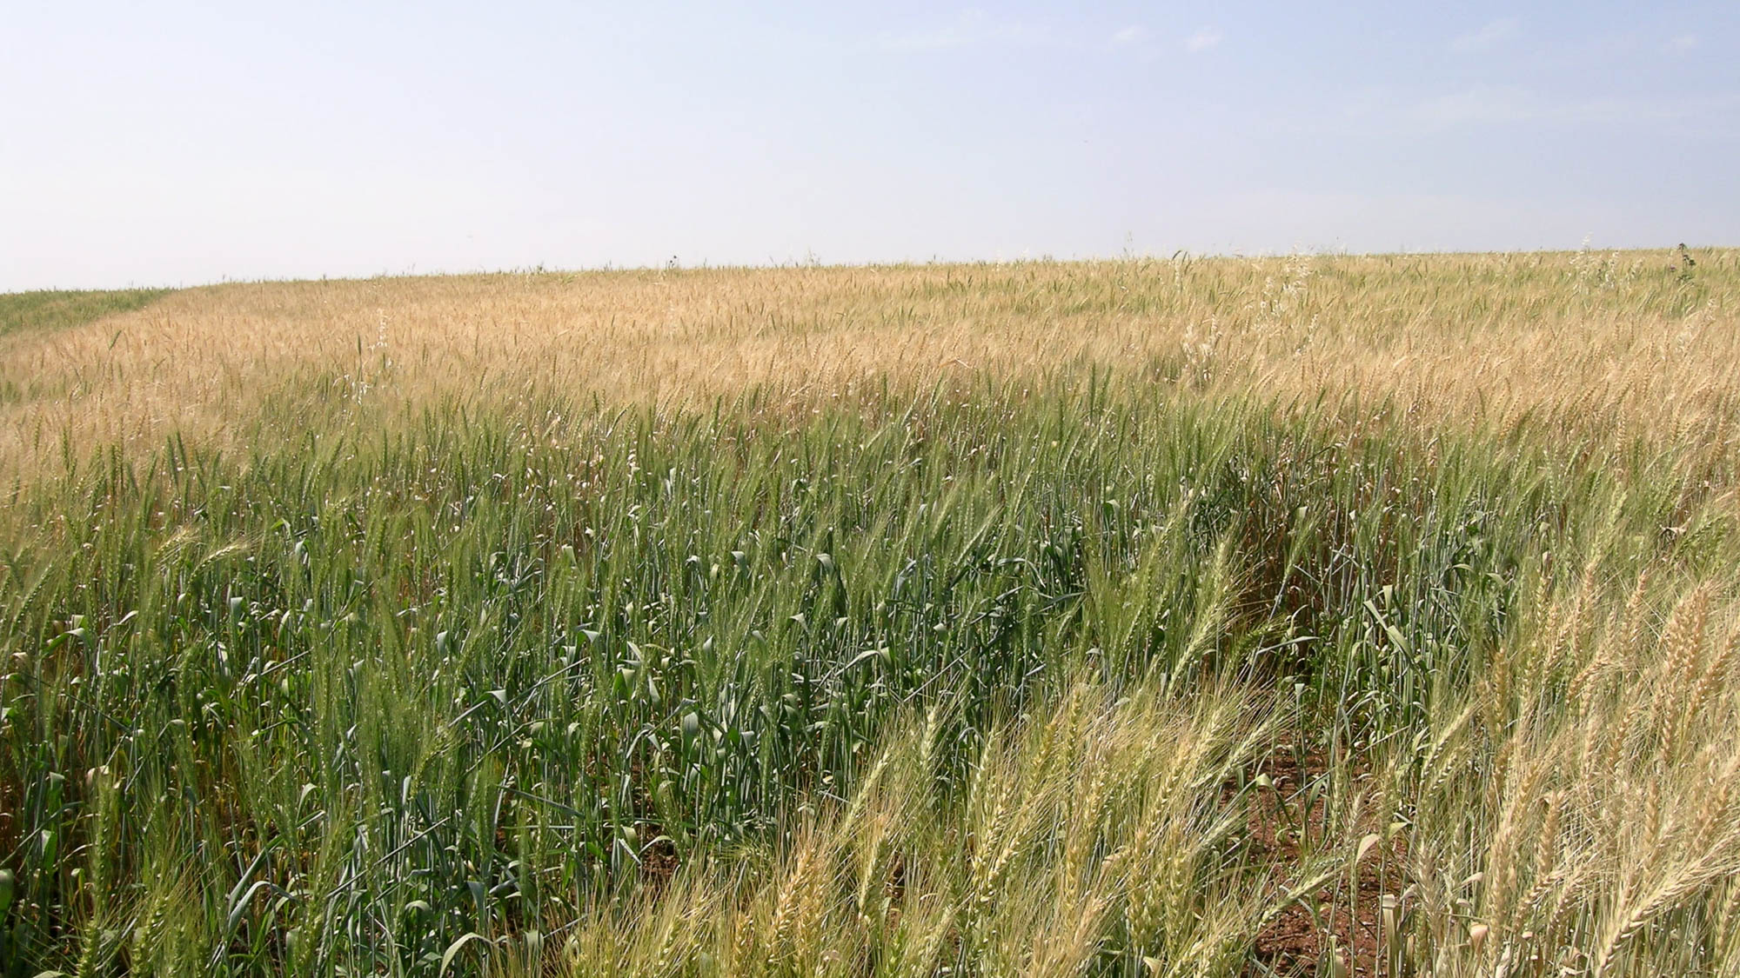
Now certainly the Levites who are priests collect a tithe from the people according to the Law
Wheatfield, near Arbel
7:5
Notes:
The Israelites were to give a tithe from all of their produce. This photo shows a field of wheat, one of the crops from which the Israelites were to tithe, near Arbel in Galilee.
tb033005859h

Slide 47
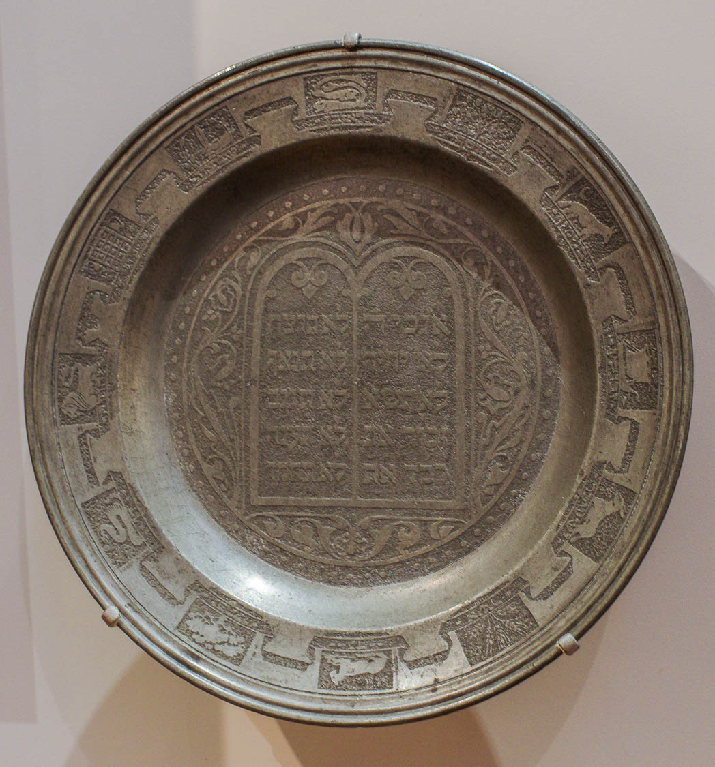
This was collected from their brothers, even though they are descended from Abraham
Shavuot plate with 12 tribes and 10 commandments, from central Europe, 19th century AD
7:5
Notes:
The Levites received a tithe from Israelites of other tribes, even though they were together descended from Abraham and part of the same people of Israel. This picture shows a pewter Shavuot (Feast of Weeks; Pentecost) plate with symbols for each of the twelve tribes around its perimeter and tablets of the Ten Commandments in the center, expressing the unity of the twelve tribes and the centrality of Torah. It was photographed at the Hebrew Union College and Jewish Institute of Religion in the Skirball Museum.
adr1709108454

Slide 48
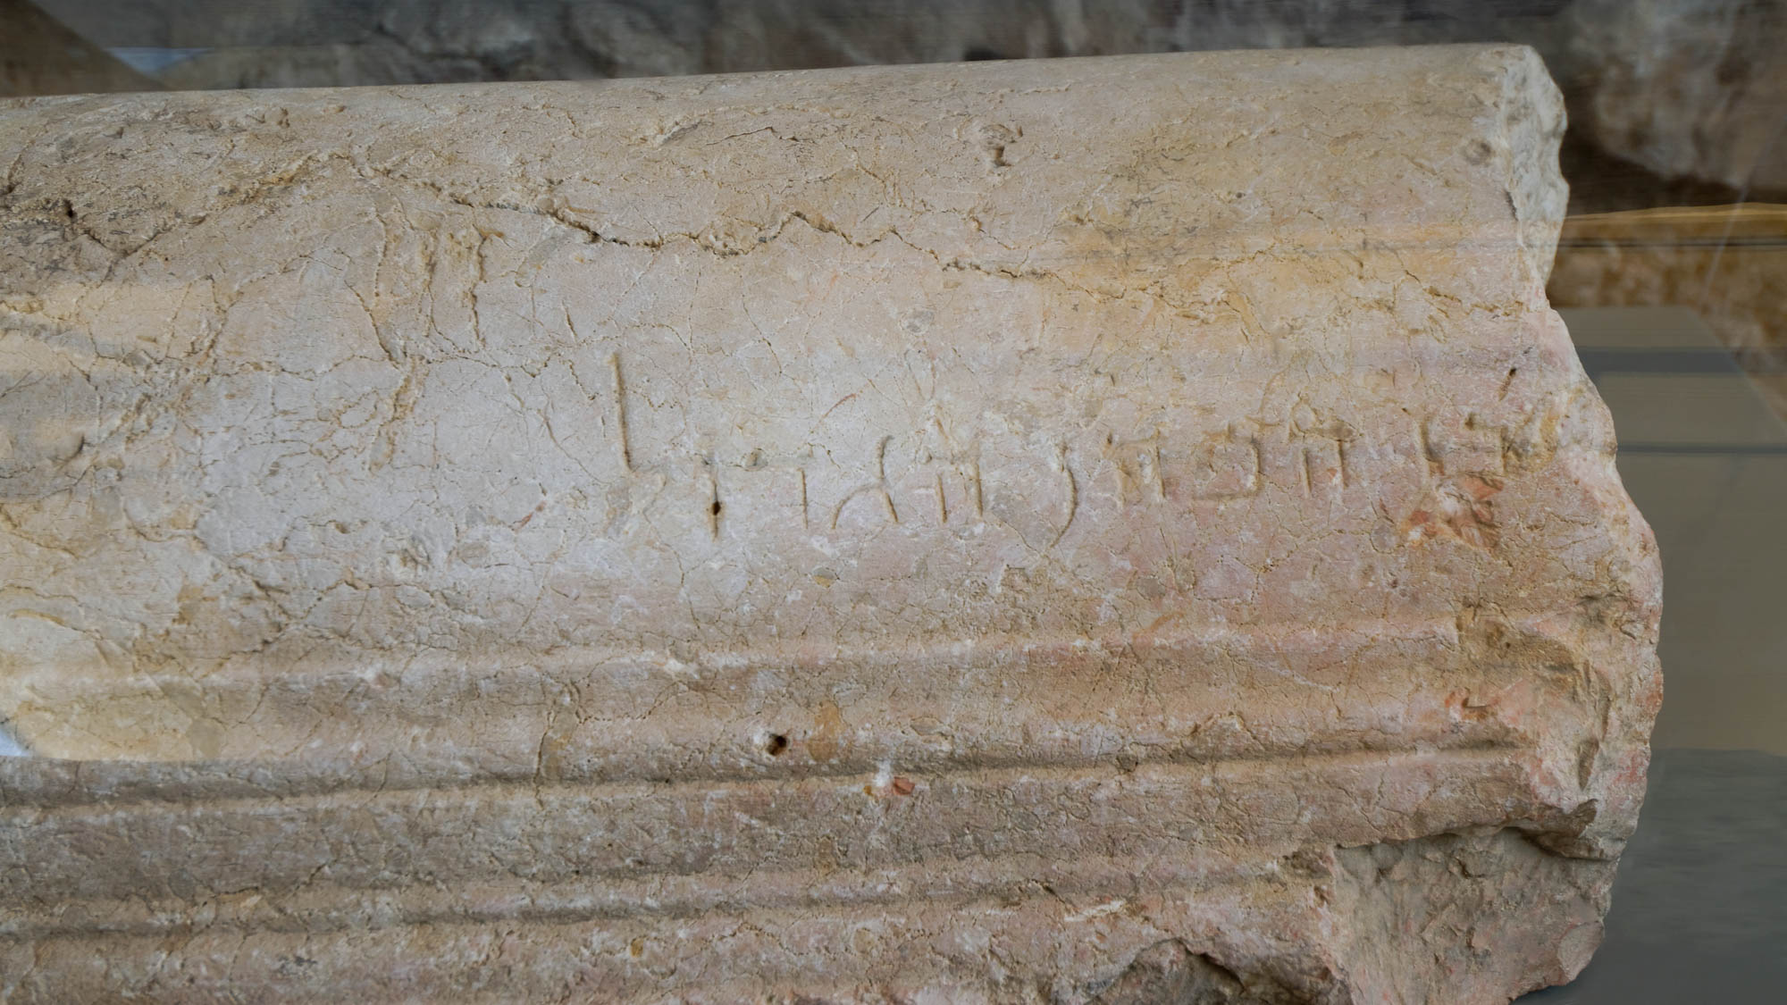
But one whose genealogy is not traced from them has taken a tenth from Abraham
Sarcophagus lid of high priest’s son, from Jerusalem, 1st century AD
7:6
Notes:
In making his point that the priesthood of Melchizedek is superior to the Levitical priesthood, the author observes that Abraham himself gave a tithe to Melchizedek, implying that Melchizedek is greater than Abraham and thus greater than any of Abraham’s descendants.
The beginning of the Hebrew inscription on this sarcophagus lid is missing, but the surviving portion reads “. . . son of the high priest” (Heb.בן הכהן הגדול). Because the other part of the inscription is lost, we can only speculate as to the owner of the sarcophagus, but presumably he was a priest of the genealogy of Abraham. The next slide includes labels.
tb060516868h

Slide 49

But one whose genealogy is not traced from them has taken a tenth from Abraham
Sarcophagus lid of high priest’s son, from Jerusalem, 1st century AD
7:6
Notes:
In making his point that the priesthood of Melchizedek is superior to the Levitical priesthood, the author observes that Abraham himself gave a tithe to Melchizedek, implying that Melchizedek is greater than Abraham and thus greater than any of Abraham’s descendants.
The beginning of the Hebrew inscription on this sarcophagus lid is missing, but the surviving portion reads “. . . son of the high priest” (Heb.בן הכהן הגדול). Because the other part of the inscription is lost, we can only speculate as to the owner of the sarcophagus, but presumably he was a priest of the genealogy of Abraham. An editable version is included beneath the graphic for those who wish to modify it.
tb060516868

Slide 50
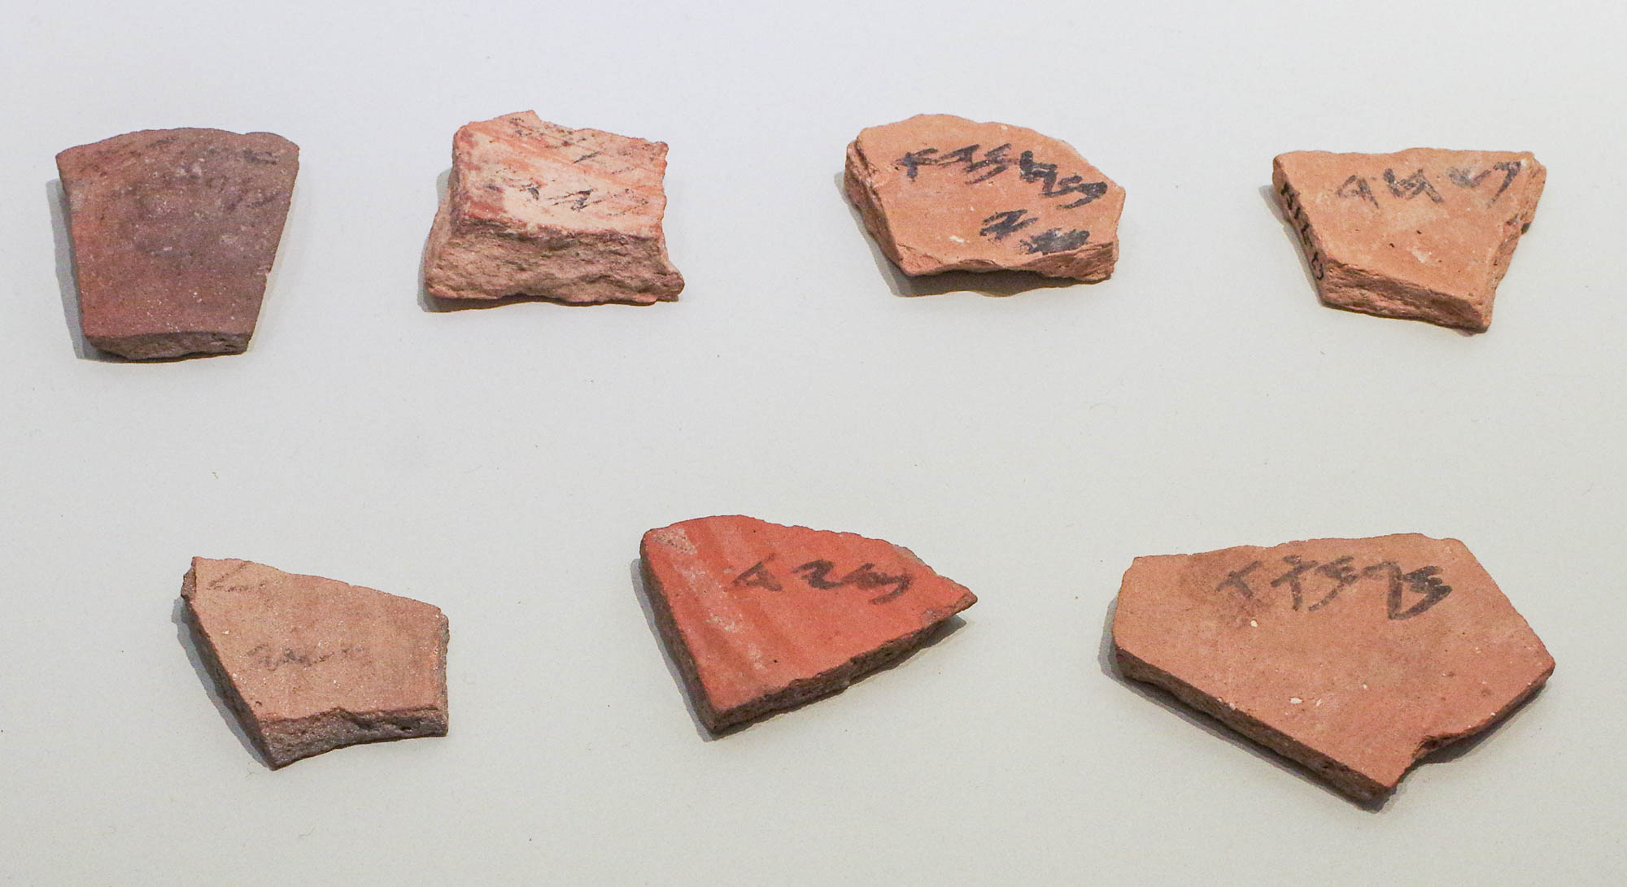
But one whose genealogy is not traced from them has taken a tenth from Abraham
Ostraca with names of priestly families, from Arad, 7th century BC
7:6
Notes:
These 7th-century BC ostraca from Arad bear personal names; some are thought to be from priestly families. The upper right ostracon bears the name Pashhur (Heb. פשחר), known as a name of a course of priests from the list of priests that returned from Babylon to Jerusalem with Zerubbabel (Ezra 2:38). The lower right ostracon bears the name Meremoth (Heb. מרמות), also known as one of the priestly courses to return from Babylon (Neh 12:3). Other names listed on these ostraca include son of Hemda, son of Netanyahu, and Eshiyahu son of Ezer. This display was photographed at the Israel Museum.
adr1806199824h

Slide 51
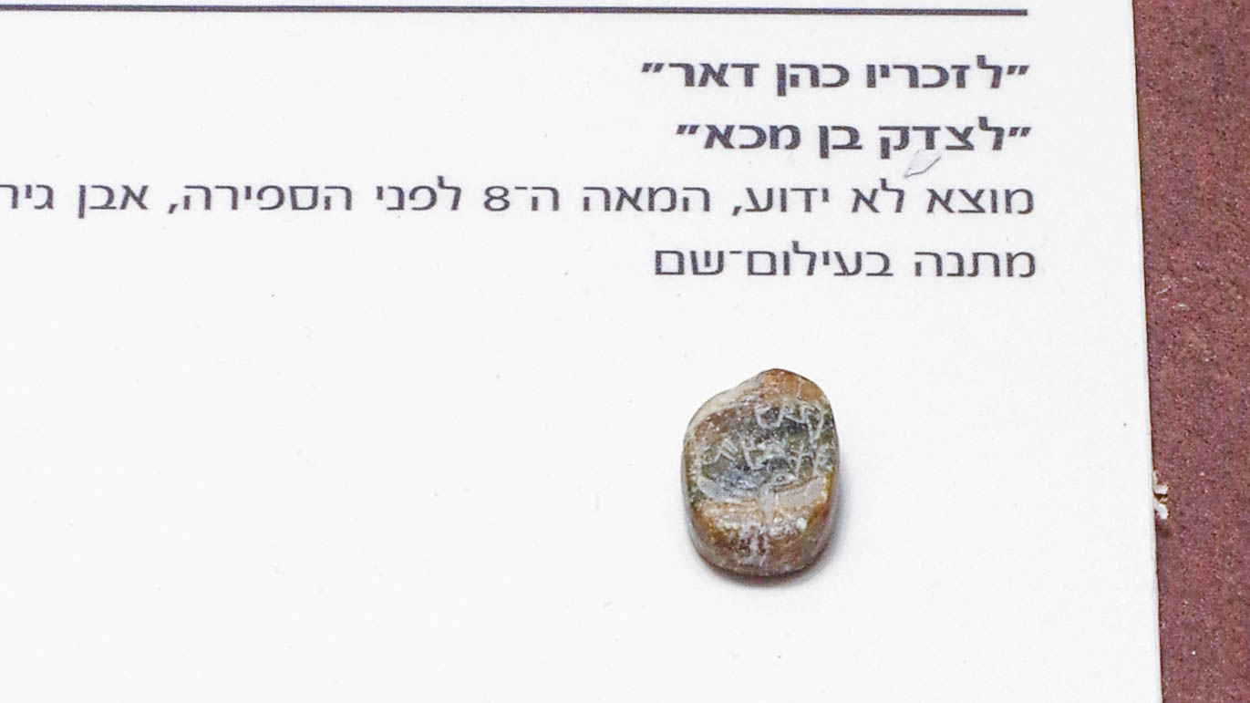
But one whose genealogy is not traced from them has taken a tenth from Abraham
Limestone seal of Zekariah priest of Dor and Zadoq son of Milka, 8th century BC
7:6
Notes:
This unprovenanced 8th-century BC seal is inscribed on either side with two names: Zekariah, the priest of Dor, and Zadoq son of Milka. The side shown in this photo has the name “Zekariah, priest of Dor” (Heb. לזכריו כהן דאר), below which is a winged uraeus. This seal was photographed at the Israel Museum.
adr1806199544h

Slide 52
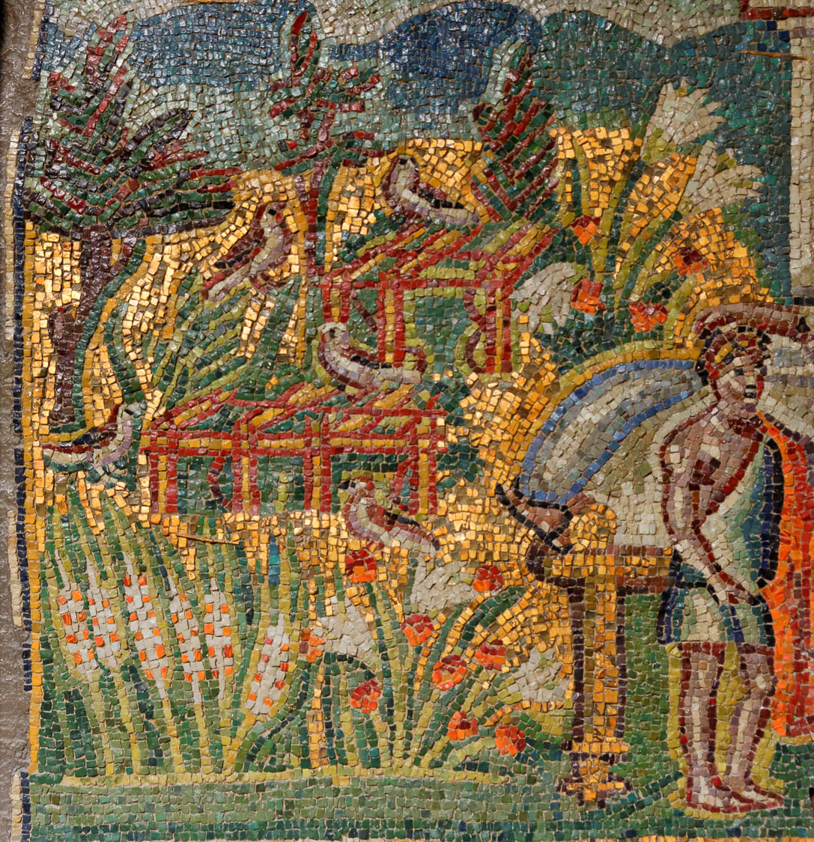
And he blessed the one who had the promises
Mosaic of Abraham blessing Jacob, from the Basilica of Saint Mary Major
7:6
Notes:
The author observes that Melchizedek blessed Abraham, even though Abraham was the one who had received the promise of the covenant. Abraham later blessed Isaac (Gen 25:11), and Isaac blessed Jacob (Gen 27:27-29). This mosaic was photographed at the Basilica of Saint Mary Major in Rome.
tb0512175920h

Slide 53
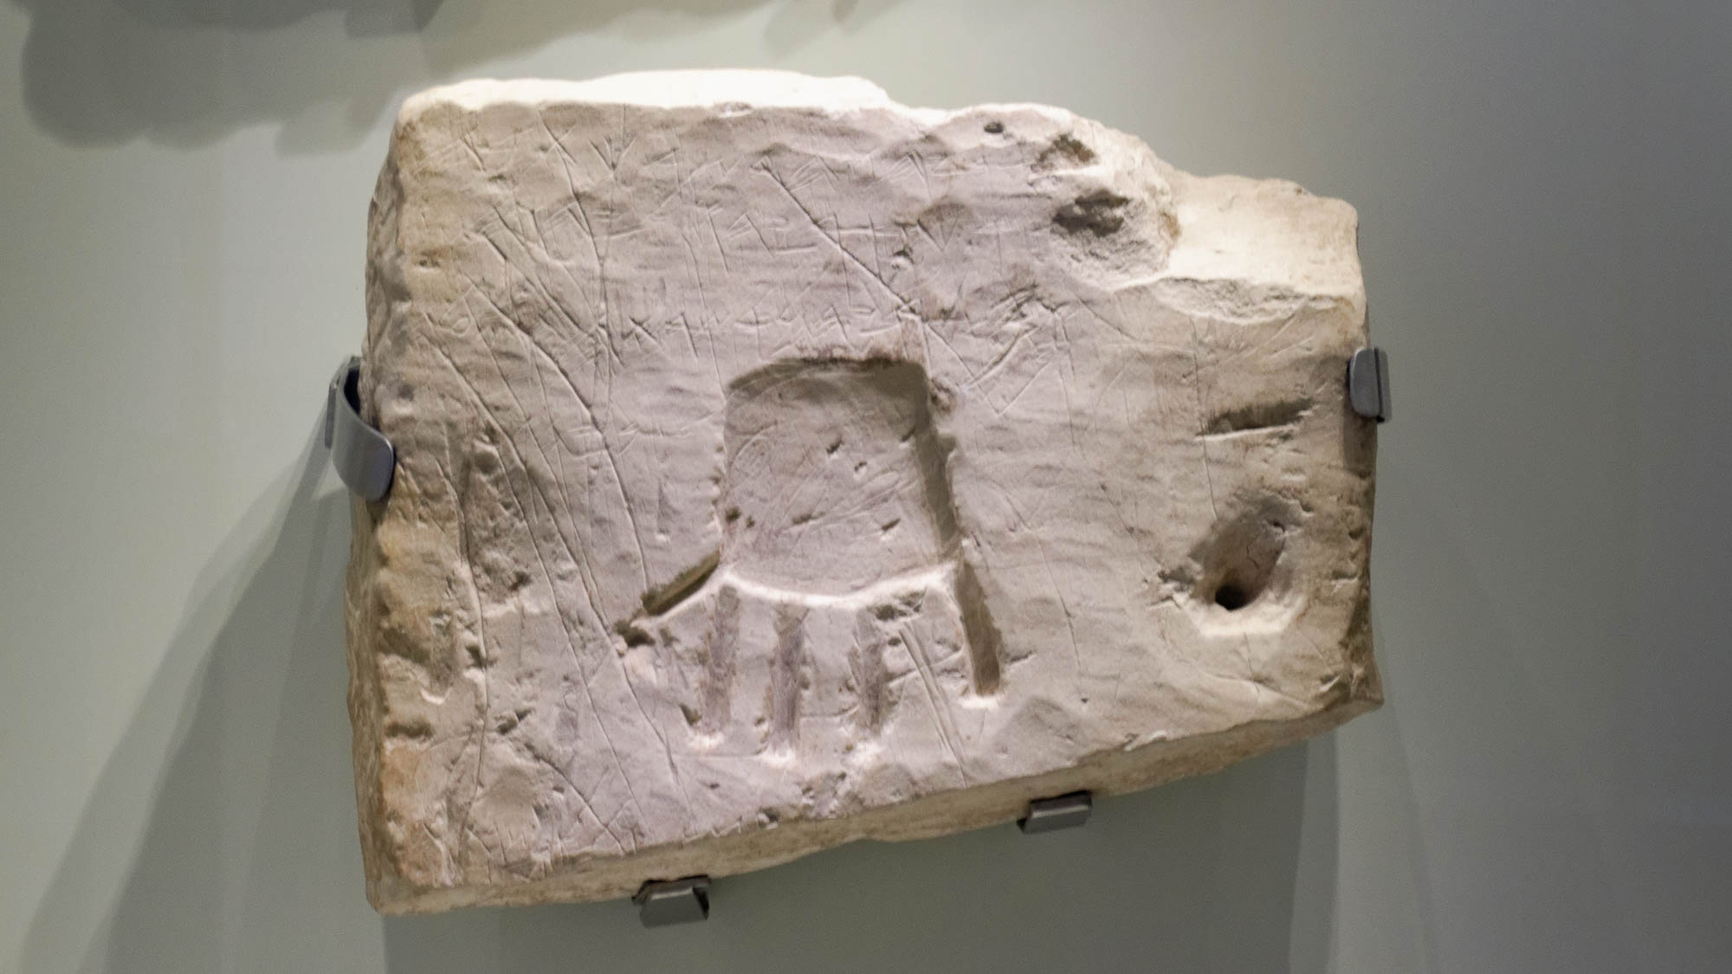
But without any dispute the lesser is blessed by the greater
Burial inscription mentioning “YHWH,” from Khirbet el-Qom, 8th century BC
7:7
Notes:
The principle of the lesser being blessed by the greater is illustrated by this tomb inscription from the 8th century BC, which invokes the blessing of Yahweh upon the deceased, a man named Uriah. The first line reads, “Uriah the wealthy man had it written” (אריהו הדשר כתבה). The second line reads, “Blessed be Uriah by Yahweh” (ברך אריהו ביהוה). This inscription was photographed at the Israel Museum. The next slide includes labels for the words of the second line.
tb032014433

Slide 54
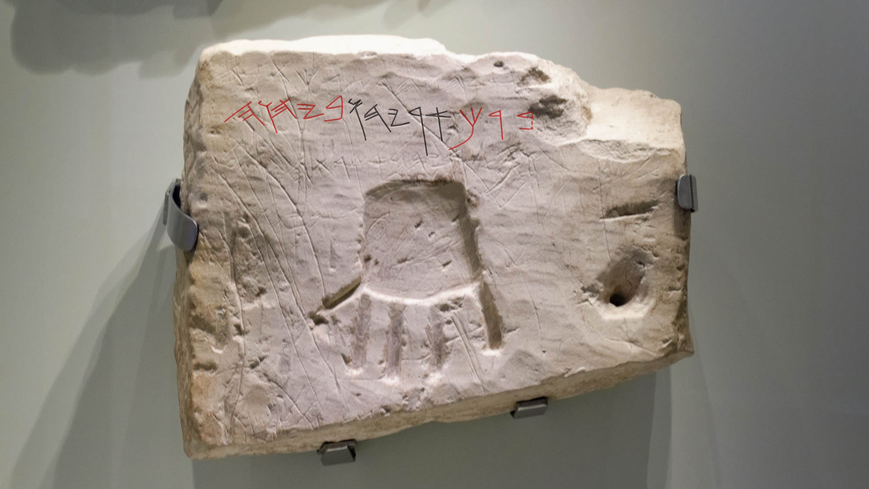
But without any dispute the lesser is blessed by the greater
Burial inscription mentioning “YHWH,” from Khirbet el-Qom, 8th century BC
7:7
Notes:
The principle of the lesser being blessed by the greater is illustrated by this tomb inscription from the 8th century BC, which invokes the blessing of Yahweh upon the deceased, a man named Uriah. The first line reads, “Uriah the wealthy man had it written” (אריהו הדשר כתבה). The second line reads, “Blessed be Uriah by Yahweh” (ברך אריהו ביהוה). In the second line, the red word to the far right is the verb “blessed” (barak, ברך), the black word in the center is the personal name Uriah (Uryahu, אריהו), and the word in red to the left is the preposition and noun “by Yahweh” (beyahweh, ביהוה). This inscription was photographed at the Israel Museum. An editable version is included behind this graphic for those who may wish to change it.
tb032014433

Slide 55

But without any dispute the lesser is blessed by the greater
Silver amulet with a blessing of Yahweh, from Ketef Hinnom in Jerusalem, circa 600 BC
7:7
Notes:
The amulet shown here illustrates the same principle, except that it quotes Scripture. It is inscribed with the text of the priestly blessing recorded in Numbers 6:24-26, and it is the oldest known portion of Scripture found to date. It originally had the phrase “May Yahweh bless you and keep you.” This amulet was discovered in a tomb at the site of Ketef Hinnom on the western slope of the Hinnom Valley in Jerusalem. Some of the letters along the edges of this amulet have eroded away. This artifact was photographed in the Israel Museum. The next slide includes labels.
adr1806199661c

Slide 56

But without any dispute the lesser is blessed by the greater
Silver amulet with a blessing of Yahweh, from Ketef Hinnom in Jerusalem, circa 600 BC
7:7
Notes:
The amulet shown here illustrates the same principle, except that it quotes Scripture. It is inscribed with the text of the priestly blessing recorded in Numbers 6:24-26, and it is the oldest known portion of Scripture found to date. It originally had the phrase “May Yahweh bless you and keep you.” This amulet was discovered in a tomb at the site of Ketef Hinnom on the western slope of the Hinnom Valley in Jerusalem. Some of the letters along the edges of this amulet have eroded away. This artifact was photographed in the Israel Museum. The partially preserved upper word that has been highlighted is the verb “to bless” (Heb. barak, ברך), while the highlighted word on the next line is the divine name “Yahweh” (Heb. יהוה). An editable version is included beneath the graphic for those who wish to modify it.
adr1806199661c

Slide 57

But without any dispute the lesser is blessed by the greater
Greek inscription asking St. Lot to bless the builders of St. Lot’s Monastery, 7th century AD
7:7
Notes:
This inscribed sandstone block was photographed at the Museum at the Lowest Place on Earth near Ghor es-Safi, Jordan.
tb031215782

Slide 58

But without any dispute the lesser is blessed by the greater
Priestly blessing at the Western Wall during Passover
7:7
Notes:
This photo shows people gathered at the Western Wall for the priestly blessing at Passover.
tb042605546

Slide 59

But without any dispute the lesser is blessed by the greater
Man blessing his sons at the Western Wall
7:7
Notes:
tb042605530

Slide 60

In the one case mortal men receive tithes, but in the other case one who is affirmed to be alive
Second Temple period tomb, possibly of a priest, in the Hinnom Valley, circa 1st century AD
7:8
Notes:
The author emphasizes that the Levitical priesthood is composed of ordinary men who die (Gk. apothnēskō, ἀποθνῄσκω). This picture shows the façade of a Second Temple period tomb in the Hinnom Valley that has been proposed as the tomb of Annas the high priest.
Reference:
Ritmeyer, Leen, and Ritmeyer, Kathleen.
1994 Akeldama: Potter’s Field or High Priest’s Tomb? Biblical Archaeology Review 20/6: 23–35, 76, 78.
tb110804038

Slide 61

In the one case mortal men receive tithes, but in the other case one who is affirmed to be alive
Second Temple period tomb interior, possibly of a priest, circa 1st century AD
7:8
Notes:
This tomb is extraordinarily decorated, one of the things that led to the proposal that it may be the tomb of Annas the high priest.
tb110804033

Slide 62

In the one case mortal men receive tithes, but in the other case one who is affirmed to be alive
Second Temple period tomb ceiling, possibly of a priest, circa 1st century AD
7:8
Notes:
This picture shows the carved ceiling of the tomb in the Hinnom Valley that has been proposed as the tomb of Annas the high priest.
tb110804030

Slide 63

In the one case mortal men receive tithes, but in the other case one who is affirmed to be alive
Cemetery sign near Sepphoris
7:8
Notes:
Leviticus 21:1-4 forbids priests, because of their consecration, from contact with corpses except for the bodies of their closest family members. This picture shows a sign for a cemetery near Sepphoris in Galilee stating that priests are forbidden from entering. The sign reads, “Cemetery: Priests are forbidden to enter.”
tb102904917

Slide 64

Through Abraham, even Levi, who receives tithes, paid tithes
“Levi Street” sign in Jerusalem
7:9
Notes:
“Levi Street” is located in the Baqa neighborhood, southwest of the Old City.
tb072404813

Slide 65

Through Abraham, even Levi, who receives tithes, paid tithes
Women harvesting wheat near Bethlehem
7:9
Notes:
Leviticus 27:30 describes the tithe that Israelites were to pay by saying, “And all the tithe of the land, whether of the seed of the land, or of the fruit of the tree, belongs to Yahweh: it is holy unto Yahweh.” This picture shows women harvesting wheat near Bethlehem, illustrating seed/grain as one item of the Israelites' tithe.
cd060087113

Slide 66

Through Abraham, even Levi, who receives tithes, paid tithes
Grapevines near Lachish
7:9
Notes:
Another common crop of the land of Israel was grapes, another product that was to be tithed.
tb100902854

Slide 67


Through Abraham, even Levi, who receives tithes, paid tithes
Column with inscription that a statue was paid for with 1/10 of Kalis’s earnings
7:9
Notes:
This picture shows the so-called “Kalis column” from Athens. The inscription on this column states that Kalis dedicated a statue to Athena from one tenth of his earnings. This column was photographed at the Athens Acropolis Museum.
tb011117705

Slide 68

For he was still in the loins of his father when Melchizedek met him
Village elder with son and grandson in Dahariyeh, 1940
7:10
Notes:
Levi was Abraham’s great-grandson, so he was not yet born when Abraham gave a tithe to Melchizedek. The author makes the point, however, that he paid tithes through his great-grandfather, as it were. This picture shows three generations, a grandfather with son and grandson, in Dahariyeh (ad-Dhahiriya), an Arab village located southwest of Hebron. This American Colony photograph was taken on February 9, 1940.
mat20039

Slide 69

Now if there was perfection through the Levitical priesthood
Sign for a priestly school in the Jewish Quarter of Jerusalem
7:11
Notes:
This sign identifies the School [Yeshiva] of Priests in the Jewish Quarter of the Old City in Jerusalem.
tb090405858h

Slide 70

Now if there was perfection through the Levitical priesthood
Commentary of the Habakkuk Scroll (1QpHab), late 1st century BC
7:11
Notes:
Israel’s history made it painfully obvious that the Levitical priesthood was far from perfect, not least of all because of inadequacies of the priests themselves, which was seen from the very beginning in Aaron himself (see Exod 32). This imperfection was still obvious at the time of the writing of this letter to the Hebrews.
Around the turn of the first millennium AD, a group of separatists formed a unique community at Qumran on the northwestern shore of the Dead Sea. Several documents found there refer to a wicked priest who was at odds with the “teacher of righteousness” that the Qumran sect followed. This issue is mentioned several times in the commentary (pesher) on Habakkuk. The portion of the scroll shown here includes columns six and seven of the Habakkuk Pesher. In the column to the left, just out of view, the wicked priest is described as antithetical to this “teacher of righteousness.” The “teacher of righteousness” is generally understood to have been a central figure in the Jewish sect at Qumran, perhaps even a Zadokite Levitical priest, although his identity is debated.
Likewise, many proposals have been made for the identity of the wicked priest mentioned in this and several other documents from Qumran. One suggestion is that he was the contemporary high priest in Jerusalem. However, the point of the writer to the Hebrews is that the Levitical priesthood in its entirety, not just defective individual priests, was by its very nature temporary; it must give way to the superior priesthood of Jesus, which was after the order of Melchizedek. See the following slide for a highlight of the relevant text.
The image comes from Desconocido and is in the public domain, via Wikimedia Commons: https://commons.wikimedia.org/wiki/File:Pesher_Habakkuk_Scroll.JPG.
wiki0814201220394752

Slide 71
Now if there was perfection through the Levitical priesthood
“Its interpretation is concerning the Teacher of Righteousness to whom God has made known all the mysteries of the words of his servants the prophets.”
Commentary of the Habakkuk Scroll (1QpHab), late 1st century BC
7:11
Notes:
Israel’s history made it painfully obvious that the Levitical priesthood was far from perfect, not least of all because of inadequacies of the priests themselves, which was seen from the very beginning in Aaron himself (see Exod 32). This imperfection was still obvious at the time of the writing of this letter to the Hebrews.
Around the turn of the first millennium AD, a group of separatists formed a unique community at Qumran on the northwestern shore of the Dead Sea. Several documents found there refer to a wicked priest who was at odds with the “teacher of righteousness” that the Qumran sect followed. This issue is mentioned several times in the commentary (pesher) on Habakkuk. The portion of the scroll shown here includes columns six and seven of the Habakkuk Pesher. In the column to the left, just out of view, the wicked priest is described as antithetical to this “teacher of righteousness.” The “teacher of righteousness” is generally understood to have been a central figure in the Jewish sect at Qumran, perhaps even a Zadokite Levitical priest, although his identity is debated.
Likewise, many proposals have been made for the identity of the wicked priest mentioned in this and several other documents from Qumran. One suggestion is that he was the contemporary high priest in Jerusalem. However, the point of the writer to the Hebrews is that the Levitical priesthood in its entirety, not just defective individual priests, was by its very nature temporary; it must give way to the superior priesthood of Jesus, which was after the order of Melchizedek.
Concerning the text of Habakkuk 2:2, the commentator writes, “Its interpretation is concerning the Teacher of Righteousness to whom God has made known all the mysteries of the words of his servants the prophets” (פשרו על מורה הצדק אשר הודיעו אל את כול רזי דברי עבדיו הנבאים).
The image comes from Desconocido and is in the public domain, via Wikimedia Commons: https://commons.wikimedia.org/wiki/File:Pesher_Habakkuk_Scroll.JPG.
wiki0814201220394752

Slide 72


For under it the people received the law
Dead Sea Scroll 4Q175 Testimonia
7:11
Notes:
4QTestimonia (4Q175) is one of the Dead Sea Scrolls. It contains a series of quotations from the Old Testament, including Deuteronomy 33:8-11, Moses’s blessing on the Levites. Deuteronomy 33:10 mentions the Levites’ role in teaching Torah: “They shall teach Jacob your ordinances, and Israel your law.” This document was photographed at the Amman Museum. See the next slide for highlighting of this text.
tb060303118

Slide 73
For under it the people received the law
Dead Sea Scroll 4Q175 Testimonia
7:11
Notes:
4QTestimonia (4Q175) is one of the Dead Sea Scrolls. It contains a series of quotations from the Old Testament, including Deuteronomy 33:8-11, Moses’s blessing on the Levites. Deuteronomy 33:10 mentions the Levites’ role in teaching Torah: “They shall teach Jacob your ordinances, and Israel your law.” This document was photographed at the Amman Museum. The highlighted text, which is based on Deuteronomy 33:10, reads: “And they will cause your judgments to shine for Jacob, your law for Israel” (Heb. weya’iru mishpateykha leYa‘aqov toratkha leYisra’el, ויאירו משפטיכ ליעקוב תורתכה לישראל).
tb060303118

Slide 74

For under it the people received the law
Torah scroll at the Western Wall in Jerusalem
7:11
Notes:
This picture shows a Torah scroll being held up at the Western Wall during the celebration of Passover.
tb042605465

Slide 75

What need would there be for a priest . . . not according to the order of Aaron?
Model of tabernacle priest with menorah
7:11
Notes:
Jews already had priests descended from Aaron, so the author of Hebrews asked rhetorically why there was a need for a priest after the order of Melchizedek. This photo was taken at the tabernacle model at Timna Park in southern Israel.
tb030301334

Slide 76

For when the priesthood is changed, of necessity a change in the law is made
“And you shall appoint Aaron and his sons, and they shall keep their priesthood: and the stranger that approaches shall be put to death”
Torah scroll with Numbers 3:10
7:12
Notes:
This Yemenite Torah scroll was photographed at The Master’s Seminary in California. “And you shall appoint Aaron and his sons, and they shall keep their priesthood: and the stranger that approaches shall be put to death” (Num 3:10).
tb031416433

Slide 77

For when the priesthood is changed, of necessity a change in the law is made
Christ gives his new law to Peter, on a sarcophagus from the Vatican necropolis, 4th century AD
7:12
Notes:
The relationship of Christ and Christians to the Mosaic Law has been a matter of discussion throughout the history of Christianity. This picture shows a cast of a sarcophagus that depicts Christ giving his new law to Peter in the form of a scroll. This iconographic motif is called Traditio Legis. This cast was photographed at the Vatican Museums.
tb0512175622h

Slide 78

For He of whom these things are said belongs to another tribe
Tribes of Israel, listed on the high priest’s ephod, at Shiloh
7:13
Notes:
Israelite priests could only come from the tribe of Levi. This display at the ancient site of Shiloh shows the names of each of the tribes of Israel along with the precious stones associated with each of them on the high priest's ephod (Exod 39:8-14). Levi is in the upper left.
cm05201809

Slide 79

For He of whom these things are said belongs to another tribe
“Tribes of Israel Street” sign in Jerusalem
7:13
Notes:
This sign identifies Shivtei Israel Street (“Tribes of Israel Street”) in Jerusalem.
tb081004129h

Slide 80

A tribe from which no one has ever officiated at the altar
Model of the Jerusalem temple and the altar
7:13
Notes:
The specific altar to which the author of Hebrews refers is certainly the altar at the temple of Yahweh in Jerusalem, the only place where Levitical priests served. The temple, like the tabernacle before it, had two altars, one for sacrifices and one for incense. The word “altar” (Gk. thusiastērion, θυσιαστήριον) specifically designates the altar of sacrifice. This model approximates what the Second Temple and altar would have looked like prior to its destruction in AD 70. The very large altar is situated directly in front of the entrance into the temple itself. Part of the actual Temple Mount where the Second Temple stood can be seen in the background of this photo.
tb010312509

Slide 81

A tribe from which no one has ever officiated at the altar
Architectural model of Solomon’s Temple with stands and basins
7:13
Notes:
The statement that no one from the Messiah’s tribe “has ever” officiated at the altar can be taken to refer back to earlier times. It is illustrated here by a model of the altar and temple built by Solomon. This model was created in 1883 following a design by Thomas Newberry. The materials used are gilded wood, gilded carton pierre, gilded silver, gilded bronze, enamel, and linen. The model was carved and gilded by Messrs. Bartlet, with gilded silver and brass appurtenances by W. Spurrier. This image comes from The Metropolitan Museum of Art and is in the public domain. Source: https://www.metmuseum.org/art/collection/search/786829
met786829a

Slide 82

A tribe from which no one has ever officiated at the altar
Tabernacle model with altar and bronze laver
7:13
Notes:
The original altar at which the Levites officiated was associated with the tabernacle. In this full-size model, the bronze sacrificial altar can be seen in front of the tabernacle; the laver is situated between the tabernacle and the altar. This model was photographed at Timna Park in southern Israel.
tb030301343

Slide 83

A tribe from which no one has ever officiated at the altar
Sacrificial altar in a tabernacle model
7:13
Notes:
This full-size model of the bronze altar of sacrifice was photographed at Timna Park in southern Israel.
tb052208360

Slide 84

It is evident that our Lord is descended from the tribe of Judah
“Yehuda (Judah)” and “Bethlehem Streets,” signs in Jerusalem
7:14
Notes:
The junction where these street signs were photographed is located southwest of the Old City of Jerusalem.
lbd102218488

Slide 85

It is evident that our Lord is descended from the tribe of Judah
Bethlehem (from the north)
7:14
Notes:
Jesus was of the tribe of Judah, as stated in the genealogies of Matthew and Luke (Matt 1:1-3; Luke 3:23-33). He was born in Bethlehem, a city of Judah, because of His descent from David (Luke 2:4).
tb092405375h

Slide 86

Moses said nothing about that tribe concerning priests
Sarcophagus fragment depicting Moses receiving the Law, 3rd or 4th centuries AD
7:14
Notes:
The specification that priests were to be from the tribe of Levi is part of the Mosaic Law. This fragment from the front of a 3rd or 4th centuries AD sarcophagus depicts Moses receiving the Law. It was photographed at the Vatican Museums.
tb0512175762

Slide 87

Moses said nothing about that tribe concerning priests
Bronze coin of Mattathias Antigonus, high priest and king of the Jews, 40–37 BC
7:14
Notes:
Mattathias Antigonus was the last Maccabean ruler. He was installed as a puppet king by the Parthians. As had become customary by that point, he also appointed himself as the high priest; some scholars believe he may be the figure referred to as the Wicked Priest in the Dead Sea Scrolls. Although he was a Levite, he also acted as a king, even though the kings of Israel were to be from the tribe of Judah. This is the reverse of Jesus who, although from Judah, is also a priest. This coin has a partial inscription and a representation of the menorah. It was photographed at the Eretz Israel Museum in Tel Aviv.
tb031114334

Slide 88

Now it is even clearer that if another priest arises who is like Melchizedek
Cast of a sarcophagus depicting Job with wife and friend, AD 359
7:15
Notes:
Prior to the establishment of the Levitical priesthood, some individuals in the Old Testament performed actions similar to those of priests, such as offering sacrifices. One example is Job, who offered sacrifices for his children. No one in the Bible besides Jesus, however, is referred to as a priest like Melchizedek. This sarcophagus, which belonged to a man named Junius Bassus, depicts the suffering Job with his wife and a friend. This artifact was photographed at the Vatican Museums.
tb0512175592

Slide 89

Now it is even clearer that if another priest arises who is like Melchizedek
Statue of Vestal Virgin at House of the Vestal Virgins, Upper Via Sacra, Rome, 2nd century AD
7:15
Notes:
As much as the author of Hebrews emphasizes the significance of Jesus being a non-Levitical priest, priests and priestesses were also common outside of Judaism. An example is the virgins who acted as priestesses of the goddess Vesta. They were required to remain chaste through the length of their service, and the consequences of breaking this were severe. The base on which this statue stands has an inscription identifying her as Flavia Publica, the Vestalis Maxima, most eminent priestess of Vesta cult. This image comes from Carole Raddato and is licensed under CC BY-SA 2.0, via Wikimedia Commons: https://commons.wikimedia.org/wiki/File:House_of_the_Vestal_Virgins_(Atrium_Vestae),_Upper_Via_Sacra,_Rome_(9114131999).jpg.
wiki91141319991022

Slide 90

Now it is even clearer that if another priest arises who is like Melchizedek
Bronze statuette of a votary or priest, 3rd–2nd centuries BC
7:15
Notes:
Pagan priesthood is illustrated here from a Greco-Roman perspective by a small statue that portrays either a priest or a man bringing a votive offering to a god. He has a libation bowl (patera) held in his right hand. The gesture with outspread hands was typical of a person who was making a sacrifice. This image comes from The Metropolitan Museum of Art and is in the public domain. Source: https://www.metmuseum.org/art/collection/search/249095
met249095

Slide 91

Now it is even clearer that if another priest arises who is like Melchizedek
Fresco of a woman painting an image of a statue, from Pompeii, 1st century AD
7:15
Notes:
The fact that Jesus was “like” (Gk. homoiotēs, ὁμοιότης) Melchizedek shows that He was not Himself Melchizedek, nor even descended from him. But they are similar to one another in some respects. The idea of “likeness” is illustrated here by a fresco of a woman who is painting a picture of a statue, probably of the rustic god Priapus. The statue was a likeness, the painting imitates it, and the fresco itself is a likeness of the entire scene. This fresco comes from the House of the Surgeon at Pompeii. It was photographed at the Naples Archaeological Museum.
ku0622230820057c

Slide 92

Now it is even clearer that if another priest arises who is like Melchizedek
Mycenaean stirrup jar and imitation, Late Bronze IIB–Iron IA, circa 1200 BC
7:15
Notes:
It is probably to be understood from the surrounding context that Jesus actually is what Melchizedek was symbolically. This is illustrated here by two Mycenaean stirrup jars; the one on the right is an authentic jar, while the one on the left is an ancient imitation. Although the imitation in this case is not very well executed, it is clear that both the form and decoration have been copied. These jars were photographed at the University of Pennsylvania Museum of Archaeology and Anthropology.
tb072311685

Slide 93

Who has not become a priest on the basis of a law of a physical requirement
Tablets of the Ten Commandments in a model of the Ark of the Covenant
7:16
Notes:
The physical requirement for a priest of the law referred to in Hebrews 7:16 is belonging to the tribe of Levi and descent from Aaron. In Numbers 17, God affirmed Aaron as the legitimate priest when others challenged him by causing his rod to bud and produce almonds. Aaron's rod that testified that only he and his sons would be legitimate priests was kept in the Ark of the Covenant. The reconstruction of these tablets of the covenant were photographed at the tabernacle reconstruction at Timna Park in southern Israel.
tb022804712c

Slide 94

Who has not become a priest on the basis of a law of a physical requirement
Almond blossoms, at Bet Guvrin
7:16
Notes:
This picture shows branches of an almond tree with blossoms and almonds, reminiscent of Aaron’s budding rod that confirmed the legitimacy of his priesthood.
tb022807499h

Slide 95

But according to the power of an indestructible life
The Ascension, by Rembrandt, 1636
7:16
Notes:
The word “indestructible” (Gk. akatalutos, ἀκατάλυτος) refers to that which cannot be dissolved or broken up. The evidence of this power in Jesus’s life was the resurrection. This image comes from Beth Timken and is in the public domain, via Wikimedia Commons: https://commons.wikimedia.org/wiki/File:Rembrandt_The_Ascension_1636_Oil_on_canvas_Alte_Pinakothek_Munich_Germany.jpg.
wiki0130201322541636398

Slide 96

But according to the power of an indestructible life
The Resurrection, by James Tissot, circa 1890
7:16
Notes:
This painting, by James Tissot, was created using opaque watercolor over graphite on gray wove paper. This image comes from the Brooklyn Museum and is in the public domain, via Wikimedia Commons: https://commons.wikimedia.org/wiki/File:Brooklyn_Museum_-_The_Resurrection_(La_R%C3%A9surrection)_-_James_Tissot.jpg
wiki071620102016517

Slide 97

But according to the power of an indestructible life
“Haye Olam Road” (Eternal Life), street sign in Jewish Quarter
7:16
Notes:
The life that is indestructible is, by extension, endless. This picture shows a sign for Haye Olam (“Eternal Life”) Road in the Jewish Quarter in the Old City of Jerusalem.
tb010312566h

Slide 98

For it is declared of him, “You are a priest forever according to the order of Melchizedek”
Bible with mesorah and Sefer Haniqud, by Rabbi David Kimhi, AD 1299–1300
7:17
Notes:
The quote comes from Psalm 110:4, which was quoted earlier in the book (Heb 5:6). The foretelling of the coming of a Messiah who was like Melchizedek, a thousand years before the time of Jesus, is represented here by a hand-copied Hebrew Bible. This 13th-century Hebrew Bible by Rabbi David Kimhi is open to Zechariah 4. This Bible was photographed at the Jewish Museum of Rome.
tb0518173784h

Slide 99

For it is declared of him, “You are a priest forever according to the order of Melchizedek”
Cenotaph at David’s Tomb in Jerusalem
7:17
Notes:
Psalm 110, which the author quotes here, is one of the psalms of David. The cenotaph (an empty monument that memorializes someone whose remains are buried elsewhere) pictured here is in the traditional tomb of David on Mount Zion.
tb070807983

Slide 100

For it is declared of him, “You are a priest forever according to the order of Melchizedek”
Stylized representation of Abraham and Melchizedek
7:17
Notes:
This representation of Abraham and Melchizedek was photographed at the Tower of David Museum.
tb060716345

Slide 101

For there is a setting aside of a former commandment because it was weak and useless
Deformed sword and scabbard, from tomb of Ranquette road at Nimes, circa 100 BC
7:18
Notes:
The “former commandment” (Gk. proagousēs entolēs, προαγούσης ἐντολῆς) refers specifically to the priestly regulation of verse 16, but ultimately encompasses the whole Old Testament law system. The terms “weak” (Gk. asthenēs, ἀσθενής) and “useless” (Gk. anōphelēs, ἀνωφελής) indicate that it was not able to accomplish what was necessary, to deal permanently with mankind’s sin. Such uselessness and weakness is illustrated here by a badly corroded and bent sword, along with what is left of its scabbard. This display was photographed at the Nimes Archaeological Museum.
tb092019389

Slide 102

For there is a setting aside of a former commandment because it was weak and useless
Fragments of glass vessels, Roman period
7:18
Notes:
Roman glass could be quite beautiful, but it was also fragile and weak, and when cracked or broken became completely useless. The idea is illustrated here by a pile of shards from broken glass vessels, now destroyed and without usefulness. This display was photographed at the Hecht Museum at the University of Haifa.
cm1706271935h

Slide 103

On the other hand, there is a bringing of a better hope
Limoges artwork plaque depicting three saints rising from the dead, circa AD 1250
7:18
Notes:
It is significant that the “former commandment” is not contrasted here with a new commandment, but rather with a “better hope” (Gk. kreittonos elpidos, κρείττονος ἐλπίδος). That hope is the final conquest of sin and death, expressed in the resurrection of the dead. This champlevé enamel on copper plaque captures the joy of resurrection as believers are raised from their tombs into glory. This plaque was photographed at the Victoria and Albert Museum in London. This image comes from Marie-Lan Nguyen and is licensed under CC BY 2.5, via Wikimedia Commons: https://commons.wikimedia.org/wiki/File:Plaque_resurrection_dead_VandA_M.104-1945.jpg.
wiki03032012181734881994h

Slide 104

On the other hand, there is a bringing of a better hope
Gravestone depicting Christogram, dolphins, dove, and the word “hope,” 5th–6th centuries AD
7:18
Notes:
The better hope brought by Jesus is represented here by a tombstone with numerous Christian symbols. The main circular symbol at the top features the Christogram (superimposed Greek letters chi and rho, the first two letters of the name “Christ”), flanked by an alpha and omega, the first and last letters of the Greek alphabet (cf. Rev 1:8; 22:13). Above this symbol are a pair of dolphins, and to the lower left a dove. The Greek word “hope” (Gk. elpis, ΕΛΠΙΣ) appears at the start of the 6th line of text. This tombstone was photographed at the Istanbul Archaeological Museum.
tb122916423

Slide 105

Through which we draw near to God
Silver amulet with a man standing before a god, from northwest Iran, 8th–7th centuries BC
7:19
Notes:
Hebrews 7 describes Jesus, in His role as priest, as the means of coming near to God. This picture shows a plaque amulet from northwest Iran dating to the 8th or 7th century BC that depicts a man approaching a deity on a mountain. This display was photographed at the Boston Museum of Fine Arts.
adr1711202101c

Slide 106

Through which we draw near to God
Priests of Isis perform a water ritual before the temple, from Herculaneum, 1st century AD
7:19
Notes:
Even the pagans of the 1st century were well aware of the distance that separates people from deity. That knowledge or belief is illustrated by this fresco of a ritual taking place at a pagan temple. The priest in the foreground tends a fire on an altar, while another behind him holds up a vessel of sacred water at the door of a temple flanked by sphinxes. Devotees of the cult line the steps of the goddess’s temple and chant during the ceremony. It is this kind of distance and separation, argues the author of Hebrews, that is overcome by Jesus. This image comes from Wikimedia Commons and is in the public domain. Source: https://commons.wikimedia.org/wiki/File:Isiac_water_ceremony.jpg
wiki04062013220358897

Slide 107

And it was not without an oath
Declaration under oath concerning agricultural work, from Uruk, circa 500 BC
7:20
Notes:
The fact that the priesthood of Jesus, which was like that of Melchizedek, was a priesthood given with an oath (Ps 110:4) is both different than the Levitical priesthood and confirms its permanency. This image comes from Yale Peabody Museum of Natural History and is in the public domain. Source: http://collections.peabody.yale.edu/search/Record/YPM-BC-007485
dydc007485

Slide 108

And it was not without an oath
Building where athletes took the oath for the games, at Isthmia
7:20
Notes:
The remains in this photo are of a building where athletes participating in the Isthmian games would take oaths to abide by the rules.
tb011601158

Slide 109

And it was not without an oath
Silver denarius with an oath-taking scene, from Rome, 137 BC
7:20
Notes:
This silver denarius was struck in Rome in commemoration of Titus Veturius Calvinus, a Roman statesman who held the consulship in 334 and 321 BC. The obverse depicts a helmeted and draped bust of Mars, with a mark of value behind the neck. The reverse depicts an oath-taking scene; a youth kneels at the center, flanked by two soldiers, each of whom holds a spear and touches his sword to a pig held by the youth. This military oath (sacramentum militare) was taken by soldiers to pledge their loyalty to the emperor. This image comes from Classical Numismatic Group, Inc. http://www.cngcoins.com/ and is licensed under CC BY-SA 2.5, via Wikimedia Commons: https://commons.wikimedia.org/wiki/File:Ti._Veturius,_denarius,_137_BC,_RRC_234-1.jpg.
wiki09122007701345

Slide 110

For the others were made priests without any oath
Samaritan high priest and son on Mount Gerizim
7:20
Notes:
In contrast to Jesus, whose priesthood was established with an oath, the Aaronic priesthood was not based on an oath, but simply on lineage. A similar method is practiced today by the Samaritans, as illustrated by this photo.
bwb041800102

Slide 111

For the others were made priests without any oath
Bronze prutah inscribed “Jonathan the High Priest and the Council of the Jews,” 67 BC
7:21
Notes:
This bronze prutah was minted by the Maccabean ruler John Hyrcanus II, who functioned as both king and high priest. It is inscribed with “Jonathan the High Priest and the Council of the Jews.” This coin is part of the Jared James Clark Collection.
tb0309169312

Slide 112

But He with an oath
Hittite soldiers’ oath, from Hattusha, 13th century BC
7:21
Notes:
Oaths have been a means of expressing a person’s assured commitment in many cultures. This picture shows a 13th-century BC inscription with the oath of Hittite soldiers. This artifact was photographed at the Istanbul Archaeological Museum.
tb122916510

Slide 113

But He with an oath
Oath tablet by officials of the Eanna temple in Uruk, 4th year of Cambyses, circa 526 BC
7:21
Notes:
The practice of swearing or taking oaths had a long history. Tablets with oaths are known from almost as early as writing itself. The tablet shown here is dated to the 4th year of Cambyses, about 526 BC. It includes an oath regarding the temple in Uruk. This tablet was photographed at the Louvre Museum.
tb0927195462h

Slide 114

Accordingly, Jesus has become the guarantor of a better covenant
Royal decree freeing one who was a guarantor for another, from Philadelphia, Egypt, 237 BC
7:22
Notes:
The word “guarantor” (Gk. enguos, ἔγγυος,) refers to that which assures the fulfillment of something. It was often used of a person who made a pledge on another’s behalf. The document pictured here illustrates such a usage, in which a certain Zenon pledged himself as a guarantor for a man named Kallias, guaranteeing his appearance in court. Jesus, by contrast, pledged himself—his own obedience which we owed and his own suffering which we deserved, he pledged on our behalf before the judge of the universe, guaranteeing salvation for all who trust in him.
According to the University of Michigan, Advanced Papyrological Information System website, the document reads, “By order of the king, announced by Aischylos agent of Sostratos to Zenon, on behalf of whom Heniochos of the troop of Anthippos, taxiarch, presented a petition. If he has become surety for the appearance of Kallias as defendant against Eukles, on producing his person let him be released from the penalty of exceeding the term, and in like manner let all who become surety for the appearance of another be on producing his person released from their bond and not debarred from exceeding the term. Year 10, Audnaios.” See the next slide for highlighting of the word “guarantor” (Gk. ἔγγυος, enguos) in this document.
This image comes from the University of Michigan, Advanced Papyrological Information System, and is in the public domain. Source: https://quod.lib.umich.edu/a/apis/x-1795/3106r_a.tif University of Michigan Library Digital Collections. Accessed: Jun 13, 2021.
umapis17953106231254608

Slide 115
Accordingly, Jesus has become the guarantor of a better covenant
Royal decree freeing one who was a guarantor for another, from Philadelphia, Egypt, 237 BC
7:22
Notes:
The word “guarantor” (Gk. enguos, ἔγγυος,) refers to that which assures the fulfillment of something. It was often used of a person who made a pledge on another’s behalf. The document pictured here illustrates such a usage, in which a certain Zenon pledged himself as a guarantor for a man named Kallias, guaranteeing his appearance in court, a pledge from which he now requests relief, not being able to produce Kallias. Jesus, by contrast, pledged himself—his own obedience which we owed and his own suffering which we deserved, he pledged on our behalf before the judge of the universe, guaranteeing salvation for all who trust in him.
According to the University of Michigan, Advanced Papyrological Information System website, the document reads, “By order of the king, announced by Aischylos agent of Sostratos to Zenon, on behalf of whom Heniochos of the troop of Anthippos, taxiarch, presented a petition. If he has become surety for the appearance of Kallias as defendant against Eukles, on producing his person let him be released from the penalty of exceeding the term, and in like manner let all who become surety for the appearance of another be on producing his person released from their bond and not debarred from exceeding the term. Year 10, Audnaios.”
This image comes from the University of Michigan, Advanced Papyrological Information System, and is in the public domain. Source: https://quod.lib.umich.edu/a/apis/x-1795/3106r_a.tif University of Michigan Library Digital Collections. Accessed: Jun 13, 2021.
umapis17953106231254608

Slide 116

Accordingly, Jesus has become the guarantor of a better covenant
Cancelled record of debt, from Oxyrhyncha, Egypt, AD 17
7:22
Notes:
This document is a loan contract for 480 drachmas, to be paid back with interest. It records that a man named Dionysius, and his wife Thasos, signed as sureties for each other to guarantee that the debt would be repaid. When the debt was satisfied, the record of debt was crossed out. This image comes from the University of Michigan, Advanced Papyrological Information System, and is in the public domain. Source: https://quod.lib.umich.edu/a/apis/x-1256/c2_5r.tif. University of Michigan Library Digital Collections. Accessed: Oct 22, 2019. The word “guarantees” (Gk. enguoi, εγγυοι) is highlighted. An editable version is included behind this graphic.
umapis12561312

Slide 117

Accordingly, Jesus has become the guarantor of a better covenant
Cancelled record of debt, from Oxyrhyncha, Egypt, AD 17
7:22
Notes:
This document is a loan contract for 480 drachmas, to be paid back with interest. It records that a man named Dionysius, and his wife Thasos, signed as sureties for each other to guarantee that the debt would be repaid. When the debt was satisfied, the record of debt was crossed out. This image comes from the University of Michigan, Advanced Papyrological Information System, and is in the public domain. Source: https://quod.lib.umich.edu/a/apis/x-1256/c2_5r.tif. University of Michigan Library Digital Collections. Accessed: Oct 22, 2019. The word “guarantees” (Gk. enguoi, εγγυοι) is highlighted. An editable version is included behind this graphic.
umapis12561312

Slide 118

Accordingly, Jesus has become the guarantor of a better covenant
Neo-Babylonian clay tablet with man registered as surety for the fulfillment of a promise
7:22
Notes:
In this document, a man is registered as surety for the fulfilment of a promise to deliver an estimated yield (imittu) of a date grove. The pledge is witnessed. This image comes from the Yale Peabody Museum of Natural History and is in the public domain. Source: https://collections.peabody.yale.edu/search/Record/YPM-BC-034031.
yale034031c

Slide 119

Accordingly, Jesus has become the guarantor of a better covenant
Bronze inscription of hospitality pact between Augusta Emerita and Ugia, from Merida, AD 6
7:22
Notes:
While differing from a covenant between God and people mentioned in Hebrews 7:22, this bronze inscription records a covenant of hospitality and peace. This covenant was between Augusta Emerita, a Roman colony located at present-day Merida, Spain, and the city of Ugia (Torre Alocaz). It was photographed at the Merida Archaeological Museum.
tb092519211h

Slide 120

Those priests indeed were numerous, since they were prevented by death from continuing
Samaritan high priest with a Torah scroll on Mount Gerizim, circa 1910
7:23
Notes:
In this photo, the Samaritan high priest exposes a Torah scroll to the people. Behind him stands a line of Samaritan priests. As the author of Hebrews notes, these men continue to die, and must be replaced with each new generation, resulting in an increasing number of priests. This American Colony photo was taken during Passover sometime between 1900 and 1920.
mat00114

Slide 121

Those priests indeed were numerous, since they were prevented by death from continuing
“Mishmerot HaKehuna Street” sign in Jerusalem
7:23
Notes:
The name of this street refers to the courses of priests who served at the Temple, a tacit acknowledgment that there have been very many priests over the centuries.
tb010312596

Slide 122

Those priests indeed were numerous, since they were prevented by death from continuing
Jebel Haroun (Mountain of Aaron) (from the east)
7:23
Notes:
The small shrine at the top of this mountain marks the traditional place of Aaron’s death (Num 20:25-29). Aaron was the very first high priest, but he succumbed to death and his priestly function ceased. It was therefore necessary that he be replaced by his son Eleazar, who also eventually died and was replaced. For the author of Hebrews, this continuous cycle points to a deficiency in the Aaronic priesthood.
tb061504297h

Slide 123

Those priests indeed were numerous, since they were prevented by death from continuing
Ossuary of Caiaphas, from Jerusalem, 1st century AD
7:23
Notes:
This beautifully carved ossuary (bone box) is inscribed with the name “Joseph son of Caiaphas,” which can be identified with the high priest at the time of Jesus’s crucifixion (cf. Josephus, Antiquities, 18.95). The ossuary was discovered in excavations just outside Jerusalem in 1990. It illustrates the fact that Jewish priests died just like everyone else. This ossuary was photographed in the Israel Museum.
mjb1904166346h

Slide 124

Those priests indeed were numerous, since they were prevented by death from continuing
Funerary stela of a couple, from a house near the amphitheater at Nimes, circa AD 100
7:23
Notes:
The fact that Israel’s priests were susceptible to death was a trait they shared with the pagan priests and priestesses of the Greco-Roman world. Although there were other substantive differences, the fact that all of them died, Israelite and pagan priest alike, pointed toward a deficiency in the Aaronic priesthood. The inscription accompanying this funerary stela identifies the man as a quattuorvir (a Roman civil office) and his wife as a flaminic (a priestess in a Roman temple). The portrait of the two on this funerary stela likely indicates that they remained married until one of them died. This stela was photographed at the Nimes Museum.
tb092019517

Slide 125

But Jesus, because He lives forever, has His priesthood permanently
Resurrection of Our Lord, tapestry from workshop of Pieter van Aelst, 1524–1531
7:24
Notes:
Jesus, having risen from the dead and ascended to heaven, lives forever as a priest. This tapestry, Resurrection of Our Lord, is from the workshop of Pieter van Aelst. It is based on a drawing from a school of Raphael. It was photographed at the Vatican Museums.
tb0512177027

Slide 126

But Jesus, because He lives forever, has His priesthood permanently
The resurrection of Jesus depicted on the “holy door” at St. Paul Outside the Walls in Rome
7:24
Notes:
tb0517173031

Slide 127

But Jesus, because He lives forever, has His priesthood permanently
Sarcophagus with Traditio Legis, from Rome, 4th century AD
7:24
Notes:
This fragmentary Christian sarcophagus shows Jesus with a phoenix (in the palm tree, above his left hand), a symbol of resurrection and life that Christianity of later centuries adopted from pagan systems. This sarcophagus was photographed at the Vatican Museums.
tb0512175579

Slide 128

Therefore He is able to save forever those that draw near to God through him
Location along the Western Wall of the Temple Mount, closest to the Holy of Holies
7:25
Notes:
These women are praying in the tunnels along the Western Wall of the Temple Mount, at the place closest to where the Holy of Holies of the temple was situated. This illustrates symbolically Jesus’s ability to save those who draw near to God, although the author does not intend this to be understood in a physical sense, but by coming to Him through Jesus.
tb010112182

Slide 129

Therefore He is able to save forever those that draw near to God through him
Baptism in the Jordan River
7:25
Notes:
The public expression of drawing near to God, from as early as the time of Jesus, was baptism. This photo shows sailors and Marines assigned to the amphibious transport dock ship USS Mesa Verde (LPD 19) being baptized during a tour to the Jordan River during a port visit. This image comes from Seaman Phylicia Hanson and is in the public domain, via Wikimedia Commons: https://commons.wikimedia.org/wiki/File:Baptism_in_the_Jordan_River_140308-N-HB951-058.jpg.
wiki052120150215768

Slide 130

Since He always lives to intercede for them
Fresco of a man pleading, from Triclinium C of Villa Farnesina in Rome, circa 20 BC
7:25
Notes:
The verb “intercede” (Gk. entunchanō, ἐντυγχάνω) refers to making an earnest request through personal contact. This fresco comes from the Villa Farnesina in Rome. Most of the scenes depicted in the triclinium are of uncertain or unknown events, perhaps from mythology. The central figure in this scene holds out his hands toward a seated figure, who might represent a judge or some ruler. The posture of holding out the hands communicates a heartfelt plea, an earnest request for the other party to do some particular action. This fresco was photographed at the National Museum of Rome.
tb0513177787

Slide 131

Since He always lives to intercede for them
Fresco of Olympus interceding for the life of Marsyas, Roman period
7:25
Notes:
This fresco depicts Olympus begging for the life of Marsyas after Marsyas had challenged Apollo to a musical contest and lost. His kneeling posture and outstretched hands indicate the earnestness with which his appeal is being made. This fresco was photographed at the Naples Archaeological Museum.
tb0515170266h

Slide 132

Since He always lives to intercede for them
Ivory diptych with last supper, from France or Germany, AD 1350–1375
7:25
Notes:
This 14th-century diptych depicts Jesus and the disciples at the Last Supper. John 17 presents a prayer of Jesus for His disciples and those who would believe through their word. This prayer was offered before Jesus went to Gethsemane. This ivory object was photographed at the Louvre Abu Dhabi.
tb0520184928h

Slide 133

Since He always lives to intercede for them
Samaritan high priest leading in prayer during Passover, circa 1910
7:25
Notes:
This photo shows a Samaritan high priest leading others in prayer at Passover, a more modern illustration of intercession. This American Colony photograph was taken on Mount Gerizim between 1900 and 1920.
mat01868

Slide 134

For such a high priest meets our need: holy, innocent, undefiled
Sarcophagus depicting the deceased in prayer, from the Vatican Necropolis, 4th century AD
7:26
Notes:
The word “holy” (Gk. hosios, ὅσιος) pertains to someone who is without fault in relation to a deity. In this sense, it denotes someone who is not only aware of spiritual things but who lives blamelessly in that regard. This relief portrays a man with hands outstretched, the typical way in which prayer was depicted in the Greco-Roman world. This sarcophagus fragment was photographed at the Vatican Museums.
tb0512175505h

Slide 135

For such a high priest meets our need: holy, innocent, undefiled
Shepherdess with lamb on Roman road west of Assos
7:26
Notes:
The word “innocent” (Gk. akakos, ἄκακος) refers to that which is without guile or deception. It is illustrated here by a young lamb held by a shepherdess (cf. 1 Pet 1:19).
tb010517846h

Slide 136


For such a high priest meets our need: holy, innocent, undefiled
Kylix depicting a wreathed youth washing his hands in a laver, circa 500 BC
7:26
Notes:
The word “undefiled” (Gk. amiantos, ἀμίαντος) refers to that which is pure in a religious or moral sense (cf. Heb 13:4; Jas 1:27; 1 Pet 1:4). Jews of the 1st century were concerned with washing their hands to avoid defilement, as noted, for example, in the Gospel of Mark. “The Pharisees and some of the teachers of the law who had come from Jerusalem gathered around Jesus and saw some of his disciples eating food with hands that were defiled, that is, unwashed. (The Pharisees and all the Jews do not eat unless they give their hands a ceremonial washing, holding to the tradition of the elders. When they come from the marketplace they do not eat unless they wash. And they observe many other traditions, such as the washing of cups, pitchers and kettles.) So the Pharisees and teachers of the law asked Jesus, ‘Why don’t your disciples live according to the tradition of the elders instead of eating their food with defiled hands?’ He replied, ‘Isaiah was right when he prophesied about you hypocrites; as it is written: ‘These people honor me with their lips, but their hearts are far from me. They worship me in vain; their teachings are merely human rules.’ You have let go of the commands of God and are holding on to human traditions.’ And he continued, ‘You have a fine way of setting aside the commands of God in order to observe your own traditions!’” (Mark 7:1-9, NIV).
This red-figure kylix fragment depicts a youth washing his hands in a deep basin. A partially preserved inscription probably read, “The good lad” (Gk. Ο ΠΑΙΣ ΚΑΛΟΣ). This image comes from The Metropolitan Museum of Art and is in the public domain. Source: https://www.metmuseum.org/art/collection/search/704144
met704144b

Slide 137

Separated from sinners and exalted above the heavens
Sign forbidding entrance to the Temple Mount in Jerusalem
7:26
Notes:
This sign at the entrance of the Temple Mount expresses an understanding of what is holy, and the importance of keeping it from being profaned. It is a statement by the Chief Rabbinate of Israel that entering the Temple Mount is forbidden.
tb122604453

Slide 138

Separated from sinners and exalted above the heavens
Dome of the Ascension on the Mount of Olives (from the northeast)
7:26
Notes:
The Dome of the Ascension on the Mount of Olives is built on a traditional site of Jesus’s ascension, illustrating His exaltation above the heavens.
tb060116218h

Slide 139

Separated from sinners and exalted above the heavens
St. Mary of Maggiore Basilica commemorative doors, depicting the ascension of Christ
7:26
Notes:
tb0513177066

Slide 140

He does not need, like those high priests, to offer sacrifices daily
“And Aaron shall present the bull of the sin-offering, which is for himself, to make atonement for himself and for his house”
Torah scroll with Leviticus 16:6
7:27
Notes:
“And Aaron shall present the bull of the sin-offering, which is for himself, to make atonement for himself and for his house” (Lev 16:6). This Yemenite Torah scroll was photographed at The Master’s Seminary in California.
tb031416421

Slide 141

He does not need, like those high priests, to offer sacrifices daily
Model of Herod’s temple overlooking the Temple Mount
7:27
Notes:
This model is located on top of the Aish HaTorah World Center overlooking the Western Wall prayer plaza. It was built by Michael Osanis and installed in August 2009. The 1.2-ton (1 t) model was constructed with gold, silver, wood, and stone and features a hydraulic elevator that lifts the temple building so visitors can view the interior. The model is built on a scale of 1:60 and faces west, opposite the orientation of the temple it represents. The altar of burnt offering is situated directly in front of the doors to the sanctuary.
tb010312508

Slide 142

He does not need, like those high priests, to offer sacrifices daily
Altar of burnt offering in a tabernacle model
7:27
Notes:
The service of the Levitical priests included making sacrifices daily. This tabernacle model in the Creation and Earth History Museum shows two priests by the bronze altar of sacrifice.
tb040816551h

Slide 143

First for his own sins, and then for the sins of the people
“And Moses said to Aaron, ‘Draw near the altar and offer your sin-offering and your burnt-offering, and make atonement for yourself and for the people; and make the offering for the people, and make atonement for them; as Yahweh commanded’”
Torah scroll with Leviticus 9:7
7:27
Notes:
“And Moses said to Aaron, ‘Draw near the altar and offer your sin-offering and your burnt-offering, and make atonement for yourself and for the people; and make the offering for the people, and make atonement for them; as Yahweh commanded’” (Lev 9:7). This Yemenite Torah scroll was photographed at The Master’s Seminary in California.
tb031416419

Slide 144

Because he did this once for all, when He offered up Himself
The Raising of the Cross, by James Tissot, circa 1890
7:27
Notes:
Jesus’s once-for-all sacrifice was accomplished through His substitutionary death on the cross, pictured here in art. This painting by James Tissot was executed using opaque watercolor over graphite on gray wove paper. This image is in the public domain, via the Brooklyn Museum: https://www.brooklynmuseum.org/opencollection/objects/4587.
bmny001592944587

Slide 145

Because he did this once for all, when He offered up Himself
Bronze statue of Jesus, Byzantine period
7:27
Notes:
This figurine is one of a type of crucifix that became very popular in Western churches during the Middle Ages, and they are still used extensively by Roman Catholics, Lutherans, and many Orthodox churches. This bronze artifact was photographed at the Yalvac Museum near ancient Pisidian Antioch.
mjb123116486

Slide 146

Because he did this once for all, when He offered up Himself
Heel bone with an iron crucifixion nail (replica), from Jerusalem, 1st century AD
7:27
Notes:
Although crucifixion is well-known from ancient literary sources, the physical evidence for it is quite scarce. One notable exception is the heel bone shown here. It was discovered in an ossuary (bone box) discovered in Giv'at ha-Mivtar, a Jewish neighborhood in northern East Jerusalem. The ossuary had an inscription identifying the deceased as “Jehohanan the son of Hagkol.” This man had been crucified (for reasons unknown); it appears that the iron nail driven through this heel bone hit a knot and curled back on itself, preventing it from being removed. The replica shown here was photographed at the Israel Museum. For religious and political reasons, the Israel Museum does not display actual human remains.
tb032014591

Slide 147

For the law appoints men as high priests who are weak
Inscription of tomb of Caius Hostius Pamphilus, physician and freedman, late 1st century BC
7:28
Notes:
Although the descendants of Aaron had the special privilege of the priesthood, the priests were ordinary men subject to the same weakness and death as others. This human weakness is illustrated by this 1st-century BC tomb inscription. It comes from the tomb of Caius Hostius Pamphilus, a physician. Although a physician’s work involved tending to the sicknesses of others, both he and all his patients eventually died. This inscription was photographed at the Capitoline Museums in Rome.
tb0514179627

Slide 148

For the law appoints men as high priests who are weak
Marble head of an old man, possibly the poet Hesiod, Roman period
7:28
Notes:
The word “weak” (Gk. astheneia, ἀσθένεια) in this context refers to some sort of incapacity, frailty, or limitation. As noted in the preceding verses, death is a major factor in the “weakness” of the Levitical priests. This bust of an older man illustrates the effect of the accumulated worries and strain that come with the passing of years. This bust is thought to be a copy of an original from about the 2nd century BC. It was photographed at the British Museum.
tb0930199308

Slide 149

For the law appoints men as high priests who are weak
Roman sarcophagus fragment with mourners grieving the deceased, mid-2nd century AD
7:28
Notes:
Death is the ultimate end of those who function as Levitical priests (Heb 7:23), illustrated here by a dead man and those mourning for him. Mourning was an essential and even highly formalized part of death in the ancient world. While death is something that believers should deeply mourn (cf. John 11:35), for followers of Jesus it should be done in light of the hope of resurrection (cf. 1 Thess 4:13). This image comes from The Metropolitan Museum of Art and is in the public domain. Source: https://www.metmuseum.org/art/collection/search/250926
met250926

Slide 150

But the word of the oath, which came after the law, appoints a Son, made perfect forever
Mosaic depiction of Christ in the Hagia Sophia, Istanbul, circa AD 1261
7:28
Notes:
The Deësis mosaic (Gk. Δέησις, “Entreaty”) includes a portrait of Jesus Christ and the abbreviated form of his name (Gk. Ι[ΗΣΟΥ]Σ Χ[ΡΙΣΤΟ]Σ). The mosaic probably dates to AD 1261. It was commissioned to mark the end of 57 years of Roman Catholic use of the church and its return to the Orthodox church. It is widely considered the finest mosaic in the Hagia Sophia because of the softness of the features, the humane expressions, and the tones of the mosaic. The background tesserae are made of glass backed with gold foil. This image comes from Myrabella and is licensed under CC BY-SA 3.0, via Wikimedia Commons: https://commons.wikimedia.org/wiki/File:Christ_Pantocrator_Deesis_mosaic_Hagia_Sophia.jpg.
wiki110820122430899h

Slide 151

But the word of the oath, which came after the law, appoints a Son, made perfect forever
Aion, the Greek god of Eternity, depicted on the monument of C Julius Zoilos, circa 30 BC
7:28
Notes:
A literalistic rendering of the phrase translated “forever” (Gk. eis ton aiōna, εἰς τὸν αἰῶνα) would be “into the ages,” although the phrase is used with the meaning “forever.” In Greek mythology Aion was personified as the god of eternity. This relief portrays Aion on a monument of C Julius Zoilos from 30 BC. It was photographed at the Aphrodisias Museum.
shs031215142c

Slide 152

But the word of the oath, which came after the law, appoints a Son, made perfect forever
Founder’s inscription with Christ symbol (chi rho), Alpha, Omega
7:28
Notes:
The symbol displayed on this inscription was used in the Byzantine period to symbolize Christ. The wheel-shaped symbol is composed of, or can be broken down into, the various letters spelling the name of Christ in Greek (Gk. ΧΡΙΣΤΟΣ); in addition, the first and last letters of the Greek alphabet, alpha and omega, refer to the eternality of Christ (cf. Rev 1:8; 22:13). This inscription was photographed in the Museum of Byzantine Culture at Thessaloniki.
tb031306303

Slide 153

More than 1,900 slides in PowerPoint format. Available now from BiblePlaces.com.
Notes:
This is a free sample of the Hebrews 7 presentation from the Photo Companion to the Bible. To purchase the full volume, visit https://www.bibleplaces.com/hebrews/
The Photo Companion to the Bible is an image-rich resource for Bible students, teachers, and researchers. Just as a librarian stocks the shelves with as many relevant materials as possible, so we have tried to provide a broad selection of images. Our goal is that you will find in this “library” whatever it is you are looking for.
Credits: The primary creators of this presentation are Steven D. Anderson, Kai Akagi, Kris Udd, Christian Locatell, and Todd Bolen. The photographs have an individual file code which usually includes the initials of the photographer. Other images have additional credit or source information.
Updates: We plan to update this collection as we are able. We welcome your suggestions for improving this resource (photocompanion@bibleplaces.com). Purchasers of the Hebrews volume are provided free, lifetime updates to the volume.
Copyright: This photo collection is protected by copyright law and may not be distributed without written permission from BiblePlaces.com. Slide notes should be treated as any other copyrighted written material, with credit given when quoting from these notes.
For more information, see our complete “Introduction to the Photo Companion to the Bible” online at https://www.BiblePlaces.com/Intro-Photo-Companion-Bible/. Here you will find more information about photo selection, explanatory notes, Bible translation, credit information, and copyright allowances.

