Slide 1
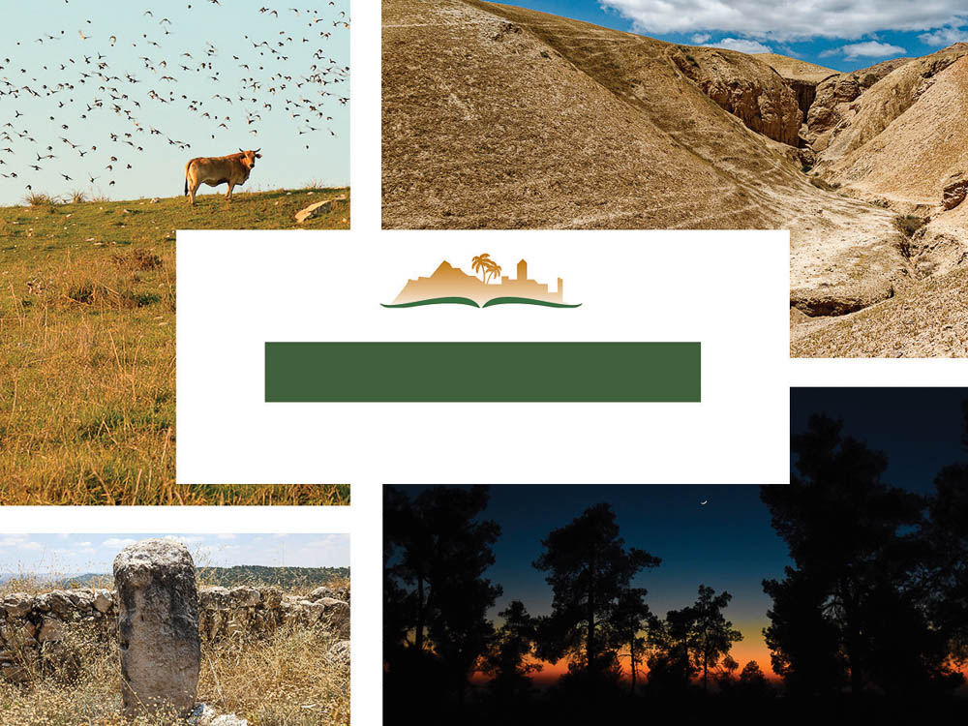
Hosea 5
Notes:
This is a free sample of the Hosea 5 presentation from the Photo Companion to the Bible. To purchase the full volume, visit https://www.bibleplaces.com/hosea/
The Photo Companion to the Bible is an image-rich resource for Bible students, teachers, and researchers. Just as a librarian stocks the shelves with as many relevant materials as possible, so we have tried to provide a broad selection of images. Our goal is that you will find in this “library” whatever it is you are looking for.
Credits: The primary creators of this presentation are Chris McKinny, Kris Udd, Steven D. Anderson, and Todd Bolen. The photographs have an individual file code which usually includes the initials of the photographer. Other images have additional credit or source information.
Updates: We plan to update this collection as we are able. We welcome your suggestions for improving this resource (photocompanion@bibleplaces.com). Purchasers of the Hosea volume are provided free, lifetime updates to the volume.
Copyright: This photo collection is protected by copyright law and may not be distributed without written permission from BiblePlaces.com. Slide notes should be treated as any other copyrighted written material, with credit given when quoting from these notes.
For more information, see our complete “Introduction to the Photo Companion to the Bible” online at https://www.BiblePlaces.com/Intro-Photo-Companion-Bible/. Here you will find more information about photo selection, explanatory notes, Bible translation, credit information, and copyright allowances.

Slide 2
Hosea 5
This is a free sample of the Hosea 5 presentation from the Photo Companion to the Bible. To purchase the full volume, visit www.bibleplaces.com/hosea/
The Photo Companion to the Bible is an image-rich resource for Bible students, teachers, and researchers. Just as a librarian stocks the shelves with as many relevant materials as possible, so we have tried to provide a broad selection of images. Our goal is that you will find in this “library” whatever it is you are looking for.
For more details (for this and every slide), see the Notes section below.
Notes:
This is a free sample of the Hosea 5 presentation from the Photo Companion to the Bible. To purchase the full volume, visit https://www.bibleplaces.com/hosea/
The Photo Companion to the Bible is an image-rich resource for Bible students, teachers, and researchers. Just as a librarian stocks the shelves with as many relevant materials as possible, so we have tried to provide a broad selection of images. Our goal is that you will find in this “library” whatever it is you are looking for.
Credits: The primary creators of this presentation are Chris McKinny, Kris Udd, Steven D. Anderson, and Todd Bolen. The photographs have an individual file code which usually includes the initials of the photographer. Other images have additional credit or source information.
Updates: We plan to update this collection as we are able. We welcome your suggestions for improving this resource (photocompanion@bibleplaces.com). Purchasers of the Hosea volume are provided free, lifetime updates to the volume.
Copyright: This photo collection is protected by copyright law and may not be distributed without written permission from BiblePlaces.com. Slide notes should be treated as any other copyrighted written material, with credit given when quoting from these notes.
For more information, see our complete “Introduction to the Photo Companion to the Bible” online at https://www.BiblePlaces.com/Intro-Photo-Companion-Bible/. Here you will find more information about photo selection, explanatory notes, Bible translation, credit information, and copyright allowances.

Slide 3
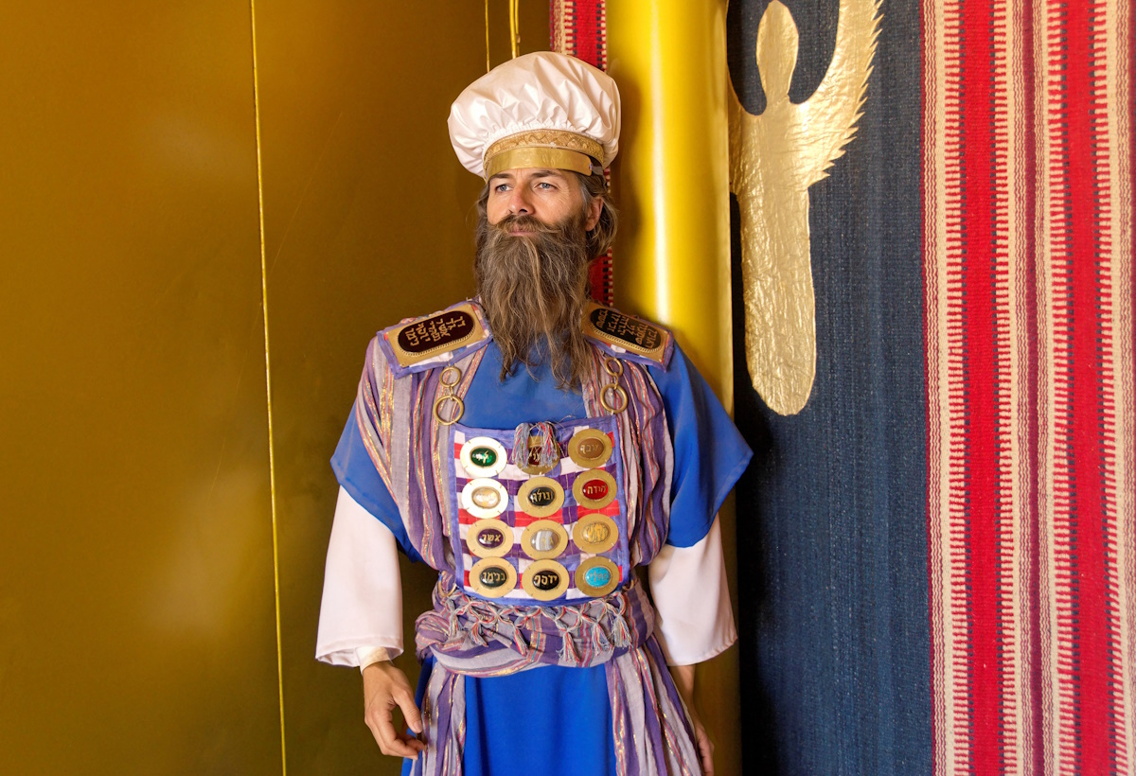
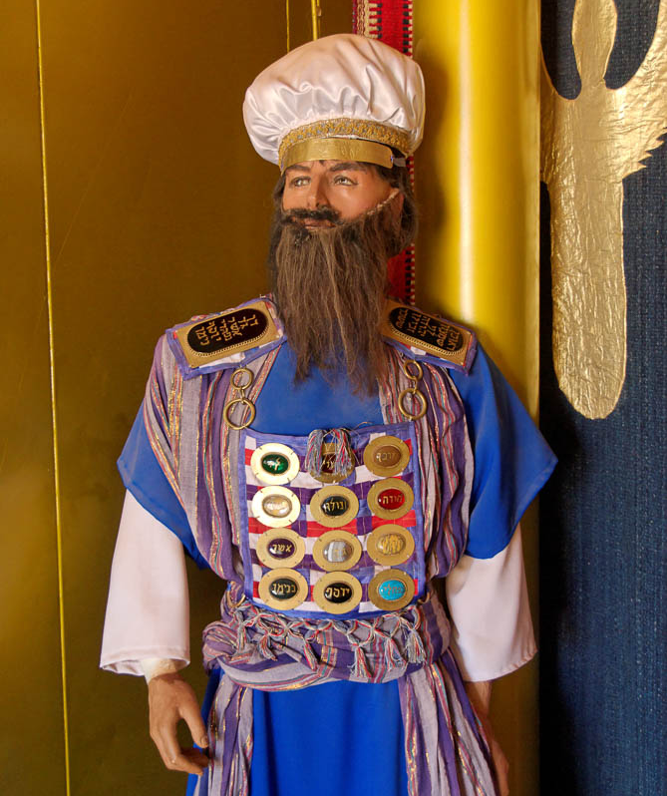
Hear this, O priests
The high priest in a tabernacle model
5:1
Notes:
This model of the high priest was photographed at the full-size replica of the tabernacle in the Timna Valley in southern Israel. Generative AI was used to enhance the image; the original photo is available behind this image.
tb010710921psai

Slide 4
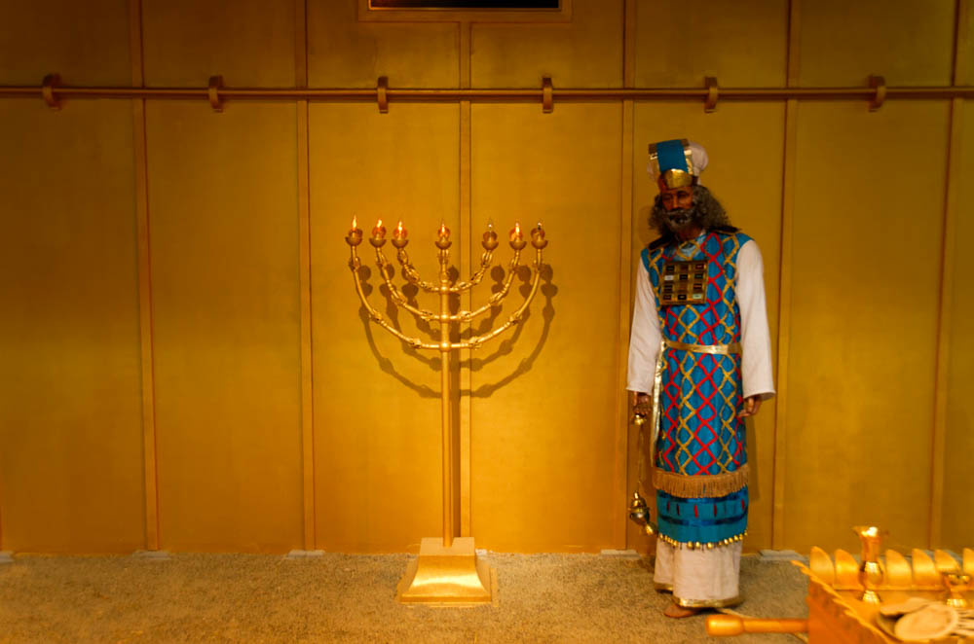
Hear this, O priests
The high priest beside the menorah in a tabernacle model
5:1
Notes:
This photograph was taken at the tabernacle model at the Creation and Earth History Museum in Santee, California.
tb040816495

Slide 5
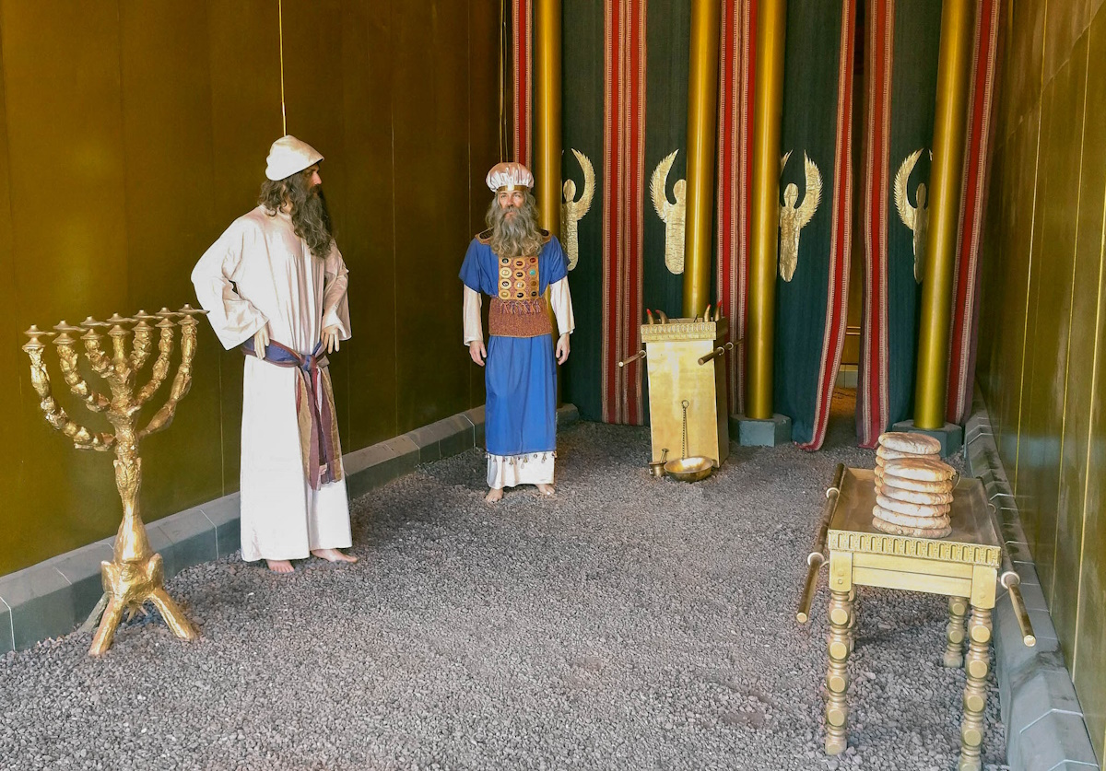
Hear this, O priests
Priests in a model of the tabernacle
5:1
Notes:
This model of the priests serving in the tabernacle was photographed at the full-size model of the tabernacle in Timna Park in southern Israel. This image comes from Mboesch and is licensed under CC BY-SA 4.0, via Wikimedia Commons: https://commons.wikimedia.org/wiki/File:Timna-park-tabernacle-heiligtum.jpg.
wiki1106161120453672171c

Slide 6
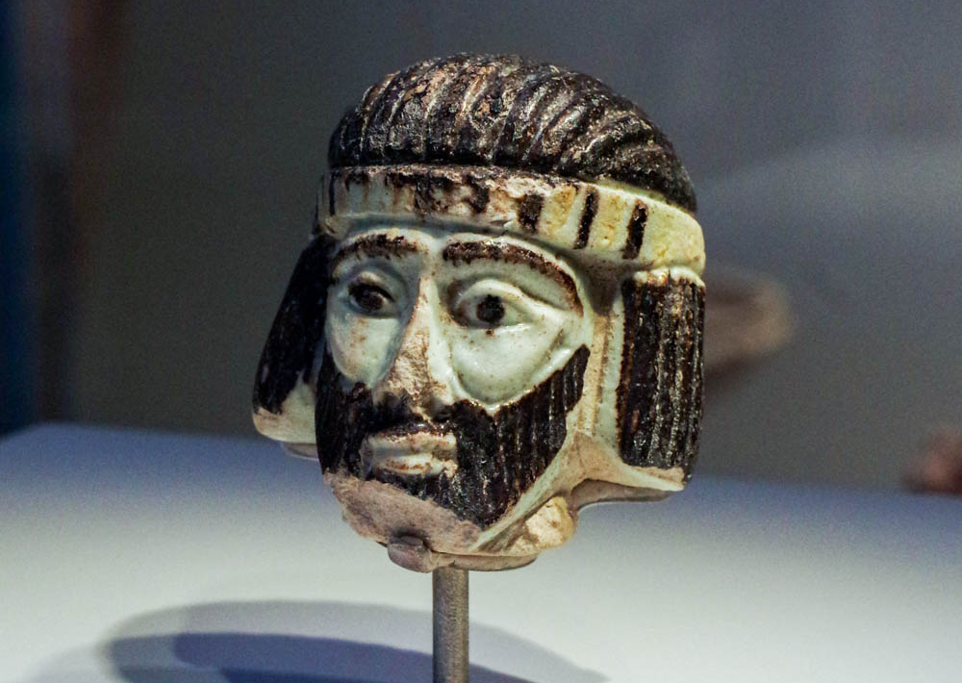
Hear this, O priests, and listen, O house of Israel
Faience statue head of an elite man or ruler, from Abel-beth-maacah, 9th century BC
5:1
Notes:
The identity of the “house of Israel” is not immediately clear. “This could be a reference to the common people in general, except that the thrust of this passage appears to be to bring charges against the leadership. A better solution . . . is to take ‘house of Israel’ to refer to the landed middle and upper classes. These were the men who thought of themselves as, and actually were, the social backbone of the country. They were not the political or religious elite, but neither were they the impoverished peasants and landless laborers. A parallel text is Jer 2:26” (Garrett 1997: 141). The small faience head shown here comes from northern Israel and is thought to represent an Israelite man of some standing, perhaps even a ruler or a king. It was photographed at the Israel Museum.
Reference:
Garrett, Duane A.
1997 Hosea, Joel. New American Commentary. Nashville: Broadman and Holman.
adr1806199382

Slide 7
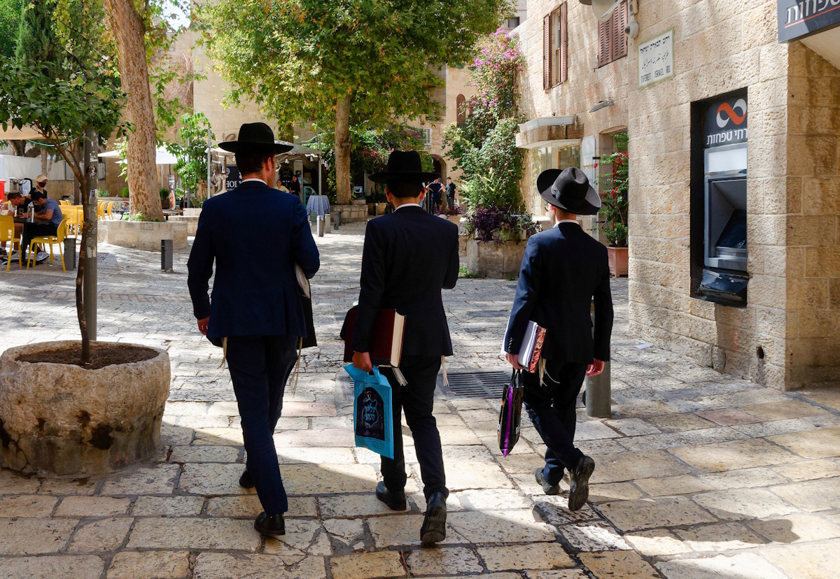
Hear this, O priests, and listen, O house of Israel
Orthodox men walking in the Jewish Quarter of Jerusalem
5:1
Notes:
bjb090121889c

Slide 8
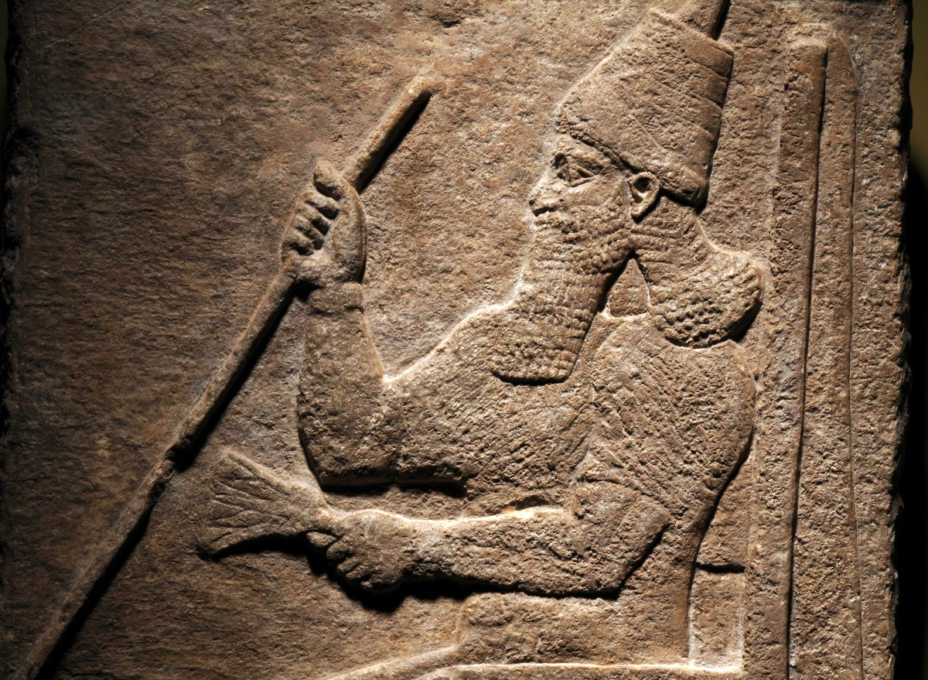
Hear this, O priests, and listen, O house of Israel, and give ear, O house of the king
Relief of the Assyrian king Tiglath-pileser III on his throne, 8th century BC
5:1
Notes:
The “house of the king” refers to the royal household, which in Hosea’s day was ruled by Jeroboam II (Hos 1:1). This relief depicts a contemporary Assyrian king, Tiglath-pileser III (r. 745–727), sitting on his throne. He grasps a scepter in his right hand and holds a lotus flower in his left.
This relief was photographed at the National Museum of Antiquities (Rijksmuseum van Oudheden) in Leiden. This image comes from the Dutch National Museum of Antiquities, A 1934/6.1, Creative Commons-BY. Source: https://www.rmo.nl/collectie/collectiezoeker/collectiestuk/?object=33876.
rmo33876

Slide 9
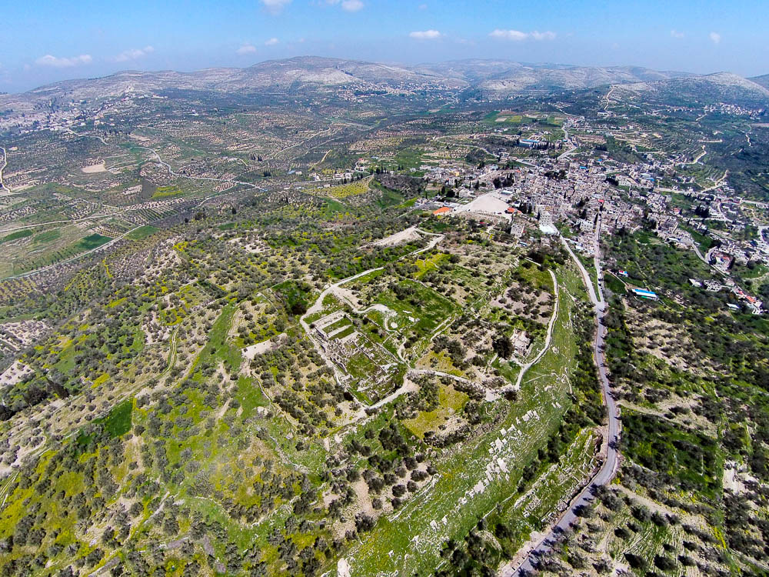
Hear this, O priests, and listen, O house of Israel, and give ear, O house of the king
Samaria acropolis (aerial view from the southwest)
5:1
Notes:
Israel’s royal house ruled from the palace at Samaria, where it had been established by Omri and his son Ahab in the 9th century BC.
ws030515594

Slide 10
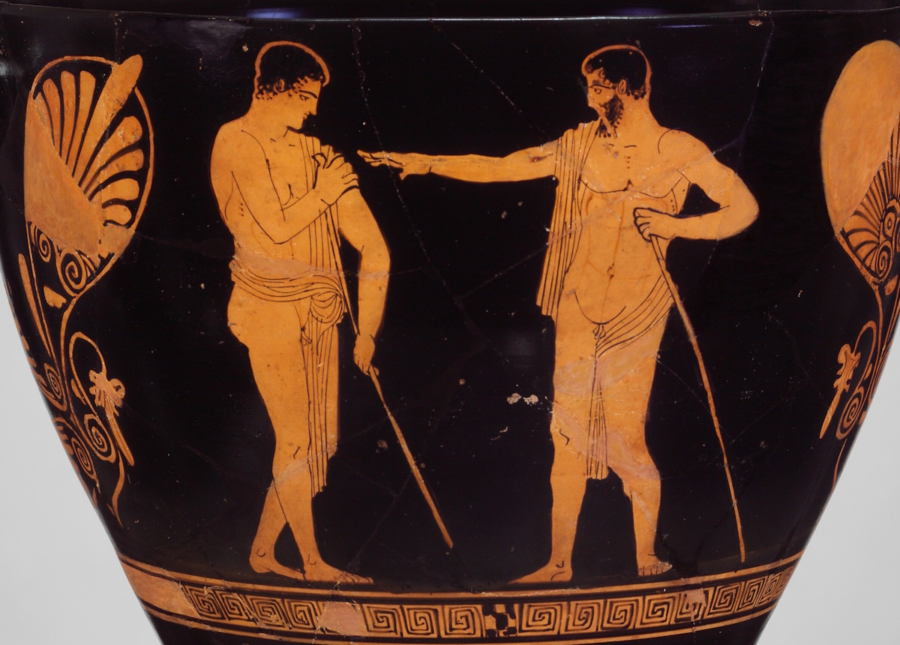
For this judgment pertains to you
Skyphos with a youth and a man in conversation, circa 450 BC
5:1
Notes:
This image comes from the Metropolitan Museum of Art, public domain, Purchase by subscription, 1896, accession number 96.18.73, https://www.metmuseum.org/art/collection/search/246588. A removable graphic has been added to prevent surprise or offense.
met246588b

Slide 11
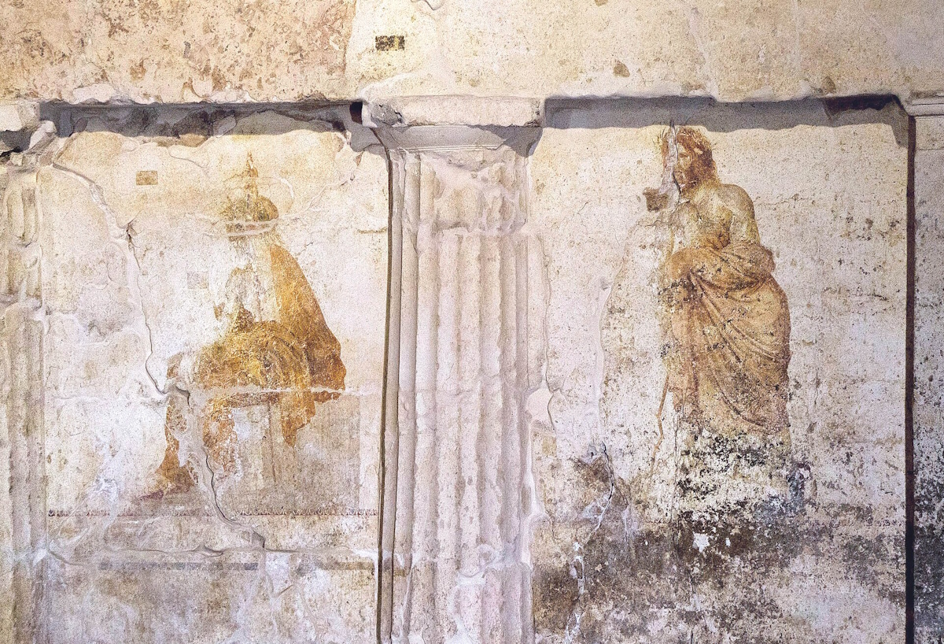
For this judgment pertains to you
Depiction of two judges in a tomb in Lefkadia, circa 325 BC
5:1
Notes:
Depictions of judges became more common in later periods, particularly in the art of the Greeks. This tomb painting depicts two judges, named Aiakos and Rhadamanthys, who are waiting for the deceased. They will decide whether he has been good enough to send him to the Isles of the Blessed, or whether his behavior has been bad, in which case he will be punished with eternal torture in Tartara.
This image comes from Egisto Sani and is licensed under CC BY-SA 2.0, via Wikimedia Commons: https://commons.wikimedia.org/wiki/File:Lefkadia_The_Judgment_Tomb_%E2%80%93_VI_(37242295582).jpg.
wiki083017616441141509c

Slide 12
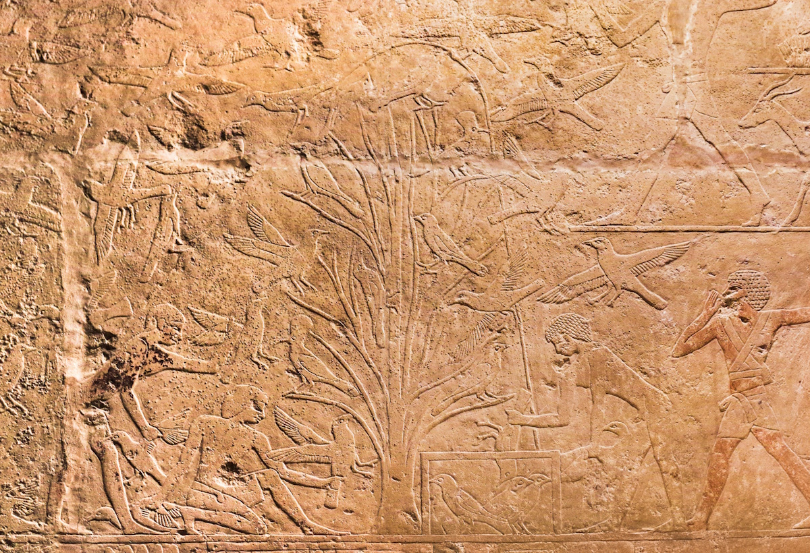
For you have been a snare at Mizpah
Men snaring birds in a tree, from the tomb chapel of Hetepherakhty at Saqqara, circa 2500 BC
5:1
Notes:
The word “snare” (Heb. paḥ, פַּח) refers to a trap for birds. This relief depicts men using a net to capture birds in a tree. Note the cage just to the right of center at the bottom, into which the birds are being placed. This relief was photographed at the National Museum of Antiquities in Leiden, Netherlands.
adr1805206159c

Slide 13
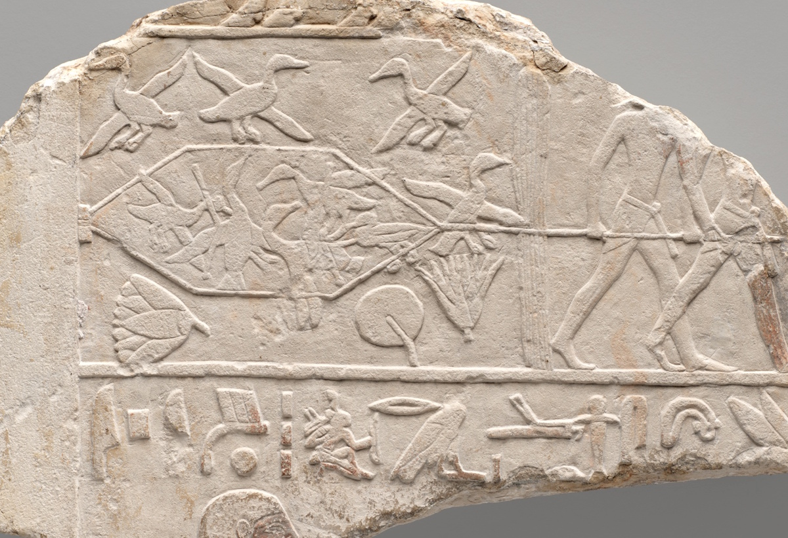
For you have been a snare at Mizpah
Relief fragment depicting men trapping waterfowl, from Saqqara, circa 2050 BC
5:1
Notes:
This relief comes from the tomb of Ipi at Saqqara. It shows men behind a reed blind who are drawing a clap net closed to trap waterfowl.
This image comes from the Art Institute Chicago, W. Moses Willner Fund, accession number 1910.230, and is in the public domain: https://www.artic.edu/artworks/130065/relief-fragment-depicting-ipi-and-fowling-in-the-marshes.
artic130065

Slide 14
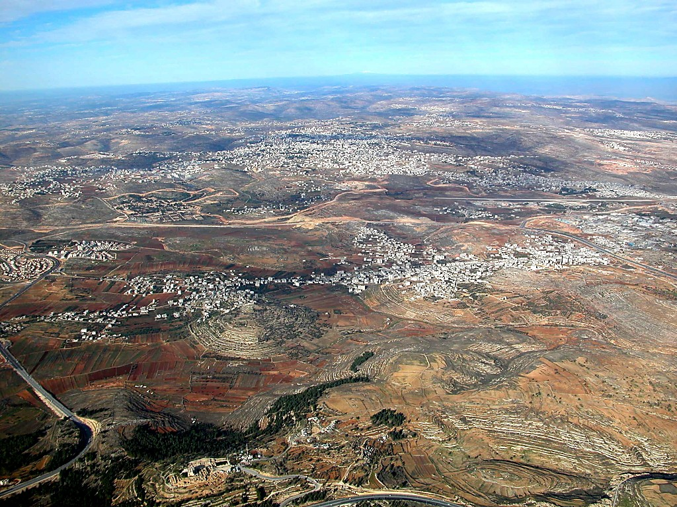
For you have been a snare at Mizpah
Central Benjamin Plateau (aerial view from the south)
5:1
Notes:
The inclusion of Mizpah in a statement against Israel probably refers to the close connection between Mizpah and Bethel. In other words, Mizpah could be drawn away from Judah and Jerusalem by the presence of the cult site at Bethel. The next slide includes labels.
tb010703103

Slide 15
For you have been a snare at Mizpah
Beitin
= Bethel?
Baal Hazor
Ramallah/
El-Bireh (= Bethel?)
et-Tell
Beth-horon
Ridge
Ramah
Mizpah
Gibeon
Central Benjamin Plateau (aerial view from the south)
5:1
Notes:
The inclusion of Mizpah in a statement against Israel probably refers to the close connection between Mizpah and Bethel. In other words, Mizpah could be drawn away from Judah and Jerusalem by the presence of the cult site at Bethel.
tb010703103

Slide 16
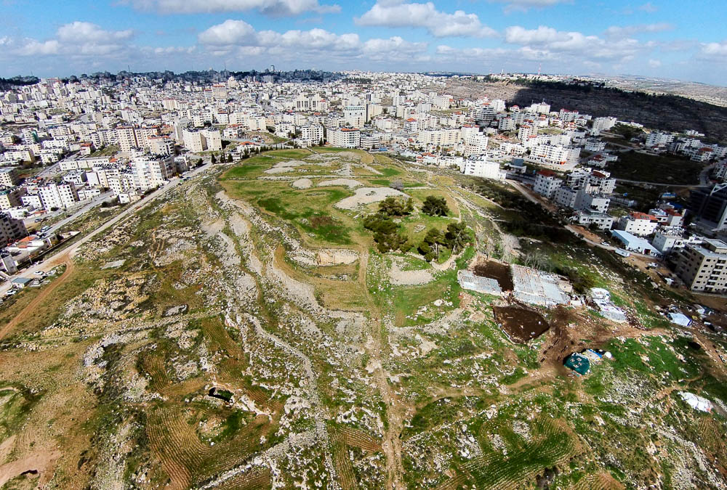
For you have been a snare at Mizpah
Mizpah, modern Tell en-Nasbeh (aerial view from the south)
5:1
Notes:
W. F. Bade excavated Tell en-Nasbeh from 1926 to 1935. Much of the central part of the tell had been eroded away already by the time of Bade’s excavations, as may be apparent in this photo. About two-thirds of the site’s 8 acres (3.2 ha) was excavated by Bade and his team.
ws010515939

Slide 17
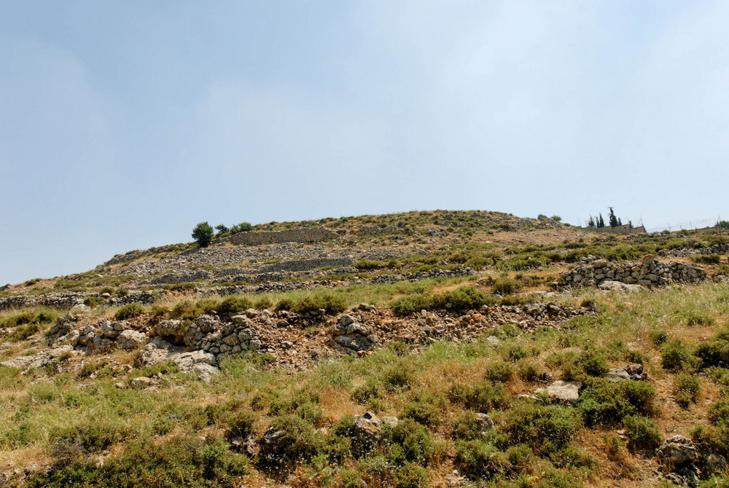
For you have been a snare at Mizpah
Mizpah, Tell en-Nasbeh (from the north)
5:1
Notes:
In accord with the biblical record, evidence was found at Tell en-Nasbeh of occupation during the Iron Age, Persian, and Hellenistic periods. Additionally, large Iron Age walls, glacis (earthen ramparts), and towers were found which correspond to the type of fortress construction that would be expected by King Asa’s building of Mizpah, recorded in 1 Kings 15:22.
tb051407509

Slide 18
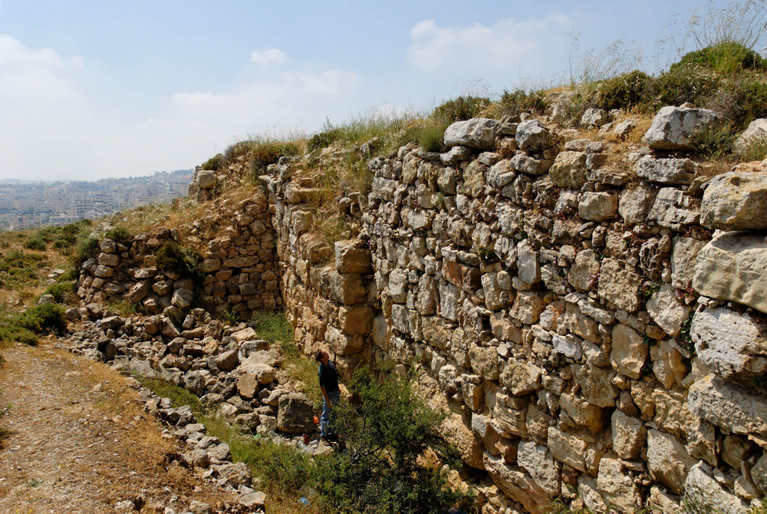
For you have been a snare at Mizpah
Iron Age offset-inset wall at Mizpah, Tell en-Nasbeh
5:1
Notes:
This offset-inset wall was constructed in the Iron II period and is believed by some to be associated with Asa’s fortification of the city (1 Kgs 15:22). The entire length of the wall was revealed in the excavations, a length of 2,100 feet (640 m), including eleven towers that were built along the exterior face of the wall. The wall is believed to have originally been 38–45 feet (11.6–13.7 m) tall.
tb051407526

Slide 19
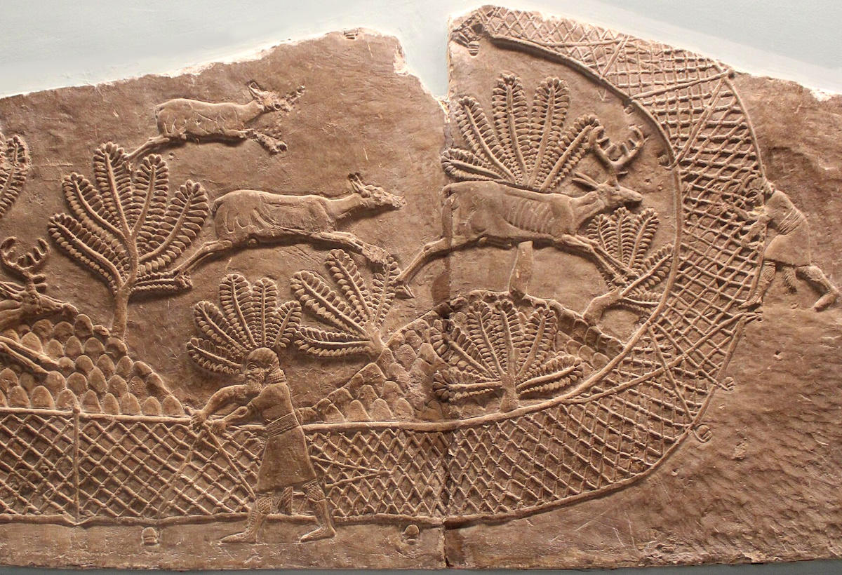
And you have been a net spread out on Tabor
Capturing deer with nets, from the palace of Ashurbanipal at Nineveh, 7th century BC
5:1
Notes:
This relief portrays hunters using a combination of deadly weapons (bow and arrow) and a large net to trap deer. This relief was photographed at the British Museum. This image comes from Zunkir and is licensed under CC BY-SA 4.0, via Wikimedia Commons: https://commons.wikimedia.org/wiki/File:Hunt_of_Ashurbanipal_-_netting_deer.jpg.
wiki03092020163301

Slide 20
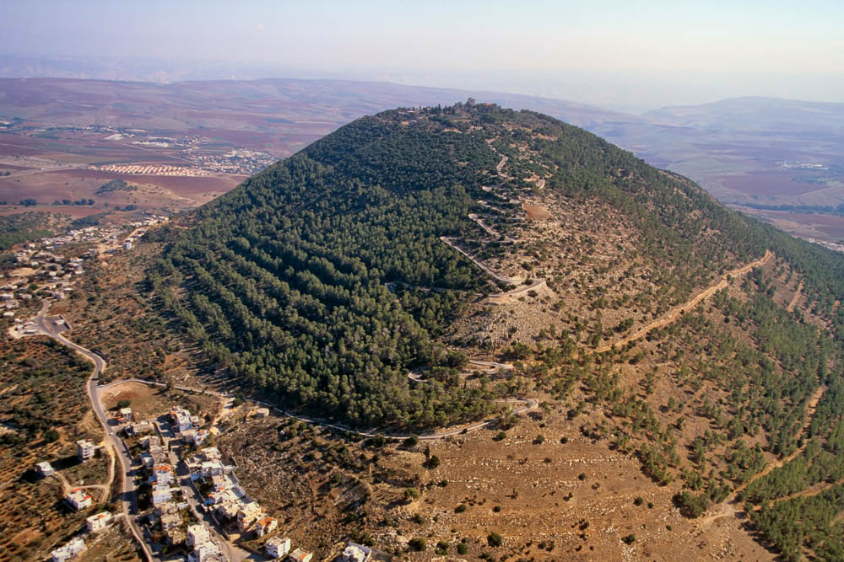
And you have been a net spread out on Tabor
Mount Tabor (aerial view from the northwest)
5:1
Notes:
Mount Tabor is located at the eastern end of the Jezreel Valley. It is a tall, isolated mountain. It does not appear often in the Hebrew Bible, and it is best known as the place where Barak gathered his troops prior to the battle with Sisera (Judg 4).
tbs121210011

Slide 21
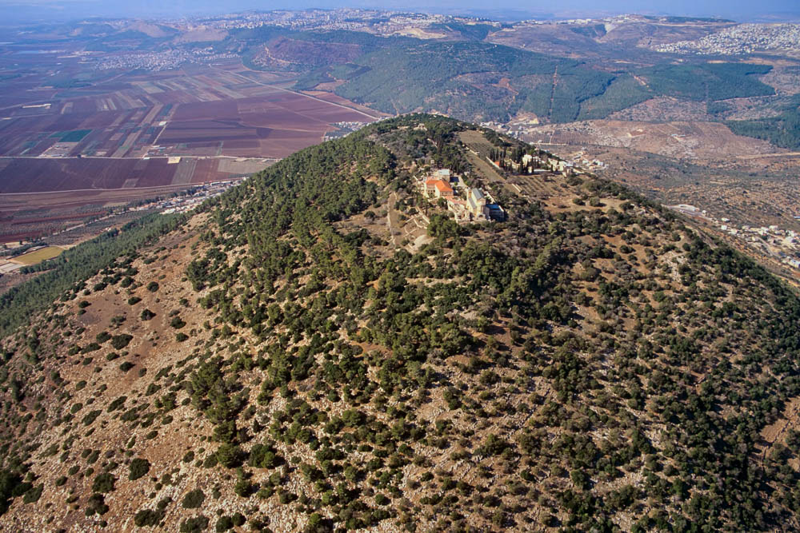
And you have been a net spread out on Tabor
Summit of Mount Tabor (aerial view from the east)
5:1
Notes:
Dearman suggests the possibility that Mount Tabor may have had a shrine to a Canaanite deity at its summit in Hosea’s day (Dearman 2010: 172). Although evidence is lacking, the idea is not implausible. Even today, a church stands on the summit.
Reference:
Dearman, J. Andrew.
2010 Hosea. New International Commentary on the Old Testament. Grand Rapids: Eerdmans.
tbs121280011

Slide 22
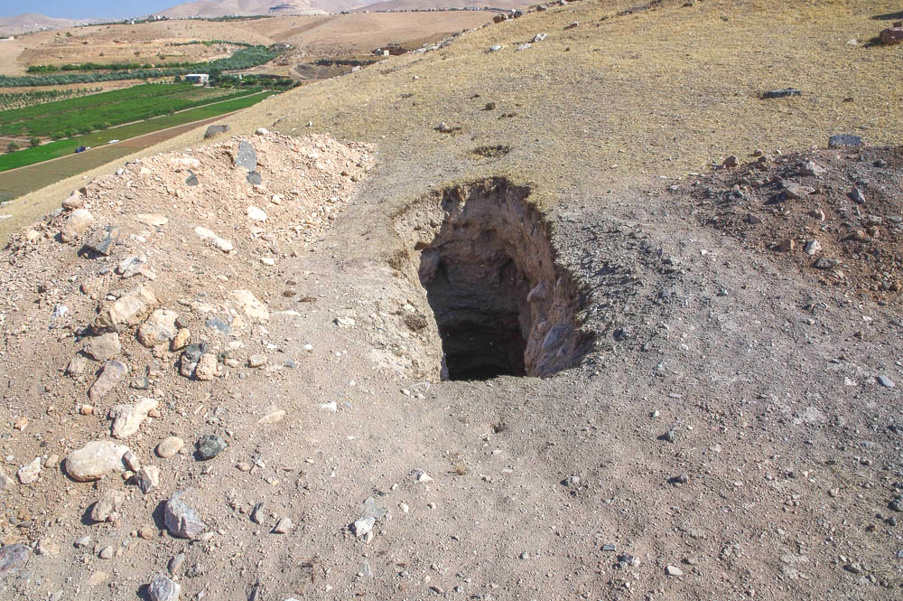
And a pit dug deep at Shittim
Looters’ pit on Tell al-Birah
5:2
Notes:
The Hebrew text here is very difficult; Andersen and Freedman assert that it is “largely unintelligible in its present form” (1980: 386). English versions and biblical scholars are largely divided between two options: 1) “Those who revolt are deep in slaughter;” 2) “And a pit dug deep at Shittim.”
The first possibility, “Those who revolt are deep in slaughter,” retains the letters preserved in the MT, “but depends heavily on hypothetical translations of some very unusual Hebrew” (Garrett 1997: 142). Most English versions take this approach. The second reading, “And a pit dug deep at Shittim,” requires two emendations, šḥṭh to šḥt, and śēṭı̂m to šiṭṭı̂m. The appeal to this approach is that it parallels the two preceding phrases (“You are a snare at Mizpah, and a net spread out on Tabor”). This approach is taken by the NRSV, REB, and NLT; it is also preferred by the authors of the four commentaries listed below.
A “pit” (Heb. shaḥat, שַׁחַת) was a deep hole dug in the ground, and it was likely covered over with a disguise that was intended to deceive and entrap the prey. The deep pit shown here was dug by looters looking for valuables, perhaps from an ancient tomb.
References:
Andersen, Francis I. and Freedman, David Noel.
1980 Hosea. The Anchor Bible. New York: Doubleday.
Dearman, J. Andrew.
2010 Hosea. New International Commentary on the Old Testament. Grand Rapids: Eerdmans.
Garrett, Duane A.
1997 Hosea, Joel. New American Commentary. Nashville: Broadman and Holman.
Stuart, Douglas.
1988 Hosea–Jonah. Word Biblical Commentary. Grand Rapids: Zondervan.
adr1806096157

Slide 23
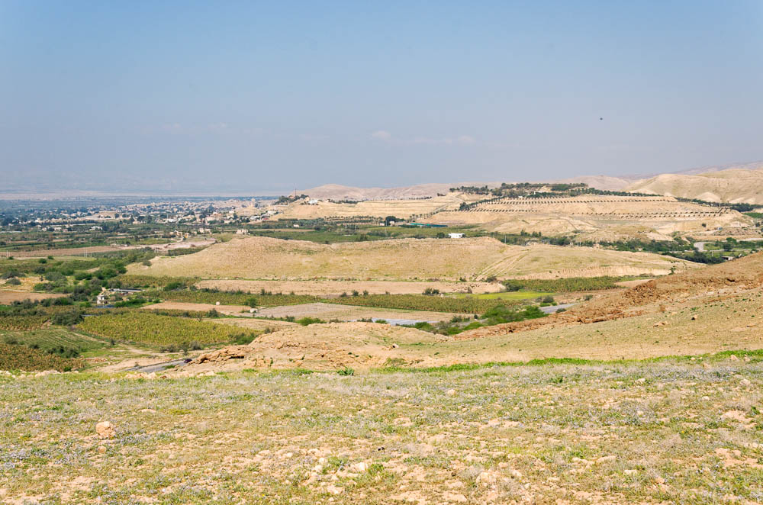
And a pit dug deep at Shittim
Tell el-Hammam, possible Shittim (from the southeast)
5:2
Notes:
Shittim was the last location where the Israelites camped before crossing the Jordan River into the Promised Land. It is notable as the place where they fell into the idolatrous and immoral practices of Baal-peor (Num 25). The location of Shittim is not known with certainty, but a good candidate is Tell el-Hammam, a large site on the eastern edge of the plain of Moab (Slayton 1992: 1,222; so also HALOT). The tell is visible as the long, low, barren hill in the middle of this photo.
Reference:
Slayton, Joel C.
1992 Shittim. Anchor Bible Dictionary, vol. 5, ed. D. N. Freedman. New York: Doubleday.
tb031315304

Slide 24
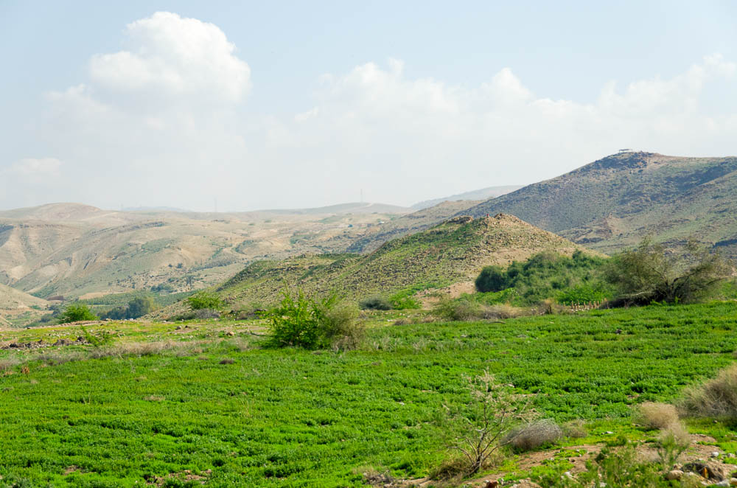
And a pit dug deep at Shittim
The acropolis of Tell el-Hammam, possible Shittim, from the lower city
5:2
Notes:
The acropolis at Tell el-Hammam is situated above the lower city, which spreads out to the west. This view shows the acropolis from the perspective of the lower city.
tb031315253

Slide 25
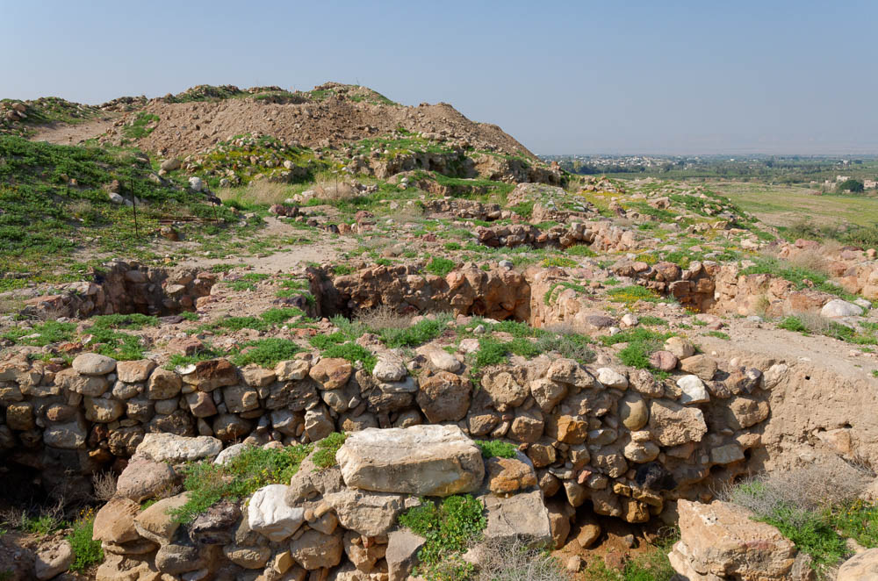
And a pit dug deep at Shittim
Tell el-Hammam acropolis excavations
5:2
Notes:
The excavator at Tell el-Hammam has advocated for identifying it as ancient Sodom. However, this identification conflicts with the chronology and the geographical description of the city as laid out in the Hebrew Bible.
tb031315201

Slide 26
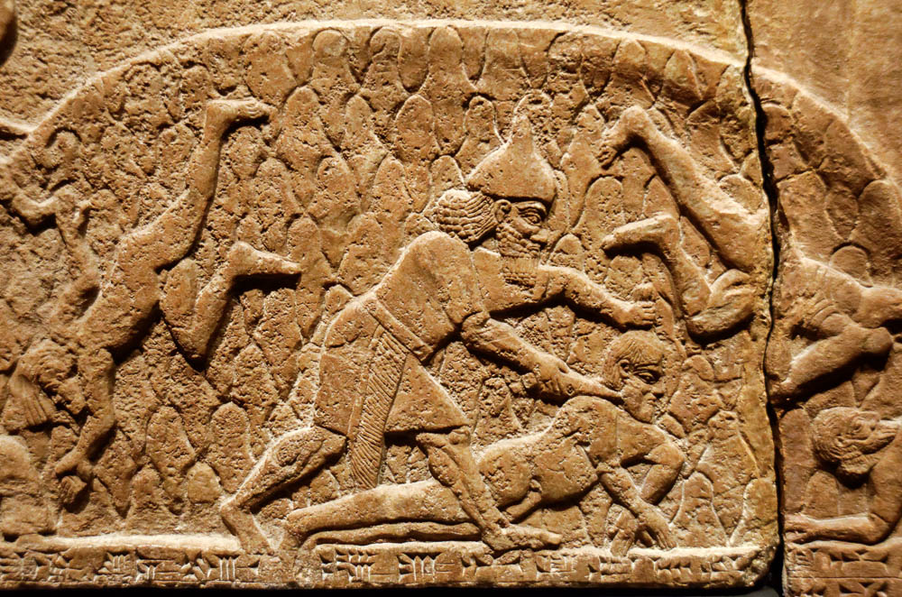
Those who revolt are knee-deep in slaughter
Assyrian soldier killing enemy prisoners, from the central palace at Nimrud, 730–727 BC
5:2
Notes:
This slide illustrates an alternative translation of Hosea 5:2. This relief was photographed at the Getty Villa in southern California while on loan from the British Museum.
tb100919408

Slide 27
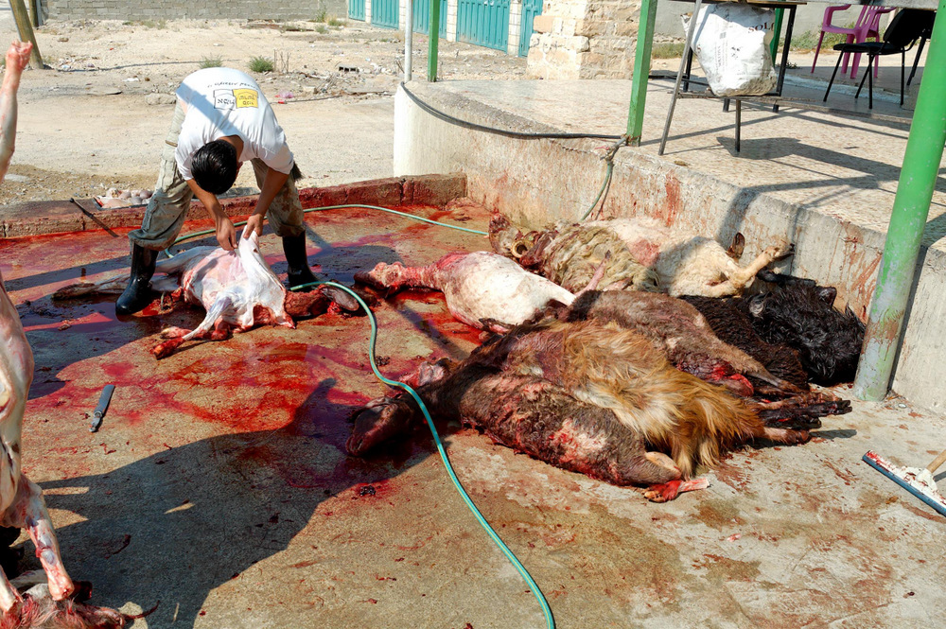
Those who revolt are knee-deep in slaughter
Skinning and gutting sheep in Jericho
5:2
Notes:
tb051106810

Slide 28
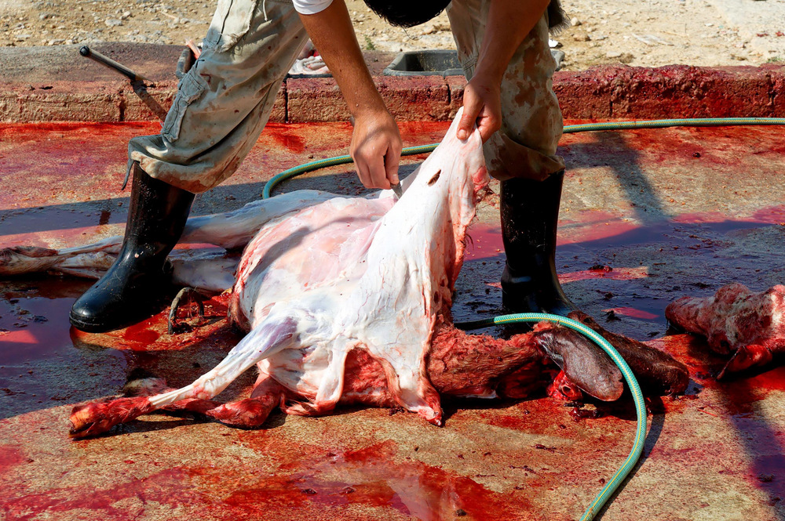
Those who revolt are knee-deep in slaughter
Skinning sheep in Jericho
5:2
Notes:
tb051106812

Slide 29
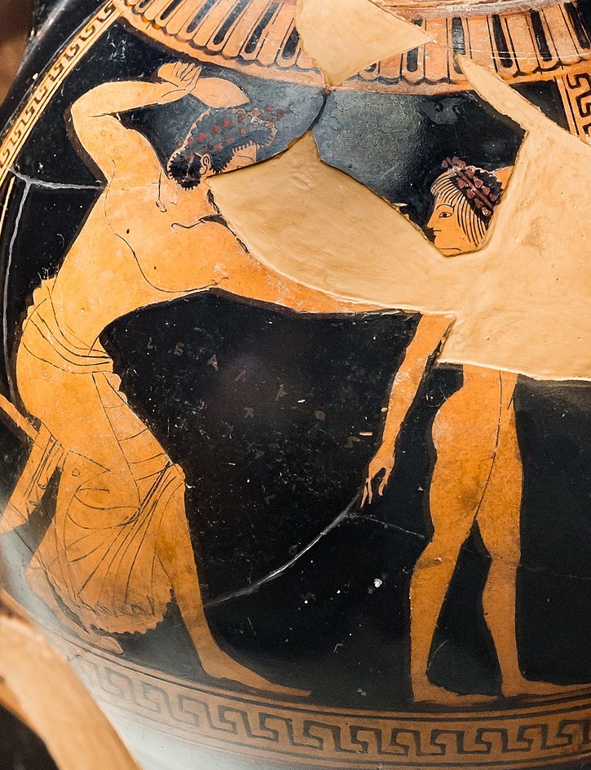
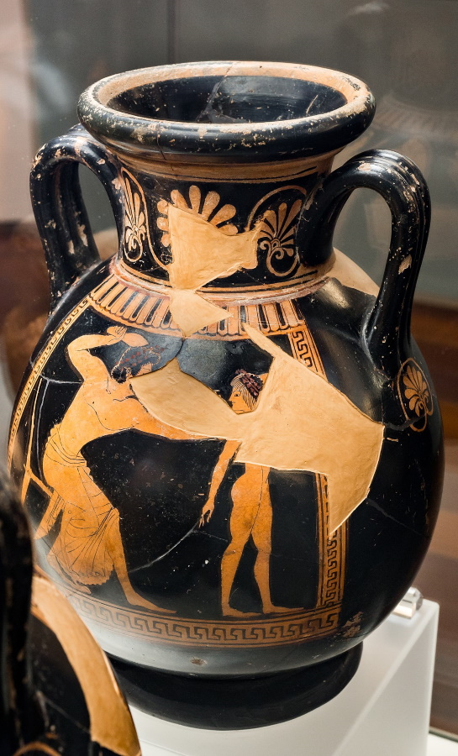
But I will punish all of them
Red-figure pelike with a man beating a youth with a sandal, from Athens, circa 520 BC
5:2
Notes:
This two-handled wine jar (pelike) depicts a man beating a youth with a sandal, likely a form of discipline. It was photographed at the National Etruscan Museum at Villa Giulia in Rome. This image comes from ArchaiOptix and is licensed under CC BY-SA 4.0, via Wikimedia Commons: https://commons.wikimedia.org/wiki/File:Euphronios_-_ARV_15_11_-_man_beating_youth_with_sandal_-_youth_leading_horse_-_Roma_MNEVG_121109_-_01.jpg. This image has been modified to avoid causing surprise or offense.
wiki082520211609211211

Slide 30
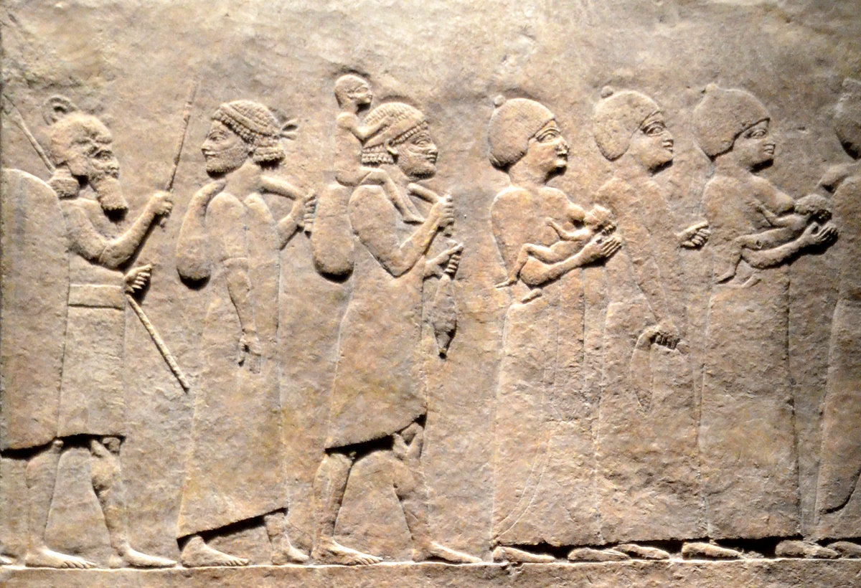
But I will punish all of them
Relief of refugees or captives, from the reign of Ashurbanipal, 7th century BC
5:2
Notes:
The primary way in which God punished Israel was through their defeat and deportation by the Assyrians. This relief portrays people who have been conquered by the Assyrian king Ashurbanipal and are being deported to live in a different land, a common Assyrian practice. As the line of refugees marches along, they are followed and harassed by a fully-armed Assyrian soldier who threatens them with an upraised stick.
This relief was photographed at the British Museum. This image comes from Carole Raddato and is licensed under CC BY-SA 2.0, via Wikimedia Commons: https://commons.wikimedia.org/wiki/File:Exhibition_I_am_Ashurbanipal_king_of_the_world,_king_of_Assyria,_British_Museum_(45924161812).jpg.
wiki4592416181214342018

Slide 31
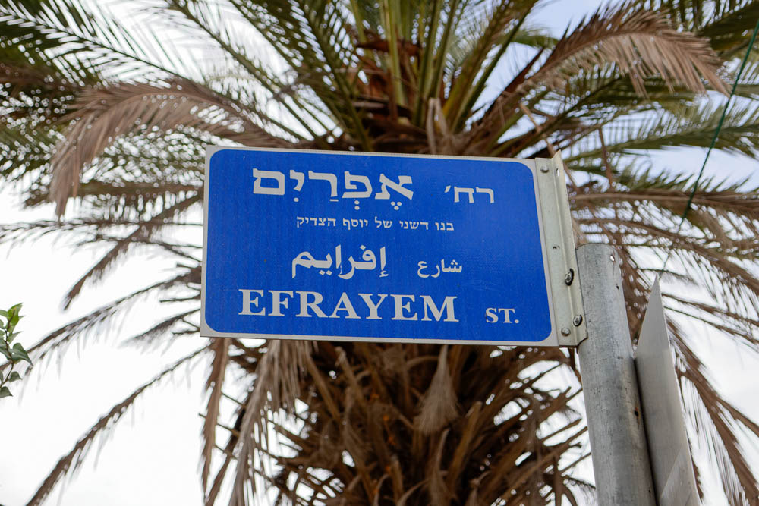
I know Ephraim, and Israel is not hidden from Me
“Ephraim Street” sign in Jerusalem
5:3
Notes:
Ephraim Street is located in the Baka neighborhood, southwest of the Old City.
lbd102318895

Slide 32
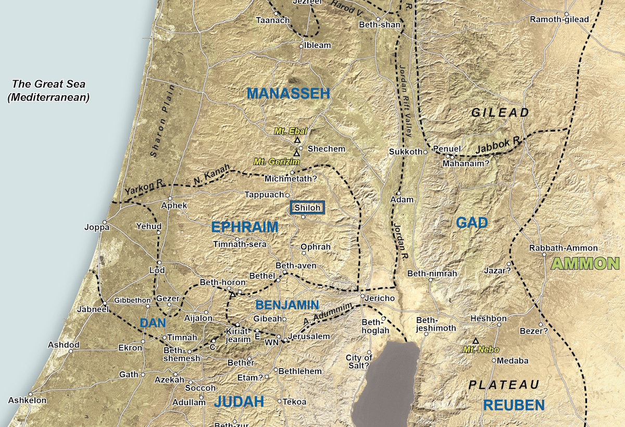
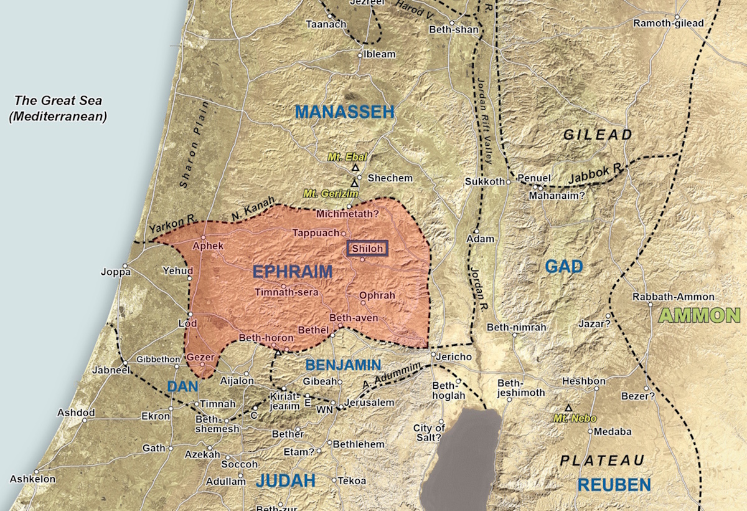
I know Ephraim, and Israel is not hidden from Me
Satellite map of the territory of Ephraim
5:3
Notes:
The tribal territory of Ephraim was located in the heart of the Promised Land. When the kingdom split, it became the southernmost region of the northern kingdom (the territory of Benjamin was disputed, and the border between Israel in the north and Judah in the south shifted periodically). When Israel began to lose territory to the Assyrians, it was from the north, so that Ephraim was the last territory to fall. Note also the location of Shiloh in Ephraim. Shiloh was the home of the tabernacle for many centuries (in the Judges period). An editable version is included behind this image.
The map shown here is a close-up from map 4-1 from the Satellite Bible Atlas, by William Schlegel. Used by permission.

Slide 33
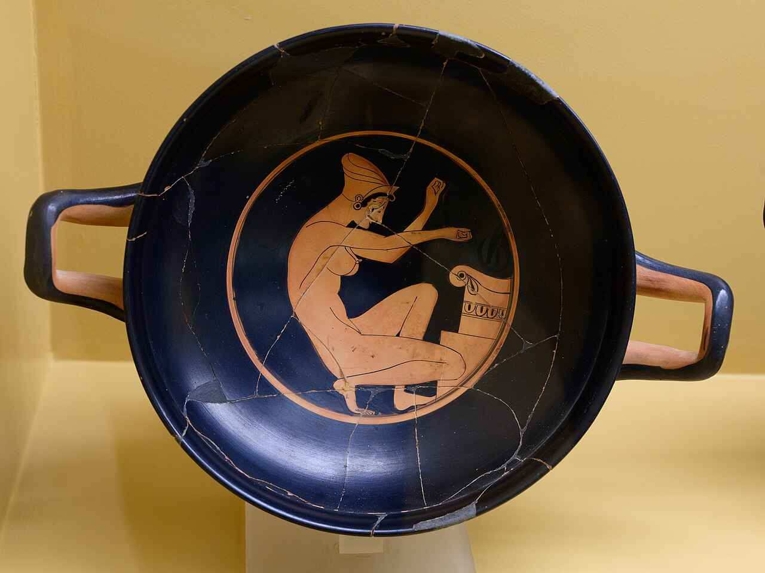
For now, Ephraim has played the harlot, and Isarel has defiled herself
Kylix with a prostitute (hetaira) at an altar, circa 500 BC
5:3
Notes:
The image on this drinking cup (kylix) depicts a prostitute (hetaira) next to an altar, perhaps offering incense. It captures both the metaphor of Ephraim as a prostitute, and participation in a non-Yahwistic religion.
This kylix was photographed at the Ancient Agora Museum in Athens. This image comes from Zde and is licensed under CC BY-SA 4.0, via Wikimedia Commons: https://commons.wikimedia.org/wiki/File:Red-figure_kylix,_Chairias,woman_kneeling_at_altar,_AGMA,225316.jpg. A removable graphic has been added to this image to avoid causing surprise or offense.
wiki0610224031302362

Slide 34
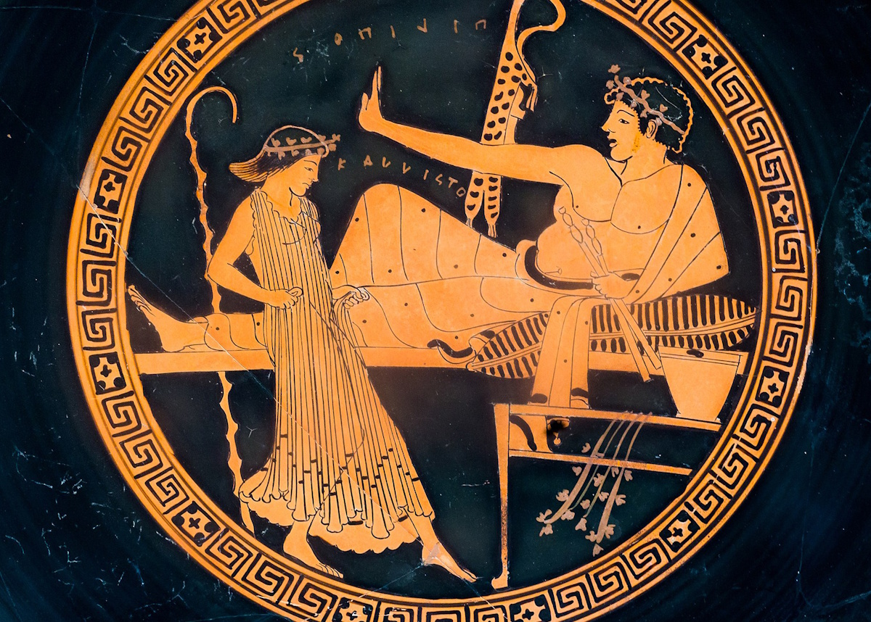
Their deeds will not allow them to return to their God
Kylix with a man holding out the palm of his hand, from Athens, circa 490 BC
5:4
Notes:
This kylix was photographed at the British Museum. This image comes from ArchaiOptix and is licensed under CC BY-SA 4.0, via Wikimedia Commons: https://commons.wikimedia.org/wiki/File:Brygos_Painter_ARV_371_24_symposion_(02).jpg.
wiki0212161611503476867c

Slide 35
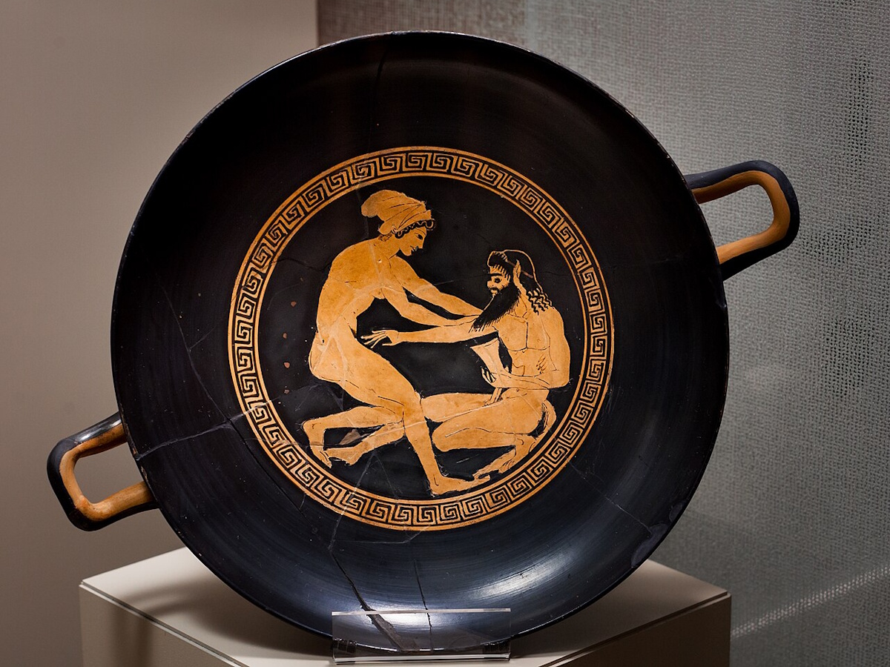
For a spirit of prostitution is in them
Kylix with a prostitute approaching a satyr, from Athens, circa 500 BC
5:4
Notes:
This kylix was photographed at the Archaeological Museum of Milan. This image comes from ArchaiOptix and is licensed under CC BY-SA 4.0, via Wikimedia Commons: https://commons.wikimedia.org/wiki/File:Near_the_Chairias_Painter_ARV_176_2extra_hetaira_attacking_satyr_(01).jpg.
wiki08181537442848607

Slide 36
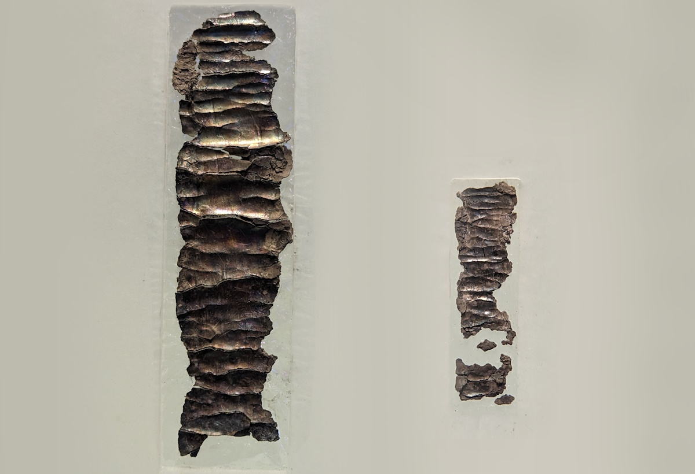
And they do not know Yahweh
Priestly blessing on the Ketef Hinnom silver scrolls, circa 600 BC
5:4
Notes:
The small silver scrolls shown here contain portions of the priestly blessing which God told Aaron to use in blessing the Israelites. This mentions Yahweh by name. They date to about 600 BC and are the oldest Scripture discovered. Although fragmentary, they read, in part: “. . . the grea[t who keeps] the covenant and [g]raciousness towards those who love [Him] and those who keep [His commandments] . . . For Yahweh is our restorer [and] rock. May Yahweh bles[s] you and keep you. [May] Yahweh make [His face] shine . . .” (see Ahituv 2008: 49ff).
These tiny scrolls were found in a tomb in Ketef Hinnom, on the south side of Jerusalem. They were photographed at the Israel Museum. This is a composite photo; the two scrolls, which are shown here to scale, are displayed separately.
Reference:
Ahituv, Shmuel.
2008 Echoes from the Past: Hebrew and Cognate Inscriptions from the Biblical Period. Jerusalem: Carta.
Left: ku0607231005485
Right: ku0607231006100

Slide 37
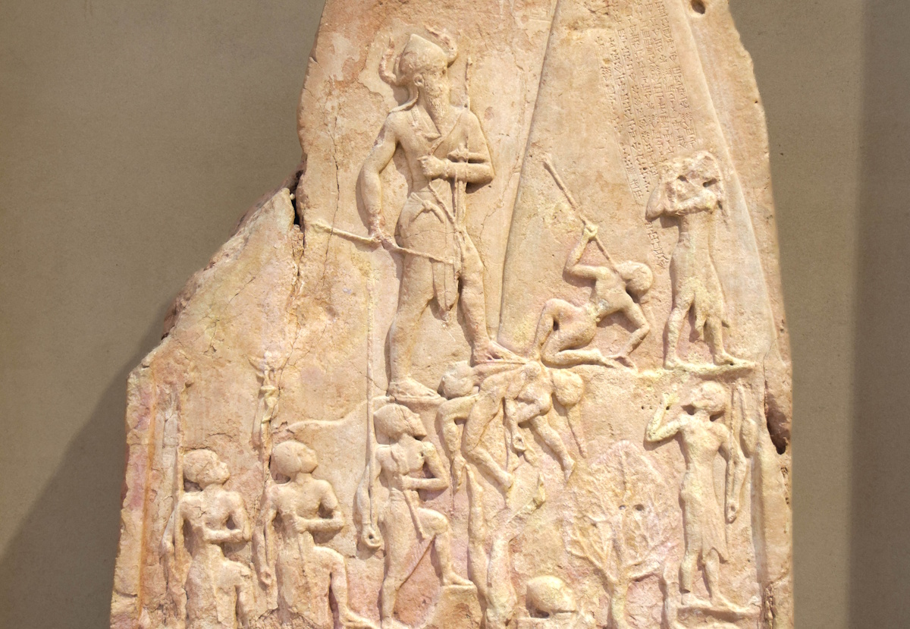
Moreover, Israel’s arrogance testifies against him
Victory stele of Naram-Sin of Akkad, circa 2230 BC
5:5
Notes:
The ideas of pride, arrogance, and evil are illustrated here by a stele that depicts the Akkadian ruler Naram-Sin as a larger-than-life figure who ascends steps upward even as he vanquishes his enemies. The horned helmet he wears is a proclamation not only of strength, but even of his own divinity, since horned helmets were regularly used in Mesopotamian art to depict the gods. Notice that he approaches a speared enemy who crumples before him even as he walks on the fallen bodies of other vanquished enemies.
This stele was brought as spoil from Sippar to Susa in the 12th century BC. It was photographed at the Louvre Museum.
tb0927194856c

Slide 38
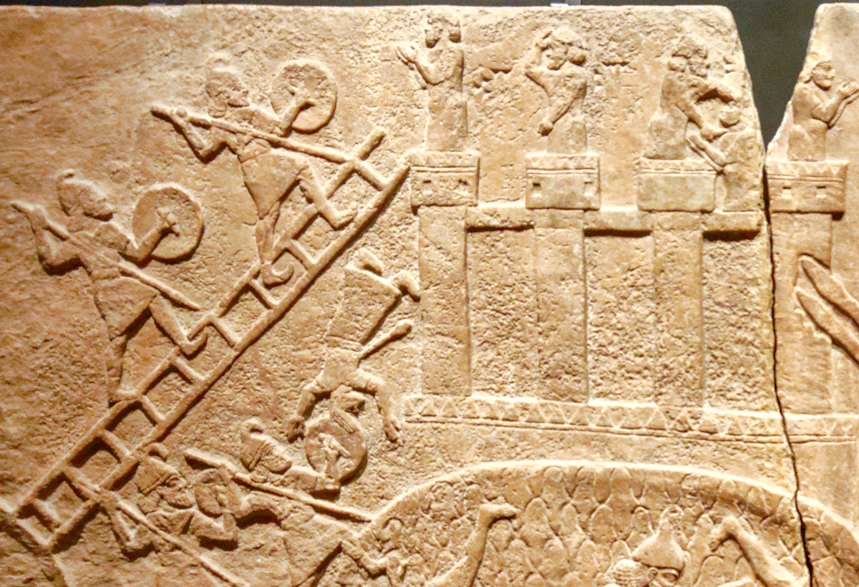
Both Israel and Ephraim will stumble in their iniquity
Relief a man falling headlong from a tower during an Assyrian attack, from Nimrud, circa 730 BC
5:5
Notes:
The verb “to stumble” (Heb. kashal, כָּשַׁל) is to lose one’s footing or to fall down; it is often a metaphor for being defeated, overthrown, or even destroyed. In the relief shown here, a man is shown falling from the fortified walls of a city; pierced by an arrow, he is falling headlong to the ground.
This relief comes from the central palace of Tiglath-pileser III at Nimrud. It was photographed at the Getty Villa in southern California.
tb100919395

Slide 39
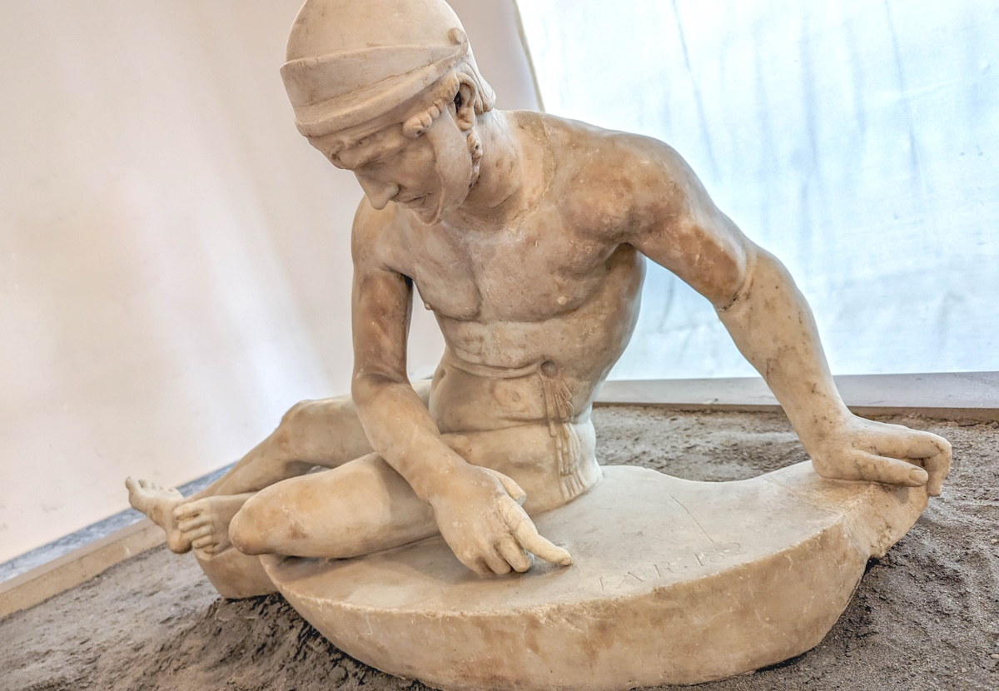
Judah also will stumble with them
Statue of a fallen soldier in the Pergamene votive offering, 2nd century AD
5:5
Notes:
This statue was photographed at the Naples Archaeological Museum.
ku0622230924296c

Slide 40
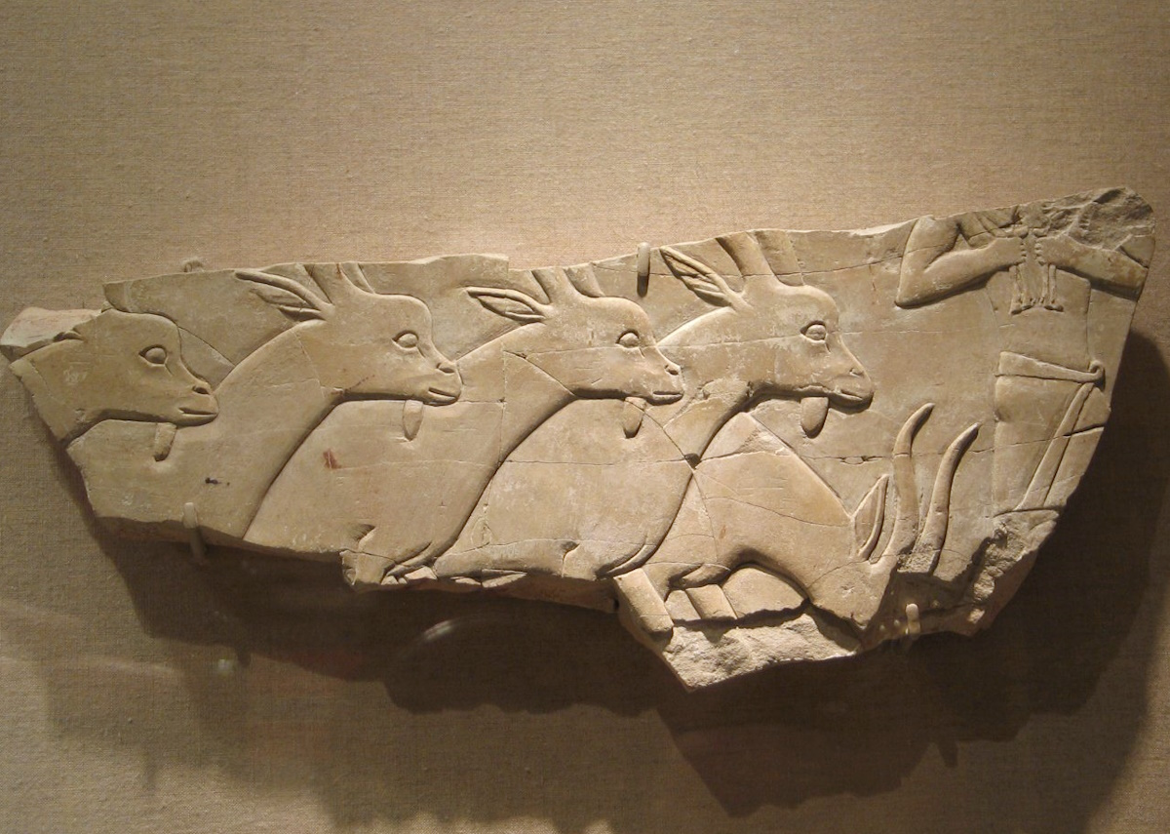
They will go with their flocks and herds to seek Yahweh
Herdsman leading a flock of goats, from el-Asasif, circa 650 BC
5:6
Notes:
Presumably the purpose of bringing the flocks and herds is for sacrifice. This image comes from the Brooklyn Museum, Creative Commons-BY, Charles Edwin Wilbour Fund, accession number 58.31, https://www.brooklynmuseum.org/opencollection/objects/74423.
bmny74423

Slide 41
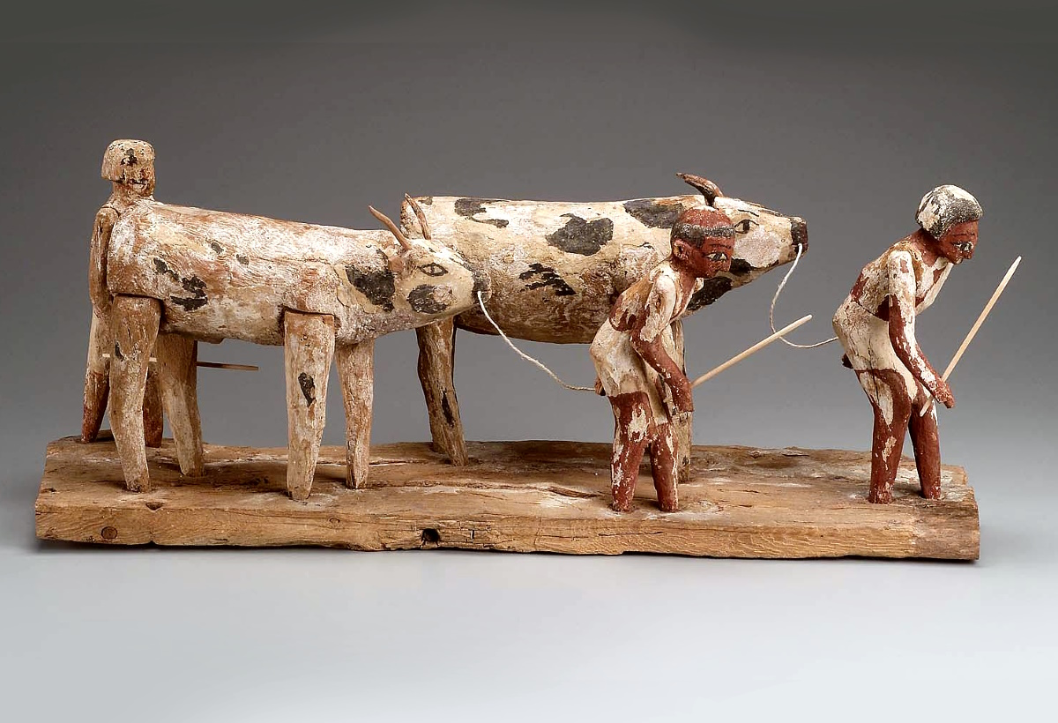
They will go with their flocks and herds to seek Yahweh
Model of men herding cattle, from Deir el-Bersha, circa 2000 BC
5:6
Notes:
This image comes from the Boston Museum of Fine Arts, public domain, Harvard University—Boston Museum of Fine Arts Expedition, accession number 21.831, https://collections.mfa.org/objects/143832.
mfa143832

Slide 42
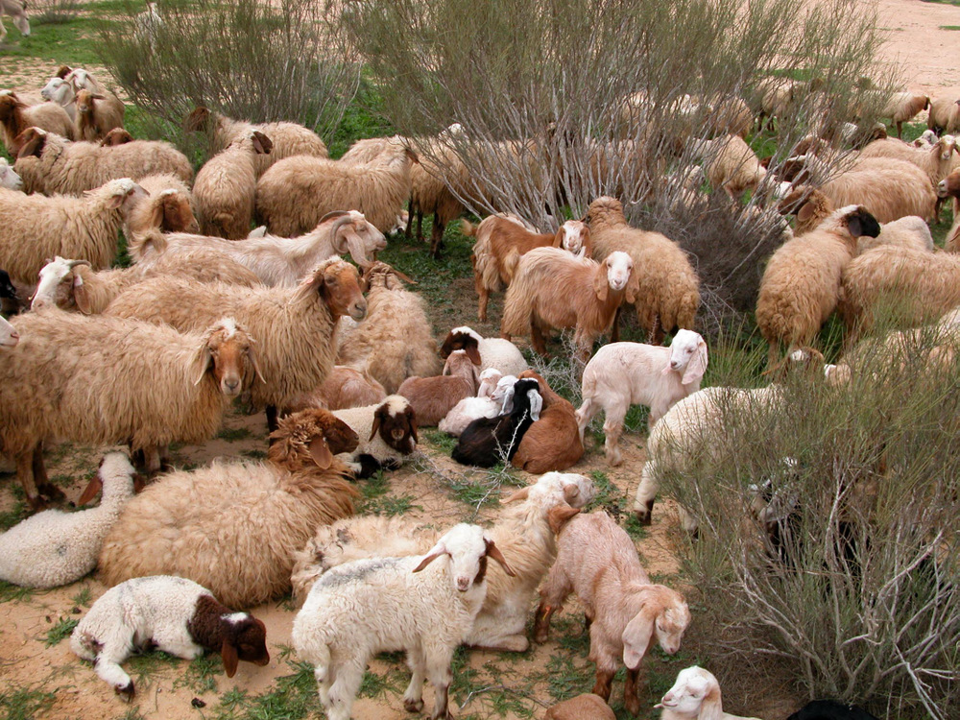
They will go with their flocks and herds to seek Yahweh
Sheep with lambs in a Negev riverbed
5:6
Notes:
tb010303828

Slide 43
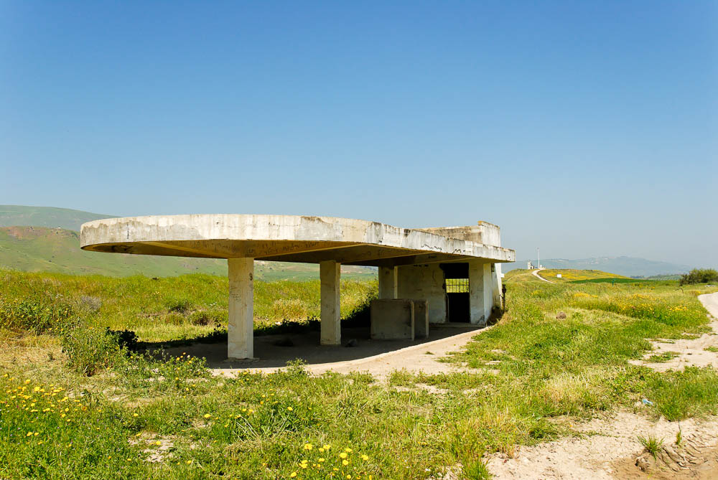
But they will not find Him, for He has withdrawn from them
Abandoned train station at Peace Island
5:6
Notes:
The idea of Israel being unable to find Yahweh because he has departed is illustrated here symbolically by an abandoned train station. This was originally a stop on the railroad between Haifa and Damascus.
tb033007202

Slide 44
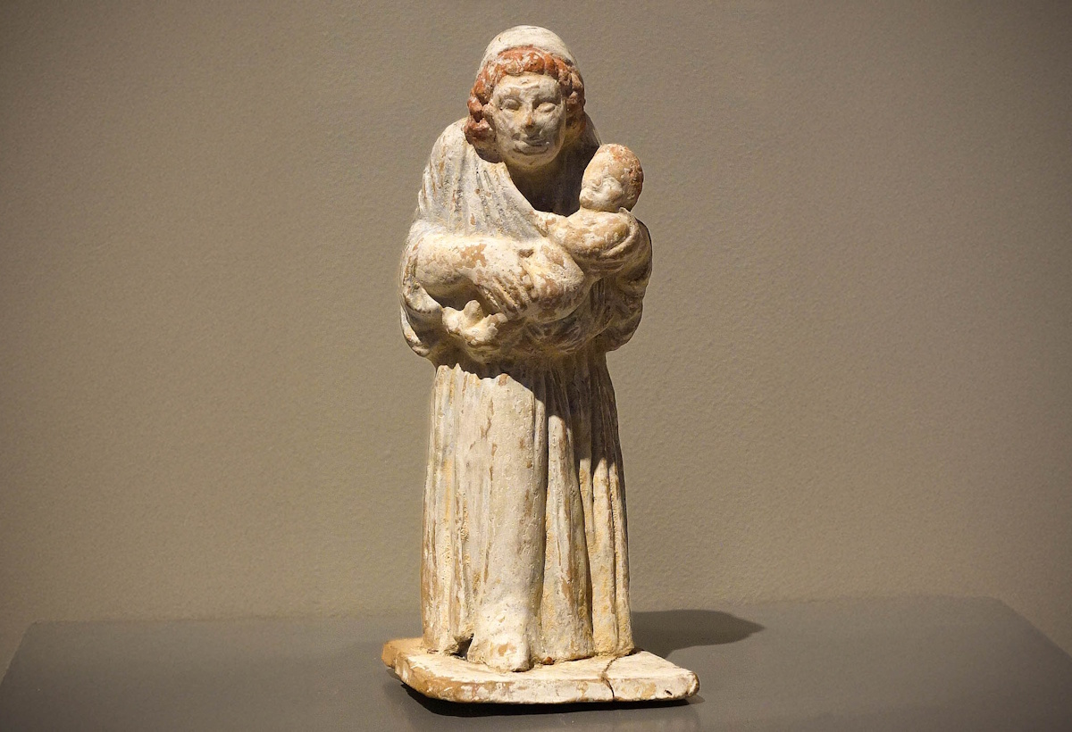
They have dealt treacherously against Yahweh, for they have borne illegitimate children
Figurine of an old nurse with a child, 4th century BC
5:7
Notes:
This figurine was photographed at the Boston Museum of Fine Arts. This image comes from Mark Landon and is licensed under CC BY 4.0, via Wikimedia Commons: https://commons.wikimedia.org/wiki/File:Terracotta_figurine_of_old_nurse_(Boston_MFA_01.7842).jpg.
wiki03062313842208129

Slide 45
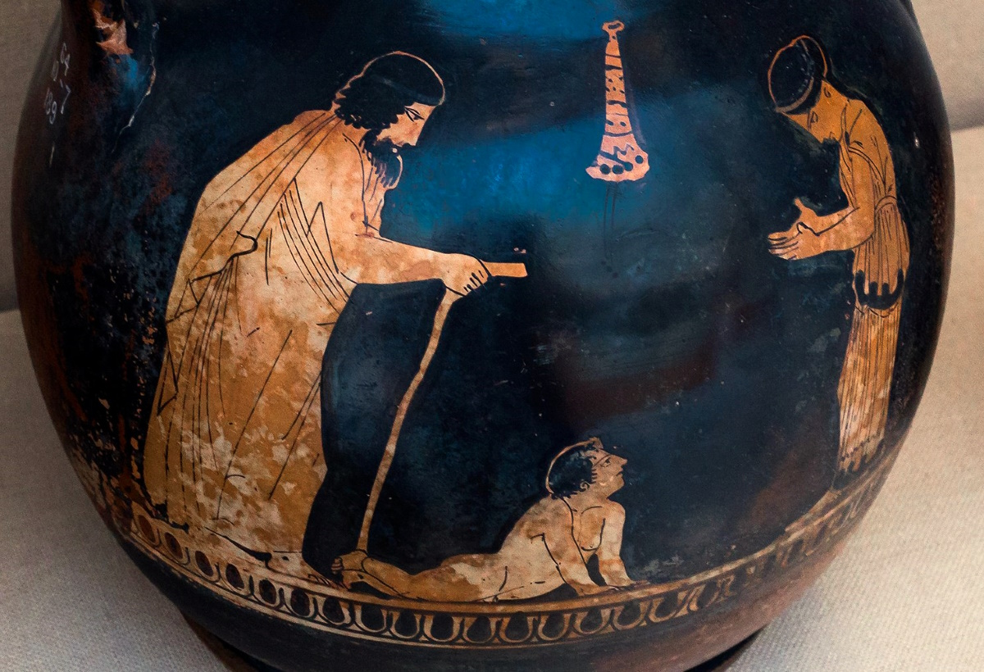
They have dealt treacherously against Yahweh, for they have borne illegitimate children
Pelike with a father, mother, and infant, from Athens, circa 430 BC
5:7
Notes:
This pelike (a small, squat, two-handled amphora) depicts a bearded father with a walking stick, and an infant boy crawling toward his mother. It was photographed at the British Museum. This image comes from ArchaiOptix and is licensed under CC BY-SA 4.0, via Wikimedia Commons: https://commons.wikimedia.org/wiki/File:Manner_of_the_Washing_Painter_ARV_1134_6_family_-_youth.jpg.
wiki070718165414516

Slide 46
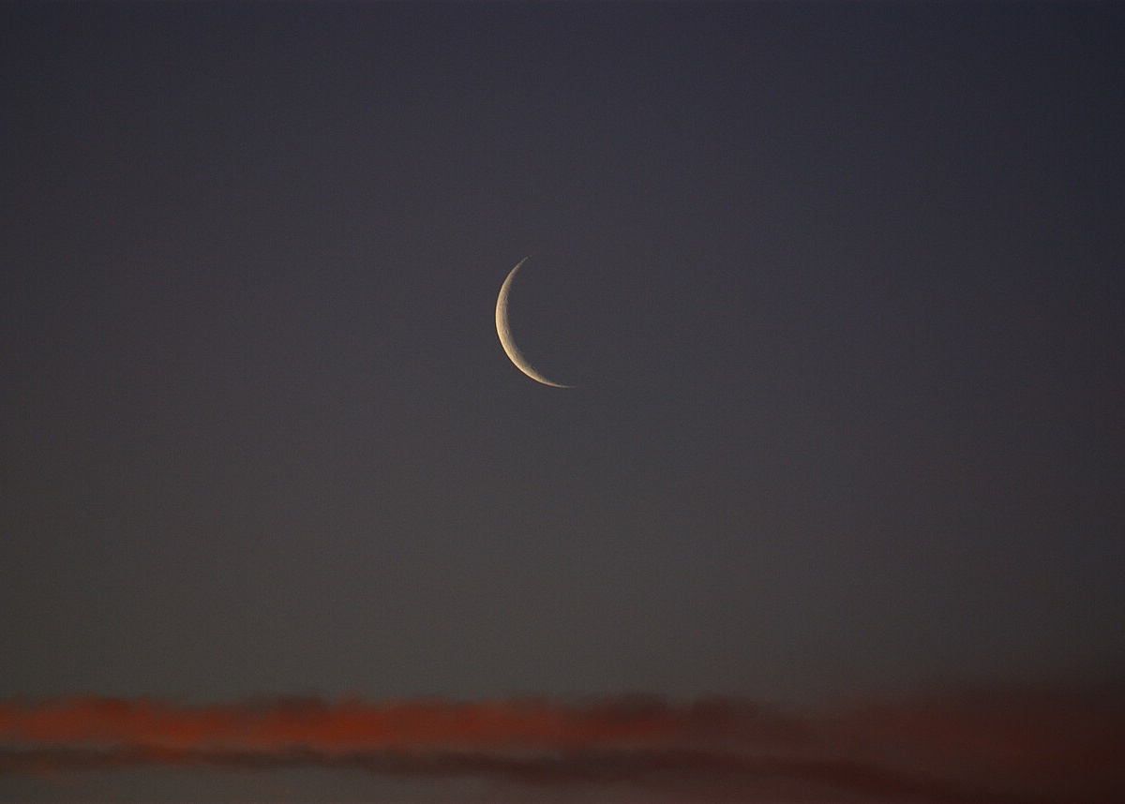
Now the new moon will devour them with their fields
New moon at sunset
5:7
Notes:
The new moon (Heb. ḥodesh, חֹדֶשׁ) marked the beginning of the month in the Hebrew calendar. It was considered a minor holiday, but according to the Mosaic law was to be marked by the offering of a burnt sacrifice (Num 29:6; Neh 10:33). This image comes from Andrew McMillan and is in the public domain, via Wikimedia Commons: https://commons.wikimedia.org/wiki/File:New_Moon_at_sunset.jpg.
wiki03011339002613763

Slide 47
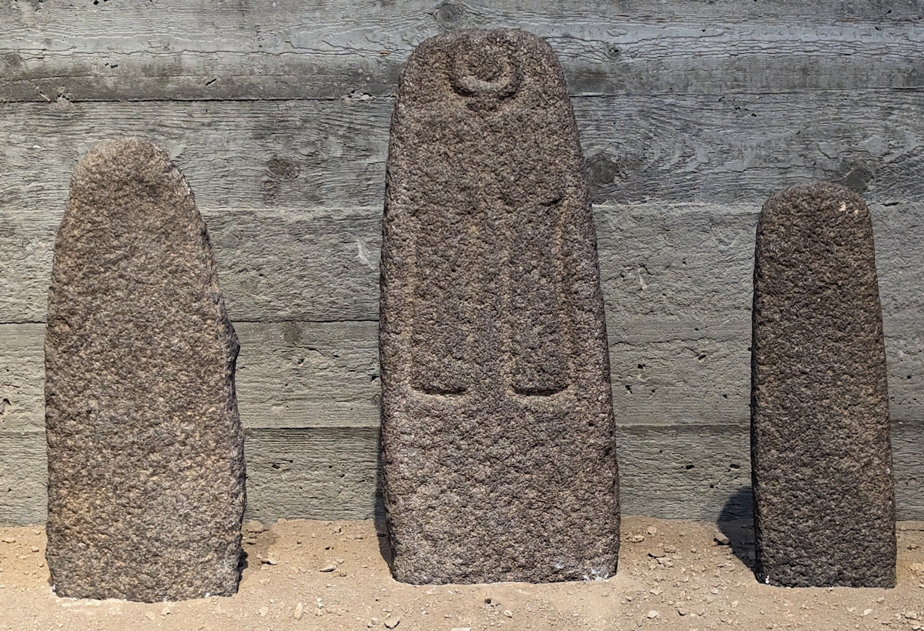
Now the new moon will devour them with their fields
Collection of standing stones, from a Late Bronze temple at Hazor, 15th–13th centuries BC
5:7
Notes:
In Canaanite religion, the crescent moon was worshiped as a symbol of a god, probably the Mesopotamian god Sin (also known as Suen or Nanna). The basalt stelae shown here are from the so-called Temple of the Stelae at Hazor. The stele in the center features a carving with a pair of hands raised toward a symbol of the crescent moon.
It was probably a perversion such as that that is addressed here by Hosea. “’New moon’ connotes religious festivals, as in Isa 1:13: ‘New Moons, Sabbaths and convocations—I cannot bear your evil assemblies.’ This looks back to the corruption of the religious leadership and the fact that the shrines had become snares (5:1-2). By metonymy new moon could be taken to mean that the religious practices of Israel would be their downfall” (Garrett 1997: 147).
This display was photographed at the Israel Museum.
Reference:
Garrett, Duane A.
1997 Hosea, Joel. New American Commentary. Nashville: Broadman and Holman.
ku060723090838013

Slide 48
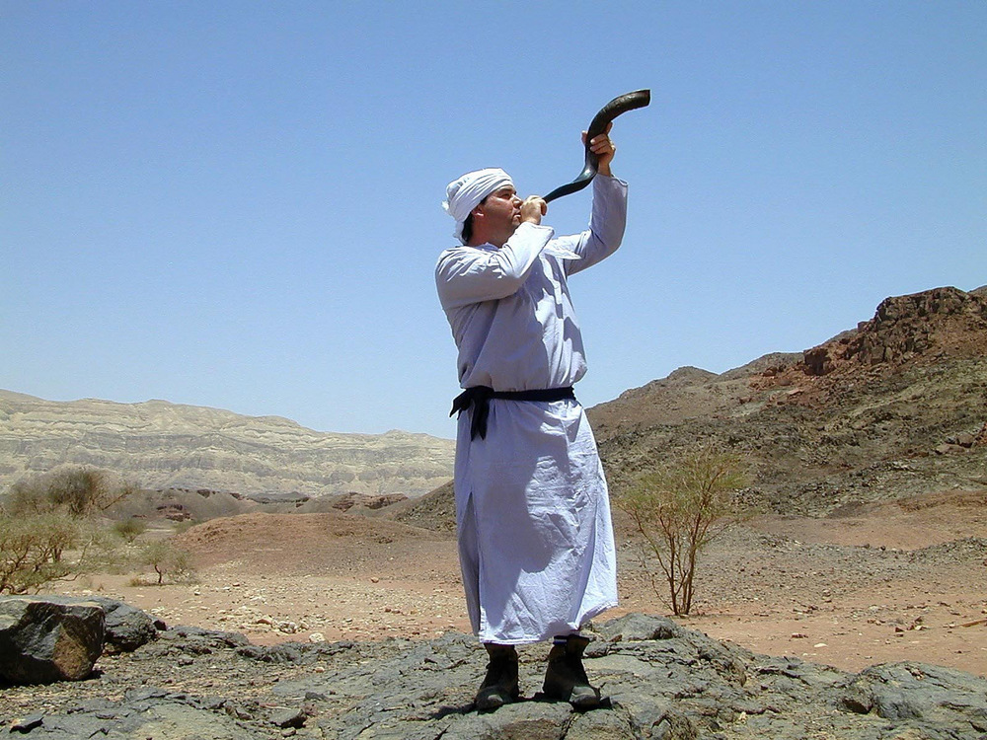
Blow the horn in Gibeah, and the trumpet in Ramah; sound the alarm at Beth-aven
Reenactment of a priest blowing a shofar
5:8
Notes:
The horn (Heb. shofar, שׁוֹפָר) is a wind instrument made from the hollowed-out horn of an animal. Despite its sometimes diminutive size, a shofar with normal acoustics and mouthpiece plays approximately 90–95 decibels, a level at which sustained exposure may result in hearing loss. Horns were used in antiquity to mark ceremonial occasions and for celebration, but they were also used by a watchman to announce the approach of an enemy and to direct movements in battle. This photograph was taken at the tabernacle model at Timna Park in southern Israel.
tb052201370

Slide 49
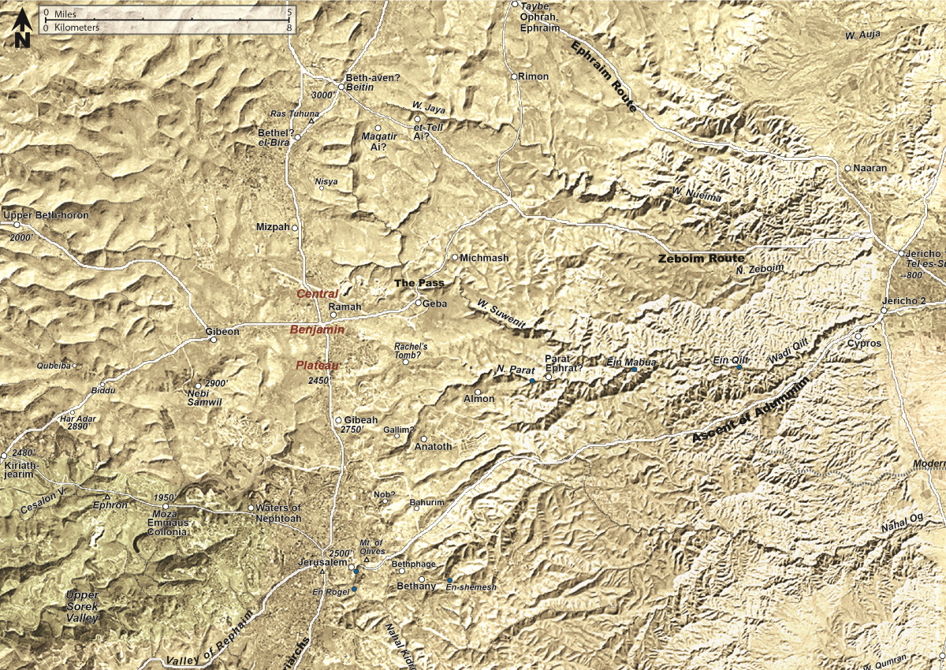
Blow the horn in Gibeah, and the trumpet in Ramah; sound the alarm at Beth-aven
Map of proposed locations for Bethel
5:8
Notes:
The three sites listed here are all located along the central ridge route on the Benjamin Plateau. At the southern edge of the heartland of Israel, the sounding of an alarm in this region would be an indication that the enemy has broken through any more distant defenses and is ready to overwhelm whatever may be left of the country.
The map shown here is a close-up from map 1-9 from the Satellite Bible Atlas, by William Schlegel. Used by permission.

Slide 50

Blow the horn in Gibeah, and the trumpet in Ramah; sound the alarm at Beth-aven
Gibeah of Saul (from the west)
5:8
Notes:
Gibeah was the home of Israel’s first king, Saul, and served as the nation’s first capital.
tb040304297

Slide 51

Blow the horn in Gibeah, and the trumpet in Ramah; sound the alarm at Beth-aven
Gibeah of Saul (from the southeast)
5:8
Notes:
The area of Gibeah was initially allotted to the tribe Benjamin. The city was close to the crossroads guarding east-west traffic from Gezer to Jericho.
tb122201102

Slide 52

Blow the horn in Gibeah, and the trumpet in Ramah; sound the alarm at Beth-aven
Gibeah (aerial view from the west)
5:8
Notes:
Gibeah has been conclusively identified with Tell el-Fûl (e.g., Schniedewind 2006; Harris 2014; contra Finkelstein 2011). Tell el-Fûl was excavated by Albright, Lapp, and Gibson who revealed remains from the Middle Bronze II, Iron I, Iron II (including Babylonian period), and Hellenistic-Byzantine periods (Gibson 1996; Kloner 2001: site 79; Albright 1924; Lapp 1976, 1978; cf. Sinclair 1954).
References:
Albright, W. F.
1924 Excavations and Results at Tell el-Fûl (Gibeah of Saul). The Annual of the American Schools of Oriental Research 4: iii–160.
Feldstein, A.; Kidron, G.; Nitzan, M. K.; Kamaisky, Y.; and Eitam, D.
2013 Map of El Bira—Benjamin Survey. Eds. Y. Magen, I. Finkelstein, and R. Eshel. Online Edition. Archaeological Survey of Israel 101. Jerusalem: Israel Antiquities Authority.
Finkelstein, I.
2011 Tell el-Ful Revisited: The Assyrian and Hellenistic Periods (With a New Identification). Palestine Exploration Quarterly 143: 106–118.
Gibson, S.
1996 Tell el-Ful and the Results of the North-East Jerusalem survey. Pp. 9–23 in New Studies on Jerusalem, vol. 2, ed. A. Faust. Ramat Gan: Ingeborg Rennert Center for Jerusalem Studies.
Harris, H.
2014 Albright’s Identification of Gibeah with Tell el-Ful. Palestine Exploration Quarterly 146: 17–30.
Kloner, A.
2001 Survey of Jerusalem: The Northeastern Sector. Archaeological Survey of Israel 102. Jerusalem: Israel Antiquities Authority.
Lapp, N. L.
1976 Casemate Walls in Palestine and the Late Iron II Casemate at Tell el-Fûl (Gibeah). Bulletin of the American Schools of Oriental Research 223: 25–42.
1978 The Third Campaign at Tell el-Fûl: The Excavations of 1964. The Annual of the American Schools of Oriental Research 45: iii–313.
Schniedewind, W. M.
2006 In Search of Gibeah and Proper Method in Historical Geography. Pp. 711–22 in “I Will Speak the Riddles of Ancient Times”: Archaeological and Historical Studies in Honor of Amihai Mazar on the Occasion of His Sixtieth Birthday, vol. 2, eds. A. Maeir and P. D. Miroschedji. Winona Lake: Eisenbrauns.
Sinclair, L. A.
1954 An Archaeological Study of Gibeah (Tell el-Fûl). The Annual of the American Schools of Oriental Research 34/35: 1–52.
ws092414366

Slide 53

Blow the horn in Gibeah, and the trumpet in Ramah; sound the alarm at Beth-aven
Silver- and gold-plated trumpet and wooden mute, from Egypt, 14th century BC
5:8
Notes:
The trumpet (Heb. ḥatsotsrah, חֲצֹצְרָה) was also a wind instrument, but long and straight and made of metal. This display was photographed at the Exposition of Tutankhamun Treasure in Paris in 2019. This image comes from Suaudeau and is licensed under CC BY-SA 4.0, via Wikimedia Commons: https://commons.wikimedia.org/wiki/File:Trompette_d%27argent_et_sa_sourdine_en_bois_du_tombeau_de_Tout%C3%A2nkhamon.jpg.
wiki0429201919234413261336

Slide 54

Blow the horn in Gibeah, and the trumpet in Ramah; sound the alarm at Beth-aven
Relief with a trumpeter, from Egypt, 14th century BC
5:8
Notes:
This relief shows a similar type of straight metallic horn. This image comes from The Metropolitan Museum of Art, public domain, Purchase, Lila Acheson Wallace Gift and Louis V. Bell Fund, 1991, accession number 1991.240.14, https://www.metmuseum.org/art/collection/search/545020.
met545020

Slide 55

Blow the horn in Gibeah, and the trumpet in Ramah; sound the alarm at Beth-aven
Ramah (aerial view from the southeast)
5:8
Notes:
Ramah was the hometown of the prophet Samuel, who lived and died there. Portions of the tell are now covered with apartment buildings and other construction, but some remnants of an earlier village remain at the top of the hill. This aerial photograph provides a wider view of the area, including the runway of the Jerusalem airport. The ancient “Road of the Patriarchs” ran below the tell on its west side, close to where the main road today travels north to Ramallah (to the right) and south to Jerusalem (to the left).
ws053017071

Slide 56

Blow the horn in Gibeah, and the trumpet in Ramah; sound the alarm at Beth-aven
Old buildings atop the ruins of ancient Ramah
5:8
Notes:
Though these buildings do not date to ancient times, they are more similar to ancient buildings than are the modern apartment buildings visible behind them.
tb060116449

Slide 57


Blow the horn in Gibeah, and the trumpet in Ramah; sound the alarm at Beth-aven
Jewish man blowing a shofar, circa 1935
5:8
Notes:
The verb “to sound an alarm” (Heb. rua, רוּעַ) provides a poetic parallel for the use of the horn and trumpet. The following phrase, “Behind you, Benjamin!” indicates that the setting is a battle, and a desperate one at that (as opposed to celebration or festivities, where shout or a trumpet blast might also have been heard). This American Colony photograph was taken between 1934 and 1939. Generative AI was used to extend the edges of this image; the original photo is available behind this image.
mat19320psai

Slide 58

Blow the horn in Gibeah, and the trumpet in Ramah; sound the alarm at Beth-aven
Beitin, a possible location of Beth-aven (aerial view from the northwest)
5:8
Notes:
Beth-aven (“house of wickedness”) is a site in the vicinity of Bethel (Josh 7:2). Earlier, Hosea may have used Beth-aven as a polemical name for Bethel (”house of God”), where the high place was set up by Jeroboam (along with another at Dan; 2 Kgs 12:28-29; see Hos 4:15). In Hosea 5:8, however, it is more likely that Beth-aven refers to the distinct site of Beth-aven, as opposed to a polemic for Bethel, because of the logical geographical itinerary of sites along the central ridge of Gibeah, Ramah and Beth-aven.
The general area of Beth-aven can be determined from numerous descriptions in the Hebrew Bible, but the identification of the specific site is a point of controversy. One possibility is Beitin, about 5 miles (8 km) north of Ramah. Although Beitin has been excavated a number of times, it was poorly excavated and poorly published. Excavations did confirm, however, the existence of a small fortress at the site in both the Middle Bronze and Late Bronze Ages (ca. 2000–1200 BC).
ws071617275

Slide 59

Blow the horn in Gibeah, and the trumpet in Ramah; sound the alarm at Beth-aven
Beitin, a possible location of Beth-aven (from the south)
5:8
Notes:
This is a ground view of the Arab village of Beitin, a possible location of ancient Beth-aven. The remains of a Roman reservoir are visible in the foreground.
tb051407595

Slide 60

Behind you, O Benjamin!
Moving soldiers with one looking back, from Nineveh, reign of Ashurbanipal, 7th century BC
5:8
Notes:
This relief depicts soldiers on the move, with one looking behind him. The warning “Behind you, O Benjamin!” has the ring of intense and desperate fighting. This relief was photographed at the British Museum. This image comes from Anthony Huan and is licensed under CC BY-SA 2.0, via Wikimedia Commons: https://commons.wikimedia.org/wiki/File:2018_Ashurbanipal_City_of_Nineveh.jpg.
wiki111020182135214896

Slide 61

Behind you, O Benjamin!
Assyrian soldiers pursuing Arabs, from the north palace of Ashurbanipal, in Nineveh, 640 BC
5:8
Notes:
This relief carving was photographed at the British Museum.
tb112004747

Slide 62

Ephraim will become a desolation in the day of rebuke
Mosaic for the tribes of Ephraim and Manasseh
5:9
Notes:
Traditionally Ephraim has been represented by a bull or ox (Jer 31:18), and Manasseh with the unicorn or wild ox (Deut 33:17).
This medallion was photographed in the Prinsenstraat synagogue in Enschede, Netherlands. This image comes from Rijksdienst voor het Cultureel Erfgoed and is licensed under CC BY-SA 4.0, via Wikimedia Commons: https://commons.wikimedia.org/wiki/File:Koepel_van_de_synagoge_te_Enschede_met_een_close-up_van_een_mozai%C3%ABk,_waarin_de_stammen_Efraim_en_Menasje_zijn_afgebeeld_-_Enschede_-_20328556_-_RCE.jpg.
wiki01191309171190547c

Slide 63

Ephraim will become a desolation in the day of rebuke
Assyrian soldiers cutting down trees next to a city, reign of Shalmaneser III, 9th century BC
5:9
Notes:
The bronze band shown on this slide was once part of the city gate at ancient Balawat. It depicts men cutting down trees with axes (numerous features in this depiction are not to scale). This was a common way of laying waste to a land that was under siege. This relief was photographed at the British Museum.
adr1805194244

Slide 64

Ephraim will become a desolation in the day of rebuke
Burning village in the Shephelah of Judah, 1929
5:9
Notes:
The smoke in this American Colony photo comes from the village of Artuf, as it burned during the 1929 riots. Artuf was located north of Beth-shemesh.
mat03043

Slide 65

Ephraim will become a desolation in the day of rebuke
Burned field on the Plain of Bethsaida
5:9
Notes:
tb053123239

Slide 66

Among the tribes of Israel have I made known that which shall surely be
“Tribes of Israel Street” sign in Jerusalem
5:9
Notes:
“Shivtei Israel Street” is located in the Musrara neighborhood of Jerusalem.
lbd012119679

Slide 67

The princes of Judah have become like those who move a boundary stone
Mosaic for the tribe of Judah
5:10
Notes:
In accordance with Israel’s blessing (Gen 49:9), Judah’s symbol has traditionally been the lion.
This medallion was photographed in the Prinsenstraat synagogue in Enschede, Netherlands. This image comes from Rijksdienst voor het Cultureel Erfgoed and is licensed under CC BY-SA 4.0, via Wikimedia Commons: https://commons.wikimedia.org/wiki/File:Koepel_van_de_synagoge_te_Enschede_met_een_close-up_van_een_mozai%C3%ABk,_waarin_de_stam_Juda_(Jehoeda)_is_afgebeeld_-_Enschede_-_20328552_-_RCE.jpg.
wiki01191309171190513

Slide 68

The princes of Judah have become like those who move a boundary stone
Painting of an old farmer checking his field, from Thebes, circa 1350 BC
5:10
Notes:
A boundary stone (Heb. gebul, גְּבוּל) was intended as an official marker of property. Moving one was tantamount to theft and was prohibited in the Mosaic law (e.g., Deut 19:14; 27:17). It is probable that, in most cases, they were ordinary, uninscribed stones, although perhaps of unusual size or shape.
This wall painting from ancient Egypt depicts an old farmer standing in a grain field (his age is indicated by his partially bald head and his stooped posture). He holds a staff, and at his feet is a boundary marker that indicates the edge of the field. The chariot ahead of him has a youth or servant sitting in it, perhaps to take him wherever he wishes to go next. This wall painting comes from the tomb-chapel of Nebamun at Thebes and was photographed at the British Museum.
adr1805170174

Slide 69

The princes of Judah have become like those who move a boundary stone
Boundary stele marking the land of the Chief Priest of Horus, from Buhen, circa 1400 BC
5:10
Notes:
Inscribed boundary markers are known from both ancient Egypt and ancient Mesopotamia. The marker shown here dates to the reign of Thutmose IV. It was photographed at the Ashmolean Museum at the University of Oxford.
adr1805183401c

Slide 70

The princes of Judah have become like those who move a boundary stone
Man plowing with horse in eastern Samaria
5:10
Notes:
Boundary markers can still be seen in agricultural fields of Samaria and Judah.
tb031405420

Slide 71

Therefore I will pour out My wrath on them like water
Bronze statue of a kneeling man pouring water from a vase, circa 650–200 BC
5:10
Notes:
The museum website suggests that this statue of a man pouring water from a vase has religious meaning. “His short-cropped hair (or a skull cap covering it) suggests he is a priest in the act of pouring libation.” This image comes from The Metropolitan Museum of Art, public domain, Bequest of Nanette B. Kelekian, 2020, accession number 2021.41.139, https://www.metmuseum.org/art/collection/search/329919.
met329919d

Slide 72

Therefore I will pour out My wrath on them like water
Relief of a king dressed in royal robes, from the north palace at Nineveh, circa 640 BC
5:10
Notes:
This relief portrays the Assyrian king Ashurbanipal at the end of a royal lion hunt. He is pouring out a libation over several dead lions. This could indicate a celebration of his conquest of those beasts, or perhaps it is a dedication to the gods. This relief was photographed at the Getty Villa in southern California while on loan from the British Museum.
tb100919386

Slide 73

Ephraim is oppressed, crushed in judgment
Relief of Tiglath-pileser III with his foot on the neck of an enemy, from Nineveh, circa 728 BC
5:11
Notes:
It was ultimately the Assyrians who conquered the northern kingdom of Israel (referred to here by the tribal name of the last remaining territory, Ephraim). This relief depicts the Assyrian king Tiglath-pileser III with his foot on the neck of an enemy that he has overcome; the point of the king’s spear is visible not far above the shoulders of the prostrate enemy. This relief was photographed at the British Museum.
tb0929197010

Slide 74

Because he willingly went with the policy
Tiglath-pileser III receiving homage, probably from Nimrud, circa 745–727 BC
5:11
Notes:
This phrase is very difficult. The main issue is the final word (Heb. tsav, צַו), which English versions render variously as “command [of man],” “filth,” “idols,” or “what is worthless,” several of which are dependent on emending the text. Andersen and Freedman discuss the possibility that it means “nothing, babble,” noting a comparison with the appearance of the same word in Isaiah 28:10, but in the end suggest that it is an idiom for excrement; “The complete idiom means to join a cult by following a detestable god, called ‘Shit’” (Andersen and Freedman 1980: 410). Stuart renders it “a blah, nothing,” but is also tempted to emend the text by reconstructing “Rezin,” the Syrian king of Damascus, which would suggest an alliance with him (Stuart 1988: 105).
The translation given on this slide follows that suggested by Garrett, where the “command” is not a command of God, but of a human. “The ‘policy’ here is not a command of God but the stipulations laid down by the Assyrian government for its vassals. The complaint of v. 13, that Ephraim went (using the same as verb 5:11b, hālak) to Assyria for aid, is the only possible way to understand this otherwise enigmatic line. Thus the point of this verse is that Ephraim followed the policies that Assyria demanded that its client states follow. This most likely refers to Menahem’s submission to the Assyrian government in return for their support (2 Kgs 15:19-20)” (Garrett 1997: 152).
This relief depicts the Assyrian king Tiglath-pileser III receiving homage from a helmeted soldier and several courtiers. This king, known as Pul in the Hebrew Bible (2 Kgs 15:19) collected tribute from the Israelite kings Menahem and Hoshea, and from the Judahite king Ahaz.
This image comes from the Detroit Institute of Arts, Founders Society Purchase, Ralph Harman Booth Bequest Fund, accession number 50.32, and is in the public domain: https://dia.org/collection/assyrian-king-tukul-apil-esharra-iii-also-called-tiglath-pileser-iii-receiving-homage-33256.
References:
Andersen, Francis I. and Freedman, David Noel.
1980 Hosea. The Anchor Bible. New York: Doubleday.
Garrett, Duane A.
1997 Hosea, Joel. New American Commentary. Nashville: Broadman and Holman.
Stuart, Douglas.
1988 Hosea–Jonah. Word Biblical Commentary. Grand Rapids: Zondervan.
dia33256

Slide 75

Therefore I am like a moth to Ephraim, and like rottenness to the house of Judah
Moth
5:12
Notes:
Although the moth may not sound like a powerful adversary, it was capable of serious destruction. The larvae of the common clothes moth are known to eat cotton, linen, silk and wool fabrics, as well as furs. In addition to clothing, they are also known to feed on feathers, hair, and foodstuffs made of various kinds of flour. This image was taken by Olaf Leillinger and is licensed under CC-BY-SA-2.5, via Wikimedia Commons, https://commons.wikimedia.org/wiki/File:Tineola.bisselliella.7218.jpg.
wiki061320061857

Slide 76

Therefore I am like a moth to Ephraim, and like rottenness to the house of Judah
Two clothes moths (Tineola bisselliella) beside a moth-eaten hole
5:12
Notes:
This image comes from Frdel and is licensed under CC BY-SA 4.0, via Wikimedia Commons: https://commons.wikimedia.org/wiki/File:Polilla_de_la_Ropa..jpg.
wiki052816631531155c

Slide 77

Therefore I am like a moth to Ephraim, and like rottenness to the house of Judah
Common clothes moth (Tineola bisselliella) and larva
5:12
Notes:
It may be noted that a similar parallel between what is rotten and what is moth-eaten appears in Job: “I am decaying like something rotten, like a garment that is moth-eaten” (Job 13:28). This image comes from Clemson University - USDA Cooperative Extension Slide Series and is licensed under CC BY 3.0 US, via Wikimedia Commons: https://commons.wikimedia.org/wiki/File:MiteTineola_1233096.jpg.
wiki04051030723072511

Slide 78

When Ephraim realized his sickness, and Judah saw his wound
Bronze figure of a dying Gaul ornament on a krater, Roman period
5:13
Notes:
Both Israel and Judah refused to recognize that their difficulties (“sickness,” “wound”) were due to their infidelity to God. The idea of a wounded person is illustrated here by a somewhat later figurine representing a wounded Gaulish warrior. The Gauls were one of the traditional enemies of the Romans, and they were often depicted by the Romans in a wounded or subjugated state. This bronze figure is thought to have once been an ornament on a krater. It was photographed at the Nicopolis Museum.
tb051103219c

Slide 79


Then Ephraim went to Assyria, and sent to the great king
Dolomite stele of Tiglath-pileser III, from the Zagros Mountains in Iran, circa 740–739 BC
5:13
Notes:
The “great king” spoken of in this verse is apparently Tiglath-pileser III (r. 745–727 BC). Pul is an alternate name for Tiglath-pileser III (cf. 2 Kgs 15:29; 1 Chr 5:26). According to 2 Kings 15:19-21, Menahem paid Tiglath-pileser III 1,000 talents of silver and “the king of Assyria pulled back and did not remain in the land.” It is unclear if this tribute is identical to the tribute offered in the annal fragment or the Iran Stele (Cogan 2008: 52). “Menahem of Samaria” is mentioned in both of these texts as a tribute bearer.
The reign of Tiglath-pileser III was marked by an unparalleled Neo-Assyrian expansion into the west and a fundamental shift in Neo-Assyrian involvement in the southern Levant that would pave the way for successive campaigns against Israel (Tiglath-pileser III, Shalmaneser V, Sargon II), Philistia (Tiglath-pileser III, Sargon II, Sennacherib), and Judah (Sargon II [?] and Sennacherib). From a historical perspective, it is clear that Assyria desired to control the entire Levant in order to gain access to the various trade routes (e.g., Stern 2001: 10–13; Bagg 2013: 119). Over the course of the reigns of Assyrian kings from Tiglath-pileser III until Ashurbanipal in the mid-7th century BC, the southern Levant witnessed a steady Assyrian territorial expansion that began with the conquering of Aram-Damascus and Transjordan (732 BC) and ended with the campaigns of Esarhaddon and Ashurbanipal that brought northern Egypt into the realm of Assyrian control. Significantly, Tiglath-pileser III reformed Neo-Assyrian policy regarding disloyal vassal states. This reformation had huge consequences for the nation-states of Israel and Aram-Damascus, which were both eventually conquered and turned into provinces.
This stele was photographed in the Israel Museum.
References:
Bagg, Ariel M.
2013 Palestine under Assyrian Rule: A New Look at the Assyrian Imperial Policy in the West. Journal of the American Oriental Society 133: 119–144.
Cogan, Mordechai.
2008 The Raging Torrent: Historical Inscriptions from Assyria and Babylonia Relating to Ancient Israel. Jerusalem: Carta.
Stern, Ephraim.
2001 Archaeology of the Land of the Bible, Volume II: The Assyrian, Babylonian, and Persian Periods (732–332 B.C.E.). New York: Yale University Press.
tb052723389c

Slide 80


But he is not able to heal you or to cure your wound
Statue of a wounded Galatian warrior, known as the Dying Gaul, from Rome, 1st century BC
5:13
Notes:
This statue depicts a Gaulish soldier who has received a mortal chest wound and is dying on the battlefield. The statue was erected by Attalus I and was recovered from the Gardens of Sallust in Rome. It is considered to be a 1st century BC copy of an original from about 230 BC. It photographed at the Capitoline Museums in Rome. A removable graphic has been added to avoid causing surprise or offense.
tb0514179917c

Slide 81

But he is not able to heal you or to cure your wound
Medical instruments from the ancient world
5:13
Notes:
This display of ancient medical tools was photographed in the Athens Archaeological Museum.
tb030806018

Slide 82

But he is not able to heal you or to cure your wound
Fresco of Japix removing an arrowhead from the leg of Aeneas, from Pompeii, 1st century AD
5:13
Notes:
In this fresco, the physician Japix is shown removing an arrowhead from the leg of Aeneas. His son Julius Ascanius stands beside him crying, and his mother, the goddess Aphrodite/Venus, is visible to the left.
This fresco was photographed at the Naples Archaeological Museum. This image comes from Michael Lahanis and is in the public domain, via Wikimedia Commons: https://commons.wikimedia.org/wiki/File:Iapyx_removing_arrowhead_from_Aeneas.jpg.
wiki0905202116352320123

Slide 83

But he is not able to heal you or to cure your wound
Relief depicting medical instruments, on the temple at Kom Ombo, circa 180–50 BC
5:13
Notes:
tb011005628c

Slide 84

For I will be like a lion to Ephraim, and like a young lion to the house of Judah
Lion from the processional way in Babylon, circa 600 BC
5:14
Notes:
The Asiatic lion (Panthera leo leo), also known as the Persian lion, once lived throughout this region. Today the wild population is restricted to a few small places in India. Males stand about 4 feet (122 cm) at the shoulder and average about 350 pounds (160 kg) in weight. This glazed brick representation of a roaring lion comes from the Processional Way at Babylon. This relief was photographed at the Pergamon Museum in Berlin. This image comes from Richard Mortel and is licensed under CC BY 2.0, via Wikimedia Commons: https://commons.wikimedia.org/wiki/File:Processional_Way,_Babylon,_ca._575_BCE,_built_by_Nebuchadnezzar_II,_detail;_Pergamon_Museum,_Berlin_(9)_(39344357515).jpg.
wiki011618586237821248c

Slide 85

For I will be like a lion to Ephraim, and like a young lion to the house of Judah
Lion carved from ivory, from Samos, circa 6th century BC
5:14
Notes:
This ivory lion was photographed at the Samos Museum.
tb061606058c

Slide 86

For I will be like a lion to Ephraim, and like a young lion to the house of Judah
Ivory lioness devouring a man, with gold leaf and inlays, from Nimrud, 9th‒8th centuries BC
5:14
Notes:
This ivory object depicts a lioness killing a man. It was photographed at the British Museum. The background of this image has been modified using generative AI.
tb112004014psai

Slide 87

I will go away and return to My place, until they recognize their guilt and seek My face
Man traveling the path over the Mount of Olives toward Bethany, circa 1935
5:15
Notes:
This American Colony photograph was taken between 1934 and 1939.
mat16343

Slide 88

In their distress they will seek Me earnestly
Statue of Nakhtorheb in prayer, from Egypt, early 6th century BC
5:15
Notes:
This quartzite statue shows an Egyptian kneeling in prayer. It was photographed at the Louvre Museum.
tb0928196362c

Slide 89


In their distress they will seek Me earnestly
Bronze figurine of an Egyptian man praying, circa 330–30 BC
5:15
Notes:
This figurine portrays an Egyptian man praying. His stance, with his hand to his head, shows humility and deference before the god. This figurine was photographed at the Louvre Museum. This image comes from Rama and is in the public domain, via Wikimedia Commons: https://commons.wikimedia.org/wiki/File:Man_praying-N_1593-IMG_2196.JPG. Generative AI was used to extend the edges of this image; the original photo is available behind this image.
wiki07111911481230212psai

Slide 90

Notes:
This is a free sample of the Hosea 5 presentation from the Photo Companion to the Bible. To purchase the full volume, visit https://www.bibleplaces.com/hosea/
The Photo Companion to the Bible is an image-rich resource for Bible students, teachers, and researchers. Just as a librarian stocks the shelves with as many relevant materials as possible, so we have tried to provide a broad selection of images. Our goal is that you will find in this “library” whatever it is you are looking for.
Credits: The primary creators of this presentation are Chris McKinny, Kris Udd, Steven D. Anderson, and Todd Bolen. The photographs have an individual file code which usually includes the initials of the photographer. Other images have additional credit or source information.
Updates: We plan to update this collection as we are able. We welcome your suggestions for improving this resource (photocompanion@bibleplaces.com). Purchasers of the Hosea volume are provided free, lifetime updates to the volume.
Copyright: This photo collection is protected by copyright law and may not be distributed without written permission from BiblePlaces.com. Slide notes should be treated as any other copyrighted written material, with credit given when quoting from these notes.
For more information, see our complete “Introduction to the Photo Companion to the Bible” online at https://www.BiblePlaces.com/Intro-Photo-Companion-Bible/. Here you will find more information about photo selection, explanatory notes, Bible translation, credit information, and copyright allowances.

