Slide 1
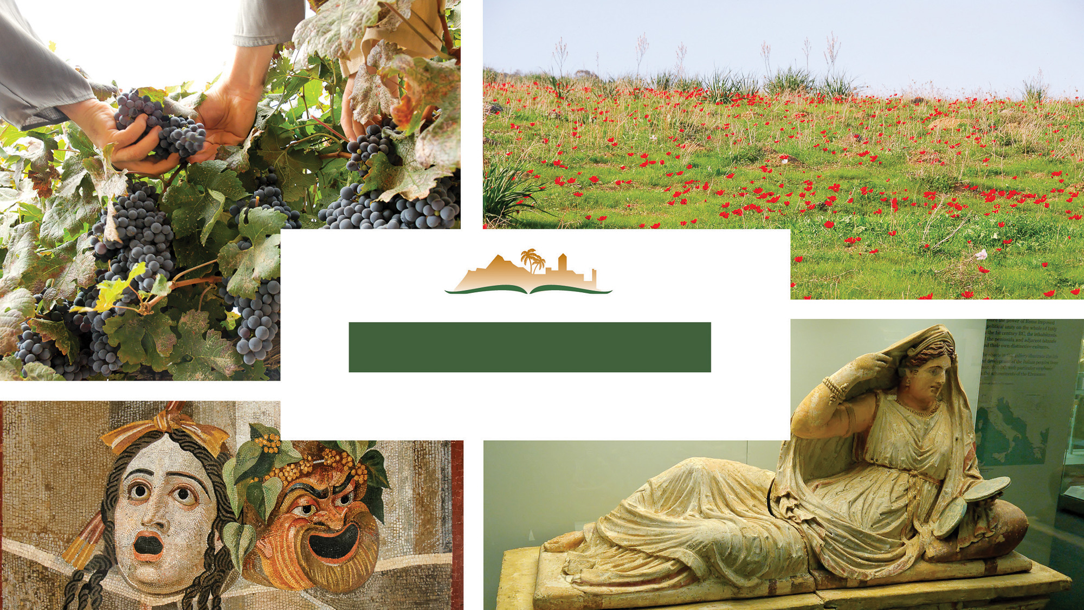
James 3
Notes:
This is a free sample of the James 3 presentation from the Photo Companion to the Bible. To purchase the full volume, visit https://www.bibleplaces.com/james/
The Photo Companion to the Bible is an image-rich resource for Bible students, teachers, and researchers. Just as a librarian stocks the shelves with as many relevant materials as possible, so we have tried to provide a broad selection of images. Our goal is that you will find in this “library” whatever it is you are looking for.
A separate student edition that comes with this volume includes about half of the number of slides, reducing the amount of background and more advanced material. We created it for use in a college course so our students could be introduced to the value of photographs in their study of the book.
Credits: The primary creators of this presentation are Steven Anderson, Chris McKinny, Kai Akagi, Kris Udd, and Todd Bolen. The photographs have an individual file code which usually includes the initials of the photographer. Other images have additional credit or source information.
Updates: We plan to update this collection as we are able. We welcome your suggestions for improving this resource (photocompanion@bibleplaces.com). Purchasers of the James volume are provided free, lifetime updates to the volume.
Copyright: This photo collection is protected by copyright law and may not be distributed without written permission from BiblePlaces.com. Slide notes should be treated as any other copyrighted written material, with credit given when quoting from these notes.
For more information, see our complete “Introduction to the Photo Companion to the Bible” online at https://www.BiblePlaces.com/Intro-Photo-Companion-Bible/. Here you will find more information about photo selection, explanatory notes, Bible translation, credit information, and copyright allowances.

Slide 2
James 3
This is a free sample of the James 3 presentation from the Photo Companion to the Bible. To purchase the full volume, visit https://www.bibleplaces.com/james/
The Photo Companion to the Bible is an image-rich resource for Bible students, teachers, and researchers. Just as a librarian stocks the shelves with as many relevant materials as possible, so we have tried to provide a broad selection of images. Our goal is that you will find in this “library” whatever it is you are looking for.
For more details (for this and every slide), see the Notes section below.
Notes:
This is a free sample of the James 3 presentation from the Photo Companion to the Bible. To purchase the full volume, visit https://www.bibleplaces.com/james/
The Photo Companion to the Bible is an image-rich resource for Bible students, teachers, and researchers. Just as a librarian stocks the shelves with as many relevant materials as possible, so we have tried to provide a broad selection of images. Our goal is that you will find in this “library” whatever it is you are looking for.
A separate student edition that comes with this volume includes about half of the number of slides, reducing the amount of background and more advanced material. We created it for use in a college course so our students could be introduced to the value of photographs in their study of the book.
Credits: The primary creators of this presentation are Steven Anderson, Chris McKinny, Kai Akagi, Kris Udd, and Todd Bolen. The photographs have an individual file code which usually includes the initials of the photographer. Other images have additional credit or source information.
Updates: We plan to update this collection as we are able. We welcome your suggestions for improving this resource (photocompanion@bibleplaces.com). Purchasers of the James volume are provided free, lifetime updates to the volume.
Copyright: This photo collection is protected by copyright law and may not be distributed without written permission from BiblePlaces.com. Slide notes should be treated as any other copyrighted written material, with credit given when quoting from these notes.
For more information, see our complete “Introduction to the Photo Companion to the Bible” online at https://www.BiblePlaces.com/Intro-Photo-Companion-Bible/. Here you will find more information about photo selection, explanatory notes, Bible translation, credit information, and copyright allowances.

Slide 3
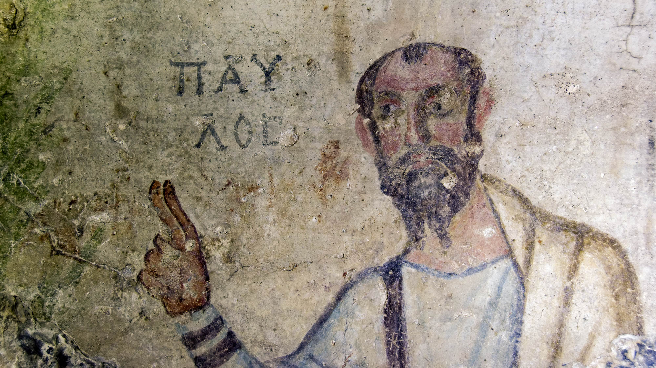
Let not many of you be teachers, my brothers, knowing that we will receive stricter judgment
Painting of Paul from a cave at Ephesus, late 5th or early 6th centuries AD
3:1
Notes:
This fresco of the Apostle Paul comes from a cave known as the Grotto of Saint Paul, located in the foothills on the southern side of ancient Ephesus. It depicts the apostle with upraised hand, two fingers extended. This gesture indicates that he is teaching. His name is inscribed beside him, “Paul” (Gk. ΠΑΥΛΟΣ). This is one of the earliest known depictions of Paul.
tb010317169

Slide 4
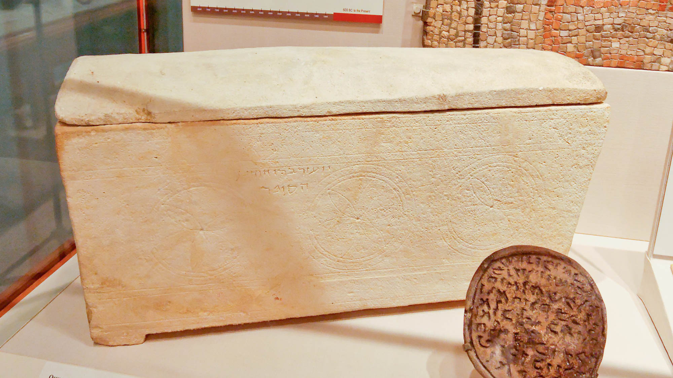
Let not many of you be teachers, my brothers, knowing that we will receive stricter judgment
Limestone ossuary with inscription “Yoezer the scribe,” from Jifna, 70 BC – AD 70
3:1
Notes:
This statement is reminiscent of many of Jesus’s statements concerning the teachers of Judaism, often referred to as the “scribes.” The ossuary shown here dates to about the time of James, and bears an inscription reading “Yoezer son of Yehuda, the scribe” (Arm. יועזר בר יהודה הסופר). This ossuary was photographed at the Oriental Institute Museum at the University of Chicago.
tb072705016

Slide 5
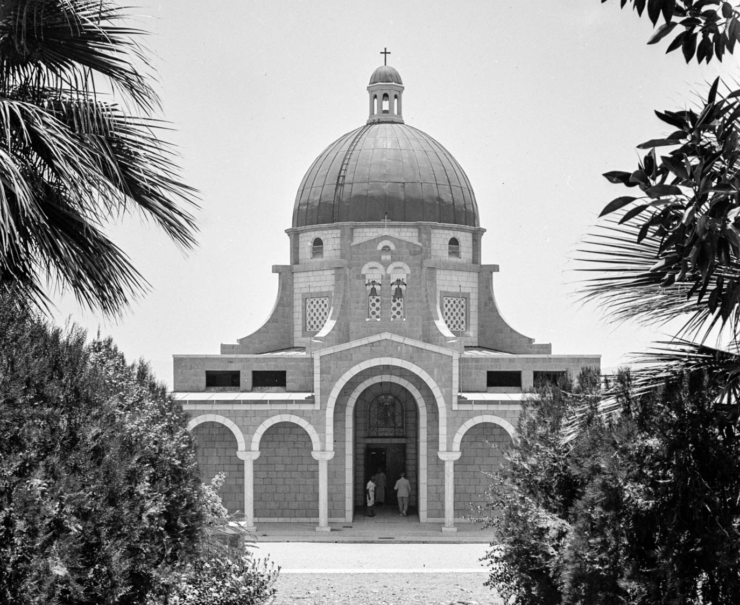
Let not many of you be teachers, my brothers, knowing that we will receive stricter judgment
Mount of Beatitudes chapel, circa 1940
3:1
Notes:
James’s warning echoes a similar warning given by Jesus in His Sermon on the Mount, against those who might break the least of the commandments and teach others to do the same (Matt 5:19-20). This American Colony photograph was taken between 1940 and 1946.
mat21769h

Slide 6
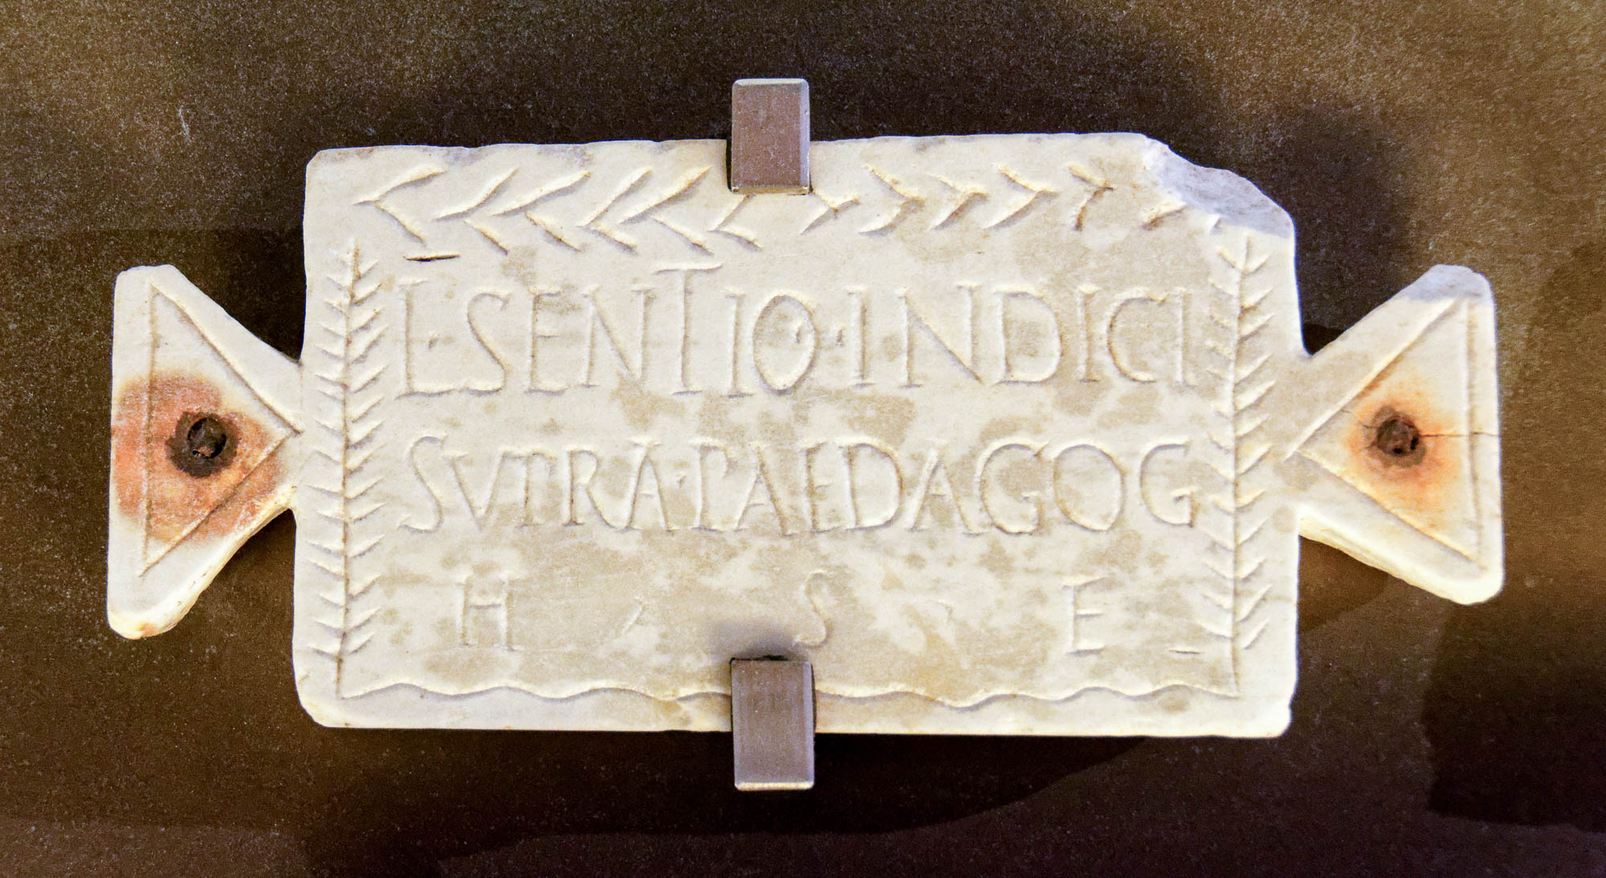
Let not many of you be teachers, my brothers, knowing that we will receive stricter judgment
Funerary inscription of Lucius Sentius Index, “Head of Tutors,” 1st century AD
3:1
Notes:
This picture shows a 1st-century AD funerary inscription from Rome for a certain Lucius Sentius Index, the “Head of Tutors” (Lat. SVPRA PAIDAGOG). Although this man would not have been a teacher in a church, the inscription provides an illustration of the role of a teacher. This inscription was photographed at the Capitoline Museums in Rome.
tb0514179622

Slide 7
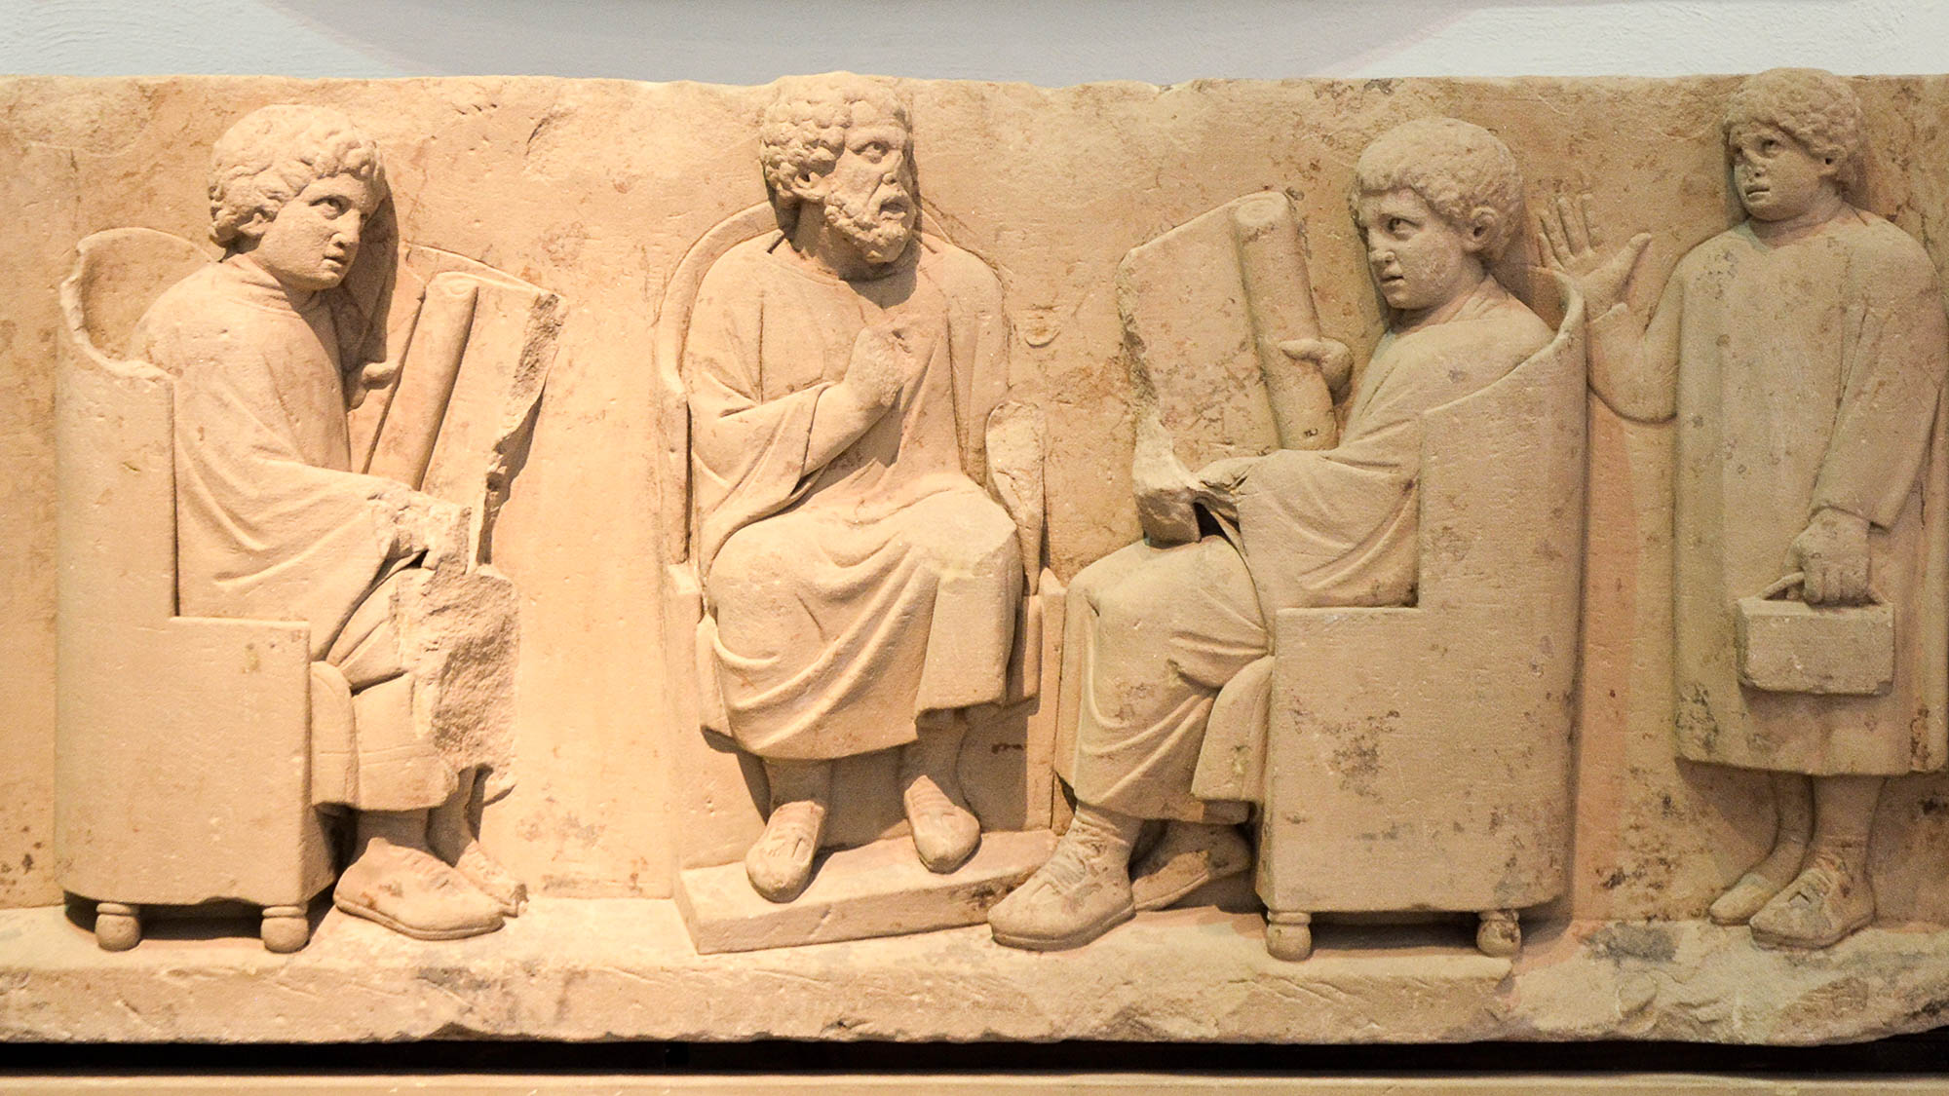
Let not many of you be teachers, my brothers, knowing that we will receive stricter judgment
Relief depicting a teacher with three disciples, circa AD 180–185
3:1
Notes:
This sandstone relief depicts a teacher and three of his students; two are seated on either side of the teacher, holding open scrolls. The third student approaches from the right, holding a set of wax tablets bound together with a leather strap. He lifts his hand in greeting but does not look particularly happy to be there. This relief was found in Neumagen near Trier, and was photographed at the Rheinisches Landesmuseum Trier, Germany. This image comes from Carole Raddato and is licensed under CC BY-SA 2.0, via Wikimedia Commons: https://commons.wikimedia.org/wiki/File:Funerary_relief_found_in_Neumagen_near_Trier,_a_teacher_with_three_discipuli,_around_180-185_AD,_Rheinisches_Landesmuseum_Trier,_Germany_(29656302165).jpg.
wiki296563021651636

Slide 8
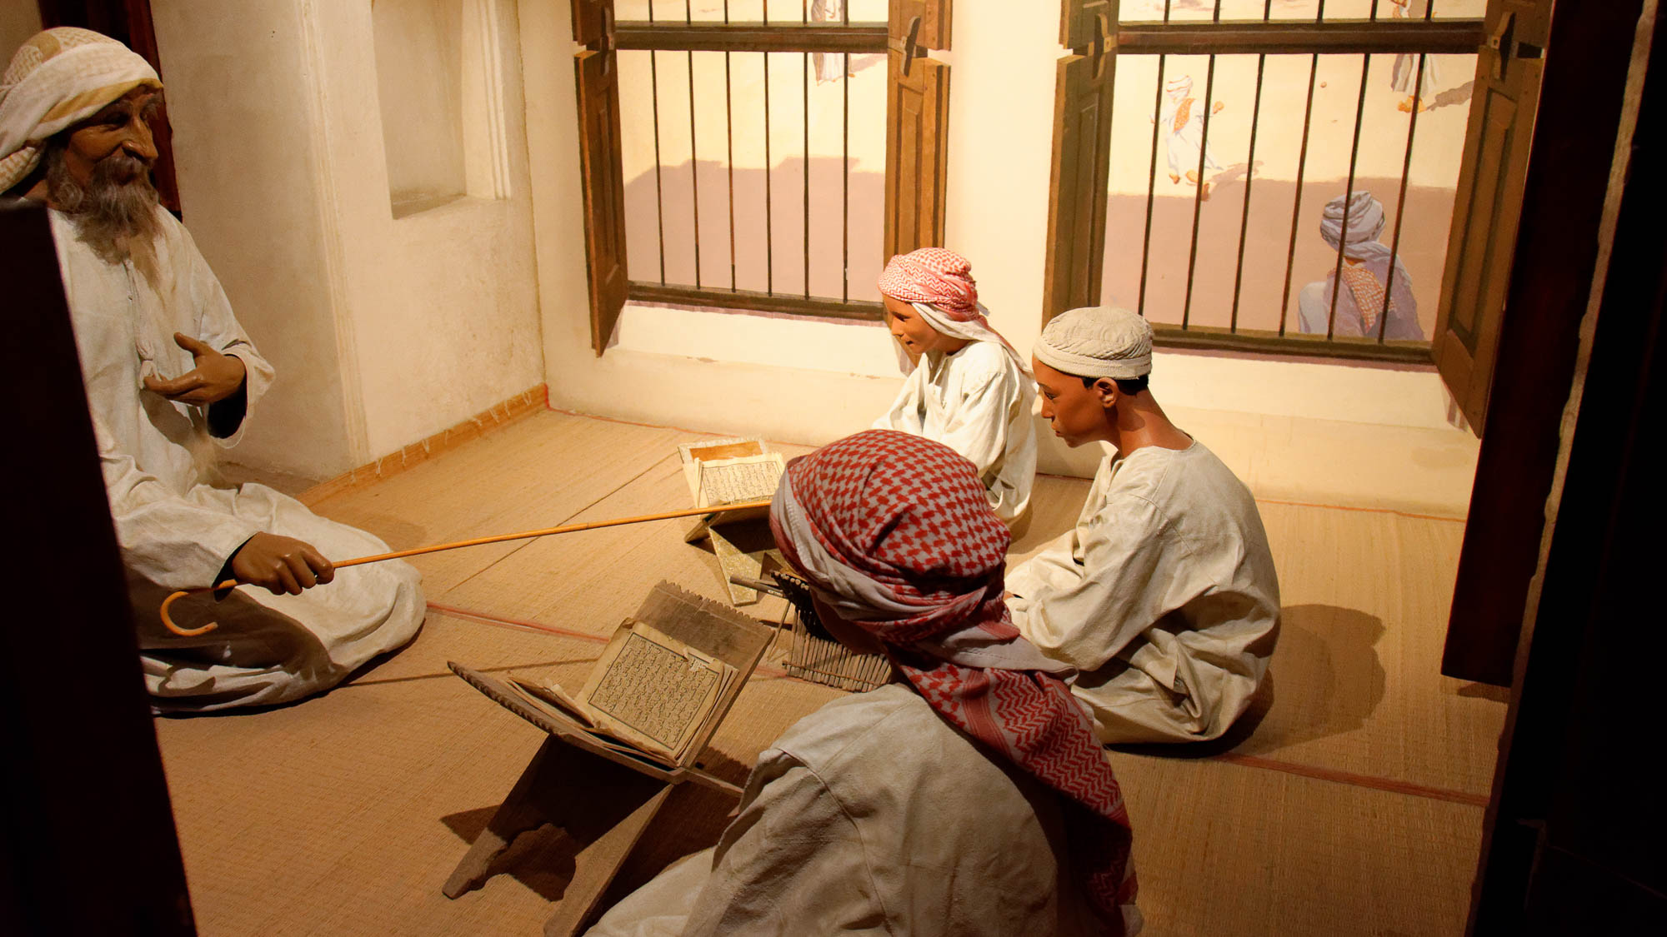
Let not many of you be teachers, my brothers, knowing that we will receive stricter judgment
School display with teacher and students
3:1
Notes:
This picture shows a model of a school in the Dubai Museum, illustrating the role of a teacher.
tb050317539h

Slide 9
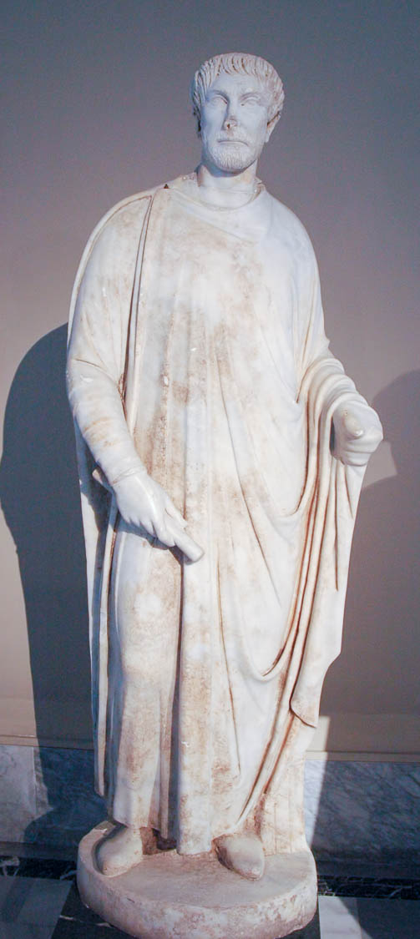
Let not many of you be teachers, my brothers, knowing that we will receive stricter judgment
Statue of a Roman judge, from Aphrodisias, circa AD 450
3:1
Notes:
This statue was photographed at the Istanbul Archaeological Museum.
tb041705170

Slide 10
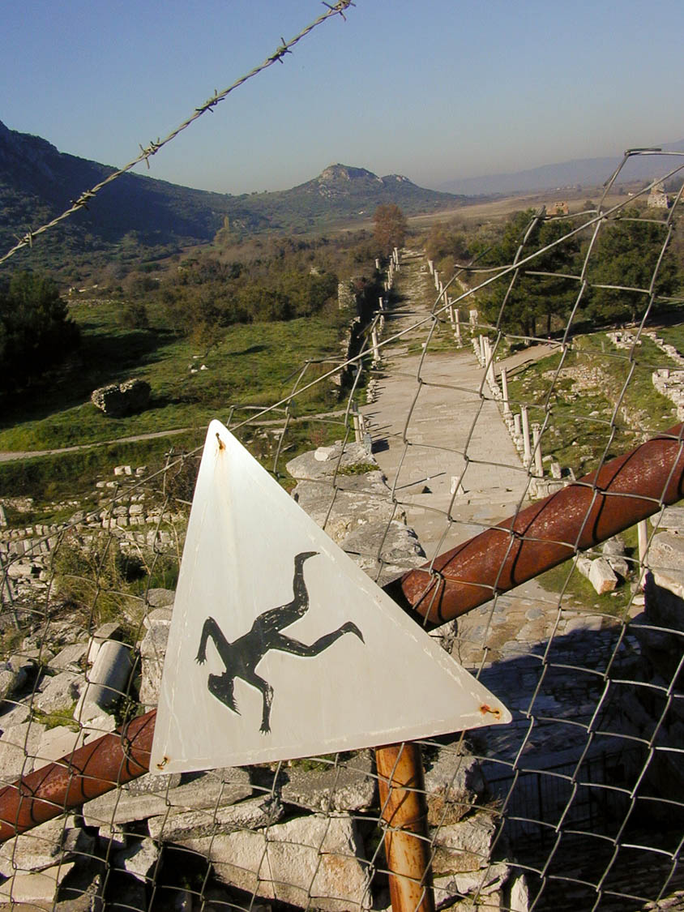
For we all stumble in many ways
Man falling sign in Ephesus
3:2
Notes:
This signs illustrates not only stumbling, but the subsequent fall that can result from stumbling.
mf010199001

Slide 11
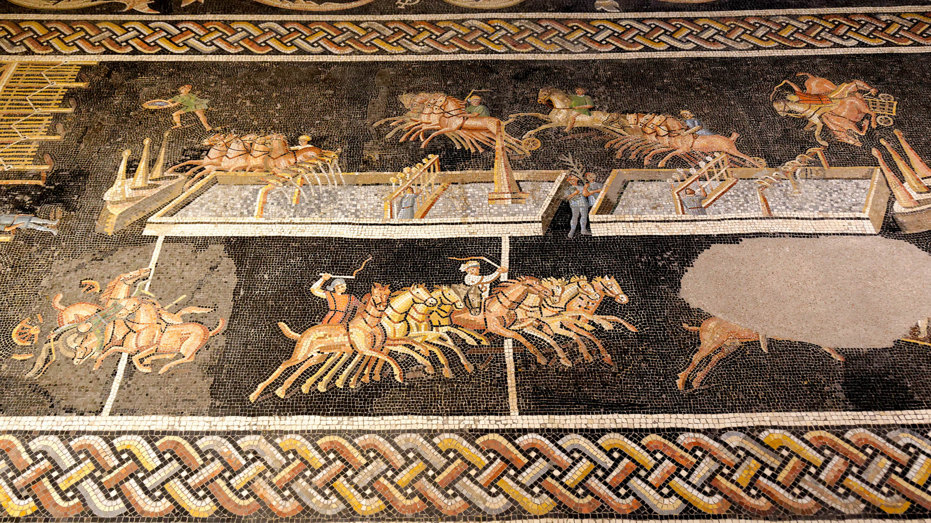
For we all stumble in many ways
Mosaic of a hippodrome race with accidents, from Presquile in Lyon, 2nd century AD
3:2
Notes:
An illustration from the world of chariot racing may be taken from this mosaic. Although a number of chariot teams are running well, a team at the upper right and another at the lower left have been upset, resulting in a dangerous or even deadly tangle of horses, driver, and equipment. Such a team is disqualified from the race and may endanger others as well. This mosaic was photographed at the Lyon Gallo-Roman Museum. The next slide includes labels for the two accidents.
tb091719332c

Slide 12
For we all stumble in many ways
Mosaic of a hippodrome race with accidents, from Presquile in Lyon, 2nd century AD
3:2
Notes:
An illustration from the world of chariot racing may be taken from this mosaic. Although a number of chariot teams are running well, a team at the upper right and another at the lower left have been upset, resulting in a dangerous or even deadly tangle of horses, driver, and equipment. Such a team is disqualified from the race and may endanger others as well. This mosaic was photographed at the Lyon Gallo-Roman Museum. The next slide includes a close-up of one of the accidents.
tb091719332c

Slide 13
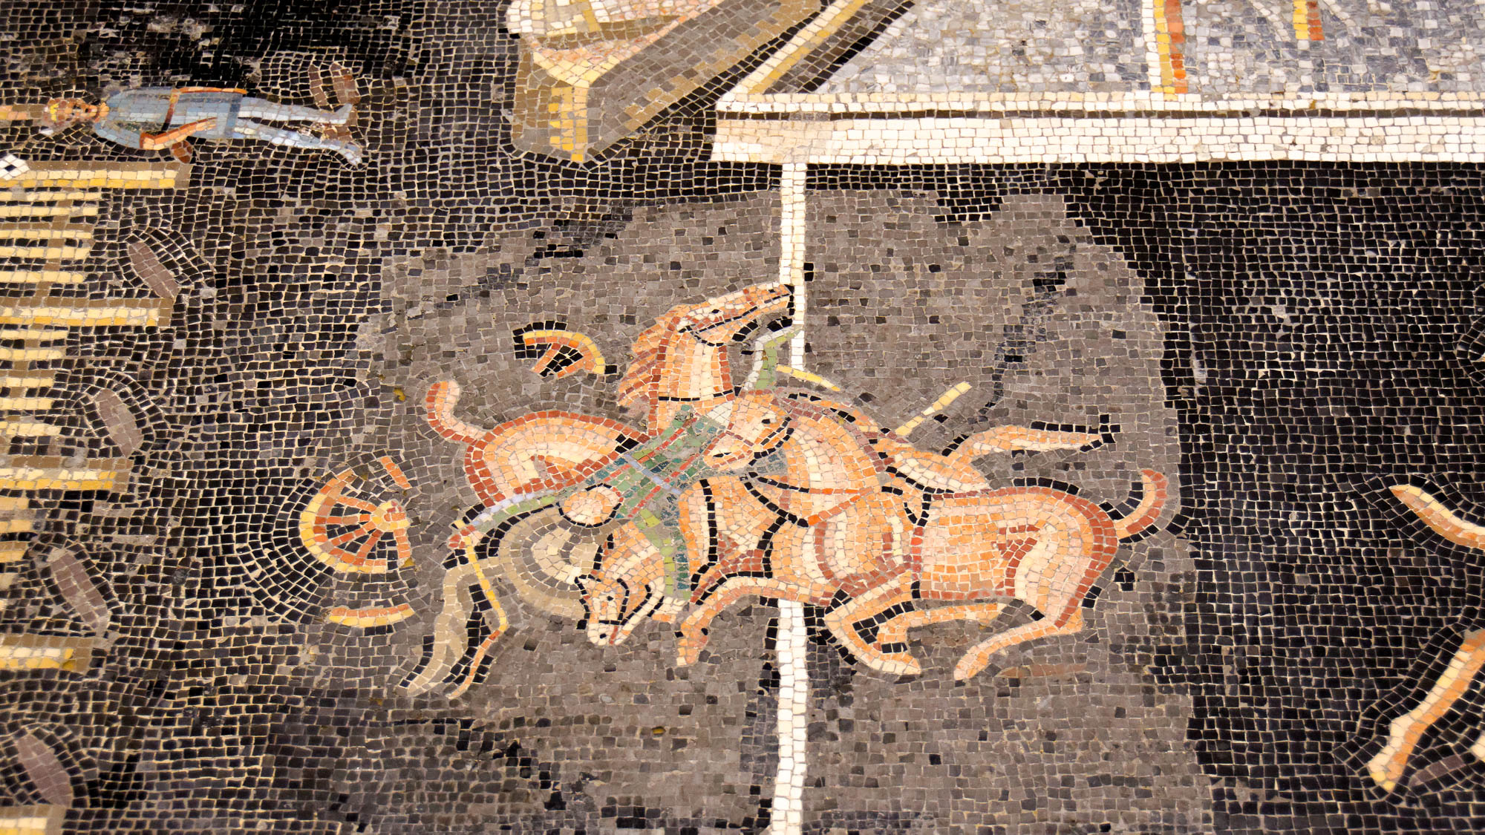
For we all stumble in many ways
Mosaic of a hippodrome race with an upset team, from Presquile in Lyon, 2nd century AD
3:2
Notes:
This mosaic was photographed at the Lyon Gallo-Roman Museum.
tb091719338h

Slide 14
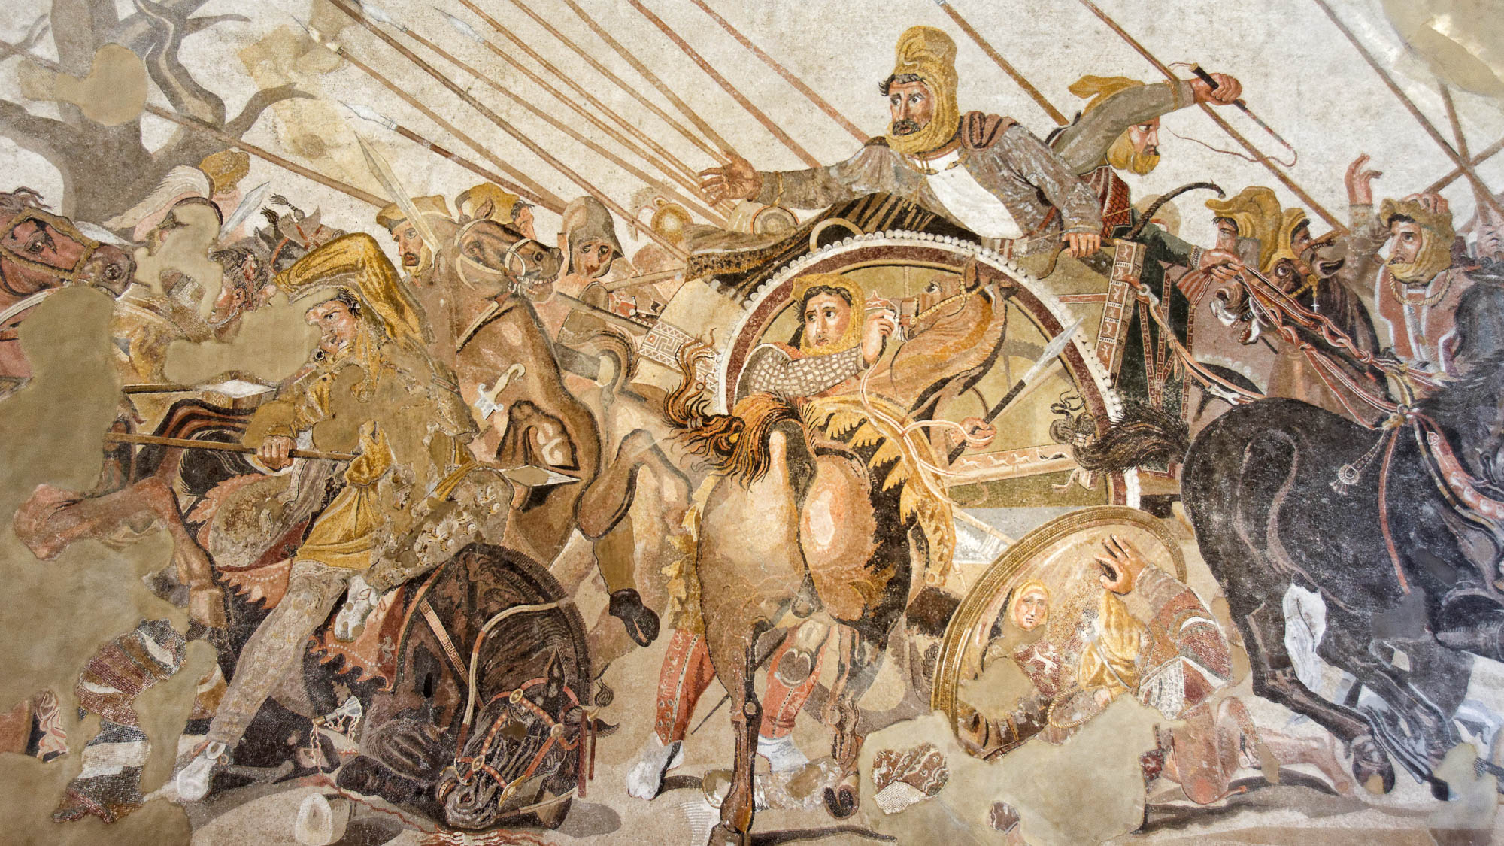
For we all stumble in many ways
Mosaic depicting the Persians fleeing from Alexander the Great, from Pompeii, 1st century AD
3:2
Notes:
This mosaic depicts the last Persian king, Darius III, fleeing from Alexander the Great. On the lower left is a horse and rider who have stumbled, even as the rider is pierced by a spear. On the lower right is a foot soldier who has stumbled and fallen; his face is reflected in the shield before him. Although this mosaic dates to the late 2nd century BC (125–120 BC), it is thought to be a copy of an earlier, 4th century BC painting by Philoxenos. It comes from the exedra of the House of the Faun at Pompeii. It was photographed at the Naples Archaeological Museum.
tb0515170676

Slide 15
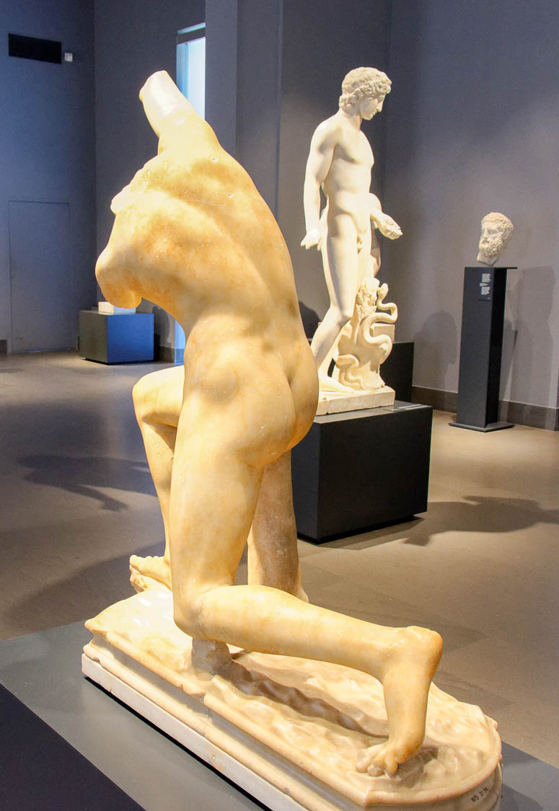
If anyone does not stumble in word, he is a perfect man, able to bridle the whole body also
Statue of young man about to fall, from Villa of Nero in Subiaco
3:2
Notes:
This statue was photographed at the National Museum of Rome.
tb0513177498

Slide 16
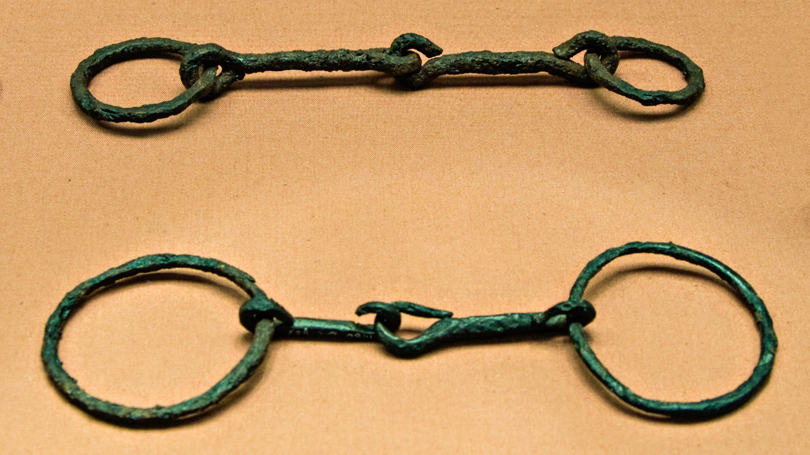
We put bits into the mouths of horses so that they obey us
Two Roman iron snaffle bits from Hod Hill, Dorset, England, 1st century AD
3:3
Notes:
The word “bit” (Gk. chalinos, χαλινός) refers generally to the bridle equipment (including bridle, bit, and reins), although only a portion of this equipment is actually placed inside the horse’s mouth (thus the common practice among English versions to translate it “bit”). Snaffle bits, like these two examples, apply direct pressure to the mouth, but without leverage. They are less severe than the curb bits also used by the Roman army. This display was photographed at the British Museum. This image comes from Ealdgyth and is licensed under CC BY-SA 3.0, via Wikimedia Commons: https://commons.wikimedia.org/wiki/File:Britishmuseumromanironsnafflebits.jpg.
wiki060420101293225206

Slide 17
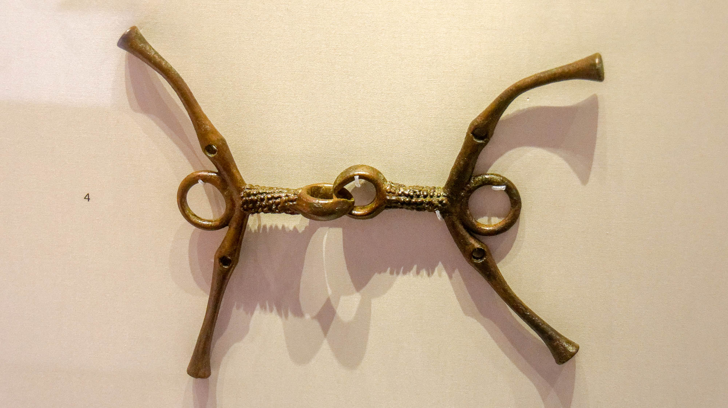
We put bits into the mouths of horses so that they obey us
Horse bit with evidence of wear, from Deve Huyuk, mid 6th–4th centuries BC
3:3
Notes:
This bit was photographed at the British Museum.
tb0929196928h

Slide 18
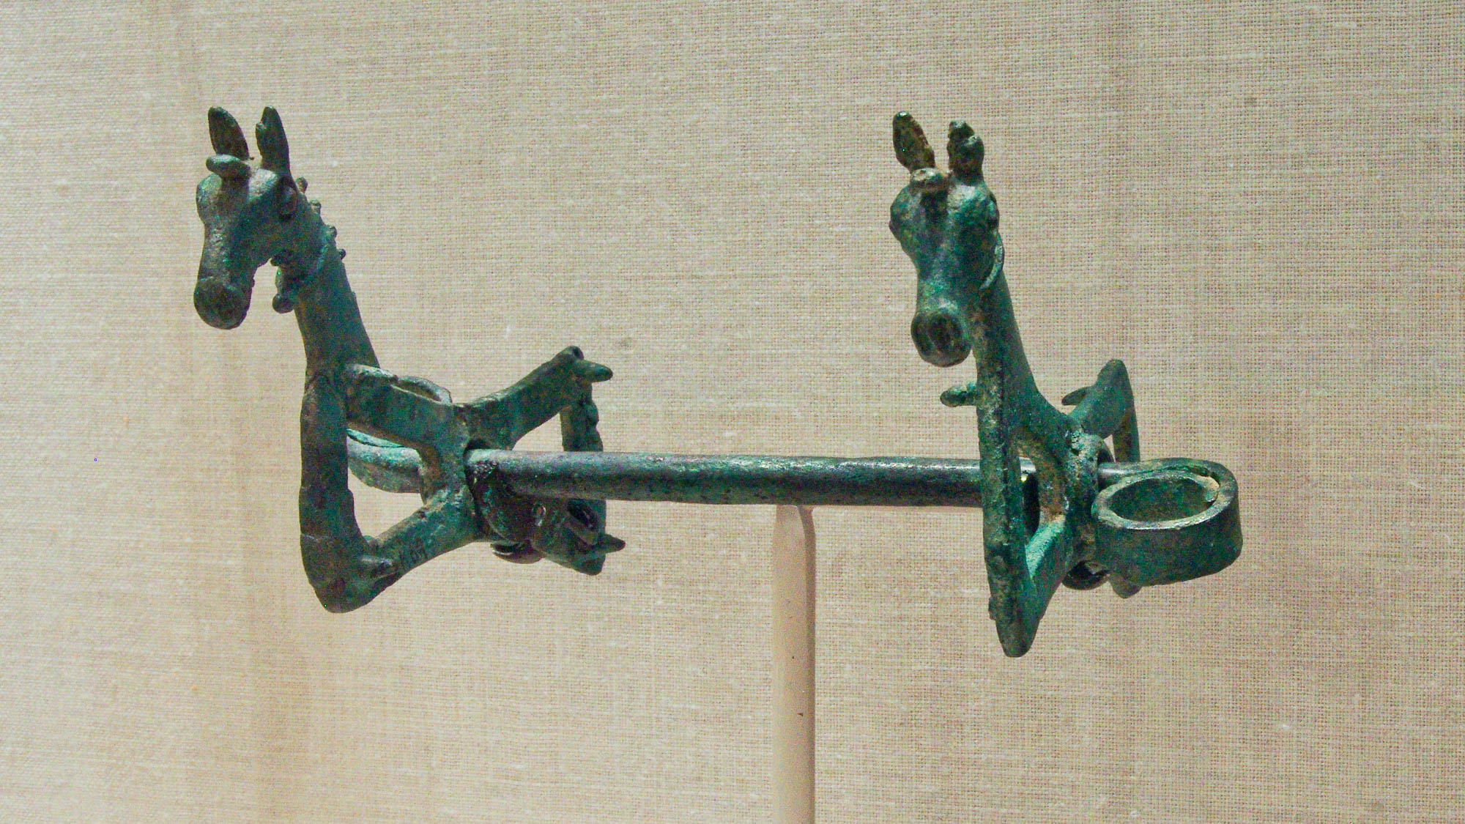
We put bits into the mouths of horses so that they obey us
Bronze horse bit, Greco-Roman period
3:3
Notes:
This horse bit was photographed at the Johns Hopkins Archaeological Museum.
adr1311224123

Slide 19
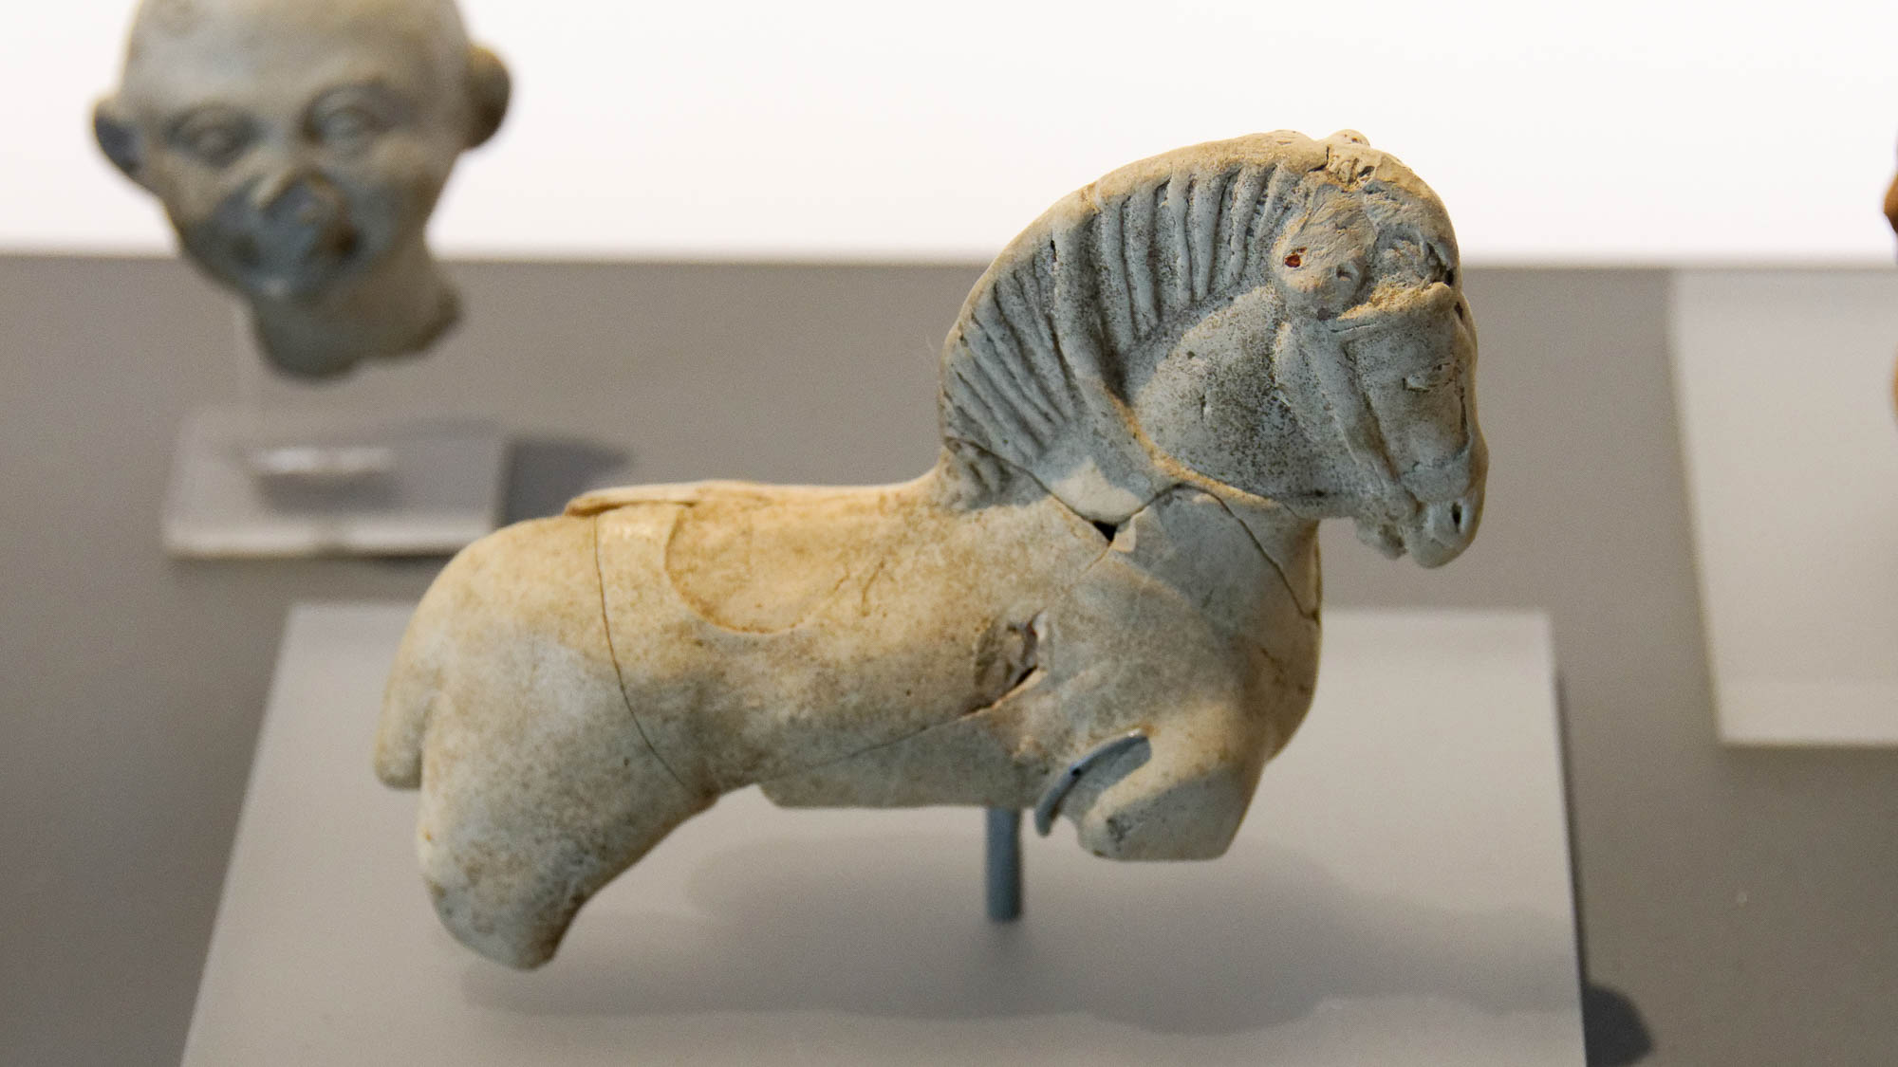
We put bits into the mouths of horses so that they obey us
Clay horse with bridle and reins, 1st–3rd centuries AD
3:3
Notes:
This clay model of a horse was crafted with clearly defined bridle and reins. It was photographed at the Nimes Museum.
tb092019490h

Slide 20
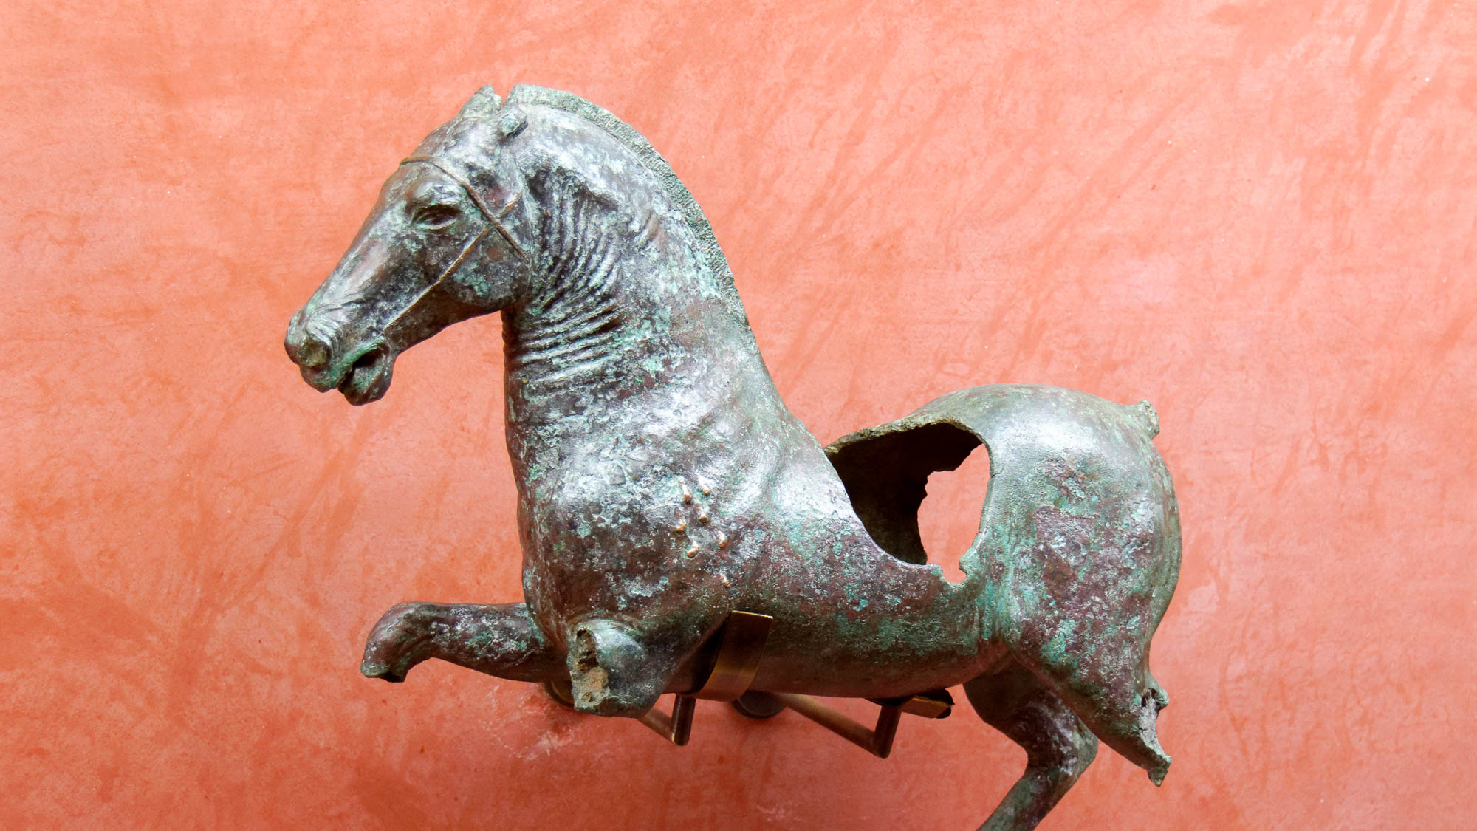
We put bits into the mouths of horses so that they obey us
Bronze statue of a galloping horse, from Merida, 1st century AD
3:3
Notes:
This bronze statue was photographed at the Merida Archaeological Museum.
tb092519238h

Slide 21
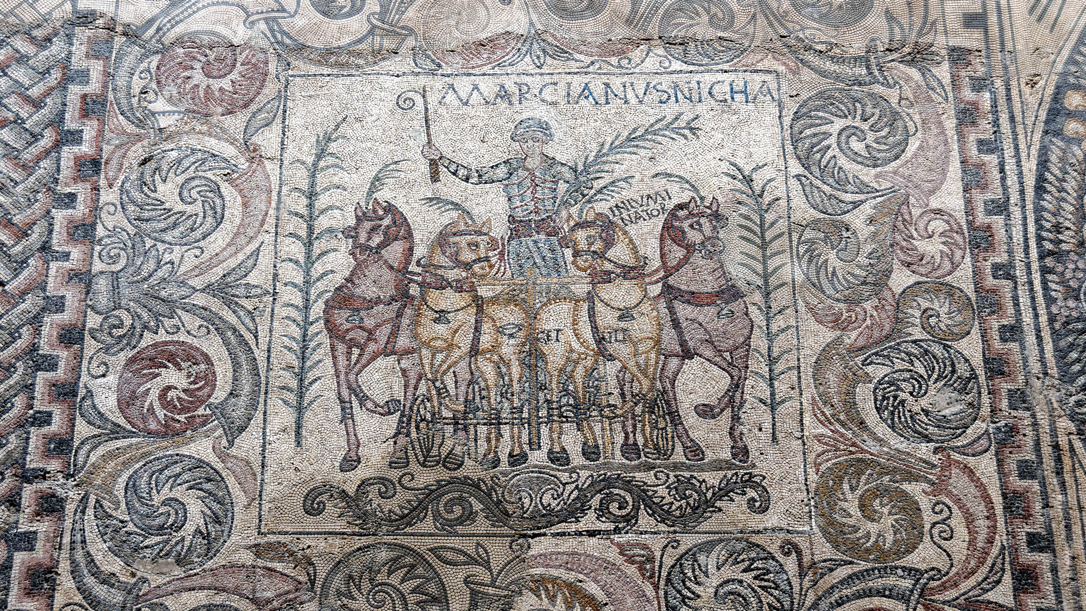
We put bits into the mouths of horses so that they obey us
Mosaic with chariot, from a Roman house at Merida, 4th century AD
3:3
Notes:
This mosaic portrays a victorious chariot team from the front. The equipment, including bridles and harnesses, which are necessary to ensure that the driver can direct the team, are shown in fine detail. The inscription indicates that the driver, who holds the palm branch symbolizing victory, is named Marcianus. This mosaic was photographed at the Merida Archaeological Museum.
tb092519256h

Slide 22
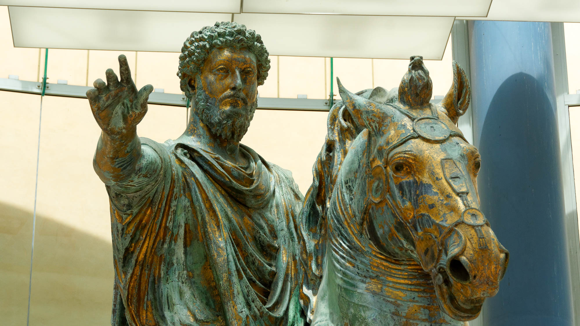
We put bits into the mouths of horses so that they obey us
Equestrian statue of Marcus Aurelius, circa AD 175
3:3
Notes:
Although the original reins that were once part of this statue have not survived, the bridle and bit are still clearly visible. The statue was photographed at the Capitoline Museums in Rome.
tb0514179487

Slide 23
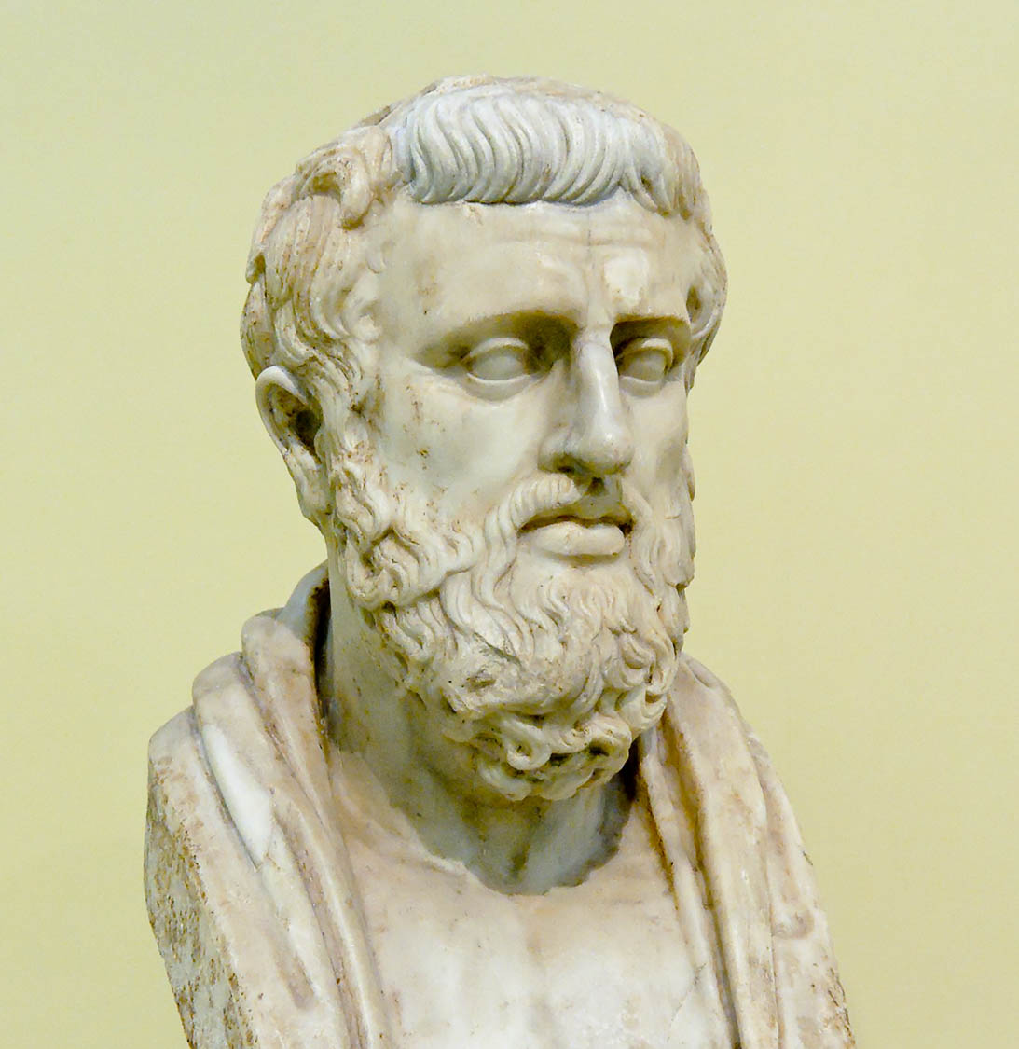
We put bits into the mouths of horses so that they obey us
Marble bust of Sophocles, 4th century BC
3:3
Notes:
Sophocles was a famous Greek playwright who lived in the 5th century BC. He wrote: ”I know that spirited horses are broken by the use of a small bit” (Antigone, 477). This bust was photographed at the Naples Archaeological Museum.
tb111705738h

Slide 24
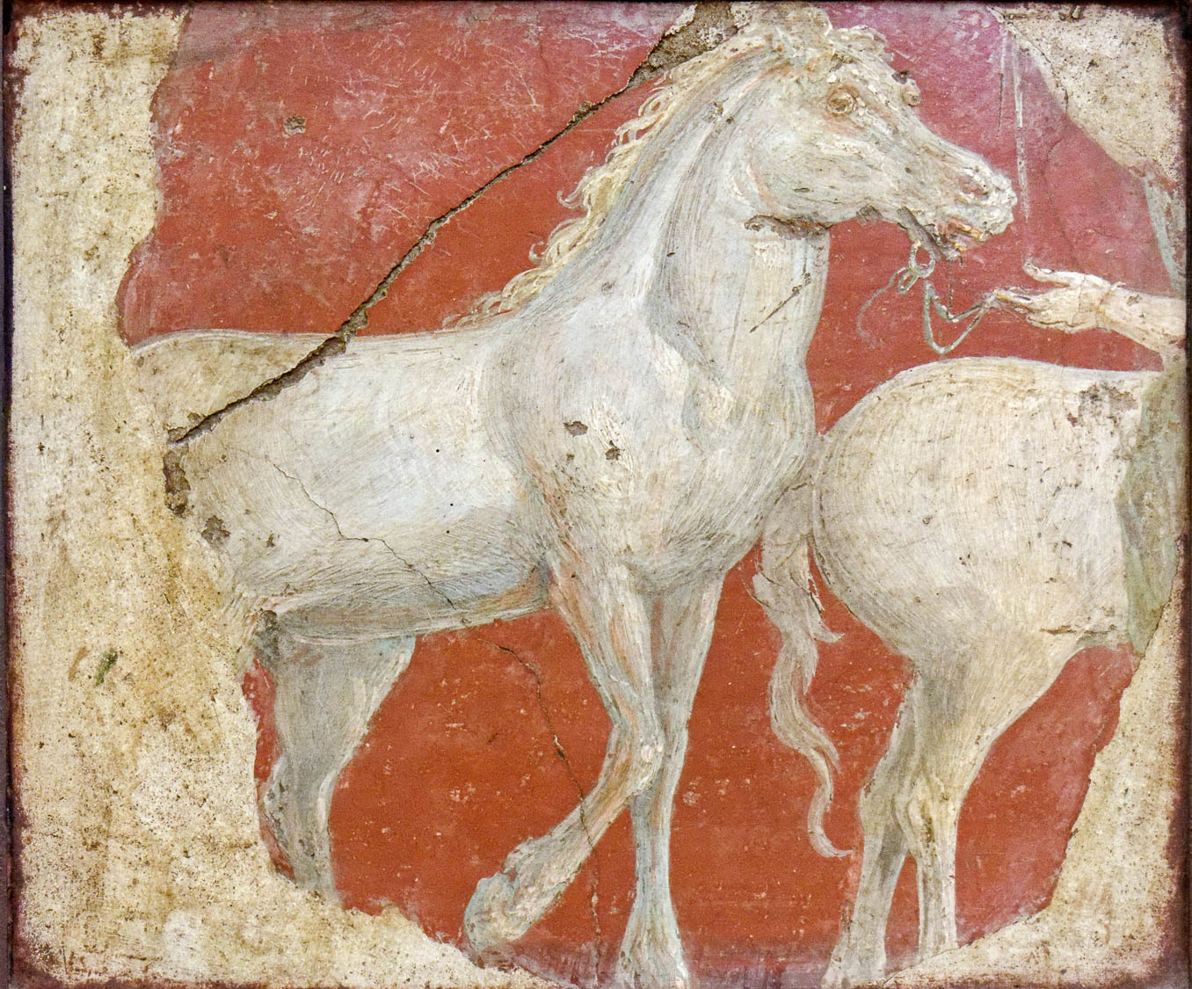
We guide the whole body as well
Fresco of running horses, from Villa Ariadne, Stabiae, 1st century AD
3:3
Notes:
This fresco comes from Villa Ariadne (Arianna) at Stabiae, a city on the coast near Pompeii that was also destroyed in the eruption of Mount Vesuvius in AD 79. It depicts a white horse being led by a bridle and reins. This fresco was photographed at the Naples Archaeological Museum.
tb0515170317c

Slide 25
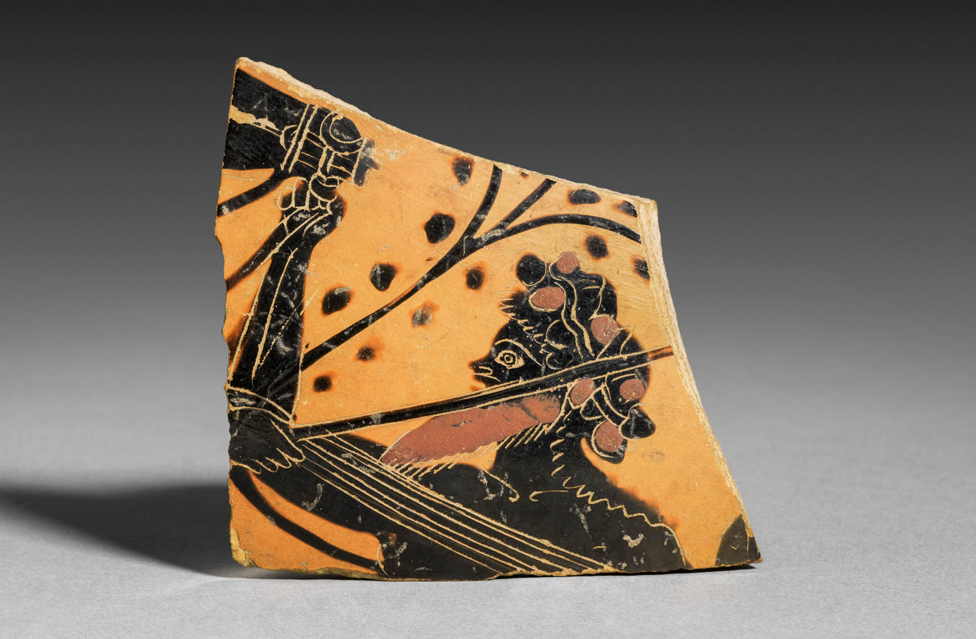
We guide the whole body as well
Attic Greek Black-Figure neck amphora with a bridled horse, circa 500 BC
3:3
Notes:
In this depiction, a male figure (probably a satyr) controls a horse by grasping the bridle below the horse’s mouth, illustrating the control to which James refers. This image comes from The Cleveland Museum of Art and is in the public domain. Source: https://www.clevelandart.org/art/1915.533.c
tcma1915533c

Slide 26
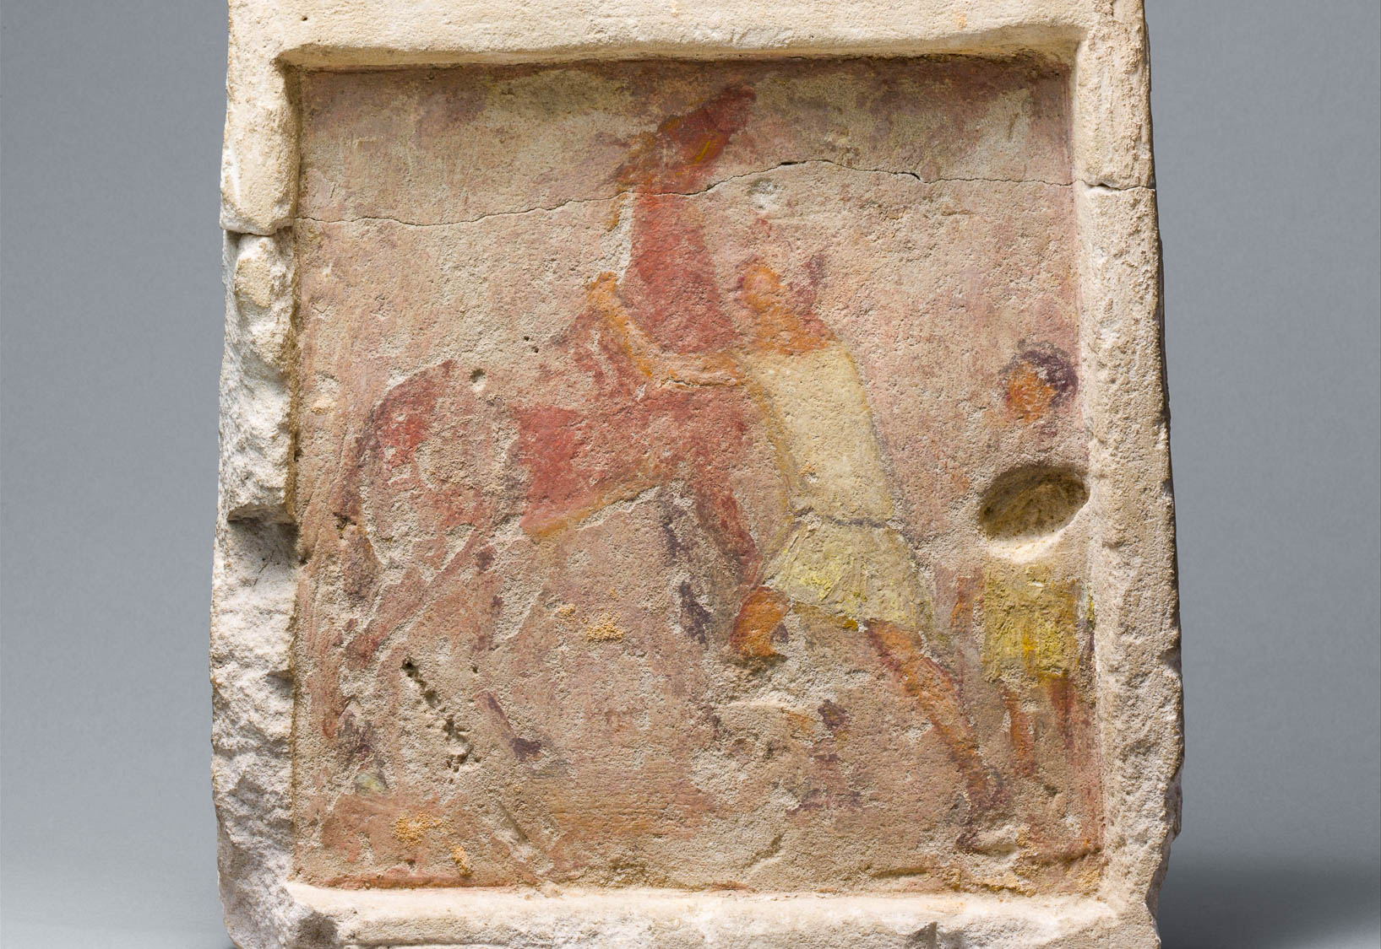
We guide the whole body as well
Painted limestone funerary slab with a man controlling a rearing horse, circa 250 BC
3:3
Notes:
This painted tombstone depicts a man working to control a rearing horse, while a boy stands behind him. The bridle reins are faintly visible between the head of the horse and the head of the man, and are clearly what allows him to control the horse. The stone comes from a tomb in Alexandria, Egypt, and commemorates a man from Thessaly in northern Greece. This image comes from The Metropolitan Museum of Art and is in the public domain. Source: https://www.metmuseum.org/art/collection/search/247108
met247108

Slide 27
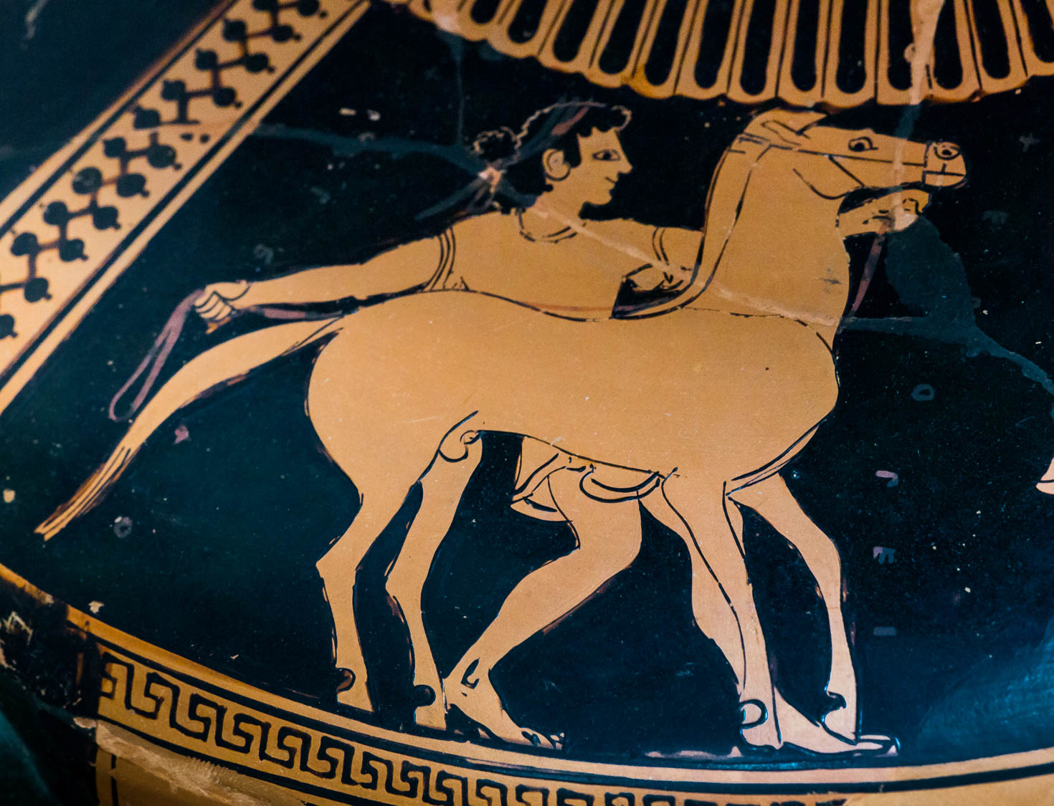
We guide the whole body as well
Red-figure hydria with an Amazon leading a horse, from Vulci, circa 500 BC
3:3
Notes:
This vase is several centuries earlier than the time of James, illustrating the antiquity of bridles. The bridle is affixed to the horse’s head, and the reins can be seen attached to it under the horse’s mouth, with the other end of the reins held in the right hand of the figure behind the horse. This vase was photographed at the State Collection of Antiquities in Munich, Germany. This image comes from ArchaiOptix and is licensed under CC BY-SA 4.0, via Wikimedia Commons: https://commons.wikimedia.org/wiki/File:Pezzino_Group_ARV_32_3_Amazons_harnessing_a_quadriga_-_athletes_(04).jpg.
wiki012220202007582420

Slide 28
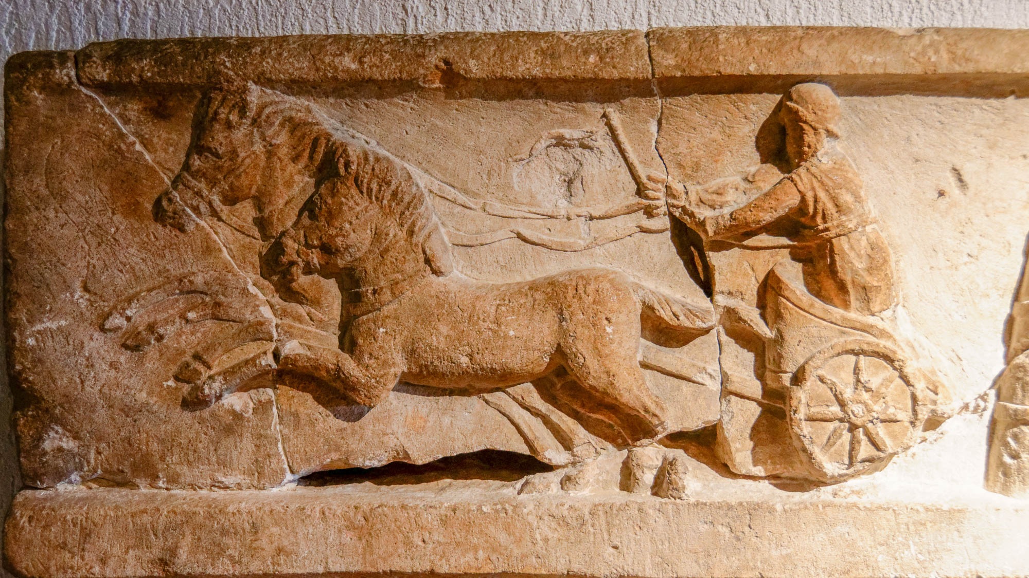
We guide the whole body as well
Relief of chariot race, from St. Paul station at Lyon, Roman period
3:3
Notes:
This limestone relief was photographed at the Lyon Gallo-Roman Museum.
tb091719343h

Slide 29
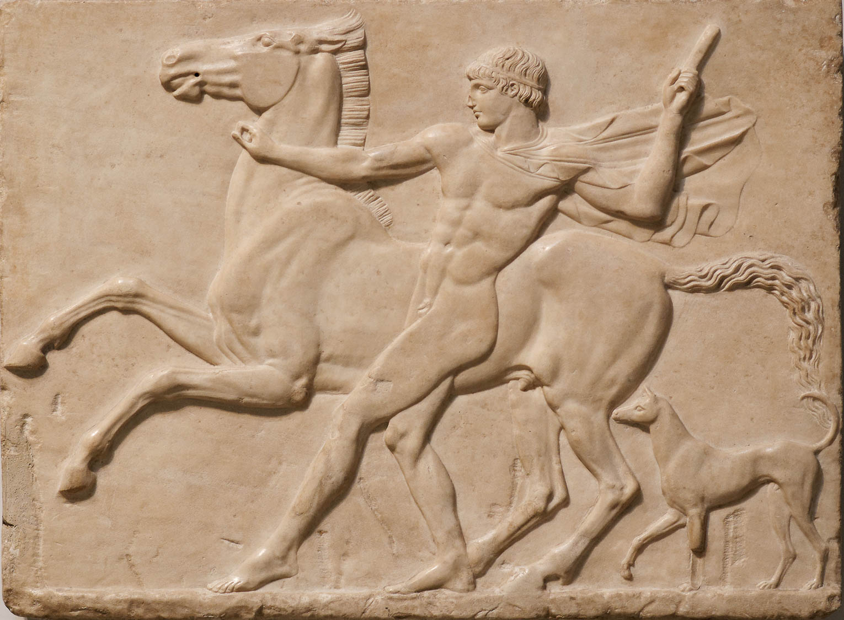
We guide the whole body as well
Relief of a youth mastering his horse, from the Villa Adriana near Tivoli, circa AD 125
3:3
Notes:
This relief depicts a young man bringing his horse under control. He holds a whip in his left hand, and the (now missing) bridle in his right hand. This relief was photographed at the British Museum. This image comes from Marie-Lan Nguyen and is licensed under CC BY 2.5, via Wikimedia Commons: https://commons.wikimedia.org/wiki/File:Youth_horse_dog_BM_Sc2206.jpg.
wiki06162011194920072206

Slide 30
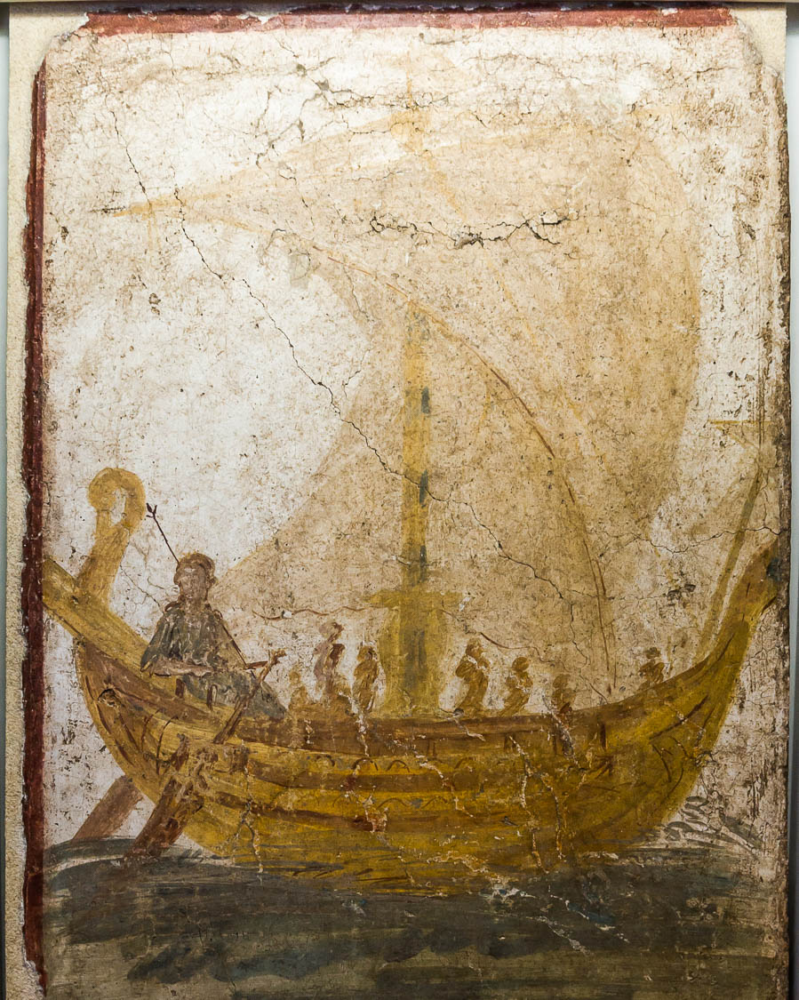
Look at the ships as well, though they are so large and are driven by strong winds
Fresco depicting a sailing ship, from Pompeii, 1st century AD
3:4
Notes:
The reference to ships as “driven by strong winds” clearly refers to ships with sails. Sails were standard equipment for ocean-going vessels, even those (such as warships) that were also equipped with banks of oars. The fresco shown here comes from the external wall of a modest house at Pompeii. It depicts a cargo ship (nave oneraria) with a square sail flying from the central mast, with another small sail visible at the bow. Various crew members are visible in the boat. The ship is steered by a female figure of much greater dimensions than the crew. An inscription (now all but illegible) identifies her as “Aphrodite the Savior.” She is seated at the stern, wielding a scepter and steering the ship with the rudder. This fresco was photographed at the Antiquarium of Boscoreale. This image comes from Jebulon and is in the public domain, via Wikimedia Commons: https://commons.wikimedia.org/wiki/File:Fresco_boat_Pompeii_Boscoreale.jpg.
wiki072320151309451452

Slide 31
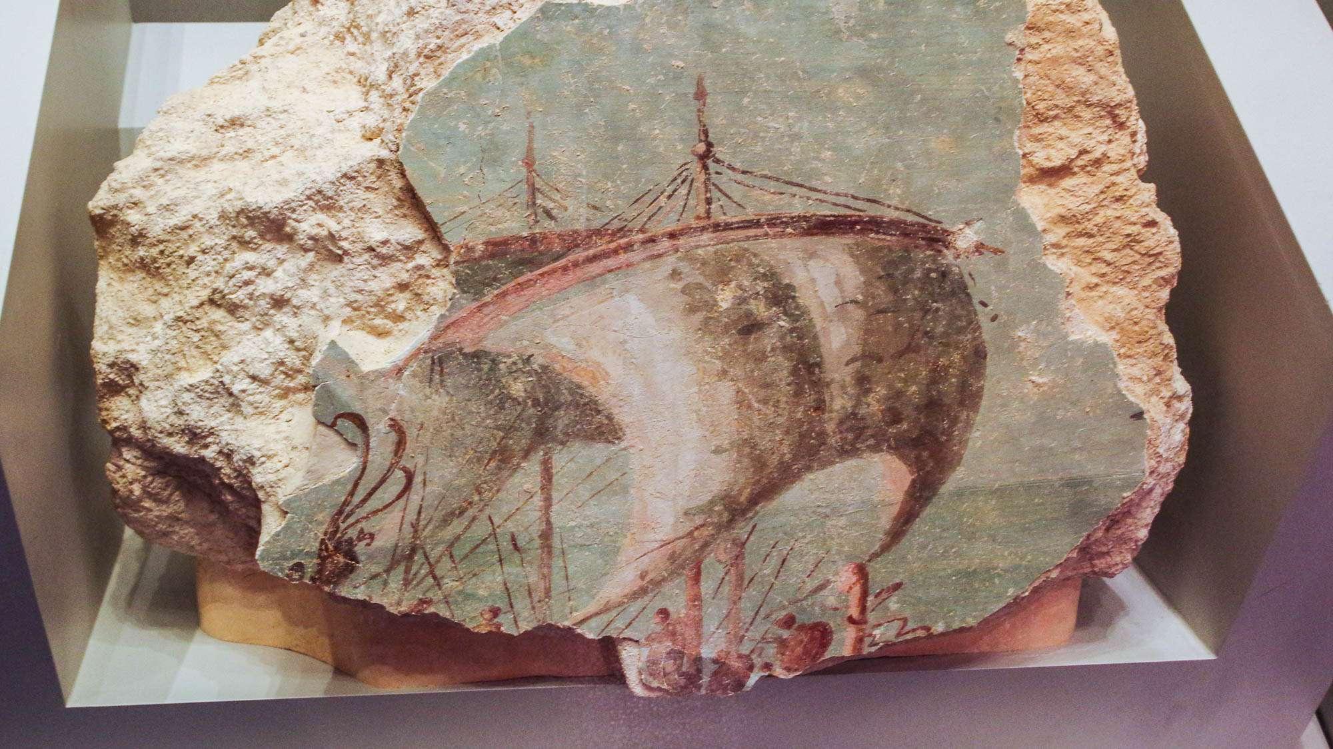
Look at the ships as well, though they are so large and are driven by strong winds
Sail of a battleship filled with wind, from Herodium, 20–15 BC
3:4
Notes:
This fresco from the Royal Room of King Herod at Herodium depicts a warship under sail. It was photographed at the Israel Museum.
adr1806199931h

Slide 32
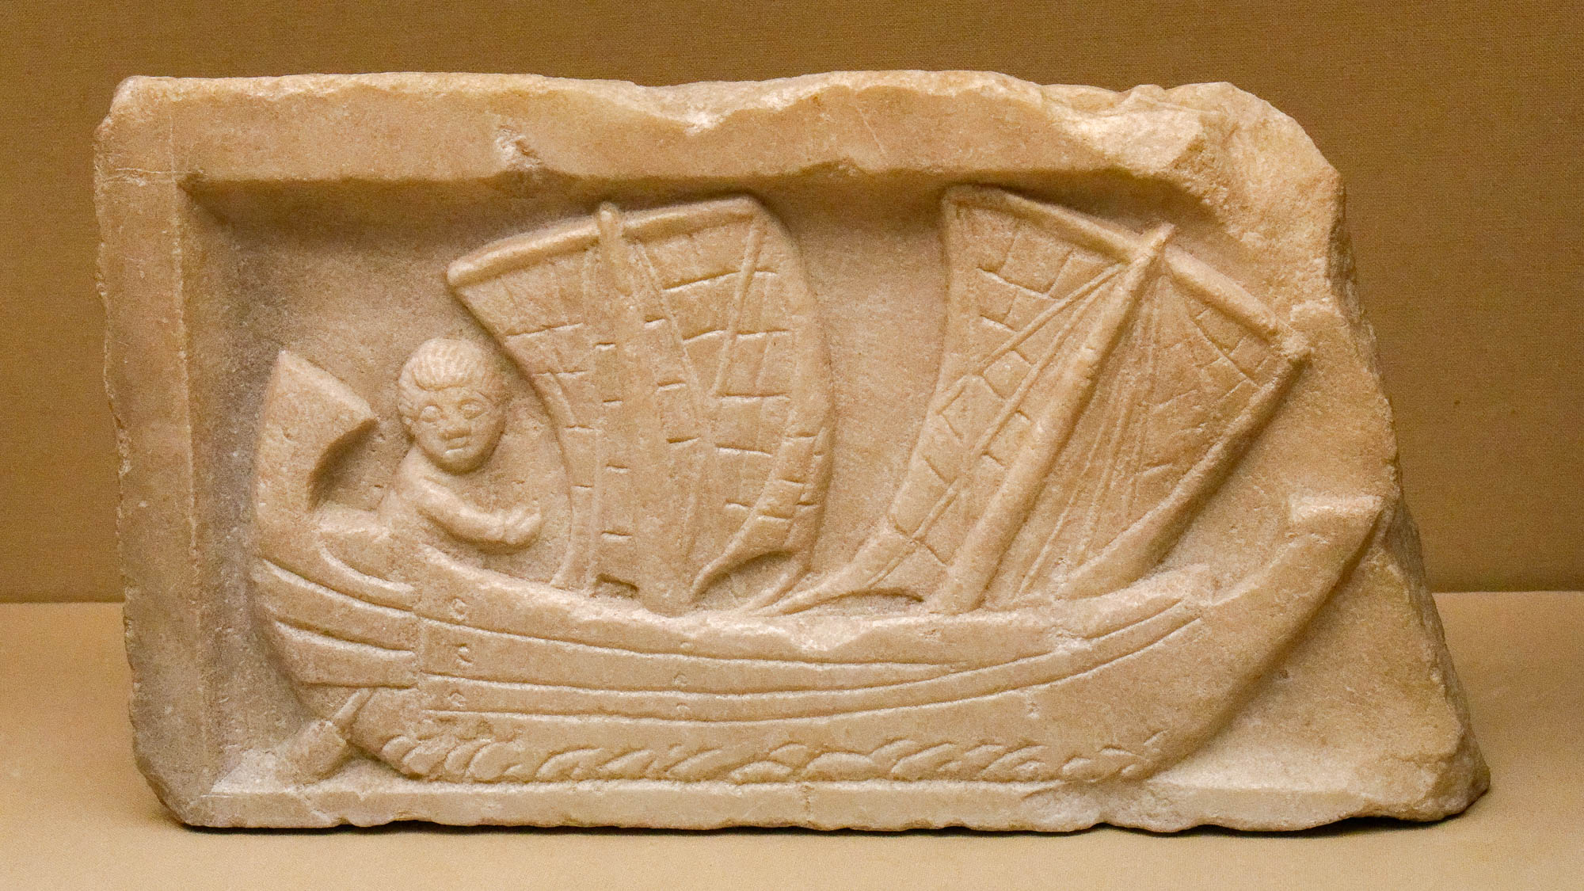
Look at the ships as well, though they are so large and are driven by strong winds
Marble relief of a man sailing a corbita, from Carthage, circa AD 200
3:4
Notes:
This relief depicts a ship with square sails that is steered by two side rudders connected to each other, also known as a corbita. It was photographed at the British Museum.
tb0929197997h

Slide 33
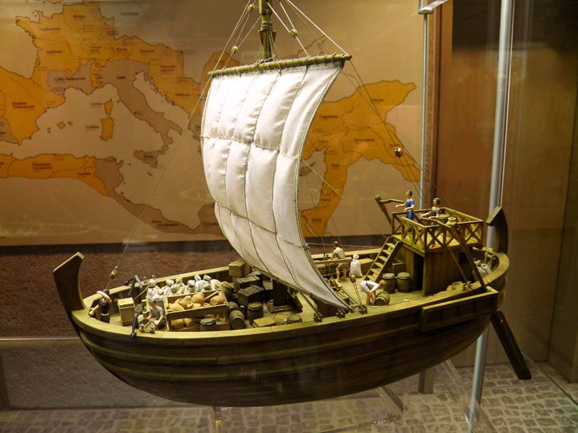
Look at the ships as well, though they are so large and are driven by strong winds
Model of an ancient Roman merchant ship
3:4
Notes:
This model was photographed in the Lobdengau-Museum in Ladenburg, Germany. This image comes from Carole Raddato and is licensed under CC-BY-SA-2.0, via Wikimedia Commons: https://commons.wikimedia.org/wiki/File:Lobdengau-Museum,_Ladenburg,_Germany_(9405166285).jpg.
wiki9405166285

Slide 34
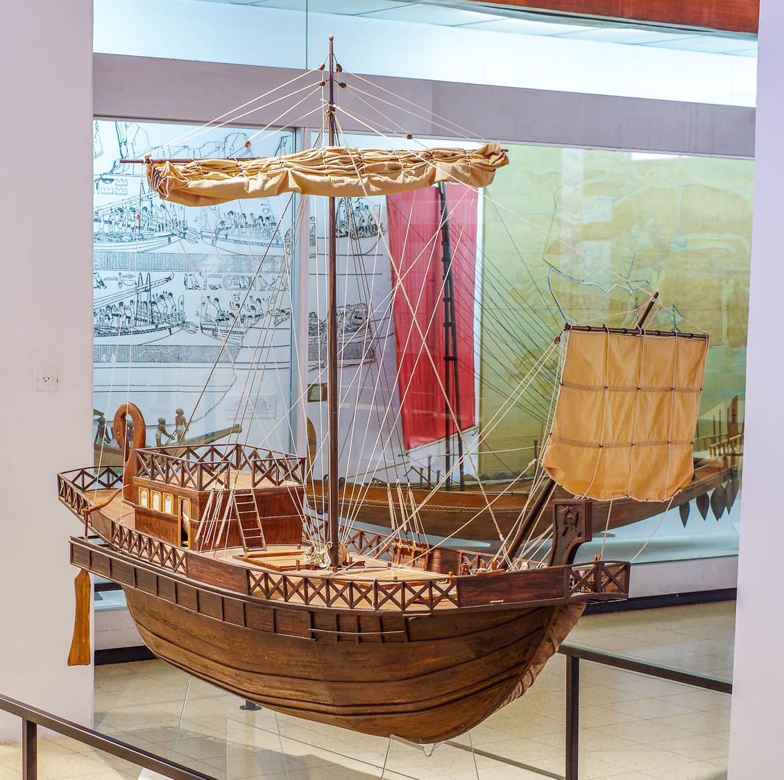
Look at the ships as well, though they are so large and are driven by strong winds
Model of a Roman merchant ship from the 1st century AD
3:4
Notes:
This ship model was photographed at the National Maritime Museum in Haifa.
adr1805231160

Slide 35
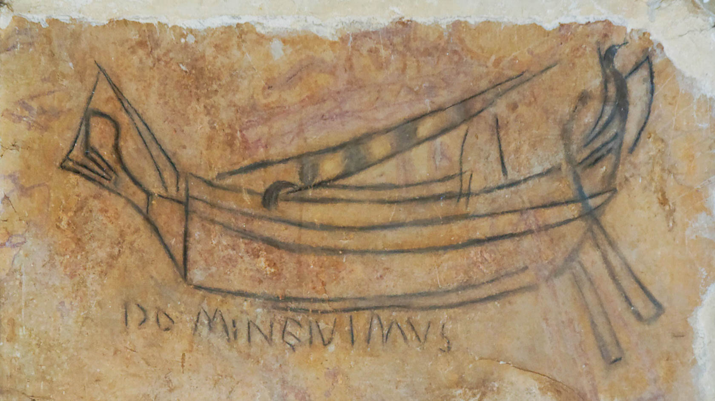
Yet they are steered by a very small rudder, wherever the desire of the pilot directs
Ship in charcoal in St. Vartan’s Chapel in the Church of the Holy Sepulcher, Jerusalem, 4th c. AD
3:4
Notes:
In the 1st century AD, rudders were not blades attached to a ship’s sternpost, but rather consisted of two large paddles fastened to the stern and connected to a tiller. The rudders were nearly always depicted on ancient representations of ships, which is an indication of the ancient view that they were a critical part of any ship. In this charcoal graffiti, the rudders are visible hanging down from the stern of the ship. Below the ship is the Latin inscription, “Lord, we went” (DOMINE IVIMUS). This graffiti was photographed at its original location in the St. Vartan’s chapel below the Church of the Holy Sepulcher in Jerusalem, where it was left by a pilgrim, perhaps in the 4th century AD.
tb030706669c

Slide 36
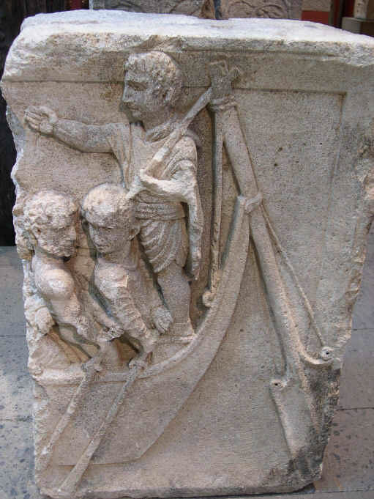
Yet they are steered by a very small rudder, wherever the desire of the pilot directs
Stern-mounted steering oar of a Roman Rhine boat, 1st century AD
3:4
Notes:
The rudder is very small in comparison to the size of the ship it directs. This relief depicts the pilot with his steering rod over his shoulder, connected to the rudder itself which hangs down behind the boat. This relief was photographed at the Römisch-Germanischen Museum in Köln, Germany. This image comes from Wikimedia Commons and is in the public domain. Source: https://commons.wikimedia.org/wiki/File:Rudder_of_a_Roman_Boat_(RG_Museum_Koeln,_Germany).JPG
wiki01232007013468147

Slide 37
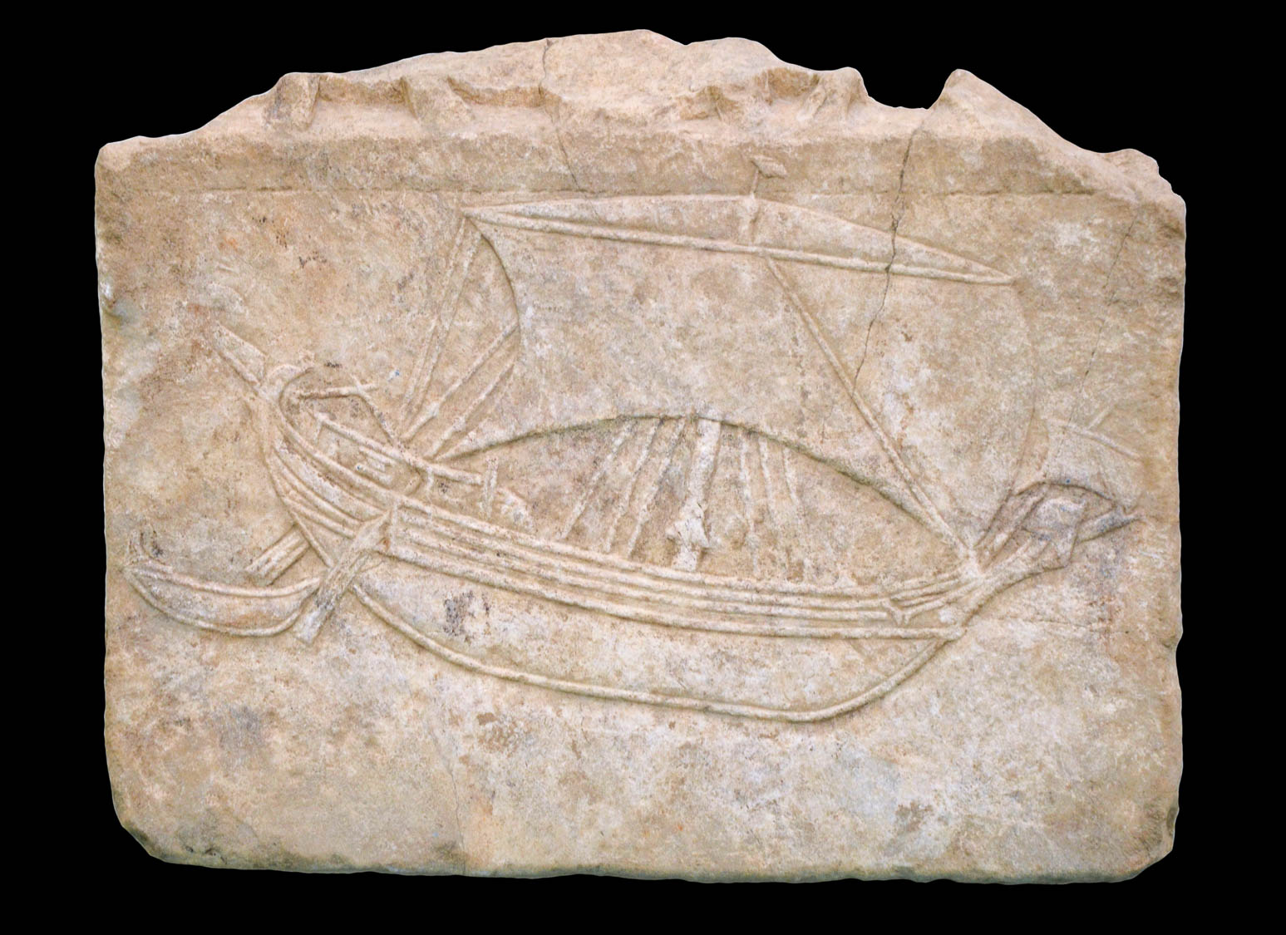
Yet they are steered by a very small rudder, wherever the desire of the pilot directs
Roman cargo ship and skiff, 1st–3rd centuries AD
3:4
Notes:
This relief of a Mediterranean cargo ship dates to the 1st to 3rd centuries AD. It has a fully extended main sail, a smaller sail at the prow, and two steering rudders at the stern. It is also pulling a smaller boat. This relief was photographed at the Museum für Antike Schiffahrt, Mainz, Germany. This image comes from Carole Raddato and is licensed under CC BY-SA 2.0, via Wikimedia Commons: https://commons.wikimedia.org/wiki/File:Relief_of_a_Mediterranean_cargo_ship,_1st_-_3rd_century_AD,_Museum_f%C3%BCr_Antike_Schiffahrt,_Mainz_(35000055671).jpg.
wiki35000055671

Slide 38
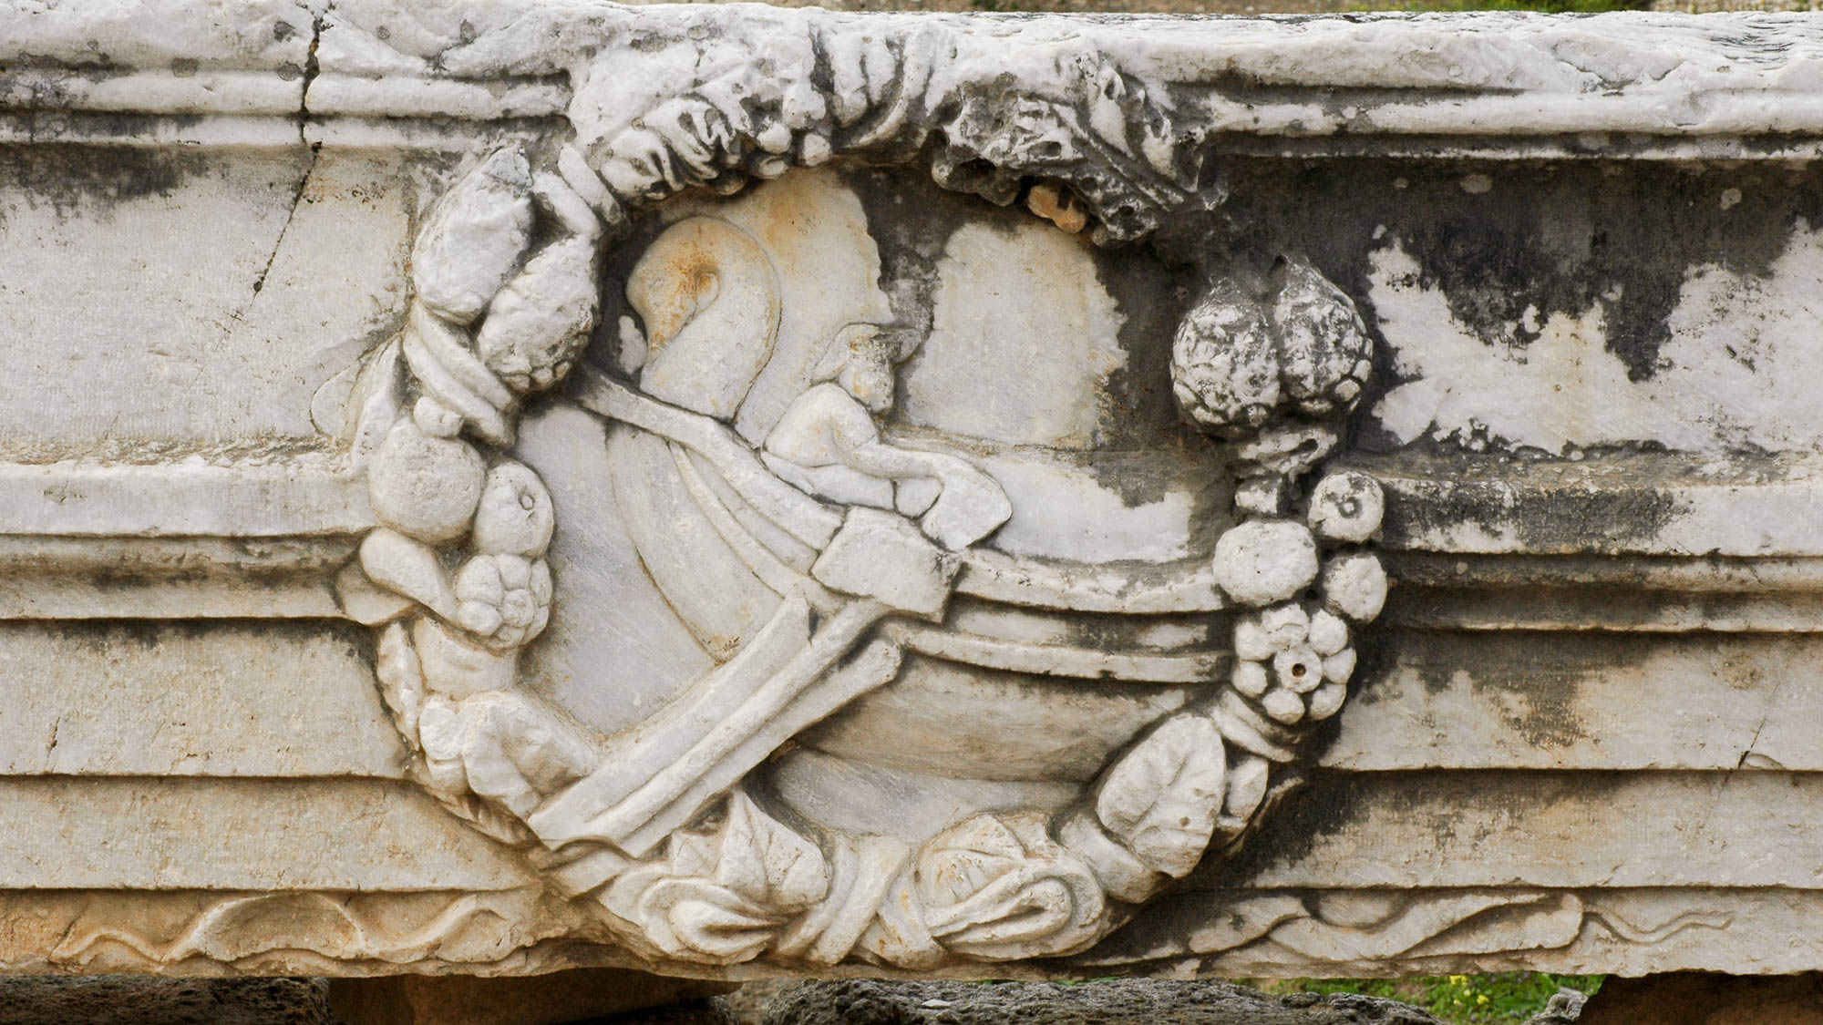
Yet they are steered by a very small rudder, wherever the desire of the pilot directs
Architectural fragment from Corinth with a boat and helmsman holding a tiller
3:4
Notes:
In this relief, the pilot grasps the tiller while the rudder hangs down toward the left.
tb031706123

Slide 39
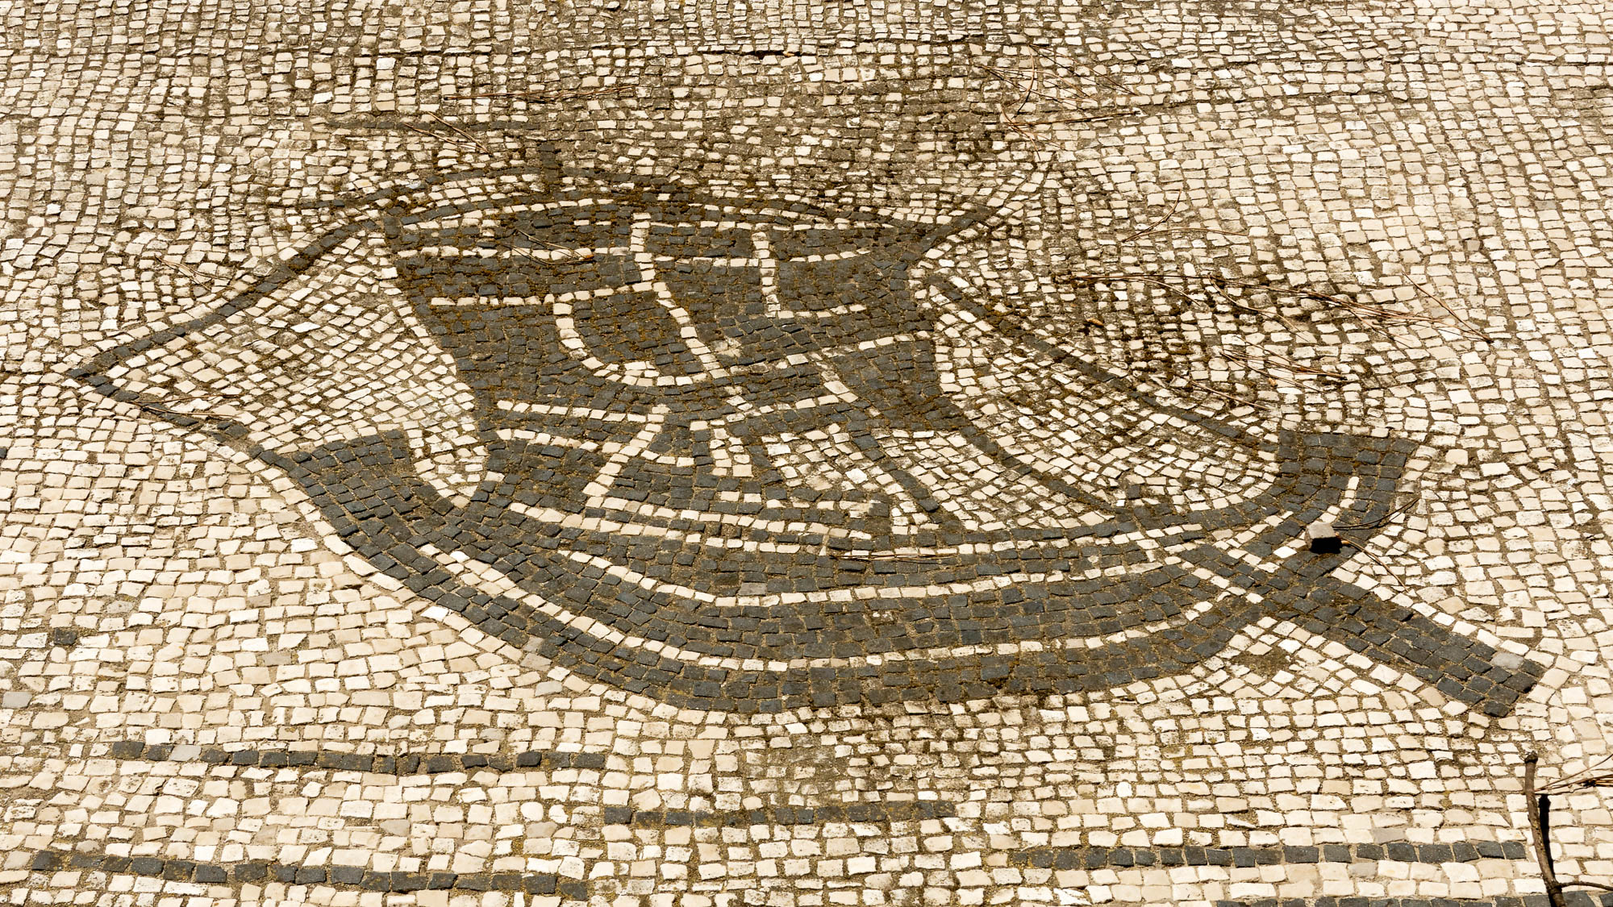
Yet they are steered by a very small rudder, wherever the desire of the pilot directs
Roman ship mosaic in the Plaza of the Guilds at Ostia, Station 49
3:4
Notes:
Ostia was the primary port city of Rome in the 1st century AD. The city housed various trade guides, and the Plaza of the Guilds (Piazzale delle Corporazioni) held 70 commercial offices with mosaic floors portraying the specific trades and guilds. This mosaic is part of a much larger floor that includes depictions of various sailing ships from around the Mediterranean. The rudder is visible at the rear of the ship (right).
tb0517172919

Slide 40
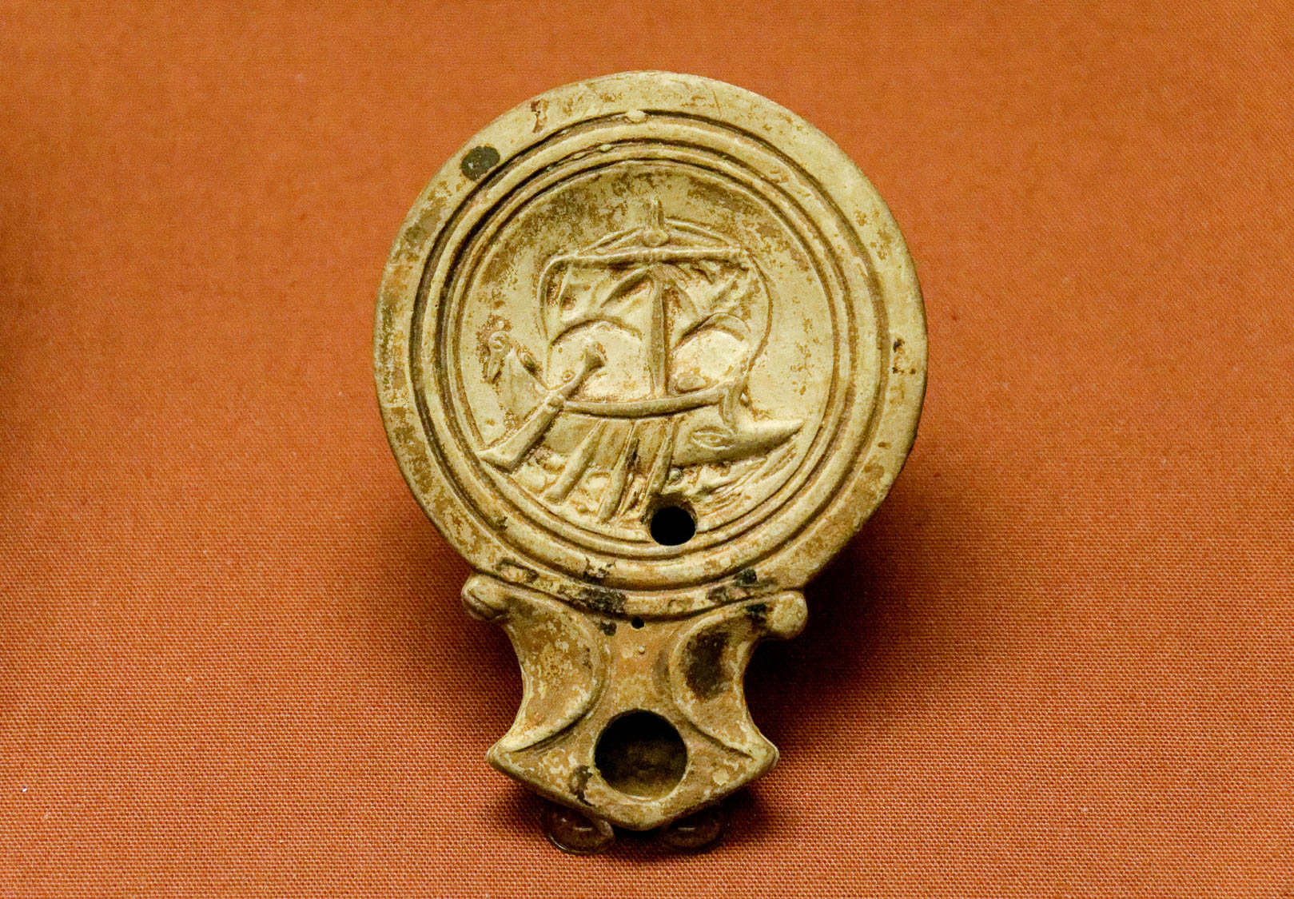
Yet they are steered by a very small rudder, wherever the desire of the pilot directs
Terracotta lamp with a ship, from Colchester, 1st century AD
3:4
Notes:
This molded Roman oil lamp has a depiction of a sailing ship, possibly a warship, depicted on its discus. Although the small nature of this depiction limits the details that could be included, the rudder is featured prominently at the stern (left on this photo), illustrating its importance in the mind of the artist. This oil lamp was photographed at the British Museum.
tb1001199691

Slide 41
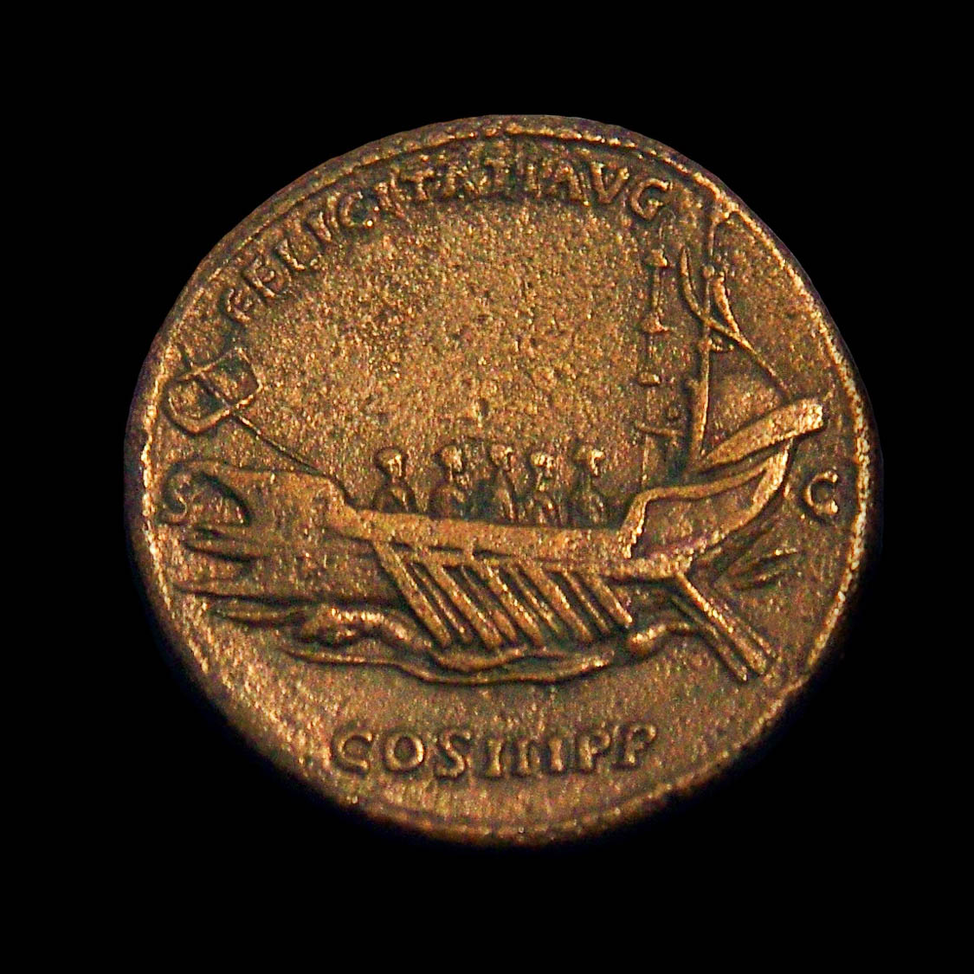
Yet they are steered by a very small rudder, wherever the desire of the pilot directs
Roman brass coin depicting Hadrian’s imperial flagship, AD 132–134
3:4
Notes:
A rudder can be seen underneath the right side of the ship on this coin. The coin depicts a praetorian galley with five rowers and the pilot. The prow (left side) has three spikes for ramming. The inscription reads “Successful Emperor, by the decree of the Senate, Consul for the 3rd time, Father of the country” (FELICITATI AVG S C COS III P P). This coin was photographed at the Ashmolean Museum at the University of Oxford.
adr1305240082

Slide 42
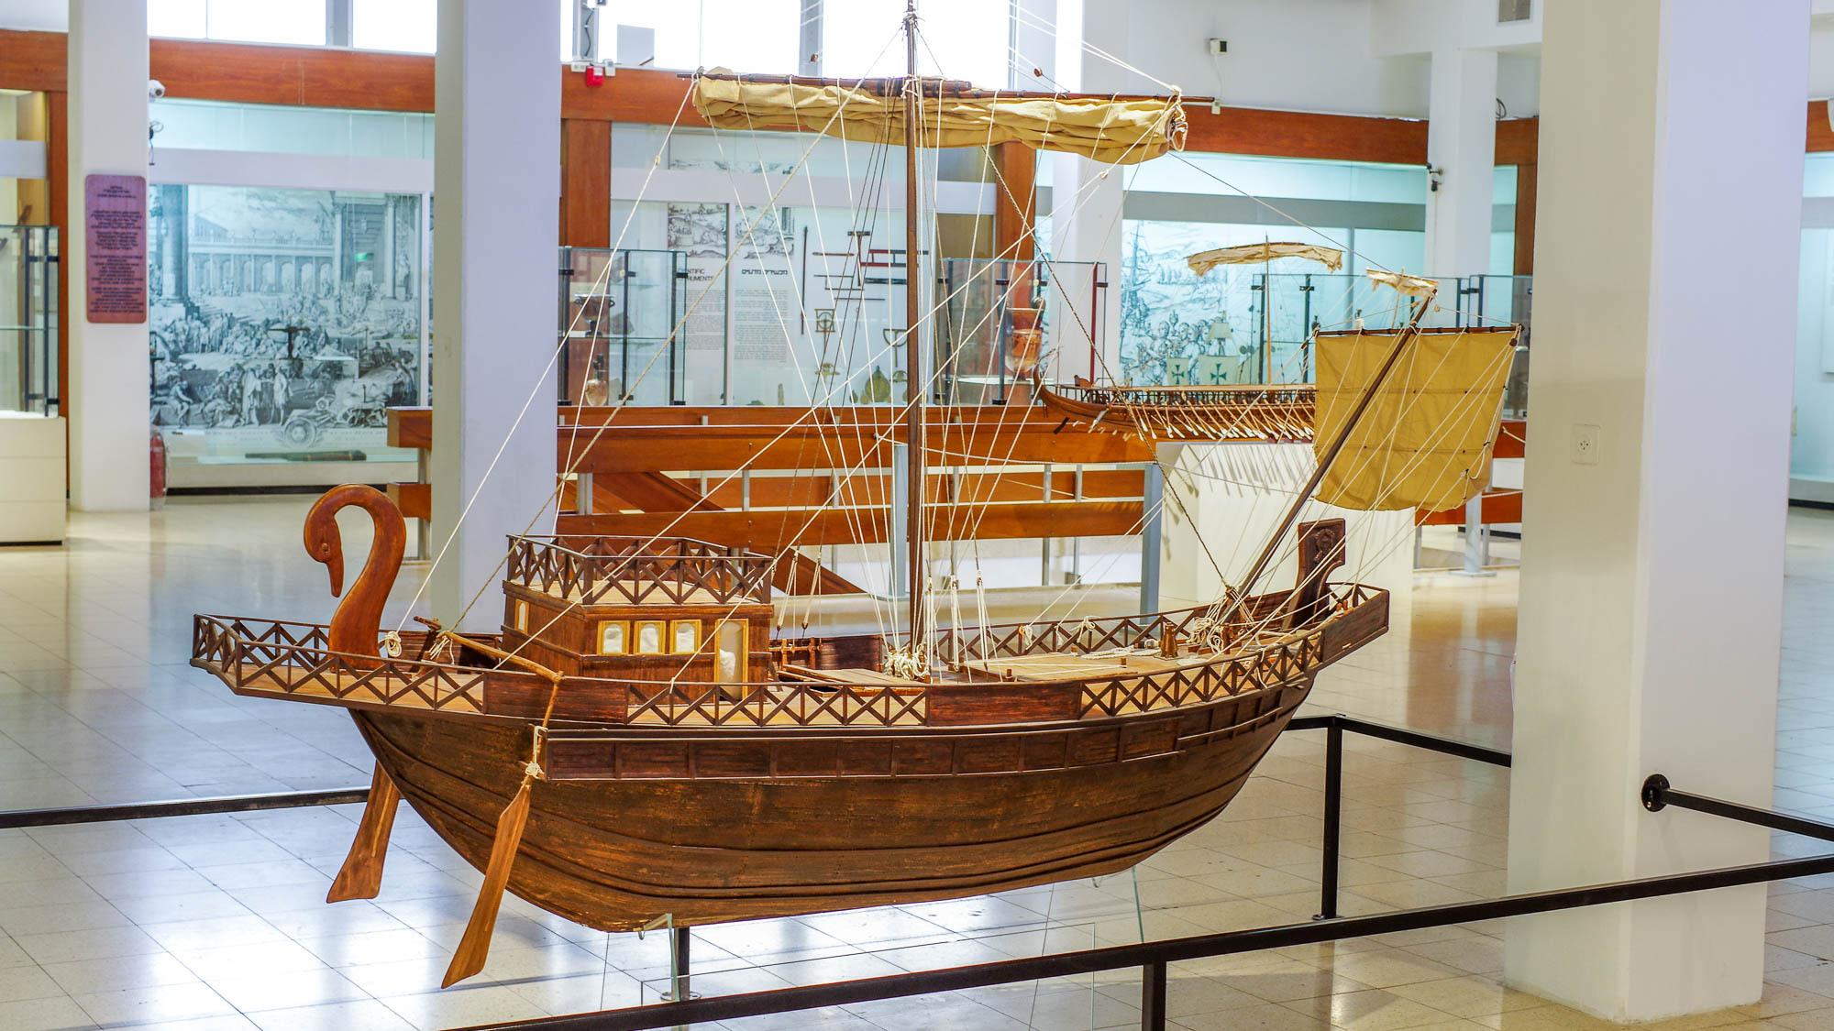
Yet they are steered by a very small rudder, wherever the desire of the pilot directs
Model of a Roman merchant ship from the 1st century AD
3:4
Notes:
This ship model was photographed at the National Maritime Museum in Haifa.
adr1805231148h

Slide 43
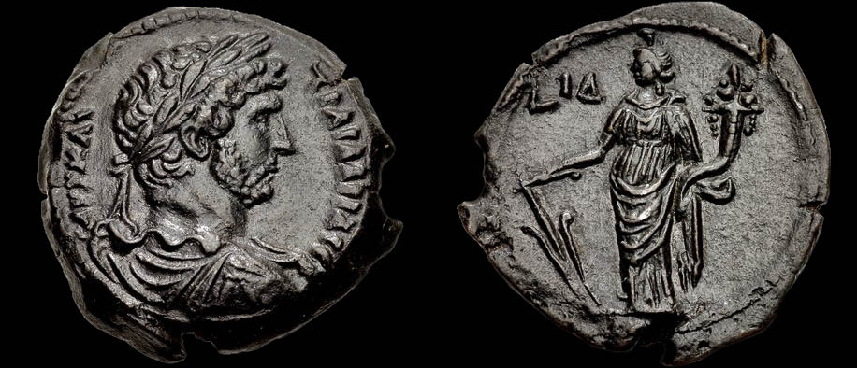
Yet they are steered by a very small rudder, wherever the desire of the pilot directs
Bronze diobol of Hadrian, with Tyche holding a rudder, circa AD 130
3:4
Notes:
The reverse side of this coin (right) portrays Tyche (Fortuna) holding a large rudder in her right hand and a cornucopia in her left hand. Tyche was supposed to have been responsible for guiding world affairs, which is why she is holding the rudder. The cornucopia represents her supposed role in bestowing gifts of fortune. The reverse also contains the date mark L ΙΔ (Year 14). The obverse side of this coin (left) depicts a laureate, draped, and cuirassed bust of Emperor Hadrian, and is inscribed “Autocrat and Trajan Hadrian Augustus” (ΑΥΤ ΚΑΙ ΤΡΑΙ ΑΔΡΙΑ ϹΕΒ). This photograph comes from CNG. Source: https://www.cngcoins.com/Coin.aspx?CoinID=349221
cng349221b

Slide 44
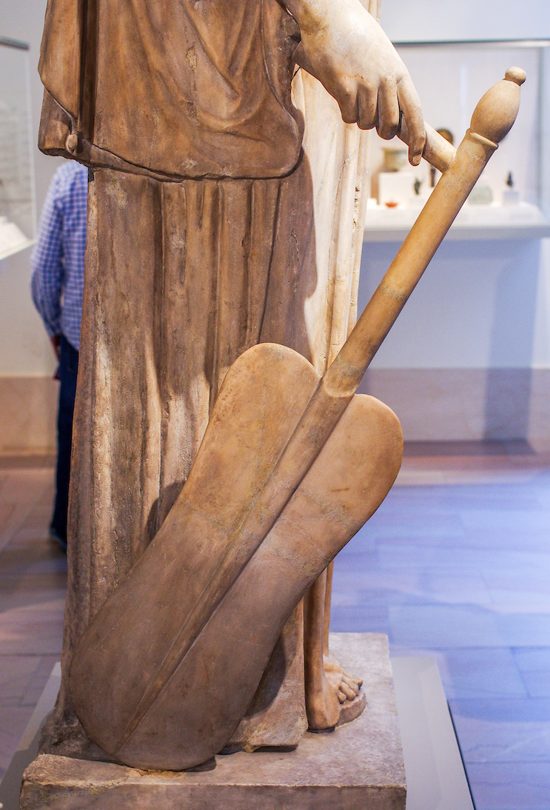
Yet they are steered by a very small rudder, wherever the desire of the pilot directs
Roman statue of Tyche-Fortuna holding a rudder and cornucopia, marble, 1st or 2nd century AD
3:4
Notes:
This statue, which was restored in the 18th century, was photographed at the Metropolitan Museum of Art.
adr1605243291

Slide 45
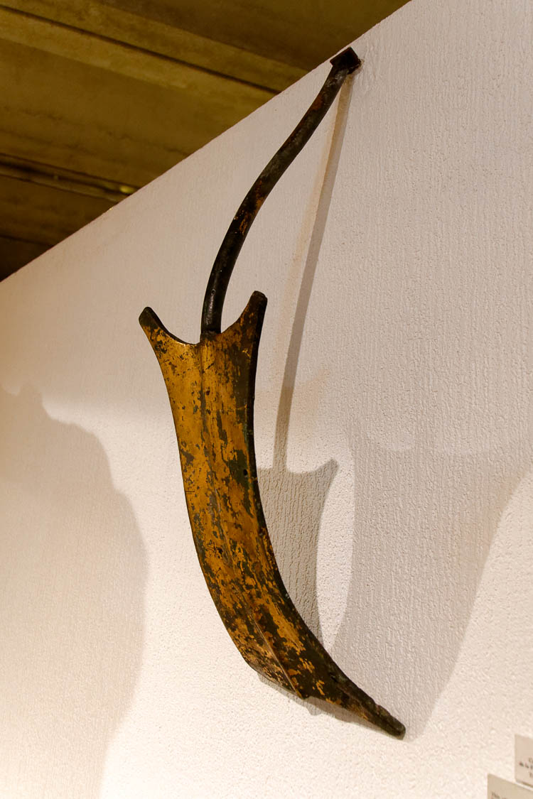
Yet they are steered by a very small rudder, wherever the desire of the pilot directs
Gilded bronze rudder from a statue of Fortuna, from Jardin des Plantes in Lyon, Roman period
3:4
Notes:
This model rudder was photographed at the Lyon Roman-Gallo Museum.
tb091719431

Slide 46
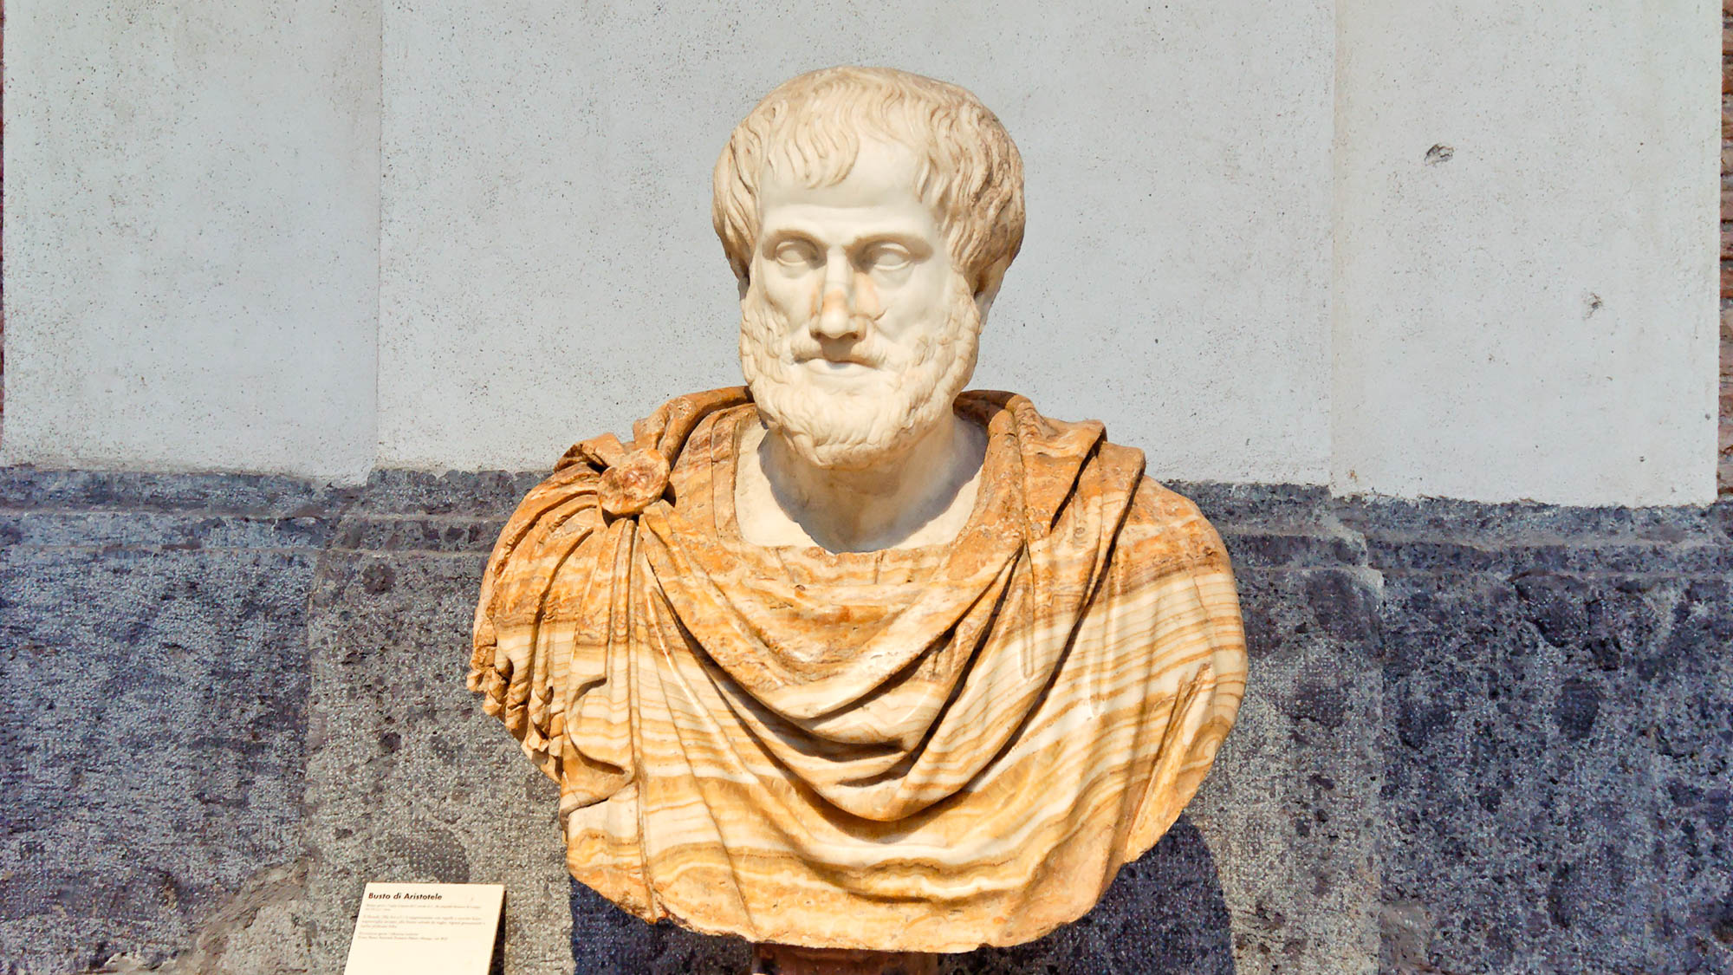
Yet they are steered by a very small rudder, wherever the desire of the pilot directs
“Why is it that the rudder, being small and at the extreme end of the ship, has such power that vessels of great burden can be moved by a small tiller and the strength of one man only gently exerted? Is it because the rudder, too, is a lever and the steersman works it?”
Bust of Aristotle, Roman period
3:4
Notes:
Other ancient writers also noted the way in which a large ship was driven by a small rudder. “Why is it that the rudder, being small and at the extreme end of the ship, has such power that vessels of great burden can be moved by a small tiller and the strength of one man only gently exerted? Is it because the rudder, too, is a lever and the steersman works it?” (Aristotle 2014: 1304). This statue is thought to be a copy of a Greek original from the 4th century BC. It was photographed at the Naples Archaeological Museum.
Reference:
Aristotle.
2014 Complete Works of Aristotle, Volume 2: The Revised Oxford Translation. Trans. and ed., J. Barnes. Princeton, NJ: Princeton University Press.
tb111705698

Slide 47
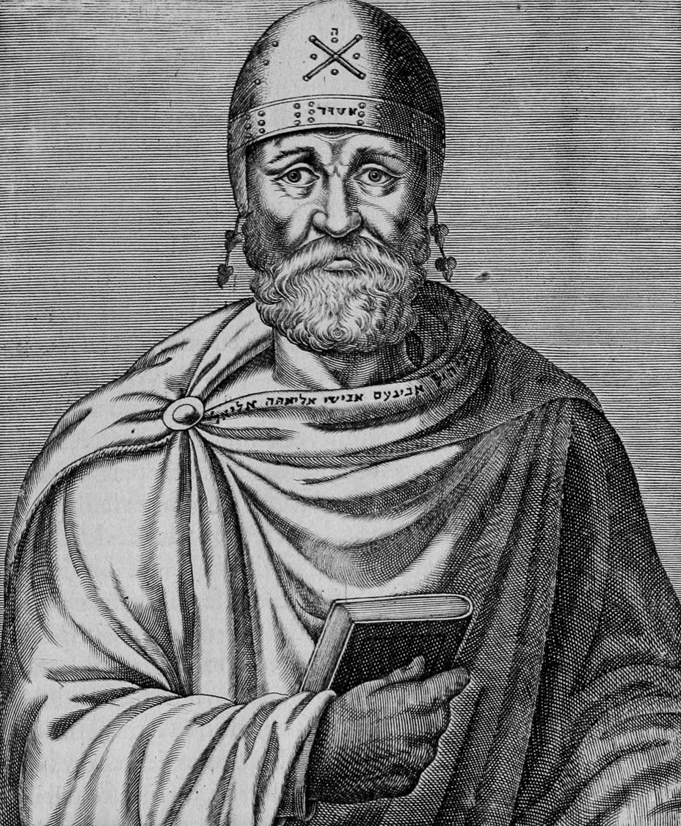
Yet they are steered by a very small rudder, wherever the desire of the pilot directs
“For as a charioteer holding the reigns or a helmsman with his hand upon the rudder, he guides everything as he pleases, in accordance with law and justice, needing no one else as his assistant; for all things are possible to God.”
Depiction of Philo of Alexandria, by André Threvet, 16th century AD
3:4
Notes:
Philo of Alexandria—a 1st century BC/AD Jewish philosopher who was a contemporary of James (died c. AD 50)—made a similar analogy with horses and ships. “For as a charioteer holding the reigns or a helmsman with his hand upon the rudder, he guides everything as he pleases, in accordance with law and justice, needing no one else as his assistant; for all things are possible to God” (Creation XIV.46; Moo 2002: 104). This image comes from Wikimedia Commons and is in the public domain. Source: https://commons.wikimedia.org/wiki/File:PhiloThevet.jpg
Reference:
Moo, Douglas.
2002 James. Zondervan Illustrated Bible Backgrounds Commentary, vol. 4, ed. C. E. Arnold. Grand Rapids: Zondervan.
wiki12172014053915161590

Slide 48
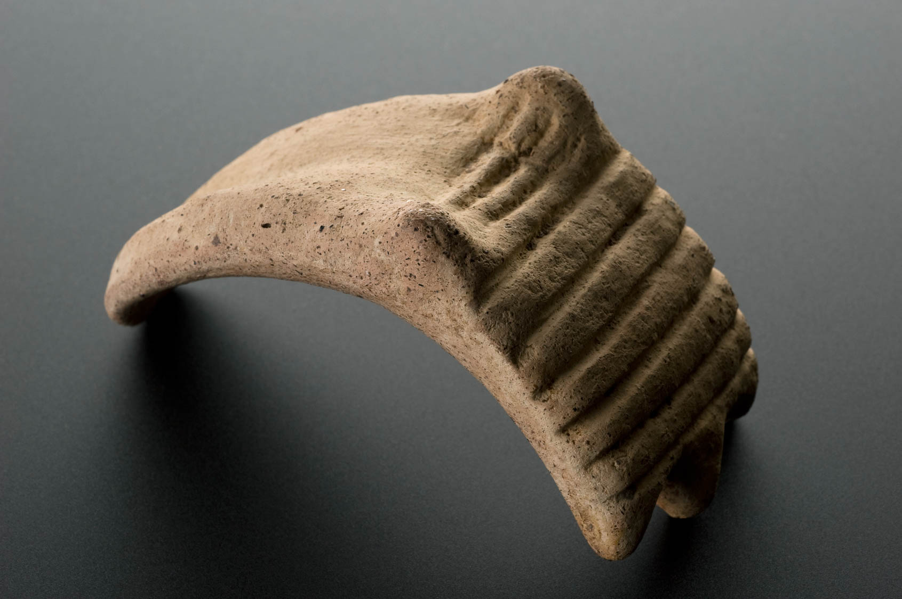
So also the tongue is a small member yet boasts of great things
Terracotta tongue and tonsils, Roman, 400 BC – AD 200
3:5
Notes:
The point toward which James is driving is that speech, represented by the tongue, directs much of human activity. The tongue was not normally depicted in Greco-Roman representations of people. Human faces were shown with a closed mouth (normal for statuary) or with a gaping mouth (normal for theater masks). Contemporary illustrations of human tongues are quite rare. This model of a tongue was probably created as a votive offering intended to be offered at the temple of a healing god such as Asklepios, the Greco-Roman god of medicine. This image comes from Wellcome Images and is licensed under CC BY 4.0, via Wikimedia Commons: https://commons.wikimedia.org/wiki/File:Terracotta_tongue_and_tonsils,_Roman,_400_BCE-200_CE_Wellcome_L0058431.jpg.
wiki1017201413480058431

Slide 49
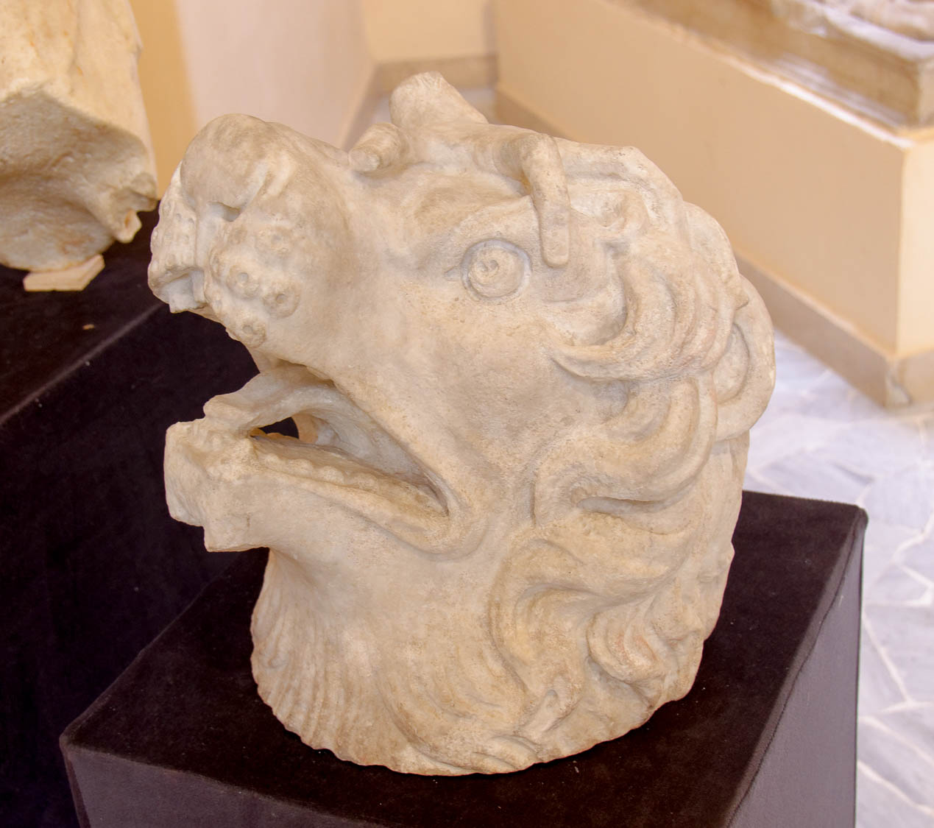
So also the tongue is a small member yet boasts of great things
Limestone lion’s head, Roman period
3:5
Notes:
When tongues were depicted by Greco-Roman artists, they were usually associated with animals. Although this picture shows the tongue in a lion’s mouth rather than a human’s tongue, it illustrates the smallness of the tongue as a part of the body. This statue was photographed at the Ostia Museum.
tb0517172864

Slide 50
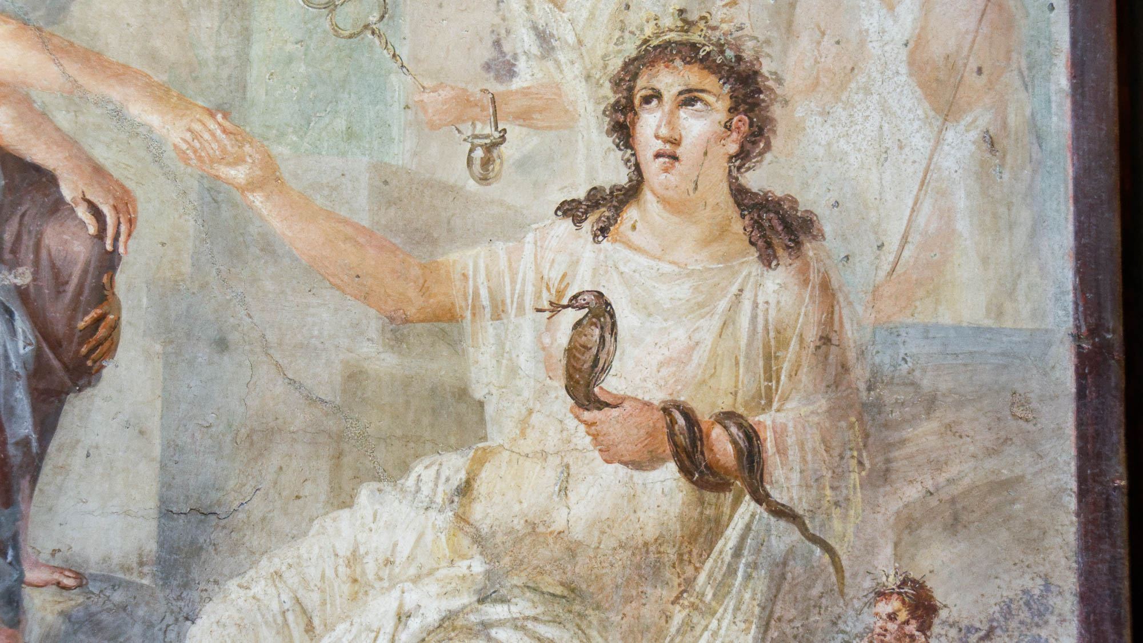
So also the tongue is a small member yet boasts of great things
Io welcomed by Isis at Canopo, from Pompeii, 1st century AD
3:5
Notes:
Other animals that were depicted with tongues were birds, fantastical beasts like griffins, and snakes. This fresco from Pompeii shows the Greco-Egyptian goddess Isis holding a snake with a forked tongue. This fresco comes from the central area of the south wall of the Ekklesiasterion of the Isis temple at Pompeii. It was photographed at the Naples Archaeological Museum.
tb0515170376

Slide 51
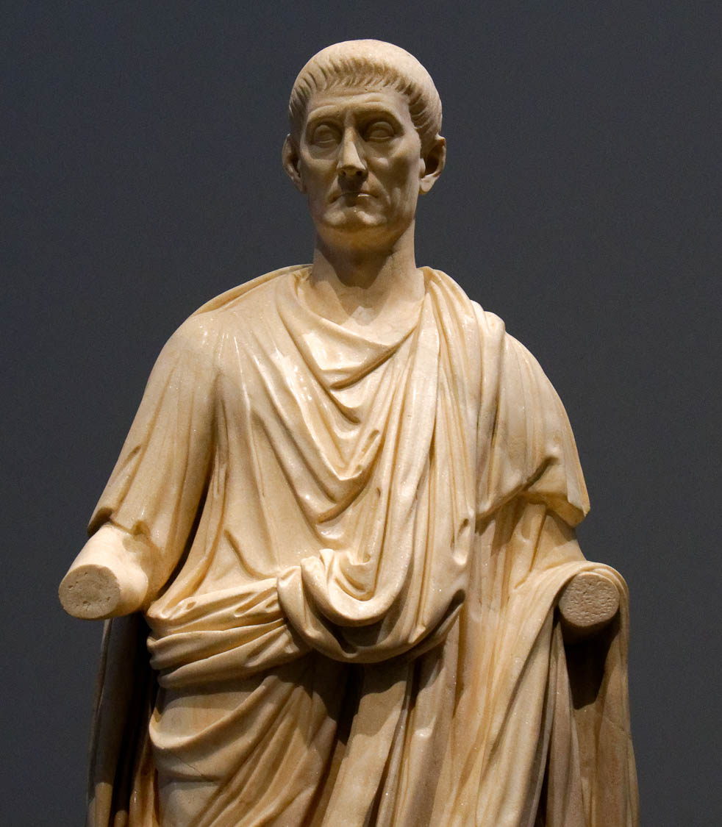
So also the tongue is a small member yet boasts of great things
Statue of a man in a Roman toga, called The Orator, from Italy, AD 100–150
3:5
Notes:
The act of speech, which is what the tongue represents, is illustrated here by a marble statue of an orator or public speaker. This statue was photographed at the Louvre Abu Dhabi.
tb0520184885h

Slide 52
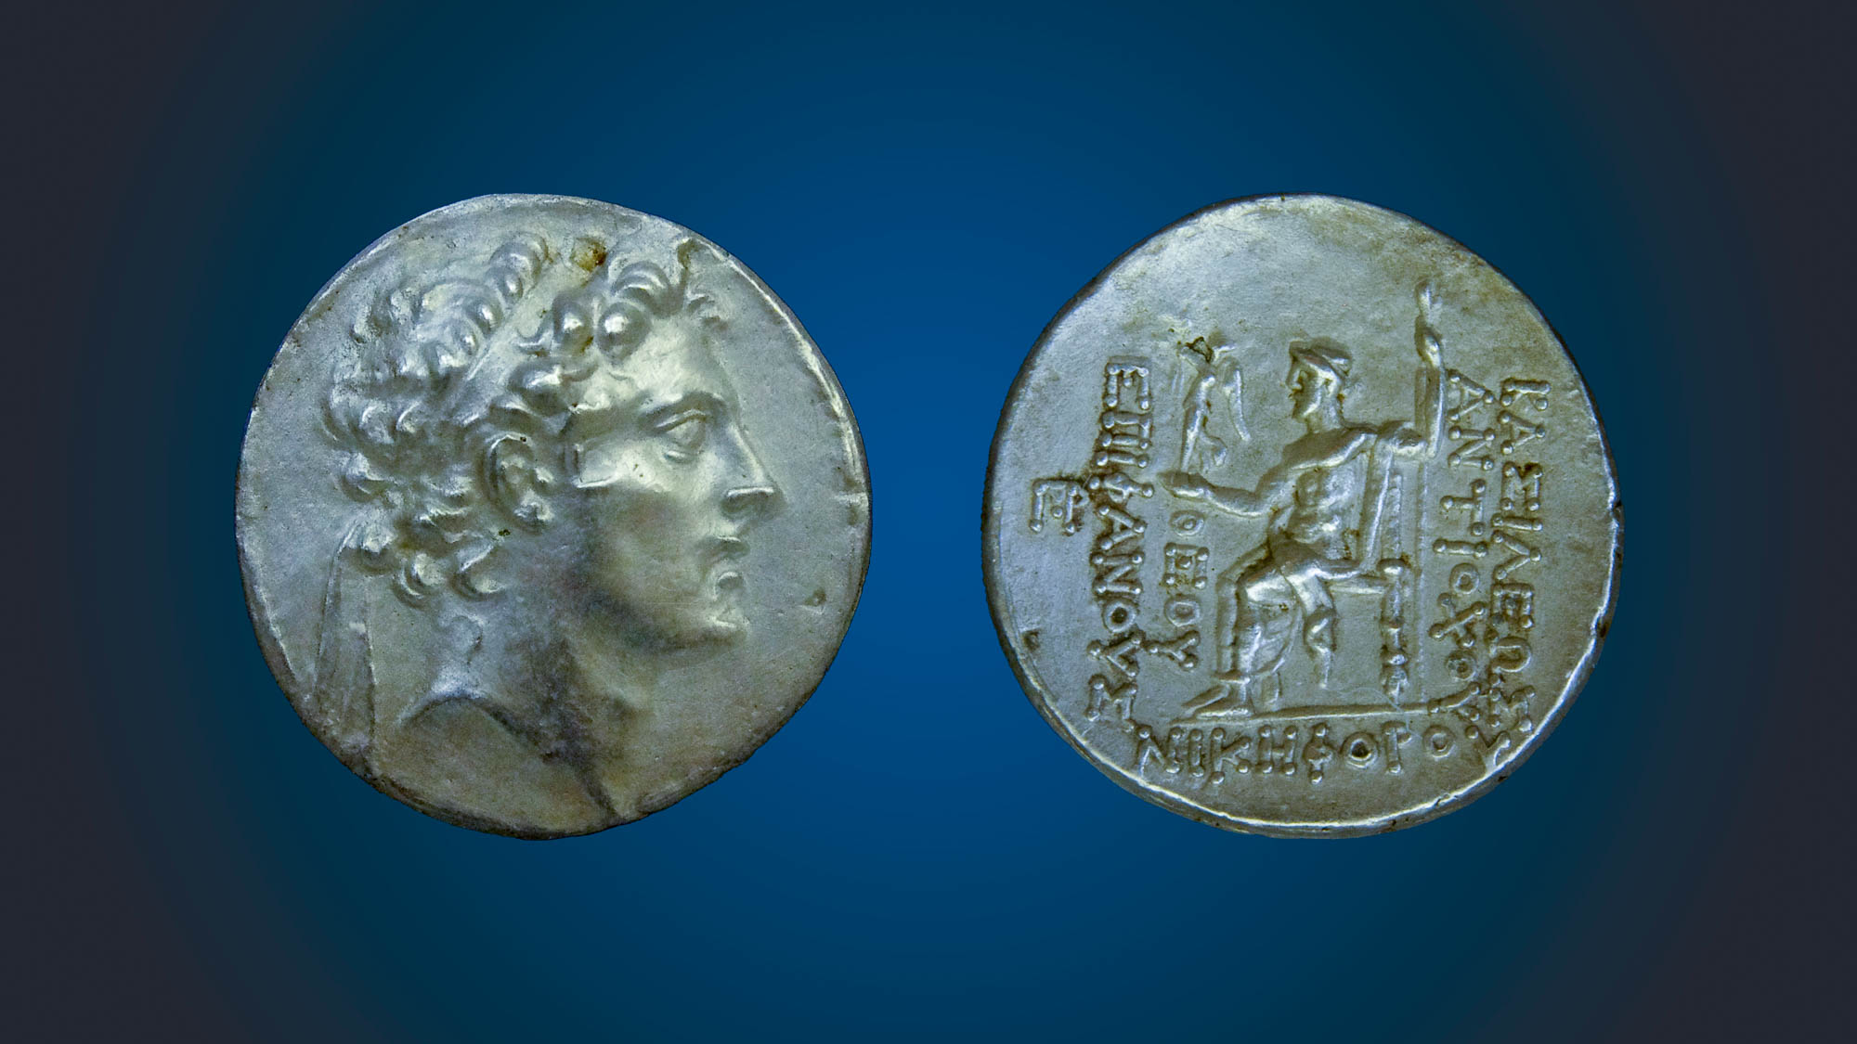
So also the tongue is a small member yet boasts of great things
Silver tetradrachma of Antiochus IV Epiphanes, with Zeus enthroned, 175–164 BC
3:5
Notes:
An example of making great boasts appears on the coinage of the Seleucid king Antiochus IV Epiphanes. The obverse side of this coin (left) shows a portrait of Antiochus IV, who claimed to be the manifestation of the god Zeus in the flesh. The reverse side of the coin (right) shows the god Zeus enthroned with a scepter in his left hand and a small winged statue of Nike in his right hand, placing a crown on the word “revealed/manifest” (ΕΠΙΦΑΝΟΥΣ). The inscription reads “(A coin) of King Antiochus—God Manifest, Conqueror” (ΒΑΣΙΛΕΩΣ ΑΝΤΙΟΧΟΥ ΘΕΟΥ ΕΠΙΦΑΝΟΥΣ ΝΙΚHΦΟΡΟΥ). This coin was photographed at the Trinity Evangelical Divinity School Biblical Coin Collection.
adr1409307204h

Slide 53

So also the tongue is a small member yet boasts of great things
Inscription of “Divine Claudius,” from Perga, mid-1st century AD
3:5
Notes:
An example of great boasting from the time of James is this inscription from Perga. The first two words identify the author as “Divine Claudius” (Lat. DIVI CLAVDI), assigning divinity to the Roman emperor Claudius (r. AD 41–54). Such boasting was not uncommon for Roman emperors, and many of them had temples dedicated to their worship. The inscription honors Sextus Afranius Burrus, the governor of Galatia and Pamphylia.
tb123016691

Slide 54

Behold how great a forest is set ablaze by so small a fire!
Forest fire on Mount Carmel, 2010
3:5
Notes:
James uses the example of a forest fire, which can begin with nothing more than a spark, to illustrate how only a few words can have a dramatic impact on the rest of the body. This fire lasted four days (Dec 2–5) and burned 37,000 acres (15,000 ha), which is half of the forest reserve. Forty-four people were killed, making it the deadliest fire in modern history in Israel. This image comes from יחידה אווירית משטרת ישראל and is licensed under CC BY-SA 3.0, via Wikimedia Commons: https://commons.wikimedia.org/wiki/File:Mount_Carmel_forest_fire06.jpg.
wiki1222201022572010h

Slide 55

Behold how great a forest is set ablaze by so small a fire!
Forest fire on Mount Carmel, 2010
3:5
Notes:
This deadly fire was started by a 14-year-old boy who threw a lit coal into the forest. This image comes from the Israeli Air Force and is licensed under CC-BY-SA-3.0, via Wikimedia Commons, https://commons.wikimedia.org/wiki/File:Mount_Carmel_forest_fire14.jpg
wiki122220102305

Slide 56

Behold how great a forest is set ablaze by so small a fire!
Forest fire on Mount Carmel at night, 2010
3:5
Notes:
A fire started by one boy led to many nations sending firefighting teams to help Israel battle the blaze, including Greece, Turkey, the Netherlands, Russia, and the United Kingdom. This image comes from Hali Shaked and is licensed under CC-BY-SA-2.5, via Wikimedia Commons, https://commons.wikimedia.org/wiki/File:Carmel_Fire_Highway2_near_HaBonim_021210.jpg
wiki120320101901h

Slide 57

Behold how great a forest is set ablaze by so small a fire!
Forest fire scars in Nahal Oren on Mount Carmel, 2010
3:5
Notes:
This image comes from Hanay and is licensed under CC-BY-SA-3.0, via Wikimedia Commons, https://commons.wikimedia.org/wiki/File:Nahal_Oren_after_fire_(4).JPG
wiki121120101431

Slide 58

Behold how great a forest is set ablaze by so small a fire!
Forest fire remains in Judean hills near Kiriath Jearim, 2004
3:5
Notes:
tb092504806

Slide 59

Behold how great a forest is set ablaze by so small a fire!
Oil lamp from the Roman period
3:5
Notes:
Even a very small flame, like the flame of this small Roman oil lamp, can set off a firestorm of large proportions.
tb090416962h

Slide 60

Behold how great a forest is set ablaze by so small a fire!
Scroll of the Book of Proverbs
3:5
Notes:
James’s comparison of speech to fire is reminiscent of Proverbs 16:27: “A vile man digs up evil, And the words on his lips are like scorching fire” (LSB).
wiki112720092225

Slide 61

And the tongue is a fire, the world of iniquity
Large bonfire during celebration of Lag BaOmer in the Judean hills
3:6
Notes:
This photo illustrates how a small flame may quickly grow into a large fire.
tb051506295h

Slide 62

The tongue is set among our members as the thing that defiles the entire body
Pillar with painted scenes of fullones at work in a treading vat, from Pompeii, 1st century AD
3:6
Notes:
The verb “defile” (Gk. spiloō, σπιλόω) refers to polluting or staining something. Jude 23 uses the word to describe (in metaphor) a garment that has been stained. The idea is illustrated here by a fresco of a laundry at Pompeii, which pictures a group of workers treading clothes in vats in an attempt to remove dirt and oils from clothing.
A laundry establishment in the Roman world was known as a fullonica. So far, eleven fullonicae are known from Pompeii; others have been found at places such as Herculaneum, Ostia, and Rome. The first step in the laundry process, illustrated in this fresco, was to trample the cloth in a small tub with alkaline chemicals. The alkaline chemicals were often a form of ammonia from urine collected from public donations at the front door of the shop. This worked as a release agent to dissolve dirt, oils, and grease. This fresco was photographed at the Naples Archaeological Museum.
tb0515170878

Slide 63


It sets on fire the entire cycle of life
Priest sacrificing to Attis, Archigallus, 3rd century AD
3:6
Notes:
The verb “set on fire” (Gk. phlogizō, φλογίζω) is illustrated here by a relief of a priest with two torches, perhaps in preparation for lighting a sacrifice to the god Attis (Archigallus). This relief was photographed at the Ostia Museum.
tb0517172840c

Slide 64

It sets on fire the entire cycle of life
Farnese Atlas, 2nd century AD
3:6
Notes:
The word “cycle” (Gk. trochos, τροχός) is used only here in the New Testament. It refers to something that is round, in some cases a wheel. The expression is probably intended to refer to the whole of a person’s existence. The idea is illustrated here by a statue of Atlas weighed down by a celestial globe. This statue is the oldest extant statue of Atlas. He is pictured holding a globe, although the globe is covered with constellations to indicate that it pictures the heavens, not the earth. This statue is considered to be a copy of an original from the 1st century BC. It was photographed at the Naples Archaeological Museum.
tb0515170133c

Slide 65

It sets on fire the entire cycle of life
Relief of Urania, muse of astronomy, gesturing to a globe, possibly from Italy, 1st century AD
3:6
Notes:
This relief shows the muse Urania gesturing toward a globe. Close inspection reveals that this globe is also held up by a small figure, likely intended to represent Atlas. The globe in this case should also be taken to represent the cosmos, and thus everything that exists. This relief was photographed at the Louvre Abu Dhabi.
tb0520184994

Slide 66

It sets on fire the entire cycle of life, and is itself set on fire by hell
Jerusalem and Hinnom Valley (gai hinnom = Gehenna; aerial view from the north)
3:6
Notes:
The word often translated as “hell” in this verse is “Gehenna” in Greek (γέεννα). The word Gehenna comes from the Hebrew gai (גַּיְא), meaning “valley,” and the Hebrew name “Hinnom” (הִנֹּם), the name of the valley on the west and south sides of ancient Jerusalem. By the 1st century AD, gai hinnom had become gehenna and was identified with a place of fiery torment. The association of the Hinnom Valley with a place of fiery torment may derive from the sacrifices to the pagan gods that were made there in earlier periods (cf. Jer 7:31-32). See the next slide for labels.
ws012017078

Slide 67
It sets on fire the entire cycle of life, and is itself set on fire by hell
Hinnom Valley
Western Hill of Jerusalem
Hinnom Valley
Jerusalem and Hinnom Valley (gai hinnom = Gehenna; aerial view from the north)
3:6
Notes:
The word often translated as “hell” in this verse is “Gehenna” in Greek (γέεννα). The word Gehenna comes from the Hebrew gai (גַּיְא), meaning “valley,” and the Hebrew name “Hinnom” (הִנֹּם), the name of the valley on the west and south sides of ancient Jerusalem. By the 1st century AD, gai hinnom had become gehenna and was identified with a place of fiery torment. The association of the Hinnom Valley with a place of fiery torment may derive from the sacrifices to the pagan gods that were made there in earlier periods (cf. Jer 7:31-32).
ws012017078

Slide 68

It sets on fire the entire cycle of life, and is itself set on fire by hell
Hinnom Valley (from the south)
3:6
Notes:
This photo of the Hinnom Valley was taken by David Bivin in 1966 when it was part of the no-man’s land between Israel and the Jordanian forces occupying the Old City.
db6607262508

Slide 69

It sets on fire the entire cycle of life, and is itself set on fire by hell
Hinnom Valley with evidence of a recent fire (from the west)
3:6
Notes:
This photo shows remains of a fire on a slope of the Hinnom Valley.
tb061616047h

Slide 70

It sets on fire the entire cycle of life, and is itself set on fire by hell
Fire in the Hinnom Valley
3:6
Notes:
The term “Gehenna” would have been a familiar one to James’s Jewish audience.
tb052005996

Slide 71

It sets on fire the entire cycle of life, and is itself set on fire by hell
Hinnom Valley with snow (from the east)
3:6
Notes:
This image shows “hell” with snow. In the First Temple period, the Hinnom Valley was connected with child sacrifice to Baal/Molech as indicated by numerous passages. This probably was one of the main reasons for the association of this valley with the place of eternal judgment.
“And they have built the high places of Tophet, which is in the valley of the son of Hinnom, to burn their sons and their daughters in the fire; which I commanded them not, neither came it into my heart. Therefore, behold, the days come, saith the LORD, that it shall no more be called Tophet, nor the valley of the son of Hinnom, but the valley of slaughter: for they shall bury in Tophet, till there be no place. And the carcasses of this people shall be meat for the fowls of the heaven, and for the beasts of the earth; and none shall fray them away. Then will I cause to cease from the cities of Judah, and from the streets of Jerusalem, the voice of mirth, and the voice of gladness, the voice of the bridegroom, and the voice of the bride: for the land shall be desolate.” (Jer 7:31-34, KJV)
tb021504810

Slide 72

It sets on fire the entire cycle of life, and is itself set on fire by hell
Lekythos with Charon welcoming a soul into his boat, circa 500–450 BC
3:6
Notes:
The Greco-Roman conception of hell, with which James’s audience would have also been familiar, was the underworld known as Hades (cf. Luke 10:15; Acts 2:27). This lekythos depicts the Greek god Charon, who ferried souls to Hades, receiving the soul of a youth into his skiff. The ferryman leans on his pole and is surrounded by the reeds of the river Acheron (one of the five rivers of the Greek underworld). This lekythos is attributed to the Tymbos painter; the vessel was photographed at the Ashmolean Museum in Oxford.
This image comes from Carole Raddato and is licensed under CC BY-SA 2.0, via Wikimedia Commons: https://commons.wikimedia.org/wiki/File:Attic_Red_Figure_(White_Ground)_Lekythos_with_Charon,_attributed_to_the_Tymbos_painter,_ca_500_-_450_BC,_Ashmolean_Museum,_Oxford,_UK_(22681344331).jpg.
wiki22681344331

Slide 73

It sets on fire the entire cycle of life, and is itself set on fire by hell
Black-figured oil flask with Weighing of Souls, from Athens, circa 480 BC
3:6
Notes:
This lekythos is decorated with a scene representing the Greco-Roman perception of the afterlife, in which souls are weighed on a scale. This lekythos was photographed at the British Museum.
tb0929198092

Slide 74

For every kind of beasts and birds, of reptiles and sea creatures . . . has been tamed by mankind
Roman mosaic depicting an African elephant being loaded onto a ship, 3rd–4th centuries AD
3:7
Notes:
The word “tamed” (Gk. damazō, δαμάζω) does not mean to domesticate, but to control or subdue. Elephants were used by the Roman army several centuries before the time of James; it was necessary to bind such animals to limit their movements, especially when travelling over bridges or on board a ship, as shown here. This mosaic comes from Veii (Isola Farnese, Italy). It was photographed at the Badisches Landesmuseum Karlsruhe, Germany. This image comes from Carole Raddato and is licensed under CC BY-SA 2.0, via Wikimedia Commons: https://commons.wikimedia.org/wiki/File:Detail_of_Roman_mosaic_from_Veii_(Isola_Farnese,_Italy)_depicting_an_African_elephant_being_loaded_onto_a_ship,_3rd-4th_century_AD,_Badisches_Landesmuseum_Karlsruhe,_Germany_(18460609338).jpg.
wiki18460609338

Slide 75

For every kind of beasts and birds, of reptiles and sea creatures . . . has been tamed by mankind
Venus standing on a chariot pulled by four elephants, from Pompeii, 1st century AD
3:7
Notes:
This fresco depicts the goddess Venus in a chariot (quadriga) pulled by four elephants. It illustrates the way in which even the largest land animals have been subdued by humans. This fresco was photographed at the Pompeii exhibition, Grand Palais, Paris 2020. This image comes from Siren-Com and is licensed under CC BY-SA 4.0, via Wikimedia Commons: https://commons.wikimedia.org/wiki/File:Pompei_peinture_murale_V%C3%A9nus.jpg.
wiki072020201319897

Slide 76

For every kind of beasts and birds, of reptiles and sea creatures . . . has been tamed by mankind
Marble relief of an African elephant, AD 79–96
3:7
Notes:
This relief was photographed at the Getty Villa in southern California (object number 71.AA.463.2). For more information, see http://www.getty.edu/art/collection/objects/6908/unknown-maker-left-member-of-a-pair-of-architectural-reliefs-with-elephants-roman-ad-80-100/
tb082214395

Slide 77

For every kind of beasts and birds, of reptiles and sea creatures . . . has been tamed by mankind
Relief of a man and woman on camels by a well, 4th–1st centuries BC
3:7
Notes:
Another large animal that was subdued by the ancients was the camel, which became a regular beast of burden long before the time of James. This relief predates the time of James by a couple of centuries. It was photographed at the Istanbul Museum of the Ancient Orient.
adr1006053386

Slide 78

For every kind of beasts and birds, of reptiles and sea creatures . . . has been tamed by mankind
Camels eating palm leaves in the Sinai desert
3:7
Notes:
tb062205413h

Slide 79

For every kind of beasts and birds, of reptiles and sea creatures . . . has been tamed by mankind
Gladiator stele from Serapium of Pergamum, Roman period
3:7
Notes:
This stele depicts men fighting a bear and a bull. Staged animal fighting and hunting was a common form of entertainment, first appearing in the early 2nd century BC. Various animals were used, including elephants, wild boars, buffaloes, aurochs, bears, lions, tigers, leopards, hyenas, and wolves. The most popular animals were lions, which were imported into Rome in significant numbers, imported mainly from Africa. Bears were less popular, and were imported from Gaul, Germany, and North Africa. Of course, such fights depended on the ability of men to first capture and transport the animals. This relief was photographed at the Bergama Museum.
tb041505883

Slide 80

For every kind of beasts and birds, of reptiles and sea creatures . . . has been tamed by mankind
“Beware of dog” mosaic in the House of the Tragic Poet at Pompeii, 1st century AD
3:7
Notes:
This mosaic floor at Pompeii is accompanied by the warning, “Beware of the dog!” (Lat. CAVE CANEM). This house, like the rest of Pompeii, was buried in the ash-fall that followed the eruption of Mount Vesuvius in AD 79.
tb0516172301

Slide 81

For every kind of beasts and birds, of reptiles and sea creatures . . . has been tamed by mankind
Fresco of a chicken, rabbit, and partridge, from Herculaneum, 1st century AD
3:7
Notes:
This fresco depicts game animals that have been captured for food. The chicken at the far left has already been plucked; it shares a frame with a rabbit. The partridge at the right has been hung up in preparation for plucking. This fresco was photographed at the Naples Archaeological Museum. This image comes from ArchaiOptix and is licensed under CC BY-SA 4.0, via Wikimedia Commons: https://commons.wikimedia.org/wiki/File:Wall_painting_-_still_life_with_food_-_Herculaneum_(IV_21)_-_Napoli_MAN_8647_-_01.jpg.
wiki100720181438541216h

Slide 82

For every kind of beasts and birds, of reptiles and sea creatures . . . has been tamed by mankind
Mosaic with birds and fruit, late 2nd or early 3rd centuries AD
3:7
Notes:
This display illustrates the domestication of a variety of birds. It was once part of the Kircherian Museum and was photographed at the National Museum of Rome.
tb0513177665

Slide 83

For every kind of beasts and birds, of reptiles and sea creatures . . . has been tamed by mankind
Falconer display
3:7
Notes:
This display was photographed at the Ajman Museum.
tb050817891h

Slide 84

For every kind of beasts and birds, of reptiles and sea creatures . . . has been tamed by mankind
Statue of a female with snake emptying venom into bowl, from Caesarea, Greco-Roman period
3:7
Notes:
This statue depicts a female with a snake wrapped around her arm, emptying its venom into a bowl. It was photographed at the Caesarea Maritima Museum.
cm1706250695

Slide 85

For every kind of beasts and birds, of reptiles and sea creatures . . . has been tamed by mankind
Mediterranean chameleon at Gezer
3:7
Notes:
tb052007785h

Slide 86

For every kind of beasts and birds, of reptiles and sea creatures . . . has been tamed by mankind
Fresco of birds and eels, from Herculaneum, 1st century AD
3:7
Notes:
This fresco depicts two shelves with fresh food. The upper shelf holds two birds, perhaps thrushes, and the lower shelf holds a couple of eels. This fresco was photographed at the Naples Archaeological Museum. This image comes from ArchaiOptix and is licensed under CC BY-SA 4.0, via Wikimedia Commons: https://commons.wikimedia.org/wiki/File:Wall_painting_-_still_life_with_food_-_Herculaneum_(IV_21)_-_Napoli_MAN_8647_-_01.jpg.
wiki100720181438541216h2

Slide 87

For every kind of beasts and birds, of reptiles and sea creatures . . . has been tamed by mankind
Mosaic panel of edible fish from the Mediterranean Sea, possibly from Populonia, circa AD 100
3:7
Notes:
This mosaic depicts a variety of sea creatures that were known to, and captured by, the people of approximately the time of James. It includes a variety of fish, an eel, an octopus, and a lobster. This mosaic comes from Populonia, an ancient city on the western shore of central Italy. It was photographed at the British Museum.
tb0930198695c

Slide 88

For every kind of beasts and birds, of reptiles and sea creatures . . . has been tamed by mankind
Dolphin jumping through a hoop held by trainer at Loro Parque, Tenerife Island, Spain
3:7
Notes:
Though the taming of dolphins was not known in James’s day, it is true in our day and underscores the point made here. Man can tame all kinds of animals but not the tongue. This image comes from Piotrus and is licensed under CC BY-SA 3.0, via Wikimedia Commons: https://commons.wikimedia.org/wiki/File:Dolphins_at_Loro_Parque_13.JPG.
wiki0503200720352304h

Slide 89

No one can tame the tongue; it is a restless evil
Fresco of a theater mask, from Pompeii, 1st century AD
3:8
Notes:
The word “restless” (Gk. akatastaton, ἀκατάστατον) in this context refers to something that does not rest, but is continually on the move. In Greco-Roman religion, there were shades known as lemures that were the restless spirits of the dead. The wide, staring eyes on this theater mask from Pompeii along with horns and general wild look, could be taken to represent a similar idea. It was photographed at the Naples Archaeological Museum. This image comes from WolfgangRieger and is in the public domain, via Wikimedia Commons: https://commons.wikimedia.org/wiki/File:Pompeii_-_Theatre_Mask_-_MAN.jpg.
wiki0313200925503510

Slide 90

No one can tame the tongue; it is a restless evil
Limestone snake, from Athens, 6th century BC
3:8
Notes:
The snake (Gk. ophis, ὄφις) appears regularly in religious contexts of the Greco-Roman world. Its lidless eyes also hint at the restless nature that James attributes to the tongue. This limestone carving was photographed at the Athens Acropolis Museum.
tb031806359c

Slide 91

No one can tame the tongue; it is a restless evil, full of deadly poison
Medicine bottles possibly for hemlock from Athens prison, 5th century BC
3:8
Notes:
The Greeks used hemlock (Conium maculatum) to carry out the death sentence on prisoners. It was usually drunk as a liquid. Socrates was the most famous victim of hemlock poisoning. This display was photographed at the Athens Agora Museum.
tb031806401

Slide 92

No one can tame the tongue; it is a restless evil, full of deadly poison
Scorpion on the Mount of Beatitudes
3:8
Notes:
Poison (Gk. ios, ἰός) comes in many other forms as well, including through the bites or stings of insects, such as this scorpion.
mjb1904024480h

Slide 93

No one can tame the tongue; it is a restless evil, full of deadly poison
Posthumous portrait of Cleopatra VII, from Herculaneum, 1st century AD
3:8
Notes:
One of the well-known ancient figures to die by poison was Cleopatra VII. A number of scholars consider this portrait from Herculaneum to be a posthumous portrait of her (e.g., Walker and Higgs 2001: 314–15). This image comes from Ángel M. Felicísimo and is in the public domain, via Wikimedia Commons: https://commons.wikimedia.org/wiki/File:Retrato_femenino_(26771127162).jpg.
Reference:
Walker, Susan, and Higgs, Peter.
2001 Cleopatra of Egypt: From History to Myth. Princeton, NJ: Princeton University Press.
wiki26771127162

Slide 94

No one can tame the tongue; it is a restless evil, full of deadly poison
Fresco of a banquet scene of a wealthy couple, from Pompeii, 1st century AD
3:8
Notes:
Although this fresco from Pompeii is often taken to represent a banquet, some have suggested that it depicts Cleopatra VII in the moment before her suicide by taking poison (Roller 2010: 178–79). If this is correct, she appears to drink the poison from a silver dish while her son Caesarion, also wearing a royal diadem, stands behind her. Ancient sources do not agree on the method by which she took the poison, as some argue that she was bitten by a venomous snake while others suggest it was injected, taken through an ointment, or by some other method. This fresco was photographed at the Naples Archaeological Museum.
Reference:
Roller, Duane W.
2010 Cleopatra: A Biography. Oxford: Oxford University Press.
tb0515170192

Slide 95

No one can tame the tongue; it is a restless evil, full of deadly poison
Palestinian viper with venom
3:8
Notes:
Comparison of the tongue to snake venom or poison is not unique to James. The Psalmist said, “They have sharpened their tongue like a serpent; Adders’ poison is under their lips” (Ps 140:3, ASV).
tb060806908

Slide 96

With it we bless the Lord and Father
Priestly blessing during the Feast of Tabernacles at the Western Wall in Jerusalem
3:9
Notes:
tb092302012

Slide 97

With it we bless the Lord and Father
Armenian Palm Sunday worship service at the Church of the Holy Sepulcher
3:9
Notes:
tb041506896

Slide 98

With it we bless the Lord and Father
Byzantine mosaic with a blessing, from Caesarea, circa AD 500
3:9
Notes:
This Byzantine mosaic inscription contains a blessing of both greeting and departure. The inscription reads, “Peace be upon your entrance and upon your departure” (Gk. ΕΙΡΗΝΗ Η ΕΙΣΟΔΟΣ ΣΟΥ ΚΑΙ Η ΕΧΟΔΟΣ ΣΟΥ), calling down a blessing on anyone who visited the mansion where this mosaic was once located.
adr1305196256

Slide 99

With it we curse men, who are made in the likeness of God
Lead curse tablet, from the funerary area of the Via Latina in Rome, 1st century BC
3:9
Notes:
The text of this curse invokes the Greek god Pluto to ruin the love of a couple. Such a curse comes from a selfish sense of personal injury or disrespect. This artifact was photographed at the National Museum of Rome at the Diocletian Baths.
tb0513178228

Slide 100

With it we curse men, who are made in the likeness of God
Lead tablets with curses, from Kaklik in Phrygia, 1st–3rd centuries AD
3:9
Notes:
This picture shows lead tablets dating to the 1st–3rd centuries AD on which are inscriptions cursing individuals by name. They are from Kaklik in Phrygia and were photographed in the British Museum.
adr1805171714

Slide 101

With it we curse men, who are made in the likeness of God
Jewish men arguing, discussing, and debating in the Hurva Synagogue in Jerusalem
3:9
Notes:
dp051219165

Slide 102

With it we curse men, who are made in the likeness of God
“And God created man in his own image, in the image of God created he him; male and female created he them.”
Torah scroll with Genesis 1:27
3:9
Notes:
James’s assertion that humans are made “in the likeness of God” is based on the text of Genesis 1:26-27. This Yemenite Torah scroll was photographed at The Master’s Seminary in California.
tb031416331

Slide 103

With it we curse men, who are made in the likeness of God
Michelangelo’s “Creation of Adam,” Sistine Chapel, circa 1510
3:9
Notes:
This well-known work of Michelangelo depicts God and Adam nearly touching at the point of creation. This image comes from Wikimedia Commons and is in the public domain. Source: https://commons.wikimedia.org/wiki/File:Creation_of_Adam_(Michelangelo)_Detail.jpg
wiki020320180523h

Slide 104

With it we curse men, who are made in the likeness of God
Adam and Eve in Garden of Eden, by Wenzel Peter, circa 1800
3:9
Notes:
James makes one of the few explicit references in the Bible to man being made in the likeness of God, following its initial statement in the creation account of Genesis 1:26-27. This painting of the Garden of Eden, by Wenzel Peter, was photographed at the Vatican Museums.
tb0512176054h

Slide 105

With it we curse men, who are made in the likeness of God
Tell Fekheriyeh statue, Damascus National Museum, 9th century BC
3:9
Notes:
The Tell Fekheriyeh statue includes a bilingual (Aramaic and Akkadian) inscription by Hadad-yithʿI the governor of Gozan, who dedicated the statue to Hadad (the Aramean storm-god). The Aramaic version is the oldest extant Aramaic inscription. Significantly, Hadad-yithʿI states that he is the “image” (dmwt) of Hadad. The Aramaic text of the Tell Fekheriyeh statue uses both ṣlm and dmwt to refer to the statue itself, which are cognates of Hebrew ṣlm (usually translated as “image”) and dmwt (usually translated as ”likeness”) in Genesis 1:26; 5:3; and Ezekiel 23:14-15. This is the only extra-biblical text where these terms are used together. The Aramaic ṣlm and dmwt are both rendered by Akkadian ṣalmu in the Akkadian version (see discussion in Millard and Bordreuil 1982). This image comes from Wayne Pitard and is in the public domain, via Wikimedia Commons: https://commons.wikimedia.org/wiki/File:Tell_Fekheriyeh_statue.jpg.
Reference:
Millard, A. R., and Bordreuil, P.
1982 A Statue from Syria with Assyrian and Aramaic Inscriptions. The Biblical Archaeologist 45: 135–41.
wiki12122018143829585

Slide 106

Out of the same mouth come blessing and cursing. My brothers, these things ought not to be
Marble comic mask, 2nd century AD
3:10
Notes:
The “double” nature of the tongue/mouth is in keeping with James’s teaching against the divided loyalties of the “double-minded/soul” (Moo 2002: 105). This mask was photographed at the National Museum of Rome at the Diocletian Baths.
Reference:
Moo, D.
2002 James. Zondervan Illustrated Bible Backgrounds Commentary, vol. 4, ed. C. E. Arnold. Grand Rapids: Zondervan.
tb0513178578

Slide 107

Does a spring send out from the same opening both fresh and bitter water?
Spring near Khirbet Bet Lei
3:11
Notes:
The answer to this rhetorical question is that it is not possible. Springs only produce a single kind of water. Khirbet Bet Lei is located in the southern Shephelah of Judah.
tb052816993h

Slide 108

Does a spring send out from the same opening both fresh and bitter water?
Elisha’s spring (Ein es-Sultan) in Jericho
3:11
Notes:
In ancient times, the waters that came out from this spring were bitter, but they were made sweet by the prophet Elisha (2 Kgs 2:19-22). However, at no time did it produce both bitter and sweet water.
tb052006450h

Slide 109

Does a spring send out from the same opening both fresh and bitter water?
Hot spring on the shore of the Dead Sea
3:11
Notes:
The Dead Sea is known for its very bitter (and very salty) water.
tb022806407h

Slide 110

Does a spring send out from the same opening both fresh and bitter water?
Spring at Ayun Musa, possible Marah
3:11
Notes:
Exodus 15:23-26 tells of the episode of the Israelites at Marah shortly after their departure from Egypt. The water at Marah was bitter, so they were unable to drink it. Moses prayed when the people grumbled against him, and God showed Moses a tree to throw into the water, making the water sweet. Once the spring was sweet, it was no longer bitter, a change that made it potable. This picture shows Ayun Musa, possibly the site of Marah.
tb032306473h

Slide 111

Can a fig tree, my brothers, produce olives, or can a grapevine produce figs?
Path through an olive grove on the Mount of Beatitudes
3:12
Notes:
The argument made here by James echoes a similar statement by Jesus. “Beware of the false prophets, who come to you in sheep’s clothing, but inwardly are ravenous wolves. You will know them by their fruits. Are grapes gathered from thorn bushes or figs from thistles? Even so, every good tree bears good fruit, but the bad tree bears bad fruit. A good tree cannot bear bad fruit, nor can a bad tree bear good fruit. Every tree that does not bear good fruit is cut down and thrown into the fire” (Matt 7:15-19, LSB).
tb032805784h

Slide 112

Can a fig tree, my brothers, produce olives, or can a grapevine produce figs?
Vine, fig tree, and olive tree, near Adora
3:12
Notes:
This photo shows all three of these species that James mentions, growing in the same garden. See the next slide for labels.
tb052816015h

Slide 113
Can a fig tree, my brothers, produce olives, or can a grapevine produce figs?
Fig tree
Olive tree
Grape vine
Vine, fig tree, and olive tree, near Adora
3:12
Notes:
This photo shows all three of these species that James mentions, growing in the same garden.
tb052816015h

Slide 114

Can a fig tree, my brothers, produce olives, or can a grapevine produce figs?
Fig tree near Aijalon Valley
3:12
Notes:
Mentioned over fifty times in Scripture, the fig tree (Heb. t’aynah, תְּאֵנָה; Gk. sukē, συκῆ) was extremely important for both nutritional and economic reasons in ancient times. When things were well in Israel and the people prosperous, the Bible describes “every man sitting under his own fig tree” (1 Kgs 4:25), while the prophets, when predicting judgment on Israel, speak of the fig trees being destroyed (Jer 5:17). The prophet Joel also used the revival of the fig trees to depict the restoration of Israel after repentance (2:22). Because figs are easily removed from their trees, Nahum used fig trees to illustrate the future destruction of Nineveh (3:12). Jeremiah used baskets of figs, one with rotten figs unfit to eat and one full of good fruit, as examples of those who followed God’s words and those who disobeyed (Jer 24).
tb092406757h

Slide 115

Can a fig tree, my brothers, produce olives, or can a grapevine produce figs?
Vine and fig tree near Aijalon Valley
3:12
Notes:
Grapevines are known to wrap themselves around the branches of fig trees, as here, but a grapevine has never produced figs.
tb092406787h

Slide 116

Can a fig tree, my brothers, produce olives, or can a grapevine produce figs?
Figs on a tree at Zorah
3:12
Notes:
As expected, this fig tree is producing figs, not olives.
tb060204790h

Slide 117

Can a fig tree, my brothers, produce olives, or can a grapevine produce figs?
Fig tree at Samaria (Sebaste)
3:12
Notes:
tb070507706h

Slide 118

Can a fig tree, my brothers, produce olives, or can a grapevine produce figs?
Fresco of a bird eating figs, from Oplontis, 1st century AD
3:12
Notes:
This fresco comes from Villa Poppaea at Oplontis, an estate that was destroyed (along with Pompeii and Herculaneum) in the eruption of Mount Vesuvius in AD 79. This image comes from Jebulon and is in the public domain, via Wikimedia Commons: https://commons.wikimedia.org/wiki/File:Fresco_bird_figs_Villa_Poppaea_Oplontis_Italy.jpg.
wiki072220151038531004

Slide 119

Can a fig tree, my brothers, produce olives, or can a grapevine produce figs?
Olive trees on terraces in the hill country of Ephraim
3:12
Notes:
The olive tree (Heb. zayith, זַיִת; Gk. elaia, ἐλαία) was also crucial to the economy and daily living of the Hebrews. Its oil was used for lighting, cooking, medicinal purposes, and moisturizing skin. Although black when ripe, olives were harvested for oil production while still green. Harvesters would use sticks and beat the branches, causing the fruit to fall, a process still employed today. The olives were then collected and pressed. The method of pressing olives varied during different time periods. Sometimes a small mortar was carved into the rock near the olive orchard and to be used to press the olives. Sometimes the olives were placed in baskets which were weighted down forcing the oil out of them. Olive oil can be stored for years.
tb051207289h

Slide 120

Can a fig tree, my brothers, produce olives, or can a grapevine produce figs?
Woman harvesting olives near Bethlehem
3:12
Notes:
tb111106833h

Slide 121

Can a fig tree, my brothers, produce olives, or can a grapevine produce figs?
Olive tree at Ein Harod
3:12
Notes:
tb102402828h

Slide 122

Can a fig tree, my brothers, produce olives, or can a grapevine produce figs?
Olive trees with fruit along the Haas Promenade, south of Jerusalem
3:12
Notes:
tb100202829h

Slide 123

Can a fig tree, my brothers, produce olives, or can a grapevine produce figs?
Olives ready for pressing
3:12
Notes:
tb112802825h

Slide 124

Can a fig tree, my brothers, produce olives, or can a grapevine produce figs?
Fresco of a cup with olives, a tray with fish, and two partridges, from Pompeii, 1st century AD
3:12
Notes:
This fresco comes from the Villa of Diomedes at Pompeii. It illustrates black olives prepared to be eaten fresh. This fresco was photographed at the Naples Archaeological Museum. This image comes from Carole Raddato and is licensed under CC BY-SA 2.0, via Wikimedia Commons: https://commons.wikimedia.org/wiki/File:Wall_painting_of_cup_with_olives,_tray_with_fish_and_two_partridges_from_the_Villa_of_Diomedes,_Pompeii,_Naples_National_Archaeological_Museum_(14658996419).jpg.
wiki14658996419

Slide 125

Can a fig tree, my brothers, produce olives, or can a grapevine produce figs?
Harvesting grapes near Kiriath Jearim
3:12
Notes:
The grapevine (Heb. gephen, גֶּפֶן; Gk. ampelos, ἄμπελος) produced a valuable crop. The fruit was eaten fresh or used for juice, wine, or raisins.
tb092506929h

Slide 126

Can a fig tree, my brothers, produce olives, or can a grapevine produce figs?
Grapevine growing in a fig tree near Aijalon Valley
3:12
Notes:
A grapevine can grow on a fig tree, but the tree remains separate from the vine.
tb092406786h

Slide 127

Can a fig tree, my brothers, produce olives, or can a grapevine produce figs?
Grapes on vine near Dor
3:12
Notes:
tb090506907h

Slide 128

Can a fig tree, my brothers, produce olives, or can a grapevine produce figs?
Harvesting grapes in vineyard
3:12
Notes:
tb092506847h

Slide 129

Can a fig tree, my brothers, produce olives, or can a grapevine produce figs?
Fresco of pomegranates, grapes, wine, and raisins, from Pompeii, 1st century AD
3:12
Notes:
This fresco from the House of Julia Felix in Pompeii shows fresh fruit (including grapes and pomegranates) in a large glass bowl, a jar of wine, and a jar of raisins. It illustrates three different ways in which grapes or grape products were used in the 1st century. This fresco was photographed at the Naples Archaeological Museum. This image comes from Carole Raddato and is licensed under CC BY-SA 2.0, via Wikimedia Commons: https://commons.wikimedia.org/wiki/File:Fresco_showing_fruit_bowl,_jar_of_wine,_jar_of_raisins,_from_the_House_of_Julia_Felix_in_Pompeii,_Naples_National_Archaeological_Museum_(14843192524).jpg.
wiki070420141337968c

Slide 130

Can a fig tree, my brothers, produce olives, or can a grapevine produce figs?
Fig tree at Zorah
3:12
Notes:
tb060204798h

Slide 131

Can a fig tree, my brothers, produce olives, or can a grapevine produce figs?
Fig tree with fruit, near Aijalon
3:12
Notes:
tb101202004h

Slide 132

Can a fig tree, my brothers, produce olives, or can a grapevine produce figs?
Basket of good figs
3:12
Notes:
tb092506016h

Slide 133

Who is wise and understanding among you?
Statue of Wisdom in the Library of Celsus at Ephesus, circa AD 100
3:13
Notes:
The statue shown here is a personification of wisdom, represented as a goddess. It was originally placed in the façade of the Library of Celsus in Ephesus, where it has now been restored. The inscription reads “Wisdom of Celsus” (Gk. ΣΟΦΙΑ ΚΕΛΣΟΥ).
tb010317241

Slide 134

Who is wise and understanding among you?
Statue of Understanding in the Library of Celsus at Ephesus, circa AD 100
3:13
Notes:
This statue is a personification of understanding, represented as a goddess. It was originally placed in the façade of the Library of Celsus in Ephesus, where it has now been restored. The inscription reads “Understanding of Celsus” (Gk. ΕΠΙΣΤΗΜΗ ΚΕΛΣΟΥ).
tb010317239

Slide 135

Who is wise and understanding among you?
Bronze bust of Pythagoras, Roman copy
3:13
Notes:
Greco-Roman culture in the 1st century valued wisdom and prized philosophy. The term philosophy (Gk. philosophia, φιλοσοφία) means “love of wisdom” and is commonly thought to have originated with the philosopher Pythagoras (circa 570–495 BC). Pythagoras is now most famous for the Pythagorean theorem named after him, even though the theorem likely did not originate with him. This bronze bust of Pythagoras was photographed at the Naples Archaeological Museum.
tb111705779h

Slide 136

Who is wise and understanding among you?
Herm of the Greek philosopher Socrates, 1st century AD
3:13
Notes:
Socrates (circa 470–399 BC) continued to be revered as a wise philosopher during the 1st century, when James was written. This picture shows a herm of Socrates from the 1st century AD that is considered to be based on a 4th century BC original crafted by Lysippos. The inscription on this herm reads, “Socrates, [son] of Sophroniscus, the Athenean” (ΣΟΚΡΑΤΗΣ ΣΟΦΡΟΝΙΣΚΟΥ ΑΘΗΝΑΙΟΣ). This herm was photographed at the Capitoline Museums in Rome.
tb0514179460

Slide 137

Who is wise and understanding among you?
Fresco with scene from the Judgment of Solomon, from Pompeii, 1st century AD
3:13
Notes:
Given that James’s audience was Jewish, they would have been familiar with the wisdom of Solomon. What is perhaps unexpected is that Solomon’s wisdom seems to have been known even outside the Jewish community, illustrated here by a fresco from Pompeii that depicts one of the more famous scenes from Solomon’s life. This fresco depicts a scene in which he acted as judge in the case of the two women who were fighting over a child (1 Kgs 3:15-27). Of particular interest is the way the artist has depicted the people and setting in a way that reflects the 1st century world. Not only are the soldiers dressed as Romans, but the judge and his associates are sitting on a raised platform (bema) while the woman pleads her case before them. This is quite similar to the bema discovered at Corinth and is likely what Paul and his contemporaries would have envisioned the judgment seat of Christ to look like, at least in a relative way. This fresco comes from the House of the Doctor at Pompeii. It was photographed at the Naples Archaeological Museum.
tb0515170279c

Slide 138

Who is wise and understanding among you?
Icon of “Jesus Christ, the Wisdom of God,” 14th century AD
3:13
Notes:
Jesus was revered as “the wisdom of God” by the early church (cf. 1 Cor 1:24). This icon shows Jesus holding a book; the inscriptions in red that surround Him read, “Jesus Christ, the Wisdom of God” (Gk. I[ΗΣΟΥΣ] Χ[ΡΙΣΤΟ]Σ Η ΣΟΦΙΑ ΤΟΥ Θ[ΕΟ]Υ). This artifact was photographed at the Museum of Byzantine Culture in Thessalonica.
tb031306333

Slide 139

Let him show by his good behavior his deeds in the gentleness of wisdom
Silver statuette of shepherd carrying sheep in skin bag over shoulder, circa 1st century AD
3:13
Notes:
The word “gentleness” (Gk. prautēs, πραΰτης) is illustrated here by a shepherd carrying a young lamb over his shoulder in a skin bag. This statue was photographed at the British Museum.
tb0929197841h

Slide 140

Let him show by his good behavior his deeds in the gentleness of wisdom
Statuette of a shepherd carrying a sheep, 1st century AD
3:13
Notes:
This statue was photographed at the Spartacus Exhibit at the Museum of the Ara Pacis in Rome.
tb0518174071

Slide 141

Let him show by his good behavior his deeds in the gentleness of wisdom
Shepherdess with lamb on the Roman road west of Assos
3:13
Notes:
This photo shows a modern-day shepherd who gently cares for a lamb.
tb010517846h

Slide 142

But if you have bitter jealousy and ambition in your heart, do not boast and lie against the truth
Balaam son of Beor inscription, from Tell Deir Alla, circa 800 BC
3:14
Notes:
Balaam is a classic example of the greed and ambition that characterize earthy wisdom (Num 22–24). The inscription shown here is an ink-on-plaster inscription discovered at Tell Deir Alla, east of the Jordan. The introduction to the first line reads “Book of Balaam son of Beor, the man who was a seer of the gods” (Heb. ספר בלעם בר בער אשׁ חזה אלהנ) (see Lemaire 1985: 35; cf. Ahituv 2008: 435–40). There are several fragments missing from the display at the Amman Museum shown here, and there is some dispute about the arrangement of the existing fragments (see further discussion in Lemaire 1985 and Ahituv 2008). The next slide includes highlights for the first part of the inscription.
References:
Ahituv, Shmuel.
2008 Echoes from the Past. Jerusalem: Carta.
Lemaire, André.
1985 Fragments from the Book of Balaam Found at Deir Alla. Biblical Archaeology Review 11/5: 26–39.
tb031115456rc

Slide 143

But if you have bitter jealousy and ambition in your heart, do not boast and lie against the truth
Balaam son of Beor inscription, from Tell Deir Alla, circa 800 BC
3:14
Notes:
Balaam is a classic example of the greed and ambition that characterize earthy wisdom (Num 22–24). The inscription shown here is an ink-on-plaster inscription discovered at Tell Deir Alla, east of the Jordan. The introduction to the first line reads “Book of Balaam son of Beor, the man who was a seer of the gods” (Heb. ספר בלעם בר בער אשׁ חזה אלהנ) (see Lemaire 1985: 35; cf. Ahituv 2008: 435–40). There are several fragments missing from the display at the Amman Museum shown here, and there is some dispute about the arrangement of the existing fragments (see further discussion in Lemaire 1985 and Ahituv 2008). The word “seer” (Arm. חֹזֶה) is underlined.
References:
Ahituv, Shmuel.
2008 Echoes from the Past. Jerusalem: Carta.
Lemaire, André.
1985 Fragments from the Book of Balaam Found at Deir Alla. Biblical Archaeology Review 11/5: 26–39.
tb031115456rc

Slide 144

But if you have bitter jealousy and ambition in your heart, do not boast and lie against the truth
Double herm of Aristotle
3:14
Notes:
Aristotle used the word “ambition” (Gk. eritheia, ἐριθεία) to describe the “selfish party spirit that governed many politicians in his day” (Moo 2002: 106). This herm was photographed at the Athens Archaeological Museum.
Reference:
Moo, Douglas.
2002 James. Zondervan Illustrated Bible Backgrounds Commentary, vol. 4, ed. C. E. Arnold. Grand Rapids: Zondervan.
tb011601105h

Slide 145

But if you have bitter jealousy and ambition in your heart, do not boast and lie against the truth
Marble bust of Caligula, from Gortys, Crete, circa AD 40
3:14
Notes:
Caligula was the Roman emperor from AD 37–41. He was described by ancient authors as cruel, sadistic, sexually perverted, and tyrannical, and thus would have been a current and well-known example of what James warns against. Caligula’s short reign ended in assassination at the hands of officers of the Praetorian Guard, senators, and courtiers. This bust was photographed at the Heraklion Archaeological Museum. This image comes from Jebulon and is in the public domain, via Wikimedia Commons: https://commons.wikimedia.org/wiki/File:Caligula_head_archmus_Heraklion.jpg.
wiki02232015125612615

Slide 146

But if you have bitter jealousy and ambition in your heart, do not boast and lie against the truth
Adam and Eve expelled from Eden, depicted in Mar Saba monastery
3:14
Notes:
This verse warns the audience of the book against lying against the truth out of jealousy and ambition. Jesus refers to the devil as the “father of lies” in John 8:44. Among the lies of the devil is that with which he tempted the woman in the Garden, saying that what God had said was not true and that eating of the fruit would lead to becoming like God. This picture from the Mar Saba monastery includes biblical scenes, including Adam and Eve leaving the Garden in sorrow and the serpent winds around their feet.
tb010107309

Slide 147

But if you have bitter jealousy and ambition in your heart, do not boast and lie against the truth
Temple of Apollo at Corinth (from the west)
3:14
Notes:
The Greek deity of truth was the goddess Aletheia, whose Roman equivalent was Veritas. Apollo, however, was also associated with truth, particularly through his connection with prophecy. According to Plutarch (Moralia 657e), he was in part raised by Aletheia, although he was the son of Zeus and Leto, one of the many women with whom Zeus had affairs. This picture shows the temple of Apollo at Corinth.
tb050803142h

Slide 148

This wisdom is not a wisdom that comes down from above
Storm on the Sea of Galilee with a rainbow
3:15
Notes:
The “wisdom from above” is contrasted with an “earthly, natural, demonic” wisdom—or “wisdom from below.” This points back to James 1.
“Do not be deceived, my beloved brothers. Every good thing given and every perfect gift is from above, coming down from the Father of lights, with whom there is no variation or shifting shadow” (Jas 1:16-17, LSB).
tb111103790h

Slide 149

But it is earthly, natural, demonic
Portrait head of a Cynic philosopher, probably Bion, from Antikythera shipwreck, circa 240 BC
3:15
Notes:
Philosophers professed to be lovers of wisdom, but Greek philosophy was certainly characterized by the factionalism, strife, and selfish ambition described in the previous verse. It also rejected biblical faith, and therefore was demonic. This bronze bust of a philosopher was photographed at the National Archaeological Museum of Athens.
tb011117527

Slide 150

But it is earthly, natural, demonic
Jesus and Mary Magdalene depicted in Duc In Altum in Magdala
3:15
Notes:
On this mosaic from the Duc in Altum chapel at Magdala, Mary Magdalene’s seven demons are portrayed on the tree behind her—which is also a subtle hint at Genesis 3. Connecting wisdom with demons also demonstrates their current dominion over the earth.
“And certain women who had been healed of evil spirits and infirmities: Mary that was called Magdalene, from whom seven demons had gone out.” (Luke 8:2, ASV)
tb053116465h

Slide 151

But it is earthly, natural, demonic
Bronze statuette of demon Pazuzu, Assyrian, early 1st millennium BC
3:15
Notes:
This bronze statuette of the Assyrian demon Pazuzu was photographed at the Louvre Museum.
tb0927194697

Slide 152

But it is earthly, natural, demonic
Painting of Paul delivering girl from spirit of Python, St. Lydia Chapel in Philippi
3:15
Notes:
This mural depicts Paul delivering the slave girl in Philippi from the python spirit (often translated “spirit of divination”), an episode found in Acts 16:16-18. In Acts, the episode shows the superiority and greater power of the Holy Spirit in comparison with the demonic. The episode also leads to Paul and Silas’s imprisonment, and eventually to the evangelization of the jailer in Philippi. In Greek mythology, the python was a spirit associated with the Delphic oracle.
tb010717077

Slide 153

For where jealousy and selfish ambition are, there is confusion and every vile deed
Fresco of a fight in and around the amphitheater of Pompeii, AD 59
3:16
Notes:
The word “confusion” (Gk. akatastasia, ἀκαταστασία) refers to disorderliness, disturbance, or tumult. It is illustrated here by a riot. Mobs and riots often found their beginnings in public places like the forum, theaters, or amphitheaters. In the fresco from Pompeii shown here, fighting has broken out at the amphitheater and spilled into the surrounding streets. This fresco was photographed in the Naples Archaeological Museum. See the next slide for labels.
tb0515170287

Slide 154
For where jealousy and selfish ambition are, there is confusion and every vile deed
fighting in the upper seats
elite section emptied
man being beaten
man being beaten
fighting in the arena
staircases
kiosks
Fresco of a fight in and around the amphitheater of Pompeii, AD 59
3:16
Notes:
The word “confusion” (Gk. akatastasia, ἀκαταστασία) refers to disorderliness, disturbance, or tumult. It is illustrated here by a riot. Mobs and riots often found their beginnings in public places like the forum, theaters, or amphitheaters. In the fresco from Pompeii shown here, fighting has broken out at the amphitheater and spilled into the surrounding streets. This fresco was photographed in the Naples Archaeological Museum.
tb0515170287

Slide 155

For where jealousy and selfish ambition are, there is confusion and every vile deed
The Great Theater of Ephesus
3:16
Notes:
An example of jealousy, selfishness, and disorder can be found in Acts 19, where jealous silversmiths in Ephesus dragged Paul’s travelling companions to the Great Theater, claiming that they were attempting to dethrone Artemis. The confusion and bedlam lasted for two hours and nearly turned into a riot before the town clerk defused the situation and sent everyone home.
tb041405350

Slide 156

For where jealousy and selfish ambition are, there is confusion and every vile deed
Model of the Ziggurat of Nanna, in Ur
3:16
Notes:
An example from the Hebrew Bible of both human ambition and confusion is the Tower of Babel (Gen 11:1-9). The Tower of Babel is often compared to the ziggurats of ancient Mesopotamia. This model of a ziggurat was photographed at the Bible Lands Museum in Jerusalem.
mjb1903102714h

Slide 157

For where jealousy and selfish ambition are, there is confusion and every vile deed
Forum and the Temple of Apollo at Corinth
3:16
Notes:
Paul expressed similar concern, that jealousy and selfish ambition might characterize the church in Corinth. “For I fear that perhaps when I come I may find you not as I wish, and that you may find me not as you wish—that perhaps there may be quarreling, jealousy, anger, hostility, slander, gossip, conceit, and disorder. I fear that when I come again my God may humble me before you, and I may have to mourn over many of those who sinned earlier and have not repented of the impurity, sexual immorality, and sensuality that they have practiced” (2 Cor 12:20-21, ESV).
tb031706097h

Slide 158

For where jealousy and selfish ambition are, there is confusion and every vile deed
Statue of Hera, from Rome, mid-2nd century AD
3:16
Notes:
Greek mythology includes many stories of the jealousy of the goddess Hera. Her jealousy in these stories is typically aroused by the many affairs of her husband Zeus. This statue of Hera is considered to be a copy of an original from the 5th century BC. It was photographed at the Vatican Museums.
tb0512176179

Slide 159

For where jealousy and selfish ambition are, there is confusion and every vile deed
Dionysus Sarcophagus of Attic Type, marble, from Perga, 3rd century AD
3:16
Notes:
This relief of tumult and bedlam is depicted on the so-called “Dionysus Sarcophagus.” Dionysus was the god of wine and was often depicted drunk. The behavior of the figures on this relief it illustrates confusion and vileness. This sarcophagus was photographed at the Antalya Museum. A removable graphic has been added to this photo to avoid causing offense or surprise.
tb123016947

Slide 160

But the wisdom from above is first pure
Statue of Vestal Virgin at House of the Vestal Virgins, Upper Via Sacra, Rome, 2nd century AD
3:17
Notes:
The word “pure” (Gk. hagnos, ἁγνός) is a cultic word that refers to being holy, innocent, or undefiled. It is sometimes used of women who are chaste (2 Cor 11:2; Titus 2:5). An illustration comes from the Vestal Virgins in the Greco-Roman world. These virgins acted as priestesses of the goddess Vesta and were required to remain chaste through the length of their service as a sign of holiness. The base on which this statue stands has an inscription identifying her as Flavia Publica, the Vestalis Maxima, most eminent priestess of Vesta cult. This image comes from Carole Raddato and is licensed under CC BY-SA 2.0, via Wikimedia Commons: https://commons.wikimedia.org/wiki/File:House_of_the_Vestal_Virgins_(Atrium_Vestae),_Upper_Via_Sacra,_Rome_(9114131999).jpg.
wiki91141319991022

Slide 161

But the wisdom from above is first pure, then peaceable
Grave stele depicting two women shaking hands, circa 350 BC
3:17
Notes:
The attribute of being “peaceable” (Gk. eirēnikos, εἰρηνικός) indicates being involved in or promoting harmonious relationships. Peace is illustrated here by two women shaking hands, a sign that was sometimes used to signify an agreement between parties. This image comes from The Metropolitan Museum of Art and is in the public domain. Source: https://www.metmuseum.org/art/collection/search/255192
met255192

Slide 162

But the wisdom from above is first pure, then peaceable
Marble relief with Tiberius, Concordia, and a genius, AD 14–37
3:17
Notes:
Peace is illustrated here by a depiction of the Roman goddess Concordia, who embodied agreement and peace. She was regarded as the equivalent of the Greek goddess Harmonia. This relief was photographed at the Getty Villa in southern California.
tb100919596h

Slide 163

But the wisdom from above is first pure, then peaceable, gentle
Statue of an adult holding a young child, mid-2nd century AD
3:17
Notes:
The word “gentle” (Gk. epieikēs, ἐπιεικής) carries the idea of being kind, tolerant, and courteous. First Peter 2:18 contrasts the “good and gentle” master with the unreasonable one. This statue illustrates the tenderness of an adult with a young child, a fitting example of gentleness or forbearance. This statue is thought to represent the Greek god Silenus holding the child Dionysus. It is likely a 2nd century AD copy of an earlier Greek original. It was photographed at the Vatican Museums.
tb0512176613

Slide 164

But the wisdom from above is first pure, then peaceable, gentle
Greek pedagogue with a boy, 3rd–2nd centuries BC
3:17
Notes:
The idea of gentleness is illustrated here by a small statue of a boy and his tutor. This image comes from The Walters Art Museum in Baltimore and is in the public domain. Source: https://art.thewalters.org/detail/3452/pedagogue-and-boy/.
twam3452

Slide 165

But the wisdom from above is first pure, then peaceable, gentle
Children at the Negba settlement in southern Israel, 1946
3:17
Notes:
Gentleness is also a trait that is often associated with those who care for children, illustrated here by a group of toddlers gathered around a young woman (cf. Mark 3:35; Gal 4:28; Heb 2:13; 1 John 3:10). This American Colony photograph was taken on February 12, 1946.
mat12772h

Slide 166

But the wisdom from above is first pure, then peaceable, gentle, submissive
Statuette of a kneeling youth, 2nd–3rd centuries AD
3:17
Notes:
The word “submissive” (Gk. eupeithēs, εὐπειθής) occurs only here in the New Testament. It refers to being compliant or obedient. It is illustrated here by a bronze statue of a youth, probably a servant or slave, who has his hand raised in what appears to be a gesture of deference or submission. This statuette was photographed at the Spartacus Exhibit, a temporary exhibition at the Ara Pacis Museum in Rome.
tb0518174003

Slide 167

But the wisdom from above is first pure, then peaceable, gentle, submissive
Marble grave stele of a young woman and her servant, circa 400–390 BC
3:17
Notes:
This grave stele depicts a young slave girl looking up at her mistress in a way that communicates submissiveness and an eagerness to serve. She holds a small jewelry box in her hands. This image comes from The Metropolitan Museum of Art and is in the public domain. Source: https://www.metmuseum.org/art/collection/search/253505
met253505h

Slide 168

But the wisdom from above is first pure, then peaceable, gentle, submissive, full of mercy
Silver cup depicting Priam begging Achilles to release the body of Hector, 1st century AD
3:17
Notes:
“Mercy” (Gk. eleos, ἔλεος) refers to kindness or compassion granted to someone in need. This silver cup from the time of James depicts the Greek legendary figure Priam requesting mercy from Achilles; his approach on bended knee and act of kissing the hand of Achilles expresses the fact that he is in no position to demand anything, and instead relies on the mercy of Achilles. This silver cup was found in 1920 in the grave of a roughly 30-year-old man in Hoby, Lolland, Denmark. It was made in Capua, south Italy, in the early 1st century AD. It was photographed at the National Museum of Denmark. This image comes from Marie-Lan Nguyen and is licensed under CC BY-SA 4.0, via Wikimedia Commons: https://commons.wikimedia.org/wiki/File:Silver_cup_Hoby_Priam_Nationalmuseet_n2.jpg.
wiki071720172669537

Slide 169

But the wisdom from above is first pure, then peaceable, gentle, submissive, full of mercy
Mount of Beatitudes and the Sea of Galilee (aerial view from the northeast)
3:17
Notes:
James’s list shares several similarities with the list of character traits Jesus advocated in the beatitudes.
“Blessed are the poor in spirit, for theirs is the kingdom of heaven.
Blessed are those who mourn, for they will be comforted.
Blessed are the meek, for they will inherit the earth.
Blessed are those who hunger and thirst for righteousness, for they will be filled.
Blessed are the merciful, for they will be shown mercy.
Blessed are the pure in heart, for they will see God.
Blessed are the peacemakers, for they will be called children of God.
Blessed are those who are persecuted because of righteousness, for theirs is the kingdom of heaven.
Blessed are you when people insult you, persecute you and falsely say all kinds of evil against you because of me. Rejoice and be glad, because great is your reward in heaven, for in the same way they persecuted the prophets who were before you” (Matt 5:3-12, NIV).
ws040417385

Slide 170

But the wisdom from above is . . . full of mercy and good fruits
Still life fresco depicting fruit and glassware, from Pompeii, 1st century AD
3:17
Notes:
The fresh fruit on the left side of this fresco appears to depict peaches. Peaches were first cultivated in China. The fruit appeared in India around 1700 BC and was cultivated in Greece around 300 BC. The items on the left side of this fresco are thought to be dried fruits, perhaps including dates and figs. This fresco was photographed at the Naples Archaeological Museum. This image comes from ArchaiOptix and is licensed under CC BY-SA 4.0, via Wikimedia Commons: https://commons.wikimedia.org/wiki/File:Wall_painting_-_three_still_lifes_with_fruit_and_glassware_-_Pompeii_-_Napoli_MAN_8645.jpg.
wiki1007201814383879h

Slide 171

But the wisdom from above is . . . full of mercy and good fruits
Still life fresco depicting a glass bowl of fruit, from Boscoreale, circa 50 BC
3:17
Notes:
This fresco comes from Room M of the Villa of P. Fannius Synistor at Boscoreale. The site was buried by the eruption of Mount Vesuvius in AD 79. Room M functioned as a bedroom. This image comes from The Metropolitan Museum of Art and is in the public domain. Source: https://www.metmuseum.org/art/collection/search/247017
met247017

Slide 172

But the wisdom from above is . . . full of mercy and good fruits
Grapes on vine in Medeba
3:17
Notes:
The grapes on this vine in Medeba illustrate fruit, a picture that this verse uses to describe the produce of wisdom in a figurative way.
tb061304286h

Slide 173

But the wisdom from above is . . . full of mercy and good fruits
Fruit vendor near Nablus market
3:17
Notes:
This picture shows a fruit vendor near Nablus pushing a cart full of good fruit, illustrating the idea of wisdom’s good fruit.
tb052916526h

Slide 174

But the wisdom from above is . . . full of mercy and good fruits, impartial
Bedouins greeting each other with a kiss
3:17
Notes:
The word “impartial” (Gk. adiakritos, ἀδιάκριτος) occurs only here in the New Testament; it probably refers to being nonjudgmental or not divisive. This understanding is illustrated here by two Bedouin men greeting each other with a kiss, showing that they are accepting and welcoming each other. A kiss of salutation was a commonly commended greeting among the early church (cf. 1 Cor 16:20; 2 Cor 13:12; 1 Thess 5:26; 1 Pet 5:14). This American Colony photograph was taken between 1898 and 1946.
mat01346h

Slide 175

But the wisdom from above is . . . full of mercy and good fruits, impartial
Grave stele with a man shaking hands with a youth, from Athens, circa 400 BC
3:17
Notes:
In Roman civil society, the joining of right hands, known as dextrarum iunctio, was used for meeting and parting, as well as to signify harmony, affinity, friendship, and loyalty (Tac. Hist. 1.54.1, 2.8.2). In domestic scenes, it sometimes represented the marriage relationship, and in scenes of a political nature the handclasp represented political concord at the conclusion of a contract. This relief is shown here to illustrate James’s desire that his audience be impartial and accepting, not divisive. This grave stele showing a handshake was photographed at the Athens Archaeological Museum.
mjb011117032

Slide 176

But the wisdom from above is . . . full of mercy and good fruits, impartial
Alexander the Great in battle with Darius III, from Pompeii, circa 125–120 BC
3:17
Notes:
It is also possible that “impartial” (Gk. adiakritos, ἀδιάκριτος) pertains to not being uncertain, but to being single-minded and unhesitating (in contrast to the one who is “double-minded, uncertain in all his ways,” 1:8). This understanding is reflected in the NASB’s “unwavering,” for example. Although not a biblical figure, Alexander the Great was known for his extraordinary focus and single-minded drive. He did not waver from his objective of conquering the world. James’s audience would have been well acquainted with Alexander the Great, who was responsible for the Hellenization of the entire Mediterranean basin and many of the regions beyond. This mosaic depicts Alexander the Great engaged in battle with Darius III, the last king of the Persian empire. Alexander’s face shows the focus and resolve that characterized his rise to power. It is thought that this mosaic, which comes from the late 2nd century BC, is likely a copy of a 4th century painting by the Greek painter Philoxenos. It was discovered in the exedra of House of Faun at Pompeii and was photographed at the Naples Archaeological Museum.
tb0515170673

Slide 177

But the wisdom from above is . . . full of mercy and good fruits, impartial
Double-sided herm of Herodotus and Thucydides, 2nd century AD
3:17
Notes:
The opposite of being single-minded and unhesitating is illustrated by this two-faced herm. This and similar herms may be reminiscent of the two-faced Roman god Janus, who was depicted looking both to the past and the future. This two-faced, marble statue is considered a 2nd century AD Roman copy of a 4th century BC Greek original. It was photographed at the Naples Archaeological Museum.
tb0515171488

Slide 178

But the wisdom from above is . . . full of mercy and good fruits, impartial
“King Solomon Street” sign in Jerusalem
3:17
Notes:
The word “impartial” (Gk. adiakritos, ἀδιάκριτος) also occurs once in the Greek translation of Proverbs 25:1 to describe the certainty of the proverbs of Solomon copied by the “friends” (philoi) of Hezekiah. The Masoretic Text of Proverbs 25:1 does not contain a corresponding word and simply says “men” rather than “friends.” This picture shows a sign for King Solomon Street in Jerusalem.
tb010312723

Slide 179

But the wisdom from above is . . . full of mercy and good fruits, impartial, without hypocrisy
Head of a comic actor, late 1st century AD
3:17
Notes:
“Without hypocrisy” (Gk. anupokritos, ἀνυπόκριτος) refers to what is genuine or sincere, without pretense. The idea of hypocrisy is beautifully rendered in this bust, which portrays an actor wearing a comic mask. The mask gives the impression from a distance that the actor is continually smiling, even though closer inspection reveals that the actor himself is not. This statue was photographed at the Vatican Museums.
tb0512176536

Slide 180

But the wisdom from above is . . . full of mercy and good fruits, impartial, without hypocrisy
Female holding a theatrical mask, 2nd century AD
3:17
Notes:
The use of masks allowed a theatrical actor to portray someone whom they were not, as with this female holding the mask of a bearded male. James calls his audience to sincerity with one another, not pretending to be other than what they are. This statue is thought that this 2nd century AD statue is a copy of a 5th century BC original. It was photographed at the Naples Archaeological Museum.
tb0515171184

Slide 181

But the wisdom from above is . . . full of mercy and good fruits, impartial, without hypocrisy
Melpomene (a Greek muse) holding mask of Pan or Satyr, from Petra, 1st century AD
3:17
Notes:
Sincerity is illustrated here by a relief of an actor who has removed her mask, revealing her true face. It is thought that the young woman represents Melpomene, the Greek muse of Tragedy. This sculpture comes from Petra and was photographed at the Jordan Museum in Amman.
tb031115484r

Slide 182

But the wisdom from above is . . . full of mercy and good fruits, impartial, without hypocrisy
Modern depiction of Pharisees declaring that the whole world has gone after Jesus
3:17
Notes:
In Matthew 23, Jesus repeatedly denounces the Pharisees as hypocrites. Jesus’s criticism of the Pharisees largely did not concern their teaching (although He did criticize their stress on oral tradition added to the biblical law), but that, while being superficially careful about following certain commandments, they had lost sight of the heart of the law and, in hypocrisy, violated the law by their wrong treatment of others, desire for the praise of men, and pride. This modern fresco was photographed at the chapel of Bethphage.
tb060116244h

Slide 183

And the fruit of righteousness is sown in peace by those who make peace
Man sowing grain on the Mount of Olives, circa 1930
3:18
Notes:
The phrasing of this verse is somewhat awkward, since “fruit” (Gk. karpos, καρπός) is usually understood to be the product of growth and harvest, not the item that is sown (cf. Matt 13:27; Luke 8:5). Some versions reword the sentence to relieve some of this tension, or simply replace “fruit” with “seeds.” The gist of the metaphor, however, seems clear enough.
This American Colony photo was taken between 1927 and 1933. The walls of the Old City are visible in the background. The peak of the façade of the Church of All Nations (Gethsemane) is visible on the middle left. On the horizon, the three domes are (from left to right) the Al Aqsa Mosque, the Hurvah Synagogue (destroyed in 1948), and the Dome of the Rock.
mat02971h

Slide 184

And the fruit of righteousness is sown in peace by those who make peace
Bronze seed-sower figurine, Roman, 1st–2nd centuries AD
3:18
Notes:
This figurine shows a man sowing seed. His left hand grasps a fold of his garment in which is a pile of seed, while his right is flung outward as he spreads the seed across recently tilled soil. This bronze figurine is in the Jared James Clark Collection.
tb0309169388h

Slide 185

And the fruit of righteousness is sown in peace by those who make peace
The Mount of Beatitudes from the chapel (from the northeast)
3:18
Notes:
James’s reference to making peace is similar to Jesus’s blessing on peacemakers (Matt 5:9).
db6704091001h

Slide 186

And the fruit of righteousness is sown in peace by those who make peace
Lekythos with a young man giving a young woman a dove, from Athens, circa 450 BC
3:18
Notes:
This lekythos depicts a young woman sitting in a chair, holding a piece of fruit and a flower. In front of her stands a draped youth, giving her a dove as present. The scene is marked by peace and concord. This lekythos was photographed at the Schloss Wilhelmshöhe in Kassel, Germany. This image comes from ArchaiOptix and is licensed under CC BY-SA 4.0, via Wikimedia Commons: https://commons.wikimedia.org/wiki/File:Nikon_Painter_ARV_652_33bis_woman_sitting_in_a_chair_and_standing_draped_youth_(04).jpg.
wiki06112017140051h

Slide 187

And the fruit of righteousness is sown in peace by those who make peace
“And the work of righteousness shall be peace; and the effect of righteousness, quietness and confidence for ever.”
Isaiah 32:17 on the Great Isaiah Scroll
3:18
Notes:
The words of James are reminiscent of the prophet Isaiah when he said, “The work of righteousness will be peace, And the effect of righteousness, quietness and assurance forever” (Isa 32:17, NKJV). The Great Isaiah Scroll is owned by the Israel Museum. This image is public domain, from Wikimedia: https://commons.wikimedia.org/wiki/File:The_Great_Isaiah_Scroll_MS_A_(1QIsa)_-_Google_Art_Project-x2-y0.jpg
isax2y0

Slide 188

And the fruit of righteousness is sown in peace by those who make peace
Altar dedicated to Augustan Peace, Pax Augusta, circa 26–25 BC (replica)
3:18
Notes:
In Greco-Roman culture, peace was personified as the goddess Pax. This picture shows a replica of an altar to Pax. Roman peace was, however, also part of a complex of ideas used for imperial propaganda.
tb092119937h

Slide 189

And the fruit of righteousness is sown in peace by those who make peace
“Go in Peace” sign in Ashkelon
3:18
Notes:
This picture shows a sign in Ashkelon wishing peace on visitors as they return home.
dgg052405101

Slide 190

More than 950 slides in PowerPoint format. Available now from BiblePlaces.com.
Notes:
This is a free sample of the James 3 presentation from the Photo Companion to the Bible. To purchase the full volume, visit https://www.bibleplaces.com/james/
The Photo Companion to the Bible is an image-rich resource for Bible students, teachers, and researchers. Just as a librarian stocks the shelves with as many relevant materials as possible, so we have tried to provide a broad selection of images. Our goal is that you will find in this “library” whatever it is you are looking for.
A separate student edition that comes with this volume includes about half of the number of slides, reducing the amount of background and more advanced material. We created it for use in a college course so our students could be introduced to the value of photographs in their study of the book.
Credits: The primary creators of this presentation are Steven Anderson, Chris McKinny, Kai Akagi, Kris Udd, and Todd Bolen. The photographs have an individual file code which usually includes the initials of the photographer. Other images have additional credit or source information.
Updates: We plan to update this collection as we are able. We welcome your suggestions for improving this resource (photocompanion@bibleplaces.com). Purchasers of the James volume are provided free, lifetime updates to the volume.
Copyright: This photo collection is protected by copyright law and may not be distributed without written permission from BiblePlaces.com. Slide notes should be treated as any other copyrighted written material, with credit given when quoting from these notes.
For more information, see our complete “Introduction to the Photo Companion to the Bible” online at https://www.BiblePlaces.com/Intro-Photo-Companion-Bible/. Here you will find more information about photo selection, explanatory notes, Bible translation, credit information, and copyright allowances.

