Slide 1
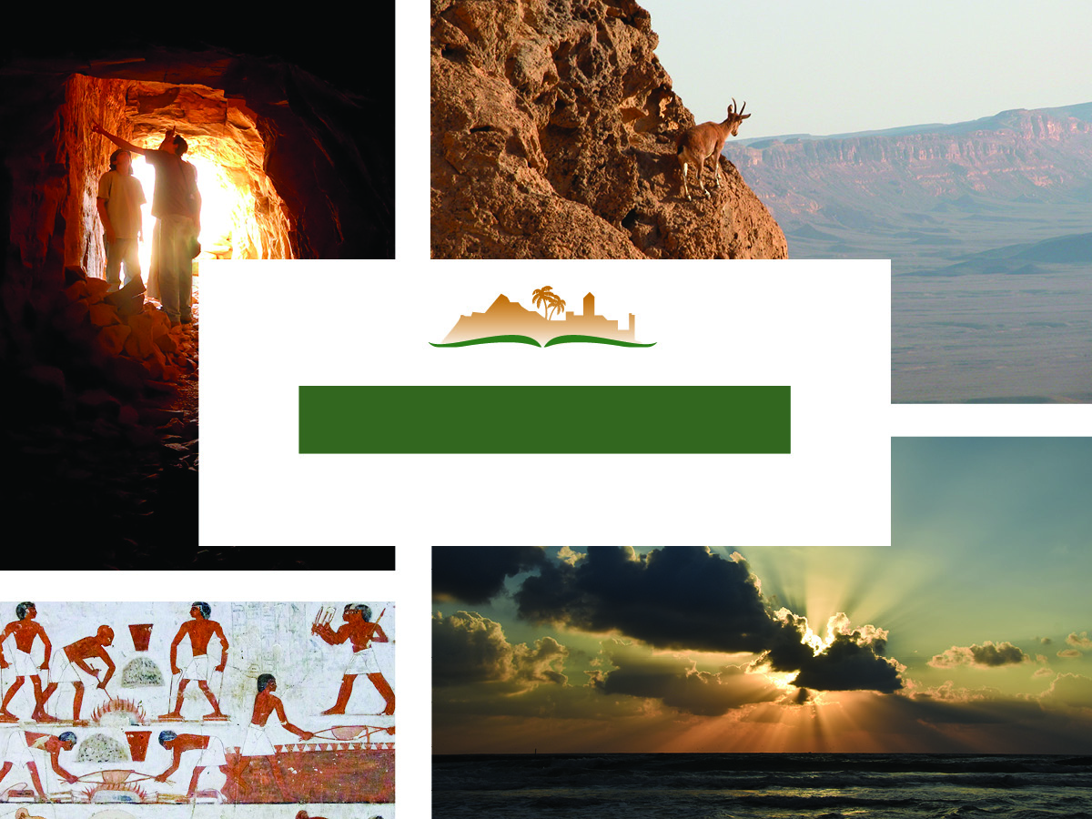
Job 6
Notes:
This is a free sample of the Job 6 presentation from the Photo Companion to the Bible. To purchase the full volume, visit https://www.bibleplaces.com/job/
The Photo Companion to the Bible is an image-rich resource for Bible students, teachers, and researchers. Just as a librarian stocks the shelves with as many relevant materials as possible, so we have tried to provide a broad selection of images. Our goal is that you will find in this “library” whatever it is you are looking for.
Credits: The primary creators of this presentation are Kris Udd and Todd Bolen. The photographs have an individual file code which usually includes the initials of the photographer. Other images have additional credit or source information.
Updates: We plan to update this collection as we are able. We welcome your suggestions for improving this resource (photocompanion@bibleplaces.com). Purchasers of the Job volume are provided free, lifetime updates to the volume.
Copyright: This photo collection is protected by copyright law and may not be distributed without written permission from BiblePlaces.com. Slide notes should be treated as any other copyrighted written material, with credit given when quoting from these notes.
For more information, see our complete “Introduction to the Photo Companion to the Bible” online at https://www.BiblePlaces.com/Intro-Photo-Companion-Bible/. Here you will find more information about photo selection, explanatory notes, Bible translation, credit information, and copyright allowances.

Slide 2
Job 6
This is a free sample of the Job 6 presentation from the Photo Companion to the Bible. To purchase the full volume, visit www.bibleplaces.com/job/ The Photo Companion to the Bible is an image-rich resource for Bible students, teachers, and researchers. Just as a librarian stocks the shelves with as many relevant materials as possible, so we have tried to provide a broad selection of images. Our goal is that you will find in this “library” whatever it is you are looking for. For more details (for this and every slide), see the Notes section below.
Ecclesiastes 2
Notes:
This is a free sample of the Job 6 presentation from the Photo Companion to the Bible. To purchase the full volume, visit https://www.bibleplaces.com/job/
The Photo Companion to the Bible is an image-rich resource for Bible students, teachers, and researchers. Just as a librarian stocks the shelves with as many relevant materials as possible, so we have tried to provide a broad selection of images. Our goal is that you will find in this “library” whatever it is you are looking for.
Credits: The primary creators of this presentation are Kris Udd and Todd Bolen. The photographs have an individual file code which usually includes the initials of the photographer. Other images have additional credit or source information.
Updates: We plan to update this collection as we are able. We welcome your suggestions for improving this resource (photocompanion@bibleplaces.com). Purchasers of the Job volume are provided free, lifetime updates to the volume.
Copyright: This photo collection is protected by copyright law and may not be distributed without written permission from BiblePlaces.com. Slide notes should be treated as any other copyrighted written material, with credit given when quoting from these notes.
For more information, see our complete “Introduction to the Photo Companion to the Bible” online at https://www.BiblePlaces.com/Intro-Photo-Companion-Bible/. Here you will find more information about photo selection, explanatory notes, Bible translation, credit information, and copyright allowances.

Slide 3

Then Job answered and said
Illustration of Job
6:1
Notes:
This image was created using generative AI.
job0601psai

Slide 4
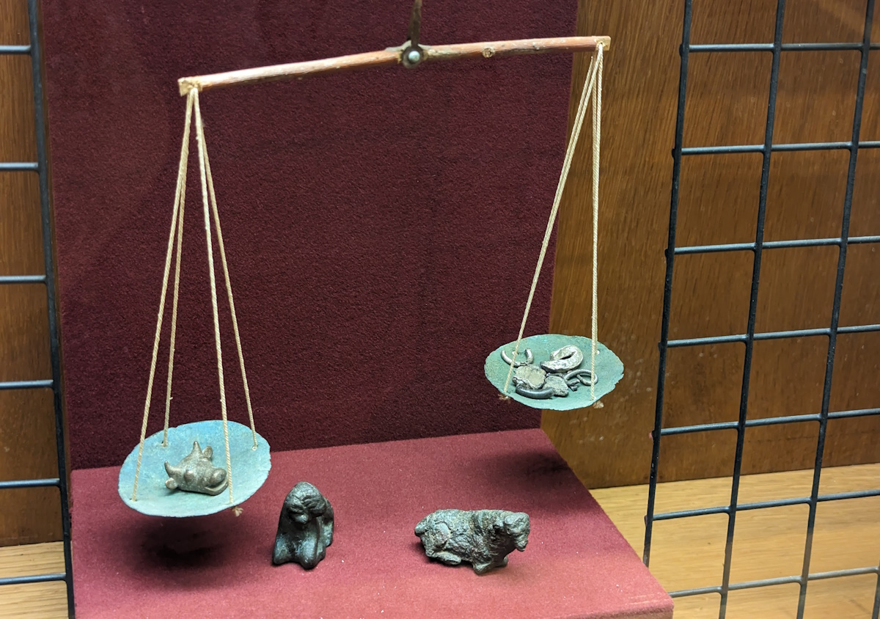
How I wish that my grief were weighed, placed in the balance with my calamity!
Balance beam scales with hacksilver and cattle-shaped weights
6:2
Notes:
This display was photographed at the Eretz Israel Museum in Tel Aviv.
ku0617231028025

Slide 5
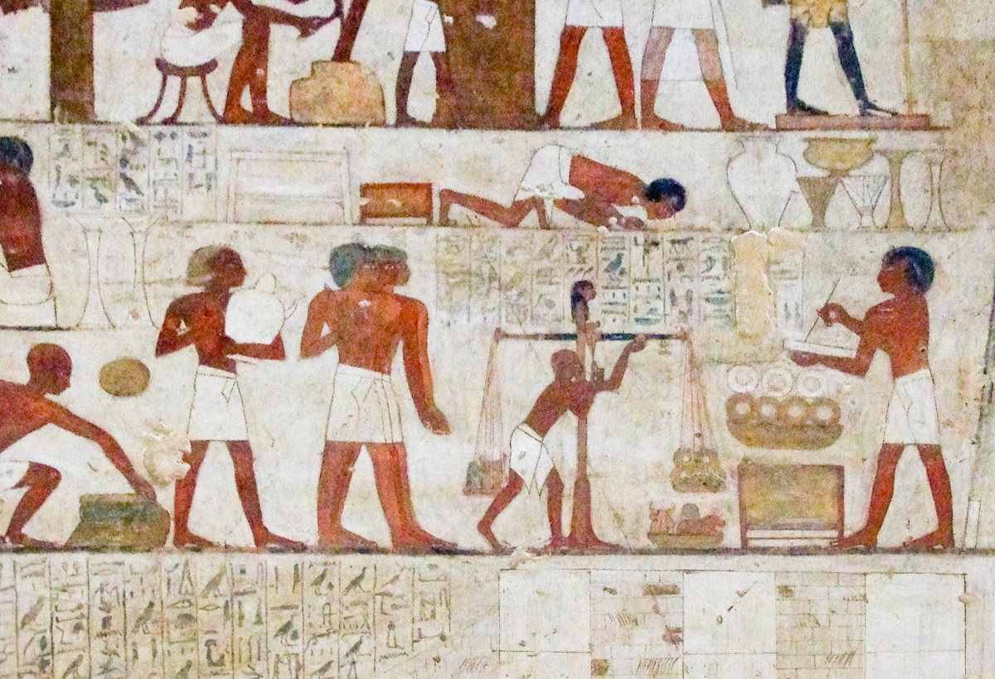
How I wish that my grief were weighed, placed in the balance with my calamity!
Metalworkers weighing gold and silver on scales, from Thebes, 15th century BC
6:2
Notes:
This tomb painting depicts men weighing out rings of gold on a balance scale. In this case, the rings are weighed on the right, and the weights (shaped like various animals) are in the pan on the left. Note also the scribe at the right, recording the weights and amounts. This painting dates to Egypt’s Dynasty 18 and was photographed in the tomb of Rekhmire at Thebes.
adr1603142969c

Slide 6
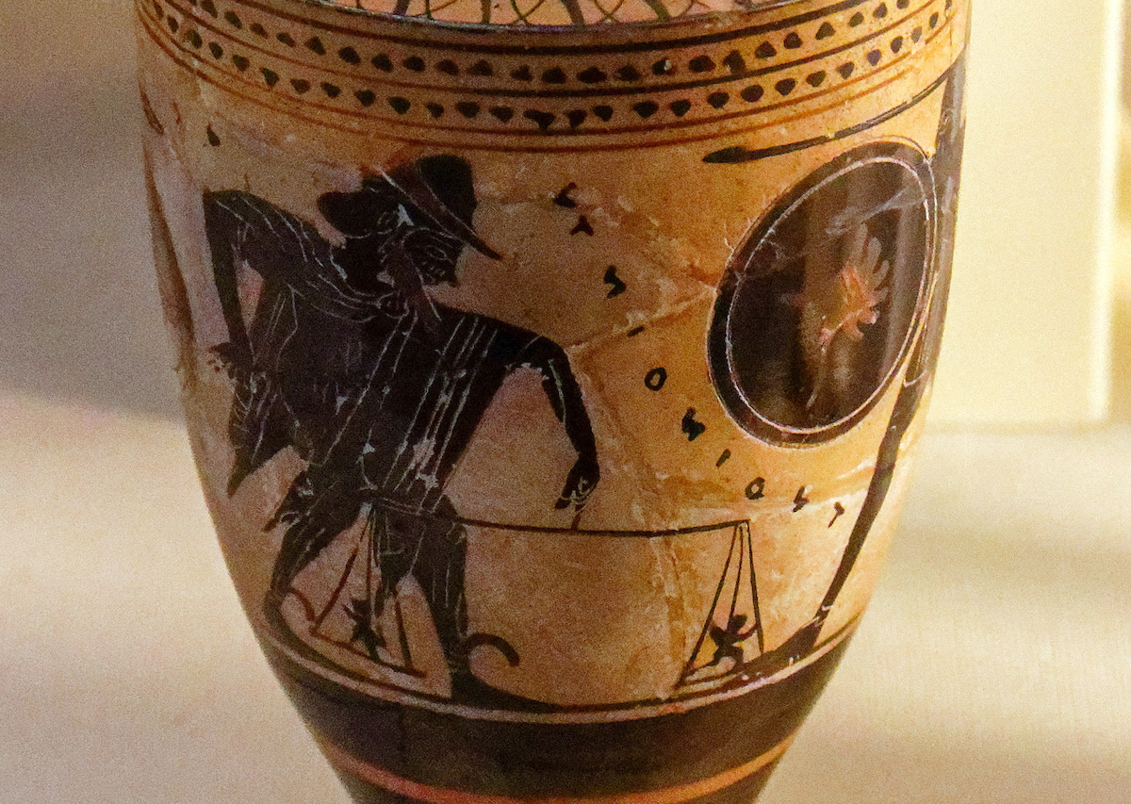
How I wish that my grief were weighed, placed in the balance with my calamity!
Black-figured oil flask with Weighing of Souls, from Athens, circa 480 BC
6:2
Notes:
Job speaks figuratively of the weighing of non-physical entities, grief and disaster. This lekythos is decorated with a scene representing the Greco-Roman perception of the afterlife, in which souls are weighed on a scale. As is typical, the souls are depicted as small, wispy characters with a generally human shape. The scale consists of a balance beam held suspended by one hand, with a plate or dish on each end in which the items to be weighed were placed. This lekythos was photographed at the British Museum.
tb0929198092c

Slide 7

For it would be heavier than the sand of the oceans
Sand along the beach at Palmachim
6:3
Notes:
bjb092121940

Slide 8
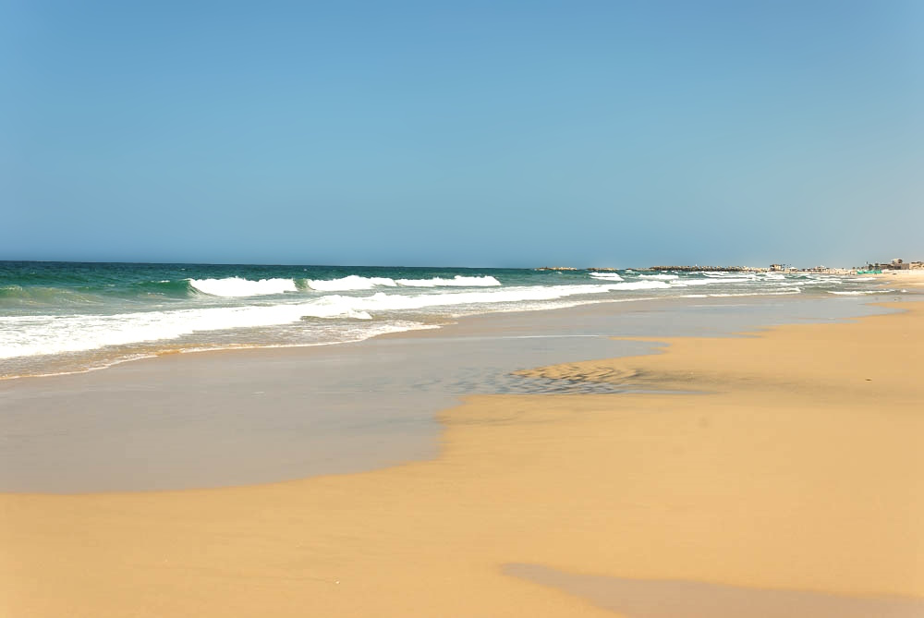
For it would be heavier than the sand of the oceans
Sandy beach at Ashkelon
6:3
Notes:
tb083006551

Slide 9
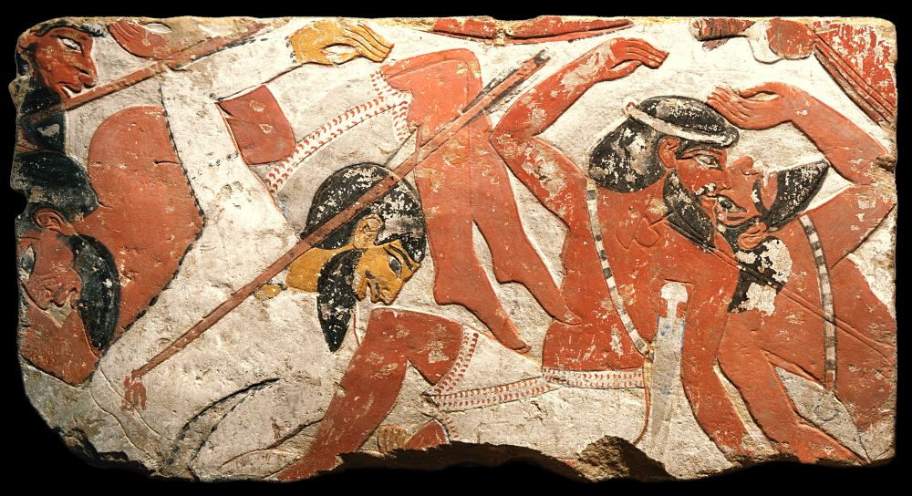
For I have been pierced by the arrows of the Almighty
Asiatic soldiers trampled by royal chariot and pierced by arrows, from el-Asasif, 15th century BC
6:4
Notes:
This Egyptian painted relief shows Asiatic soldiers who are being struck down by the forces of the Egyptian king. This image comes from the Metropolitan Museum of Art and is in the public domain. Source: https://www.metmuseum.org/art/collection/search/544720.
met544720

Slide 10
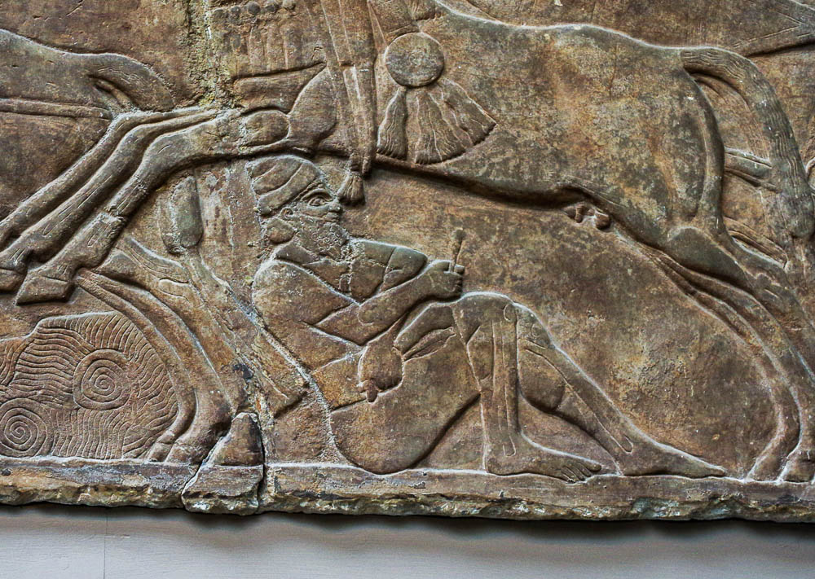
For I have been pierced by the arrows of the Almighty
Enemy pierced by arrows, from Nimrud, reign of Ashurnasirpal II, circa 860 BC
6:4
Notes:
This Assyrian relief shows an enemy soldier who has been pierced by arrows. He sits on the ground and holds the end of an arrow shaft in each hand, presumably desiring to pull them out. This relief dates to the reign of Ashurnasirpal II (883–859 BC) and was discovered at Nimrud. It was photographed at the British Museum.
adr1805194541

Slide 11
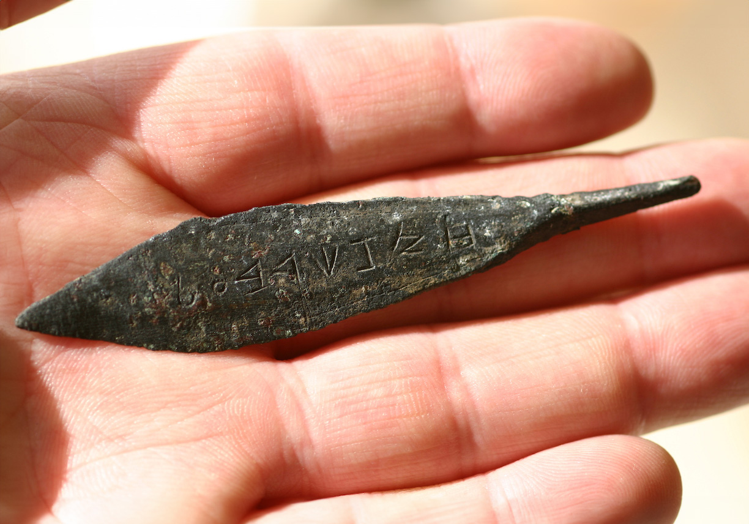
For I have been pierced by the arrows of the Almighty
Arrowhead inscribed “arrow of Zekarba’al,” 11th century BC
6:4
Notes:
The type of leaf-shaped arrow shown here is typical of arrow shapes in the Levant in the 3rd and 2nd millennia BC. This bronze arrowhead is inscribed “arrow of Zekarba’al” (Heb. חץ זכרבעל). The personal name means “Baal remembers,” similar to the name Zechariah (Heb. זְכַרְיָהוּ, “Yahweh remembers”). For an arrowhead with a similar but incomplete inscription, see Naveh (1982: 40).
Reference:
Naveh, Joseph.
1982 Early History of the Alphabet: an Introduction to West Semitic Epigraphy and Palaeography. Leiden: Brill.
as021706500c

Slide 12
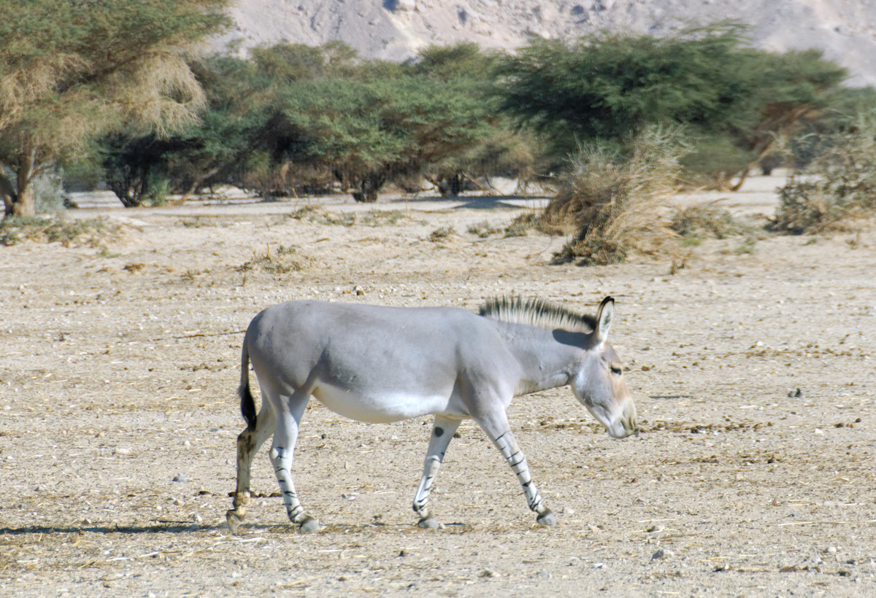
Does the wild donkey bray when he has grass?
Somali wild donkey at Haibar Nature Reserve
6:5
Notes:
The answer to this set of rhetorical questions is “no.” Animals are generally quiet when they have plenty to eat and drink. The implication is that Job’s own complaint comes from the crisis he is facing, having lost his family, fortune, and health. Haibar Nature Reserve is located in the southern Arabah Valley.
tb010712012

Slide 13
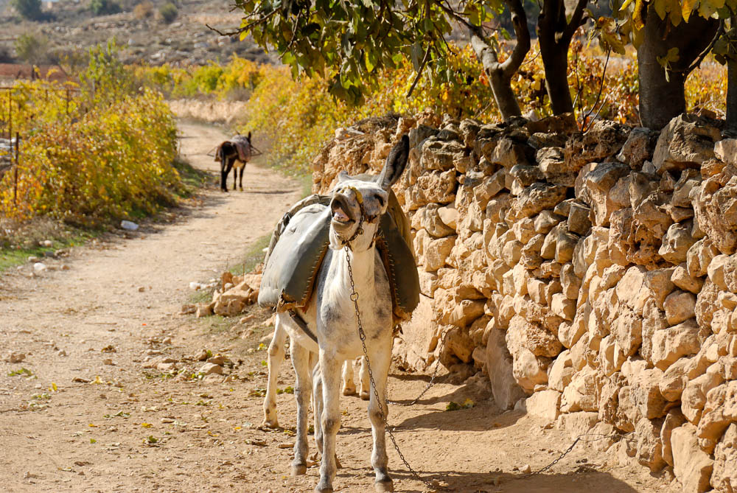
Does the wild donkey bray when he has grass?
Donkey on path in Wadi Biyar
6:5
Notes:
tb112406331

Slide 14
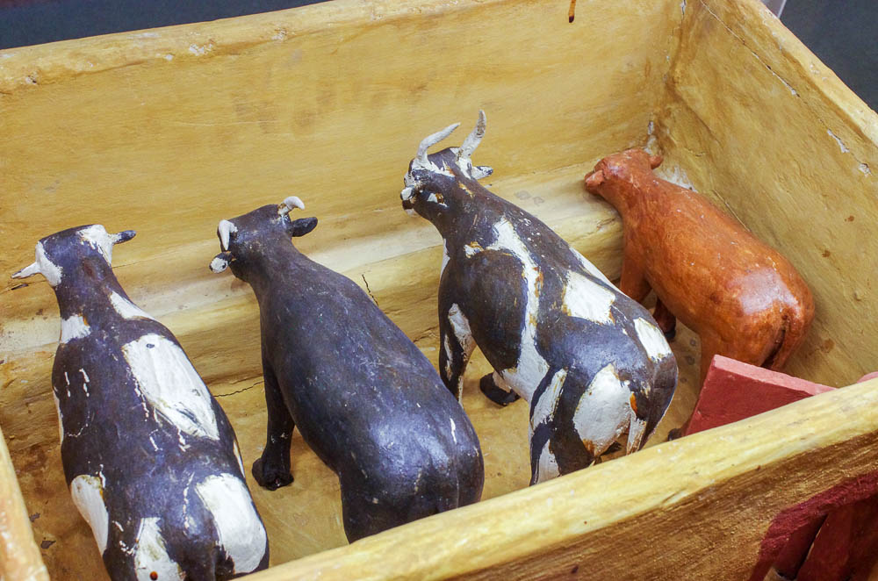
Or does the ox low when he has fodder?
Cattle feeding at a trough, from el-Asasif, circa 1900 BC
6:5
Notes:
This model comes from the tomb of Meketre at el-Asasif. It was photographed at the Metropolitan Museum of Art in New York City.
adr1711140441

Slide 15
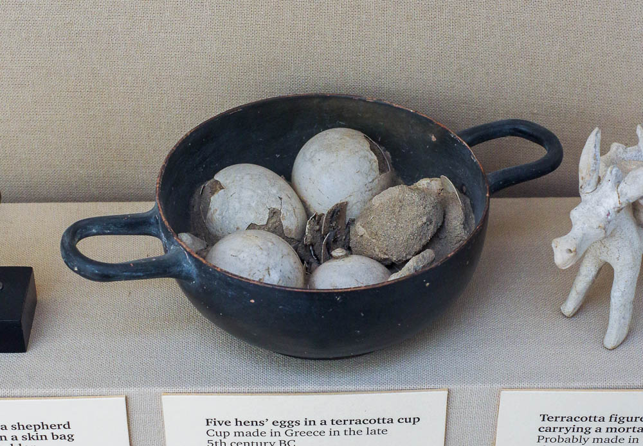
Is there any flavor in the white of an egg?
Hen eggs in a terracotta cup, found in a tomb on Rhodes, 5th century BC
6:6
Notes:
This display was photographed at the British Museum.
adr1805171655

Slide 16
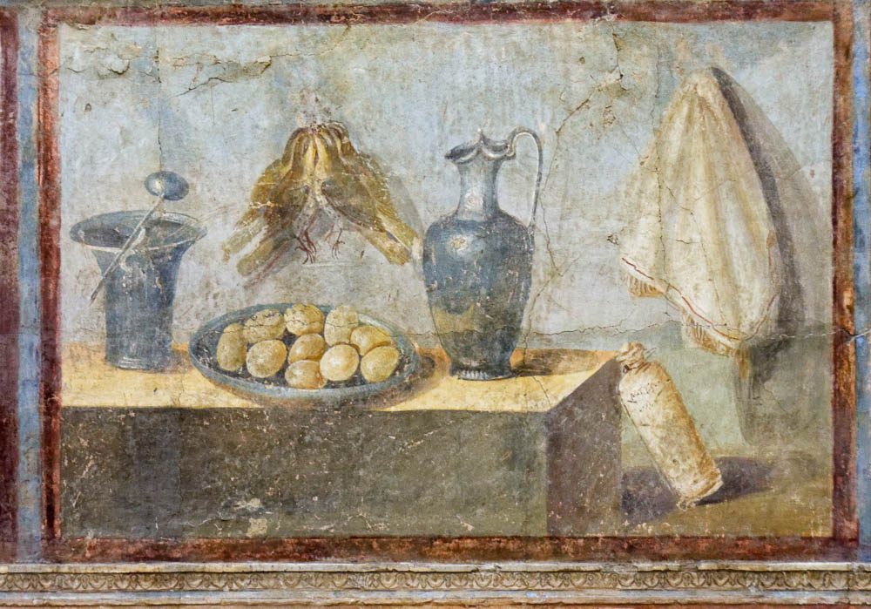
Is there any flavor in the white of an egg?
Fresco with partridges, eggs, and wine, from Pompeii, 1st century AD
6:6
Notes:
Food items were a commonly portrayed subject in the frescoes of the 1st century. Some of these murals, like the one shown here, depict ordinary food items that might be found in almost any house, although the silver dishes shown here suggest wealth. Other murals depict more expensive or exotic foods, like high quality wine, garum, imported fruits, or seafood like eels or prawns. This fresco comes from the estate of Julia Felix at Pompeii and was photographed at the Naples Archaeological Museum.
tb0515170274c

Slide 17
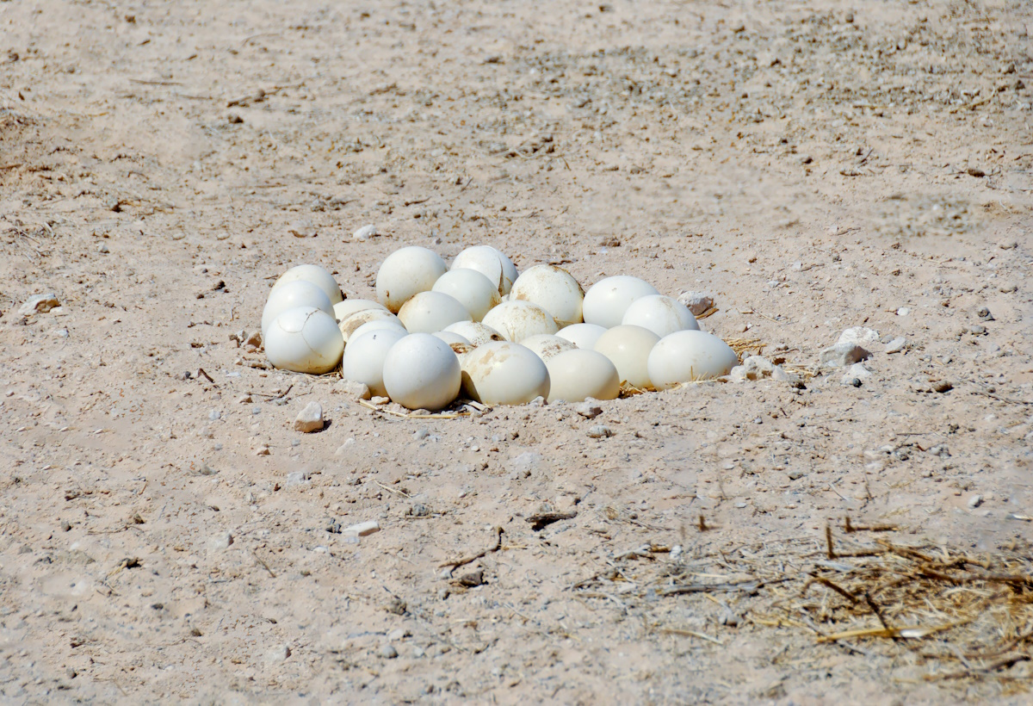
Is there any flavor in the white of an egg?
Ostrich eggs in the sand at Haibar Nature Reserve
6:6
Notes:
tb052208439c

Slide 18
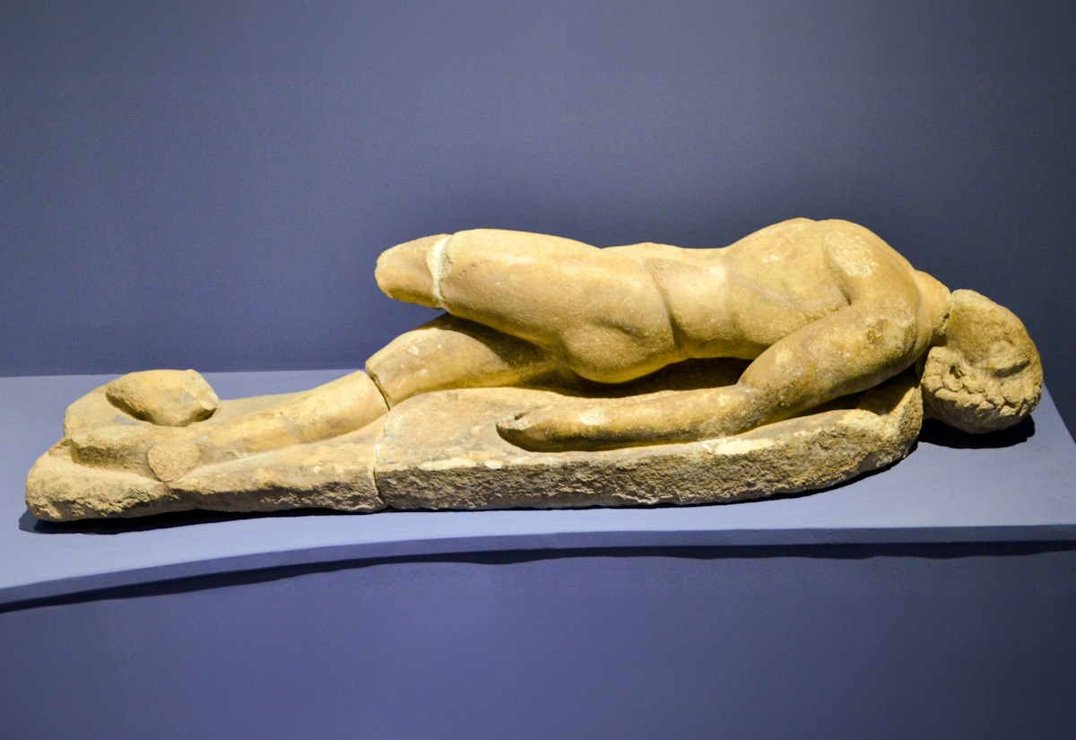
I wish that God was willing to crush me, to unleash His power and cut me off!
Dead companion of Odysseus, from the Odysseus-Polyphemus Group, 1st century BC
6:9
Notes:
This statue portrays a dead man who had accompanied the legendary Odysseus and was killed while trying to escape from the cyclops Polyphemus. It was photographed in the Ephesus Museum.
shs031315639c

Slide 19
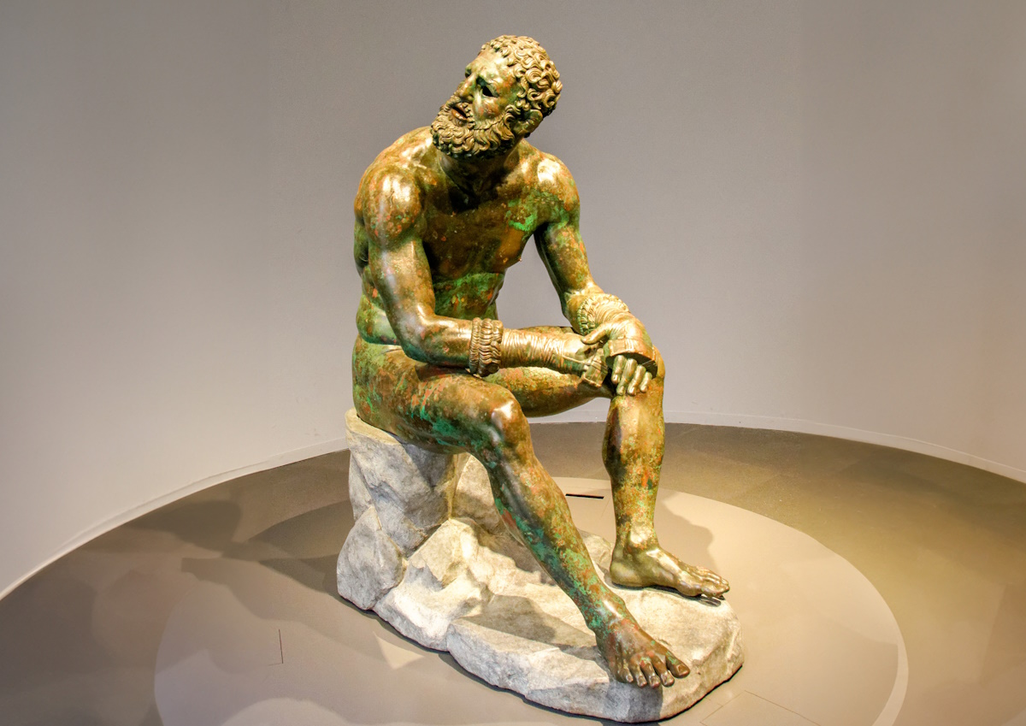
Is my strength like that of stone, or is my flesh as strong as bronze?
Statue of a boxer made of bronze, on a stone base, from Rome, circa 100 BC
6:12
Notes:
This bronze statue portrays a strong, well-muscled man in the prime of life. Portrayed as a boxer, he is stripped for competition but wears boxing gloves on his hands. This statue comes from the Via IV Novembre on the Quirinal slopes in Rome. It was photographed at the National Museum of Rome.
tb0513177296c

Slide 20
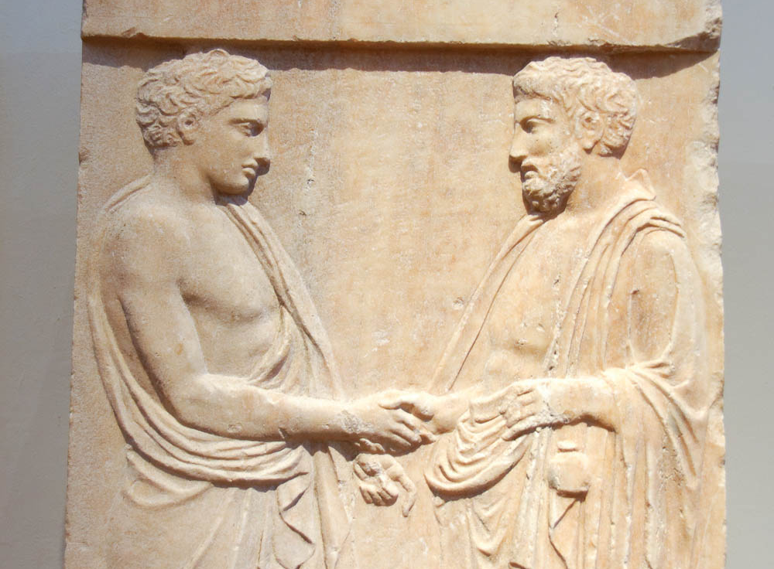
Should not a despairing man expect kindness from his friend?
Marble grave stele with bearded man and youth shaking hands, from Athens, circa 400 BC
6:14
Notes:
This relief shows two Greek men, younger and older, shaking hands. This gesture was used as a sign of agreement and concord at least as early as the 9th century BC. This relief was photographed at the National Archaeological Museum in Athens.
tb011117659

Slide 21
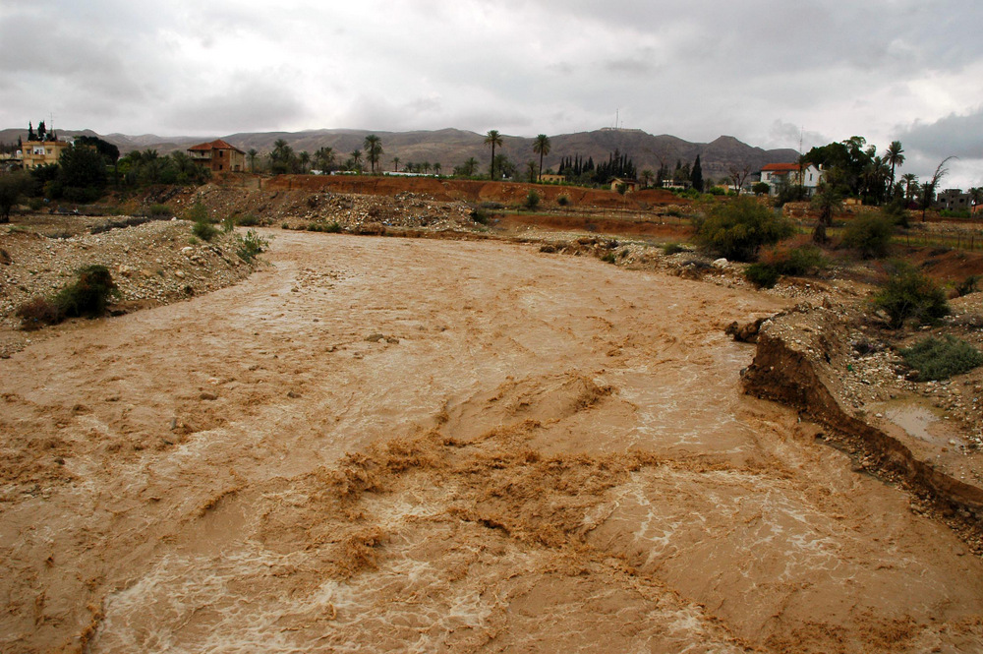
But my brothers have been like a treacherous wadi, like streams that overflow
Flash flood in the Wadi Qilt at Jericho
6:15
Notes:
fj040206101

Slide 22
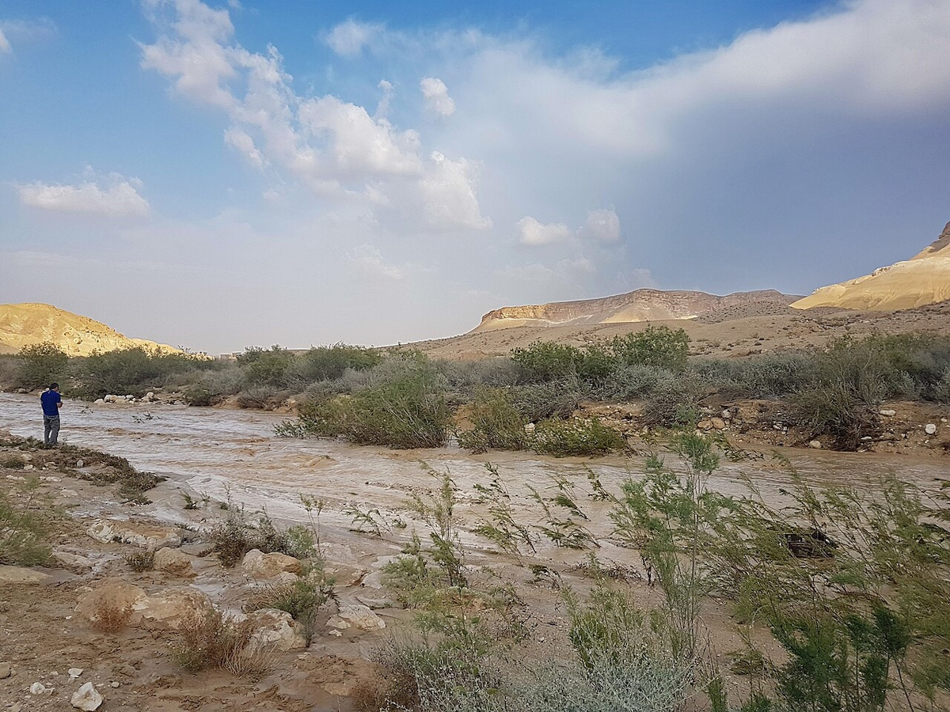
They run dark with ice, they are swollen with melting snow
Flood waters in the Arabah Valley
6:16
Notes:
This image comes fromיהודית קירשבאום and is licensed under CC BY 2.5, via Wikimedia Commons: https://commons.wikimedia.org/wiki/File:PikiWiki_Israel_52085_the_flood_in_the_arava.jpg.
wiki051840323024386

Slide 23
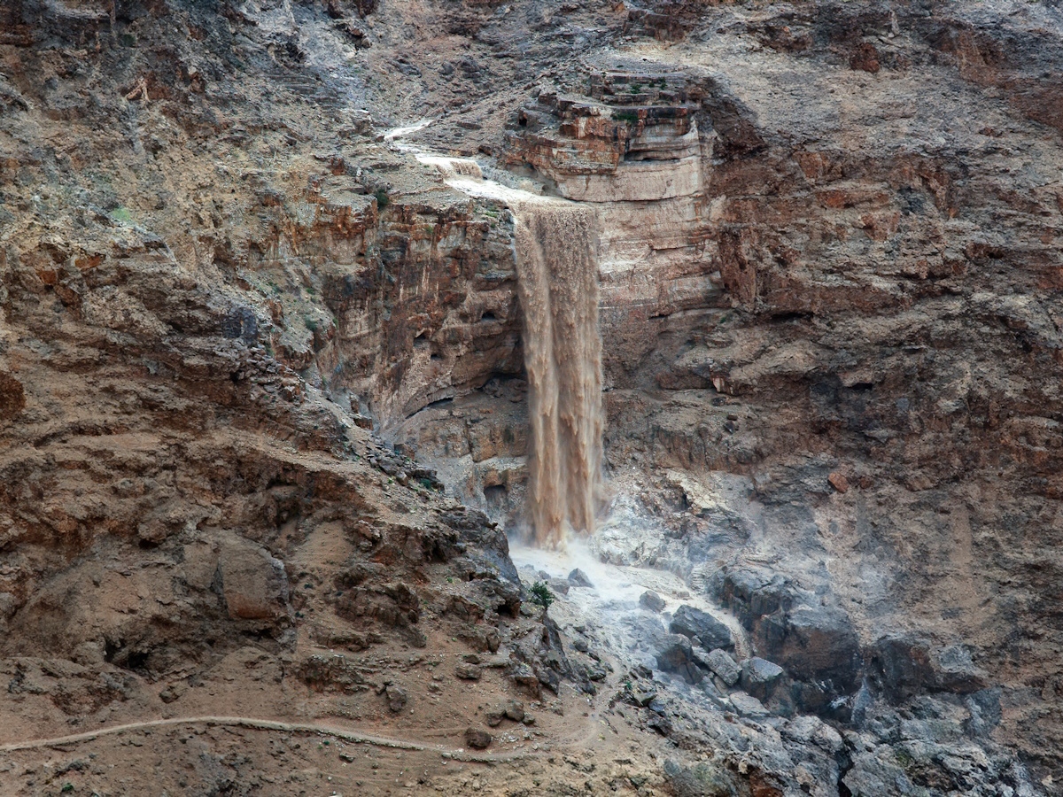
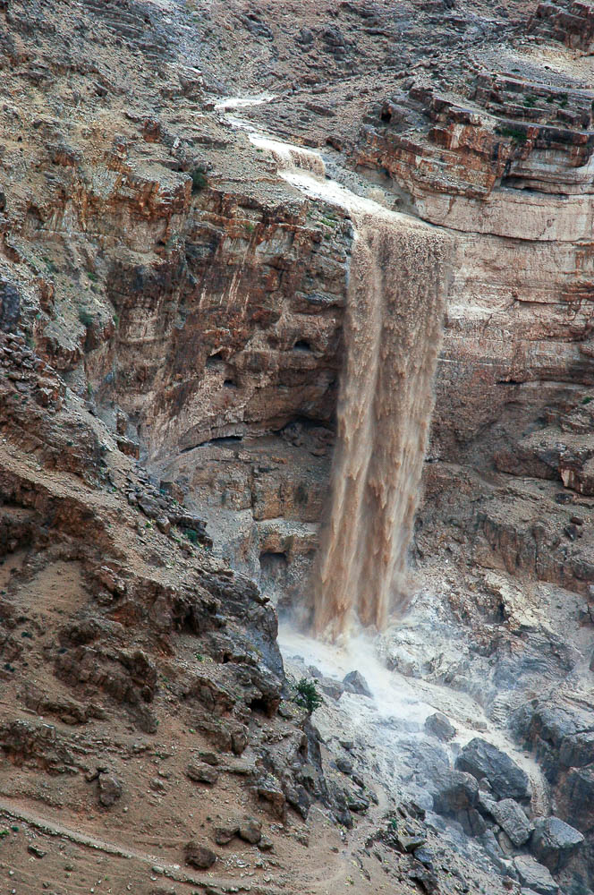
They run dark with ice, they are swollen with melting snow
Waterfall from a brief rain in the Wadi Qilt
6:16
Notes:
In most regions of Israel, water quickly runs off and disappears. This is particularly true in the Judean wilderness, which sees occasional rainfall that produces streams, but those streams quickly disappear. This waterfall was photographed during a flash flood in Wadi Qilt. Most days of the year, this wadi is completely dry. Generative AI was used to extend the sides of this image; the original photo is available behind this image.
fj040206102psai

Slide 24
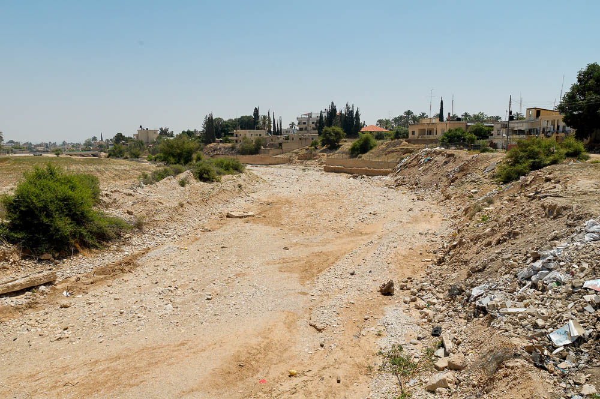
When it turns warm they disappear, and they vanish when it becomes hot
Dry riverbed from the Wadi Qilt near Jericho
6:17
Notes:
tb051106978

Slide 25
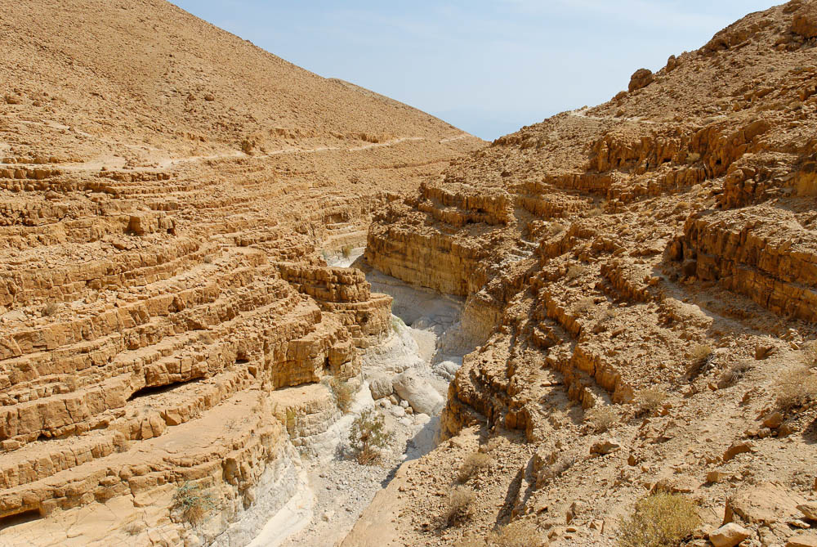
Their courses wind along, they go up into nothing and vanish
Dry bed of Nahal David, above En Gedi
6:18
Notes:
tb100106521

Slide 26
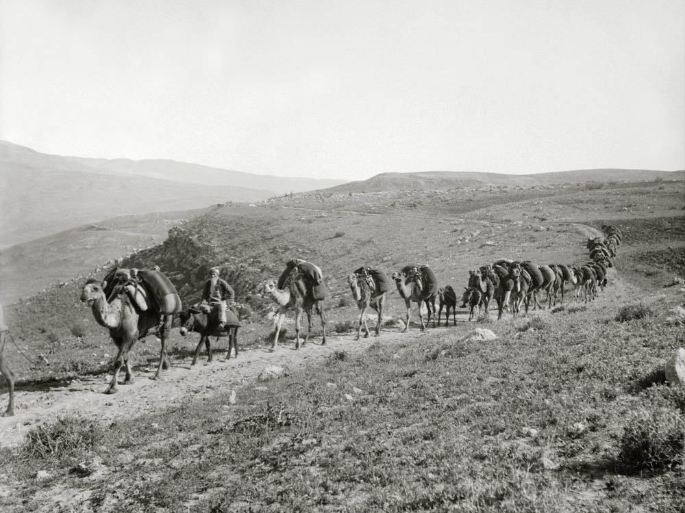
The caravans of Tema looked for them, and travelers from Sheba hoped for them
Camel caravan, circa 1920
6:19
Notes:
This American Colony photo was taken between 1898 and 1946. The next slide includes a colorized version of this photo.
mat06361

Slide 27
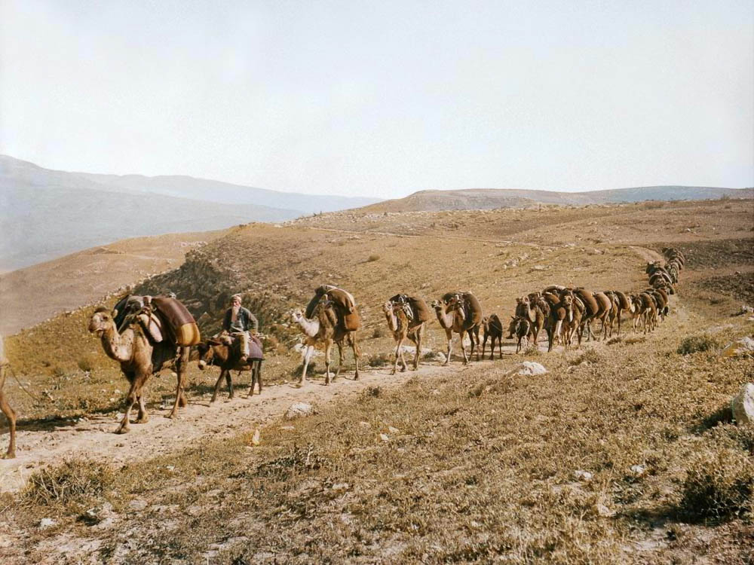
The caravans of Tema looked for them, and travelers from Sheba hoped for them
Camel caravan, circa 1920
6:19
Notes:
This American Colony photo was taken between 1898 and 1946. Generative AI was used to colorize this photo.
mat06361col

Slide 28
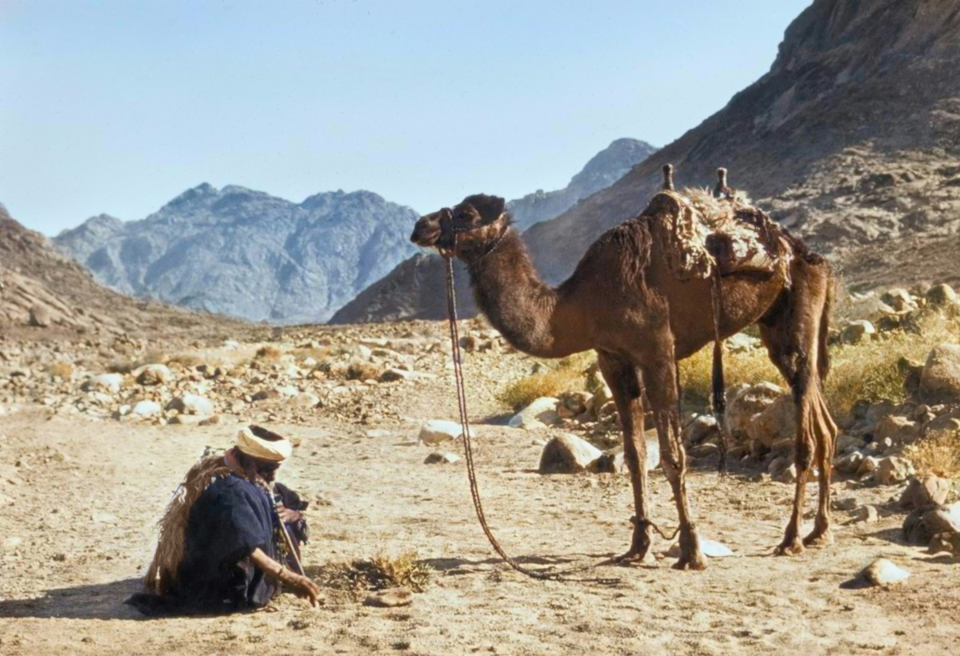
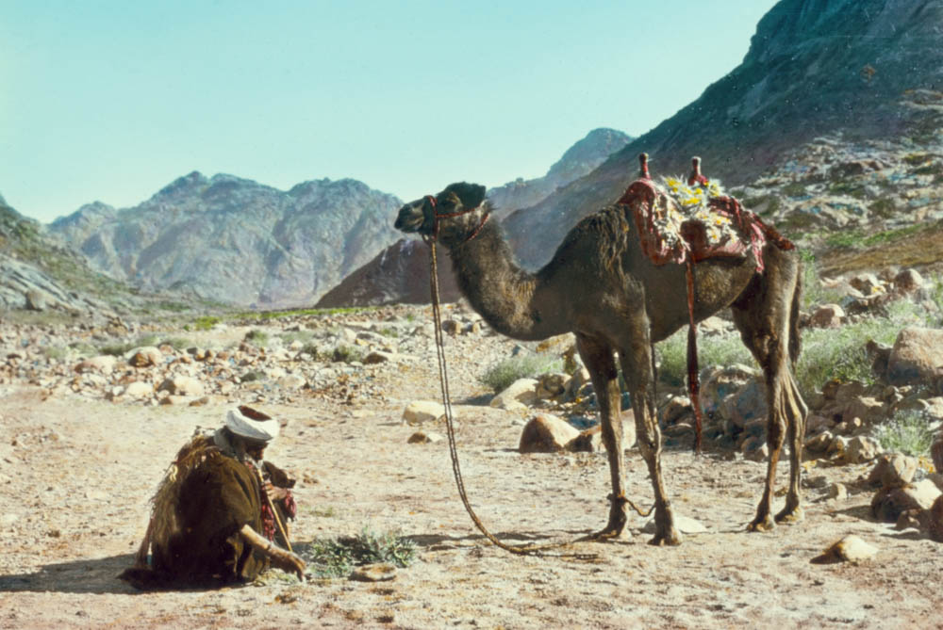
The caravans of Tema looked for them, and travelers from Sheba hoped for them
Bedouin with camel at Wadi es-Sheikh
6:19
Notes:
This photograph was taken by American Colony photographers in the early 1900s. This version has been colorized by AI; the photo that was handcolored by the American Colony is available behind this image.
According to notes on the Library of Congress website, this photograph was “taken from Wadi El Sheikh above the junction with Wadi El Dier (Biblical Holy Valley) in upper-right and Wadi Sharig, looking northeast and showing the upstream area of the Wadi El Sheikh and the summits of Gebel Ghabghab and Gebel Hamami to the right and left of the camel’s head respectively, from a 5.5km distance” (https://www.loc.gov/pictures/collection/matpc/item/2019705678/).
mat23018

Slide 29
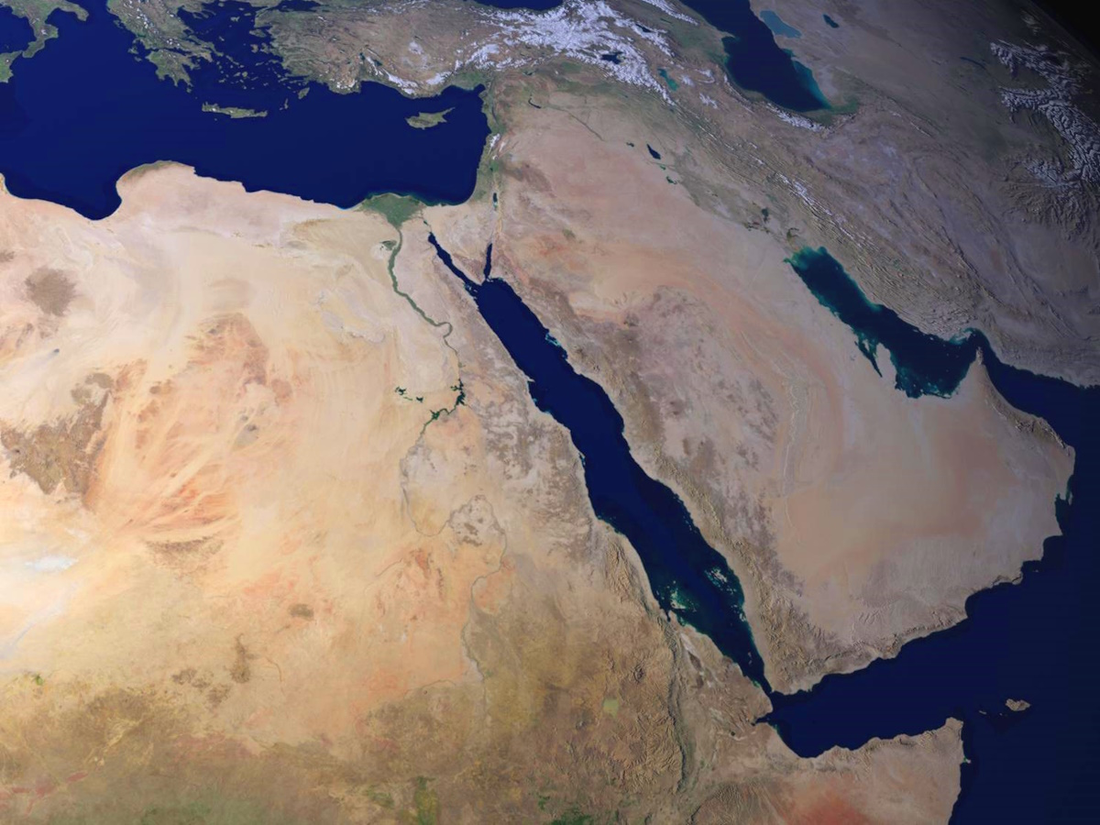
The caravans of Tema looked for them, and travelers from Sheba hoped for them
Edom
Tema
Sheba
Satellite view of the Red Sea, with approximate locations of Tema and Sheba
6:19
Notes:
Both Tema and Sheba were located along the trade route that brought goods, especially incense, up the northeastern side of the Red Sea, for trade with Egypt and the Fertile Crescent. These were desert routes, and the presence of reliable water sources (and knowledge of where they were to be found) were critical for making the journey. Tema is identical to Tayma, a major caravan oasis situated in northern Saudi Arabia about 78 miles (126 km) to the northeast of Dedan (al-ʿUla) and roughly 250 miles (400 km) to the southeast of Edom. Sheba, also known as the Sabean kingdom, was famous for its long-distance trade with camels (cf. Isa 60:6; Jer 6:20; Ezek 27:22), and may be connected with the queen of Sheba who visited Solomon (1 Kgs 10:1-13). “As early as Strabo, the famous Sabean kingdom has been known to center at Ma’rib, in eastern Yemen, and it is here that one should locate Sheba” (Beitzel 2009: 93). Sheba was approximately 1,200 miles (1,930 km) from Edom.
This image comes from NASA Goddard Space Flight Center and is licensed under CC BY 2.0, via Wikimedia Commons: https://commons.wikimedia.org/wiki/File:Blue_Marble_-_2005_(Blue_Marble-_Next_Generation)_(8245544980).jpg.
Reference: Beitzel, Barry J.
2009 New Moody Bible Atlas. Chicago: Moody.
wiki10120521214096608c

Slide 30
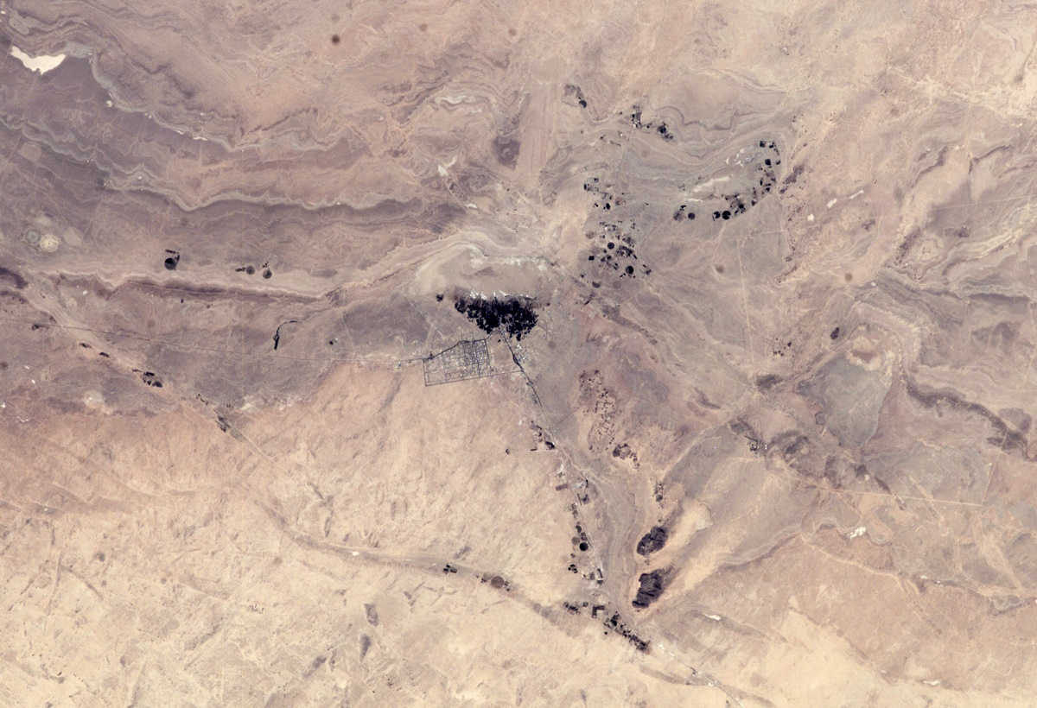
The caravans of Tema looked for them, and travelers from Sheba hoped for them
Tema
(Tayma)
Satellite view of the Tayma oasis
6:19
Notes:
This satellite view of the Tayma oasis was taken from the International Space Station in September 2004. This image comes from Earth Science and Remote Sensing Unit, Lyndon B. Johnson Space Center and is in the public domain, via Wikimedia Commons: https://commons.wikimedia.org/wiki/File:ISS009-E-24533_-_View_of_Saudi_Arabia.jpg.
wiki092404104533706

Slide 31
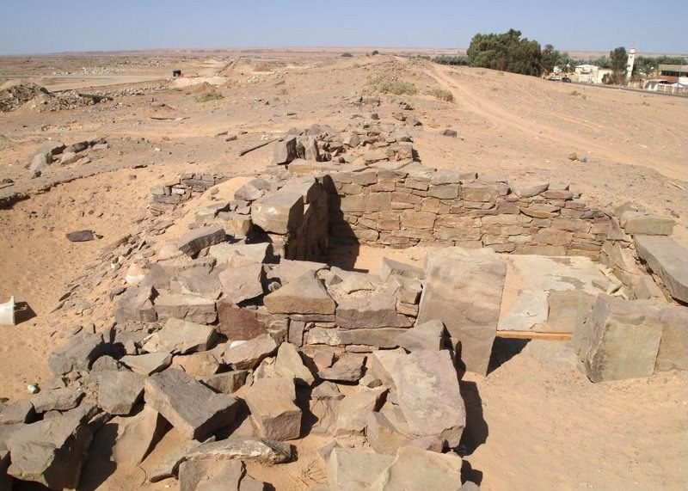
The caravans of Tema looked for them, and travelers from Sheba hoped for them
Ancient remains at Tayma
6:19
Notes:
These ancient remains are located near the oasis of Tayma. This image comes from Heritage Commission and is licensed under CC BY-SA 4.0, via Wikimedia Commons: https://commons.wikimedia.org/wiki/File:%D8%AC%D8%A7%D9%86%D8%A8_%D9%85%D9%86_%D8%B3%D9%88%D8%B1_%D8%AA%D9%8A%D9%85%D8%A7%D8%A1.jpg.
wiki070120804571124

Slide 32
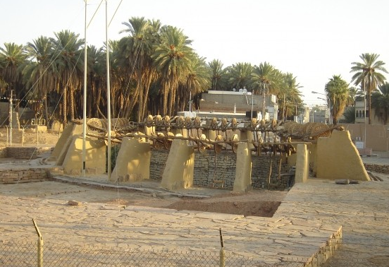
The caravans of Tema looked for them, and travelers from Sheba hoped for them
Hadaj Well, in the city of Tayma
6:19
Notes:
Hadaj Well is one of the most famous wells in the Arabian Peninsula. It is located in northwest Saudi Arabia in the city of Tayma. This image comes from X1700 and is licensed under CC BY-SA 4.0, via Wikimedia Commons: https://commons.wikimedia.org/wiki/File:%D8%A8%D8%A6%D8%B1_%D9%87%D8%AF%D8%A7%D8%AC.png.
wiki090217552378438

Slide 33
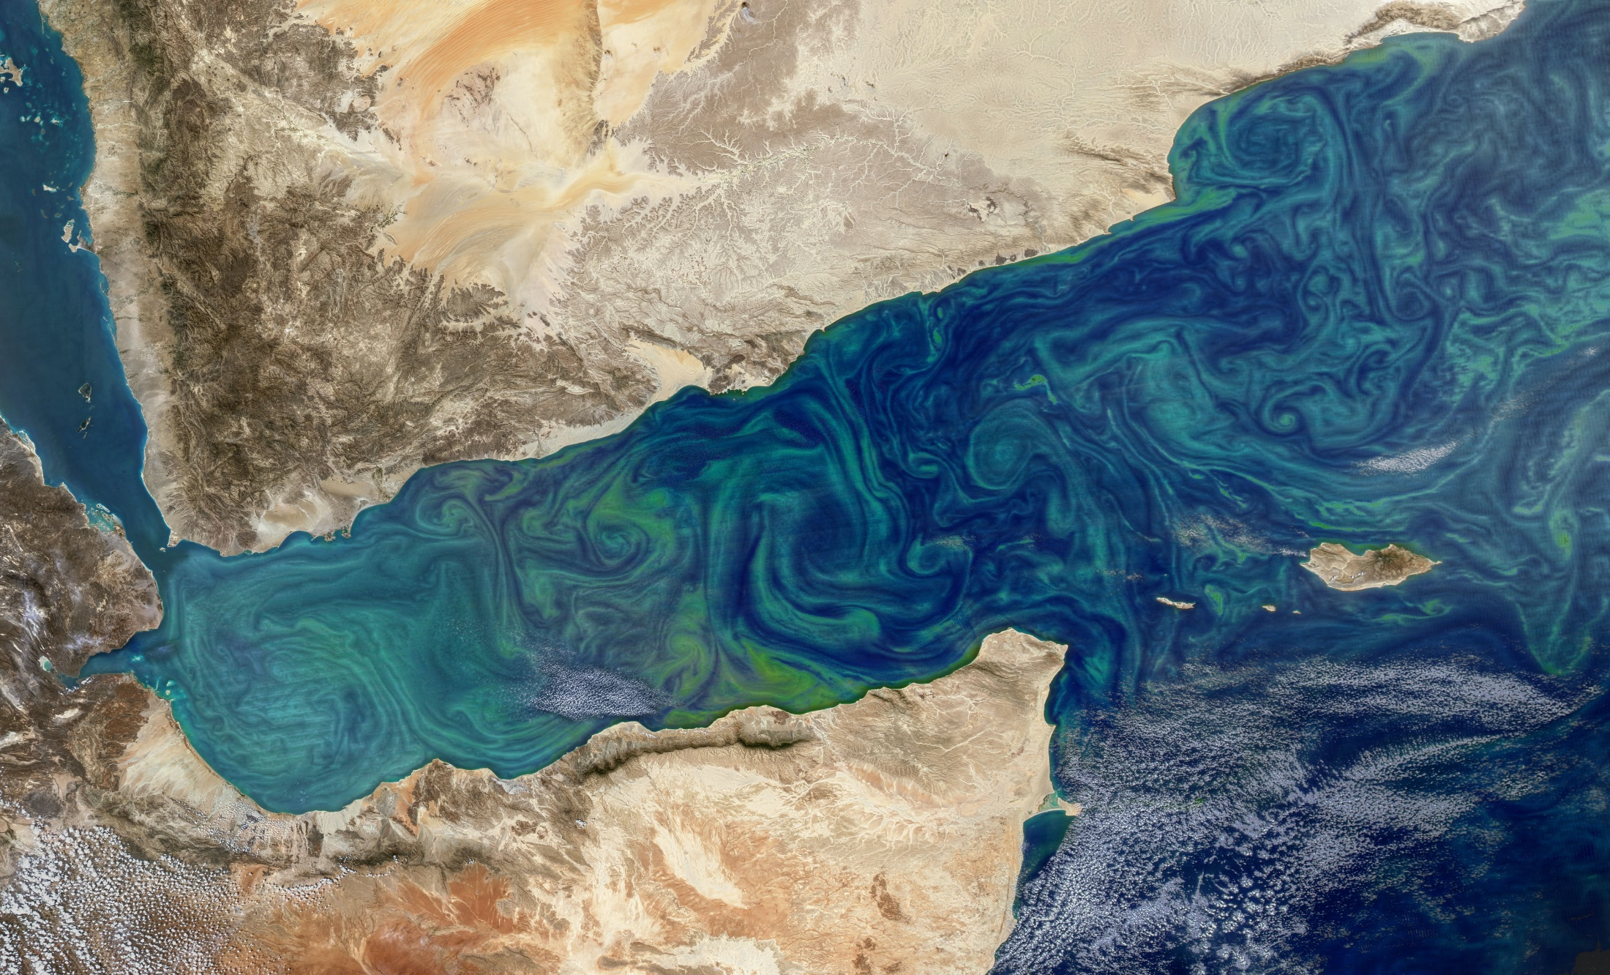
The caravans of Tema looked for them, and travelers from Sheba hoped for them
Sheba
(Marib)
Sabtah
(Shabwah?)
Sabteca?
Gulf of Aden
Satellite image of the Gulf of Aden and Yemen, with a phytoplankton bloom
6:19
Notes:
Sheba is consistently located in Arabia, and is not to be confused with Seba, which is associated with Egypt and Ethiopia/Cush. The two are clearly distinguished in Psalm 72:10. The kingdom of Sheba, also known as the Sabean kingdom, was famous for its long-distance trade with camels (cf. Isa 60:6; Jer 6:20; Ezek 27:22), and may be connected with the queen of Sheba who visited Solomon (1 Kgs 10:1-13).
This image comes from Norman Kuring/NASA and is in the public domain. Source: https://earthobservatory.nasa.gov/images/91937/bloom-in-the-gulf-of-aden
nasa91937

Slide 34
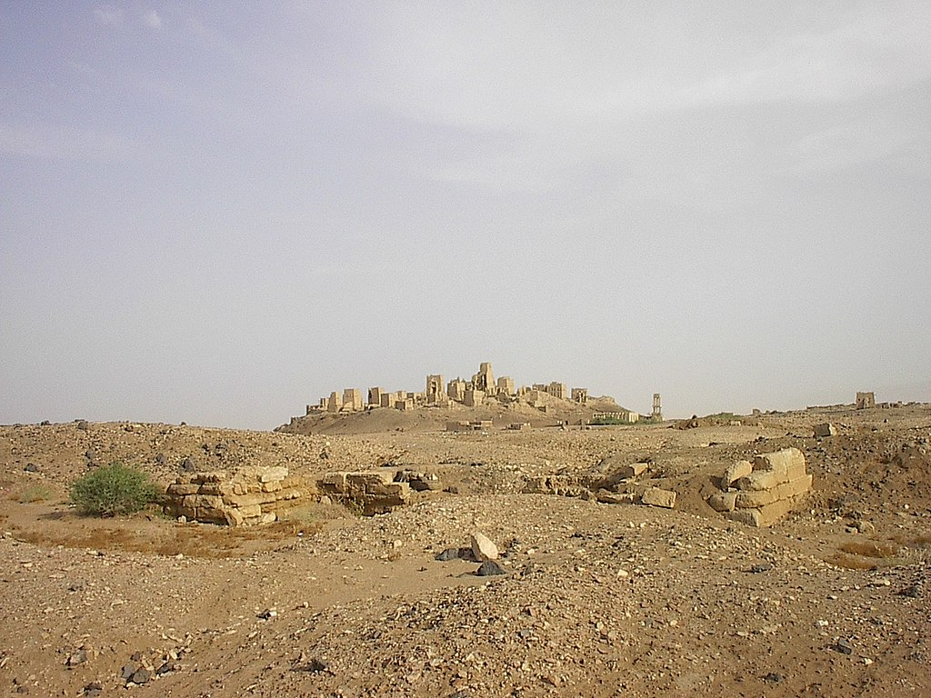
The caravans of Tema looked for them, and travelers from Sheba hoped for them
Ancient Maʿrib, capital of the Sabeans
6:19
Notes:
There appears to have been at least two groups of Sabeans (alternately spelled with a ס or ש)—one in southern Arabia (Yemen) and another in Nubia, although these two groups may be related (Müller 1992: 1064). This photo and the next are from the Arabian “Sheba” (i.e., the Sabeans—Gen 10:7, 28; 35:3), which may have been functioning as a trade merchant as early as the 12th century BC (Kitchen 2003: 116–18). This image comes from Tapatio and is licensed under CC BY-SA 3.0, via Wikimedia Commons: https://commons.wikimedia.org/wiki/File:Old_Marib.JPG.
References: Kitchen, K. A.
2003 On the Reliability of the Old Testament. Grand Rapids: Eerdmans.
Müller, W. W.
1992 Seba. Anchor Bible Dictionary, vol. 5, ed. D. N. Freedman. New York: Doubleday.
wiki02272008638

Slide 35
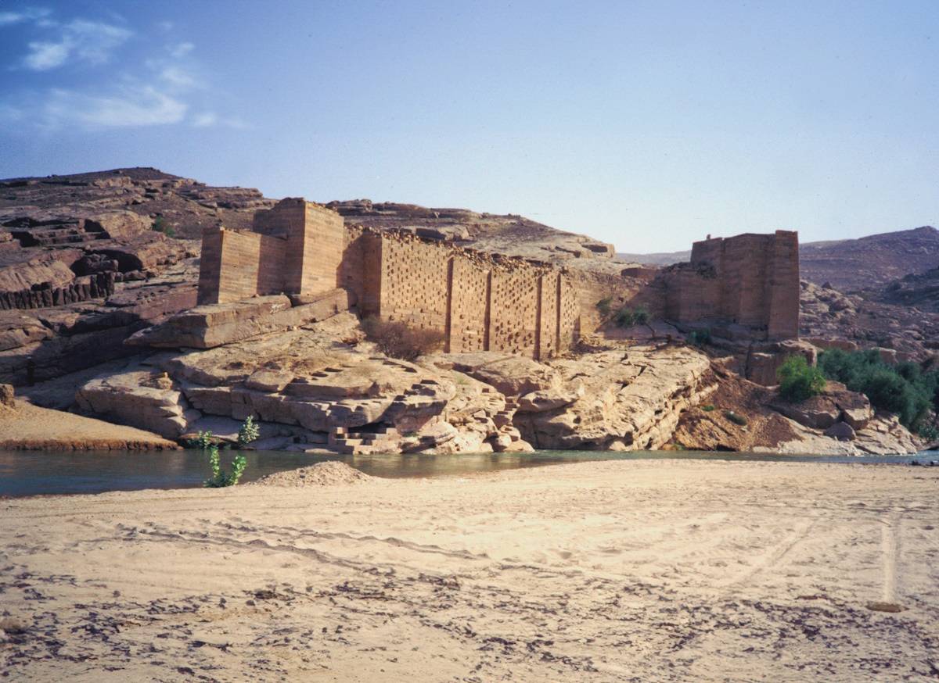
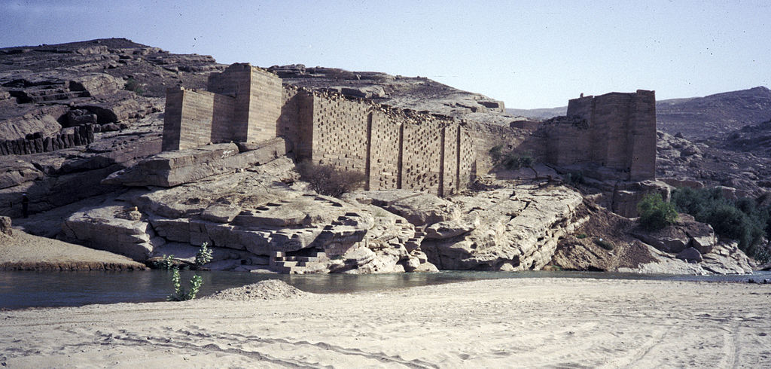
The caravans of Tema looked for them, and travelers from Sheba hoped for them
Dam at Maʿrib, built in the 8th century BC and rebuilt until modern times
6:19
Notes:
This image comes from H. Grobe and is licensed under CC BY-SA 3.0, via Wikimedia Commons: https://commons.wikimedia.org/wiki/File:Jemen1988-022_hg.jpg. Generative AI has been used to extend the edges of this image; the original photo is available behind this image.
wiki1988021220112041psai

Slide 36
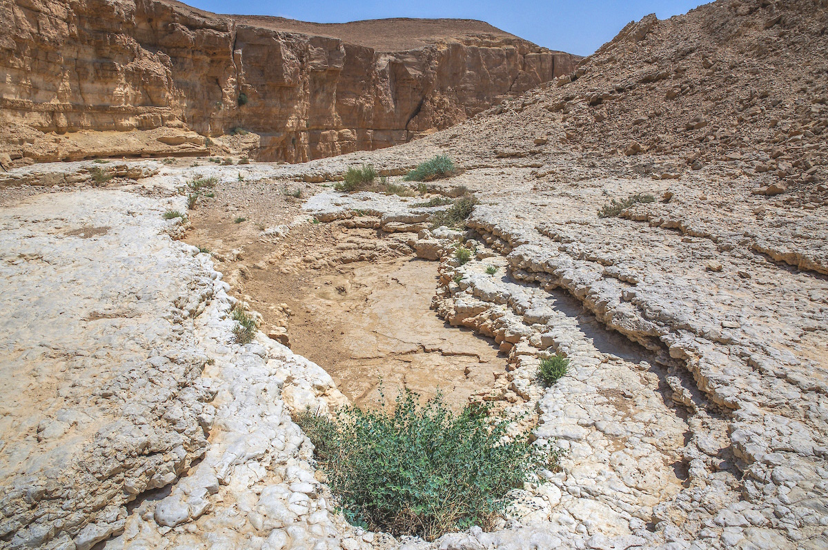
They were disappointed, because they had been confident; they arrived only to be frustrated
Dry pool above a dry waterfall in Nahal Qetura
6:20
Notes:
Nahal Qetura is a wadi located on the west side of the Arabah, a few miles north of the Timna Valley.
adr1805304272

Slide 37
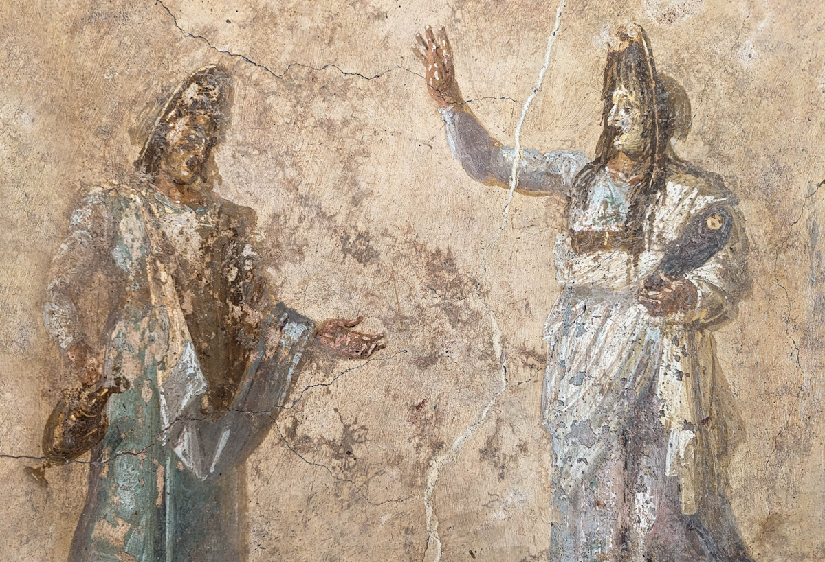
Surely this is what you have become, for you see my calamity and are afraid
Fresco of a tragic theater scene, from the House of the Dioscurs in Pompeii, circa AD 62–79
6:21
Notes:
Job’s hope had been that his friends would encourage and support him. Instead, they seemed frightened themselves, perhaps fearful for their own prosperity, and they were quick to blame Job for the tragedy that had come upon him. This fresco was photographed at the Naples Archaeological Museum.
ku0622230844286c

Slide 38
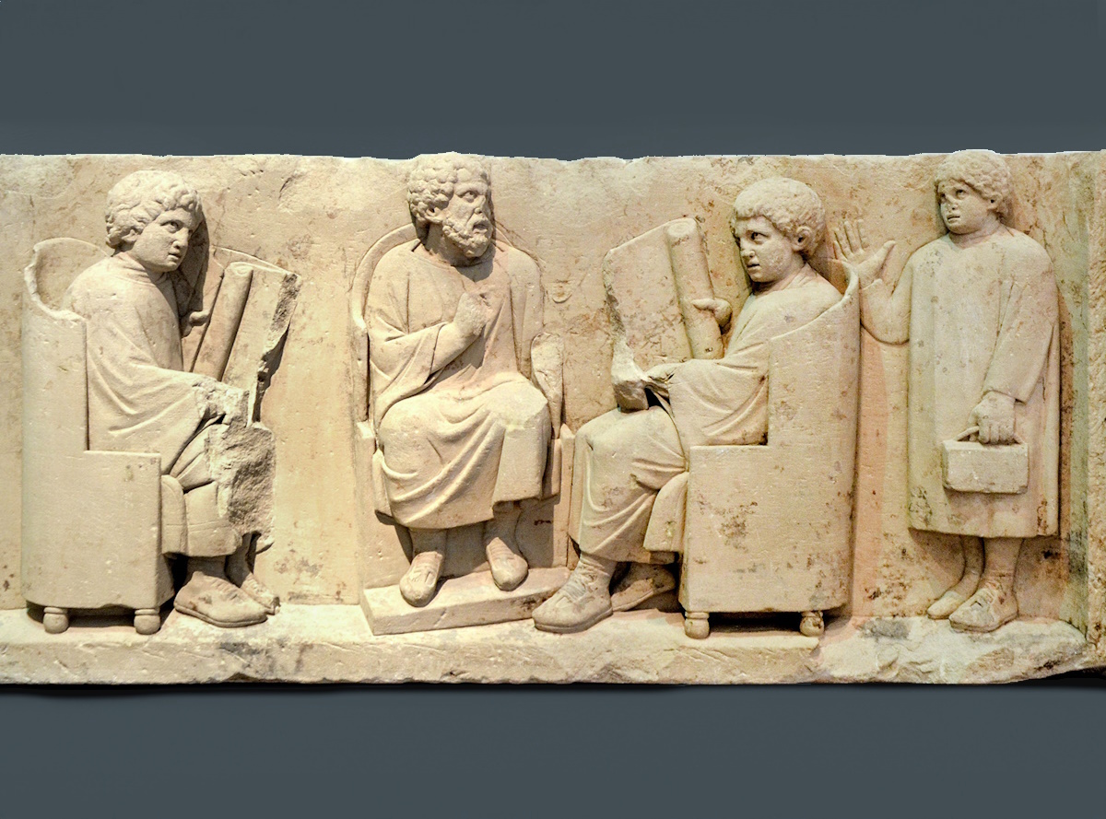
Teach me and I will listen; show me where I have gone wrong
Relief depicting a teacher with three disciples, circa AD 180–185
6:24
Notes:
This sandstone relief depicts a teacher and three of his students; two are seated on either side of the teacher, holding open scrolls. The third student approaches from the right, holding a set of wax tablets bound together with a leather strap. He lifts his hand in greeting but does not look particularly happy to be there.
This relief was found in Neumagen near Trier, and was photographed at the Rheinisches Landesmuseum Trier, Germany. This image comes from Carole Raddato and is licensed under CC BY-SA 2.0, via Wikimedia Commons: https://commons.wikimedia.org/wiki/File:Funerary_relief_found_in_Neumagen_near_Trier,_a_teacher_with_three_discipuli,_around_180-185_AD,_Rheinisches_Landesmuseum_Trier,_Germany_(29656302165).jpg.
wiki296563021651636c

Slide 39
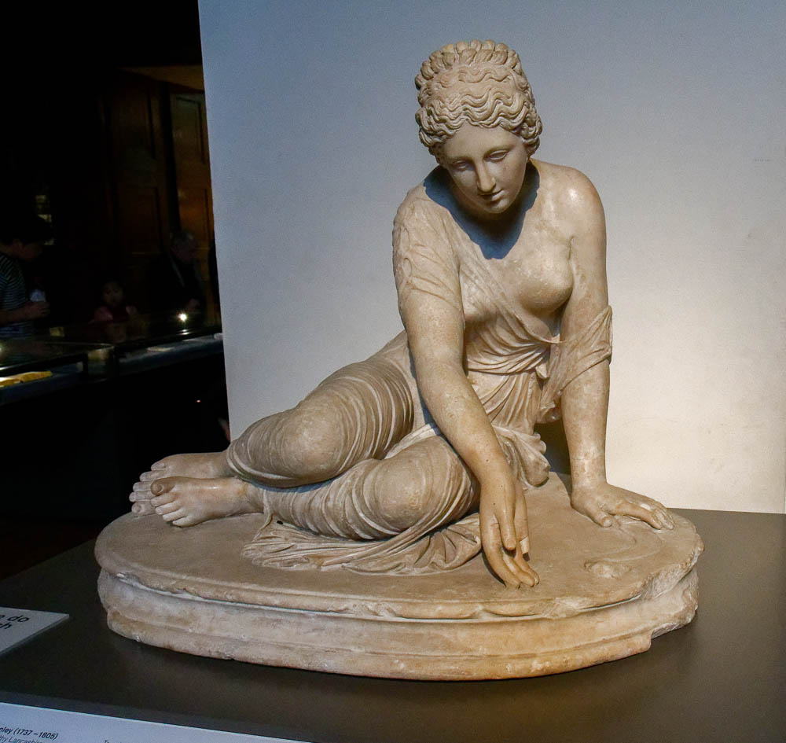
You would cast lots for orphans, or barter over your friends
Statue of a girl playing knucklebones, 1st–2nd centuries AD
6:27
Notes:
This statue depicts a girl playing knucklebones, a game of chance that may have been similar to casting lots, although it was often only played for sport. The statue was photographed at the British Museum.
tb0929197120

Slide 40
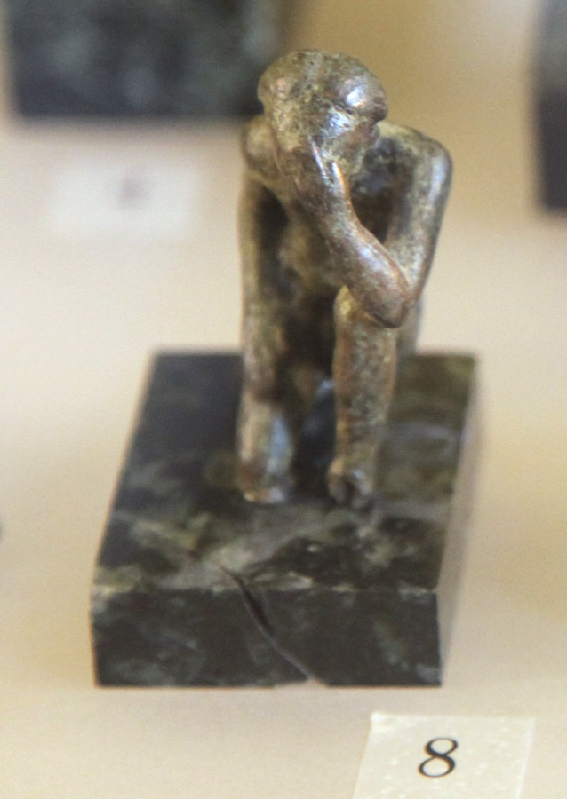
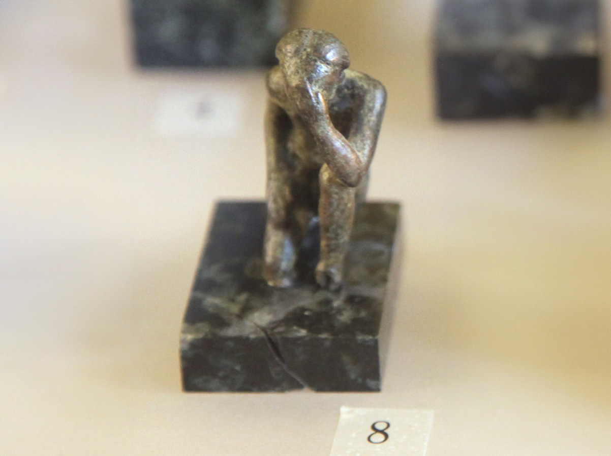
Please relent, and do not be unjust, for my integrity is at stake
Bronze figurine of an Egyptian man praying, circa 330–30 BC
6:29
Notes:
This figurine portrays an Egyptian man praying. His stance, with his hand to his head, shows humility and deference before the god. This figurine was photographed at the Louvre Museum. This image comes from Rama and is in the public domain, via Wikimedia Commons: https://commons.wikimedia.org/wiki/File:Man_praying-N_1593-IMG_2196.JPG. Generative AI was used to extend the edges of this image; the original photo is available behind this image.
wiki07111911481230212psai

Slide 41
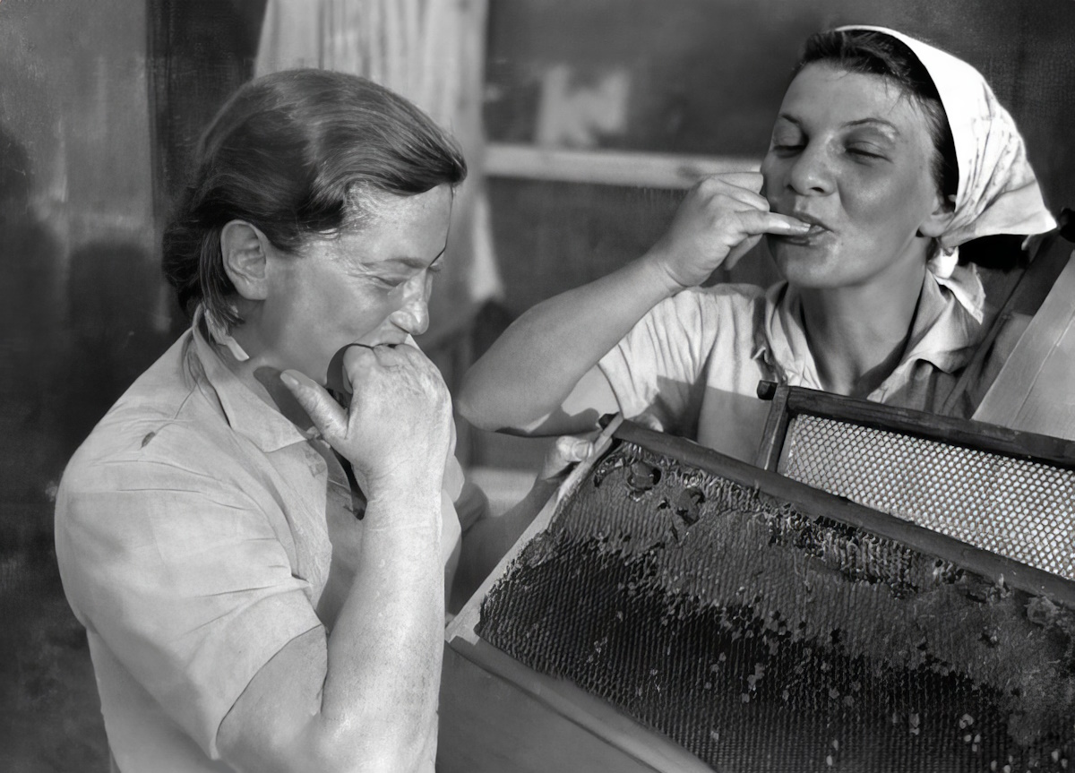
Is there something wrong with my tongue? Can my palate not discern disaster?
Two women tasting honey at the Ein Hahoresh kibbutz, circa 1945
6:30
Notes:
Kibbutz Ein Hahoresh is located north of Netanya in central Israel. This image, taken between 1940 and 1950, comes from Ein Hahoresh Archive and is in the public domain, via Wikimedia Commons: https://commons.wikimedia.org/wiki/File:PikiWiki_Israel_3228_Ein_Hahoresh.jpg. The next slide includes a colorized version of this photo.
wiki0630200912021940c

Slide 42
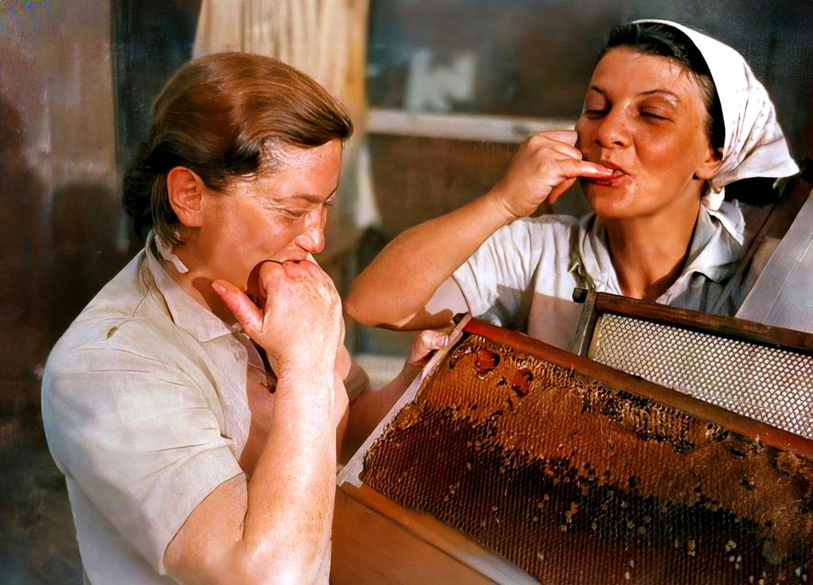
Is there something wrong with my tongue? Can my palate not discern disaster?
Two women tasting honey at the Ein Hahoresh kibbutz, circa 1945
6:30
Notes:
Kibbutz Ein Hahoresh is located north of Netanya in central Israel. This image, taken between 1940 and 1950, comes from Ein Hahoresh Archive and is in the public domain, via Wikimedia Commons: https://commons.wikimedia.org/wiki/File:PikiWiki_Israel_3228_Ein_Hahoresh.jpg. Generative AI was used to colorize this photo.
wiki0630200912021940ccol

Slide 43
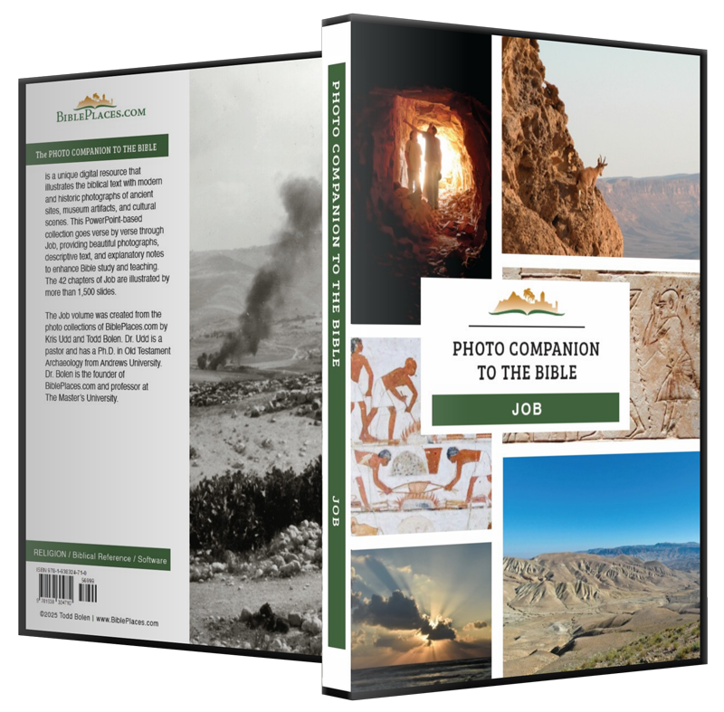
More than 1,600 slides in PowerPoint format. Available now from BiblePlaces.com.
Notes:
This is a free sample of the Job 6 presentation from the Photo Companion to the Bible. To purchase the full volume, visit https://www.bibleplaces.com/job/
The Photo Companion to the Bible is an image-rich resource for Bible students, teachers, and researchers. Just as a librarian stocks the shelves with as many relevant materials as possible, so we have tried to provide a broad selection of images. Our goal is that you will find in this “library” whatever it is you are looking for.
Credits: The primary creators of this presentation are Kris Udd and Todd Bolen. The photographs have an individual file code which usually includes the initials of the photographer. Other images have additional credit or source information.
Updates: We plan to update this collection as we are able. We welcome your suggestions for improving this resource (photocompanion@bibleplaces.com). Purchasers of the Job volume are provided free, lifetime updates to the volume.
Copyright: This photo collection is protected by copyright law and may not be distributed without written permission from BiblePlaces.com. Slide notes should be treated as any other copyrighted written material, with credit given when quoting from these notes.
For more information, see our complete “Introduction to the Photo Companion to the Bible” online at https://www.BiblePlaces.com/Intro-Photo-Companion-Bible/. Here you will find more information about photo selection, explanatory notes, Bible translation, credit information, and copyright allowances.

