Slide 1
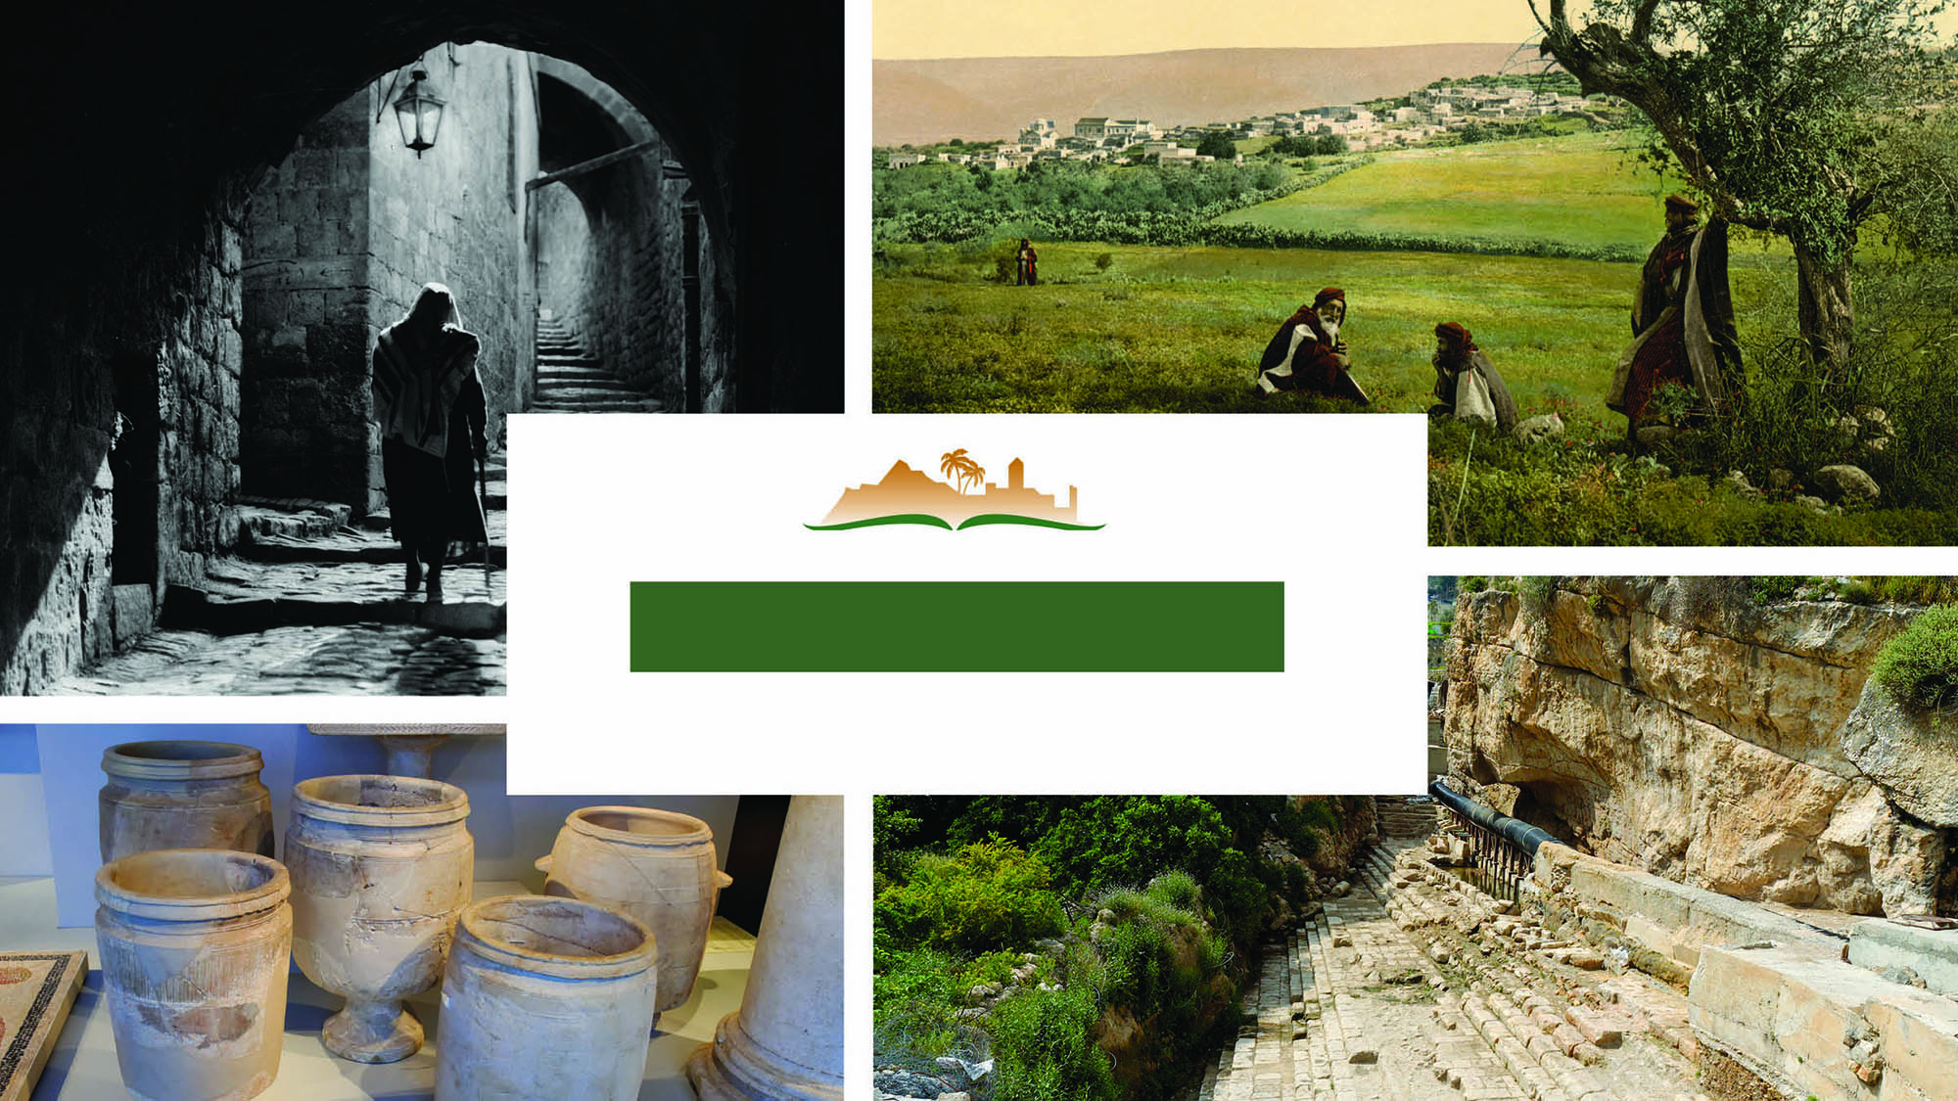
JOHN 2
Notes:
This is a free sample of the John 2 presentation from the Photo Companion to the Bible. To purchase the full volume, visit https://www.bibleplaces.com/john/
The Photo Companion to the Bible is an image-rich resource for Bible students, teachers, and researchers. Just as a librarian stocks the shelves with as many relevant materials as possible, so we have tried to provide a broad selection of images. Our goal is that you will find in this “library” whatever it is you are looking for.
Credits: The primary creators of this presentation are Steven D. Anderson, A.D. Riddle, and Todd Bolen. The photographs have an individual file code which usually includes the initials of the photographer. Other images have additional credit or source information.
Updates: We plan to update this collection as we are able. We welcome your suggestions for improving this resource (photocompanion@bibleplaces.com). Purchasers of the John volume are provided free, lifetime updates to the volume.
Copyright: This photo collection is protected by copyright law and may not be distributed without written permission from BiblePlaces.com. Slide notes should be treated as any other copyrighted written material, with credit given when quoting from these notes.
For more information, see our complete “Introduction to the Photo Companion to the Bible” online at http://www.BiblePlaces.com/Intro-Photo-Companion-Bible/. Here you will find more information about photo selection, explanatory notes, Bible translation, credit information, and copyright allowances.

Slide 2
JOHN 2
This is a free sample of the John 2 presentation from the Photo Companion to the Bible. To purchase the full volume, visit https://www.bibleplaces.com/john/
The Photo Companion to the Bible is an image-rich resource for Bible students, teachers, and researchers. Just as a librarian stocks the shelves with as many relevant materials as possible, so we have tried to provide a broad selection of images. Our goal is that you will find in this “library” whatever it is you are looking for.
For more details (for this and every slide), see the Notes section below.
Notes:
This is a free sample of the John 2 presentation from the Photo Companion to the Bible. To purchase the full volume, visit https://www.bibleplaces.com/john/
The Photo Companion to the Bible is an image-rich resource for Bible students, teachers, and researchers. Just as a librarian stocks the shelves with as many relevant materials as possible, so we have tried to provide a broad selection of images. Our goal is that you will find in this “library” whatever it is you are looking for.
Credits: The primary creators of this presentation are Steven D. Anderson, A.D. Riddle, and Todd Bolen. The photographs have an individual file code which usually includes the initials of the photographer. Other images have additional credit or source information.
Updates: We plan to update this collection as we are able. We welcome your suggestions for improving this resource (photocompanion@bibleplaces.com). Purchasers of the John volume are provided free, lifetime updates to the volume.
Copyright: This photo collection is protected by copyright law and may not be distributed without written permission from BiblePlaces.com. Slide notes should be treated as any other copyrighted written material, with credit given when quoting from these notes.
For more information, see our complete “Introduction to the Photo Companion to the Bible” online at http://www.BiblePlaces.com/Intro-Photo-Companion-Bible/. Here you will find more information about photo selection, explanatory notes, Bible translation, credit information, and copyright allowances.

Slide 3
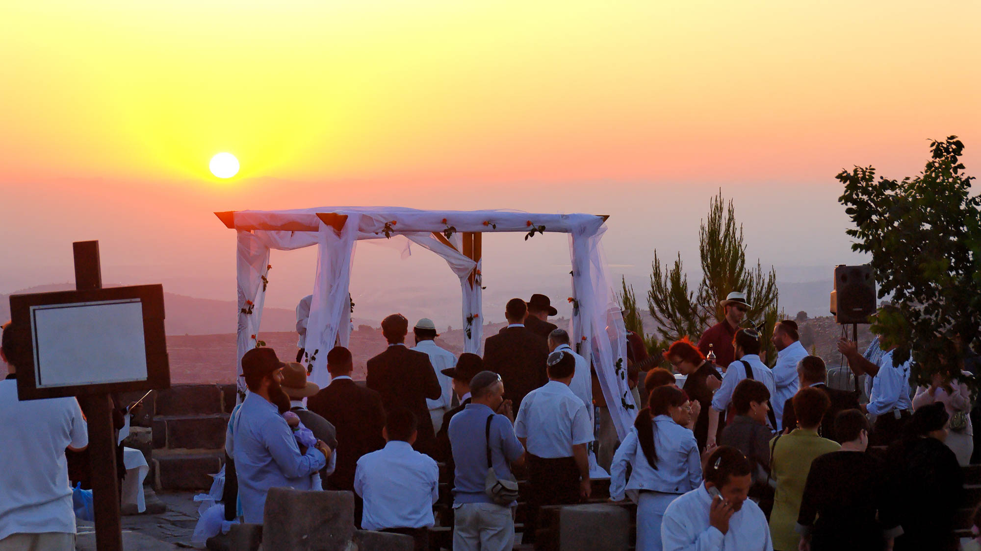
And on the third day there was a wedding
Orthodox Jewish wedding under chuppah
2:1
Notes:
This wedding was photographed in the Judean hills with a view towards the Mediterranean Sea.
tb070906352

Slide 4
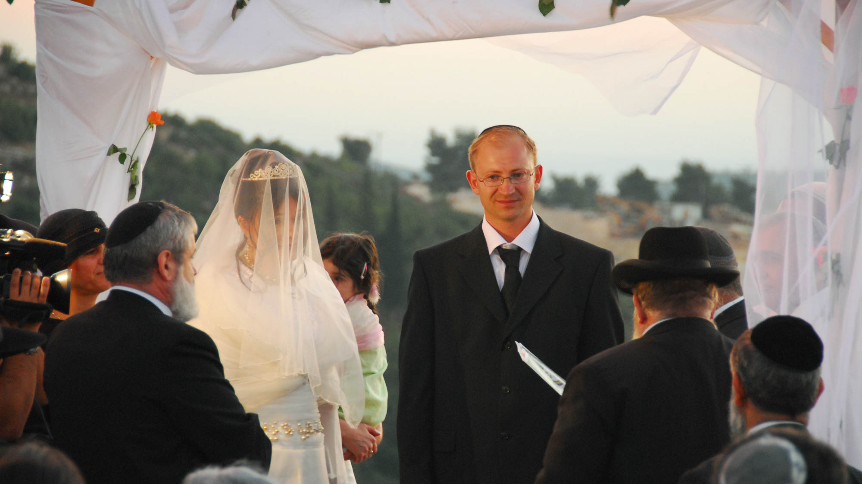
And on the third day there was a wedding
Bride and groom at Orthodox Jewish wedding
2:1
Notes:
A modern Jewish wedding has many traditions that did not exist in the 1st century AD, but it may provide a closer idea than modern weddings in other cultures.
tb070906399

Slide 5
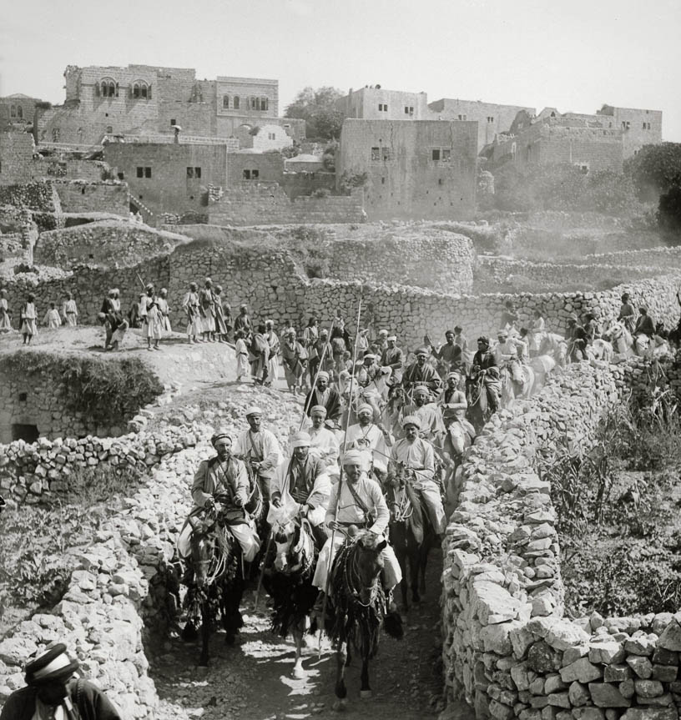
And on the third day there was a wedding
Wedding procession with horsemen in Abu Ghosh, 1904
2:1
Notes:
Abu Ghosh is located in the Judean hills west of Jerusalem. This American Colony photograph was taken in July 1904.
mat01297

Slide 6
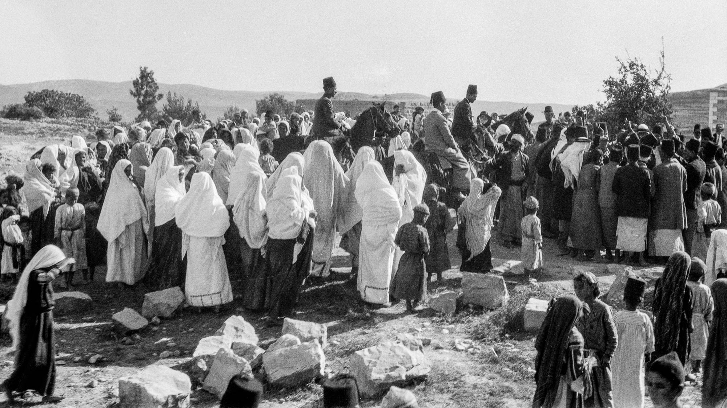
And on the third day there was a wedding
Wedding procession at Betunia
2:1
Notes:
This American Colony photograph was taken between 1934 and 1939.
mat18990

Slide 7
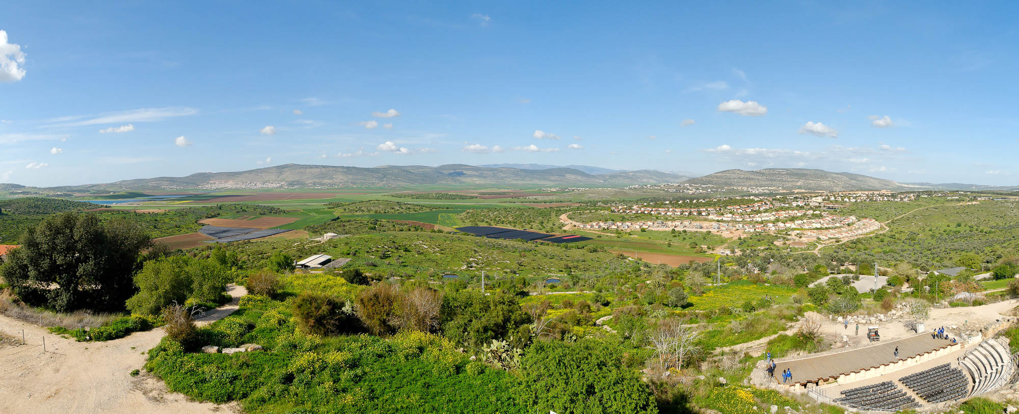
And on the third day there was a wedding in Cana of Galilee
View towards Cana from Sepphoris across the Bet Netofa Valley
2:1
Notes:
Jesus would have traveled across this valley if coming to Cana from Nazareth or the south. See the next slide for a label identifying Cana (Khirbet Qana).
tb03250766p

Slide 8
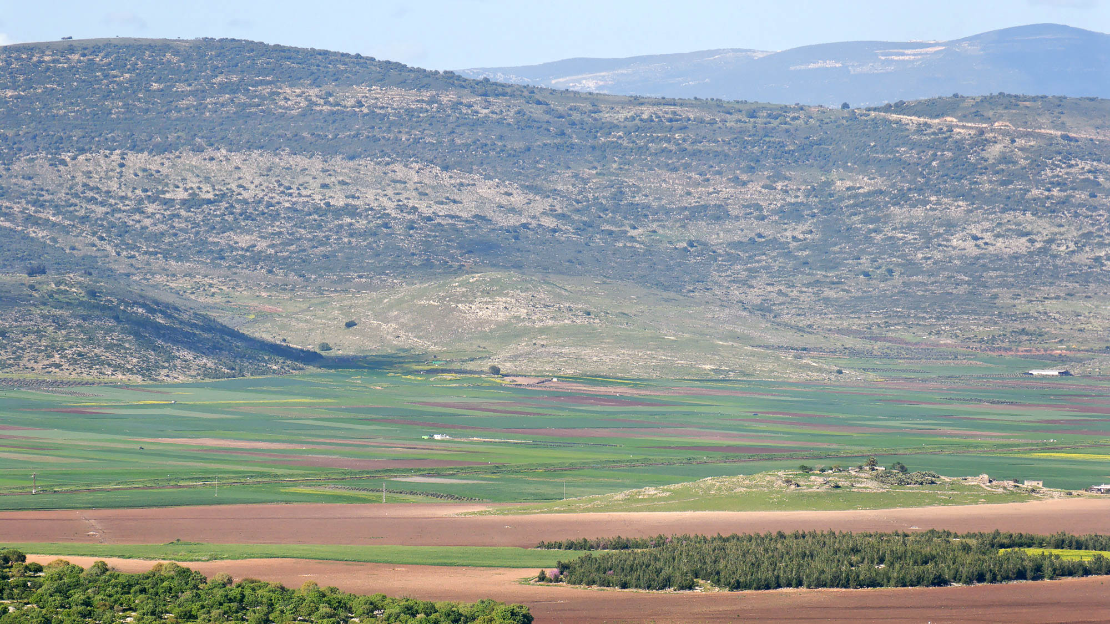
And on the third day there was a wedding in Cana of Galilee
Khirbet Qana, likely location of Cana (from the south)
2:1
Notes:
Khirbet Qana is located in the center of the photo (see the next slides for closer perspectives). A number of locations have been suggested as the site of the Cana of John’s Gospel. The most likely one is Khirbet Qana, shown here. Following slides show two other candidates: (1) Kefar Kenna near Nazareth and (2) the village of Qana in Lebanon, about 6 miles (10 km) southeast of Tyre.
tb032507669

Slide 9
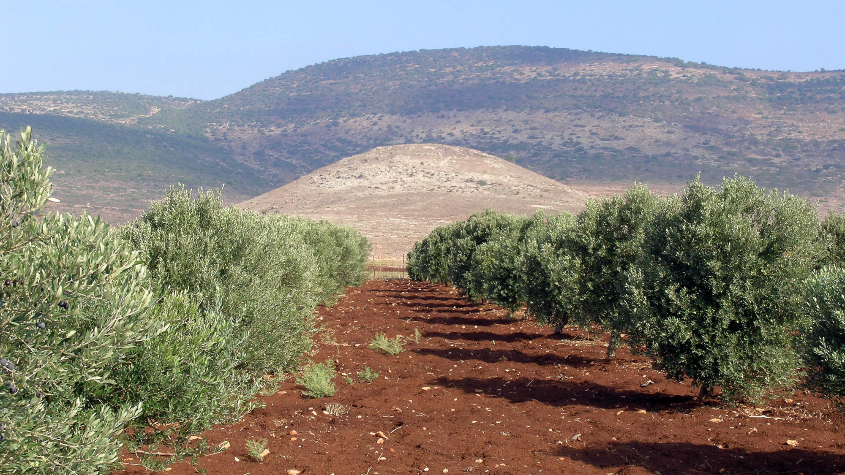
And on the third day there was a wedding in Cana of Galilee
Khirbet Qana, likely location of Cana (from the south)
2:1
Notes:
Khirbet Qana is west-southwest of the main area of Jesus’s ministry around the northern shore of the Sea of Galilee.
tb110306560

Slide 10
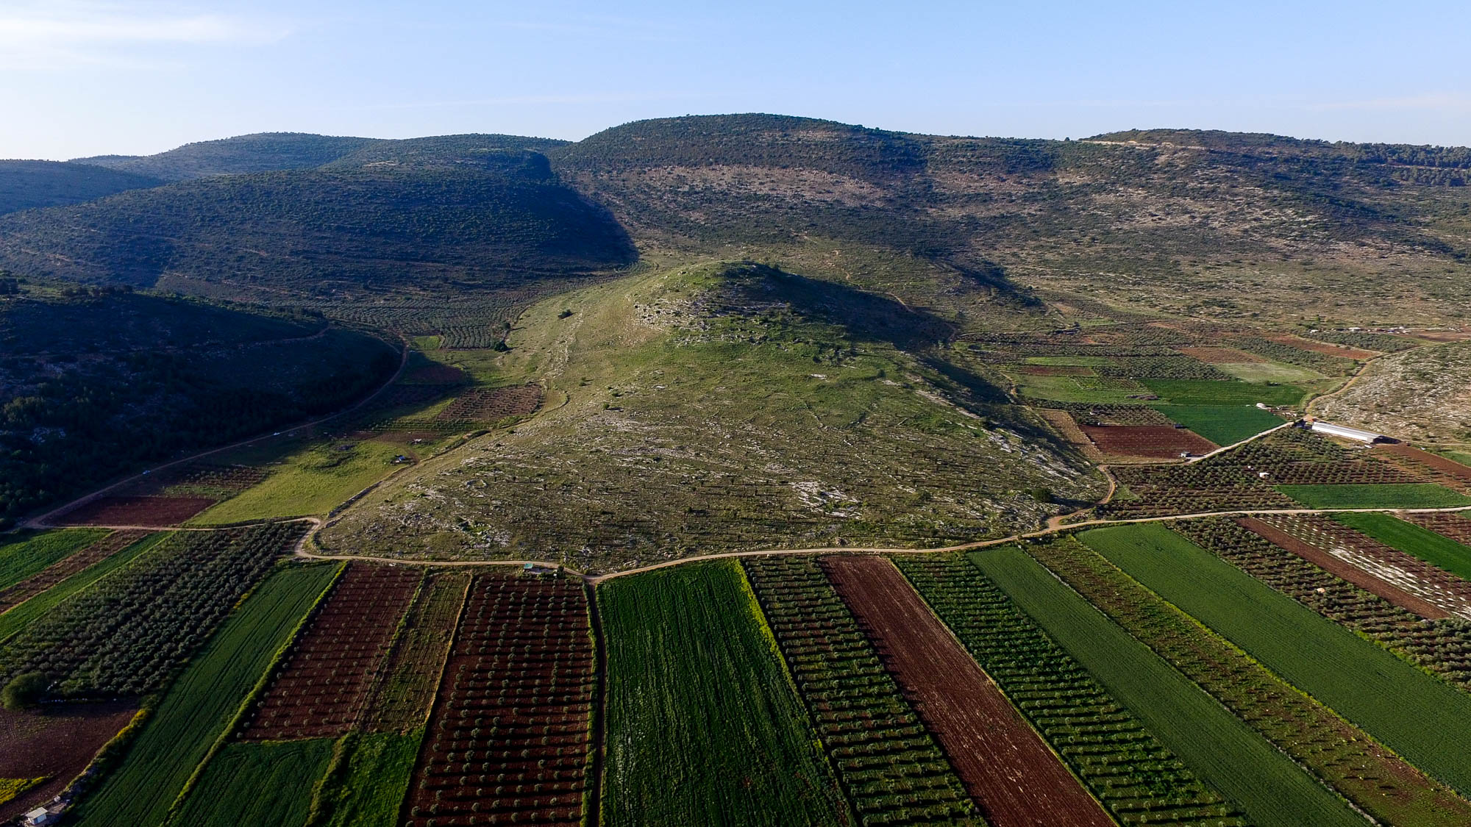
And on the third day there was a wedding in Cana of Galilee
Khirbet Qana, likely location of Cana (aerial view from the south)
2:1
Notes:
The Gospel of John records two of Jesus’s visits to Cana (John 2:1; 4:46). Cana was also the hometown of Nathanael (John 21:2), who was associated with the Twelve.
ws040316790

Slide 11
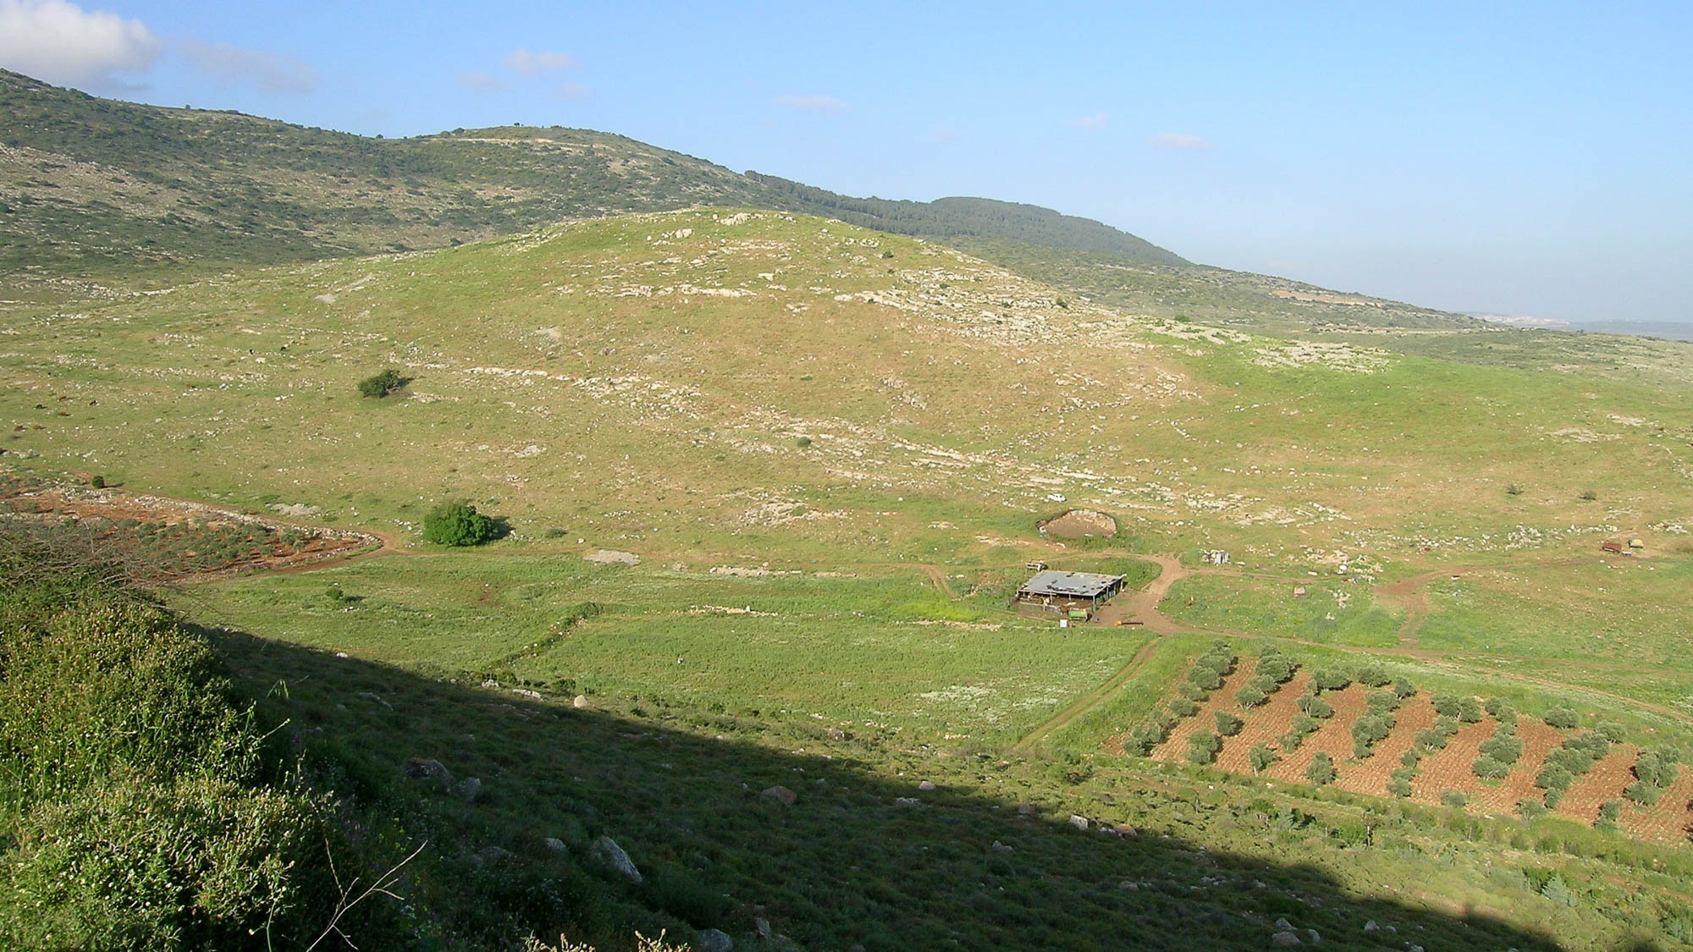
And on the third day there was a wedding in Cana of Galilee
Khirbet Qana, likely location of Cana (from the west)
2:1
Notes:
Khirbet Qana (shown here) is more likely to be the site of Cana in the 1st century AD than other candidates because of its location in lower Galilee not far from Nazareth (8 mi; 13 km distant) and the archaeological evidence from the 1st century AD. Josephus located Cana near the plain of Asochis (modern Bet Netofa Valley). Theodosius located Cana as being 5 miles (8 km) away from Sepphoris. The Pilgrim of Piacenza placed it 3 miles (5 km) away.
tb033104454

Slide 12
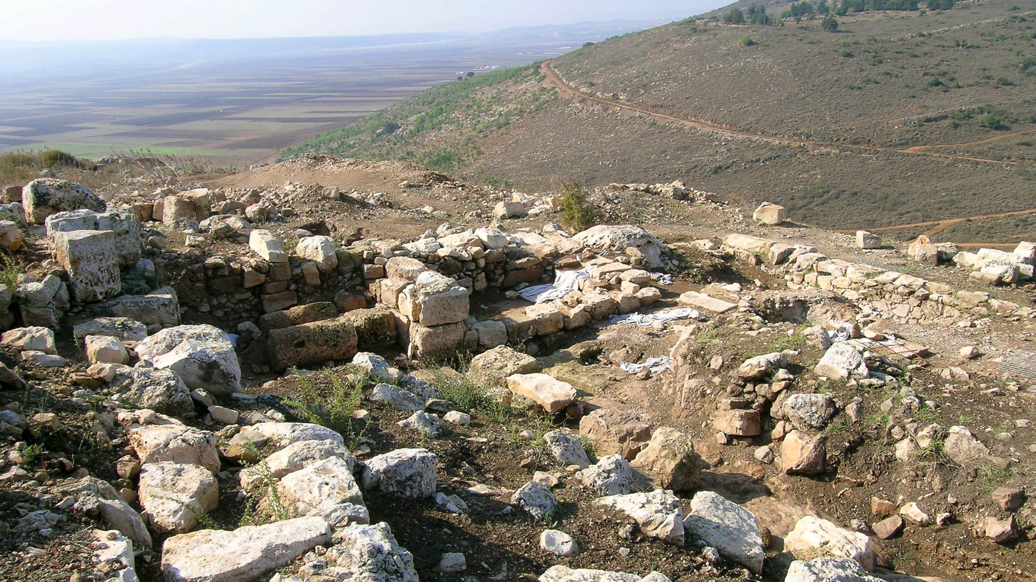
And on the third day there was a wedding in Cana of Galilee
Excavations of Khirbet Qana, likely location of Cana
2:1
Notes:
Excavations of Khirbet Qana have strengthened the theory that the site is to be identified with the Cana of the Gospels. The site was excavated from 1998–2008 by the University of Puget Sound, under the direction of the late Douglas R. Edwards (1950–2008). Tom McCollough, of Centre College, has directed the excavations since that time.
tb110306566

Slide 13
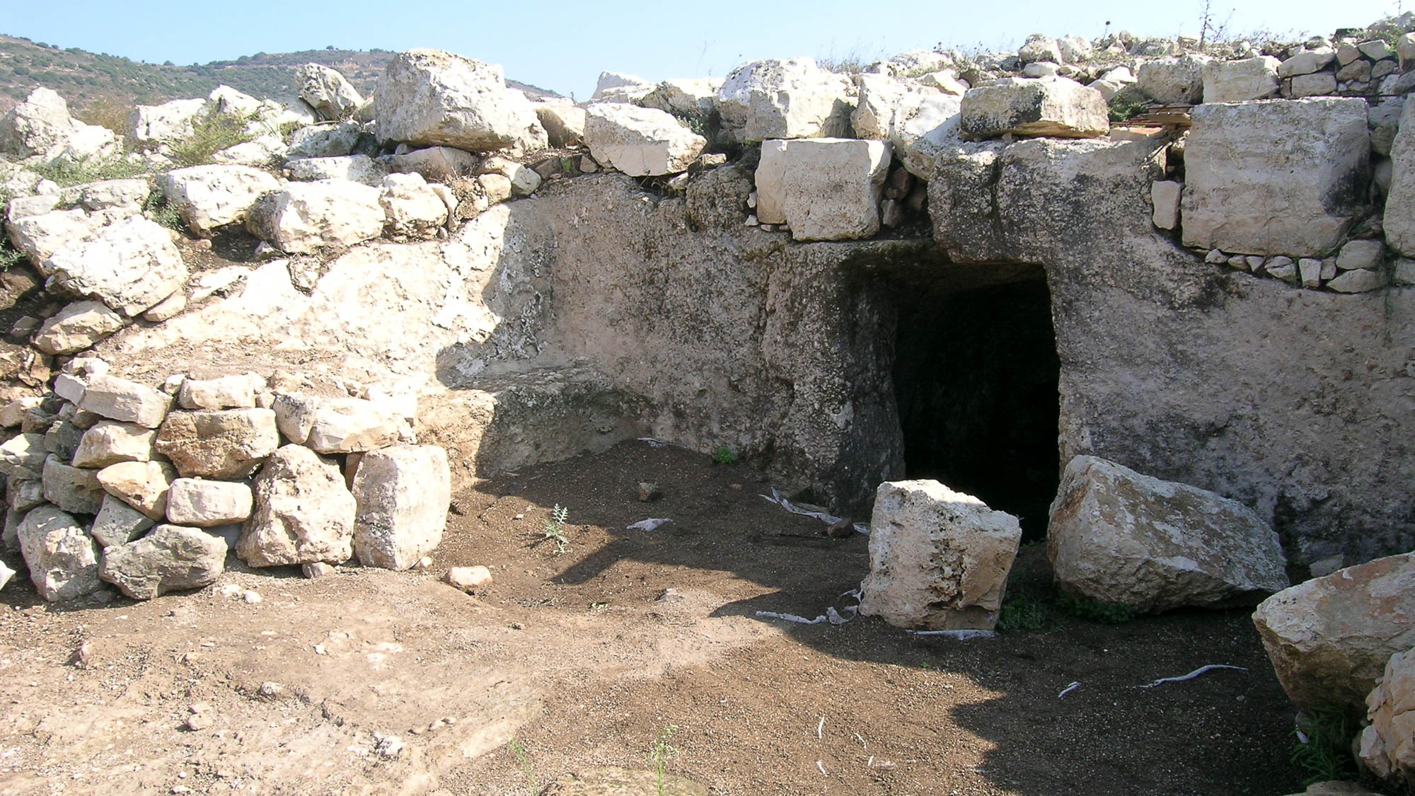
And on the third day there was a wedding in Cana of Galilee
Excavations of room and cellar at Khirbet Qana, likely location of Cana
2:1
Notes:
Recent excavations of the site have uncovered a cave on the southern slope (not shown here) with Greek graffiti reading “Lord Jesus” written on the wall. The cave apparently served as a place for Byzantine pilgrims to remember Jesus’s miracle. This provides the earliest archaeological evidence connecting the miracle of John 2 to any of the candidates for Cana. For more information, see McCollough (2015).
Reference:
McCollough, C. Thomas.
2015 Searching for Cana: Where Jesus Turned Water into Wine. Biblical Archaeology Review 41/6: 30–39.
tb110306575

Slide 14
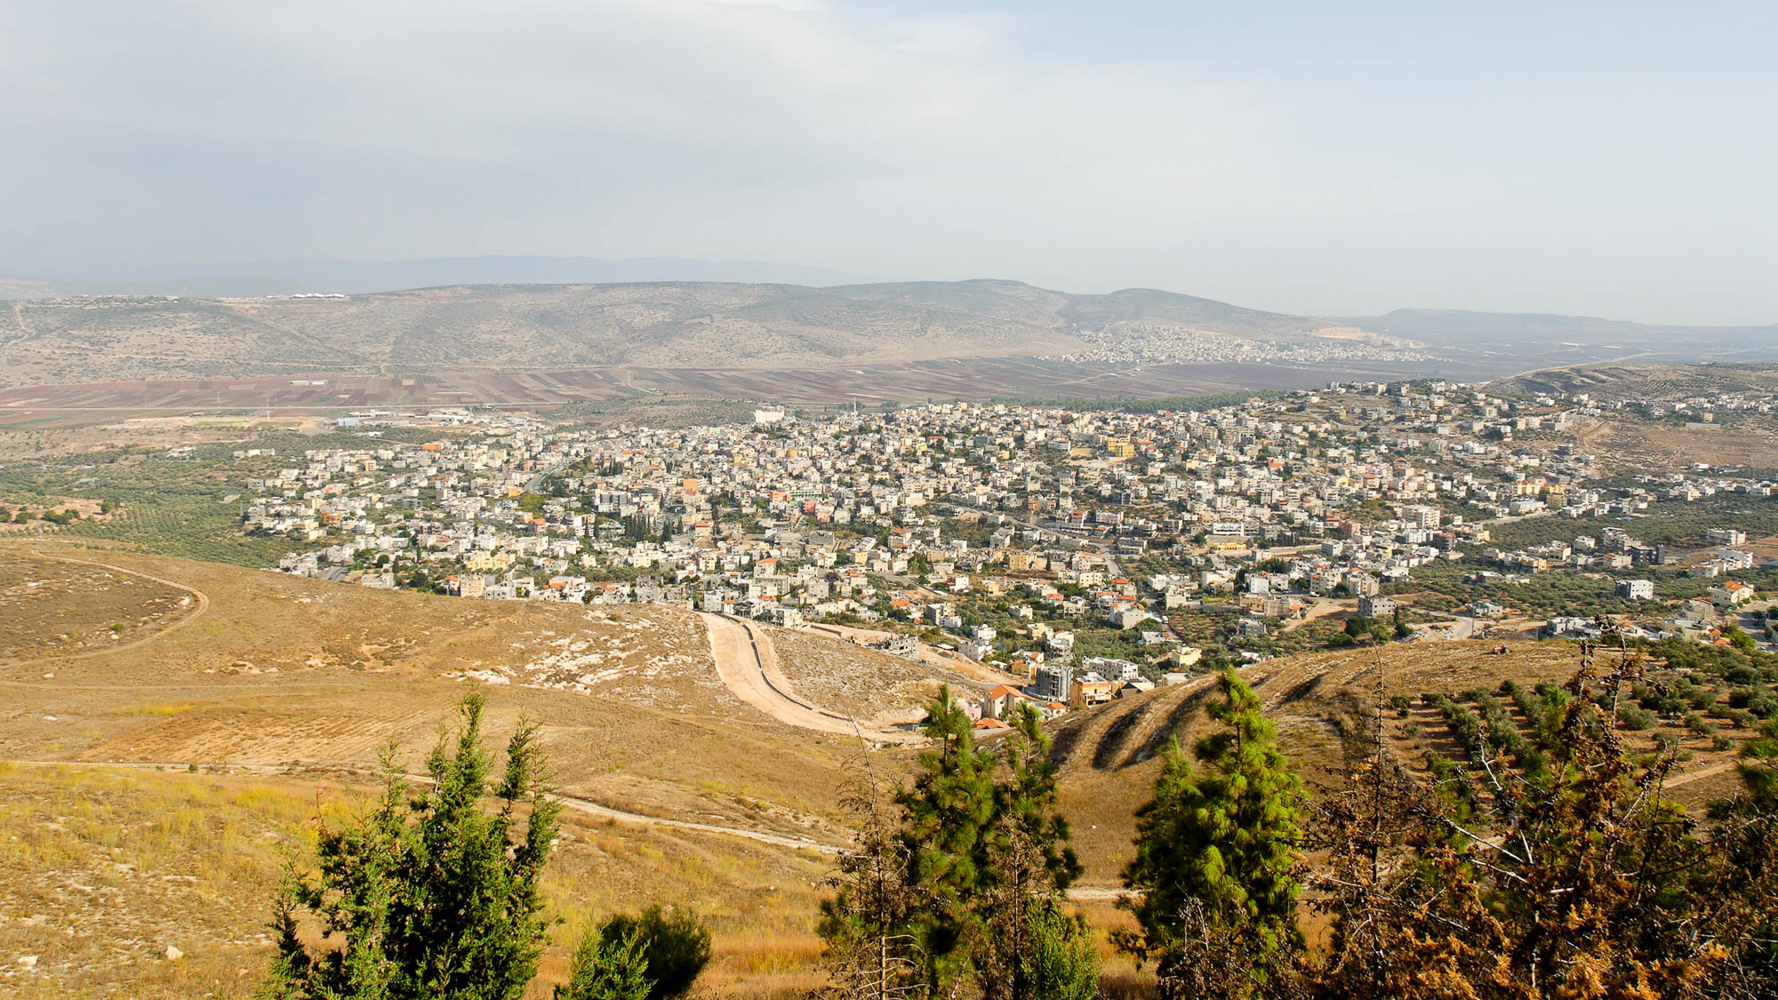
And on the third day there was a wedding in Cana of Galilee
Kefar Kenna, traditional location of Cana (from the south)
2:1
Notes:
Kefar Kenna lays claim to being the biblical city of Cana, but this identification is unknown before the 17th century and therefore is dubious. The name “kenna” is not related to “qana,” and thus the village does not preserve the biblical name.
tb110106362

Slide 15
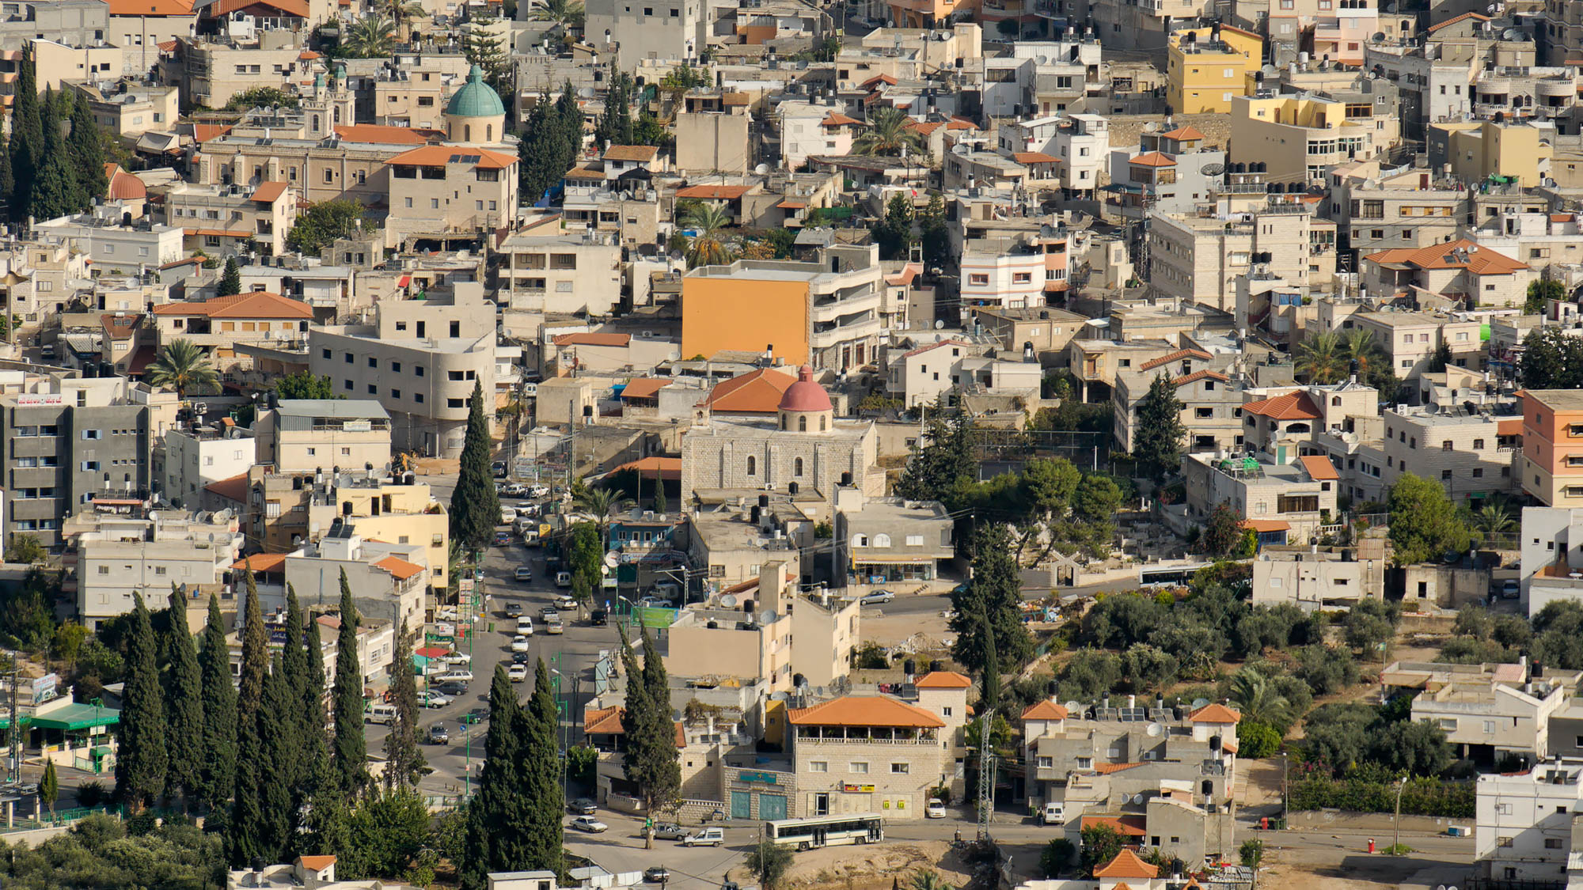
And on the third day there was a wedding in Cana of Galilee
Kefar Kenna, traditional location of Cana (from the south)
2:1
Notes:
The domes of two historic churches are visible in this photo of the downtown area of Kefar Kenna.
tb110106364

Slide 16
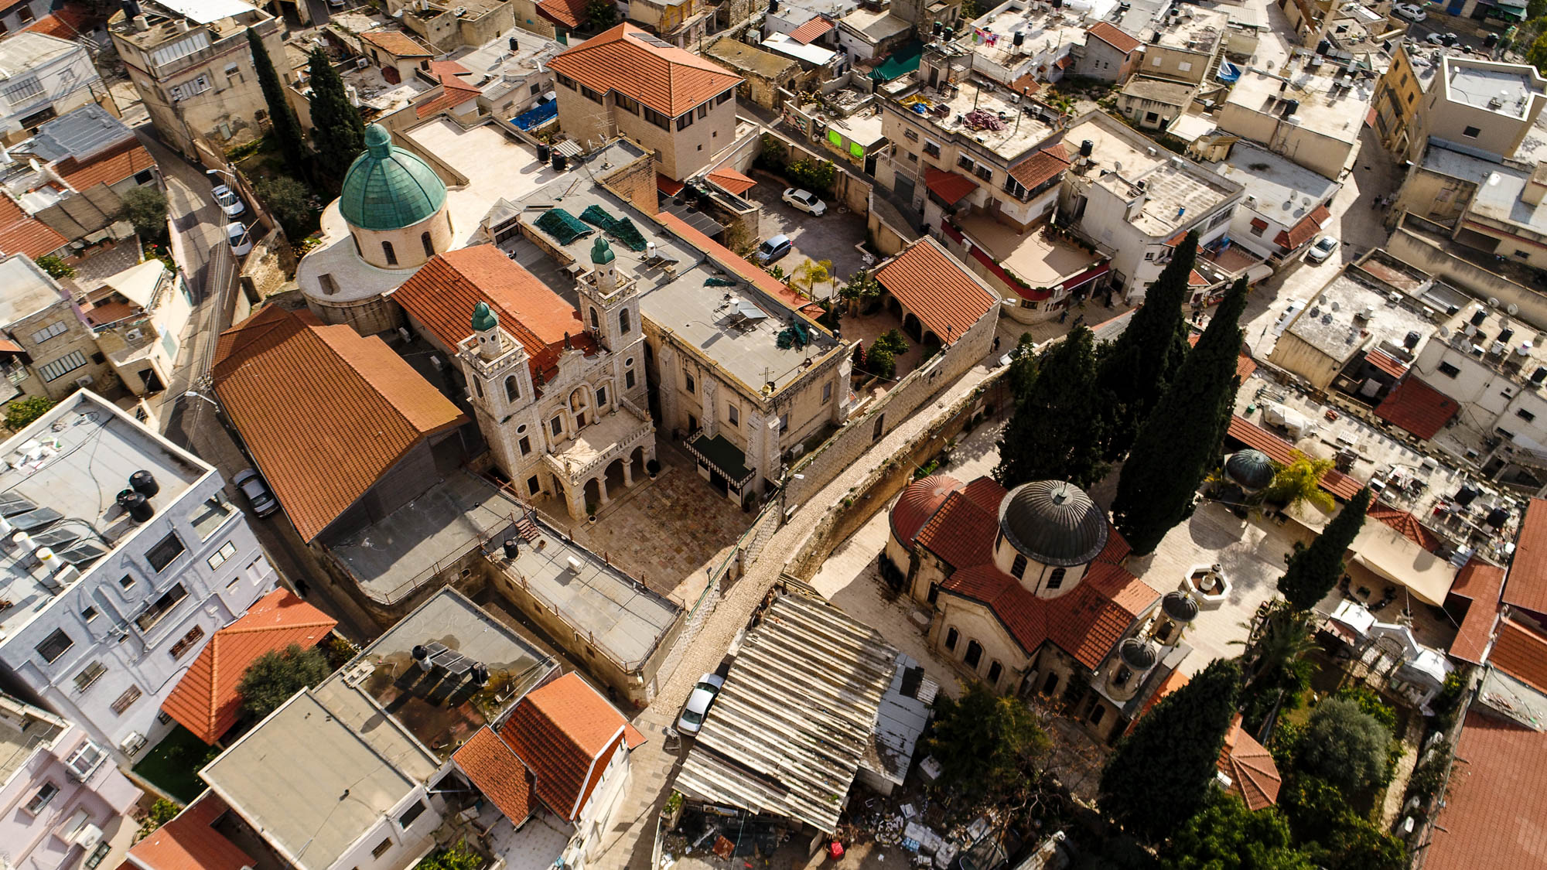
And on the third day there was a wedding in Cana of Galilee
Kefar Kenna, Catholic Wedding Church and Orthodox Church (aerial view from the northwest)
2:1
Notes:
Catholic and Orthodox pilgrims commemorate Jesus’s miracle at these churches in Kefar Kenna.
ws012217046

Slide 17
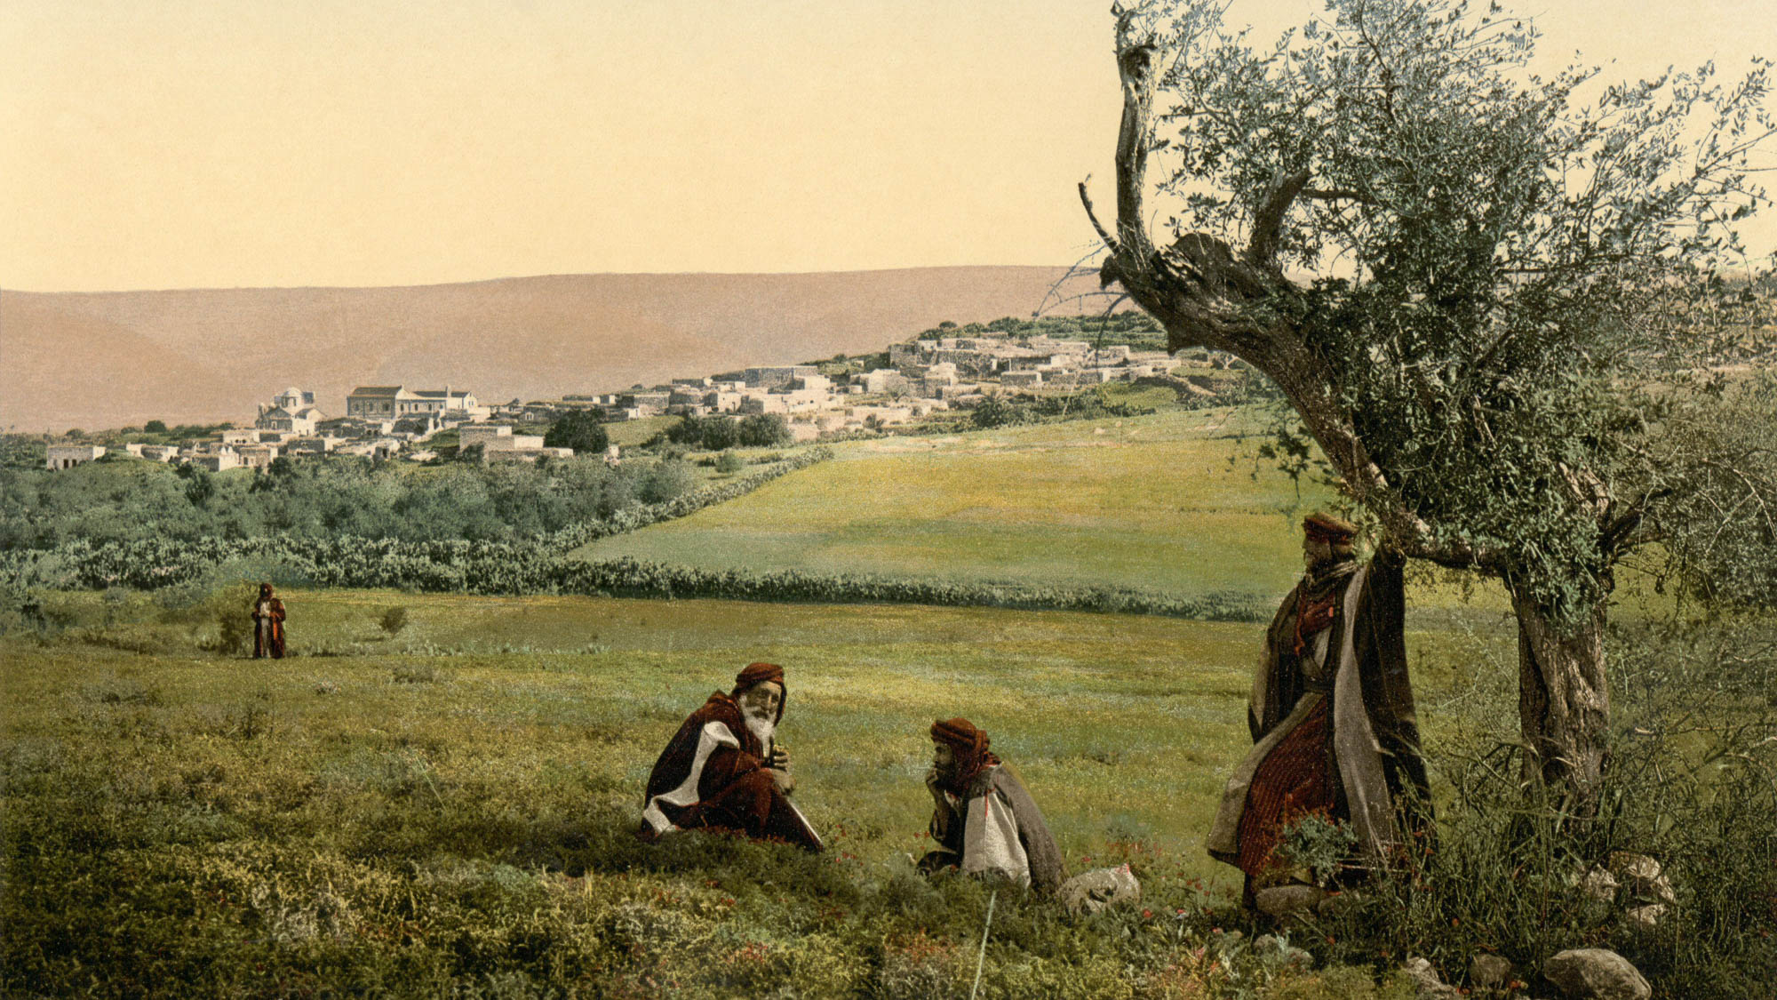
And on the third day there was a wedding in Cana of Galilee
Kefar Kenna, traditional location of Cana
2:1
Notes:
Pilgrims from the Byzantine period seem to have identified Cana at Kefar Kenna, and some suggest this identification was made in part because of the convenient location of the site on the route from Nazareth to Tiberias. Kefar Kenna is located 4 miles (6 km) northeast of Nazareth, opposite Gath-Hepher. This photochrom image was taken in the 1890s.
pcm02665

Slide 18
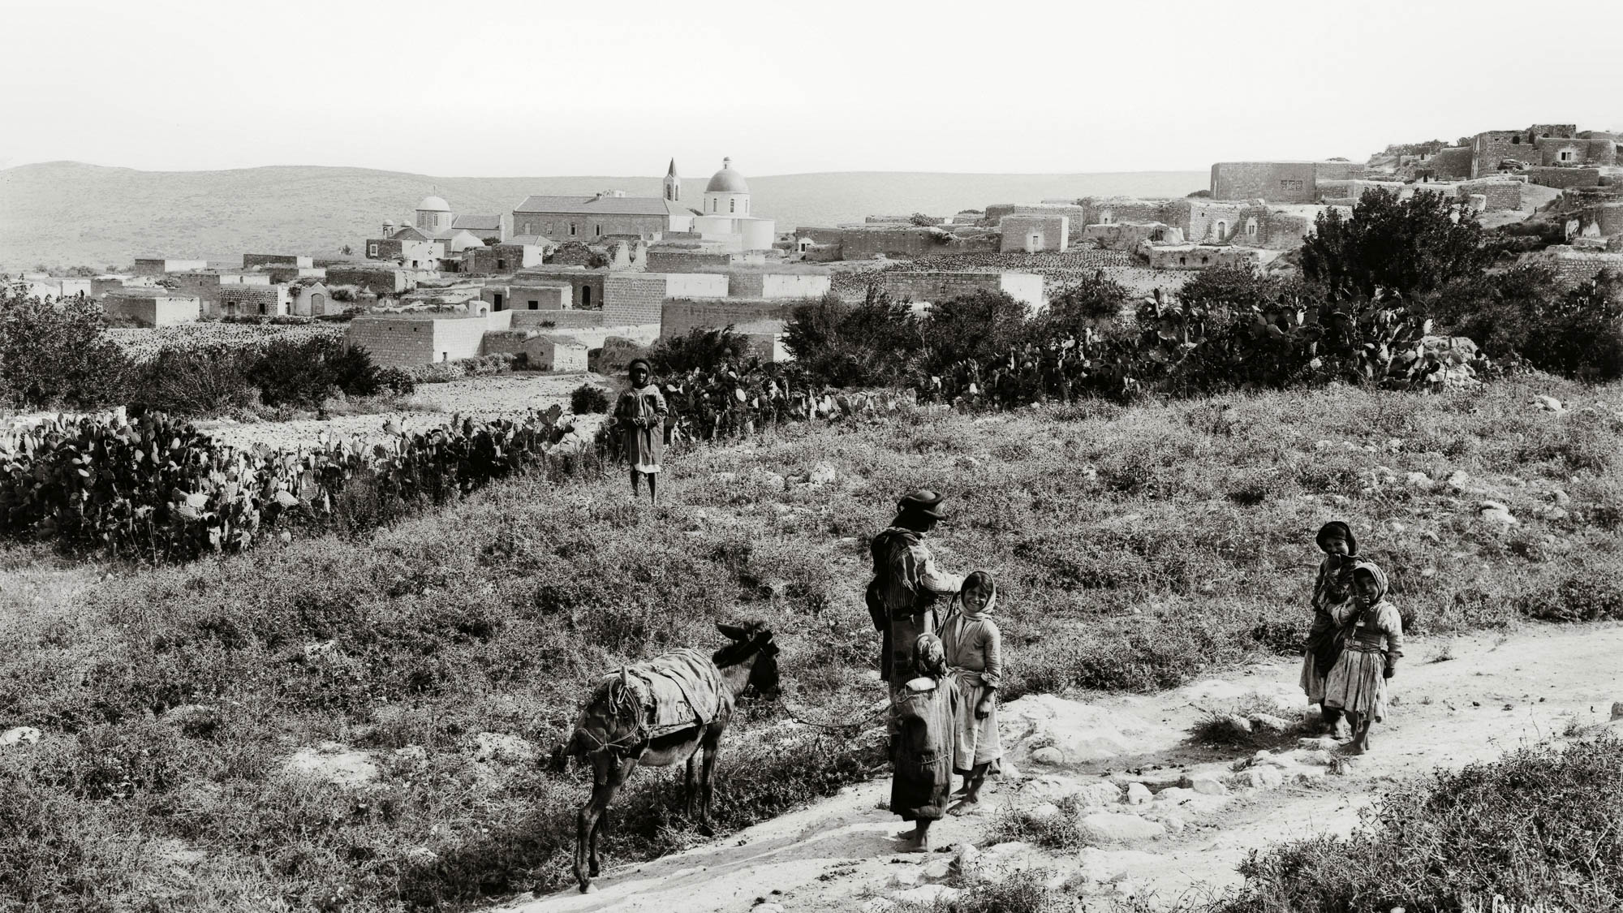
And on the third day there was a wedding in Cana of Galilee
Kefar Kenna, traditional location of Cana
2:1
Notes:
This American Colony photograph was taken from the same perspective as the previous slide. It was taken between 1898 and 1914.
mat07007

Slide 19
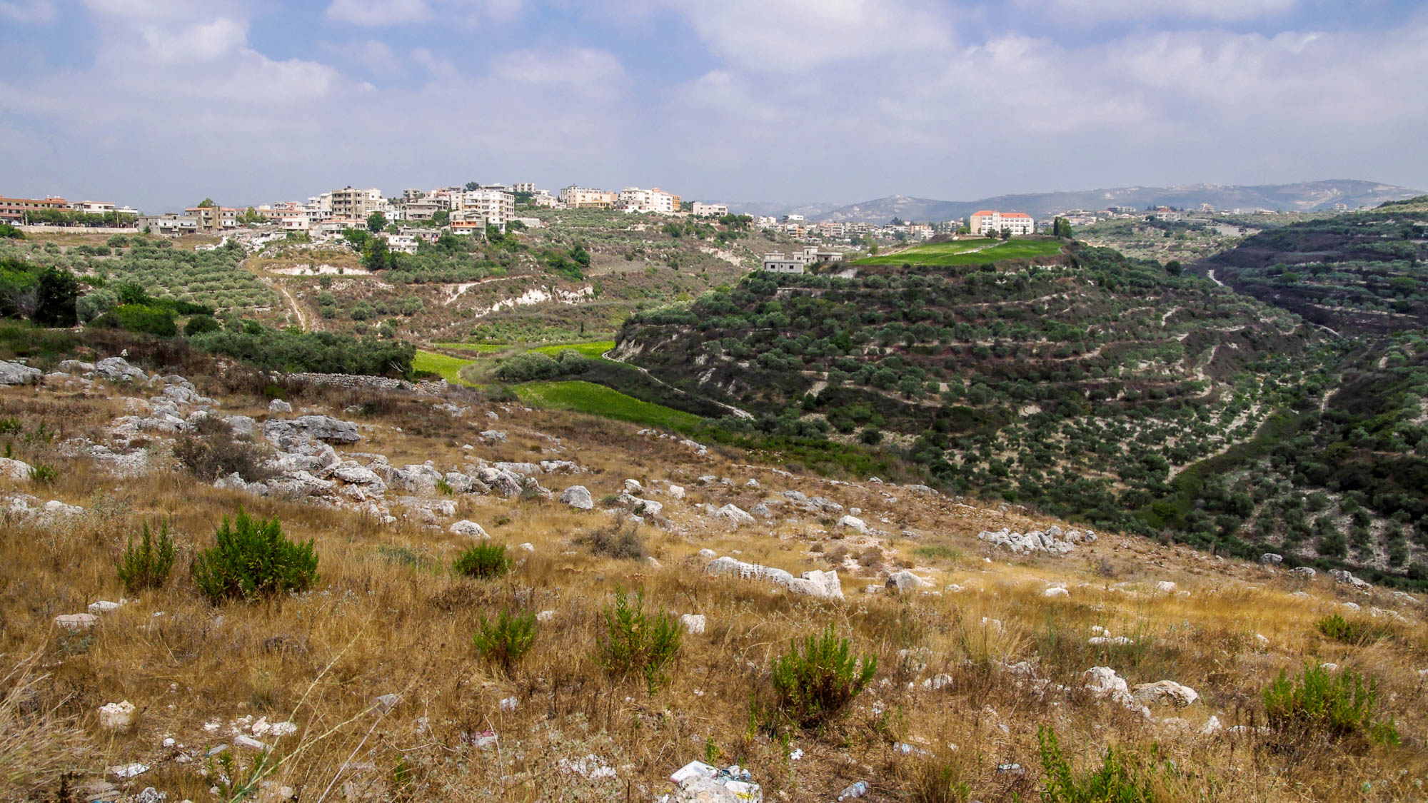
And on the third day there was a wedding in Cana of Galilee
Village of Cana in Lebanon (from the west)
2:1
Notes:
The modern village of Cana (also spelled Qana) in Lebanon has a long tradition identifying it as the Cana of John’s Gospel. The church historian Eusebius located Cana here in his Onomasticon.
adr1307169673

Slide 20
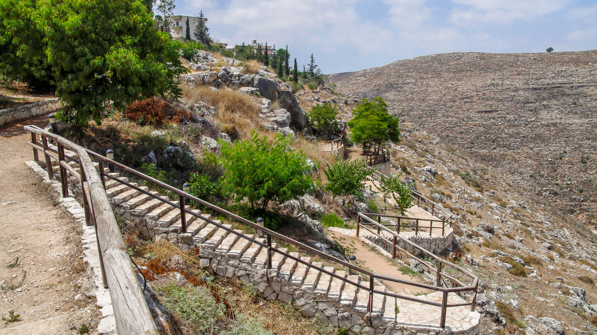
And on the third day there was a wedding in Cana of Galilee
Cana Grotto and Wadi el-Aghrab
2:1
Notes:
According to one tradition, the miracle of Cana took place in a cave, today venerated as the Cana Grotto.
adr1307169614

Slide 21
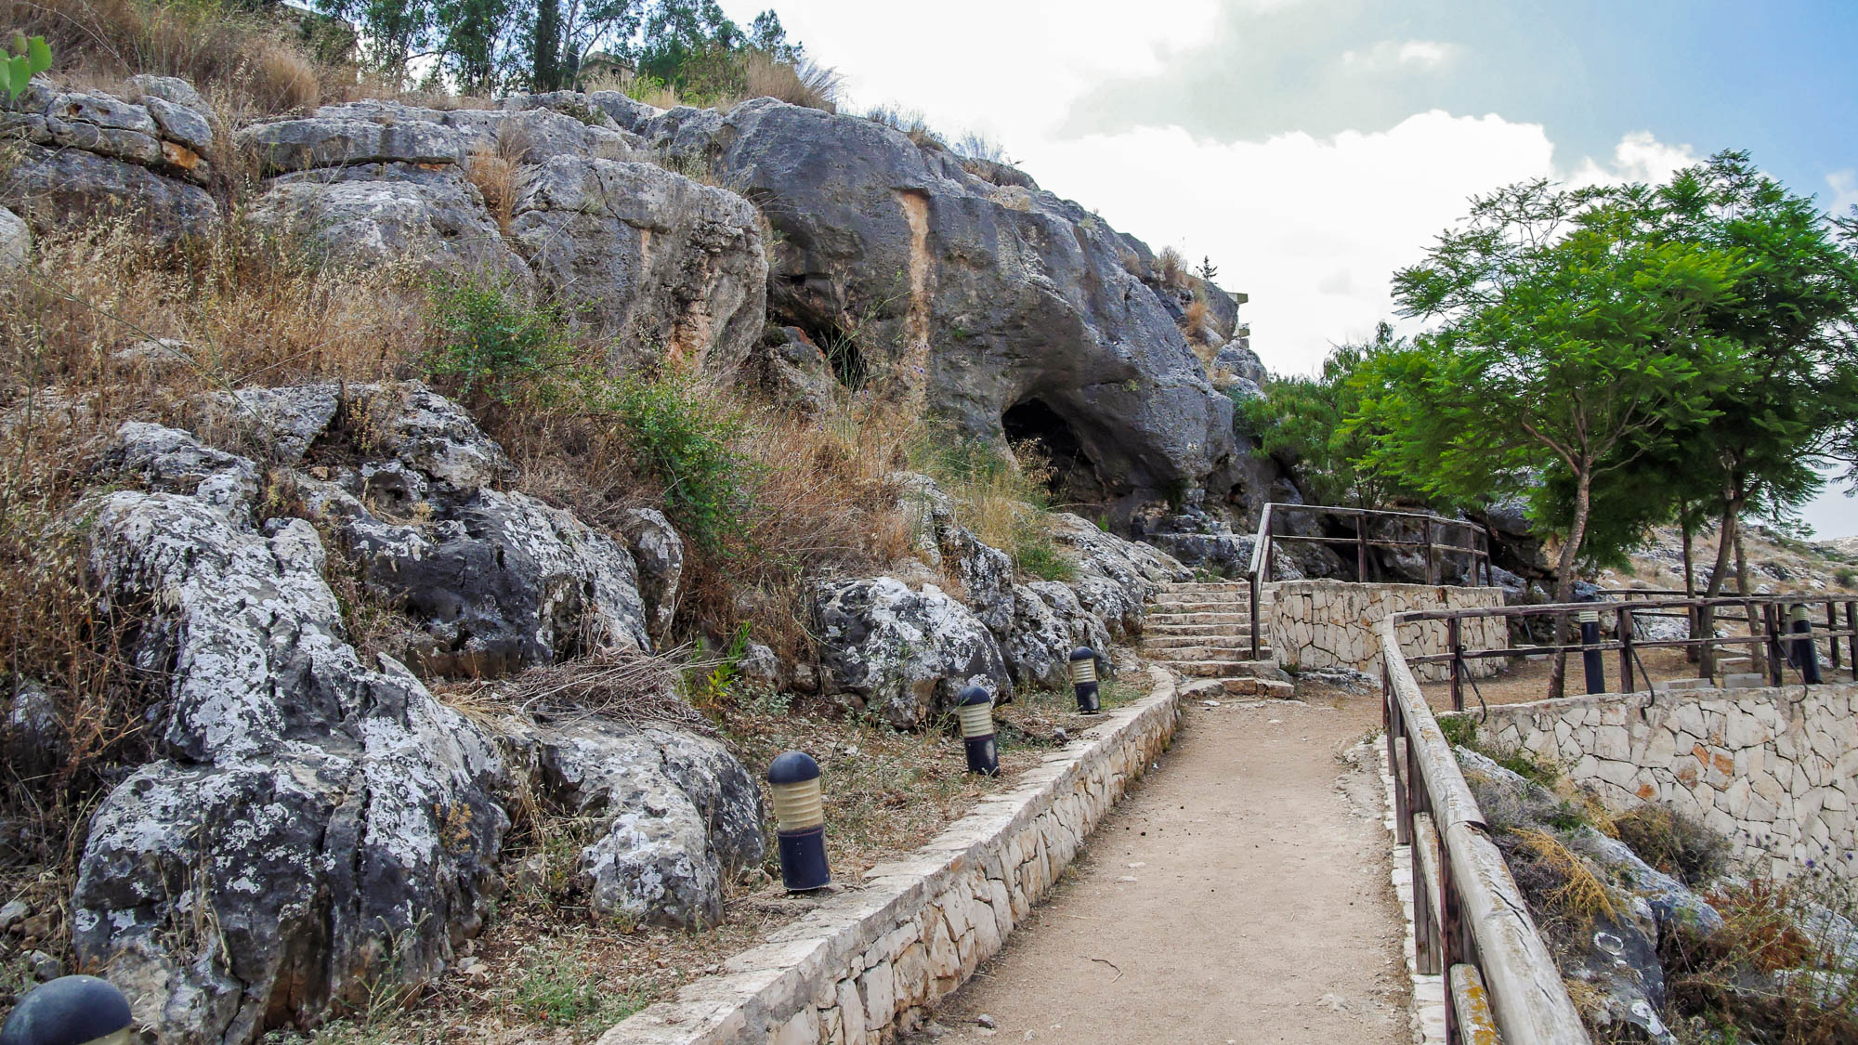
And on the third day there was a wedding in Cana of Galilee
Cana Grotto
2:1
Notes:
adr1307169624

Slide 22
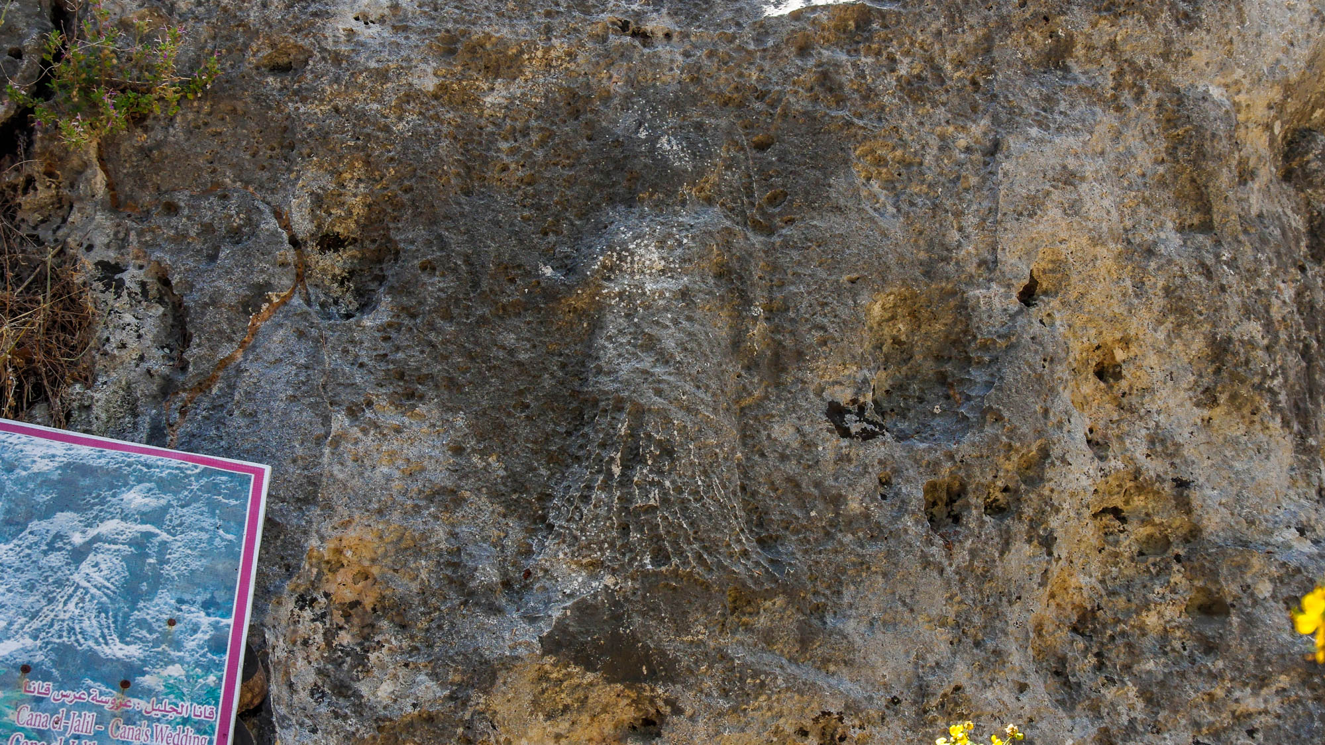
And on the third day there was a wedding in Cana of Galilee
Relief near Grotto of Wedding at Cana
2:1
Notes:
This relief depicting the wedding of Cana was carved on the rocky escarpment next to a traditional location where Jesus turned water into wine.
adr1307169649

Slide 23
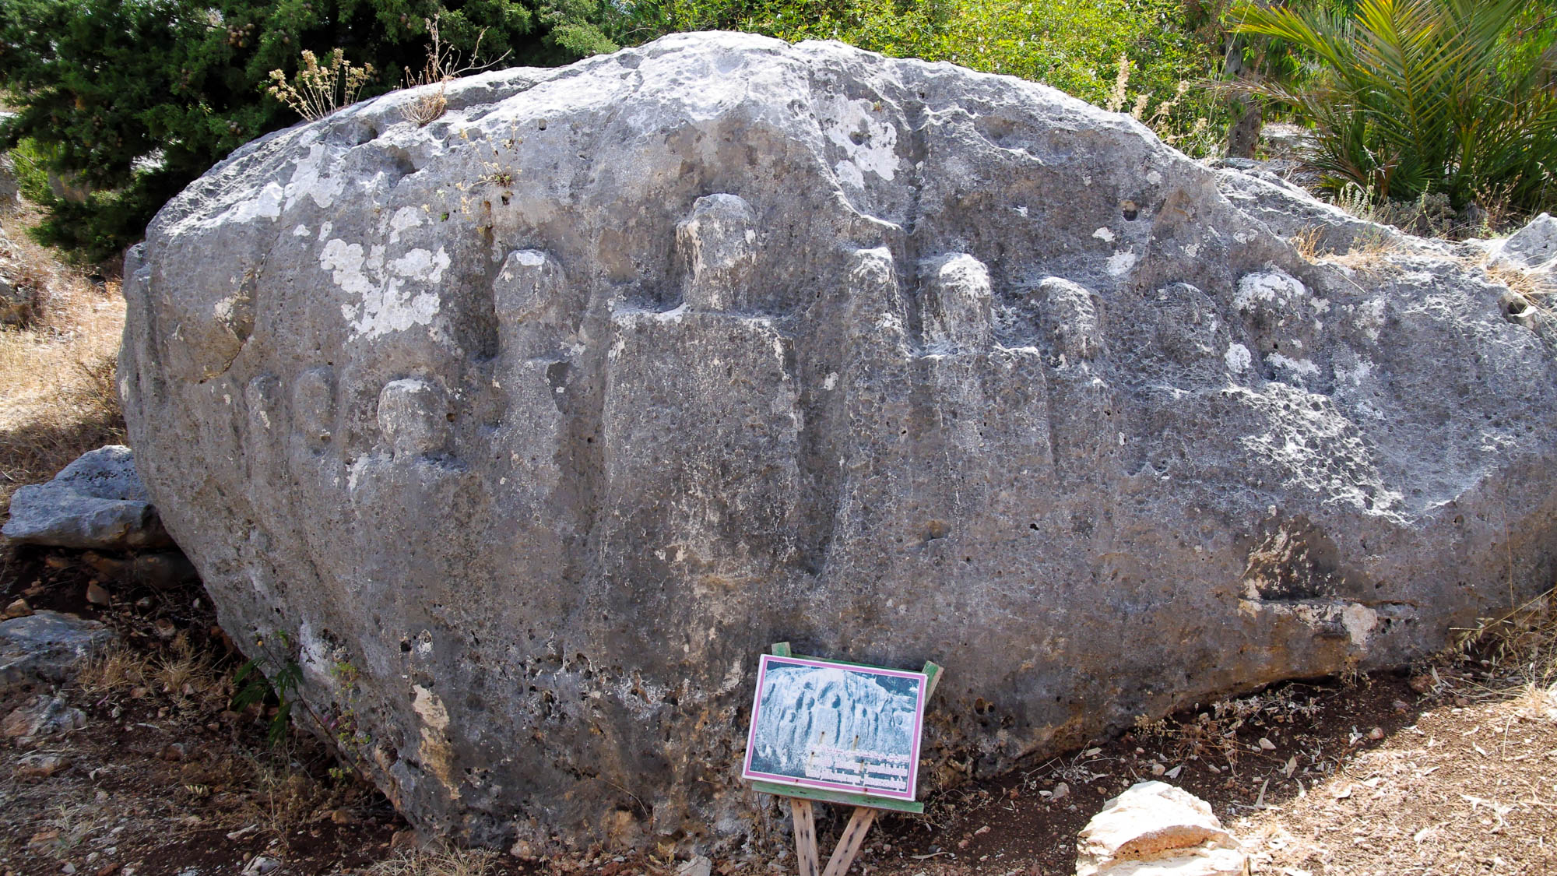
And on the third day there was a wedding in Cana of Galilee
Relief of Jesus and the apostles near the grotto of the Last Supper at Cana Grotto
2:1
Notes:
This relief of Jesus and the apostles was carved on the rocky escarpment next to a traditional location where Jesus turned water into wine.
adr1307169640

Slide 24
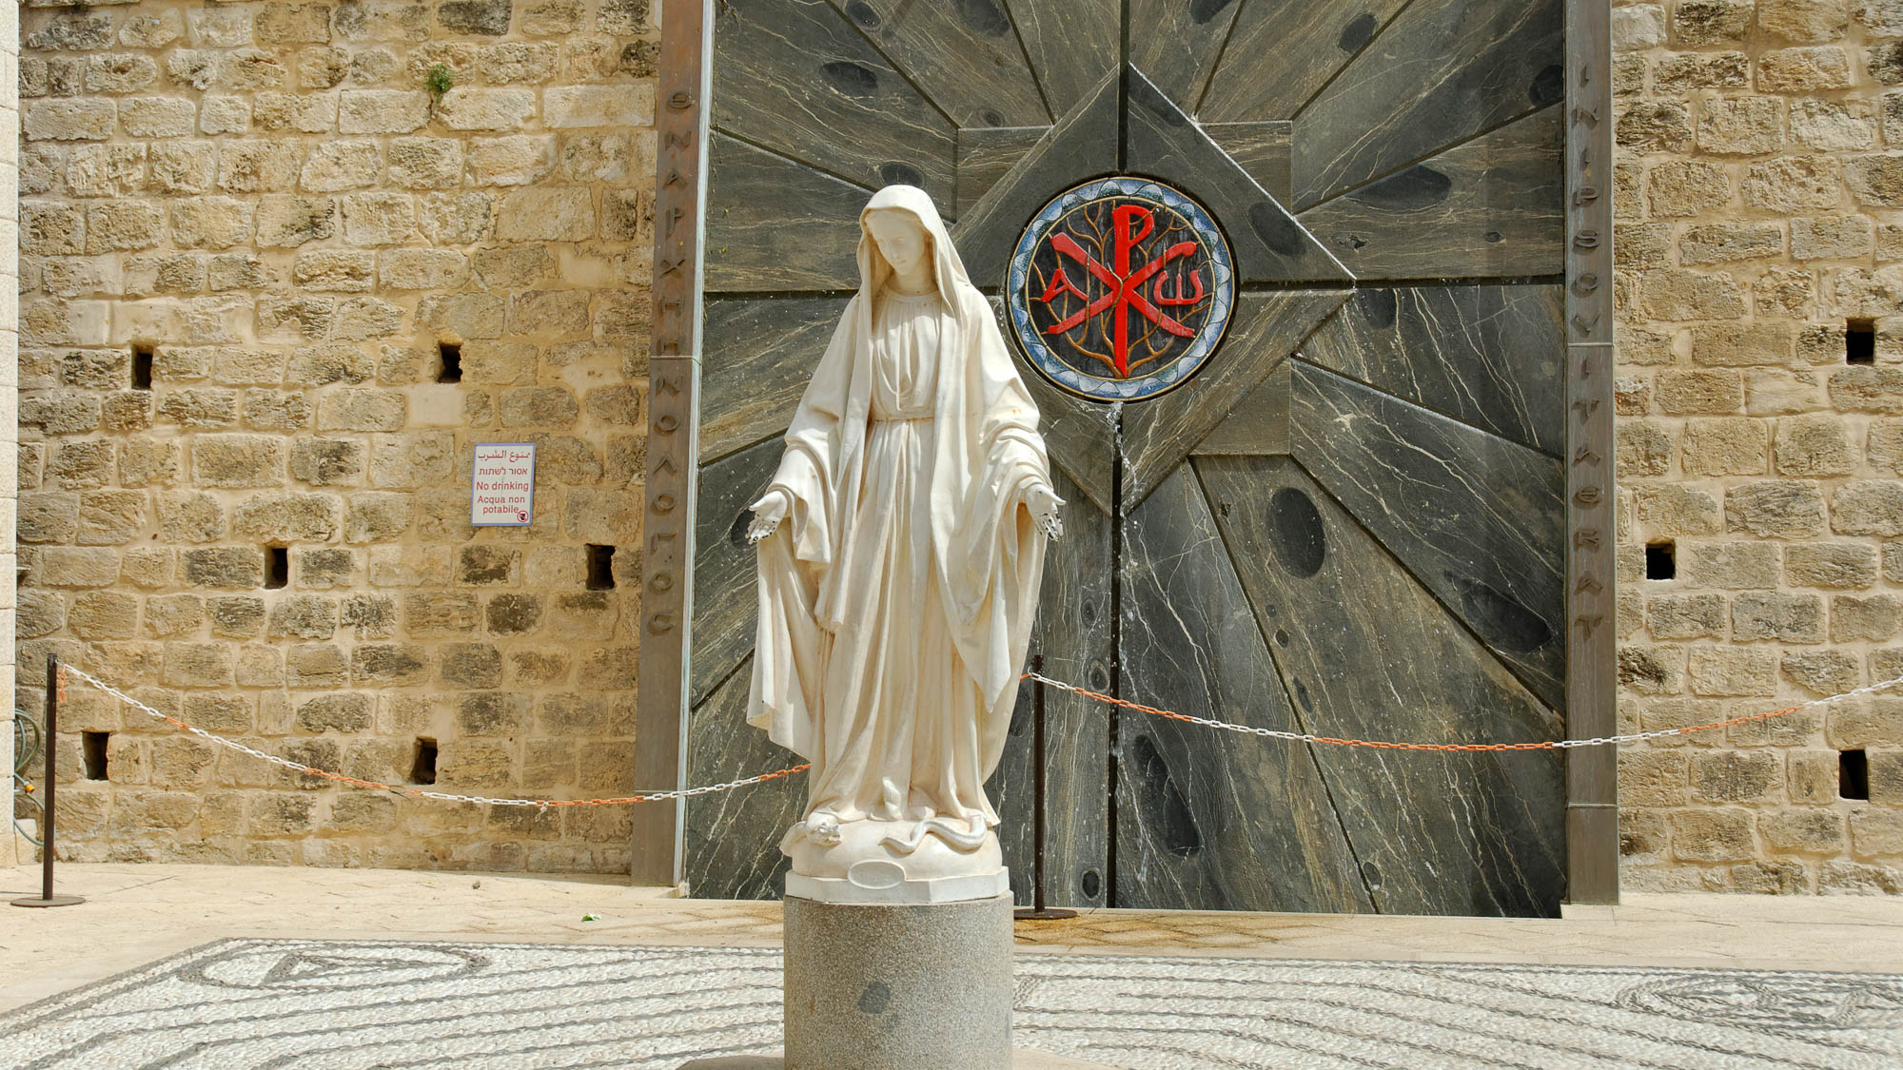
And when the wine ran out, the mother of Jesus said to Him, “They have no wine”
Statue of Mary at the Church of the Annunciation in Nazareth
2:1
Notes:
This statue is located in the courtyard of the Roman Catholic Church of the Annunciation in Nazareth.
tb043012973

Slide 25
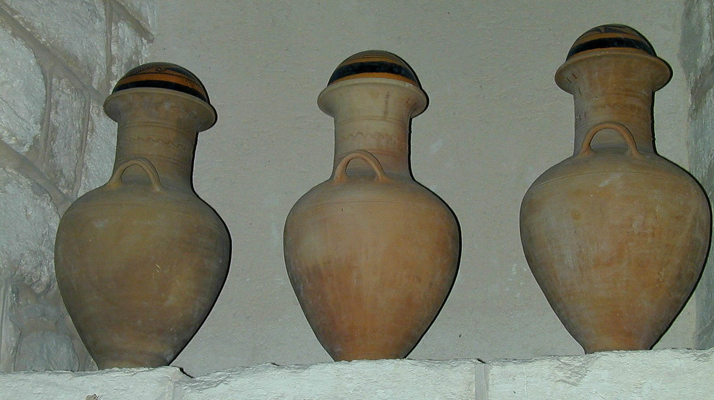
And when the wine ran out, the mother of Jesus said to Him, “They have no wine”
Clay wedding jars on display in Kefar Kenna
2:3
Notes:
Jars like these (much smaller than the stone waterpots) could have been used for storing wine at the wedding feast.
tb040200201

Slide 26
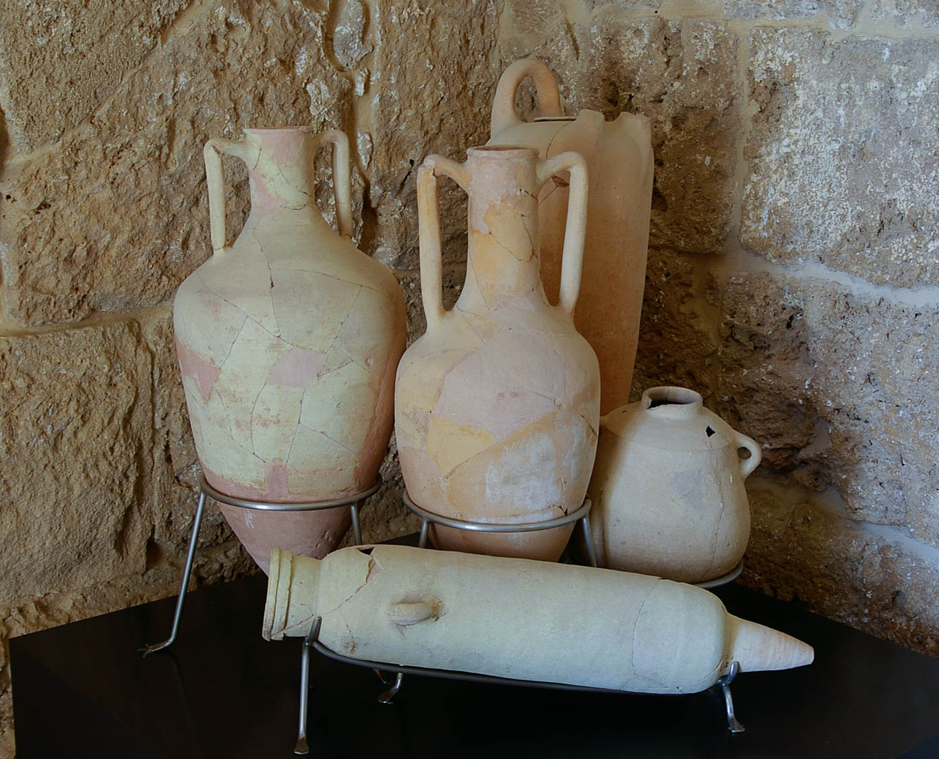
And when the wine ran out, the mother of Jesus said to Him, “They have no wine”
Amphorae for holding wine
2:3
Notes:
These artifacts date to various periods and were photographed in the Byblos Museum.
adr090507241

Slide 27
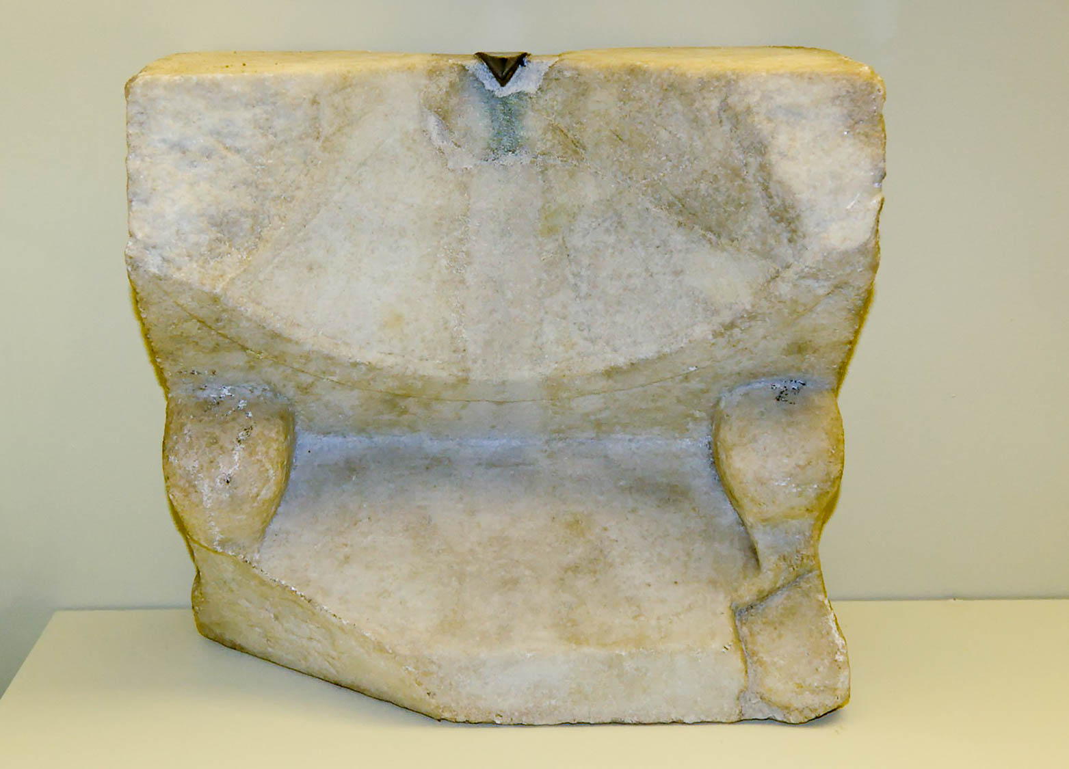
Jesus said . . . “My hour has not yet come”
Marble sundial from Pompeii, 1st century AD
2:4
Notes:
This sundial was photographed in the Naples Archaeological Museum.
tb111705794h

Slide 28
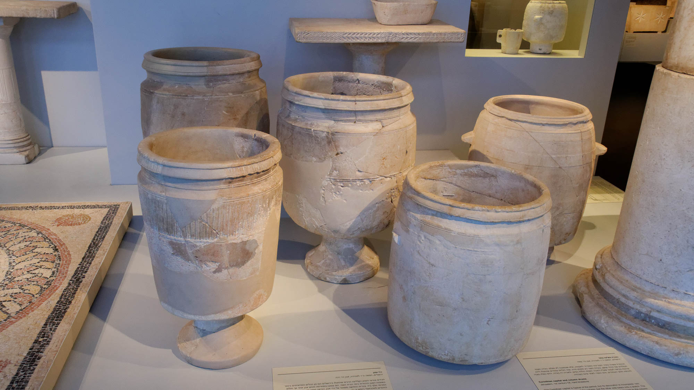
Now there were six stone water jars set there, each holding twenty or thirty gallons
Stone water jars from Jerusalem, 1st century AD
2:6
Notes:
Stone jars were more expensive than those made of pottery, but they had the advantage of being able to be purified after ritual defilement, according to rabbinic rulings. This type of jar is well known in Jerusalem and elsewhere in the 1st century AD. This display was photographed in the Israel Museum.
tb032014537

Slide 29
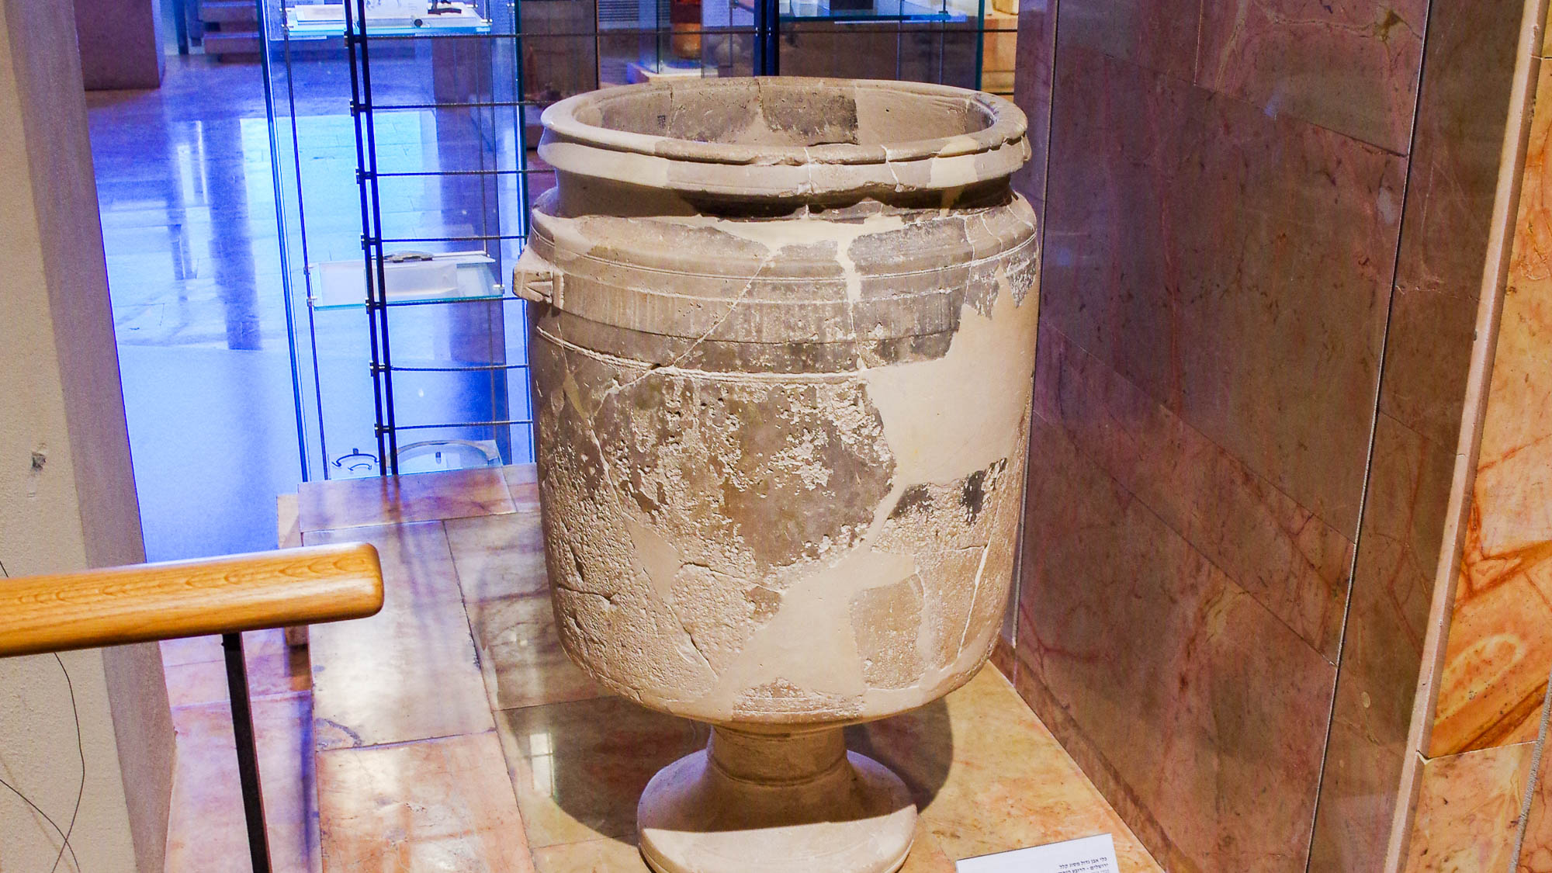
Now there were six stone water jars set there, each holding twenty or thirty gallons
Stone water jar from Jewish Quarter in Jerusalem, 1st century AD
2:6
Notes:
This artifact was photographed in the Hecht Museum at the University of Haifa.
adr1805242621

Slide 30
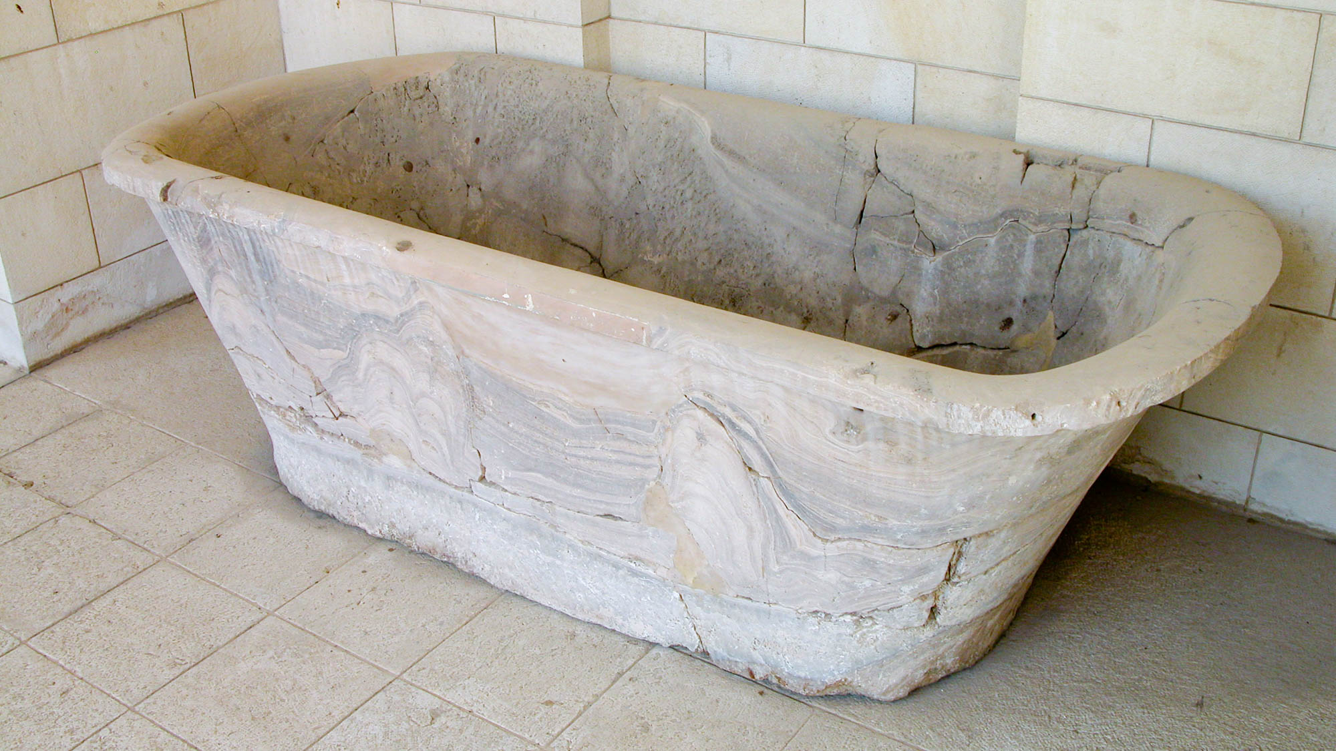
Now there were six stone water jars set there, each holding twenty or thirty gallons
Stone bath from Cypros, 1st century BC
2:6
Notes:
This is not a “water jar,” but the volume of this stone container is close to that mentioned in this verse. Cypros was a hilltop fortress by Jericho. This artifact was photographed in the Rockefeller Museum.
tb042403142

Slide 31
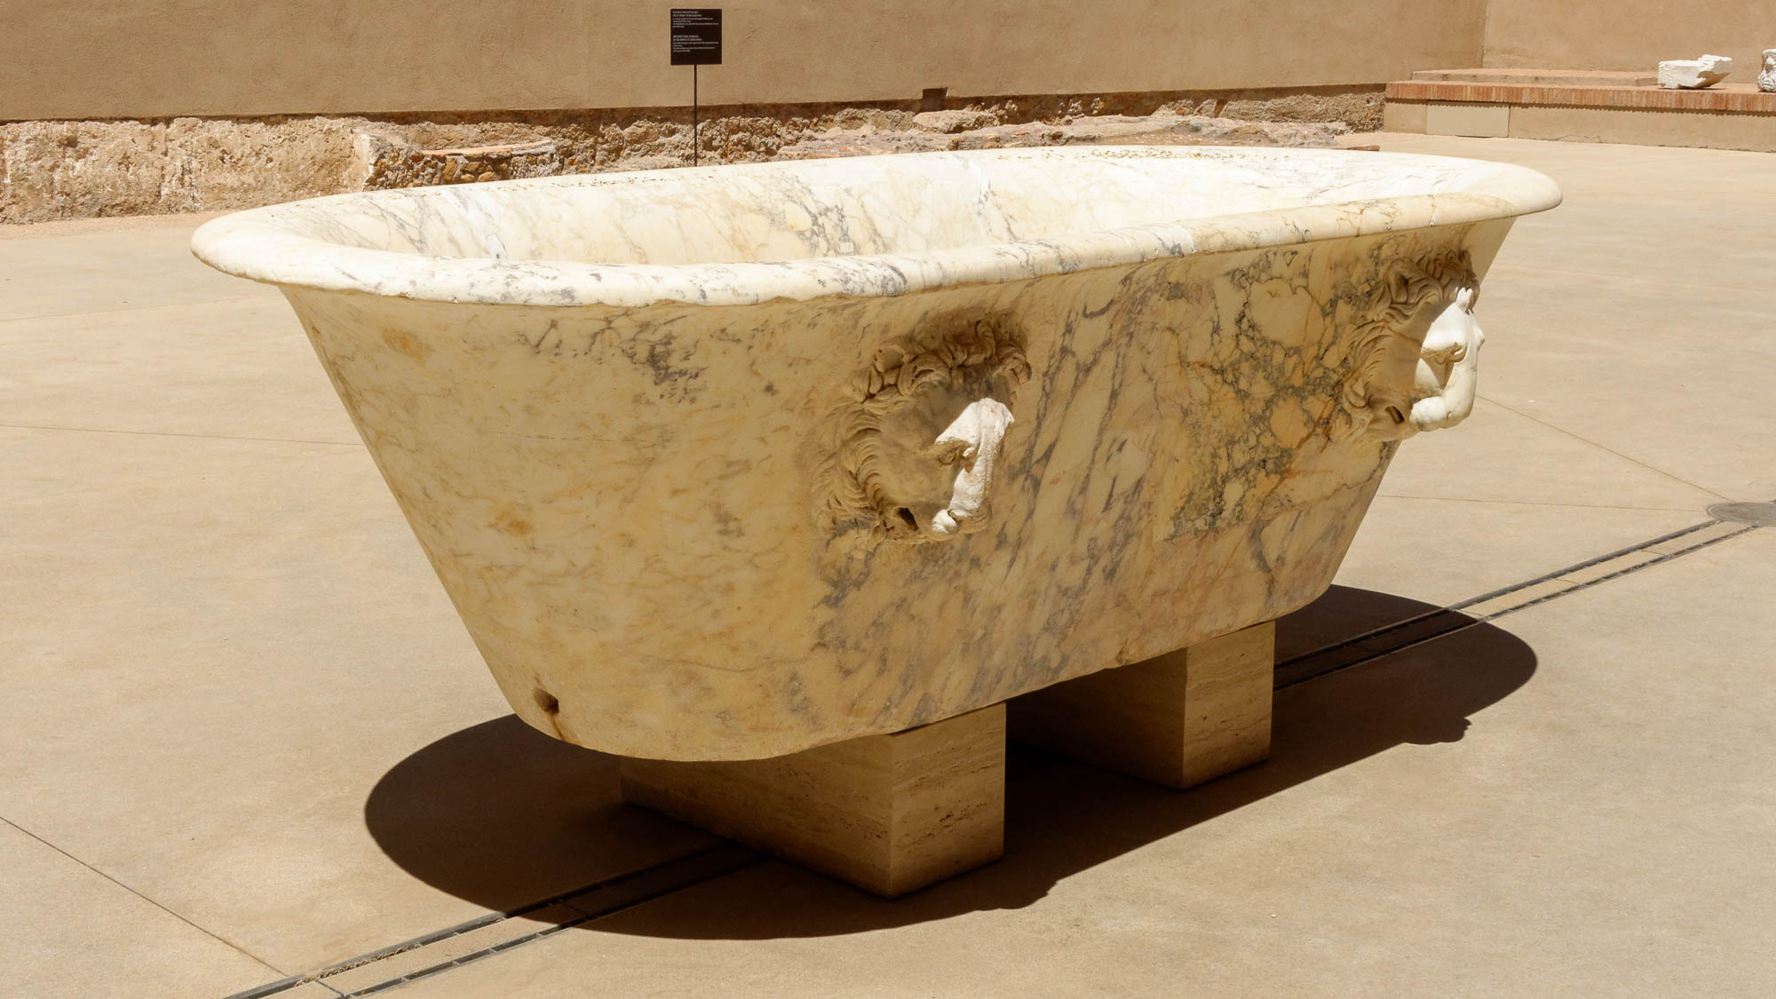
Now there were six stone water jars set there, each holding twenty or thirty gallons
Marble basin at the Diocletian Baths in Rome
2:6
Notes:
This photo shows how water could be let out of one of these large basins through a hole at the bottom.
tb0513178144

Slide 32
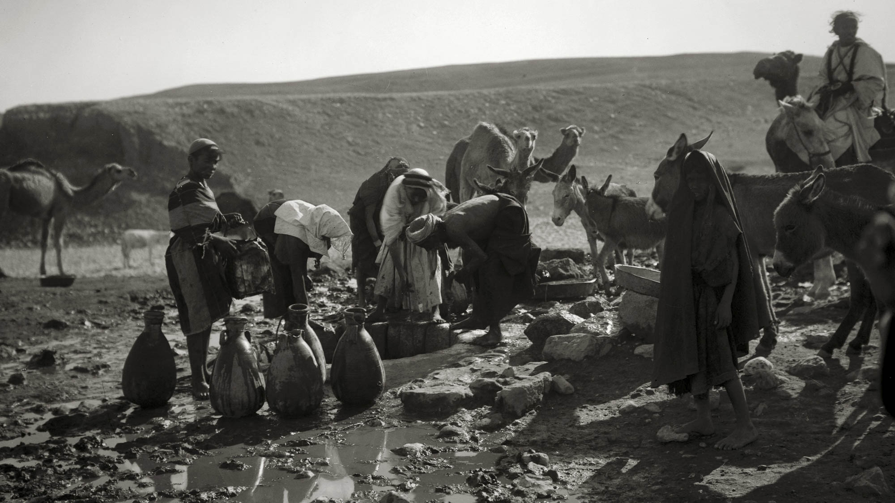
Jesus said to them, “Fill the water jars with water”
Filling water jars at well in the desert
2:7
Notes:
This scene at a local well reminds the reader that the servants had to take the jars out to the town spring or well in order to fill them and bring them back to the wedding party. This American Colony photograph was taken between 1898 and 1946.
mat05402

Slide 33
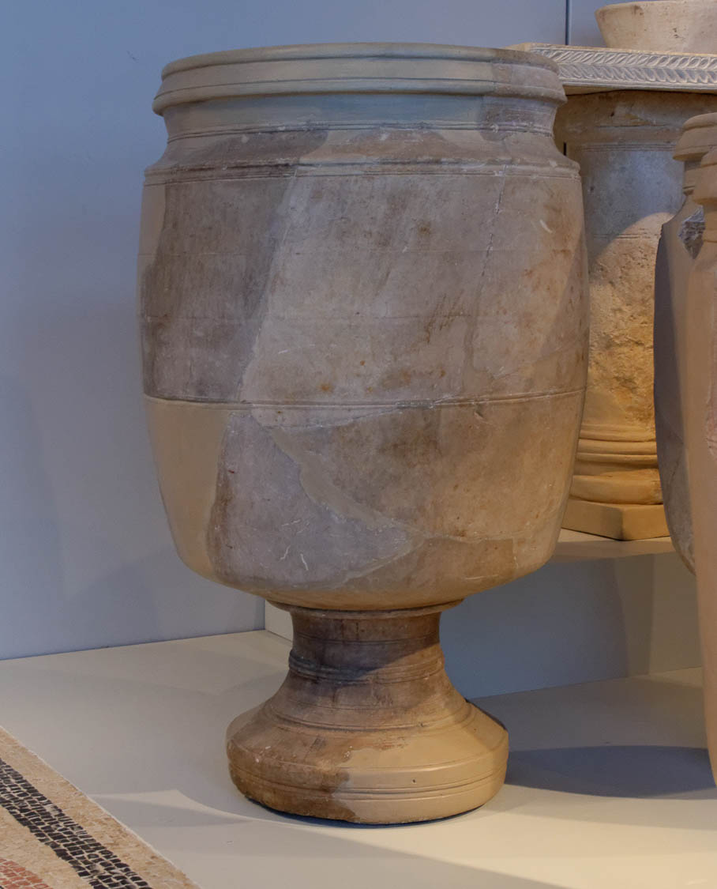
Jesus said to them, “Fill the water jars with water. And they filled them up to the brim”
Stone water jar from Jerusalem, 1st century AD
2:7
Notes:
This stone water jar was photographed in the Israel Museum.
tb032014539

Slide 34
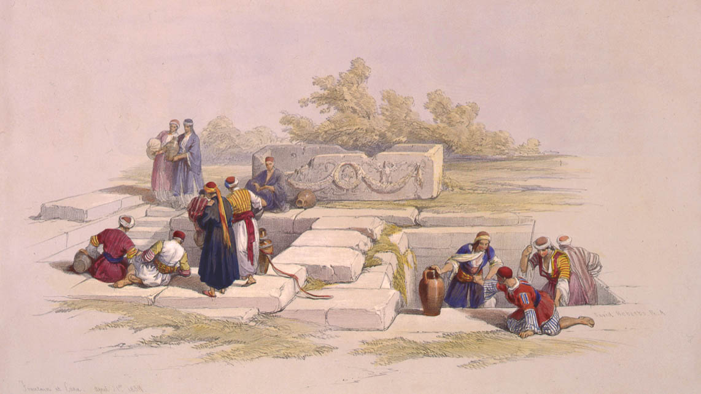
Jesus said to them, “Fill the water jars with water. And they filled them up to the brim”
Drawing water at the spring of Cana
2:7
Notes:
This lithograph by Louis Haghe was based on a drawing made by David Roberts on April 21, 1839.
drra3g03454

Slide 35
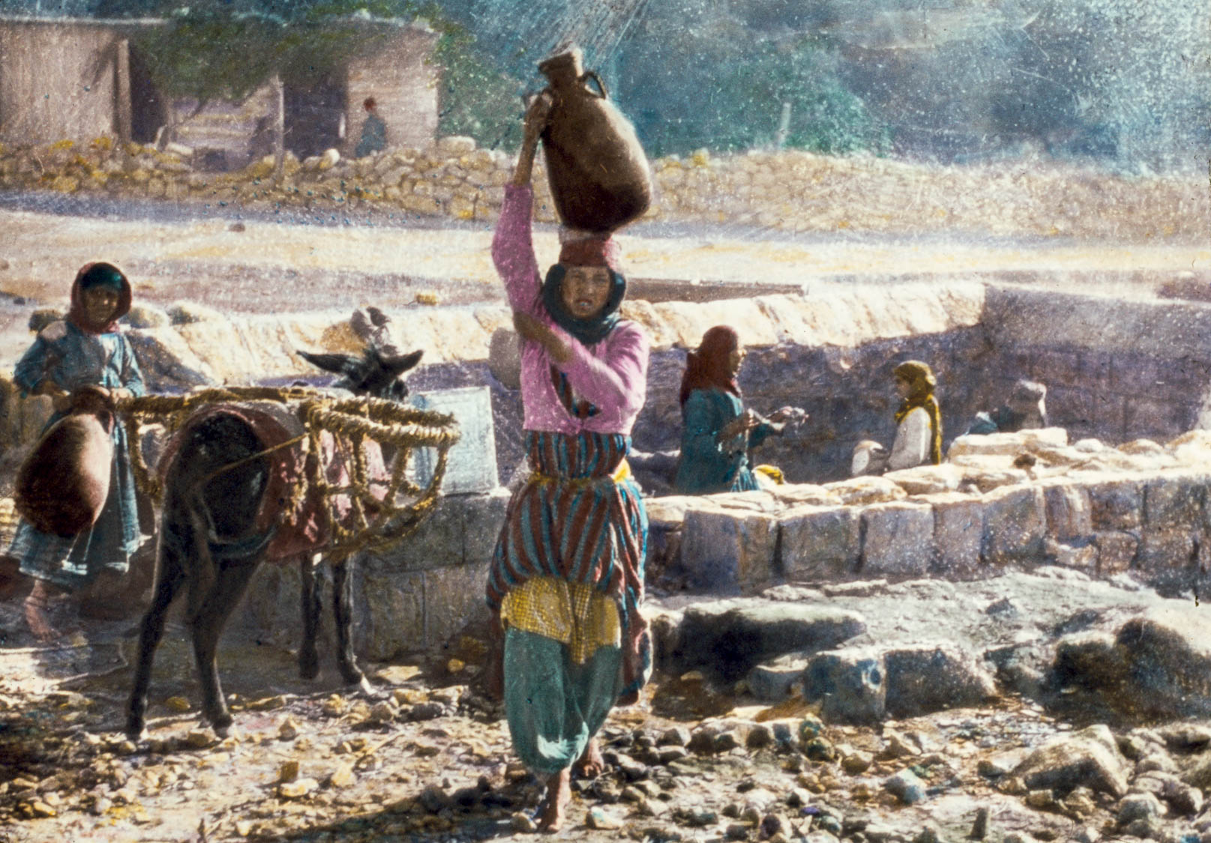
Jesus said to them, “Fill the water jars with water. And they filled them up to the brim”
Women at Kefar Kenna spring, traditional Cana
2:7
Notes:
This is a colorized version of an American Colony photograph taken between 1900 and 1920.
mat22950

Slide 36
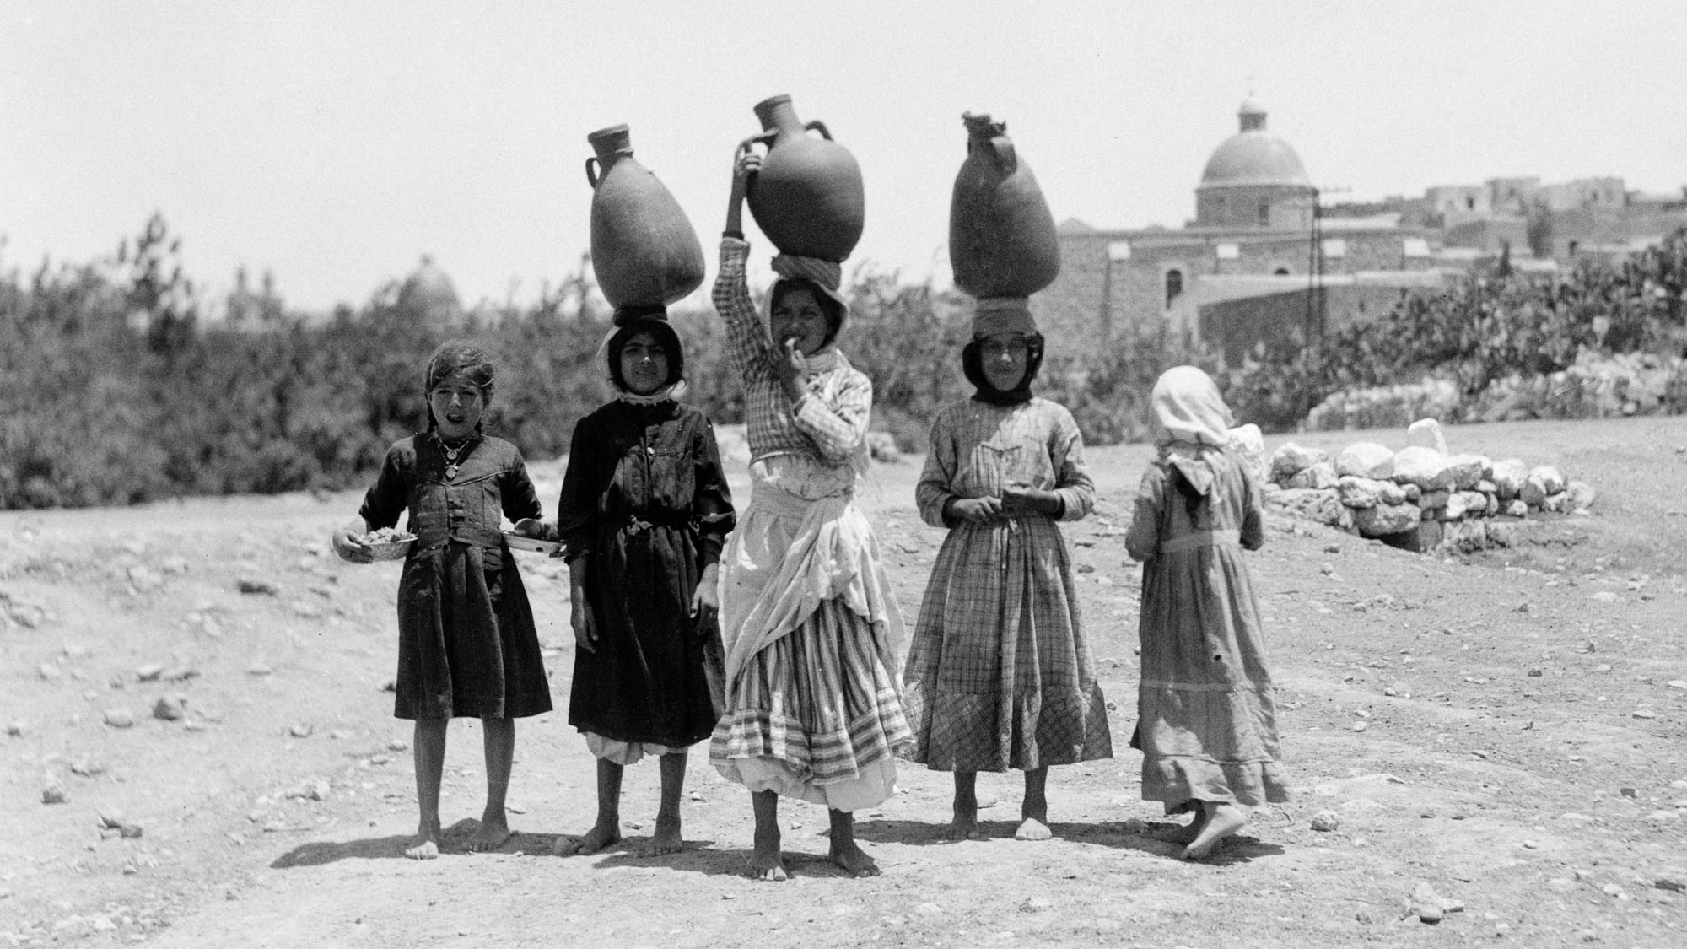
Jesus said to them, “Fill the water jars with water. And they filled them up to the brim”
Girls carrying water jars on their heads from the spring at Kefar Kenna, traditional Cana
2:7
Notes:
This American Colony photograph was taken between 1934 and 1939.
mat18959h

Slide 37
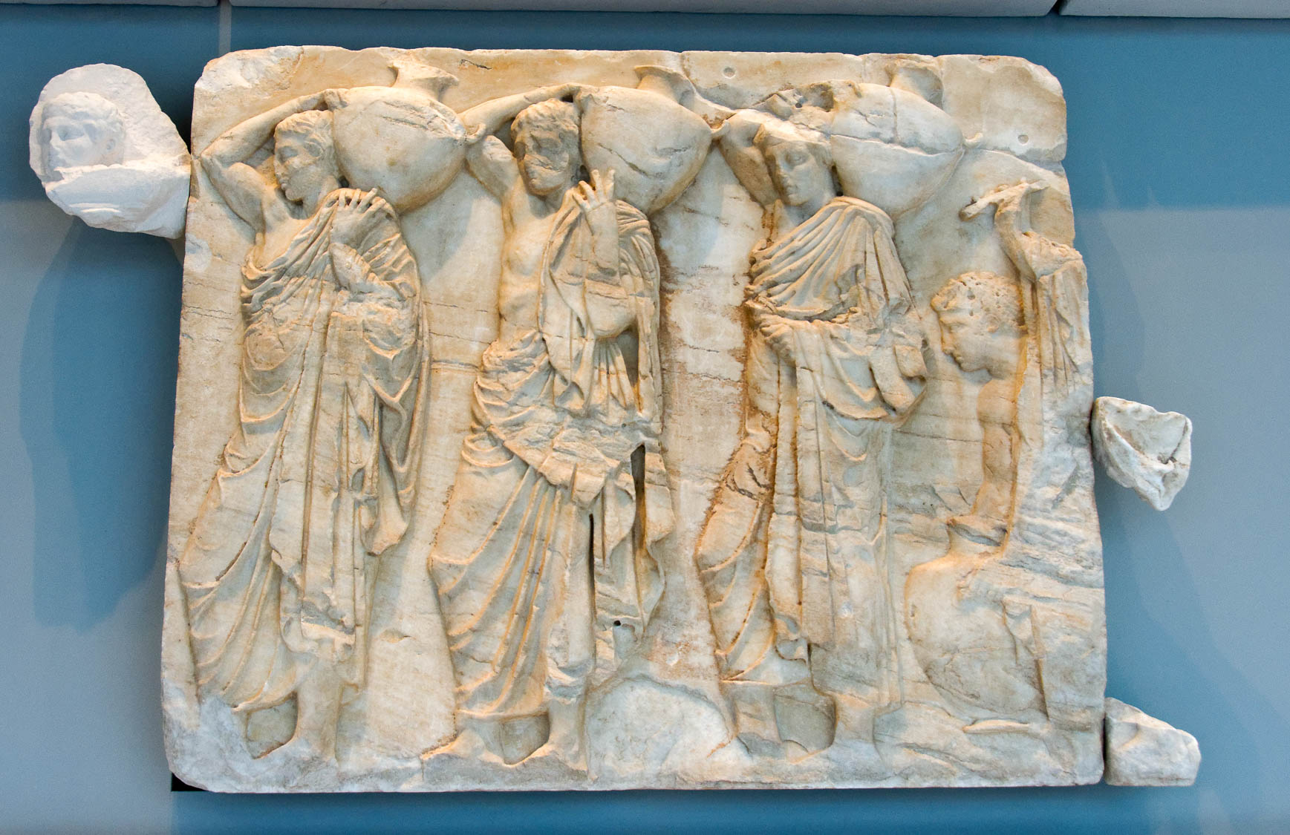
Jesus said to them, “Fill the water jars with water. And they filled them up to the brim”
Relief of four hydria-bearers from the Parthenon in Athens
2:7
Notes:
This relief was photographed in the Athens Acropolis Museum.
tb011117691

Slide 38
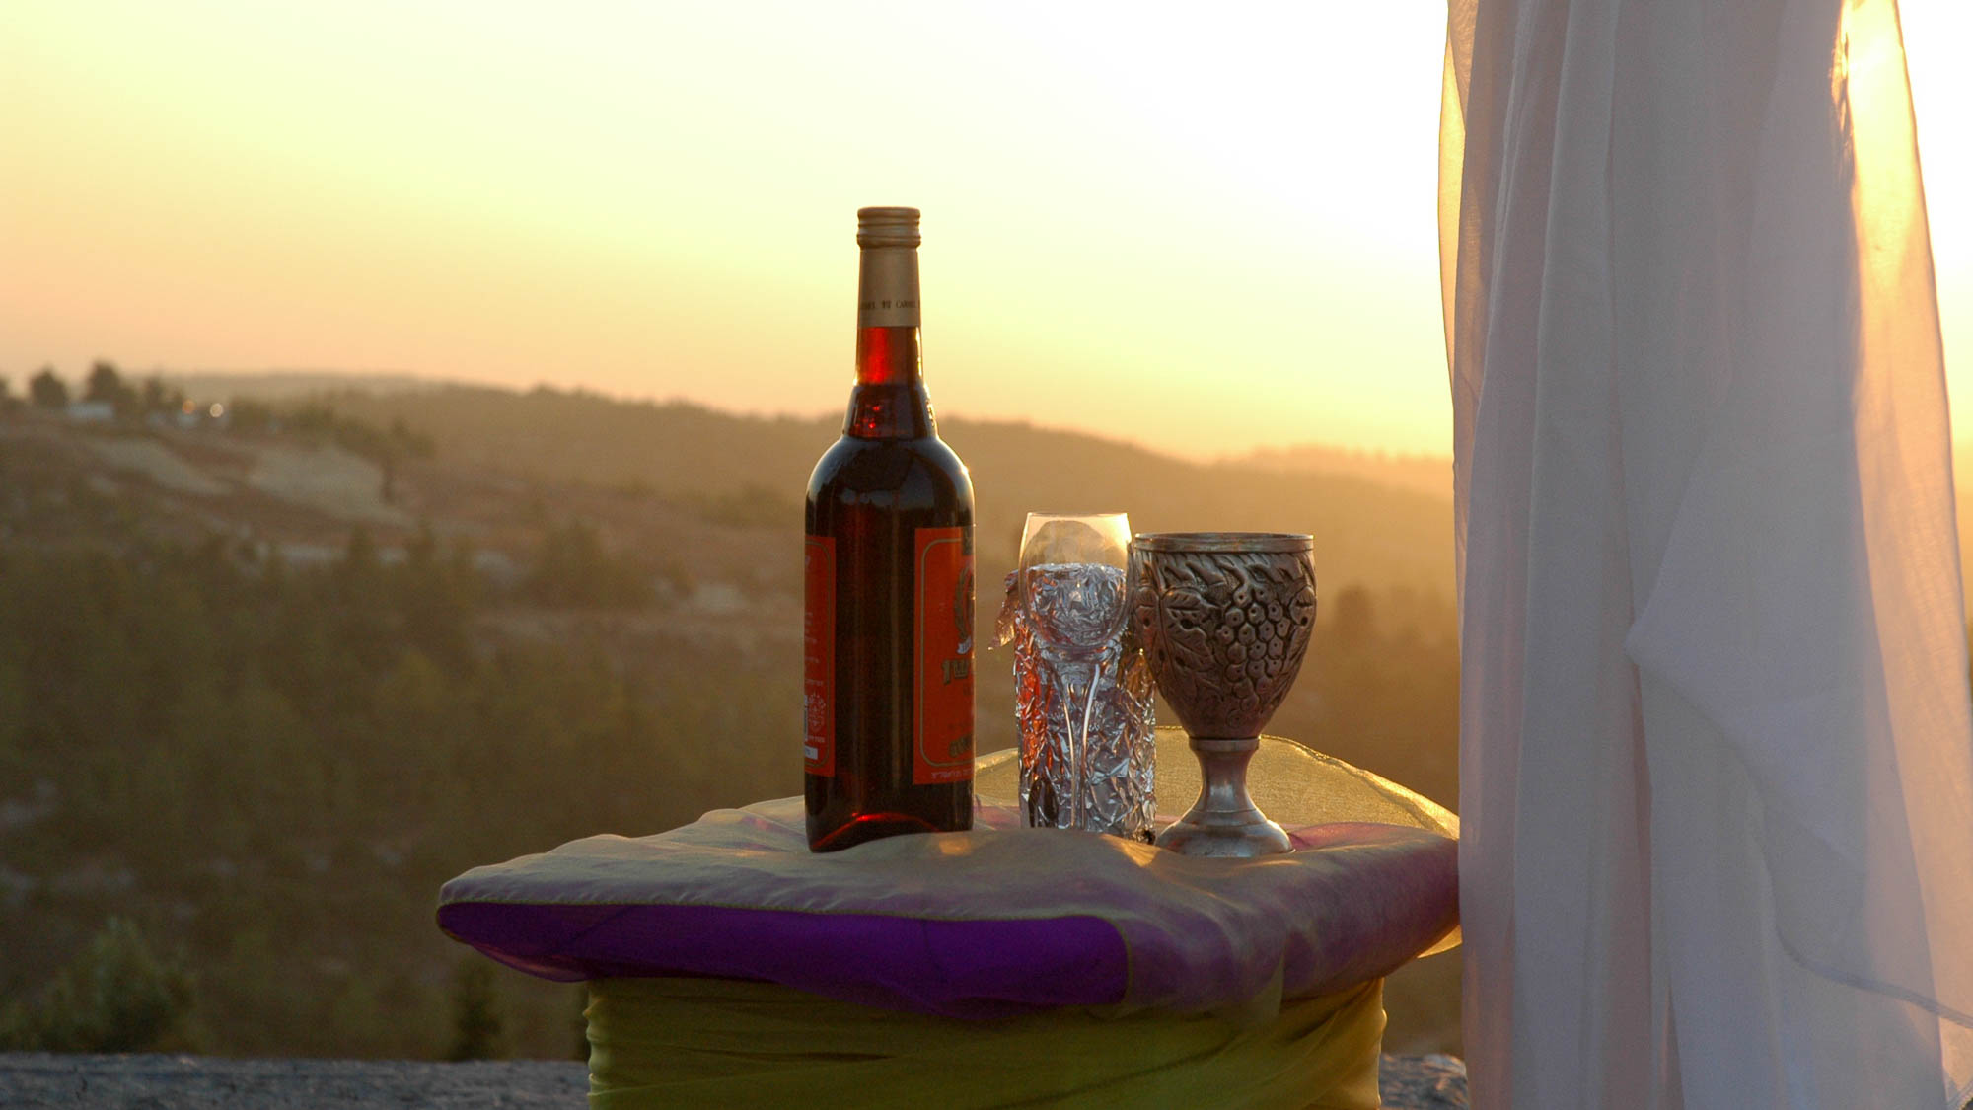
And He said to them, “Draw some out now, and take it to the master of the feast”
Wedding wine and goblet
2:8
Notes:
This photograph from a modern wedding reminds us that wine continues to be popular at wedding celebrations.
tb081605418

Slide 39
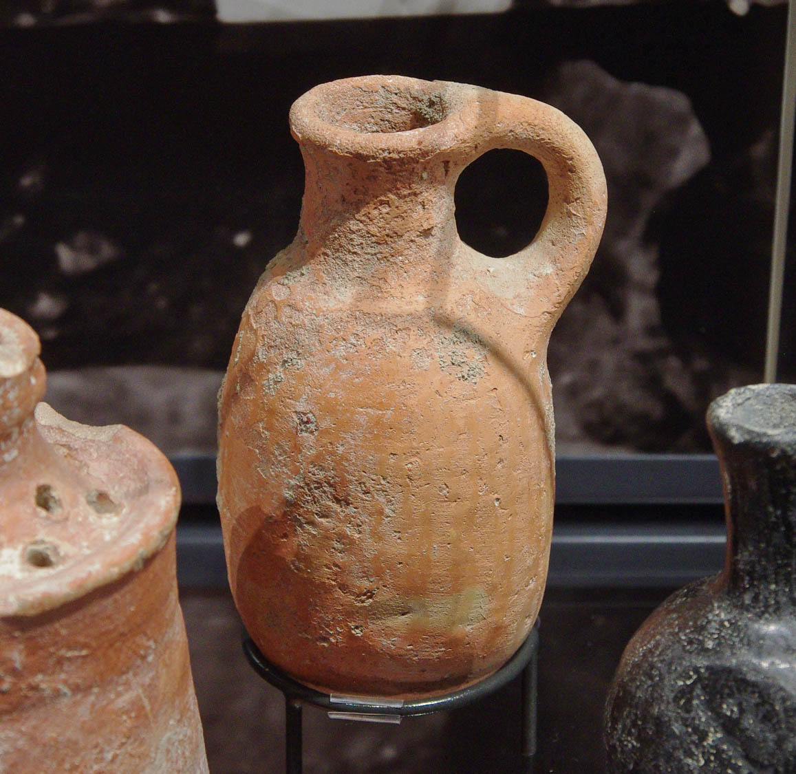
And He said to them, “Draw some out now, and take it to the master of the feast”
Dipper juglet from Jerusalem, 650–587 BC
2:8
Notes:
This juglet was excavated in Ophel cave 1 and was photographed in the Ashmolean Museum at the University of Oxford.
adr1305227941

Slide 40
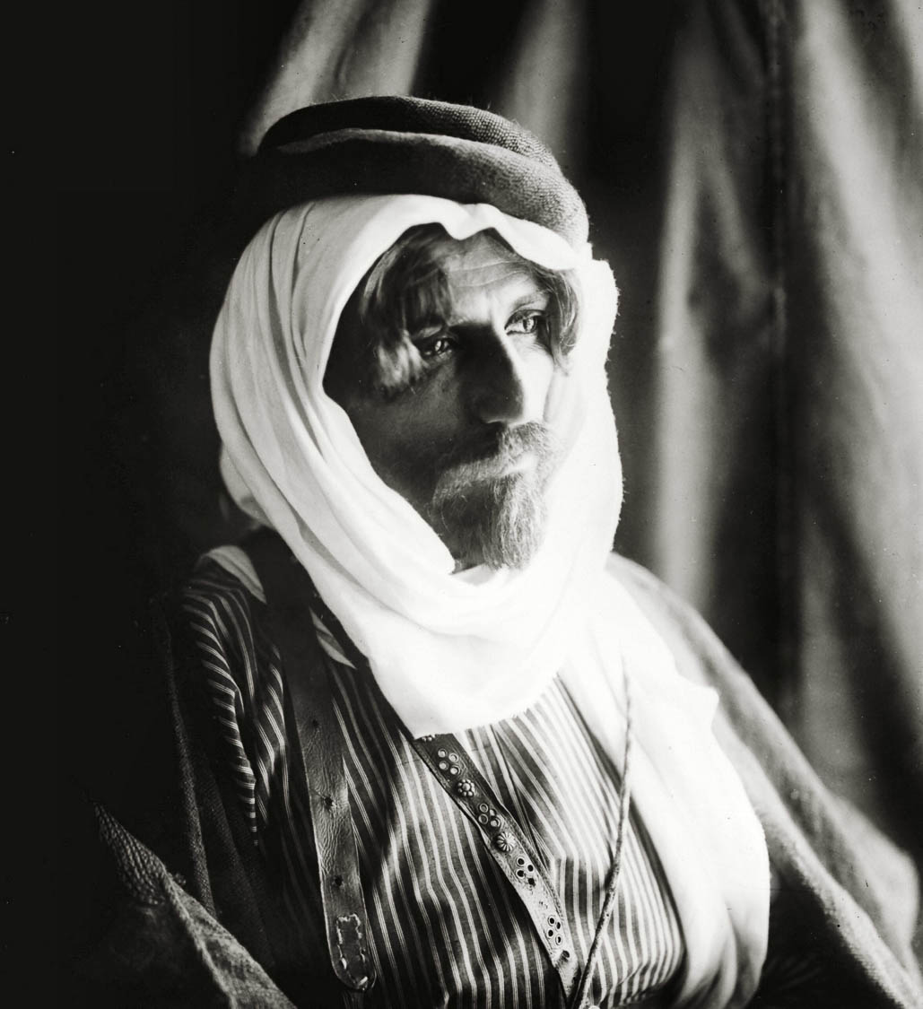
The ruler of the feast called the groom
Bridegroom at Bedouin wedding
2:9
Notes:
This American Colony photograph was taken between 1900 and 1920.
mat01342

Slide 41
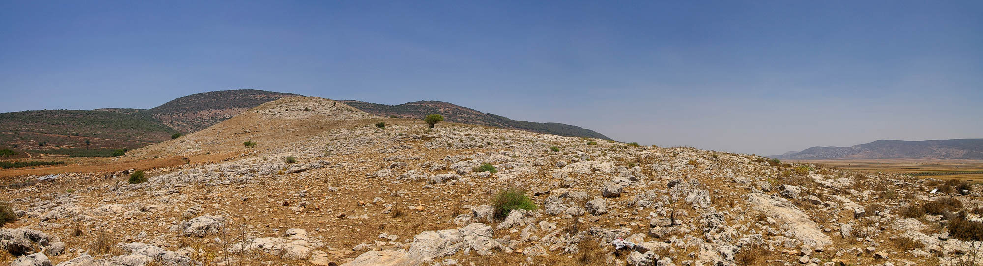
Jesus performed this first of His signs in Cana of Galilee
Khirbet Qana, likely location of Cana (from the southwest)
2:11
Notes:
This photograph was taken from the lower city looking up to the acropolis of the site. It is unknown where the wedding took place in Cana.
adr0807090011

Slide 42
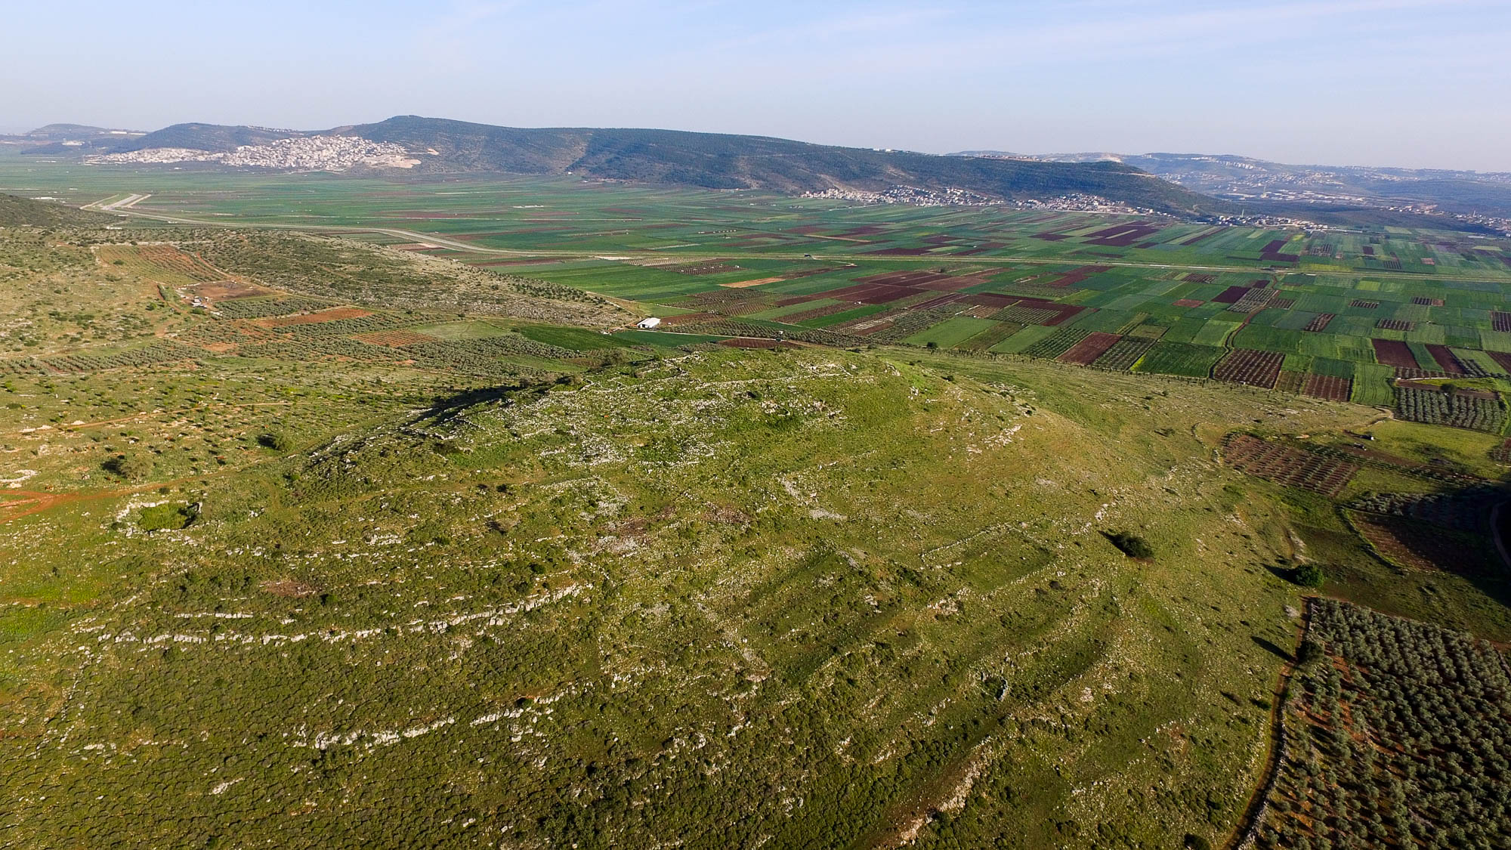
Jesus performed this first of His signs in Cana of Galilee
Khirbet Qana, likely location of Cana (from the northwest)
2:11
Notes:
The Bet Netofa Valley lies south of Khirbet Qana. Jesus would have traveled through this valley on His way to Nazareth or Capernaum.
ws040316762

Slide 43
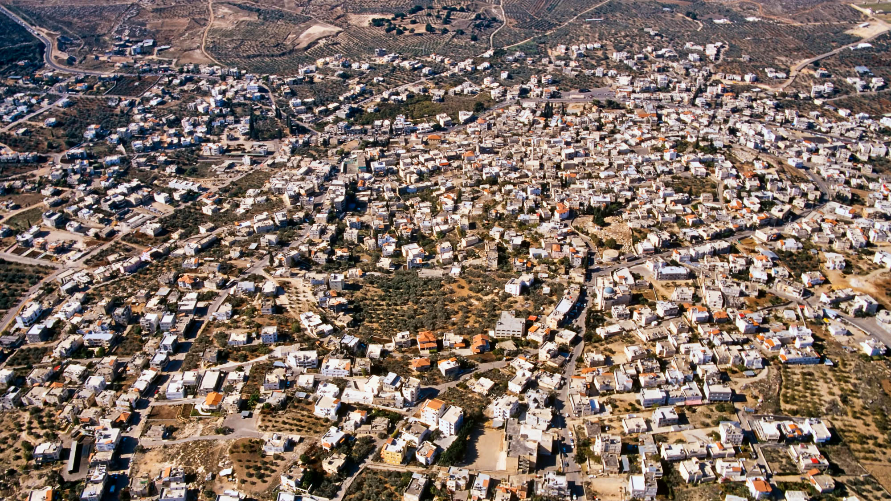
Jesus performed this first of His signs in Cana of Galilee
Kefar Kenna, alternate location for Cana (aerial view from the east)
2:11
Notes:
The most ancient part of Kefar Kenna is circled on the next slide.
tbs122040011

Slide 44
Jesus performed this first of His signs in Cana of Galilee
Kefar Kenna, alternate location for Cana (aerial view from the east)
2:11
Notes:
The most ancient part of Kefar Kenna is circled here.
tbs122040011

Slide 45
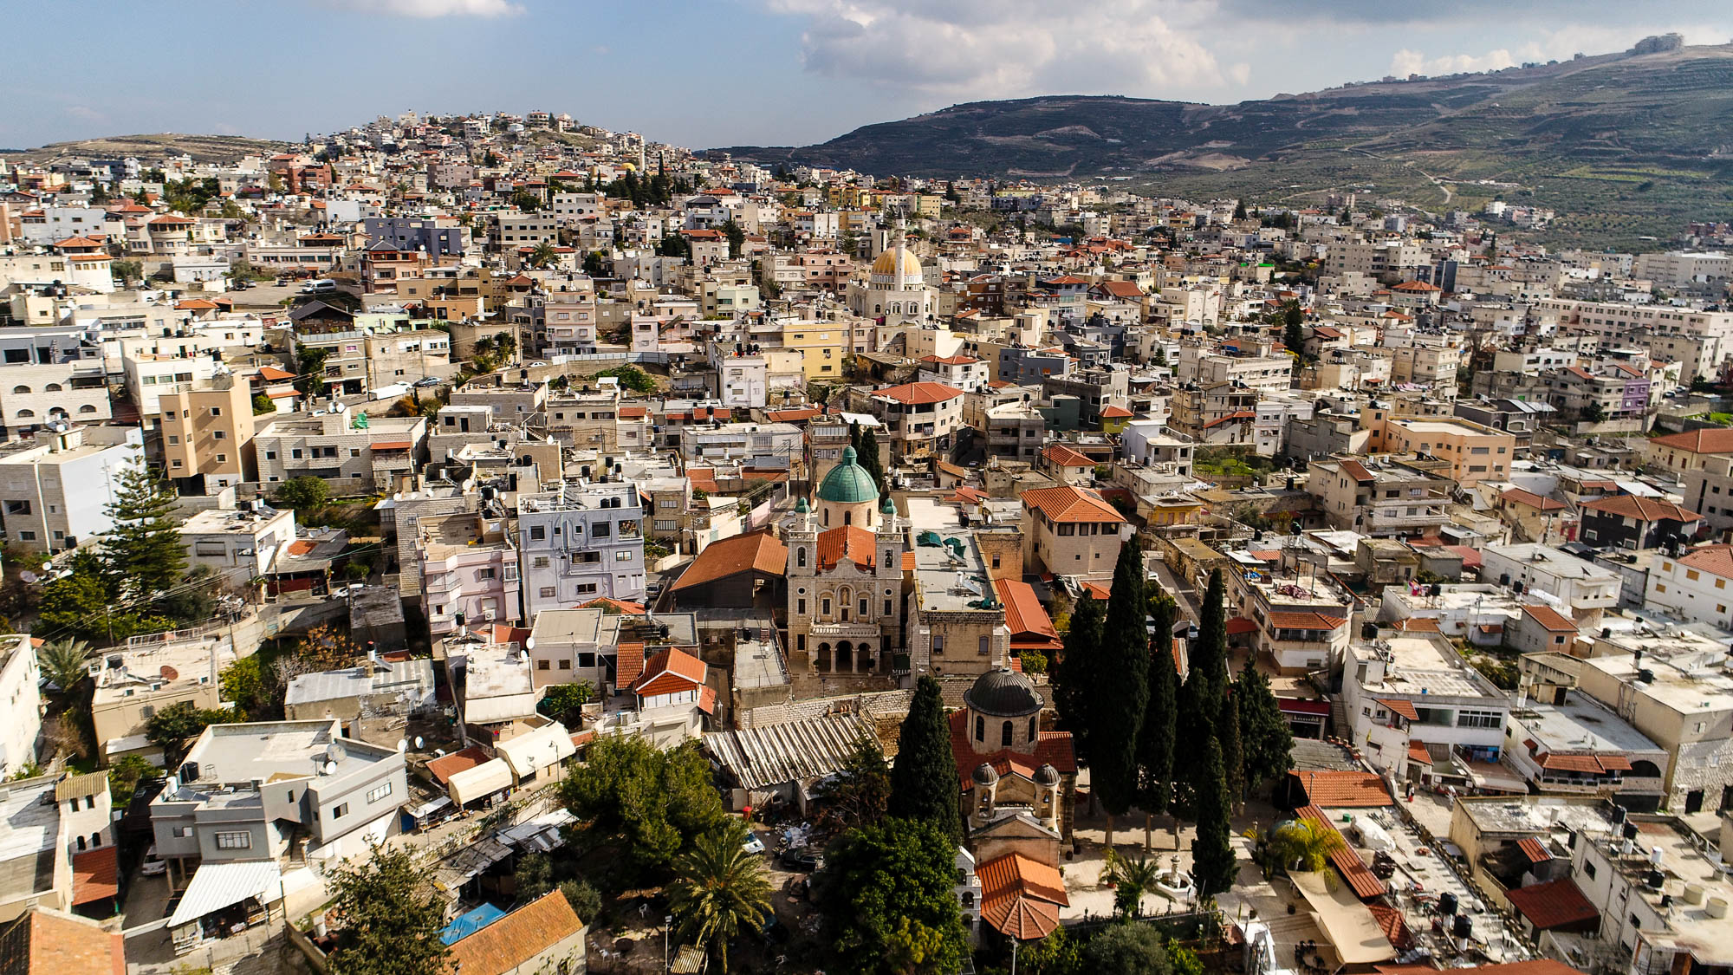
Jesus performed this first of His signs in Cana of Galilee
Kefar Kenna, Orthodox Church and Catholic Wedding Church (aerial view from the northwest)
2:11
Notes:
ws012217044

Slide 46
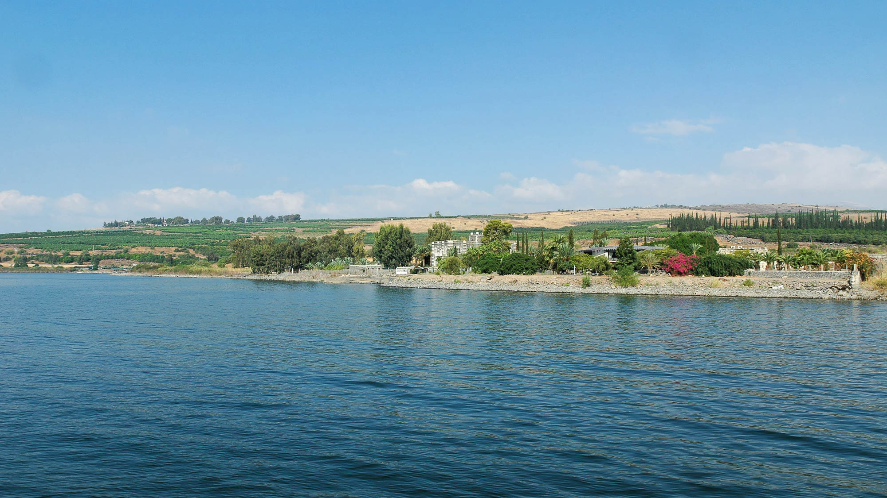
After this He went down to Capernaum, He, His mother, and His brothers, and His disciples
Capernaum and Mount of Beatitudes from the Sea of Galilee
2:12
Notes:
Capernaum is located on the northern shore of the Sea of Galilee. The Catholic church over Peter’s house is visible through the trees along the shore. The traditional Mount of Beatitudes can be identified by the trees on the left horizon.
tb100805596

Slide 47
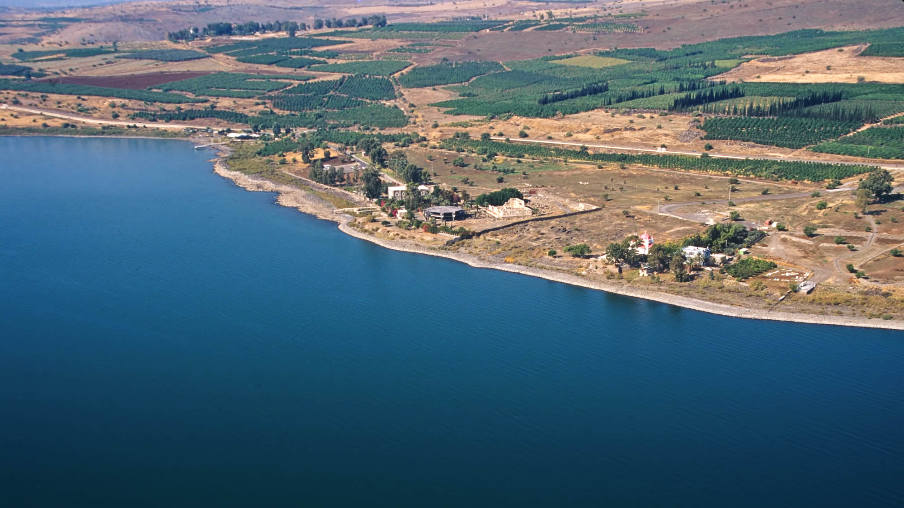
After this He went down to Capernaum, He, His mother, and His brothers, and His disciples
Capernaum area (aerial view from the southeast)
2:12
Notes:
From other accounts in the Gospels, it is clear that Jesus moved to Capernaum from Nazareth (Mark 2:1; Matt 9:1).
tbs115190011

Slide 48
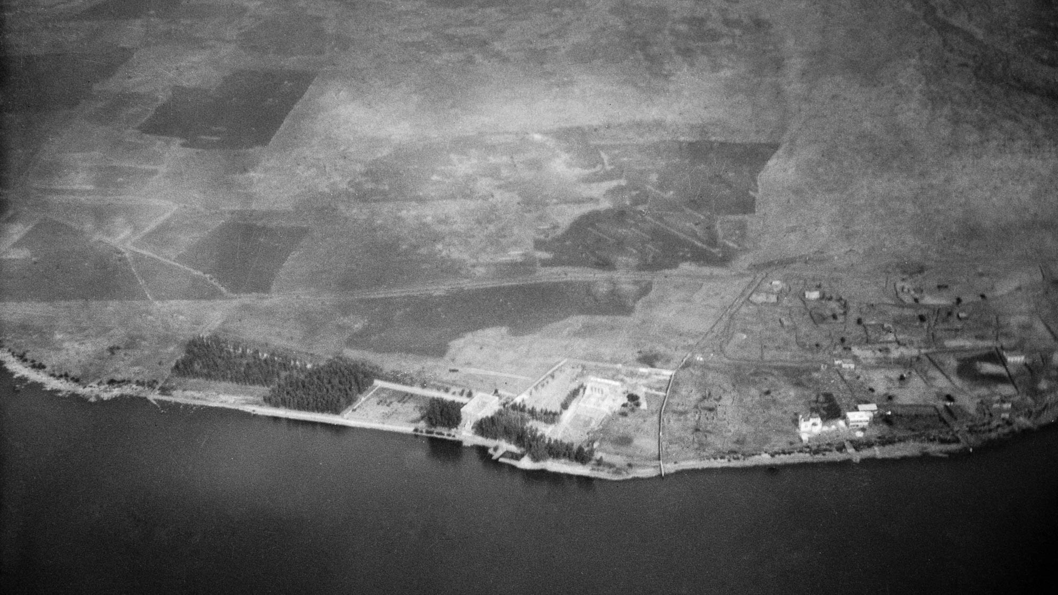
After this He went down to Capernaum, He, His mother, and His brothers, and His disciples
Capernaum (aerial view from the south), 1931
2:12
Notes:
This American Colony photograph was taken in October 1931.
mat15818

Slide 49
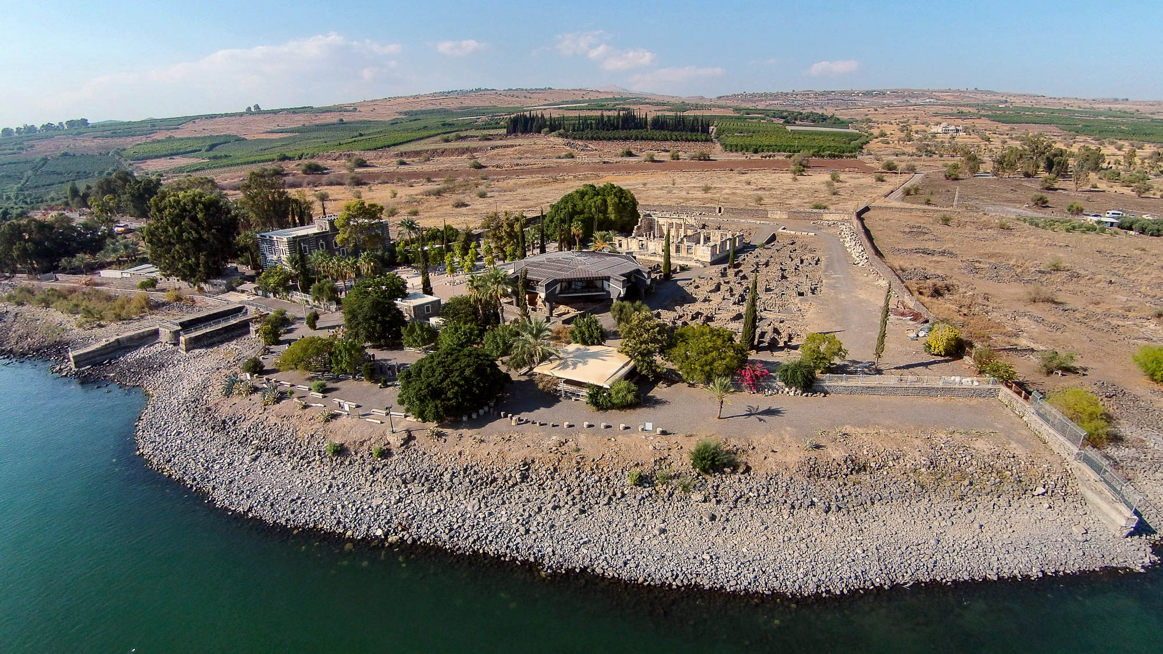
After this He went down to Capernaum, He, His mother, and His brothers, and His disciples
Capernaum (aerial view from the southeast)
2:12
Notes:
Capernaum was a significant town on the northern shore of the Sea of Galilee as is clear from the abundant archaeological remains, the presence of a harbor, and its proximity to a major trade route.
ws102414651

Slide 50
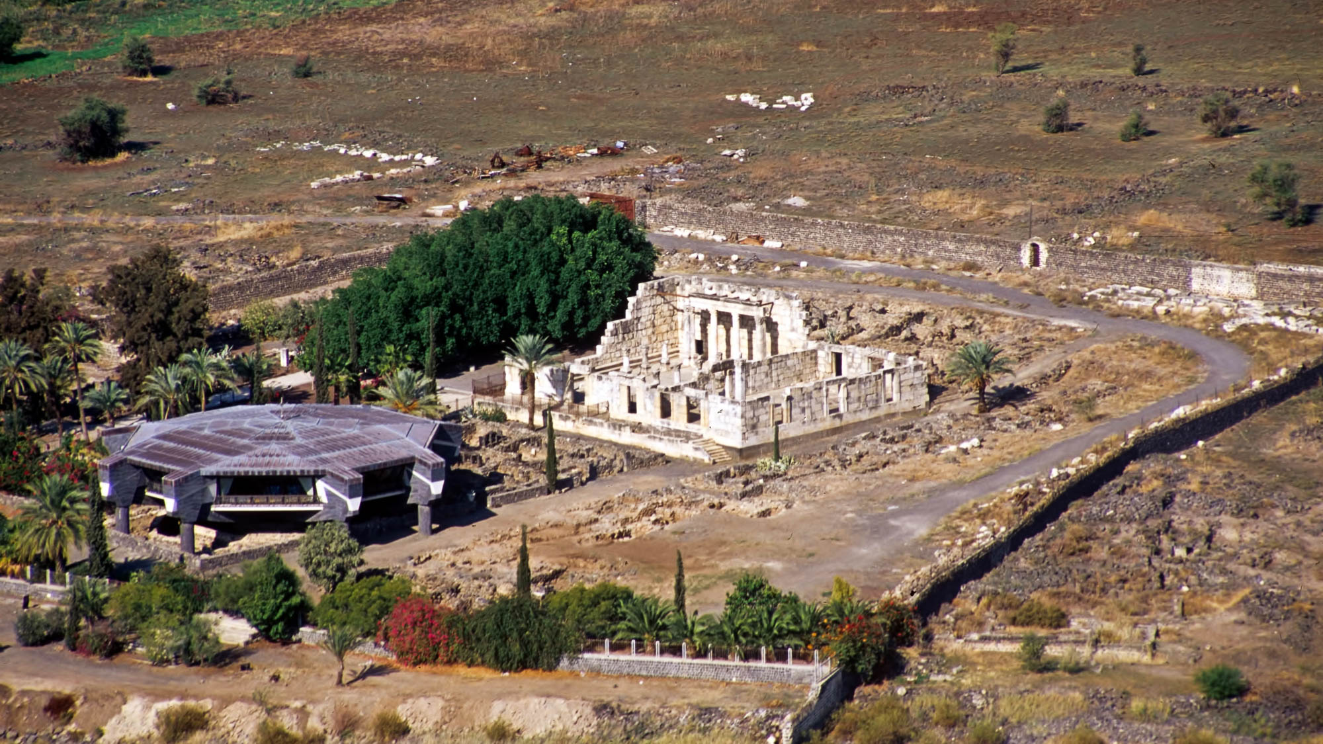
After this He went down to Capernaum, He, His mother, and His brothers, and His disciples
Capernaum (aerial view from the southeast)
2:12
Notes:
As best as we can tell, the two most important places for Jesus in Capernaum are marked by the large buildings in this photo. The white building is a synagogue constructed over remains of an earlier 1st-century synagogue. The gray building is a Roman Catholic church constructed above the remains of what is thought to be Peter’s house.
tbs115170011

Slide 51
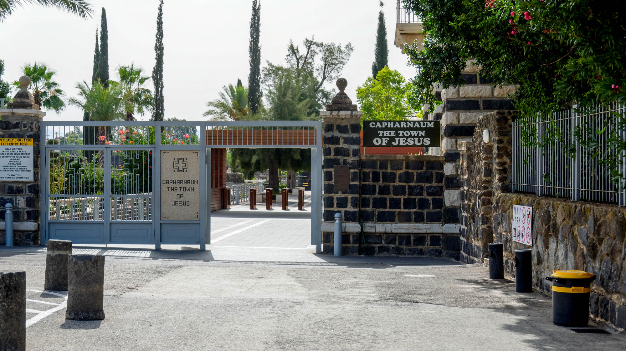
After this He went down to Capernaum, He, His mother, and His brothers, and His disciples
Entrance to Capernaum
2:12
Notes:
In Hebrew, Capernaum is “Kefar Nahum,” the village of Nahum. Because the city was only first settled in the 2nd century BC, it is unlikely that the name is related to the Old Testament prophet Nahum. In addition, Nahum was probably from Judah, especially since the northern kingdom (including the area of Capernaum) was deported a century before his ministry.
tb061516511

Slide 52
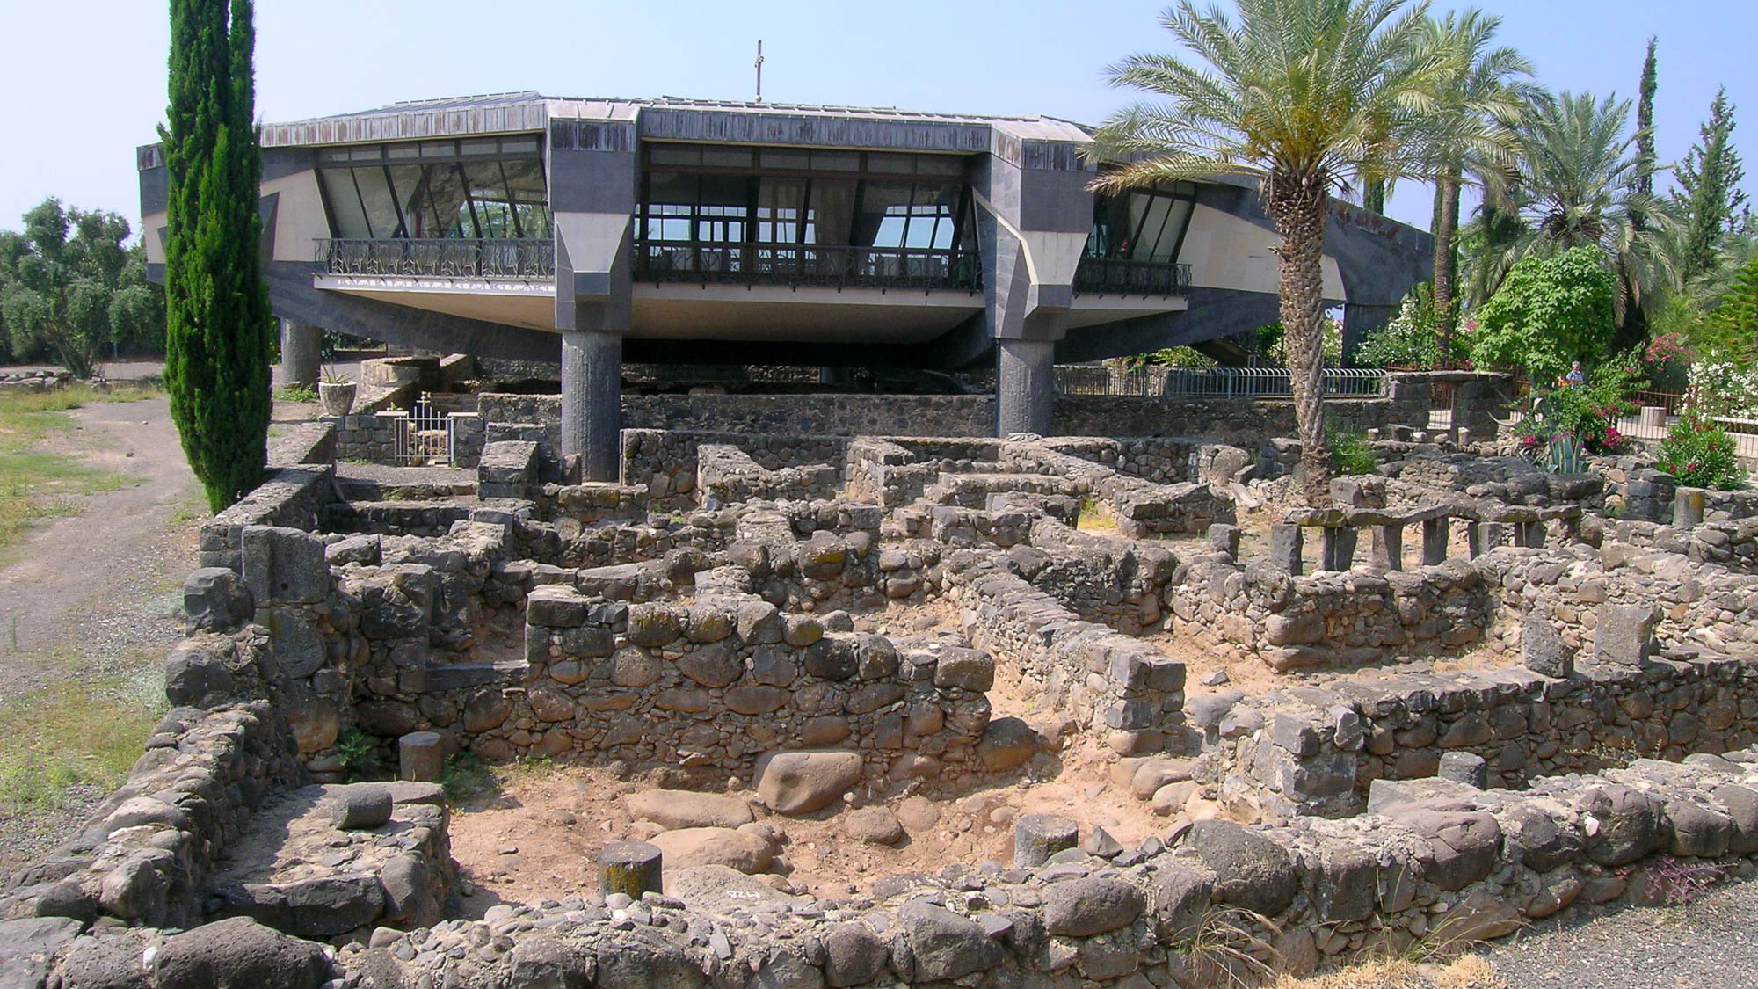
After this He went down to Capernaum, He, His mother, and His brothers, and His disciples
Basalt houses in Capernaum (from the north)
2:12
Notes:
Archaeologists have exposed the remains of these ancient houses between the traditional home of Peter and the 1st-century synagogue.
tb052604018

Slide 53

And the Passover of the Jews was at hand
Celebration of Samaritan Passover
2:13
Notes:
The Samaritans today celebrate Passover much the same way that they have for more than two thousand years. Because the temple in Jerusalem does not exist, Jews do not practice animal sacrifice and thus the closest we can get to the practices of the 1st century is at the Samaritan celebration each year on Mount Gerizim.’
tb043007194

Slide 54

And the Passover of the Jews was at hand
Aramaic letter mentioning Passover, from Elephantine, 5th century BC
2:13
Notes:
A community of Jews lived on Elephantine Island in southern Egypt following the destruction of Jerusalem in 586 BC. This artifact was photographed in the Ashmolean Museum at the University of Oxford.
adr1305226783

Slide 55

And the Passover of the Jews was at hand, and Jesus went up to Jerusalem
Road leading into Jerusalem (from the north)
2:13
Notes:
This American Colony photograph was taken between 1898 and 1914. The Dome of the Rock, once the location of the temple, is visible on the far left side.
mat07474

Slide 56

And the Passover of the Jews was at hand, and Jesus went up to Jerusalem
Jerusalem from the Mount of Olives (from the east)
2:13
Notes:
This photograph was taken from a popular overview in front of the Seven Arches Hotel on the Mount of Olives. A Jewish cemetery is visible in the foreground.
tb092405392

Slide 57

He found in the temple
Temple Mount (aerial view from the southeast)
2:14
Notes:
The temple was located where the Dome of the Rock sits today. From the context, it is clear that the reference here to temple is to the broader temple courts and not to the sanctuary proper.
tb010703230

Slide 58

He found in the temple
Jerusalem Temple Mount, City of David, and Silwan (aerial view from the north)
2:14
Notes:
This American Colony photograph, taken in 1931, gives a feel for how large the Temple Mount is before many trees were planted.
mat22135

Slide 59

He found in the temple
Temple Mount and the Mount of Olives (aerial view from the northwest)
2:14
Notes:
At about 35 acres (14 ha), the Temple Mount would fit a total of 25 football fields.
ws091316219

Slide 60

He found in the temple
Temple Mount on the model of 1st-century Jerusalem (from the east)
2:14
Notes:
The outer court was known as the Court of the Gentiles and any person could enter this. This was likely the area where Jesus overturned the tables of the money changers. This model was photographed at the Israel Museum.
tb060316625

Slide 61

He found in the temple
Temple Mount on the model of 1st-century Jerusalem (from the east)
2:14
Notes:
This model was photographed at the Israel Museum.
tb091506482

Slide 62

He found in the temple
Royal Stoa of the Temple Mount on the Jerusalem model (from the northeast)
2:14
Notes:
The temple courts were surrounded by covered colonnades. These were ideal places for gathering out of the sun and rain. This model was photographed at the Israel Museum.
tb051703211

Slide 63

He found in the temple
Temple Mount open area on southeastern corner
2:14
Notes:
Visitors to the Temple Mount are often surprised by how large and spacious the area is.
tb092103160

Slide 64

He found in the temple
Herodian pavement on the Temple Mount
2:14
Notes:
This section of pavement apparently dates to the Herodian construction. It is located near the Gate of the Cotton Merchants on the western side of the Temple Mount.
tb060516818

Slide 65

He found in the temple those who were selling
Shops alongside the western wall of the Temple Mount
2:14
Notes:
Archaeologists have discovered shops built outside the Temple Mount on both the western and southern walls. Jesus presumably had no objection to these. What He took offense with was the commercial activity that had invaded the places intended for worship on the Temple Mount itself.
tb123109386

Slide 66

He found in the temple those who were selling
Shops below Robinson’s Arch (from the west)
2:14
Notes:
A staircase ran over Robinson’s arch (the spring of which is visible near the top of the photo). In the space below, several shops were located. (See the next slide for a perspective from the front.)
tb091702213

Slide 67

He found in the temple those who were selling
Shops underneath staircase of Robinson’s Arch
2:14
Notes:
Shops occupied the space underneath the monumental staircase that passed over Robinson’s Arch to provide access to the temple courts.
tb020101216

Slide 68

He found in the temple those who were selling
Burnt shops on southern wall of the Temple Mount
2:14
Notes:
Evidence of the arched shops that stood next to the Temple Mount can be seen from the remains of their destruction by the Roman fires in AD 70.
tb052005985

Slide 69

He found in the temple those who were selling oxen
Relief of Roman herdsman and oxen, Thasian marble, 1st century AD
2:14
Notes:
This relief was photographed in the Walters Art Museum in Baltimore.
adr1311245127

Slide 70

He found in the temple those who were selling oxen
Oxen depicted in plaster on tomb wall from Tomb of Huy in Luxor, 1549–1292 BC
2:14
Notes:
This 18th dynasty tomb dates to the reign of Thutmose IV–Amenhotep III. The artifact was photographed in the Oriental Institute Museum at the University of Chicago.
adr1301090054

Slide 71

He found in the temple those who were selling oxen
Circassian ox-carts
2:14
Notes:
This American Colony photograph was taken between 1900 and 1920.
mat05355

Slide 72

He found in the temple those who were selling oxen and sheep
Sheep market outside Herod’s Gate of Jerusalem
2:14
Notes:
Herod’s Gate was built in the 16th century and has no relation to any ruler by that name. But this gate is not far from the “Sheep’s Gate” that was located near the Pools of Bethesda north of the Temple Mount (see John 5). This American Colony photograph was taken between 1898 and 1946.
mat06866

Slide 73

He found in the temple those who were selling oxen and sheep
Sheep market at Damascus Gate
2:14
Notes:
This American Colony photograph was taken between 1940 and 1946.
mat21594

Slide 74

He found in the temple those who were selling oxen and sheep and doves
Dovecote in the City of David, 1st century AD
2:14
Notes:
Once identified as the base of the collapsed Tower of Siloam (cf. Luke 13:4), archaeologists today believe that this building served as a dovecote. Perhaps these birds were raised to be sold for sacrifices in the temple.
tb030103201

Slide 75

He found in the temple those who were selling oxen and sheep and doves
Dovecotes near Saint Mina Monastery in Mariut
2:14
Notes:
This photo shows a couple of modern circular dovecotes in use in Egypt today.
adr1603278669

Slide 76

He found in the temple those who were selling oxen and sheep and doves
Columbarium at Masada
2:14
Notes:
This room was built in the Herodian period for the purpose of raising pigeons.
tb010810018

Slide 77

He found in the temple those who were selling oxen and sheep and doves
Columbarium at Bet Guvrin
2:14
Notes:
The Greek word περιστερά (peristera) can be translated as either ”dove” or ”pigeon,” and a couple of English Bible versions (RSV, ESV) opt for the latter translation. Doves and pigeons were both acceptable for temple sacrifices (cf. Luke 2:24). This photo shows a large columbarium for raising pigeons that was shaped like a double cross and measured nearly 100 feet (30 m) in length. There are approximately 1,900 niches in this columbarium, which dates to about 200 BC. It is located at Bet Guvrin in the Shephelah of Judah, southwest of Jerusalem.
tb100902219

Slide 78

He found in the temple those who were selling oxen and sheep and doves
Mosaic of the Doves, 2nd century BC
2:14
Notes:
This mosaic was photographed in the Capitoline Museum in Rome.
tb111802003

Slide 79

He found in the temple those who were selling oxen and sheep and doves
Cypriot statue fragment of hand on dove, Hellenistic, 3rd–1st centuries BC
2:14
Notes:
This limestone artifact was photographed in The Metropolitan Museum of Art in New York City.
adr1606034641

Slide 80

He found in the temple . . . the money-changers sitting
Relief of money exchange scene
2:14
Notes:
This relief was photographed at The National Museum of Rome.
tb0513178051

Slide 81

He found in the temple . . . the money-changers sitting
Proconnesian marble sarcophagus fragment showing money-changing counter
2:14
Notes:
This relief was photographed at The National Museum of Rome. It comes from Viale del Re in Rome.
tb0513177984

Slide 82

He found in the temple . . . the money-changers sitting
Jewish money changer
2:14
Notes:
This American Colony photograph was taken between 1934 and 1939.
mat16536

Slide 83

He found in the temple . . . the money-changers sitting
Money changer in the Old City of Jerusalem
2:14
Notes:
As a city that continues to attract travelers from all over the world, Jerusalem has a need for those who will exchange foreign currency into that which is accepted locally. For the temple tax, the authorities accepted only Tyrian shekels, thus requiring the exchange of money, sometimes at poor exchange rates.
tb061116276

Slide 84

He made a whip of cords
Palm or papyrus fiber rope, from Deir el-Bahari near Luxor, circa 1503–1473 BC
2:15
Notes:
This artifact from the reign of Hatshepsut dates to the 18th dynasty and was photographed in the Oriental Institute Museum at the University of Chicago.
adr1309252333

Slide 85

He made a whip of cords
New Kingdom limestone stele showing Seti I with flail, 19th dynasty, circa 1292–1189 BC
2:15
Notes:
The crook and flail were royal symbols in ancient Egypt. The flail may have derived from the whip used by shepherds. This artifact was photographed in the Oriental Institute Museum at the University of Chicago.
adr1401046130

Slide 86

He made a whip of cords
Pharaoh holding flail, relief in Temple of Seti I in Abydos, circa 1290–1279 BC
2:15
Notes:
Seti I was a pharaoh in the 19th dynasty and he ruled approximately 1290 to 1279 BC.
tb010905405

Slide 87

He drove them all out of the temple
Pharaoh smiting enemies, relief on door jamb from palace of Merneptah in Memphis
2:15
Notes:
This relief was photographed in the Museum of Archaeology and Anthropology at the University of Pennsylvania. It dates to about 1200 years before the ministry of Jesus.
tb072311798

Slide 88

He drove them all out of the temple
Temple Mount on a wooden model of Jerusalem, 1st century AD (from the northeast)
2:15
Notes:
This wooden model was photographed when on display in the Ben Gurion airport.
adr1305040791

Slide 89

He drove them all out of the temple
The Merchants Chased from the Temple, by James Tissot, circa 1890
2:15
Notes:
This image of an opaque watercolor over graphite on gray wove paper comes from the Brooklyn Museum, public domain, purchased by public subscription, accession number 00.159.198, https://www.brooklynmuseum.org/opencollection/objects/4543.
bmny4543

Slide 90

And he poured out the coins of the money-changers, and overturned their tables
Hoard of Tyrian shekels, possibly intended for Temple tax, 1st century AD
2:15
Notes:
This hoard of Tyrian shekels was found in Isfiya and may have been intended for use in paying the temple tax in Jerusalem. It was photographed in the Eretz Israel Museum. Tyrian shekels (tetradrachms) and half-shekels (didrachms) were used as official temple currency, since they were made of purer silver than other tetradrachms and didrachms in the Roman world. Thus, although a Roman silver denarius was generally equivalent to Greek silver drachm, and a tetradrachm was equivalent to four denarii, the moneychangers in the temple would have charged more than four denarii for a Tyrian shekel due to the higher silver content of Tyrian coinage. Of course, the moneychangers also charged a healthy premium for their services.
tb061804589gr

Slide 91

And he poured out the coins of the money-changers, and overturned their tables
Stone table from Jerusalem, 1st century AD
2:15
Notes:
Stone tables were common in the homes of the wealthy in Jerusalem in the 1st century AD because of Jewish ritual laws. This table was photographed in the Israel Museum.
tb032014542

Slide 92

And he poured out the coins of the money-changers, and overturned their tables
Relief of money exchange scene
2:15
Notes:
This relief was photographed at The National Museum of Rome.
tb0513178052

Slide 93

And he poured out the coins of the money-changers, and overturned their tables
Relief of money exchange scene
2:15
Notes:
This relief was photographed at The National Museum of Rome.
tb0513178053

Slide 94

And to those who sold doves, He said . . .
Cypriot bird, circa 600–480 BC
2:16
Notes:
This limestone artifact was photographed in the Metropolitan Museum of Art in New York City.
adr1606034506

Slide 95

Do not make My Father’s house a house of merchandise
Model of Jerusalem temple
2:16
Notes:
This model of the temple is located on the roof of the Aish HaTorah building in the Jewish Quarter of the Old City of Jerusalem.
tb010312509

Slide 96

Do not make My Father’s house a house of merchandise
Market in Jewish Quarter of Jerusalem
2:16
Notes:
Jesus criticized the religious leaders for transforming the temple area into a commercial market. This American Colony photograph was taken between 1900 and 1920.
mat00912h

Slide 97

Do not make My Father’s house a house of merchandise
Jewish fishmonger’s stall and customers
2:16
Notes:
This American Colony photograph was taken between 1934 and 1939.
mat19391

Slide 98

Jesus answered them, “Destroy this temple, and in three days I will raise it up”
Traditional tomb of Jesus in the Church of the Holy Sepulcher
2:19
Notes:
According to the earliest tradition, Jesus was laid in this tomb, now built over by a large structure inside the Church of the Holy Sepulcher.
tb092902205

Slide 99

Jesus answered them, “Destroy this temple, and in three days I will raise it up”
Temple on the model of 1st-century AD Jerusalem
2:19
Notes:
The word that Jesus used here for “temple” is ναός (naos), which refers to the sanctuary proper. This is in contrast to the word ἱερόν (hieron) which speaks of the broader temple complex (cf. 2:14). This model was photographed at the Israel Museum.
adr0807261081

Slide 100

Jesus answered them, “Destroy this temple, and in three days I will raise it up”
Fallen stones from Temple Mount destruction
2:19
Notes:
Archaeologists excavated this area in the 1990s and left these stones in place as a testimony to the Roman destruction in AD 70. Archaeologists have estimated that if all the Herodian stones which are in secondary use around Jerusalem were gathered together, almost the entire height of the Temple Mount walls could be reconstructed.
tb090705034

Slide 101

Jesus answered them, “Destroy this temple, and in three days I will raise it up”
Rolling stone tomb from inside at Tell Hesban
2:19
Notes:
As verse 21 makes clear, Jesus was speaking about raising up the temple of His body. This He did when He was raised from the dead following His crucifixion (John 20).
tb061304085

Slide 102

The Jews then said, “This temple has been under construction for forty-six years”
Temple Mount on the Jerusalem model (from the east)
2:20
Notes:
Herod began re-building the temple circa 20 BC. The sanctuary proper was finished circa 18 BC, but work continued on the complex until AD 66. This statement was made at the beginning of Jesus’s ministry in about the year AD 30 (there was no year 0). This Jerusalem model was photographed in the Israel Museum.
tb032014043h

Slide 103

The Jews then said, “This temple has been under construction for forty-six years”
Herod’s Temple on the Jerusalem model (from the northeast)
2:20
Notes:
This Jerusalem model was photographed at the Holyland Hotel and is now on display at the Israel Museum.
tb020101209

Slide 104

The Jews then said, “This temple has been under construction for forty-six years”
Façade of the Jerusalem temple depicted on a coin, AD 132–35
2:20
Notes:
This coin dates to the Bar Kochba rebellion of AD 132–35. It depicts the façade of the Jerusalem temple less than one century after it was destroyed by the Romans. The object in the center entrance of the temple is likely the table of showbread, as seen from the end. On either side of the temple are the letters for “Simon,” which was the given name of the false messiah who led the revolt. A star is depicted above the temple; “Bar Kochba” means “son of the star” in Aramaic, with reference to the messianic prophecy of Numbers 24:17. This coin was photographed in the Israel Museum.
tb032014689h

Slide 105

The Jews then said, “This temple has been under construction for forty-six years”
Limestone Greek inscription with drachma donation for Herod’s Temple from Jerusalem, 21 BC
2:20
Notes:
This limestone artifact was photographed in the Hecht Museum at the University of Haifa.
tb122200095

Slide 106

The Jews then said, “This temple has been under construction for forty-six years”
Ossuary of Simon, builder of the Temple, from Jerusalem, 1st century AD
2:20
Notes:
This ossuary belonged to a man whose family was proud of his participation in constructing Herod’s temple, as is evident from the inscription, “Simon, builder of the Temple” marked on the bone box after Simon’s secondary burial. This ossuary was discovered in Jerusalem and photographed in the Israel Museum.
tb032014505h

Slide 107

The Jews then said, “This temple has been under construction for forty-six years”
Herodian stones in eastern wall of Temple Mount
2:20
Notes:
Herod constructed the Temple Mount with dry masonry, using precise cuts so that no mortar was necessary. Most of the stones weigh 2–4 tons (1.8–3.6 t), but some weigh up to 10 tons (9 t), and a few on the southwest corner weigh about 50 tons (45 t).
tb102903630

Slide 108

“And you will raise it up in three days?”
Southeastern corner of Temple Mount
2:20
Notes:
Herodian masonry is preserved to a great height here at the southeastern corner. Large Herodian stones can be seen as high as the bottom of the window on the right.
tb070305514

Slide 109

“And you will raise it up in three days?”
Large stones at southwestern corner of Temple Mount
2:20
Notes:
Some of the largest stones used in the Temple Mount construction are found at the southwestern corner. Some of these weigh up to 50 tons (45 t). They were laid in a headers-and-stretchers style.
tb091702210

Slide 110

When therefore He was raised from the dead, His disciples remembered that He had said this
Traditional tomb of Jesus in the Church of Holy Sepulcher
2:22
Notes:
The bench on the right is the traditional place where Jesus’s body was laid. Today visitors will stand in line for hours in order to enter the chamber and touch the place.
adr1306234904

Slide 111

And they believed the Scripture
Torah Scroll
2:22
Notes:
This Torah scroll was photographed during a scribal demonstration at Neot Kedumim Biblical Landscape Reserve.
tb102605484

Slide 112

Now when He was in Jerusalem at the Passover, during the feast, many believed in His name
Street scene near Damascus Gate
2:23
Notes:
This American Colony photograph was taken between 1898 and 1914.
mat01304

Slide 113

Now when He was in Jerusalem at the Passover, during the feast, many believed in His name
Model of Jerusalem in the 1st century AD (from the south)
2:23
Notes:
This model of Jerusalem was photographed at the Israel Museum.
tb091506445

Slide 114

Now when He was in Jerusalem at the Passover, during the feast, many believed in His name
Unleavened bread (matza) for Passover
2:23
Notes:
The Passover is celebrated on the first day of the Feast of Unleavened Bread.
tb042000100

Slide 115

Now when He was in Jerusalem at the Passover, during the feast, many believed in His name
Passover Seder matza (unleavened bread)
2:23
Notes:
tb042216675

Slide 116

Now when He was in Jerusalem at the Passover, during the feast, many believed in His name
Kashering pots in preparation for Passover
2:23
Notes:
The process of kashering (or koshering) pots and utensils is necessary according to rabbinic law in order to make vessels contaminated with leaven acceptable for Passover.
tb041403008

Slide 117

Now when He was in Jerusalem at the Passover, during the feast, many believed in His name
Passover Seder plate
2:23
Notes:
Many traditions have developed over the years among Jewish families and groups as to how to commemorate God’s deliverance of the people from Egypt. Each element in the service has some significance to remind the participants of God’s grace.
tb042216670

Slide 118

Now when He was in Jerusalem at the Passover, during the feast, many believed in His name
Samaritan home with Passover blood on doorposts
2:23
Notes:
The practice of dabbing blood from the sacrificial lamb on the doorposts of the house continues in the Samaritan community on Mount Gerizim.
tb041106866

Slide 119

They saw the signs that He was doing
Ivory plaque with healing of blind, 5th century AD
2:23
Notes:
Jesus healed a number of blind men, including one recorded in the Gospel of John in chapter 9. This artifact was photographed in the Amphipolis Museum.
tb011301166

Slide 120

They saw the signs that He was doing
Pools of Bethesda on the Jerusalem model
2:23
Notes:
Jesus would later heal a man paralyzed for 38 years at the Pools of Bethesda (John 5). This model was photographed when on display at the Holyland Hotel. It is now on display at the Israel Museum.
tb010200217

Slide 121

More than 2,000 slides in PowerPoint format. Available now from BiblePlaces.com.
Notes:
This is a free sample of the John 2 presentation from the Photo Companion to the Bible. To purchase the full volume, visit https://www.bibleplaces.com/john/
The Photo Companion to the Bible is an image-rich resource for Bible students, teachers, and researchers. Just as a librarian stocks the shelves with as many relevant materials as possible, so we have tried to provide a broad selection of images. Our goal is that you will find in this “library” whatever it is you are looking for.
Credits: The primary creators of this presentation are Steven D. Anderson, A.D. Riddle, and Todd Bolen. The photographs have an individual file code which usually includes the initials of the photographer. Other images have additional credit or source information.
Updates: We plan to update this collection as we are able. We welcome your suggestions for improving this resource (photocompanion@bibleplaces.com). Purchasers of the John volume are provided free, lifetime updates to the volume.
Copyright: This photo collection is protected by copyright law and may not be distributed without written permission from BiblePlaces.com. Slide notes should be treated as any other copyrighted written material, with credit given when quoting from these notes.
For more information, see our complete “Introduction to the Photo Companion to the Bible” online at http://www.BiblePlaces.com/Intro-Photo-Companion-Bible/. Here you will find more information about photo selection, explanatory notes, Bible translation, credit information, and copyright allowances.

