Slide 1
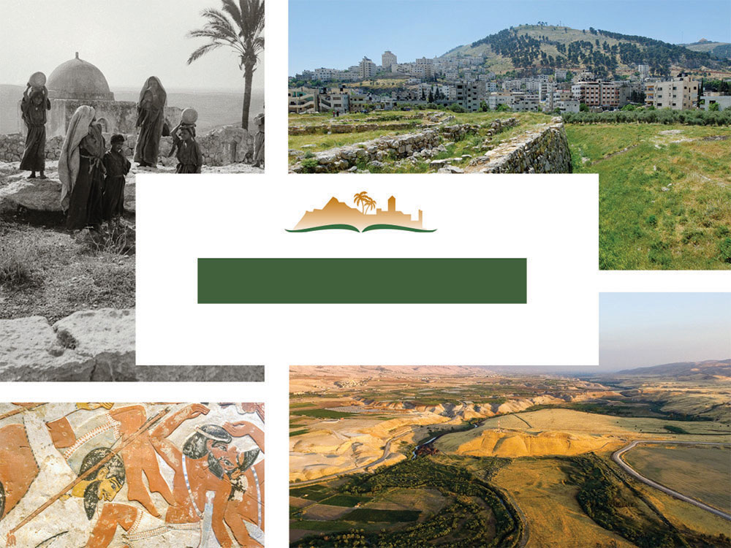
JUDGES 4
Notes:
This is a free sample of the Judges 4 presentation from the Photo Companion to the Bible. To purchase the full volume, visit https://www.bibleplaces.com/judges/
The Photo Companion to the Bible is an image-rich resource for Bible students, teachers, and researchers. Just as a librarian stocks the shelves with as many relevant materials as possible, so we have tried to provide a broad selection of images. Our goal is that you will find in this “library” whatever it is you are looking for.
Credits: The primary creators of this presentation are Chris McKinny, Steven Anderson, Kris Udd, and Todd Bolen. The photographs have an individual file code which usually includes the initials of the photographer. Other images have additional credit or source information.
Updates: We plan to update this collection as we are able. We welcome your suggestions for improving this resource (photocompanion@bibleplaces.com). Purchasers of the Judges volume are provided free, lifetime updates to the collection.
Copyright: This photo collection is protected by copyright law and may not be distributed without written permission from BiblePlaces.com. Slide notes should be treated as any other copyrighted written material, with credit given when quoting from these notes.
For more information, see our complete “Introduction to the Photo Companion to the Bible” online at http://www.BiblePlaces.com/Intro-Photo-Companion-Bible/. Here you will find more information about photo selection, explanatory notes, Bible translation, credit information, and copyright allowances.

Slide 2
JUDGES 4
This is a free sample of the Judges 4 presentation from the Photo Companion to the Bible. To purchase the full volume, visit https://www.bibleplaces.com/judges/ The Photo Companion to the Bible is an image-rich resource for Bible students, teachers, and researchers. Just as a librarian stocks the shelves with as many relevant materials as possible, so we have tried to provide a broad selection of images. Our goal is that you will find in this “library” whatever it is you are looking for. For more details (for this and every slide), see the Notes section below.
Notes:
This is a free sample of the Judges 4 presentation from the Photo Companion to the Bible. To purchase the full volume, visit https://www.bibleplaces.com/judges/
The Photo Companion to the Bible is an image-rich resource for Bible students, teachers, and researchers. Just as a librarian stocks the shelves with as many relevant materials as possible, so we have tried to provide a broad selection of images. Our goal is that you will find in this “library” whatever it is you are looking for.
Credits: The primary creators of this presentation are Chris McKinny, Steven Anderson, Kris Udd, and Todd Bolen. The photographs have an individual file code which usually includes the initials of the photographer. Other images have additional credit or source information.
Updates: We plan to update this collection as we are able. We welcome your suggestions for improving this resource (photocompanion@bibleplaces.com). Purchasers of the Judges volume are provided free, lifetime updates to the collection.
Copyright: This photo collection is protected by copyright law and may not be distributed without written permission from BiblePlaces.com. Slide notes should be treated as any other copyrighted written material, with credit given when quoting from these notes.
For more information, see our complete “Introduction to the Photo Companion to the Bible” online at http://www.BiblePlaces.com/Intro-Photo-Companion-Bible/. Here you will find more information about photo selection, explanatory notes, Bible translation, credit information, and copyright allowances.

Slide 3
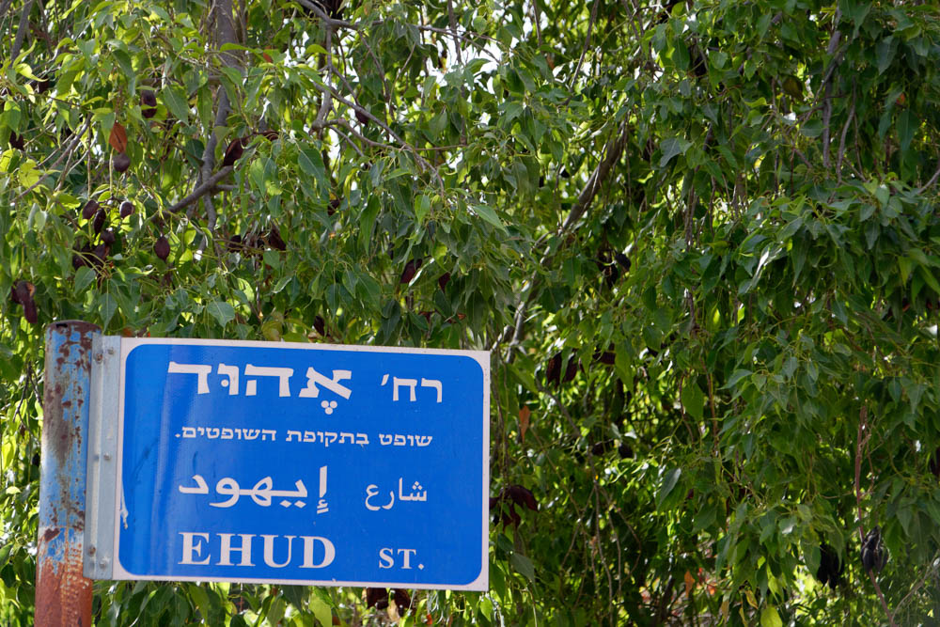
And the people of Israel did what was evil in the sight of Yahweh after Ehud died
“Ehud Street” sign in Jerusalem
4:1
Notes:
“Ehud Street” is located in the Baka neighborhood, south of the Old City.
lbd102218367

Slide 4
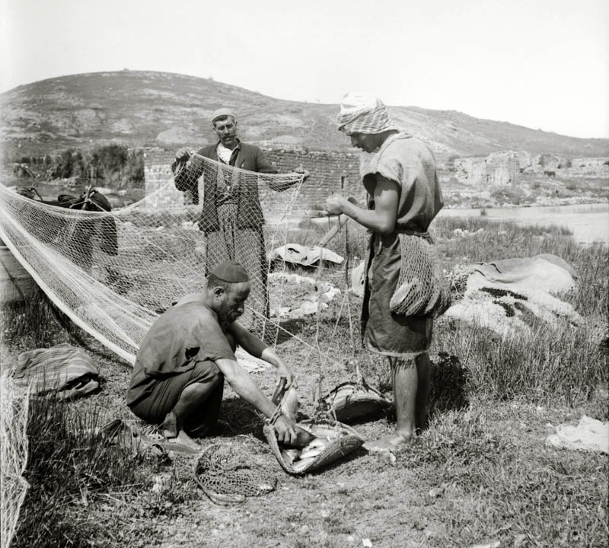
And Yahweh sold them into the hand of Jabin king of Canaan
Fisherman selling fish in Tiberias
4:2
Notes:
The imagery of God selling his people into the hand of a Gentile enemy is almost shocking. Allowing a buyer access to goods, like the man shown here squatting as he mulls over the fish and price, implies that Israelites had made themselves of little value and that God was willing to part with them. This American Colony photo was taken between 1900 and 1920.
mat09008

Slide 5
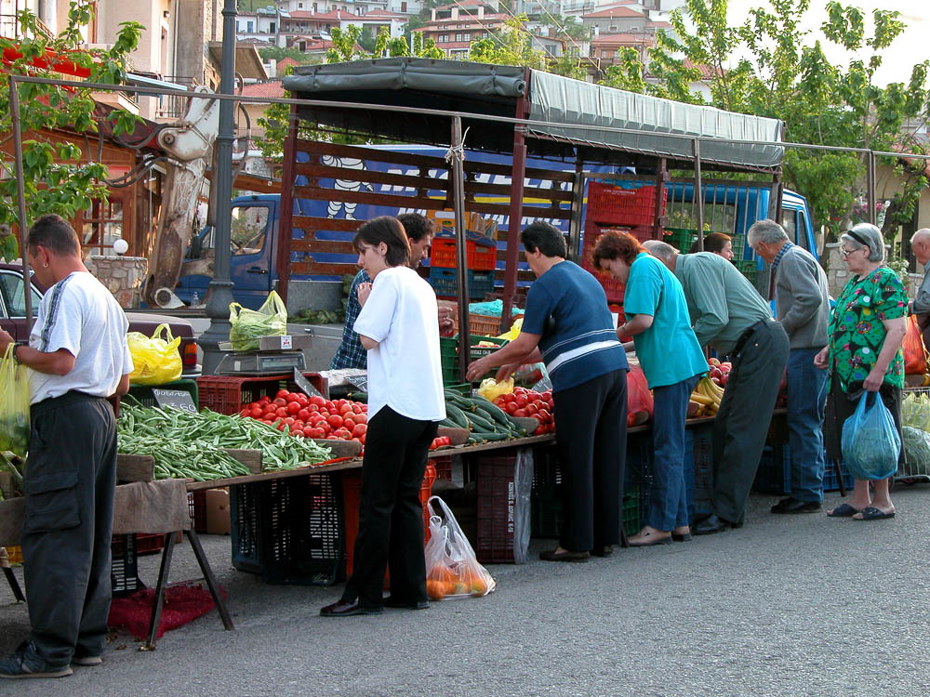
And Yahweh sold them into the hand of Jabin king of Canaan
Buyers and sellers at outdoor market in Arahova
4:2
Notes:
As shoppers look over produce to pick out the best deal, God allowed Jabin to pick what he wanted from among the Israelites. For the Israelites this metaphor would have been very humiliating. This outdoor market is located in Arahova, in southern Greece.
tb051403002

Slide 6
And Yahweh sold them into the hand of Jabin king of Canaan, who reigned in Hazor
Cuneiform letter to Jabin-Addu king of Hazor, discovered at Hazor, 18th–17th centuries BC
4:2
Notes:
The broken piece of cuneiform tablet shown here mentions a certain “Ibni-Addu, king of Hazor.” Ibni is the equivalent of Jabin. This tablet fragment was found at Hazor by archaeologists in 1992. Written in Old Babylonian, the few phrases that survive record objections raised over the transfer of a young woman. It measures 1.18 x 1.06 inches (3.00 x 2.69 cm). It was photographed at the Israel Museum.
In the Bible, Jabin is mentioned as the king of Hazor in Joshua’s conquest of the city in Joshua 11, and again in Judges 4 where a Jabin is named king of Hazor. Outside of the Bible, Jabin (or close equivalents) occurs in two extra-biblical documents that may be associated with Hazor. First, the name Ibni-Addu along with his identification as the king of Hazor is included the cuneiform letter shown here that was discovered at Hazor, which dates to the Middle Bronze Age (Horowitz et al. 2006: 77–78, cf. 69–71). The first element of the name “Ibni” seems to be the Babylonian form for the Semitic name of Jabin, which could indicate that the name was used dynastically (particularly in light of its occurrence in Josh 11 and Judg 4–5). Ibni-Addu of Hazor also appears in the Mari Archive (Bonechi 1992). See the next slide for another reference to Jabin of Hazor.
References:
Bonechi, M.
1992 Relations amicales syro-palestiniennes: Mari et Hasor au XVIII e siècle av. JC. Recueil d’études en l’honneur de Michel Fleury, Mémoires de NABU 1: 9–22.
Horowitz, W., Oshima, T., and Sanders, S. L.
2006 Cuneiform in Canaan: Cuneiform Sources from the Land of Israel in Ancient Times. Jerusalem: Israel Exploration Society and Hebrew University of Jerusalem.
adr1306212098

Slide 7
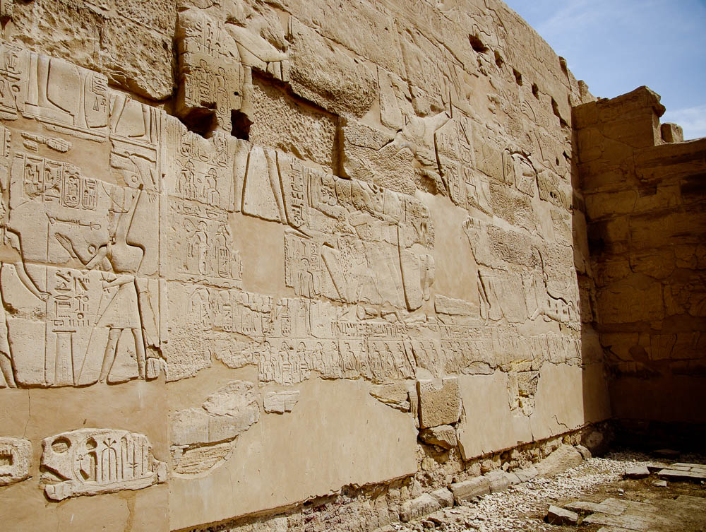
And Yahweh sold them into the hand of Jabin king of Canaan, who reigned in Hazor
Ramses II’s list of cities on the Great Hypostyle Hall at the Karnak Temple, 13th century BC
4:2
Notes:
A second and later reference to Jabin of Hazor may be found in Egyptian records. C. R. Krahmalkov has argued that the name Jabin appears in the topographic list of Ramses II at Karnak (the Great Temple of Amon, Krahmalkov 1994; cf. Simons 1937: 157–59). In this text, Krahmalkov reconstructs the following toponyms “Qerumin-Qishon of Jabin (Ybn)-Shimshon-Hadasht” (Nos. 21–23; cf. Simons 1937: 158–59), which he connects with the Kishon River and the town of Kishon, which was ruled over by Jabin and Hadasht at Harosheth-hagoiim (1994). With regards to Jabin, Krahmalkov believes that an editor of Judges incorrectly connected Jabin to Hazor due to the influence of Joshua 11, and that the Jabin of Ramses II’s list and Judges 4 should be connected with Kishon (1994).
References:
Krahmalkov, C. R.
1994 Exodus Itinerary Confirmed by Egyptian Evidence. Biblical Archaeological Review 20/5: 54–62.
Simons, J. J.
1937 Handbook for the Study of Egyptian Topographical Lists Relating to Western Asia. Leiden: Brill.
adr1603122315

Slide 8
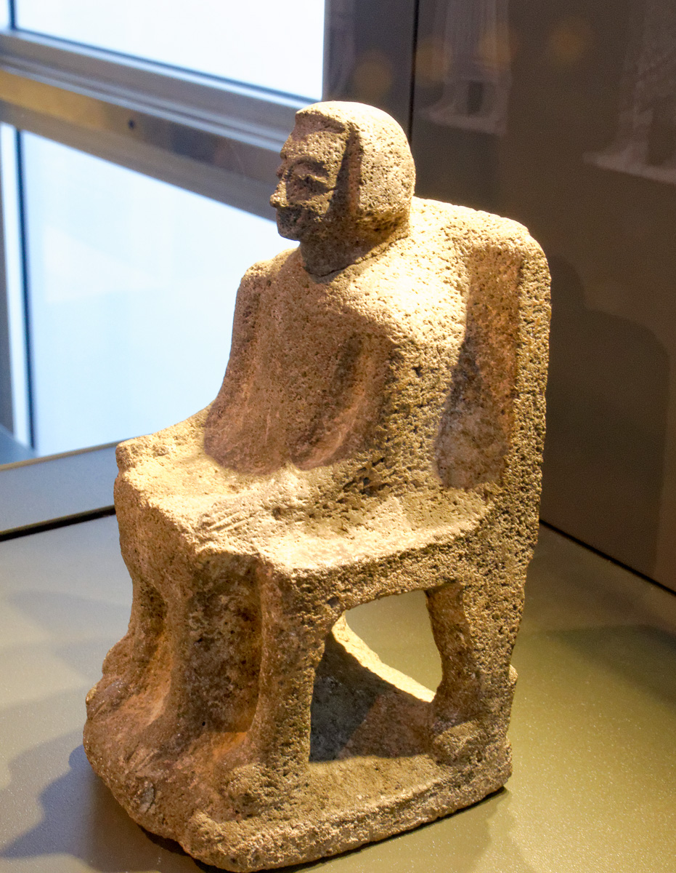
And Yahweh sold them into the hand of Jabin king of Canaan, who reigned in Hazor
Statue of a Canaanite ruler, from Hazor, 15th–13th centuries BC
4:2
Notes:
This statue is roughly contemporary with the time of Deborah and Barak. This basalt artifact was photographed in the Israel Museum.
tb032014120

Slide 9
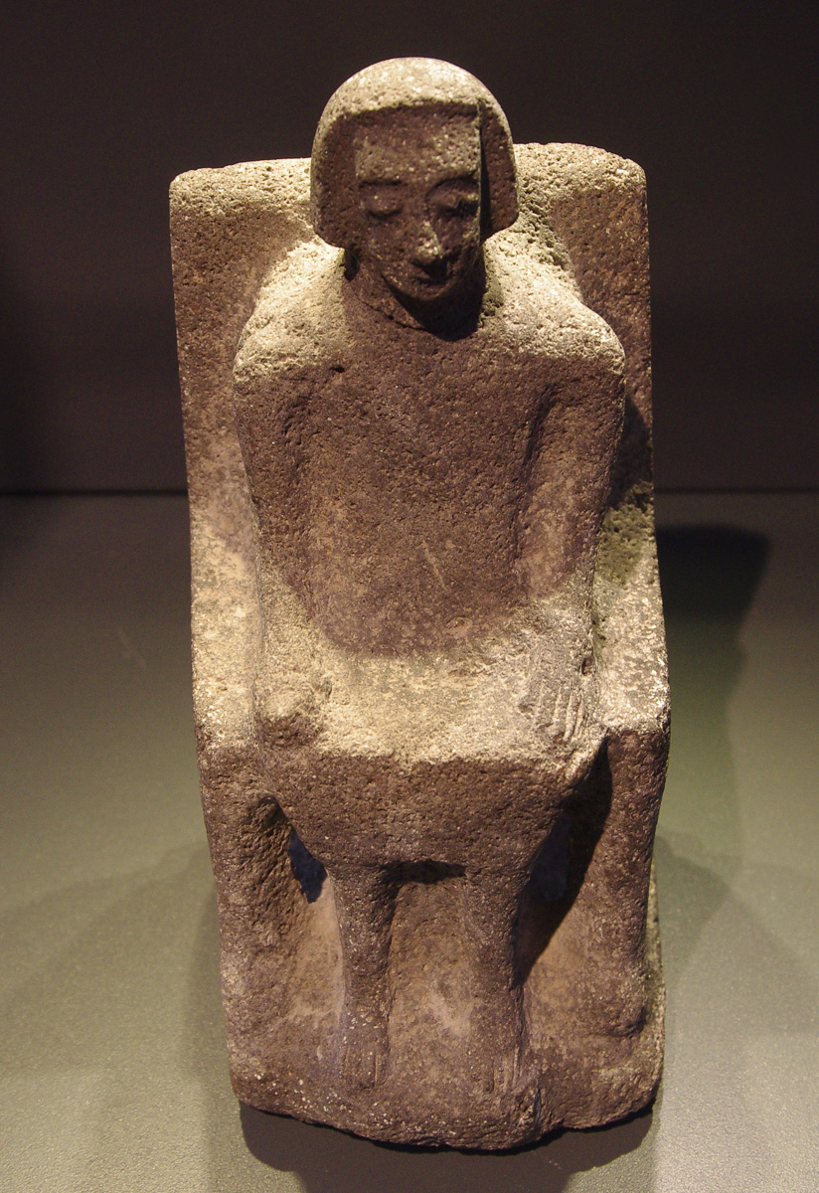
And Yahweh sold them into the hand of Jabin king of Canaan, who reigned in Hazor
Statue of a Canaanite ruler, from Hazor, 15th–13th centuries BC
4:2
Notes:
This basalt statue was photographed in the Israel Museum.
adr1305113219

Slide 10
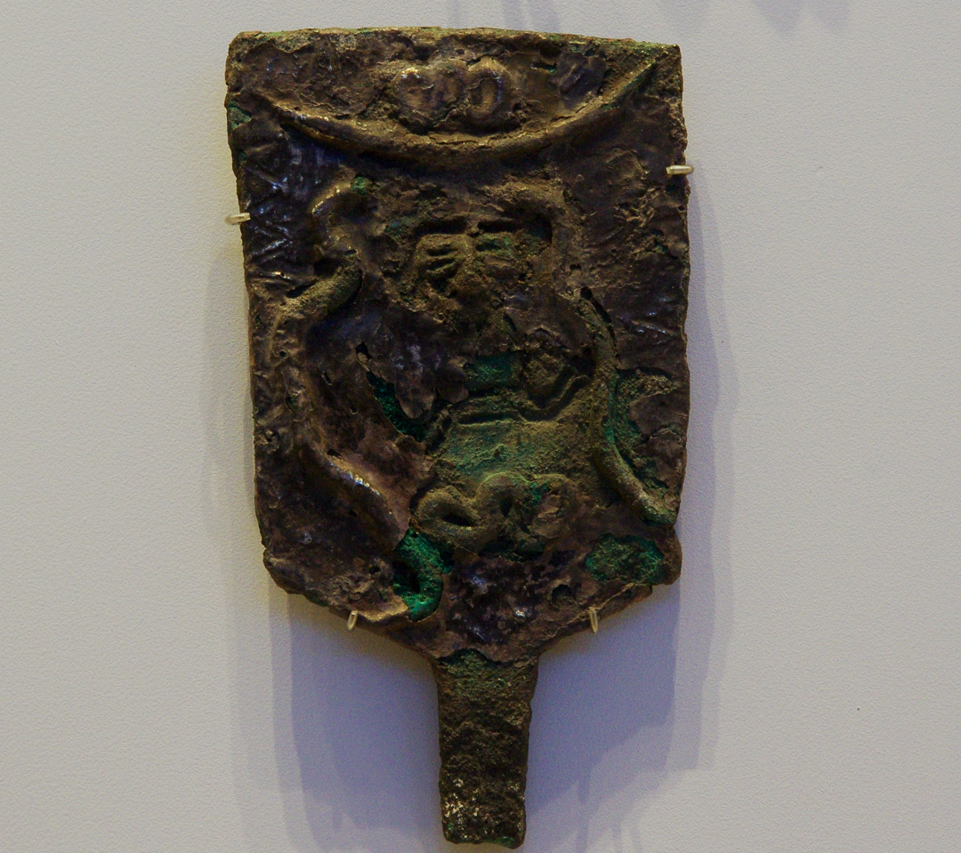
And Yahweh sold them into the hand of Jabin king of Canaan, who reigned in Hazor
Scepter head from Hazor, 14th–13th centuries BC
4:2
Notes:
This artifact is made of bronze and covered with a thin sheet of beaten silver. It was once attached to a wooden pole by means of a tang. Its use is uncertain; suggestions include the head of a scepter or a standard that would have been used in religious processions. It portrays with a figure (perhaps a goddess) surrounded by two snakes. It was photographed in the Israel Museum.
adr1306212388

Slide 11
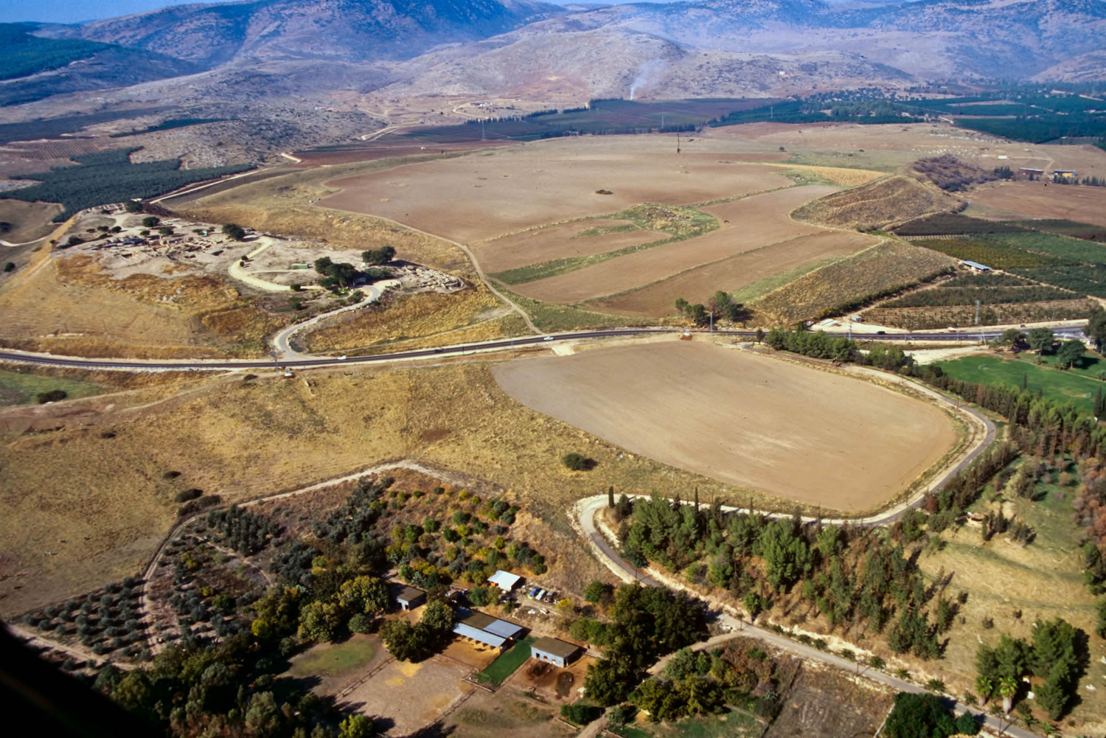
And Yahweh sold them into the hand of Jabin king of Canaan, who reigned in Hazor
Hazor (aerial view from the southeast)
4:2
Notes:
Known in Joshua’s day as “the head of all those kingdoms,” the 200-acre (81-ha) tell of Hazor is the largest tell in Israel. At its height, in the Canaanite period, the city encompassed the entire tell, including both the lower and upper sections. When it was later inhabited by the Israelites, the fortified city included only the Upper City. Hazor sat along the route of the International Highway. The next slide includes labels.
tbs112120011

Slide 12
And Yahweh sold them into the hand of Jabin king of Canaan, who reigned in Hazor
upper tell
lower city
lower city
Hazor (aerial view from the southeast)
4:2
Notes:
Known in Joshua’s day as “the head of all those kingdoms,” the 200-acre (81-ha) tell of Hazor is the largest tell in Israel. At its height, in the Canaanite period, the city encompassed the entire tell, including both the lower and upper sections. When it was later inhabited by the Israelites, the fortified city included only the Upper City. Hazor sat along the route of the International Highway.
tbs112120011

Slide 13
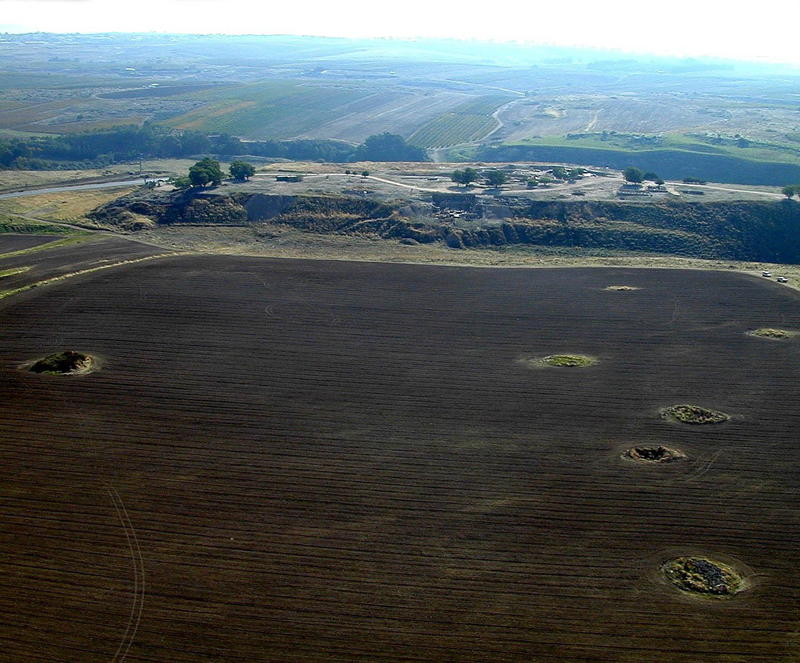
And Yahweh sold them into the hand of Jabin king of Canaan, who reigned in Hazor
Hazor (aerial view from the north)
4:2
Notes:
Identified with Tell el-Qedah (also known as Tell Waqqas), Hazor is located 14 miles (26 km) north of the Sea of Galilee. The site’s 21 occupational levels cover 3,000 years of history, and inhabitation of the upper city began in the Early Bronze period. A major center of commerce in the Fertile Crescent in ancient times, Hazor is one of the few cities of antiquity noted in extrabiblical texts from Egypt, Israel, and Mesopotamia.
tb112000207

Slide 14
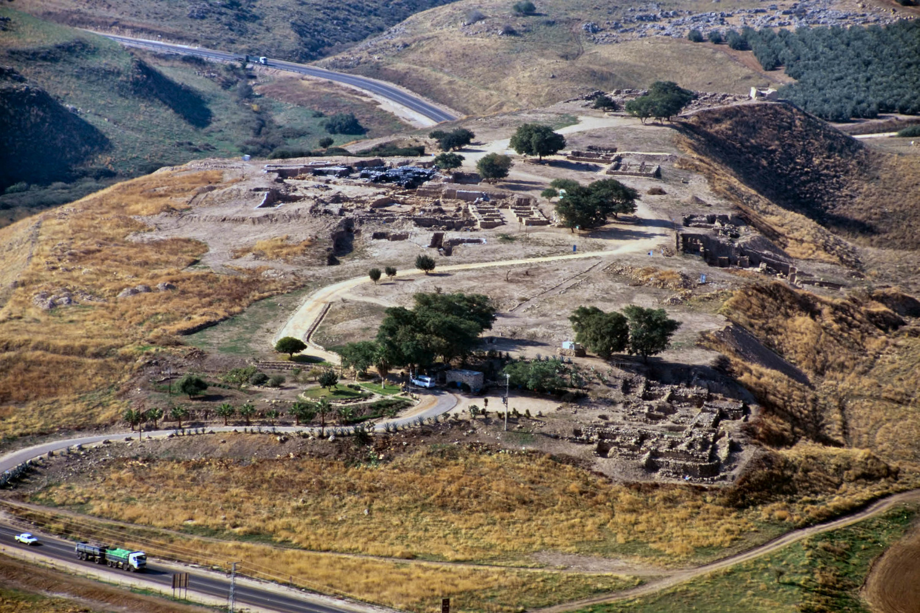
And Yahweh sold them into the hand of Jabin king of Canaan, who reigned in Hazor
Upper city of Hazor (aerial view from the east)
4:2
Notes:
John Garstang identified this site as Hazor, though he was unaware that it had previously been identified as such by an earlier explorer. He was able to make the identification without the use of Egyptian sources. Hazor was first excavated by Yigael Yadin and the Hebrew University from 1955 to 1958, and again in 1969. A tourist in the 1960s found a lump of clay with writing on it at Hazor and took it back to the U.S. He later showed the piece to Shalom Paul, who recognized it as a cuneiform tablet with the name “Hazor” written on it. That piece of pottery confirmed that this tell was indeed the mound of biblical Hazor. Since 1990, excavations have been conducted by Amnon Ben-Tor of Hebrew University.
tbs112280011

Slide 15
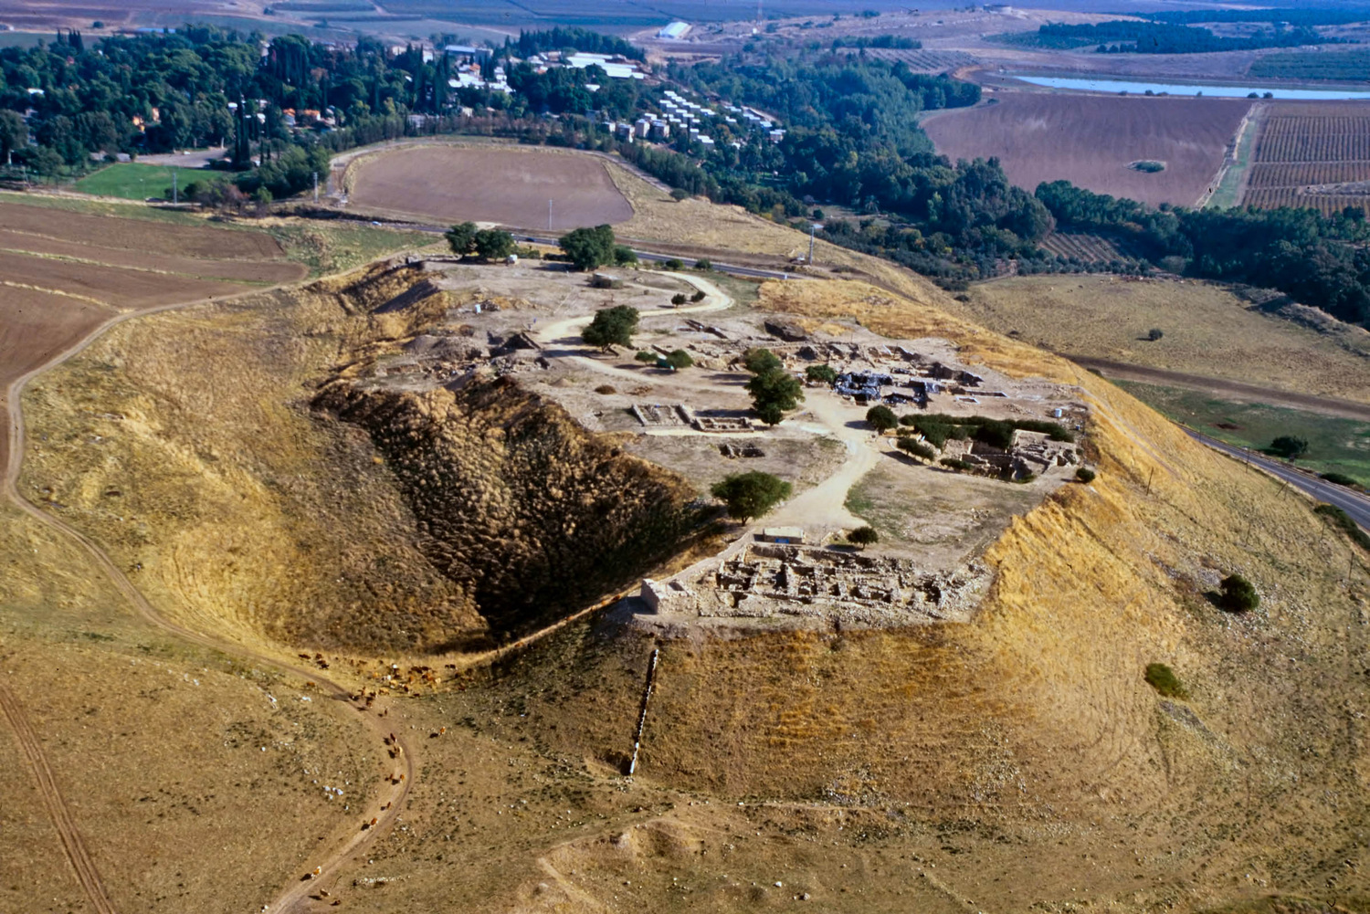
And Yahweh sold them into the hand of Jabin king of Canaan, who reigned in Hazor
Upper city of Hazor (aerial view from the west)
4:2
Notes:
Hazor is mentioned in the second set of Execration Texts (Egypt), the Amarna letters (Egypt), as well as in letters from the Mari palace (Mesopotamia). Hazor was at the end of a major trade route and was the Canaanite stronghold of the Fertile Crescent. Several Canaanite temples and stelae have been found at the site.
tbs112040011

Slide 16
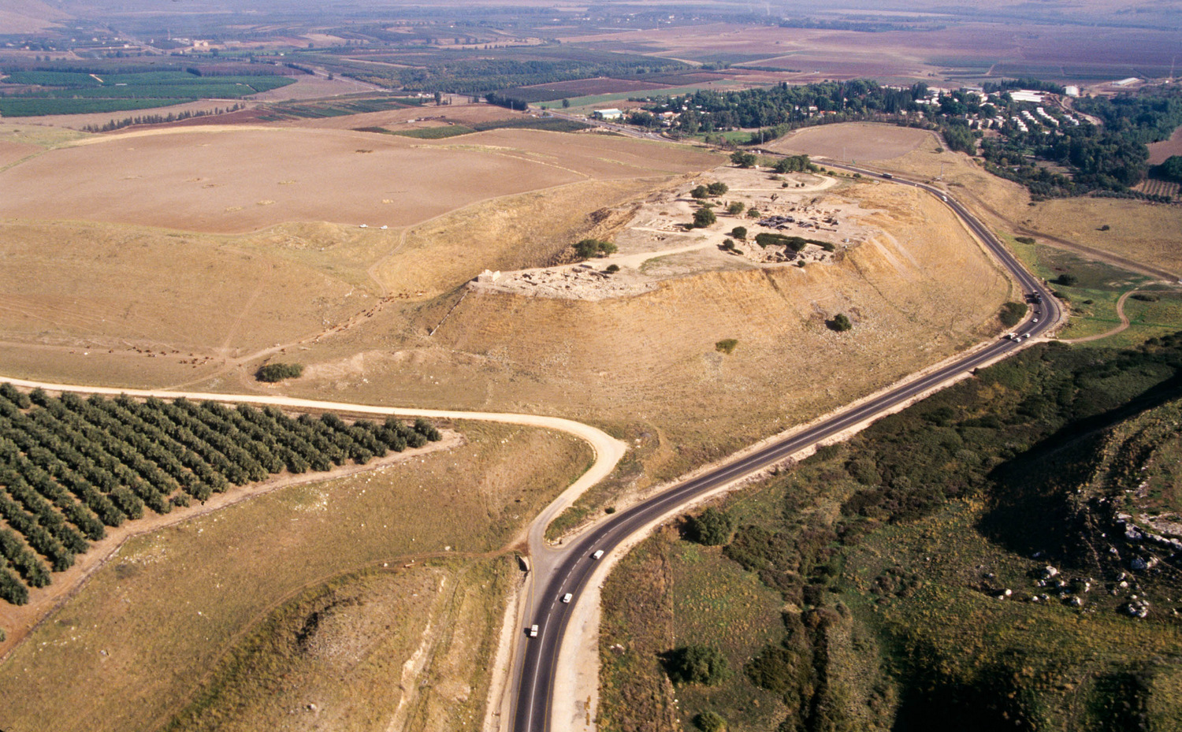
And Yahweh sold them into the hand of Jabin king of Canaan, who reigned in Hazor
Upper city of Hazor (aerial view from the west)
4:2
Notes:
In Joshua 11:1-15, Jabin, king of Hazor, called all the cities together to fight against Joshua. Joshua killed the king of the city, and Hazor was one of only three cities burned by Joshua in the conquest.
tbs112220011

Slide 17
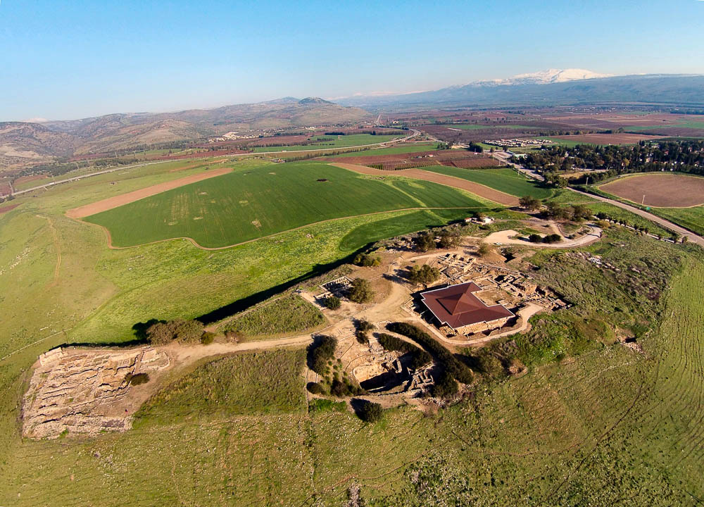
And Yahweh sold them into the hand of Jabin king of Canaan, who reigned in Hazor
Hazor (aerial view from the south)
4:2
Notes:
After a period when the city was neglected and habitation was sparse, Solomon rebuilt the upper city of Hazor, seen here in the foreground (1 Kgs 9:15).
ws011315095

Slide 18
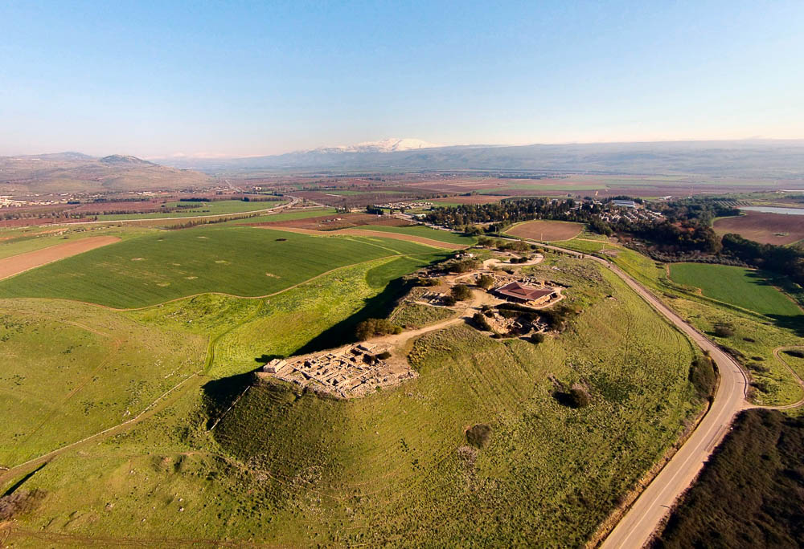
And Yahweh sold them into the hand of Jabin king of Canaan, who reigned in Hazor
Hazor (aerial view from the southwest)
4:2
Notes:
The Huleh Valley and snow-capped Mount Hermon are visible in the background of this photo.
ws011315081

Slide 19
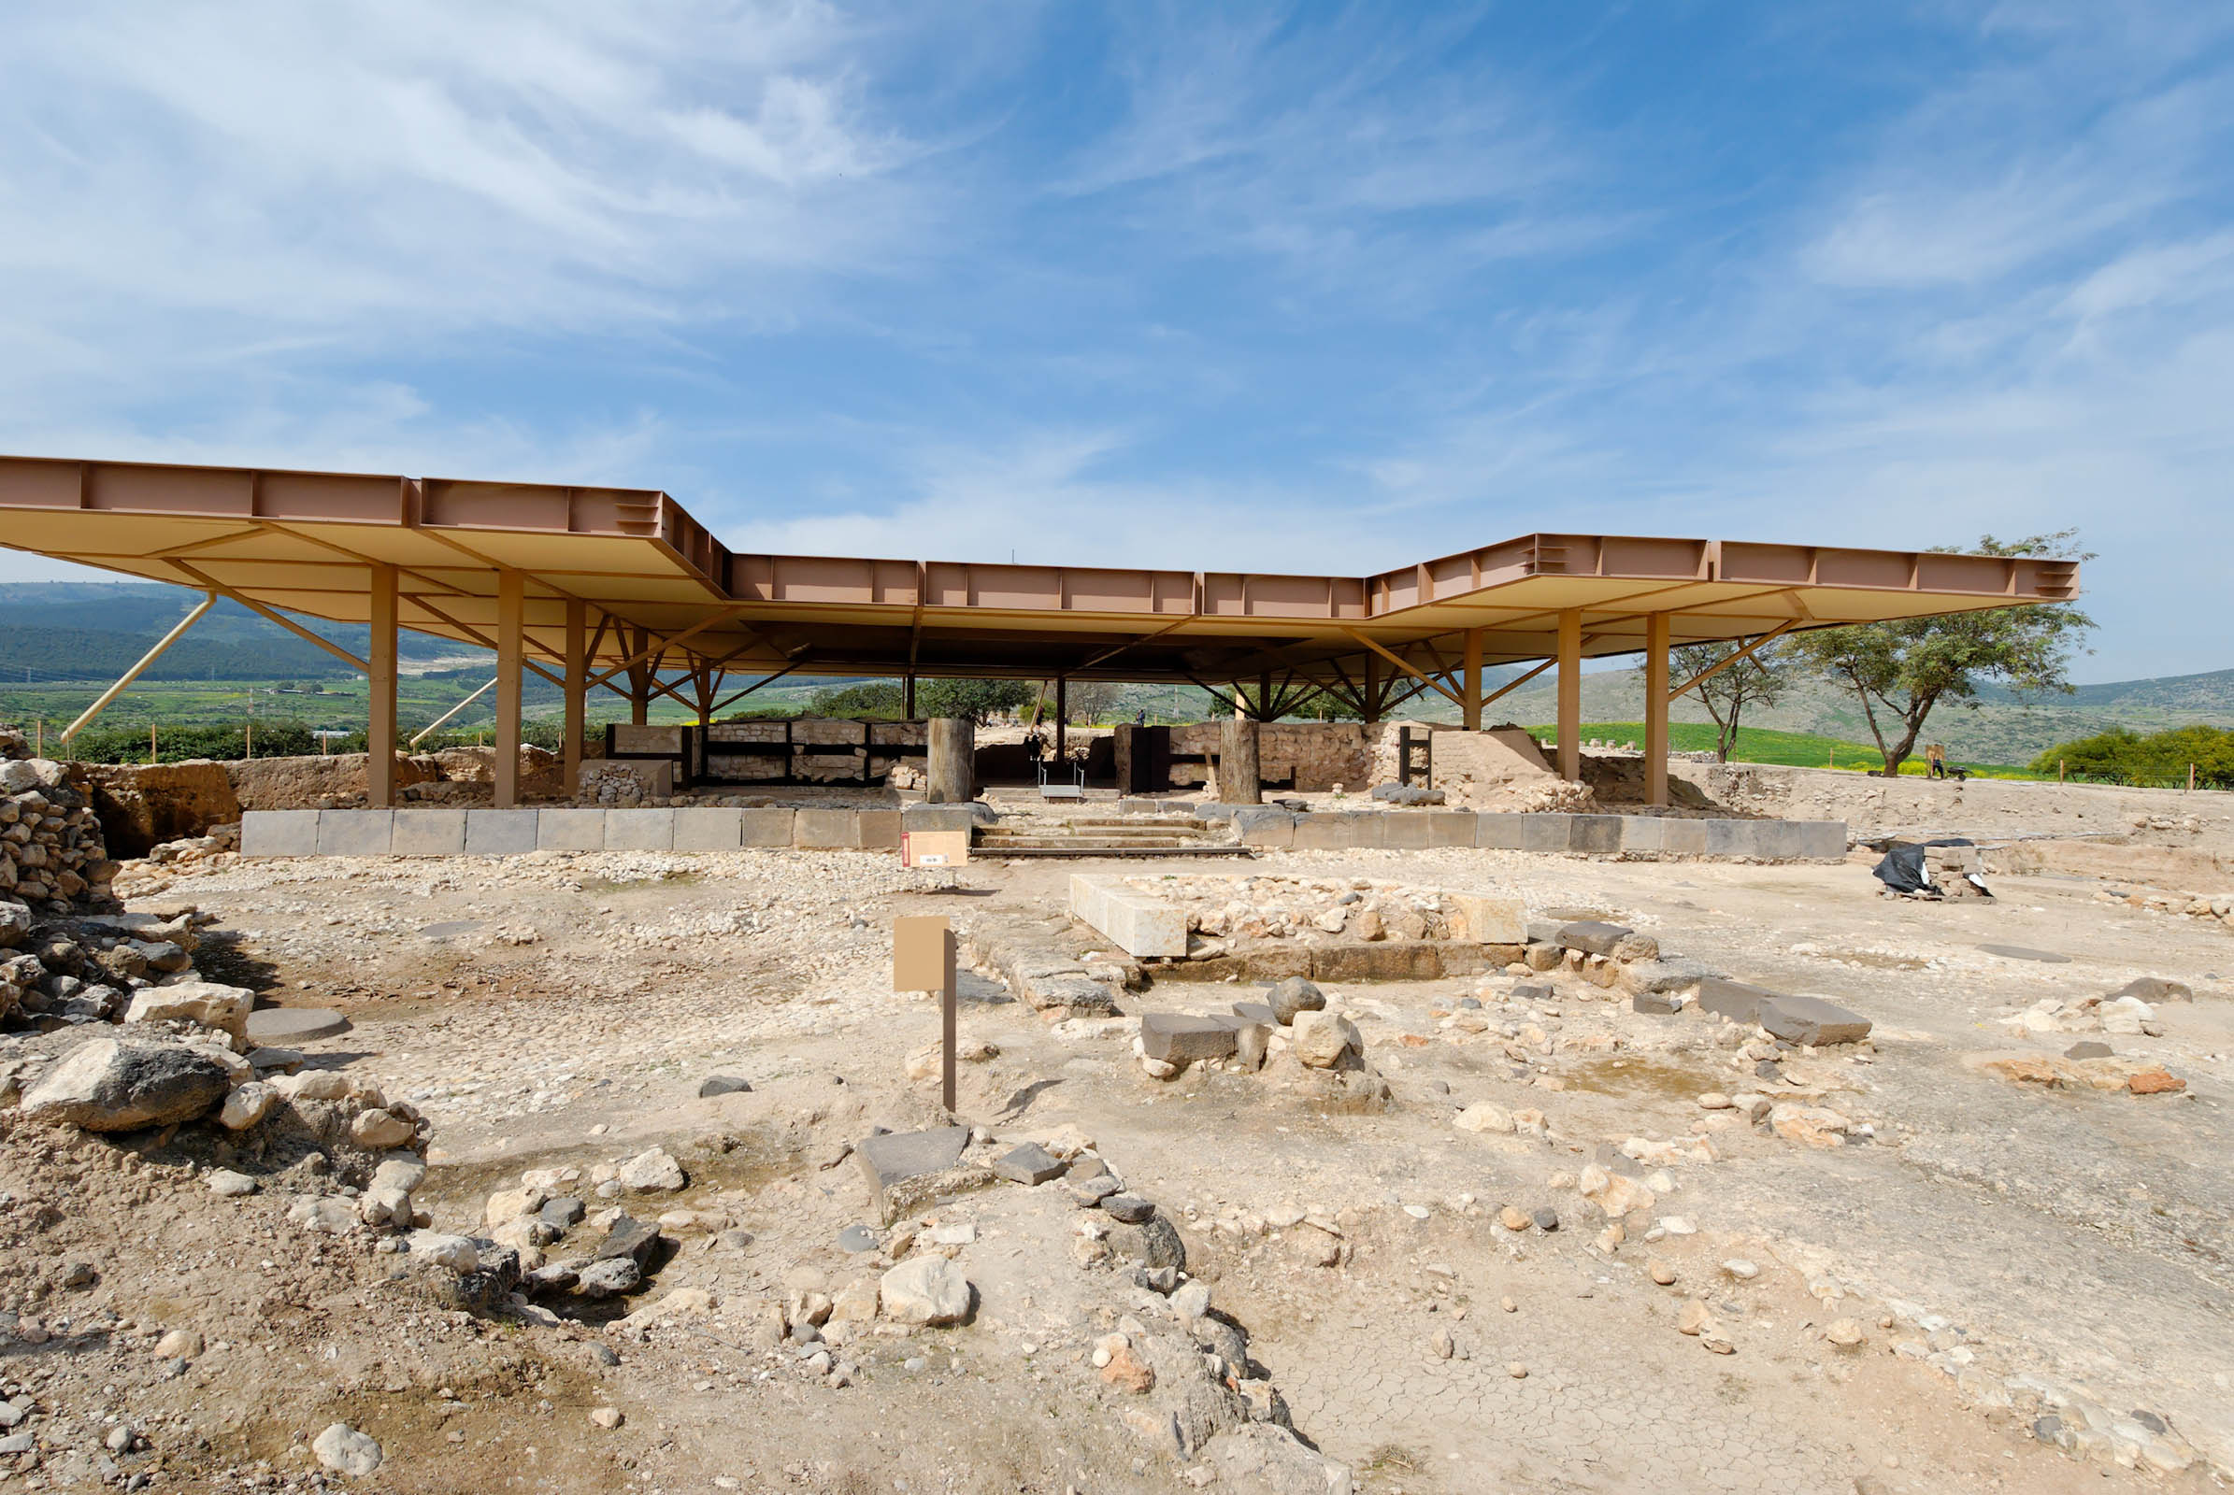
And Yahweh sold them into the hand of Jabin king of Canaan, who reigned in Hazor
Canaanite palace at Hazor, 14th–13th centuries BC
4:2
Notes:
The structure that lies beneath the protective modern roof in this photo is the final Canaanite palace. The foundations were built of finely cut basalt stones, above which were mudbrick walls. The squarish ruin in the foreground may have been an altar. A temple was found on the north side of this square (off the photo to the right), which was likely associated with this altar.
tb032607744

Slide 20
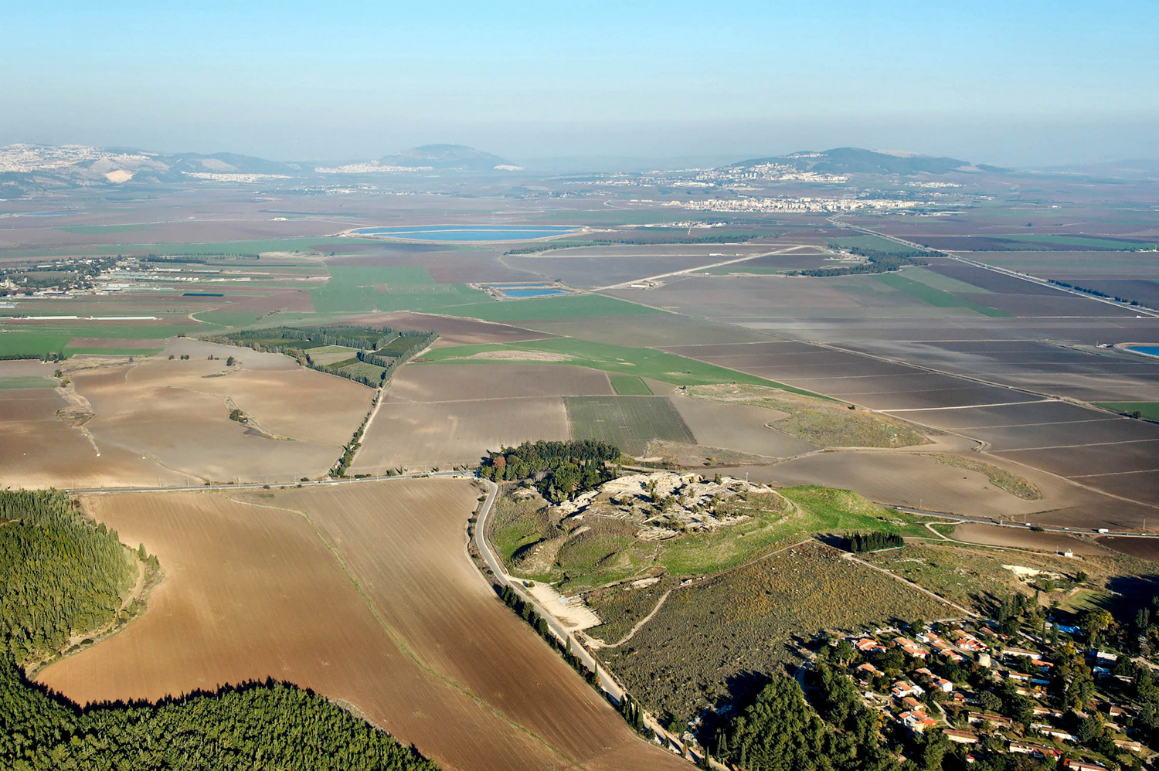
The commander of his army was Sisera, who lived in Harosheth-hagoiim
Megiddo and the Jezreel Valley, possible area of Harosheth-hagoiim (aerial view from the west)
4:2
Notes:
Harosheth-hagoiim is only definitively mentioned in Judges 4 (verses 2, 13, and 16), and its location and etymology remain unclear. “Harosheth” could be related to the Akkadian erištu, “cultivated land.” The term “hagoiim” is Hebrew for “the nations” or “the Gentiles,” so together these two words might mean “cultivated lands of the Gentiles.” Judges 5:19 indicates that this region is to be found in the same area as Megiddo and Taanach.
It is possible that Goiim of Galilee (Josh 12:23, following the LXX “Galilee” over the MT’s “Gilgal”) represents the same locality as Harosheth-hagoyim. The general geographic context of the list in Joshua 12 would favor the Septuagintal reading of “in the Galilee” over the Masoretic Text’s “in Gilgal,” which would also point to a location near the preceding towns of Taanach, Megiddo, Jokneam, Kedesh, and Dor (Josh 12:21-23; cf. Judg 5:19). It is also possible that the toponym is mentioned in Isaiah 9:1, which states “in the former time he brought into contempt the land of Zebulun and the land of Naphtali, but in the latter time he has made it glorious, by the way of the sea, beyond the Jordan, Galilee of the Goiim” (cf. also Matt 4:15). The statement in Isaiah is probably connected with the campaign of Tiglath-pileser III in 732 BC, which included an attack on Gilead and Galilee (i.e., Zebulun and Naphtali; see 2 Kgs 15:29 and various Neo-Assyrian annals). While there are varied opinions on the exact identification, it seems best to follow Aharoni’s suggestion to understand Harosheth-hagoyim and its variants as a regional term that refers to the plain near Megiddo and Taanach (Aharoni 1979: 221; Rainey and Notley 2014: 150).
References:
Aharoni, Yohanan.
1979 The Land of the Bible: A Historical Geography. Trans. Anson F. Rainey, from Hebrew. Philadelphia: Westminster Press.
Rainey, Anson F., and Notley, R. Steven.
2014 The Sacred Bridge. 2nd edition. Jerusalem: Carta Jerusalem.
tb121704968

Slide 21
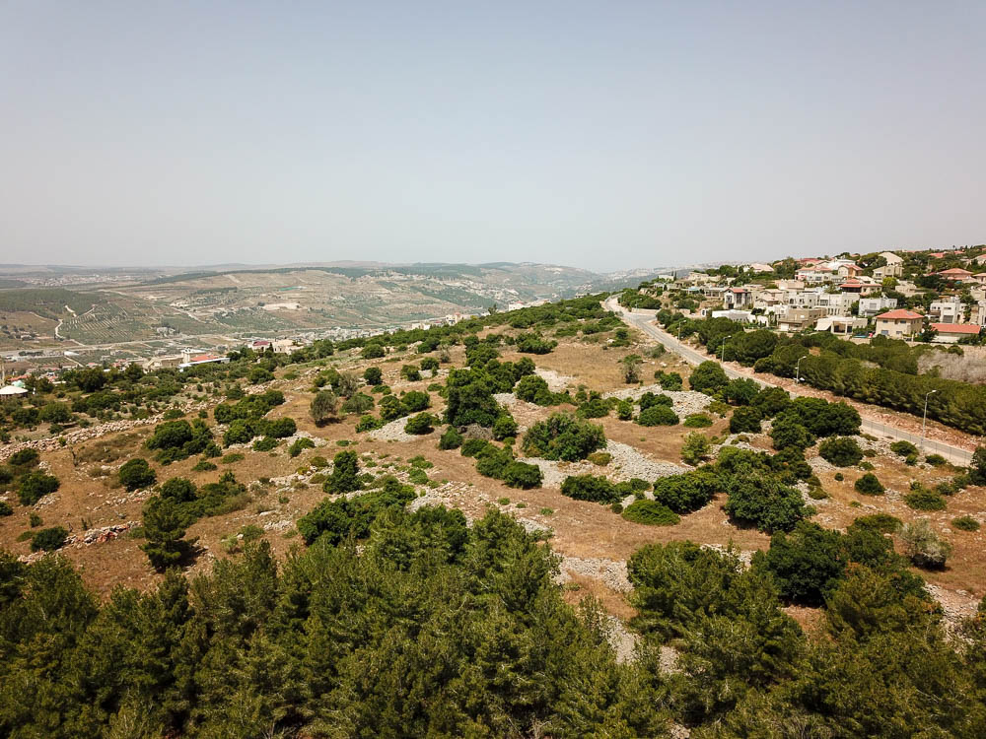
The commander of his army was Sisera, who lived in Harosheth-hagoiim
El-Ahwat, proposed location of Harosheth-hagoiim, and Arunah Pass (aerial from southwest)
4:2
Notes:
Excavator Adam Zertal proposed that the site of el-Ahwat should be identified with Harosheth-hagoiim. While its location on the western side of Mount Carmel seems to be contrary to the apparent location in the valley (4:13), several photographs are included here for the sake of completeness and because no other site has widespread recognition as Harosheth-hagoiim.
adr1805260005

Slide 22
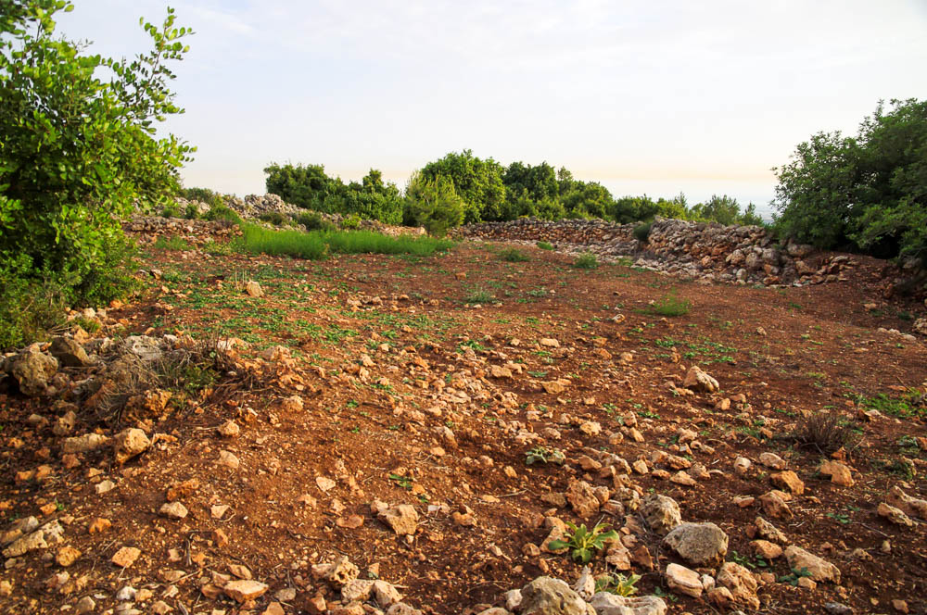
The commander of his army was Sisera, who lived in Harosheth-hagoiim
El-Ahwat, proposed location of Harosheth-hagoiim
4:2
Notes:
Zertal dated to the remains at el-Ahwat to 1220–1150 BC, and he identified Sisera as belonging to the tribe of the Shardana who settled here. Those who hold to an early date for the Conquest would date the events of Judges 4 to the 13th century. This photograph shows Area D of the excavations.
adr1305196373

Slide 23
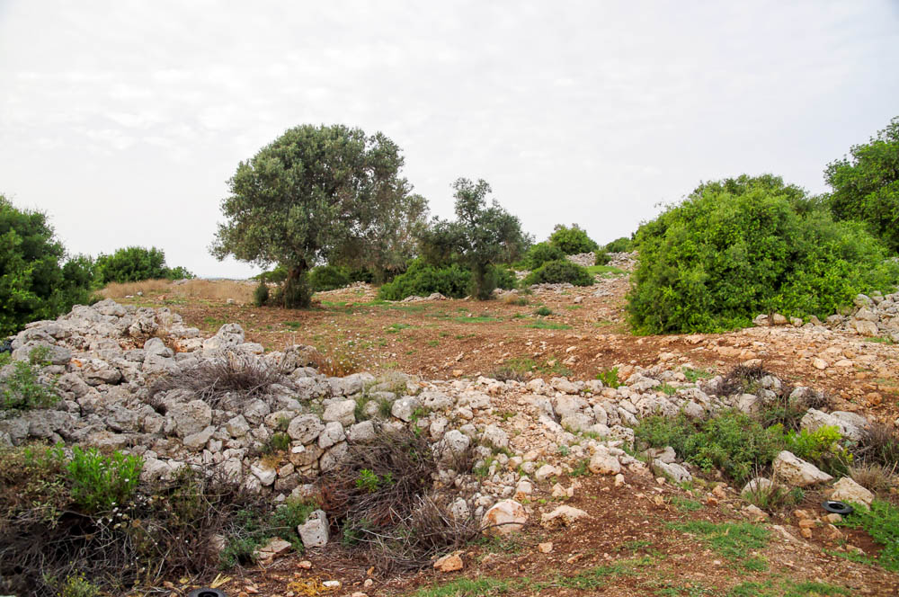
The commander of his army was Sisera, who lived in Harosheth-hagoiim
El-Ahwat, proposed location of Harosheth-hagoiim, Area A excavations
4:2
Notes:
The results of the excavations have been published in Adam Zertal, ed., El-Ahwat: A Fortified Site from the Early Iron Age Near Nahal 'Iron, Israel: Excavations 1993–2000. Culture and History of the Ancient Near East, vol. 24. Leiden: Brill, 2011. An abstract and table of contents of the book is available here: https://brill.com/view/title/15651.
adr1305196353

Slide 24
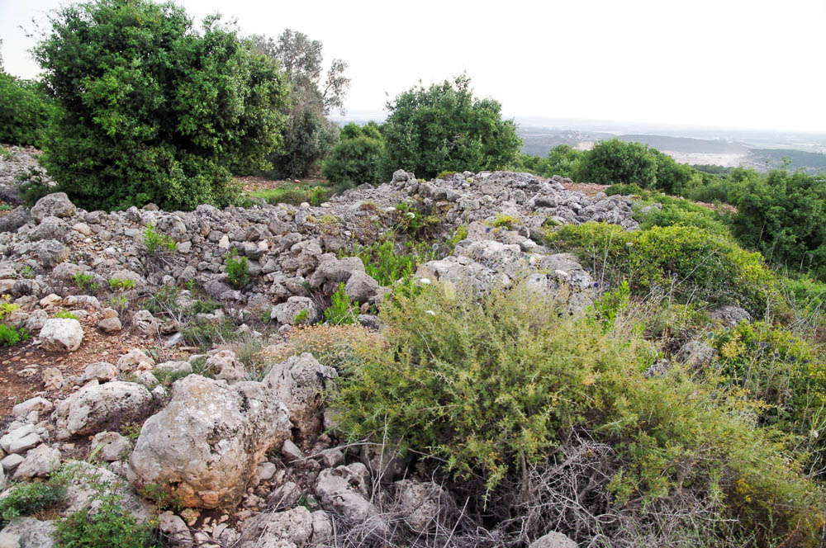
The commander of his army was Sisera, who lived in Harosheth-hagoiim
El-Ahwat, proposed location of Harosheth-hagoiim, city gate in Area A
4:2
Notes:
adr1305196360

Slide 25
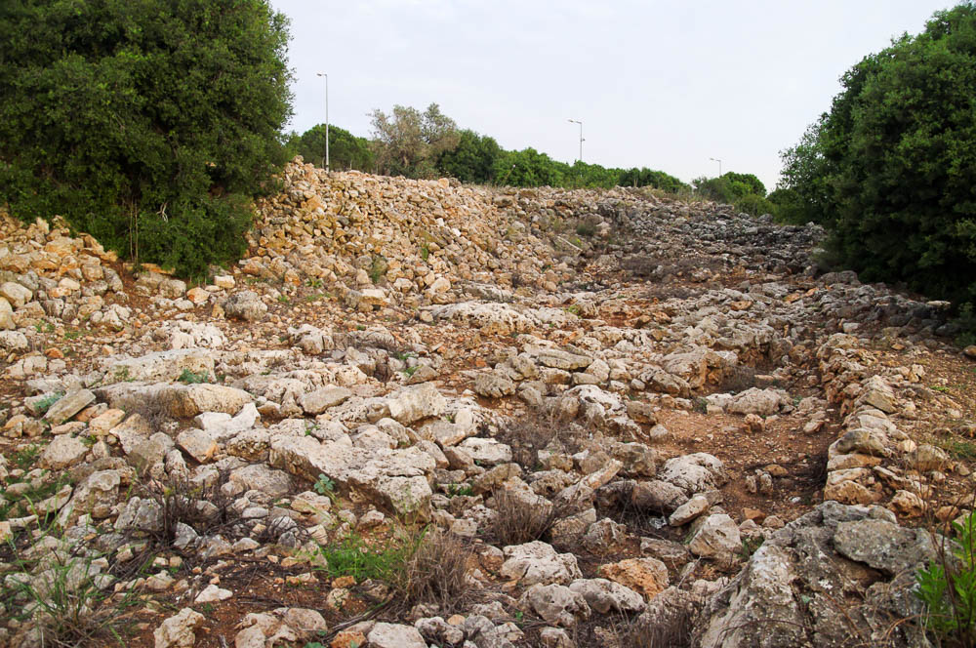
The commander of his army was Sisera, who lived in Harosheth-hagoiim
El-Ahwat, Complex 100 possible governor’s residence in Area A3
4:2
Notes:
The excavators identified this large building as a governor’s palace. The bronze plaque shown on the next slide was discovered here.
adr1305196365

Slide 26
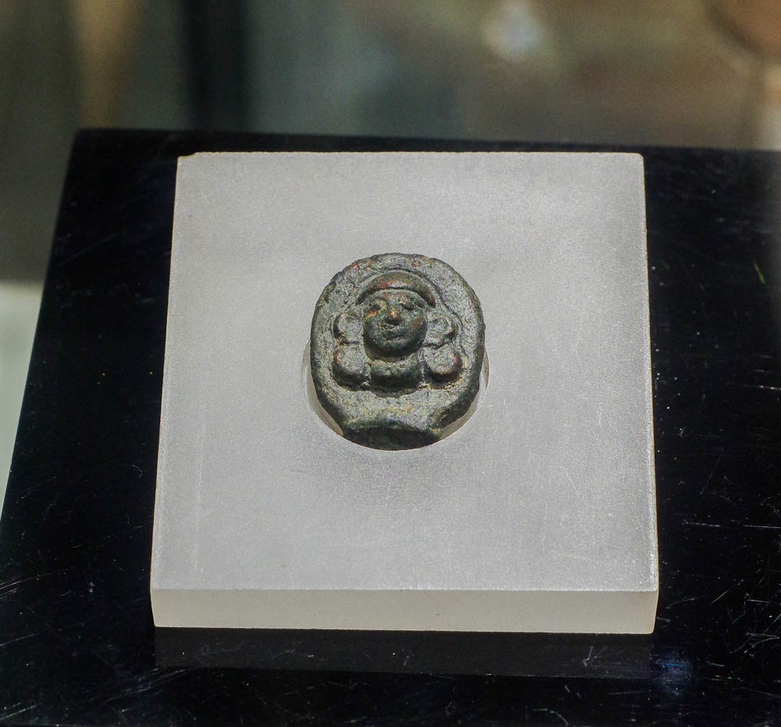
The commander of his army was Sisera, who lived in Harosheth-hagoiim
Woman’s head bronze plaque, from el-Ahwat, 13th–12th centuries BC
4:2
Notes:
Archaeologists have proposed that this bronze plaque actually served as a linchpin for the wheel of a chariot. Archaeologist Adam Zertal believes that this lends support to his theory that el-Ahwat is to be identified with Harosheth-hagoiim. For more information, see this press release from the University of Haifa: https://web.archive.org/web/20100705114906/http://newmedia-eng.haifa.ac.il/?p=3309
adr1805253426

Slide 27
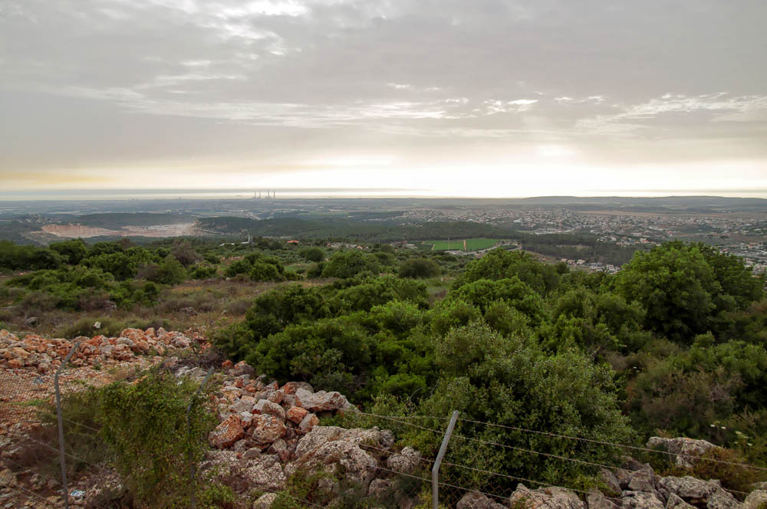
The commander of his army was Sisera, who lived in Harosheth-hagoiim
View of Sharon Plain from el-Ahwat (from the northeast)
4:2
Notes:
The proximity of el-Ahwat to the coastal plain is more compatible with the idea that Sea Peoples settled here than it is with the theory that this was the Harosheth-hagoiim that was involved in the battle against Barak in the Jezreel Valley to the west. Zertal’s theory has not met with significant scholarly acceptance to date.
adr1305196338

Slide 28
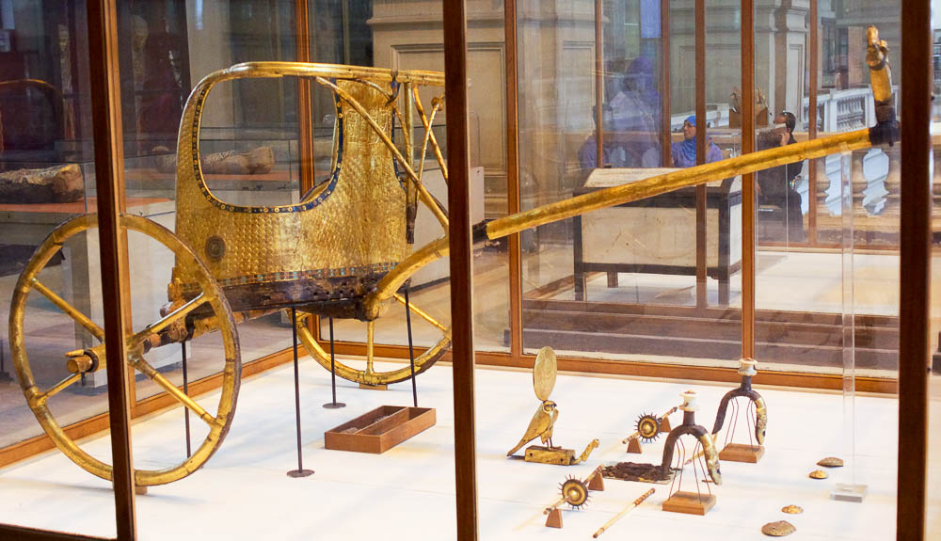
He had nine hundred iron chariots, and he oppressed the sons of Israel severely for twenty years
Ceremonial chariot of Tutankhamun, from the Valley of the Kings, 14th century BC
4:3
Notes:
During the Iron Age (1200–586 BC), bronze remained the most used metal due to its availability in the regions of Feinan and Timna (Arabah) and the island of Cyprus. Typically, English versions of the Old Testament translate barzel (בַּרְזֶל) as “iron” and nechoshet (נְחשֶׁת) as “bronze” (e.g., Gen 4:22). However, there are now several archaeological examples of Iron Age metal workshops or smithies where it was discovered that iron and bronze objects were produced side by side (e.g., Tell es-Safi/Gath). While it is difficult to speak with certainty, this evidence may indicate that the term barzel could be used as a general term for both iron and bronze, and that nechoshet should be used only for copper (bronze is an alloy of 90% copper and 10% tin). The photos of Tutankhamun’s chariots show a gilded (gold) wooden chariot, but chariots that were actually used in battle would have used bronze, and perhaps some iron components. This chariot was photographed at the Egyptian Museum in Cairo.
adr1603111801

Slide 29
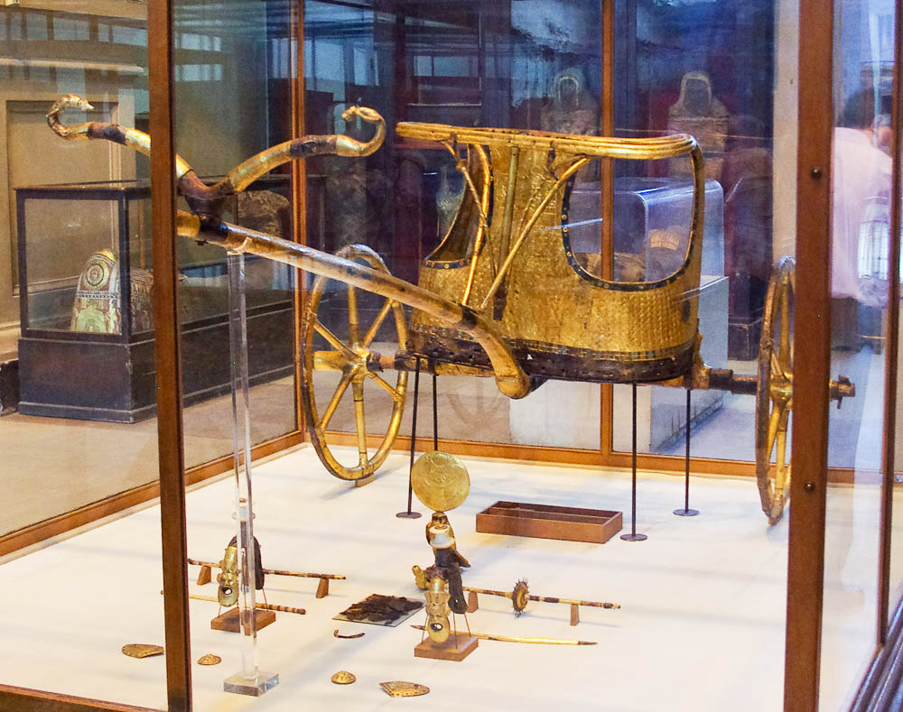
He had nine hundred iron chariots, and he oppressed the sons of Israel severely for twenty years
Ceremonial chariot of Tutankhamun, from the Valley of the Kings, 14th century BC
4:3
Notes:
Although this chariot, which dates to approximately the same time as Deborah and Barak, is unusual in its gilding, it demonstrates the basic lightweight form of chariots from this period. This chariot was photographed at the Egyptian Museum in Cairo.
adr1603111804

Slide 30
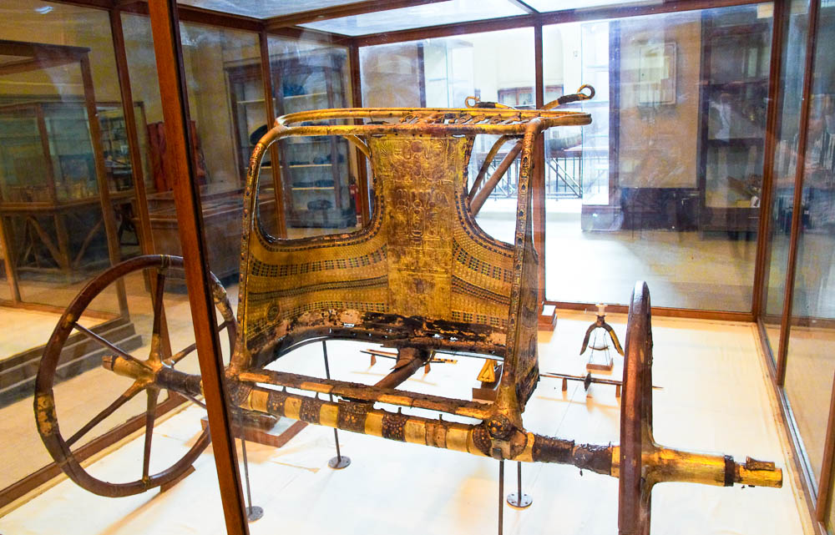
He had nine hundred iron chariots, and he oppressed the sons of Israel severely for twenty years
Ceremonial chariot of Tutankhamun, from the Valley of the Kings, 14th century BC
4:3
Notes:
The floor is missing from this chariot. It is known from other examples that the floor was typically made of leather strips woven together. This chariot was photographed at the Egyptian Museum in Cairo.
adr1603111824

Slide 31
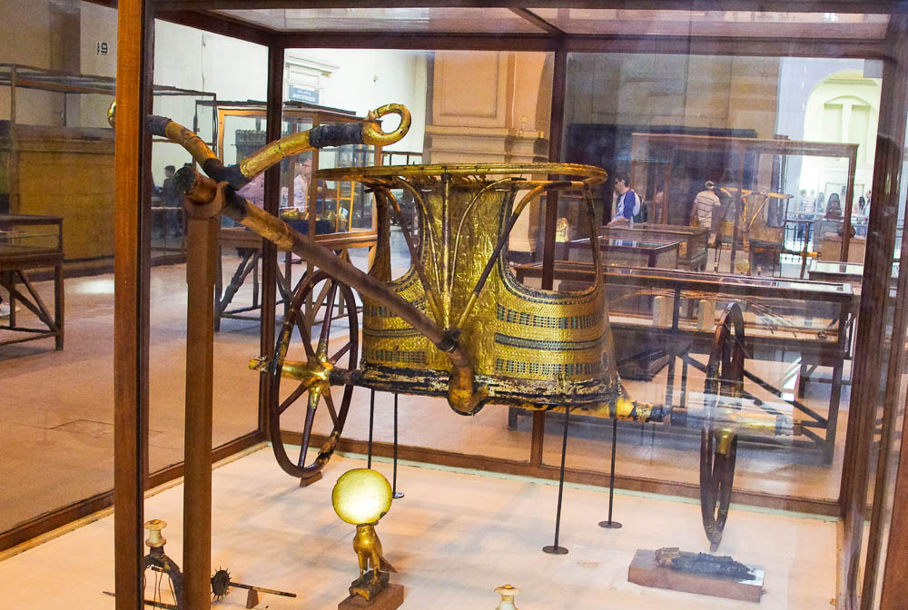
He had nine hundred iron chariots, and he oppressed the sons of Israel severely for twenty years
Ceremonial chariot of Tutankhamun, from the Valley of the Kings, 14th century BC
4:3
Notes:
The yoke located at the end of the draft pole was attached to the harnesses on two horses. This chariot was photographed at the Egyptian Museum in Cairo.
adr1603111825

Slide 32
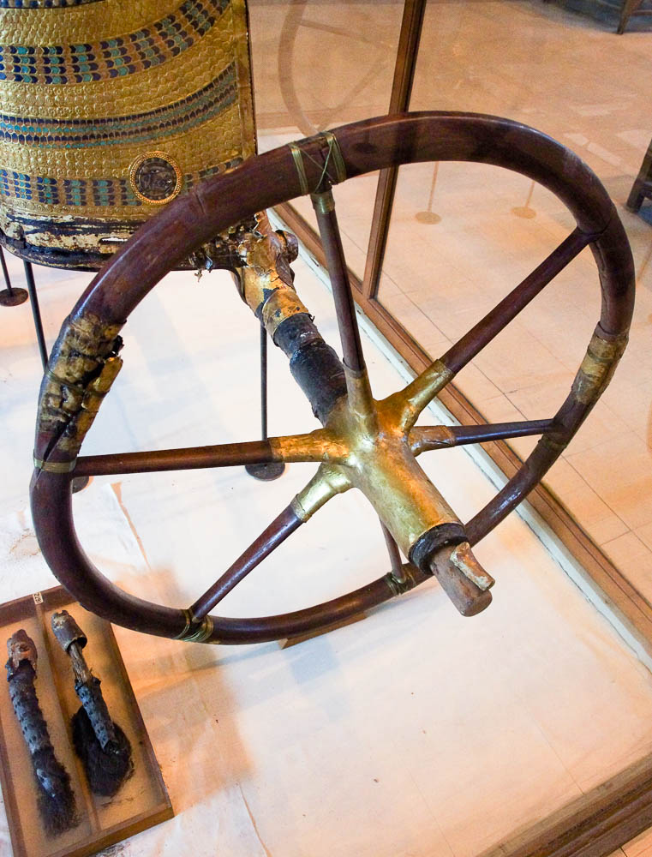
He had nine hundred iron chariots, and he oppressed the sons of Israel severely for twenty years
Ceremonial chariot of Tutankhamun, from the Valley of the Kings, 14th century BC
4:3
Notes:
This chariot was photographed at the Egyptian Museum in Cairo.
adr1603111827

Slide 33
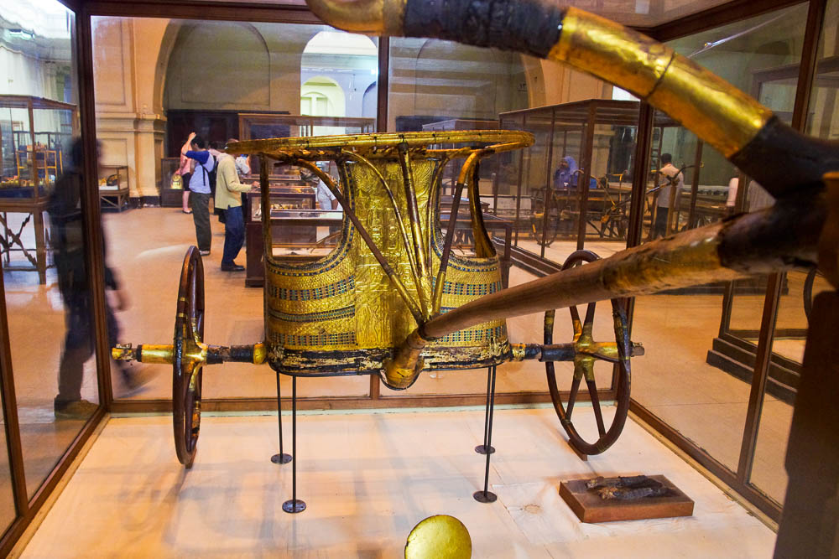
He had nine hundred iron chariots, and he oppressed the sons of Israel severely for twenty years
Ceremonial chariot of Tutankhamun, from the Valley of the Kings, 14th century BC
4:3
Notes:
This chariot was photographed at the Egyptian Museum in Cairo.
adr1603111828

Slide 34
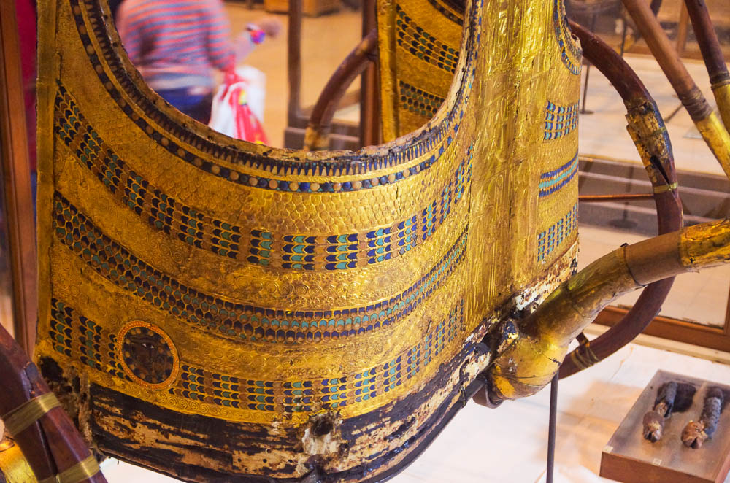
He had nine hundred iron chariots, and he oppressed the sons of Israel severely for twenty years
Ceremonial chariot of Tutankhamun, from the Valley of the Kings, 14th century BC
4:3
Notes:
This chariot was photographed at the Egyptian Museum in Cairo.
adr1603111829

Slide 35
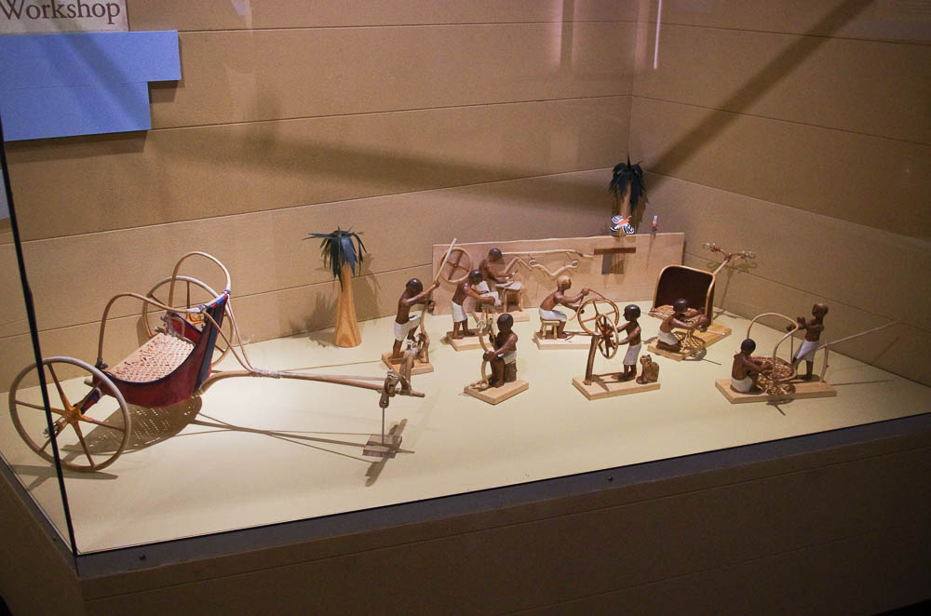
He had nine hundred iron chariots, and he oppressed the sons of Israel severely for twenty years
Model of an Egyptian chariot workshop, overview
4:3
Notes:
This photo was taken at the International Museum of the Horse at the Kentucky Horse Park in Lexington, Kentucky.
adr1601179937

Slide 36
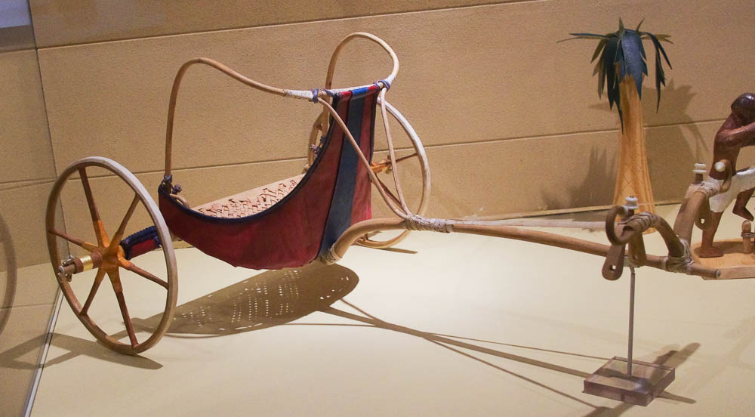
He had nine hundred iron chariots, and he oppressed the sons of Israel severely for twenty years
Model of an Egyptian chariot workshop, finished chariot
4:3
Notes:
This photo was taken at the International Museum of the Horse at the Kentucky Horse Park in Lexington, Kentucky.
adr1601179946

Slide 37
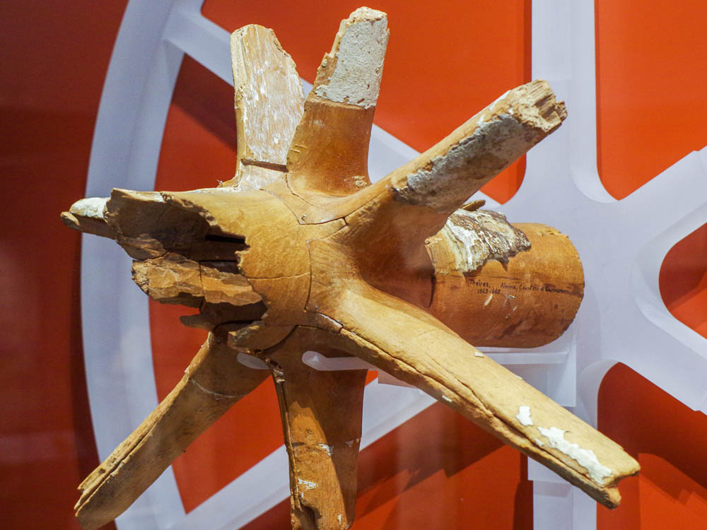
He had nine hundred iron chariots, and he oppressed the sons of Israel severely for twenty years
Chariot wheel hub, from tomb of Amenhotep III, 14th century BC
4:3
Notes:
This chariot wheel hub was fashioned out of elm wood. It dates to about the time of Deborah and Barak. It was photographed at the Ashmolean Museum at the University of Oxford.
adr1805183290

Slide 38
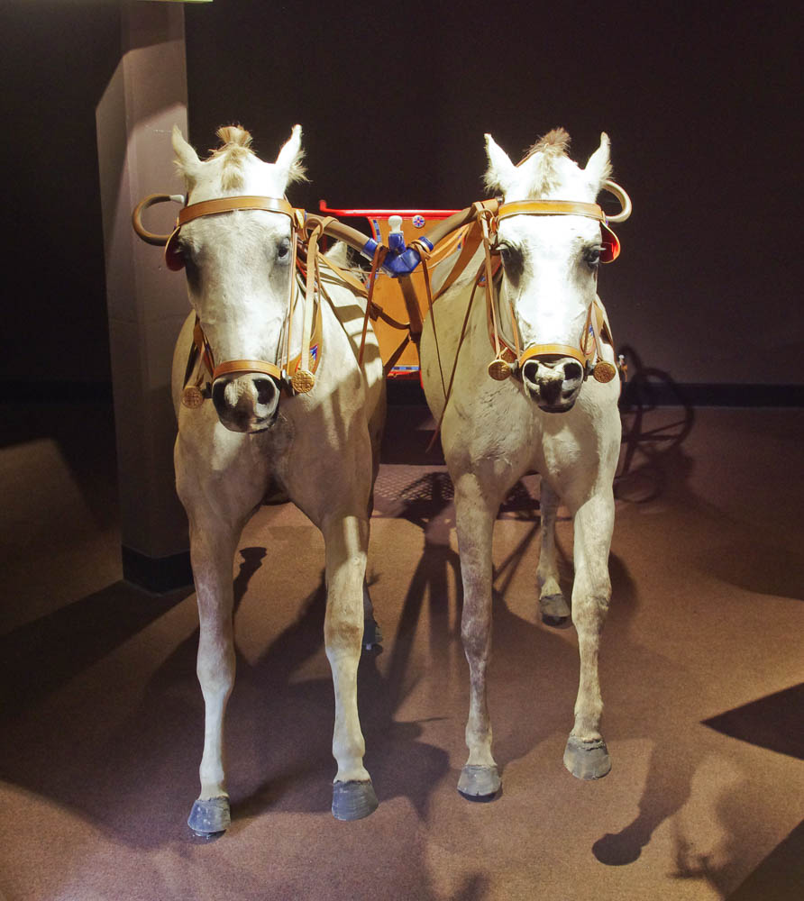
He had nine hundred iron chariots, and he oppressed the sons of Israel severely for twenty years
Egyptian two-horse chariot of Tutankhamun, circa 1320 BC (replica)
4:3
Notes:
Most chariots of this period were pulled by two horses, as demonstrated by this model at the International Museum of the Horse at the Kentucky Horse Park in Lexington, Kentucky.
adr1601179733

Slide 39
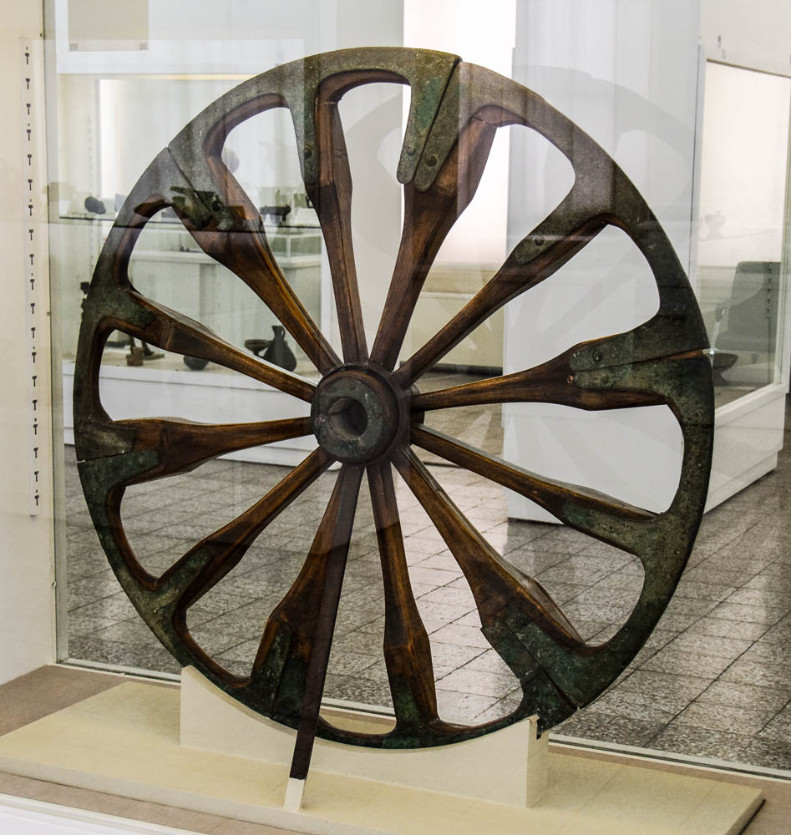
He had nine hundred iron chariots, and he oppressed the sons of Israel severely for twenty years
Restored chariot wheel with bronze components, from Susa, circa 2800–1900 BC
4:3
Notes:
This chariot wheel from Mesopotamia was constructed using both wood and bronze components (the wooden parts in this example have been restored). It comes from south of the Ville Royale in Susa and illustrates the use of metal components in a chariot from a period even earlier than that of Deborah and Barak. It was photographed at the National Museum of Iran in Tehran.
tb0514183948

Slide 40
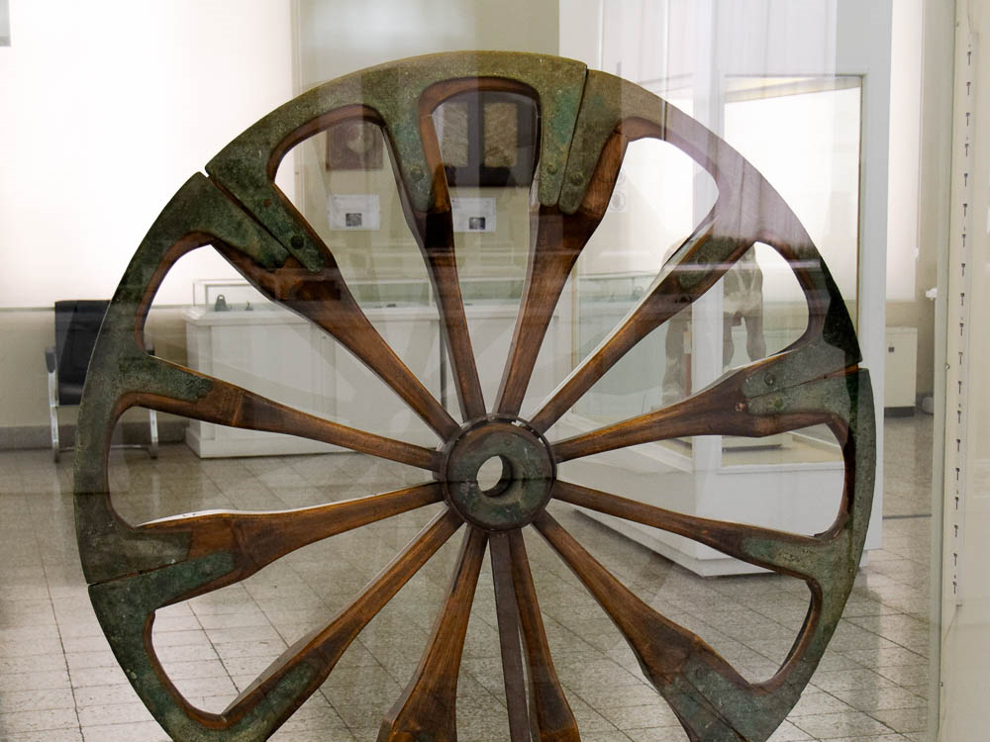
He had nine hundred iron chariots, and he oppressed the sons of Israel severely for twenty years
Restored chariot wheel with bronze components, from Susa, circa 2800–1900 BC
4:3
Notes:
Beginning with the 14th century BC it was common for chariot wheels to be constructed with six spokes. Prior to this time wheels sometimes had fewer (as few as four), or many more, such as the twelve shown in this example. This artifact was photographed at the National Museum of Iran in Tehran.
tb0514183947

Slide 41
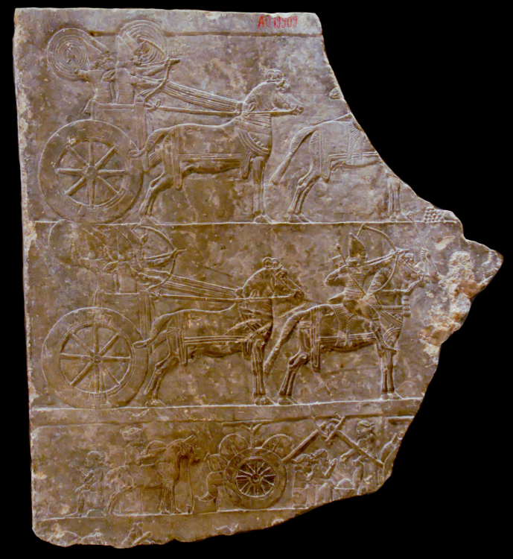
He had nine hundred iron chariots, and he oppressed the sons of Israel severely for twenty years
Relief of Assyrian chariots and horsemen, 645 BC
4:3
Notes:
This relief was photographed in the Louvre Museum.
tb060408618

Slide 42
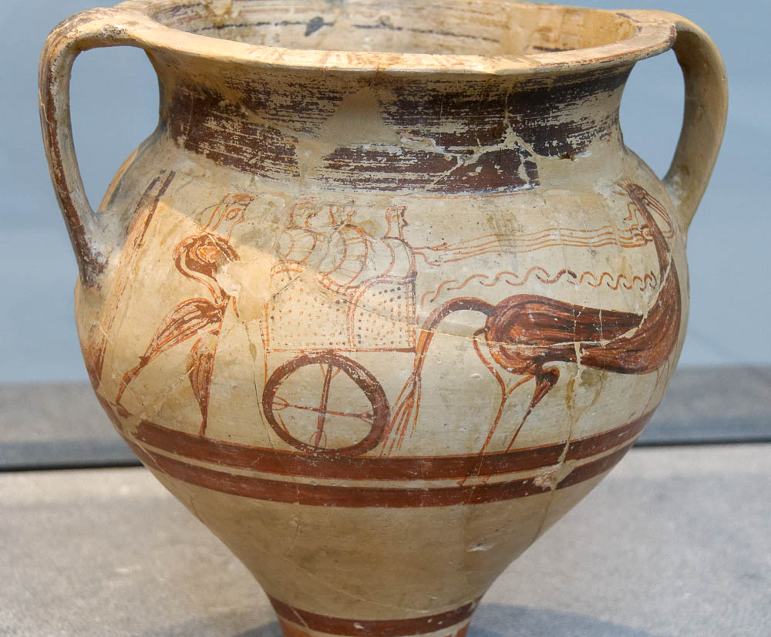
He had nine hundred iron chariots, and he oppressed the sons of Israel severely for twenty years
Vase painted with a chariot scene, from the Larnaca region in Cyprus, 1300–1100 BC
4:3
Notes:
This depiction of a chariot from the island of Cyprus also dates to the period of the biblical judges. It was photographed at a temporary exhibit of the Louvre Museum in Abu Dhabi.
tb0520184785

Slide 43
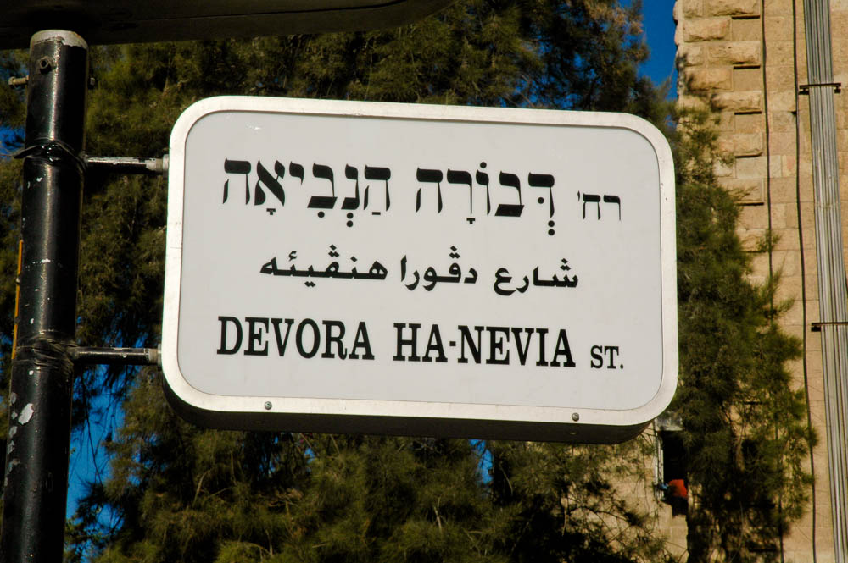
Now Deborah, a prophetess, the wife of Lappidoth, was judging Israel at that time
“Deborah the Prophetess Street” sign in Jerusalem
4:4
Notes:
“Deborah the Prophetess Street” is located near Strauss Square, north of the Old City.
tb081004135

Slide 44
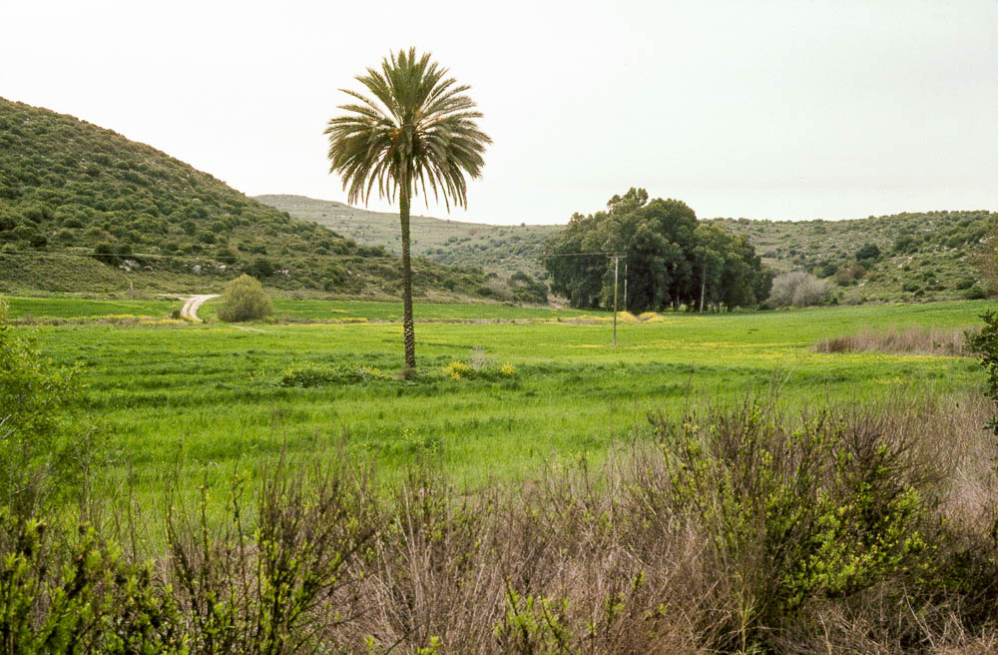
She sat under the palm tree of Deborah between Ramah and Bethel in . . . Ephraim
Palm tree at Jarmuth
4:5
Notes:
The reference to “the palm tree” suggests that it may have been a lone specimen that was something of a landmark, rather than a grove of such trees. The palm shown here at Jarmuth is located in the Shephelah of Judah, some miles southwest of the hill country of Ephraim.
dad0153

Slide 45
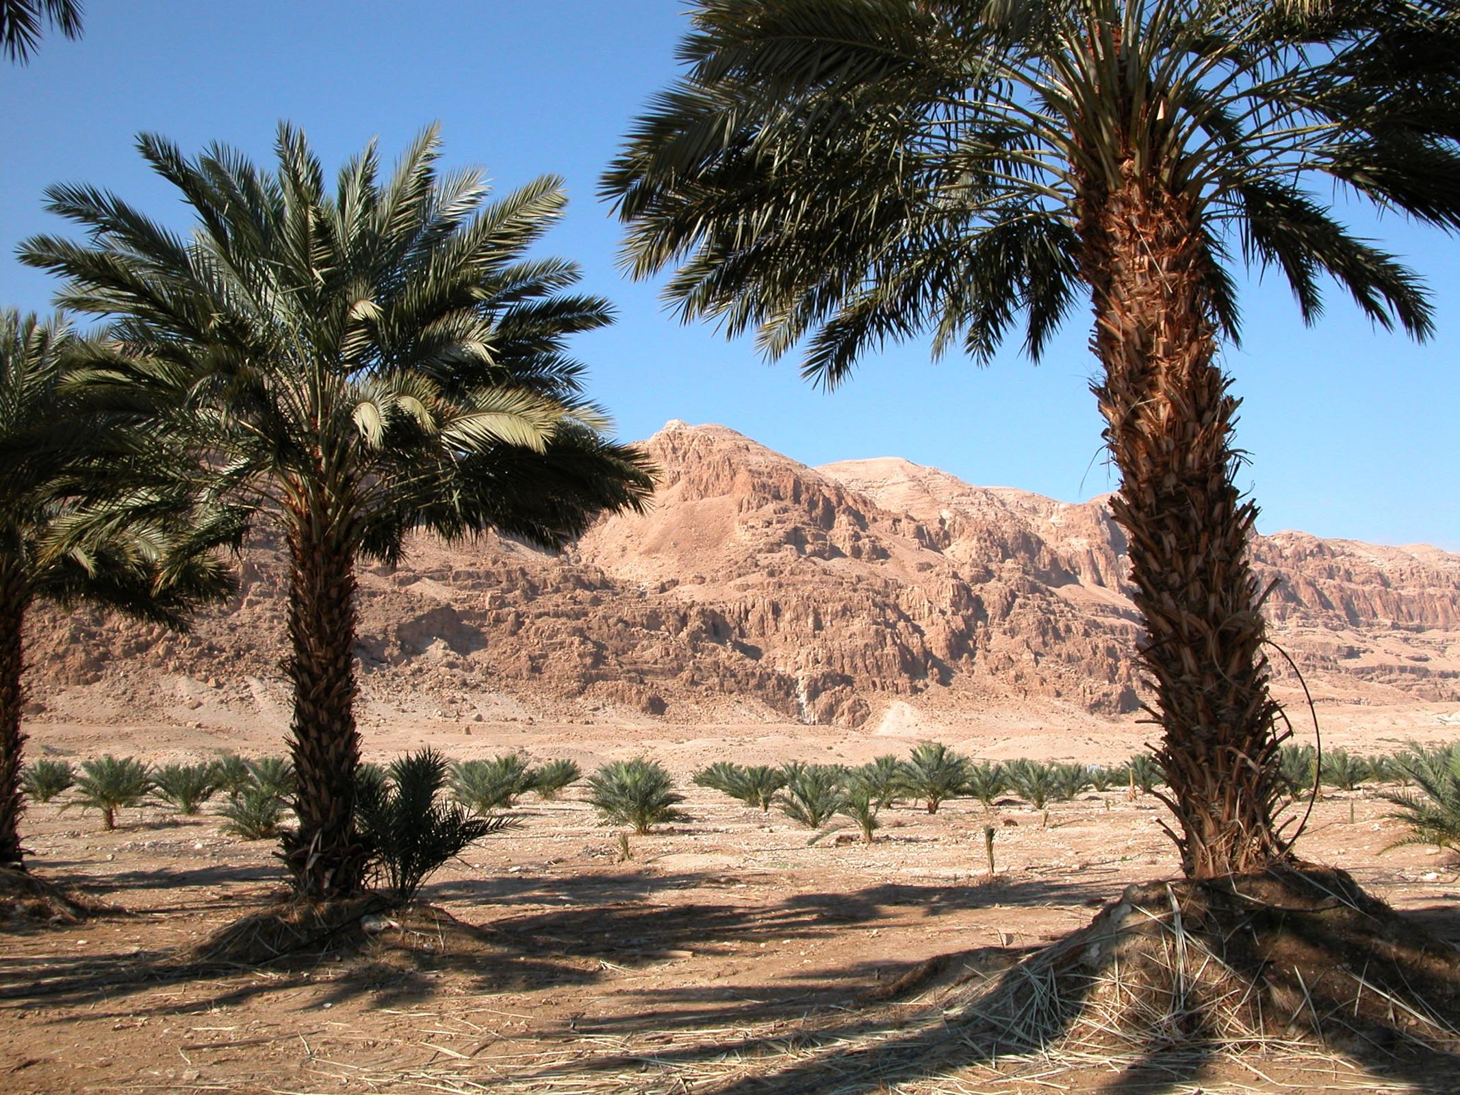
She sat under the palm tree of Deborah between Ramah and Bethel in . . . Ephraim
Date palm trees near the Dead Sea
4:5
Notes:
Palm trees can provide welcome shade from the heat of the sun, as demonstrated by these palms growing along the Dead Sea.
tb011703230

Slide 46
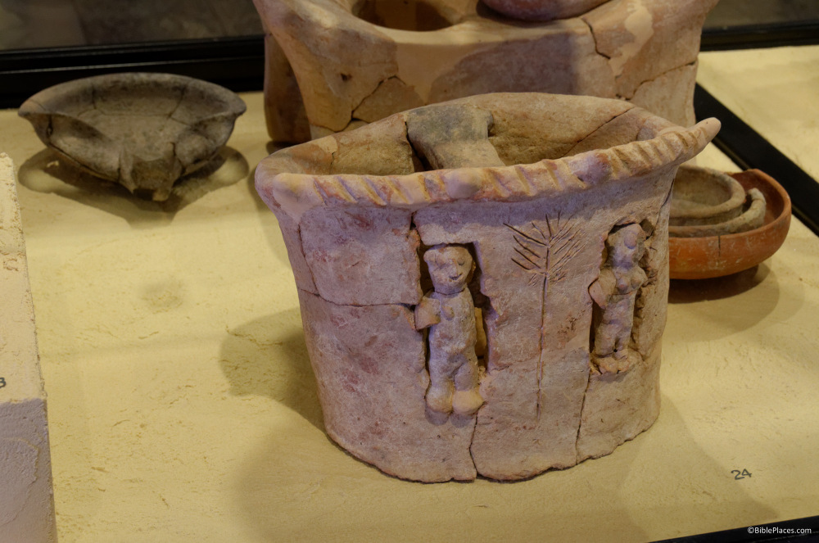
She sat under the palm tree of Deborah between Ramah and Bethel in . . . Ephraim
Cult stand decorated with women flanking a palm tree, from Yavneh, 9th century BC
4:5
Notes:
This artifact was photographed in the Eretz Israel Museum in Tel Aviv.
tb031114525

Slide 47
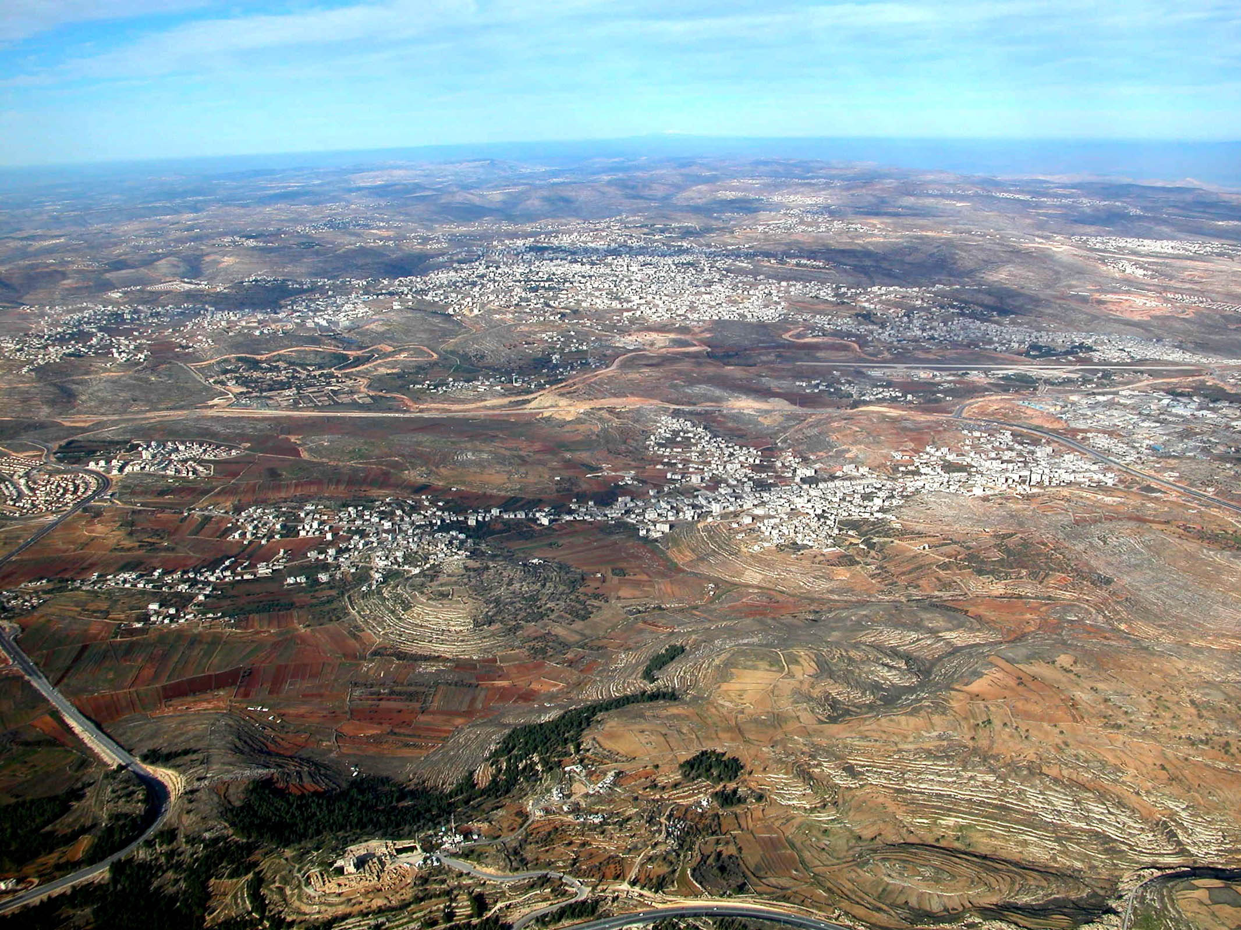
She sat under the palm tree of Deborah between Ramah and Bethel in . . . Ephraim
Central Benjamin Plateau (aerial view from the south)
4:5
Notes:
Deborah’s “palm tree” (tamar) was located along the Central Ridge Road (i.e., the “Way of the Patriarchs”) between Bethel (Beitin) and Ramah (er-Ram), but there is no indication that it was a permanent site. A palm tree in the hill country would not have been particularly rare, but they would have been (and are until today) much more common in the desert regions of the Jordan Valley, the Arabah, and the Negev. It is possible that Deborah’s tamar is identical to Baal-tamar of Judges 20, which is mentioned in connection with Gibeah (Tell el-Ful) and “highways” (Judg 20:32-33). Eusebius indicates that this region was known as “Beththamar” in the vicinity of Gibeah (Onom. 56.1). The next slide includes labels.
tb010703103

Slide 48
She sat under the palm tree of Deborah between Ramah and Bethel in . . . Ephraim
Mt. Hermon
Beitin
(Bethel?)
el-Bireh (Bethel?)
Ramah
Mizpah
Gibeon
Central Benjamin Plateau (aerial view from the south)
4:5
Notes:
Deborah’s “palm tree” (tamar) was located along the Central Ridge Road (i.e., the “Way of the Patriarchs”) between Bethel (Beitin) and Ramah (er-Ram), but there is no indication that it was a permanent site. A palm tree in the hill country would not have been particularly rare, but they would have been (and are until today) much more common in the desert regions of the Jordan Valley, the Arabah, and the Negev. It is possible that Deborah’s tamar is identical to Baal-tamar of Judges 20, which is mentioned in connection with Gibeah (Tell el-Ful) and “highways” (Judg 20:32-33). Eusebius indicates that this region was known as “Beththamar” in the vicinity of Gibeah (Onom. 56.1).
tb010703103

Slide 49
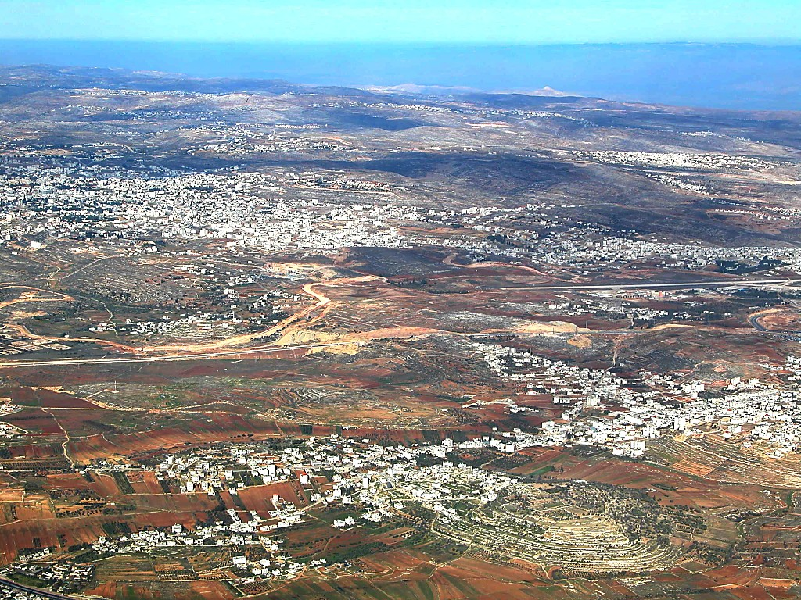
She sat under the palm tree of Deborah between Ramah and Bethel in . . . Ephraim
Central Benjamin Plateau (aerial view from the south)
4:5
Notes:
The palm tree of Deborah was located not far from the “oak below Bethel” where another Deborah, the nurse of Rebekah, was buried (Gen 35:8). Whether there was any more significance to these two trees associated with two women named Deborah is not known. The next slide includes labels.
tb010703104

Slide 50
She sat under the palm tree of Deborah between Ramah and Bethel in . . . Ephraim
el-Bireh (Bethel?)
Beitin (Bethel?)
Mizpah
Ramah
Gibeon
Central Benjamin Plateau (aerial view from the south)
4:5
Notes:
The palm tree of Deborah was located not far from the “oak below Bethel” where another Deborah, the nurse of Rebekah, was buried (Gen 35:8). Whether there was any more significance to these two trees associated with two women named Deborah is not known.
tb010703104

Slide 51
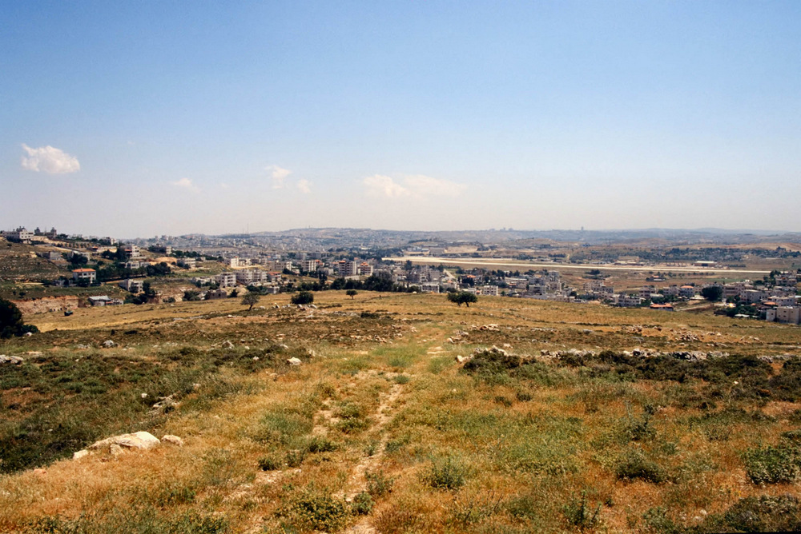
She sat under the palm tree of Deborah between Ramah and Bethel in . . . Ephraim
Ramah, modern er-Ram (from the north)
4:5
Notes:
Ramah was located at the site today known as er-Ram, which means “the height.” It is located about 4 miles (7 km) north of Jerusalem. The site sits on a low hill astride the Road of the Patriarchs and was located on an important crossroads. This photograph was taken from Mizpah (Tell en-Nasbeh). The next slide includes labels.
tbs98319805

Slide 52
She sat under the palm tree of Deborah between Ramah and Bethel in . . . Ephraim
Mt. of Olives, Jerusalem
Ramah
Gibeah
Ramah, modern er-Ram (from the north)
4:5
Notes:
Ramah was located at the site today known as er-Ram, which means “the height.” It is located about 4 miles (7 km) north of Jerusalem. The site sits on a low hill astride the Road of the Patriarchs and was located on an important crossroads. This photograph was taken from Mizpah (Tell en-Nasbeh).
tbs98319805

Slide 53
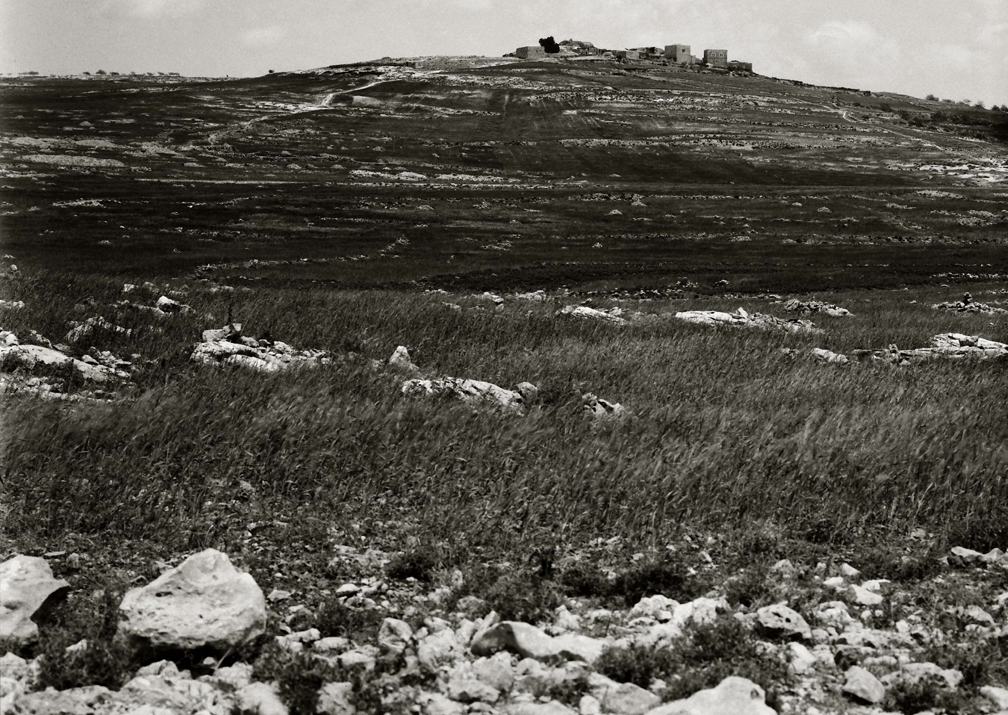
She sat under the palm tree of Deborah between Ramah and Bethel in . . . Ephraim
Ramah of Benjamin, modern er-Ram
4:5
Notes:
This American Colony photograph was taken between 1900 and 1920 before all of the modern construction was built over the site.
mat01040

Slide 54
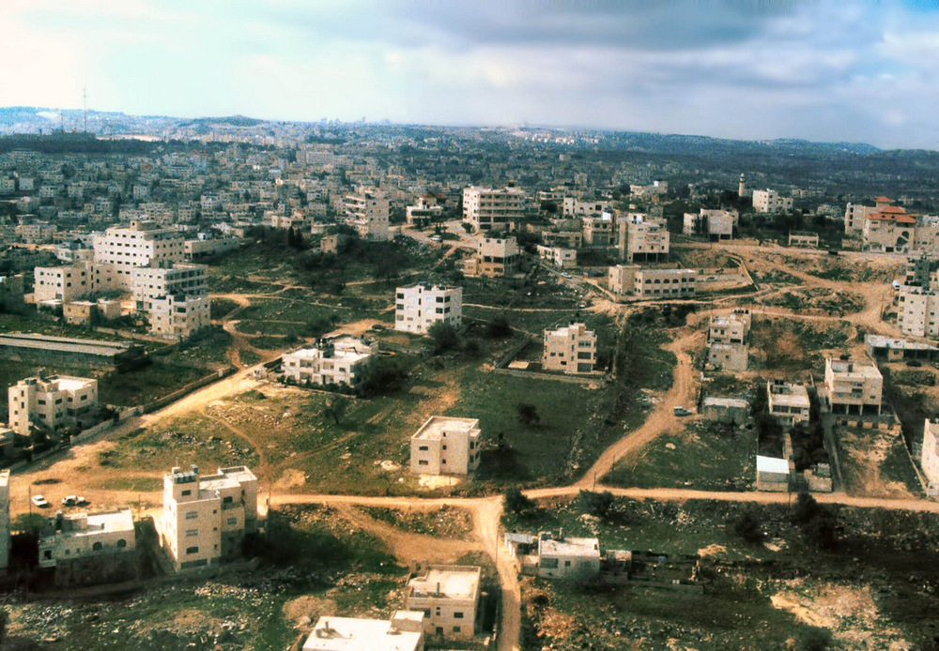
She sat under the palm tree of Deborah between Ramah and Bethel in . . . Ephraim
Ramah, modern er-Ram (aerial view from the north)
4:5
Notes:
Ramah’s significance in biblical times was a result of its central location. The same reality makes it ideal for settlement today, and the area is now largely covered with apartment buildings.
tbs108149900

Slide 55
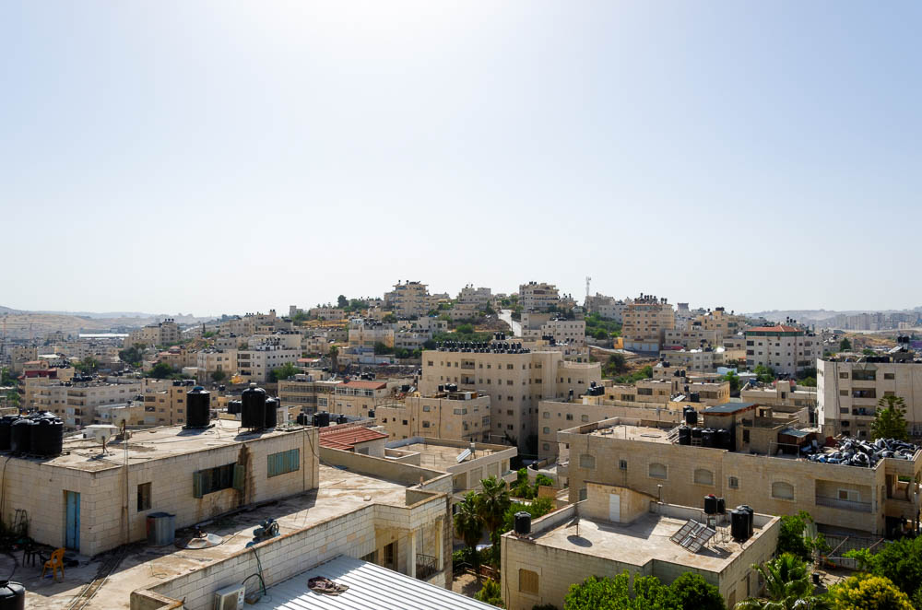
She sat under the palm tree of Deborah between Ramah and Bethel in . . . Ephraim
Ramah, modern er-Ram (from the east)
4:5
Notes:
tb060116477

Slide 56
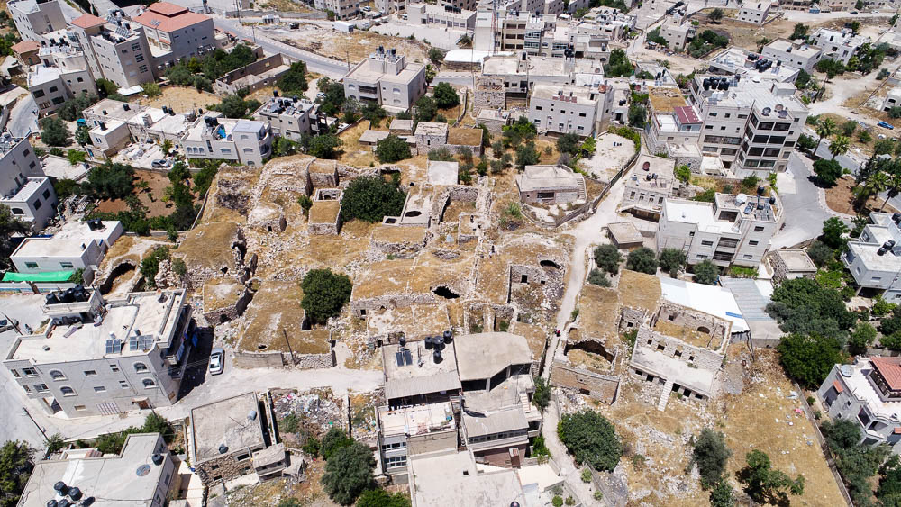
She sat under the palm tree of Deborah between Ramah and Bethel in . . . Ephraim
Ramah, modern er-Ram (aerial view from the north)
4:5
Notes:
The dilapidated stone buildings at the summit of the tell, shown here, are relatively recent and cover the more ancient remains.
ws053017059

Slide 57
She sat under the palm tree of Deborah between Ramah and Bethel in . . . Ephraim
Beitin, a possible location of Bethel (aerial view from the northwest)
4:5
Notes:
Since Edward Robinson’s identification in 1838, many scholars have identified the Arab village of Beitin, shown here, as Bethel. Robinson’s search for Bethel was based on Eusebius’s measurements. Robinson measured the mileage by how fast his horse covered the distance. He calculated 12 Roman miles (just over 11 English miles [17.6 km]) north of Jerusalem to be at Beitin. The word beit means house. Robinson believed “beitin” was a preservation of the name, Bethel, with the ‘l’ changed to an ‘n,’ something which often occurs in names. Once he located Bethel, Robinson went to the east and found the ruin of et-Tell, which he identified as Ai. Excavations and surveys of Beitin indicate that the site has remains from the Middle Bronze, Late Bronze, and Iron Age periods. However, if Bethel is located at a different site, such as el-Bireh (see below), then a different name must be sought for the remains at Beitin.
ws071617260

Slide 58
She sat under the palm tree of Deborah between Ramah and Bethel in . . . Ephraim
Canaanite houses at Beitin, a possible location of Bethel
4:5
Notes:
Excavations were undertaken at Beitin in 1934, 1954, 1957, and 1960. The excavations shown here are from the 1954 excavations under James L. Kelso. The main structural feature visible here is a Canaanite house from the Late Bronze period (1500–1200 BC). This American Colony photograph was taken in 1954.
mat13005

Slide 59
She sat under the palm tree of Deborah between Ramah and Bethel in . . . Ephraim
House from the Judges period at Beitin, a possible location of Bethel
4:5
Notes:
This view, also from the 1954 excavation season at Beitin, shows another Canaanite house from the Late Bronze period (1500–1200 BC). One difficulty with the identification of Beitin as Bethel is that none of the impressive remains from the Iron Age that one would expect given Jeroboam’s cult center has been found. This American Colony photograph was taken in 1954.
mat13006

Slide 60
She sat under the palm tree of Deborah between Ramah and Bethel in . . . Ephraim
El-Bireh (Ras et-Tahuneh), a possible location of Bethel (aerial view from the northwest)
4:5
Notes:
Another possible location for ancient Bethel is el-Bireh (top center of photo). David Livingston (1994) has argued that Bethel should be located here instead of Beitin based on the counting of the Roman miles. Several milestones have been found on the road, some of which have numbers. Livingston argues that 12 Roman miles (just over 11 miles [17.6 km]) from Jerusalem is el-Bireh.
Reference:
Livingston, David P.
1994 Further Considerations on the Location of Bethel at El-Bireh. Palestine Exploration Quarterly 126: 154–59.
ws061015066

Slide 61
She sat under the palm tree of Deborah between Ramah and Bethel in . . . Ephraim
El-Bireh (Ras et-Tahuneh), a possible location of Bethel (from the south)
4:5
Notes:
Several surveys of Ras et-Tauneh showed remains from the Middle Bronze II and Iron II, but many scholars continue to identify Beitin with Bethel.
tb122201100

Slide 62
She sent and called Barak the son of Abinoam from Kedesh of Naphtali
“Barak Street” sign in Jerusalem
4:6
Notes:
“Barak Street” is located in the Baka neighborhood, south of the Old City.
tb072404799

Slide 63
She sent and called Barak the son of Abinoam from Kedesh of Naphtali
“Naphtali Street” sign in Jerusalem
4:6
Notes:
There are three candidates for the location of “Kedesh of Naphtali” of Judges 4–5. They include (1) Khirbet Qedish in the territory of Naphtali above the southwestern shores of the Sea of Galilee and near the border of Issachar; (2) Tell Qades in Upper Galilee within the tribal allotment of Naphtali; and (3) Tell Abu Qudeis near Megiddo. In our opinion, Khirbet Qedish is the best option for Kedesh of Naphtali. Photos of each candidate are provided here.
tb072404785

Slide 64
She sent and called Barak the son of Abinoam from Kedesh of Naphtali
Kedesh of Naphtali, modern Khirbet Qedish (from the northwest)
4:6
Notes:
Khirbet Qedish preserves the name of Kedesh and is best equated with the site identified as Kedesh-naphtali, the hometown of Barak (Judg 4:6). This location corresponds with the biblical data that Kedesh was located east of Mount Tabor, unlike Tell Abu Qudeis in the Jezreel Valley (Judg 4:11; Rainey and Notley 2006: 138). While it appears that Khirbet Qedish is the best current candidate for Kedesh-naphtali, the nature of the archaeological remains at the site are completely unknown (personal communication—U. Leibner). The next slide includes a label identifying this unexcavated site.
Reference:
Rainey, Anson F., and Notley, R. Steven.
2006 The Sacred Bridge: Carta’s Atlas of the Biblical World. Jerusalem: Carta.
tb033005883

Slide 65
She sent and called Barak the son of Abinoam from Kedesh of Naphtali
Kedesh of Naphtali, modern Khirbet Qedish (from the northwest)
4:6
Notes:
Khirbet Qedish preserves the name of Kedesh and is best equated with the site identified as Kedesh-naphtali, the hometown of Barak (Judg 4:6). This location corresponds with the biblical data that Kedesh was located east of Mount Tabor, unlike Tell Abu Qudeis in the Jezreel Valley (Judg 4:11; Rainey and Notley 2006: 138). While it appears that Khirbet Qedish is the best current candidate for Kedesh-naphtali, the nature of the archaeological remains at the site are completely unknown (personal communication—U. Leibner).
Reference:
Rainey, Anson F., and Notley, R. Steven.
2006 The Sacred Bridge: Carta’s Atlas of the Biblical World. Jerusalem: Carta.
tb033005883

Slide 66
She sent and called Barak the son of Abinoam from Kedesh of Naphtali
Kedesh (Tell Qades) and Mount Hermon
4:6
Notes:
A second possibility for the location of Kedesh is Tell Qades. Edward Robinson first suggested that Tell Qades was the location of the biblical city of Kedesh. Today many scholars agree with that identification. Archaeological work has determined that the site was occupied from the Early Bronze through the Arab periods. Tell Qades is strategically located on the eastern edge of the Galilean mountains near the Huleh Basin. The next slide includes a label for this site.
tb051700203

Slide 67
She sent and called Barak the son of Abinoam from Kedesh of Naphtali
Kedesh (Tell Qades) and Mount Hermon
4:6
Notes:
A second possibility for the location of Kedesh is Tell Qades. Edward Robinson first suggested that Tell Qades was the location of the biblical city of Kedesh. Today many scholars agree with that identification. Archaeological work has determined that the site was occupied from the Early Bronze through the Arab periods. Tell Qades is strategically located on the eastern edge of the Galilean mountains near the Huleh Basin.
tb051700203

Slide 68
She sent and called Barak the son of Abinoam from Kedesh of Naphtali
Kedesh, modern Tell Qades (from the west)
4:6
Notes:
tb032807964

Slide 69
She sent and called Barak the son of Abinoam from Kedesh of Naphtali
Kedesh, modern Tell Qades (from the northwest)
4:6
Notes:
tb032807967

Slide 70
She sent and called Barak the son of Abinoam from Kedesh of Naphtali
Trees and flowers at Kedesh (Tell Qades)
4:6
Notes:
tb032807969

Slide 71
She sent and called Barak the son of Abinoam from Kedesh of Naphtali
Tel Kedesh near Megiddo
4:6
Notes:
A third possibility for the location of Kedesh is Tel Kedesh. Tel Kedesh (Tell Abu Qudeis) is located in the Jezreel Valley about 2.5 miles (4 km) southeast of Megiddo. The site was excavated in 1968 by Ephraim Stern and remains were found from the Late Bronze, Iron, Persian, Late Roman, and Early Arab periods. The presence of remains from the 12th century BC, approximately the time of Deborah and Barak, together with a cultic site, has led some to identify this site with the Kedesh of Judges 4:11, home of Heber the Kenite. Ephraim Stern writes, “This locality is clearly linked with the battle on the Kishon near ‘Taanach, by the waters of Megiddo’ (Judg 5:19). The biblical description fits the site of Tel Kedesh surprisingly well” (Stern 1993: 860). Anson F. Rainey has argued that Khirbet Qedish of the southwestern side of the Sea of Galilee is a better candidate for the Kedesh of Judges 4 (Rainey and Notley 2006: 138).
References:
Rainey, Anson F., and Notley, R. Steven.
2006 The Sacred Bridge: Carta’s Atlas of the Biblical World. Jerusalem: Carta.
Stern, Ephraim.
1993 Kedesh, Tel (in Jezreel Valley). The New Encyclopedia of Archaeological Excavations in the Holy Land vol. 3, ed. E. Stern. Jerusalem: The Israel Exploration Society and Carta.
tb033007249

Slide 72
Has not Yahweh, the God of Israel commanded you
Silver amulet mentioning “Yahweh,” from Ketef Hinnom in Jerusalem, circa 600 BC
4:6
Notes:
The amulet shown here is inscribed with the text of priestly blessing recorded in Numbers 6:24-26, and it is the oldest known portion of Scripture found to date. It was discovered in a tomb at the site of Ketef Hinnom on the western slope of the Hinnom Valley in Jerusalem. This artifact was photographed in the Israel Museum. The next slide includes a label highlighting the divine name.
adr1806199661c

Slide 73
Has not Yahweh, the God of Israel commanded you
Silver amulet mentioning “Yahweh,” from Ketef Hinnom in Jerusalem, circa 600 BC
4:6
Notes:
The amulet shown here is inscribed with the text of priestly blessing recorded in Numbers 6:24-26, and it is the oldest known portion of Scripture found to date. It was discovered in a tomb at the site of Ketef Hinnom on the western slope of the Hinnom Valley in Jerusalem. This artifact was photographed in the Israel Museum.
adr1806199661c

Slide 74
Go . . . to Mount Tabor, and take with you ten thousand men
Mount Tabor (aerial view from the west)
4:6
Notes:
Mount Tabor sits at the eastern end of the Jezreel Valley, 11 miles (17 km) southwest of the Sea of Galilee.
ws012217006

Slide 75
Go . . . to Mount Tabor, and take with you ten thousand men
Mount Tabor (aerial view from the west)
4:6
Notes:
The elevation at the summit of Mount Tabor is 1,843 feet (575 m).
ws011215060

Slide 76
Go . . . to Mount Tabor, and take with you ten thousand men
Mount Tabor (from the northwest)
4:6
Notes:
This photochrom image was taken in the 1890s when the mountain was largely barren of trees. This makes it easier to imagine the gathering of Barak’s forces than today.
pcm02726

Slide 77
Take with you ten thousand men from the people of Naphtali and the people of Zebulun
“Naphtali Street” sign in Jerusalem
4:6
Notes:
“Naphtali Street” is located in the Baka neighborhood, south of the Old City.
lbd102218476

Slide 78
Take with you ten thousand men from the people of Naphtali and the people of Zebulun
“Zebulun Street” sign in Jerusalem
4:6
Notes:
“Zebulun Street” is located in the Baka neighborhood, south of the Old City.
tb072404812

Slide 79
Take with you ten thousand men from the people of Naphtali and the people of Zebulun
Mount Tabor, the Jezreel Valley, and the Hill of Moreh (aerial view from the northwest)
4:6
Notes:
Mount Tabor served as the western boundary of Issachar (Josh 19:22), which formed a border point with Naphtali (oak in Zaanannim—Josh 19:22) and Zebulun (Daberath—Josh 19:12). The next slide includes labels.
ws032815927

Slide 80
Take with you ten thousand men from the people of Naphtali and the people of Zebulun
Mt. Tabor
Daberath
Hill of Moreh
ISSACHAR
NAPHTALI
ZEBULUN
Mount Tabor, the Jezreel Valley, and the Hill of Moreh (aerial view from the northwest)
4:6
Notes:
Mount Tabor served as the western boundary of Issachar (Josh 19:22), which formed a border point with Naphtali (oak in Zaanannim—Josh 19:22) and Zebulun (Daberath—Josh 19:12).
ws032815927

Slide 81
I will draw out Sisera, the captain of Jabin’s army, with his chariots and his troops
Reliefs of war chariots riding over naked enemies, from Carchemish, 9th century BC
4:7
Notes:
These basalt and limestone reliefs from Carchemish portray a series of chariots trampling various enemies. Each chariot holds a driver and an archer, making them a swift and formidable force. These carvings were photographed at the Ankara Museum of Anatolian Civilizations.
adr1006031462

Slide 82
To meet you by the river Kishon . . . and I will deliver him into your hand
Map of the battle theater
4:7
Notes:
The initial stages of the battle between Sisera and Barak seem to have happened on the plain west of Mount Tabor. Once they Canaanites were put to flight, they fled back toward Megiddo. From Judges 5:21 it is apparent that they were entrapped along the (now flooded) Kishon River, where their chariots were turned from an asset to a hindrance. This is a detail of map 4-5 from the Satellite Bible Atlas, by William Schlegel. Used by permission.

Slide 83
To meet you by the river Kishon . . . and I will deliver him into your hand
Jezreel Valley from Mount Carmel (aerial view from the west)
4:7
Notes:
Muhraqa, in the foreground of the picture, is the summit of the Mount Carmel range. On a clear day the entire Jezreel Valley is visible from this vantage point. Somewhere in this valley the battle between the Israelites and Jabin/Sisera was fought, just as the Lord predicted through Deborah. The next slide includes labels.
ws040316644

Slide 84
To meet you by the river Kishon . . . and I will deliver him into your hand
Mount Tabor
Hill of Moreh
Mount Gilboa
Tell Qassis
Megiddo/Taanach
Kishon River
Jokneam
Jezreel Valley from Mount Carmel (aerial view from the west)
4:7
Notes:
Muhraqa, in the foreground of the picture, is the summit of the Mount Carmel range. On a clear day the entire Jezreel Valley is visible from this vantage point. Somewhere in this valley the battle between the Israelites and Jabin/Sisera was fought, just as the Lord predicted through Deborah. The Kishon River begins in the vicinity of Mount Gilboa, running west/northwest through the Jezreel Valley until it reaches the Mediterranean Sea in the bay of Haifa. If Harosheth-hagoiim is located in the vicinity of Megiddo and Taanach, Sisera and his chariots would have first crossed the Kishon on their way to confront Barak at Mount Tabor.
ws040316644

Slide 85
To meet you by the river Kishon . . . and I will deliver him into your hand
Jezreel Valley and Kishon River (aerial view from the south)
4:7
Notes:
As the Kishon River flows westward it skirts the foot of Tell Qassis, which may preserve the name of Kishon. Tell Qassis (Kassis) is located in a bend just to the north of the river. Excavations there revealed extensive Early Bronze, Middle Bronze, and Late Bronze Age remains. The next slide includes labels.
ws040316664

Slide 86
To meet you by the river Kishon . . . and I will deliver him into your hand
Tell Qassis
Kishon River
Jezreel Valley and Kishon River (aerial view from the south)
4:7
Notes:
As the Kishon River flows westward it skirts the foot of Tell Qassis, which may preserve the name of Kishon. Tell Qassis (Kassis) is located in a bend just to the north of the river. Excavations there revealed extensive Early Bronze, Middle Bronze, and Late Bronze Age remains.
ws040316664

Slide 87
To meet you by the river Kishon . . . and I will deliver him into your hand
Tell Qassis
Kishon Pass (from the east)
4:7
Notes:
This perspective provides a view of the Kishon Pass through which the Kishon River drains just south (to the left) of Tell Qassis.
tbs93189708

Slide 88
To meet you by the river Kishon . . . and I will deliver him into your hand
Kishon River from Mount Carmel (from the south)
4:7
Notes:
The Kishon River can be seen in this photo as the tree-lined course just beyond the modern highway.
tb052200100

Slide 89
To meet you by the river Kishon . . . and I will deliver him into your hand
Kishon Pass and Mount Carmel (aerial view from the southwest)
4:7
Notes:
The Kishon River flows through a relatively narrow pass as it nears the Mediterranean, visible on the right side of this aerial photo. In all likelihood the Canaanites attempted to cross the river before it reached this narrow path. See the next slide for labels.
ws040316712

Slide 90
To meet you by the river Kishon . . . and I will deliver him into your hand
Hill of Moreh
Mount Gilboa
Mount Tabor
Kishon Pass and Mount Carmel (aerial view from the southwest)
4:7
Notes:
The Kishon River flows through a relatively narrow pass as it nears the Mediterranean, visible on the right side of this aerial photo. In all likelihood the Canaanites attempted to cross the river before it reached this narrow path.
ws040316712

Slide 91
To meet you by the river Kishon . . . and I will deliver him into your hand
Kishon River and the Plain of Asher (aerial view from the south)
4:7
Notes:
The Kishon River empties into the Mediterranean Sea in the vicinity of Haifa, as seen here. The next slide includes a label to help pick out the Kishon River.
ws040316692

Slide 92
To meet you by the river Kishon . . . and I will deliver him into your hand
Kishon River
Kishon River and the Plain of Asher (aerial view from the south)
4:7
Notes:
The Kishon River empties into the Mediterranean Sea in the vicinity of Haifa, as seen here.
ws040316692

Slide 93
To meet you by the river Kishon . . . and I will deliver him into your hand
Kishon River
4:7
Notes:
This photograph was taken below Mount Carmel near where the Kishon River enters the Plain of Acco. More specifically, it was taken where the Israel Trail crosses the river, not far from the town of Yagur.
tb052200101

Slide 94
To meet you by the river Kishon . . . and I will deliver him into your hand
Kishon River
4:7
Notes:
This sketch illustrates the Kishon River when it was still a wild, freely-running river. This illustration comes from Picturesque Palestine, volume 3.
pp3097

Slide 95
To meet you by the river Kishon . . . and I will deliver him into your hand
The Kishon River flowing through the Jezreel Valley with Mount Carmel
4:7
Notes:
This American Colony photograph was taken between 1900 and 1920.
mat00059

Slide 96
To meet you by the river Kishon . . . and I will deliver him into your hand
The Kishon River near Haifa with Mount Carmel
4:7
Notes:
This view of the Kishon is near its mouth, where it broadens before emptying into the Mediterranean Sea. This American Colony photograph was taken between 1900 and 1920.
mat01200

Slide 97
To meet you by the river Kishon . . . and I will deliver him into your hand
Kishon River near Haifa
4:7
Notes:
tb122000201

Slide 98
To meet you by the river Kishon . . . and I will deliver him into your hand
Jezreel Valley from the Nazareth ridge (view to the east and south)
4:7
Notes:
Psalm 83 indicates that at least some portion of the battle with Sisera took place near Endor (Ps 83:9-10; cf. Josh 17:11; 1 Sam 28:7). The name of Endor is preserved until today at Indur, which is located at the northern base of the Hill of Moreh (Judg 7:1), but the ancient site is likely located at Khirbet Safṣâfeh to the north of Indur (Zori 1977: 113–14). Khirbet Safṣâfeh is a small tell (1.2 acres, 0.5 ha) located near a spring that has remains from the Paleolithic until the Ottoman period including remains from the Late Bronze and Iron Age II (Gal 1998a: Site 7; cf. Frankel 1988). Classical Endor was probably located at Indur (Gal 1998a: site 6; Zori 1977: 113), which Eusebius called “a very large village . . . near to Mount Thabor about four milestones to the south” (Onom. 34.4). The occurrence of Endor alongside Kishon in Psalm 83 may refer to two stages of the battle, with the initial conflict occurring on the plain before Endor and the final slaughter of the Canaanites occurring in the torrent of the Kishon River. Between Tabor and Endor is Tell Kasyun/Kishion, which may preserve an ancient memory of this battle, although it is not near the Kishon River. Surveys at Tell Kasyun have revealed remains from the Early Bronze Age through the Iron Age II. The next slide includes labels.
References:
Frankel, Rafael.
1988 An Oil Press at Tel Safsafot. Tel Aviv 15: 77–91.
Gal, Z.
1998 ’En Dor. Online. Archaeological Survey of Israel 45. Jerusalem: Israel Antiquities Authority.
Zori, N.
1977 The Land of Issachar: Archaeological Survey. Jerusalem: Israel Exploration Society.
tb05300545p

Slide 99
To meet you by the river Kishon . . . and I will deliver him into your hand
Mt. Tabor
Tell Kasyun/
Kishion
Hill of Moreh
Endor
Jezreel Valley from the Nazareth ridge (view to the east and south)
4:7
Notes:
Psalm 83 indicates that at least some portion of the battle with Sisera took place near Endor (Ps 83:9-10; cf. Josh 17:11; 1 Sam 28:7). The name of Endor is preserved until today at Indur, which is located at the northern base of the Hill of Moreh (Judg 7:1), but the ancient site is likely located at Khirbet Safṣâfeh to the north of Indur (Zori 1977: 113–14). Khirbet Safṣâfeh is a small tell (1.2 acres, 0.5 ha) located near a spring that has remains from the Paleolithic until the Ottoman period including remains from the Late Bronze and Iron Age II (Gal 1998a: Site 7; cf. Frankel 1988). Classical Endor was probably located at Indur (Gal 1998a: site 6; Zori 1977: 113), which Eusebius called “a very large village . . . near to Mount Thabor about four milestones to the south” (Onom. 34.4). The occurrence of Endor alongside Kishon in Psalm 83 may refer to two stages of the battle, with the initial conflict occurring on the plain before Endor and the final slaughter of the Canaanites occurring in the torrent of the Kishon River. Between Tabor and Endor is Tell Kasyun/Kishion, which may preserve an ancient memory of this battle, although it is not near the Kishon River. Surveys at Tell Kasyun have revealed remains from the Early Bronze Age through the Iron Age II.
References:
Frankel, Rafael.
1988 An Oil Press at Tel Safsafot. Tel Aviv 15: 77–91.
Gal, Z.
1998 ’En Dor. Online. Archaeological Survey of Israel 45. Jerusalem: Israel Antiquities Authority.
Zori, N.
1977 The Land of Issachar: Archaeological Survey. Jerusalem: Israel Exploration Society.
tb05300545p

Slide 100
Then Barak said, “If you will go with me, then I will go”
Clasped hands, from the Akhenaten and Nefertiti group, from Amarna, 14th century BC
4:8
Notes:
This quartzite sculpture of clasped hands illustrates Barak’s refusal to go to battle alone, without Deborah. This sculpture dates to about the same time as Deborah and Barak, and it was photographed in the Berlin Egyptian Museum.
adr070511316

Slide 101
The journey . . . will not be for your glory, for Yahweh will sell Sisera into the hand of a woman
Bedouin woman with a sword
4:9
Notes:
This American Colony photo was taken between 1900 and 1920.
mat01326

Slide 102
The journey . . . will not be for your glory, for Yahweh will sell Sisera into the hand of a woman
Marble statue of an Amazon on horseback overcoming a barbarian, 2nd century AD
4:9
Notes:
In Greek mythology, the Amazons were a tribe of women warriors. Although Deborah is not described as participating in combat, her courage in leading the Israelites into battle shifted the glory for the victory from Barak to her. The sculpture shown here is considered to be based on a 2nd century BC Pergamene models, and it comes from the imperial villa in Anzio. This sculpture was photographed at the National Museum of Rome. A removable graphic has been added to this photo to avoid causing surprise or offense.
tb0513177479

Slide 103
Deborah arose and went with Barak to Kedesh
Kedesh-naphtali, modern Khirbet Qedish (from the northwest)
4:9
Notes:
This site, if it is the correct location of Kedesh (see discussion above), was the setting for Barak’s assembling of the Israelite troops before battle.
tb033005883

Slide 104
Barak called Zebulun and Naphtali together to Kedesh
Jewish man blowing shofar
4:10
Notes:
The way in which Barak called together the two tribes is not detailed. He likely sent messengers to various villages. It is also possible that he or his messengers used a signal like the blowing of a shofar to gather the people (cf. Judg 3:27). This American Colony photograph was taken between 1934 and 1939.
mat19320

Slide 105
Now Heber the Kenite had separated himself from the Kenites
Bedouin tents near Beersheba
4:11
Notes:
The Kenites were a nomadic group located mostly in the Negev and wildernesses of the south. They had close ties to Israel (e.g., Gen 15:19; Num 24:21; Judg 1:16; 4:11, 17; 5:24; 1 Sam 15:6; 27:10; 30:29; 1 Chr 2:55).
db6904196706

Slide 106
Even from the children of Hobab the father-in-law of Moses
Jethro’s Mountain (from the north)
4:11
Notes:
Hobab is generally considered to be another name of Jethro. The site shown here is adjacent to St. Catherine’s Monastery at the base of Jebel Musa, the traditional Mount Sinai. In tradition it has been associated with Moses’s father-in-law.
tb062205297

Slide 107
And had pitched his tent as far as the oak in Zaanannim, which is by Kedesh
Bedouin family preparing to raise their tent
4:11
Notes:
Although some Israelites were living in towns and villages at this time, clearly a contingent were also still living in tents. This American Colony photograph was taken between 1900 and 1920.
mat05269

Slide 108
And had pitched his tent as far as the oak in Zaanannim, which is by Kedesh
Bedouin encampment, with a large tent belonging to the sheikh
4:11
Notes:
This American Colony photograph was taken between 1898 and 1946.
mat05979

Slide 109
And had pitched his tent as far as the oak in Zaanannim, which is by Kedesh
Mount Tabor (aerial view from the northwest)
4:11
Notes:
The “oak in Zaanannim” may have been a well-known forest that defined the border between Naphtali and Issachar (Josh 19:33-34). This oak is also mentioned in association with Kedesh (Khirbet Kadish—above the Sea of Galilee to the west). The exact location of this forest is not known, but it should presumably be located west of Khirbet Damiyeh (Adaminekeb), the next town in Naphtali’s southern boundary description in Joshua 19. The Sea of Galilee and Kedesh-naphtali are not visible in this photo due to drop in elevation. See the next slide for labels.
tbs121210011

Slide 110
And had pitched his tent as far as the oak in Zaanannim, which is by Kedesh
Sea of Galilee
Kedesh-naphtali
Tabor
Mount Tabor (aerial view from the northwest)
4:11
Notes:
The “oak in Zaanannim” may have been a well-known forest that defined the border between Naphtali and Issachar (Josh 19:33-34). This oak is also mentioned in association with Kedesh (Khirbet Kadish—above the Sea of Galilee to the west). The exact location of this forest is not known, but it should presumably be located west of Khirbet Damiyeh (Adaminekeb), the next town in Naphtali’s southern boundary description in Joshua 19. The Sea of Galilee and Kedesh-naphtali are not visible in this photo due to drop in elevation, but the arrows and labels show their approximate location.
tbs121210011

Slide 111
And had pitched his tent as far as the oak in Zaanannim, which is by Kedesh
Tabor oak at Horeshat Tal
4:11
Notes:
This photo shows an impressive oak tree in a grove of old oaks in the Horeshat Tal Nature Reserve. This nature reserve is located in the Jordan Valley north of the Sea of Galilee, not far from Tel Dan.
tb032905182

Slide 112
And had pitched his tent as far as the oak in Zaanannim, which is by Kedesh
Oak on Mount Carmel
4:11
Notes:
tb040100837

Slide 113
And they told Sisera that Barak the son of Abinoam had gone up to Mount Tabor
Mount Tabor (from the northwest)
4:12
Notes:
This American Colony photograph was taken between 1934 and 1939.
mat04152

Slide 114
And they told Sisera that Barak the son of Abinoam had gone up to Mount Tabor
Mount Tabor
Hill of Moreh
Mount Tabor, Jezreel Valley, and the Hill of Moreh (aerial view from the west)
4:12
Notes:
This slide begins a series that map out possible locations for Barak’s army, Sisera’s army, and the initial clash of the forces. For reference, the modern city in the foreground of this photo is Afula.
ws102115070

Slide 115
And they told Sisera that Barak the son of Abinoam had gone up to Mount Tabor
Mount Tabor
Hill of Moreh
Barak and Deborah with 10,000
Mount Tabor, Jezreel Valley, and the Hill of Moreh (aerial view from the west)
4:12
Notes:
This arrow shows Barak and his army approaching from the east, the direction of his hometown of Kedesh.
ws102115070

Slide 116
Sisera gathered together all his chariots . . . from Harosheth-hagoiim to the river Kishon
Mount Tabor
Hill of Moreh
Barak and Deborah with 10,000
Sisera and 900 chariots
Mount Tabor, Jezreel Valley, and the Hill of Moreh (aerial view from the west)
4:13
Notes:
Sisera’s army was gathered on the southwestern side of the Jezreel Valley and they would have skirted the northern side of the Hill of Moreh to approach Mount Tabor.
ws102115070

Slide 117
Sisera gathered together all his chariots . . . from Harosheth-hagoiim to the river Kishon
Mount Tabor (from the southeast)
4:13
Notes:
Having crossed the Kishon River and moved toward the site of the initial battle that took place in the plain between Mount Tabor and the Hill of Moreh (i.e., next to Tell Qasyun and Ednor), this photo represents the likely view that Sisera had as Barak’s forces came down to meet him on the plain.
tb041003101

Slide 118
Sisera gathered together all his chariots, nine hundred iron chariots
Relief of Hittite chariots in the Battle of Kadesh, 1274 BC
4:13
Notes:
The chariots depicted here are those of the Hittite army. The Battle of Kadesh is generally dated to 1274 BC, and was fought along the Orontes River, just upstream of Lake Homs near the modern Lebanon–Syria border (a different Kadesh than the one mentioned in this chapter). The battle was between the Egyptians under Ramesses II and the Hittites under Muwatalli II. It is often considered to have been the largest chariot battle ever fought, involving between 5,000 and 6,000 chariots. The battle may have ended in what was effectively a draw, although opinions on the final outcome vary. The relief shown here was photographed at the second pylon at the mortuary temple of Ramesses II (the Ramesseum) at Thebes.
adr1603132789

Slide 119
Deborah said to Barak, “Up, for today Yahweh has delivered Sisera into your hand"
Mount Tabor (from the west)
4:14
Notes:
The only role that Deborah has in the battle is to direct (at the Lord’s command?) Barak to initiate the battle. Following this instruction, Barak obeyed and led the Israelite army down the mountain and into battle.
tb011400115

Slide 120
So Barak went down from Mount Tabor with ten thousand men after him
Mount Tabor
Hill of Moreh
Barak and Deborah with 10,000
Barak’s charge
Sisera and 900 chariots
Mount Tabor, Jezreel Valley, and the Hill of Moreh (aerial view from the west)
4:14
Notes:
The focus of this account in Judges 4 is on matters other than the actual battle itself, and so we can only speculate on some of the details. Whether Barak caught Sisera off guard is not certain; what is clear is that the Lord fought for Israel that day and gave Barak a great victory over Sisera’s men.
ws102115070

Slide 121
Yahweh routed Sisera and all his chariots and all his host before Barak by the edge of the sword
Mount Tabor
Hill of Moreh
Barak’s charge
Yahweh fought
Sisera and 900 chariots
Mount Tabor, Jezreel Valley, and the Hill of Moreh (aerial view from the west)
4:14
Notes:
The language here is reminiscent of the Lord fighting for Israel in the time of Joshua. As then, the Lord faithfully gave His people victory as they obeyed Him.
ws102115070

Slide 122
Yahweh routed Sisera and all his chariots and all his host before Barak by the edge of the sword
Relief of men being shot in chariots, circa 700 BC (sketch)
4:15
Notes:
This relief, preserved today as a sketch from the original discoverer, provides some illustration of the mayhem of battle. This comes from the Assyrian warfare and dates to hundreds of years after the time of the judges. This illustration comes from Sir Austen Henry Layard, Second Series of the Monuments of Nineveh, published in 1853. Public domain, from The New York Public Library, http://digitalcollections.nypl.org/items/510d47dc-474e-a3d9-e040-e00a18064a99
nypl494764

Slide 123
Barak pursued after the chariots, and after the army, to Harosheth-hagoiim
Mount Tabor
Hill of Moreh
Sisera fled on foot
Kishion
Barak’s charge
Pursued by Barak
Chariots and army fled
Mount Tabor, Jezreel Valley, and the Hill of Moreh (aerial view from the west)
4:16
Notes:
Sisera’s army fled back the way they had come, back to Haroshet-hagoiim. It was to be expected that Sisera would flee that way as well, but the narrator observes that the Canaanite general ran the other way to find refuge with the Kenites. Thus he eluded Barak’s grasp.
ws102115070

Slide 124
Barak pursued after the chariots, and after the army, to Harosheth-hagoiim
Kishon River and the Jezreel Valley from Mount Carmel (view from the west)
4:16
Notes:
This panoramic view of the Jezreel Valley is taken from atop Mount Carmel, west of the battlefield. Mount Tabor can be seen on the horizon, as well as the plain across which Sisera’s forces fled from the Israelites. The destination of the Canaanite forces was Harosheth-hagoiim, which is commonly believed to be in the area of Taanach or Megiddo. The next slide includes labels.
tb032407526

Slide 125
Barak pursued after the chariots, and after the army, to Harosheth-hagoiim
Mount Tabor
Hill of Moreh
Mount Gilboa
Harosheth-hagoiim
Tell Qassis
Kishon River
Jokneam
Kishon River and the Jezreel Valley from Mount Carmel (view from the west)
4:16
Notes:
The distance from the Mount Tabor to the nearest stretch of the Kishon River is about 10 miles (16 km). The river wanders across the Jezreel Valley all the way from Mount Gilboa to the Mediterranean Sea; anyone travelling from Mount Tabor to the region of Megiddo and Taanach, as was Sisera’s army, would have to either cross the river or march much farther to the east, skirting the lower reaches of Mount Gilboa.
ws040316644

Slide 126
Barak pursued after the chariots, and after the army, to Harosheth-hagoiim
Taanach, probable area of Harosheth-hagoiim (aerial view from the north)
4:16
Notes:
The next chapter in Judges provides additional geographical information. “The kings came and fought; Then fought the kings of Canaan. In Taanach by the waters of Megiddo: They took no gain of money” (Judg 5:19, ASV). Taanach has always been identified with Tell Ta’annek on the southern edge of the Jezreel Valley. The site has been excavated numerous times and has been shown to have been inhabited during the Late Bronze Age (1500–1200 BC). The importance of the city during the time of the Judges is demonstrated by a series of cuneiform letters found there that date to about the same time as the Amarna Letters (about 1350 BC).
tbs120040011

Slide 127
Barak pursued after the chariots, and after the army, to Harosheth-hagoiim
Villages of Mount Carmel, near Taanach (aerial view from the east)
4:16
Notes:
As suggested above (Judg 4:2), “Harosheth” may be related to the Akkadian erištu, “cultivated land,” producing the meaning “cultivated lands of the Gentiles” (goiim = nations or Gentiles). The fields in and around the Jezreel Valley were quite fertile and sometimes associated with royal estates. As early as Thutmose III it was maintained as a royal estate for the Pharaohs; the Israelite king Ahab had a royal city/citadel there, along with a very productive vineyard that had been taken from Naboth; the region was later given as a gift from Mark Antony to Cleopatra and then was awarded to Herod I by the Roman emperor Augustus. The region is still very productive agricultural land, as seen in this photo.
tbs120110011

Slide 128
Barak pursued after the chariots, and after the army, to Harosheth-hagoiim
Megiddo (aerial view from the northeast)
4:16
Notes:
The ancient mound of Megiddo, seen here, was also near the region of Harosheth-hagoiim (cf. Judg 5:19). During the Late Bronze Age, the kings of Megiddo were wealthy, as attested to by a collection of gold artifacts, ivory ornaments, and necklaces of gold and lapis lazuli found in Level VIII. A collection of more than 200 ivory plaques without parallel in the archaeology of this country were found in Level VII (13th–12th centuries BC, about the time of Deborah and Barak).
tbs120210011

Slide 129
All the army of Sisera fell by the edge of the sword; not even one remained
Swords from the 14th century BC, from Crete
4:16
Notes:
This display was photographed in the Heraklion Archaeological Museum on the island of Crete. It gives some idea of the variety of daggers and swords in use in the broader Near Eastern world at the time.
tb041504201c

Slide 130
All the army of Sisera fell by the edge of the sword; not even one remained
Relief of a city being attacked, circa 700 BC (sketch)
4:16
Notes:
This illustration comes from Paul Emile Botta and Eugène Flandin, Monument de Ninive, published in 1849–50. Public domain, from The New York Public Library, http://digitalcollections.nypl.org/items/510d47e2-7288-a3d9-e040-e00a18064a99
nypl1534758

Slide 131
But Sisera fled away on his feet to the tent of Jael the wife of Heber the Kenite
Model of a Bedouin tent
4:17
Notes:
This display was photographed in the Mini Israel.
tb122303456

Slide 132
But Sisera fled away on his feet to the tent of Jael the wife of Heber the Kenite
Bedouin tent at Hazor
4:17
Notes:
This Bedouin tent, located near Hazor, provides an illustration of what the tent of Jael may have looked like. Note the guy ropes that are being used to secure the tent to stakes driven into the ground.
tb011310445

Slide 133
For there was peace between Jabin the king of Hazor and the house of Heber the Kenite
Hazor (aerial view from the south)
4:17
Notes:
Sisera considered the Kenites in this region to be allies, since there were friendly relations between them and his own king, Jabin, who ruled from Hazor.
ws040616005

Slide 134
And Jael came out to meet Sisera and said to him, “Turn aside, my lord, turn aside to me”
“Jael Street” sign in Jerusalem
4:18
Notes:
“Jael Street” is located in the Baka neighborhood, south of the Old City.
lbd102218316

Slide 135
And Jael came out to meet Sisera and said to him, “Turn aside, my lord, turn aside to me”
Bedouin woman
4:18
Notes:
This American Colony photograph was taken between 1898 and 1914.
mat06833

Slide 136
And Jael came out to meet Sisera and said to him, “Turn aside, my lord, turn aside to me”
Ibex (jael) at En Gedi
4:18
Notes:
The name “Jael” means “ibex” in Hebrew (cf. 1 Sam 24:3; Ps 104:18).
tb061016745

Slide 137
And he turned aside to her into the tent, and she covered him with a rug
Bedouin tent of Sheikh Abu Miamar near Beersheba
4:18
Notes:
Rugs were commonly used in tents to provide a cleaner and more comfortable floor surface than the ground itself. Numerous rugs can be seen in this photo of a Bedouin tent near Beersheba, illustrating the common use of such floor coverings. This photograph was taken by David Bivin in 1964.
db6401061503

Slide 138
And he turned aside to her into the tent, and she covered him with a rug
Women seated on a carpet in Bethlehem
4:18
Notes:
This American Colony photograph was taken between 1898 and 1946.
mat07351

Slide 139
He said to her, “Please give me a little water to drink, for I am thirsty”
Relief with a man drinking from a waterskin, circa 700 BC (sketch)
4:19
Notes:
This illustration comes from Sir Austen Henry Layard, Second Series of the Monuments of Nineveh, published in 1853. Public domain, from The New York Public Library, http://digitalcollections.nypl.org/items/510d47dc-4744-a3d9-e040-e00a18064a99
nypl494754

Slide 140
And she opened a skin of milk and gave him a drink and covered him
Bedouin woman milking goats
4:19
Notes:
The word used here for milk, chalab (חָלָב), is not specific as to kind. The most likely source of this milk would have been sheep or goats. The Bedouin woman in this photo is milking a line of goats, which under ideal conditions produce 2–3 quarts (1.9–2.8 l) of milk each per day. This American Colony photograph was taken between 1898 and 1946.
mat06051

Slide 141
And she opened a skin of milk and gave him a drink and covered him
Bedouin woman milking goats
4:19
Notes:
This American Colony photograph was taken between 1900 and 1920.
mat01317

Slide 142
And she opened a skin of milk and gave him a drink and covered him
Goatskin butter churn
4:19
Notes:
The term “skin” (nod or nodah, נאֹד) refers to an animal skin used as a leather bottle. Such skins were also used for other liquids, such as water and wine. The skin shown here is suspended from a small tripod, allowing it to be shaken back and forth with little effort to produce butter. This display was photographed in the Upper Galilee Museum of Prehistory.
tb121902008

Slide 143
And she opened a skin of milk and gave him a drink and covered him
Skin churn at Petra
4:19
Notes:
tb053008840

Slide 144
And she opened a skin of milk and gave him a drink and covered him
Late Cypriot II round-bottomed milk bowl, circa 1450–1200 BC
4:19
Notes:
Hemispherical bowls with wishbone handles, like the one shown here, were very popular in the Aegean and the Levant during the Late Cypriot Period (1600–1050 BC). Although such a bowl is not mentioned specifically in Judges 4:19, it seems possible if not probable that Jael would have used something like this to give her guest a drink (cf. 5:25). Despite the modern name given to them, such bowls were not used exclusively for milk. Their fabric and shape do indicate that they were used as drinking vessels. This bowl was photographed at the Brooklyn Museum in New York City.
adr1606022371

Slide 145
And he said to her, “Stand in the opening of the tent”
Bedouin tent in the mountains of Gilead
4:20
Notes:
Sisera’s request that Jael stand “in the opening” of the tent indicates that the sides of the tent were down, leaving an entrance or doorway at one point. During the hot summer months it is not uncommon for an entire side or more of such a tent to be opened up to increase circulation.
tb110603115

Slide 146
And he said to her, “Stand in the opening of the tent”
Bedouin woman of southern Palestine
4:20
Notes:
This American Colony photograph was taken between 1898 and 1946.
mat05395

Slide 147
If anyone comes and asks you, “Is anyone here?” you will say “No”
Guards conversing with hand gestures, from Tell el-Amarna, circa 1350 BC
4:20
Notes:
This relief was photographed at the Brooklyn Museum in New York City.
adr1606020776

Slide 148
Then Jael, Heber’s wife, took a tent peg, and took a hammer in her hand
Toggle pins from Syria-Palestine
4:21
Notes:
The “peg” used by Jael is a translation of the Hebrew word yathed (יָתֵד). In the description of the tabernacle, such pegs were used to secure both the tabernacle and the curtains of the court that surrounded it, and they were to be made of bronze (Exod 27:19). The pegs shown here are also made of bronze, but they are much smaller (the pegs/pins are on the right; the items on the left are cosmetic tools). These pegs, known as toggle pins, are thought to have been used mainly to secure clothing; they may also have functioned as status symbols or jewelry. Their use was widespread in the Levant during the Middle and Late Bronze Ages. Although they are somewhat different than the peg used by Jael, which is specified to be the kind used for a tent (ohel, אֹהֶל), these toggle pins illustrate the approximate shape that such pegs would have had and are roughly contemporary with Jael. This display was photographed in the Istanbul Archaeological Museum.
tb041705908c

Slide 149
Then Jael, Heber’s wife, took a tent peg, and took a hammer in her hand
Bronze pins from Gordion, 1900–1500 BC
4:21
Notes:
As with the toggle pins shown above, these bronze pins from Gordion were almost certainly used for fastening garments. They do, however, provide a roughly contemporary example of a bronze peg/pin that could easily have been used as Jael did. This display was photographed in the Gordion Museum in Turkey.
adr1006028620

Slide 150
Then Jael, Heber’s wife, took a tent peg, and took a hammer in her hand
Display of hammers at the Nazareth Village
4:21
Notes:
This display was photographed in the Nazareth Village. Nazareth Village recreates life as it was in the time of Jesus through its historic artifacts, modern reconstructions, and lively reenactments.
tb052704168

Slide 151
And went softly to him, and hammered the peg into his temples, and it pierced . . . to the ground
Jael Smote Sisera, and Slew Him, by James Tissot, circa 1899
4:21
Notes:
This illustration of Jael killing Sisera was painted by James Tissot, circa 1896–1902. This image comes from The Jewish Museum and is in the public domain. Source: https://thejewishmuseum.org/collection/26430-jael-smote-sisera-and-slew-him
tjm26430183619021952

Slide 152
For he was in a deep sleep, so he died
Men sleeping next to a campfire, from Tell el-Amarna, circa 1350 BC
4:21
Notes:
This carved relief, which is roughly contemporary with the time of Deborah and Barak, is thought to depict two men sleeping by a fire. It dates to the reign of Akhenaten and was photographed at the Brooklyn Museum in New York City.
adr1606020771

Slide 153
As Barak pursued Sisera, Jael came out to meet him
“Barak Street” sign in Jerusalem
4:22
Notes:
“Barak Street” is located in the Baka neighborhood, south of the Old City.
lbd102218345

Slide 154
Come, and I will show you the man whom you are seeking
Sketch of Jael presenting Sisera to Barak
4:22
Notes:
This image comes from Doré's English Bible, 1866, and is public domain, via Wikimedia: https://commons.wikimedia.org/wiki/File:052.Jael_Kills_Sisera.jpg
wiki1866462263

Slide 155
Come, and I will show you the man whom you are seeking
Jael Shows to Barak, Sisera Lying Dead, by James Tissot, circa 1899
4:22
Notes:
This illustration of Jael killing Sisera was painted by James Tissot, circa 1896–1902. This image comes from The Jewish Museum and is in the public domain. Source: https://thejewishmuseum.org/collection/26431-jael-shows-to-barak-sisera-lying-dead
tjm2643118362341952

Slide 156
So God subdued Jabin the king of Canaan on that day
Enemy tents being set on fire at the end of a victorious Assyrian attack, 7th century BC
4:23
Notes:
The soldier on the right in this relief is setting fire to the tent of dead Arab enemies. It comes from the Nineveh palace of Ashurbanipal and illustrates the subjugation of enemies. This carved relief was photographed at the Vatican Museums in Rome.
tb0512176457

Slide 157
And the hand of the children of Israel prevailed more and more against Jabin king of Canaan
Head of a Canaanite figure, from Hazor, 15th–13th centuries BC
4:24
Notes:
It is worth noting that Jabin is referred to as “the king of Canaan,” indicating the extensive area of his rule. This artifact was photographed in the Israel Museum.
tb032014090

Slide 158
And the hand of the children of Israel prevailed more and more against Jabin king of Canaan
Upper city of Hazor (aerial view from the west)
4:24
Notes:
Hazor suffered several destructions over the course of the Late Bronze Age (1550–1200 BC). The 13th century BC destruction was especially severe, encompassing the entire lower and upper mounds. This destruction included the burning of several temples/shrines and the beheading of numerous basalt idols (see slides below). Yigal Yadin (past excavator) and Amnon Ben-Tor (current excavator) connected this destruction with the Israelite conquest narratives in Joshua 11. However, proponents of the Early Date for the Exodus associate this final destruction with Deborah and Barak in Judges 4, and assign the earlier destruction of Hazor in the Late Bronze Age with Joshua as described in Joshua 11 (Petrovich 2008, Wood 2005). The next slide includes labels identifying some of the key features of Hazor’s upper city.
References:
Petrovich, Douglas.
2008 The Dating of Hazor’s Destruction in Joshua 11 by Way of Biblical, Archaeological, and Epigraphical Evidence. Journal of the Evangelical Theological Society 51: 489–512.
Wood, Bryant G.
2005 The Rise and Fall of the 13th-Century Exodus-Conquest Theory. Journal of the Evangelical Theological Society 48: 475–89.
tbs112040011

Slide 159
And the hand of the children of Israel prevailed more and more against Jabin king of Canaan
lower city
Solomonic
gate
Canaanite
palace
lower city
Israelite
water system
four-room
house
Israelite
tower
Upper city of Hazor (aerial view from the west)
4:24
Notes:
Hazor suffered several destructions over the course of the Late Bronze Age (1550–1200 BC). The 13th century BC destruction was especially severe, encompassing the entire lower and upper mounds. This destruction included the burning of several temples/shrines and the beheading of numerous basalt idols (see slides below). Yigal Yadin (past excavator) and Amnon Ben-Tor (current excavator) connected this destruction with the Israelite conquest narratives in Joshua 11. However, proponents of the Early Date for the Exodus associate this final destruction with Deborah and Barak in Judges 4, and assign the earlier destruction of Hazor in the Late Bronze Age with Joshua as described in Joshua 11 (Petrovich 2008, Wood 2005). The next slide includes labels identifying some of the key features of Hazor’s upper city.
References:
Petrovich, Douglas.
2008 The Dating of Hazor’s Destruction in Joshua 11 by Way of Biblical, Archaeological, and Epigraphical Evidence. Journal of the Evangelical Theological Society 51: 489–512.
Wood, Bryant G.
2005 The Rise and Fall of the 13th-Century Exodus-Conquest Theory. Journal of the Evangelical Theological Society 48: 475–89.
tbs112040011

Slide 160
Until they had destroyed Jabin the king of Canaan
Canaanite palace and other excavations at Hazor
4:24
Notes:
The structure located under the modern roof is a massive palace from the end of the Late Bronze Age. It was destroyed in a massive fire. It is worth noting that despite the fact that Hazor was resettled and heavily fortified during the Iron II, the area of the Canaanite palace was never used again even though it was situated at the most desirable location on the tell. In fact, the excavators found a few shrines dating from the Iron I and Iron IIA that they suggest were devoted to the remembrance of the Israelite destruction of Hazor.
tb100705560

Slide 161
Until they had destroyed Jabin the king of Canaan
Canaanite palace at Hazor with basalt orthostats cracking from conflagration
4:24
Notes:
The fire that destroyed the final Canaanite palace at Hazor was intense enough to cause the basalt orthostats lining the palace to fracture, as seen in this photo.
tb061416469

Slide 162
Until they had destroyed Jabin the king of Canaan
Wall of Canaanite palace at Hazor
4:24
Notes:
The final Canaanite palace superstructure was built of mudbrick with wooden beams incorporated both horizontally and vertically. The wooden beams seen here are modern beams inserted where the ancient beams once stood. The heat of the fire that destroyed this palace was intense enough that some of the mudbricks were fired, creating hard and long-lasting bricks. After the destruction of Canaanite Hazor, the city was abandoned. The only meager evidence of habitation is the presence of stone-lined silos dug into the ground that were apparently used by squatters for grain storage. It was not until the rise of the Israelite kings that Hazor was once more and fortified (1 Kgs 9:15), as is evidenced by the archaeological record.
adr1305061593

Slide 163
More than 2,800 slides in PowerPoint format. Available now from BiblePlaces.com.
Notes:
This is a free sample of the Judges 4 presentation from the Photo Companion to the Bible. To purchase the full volume, visit https://www.bibleplaces.com/judges/
The Photo Companion to the Bible is an image-rich resource for Bible students, teachers, and researchers. Just as a librarian stocks the shelves with as many relevant materials as possible, so we have tried to provide a broad selection of images. Our goal is that you will find in this “library” whatever it is you are looking for.
Credits: The primary creators of this presentation are Chris McKinny, Steven Anderson, Kris Udd, and Todd Bolen. The photographs have an individual file code which usually includes the initials of the photographer. Other images have additional credit or source information.
Updates: We plan to update this collection as we are able. We welcome your suggestions for improving this resource (photocompanion@bibleplaces.com). Purchasers of the Judges volume are provided free, lifetime updates to the collection.
Copyright: This photo collection is protected by copyright law and may not be distributed without written permission from BiblePlaces.com. Slide notes should be treated as any other copyrighted written material, with credit given when quoting from these notes.
For more information, see our complete “Introduction to the Photo Companion to the Bible” online at http://www.BiblePlaces.com/Intro-Photo-Companion-Bible/. Here you will find more information about photo selection, explanatory notes, Bible translation, credit information, and copyright allowances.

