Slide 1
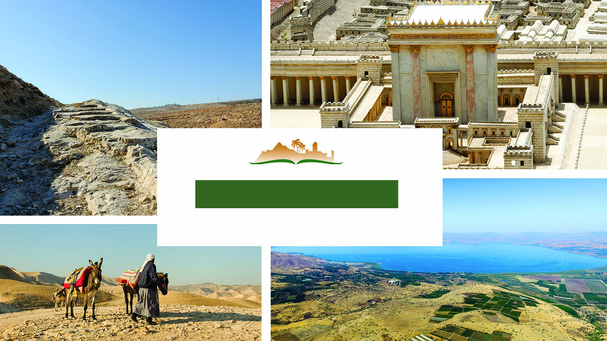
LUKE 8
Notes:
This is a free sample of the Luke 8 presentation from the Photo Companion to the Bible. To purchase the full volume, visit https://www.bibleplaces.com/luke/
The Photo Companion to the Bible is an image-rich resource for Bible students, teachers, and researchers. Just as a librarian stocks the shelves with as many relevant materials as possible, so we have tried to provide a broad selection of images. We do not expect many situations where someone will need, desire, or even approve of every image, but our goal is that you will find in this “library” whatever it is you are looking for.
Credits: The primary creators of this presentation are Steven D. Anderson, A.D. Riddle, and Todd Bolen. The photographs have an individual file code which usually includes the initials of the photographer. Other images have additional credit or source information.
Updates: We plan to update this collection as we are able. We welcome your suggestions for improving this resource (photocompanion@bibleplaces.com). Purchasers of the Luke volume are provided free, lifetime updates to the volume.
Copyright: This photo collection is protected by copyright law and may not be distributed without written permission from BiblePlaces.com. Slide notes should be treated as any other copyrighted written material, with credit given when quoting from these notes.
For more information, see our complete “Introduction to the Photo Companion to the Bible” online at http://www.BiblePlaces.com/Intro-Photo-Companion-Bible/. Here you will find more information about photo selection, explanatory notes, Bible translation, credit information, and copyright allowances.

Slide 2
LUKE 8
This is a free sample of the Luke 8 presentation from the Photo Companion to the Bible. To purchase the full volume, visit https://www.bibleplaces.com/luke/
The Photo Companion to the Bible is an image-rich resource for Bible students, teachers, and researchers. Just as a librarian stocks the shelves with as many relevant materials as possible, so we have tried to provide a broad selection of images. Our goal is that you will find in this “library” whatever it is you are looking for.
For more details (for this and every slide), see the Notes section below.
Notes:
This is a free sample of the Luke 8 presentation from the Photo Companion to the Bible. To purchase the full volume, visit https://www.bibleplaces.com/luke/
The Photo Companion to the Bible is an image-rich resource for Bible students, teachers, and researchers. Just as a librarian stocks the shelves with as many relevant materials as possible, so we have tried to provide a broad selection of images. We do not expect many situations where someone will need, desire, or even approve of every image, but our goal is that you will find in this “library” whatever it is you are looking for.
Credits: The primary creators of this presentation are Steven D. Anderson, A.D. Riddle, and Todd Bolen. The photographs have an individual file code which usually includes the initials of the photographer. Other images have additional credit or source information.
Updates: We plan to update this collection as we are able. We welcome your suggestions for improving this resource (photocompanion@bibleplaces.com). Purchasers of the Luke volume are provided free, lifetime updates to the volume.
Copyright: This photo collection is protected by copyright law and may not be distributed without written permission from BiblePlaces.com. Slide notes should be treated as any other copyrighted written material, with credit given when quoting from these notes.
For more information, see our complete “Introduction to the Photo Companion to the Bible” online at http://www.BiblePlaces.com/Intro-Photo-Companion-Bible/. Here you will find more information about photo selection, explanatory notes, Bible translation, credit information, and copyright allowances.

Slide 3
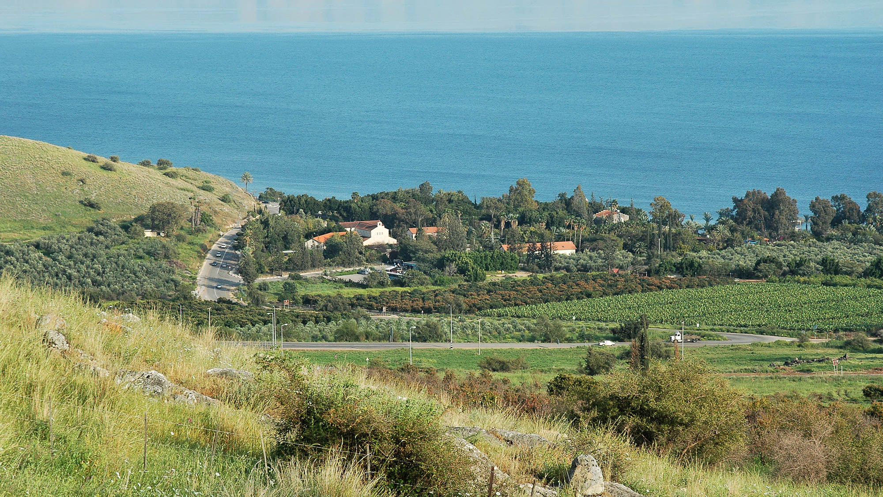
He went about cities and villages, preaching, and proclaiming the good news of the kingdom
Tabgha (from the northwest)
8:1
Notes:
Although Luke does not state specifically where Jesus was preaching, comparison with the other Gospels indicates that this was a preaching tour of Galilee. Tabgha is the modern version of the ancient Heptapegon, an area of seven springs that has been popular with fishermen throughout history. Tradition places Jesus here on multiple occasions.
tb032805829

Slide 4
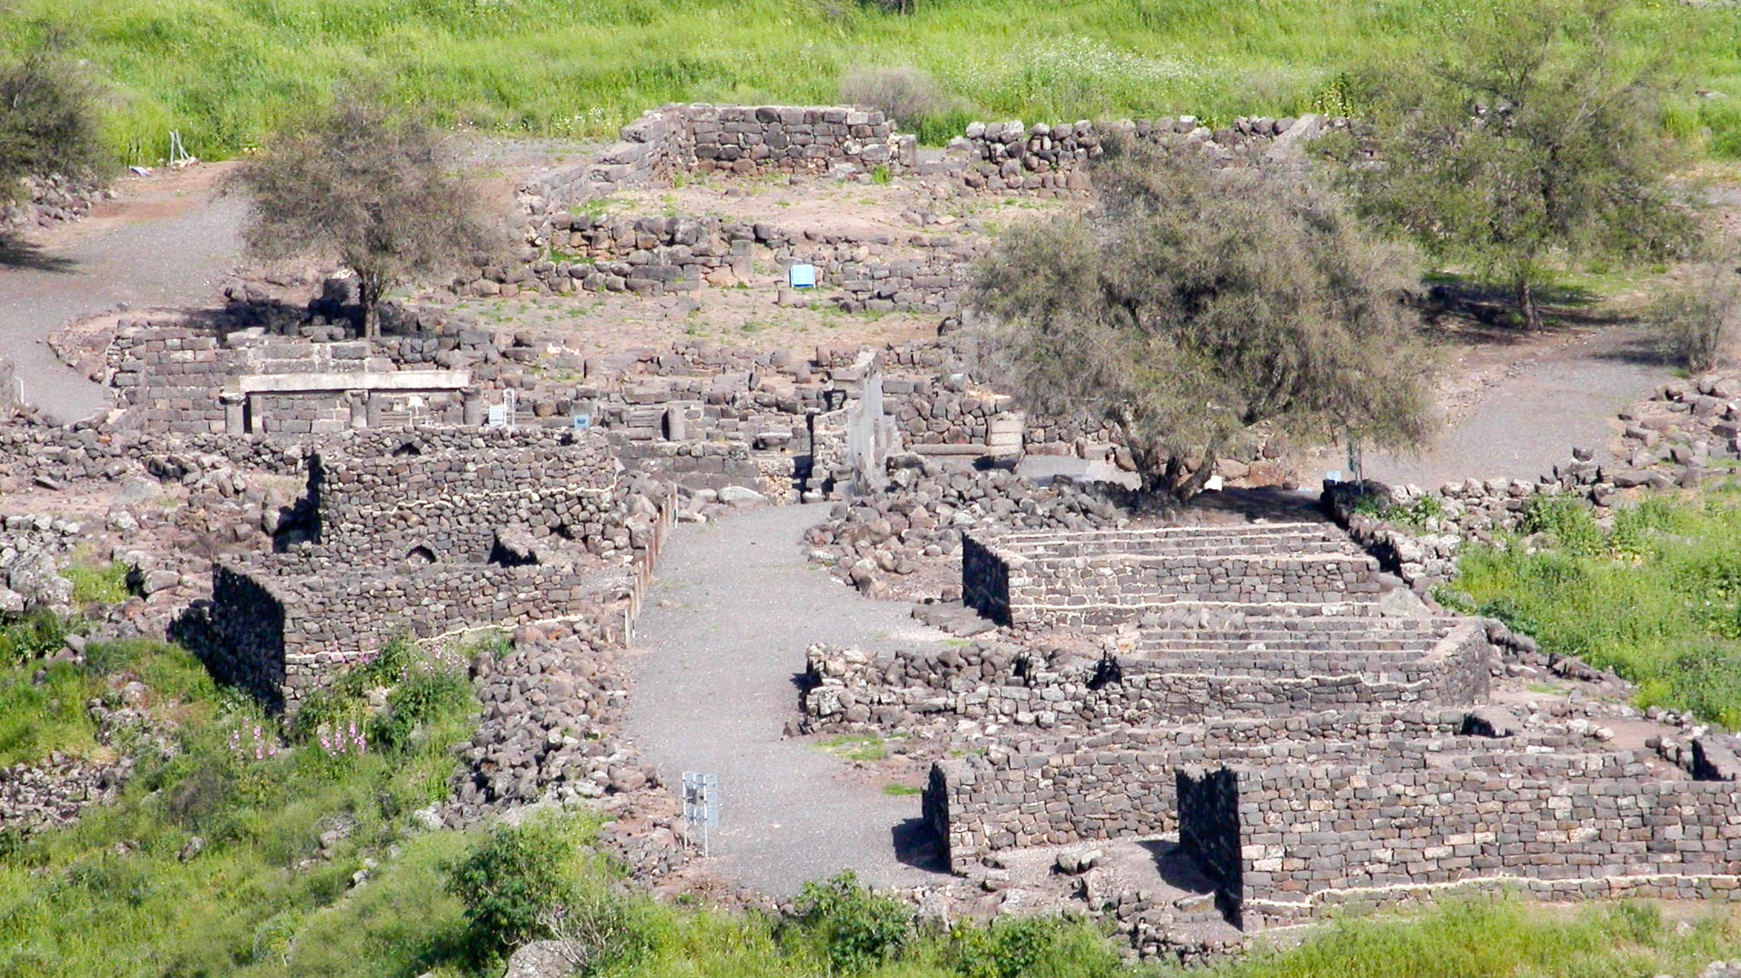
He went about cities and villages, preaching, and proclaiming the good news of the kingdom
Chorazin (from the west)
8:1
Notes:
Chorazin was a town frequented by Jesus, as is clear from His condemnation in Luke 10:13.
tb041103213

Slide 5
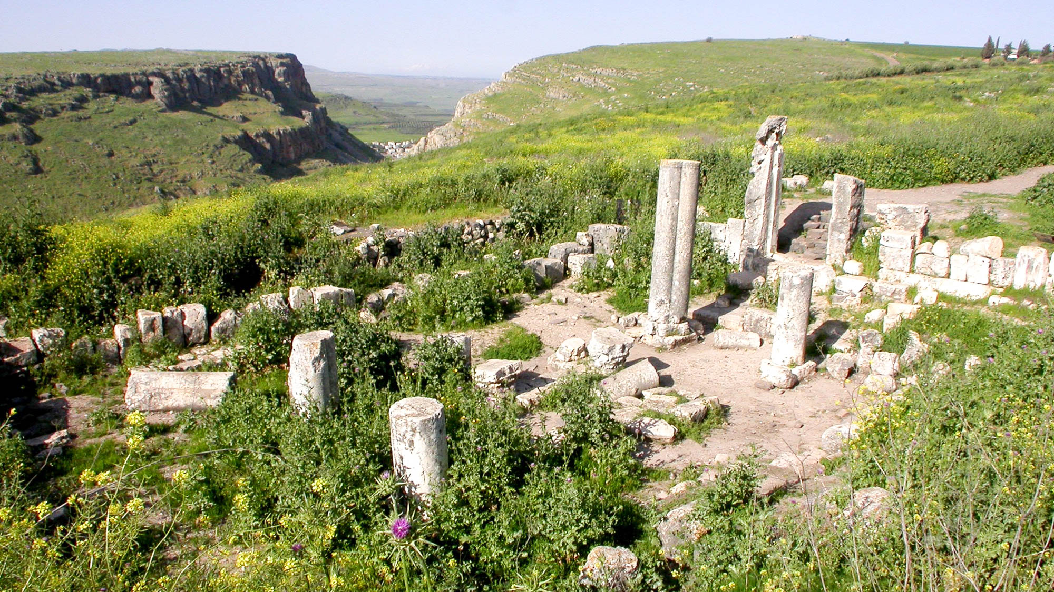
He went about cities and villages, preaching, and proclaiming the good news of the kingdom
Arbel synagogue with the Valley of Doves
8:1
Notes:
Jesus may well have visited Arbel on the western side of the Sea of Galilee. The Valley of Doves on the left leads to the Plain of Gennesaret and the shore of the Sea of Galilee.
tb041003202

Slide 6
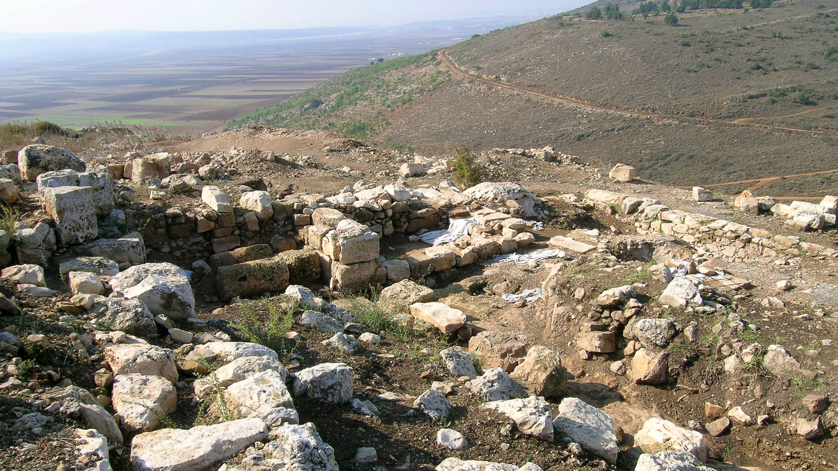
He went about cities and villages, preaching, and proclaiming the good news of the kingdom
Excavations at Cana (Khirbet Qana)
8:1
Notes:
Cana was the hometown of Nathanael (John 21:2), who was associated with the Twelve. The Gospel of John records two occasions when Jesus visited Cana (John 2:1-11; 4:46).
tb110306566

Slide 7
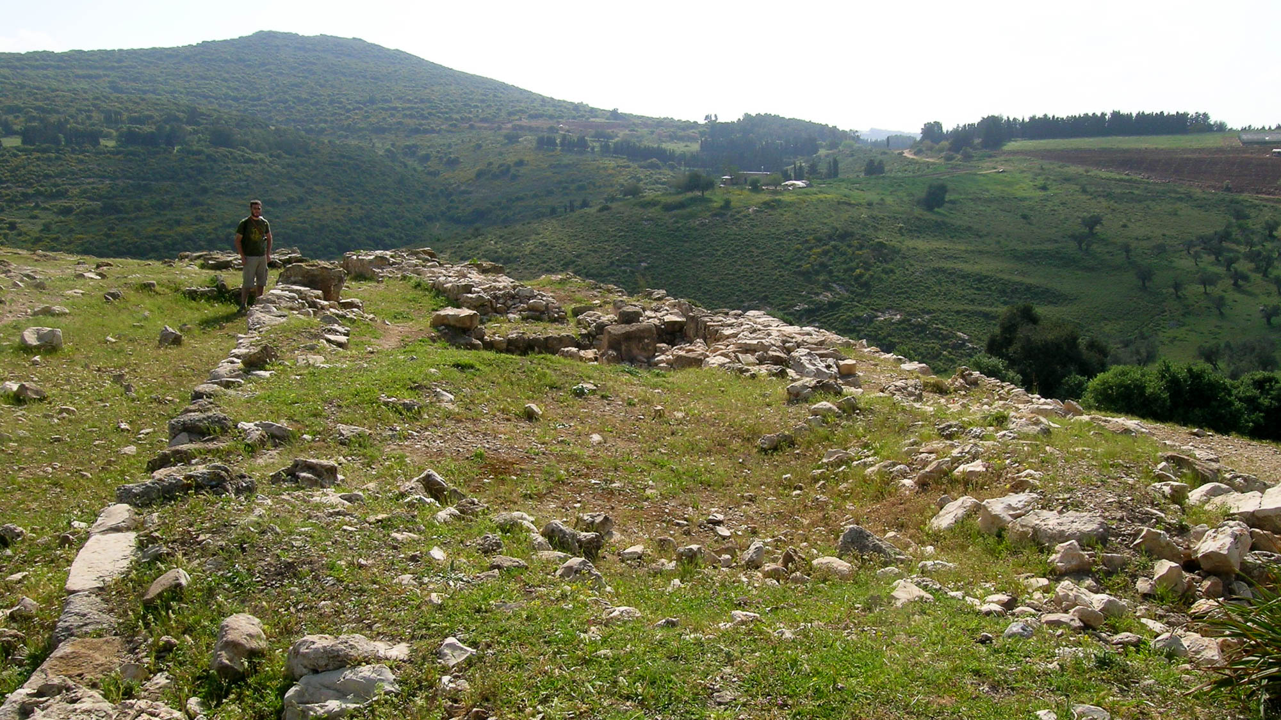
He went about cities and villages, preaching, and proclaiming the good news of the kingdom
Jotapata with ruins of northern wall
8:1
Notes:
Jotapata was a walled city of 13 acres (5 ha) during the 1st century AD. It was the city where Josephus was defeated and surrendered to the Romans in July of AD 67.
tb033104418

Slide 8
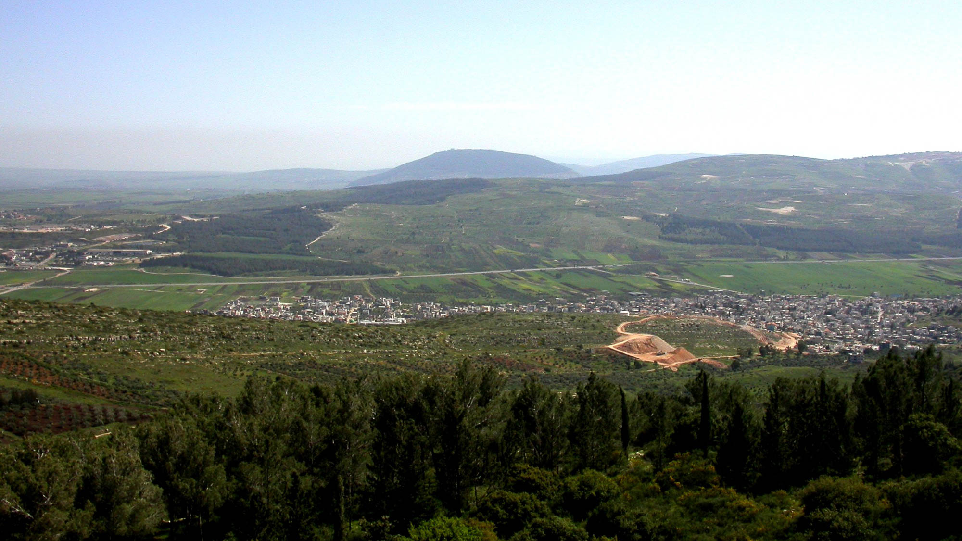
He went about cities and villages, preaching, and proclaiming the good news of the kingdom
Turan Valley and Mount Tabor, looking southward from Mount Turan
8:1
Notes:
The valleys of Lower Galilee, including the Turan and Bet Netofa Valleys, typically run east-west and provide convenient passage from the coast to the Sea of Galilee.
tb041003227

Slide 9
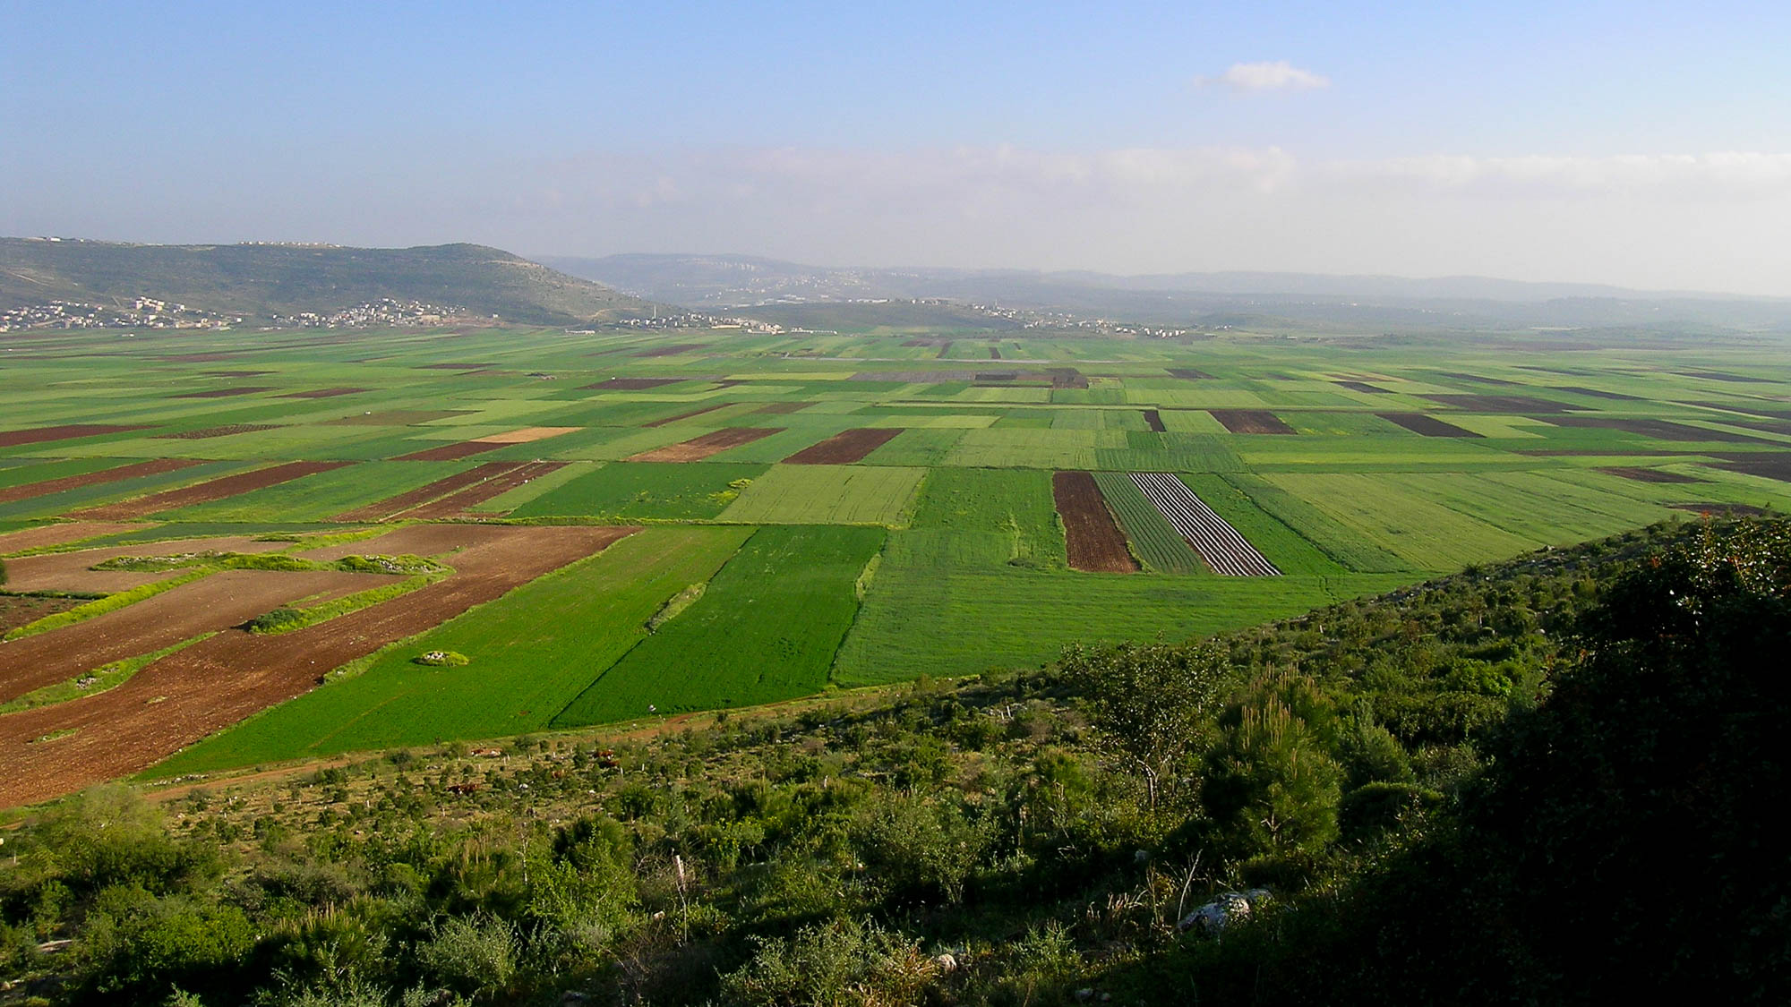
He went about cities and villages, preaching, and proclaiming the good news of the kingdom
Bet Netofa Valley (from the north)
8:1
Notes:
The Bet Netofa Valley runs east-west and separates Cana (Kh. Qana) on the north from Sepphoris on the south.
tb033104452

Slide 10
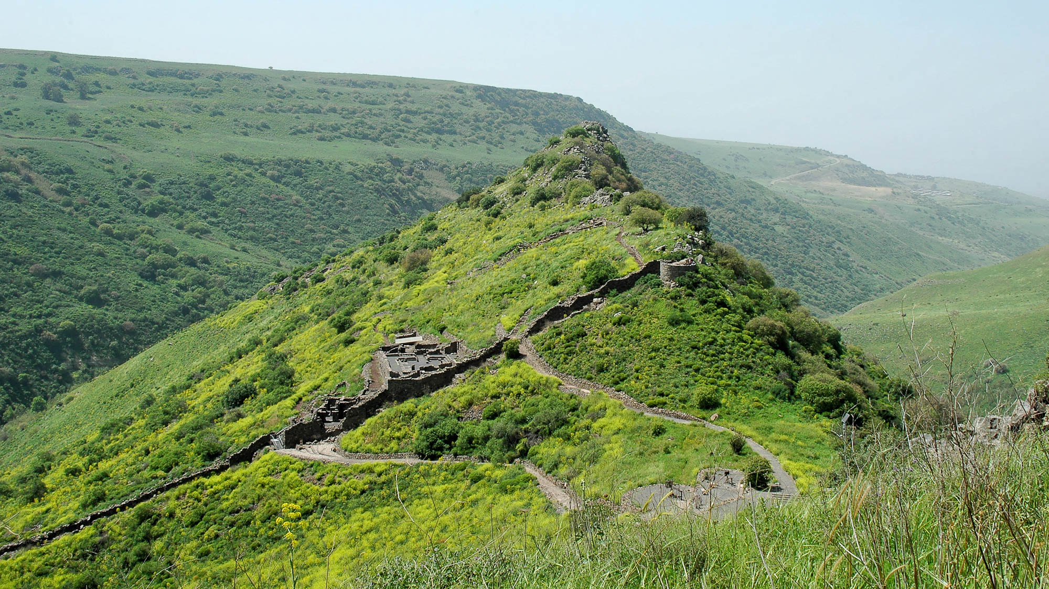
He went about cities and villages, preaching, and proclaiming the good news of the kingdom
Gamla (from the east)
8:1
Notes:
Gamla was settled during the Hellenistic period by Jewish exiles returning from Babylon. Later, Herod the Great encouraged settlement here in his effort to populate the borders of his kingdom. The city is best known for its resistance of a Roman siege beginning in AD 66. Josephus reports that 9,000 Jews were killed during the Roman victory. See the next slide for labels.
tb032705332

Slide 11
He went about cities and villages, preaching, and proclaiming the good news of the kingdom
summit
round tower
synagogue
breach
city wall
Gamla (from the east)
8:1
Notes:
Gamla was settled during the Hellenistic period by Jewish exiles returning from Babylon. Later, Herod the Great encouraged settlement here in his effort to populate the borders of his kingdom. The city is best known for its resistance of a Roman siege beginning in AD 66. Josephus reports that 9,000 Jews were killed during the Roman victory.
tb032705332

Slide 12
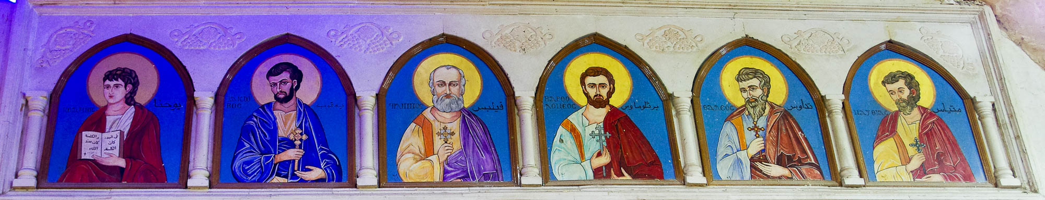
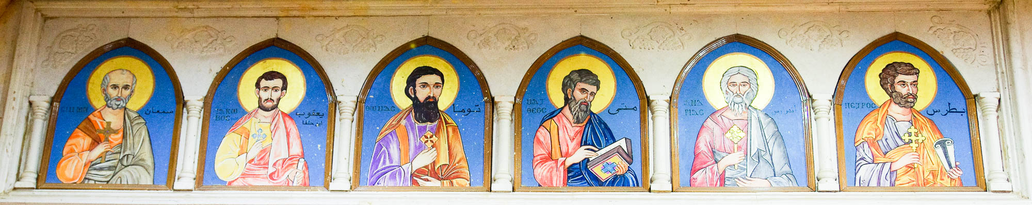
And with Him the Twelve
Icons of the Twelve Apostles in the Cave Church of Saint Simon in Mokattam
8:1
Notes:
In the 1970s, the Coptic Orthodox Christians living in “Garbage City” built churches in the caves of Mokattam Mountain, on the southeast outskirts of Cairo. These modern icons of the apostles are in the largest of the cave churches which is dedicated to Saint Simon the Tanner. Matthias replaces Judas Iscariot in this depiction of the Twelve.
Top: adr1603101342
Bottom: adr1603101356

Slide 13
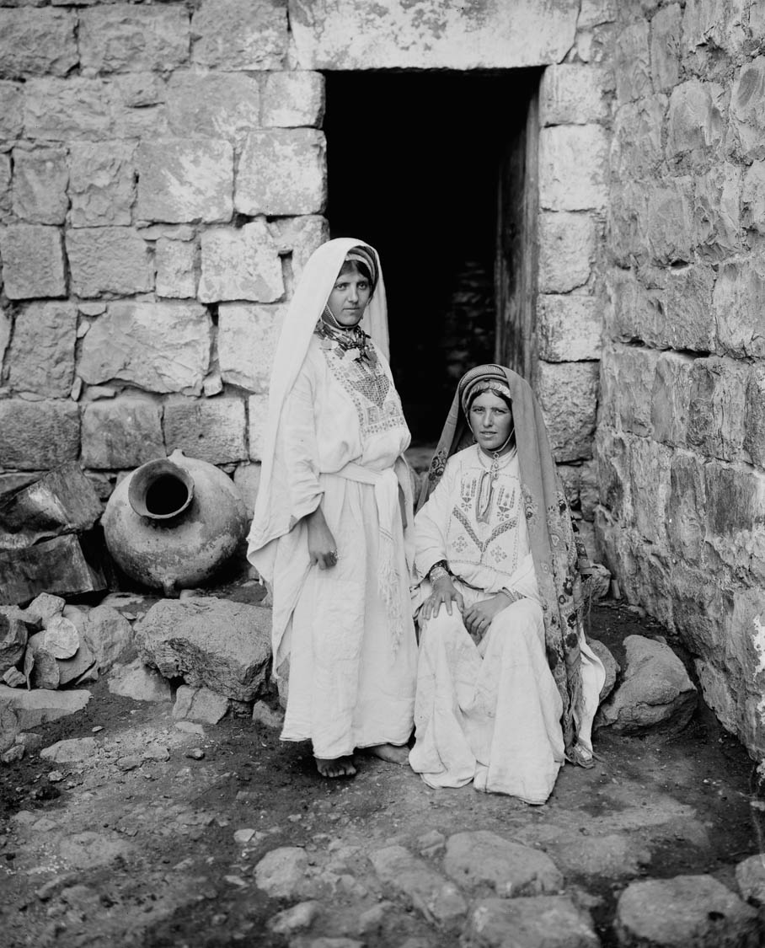
And certain women who had been healed of evil spirits and sicknesses
Peasant women from the Ramallah district
8:2
Notes:
This American Colony photograph shows native women in traditional dress. It was taken between 1898 and 1946.
mat11838

Slide 14
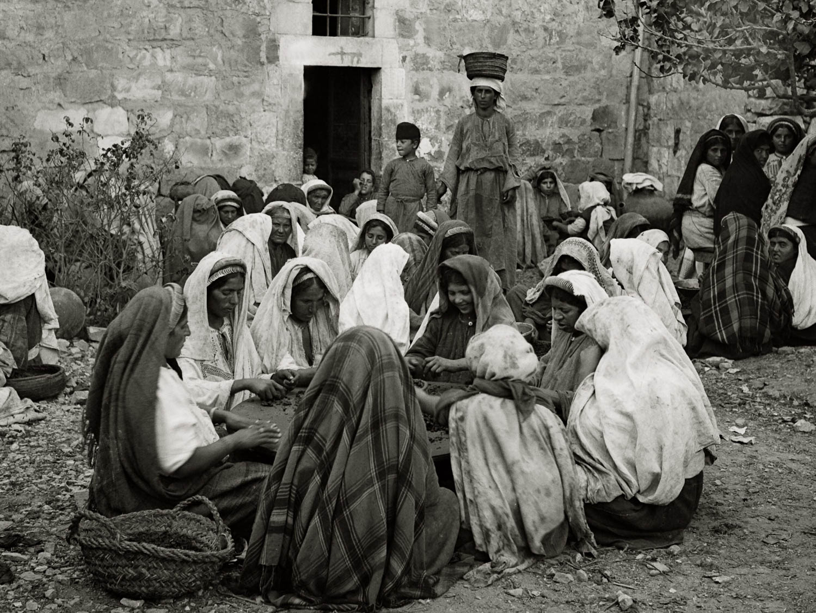
And certain women who had been healed of evil spirits and sicknesses
Peasant women sorting raisins
8:2
Notes:
This American Colony photograph was taken between 1900 and 1920.
mat01256

Slide 15
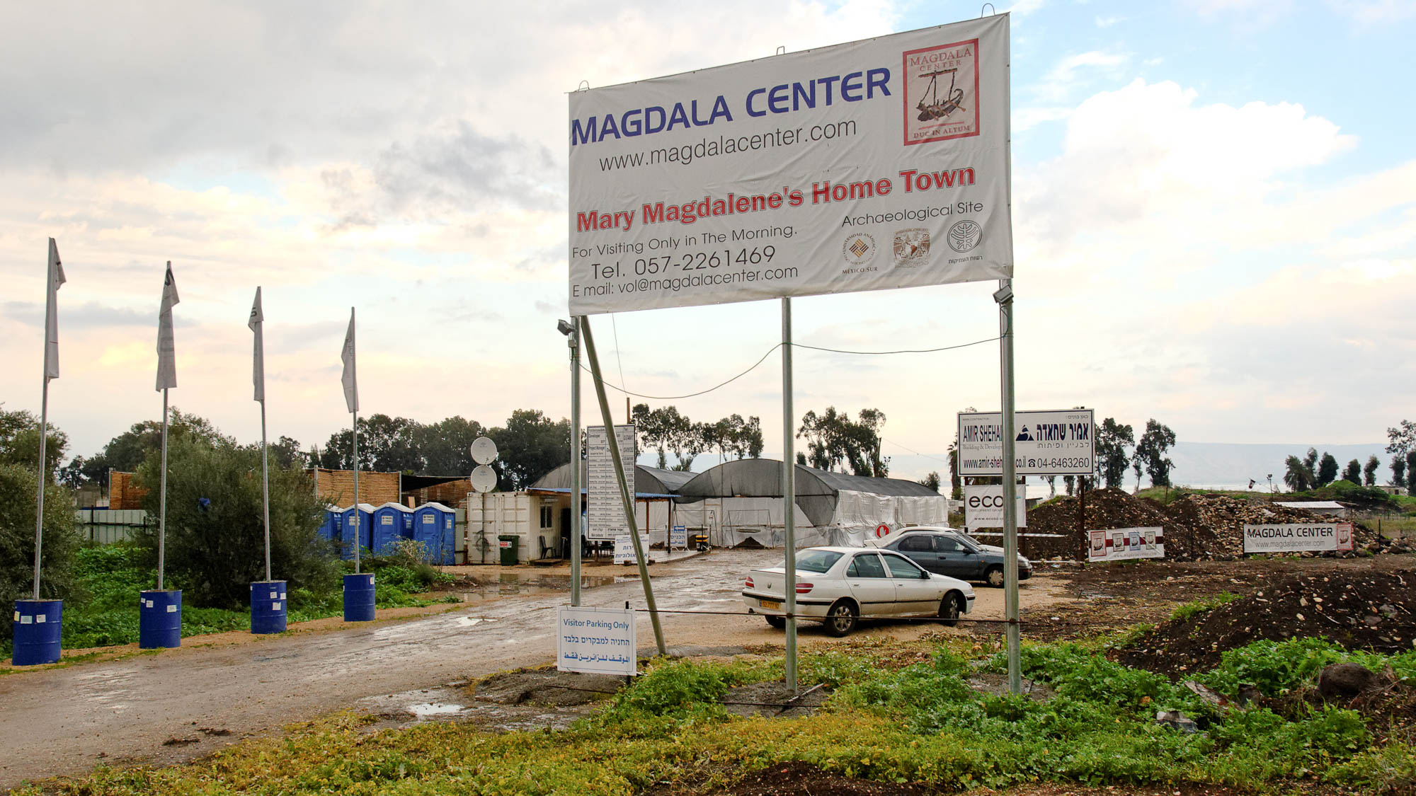
Mary who was called Magdalene, from whom seven demons had gone out
Magdala excavations
8:2
Notes:
A “Magdalene” is a person from Magdala. Excavations began at Magdala in 2009.
tb011212440

Slide 16
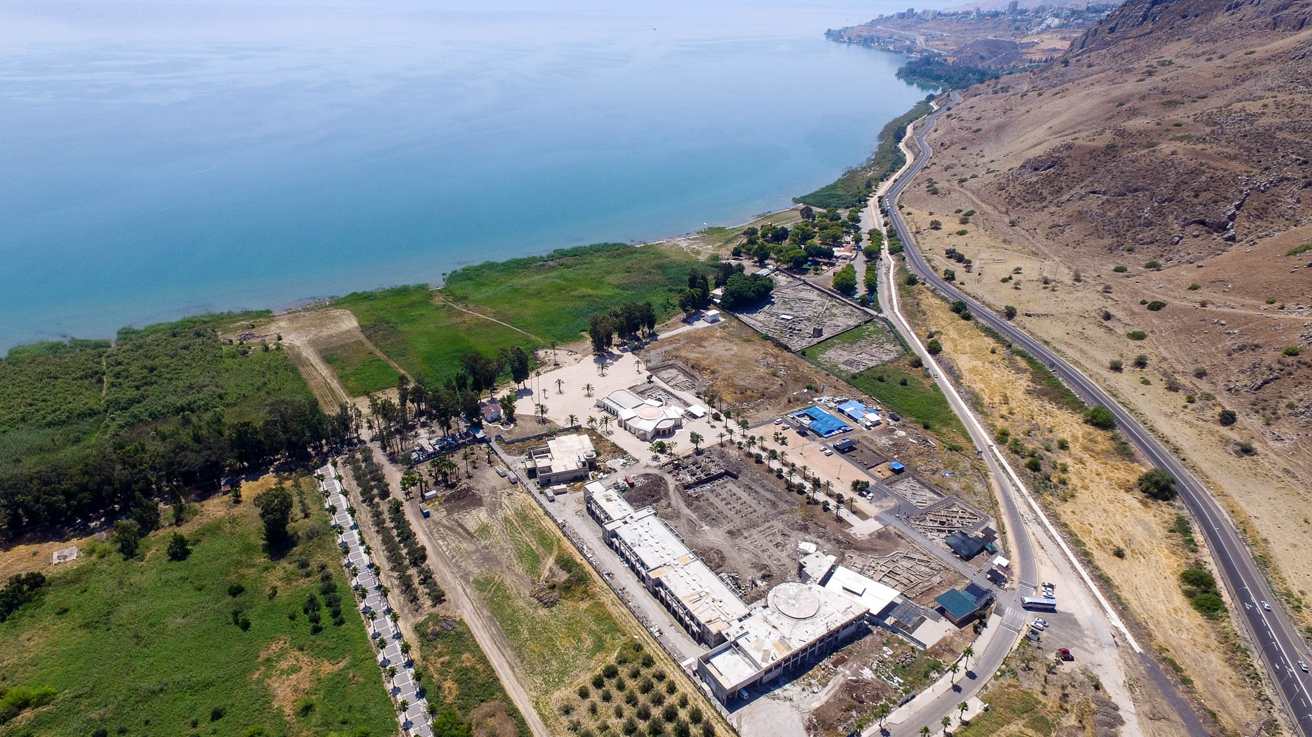
Mary who was called Magdalene, from whom seven demons had gone out
Magdala (aerial view from the northwest)
8:2
Notes:
The recent excavations and construction of a Roman Catholic pilgrimage center can be seen at the bottom center of the photo.
ws053116526

Slide 17
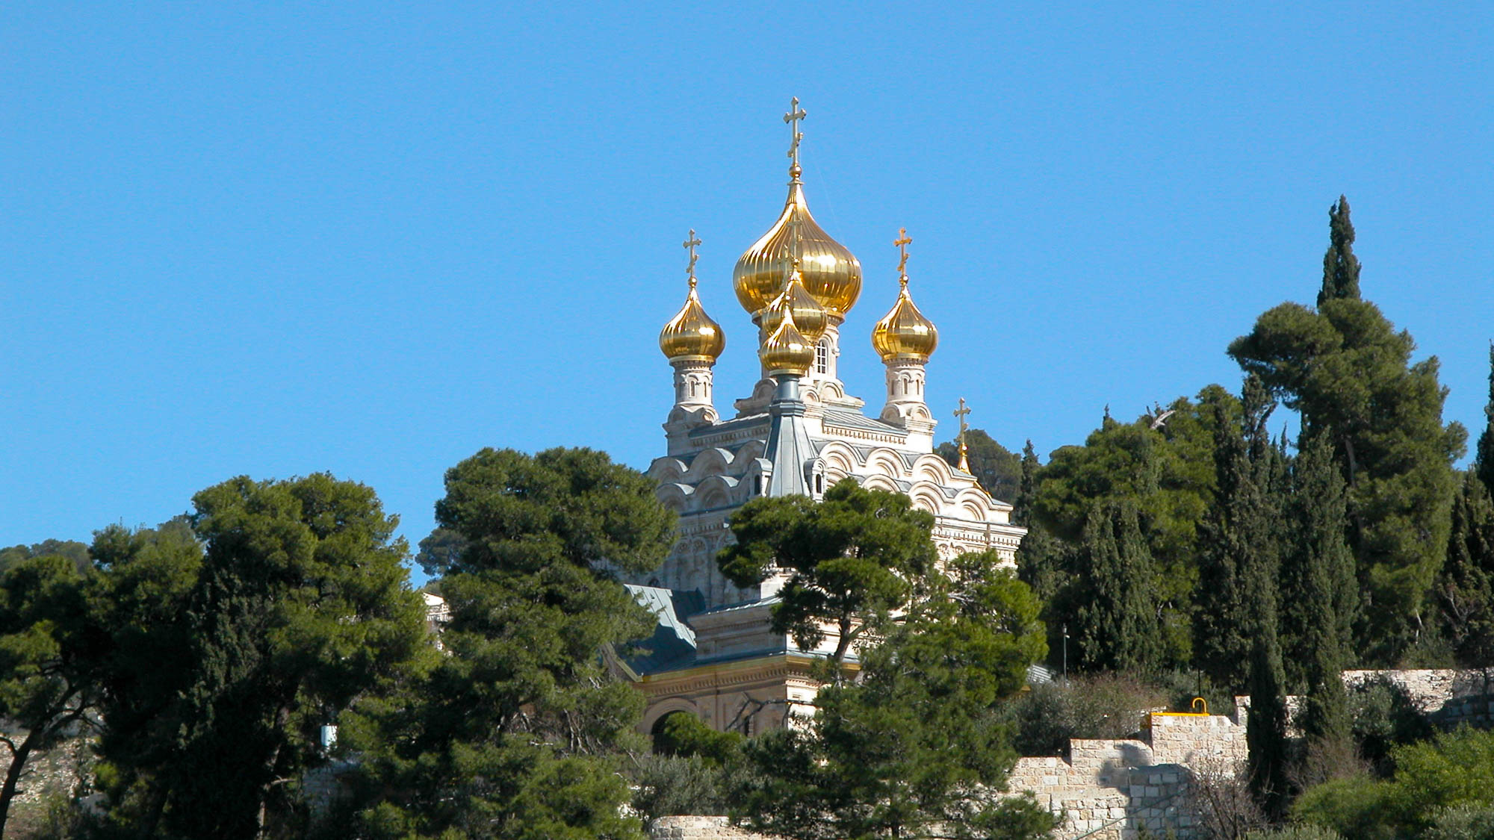
Mary who was called Magdalene, from whom seven demons had gone out
Russian Orthodox Church of Mary Magdalene on the Mount of Olives
8:2
Notes:
This Russian Orthodox church commemorates Mary Magdalene. Built by the Czar in honor of his mother in 1888, the church features a mosaic depicting the legend of Mary Magdalene presenting an egg to the Emperor Tiberius. The egg allegedly turned red when she handed it to him, symbolic of Jesus’s blood.
tb012603226

Slide 18
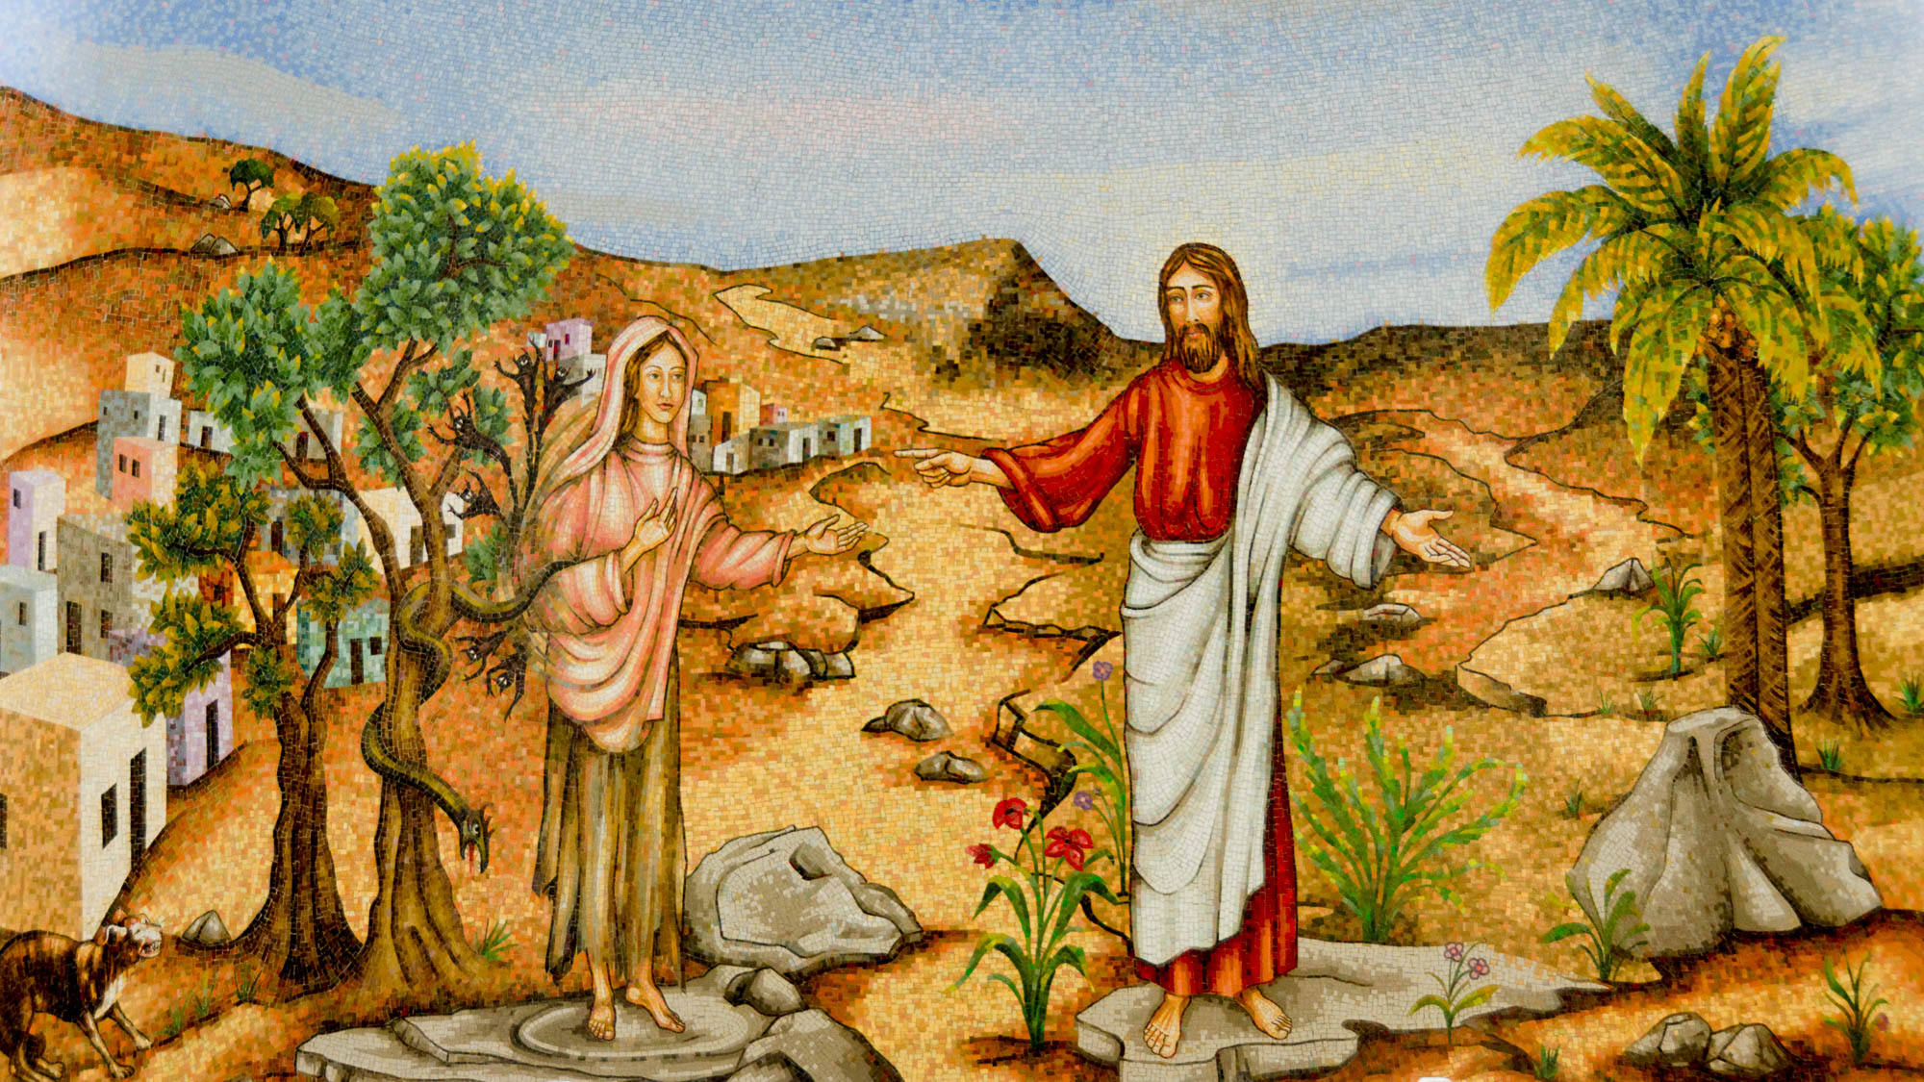
Mary who was called Magdalene, from whom seven demons had gone out
Painting of Jesus with Mary Magdalene, in Duc In Altum chapel in Magdala
8:2
Notes:
The Duc In Altum Church was dedicated in May 2014. Duc In Altum is Latin for “put out into the deep water,” recalling Jesus’s words in Luke 5:4.
tb053116465

Slide 19
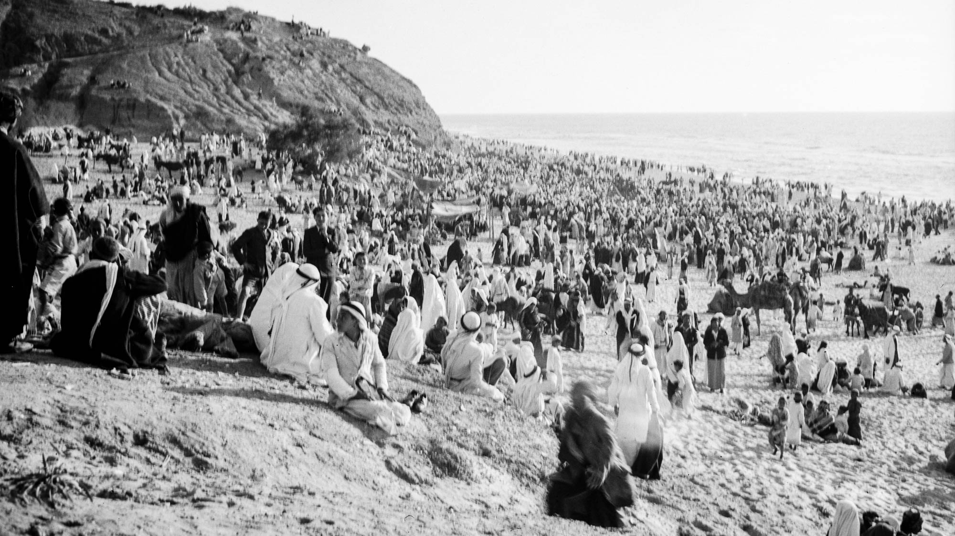
And when a large crowd came together . . . He spoke by means of a parable
Crowds on the beach at Ashkelon during Muslim celebrations
8:4
Notes:
This American Colony photograph was taken on April 20, 1943.
mat21671

Slide 20
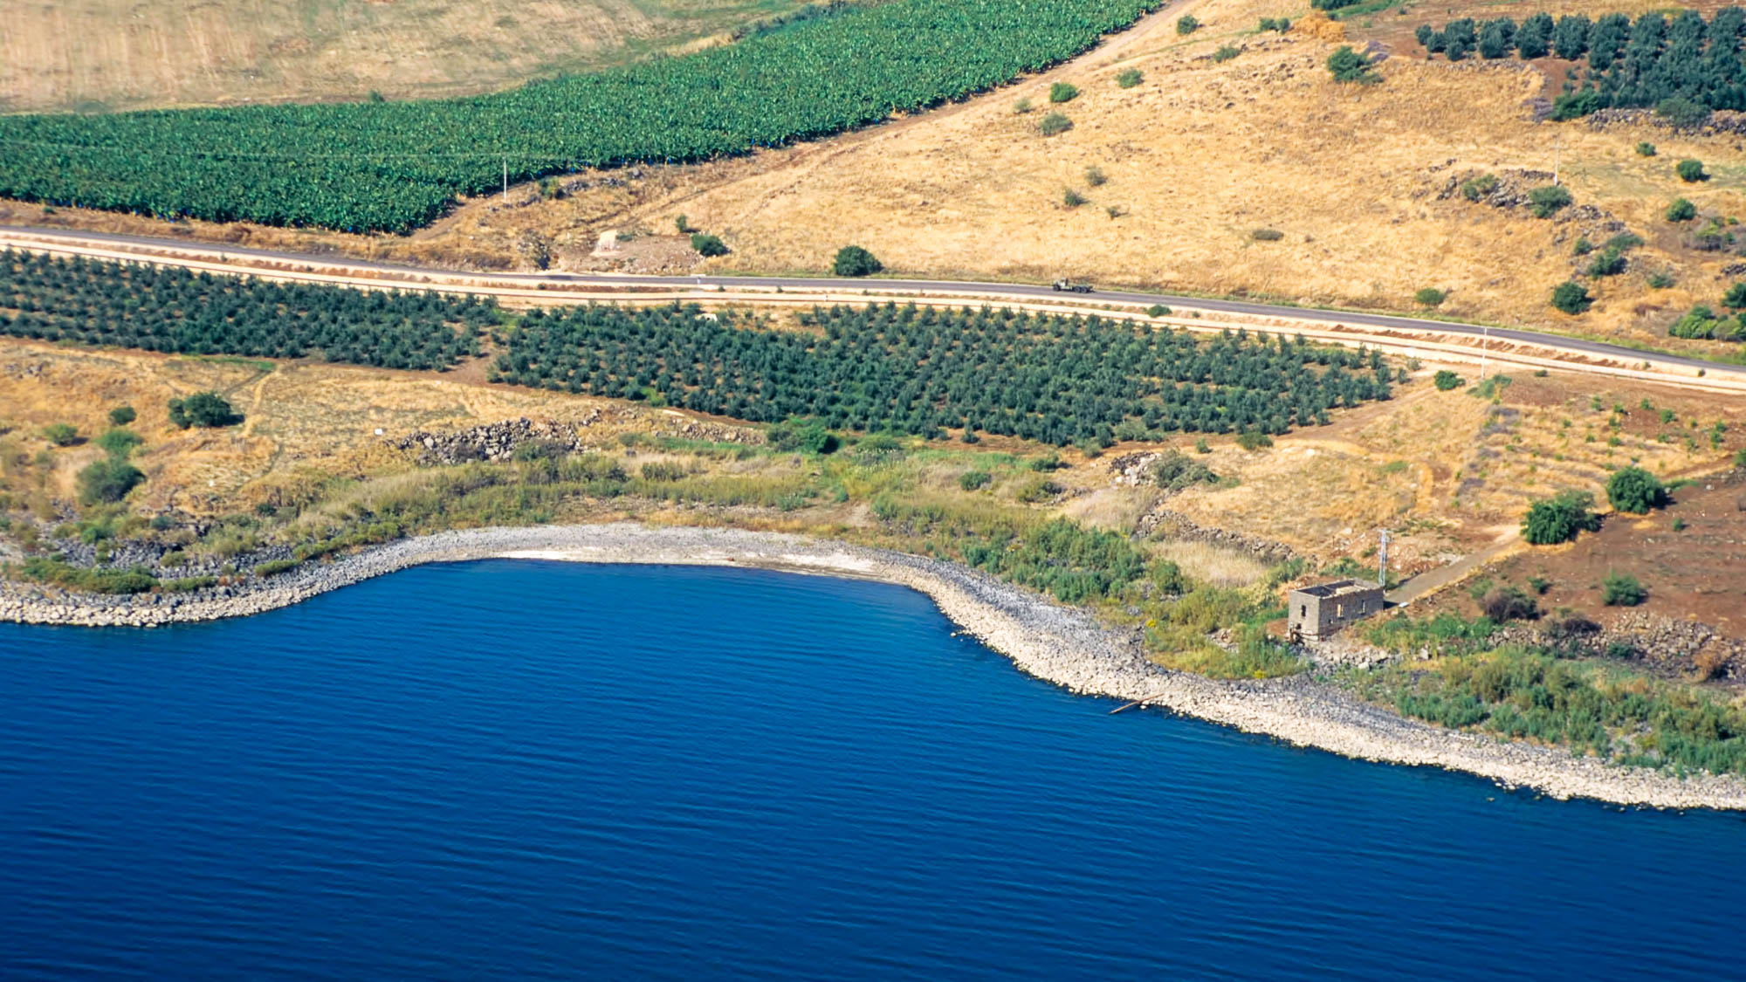
And when a large crowd came together . . . He spoke by means of a parable
The “Cove of the Sower” (aerial view from the south)
8:4
Notes:
According to Matthew 13:1 and Mark 4:1, this discourse occurred on the shore of the Sea of Galilee. The traditional Cove of the Sower, located midway between Capernaum and Heptapegon (Tabgha) has remarkable acoustic properties and would have served as an ideal location for Jesus to address large crowds on the shore. The modern road certainly follows an ancient path, bringing travelers within hearing range of the teacher.
tbs115120011

Slide 21
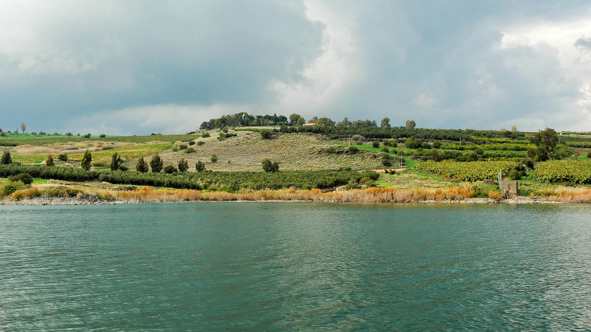
And when a large crowd came together . . . He spoke by means of a parable
The “Cove of the Sower” (from the Sea of Galilee)
8:4
Notes:
An acoustical study of the cove by B. Cobby Crisler determined that 5,000–7,000 people could fit in the area below the road. In numerous personal experiences, we have been able to communicate easily from the shoreline with students scattered all over the cove and to the top of the slope (as far as is visible from the shoreline).
tb011306459

Slide 22
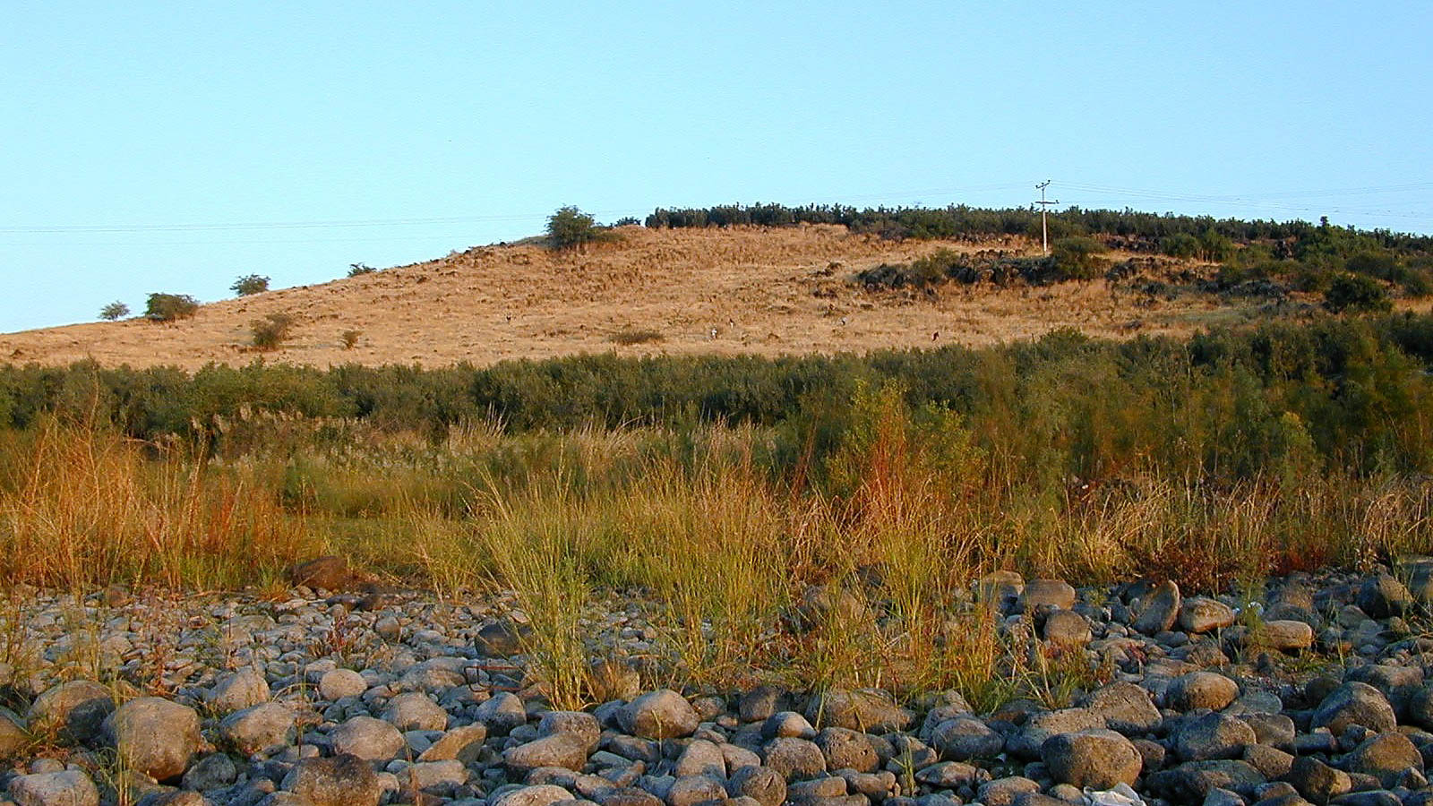
And when a large crowd came together . . . He spoke by means of a parable
The “Cove of the Sower” (from the water’s edge)
8:4
Notes:
The small specks in the distance are people listening to a preacher speaking from where the photograph was taken. On the occasion when this photograph was taken, the individuals in the distance could hear the speaker’s voice clearly.
tb112000202

Slide 23
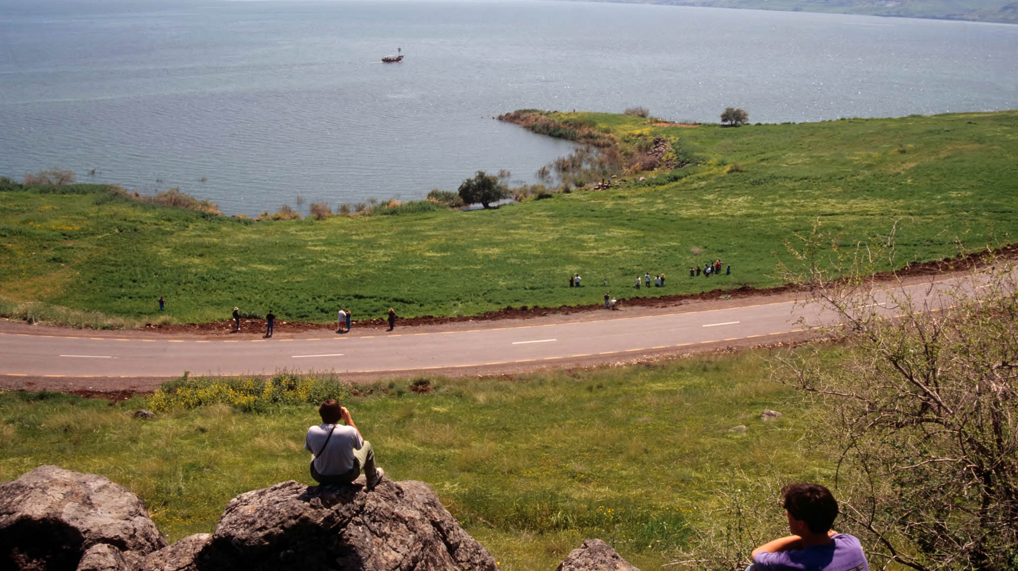
And when a large crowd came together . . . He spoke by means of a parable
The “Cove of the Sower” (from midway up the slope)
8:4
Notes:
From this vantage point, a person standing on the shoreline is a mere speck. Though it seems unlikely, the voice of the speaker on the shoreline carries itself very well, and the listeners at the top of the cove would have had no problem hearing someone they could barely see. The rocks in the foreground of this photo are visible on the previous slide (on the right side near the electrical pole). This photograph was taken in 1993, before the olive grove was planted south of the road.
tbs76029303

Slide 24
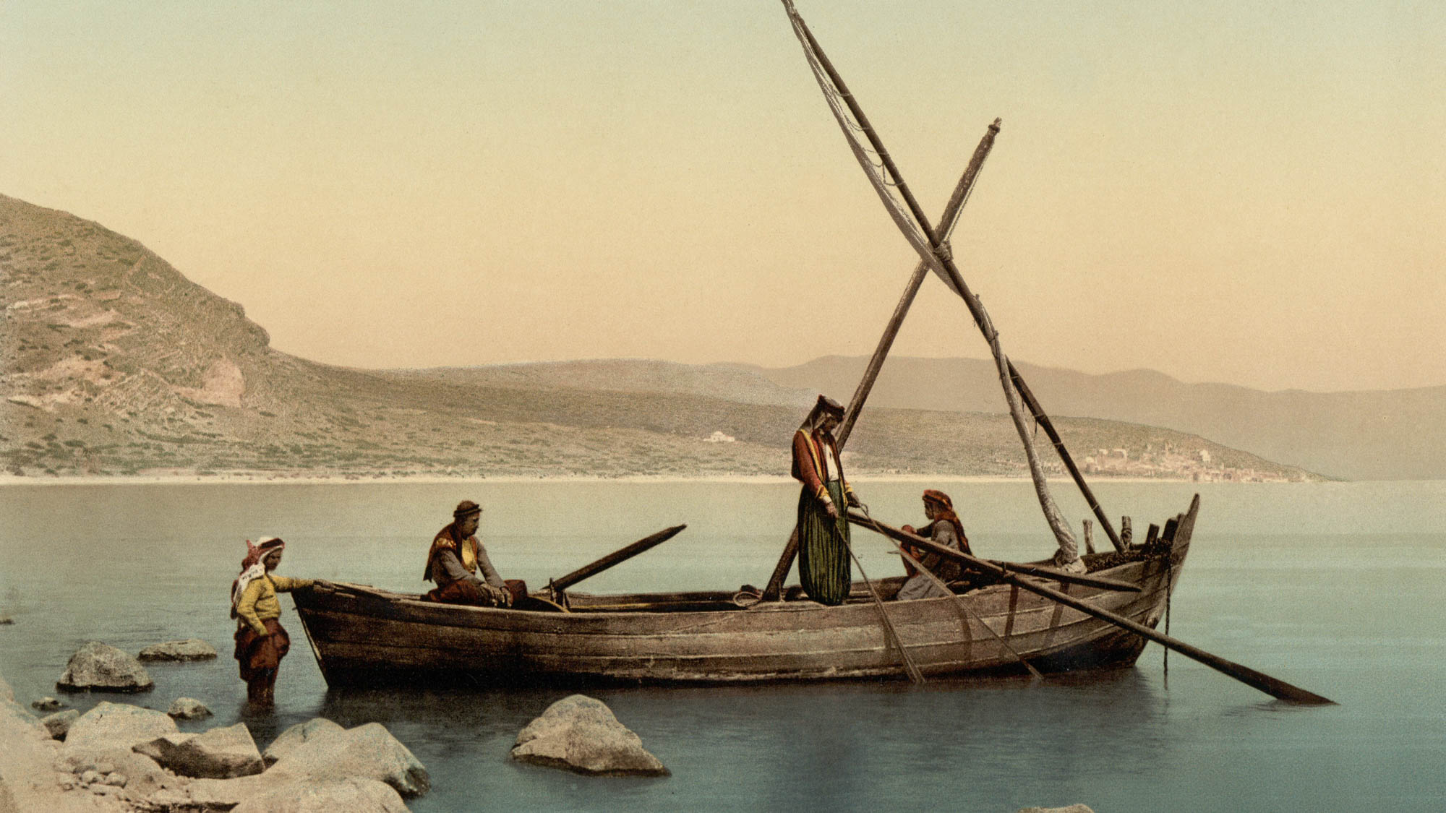
And when a large crowd came together . . . He spoke by means of a parable
Fisherman’s boat on the Sea of Galilee
8:4
Notes:
According to Matthew 13:2 and Mark 4:1, Jesus taught the crowds from a boat that was just offshore. This photochrom image dates to the 1890s.
pcm02740

Slide 25
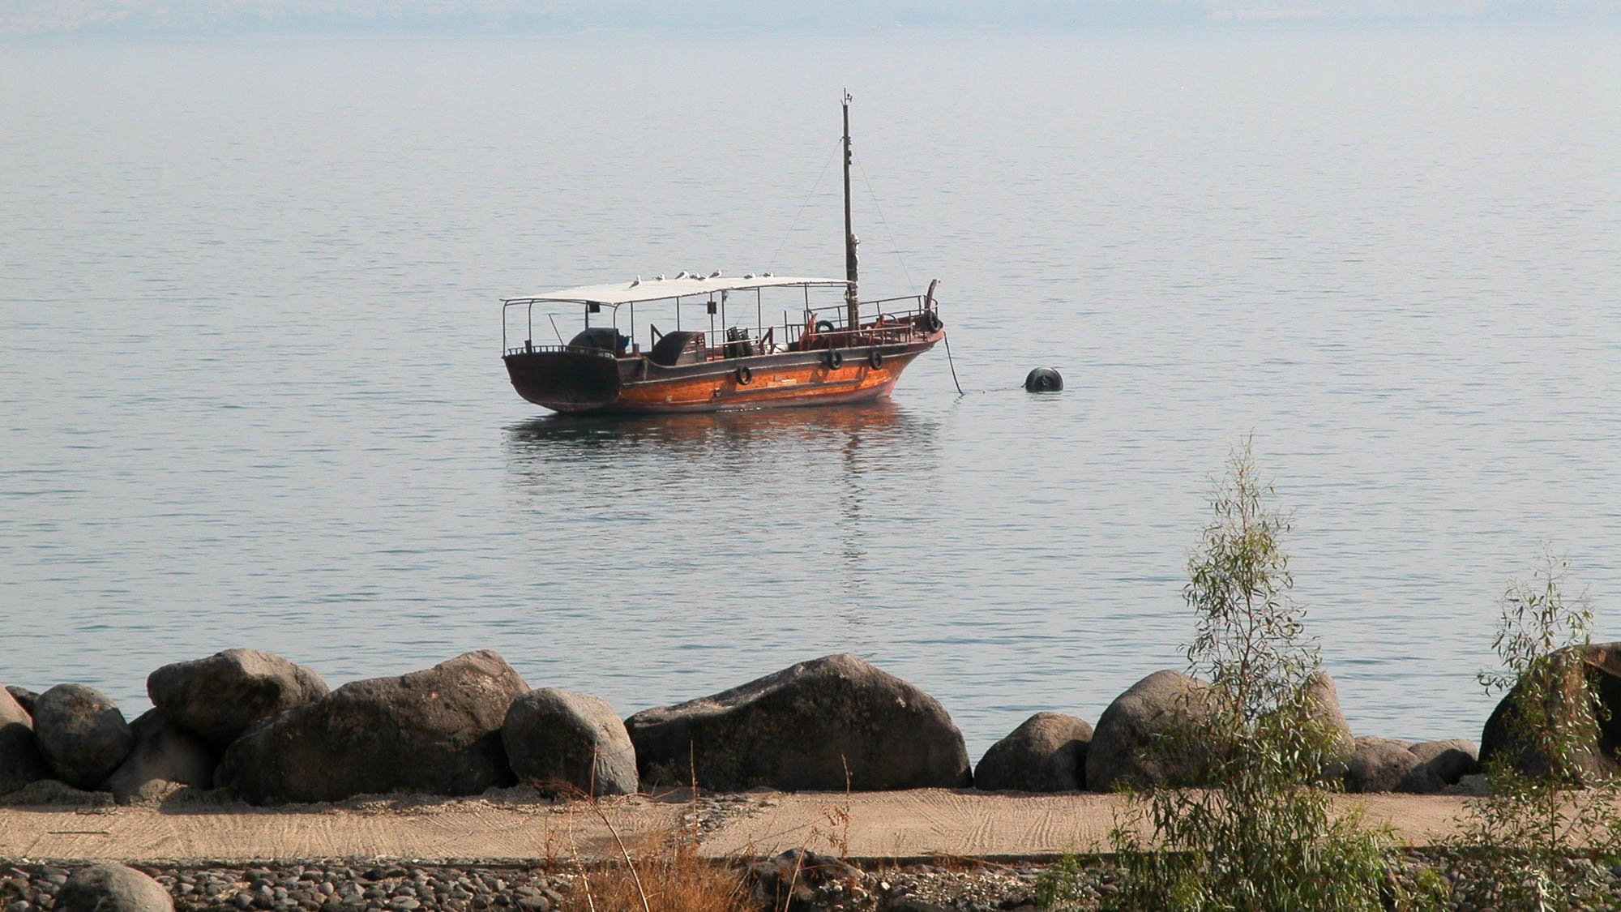
And when a large crowd came together . . . He spoke by means of a parable
Boat near the shoreline of Tiberias
8:4
Notes:
Today, few boats can be seen on the Sea of Galilee. Fishing is minimal (and at times outlawed altogether). The most common boats on the lake are vessels carrying Christian tourists.
tb102802004

Slide 26
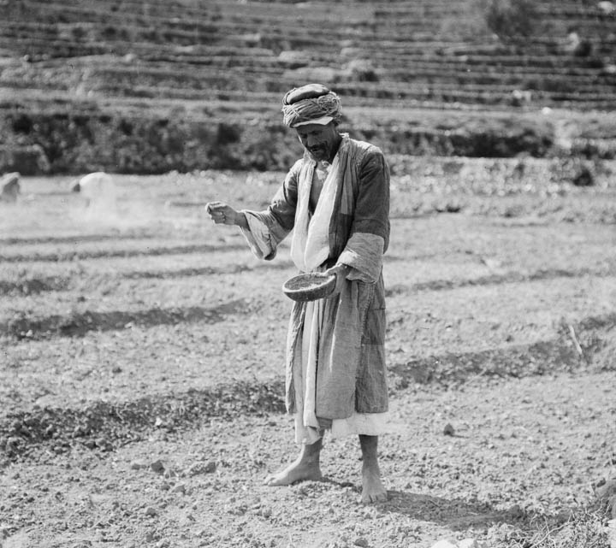
The sower went out to sow his seed
Arab peasant sowing grain
8:5
Notes:
This photo was taken by a photographer from the American Colony between 1898 and 1946.
mat10616

Slide 27
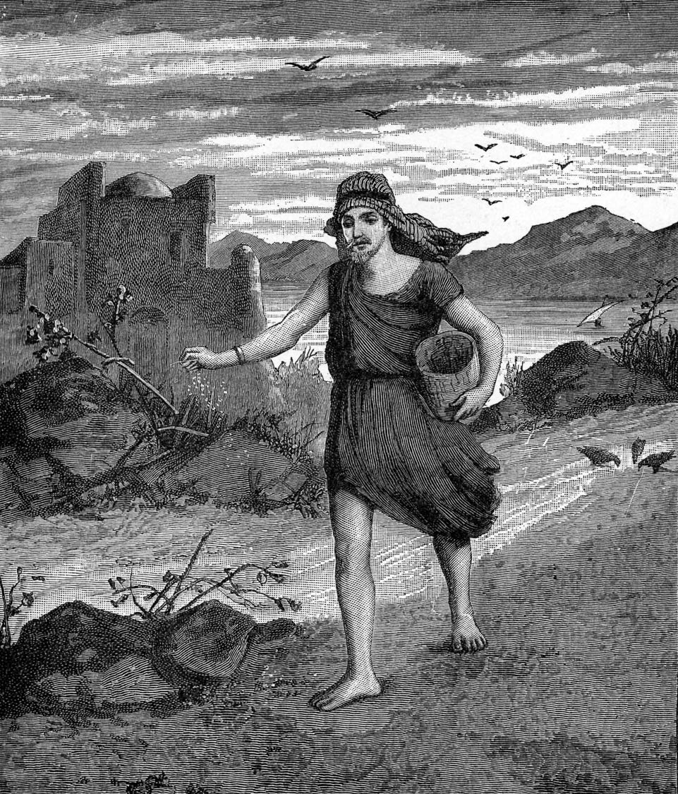
The sower went out to sow his seed
An eastern sower
8:5
Notes:
This illustration comes from Charles Foster, Bible Pictures and What They Teach Us (1886, 1914).
fbp226

Slide 28
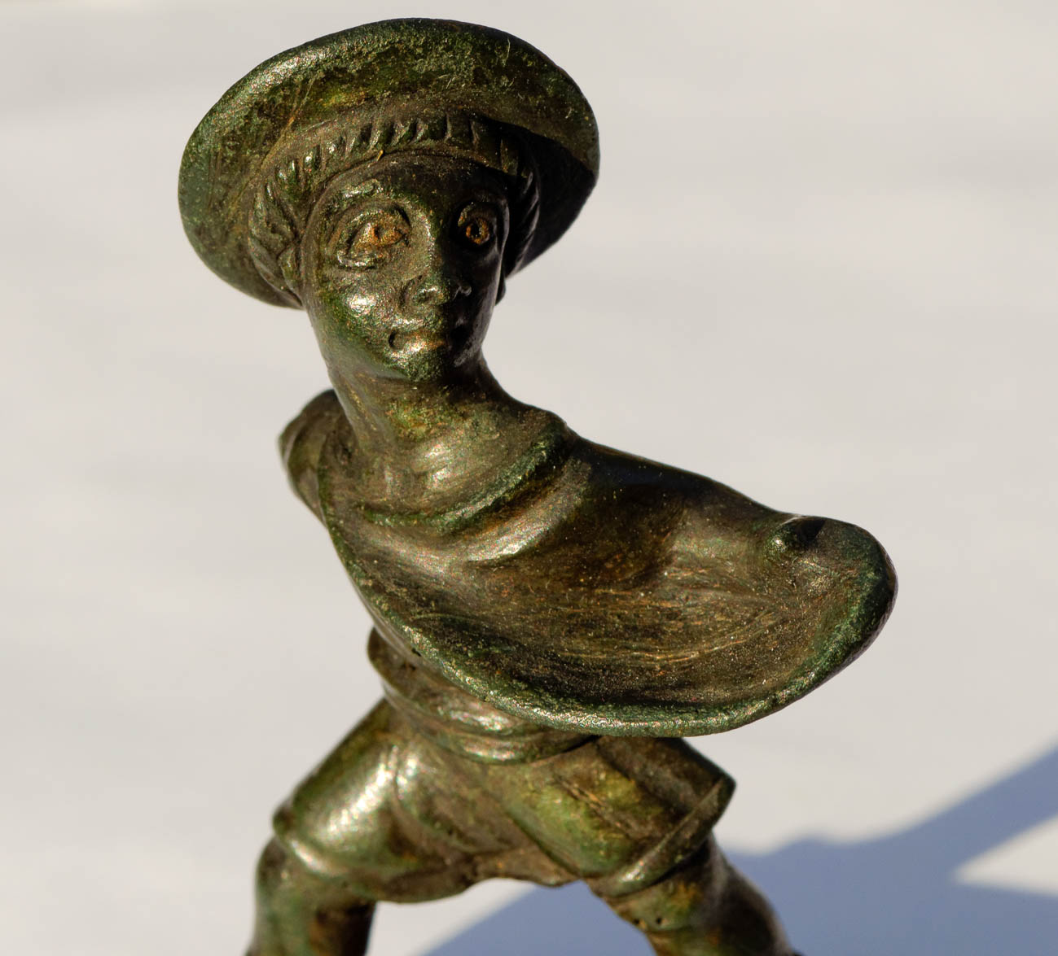
The sower went out to sow his seed
Seed sower figurine, bronze, 1st–2nd centuries AD
8:5
Notes:
This Roman figurine is in the Jared James Clark Collection.
tb0309169369

Slide 29
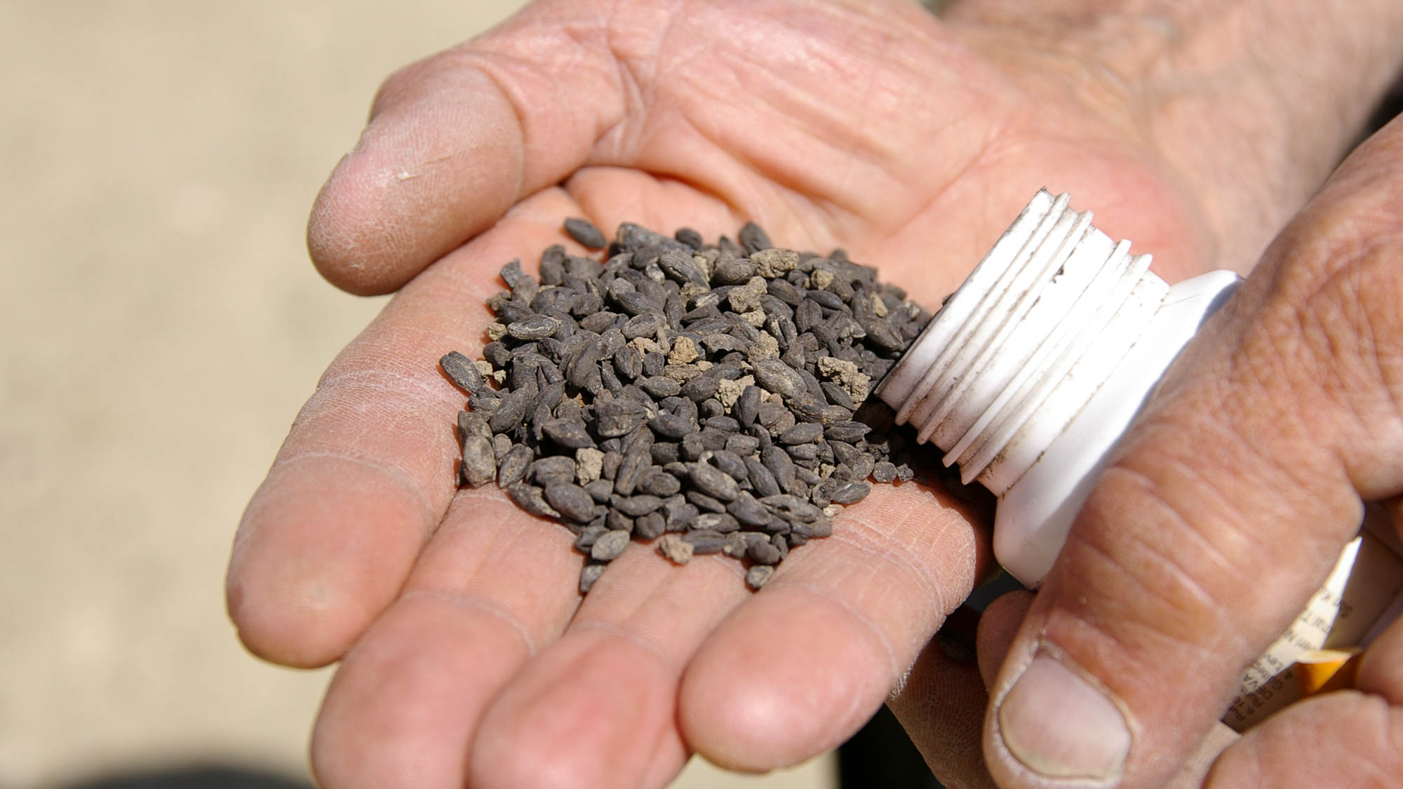
The sower went out to sow his seed
Carbonized seeds from Chavushtepe, Turkey, circa 700 BC
8:5
Notes:
These seeds were found in the Lower Fortress Supply Store Building at Chavushtepe in ancient Urartu (eastern Turkey).
adr1005253864

Slide 30
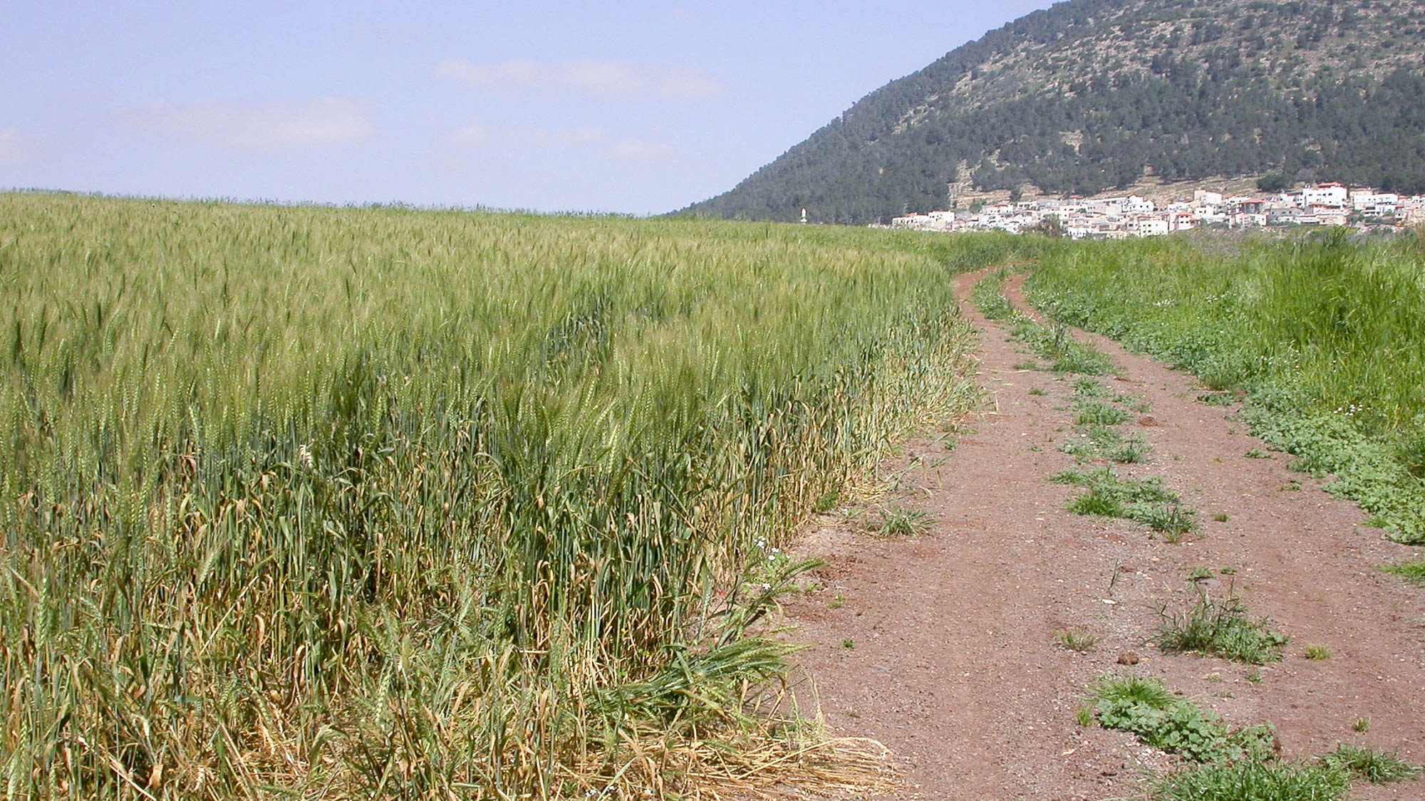
Some fell by the road, and it was trampled underfoot, and the birds of the sky devoured it
Wheat field and path near Mount Tabor
8:5
Notes:
This spring scene in the Jezreel Valley would have been familiar to Jesus’s disciples.
tb041003837

Slide 31
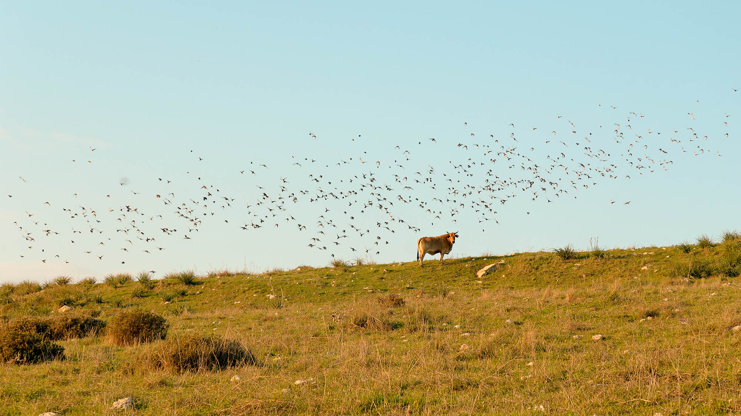
Some fell by the road, and it was trampled underfoot, and the birds of the sky devoured it
Birds at Tel Burna
8:5
Notes:
Tel Burna is located in the Shephelah and may be identified with biblical Libnah.
tb011606882

Slide 32
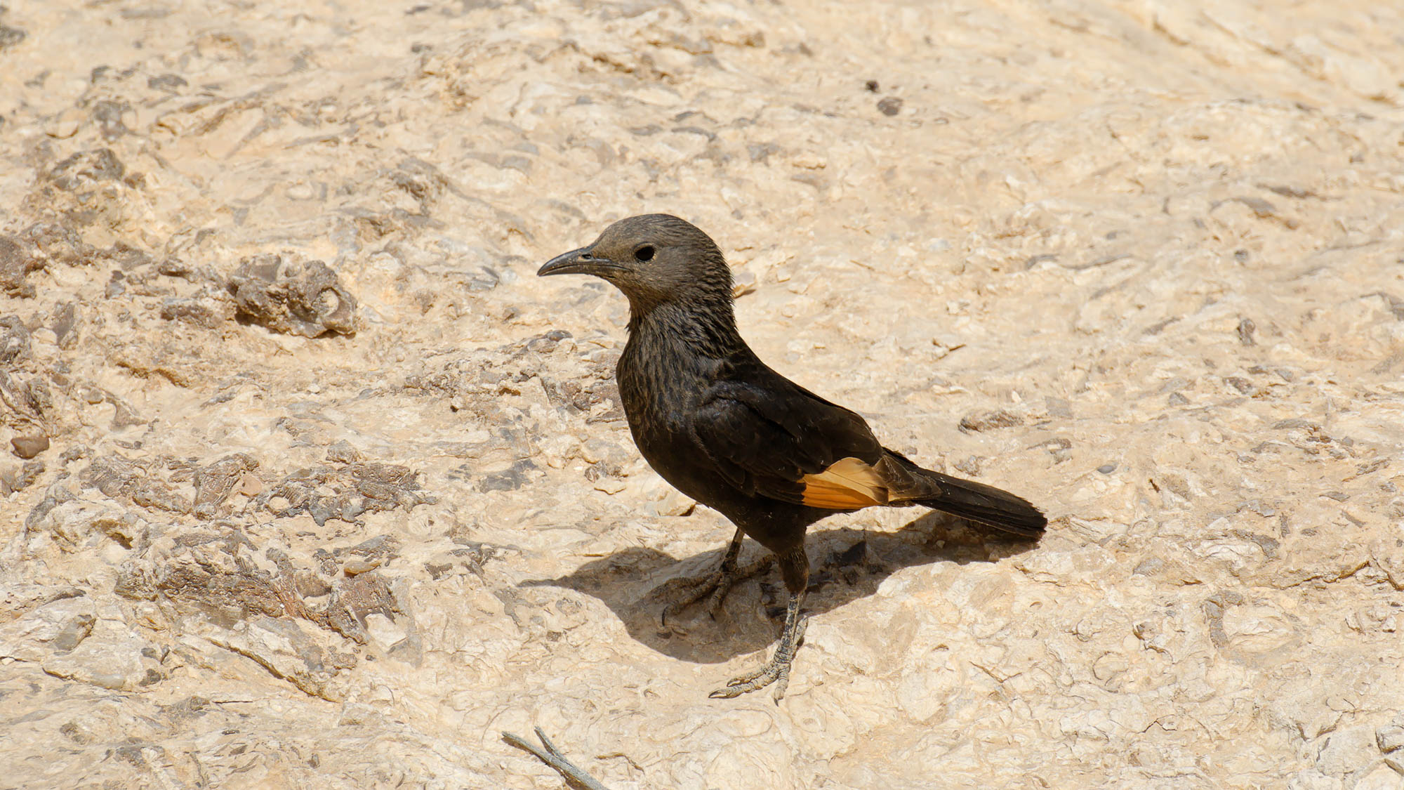
Some fell by the road, and it was trampled underfoot, and the birds of the sky devoured it
Bird at Ein Yorkeam
8:5
Notes:
Ein Yorkeam is located in the Negev of Israel, on the eastern side of Machtesh Gadol, on the road leading to Maale Aqrabbim (the Ascent of Scorpions).
tb042207858

Slide 33
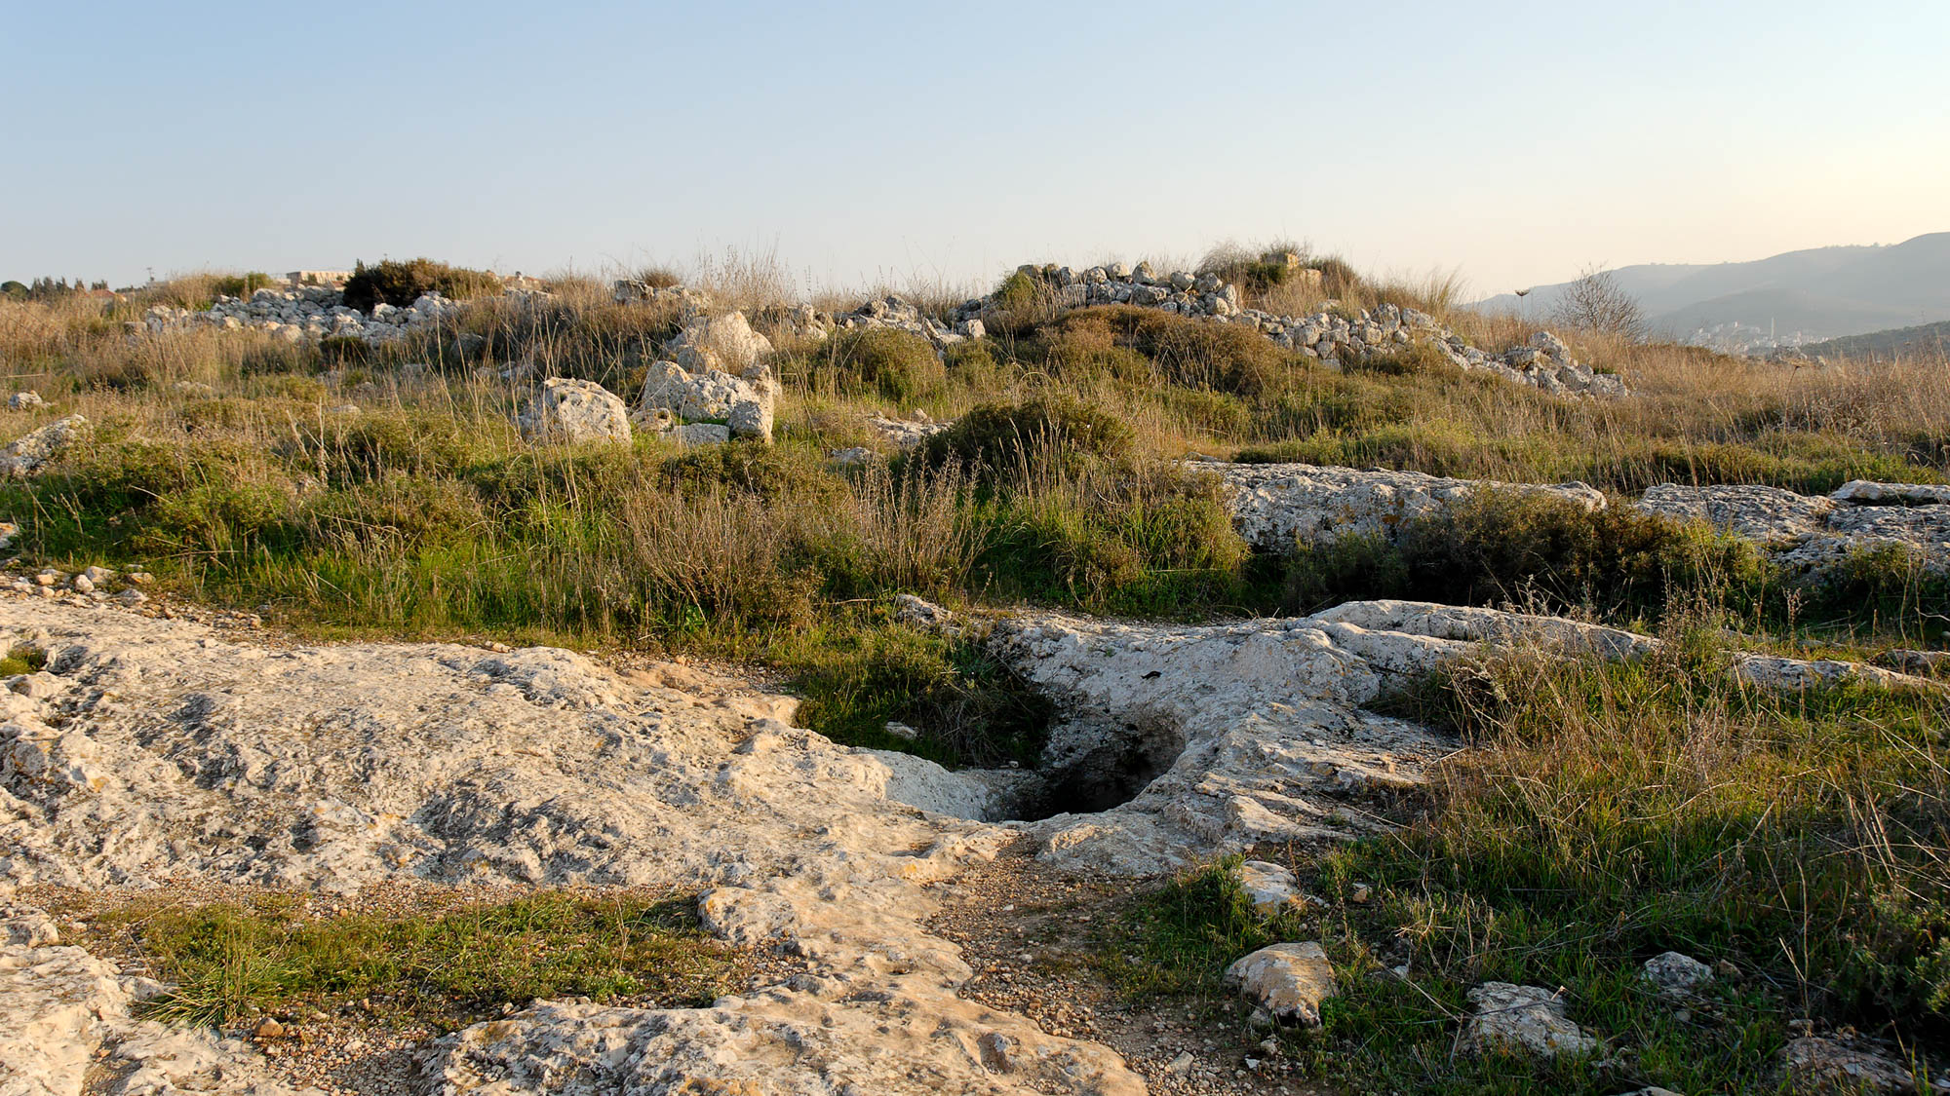
Other seed fell on rock, and as soon as it grew up, it withered away, because it had no moisture
Exposed bedrock at Shiloh
8:6
Notes:
Exposed bedrock is common in Israel.
tb120806894

Slide 34
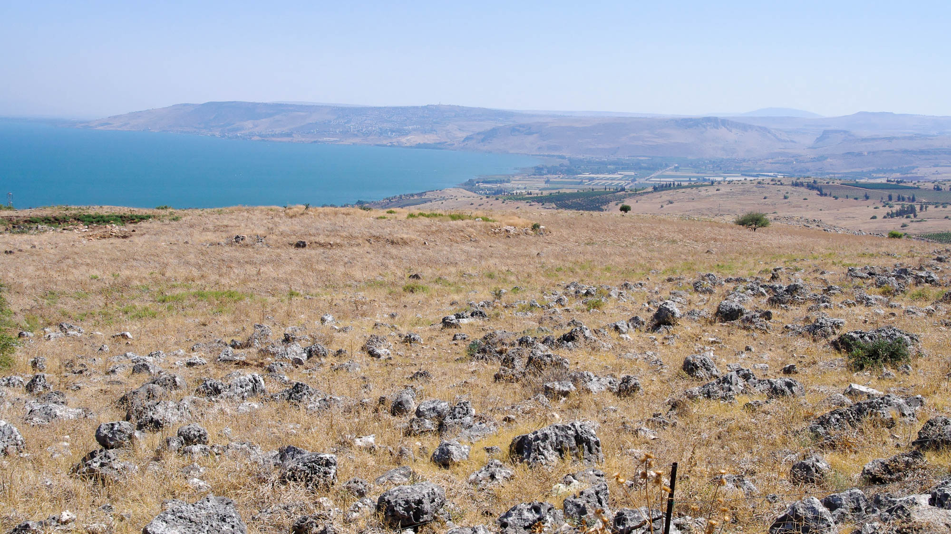
Other seed fell on rock, and as soon as it grew up, it withered away, because it had no moisture
Rocky terrain near Vered HaGalil, north of the Sea of Galilee
8:6
Notes:
The first task of any farmer in Israel is to clear the fields of stones. This process must be repeated each year at the time of plowing.
adr1307055758

Slide 35
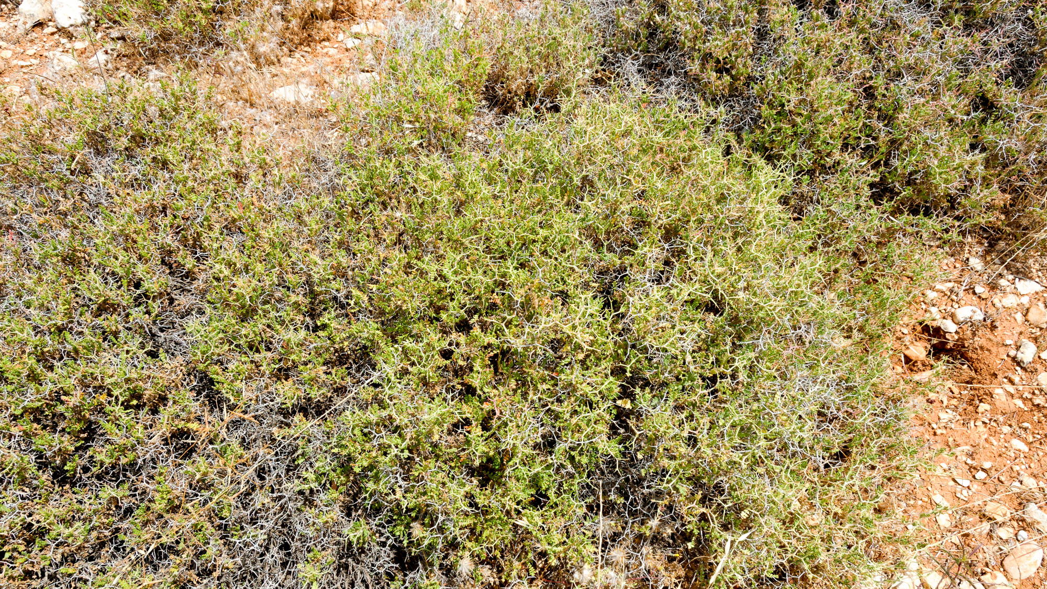
And other seed fell amidst the thorns, and the thorns grew up with it and choked it
Thorny burnet near Baal Hazor
8:7
Notes:
tb052916357

Slide 36
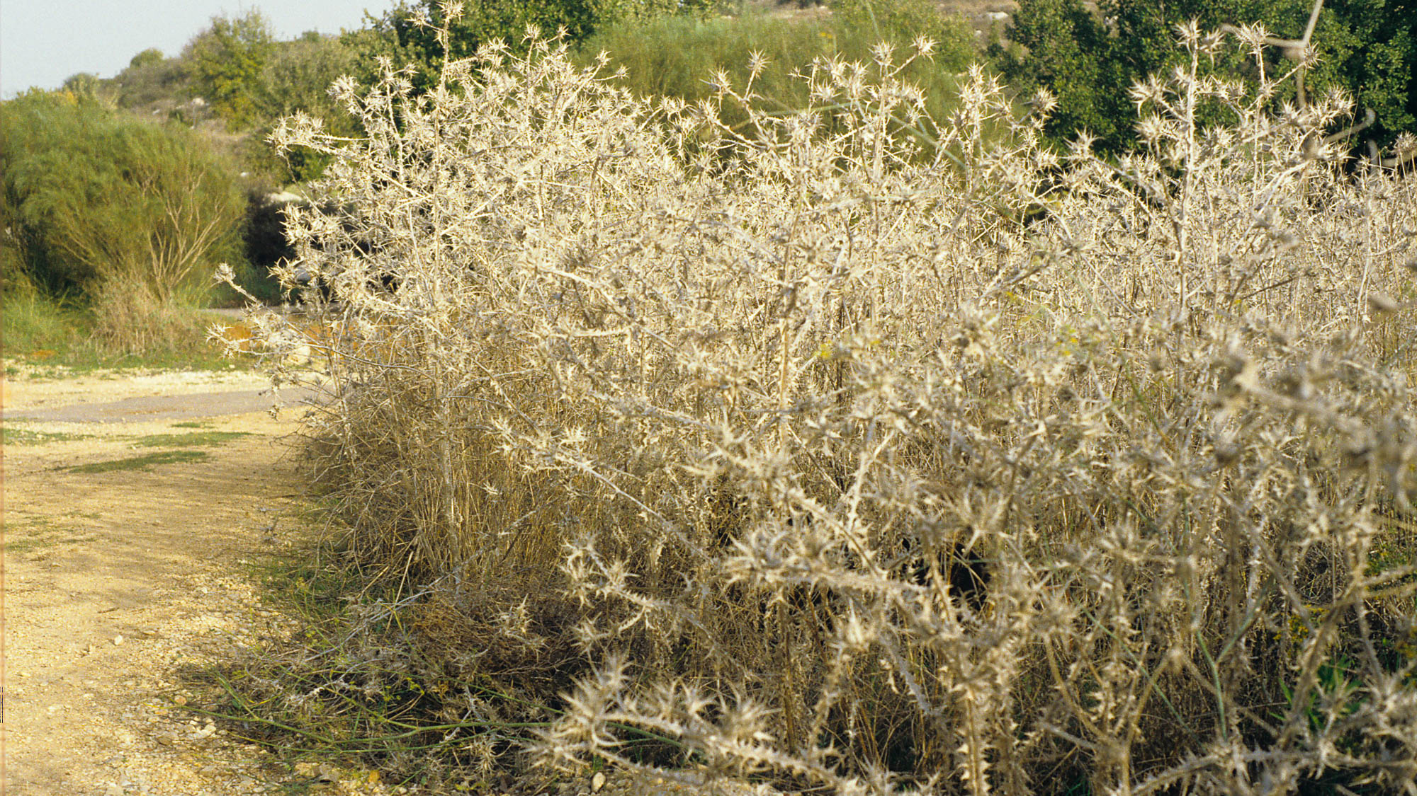
And other seed fell amidst the thorns, and the thorns grew up with it and choked it
Common thistle at Neot Kedumim
8:7
Notes:
This photograph was taken at Neot Kedumim Biblical Landscape Reserve.
gs110094b204

Slide 37
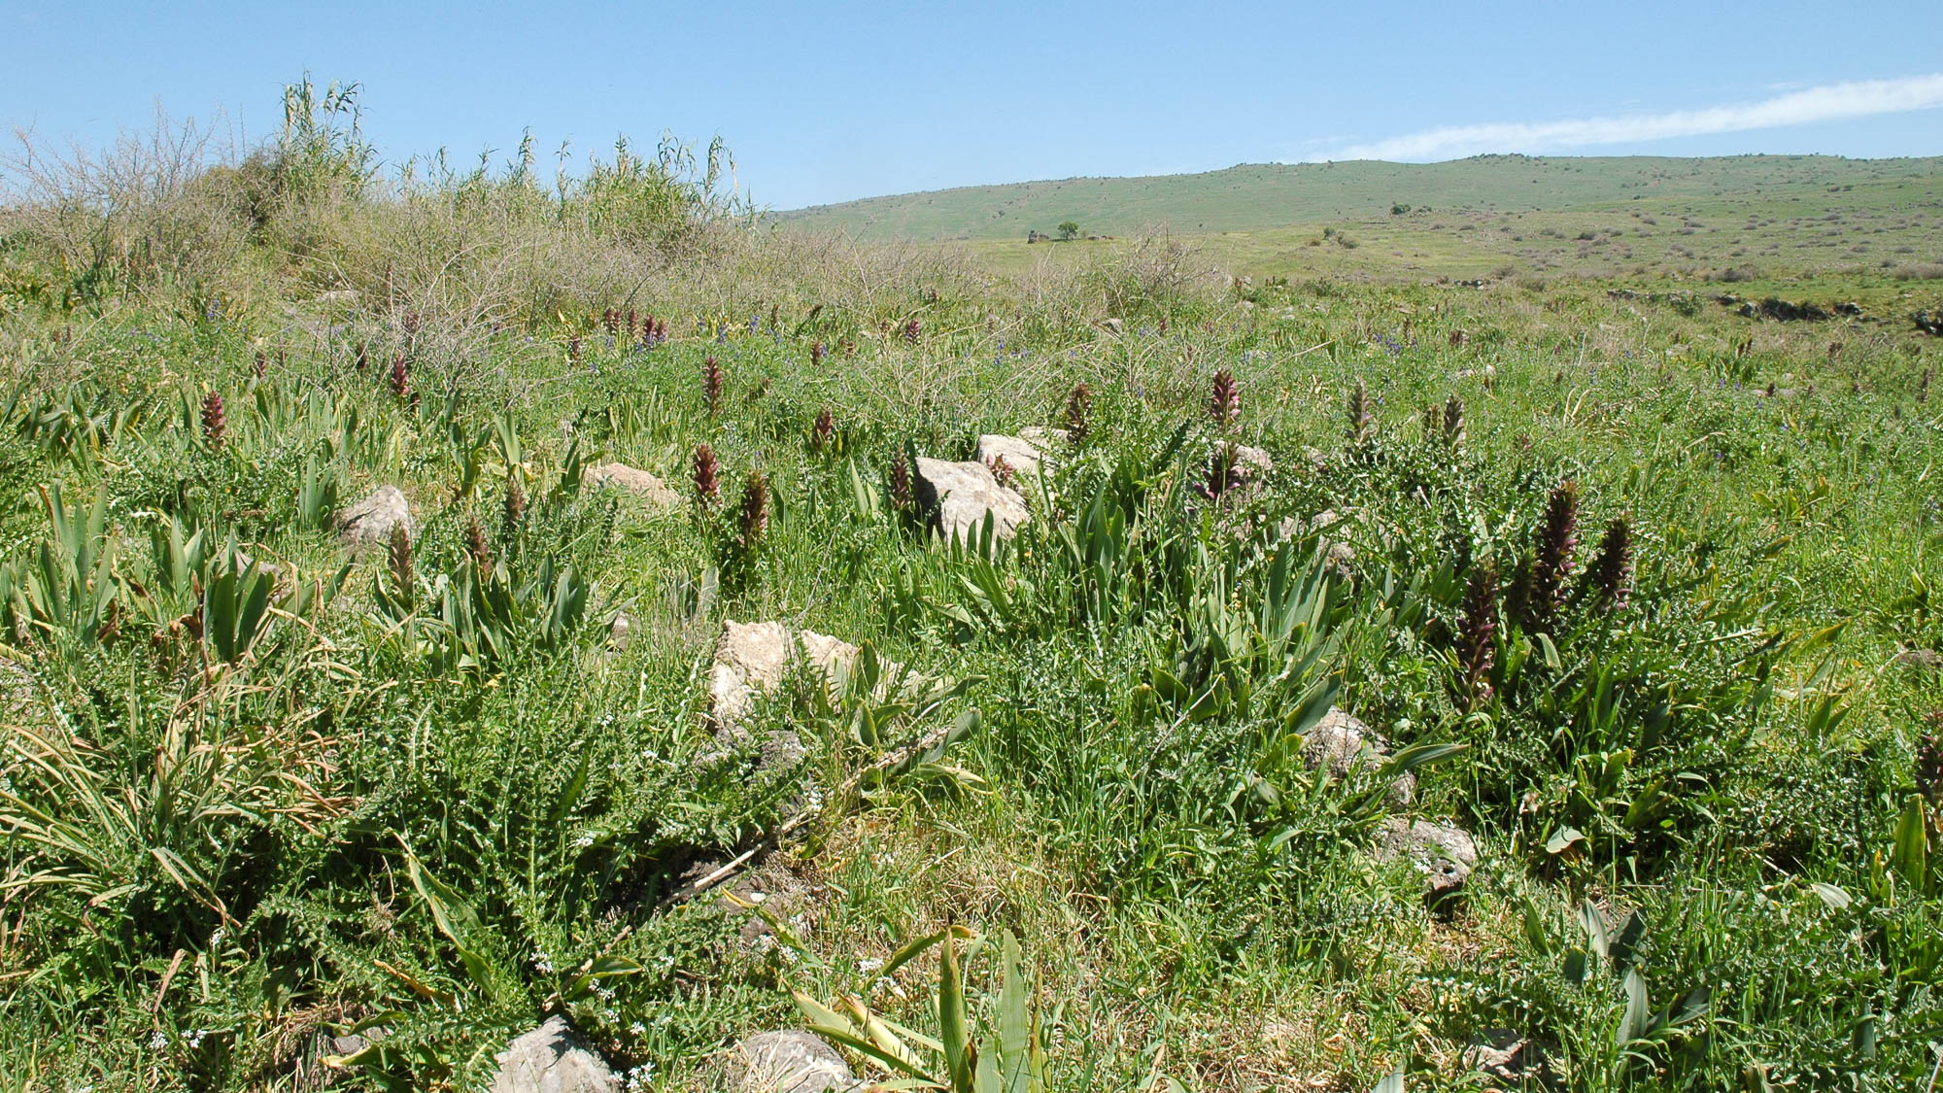
And other seed fell amidst the thorns, and the thorns grew up with it and choked it
Field with thorns in Galilee, near Omrit
8:7
Notes:
Omrit is located south of Caesarea Philippi near the northern border of Israel.
tb032905148

Slide 38
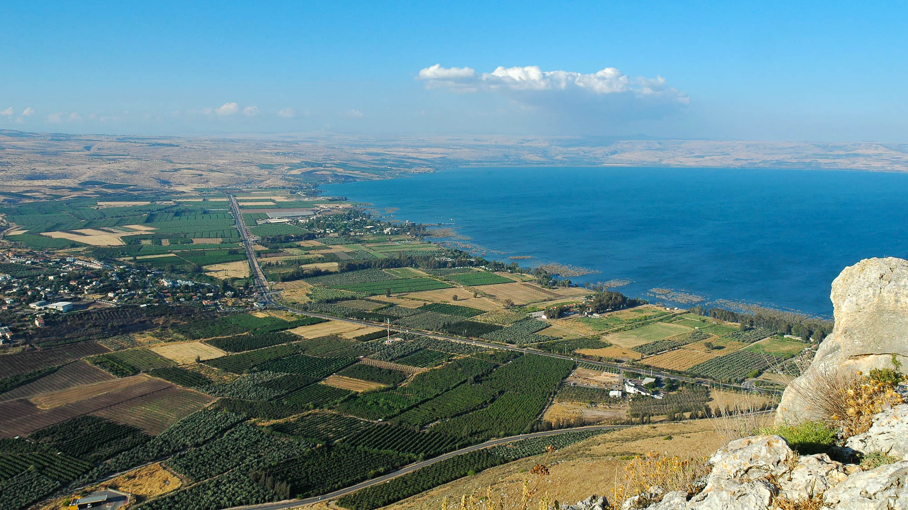
And other seed fell onto good soil, and grew, and yielded a hundredfold crop
Plain of Gennesaret (from Arbel)
8:8
Notes:
The first-century Jewish historian Josephus wrote of the exceptional fertility of the Plain of Gennesaret.
tb053005508

Slide 39
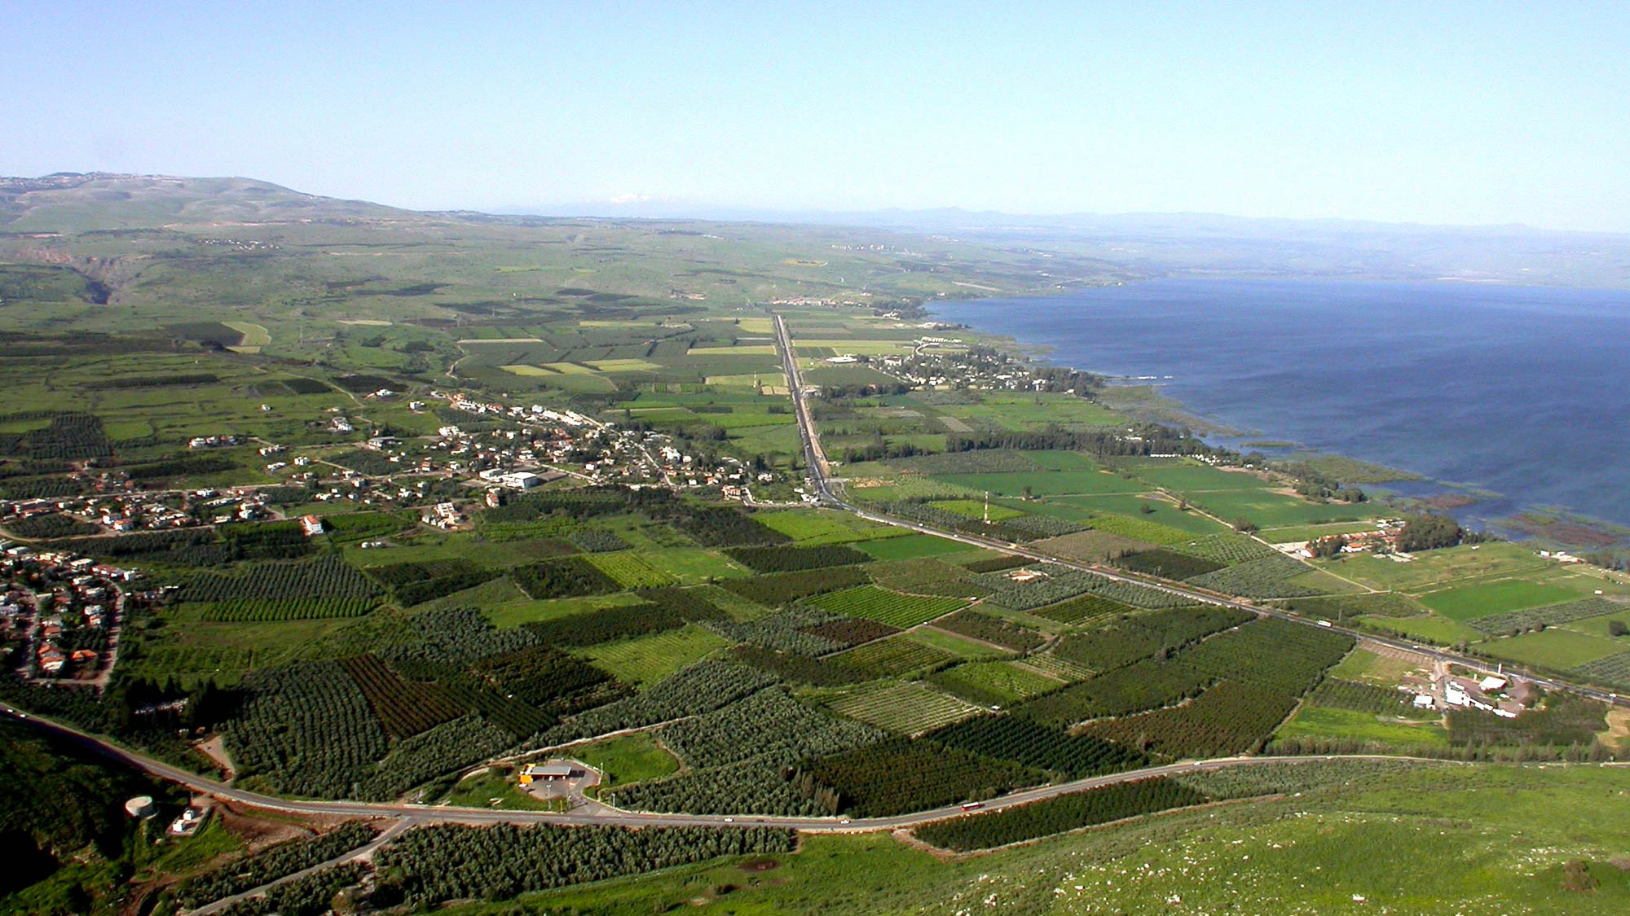
And other seed fell onto good soil, and grew, and yielded a hundredfold crop
Plain of Gennesaret (from Arbel)
8:8
Notes:
The Plain of Gennesaret is situated along the western shore of the Sea of Galilee, southwest of Tabgha (Heptapegon) and the Cove of the Sower.
tb041003220

Slide 40
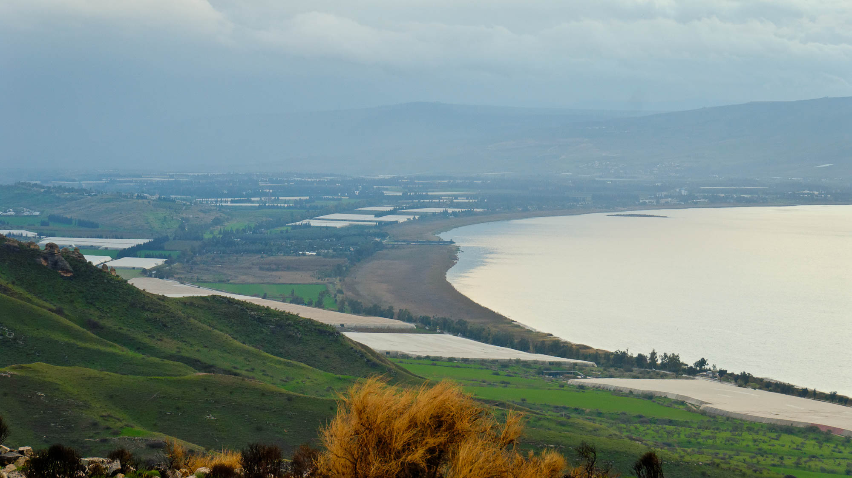
And other seed fell onto good soil, and grew, and yielded a hundredfold crop
Area of Gadara harbor on the Sea of Galilee
8:8
Notes:
Varrow, a Roman historian from the 1st century BC, wrote of two places that produced crops exceptionally well, one of which was Gadara. It produced a hundredfold—Jesus’s illustration was not an exaggeration.
tb011312538

Slide 41
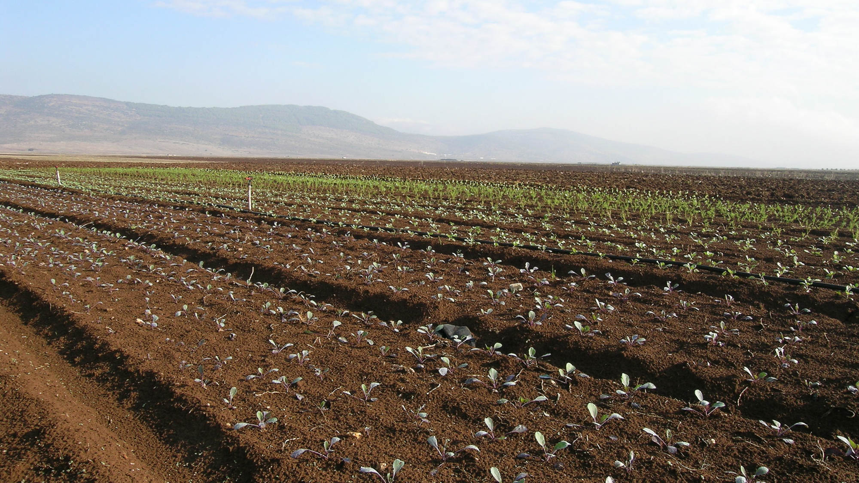
And other seed fell onto good soil, and grew, and yielded a hundredfold crop
Fertile fields in the Bet Netofa Valley
8:8
Notes:
The Bet Netofa Valley is located in Lower Galilee. This photo was taken in early November after planting.
tb110306550

Slide 42
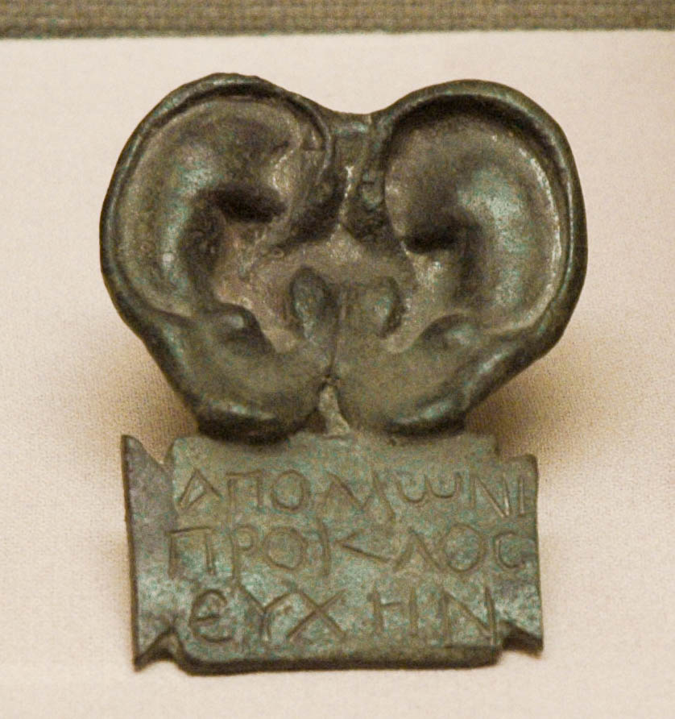
He who has ears to hear, let him hear!
Model of ears from the Asclepium of Pergamum
8:8
Notes:
The Asclepium at ancient Pergamum was an ancient pagan healing center. Body parts like the ears shown here would be created as sacrifices for healing. This model was photographed in the Bergama Museum.
tb041505897

Slide 43
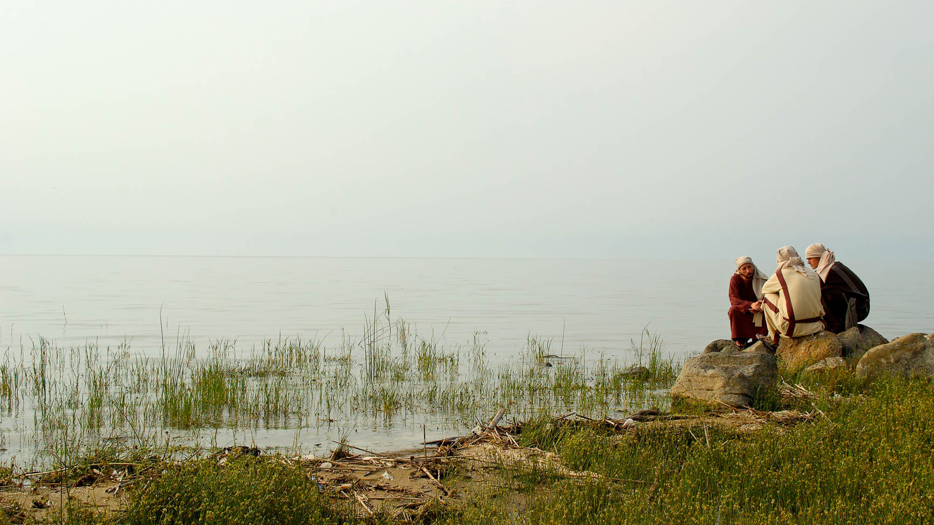
And His disciples asked Him what this parable might be
Reenactment of disciples on the Sea of Galilee shoreline
8:9
Notes:
This reenactment was photographed on a hazy spring day on the eastern shore of the Sea of Galilee.
tb040706265

Slide 44
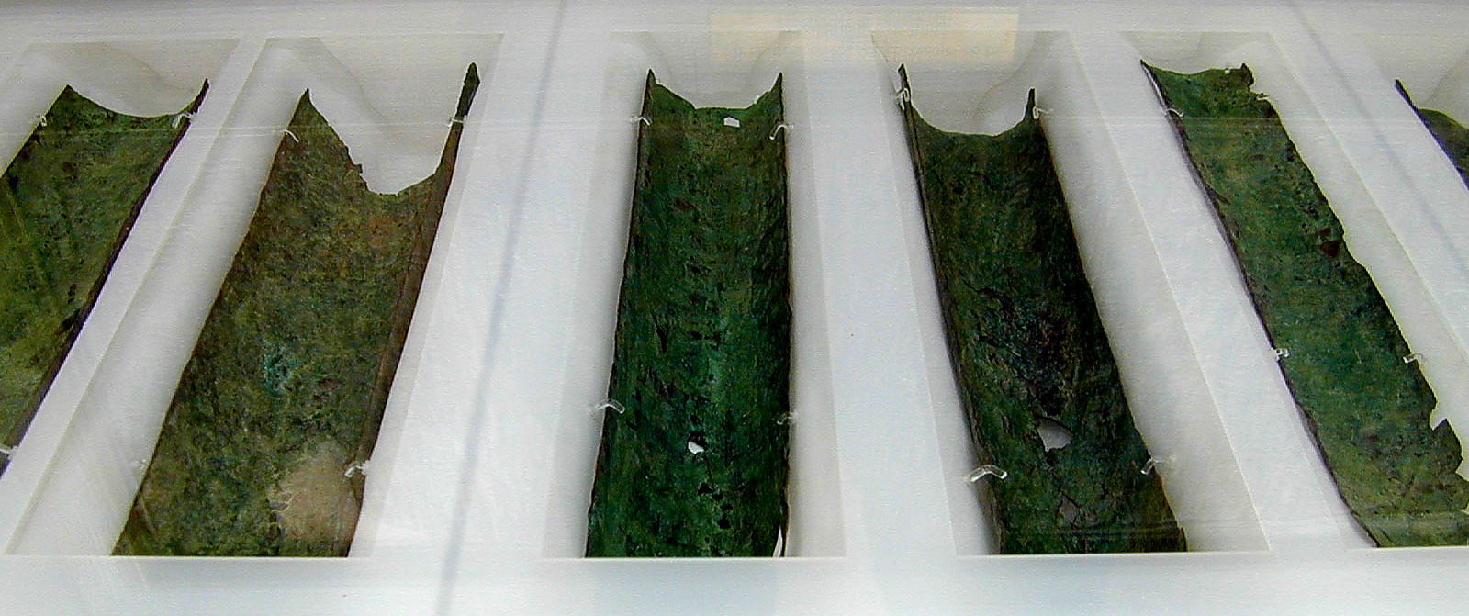
To you it is given to know the mysteries of the kingdom of God
Copper Scroll, listing treasures hidden in Judean wilderness
8:10
Notes:
The “mysteries” that Jesus revealed were previously unrevealed truths about the kingdom of God. The Copper Scroll shown above was a list of secret treasures apparently hidden by a Jewish sect in the first century. The Copper Scroll is one of the most famous Dead Sea Scrolls, providing a list of 63 treasures hidden in Jerusalem and the Judean wilderness. In 1956, the total value of the treasures was appraised at $60 million. The Copper Scroll is now on display in the Jordan Museum in Amman.
tb031801017h

Slide 45
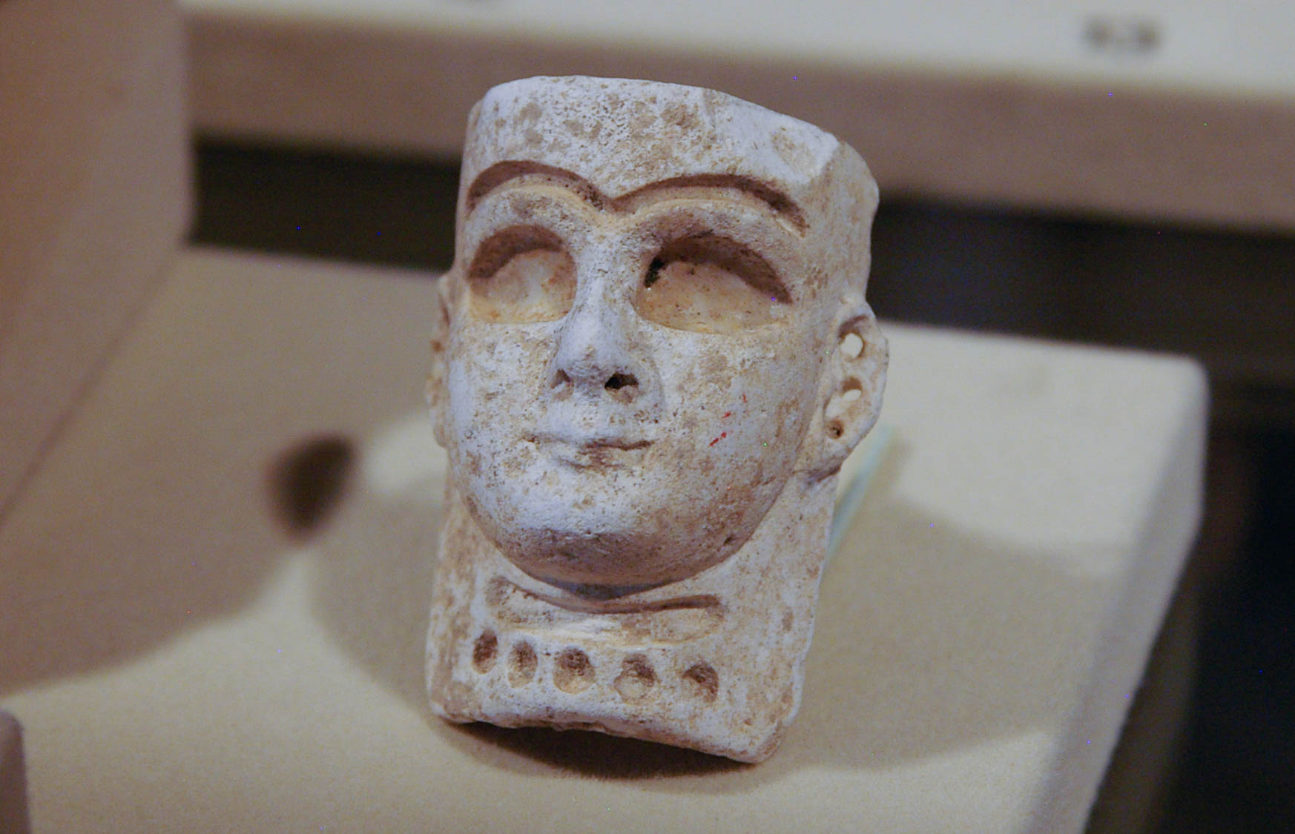
That seeing they may not see
Mesopotamian face pendant with hollowed eyes and eyebrows, 14th–13th centuries BC
8:10
Notes:
Bitumen inlays were placed in the hollowed out areas of this necklace pendant. This artifact was photographed in the Eretz Israel Museum in Tel Aviv.
adr0807103831

Slide 46
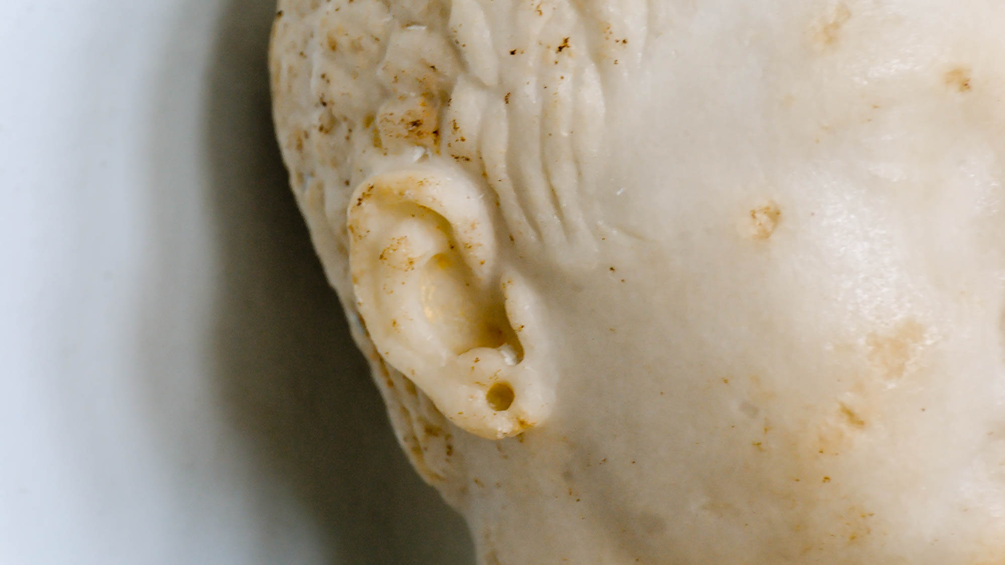
That hearing they may not understand
Head of girl with ear piercing, from the island of Cos, 1st century AD
8:10
Notes:
This statue was photographed in the Cos Museum.
tb062006718

Slide 47
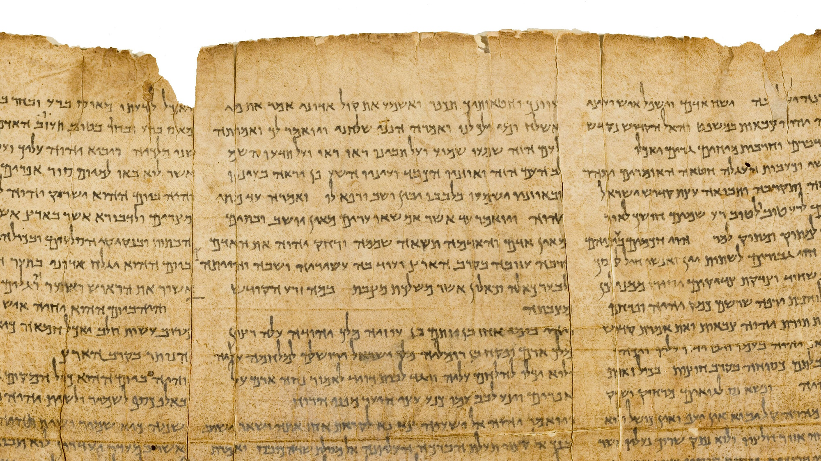
That seeing they may not see, that hearing they may not understand
Isaiah 6:9-10 on the Great Isaiah Scroll
8:10
Notes:
“And he said, Go, and tell this people, Hear ye indeed, but understand not; and see ye indeed, but perceive not. Make the heart of this people fat, and make their ears heavy, and shut their eyes; lest they see with their eyes, and hear with their ears, and understand with their heart, and turn again, and be healed” (Isa 6:9–10, ASV).
At this point in His ministry, Jesus recognized that the people had rejected His ministry and thus would face the same judgment as Isaiah’s contemporaries. Thus Jesus’s continued teaching would, like Isaiah’s, serve only to harden their hearts and prepare them for divine punishment.
The Great Isaiah Scroll is owned by the Israel Museum. This image is public domain, from Wikimedia: https://commons.wikimedia.org/wiki/File:The_Great_Isaiah_Scroll_MS_A_(1QIsa)_-_Google_Art_Project-x3-y0.jpg
isax3y0

Slide 48
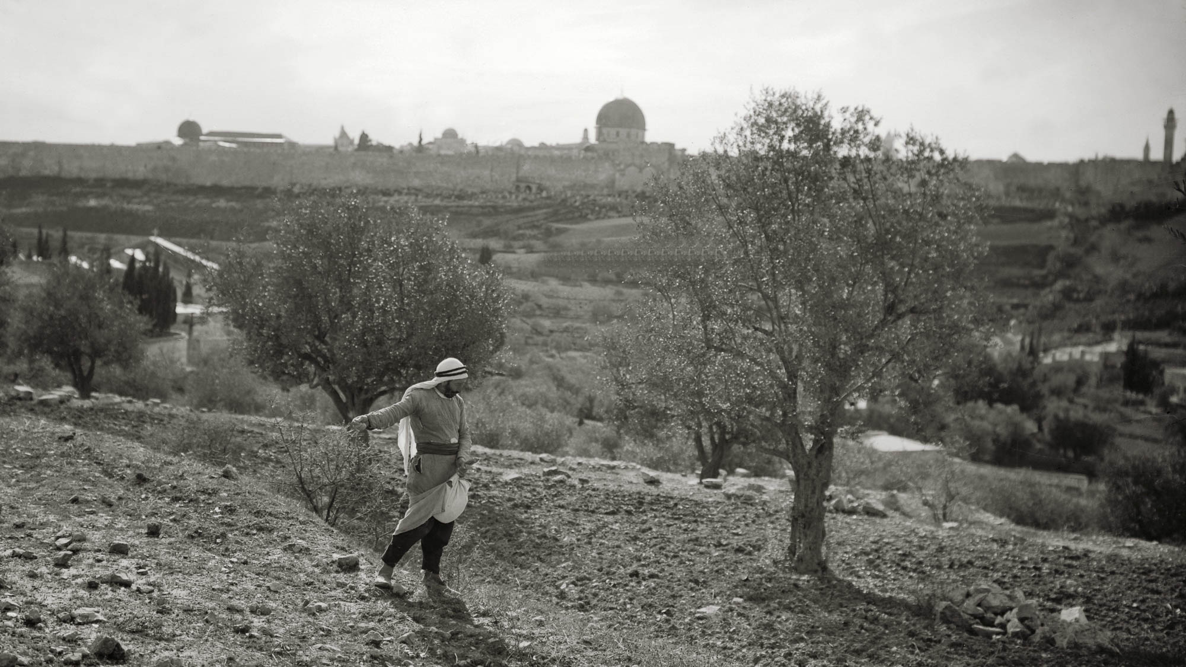
Now the parable is this: The seed is the word of God
Sowing grain on the Mount of Olives
8:11
Notes:
This photo was taken by a photographer from the American Colony between 1920 and 1933. The walls of the Old City are visible in the background, and the peak of the façade of the Church of All Nations (Gethsemane) is visible on the left. On the horizon, the three domes are (from left to right) the Al Aqsa Mosque, the Hurvah Synagogue (destroyed in 1948), and the Dome of the Rock.
mat02971

Slide 49
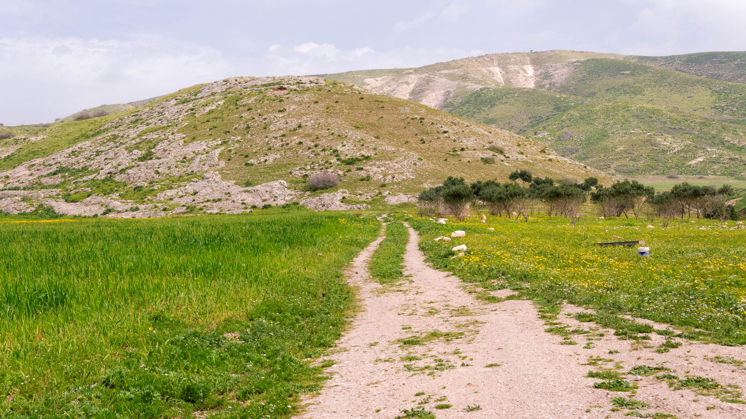
Those by the road are those who have heard . . .
Dirt road near Umm ed-Dabar
8:12
Notes:
Umm ed-Dabar is a possible location for biblical Lo-Debar. It is located south of the Sea of Galilee on the eastern side of the Jordan River.
tb030915580

Slide 50
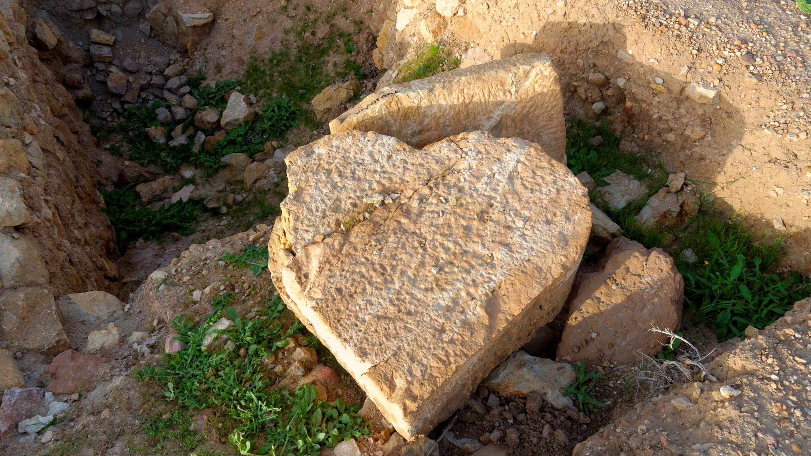
Then the devil comes and takes away the word from their hearts
Heart-shaped column drum on summit of Penuel
8:12
Notes:
Recent excavations on the summit of Tell adh-Dhahab al-Garbiyya have revealed heart-shaped columns, probably from a Roman-era structure.
tb030815351

Slide 51
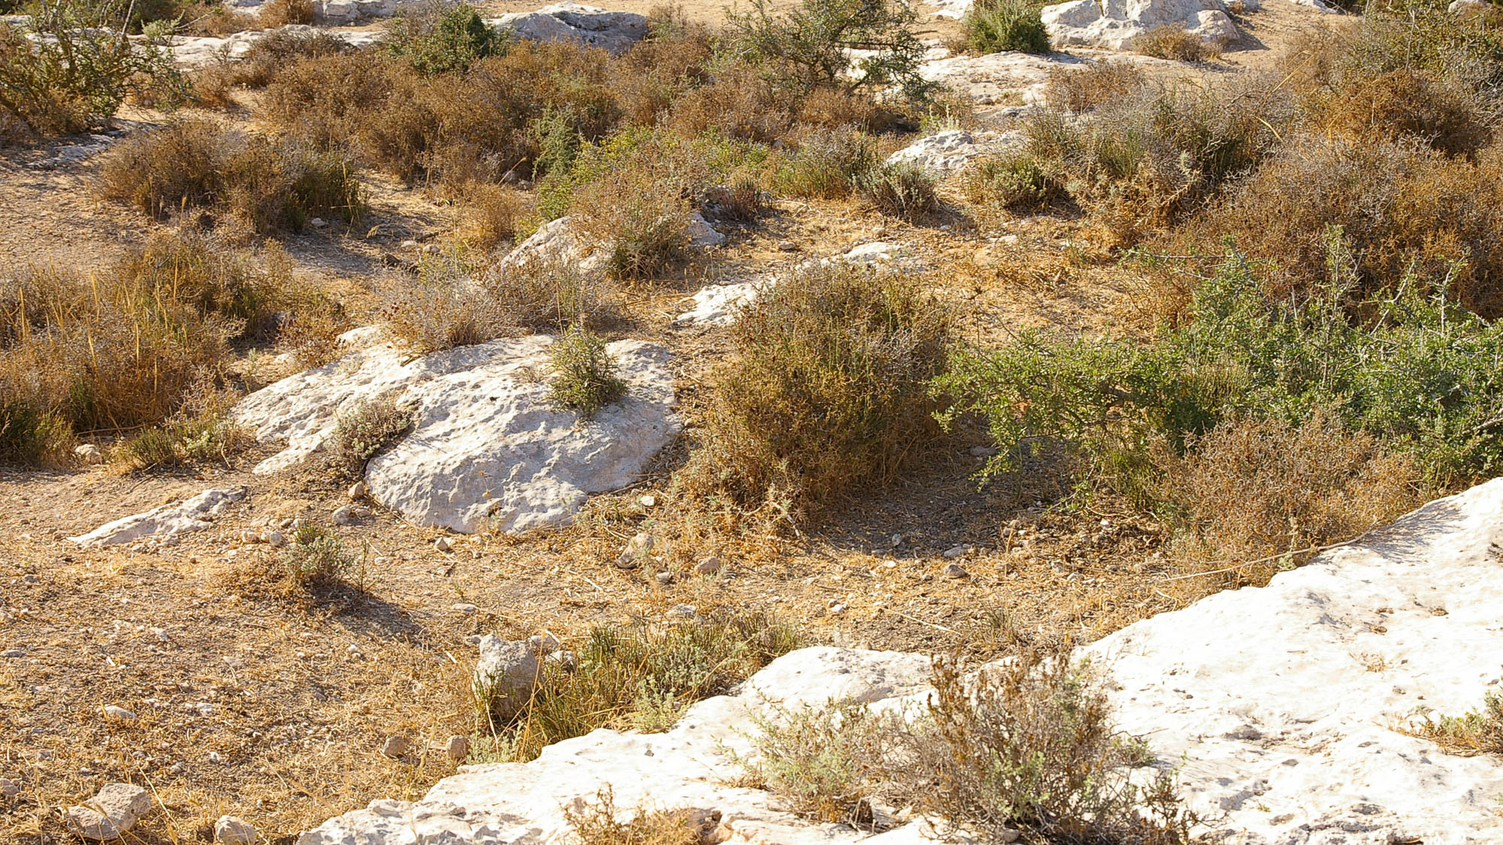
And those on the rock are those who . . . have no root
Rocky ground near the ancient Philistine city of Gath
8:13
Notes:
This illustration gives a good example of the rocky and thorny soil that the ancient farmer had to contend with.
adr08072470311

Slide 52

And that which fell among the thorns . . .
Zilla spinosa near Shaharut
8:14
Notes:
Shaharut is located in the Negev about 25 miles (40 km) north of Eilat.
gs040100a11

Slide 53

They are choked by cares and riches and the pleasures of this life
Gold necklace from Sindos, 500 BC
8:14
Notes:
This necklace was photographed at the Thessalonica Archaeological Museum.
tb011301128

Slide 54

They are choked by cares and riches and the pleasures of this life
Roman coin belt, AD 370–400
8:14
Notes:
This coin belt with precious minerals in the buckle was photographed at the Getty Villa in California.
tb082214554

Slide 55

They are choked by cares and riches and the pleasures of this life
Inscription from Rome, “death renders us free of wealth and anxiety,” early 1st century AD
8:14
Notes:
This inscription comes from the funerary monument of Lucius Vettenius Musa Campester. It was photographed at the Capitoline Museum in Rome.
tb0514179686

Slide 56

And bring no fruit to maturity
Wheat field at Yad HaShmonah
8:14
Notes:
This wheat field was photographed at the Yad HaShmonah Biblical Gardens in the Judean hills.
tb020103820

Slide 57

And as for that in the good ground . . .
Plowed field in Huleh basin
8:15
Notes:
The Huleh Basin is located north of the Sea of Galilee. In the distance rise the mountains of Galilee, once home to the tribe of Naphtali.
tb032905095

Slide 58

These . . . in an honest and good heart . . . bear fruit with perseverance
Wheat near Mount Tabor
8:15
Notes:
The fields of the Jezreel Valley are especially productive for grain crops. The Jezreel Valley has been called the “breadbasket” of Israel.
tb041003821

Slide 59

No one after lighting a lamp covers it
Oil lamps from the Roman period
8:16
Notes:
This collection of oil lamps dates from AD 50–395 and thus provides a picture of oil lamps shortly after the years of Jesus’s earthly ministry. This display is located at the Barnabas Church Museum, Cyprus.
tb030305886

Slide 60

No one after lighting a lamp covers it
Oil lamps from Gezer
8:16
Notes:
These oil lamps date to the Hellenistic and Roman periods, and thus were common in the time of Jesus. They were photographed in the Istanbul Archaeological Museum.
tb041705849

Slide 61

No one after lighting a lamp covers it
Oil lamp on ledge in house at Qatzrin
8:16
Notes:
This oil lamp sits on a ledge in the wall so that it can light the house. This photo was taken at a reconstructed Talmudic (Byzantine-era) village at Qatzrin.
tb041103250

Slide 62

No one after lighting a lamp covers it with a container
Vessel from Roman house in Rabat, 1st century BC – 2nd century AD
8:16
Notes:
This artifact was photographed in the Domus Romana Museum on the island of Malta.
tb112005648

Slide 63

No one after lighting a lamp covers it with a container or puts it under a bed
Bedroom at Qatzrin
8:16
Notes:
This reconstruction was photographed at the Qatzrin Talmudic Village in the Golan Heights.
tb041103208

Slide 64

No one after lighting a lamp covers it with a container or puts it under a bed
Bed in upper room in the “Parables House” in Taybeh
8:16
Notes:
This traditional house is located in Taybeh, probably the site of New Testament Ephraim (John 11:54).
tb052916236

Slide 65

He puts it on a stand, so that those who enter may see the light
Lampstand illustration
8:16
Notes:
This oil lamp sits on a bronze stand. This illustration was photographed at the Ephesus Museum.
tb010501658

Slide 66

He puts it on a stand, so that those who enter may see the light
Candelabra floor stands for lamps (Greek and Roman)
8:16
Notes:
These Greek and Roman stands were used to elevate oil lamps so they could light an entire room. They were photographed in the Getty Villa in California.
tb082214135h

Slide 67

He puts it on a stand, so that those who enter may see the light
Lampstand, 1st century AD
8:16
Notes:
This bronze oil lamp and stand dates to the time of Jesus and Paul. It was photographed at the Ephesus Museum.
tb010501660

Slide 68

He puts it on a stand, so that those who enter may see the light
Oil lamp from the Roman period
8:16
Notes:
This oil lamp is in a private collection.
tb090416138

Slide 69

For there is nothing that will not be made manifest
Anchor buried in sand at Dor
8:17
Notes:
An earnest individual was digging this large anchor out of the sand when the photographer passed by on his way to Tel Dor.
tb090506864

Slide 70

For whosoever has, to him will be given more
Storehouses at Herculaneum
8:18
Notes:
The storehouses of Herculaneum were preserved by the eruption of Mount Vesuvius in AD 79.
tb111405862

Slide 71

For whosoever has, to him will be given more
Storehouses at Masada
8:18
Notes:
King Herod constructed large storehouses at his mountain fortress at Masada.
tb030907203

Slide 72

And it was reported to Him, “Your mother and Your brothers stand outside, desiring to see You”
Residential quarter in Capernaum
8:20
Notes:
Luke does not name the city where this event occurred, but the remains of this residential quarter in Capernaum provide an illustration of houses from that time period. A portion of the later synagogue is visible near the top of the photo.
tb011306448

Slide 73

Now it came about on one of those days that He and His disciples entered into a boat
Sea of Galilee boat from the 1st century AD
8:22
Notes:
This boat was discovered buried in mud along the shore of the Sea of Galilee in January 1986 and was treated in a preserving solution for a decade before being put on display in 2000 in the Yigal Alon Museum at Kibbutz Ginnosar.
tb060105629

Slide 74

Now it came about on one of those days that He and His disciples entered into a boat
Sea of Galilee boat from the 1st century AD
8:22
Notes:
The boat has been dated by scholars to 100 BC – AD 70. This date is based on construction techniques, Carbon 14 tests, and pottery found inside the boat. Datable material found with the boat includes an oil lamp, a cooking pot, and an arrowhead.
adr1305051095

Slide 75

Now it came about on one of those days that He and His disciples entered into a boat
Sea of Galilee boat from the 1st century AD
8:22
Notes:
Scholars believe that the boat was in use in the 1st century AD and was sunk during the Great Revolt (AD 66–70). Josephus tells us that in the war “the beaches were thick with wrecks.”
adr1305051109

Slide 76

Now it came about on one of those days that He and His disciples entered into a boat
Model of Sea of Galilee boat from the 1st century AD
8:22
Notes:
This model was photographed with the ancient boat at the Yigal Alon Museum at Kibbutz Ginnosar.
adr1305051072

Slide 77

Now it came about on one of those days that He and His disciples entered into a boat
Full-size replica of Sea of Galilee boat from the 1st century AD
8:22
Notes:
This boat was photographed at Kibbutz En Gev.
tb033104467

Slide 78

He said to them, “Let us go over to the other side of the lake”
Sea of Galilee from space
8:22
Notes:
See the next slide for the approximate route taken by Jesus and the disciples across the Sea of Galilee.
This image was taken by Expedition Crew 20 from the International Space Station and is provided by NASA’s Earth Observatory. Source: http://earthobservatory.nasa.gov/IOTD/view.php?id=40147
nasa40147

Slide 79
He said to them, “Let us go over to the other side of the lake”
Capernaum
Gadara harbor
Sea of Galilee from space
8:22
Notes:
This arrow shows the approximate route taken by Jesus and the disciples across the Sea of Galilee.
This image was taken by Expedition Crew 20 from the International Space Station and is provided by NASA’s Earth Observatory. Source: http://earthobservatory.nasa.gov/IOTD/view.php?id=40147
nasa40147

Slide 80

He said to them, “Let us go over to the other side of the lake”
Sea of Galilee (aerial view from the east)
8:22
Notes:
Jesus and the disciples traveled across the Sea of Galilee from Capernaum (right side) to the territory of the Gadarenes (left side). See the next slide for labels.
ws053016342

Slide 81
He said to them, “Let us go over to the other side of the lake”
Capernaum
Sea of Galilee (aerial view from the east)
8:22
Notes:
This arrow shows the direction of Jesus’s travel across the Sea of Galilee from Capernaum (Matt 8:5) to the territory of the Gerasenes (v. 26).
ws053016342

Slide 82

He said to them, “Let us go over to the other side of the lake”
Looking across the Sea of Galilee from Capernaum
8:22
Notes:
This photograph shows the eastern shore of the Sea of Galilee from the vicinity of Capernaum. Jesus traveled from Capernaum towards the eastern side, ultimately landing in the region of the Gerasenes/Gadarenes on the southeastern shore of the lake. See the next slide for labels.
tb040903267

Slide 83
He said to them, “Let us go over to the other side of the lake”
Bethsaida
Golan Heights
Kursi
Hippos
Looking across the Sea of Galilee from Capernaum
8:22
Notes:
This photograph shows the eastern shore of the Sea of Galilee from the vicinity of Capernaum. Jesus traveled from Capernaum towards the eastern side, ultimately landing in the region of the Gerasenes/Gadarenes on the southeastern shore of the lake.
tb040903267

Slide 84

He said to them, “Let us go over to the other side of the lake”
View towards the eastern shore of the Sea of Galilee
8:22
Notes:
Jesus and His disciples crossed from the northern end of the lake (left side) to the southeastern end (right). Hippos is located on the opposite side in the center. This photo was taken from Arbel.
tb100605559

Slide 85

And a fierce windstorm came down on the lake, and they were filling with water
Waves on the Sea of Galilee
8:23
Notes:
A storm in March 1992 sent waves more than 10 feet (3 m) high crashing into downtown Tiberias, causing significant damage.
tb040406047

Slide 86

And a fierce windstorm came down on the lake, and they were filling with water
Great storm on the Sea of Galilee
8:23
Notes:
This American Colony photograph was taken between 1900 and 1920.
mat21984

Slide 87

And a fierce windstorm came down on the lake, and they were filling with water
Great storm on the Sea of Galilee
8:23
Notes:
This hand-colored American Colony photograph was taken before 1946, and colorized by hand later.
mat23178

Slide 88

He awoke and rebuked the wind and the raging waves, and they ceased, and there was a calm
Calm waters of the Sea of Galilee (from the east)
8:24
Notes:
This view was taken from near Hippos. Part of the city of Tiberias is visible on the far right shore.
tb011212443

Slide 89

He awoke and rebuked the wind and the raging waves, and they ceased, and there was a calm
Calm waters of the Sea of Galilee (from the east)
8:24
Notes:
This photo was taken from the En Gev Holiday Village. The city of Tiberias is just out of view on the right side.
tb103106343

Slide 90

He awoke and rebuked the wind and the raging waves, and they ceased, and there was a calm
Calm water on the Sea of Galilee (north shore)
8:24
Notes:
This photo was taken from the Capernaum National Park (east of the ancient ruins).
adr1305061395

Slide 91

And they arrived at the country of the Gerasenes, which is opposite Galilee
Sea of Galilee (aerial view from the west)
8:26
Notes:
This photo shows the (alleged) area of the Gergesenes near the modern-day Kursi. As noted in the following slides, there is substantial reason to question whether a place known as “Gergesa” existed in the 1st century AD. The territory of the Gerasenes (and Gadarenes) is on the southeastern shore of the lake. For a detailed examination of this issue, see Todd Bolen, “Where Did the Possessed-Pigs Drown? Challenging Tradition and Respecting Textual Evidence.” In Lexham Geographic Commentary on the Gospels, ed. Barry J. Beitzel, 196–218. Bellingham, WA: Lexham Press, 2017. See the next slide for labels.
ws092616420

Slide 92
And they arrived at the country of the Gerasenes, which is opposite Galilee
Gergesenes
Gerasenes
Sea of Galilee (aerial view from the west)
8:26
Notes:
This photo shows the (alleged) area of the Gergesenes near the modern-day Kursi. As noted in the following slides, there is substantial reason to question whether a place known as “Gergesa” existed in the 1st century AD. The territory of the Gerasenes (and Gadarenes) is on the southeastern shore of the lake. For a detailed examination of this issue, see Todd Bolen, “Where Did the Possessed-Pigs Drown? Challenging Tradition and Respecting Textual Evidence.” In Lexham Geographic Commentary on the Gospels, ed. Barry J. Beitzel, 196–218. Bellingham, WA: Lexham Press, 2017.
ws092616420

Slide 93

And they arrived at the country of the Gerasenes, which is opposite Galilee
Cardo (main street) of Gerasa (from the south)
8:26
Notes:
There is a well-known textual variant here and in 8:37, between “Gerasenes,” “Gadarenes,” and “Gergesenes.” The best manuscript evidence supports the reading “Gerasenes,” as also in Mark 5:1, although the parallel in Matthew 8:28 has “Gadarenes.” There is no contradiction, however, since Gadara was a city within the district of Gerasa. Gerasa was the leading city of the Decapolis.
tb052908655

Slide 94

And they arrived at the country of the Gerasenes, which is opposite Galilee
Sea of Galilee and the Yarmuk Valley from Gadara
8:26
Notes:
This is a view towards the Sea of Galilee from Gadara. The district of Gadara stretched to the lake and included a harbor on the Sea of Galilee. See the next slide for a telephoto image from this same location.
tb030915686p

Slide 95

And they arrived at the country of the Gerasenes, which is opposite Galilee
Sea of Galilee shoreline from Gadara
8:26
Notes:
This picture was taken from Gadara and shows a portion of the district controlled by the city.
tb060503128

Slide 96

A certain man met Him . . . who had demons . . . he did not live in a house, but in tombs
First century cemetery in Jericho
8:27
Notes:
Ancient cemeteries were not like modern ones. Instead of sleeping among open-air rows of tombstones, the demoniac would have dwelt in caves like these, probably nestled between sarcophagi. This extensive cemetery is located on the outskirts of Jericho.
tb051106920

Slide 97

A certain man met Him . . . who had demons . . . he did not live in a house, but in tombs
Tombs south of Hippos, Roman period
8:27
Notes:
These tombs, east of the Sea of Galilee, are from about the time period of Jesus’s ministry. They are located south of Kursi (aka Gergesa) and north of the region of Gadara.
ws102017054

Slide 98

A certain man met Him . . . who had demons . . . he did not live in a house, but in tombs
Tomb south of Hippos, Roman period
8:27
Notes:
Burial caves were large enough for people to move around in and sleep in. Many ancient tombs have been re-used by people over the millennia.
ws102017166

Slide 99

A certain man met Him . . . who had demons . . . he did not live in a house, but in tombs
Tomb with burial niches south of Hippos, Roman period
8:27
Notes:
These burial niches are characteristic of tombs from the time of Jesus.
ws102017167

Slide 100

For a long time he had worn no clothes
Greek kouros, 530 BC
8:27
Notes:
This limestone statue was photographed in the Walters Art Museum in Baltimore. A removable box has been added to avoid causing offense or surprise.
adr1311245366

Slide 101

For a long time he had worn no clothes
Naked men collecting salt from Dead Sea lagoon
8:27
Notes:
This American Colony photograph was taken between 1900 and 1920. A removable box has been added above to avoid causing offense or surprise.
mat01748

Slide 102

And when he saw Jesus, he cried out and fell down before Him
Farming supervisors prostrated before the deceased in the tomb of Renni at El-Kab
8:28
Notes:
adr1603226728

Slide 103

And he was kept under guard and bound with chains and fetters
Relief of prisoners, from Miletus, 2nd–3rd century AD
8:29
Notes:
This artifact was photographed in the Istanbul Archaeological Museum.
tb122922407

Slide 104

And he was kept under guard and bound with chains and fetters
Iron chains worn by slaves, 1st century AD
8:29
Notes:
These iron shackles were photographed at the Spartacus Exhibit in Rome.
tb0518174080

Slide 105

And he was kept under guard and bound with chains and fetters
Iron chains worn by slaves, 1st century AD
8:29
Notes:
These iron shackles were photographed at the Spartacus Exhibit in Rome.
tb0518174081

Slide 106

For it had often gripped him . . . and . . . he was driven by the demon into desolate places
Sea of Galilee from Gadara
8:29
Notes:
The demon-possessed man had many desolate places in this area in which he could hide.
tb060503104

Slide 107

Jesus asked him, “What is your name?” And he said, “Legion,” for many demons had entered him
Tile with Tenth Roman Legion stamp, from Jerusalem, 1st or 2nd century AD
8:30
Notes:
A legion was a unit of about 6,000 Roman soldiers. This artifact was photographed in the Israel Museum.
tb032014725

Slide 108


Jesus asked him, “What is your name?” And he said, “Legion,” for many demons had entered him
Bronze coin from Judea with legionary countermarks
8:30
Notes:
This coin is probably an overstrike of a bronze prutah of Alexander Jannaeus. The reverse side is blank. The obverse contains two countermarks of Roman legions, each contained within a rectangular incuse. The first is LVIF, referring to Legio VI Ferrata. Only part of the V and the IF are showing. This is overstruck by a galley (upside down in this photo), which was an insignia of Legio X Fretensis. Both of these legions fought in the Jewish War; the Tenth subsequently became the legion which permanently occupied Judea. This coin is in the Jared James Clark Collection.
Obverse (left): tb030217787h
Reverse (right): tb030217791h

Slide 109

Now there was a herd of many swine feeding on the mountain
Herd of boars near Mount Olympus
8:32
Notes:
Pigs do not graze near the Sea of Galilee today. These were photographed in Greece, not far from Mount Olympus.
tb051203104

Slide 110

Now there was a herd of many swine feeding on the mountain
Sculpture of boar being attacked by dogs, from Pompeii, 1st century AD
8:32
Notes:
This sculpture was discovered at Pompeii and is now on display in the Naples Archaeological Museum.
tb111705708

Slide 111

And the herd rushed down the steep slope into the lake and were drowned
Area of Gadara harbor
8:33
Notes:
This aerial photograph shows the “region of the Gadarenes,” the likely area where the pigs ran into the lake and were drowned. The city of Gadara had a harbor along the shore, remains of which have been discovered in recent years. An archaeological survey discovered Roman-period tombs near Tell Samra as well as a Byzantine chapel at the site. One can speculate that this church commemorated the site of a miracle in Jesus’s ministry, but this cannot be proved given the poor state of preservation of the chapel. The pigs may have been grazing on the steep slope behind Tell Samra. See the following slide for labels.
tbs117020011

Slide 112
And the herd rushed down the steep slope into the lake and were drowned
Steep slope
Tell Samra
Gadara harbor
Area of Gadara harbor
8:33
Notes:
This aerial photograph shows the “region of the Gadarenes,” the likely area where the pigs ran into the lake and were drowned. The city of Gadara had a harbor along the shore, remains of which have been discovered in recent years. An archaeological survey discovered Roman-period tombs near Tell Samra as well as a Byzantine chapel at the site. One can speculate that this church commemorated the site of a miracle in Jesus’s ministry, but this cannot be proved given the poor state of preservation of the chapel. The pigs may have been grazing on the steep slope behind Tell Samra.
tbs117020011

Slide 113

And the herd rushed down the steep slope into the lake and were drowned
Gadara harbor area with hill
8:33
Notes:
This photograph shows a view from the shoreline of the Sea of Galilee towards the hill where the pigs may have been grazing.
tb111800202

Slide 114

And the herd rushed down the steep slope into the lake and were drowned
Shoreline near Gadara harbor
8:33
Notes:
This shows a possible area where the pigs drowned.
ws033007001

Slide 115

And the herd rushed down the steep slope into the lake and were drowned
Sea of Galilee southeastern slope and shore
8:33
Notes:
If one accepts the earliest manuscripts as the best, then the most likely reconstruction of this event is that the swine were grazing on this hill before they rushed down it and plunged into the sea.
tb060305696

Slide 116

And the herd rushed down the steep slope into the lake and were drowned
Horses running near Sea of Galilee
8:33
Notes:
This photograph is the closest we have to a herd of animals running near the Sea of Galilee. Pigs do not graze near the Sea of Galilee today.
tb022107114

Slide 117

And the herd rushed down the steep slope into the lake and were drowned
Steep slope at Kursi (traditional site of event)
8:33
Notes:
A traditional location for the “swine dive” is at Kursi, but this is based upon late and inferior manuscripts that place the miracle in the land of the Gergesenes. This photo is included for those who prefer this site, but the previous photographs follow the earlier reading of the “land of the Gadarenes” (Matthew) and “land of the Gerasenes” (Mark and Luke).
tb032804322

Slide 118

And the herd rushed down the steep slope into the lake and were drowned
Kursi slope (aerial view from the north)
8:33
Notes:
ws040617565

Slide 119

And the herd rushed down the steep slope into the lake and were drowned
Kursi slope (aerial view from the north)
8:33
Notes:
ws012217044

Slide 120

And the herd rushed down the steep slope into the lake and were drowned
Kursi slope (aerial view from the south)
8:33
Notes:
This photograph shows an aerial view of the slope shown in the previous slide. This perspective shows the distance between the slope and the church presumed to commemorate this miracle. See the next slide for labels.
ws092816467

Slide 121
And the herd rushed down the steep slope into the lake and were drowned
Kursi church
Kursi slope
Kursi slope (aerial view from the south)
8:33
Notes:
This photograph shows an aerial view of the slope shown in the previous slide. This perspective shows the distance between the slope and the church presumed to commemorate this miracle.
ws092816467

Slide 122

And the herd rushed down the steep slope into the lake and were drowned
Kursi area (aerial view from the southwest)
8:33
Notes:
This photo shows the area of Kursi north of the slope identified as the location of the miracle shown in the previous slides. See the next slide for labels.
ws092816461

Slide 123
And the herd rushed down the steep slope into the lake and were drowned
Golan Heights
Nahal Samakh
Kursi church
Kursi slope
Kursi area (aerial view from the southwest)
8:33
Notes:
This photo shows the area of Kursi north of the slope identified as the location of the miracle shown in the previous slides.
ws092816461

Slide 124

And the herd rushed down the steep slope into the lake and were drowned
Byzantine church and hillside chapel at Kursi (aerial view from the northwest)
8:33
Notes:
This photo shows the church and hillside chapel built here in the Byzantine period. While some scholars have suggested that this commemorated the drowning of the pigs, there is nothing that clearly makes this identification. In any case, the area was already identified as the site by Origen in about AD 200, so a later church does not provide an independent witness to the location.
ws040617554

Slide 125

The herdsmen . . . fled, and told it in the city and in the country
Ruins of Gadara, with Sea of Galilee in the background
8:34
Notes:
This photograph shows the relationship between the city of Gadara and the Sea of Galilee. Those tending the pigs fled back to the city (presumably Gadara) in order to report what had happened.
tb060503103

Slide 126

The herdsmen . . . fled, and told it in the city and in the country
The Cardo of Gadara with shops
8:34
Notes:
This area of Gadara would have been a likely gathering place for a crowd of people.
tb030915741

Slide 127

The herdsmen . . . fled, and told it in the city and in the country
The Decumanus Maximus of Gadara (from the east)
8:34
Notes:
The Decumanus runs east to west through the city. It was the main street in town, much longer than the Cardo Maximus.
tb030915681

Slide 128

The herdsmen . . . fled, and told it in the city and in the country
Gadara western theater
8:34
Notes:
The western theater originally seated up to 3,000 spectators.
tb030915638

Slide 129

They . . . found the man . . . sitting, clothed and in his right mind, at the feet of Jesus
Man sitting under tent in Transjordan
8:35
Notes:
This American Colony photograph was taken in 1941.
mat06455

Slide 130
And He entered a boat and returned
Fisherman’s boat on the Sea of Galilee
8:37
Notes:
Arab fishermen ply their trade in this photochrom image from the 1890s.
pcm02740

Slide 131

And He entered a boat and returned
Sea of Galilee with boats near Tabgha
8:37
Notes:
This hand-colored American Colony photograph was taken before 1946.
mat22958

Slide 132
And He entered a boat and returned
Sea of Galilee from space
8:37
Notes:
See the next slide for the approximate route taken by Jesus and the disciples across the Sea of Galilee.
This image was taken by Expedition Crew 20 from the International Space Station and is provided by NASA’s Earth Observatory. Source: http://earthobservatory.nasa.gov/IOTD/view.php?id=40147
nasa40147

Slide 133
And He entered a boat and returned
Capernaum
Gadara harbor
Sea of Galilee from space
8:37
Notes:
This arrow shows the approximate route taken by Jesus and the disciples across the Sea of Galilee.
This image was taken by Expedition Crew 20 from the International Space Station and is provided by NASA’s Earth Observatory. Source: http://earthobservatory.nasa.gov/IOTD/view.php?id=40147
nasa40147

Slide 134
And He entered a boat and returned
Sea of Galilee (aerial view from the east)
8:37
Notes:
See the next slide for a label.
ws053016342

Slide 135
And He entered a boat and returned
Capernaum
Sea of Galilee (aerial view from the east)
8:37
Notes:
This arrow shows the direction of Jesus’s travel across the Sea of Galilee from the territory of the Gerasenes/Gadarenes back to Capernaum (Matt 9:1).
ws053016342

Slide 136

And He entered a boat and returned
Sea of Galilee (from the northwest)
8:37
Notes:
This photograph was taken by David Bivin in April 1967.
db6704101302

Slide 137

He departed, proclaiming throughout the whole city what great things Jesus had done for him
Decumanus Maximus of Gadara (from the east)
8:39
Notes:
This city is not named, but it may have been Gadara. The length of the Decumanus Maximus shows that Gadara was once an impressive city.
tb030915679

Slide 138


He departed, proclaiming throughout the whole city what great things Jesus had done for him
Bronze coin of the city of Gadara, 1st century BC, inscribed “of the Gadarenes”
8:39
Notes:
The obverse of this coin shows a turreted, veiled and draped bust of Tyche. The reverse depicts a cornucopia and is inscribed ΓΑΔΑΡΕωΝ (“of the Gadarenes”), with a date mark (ΕΚ[?] = year 25 of the Pompeian era, i.e., 39/38 BC). This coin is in the Jared James Clark Collection.
Reverse (left): tb030217866h
Obverse (right): tb030217861h

Slide 139

As Jesus returned, the crowd welcomed Him, for they were all waiting for Him
Capernaum from the Sea of Galilee
8:40
Notes:
Although the place to which Jesus returned is not named, it was likely Capernaum. Arriving by boat at Capernaum, Jesus would have had a view similar to this one, though the ancient harbor is no longer preserved.
tb011306464

Slide 140

As Jesus returned, the crowd welcomed Him, for they were all waiting for Him
Crowds on the beach at Ashkelon during Muslim celebrations
8:40
Notes:
This American Colony photograph was taken on April 20, 1943.
mat21670

Slide 141

There came a man named Jairus, and he was a ruler of the synagogue
Capernaum synagogue (western wall) with the Sea of Galilee
8:41
Notes:
This American Colony photograph shows the remains of the synagogue in the early 1900s. The site was purchased by the Franciscans in 1894 and the first excavations were carried out by H. Kohl and C. Watzinger in 1905. These were followed by F. V. Hinterkeuser, 1905–14, and P. Gaudentius Orfali, 1921–26.
mat05171

Slide 142

There came a man named Jairus, and he was a ruler of the synagogue
Capernaum synagogue and houses (from the south)
8:41
Notes:
This is the only known synagogue in Capernaum. The white limestone walls date from the 3rd–4th centuries, but an earlier synagogue from the time of Jesus lies below.
tb011306443

Slide 143

There came a man named Jairus, and he was a ruler of the synagogue
Capernaum synagogue (aerial view from the southeast)
8:41
Notes:
ws053016482

Slide 144

There came a man named Jairus, and he was a ruler of the synagogue
Capernaum synagogue interior
8:41
Notes:
Jesus taught and did miracles in this synagogue on a number of occasions, including those recorded in Mark 1 and John 6.
tb102602011

Slide 145

There came a man named Jairus, and he was a ruler of the synagogue
Tomb inscription of archon Delphinos, with menorah, 3rd century AD
8:41
Notes:
The last line of this inscription refers to a Jewish ἄρχων, “archon/ruler,” which is the word used by Luke in this verse. However, the inscription likely refers to a secular official. This was photographed in the Vatican Museums.
tb0518174192

Slide 146

For he had an only daughter, about twelve years of age
Young girl, from Magnesia on the Maeander, 1st century BC
8:42
Notes:
This statue was photographed at the Istanbul Archaeological Museum.
tb041705222

Slide 147

But as He went the crowds pressed against Him
Crowds gathered to protest Maccabee football game
8:42
Notes:
This American Colony photograph was taken between 1934 and 1939.
mat19316

Slide 148

A woman . . . who had spent all her living on physicians yet could not be healed by any
Medical instruments from Asclepium of Pergamum
8:43
Notes:
Some important manuscripts omit the clause “who had spent all her living on physicians,” but there are good arguments for regarding the phrase as authentic. These physician’s tools were discovered in Pergamum and are now on display in the Bergama Museum in Turkey.
tb041505899

Slide 149

A woman . . . who had spent all her living on physicians yet could not be healed by any
Medical instruments from the ancient world
8:43
Notes:
Luke is called “the beloved physician” in Colossians 4:14. In Luke’s account of this miracle, he puts the blame on the disease, rather than the physicians, by stating that “she could not be healed by anyone.” Mark 5:26 is less generous to the physicians, although it does not contradict Luke 8:43. This display of ancient medical tools was photographed in the Athens Archaeological Museum.
tb030806018

Slide 150

A woman . . . who had spent all her living on physicians yet could not be healed by any
Statue of Galen the physician near Pergamum Asclepium
8:43
Notes:
Galen was a famous physician from Pergamum. He lived in the 2nd century AD, and his impact on medicine extended for many centuries.
tb010417577

Slide 151

A woman . . . came behind Him, and touched the fringe of His garment
Fringes (tzitzit) of garment
8:44
Notes:
According to Numbers 15:38-39, the Israelites were to make tassels on the corners of their garments to remind them to obey God’s commandments. Jesus would later condemn the Pharisees for making their tassels long (Matt 23:5).
tb100906898

Slide 152

A woman . . . came behind Him, and touched the fringe of His garment
Hellenistic statue of man with cloak, circa mid-2nd–1st centuries BC
8:44
Notes:
This bronze statue was photographed in the Metropolitan Museum of Art in New York City.
adr1605242873

Slide 153

A woman . . . came behind Him, and touched the fringe of His garment
Painting of woman touching Jesus’s garment, in Duc In Altum chapel in Magdala
8:44
Notes:
This painting is the focal point of the Encounter Chapel in Duc In Altum, the chapel at Magdala.
tb053116468

Slide 154

A woman . . . came behind Him, and touched the fringe of His garment
The Woman with an Issue of Blood, by James Tissot, circa 1891
8:44
Notes:
This image is in the public domain, via the Brooklyn Museum: https://www.brooklynmuseum.org/opencollection/objects/13413.
bmny13413

Slide 155

Peter said, “Master, the crowds are surrounding and pressing against You!”
Large crowds of pilgrims at the Holy Fire ceremony at the Church of Holy Sepulcher
8:45
Notes:
This photo captures something of the busy nature of a crowd and highlights Jesus’s reaction in wondering at who touched him. This American Colony photo, taken between 1900 and 1920, shows a crowd of pilgrims gathered at the Church of the Holy Sepulcher to witness the “miracle” of the holy fire.
mat00873h

Slide 156

She came trembling, and falling down before Him
Male courtiers kiss ground before royal figure, from Tell el-Amarna, circa 1353–1336 BC
8:47
Notes:
This limestone object dates to the 18th dynasty and the reign of Akhenaten. It was photographed in the Metropolitan Museum of Art in New York City.
adr1605232386

Slide 157

And when He came to the house
Basalt houses in Capernaum
8:51
Notes:
The houses of Capernaum were constructed of basalt stone. These excavated houses provide the best picture of what the city looked like in the 1st century AD.
tb102602006

Slide 158

He permitted no man to enter with Him, except Peter
Bronze statue of Peter in Capernaum
8:51
Notes:
This one-ton statue was dedicated by Pope John Paul II in March 2000. It was created by the American sculptor Charles L. Madden.
adr1305051233

Slide 159

He permitted no man to enter with Him, except Peter and John
Apostle John painting, in Duc In Altum chapel in Magdala
8:51
Notes:
The Duc In Altum Church was dedicated in May 2014. Duc In Altum is Latin for “put out into the deep water,” recalling Jesus’s words in Luke 5:4.
tb053116483

Slide 160

He permitted no man to enter with Him, except Peter and John and James
Apostle James son of Zebedee painting, in Duc In Altum chapel in Magdala
8:51
Notes:
The Duc In Altum Church was dedicated in May 2014. Duc In Altum is Latin for “put out into the deep water,” recalling Jesus’s words in Luke 5:4.
tb053116480

Slide 161

And all were weeping and bewailing her
Musician figurines from Tyre, circa 1000–586 BC (figure on left is playing a double flute)
8:52
Notes:
According to Matthew 9:23, the crowd of mourners included flute players. These Iron Age II figurines date to about 700 years before the time of Jesus but they illustrate a scene that was certainly familiar in His day. They were photographed in the Beirut National Museum.
adr090509378

Slide 162

And all were weeping and bewailing her
Sarcophagus with mourning women, from Sidon necropolis, 4th century BC
8:52
Notes:
This sarcophagus was photographed at the Istanbul Archaeological Museum.
adr1006052979

Slide 163

She is not dead, but sleeping
Head of sleeping or dead girl, Imperial era copy of late Hellenistic Greek original, from Subiaco
8:52
Notes:
This head from a statue was photographed at the National Museum of Rome. It was carved in Asia Minor marble and comes from the Villa of Nero in Subiaco, near Rome.
tb0513177476

Slide 164

But He, taking her by the hand, called, saying, “Child, get up!”
Painting of Jesus raising the daughter of Jairus, in Duc In Altum chapel in Magdala
8:54
Notes:
The Duc In Altum Church was dedicated in May 2014. Duc In Altum is Latin for “put out into the deep water,” recalling Jesus’s words in Luke 5:4.
tb053116494

Slide 165

And He commanded that she be given something to eat
Meal preparation, fresco wall fragment, Roman, AD 50–75
8:55
Notes:
This fresco was photographed at the Getty Villa in southern California.
tb082214173

Slide 166

More than 3,000 slides in PowerPoint format. Available now from BiblePlaces.com.
Notes:
This is a free sample of the Luke 8 presentation from the Photo Companion to the Bible. To purchase the full volume, visit https://www.bibleplaces.com/luke/
The Photo Companion to the Bible is an image-rich resource for Bible students, teachers, and researchers. Just as a librarian stocks the shelves with as many relevant materials as possible, so we have tried to provide a broad selection of images. We do not expect many situations where someone will need, desire, or even approve of every image, but our goal is that you will find in this “library” whatever it is you are looking for.
Credits: The primary creators of this presentation are Steven D. Anderson, A.D. Riddle, and Todd Bolen. The photographs have an individual file code which usually includes the initials of the photographer. Other images have additional credit or source information.
Updates: We plan to update this collection as we are able. We welcome your suggestions for improving this resource (photocompanion@bibleplaces.com). Purchasers of the Luke volume are provided free, lifetime updates to the volume.
Copyright: This photo collection is protected by copyright law and may not be distributed without written permission from BiblePlaces.com. Slide notes should be treated as any other copyrighted written material, with credit given when quoting from these notes.
For more information, see our complete “Introduction to the Photo Companion to the Bible” online at http://www.BiblePlaces.com/Intro-Photo-Companion-Bible/. Here you will find more information about photo selection, explanatory notes, Bible translation, credit information, and copyright allowances.

