Slide 1
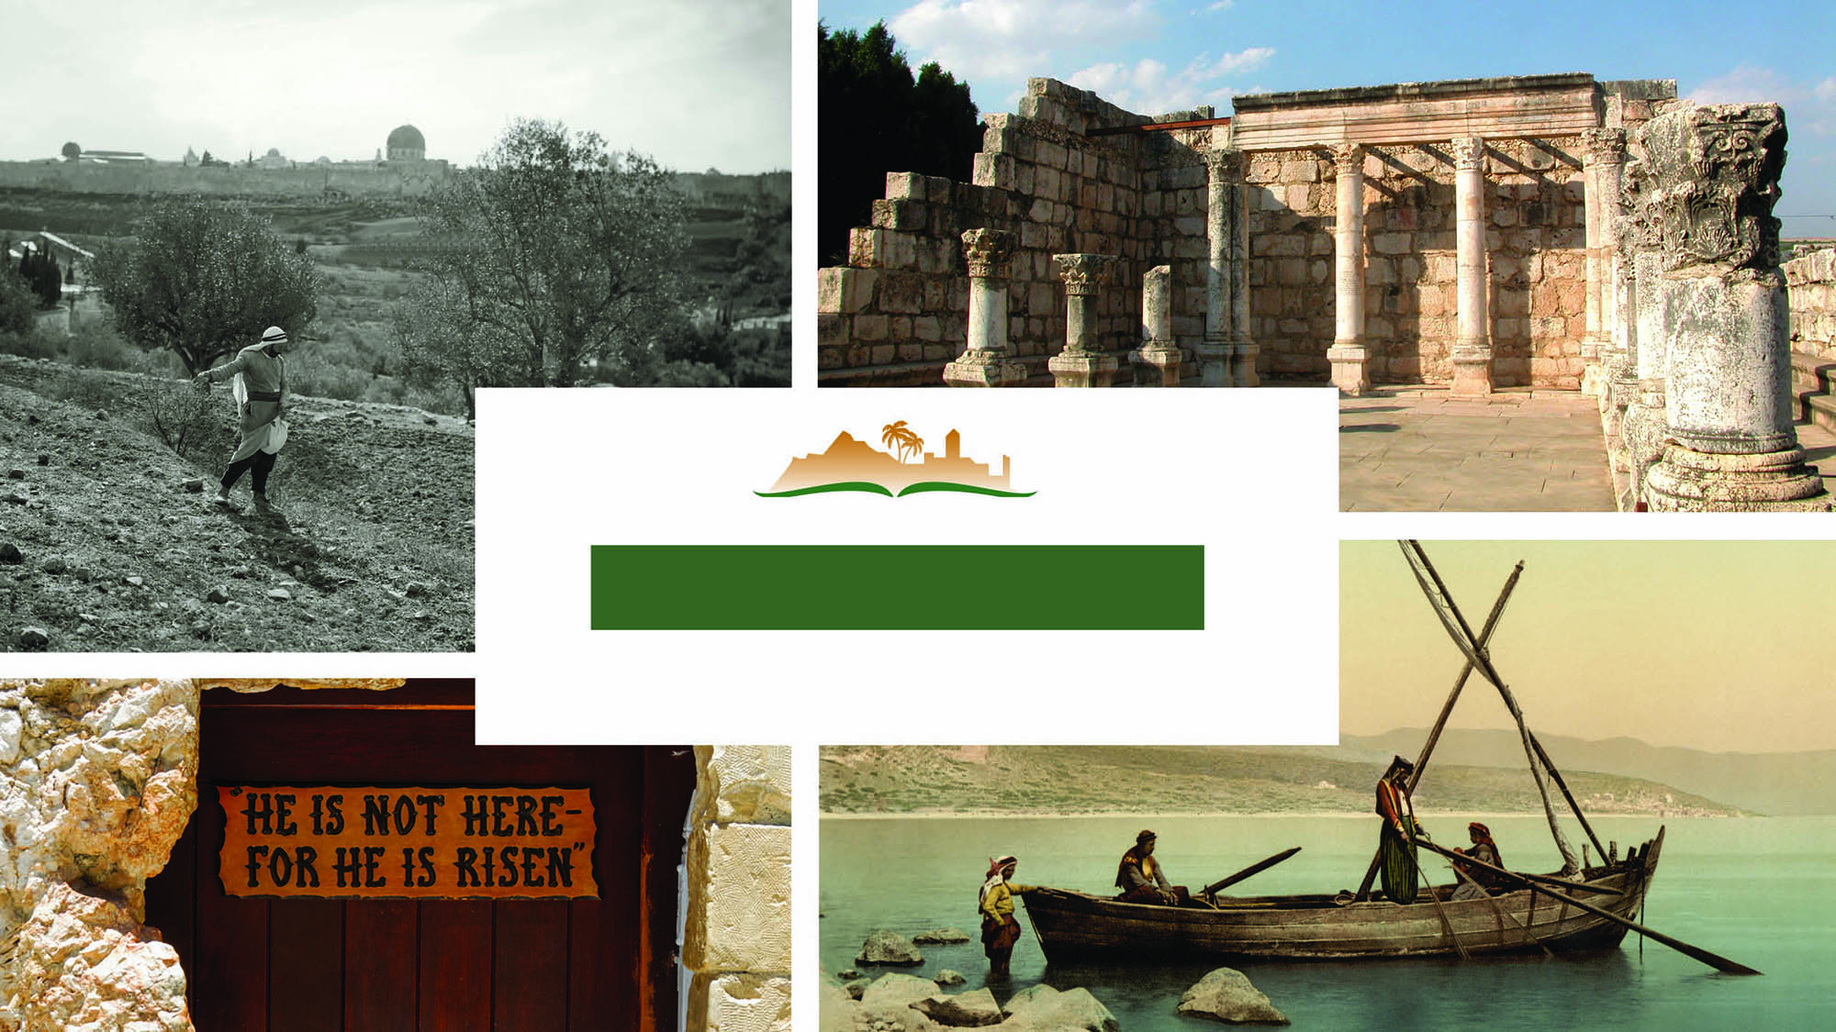
MARK 6
Notes:
This is a free sample of the Mark 6 presentation from the Photo Companion to the Bible. To purchase the full volume, visit https://www.bibleplaces.com/mark/
The Photo Companion to the Bible is an image-rich resource for Bible students, teachers, and researchers. Just as a librarian stocks the shelves with as many relevant materials as possible, so we have tried to provide a broad selection of images. We do not expect many situations where someone will need, desire, or even approve of every image, but our goal is that you will find in this “library” whatever it is you are looking for.
Credits: The primary creators of this presentation are Steven D. Anderson, A.D. Riddle, and Todd Bolen. The photographs have an individual file code which usually includes the initials of the photographer. Other images have additional credit or source information.
Updates: We plan to update this collection as we are able. We welcome your suggestions for improving this resource (photocompanion@bibleplaces.com). Purchasers of the Mark volume are provided free, lifetime updates to the volume.
Copyright: This photo collection is protected by copyright law and may not be distributed without written permission from BiblePlaces.com. Slide notes should be treated as any other copyrighted written material, with credit given when quoting from these notes.
For more information, see our complete “Introduction to the Photo Companion to the Bible” online at http://www.BiblePlaces.com/Intro-Photo-Companion-Bible/. Here you will find more information about photo selection, explanatory notes, Bible translation, credit information, and copyright allowances.

Slide 2
MARK 6
This is a free sample of the Mark 6 presentation from the Photo Companion to the Bible. To purchase the full volume, visit https://www.bibleplaces.com/mark/ The Photo Companion to the Bible is an image-rich resource for Bible students, teachers, and researchers. Just as a librarian stocks the shelves with as many relevant materials as possible, so we have tried to provide a broad selection of images. Our goal is that you will find in this “library” whatever it is you are looking for. For more details (for this and every slide), see the Notes section below.
Notes:
This is a free sample of the Mark 6 presentation from the Photo Companion to the Bible. To purchase the full volume, visit https://www.bibleplaces.com/mark/
The Photo Companion to the Bible is an image-rich resource for Bible students, teachers, and researchers. Just as a librarian stocks the shelves with as many relevant materials as possible, so we have tried to provide a broad selection of images. We do not expect many situations where someone will need, desire, or even approve of every image, but our goal is that you will find in this “library” whatever it is you are looking for.
Credits: The primary creators of this presentation are Steven D. Anderson, A.D. Riddle, and Todd Bolen. The photographs have an individual file code which usually includes the initials of the photographer. Other images have additional credit or source information.
Updates: We plan to update this collection as we are able. We welcome your suggestions for improving this resource (photocompanion@bibleplaces.com). Purchasers of the Mark volume are provided free, lifetime updates to the volume.
Copyright: This photo collection is protected by copyright law and may not be distributed without written permission from BiblePlaces.com. Slide notes should be treated as any other copyrighted written material, with credit given when quoting from these notes.
For more information, see our complete “Introduction to the Photo Companion to the Bible” online at http://www.BiblePlaces.com/Intro-Photo-Companion-Bible/. Here you will find more information about photo selection, explanatory notes, Bible translation, credit information, and copyright allowances.

Slide 3
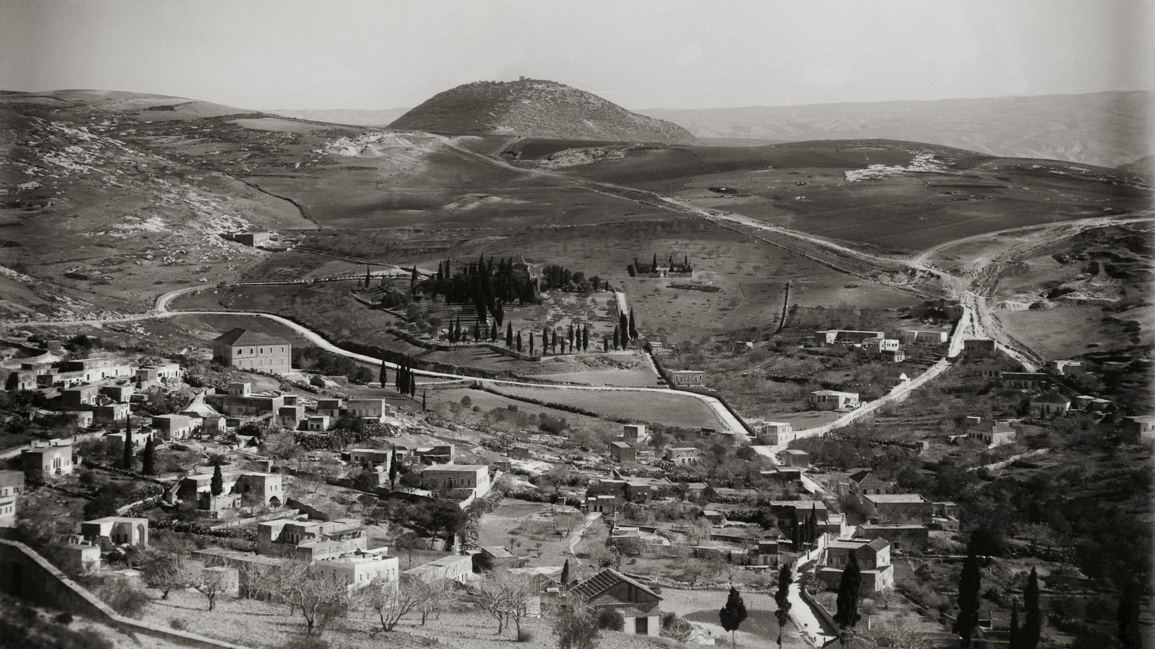
And He went out from there, and He came to His own hometown
Village of Nazareth (from the northwest)
6:1
Notes:
This photograph from the American Colony shows Nazareth in the early 1900s. Mount Tabor is visible in the distance.
mat05532

Slide 4
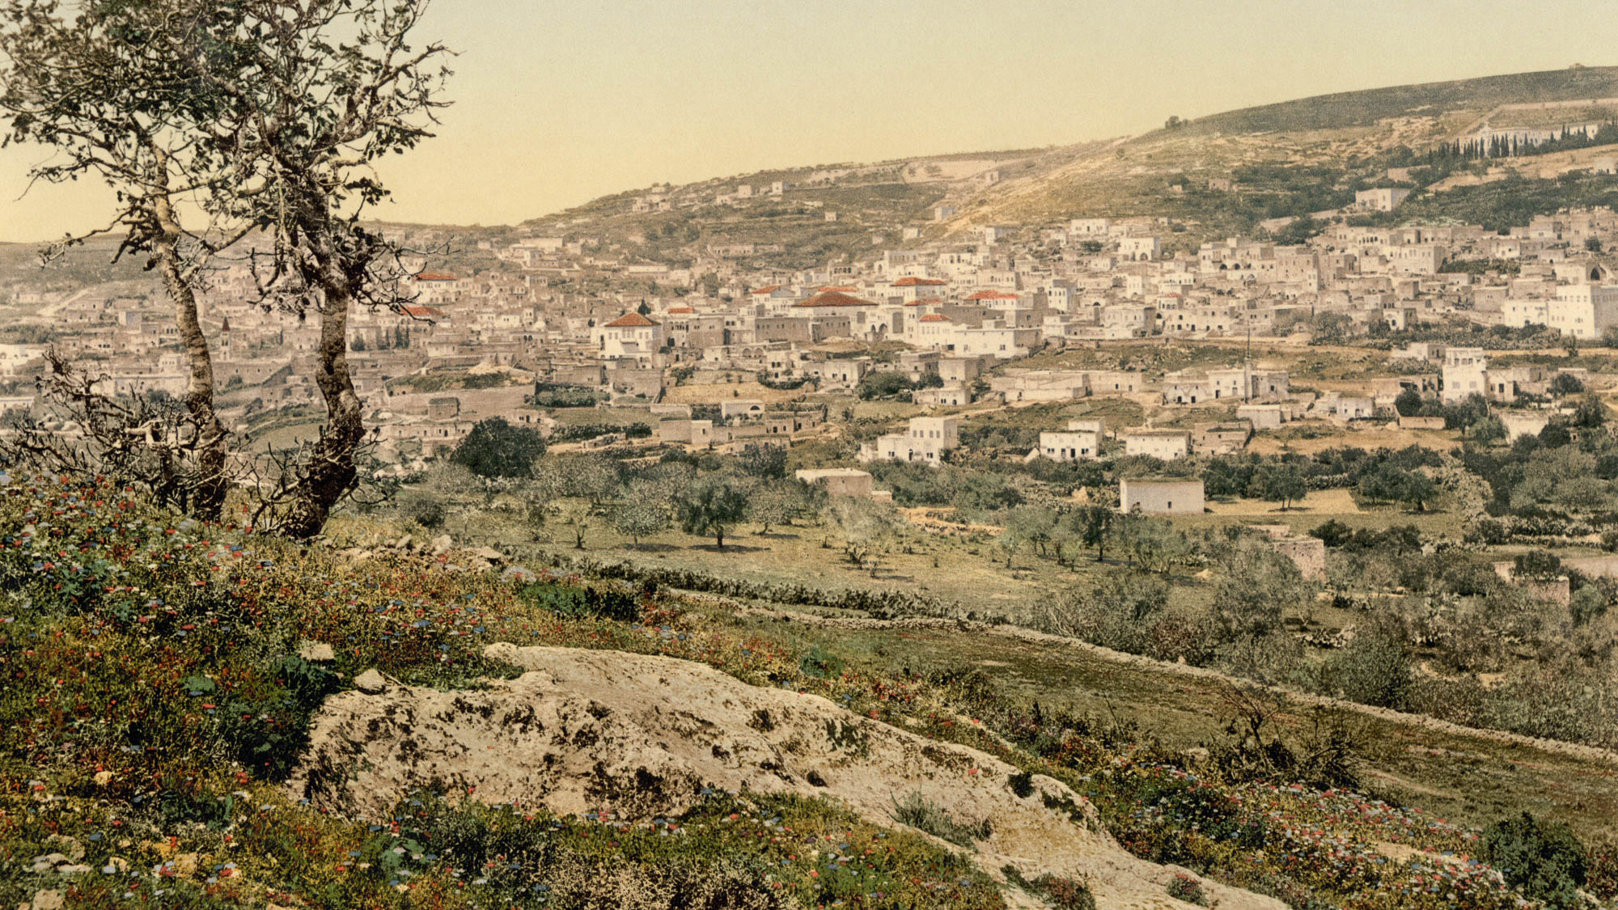
And He went out from there, and He came to His own hometown
Nazareth (from the east)
6:1
Notes:
This photochrom image was taken in the late 1800s.
pcm02729

Slide 5
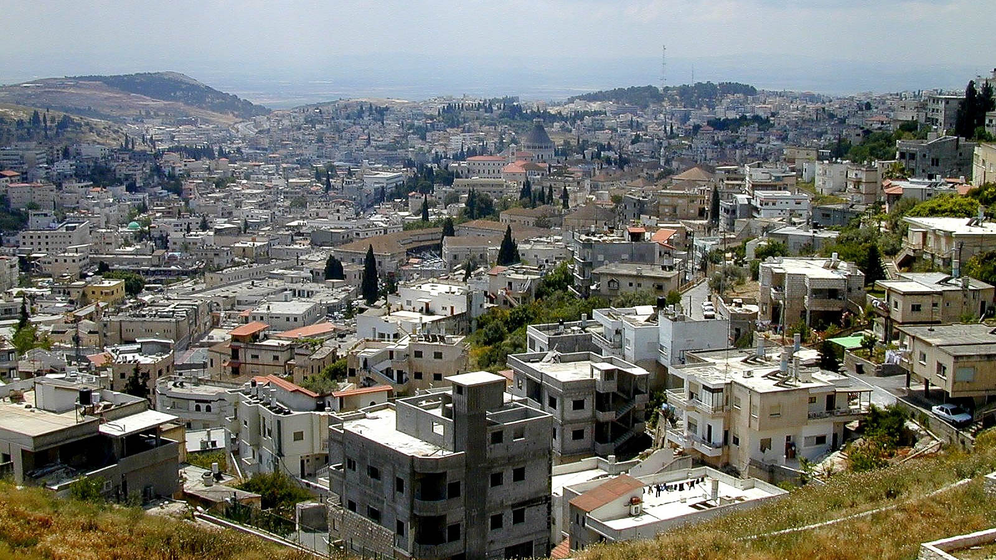
And He went out from there, and He came to His own hometown
Nazareth (from the northeast)
6:1
Notes:
The ancient part of Nazareth was located around the area of today’s Church of the Annunciation, located in the center of the photograph with a large domed roof.
tb050800203

Slide 6
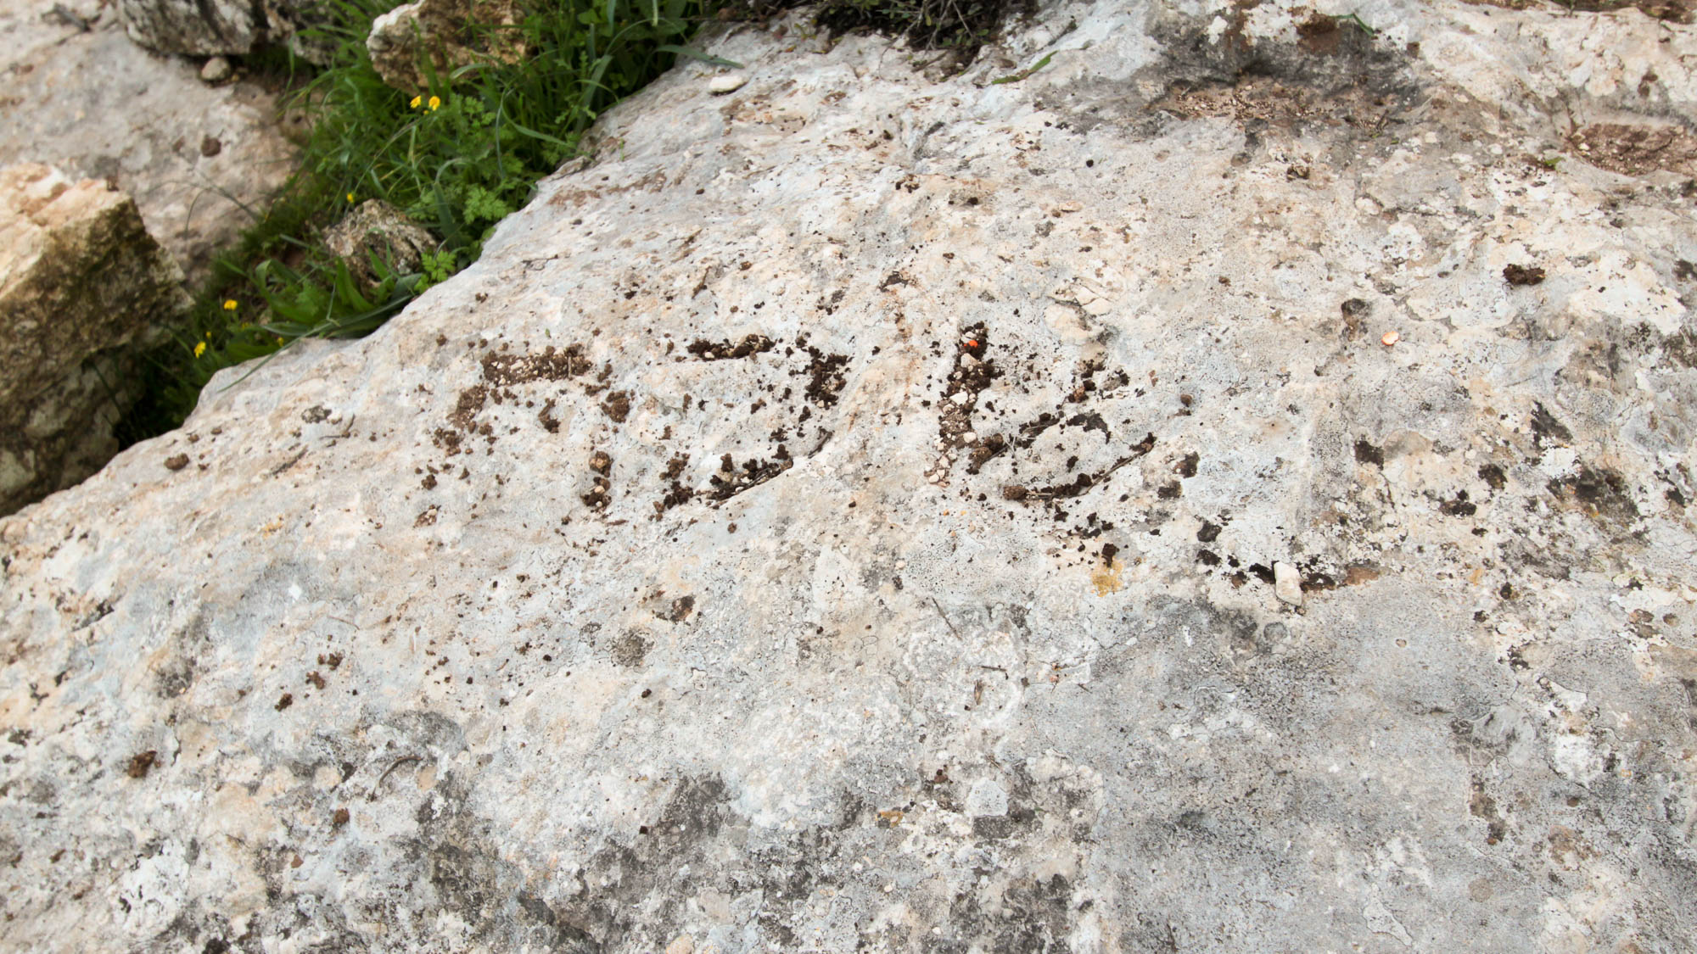
When the Sabbath came, He began to teach in the synagogue
Sabbath boundary marker near Timrat
6:2
Notes:
This inscription was discovered by Natan Ben-Yehuda in June 2011 and published by Mordechai Aviam. The inscription reads “Shabbat” and marked the limit of Sabbath travel for one of the nearby towns. The inscription apparently dates to the 3rd–5th centuries AD and may have been painted in antiquity to make it more visible.
jj011612861h

Slide 7
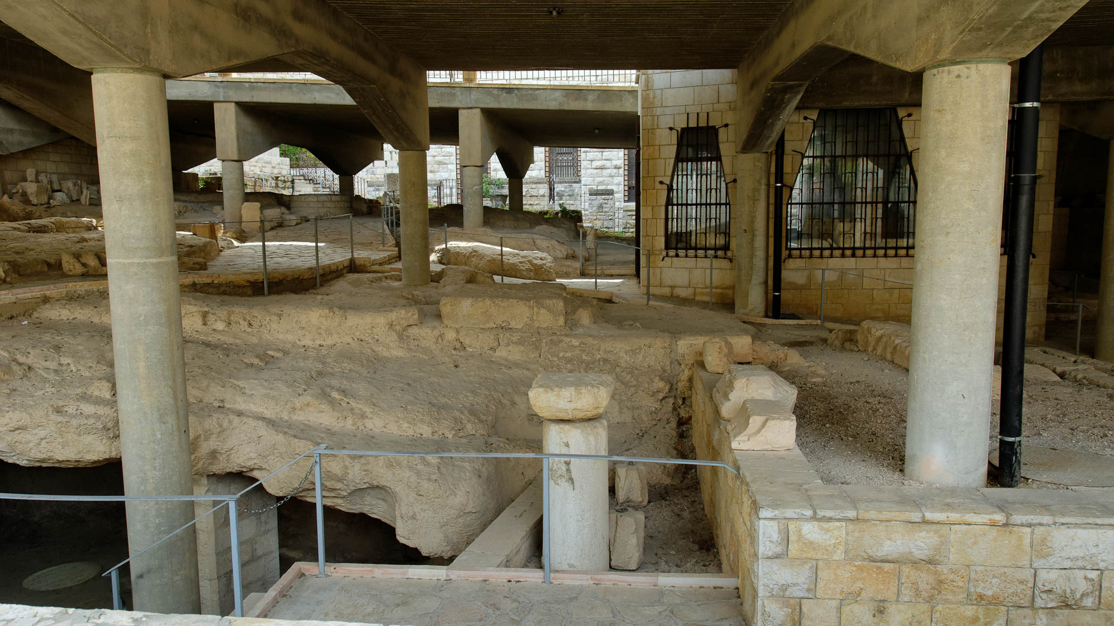
When the Sabbath came, He began to teach in the synagogue
The Church of the Annunciation at Nazareth, with Byzantine excavations
6:2
Notes:
Archaeologists uncovered here remains of a fourth century AD synagogue, with a style similar to other synagogues from this period in Galilee. Like the other Galilean synagogues, this one was oriented south toward Jerusalem.
tb043012979

Slide 8
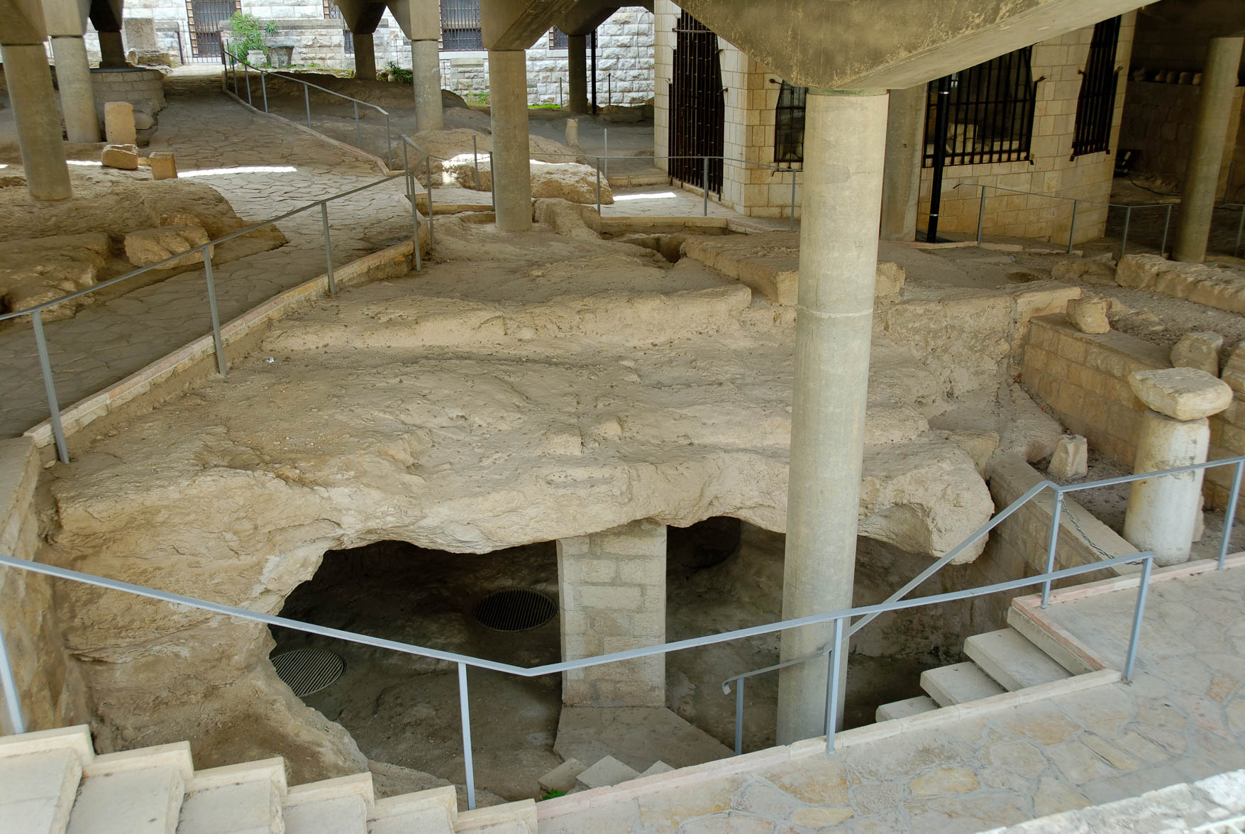
When the Sabbath came, He began to teach in the synagogue
The Church of the Annunciation at Nazareth, with ancient village excavations
6:2
Notes:
The remains seen here include a fifth-century church. The church’s grounds included the fourth-century synagogue that preceded it. When the church was built, a related monastery was also constructed.
tb043012982

Slide 9
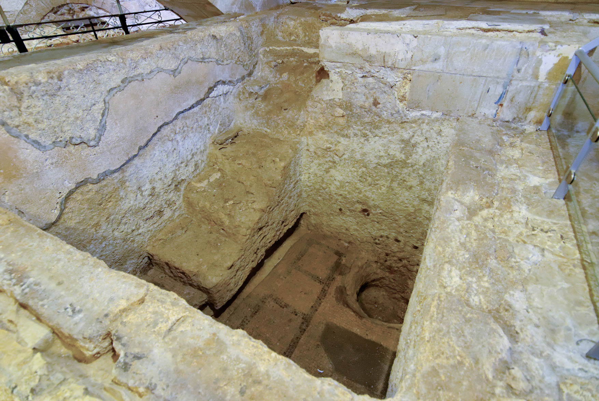
When the Sabbath came, He began to teach in the synagogue
The Church of St. Joseph at Nazareth, with likely remains of an ancient mikveh
6:2
Notes:
This was probably a Jewish ritual bath, or mikveh. It contains seven stairs and a basin with which to wash. The bath was likely built before the fourth-century synagogue since it does not cohere with the orientation of the synagogue.
tb043012013

Slide 10
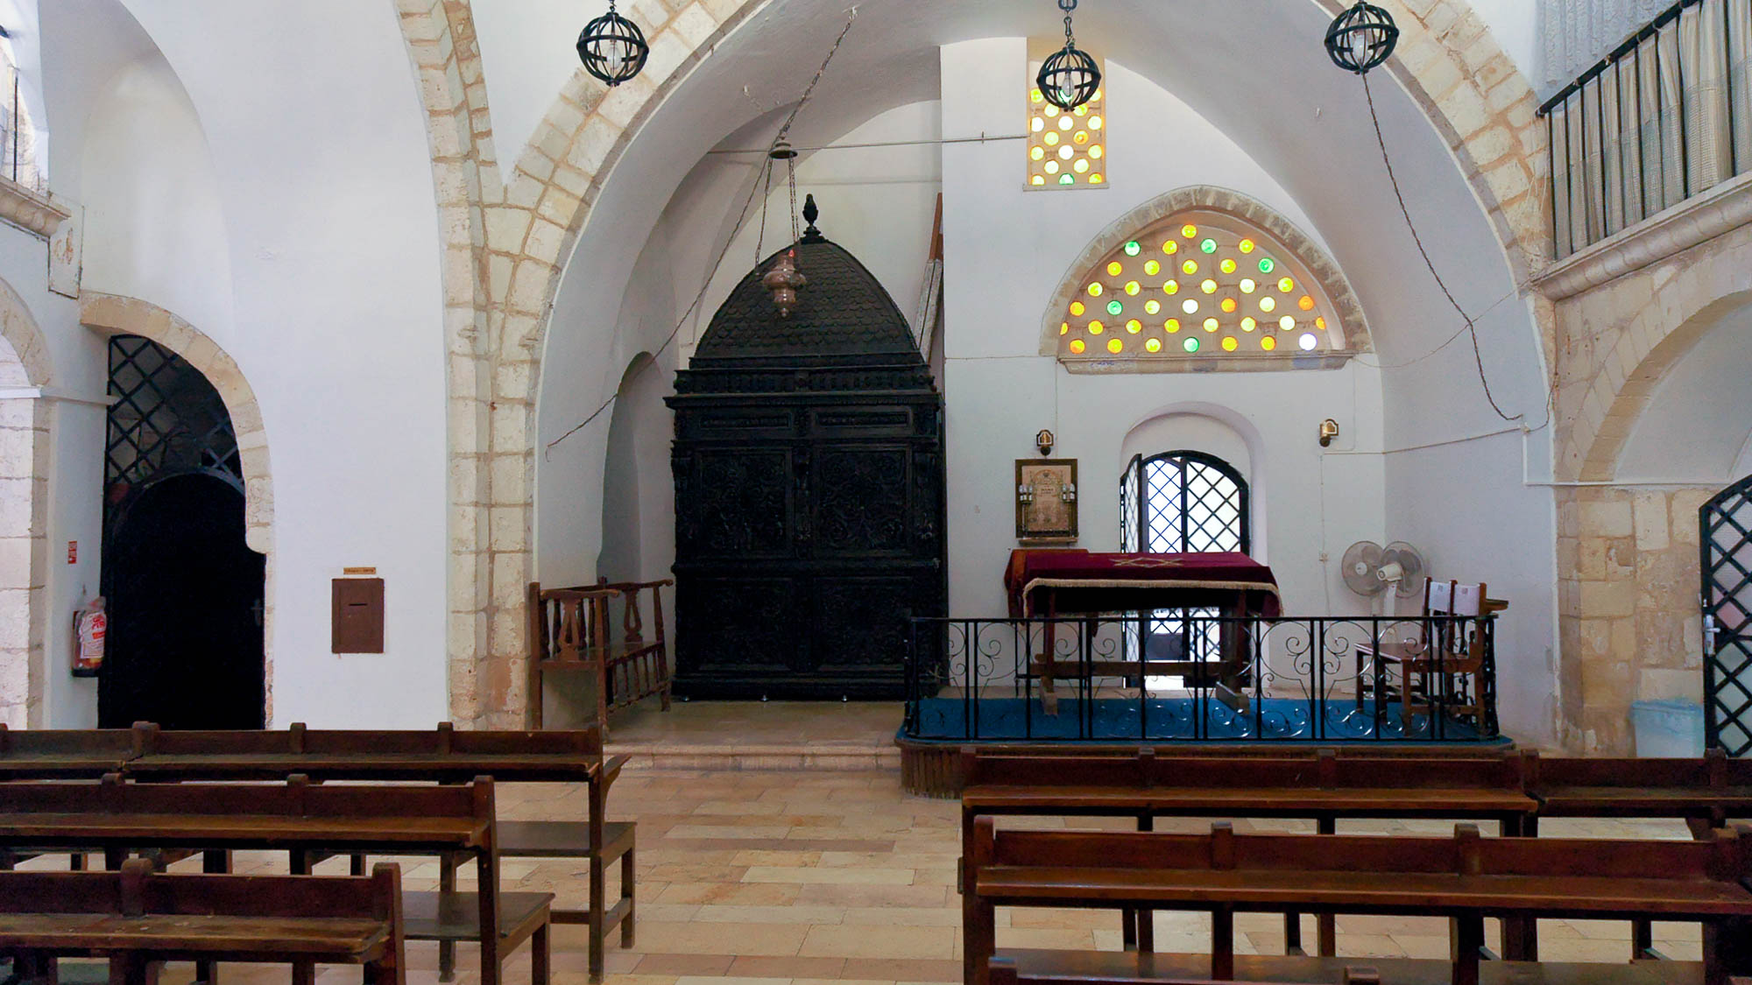
When the Sabbath came, He began to teach in the synagogue
Eliyahu HaNavi (Elijah the Prophet) Synagogue in Jerusalem
6:2
Notes:
This synagogue is located in the Jewish Quarter of the Old City of Jerusalem. Founded in the sixteenth century, this is the oldest of four Sephardic synagogues in the Jewish Quarter. Legend says that the synagogue got its name when a mysterious man appeared one Yom Kippur as the tenth adult male needed for a minyan, a quorum necessary for certain religious observances in Judaism. After prayers were said, the man disappeared and the men present concluded that the visitor must have been Elijah himself. The photograph is included here as an illustration of the inside of a synagogue.
tb083104538

Slide 11
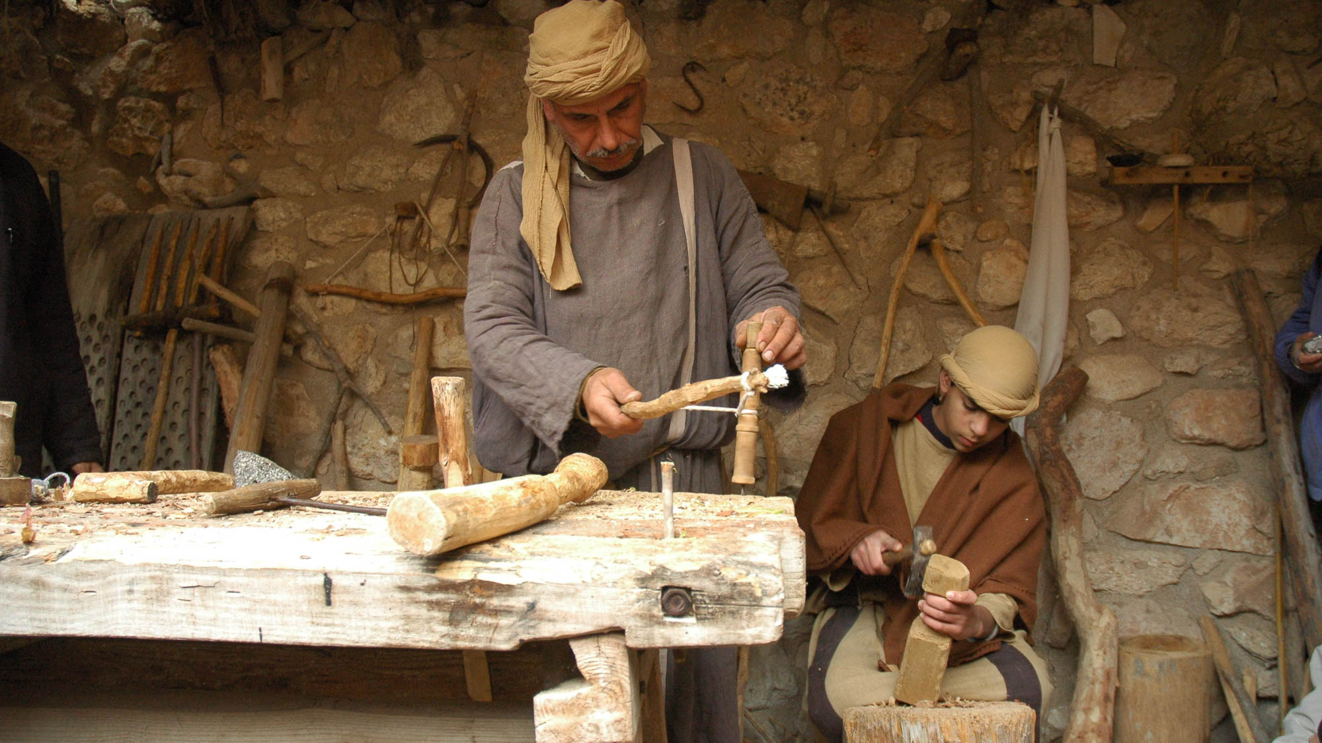
Is not this the carpenter?
Carpenter and son at Nazareth Village
6:3
Notes:
Nazareth Village recreates life as it was in the time of Jesus through its historic artifacts, modern reconstructions, and lively reenactments.
tb011406565

Slide 12
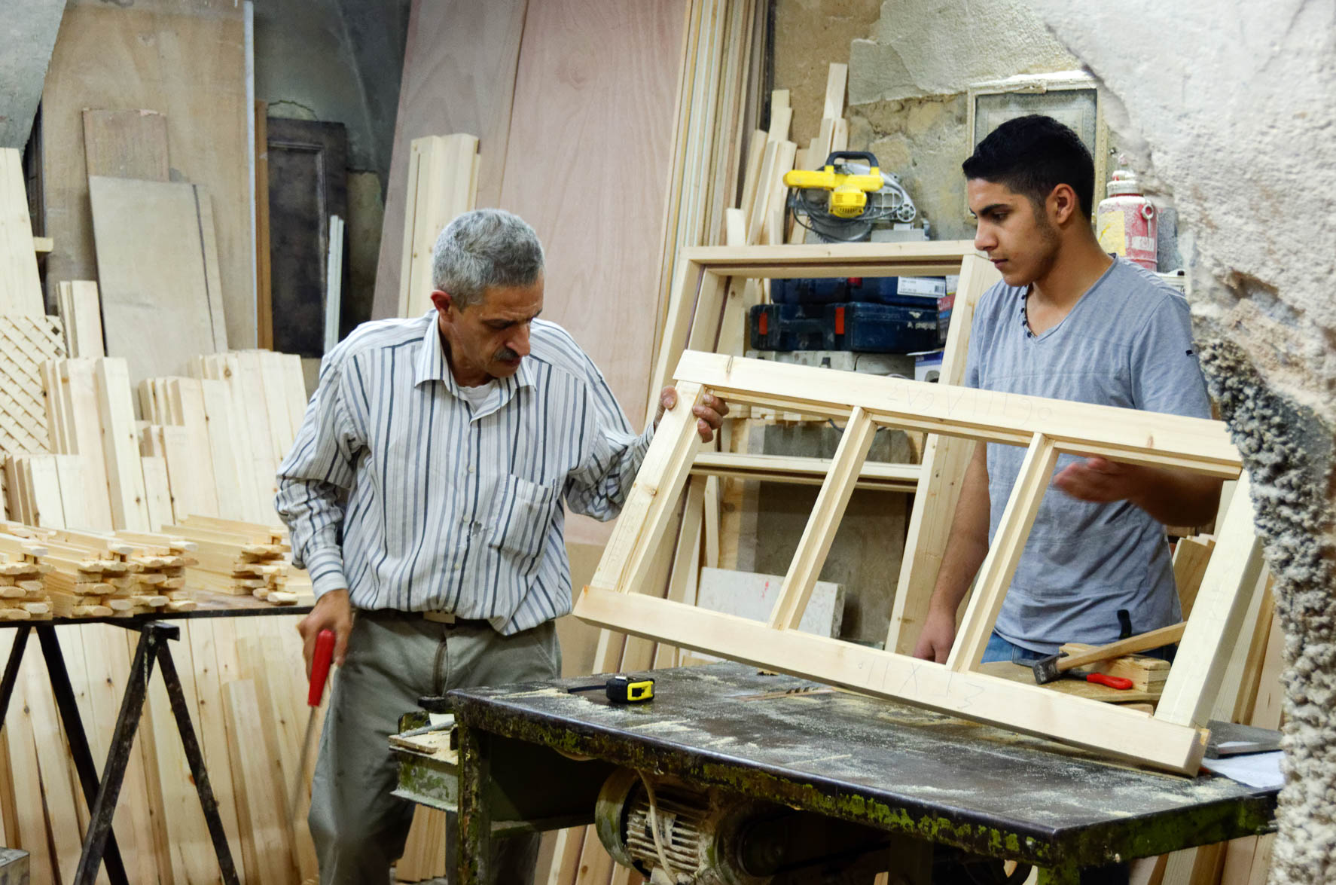
Is not this the carpenter?
Father and son working in carpenter shop in Nablus
6:3
Notes:
Nablus is the modern Arab city located around the ancient site of Shechem.
tb052916518

Slide 13
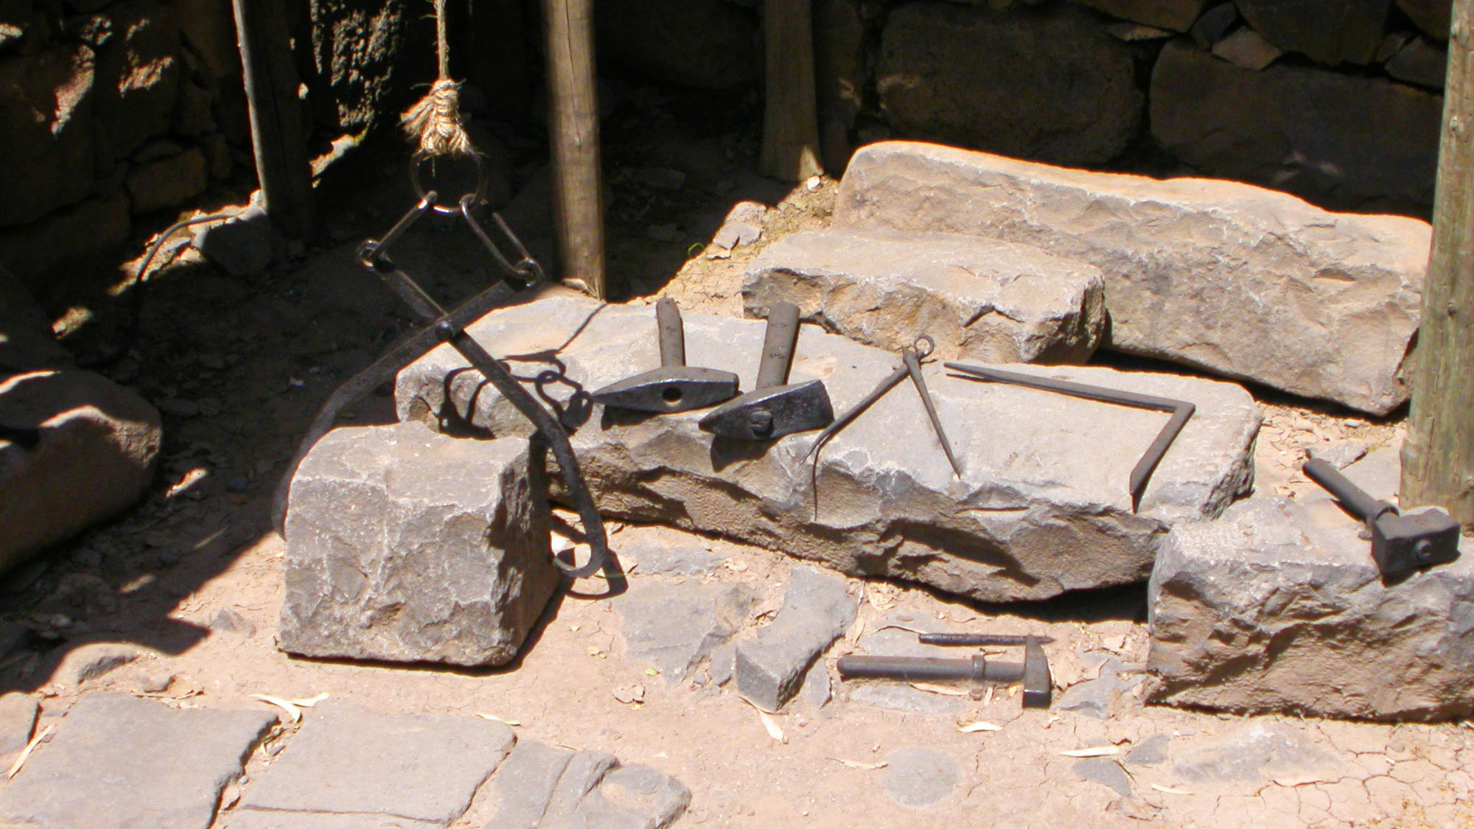
Is not this the carpenter?
Construction tools at Qatzrin
6:3
Notes:
This display is located in the Qatzrin Talmudic Village in the Golan Heights.
tb041103215

Slide 14
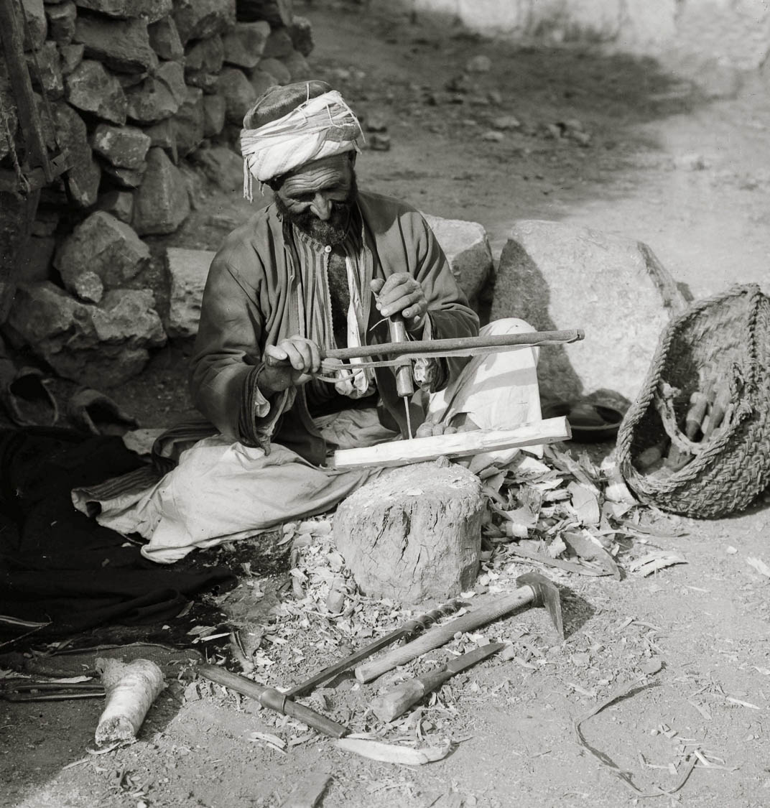
Is not this the carpenter?
Village carpenter with awl
6:3
Notes:
This American Colony photograph was taken between 1898 and 1919.
mat05292

Slide 15
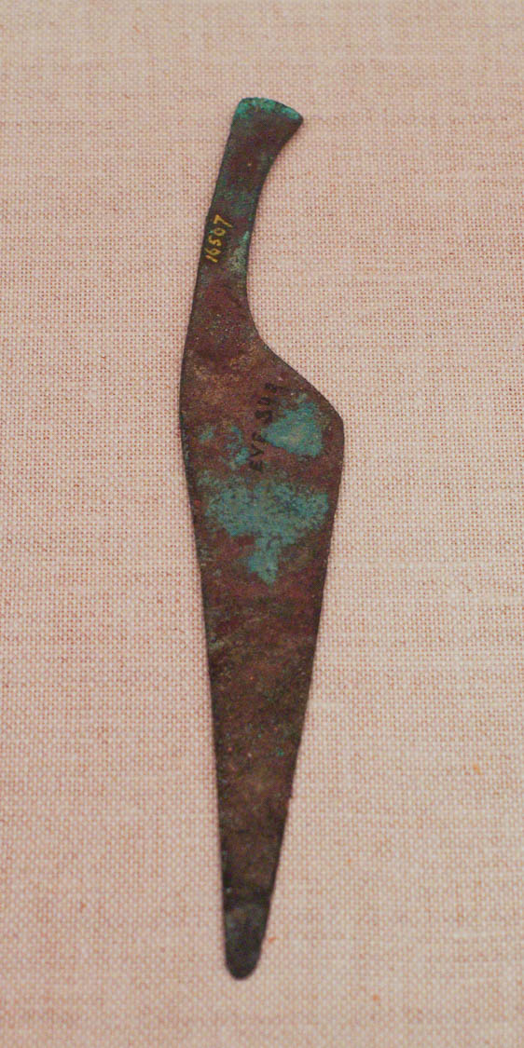
Is not this the carpenter?
Copper alloy saw from Medinet Habu, temple of Aye and Horemheb, ca. 1321 BC
6:3
Notes:
This artifact is on display at the Museum of the Oriental Institute of the University of Chicago.
adr1309252305

Slide 16
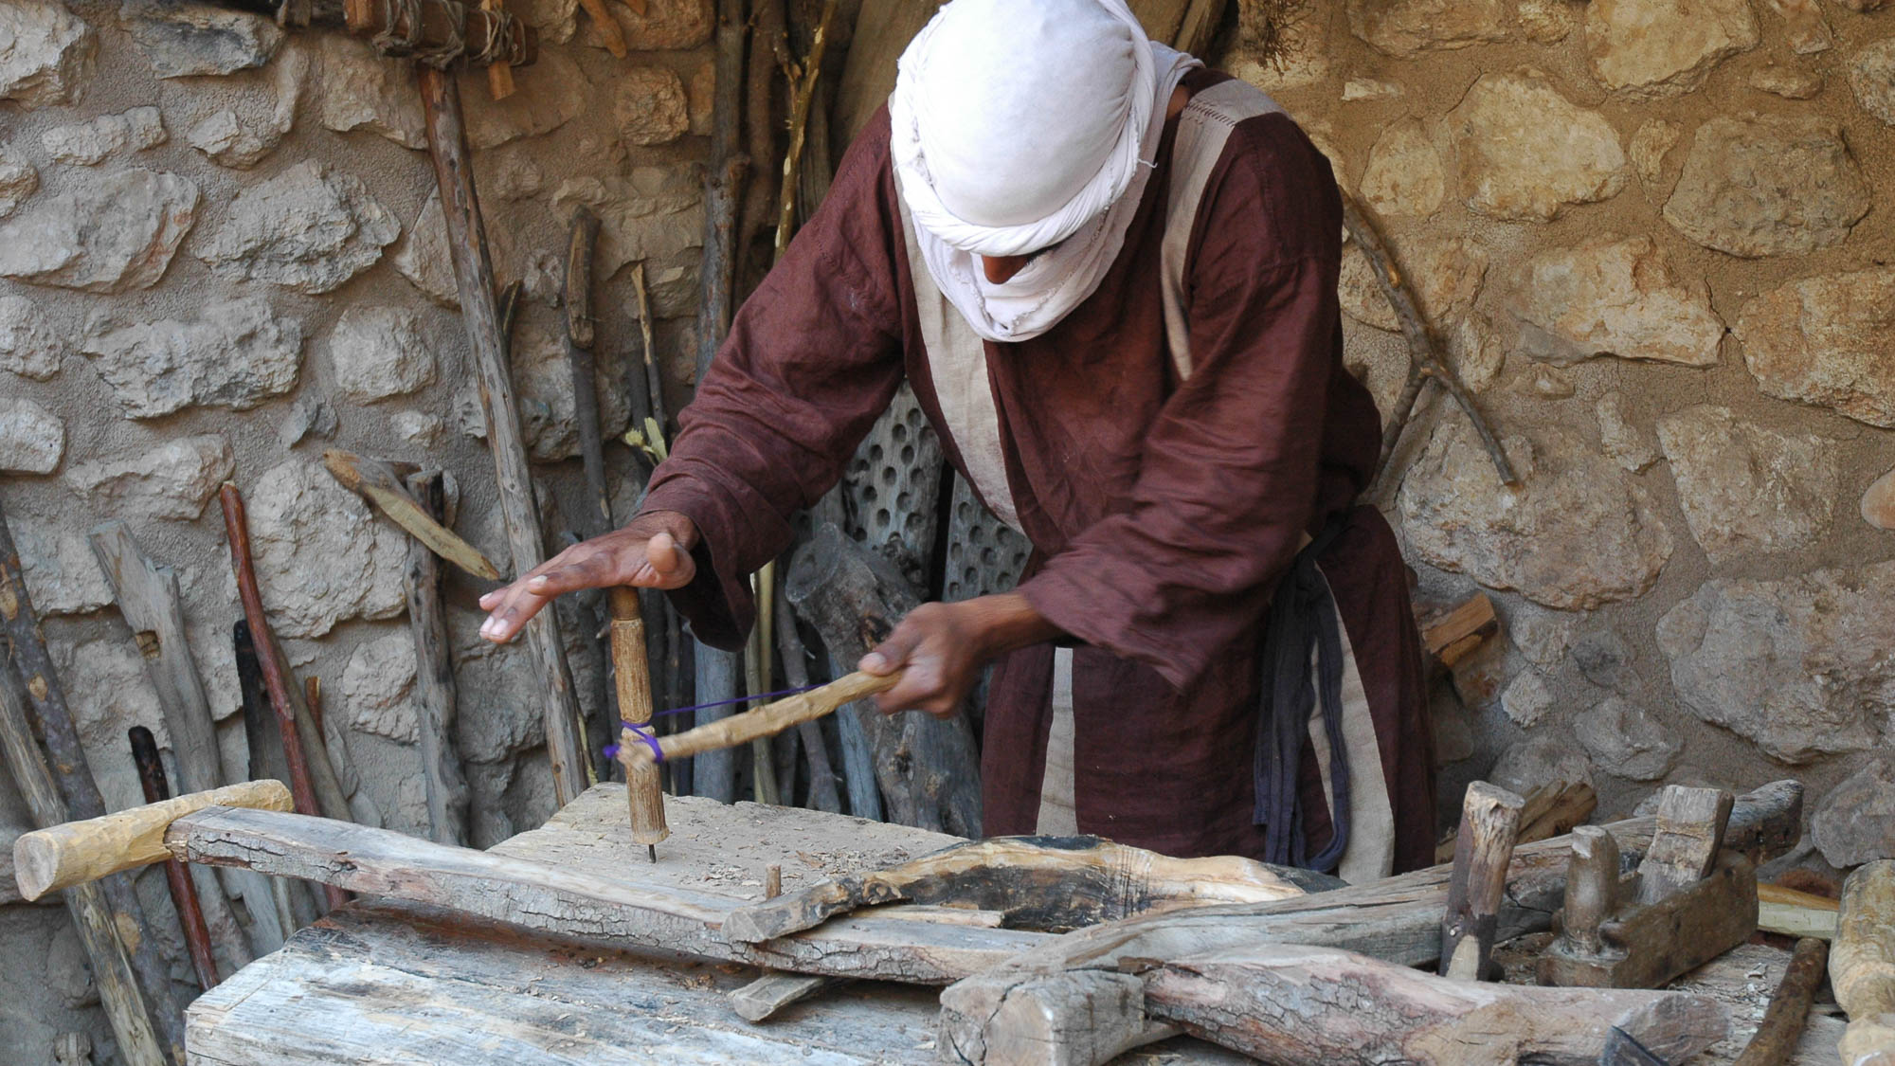
Is not this the carpenter?
Carpenter at work in Nazareth Village
6:3
Notes:
Nazareth Village recreates life as it was in the time of Jesus through its historic artifacts, modern reconstructions, and lively reenactments.
tb053005481

Slide 17
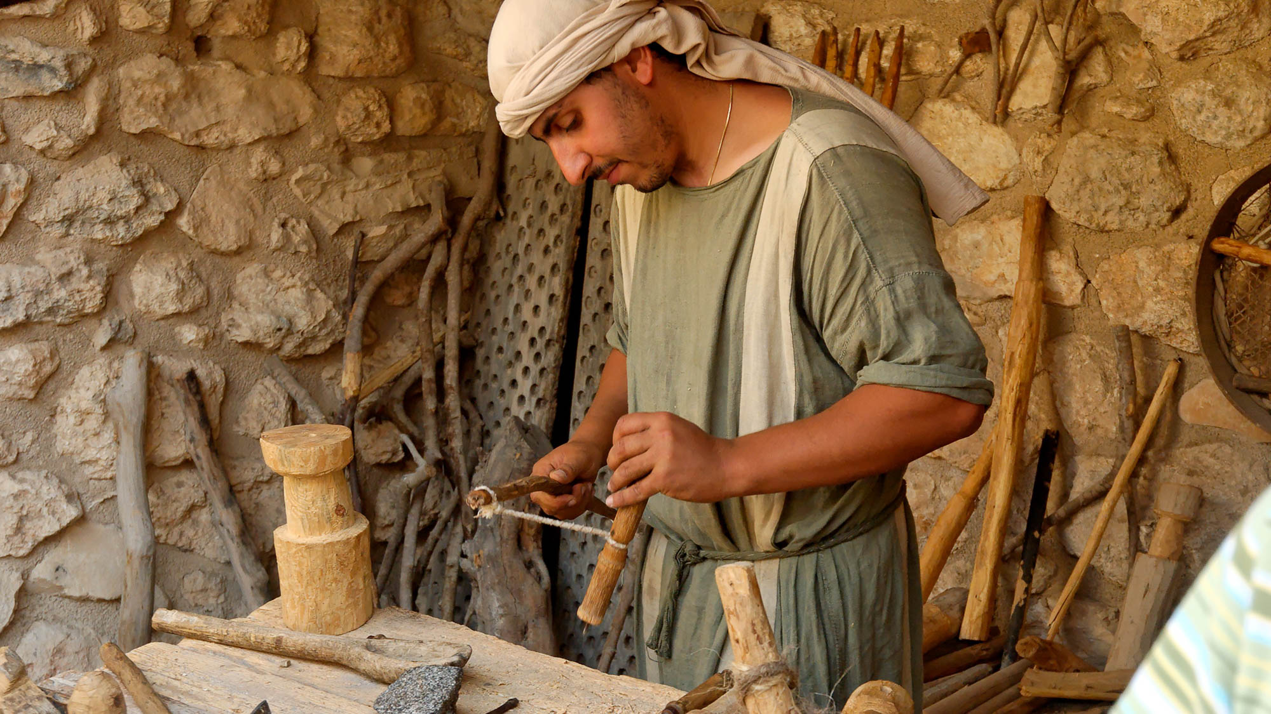
Is not this the carpenter?
Carpenter at work in Nazareth Village
6:3
Notes:
Nazareth Village is located in the oldest part of the city.
tb060106827

Slide 18
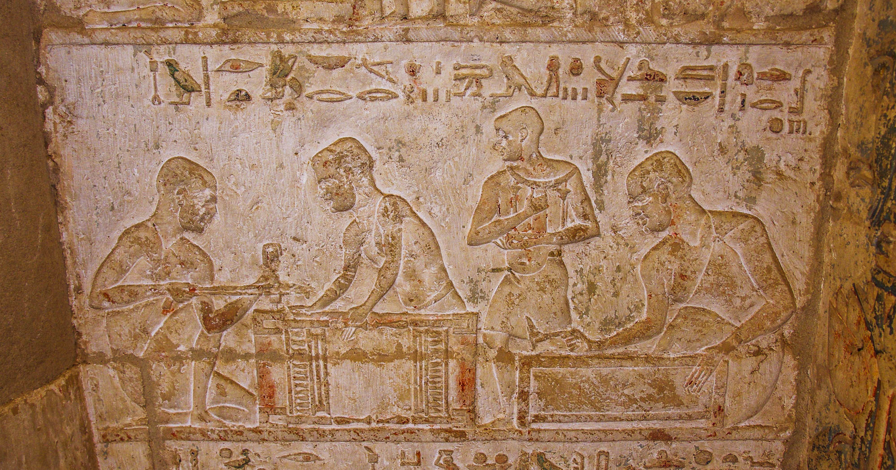
Is not this the carpenter?
Carpenters with bow drill and adze in Petosiris temple-tomb, from Tuna el-Gebel
6:3
Notes:
adr1603247182

Slide 19
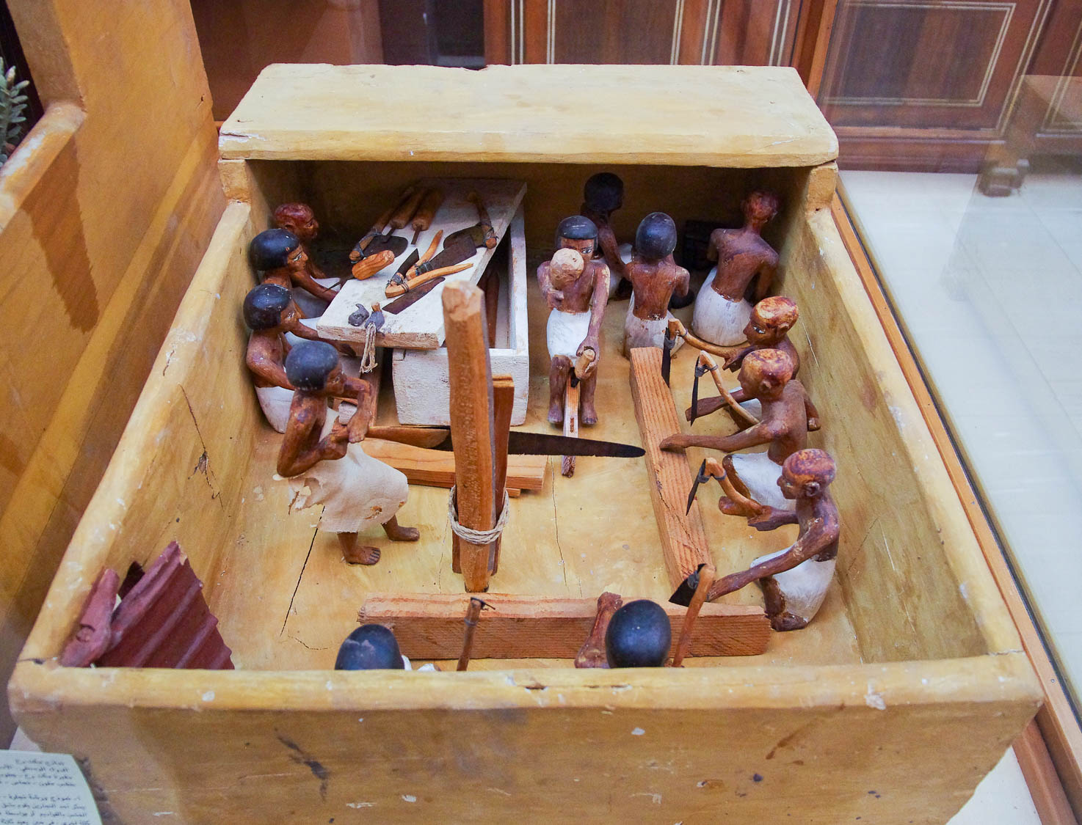
Is not this the carpenter?
Carpenters with tools, from Thebes, circa 2000–1900 BC
6:3
Notes:
This miniature workshop, created between the late 11th and early 12th dynasties, was photographed in the Egyptian Museum in Cairo.
adr1603195080

Slide 20
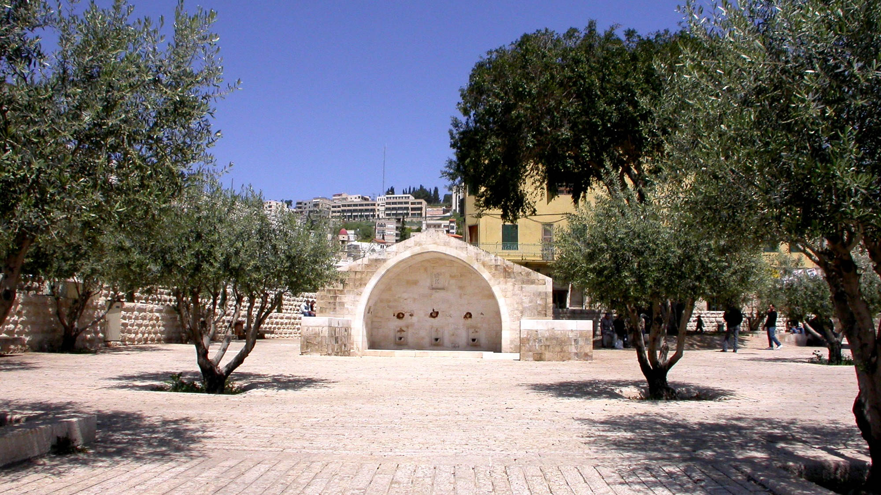
Is not this the carpenter, the son of Mary?
Mary’s Well in Nazareth
6:3
Notes:
Mary’s Well in Nazareth is the original town water supply, named today for its most famous mother.
tb041003218h

Slide 21
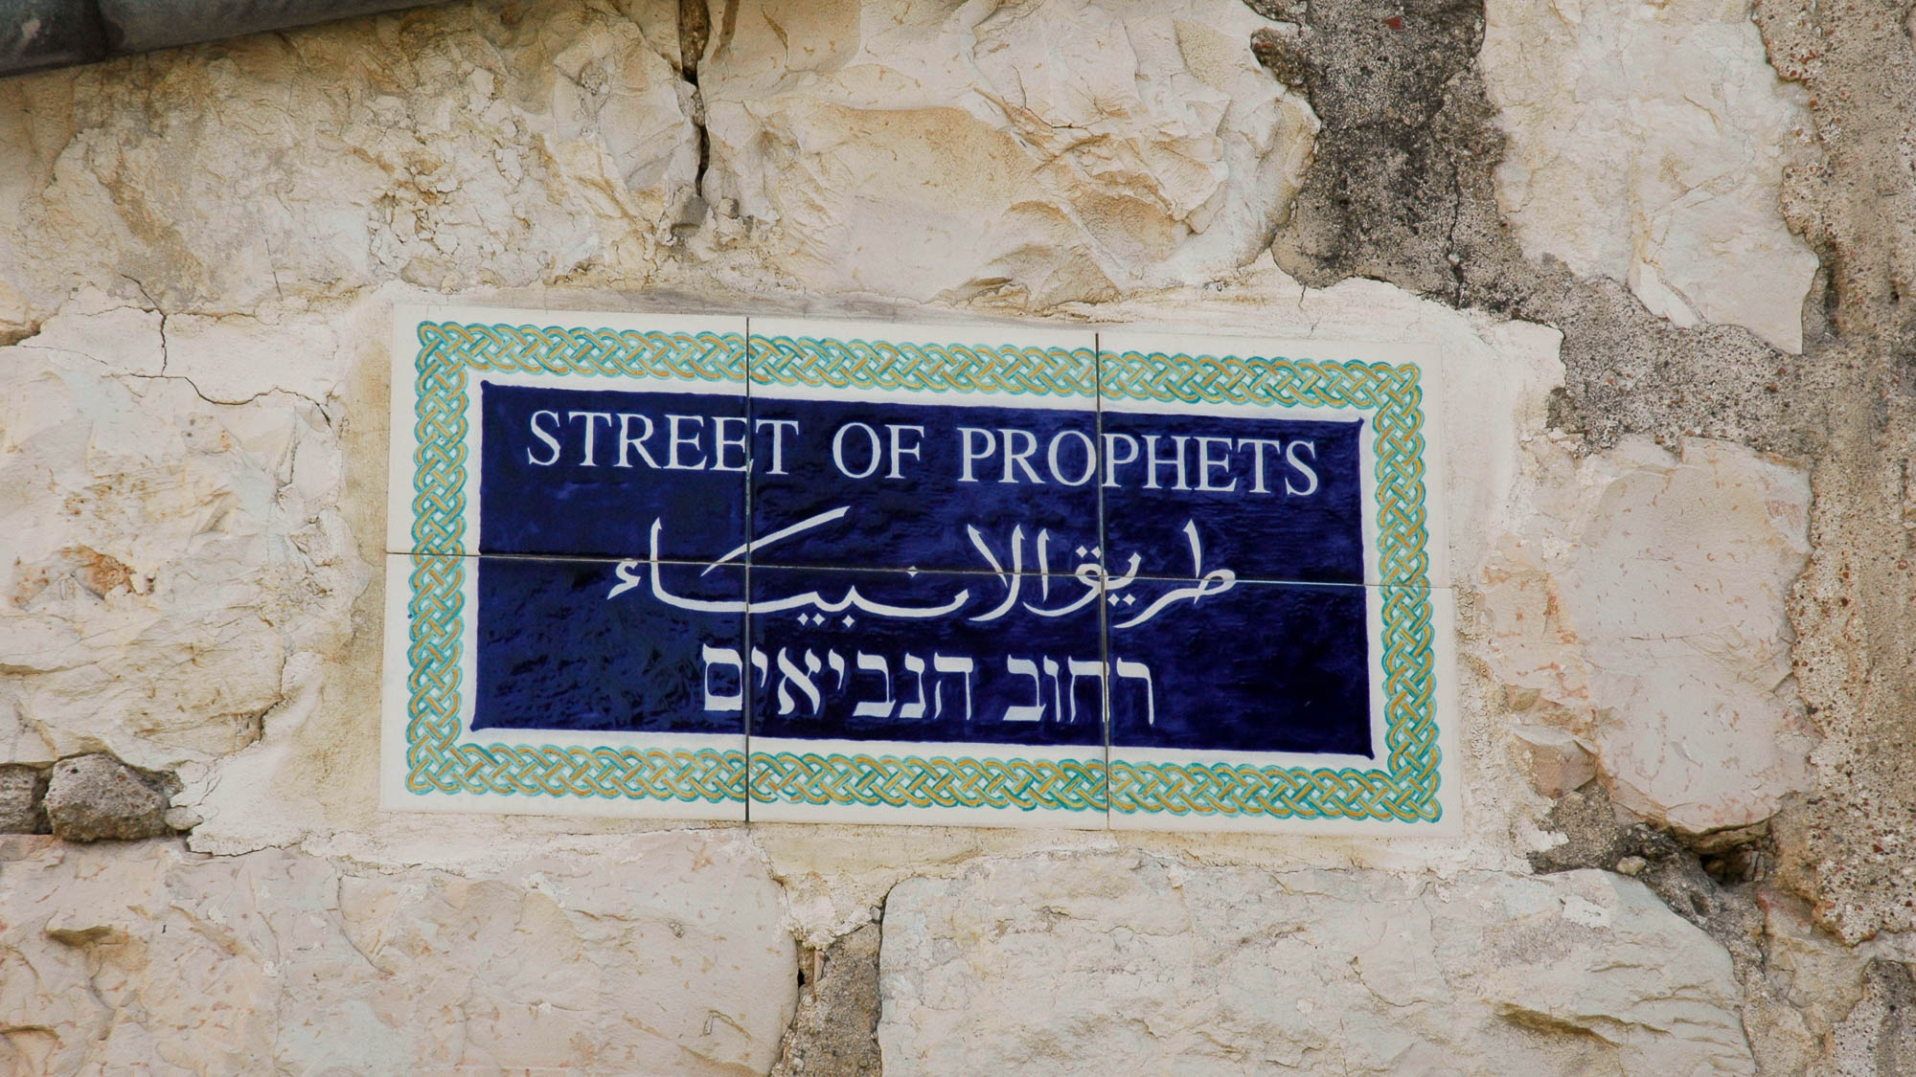
A prophet is not without honor, except in his hometown and . . . in his own house
“Street of the Prophets” sign in Jerusalem
6:4
Notes:
An important street in Jerusalem today is the “Street of the Prophets.” It is located north of the Old City and is home to many historic buildings from the expansion of Jerusalem in the late nineteenth and early twentieth centuries.
tb081004128h

Slide 22
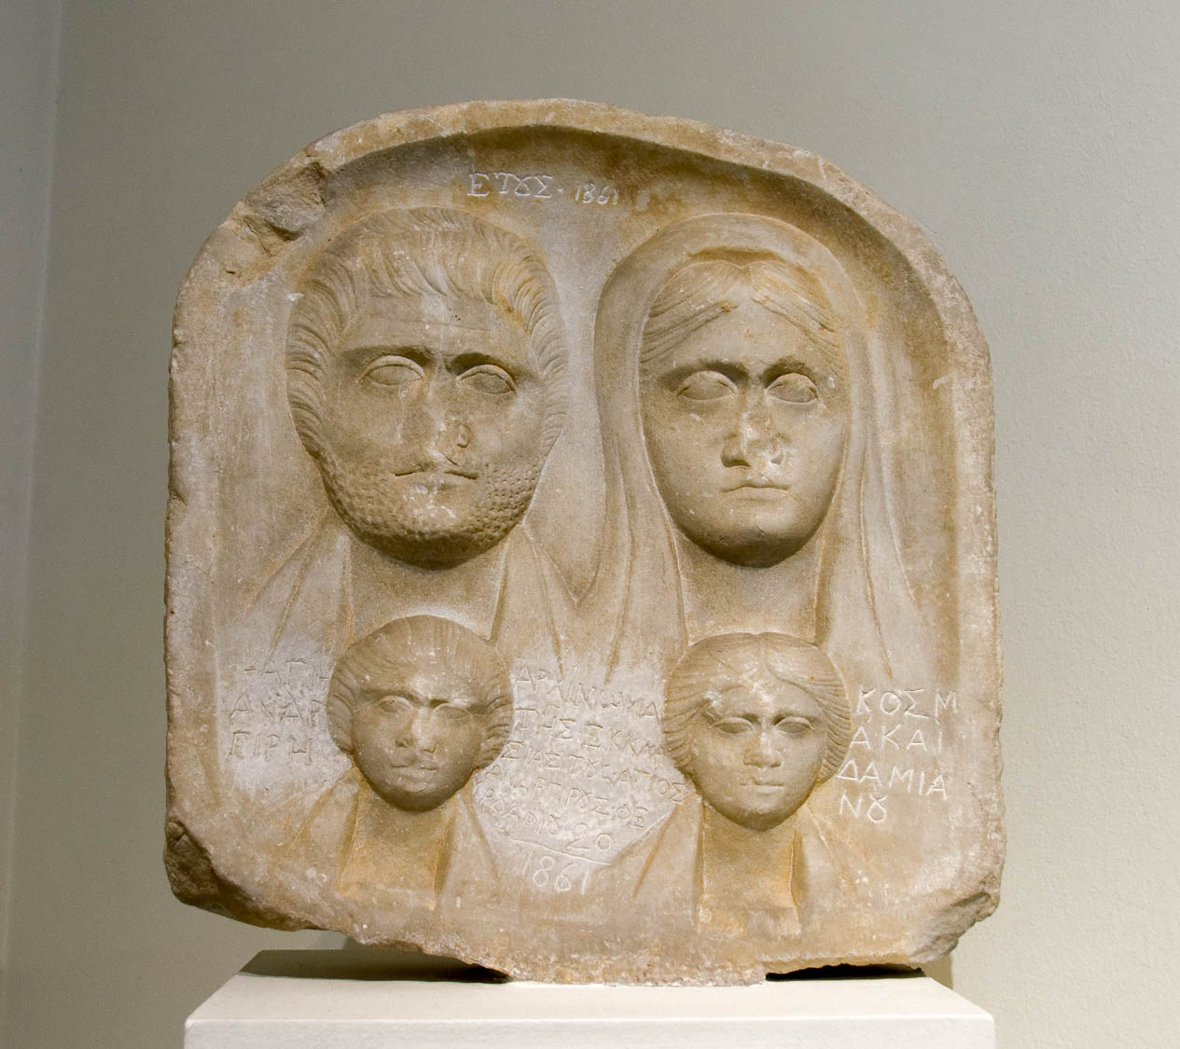
A prophet is not without honor, except in his hometown and . . . in his own house
Roman funerary relief with man, wife, and children, from Sandanski, 3rd century AD
6:4
Notes:
This relief was photographed in the National Archaeological Museum of Athens.
tb011117415

Slide 23
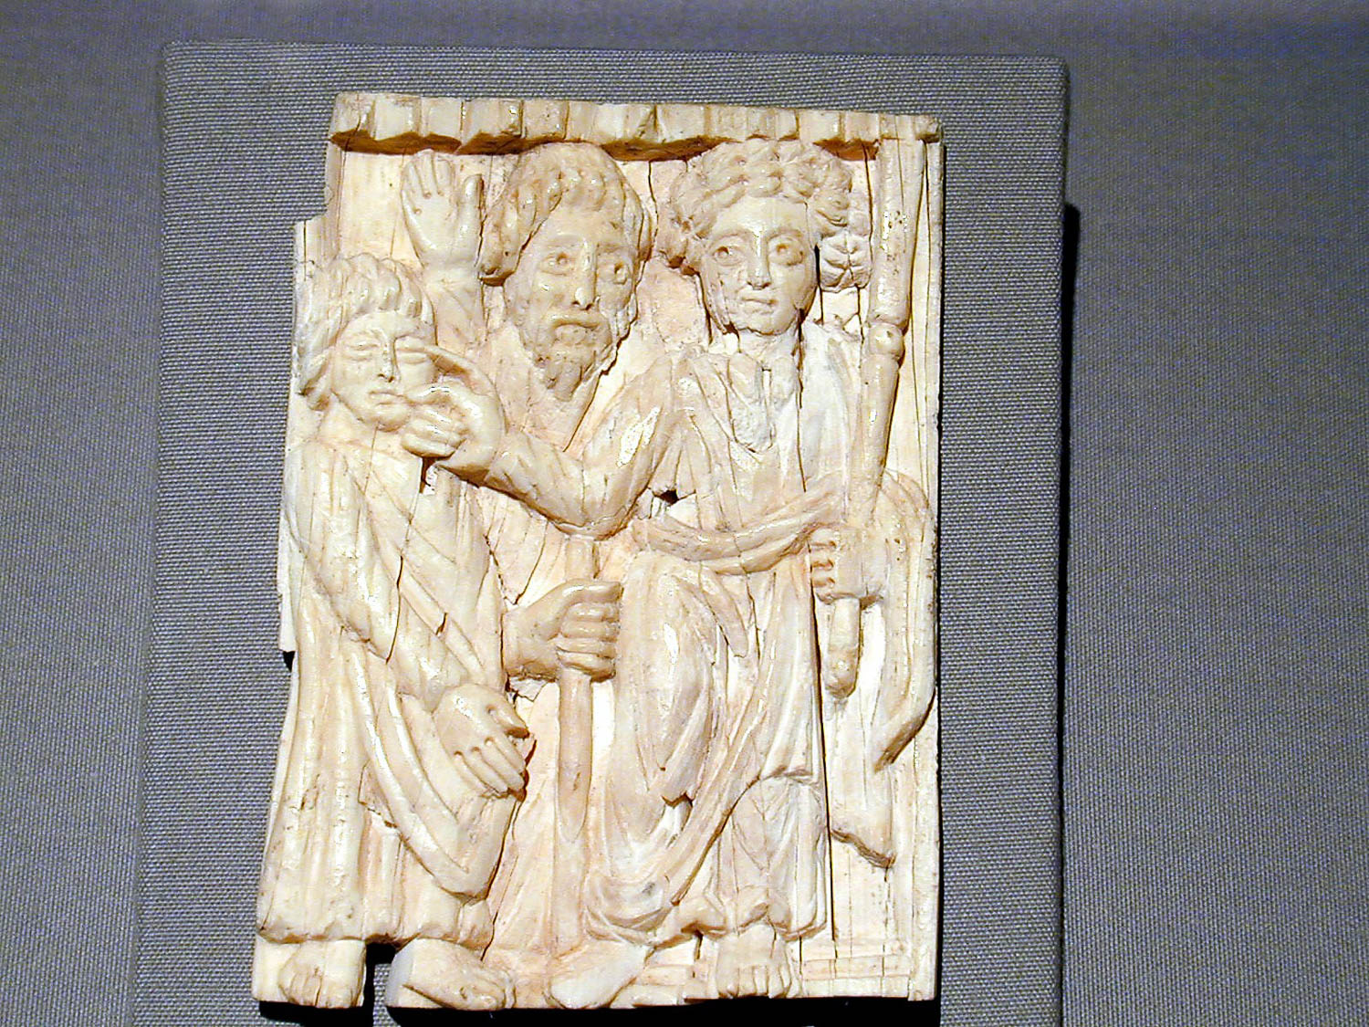
And He could not do any miracles there except lay His hands upon a few sick people
Ivory plaque showing Jesus healing the blind, 5th century AD
6:5
Notes:
This artifact is on display in the Amphipolis Museum.
tb011301166

Slide 24
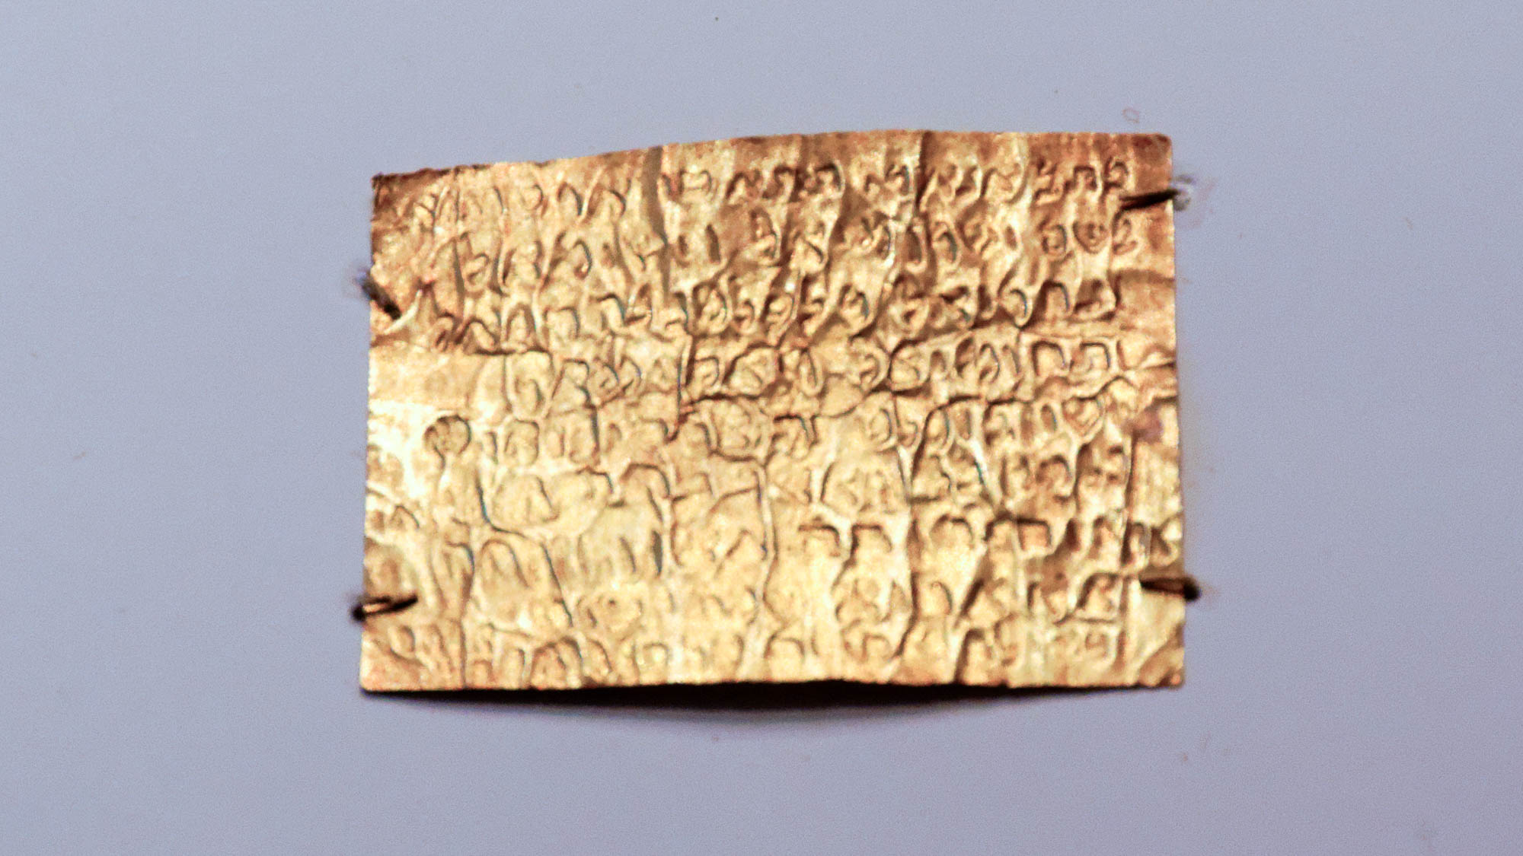
And He could not do any miracles there except lay His hands upon a few sick people
Gold sheet with Jewish prayer for healing, from Syria, AD 200-300
6:5
Notes:
This artifact is on display in the Getty Villa in California.
tb082214882h

Slide 25
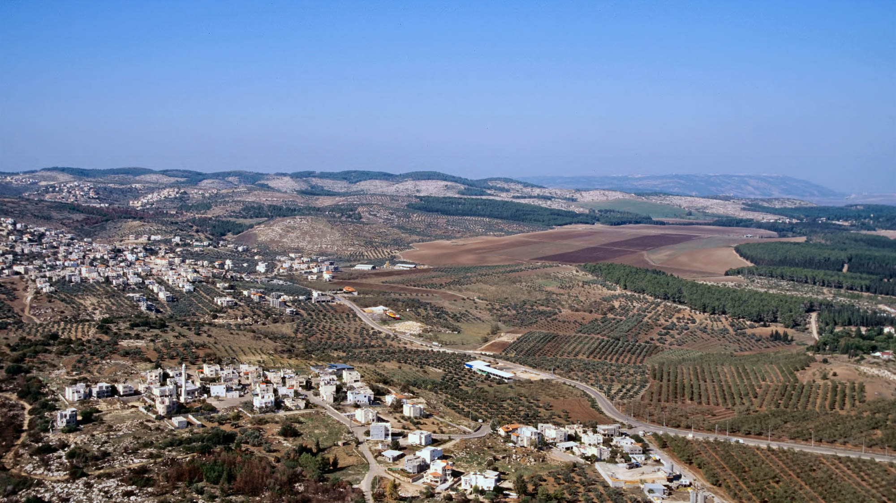
And He went around the villages teaching
Villages in hills near the Jezreel Valley (aerial view from the east)
6:6
Notes:
This photo was taken near the Old Testament site of Taanach. Mount Carmel is visible on the far right.
tbs120110011

Slide 26
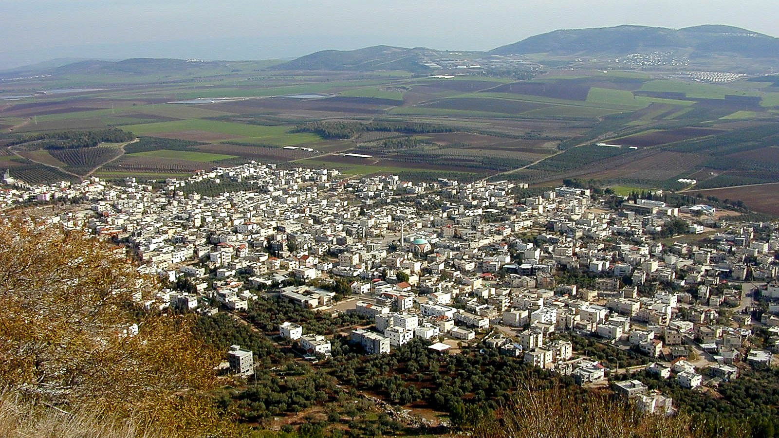
And He went around the villages teaching
The village of Exaloth in the Jezreel Valley
6:6
Notes:
The Arab village of Exaloth, which preserves the name of Chesulloth, is located south of Nazareth. The Hill of Moreh is visible in the distance.
tb011400100

Slide 27
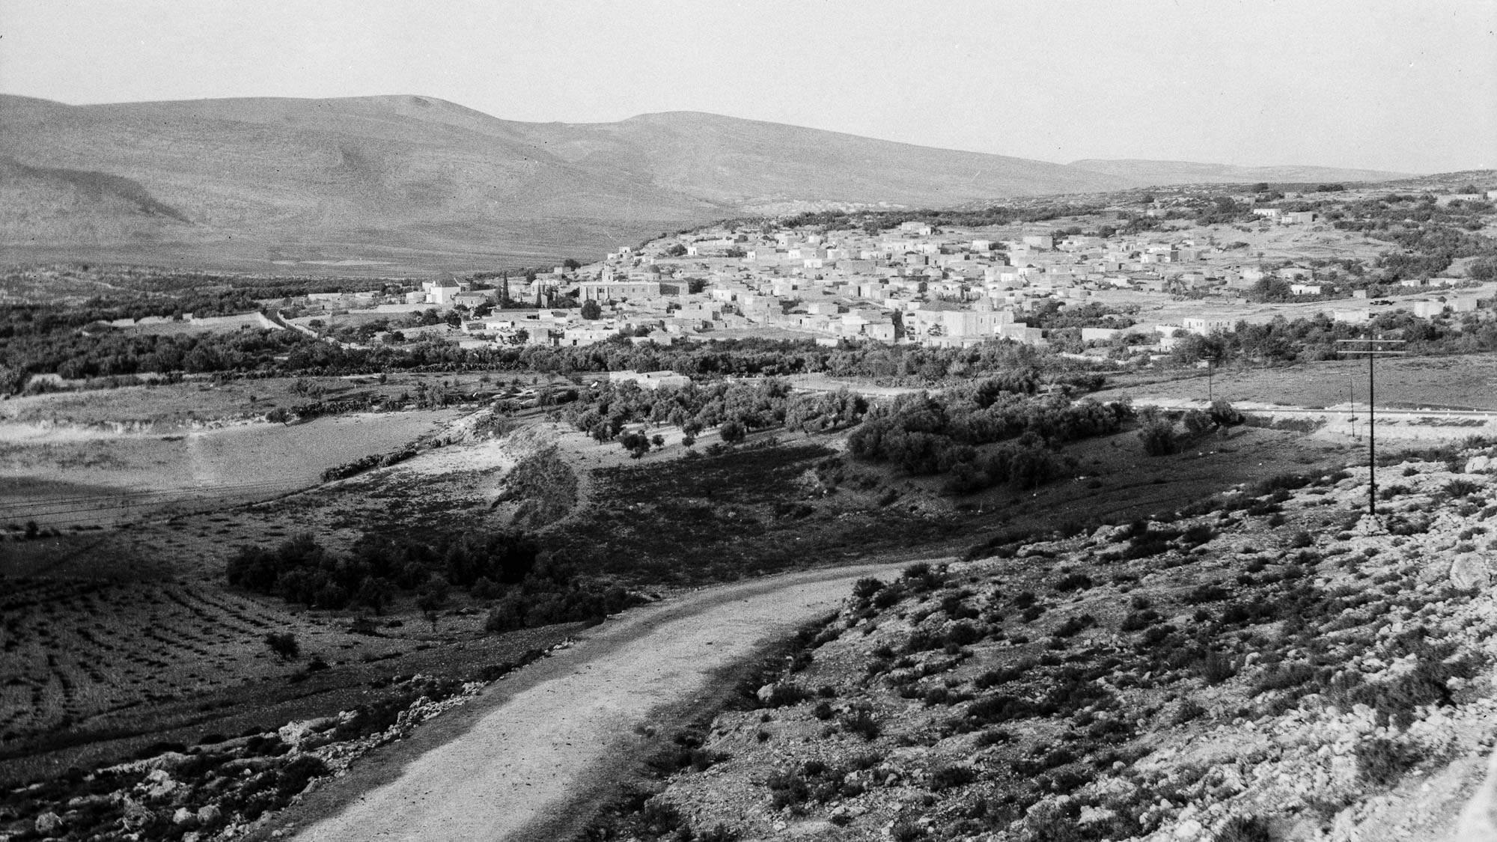
And He went around the villages teaching
Kefar Kenna, traditional Cana (from the southwest)
6:6
Notes:
The villages that Jesus visited may have looked something like the one pictured above. This American Colony photograph was taken between 1934 and 1939.
mat18953h

Slide 28
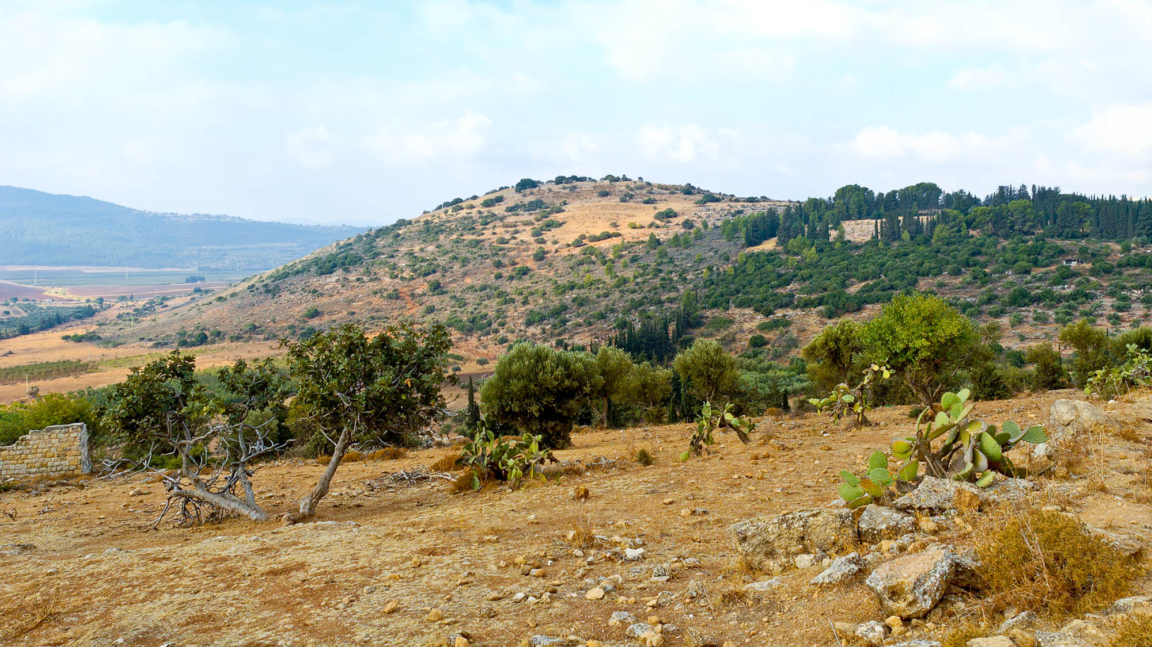
And He went around the villages teaching
Tel Beersheba of Galilee (from the northeast)
6:6
Notes:
Tel Beersheba is an ancient ruin in Galilee that has not yet been excavated.
tb100905629h

Slide 29
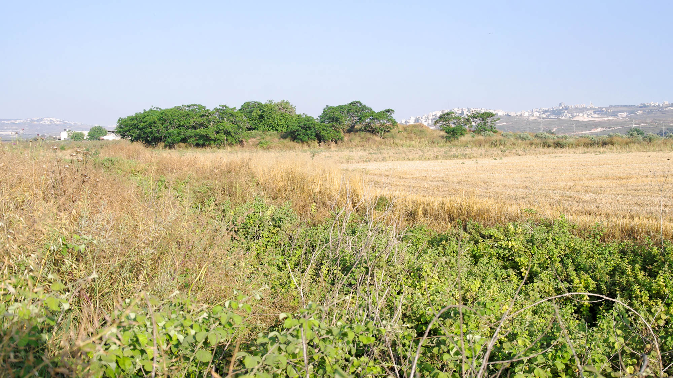
And He went around the villages teaching
Tell Ein Zippori (from the northwest)
6:6
Notes:
Tell Ein Zippori is located near Sepphoris in Galilee.
adr1305092556h

Slide 30
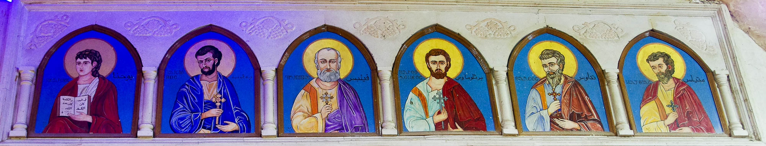
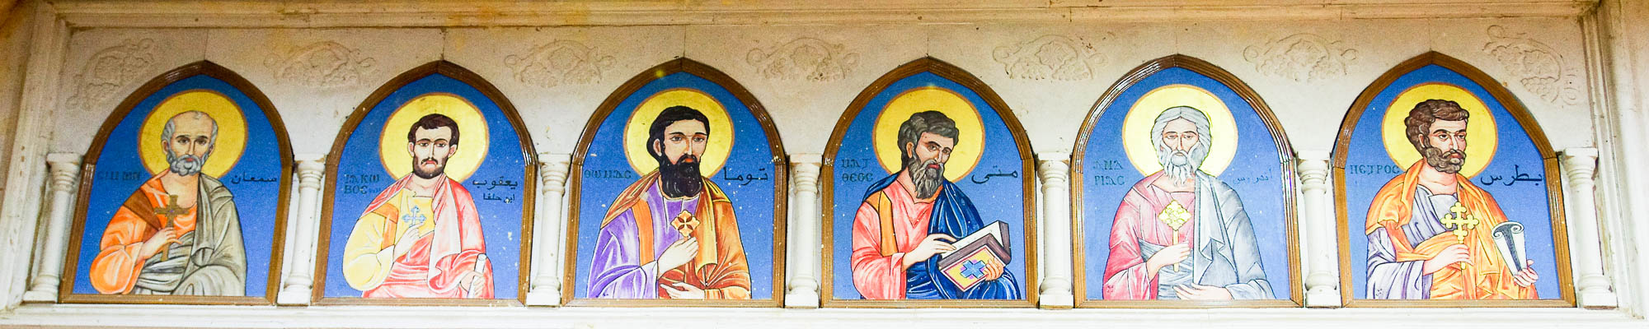
He summoned the twelve and began to send them out two by two
Icons of the Twelve Apostles in the Cave Church of Saint Simon in Mokattam
6:7
Notes:
In the 1970s, the Coptic Orthodox Christians living in “Garbage City” built churches in the caves of Mokattam Mountain, on the southeast outskirts of Cairo. These modern icons of the apostles are in the largest of the cave churches which is dedicated to Saint Simon the Tanner. Matthias replaces Judas Iscariot in this depiction of the Twelve.
adr1603101342 (top), adr1603101356 (bottom)

Slide 31
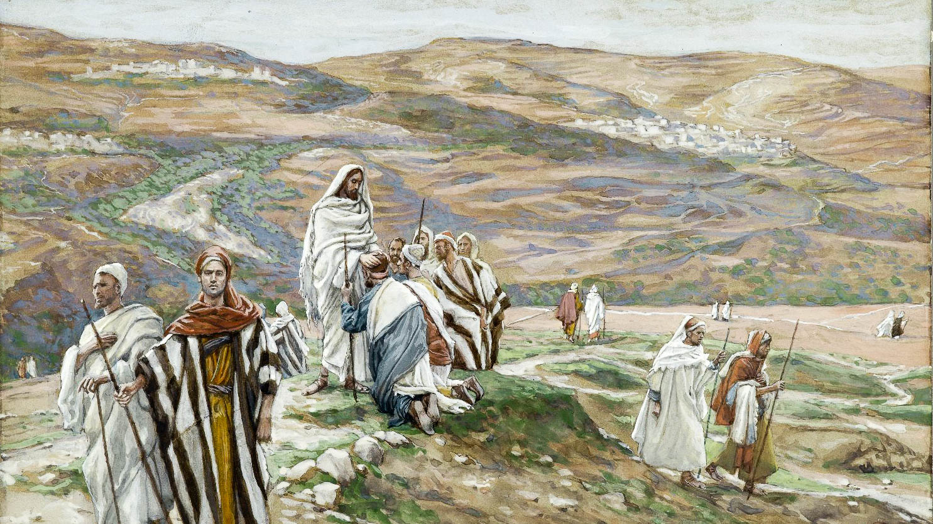
He summoned the twelve and began to send them out two by two
He Sent Them Out Two by Two, by James Tissot, circa 1890
6:7
Notes:
This image comes from the Brooklyn Museum and is in the public domain. Source: https://www.brooklynmuseum.org/opencollection/objects/4517
bmny45171886h

Slide 32
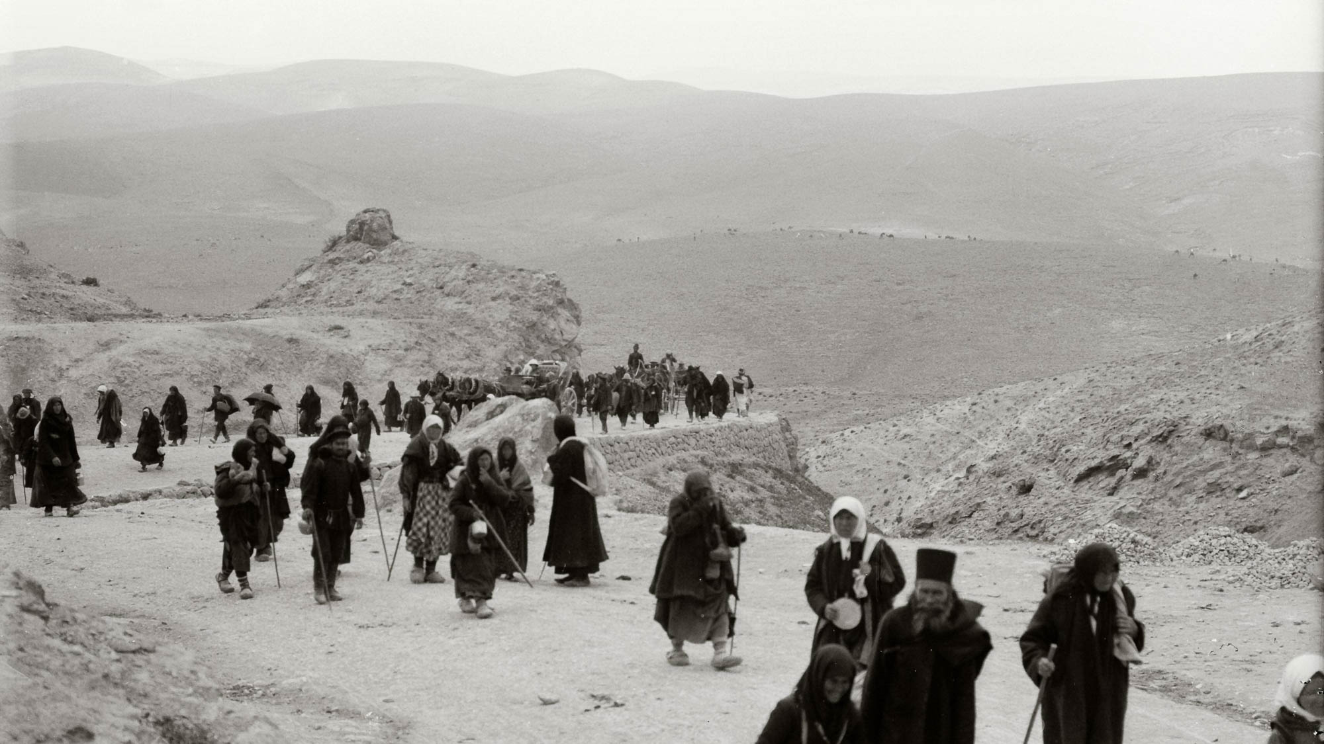
He charged them that they should take nothing for their journey except only a staff
Pilgrims on the road from Jericho to Jerusalem
6:8
Notes:
This American Colony photograph shows Christian pilgrims traveling from the Jordan River up to Jerusalem. It was taken between 1898 and 1946.
mat10617

Slide 33
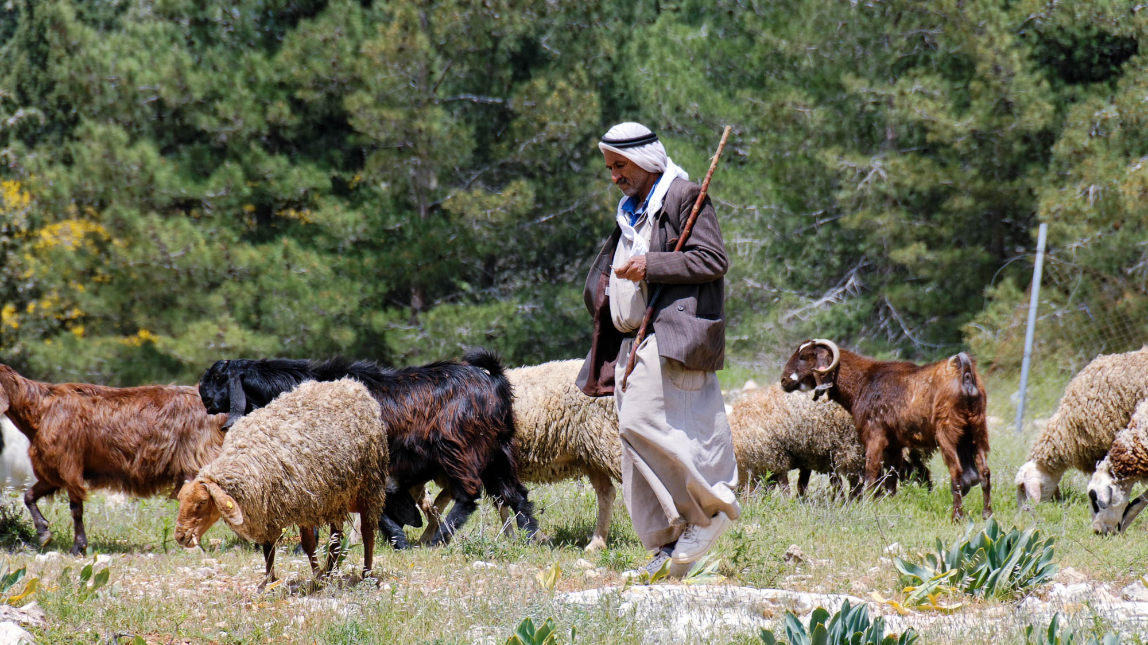
He charged them that they should take nothing for their journey except only a staff
Shepherd with staff near Bethlehem
6:8
Notes:
This modern-day shepherd carries a staff with him all the time.
cd090417141

Slide 34
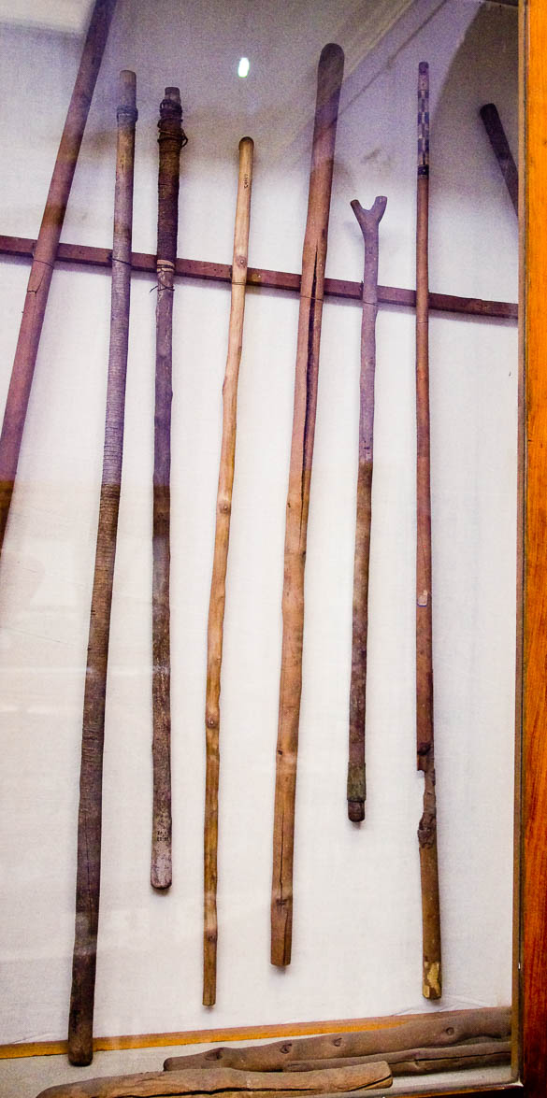
He charged them that they should take nothing for their journey except only a staff
Wood staffs and walking sticks, from Egypt
6:8
Notes:
This display was photographed in the Egyptian Museum in Cairo.
adr1603194665

Slide 35
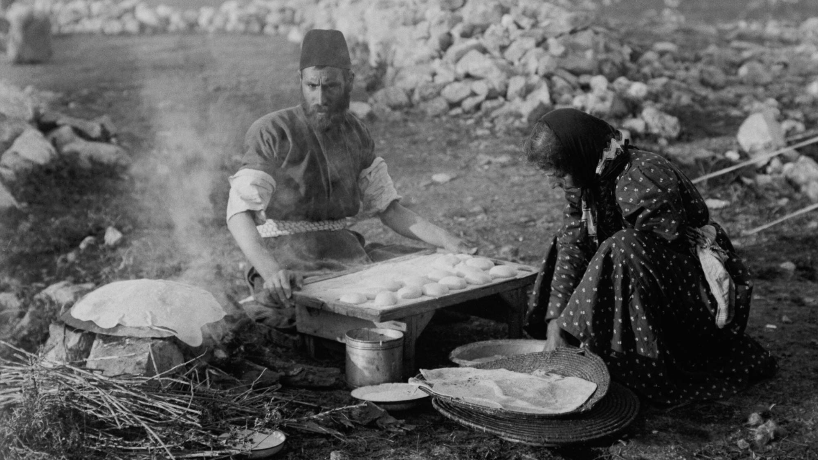
No bread
Samaritans baking unleavened bread for Passover
6:8
Notes:
This early twentieth-century photo from the American Colony illustrates the ancient style of bread-making.
mat01842

Slide 36
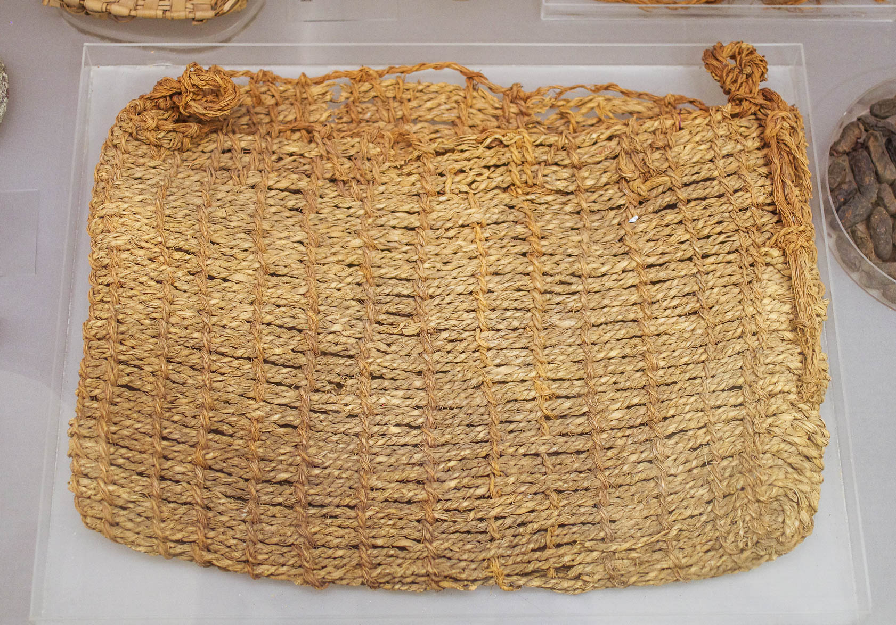
No bread, no bag
Basket or pack made of grass rope, probably reign of Tutankhamun, eighteenth dynasty, Lisht
6:8
Notes:
This basket dates to more than a millennium before the time of Jesus, but because textiles are generally not preserved in the wetter climate of Israel, this is one of the better examples we have. This artifact was photographed in the Metropolitan Museum of Art in New York City.
adr1605232559

Slide 37
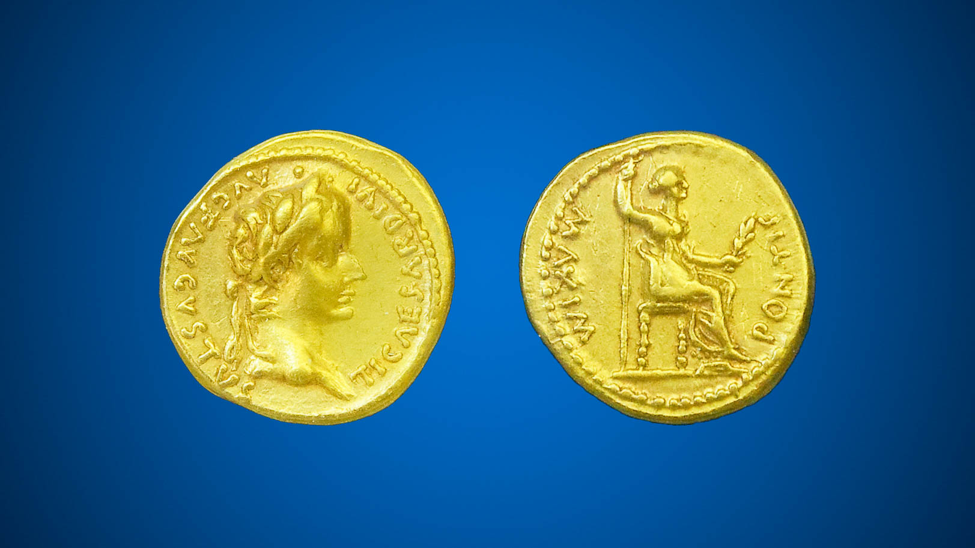
No bread, no bag, no money in their belt
Gold aureus showing Tiberius (left) and vestal priestess (right), AD 14–37
6:8
Notes:
The picture above shows the obverse and reverse sides of the same coin. The obverse depicts Tiberius and is inscribed TI CAESAR DIVI AVG F AVGVSTVS (=Tiberius Caesar divi Augustus Filius, Augustus = “Tiberius Caesar, son of the divine Augustus, Augustus”). The reverse depicts a vestal priestess and is inscribed PONTIF MAXIM (= Pontifex Maximus = “high priest”). This coin is part of the Trinity Evangelical Divinity School Biblical Coin Collection.
adr1410087958h

Slide 38
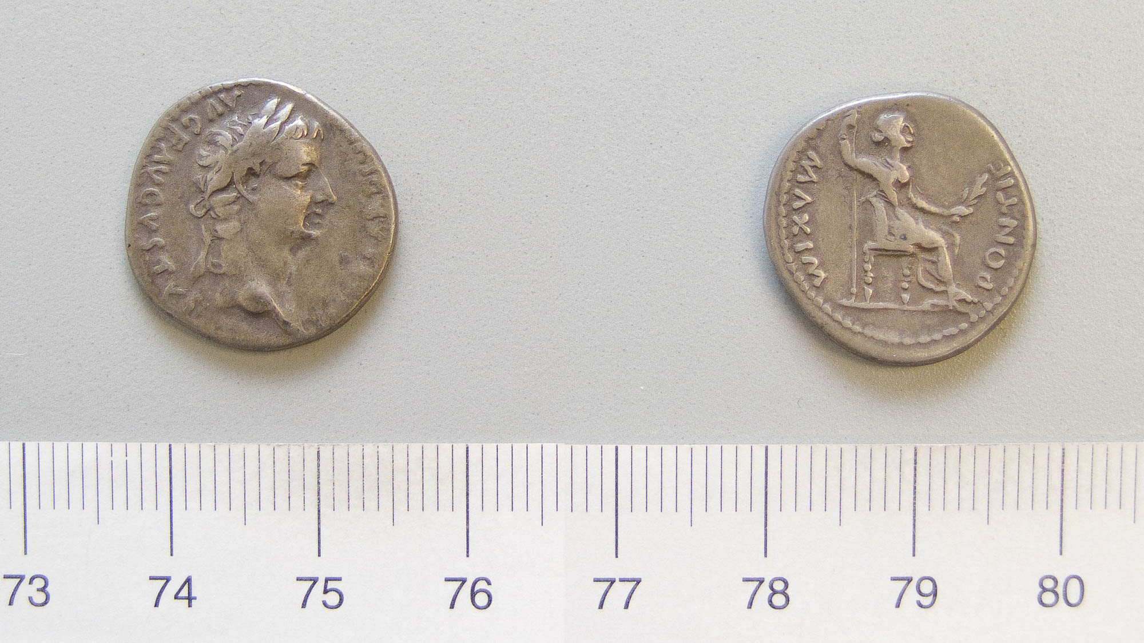
No bread, no bag, no money in their belt
Silver denarius of Tiberius from Lugdunum, AD 14–37
6:8
Notes:
The obverse depicts Tiberius and is inscribed TI CAESAR DIVI AVG F AVGVSTVS (=Tiberius Caesar divi Augustus Filius, Augustus = “Tiberius Caesar, son of the divine Augustus, Augustus”). The reverse depicts a vestal priestess and is inscribed PONTIF MAXIM (= Pontifex Maximus = “high priest”). This image comes from the Yale University Art Gallery, and is in the public domain. Source: http://artgallery.yale.edu/collections/objects/127672
yale127672h

Slide 39
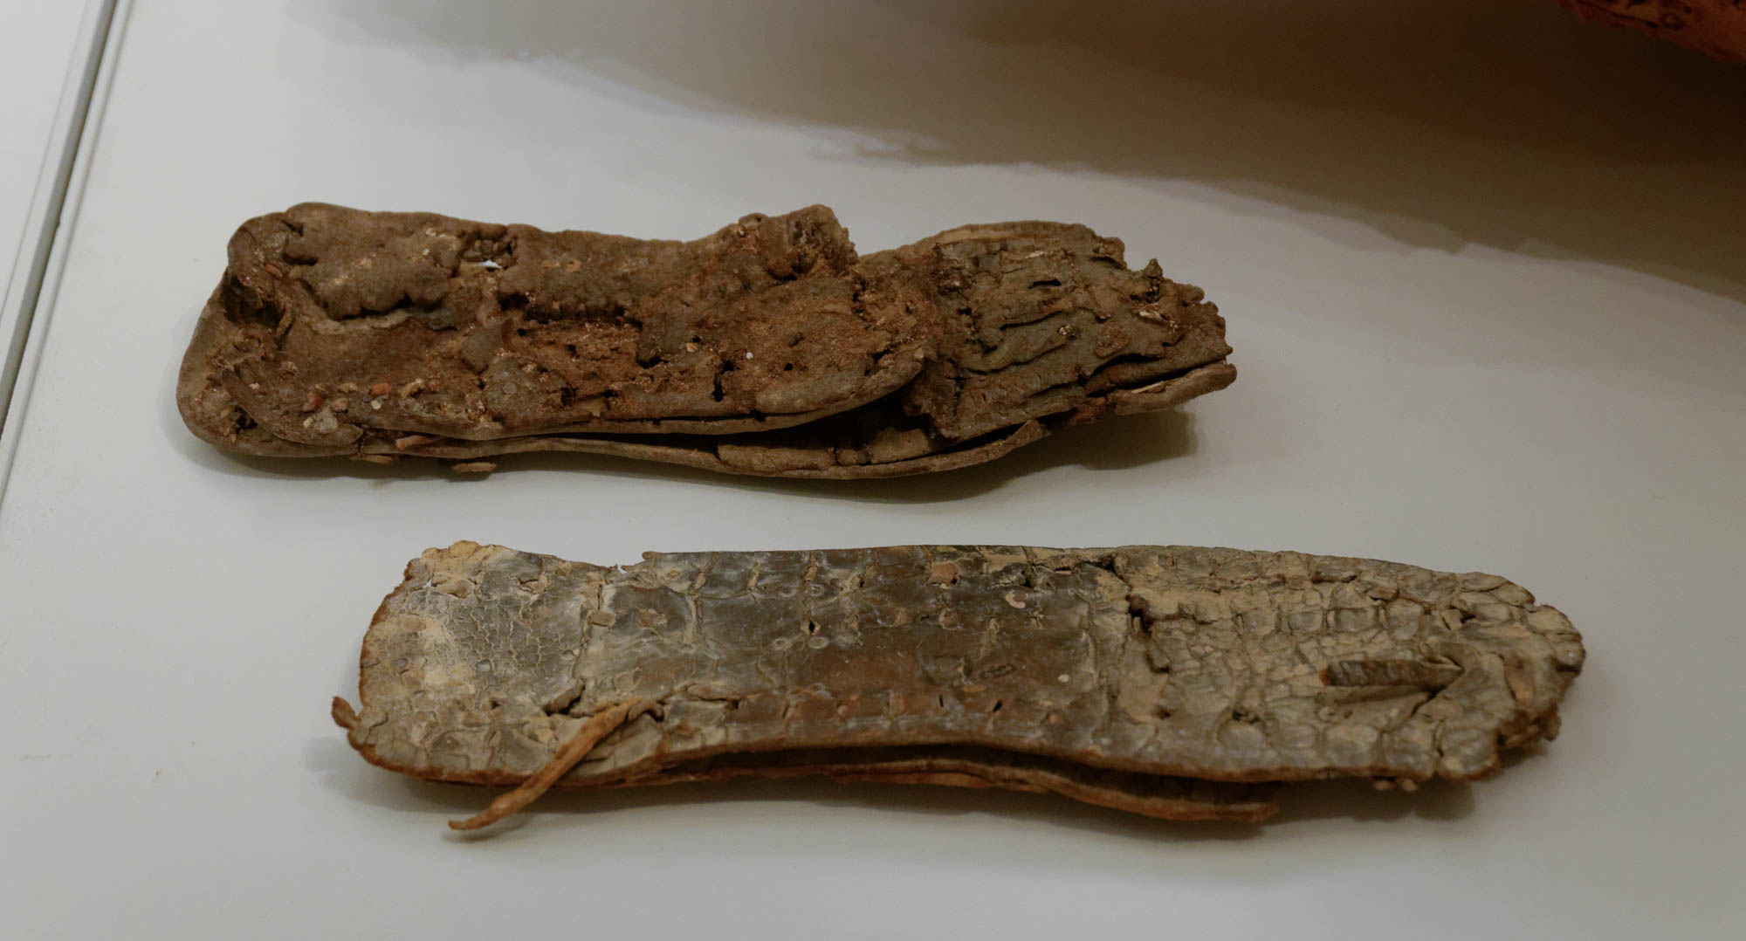
Wearing sandals
Leather sandals from Cave of the Letters in Nahal Hever
6:9
Notes:
These sandals were found with other items dating to the late 1st century and early 2nd century AD. Nahal Hever is located in the Judean wilderness south of En Gedi and north of Masada. The sandals are now on display in the Israel Museum in Jerusalem.
tb032014702

Slide 40
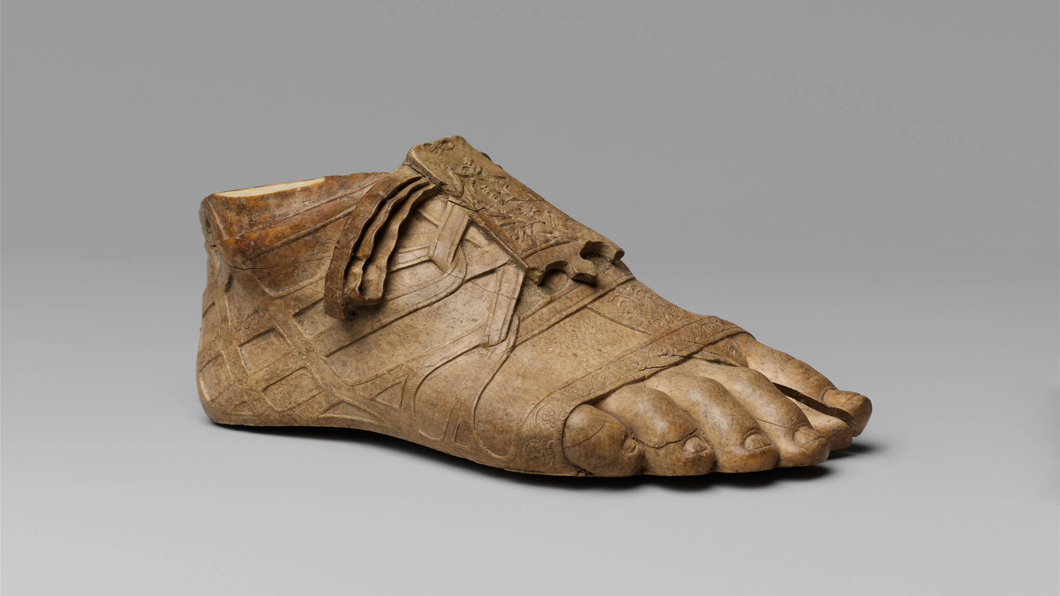
Wearing sandals
Ivory sandaled foot, ca. 31 BC – AD 14
6:9
Notes:
This is the foot of a small statue that comes from Rome, circa 31 BC – 14 AD. The tongue of the sandal is decorated with a personification of the Nile, suggesting that the statue depicted was either an Egyptian deity or the Emperor Augustus, who annexed Egypt after the defeat of Antony and Cleopatra at the Battle of Actium in 31 BC. This image comes from The Metropolitan Museum of Art, public domain, Fletcher Fund, 1925, accession number 25.78.43, http://metmuseum.org/art/collection/search/251827.
met251827h

Slide 41
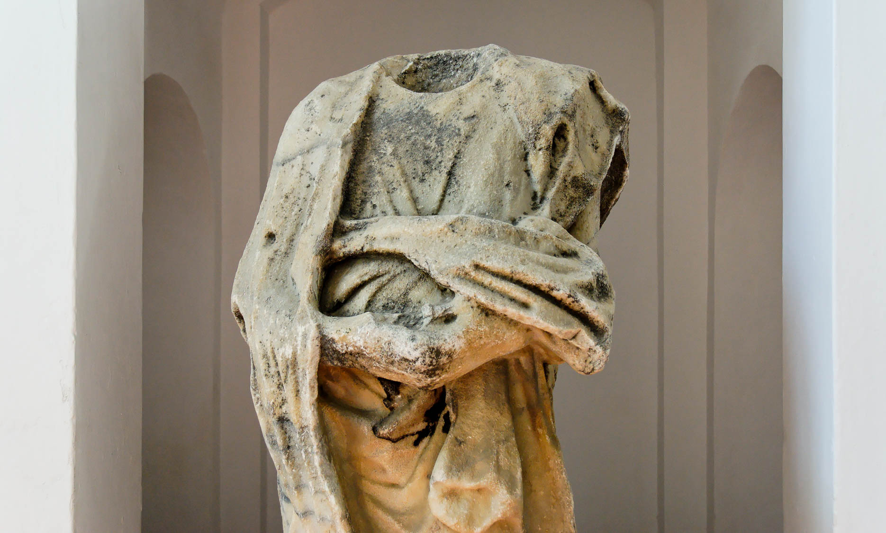
Do not put on two tunics
Statue of man holding coat, from Samos
6:9
Notes:
This statue is on display in the Samos Museum on the Greek island of Samos.
tb061606039h

Slide 42
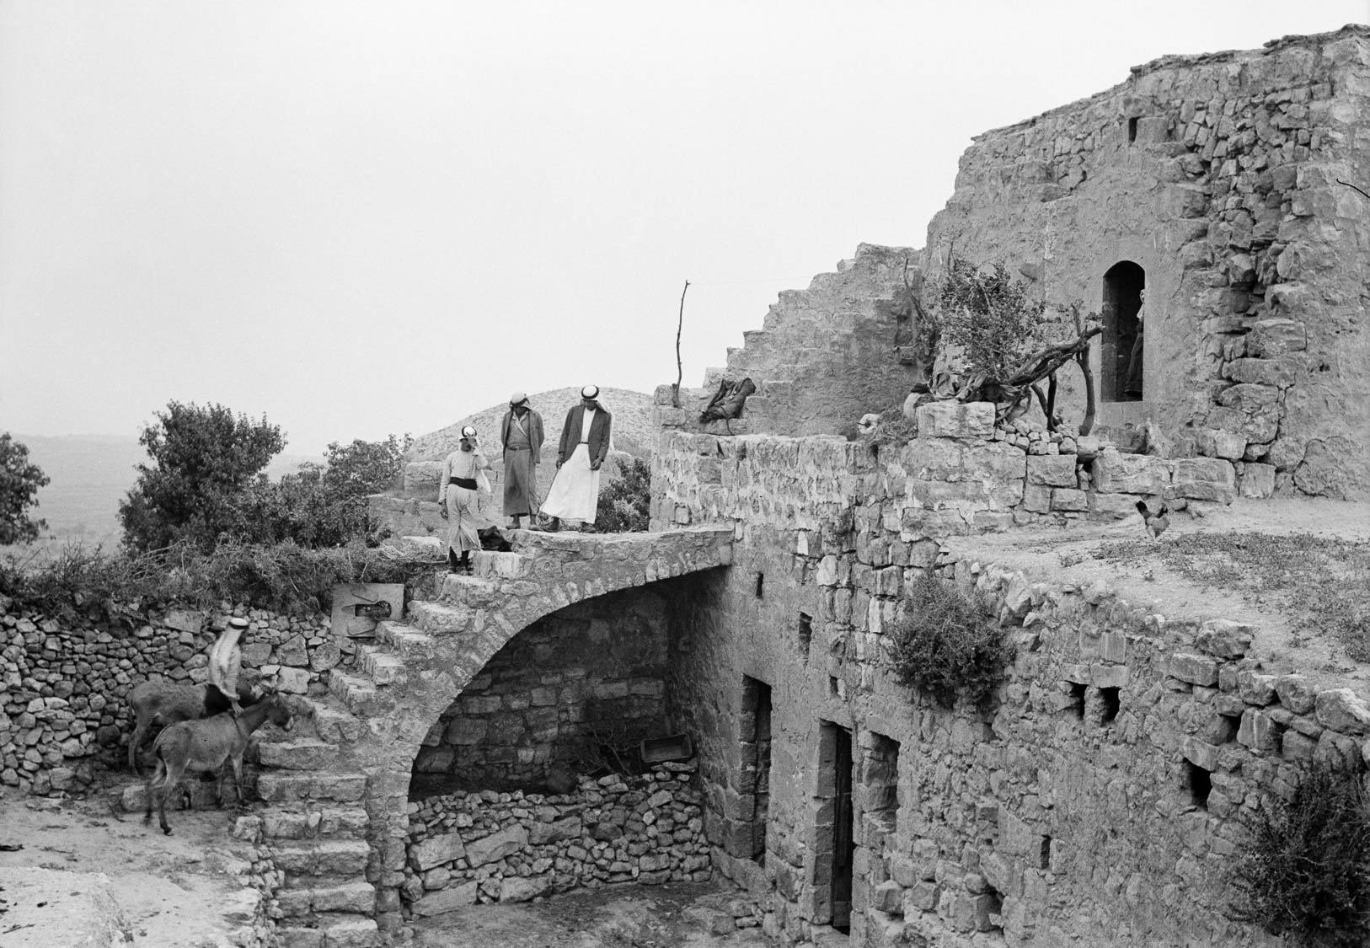
Into whatever house you enter, stay there
Typical peasant house in Halhul
6:10
Notes:
Halhul is a village in Judea in the vicinity of Hebron. This American Colony photograph was taken on May 18, 1940.
mat20321

Slide 43
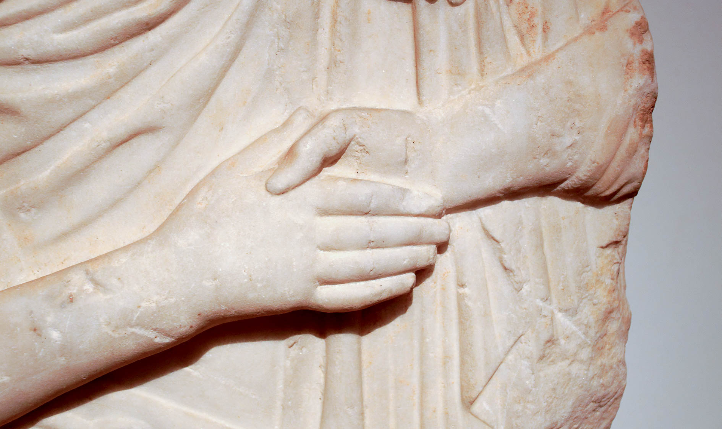
And if any place does not welcome you or listen to you
Grave stele depicting handshake, from Piraeus, ca 400 BC
6:11
Notes:
This relief was photographed in the National Archaeological Museum of Athens.
mjb011117941h

Slide 44
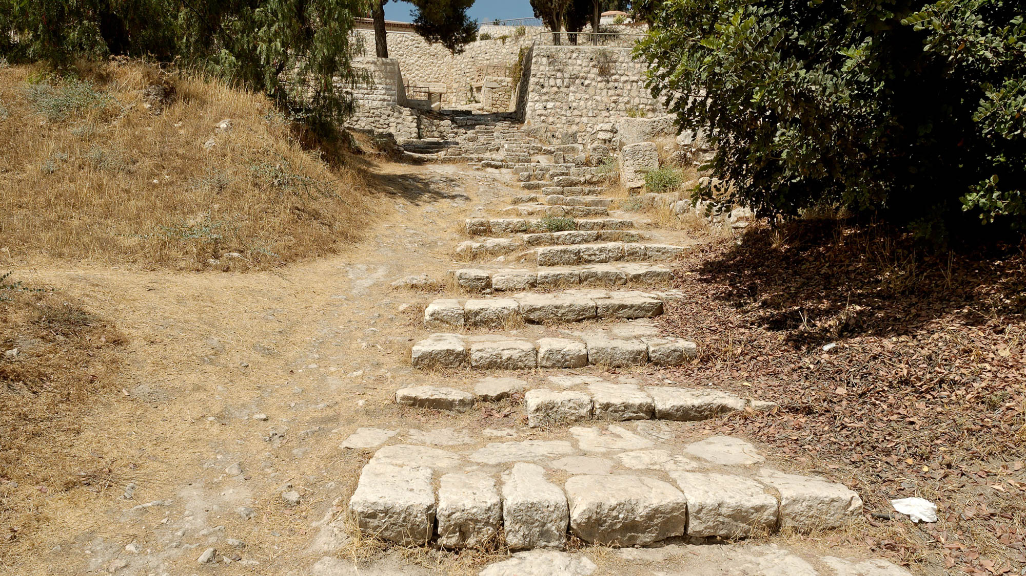
Shake off the dust that is under your feet as a witness to them
Ancient street near St. Peter in Gallicantu, Jerusalem
6:11
Notes:
Plenty of dirt would stick to the sandals of travelers who walked the dusty roads of ancient Israel.
tb082305529h

Slide 45
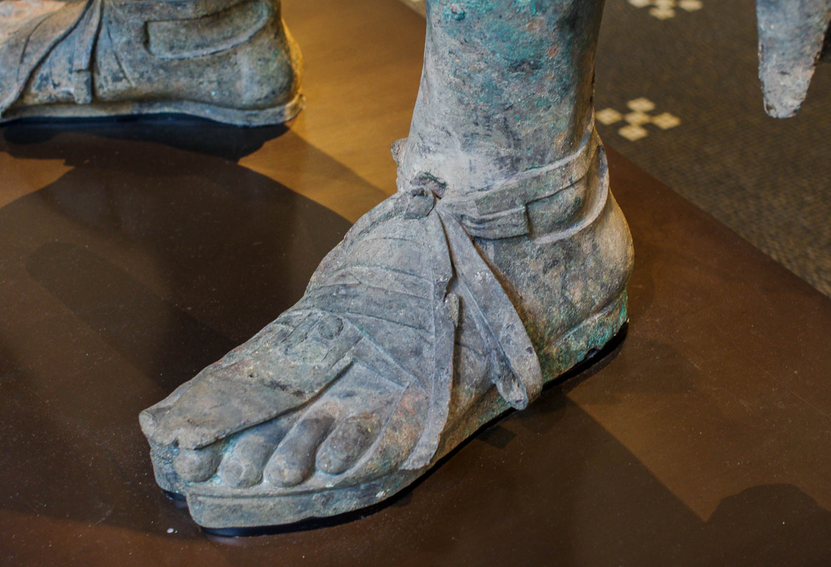
Shake off the dust that is under your feet as a witness to them
Hellenistic statue of man with cloak, circa mid-2nd–1st centuries BC
6:11
Notes:
This bronze statue was photographed in the Metropolitan Museum of Art in New York City.
adr1605242876

Slide 46
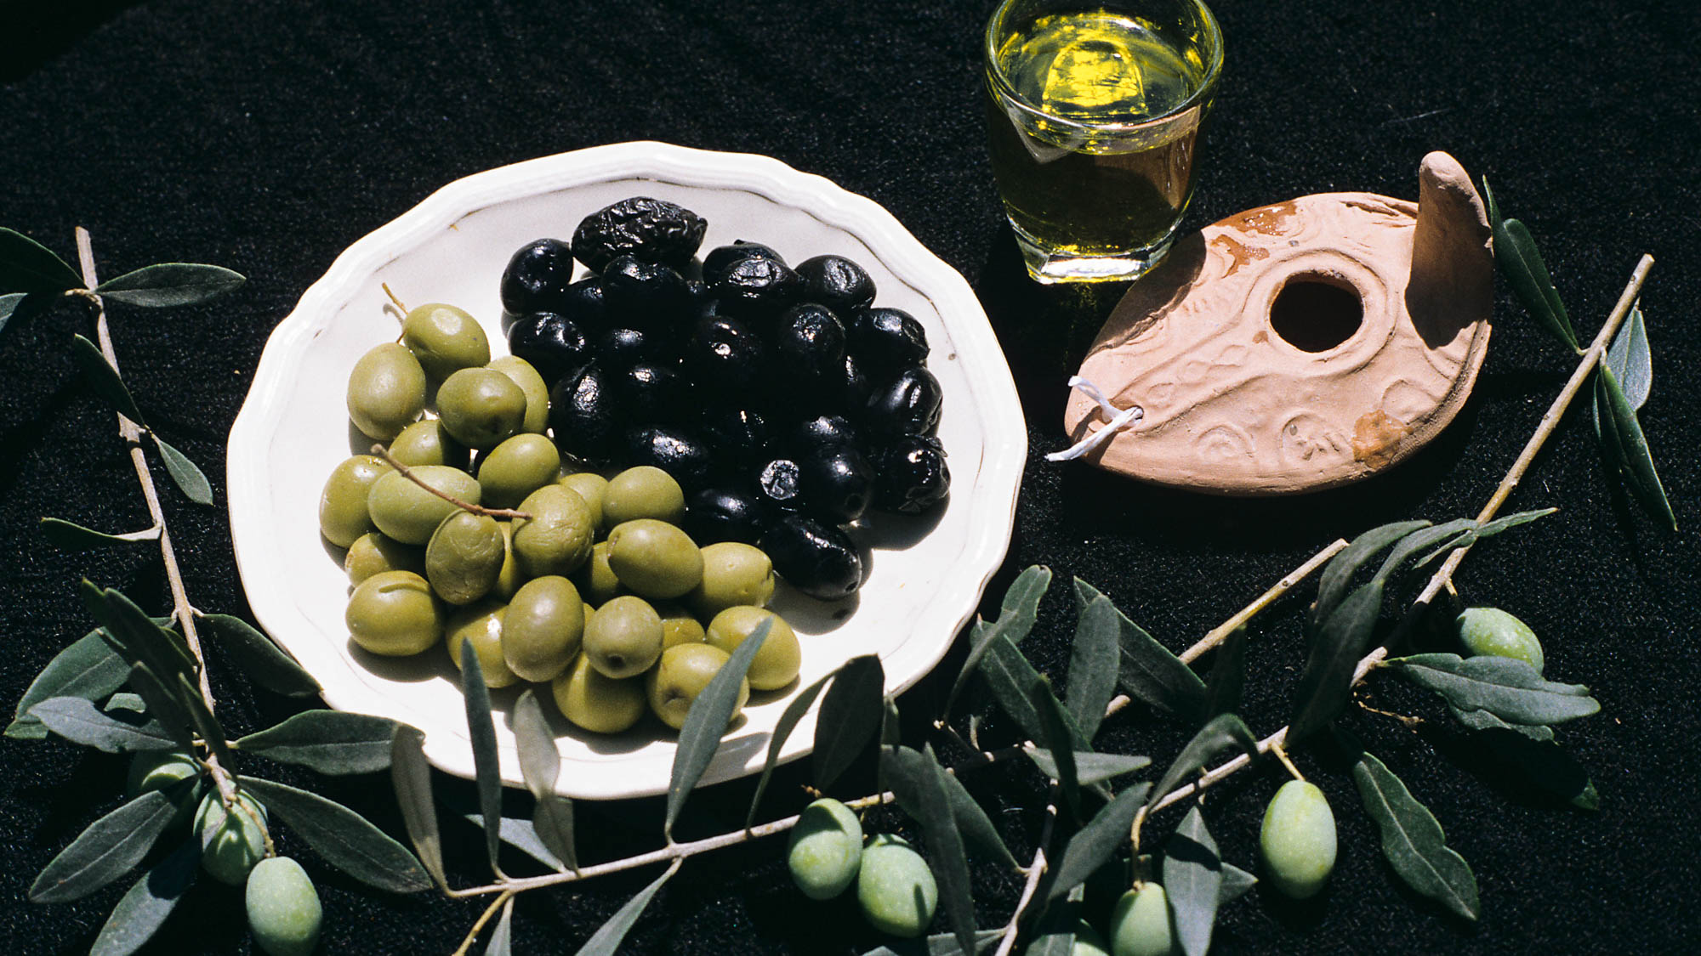
They anointed with oil many who were sick and healed them
Olive oil and lamps
6:13
Notes:
“Oil” in the Bible usually refers to olive oil.
gs080094c26

Slide 47
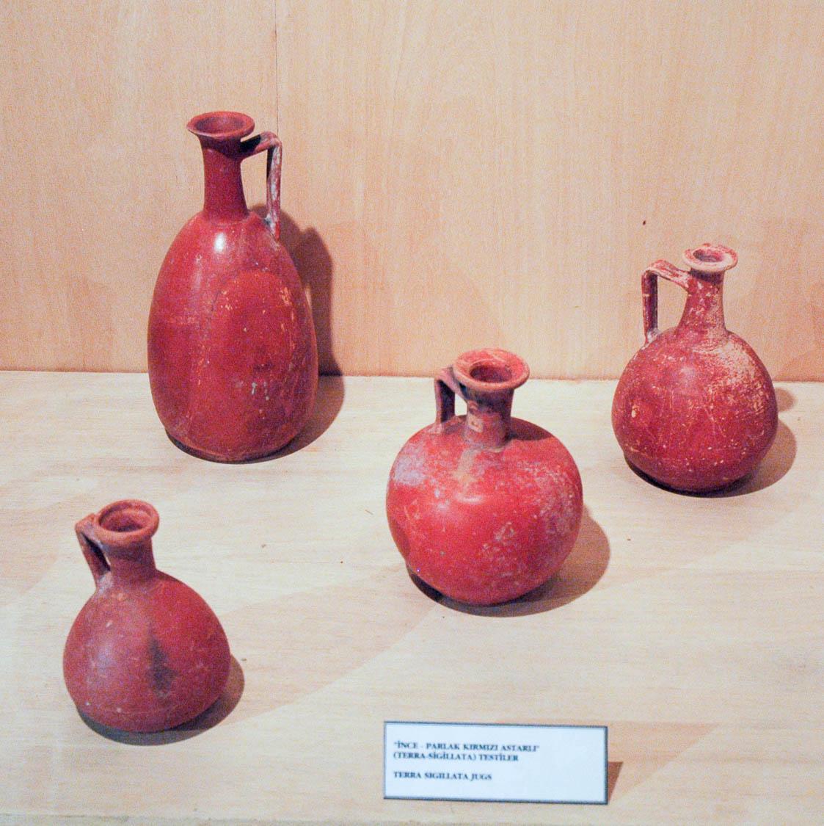
They anointed with oil many who were sick and healed them
Hellenistic-Roman terra sigillata jugs from Cyprus
6:13
Notes:
This display is located in the Istanbul Archaeological Museum.
tb041705975

Slide 48
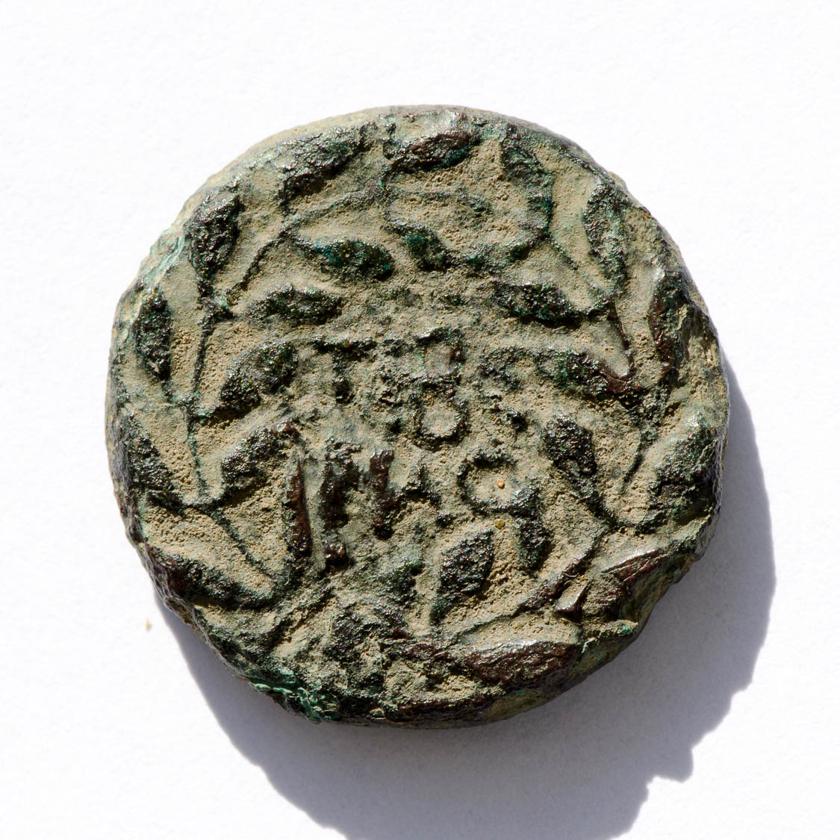
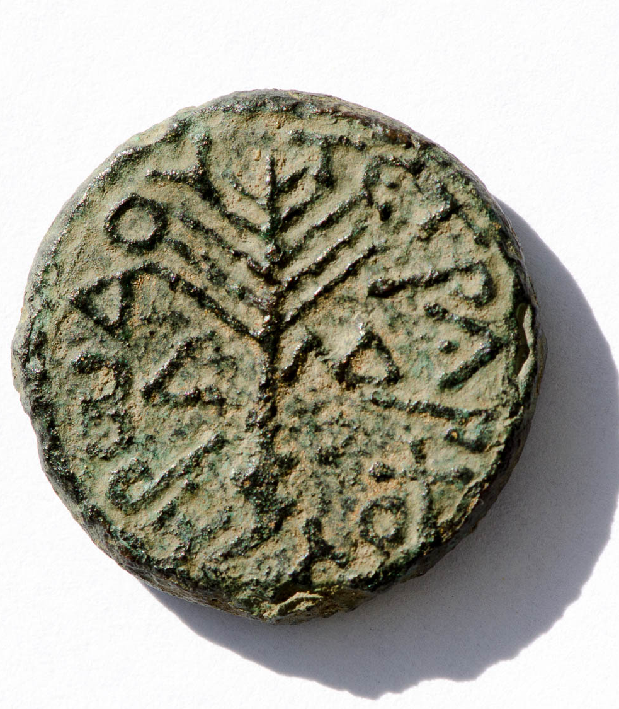
And King Herod heard of it
Bronze coin of Herod Antipas, AD 30/31, from the Tiberias mint
6:14
Notes:
The obverse of this coin contains the text ΤΙΒΕΡΙΑϹ (“Tiberias”) within a wreath. The reverse depicts an upright palm branch surrounded by the inscription ΗΡωΔΟΥ ΤΕΤΡΑΡΧΟΥ (“[a coin of] Herod the tetrarch”). The reverse also contains the date L (“year”) ΛΔ (34 = AD 30/31). This coin is in the Jared James Clark Collection.
Obverse (left): tb0713158582; reverse (right): tb0713158578

Slide 49
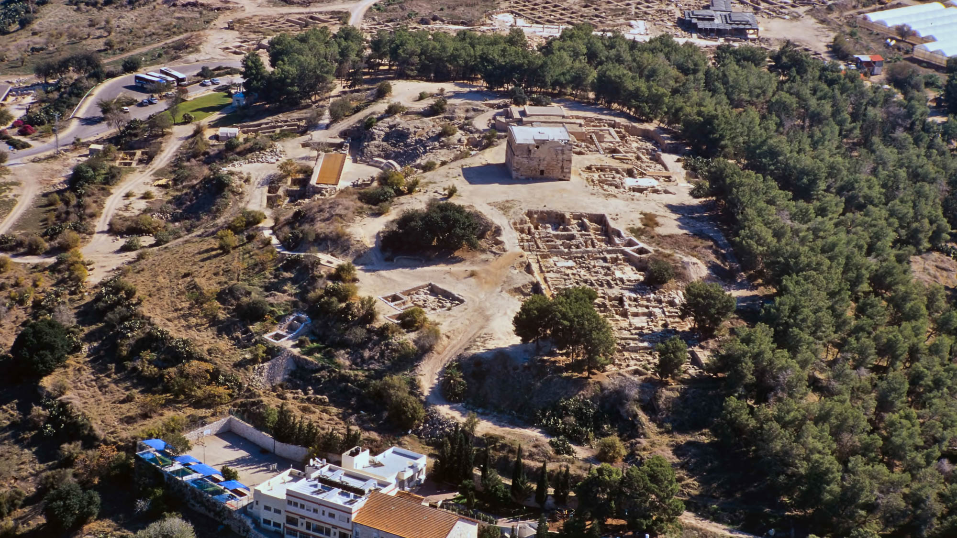
And King Herod heard of it
Sepphoris (aerial view from the west)
6:14
Notes:
Herod Antipas ruled from his capital in Sepphoris during the earlier years of Jesus’s life. In AD 20, he founded Tiberias and moved the capital there.
tbs122100011h

Slide 50

And King Herod heard of it
Cardo of Sepphoris
6:14
Notes:
One of the main streets of Sepphoris, this colonnaded road dates to the Roman period. The ruts in the limestone pavement were made by wheeled carts over the course of decades.
tb032507689h

Slide 51

And King Herod heard of it
Tiberias (from the north)
6:14
Notes:
Herod Antipas founded Tiberias on the western shore of the Sea of Galilee to be his new capital city in AD 20. He named it after the emperor Tiberius. This photochrom image was taken in the 1890s.
pcm02739

Slide 52

And King Herod heard of it
Roman bathhouse in Tiberias with cardo and shops
6:14
Notes:
The Gospels never record Jesus visiting the city of Tiberias. Recent excavations have uncovered remains of the Roman city.
adr1305050969h

Slide 53

And King Herod heard of it
Roman-Byzantine theater of Tiberias
6:14
Notes:
This theater was constructed at the foot of Mount Berenice, west of the Cardo. The first phase dates to the first century AD.
tb01141053p

Slide 54

And King Herod heard of it
Ramah, possible site of Livias (from the south)
6:14
Notes:
Herod Antipas ruled not only over Galilee but also over Perea, east of the Jordan River. Not much is known of cities from this region, but Livias was an important one. It is located on the Plains of Moab, east of Jericho, and may be identified with Tell Ramah.
tb031315148h

Slide 55

He said, “John the Baptist has risen from the dead”
Interior of the Church of St. John in Samaria
6:14
Notes:
Three church buildings were erected in Samaria (Sebaste) in the fifth, ninth, and twelfth centuries to commemorate the death of John. These are located to the east of the ruins of the city of Samaria (Sebaste). Saladin converted the church to a mosque in the late twelfth century. This American Colony photograph was taken between 1900 and 1920.
mat01065

Slide 56

He said, “John the Baptist has risen from the dead”
Interior of the Church of St. John in Samaria
6:14
Notes:
The domed structure is built over one of the traditional tombs of John.
tb070507845h

Slide 57

Others said, “He is Elijah”
Statue of Elijah on Mount Carmel
6:15
Notes:
This statue stands in the courtyard of the Discalced Carmelite Monastery at Muhraqa.
tb011400103

Slide 58

Others said, “He is a prophet, like one of the prophets of old”
Jeremiah seal, 8th century BC
6:15
Notes:
Matthew 16:14 specifically identifies Jeremiah as a prophet that some identified with Jesus. Perhaps this is because Jeremiah, like Jesus, was opposed by the leaders of his day because he brought an unpopular message. This carnelian seal has the name “Jeremiah” on it, but it dates to about a century before the time of the prophet, and therefore did not belong to him. It is now on display in the Israel Museum in Jerusalem.
tb032014489

Slide 59

Herod himself had sent and arrested John and bound him in prison
Sarcophagus depicting bound captive in Trojan War, from Perga, 2nd century AD
6:17
Notes:
This photograph was taken in the Antalya Museum.
tb123016907

Slide 60

Herod himself had sent and arrested John and bound him in prison
Iron chains worn by slaves, 1st century AD
6:17
Notes:
These iron shackles were photographed at the Spartacus Exhibit in Rome.
tb0518174081

Slide 61

Herod himself had sent and arrested John and bound him in prison
Macherus, traditional place of John’s imprisonment (from the east)
6:17
Notes:
Macherus was a fortress-palace complex of Herod Antipas in Perea, on the east side of the Dead Sea. According to Josephus (see below), John the Baptist was imprisoned and executed here.
Josephus’s Record:
About this time Aretas (the king of Arabia Petra) and Herod had a quarrel on the account following: Herod the tetrarch had married the daughter of Aretas, and had lived with her a great while; but when he was once at Rome, he lodged with Herod Philip (not the same Philip as the ruler in Caesarea Philippi), who was his brother indeed, but not by the same mother; for this Herod (Philip) was the son of the high priest Sireoh’s daughter. However, he fell in love with Herodias, this last Herod’s wife, who was the daughter of Aristobulus their brother, and the sister of Agrippa the Great. This man ventured to talk to her about a marriage between them; which address, when she admitted, an agreement was made for her to change her habitation, and come to him as soon as he should return from Rome; one article of this marriage also was this, that he should divorce Aretas’s daughter. So Antipas, when he had made this agreement, sailed to Rome; but when he had done there the business he went about, and was returned again, his wife having discovered the agreement he had made with Herodias, and having learned it before he had notice of her knowledge of the whole design, she desired him to send her to Macherus, which is a place in the borders of the dominions of Aretas and Herod, without informing him of any of her intentions. Accordingly Herod sent her thither, as thinking his wife had not perceived any thing; now she had sent a good while before to Macherus, which was subject to her father and so all things necessary for her journey were made ready for her by the general of Aretas’s army; and by that means she soon came into Arabia, under the conduct of the several generals, who carried her from one to another successively; and she soon came to her father, and told him of Herod’s intentions. So Aretas made this the first occasion of his enmity between him and Herod, who had also some quarrel with him about their limits at the country of Gamalitis. So they raised armies on both sides, and prepared for war, and sent their generals to fight instead of themselves; and when they had joined battle, all Herod’s army was destroyed by the treachery of some fugitives, who, though they were of the tetrarchy of Philip, joined with Aretas’s army. So Herod wrote about these affairs to Tiberius, who being very angry at the attempt made by Aretas, wrote to Vitellius to make war upon him, and either to take him alive, and bring him to him in bonds, or to kill him, and send him his head. This was the charge that Tiberius gave to the president of Syria.
Now some of the Jews thought that the destruction of Herod’s army came from God, and that very justly, as a punishment of what he did against John, that was called the Baptist: for Herod slew him, who was a good man, and commanded the Jews to exercise virtue, both as to righteousness towards one another, and piety towards God, and so to come to baptism; for that the washing [with water] would be acceptable to him, if they made use of it, not in order to the putting away [or the remission] of some sins [only], but for the purification of the body; supposing still that the soul was thoroughly purified beforehand by righteousness. Now when [many] others came in crowds about him, for they were very greatly moved [or pleased] by hearing his words, Herod, who feared lest the great influence John had over the people might put it into his power and inclination to raise a rebellion, (for they seemed ready to do any thing he should advise) thought it best, by putting him to death, to prevent any mischief he might cause, and not bring himself into difficulties, by sparing a man who might make him repent of it when it would be too late. Accordingly he was sent a prisoner, out of Herod’s suspicious temper, to Macherus, the castle I before mentioned, and was there put to death. Now the Jews had an opinion that the destruction of this army was sent as a punishment upon Herod, and a mark of God’s displeasure to him (Ant. 18.5.1-2/18.109-119, Whiston’s translation).
tb031415672h

Slide 62

Herod himself had sent and arrested John and bound him in prison
Macherus, traditional place of John’s imprisonment (from the east)
6:17
Notes:
Macherus rises dramatically from the surrounding landscape; the tapered sides of the hill give it a distinctive appearance.
tb031415721h

Slide 63

Herod himself had sent and arrested John and bound him in prison
Ritual bath (mikveh) on the summit of Macherus
6:17
Notes:
The Jewish character of the site is revealed by the presence of a large mikveh near the palace.
tb031415792

Slide 64

Herod himself had sent and arrested John and bound him in prison
Cave at Macherus, traditional prison of John the Baptist
6:17
Notes:
According to one tradition, John was imprisoned in this cave prior to his beheading.
tb061204077

Slide 65

Herod himself had sent and arrested John and bound him in prison
Excavations of Tiberias
6:17
Notes:
Tiberias was the capital city of Herod Antipas, and it is another possible location for the imprisonment of John the Baptist. John 3:23 locates John’s later ministry closer to the Sea of Galilee than his earlier ministry focus.
tb052808500h

Slide 66

Herod . . . arrested John . . . for the sake of Herodias his brother Philip’s wife
Bronze coins of Herod, Philip, and Pilate
6:17
Notes:
These coins were minted under the authority of three rulers in the land of Israel during the lifetime of Jesus. They are on display in the British Museum. The coin on the upper right is from the Philip who ruled over what is known today as the Golan Heights. However, many scholars believe this is a different Herod than the one married to Herodias.
tb112004261

Slide 67


Herod . . . arrested John . . . for the sake of Herodias his brother Philip’s wife
Coin of Philip the Tetrarch, minted in Caesarea Philippi, AD 1/2
6:17
Notes:
This coin (obverse and reverse sides) was minted under the authority of Herod Antipas’s brother Philip, who ruled over what is known today as the Golan Heights. (Some scholars believe this is a different Philip than the one married to Herodias.) The obverse of this coin depicts the bare head of Augustus and is inscribed ΚΑΙϹΑΡ ϹΕΒΑϹΤΟΥ (“[a coin of] Caesar Augustus”). The reverse depicts the bare head of Herod Philip and is inscribed ΦΙΛΙΠΠΟΥ ΤΕΤΡΑΡΧΟΥ (“[a coin of] Philip the Tetrarch”). The reverse also contains the date mark L (“year”) Ε (“5” = AD 1/2, counting from 4 BC). This coin is in the Jared James Clark Collection.
Obverse (left): tb0713158759; reverse (right): tb0713158757

Slide 68


Herod . . . arrested John . . . for the sake of Herodias his brother Philip’s wife
Bronze half-quadrans of Aretas IV, ca. 7–6 BC, from Petra mint
6:17
Notes:
Herod Antipas was originally married to the daughter of the Nabatean king Aretas IV. He divorced her in order to marry Herodias. In AD 36, Aretas IV attacked Antipas and defeated him in order to avenge himself for the divorce. The obverse side of the coin on this slide shows a laureate head of Aretas IV. The reverse shows a veiled female head. This coin is in the Jared James Clark Collection.
Obverse (left): tb0713158374h; reverse (right): tb0713158377h

Slide 69

John said to Herod, “It is not lawful for you to have your brother’s wife”
Ten Commandments plaque at Western Wall in Jerusalem
6:18
Notes:
By taking the wife of his brother, Herod Antipas was not only guilty of breaking the commandment against adultery (the commandment listed above on the left tablet, second line; see next slide for label), but also of breaking the commandment against having sexual relations with your brother’s wife (Lev 18:16). This plaque sits atop a Torah ark at the Western Wall prayer plaza.
tb091306089h

Slide 70
John said to Herod, “It is not lawful for you to have your brother’s wife”
Ten Commandments plaque at Western Wall in Jerusalem
6:18
Notes:
By taking the wife of his brother, Herod Antipas was not only guilty of breaking the commandment against adultery (the commandment listed above on the left tablet, second line), but also of breaking the commandment against having sexual relations with your brother’s wife (Lev 18:16). This plaque sits atop a Torah ark at the Western Wall prayer plaza.
tb091306089h

Slide 71

John said to Herod, “It is not lawful for you to have your brother’s wife”
Torah scroll with Leviticus 20:21 forbidding a man from marrying his brother’s wife
6:18
Notes:
“And if a man shall take his brother’s wife, it is impurity: he hath uncovered his brother’s nakedness; they shall be childless” (Lev 20:21, ASV).
This Yemenite Torah scroll was photographed at The Master’s Seminary in California.
tb031416425

Slide 72

Herod on his birthday gave a banquet for his nobles and military officers
Calendar from time of Nero, sacrifice for birthday of Nero on December 15, AD 60
6:21
Notes:
This inscription was photographed at the National Museum at the Diocletian Baths in Rome.
tb0513178668

Slide 73

Herod on his birthday gave a banquet for his nobles and military officers
Macherus palace courtyard (from the north)
6:21
Notes:
If Josephus is correct in placing John’s execution at Macherus, this would imply that Herod’s birthday party also took place at Macherus. Herod’s palace was located on the summit of the site, and has been excavated and reconstructed in recent years.
tb061204110

Slide 74

Herod on his birthday gave a banquet for his nobles and military officers
Macherus palace courtyard (from the east)
6:21
Notes:
This photo shows a more recent view of the palace courtyard, after previous reconstruction work was dismantled and replaced.
tb031415817

Slide 75

Herod on his birthday gave a banquet for his nobles and military officers
Macherus palace courtyard (from the west)
6:21
Notes:
tb031415758h

Slide 76

Herod on his birthday gave a banquet for his nobles and military officers
First-century BC mosaic from Macherus
6:21
Notes:
This mosaic comes from the palace of Herod and is now on display in the Medeba Archaeological Park.
tb061304126

Slide 77

Herod on his birthday gave a banquet for his nobles and military officers
Capital from Sebaste depicting feast of Herod Antipas (12th century AD)
6:21
Notes:
This Crusader-era capital comes from the church in Samaria (Sebaste) that commemorated John’s death. It is now on display in the Istanbul Archaeological Museum.
tb041705982

Slide 78

A banquet for his officials, military commanders, and leading men of Galilee
Sculpture of emperor on horseback
6:21
Notes:
This sculpture is on display in the Capitoline Museum in Rome.
tb112102056

Slide 79

A banquet for his officials, military commanders, and leading men of Galilee
El Azraq, Druze chief
6:21
Notes:
This American Colony photograph was taken in 1926.
mat00215

Slide 80

And when the daughter of Herodias came in and danced
Statuette of veiled and masked dancer, 3rd–2nd centuries BC, perhaps from Alexandria
6:22
Notes:
This bronze artifact was photographed in the Metropolitan Museum of Art in New York City.
adr1605244062

Slide 81

And when the daughter of Herodias came in and danced
Bronze coin of Aristobulus, depicting Aristobulus (l) and Salome (r), AD 66/7
6:22
Notes:
This coin (Hendin 1257a) was minted about 35 years after the event recorded in Mark 6. Although Herodias’s daughter is not named in the Gospels, many scholars identify her as Salome on the basis of statements made by Josephus. The obverse side of this coin (left) depicts a diademed and draped bust of Aristobulus, king of Lesser Armenia (Armenia Minor), and great-grandson of Herod the Great. It is inscribed ΒΑϹΙΛΕΩϹ ΑΡΙϹΤΟΒΟΥΛΟΥ ΕΤ ΙΓ (of King Aristobulus, year 13). The reverse side (right) depicts a diademed and draped bust of Salome and is inscribed ΒΑϹΙΛΙϹϹΗϹ ϹΑΛΩΜΗϹ (of Queen Salome). As Aristobulus was a client king of Rome, this coin was likely minted for propaganda purposes at the outbreak of the Jewish War. Photo credit: CNG. Source: https://www.cngcoins.com/Coin.aspx?CoinID=300452
cng300452

Slide 82

The king was very sorry, but because of his oaths and his dinner guests he would not refuse her
Dinner spread at Pan-Islamic conference at Shunat Nimrin
6:26
Notes:
This American Colony photograph shows a sumptuous dinner prepared for a conference in modern Jordan on December 12, 1931.
mat03058

Slide 83

He went and beheaded him in the prison
Capital from Sebaste depicting the execution of John the Baptist, 12th century
6:27
Notes:
This Crusader-era capital comes from the church in Samaria (Sebaste) that commemorated John’s death. It is now on display in the Istanbul Archaeological Museum.
tb041705979

Slide 84

He went and beheaded him in the prison
Painting of the beheading of John the Baptist in Medeba
6:27
Notes:
This painting is on display in the Shrine of the Beheading of John the Baptist in Medeba, Jordan.
tb031315590

Slide 85

He went and beheaded him in the prison
Church of John the Baptist, alternate location of John’s imprisonment
6:27
Notes:
An early tradition (before 361) identified Samaria (Sebaste) as the place of John’s imprisonment and execution. A chapel was built here in the sixth century to commemorate the supposed discovery of John’s head. The chapel was later rebuilt by the Crusaders.
adr1305144906

Slide 86

He went and beheaded him in the prison
Church of John the Baptist, alternate location of John’s imprisonment
6:27
Notes:
In addition to this chapel, a cathedral was built east of the ruins by the Crusaders to commemorate John’s death.
tb070507835h

Slide 87

He brought his head on a platter and gave it to the girl, and the girl gave it to her mother
Head of John the Baptist on platter in Medeba Church of John the Baptist
6:28
Notes:
This display is located in the Shrine of the Beheading of John the Baptist in Medeba, Jordan.
tb031315629

Slide 88

He brought his head on a platter and gave it to the girl, and the girl gave it to her mother
Depiction of head of John the Baptist at the Church of St. John
6:28
Notes:
The Church of St. John is located in the Christian Quarter of the Old City of Jerusalem.
tb060616929

Slide 89

He brought his head on a platter and gave it to the girl, and the girl gave it to her mother
Platter with other dishes discovered in Jerusalem, 1st century AD
6:28
Notes:
This display was photographed in the Wohl Museum of the Jewish Quarter in Jerusalem.
tb060516890

Slide 90

He brought his head on a platter and gave it to the girl, and the girl gave it to her mother
Platter made of greywacke stone, Ptolemaic-Roman period, from Egypt
6:28
Notes:
This platter dates from about the time of Jesus and is now on display in the Field Museum in Chicago.
adr1506083807

Slide 91

When his disciples heard of it, they came and took away his corpse and laid it in a tomb
The traditional tomb of John the Baptist in Samaria
6:29
Notes:
Three church buildings were erected in Samaria (Sebaste) in the fifth, ninth, and twelfth centuries to commemorate the death of John. These are located to the east of the ruins of the city of Samaria (Sebaste) and the chapel shown in previous slides. Saladin converted the church to a mosque in the late twelfth century. This illustration comes from Picturesque Palestine, published in the 1880s.
pp2015

Slide 92
When his disciples heard of it, they came and took away his corpse and laid it in a tomb
The traditional tomb of John the Baptist in Church of St. John in Samaria
6:29
Notes:
The domed structure is built over a traditional tomb of John.
tb070507845h

Slide 93

When his disciples heard of it, they came and took away his corpse and laid it in a tomb
The traditional tomb of John the Baptist in Church of St. John in Samaria
6:29
Notes:
Inside the domed structure is a Roman tomb dating to the second or third centuries AD.
tb070507850h

Slide 94

When his disciples heard of it, they came and took away his corpse and laid it in a tomb
The traditional tomb of John the Baptist in Church of St. John in Samaria
6:29
Notes:
tb070507848h

Slide 95

The apostles gathered themselves together to Jesus and told Him all the things they had done
Reenactment of disciples talking on the shoreline of the Sea of Galilee
6:30
Notes:
This photo was taken on the eastern side of the Sea of Galilee.
tb040706265

Slide 96

They did not have time even to eat
Druze peasant men of Mount Carmel eating meal
6:31
Notes:
This photochrom image was taken in the late 1800s.
pcm02768

Slide 97

They went away in a boat to a deserted place by themselves
First century AD boat reconstruction on shore of the Sea of Galilee
6:32
Notes:
This reconstruction is based on the first-century boat now on display at the Yigal Alon Museum at Nof Ginosar. It would have held up to fifteen passengers, making it the type of boat that Jesus and his disciples used frequently for transport. The reconstruction was photographed when it was on display at Kibbutz En Gev on the eastern side of the Sea of Galilee.
tb040506105

Slide 98

They went away in a boat to a deserted place by themselves
Plain of Bethsaida (from the northwest)
6:32
Notes:
Mark does not say exactly where Jesus went, but Luke 9:10 indicates that He was in the vicinity of Bethsaida. The plain of Bethsaida is located on the northeastern shore of the Sea of Galilee. The exact location of the city of Bethsaida is disputed. In any case, Jesus was teaching the crowds at a remote place, the closest city to which was Bethsaida. A good suggestion is that Jesus was teaching on the southern end of the Plain of Bethsaida (on the far left of the photo above). See the next slide for labels.
tb032807137h

Slide 99
They went away in a boat to a deserted place by themselves
Feeding of the 5000?
Plain of Bethsaida (from the northwest)
6:32
Notes:
The Plain of Bethsaida is located on the northeastern shore of the Sea of Galilee. The exact location of the city of Bethsaida is disputed. In any case, Jesus was teaching the crowds at a remote place, the closest city to which was Bethsaida. A good suggestion is that Jesus was teaching on the southern end of the Plain of Bethsaida (on the far left of the photo above).
tb032807137h

Slide 100

They went away in a boat to a deserted place by themselves
Plain of Bethsaida (from the east)
6:32
Notes:
Jesus may have fed the multitudes not far from the shore on the left side of the photo above. See the next slide for labels.
tb022107021h

Slide 101
They went away in a boat to a deserted place by themselves
Feeding of the 5000?
Bethsaida?
Plain of Bethsaida (from the east)
6:32
Notes:
Jesus may have fed the multitudes not far from the shore on the left side of the photo above.
tb022107021h

Slide 102

They went away in a boat to a deserted place by themselves
Plain of Bethsaida southern end, area of feeding of 5,000 (aerial view from the southwest)
6:32
Notes:
The proposal that Jesus fed the multitude on the southern end of the Plain of Bethsaida is based on the site being in a remote place yet being in the greater vicinity of Bethsaida. See the next slide for labels.
ws102215088

Slide 103
They went away in a boat to a deserted place by themselves
Bethsaida?
Feeding of the 5000?
Southern end of the Plain of Bethsaida (aerial view from the southwest)
6:32
Notes:
The proposal that Jesus fed the multitude on the southern end of the Plain of Bethsaida is based on the site being in a remote place yet being in the greater vicinity of Bethsaida.
ws102215088

Slide 104

They went away in a boat to a deserted place by themselves
Southern end of the Plain of Bethsaida (aerial view from the south)
6:32
Notes:
ws102215092

Slide 105

The people saw them going . . . and ran there together on foot from all the towns
Plain of Gennesaret from Arbel
6:33
Notes:
People from all over the region pursued Jesus to the east side of the lake. This photo shows the northwestern shore with the bountiful Plain of Gennesaret.
tb041003220h

Slide 106

The people saw them going . . . and ran there together on foot from all the towns
Running servant statuette, bronze, Italic, 300–200 BC
6:33
Notes:
This statuette was photographed in the Getty Villa in California.
tb100919748

Slide 107

The people saw them going . . . and ran there together on foot from all the towns
Area of ancient Magdala (aerial view from the east)
6:33
Notes:
Perhaps people came from Magdala to hear Jesus’s teaching. One of Jesus’s famous disciples, Mary of Magdalene, came from this town.
tbs123190011

Slide 108

The people saw them going . . . and ran there together on foot from all the towns
Chorazin (from the west)
6:33
Notes:
Chorazin is not far from the Plain of Bethsaida and it is likely that some people pursued Jesus from this town. According to Matthew 11, Jesus performed many miracles here.
tb041103212

Slide 109

The people saw them going . . . and ran there together on foot from all the towns
Roman street in Bethsaida
6:33
Notes:
It is likely that villagers came from Bethsaida to hear Jesus. Several of Jesus’s disciples were originally from this town (John 1:44, 12:21). Philip lived here during the years of Jesus’s ministry.
adr1305061407

Slide 110

The people saw them going . . . and ran there together on foot from all the towns
Gamla (from the southwest)
6:33
Notes:
While not mentioned in the New Testament, Gamla was a significant Jewish city in the time of Jesus. It is quite likely that people traveled from Gamla to hear teaching on the Plain of Bethsaida.
tb040803201

Slide 111

When He went ashore, He saw a large crowd
Crowds at the Tiberias harbor on the Sea of Galilee
6:34
Notes:
This American Colony photograph was taken in October 1931 when the crowds were awaiting the first landing of a seaplane on the Sea of Galilee.
mat15803

Slide 112

When He went ashore, He saw a large crowd
Crowds on the beach at Ashkelon during Muslim celebrations
6:34
Notes:
This American Colony photograph was taken on April 21, 1943.
mat21676

Slide 113

He had compassion on them, because they were as sheep without a shepherd
Sheep grazing in the Elah Valley
6:34
Notes:
tb030407705h

Slide 114

He had compassion on them, because they were as sheep without a shepherd
Sheep grazing in the Judean wilderness
6:34
Notes:
The green grass in the Judean wilderness only lasts a brief time after the rain, before the winds blow off the desert.
tb021107701h

Slide 115

He had compassion on them, because they were as sheep without a shepherd
Sheep at Gath
6:34
Notes:
tb060906112h

Slide 116

He had compassion on them, because they were as sheep without a shepherd
Torah scroll with Numbers 27:17 requesting a shepherd for the sheep of Israel
6:34
Notes:
The description of the Jews as sheep without a shepherd was an indictment of their spiritual leaders. Here Moses requests a new leader for the nation as he prepares to die.
“Who may go out before them, and who may come in before them, and who may lead them out, and who may bring them in; that the congregation of Jehovah be not as sheep which have no shepherd” (Num 27:17, ASV).
This Yemenite Torah scroll was photographed at The Master’s Seminary in California.
tb031416441

Slide 117

When it was already growing late in the day
Sea of Galilee sunset
6:35
Notes:
tb061316458

Slide 118

When it was already growing late in the day
Sunset over the Sea of Galilee from Kursi
6:35
Notes:
This photograph was taken a few miles south of the area where the feeding of the 5,000 likely took place.
tb011212447h

Slide 119

When it was already growing late in the day
Clouds over the Sea of Galilee
6:35
Notes:
tb102904607h

Slide 120

Send them away so that they may go into the surrounding countryside and villages
Arab village of el-Jib
6:36
Notes:
El-Jib preserves the name of biblical Gibeon. The villages that Jesus visited may have looked something like the one pictured above. This American Colony photograph was taken between 1934 and 1939.
mat18995h

Slide 121

Send them away so that they may go . . . and buy themselves something to eat
Men selling fruit in Luxor
6:36
Notes:
The displays of the food vendors in Luxor, Egypt, may not be all that different from markets in ancient times.
tb110500394

Slide 122

Send them away so that they may go . . . and buy themselves something to eat
Fruit vendor, circa 1910
6:36
Notes:
This American Colony photograph was taken between 1900 and 1920.
mat01248

Slide 123

Shall we go and buy two hundred denarii worth of bread and give it to them to eat?
Gold aureus of Tiberius from Lugdunum, AD 14–37
6:37
Notes:
The aureus was a Roman gold coin that was equal in value to 25 silver denarii. Thus, 8 aurei would equal 200 denarii. The above photograph shows the obverse and reverse sides of a gold aureus minted around the time of Jesus’s ministry. The obverse depicts Tiberius and is inscribed TI CAESAR DIVI AVG F AVGVSTVS (=Tiberius Caesar divi Augustus Filius, Augustus = “Tiberius Caesar, son of the divine Augustus, Augustus”). The reverse depicts a vestal priestess and is inscribed PONTIF MAXIM (= Pontifex Maximus = “high priest”). This image is from the Yale University Art Gallery, and is in the public domain. Source: http://artgallery.yale.edu/collections/objects/127662
yale127662

Slide 124

Shall we go and buy two hundred denarii worth of bread and give it to them to eat?
Denarius of Augustus from Emerita, Spain, 25–23 BC
6:37
Notes:
The obverse of this coin depicts the bare head of Augustus and is inscribed IMP CAESAR AVGVST (“Imperator Caesar Augustus”). The reverse reads P CARISIVS LEG PRO PR (P. Carisius Legatus Pro Praetore) around a depiction of the city walls, with the name of the city (EMERITA) in the center. This image comes from the Yale University Art Gallery, and is in the public domain. Source: http://artgallery.yale.edu/collections/objects/135070
yale135070

Slide 125

Shall we go and buy two hundred denarii worth of bread and give it to them to eat?
Bread sellers of Jerusalem
6:37
Notes:
Bakeries were to be found in Bethsaida and other nearby villages, but Jesus chose to provide for the people Himself. This photochrom image was taken in the late 1800s.
pcm02762

Slide 126

Shall we go and buy two hundred denarii worth of bread and give it to them to eat?
Bread vendor
6:37
Notes:
This American Colony photograph was taken between 1900 and 1920.
mat01247

Slide 127

He said to them, “How many loaves do you have?” . . . They said, “Five, and two fish”
St. Peter’s fish with bread
6:38
Notes:
The musht fish is known today as ”St. Peter’s fish.” One of them, along with some pita bread and salad, makes for a good meal for one person.
tb041103264h

Slide 128

He said to them, “How many loaves do you have?” . . . They said, “Five, and two fish”
Mosaic of fish and loaves from Tabgha
6:38
Notes:
The Church of Multiplication of Loaves and Fishes at Tabgha (ancient Heptapegon) commemorates this miracle, but it is based on the incorrect identification of Tabgha with Bethsaida. Nonetheless, the ancient depiction of the loaves and fish provides a valuable historic (Byzantine-era) illustration of the event.
tb032804310h

Slide 129

He said to them, “How many loaves do you have?” . . . They said, “Five, and two fish”
Mosaic of fish and loaves from Tabgha
6:38
Notes:
This is a close-up of the mosaic shown in the previous photo.
tb102702024h

Slide 130

He said to them, “How many loaves do you have?” . . . They said, “Five, and two fish”
Byzantine mosaic of fish and loaves from the Ajlun Castle
6:38
Notes:
Though difficult to see today, the above mosaic depicts fish and loaves. It is located in the Ajlun Castle in the hills of Gilead, Jordan.
tb060403082

Slide 131

He commanded them all to sit down by groups on the green grass
Plain of Bethsaida with green grass
6:39
Notes:
The area pictured above may not be the same area as the miracle, but it gives a good visual representation and is likely not far from the place where the crowds sat down to eat.
tb110206630

Slide 132

He commanded them all to sit down by groups on the green grass
Eating meal
6:39
Notes:
This American Colony photograph was taken between 1900 and 1920.
mat01233h

Slide 133

He commanded them all to sit down by groups on the green grass
The Miracle of the Loaves and the Fishes, by James Tissot, circa 1891
6:39
Notes:
This image of an opaque watercolor over graphite on gray wove paper comes from the Brooklyn Museum, purchased by public subscription, 00.159.134, and has no known copyright restrictions. Source: https://www.brooklynmuseum.org/opencollection/objects/13423
bmny13423

Slide 134

And they sat down in groups, by hundreds, and by fifties
Private garden and vineyards in Wadi Biyar
6:40
Notes:
The word translated above as “groups” is literally a “bed in a garden, garden-plot” and metaphorically “in companies or groups” (LSJ).
tb112406336

Slide 135

And they sat down in groups, by hundreds, and by fifties
Turkish soldiers on parade grounds
6:40
Notes:
This photograph illustrates the organization of a large number of people into groups. This American Colony photograph was taken between 1910 and 1917. Dormition Abbey on the summit of Mount Zion is visible in the distance on the left.
mat08131h

Slide 136

Looking up to heaven, He blessed the food
Clouds above the Sea of Galilee
6:41
Notes:
This photo was taken at the En Gev Holiday village on the eastern shore of the Sea of Galilee.
tb110106566h

Slide 137

And they all ate and were filled
Church of the Multiplication of Loaves and Fishes at Heptapegon (Tabgha)
6:42
Notes:
Tabgha is a traditional location for the feeding of the 5,000, based on the incorrect assumption that Tabgha was ancient Bethsaida.
tb102602019h

Slide 138

And they all ate and were filled
Hadjar en-Nasaroh, a traditional location of the multiplication of the five loaves
6:42
Notes:
Another traditional location for the feeding of the 5,000 is Hadjar en-Nasaroh near the Horns of Hattin (visible in the distance on the left). This photochrom image was taken in the 1890s.
pcm02676

Slide 139

They took up twelve baskets full of broken pieces and of the fish
Fiber basket with pottery cups, Middle Kingdom, from Dashur
6:43
Notes:
Baskets are rarely preserved from the ancient world because they are made of perishable materials. This one dates to the early 2nd millennium BC and comes from Dashur in northern Egypt. It is now on display in the Field Museum in Chicago.
adr1506042991

Slide 140

They took up twelve baskets full of broken pieces and of the fish
Fish market in Alexandria
6:43
Notes:
adr1603268380

Slide 141

They took up twelve baskets full of broken pieces and of the fish
Oval basket with linen cord, 18th dynasty, from Sheikh Abd el-Qurna
6:43
Notes:
This basket is made of halfa grass and palm leaf and dates to about the time of Moses. This photo is provided here because we do not have many baskets preserved from the ancient world. This basket was photographed in the Metropolitan Museum of Art in New York City.
adr1605244446

Slide 142

They took up twelve baskets full of broken pieces and of the fish
Women on the way to the market with baskets on their heads
6:43
Notes:
This American Colony photograph was taken before 1946.
mat07350h

Slide 143

Those who ate the loaves were five thousand men
Men’s prayer area at the Western Wall filled during Sukkot
6:44
Notes:
Matthew 14:21 notes that these “five thousand” are adult men only, without counting women and children. Evidently the men sat down in groups that were segregated from the groups of women and children, and therefore the men were counted separately. The practice of separating men and women in certain public situations is continued today in Orthodox Judaism.
tb1009069609

Slide 144
Those who ate the loaves were five thousand men
Druze peasant men of Mount Carmel eating meal
6:44
Notes:
In the traditional Arab (not Muslim per se) cultures of Palestine and Transjordan, men and women would eat meals separately. This photochrom image was taken in the late 1800s.
pcm02768h

Slide 145

He made His disciples get into a boat and go ahead of Him to the other side, to Bethsaida
First-century AD boat excavated in the Sea of Galilee
6:45
Notes:
This boat was excavated about 1900 feet (600 m) south of Kibbutz Nof Ginosar. It is now on display in the Yigal Alon Museum at the kibbutz.
adr1305051109

Slide 146

He made His disciples get into a boat and go ahead of Him to the other side, to Bethsaida
Sea of Galilee with boat
6:45
Notes:
The boat shown in the photo above is one of the common tourist boats that now carry pilgrims across the lake.
tb100805618h

Slide 147

He made His disciples get into a boat and go ahead of Him to the other side, to Bethsaida
Et-Tell, possible location of Bethsaida (aerial view from the northeast)
6:45
Notes:
Textual descriptions indicate that Bethsaida is located on the northeastern side of the Sea of Galilee, and archaeologists have been excavating the site shown above (et-Tell) since 1987. Some commentators argue that the feeding of the 5,000 occurred near a “Bethsaida Julias” in the territory of Herod Philip (cf. Luke 9:10; Josephus Ant. 18.28/18.2.1; War 2.168/2.9.1), where Jesus went to avoid a meeting with Herod Antipas after Herod’s execution of John the Baptist (though see Mark 6:31), and that the Bethsaida of the present verse is a “Bethsaida of Galilee,” where several of the disciples were from (cf. John 12:21). No ancient evidence supports such a view.
ws040215089h

Slide 148

He made His disciples get into a boat and go ahead of Him to the other side, to Bethsaida
Et-Tell, possible location of Bethsaida (aerial view from the east)
6:45
Notes:
One problem in identifying et-Tell with Bethsaida is its distance from the Sea of Galilee and its elevation above the ancient level of the lake. Another problem is the lack of monumental remains from the Roman period.
ws040215096h

Slide 149

He made His disciples get into a boat and go ahead of Him to the other side, to Bethsaida
View to the Sea of Galilee from the ruins of et-Tell, possible location of Bethsaida
6:45
Notes:
Impressive remains from the Iron Age have been discovered at et-Tell, but limited remains from the first century have led some scholars to question its identification with Bethsaida.
tb052808523

Slide 150

He made His disciples get into a boat and go ahead of Him to the other side, to Bethsaida
El-Araj (possible Bethsaida), Jordan River, and Sea of Galilee (aerial view from the north)
6:45
Notes:
Another proposed site for first-century Bethsaida is el-Araj. El-Araj is located close to the shoreline of the Sea of Galilee and would be a suitable location for a fishing village. See the next slide for a label and the following slide for a close-up.
ws040617528

Slide 151
He made His disciples get into a boat and go ahead of Him to the other side, to Bethsaida
el-Araj
El-Araj (possible Bethsaida), Jordan River, and Sea of Galilee (aerial view from the north)
6:45
Notes:
Another proposed site for first-century Bethsaida is el-Araj. El-Araj is located close to the shoreline of the Sea of Galilee and would be a suitable location for a fishing village.
ws040617528

Slide 152

He made His disciples get into a boat and go ahead of Him to the other side, to Bethsaida
El-Araj, possible location of Bethsaida
6:45
Notes:
Another proposed site for first-century Bethsaida is el-Araj. El-Araj is located close to the shoreline of the Sea of Galilee and would be a suitable location for a fishing village.
ws033115030h

Slide 153

He made His disciples get into a boat and go ahead of Him to the other side, to Bethsaida
Architectural pieces from el-Araj, possible location of Bethsaida
6:45
Notes:
Some architectural remains are visible on the surface, and recent excavations have begun uncovering Roman and Byzantine-era structures.
tb110206608

Slide 154

After He had taken leave of them, He departed to the mountain to pray
Plain of Bethsaida and the Sea of Galilee (from the west)
6:46
Notes:
This photograph shows a high hill overlooking the Plain of Bethsaida. The mountains surrounding the Plain of Bethsaida, including this one, have a clear view of the nearby Sea of Galilee. As Jesus prayed, he may have noticed his disciples' struggle with the wind and decided to rejoin them. The account seems to imply it took several hours for him to reach them, which makes sense given the distance. This photo was taken by David Bivin in April of 1967, when Syria controlled the shoreline of the Sea of Galilee from the Jordan River to slope of Kursi.
db6704091009h

Slide 155

After He had taken leave of them, He departed to the mountain to pray
Plain of Bethsaida, showing mountains or hills on sides of plain (from the northwest)
6:46
Notes:
If our reconstruction of the feeding occurring on the south side of the Plain of Bethsaida is accurate, the mountain on which Jesus prayed was probably on the east side of the plain (on the left side of the photo).
tb032807130h

Slide 156

After He had taken leave of them, He departed to the mountain to pray
Southern end of the Plain of Bethsaida
6:46
Notes:
This hill is our best guess as to the one that Jesus climbed after sending the crowds away.
tb040606118h

Slide 157

When evening came, the boat was in the middle of the sea, and He was alone on the land
Sea of Galilee at dusk from Tiberias
6:47
Notes:
One can see a boat with its lights on in this photo.
tb022107219h

Slide 158

When evening came, the boat was in the middle of the sea, and He was alone on the land
Sea of Galilee (aerial view from the east)
6:47
Notes:
This is a view from the middle of the lake looking towards Mount Arbel (center). The outskirts of Tiberias is visible on the far left.
ws092816458

Slide 159

And He was alone on the land
Man on shoreline of the Sea of Galilee at Tabgha
6:47
Notes:
This American Colony photograph was taken between 1898 and 1946.
mat08992h

Slide 160

And He was alone on the land
Man on shore of the Sea of Galilee
6:47
Notes:
This photograph was taken on the eastern shore of the Sea of Galilee.
tb040706310

Slide 161

And seeing them straining at the oars
Capernaum from the Sea of Galilee
6:48
Notes:
This American Colony photograph was taken between 1900 and 1920.
mat05165h

Slide 162

And seeing them straining at the oars
Fishermen in boats on the Sea of Galilee near the mouth of the Jordan River
6:48
Notes:
This American Colony photograph was taken between 1900 and 1920.
mat05162

Slide 163

About the fourth watch of the night He came to them, walking on the sea
Sea of Galilee at dusk (from the east)
6:48
Notes:
The fourth watch of the night runs from 3:00 to 6:00 am and is a difficult time to take photos that don’t look underexposed.
tb011312570

Slide 164

About the fourth watch of the night He came to them, walking on the sea
Christ Walking on the Waters, by Julius Sergius Von Klever, circa 1880
6:48
Notes:
This image comes from Julius Sergius Von Klever and is in the public domain, via Wikimedia Commons: https://commons.wikimedia.org/wiki/File:Christ_Walking_on_the_Waters,_Julius_Sergius_Von_Klever.jpg.
wiki080720150013

Slide 165

About the fourth watch of the night He came to them, walking on the sea
Dramatization of Jesus walking on the Sea of Galilee
6:48
Notes:
It was quite dark when Jesus walked on water. As this recreation shows, the disciples would have struggled to distinguish facial features, even closer to sunrise. It's no wonder the disciples didn't recognize their teacher at first. This scene was re-created with one of our students one evening while staying at the En Gev Holiday Resort. The effect was accomplished without the assistance of Photoshop.
tb040406061

Slide 166

About the fourth watch of the night He came to them, walking on the sea
Dramatization of Jesus walking on the Sea of Galilee
6:48
Notes:
This scene was re-created with one of our students one evening while staying at the En Gev Holiday Resort. The effect was accomplished without the assistance of Photoshop.
tb040606153h

Slide 167

About the fourth watch of the night He came to them, walking on the sea
“No walking on water” sign
6:48
Notes:
This sign is posted today at Caesarea Philippi.
tb102502501

Slide 168

And He would have passed by them
Dramatization of Jesus walking on the Sea of Galilee
6:48
Notes:
This scene was re-created with one of our students one evening while staying at the En Gev Holiday Resort. The effect was accomplished without the assistance of Photoshop.
tb040606161

Slide 169

And He would have passed by them
Dramatization of Jesus walking on the Sea of Galilee
6:48
Notes:
tb040606166h

Slide 170

He went up to them into the boat, and the wind ceased
Sea of Galilee calm at dusk
6:51
Notes:
tb032805894h

Slide 171

For they did not understand about the loaves
Bread for sale near Damascus Gate
6:52
Notes:
tb061116154

Slide 172

But their hearts were hardened
Heart-shaped column drum on summit of Penuel
6:52
Notes:
Recent excavations on the summit of Tell adh-Dhahab al-Garbiyya have revealed heart-shaped columns, probably from a Roman-era structure. Heart-shaped columns were used at the junction of colonnades.
tb030815351h

Slide 173

When they had crossed over, they landed at Gennesaret
Plain of Gennesaret and the Sea of Galilee (aerial view from the southwest)
6:53
Notes:
The Plain of Gennesaret runs along the northwestern shore of the Sea of Galilee. It is not known exactly where Jesus landed on this occasion.
ws011315178h

Slide 174

When they had crossed over, they landed at Gennesaret
Sea of Galilee and Plain of Gennesaret (from the north)
6:53
Notes:
tb053016359h

Slide 175

When they had crossed over, they landed at Gennesaret
Fishing boat along the shore of the Sea of Galilee
6:53
Notes:
This illustration comes from Picturesque Palestine, first published in the 1880s.
pp2082h

Slide 176

They landed at Gennesaret and anchored to the shore
Men anchoring boat on the shore of the Sea of Galilee
6:53
Notes:
This American Colony photograph was taken in Tiberias between 1900 and 1920.
mat01099

Slide 177

And when they got out of the boat
First-century AD boat discovered on the Sea of Galilee
6:54
Notes:
The remains of this boat were discovered along the northwestern shore of the Sea of Galilee and today are on display in the Yigal Alon Museum at Nof Ginosar.
adr1305051166

Slide 178

And began to carry on their mats those who were sick
Woven mat from the Cave of the Treasure in Nahal Mishmar, 4th millennium BC
6:55
Notes:
This mat is on display in the Israel Museum in Jerusalem. Its preservation is remarkable. Nahal Mishmar is located near the Dead Sea.
tb032014054h

Slide 179

And began to carry on their mats those who were sick
Mats in traditional house at Taiyibeh
6:55
Notes:
This house in modern Taiyibeh is furnished with a number of mats. The house reflects a traditional style going back many hundreds of years and perhaps longer. Taiyibeh is located in the hill country north of Jerusalem and may be identified with Ophrah of 1 Samuel 13:7 and Ephraim of John 11:54.
tb051207366h

Slide 180

And they ran about that whole country . . . to the place where they heard He was
Plain of Gennesaret (from the northeast)
6:55
Notes:
See the following slide for specific locations on the Plain of Gennesaret.
tbs99209810h

Slide 181
And they ran about that whole country . . . to the place where they heard He was
Arbel
Kibbutz
Nof Ginosar
Magdala
Valley of Doves
Sea of
Galilee
Khirbet el-Minya
Plain of Gennesaret (from the northeast)
6:55
Notes:
tbs99209810h

Slide 182

And they ran about that whole country . . . to the place where they heard He was
Plain of Gennesaret (from the southwest)
6:55
Notes:
The kibbutz in the center of the photograph, Nof Ginosar, preserves the ancient name of Gennesaret. This kibbutz has one of only four modern harbors on the Sea of Galilee. This photograph was taken from Arbel.
tb011400819

Slide 183

And wherever He entered, into the villages, towns, or countryside
Traditional village scene at el-Qubeibeh
6:56
Notes:
El-Qubeibeh is one of the possible sites of Emmaus. This photo was chosen here to illustrate a traditional village scene. This American Colony photograph was taken in October 1934.
mat22237h

Slide 184

And wherever He entered, into the villages, towns, or countryside
Tiberias (from the north)
6:56
Notes:
This photochrom image was taken in the late 1800s.
pcm02739h

Slide 185

And wherever He entered, into the villages, towns, or countryside
Northern shore of the Sea of Galilee (aerial view from the northeast)
6:56
Notes:
This photograph was taken above the traditional Mount of Beatitudes and looks towards the Plain of Gennesaret.
ws011415240

Slide 186

And wherever He entered . . . they laid the sick in the marketplaces
Bethlehem marketplace
6:56
Notes:
This illustration comes from Assortment of photographs of Palestine and Jerusalem, circa 1870–1900, in The Miriam and Ira D. Wallach Division of Art. Public domain, from The New York Public Library, https://digitalcollections.nypl.org/items/510d47d9-77d6-a3d9-e040-e00a18064a99.
nypl112600

Slide 187

And wherever He entered . . . they laid the sick in the marketplaces
Market in the Old City of Jerusalem
6:56
Notes:
tb071304527h

Slide 188

And wherever He entered . . . they laid the sick in the marketplaces
Mahane Yehuda market in Jerusalem
6:56
Notes:
tb091502205

Slide 189

And wherever He entered . . . they laid the sick in the marketplaces
Group of handicapped beggars
6:56
Notes:
A photographer of the American Colony in Jerusalem took this photograph sometime before 1946.
mat06348

Slide 190

They implored Him that they might only touch the tassel of His cloak
The fringe of a garment
6:56
Notes:
Jewish men wear fringes (tzitzit) in obedience to Numbers 15:38: “Speak to the Israelites and command them to make corners on the borders of their garments.” This photo was taken in Jerusalem.
tb100906898

Slide 191

They implored Him that they might only touch the tassel of His cloak
Hellenistic statue of man with cloak, circa mid-2nd–1st centuries BC
6:56
Notes:
This bronze statue was photographed in the Metropolitan Museum of Art in New York City.
adr1605242873

Slide 192

More than 2,000 slides in PowerPoint format. Available now from BiblePlaces.com.
Notes:
This is a free sample of the Mark 6 presentation from the Photo Companion to the Bible. To purchase the full volume, visit https://www.bibleplaces.com/mark/
The Photo Companion to the Bible is an image-rich resource for Bible students, teachers, and researchers. Just as a librarian stocks the shelves with as many relevant materials as possible, so we have tried to provide a broad selection of images. We do not expect many situations where someone will need, desire, or even approve of every image, but our goal is that you will find in this “library” whatever it is you are looking for.
Credits: The primary creators of this presentation are Steven D. Anderson, A.D. Riddle, and Todd Bolen. The photographs have an individual file code which usually includes the initials of the photographer. Other images have additional credit or source information.
Updates: We plan to update this collection as we are able. We welcome your suggestions for improving this resource (photocompanion@bibleplaces.com). Purchasers of the Mark volume are provided free, lifetime updates to the volume.
Copyright: This photo collection is protected by copyright law and may not be distributed without written permission from BiblePlaces.com. Slide notes should be treated as any other copyrighted written material, with credit given when quoting from these notes.
For more information, see our complete “Introduction to the Photo Companion to the Bible” online at http://www.BiblePlaces.com/Intro-Photo-Companion-Bible/. Here you will find more information about photo selection, explanatory notes, Bible translation, credit information, and copyright allowances.

