Slide 1
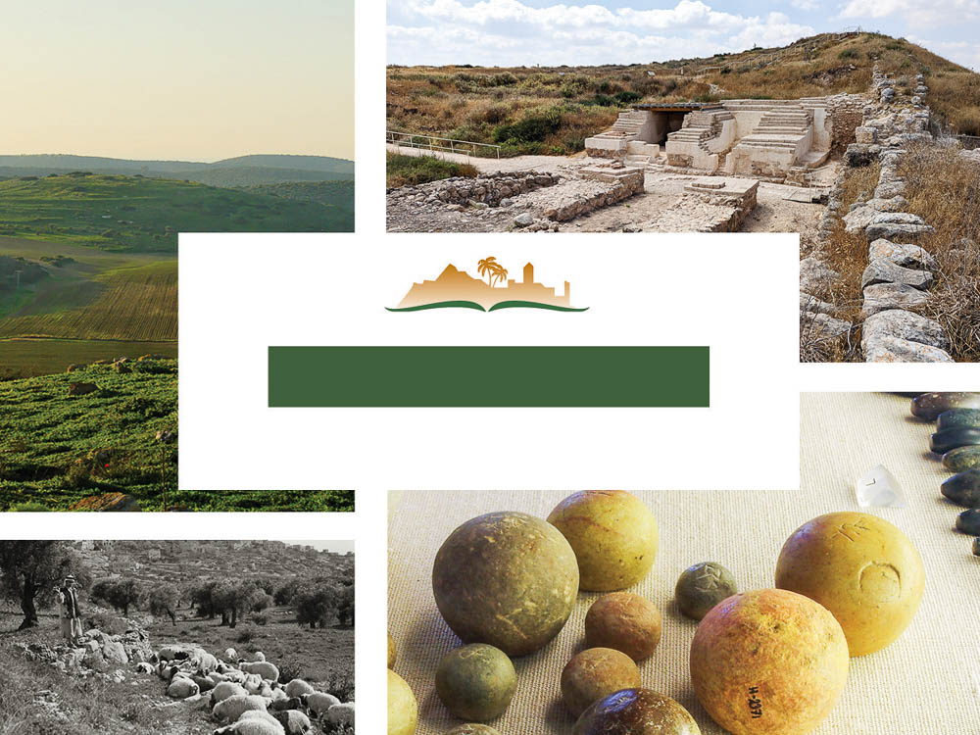
Micah 6
Notes:
This is a free sample of the Micah 6 presentation from the Photo Companion to the Bible. To purchase the full volume, visit www.bibleplaces.com/micah/
The Photo Companion to the Bible is an image-rich resource for Bible students, teachers, and researchers. Just as a librarian stocks the shelves with as many relevant materials as possible, so we have tried to provide a broad selection of images. Our goal is that you will find in this “library” whatever it is you are looking for.
Credits: The primary creators of this presentation are Chris McKinny, Kris Udd, Steven D. Anderson, and Todd Bolen. The photographs have an individual file code which usually includes the initials of the photographer. Other images have additional credit or source information.
Updates: We plan to update this collection as we are able. We welcome your suggestions for improving this resource (photocompanion@bibleplaces.com). Purchasers of the Micah volume are provided free, lifetime updates to the volume.
Copyright: This photo collection is protected by copyright law and may not be distributed without written permission from BiblePlaces.com. Slide notes should be treated as any other copyrighted written material, with credit given when quoting from these notes.
For more information, see our complete “Introduction to the Photo Companion to the Bible” online at https://www.BiblePlaces.com/Intro-Photo-Companion-Bible/. Here you will find more information about photo selection, explanatory notes, Bible translation, credit information, and copyright allowances.

Slide 2
Micah 6
This is a free sample of the Micah 6 presentation from the Photo Companion to the Bible. To purchase the full volume, visit www.bibleplaces.com/micah/
The Photo Companion to the Bible is an image-rich resource for Bible students, teachers, and researchers. Just as a librarian stocks the shelves with as many relevant materials as possible, so we have tried to provide a broad selection of images. Our goal is that you will find in this “library” whatever it is you are looking for.
For more details (for this and every slide), see the Notes section below.
Notes:
This is a free sample of the Micah 6 presentation from the Photo Companion to the Bible. To purchase the full volume, visit www.bibleplaces.com/micah/
The Photo Companion to the Bible is an image-rich resource for Bible students, teachers, and researchers. Just as a librarian stocks the shelves with as many relevant materials as possible, so we have tried to provide a broad selection of images. Our goal is that you will find in this “library” whatever it is you are looking for.
Credits: The primary creators of this presentation are Chris McKinny, Kris Udd, Steven D. Anderson, and Todd Bolen. The photographs have an individual file code which usually includes the initials of the photographer. Other images have additional credit or source information.
Updates: We plan to update this collection as we are able. We welcome your suggestions for improving this resource (photocompanion@bibleplaces.com). Purchasers of the Micah volume are provided free, lifetime updates to the volume.
Copyright: This photo collection is protected by copyright law and may not be distributed without written permission from BiblePlaces.com. Slide notes should be treated as any other copyrighted written material, with credit given when quoting from these notes.
For more information, see our complete “Introduction to the Photo Companion to the Bible” online at https://www.BiblePlaces.com/Intro-Photo-Companion-Bible/. Here you will find more information about photo selection, explanatory notes, Bible translation, credit information, and copyright allowances.

Slide 3
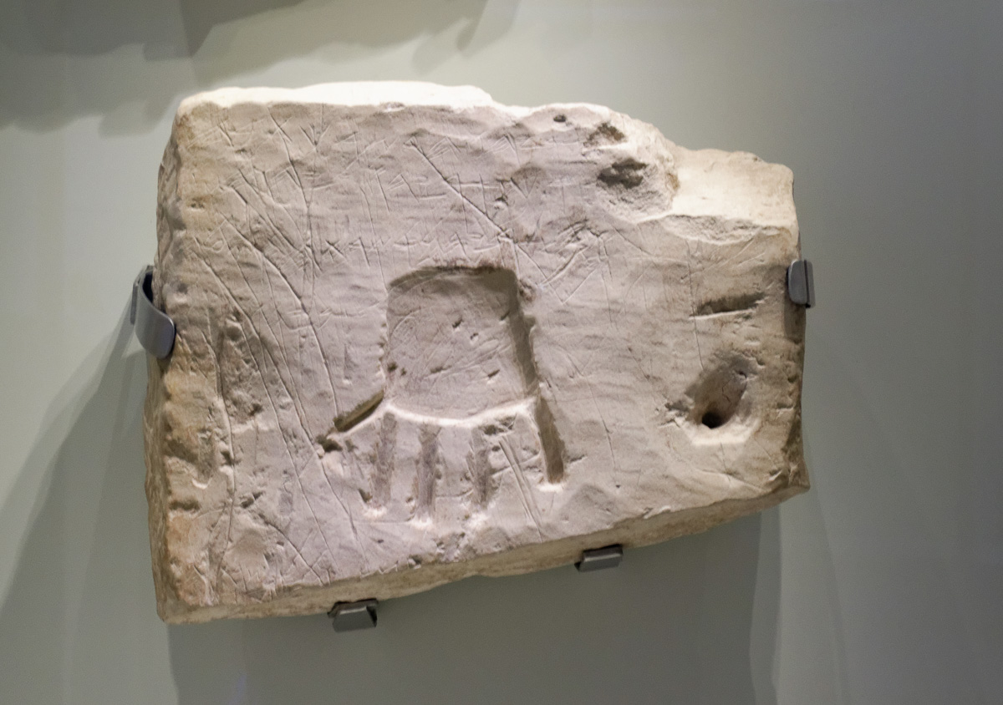
Hear now what Yahweh says
Burial inscription mentioning “YHWH,” from Khirbet el-Qom, 8th century BC
6:1
Notes:
This tomb inscription from the 8th century BC invokes the blessing of Yahweh upon the deceased, a man named Uriah. The first line reads, “Uriah the wealthy man had it written” (אריהו הדשר כתבה). The second line reads, “Blessed be Uriah by Yahweh” (ברך אריהו ביהוה). This inscription was photographed at the Israel Museum. The next slide includes labels for the words of the second line.
tb032014433

Slide 4
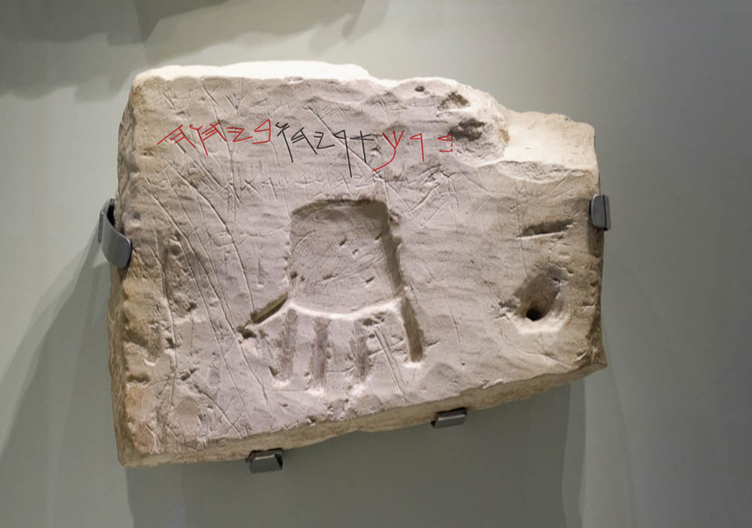
Hear now what Yahweh says
Burial inscription mentioning “YHWH,” from Khirbet el-Qom, 8th century BC
6:1
Notes:
This tomb inscription from the 8th century BC invokes the blessing of Yahweh upon the deceased, a man named Uriah. The first line reads, “Uriah the wealthy man had it written” (אריהו הדשר כתבה). The second line reads, “Blessed be Uriah by Yahweh” (ברך אריהו ביהוה). In the second line, the red word to the far right is the verb “blessed” (barak, ברך), the black word in the center is the personal name Uriah (Uryahu, אריהו), and the word in red to the left is the preposition and noun “by Yahweh” (beyahweh, ביהוה). This inscription was photographed at the Israel Museum. An editable version is included behind this graphic for those who may wish to change it.
tb032014433

Slide 5
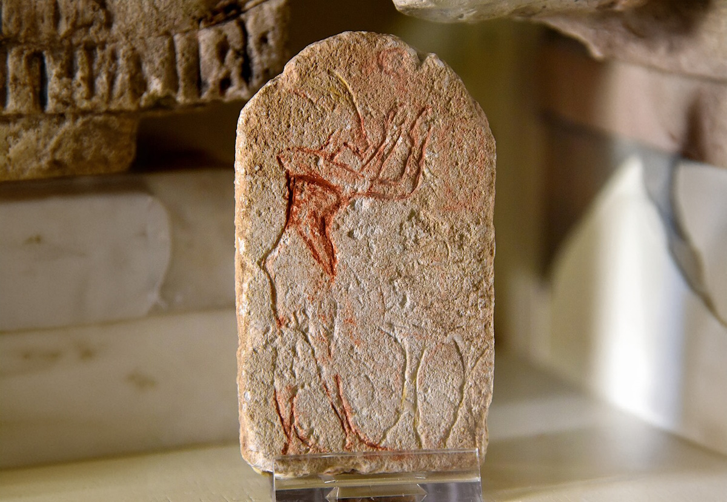
Arise, plead your case before the mountains, and let the hills hear your voice
Crude stele with Akhenaten calling on a god, 14th century BC
6:1
Notes:
The verb “plead your case” (Heb. rib, רִיב), in this context, refers to a legal setting where parties are engaged in a lawsuit (cf. Mic 7:9). The idea is illustrated here by a crude stele that depicts the Egyptian king Akhenaten standing with his hands raised to a deity.
This stele was photographed at the Petrie Museum of Egyptian Archaeology in London. This image comes from Osama Shukir Muhammed Amin and is licensed under CC BY-SA 4.0, via Wikimedia Commons: https://commons.wikimedia.org/wiki/File:Painted_limestone_miniature_stela._It_shows_Akhenaten_standing_before_2_incense_stands,_Aten_disc_above._From_Amarna,_Egypt._18th_Dynasty._The_Petrie_Museum_of_Egyptian_Archaeology,_London.jpg.
wiki03101617242010161283c

Slide 6
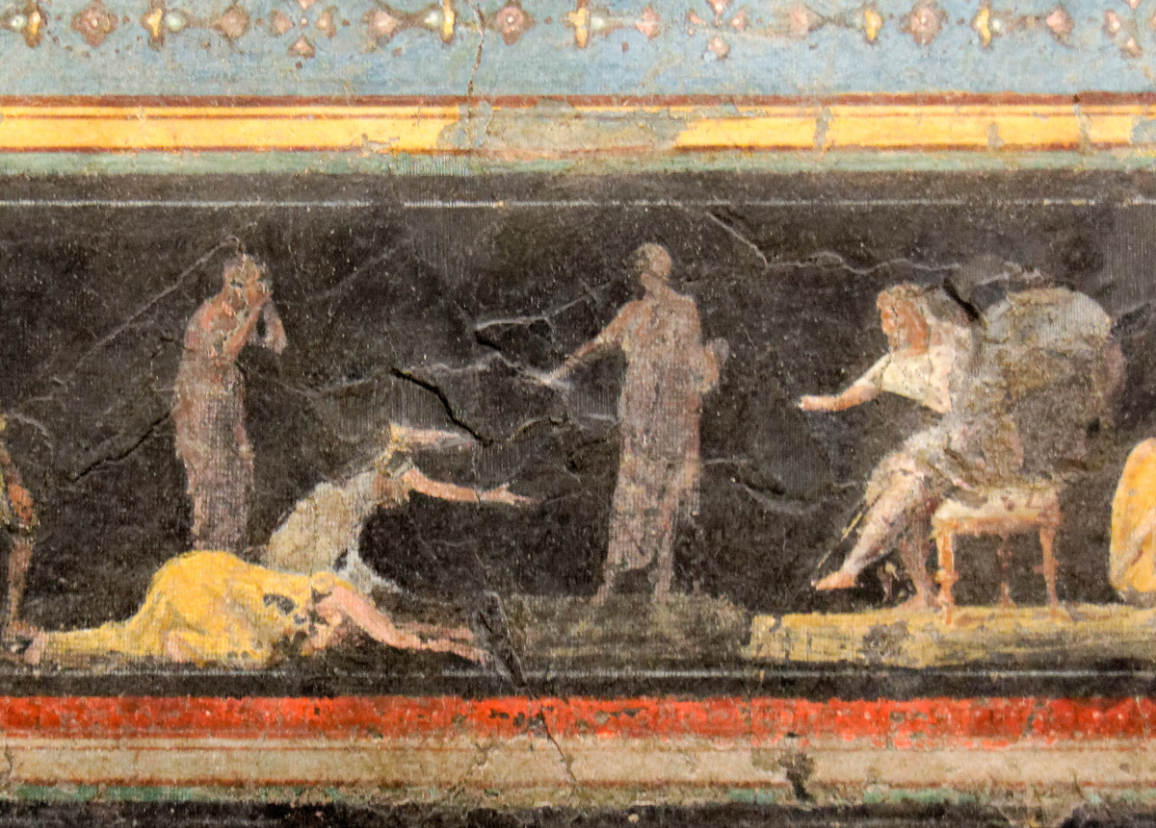
Arise, plead your case before the mountains, and let the hills hear your voice
Fresco of figures pleading before a ruler, from the Villa Farnesina in Rome, 1st century BC
6:1
Notes:
The mural paintings in this triclinium depict a variety of judgment scenes. Some are thought to represent the pharaoh Bocchoris (735–728 BC), known for his jurisprudence and for his knowledge of legal matters; another scene may represent Solomon. However, most cannot be associated with any known event. In the scene shown here, two women appear to appeal to the seated ruler.
This fresco comes from triclinium C in the Villa of Farnesina in Rome. It was photographed at the National Museum of Rome.
tb0513177784

Slide 7
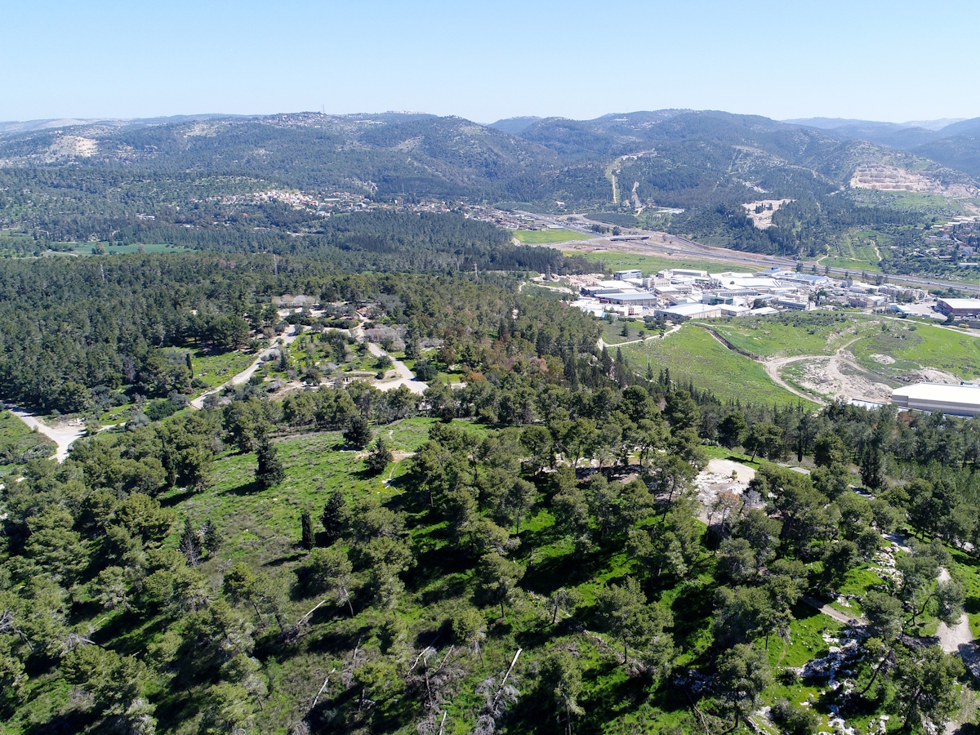
Arise, plead your case before the mountains, and let the hills hear your voice
Zorah and the Judean hills (aerial view from the west)
6:1
Notes:
The mountains stand as silent witnesses to the deeds of Israel across the ages and to God’s enduring acts on behalf of His people.
ws022818514

Slide 8
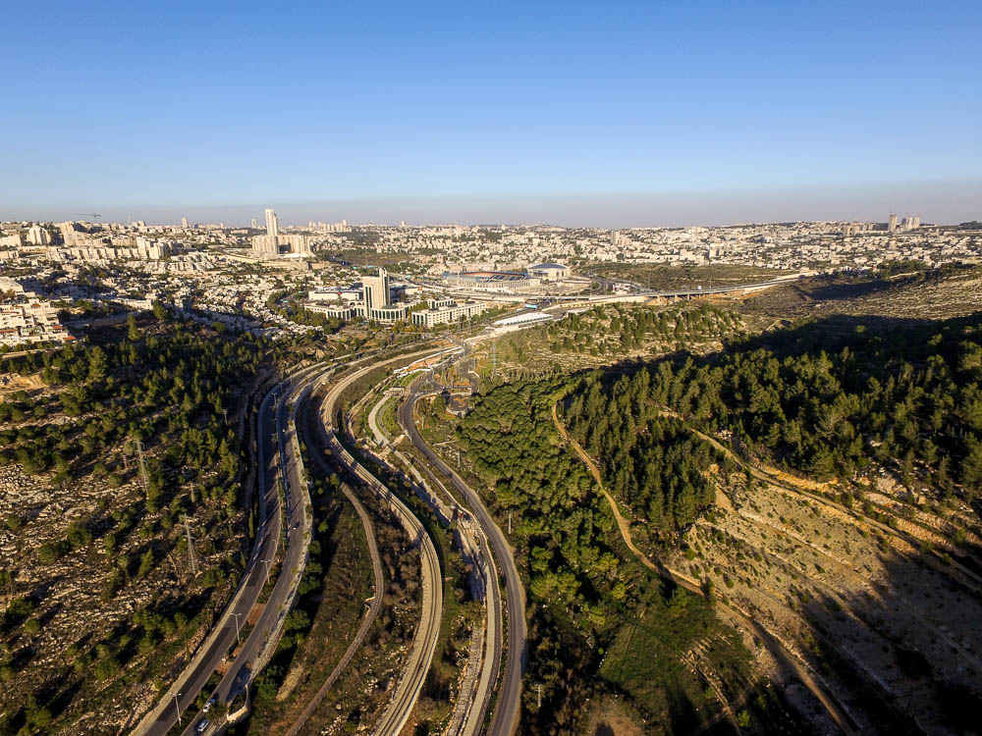
Arise, plead your case before the mountains, and let the hills hear your voice
Rephaim Valley and the city of Jerusalem (aerial view from the west)
6:1
Notes:
ws120415275

Slide 9
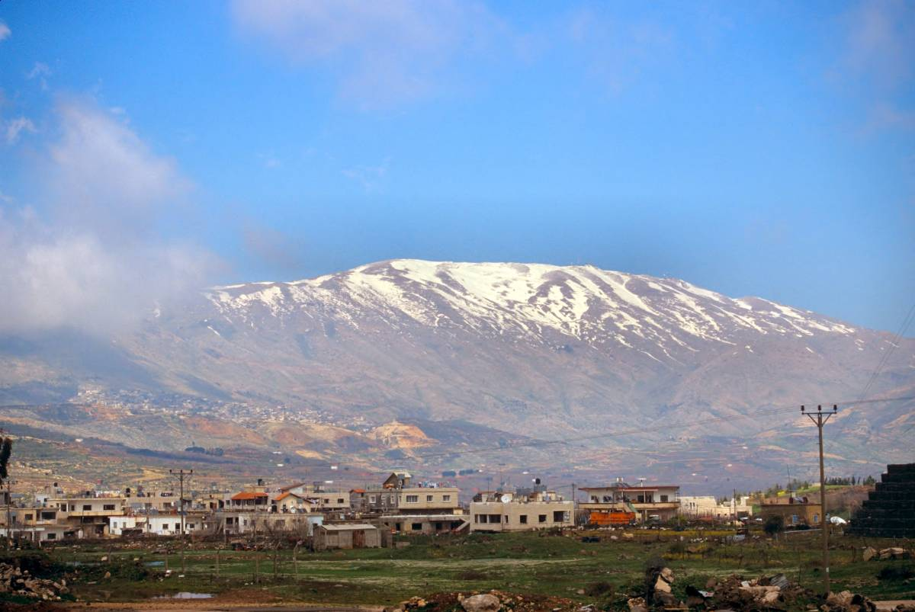
Hear Yahweh’s indictment, you mountains, and you enduring foundations of the earth
Mount Hermon (from the south)
6:2
Notes:
tbs98139804

Slide 10
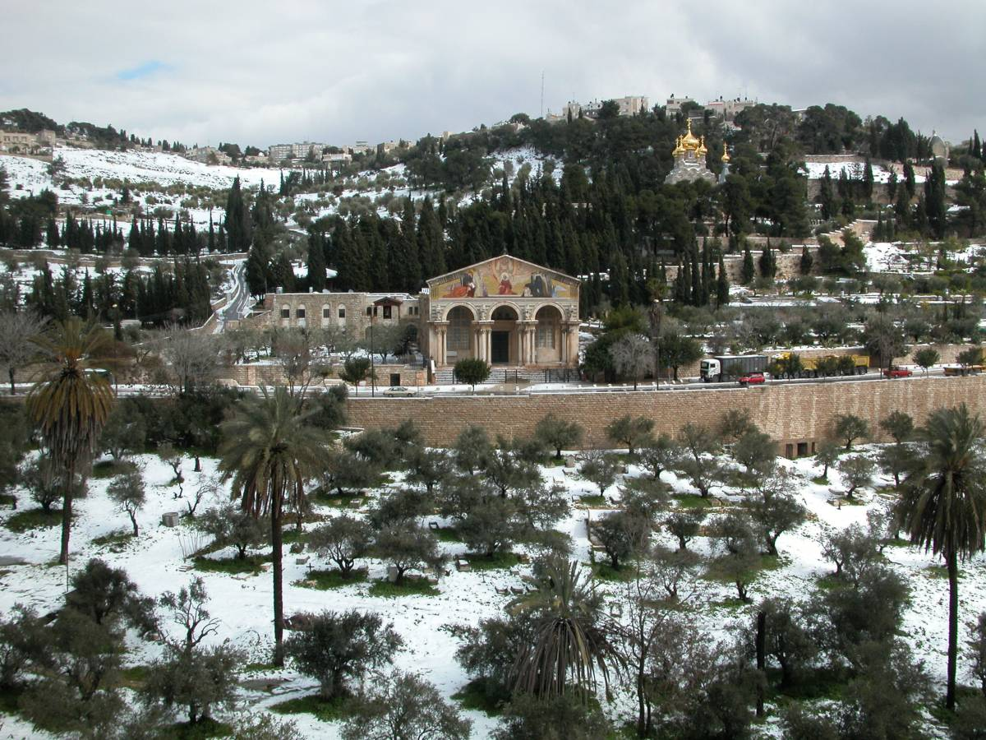
Hear Yahweh’s indictment, you mountains, and you enduring foundations of the earth
Mount of Olives with winter snow
6:2
Notes:
tb022603201

Slide 11
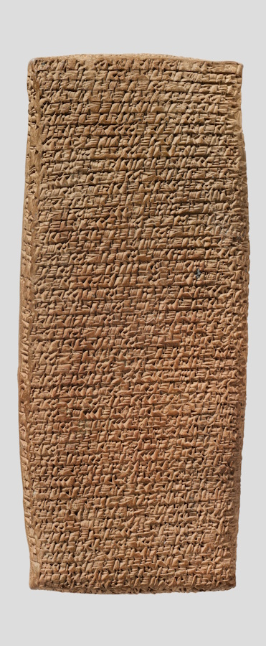
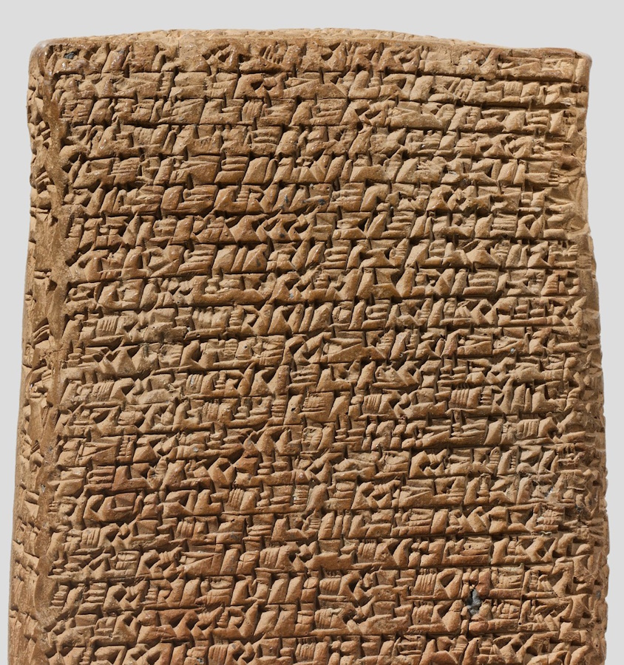
Because Yahweh has an indictment against His people, and He will dispute with Israel
Cuneiform tablet with a record of a lawsuit, from Kültepe, circa 1900 BC
6:2
Notes:
Records of lawsuits are one of the kinds of documents that are commonly found among hoards of tablets. The one shown here is many centuries earlier than the time of Micah and probably comes from the Assyrian trading colony at Kültepe (Karum Kanesh) in Anatolia. According to the museum website, it is the record of a lawsuit between two merchants. “This testimony was delivered before witnesses representing the authority of the merchant government in Kanesh as well as the dagger of the god Ashur. In the text, Suen-nada and Ennum-Ashur accuse each other of stealing the valuable contents of a private archive which they both claim to own. Items within the archive include cylinder seals, tablets belonging to various named merchants, and tablets belonging to strangers that were deposited there for safe keeping.”
This image comes from the Metropolitan Museum of Art, public domain, Gift of Mr. and Mrs. J. J. Klejman, 1966, accession number 66.245.5a, https://www.metmuseum.org/art/collection/search/325846.
met325846

Slide 12
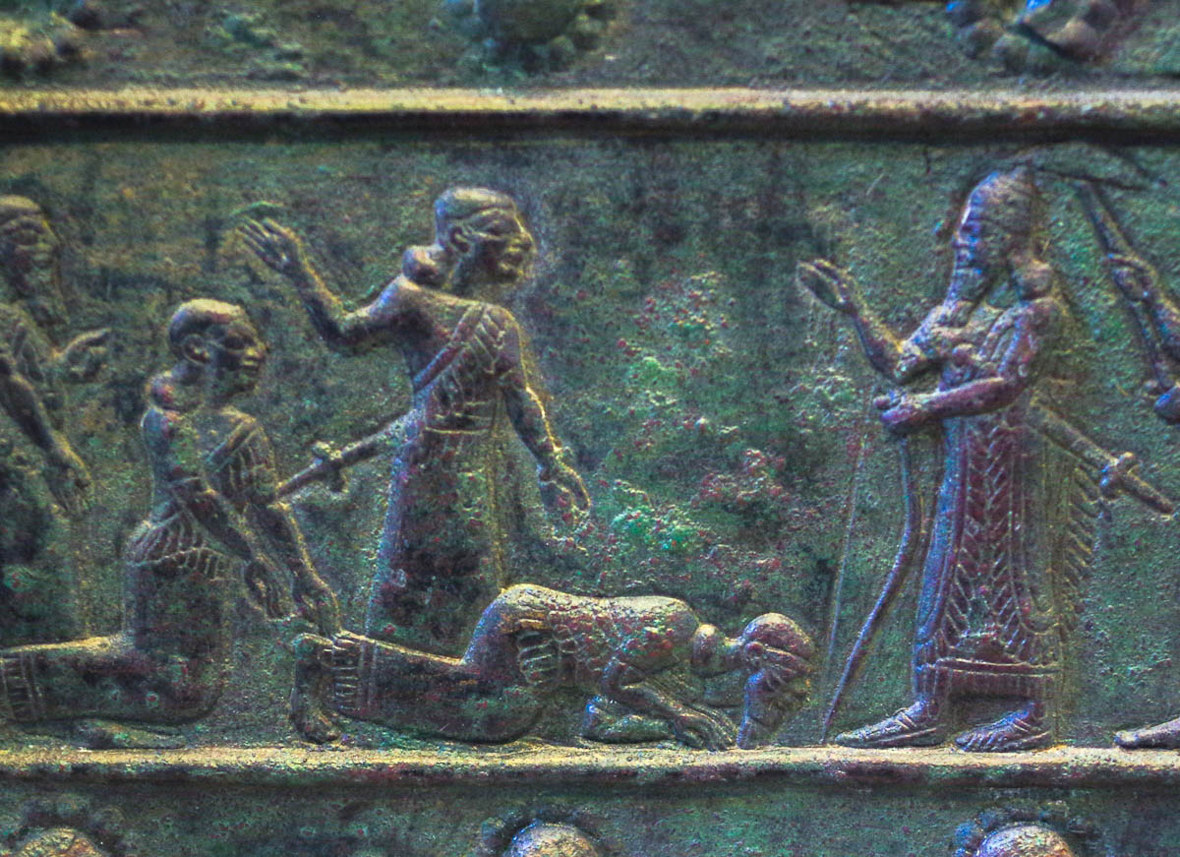
O My people, what have I done to you? How have I wearied you? Answer Me!
Men presenting themselves before Shalmaneser III, from Balawat, 9th century BC
6:3
Notes:
This relief from the reign of the Assyrian king Shalmaneser III depicts him standing with raised hand as a number of his subjects bow before him. This bronze relief was photographed at the British Museum.
adr1805194234

Slide 13
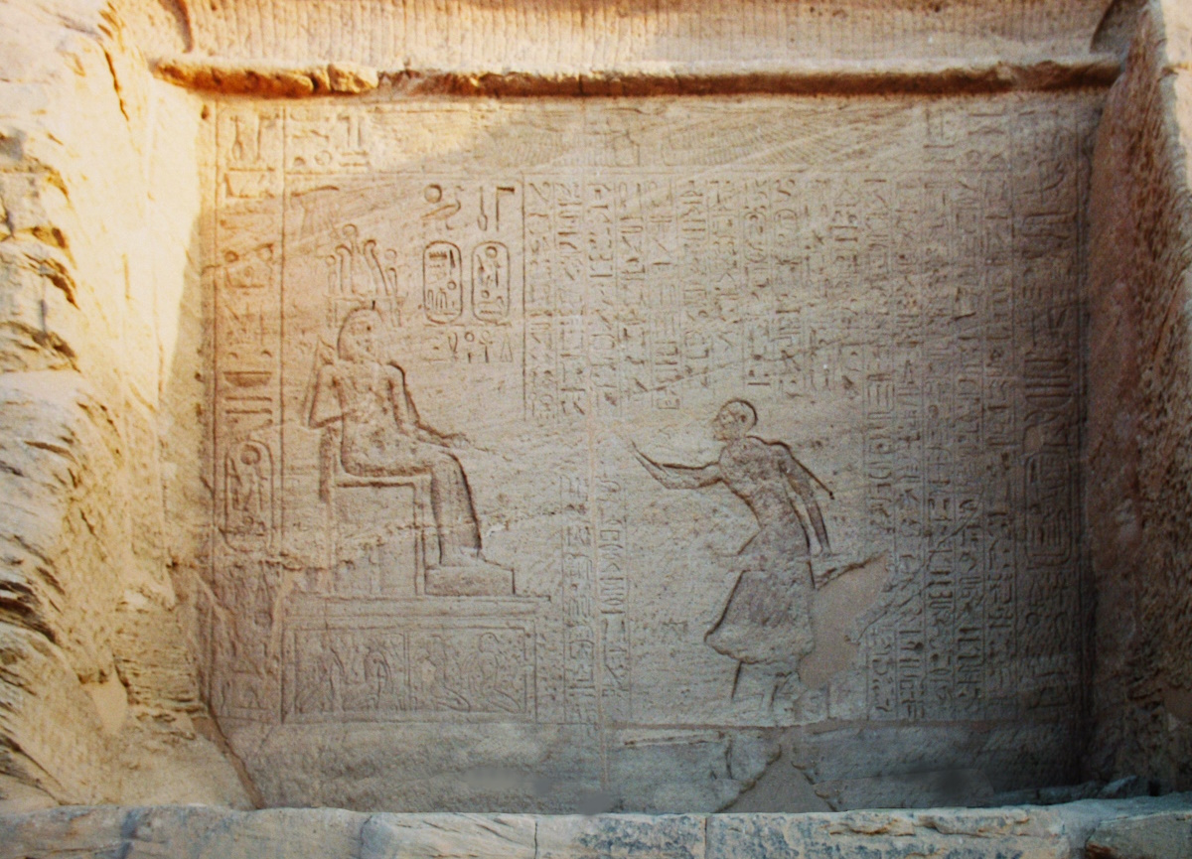
O My people, what have I done to you? How have I wearied you? Answer Me!
Courtier standing before Rameses II, at the Temple of Abu Simbel, 13th century BC
6:3
Notes:
This image comes from Gary Todd and is licensed under CC0, via Wikimedia Commons: https://commons.wikimedia.org/wiki/File:Abu_Simbel_Temple_of_Ramesses_II_(9794612823).jpg.
wiki06120205133647148

Slide 14
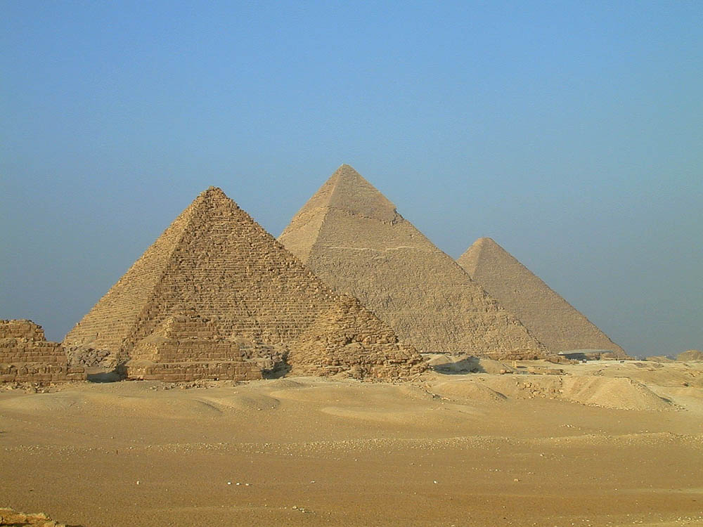
For I brought you up from the land of Egypt and ransomed you from the house of slavery
Three Great Pyramids with the smaller pyramids of the queens
6:4
Notes:
tb110400508

Slide 15
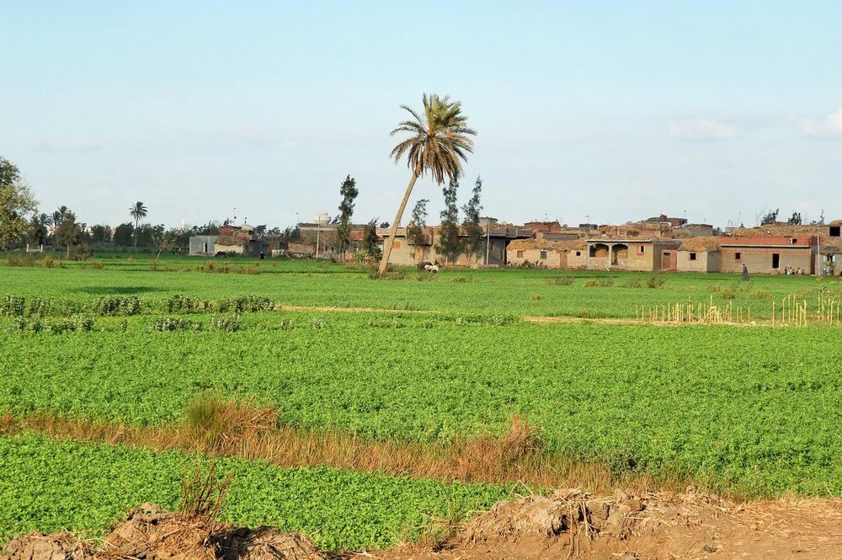
For I brought you up from the land of Egypt and ransomed you from the house of slavery
Fields of the Nile Delta near Tanis
6:4
Notes:
While in Egypt, the Israelites lived in Goshen, a region in the eastern part of the Nile Delta.
tb010605710

Slide 16
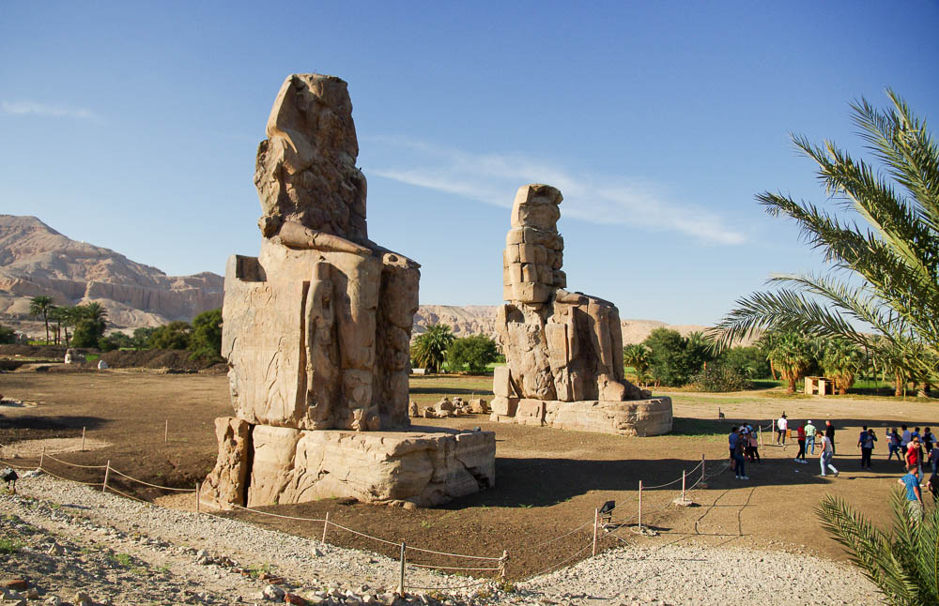
For I brought you up from the land of Egypt and ransomed you from the house of slavery
Colossi of Memnon, at the first pylon of the temple of Amenhotep III, Thebes, circa 1375 BC
6:4
Notes:
adr1603226864

Slide 17
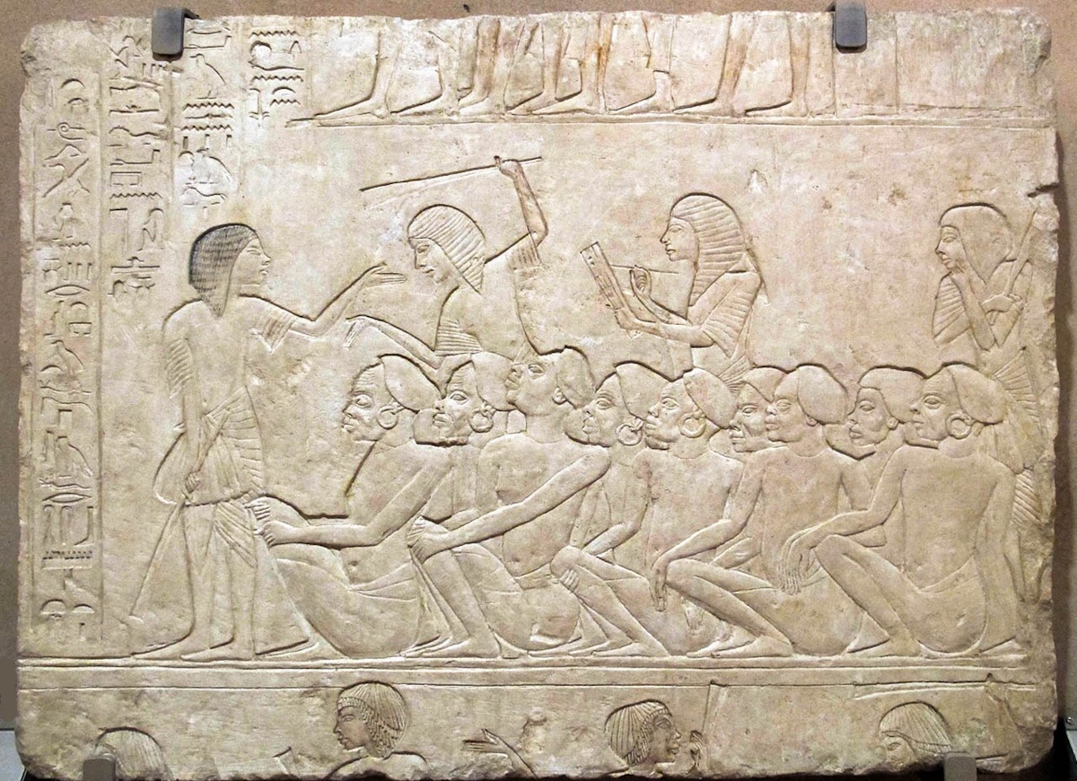
For I brought you up from the land of Egypt and ransomed you from the house of slavery
Relief of Nubian prisoners recorded by a scribe, from Saqqara, circa 1300 BC
6:4
Notes:
The enslavement of the Hebrews in Egypt is illustrated here by a relief that depicts a group of Nubian prisoners who are being recorded by a scribe, no doubt headed for involuntary work.
This relief comes from the tomb of the Egyptian king Horemheb at Saqqara. It was photographed at the Archaeological Museum of Bologna. This image comes from Sailko and is licensed under CC BY-SA 3.0, via Wikimedia Commons: https://commons.wikimedia.org/wiki/File:Saqqara,_rilievo_di_horemheb,_1332-1323_ac.,_B_01.JPG.
wiki10191331562288555c

Slide 18
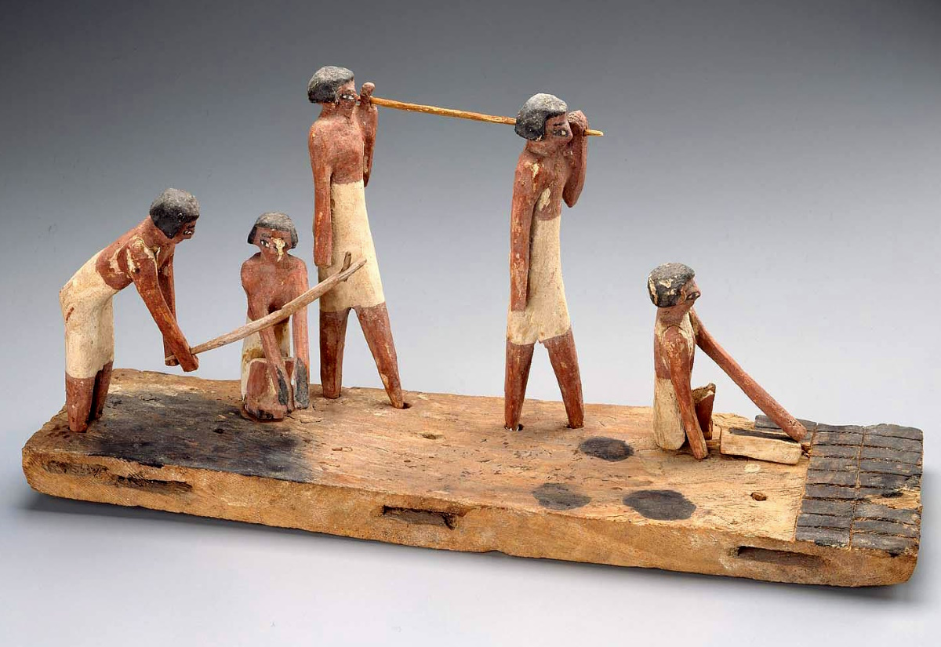
For I brought you up from the land of Egypt and ransomed you from the house of slavery
Model of brick makers, from the Tomb of Djehutynakht at Deir el-Bersha, circa 2000 BC
6:4
Notes:
One of the tasks required of the Israelites during their oppression was the manufacture of bricks for building (Exod 5:7-8). This image comes from the Boston Museum of Fine Arts, Harvard University—Boston Museum of Fine Arts Expedition, accession number 21.411, public domain: https://collections.mfa.org/download/143704.
mfa143704

Slide 19
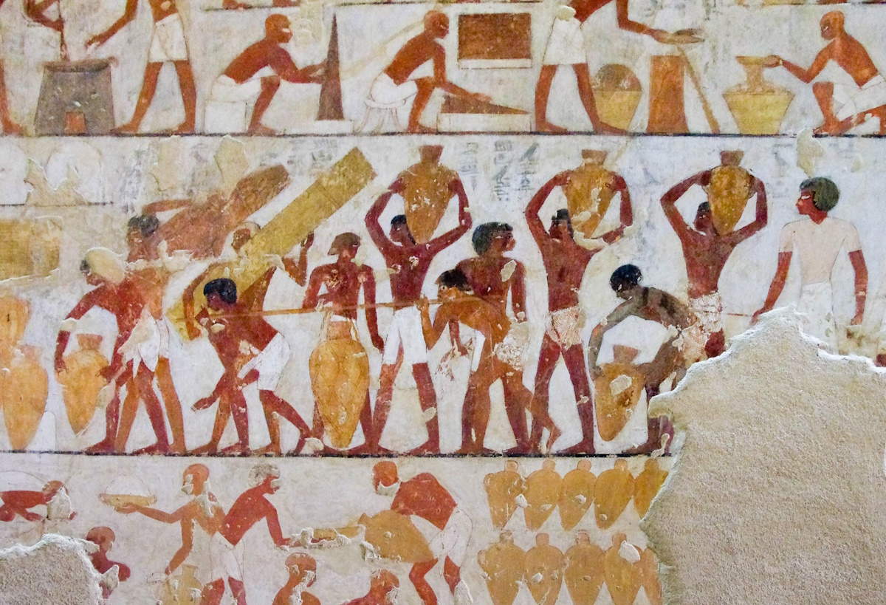
For I brought you up from the land of Egypt and ransomed you from the house of slavery
Tomb depiction of carrying wine and papyrus, from Thebes, 15th century BC
6:4
Notes:
The men depicted in this tomb painting, which is roughly contemporary with the time of the Exodus, are carrying wine and papyrus for the treasuries of Amun. Note the taskmaster with a rod on the right side of this tomb painting. This painting was photographed at the tomb of Rekhmire in Thebes. It dates to the reign of Thutmose III (r. 1479–1425 BC) or perhaps early in the reign of Amenhotep II (r. 1425–1400 BC).
adr1603142960c

Slide 20
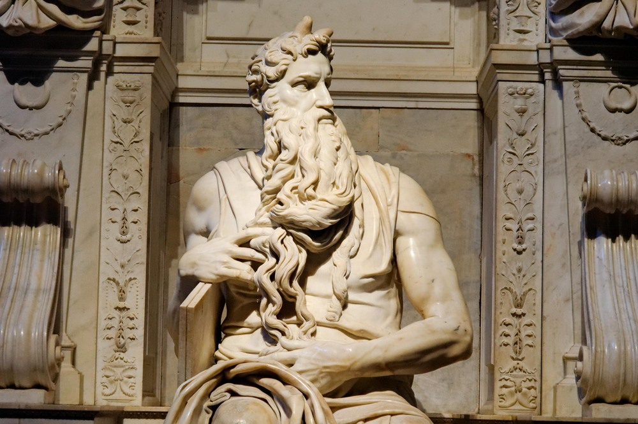
I sent Moses, Aaron, and Miriam before you
Michelangelo’s Moses
6:4
Notes:
This famous sculpture of Moses was created by Michelangelo. It was originally intended to decorate the tomb of Pope Julius II, but is now housed in the Church of Saint Peter in Chains (San Pietro in Vincoli) in Rome.
tb111905222

Slide 21
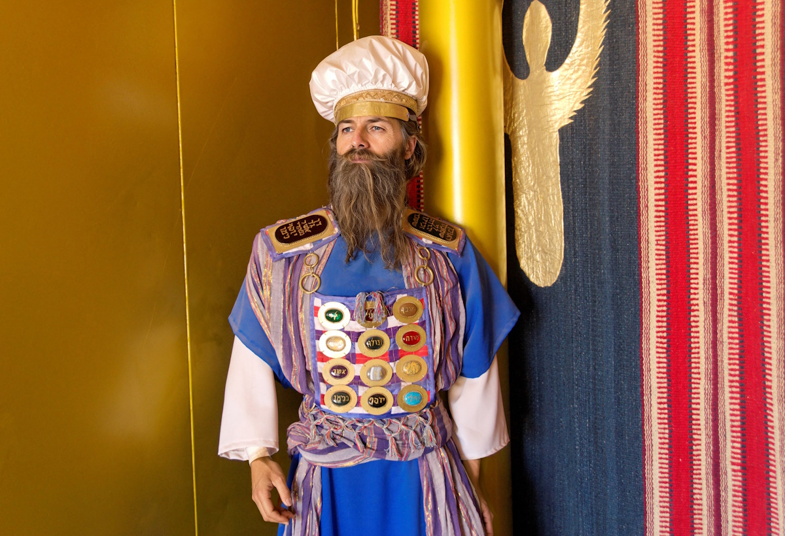
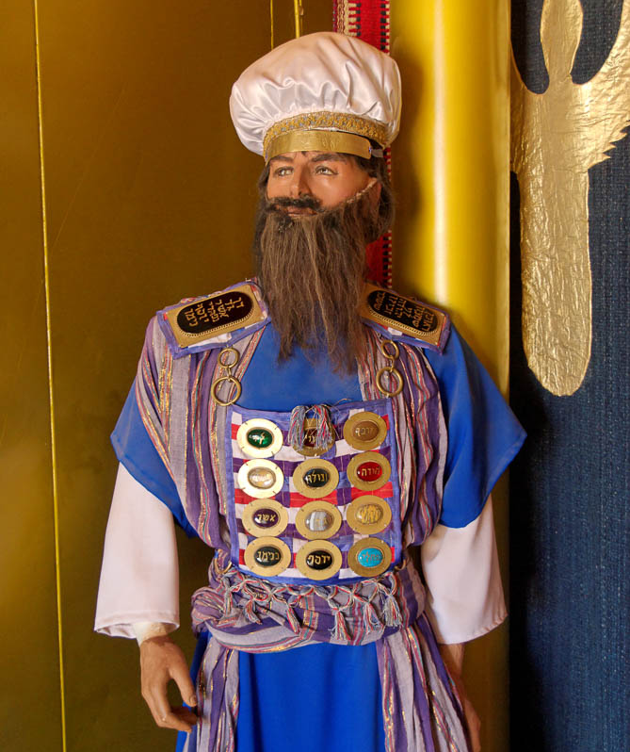
I sent Moses, Aaron, and Miriam before you
The high priest in a tabernacle model
6:4
Notes:
Aaron was Israel’s first high priest. This model of the high priest was photographed at the full-size replica of the tabernacle in the Timna Valley in southern Israel. Generative AI was used to enhance the image; the original photo is available behind this image.
tb010710921psai

Slide 22
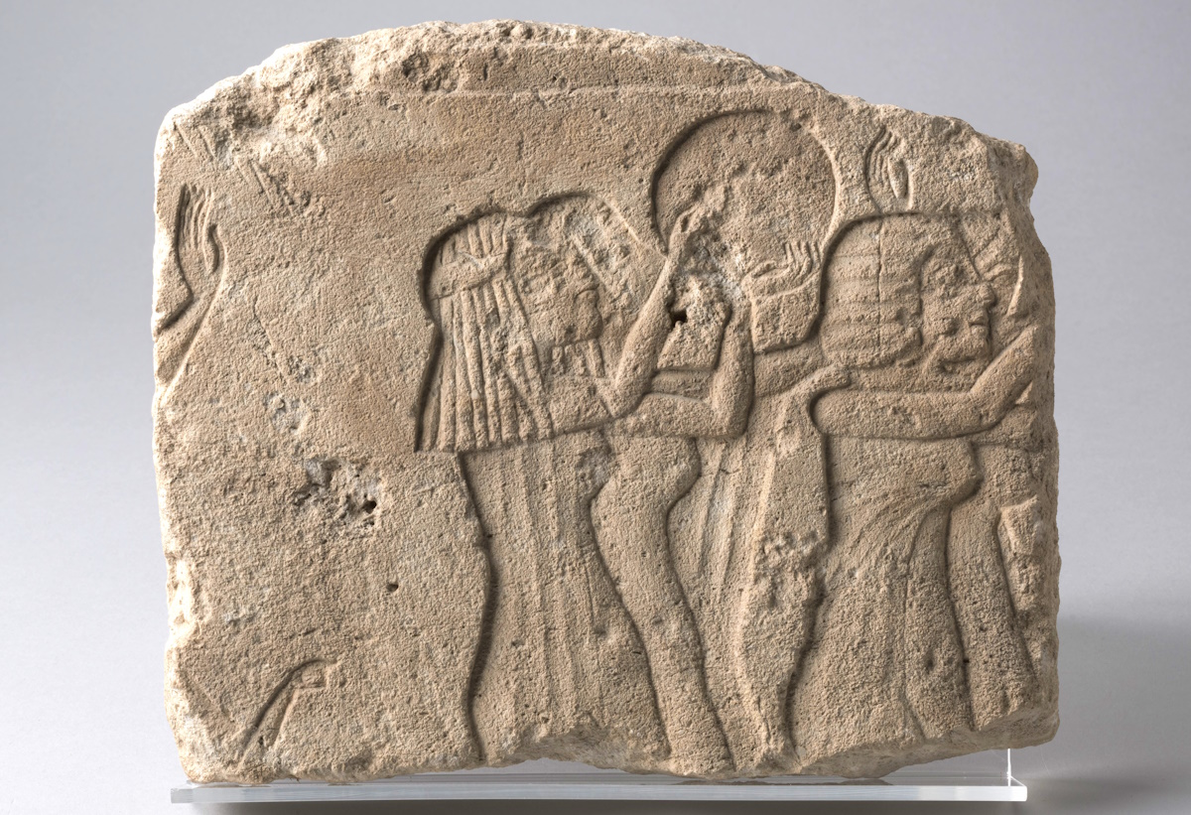
I sent Moses, Aaron, and Miriam before you
Relief of female worshipers and tambourine players, circa 1350 BC
6:4
Notes:
Exodus 15:20 describes Miriam playing a tambourine. This image comes from Museo Egizio and is in the public domain. Source: https://collezioni.museoegizio.it/en-GB/material/S_18060.
czme18060

Slide 23
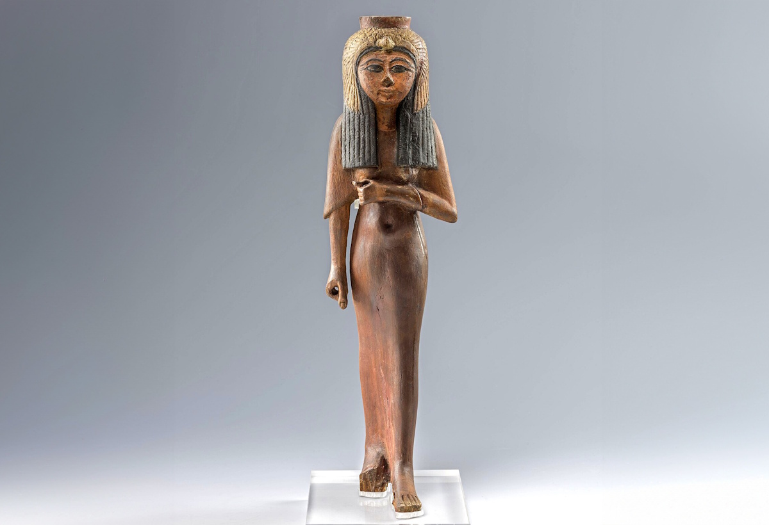
I sent Moses, Aaron, and Miriam before you
Statuette of queen Ahmose Nefertari, circa 1300–1100 BC
6:4
Notes:
Given that Moses and Aaron were about 80 years old, their sister Miriam would have been similarly aged. This wooden statue depicts a mature Egyptian woman and is roughly contemporary with the time of the Exodus.
This image comes from Marco Chemello and Museo Egizio and is licensed under CC BY 4.0, via Wikimedia Commons: https://commons.wikimedia.org/wiki/File:Statuette_of_the_deified_queen_Ahmose_Nefertari,_wood_-_Museo_Egizio_Turin_C_1388_p02.jpg.
wiki01152418293543772

Slide 24
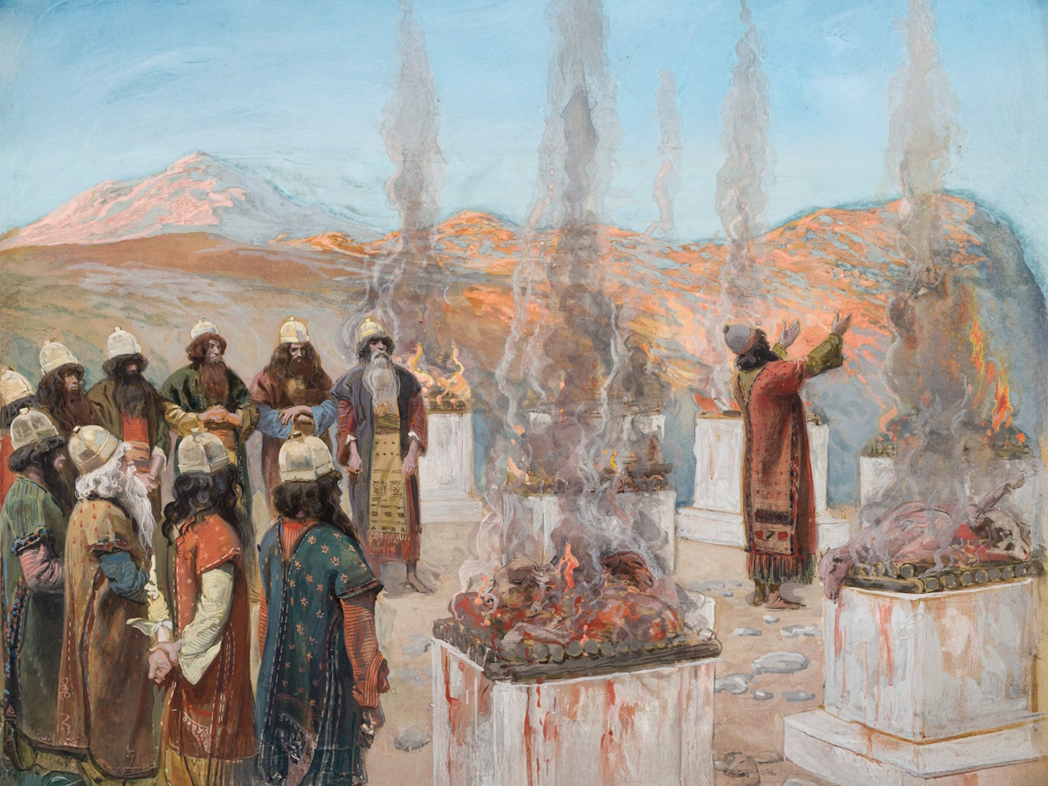
Remember what Balak the king of Moab proposed, and what Balaam son of Beor answered him
The Seven Altars of Balaam, by James Tissot, circa 1899
6:5
Notes:
According to the account found in Numbers 22–24, Balak set up seven altars and offered sacrifices, after which he asked Balaam to curse the people. Balaam, however, had only agreed to speak what God wanted, and he ended up blessing Israel. This happened three different times before Balaam was finally dismissed.
This image of a gouache on board painting by James Tissot is in the public domain, via The Jewish Museum: https://collections.thejewishmuseum.org/collection/26398-the-seven-altars-of-balaam-les-sept-autels-de-balaam.
tjm26398c

Slide 25
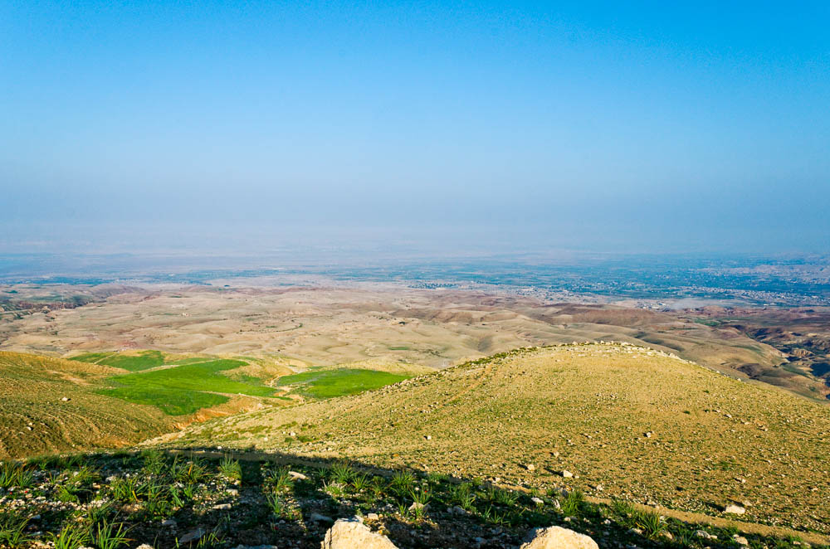
Remember what Balak the king of Moab proposed, and what Balaam son of Beor answered him
View from Mount Nebo to the plains of Moab (from the east)
6:5
Notes:
The Israelites were encamped on the plains of Moab when Balak tried to get Balaam to curse them (Num 22:1). Balak and Balaam built their altars and attempted to curse Israel from an elevated location that overlooked at least a part of the Israelite camp (Num 22:41). This may have been in the vicinity of Mount Nebo, as shown here. The next slide includes labels.
tb031315130

Slide 26
Remember what Balak the king of Moab proposed, and what Balaam son of Beor answered him
Jericho oasis
Dead Sea
Plains of Moab
View from Mount Nebo to the plains of Moab (from the east)
6:5
Notes:
The Israelites were encamped on the plains of Moab when Balak tried to get Balaam to curse them (Num 22:1). Balak and Balaam built their altars and attempted to curse Israel from an elevated location that overlooked at least a part of the Israelite camp (Num 22:41). This may have been in the vicinity of Mount Nebo, as shown here.
tb031315130

Slide 27
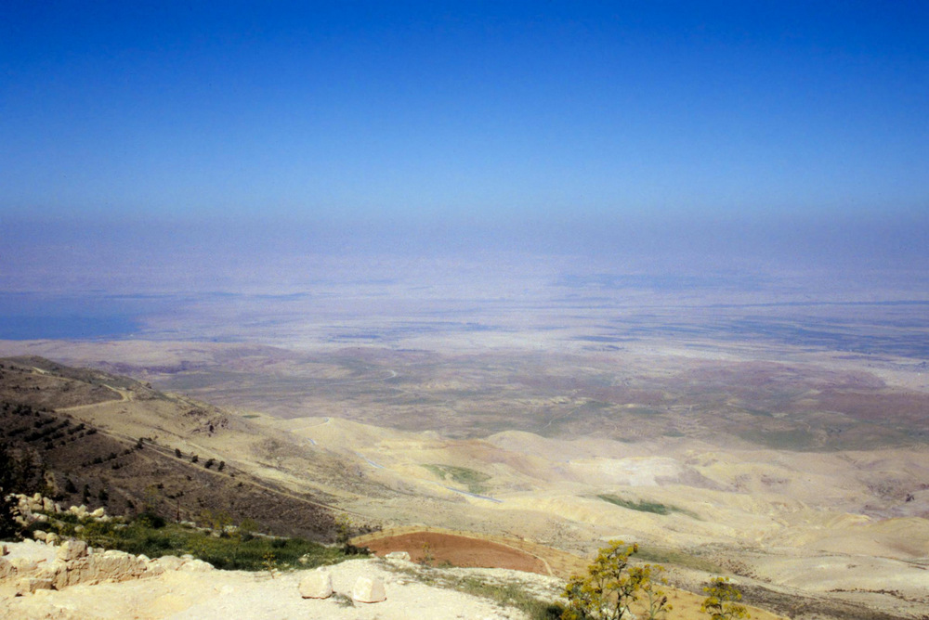
Remember what Balak the king of Moab proposed, and what Balaam son of Beor answered him
Plains of Moab, from Mount Nebo
6:5
Notes:
The next slide includes labels.
tbs91349704

Slide 28
Remember what Balak the king of Moab proposed, and what Balaam son of Beor answered him
Jericho oasis
Dead Sea
Jordan River
Plains of Moab
Plains of Moab, from Mount Nebo
6:5
Notes:
tbs91349704

Slide 29
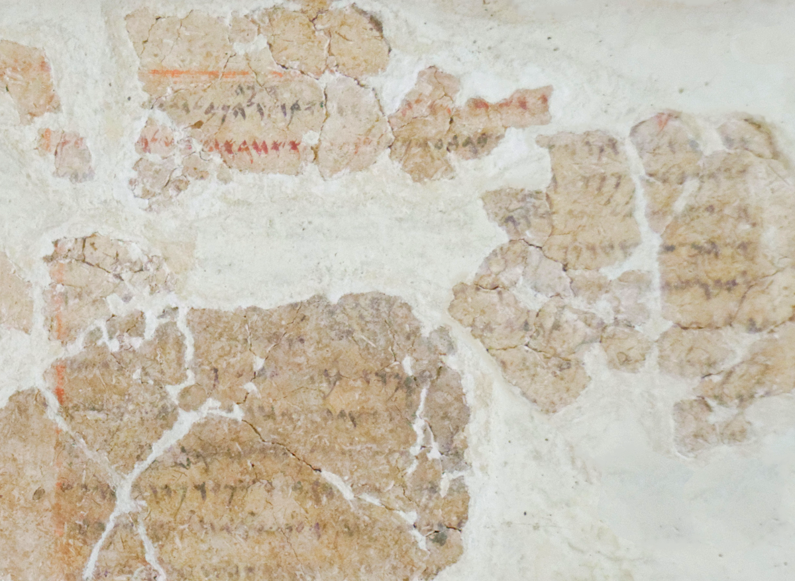
Remember what Balak the king of Moab proposed, and what Balaam son of Beor answered him
Balaam son of Beor inscription, from Tell Deir Alla, circa 800 BC
6:5
Notes:
The inscription shown here is an ink-on-plaster inscription discovered at Tell Deir Alla, east of the Jordan River. The introduction to the first line reads “Book of Balaam son of Beor, the man who was a seer of the gods” (Heb. ספר בלעם בר בער אשׁ חזה אלהן) (see Lemaire 1985: 35; cf. Ahituv 2008: 435–40). This text was once written on the wall of a house. There are several fragments missing from the display at the Amman Museum shown here, and there is some dispute about the arrangement of the existing fragments (see further discussion in Lemaire 1985 and Ahituv 2008).
The account of Balaam is recorded in Numbers 22–24. Balaam was eventually killed by the Israelites (Num 31:8), and he is mentioned in the New Testament in a negative light (2 Pet 2:15; Jude 11; Rev 2:14). The next slide includes highlights for the first part of the inscription.
References:
Ahituv, Shmuel.
2008 Echoes from the Past. Jerusalem: Carta.
Lemaire, André.
1985 Fragments from the Book of Balaam Found at Deir Alla. Biblical Archaeology Review 11/5: 26–39.
tb031115456rc

Slide 30
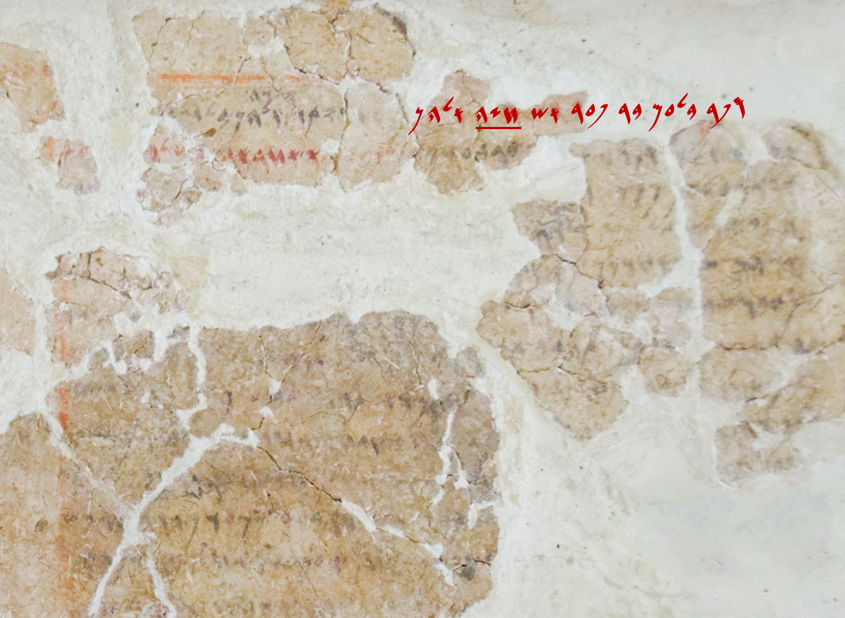
Remember what Balak the king of Moab proposed, and what Balaam son of Beor answered him
“Book of Balaam son of Beor, the man who was a seer of the gods”
Balaam son of Beor inscription, from Tell Deir Alla, circa 800 BC
6:5
Notes:
The inscription shown here is an ink-on-plaster inscription discovered at Tell Deir Alla, east of the Jordan River. The introduction to the first line reads “Book of Balaam son of Beor, the man who was a seer of the gods” (Heb. ספר בלעם בר בער אשׁ חזה אלהן) (see Lemaire 1985: 35; cf. Ahituv 2008: 435–40). This text was once written on the wall of a house. There are several fragments missing from the display at the Amman Museum shown here, and there is some dispute about the arrangement of the existing fragments (see further discussion in Lemaire 1985 and Ahituv 2008).
The account of Balaam is recorded in Numbers 22–24. Balaam was eventually killed by the Israelites (Num 31:8), and he is mentioned in the New Testament in a negative light (2 Pet 2:15; Jude 11; Rev 2:14). The first part of the inscription is highlighted here. The word “seer” (Arm. חֹזֶה) is underlined.
References:
Ahituv, Shmuel.
2008 Echoes from the Past. Jerusalem: Carta.
Lemaire, André.
1985 Fragments from the Book of Balaam Found at Deir Alla. Biblical Archaeology Review 11/5: 26–39.
tb031115456rc

Slide 31
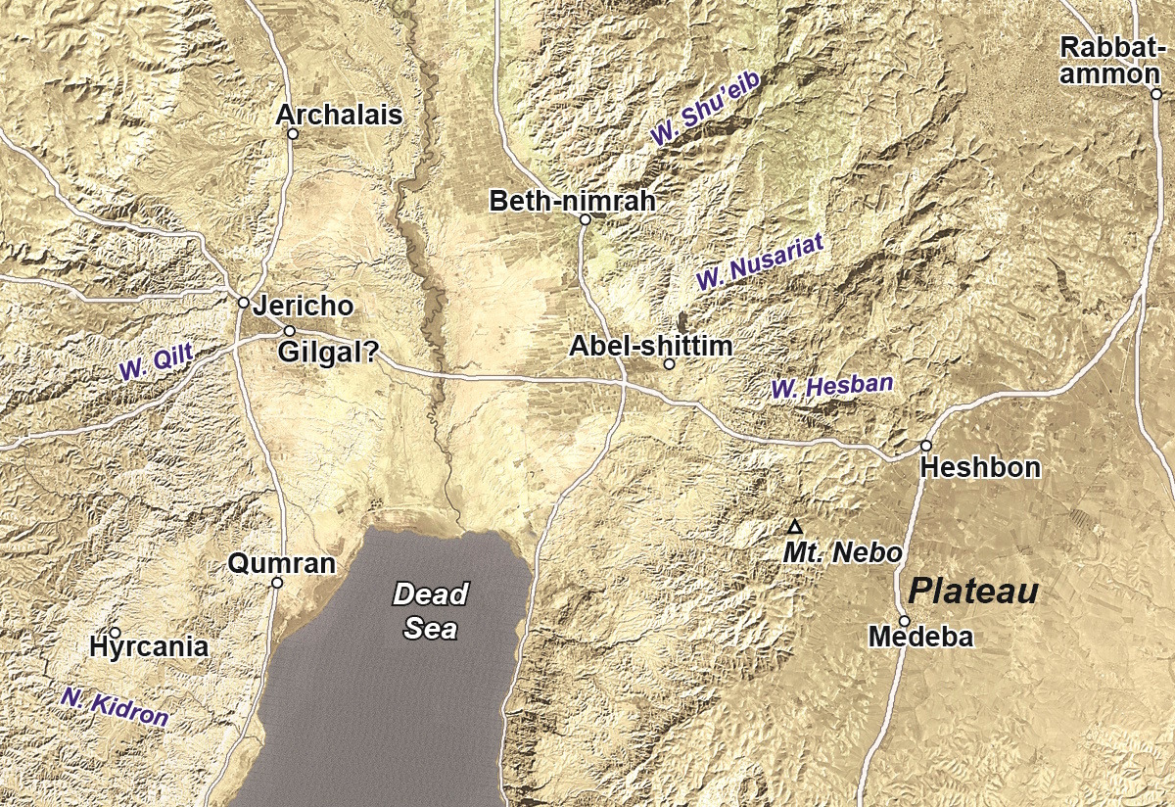
And recall what happened between Shittim and Gilgal
Satellite map of the southern Jordan Valley
6:5
Notes:
Shittim (also known as Abel-shittim; Num 33:49) was the final campsite of the Israelites on the plains of Moab just prior to their entry into the Promised Land. It should probably be identified with either Tell el-Kefrein or Tell el-Hammam, both of which are located northeast of the Dead Sea in the plains of Moab (Slayton 1992: 222). The Hebrew word for acacia wood is shittah (שִׁטָּה), or the plural shittim (שִׁטִּים), which has led some scholars to speculate that the location mentioned in this verse may have been known at that time for its acacia trees.
Gilgal was the first campsite of the Israelites inside the promised land. It was in the vicinity of Jericho, although its exact location remains uncertain. The event that happened between these two sites was the crossing of the Jordan River on dry land, when the river was in flood stage (Josh 3:14-17).
Reference:
Slayton, J. C.
1992 Shittim (Place). Anchor Bible Dictionary, vol. 5, ed. D. N. Freedman. New York: Doubleday.
This map is adapted from map 1-6 in the Satellite Bible Atlas, by William Schlegel. Used by permission.

Slide 32
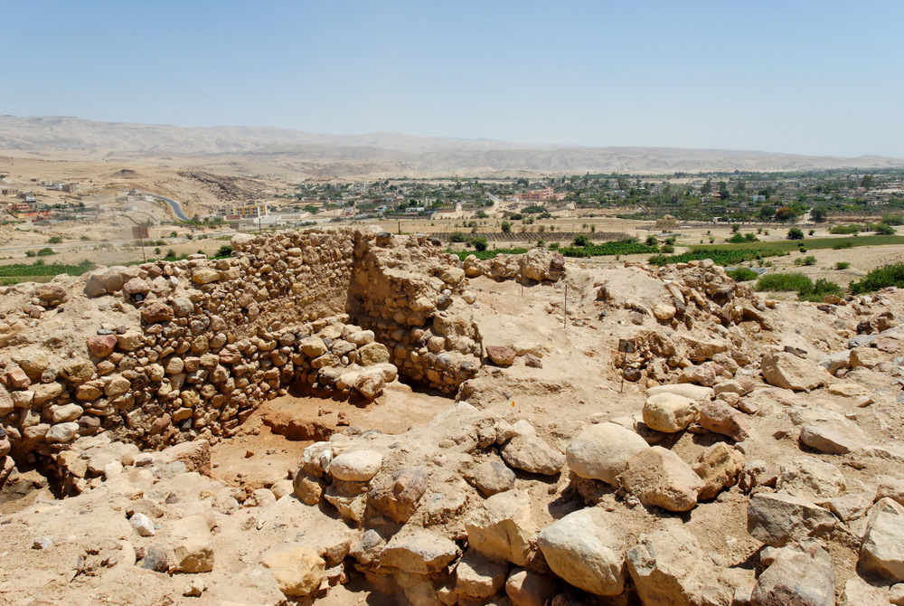
And recall what happened between Shittim and Gilgal
Excavations at Tell el-Hammam, possible location of Shittim
6:5
Notes:
Excavations in recent years at Tell el-Hammam have revealed extensive Middle Bronze and Iron Age remains, although evidence from the Late Bronze period is scanty.
tb060108198

Slide 33
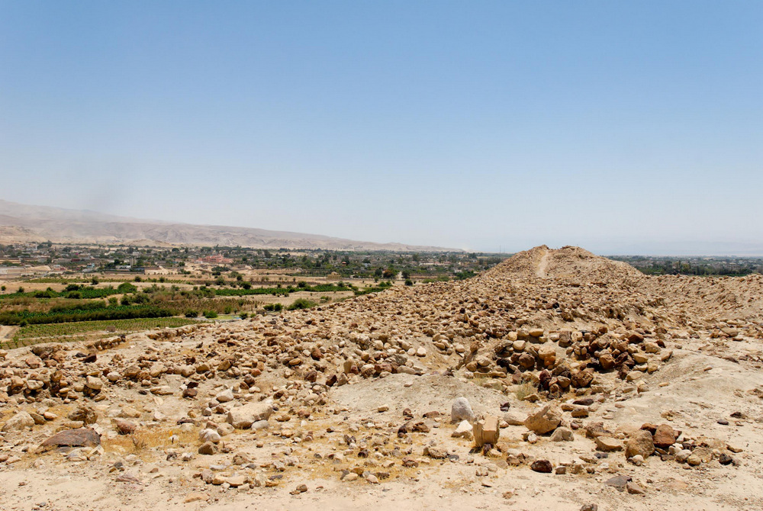
And recall what happened between Shittim and Gilgal
Excavations at Tell el-Hammam, possible location of Shittim (from the south)
6:5
Notes:
tb060108182

Slide 34
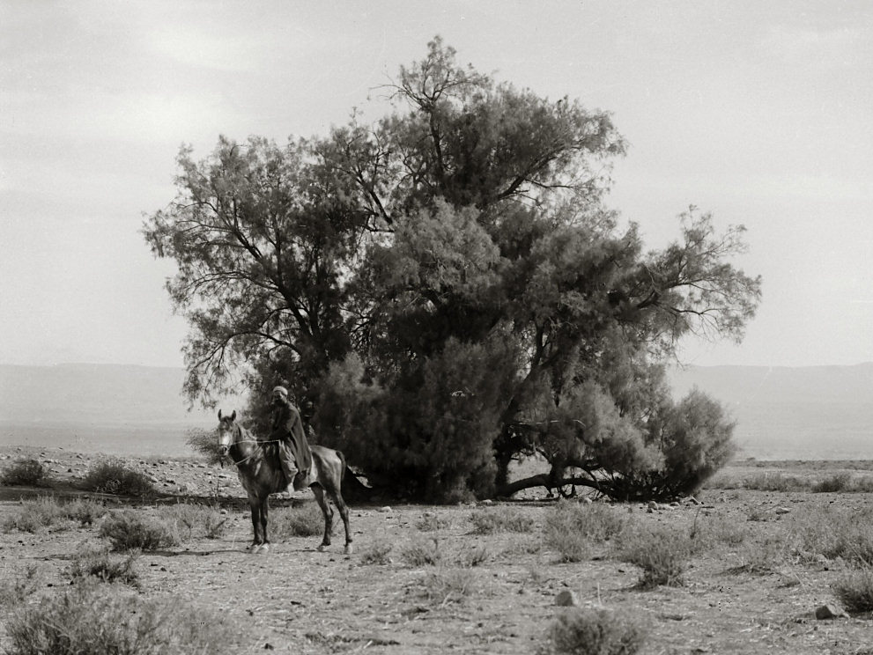
And recall what happened between Shittim and Gilgal
Tree near the pools of Khirbet en-Nitleh/Jiljulieh, possible location of Gilgal, circa 1910
6:5
Notes:
As noted above, the precise location of Gilgal is not known. In fact, Gilgal may not have been a city at all, but rather a region or even a non-urban cult site (cf. Josh 5:9; Judg 3:19; 1 Sam 11:15). This American Colony photograph, taken between 1900 and 1920, is of a tree growing near the pool of Jiljulieh, near the ruins of Khirbet en-Nitleh, a possible location of Gilgal. “It should also be remembered that the term Gilgal must have included a large district. The place where the tabernacle, with its priestly keepers, was pitched may have been at or near the pool of Jiljulieh, but the entire camp would necessarily spread over the plain” (Thomson 1880: 388).
Reference:
Thomson, William M.
1880 The Land and the Book. Vol. 1: Southern Palestine and Jerusalem. New York: Harper & Brothers.
mat01029

Slide 35
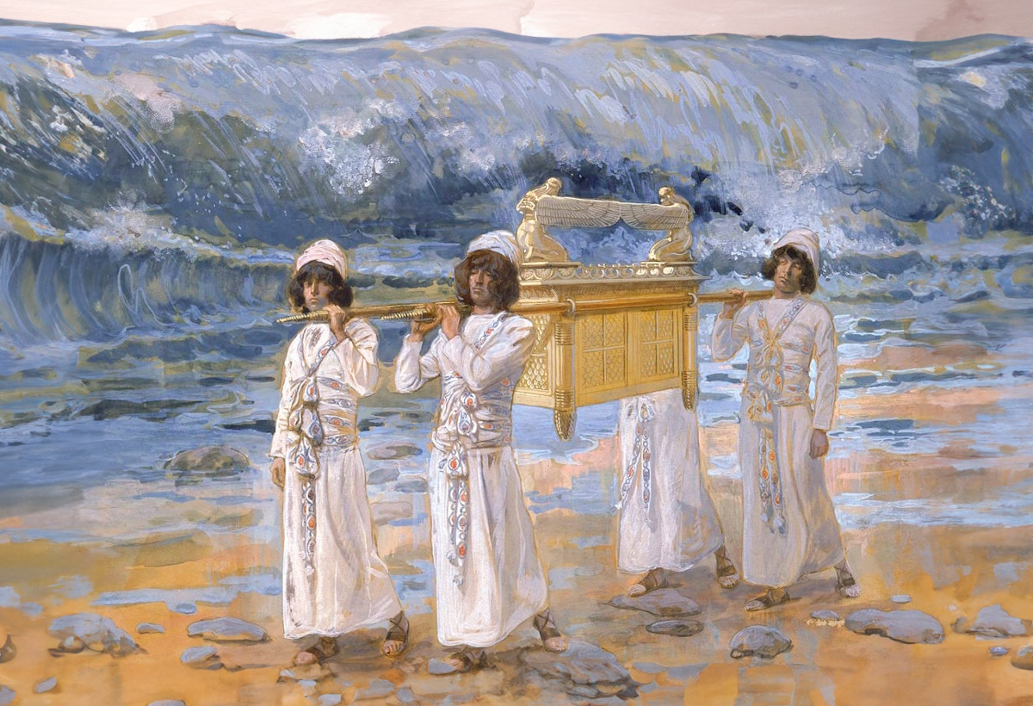
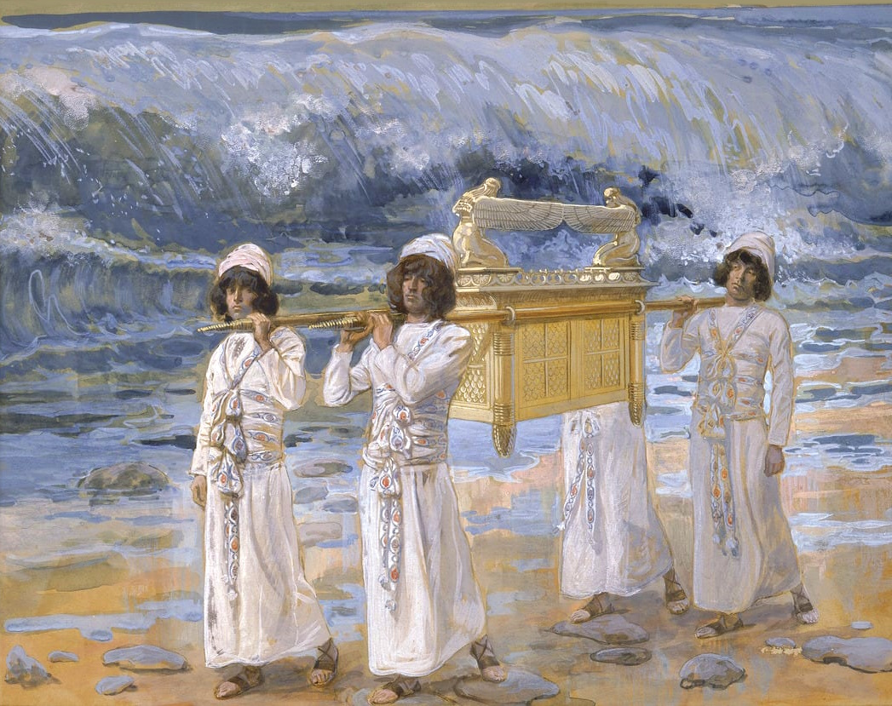
And recall what happened between Shittim and Gilgal
The Ark Passes Over the Jordan, by James Tissot, circa 1899
6:5
Notes:
The significance of what happened “between Shittim and Gilgal” is that God led his people into the promised land. The importance of this event was augmented by the fact that God led them across the Jordan River during flood stage, when it should have been completely impassable. This was reminiscent of the Exodus from Egypt, when God divided the waters of the Red Sea and brought His people across on dry ground.
This image is in the public domain, via the Jewish Museum: https://thejewishmuseum.org/collection/26409-the-ark-passes-over-the-jordan. Generative AI was used to extend the edges of this image; the original photo is available behind this image.
tjm26409psai

Slide 36
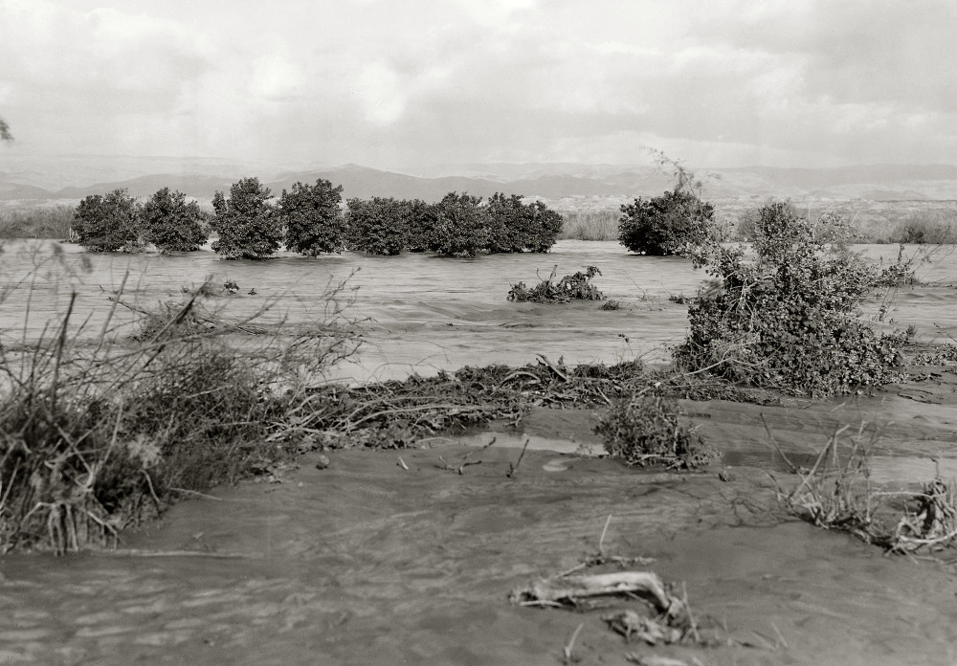
And recall what happened between Shittim and Gilgal
The Jordan River with flooded banks, 1935
6:5
Notes:
The swollen waters of the Jordan River once covered the floodplain, making the river as much as a mile (1.6 km) wide before the Sea of Galilee was dammed and water diverted. This American Colony photograph was taken in February 1935.
mat04343

Slide 37
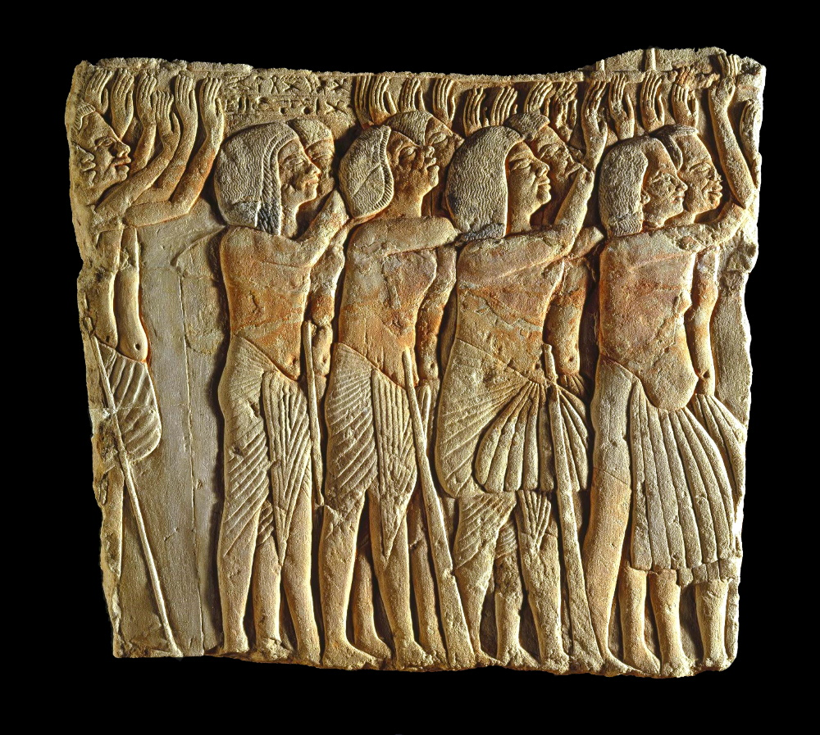
So that you may know the righteous acts of Yahweh
Egyptian soldiers shown honoring their commander, from Egypt, 14th century BC
6:5
Notes:
Recognition of God’s righteous acts should have produced awe and gratitude in the hearts of the Israelites. These soldiers are shown with their hands upraised, a stance intended to show that they are praising their military commander, General Horemheb. Note the wide range of ethnic types reflected among the soldiers. This is considered to be an accurate reflection of the composition of the Egyptian military during the New Kingdom.
This image comes from the Brooklyn Museum and is in the public domain. Source: https://www.brooklynmuseum.org/opencollection/objects/3308.
bmny3308

Slide 38
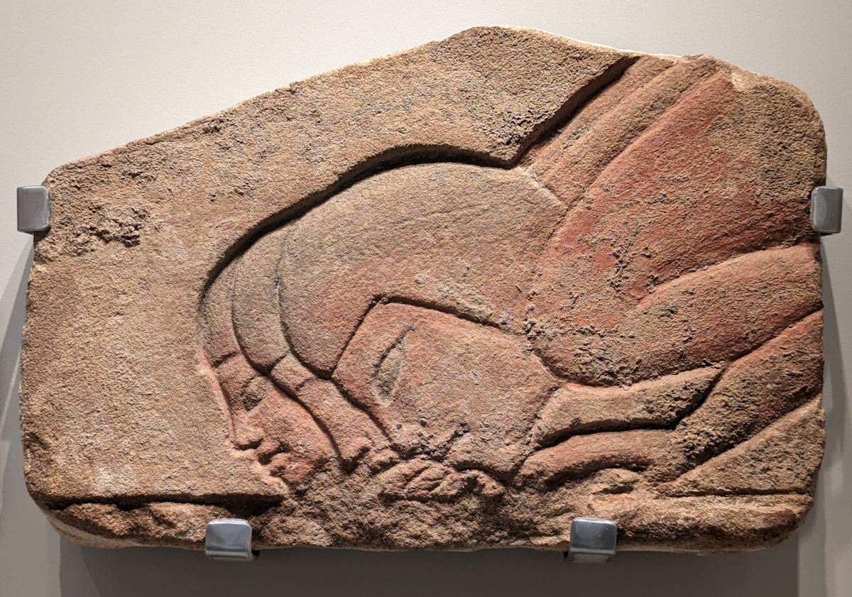
So that you may know the righteous acts of Yahweh
Egyptian sandstone relief with bowing courtiers, 14th century BC
6:5
Notes:
This relief was photographed at the Israel Museum.
ku0607230842513

Slide 39
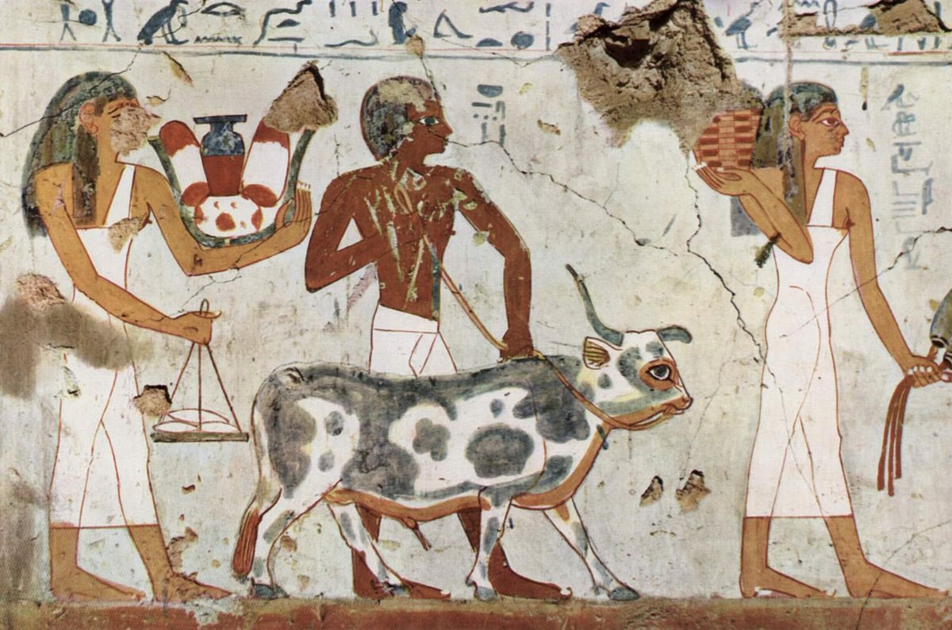
With what shall I come before Yahweh, and bow myself before the God on high?
Fat bull led to sacrifice, from the tomb of a high-ranking officer, 14th century BC
6:6
Notes:
The question “with what?” assumes that it would only be fitting to bring a sacrifice or gift to God. The idea is illustrated here by a procession of Egyptians who are bringing offerings to an Egyptian god, including a variety of food items and a bull intended for sacrifice.
This image comes from Maler der Grabkammer des Amenemhêt and is in the public domain, via Wikimedia Commons: https://commons.wikimedia.org/wiki/File:Maler_der_Grabkammer_des_Amenemh%C3%AAt_001.jpg.
wiki15001450800496

Slide 40
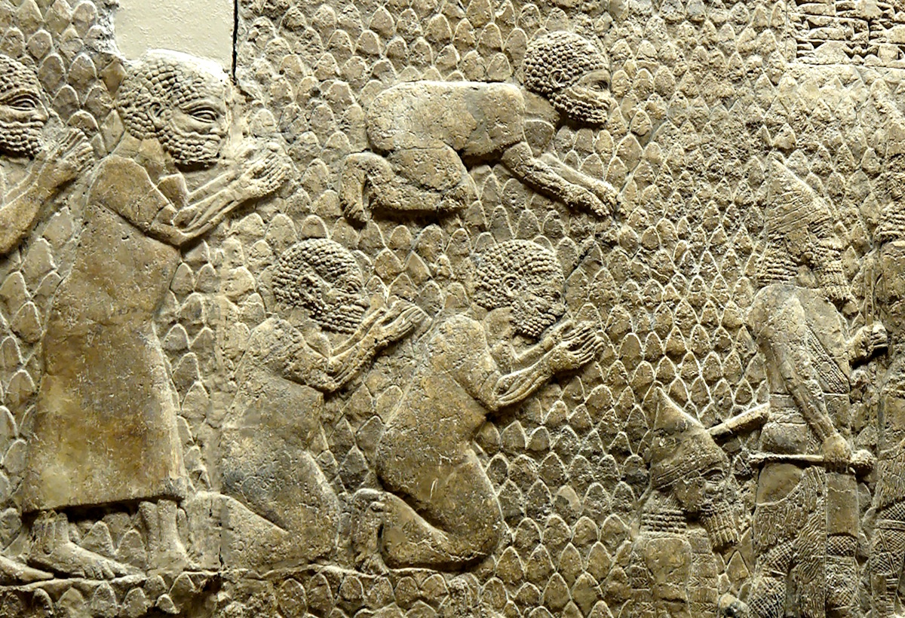
With what shall I come before Yahweh, and bow myself before the God on high?
Judeans bowing down before the Assyrian king Sennacherib, circa 700 BC
6:6
Notes:
This photo shows panel 12 of the Lachish reliefs, discovered in Nineveh and photographed at the British Museum.
tb112004327

Slide 41
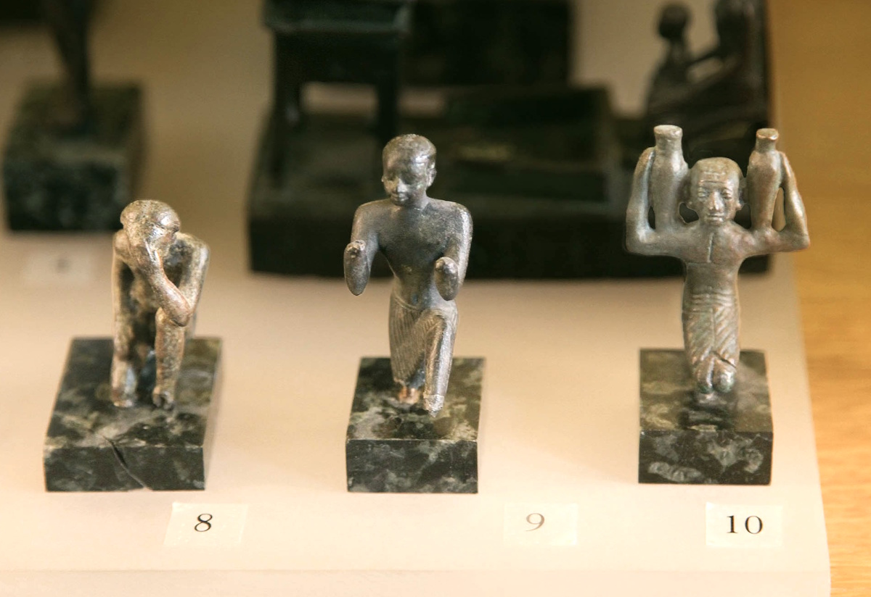
With what shall I come before Yahweh, and bow myself before the God on high?
Bronze figures praying and worshiping, from Egypt, circa 330–30 BC
6:6
Notes:
The three bronze figures shown here are portrayed as worshiping before a deity. The one on the left has his hand to his head as he bows reverently; the one on the right carries two jugs that may have held libations for the god; the center figure likely held offerings in his now-missing hands. All three are shown kneeling, another sign of reverence for the god.
This display was photographed at the Louvre Museum. This image comes from Rama and is licensed under CC BY-SA 3.0, via Wikimedia Commons: https://commons.wikimedia.org/wiki/File:Louvre_room_644_display_2-IMG_2196.JPG.
wiki07111956163744634

Slide 42
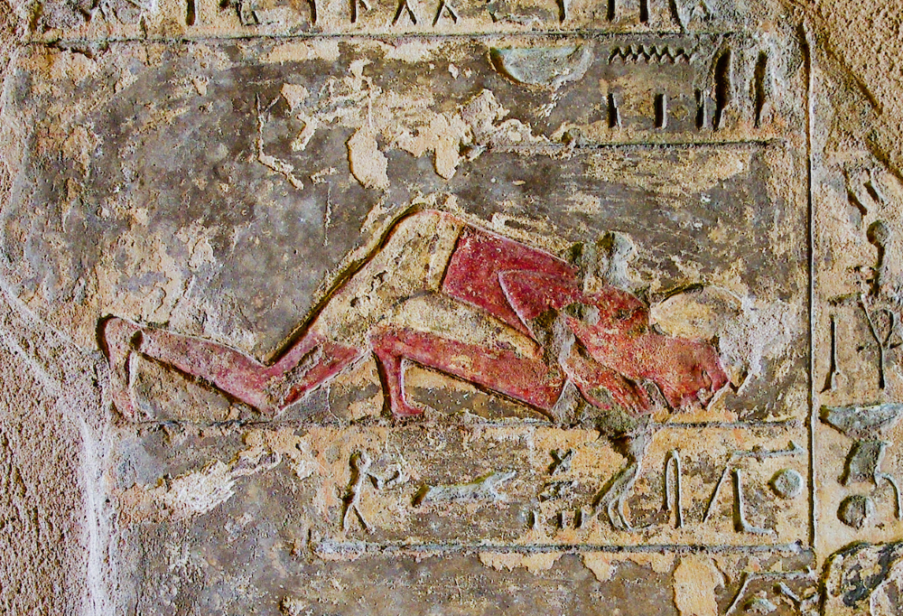
With what shall I come before Yahweh, and bow myself before the God on high?
Depiction of a man bowing to the ground, from el-Kab, circa 1500 BC
6:6
Notes:
Bowing down with knees, hands, and face to the ground is a stance that conveys worship or submission across many cultures. The Egyptian man shown here is bowing down to his deceased master. This relief was photographed at the tomb of Renni at el-Kab, an Upper Egyptian site on the east bank of the Nile at the mouth of the Wadi Hillal about 50 miles (80 km) south of Luxor (ancient Thebes).
adr1603226728

Slide 43
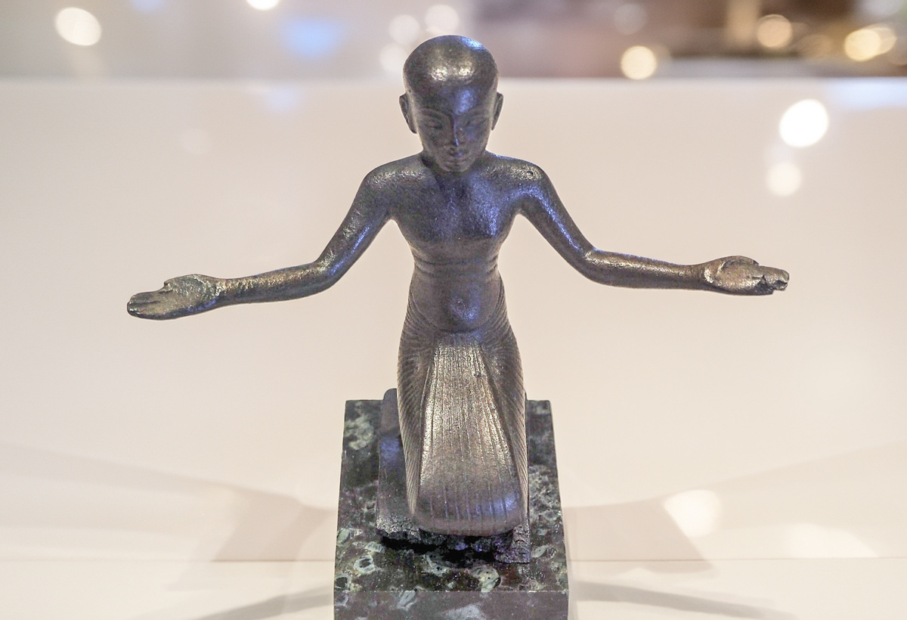
With what shall I come before Yahweh, and bow myself before the God on high?
Bronze statue of a man praying, circa 1200 BC
6:6
Notes:
This statue shows an Egyptian man in a posture of worship. It was photographed at the Louvre Museum. This image comes from Rama and is licensed under CC BY-SA 3.0 FR, via Wikimedia Commons: https://commons.wikimedia.org/wiki/File:Worshiper-E_3188-P7181006-white.jpg. The background of this image has been modified using generative AI.
wiki07182014483535534c

Slide 44
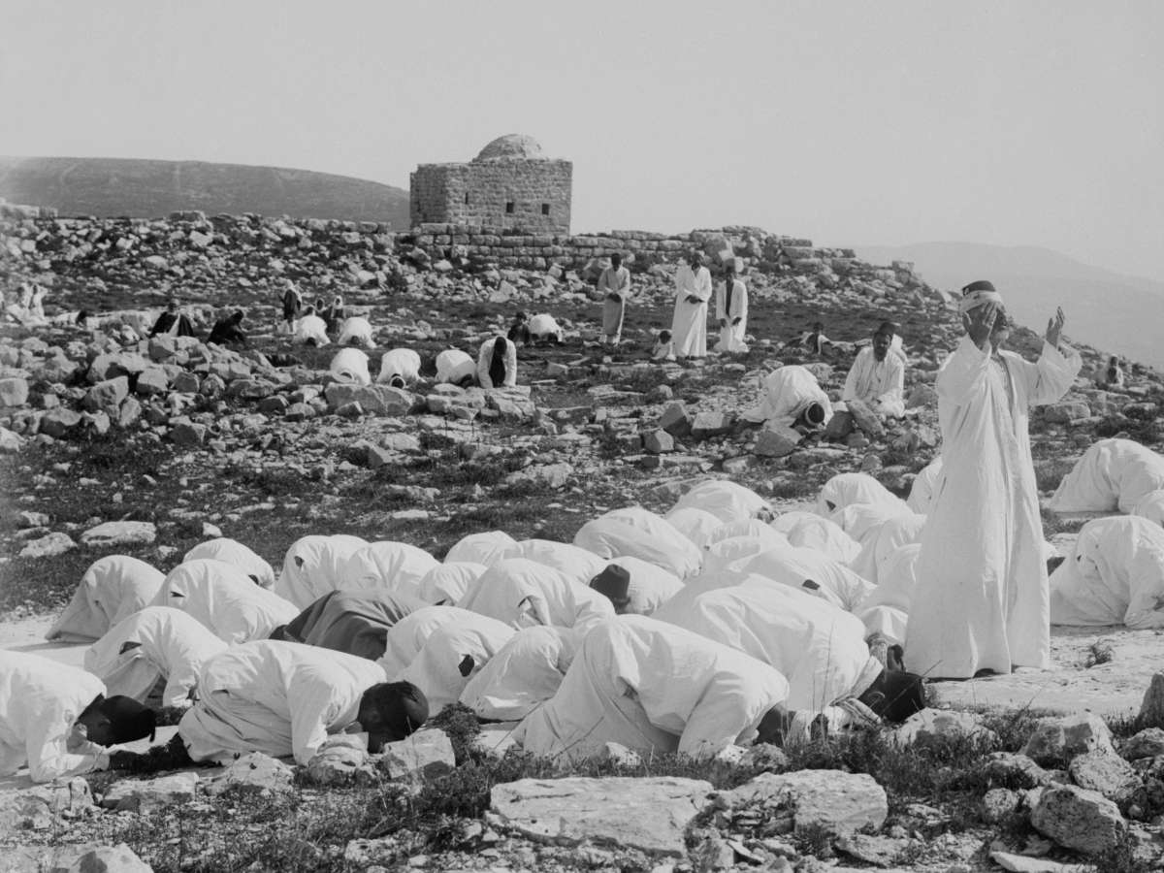
With what shall I come before Yahweh, and bow myself before the God on high?
Samaritans praying on a holy rock on Mt. Gerizim during the Samaritan Passover, circa 1910
6:6
Notes:
This American Colony photo was taken between 1900 and 1920. The next slide includes a colorized version of this photo.
mat01870

Slide 45
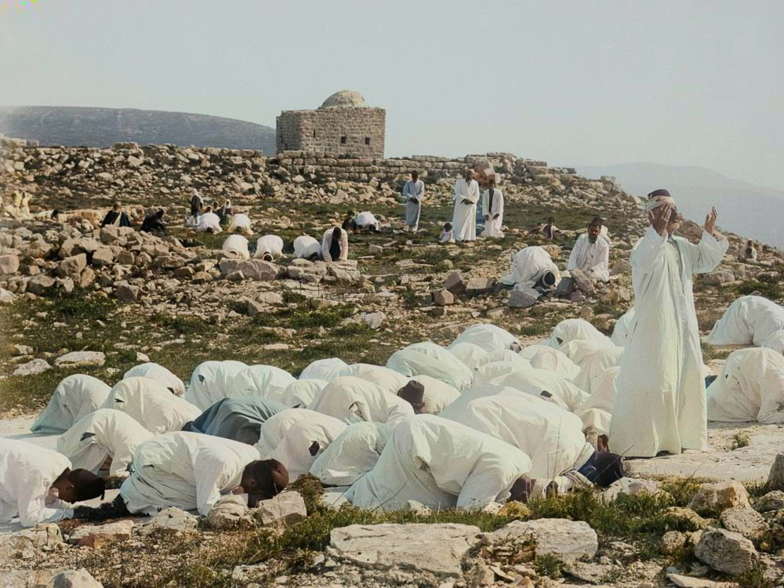
With what shall I come before Yahweh, and bow myself before the God on high?
Samaritans praying on a holy rock on Mt. Gerizim during the Samaritan Passover, circa 1910
6:6
Notes:
This American Colony photo was taken between 1900 and 1920. Generative AI was used to colorize this photo.
mat01870col

Slide 46
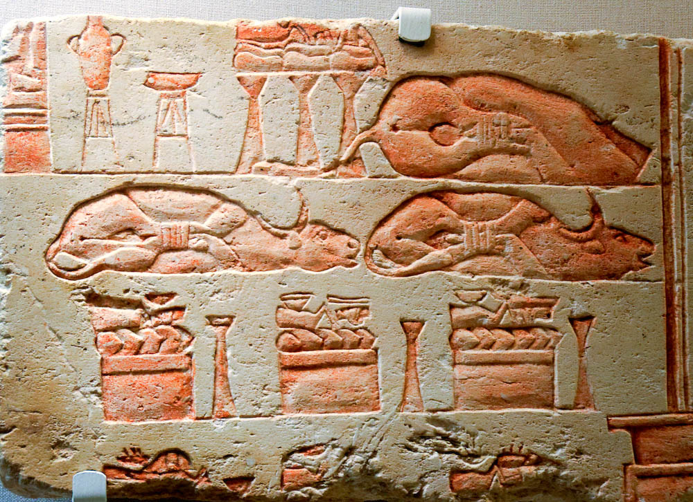
Shall I come before Him with burnt offerings, with yearling calves?
Relief of cattle trussed as offerings, from Heliopolis, reign of Akhenaten, 14th century BC
6:6
Notes:
This Egyptian relief shows a group of items prepared for sacrifice. In addition to the trussed cattle, there are three tables that include other cuts of meat and additional sacrificial items including wine, oil, breads, and cakes. It was photographed in the San Antonio Museum of Art.
tb111716935

Slide 47
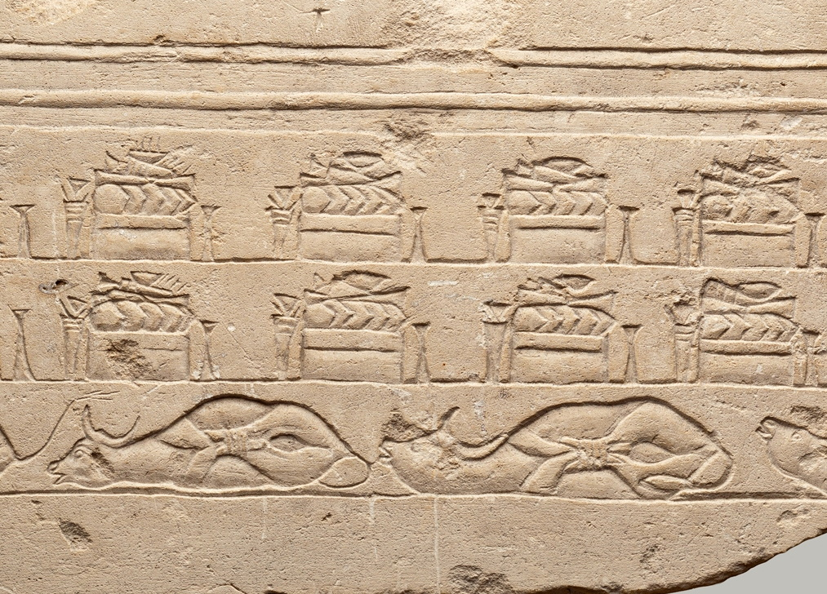
Shall I come before Him with burnt offerings, with yearling calves?
Sacrificial altars and trussed cattle, from the Great Temple at Amarna, 14th century BC
6:6
Notes:
This relief from Tel Amarna, Egypt, depicts rows of sacrificial altars and cattle that have been prepared for sacrifice. According to the museum website, “The rectangular altars are topped with overlapping round bread loaves, conical loaves, bunches of flowers, and small dishes for incense, some of which are burning. At either end stands a tall narrow offering stand and an upright bouquet. The cattle are awaiting slaughter, thrashing and bellowing in misery.” This image comes from The Metropolitan Museum of Art, public domain, Gift of Edward S. Harkness, 1921, accession number 21.9.8, https://www.metmuseum.org/art/collection/search/572218.
met572218

Slide 48
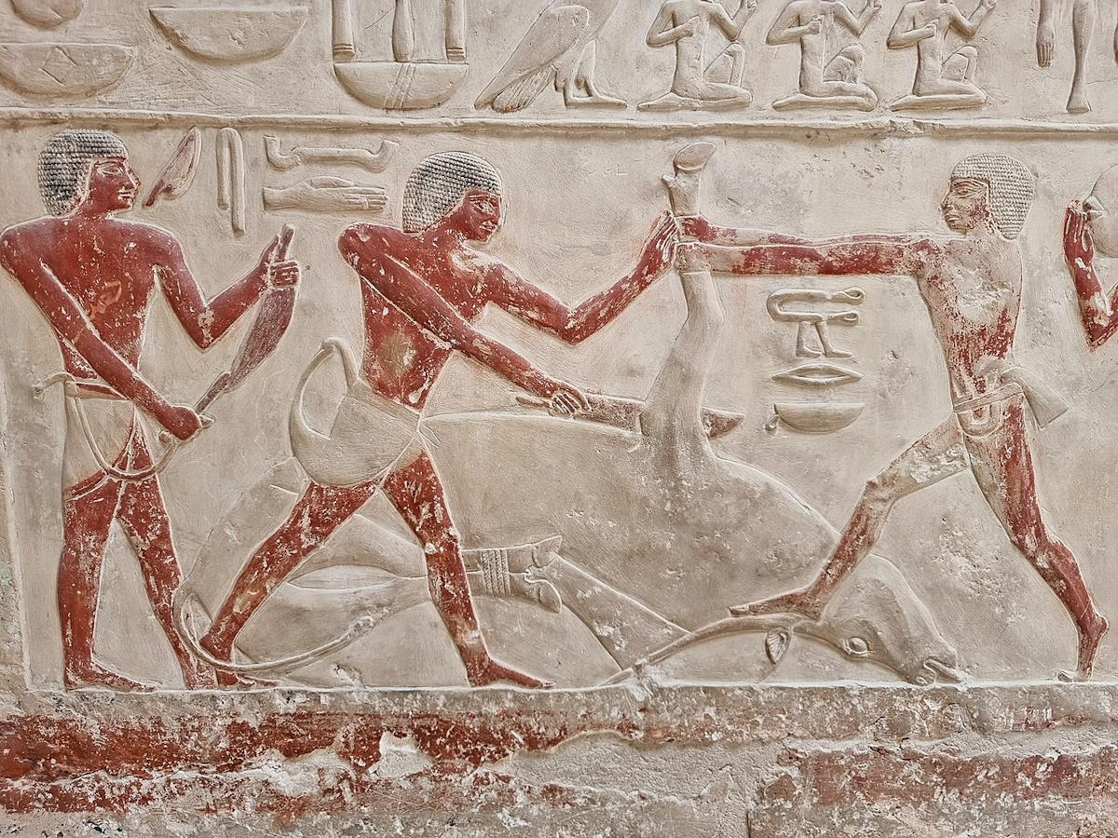
Shall I come before Him with burnt offerings, with yearling calves?
Men butchering a cow for sacrifice, from the tomb of Princess Idut at Saqqara, circa 2300 BC
6:6
Notes:
The figure at the left is sharpening his knife, while the two on the right are working to sever a foreleg. The hind feet (and probably the front feet originally) of the cow were trussed prior to its demise. This relief was photographed at the mastaba of Idut at Saqqara. This image comes from Prof. Mortel and is licensed under CC BY 2.0, via Wikimedia Commons: https://commons.wikimedia.org/wiki/File:Tomb_of_Princess_Sesheshet_Idut,_6th_dynasty._ca._2330_BCE;_Saqqara_(7).jpg.
wiki0505221258414000541

Slide 49
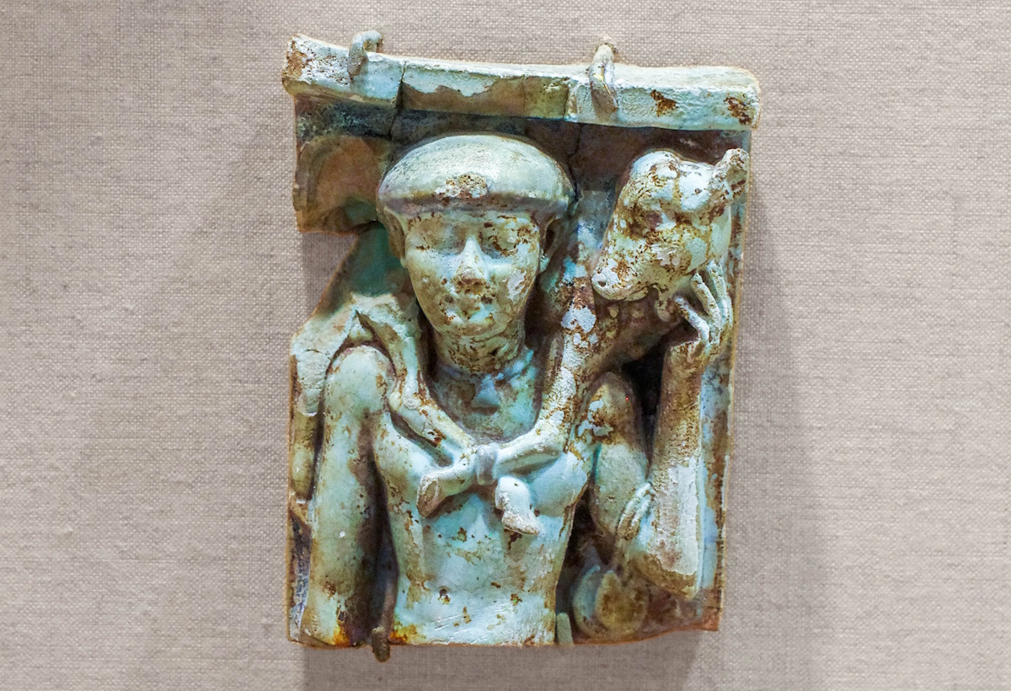
Shall I come before Him with burnt offerings, with yearling calves?
Faience plaque with calf bearer, from Egypt, 4th–3rd centuries BC
6:6
Notes:
This plaque from the Late–Ptolemaic periods was photographed at the Brooklyn Museum.
adr1606021568c

Slide 50
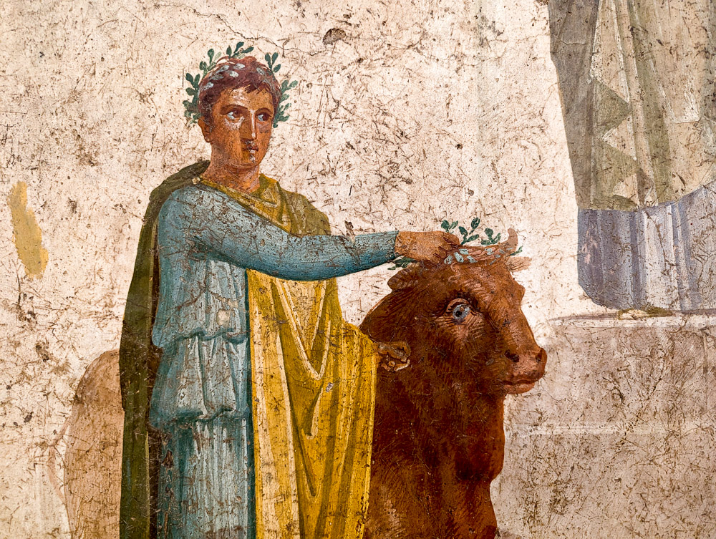
Shall I come before Him with burnt offerings, with yearling calves?
Fresco with man bringing a bull for sacrifice, from Pompeii, AD 20–25
6:6
Notes:
This fresco was photographed at the Naples Archaeological Museum.
ku0622230829583

Slide 51

Shall I come before Him with burnt offerings, with yearling calves?
Calf near the Jordan River, north of the Sea of Galilee
6:6
Notes:
tb032807042

Slide 52

Will Yahweh be pleased with thousands of rams?
Procession to an altar to sacrifice a lamb, from Sikyon, circa 530 BC
6:7
Notes:
Sheep were commonly used for sacrifice, not only in the Jewish tradition but also in the Greco-Roman world. This painted wooden plaque depicts a lamb being led to an altar, accompanied by two figures playing a flute and lyre. The dedication is to the Charites.
The wooden plaque was found near ancient Sikyon, in a cave above the village Pitsa. This is about 10 miles (16 km) due west of ancient Corinth. This plaque was photographed at the National Archaeological Museum in Athens. This image comes from Zde and is licensed under CC BY-SA 4.0, via Wikimedia Commons: https://commons.wikimedia.org/wiki/File:Painted_wooden_plaque,_procession_to_sacrifice,_540-530_BC,_NAMA_16464,_191289.jpg.
wiki06112019164945

Slide 53

Will Yahweh be pleased with thousands of rams?
Kylix depicting a warrior sacrificing a ram, 5th century BC
6:7
Notes:
The warrior depicted on this kylix may be sacrificing the ram as a religious act before battle, a plea to the gods to save his own and his company’s lives. This image comes from the Cleveland Museum of Art, public domain, Dudley P. Allen Fund 1926.242, https://www.clevelandart.org/art/1926.242.
tcma1926242

Slide 54

Will Yahweh be pleased with thousands of rams?
Sheep in Negev riverbed
6:7
Notes:
tb010303615

Slide 55

Will Yahweh be pleased with thousands of rams?
Sheep and shepherd in eastern Samaria
6:7
Notes:
tb031405269c

Slide 56

Will Yahweh be pleased with thousands of rams?
Sheep slain for the Samaritan Passover on Mount Gerizim
6:7
Notes:
The Jewish people have not offered animal sacrifices since the temple in Jerusalem was destroyed in AD 70. The Samaritans did not worship at that temple and so were unaffected by its destruction. They have maintained their annual Passover sacrifice on Mount Gerizim for millennia, and today this ritual provides the closest living glimpse into the sacrificial practices described in the Bible.
tb041106749

Slide 57

Will Yahweh be pleased with thousands of rams?
Lambs slain during celebration of the Samaritan Passover on Mount Gerizim
6:7
Notes:
tb041106729

Slide 58

Will Yahweh be pleased with thousands of rams?
Ram in Nazareth
6:7
Notes:
This photograph was taken at Nazareth Village, a reconstruction of the 1st-century town where Jesus lived.
tb011406548

Slide 59

Will He be pleased with ten thousand rivers of oil?
Relief of a worshiper twice pouring a libation, from Arslantepe, 11th–10th centuries BC
6:7
Notes:
This relief portrays PUGNUS-mili pouring out libations before his gods. In this case, he pours the libation liquid into other vessels. The relief comes from the Lion Gate at Arslantepe and was photographed at the Ankara Museum of Anatolian Civilizations.
adr1006031289c

Slide 60

Will He be pleased with ten thousand rivers of oil?
Priests with libation offerings, sketch of an Assyrian relief
6:7
Notes:
This illustration comes from Paul Emile Botta and Eugène Flandin, Monument de Ninive, published in 1849–1850. Public domain, from The New York Public Library, http://digitalcollections.nypl.org/items/510d47e2-7295-a3d9-e040-e00a18064a99.
nypl1534771

Slide 61

Will He be pleased with ten thousand rivers of oil?
Olive oil and fresh olives from Israel
6:7
Notes:
This image comes from ישראל פרקר and is licensed under CC BY-SA 4.0, via Wikimedia Commons: https://commons.wikimedia.org/wiki/File:%D7%A9%D7%9E%D7%9F_%D7%96%D7%99%D7%AA_%D7%99%D7%A9%D7%A8%D7%90%D7%9C_%D7%9E%D7%96%D7%99%D7%AA%D7%99_%D7%9E%D7%A9%D7%A7_%D7%94%D7%A8%D7%90%D7%9C.jpg.
wiki09232022303134326

Slide 62

Will He be pleased with ten thousand rivers of oil?
Olive oil production at Meshek Achiya
6:7
Notes:
Meshek Achiya is an agricultural company located in Shiloh. This image comes from Yonyon99, and is licensed under CC BY-SA 4.0, via Wikimedia Commons: https://commons.wikimedia.org/wiki/File:Oile.jpg.
wiki11221028162112284c

Slide 63

Will He be pleased with ten thousand rivers of oil?
Stream in Nahal Perat
6:7
Notes:
The idea of a “river of oil” is illustrated here by a stream of water that runs eastward through the Judean wilderness toward the Jordan River. Nahal Perat originates at Ein Perat, which is a spring located near Jerusalem that flows down the Wadi Qilt to Jericho.
tb020804351

Slide 64

Shall I give my firstborn for my transgression, the fruit of my body for the sin of my soul?
Sacrifice of Polyxena after the capture of Troy, 6th century BC
6:7
Notes:
There are two examples in the Hebrew Bible of a first-born child being sacrificed. One is the daughter of the judge Jephthah, a death that came about as a result of Jephthah’s rash vow (Judg 11). The idea is illustrated here by a similar event from ancient Greek mythology, in which Polyxena was sacrificed. She had helped to uncover the weakness of Achilles that led to his death, so was offered as a human sacrifice after the fall of the city. The amphora shown here depicts her being killed over an altar. Polyxena is considered the Trojan version of Iphigenia, who met a similar fate.
This amphora is dated on stylistic grounds to about 570–550 BC. This image comes from Jastrow and is licensed under CC BY 2.5, via Wikimedia Commons: https://commons.wikimedia.org/wiki/File:Sacrifice_Polyxena_BM_GR1897.7-27.2.jpg.
wiki07302007181918972

Slide 65

Shall I give my firstborn for my transgression, the fruit of my body for the sin of my soul?
Relief of the sacrifice of Polyxena, from the Polyxena sarcophagus, late 6th century BC
6:7
Notes:
This marble sarcophagus depicts the sacrifice of Polyxena. It was photographed at the Çanakkale Archaeological Museum. This image comes from Dick Osseman and is licensed under CC BY-SA 4.0, via Wikimedia Commons: https://commons.wikimedia.org/wiki/File:Polyxena_side_0059,_the_actual_kill.jpg.
wiki12192018132812c

Slide 66

Shall I give my firstborn for my transgression, the fruit of my body for the sin of my soul?
Possible depiction of child sacrifice in Ashkelon during Merneptah’s siege, circa 1195 BC
6:7
Notes:
The other example from the Hebrew Bible comes from 2 Kings 3, where the king of Moab offers his first-born son on the city wall during a siege by the Israelites. This photo from the Karnak Temple in Luxor shows the city of Ashkelon (in relief) and a possible Canaanite child sacrifice (notice the priest with the incense burner), which was being attacked by Pharaoh Merneptah. This relief may be one of the only illustrations of ancient Near Eastern child sacrifice during the besieging of a city. The next slide includes highlights.
tb011105005

Slide 67

Shall I give my firstborn for my transgression, the fruit of my body for the sin of my soul?
Possible depiction of child sacrifice in Ashkelon during Merneptah’s siege, circa 1195 BC
6:7
Notes:
The other example from the Hebrew Bible comes from 2 Kings 3, where the king of Moab offers his first-born son on the city wall during a siege by the Israelites. This photo from the Karnak Temple in Luxor shows the city of Ashkelon (in relief) and a possible Canaanite child sacrifice (notice the priest with the incense burner), which was being attacked by Pharaoh Merneptah. This relief may be one of the only illustrations of ancient Near Eastern child sacrifice during the besieging of a city.
tb011105005

Slide 68

Shall I give my firstborn for my transgression, the fruit of my body for the sin of my soul?
Father and son wearing phylacteries at the Western Wall in Jerusalem
6:7
Notes:
tb071207088

Slide 69

He has shown you, O man, what is good
The Ten Commandments in a model of the ark of the covenant
6:8
Notes:
Probably the earliest direct revelation of God that made it into written form was the Ten Commandments, given by God to Moses on Mount Sinai in the 15th century BC (Exod 31:18). This display, which includes modern replicas of the two stone tablets, along with Aaron’s rod that budded, was photographed at the full-size model of the tabernacle in Timna Valley in southern Israel.
tb052523991

Slide 70

What does Yahweh require of you, but to do justice, and to love kindness
Fresco with a scene from the Judgment of Solomon, from Pompeii, 1st century AD
6:8
Notes:
Justice is illustrated here by a depiction of Solomon deciding the infamous case between two women, one of whom had lost her infant child (1 Kgs 3:16ff). Of particular interest is the way the artist has depicted the people and setting in a way that reflects the 1st century world. Not only are the soldiers dressed as Romans, but the king and his associates are sitting on a raised platform (bema) while the woman pleads her case before them. The living child has been placed on a table, and the soldier has his sword raised to cut it in half as the true mother kneels before the king. This fresco comes from the House of the Doctor at Pompeii. It was photographed at the Naples Archaeological Museum.
tb0515170279c

Slide 71


What does Yahweh require of you, but to do justice, and to love kindness
Statue of Themis, the Roman goddess of justice, about 300 BC
6:8
Notes:
Themis was the Roman goddess of divine law and justice. She was often portrayed holding a sword and a balance scale.
This statue was made of marble by the Greek sculptor Chairestratos. It was discovered in Rhamnonte, at the temple of Nemesis. The statue was dedicated to Themis by a man known as Megacles. It was photographed at the National Archaeological Museum in Athens. This image comes from Ricardo André Frantz and is licensed under CC BY-SA 3.0, via Wikimedia Commons: https://commons.wikimedia.org/wiki/File:0029MAN-Themis.jpg.
wiki1018200704452006c

Slide 72

What does Yahweh require of you, but to do justice, and to love kindness
Fresco of a woman handing a beggar a drink, from Pompeii, 1st century AD
6:8
Notes:
This fresco depicts a woman handing a drink to a beggar, an act of kindness. This fresco was photographed at the Naples Archaeological Museum. This image comes from Gary Todd and is in the public domain, via Wikimedia Commons: https://commons.wikimedia.org/wiki/File:Roman_fresco_Woman_handing_a_beggar_a_drink,_from_House_of_the_Dioscuri,_Pompeii_(48452588127).jpg.
wiki48452588127080220190321

Slide 73

And to walk humbly with your God
Relief with the commander of the Persian royal bodyguard covering his lips
6:8
Notes:
The commander of the Persian bodyguard shown here raises his hand to his mouth in a gesture of humility and deference to the king. This scene is part of the audience relief from Persepolis, which is on display in the National Museum in Tehran.
tb0514183858

Slide 74


And to walk humbly with your God
Bronze figurine of an Egyptian man praying, circa 330–30 BC
6:8
Notes:
This figurine portrays an Egyptian man praying. His stance, with his hand to his head, shows humility and deference before his god. This figurine was photographed at the Louvre Museum. This image comes from Rama and is in the public domain, via Wikimedia Commons: https://commons.wikimedia.org/wiki/File:Man_praying-N_1593-IMG_2196.JPG. Generative AI was used to extend the edges of this image; the original photo is available behind this image.
wiki07111911481230212psai

Slide 75

And to walk humbly with your God
Statuette of a kneeling youth, 2nd–3rd centuries AD
6:8
Notes:
Humility is illustrated here by a much later Roman statuette of a servant, down on one knee and lifting a hand in deference. This figurine was photographed as part of the Spartacus Exhibit, a temporary exhibition at the Ara Pacis Museum in Rome.
tb0518174003c

Slide 76

And to walk humbly with your God
Jewish woman praying at the Western Wall in Jerusalem
6:8
Notes:
This image comes fromלנה קונסטנטינובה and is licensed under CC BY-SA 3.0, via Wikimedia Commons: https://commons.wikimedia.org/wiki/File:Dispair_(_The_Western_Wall).jpg.
wiki0917140947172479412

Slide 77

The voice of Yahweh is calling to the city
Relief of an aged courtier, from Saqqara, circa 1300 BC
6:9
Notes:
The usual way that God spoke to His people in the days of Micah was through one of His prophets. The idea is illustrated here by a relief of an elderly court official. He holds out his hand as though he were giving counsel or addressing someone. This image comes from the Brooklyn Museum and is in the public domain. Source: https://www.brooklynmuseum.org/opencollection/objects/3483.
bmny3483

Slide 78

And it is wise to fear Your name
Stele with Userhat and his wife with hands raised in prayer, from Deir el-Bahari, circa 1300 BC
6:9
Notes:
The text here is debated. The Hebrew text is pointed as “he sees” (Heb. yir’eh, יִרְאֶה; so KJV), but most English versions prefer a slightly emended vocalization, “fearing” (Heb. yir’ah, יִרְאָה). The two figures on this stone relief have their hands raised in the age-old gesture of prayer or supplication.
This image comes from the Metropolitan Museum of Art, public domain, Gift of Egypt Exploration Fund, 1905, accession number 05.4.2, https://www.metmuseum.org/art/collection/search/544776.
met544776

Slide 79

Pay attention to the rod and the One who appointed it!
Overseer beating prisoners of war hauling a sledge, from Nineveh, circa 700 BC
6:9
Notes:
The final phrase in this verse is very difficult. The Hebrew word matteh (Heb. מַטֶּה) can mean either “rod, stick, staff” (e.g., Gen 38:1; Exod 7:12; 1 Sam 14:27) or “tribe” (e.g., Josh 7:1; Num 1:4; 1 Kgs 8:1). In addition, some translators opt for additional emendations. Most English versions follow some variation of “Heed the rod, and the One who appointed it” (so NIV) or a variation of “Hear, O tribe, and assembly of the city” (so NRSV).
Those who accept the reading “rod” typically understand it to refer metaphorically to a foreign nation such as the Assyrians, used by God as an instrument of judgment (cf. Isa 10:5; see discussion in Barker and Bailey 1998: 117). Those who prefer “tribe” usually redivide the final few words, from “and who appointed it still” (Heb. מי יעדה עוד ) to “and assembly of the city” (Heb. ומועד עיד) (so Smith 1984: 52–53).
This relief, which depicts an Assyrian taskmaster threatening slave laborers with a rod, comes from the palace of Sennacherib and was photographed at the British Museum.
References:
Barker, Kenneth L. and Bailey, Waylon.
1998 Micah, Nahum, Habakkuk, Zephaniah. New American Commentary. Nashville: Broadman and Holman.
Smith, Ralph L.
1984 Micah–Malachi. Word Biblical Commentary. Dallas: Word.
adr1805195374

Slide 80

Am I to forget the treasures of wickedness in the house of the wicked?
Relief of Assyrian soldiers carrying away booty, from Nineveh, circa 700 BC
6:10
Notes:
This relief carving comes from the palace of Sennacherib at Nineveh. It was photographed at the Vatican Museums.
tb111802009

Slide 81

Am I to forget the treasures of wickedness in the house of the wicked?
Assyrian soldiers pulling a cart with a plundered pithos, from Balawat, 9th century BC
6:10
Notes:
This bronze relief depicts Assyrian soldiers carrying off a very large pithos on a wheeled cart. It may be deduced that either the contents or the pithos itself were very valuable. This relief was originally part of a large set of bronze bands that were attached to the city gates of Balawat during the reign of the Assyrian king Shalmaneser III. It was photographed at the British Museum.
adr1805194247

Slide 82

Am I to forget the treasures of wickedness in the house of the wicked?
Relief of Assyrian soldiers carrying off the gods of conquered people, from Nimrud, circa 728 BC
6:10
Notes:
This relief depicts victorious Assyrian soldiers carrying off the idols of those they conquered. When the Babylonians conquered Jerusalem in 586 BC, they also carried off the equipment of the temple, some of which was returned a couple of generations later. This relief comes from the Central Palace at Nimrud. It was photographed at the British Museum.
tb0929197027

Slide 83

Am I to forget the treasures of wickedness in the house of the wicked?
Hoards of hacksilver, from En Hofez, 10th–9th centuries BC
6:10
Notes:
These jars full of randomly shaped pieces of silver, often referred to as hacksilver, illustrate the common form in which silver was kept and traded during the Iron Age. This display was photographed in the Hecht Museum at the University of Haifa.
cm17062709822c

Slide 84

And the scant ephah that is cursed?
Relief of men measuring grain, probably from Thebes, circa 1375 BC
6:10
Notes:
An ephah was a dry measure equal to about 6 US gallons (23 l). A scant ephah would be one that was undersized and thus did not give the purchaser the full amount of grain. In this relief, a scribe and an overseer are keeping watch to ensure that everything is done correctly.
This relief comes from the tomb of the Royal Cup-bearer Tjawy, who served during the reign of Amenhotep III. It was photographed at the Boston Museum of Fine Arts.
adr1711202745

Slide 85

Can I justify wicked scales or a bag of deceptive weights?
Reconstructed scales for weighing precious metal and jewelry, 14th–13th centuries BC
6:11
Notes:
During the Iron Age, money was measured by weight on a balance-beam scale. The accuracy depended on both the construction of the balance beam and on the correctness of the standardized weights used on the opposing side (cf. Prov 16:11; Amos 8:4-6). In the display shown here, the two bronze pans are original, whereas the strings and the balance beam itself are reconstructed to show how the system worked. This display was photographed at the Israel Museum.
ku0607230852311

Slide 86

Can I justify wicked scales or a bag of deceptive weights?
Balance beam scales with hacksilver and cattle-shaped weights
6:11
Notes:
Here the weight, shaped like the head of a bull, is placed in the pan on the left, and the randomly sized pieces of silver (hacksilver) to be weighed are placed in the opposing pan. This display was photographed at the Eretz Israel Museum in Tel Aviv.
ku0617231028025

Slide 87

Can I justify wicked scales or a bag of deceptive weights?
Relief of two Neo-Assyrian officials weighing talents of precious metal, from Khorsabad (sketch)
6:11
Notes:
Once again, the value of the items made of precious metals is said to have been measured by weight. This would have required the use of a scale, such as the one shown here, with which the items to be recorded were weighed against an item of known weight.
This illustration comes from Paul Emile Botta and Eugène Flandin, Monument de Ninive, published in 1849–1850. Public domain, from the New York Public Library, http://digitalcollections.nypl.org/items/510d47e2-72d7-a3d9-e040-e00a18064a99.
nypl1534838

Slide 88

Can I justify wicked scales or a bag of deceptive weights?
Weighing gold and silver on scales, tomb painting from Thebes, 15th century BC
6:11
Notes:
This painting was photographed in the tomb of Rekhmire at Thebes.
adr1603142969c

Slide 89

Can I justify wicked scales or a bag of deceptive weights?
Kylix depicting men using a scale to weigh silphium prior to shipment, from Vulci, circa 560 BC
6:11
Notes:
This kylix, known as the Arkesilas Cup, depicts workmen weighing, recording, and packaging silphium for shipment. Silphium was a plant of antiquity that was valued as a seasoning, perfume, aphrodisiac, and medicine. It had a very narrow growth range in ancient Cyrenaica and is generally considered to now be extinct.
This kylix comes from Vulci, Italy, and was photographed at the Cabinet des Médailles in Paris. This image comes from Sailko and is licensed under CC BY 2.5, via Wikimedia Commons: https://commons.wikimedia.org/wiki/File:Arkesilas_Cup_Cdm_Paris_DeRidder189.jpg.
wiki01172009189654899522707c

Slide 90

Can I justify wicked scales or a bag of deceptive weights?
Stone weights in various sizes and units, from Judah, 8th‒7th centuries BC
6:11
Notes:
The “shekel” (Heb. sheqel, שֶׁקֶל) was not a coin at this time, but a measure of weight. The most common shekel measurement was in silver, which can be taken as the standard unit if no other precious metal is indicated. The various weights in this display were used on a balance to measure the weight of silver or other items. It includes a variety of marked weights, including various denominations of shekel weights and sub-shekel weights like the nesef, pym, and beqa. This display was photographed at the Hecht Museum at the University of Haifa. The next slide includes labels.
adr1805229875c

Slide 91
Can I justify wicked scales or a bag of deceptive weights?
eight shekel
beqa
shekel
two shekel
nesef
Stone weights in various sizes and units, from Judah, 8th‒7th centuries BC
6:11
Notes:
The “shekel” (Heb. sheqel, שֶׁקֶל) was not a coin at this time, but a measure of weight. The most common shekel measurement was in silver, which can be taken as the standard unit if no other precious metal is indicated. The various weights in this display were used on a balance to measure the weight of silver or other items. It includes a variety of marked weights, including various denominations of shekel weights and sub-shekel weights like the nesef, pym, and beqa. This display was photographed at the Hecht Museum at the University of Haifa.
adr1805229875c

Slide 92

Can I justify wicked scales or a bag of deceptive weights?
400 shekels
40 shekels
8 shekels
10 gerah
8 gerah
4 shekels
6 gerah
2 shekels
4 gerah
3 gerah
1 shekel
2 gerah
Judahite gerah and shekel weights, Iron Age
6:11
Notes:
The weight of a shekel varied in antiquity but is usually considered to have fallen between about 11 and 12 grams (0.38–0.42 oz). Evidence of cheating with such weights is known from the archaeological records. For example, a weight discovered in Jerusalem, dating to about the time of Micah, was marked as a two-gerah weight, and should have weighed about 0.033 ounces (1 gram). However, when the archaeologists placed it on a scale, they discovered its real weight was 0.127 ounces (3.6 grams). Dishonest merchants would hold separate heavy and lightweight systems, using them to cheat customers when buying or selling (cf. Deut 25:13; Mic 6:11).
These weights were photographed at the Israel Museum. For more on the heavy two-gerah weight discovered in Jerusalem, see https://www.timesofisrael.com/stone-cold-sting-ancient-jerusalem-weight-points-to-2700-year-old-hustle/.
tb032014357

Slide 93

Can I justify wicked scales or a bag of deceptive weights?
Silver hoard from Tel Dor, 11th century BC
6:11
Notes:
The jar shown here was buried in antiquity with a hoard of hacksilver stored inside. The mass visible inside the jar is uncleaned hacksilver, whereas the pieces displayed in front have been cleaned in order to show how they would have appeared in antiquity. This display was photographed at the Israel Museum.
ku0607230951342c

Slide 94

For her rich men are full of violence
Statue of a young dignitary in a striding pose, from Saqqara, circa 2400 BC
6:12
Notes:
This image comes from the State Museums of Berlin, Egyptian Museum and Papyrus Collection / Jürgen Liepe and is licensed under CC BY-SA 4.0; Source: https://recherche.smb.museum/detail/606401.
smb606401

Slide 95

For her rich men are full of violence
Fresco depicting a boxing match and a gladiatorial contest, 4th century BC
6:12
Notes:
This fresco depicts two bloody struggles, a boxing match (left) and a gladiatorial contest (right), probably fought in honor of the deceased. This fresco was photographed at the National Archaeological Museum of Paestum. This image comes from Velvet and is licensed under CC BY-SA 3.0, via Wikimedia Commons: https://commons.wikimedia.org/wiki/File:Paestum_tombe_lucanienne_2.jpg. A removable graphic has been added to prevent surprise or offense.
wiki080520114091777

Slide 96

For her rich men are full of violence
Assyrian soldier executing a man, from Nineveh, reign of Sennacherib, circa 700 BC
6:12
Notes:
This relief comes from Nineveh and was photographed at the British Museum.
adr1805195341c

Slide 97

Her inhabitants speak lies, and their tongue is deceitful in their mouth
Head of a comic actor, late 1st century AD
6:12
Notes:
The idea of deceit is beautifully rendered in this bust, which portrays an actor wearing a comic mask. The mask gives the impression from a distance that the comic mask is speaking, even though closer inspection reveals that the mouth of the actor himself produces the sound. This statue was photographed at the Vatican Museums.
tb0512176536

Slide 98

Her inhabitants speak lies, and their tongue is deceitful in their mouth
Young satyr wearing a theater mask, from Italy, circa AD 150
6:12
Notes:
The idea of deceit is illustrated here by a humorous statue that depicts a young satyr who has donned a theater mask that is much too large, pushing his hand through the mouth of the mask. Although the mask depicts the face of an angry adult, the person behind is actually a playful child.
This photo was taken at the Getty Villa in southern California. This image comes from alijava and is licensed under CC BY-SA 2.0, via Wikimedia Commons: https://commons.wikimedia.org/wiki/File:Getty_villa_1033_(6571514287).jpg.
wiki6571514287c

Slide 99

Her inhabitants speak lies, and their tongue is deceitful in their mouth
Fragment of a drinking cup with two men in conversation, 5th century BC
6:12
Notes:
The idea of scheming is illustrated here by a fragment from a drinking cup that depicts two men in close conversation. This image of a kylix (drinking cup) fragment comes from the Metropolitan Museum of Art, public domain, Gift of Dietrich von Bothmer, Distinguished Research Curator, Greek and Roman Art, 2011, accession number 2011.604.1.6801, www.metmuseum.org/art/collection/search/713391.
met713391

Slide 100

Therefore I will make you sick, striking you down
Assyrian soldiers attacking an enemy, from Nimrud, reign of Tiglath-pileser III, 8th century BC
6:13
Notes:
This image comes from the Dutch National Museum of Antiquities (Rijksmuseum van Oudheden), A 1952/12.1, Creative Commons-BY. Source: https://www.rmo.nl/en/collection/search-collection/collection-piece/?object=33878.
rmo33878

Slide 101

Therefore I will make you sick, striking you down
Enemy pierced by arrows, from Nimrud, reign of Ashurnasirpal II, circa 860 BC
6:13
Notes:
This Assyrian relief shows an enemy soldier who has been pierced by arrows. He sits on the ground and holds the end of an arrow shaft in each hand, presumably desiring to pull them out.
This relief dates to the reign of Ashurnasirpal II (883–859 BC) and was discovered at Nimrud. It was photographed at the British Museum.
adr1805194541

Slide 102

Therefore I will make you sick, striking you down
Capitoline Galatian, known as the “Dying Gaul,” 1st century BC
6:13
Notes:
This statue depicts a Gaulish soldier who has been mortally wounded by a chest wound, likely inflicted by a sword or spear. This statue is considered to be a 1st century BC copy of a 3rd century BC original. It was photographed at the Capitoline Museums in Rome.
tb0514179918

Slide 103

I will make you desolate because of your sins
Nubian prisoners of war being deported to Assyria, from Nineveh, 7th century BC
6:13
Notes:
This relief depicts Nubian prisoners of war being deported by Assyrian soldiers. The men are restrained both hand and foot.
This relief comes from the palace of Ashurbanipal at Assyria and was photographed at the British Museum. This image comes from Osama Shukir Muhammed Amin and is licensed under CC BY-SA 4.0, via Wikimedia Commons: https://commons.wikimedia.org/wiki/File:Detail._Ashurbanipal_II%27s_army_attacking_Memphis,_Egypt,_645-635_BCE,_from_Nineveh,_Iraq._British_Museum,_UK.jpg.
wiki031416601640161749

Slide 104

I will make you desolate because of your sins
Egyptian women in various mourning poses, tomb of Merymery, 14th century BC
6:13
Notes:
This Egyptian relief is part of a larger scene that decorated a funerary inscription for Merymery, an Egyptian official during the reign of Amenhotep III. Notice that although no two figures are alike, most have their hands raised to their heads in mourning; one is bent over to touch the ground. As is typically the case, most of the mourners depicted are female.
This image comes from the Dutch National Museum of Antiquities, Creative Commons-BY. Source: https://www.rmo.nl/en/collection/search-collection/collection-piece/?object=22546. Specific image: https://www.rmo.nl/imageproxy/jpg/017915.
rmo017915

Slide 105

I will make you desolate because of your sins
Bronze statuettes of two bound slaves, 3rd–1st centuries BC
6:13
Notes:
This display was photographed at the Altes Museum in Berlin. This image comes from Gary Todd and is licensed under CC0, via Wikimedia Commons: https://commons.wikimedia.org/wiki/File:Ancient_Greece_Bronze_Statues_of_Ordinary_People,_3rd-1st_Century_BC_(28661042021).jpg.
wiki0802161951843456262

Slide 106

I will make you desolate because of your sins
Terracotta statue of a beggar boy, Hellenistic period, circa 100 BC
6:13
Notes:
This terracotta statue depicts a beggar boy. One hand is held out (a dish is probably missing) while he holds his other hand to his head with a look of despondency. This statue was photographed at the Eretz Israel Museum.
ku061723085237923

Slide 107


You will eat, but you will not be satisfied, for you will still be hungry
Workers harvesting and eating grain, from Saqqara, 5th dynasty, circa 2300 BC
6:14
Notes:
The central figure in this relief is an Egyptian man who is snacking on grain as he harvests it. This relief was photographed at the National Museum of Antiquities (Rijksmuseum van Oudheden) in Leiden. A removable graphic has been added to avoid causing surprise or offense.
adr1805206148c

Slide 108

You will eat, but you will not be satisfied, for you will still be hungry
Bronze statuette of a dwarf street hawker eating from his own tray of food, circa 1st century BC
6:14
Notes:
This image comes from the Metropolitan Museum of Art, public domain, Gift of Henry G. Marquand, 1897, accession number 97.22.9, https://www.metmuseum.org/art/collection/search/246687.
met246687c

Slide 109


You will eat, but you will not be satisfied, for you will still be hungry
Statuette of an emaciated woman, from Smyrna, 1st century BC
6:14
Notes:
The idea of famine is illustrated here by a small statue of a woman that may be intended to depict someone in a state of starvation. This image comes from the Metropolitan Museum of Art, Gift of Joseph W. Drexel, 1889, accession number 89.2.2141, public domain: https://www.metmuseum.org/art/collection/search/245538.
met245538

Slide 110

You will store things up, but you will not preserve anything
Egyptian workman carrying a sack of grain on his shoulder, from Egypt, circa 2000 BC
6:14
Notes:
The middle section of this verse is grammatically quite difficult. It includes a hapax legomena (Heb. yeshaḥ, יֶשַׁח), the meaning of which can only be guessed at based on the context. The reading given on this slide is a fairly common rendition of the verse (cf. NIV, CSB, NRSV, NASB). An alternate reading is that it describes an inability to bear children (so Allen 1976: 376; cf. Smith 1984: 53).
One of the first commodities to be set aside in times of surplus would have been food, and the most common form of stored food was grain. This relief depicts a workman carrying a sack of grain on his shoulder as he ascends a flight of stairs, probably to the top of a granary.
This display was photographed at an exhibit in the Albany Institute of History and Art, Albany, New York. This image comes from Daderot and is licensed under CC0, via Wikimedia Commons: https://commons.wikimedia.org/wiki/File:Granary_relief,_Egypt,_Middle_Kingdom,_Dynasty_11,_limestone_-_Albany_Institute_of_History_and_Art_-_DSC08203.JPG.
References:
Allen, Leslie C.
1976 Joel, Obadiah, Jonah and Micah. New International Commentary on the Old Testament. Grand Rapids: Eerdmans.
Smith, Ralph L.
1984 Micah–Malachi. Word Biblical Commentary. Dallas: Word.
wiki061313112932

Slide 111

You will store things up, but you will not preserve anything
Model of men at a granary with sacks of grain, from Thebes, circa 1975 BC
6:14
Notes:
This model depicts workers who are emptying sacks of grain into a granary. This image comes from The Metropolitan Museum of Art, public domain, Rogers Fund and Edward S. Harkness Gift, 1920, accession number 20.3.11, https://www.metmuseum.org/art/collection/search/545281.
met545281

Slide 112


You will store things up, but you will not preserve anything
Relief with storerooms and a bedroom, from Tell Amarna, circa 1345 BC
6:14
Notes:
This relief depicts a storeroom next to a bedroom. In the storeroom are various sacks, chests and jars. The bedroom features a bed, on which is a headrest (the equivalent of a pillow) and a large bundle of bedding.
This image comes from The Metropolitan Museum of Art, public domain, Gift of Mr. and Mrs. Jonathan P. Rosen, 1991, accession number 1991.237.50, https://www.metmuseum.org/art/collection/search/544969. This image has been color corrected; the original photo is available behind this image.
met544969c

Slide 113

Because what you do save, I will give to the sword
Relief depicting prisoners and loot from the Elamite city of Hamanu, 645–640 BC
6:14
Notes:
In this context, “sword” represents violence and battle. This relief shows both victorious Assyrians and their prisoners leaving a conquered town. The figures that have helmets and/or swords are Assyrian soldiers; a number of them are carrying off loot in the form of large (metal) pots and furniture. The two figures toward the end of the line are prisoners; note that they are not armed, they have no armor, and their hands are bound together at the wrist.
This relief dates to the reign of Ashurbanipal and was photographed at the British Museum. This image comes from Carole Raddato and is licensed under CC BY-SA 2.0, via Wikimedia Commons: https://commons.wikimedia.org/wiki/File:Relief_depicting_the_destruction_of_Hamanu_of_Elam_by_Ashurbanipal,_645-640_BC,_North_Palace,_Nineveh,_Exhibition-_I_am_Ashurbanipal_king_of_the_world,_king_of_Assyria,_British_Museum.jpg.
wiki1118201814302547703c

Slide 114

Because what you do save, I will give to the sword
Assyrian scribes recording items taken in war, from Nineveh, 7th century BC
6:14
Notes:
This relief shows a pile of goods taken as booty in war. On the left, two men are adding items to the pile, while to the right, two scribes are making a record of what is there. Items include furniture, vessels of various kinds, and even arms (a quiver and a stack of bows).
This relief came from the palace of Ashurbanipal at Nineveh and was photographed at the British Museum. This image comes from Zunkir and is licensed under CC BY-SA 4.0, via Wikimedia Commons: https://commons.wikimedia.org/wiki/File:Campaign_in_southern_Iraq_of_Ashurbanipal_-_carriying_and_couting_booty_in_a_palm_grove.jpg.
wiki03092020164332

Slide 115

You will sow, but you will not reap
Men sowing seed, from Saqqara, circa 2400 BC
6:15
Notes:
The relief shown here depicts two men (left) who are sowing seed. Each has a basket of seed grain slung around his neck, held with the left arm, while the right arm is used to broadcast the seed. The man at the far right is a scribe, as indicated by the writing palette grasped under his right arm. He is likely responsible for recording the amount of grain used for planting, and perhaps for other records such as the number of men employed and their work hours.
This relief comes from the offering chapel of Sekhemankhptah at Saqqara. It was photographed at the Boston Museum of Fine Arts.
adr1711203307c

Slide 116

You will sow, but you will not reap
Men tilling and sowing, from a mastaba chapel at Saqqara, circa 2400 BC
6:15
Notes:
This relief is from the mastaba chapel of Hetepherakhty and dates to the 5th dynasty.
adr1805206131

Slide 117

You will sow, but you will not reap
Painting of men plowing and planting, from the tomb of Ounsou, circa 1450 BC
6:15
Notes:
This Egyptian tomb painting depicts various stages of crop production, illustrating the activities normally associated with raising a particular crop. The section shown here depicts men pulling a plow as another broadcasts seed over the newly tilled soil. The sower holds a basket in one hand, and a stream of seeds can be seen falling from the other hand to the ground. This painting was photographed at the Louvre Museum.
tb060408915c

Slide 118

You will sow, but you will not reap
Arab peasant sowing grain, circa 1925
6:15
Notes:
This American Colony photograph was taken between 1898 and 1946. The next slide includes a colorized version of this photo.
mat10616c

Slide 119

You will sow, but you will not reap
Arab peasant sowing grain, circa 1925
6:15
Notes:
This American Colony photograph was taken between 1898 and 1946. Generative AI was used to colorize this photo.
mat10616col

Slide 120

You will sow, but you will not reap
Relief depicting grain harvest, from the Tomb Chapel of Raemkai at Saqqara, circa 2400 BC
6:15
Notes:
This relief comes from Egypt and dates to about 2400 BC, but it illustrates the way in which grain was harvested for millennia. This image comes from the Metropolitan Museum of Art, public domain, Rogers Fund, 1908, accession number 08.201.1a–i, https://www.metmuseum.org/art/collection/search/590874.
met590874e561

Slide 121

You will sow, but you will not reap
Painting of men hauling sheaves to the threshing floor, from the tomb of Ounsou, circa 1450 BC
6:15
Notes:
This Egyptian tomb painting depicts various stages of crop production, illustrating the activities normally associated with raising a particular crop. The lower register shows them harvesting the ripe grain. The upper register shows the final stages of hauling sheaves in large baskets, and threshing. This painting was photographed at the Louvre Museum.
tb060408915c

Slide 122

You will sow, but you will not reap
Arab peasants reaping, circa 1925
6:15
Notes:
This American Colony photograph was taken between 1898 and 1946.
mat07433c

Slide 123

You will press the olives, but will not anoint yourselves with oil
Hand clutching an olive branch, from Amarna, 14th century BC
6:15
Notes:
An olive branch was an ancient sign of prosperity and peace. In this relief, the olive branch is also loaded with ripe olives. Note also the sunrays shining down from the upper left, each ending with a hand intended to portray the benevolence of the Egyptian sun god.
This image comes from the Metropolitan Museum of Art, public domain, Gift of Norbert Schimmel, 1981, accession number 1981.449, https://www.metmuseum.org/art/collection/search/544057.
met544057

Slide 124

You will press the olives, but will not anoint yourselves with oil
Olives ready for harvest in Sepphoris
6:15
Notes:
Olives are native to the regions of ancient Israel. They could be consumed as fruit but were perhaps even more highly valued for the oil that could be pressed from them. Olive oil was useful for a wide variety of purposes, including food, medicine, and as a clean-burning fuel for lamps.
tb110106420

Slide 125

You will press the olives, but will not anoint yourselves with oil
Olives with basket and tree
6:15
Notes:
This photograph, and the three following, were taken at Neot Kedumim Biblical Landscape Reserve.
tb112802825

Slide 126

You will press the olives, but will not anoint yourselves with oil
Olive press with mash
6:15
Notes:
The first step in extracting olive oil was to crush the pulpy flesh, usually in a mill similar to the one shown here.
tb112802809

Slide 127

You will press the olives, but will not anoint yourselves with oil
Man scooping mash out of an olive press
6:15
Notes:
The olive mash was then scooped out and loaded into baskets to be pressed.
tb112802815

Slide 128

You will press the olives, but will not anoint yourselves with oil
Olive screw press with baskets dripping oil
6:15
Notes:
The baskets of pulp were stacked and then pressed to extract the oil. This display was photographed at the Neot Kedumim Biblical Landscape Reserve.
tb112802817

Slide 129

You will press the olives, but will not anoint yourselves with oil
Olive oil press in a four-room house, at Hazor, 8th century BC
6:15
Notes:
The olive press shown here is approximately contemporary with the time of Micah. Note the large stones hung on the end of the beam, used to exert weight during the pressing process.
tb053006650

Slide 130

You will press the olives, but will not anoint yourselves with oil
Skyphos with two men working at an olive press, from Athens, circa 525 BC
6:15
Notes:
This drinking cup (skyphos) depicts two men working an olive press. The baskets of crushed olives are stacked on a table at the far right. The long beam provides leverage for pressing the stack; two large weights are attached to its end (left) and one of the men has swung onto the beam to lend extra weight. Below him, the fresh olive oil pours from the edge of the table into a large jar.
This skyphos was photographed at the Boston Museum of Fine Arts. This image comes from Mark Landon and is licensed under CC BY 4.0, via Wikimedia Commons: https://commons.wikimedia.org/wiki/File:Black-figure_skyphos_oil_press_(Boston_MFA_99.525)_02.jpg.
wiki04152335882466248

Slide 131

You will press the olives, but will not anoint yourselves with oil
Olive display at Moza Illit
6:15
Notes:
This display includes fresh olives, two piles of the fruits in their ripe state, a glass of fresh olive oil, and an oil lamp that could use the olive oil as fuel.
gs080094c26

Slide 132

You will press the olives, but will not anoint yourselves with oil
Jar fragment inscribed “oil,” from Ekron, 7th century BC
6:15
Notes:
Oil (Heb. shemen, שֶׁמֶן) refers to olive oil, which was extracted from the crushed fruits of the olive tree. Oil had many uses, both utilitarian and luxury. It was used in cooking, medicine, and in perfumes and ointments, and was also used for light. It is often referred to in the Hebrew Bible as a prestige item (e.g., Exod 29:7; Lev 21:10; Pss 45:7; 133:2). Olive oil was a cash crop in Canaan and was particularly exported to Egypt. The broken jar shown here is inscribed “oil” (Heb. shemen, שמן) which certainly refers to olive oil. This inscription was photographed at the Israel Museum.
ku0607231014482

Slide 133

You will press the olives, but will not anoint yourselves with oil
Relief depicting women making perfume, from the tomb of Pairkep, circa 600 BC
6:15
Notes:
The reference here to anointing oneself with oil may be a reference to using a scented oil or a perfume. Oil, most commonly olive oil, was the base ingredient used to make perfume in antiquity. Various fragrant ingredients were added, such as powdered spices or plant products (see the recipe given in Exod 30:34-38; cf. Eccl 10:1). This relief portrays Egyptian women making perfume from lilies (known as lirinon). They are using sticks to tightly wind a cloth sack that contains the ingredients, pressing out the fragrant liquid, which can be seen flowing in a wide stream into the large jar between them.
This relief was photographed at the Louvre Museum. This image comes from Pierre-Yves Beaudouin and is licensed under CC BY 4.0, via Wikimedia Commons: https://commons.wikimedia.org/wiki/File:Sc%C3%A8ne_de_la_pr%C3%A9paration_du_parfum_de_lis,_le_lirinon_-_Louvre_-_E_11377_-_03.jpg.
wiki072621276038401559

Slide 134

You will press the olives, but will not anoint yourselves with oil
Royal wife holding a perfume bottle, from Deir el-Bahari, circa 2000 BC
6:15
Notes:
This relief depicts Kemsit, favorite wife of Mentuhotep II (and a priestess of Hathor), seated and holding a jar of perfume to her nose. It comes from her shrine at the Temple of Mentuhotep II at Deir el-Bahari. It was photographed at the British Museum. This image comes from Jl FilpoC and is licensed under CC BY-SA 4.0, via Wikimedia Commons: https://commons.wikimedia.org/wiki/File:Relieve_mural_de_Kemsit,_British_Museum.jpg.
wiki05052329322932629

Slide 135

You will tread the grapes, but will not drink the wine
Relief of grape vines in a tree, from the north palace at Nineveh, circa 645–640 BC
6:15
Notes:
This relief was photographed at the Getty Villa in southern California while on loan from the British Museum.
tb100919366

Slide 136

You will tread the grapes, but will not drink the wine
Glass ornamental bunch of grapes, from Tell-el-Amarna, circa 1350 BC
6:15
Notes:
This object was photographed at the Ashmolean Museum of the University of Oxford.
adr1805183493c

Slide 137

You will tread the grapes, but will not drink the wine
Grape clusters on a vine near Dor
6:15
Notes:
tb090506919

Slide 138

You will tread the grapes, but will not drink the wine
Putting grapes into a winepress in the Judean hill country
6:15
Notes:
The first step in extracting the juice from harvested grapes was to dump them into a winepress. In antiquity, the winepress was typically carved from the living stone, having just enough slope that the juice would run toward an outlet that led to a collection pit. This photograph was taken at the Yad HaShmonah Biblical Gardens.
tb100806628

Slide 139

You will tread the grapes, but will not drink the wine
Treading grapes in a winepress
6:15
Notes:
Treading the grapes was usually done by foot in order to avoid crushing the bitter grape seeds. This photograph was taken at the Yad HaShmonah Biblical Gardens.
tb100806663

Slide 140

You will tread the grapes, but will not drink the wine
Treading grapes in a winepress at Avdat
6:15
Notes:
tb102005095

Slide 141

You will tread the grapes, but will not drink the wine
Treading grapes in a winepress at Avdat
6:15
Notes:
As the grapes were crushed, the juice trickled to the outlet (visible at the upper left in this photo) where it was channeled into a collection pit.
tb102005091

Slide 142

You will tread the grapes, but will not drink the wine
Collecting juice from a winepress
6:15
Notes:
This demonstration was photographed at the Yad HaShmonah Biblical Gardens.
tb100806734

Slide 143

You will tread the grapes, but will not drink the wine
Relief of harvesting and crushing grapes, from tomb of Paheri at el-Kab, 15th century BC
6:15
Notes:
This painted relief from the tomb of Paheri at el-Kab (the ancient town of Nekhen) shows grapes being harvested from the vines; the grapes are then carried to the winepress on the right where men crush them as they hold onto ropes suspended from a beam. The jars at the top are for storing the pressed juice as it becomes wine.
adr1603226678c

Slide 144

You will tread the grapes, but will not drink the wine
Winepress at Jezreel, Iron Age II, circa 1000–586 BC
6:15
Notes:
The next slide includes labels.
ku060423093933956

Slide 145
You will tread the grapes, but will not drink the wine
winepress
cup marks for amphorae
collection pit
channel
Winepress at Jezreel, Iron Age II, circa 1000–586 BC
6:15
Notes:
ku060423093933956

Slide 146

You will tread the grapes, but will not drink the wine
Servants preparing wine amphorae with straws, from Thebes, circa 1370 BC
6:15
Notes:
Drinking wine was a sign of prosperity and blessing (Deut 7:13; 11:14; 32:13-14), and it was a standard part of the sacrifices that were offered at the tabernacle and temple (e.g., Exod 29:40; Lev 23:13; Num 15:5; Deut 18:4; etc.).
This fragmentary painting comes from a tomb chapel at Thebes; it dates to the reign of Amenhotep III (r. 1390–1353 BC). The wine amphorae, which are set on stands, may have been imported from Canaan, where viticulture was a much easier task. The museum website identifies the items being fitted into the amphorae as “syphons,” but the shape (with no downward slope) would not work for siphoning liquid, and they are identical in appearance to straws of this period used for drinking.
This image comes from the Museo Egizio in Turin. This image comes from Marco Chemello and is licensed under CC0, via Wikimedia Commons: https://commons.wikimedia.org/wiki/File:Fragments_of_a_wall_painting_from_a_tomb_chapel_Clay,_stucco,_paint_-_Museo_Egizio,_Turin_S_1341_S_1344_p02.jpg.
wiki03252458314798585

Slide 147

You will tread the grapes, but will not drink the wine
Stele depicting a Syrian mercenary drinking from an amphora, from Amarna, 14th century BC
6:15
Notes:
This painted stele depicts a Syrian mercenary (identifiable by his beard and the spear behind him) drinking wine or beer from an amphora through a long straw. This image comes from Staatliche Museen zu Berlin and is licensed under CC BY-SA 4.0. Source: https://recherche.smb.museum/detail/607112.
smb607112c

Slide 148

You will tread the grapes, but will not drink the wine
Relief of Ashurbanipal dining with his wife, from Nineveh, 7th century BC
6:15
Notes:
This relief was photographed at the Getty Villa in southern California while on loan from the British Museum.
tb100919348

Slide 149





For you have followed the statutes of Omri, and the practices of the house of Ahab
Chronology chart of Israel and Judah’s kings, 900–850 BC
6:16
Notes:
Omri was the first king of a new dynasty in Israel, ruling 885–874 BC. His reign began in the turmoil following the death of Zimri, a short-lived usurper. For about five years there was conflict between two men who claimed to be king, Omri and Tibni, with Omri eventually emerging as the sole king. He was followed on the throne by his son Ahab (r. 874–853 BC).
“The meaning of ‘statutes of Omri’ is not clear from other biblical texts since Omri is passed over with almost no comment by the author of Kings. This lack of comment is in stark contrast to the portrayal of Omri in ninth century inscriptions. In the Mesha stela, Omri’s rule over Moab is unchallenged by even the rebellious Moabite king, and in the Black Obelisk of Shalmaneser III, Omri’s name is as famous in the northern kingdom of Israel as David’s was in the southern kingdom of Judah” (Master 2009: 142).
The details of this chart are best viewed at a higher zoom level. This chart comes from The Regnal Chronology of the Kings of Judah and Israel: An Illustrated Guide, by Chris McKinny, available from BiblePlaces.com.
Reference:
Master, Daniel M.
2009 Micah. Pp. 120–47 in Zondervan Illustrated Bible Background Commentary, vol. 5, ed. John Walton. Grand Rapids: Zondervan.

Slide 150

For you have followed the statutes of Omri, and the practices of the house of Ahab
“Omri, king of Israel” on the Mesha Stele, circa 820 BC
6:16
Notes:
Omri is known from a number of contemporary inscriptions. One of them, written about a generation after his time, is the Mesha Stele (or Moabite Stone). The Mesha Stele records the activities of King Mesha of Moab in the late 9th century BC. Omri is mentioned on the inscription twice as the king of Israel who had been the initial aggressor in taking land from the Moabite king Mesha. This inscription was photographed at the Louvre Museum. The next slide is a closeup of the upper portion of this inscription, highlighting the appearances of Omri’s name.
tb0927195017

Slide 151

For you have followed the statutes of Omri, and the practices of the house of Ahab
“Omri, king of Israel” on the Mesha Stele, circa 820 BC
6:16
Notes:
Omri is referred to twice on this inscription. The first time his name (Heb. עמרי) appears at the end of line 4 (reading right to left); the last letter of his name appears at the beginning of line 5, followed by the title “king of Israel” (Heb. מלך ישראל). His name appears again toward the end of line 7. It is important to know that although parts of this inscription are reconstructed, the reading is certain. The stone was discovered intact by Frederick Klein in 1868. It was subsequently broken up by local Bedouin, but not before a squeeze had been obtained that allowed it to eventually be reconstructed accurately, with the missing letters.
The text of these lines is as follows: “I (am) Mesha, son of Chemosh-[. . .], king of Moab, the Dibonite—my father (had) reigned over Moab thirty years, and I reigned after my father,—(who) made this high place for Chemosh in Qarhoh [. . .] because he saved me from all the kings and caused me to triumph over all my adversaries. As for Omri, king of Israel, he humbled Moab many years (lit. days), for Chemos was angry at his land. And his son followed him and he also said, ‘I will humble Moab.’ In my time he spoke (thus), but I have triumphed over him and over his house, while Israel hath perished forever! (Now) Omri had occupied the land of Medeba, and (Israel) had dwelt there in his time and half the time of his son (Ahab), forty years, but Chemosh dwelt there in my time” (Pritchard 1969: 320).
This inscription was photographed at the Louvre Museum. The next slide includes labels.
Reference:
Pritchard, James B., ed.
1969 Ancient Near Eastern Texts Relating to the Old Testament. 3rd edition with supplement. Princeton: Princeton University Press.
tb060408127

Slide 152

For you have followed the statutes of Omri, and the practices of the house of Ahab
“Omri, king of Israel” on the Mesha Stele, circa 820 BC
6:16
Notes:
Omri is referred to twice on this inscription. The first time his name (Heb. עמרי) appears at the end of line 4 (reading right to left); the last letter of his name appears at the beginning of line 5, followed by the title “king of Israel” (Heb. מלך ישראל). His name appears again toward the end of line 7. It is important to know that although parts of this inscription are reconstructed, the reading is certain. The stone was discovered intact by Frederick Klein in 1868. It was subsequently broken up by local Bedouin, but not before a squeeze had been obtained that allowed it to eventually be reconstructed accurately, with the missing letters.
The text of these lines is as follows: “I (am) Mesha, son of Chemosh-[. . .], king of Moab, the Dibonite—my father (had) reigned over Moab thirty years, and I reigned after my father,—(who) made this high place for Chemosh in Qarhoh [. . .] because he saved me from all the kings and caused me to triumph over all my adversaries. As for Omri, king of Israel, he humbled Moab many years (lit. days), for Chemos was angry at his land. And his son followed him and he also said, ‘I will humble Moab.’ In my time he spoke (thus), but I have triumphed over him and over his house, while Israel hath perished forever! (Now) Omri had occupied the land of Medeba, and (Israel) had dwelt there in his time and half the time of his son (Ahab), forty years, but Chemosh dwelt there in my time” (Pritchard 1969: 320).
This inscription was photographed at the Louvre Museum. The name of Omri (Heb. עמרי) appears highlighted here in orange, “king” (Heb. מלך) is highlighted in white, and “Israel” (Heb. ישראל) is highlighted in green.
Reference:
Pritchard, James B., ed.
1969 Ancient Near Eastern Texts Relating to the Old Testament. 3rd edition with supplement. Princeton: Princeton University Press.
tb060408127

Slide 153

For you have followed the statutes of Omri, and the practices of the house of Ahab
Black Obelisk of Shalmaneser III, circa 830 BC
6:16
Notes:
Omri also appears by name on the so-called “Black Obelisk” of the Assyrian king Shalmaneser III (r. 858–824 BC). The Black Obelisk depicts various people groups who were subjugated by Shalmaneser; among them was “Jehu the son of Omri.” See the next slide for a close-up of the relevant section. Jehu was not actually a descendant of Ahab; he killed Ahab’s grandson Joram and took his throne (2 Kgs 9:24). However, the fact that he is referred to by Shalmaneser III as a “son of Omri” is an indication of how well known the Omride dynasty had become. This obelisk was photographed at the British Museum.
tb112004826c

Slide 154

For you have followed the statutes of Omri, and the practices of the house of Ahab
Tribute from Jehu of Israel, on the Black Obelisk of Shalmaneser III, circa 830 BC
6:16
Notes:
This section of the Black Obelisk depicts Jehu the king of Israel (r. 841–814 BC) bowing before Shalmaneser III. The inscription above this section identifies him as “Jehu, the son of Omri.” Such a designation might seem odd at first, since Jehu was not even of the same blood-line as Omri. However, the Assyrians often referred to Israel as the “land of Omri,” and identifying Jehu as the “son of Omri” makes sense in that context. This obelisk was photographed at the British Museum. The next slide includes labels.
tb112004817

Slide 155

For you have followed the statutes of Omri, and the practices of the house of Ahab
ma - da - tu
tribute
sha
of
Ya - u - a
Jehu
mār
son of
Khu - um - ri - i
Omri
kaspi
silver
D.A.
[I received]
Tribute from Jehu of Israel, on the Black Obelisk of Shalmaneser III, circa 830 BC
6:16
Notes:
This section of the Black Obelisk depicts Jehu the king of Israel (r. 841–814 BC) bowing before Shalmaneser III. The inscription above this section identifies him as “Jehu, the son of Omri.” Such a designation might seem odd at first, since Jehu was not even of the same blood-line as Omri. However, the Assyrians often referred to Israel as the “land of Omri,” and identifying Jehu as the “son of Omri” makes sense in that context. This obelisk was photographed at the British Museum.
tb112004817

Slide 156

For you have followed the statutes of Omri, and the practices of the house of Ahab
Stele of Shalmaneser III mentioning Ahab the Israelite at Battle of Qarqar, from Kurkh, 853 BC
6:16
Notes:
Ahab is also known from contemporary inscriptions, including the Kurkh Stele, shown here. This stele boasts of many battles won by Shalmaneser III, and in his description of the foes he claims to have defeated at Qarqar in 853 BC, he lists “Ahab the Israelite.” It may be noted that, according to this description, Ahab brought more chariots to the battle than any other participant.
“I approached the city of Qarqar. I razed, destroyed and burned the city of Qarqar, his royal city. 1,200 chariots, 1,200 cavalry, (and) 20,000 troops of Hadad-ezer (Adad-idri) of Damascus; 700 chariots, 700 cavalry, (and) 10,000 troops of Irḫulēni, the Hamathite; 2,000 chariots, (and) 10,000 troops of Ahab, the Israelite (Sirʾalāia); 500 troops of Byblos; 1,000 troops of Egypt; 10 chariots (and) 10,000 troops of the land of Irqanatu (Irqata); 200 troops of Matinu-baʾal of the city of Arvad; 200 troops of the land of Usanatu (Usnu); 30 chariots (and) [ ],000 troops of Adon-baʿal of the land of Šianu (Siyannu); 1,000 camels of Gindibuʾ of Arabia; [ ] hundred troops of Baʾasa, (the man) of Bı̂t-Ruḫubi, the Ammonite — these 12 kings he took as his allies” (Younger 2000: 263–64).
See the next slide for a close-up of the name “Ahab” on this stele. This stele was photographed at the British Museum.
Reference:
Younger, K. Lawson, Jr.
2000 Kurkh Monolith (2.113A). The Context of Scripture, vol. 2, ed. W. Hallo and K. Lawson Younger Jr. New York: Brill.
adr1805194043c

Slide 157

For you have followed the statutes of Omri, and the practices of the house of Ahab
Stele of Shalmaneser III mentioning Ahab the Israelite at Battle of Qarqar, from Kurkh, 853 BC
6:16
Notes:
This stele was photographed at the British Museum.
adr1805194024a

Slide 158

For you have followed the statutes of Omri, and the practices of the house of Ahab
Signet ring of “Ahab, king of Israel,” 9th century BC
6:16
Notes:
Ahab was one of the most notorious of all of Israel’s kings, largely due to his marriage to a foreign wife and his worship of Baal and other false gods (1 Kgs 21:25-26). This signet ring bears the inscription “Ahab king of Israel” (Heb. אחאב מלך ישראל).
This ring was photographed at the Hecht Museum at the University of Haifa. It is unprovenanced and suspected by some to be a modern forgery. The inscriptions on ancient seals were typically cut in reverse so that they would display correctly when impressed into soft clay, which was the purpose of the seal. The next slide includes a reversed photo of this image, so that the inscription reads as it would have when used; it also includes highlights for the inscription.
adr1805229557c

Slide 159

For you have followed the statutes of Omri, and the practices of the house of Ahab
Signet ring of “Ahab, king of Israel,” 9th century BC
6:16
Notes:
Ahab was one of the most notorious of all of Israel’s kings, largely due to his marriage to a foreign wife and his worship of Baal and other false gods (1 Kgs 21:25-26). This signet ring bears the inscription “Ahab king of Israel” (Heb. אחאב מלך ישראל).
This ring was photographed at the Hecht Museum at the University of Haifa. It is unprovenanced and suspected by some to be a modern forgery. The name “Ahab” is highlighted in yellow, the word “king” is highlighted in white, and the word “Israel” is highlighted in blue. An editable version is included behind the graphic.
adr1805229557c

Slide 160

For you have followed the statutes of Omri, and the practices of the house of Ahab
Samaria (from the north)
6:16
Notes:
Omri may be best known for establishing a new city, Samaria, as the capital city of Israel. He bought the hill from a man named Shemer, for two talents of silver, and made it his capital (1 Kgs 16:24-28). The site remained the capital from about 880 BC until Israel was conquered and deported in 723 BC.
tb050800105

Slide 161

For you have followed the statutes of Omri, and the practices of the house of Ahab
Samaria acropolis (aerial view from the southwest)
6:16
Notes:
Samaria may have covered as much as 150 acres (61 ha)—roughly the size of Jerusalem in Hezekiah’s time—and at an estimated density of 100 inhabitants per acre, its population could have reached about 15,000. The importance of the site diminished with non-westward-looking rulers. “For as long as there ruled in the land a power with no interests towards the coast and sea, Samaria was forced to yield again to central Shechem the supremacy which Ahab and Herod, with their western obligations, had taken from Shechem to give her” (Smith 1931: 229).
Reference:
Smith, George A.
1931 The Historical Geography of the Holy Land. 26th edition. Grand Rapids: Kregel.
ws030515594

Slide 162

For you have followed the statutes of Omri, and the practices of the house of Ahab
Small figurine of a golden calf, from Byblos, circa 1500–1000 BC
6:16
Notes:
Although it has been suggested that the “statutes” and “practices” of Omri and Ahab could have been political or economic practices (so Allen 1976: 382), it seems inescapable that the great moral shortcoming of both men was idolatry and associated religious practices. The following summary is given of Omri at the end of his life, “But Omri did evil in the eyes of the Lord and sinned more than all those before him. He walked in all the ways of Jeroboam son of Nebat and in his sin, which he had caused Israel to commit, so that they provoked the Lord, the God of Israel, to anger by their worthless idols” (1 Kgs 16:25; NIV).
The cardinal sin of Jeroboam I was the installation of golden calves for the Israelites to worship. The initial calf idols set up at Dan and Bethel by Jeroboam I were made of gold (1 Kgs 12:28-29). This calf figurine covered with gold leaf was photographed at the Louvre Museum. This image comes from Tangopaso and is in the public domain, via Wikimedia Commons: https://commons.wikimedia.org/wiki/File:Golden_Calf_(Louvre,_AO_14680)_2.jpg.
Reference:
Allen, Leslie C.
1976 Joel, Obadiah, Jonah and Micah. New International Commentary on the Old Testament. Grand Rapids: Eerdmans.
wiki05161828162112108c

Slide 163

For you have followed the statutes of Omri, and the practices of the house of Ahab
Stele depicting worship of the Apis bull, from Egypt, 13th century BC
6:16
Notes:
This stele depicts an Egyptian worshiping an Apis bull, a practice that seems to have influenced at least some of the illegitimate Israelite worship (cf. Exod 32:1-4). This stele was photographed at the Louvre Museum. This image comes from Rama and is licensed under CC BY-SA 2.0-FR, via Wikimedia Commons: https://commons.wikimedia.org/wiki/File:Stele_for_Apis-N_412-IMG_2520-gradient.jpg.
wiki0801201910295000617

Slide 164

For you have followed the statutes of Omri, and the practices of the house of Ahab
Baal figurine from Ugarit, 14th–13th centuries BC
6:16
Notes:
Ahab followed his father in the practice of worshiping false gods. Following his marriage to Jezebel, a Phoenician princess, he promoted the worship of Baal and Asherah. “And Ahab the son of Omri did evil in the sight of the Lord more than all who were before him. And it came about, as though it had been a trivial thing for him to walk in the sins of Jeroboam the son of Nebat, that he married Jezebel the daughter of Ethbaal king of the Sidonians, and went to serve Baal and worshiped him. So he erected an altar for Baal in the house of Baal, which he built in Samaria. And Ahab also made the Asherah. Thus Ahab did more to provoke the Lord God of Israel than all the kings of Israel who were before him” (1 Kgs 16:30-33; NASB).
This statue of Baal is made of copper, with an overlay of silver and gold. The upright hand is typical of the so-called “smiting” pose, and likely once held a weapon.
Baal was perhaps the most commonly worshiped of the Canaanite gods. He appeared in a number of different regions with slight variations; often he was considered a weather god, since weather (particularly rain or drought) was critical to survival in that region. This artifact was photographed in the Louvre Museum.
tb060408296c

Slide 165

For you have followed the statutes of Omri, and the practices of the house of Ahab
Gold foil pendant with Asherah standing on a bull, circa 1500–1300 BC
6:16
Notes:
This representation of a Canaanite goddess, thought to be Asherah, was discovered near Ugarit, on the Mediterranean coast of modern Syria. She is depicted standing on a bull. This artifact was photographed at the Bible Lands Museum in Jerusalem.
adr1806262331

Slide 166

You have followed their traditions
Ivory plaque with a figure kneeling in worship, from Nimrud, circa 700 BC
6:16
Notes:
This ivory plaque from Nimrud depicts a man kneeling with uplifted hands as he worships a pagan deity. This image comes from The Metropolitan Museum of Art, public domain, Rogers Fund, 1964, accession number 64.37.14, https://www.metmuseum.org/art/collection/search/325673.
met325673c

Slide 167

You have followed their traditions
Bronze model of Pharaoh worshiping an Apis bull, circa 500 BC
6:16
Notes:
This bronze set depicts an Egyptian pharaoh worshiping an Apis bull, one of the deities of Egypt. It is similar to the Israelite practice of worshiping calves (cf. Hos 8:5-6).
This display was photographed at a temporary exhibit at the Cleveland Museum of Art. This image comes from Tim Evanson and is licensed under CC BY-SA 2.0, via Wikimedia Commons: https://commons.wikimedia.org/wiki/File:Pharaoh_worshipping_apis_bull_-_Pharaoh_exhibit_-_Cleveland_Museum_of_Art_(27375115573).jpg.
wiki27375115573043020161527c

Slide 168


I will make you a desolation
Tragic mask expressing dread, 1st century BC – 1st century AD
6:16
Notes:
The word “desolation” (Heb. shammah, שַׁמָּה) is often linked to something that produces horror in the one who sees or hears (Deut 28:37; Ezek 23:33; Ps 73:19). Artists prior to the Greco/Roman period rarely depicted emotion on the faces of their subjects. This tragic mask is of a later time but expresses the emotions of terror and dread that are described.
This mask was photographed at the Ashmolean Museum. This image comes from Carole Raddato and is licensed under CC BY-SA 2.0, via Wikimedia Commons: https://commons.wikimedia.org/wiki/File:Tragic_mask,_1st_century_BC_to_1st_century_AD,_Ashmolean_Museum_(8400675987).jpg. Generative AI has been used to extend the edges of this image; the original photo is available behind this image.
wiki07121114313751836psai

Slide 169

I will make you a desolation
House of Ahiel on the eastern slope of the City of David
6:16
Notes:
The word “desolation” (Heb. shammah, שַׁמָּה) often refers to the ruin or destruction of an inanimate object such as a land or a city (e.g., Jer 18:16; 19:8), and that may be the sense intended here.
In this house, which was supported by pillars, two ostraca were found bearing the name of Ahiel. For this reason, the house has been dubbed the “House of Ahiel.” This is a typical Israelite house; it has four rooms separated by pillars which supported the roof. Outside, the stairway to the south (left) presumably led to the flat roof of Ahiel’s house. The eastern side of Ahiel’s house was poorly preserved, but the western side was well preserved because it is close to the slope. Inside the house were found cosmetics and housewares, all destroyed in the Babylonian invasion of 586 BC. This house belongs to Shiloh’s stratum 10.
tb123005418

Slide 170

I will make you a desolation
Ruins on the summit of Herodium, circa 1913
6:16
Notes:
This American Colony photo was taken between 1900 and 1926. The next slide includes a colorized version of this photo.
mat01383c

Slide 171

I will make you a desolation
Ruins on the summit of Herodium, circa 1913
6:16
Notes:
This American Colony photo was taken between 1900 and 1926. Generative AI was used to colorize this photo.
mat01383col

Slide 172

I will make you a desolation
Stones fallen from the Temple Mount in the destruction of Jerusalem, AD 70
6:16
Notes:
tb050312377

Slide 173

And your inhabitants the object of derision
Elamite subjects bowing before Ashurbanipal, from Nineveh, 7th century BC
6:16
Notes:
“Derision” (Heb. shereqah, שְׁרֵקָה) always appears in the Hebrew Bible in parallel with “desolation” (Heb. shammah, שַׁמָּה). It is often translated “hissing” or “whistling,” and it carries the idea of mockery or of being appalled at something. This relief shows several captured enemies bowing to the ground, along with two captured Elamite kings being forced to act as servants. Assyrian courtiers jeer at the Elamite kings, who are distinguished by their fringed robes and bulbous hats. The one on the left carries a wine jar, while the one on the right holds a fly whisk. The inscription states that Ashurbanipal captured the Elamites with the help of the gods and compelled them to prepare and serve him a meal. This relief was photographed at the Getty Villa, while on loan from the British Museum.
tb100919343

Slide 174


And your inhabitants the object of derision
Bronze statue of an actor portraying a slave, 1st century AD
6:16
Notes:
The idea of mockery is illustrated here by a Greco-Roman statue that depicts a gloating figure. This statue can be identified as an actor because of the exaggerated facial features. His short tunic thrown over one shoulder identifies him as portraying a slave. The grimace, contorted body, and outstretched arm seem to be the pose of one who is mocking or deriding someone. This image comes from the Walters Art Museum, public domain, Acquired by Henry Walters, accession number 54.746, https://art.thewalters.org/detail/16769/actor-with-right-arm-extended/. This image has been colorized using generative AI. The original photo is available behind this image.
twam16769col

Slide 175

And you will bear the reproach of My people
Procession of women and child prisoners, from Nimrud, reign of Ashurnasirpal II, circa 850 BC
6:16
Notes:
The word “reproach” (Heb. ḥerpah, חֶרְפָּה) indicates the shame or disgrace experienced by someone who is taunted or reviled. This relief depicts captive women and a child. The women each have a hand held to their head, a common sign of grief or mourning. This relief was photographed at the British Museum.
adr1805194453

Slide 176

And you will bear the reproach of My people
Bronze statue of a female covering her face, from Crete, circa 1500 BC
6:16
Notes:
This bronze figurine depicts an adolescent girl with her hands raised to cover her face, an action that could reflect grief or embarrassment. This image comes from the Cleveland Museum of Art, public domain, Purchase from the J. H. Wade Fund, 2002.89, https://www.clevelandart.org/art/2002.89.
tcma200289141134c

Slide 177

And you will bear the reproach of My people
Fresco of a man thinking, from the Farm of Irace in Pompeii, 1st century AD
6:16
Notes:
The idea of shame or disgrace is illustrated here from a later period by a fresco of a man with his head in his hand. This fresco is part of a larger scene illustrating the story of Admetus and Alcestis, in which the wife of Admetus volunteers to give her life for his. It was photographed at a special exhibit at the Oklahoma City Museum of Art.
ku0924210225

Slide 178

Notes:
This is a free sample of the Micah 6 presentation from the Photo Companion to the Bible. To purchase the full volume, visit www.bibleplaces.com/micah/
The Photo Companion to the Bible is an image-rich resource for Bible students, teachers, and researchers. Just as a librarian stocks the shelves with as many relevant materials as possible, so we have tried to provide a broad selection of images. Our goal is that you will find in this “library” whatever it is you are looking for.
Credits: The primary creators of this presentation are Chris McKinny, Kris Udd, Steven D. Anderson, and Todd Bolen. The photographs have an individual file code which usually includes the initials of the photographer. Other images have additional credit or source information.
Updates: We plan to update this collection as we are able. We welcome your suggestions for improving this resource (photocompanion@bibleplaces.com). Purchasers of the Micah volume are provided free, lifetime updates to the volume.
Copyright: This photo collection is protected by copyright law and may not be distributed without written permission from BiblePlaces.com. Slide notes should be treated as any other copyrighted written material, with credit given when quoting from these notes.
For more information, see our complete “Introduction to the Photo Companion to the Bible” online at https://www.BiblePlaces.com/Intro-Photo-Companion-Bible/. Here you will find more information about photo selection, explanatory notes, Bible translation, credit information, and copyright allowances.

