Slide 1
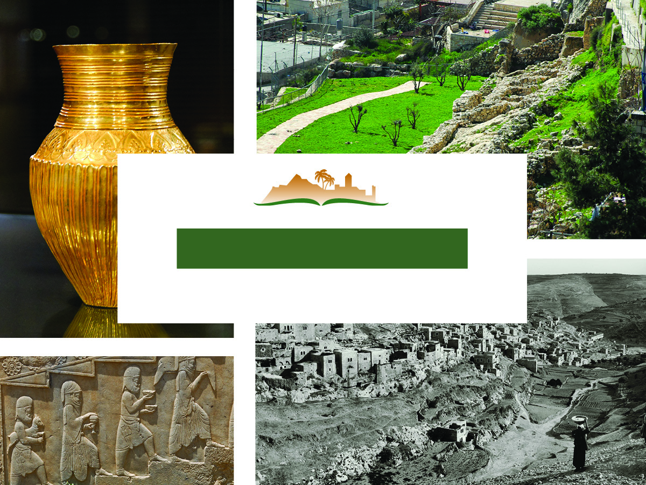
Nehemiah 2
Notes:
This is a free sample of the Nehemiah 2 presentation from the Photo Companion to the Bible. To purchase the full volume, visit https://www.bibleplaces.com/nehemiah/
The Photo Companion to the Bible is an image-rich resource for Bible students, teachers, and researchers. Just as a librarian stocks the shelves with as many relevant materials as possible, so we have tried to provide a broad selection of images. Our goal is that you will find in this “library” whatever it is you are looking for.
Credits: The primary creators of this presentation are Steven D. Anderson, Kris Udd, Kai Akagi, Chris McKinny, and Todd Bolen. The photographs have an individual file code which usually includes the initials of the photographer. Other images have additional credit or source information.
Updates: We plan to update this collection as we are able. We welcome your suggestions for improving this resource (photocompanion@bibleplaces.com). Purchasers of the Nehemiah volume are provided free, lifetime updates to the volume.
Copyright: This photo collection is protected by copyright law and may not be distributed without written permission from BiblePlaces.com. Slide notes should be treated as any other copyrighted written material, with credit given when quoting from these notes.
For more information, see our complete “Introduction to the Photo Companion to the Bible” online at https://www.BiblePlaces.com/Intro-Photo-Companion-Bible/. Here you will find more information about photo selection, explanatory notes, Bible translation, credit information, and copyright allowances.

Slide 2
Nehemiah 2
This is a free sample of the Nehemiah 2 presentation from the Photo Companion to the Bible. To purchase the full volume, visit https://www.bibleplaces.com/nehemiah/
The Photo Companion to the Bible is an image-rich resource for Bible students, teachers, and researchers. Just as a librarian stocks the shelves with as many relevant materials as possible, so we have tried to provide a broad selection of images. Our goal is that you will find in this “library” whatever it is you are looking for.
For more details (for this and every slide), see the Notes section below.
Notes:
This is a free sample of the Nehemiah 2 presentation from the Photo Companion to the Bible. To purchase the full volume, visit https://www.bibleplaces.com/nehemiah/
The Photo Companion to the Bible is an image-rich resource for Bible students, teachers, and researchers. Just as a librarian stocks the shelves with as many relevant materials as possible, so we have tried to provide a broad selection of images. Our goal is that you will find in this “library” whatever it is you are looking for.
Credits: The primary creators of this presentation are Steven D. Anderson, Kris Udd, Kai Akagi, Chris McKinny, and Todd Bolen. The photographs have an individual file code which usually includes the initials of the photographer. Other images have additional credit or source information.
Updates: We plan to update this collection as we are able. We welcome your suggestions for improving this resource (photocompanion@bibleplaces.com). Purchasers of the Nehemiah volume are provided free, lifetime updates to the volume.
Copyright: This photo collection is protected by copyright law and may not be distributed without written permission from BiblePlaces.com. Slide notes should be treated as any other copyrighted written material, with credit given when quoting from these notes.
For more information, see our complete “Introduction to the Photo Companion to the Bible” online at https://www.BiblePlaces.com/Intro-Photo-Companion-Bible/. Here you will find more information about photo selection, explanatory notes, Bible translation, credit information, and copyright allowances.

Slide 3
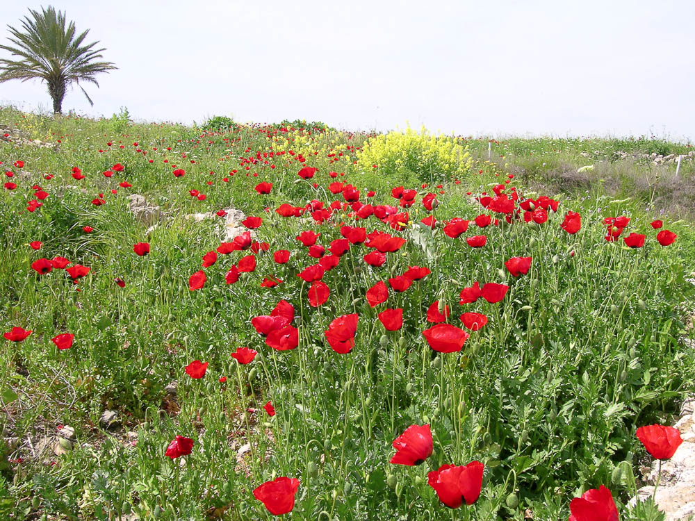
It came about in the month Nisan
Field of red poppies in March, near Megiddo
2:1
Notes:
Nisan (Heb. נִיסָן) was considered the first month of the Hebrew calendar (cf. Esth 3:7). This month falls in March/April of the Gregorian calendar. In the land of Israel, this is spring time, when flowers are prolific and the trees are putting on leaves. This photo was taken near Megiddo toward the end of March.
tb032604160

Slide 4
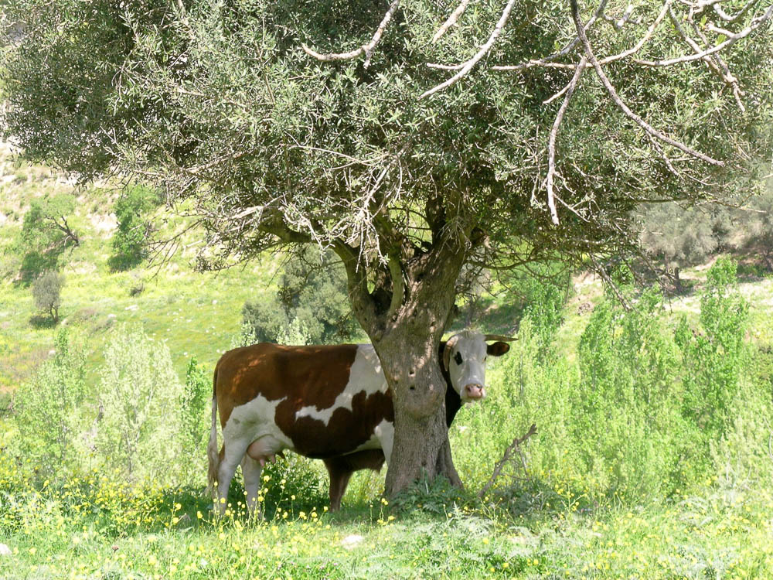
It came about in the month Nisan
Cows beneath an olive tree, near Gischala
2:1
Notes:
This photo was taken in Galilee at the end of March. The fields are lush with new growth and the trees have put on leaves.
tb033104353

Slide 5
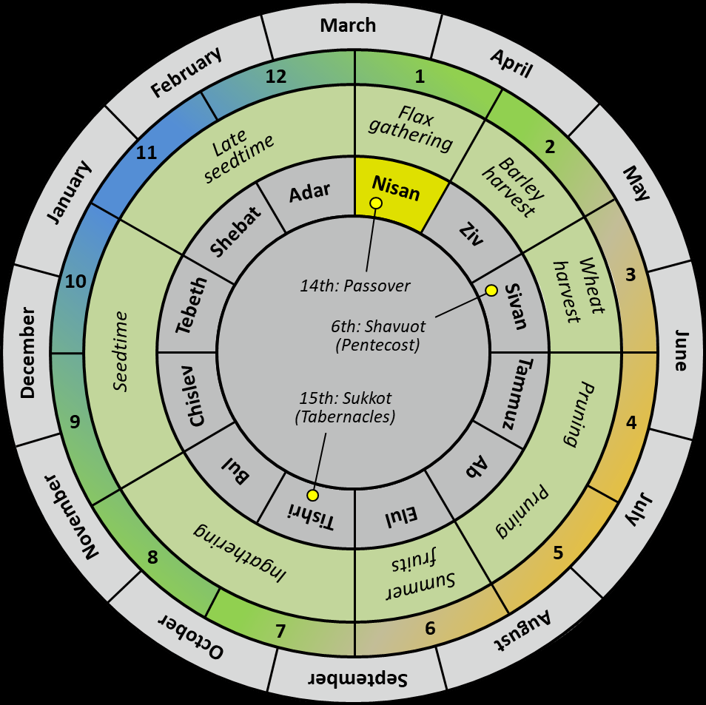
It came about in the month Nisan
March
February
April
12
1
Flax
gathering
11
Late
seedtime
2
January
Adar
Nisan
Barley harvest
May
Shebat
Ziv
10
14th: Passover
Wheat harvest
3
Tebeth
Sivan
6th: Shavuot (Pentecost)
December
Seedtime
June
Chislev
15th: Sukkot (Tabernacles)
Tammuz
9
Pruning
4
Bul
Ab
November
Tishri
Elul
Pruning
July
8
Ingathering
Summer fruits
5
October
7
6
August
September
Hebrew calendar with the three major festivals
2:1
Notes:
Chronologists of the Hebrew Bible have shown that, while Nisan was considered the first month, there were also regions and times where the New Year was calculated to begin six months later, in Tishri. Some believe that Nehemiah (like the community in Elephantine) was using a Jewish Tishri-to-Tishri calendar. Nehemiah 2:1 is clearly subsequent to the events described in Nehemiah 1:1 (which occurred in Chislev), but both are still attributed to the 20th year of Artaxerxes, which is only possible if the year is being calculated as starting in Tishri. For further evidence of this practice, a doubly-dated papyrus from the Jewish community in Elephantine (Cowley #6) shows that the Jews reckoned Artaxerxes’s first year from Tishri 1, 464 BC, rather than 465. This was a different date than the one used in the Persian court, which started its years with Nisan 1. For more information, see Neuffer (1968: 82–83).
An editable version is included beneath the graphic for those who wish to modify it.
Reference:
Neuffer, Julia.
1968 The Accession of Artaxerxes I. Andrews University Seminary Studies 6: 60–87.

Slide 6
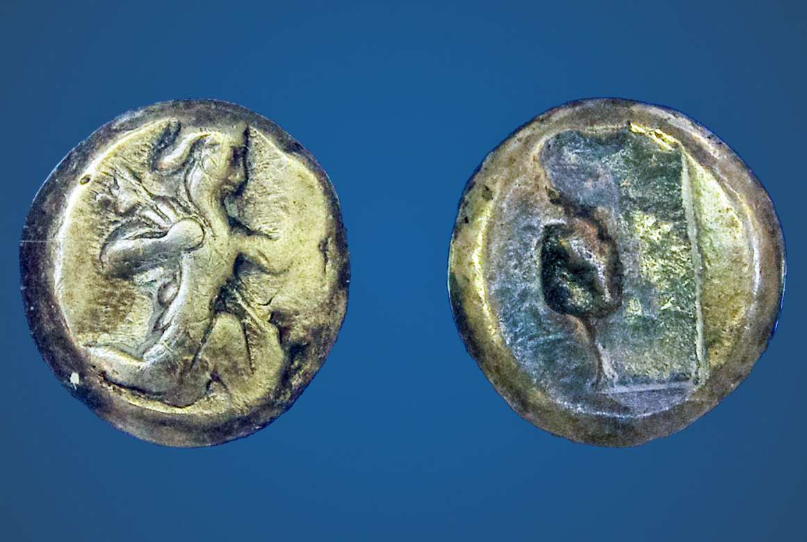
It came about in the month Nisan, in the twentieth year of King Artaxerxes
Silver siglos coin of Artaxerxes I, with the king holding a spear and a bow, 465–425 BC
2:1
Notes:
The twentieth year of Artaxerxes I (r. 465–423 BC) may be calculated to cover the last third of 446 BC and the first two-thirds of 445 BC. The events described here most likely took place in early April, 445 BC.
The Persian empire issued gold darics and silver sigloi, as pictured here. The siglos weighed about 5.4 grams (0.19 oz; historically a US silver dollar weighed about 27 grams [0.95 oz]) and was equal to 7.5 Attic obols. This coin is part of the Trinity Evangelical Divinity School Biblical Coin Collection.
adr1410087898

Slide 7
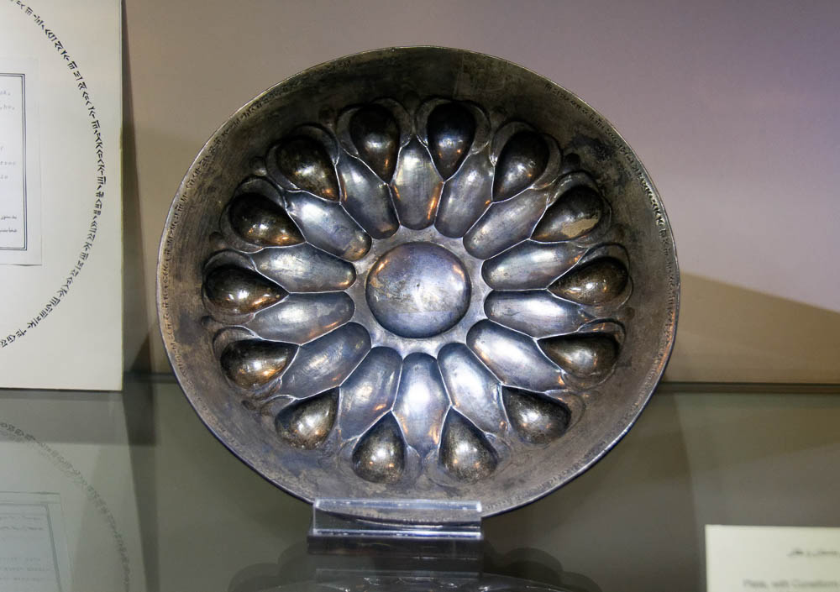
It came about in the month Nisan, in the twentieth year of King Artaxerxes
Silver plate with the name of Artaxerxes I in Old Persian cuneiform, 465–424 BC
2:1
Notes:
Numerous inscriptions have been found with the name of Artaxerxes, king of Persia. The silver plate shown here is one example. It was photographed at the Reza Abbasi Museum in Tehran, Iran. The next slide shows a close-up with the name of Artaxerxes highlighted.
tb0514183457

Slide 8
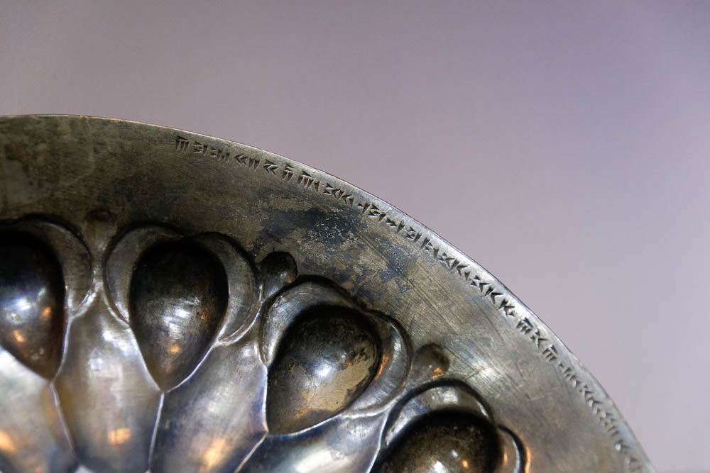
It came about in the month Nisan, in the twentieth year of King Artaxerxes
Silver plate with the name of Artaxerxes I in Old Persian cuneiform, 465–424 BC
2:1
Notes:
Numerous inscriptions have been found with the name of Artaxerxes, king of Persia. The silver plate shown here is one example. It was photographed at the Reza Abbasi Museum in Tehran, Iran.
tb0514183459

Slide 9
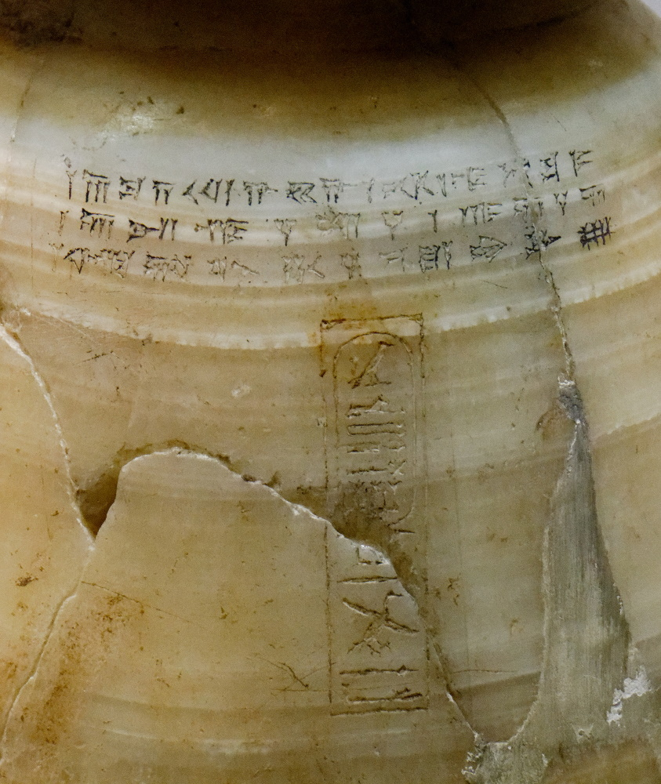
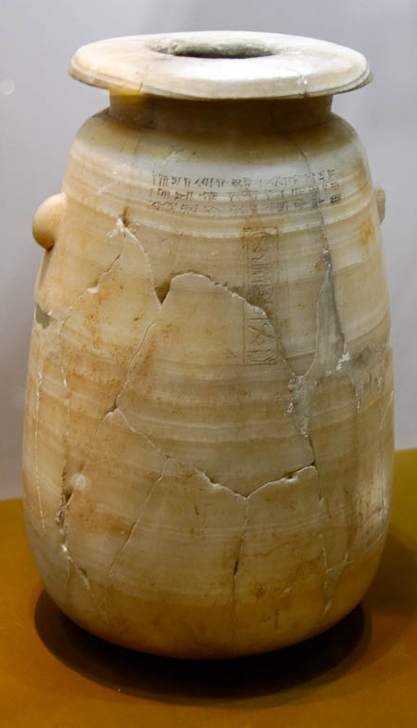
It came about in the month Nisan, in the twentieth year of King Artaxerxes
Calcite vase naming Artaxerxes in four languages, 465–424 BC
2:1
Notes:
This calcite (alabaster) vase has the name and title of Artaxerxes I in four languages: Old Persian, Elamite, Babylonian, and Egyptian hieroglyphs. It was photographed at the Reza Abbasi Museum in Tehran, Iran.
Left: tb0514183472
Right: tb0514183476

Slide 10
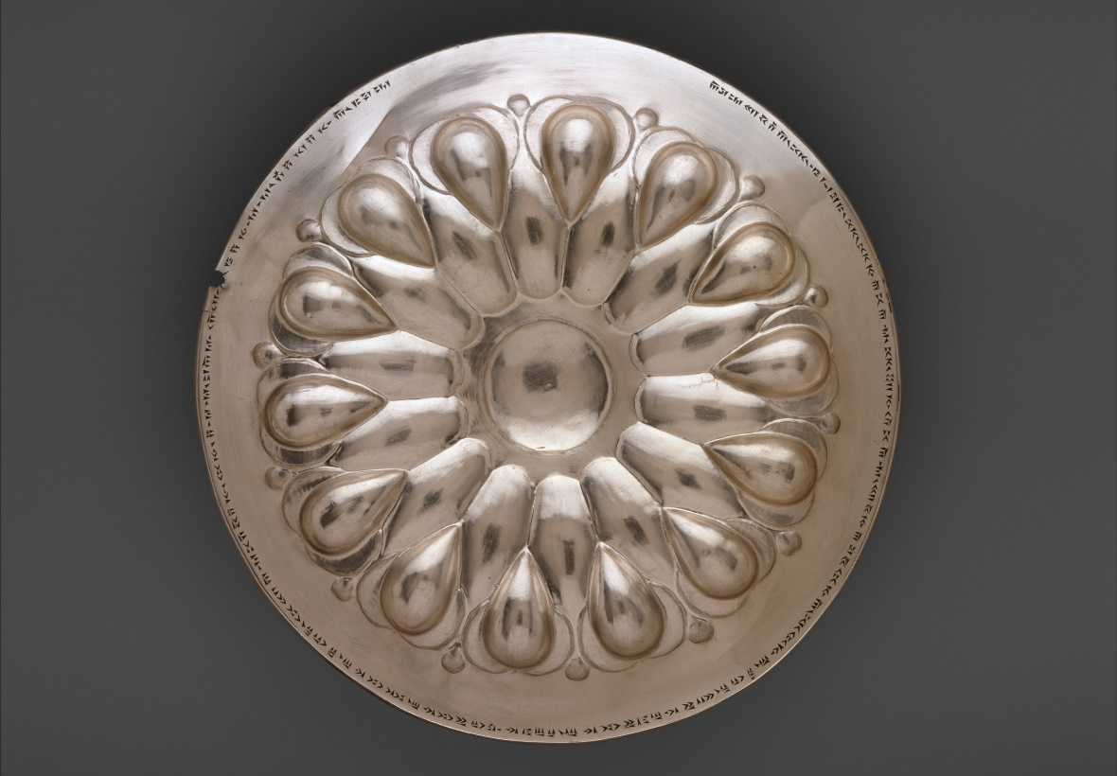
It came about in the month Nisan, in the twentieth year of King Artaxerxes
Silver bowl of Artaxerxes I inscribed “Artaxerxes, the great king, king of kings,” circa 450 BC
2:1
Notes:
This silver bowl is thought to have been used at the royal table of Artaxerxes I. An inscription runs around the rim of the bowl. According to the museum website, it reads, “Artaxerxes, the great king, king of kings, king of lands, son of Xerxes the king, Xerxes son of Darius the king, the Achaemenid: in his house this silver bowl was made.” This image comes from The Metropolitan Museum of Art, public domain, Rogers Fund, 1947, accession number 47.100.84, https://www.metmuseum.org/art/collection/search/324026. The next slide is a close-up of the text.
met324026

Slide 11
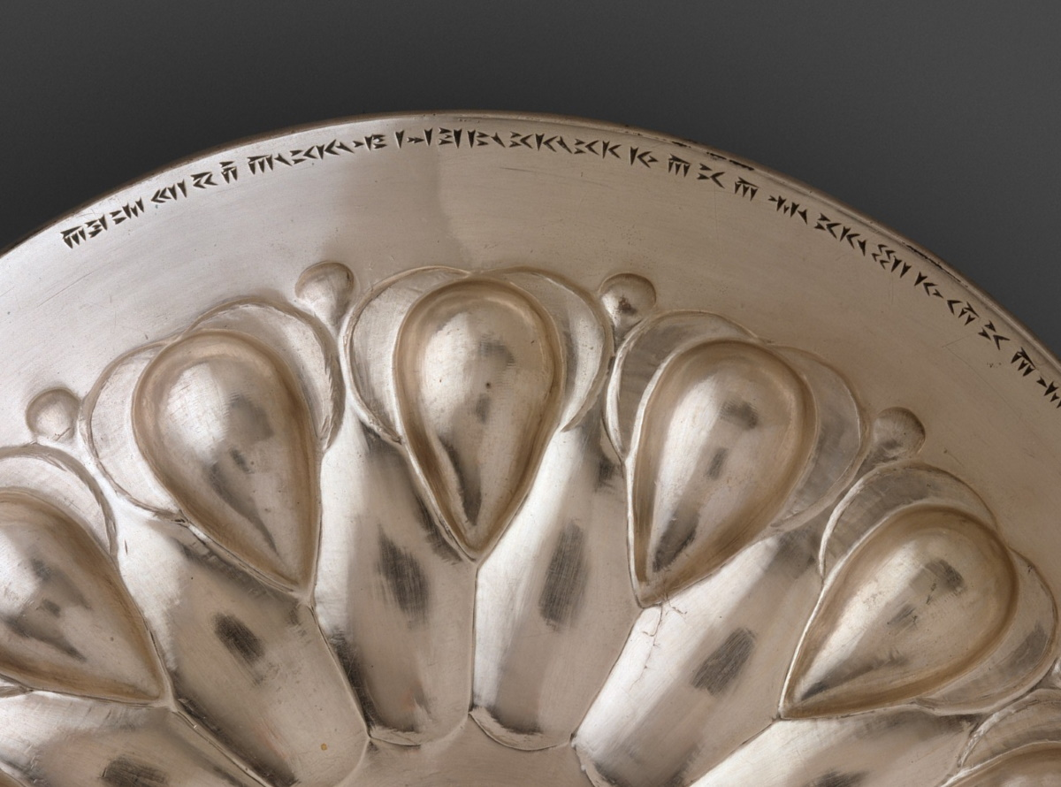
It came about in the month Nisan, in the twentieth year of King Artaxerxes
Silver bowl of Artaxerxes I inscribed “Artaxerxes, the great king, king of kings,” circa 450 BC
2:1
Notes:
This silver bowl is thought to have been used at the royal table of Artaxerxes I. An inscription runs around the rim of the bowl. According to the museum website, it reads, “Artaxerxes, the great king, king of kings, king of lands, son of Xerxes the king, Xerxes son of Darius the king, the Achaemenid: in his house this silver bowl was made.” This image comes from The Metropolitan Museum of Art, public domain, Rogers Fund, 1947, accession number 47.100.84, https://www.metmuseum.org/art/collection/search/324026. The next slide includes labels.
met324026

Slide 12
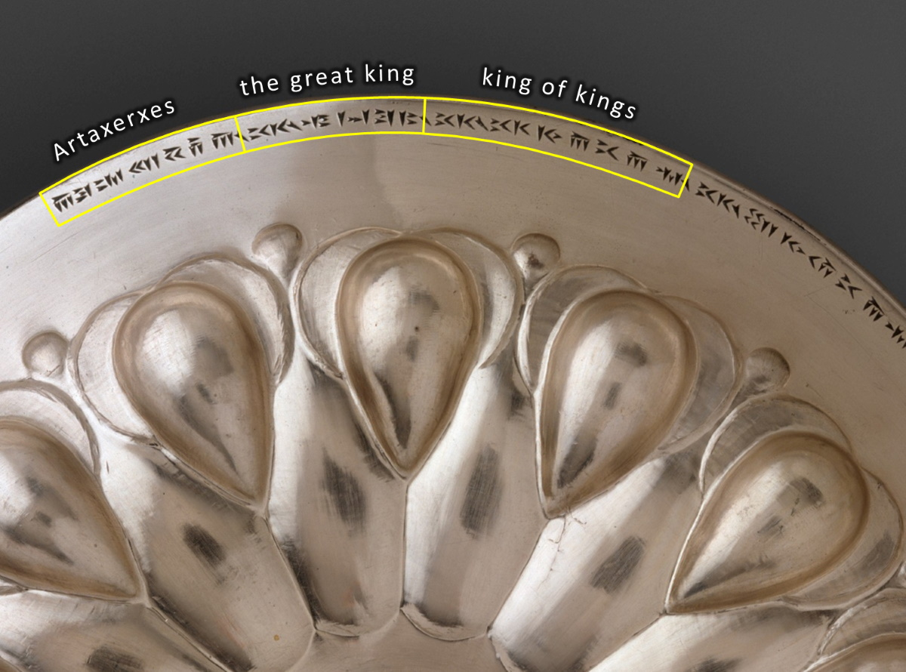
It came about in the month Nisan, in the twentieth year of King Artaxerxes
Artaxerxes the great king king of kings
Silver bowl of Artaxerxes I inscribed “Artaxerxes, the great king, king of kings,” circa 450 BC
2:1
Notes:
This silver bowl is thought to have been used at the royal table of Artaxerxes I. An inscription runs around the rim of the bowl. According to the Museum website, it reads, “Artaxerxes, the great king, king of kings, king of lands, son of Xerxes the king, Xerxes son of Darius the king, the Achaemenid: in his house this silver bowl was made.” This image comes from The Metropolitan Museum of Art, public domain, Rogers Fund, 1947, accession number 47.100.84, https://www.metmuseum.org/art/collection/search/324026.
met324026

Slide 13
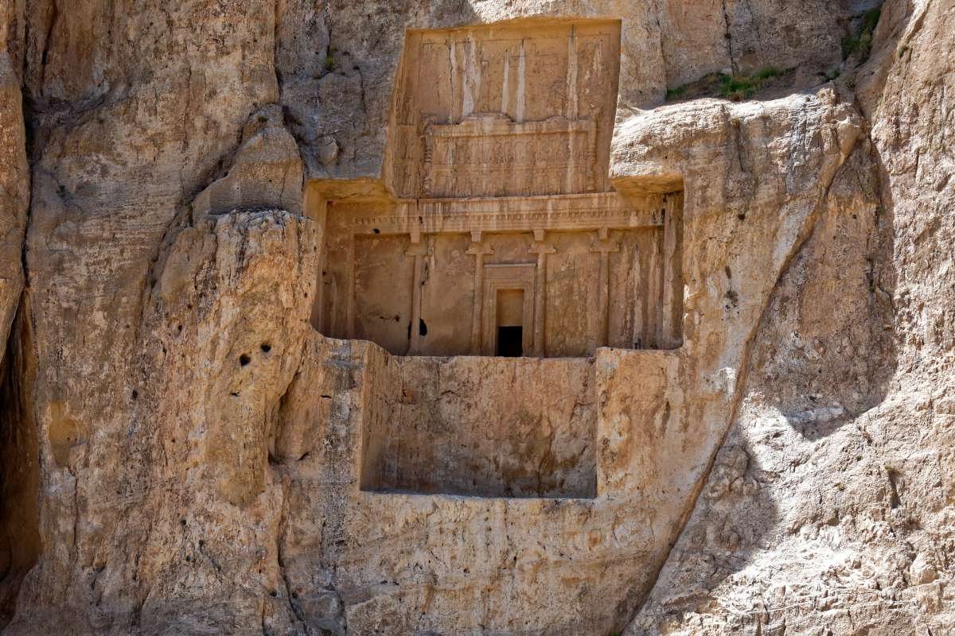
It came about in the month Nisan, in the twentieth year of King Artaxerxes
Tomb of Artaxerxes I in the royal necropolis of Persepolis
2:1
Notes:
Artaxerxes I took great care to prepare his own tomb and to safeguard the sanctity of his fathers' tombs. The fact that Nehemiah’s ancestors’ tombs lacked upkeep (Neh 2:3) probably would have struck the Persian king as a good reason to send Nehemiah back to Jerusalem to rebuild the city.
tb0506181621

Slide 14
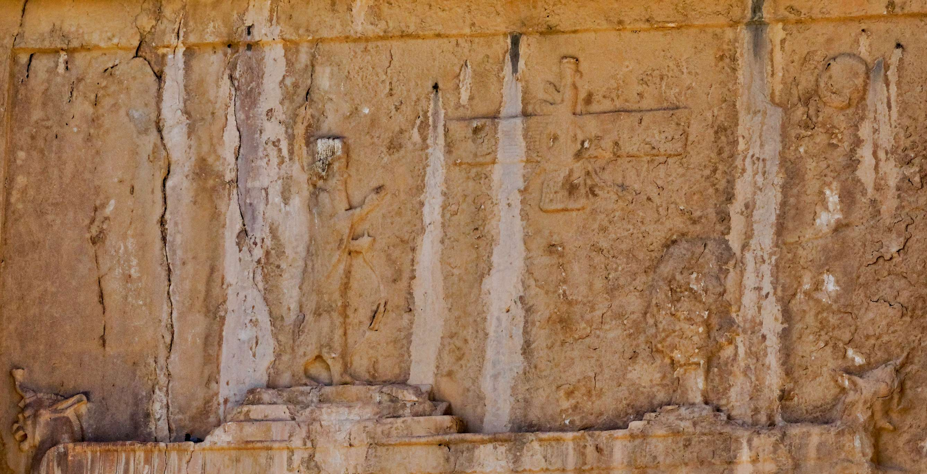
It came about in the month Nisan, in the twentieth year of King Artaxerxes
Artaxerxes facing Ahuramazda, tomb of Artaxerxes I in the royal necropolis of Persepolis
2:1
Notes:
At the top of this relief, Artaxerxes I is depicted on a stepped platform, facing a winged representation of the deity Ahuramazda.
tb0506181622

Slide 15
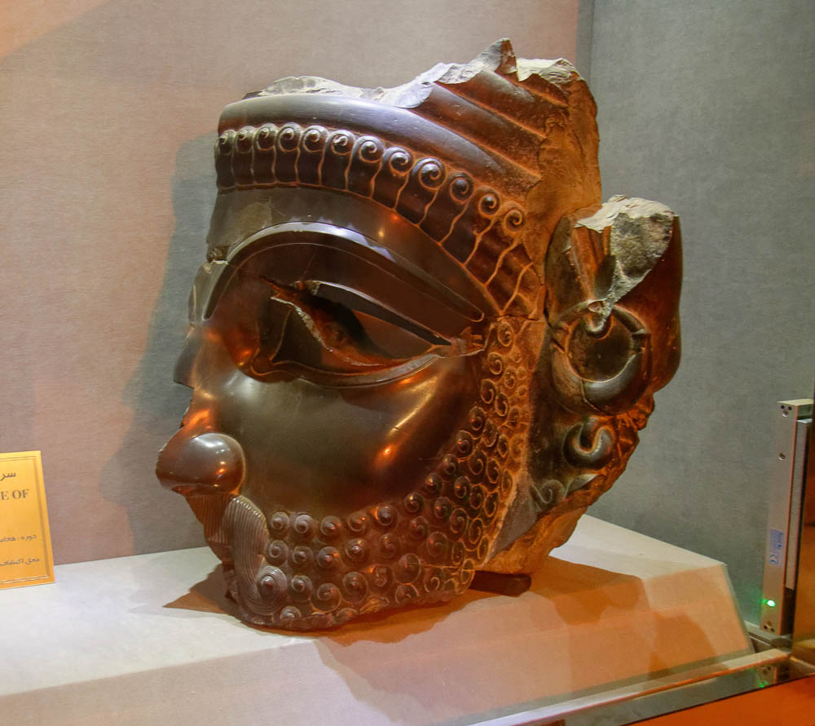
It came about in the month Nisan, in the twentieth year of King Artaxerxes
Head from a statue of Xerxes, from Persepolis, circa 480 BC
2:1
Notes:
Artaxerxes was the son of Xerxes, who is famous to Bible readers as the Ahasuerus of the book of Esther. To the ancient Greeks, Xerxes was the king whom they famously defeated at the Battle of Salamis in 480 BC. This statue head was photographed at the Persepolis Museum.
tb0506181527e

Slide 16
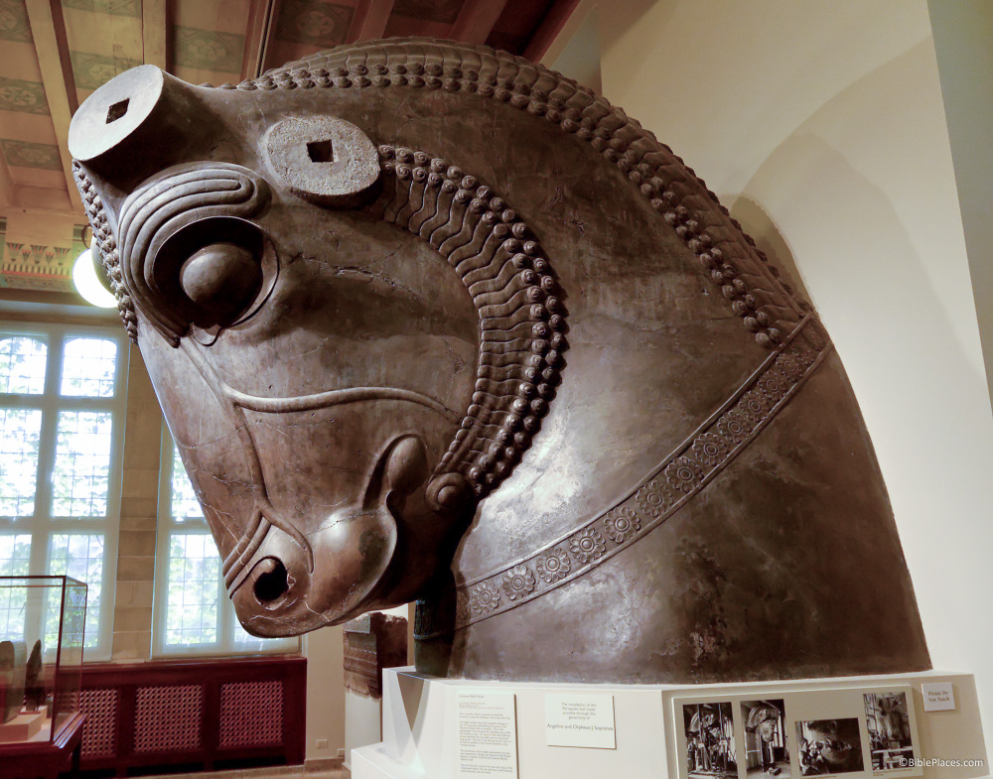
It came about in the month Nisan, in the twentieth year of King Artaxerxes
Colossal limestone bull, from Persepolis, reign of Xerxes and Artaxerxes I, circa 465 BC
2:1
Notes:
Artaxerxes I inherited a very large and wealthy empire from his father Xerxes, which included monumental construction projects. This carved bull head was once attached to the body of a bull, one of a pair that guarded the northern portico of the Hundred-Column Hall at Persepolis. The head alone weighs an estimated 10 tons (9 t) and stands over 6 feet (2 m) tall. It illustrates the wealth and power of the Persian kingdom during the reign of Artaxerxes. It was photographed at the Oriental Institute Museum at the University of Chicago.
tb072705204

Slide 17
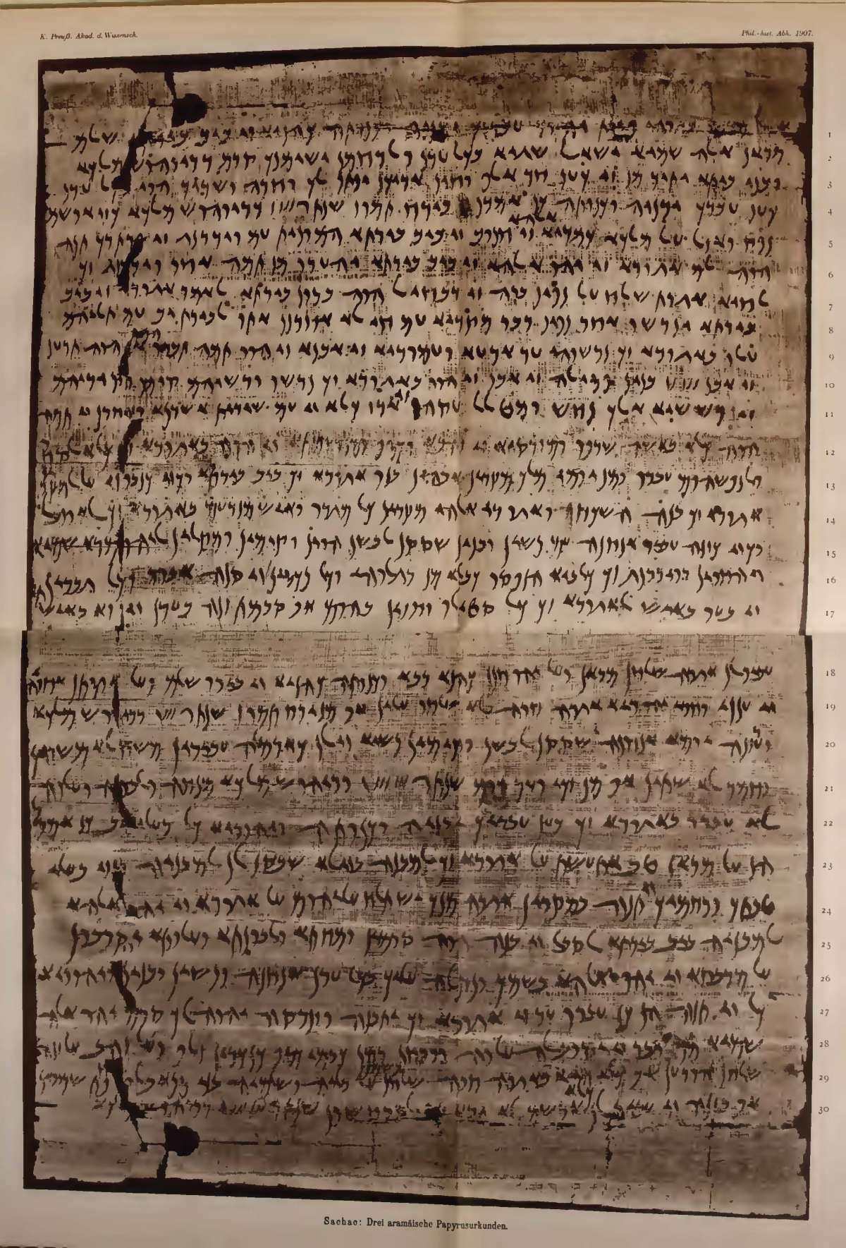
It came about in the month Nisan, in the twentieth year of King Artaxerxes
Letter mentioning the sons of Sanballat, from Elephantine, November 25, 407 BC
2:1
Notes:
According to Yamauchi, it is certain that the king called “Artaxerxes” by Nehemiah (Neh 2:1; 5:14; 13:6) is Artaxerxes I (r. 465–423 BC), not Artaxerxes II (r. 404–359 BC), since “an Elephantine papyrus (Cowley #30), dated to 407, mentions the sons of Sanballat, the governor of Samaria and adversary of Nehemiah” (1990: 242). The year 407 BC fell during the reign of the intervening king Darius II (r. 423–404 BC), and if Nehemiah was already in the land at this time, he must have been commissioned to return by Artaxerxes I, not Artaxerxes II. This is the papyrus letter shown on this slide. For the text and translation of this document, see https://www.kchanson.com/ANCDOCS/westsem/templeauth.html.
This image was scanned from the book Abhandlungen der königlich preussischen Akademie der Wissenschaften (Berlin: Königlichen Akademie der Wissenschaften, 1907), contributed by Smithsonian Libraries, via Biodiversity Library: https://www.biodiversitylibrary.org/item/93093#page/329/mode/1up.
Reference:
Yamauchi, Edwin.
1990 Persia and the Bible. Grand Rapids: Baker.
bdl93093329a

Slide 18
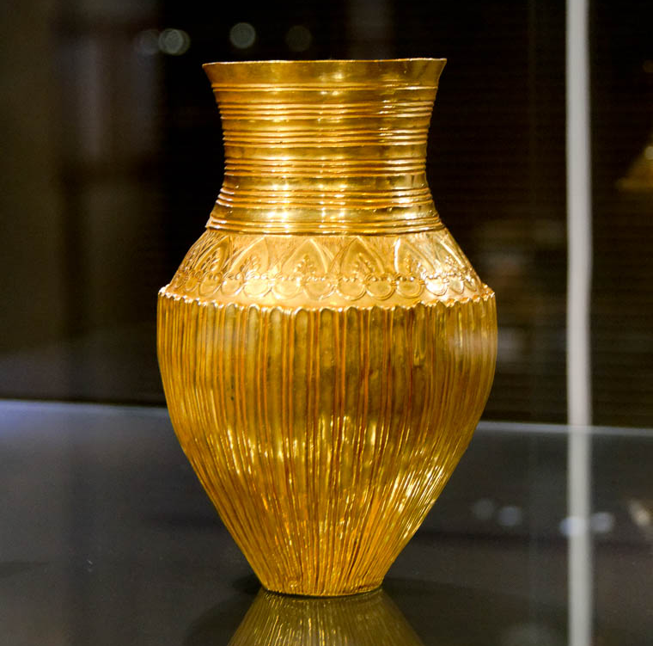
When wine was served, I carried the wine and gave it to the king
Gold amphora, circa 550–450 BC
2:1
Notes:
This gold amphora (jar) was likely used for storing and pouring out wine at the royal court. It was photographed at the Reza Abbasi Museum in Tehran.
tb0514183443

Slide 19
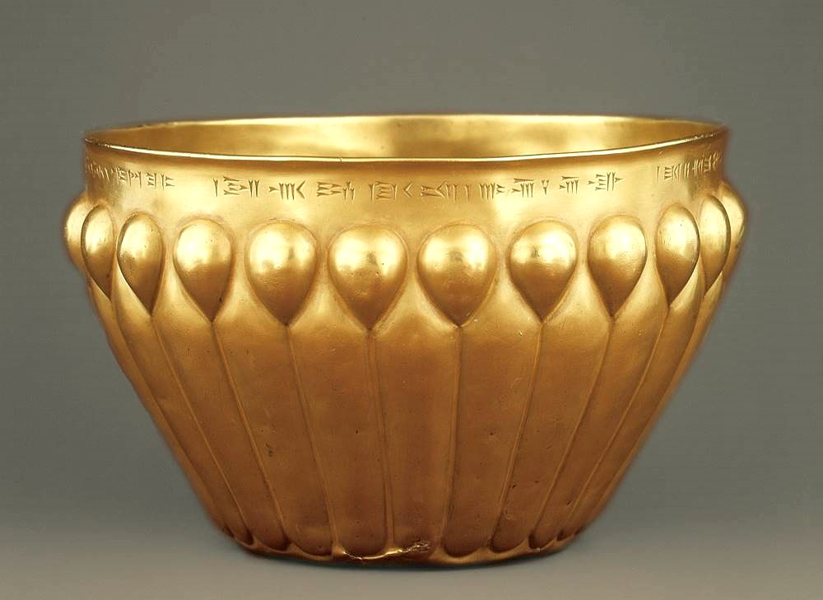
When wine was served, I carried the wine and gave it to the king
Fluted gold Persian drinking bowl, reign of Darius I, circa 500 BC
2:1
Notes:
This bowl-style drinking cup matches depictions of cups carried by servants on the reliefs of Persepolis. These bowls are sometimes depicted with a cover, presumably so as to prevent anything from contaminating the wine before it was handed to the king. This bowl is inscribed in three languages: Persian, Elamite, and Babylonian. All three languages mention the name of Darius I, the father of Xerxes/Ahasuerus.
This image comes from the Metropolitan Museum of Art, public domain, Harris Brisbane Dick Fund, 1954, accession number 54.3.1, http://metmuseum.org/art/collection/search/324289.
met324289

Slide 20
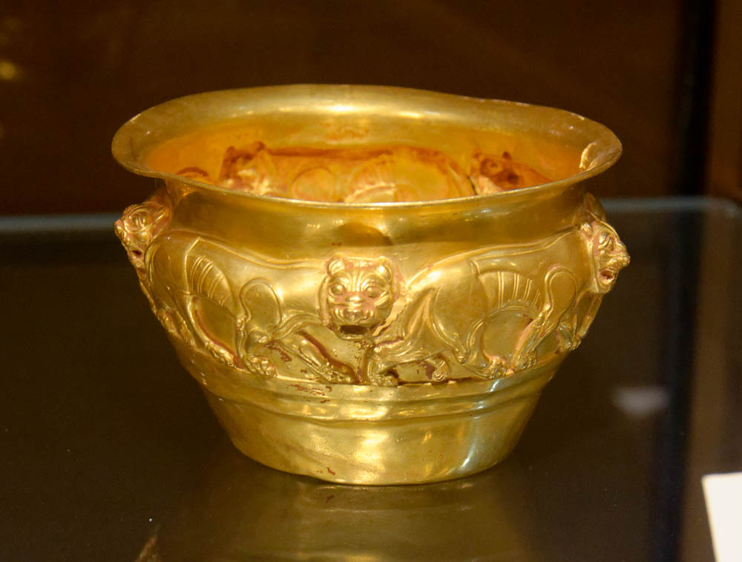
When wine was served, I carried the wine and gave it to the king
Gold beaker with wildcats, 6th–5th centuries BC
2:1
Notes:
This gold beaker was photographed at the Reza Abbasi Museum in Tehran.
tb0514183690

Slide 21
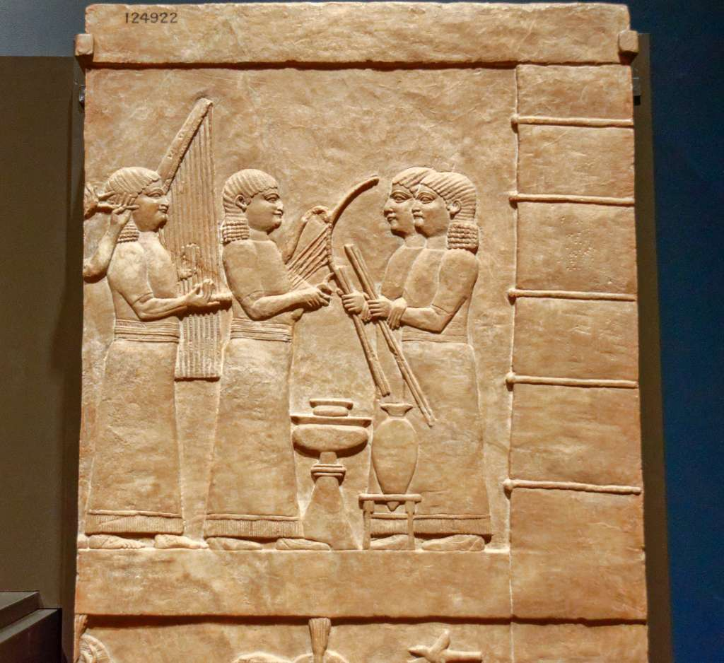
When wine was served, I carried the wine and gave it to the king
Relief of garden of Ashurbanipal with musicians, amphora, and bowl, 645–640 BC
2:1
Notes:
This Assyrian relief carving from the north palace at Nineveh shows an amphora for pouring wine and a bowl for drinking wine, both set on stands. This relief was photographed at the Getty Villa in southern California when on loan from the British Museum.
tb100919357

Slide 22
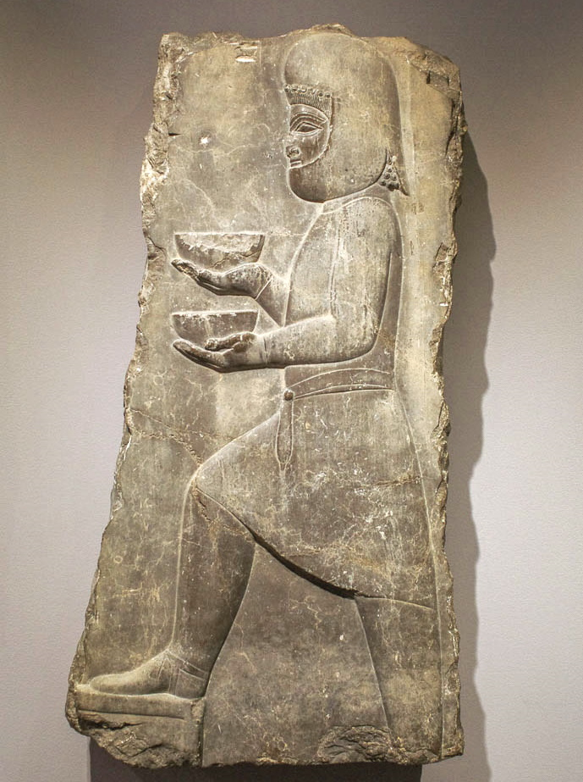
When wine was served, I carried the wine and gave it to the king
Relief of a servant with bowls, from Persepolis, reign of Darius or Xerxes, 5th century BC
2:1
Notes:
This relief carving was photographed at the Harvard Art Museums.
adr1711203416

Slide 23
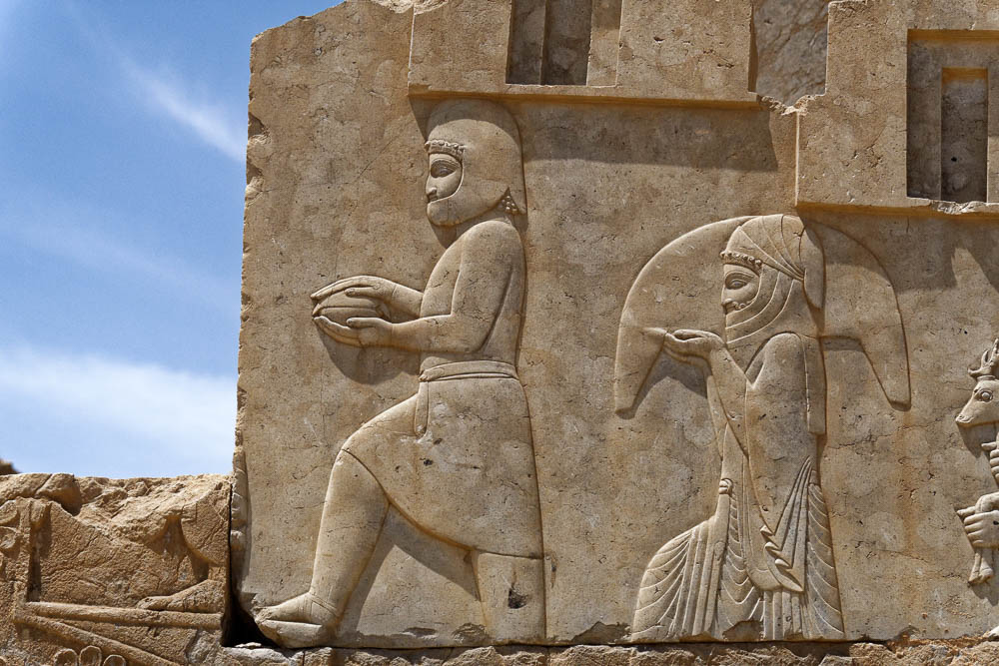
When wine was served, I carried the wine and gave it to the king
Relief of servants carrying a covered bowl and a wineskin, from Persepolis, circa 500 BC
2:1
Notes:
This relief is situated on the southern staircase of the palace of Darius at Persepolis. It depicts a servant carrying a covered bowl, and behind him, another servant who carries a large wineskin over his shoulder on a tray.
tb0506181223

Slide 24
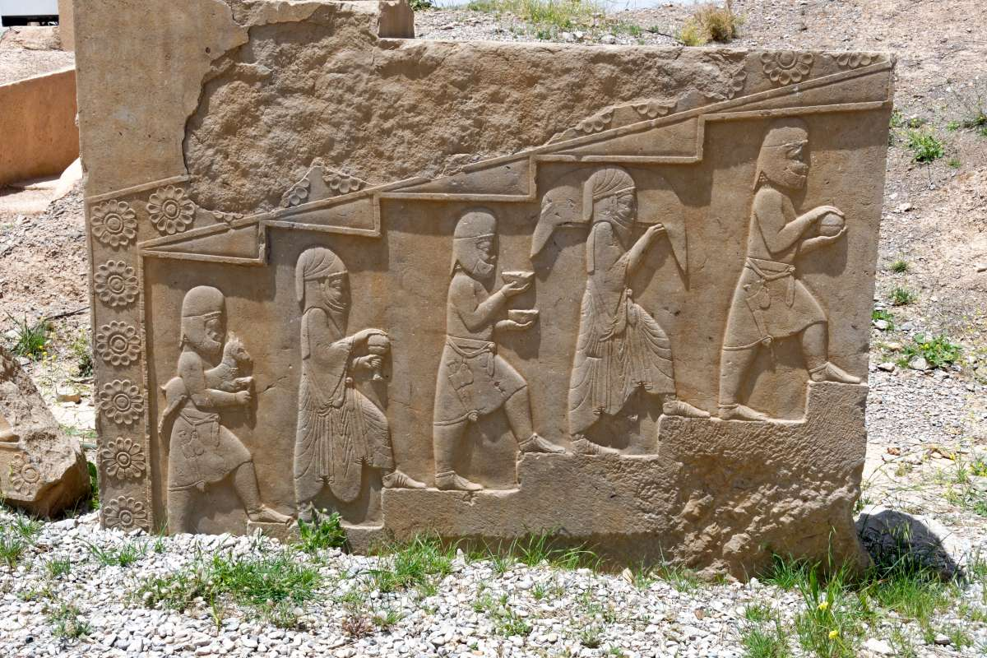
When wine was served, I carried the wine and gave it to the king
Relief depicting line of servants bearing food and drink, from the palace of Xerxes at Persepolis
2:1
Notes:
This relief depicts a line of alternating Median and Persian servants. The servant on the bottom step is a Median carrying a young deer to be slaughtered. The Persian servant above him is carrying a covered vessel, possibly a goblet. The Median above him is carrying two bowls, likely filled with wine. The Persian above him is carrying a heavy wineskin on a platter. The Median servant at the top is carrying a covered bowl. The three Median servants also carry short swords on their right hips.
tb0506181138

Slide 25
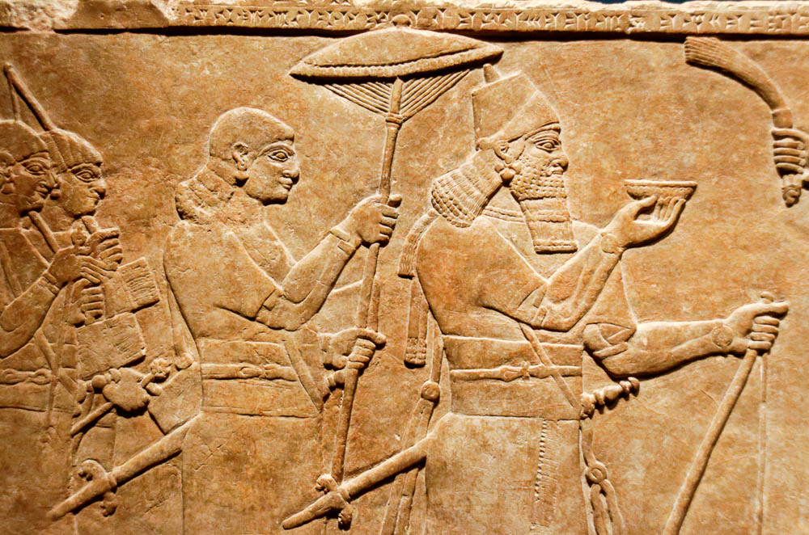
When wine was served, I carried the wine and gave it to the king
Relief of the Assyrian king Ashurnasirpal II, from the northwest palace at Nimrud, 875–860 BC
2:1
Notes:
This relief depicts the Assyrian king Ashurnasirpal II in celebration after a successful bull hunt. He is depicted lifting a drinking bowl in his right hand. This relief was photographed at the Getty Villa in southern California while on loan from the British Museum.
tb100919323

Slide 26
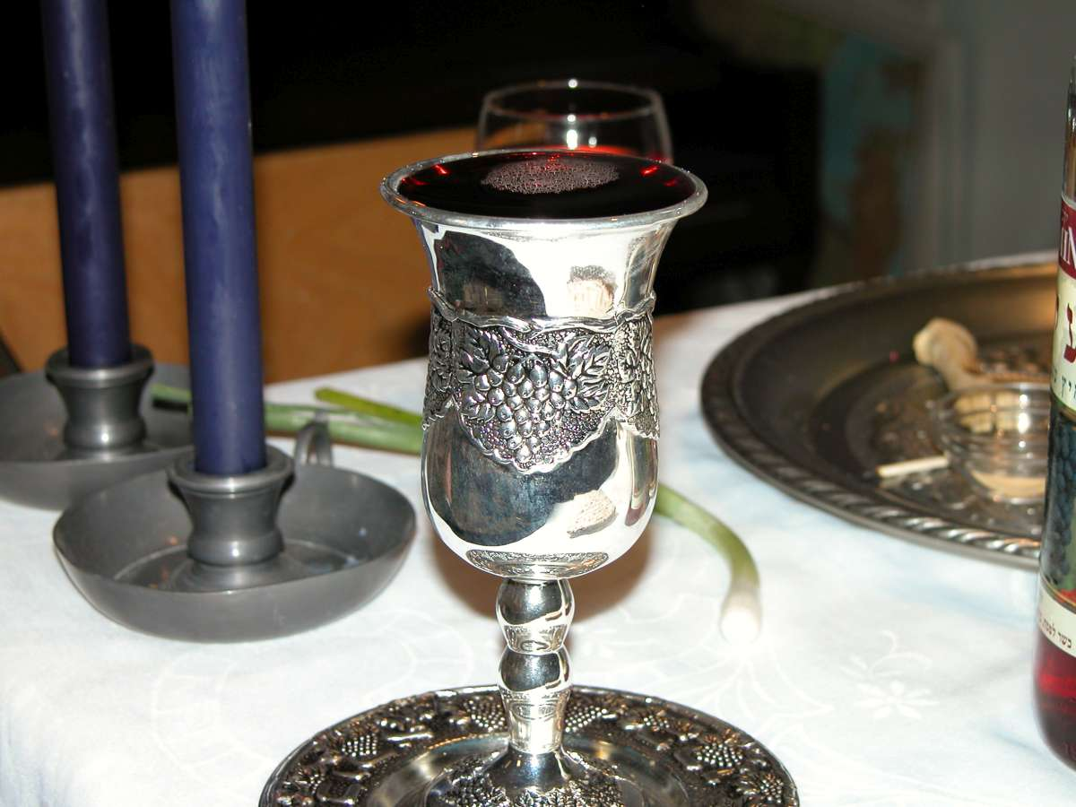
When wine was served, I carried the wine and gave it to the king
Elijah’s cup at a Passover Seder in the Judean hills
2:1
Notes:
tb041603007

Slide 27
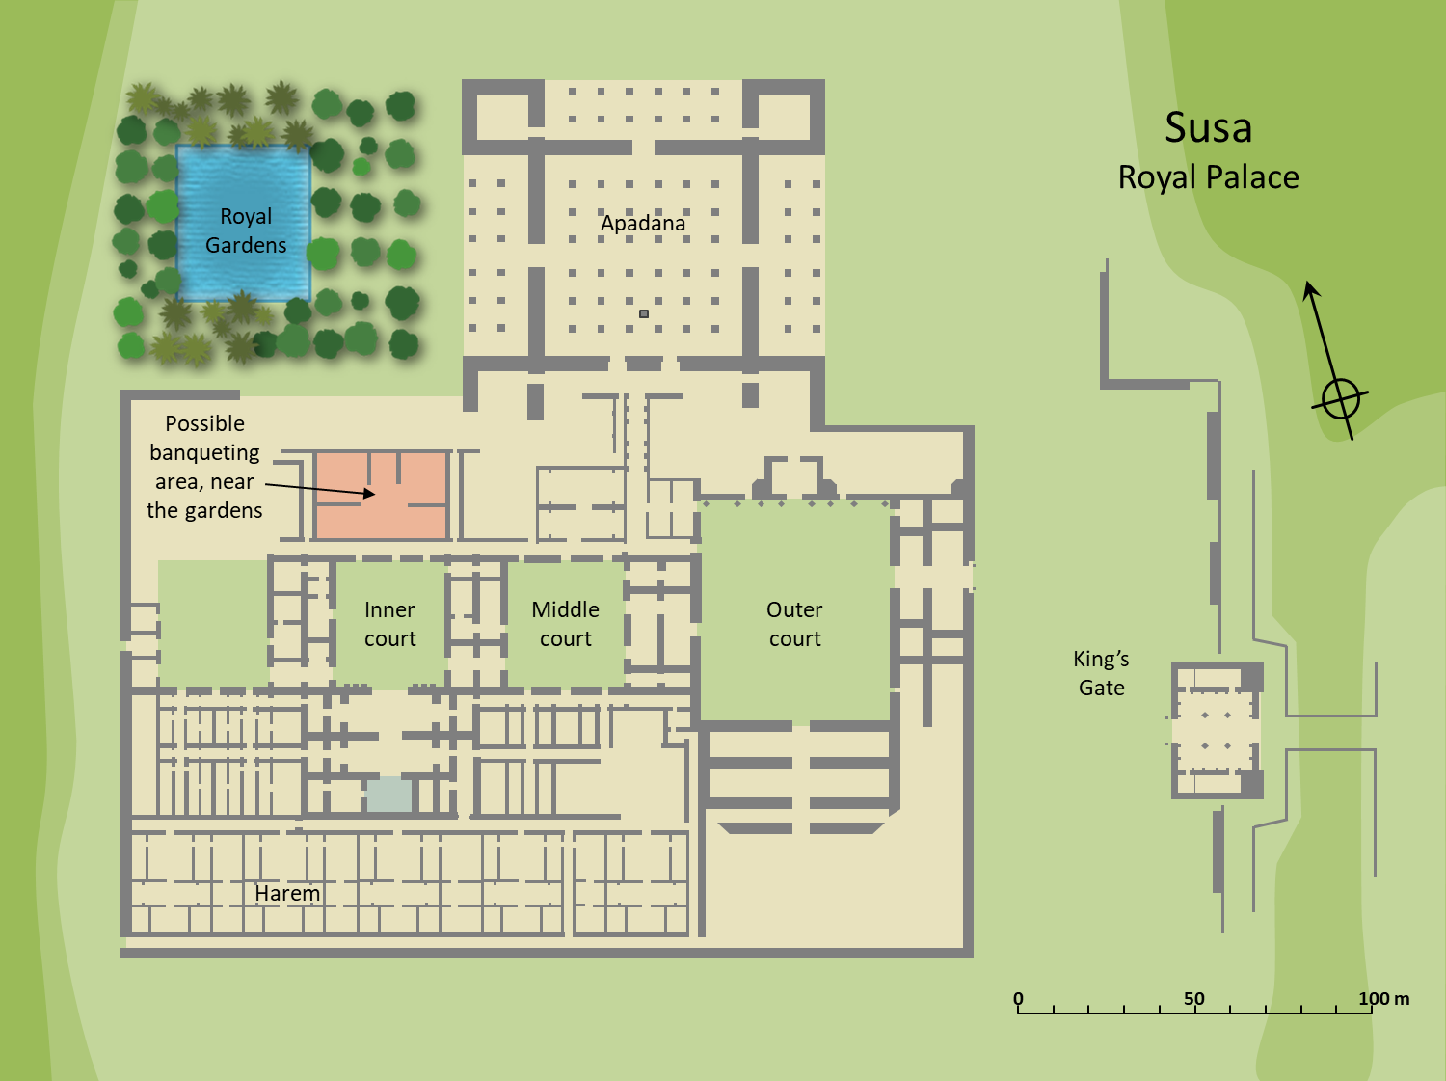
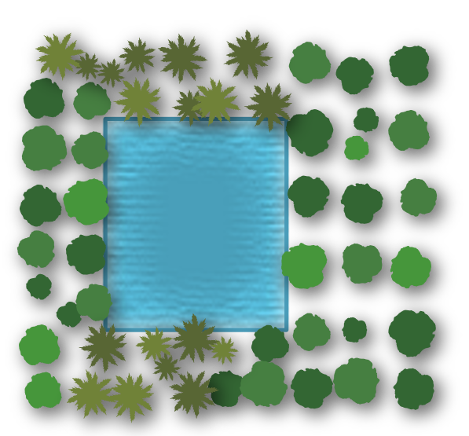
When wine was served, I carried the wine and gave it to the king
Susa
Royal Palace
Royal Gardens
Apadana
Possible banqueting area, near the gardens
Inner court
Middle court
Outer court
King’s Gate
Harem
0
50
100 m
Plan showing possible banqueting area next to the garden at the Royal Palace at Susa
2:1
Notes:
The text does not say where Nehemiah served wine to the king. If it was not in his throne room, another possible location is the place of banqueting next to the palace garden (cf. Esth 7:7). The area shown highlighted here was very poorly preserved and little is known of its layout or use, but it is perhaps the most likely location of the banquet area. An editable version is included beneath the graphic for those who wish to modify it.
Plan by Kris Udd.

Slide 28
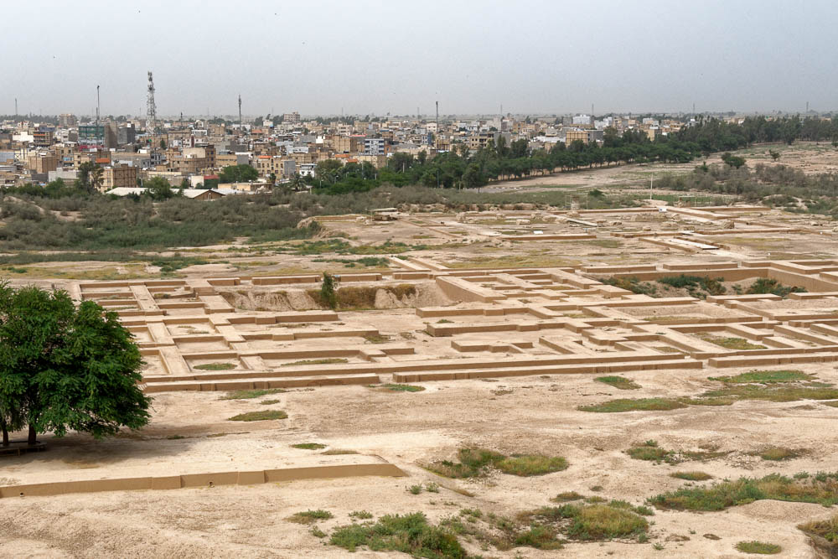
When wine was served, I carried the wine and gave it to the king
Royal palace at Susa (from the south)
2:1
Notes:
Nehemiah most likely made his request at a private banquet, perhaps in the throne room or near the king’s garden, where Artaxerxes was dining with the queen. Since the only other structure located next to the royal gardens was the apadana, it may be surmised that a banquet may have been held in the poorly preserved area shown here, across the inner courtyard from the royal residence. See the next slide for labels.
tb0508182356

Slide 29
When wine was served, I carried the wine and gave it to the king
Possible banquet area
Royal Gardens
Apadana
Middle courtyard
Inner courtyard
Throne room
Royal palace at Susa (from the south)
2:1
Notes:
Nehemiah most likely made his request at a private banquet, perhaps in the throne room or near the king’s garden, where Artaxerxes was dining with the queen. Since the only other structure located next to the royal gardens was the apadana, it may be surmised that a banquet may have been held in the poorly preserved area shown here, across the inner courtyard from the royal residence.
tb0508182356

Slide 30
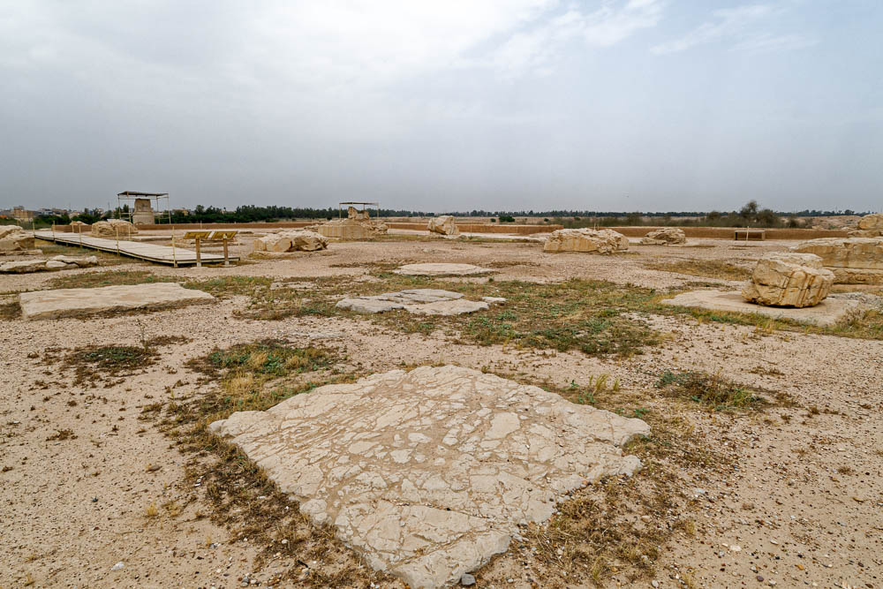
When wine was served, I carried the wine and gave it to the king
Location of the royal throne in the apadana of the royal palace of Susa (from the south)
2:1
Notes:
It is less likely that Nehemiah made his request to Artaxerxes while the king was holding official audiences in the apadana. There were two known locations of the king’s throne in Susa at the time of Artaxerxes I. One was the main throne room in the king’s quarters in the palace. The other is the place for the king’s throne in the apadana (audience hall). An elevated stone between the rows of columns is believed to have served as a platform for the king’s throne. In the Treasury Reliefs found at Persepolis, the king’s throne is shown sitting on just such a pedestal. See the next slide for labels.
tb0508182188

Slide 31
When wine was served, I carried the wine and gave it to the king
Column base
Column base
Throne pedestal
Column base
Column base
Location of the royal throne in the apadana of the royal palace of Susa (from the south)
2:1
Notes:
It is less likely that Nehemiah made his request to Artaxerxes while the king was holding official audiences in the apadana. There were two known locations of the king’s throne in Susa at the time of Artaxerxes I. One was the main throne room in the king’s quarters in the palace. The other is the place for the king’s throne in the apadana (audience hall). An elevated stone between the rows of columns is believed to have served as a platform for the king’s throne. In the Treasury Reliefs found at Persepolis, the king’s throne is shown sitting on just such a pedestal.
tb0508182188

Slide 32
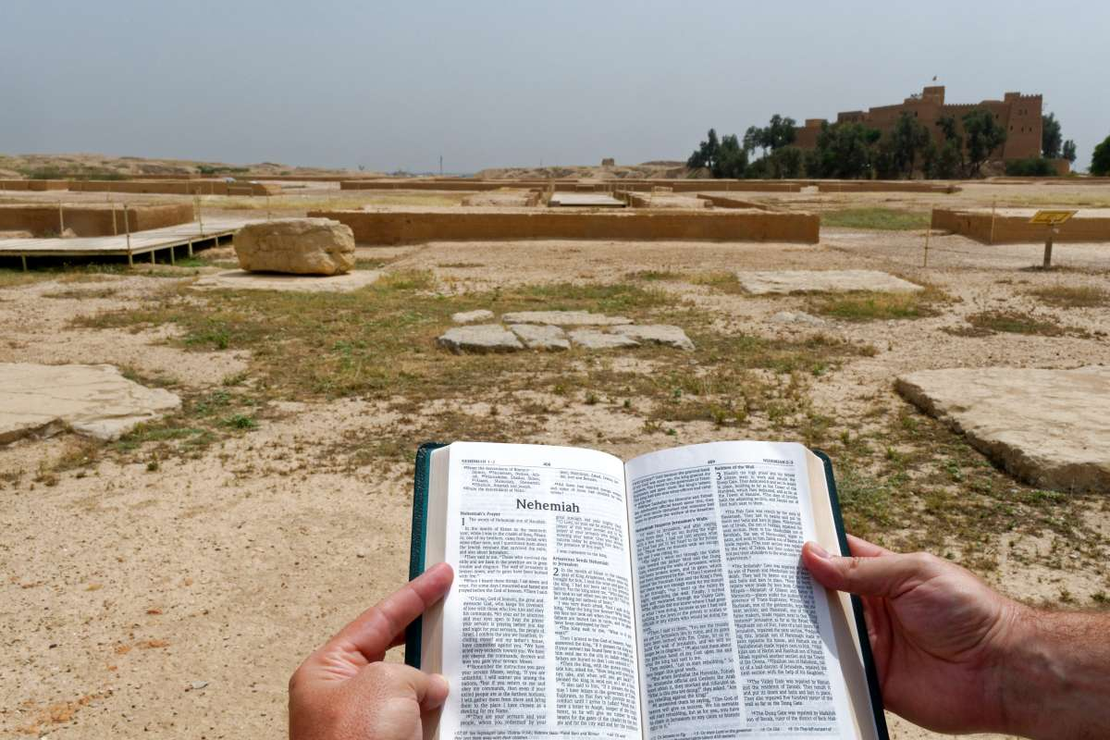
When wine was served, I carried the wine and gave it to the king
Position of throne in the apadana of the royal palace at Susa, with the book of Nehemiah
2:1
Notes:
tb0508182230

Slide 33
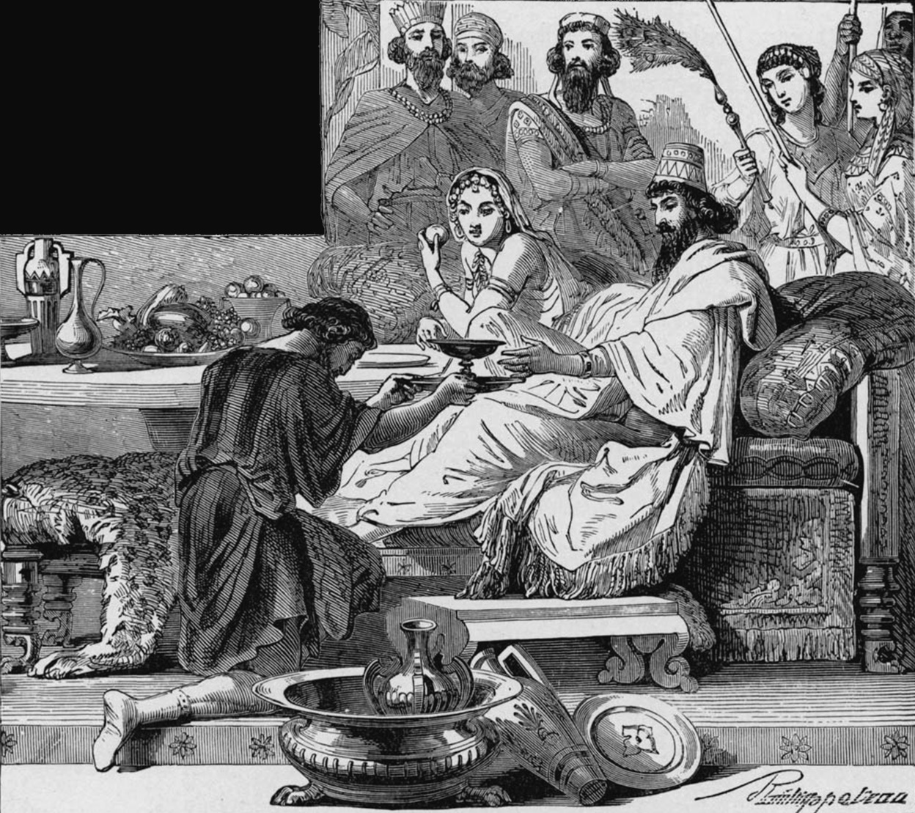
When wine was served, I carried the wine and gave it to the king
The cupbearer Nehemiah asks to go back to Jerusalem
2:1
Notes:
This illustration comes from Charles Foster, Bible Pictures and What They Teach Us (1886, 1914).
fbp163

Slide 34
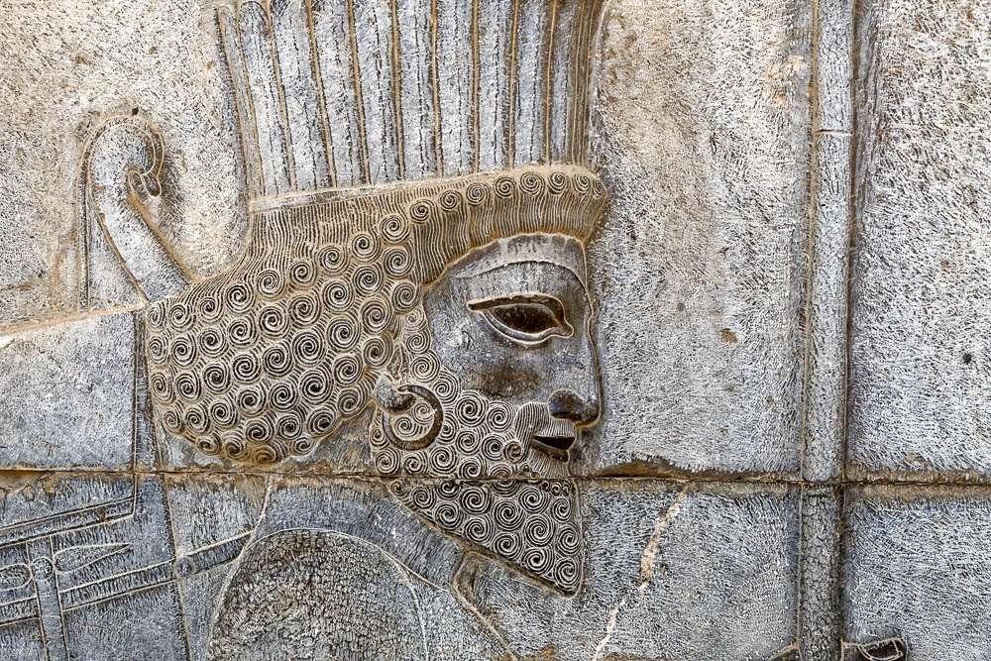
Now I had not been sad in his presence before
Face of a guardsman with a spear, bow, and quiver, from Persepolis, circa 500 BC
2:1
Notes:
This royal guard is depicted as attentive and cheerful. This relief was photographed at the north stairs of the Tripylon at Persepolis.
tb0506181109

Slide 35
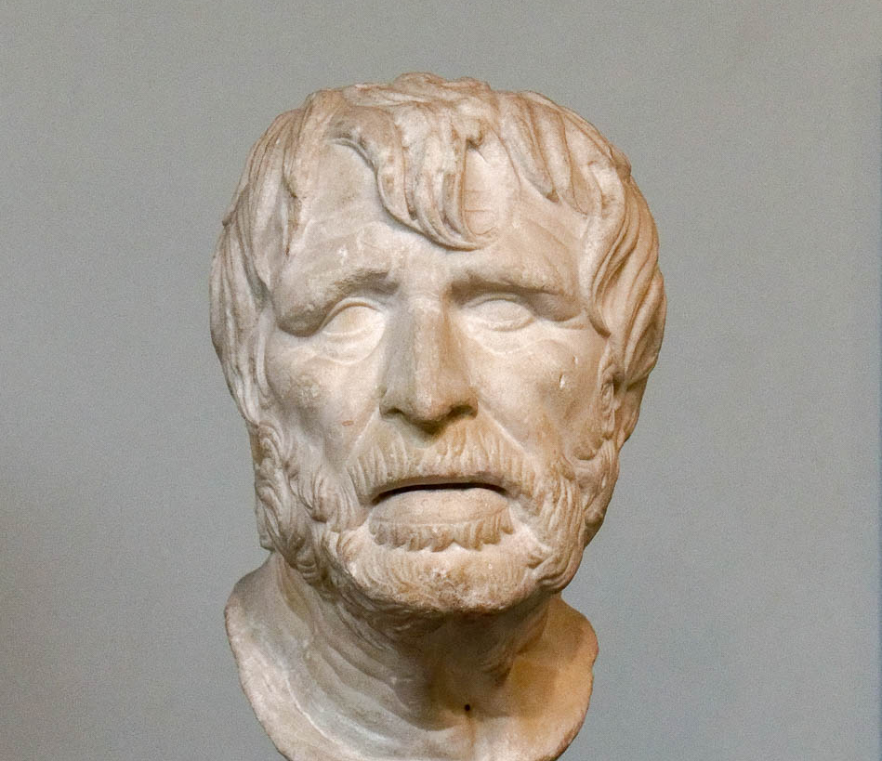
Now I had not been sad in his presence before
Marble head of an old man, possibly the poet Hesiod, Roman era
2:1
Notes:
The verb translated here as “to be sullen” or “to be sad” (Heb. ra’, רַע) is a common word in the Hebrew Bible, but more often refers to something that is bad or evil (e.g., Gen 38:7; Neh 9:28). It only occurs elsewhere in the sense of sadness or sullenness in Genesis 40:7 and Ecclesiastes 7:3. In Genesis 40:7, Joseph, in prison, asks the baker and cup-bearer of Pharaoh why they appear downcast after their dreams. This bust portrays an older man who appears sad. It is considered to be a Roman copy of a Greek original from the 2nd century BC. It was photographed at the British Museum.
tb0930199307

Slide 36
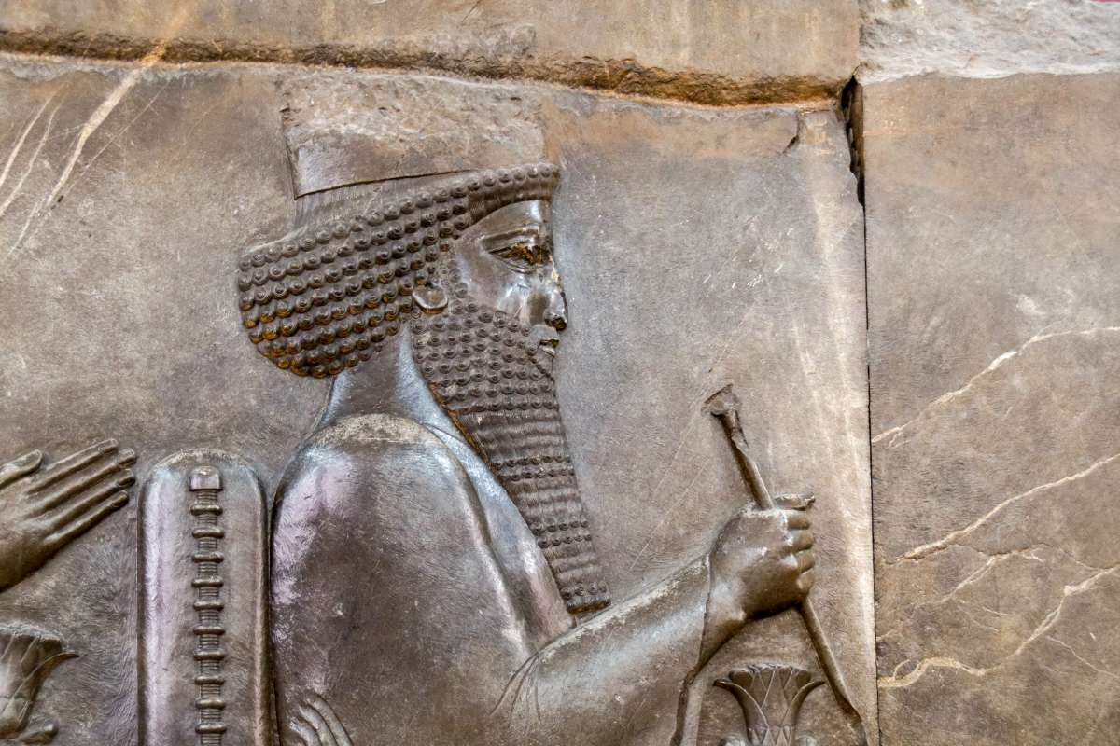
And the king said to me, “Why is your face said, seeing you are not sick?”
Darius I on his throne, relief from the Persepolis Audience Hall, circa 500 BC
2:2
Notes:
This relief of a Persian king, most often identified as Darius I (r. 522–486 BC) was photographed at the National Museum of Iran in Tehran.
tb0514183834

Slide 37
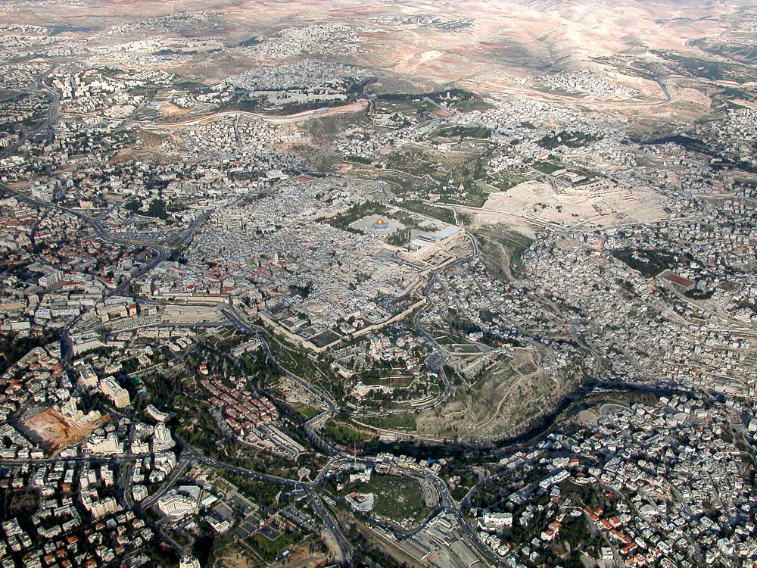
The city, the place of my fathers’ tombs, lies desolate
Jerusalem (aerial view from the southwest)
2:3
Notes:
Three necropolises from the time of the Israelite monarchy (the Iron Age) are known today: (1) the Silwan necropolis, located opposite the City of David on the southern end of the Mount of Olives; (2) the Hinnom necropolis, including the famous tombs of Ketef Hinnom; and (3) the Northern necropolis, which includes the Garden Tomb and the tombs of St. Etienne’s. These ancient cemeteries form a ring around the city, and it is noteworthy that all of them include impressive, well-preserved monumental tombs. Nehemiah was not exaggerating when he spoke of Jerusalem as the “place of my fathers’ tombs.” See the next slide for labels.
tb010703209

Slide 38
The city, the place of my fathers’ tombs, lies desolate
Northern necropolis
Silwan necropolis
City of David
Ketef Hinnom
Jerusalem (aerial view from the southwest)
2:3
Notes:
Three necropolises from the time of the Israelite monarchy (the Iron Age) are known today: (1) the Silwan necropolis, located opposite the City of David on the southern end of the Mount of Olives; (2) the Hinnom necropolis, including the famous tombs of Ketef Hinnom; and (3) the Northern necropolis, which includes the Garden Tomb and the tombs of St. Etienne’s. These ancient cemeteries form a ring around the city, and it is noteworthy that all of them include impressive, well-preserved monumental tombs. Nehemiah was not exaggerating when he spoke of Jerusalem as the “place of my fathers’ tombs.”
tb010703209

Slide 39
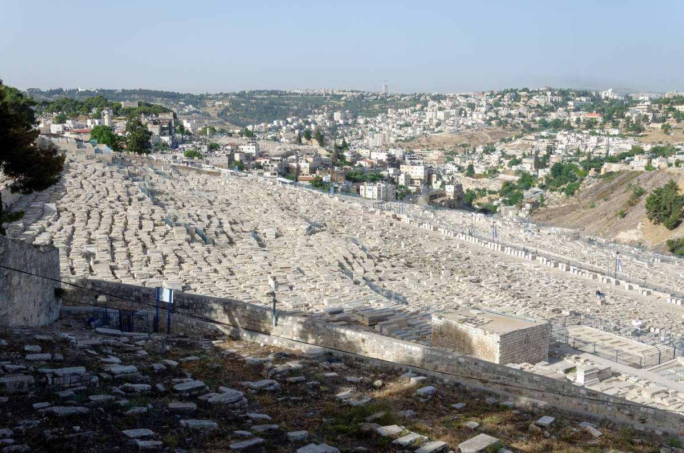
The city, the place of my fathers’ tombs, lies desolate
Cemetery on the Mount of Olives
2:3
Notes:
The Mount of Olives, east of Jerusalem, has evidence of being a place of burial for the last four millennia. Most of the tombs seen in this photograph are from the last couple of centuries, but archaeologists have discovered many ancient tombs, including tomb monuments. Nehemiah’s reference to Jerusalem as “the place of my fathers’ tombs” does not imply or demand that the tombs he was thinking of were inside the city, though the tomb of the Davidic house apparently was (1 Kgs 2:10). Nehemiah’s reference to the city as the place of his father’s burials, without naming Jerusalem, probably had diplomatic intent. Nehemiah wanted to emphasize why he cared about the city without immediately raising what the king could perceive as a challenge to his earlier decree (Ezra 4:21).
tb060116002

Slide 40
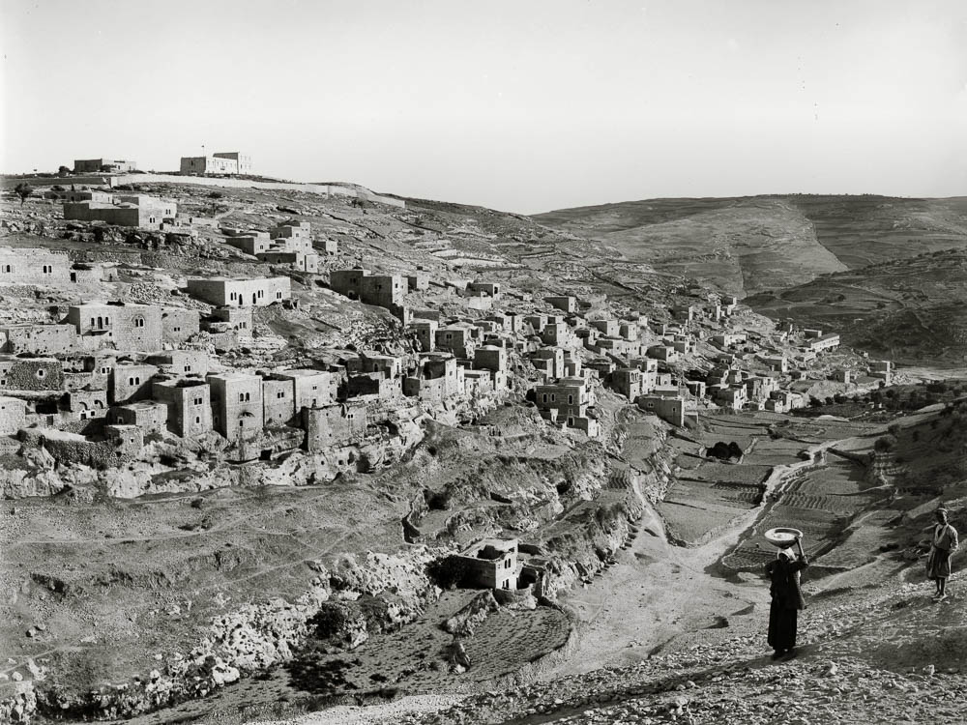
The city, the place of my fathers’ tombs, lies desolate
Silwan with ancient necropolis (from the northwest)
2:3
Notes:
The oldest necropolis from the time of Judah’s kings is that of Silwan, located on the southern end of the Mount of Olives, opposite the ancient core of Jerusalem, the City of David. Fifty tombs from the time of the Judean kings have been identified in a survey of the area carried out by David Ussishkin and Gabriel Barkay between 1968 and 1970. Some of these tombs are today inside houses, while others are visible, including in the rocky belt that can be seen in this American Colony photo, taken between 1898 and 1914. See the next slide for labels.
mat06744

Slide 41
The city, the place of my fathers’ tombs, lies desolate
rocky belt with tombs
Silwan with ancient necropolis (from the northwest)
2:3
Notes:
Three necropolises from the time of the Israelite monarchy (the Iron Age) are known today. The oldest is that of Silwan, located on the southern end of the Mount of Olives, opposite the ancient core of Jerusalem, the City of David. Fifty tombs from the time of the Judean kings have been identified in a survey of the area carried out by David Ussishkin and Gabriel Barkay between 1968 and 1970. Some of these tombs are today inside houses, while others are visible, including in the rocky belt that can be seen in this American Colony photo, taken between 1898 and 1914.
mat06744

Slide 42
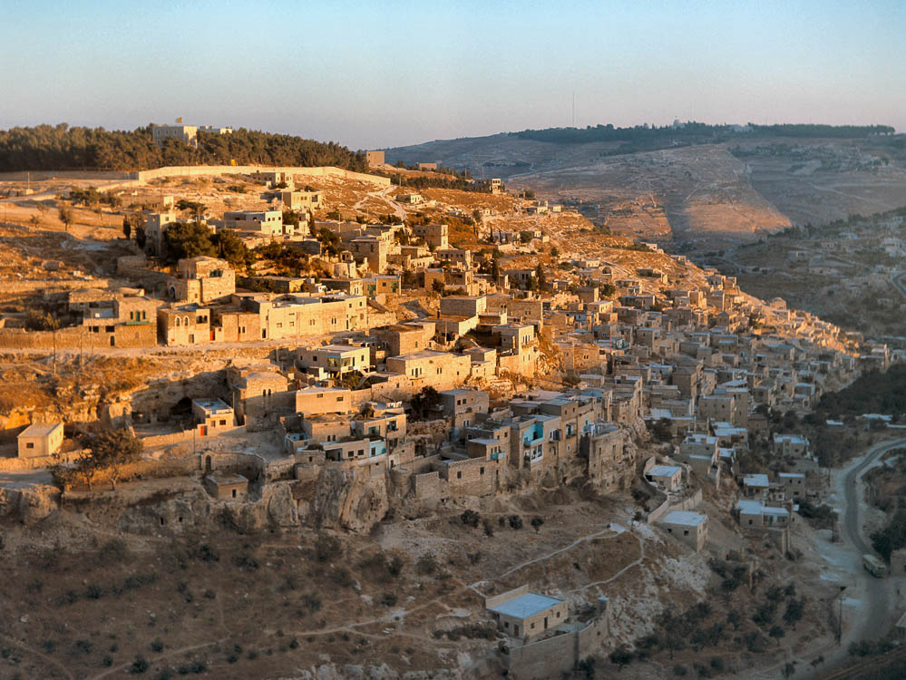
The city, the place of my fathers’ tombs, lies desolate
Silwan with ancient necropolis (from the northwest)
2:3
Notes:
This photograph shows the neighborhood of Silwan in 1967, after more construction of residences took place. See the next slide for labels.
db6709051904

Slide 43
The city, the place of my fathers’ tombs, lies desolate
Tomb of
Pharaoh’s Daughter
rocky belt with tombs
Silwan with ancient necropolis (from the northwest)
2:3
Notes:
This photograph shows the neighborhood of Silwan in 1967, after more construction of residences took place.
db6709051904

Slide 44
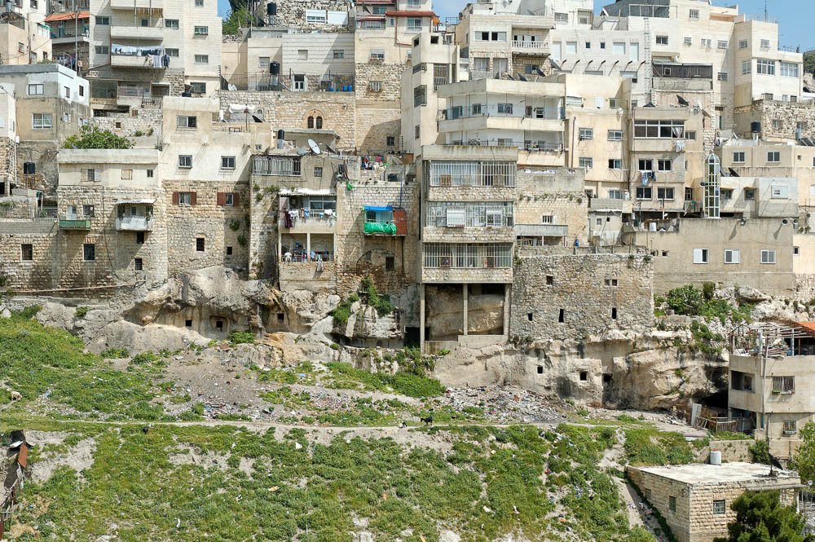
The city, the place of my fathers’ tombs, lies desolate
Silwan with ancient necropolis (from the west)
2:3
Notes:
The square openings to the ancient tombs can be seen here in the rocky belt beneath the houses. These were undoubtedly some of the tombs that Nehemiah was referring to.
tb042306040

Slide 45
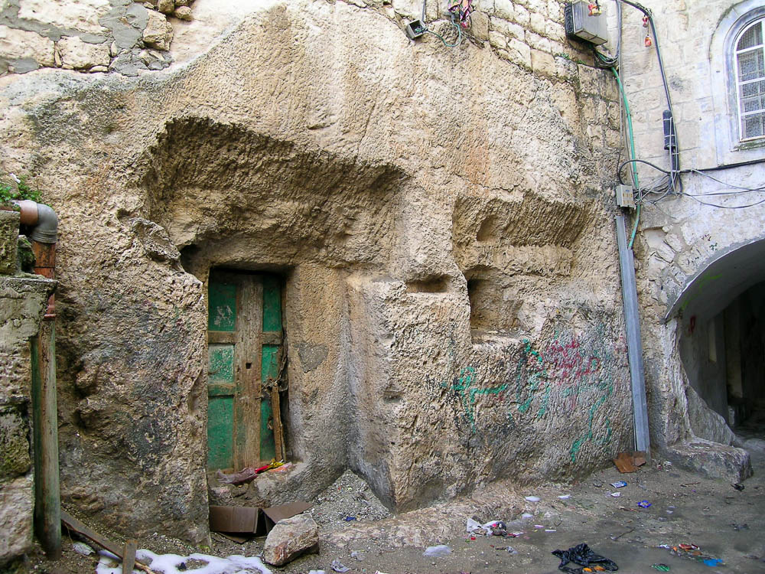
The city, the place of my fathers’ tombs, lies desolate
Tomb of the Royal Steward in the ancient necropolis of Silwan
2:3
Notes:
One of the most impressive tombs of the Iron Age necropolis of Silwan is the Tomb of the Royal Steward. Two inscriptions above this tomb identified its owner: an individual, possibly named Shebna(yahu) who was “over the king’s house.” It is possible that this very tomb is referred to in Isaiah 22:16, though it is impossible to be certain because the portion with the owner’s name was destroyed in antiquity. In any case, Nehemiah likely knew of this tomb after he moved to Jerusalem.
tb021504410

Slide 46
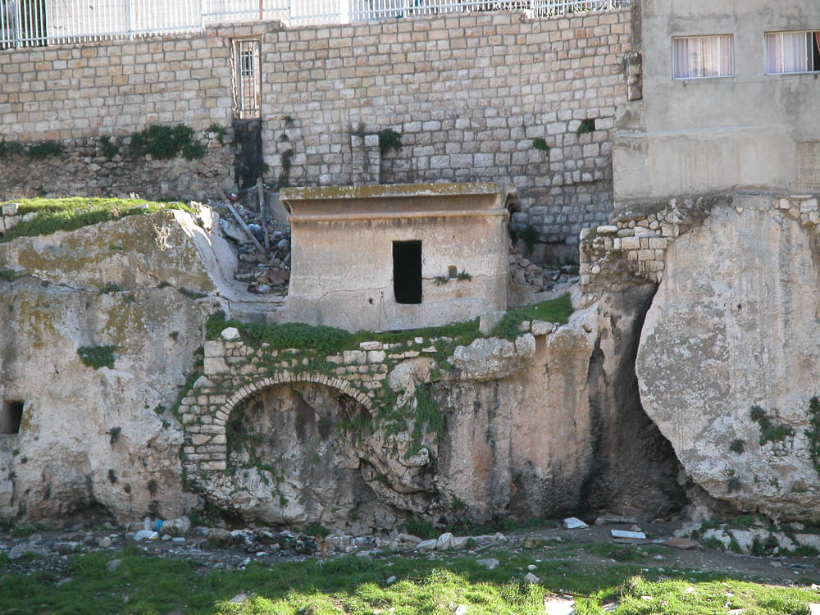
The city, the place of my fathers’ tombs, lies desolate
Tomb of Pharaoh’s Daughter in the ancient necropolis of Silwan (from the west)
2:3
Notes:
Another monumental tomb in the Silwan necropolis is the so-called “Tomb of Pharaoh’s Daughter.” This tomb clearly was hewn in the Iron Age II, but it more likely dates to the 8th or 7th centuries than to the time of Solomon’s wife (10th century).
tb012603111

Slide 47
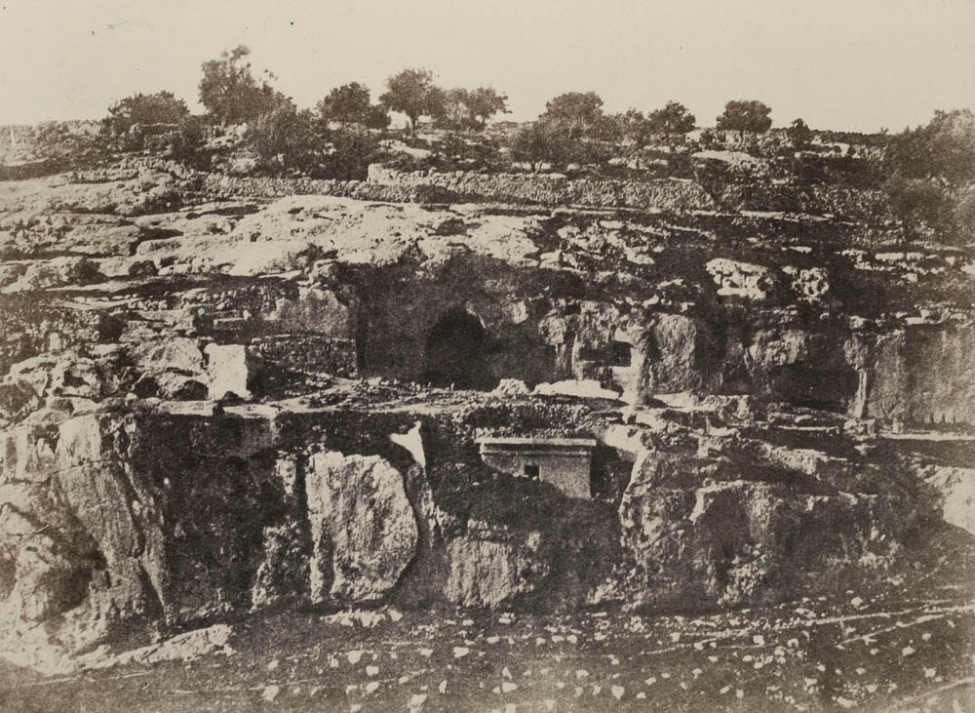
The city, the place of my fathers’ tombs, lies desolate
Tomb of Pharaoh’s Daughter in the ancient necropolis of Silwan (from the west)
2:3
Notes:
This image, taken in 1856 by Auguste Salzmann, shows the area around the “Tomb of Pharaoh’s Daughter” prior to construction of the Silwan neighborhood around it or even clearance of the accumulated dirt around the tomb monument. This image comes from Auguste Salzmann, Jerusalem, published in 1856. Public domain, from The New York Public Library, https://digitalcollections.nypl.org/items/510d47d9-5d25-a3d9-e040-e00a18064a99.
nypl76494

Slide 48
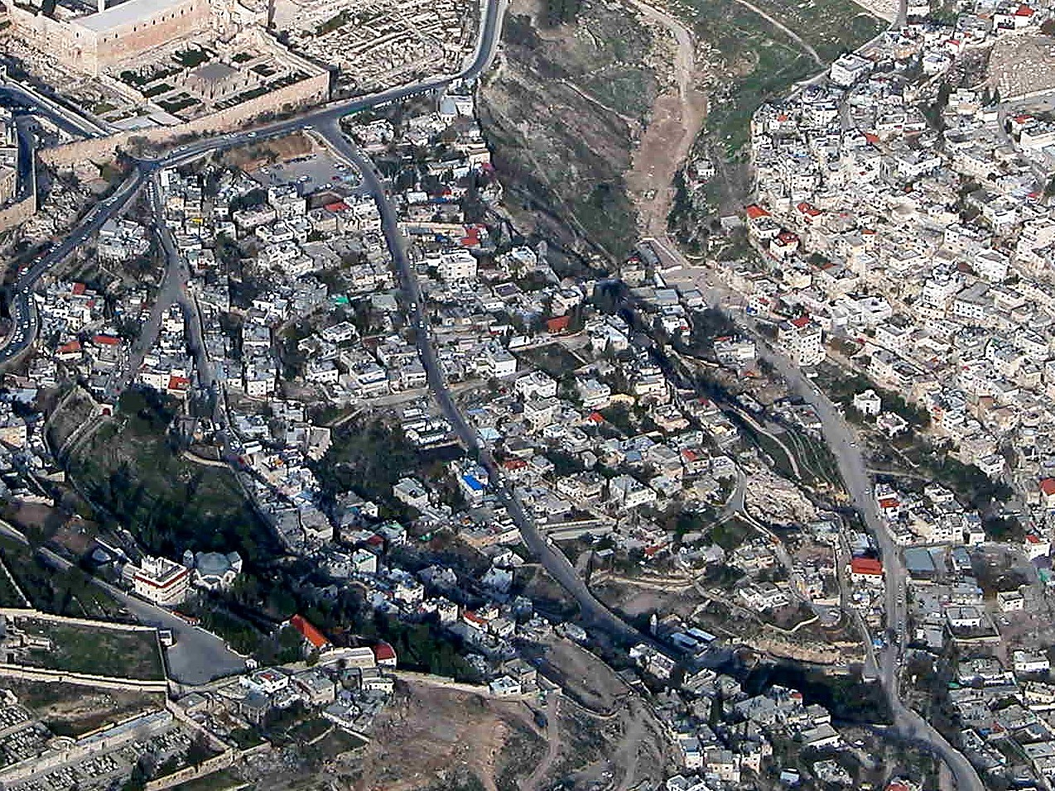
The city, the place of my fathers’ tombs, lies desolate
City of David (aerial view from the southwest)
2:3
Notes:
Although dead bodies were considered unclean and burials were normally kept outside the city, the biblical text is quite clear that the kings of Judah were buried within the confines of the city itself. Raymond Weill excavated the southeastern portion of the City of David in 1913–1914. He uncovered large rock-hewn caverns that he identified as the royal tombs of the House of David. The rock-hewn structures discovered by Weill are in the southern part of the City of David, the same area that is indicated by Nehemiah in his description (Neh 3:16). The next slide includes labels.
tb010703234

Slide 49
The city, the place of my fathers’ tombs, lies desolate
Kidron Valley
Silwan
necropolis
Jerusalem
Central (Tyropean) Valley
Royal Tombs?
City of David (aerial view from the southwest)
2:3
Notes:
Although dead bodies were considered unclean and burials were normally kept outside the city, the biblical text is quite clear that the kings of Judah were buried within the confines of the city itself. Raymond Weill excavated the southeastern portion of the City of David in 1913–1914. He uncovered large rock-hewn caverns that he identified as the royal tombs of the House of David. The rock-hewn structures discovered by Weill are in the southern part of the City of David, the same area that is indicated by Nehemiah in his description (Neh 3:16).
tb010703234

Slide 50
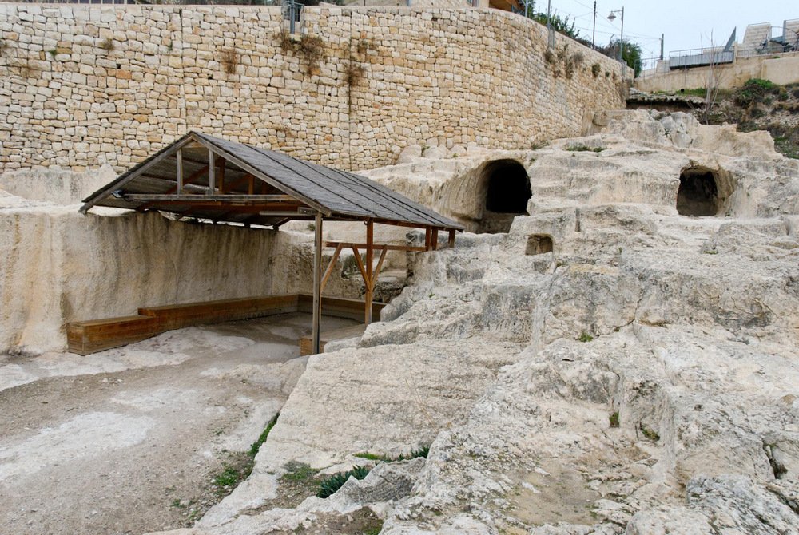
The city, the place of my fathers’ tombs, lies desolate
Proposed tomb of the House of David
2:3
Notes:
When Weill made the identification, most scholars accepted it as accurate. Most scholars today reject this identification. These structures do not have features typical of Iron Age tombs; there are no burial benches or repositories. This area was heavily quarried for building stone in the Hadrianic period, after the destruction of Jerusalem in the 1st century AD, making archaeological work and interpretation difficult. Because of later destruction, there is no stratigraphy, pottery, or burial gifts which would make dating the structures possible. Some scholars think that they date to the Herodian period and may have been used as wine cellars for the structures built above them. There is no other candidate for the tomb of David.
Weill discovered several underground structures in this immediate area. Two are visible behind the modern structure in this photo, and a third is around the corner to the right. If these are the tombs of the kings of Judah, perhaps the desire to separate out some members of the royal line, such as Jehoram, explains the fact that there are multiple tombs.
tb123011013

Slide 51
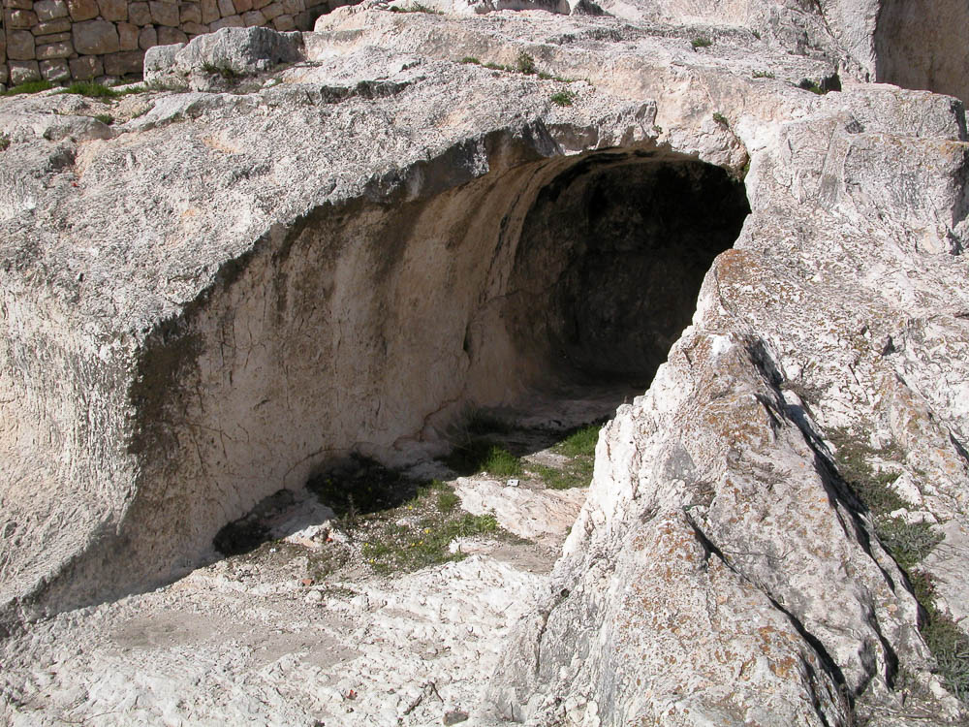
The city, the place of my fathers’ tombs, lies desolate
Proposed tomb of the House of David
2:3
Notes:
There are some scholars who continue to believe that these are the best candidates we have for the royal tombs. Jeffrey Zorn argues that Hezekiah’s Tunnel was dug on the eastern edge of the City of David in order to avoid the “burial grounds of the Davidic kings” (2012: 47). Zorn also observes that there are other examples of royal tombs that were quite simple in design, such as the tomb of King Ahiram of Byblos (11th century BC; 2012: 52).
Reference:
Zorn, Jeffrey.
2012 Is T1 David's Tomb? Biblical Archaeology Review 38/6: 44–52, 78.
tb012603231

Slide 52
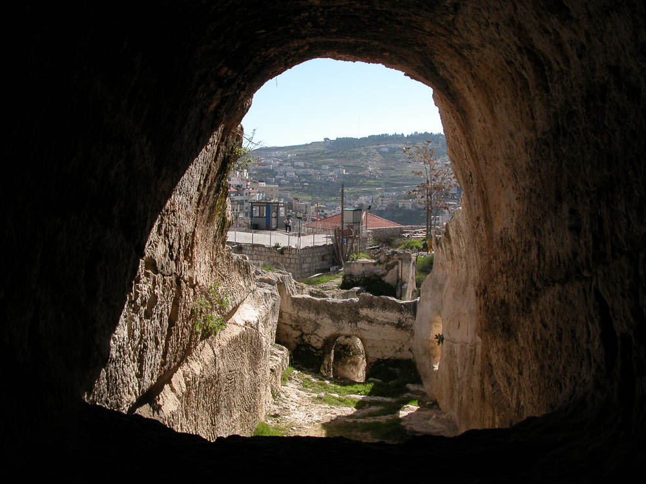
The city, the place of my fathers’ tombs, lies desolate
View from the proposed tomb of the House of David (from the north)
2:3
Notes:
This view from inside the proposed tomb of the House of David shows the small entrances that seem to have once given access to the room. Note also the ledges carved along either side (the one on the left is most visible). These may have allowed the insertion of planks to form a multi-floored room.
tb012603232

Slide 53
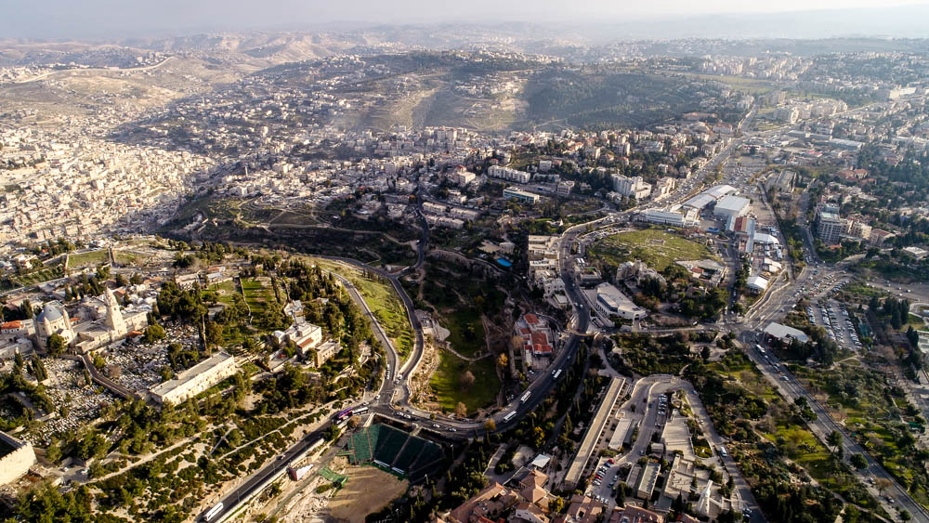
The city, the place of my fathers’ tombs, lies desolate
Hinnom Valley (aerial view from the north)
2:3
Notes:
This aerial view shows the sweep of the Hinnom Valley around the Western Hill. Archaeologists have identified another necropolis with dozens of Iron Age tombs along both sides of the Hinnom Valley. The most famous of these tombs was dubbed by archaeologist Gabriel Barkay as “Ketef Hinnom” (shoulder of Hinnom). This is located near the Church of St. Andrews and Menahem Begin Heritage Center. See the next slide for labels,
ws012017078

Slide 54
The city, the place of my fathers’ tombs, lies desolate
Silwan
Ketef Hinnom tombs
Western Hill
Hinnom Valley (aerial view from the north)
2:3
Notes:
This aerial view shows the sweep of the Hinnom Valley around the Western Hill. Archaeologists have identified another necropolis with dozens of Iron Age tombs along both sides of the Hinnom Valley. The most famous of these tombs was dubbed by archaeologist Gabriel Barkay as “Ketef Hinnom” (shoulder of Hinnom). This is located near the Church of St. Andrews and Menahem Begin Heritage Center.
ws012017078

Slide 55
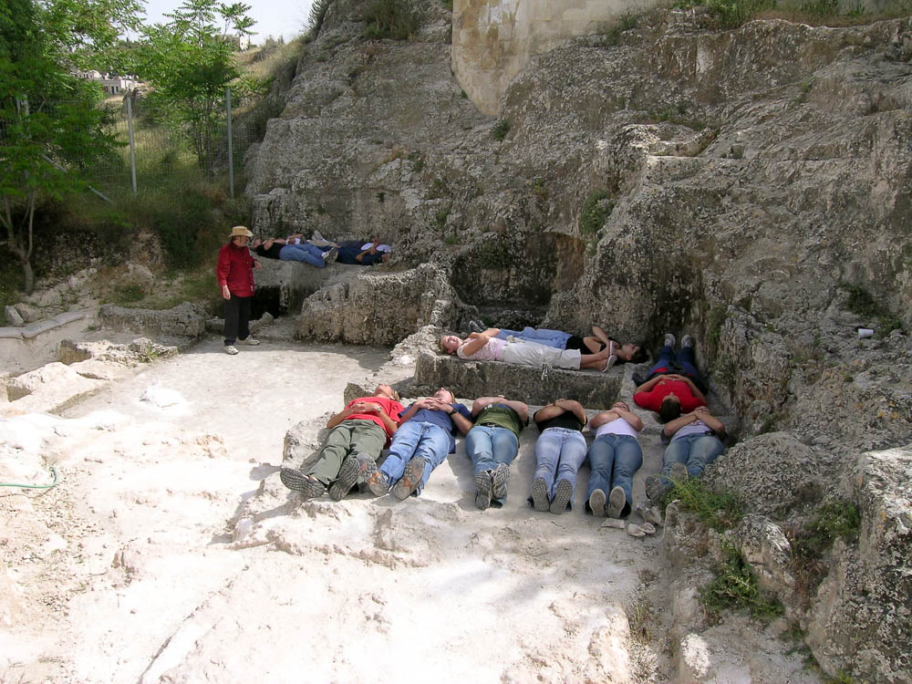
The city, the place of my fathers’ tombs, lies desolate
Cave 24 of the Ketef Hinnom necropolis
2:3
Notes:
Of the seven rock-hewn burial caves at Ketef Hinnom, Cave 24 is the most important because of its large design and the intact repository. The cave consists of an entrance hall and five tomb chambers, most of which were destroyed in ancient times. Chamber 25 is the best-known and best-preserved of the five chambers, and it is shown here with nine persons laying on the burial benches, with a headrest for each individual. The oldest artifact with Scripture on it, the silver amulets of Ketef Hinnom, was found in the repository of this chamber. This tomb was likely hewn in the 8th or 7th centuries BC and it continued in use into the 6th century.
tb042705897

Slide 56
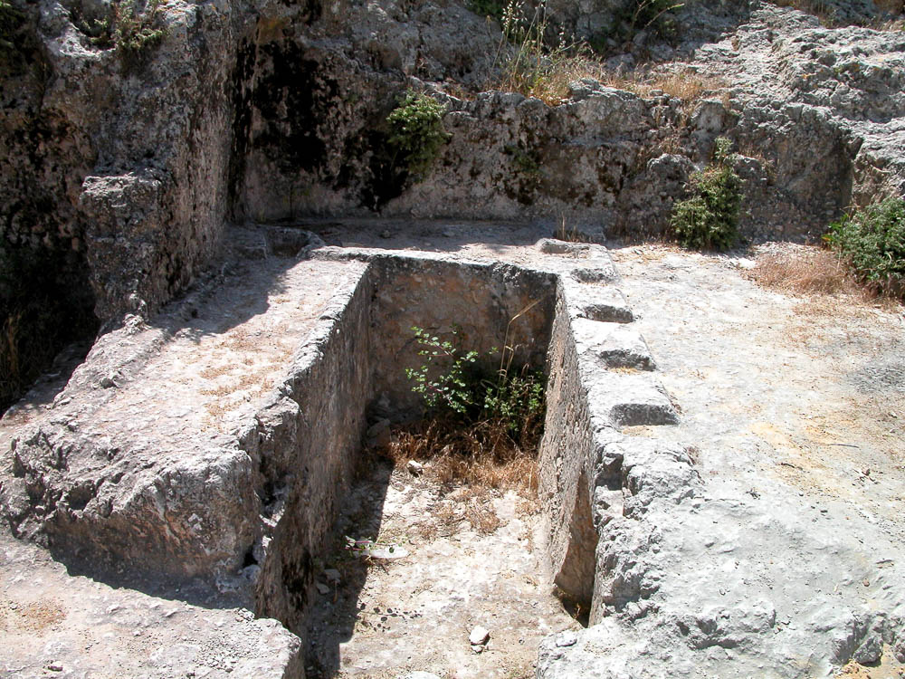
The city, the place of my fathers’ tombs, lies desolate
Ketef Hinnom tomb
2:3
Notes:
Chamber 25 is the best preserved of the five chambers. In this tomb three burial benches are situated in the typical horseshoe shape, with one of the benches consisting of a row of six headrests. This design is not found elsewhere in Israel. No other known tombs have benches with more than two headrests.
tb051703209

Slide 57

The city, the place of my fathers’ tombs, lies desolate
St Etienne’s Cave 1 courtyard and burial chambers
2:3
Notes:
The third necropolis from the time of Israel’s kings is the northern necropolis. The most famous Iron Age tomb in this necropolis is the Garden Tomb, but this is not as well-preserved as its next-door neighbor, shown here. Cave 1, located on the premises of St. Etienne’s Church/Ecole Biblique, has an entrance chamber and a courtyard, around which six chambers are arranged, two on each of three sides. The design is essentially an imitation of a palace room from the time of the Judean monarchy. The burial chambers were arranged around a courtyard, like rooms in a palace. The entrances are 5.9 feet (1.8 m) high, with shallow, rock-cut frames around the doorjambs and lintels, and the ceiling is 7.5 feet (2.3 m) above the floor.
tb062907487

Slide 58

The city, the place of my fathers’ tombs, lies desolate
St Etienne’s Cave 1 burial chamber
2:3
Notes:
The well-preserved tomb complex at St. Etienne’s reveals the standard characteristics of tombs of the most wealthy people in the time of Judah’s kings. This burial chamber, like many, included a square room that was entered through a small, square entrance, which could be blocked with a stone. Benches were cut into the rock on three sides. The benches were 3 feet (1 m) high and lined the room in the shape of a horseshoe. The bodies of the deceased were laid on the benches along with burial gifts, including jewelry, weapons, pottery, food, drinks, and oil lamps. To make room for new burials, bones and gifts would be moved from the benches to a special repository (a sunken pit located under one of the benches, or a small side or rear chamber). In some cases, “headrests” were shaped on the stone benches either in the form of a horseshoe or in the shape of a curled “Hathor headrest.” These examples of ancient tombs provide striking illustrations of Nehemiah’s reference to Jerusalem as “the place of my fathers’ tombs.”
tb062907546

Slide 59

The city, the place of my fathers’ tombs, lies desolate
The royal necropolis of Persepolis at Naqsh-e Rostam
2:3
Notes:
Nehemiah’s mention of his fathers’ tombs surely reckoned with his knowledge of the importance that the Persians placed on their fathers’ tombs. Nehemiah’s concern would have been very understandable to Artaxerxes. The cemetery shown here is located about 3.5 miles (5.5 km) north of the capital city of Persepolis. Artaxerxes’s father, Xerxes, and his grandfather, Darius, were already buried here by the time that Nehemiah presented his request to the king. See the next slide for labels.
tb0506181671

Slide 60
The city, the place of my fathers’ tombs, lies desolate
Darius II
Artaxerxes
Darius I
Xerxes I
The royal necropolis of Persepolis at Naqsh-e Rostam
2:3
Notes:
Nehemiah’s mention of his fathers’ tombs surely reckoned with his knowledge of the importance that the Persians placed on their fathers’ tombs. Nehemiah’s concern would have been very understandable to Artaxerxes. The cemetery shown here is located about 3.5 miles (5.5 km) north of the capital city of Persepolis. Artaxerxes’s father, Xerxes, and his grandfather, Darius, were already buried here by the time that Nehemiah presented his request to the king.
tb0506181671

Slide 61

And its gates have been consumed by fire
Assyrians setting fire to a city gate, from Nineveh, 7th century BC
2:3
Notes:
This relief depicts an Assyrian soldier setting fire to the city gate. Note also the soldier at the far left who is prying loose stones from the city wall in an effort to collapse a section of it. This relief comes from the north palace of Tiglath-pileser III at Nineveh. It was photographed at the British Museum.
tb0929197314

Slide 62

And its gates have been consumed by fire
Relief depicting the destruction of the city of Hamanu in Elam by Ashurbanipal, 645–640 BC
2:3
Notes:
Following the capture of Jerusalem, its walls were broken down (2 Kgs 25:10). The dismantling of the city walls would have been a major project. It was doubtless meant to dissuade any further use of the city as a base for rebellion. The Assyrian soldiers depicted in this relief are dismantling the defenses of a city after its conquest. Some use pick axes and others use pry bars as they toss stones and timbers to the ground. The sculptor also depicted flames coming from the city gate and from the towers in the background.
This relief was photographed at the British Museum. This image comes from Carole Raddato and is licensed under CC BY-SA 2.0, via Wikimedia Commons: https://commons.wikimedia.org/wiki/File:Relief_depicting_the_destruction_of_Hamanu_of_Elam_by_Ashurbanipal,_645-640_BC,_North_Palace,_Nineveh,_Exhibition-_I_am_Ashurbanipal_king_of_the_world,_king_of_Assyria,_British_Museum.jpg.
wiki1118201814302547703

Slide 63

And its gates have been consumed by fire
Eastern slope of the City of David (Area G)
2:3
Notes:
Nehemiah does not expressly mention the ruined state of Jerusalem’s wall, but burned gates would imply a destroyed wall. The ruins in this photo include the remains of a house that was destroyed when Jerusalem fell to the Babylonians in 586 BC (lower left).
tb051803201

Slide 64

And its gates have been consumed by fire
House of Ahiel on the eastern slope of the City of David
2:3
Notes:
In this house, which was supported by pillars, two ostraca were found bearing the name of Ahiel. For this reason, the house has been dubbed the “House of Ahiel.” This is a typical Israelite house; it has four rooms separated by pillars which supported the roof. Outside, the stairway to the south (left) presumably led to the flat roof of Ahiel’s house. The eastern side of Ahiel’s house was poorly preserved, but the western side was well preserved because it is close to the slope. Inside the house were found cosmetics and housewares, all destroyed in the Babylonian invasion of 586 BC. This house belongs to Shiloh’s stratum 10.
tb123005418

Slide 65

And its gates have been consumed by fire
House of Ahiel on the eastern slope of the City of David
2:3
Notes:
The Babylonians burned all the houses in Jerusalem in 586 BC (2 Kgs 25:9).
df090701202

Slide 66

And its gates have been consumed by fire
House of Bullae on the eastern slope of the City of David (from the north)
2:3
Notes:
Another building excavated in Area G is remarkable because 51 clay bullae were found inside. This collection of seal impressions is one of the most important finds in the history of Jerusalem archaeology. This building may have been an archive where many scrolls were kept. A fire destroyed the scrolls but hardened the clay seals. Two of the people listed on the bullae are mentioned in the Bible. One is Gemariah son of Shaphan, who is mentioned four times in Jeremiah 36:9-12, 25-26, as an official friendly to Jeremiah. The other is Azariah son of Hilkiah, a priest and the grandfather of Ezra (1 Chr 6:36; Ezra 7:1).
Another collection of seal impressions appeared on the antiquities market in 1975. This hoard of 250 bullae, of unknown provenance, dated to the same time period (just before the Babylonian destruction). Among these seals, one included the name of Baruch, son of Neriah, the personal assistant of the prophet Jeremiah.
tb051803203

Slide 67

And its gates have been consumed by fire
Burnt Chamber on the eastern slope of the City of David
2:3
Notes:
North of the House of Ahiel is a building known as the “Burnt Chamber” (to be distinguished from the 1st century AD “Burnt House” in the Jewish Quarter). Like the other buildings in the area, the “Burnt Chamber” was built in the 7th century BC and was destroyed in 586. This building is so named because it showed such abundant evidence of the Babylonian destruction. In the massive conflagration, the wooden furniture was carbonized. In addition, a metal spoon and arrowheads were found. The Burnt Chamber provides archaeological attestation to the Babylonian destruction, described in 2 Kings 25:9. “And he burnt the house of the Lord, and the king’s house, and all the houses of Jerusalem, and every great man’s house burnt he with fire” (KJV).
tb091102201

Slide 68

And its gates have been consumed by fire
Ruins on the summit of Debir (Khirbet Rabud)
2:3
Notes:
A few photos of ancient ruins are provided here to give a sense of what a ruined city might look like.
tb022407378

Slide 69

And its gates have been consumed by fire
Ruins at Zobah
2:3
Notes:
Ruined buildings in Jerusalem perhaps looked something like these.
tb020305232

Slide 70

And its gates have been consumed by fire
Remains of the west gate at Khirbet Qeiyafa
2:3
Notes:
The foundations of Jerusalem’s burned gates might have looked something like this. A city without gates was open to attack. In addition, the gate complexes were the normal place to conduct commercial, judicial, and social affairs, so common commercial activities were also disrupted.
tb010412815

Slide 71

Then the king asked me, “What would you request?”
Pharnaces approaching Darius I, from the audience room at Persepolis, 522–486 BC
2:4
Notes:
This relief carving was photographed at the National Museum of Tehran.
tb0514183856

Slide 72

So I prayed to the God of heaven
Dedicatory inscription to Baalshamim, “Lord of the heavens,” from Umm el-Amed, 132–131 BC
2:4
Notes:
The phrase “the God of heaven” (Heb. elohey hashamayim, אֱלֹהֵי הַשָּׁמָיִם), while also appearing in other books, is particularly characteristic of Ezra, Nehemiah, and Daniel. This inscription from Umm el-Amed has a similar designation for a deity, Baalshamim, “Lord of the heavens.” This inscription was photographed at the Louvre Museum. The next slide includes a closeup.
tb0928195541

Slide 73

So I prayed to the God of heaven
Dedicatory inscription to Baalshamim, “Lord of the heavens,” from Umm el-Amed, 132–131 BC
2:4
Notes:
The phrase “the God of heaven” (Heb. elohey hashamayim, אֱלֹהֵי הַשָּׁמָיִם), while also appearing in other books, is particularly characteristic of Ezra, Nehemiah, and Daniel. This inscription from Umm el-Amed has a similar designation for a deity, Baalshamim, “Lord of the heavens.” The inscription begins, “To the Lord, to Baalshamim, I, Abdelim, son of Matton, son of Abdelim, son of Baalshamar, in the district of Laodicea, have dedicated this gateway and its panels, which I have completed.” This inscription was photographed at the Louvre Museum. The next slide includes a highlight for the name Baalshamim.
tb0928195541

Slide 74

So I prayed to the God of heaven
Dedicatory inscription to Baalshamim, “Lord of the heavens,” from Umm el-Amed, 132–131 BC
2:4
Notes:
The phrase “the God of heaven” (Heb. elohey hashamayim, אֱלֹהֵי הַשָּׁמָיִם), while also appearing in other books, is particularly characteristic of Ezra, Nehemiah, and Daniel. This inscription from Umm el-Amed has a similar designation for a deity, Baalshamim, “Lord of the heavens.” The inscription begins, “To the Lord, to Baalshamim, I, Abdelim, son of Matton, son of Abdelim, son of Baalshamar, in the district of Laodicea, have dedicated this gateway and its panels, which I have completed.” This inscription was photographed at the Louvre Museum. An editable version is included behind the graphic.
tb0928195541

Slide 75

I said to the king, “If it please the king . . . please send me to Judah”
Jar handle with the inscription “Yehud,” circa 450 BC
2:5
Notes:
At the time of Nehemiah, the former kingdom of Judah was the Persian province of “Yehud” (Aram. יְהוּד). A variety of inscriptions and stamped jar handles with the name Yehud have been discovered at various sites in Israel. The inscription on this jar handle preserves the letters for “Yehud,” but they are arranged stylistically to fit within a circle. This handle was photographed at the Eretz Israel Museum in Tel Aviv. The letters are placed to be read in a clockwise direction. With the orientation of this photo the inscription begins with the yod at the lower left, followed by the he at the top, and finally the dalet. The next slide includes labels.
tb031114330

Slide 76


I said to the king, “If it please the king . . . please send me to Judah”
Jar handle with the inscription “Yehud,” circa 450 BC
2:5
Notes:
At the time of Nehemiah, the former kingdom of Judah was the Persian province of “Yehud” (Aram. יְהוּד). A variety of inscriptions and stamped jar handles with the name Yehud have been discovered at various sites in Israel. The inscription on this jar handle preserves the letters for “Yehud,” but they are arranged stylistically to fit within a circle. This handle was photographed at the Eretz Israel Museum in Tel Aviv. The letters are placed to be read in a clockwise direction. With the orientation of this photo the inscription begins with the yod at the lower left, followed by the he at the top, and finally the dalet. An editable version is included beneath the graphic for those who wish to modify it.
tb031114330

Slide 77

I said to the king, “If it please the king . . . please send me to Judah”
Map of the Persian province of Yehud
2:5
Notes:
This map shows the Persian province of Yehud. This map is a detail adapted from map 8-2 in the Satellite Bible Atlas, by William Schlegel. Used by permission.

Slide 78
To the city of my fathers’ tombs
Jerusalem (aerial view from the southwest)
2:5
Notes:
Nehemiah once again avoids naming Jerusalem to elicit support from the king personally, rather than risk raising his ire given his previous order for construction to be halted (Ezra 4:21). This aerial view shows the entire area of ancient Jerusalem in the biblical periods. The next slide includes labels.
tb010703209

Slide 79
To the city of my fathers’ tombs
Area of Temple
Mount of Olives
Kidron Valley
City of David
Western Hill
Hinnom Valley
Jerusalem (aerial view from the southwest)
2:5
Notes:
Nehemiah once again avoids naming Jerusalem to elicit support from the king personally, rather than risk raising his ire given his previous order for construction to be halted (Ezra 4:21). This aerial view shows the entire area of ancient Jerusalem in the biblical periods. The highlighted area shows the approximate size of the city of Jerusalem when it was destroyed by the Babylonians in 586 BC. The most ancient part of the city was the City of David; the Western Hill was an expansion that was fortified in the days of Hezekiah.
tb010703209

Slide 80

To the city of my fathers’ tombs
Iron Age tombs below the western wall of the Old City of Jerusalem
2:5
Notes:
This photograph shows more of the tombs in the Hinnom necropolis. These are located just south of Jaffa Gate.
as1110174761b

Slide 81

To the city of my fathers’ tombs, that I may rebuild it
Monument of Ashurbanipal as builder, from Marduk Temple at Babylon, circa 668–655 BC
2:5
Notes:
This depiction of an ancient Assyrian king as a builder was photographed at the British Museum.
tb0929197308

Slide 82

To the city of my fathers’ tombs, that I may rebuild it
Construction site at Qatzrin
2:5
Notes:
tb041103214

Slide 83

To the city of my fathers’ tombs, that I may rebuild it
Seated Assyrian overseeing bridge construction, on bronze gate bands of Shalmaneser III
2:5
Notes:
This depiction of an ancient construction project with a supervisor was photographed at the British Museum.
adr1805194266

Slide 84

To the city of my fathers’ tombs, that I may rebuild it
Terracotta relief of Athena supervising building of Argo, Roman, probably 1st century AD
2:5
Notes:
This ancient depiction of an overseer of a building project was photographed at the British Museum.
tb0929198026

Slide 85

Then the king replied
Fragment of colossal royal statue, from apadana at Susa, possibly reign of Darius I (522–486 BC)
2:6
Notes:
This depiction of a Persian king’s mouth comes from the royal audience hall in the palace at Susa, where Nehemiah worked. It was photographed at the Louvre Museum.
tb0927195321c

Slide 86

Then the king replied, as the queen sat beside him, “How long will your journey be?”
Relief of servants serving wine and food in Ashurbanipal’s garden, from Nineveh
2:6
Notes:
The Assyrian king Ashurbanipal (669–627 BC) is shown reclining and drinking wine in his garden, surrounded by servants. The queen is seated at the feet of the reclining king. Women are rarely depicted in the art of Achaemenid Persia, but it is known from literary sources that the name of Artaxerxes I’s queen was Damaspia. This relief carving was photographed at the Getty Villa while on loan from the British Museum. See the next slide for a closer view.
tb100919345

Slide 87

Then the king replied, as the queen sat beside him, “How long will your journey be?”
Ashurbanipal and his wife drinking wine in a garden, relief from Nineveh, 7th century BC
2:6
Notes:
The Assyrian king Ashurbanipal (669–627 BC) is shown reclining and drinking wine in his garden, surrounded by servants. The queen is seated at the feet of the reclining king. Women are rarely depicted in the art of Achaemenid Persia, but it is known from literary sources that the name of Artaxerxes I’s queen was Damaspia. This relief carving was photographed at the Getty Villa while on loan from the British Museum.
tb100919348

Slide 88

So it pleased the king to send me
Alabastron vase naming Artaxerxes in four languages, from Egypt, 465–424 BC
2:6
Notes:
From the beginning of his reign, Artaxerxes I dealt with revolts and unrest in Egypt and other parts of his empire. Probably one reason why he approved Nehemiah’s mission was to ensure that he had a loyal official governing the province of Yehud, close to Egypt. This vase has the name and title of Artaxerxes I in four languages: Old Persian, Elamite, Babylonian, and Egyptian hieroglyphs. It was photographed at the Michael C. Carlos Museum at Emory University.
adr1511187912

Slide 89

And I set him a time
Jewish girls during a Bat Mitzvah in Alexandria
2:6
Notes:
Nehemiah gave the king a time that he would need to be away, but the duration is not recorded. Later in the book we learn that Nehemiah was in Jerusalem for twelve years (5:14; 13:6), but it is not known whether Nehemiah originally asked for such a long time (unlikely), made a return trip in the interim, or extended his stay once he arrived based on his success (most likely). Bat Mitzvahs are performed when Jewish girls reach the age of twelve. Thus, this photo can serve to illustrate the concept of twelve years.
This image comes from Nebi Daniel Association public photo collection / Maurice Studio and is licensed under CC BY 3.0, via Wikimedia Commons: https://commons.wikimedia.org/wiki/File:Egyptian_Alexandria_Jewish_girls_during_BatMitzva.jpg.
wiki1967770287429

Slide 90

Let letters be given to me for the governors of the Trans-Euphrates
Aramaic translation of the Behistun inscription, from Elephantine, 520 BC
2:7
Notes:
This photograph shows an example of a letter sent from the imperial administration of Persia to a faraway province. A traveler with the rank and entourage of Nehemiah would need a sort of passport so as to authenticate his business as he passed through the empire.
This image comes from Wikimedia Commons. Attribution: Jona Lendering. License: CC-BY-SA 4.0. Source: https://commons.wikimedia.org/wiki/File:Aramaic_translation_of_the_behistun_inscripton.png
wiki091320152321700705

Slide 91

Let letters be given to me for the governors of the Trans-Euphrates
Relief of Persian and Median officials at Persepolis, reign of Darius I, 522–486 BC
2:7
Notes:
This photograph illustrates officials in the government of the Medo-Persian Empire. This relief is located on the east stairs of the apadana of Persepolis.
tb0506180791

Slide 92

That they may let me pass through until I come to Judah
Jar handle with Yehud stamp impression, from Ramat Rahel, 5th–4th centuries BC
2:7
Notes:
The inscription on this jar handle reads “Yehud/Yeho’ezer/governor” (יהוד יהועזר פחוא), apparently giving the name of the province (Yehud), a personal name (Yeho’ezer), and this person’s title (district governor). Ramat Rahel, where this stamped jar handle was found, is located on a prominent ridge between Jerusalem and Bethlehem. This artifact was photographed at the Israel Museum.
adr1806199697

Slide 93

Also, a letter to Asaph the keeper of the king’s forest
Aramaic receipt for a grain loan, from the Jewish community in Elephantine, 402 BC
2:8
Notes:
Timber was a valuable and closely-guarded commodity in the ancient Near East. Nehemiah would not be able to obtain a large supply of timber without the king’s authorization. The king’s letter to Asaph would probably have been written in Aramaic, and may have looked something like the letter shown here. This image comes from the Brooklyn Museum and is in the public domain, via Wikimedia Commons: https://commons.wikimedia.org/wiki/File:Receipt_for_a_Grain_Loan,_December,_402_B.C.E.,_47.218.93.jpg.
wiki061020141550324024721893

Slide 94

Also, a letter to Asaph the keeper of the king’s forest
Etam (aerial view from the west)
2:8
Notes:
Some suggest that the “king’s forest” is a reference to the forests of Lebanon, from which Cyrus had decreed that wood be brought for the temple (Ezra 3:7). However, this forest was probably closer to Jerusalem, since Nehemiah was able to begin building the wall immediately upon his arrival, without transporting timber through the territory of his hostile neighbors. It is also unlikely that cedar, which was a costly softwood, would be used in the construction of a city wall and city gates. Furthermore, the keeper of the forest was a man with a Hebrew name, Asaph, which again suggests a location near Jerusalem. One suggested location is Etam, located next to Solomon’s Pools, about seven miles (11 km) south of Jerusalem. See the next slide for a label identifying the site.
ws100816594

Slide 95
Also, a letter to Asaph the keeper of the king’s forest
Etam
Etam (aerial view from the west)
2:8
Notes:
Some suggest that the “king’s forest” is a reference to the forests of Lebanon, from which Cyrus had decreed that wood be brought for the temple (Ezra 3:7). However, this forest was probably closer to Jerusalem, since Nehemiah was able to begin building the wall immediately upon his arrival, without transporting timber through the territory of his hostile neighbors. It is also unlikely that cedar, which was a costly softwood, would be used in the construction of a city wall and city gates. Furthermore, the keeper of the forest was a man with a Hebrew name, Asaph, which again suggests a location near Jerusalem. One suggested location is Etam, located next to Solomon’s Pools, about seven miles (11 km) south of Jerusalem.
ws100816594

Slide 96

Also, a letter to Asaph the keeper of the king’s forest
Etam (aerial view from the west)
2:8
Notes:
This photo was taken by David Bivin in 1968 from the vicinity of Solomon's Pools. Etam is the hill in the center of the photo.
db6811095811

Slide 97

Also, a letter to Asaph the keeper of the king’s forest
Pines and cypress trees on the western slopes of Mount Herzl
2:8
Notes:
This image comes from צילם דורון ארז 2010 and is licensed under CC BY 2.5, via Wikimedia Commons: https://commons.wikimedia.org/wiki/File:PikiWiki_Israel_8883_Pines_and_cypresses_on_the_western_slopes_of_Mount.jpg.
wiki201013519442592

Slide 98

Also, a letter to Asaph the keeper of the king’s forest
Jerusalem Forest scenery from the Revida area
2:8
Notes:
This image comes from צילום: דרור פייטלסון and is licensed under CC BY 2.5, via Wikimedia Commons: https://commons.wikimedia.org/wiki/File:PikiWiki_Israel_9752_Jerusalem_forest.JPG.
wiki102920100120081560

Slide 99

Also, a letter to Asaph the keeper of the king’s forest
Cedar planted by David Ben Gurion in the Jerusalem Forest
2:8
Notes:
This image comes from Hedva Sanderovitz Pikiwiki Israel and is licensed under CC BY 2.5, via Wikimedia Commons: https://commons.wikimedia.org/wiki/File:PikiWiki_Israel_29151_Ben_Gurion_Cedar_in_Jerusalem_Forest.JPG.
wiki0126201326229151

Slide 100

That he may give me timbers to make beams for the gates of the citadel
Relief with a stack of hewn cedar logs, from the Assyrian palace at Khorsabad, circa 710 BC
2:8
Notes:
This relief depicts men dragging cedar beams and stacking them in a pile. The larger scene, of which this is a detail, depicts the beams being transported by sea from the mountains of Lebanon to the Assyrian city of Khorsabad, during the reign of Sargon II. This relief was photographed at the Louvre Museum.
tb0927194425

Slide 101

That he may give me timbers to make beams for the gates of the citadel
Assyrian soldiers cutting down trees next to a city, reign of Shalmaneser III, 9th century BC
2:8
Notes:
The bronze band shown here was once part of the city gate at ancient Balawat. It depicts men cutting down trees with axes (numerous features in this depiction are not to scale). This relief was photographed at the British Museum.
adr1805194244

Slide 102

That he may give me timbers to make beams for the gates of the citadel
Princes of Lebanon felling cedars for Seti I, from the Karnak Temple, circa 1280 BC
2:8
Notes:
This relief was photographed at the Great Hypostyle Hall at Karnak.
adr1603122167

Slide 103

For the gates of the citadel which is by the temple
Antonia Fortress on a model of 1st-century Jerusalem (from the east)
2:8
Notes:
Though the location of the citadel is not here identified, historians usually locate it on the north side of the temple, as that was the side most vulnerable to attack. This citadel may have been renovated or rebuilt several times in the centuries to come, possibly being replaced by the Antonia Fortress in the days of King Herod. This model was photographed at the Israel Museum.
tb060316637

Slide 104

Timber to make beams for . . . the wall of the city
Traditional place where Paul escaped in basket, Damascus, circa 1920
2:8
Notes:
Wooden beams do not seem to have been incorporated into the actual structure of city walls in this period, other than in gateway complexes (but compare the structure of Solomon’s Temple, 1 Kgs 6:36). However, they were probably necessary for the construction of the walls, as can be seen, for example, in the scaffolding used in this photo for the reconstruction of a section of the old city wall in Damascus. This American Colony photograph was taken between 1898 and 1946.
mat09526

Slide 105

And for the house that I will occupy
Cedar beams in the Al Aqsa Mosque, Jerusalem, circa 1910
2:8
Notes:
Nehemiah wanted to build an official governor’s residence in Jerusalem, so as to make the city a proper administrative center once again. The construction of such a residence would have required large wooden beams, particularly for the roofing. An example can be seen in the many Lebanese cedar beams still located inside of the Al Aqsa Mosque (part of which overlaps the ancient location of Herod’s Royal Stoa). Some of these beams have been removed from the building in recent years as part of structural renovations.
Recent analysis has indicated that some of the beams in the Al Aqsa Mosque date to the Second and even First Temple periods, and their location on the Temple Mount is even more suggestive as to their potential use in one of the ancient temples (Liphschitz et al. 1997; Reuven 2013). This illustrates both the longevity of the Lebanese cedars and the importance of these beams for monumental building projects. This American Colony photograph was taken between 1900 and 1920. The next slide includes labels.
References:
Liphschitz, N.; Biger, G.; Bonani, G.; and Wolfli, W.
1997 Comparative Dating Methods: Botanical Identification and ¹⁴C Dating of Carved Panels and Beams from the Al-Aqsa Mosque in Jerusalem. Journal of Archaeological Science 24: 1045–50.
Reuven, Peretz.
2013 Wooden Beams from Herod's Temple Mount: Do They Still Exist? Biblical Archaeology Review 39/3: 40–47.
mat00901

Slide 106
And for the house that I will occupy
Cedar beams
Cedar beams in the Al Aqsa Mosque, Jerusalem, circa 1910
2:8
Notes:
Nehemiah wanted to build an official governor’s residence in Jerusalem, so as to make the city a proper administrative center once again. The construction of such a residence would have required large wooden beams, particularly for the roofing. An example can be seen in the many Lebanese cedar beams still located inside of the Al Aqsa Mosque (part of which overlaps the ancient location of Herod’s Royal Stoa). Some of these beams have been removed from the building in recent years as part of structural renovations.
Recent analysis has indicated that some of the beams in the Al Aqsa Mosque date to the Second and even First Temple periods, and their location on the Temple Mount is even more suggestive as to their potential use in one of the ancient temples (Liphschitz et al. 1997; Reuven 2013). This illustrates both the longevity of the Lebanese cedars and the importance of these beams for monumental building projects. This American Colony photograph was taken between 1900 and 1920.
References:
Liphschitz, N.; Biger, G.; Bonani, G.; and Wolfli, W.
1997 Comparative Dating Methods: Botanical Identification and ¹⁴C Dating of Carved Panels and Beams from the Al-Aqsa Mosque in Jerusalem. Journal of Archaeological Science 24: 1045–50.
Reuven, Peretz.
2013 Wooden Beams from Herod's Temple Mount: Do They Still Exist? Biblical Archaeology Review 39/3: 40–47.
mat00901

Slide 107

And for the house that I will occupy
Carved cedar beams from the Al Aqsa Mosque
2:8
Notes:
The ornately carved cedar beams shown here were removed from the Al Aqsa Mosque on the Temple Mount during renovations following severe earthquakes in 1927 and 1937. The mosque was largely dismantled and rebuilt between 1938 and 1942, and the ancient wooden beams were removed during this reconstruction. Many of the beams show evidence of secondary uses. This display was photographed at the Rockefeller Museum.
tb042403006

Slide 108

And for the house that I will occupy
Multi-level house at Qatzrin with construction scaffolding
2:8
Notes:
This modern exhibit illustrates another way in which wood is used during the construction of a building that is otherwise made of stone. Excavations at Qatzrin from 1983 to 1990 revealed a village from the Byzantine and early Arab periods (4th–8th centuries). This village has been restored and is situated about 0.6 miles (1 km) southeast of the modern city of Qatzrin. Because the site was Jewish, the site’s management prefers to reference it as a Talmudic-period site rather than a Byzantine-era site.
tb053016950

Slide 109

And for the house that I will occupy
Governor’s residence at Beersheba, late 7th century BC
2:8
Notes:
Second Kings 23:8 mentions the governor’s residence at Beersheba, referring to a Judean official in the administration of King Josiah (r. 641–609 BC). That verse is quite specific about the location of the residence, enabling a proposed identification by archaeologists.
tb062400145

Slide 110

And for the house that I will occupy
Israelite four-room house reconstruction
2:8
Notes:
Even the houses of peasants in ancient Israel included the use of wooden beams for support. This reconstruction of a typical preexilic Israelite house was photographed at the Harvard Museum of the Ancient Near East.
adr1711181127

Slide 111

And for the house that I will occupy
Model of the apadana (audience hall) at Susa
2:8
Notes:
This model shows how wooden beams were used in the construction of large buildings by the Persians, including the ones in which Nehemiah would have served under Artaxerxes. The wooden beams span the distance between columns, and in turn, support the overlying structure of the roof. This model was photographed at the Bible Lands Museum in Jerusalem.
mjb1903102576

Slide 112

And the king granted them to me, for the good hand of my God was upon me
Seal impression depicting a Persian king and Ahuramazda, from Egypt, 664–333 BC
2:8
Notes:
The king’s letters would have been sealed with a royal seal such as this one. A seal impression was made on semi-soft clay, which then hardened as it dried; any tampering would have been immediately evident. Most impressions of this kind did not survive unless they were somehow baked, perhaps in an accidental fire or during the destruction of a building.
This image comes from the Los Angeles County Museum of Art and is in the public domain. Source: https://collections.lacma.org/node/245562.
lacma245562

Slide 113

Then I came to the governors of the Trans-Euphrates
Syrian delegation, also representing Lebanon and Israel, from Persepolis, circa 500 BC
2:9
Notes:
The satrapy of the Trans-Euphrates consisted of all the land from the border of Egypt to the Euphrates River in northern Syria. This relief depicts officials from that region making an appearance at the Persian royal court, about 50 years before the time of Nehemiah. This relief is located on the east stairs of the apadana at Persepolis.
tb0506180988

Slide 114

And I gave them the king’s letters
Aramaic receipt for a grain loan, from the Jewish community in Elephantine, 402 BC
2:9
Notes:
This document is from approximately the same time as Nehemiah’s governorship of Judah, and it is written in Aramaic, the standard language of administration in the Persian empire at that time, especially in the western provinces. It was photographed at the Brooklyn Museum.
adr1606021756

Slide 115

Now the king had sent officers of the army and horsemen with me
Glazed brick depiction of archers, from the palace of Darius I in Susa, circa 500 BC
2:9
Notes:
Nehemiah’s escort of Persian soldiers kept hostile governors—especially Sanballat and Tobiah—from blocking his return to Jerusalem. This depiction of Persian warriors was photographed at the Louvre Museum.
tb0927194269

Slide 116

Now the king had sent officers of the army and horsemen with me
Bridled horse in a procession of Median and Persian dignitaries, from Persepolis, circa 500 BC
2:9
Notes:
Since Nehemiah was a high official in the royal court, and he left on official business, it would be customary for an escort to accompany him. This relief is located on the east stairs of the Persepolis apadana.
tb0506180754

Slide 117

Now the king had sent officers of the army and horsemen with me
Relief with horsemen, from the Parthenon in Athens, 5th century BC
2:9
Notes:
This relief was once part of the architectural decorations of the famous Parthenon in Athens. It dates to about the time of Nehemiah. This relief was photographed at the Athens Acropolis Museum.
tb011117687

Slide 118

Now the king had sent officers of the army and horsemen with me
Fragment of limestone bas-relief with galloping horseman, from Assyria, 7th century BC
2:9
Notes:
This representation of a horseman was photographed at the Louvre Abu Dhabi.
tb0520184796

Slide 119

Now the king had sent officers of the army and horsemen with me
Relief with horses and riders
2:9
Notes:
This relief was photographed at the Antalya Museum. It probably comes from the nearby site of Perga.
tb123016983

Slide 120

Now when Sanballat the Horonite and Tobiah the Ammonite official heard about it
Letter from Elephantine, mentioning the sons of Sanballat, dated November 25, 407 BC
2:10
Notes:
Nehemiah never says what Sanballat’s position was, but the Elephantine papyri describe him as the governor of the province of Samaria. This letter mentions “Delaiah and Shelemiah, the sons of Sanballat, the governor of Samaria.” It is interesting that Sanballat’s sons have Hebrew names. This indicates that the nations around Judah had been intermingling with the Jews. See the next slide for a box around the name “Sanballat.”
For the text and translation of this document, see https://www.kchanson.com/ANCDOCS/westsem/templeauth.html.
This image was scanned from the book Abhandlungen der königlich preussischen Akademie der Wissenschaften (Berlin: Königlichen Akademie der Wissenschaften, 1907), contributed by Smithsonian Libraries, via Biodiversity Library: https://www.biodiversitylibrary.org/item/93093#page/329/mode/1up.
bdl93093329a

Slide 121
Now when Sanballat the Horonite and Tobiah the Ammonite official heard about it
Sanballat
Letter from Elephantine, mentioning the sons of Sanballat, dated November 25, 407 BC
2:10
Notes:
Nehemiah never says what Sanballat’s position was, but the Elephantine papyri describe him as the governor of the province of Samaria. This letter mentions “Delaiah and Shelemiah, the sons of Sanballat, the governor of Samaria.” It is interesting that Sanballat’s sons have Hebrew names. This indicates that the nations around Judah had been intermingling with the Jews.
For the text and translation of this document, see https://www.kchanson.com/ANCDOCS/westsem/templeauth.html.
This image was scanned from the book Abhandlungen der königlich preussischen Akademie der Wissenschaften (Berlin: Königlichen Akademie der Wissenschaften, 1907), contributed by Smithsonian Libraries, via Biodiversity Library: https://www.biodiversitylibrary.org/item/93093#page/329/mode/1up.
bdl93093329a

Slide 122

Now when Sanballat the Horonite and Tobiah the Ammonite official heard about it
Bronze crescent standard from Tel Sera, 7th century BC
2:10
Notes:
According to Yamauchi, “The name ‘Sanballat’ derives from the Akkadian Sin-uballiṭ, which means ‘Sin [the moon god] has given life’” (2010: 473). Sanballat’s name gives an indication of his mixed background. Sin’s symbol was a crescent moon. This bronze crescent was photographed at the Israel Museum.
Reference:
Yamauchi, Edwin M.
2010 Ezra and Nehemiah. Pp. 337–568 in The Expositor’s Bible Commentary: 1 Chronicles–Job (Revised Edition), vol. 4, eds. Tremper Longman III and David E. Garland. Grand Rapids: Zondervan.
adr1306213188

Slide 123

Now when Sanballat the Horonite and Tobiah the Ammonite official heard about it
Beth-horon ridge (aerial view from the west)
2:10
Notes:
The term “Horonite” apparently identifies Sanballat as a person from the town of Upper or Lower Beth-horon. Both of the Beth-horons lay within the territory of the province of Yehud (see 1 Macc 3:24, and Avi-Yonah 1977: 17). The next slide includes labels.
Reference:
Avi-Yonah, Michael.
1977 The Holy Land: Revised Edition. Grand Rapids: Baker.
tb010703102

Slide 124
Now when Sanballat the Horonite and Tobiah the Ammonite official heard about it
Transjordan
Upper Beth-horon
Lower Beth-horon
Aijalon Valley
Beth-horon ridge (aerial view from the west)
2:10
Notes:
The term “Horonite” apparently identifies Sanballat as a person from the town of Upper or Lower Beth-horon. Both of the Beth-horons lay within the territory of the province of Yehud (see 1 Macc 3:24, and Avi-Yonah 1977: 17).
Reference:
Avi-Yonah, Michael.
1977 The Holy Land: Revised Edition. Grand Rapids: Baker.
tb010703102

Slide 125

Now when Sanballat the Horonite and Tobiah the Ammonite official heard about it
Upper Beth-horon and ridge (aerial view from the south)
2:10
Notes:
The southern border of Samaria was only about 9 miles (14 km) north of Upper Beth-horon. See the next slide for labels.
tb010703135

Slide 126
Now when Sanballat the Horonite and Tobiah the Ammonite official heard about it
Shiloh
Beitin
SAMARIA
YEHUD
Upper Beth-horon
Upper Beth-horon and ridge (aerial view from the south)
2:10
Notes:
The southern border of Samaria was only about 9 miles (14 km) north of Upper Beth-horon.
tb010703135

Slide 127

Now when Sanballat the Horonite and Tobiah the Ammonite official heard about it
The name “Tobiah” inscribed outside a cave in Iraq el-Emir, 2nd century BC
2:10
Notes:
Tobiah is identified as an Ammonite, but his name is Hebrew, meaning “Yahweh is good.” This situation suggests that the Jews were intermarrying with the people around them. Tobiah’s son also had a Hebrew name, Jehohanan, and Tobiah’s sons and daughters had married into Jewish noble families (Neh 6:18). A public building or palace of this period has been found near Amman, and a series of nearby caves are identified as belonging to “Tobiah” (Heb. טוביה). One of the inscriptions on a nearby cave is shown here.
adr1806065405

Slide 128

It greatly displeased them that a man had come to seek the welfare of the sons of Israel
Round marble relief with portraits of Silenus and a satyr, late 1st–2nd centuries AD
2:10
Notes:
Although Sanballat and Tobiah were outwardly friendly toward the Jews, they were religiously syncretistic and opposed the Jews’ claim to a unique covenantal relationship with their God. Sanballat and Tobiah saw Nehemiah’s letters from the king that gave him authorization to harvest timber, and they knew he intended to advance the position of Judah and Jerusalem. Being governor of Yehud was a considerably less desirable job in the Persian empire than serving as cupbearer to the king in Susa, so it was obvious that Nehemiah was not seeking personal advancement through his position as governor. This ancient portrait of two angry men was photographed at the Nimes Museum.
tb092019526

Slide 129

So I came to Jerusalem and was there three days
Jerusalem in April of 1839 (from the north)
2:11
Notes:
Nehemiah likely approached Jerusalem from the north, traveling through Sanballat’s Samaria. This lithograph by Louis Haghe was based on a drawing made by David Roberts in April 1839.
drra3g03443

Slide 130

So I came to Jerusalem and was there three days
Approaching Jerusalem (from the north), circa 1905
2:11
Notes:
This view shows a road approaching Jerusalem from the north. The Dome of the Rock, which most scholars believe is in approximately the same location as the Jewish temple, is visible at the upper left edge of the photo. This American Colony photograph was taken between 1898 and 1914.
mat07474

Slide 131

So I came to Jerusalem and was there three days
Jerusalem at sunrise (from the north)
2:11
Notes:
This is a modern view of Jerusalem from the north.
tb031614804

Slide 132

So I came to Jerusalem and was there three days
March
February
April
12
1
Flax
gathering
11
Late
seedtime
2
January
Adar
Nisan
Barley harvest
May
Shebat
Ziv
10
14th: Passover
Wheat harvest
3
Tebeth
Sivan
6th: Shavuot (Pentecost)
December
Seedtime
June
Chislev
15th: Sukkot (Tabernacles)
Tammuz
9
Pruning
4
Cheshvan
Ab
November
Tishri
Elul
Pruning
July
8
Ingathering
Summer fruits
5
October
7
6
August
September
Hebrew calendar with Nehemiah’s approximate travel time from Susa to Jerusalem
2:11
Notes:
Nehemiah does not give a date for his arrival in Jerusalem. However, as the narrative stands, it seems that events unfold fairly rapidly and that there are not significant delays. A notice is given in Nehemiah 6:15 that the wall was finished on Elul 25, after a mere 52 days of construction. This would place the start of construction on the 4th of Ab. Nehemiah 2:11 indicates that he spent three days in Jerusalem after his arrival before his night tour of the walls. If construction was begun right away, as seems to have been the case, Nehemiah would have arrived in Jerusalem around the 1st of Ab.
Nehemiah 2:1 states that Nehemiah received permission to travel in the first month, Nisan, although a specific departure date is not given. This is comparable to the four months that it took Ezra to make a similar journey, at essentially the same time of year. Ezra and his group of returnees left Babylon on the 1st of the first month and arrived on the 1st of the fifth month (Ezra 7:9). Nehemiah, by contrast, travelled further, beginning in Susa, but his group seems to have been able to move more quickly since it was not comprised of returning families with children and flocks, as Ezra’s had been.
An editable version is included beneath the graphic for those who wish to modify it.

Slide 133


So I came to Jerusalem and was there three days
Map of the royal cities of the Persian Empire
2:11
Notes:
The route from Susa to Jerusalem was approximately 1,030 miles (1,660 km). This map shows a likely route for Nehemiah’s journey. This image comes from Mossmaps and is licensed under CC BY-SA 4.0, via Wikimedia Commons: https://commons.wikimedia.org/wiki/File:Achaemenid_Empire_at_its_greatest_extent_according_to_Oxford_Atlas_of_World_History_2002.jpg.
wiki1020201815152250c

Slide 134

So I came to Jerusalem and was there three days
Investiture of Ardashir I, relief at Persepolis, Naqsh-e Rostam, 3rd century AD
2:11
Notes:
One of Nehemiah’s first acts after arriving at Jerusalem would have been to be formally installed as governor, replacing the previous man. He likely proceeded to organize his administration during those first three days. This rock-cut relief depicts the investiture of Ardashir I. Ardarshir I defeated the last Parthian king, Artabanus IV, in AD 224, and he became the first king of the Sasanian Empire.
tb0506181653

Slide 135

I arose at night, I and a few men with me
Jerusalem and the Mount of Olives at night (from the northwest)
2:12
Notes:
As noted above, Nehemiah may have arrived in Jerusalem around the first day of the month. The Hebrew months were based on the moon, with the new moon marking the start of each month. The moon would not have been very bright on only the fourth day of the lunar month (see Neh 6:15), but evidently the night was clear enough to give Nehemiah the light he needed to see the wall.
wk030919296

Slide 136

I arose at night, I and a few men with me
Kidron Valley tombs and the Mount of Olives at night
2:12
Notes:
This photo provides a sense of what may have been the ambiance on Nehemiah’s night ride. Nehemiah likely did not make it up this far north in the Kidron Valley, and he would not have seen the monumental tombs that were built there in the 1st century BC and 1st century AD.
tb092802806

Slide 137


I arose at night, I and a few men with me
Depictions of Persian guards on glazed bricks from Susa
2:12
Notes:
The “few men” who went with Nehemiah were probably bodyguards, since they walked on foot while Nehemiah rode. Bodyguards would be needed to protect the governor during a night journey. The image on the left is a glazed brick relief panel from the east gate of the palace at Susa, dating to the 6th century BC. It was photographed at the British Museum. The image on the right depicts an archer from the Archers’ Frieze in the palace of Darius I and was photographed at the Louvre Museum.
Left image: tb112004187
Right image: tb060408680

Slide 138

And there was no animal with me, except the animal on which I rode
Bridled horse in a procession of Median and Persian dignitaries, relief at Persepolis
2:12
Notes:
Nehemiah does not say what species of animal he rode. The likely possibilities are a horse, a mule, or a donkey. A horse may be less likely, since it is not as surefooted as a mule or a donkey.
tb0506180755

Slide 139

And there was no animal with me, except the animal on which I rode
Mule at Neot Kedumim
2:12
Notes:
Mules and donkeys are more surefooted than horses, and therefore would be the animals of choice for a night right over rough terrain.
tb091403259

Slide 140

And there was no animal with me, except the animal on which I rode
Native of Bethlehem on a donkey, 1890s
2:12
Notes:
This photochrom image was taken in the 1890s.
pcm05912

Slide 141

And there was no animal with me, except the animal on which I rode
Relief of an Indian delegation with a donkey, from Persepolis, circa 500 BC
2:12
Notes:
This relief was photographed on the east stairs of the apadana at Persepolis. This relief dates to about 50 years before Nehemiah’s arrival in Jerusalem.
tb0506181017

Slide 142


I went out by night by the Valley Gate, and toward the Serpent Spring, and to the Dung Gate
Temple
Mount
Valley Gate
Gihon Spring
Western Hill
City of David
Hezekiah’s Tunnel
Siloam Pool
0
50
100
150 Yards
Dung Gate
Plan of Jerusalem around the time of Nehemiah
2:13
Notes:
Nehemiah’s night inspection began at the Valley Gate. This gate is mentioned again in Nehemiah 3:13, and its placement in the sequence there indicates that it was located along the western side of the city, south of the Temple Mount. Ritmeyer and other scholars identify this with the gate discovered by J. W. Crowfoot in 1927 (Ritmeyer and Ritmeyer 2014: 38–39). The location of the “Serpent Spring” (Heb. Ein Tannim, עֵין תַּנִּים) is uncertain, but it appears to have been along the line of the western wall south of the Valley Gate. The Dung Gate is located at the extreme southern end of the ancient city. An editable version is included behind this graphic.
Reference:
Ritmeyer, Leen, and Ritmeyer, Kathleen.
2014 Jerusalem in the Time of Nehemiah. Ed. Barbara Ball. 2nd revised edition. Jerusalem: Carta.
Plan by Kris Udd.

Slide 143

I went out by night by the Valley Gate, and toward the Serpent Spring, and to the Dung Gate
Model of pre-exilic Jerusalem, showing the City of David and the Temple Mount
2:13
Notes:
Nehemiah only inspected the southwestern section of the wall, perhaps because it was more technically challenging to rebuild than the other sections. This model shows the layout of the city around the time of Hezekiah, when the city had expanded beyond the original City of David and Temple Mount areas and onto the Western Hill. This photograph was taken at the Ariel Center for Jerusalem in the First Temple Period. The next slide includes labels.
tb060216511

Slide 144
I went out by night by the Valley Gate, and toward the Serpent Spring, and to the Dung Gate
Temple
Valley Gate
Western Hill
City of David
Mount of Olives
Kidron Valley
Dung Gate
Model of pre-exilic Jerusalem, showing the City of David and the Temple Mount
2:13
Notes:
Nehemiah only inspected the southwestern section of the wall, perhaps because it was more technically challenging to rebuild than the other sections. This model shows the layout of the city around the time of Hezekiah, when the city had expanded beyond the original City of David and Temple Mount areas and onto the Western Hill. This photograph was taken at the Ariel Center for Jerusalem in the First Temple Period.
tb060216511

Slide 145

I went out by night by the Valley Gate, and toward the Serpent Spring, and to the Dung Gate
Topography model of Jerusalem
2:13
Notes:
One can see from this model of the topography of Jerusalem why the “Valley Gate” was so named. It led down into the Central Valley, a once-deep gulley that has largely been filled in since Nehemiah’s day. This American Colony photograph was taken between 1934 and 1939. The next slide includes labels.
mat03661

Slide 146
I went out by night by the Valley Gate, and toward the Serpent Spring, and to the Dung Gate
Valley Gate
Dung Gate
Topography model of Jerusalem
2:13
Notes:
One can see from this model of the topography of Jerusalem why the “Valley Gate” was so named. It led down into the Central Valley, a once-deep gulley that has largely been filled in since Nehemiah’s day. This American Colony photograph was taken between 1934 and 1939.
mat03661

Slide 147

I went out by night by the Valley Gate, and toward the Serpent Spring, and to the Dung Gate
Excavations of the Valley Gate on the west side of the City of David, circa 1927
2:13
Notes:
The Valley Gate was important as the main gate to the Central Valley. It had been specially fortified with defensive towers by King Uzziah some 300 years earlier (2 Chr 26:9). This photo shows excavations of the Valley Gate, undertaken by J. W. Crowfoot in 1927. The excavations revealed a stretch of the western defensive wall, “into which was built a 20-foot (6-m) high gate of very large stones which gave access to the City of David from the west. Although the gate was used by the Hasmoneans, as witnessed by the hoard of Maccabean coins found in the gateway, the lower courses appear to date back some centuries earlier, making it a prime candidate for the Valley Gate” (Ritmeyer and Ritmeyer 2014: 38–39).
The noted Jerusalem archaeologist Benjamin Mazar noted that “this gate is about 12 feet (3.5m.) wide and stands between two towers; its construction could only be attributed to a time when the City of David required protection on the western side. . . . The presence there of pottery from the period of the divided monarchy, as well as from Persian and Hellenistic times, favors the theory that it was in existence in pre-exilic times, and was rebuilt in the days of Nehemiah, with continuing attention and maintenance in the Hellenistic period” (Mazar 1975: 193–94).
This American Colony photograph was taken between 1920 and 1933.
Reference:
Mazar, Benjamin.
1975 The Mountain of the Lord. Garden City, NY: Doubleday.
Ritmeyer, Leen, and Ritmeyer, Kathleen.
2014 Jerusalem in the Time of Nehemiah. Ed. Barbara Ball. 2nd revised edition. Jerusalem: Carta.
mat02524

Slide 148

I went out by night by the Valley Gate, and toward the Serpent Spring, and to the Dung Gate
Gateway excavated by J. W. Crowfoot, identified as the Valley Gate, circa 1927
2:13
Notes:
This photo shows the preserved height of the Valley Gate when it was excavated in 1927, as well as the depth of debris that had accumulated over it in the subsequent millennia. Crowfoot argued that the gate was first built in the Iron Age, or even the preceding Jebusite era, although this is difficult to prove. It is certain, however, that the gate continued to be used into the Roman period (Simons 1952: 90).
This photo is the frontispiece of the excavation report: J. W. Crowfoot and G. M. Fitzgerald, Excavations in the Tyropoeon Valley, Jerusalem, 1927. P.E.F. Annual, No. 5. London: Palestine Exploration Fund, 1929. The photo was taken by Father Savignac on July 17, 1927, and the caption identifies it as having been taken from the northwest.
Reference:
Simons, J.
1952 Jerusalem in the Old Testament. Leiden: Brill.
pef1927

Slide 149

I went out by night by the Valley Gate, and toward the Serpent Spring, and to the Dung Gate
Jerusalem and En-rogel (aerial view from the southwest)
2:13
Notes:
The identity of the “Serpent Spring” (Heb. Ein Tannim, עֵין תַּנִּים) is uncertain. English versions translate it variously as “Serpent Spring,” “Dragon Spring/Well,” or “Jackal Well.” The phrase “toward” (Heb. al-paney, אֶל־פְּנֵי), without further context, would normally indicate that Nehemiah passed “in front of” this water source, that is, that it was situated between the Valley Gate and the Dung Gate. However, it is also possible that the phrase indicates the direction he went, that is, from the Valley Gate in the direction of (although perhaps never actually going so far as) this water source. A variety of proposals have been made for this water source. It may be that it is a well or spring that has not been discovered; it could be a reference to the Pool of Siloam or the mouth of Hezekiah’s Tunnel (that provided water to the Pool of Siloam); it could also refer to the well/spring further down the Kidron Valley that is also known as En-rogel.
En-rogel, which means “the spring of the footman,” is located in the Kidron Valley south of Jerusalem, about 1,425 feet (435 m) from the wall of the ancient city. The spring was located on the ancient border between the tribes of Benjamin and Judah (Josh 18:16). The next slide includes labels.
tb010703209

Slide 150
I went out by night by the Valley Gate, and toward the Serpent Spring, and to the Dung Gate
Mount of Olives
Kidron Valley
BENJAMIN
Jerusalem
En-rogel
Western Hill
JUDAH
Hinnom Valley
Jerusalem and En-rogel (aerial view from the southwest)
2:13
Notes:
The identity of the “Serpent Spring” (Heb. Ein Tannim, עֵין תַּנִּים) is uncertain. English versions translate it variously as “Serpent Spring,” “Dragon Spring/Well,” or “Jackal Well.” The phrase “toward” (Heb. al-paney, אֶל־פְּנֵי), without further context, would normally indicate that Nehemiah passed “in front of” this water source, that is, that it was situated between the Valley Gate and the Dung Gate. However, it is also possible that the phrase indicates the direction he went, that is, from the Valley Gate in the direction of (although perhaps never actually going so far as) this water source. A variety of proposals have been made for this water source. It may be that it is a well or spring that has not been discovered; it could be a reference to the Pool of Siloam or the mouth of Hezekiah’s Tunnel (that provided water to the Pool of Siloam); it could also refer to the well/spring further down the Kidron Valley that is also known as En-rogel.
En-rogel, which means “the spring of the footman,” is located in the Kidron Valley south of Jerusalem, about 1,425 feet (435 m) from the wall of the ancient city. The spring was located on the ancient border between the tribes of Benjamin and Judah (Josh 18:16).
tb010703209

Slide 151

I went out by night by the Valley Gate, and toward the Serpent Spring, and to the Dung Gate
En-rogel in the Kidron Valley, circa 1839
2:13
Notes:
This lithograph gives some indication of what the En-rogel Spring looked like before it was surrounded and covered over by modern construction. This lithograph by Louis Haghe was based on a drawing made by David Roberts in 1839.
drra3g03442

Slide 152

I went out by night by the Valley Gate, and toward the Serpent Spring, and to the Dung Gate
En-rogel in the Kidron Valley, circa 1905
2:13
Notes:
The broken-down building on the right marks the spring of En-rogel. This American Colony photograph was taken between 1898 and 1914.
mat06743

Slide 153

I went out by night by the Valley Gate, and toward the Serpent Spring, and to the Dung Gate
En-rogel in the Kidron Valley, circa 1910
2:13
Notes:
En-rogel lies south of the Old City and the City of David, just south of the confluence of the Kidron and Hinnom Valleys. This view is looking north, up the Hinnom Valley. At top center is the walled compound of the Akeldama Monastery; at upper right are the southern slopes of Mount Zion.
En-rogel is mentioned in the Old Testament as a landmark on the border between Benjamin and Judah (Josh 15:7; 18:16), and in connection with the intrigues of David’s sons Absalom (2 Sam 17:17) and Adonijah (1 Kgs 1:5-10). The latter incident may be the source of the “Joab” connection of the traditional place-name, as the biblical account implies Joab’s presence at the spring among the supporters of Adonijah in his succession rivalry with Solomon (cf. 1 Kgs 1:7, 9). This American Colony photograph was taken between 1900 and 1920.
mat00939

Slide 154

I went out by night by the Valley Gate, and toward the Serpent Spring, and to the Dung Gate
Pool of Siloam and En-rogel (from the north)
2:13
Notes:
This modern view illustrates the extent to which this area has been built up in the last century, making it difficult to see some of the ancient sites. The next slide includes labels.
adr080718253

Slide 155
I went out by night by the Valley Gate, and toward the Serpent Spring, and to the Dung Gate
En-rogel
JUDAH
Kidron Valley
Pool of Siloam
BENJAMIN
City of David
approximate location of the Dung Gate
Central Valley
Pool of Siloam and En-rogel (from the north)
2:13
Notes:
This modern view illustrates the extent to which this area has been built up in the last century, making it difficult to see some of the ancient sites.
adr080718253

Slide 156

I went out by night by the Valley Gate, and toward the Serpent Spring, and to the Dung Gate
En-rogel (from the northwest)
2:13
Notes:
Today, En-rogel is a walled well located inside an Arab neighborhood south of the City of David. The next slide includes a circle around the spring.
tb082305480

Slide 157
I went out by night by the Valley Gate, and toward the Serpent Spring, and to the Dung Gate
En-rogel (from the northwest)
2:13
Notes:
Today, En-rogel is a walled well located inside an Arab neighborhood south of the City of David. The spring is circled in this photograph.
tb082305480

Slide 158

I went out by night by the Valley Gate, and toward the Serpent Spring, and to the Dung Gate
En-rogel with a view to Mount Zion (from the southeast)
2:13
Notes:
The spring is located beneath the grates at the bottom left and center of the image here.
tb110804022

Slide 159

I went out by night by the Valley Gate, and toward the Serpent Spring, and to the Dung Gate
En-rogel
2:13
Notes:
Few tourists venture this way today, in part because of the political situation and possibly also because what remains here is not visually impressive.
tb110804019

Slide 160

I went out by night by the Valley Gate, and toward the Serpent Spring, and to the Dung Gate
Model of pre-exilic Jerusalem (southeastern end)
2:13
Notes:
Archaeological remains of the Dung Gate have not been discovered, but the context indicates that it was located at the extreme southern end of the city. The gate probably got its name from the fact that the city’s trash was taken out this gate, to be dumped in the Hinnom Valley. This model depicts the city as it looked before it was destroyed by the Babylonians in 586 BC. In Nehemiah’s time, the Western Hill (left side of this photo) would have been deserted, and all of the walls would have been destroyed. This model was photographed at the Bible Lands Museum in Jerusalem. The next slide includes labels.
mjb1903102470

Slide 161
I went out by night by the Valley Gate, and toward the Serpent Spring, and to the Dung Gate
Valley Gate
Siloam Pool
Dung Gate
Model of pre-exilic Jerusalem (southeastern end)
2:13
Notes:
Archaeological remains of the Dung Gate have not been discovered, but the context indicates that it was located at the extreme southern end of the city. The gate probably got its name from the fact that the city’s trash was taken out this gate, to be dumped in the Hinnom Valley. This model depicts the city as it looked before it was destroyed by the Babylonians in 586 BC. In Nehemiah’s time, the Western Hill (left side of this photo) would have been deserted, and all of the walls would have been destroyed. This model was photographed at the Bible Lands Museum in Jerusalem.
mjb1903102470

Slide 162

I went out by night by the Valley Gate, and toward the Serpent Spring, and to the Dung Gate
Gate at southern end of the Central Valley, City of David, in a model of 1st-century Jerusalem
2:13
Notes:
What is commonly called the “Dung Gate” in English is better translated as the “Refuse Gate” (NASB, NKJV) or, more literally, the “Gate of the Ash Piles” (RV), since this gate led to the city garbage dump, not to the lagoon of a sanitary sewer. This slide shows archaeologists’ hypothetical reconstruction of this gate on a model of Jerusalem in the 1st century AD. This model was photographed at the Israel Museum.
dp051519042

Slide 163

I went out by night by the Valley Gate, and toward the Serpent Spring, and to the Dung Gate
Modern Dung Gate in the wall of the Old City, circa 1943
2:13
Notes:
This gate in the wall of the Old City of Jerusalem is also known as the Dung Gate, although it lies well to the north of the Dung Gate of Nehemiah’s Jerusalem. This view is from inside the Old City walls. This American Colony photograph was taken between 1940 and 1946.
mat21136

Slide 164

I went out by night by the Valley Gate, and toward the Serpent Spring, and to the Dung Gate
The Dung Gate of the Old City of Jerusalem, circa 1943
2:13
Notes:
The Dung Gate, one of two functioning gates in the Old City’s south wall, was formerly a postern (pedestrian) gate, as seen here; this view is looking roughly northwest, from outside the city wall. This gate long carried the traditional Arabic name Bab el-Magharbeb, “Gate of the Moors,” since Muslim immigrants from North Africa settled in the area inside the gate in the 16th century (this became the Mughrabi Quarter, razed by the Israelis in 1967 to create the Western Wall Plaza). “Dung Gate” is actually the traditional Jewish name, after the gate in the south wall of Nehemiah (Neh 2:13; 3:13-14; 12:31). This American Colony photograph was taken between 1940 and 1946.
mat04463

Slide 165

I went out by night by the Valley Gate, and toward the Serpent Spring, and to the Dung Gate
Dung Gate in the wall of the Old City of Jerusalem
2:13
Notes:
In 1953, during the time when the west-facing Jaffa Gate was sealed by a de facto frontier (1948–1967), the Jordanians redesigned and widened the Dung Gate to allow motor vehicle access into the Old City, especially to their military post at the Citadel. This photo shows the Dung Gate as it looks today.
tb091702861

Slide 166

I went out by night by the Valley Gate, and toward the Serpent Spring, and to the Dung Gate
Modern Dung Gate (from the north)
2:13
Notes:
tb092902804

Slide 167

I went out by night by the Valley Gate, and toward the Serpent Spring, and to the Dung Gate
“Dung Gate” sign
2:13
Notes:
tb050312192

Slide 168

I was inspecting the walls of Jerusalem, which were broken down
Eastern slope of the City of David with the Stepped Stone Structure cross-section (Area G)
2:13
Notes:
The purpose of Nehemiah’s journey was to inspect the walls in order to understand how best to rebuild them. In some areas, there were multiple options for where to situate the rebuilt wall.
tb123199220

Slide 169

I was inspecting the walls of Jerusalem, which were broken down
Middle Bronze and Iron Age walls of the City of David, excavated by Kenyon
2:13
Notes:
The walls shown here are located on the eastern slope of the City of David, just above the Gihon Spring. See the next slide for labels.
tb031003204

Slide 170
I was inspecting the walls of Jerusalem, which were broken down
Middle Bronze wall
Iron Age wall
Middle Bronze and Iron Age walls of the City of David, excavated by Kenyon
2:13
Notes:
The walls shown here are located on the eastern slope of the City of David, just above the Gihon Spring.
tb031003204

Slide 171

I was inspecting the walls of Jerusalem, which were broken down
Middle Bronze and Iron Age walls below the City of David
2:13
Notes:
This photo shows the same walls as the previous photograph, but from a different perspective. In the 1960s, Kathleen Kenyon excavated a trench down the eastern slope of the City of David in order to discover the history of the fortification of the site. She discovered these two walls at the bottom of her trench. (Further excavation below was prevented by the presence of the primary path leading to the Gihon Spring.) See the next slide for labels.
tb042306032

Slide 172
I was inspecting the walls of Jerusalem, which were broken down
Iron Age wall
Middle Bronze wall
Middle Bronze and Iron Age walls below the City of David
2:13
Notes:
This photo shows the same walls as the previous photograph, but from a different perspective. In the 1960s, Kathleen Kenyon excavated a trench down the eastern slope of the City of David in order to discover the history of the fortification of the site. She discovered these two walls at the bottom of her trench. (Further excavation below was prevented by the presence of the primary path leading to the Gihon Spring.)
tb042306032

Slide 173

And its gates were consumed by fire
Remains of the outer gate at Dan, 9th century BC
2:13
Notes:
City gates were important defensive structures, but they were also important as the place where business was conducted. The city gate shown here is from the Iron Age II. The threshold of the gate can be seen as a row of raised stones running between the places where the gates were once set.
tb052907113

Slide 174

Then I crossed over to the Fountain Gate and to the King’s Pool
Temple
Mount
Valley Gate
Gihon Spring
Western Hill
City of David
Hezekiah’s Tunnel
King’s Pool
Fountain Gate
0
50
100
150 Yards
Dung Gate
Plan of Jerusalem in the time of Nehemiah
2:14
Notes:
The Fountain Gate was located at the southern end of the City of David. It gave access to the Kidron Valley, from which water was accessible either from the Siloam Pool or from the more distant spring of En-rogel. Ritmeyer suggests that “the people of the time apparently believed the Siloam Pool to be a fountain and did not know that the water came from the Gihon Spring” (Ritmeyer and Ritmeyer 2014: 43). The “King’s Pool” is apparently another name for the Siloam Pool, also known as the Shelah (Siloah) Pool (Neh 3:15). An editable version is included behind this graphic.
Reference:
Ritmeyer, Leen, and Ritmeyer, Kathleen.
2014 Jerusalem in the Time of Nehemiah. Ed. Barbara Ball. 2nd revised edition. Jerusalem: Carta.
Plan by Kris Udd.

Slide 175

Then I crossed over to the Fountain Gate and to the King’s Pool
Fountain Gate
King’s Pool
Model of pre-exilic Jerusalem, showing the City of David and the Temple Mount
2:14
Notes:
The Fountain Gate may have been named for the spring of En-rogel, which is below the bottom of this photo. This photograph was taken at the Ariel Center for Jerusalem in the First Temple Period.
tb060216513

Slide 176

Then I crossed over to the Fountain Gate and to the King’s Pool
The City of David and southern city wall (aerial view from the southeast)
2:14
Notes:
The French archaeologist Raymond Weill conducted excavations in this area in 1923–1924. “He found that the bedrock had been transformed into a vertical wall of c. 26 feet (8 m) high in order to enhance the defenses in the southern part of the city. In this scarp he found a 10-foot (3-m) wide opening, which he identified as the Fountain Gate” (Ritmeyer and Ritmeyer 2014: 43). Much of this excavated area has since been covered up and built over, although the rock scarp in this area is still partially visible, especially as it curves around the southern end of the ridge above the Pool of Siloam. The next slide includes labels.
Reference:
Ritmeyer, Leen, and Ritmeyer, Kathleen.
2014 Jerusalem in the Time of Nehemiah. Ed. Barbara Ball. 2nd revised edition. Jerusalem: Carta.
ws020517372

Slide 177
Then I crossed over to the Fountain Gate and to the King’s Pool
Valley Gate
King’s Pool
Fountain Gate
The City of David and southern city wall (aerial view from the southeast)
2:14
Notes:
The French archaeologist Raymond Weill conducted excavations in this area in 1923–1924. “He found that the bedrock had been transformed into a vertical wall of c. 26 feet (8 m) high in order to enhance the defenses in the southern part of the city. In this scarp he found a 10-foot (3-m) wide opening, which he identified as the Fountain Gate” (Ritmeyer and Ritmeyer 2014: 43). Much of this excavated area has since been covered up and built over, although the rock scarp in this area is still partially visible, especially as it curves around the southern end of the ridge above the Pool of Siloam.
Reference:
Ritmeyer, Leen, and Ritmeyer, Kathleen.
2014 Jerusalem in the Time of Nehemiah. Ed. Barbara Ball. 2nd revised edition. Jerusalem: Carta.
ws020517372

Slide 178

Then I crossed over to the Fountain Gate and to the King’s Pool
Pool of Siloam excavations (from the southeast)
2:14
Notes:
In the summer of 2004, work along a drainage pipe revealed some large stone steps. Archaeologists Ronny Reich and Eli Shukron quickly revealed a series of steps leading down into the adjacent garden. This photo was taken a year later, after much earth was removed to reveal the monumental staircase entering the pool. This pool was constructed during the Herodian period, utilizing the same waters that were conducted to this area by Hezekiah’s Tunnel from the Gihon Spring, and had earlier fed the King’s Pool.
tb070305456

Slide 179

Then I crossed over to the Fountain Gate and to the King’s Pool
Pool of Siloam (from the southeast)
2:14
Notes:
In the photo, the steps of the Siloam Pool are visible in the foreground, and part of the steep rock scarp is visible to the upper right. The Fountain Gate was located off the photo to the right.
tb091306427

Slide 180

Then I crossed over to the Fountain Gate and to the King’s Pool
City of David, the King’s Pool, and the Fountain Gate (aerial view from the south)
2:14
Notes:
This aerial view of the southern end of the City of David includes the approximate locations of the King’s Pool and the Fountain Gate. The modern structure that houses the exit of Hezekiah’s Tunnel is visible at the center left (white roofs). Water from this tunnel fed the King’s Pool, which must have been located below it, perhaps as far down as the Siloam Pool, but possibly further up the valley and nearer the exit of the tunnel, which would have left room for the King’s Garden (Neh 3:15). The rock scarp uncovered by Raymond Weill is partially visible as well, marking the approximate location of the Fountain Gate. The next slide includes labels.
ws012917260

Slide 181
Then I crossed over to the Fountain Gate and to the King’s Pool
Possible location of the Royal Tombs
Exit of Hezekiah’s Tunnel
City of David
King’s Pool
Approximate location of the Fountain Gate
City of David, the King’s Pool, and the Fountain Gate (aerial view from the south)
2:14
Notes:
This aerial view of the southern end of the City of David includes the approximate locations of the King’s Pool and the Fountain Gate. The modern structure that houses the exit of Hezekiah’s Tunnel is visible at the center left (white roofs). Water from this tunnel fed the King’s Pool, which must have been located below it, perhaps as far down as the Siloam Pool, but possibly further up the valley and nearer the exit of the tunnel, which would have left room for the King’s Garden (Neh 3:15). The rock scarp uncovered by Raymond Weill is partially visible as well, marking the approximate location of the Fountain Gate.
ws012917260

Slide 182

But there was no place for my mount to pass through
Man on a donkey on the Ascent of Adummim
2:14
Notes:
Nehemiah was probably riding a donkey or a mule.
tb113006545

Slide 183

But there was no place for my mount to pass through
Area E excavations in the City of David (from the south)
2:14
Notes:
One can see that a donkey carrying a man would might not be able to traverse broken down walls and terraces like the ones in this photo. A retaining wall at the base of the hill had collapsed or been broken down, and this created a domino effect, collapsing the terraces and walls above it. Nehemiah decided that it would be best to build the wall higher up the hill, rather than attempting to rebuild all the supporting terraces and lower walls (Yamauchi 2010: 477). Thus, Nehemiah’s new wall abandoned part of the city that had been situated on the slope of the hill, and he moved his new wall up, nearly to the ridgeline.
Reference:
Yamauchi, Edwin M.
2010 Ezra and Nehemiah. Pp. 337–568 in The Expositor’s Bible Commentary: 1 Chronicles–Job (Revised Edition), vol. 4, eds. Tremper Longman III and David E. Garland. Grand Rapids: Zondervan.
tb022705709

Slide 184

Then I went up by the wadi at night, inspecting the wall
City of David, Kidron Valley, Temple Mount, and the Mount of Olives (from the south)
2:15
Notes:
When the jumble of fallen stones prevented him from traveling close to the ruined city wall, Nehemiah descended into the valley, which had a passable road. The wadi Nehemiah turned into was the Kidron Valley. That he “went up” the wadi means that he ascended the valley for some distance in the direction of the Temple Mount.
Kathleen Kenyon described what she discovered in her excavations of this area. “Our excavations on the eastern slopes have revealed the tumbled mass of stones that blocked the way of Nehemiah’s donkey. We also know why the ruins were so much worse on the east side than the west, for it was only here that the buildings were terraced down into the valley in such a way that damage to the walls would result in wholesale devastation. . . . When Nehemiah gave up his survey of the eastern walls, and went back inside the city, he decided to abandon the part of the town that lies on the eastern slope and to make the boundary on the east the crest of the comparabively level summit, as it had always been on the west” (Kenyon 1967: 107–8).
Reference:
Kenyon, Kathleen M.
1967 Jerusalem: Excavating 3000 Years of History. New York: McGraw-Hill.
mjb1902060236

Slide 185

Then I went up by the wadi at night, inspecting the wall
Kidron Valley and the Mount of Olives from the City of David
2:15
Notes:
The depth of the valley from which Nehemiah surveyed the eastern side of the city walls is evident in this photo of the Kidron Valley. Notice the people walking along the road on the floor of the valley. It is also worth noting that this valley has filled in during the intervening centuries; it was roughly 30 feet (9 m) deeper in antiquity.
tb123199213

Slide 186

Then I turned around and went back to the Valley Gate, and so returned
Kidron Valley and Temple Mount (aerial view from the south)
2:15
Notes:
The text does not clearly state where Nehemiah turned around to begin his trek home, but it was probably his intent to see as much as he could of the eastern city wall, south of the Temple Mount, since this was apparently the most ruined area. This aerial photo shows approximately how far he would have needed to travel before returning. The next slide includes labels.
ws020517358

Slide 187
Then I turned around and went back to the Valley Gate, and so returned
Temple Mount
City of David
Kidron Valley
Kidron Valley and Temple Mount (aerial view from the south)
2:15
Notes:
The text does not clearly state where Nehemiah turned around to begin his trek home, but it was probably his intent to see as much as he could of the eastern city wall, south of the Temple Mount, since this was apparently the most ruined area. This aerial photo shows approximately how far he would have needed to travel before returning.
ws020517358

Slide 188
Then I turned around and went back to the Valley Gate, and so returned
Model of Jerusalem, showing Nehemiah’s return route
2:15
Notes:
This photograph was taken at the Ariel Center for Jerusalem in the First Temple Period. The next slide includes labels.
tb060216513

Slide 189
Then I turned around and went back to the Valley Gate, and so returned
Valley Gate
City of David
King’s Pool
Rubble
Fountain Gate
Dung Gate
Model of Jerusalem, showing Nehemiah’s return route
2:15
Notes:
This photograph was taken at the Ariel Center for Jerusalem in the First Temple Period.
tb060216513

Slide 190

Then I turned around and went back to the Valley Gate, and so returned
Jerusalem at dawn (aerial view from the south)
2:15
Notes:
This aerial photo, which was taken at dawn in early June, shows the area which Nehemiah would have traversed during his night inspection. The total distance traveled would have been roughly 1.5 miles (2.4 km). The next slide includes labels.
ws060718009

Slide 191
Then I turned around and went back to the Valley Gate, and so returned
Valley Gate
City of David
King’s Pool
Rubble
Fountain Gate
Dung Gate
Jerusalem at dawn (aerial view from the south)
2:15
Notes:
This aerial photo, which was taken at dawn in early June, shows the area which Nehemiah would have traversed during his night inspection. The total distance traveled would have been roughly 1.5 miles (2.4 km).
ws060718009

Slide 192

I had not yet told it to the Jews, the priests, the nobles, the officials, or the rest who did the work
Jewish men at the Western Wall in Jerusalem during the Feast of Tabernacles
2:16
Notes:
Nehemiah had not yet told “it” (his plan to rebuild the wall) to anyone in the area. If word got out that Nehemiah had come to rebuild the wall, people would start discussing the idea and arguing about it privately, and would have their minds made up before Nehemiah could tell them about his plan. If Sanballat and Tobiah found out, they would try to discourage the people immediately, and to stop the work before it began. Nehemiah wanted to gather everyone together, present a good argument for rebuilding, and use the element of surprise to get people excited about his plan.
Nehemiah lists four groups of prominent people in Judah, plus the commoners. The first is “the Jews,” which is a general reference to the leaders of the people (cf. 5:1, 17). The “officials” (סְגָנִים) were probably the officials underneath Nehemiah in the provincial government. The other two upper classes enumerated are the priests and nobles. Many within the upper classes of Judah were allied with Tobiah and Sanballat. Hence, if Nehemiah had disclosed his plans to one of the nobles, they would have told the Jews’ enemies, who then would have tried to discourage the people from rebuilding before Nehemiah could propose his plans to them.
tb092302206

Slide 193

I had not yet told it to the Jews, the priests, the nobles, the officials, or the rest who did the work
Workers digging out rock to build a terrace at Abu Gosh, circa 1943
2:16
Notes:
“The rest who did the work” were the common, ordinary people. This American Colony photograph was taken between 1940 and 1946.
mat21422

Slide 194

I had not yet told it to the Jews, the priests, the nobles, the officials, or the rest who did the work
Bonei HaHoma, “Builders of the Wall Street” sign in the Jewish Quarter of Jerusalem
2:16
Notes:
tb010312445

Slide 195

Then I spoke to them
Jews praying at the Western Wall during the Feast of Tabernacles
2:17
Notes:
It is implied, though not directly stated, that Nehemiah called a general assembly of the people of Judah in order to announce his plan to rebuild the wall of Jerusalem.
tb1009069569

Slide 196

Jerusalem is desolate, and its gates are burned by fire
Ruins at Tekoa
2:17
Notes:
This photo shows an example of a desolate ancient city.
“Jerusalem was the focal point for the people of Yahweh because it contained his temple, and its ruin indicated to everyone either Yahweh’s powerlessness or his unwillingness to support his people. Indeed, the prophets had proclaimed that the ruination of Jerusalem was punishment from the hand of Yahweh because of Israel’s continued disregard for his covenant and their embrace of evil ways (cf. Isa 25:60-8; Jer 23:39-40; 24:8-10; 25:8-11; Ezek 16:27-59; 22:1-5; Dan 9:16). Jerusalem in its present situation was an insult to Yahweh in front of the surrounding peoples (cf. Ezek 16:27-59), and the city was certainly not fit to be the place which housed his name (Deut 12:11)” (Harrington 2022: 292).
Reference:
Harrington, Hannah K.
2022 The Books of Ezra and Nehemiah. The New International Commentary on the Old Testament. Grand Rapids: Eerdmans.
tb111706028

Slide 197

Jerusalem is desolate, and its gates are burned by fire
Ruins at Nimrod’s Fortress
2:17
Notes:
This photo shows an example of a broken-down wall.
tb032607802

Slide 198

Jerusalem is desolate, and its gates are burned by fire
Jerusalem (from the south)
2:17
Notes:
This drawing of Jerusalem as it appeared before the great increase in modern settlement almost seems like the picture of a desolate city by comparison. This lithograph by Louis Haghe was based on a drawing made by David Roberts in 1839.
drra3g03431

Slide 199

Come, let us rebuild the wall of Jerusalem
Citadel gate tower reconstruction in Jerusalem, 1967
2:17
Notes:
This photograph was taken just inside Jaffa Gate, one month after Israel conquered the Old City of Jerusalem.
db6707031706

Slide 200

Come, let us rebuild the wall of Jerusalem
Middle Bronze and Iron Age walls on the eastern slope of the City of David (from the east)
2:17
Notes:
The walls highest on the slope are modern retaining walls created by Kathleen Kenyon’s archaeological excavations.
tb021504853

Slide 201

Come, let us rebuild the wall of Jerusalem
South wall of the Old City of Jerusalem, with olive trees
2:17
Notes:
This photograph shows a portion of the wall of Jerusalem’s Old City, which dates to the 16th century.
tb091306057

Slide 202

I told them . . . what the king had said to me
Hundred-Column Hall doorway with reliefs, at Persepolis
2:18
Notes:
The favor that Nehemiah received from the Persian king was evidence of God’s providential hand of blessing on his mission. Nehemiah’s personal relationship with the king also gave the people confidence that the rebuilding of Jerusalem was officially sanctioned and would not bring them punishment from the king. Essentially, the people had previously believed that rebuilding the wall was impossible, but they now saw that it was possible.
tb0506181453

Slide 203

And they replied, “Let us rise up and build”
Construction tools at Qatzrin
2:18
Notes:
This display was photographed at the Qatzrin Talmudic Village.
tb041103215

Slide 204

When Sanballat the Horonite, and Tobiah the Ammonite official, and Geshem the Arab heard
Seal impression of “Sanballat, governor of Samaria,” from Wadi ed-Daliyeh, 4th century BC
2:19
Notes:
This seal impression belonged to a later governor of Samaria who bore the same name. The lower portion of the inscription reads, “[belonging to San]ballat, satrap of Samaria” (Heb. [ין]בלת פחת שמר[לסנ]). This seal impression was photographed at the Israel Museum. The next slide includes labels for this line of text.
adr1806199694

Slide 205

When Sanballat the Horonite, and Tobiah the Ammonite official, and Geshem the Arab heard
Seal impression of “Sanballat, governor of Samaria,” from Wadi ed-Daliyeh, 4th century BC
2:19
Notes:
This seal impression belonged to a later governor of Samaria who bore the same name. The lower portion of the inscription reads, “[belonging to San]ballat, satrap of Samaria” (Heb. [ין]בלת פחת שמר[לסנ]). This seal impression was photographed at the Israel Museum. An editable version is included behind the graphic.
adr1806199694

Slide 206

When Sanballat the Horonite, and Tobiah the Ammonite official, and Geshem the Arab heard
The name “Tobiah” inscribed outside a banqueting hall cave in Iraq el-Emir
2:19
Notes:
The Tobiad family apparently used caves at Iraq el-Emir, just east of the Plains of Jericho, for banqueting, sleeping, and stabling horses. Josephus, however, attributes these caves to Hyrcanus: “He also made caves of many furlongs in length, by hollowing a rock that was over against him; and then he made large rooms in it, some for feasting, and some for sleeping, and living in” (Josephus Ant. 12.231).
adr1806065420

Slide 207

When Sanballat the Horonite, and Tobiah the Ammonite official, and Geshem the Arab heard
“Geshem king of Qedar” inscription on a silver phiale, from Tell el-Maskhuta, circa 410 BC
2:19
Notes:
A man called “Geshem the Arab” is mentioned in this verse for the first time in the book of Nehemiah. Geshem figures less prominently in the narrative than Sanballat and Tobiah; his name appears again only in Nehemiah 6:1-2, 6, although “Arabs” are also mentioned in Nehemiah 4:7. It appears that Geshem was actually more powerful than Sanballat and Tobiah, though he was less involved in Judean affairs. “Geshem and his son ruled a league of Arabian tribes which took control of Moab and Edom (Judah’s neighbors to the east and south) together with part of Arabia and the approaches to Egypt, under the Persian empire” (Kidner 1979: 91). This artifact was photographed at the Brooklyn Museum.
Reference:
Kidner, Derek.
1979 Ezra and Nehemiah: An Introduction and Commentary. Tyndale Old Testament Commentaries. Downers Grove, IL: InterVarsity Press.
adr1711145252

Slide 208

When Sanballat the Horonite, and Tobiah the Ammonite official, and Geshem the Arab heard
“Geshem king of Qedar” inscription on a silver phiale, from Tell el-Maskhuta, circa 410 BC
2:19
Notes:
The Brooklyn Museum acquired eight silver vessels, four with Aramaic inscriptions which mention “Qayanu son of Geshem.” The vessels were acquired along with agate stones set in gold, all said to have come from Tell el-Maskhuta (the Succoth of Exod 12:37; 13:20; Num 33:5-6). The provenance of the bowls is dependent on the near-certain provenance of the stones, which were included in a description of a shrine discovered at Tell el-Maskhuta. Recovered from the shrine was a hoard of coins which date from the end of the 5th to the first quarter of the 4th century BC. Nehemiah rebuilt the wall of Jerusalem in 444 BC, when Geshem was king. Thus, the date of the coins matches well with the date when Qayanu, Geshem’s son, would have ruled. Dumbrell (1971) confirmed the dating to circa 400 BC based on vessel typology and paleography. See the next slide for labels.
Reference:
Dumbrell, William J.
1971 The Tell el-Maskhuta Bowls and the ‘Kingdom’ of Qedar in the Persian Period. Bulletin of the American Schools of Oriental Research 203: 35–44.
adr1711149759

Slide 209

When Sanballat the Horonite, and Tobiah the Ammonite official, and Geshem the Arab heard
“Qayanu son of Geshem, king of Qedar, brought this [bowl] for the goddess”
“Geshem king of Qedar” inscription on a silver phiale, from Tell el-Maskhuta, circa 410 BC
2:19
Notes:
The Brooklyn Museum acquired eight silver vessels, four with Aramaic inscriptions which mention “Qayanu son of Geshem.” The vessels were acquired along with agate stones set in gold, all said to have come from Tell el-Maskhuta (the Succoth of Exod 12:37; 13:20; Num 33:5-6). The provenance of the bowls is dependent on the near-certain provenance of the stones, which were included in a description of a shrine discovered at Tell el-Maskhuta. Recovered from the shrine was a hoard of coins which date from the end of the 5th to the first quarter of the 4th century BC. Nehemiah rebuilt the wall of Jerusalem in 444 BC, when Geshem was king. Thus, the date of the coins matches well with the date when Qayanu, Geshem’s son, would have ruled. Dumbrell (1971) confirmed the dating to circa 400 BC based on vessel typology and paleography.
Reference:
Dumbrell, William J.
1971 The Tell el-Maskhuta Bowls and the ‘Kingdom’ of Qedar in the Persian Period. Bulletin of the American Schools of Oriental Research 203: 35–44.
adr1711149759

Slide 210

They mocked and despised us and said, “What are you doing? Do you rebel against the king?”
Behistun Inscription depicting Darius I and the rebels he defeated, circa 500 BC
2:19
Notes:
The danger of actually rebelling against the king is illustrated by this relief. It depicts Darius I (tallest figure, toward the left), facing a line of bound prisoners. He has his foot planted on the chest of Gaumata, who he accused of inciting a rebellion. Among the standing figures are three who, according to the text written above them, were killed by impalement.
The suggestion that Judah was planning to rebel against the Persian king was hardly believable, but the enemies of the Jews tried to stop the work from going forward by threatening to make this allegation to the king (cf. Neh 6:5-7). They never actually did make an official accusation, however, probably because it would not have been credible in the context of Nehemiah’s relationship to Artaxerxes I.
tb0509182670b

Slide 211

But I replied to them, “The God of heaven will give us success”
Model of the Second Temple in Jerusalem
2:20
Notes:
The temple was a visible representation of the presence of the God of heaven in the city which Nehemiah sought to rebuild. Herod’s temple, a model of which is shown here, was a rebuild of the temple that existed at the time of Nehemiah. This model of the temple is located on the roof of the Aish HaTorah (“Fire of the Torah”) building in the Jewish Quarter of the Old City of Jerusalem.
tb010312508

Slide 212

We His servants will arise and build
Jewish men praying during the Feast of Tabernacles at the Western Wall
2:20
Notes:
Nehemiah refers to the Jews as God’s special servants. This photograph shows religious Jews assembled for worship in Jerusalem during the Feast of Tabernacles (Sukkot).
tb092302017

Slide 213

We His servants will arise and build
Brick mason working in Tel Aviv, circa 1925
2:20
Notes:
This American Colony photo was taken between 1920 and 1930.
mat05829

Slide 214

But you have no portion, nor right, nor memorial in Jerusalem
Menorah outside the Knesset
2:20
Notes:
Nehemiah asserts that Gentiles have no legitimate claim to any portion of Jerusalem. It is apparent from the remainder of the book that some of the neighbors of the Jews did indeed desire to destroy the unique Jewish identity and establish a presence for themselves in Jerusalem (cf. Neh 6:17-19; 13:4-9, 23-27).
tb040605651

Slide 215

But you have no portion, nor right, nor memorial in Jerusalem
Municipal seal of Jerusalem
2:20
Notes:
The Jewish identity of Jerusalem remains a hotly contested issue today.
df090501802

Slide 216

More than 2,700 slides in PowerPoint format. Available now from BiblePlaces.com.
Notes:
This is a free sample of the Nehemiah 2 presentation from the Photo Companion to the Bible. To purchase the full volume, visit https://www.bibleplaces.com/nehemiah/
The Photo Companion to the Bible is an image-rich resource for Bible students, teachers, and researchers. Just as a librarian stocks the shelves with as many relevant materials as possible, so we have tried to provide a broad selection of images. Our goal is that you will find in this “library” whatever it is you are looking for.
Credits: The primary creators of this presentation are Steven D. Anderson, Kris Udd, Kai Akagi, Chris McKinny, and Todd Bolen. The photographs have an individual file code which usually includes the initials of the photographer. Other images have additional credit or source information.
Updates: We plan to update this collection as we are able. We welcome your suggestions for improving this resource (photocompanion@bibleplaces.com). Purchasers of the Nehemiah volume are provided free, lifetime updates to the volume.
Copyright: This photo collection is protected by copyright law and may not be distributed without written permission from BiblePlaces.com. Slide notes should be treated as any other copyrighted written material, with credit given when quoting from these notes.
For more information, see our complete “Introduction to the Photo Companion to the Bible” online at https://www.BiblePlaces.com/Intro-Photo-Companion-Bible/. Here you will find more information about photo selection, explanatory notes, Bible translation, credit information, and copyright allowances.

