Slide 1
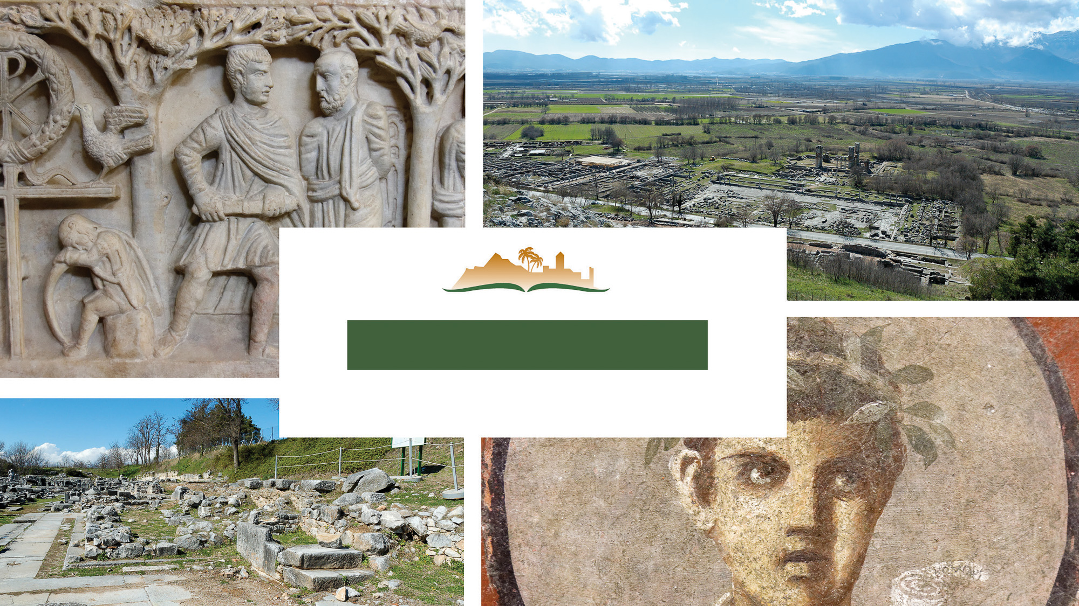
Philippians 4
Notes:
This is a free sample of the Philippians 4 presentation from the Photo Companion to the Bible. To purchase the full volume, visit https://www.bibleplaces.com/philippians/
The Photo Companion to the Bible is an image-rich resource for Bible students, teachers, and researchers. Just as a librarian stocks the shelves with as many relevant materials as possible, so we have tried to provide a broad selection of images. Our goal is that you will find in this “library” whatever it is you are looking for.
Credits: The primary creators of this presentation are Christian Locatell, Steven D. Anderson, Kris Udd, and Todd Bolen. The photographs have an individual file code which usually includes the initials of the photographer. Other images have additional credit or source information.
Updates: We plan to update this collection as we are able. We welcome your suggestions for improving this resource (photocompanion@bibleplaces.com). Purchasers of the Philippians volume are provided free, lifetime updates to the volume.
Copyright: This photo collection is protected by copyright law and may not be distributed without written permission from BiblePlaces.com. Slide notes should be treated as any other copyrighted written material, with credit given when quoting from these notes.
For more information, see our complete “Introduction to the Photo Companion to the Bible” online at https://www.BiblePlaces.com/Intro-Photo-Companion-Bible/. Here you will find more information about photo selection, explanatory notes, Bible translation, credit information, and copyright allowances.

Slide 2
Philippians 4
This is a free sample of the Philippians 4 presentation from the Photo Companion to the Bible. To purchase the full volume, visit https://www.bibleplaces.com/philippians/ The Photo Companion to the Bible is an image-rich resource for Bible students, teachers, and researchers. Just as a librarian stocks the shelves with as many relevant materials as possible, so we have tried to provide a broad selection of images. Our goal is that you will find in this “library” whatever it is you are looking for. For more details (for this and every slide), see the Notes section below.
Notes:
This is a free sample of the Philippians 4 presentation from the Photo Companion to the Bible. To purchase the full volume, visit https://www.bibleplaces.com/philippians/
The Photo Companion to the Bible is an image-rich resource for Bible students, teachers, and researchers. Just as a librarian stocks the shelves with as many relevant materials as possible, so we have tried to provide a broad selection of images. Our goal is that you will find in this “library” whatever it is you are looking for.
Credits: The primary creators of this presentation are Christian Locatell, Steven D. Anderson, Kris Udd, and Todd Bolen. The photographs have an individual file code which usually includes the initials of the photographer. Other images have additional credit or source information.
Updates: We plan to update this collection as we are able. We welcome your suggestions for improving this resource (photocompanion@bibleplaces.com). Purchasers of the Philippians volume are provided free, lifetime updates to the volume.
Copyright: This photo collection is protected by copyright law and may not be distributed without written permission from BiblePlaces.com. Slide notes should be treated as any other copyrighted written material, with credit given when quoting from these notes.
For more information, see our complete “Introduction to the Photo Companion to the Bible” online at https://www.BiblePlaces.com/Intro-Photo-Companion-Bible/. Here you will find more information about photo selection, explanatory notes, Bible translation, credit information, and copyright allowances.

Slide 3
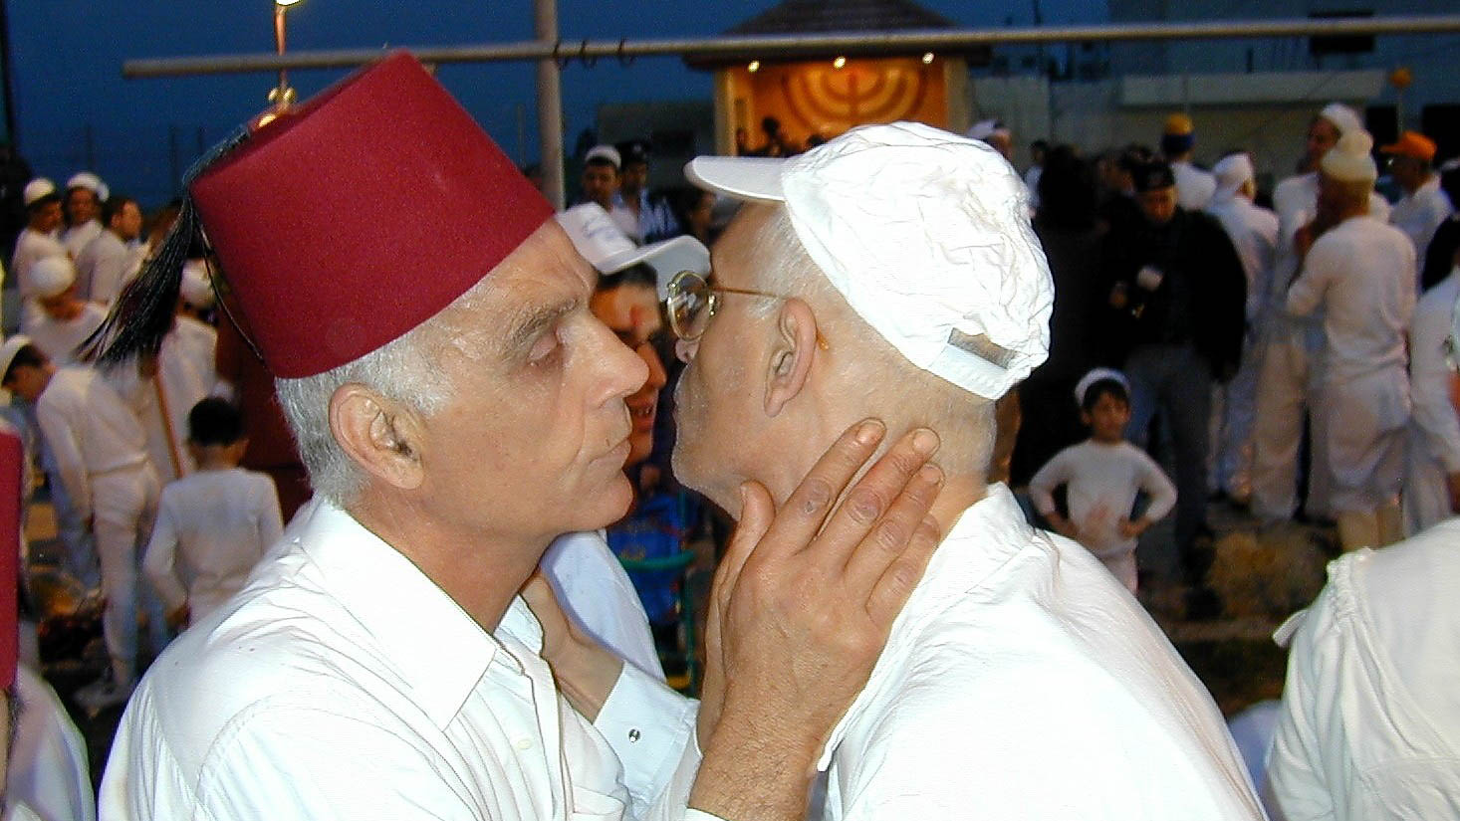
My beloved and longed-for brethren
Samaritans greet one another with kiss
4:1
Notes:
Greeting with a kiss was common in Paul’s day (cf. Rom 16:16; 1 Cor 16:20; 1 Thess 5:26, etc.), as it still is today in some parts of the world. Paul likely longed to embrace and kiss his spiritual brothers and sisters in the Philippian church.
sj041800108h

Slide 4
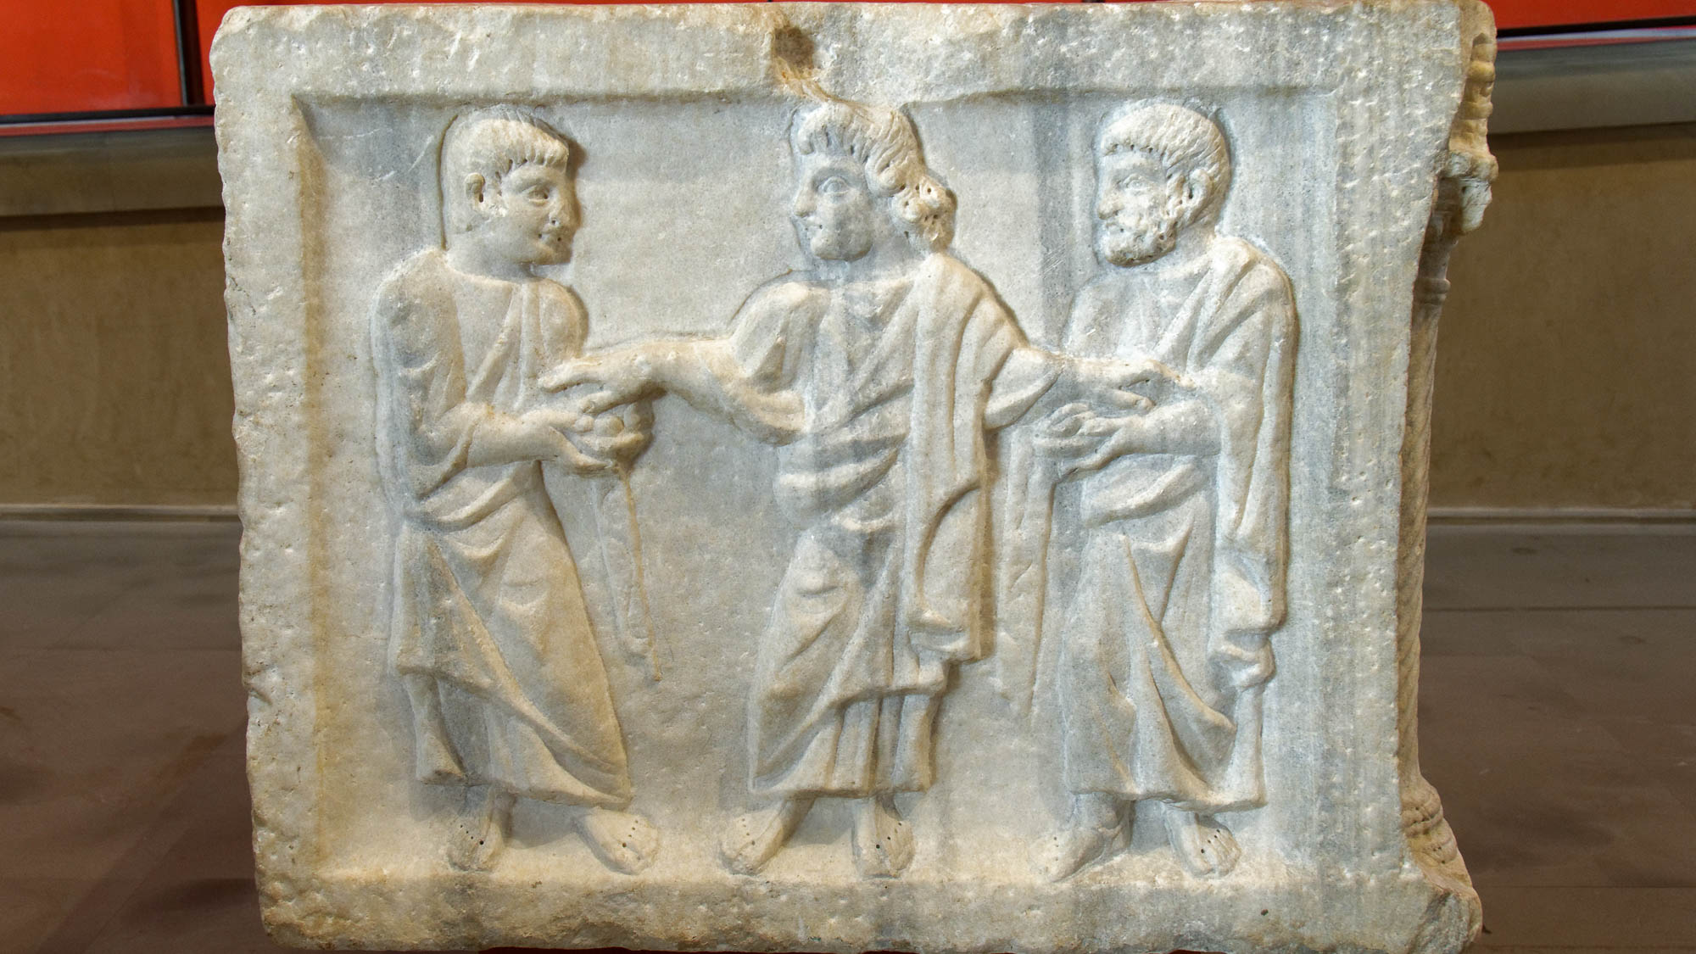
My beloved and longed-for brethren
Relief of three men, from museum in Arles, France
4:1
Notes:
This relief of three men who appear to be close friends was photographed at the Arles Museum.
tb091919193

Slide 5
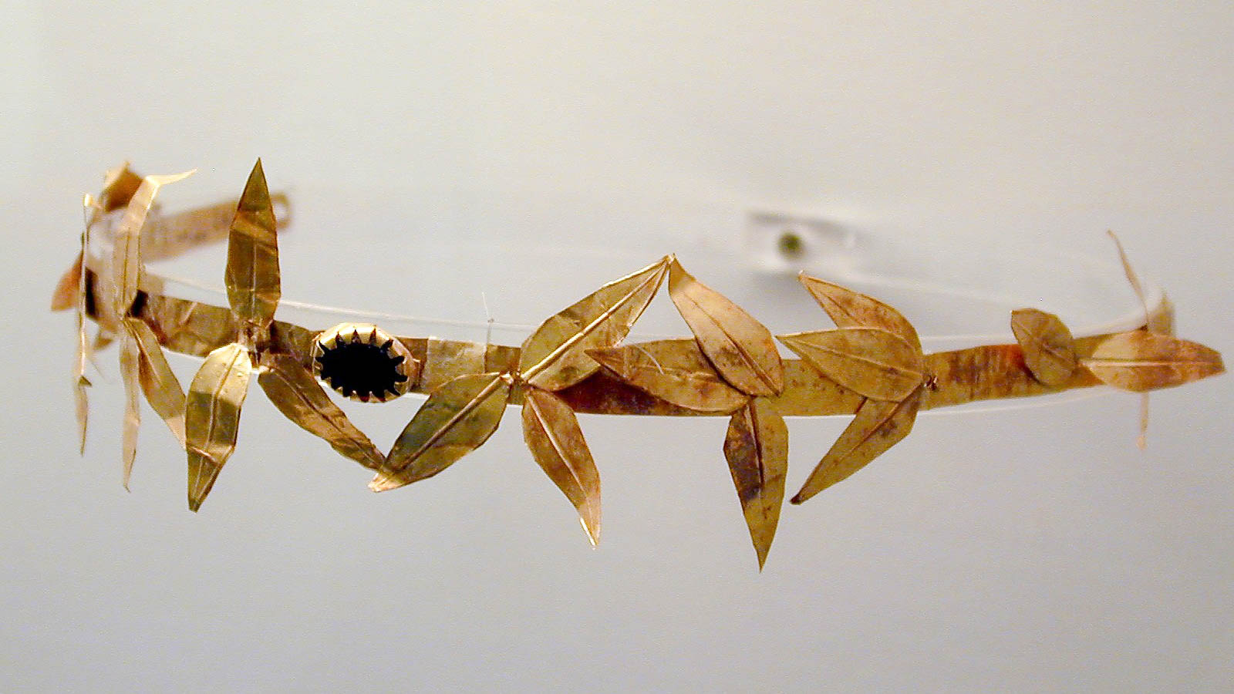
My beloved and longed-for brethren, my joy and crown
Golden crown with olive leaves
4:1
Notes:
When Paul refers to the believers at Philippi as his “crown” (Gk. stephanos, στέφανος), he suggests that they represent a prized possession and the culmination of his work there (cf. 1 Thess 2:19). In Paul’s day, this word was used for a wreath made of foliage (or designed to resemble foliage, like the gold crown in this photo); it was sometimes given as a prize for the winner of an athletic competition, and thus brought status or high regard to the recipient. This crown was photographed at the Amphipolis Museum in Greece.
tb011301134h

Slide 6
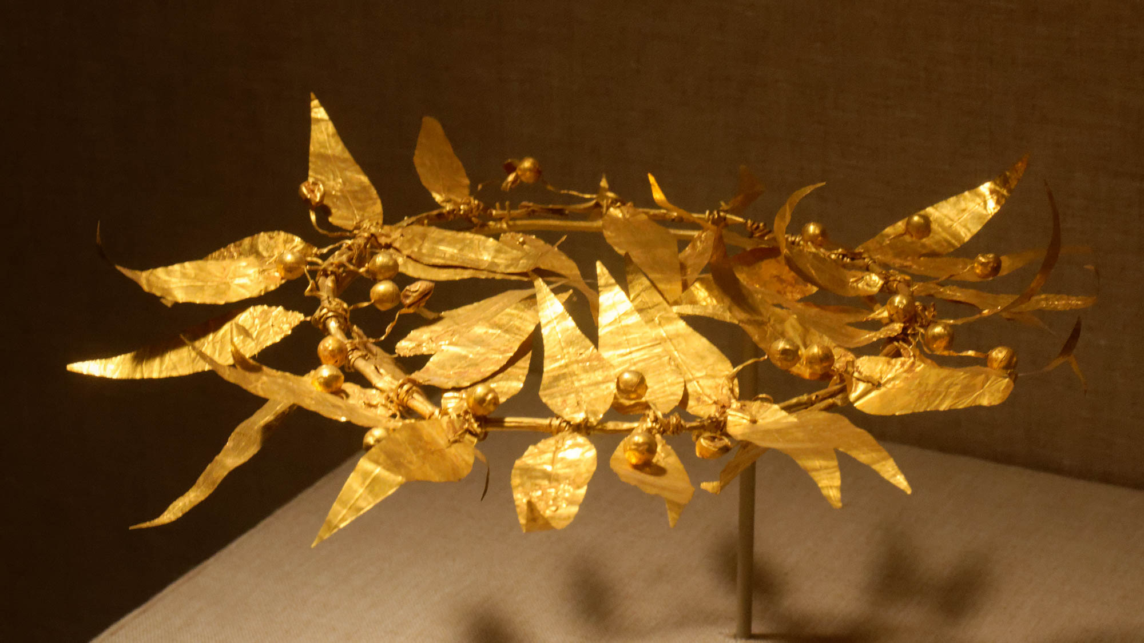
My beloved and longed-for brethren, my joy and crown
Gold wreath of laurel leaves and berries, 4th–1st centuries BC
4:1
Notes:
This wreath was photographed at the San Antonio Museum of Art in Texas.
tb111716918

Slide 7
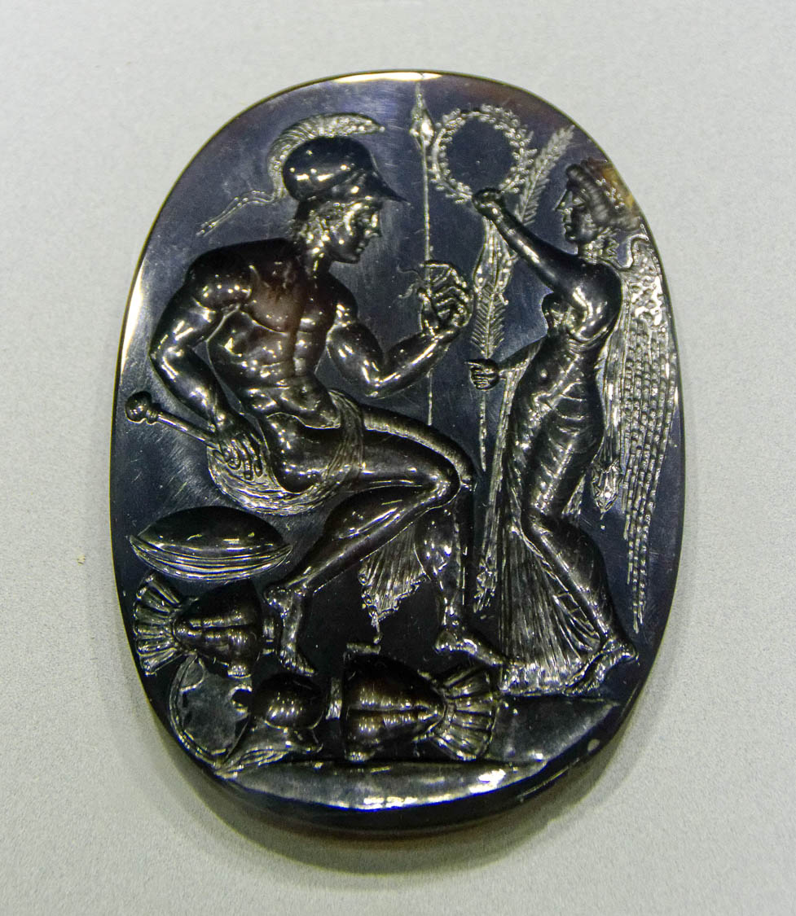
My beloved and longed-for brethren, my joy and crown
Gem depicting Nike crowning Ares
4:1
Notes:
This intaglio gemstone portrays Nike crowning Ares, the Greek god of war, with a foliage-like wreath. This illustrates the honor associated with such an activity, even if the crown itself was made of short-lived organic materials. This gemstone was photographed at the Naples Archaeological Museum.
tb0515171224h

Slide 8
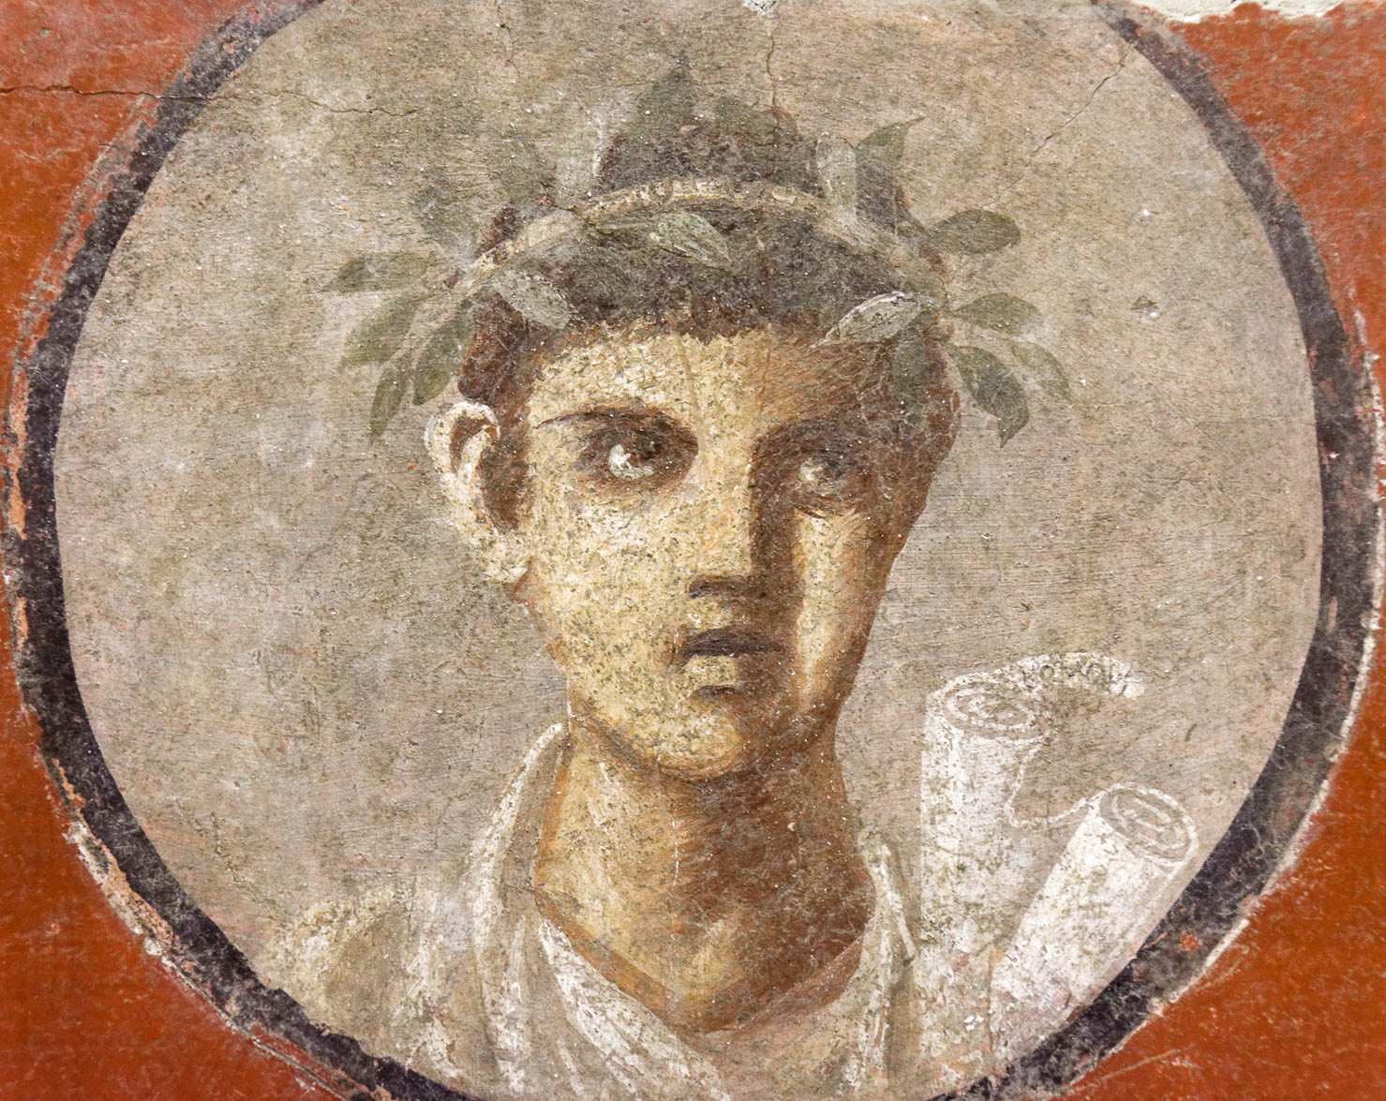
My beloved and longed-for brethren, my joy and crown
Fresco of a young poet awarded a garland for a literary contest, from Pompeii, 1st century AD
4:1
Notes:
This fresco depicts a young man who has been awarded a crown for a literary contest. One of the rolls in his hand bears a tag with the name of the famed philosopher Plato. This fresco comes form the House of the Cenaculum in Pompeii and was photographed at the Naples Archaeological Museum.
tb0515170308

Slide 9
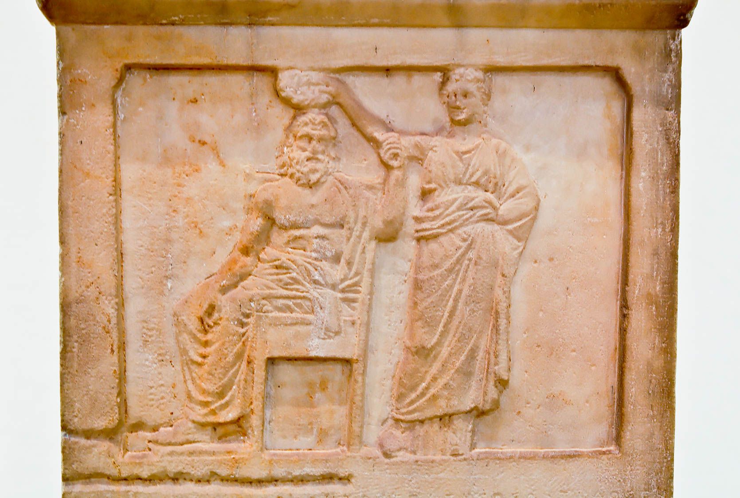
My beloved and longed-for brethren, my joy and crown
Stele of Democracy crowning Demos, from Athens, 336 BC
4:1
Notes:
This stele from Athens depicts Democracy (personified as a woman) placing a crown on Demos, the personification of the ruling body of free citizens in Athens. Paul’s audience at Philippi would have been familiar with such practices and would have understood his statement through such a lens. This stele was photographed at the Museum of the Ancient Agora in Athens.
tb031806399h

Slide 10
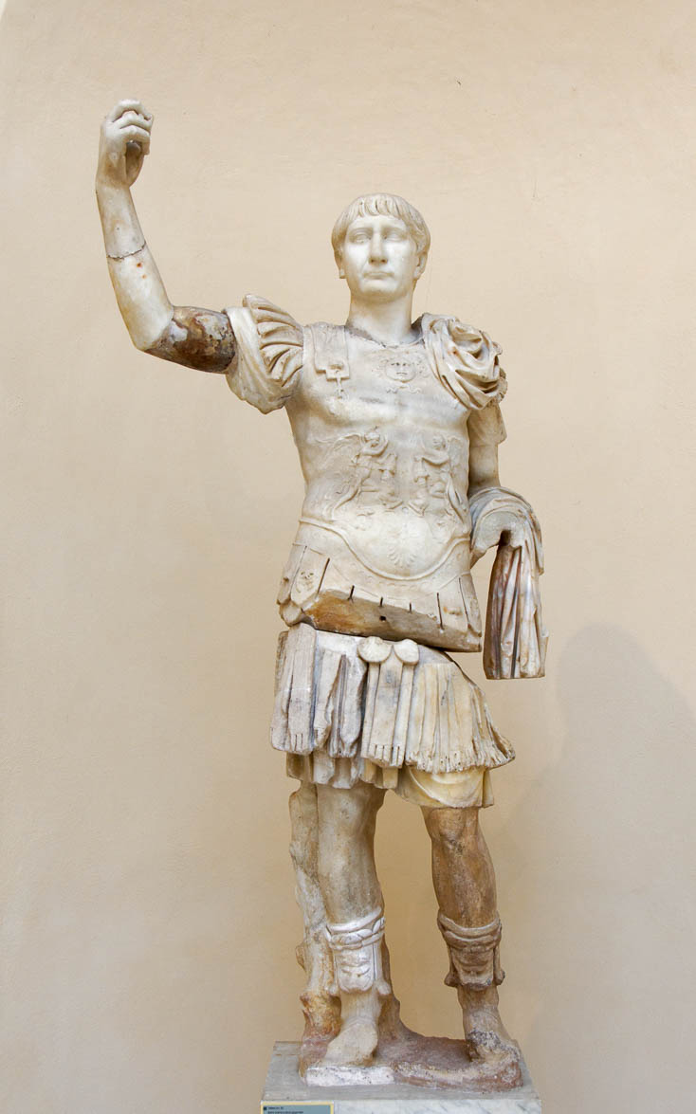
Stand firm in the Lord, my beloved
Statue of Trajan in military gear, 2nd century AD
4:1
Notes:
To “stand firm” (Gk. stēkō, στήκω) is to take a standing posture in a position of strength. The alternative would be to waver and fall (cf. Rom 14:4). Paul uses the word metaphorically to exhort the Philippian believers to remain firmly committed to their faith in Jesus. This statue was photographed at the Ostia Museum in Rome.
tb0517172736

Slide 11
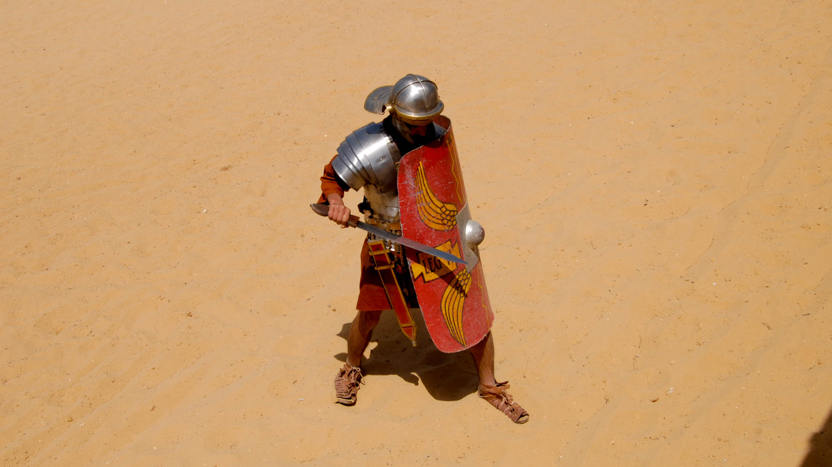
Stand firm in the Lord, my beloved
Roman soldier reenactor in the Gerasa hippodrome
4:1
Notes:
This Roman soldier reenactor demonstrates a strong defensive posture. As a soldier, he is prepared to stand his ground even if attacked, as evidenced by the raised shield, lowered head, and wide stance. The Roman Army and Chariot Experience, pictured here, takes place daily during most of the year at Jerash (Gerasa).
dp041108691

Slide 12
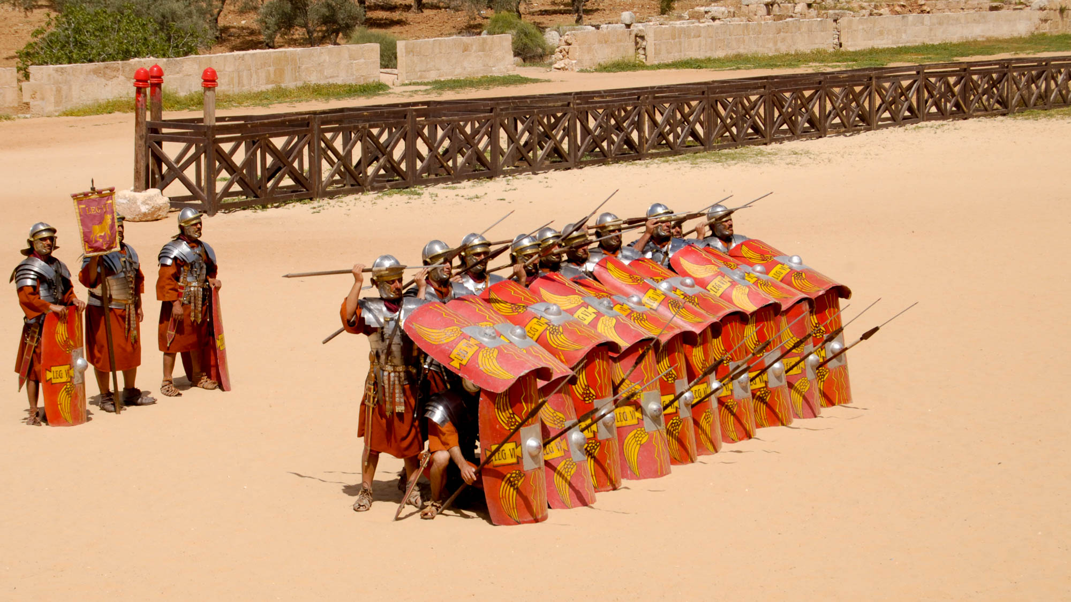
Stand firm in the Lord, my beloved
”Roman soldiers” in the Gerasa hippodrome
4:1
Notes:
dp041108623

Slide 13
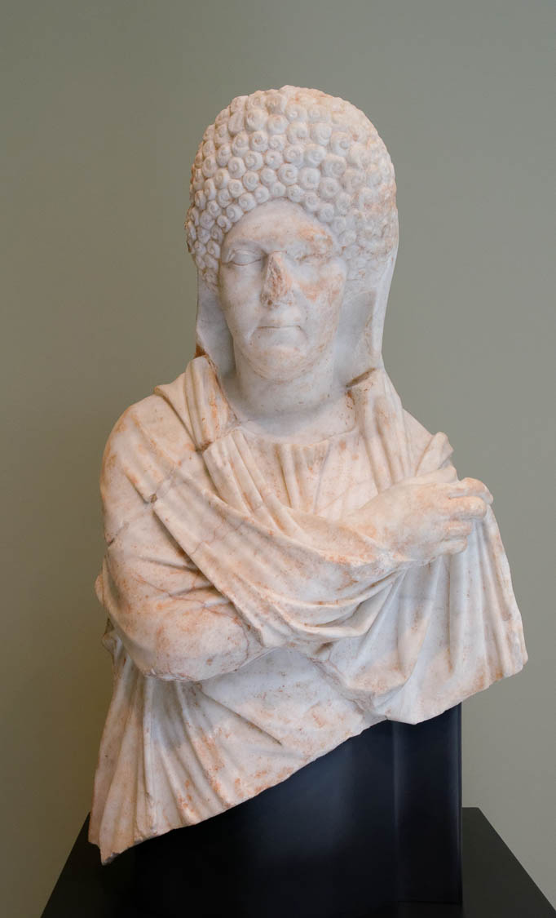
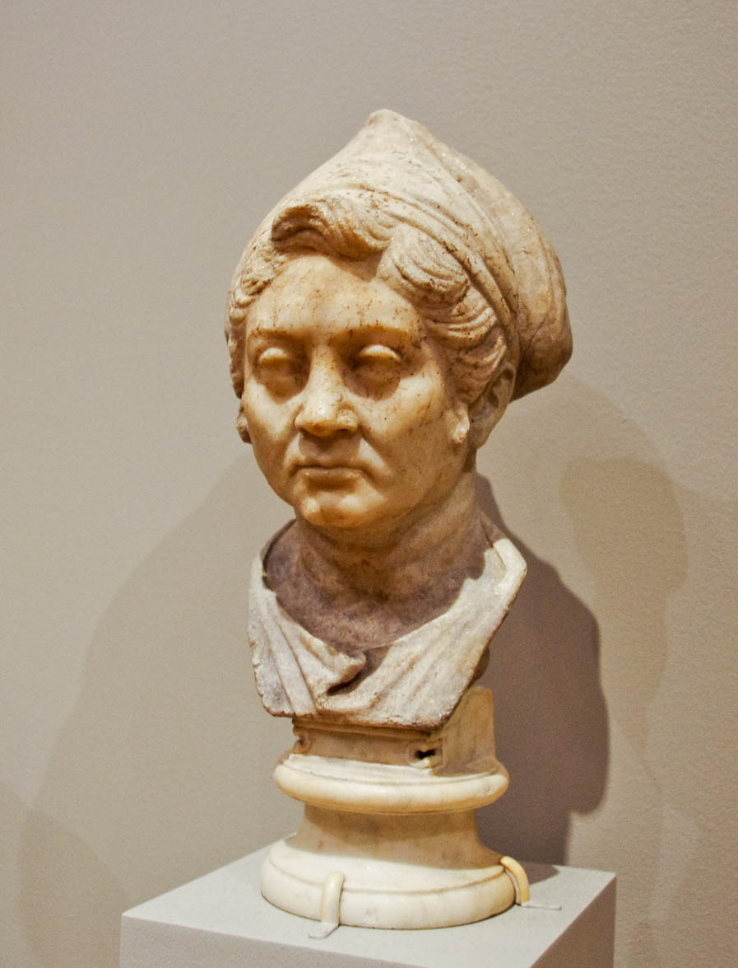
I exhort Euodia and I exhort Syntyche to be of the same mind in the Lord
Roman portraits of women, 1st centuries BC and AD
4:2
Notes:
Both of these names, Euodia (Gk. Εὐοδία) and Syntyche (Gk. Συντύχη), are feminine, indicating that the quarrel to which Paul refers was between two women in the church (for unknown reasons the KJV renders the first as Euodias, a male name). Neither woman is mentioned elsewhere in Scripture, nor is the nature of their quarrel known. The marble portrait on the left dates to AD 68–96 and was photographed in the Getty Villa in southern California. The marble portrait on the right dates to 100-50 BC and was photographed in the Michael C. Carlos Museum at Emory University.
left: tb082214842; right: adr1511188839

Slide 14
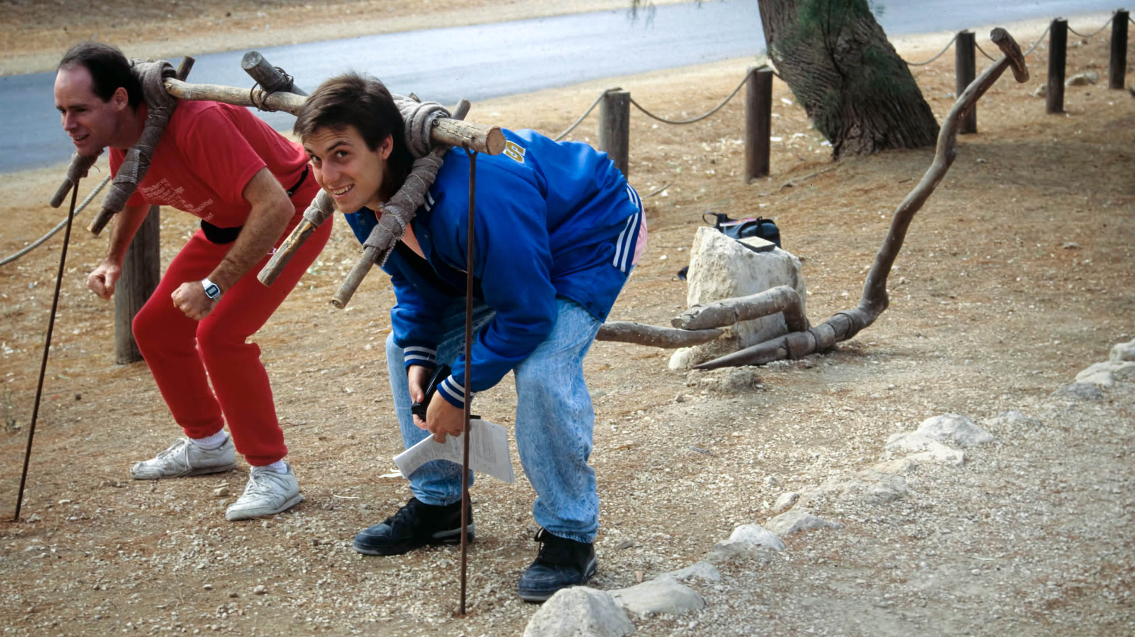
Indeed, I also ask you, true yokefellow
Plow reconstruction
4:3
Notes:
The person addressed by Paul at this point, whom he asks to intervene in the quarrel between Euodia and Syntyche, is not named and is therefore unknown to us. Paul’s reference to him as a “yokefellow” (Gk. suzugos, σύζυγος) would indicate that he was a comrade or companion of Paul. Some scholars have argued that this term should itself be taken as a proper name, but no other instances of this common word have been discovered in which it is a proper name. The two men in this photo have taken the positions under a yoke that would typically be filled by beasts of burden. This reconstruction was photographed at the Ekron Museum.
tbs71279211h

Slide 15
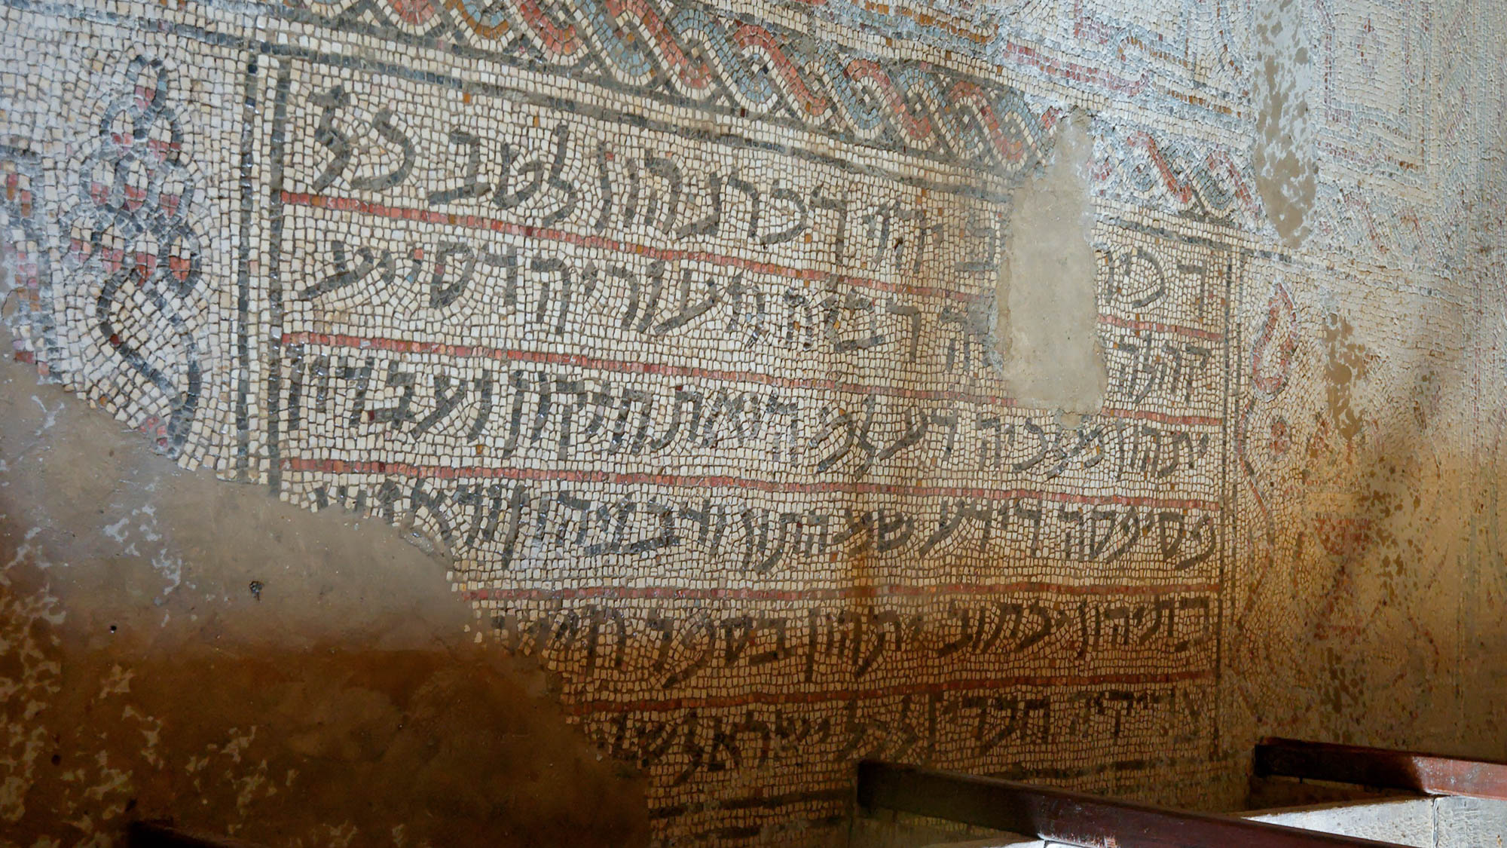
And the rest of my fellow workers, whose names are in the book of life
Mosaic floor with Aramaic inscription, in an ancient synagogue of Jericho
4:3
Notes:
The concept of the “book of life” is mentioned in the Old Testament in Psalm 69:28 [69:29 Heb] and Exodus 32:32. Paul’s use of it here would have also been familiar to the broader Jewish context of his day as seen, for example, in the non-biblical manuscripts of the Dead Sea Scrolls. This background is reflected in this synagogue mosaic from the 6th–7th century AD at Jericho. The phrase “he will write them in the book of life” is highlighted in the next slide.
דכירן לטב יהוי דכרנהון לטב כל
קהלה ק[די]שה רביה וזעוריה דסייע
יתהון מלכיה דעלמה ואתחזקון ועבדון
פסיפסה דידע שמהתון ודבניהון ודאנשי
בתיהון יכתוב יתהון בספר חייה [עם כל]
צדיקיה חברין לכל ישראל של[ום אמן]
‘Remembered for good—may their memory be for good,
all the ho[l]y assembly, the elders and the youth, whom
the King of the Universe has aided and (who) have exerted themselves and made the mosaic. (He) who knows their names and (those) of their children and of the people of their households will write them in the book of life [with all]
the righteous (as) companions for all Israel. Pea[ce! Amen!]’
Translation from Fassberg 2017: 82, citing Naveh 1978: 103–5.
References:
Fassberg, Steven E.
2017 Judeo-Aramaic. Pp. 64–117 in Handbook of Jewish Languages. Revised and updated edition, ed. Lily Kahn and Aaron D. Rubin. Leiden: Brill.
Naveh, Joseph
1978 On Stone and Mosaic: The Aramaic and Hebrew Inscriptions from Ancient Synagogues [על פסיפס ואבן: הכתובות הארמיות והעבריות מבתי-הכנסת העתיקים]. Jerusalem: Israel Exploration Society and Carta.
tb051106779

Slide 16
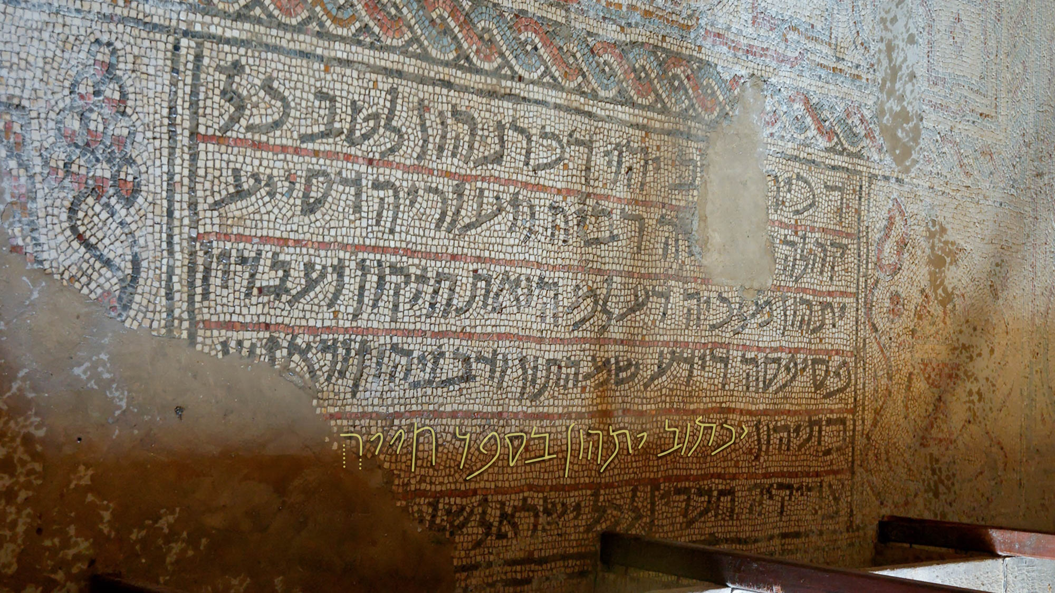
And the rest of my fellow workers, whose names are in the book of life
Mosaic floor with Aramaic inscription, in an ancient synagogue of Jericho
4:3
Notes:
The concept of the “book of life” is mentioned in the Old Testament in Psalm 69:28 [69:29 Heb] and Exodus 32:32. Paul’s use of it here would have also been familiar to the broader Jewish context of his day as seen, for example, in the non-biblical manuscripts of the Dead Sea Scrolls. This background is reflected in this synagogue mosaic from the 6th–7th century AD at Jericho. The phrase “he will write them in the book of life” is highlighted.
דכירן לטב יהוי דכרנהון לטב כל
קהלה ק[די]שה רביה וזעוריה דסייע
יתהון מלכיה דעלמה ואתחזקון ועבדון
פסיפסה דידע שמהתון ודבניהון ודאנשי
בתיהון יכתוב יתהון בספר חייה [עם כל]
צדיקיה חברין לכל ישראל של[ום אמן]
‘Remembered for good—may their memory be for good,
all the ho[l]y assembly, the elders and the youth, whom
the King of the Universe has aided and (who) have exerted themselves and made the mosaic. (He) who knows their names and (those) of their children and of the people of their households will write them in the book of life [with all]
the righteous (as) companions for all Israel. Pea[ce! Amen!]’
Translation from Fassberg 2017: 82, citing Naveh 1978: 103–5. An editable version is included behind this graphic.
References:
Fassberg, Steven E.
2017 Judeo-Aramaic. Pp. 64–117 in Handbook of Jewish Languages. Revised and updated edition, ed. Lily Kahn and Aaron D. Rubin. Leiden: Brill.
Naveh, Joseph
1978 On Stone and Mosaic: The Aramaic and Hebrew Inscriptions from Ancient Synagogues [על פסיפס ואבן: הכתובות הארמיות והעבריות מבתי-הכנסת העתיקים]. Jerusalem: Israel Exploration Society and Carta.
tb051106779

Slide 17
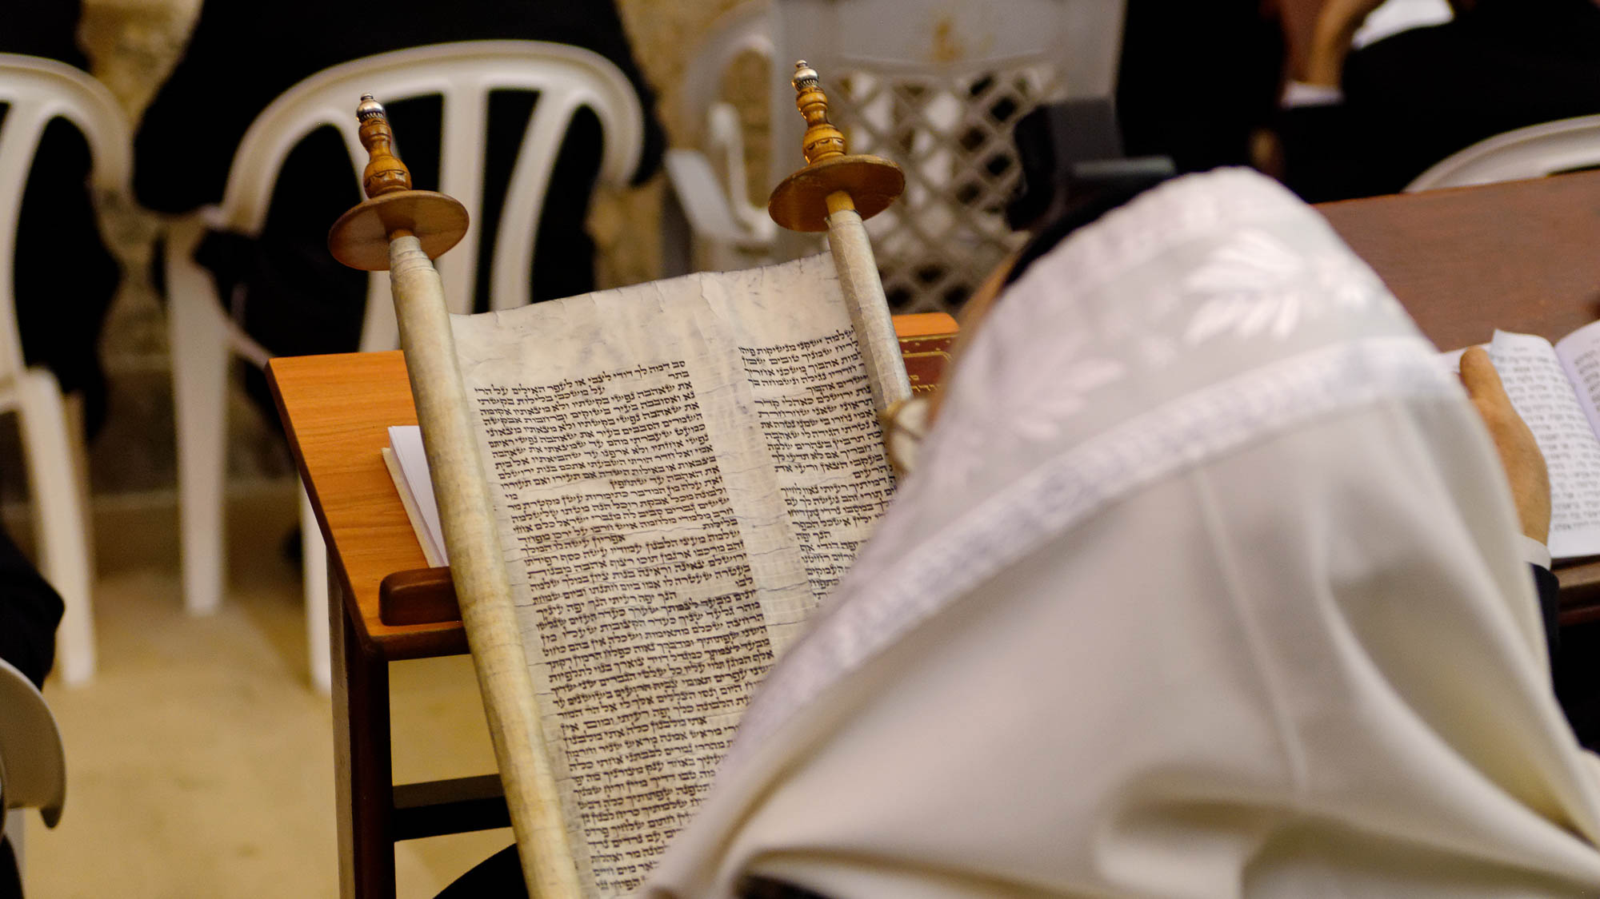
And the rest of my fellow workers, whose names are in the book of life
Man reading from a Hebrew scroll, at the Western Wall in Jerusalem
4:3
Notes:
Paul’s audience would have certainly thought of the “book” as a scroll, since the codex had not yet become a widespread book form. One of the earliest references to a book of this kind is from the days of Moses (Exod 32:32; cf. Ps 69:28).
cd090918031

Slide 18
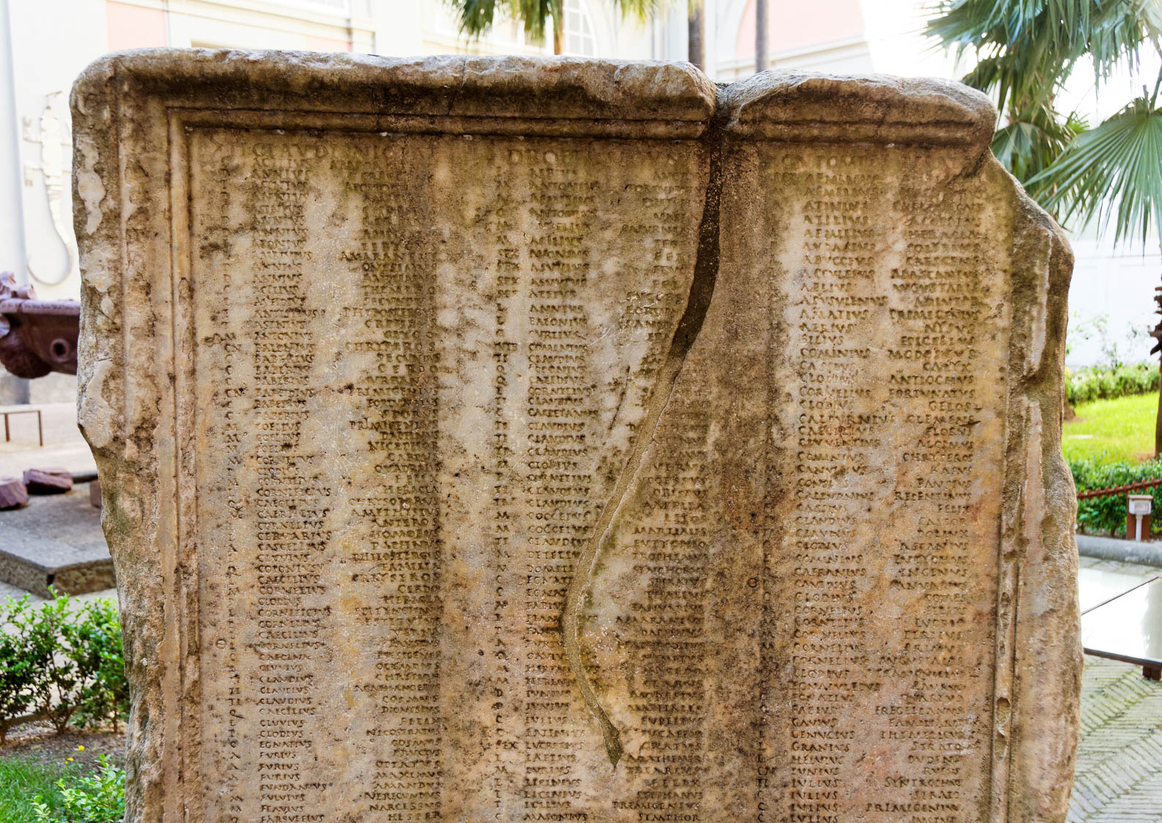
And the rest of my fellow workers, whose names are in the book of life
Latin inscription with names of Roman soldiers
4:3
Notes:
This inscription, photographed in the Fountain Garden at the Naples Archaeological Museum, provides an extended list of names of Roman soldiers. As permanent as an inscription in stone may seem, those whose names are written in heaven’s book of life know a more certain future.
tb0515171004

Slide 19
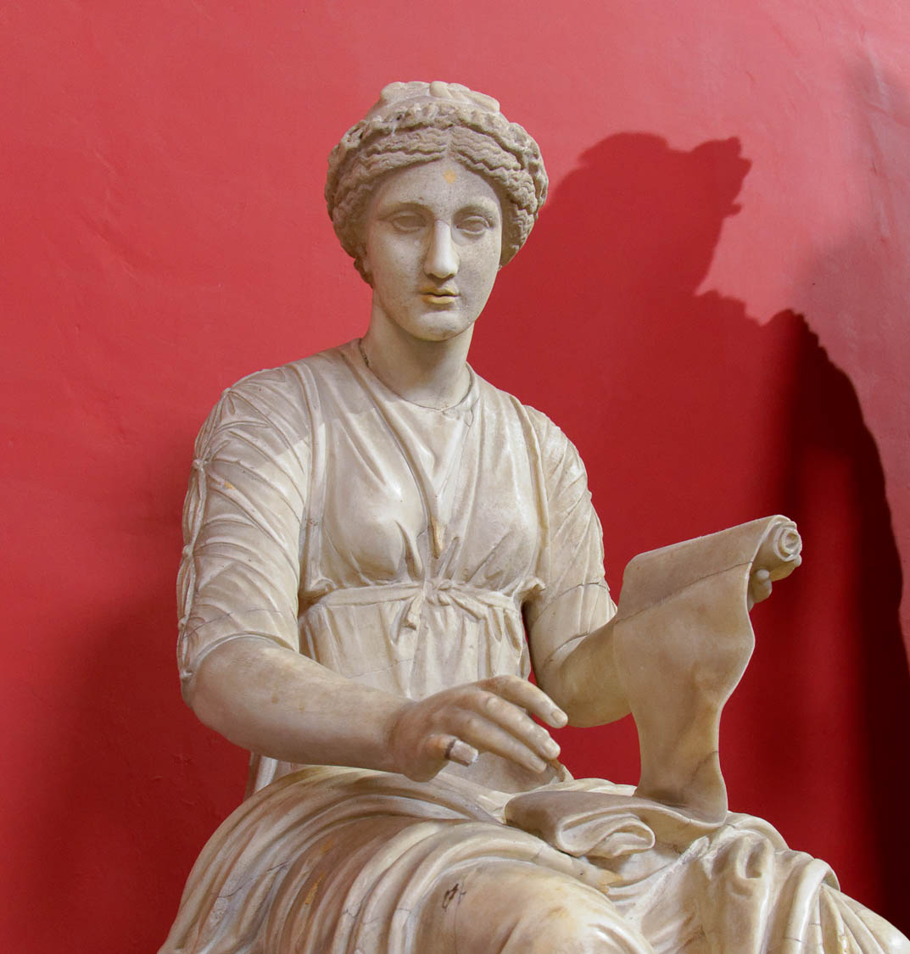
And the rest of my fellow workers, whose names are in the book of life
Statue of Clio, muse of history, with an opened scroll
4:3
Notes:
Perhaps there is some conceptual parallel between this record in heaven and the historical records kept by the muse Clio, whose name means “to recount.” Compare Revelation 20:12, in which “the books” are the source from which the dead are to be judged; these records appear to be historical. This statue was photographed at the Vatican Museums.
tb0512176156h

Slide 20
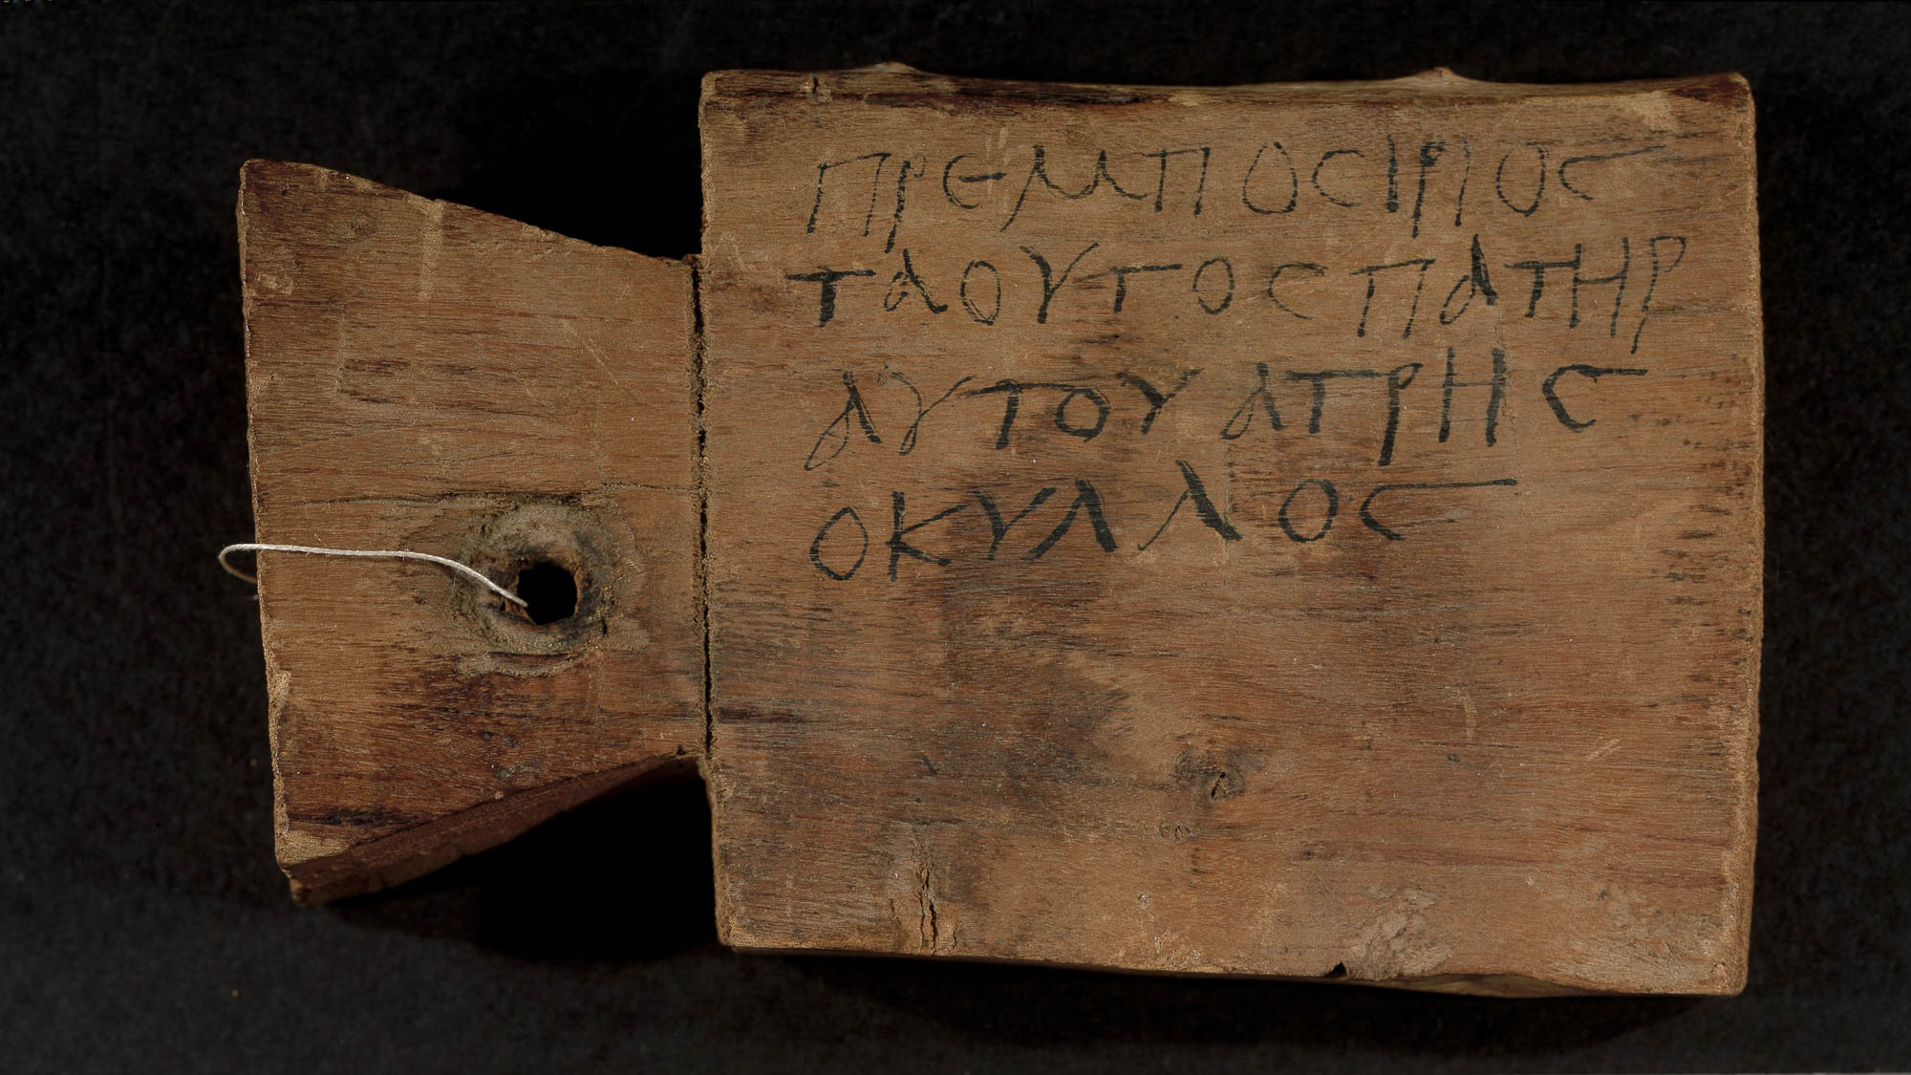
And the rest of my fellow workers, whose names are in the book of life
Wooden mummy tag of Premposirios, 2nd–4th centuries AD
4:3
Notes:
Pagans of Paul’s day were also concerned about the afterlife. In the centuries before and following Paul, the practice in Egypt was to attach a wooden tag to the mummy of the deceased, giving the person’s identity. This was considered to be their passport to eternity. The inscription on this tag reads, “Premposirios, son of Taus; his father (is) Hatres the club-footed” (Gk. πρεμποσιριος τα ουτος πατηρ αυτου ατρης οκυλλος). This image comes from the University of Michigan, Advanced Papyrological Information System, and is in the public domain. Source: http://quod.lib.umich.edu/a/apis/x-3889/4533_9r.tif.
umich4533388926424

Slide 21
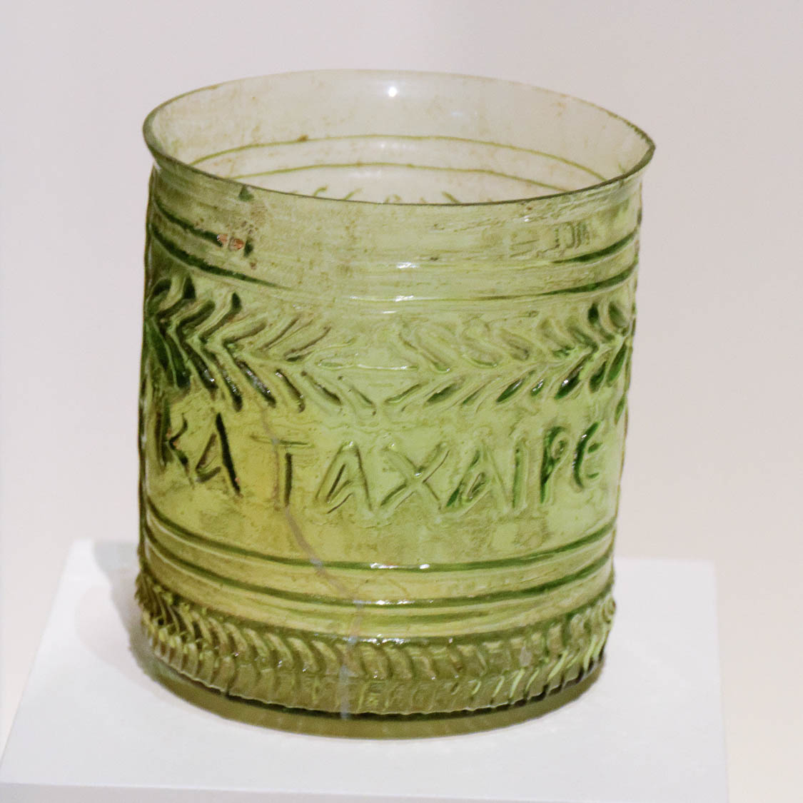
Rejoice in the Lord always! Again, I say rejoice!
Wine cup with Greek inscription, “Rejoice!,” 1st century AD
4:4
Notes:
Paul’s exhortation to the Philippians, “rejoice” (Gk. chairete, χαίρετε), appears on this 1st century AD mold-made glass in a slightly extended singular form, katachaire (καταχαιρε). The inscription on this glass continues on the reverse side; the full inscription reads “Rejoice and be glad!” (καταχαιρε και ευφραινου). This glass wine cup was photographed at the Getty Villa in California.
tb082214467h

Slide 22
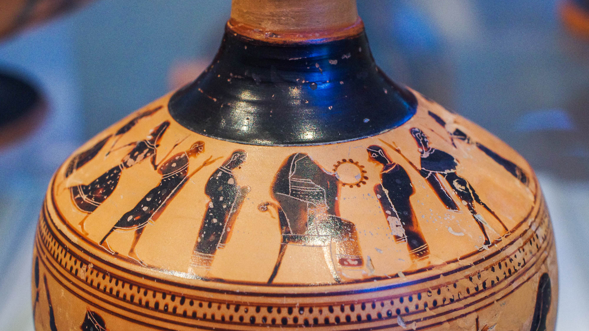
Rejoice in the Lord always! Again, I say rejoice!
Attic black-figure oil flask with dancers and musicians in a wedding procession, 6th century BC
4:4
Notes:
Dancing has long been a form of expressing joy and happiness. This scene on the shoulder of an oil flask depicts a variety of musicians and dancers. It was photographed at the Metropolitan Museum of Art in New York City.
adr1711139332

Slide 23
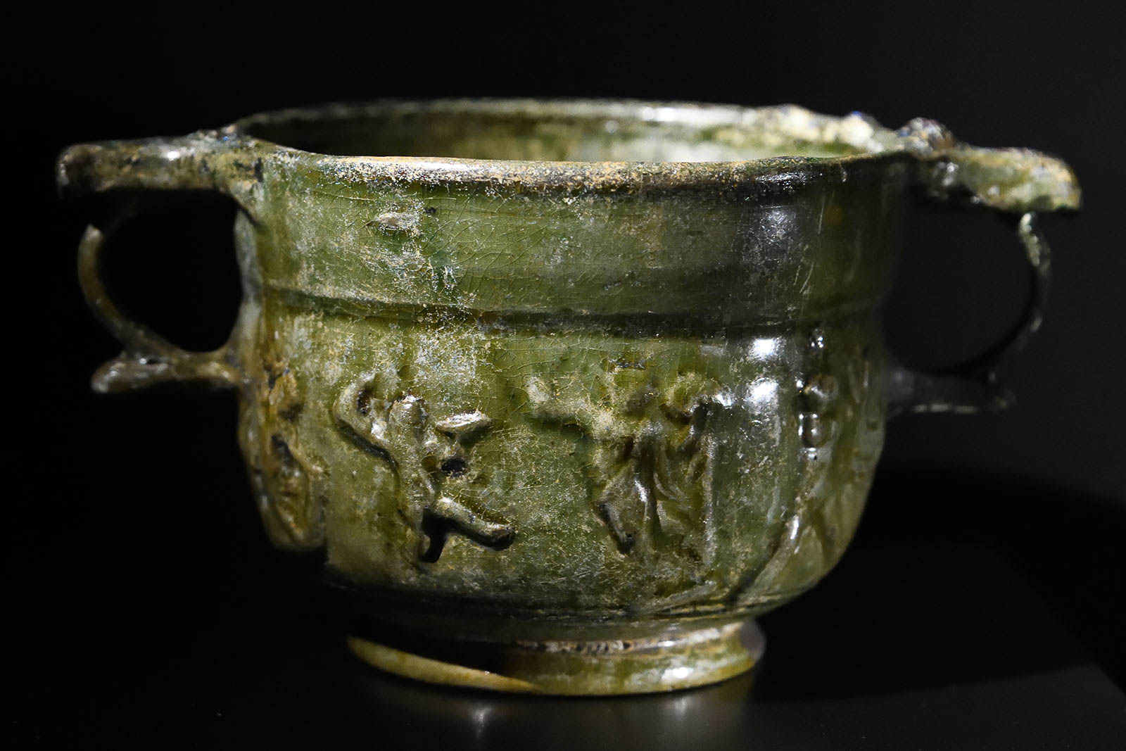
Rejoice in the Lord always! Again, I say rejoice!
Dancers on a two-handled skyphos, 1st century BC – 4th century AD
4:4
Notes:
This skyphos also depicts dancers. It was photographed at the Erimtan Archaeology and Arts Museum in Ankara, Turkey. This image comes from Dosseman and is licensed under CC BY-SA 4.0, via Wikimedia Commons: https://commons.wikimedia.org/wiki/File:Ankara_Archaeology_and_art_museum_Skyphos_Glazed_terracotta_2019_3474.jpg.
wiki070320191505381067

Slide 24
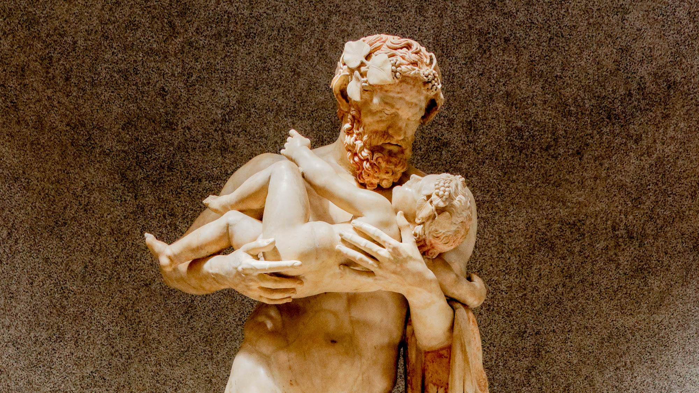
Let your gentleness be known to all men. The Lord is near
Statue of an adult holding a young child, mid-2nd century AD
4:5
Notes:
The word “gentleness” (Gk. epieikēs, ἐπιεικής) carries the idea of being kind, tolerant, and courteous. 1 Peter 2:18 contrasts the “good and gentle” master with the unreasonable one. This statue illustrates the tenderness of an adult with a young child, a fitting example of gentleness or forbearance. This statue is thought to represent the Greek god Silenus holding the child Dionysus. It is likely a 2nd century AD copy of an earlier Greek original. It was photographed at the Vatican Museums.
tb0512176613h

Slide 25
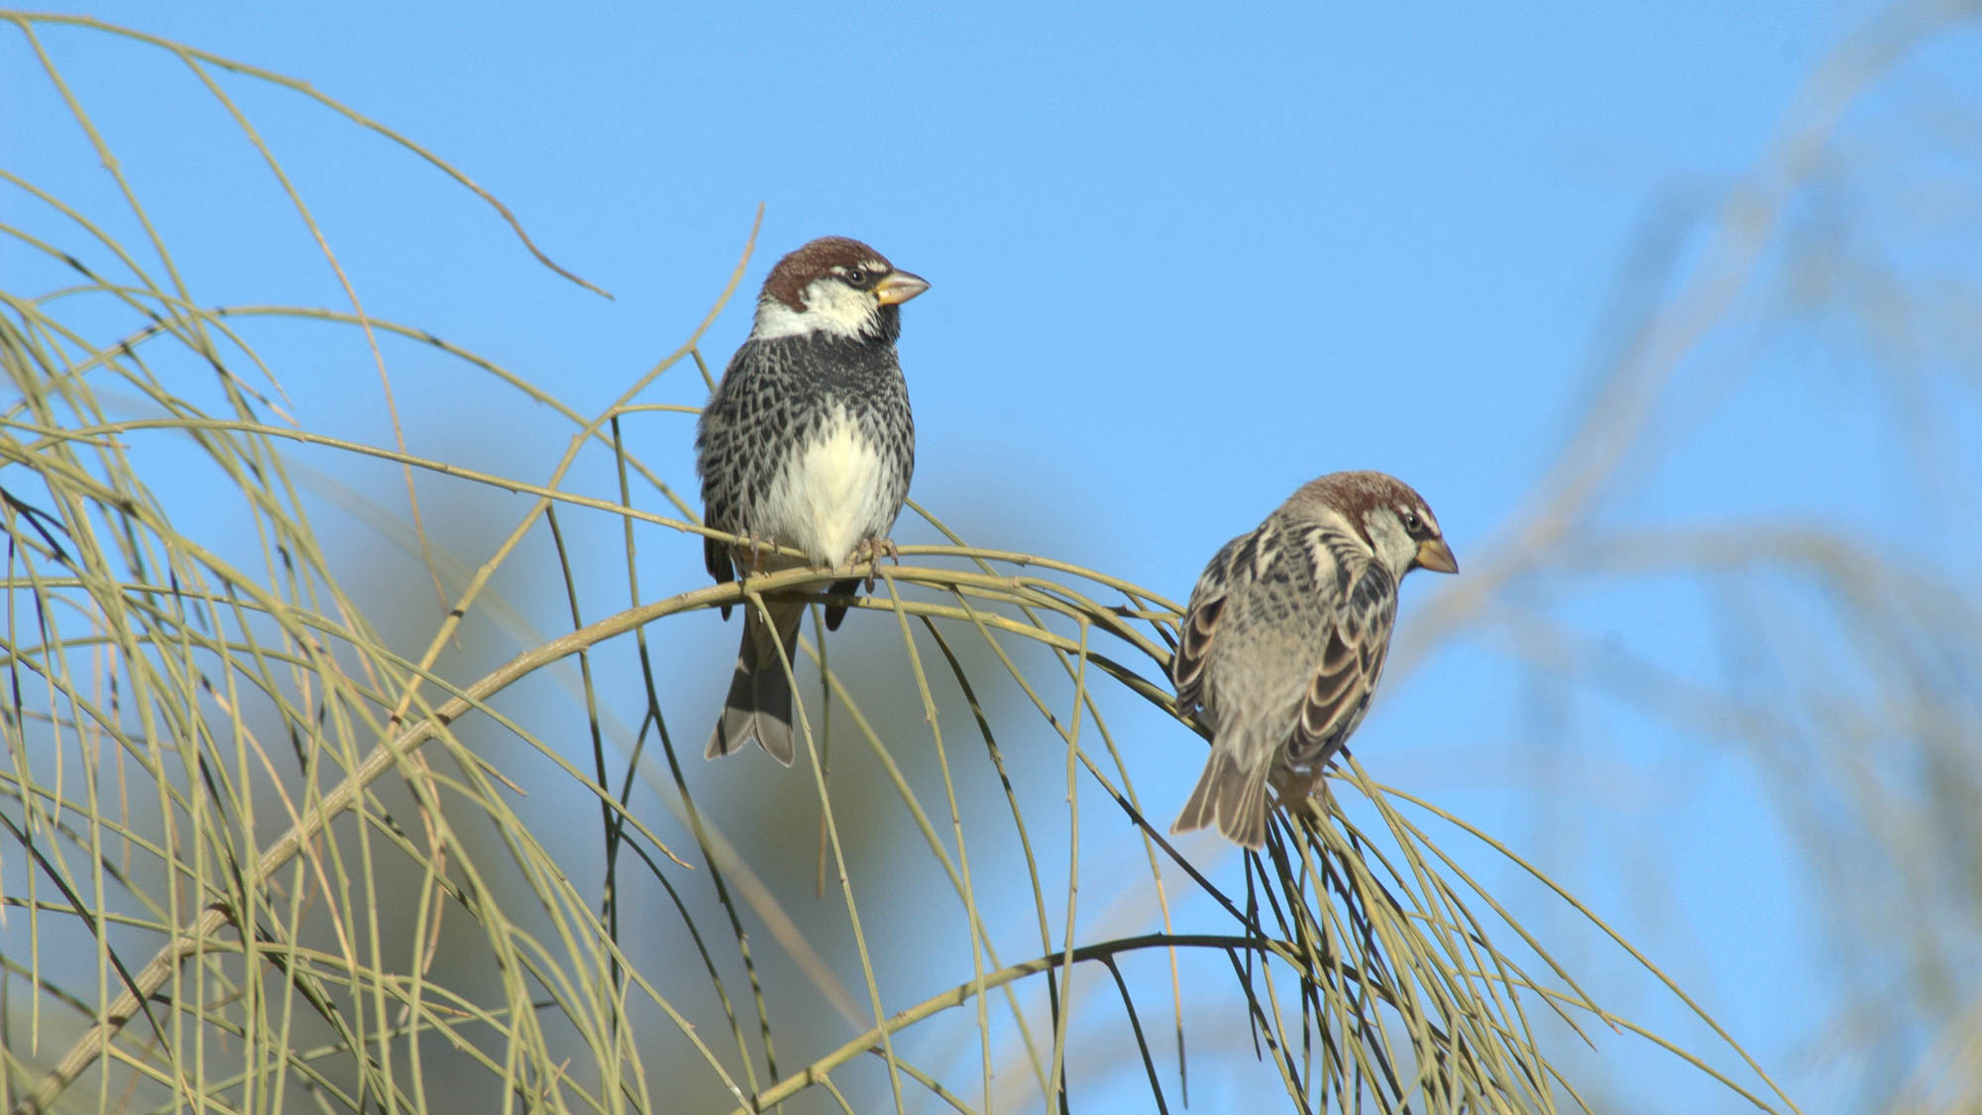
Do not worry about anything
Two male Spanish Sparrows in wilderness of Judah
4:6
Notes:
Jesus used the same word, to “worry” or “be anxious” (Gk. merimnaō, μεριμνάω), when He warned His followers about being consumed by the cares of the day. He pointed to the birds as an example of creatures that do not worry, yet their needs are taken care of by God (Matt 6:25-26). These sparrows were photographed in the southern wilderness of Judah. This image comes from נצח פרביאש and is licensed under CC BY 2.5, via Wikimedia Commons: https://commons.wikimedia.org/wiki/File:PikiWiki_Israel_4292_passer_hispaniolensis.jpg.
wiki0823200912033039

Slide 26
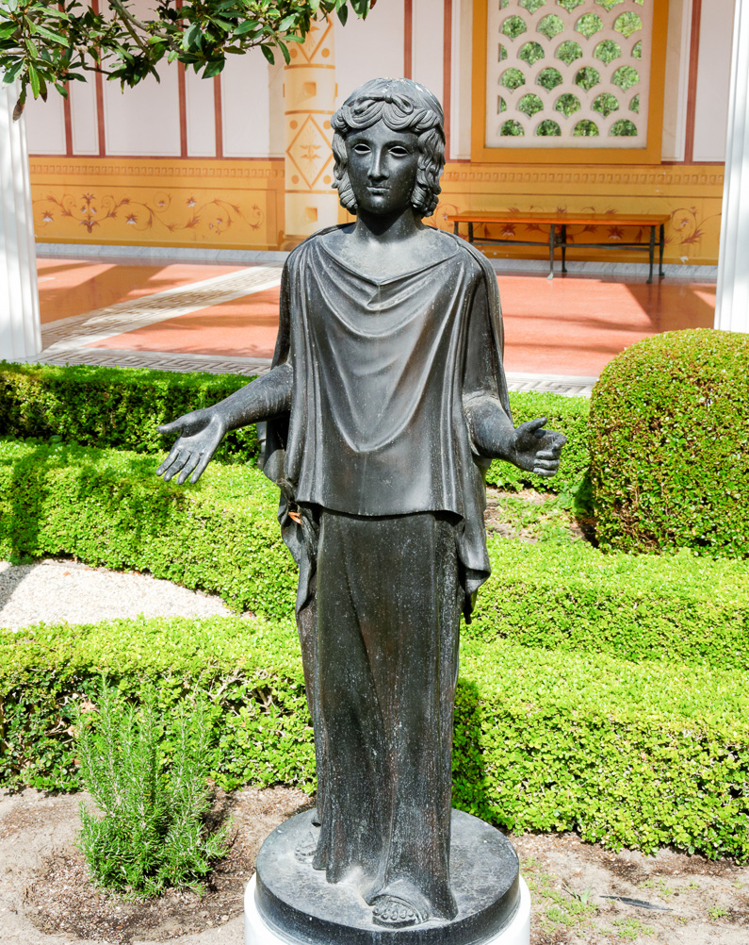
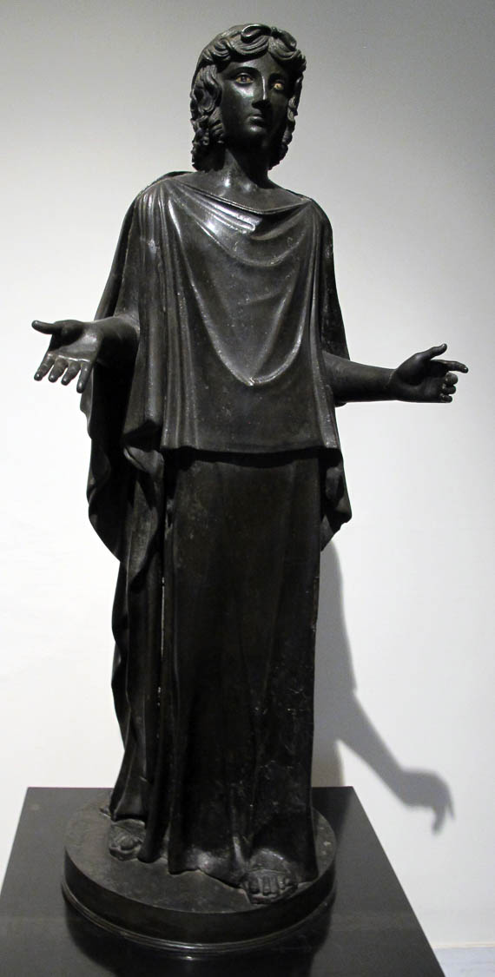
In everything by prayer and supplication with thanksgiving make your requests known to God
Statue of a woman in prayer, from Herculaneum, 1st century AD
4:6
Notes:
This statue (left) and a reproduction of it (right) show the posture of prayer that apparently would have been common in Paul’s day. The statue was discovered in 1754 in the northwest corner of the garden of the Villa of the Papyri at Herculaneum. The image on the left comes from Sailko and is licensed under CC BY SA 3.0, via Wikimedia Commons: https://commons.wikimedia.org/wiki/File:Peplophoros,_da_villa_dei_papiri,_peristilio_rettangolare.JPG. The reproduction on the right was photographed at the Getty Villa in California.
wiki11292013123211 (left); tb082214110 (right)

Slide 27
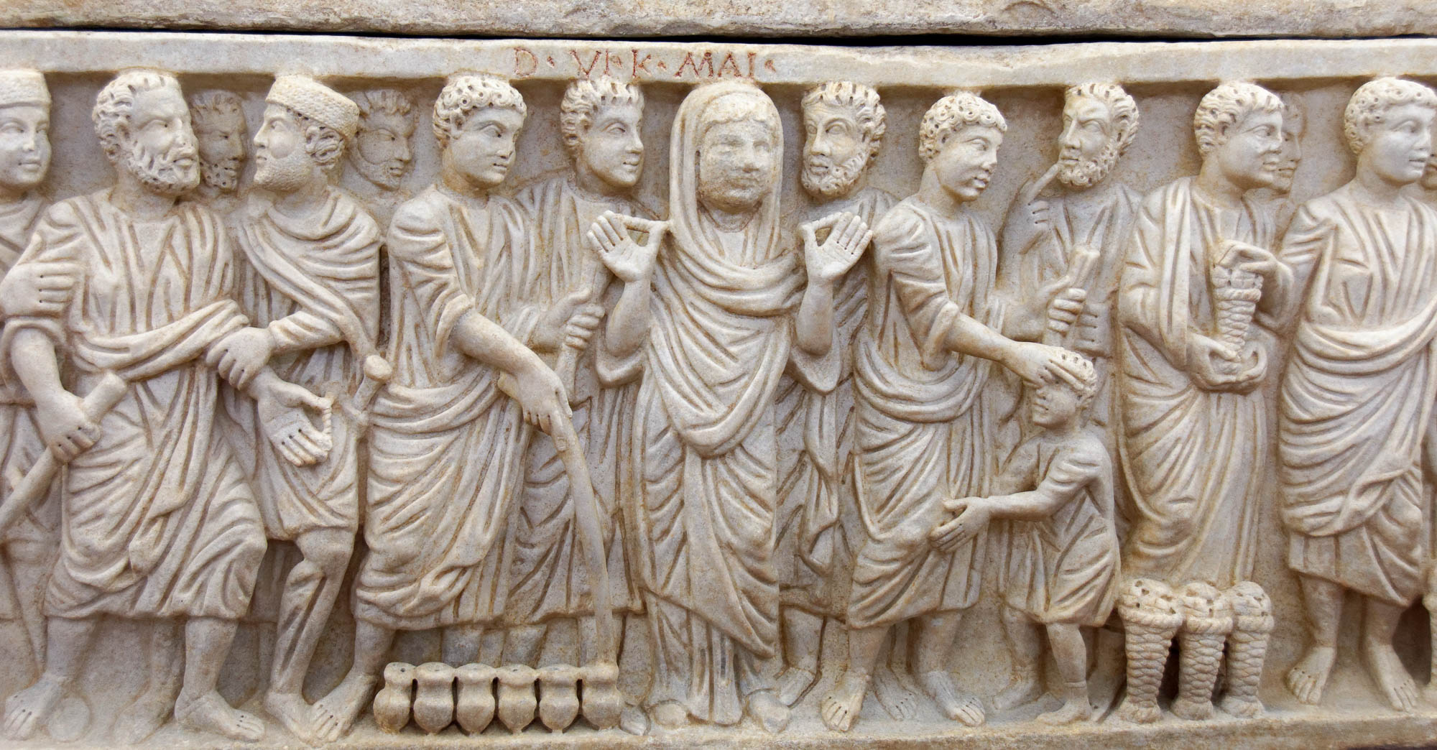
In everything by prayer and supplication with thanksgiving make your requests known to God
Frieze depicting a woman in prayer on the Sarcophagus of Sabinus, early 4th century AD
4:6
Notes:
This frieze contains a depiction of a woman in the stance of prayer. It dates to circa AD 310–320. It was photographed at the Vatican Museums.
tb0512175789

Slide 28
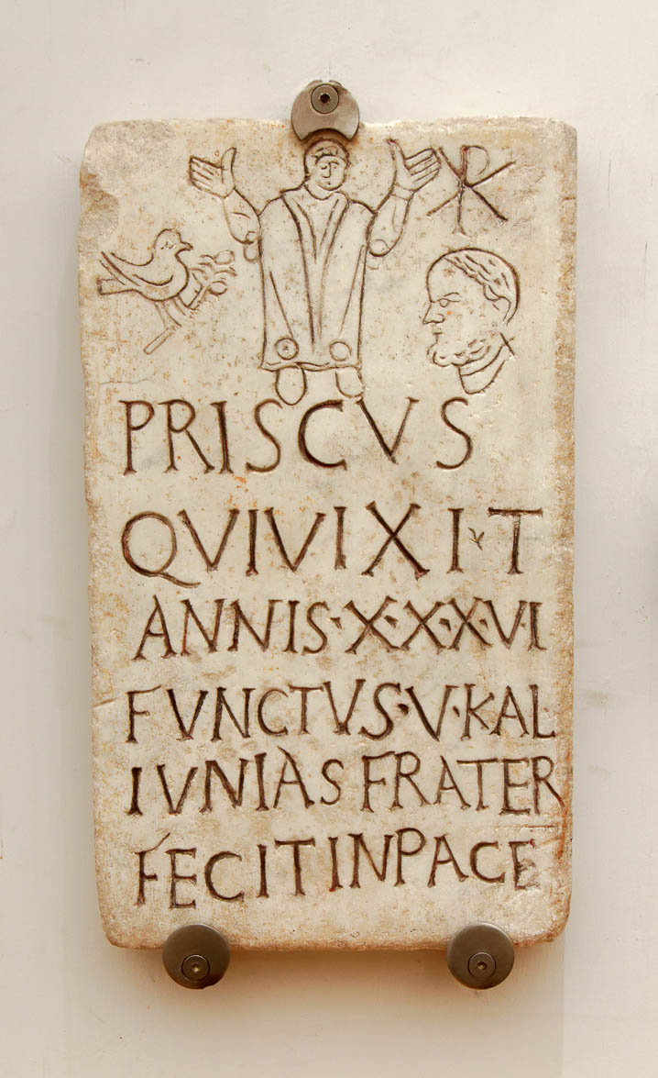
In everything by prayer and supplication with thanksgiving make your requests known to God
Christian funerary inscription with a depiction of the deceased in prayer, 4th century AD
4:6
Notes:
As seen in this depiction from the late 4th-century AD funerary inscription of someone named Priscus, the posture of prayer with hands raised continued to be used by Christians in the early church, as seen from 1 Timothy 2:8 (cf. Pss 28:2; 63:4; 141:2; Neh 8:6). The Chi Rho monogram in the upper right corner identifies the deceased as a Christian. This inscription was photographed at the National Museum in Rome.
tb0513178406

Slide 29
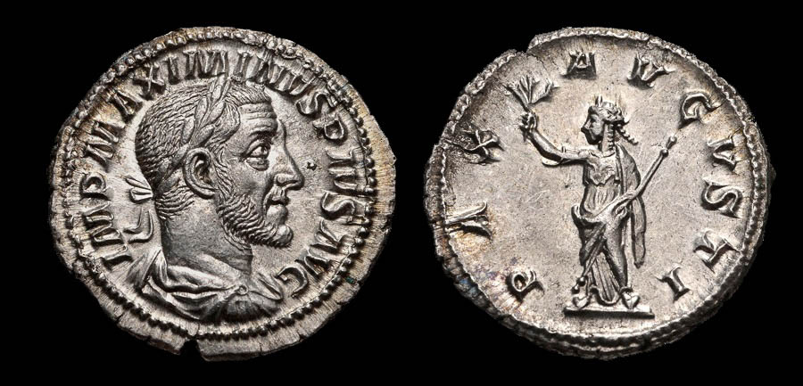
And the peace of God, which exceeds all understanding
Silver denarius depicting the “Peace of Augustus,” Roman mint, AD 236
4:7
Notes:
The Roman people had great pride in the Pax Romana (“Roman Peace”), a period of relative peace beginning with the reign of Augustus (27 BC – AD 14). The coin shown here illustrates the importance of peace to the Romans. The obverse depicts the Roman emperor Maximinus I (r. AD 235 to 238) and reads “Imperator Maximinus Pius Augustus” (IMP MAXIMINUS PIUS AUG). The reverse depicts a figure with a laurel wreath, draped, and wearing a cuirass, holding an olive branch and scepter. It reads “Peace of Augustus” (PAX AUGUSTI). For Paul, of course, it was the work of Christ that inaugurated the greatest peace of all—peace with God (cf. the slides on Rom 12:18). This image comes from Classical Numismatic Group and is licensed under CC-BY-SA-2.5, via Wikimedia Commons: https://commons.wikimedia.org/wiki/File:MAXIMINUS_I-RIC_IV_12-876901.jpg
wiki876901b

Slide 30
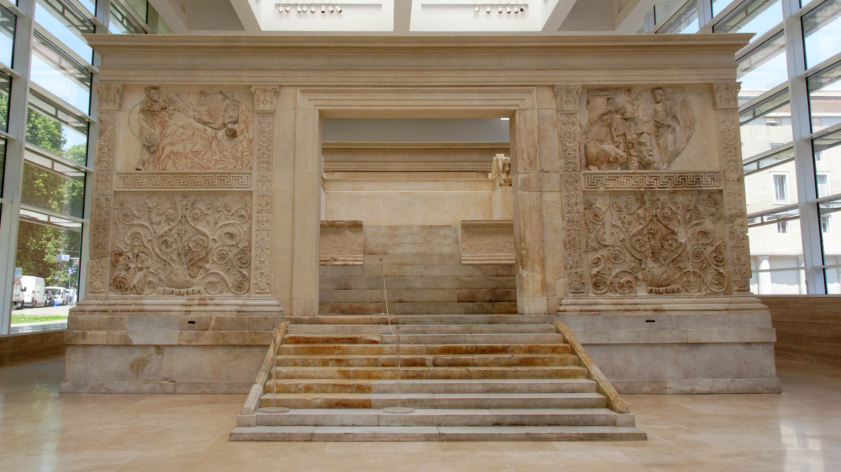
And the peace of God, which exceeds all understanding
Western side of the Ara Pacis Augustae (Augustus’s Altar of Peace)
4:7
Notes:
On January 30, 9 BC, the citizens of Rome dedicated the altar pictured here to Pax, the goddess of peace. It was built in honor of the emperor Augustus. Every year, a ram and two oxen would be sacrificed on the altar. It was originally located on the northern outskirts of Rome. Situated on a former flood plain of the Tiber River, it was gradually buried under 13 feet (4 m) of silt. Built to celebrate the national peace brought about by Augustus, it demonstrates the value the Romans placed on peace. Paul refers to a much greater and more important peace, peace with God.
tb0518173867

Slide 31
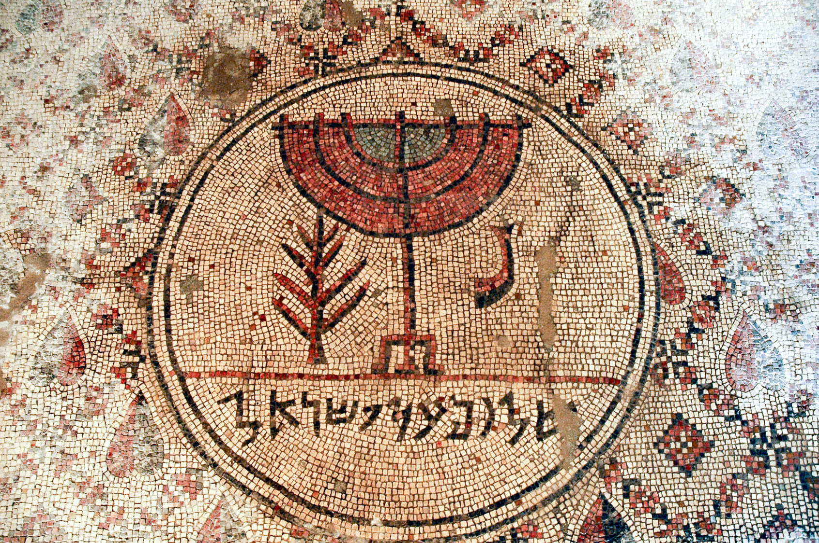
And the peace of God, which exceeds all understanding
“Peace upon Israel” mosaic, from the Jericho synagogue, 6th century AD
4:7
Notes:
Peace was highly valued from a very early time in the Old Testament (e.g., Gen 15:15). It was also an integral part of the blessings of keeping the covenant with God (Lev 26:3-6) and was even part of the priestly blessing (Num 6:26). The legend on this mosaic design reads “Peace be upon Israel” (Heb. shalom al yisrael, שלום על ישראל). It comes from a synagogue that was built in Jericho in the 6th century AD. A yeshiva was established at the site in the early 1990s, but the building was damaged in a riot in 2000 and access today is restricted.
tb051106788h

Slide 32
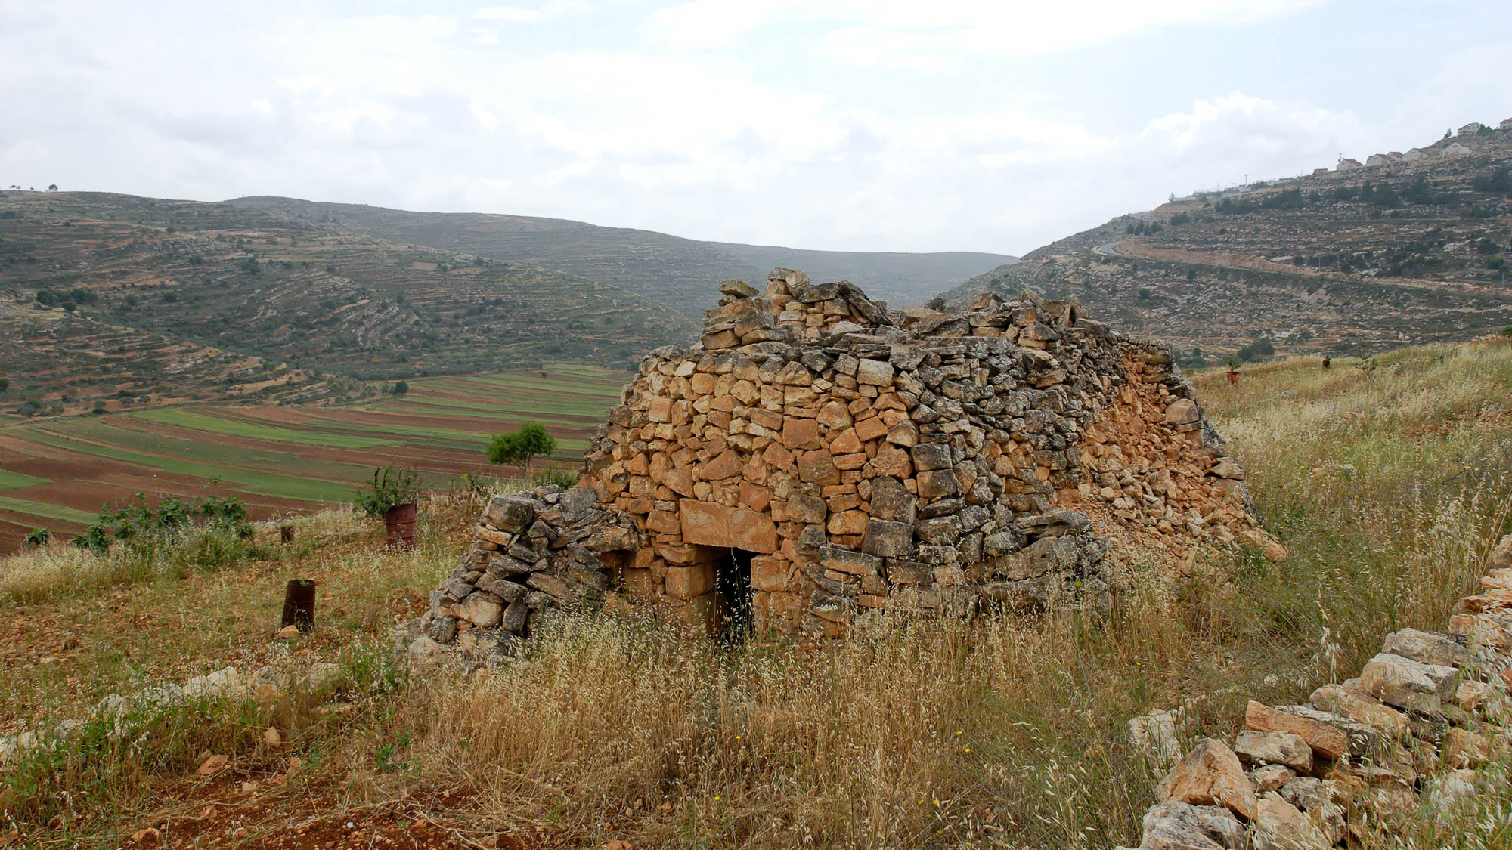
The peace of God . . . will guard your hearts and your minds in Christ Jesus
Watchtower in the hill country of Ephraim
4:7
Notes:
To “guard” (Gk. phroureō, φρουρέω) is to provide security or to protect. Guard towers were common in the land of Israel centuries before the time of Paul. In Paul’s day, such installations were less common due to the peace that resulted from the presence of Rome.
tb051207331

Slide 33
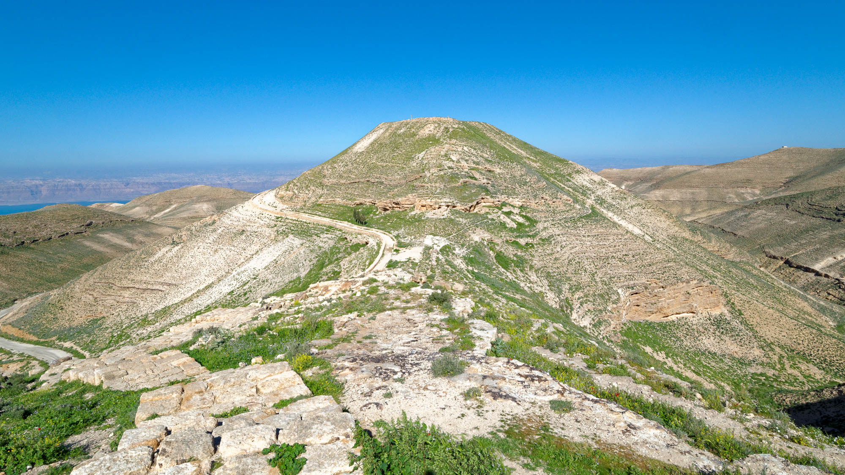
The peace of God . . . will guard your hearts and your minds in Christ Jesus
Herod’s fortress at Macherus (from the southeast)
4:7
Notes:
Herod the Great (r. 37–4 BC) built or enhanced a number of fortresses along the eastern border of his kingdom. The one shown here, Macherus, is located east of the Dead Sea (which is visible in the background at the left). John the Baptist was killed at Herod’s palace here.
tb031415848

Slide 34
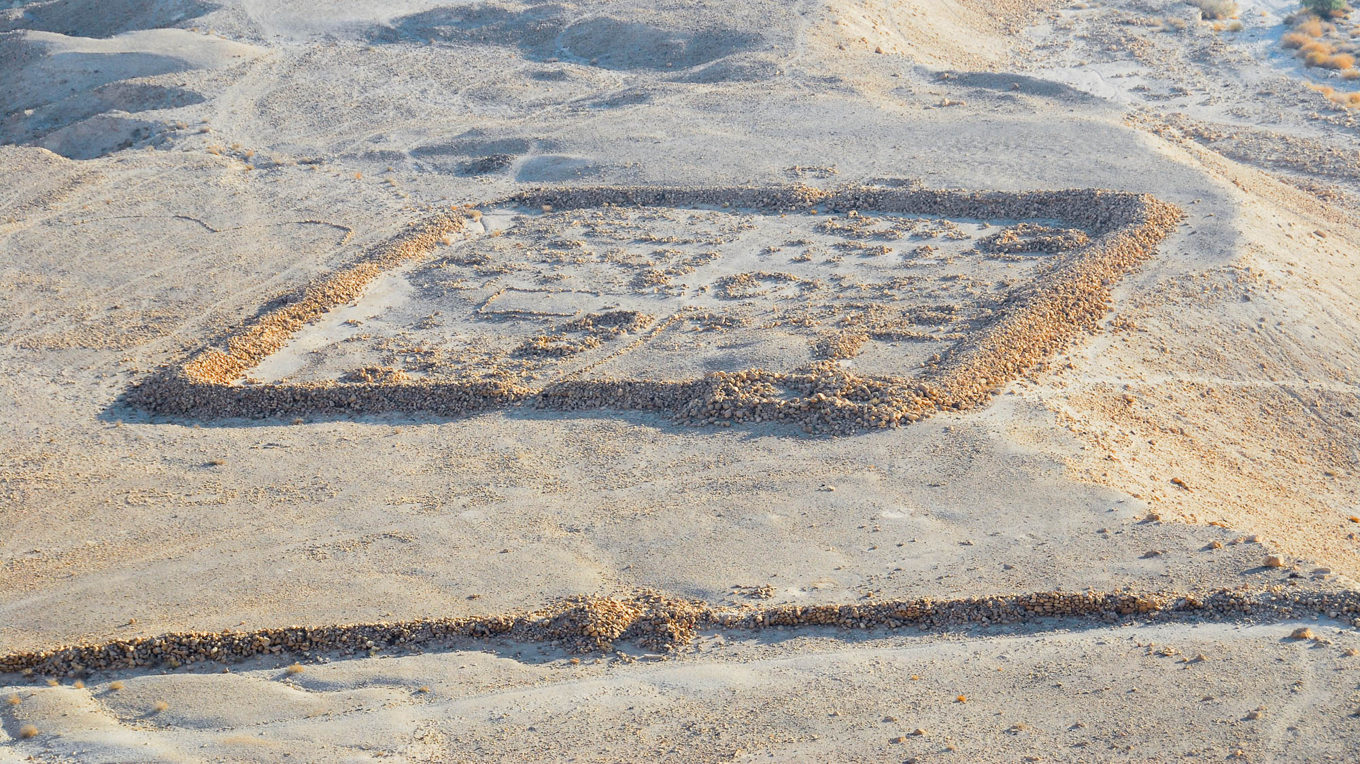
The peace of God . . . will guard your hearts and your minds in Christ Jesus
Roman camp and siege wall at Masada, 1st century AD
4:7
Notes:
The wall running across the lower portion of this photo is part of the siege wall that was built around Masada by the Romans in AD 71–73. It was intended to prevent resupply of the zealots at Masada and to prevent their escape. The wall around the camp, by contrast, was meant to guard and protect the living quarters and supplies of the Romans themselves. A number of similar camps were built around Masada as part of the preparations for the siege.
tb010810969

Slide 35
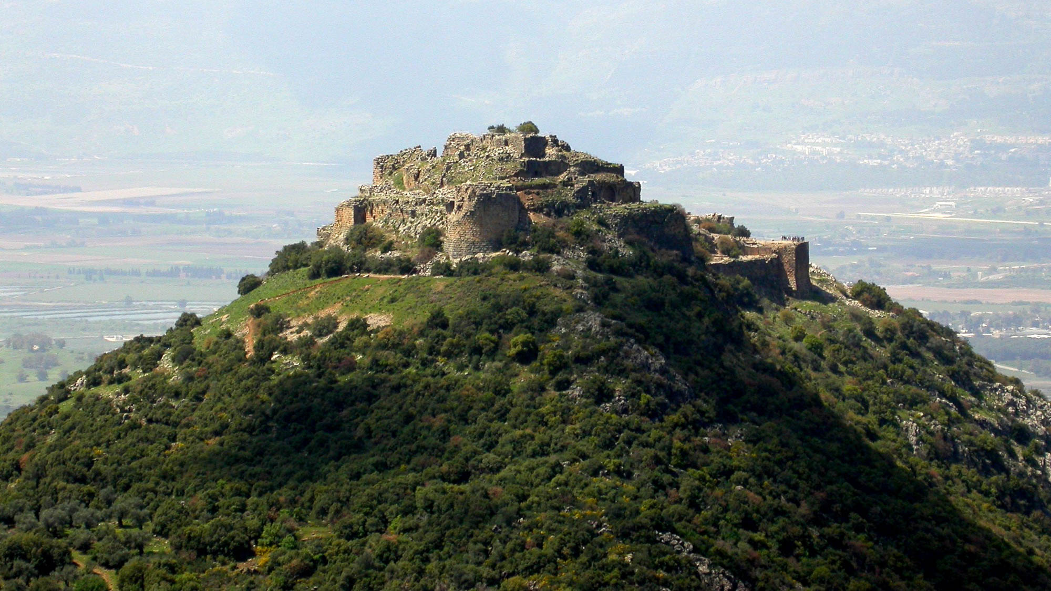
The peace of God . . . will guard your hearts and your minds in Christ Jesus
Nimrod’s Fortress in northern Israel (from the east)
4:7
Notes:
In later times the Crusaders and their opponents built a number of fortresses and castles to guard strategic locations. The fortress shown here is on the lower reaches of Mount Hermon, above the Huleh Valley. It was built by Al-Aziz Uthman, the younger son of Saladin, in the 13th century AD to protect one of the major access routes to Damascus from the west.
tb040903259

Slide 36
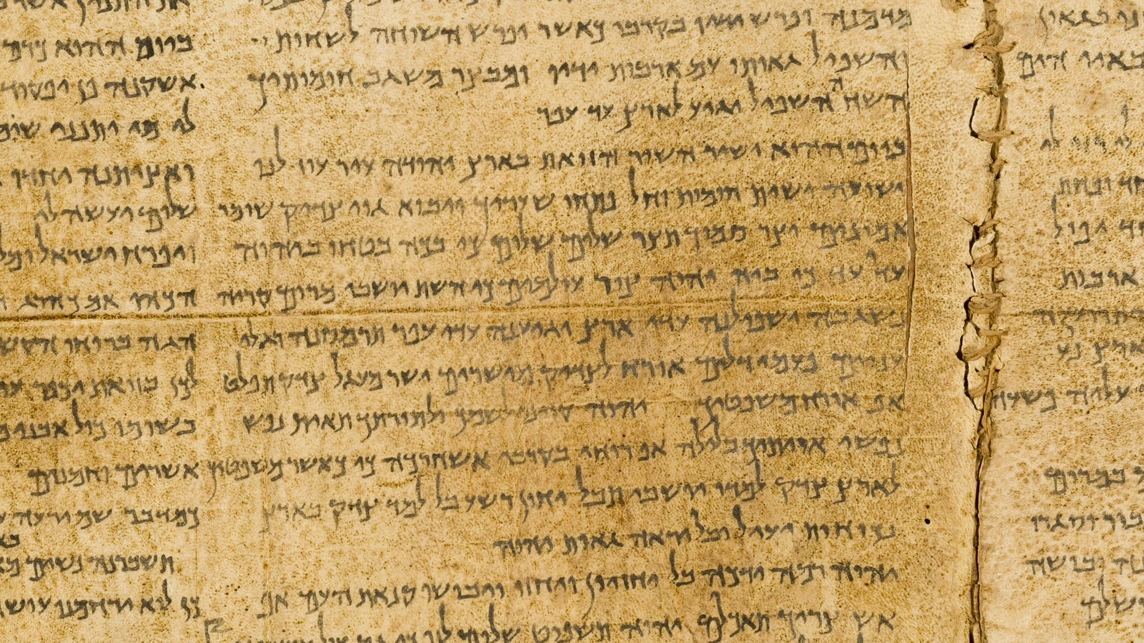
The peace of God . . . will guard your hearts and your minds in Christ Jesus
“You will keep him in perfect peace, whose mind is stayed on You, because he trusts in You.”
Isaiah 26:3 on the Great Isaiah Scroll
4:7
Notes:
Paul’s words reflect those found in the Hebrew Scriptures. “You will keep him in perfect peace, whose mind is stayed on You, because he trusts in You” (Isa 26:3). The Great Isaiah Scroll is owned by the Israel Museum in Jerusalem. This image is public domain, from Wikimedia: https://commons.wikimedia.org/wiki/File:The_Great_Isaiah_Scroll_MS_A_(1QIsa)_-_Google_Art_Project-x2-y0.jpg
isax2y0

Slide 37
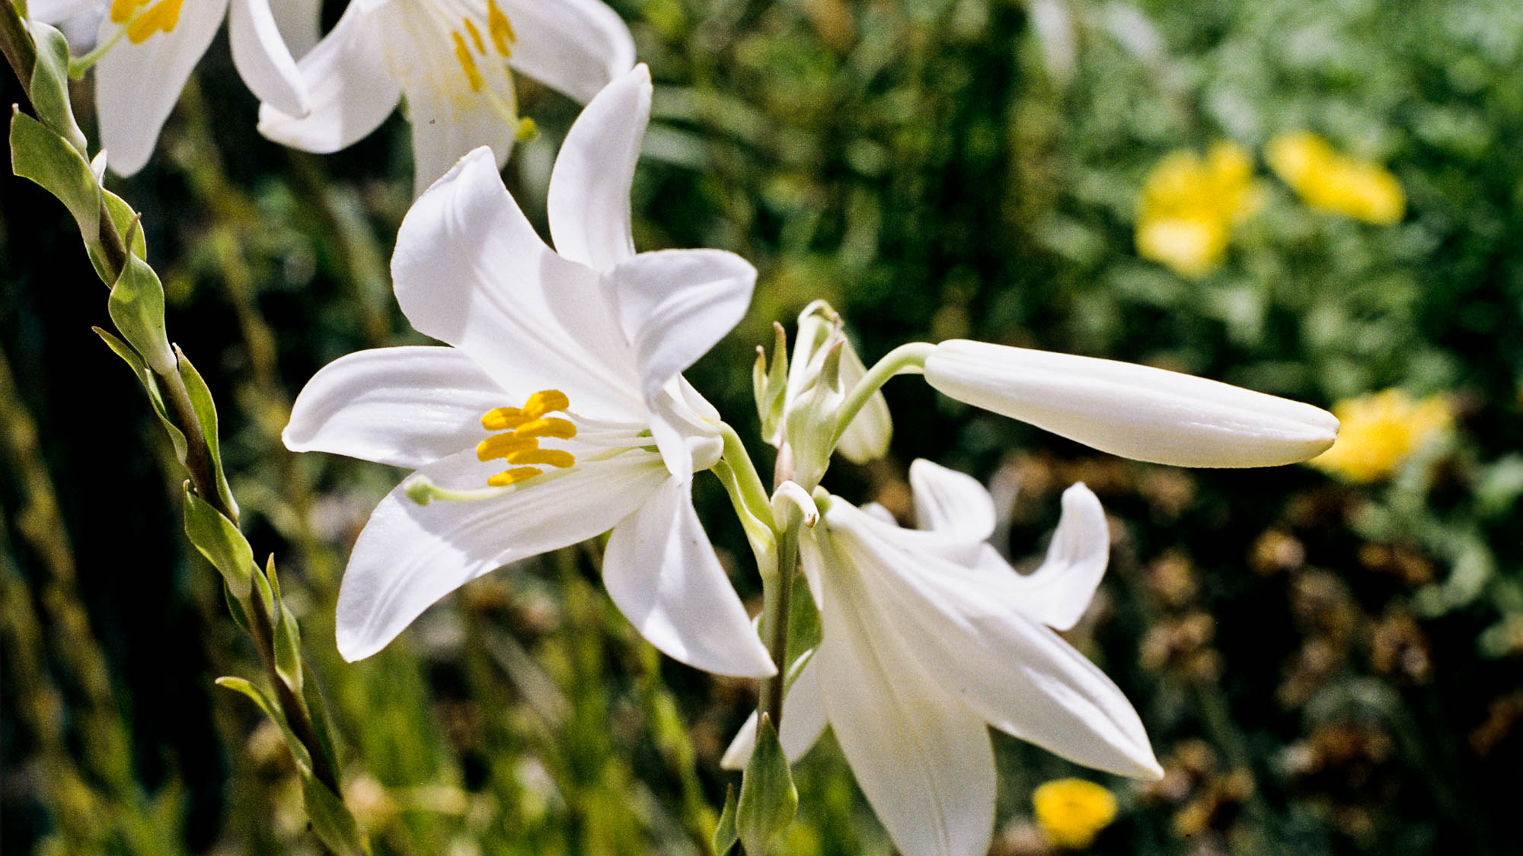
Whatever is lovely, whatever is of good report . . . think on these things
Madonna lily in Maoz Zion
4:8
Notes:
Maoz Zion is a community located in the Judean hills west of Jerusalem.
gs050094b119h

Slide 38
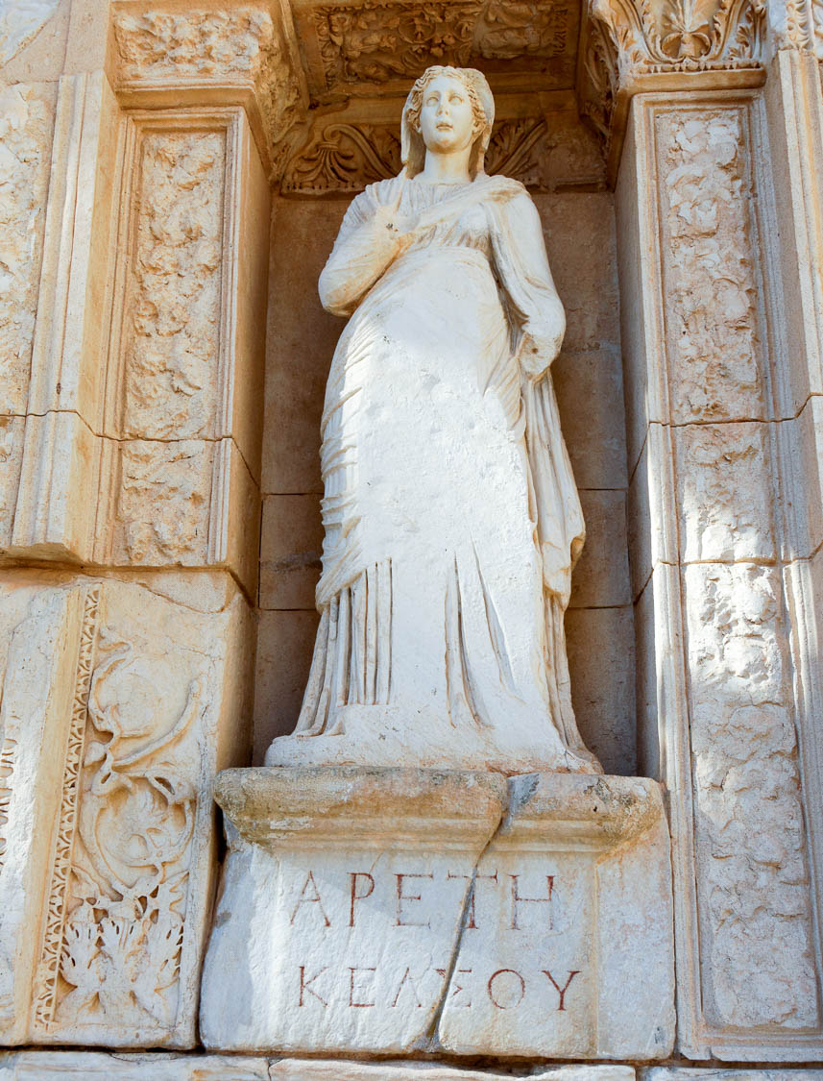
If there is any excellence
Statue of Excellence in the Library of Celsus at Ephesus, 2nd century AD
4:8
Notes:
The word “excellence” (Gk. aretē, ἀρετή) refers to moral excellence or virtue. The word appears on the base of this statue, which personifies moral excellence as a woman.
tb010317240h

Slide 39
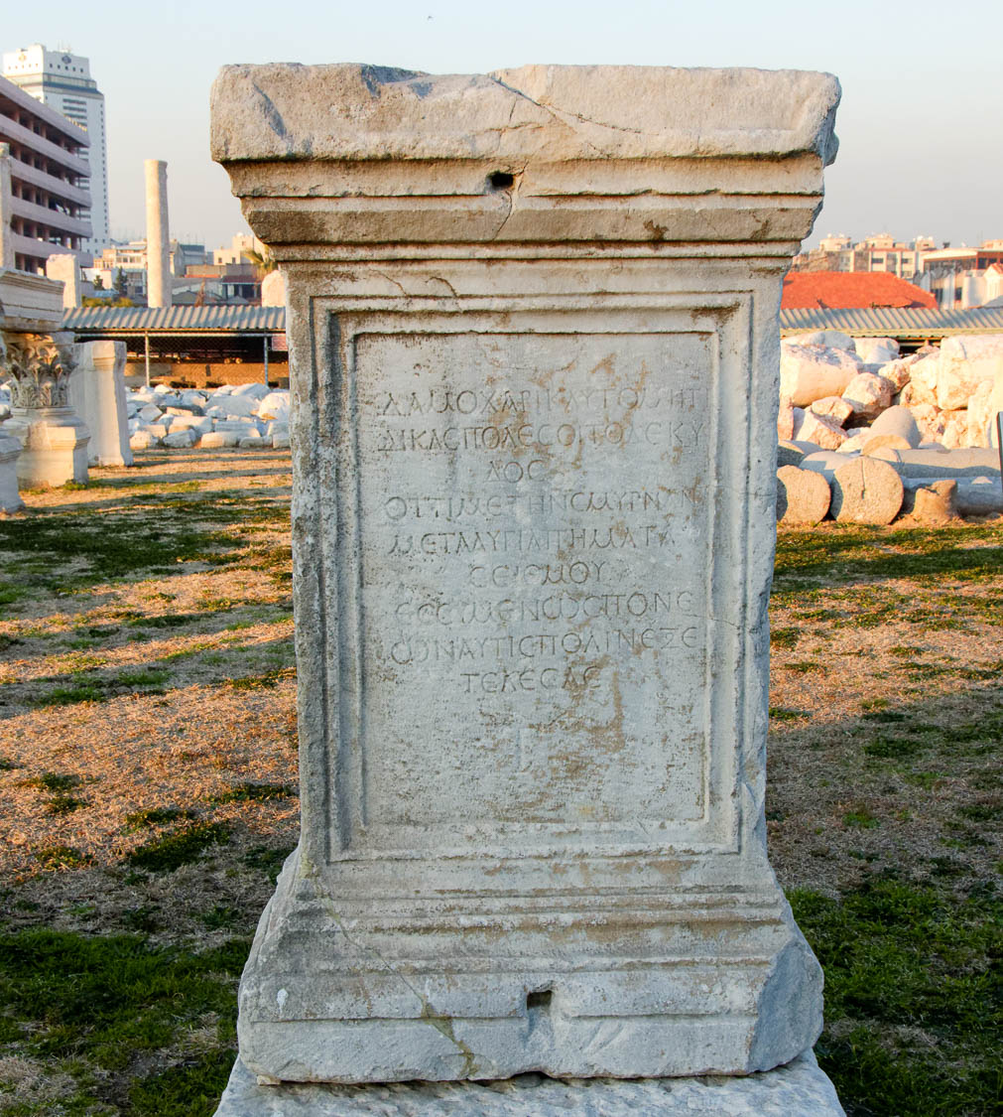
If there is any excellence, or anything worthy of praise
Inscription giving recognition to Damokharis for making developing the city of Smyrna
4:8
Notes:
The word “praise” or “praise-worthy” (Gk. epainos, ἔπαινος) indicates something worthy of admiration, recognition, or approval. The inscription shown here is from Smyrna, and attributes praise to a man named Damokharis for the role he played in the development of the city. The inscription reads, “O Judge Damokharis, famous with his skills! This success also belongs to you: After the awful (mortal) disasters of an earthquake, with a very diligent work you also succeeded in making a city out of Smyrna again.”
tb010217909h

Slide 40
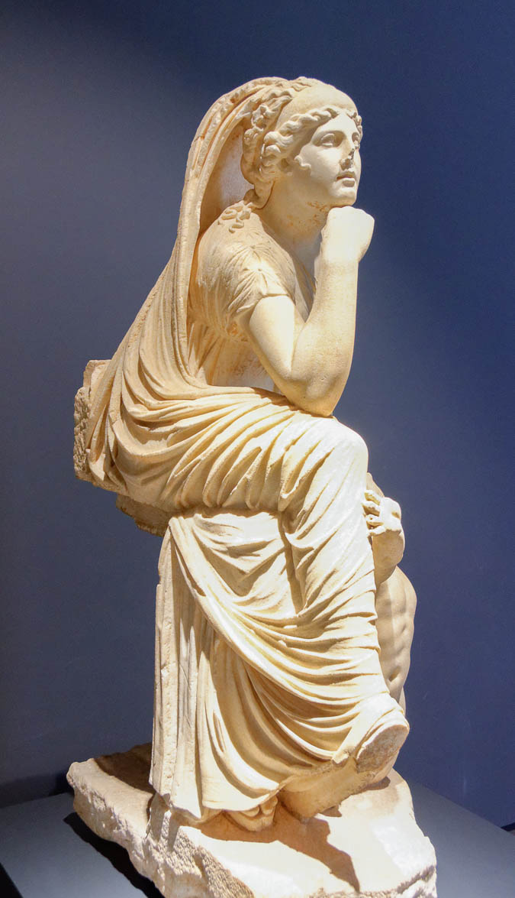
If there is any excellence, or anything worthy of praise, think on these things
Statue of a woman posed as a thinker, in Greek marble, from Rome, circa 2nd century AD
4:8
Notes:
The verb “think” (Gk. logizomai, λογίζομαι) refers to giving careful thought to a matter, or pondering it. The pose exhibited by this statue, with hand or fist to the chin, had already been used for centuries to indicate someone who was engaged in thought. This statue is considered to be a copy of a Greek original from circa 290 BC. Known as Tyche of Antioch, it comes from Stazione Termini in Rome. This statue was photographed at the National Museum of Rome.
tb0513177547

Slide 41
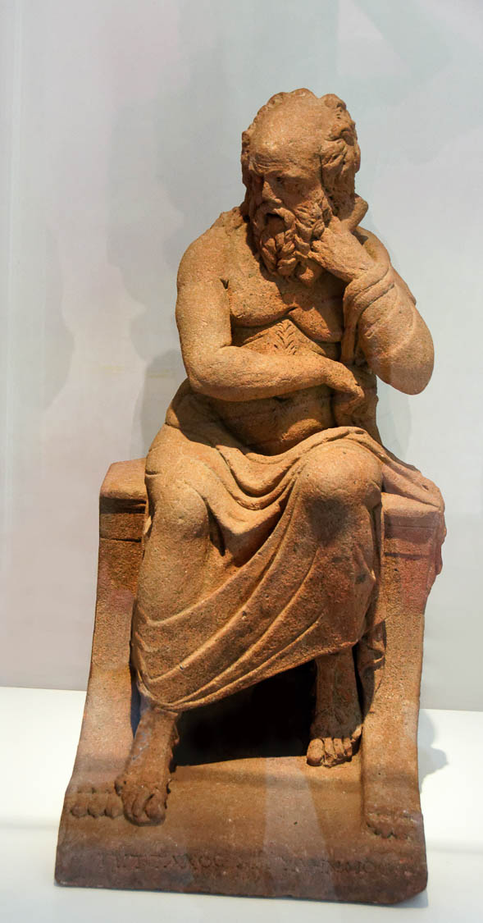
If there is any excellence, or anything worthy of praise, think on these things
Clay statue of Pittacus of Mitylene, from Pompeii, 1st century BC or 1st century AD
4:8
Notes:
This statue also depicts someone with hand to chin, engaged in thought. Pittacus of Mitylene was one of Seven Sages of Greece. This statue was photographed at a temporary exhibit at Pompeii.
tb0516172219c

Slide 42
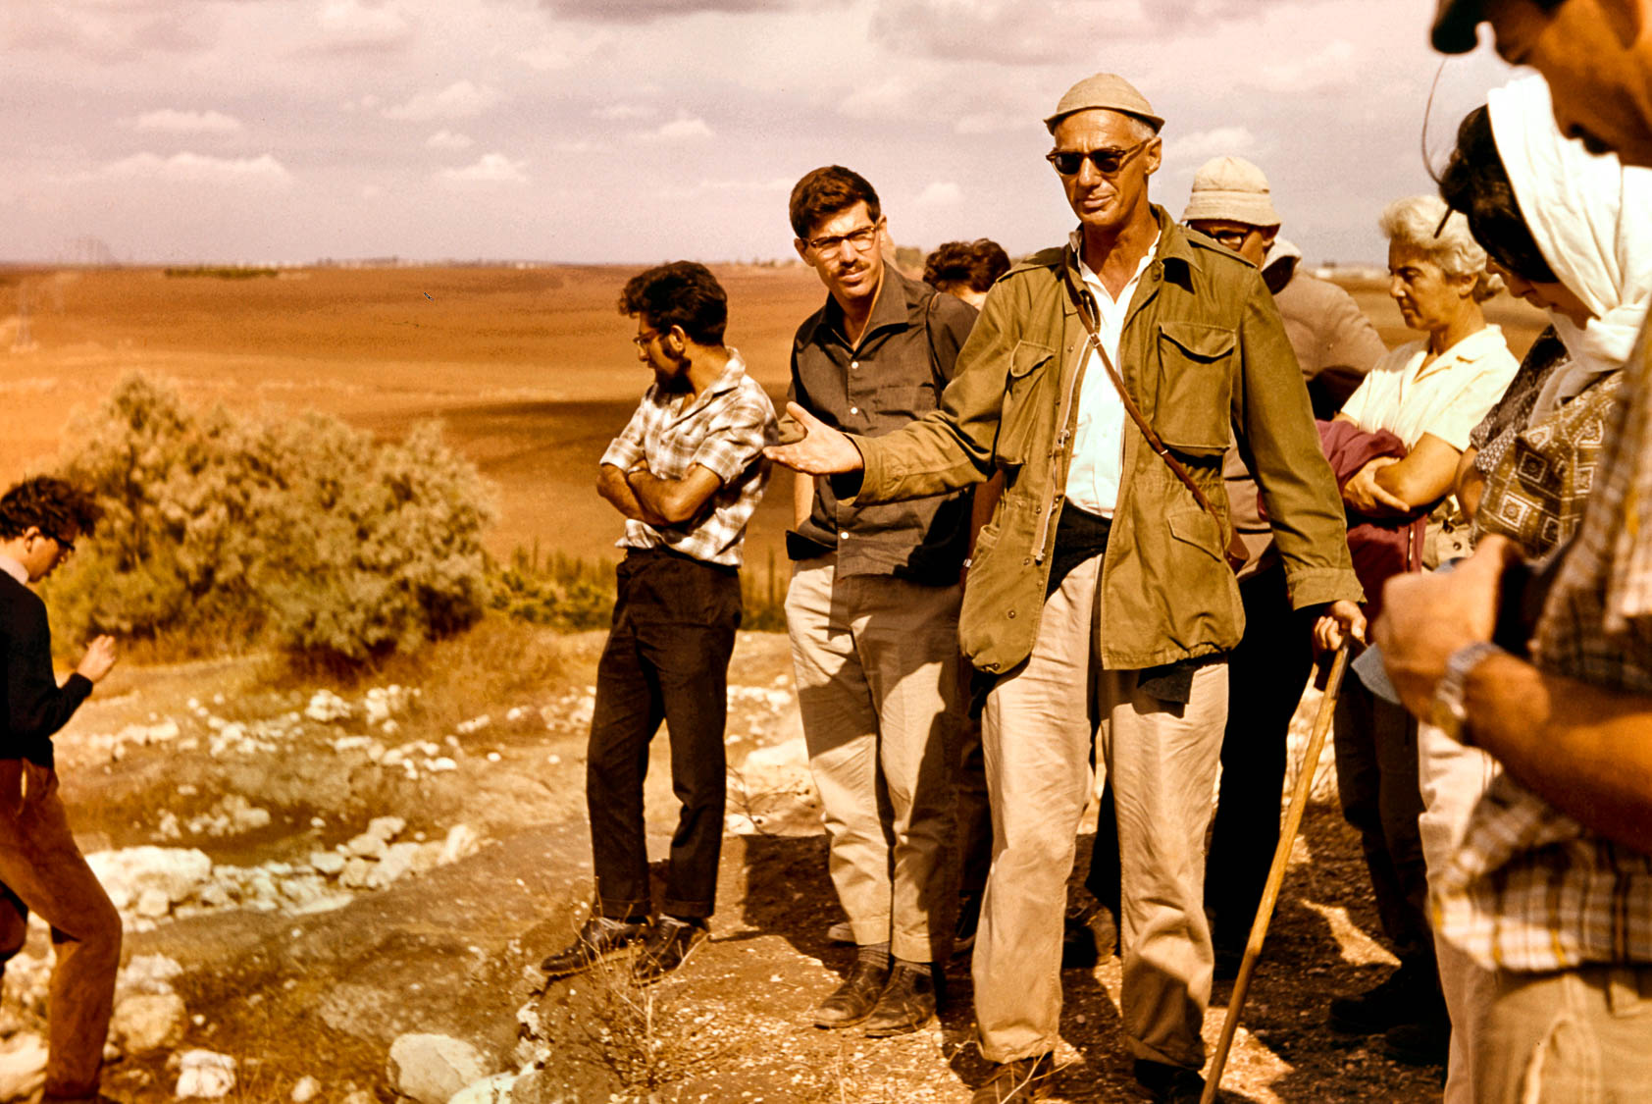
What you have learned and received and heard and seen in me, practice these things
Yohanan Aharoni with students at Tel Erani
4:9
Notes:
Paul exhorts the believers at Philippi to imitate him both in his behavior and in his teaching. Every generation has had its great teachers that others admire and emulate. This photo shows the great biblical geographer Yohanan Aharoni with a group of students (including Amihai Mazar and Anson Rainey) in the field in the 1960s. It is remarkable that Paul considered his words and actions to be of such good repute that they could and should be emulated by his audience.
db6411190206h

Slide 43
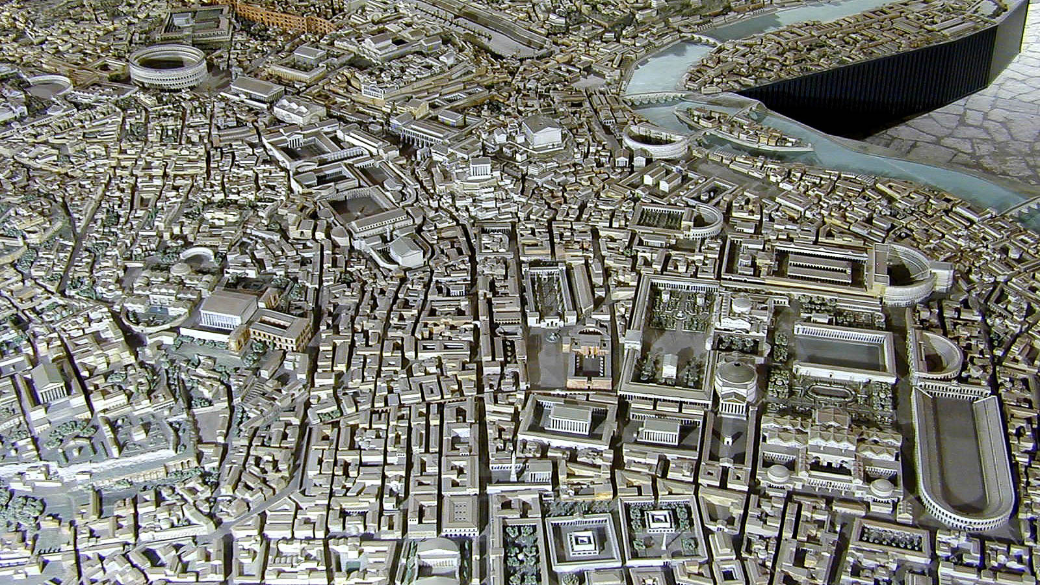
I rejoice in the Lord greatly, that now at last you have revived your concern for me
Model of Rome in the 4th century AD (from the north)
4:10
Notes:
It is not certain where Paul was imprisoned when he wrote the epistle to the Philippians. The most commonly held view is that he wrote from Rome, although imprisonments at Corinth, Ephesus, or Caesarea are also possible (for further discussion, see the slides for Phil 1:7). This model of Rome was photographed at the Museum of Roman Civilization in Rome. For slides illustrating “rejoice,” see the slides for Philippians 1:4.
tb011901735h

Slide 44
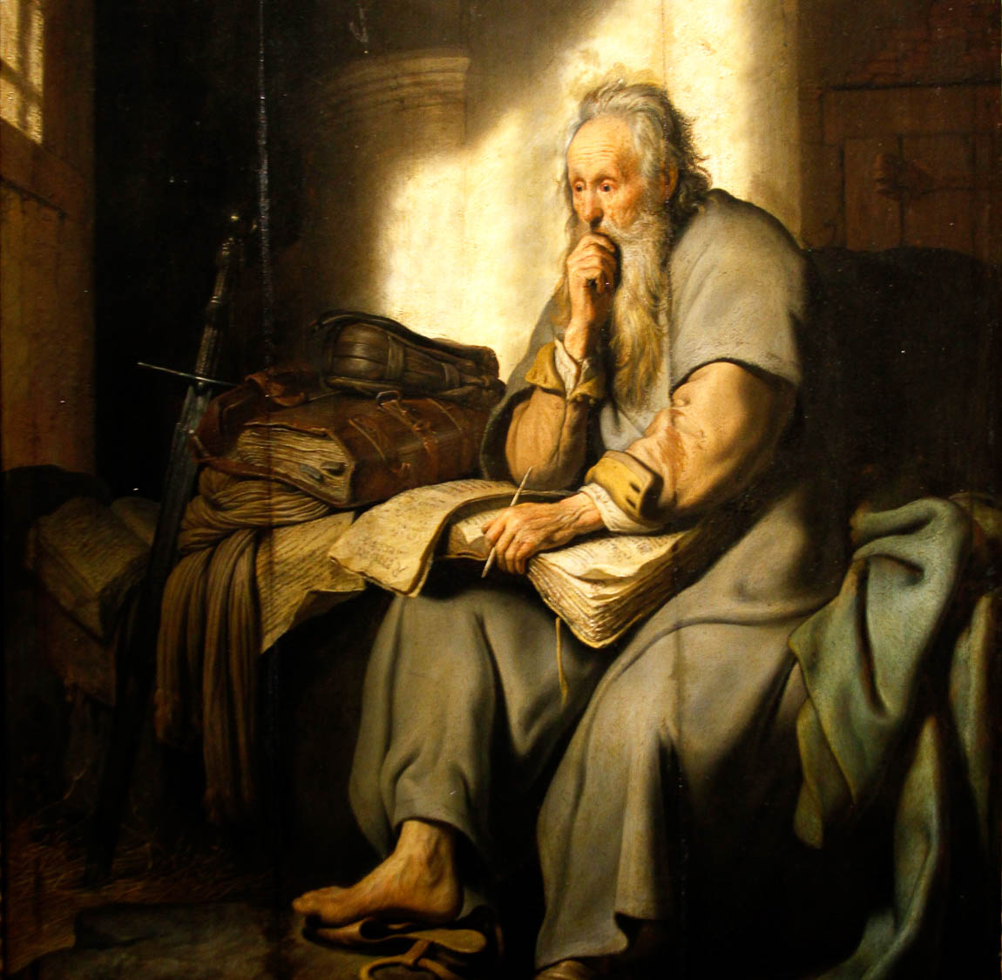
I do not speak from need, for I have learned to be content in whatever circumstances I am
St. Paul in Prison, by Rembrandt, 1627
4:11
Notes:
Paul’s circumstance at the moment of writing was imprisonment. This oil on panel painting of Paul in prison was photographed at the Staatsgalerie Stuttgart in Stuttgart, Germany. This image comes from Jose Luiz and is licensed under CC BY-SA 4.0, via Wikimedia Commons: https://commons.wikimedia.org/wiki/File:St._Paul_in_Prison_by_Rembrandt_-_Staatsgalerie_-_Stuttgart_-_Germany_2017.jpg.
wiki071920171001023328h

Slide 45
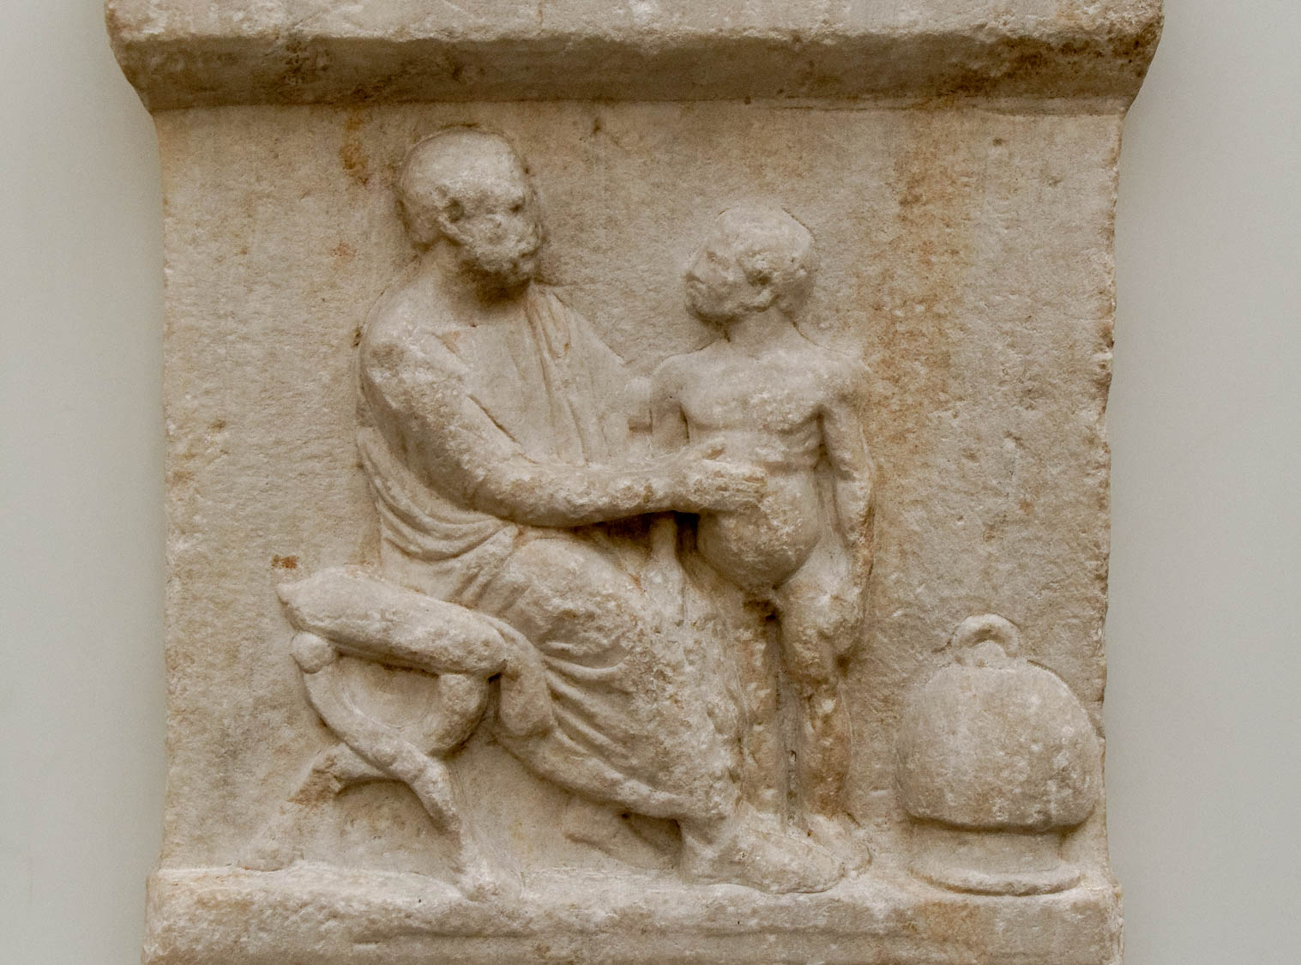
I know how to live with little
Physician Jason with a child patient with an enlarged belly, from Athens, 2nd century AD
4:12
Notes:
This relief shows a physician with a young child who has an enlarged belly. One possible cause of an enlarged belly is a form of severe protein malnutrition known as kwashiorkor. This relief was photographed at the British Museum.
tb0930198329h

Slide 46
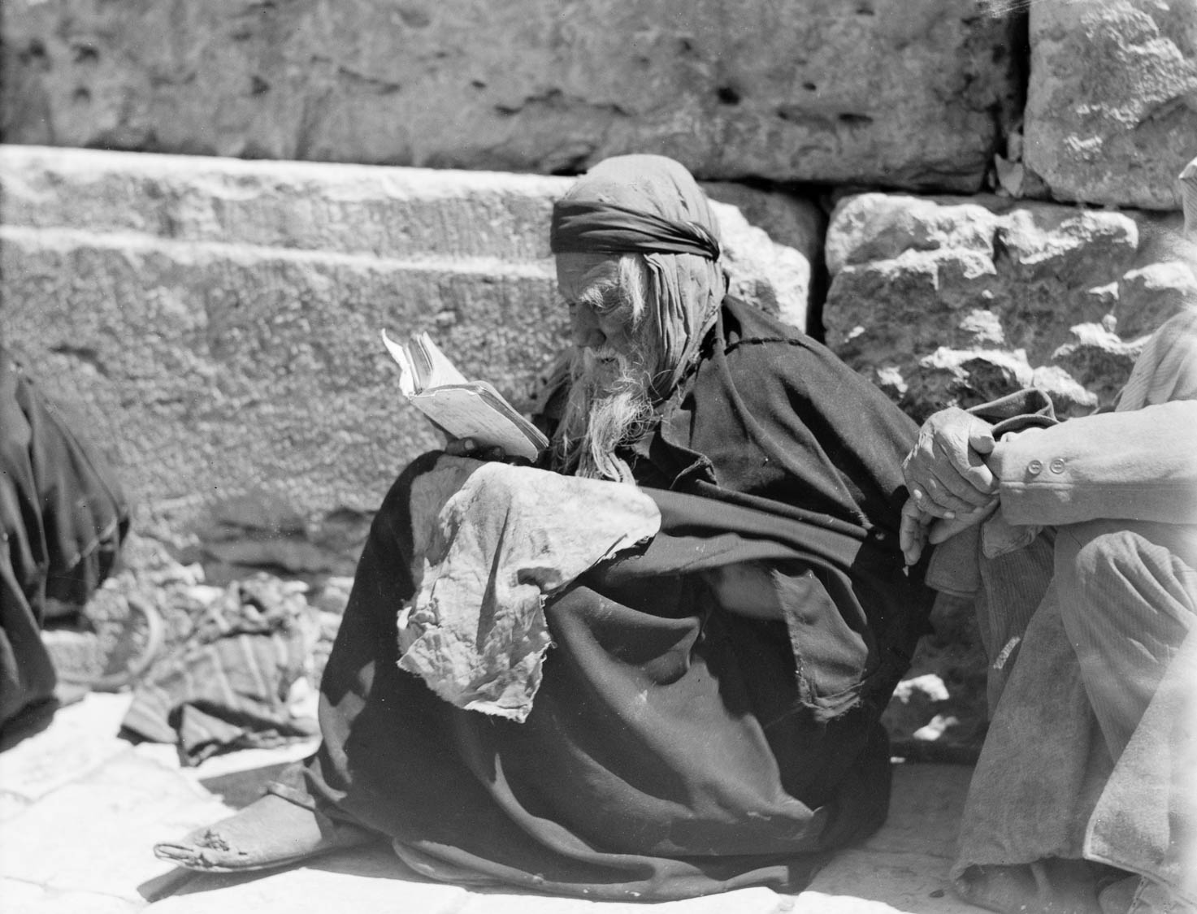
I know how to live with little
Jewish beggar reading at the Western Wall in Jerusalem
4:12
Notes:
This beggar in Jerusalem illustrates the concept of having little of earthly value, a circumstance that Paul experienced. This American Colony photo was taken between 1920 and 1933.
mat15658

Slide 47
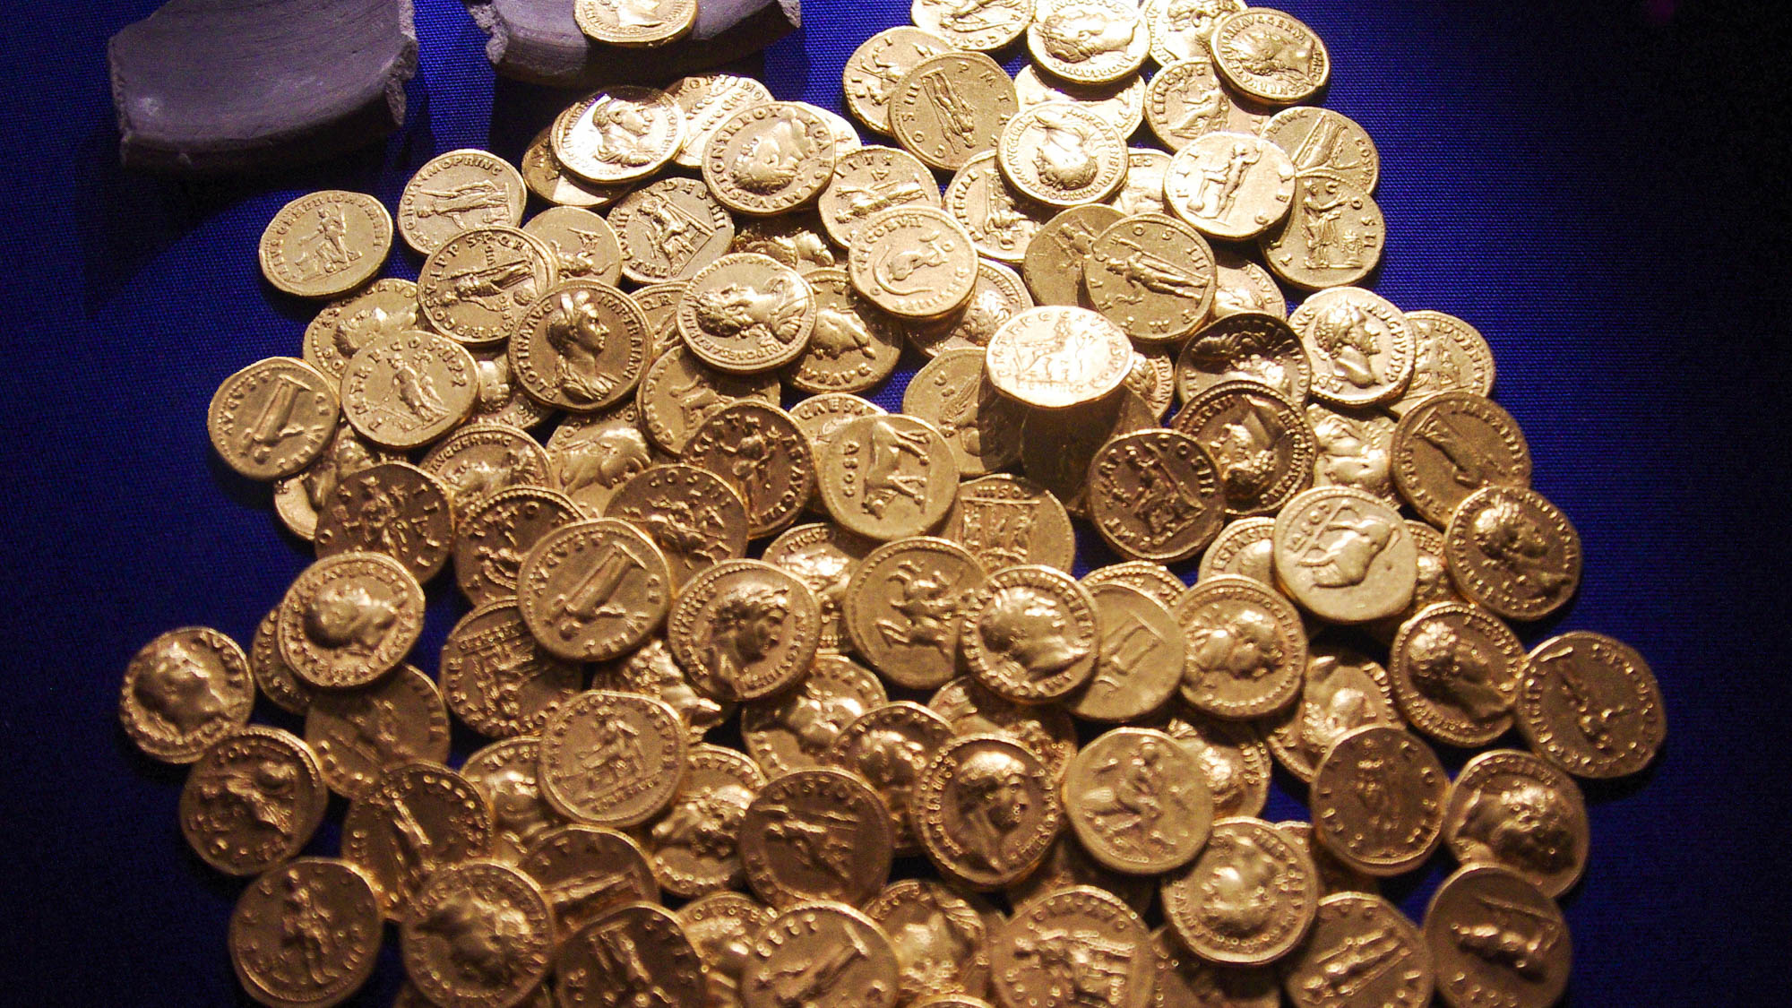
I also know how to live with an abundance
Hoard of Roman gold coins, from Didcot, AD 54–160
4:12
Notes:
Paul also argues that he has lived with relatively great riches. This could easily refer to his circumstance before his conversion when he was a respected and educated member of the Jewish community; it could also refer to times when various churches supplied his needs in generous ways. This hoard of Roman coins dating around the time of Paul’s writing was found in the modern town of Dicot in England. This collection was photographed at the Ashmolean Museum at the University of Oxford.
adr1305249723h

Slide 48
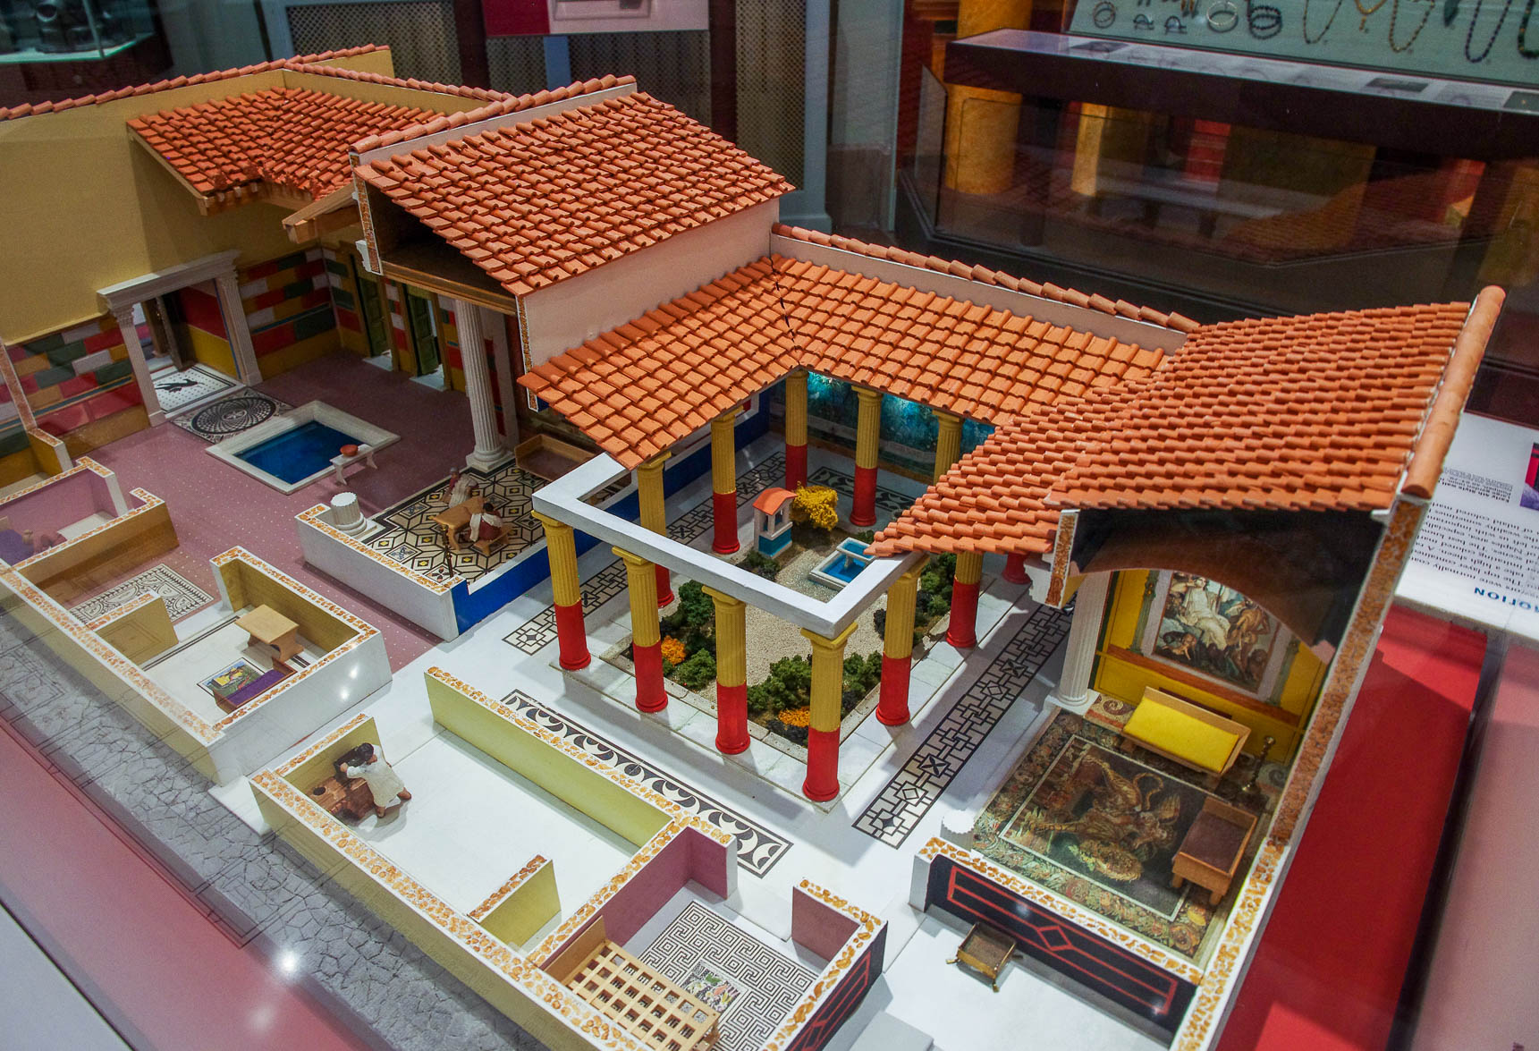
I also know how to live with an abundance
Model of a prosperous 1st century AD Roman family’s house
4:12
Notes:
The concept of “riches” may have also evoked an image of a wealthy estate, as illustrated by the above model of a wealthy Roman home in the 1st century AD. This model shows a house built around a peristyle courtyard. Although there is no indication that Paul himself owned such an estate, he was likely housed in such wealthy homes on numerous occasions (e.g., the house of Lydia, Philemon, etc.). This model was photographed in the University of Pennsylvania Museum of Archaeology and Anthropology.
adr1605265201

Slide 49
I also know how to live with an abundance
bedrooms
pool
main public room
garden
courtyard
all-purpose day room
general purpose room
kitchen
toilet
bedroom
dining room
Model of a prosperous 1st century AD Roman family’s house
4:12
Notes:
The concept of “riches” may have also evoked an image of a wealthy estate, as illustrated by the above model of a wealthy Roman home in the 1st century AD. This model shows a house built around a peristyle courtyard. Although there is no indication that Paul himself owned such an estate, he was likely housed in such wealthy homes on numerous occasions (e.g., the house of Lydia, Philemon, etc.). This model was photographed in the University of Pennsylvania Museum of Archaeology and Anthropology. See the next slide for labels.
adr1605265201

Slide 50
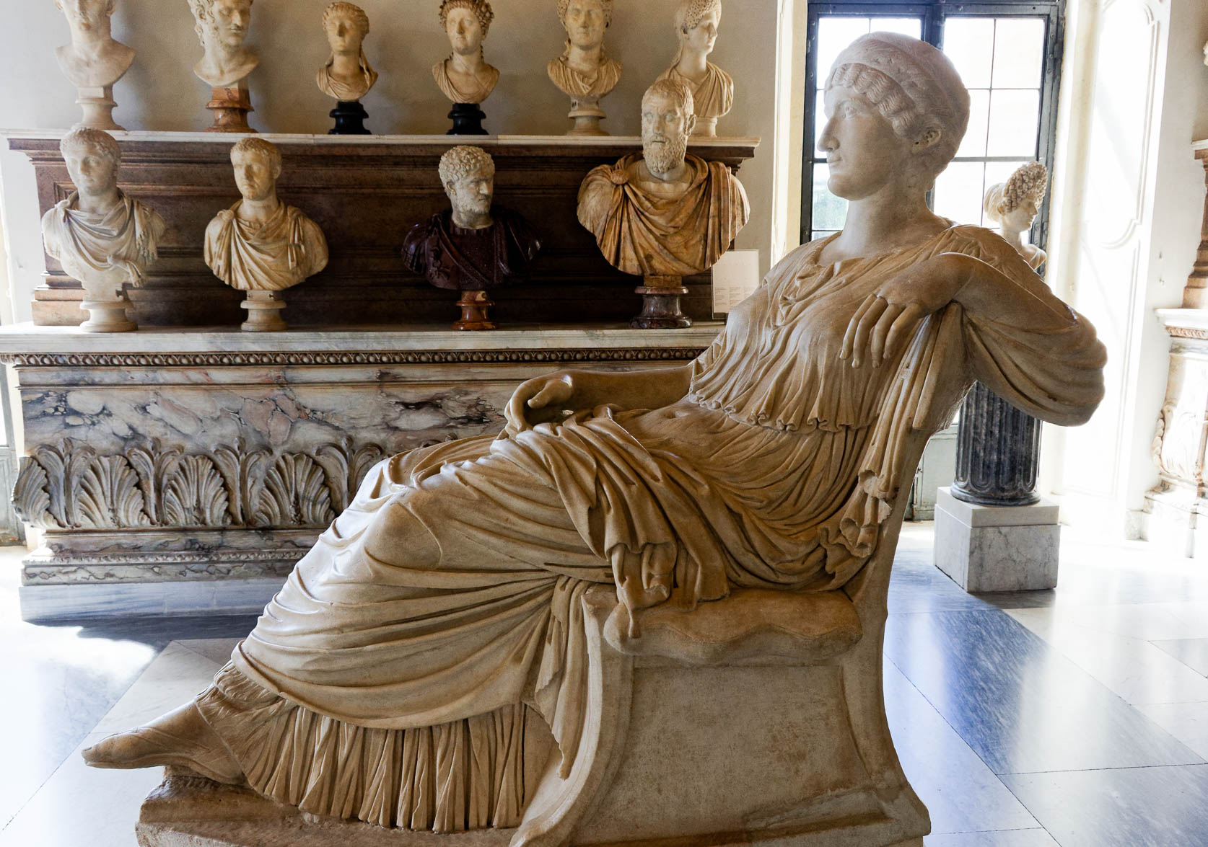
I also know how to live with an abundance
Seated marble statue of Helena, circa AD 320–325
4:12
Notes:
This seated statue depicts Helena, an empress of the Roman Empire and mother of Constantine the Great. Her relaxed posture and lavish clothing illustrate the look and demeanor of one who lacks no earthly thing. This statue was photographed at the Capitoline Museums in Rome.
tb0514179807

Slide 51

I can do all things through Him who strengthens me
Bronze boxer at rest, from Rome, circa 100 BC
4:13
Notes:
Paul was fond of using athletic metaphors to describe the Christian life. In 1 Corinthians 9:26, he compared himself to a boxer, as illustrated here. This bronze boxer statue is thought to be a Late Hellenistic work inspired by Lysippos; it comes from Via IV Novembre on the Quirinal slopes in Rome. It was photographed at the National Museum of Rome.
tb0513177296h

Slide 52

All the same, you have done well to share with me in my hardship
Statue of a hand holding a moneybag, circa AD 200
4:14
Notes:
The “sharing” in which the Philippians participated likely included a monetary gift, although it may not have been restricted to that. This detail of a statue of the Greek god Hermes shows him holding a money bag, illustrating the passing along of a monetary gift. The “hardship” (Gk. thlipsis, θλῖψις) mentioned by Paul is likely related to his imprisonment (cf. the slides for Phil 1:7). This statue is considered to be a Roman copy of an earlier Greek original. It was photographed at the Vatican Museums.
tb0512176868h

Slide 53

At the beginning of the gospel, when I departed from Macedonia
Main street in Dion
4:15
Notes:
Acts 17:14 describes Paul’s departure from Macedonia on his 2nd missionary journey. When Paul left the region known as Macedonia, he probably traveled from Berea to the city of Dion on the Vaphyras River, which in antiquity was only about one mile (1.5 km) from the shore of the Thermaikos Gulf. From there, he likely embarked on a ship to Athens.
tb031406424

Slide 54


No church partnered with me in the matter of giving and receiving except you alone
Coin commemorating the victory of Augustus at Philippi, from the reign of Claudius or Nero
4:15
Notes:
This coin was minted in Philippi between AD 41 and 68. The obverse side depicts Victoria (the Roman version of Nike) and is inscribed “Victoria Augusti” (Lat. VIC AVG). The reverse depicts three Roman war standards and is inscribed PHIL (Philippi), PRAE (Praetorian Guard), and COH (Cohort). This coin is in the Jared James Clark Collection.
Obverse (left): tb0713158985b; reverse (right): tb0713158988b

Slide 55

No church partnered with me in the matter of giving and receiving except you alone
Hoard of silver coins, 1st century BC
4:15
Notes:
To “partner” (Gr. koinōnia, κοινωνία) often refers to monetary support (as in Rom 15:26). This certainly was part of the partnership between the Philippians and Paul (Phil 4:15-18). This hoard of Greek silver coins is slightly earlier than the time of Paul; such coins tended to have a long life and could have been part of whatever gift was shared with Paul. It was photographed at the Antalya Museum in southern Turkey.
tb123016964h

Slide 56

Even in Thessalonica, you sent a gift more than once for my needs
Thessalonica and its Byzantine eastern city wall (from the north)
4:16
Notes:
The overland route from Philippi to Thessalonica was about 85 miles (137 km), a trip that would require four to five days for the normal traveler. The ancient city of Thessalonica is covered by the modern city; a few Roman ruins have been exposed, but most of the ancient city is inaccessible today.
tb031306095

Slide 57

Even in Thessalonica, you sent a gift more than once for my needs
Travelers near the old caravansary at Aphek, circa 1910
4:16
Notes:
To send a gift from Philippi to Paul at Thessalonica would have required not only the cost of the gift itself but the time, risk, and cost of many days of travel. This photo shows men packing goods by donkey; they are stopped at the old caravansary near Aphek in Israel, a heavily travelled route along the foothills of Samaria. This American Colony photo was taken between 1900 and 1920.
mat01214

Slide 58

Not that I seek for the gift, but I seek for the fruit that increases to your account
Relief at Aphrodisias with cornucopias
4:17
Notes:
The cornucopia was used as a symbol of abundance and plenty centuries before the time of Paul.
shs031215829

Slide 59

Not that I seek for the gift, but I seek for the fruit that increases to your account
Accounting list of expenses, 2nd or 3rd centuries AD
4:17
Notes:
Paul desires that credit for doing good would accrue to the “account” (lit. “word,” Gk. logos, λόγος) of the Philippians. The ostracon shown here is a record of various items and the cost paid for each, illustrating the keeping of records or accounts in a time shortly after Paul lived. The items are listed on the left column, and the cost is listed on the right. According to the museum website, the Greek text may be translated as follows: “For common (expenses): [- -]; for Kteson: 500; salt fishes: 150; for common (expenses): 3; for salt: 56; for frankincense: 280; for oil: 29; for common (expenses): [- -]; for breads: [- -]; for wine: [- -]; for common (expenses): [- -].” This image comes from the University of Michigan, Advanced Papyrological Information System, and is in the public domain. Source: http://quod.lib.umich.edu/a/apis/x-40/4192o.tif.
umich26424419240h

Slide 60

Having received from Epaphroditus what you sent
Funerary stele of Epaphroditus, from a columbarium in Rome, AD 83–96
4:18
Notes:
This funerary stele from the 1st century AD is for a man named Epaphroditus; his name appears in the second line of the inscription. The Epaphroditus named on this funerary stele was a slave of Domitian in charge of food preparation for banquets. This inscription was photographed at the National Museum of Rome at the Diocletian Baths.
tb0513178510h

Slide 61

Having received from Epaphroditus what you sent, a fragrant aroma
Relief of women burning incense on an incense altar, 1st–2nd centuries AD
4:18
Notes:
The word “fragrant aroma” (Gk. osmē, ὀσμή) refers to that which stimulates the sense of smell; depending on the context it can refer to a sweet aroma (as here) or to a bad odor, like the smell of a corpse. Paul also uses this word in the context of sacrifice elsewhere (cf. Eph 5:2). While this could simply refer to the smoke of a burnt offering, it could also refer to the popular Roman custom of burning incense to the gods, a practice that was valued solely for the fragrance it produced. This relief depicts two women, perhaps intended to represent goddesses, sprinkling incense onto a burning incense altar. It is possible that this relief is related to the cult of Eleusis, although this is uncertain. This relief was photographed at the Metropolitan Museum of Art.
adr1711139291h

Slide 62

Having received from Epaphroditus what you sent, a fragrant aroma
Incense burner shape like women around a well, from southern Italy, circa 325 BC
4:18
Notes:
Incense burners (Gk. thymiatērion, θυμιατήριον) came in a variety of shapes and sizes. This example incorporates five incense burning bowls atop the heads of five women gathered around a well head. Each woman also holds other items related to religious sacrifice. This beautifully preserved artifact dates to about the time of Alexander the Great. One of the ancient historians recounts Alexander’s religious fervor. Once, when Alexander threw large amounts of incense into the fire as an offering to the gods, his tutor Leonidas reprimanded him, telling him to be more sparing unless he had conquered the country where the incense came from. Later, after his conquest of Egypt, Alexander sent his teacher 600 talents’ worth of incense. This image comes from The Metropolitan Museum of Art and is in the public domain. Source: https://www.metmuseum.org/art/collection/search/257999
met257999h

Slide 63

Having received from Epaphroditus what you sent, a fragrant aroma
Roman incense burner, bronze, circa AD 100
4:18
Notes:
This bronze incense burner is shaped somewhat like a cup. Coals would be added to the bowl, and incense would be sprinkled on top of the coals, producing a fragrant smoke. This artifact was photographed at Michael C. Carlos Museum at Emory University.
adr1511188626h

Slide 64

Having received from Epaphroditus what you sent, a fragrant aroma, an acceptable sacrifice
Relief showing a Greco-Roman sacrifice
4:18
Notes:
This relief was photographed at the Archaeological Museum of Kavala in Greece.
tb031106486h

Slide 65

Having received from Epaphroditus what you sent, a fragrant aroma, an acceptable sacrifice
Torah scroll with Genesis 8:21, “And Yahweh smelled the sweet aroma”
4:18
Notes:
In speaking of a fragrant aroma, perhaps Paul had in mind the words of God regarding the offering of Noah following the flood. “And Yahweh smelled the sweet aroma; and Yahweh said in his heart, ‘I will not curse the ground any more for man’s sake, since the imagination of man’s heart is evil from his youth; neither will I again destroy every living thing, as I have done” (Gen 8:21). This Yemenite Torah scroll was photographed at The Master’s Seminary in California.
tb031416360

Slide 66

Having received from Epaphroditus what you sent, a fragrant aroma, an acceptable sacrifice
Torah scroll with Exodus 29:18, “It is a sweet savor”
4:18
Notes:
A similar turn of phrase appears in Exodus: “And you shall burn the whole ram upon the altar: it is a burnt-offering unto Yahweh; it is a sweet savor, an offering made by fire unto Yahweh” (Exod 29:18). This Yemenite Torah scroll was photographed at The Master’s Seminary in California.
tb031416402

Slide 67

My God will supply all your needs according to His riches in glory in Christ Jesus
Painting of a banquet scene, from Villa Doria Pamphili in Rome, circa 30–20 BC
4:19
Notes:
Paul’s chief concern, of course, would have been for the spiritual needs of the Philippians, as reflected in his letter (cf. Phil 2:1-16). At the same time, Jesus told His followers that God would supply their earthly needs as well if they would seek after heavenly things (Matt 6:31-34). Ample supply is illustrated here by Romans gathered around a table to eat and drink. This fresco was photographed at the National Museum of Rome.
tb0513177686

Slide 68

To our God and Father be the glory forever and ever. Amen
Samaritan men praying on Mount Gerizim during Passover
4:20
Notes:
Paul’s doxology to the book is illustrated here by Samaritan men raising their hands to God in prayer. This American Colony photo was taken between 1900 and 1920.
mat01869

Slide 69

Greet every saint in Christ Jesus
Bedouin men greeting with a kiss
4:21
Notes:
A common form of greeting in Paul’s day was the kiss, illustrated here by two Bedouin men kissing each other as a greeting. This American Colony photograph was taken between 1900 and 1920 and later colorized.
mat23092h

Slide 70

The brothers who are with me greet you
Depiction of a handshake greeting, circa 340 BC
4:21
Notes:
The handshake was also a recognized form of greeting (and of farewell) in Paul’s day. This relief was photographed at the National Archaeological Museum in Athens.
tb011117601h

Slide 71

All the saints greet you
Papyrus letter with greetings, circa AD 300
4:22
Notes:
This letter from the late 3rd or early 4th centuries AD includes several greetings, using the same Greek word (Gk. aspozomai, ἀσπάζομαι) that Paul uses. According to the museum website, the text may be translated as follows: “. . . our . . . father, apostle . . . of all others [he/she/they] loved . . . all the brothers with you [those whom] . . . All the brothers in the church greet you. Father and mother greet [the brothers]. The mother of Taesis/Taesion greets [you all]. And [I/we/you/they] went down . . . I pray that you may be well for the longest span of life.” The next slide includes labels that highlight the occurrences of the word “greeting.” This image comes from the University of Michigan, Advanced Papyrological Information System, and is in the public domain. Source: http://quod.lib.umich.edu/a/apis/x-11984/4349r.tif.
umich4349119843632

Slide 72
All the saints greet you
Papyrus letter with greetings, circa AD 300
4:22
Notes:
This letter from the late 3rd or early 4th centuries AD includes several greetings, using the same Greek word (Gk. aspozomai, ἀσπάζομαι) that Paul uses. According to the museum website, the text may be translated as follows: “. . . our . . . father, apostle . . . of all others [he/she/they] loved . . . all the brothers with you [those whom] . . . All the brothers in the church greet you. Father and mother greet [the brothers]. The mother of Taesis/Taesion greets [you all]. And [I/we/you/they] went down . . . I pray that you may be well for the longest span of life.” This image comes from the University of Michigan, Advanced Papyrological Information System, and is in the public domain. Source: http://quod.lib.umich.edu/a/apis/x-11984/4349r.tif.
umich4349119843632

Slide 73

All the saints greet you, especially those of Caesar’s household
Excavations on Palatine Hill in Rome
4:22
Notes:
It is evident from this verse that Paul was familiar with some residents of the royal estate in Rome; the fact that he sends greetings from them indicates that they were part of the church in Rome. Palatine Hill, shown in this photo was the location of Caesar’s household. The royal household would have been a large estate with a small army of workers.
tb012001700h

Slide 74

All the saints greet you, especially those of Caesar’s household
Bust of Nero, 1st century AD
4:22
Notes:
The “Caesar” to whose household Paul refers was almost certainly Nero (r. AD 54–68). This bust of Nero, which had been shattered and was restored in the 17th century, was photographed at the Capitoline Museums in Rome.
tb0514179816h

Slide 75

All the saints greet you, especially those of Caesar’s household
Bronze portrait of Marcus Agrippa, from Italy, early 1st century AD
4:22
Notes:
Marcus Agrippa was a confidant of Augustus and was Nero’s great-grandfather. He illustrates a member of Caesar’s household, albeit from an earlier generation. This image comes from The Metropolitan Museum of Art, public domain, Rogers Fund, 1914, http://metmuseum.org/art/collection/search/248892.
met248892

Slide 76

The grace of the Lord Jesus Christ be with your spirit
Painting of a serene garden, from Rome, circa 30–20 BC
4:23
Notes:
Paul’s final words to the Philippians are expressed as a prayer for God’s grace to be on them. Fulfillment of this prayer would almost certainly include a peaceful life and spiritual productiveness. Both of these ideas are represented in this painting from ancient Rome, with the serenity of a garden scene and the productivity of a young pomegranate tree. This painting comes from the triclinium of the Villa of Livia at Prima Porta, a suburb of Rome. It was photographed at the National Museum of Rome.
tb0513177714

Slide 77

More than 450 slides in PowerPoint format. Available now from BiblePlaces.com.
Notes:
This is a free sample of the Philippians 4 presentation from the Photo Companion to the Bible. To purchase the full volume, visit https://www.bibleplaces.com/philippians/
The Photo Companion to the Bible is an image-rich resource for Bible students, teachers, and researchers. Just as a librarian stocks the shelves with as many relevant materials as possible, so we have tried to provide a broad selection of images. Our goal is that you will find in this “library” whatever it is you are looking for.
Credits: The primary creators of this presentation are Christian Locatell, Steven D. Anderson, Kris Udd, and Todd Bolen. The photographs have an individual file code which usually includes the initials of the photographer. Other images have additional credit or source information.
Updates: We plan to update this collection as we are able. We welcome your suggestions for improving this resource (photocompanion@bibleplaces.com). Purchasers of the Philippians volume are provided free, lifetime updates to the volume.
Copyright: This photo collection is protected by copyright law and may not be distributed without written permission from BiblePlaces.com. Slide notes should be treated as any other copyrighted written material, with credit given when quoting from these notes.
For more information, see our complete “Introduction to the Photo Companion to the Bible” online at https://www.BiblePlaces.com/Intro-Photo-Companion-Bible/. Here you will find more information about photo selection, explanatory notes, Bible translation, credit information, and copyright allowances.

