Slide 1
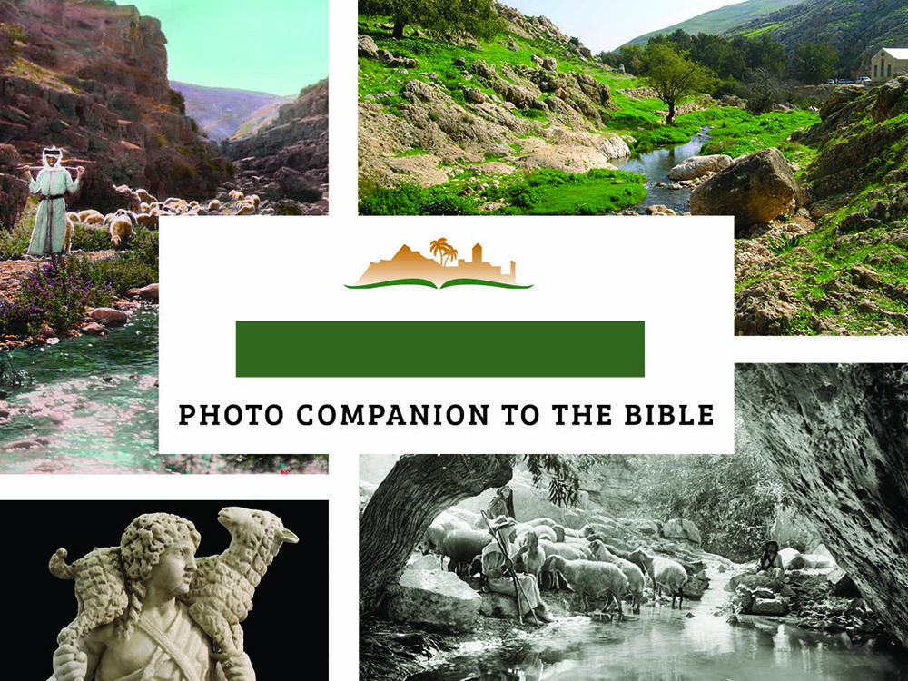
PSALM 23:1
Notes:
This is a free sample of verse 1 of Psalm 23 from the Photo Companion to the Bible. The complete Psalm 23 presentation includes more than 100 slides. To purchase the full volume, visit https://www.bibleplaces.com/ps23/
The Photo Companion to the Bible is an image-rich resource for Bible students, teachers, and researchers. Just as a librarian stocks the shelves with as many relevant materials as possible, so we have tried to provide a broad selection of images. We do not expect many situations where someone will need, desire, or even approve of every image, but our goal is that you will find in this “library” whatever it is you are looking for.
Credits: The primary creators of this presentation are Steven D. Anderson, Chris McKinny, and Todd Bolen. The photographs have an individual file code which usually includes the initials of the photographer. Other images have additional credit or source information.
Updates: We plan to update this collection as we are able. We welcome your suggestions for improving this resource (photocompanion@bibleplaces.com). Purchasers of the Psalm 23 volume are provided free, lifetime updates to the volume.
Book Version: An adaptation of this collection is available as a book (print and Kindle) from Amazon, Psalm 23: A Photo Commentary. See www.bibleplaces.com/ps23book/
Copyright: This photo collection is protected by copyright law and may not be distributed without written permission from BiblePlaces.com. Slide notes should be treated as any other copyrighted written material, with credit given when quoting from these notes.
For more information, see our complete “Introduction to the Photo Companion to the Bible” online at http://www.BiblePlaces.com/Intro-Photo-Companion-Bible/. Here you will find more information about photo selection, explanatory notes, Bible translation, credit information, and copyright allowances.

Slide 2
PSALM 23:1
This is a free sample of verse 1 of the Psalm 23 from the Photo Companion to the Bible. To purchase the full volume, visit https://www.bibleplaces.com/ps23/
The Photo Companion to the Bible is an image-rich resource for Bible students, teachers, and researchers. Just as a librarian stocks the shelves with as many relevant materials as possible, so we have tried to provide a broad selection of images. Our goal is that you will find in this “library” whatever it is you are looking for.
For more details (for this and every slide), see the Notes section below.
Notes:
This is a free sample of verse 1 of Psalm 23 from the Photo Companion to the Bible. The complete Psalm 23 presentation includes more than 100 slides. To purchase the full volume, visit https://www.bibleplaces.com/ps23/
The Photo Companion to the Bible is an image-rich resource for Bible students, teachers, and researchers. Just as a librarian stocks the shelves with as many relevant materials as possible, so we have tried to provide a broad selection of images. We do not expect many situations where someone will need, desire, or even approve of every image, but our goal is that you will find in this “library” whatever it is you are looking for.
Credits: The primary creators of this presentation are Steven D. Anderson, Chris McKinny, and Todd Bolen. The photographs have an individual file code which usually includes the initials of the photographer. Other images have additional credit or source information.
Updates: We plan to update this collection as we are able. We welcome your suggestions for improving this resource (photocompanion@bibleplaces.com). Purchasers of the Psalm 23 volume are provided free, lifetime updates to the volume.
Book Version: An adaptation of this collection is available as a book (print and Kindle) from Amazon, Psalm 23: A Photo Commentary. See www.bibleplaces.com/ps23book/
Copyright: This photo collection is protected by copyright law and may not be distributed without written permission from BiblePlaces.com. Slide notes should be treated as any other copyrighted written material, with credit given when quoting from these notes.
For more information, see our complete “Introduction to the Photo Companion to the Bible” online at http://www.BiblePlaces.com/Intro-Photo-Companion-Bible/. Here you will find more information about photo selection, explanatory notes, Bible translation, credit information, and copyright allowances.

Slide 3
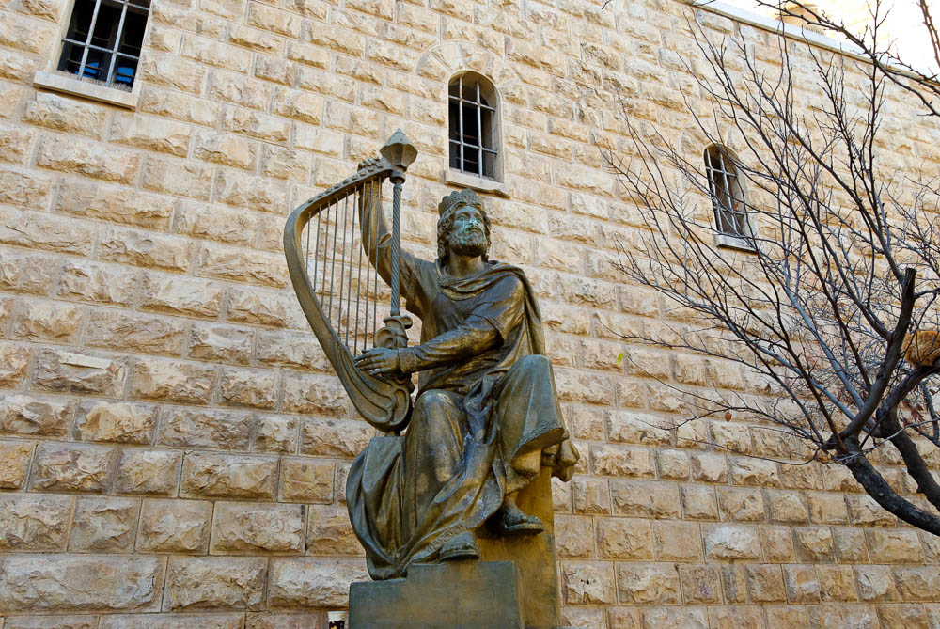
A Psalm of David
King David statue on Mount Zion
23:1
Notes:
The superscription, which is part of its original Hebrew text, attributes authorship of Psalm 23 to David. David was Israel’s greatest psalmist, and its paradigmatic king. Although kings are often called “shepherds” in ancient Near Eastern literature (e.g., Ps 78:71; Jer 23:1-4), David literally was a shepherd before he became king. It was natural for him to employ the shepherd-sheep metaphor to describe his relationship with God. While this psalm is an expression of David’s personal faith, it is applicable to any believer’s walk with God. Psalm 23 is perhaps the most comforting of psalms, and, as such, it is the best-known and most-beloved. It is not just a psalm of praise, but also a prayer of trust and confidence. The statue shown above is located on the modern “Mount Zion” adjacent to the traditional tomb of David and the Upper Room.
tb010312629

Slide 4
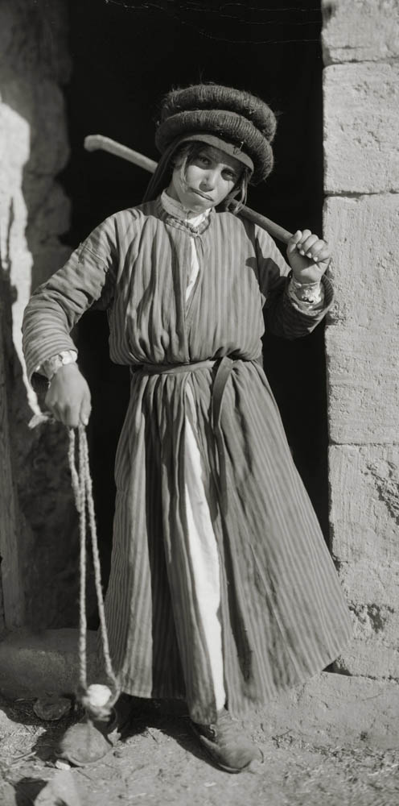
A Psalm of David
Palestinian shepherd boy
23:1
Notes:
David may have appeared in his youth something like the Palestinian shepherd boy in this photograph. This American Colony photograph was taken between 1898 and 1914.
mat06809

Slide 5
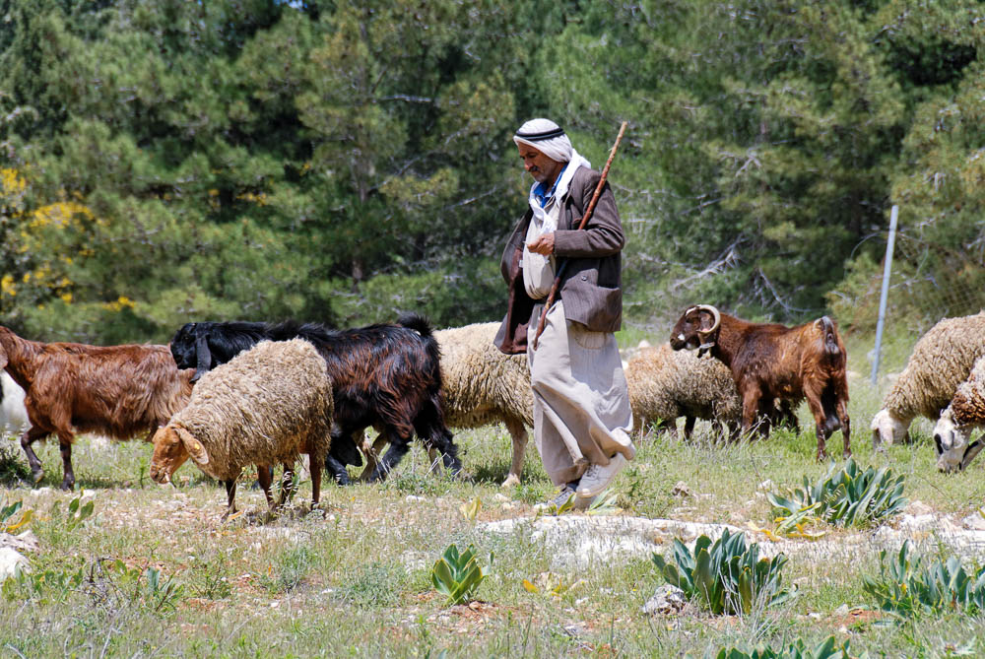
Yahweh is my Shepherd
Shepherd near Har Homa
23:1
Notes:
“Shepherd” is a particularly appropriate way to describe God’s relationship to His people, as He is not merely their Ruler, but also their Caretaker (cf. Ps 80:1; Isa 40:11; John 10:11; Heb 13:20; 1 Pet 2:25). The theme of this psalm is God’s watchful care of David, providing for him and protecting him at all times, and never abandoning or failing him. Yahweh is the word in Hebrew that is usually translated as “the Lord” in English. Yahweh is God’s personal name revealed to His people. Har Homa is located just north of Bethlehem.
cd090417141

Slide 6
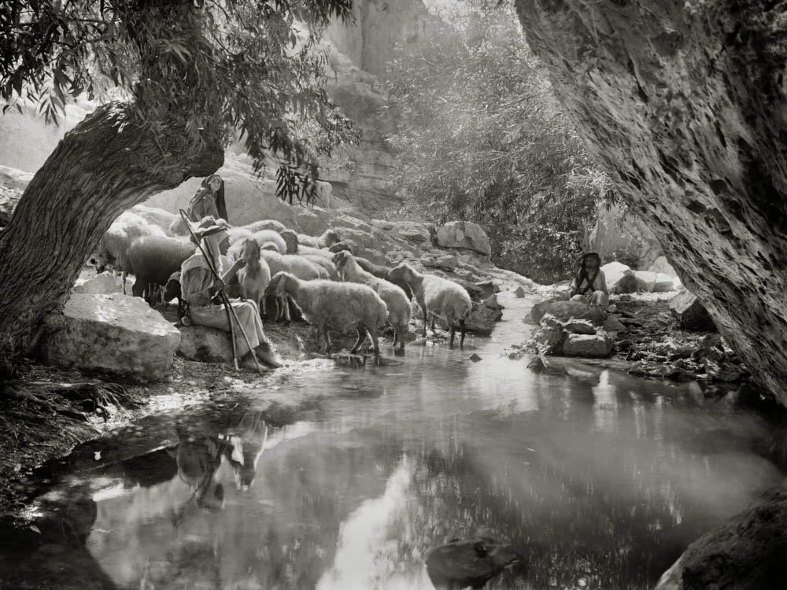
Yahweh is my Shepherd
Shepherds with their sheep in Israel
23:1
Notes:
This American Colony photograph was taken between 1900 and 1920. It is part of a series of photographs designed to illustrate Psalm 23. This photograph was probably taken in the Judean wilderness east of Jerusalem, possibly at Ein Farah in the Wadi Qilt (Nahal Perat).
mat05669

Slide 7
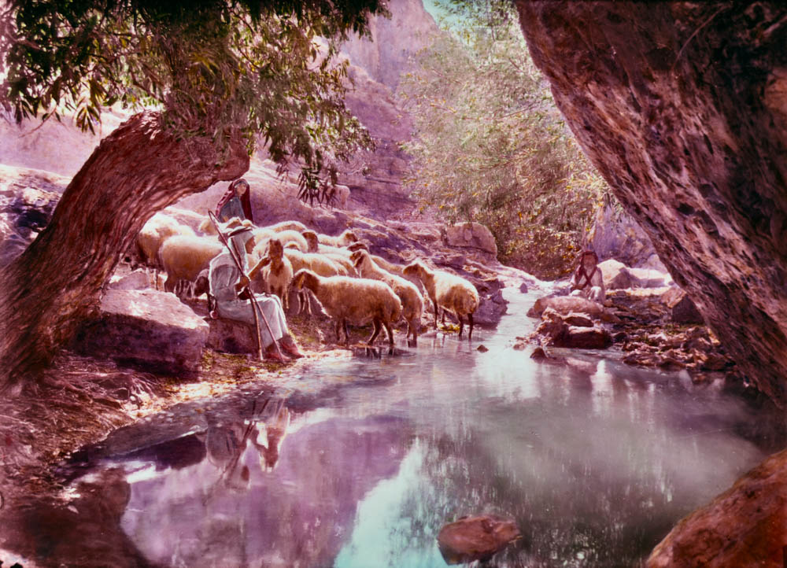
Yahweh is my Shepherd
Shepherds with their sheep in Israel
23:1
Notes:
David here identifies “Yahweh” as his Shepherd. In the New Testament, the Lamb of God becomes the Shepherd of God’s people (Rev 7:17; cf. Isa 53:7, 12). This is a hand-colored version of the black-and-white photograph shown on the previous slide. It was taken between 1900 and 1920.
mat14902

Slide 8
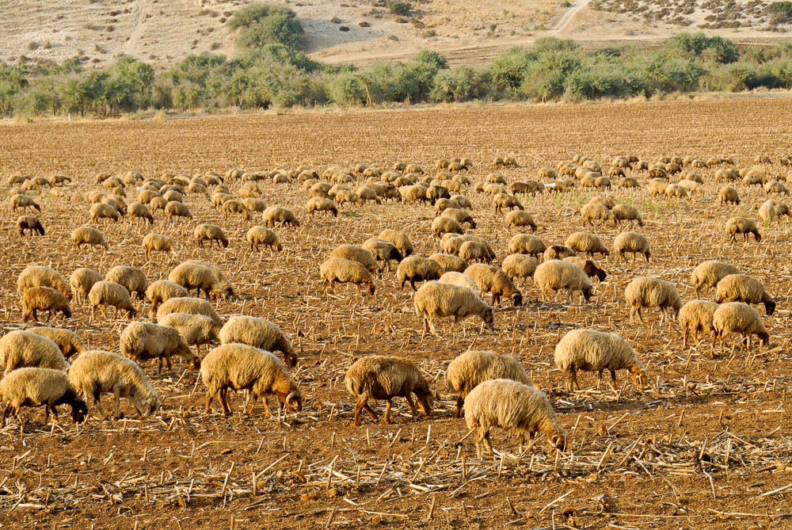
I shall not lack
Sheep grazing in the Elah Valley after the harvest
23:1
Notes:
“Yahweh is my shepherd; I shall not lack” is the main idea of Psalm 23. God provides everything David needs, just as a shepherd looks after all the needs of his sheep. God’s provision encompasses the whole of life—both physical needs and spiritual needs. This slide shows a flock of sheep in the Elah Valley, where David fought Goliath (1 Sam 17:2).
cd091007503

Slide 9
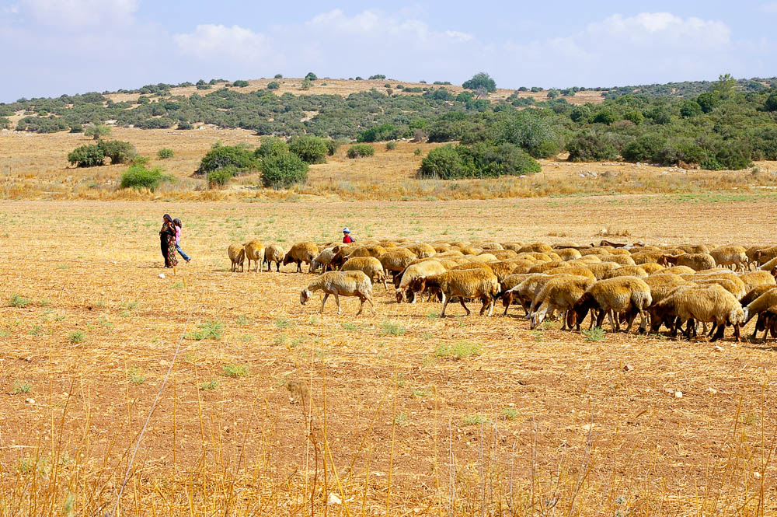
I shall not lack
Sheep and shepherds near Gath (Tell es-Safi) and the Elah Valley
23:1
Notes:
David was familiar with this area shown in this photo, if not from the years tending his father’s sheep, then from his time in Saul’s service fighting the Philistines and later fleeing from Saul (1 Sam 18:27-30; 21:10; 22:1). The shepherd here grazes her flock in fields that have been harvested.
adr0807130231

Slide 10
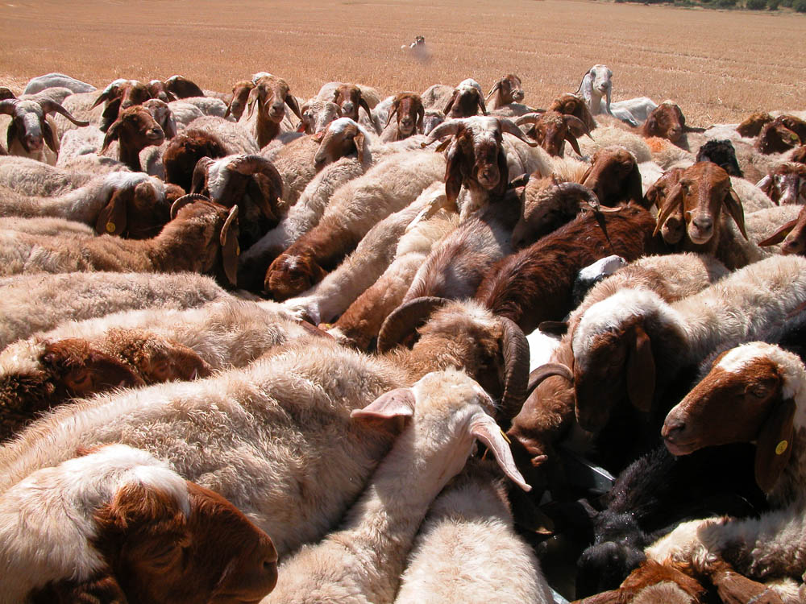
I shall not lack
Sheep and goats drinking in the Elah Valley
23:1
Notes:
The good shepherd guides his sheep to sources of food and water. In biblical times, the work was more challenging than in modern days when a shepherd can use a water hose to fill up a trough for his flock. Compare this verse with Psalm 34:9 – “O fear the Lord, you His saints; for to those who fear Him there is no lack!”
tb050504613

Slide 11
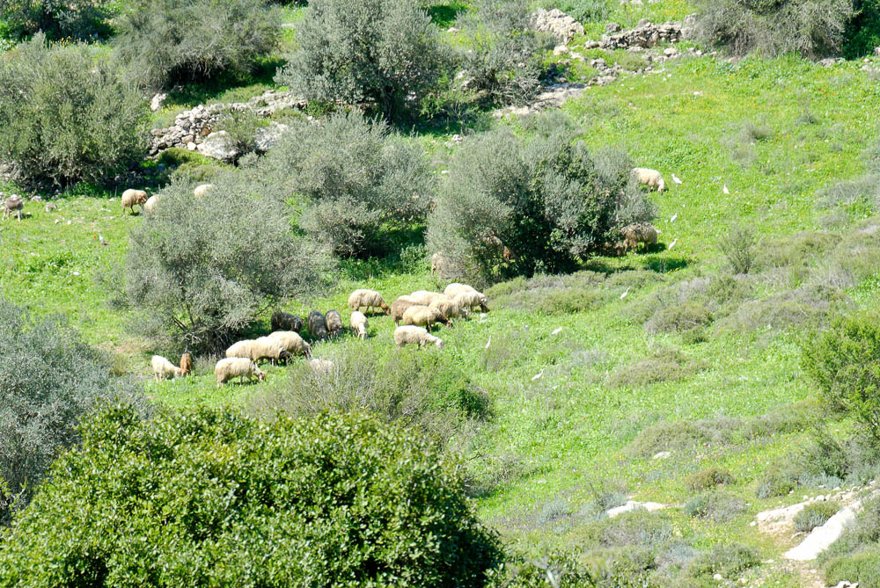
I shall not lack
Sheep grazing on the slopes of the Elah Valley
23:1
Notes:
In the Shephelah of Judah, where this photo was taken, the valley floors are ideal for cultivation. Thus the shepherd must take his flocks to the surrounding hillsides to graze until after the harvest has been brought in. This photo was taken in early March, when the fields were full of crops and thus off-limits to the sheep.
tb030407706

Slide 12
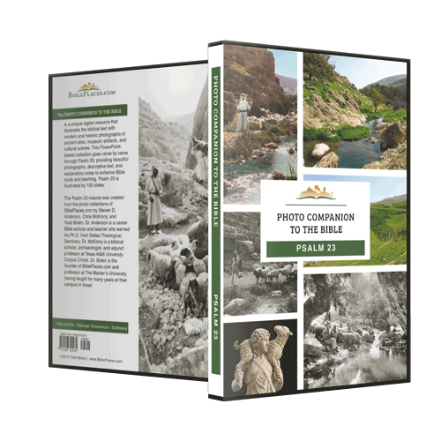
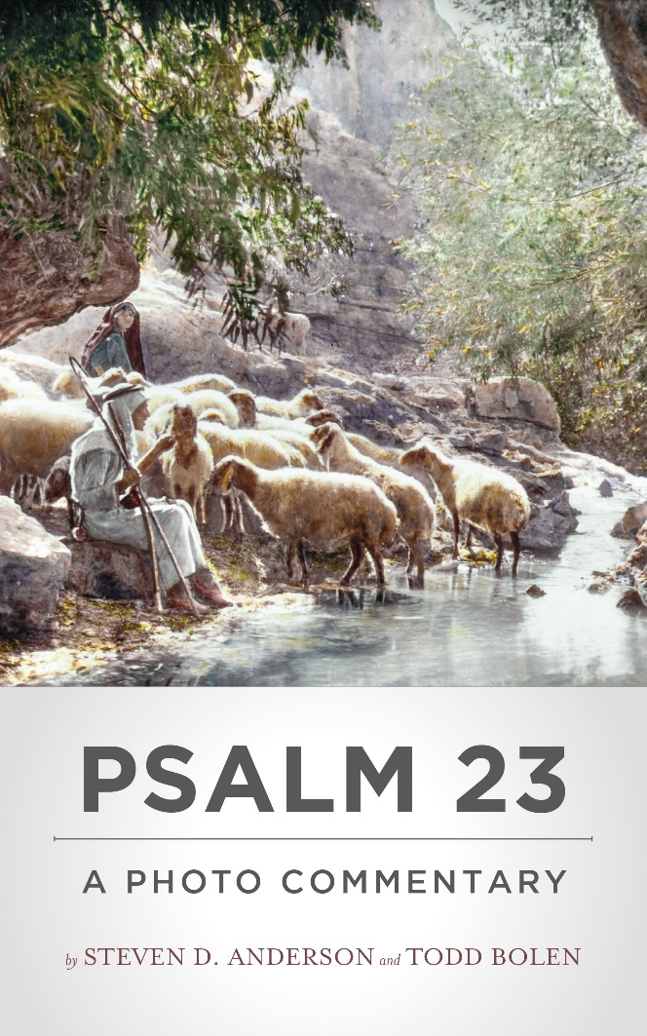
More than 100 slides in PowerPoint format. Available now from BiblePlaces.com
In paperback and Kindle format. Available now from Amazon.
Notes:
Digital Version: This free sample comes from verse 1 of Psalm 23 of the Photo Companion to the Bible. The complete Psalm 23 presentation includes more than 100 slides. This collection is an image-rich resource for Bible students, teachers, and researchers. See www.bibleplaces.com/ps23/.
Book Version: An adaptation of this collection is available as a book (print and Kindle) from Amazon, Psalm 23: A Photo Commentary. See www.bibleplaces.com/ps23book/.

