Slide 1
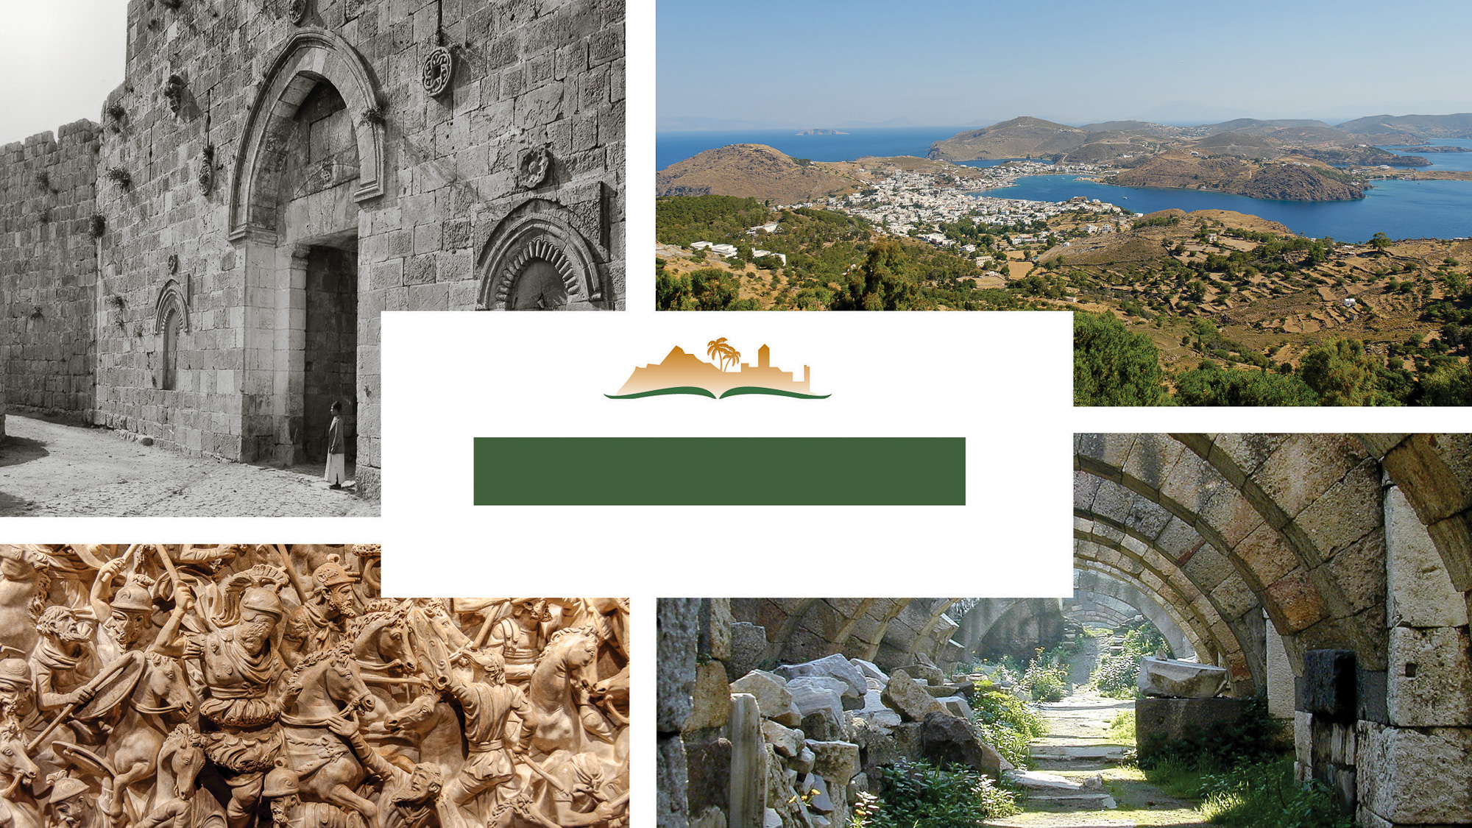
Revelation 6
Notes:
This is a free sample of the Revelation 6 presentation from the Photo Companion to the Bible. To purchase the full volume, visit https://www.bibleplaces.com/revelation/
The Photo Companion to the Bible is an image-rich resource for Bible students, teachers, and researchers. Just as a librarian stocks the shelves with as many relevant materials as possible, so we have tried to provide a broad selection of images. Our goal is that you will find in this “library” whatever it is you are looking for.
Credits: The primary creators of this presentation are Steven D. Anderson, Kai Akagi, Kris Udd, and Todd Bolen. The photographs have an individual file code which usually includes the initials of the photographer. Other images have additional credit or source information.
Updates: We plan to update this collection as we are able. We welcome your suggestions for improving this resource (photocompanion@bibleplaces.com). Purchasers of the Revelation volume are provided free, lifetime updates to the volume.
Copyright: This photo collection is protected by copyright law and may not be distributed without written permission from BiblePlaces.com. Slide notes should be treated as any other copyrighted written material, with credit given when quoting from these notes.
For more information, see our complete “Introduction to the Photo Companion to the Bible” online at https://www.BiblePlaces.com/Intro-Photo-Companion-Bible/. Here you will find more information about photo selection, explanatory notes, Bible translation, credit information, and copyright allowances.

Slide 2
Revelation 6
This is a free sample of the Revelation 6 presentation from the Photo Companion to the Bible. To purchase the full volume, visit https://www.bibleplaces.com/revelation/ The Photo Companion to the Bible is an image-rich resource for Bible students, teachers, and researchers. Just as a librarian stocks the shelves with as many relevant materials as possible, so we have tried to provide a broad selection of images. Our goal is that you will find in this “library” whatever it is you are looking for. For more details (for this and every slide), see the Notes section below.
Notes:
This is a free sample of the Revelation 6 presentation from the Photo Companion to the Bible. To purchase the full volume, visit https://www.bibleplaces.com/revelation/
The Photo Companion to the Bible is an image-rich resource for Bible students, teachers, and researchers. Just as a librarian stocks the shelves with as many relevant materials as possible, so we have tried to provide a broad selection of images. Our goal is that you will find in this “library” whatever it is you are looking for.
Credits: The primary creators of this presentation are Steven D. Anderson, Kai Akagi, Kris Udd, and Todd Bolen. The photographs have an individual file code which usually includes the initials of the photographer. Other images have additional credit or source information.
Updates: We plan to update this collection as we are able. We welcome your suggestions for improving this resource (photocompanion@bibleplaces.com). Purchasers of the Revelation volume are provided free, lifetime updates to the volume.
Copyright: This photo collection is protected by copyright law and may not be distributed without written permission from BiblePlaces.com. Slide notes should be treated as any other copyrighted written material, with credit given when quoting from these notes.
For more information, see our complete “Introduction to the Photo Companion to the Bible” online at https://www.BiblePlaces.com/Intro-Photo-Companion-Bible/. Here you will find more information about photo selection, explanatory notes, Bible translation, credit information, and copyright allowances.

Slide 3
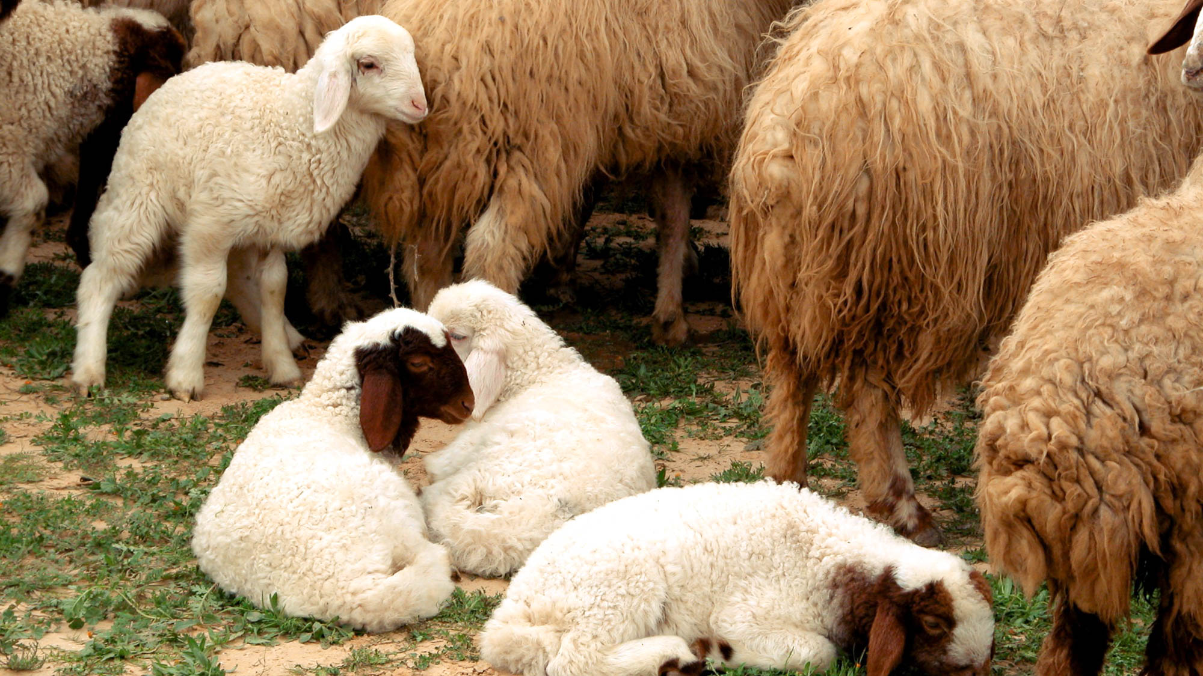
I saw when the Lamb opened one of the seven seals
Baby lambs in a Negev riverbed
6:1
Notes:
At the very beginning of His ministry, Jesus was introduced by John the Baptist as “the Lamb of God, who takes away the sin of the world” (John 1:29). The title refers to His self-sacrifice on the cross, where He gave up His own life to redeem mankind. Throughout Revelation, John refers to Jesus as the “Lamb” (Gk. arnion, ἀρνίον) 28 times. This picture shows lambs in the Negev.
tb010303518

Slide 4
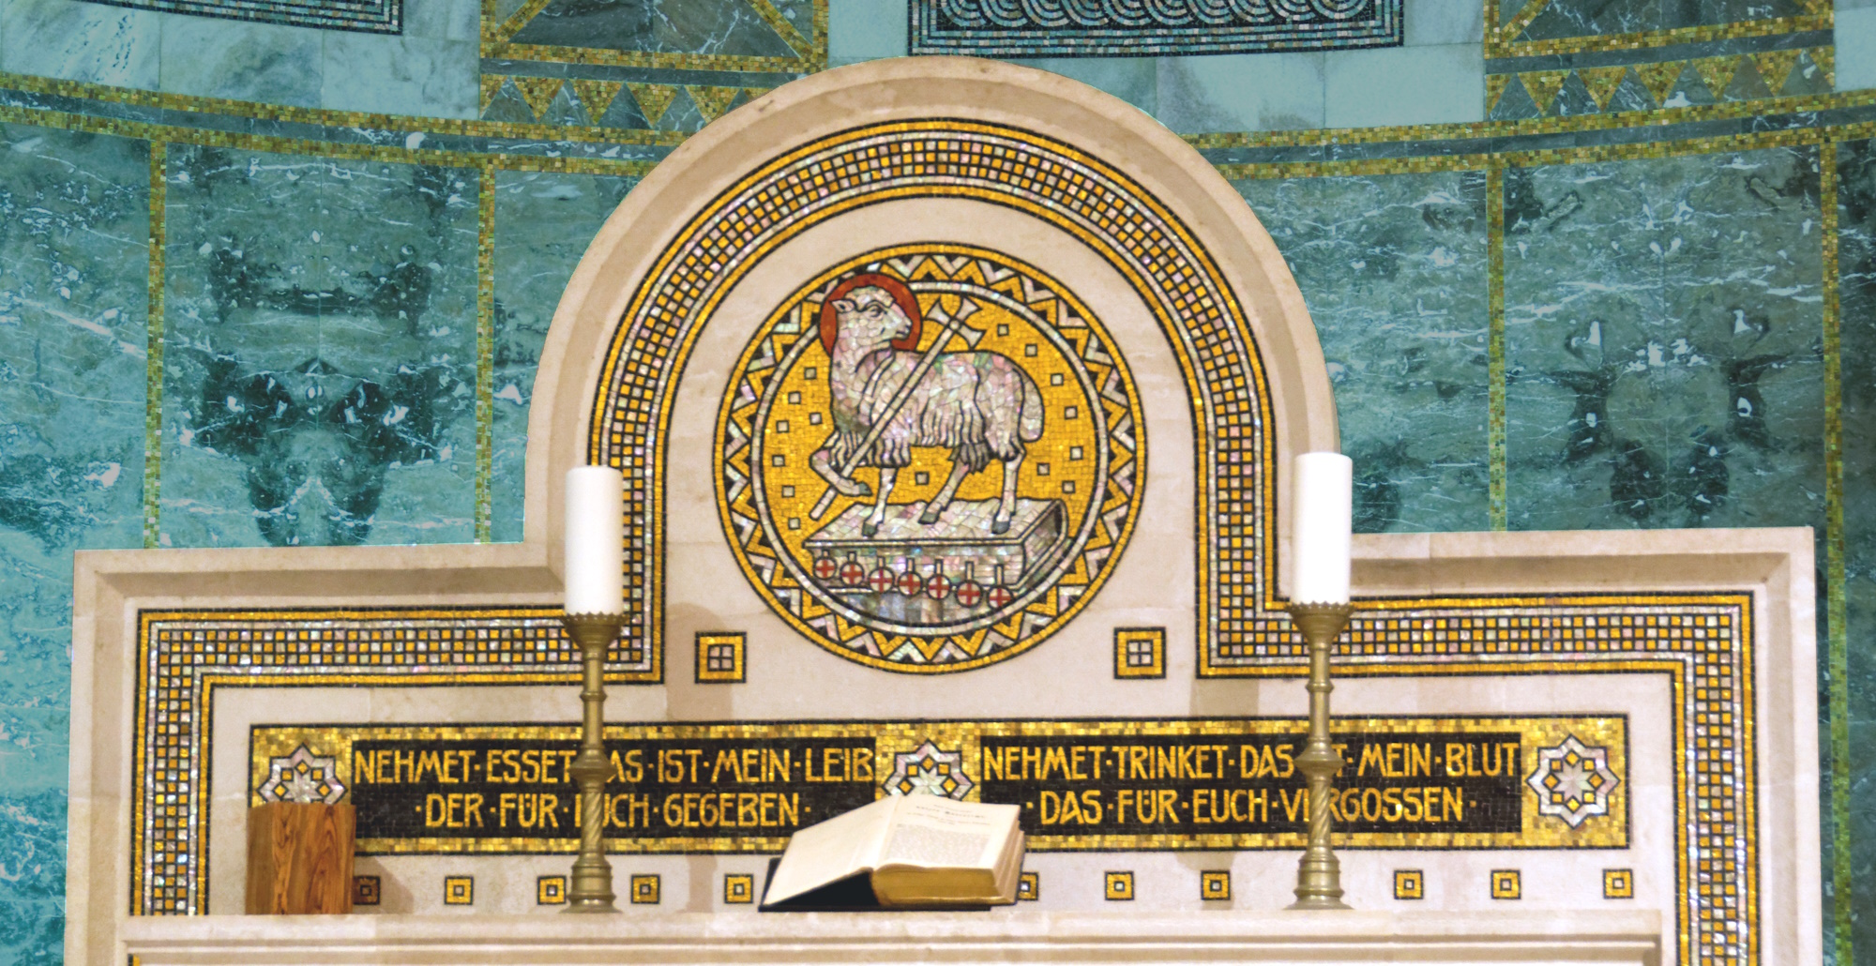
I saw when the Lamb opened one of the seven seals
Church altar with a depiction of the Lamb of God, in the Augusta Victoria Church
6:1
Notes:
This altar mosaic depicts Jesus as a lamb standing on a book with seven “seals.” The German inscription below the lamb records the institution of the Lord’s Supper. On the left, “Take, eat, this is my body given for you,” and on the right, “Take, drink, this is by blood which is shed for you.” The Augusta Victoria Church, where this altar was photographed, is located on the Mount of Olives.
tb060116201c

Slide 5
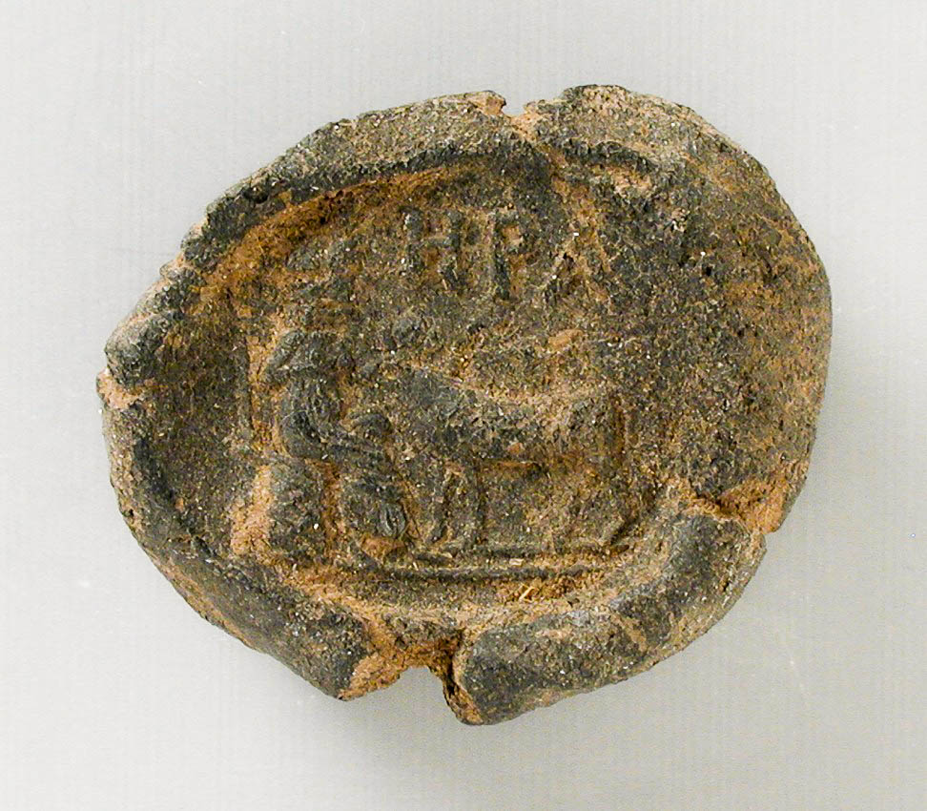
I saw when the Lamb opened one of the seven seals
Clay seal impression depicting the goddess Hera, from Egypt, circa 30 BC–AD 395
6:1
Notes:
The scroll taken by the Lamb could not be opened without breaking seven seal impressions that had been affixed to it to prevent it from being opened without authorization. This example of a seal impression roughly contemporary with the time of the writing of Revelation bears the images of the goddess Hera and a bull. At the top is the name of the goddess (Gk. ΗΡΑ). This image comes from the Los Angeles County Museum of Art and is in the public domain, via Wikimedia Commons: https://commons.wikimedia.org/wiki/File:Seal_Impression_Depicting_the_Goddess_Hera_LACMA_M.80.202.857.jpg.
wiki071720131500972850239

Slide 6
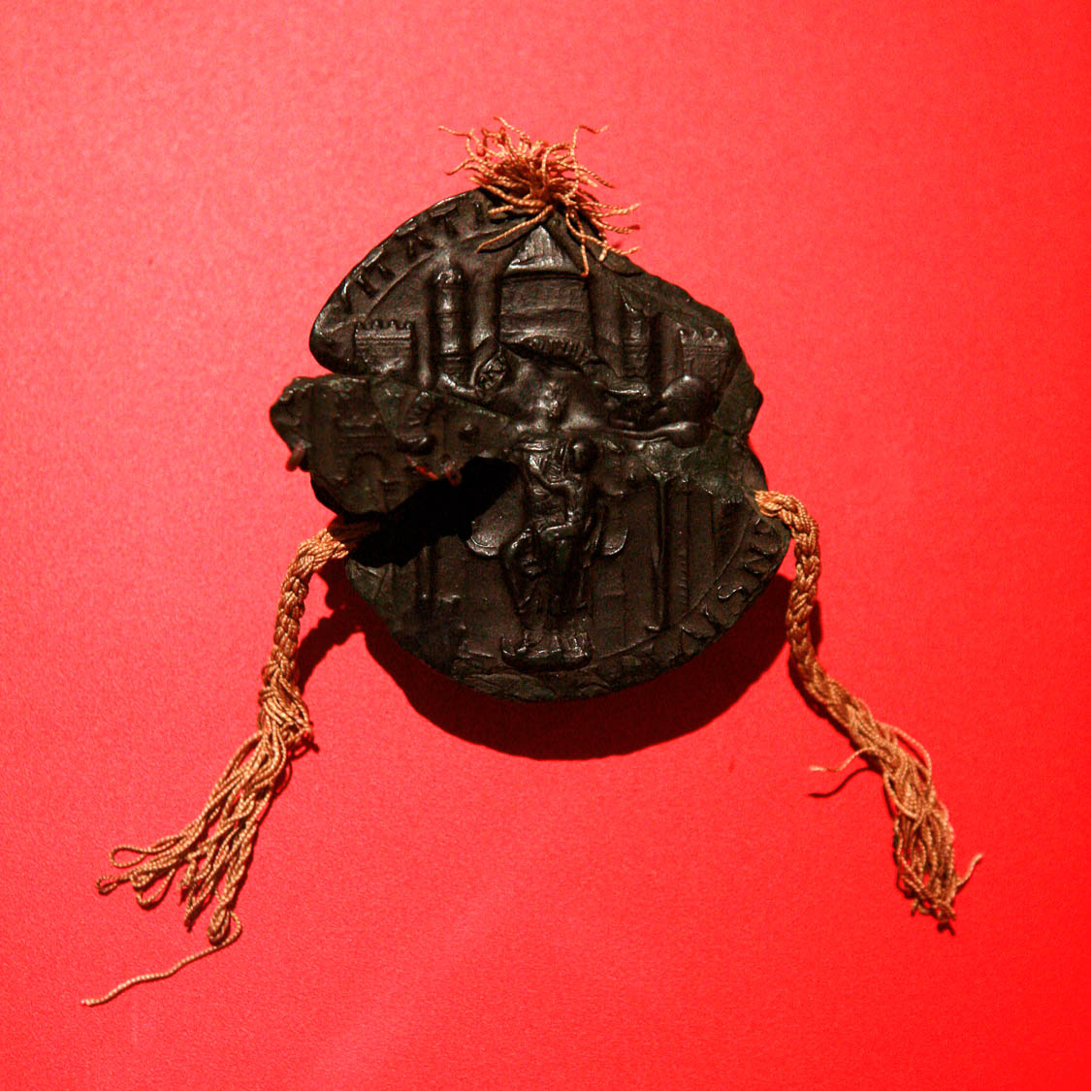
I saw when the Lamb opened one of the seven seals
Wax seal impression of the city of Strausbourg, circa AD 1200
6:1
Notes:
Because so few clay seal impressions from the Roman era have been found, it seems likely that the seals to which John refers would probably have been envisioned by his audience as having been made of wax, although wax is not durable enough to have survived from the Roman era. Among the earliest wax seal impressions to survive are those of the medieval period, like the example shown here. This wax seal impression was photographed at the Musée historique de Strasbourg. This image comes from Rama and is licensed under CC BY-SA 2.0 FR, via Wikimedia Commons: https://commons.wikimedia.org/wiki/File:Seal_of_Strasbourg-f3392641.jpg.
wiki0908201022131973392641

Slide 7
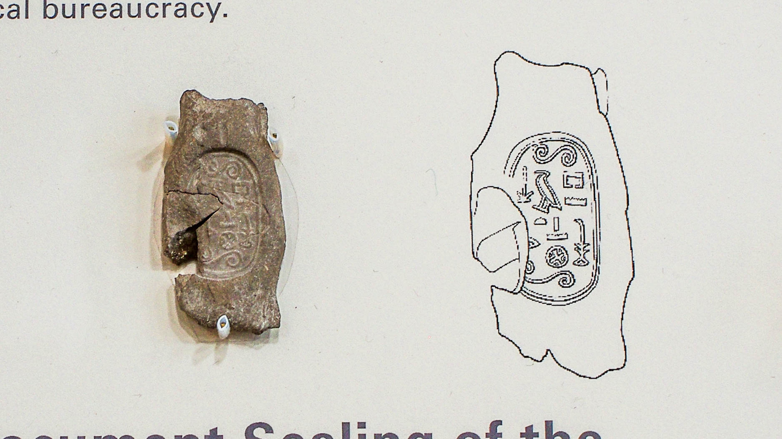
I saw when the Lamb opened one of the seven seals
Broken seal impression of the Southern Vizier, from Serra East, Egypt, 18th–17th centuries BC
6:1
Notes:
This document seal from the late Middle Kingdom was photographed at the Oriental Institute Museum at the University of Chicago.
adr1707214251h

Slide 8
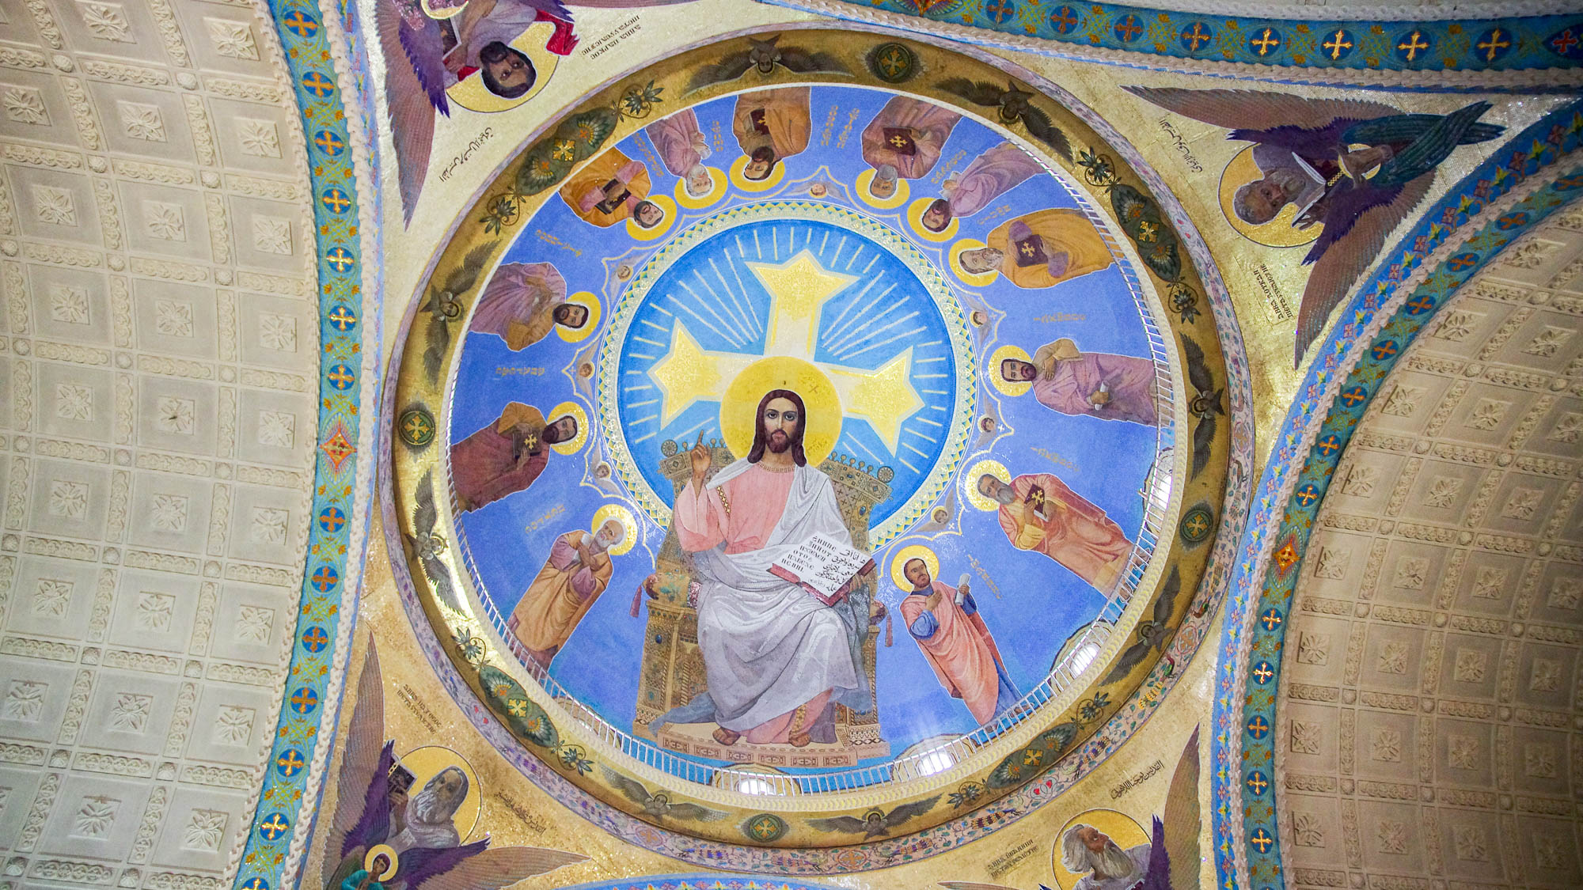
I heard one of the four living creatures saying with a voice like thunder, “Come!”
Jesus shown with twelve disciples and four evangelists, in St. Mina Monastery, Mariut
6:1
Notes:
Revelation 6:1 relates one of the four living creatures calling for John to “Come” when each of the first four seals are opened, but it does not specify the order in which the four living creatures call him. The living creatures were later appropriated as symbols of the four evangelists. This ceiling fresco in Saint Mina’s Cathedral in the Saint Mina Monastery in Egypt shows the four evangelists with the four living creatures symbolizing them at its corners.
adr1603278620h

Slide 9
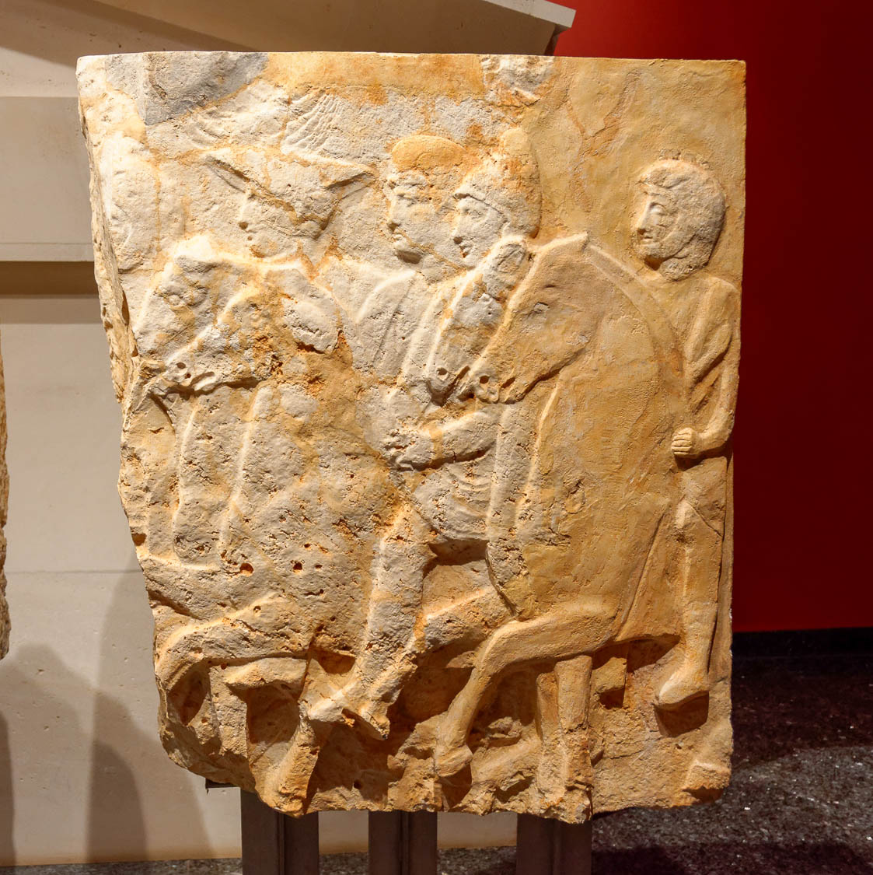
And I looked, and behold, a white horse
Four horsemen on a relief from the Tomb of Pericles, 4th century BC
6:2
Notes:
This statement is the first in a vision that includes four horsemen. Each rides a horse of a different color, carries different equipment, and represents some aspect of the end times that this section describes. This ancient representation of four horsemen was photographed at the Antalya Museum.
tb123016924h

Slide 10
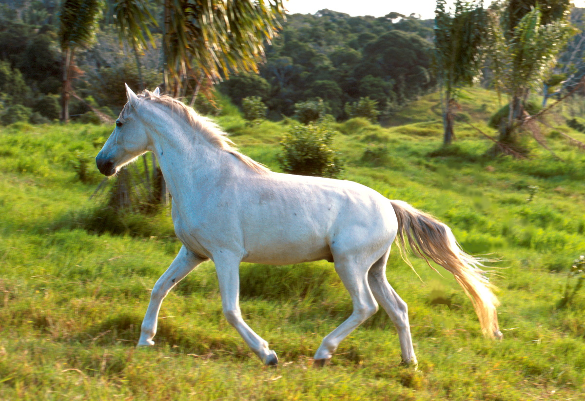
And I looked, and behold, a white horse
A white horse
6:2
Notes:
The first horse described by John is white (Gk. leukos, λευκός). The combination of the color white, the use of the bow, and a crown is suggestive of victory. This photo of a white horse was taken in the United States. This image comes from Scott Bauer and is in the public domain, via Wikimedia Commons: https://commons.wikimedia.org/wiki/File:White_horse-K8855-1.jpg.
wiki10102006101911118492700h

Slide 11
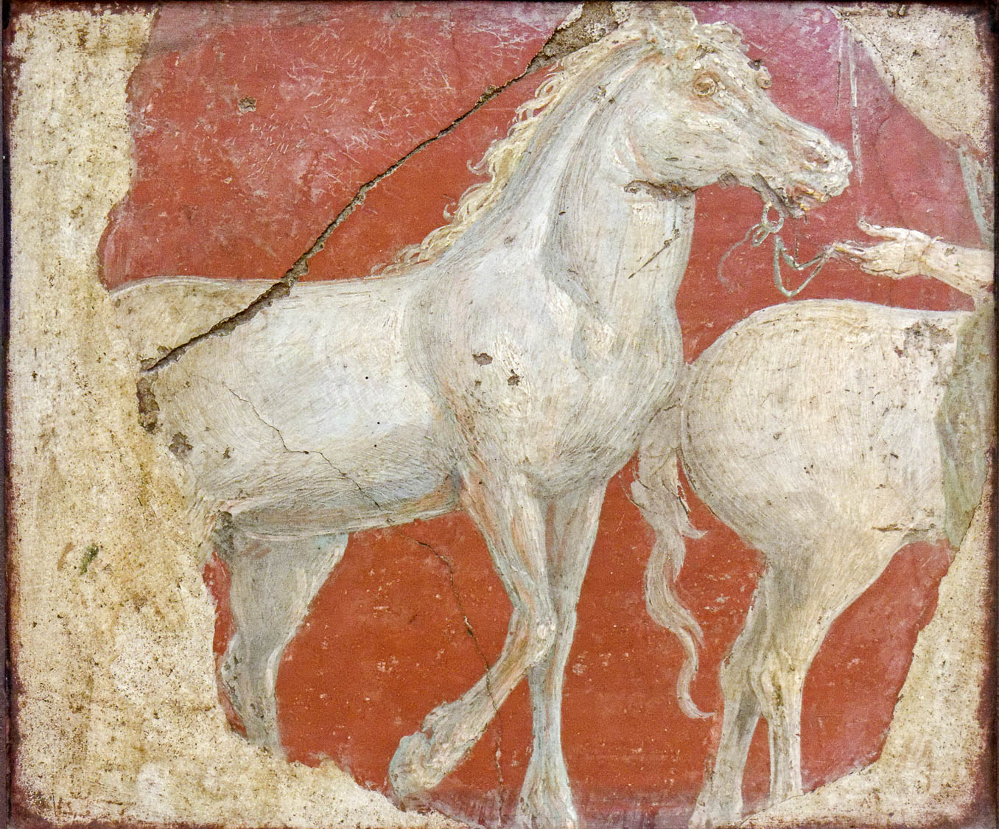
And I looked, and behold, a white horse
Fresco of running horses, from Villa Ariadne, Stabiae, 1st century AD
6:2
Notes:
This fresco comes from Villa Ariadne (Arianna) at Stabiae, a city on the coast near Pompeii that was also destroyed in the eruption of Mount Vesuvius in AD 79. It depicts a white horse being led by a bridle and reins. This fresco was photographed at the Naples Archaeological Museum.
tb0515170317h

Slide 12
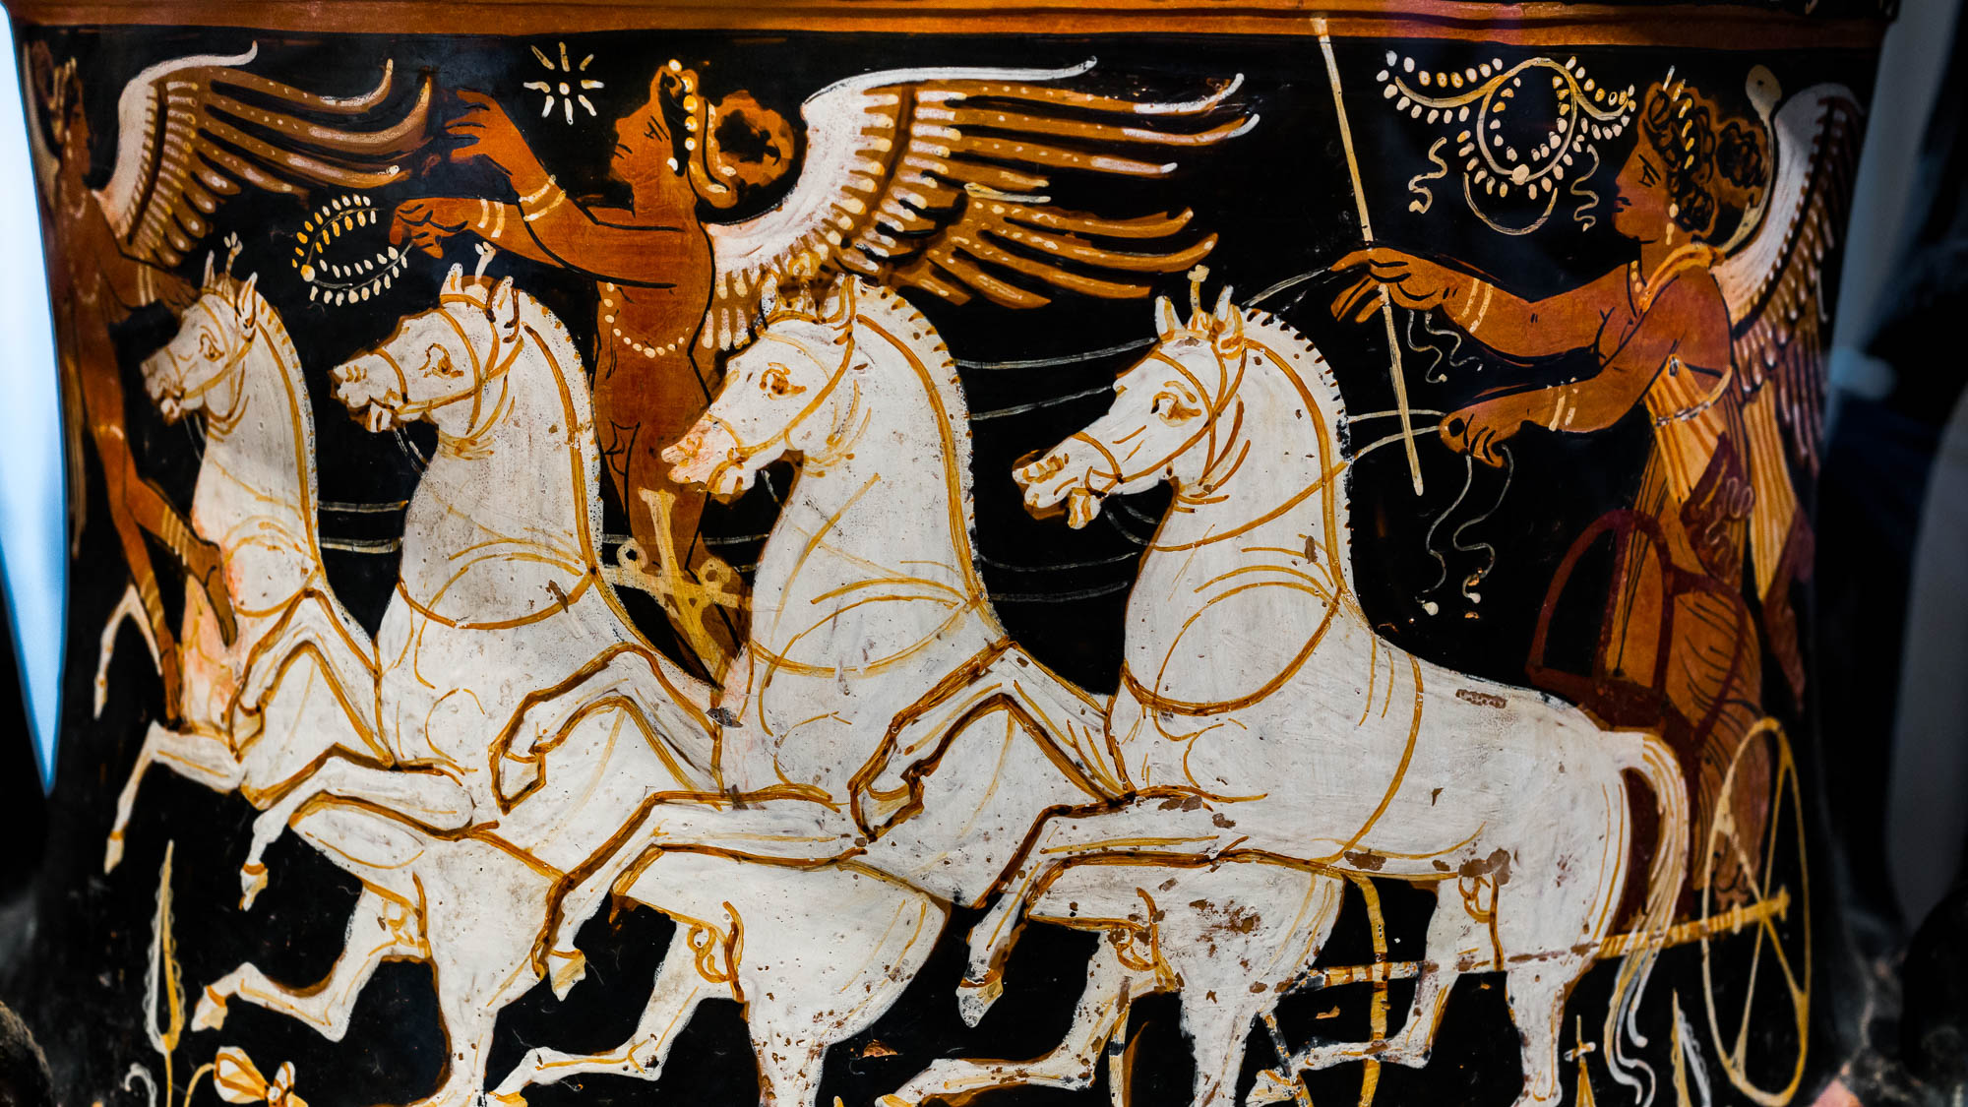
And I looked, and behold, a white horse
Krater with Nike in a chariot drawn by four white horses, circa 320 BC
6:2
Notes:
This krater depicts Nike, the personification of victory, driving a four-horse chariot (quadriga) pulled by white horses, as two erotes fly overhead. The combination of white horses and victory are similar to the vision of the first horse, as described by John. This krater was photographed at a special exhibit in the Palazzo Cavalli Franchetti, Venice. This image comes from ArchaiOptix and is licensed under CC BY-SA 4.0, via Wikimedia Commons: https://commons.wikimedia.org/wiki/File:Baltimore_Painter_-_RVAp_27-17extra_-_underworld_-_naiskos_of_young_warrior_-_Roma_SABAP-RVEm_-_06.jpg.
wiki0107202212230813193555h

Slide 13
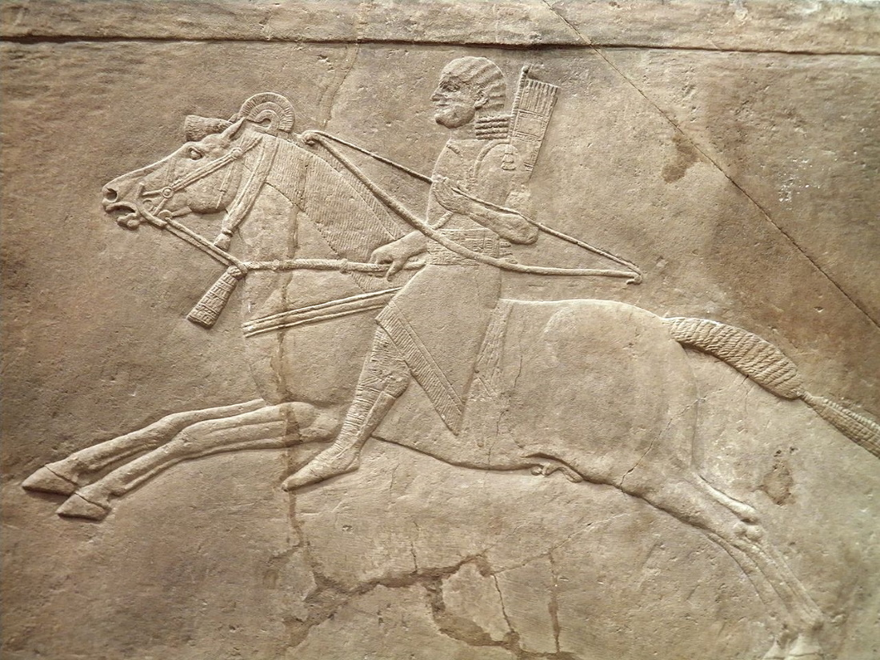
And its rider had a bow
Relief of a horseman, from the palace of Ashurbanipal at Nineveh, 7th century BC
6:2
Notes:
The bow had been used as a favorite weapon for horsemen since at least the Iron Age. This relief depicts a servant of the Assyrian king Ashurbanipal (probably a eunuch because of his beardless face) riding a galloping horse. It is part of a larger scene that portrays Ashurbanipal as a mighty and successful lion hunter. This relief was photographed at the British Museum. This image comes from Carole Raddato and is licensed under CC BY-SA 2.0, via Wikimedia Commons: https://commons.wikimedia.org/wiki/File:The_Royal_lion_hunt_reliefs_from_the_Assyrian_palace_at_Nineveh_,_about_645-635_BC,_British_Museum_(12254703695).jpg.
wiki122547036953216110420111858

Slide 14
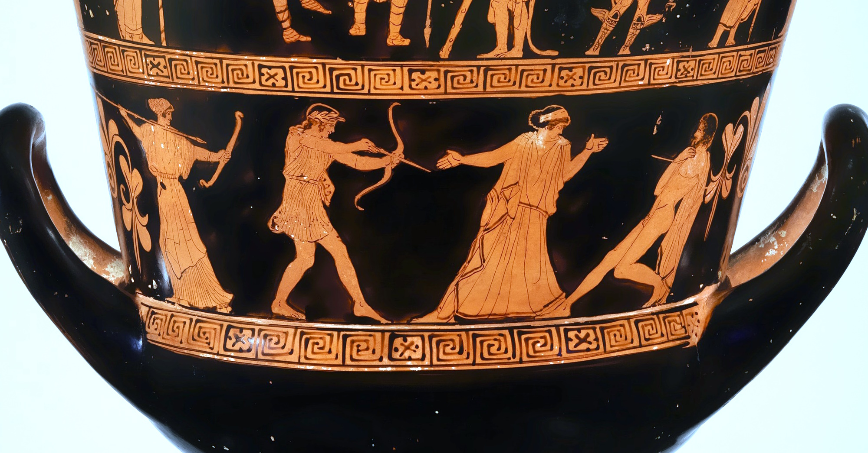
And its rider had a bow
Krater depicting Apollos and Tityos, 5th century BC
6:2
Notes:
The Romans, like the Greeks before them, used a recurve bow. This scene on a Greek krater of the 5th century depicts Apollo and Artemis killing the giant Tityos (Tityus) with arrows. This image comes from The Metropolitan Museum of Art, public domain, Rogers Fund, 1908, accession number 08.258.21, https://www.metmuseum.org/art/collection/search/248093.
met248093

Slide 15
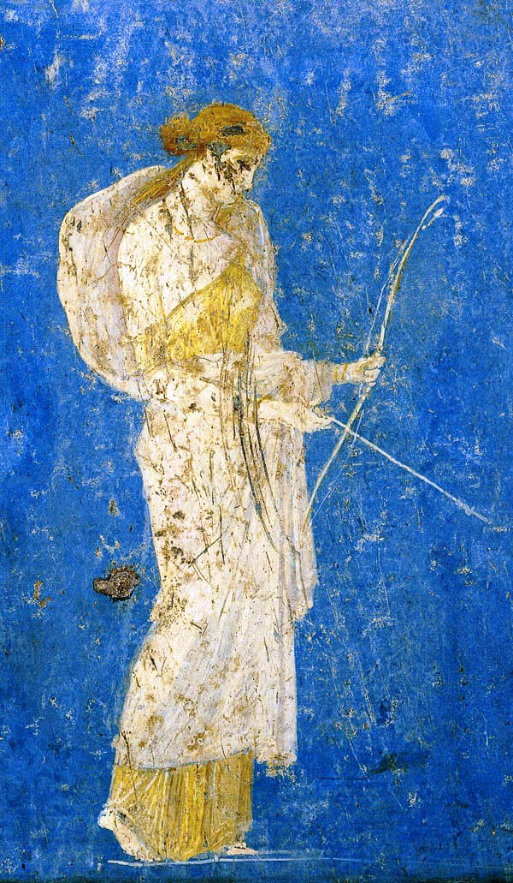
And its rider had a bow
Fresco of Diana with her bow, from the Villa of Arianne at Stabia, 1st century AD
6:2
Notes:
The bow was the favored weapon of the Greek goddess Artemis, known to the Romans as Diana. This fresco was photographed at the Naples Archaeological Museum. This image comes from Mentnafunangann and is licensed under CC BY-SA 3.0, via Wikimedia Commons: https://commons.wikimedia.org/wiki/File:Diana_Stabia_1.jpg.
wiki0511200537272692431031

Slide 16
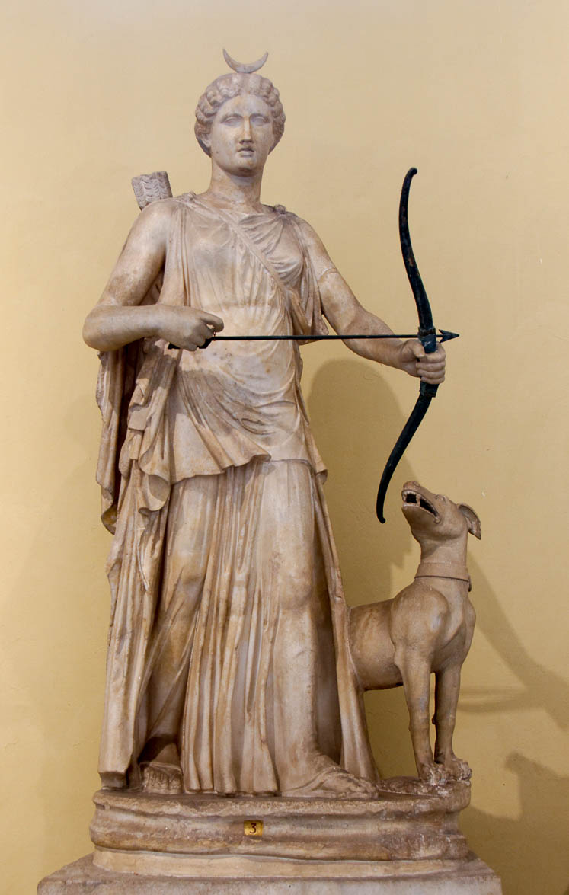
And its rider had a bow
Statue of Artemis with her bow, mid-2nd century AD
6:2
Notes:
This statue is thought to be a mid-2nd century AD copy of a mid-4th century BC Greek original. It was photographed at the Vatican Museums.
tb0512176560

Slide 17
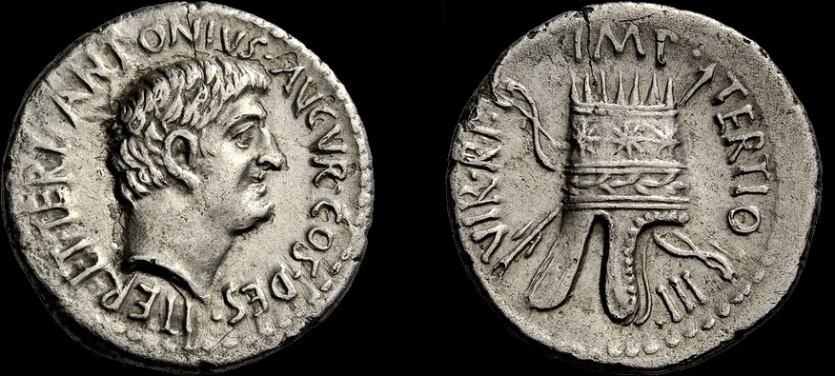
And its rider had a bow
Silver coin of Mark Antony, with bow and arrow, 1st century BC
6:2
Notes:
This silver coin was issued by Mark Antony to celebrate his victory over Armenia. He had campaigned in the region in 36 BC but was beaten back by the Parthians. He later returned to invade and pillage Armenia, and he killed its king. The obverse of this coin depicts Mark Antony. The reverse shows an Armenian crown over a crossed bow and arrow. This image comes from CNG Coins and is licensed under CC BY-SA 2.5, via Wikimedia Commons: https://commons.wikimedia.org/wiki/File:Mark_Antony_to_left_Armenian_tiara_to_right,_over_crossed_bow_and_arrow.jpg.
wiki1024201180039511811302018

Slide 18
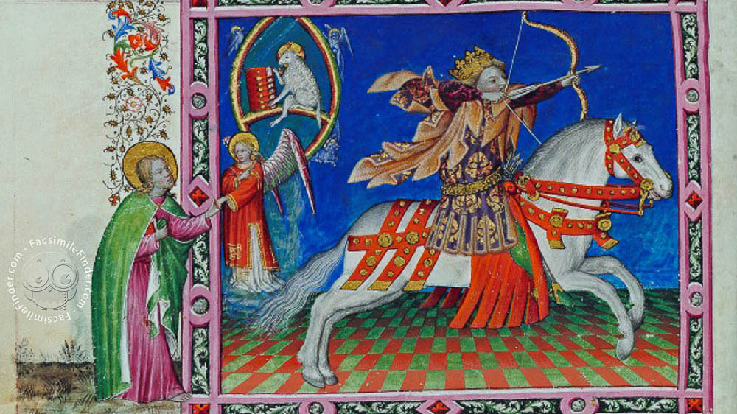
And its rider had a bow
First horseman of the Apocalypse, 15th-century illustration
6:2
Notes:
This image comes from Wikimedia Commons and is in the public domain. Source: https://commons.wikimedia.org/wiki/File:Apocalypse_figur%C3%A9e_des_ducs_de_Savoie_-_Escorial_E_Vit.5_-_White_horseman.jpg
wiki04202018184066724014281434h

Slide 19
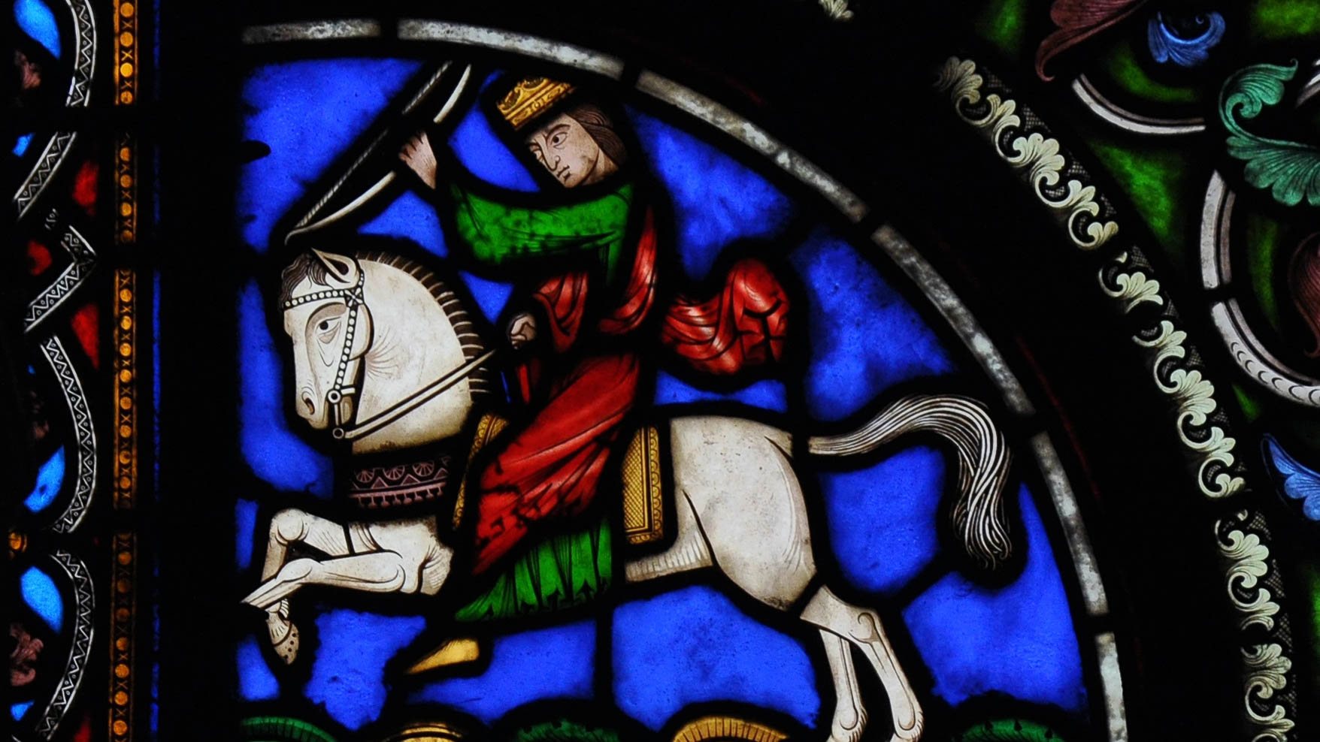
And its rider had a bow
First horseman depicted on a stained-glass window in the Basilica of Saint Denis, 1854
6:2
Notes:
This image comes from Vassil and is in the public domain, via Wikimedia Commons: https://commons.wikimedia.org/wiki/File:Vitraux_Saint-Denis_190110_32.jpg.
wiki0131201017561332750h

Slide 20
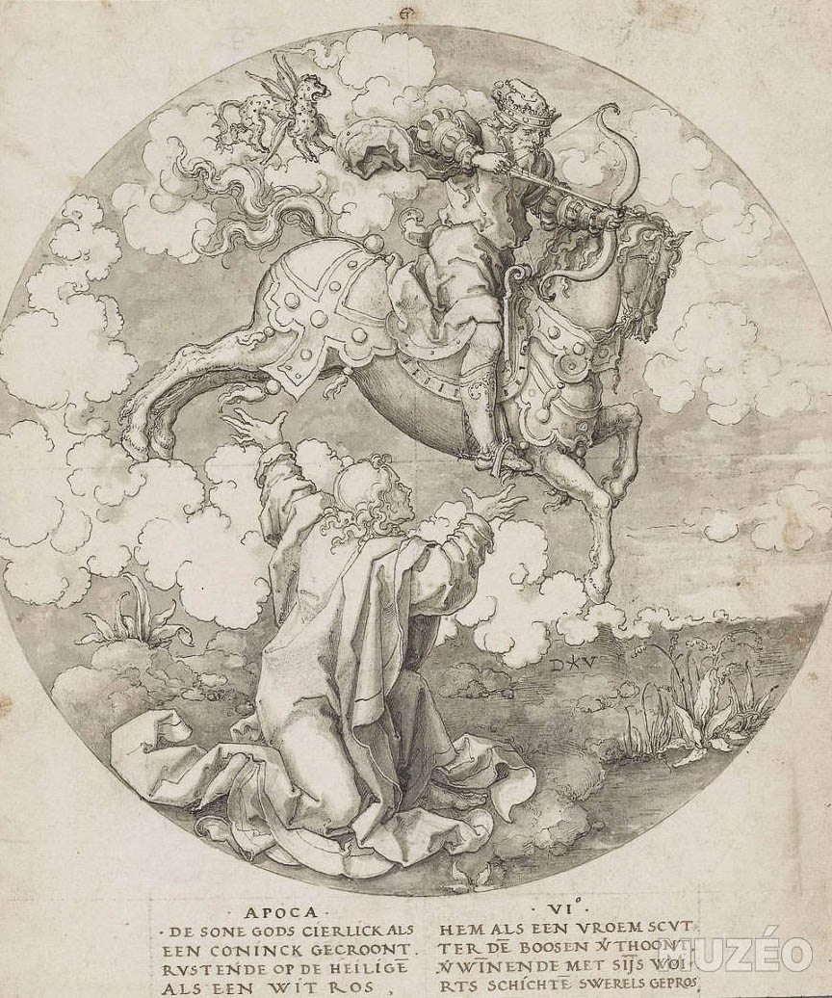
And its rider had a bow
First Horseman, by Dirck Jacobsz, 16th century
6:2
Notes:
This image comes from Dirck Jacobsz. Vellert and is in the public domain, via Wikimedia Commons: https://commons.wikimedia.org/wiki/File:1st_Horseman_of_Apocalypse_-_Dirck_Jacobsz._Vellert.jpg.
wiki0219201819559201080190h

Slide 21
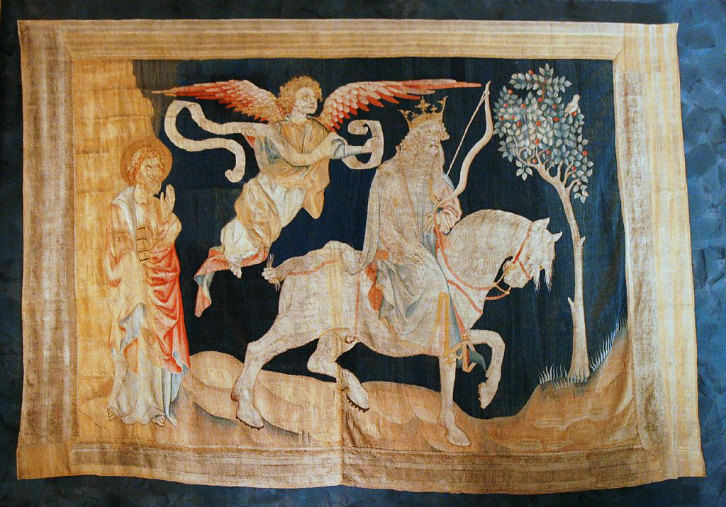
And its rider had a bow
First horseman, Angers Apocalypse tapestry, 14th century AD
6:2
Notes:
The Angers Tapestry, also known as the Apocalypse Tapestry, is a large medieval set of tapestries commissioned by Louis I, the Duke of Anjou. It was woven in Paris between 1377 and 1382, and is now located in the Château d'Angers, a castle in the city of Angers, France. This image comes from Remi Jouan and is licensed under CC BY-SA 3.0, via Wikimedia Commons: https://commons.wikimedia.org/wiki/File:Angers-_Apocalypse_(1).JPG.
wiki032520121034431119193

Slide 22
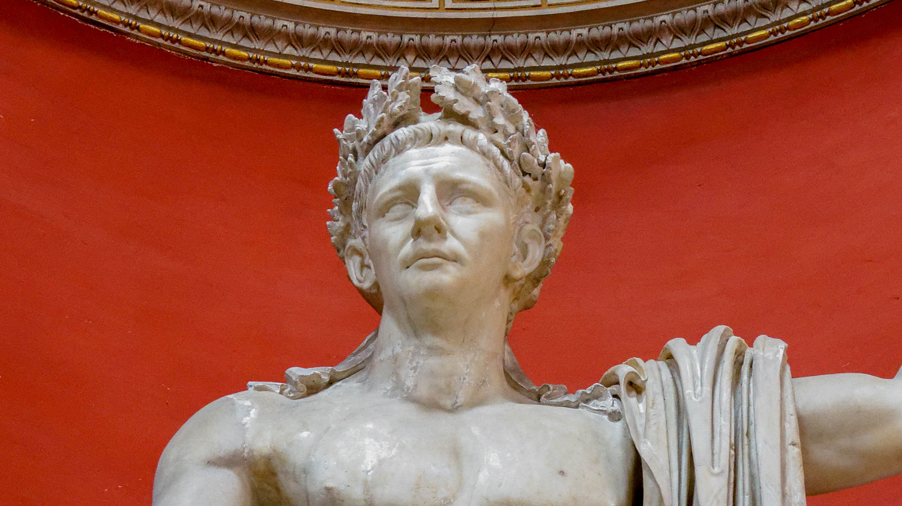
And a crown was given to him
Statue of Emperor Claudius with an oak leaf crown, from Lanuvio, AD 41–54
6:2
Notes:
The word “crown” (Gk. stephanos, στέφανος) is suggestive of both victory and dominion. This statue of the Roman emperor Claudius was photographed at the Vatican Museums.
tb0512176173h

Slide 23
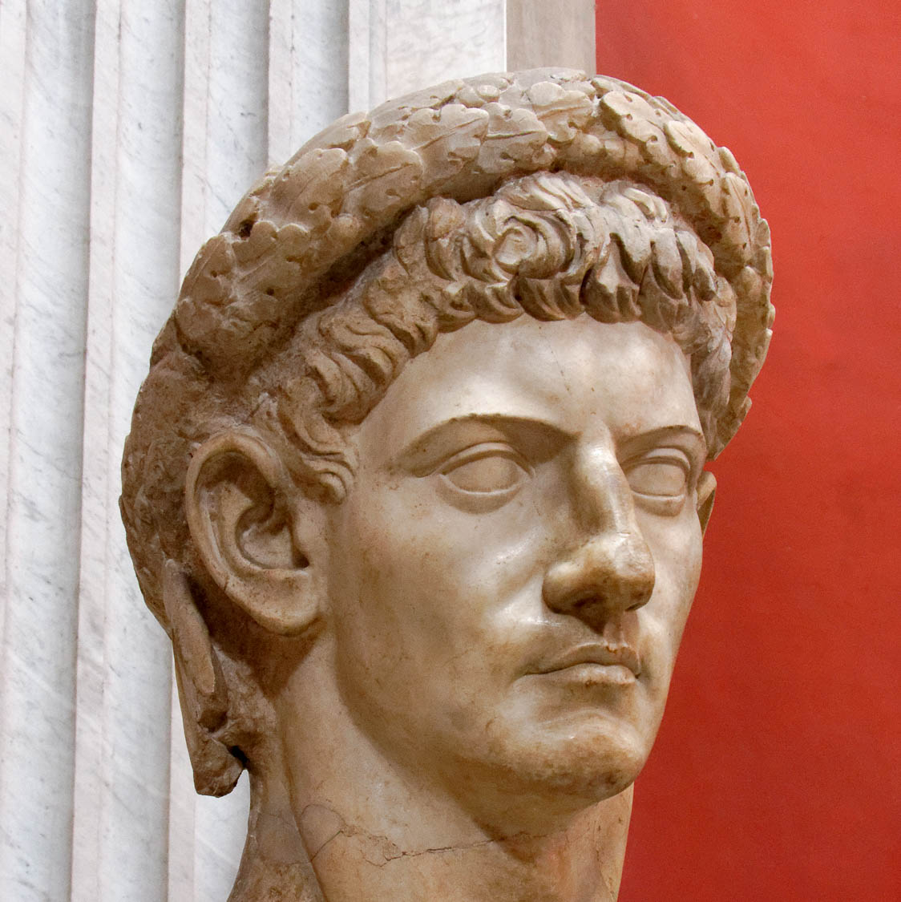
And a crown was given to him
Portrait of Emperor Claudius with an oak leaf crown, from the Basilica of Otricoli, AD 41–54
6:2
Notes:
This portrait bust was photographed at the Vatican Museums.
tb0512176170

Slide 24
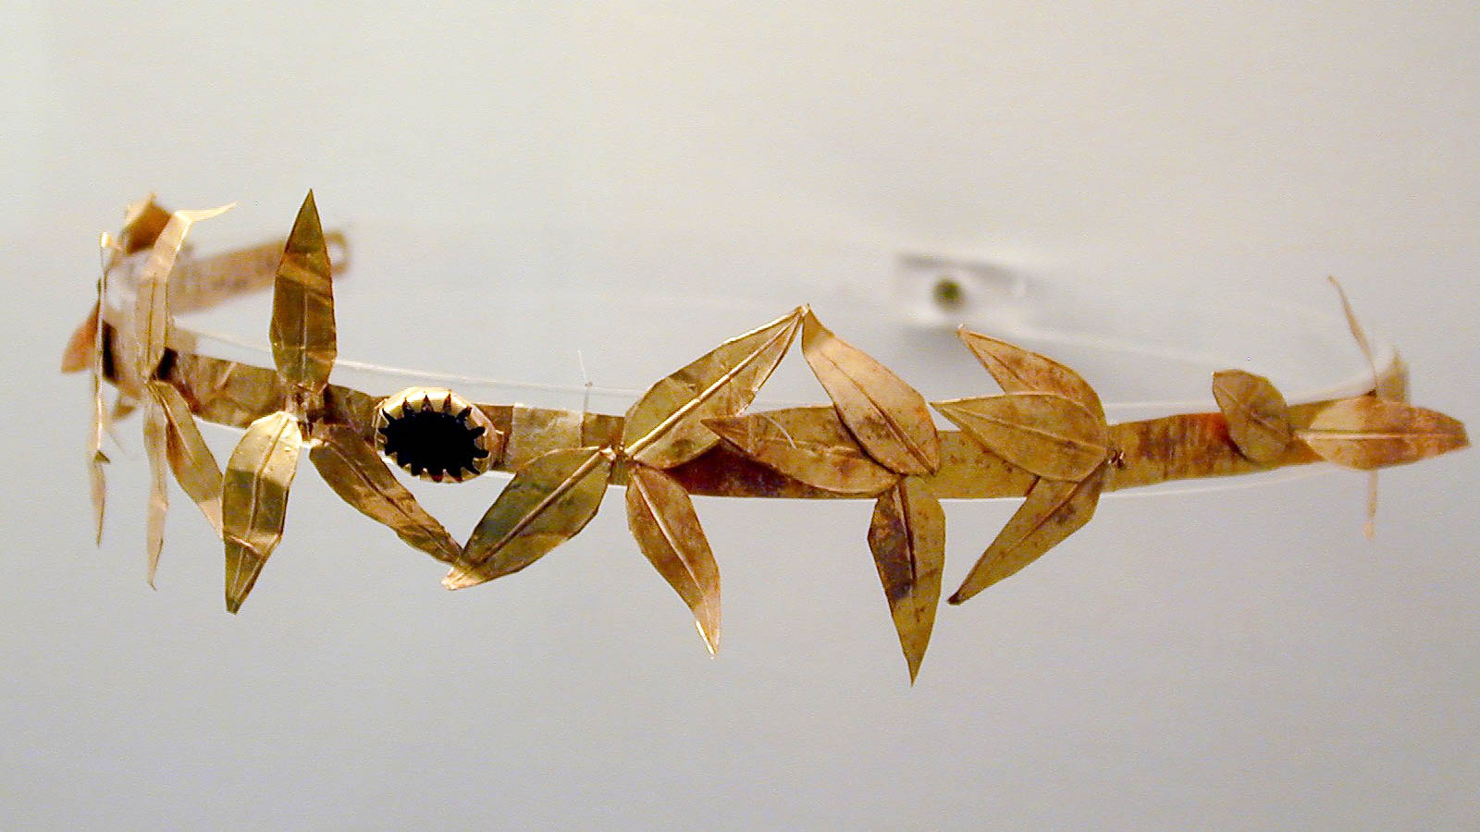
And a crown was given to him
Golden crown with olive leaves, Roman period
6:2
Notes:
This golden crown was photographed at the Amphipolis Museum.
tb011301134h

Slide 25
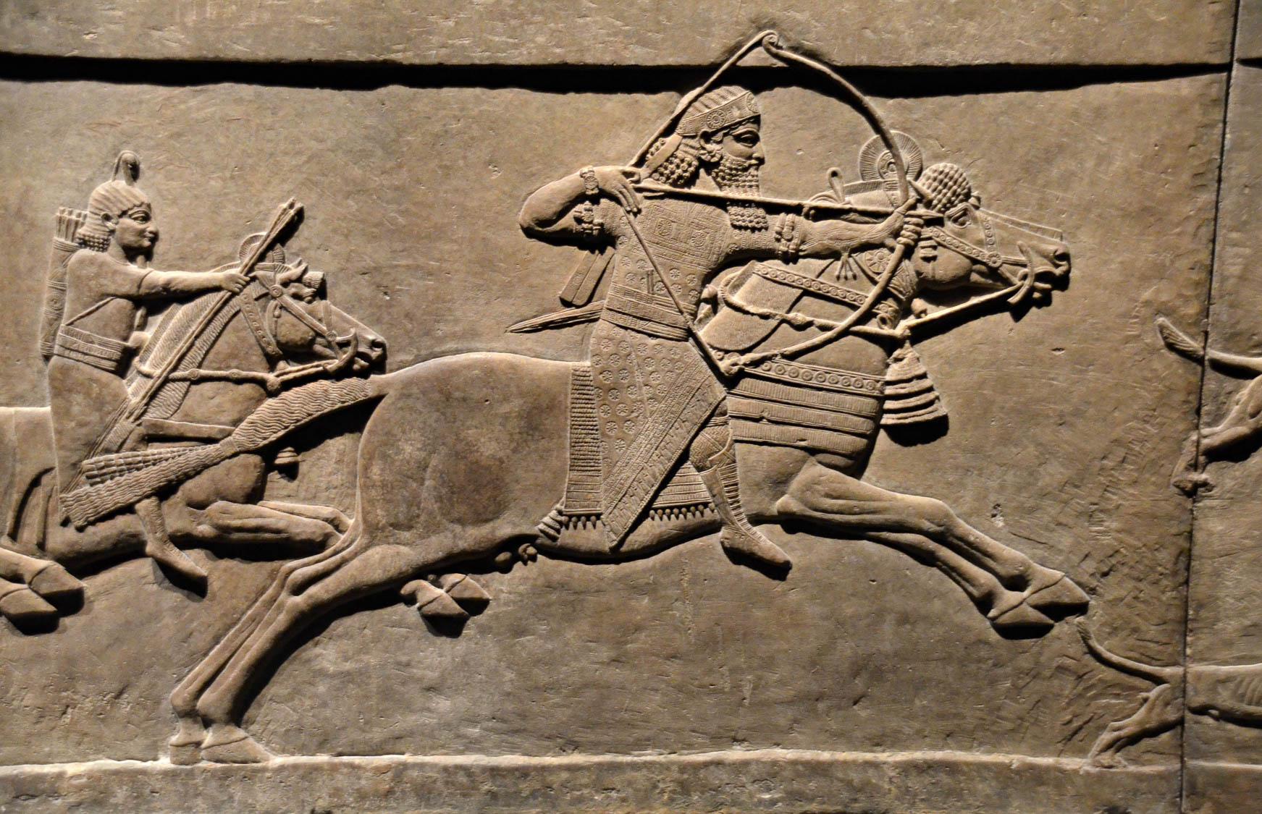
And he went out conquering and to conquer
Relief of King Ashurbanipal on horseback, from Nineveh, circa 645–635 BC
6:2
Notes:
This relief comes from the North Palace of Ashurbanipal at Nineveh. It depicts the Assyrian king Ashurbanipal mounted on a galloping horse, bow drawn, as he begins a lion hunt. It was photographed at the British Museum. This image comes from Carole Raddato and is licensed under CC BY-SA 2.0, via Wikimedia Commons: https://commons.wikimedia.org/wiki/File:Exhibition_I_am_Ashurbanipal_king_of_the_world,_king_of_Assyria,_British_Museum_(31033563287).jpg.
wiki3103356328711182018

Slide 26
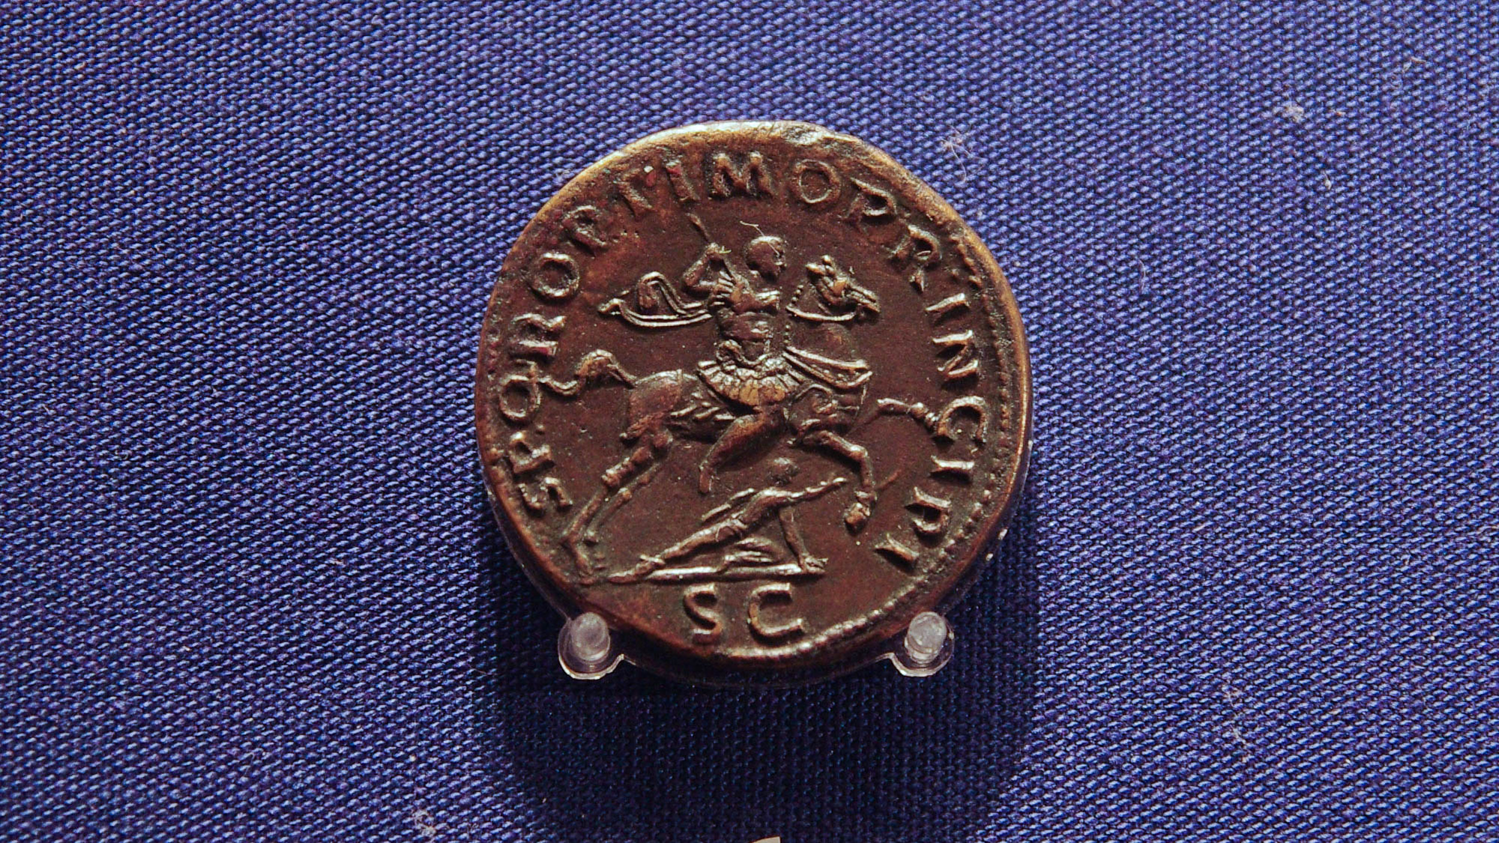
And he went out conquering and to conquer
Roman coin for Trajan’s conquest of Dacia, AD 103–111
6:2
Notes:
On this coin, the emperor Trajan is depicted in armor with a spear in his hand, as the leader of his victorious legions. The inscription on the coin reads “from the Senate and people of Rome, to the best of princes (S P Q R OPTIMO PRINCIPI), with the letters S C (Senatus Consulto, i.e., “struck by the authority of the Senate”) at the bottom. This coin was photographed at the Ashmolean Museum at the University of Oxford.
adr1305249767h

Slide 27
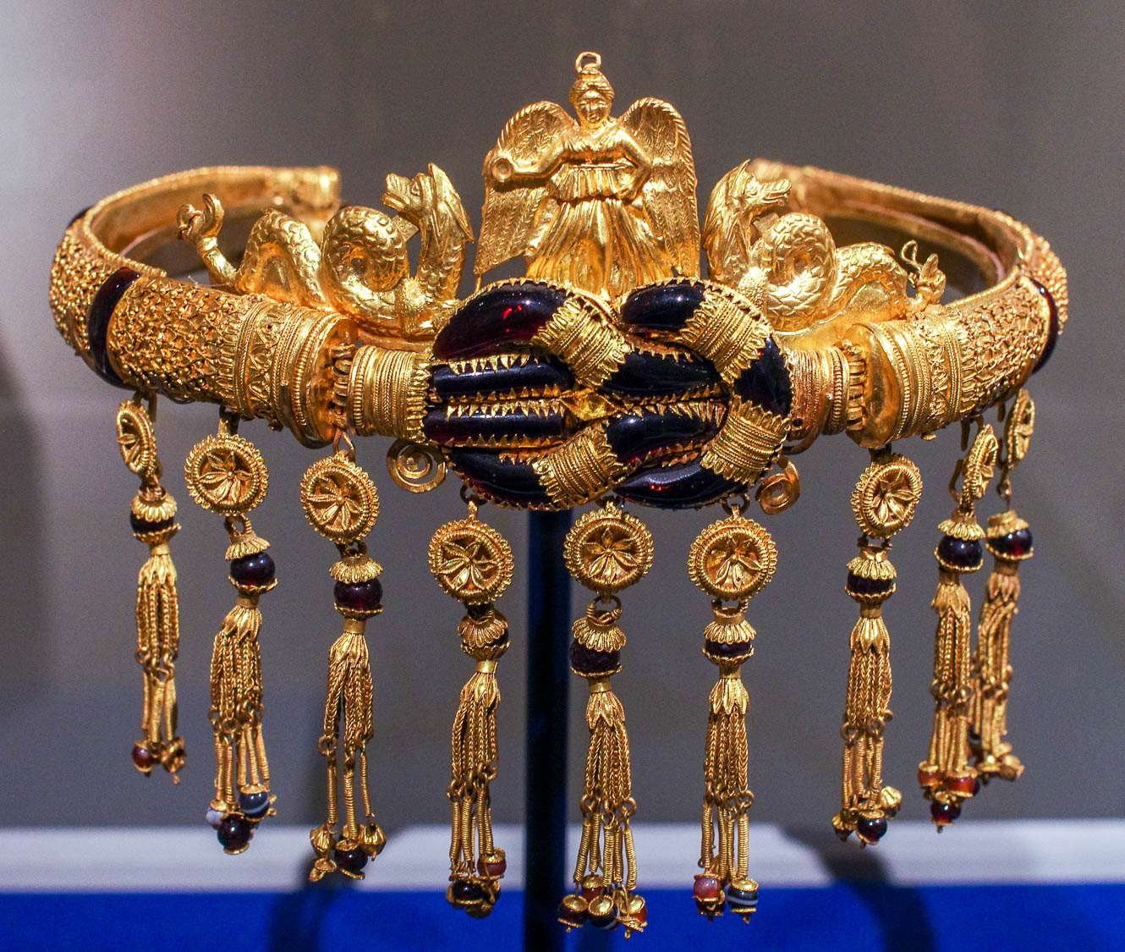
And he went out conquering and to conquer
Gold diadem with a Herakles knot, Hellenistic period, circa 200–150 BC
6:2
Notes:
This picture shows a golden diadem from the Hellenistic Period. At the top of the crown is a depiction of Nike, the goddess of Victory. This diadem dates to 200–150 BC and may come from the Crimean Peninsula. It was photographed at the Metropolitan Museum of Art in New York City.
adr1605244023h

Slide 28
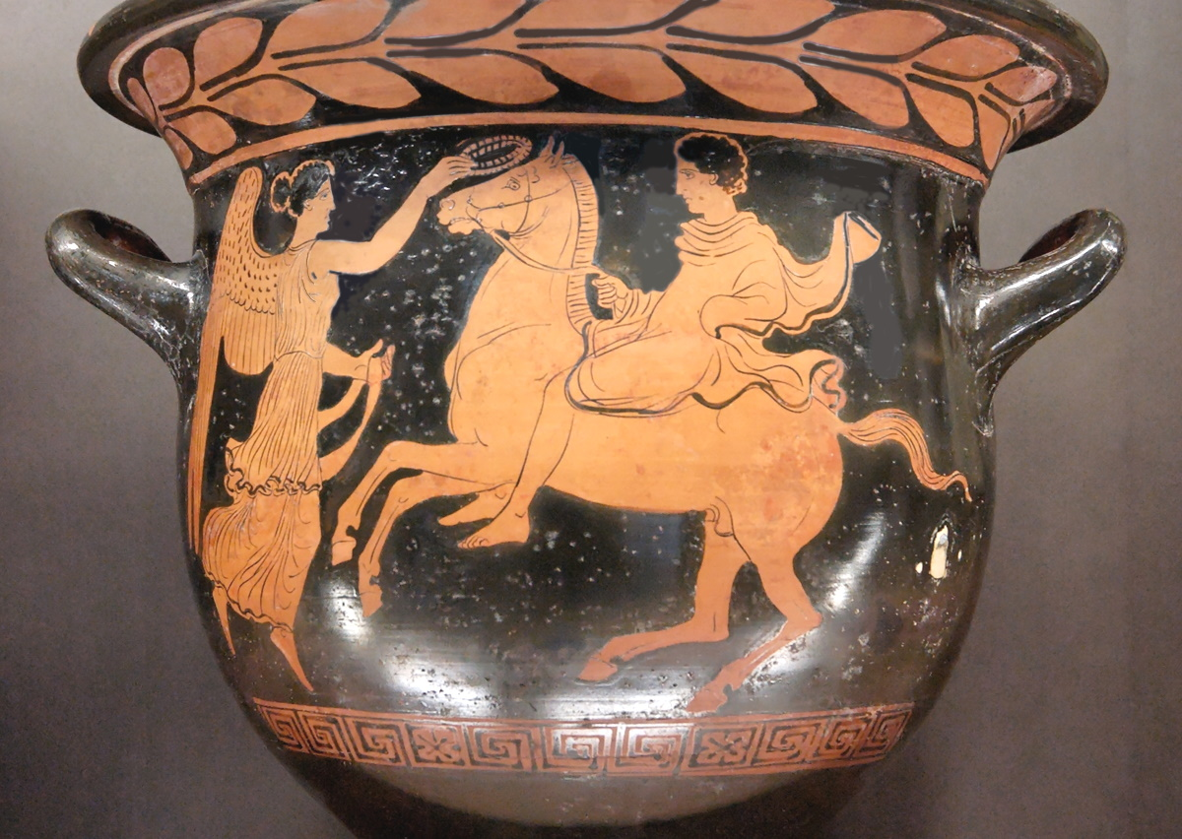
And he went out conquering and to conquer
Red-figure bell-krater with a young rider crowned by Victory, circa 420 BC
6:2
Notes:
The verb “to conquer” (Gk. nikaō, νικάω) means to be victorious, to prevail, or to overcome. It was used in a variety of contexts, from the world of military conflict to athletics; it is used in Revelation in each of the letters to the churches to indicate perseverance and victory in the face of obstacles. The idea is illustrated here by a horseman, probably a contestant in a race, who is being crowned as victor by Nike, a personification of victory. This vase was discovered at Taranto in the province of Campania, Italy. It was photographed at the Louvre Museum. This image comes from Marie-Lan Nguyen and is in the public domain, via Wikimedia Commons: https://commons.wikimedia.org/wiki/File:Bell-krater_rider_Louvre_G493.jpg.
wiki49318182006447833137265

Slide 29
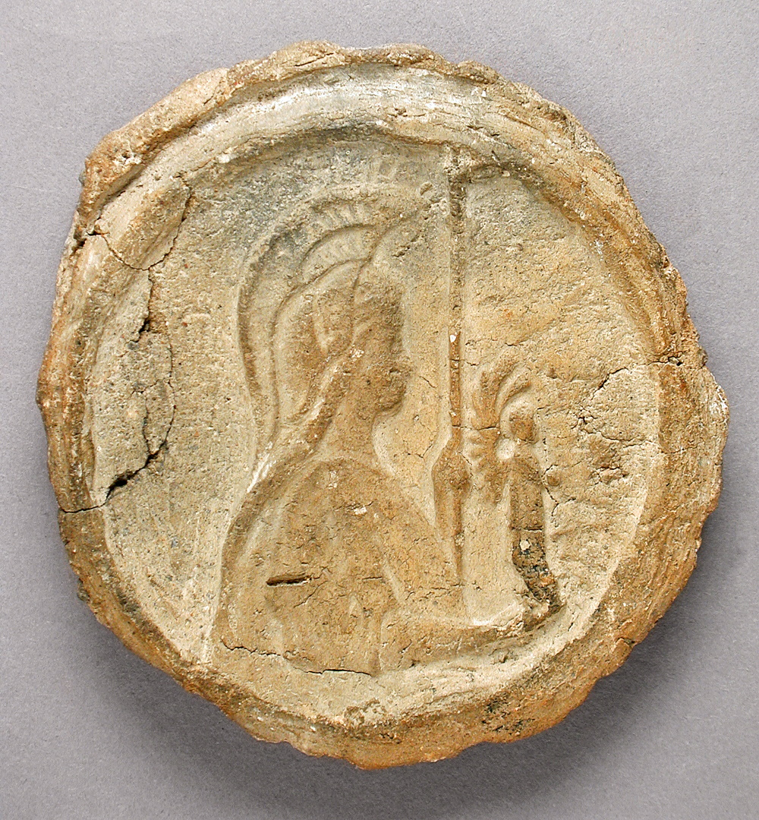
When He opened the second seal
Clay seal impression depicting a goddess, from Egypt, circa 305 BC–AD 337
6:3
Notes:
Seal impressions from the Roman era are quite rare, and the known examples, made of clay, originate in Egypt. This example depicts a helmeted figure, perhaps a goddess, holding a spear and a small winged figure. This image comes from the Los Angeles County Museum of Art and is in the public domain, via Wikimedia Commons: https://commons.wikimedia.org/wiki/File:Cone_Stamp_LACMA_M.80.202.449.jpg.
wiki0717201314441944210012149

Slide 30
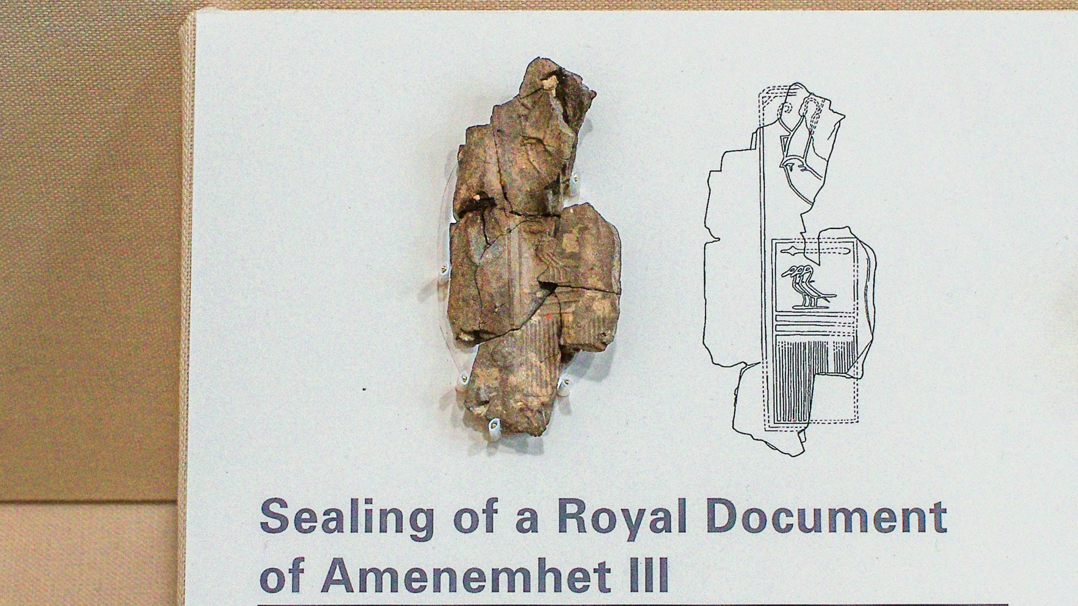
When He opened the second seal
Sealing of a royal document of Amenemhet III, from Serra East, 19th–18th centuries BC
6:3
Notes:
This broken seal from the late Middle Kingdom was photographed at the Oriental Institute Museum at the University of Chicago.
adr1707214239h

Slide 31
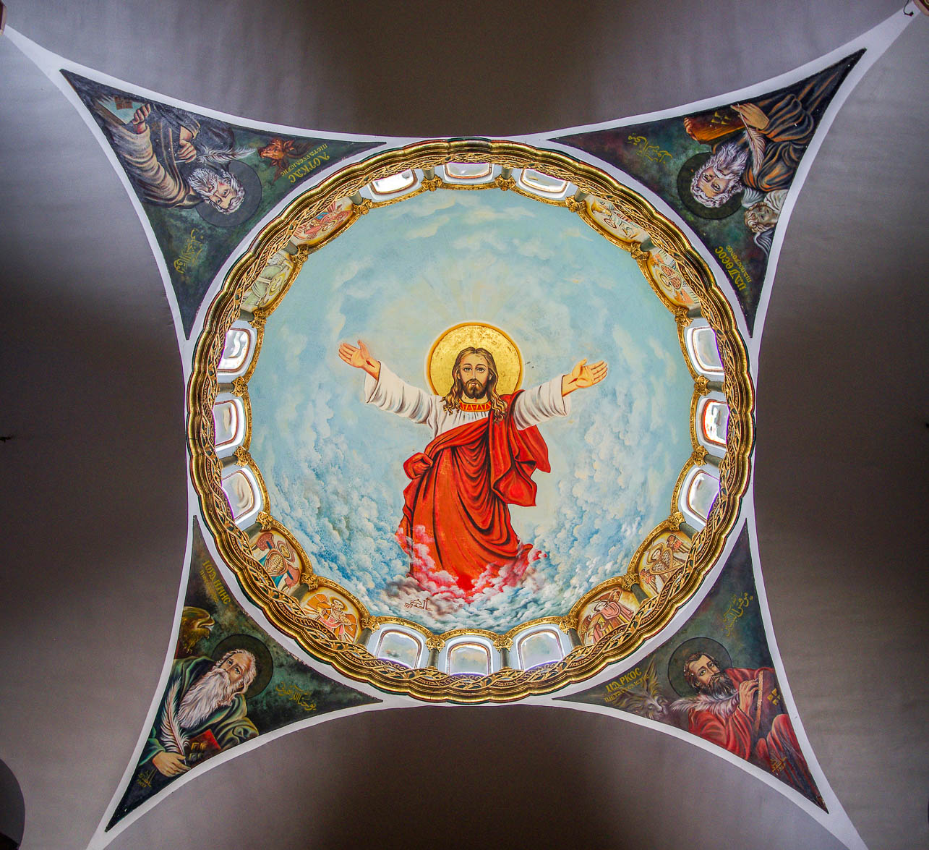
I heard the second living creature saying, “Come!”
Jesus with four evangelists, in St. Mina Monastery, in Mariut
6:3
Notes:
This picture shows the ceiling of a chapel with shrines in the Saint Mina Monastery in Mariut, Egypt. The four evangelists are depicted with the four living creatures, interpreted as symbols of the evangelists.
adr160327333

Slide 32
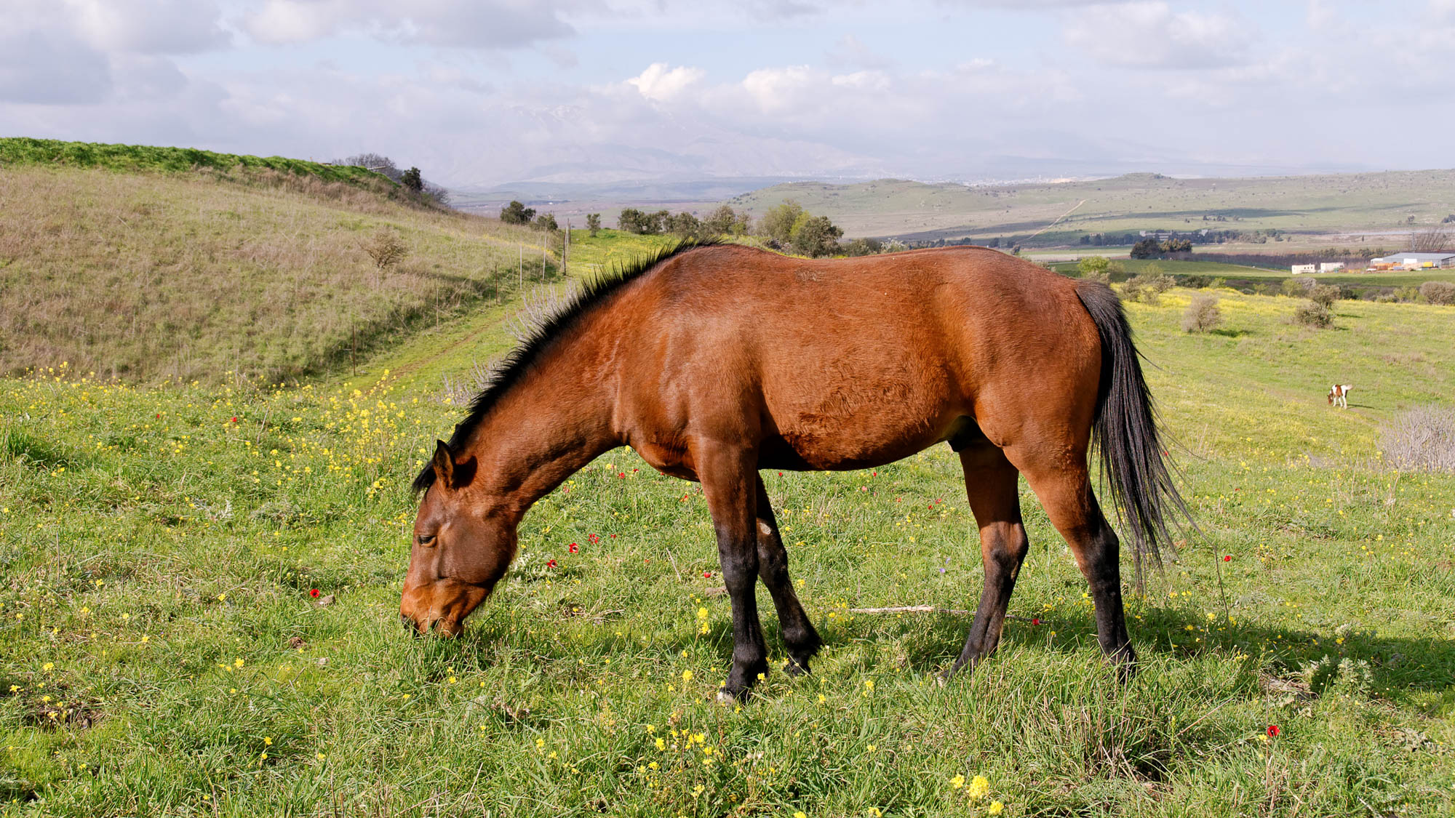
And another horse went out, a red horse
Red horse on the Golan Heights
6:4
Notes:
The word “red” (Gk. purros, πυρρός) refers to a fiery red; the Greek poet Theocritus Bucolicus, around 300 BC, used the same word to refer to the color of a fox. A red horse is more commonly referred to today as a bay (like the horse shown here, with black mane, tail, and legs) or a chestnut or a sorrel.
cd100224011h

Slide 33
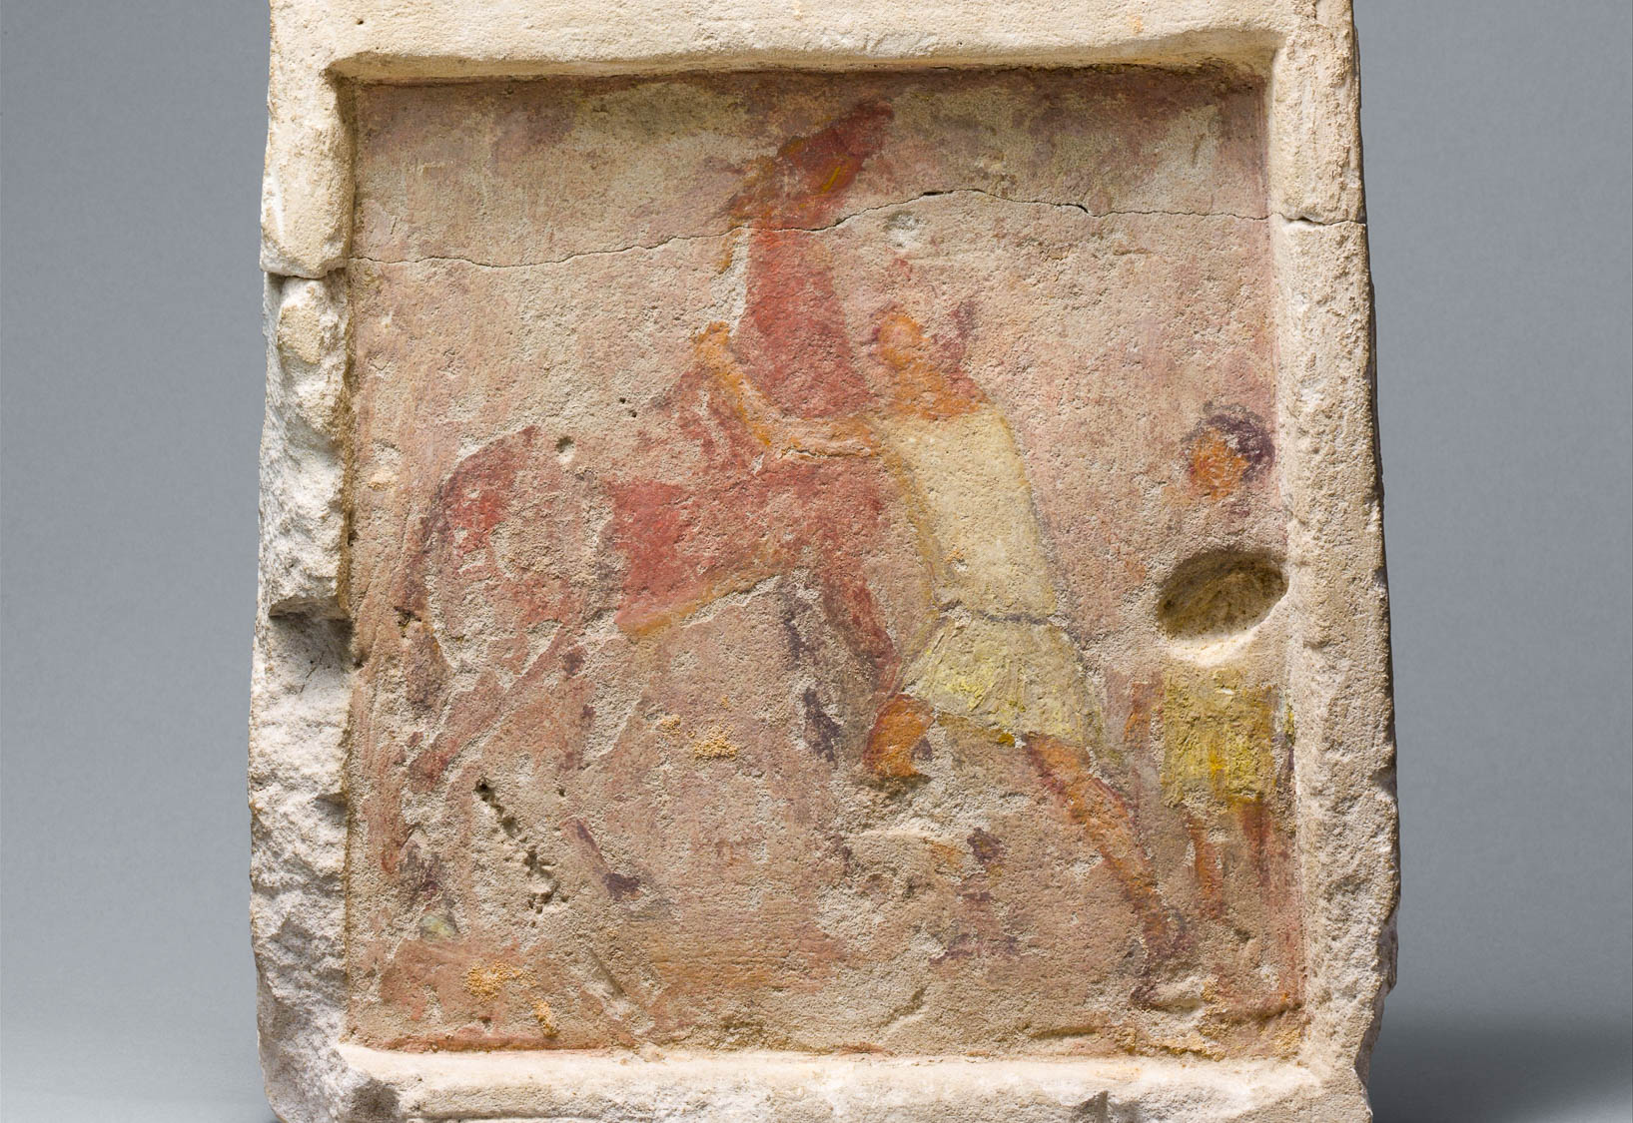
And another horse went out, a red horse
Painted limestone funerary slab with a man controlling a rearing horse, circa 250 BC
6:4
Notes:
This painted tombstone depicts a man working to control a rearing horse, while a boy stands behind him. The bridle reins are faintly visible between the head of the horse and the head of the man and are clearly what allow him to control the horse. The stone comes from a tomb in Alexandria, Egypt, and commemorates a man from Thessaly in northern Greece. This image comes from The Metropolitan Museum of Art and is in the public domain. Source: https://www.metmuseum.org/art/collection/search/247108
met247108

Slide 34
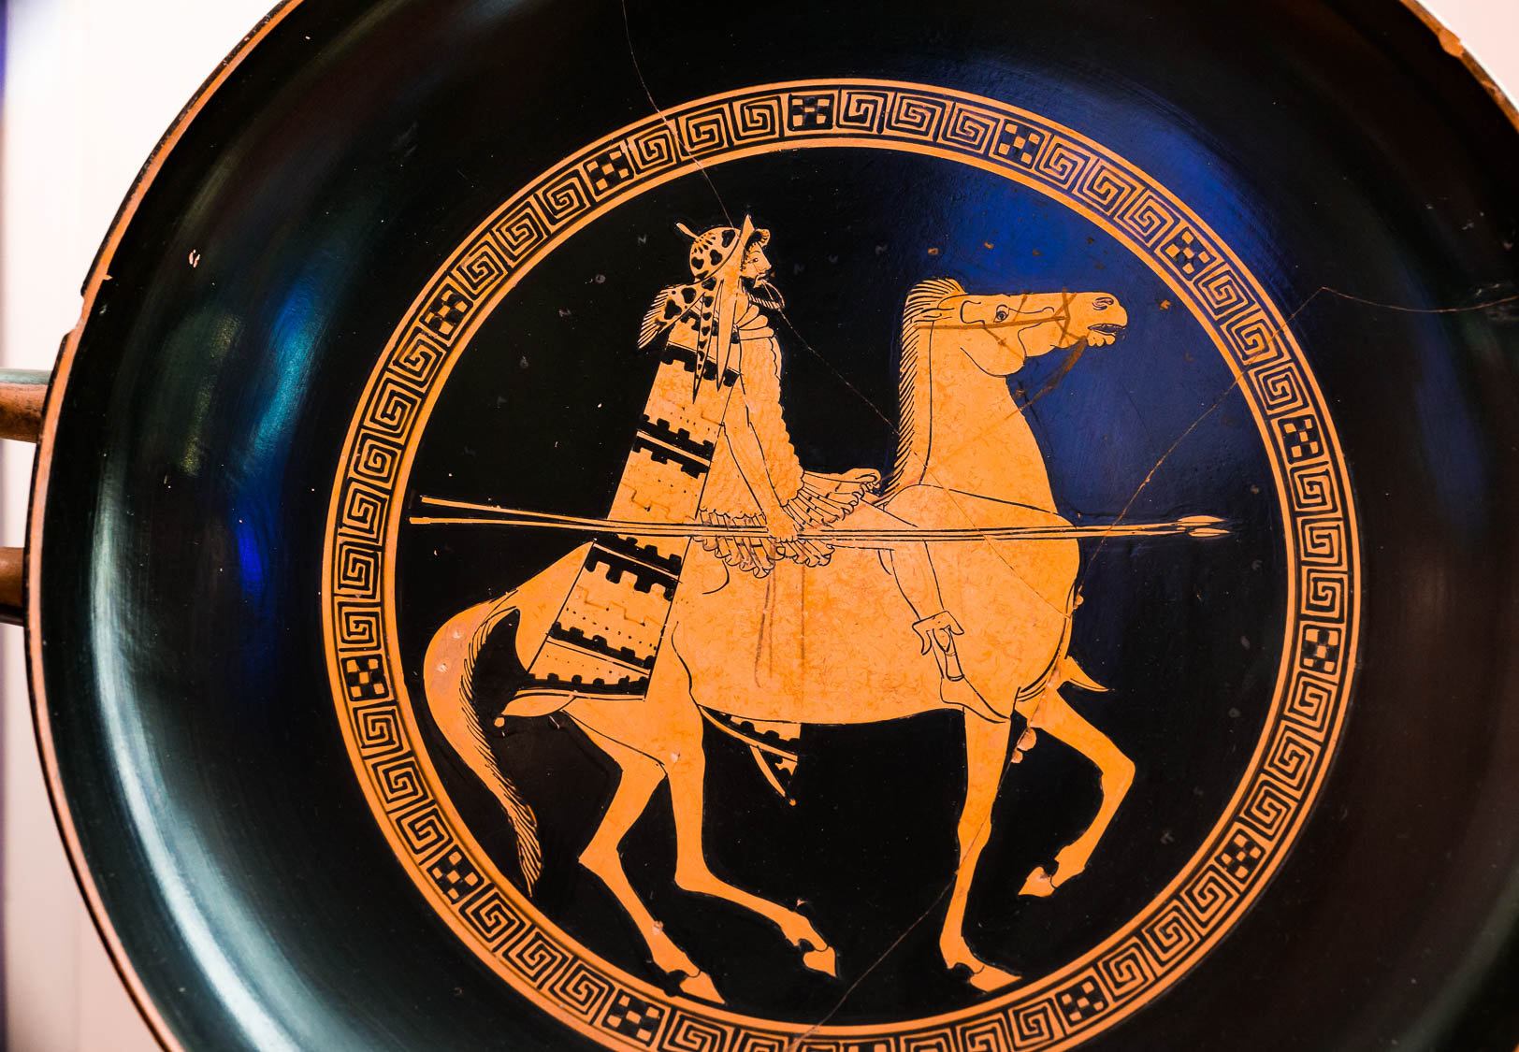
And another horse went out, a red horse
Attic red-figure kylix depicting a Thracian warrior on horseback, circa 480 BC
6:4
Notes:
This kylix was photographed at the National Etruscan Museum of Villa Giulia in Rome. This image comes from ArchaiOptix and is licensed under CC BY-SA 4.0, via Wikimedia Commons: https://commons.wikimedia.org/wiki/File:Foundry_Painter_-_ARV_402_24_-_Thracian_soldiers_with_horses_-_Roma_MNEVG_50407_-_03.jpg.
wiki08252021171121526736481365

Slide 35
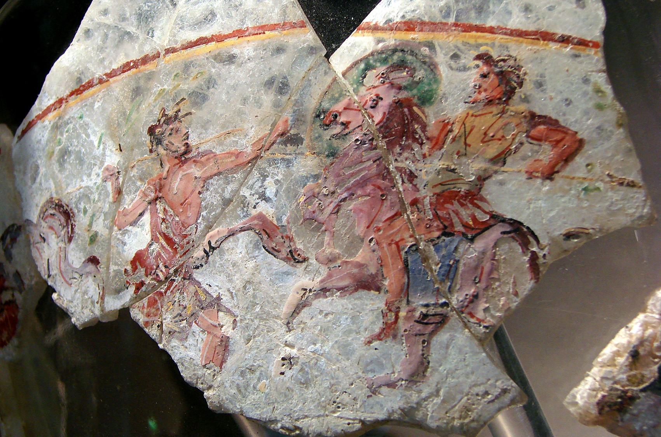
And another horse went out, a red horse
Rider on a red horse engaging in combat, from Begram, 1st century AD
6:4
Notes:
This glassware is part of the Begram hoard. It was made in Egypt but was discovered in the Kapisa (Kapica) region of Afghanistan. It was photographed at the Guimet Museum in Paris. This image comes from Vassil and is in the public domain, via Wikimedia Commons: https://commons.wikimedia.org/wiki/File:Combat_Begram_Guimet_18117.jpg.
wiki11182007165717011338142

Slide 36
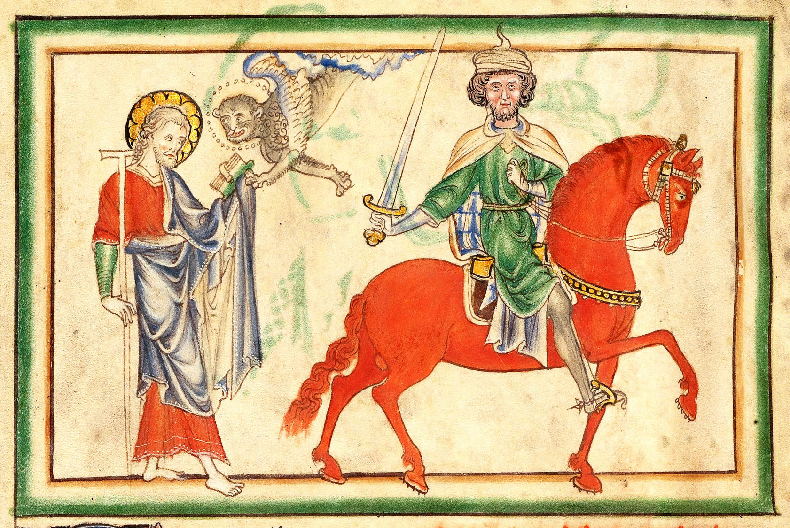
And another horse went out, a red horse
Opening of the Second Seal, drawing from England, circa 1255–1260
6:4
Notes:
This image comes from The J. Paul Getty Museum and is in the public domain, via Wikimedia Commons: https://commons.wikimedia.org/wiki/File:The_Opening_of_the_Second_Seal-_The_Second_Horseman;_Initial_E-_Two_Animals_-_Google_Art_Project_-_crop.jpg. For more information on this artwork, see www.getty.edu/art/gettyguide/artObjectDetails?artobj=3333.
wiki020920181508242716242133333

Slide 37
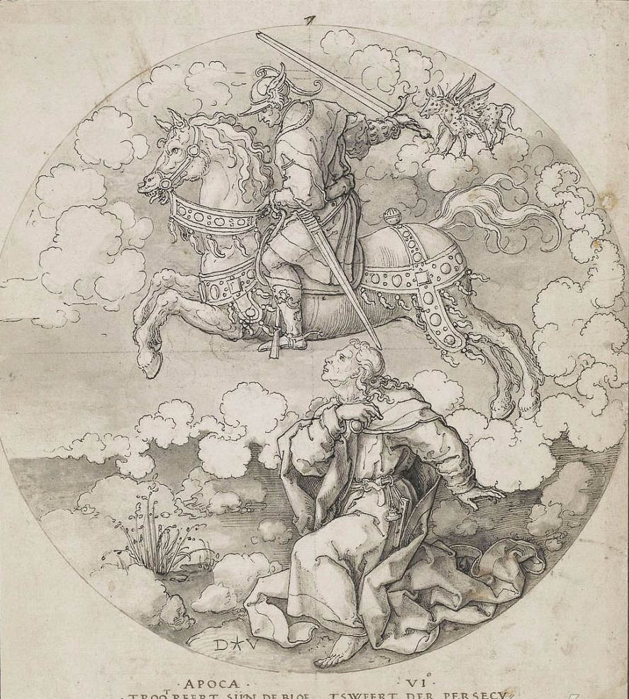
And another horse went out, a red horse
Second Horseman, by Dirck Jacobsz, 16th century
6:4
Notes:
This image comes from Dirck Jacobsz. Vellert and is in the public domain, via Wikimedia Commons: https://commons.wikimedia.org/wiki/File:2nd_Horseman_of_Apocalypse_-_Dirck_Jacobsz._Vellert.jpg.
wiki0219201819579201092206h

Slide 38
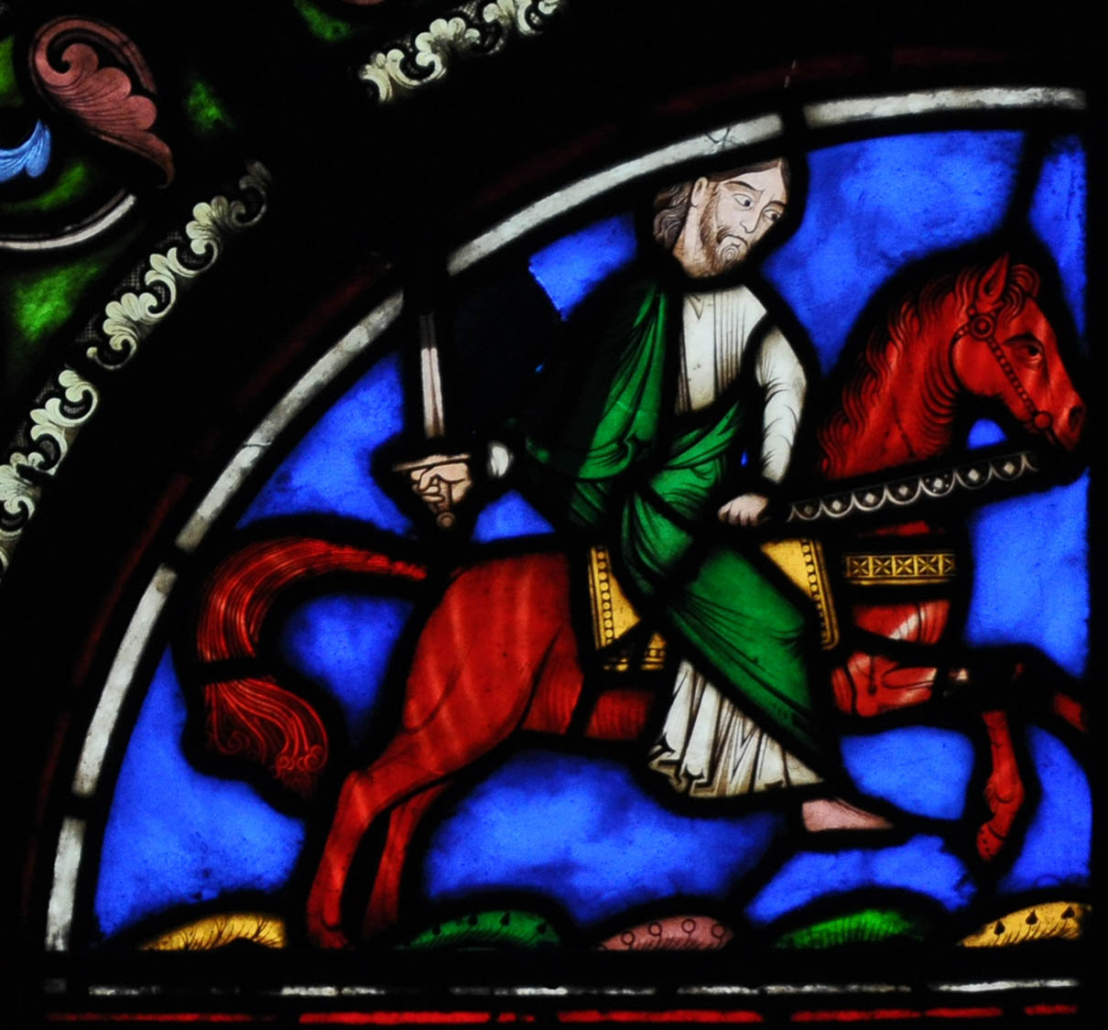
And another horse went out, a red horse
Stained glass in the Basilica of Saint Denis, 1854
6:4
Notes:
This image comes from Vassil and is in the public domain, via Wikimedia Commons: https://commons.wikimedia.org/wiki/File:Vitraux_Saint-Denis_190110_33.jpg.
wiki0131201014281328598

Slide 39
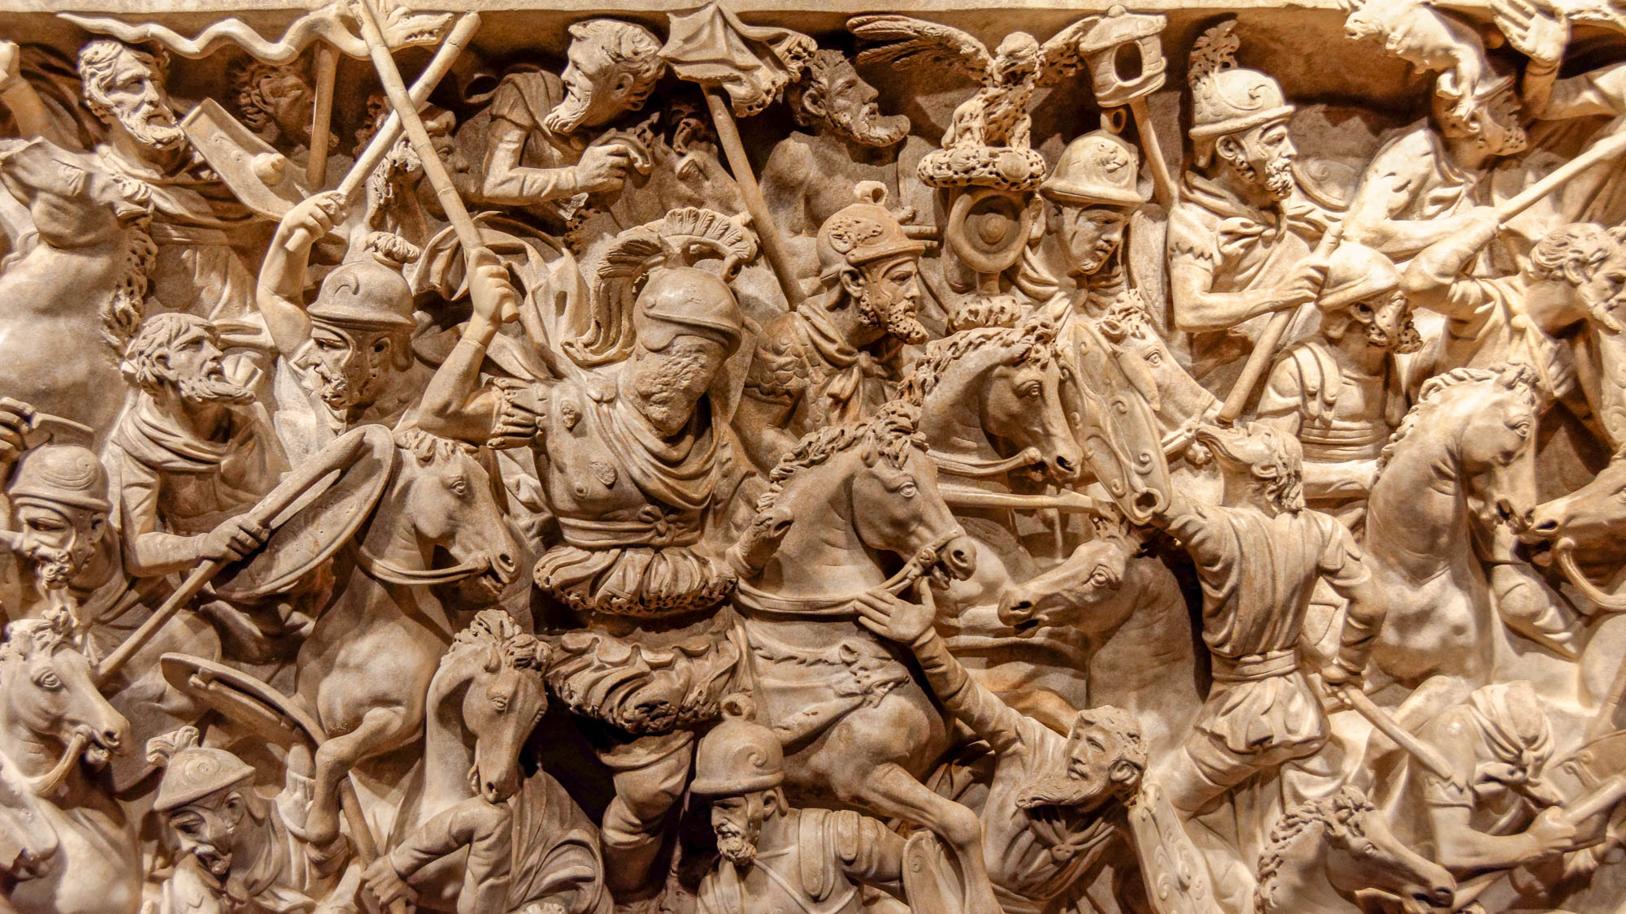
It was granted to the rider to take away peace from the earth, that men would kill each other
Deep relief of Roman horsemen in a melee of soldiers, from near via Tiburtina, circa AD 180
6:4
Notes:
This relief carving illustrates the confusion and madness of battle. It comes from the Portonaccio Sarcophagus in the 2nd century AD, which appears to have been inspired by the Antonine Column in Rome. It was photographed at the National Museum of Rome.
tb0513177601h

Slide 40
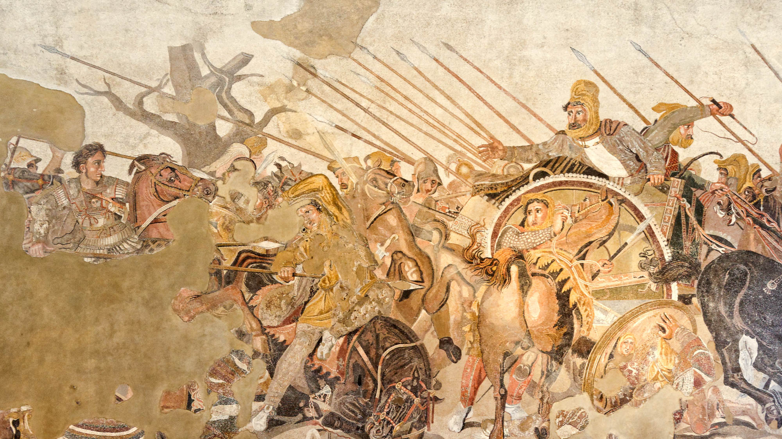
It was granted to the rider to take away peace from the earth, that men would kill each other
Mosaic of a battle between Alexander the Great and Darius III, from Pompeii, circa 125–120 BC
6:4
Notes:
This famous depiction of Alexander the Great defeating the Persians, likely at the Battle of Gaugamela, was created in the late 2nd century BC. It is probably a copy of a 4th century BC painting by Philoxenos. Alexander can be seen to the left, astride his horse; he is pursuing Darius III, seen fleeing in his chariot on the right side of the mosaic. This mosaic comes from the House of the Faun at Pompeii and was photographed at the Naples Archaeological Museum. The next slide includes a close-up of Alexander the Great.
tb0515170669h

Slide 41
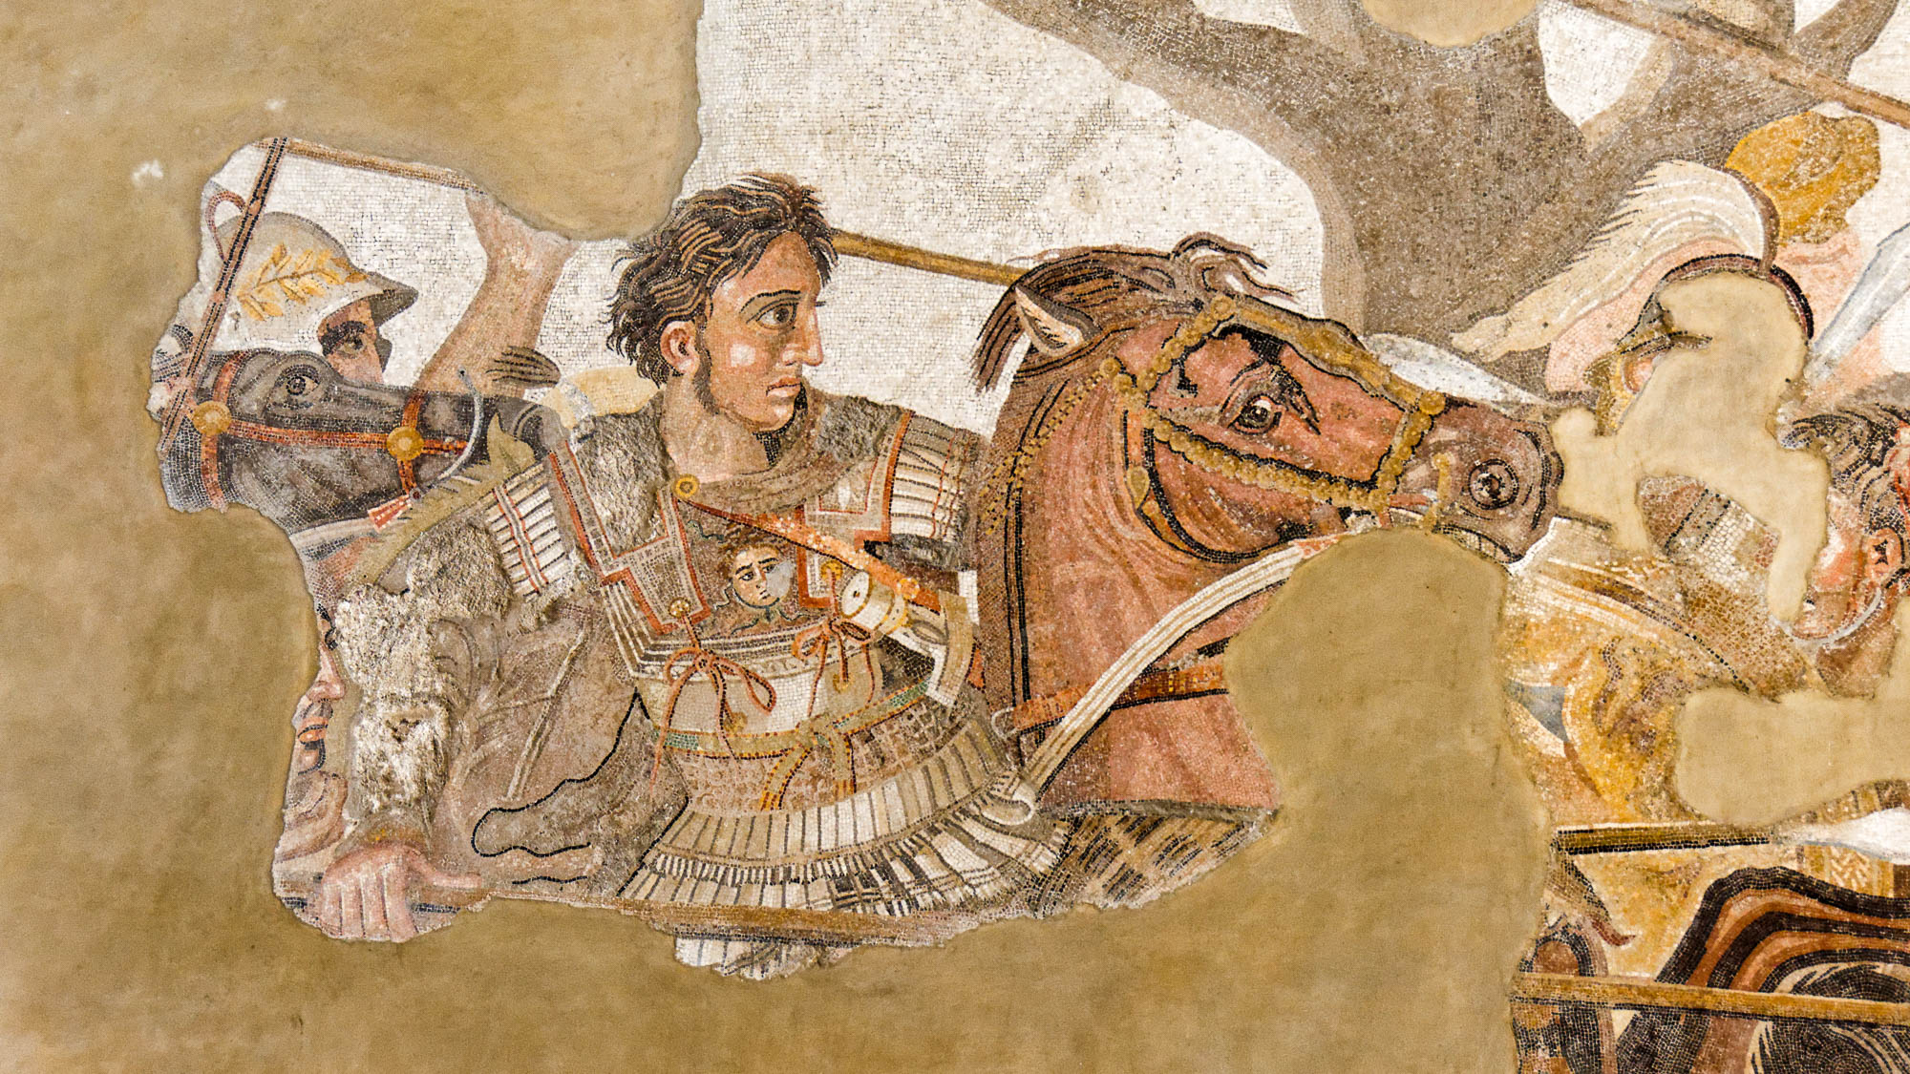
It was granted to the rider to take away peace from the earth, that men would kill each other
Alexander the Great leading the charge against Darius III, from Pompeii, circa 125–120 BC
6:4
Notes:
This close-up of the Alexander mosaic shows Alexander himself leading the charge. He is carrying a spear, wearing a cuirass to protect his chest, and mounted on his favorite horse Bucephalus. It may be noted in passing that Alexander’s horse is portrayed as red in color. This mosaic was photographed at the Naples Archaeological Museum.
tb0515170673

Slide 42
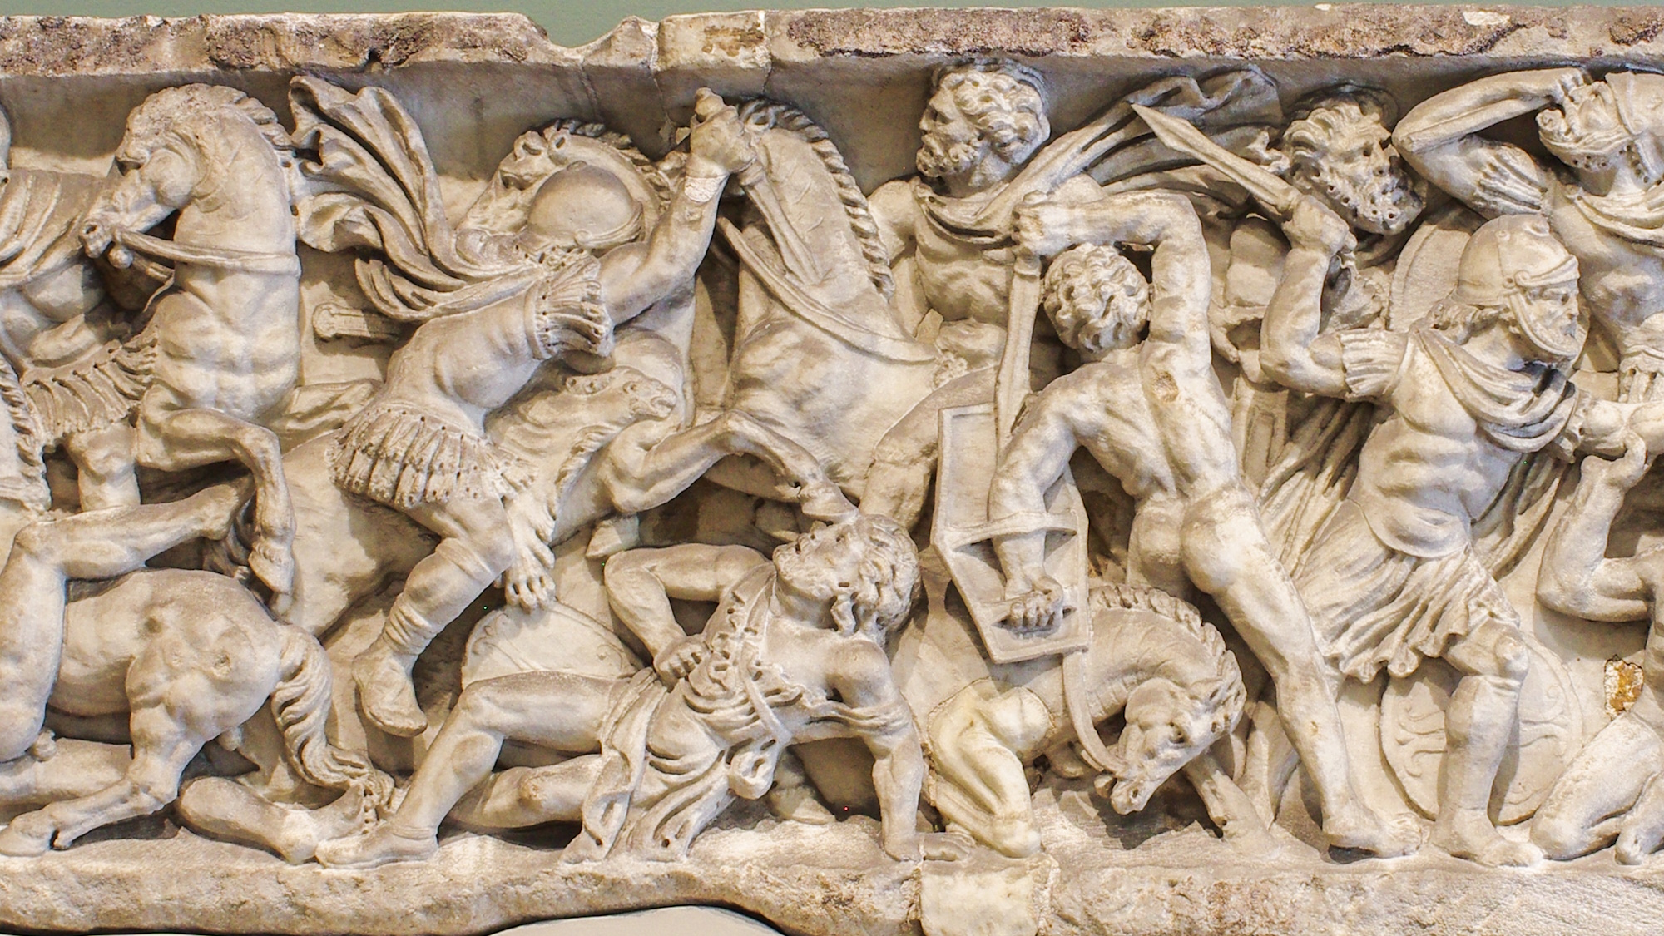
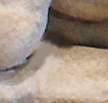
It was granted to the rider to take away peace from the earth, that men would kill each other
Roman sarcophagus with a battle scene, 2nd century AD
6:4
Notes:
This scene on a 2nd-century AD sarcophagus was photographed at the Dallas Museum of Art. A removable graphic has been added to prevent surprise or offense.
adr1710136031

Slide 43
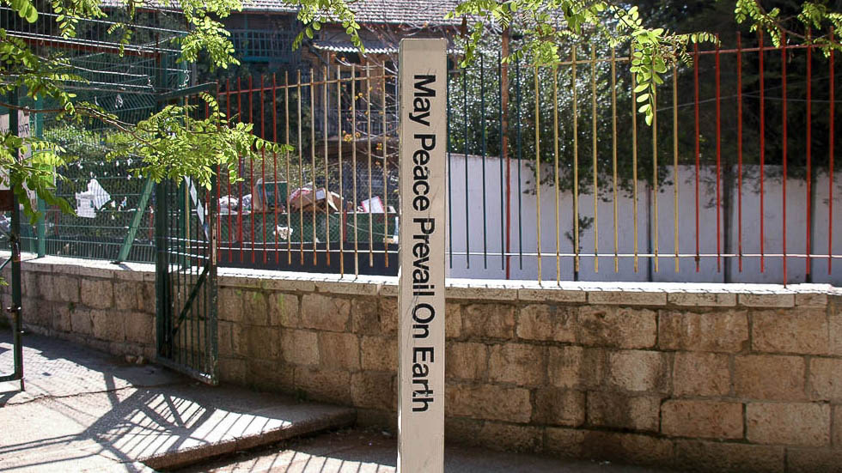
It was granted to the rider to take away peace from the earth, that men would kill each other
“May Peace Prevail on Earth” sign in Jerusalem
6:4
Notes:
The removal of peace from the earth contrasts with the words of the angels to the shepherds at the time of Jesus’s birth, when they proclaimed, “Glory to God in the highest, and on earth peace among men in whom He is well pleased” (Luke 2:14).
tb040605772h

Slide 44
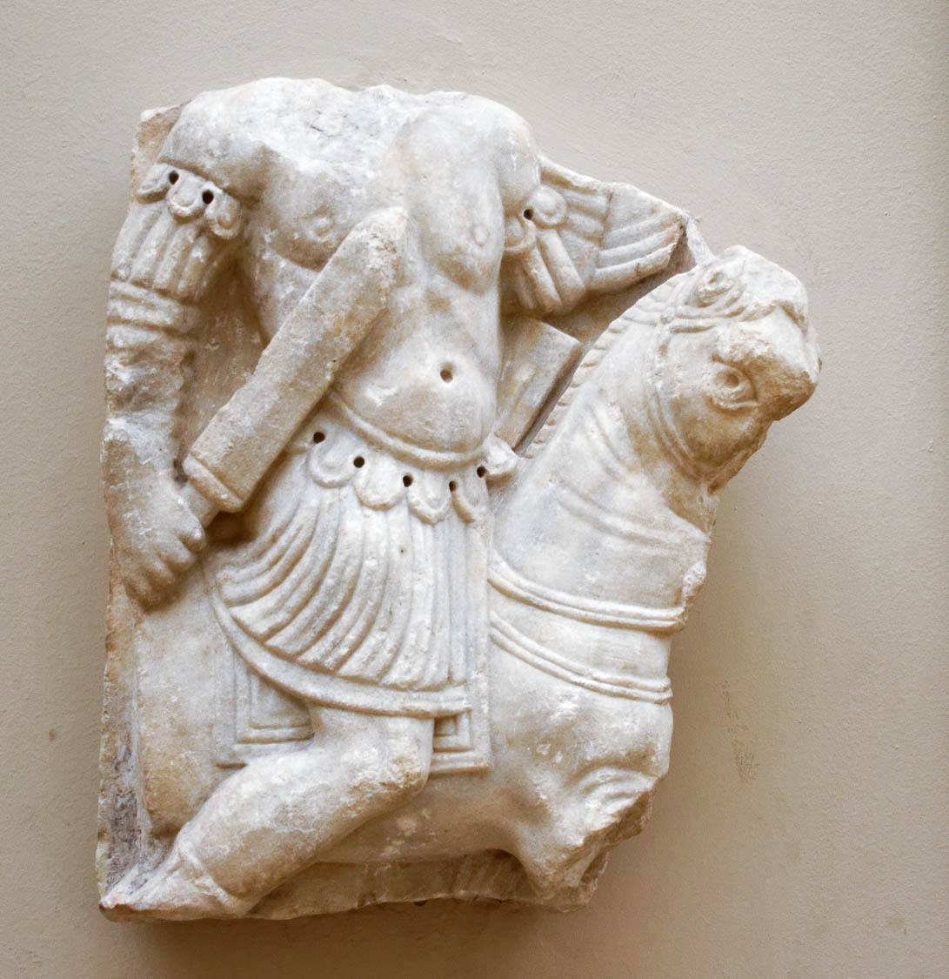
And a large sword was given to him
Fragmentary marble relief of a horseman with a sword, from Balat, 4th–5th centuries AD
6:4
Notes:
The “sword” (Gk. machaira, μάχαιρα) was a relatively short weapon, sometimes referred to as a dagger (not to be confused with the longer Thracian-type sword [Gk. hromphaia, ῥομφαία] mentioned in Rev 1:16, 2:12, 2:16). The Latin term for the standard short sword was gladius. This relief was photographed at the Istanbul Archaeological Museum.
mjb122916628

Slide 45
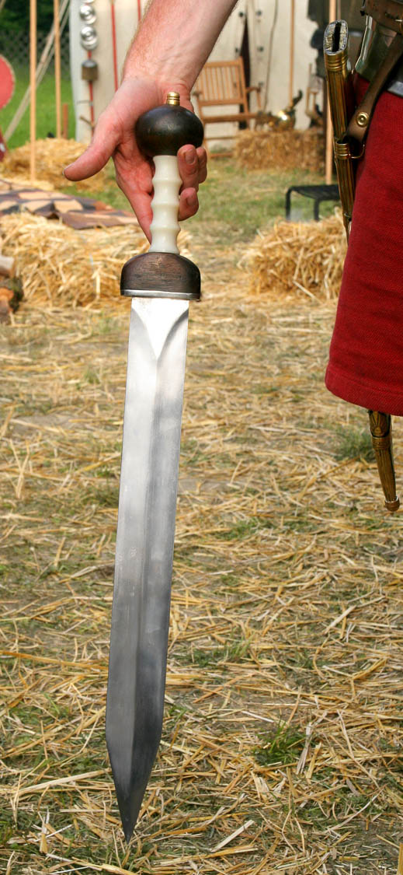
And a large sword was given to him
Roman sword, recreated based on a sword found at Pompeii
6:4
Notes:
This sword, reconstructed based on genuine 1st-century AD Roman examples, provides a good visualization of what such a double-edged sword would have looked like. This image comes from Wikimedia Commons and is licensed under CC BY-SA 3.0. Source: https://commons.wikimedia.org/wiki/File:Gladius_in_hand.jpg.
wiki06182005052915033258c

Slide 46
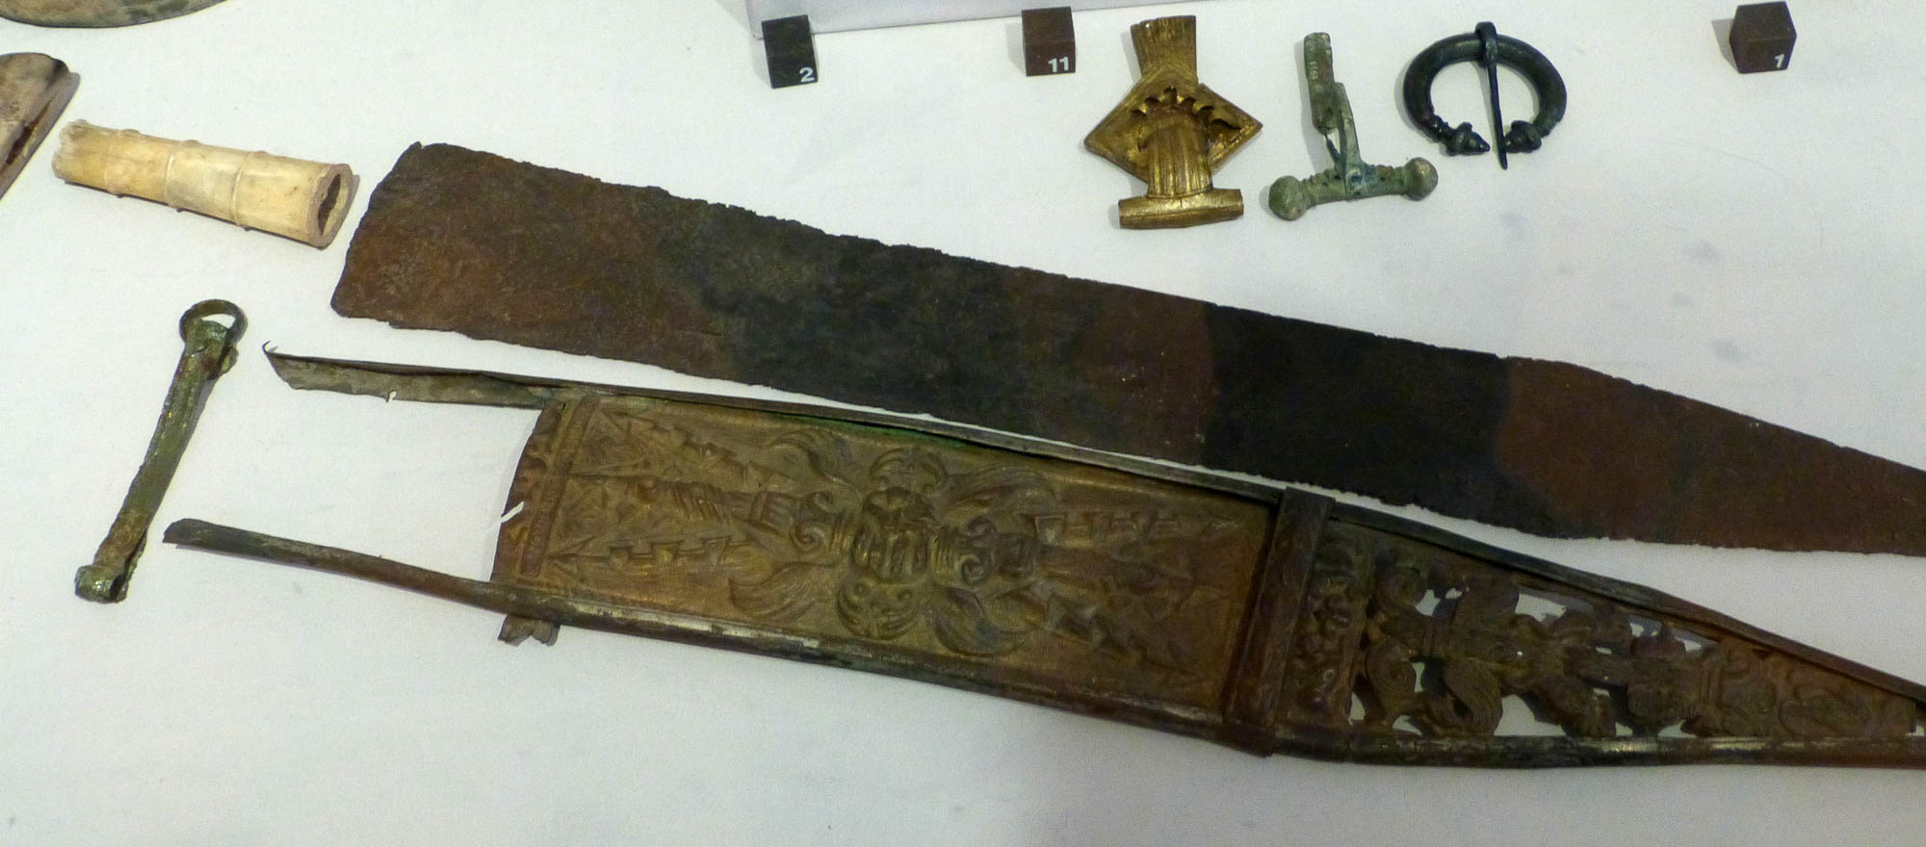
And a large sword was given to him
Roman sword (gladius) and sheath, 1st century AD
6:4
Notes:
This iron sword had a handle made of bone. The leather of the scabbard has disintegrated, leaving only the metalwork. This display was photographed at the Strasbourg Archaeological Museum. This image comes from Wolfgang Sauber and is licensed under CC BY-SA 4.0, via Wikimedia Commons: https://commons.wikimedia.org/wiki/File:MAS_-_Gladius.jpg.
wiki07132017150720

Slide 47
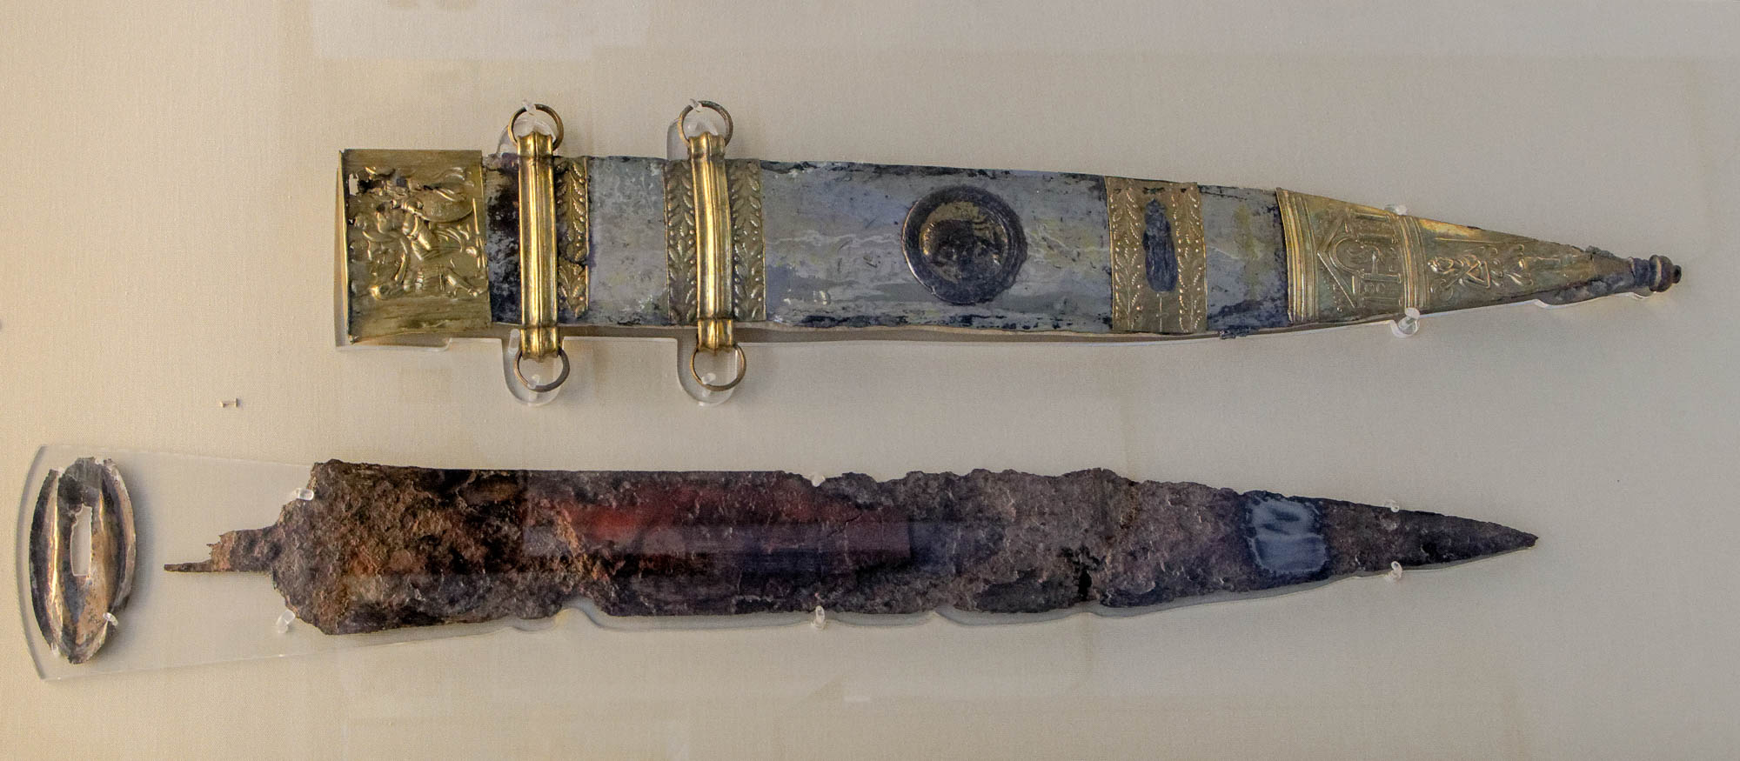
And a large sword was given to him
Roman sword (gladius) and sheath, from Mogontiacum (Mainze), circa 15 BC
6:4
Notes:
The so-called "Sword of Tiberius" is made of iron and is from the early 1st century AD. It comes from the Roman town of Mogontiacum, now Mainze, Germany. It was found in 1848 near the winter harbor in the old town of Mainz. This sword and sheath were photographed at the British Museum.
tb0930198669h

Slide 48
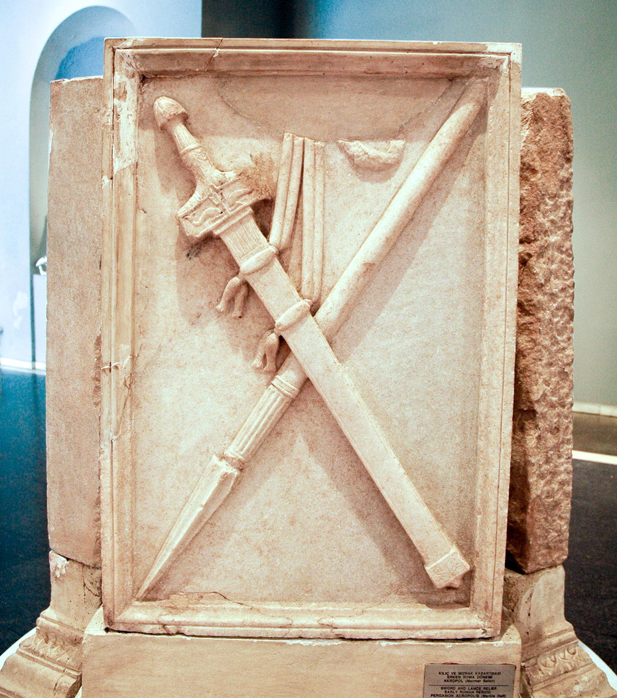
And a large sword was given to him
Sword and lance relief from the Pergamum acropolis, Roman period
6:4
Notes:
This relief was photographed at the Bergama Museum.
tb041505909c

Slide 49
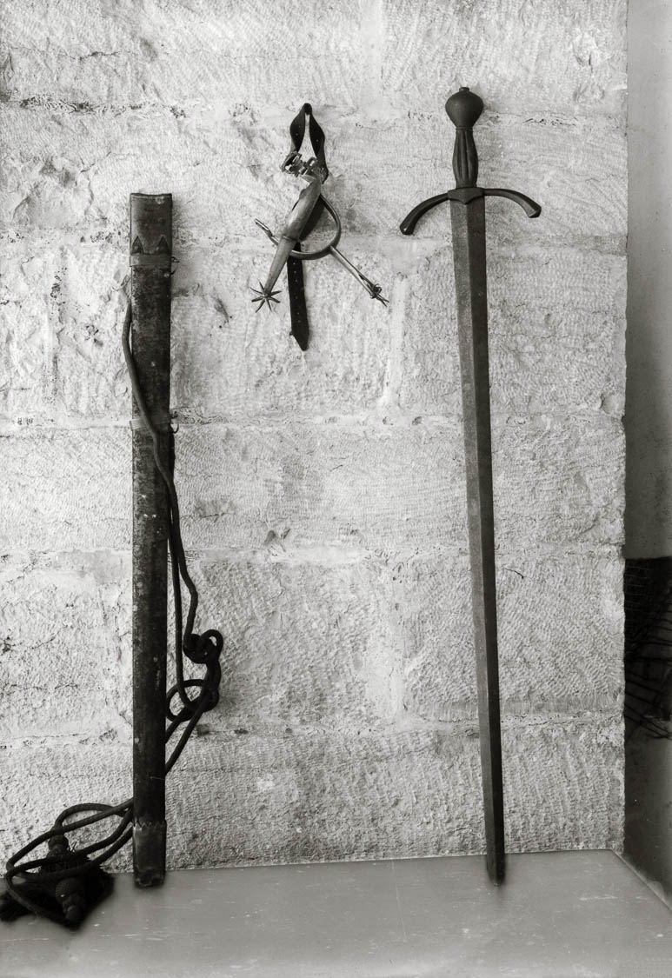
And a large sword was given to him
Sword of Godfrey in Jerusalem, circa 1910
6:4
Notes:
Although this sword, which has been displayed at the Church of the Holy Sepulcher in Jerusalem since 1808, is attributed to the Crusader king Godfrey of Bouillon (circa AD 1058–1100), its style indicates that it belongs to the late 15th or early 16th centuries. However, its large size and purported connection with a larger-than-life character provide an interesting comparison to the sword of Goliath. This American Colony photo was taken between 1900 and 1920.
mat05428

Slide 50
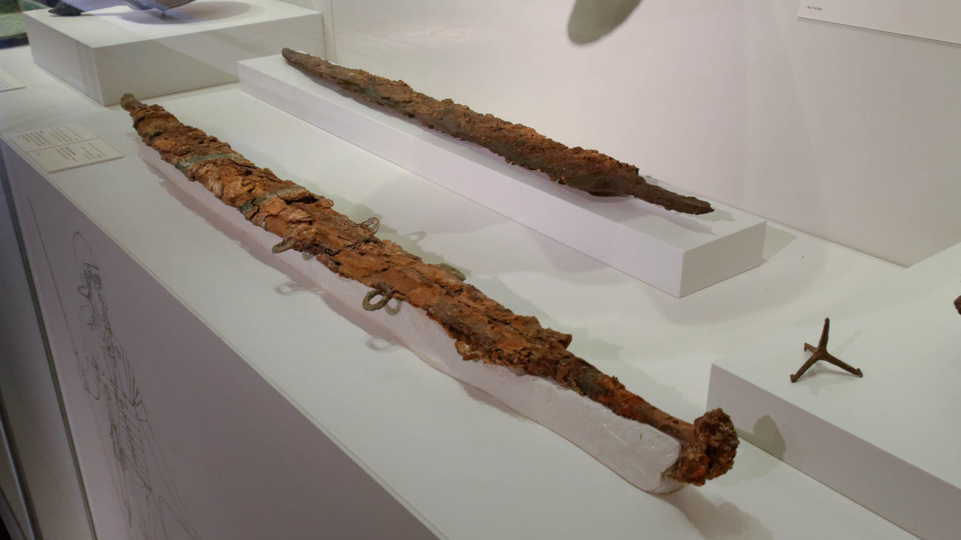
And a large sword was given to him
Sword in its scabbard, from Mount Zion, 1st century AD
6:4
Notes:
Few swords survive from antiquity, since they were generally made of metals that rusted or corroded. The Roman sword (gladius) was usually made of iron, sometimes with bronze furniture and often a wooden handle. The scabbard was usually made of leather with some sort of metal furniture (bronze, iron, or tin). This display was photographed at the Israel Museum.
tb032014719h

Slide 51
And when He broke the third seal
Clay seal impression with a bull, from Egypt, circa 333 BC–AD 350
6:5
Notes:
This seal impression dates to the Ptolemaic period. It depicts a humped bull, a bovine that was considered sacred in Egypt. This image comes from the Los Angeles County Museum of Art and is in the public domain, via Wikimedia Commons: https://commons.wikimedia.org/wiki/File:Seal_Impression_with_Bull_LACMA_M.80.202.908.jpg.
wiki0717201315301988210098280202908

Slide 52
And when He broke the third seal
Clay seal impressions from the Bullae House, City of David, Jerusalem, early 6th century BC
6:5
Notes:
This display, which includes some broken seal impressions, was photographed at the Israel Museum.
adr1306213030

Slide 53
And when He broke the third seal, I heard the third living creature saying, “Come!”
Mosaic of Jesus and symbols of the four evangelists, in St. Mina Monastery, in Mariut
6:5
Notes:
This picture shows a depiction of Jesus surrounded by the four living creatures, symbolizing the four evangelists. It was photographed at the Saint Samuel chapel niche in Saint Mina Monastery in Mariut, Egypt.
adr1603278561

Slide 54
I looked, and behold, a black horse
Friesian horse
6:5
Notes:
Black horses are uncommon, although not rare. The Friesian breed shown here, are usually black. The Greek word “black” (Gk. melas, μέλας) is also used to refer to ink (cf. 2 Cor 3:3; 2 John 12; 3 John 13). This image comes from B0rder and is licensed under CC BY-SA 3.0, via Wikimedia Commons: https://commons.wikimedia.org/wiki/File:Frisian_horse.jpg.
wiki01232005254051920061215h

Slide 55
I looked, and behold, a black horse
Amphora with a rider on a black horse, from Vulci, circa 520 BC
6:5
Notes:
This amphora was photographed at the Petit Palais, in Paris. This image comes from Vassil and is in the public domain, via Wikimedia Commons: https://commons.wikimedia.org/wiki/File:Petit_Palais_Amphore_Amazonomachie_Attr_Psiax_13012018_2.jpg.
wiki01132018175457317925

Slide 56
I looked, and behold, a black horse
Amphora with a young rider on a black horse, from Vulci, circa 520 BC
6:5
Notes:
This amphora was photographed at the Petit Palais, in Paris. This image comes from ArchaiOptix and is licensed under CC BY-SA 4.0, via Wikimedia Commons: https://commons.wikimedia.org/wiki/File:Group_of_the_Inscribed_Amphorai_-_boars_-_Helena_with_Paris_and_Andromache_with_Hektor_-_horsemen_-_W%C3%BCrzburg_MvWM_L_160_-_22.jpg.
wiki0129202216585745714379

Slide 57
I looked, and behold, a black horse
Tomb painting of a warrior returning home on horseback, from Paestum, circa 360 BC
6:5
Notes:
This painting depicts a warrior on a black horse, returning home from battle. It was discovered in the Tomb of the Pomegranates and was photographed at the National Archaeological Museum in Paestum, Italy. This image comes Xocolatl and is in the public domain, via Wikimedia Commons: https://commons.wikimedia.org/wiki/File:Grab_der_Granat%C3%A4pfel_heimkehrender_Ritter.jpg.
wiki1124201220191841174517368

Slide 58
And the rider had a pair of scales in his hand
Black-figured oil flask with Weighing of Souls, from Athens, circa 480 BC
6:5
Notes:
The term “pair of scales” (Gk. zugos, ζυγός) refers in this context to a mechanism for determining weight, something that was necessary when transactions were based on the weight of the commodity (and sometimes also the payment). This lekythos is decorated with a scene representing the Greco-Roman perception of the afterlife, in which souls are weighed on a scale. As is typical, the souls are depicted as small, wispy characters with a generally human shape. The scale consists of a balance beam held suspended by one hand, with a plate or dish on each end in which the items to be weighed were placed. This lekythos was photographed at the British Museum.
tb0929198092h

Slide 59
And the rider had a pair of scales in his hand
Red-figure kylix with the Weighing of Souls, from Cerveteri, circa 500 BC
6:5
Notes:
This scene on a red-figure kylix depicts Hermes intervening in the duel of Achilles and Memnon. Careful inspection shows that he holds a balance beam in his right hand, from which are suspended the souls of the two combatants. This motif, referred to as psychostasia (“weighing of souls”) was a form of judgment in which the overbalanced soul would be executed. Interestingly, each soul is depicted on this kylix as fully armed for battle, just like their body counterparts. This kylix was photographed at the National Etruscan Museum of Villa Giulia. This image comes from ArchaiOptix and is licensed under CC BY-SA 4.0, via Wikimedia Commons: https://commons.wikimedia.org/wiki/File:Epiktetos_-_ARV_72_24_-_woman_riding_phallos_bird_-_Achilles_and_Memnon_duelling_-_Herakles_and_Busiris_-_Roma_MNEVG_57912_-_01.jpg.
wiki0825202115205854723648

Slide 60
And the rider had a pair of scales in his hand
Scale for balancing weights, Greco-Roman period
6:5
Notes:
Scales like the ones shown here were used to determine equal weights. Typically a commodity would be measured on one side against a weight or set of weights of known size on the other. This scale was photographed at the Ephesus Museum.
tb010501913

Slide 61
And the rider had a pair of scales in his hand
Set of scales, Roman period
6:5
Notes:
These scales were photographed at the Naples Archaeological Museum.
tb0515170554

Slide 62
And the rider had a pair of scales in his hand
Scales and weight, from Pompeii, 1st century AD
6:5
Notes:
Two sets of scales are visible in this photo. The set at the back is a simple set with pans of the same size at either end of the balance beam. The set in the foreground is more complex, with a handsomely sculpted sliding weight that could be used for a whole range of weights that could be placed in the pan at the other end. This display of scales was photographed at the Naples Archaeological Museum.
tb0515170865

Slide 63
And the rider had a pair of scales in his hand
Bronze quadrans of Claudius, with a hand holding scales, AD 41–54
6:5
Notes:
The obverse side of this coin (left) is inscribed “Tiberius Claudius Caesar Augustus” (Lat. TI CLAVDIVS CAESAR AVG ). It depicts a hand holding scales, with the letters PNR beneath. These letters may stand for “the weight of the coinage restored” (Lat. Pondus Nummi Restitutum), or “the standard of the weights restored” (Lat. Ponderum Norma Restituta). This issue of coinage evidently corrected or improved the weight of the coins, to bring them into conformity with a standard. The reverse side of this coin (right) contains the letters SC in the center (Senatus Consultum, “by the decree of the senate”), with a legend around which reads “High priest, Tribunician power, Emperor, Father of the country, Consul for the second time” (Lat. PON M TR P IMP P P COS II). This image comes from http://www.forumancientcoins.com/gallery/displayimage.php?pos=-101413 and is used with permission. Coin reference: RIC 91; see further, http://numismatics.org/ocre/id/ric.1(2).cl.91.
fac101413

Slide 64
And the rider had a pair of scales in his hand
Third Horseman, by Dirck Jacobsz, 16th century
6:5
Notes:
This image comes from Dirck Jacobsz. Vellert and is in the public domain, via Wikimedia Commons: https://commons.wikimedia.org/wiki/File:3rd_Horseman_of_the_Apocalypse_-_Dirck_Jacobsz._Vellert.jpg.
wiki021920181924634768147h

Slide 65
And the rider had a pair of scales in his hand
Third horseman, Angers Apocalypse tapestry
6:5
Notes:
This image comes from Remi Jouan and is licensed under CC BY-SA 3.0, via Wikimedia Commons: https://commons.wikimedia.org/wiki/File:Tenture_Apocalypse_Angers_cavalier_3.jpg.
wiki032520121035221600994186

Slide 66
And the rider had a pair of scales in his hand
Third horseman, miniature in a 13th-century manuscript
6:5
Notes:
This image comes from Wikimedia Commons and is in the public domain. Source: https://commons.wikimedia.org/wiki/File:BritLibAddMS35166ApocalypseUnkFolio3SealBlackHorse.jpg
wiki0902201808011134766747

Slide 67
I heard a voice, “A quart of wheat for a denarius, and three quarts of barley for a denarius”
Dry measure inscribed with the word “official,” 5th century BC
6:6
Notes:
The word “quart” (Gk. choinix, χοῖνιξ) referred to a dry measure, often used for grain, that was equivalent to about a quart or a liter. This amount was the daily ration necessary for one person. This ancient measure was photographed at the Athens Agora Museum.
tb031806394

Slide 68
I heard a voice, “A quart of wheat for a denarius, and three quarts of barley for a denarius”
Display of barley and wheat, and bread made from each
6:6
Notes:
This display of grains and breads was photographed at Moza Illit in the Judean hills west of Jerusalem.
gs090094c08

Slide 69
I heard a voice, “A quart of wheat for a denarius, and three quarts of barley for a denarius”
Silver denarius, equal to a day of labor in the 1st century AD
6:6
Notes:
The denarius was the standard silver coin in the 1st century AD. In the parable of Matthew 20:1-16, the pay of laborers was a denarius a day. The denarius weighed an average of 3.9 grams (0.14 oz; a US nickel weighs 5 g [0.18 oz]). This coin is in a private collection.
tb090416867h

Slide 70
I heard a voice, “A quart of wheat for a denarius, and three quarts of barley for a denarius”
Fresco of a baker’s shop in Pompeii, 1st century AD
6:6
Notes:
The angel’s cry, that a day’s ration of wheat would cost a day’s wages, provides an interesting contrast to the practice in Rome of offering free grain (and eventually free bread) to poor citizens of the city. The practice, referred to as Cura Annonae, began in the 2nd century BC and is thought to have continued into the 6th century AD. In the 1st century, about 200,000 citizens of Rome were recipients of free or subsidized grain. In AD 22, the emperor Tiberius commented that if the Cura Annonae were to be neglected would lead to "the utter ruin of the state” (Rickman 1980: 263).
This fresco depicts a baker’s shop in the Roman city of Pompeii; the baker is selling the typical round loaves that were common at that time. About 34 bakeries have been discovered so far in Pompeii, some large enough to bake 80 loaves at a time in a single oven. This fresco was photographed at the Naples Archaeological Museum. This image comes from Marie-Lan Nguyen and is in the public domain, via Wikimedia Commons: https://commons.wikimedia.org/wiki/File:Sale_bread_MAN_Napoli_Inv9071_n01.jpg.
Reference:
Rickman, G. E.
1980 The Grain Trade Under the Roman Empire. Memoirs of the American Academy in Rome 36: 261–75.
wiki1011201122052450

Slide 71
I heard a voice, “A quart of wheat for a denarius, and three quarts of barley for a denarius”
Coin of Nero depicting Annona and Ceres offering free bread, AD 66
6:6
Notes:
This coin of Nero recognizes the Cura Annonae. The obverse has a bust of Nero with his name and titles; the neck of the bust of Nero has a countermark of Legio X Gemina (an X with a bar above) which was applied during the civil war in AD 68. The reverse depicts Annona, the personification of the grain supply, standing on the left and identified by her name. She holds a cornucopia. Seated on the right is Ceres, the goddess of agriculture, grain crops, and fertility. She holds grain ears and a torch. Her temple was the site where free grain was distributed to those in need. On the altar between them is a modius, a Roman measure for dry grain that was equal to about 2 gallons (7.5 L). The stern of a ship, likely intended to represent a grain ship, is visible in the background. This image comes from CNG and is licensed under CC BY-SA 3.0, via Wikimedia Commons: https://commons.wikimedia.org/wiki/File:Nero_Lugdunum_sestertius_691535.jpg.
wiki100920071111229

Slide 72
I heard a voice, “A quart of wheat for a denarius, and three quarts of barley for a denarius”
Diocletian’s edict of maximum prices, AD 301
6:6
Notes:
It was not uncommon for food prices to become unreasonably high, whether on account of drought and famine, or war, or the degradation of the money supply. One example of an attempt to address this was Diocletian’s edict of maximum prices in AD 301, which stated that “the maximum notional price for wheat was one hundred denarii for one castrensus modius or ten kilograms” (Vout 1996: 211). The edict, which set the price for some 1,200 different commodities, as well as wages for some occupations, and for slaves, sets the price for the ten kilograms (22 lbs) of barley at sixty denarii. A portion of that edict is pictured here, where it is in secondary use as part of the door frame of the church of St. John Chrysostomos in Geraki, Greece. An English translation of the edict is available at https://www.academia.edu/23644199/New_English_translation_of_the_Price_Edict_of_Diocletianus. This image comes from Ash and is licensed under CC-BY-SA-3.0, via Wikimedia Commons: https://commons.wikimedia.org/wiki/File:Prices_edict.jpg.
Reference:
Vout, Caroline.
1996 The Myth of the Toga: Understanding the History of Roman Dress. Greece & Rome 43: 204–20.
wiki082620091796

Slide 73
And do not damage the olive oil and the wine!
Olive grove near Bethlehem
6:6
Notes:
Both olive oil (Gk. elaion, ἔλαιον) and wine (Gk. oinos, οἶνος) were staples in the Mediterranean diet.
tb111106877h

Slide 74
And do not damage the olive oil and the wine!
Olives ready for harvest
6:6
Notes:
tb110106420h

Slide 75
And do not damage the olive oil and the wine!
Workers harvesting olives, 1938
6:6
Notes:
This American Colony photograph was taken on November 23, 1938.
mat18895h

Slide 76
And do not damage the olive oil and the wine!
Olives with basket and tree
6:6
Notes:
tb112802825h

Slide 77
And do not damage the olive oil and the wine!
Grapevines and olive trees in the mountains of Sinai
6:6
Notes:
Olive trees and grapevines put down very deep roots, and therefore are not affected by drought in the same way as grain crops are.
tb061905758h

Slide 78
And do not damage the olive oil and the wine!
Grapes in a vineyard, near Dor
6:6
Notes:
tb090506907h

Slide 79
And do not damage the olive oil and the wine!
Treading grapes in a winepress at Avdat
6:6
Notes:
tb102005095h

Slide 80
And do not damage the olive oil and the wine!
Street sign advertising a wine seller, from Herculaneum, 1st century AD
6:6
Notes:
This fresco is a wine shop sign in the main street at Herculaneum, advising customers to come to the sign of the bowls (ad cucumas). Some of the wines have vintage dates. This image comes from Jebulon and is in the public domain, via Wikimedia Commons: https://commons.wikimedia.org/wiki/File:Ad_Cucumas_wine_selling_inscriptions_Herculaneum.jpg.
wiki0723201537603056875

Slide 81
And do not damage the olive oil and the wine!
Statuette of an emaciated woman, from Smyrna, 1st century BC
6:6
Notes:
It is commonly thought that the third horseman, with its accompanying statements about the prices of grain and other staples, represents famine. Hunger is illustrated here by a small statue of a woman that may be intended to depict starvation. The combination of visible ribs and distended belly are classic indicators of extreme hunger. This image comes from The Metropolitan Museum of Art and is in the public domain. Source: https://www.metmuseum.org/art/collection/search/245538
met245538

Slide 82
When the Lamb broke the fourth seal
Clay seal impression depicting an emperor, from Egypt, circa 30 BC–AD 395
6:7
Notes:
This seal impression depicts a Roman emperor seated beside a bull, holding a spear. This image comes from the Los Angeles County Museum of Art and is in the public domain, via Wikimedia Commons: https://commons.wikimedia.org/wiki/File:Seal_Impression_of_an_Emperor_LACMA_M.80.202.841.jpg.
wiki07172013145280202841

Slide 83
When the Lamb broke the fourth seal
Broken wax seal depicting a warrior on a horse, from Carnforth, England, circa AD 1600–1800
6:7
Notes:
As noted previously, it seems likely that the seals broken by the Lamb would have been envisioned by John’s audience as having been made of wax, as is the broken seal shown here. This image comes from Dot Boughton and is licensed under CC BY-SA 2.0, via Wikimedia Commons: https://commons.wikimedia.org/wiki/File:Carnforth,_Lancs.,_Wax_Seal_(FindID_97837).jpg.
wiki02032017161597837

Slide 84
I heard the voice of the fourth living creature saying, “Come!”
Jesus with symbols of the four evangelists, in St. Mark’s Coptic Orthodox Cathedral, Cairo
6:7
Notes:
This picture shows a depiction of Jesus with the four living creatures, symbolizing the four evangelists, in the St. Mark shrine of St. Mark’s Coptic Orthodox Cathedral in Cairo.
adr1603289403h

Slide 85
I looked, and behold, a pale horse
Classic champagne colored horse
6:8
Notes:
The word “pale” (Gk. chlōros, χλωρός) is used in some context to refer to the color green (e.g., Mark 6:39; Rev 9:4) and some English versions translate it as “pale green” here (NLT, NET). Greek medical writers used the term to refer to the look of those who were frightened or even near death, and thus a relatively pale complexion (Irwin 1974: 67–68). The horse shown here is pale colored as well as being malnourished, which fits with the idea that its rider was Death. This image comes from ABHIJEET and is licensed under CC BY-SA 3.0, via Wikimedia Commons: https://commons.wikimedia.org/wiki/File:Horse_in_Chinawal.jpg.
Reference:
Irwin, Eleanor.
1974 Colour Terms in Greek Poetry. Toronto: Hakkert.
wiki10192014095015741120622

Slide 86
I looked, and behold, a pale horse
Grey horse
6:8
Notes:
It is also possible to understand “pale” (Gk. chlōros, χλωρός) to be some shade of grey (so BBE). This horse was photographed in Brackenridge, Australia. This image comes from Sheba_Also and is licensed under CC BY-SA 2.0, via Wikimedia Commons: https://commons.wikimedia.org/wiki/File:A_beautiful_Grey_at_Brackenridge-1_(8852554330).jpg.
wiki0525201315425943852

Slide 87
I looked, and behold, a pale horse
Mosaic of a warrior with a grey horse, from Ecija, late 2nd century AD
6:8
Notes:
This mosaic comes from Plaza de Santiago at Ecija and was photographed at the Astigi Museum.
tb092619908h

Slide 88
I looked, and behold, a pale horse
Painting of a man with a pale horse, from Egnatia, Italy, 300–250 BC
6:8
Notes:
This fresco was painted on a slab of tuff (volcanic rock). It was photographed at the Naples Archaeological Museum.
ku0622230807221

Slide 89
I looked, and behold, a pale horse
Equestrian statue of Marcus Aurelius, circa AD 175
6:8
Notes:
Weathered or oxidized bronze has a greyish green tint, as shown on this equestrian statue of the Roman emperor Marcus Aurelius. This statue was photographed at the Capitoline Museums in Rome.
tb0514179486

Slide 90
And its rider was Death
Bronze skeleton with an arm draped over an amphora, Roman period
6:8
Notes:
In this context, “death” (Gk. thanatos, θάνατος) should be understood as a personification of death. Small bronze skeletons such as the one shown here (memento mori) were sometimes handed out to revelers at feasts or banquets as a reminder of the shortness of life and the imminence of death. It is not unreasonable to suggest that John’s audience may have envisioned a skeleton riding the fourth horse. This object was photographed at the National Archaeological Museum in Florence, Italy. This image comes from Sailko and is licensed under CC BY 3.0, via Wikimedia Commons: https://commons.wikimedia.org/wiki/File:Scheletrino_da_tavola_(larva_convivialis),_90_dc_ca._da_orginale_alessandrino,_01.JPG.
wiki0422201415140117816001952

Slide 91
And its rider was Death
Bronze Roman statuette of skeleton, circa 25 BC – AD 100
6:8
Notes:
This macabre figurine was likely constructed in imitation of the bones of a human skeleton, perhaps from a tomb. It represents death. It was photographed at the Getty Villa in southern California.
tb100919723

Slide 92
And its rider was Death
Articulated skeleton, Memento mori, Roman, circa 200 BC – AD 500
6:8
Notes:
This articulated bronze skeleton is about 4.3 in (110 mm) tall. Memento mori translates from Latin as “Remember you must die.” For an unknown reason, the right leg of the skeleton has been substituted for a left arm. This image comes from Wellcome Images and is licensed under CC BY 4.0, via Wikimedia Commons: https://commons.wikimedia.org/wiki/File:Memento_mori,_Roman,_199_BCE-500_CE_Wellcome_L0058239.jpg.
wiki033120186294200058239

Slide 93
And its rider was Death
Death, German lindenwood sculpture, mid-17th century
6:8
Notes:
This image comes from The Metropolitan Museum of Art, public domain, Gift of J. Pierpont Morgan, 1917, accession number 17.190.729, http://metmuseum.org/art/collection/search/193613.
met193613

Slide 94
And its rider was Death, and Hades followed with him
Lamp depicting two skeletons, Roman period
6:8
Notes:
Hades (Gk. hadēs, ᾅδης) is the place of the dead, although in this vision it seems to be a personification of the place that follows the fourth rider. This Roman lamp was photographed at the State Collection of Antiquities in Munich. This image comes from Carole Raddato and is licensed under CC BY-SA 2.0, via Wikimedia Commons: https://commons.wikimedia.org/wiki/File:Staatliche_Antikensammlungen,_Munich_(8957602039).jpg.
wiki053120131236480814831134

Slide 95
And its rider was Death, and Hades followed with him
Statue of the god Hades, from Gortyna, 2nd century AD
6:8
Notes:
In Greek literature and material culture, Hades is sometimes depicted as a place and at other times is personified. When personified, Hades was typically portrayed holding a bident and accompanied by Cerberus, the three-headed guard dog of the underworld. This statue comes from the Sanctuary of the Egyptian Gods at Gortyna and was photographed at the Heraklion Archaeological Museum. This image comes from Carole Raddato and is licensed under CC BY-SA 2.0, via Wikimedia Commons: https://commons.wikimedia.org/wiki/File:Detail_of_Pluto-Serapis,_Statue_group_of_Persephone_(as_Isis)_and_Pluto_(as_Serapis),_from_the_Sanctuary_of_the_Egyptian_Gods_at_Gortyna,_mid-2nd_century_AD,_Heraklion_Archaeological_Museum_(30305313721).jpg.
wiki10172016123830305313721

Slide 96
And its rider was Death, and Hades followed with him
Hades abducting Persephone, fresco in the small royal tomb at Vergina, circa 340 BC
6:8
Notes:
This tomb painting depicts Hades as a wild, red-haired man. In this scene from Greek mythology, Hades is shown abducting Persephone to be his wife. It is noteworthy that the horses pulling his chariot are pale. This tomb painting comes from a tomb at Vergina, Macedonia, Greece. This image comes from Yann Forget and is in the public domain, via Wikimedia Commons: https://commons.wikimedia.org/wiki/File:Hades_abducting_Persephone.jpg.
wiki102012163329941091189

Slide 97
And its rider was Death, and Hades followed with him
Fourth Horseman, by Dirck Jacobsz, 16th century
6:8
Notes:
This image comes from Dirck Jacobsz. Vellert and is in the public domain, via Wikimedia Commons: https://commons.wikimedia.org/wiki/File:4th_Horseman_of_the_Apocalypse_-_Dirck_Jacobsz._Vellert.jpg.
wiki02192018192750059372h

Slide 98
And its rider was Death, and Hades followed with him
Fourth horseman, illustration in a 13th century manuscript
6:8
Notes:
This image comes from Wikimedia Commons and is in the public domain. Source: https://commons.wikimedia.org/wiki/File:Douce_Apocalypse_-_Bodleian_Ms180_-_p.016_Fourth_Horseman.jpg
wiki0120201820419341210126570

Slide 99
And its rider was Death, and Hades followed with him
Fourth horseman, stained glass window in York Minster, from 1405–1408
6:8
Notes:
This image comes from John Thornton and is in the public domain, via Wikimedia Commons: https://commons.wikimedia.org/wiki/File:York_Minster_-_4th_horseman.jpg.
wiki03232018164318442016146

Slide 100
And its rider was Death, and Hades followed with him
Fourth horseman, Angers Apocalypse tapestry
6:8
Notes:
This image comes from Remi Jouan and is licensed under CC BY-SA 3.0, via Wikimedia Commons: https://commons.wikimedia.org/wiki/File:Tenture_Apocalypse_Angers_cavalier_4.jpg.
wiki03252012103645182

Slide 101
And authority was given to them over a fourth of the earth, to kill
Cemetery on the Mount of Olives
6:8
Notes:
The Mount of Olives has always been a place for burying the dead. Today it is considered an honor for Jewish people to be buried on the Mount of Olives because of the belief that the resurrection will begin here. There are an estimated 70,000–150,000 tombs on the Mount of Olives.
tb010200216h

Slide 102
To kill with sword
Bronze relief of a Roman soldier killing a barbarian, circa AD 200
6:8
Notes:
“Sword” here is a metaphor for warfare, violence, or execution. Here it is illustrated by a Roman soldier who is killing his barbarian foe. This image comes from The Metropolitan Museum of Art and is in the public domain. Source: https://www.metmuseum.org/art/collection/search/248494
met248494

Slide 103
To kill with sword
Sarcophagus with Orestes killing Clytemnestra and Aegisthus, circa AD 100–125
6:8
Notes:
This scene from Greek mythology depicts Orestes (shown twice, with a short sword) killing Clytemnestra and Aegisthus, whom he believed to have killed his father Agamemnon. This image comes from The Cleveland Museum of Art and is in the public domain. Source: https://www.clevelandart.org/art/1928.856. A removable graphic has been added to avoid causing surprise or offense.
tcma1928856h

Slide 104
To kill with sword
Etruscan krater depicting Ajax murdering a Trojan prisoner in front of Charon, circa 300 BC
6:8
Notes:
This red-figure calyx-krater depicts Ajax (Etruscan Aivas) murdering a Trojan prisoner in front of Charon, the Etruscan demon of death. This wine jug was photographed at the Cabinet des médailles, Paris. This image comes from Bibi Saint-Pol and is in the public domain, via Wikimedia Commons: https://commons.wikimedia.org/wiki/File:Akhilleus_Charun_Cdm_Paris_2783.jpg. A removable graphic has been added to avoid causing surprise or offense.
wiki2783053120074316231758147

Slide 105
To kill with sword
Commemorative relief of gladiator, from Appian Way in Rome, 3rd century AD
6:8
Notes:
Gladiators were professional murderers. This depiction of gladiator fights was photographed at the National Museum of Rome at the Diocletian Baths. The top panel shows the victor about to behead his victim.
tb0513178478

Slide 106
To kill with sword and with famine
Mud cracking in Nahal Nekarot on the Spice Route
6:8
Notes:
The word “famine” (Gk. limos, λιμός) refers specifically to hunger. Although famine could come to city as the result of a siege (e.g., 2 Kgs 6:24-25), a widespread famine in the land was almost always the result of drought (e.g., Luke 4:25). The land of Israel was dependent on rainfall for water (as opposed to Egypt, which was dependent on the annual inundation of the Nile River). The first thing to disappear in a drought would have been standing pools of water, leaving little more than cracked mud. Famine is associated with the tribulations of the last days in the New Testament (Matt 24:7; Mark 13:8; Luke 21:11).
tb010403566h

Slide 107
To kill with sword and with famine
Famine Stele from Sehel Island near Aswan, Egypt, Ptolemaic period, 305–30 BC
6:8
Notes:
A number of famines are documented from antiquity, particularly from Egypt. This stele records a seven-year famine that occurred during the reign of Pharaoh Djoser of the Old Kingdom (circa 2600 BC). However, it was written only in the Ptolemaic period. The inscription was discovered by Sir Flinders Petrie. This image was taken by Morburre and is licensed under CC BY-SA 3.0, via Wikimedia. Source: https://commons.wikimedia.org/wiki/File:Sehel-steleFamine.jpg
wiki1026051122h

Slide 108
To kill with sword and with famine and with pestilence
Statue of Odysseus’s dead companion, from the Odysseus-Polyphemus Group, 1st century BC
6:8
Notes:
The word “pestilence” (Gk. thanatos, θάνατος) is a general term that in many contexts refers simply to death. Here it is usually taken as a fatal illness or an event that results in death. The idea is illustrated here by a sculpture of one of the companions who had accompanied the legendary Odysseus and was killed while trying to escape from the cyclops Polyphemus. It was photographed at the Ephesus Museum.
mjb010317520h

Slide 109
To kill with sword and with famine and with pestilence
Physician Jason with a child patient with an enlarged belly, from Athens, 2nd century AD
6:8
Notes:
This relief shows a physician with a young child who has an enlarged belly. One possible cause of an enlarged belly is a form of severe protein malnutrition known as kwashiorkor. The role of the physician is to restore such a person to good health. This relief was photographed at the British Museum.
tb0930198329

Slide 110
To kill with sword and with famine and with pestilence
Perfume container with a physician treating a patient, circa 470 BC
6:8
Notes:
This perfume container (aryballos) depicts a physician treating a patient for some unknown disease. It was photographed at the Louvre Museum. This image comes from Bibi Saint-Pol and is in the public domain, via Wikimedia Commons: https://commons.wikimedia.org/wiki/File:Medicine_aryballos_Louvre_CA1989-2183.jpg. A removable graphic has been added to prevent surprise or offense.
wiki072220071554198921831914h

Slide 111
To kill with sword and with famine and with pestilence
Forum of Pompeii with Mount Vesuvius in background
6:8
Notes:
Even a natural disaster like the destruction of Pompeii through the eruption of Mount Vesuvius in AD 79 might be considered as an example of pestilence. This photo shows the marketplace of Pompeii, with the remains of Mount Vesuvius in the distance.
tb111505029h

Slide 112
To kill with sword and with famine and with pestilence
Room at Pompeii with plaster casts of the dead
6:8
Notes:
This room at Pompeii is temporarily filled with plaster casts of some of the deceased who were discovered at the site during excavations. The cavities in the ash left by their bodies were filled with plaster to produce the forms seen here.
tb0516171989h

Slide 113
To kill with sword and with famine and with pestilence and by wild beasts of the earth
Fresco of a man hunting a lioness, from the amphitheater at Merida, 1st century AD
6:8
Notes:
The word “wild beast” (Gk. thērion, θηρίον) can refer to nearly any living creature that is non-human, although in this case, it refers specifically to those with lethal abilities. Animals of this kind, which were sometimes also used for entertainment either in hunting demonstrations or to kill convicted criminals, included lions, bears, leopards, and bulls. This fresco was photographed at the Merida Archaeological Museum.
tb092519226h

Slide 114
To kill with sword and with famine and with pestilence and by wild beasts of the earth
Mosaic at the Roman Colosseum, 2nd century AD
6:8
Notes:
This mosaic portrays a lion-hunting scene that took place at the Colosseum in Rome. The theta above the lion indicates that he died (Gk. θάνατος), while the V beside the right-hand figure indicates that he was victorious (Lat. vicit). This mosaic was photographed at the Colosseum in Rome.
lm122113679h

Slide 115
To kill with sword and with famine and with pestilence and by wild beasts of the earth
Mosaic of gladiators and wild animals, from Zliten, 1st century AD
6:8
Notes:
This mosaic depicts a variety of fights between gladiators and animals. It includes at least a couple of examples of criminals being fed to animals without the ability to defend themselves, but also includes men fighting wild animals. The animals depicted include a leopard, lion, boar, bear, ox, horse, and deer. This mosaic was discovered in the ruins of a seaside Roman villa in the town of Zliten in Libya, on the east coast of Leptis Magna. Experts disagree on whether it belongs to the 1st or 2nd century AD. It was photographed at the Archaeological Museum of Tripoli. This image comes from Wikimedia Commons and is in the public domain. Source: https://commons.wikimedia.org/wiki/File:Bestiarii.jpg
wiki02012018155380

Slide 116
To kill with sword and with famine and with pestilence and by wild beasts of the earth
Bronze bearded snake representing a protective spirit, 1st century AD
6:8
Notes:
The word “wild beast” (Gk. thērion, θηρίον) could also be applied to snakes (Acts 11:6), including those that are venomous (Acts 18:4). The bronze snake in this photo represents a “genius” or protective spirit in Greco-Roman mythology. It was photographed at the British Museum.
tb0929197761h

Slide 117
To kill with sword and with famine and with pestilence and by wild beasts of the earth
Carving of a lioness devouring a man, from Nimrud, 9th–8th centuries BC
6:8
Notes:
Wild animals were considered to be a nemesis for humans from a very early period in human history. This ivory plaque, decorated with gold leaf and inlays, was photographed at the British Museum.
tb112004014

Slide 118
When the Lamb broke the fifth seal
Clay seal impression with an eagle and five emperors’ profiles, from Egypt, circa 30 BC–AD 395
6:9
Notes:
Seal impressions (bullae) from the Roman period are quite rare. The few examples that have been found come from the eastern end of the Mediterranean basin, like this example from Egypt. It is certain that documents were commonly sealed as a form of authentication, and it seems likely that the more common matrix for this in the rest of the empire was wax, which has not survived the ravishes of time. The seal impression shown here is made of clay and exhibits the head of an eagle, beneath which are the heads of five emperors. This image comes from the Los Angeles County Museum of Art and is in the public domain, via Wikimedia Commons: https://commons.wikimedia.org/wiki/File:Seal_Impression_Bearing_an_Eagle%27s_Head_and_Five_Emperor%27s_Profiles_LACMA_M.80.202.832.jpg.
wiki0717201314572090832

Slide 119
When the Lamb broke the fifth seal
Wax seal impression of King Philip II of Spain, July 20, 1590
6:9
Notes:
This image comes from Koninklijke Bibliotheek and is in the public domain, via Wikimedia Commons: https://commons.wikimedia.org/wiki/File:Reward_letter_of_King_Philip_II_of_Spain_to_family_of_Balthasar_Gerards,_1590_-_was_seal.jpg.
wiki0720159042284554335240

Slide 120
I saw underneath the altar the souls of those who had been slain for the word of God
Altar of incense in a tabernacle model
6:9
Notes:
This “altar” (Gk. thusiastērion, θυσιαστήριον) is the altar of incense, where prayers are offered in heaven (cf. Rev 5:9; 8:3). There is no sacrificial altar in heaven, since Christ’s sacrifice is completely efficacious. Altars of incense made specifically to look like the altar in the tabernacle have the right general color, size, and shape, with carrying poles, but otherwise are not built according to the best archaeological research.
tb040816501h

Slide 121
I saw underneath the altar the souls of those who had been slain for the word of God
Lekythos with a youth at a tomb, from Eretria, circa 440 BC
6:9
Notes:
It is difficult to know what John saw when he saw the souls of the martyrs, given that souls are not normally visible to the human eye. The Greeks recognized the existence of the soul, and on occasion would include depictions of it in their artwork. Souls were typically portrayed as small, wispish beings that floated in the air, in this case near the tomb of the deceased. This vessel was photographed at the British Museum. This image comes from ArchaiOptix and is licensed under CC BY-SA 4.0, via Wikimedia Commons: https://commons.wikimedia.org/wiki/File:Achilles_Painter_ARV_1000_193_two_youths_standing_at_tomb_stele.jpg.
wiki02122016155540972h

Slide 122
And for the testimony which they held
Inscription mentioning the martyr Timothy, from Rome, 8th century AD
6:9
Notes:
The word “testimony” (Gk. marturia, μαρτυρία) is part of the word group from which English derives the word “martyr.” Martyrdom became increasingly common in the 2nd and 3rd centuries AD. The Latin inscription shown here venerates an 8th-century martyr by the name of Timothy. The name Timothy (Lat. TYMOTHEI) is broken across the third and fourth lines, and the word “martyr” (Lat. MARTYR) is visible at the end of the fourth line. This inscription was recovered near the Basilica of St. Paul Outside the Walls in Rome and was photographed at the Vatican Museums.
tb0512175686

Slide 123
How long before You judge, and avenge our blood on those who dwell on the earth?
“Rejoice, O nations, with His people, for He will avenge the blood of His servants, and will render vengeance on His adversaries, and will make expiation for His land and for His people.”
Torah scroll with Deuteronomy 32:43
6:10
Notes:
The cry of the martyrs under the heavenly altar echoes the promise found in Deuteronomy 32:43: “Rejoice, O nations, with His people, for He will avenge the blood of His servants, and will render vengeance on His adversaries, and will make expiation for His land and for His people.” This Yemenite Torah scroll was photographed at The Master’s Seminary in California.
tb031416462

Slide 124
How long before You judge, and avenge our blood on those who dwell on the earth?
St. Mark martyred in Alexandria, portrayed in St. Mark’s Coptic Orthodox Cathedral, Cairo
6:10
Notes:
According to tradition, Mark was martyred through being dragged in the street in Alexandria. He thus became one whose blood was shed by “those who dwell on the earth,” a frequent designation for those opposed to God in Revelation. This mural of Mark’s martyrdom was photographed in the St. Mark shrine of St. Mark’s Coptic Orthodox Cathedral in Cairo.
adr1603289415h

Slide 125
Then each of them was given a white robe
Fresco of a philosopher or poet, from Pompeii, 1st century AD
6:11
Notes:
This fresco was photographed at the Great Palaestra at Pompeii. This image comes from ArchaiOptix and is licensed under CC BY-SA 4.0, via Wikimedia Commons: https://commons.wikimedia.org/wiki/File:Wall_painting_-_River_Sarno_and_two_Nikai_and_other_figures_-_Pompeii_(Moregine_triclinium_c)_-_Pompeii_Great_Palaestra_-_02.jpg.
wiki100420180958262738

Slide 126
Then each of them was given a white robe
Samaritans in white robes praying during Passover, circa 1910
6:11
Notes:
This American Colony photograph was taken between 1900 and 1920.
mat01868h

Slide 127
I looked when He opened the sixth seal, and there was a great earthquake
Relief of AD 62 earthquake in Pompeii, from Pompeii, 1st century AD, reproduction
6:12
Notes:
This is a cast of a relief depicting an earthquake that struck Pompeii in AD 62. It illustrates the shaking of the earth. Pompeii would come to complete destruction only 17 years later through the eruption of Mount Vesuvius in AD 79. This relief comes from the House of Lucius Caecilius Iucundus. This relief was photographed at a Pompeii exhibit in the Nimes Museum.
tb092019594h

Slide 128
I looked when He opened the sixth seal, and there was a great earthquake
Pillars and arches collapsed in an earthquake at Beth-shean, AD 749
6:12
Notes:
The Roman-Byzantine city of Scythopolis (Beth-shean) was destroyed during the earthquake of AD 749.
tb052804321h

Slide 129
And the sun became as black as sackcloth made of hair
Total solar eclipse, from Makanda, Illinois, August 21, 2017
6:12
Notes:
A total solar eclipse provides a preview of the final darkening of the sun in the day of the Lord.
adr1708215777h

Slide 130
And the sun became as black as sackcloth made of hair
Supporting pole and ceiling of goat hair tent
6:12
Notes:
This modern tent made of black goat hair was photographed at the Biblical History Center in LaGrange, Georgia.
dp061909592h

Slide 131
And the sun became as black as sackcloth made of hair, and the whole moon became like blood
Waning gibbous moon rising red
6:12
Notes:
A lunar eclipse produces a blood-red color on the moon.
adr1708095458h

Slide 132
And the sun became as black as sackcloth made of hair, and the whole moon became like blood
“For the stars of heaven and their constellations will not give their light; the sun will be dark when it comes up, and the moon will not shed its light.”
Isaiah 13:10 on the Great Isaiah Scroll, 2nd century BC
6:12
Notes:
“For the stars of heaven and their constellations will not give their light; the sun will be dark when it comes up, and the moon will not shed its light” (Isa 13:10). The Great Isaiah Scroll is owned by the Israel Museum. This image is public domain, from Wikimedia: https://commons.wikimedia.org/wiki/File:The_Great_Isaiah_Scroll_MS_A_(1QIsa)_-_Google_Art_Project-x3-y0.jpg
isax3y0

Slide 133
The stars . . . fell to the earth, like a fig tree drops its unripe fruit when shaken by a great wind
Perseid meteor shower over Lithuania, August 12–13, 2016
6:13
Notes:
It is not entirely clear what is to be understood from a “star” (Gk. astēr, ἀστήρ) falling to the earth, but it may indicate meteors or meteorites, commonly referred to as “shooting stars.” This image comes from Arnas Goldberg and is licensed under CC BY 3.0, via Wikimedia Commons: https://commons.wikimedia.org/wiki/File:Perseids_2016_(167839765).jpeg.
wiki16783976508132016101818h

Slide 134
The stars . . . fell to the earth, like a fig tree drops its unripe fruit when shaken by a great wind
Trail of a Perseid meteor over the Ojito Wilderness, New Mexico, August 12, 2013
6:13
Notes:
This image comes from John Fowler and is licensed under CC BY 2.0, via Wikimedia Commons: https://commons.wikimedia.org/wiki/File:Perseids,_again_(9495887487).jpg.
wiki0812201302149495887487h

Slide 135
The stars . . . fell to the earth, like a fig tree drops its unripe fruit when shaken by a great wind
Perseid meteor shower over Germany, August 13, 2015
6:13
Notes:
This image comes from mLu.fotos and is licensed under CC BY 2.0, via Wikimedia Commons: https://commons.wikimedia.org/wiki/File:Perseids_2015.jpg.
wiki0813201505001741948h

Slide 136
The stars . . . fell to the earth, like a fig tree drops its unripe fruit when shaken by a great wind
Fig tree near the Aijalon Valley
6:13
Notes:
tb092406774h

Slide 137
The stars . . . fell to the earth, like a fig tree drops its unripe fruit when shaken by a great wind
Fig tree at Ramat HaNadiv
6:13
Notes:
tb090506775h

Slide 138
The sky receded like a scroll when it is rolled up
Fresco still life with a partially rolled papyrus scroll, from Herculaneum, 1st century AD
6:14
Notes:
The word “receded” (Gk. apochōrizō, ἀποχωρίζω) means to divide or separate (cf. Matt 19:6; Acts 15:39). Although some English versions opt for “split apart” (NASB, CSB, NET), that understanding is difficult to reconcile with the image of a scroll that is being “rolled up” (Gk. helissō, ἑλίσσω; cf. Heb 1:12). This fresco of a partially unrolled papyrus scroll was photographed at a special exhibit at the Oklahoma City Museum of Art.
ku0924218877h

Slide 139
The sky receded like a scroll when it is rolled up
Statue of the Roman Emperor Titus holding a rolled scroll, from Rome, 1st century AD
6:14
Notes:
A scroll seems to be a fitting analogy here because, when unrolled, it presents a large surface area, but when rolled up, it can be held in a hand or even tucked into a belt or fold of clothing. This statue was discovered near the Lateran baptistery in Rome and was photographed at the Vatican Museums.
tb0512176644h

Slide 140
The sky receded like a scroll when it is rolled up
Ashkenazi Torah Scroll
6:14
Notes:
If the roller on the right side were turned a few times, the sheet of writing would disappear completely from view. Based on the average physical characteristics of contemporary scrolls, Kistemaker estimates that the scroll John used to write the book of Revelation would have to be 16 feet (5 m) long (2001: 93). The scroll pictured here was photographed at Trinity International University.
Reference:
Kistemaker, Simon J.
2001 Revelation. New Testament Commentary Series. Grand Rapids: Baker.
adr1409300197

Slide 141
The sky receded like a scroll when it is rolled up
“And all the host of heaven will be dissolved, and the heavens will be rolled together like a scroll, and all their host will fade away, like the leaf that falls off the vine, and like a fading leaf from the fig-tree.”
Isaiah 34:4 on the Great Isaiah Scroll
6:14
Notes:
This passage alludes to Isaiah 34:4: “And all the host of heaven will be dissolved, and the heavens will be rolled together like a scroll, and all their host will fade away, like the leaf that falls off the vine, and like a fading leaf from the fig-tree.”
The Great Isaiah Scroll is owned by the Israel Museum. This image is public domain, from Wikimedia: https://commons.wikimedia.org/wiki/File:The_Great_Isaiah_Scroll_MS_A_(1QIsa)_-_Google_Art_Project-x2-y0.jpg
isax2y0

Slide 142
And all the mountains and islands were moved from their places
Plain of Asher coast from Rosh HaNiqra (from the north)
6:14
Notes:
It is not entirely clear whether the description here is intended to describe a flattening of mountains and islands (cf. Isa 40:4), or simply a relocation. Either way, it indicates a cataclysmic event. This photo shows the surf pounding the coast of Israel at Rosh HaNiqra, the northernmost location on Israel’s coast.
mjb1903314224h

Slide 143
Then the kings of the earth
Emperor Domitian, from Palace Giustiniani, AD 81–96
6:15
Notes:
Domitian was the powerful king who had exiled John to the Isle of Patmos. This statue of Domitian was photographed at the Vatican Museums.
tb0512176760

Slide 144
And the great men
Procession of Senators on the northern wall of the Ara Pacis Augustae, late 1st century BC
6:15
Notes:
The word “great men” (Gk. megistan, μεγιστάν) refers to those of high rank (cf. Mark 6:21). Here it is illustrated by a procession of Roman senators, some of the highest-ranking members of the Roman government. This monument was commissioned by the Roman Senate on July 4, 13 BC, to honor the return of Augustus to Rome after three years in Hispania and Gaul. It was consecrated on January 30, 9 BC. This relief was photographed on the north wall of the Ara Pacis Augustae in Rome.
tb0518173888

Slide 145
And the commanders
Tribune depicted on the altar of Domitius Ahenobarbus, Rome, 2nd century BC​
6:15
Notes:
The word “commanders” (Gk. chiliarchos, χιλίαρχος) referred to a high-ranking military officer that the Romans (in Latin) called a tribune. The tribune ranked below the legate and above the centurion. The officer depicted on the frieze shown here, standing to the left of the altar, is almost certainly a tribune. He wears a short muscled cuirass, greaves that extend slightly above the knee, and a helmet. He is armed with a spear, sword, and shield. The sash around his waist indicates his rank as a tribune. This relief probably decorated a base which supported cult statues in the Temple of Neptune in Rome.​ This image comes from Jastrow (2007) and is in the public domain, via Wikimedia Commons: https://commons.wikimedia.org/wiki/File:Altar_Domitius_Ahenobarbus_Louvre_n2.jpg​.
​
wiki040220070746​

Slide 146
And the rich
Marble statue of Julia Titi, with traces of pigment, Roman, AD 90​
6:15
Notes:
Julia Titi was the daughter of the Roman emperor Titus, and certainly a wealthy woman of high society. In antiquity, this sculpture was painted and included earrings, a necklace, and a diadem, all of which were likely composed of gold and precious stones. This portrait head was photographed at the Getty Villa in southern California.​
​
tb082214803​

Slide 147
And the powerful
Statue of the Greek boxer Damoxenes with a wrapped hand, AD 1801
6:15
Notes:
The word “strong” (Gk. ischuros, ἰσχυρός) often refers to someone who is strong physically, illustrated here by a statue of a Roman boxer. Inspired by classical art, the Italian artist Antonio Canova created this piece in 1801, and it was purchased by Pope Pius VII to replace statuary stolen from the Vatican by Napoleon. It was photographed at the Vatican Museums. Additional information on this statue can be found at http://www.patronsvaticanmuseums.org/en/projects/classical-pugilists-creugas-and-damoxenos/.
tb011801013

Slide 148
And the powerful
Bust of Lucius Caecilius Iucundus, banker and usurer, from Pompeii, 1st century AD
12:17
Notes:
The word “strong” (Gk. ischuros, ἰσχυρός) can also refer to a person who is powerful in the realm of culture or society. The idea is illustrated here by a bronze bust of a banker, who would have been a powerful force in his home city of Pompeii. This bust was photographed at the Naples Archaeological Museum.
tb0515170843h

Slide 149
And the powerful
Statue of Plancia Magna, from Perga, 2nd century AD
12:17
Notes:
Plancia Magna provides an illustration of powerful woman. She was a a priestess of Artemis Pergaea, and magistrate (demiourgos) of Perga in the 2nd century AD. Her father and brother were both Roman consuls, and all of them were honored as “founders” of the city.
jc1231149287c

Slide 150
And every slave
Marble relief of Roman collared slaves, from Smyrna, circa AD 200
6:15
Notes:
This relief was photographed at the Ashmolean Museum at the University of Oxford. This image comes from Jun and is licensed under CC BY-SA 2.0, via Wikimedia Commons: https://commons.wikimedia.org/wiki/File:Roman_collared_slaves_-_Ashmolean_Museum.jpg.
wiki02072010153136

Slide 151
And every slave
Fresco of a servant girl putting shoes on her master, from Pompeii, 1st century AD
6:15
Notes:
This fresco shows the differentiation between classes. The man is sitting on an elegant chair, with one foot resting on a footstool, as a servant girl helps with his shoe. This fresco was photographed at the Naples Archaeological Museum. This image comes from ArchaiOptix and is licensed under CC BY-SA 4.0, via Wikimedia Commons: https://commons.wikimedia.org/wiki/File:Wall_painting_-_man_on_throne_with_maid_and_mistress_-_Pompeii_(VI_9_2)_-_Napoli_MAN_9543.jpg.
wiki10072018144650922

Slide 152
And every slave
Fresco of a female slave being sold, from Pompeii, 1st century AD
6:15
Notes:
One of the harsh realities of slavery in the Roman world was that sometimes slaves were sold. This could result in the break-up of family units, which surely would have been very difficult to endure. This fresco from Pompeii was photographed at the Spartacus Exhibit at the Museum of the Ara Pacis in Rome.
tb0518173972

Slide 153
And every slave and free man
Marble relief depicting the manumission of two slaves, 1st century BC
6:15
Notes:
The relief shown here depicts two slaves being freed by their master. It was common for the master who wished to free a slave to bring his slave before the local magistrate. After appropriate pronouncements by the master, the lictor of the magistrate would lay a rod on the head of the slave and would declare him to be free. In the Roman period, the head would be shaved, and the former slave would be given a brimless, felt cap (pileus) to wear as a sign of liberty.
The two newly-freed men in this relief both wear a pileus as a sign of their manumission; the lictor can be seen in the background with his rod over his shoulder. This marble relief was photographed at the Musée Royal de Mariemont in Belgium. This image comes from Ad Meskens and is licensed under CC BY-SA 4.0, via Wikimedia Commons: https://commons.wikimedia.org/wiki/File:Mariemont_manumission_relief_02.JPG.
wiki07312015114745

Slide 154
And every slave and free man
Man wearing the pileus (conical hat), plate decoration, late 4th century BC
6:15
Notes:
A slave who had been freed in the Greco-Roman world would signal the transition by wearing a conical hat known as a pileus, illustrated here by a man shown wearing such a hat. This red-figure plate was photographed at the Louvre (accession number MNE 1330). This image comes from Marie-Lan Nguyen and is licensed under CC BY 2.5, via Wikimedia Commons: https://commons.wikimedia.org/wiki/File:Man_pilos_Louvre_MNE1330.jpg.
wiki1115200911282450

Slide 155
They hid themselves in the caves and among the rocks of the mountains
Qumran Cave 11
6:15
Notes:
The cave shown here, known as Qumran Cave 11, is one of the caves to which Jewish refugees fled during the First Jewish Revolt (AD 66–70).
tb051106019h

Slide 156
They hid themselves in the caves and among the rocks of the mountains
Cave of the Letters during excavation, 1950s
6:15
Notes:
Caves have been used since the earliest periods as primitive forms of shelter, especially in time of emergency. Not long after the time of John, during the Second Jewish Revolt (also known as the Bar Kokhba Revolt, circa AD 132–135), Jewish refugees sought shelter from the Romans in the desolate regions on the west side of the Dead Sea. The cave in this photo, named the Cave of the Letters after an archive of documents found there, was one of the caves inhabited during that period. This image comes from the Israel Antiquities Authority and is licensed under CC BY-SA 4.0, via Wikimedia Commons: https://commons.wikimedia.org/wiki/File:Cave_of_Letters_(2).jpg.
wiki03042017130215003491950h

Slide 157
They hid themselves in the caves and among the rocks of the mountains
Isaiah 2:19-21 on the Great Isaiah Scroll, 2nd century BC
6:15
Notes:
“And men enter the caves of the rocks, and holes of the earth, from before the terror of Yahweh, and from the glory of His majesty, when He rises to shake the earth mightily. In that day men will throw away their idols of silver, and their idols of gold, which have been made for them to worship, to the moles and to the bats. And they will enter the caves of the rocks, and the clefts of the ragged rocks, from before the terror of Yahweh, and from the glory of His majesty, when He rises to shake the earth mightily” (Isa 2:19-21).
The Great Isaiah Scroll is owned by the Israel Museum. This image is public domain, from Wikimedia: https://commons.wikimedia.org/wiki/File:The_Great_Isaiah_Scroll_MS_A_(1QIsa)_-_Google_Art_Project-x4-y0.jpg
isax4y0

Slide 158
And they said to the mountains and to the rocks, “Fall on us!”
Cliffs and caves of Mount Arbel
6:16
Notes:
The cliffs of Arbel are located along the western side of the Sea of Galilee.
tb040903203h

Slide 159
And they said to the mountains and to the rocks, “Fall on us!”
Fallen rocks in Nahal Nekarot on Spice Route
6:16
Notes:
This picture shows fallen rocks in Nahal Nekarot. Anything in the place where the rocks fell would have been crushed, which seems to be the point of the request in this verse.
tb010403578h

Slide 160
And they said to the mountains and to the rocks, “Fall on us!”
Valley of Boulders in Nahal Tseelim
6:16
Notes:
Nahal Tsselim is located in the Judean wilderness north of Masada.
tb031504942h

Slide 161
Hide us from the face of Him who sits on the throne, and from the wrath of the Lamb
Painting of Jesus on the throne, in St. Mark’s Coptic Orthodox Cathedral, Cairo
6:16
Notes:
This painting was photographed in the St. Athanasius shrine of St. Mark’s Coptic Orthodox Cathedral in Cairo.
adr1603289418h

Slide 162
Hide us from the face of Him who sits on the throne, and from the wrath of the Lamb
Jesus and symbols of the four evangelists, in St. Mina Monastery, Mariut
6:16
Notes:
This mosaic depiction of Jesus on a throne was photographed in the Saint Samuel chapel niche in the Saint Mina Monastery in Mariut, Egypt.
adr1603278552

Slide 163
For the great day of their wrath has come
Sculpture of an angry Roman theater mask, from Rome
6:17
Notes:
This limestone theater mask seems to portrays “anger” (Gk. orgē, ὀργή). This image comes from Livioandronico2013 and is licensed under CC BY-SA 4.0, via Wikimedia Commons: https://commons.wikimedia.org/wiki/File:Sculptures_of_Roman_theater_masks_in_Baths_of_Diocletian3.jpg.
wiki01042015182806h

Slide 164
For the great day of their wrath has come, and who is able to stand?
Statuette of a kneeling youth, 2nd–3rd centuries AD
6:17
Notes:
This statuette was photographed at the Spartacus Exhibit, a temporary exhibition at the Ara Pacis Museum in Rome.
tb0518174003

Slide 165
For the great day of their wrath has come, and who is able to stand?
“Nahum Street” sign in Jerusalem
6:17
Notes:
The question “who is able to stand?” recalls similar questions in the Hebrew Bible regarding who might stand before God’s wrath (e.g., Ps 76:7; Joel 2:11; Nah 1:6; Mal 3:2). Nahum 1:6 asks, “Who can stand before His fierce anger, and who can endure His burning fury? His wrath is poured out like fire, and the rocks are shattered before Him.” The Hebrew sign shown here marks Nahum Street in Jerusalem.
lbd061919797h

Slide 166
For the great day of their wrath has come, and who is able to stand?
Anthology of psalms, ink on parchment, from Constantinople, circa AD 1300
6:17
Notes:
In a similar way, Psalm 76:7 asks, “Certainly you are to be feared, and who may stand in your sight once you have become angry?” This anthology of psalms from Constantinople was photographed at the Louvre Abu Dhabi.
tb0520184920

Slide 167
For the great day of their wrath has come, and who is able to stand?
Fresco of a judgment scene, from triclinium C of the Villa Farnesina in Rome, 1st century BC
6:17
Notes:
The mural paintings in this triclinium depict a variety of judgment scenes. Some are thought to represent the pharaoh Bocchoris (735–728 BC), known for his jurisprudence and for his knowledge of legal matters; another scene may represent Solomon. However, most cannot be associated with any known event. In the scene shown here, two women appear to appeal to the seated ruler. This fresco was photographed at the National Museum of Rome.
tb0513177784h

Slide 168
More than 3,000 slides in PowerPoint format. Available now from BiblePlaces.com.
Notes:
This is a free sample of the Revelation 6 presentation from the Photo Companion to the Bible. To purchase the full volume, visit https://www.bibleplaces.com/revelation/
The Photo Companion to the Bible is an image-rich resource for Bible students, teachers, and researchers. Just as a librarian stocks the shelves with as many relevant materials as possible, so we have tried to provide a broad selection of images. Our goal is that you will find in this “library” whatever it is you are looking for.
Credits: The primary creators of this presentation are Steven D. Anderson, Kai Akagi, Kris Udd, and Todd Bolen. The photographs have an individual file code which usually includes the initials of the photographer. Other images have additional credit or source information.
Updates: We plan to update this collection as we are able. We welcome your suggestions for improving this resource (photocompanion@bibleplaces.com). Purchasers of the Revelation volume are provided free, lifetime updates to the volume.
Copyright: This photo collection is protected by copyright law and may not be distributed without written permission from BiblePlaces.com. Slide notes should be treated as any other copyrighted written material, with credit given when quoting from these notes.
For more information, see our complete “Introduction to the Photo Companion to the Bible” online at https://www.BiblePlaces.com/Intro-Photo-Companion-Bible/. Here you will find more information about photo selection, explanatory notes, Bible translation, credit information, and copyright allowances.

