Slide 1
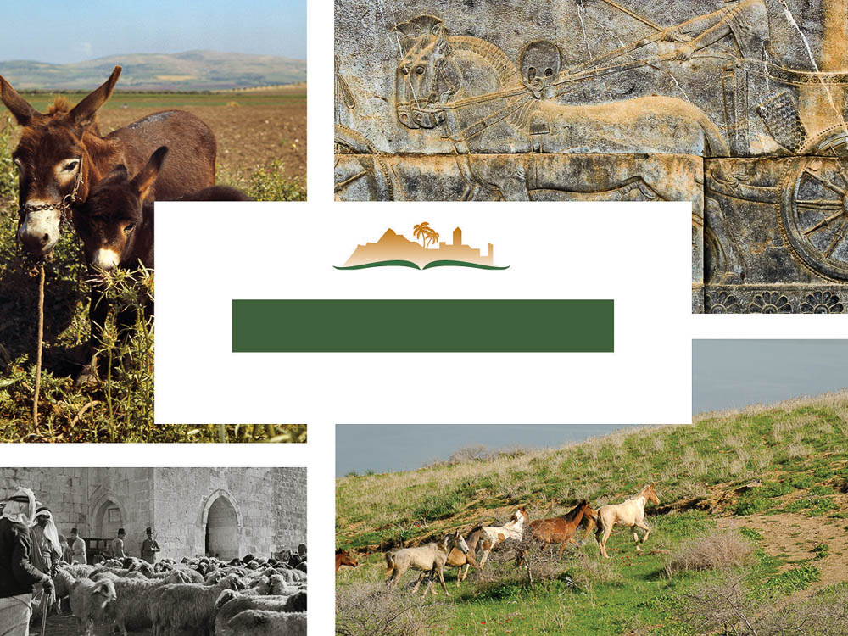
Zechariah 11
Notes:
This is a free sample of the Zechariah 11 presentation from the Photo Companion to the Bible. To purchase the full volume, visit www.bibleplaces.com/zechariah/
The Photo Companion to the Bible is an image-rich resource for Bible students, teachers, and researchers. Just as a librarian stocks the shelves with as many relevant materials as possible, so we have tried to provide a broad selection of images. Our goal is that you will find in this “library” whatever it is you are looking for.
Credits: The primary creators of this presentation are Chris McKinny, Kris Udd, Steven D. Anderson, Kai Akagi, and Todd Bolen. The photographs have an individual file code which usually includes the initials of the photographer. Other images have additional credit or source information.
Updates: We plan to update this collection as we are able. We welcome your suggestions for improving this resource (photocompanion@bibleplaces.com). Purchasers of the Zechariah volume are provided free, lifetime updates to the volume.
Copyright: This photo collection is protected by copyright law and may not be distributed without written permission from BiblePlaces.com. Slide notes should be treated as any other copyrighted written material, with credit given when quoting from these notes.
For more information, see our complete “Introduction to the Photo Companion to the Bible” online at https://www.BiblePlaces.com/Intro-Photo-Companion-Bible/. Here you will find more information about photo selection, explanatory notes, Bible translation, credit information, and copyright allowances.

Slide 2
Zechariah 11
This is a free sample of the Zechariah 11 presentation from the Photo Companion to the Bible. To purchase the full volume, visit www.bibleplaces.com/zechariah/
The Photo Companion to the Bible is an image-rich resource for Bible students, teachers, and researchers. Just as a librarian stocks the shelves with as many relevant materials as possible, so we have tried to provide a broad selection of images. Our goal is that you will find in this “library” whatever it is you are looking for.
For more details (for this and every slide), see the Notes section below.
Notes:
This is a free sample of the Zechariah 11 presentation from the Photo Companion to the Bible. To purchase the full volume, visit www.bibleplaces.com/zechariah/
The Photo Companion to the Bible is an image-rich resource for Bible students, teachers, and researchers. Just as a librarian stocks the shelves with as many relevant materials as possible, so we have tried to provide a broad selection of images. Our goal is that you will find in this “library” whatever it is you are looking for.
Credits: The primary creators of this presentation are Chris McKinny, Kris Udd, Steven D. Anderson, Kai Akagi, and Todd Bolen. The photographs have an individual file code which usually includes the initials of the photographer. Other images have additional credit or source information.
Updates: We plan to update this collection as we are able. We welcome your suggestions for improving this resource (photocompanion@bibleplaces.com). Purchasers of the Zechariah volume are provided free, lifetime updates to the volume.
Copyright: This photo collection is protected by copyright law and may not be distributed without written permission from BiblePlaces.com. Slide notes should be treated as any other copyrighted written material, with credit given when quoting from these notes.
For more information, see our complete “Introduction to the Photo Companion to the Bible” online at https://www.BiblePlaces.com/Intro-Photo-Companion-Bible/. Here you will find more information about photo selection, explanatory notes, Bible translation, credit information, and copyright allowances.

Slide 3
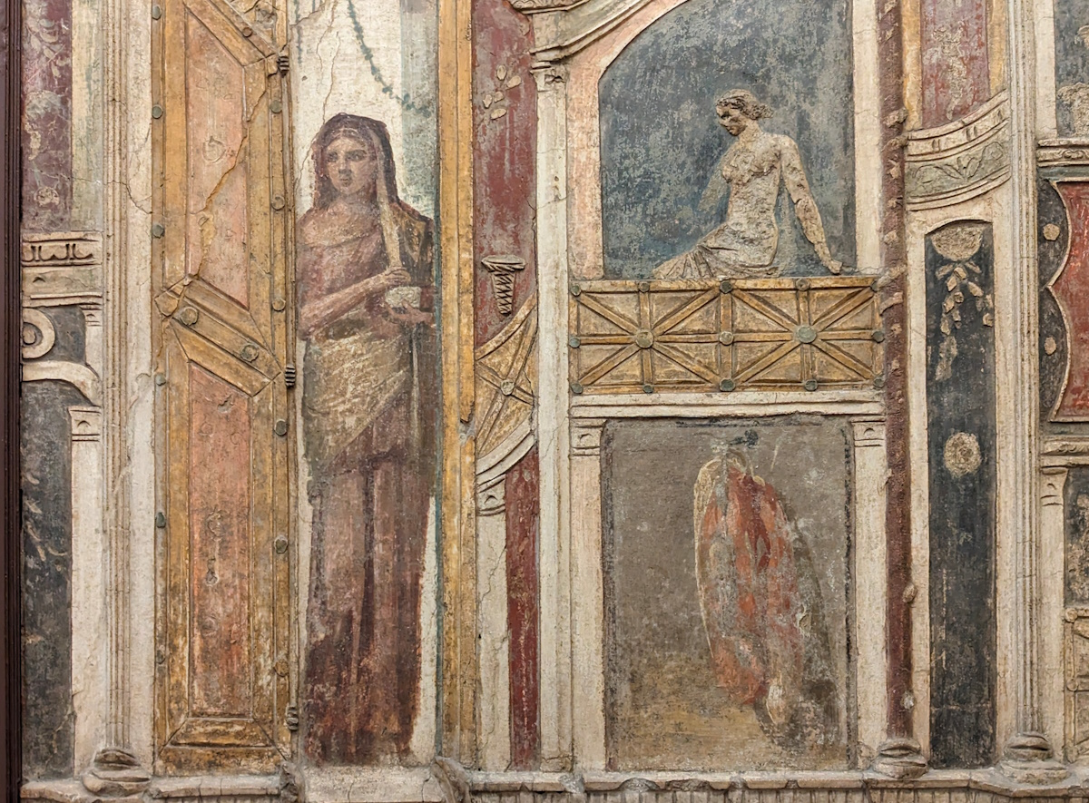
Open your doors, O Lebanon, that the fire may devour your cedars
Fresco of a woman standing in a doorway, from Pompeii, 1st century AD
11:1
Notes:
Meyers and Meyers observe that Zechariah 11 has long been regarded by commentators as one of the most difficult passages in the Hebrew Bible (1993: 293). The first section (vv. 1-3) is subject to quite divergent views. The regions mentioned by name (Lebanon, Bashan, and the pride of the Jordan) are all on the periphery of traditional Israelite settlement; none are in the heartland of either ancient Israel or Judah (compare the similarly distant zones of ch. 9: Hamath, Tyre, Sidon, and the Philistine cities). Because of this, Meyers and Meyers are inclined to take these regions (and the trees) rather literally: “The tree imagery thus has a double eschatological import: the deforestation of marginal territories to accommodate the restoration of Israel, and the destruction of political systems to accommodate the worldwide rule of Yahweh from Jerusalem” (Meyers and Meyers 1993: 295; similarly, the earlier view of Smith 1984: 267).
An alternative is given by Boda, who takes the trees, shepherds, and lions as metaphors for Judean leaders, possibly even of Davidic descent, who are being judged. In this view, both the “stately trees” and the “shepherds” are “possibly referring to leaders serving under the satrapal leadership located in the northern Levant or under provincial leadership in Yehud,” whereas the “lions are representative of other figures who are involved in the political system of this imperial region, possibly related to the rulers associated with the Davidic line” (Boda 2016: 646; similarly, Klein 2007: 317).
The mention of three regions that are all on the periphery of Israelite/Judahite territory would be unexpected if the target of this poem was the leaders of Judah, and perhaps this lends more support to the former view.
This fresco was photographed at the Naples Archaeological Museum.
References:
Boda, Mark J.
2016 Zechariah. New International Commentary on the Old Testament. Grand Rapids: Eerdmans.
Klein, George L.
2007 Zechariah. New American Commentary. Nashville: Broadman and Holman.
Meyers, Carol L. and Meyers, Eric M.
1993 Zechariah 9–14. Anchor Bible. New York: Doubleday.
Smith, Ralph L.
1984 Micah–Malachi. Word Biblical Commentary. Dallas: Word.
ku0622230845049

Slide 4
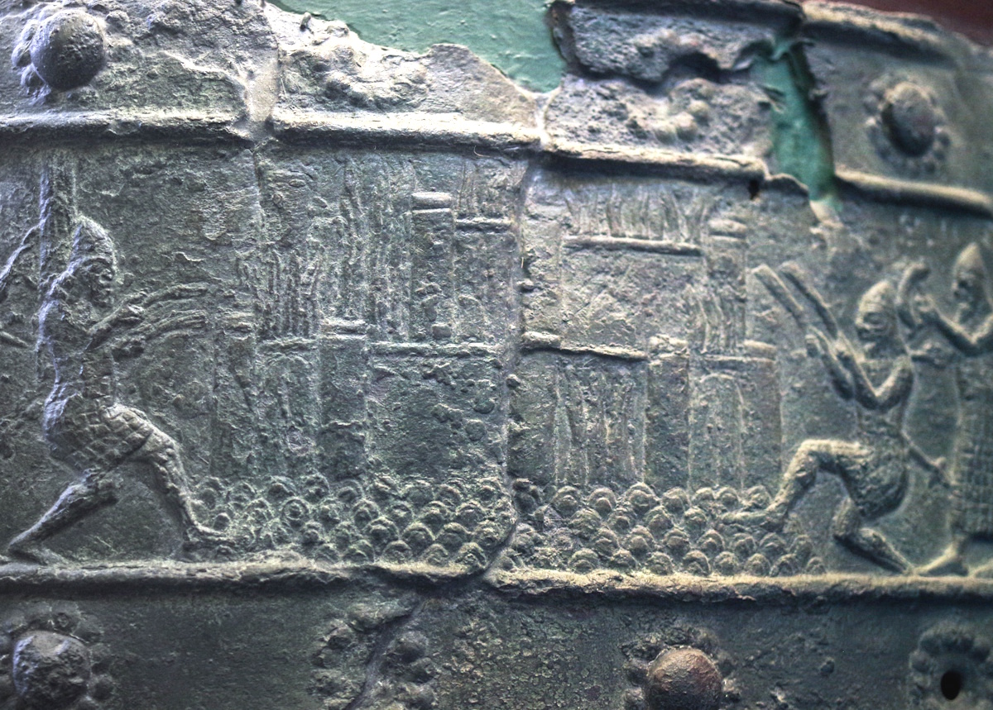
Open your doors, O Lebanon, that the fire may devour your cedars
Assyrians besieging and burning an Urartian city, reign of Shalmaneser III, 9th century BC
11:1
Notes:
This depiction of a burning city comes from the bronze bands that once decorated the gates of Balawat. Soldiers approach from either side with burning torches, and the city is depicted with flames leaping up from the walls. This relief was photographed at the British Museum.
adr1805194217c

Slide 5
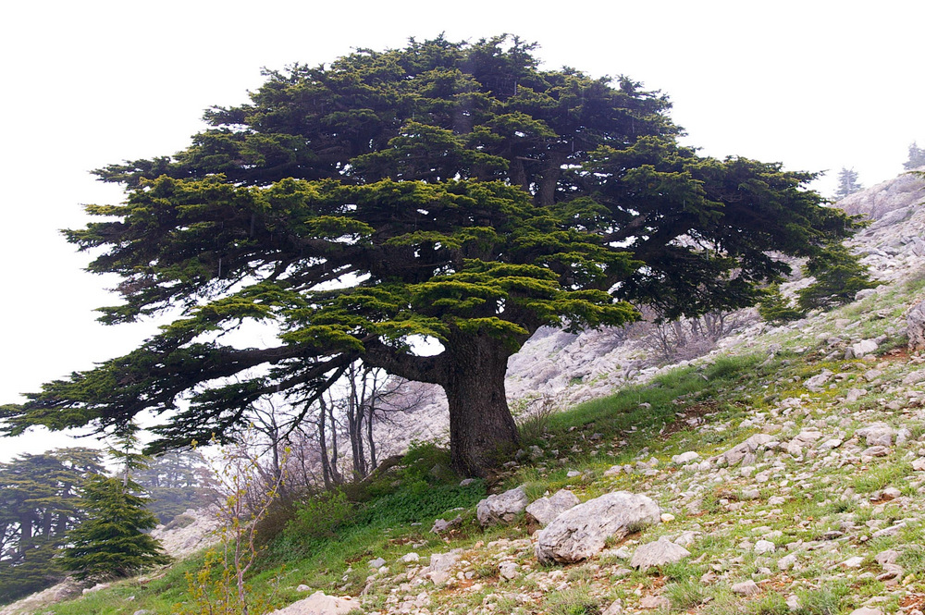
Open your doors, O Lebanon, that the fire may devour your cedars
Cedar of Lebanon
11:1
Notes:
These giant, beautiful, evergreen trees grow in mountainous regions and produce cones and bluish-green needles on their long branches. They can attain a height of 100 feet (30 m), and the trunk may reach 6 feet (2 m) in diameter. Compared with the trees of Israel, the cedar is indeed a mighty tree. It is no wonder that the beautifully grained, savory smelling, sturdy wood was imported since the lumber was larger than that of any tree in Israel. Cedars can live two to three millennia and are highly praised in Scripture. Cedar translates the word erez in Hebrew.
adr090510670

Slide 6
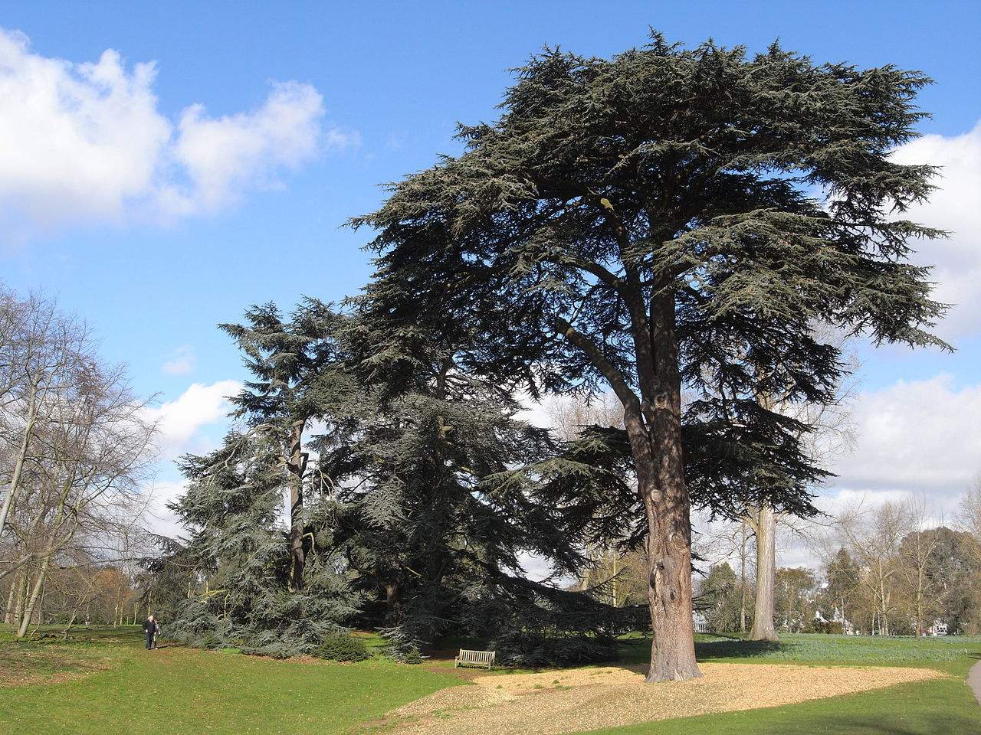
Open your doors, O Lebanon, that the fire may devour your cedars
Cedar of Lebanon (Cedrus libani) in Kew Gardens, London
11:1
Notes:
Over the centuries, the cedar forests of Lebanon were severely diminished. The government is taking steps to counter the deforestation and replenish the forests. The cedar forests in the Esh-Shouf Cedar Reserve make up about 25 percent of all remaining cedars in Lebanon. Some of the trees are estimated to be 2,000 years old. The cedar of Lebanon (Cedrus libani) grows at altitudes of 3,200–6,400 feet (975–1,950 m) and is found in Lebanon, south-central Turkey, and Cyprus.
The large tree shown here is a Cedrus libani. To the left are two smaller trees with low branches; these are cedrus atlantica. This photo was taken in Kew Gardens, London. This image comes from Patche99z and is in the public domain, via Wikimedia Commons: https://commons.wikimedia.org/wiki/File:Cedrus_libani_5191.JPG.
wiki03022009273699

Slide 7

Open your doors, O Lebanon, that the fire may devour your cedars
Cedars of Lebanon (Cedrus libani) in Arslanköy
11:1
Notes:
Commonly referred to in Scripture as the cedars of Lebanon, this aromatic, durable wood was highly desirable for building in Iron Age Israel. David used in it building his house (2 Sam 5:11; 1 Chr 17:1), and Solomon used it in the constructing the temple and a palace for himself (2 Chr 2:3-8). He was said to make the cedar as plentiful in Jerusalem as sycamore-fig trees in the Shephelah (2 Chr 1:15).
Cedars were also used in the construction of the Second Temple (Ezra 3:7). The cedar tree symbolizes strength and security. Psalm 29:5 speaks of the mighty voice of Lord breaking the strong cedars. Another psalm speaks of the righteous prospering like the palm tree and growing like a cedar of Lebanon (Ps 92:12).
This image comes from Zeynel Cebeci and is licensed under CC BY-SA 4.0, via Wikimedia Commons: https://commons.wikimedia.org/wiki/File:Cedrus_libani_-_Lebanon_Cedar_-_L%C3%BCbnan_Sediri_05.JPG.
wiki08171432642448667

Slide 8
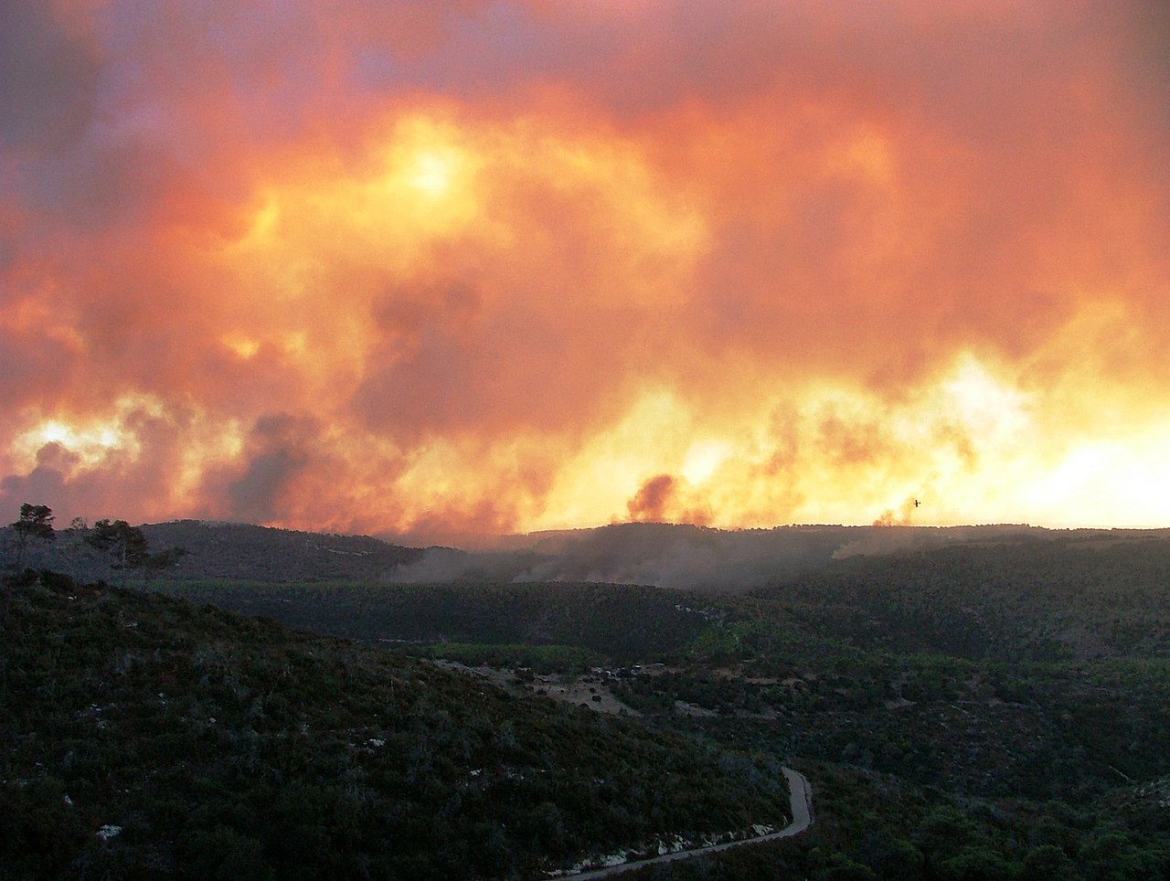
Open your doors, O Lebanon, that the fire may devour your cedars
Smoke from the Mount Carmel forest fire, 2010
11:1
Notes:
This image comes from אורי גונן and is licensed under CC BY 2.5, via Wikimedia Commons: https://commons.wikimedia.org/wiki/File:PikiWiki_Israel_10861_Cities_in_Israel.JPG.
wiki201016001205356

Slide 9
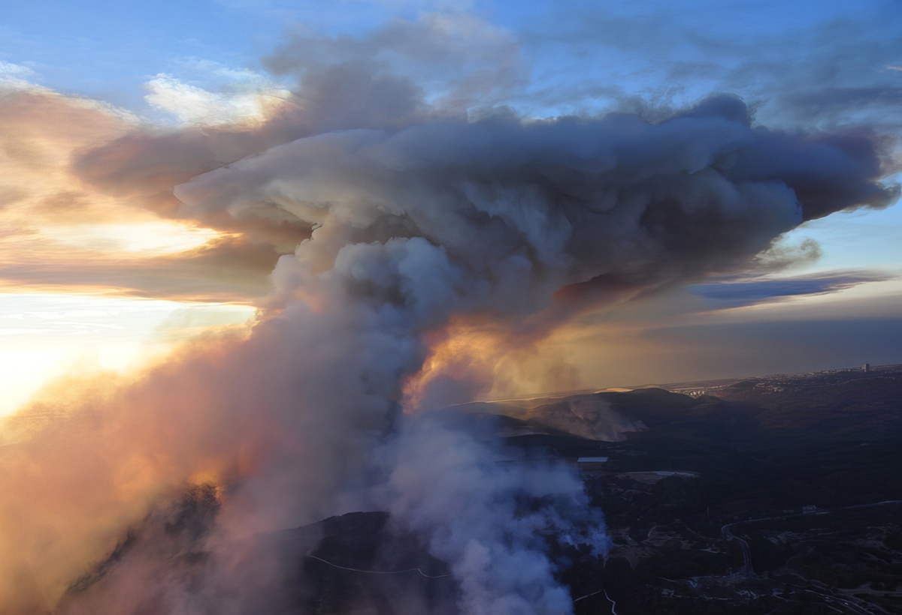
Open your doors, O Lebanon, that the fire may devour your cedars
Forest fire and column of smoke on Mount Carmel, 2010
11:1
Notes:
This image comes from Israel Police Air Unit and is licensed under CC BY-SA 3.0, via Wikimedia Commons: https://commons.wikimedia.org/wiki/File:Mount_Carmel_forest_fire36.jpg.
wiki2010102468064c

Slide 10
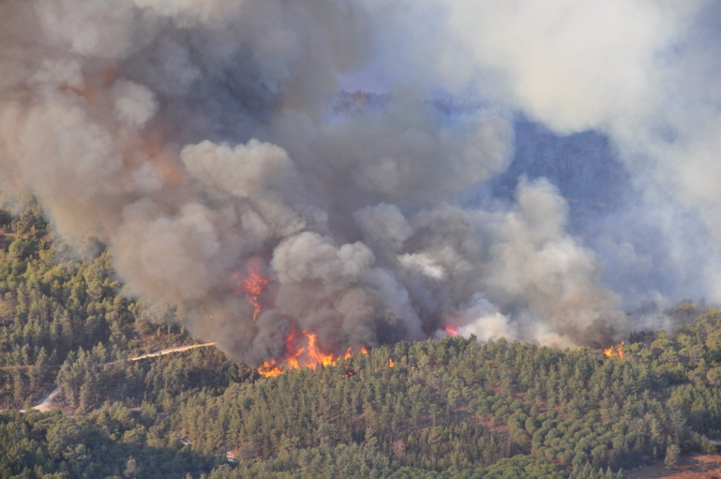
Open your doors, O Lebanon, that the fire may devour your cedars
Forest fire on Mount Carmel, 2010
11:1
Notes:
This fire was started by a 14-year-old boy who threw a lit coal into the forest. This image comes from the Israeli Air Force and is licensed under CC-BY-SA-3.0, via Wikimedia Commons, https://commons.wikimedia.org/wiki/File:Mount_Carmel_forest_fire14.jpg.
wiki122220102305

Slide 11
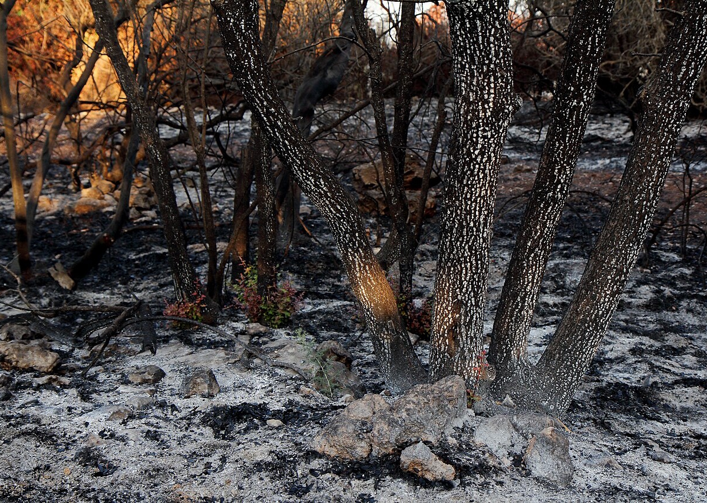
Open your doors, O Lebanon, that the fire may devour your cedars
Burnt area after a brush fire on Har Hatayasim
11:1
Notes:
This image comes from Lizzy Shaanan and is licensed under CC BY 2.5, via Wikimedia Commons: https://commons.wikimedia.org/wiki/File:98331_har_hatayasim_(pilots%27_mountain)_PikiWiki_Israel.jpg.
wiki1018160010671022

Slide 12
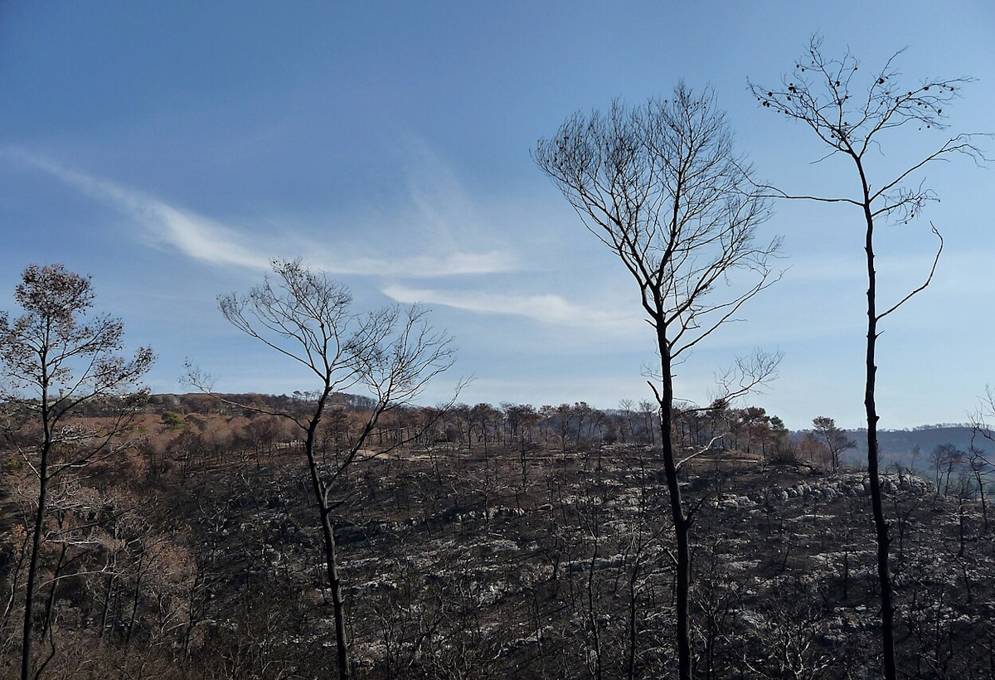
Open your doors, O Lebanon, that the fire may devour your cedars
Burnt forest after the Mount Carmel fire, 2010
11:1
Notes:
This image comes from Chenspec and is licensed under CC BY-SA 4.0, via Wikimedia Commons: https://commons.wikimedia.org/wiki/File:%D7%A4%D7%90%D7%A8%D7%A7_%D7%94%D7%9B%D7%A8%D7%9E%D7%9C_5_-_%D7%92%D7%A0%D7%99%D7%9D_%D7%9C%D7%90%D7%95%D7%9E%D7%99%D7%99%D7%9D_%D7%91%D7%A6%D7%A4%D7%95%D7%9F_%D7%94%D7%90%D7%A8%D7%A5_-_%D7%90%D7%AA%D7%A8%D7%99_%D7%9E%D7%95%D7%A8%D7%A9%D7%AA_2016_(305).jpg.
wiki01231135522368364

Slide 13
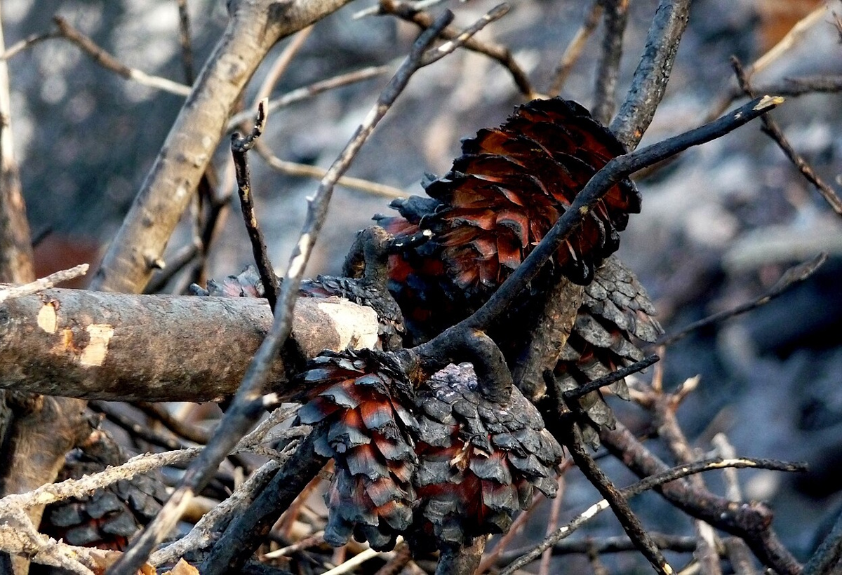
Open your doors, O Lebanon, that the fire may devour your cedars
Burnt pinecones after the Mount Carmel fire, 2010
11:1
Notes:
This image comes from Chenspec and is licensed under CC BY-SA 4.0, via Wikimedia Commons: https://commons.wikimedia.org/wiki/File:%D7%A4%D7%90%D7%A8%D7%A7_%D7%94%D7%9B%D7%A8%D7%9E%D7%9C_6_-_%D7%92%D7%A0%D7%99%D7%9D_%D7%9C%D7%90%D7%95%D7%9E%D7%99%D7%99%D7%9D_%D7%91%D7%A6%D7%A4%D7%95%D7%9F_%D7%94%D7%90%D7%A8%D7%A5_-_%D7%90%D7%AA%D7%A8%D7%99_%D7%9E%D7%95%D7%A8%D7%A9%D7%AA_2016_(485).jpg.
wiki12191035522368285

Slide 14
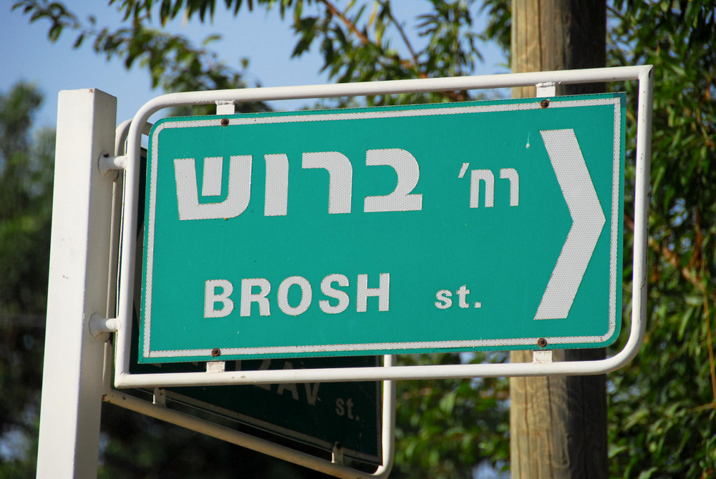
Wail, O cypress, for the cedar has fallen; for the glorious ones are destroyed
“Brosh (Cypress) Street” sign in Mevasseret
11:2
Notes:
Mevasseret Zion is a suburb west of Jerusalem.
tb090906018

Slide 15
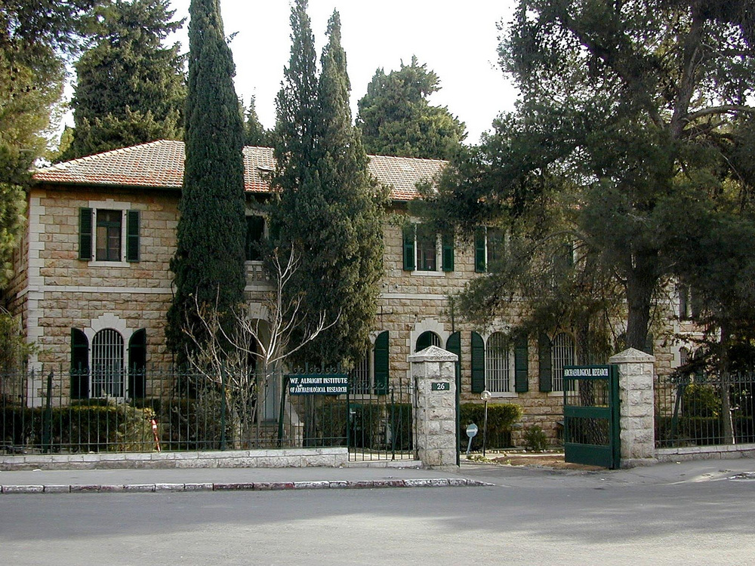
Wail, O cypress, for the cedar has fallen; for the glorious ones are destroyed
Cypress trees in front of Albright Institute, Jerusalem
11:2
Notes:
It is generally thought that the “cypress” (Heb. berosh, בְּרוֹשׁ) is the Juniperus phoenicea. Two such trees are seen here growing in front of the Albright Institute in Jerusalem.
tb010200202

Slide 16
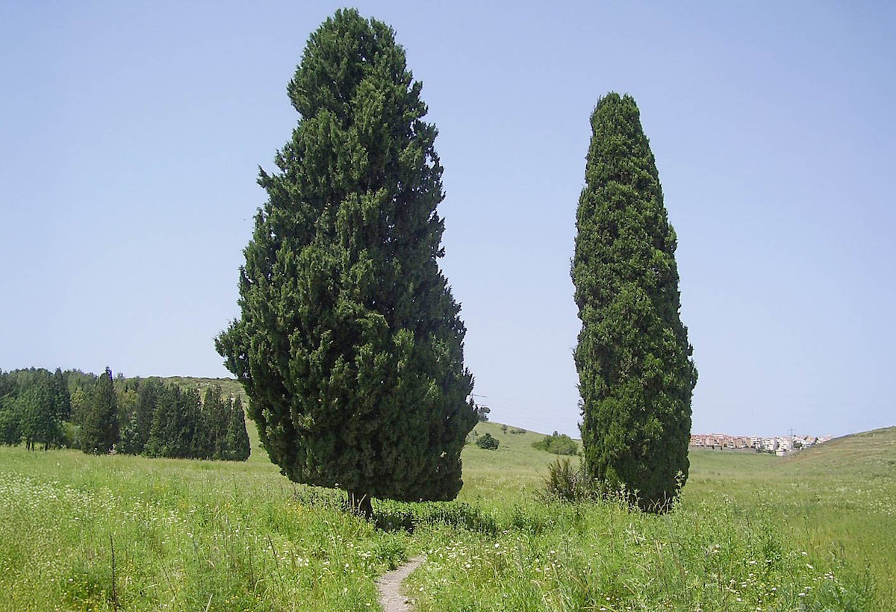
Wail, O cypress, for the cedar has fallen; for the glorious ones are destroyed
Two huge cypress trees in Ramat Hashna'im
11:2
Notes:
This image comes from Dr. Avishai Teicher and is in the public domain, via Wikimedia Commons: https://commons.wikimedia.org/wiki/File:The_Two_Cypresses_in_Ramat_Hshna%27im,_Israel.jpg.
wiki0410101220481536680c

Slide 17
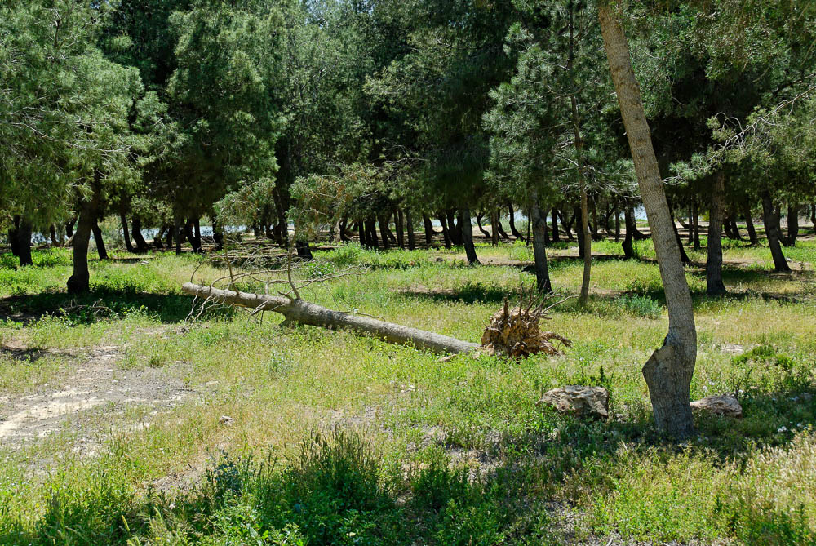
Wail, O cypress, for the cedar has fallen; for the glorious ones are destroyed
Tree fallen over at Yeroham reservoir
11:2
Notes:
tb042007413

Slide 18
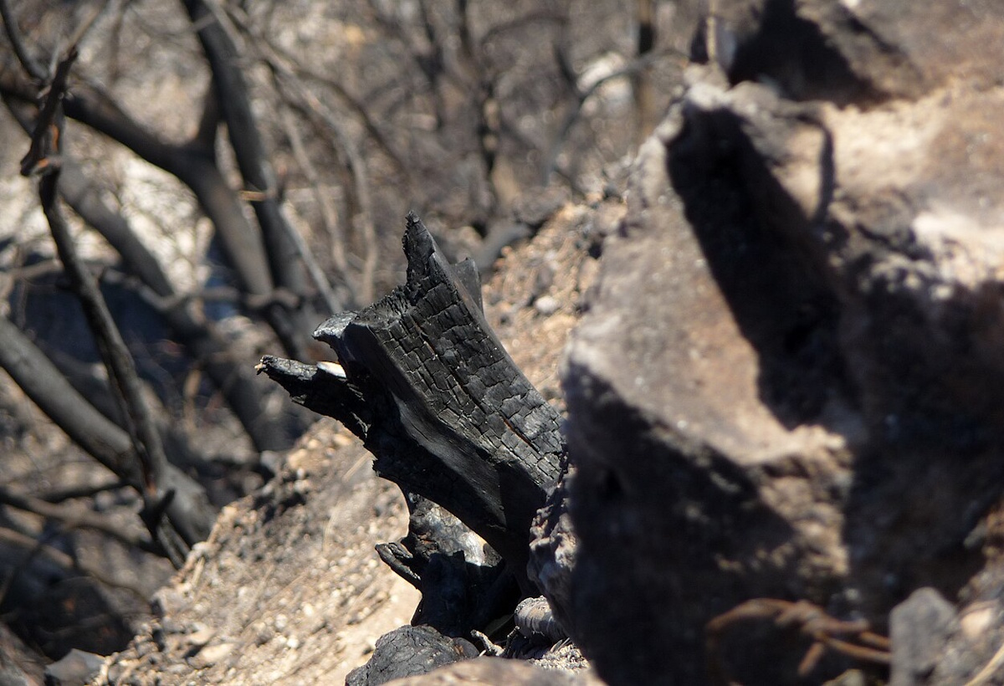
Wail, O cypress, for the cedar has fallen; for the glorious ones are destroyed
Remains of a burnt tree in the Carmel forest fire, 2010
11:2
Notes:
This image comes from Chenspec and is licensed under CC BY-SA 4.0, via Wikimedia Commons: https://commons.wikimedia.org/wiki/File:%D7%A4%D7%90%D7%A8%D7%A7_%D7%94%D7%9B%D7%A8%D7%9E%D7%9C_5_-_%D7%92%D7%A0%D7%99%D7%9D_%D7%9C%D7%90%D7%95%D7%9E%D7%99%D7%99%D7%9D_%D7%91%D7%A6%D7%A4%D7%95%D7%9F_%D7%94%D7%90%D7%A8%D7%A5_-_%D7%90%D7%AA%D7%A8%D7%99_%D7%9E%D7%95%D7%A8%D7%A9%D7%AA_2016_(10).jpg.
wiki1226103552236835

Slide 19
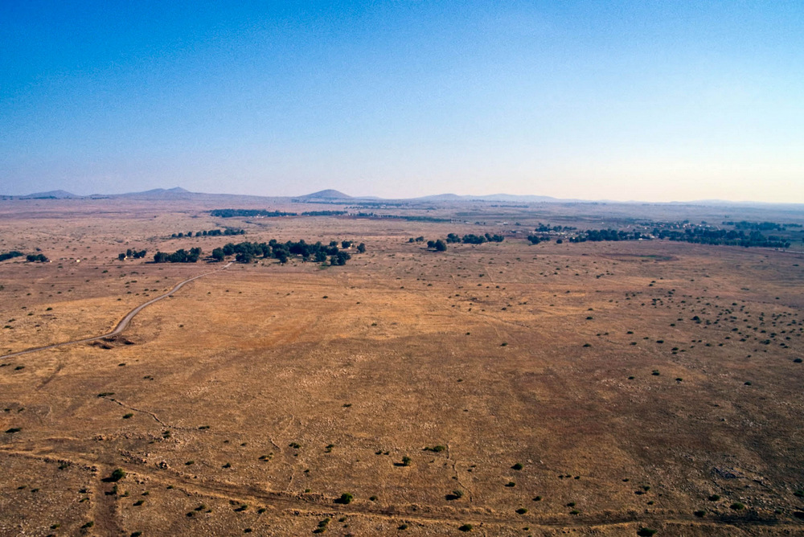
Wail, oaks of Bashan! For the impenetrable forest has come down!
Golan Heights, ancient Bashan (aerial view from the west)
11:2
Notes:
This photograph shows a mostly barren area of the Golan Heights. Basalt is volcanic lava that sometimes reaches a thickness of 330 feet (100 m) in the Golan. The lava flow was so great at one point that it filled in the Jordan Rift in a place known today as the Rosh Pinna Sill. The hills sticking out of the otherwise flat Golan plain are extinct volcanoes known as cindercones.
tbs113300011

Slide 20
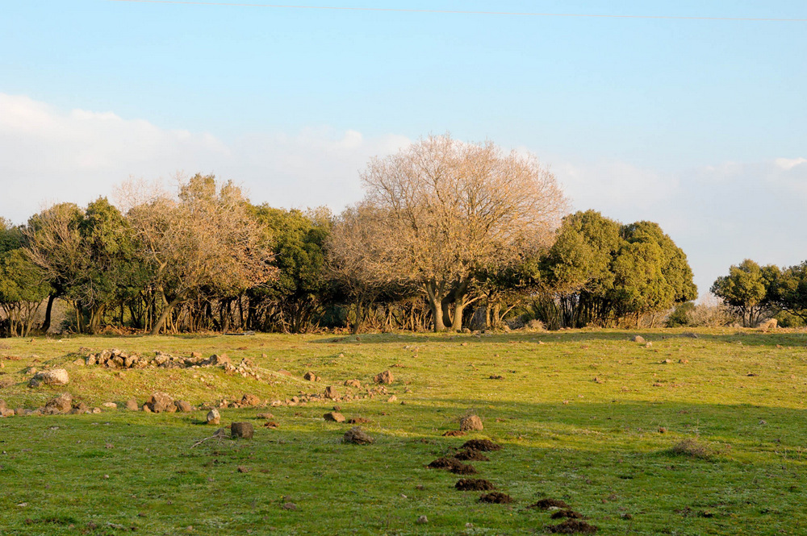
Wail, oaks of Bashan! For the impenetrable forest has come down!
Oak forest on the Golan Heights
11:2
Notes:
tb020506174

Slide 21
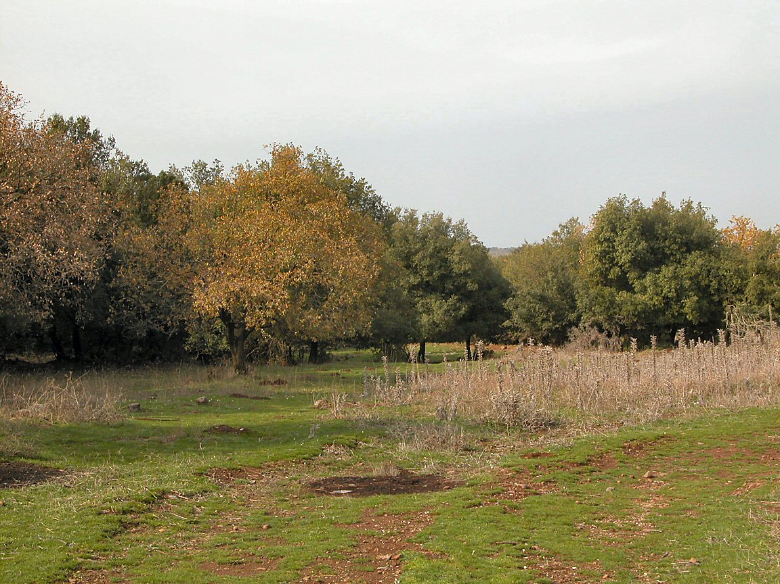
Wail, oaks of Bashan! For the impenetrable forest has come down!
Odem Forest in the Golan Heights
11:2
Notes:
tb121702205

Slide 22
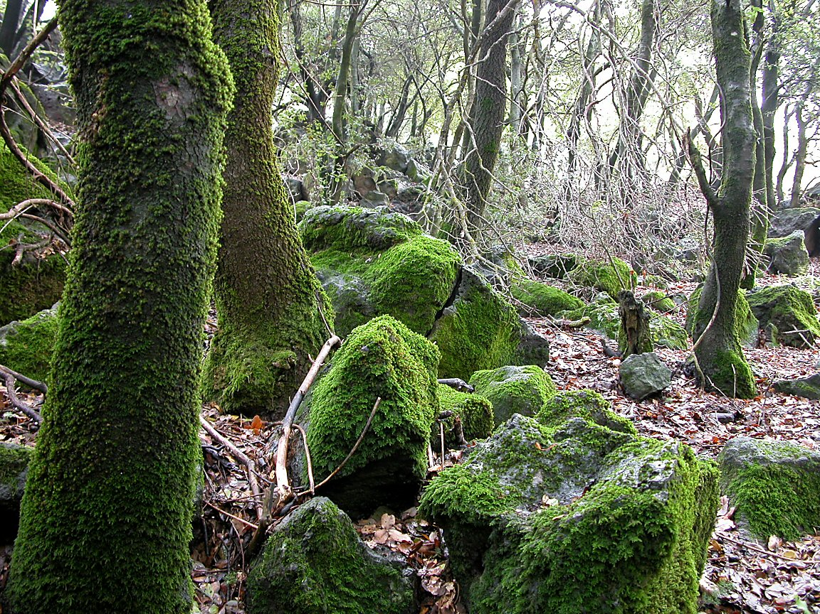
Wail, oaks of Bashan! For the impenetrable forest has come down!
Moss-covered rocks and trees in Odem Forest, Golan Heights
11:2
Notes:
tb121702204

Slide 23
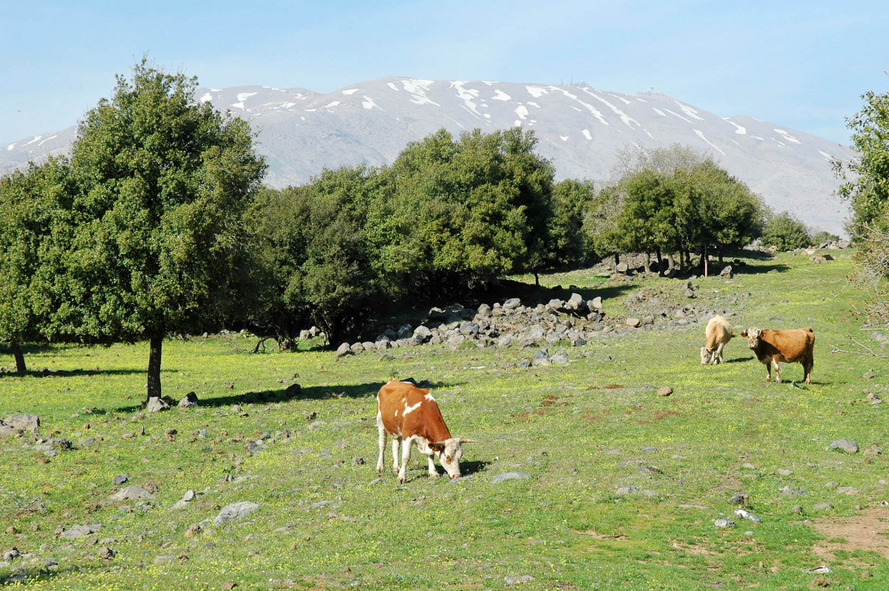
Wail, oaks of Bashan! For the impenetrable forest has come down!
Cows of Bashan with Mount Hermon
11:2
Notes:
Cattle have been raised in the Golan Heights, in ancient times as well as today. Currently, both beef and dairy cattle are raised in the area.
tb032905276

Slide 24
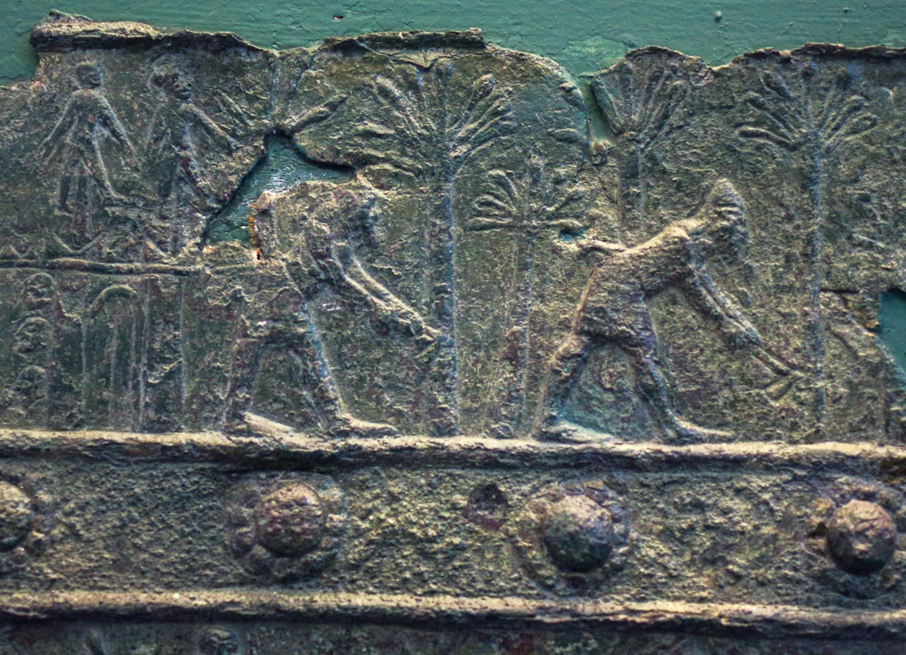
Wail, oaks of Bashan! For the impenetrable forest has come down!
Assyrian soldiers cutting down trees next to a city, reign of Shalmaneser III, 9th century BC
11:2
Notes:
The bronze band shown on this slide was once part of the city gate at ancient Balawat. It depicts men cutting down trees with axes (numerous features in this depiction are not to scale). This was a common way of laying waste to a land that was under siege. This relief was photographed at the British Museum.
adr1805194244

Slide 25
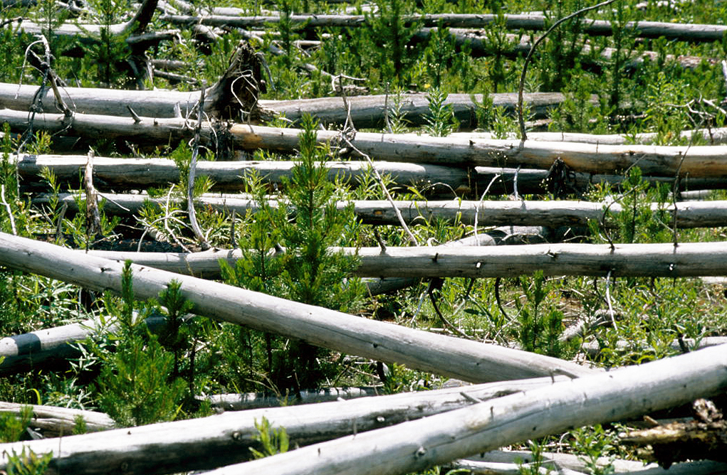
Wail, oaks of Bashan! For the impenetrable forest has come down!
Fallen trees in Yellowstone National Park after a fire
11:2
Notes:
This image comes from LBM1948 and is licensed under CC BY-SA 4.0, via Wikimedia Commons: https://commons.wikimedia.org/wiki/File:Yellowstone_N.P._1997_79.jpg.
wiki0719971021668951

Slide 26
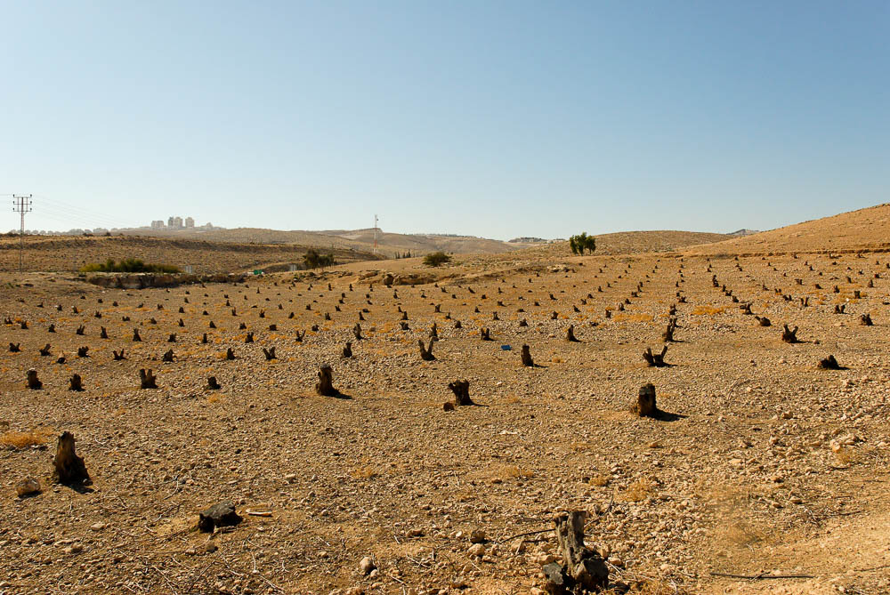
Wail, oaks of Bashan! For the impenetrable forest has come down!
Olive grove recently chopped down in the Judean wilderness
11:2
Notes:
tb113006673

Slide 27
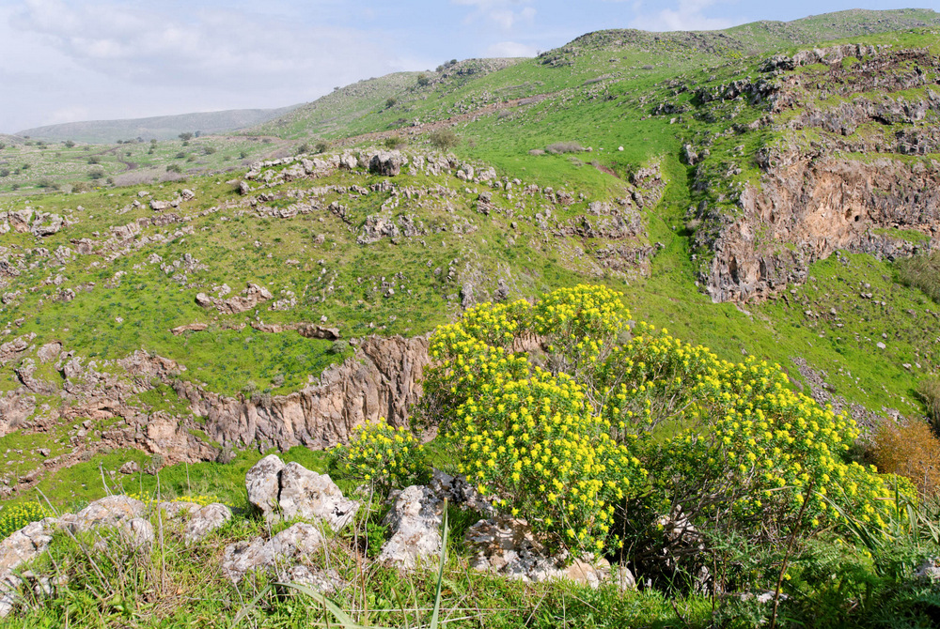
Wail, oaks of Bashan! For the impenetrable forest has come down!
Nahal Hamdal (from the southwest)
11:2
Notes:
cd100123003

Slide 28
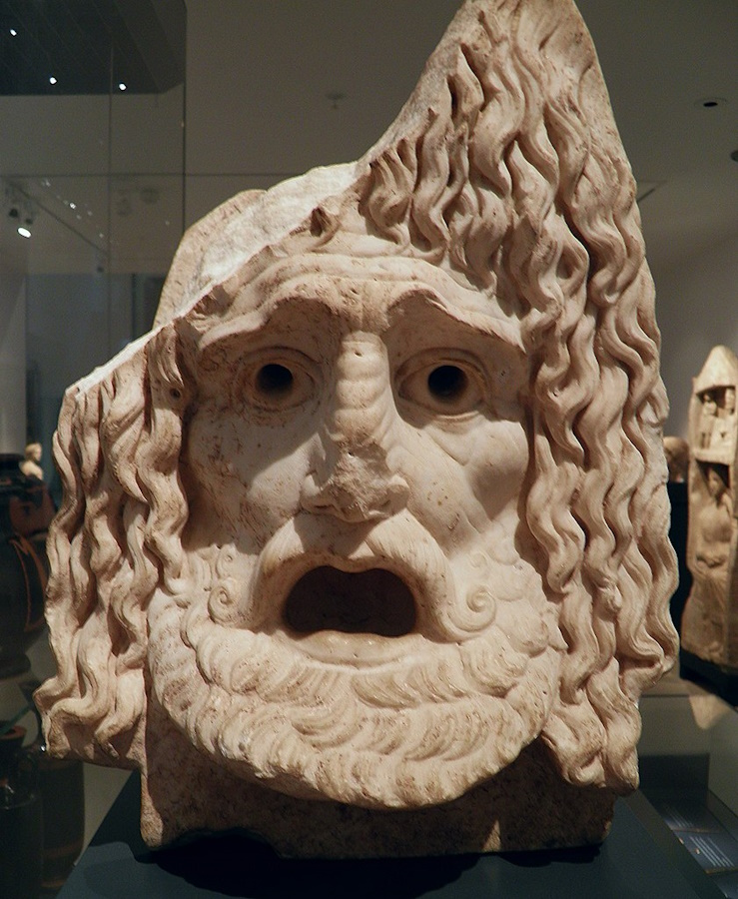
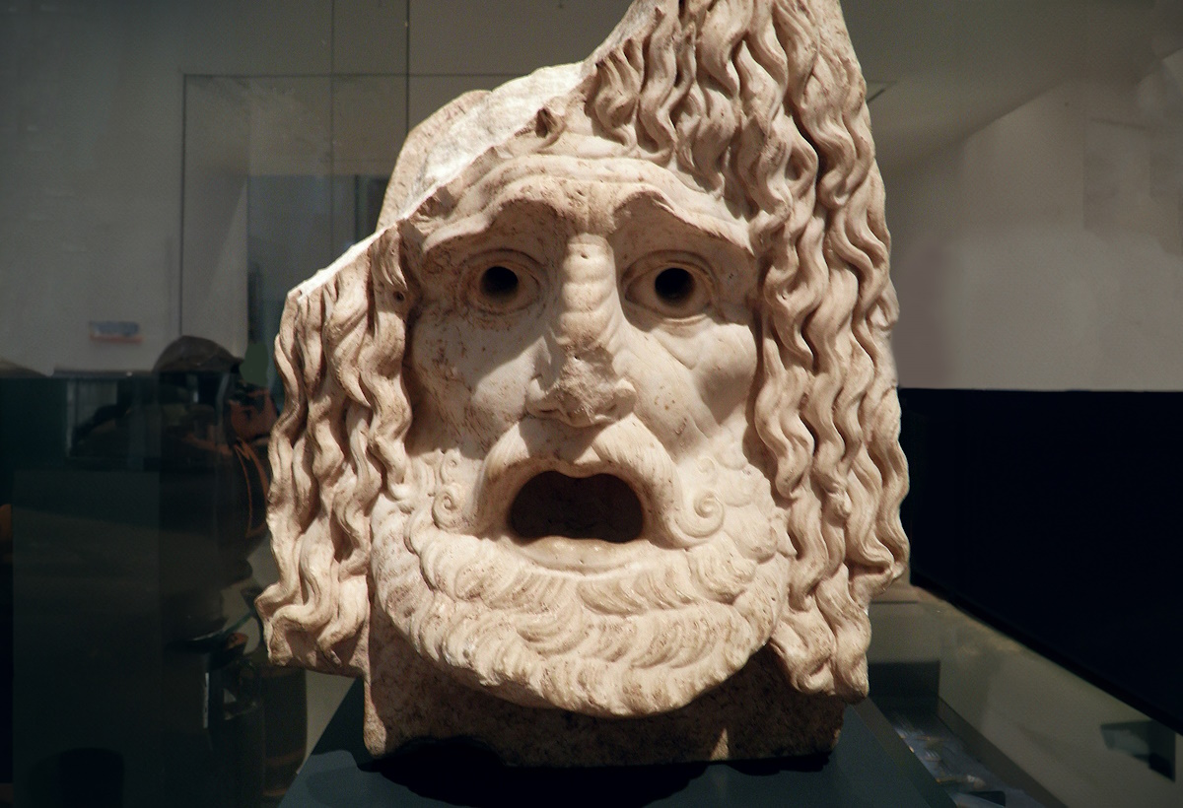
There is a sound of the shepherds wailing, for their glory is destroyed
Tragic mask expressing dread, 1st century BC – 1st century AD
11:3
Notes:
This mask was photographed at the Ashmolean Museum. This image comes from Carole Raddato and is licensed under CC BY-SA 2.0, via Wikimedia Commons: https://commons.wikimedia.org/wiki/File:Tragic_mask,_1st_century_BC_to_1st_century_AD,_Ashmolean_Museum_(8400675987).jpg. Generative AI has been used to extend the edges of this image; the original photo is available behind this image.
wiki07121114313751836

Slide 29
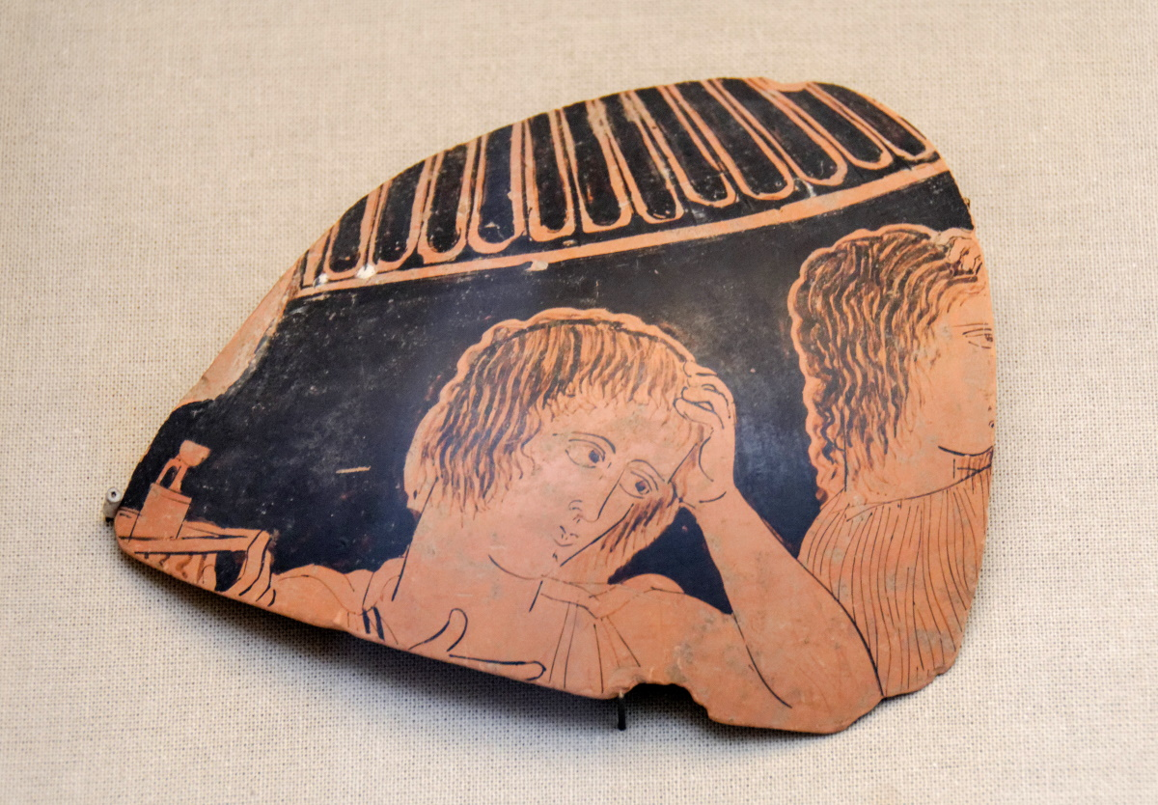
There is a sound of the shepherds wailing, for their glory is destroyed
Red-figured potsherd with mourning figures, from Athens, circa 430 BC
11:3
Notes:
The figures on this potsherd have their hands raised to their heads, indicating a state of mourning. This sherd was photographed at the British Museum.
tb0929197616

Slide 30
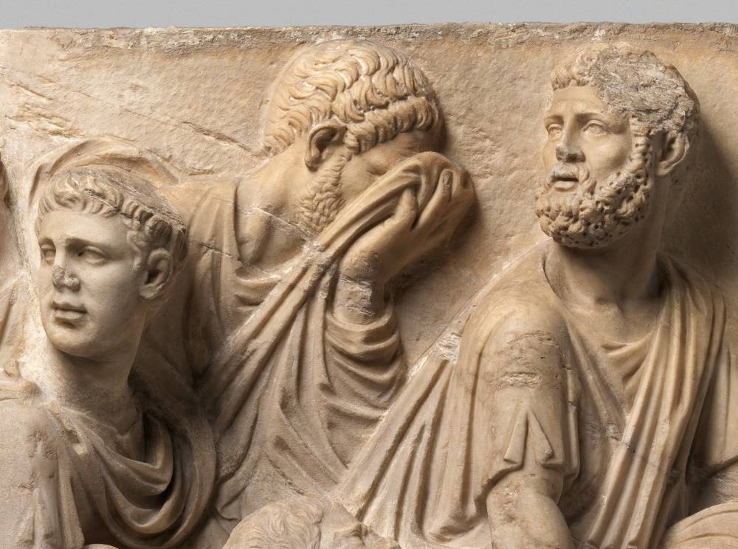
There is a sound of the shepherds wailing, for their glory is destroyed
Roman sarcophagus fragment with a grieving soldier, marble, mid-2nd century AD
11:3
Notes:
Emotions such as crying are not reflected in the artistic repertoire of the ancient Near East (outside of staged mourning for the dead), so the idea is illustrated here by a Roman depiction of grief. The man in the background of this sculpture turns his head and covers his face with his garment as he weeps. This image comes from the Metropolitan Museum of Art, public domain, Rogers Fund, 1920, accession number 20.187, https://www.metmuseum.org/art/collection/search/250926.
met250926

Slide 31
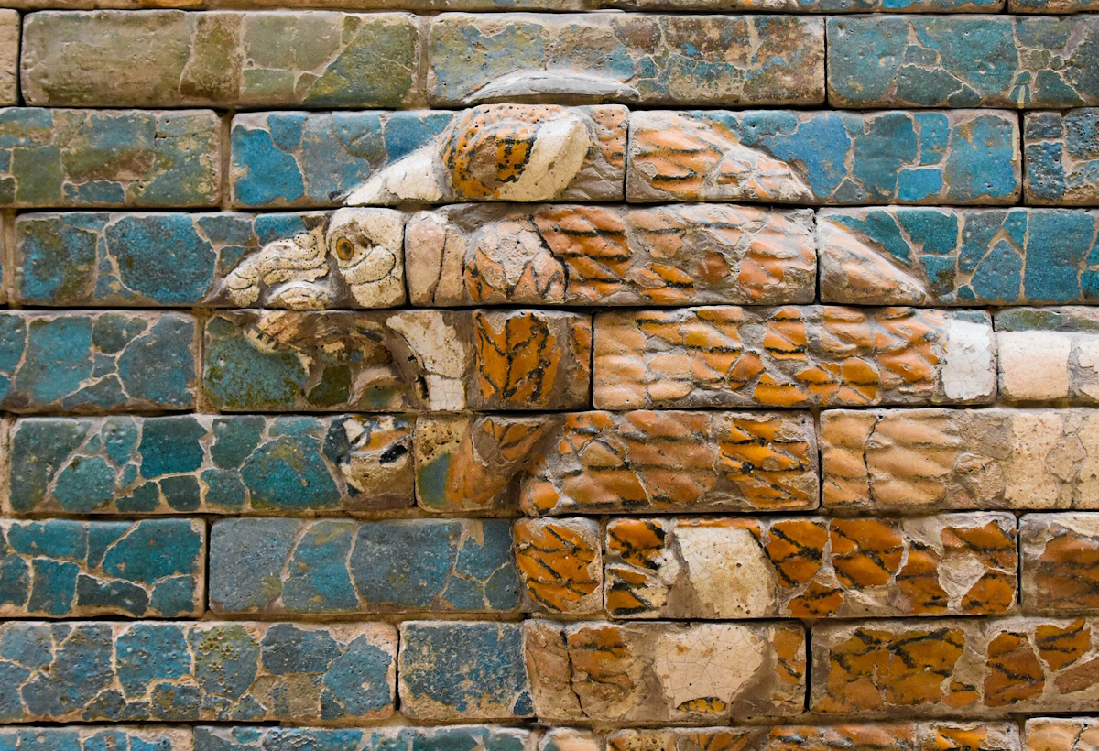
There is a sound of the young lions roaring
Lion from the processional way in Babylon, circa 600 BC
11:3
Notes:
“Roaring” (Heb. sheagah, שְׁאָגָה) is commonly used of lions in the Hebrew Bible (e.g., Judg 14:5; Isa 5:29; Jer 2:15; Ezek 22:25). The Asiatic lion (Panthera leo leo), also known as the Persian lion, once lived throughout this region. Today the wild population is restricted to a few small places in India. Males stand about 4 feet (122 cm) at the shoulder and average about 350 pounds (159 kg) in weight.
This glazed brick representation of a roaring lion comes from the Processional Way at Babylon. It was photographed at the Pergamon Museum in Berlin. This image comes from Richard Mortel and is licensed under CC BY 2.0, via Wikimedia Commons: https://commons.wikimedia.org/wiki/File:Processional_Way,_Babylon,_ca._575_BCE,_built_by_Nebuchadnezzar_II,_detail;_Pergamon_Museum,_Berlin_(9)_(39344357515).jpg.
wiki011618586237821248

Slide 32
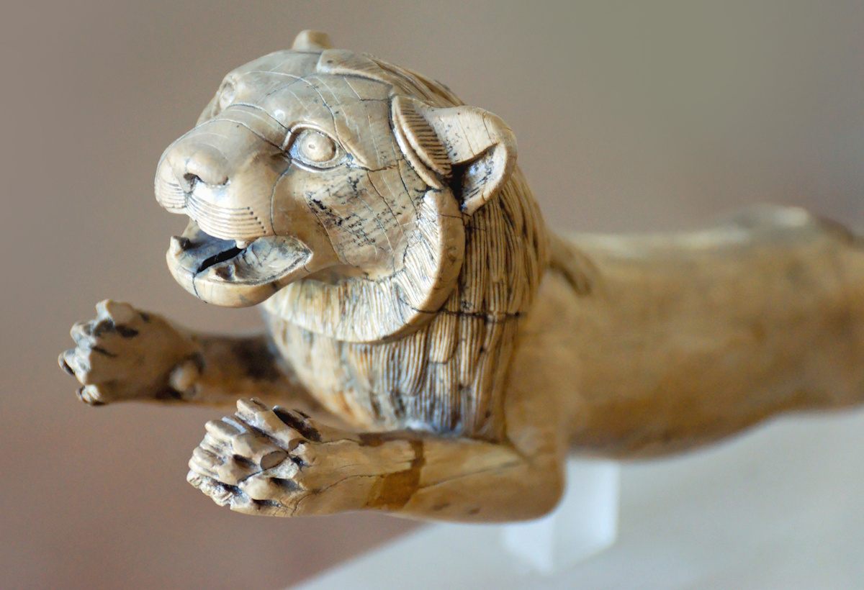
There is a sound of the young lions roaring
Lion carved from ivory, from Samos, circa 6th century BC
11:3
Notes:
This ivory lion was photographed at the Samos Museum.
tb061606058c

Slide 33
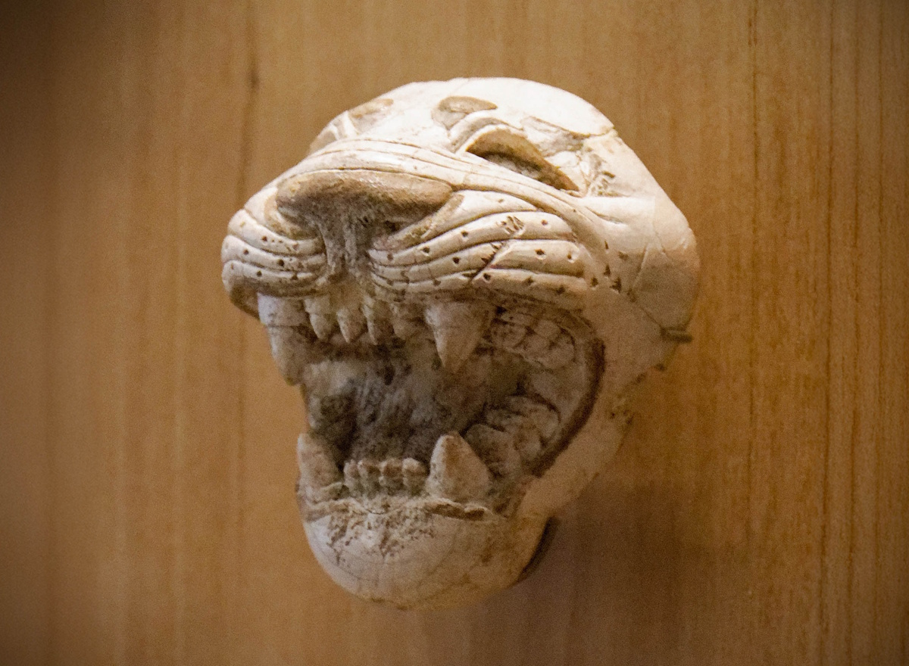
There is a sound of the young lions roaring
Ivory depiction of a roaring lion, from Arslan Tash, circa 8th century BC
11:3
Notes:
This ivory carving was photographed at the Louvre Museum.
tb0927194643c

Slide 34
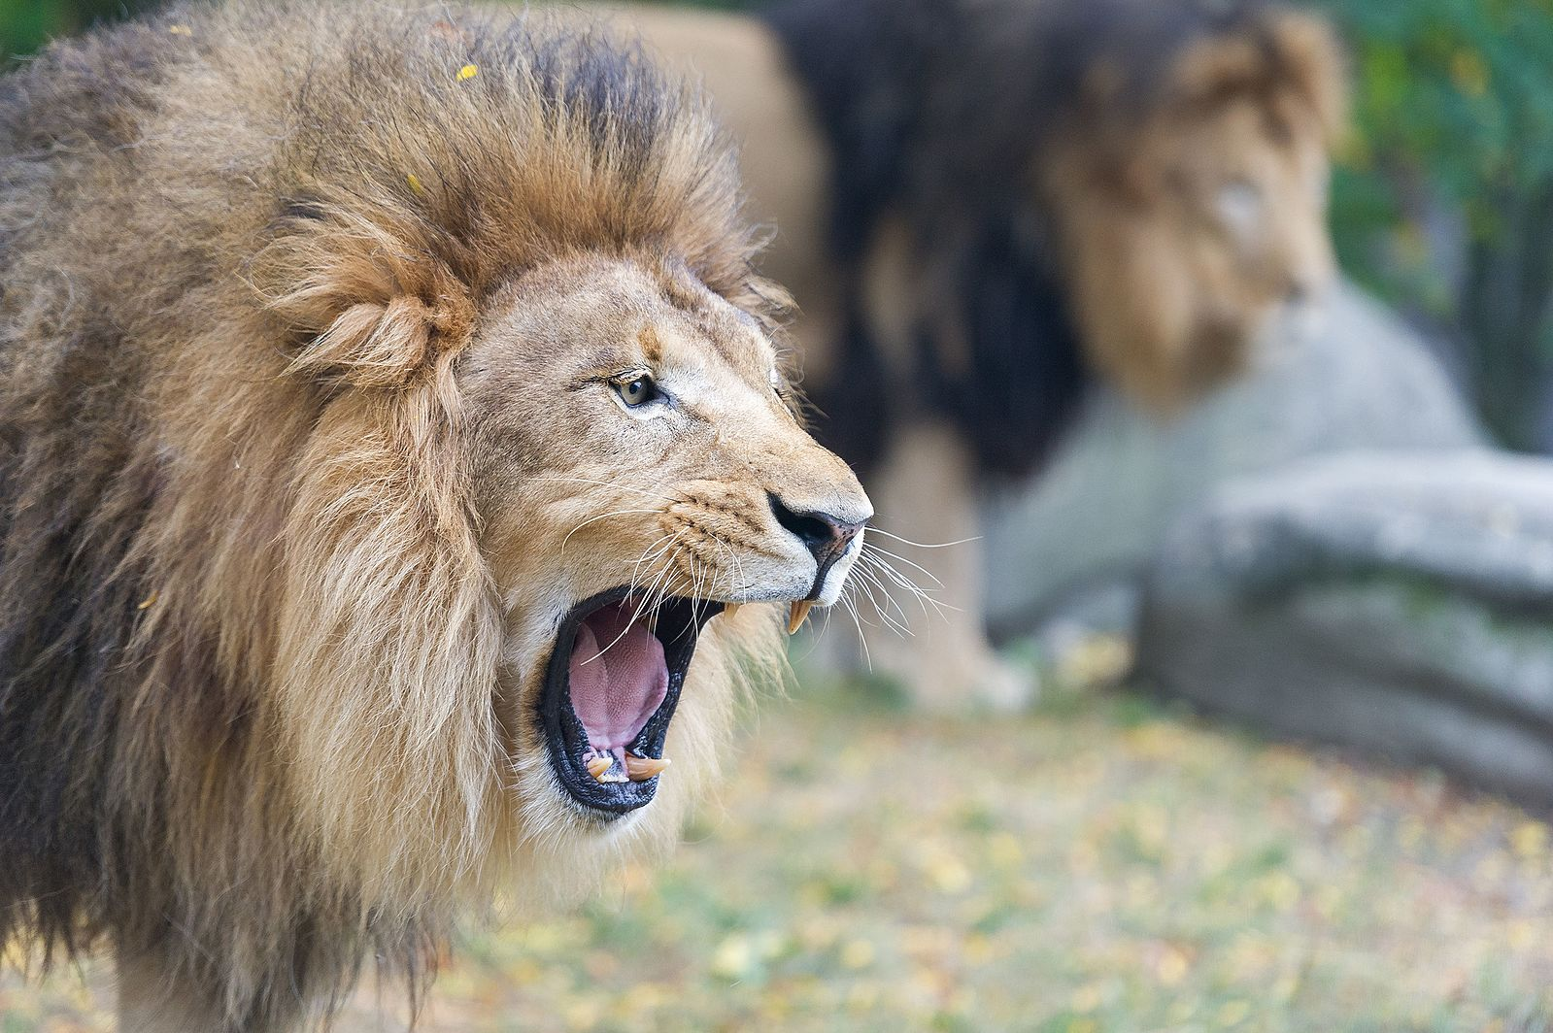
There is a sound of the young lions roaring
Roaring African lion
11:3
Notes:
Skeletal remains of lions have been discovered in excavations at the sites of Ekron and Jaffa. This image was taken by Eric Kilby and is licensed under CC-BY-SA-2.0, via Wikimedia Commons: https://commons.wikimedia.org/wiki/File:Two_Lions_Roaring_-_Closeup_(20842585554).jpg.
wiki091320151442

Slide 35
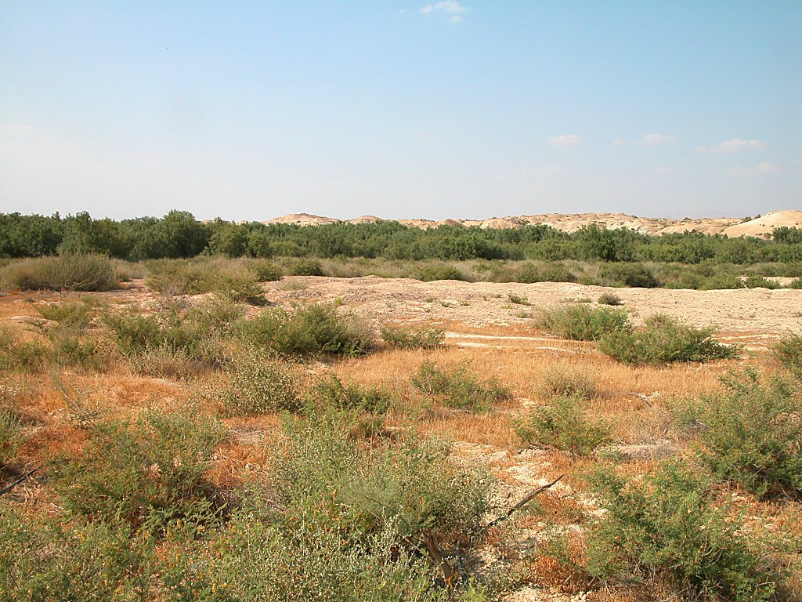
For the pride of the Jordan is destroyed
Pride of the Jordan, thickets near the river
11:3
Notes:
The Jordan Rift consists of three plateaus descending from the surrounding mountains to the Jordan River. The upper terrace is known as the Ghor, and the roads, both ancient and modern, were on this level. The middle terrace is known as the Qattara and consists of a rugged marl terrain. The lowest level is the Zor, also known as the pride of the Jordan, and is the floodplain of the river. Ranging from 200 yards (183 m) to 1 mile (1.6 km) in width, the Zor has thickly overgrown since antiquity. Especially prevalent in this growth are tamarisk, willow, and Euphrates poplar. Consequently, wild animals have found refuge in this area. Nineteenth-century explorers reported seeing lions, tigers, bears, hyenas, jackals, and otters.
tb060303276

Slide 36
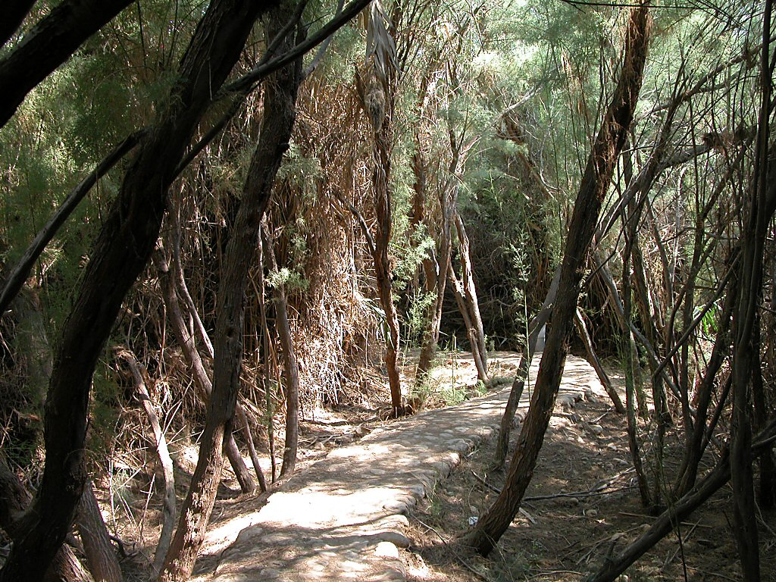
For the pride of the Jordan is destroyed
Pride of the Jordan, thickets near the river
11:3
Notes:
There are a number of references in the Hebrew Bible to the thickets of the Jordan, and several mentions feature lions.
Jeremiah 12:5 (ESV): “If you have raced with men on foot, and they have wearied you, how will you compete with horses? And if in a safe land you are so trusting, what will you do in the thicket of the Jordan?”
Jeremiah 49:19 (ESV): “Behold, like a lion coming up from the jungle of the Jordan against a perennial pasture, I will suddenly make him run away from her. And I will appoint over her whomever I choose. For who is like me? Who will summon me? What shepherd can stand before me?” (cf. Jer 50:44)
tb060303246

Slide 37
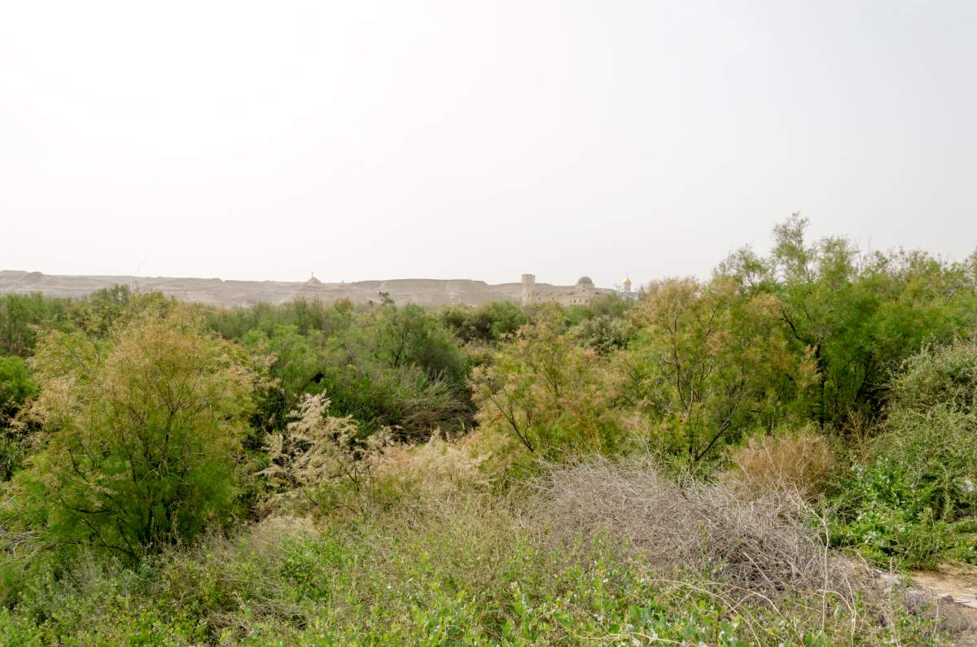
For the pride of the Jordan is destroyed
Pride of the Jordan near Jericho
11:3
Notes:
tb031814934

Slide 38
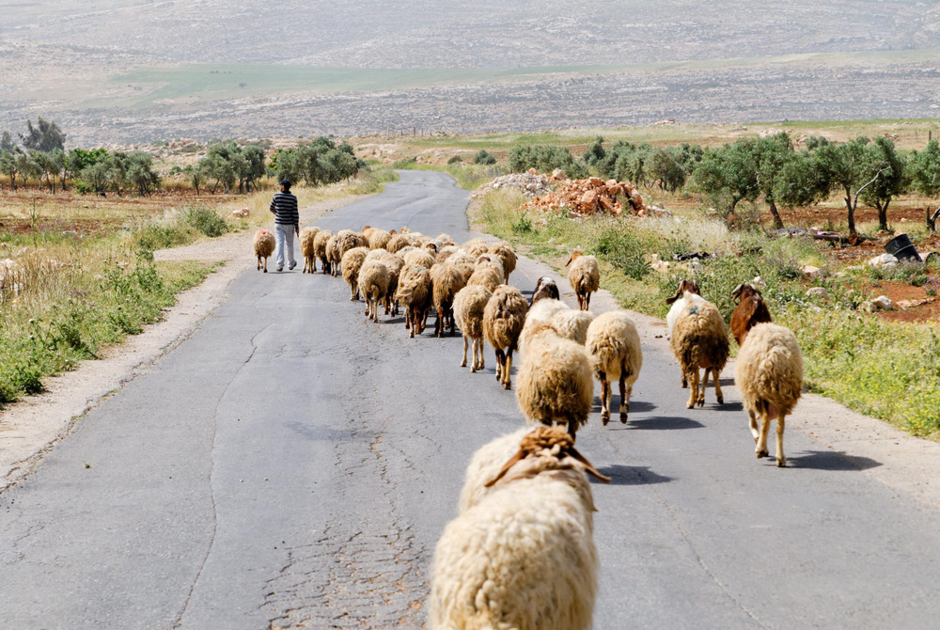
Thus says Yahweh my God, “Pasture the flock that is doomed for slaughter”
Shepherd and sheep near Taiyibeh
11:4
Notes:
cd080416111

Slide 39
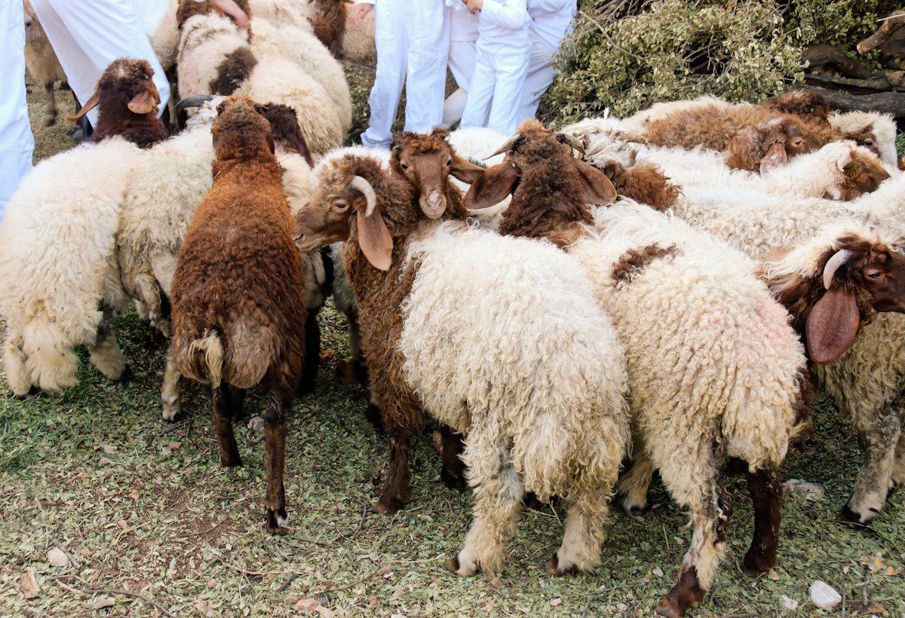
Thus says Yahweh my God, “Pasture the flock that is doomed for slaughter”
Sheep designated for slaughter at the Samaritan Passover on Mount Gerizim
11:4
Notes:
tb043007058

Slide 40
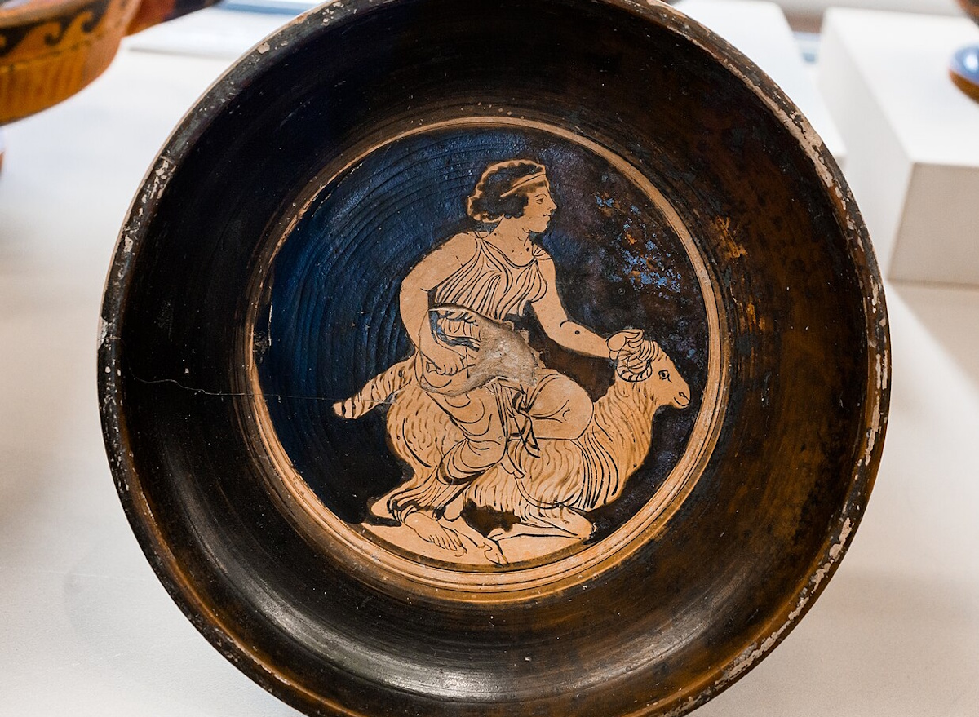
Those who buy them slaughter them but go unpunished
Cup with a woman sacrificing a ram or sheep, from Lucania, circa 400 BC
11:5
Notes:
This cup was discovered at Lucania, Italy, and was photographed at the Museum of the University of Tübingen. This image comes from ArchaiOptix and is licensed under CC BY-SA 4.0, via Wikimedia Commons: https://commons.wikimedia.org/wiki/File:Schwerin_Group_-_LCS_I_351b_-_woman_sacrificing_ram_-_T%C3%BCbingen_MUT_67-6203.jpg.
wiki06132041653450931

Slide 41
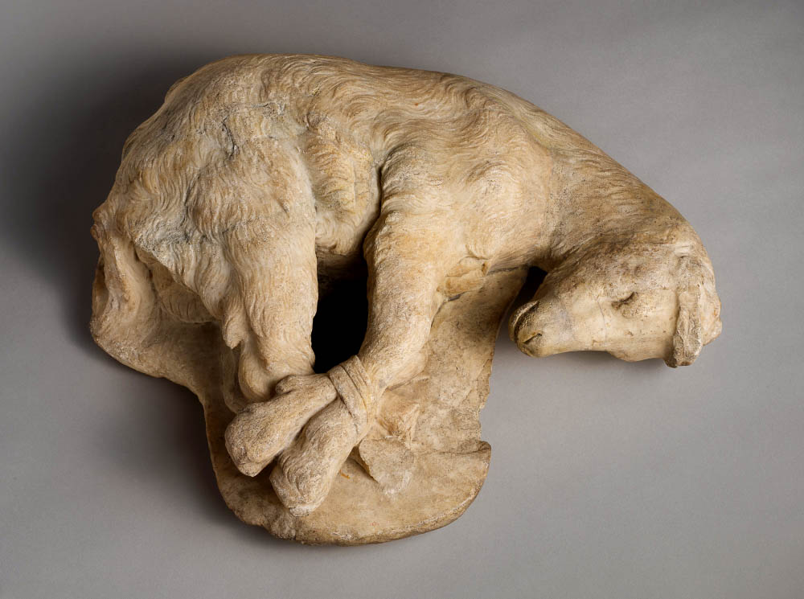
Those who buy them slaughter them but go unpunished
Roman statue of a bound goat, Pentelic marble, circa AD 100
11:5
Notes:
It was common for animals to be bound before they were sacrificed, as is the case with the goat depicted in this photo. This image comes from the Metropolitan Museum of Art, public domain, Rogers Fund, 1910, accession number 10.151, https://www.metmuseum.org/art/collection/search/248270.
met248270

Slide 42
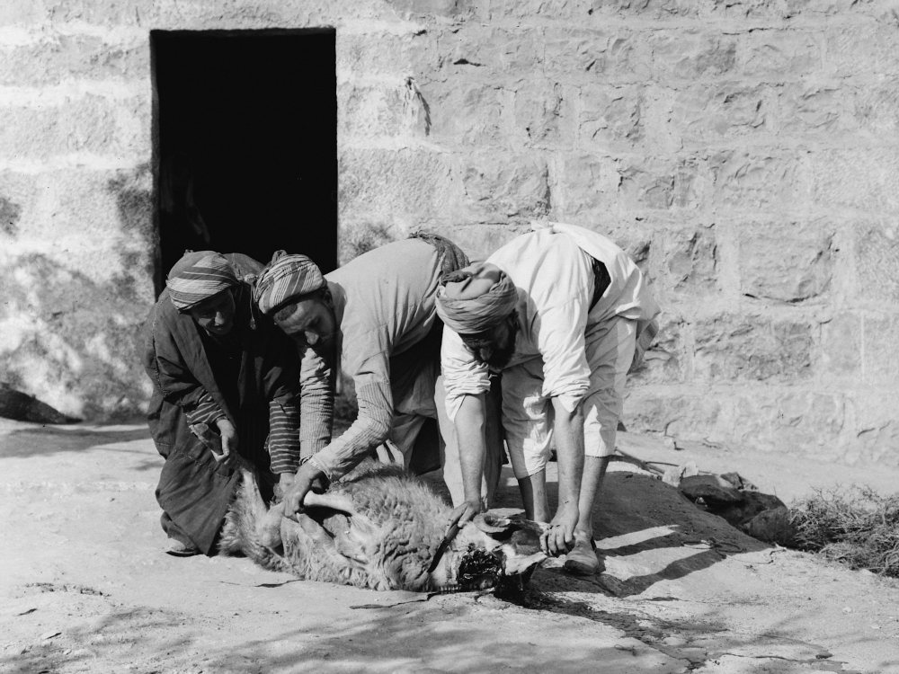
Those who buy them slaughter them but go unpunished
Weli of Budrieh with a sacrificed sheep, circa 1914
11:5
Notes:
These men have just slit the throat of a sheep in preparation for its sacrifice. This photo was taken at Sharafat, an Arab neighborhood in east Jerusalem. Sharafat was home to the Budrieh (Badriyya), a renowned family of weli (awliya, Muslim saints) to whom the village was dedicated as a waqf (Islamic trust) by the viceroy of Damascus in the 14th century. This American Colony photograph was taken between 1900 and 1926. The next slide includes a colorized version of this photo.
mat01416

Slide 43
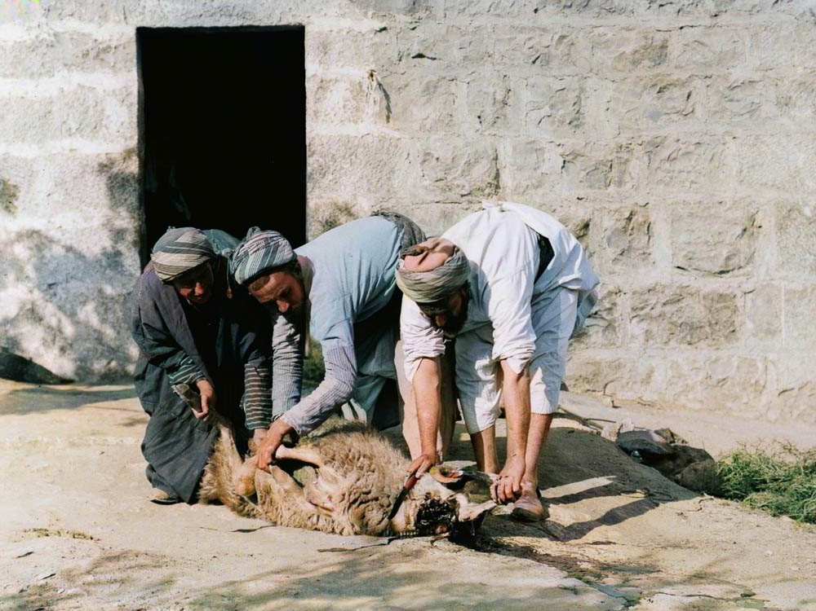
Those who buy them slaughter them but go unpunished
Weli of Budrieh with a sacrificed sheep, circa 1914
11:5
Notes:
These men have just slit the throat of a sheep in preparation for its sacrifice. This photo was taken at Sharafat, an Arab neighborhood in east Jerusalem. Sharafat was home to the Budrieh (Badriyya), a renowned family of weli (awliya, Muslim saints) to whom the village was dedicated as a waqf (Islamic trust) by the viceroy of Damascus in the 14th century. This American Colony photograph was taken between 1900 and 1926. Generative AI was used to colorize this photo.
mat01416col

Slide 44
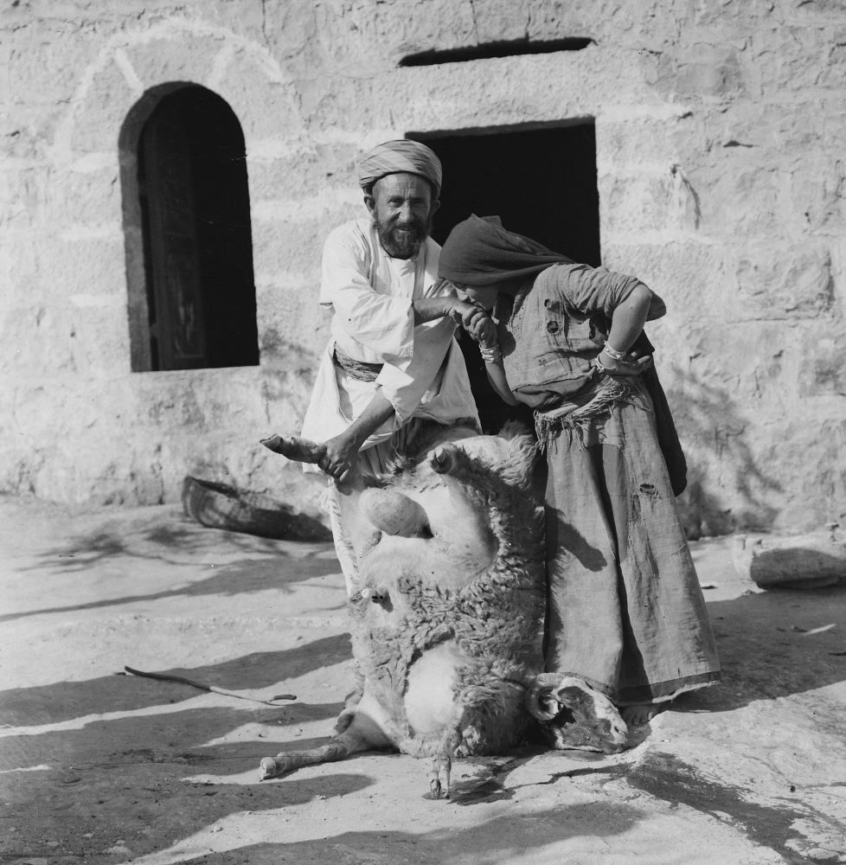
Those who buy them slaughter them but go unpunished
Weli of Budrieh with a sacrificed sheep, circa 1914
11:5
Notes:
This American Colony photo was taken between 1900 and 1926.
mat01421

Slide 45

Those who buy them slaughter them but go unpunished
Samaritan priest with slaughtering knife on Mount Gerizim
11:5
Notes:
cd090408052

Slide 46
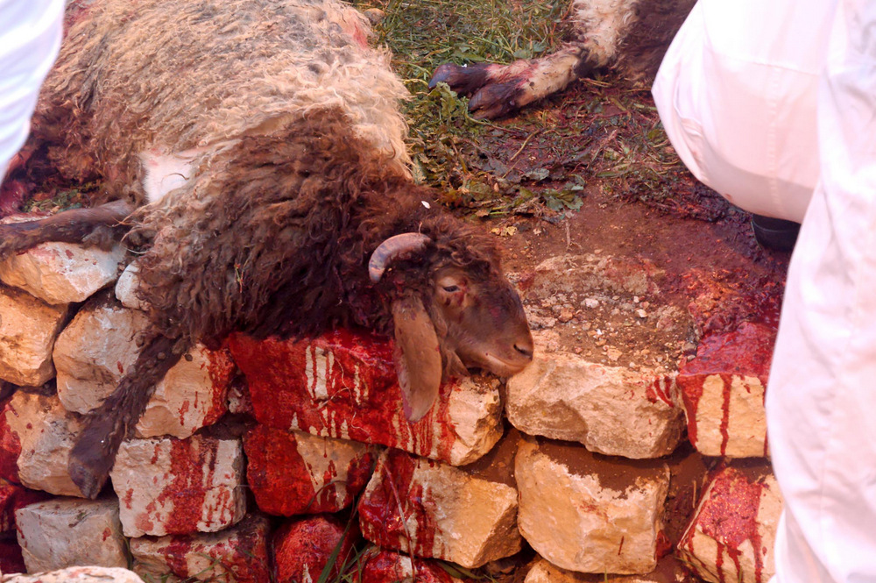
Those who buy them slaughter them but go unpunished
Slain lamb at the Samaritan Passover on Mount Gerizim
11:5
Notes:
tb041106749

Slide 47
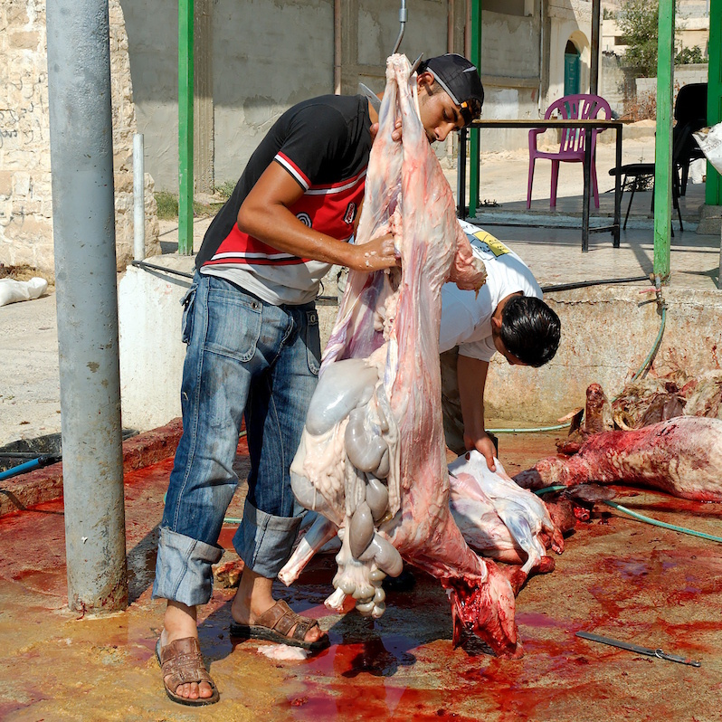
Those who buy them slaughter them but go unpunished
Skinning and gutting sheep in Jericho
11:5
Notes:
tb051106809

Slide 48
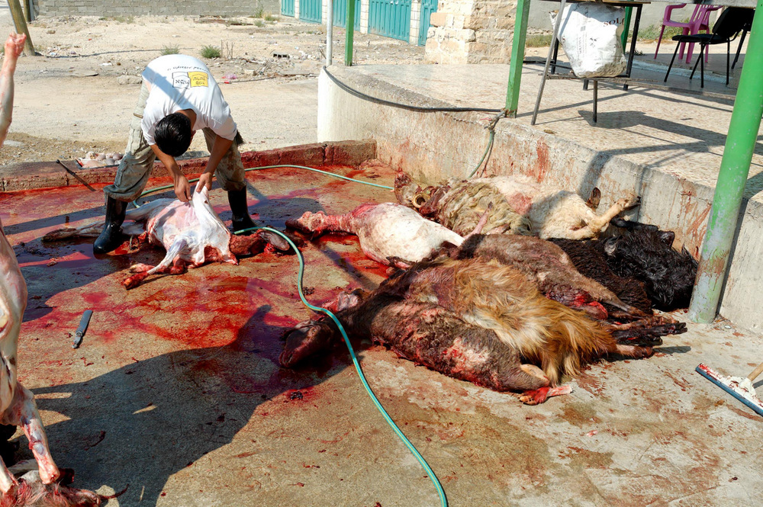
Those who buy them slaughter them but go unpunished
Skinning and gutting sheep in Jericho
11:5
Notes:
tb051106810

Slide 49
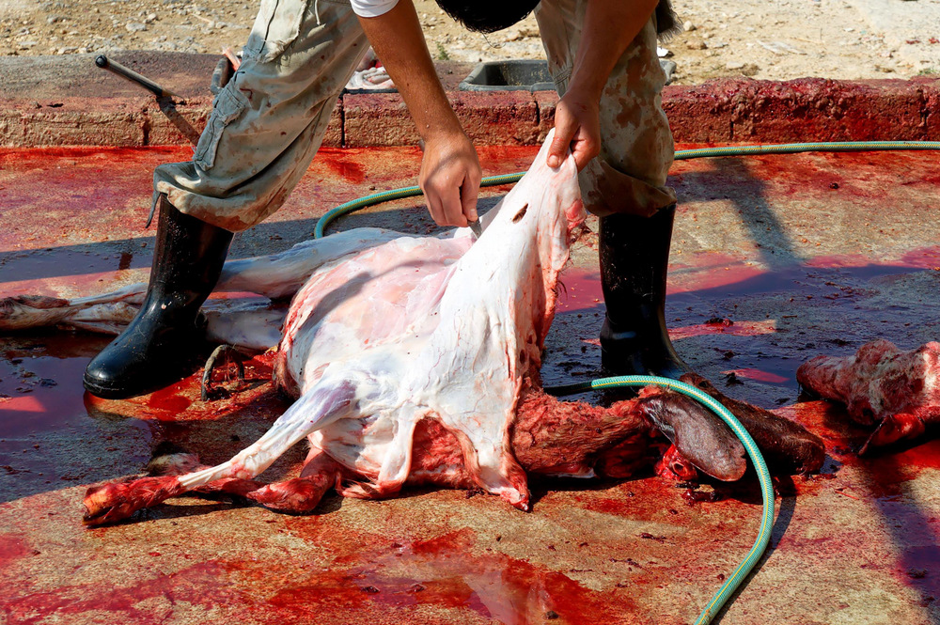
Those who buy them slaughter them but go unpunished
Skinning sheep in Jericho
11:5
Notes:
tb051106812

Slide 50
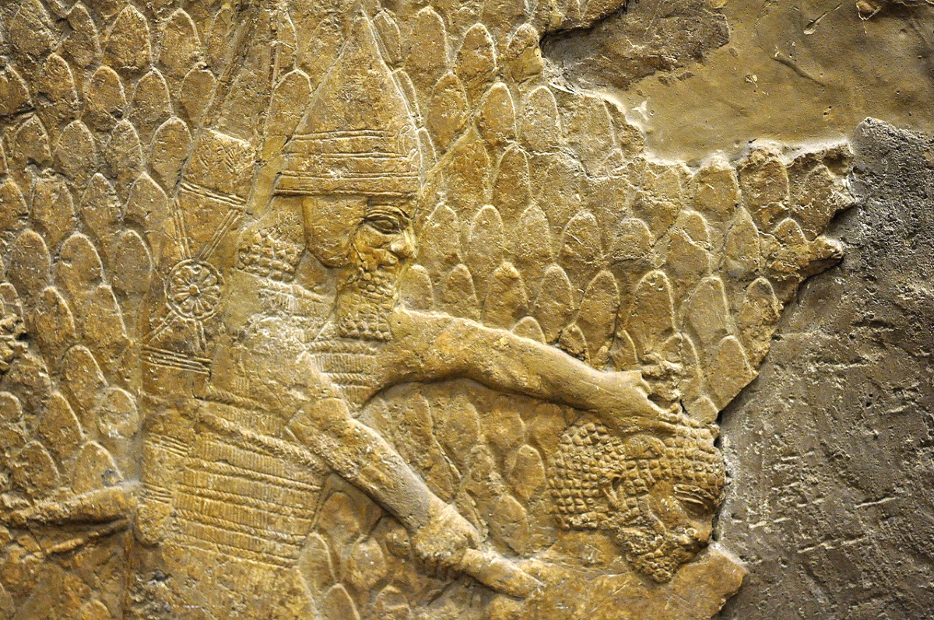
Those who buy them slaughter them but go unpunished
Assyrian soldier dispatching an enemy, from Sennacherib’s palace at Nineveh, circa 700 BC
11:5
Notes:
Most commentators take Zechariah 11:4-17 as an extended metaphor or even an allegory, where the flock is the people of Israel and the evil shepherds are rulers. If this is accepted, the slaughter of the sheep represents the killing of ordinary Israelites. This relief depicts an Assyrian soldier killing an enemy with a short sword or dagger. Note the bow and quiver that are slung on the back of this Assyrian soldier, and the scabbard for his long sword that protrudes behind him.
This relief was photographed at the British Museum. This image comes from Osama Shukir Muhammed Amin and is licensed under CC BY-SA 4.0, via Wikimedia Commons: https://commons.wikimedia.org/wiki/File:Assyrian_soldier,_using_a_dagger,_about_to_behead_a_prisoner_from_the_city_of_Lachish._Detail_of_a_wall_relief_dating_back_to_the_reign_of_Sennacherib,_700-692_BCE._From_Nineveh,_Iraq,_currently_housed_in_the_British_Museum.jpg.
wiki013020141422142848868

Slide 51
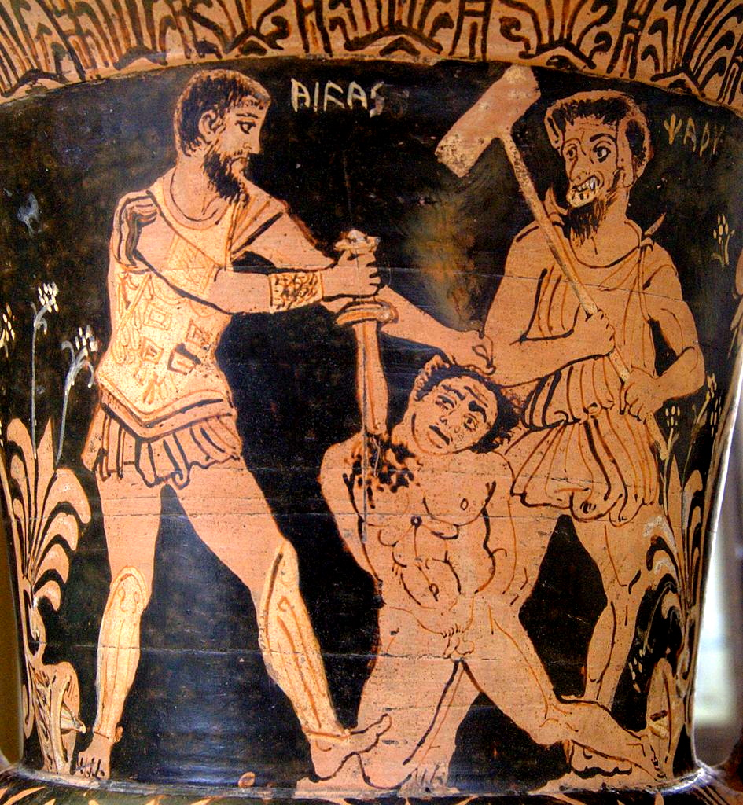

Those who buy them slaughter them but go unpunished
Etruscan krater depicting Ajax murdering a Trojan prisoner in front of Charon, circa 300 BC
11:5
Notes:
This red-figure calyx-krater depicts Ajax (Etruscan Aivas) killing a Trojan prisoner in front of Charon, the Etruscan demon of death. This wine jug was photographed at the Cabinet des médailles, Paris. This image comes from Bibi Saint-Pol and is in the public domain, via Wikimedia Commons: https://commons.wikimedia.org/wiki/File:Akhilleus_Charun_Cdm_Paris_2783.jpg. A removable graphic has been added to avoid causing surprise or offense.
wiki2783053120074316231758147

Slide 52
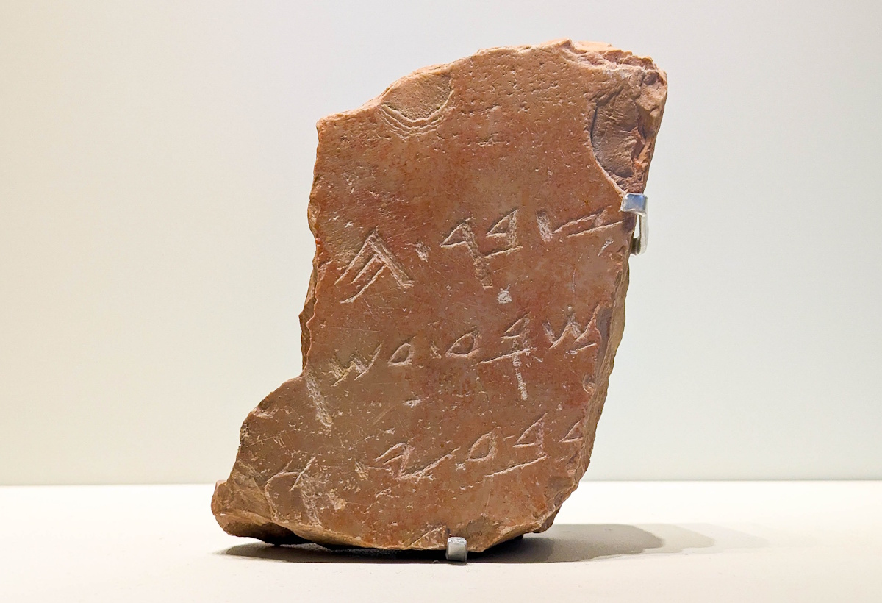
Those who sell them say, “Blessed be Yahweh, for I am rich”
Hebrew inscription praising a wealthy king, from Jerusalem, circa 700 BC
11:5
Notes:
This inscription is very fragmentary, and suggested readings are contested. It is considered to be a rare royal inscription from Jerusalem, and dates to about the reign of Hezekiah. Ahituv suggests the following reading:
“. . . ] the accumulation (heap) of the [ . . .
. . . ] on the seventeenth [year . . .
in the] fourth (month) and [ . . .” (Ahituv 2008: 26).
This is suggestive of the accumulation of wealth in one form or another. This inscription was photographed at the Israel Museum.
Reference:
Ahituv, Shmuel.
2008 Echoes from the Past: Hebrew and Cognate Inscriptions from the Biblical Period. Jerusalem: Carta.
ku0607231020231c

Slide 53

Those who sell them say, “Blessed be Yahweh, for I am rich”
General Horemheb awarded gold collars for military victories, from Saqqara, circa 1330 BC
11:5
Notes:
This relief depicts a general of the Egyptian king Tutankhamun, decorated with heavy gold collars. On the left, he looks up to the king on his throne (not shown), and on the right, he faces the other direction and leans condescendingly toward a man of lower rank.
This relief comes from the tomb of Horemheb at Saqqara. This relief was photographed at the National Museum of Antiquities (Rijksmuseum van Oudheden) in Leiden. This image comes from Sailko and is licensed under CC BY 3.0, via Wikimedia Commons: https://commons.wikimedia.org/wiki/File:Xviii_dinastia,_rilievi_parietali_dalla_tomba_di_horemheb,_da_sakkara,_1335-1320_ac_ca._04.jpg.
wiki0316171453343384752c

Slide 54

Those who sell them say, “Blessed be Yahweh, for I am rich”
Hoard of silver staters, possibly from Syracuse, early 3rd century BC
11:5
Notes:
The earliest coinage in the ancient Near East began to be circulated about the time of Zechariah’s ministry. This photo shows coins minted a couple of centuries later. These silver coins portray pegasi (winged horses). This cache was photographed at the Naples Archaeological Museum.
tb0515170950c

Slide 55

And their own shepherds do not pity them
Shepherd with flock of sheep in eastern Samaria
11:5
Notes:
tb031405447

Slide 56

And their own shepherds do not pity them
A sheep-herder and his flock near Baghdad
11:5
Notes:
This image comes from 1st Lt. Becky Bort and is in the public domain, via Wikimedia Commons: https://commons.wikimedia.org/wiki/File:Election_Day_Security_DVIDS259377.jpg.
wiki03071056163744582c

Slide 57

“I will no longer have pity on the inhabitants of the land,” declares Yahweh
Marble bust of a scowling Demosthenes, circa AD 150
11:6
Notes:
This bust of Demosthenes portrays him with a scowling face, an expression that fits the lack of pity expressed here. This bust is considered to be a Roman copy of a Greek original from about 280 BC. It was photographed at the Altes Museum, Berlin, Germany. This image comes from Osama Shukir Muhammed Amin and is licensed under CC BY-SA 4.0, via Wikimedia Commons: https://commons.wikimedia.org/wiki/File:Marble_bust_of_Demosthenes._Roman_copy_(1st_century_CE)_of_an_original_(c._280_BCE)._Altes_Museum,_Berlin,_Germany.jpg.
wiki07232019165319434280c

Slide 58

“I will no longer have pity on the inhabitants of the land,” declares Yahweh
Jewish men praying at the Western Wall in Jerusalem
11:6
Notes:
tb042605518

Slide 59

“I will no longer have pity on the inhabitants of the land,” declares Yahweh
Jewish people gathered at the Western Wall in Jerusalem for the priestly blessing
11:6
Notes:
tb101303195

Slide 60


I will deliver each man into the hand of his neighbor
Vase with wrestlers, from Arezzo, circa 530 BC
11:6
Notes:
This vase was photographed at the Archaeological Museum of Arezzo, Italy. This image comes from ArchaiOptix and is licensed under CC BY-SA 4.0, via Wikimedia Commons: https://commons.wikimedia.org/wiki/File:Painter_of_the_Arezzo_Wrestlers_-_wrestlers_and_animals_-_Arezzo_MASGCM_-_01.jpg. A removable graphic has been added to avoid causing surprise or offense.
wiki09081643693258893c

Slide 61

I will deliver each man into the hand of his neighbor
Assyrian officer killing a fallen enemy, from the palace of Ashurbanipal at Nineveh, 648–631 BC
11:6
Notes:
This relief depicts an Assyrian officer killing a fallen enemy. This relief was photographed at the Vatican Museums.
tb0512176440

Slide 62

And into the hand of his king
Sennacherib on his throne, receiving Judean prisoners, from Nineveh, 7th century BC
11:6
Notes:
The point of verses 5-6 is that the Lord will deliver the nation of Israel over to the oppressors in judgment, as a result of the failure of the nation’s bad shepherds. Sennacherib was a famous enemy of the Israelite people. This relief was photographed at the British Museum.
tb112004325

Slide 63


And into the hand of his king
Stele of Esarhaddon with enemies held by hooks, from Zincirli, 671 BC
11:6
Notes:
This stele of the Assyrian king Esarhaddon depicts two defeated kings who have rings or hooks in their noses or lips. The kneeling figure is likely the Egyptian crown prince Ushankhuru, or perhaps Pharaoh Taharqa. The standing figure is a Syrian city-state governor, perhaps Baal I of Tyre, or Abdi-Milkutti, the king of Sidon.
This stele was photographed at the Pergamon Museum in Berlin. This image comes from Yair Haklai and is licensed under CC BY-SA 4.0, via Wikimedia Commons: https://commons.wikimedia.org/wiki/File:Victory_Stele_of_Esarhaddon_over_Taharqa-671_BC-_Pergamon_Museum.jpg.
wiki07271914033023108c

Slide 64

They will strike the land, and I will not deliver them from their hand
Trampled enemies on the arm panel of a chair arm of Thutmose IV, circa 1400 BC
11:6
Notes:
This wooden relief depicts a human-headed lion (symbolizing the king of Egypt) trampling on his enemies. This image comes from the Metropolitan Museum of Art, public domain, Theodore M. Davis Collection, Bequest of Theodore M. Davis, 1915, accession number 30.8.45a–c, https://www.metmuseum.org/art/collection/search/544826.
met544826

Slide 65

They will strike the land, and I will not deliver them from their hand
Relief of Assyrian soldiers torturing captured enemies, from Nineveh, circa 650 BC
11:6
Notes:
This relief shows captured Elamite warriors undergoing various kinds of torture, including flaying and tongue extraction. This is reminiscent of the fate of Zedekiah, Judah’s last king, whose sons were slaughtered as he watched, and right before his eyes were gouged out (2 Kgs 25:7).
This relief was photographed at the British Museum. This image comes from Carole Raddato and is licensed under CC BY-SA 2.0, via Wikimedia Commons: https://commons.wikimedia.org/wiki/File:Exhibition_I_am_Ashurbanipal_king_of_the_world,_king_of_Assyria,_British_Museum_(44156996760).jpg.
wiki44156996760

Slide 66

They will strike the land, and I will not deliver them from their hand
Relief depicting the destruction of the city of Hamanu in Elam by Ashurbanipal, 645–640 BC
11:6
Notes:
God gave over the very city of Jerusalem to the Babylonians, who destroyed both the city and the temple (2 Kgs 25:9-10). The Assyrian soldiers depicted in this relief are dismantling the defenses of a city after its conquest. Some use pickaxes and others use pry bars as they toss stones and timbers to the ground.
This relief was photographed at the British Museum. This image comes from Carole Raddato and is licensed under CC BY-SA 2.0, via Wikimedia Commons: https://commons.wikimedia.org/wiki/File:Relief_depicting_the_destruction_of_Hamanu_of_Elam_by_Ashurbanipal,_645-640_BC,_North_Palace,_Nineveh,_Exhibition-_I_am_Ashurbanipal_king_of_the_world,_king_of_Assyria,_British_Museum.jpg.
wiki1118201814302547703

Slide 67

So I pastured the flock that was doomed for slaughter, the afflicted of the flock
Fragment of a sarcophagus with pastoral scene, late 3rd or early 4th centuries AD
11:7
Notes:
In this sign act, Zechariah represents Yahweh. This sarcophagus fragment was photographed at the Vatican Museums.
tb0512175877

Slide 68

So I pastured the flock that was doomed for slaughter, the afflicted of the flock
Shepherd with his flock, at Kibbutz Givat Haim, 1939
11:7
Notes:
This photo was taken May 30, 1939. Kibbutz Givat Haim is located on the northern Sharon Plain; it was founded in 1932. This image comes from Zoltan Kluger and is in the public domain, via Wikimedia Commons: https://commons.wikimedia.org/wiki/File:SHEPHERD_OF_KIBBUTZ_GIVAT_HAIM_WITH_HIS_FLOCK._%D7%A8%D7%95%D7%A2%D7%94_%D7%A6%D7%90%D7%9F_%D7%9E%D7%A7%D7%99%D7%91%D7%95%D7%A5_%D7%92%D7%91%D7%A2%D7%AA_%D7%97%D7%99%D7%99%D7%9D_%D7%91%D7%A2%D7%9E%D7%A7_%D7%97%D7%A4%D7%A8.D393-116.jpg.
wiki0530193942692178c

Slide 69

So I pastured the flock that was doomed for slaughter, the afflicted of the flock
Sheep market outside Herod’s Gate, Jerusalem, circa 1925
11:7
Notes:
The LXX, followed by the NRSV, divides the Hebrew words differently and removes the vowels, producing “for the (sheep) merchants” (Gk. εἰς τὴν Χαναανῖτιν). This reading is accepted by Finley (1982), but Klein argues that neither the internal nor external evidence supports such a reading (2007: 327). This American Colony photograph was taken between 1898 and 1946. The next slide includes a colorized version of this photo.
References:
Finley, Thomas J.
1982 The Sheep Merchants of Zechariah 11. Grace Theological Journal 3: 51–65.
Klein, George L.
2007 Zechariah. New American Commentary. Nashville: Broadman and Holman.
mat06866

Slide 70

So I pastured the flock that was doomed for slaughter, the afflicted of the flock
Sheep market outside Herod’s Gate, Jerusalem, circa 1925
11:7
Notes:
The LXX, followed by the NRSV, divides the Hebrew words differently and removes the vowels, producing “for the (sheep) merchants” (Gk. εἰς τὴν Χαναανῖτιν). This reading is accepted by Finley (1982), but Klein argues that neither the internal nor external evidence supports such a reading (2007: 327). This American Colony photograph was taken between 1898 and 1946. Generative AI was used to colorize this photo.
References:
Finley, Thomas J.
1982 The Sheep Merchants of Zechariah 11. Grace Theological Journal 3: 51–65.
Klein, George L.
2007 Zechariah. New American Commentary. Nashville: Broadman and Holman.
mat06866col2

Slide 71

Then I took for myself two staffs; the one I called Favor and the other I called Union
Wood staffs and walking sticks, from Egypt
11:7
Notes:
This display was photographed at the Egyptian Museum in Cairo.
adr1603194663e

Slide 72

Then I took for myself two staffs; the one I called Favor and the other I called Union
Statue of the Egyptian governor Mitry, with a wooden staff, from Saqqara, circa 2300 BC
11:7
Notes:
This image of an Egyptian official comes from the Metropolitan Museum of Art, public domain, Rogers Fund, 1926, accession number 26.2.4, https://www.metmuseum.org/art/collection/search/543872.
met543872

Slide 73


Then I took for myself two staffs; the one I called Favor and the other I called Union
Guardian figures in the form of a king, from Lisht, Dynasty 12, circa 1919–1885 BC
11:7
Notes:
The use of staffs as weapons in ancient times made them a symbol of power. These two statuettes were found together as guardians of a shrine. The one on the left wears the red crown of Lower Egypt; the one on the right wears the white crown of Upper Egypt. They both portray the reigning king, probably Amenemhat II or Senusret II.
The image on the left comes from The Metropolitan Museum of Art, public domain, Rogers Fund and Edward S. Harkness Gift, 1914, accession number 14.3.17, http://metmuseum.org/art/collection/search/543864. The figure on the right was photographed in the Egyptian Museum in Cairo.
Left: met543864
Right: adr1603111742c

Slide 74

Then I took for myself two staffs; the one I called Favor and the other I called Union
Skyphos with a youth and a man in conversation, circa 450 BC
11:7
Notes:
This image comes from the Metropolitan Museum of Art, public domain, Purchase by subscription, 1896, accession number 96.18.73, https://www.metmuseum.org/art/collection/search/246588. A removable graphic has been added to avoid causing surprise or offense.
met246588b

Slide 75

Then I took for myself two staffs; the one I called Favor and the other I called Union
Grave stele of bearded man on chair holding staff, from Piraeus, circa 400 BC
11:7
Notes:
This marble grave stele depicts a man holding a staff. It is from Piraeus and dates to circa 400 BC, roughly a century after Zechariah. This photograph was taken at the National Archaeological Museum in Athens.
tb011117663

Slide 76

So I pastured the flock
Shepherd and sheep at Nazareth Village
11:7
Notes:
This photograph was taken at Nazareth Village, a tourist attraction that recreates life as it was in the time of Jesus through its historic artifacts, modern reconstructions, and lively reenactments.
fj0906120089

Slide 77

So I pastured the flock
Shepherd with sheep
11:7
Notes:
cd090325041

Slide 78

Then I destroyed the three shepherds in one month, for my soul was annoyed with them
Rameses II grasping captives by their hair, 13th century BC
11:8
Notes:
This carved and painted relief shows Rameses II grasping his enemies by their hair, prepared to strike them down with the battle axe held in his other hand. Their hands are upraised in supplication, heads turned away in fear. This relief was photographed at the Egyptian Museum in Cairo.
adr1603194932

Slide 79

Then I destroyed the three shepherds in one month, for my soul was annoyed with them
Assyrian soldier killing enemy prisoners, from the central palace at Nimrud, 730–727 BC
11:8
Notes:
The idea of men striking the land is illustrated here by a relief of a man who is dispatching his enemies. This relief was photographed at the Getty Villa in southern California while on loan from the British Museum.
tb100919408

Slide 80

Then I destroyed the three shepherds in one month, for my soul was annoyed with them
Shepherds at night with Bethlehem in the distance, circa 1927
11:8
Notes:
This American Colony photograph was taken between 1920 and 1933. The next slide includes a colorized version of this photo.
mat02990

Slide 81

Then I destroyed the three shepherds in one month, for my soul was annoyed with them
Shepherds at night with Bethlehem in the distance, circa 1927
11:8
Notes:
This American Colony photograph was taken between 1920 and 1933. Generative AI was used to colorize this photo.
mat02990col

Slide 82

Then I destroyed the three shepherds in one month, for my soul was annoyed with them
Shepherd and sheep, circa 1920
11:8
Notes:
This image comes from American Colony (Jerusalem), Assortment of Photographs of Palestine and Jerusalem, 1900–1939. Public Domain, from the New York Public Library, https://digitalcollections.nypl.org/items/510d47d9-77de-a3d9-e040-e00a18064a99. The next slide includes a colorized version of this photo.
nypl112608

Slide 83

Then I destroyed the three shepherds in one month, for my soul was annoyed with them
Shepherd and sheep, circa 1920
11:8
Notes:
This image comes from American Colony (Jerusalem), Assortment of Photographs of Palestine and Jerusalem, 1900–1939. Public Domain, from the New York Public Library, https://digitalcollections.nypl.org/items/510d47d9-77de-a3d9-e040-e00a18064a99. Generative AI was used to colorize this photo.
nypl112608col

Slide 84

I became impatient with them, and they despised me
Sheep and shepherd in eastern Samaria
11:8
Notes:
There is some ambiguity about who the pronouns refer to here. Some English versions take “them” with whom Zechariah becomes impatient to be the three shepherds (so NASB, ESV, NET, NRSV), while others take it to refer to the flock itself, presumably in the aftermath of the death of the three shepherds (so NIV, NLT). Some English versions leave the statement ambiguous (so CSB, RSV). The Hebrew text is cryptic, and connecting words (“because, for, when”) that would indicate the shepherds are the referent must be supplied.
tb031405252

Slide 85

I became impatient with them, and they despised me
Sheep running from their shepherd, on Mount Ida, Greece
11:8
Notes:
bf041404001c

Slide 86

I became impatient with them, and they despised me
Two women quarreling in a wheat field, from Luxor, 7th century BC
11:8
Notes:
This relief depicts two women quarreling, each pulling the other’s hair. This relief comes from the Tomb of Mentuemhet at Luxor. It was photographed at the Oriental Institute Museum at the University of Chicago. This image comes from Daderot and is in the public domain, via Wikimedia Commons: https://commons.wikimedia.org/wiki/File:Two_girls_quarreling_in_a_wheat_field,_Luxor,_Tomb_of_Mentuemhet,_Late_Period,_Dynasty_26,_c._664_BC,_limestone,_pigment_-_Oriental_Institute_Museum,_University_of_Chicago_-_DSC07880.JPG.
wiki082214162243

Slide 87


I became impatient with them, and they despised me
Kylix depicting a man and woman fighting, from Athens, circa 480 BC
11:8
Notes:
The tondo on this kylix depicts a young man and young woman fighting. He holds her by the hair while threatening to strike her with a sandal held in his other hand.
This kylix was photographed at the Archaeological Museum of Milan in Italy. This image comes from ArchaiOptix and is licensed under CC BY-SA 4.0, via Wikimedia Commons: https://commons.wikimedia.org/wiki/File:Foundry_Painter_ARV_403_33ter_youth_attacking_woman_with_sandal.jpg. A removable graphic has been added to avoid causing surprise or offense.
wiki0818201515592240333098037

Slide 88

Then I said, “I will no longer pasture you”
Shepherd with no sheep, in Moab, circa 1925
11:9
Notes:
This American Colony photo was taken between 1898 and 1946.
mat06359c

Slide 89

Then I said, “I will no longer pasture you”
Bedouin shepherdess spinning wool, 1932
11:9
Notes:
This American Colony photo was taken in August of 1932. The next slide includes a colorized version of this photo.
mat04214c

Slide 90

Then I said, “I will no longer pasture you”
Bedouin shepherdess spinning wool, 1932
11:9
Notes:
This American Colony photo was taken in August of 1932. Generative AI was used to colorize this photo.
mat04214ccol

Slide 91

That which is dying, let it die
Relief of a dying lion, bleeding from the mouth, from Nineveh, circa 645 BC
11:9
Notes:
This relief comes from the north palace of the Assyrian king Ashurbanipal at Nineveh. It was photographed at the British Museum.
tb1001199577

Slide 92

That which is dying, let it die
A man caring for a sick camel, circa 1910
11:9
Notes:
This American Colony photograph was taken between 1900 and 1920.
mat02108

Slide 93

That which is to be destroyed, let it be destroyed
Men cleaning sheep at the Samaritan Passover on Mount Gerizim
11:9
Notes:
mjb1904186899

Slide 94

That which is to be destroyed, let it be destroyed
Carcass of a sheep, Namibia
11:9
Notes:
This image comes from Olga Ernst and is licensed under CC BY-SA 4.0, via Wikimedia Commons: https://commons.wikimedia.org/wiki/File:Flies_settle_on_a_sheep_carrion.jpg.
wiki04211714983119539c

Slide 95

Let those who are left eat each other’s flesh
Relief of a lion attacking a bull, on a staircase at Persepolis, circa 500 BC
11:9
Notes:
This relief was photographed on the western staircase of the palace of Darius at Persepolis.
tb0506181279

Slide 96

Let those who are left eat each other’s flesh
Rocky Mountain bighorn rams butting heads, Logan Pass, Glacier National Park, Montana
11:9
Notes:
This image comes from Ken Lund and is licensed under CC BY-SA 2.0, via Wikimedia Commons: https://commons.wikimedia.org/wiki/File:Rocky_Mountain_Bighorn_Rams_Butting_Heads,_Logan_Pass,_Glacier_National_Park,_Montana_(51296812460).jpg.
wiki07062128032102723c

Slide 97

Then I took my staff Favor and cut it in pieces
Wood and animal skin staff, from Egypt, late 18th dynasty, circa 14th century BC
11:10
Notes:
The staff called “Favor” or “Pleasantness” may represent peaceful relations between Israel and the nations. With the breaking of this staff, the shepherd removes His protection of Israel from the nations. This ancient staff was photographed at the Brooklyn Museum.
adr1606021005

Slide 98

Then I took my staff Favor and cut it in pieces
Two men in conversation at an altar, late 5th century BC
11:10
Notes:
This image comes from the Metropolitan Museum of Art, public domain, Gift of Mrs. Matthew C. Brush, 1957, accession number 57.43, https://www.metmuseum.org/art/collection/search/254967.
met254967a

Slide 99

To break my covenant that I had made with all the peoples
Model of the ark of the covenant, with the atonement cover and contents
11:10
Notes:
This photo illustrates the concept of “covenant,” although this verse does not refer to the Mosaic covenant. According to Finley, “The ‘covenant with all the peoples’ may be taken as the restraint imposed by God which prevents the nations from attacking and overrunning Israel” (Finley 1982: 64). This model was photographed at the model of the tabernacle in the Timna Valley in southern Israel.
Reference:
Finley, Thomas J.
1982 The Sheep Merchants of Zechariah 11. Grace Theological Journal 3: 51–65.
tb052523989

Slide 100

So it was broken that day
Broken tablet with a treaty between Arpad and Ashur-nirari V, from Nineveh, circa 750 BC
11:11
Notes:
This broken treaty tablet was photographed at the British Museum.
tb112004768

Slide 101

Then the poor of the flock who were watching me knew it was the word of Yahweh
Sheep at Maresha
11:11
Notes:
mjb1903062341

Slide 102

Then the poor of the flock who were watching me knew it was the word of Yahweh
Sheep near a Roman road west of Assos
11:11
Notes:
tb010517815

Slide 103

Then the poor of the flock who were watching me knew it was the word of Yahweh
Sheep near Nahal Nafha
11:11
Notes:
tb042207778

Slide 104

Then the poor of the flock who were watching me knew it was the word of Yahweh
Sheep market at the Damascus Gate in Jerusalem, circa 1945
11:11
Notes:
As in verse 7, the LXX has “the (sheep) merchants” (Gk. οἱ Χαναναῖοι) rather than “the poor/afflicted” (Heb. ‘ani, עָנִי). This reading is adopted by a few English versions (ESV, RSV). This American Colony photograph was taken between 1940 and 1946. The next slide includes a colorized version of this photo.
mat21594

Slide 105

Then the poor of the flock who were watching me knew it was the word of Yahweh
Sheep market at the Damascus Gate in Jerusalem, circa 1945
11:11
Notes:
As in verse 7, the LXX has “the (sheep) merchants” (Gk. οἱ Χαναναῖοι) rather than “the poor/afflicted” (Heb. ‘ani, עָנִי). This reading is adopted by a few English versions (ESV, RSV). This American Colony photograph was taken between 1940 and 1946. Generative AI was used to colorize this photo.
mat21594col

Slide 106

I said to them, “If you think it is good, give me my wages; and if not, then don’t”
Tomb relief of farmers paying for land leases, from Germania, 2nd–3rd centuries AD
11:12
Notes:
As the shepherd quits his job, he requests his pay. This Roman tomb relief comes from Germania. This copy of a Roman-era relief was photographed at the Eretz Israel Museum.
ku0617231050196c

Slide 107

And they weighed out thirty shekels of silver as my wages
Scale with balancing weights
11:12
Notes:
“The price, 30 pieces of silver, represents the lowly price a slave was worth in the earliest era in Israel’s history (Exod 21:32). The money the shepherd received was tantamount to slave wages. The exchange drips with the people’s disdain for their estimation of the value of the shepherd. His value to the entire nation did not even surpass the worth of one slave to a single family. The monetary value ascribed to the shepherd forcefully spoke of the trifling attitude of the nation to their shepherd and their God who had sent him” (Klein 2007: 337–38). Silver was weighed using a balance beam with items of pre-determined weight. This set of scales was photographed at the Eretz Israel Museum in Tel Aviv.
Reference:
Klein, George L.
2007 Zechariah. New American Commentary. Nashville: Broadman and Holman.
ku0617231028025

Slide 108

And they weighed out thirty shekels of silver as my wages
Hacksilver, pieces of silver prior to coinage, from Shechem, 8th century BC
11:12
Notes:
During the reign of Darius I, coinage was just beginning to replace hacksilver as the main currency. This display of hacksilver was photographed at the Harvard Museum of the Ancient Near East.
tb072811108c

Slide 109

And they weighed out thirty shekels of silver as my wages
Shekel and gerah weight system
11:12
Notes:
For students of the New Testament, this statement supplies the background for the betrayal of Jesus at the hands of Judas Iscariot, who received this same amount as payment for his betrayal (Matt 26:15). The thirty pieces of silver paid to Judas were apparently thirty silver shekel coins, and each of these coins originally contained approximately one shekel of silver by weight. These weights from ancient Judah were photographed at the Eretz Israel Museum. The one-shekel weight is on the left side of the upper row.
ku0617231032344c

Slide 110

And they weighed out thirty shekels of silver as my wages
Hoard of Tyrian shekels from Isfiya
11:12
Notes:
This collection was discovered in the Druze town of Isfiya on Mount Carmel. Tyrian shekels and half-shekels were the official temple currency; both are shown in this photograph, although it was probably thirty of the larger shekels which were paid to Judas. Since a Tyrian shekel was worth about four denarii, and a denarius was a good day’s wage, thirty shekels of silver were equivalent to about one-third of a good annual salary. This display was photographed at the Hecht Museum at the University of Haifa.
ku0531231100462

Slide 111

And they weighed out thirty shekels of silver as my wages
A painting of Judas Iscariot, in the Magdala Chapel of Duc In Altum Church
11:12
Notes:
Matthew 26:15 alludes to Zechariah 11:12 when it recounts the payment given to Judas Iscariot for betraying Jesus to the Jewish authorities: “And they weighed out to him thirty pieces of silver.” This modern painting depicts Judas Iscariot holding a bag of money. It was photographed in the Magdala Chapel of Duc in Altum Church.
tb053116477

Slide 112

Yahweh said to me, ”Throw it to the potter—the magnificent price that I was prized at by them”
Cup depicting a potter making a kylix on a potter’s wheel, from Athens, circa 530 BC
11:13
Notes:
This vase was photographed at the Baden State Museum (Badisches Landesmuseum). This image comes from ArchaiOptix and is licensed under CC BY-SA 4.0, via Wikimedia Commons: https://commons.wikimedia.org/wiki/File:Manner_of_the_Centaur_Painter_-_ABV_190_extra_-_potter_at_work_-_Karlsruhe_BL_67-90_-_02.jpg.
wiki0308191543622836818

Slide 113

Yahweh said to me, ”Throw it to the potter—the magnificent price that I was prized at by them”
Boeotian skyphos with a humorous scene from a potter’s workshop, circa 430 BC
11:13
Notes:
This skyphos shows a scene from a potter’s workshop. The central character is carrying a stack of vessels in his right hand. It may be that the character to the right, with upraised hand, is the master of the workshop, threatening to punish a bad employee. The vessel comes from the Greek village of Exarchos. This skyphos was photographed at the National Archaeological Museum in Athens. This image comes from Zde and is licensed under CC BY-SA 4.0, via Wikimedia Commons: https://commons.wikimedia.org/wiki/File:Boeotian_skyphos,_parodic_scene_from_potter%27s_workshop,_NAMA_442,_191210.jpg.
wiki06112019162622c

Slide 114

Yahweh said to me, ”Throw it to the potter—the magnificent price that I was prized at by them”
Black-figure hydria with scenes from a potter´s workshop, circa 500 BC
11:13
Notes:
The shoulder on this water vase (hydria) depicts various scenes in a potter’s shop. At the left are men shaping and decorating new vessels. In the center, two men carry completed vases past an overseer, and at the right, a worker monitors the pottery kiln.
This vase was photographed at the State Antiquities Collection in Munich. This image comes from ArchaiOptix and is licensed under CC BY-SA 4.0, via Wikimedia Commons: https://commons.wikimedia.org/wiki/File:Leagros_Group_-_ABV_362_36_-_potter%C2%B4s_workshop_-_Aineas_escaping_from_Troy_-_M%C3%BCnchen_AS_1717_-_04.jpg.
wiki0719201719455517177315012

Slide 115

Yahweh said to me, ”Throw it to the potter—the magnificent price that I was prized at by them”
Potter at his lathe wheel, circa 1935
11:13
Notes:
This American Colony photograph was taken between 1934 and 1939. The next slide includes a colorized version of this photo.
mat04011

Slide 116

Yahweh said to me, ”Throw it to the potter—the magnificent price that I was prized at by them”
Potter at his lathe wheel, circa 1935
11:13
Notes:
This American Colony photograph was taken between 1934 and 1939. Generative AI was used to colorize this photo.
mat04011col

Slide 117

Yahweh said to me, ”Throw it to the potter—the magnificent price that I was prized at by them”
Pottery kiln at Kom Ombo
11:13
Notes:
This text implies that there was a pottery workshop on the temple grounds. This workshop may have supplied vessels for the temple. Kom Ombo is located in southern Egypt.
tb011005713c

Slide 118

Yahweh said to me, ”Throw it to the potter—the magnificent price that I was prized at by them”
Hinnom Valley and the traditional Akeldama (from the east), circa 1943
11:13
Notes:
Matthew 27:9-10 quotes Zechariah 11:12-13 and explains that these verses are a prophecy of the betrayal money paid to Judas, which was the price at which the Sanhedrin valued Jesus. Judas returned the money and committed suicide in a potter’s field, which was subsequently purchased by the Sanhedrin for the thirty shekels of silver. This field became known as “Akeldama,” which means “the field of blood” (Acts 1:19). The traditional location of this field is the cliff-lined area in the Hinnom Valley, just left of center in this photo. This American Colony photograph was taken between 1940 and 1946.
mat14677

Slide 119

Yahweh said to me, ”Throw it to the potter—the magnificent price that I was prized at by them”
St. Onuphrius Monastery, traditional Akeldama (from the east)
11:13
Notes:
This monastery is named for St. Onuphrius, a Desert Father who lived in Egypt in the 4th and 5th centuries AD.
tb021504846

Slide 120

Yahweh said to me, ”Throw it to the potter—the magnificent price that I was prized at by them”
Steep cliffs in the Hinnom Valley near the traditional Akeldama
11:13
Notes:
It is easy to imagine Judas dangling from a rope over these cliffs before the rope snapped and his body plunged to the rocks below where it burst open. One difficulty with locating Akeldama at this spot is that the cemetery seems to have been in use for local Jewish people before the time of Judas’s death.
tb082305478

Slide 121

So I took the thirty pieces of silver and threw them to the potter in the house of Yahweh
Silver coin hoard, from Side, 1st century BC
11:13
Notes:
These tetradrachms come from the vicinity of Side in southern Turkey. Altogether, 129 tetradrachms were discovered in this collection; they were minted between 100 and 26 BC. The official temple shekel was the Tyrian tetradrachm. There are thirty-three silver coins in this photograph. These coins were photographed at the Antalya Museum in Turkey.
tb040905147

Slide 122

So I took the thirty pieces of silver and threw them to the potter in the house of Yahweh
Silver tetradrachms found at Gamla, 1st century AD
11:13
Notes:
There are about thirty pieces of silver in this photograph, the same number (and the same type of coin) as the Jewish leaders gave to Judas. These coins were photographed at the Golan Museum in Qatzrin.
tb041103021bl

Slide 123

So I took the thirty pieces of silver and threw them to the potter in the house of Yahweh
Temple Mount and the Mount of Olives (aerial view from the west)
11:13
Notes:
The “house of Yahweh” refers to the temple in Jerusalem. Most scholars believe that it was located in approximately the same place as the present-day Dome of the Rock.
ws120915430

Slide 124

So I took the thirty pieces of silver and threw them to the potter in the house of Yahweh
Herod’s Temple on a model of 1st-century Jerusalem (from the east)
11:13
Notes:
This model depicts the temple in Jerusalem after it had been dismantled and reconstructed on a grander scale by Herod the Great in the 1st century BC. This model was photographed at the Israel Museum.
tb091506434

Slide 125


Then I cut in pieces my second staff, Union
Statue of Metjetji, Old Kingdom, circa 2400–2300 BC
11:14
Notes:
The man shown here is identified on the base of the statue as Metjetji, “Overseer of the Bureau of Tenants of the Court.” This image comes from the Brooklyn Museum, Charles Edwin Wilbour Fund, 50.77. Licensed under CC-BY-3.0. Source: https://www.brooklynmuseum.org/opencollection/objects/3545.
bmny3545

Slide 126

Then I cut in pieces my second staff, Union
Staff of craftsman Amunmose, from Thebes, late 18th dynasty, circa 14th century BC
11:14
Notes:
This ancient staff was photographed at the Brooklyn Museum.
adr1606021014

Slide 127

Then I cut in pieces my second staff, Union
Relief showing Christ and the twelve apostles with sheep, probably early 4th century AD
11:14
Notes:
The shepherd with his staff was preventing fights from breaking out among rival factions. This relief carving was photographed at the Vatican Museums.
tb0512175882

Slide 128

In order to break the brotherhood between Judah and Israel
Red-figure amphora with a young pankratiast or wrestler, from Athens, circa 440 BC
11:14
Notes:
The figure shown on this amphora has his hands lifted in a stance that indicates he is expecting a fight. This amphora was photographed at the State Collection of Antiquities (Staatliche Antikensammlungen) in Munich. This image comes from ArchaiOptix and is licensed under CC BY-SA 4.0, via Wikimedia Commons: https://commons.wikimedia.org/wiki/File:Loeb_Painter_ARV_1005_7_two_pancratiasts_or_wrestlers_01b.jpg.
wiki07152020172013473

Slide 129

In order to break the brotherhood between Judah and Israel
Black-figure amphora depicting wrestlers, from Vulci, circa 490 BC
11:14
Notes:
This amphora depicts two men who have begun a wrestling match. A judge or umpire stands to the left, his long rod posed to strike either contestant who breaks the rules.
This amphora was photographed at the State Collection of Antiquities in Munich. This image comes from ArchaiOptix and is licensed under CC BY-SA 4.0, via Wikimedia Commons: https://commons.wikimedia.org/wiki/File:Painter_of_Berlin_1833_-_ABV_407_2_-_Athena_Promachos_-_wrestlers_-_M%C3%BCnchen_AS_1455_-_03.jpg.
wiki062020181802275120045068

Slide 130

In order to break the brotherhood between Judah and Israel
Greek basin with wrestlers on the rim, Late Archaic period, circa 500 BC
11:14
Notes:
This bronze basin has two handles formed like pairs of wrestlers. It is contemporary with the time of Zechariah. It was photographed at the Boston Museum of Fine Arts.
adr1711203023

Slide 131

Yahweh said to me, “Take the equipment of a foolish shepherd”
Shepherd with sheep, circa 1925
11:15
Notes:
The equipment of a shepherd probably includes items that would be used in guiding and protecting the flock, such as a staff, sling and stones, and pouch (1 Sam 17:40), and perhaps a flute for summoning the flock (Judg 5:16). It may also refer to his clothing (Klein 2007: 343). This American Colony photograph was taken between 1898 and 1946.
Reference:
Klein, George L.
2007 Zechariah. New American Commentary. Nashville: Broadman and Holman.
mat06396

Slide 132

Yahweh said to me, “Take the equipment of a foolish shepherd”
Shepherd boy using a sling and sling stone, circa 1910
11:15
Notes:
David was a shepherd whose equipment included a sling, with which he was apparently quite proficient (1 Sam 17:34-37, 49). This American Colony photo was taken between 1898 and 1946. The next slide includes a colorized version of this photo.
mat06327c

Slide 133

Yahweh said to me, “Take the equipment of a foolish shepherd”
Shepherd boy using a sling and sling stone, circa 1910
11:15
Notes:
David was a shepherd whose equipment included a sling, with which he was apparently quite proficient (1 Sam 17:34-37, 49). This American Colony photo was taken between 1898 and 1946. The next slide includes a colorized version of this photo.
mat06327col

Slide 134

Yahweh said to me, “Take the equipment of a foolish shepherd”
Marble mask of a foolish slave, from Athens, 2nd century BC
11:15
Notes:
“The Hebrew term for ‘foolish’ (ʾĕwilı̂) carries great significance, particularly in the wisdom literature. The word’s connotation is brutally frank, suggesting a stupid, brutish person” (Klein 2007: 343). The idea is illustrated here by a later Hellenistic marble bust of an idiot fool. This was a stock character in Greek comedy, sometimes referred to as the “ruler slave.”
This bust was photographed at the National Archaeological Museum in Athens. This image comes from Jebulon and is in the public domain, via Wikimedia Commons: https://commons.wikimedia.org/wiki/File:New_comedy_first_slave_theatre_mask_NAMA3373_Athens_Greece.jpg.
Reference:
Klein, George L.
2007 Zechariah. New American Commentary. Nashville: Broadman and Holman.
wiki05201523743567672

Slide 135

I will raise up a shepherd in the land who will not care for those being destroyed
Cosmetic box lid with a lion eating a ram, from the tomb of Queen Puabi at Ur, circa 2500 BC
11:16
Notes:
“Many interpreters have attempted in vain to associate the ‘foolish shepherd’ with later historical figures ranging from Herod to the Antichrist. Each of these identifications remains purely speculative, lacking any supporting evidence. Consequently, it is best to conclude that the ‘foolish shepherd’ does not symbolize one particular historical individual” (Klein 2007: 342–43). This shell and lapis lazuli depiction of a lion eating a ram was photographed at the Museum of Archaeology and Anthropology at the University of Pennsylvania.
Reference:
Klein, George L.
2007 Zechariah. New American Commentary. Nashville: Broadman and Holman.
adr1605279749b

Slide 136

I will raise up a shepherd in the land who will not care for those being destroyed
Kylix depicting a warrior sacrificing a ram, 5th century BC
11:16
Notes:
The warrior depicted on this kylix may be sacrificing the ram as a religious act before battle, a plea to the gods to save his own and his company’s lives. This kylix is approximately contemporary with the time of Zechariah. This image comes from the Cleveland Museum of Art, public domain, Dudley P. Allen Fund 1926.242, https://www.clevelandart.org/art/1926.242.
tcma1926242

Slide 137

I will raise up a shepherd in the land who will not care for those being destroyed
Sheep mauled by a wolf, Merijärvi, Finland, 1962
11:16
Notes:
This image comes from the Finnish Heritage Agency and is licensed under CC BY 4.0, via Wikimedia Commons: https://commons.wikimedia.org/wiki/File:Sheeps_mauled_by_a_wolf_in_Merij%C3%A4rvi_1962_(JOKAKAL3B-12619).tif.
wiki092562418141671665c

Slide 138


I will raise up a shepherd in the land who will not care for those being destroyed
Lappet-faced vulture with a carcass, at Haibar Nature Reserve
11:16
Notes:
This photo was taken at the Haibar Nature Reserve in southern Israel. Generative AI was used to change the background of this image; the original photo is included behind this image.
tb102105320psai

Slide 139

He will not seek those that are scattered
Sheep at Gath
11:16
Notes:
The Hebrew text here has “the young” (Heb. na’ar, נַעַר) (so KJV, ESV, NIV, LSB), but there are two other possibilities. One is an alternate Hebrew root, “to shake out, scatter” (Heb. na’ar, נַעַר; Neh 5:13; Judg 16:3; YLT). The other is to emend the text to read “roam about, wander” (Heb. nu’a, נוּעַ; e.g., Ps 59:15), a reading that is supported by many Greek and Syriac manuscripts (so NASB, CSB, NET; see Meyers and Meyers 1993: 287 for discussion).
Reference:
Meyers, Carol L. and Meyers, Eric M.
1993 Zechariah 9–14. Anchor Bible. New York: Doubleday.
tb060906112

Slide 140

He will not seek those that are scattered
Goats running along a path near Beersheba
11:16
Notes:
tb060916620

Slide 141

He will not seek those that are scattered
Samaritan man chasing runaway sheep on Mount Gerizim
11:16
Notes:
tb041106526c

Slide 142

He will not heal the broken
Marble statuette of the Good Shepherd, from Asia Minor, AD 280–290
11:16
Notes:
This artifact was photographed at the Cleveland Museum of Art.
adr1709144002

Slide 143


He will not heal the broken
Red-figure kylix with Achilles helping Patroklos, from Athens, circa 500 BC
11:16
Notes:
This kylix depicts a warrior (Achilles) giving medical aid to a wounded fellow (Patroklos). This kylix was photographed at the Altes Museum in Berlin. This image comes from ArchaiOptix and is licensed under CC BY-SA 4.0, via Wikimedia Commons: https://commons.wikimedia.org/wiki/File:Sosias_Painter_ARV_21_1_Achilles_tending_Patroklos_-_Herakles_entering_Olympus_(02).jpg. A removable graphic has been added to this photo to avoid causing surprise or offense.
wiki082720151251161055

Slide 144

Nor will he sustain the healthy
Fragment of sarcophagus with pastoral scene, late 3rd or early 4th centuries AD
11:16
Notes:
This relief was photographed at the Vatican Museums.
tb0512175876

Slide 145

Nor will he sustain the healthy
Shepherd with his sheep beside the Tigris River
11:16
Notes:
This photograph was taken by Christine VandeKerk in the 1950s in Iraq.
cvv025

Slide 146

But he will devour the flesh of the fat ones and tear off their hooves
Funerary relief with a butcher’s shop, circa AD 125–150
11:16
Notes:
This relief was photographed at the Ashmolean Museum. This image comes from Carole Raddato and is licensed under CC BY-SA 2.0, via Wikimedia Commons: https://commons.wikimedia.org/wiki/File:Funerary_relief_for_a_butcher,_AD_125-150,_Ashmolean_Museum,_Oxford_(45591363774).jpg.
wiki11171839341970517c

Slide 147

But he will devour the flesh of the fat ones and tear off their hooves
Samaritan man butchering a lamb at Passover on Mount Gerizim
11:16
Notes:
mjb1904186875

Slide 148

But he will devour the flesh of the fat ones and tear off their hooves
Dishes with mutton and rice at Tell Beit Mirsim, 1926
11:16
Notes:
This American Colony photograph was taken in 1926. The next slide includes a colorized version of this photo.
mat05735

Slide 149

But he will devour the flesh of the fat ones and tear off their hooves
Dishes with mutton and rice at Tell Beit Mirsim, 1926
11:16
Notes:
This American Colony photograph was taken in 1926. Generative AI was used to colorize this photo.
mat05735col

Slide 150

But he will devour the flesh of the fat ones and tear off their hooves
A butcher cutting meat at the Rosh HaAyin market, 1963
11:16
Notes:
This image comes from Boris Carmi and is licensed under CC BY 4.0, via Wikimedia Commons: https://commons.wikimedia.org/wiki/File:Rosh_Ha%27Ayin_(997009326005605171.jpg.
wiki1963155716022c

Slide 151

But he will devour the flesh of the fat ones and tear off their hooves
Meat in a butcher shop in Nazareth
11:16
Notes:
This image comes from Liri12300002 and is licensed under CC BY-SA 4.0, via Wikimedia Commons: https://commons.wikimedia.org/wiki/File:Meat_1.jpg.
wiki11181638882592456

Slide 152

Woe to the worthless shepherd who forsakes the flock!
Sheep and goats above Wadi Dana
11:17
Notes:
tb061404304

Slide 153

Woe to the worthless shepherd who forsakes the flock!
The Bad Shepherd, by Jan Brueghel the Younger, circa 1616
11:17
Notes:
This image comes from Sebastian Nizan and is in the public domain, via Wikimedia Commons: https://commons.wikimedia.org/wiki/File:Brueghel-j_bad-shepherd.jpg.
wiki161601

Slide 154

A sword will strike his arm and his right eye
Bronze two-edged short sword, from Luristan, circa 11th–9th centuries BC
11:17
Notes:
A two-edged sword was most dangerous because both edges were sharp, with the result that it had no safe edge.
This image comes from the Detroit Museum of Arts, Founders Society Purchase, Ancient Art General Fund with a contribution from Dr. Gennaro J. DiMaso, accession number 71.29, and is in the public domain: https://dia.org/collection/short-sword-53013.
dia53013

Slide 155

A sword will strike his arm and his right eye
Iron sword and spearheads, 6th century BC
11:17
Notes:
This iron sword was photographed at the Thessalonica Archaeological Museum.
tb031306185

Slide 156

A sword will strike his arm and his right eye
Iron short sword, from Deve Huyuk, Persian period, circa 586–332 BC
11:17
Notes:
This Persian iron short sword was photographed at the Ashmolean Museum of the University of Oxford.
adr1805183602c

Slide 157

A sword will strike his arm and his right eye
Assyrian soldier executing a man, from Nineveh, reign of Sennacherib, circa 700 BC
11:17
Notes:
This relief comes from Nineveh and was photographed at the British Museum.
adr1805195341c

Slide 158

A sword will strike his arm and his right eye
Statue of a warrior with a chest wound, 2nd century AD
11:17
Notes:
This statue depicts a warrior who has received a chest wound that is bleeding. It is considered to be a 2nd century AD copy of an original of the 5th century BC. It was photographed at the Naples Archaeological Museum.
tb0515171132

Slide 159

A sword will strike his arm and his right eye
Bronze statue of Naram-sin or Sargon of Akkad, circa 2300 BC
11:17
Notes:
This bronze statue head, thought to represent an Akkadian ruler (perhaps Naram-sin or Sargon of Akkad), has one eye missing, illustrating the eye struck by a sword. This image comes from Wikimedia Commons and is in the public domain. Source: https://commons.wikimedia.org/wiki/File:Sargon_of_Akkad.jpg
wiki010920112013570135

Slide 160

His arm will be completely withered, and his right eye will be completely blinded
Group of handicapped beggars (man on left with withered hands), circa 1925
11:17
Notes:
This American Colony photograph was taken between 1898 and 1946.
mat06348

Slide 161

His arm will be completely withered, and his right eye will be completely blinded
Blind man at the Scots Mission Hospital in Tiberias, being led by a child, circa 1935
11:17
Notes:
This American Colony photograph was taken between 1934 and 1939. The next slide includes a colorized version of this photo.
mat03622

Slide 162

His arm will be completely withered, and his right eye will be completely blinded
Blind man at the Scots Mission Hospital in Tiberias, being led by a child, circa 1935
11:17
Notes:
This American Colony photograph was taken between 1934 and 1939. Generative AI was used to colorize this photo.
mat03622col

Slide 163

Notes:
This is a free sample of the Zechariah 11 presentation from the Photo Companion to the Bible. To purchase the full volume, visit www.bibleplaces.com/zechariah/
The Photo Companion to the Bible is an image-rich resource for Bible students, teachers, and researchers. Just as a librarian stocks the shelves with as many relevant materials as possible, so we have tried to provide a broad selection of images. Our goal is that you will find in this “library” whatever it is you are looking for.
Credits: The primary creators of this presentation are Chris McKinny, Kris Udd, Steven D. Anderson, Kai Akagi, and Todd Bolen. The photographs have an individual file code which usually includes the initials of the photographer. Other images have additional credit or source information.
Updates: We plan to update this collection as we are able. We welcome your suggestions for improving this resource (photocompanion@bibleplaces.com). Purchasers of the Zechariah volume are provided free, lifetime updates to the volume.
Copyright: This photo collection is protected by copyright law and may not be distributed without written permission from BiblePlaces.com. Slide notes should be treated as any other copyrighted written material, with credit given when quoting from these notes.
For more information, see our complete “Introduction to the Photo Companion to the Bible” online at https://www.BiblePlaces.com/Intro-Photo-Companion-Bible/. Here you will find more information about photo selection, explanatory notes, Bible translation, credit information, and copyright allowances.

