Slide 1
Magdala
First-century village on the western shore of the Sea of Galilee and home of Mary Magdalene
Notes:
This presentation begins with aerial views of Magdala and then progresses through the site excavations in the residential area, the marketplace, and the synagogue, before concluding with photos inside the Duc In Altum chapel.
The Pictorial Library of Bible Lands provides PowerPoint files in addition to individual jpg images. The PowerPoint files are organized in logical sequence and may provide a quicker option for copying slides into other presentations. The PowerPoint files also include annotations about the sites and images that are not available elsewhere.
The images in the PowerPoints are approximately 1024x768 pixels, the maximum size displayed by many projectors. Users will particularly benefit from accessing the individual higher-resolution jpg images if (1) they have a projection system higher than 1024x768; (2) they want to zoom in on a particular portion of an image; or (3) they want to crop, edit, adapt, or print an image.

Slide 2
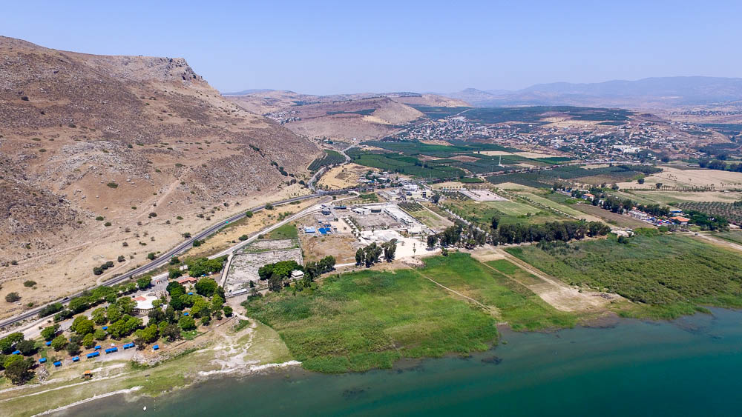
Magdala aerial from southeast
Notes:
Magdala
Magdala was also known as Taricheae, according to Josephus, which indicates that it was an important fishing center (Life, 72).
Strabo also referred to the importance of the salted fish industry: “At the place called Taricheae the lake supplies excellent fish for pickling” (16.2.45).
Josephus referred to Magdala as one of the two main administrative centers in the region, along with Tiberias. The town was important enough to have its own stadium (Strange 1992a: 463) or hippodrome (Josephus, War 3.599), as well as an aqueduct.
According to Josephus, Magdala had a population of 40,000.
The rabbis criticized the immorality of the residents.
Magdala was the base of the Zealots during the First Jewish Revolt.
In the First Jewish Revolt, Josephus tells of a great sea battle that was fought here against the Romans. The Jews lost, and 1,200 of the inhabitants of the city were slain in the theater of Tiberias. (Strange gives the number here as 12,000; 1992b: 548). Six thousand Jews were sent to build Nero’s canal in Corinth, and an additional 30,400 were sold into slavery (War 3.10.10 §539–40).
ws053116498

Slide 3
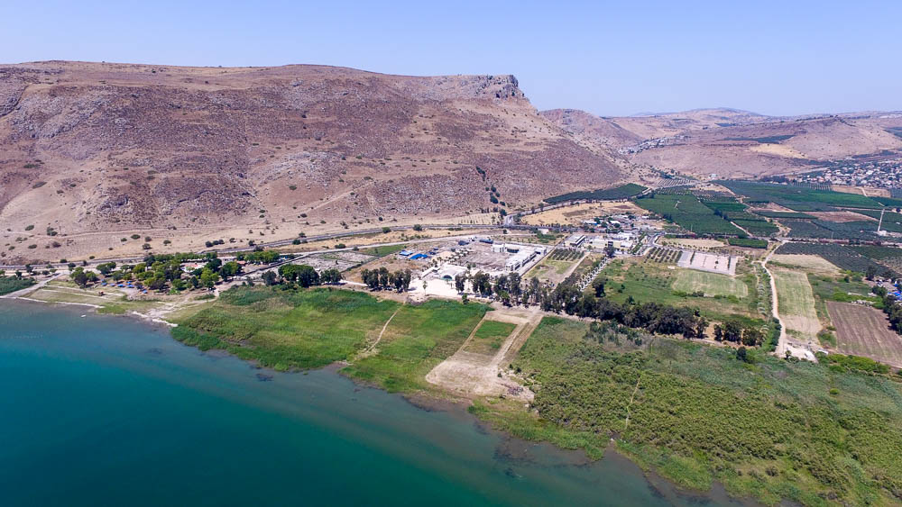
Magdala aerial from east
Notes:
Magdala Harbor
Josephus wrote that the town had many boats, shipyard workers, and wood supplies. He reported that he brought 230 boats from Migdal to Tiberias.
The Franciscan excavators, however, used the harbor as a dump, not realizing its significance.
The harbor is composed of two parts: the promenade and the sheltered basin. The promenade starts below the Arab ruins of Migdal and runs north for 330 feet (100 m), and is built in two parts (one is 0.7 feet [0.20 m] lower than the other; one part is 11.5 feet [3.5 m] wide and the other is 6.5 feet [2 m] wide). The crosswalls could be seen prior to being covered with excavation debris in the 1970s.
A mooring stone has been found at the western end of the harbor.
The breakwater is 20 feet (6 m) wide and 230 feet (69 m) long, and the foundations are made of basalt and limestone boulders.
The basin covers one acre and has a quay.
Silting has caused the topography to change since the 1970s.
ws053116502

Slide 4
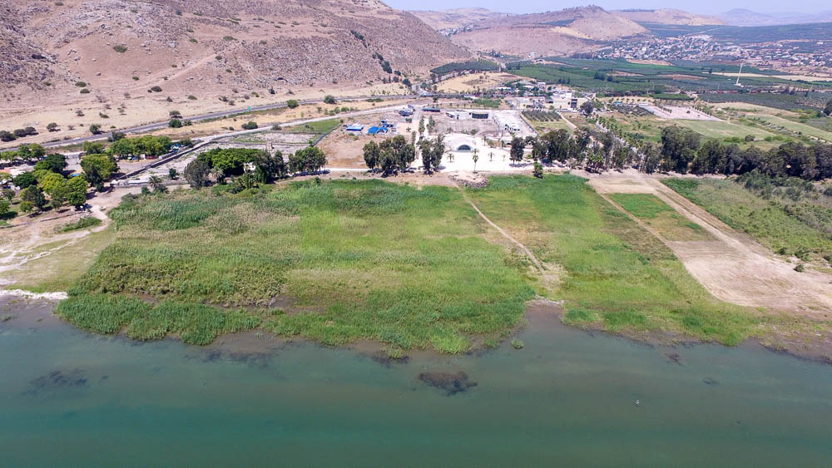
Magdala aerial from east
Notes:
Magdala in the New Testament
The fishing village of Magdala is never explicitly mentioned in Scripture, but Mary Magdalene, “from whom seven demons had come out,” was from Magdala (Luke 8:2).
Matthew 15:39 calls the village Magadan.
The region of Dalmanutha (Mark 8:10) is apparently equivalent to the “region of Magadan” (Matt 15:39).
Though not mentioned explicitly as a place that Jesus visited, Magdala was probably included in the references to Jesus’s travel to “nearby villages” (Mark 1:38-39; Luke 4:43; Matt 4:23), and “every village” (Luke 5:17).
The text of Matthew 15:39 has a strong textual tradition for “Magadan,” and a variant of “Magdala.” Both of these names may be traced to an original Hebrew name, Magdal. Magadan is most likely the correct reading in Matthew, referring to the site of Magdala (Laney 1986: 85).
Mark 8:10 reads “Dalmanutha” for the same story as Matthew 15:39. The textual evidence for this reading is very strong. Dalmanutha may be a Greek transliteration of the Aramaic word dalmynyth’, which means “of the harbor.” Thus, it could be said that “Matthew recorded the arrival of Christ in the neighborhood of Magadan (Magdala), whereas Mark, who was dependent on the preaching of Peter, recorded that Jesus had reached the site of the harbor” (Laney 1986: 85).
ws053116490

Slide 5
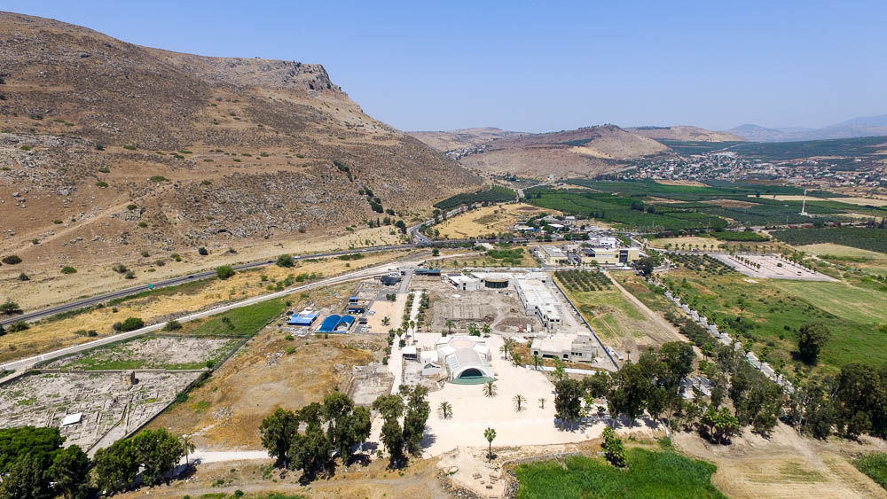
Magdala aerial from east
Notes:
The Arbel cliffs rise above Magdala. A couple of photo at the end of this presentation show the view of Magdala from Arbel.
ws053116536

Slide 6
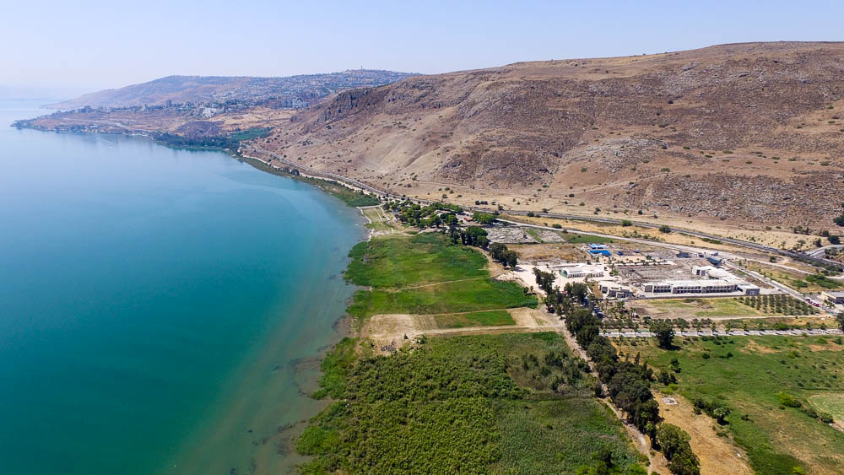
Magdala aerial from north
Notes:
Magdala is located about 2.5 miles (4 km) north of Tiberias. The outskirts of the modern city is visible further down the shore.
ws053116511

Slide 7
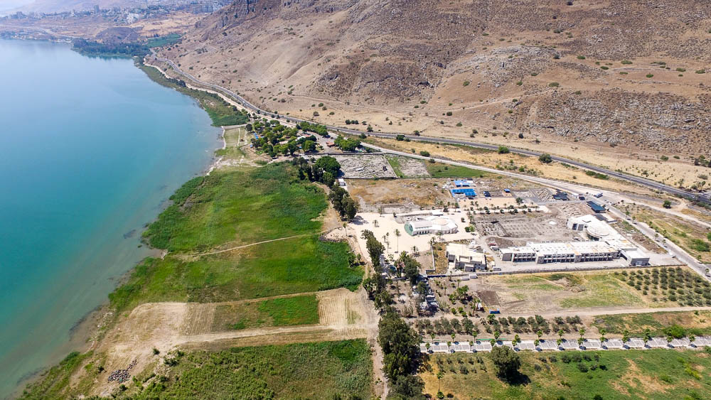
Magdala aerial from north
Notes:
ws053116520

Slide 8
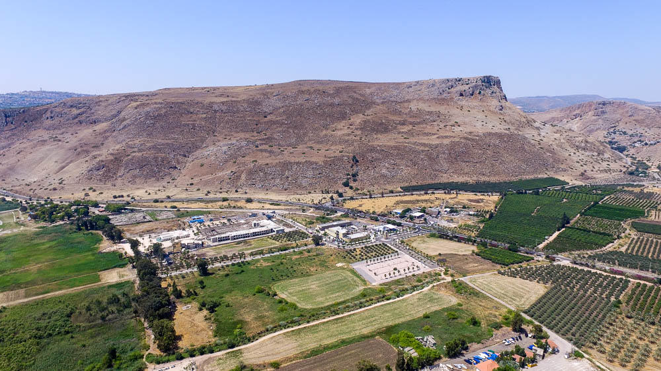
Magdala aerial from northeast
Notes:
Magdala sits on the Plain of Gennesaret, between the foot of Mount Arbel and the Sea of Galilee. Arbel is a popular outlook, offering a beautiful view of the sea and its surroundings.
ws053116516

Slide 9
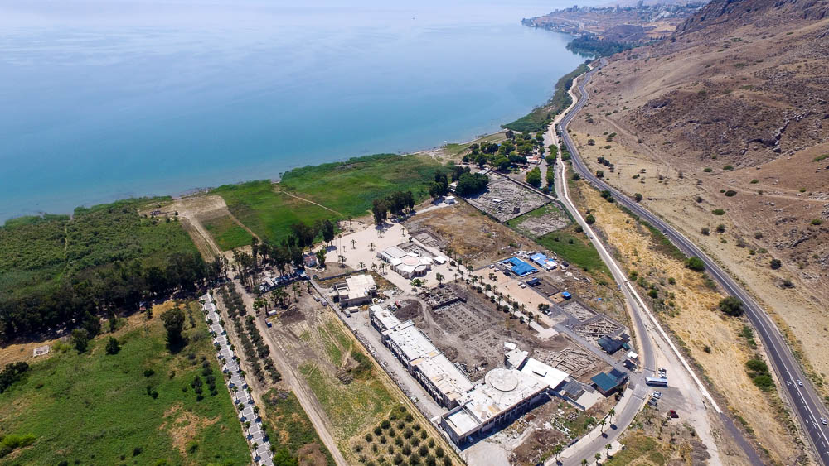
Magdala aerial from northwest
Notes:
ws053116526

Slide 10
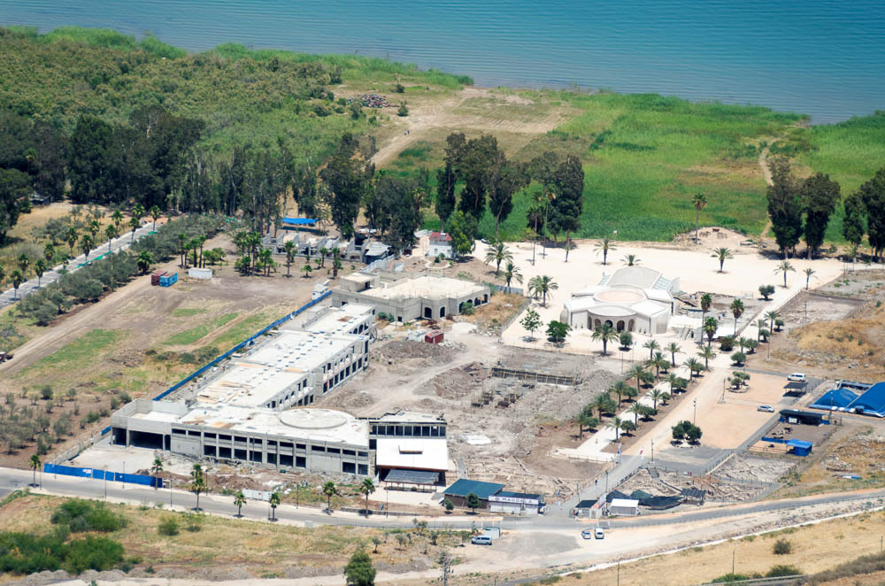
Magdala from west
Notes:
Excavations
The city of Magdala was originally excavated by the Franciscans from 1971 to 1973. A new wave of excavation began in 2006 and is still ongoing.
A small synagogue was uncovered at the southeast corner of two well-paved streets. It was approximately 26 by 23 feet (8 x 7 m), only 13 percent of the size of the contemporary Capernaum synagogue. It was apparently used as a synagogue before the First Jewish Revolt, being converted into a fish pond in the Late Roman Period.
The synagogue was constructed in Galilean style, with columns on three sides, heart-shaped double columns at the corners, and five benches lining the northern wall.
Located across the street to the west, a large water tower still stands 21 feet (6 m) high, measuring 29 by 32 feet (9 x 9.5 m), with 7-foot-thick (2 m) walls.
A 5th-6th century monastery with beautiful geometric mosaics is located on the south side of the area owned by the Franciscans.
tb061316442

Slide 11
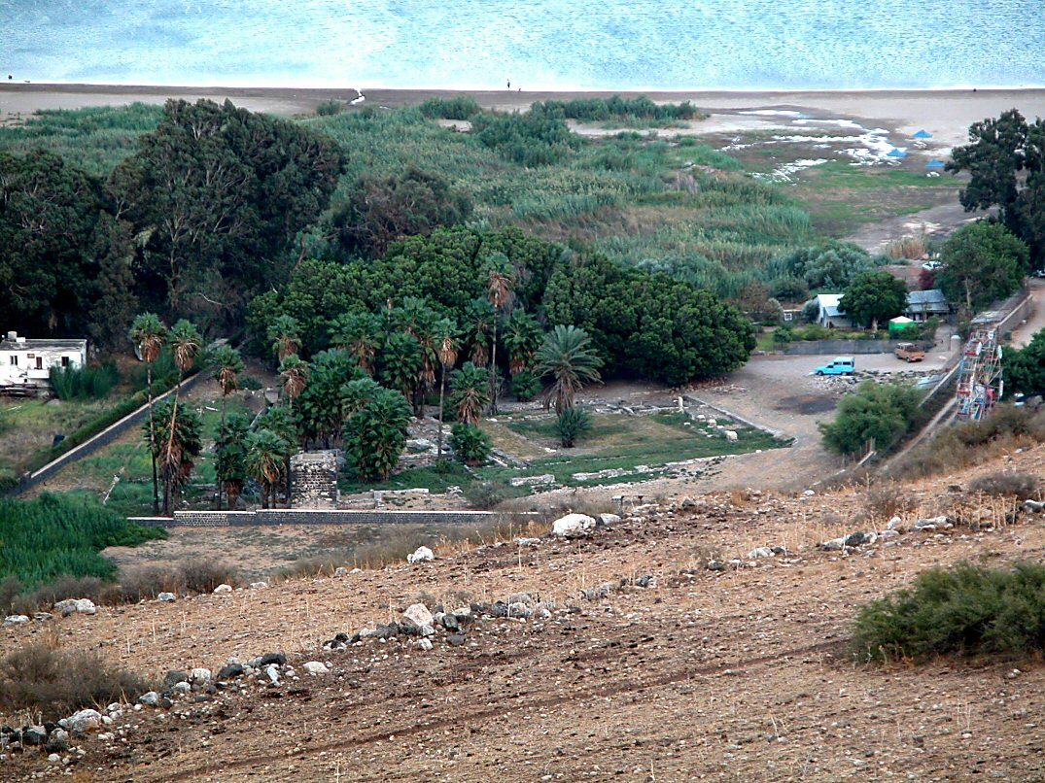
Magdala from above
Notes:
This photo and the next were taken in 2002 of the area previously excavated, before the most recent wave of excavations began in 2006.
tb102702020

Slide 12
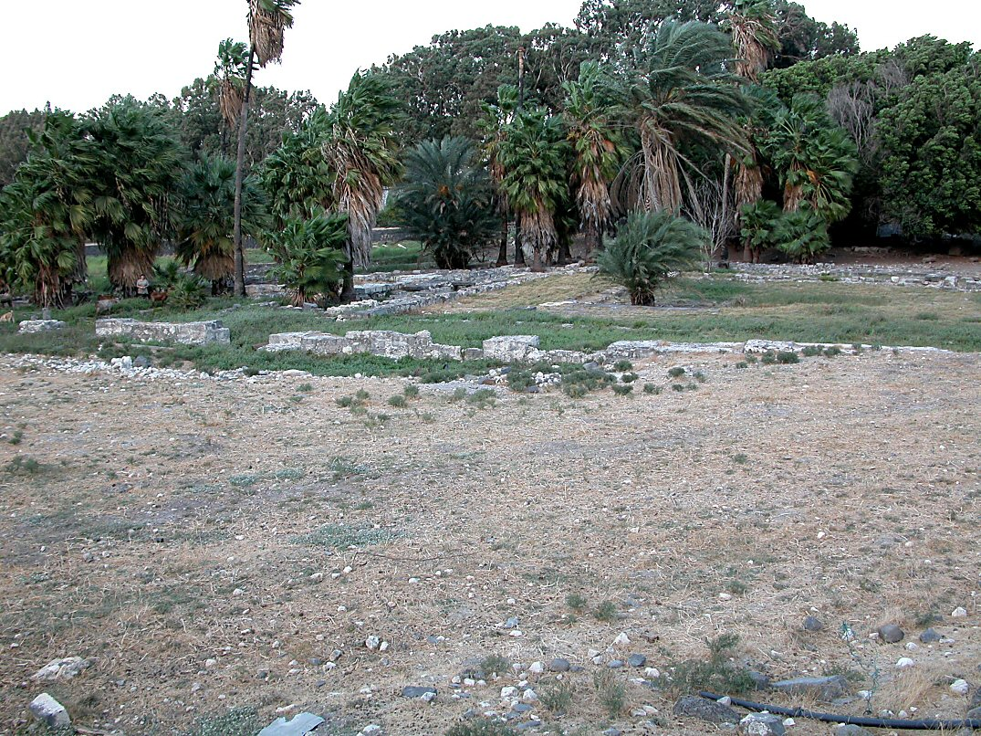
Magdala excavations from southwest
Notes:
Prior to the current excavations, tour guides would point out the region of Magdala from the bus, but there was nowhere to stop and nothing to see.
tb102702019

Slide 13
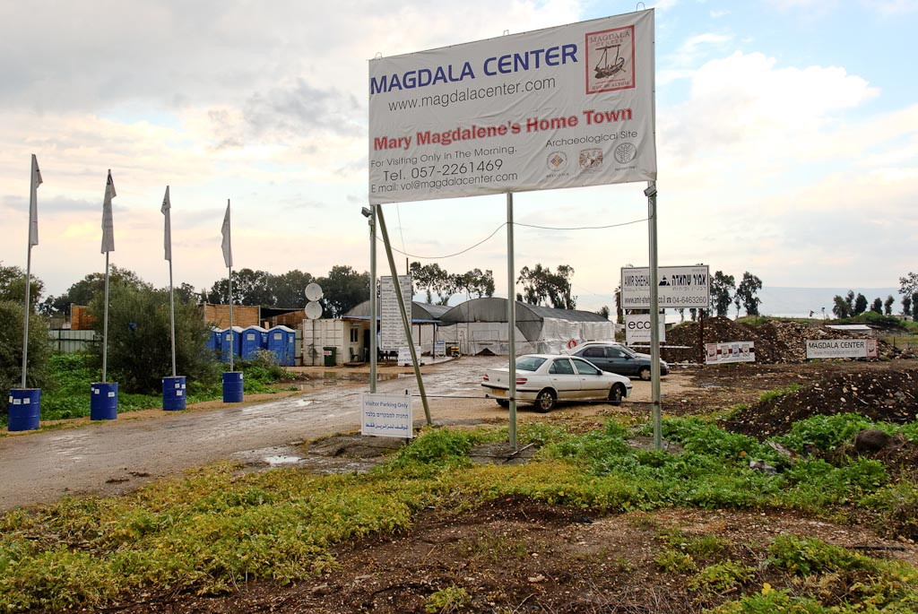
Magdala excavation area
Notes:
This photo, in contrast, was taken in 2012, showing all the trappings of an active dig site.
tb011212440

Slide 14
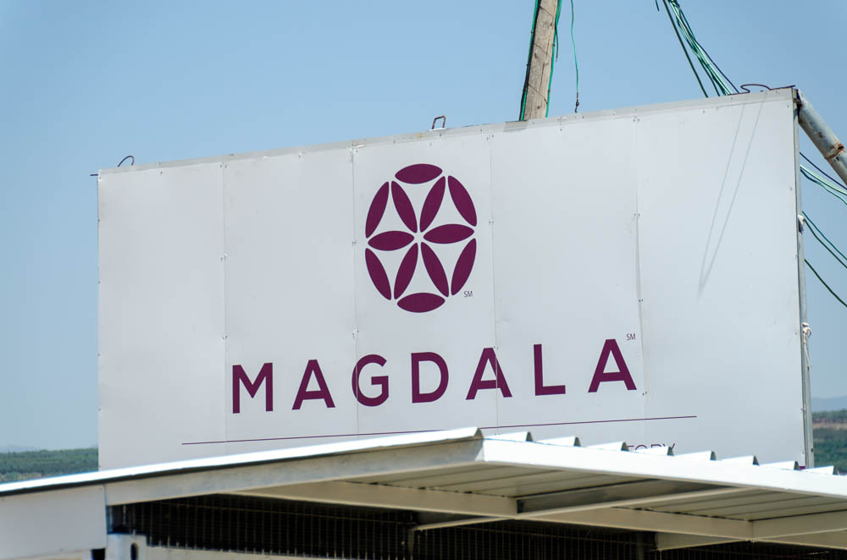
Magdala entrance sign
Notes:
tb053116553

Slide 15
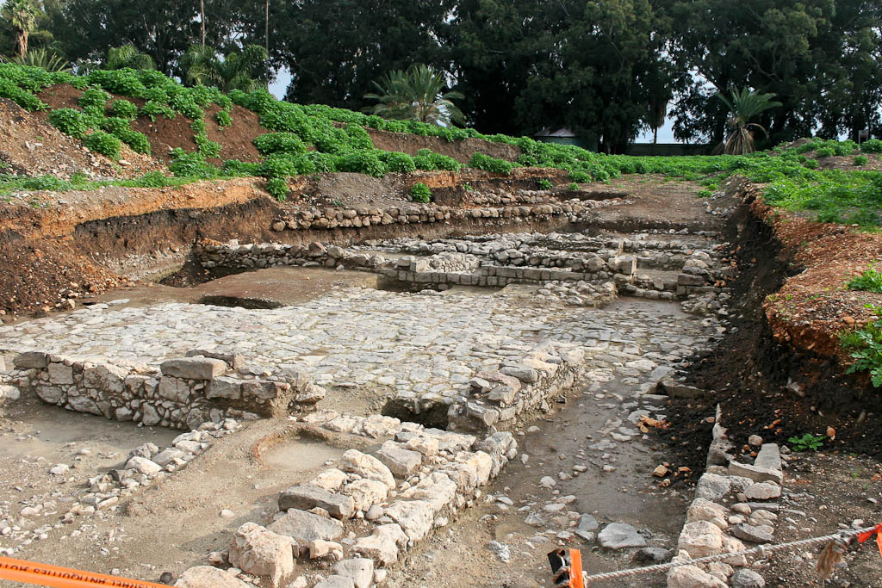
Magdala excavations
Notes:
This photo, taken in 2009, shows some of the earlier results of the present excavation project.
gf123109117

Slide 16
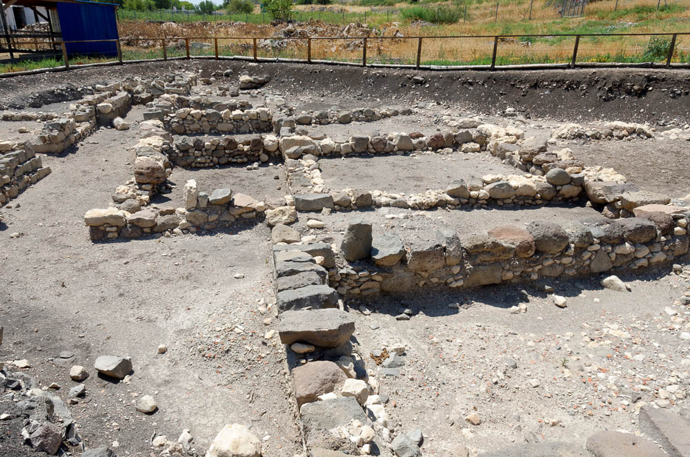
Magdala residential quarter
Notes:
The archaeological data suggests that Magdala was founded in the Hellenistic period, with a dramatic period of growth in the Early Roman period. The city’s eventual decline apparently began in the late 1st century AD.
tb053116530

Slide 17
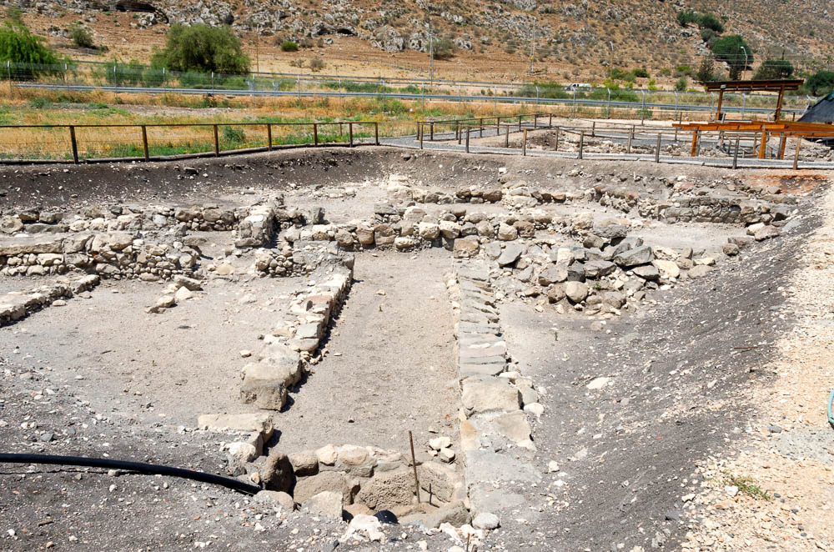
Magdala residential quarter
Notes:
Local basalt was the most readily available (and therefore most popular) building material.
tb053116527

Slide 18
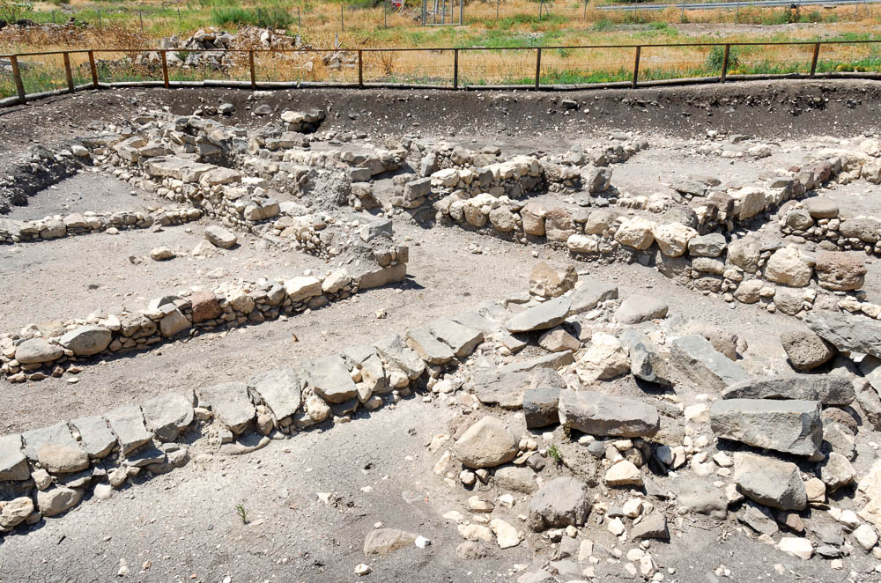
Magdala residential quarter
Notes:
tb053116528

Slide 19
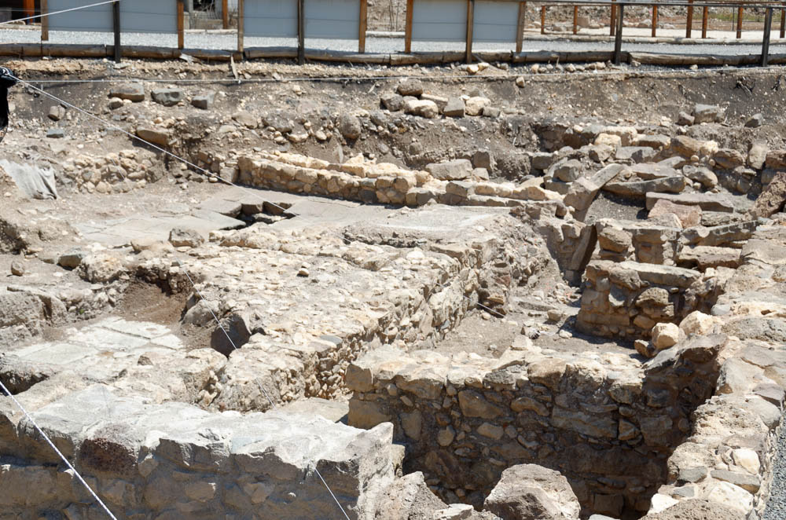
Magdala house of dice
Notes:
This area of the city appears to correspond with the period of expansion in the 1st century BC. Known as Area A by the archaeologists, this plot consists of two buildings separated by a street. One of these has been named the House of Dice, because dice were discovered during excavation.
tb053116548

Slide 20
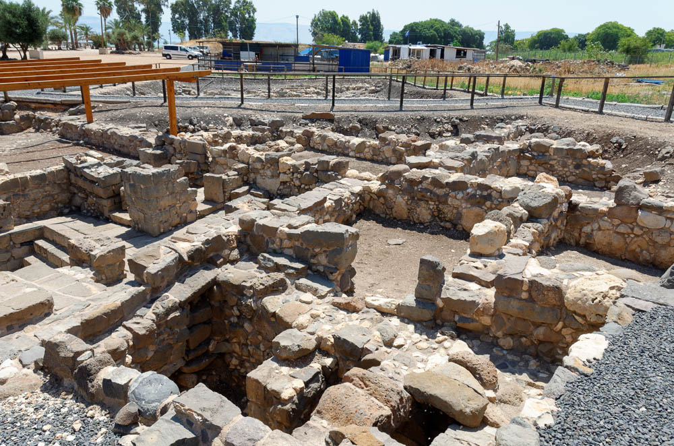
Magdala house of dice
Notes:
tb053116549

Slide 21
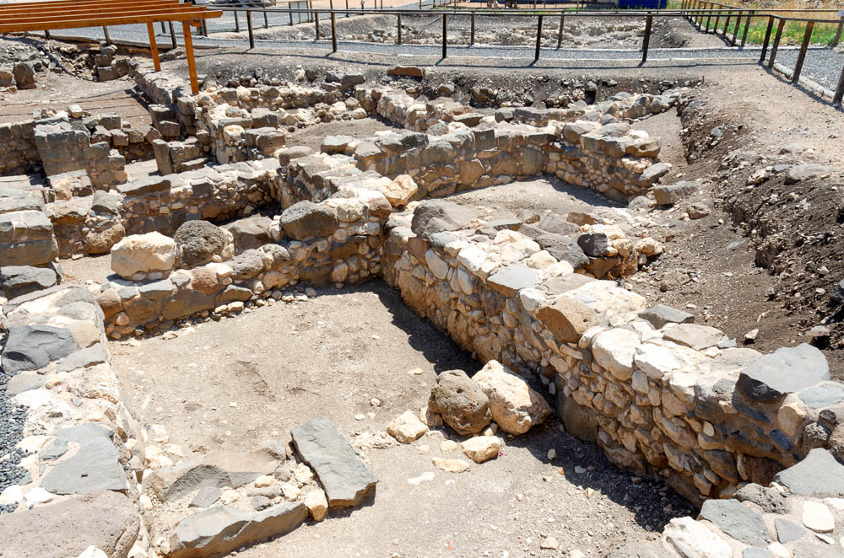
Magdala house of dice
Notes:
tb053116550

Slide 22
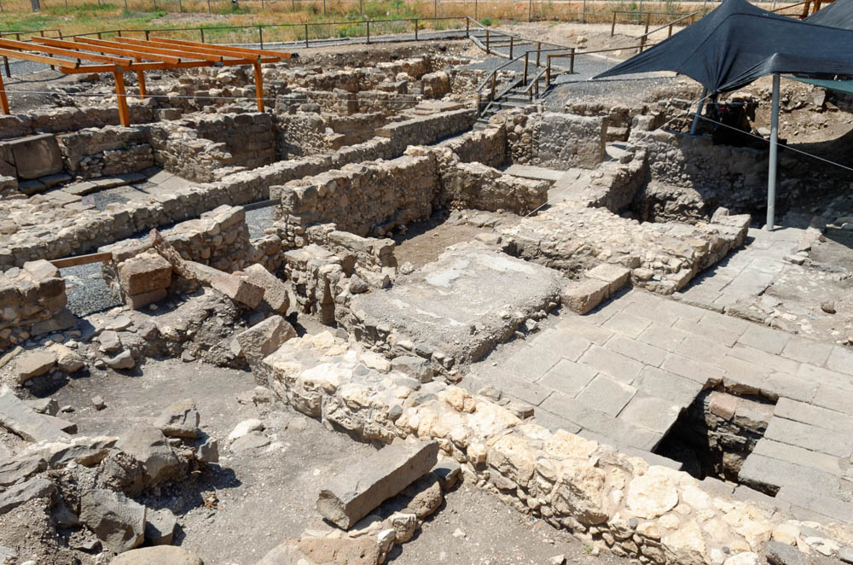
Magdala house of dice
Notes:
Both buildings in Area A appear to have been built with some care. Note the dressed basalt blocks in the lower right of this photo.
tb053116534

Slide 23
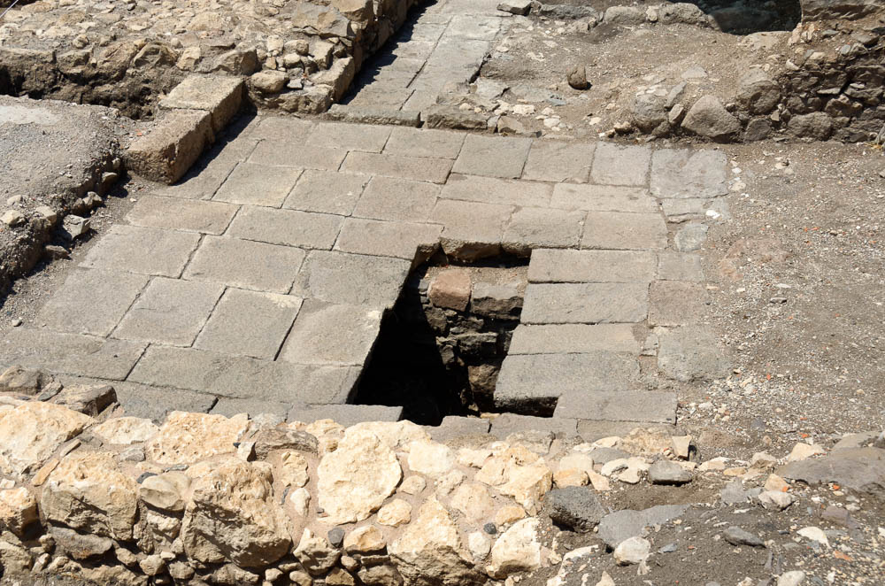
Magdala house of dice, hole in pavement
Notes:
tb053116535

Slide 24
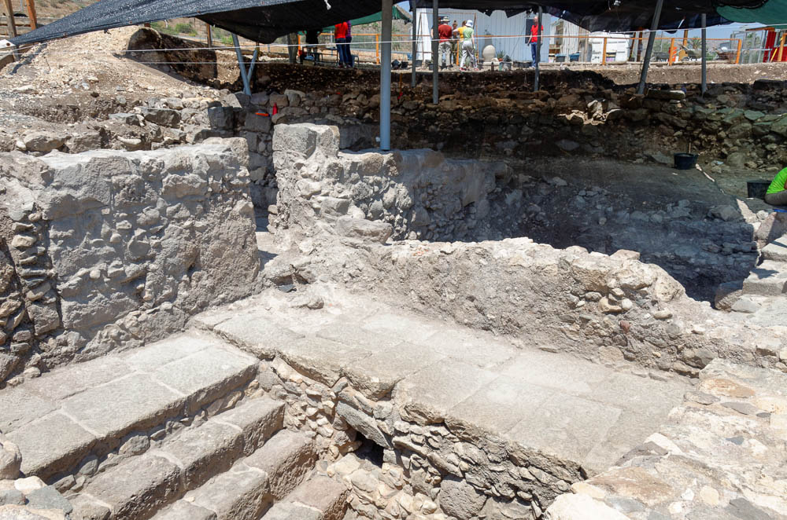
Magdala house of dice
Notes:
Each building in Area A boasts two mikvehs. This is quite unusual, because mikvehs have not been discovered at other contemporary sites near the Sea of Galilee. As Marcela Zapata-Meza points out, this is due to the obvious redundancy of having a dedicated bath for ritual purification, when the Sea of Galilee itself served that same purpose (2018: 92).
tb053116541

Slide 25
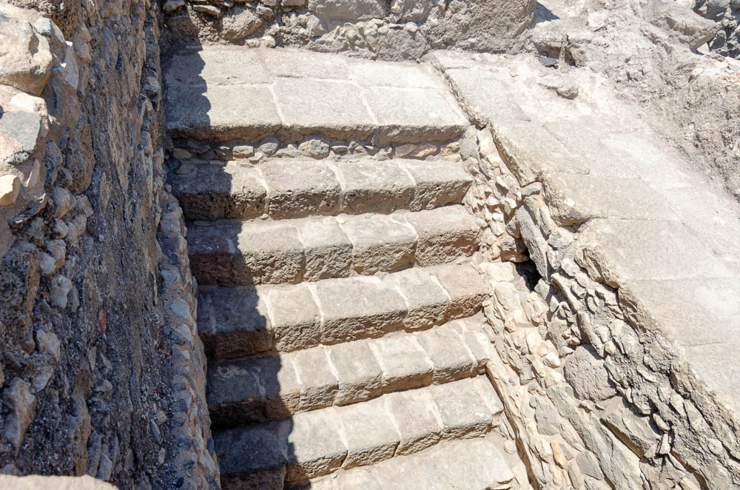
Magdala house of dice mikveh stairs
Notes:
The remains suggest that these pools were roofed with a barrel vault, which was a typical style for mikvehs.
tb053116544

Slide 26
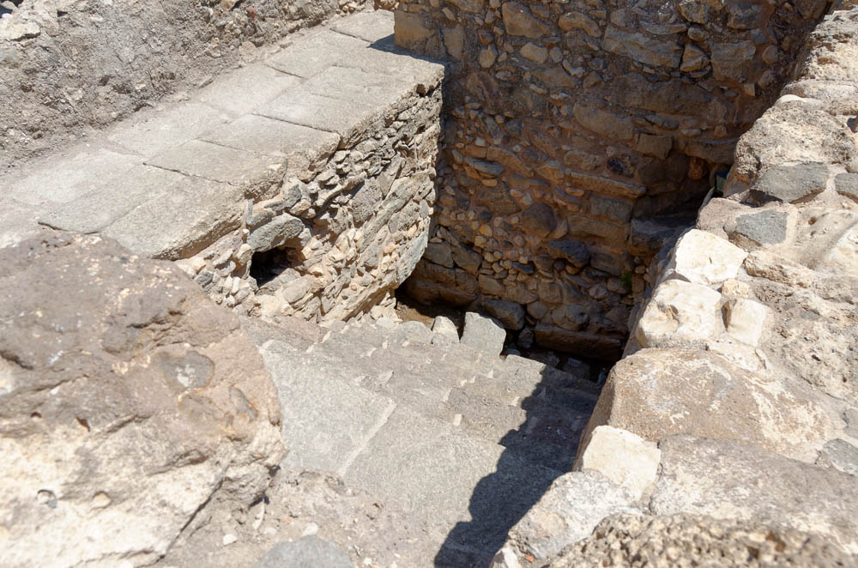
Magdala house of dice mikveh
Notes:
In addition to their location, there is something else unusual about these four mikvehs. Instead of being fed by rain or spring water, these are the only known examples of mikvehs designed to be filled by groundwater. Because of this, the pools were never plastered, in order to allow water to seep freely.
tb053116543

Slide 27
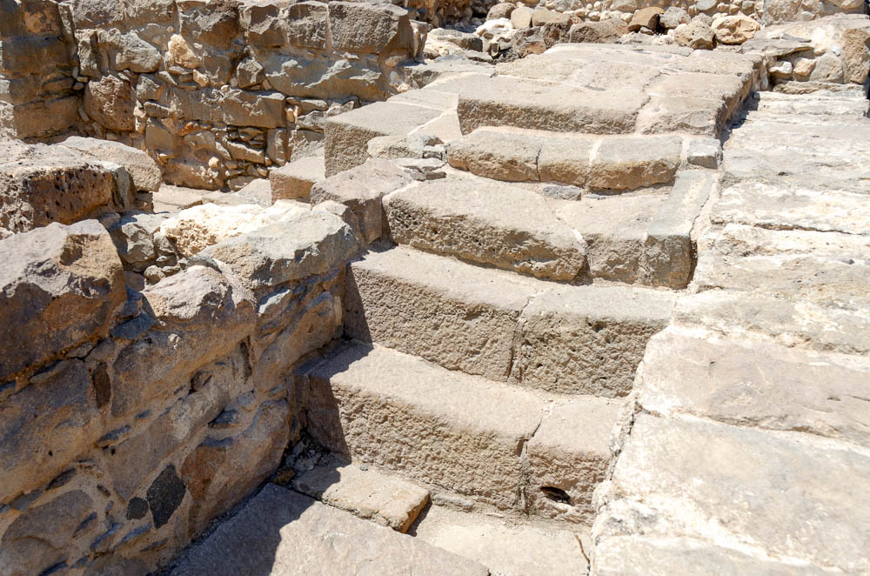
Magdala house of dice, stairs
Notes:
tb053116546

Slide 28
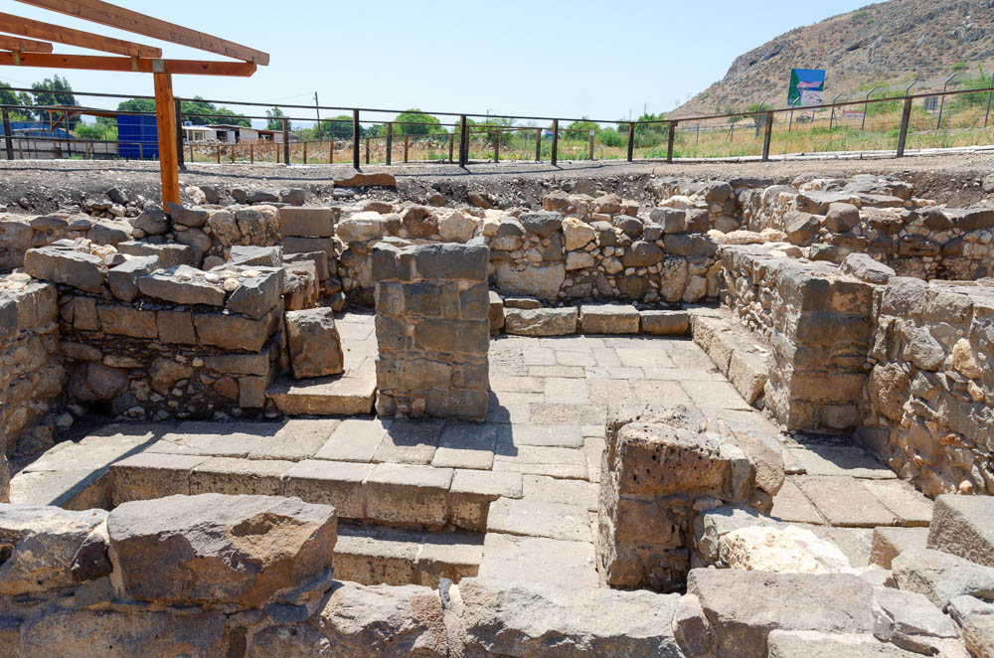
Magdala house of dice
Notes:
Archaeologists have suggested that perhaps concerns of convenience and privacy justified the installation of domestic mikvehs, in spite of the nearby lake (Reich 2018: 124).
tb053116542

Slide 29
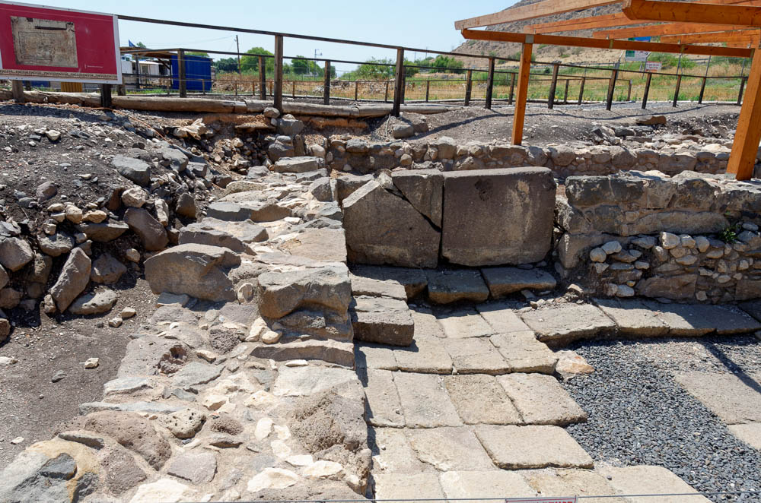
Magdala house of dice
Notes:
Given the presence of private mikvehs and the discovery of a mosaic, it is believed that the houses in Area A belonged to wealthier Jewish residents of Magdala.
tb053116540

Slide 30
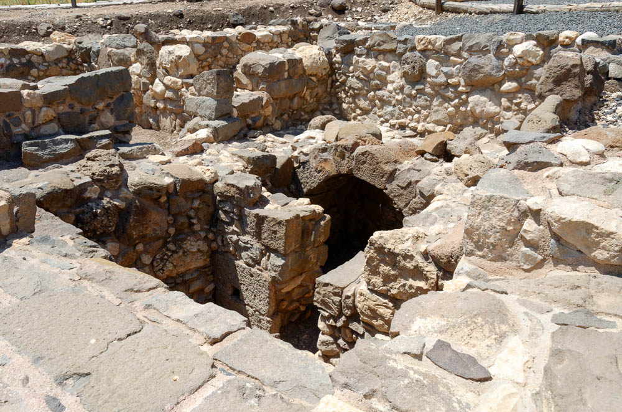
Magdala house of dice, arch
Notes:
This standing arch was part of a cistern installation, which was also designed to receive groundwater. It apparently served the purpose of helping to regulate the water level of the mikvehs—an important function, as the water table fluctuates with the seasons.
tb053116547

Slide 31
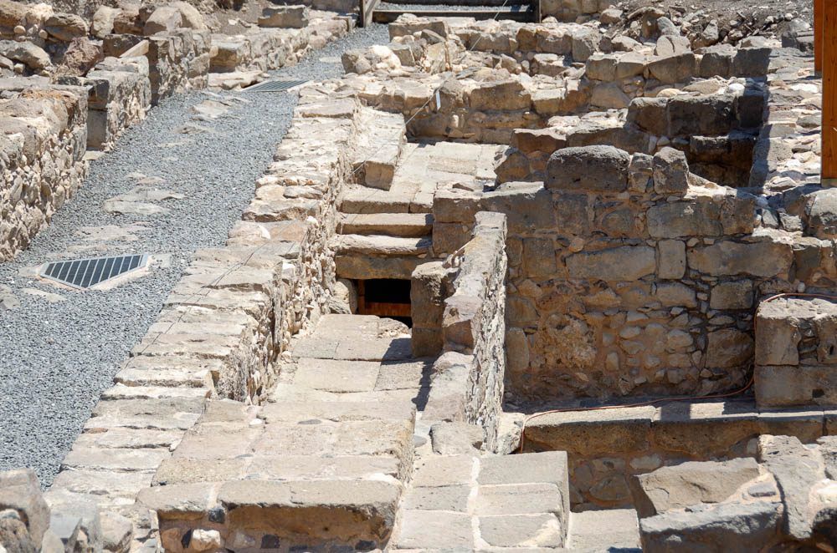
Magdala house of dice
Notes:
A channel leading into the street also aided the regulation of the pools’ water levels, preventing overflow.
tb053116552

Slide 32
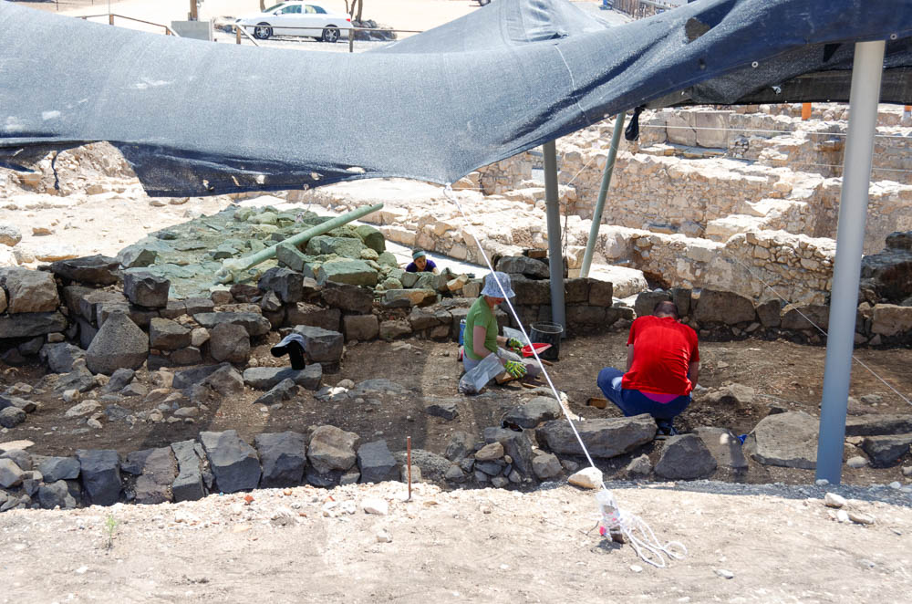
Magdala excavations
Notes:
Much of what is now known about Magdala is the result of very recent excavation and research efforts. Modern additions to the site also continue to be developed. For example, the Magdala guesthouse was inaugurated in late 2019.
tb053116555

Slide 33
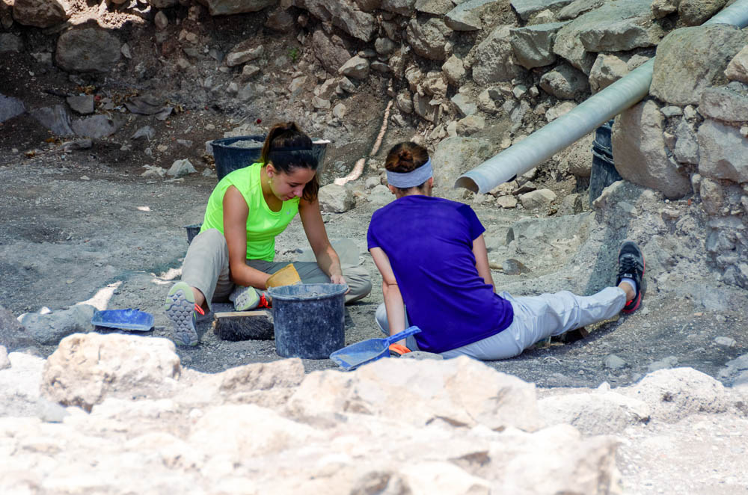
Magdala house of dice excavations
Notes:
The Magdala excavations have provided many opportunities for volunteers for more than a decade now.
tb053116538

Slide 34
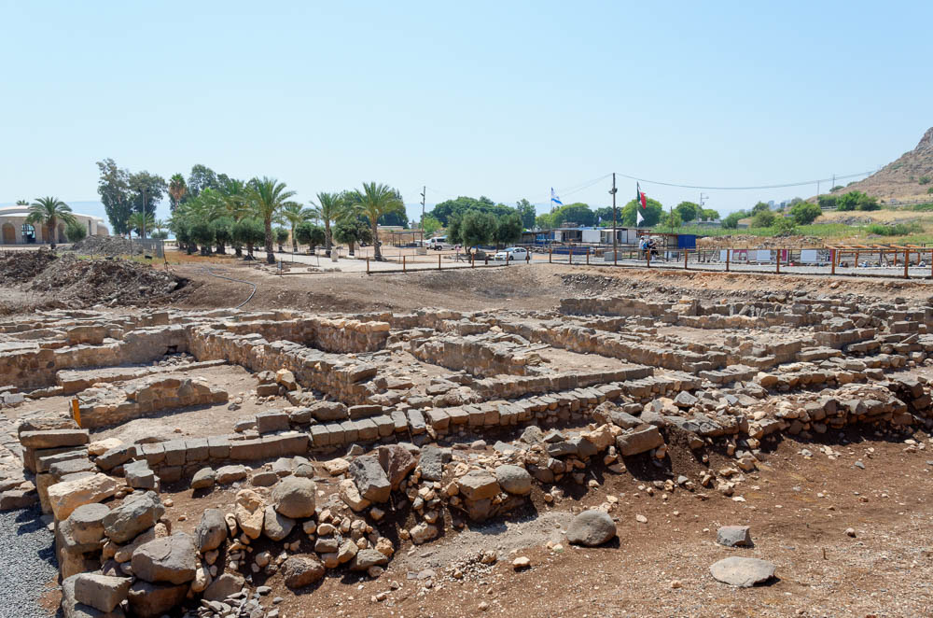
Magdala marketplace from west
Notes:
This part of the excavations, located between Area A and the synagogue, has been identified as a marketplace. As one of the more recently excavated areas of Magdala, investigation is still ongoing.
tb053116421

Slide 35
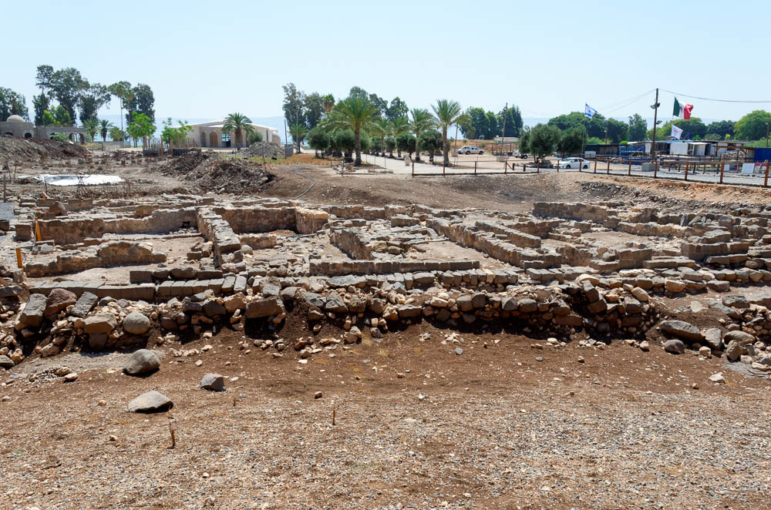
Magdala marketplace from west
Notes:
The marketplace is part of the western extremity of Magdala, so it appears to have been one of the products of the city’s urban expansion. Its first phase dates to the Early Roman period.
tb053116455

Slide 36
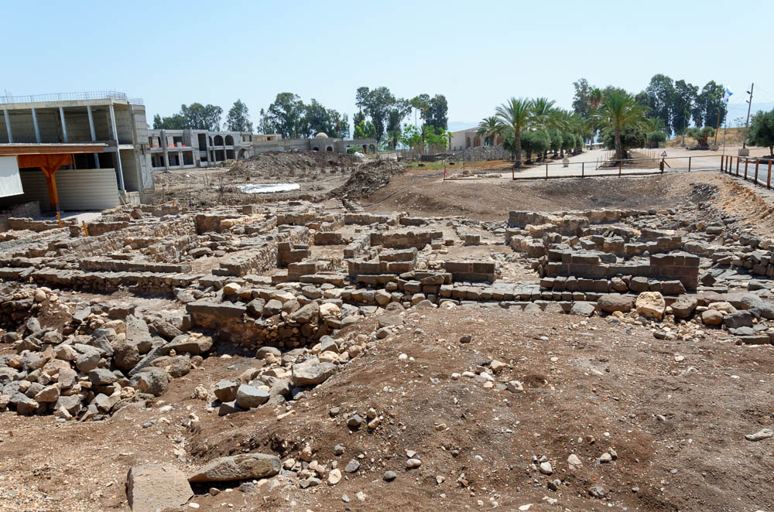
Magdala marketplace from west
Notes:
tb053116456

Slide 37
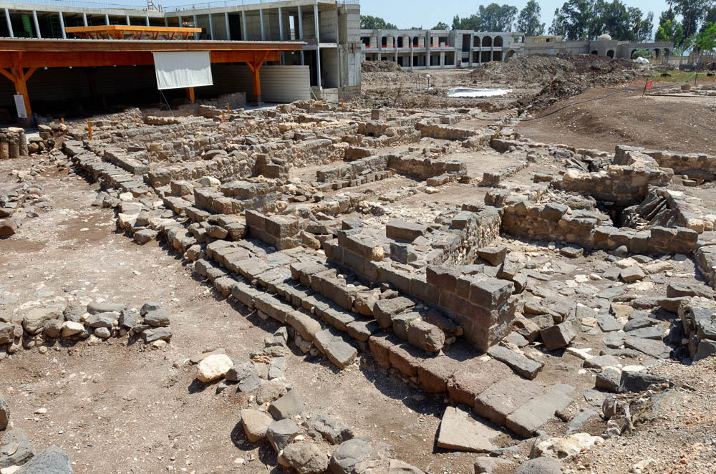
Magdala marketplace from southwest
Notes:
tb053116457

Slide 38
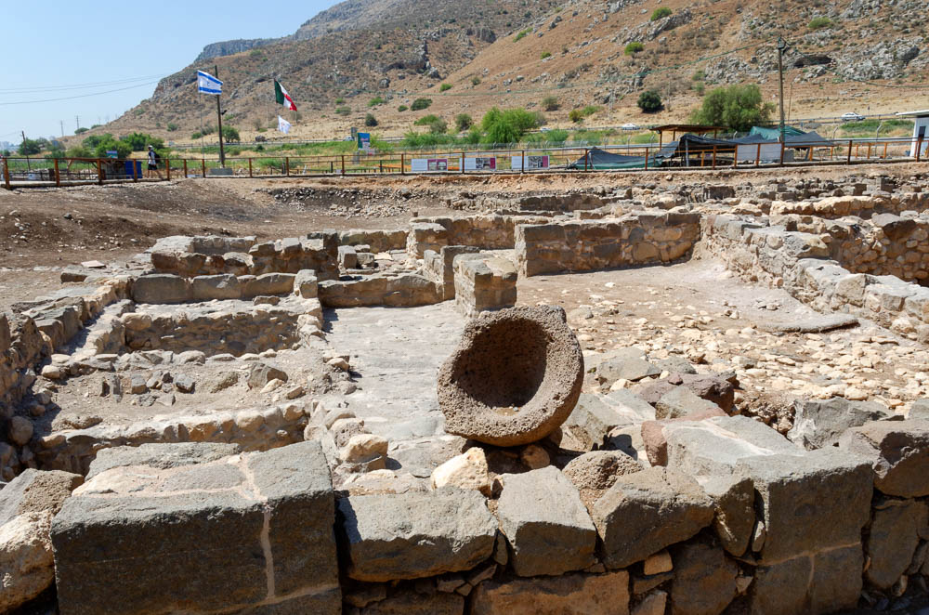
Magdala marketplace from north
Notes:
tb053116450

Slide 39
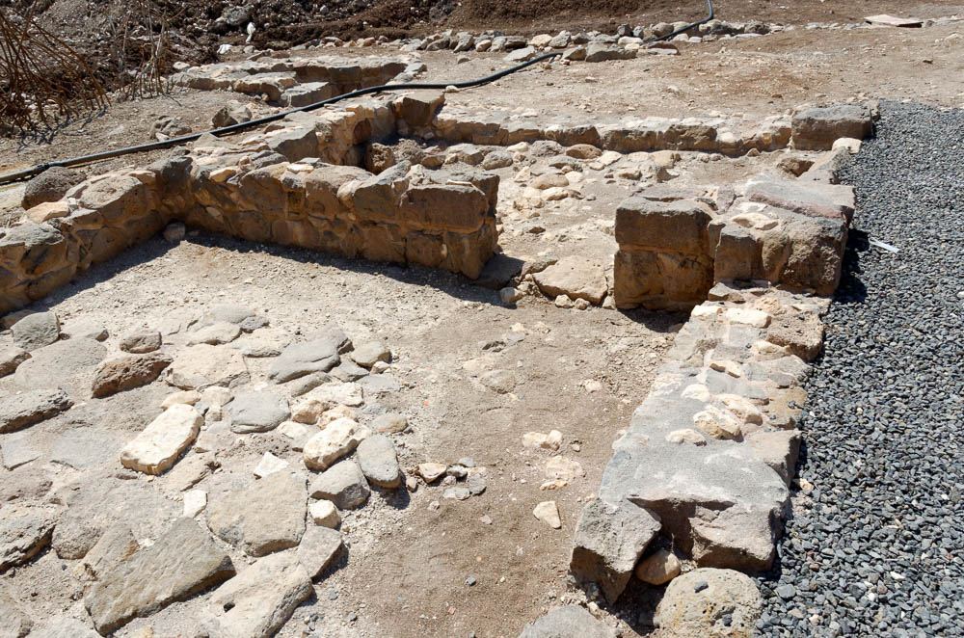
Magdala marketplace with doorway
Notes:
The remains suggest that, among other vendors, this market had a pottery merchant and a baker. Marcela Zapata-Meza also remarks on the absence of fishing weights, which perhaps hints that commerce related to the fishing trade happened elsewhere (2018: 105–6).
tb053116451

Slide 40
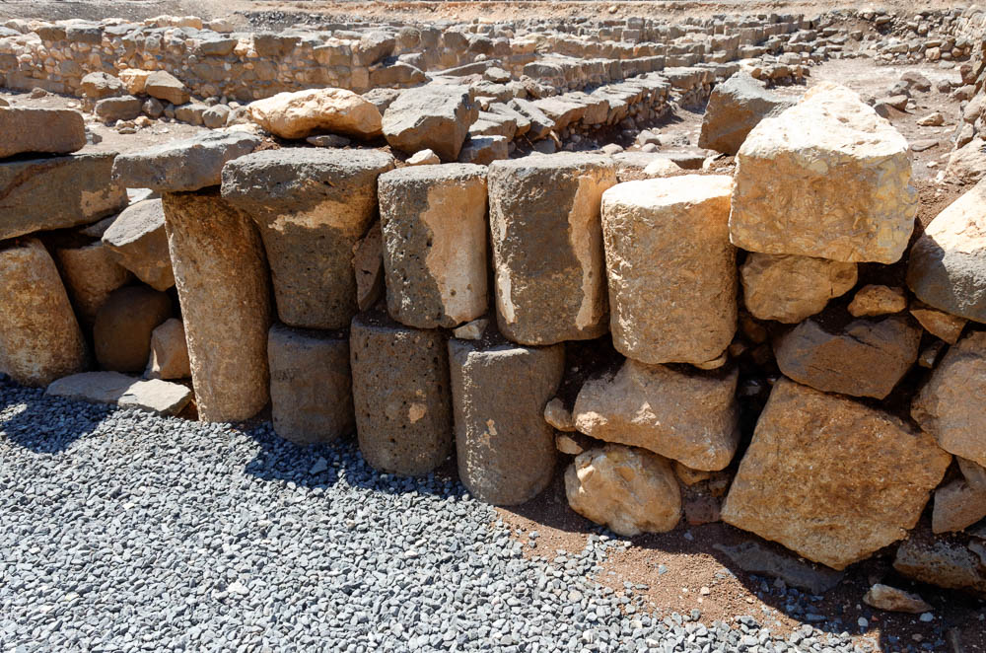
Magdala marketplace wall with column drums in secondary use
Notes:
tb053116452

Slide 41
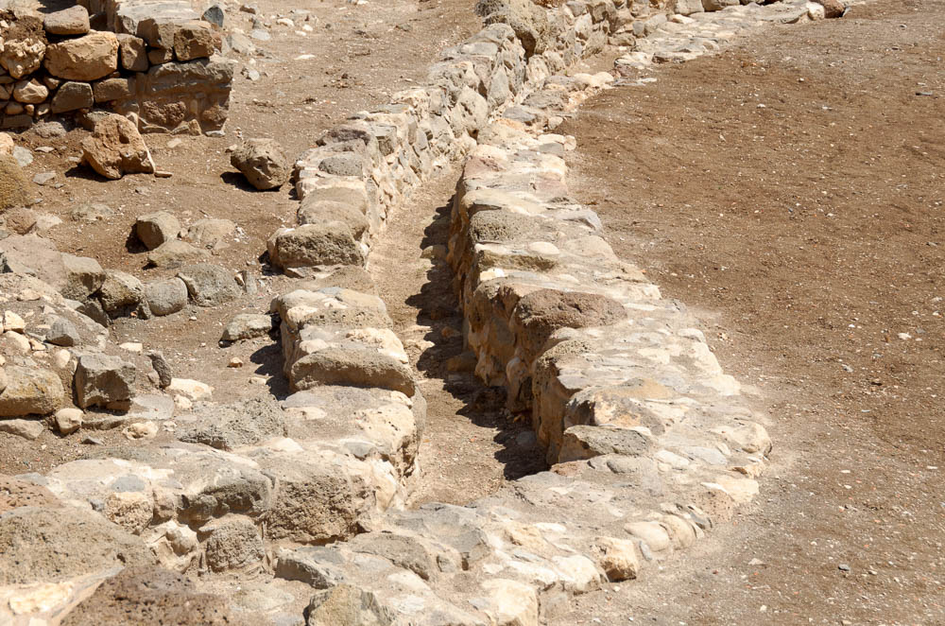
Magdala channel in marketplace
Notes:
tb053116461

Slide 42
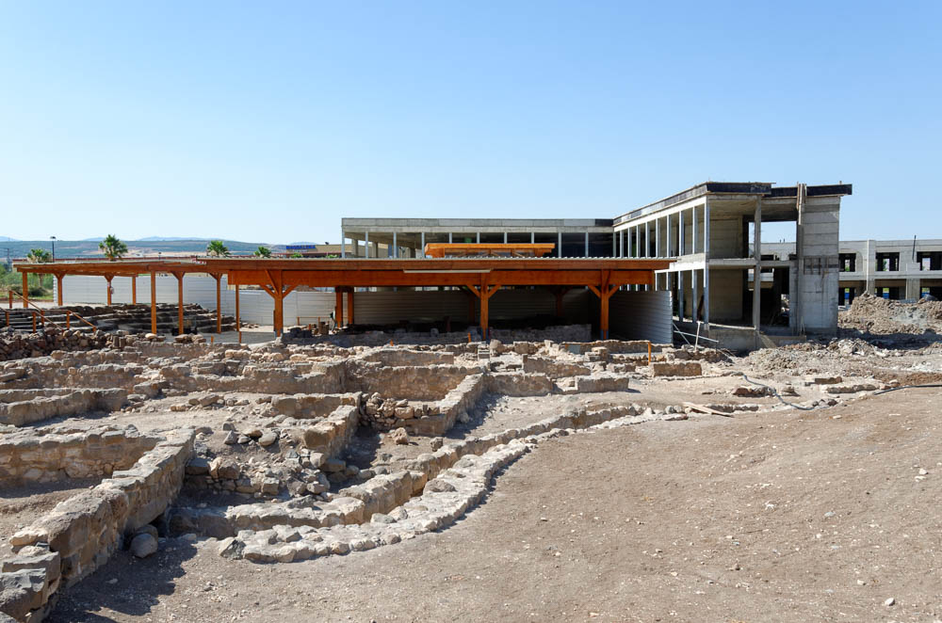
Magdala marketplace and synagogue
Notes:
The structure under the overhang in this picture is Magdala’s synagogue, which is immediately adjacent to the marketplace. At the time this photograph was taken (in 2016), the guesthouse and tourist center were under construction.
tb061316455

Slide 43
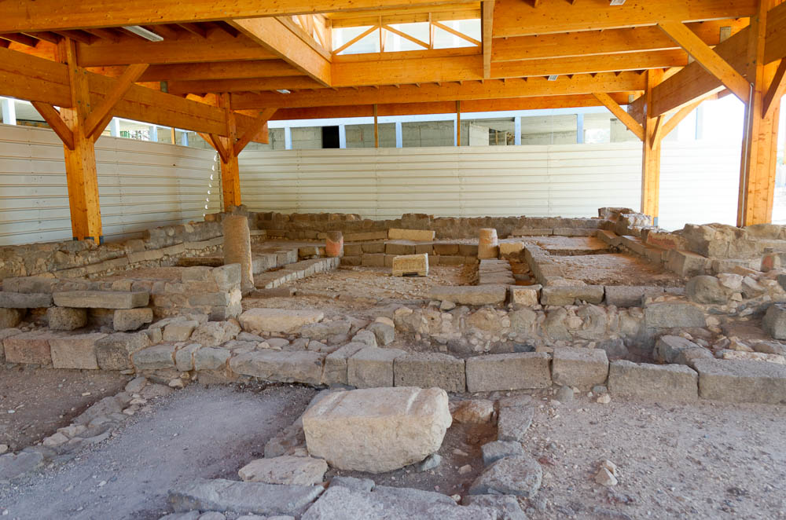
Magdala synagogue from west
Notes:
Excavators, working in advance of the construction of a tourist center, discovered a synagogue at Magdala in 2009. This synagogue is said to date from the Second Temple period (50 BC to AD 100), contemporary with the time of Jesus’s ministry and his healing of Mary Magdalene. It was the first synagogue of its period to be found at a Galilean site.
tb053116422

Slide 44
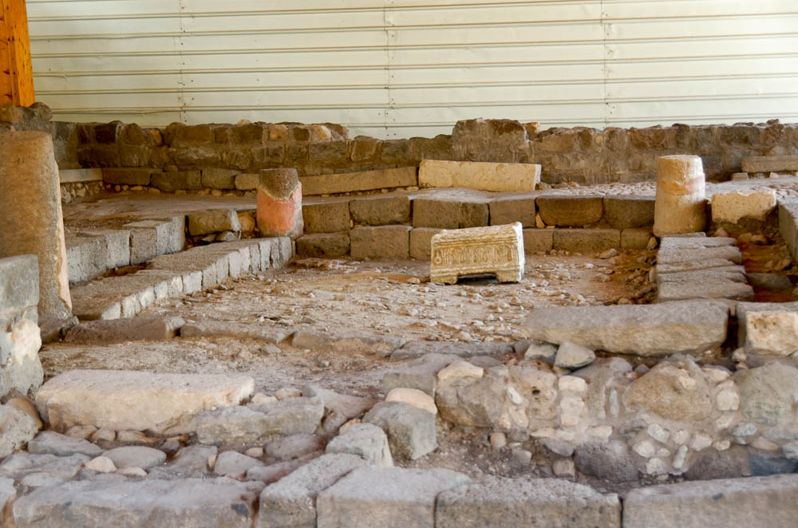
Magdala synagogue from west
Notes:
Given that Jesus probably visited Magdala during his earthly ministry, it seems quite likely that Jesus taught in this very synagogue.
tb053116424

Slide 45
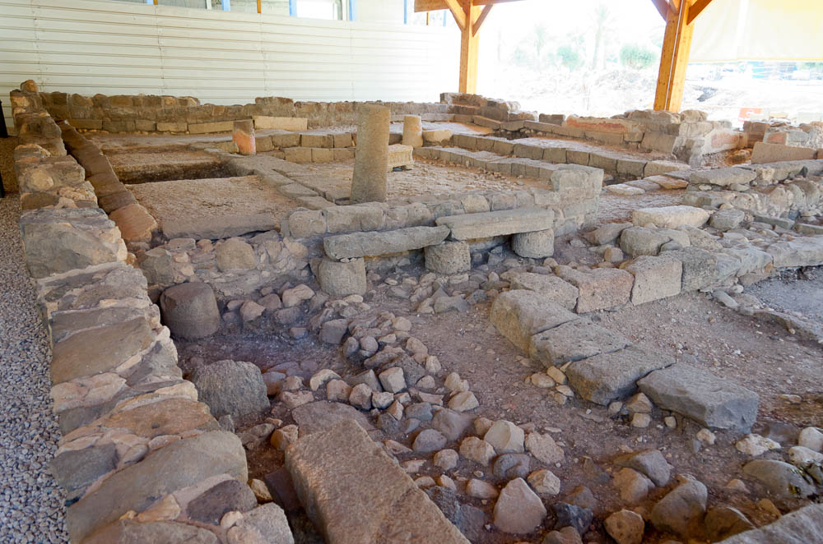
Magdala synagogue from northwest
Notes:
tb053116427

Slide 46
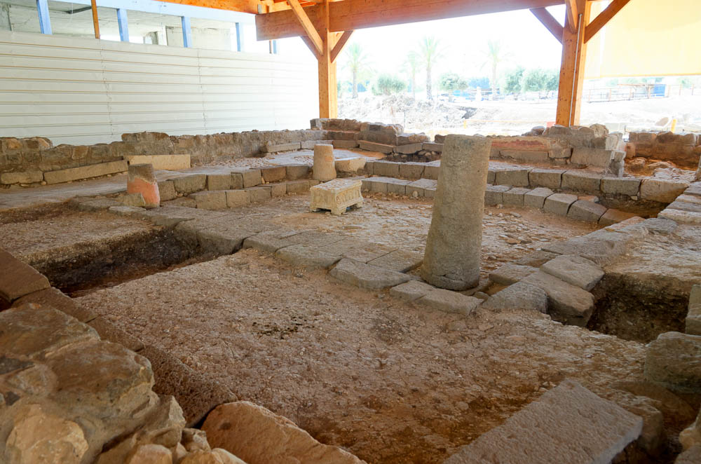
Magdala synagogue from northwest
Notes:
The main hall of the synagogue measures 1,300 square feet (120 sq m) and was surrounded by stone benches.
tb053116428

Slide 47
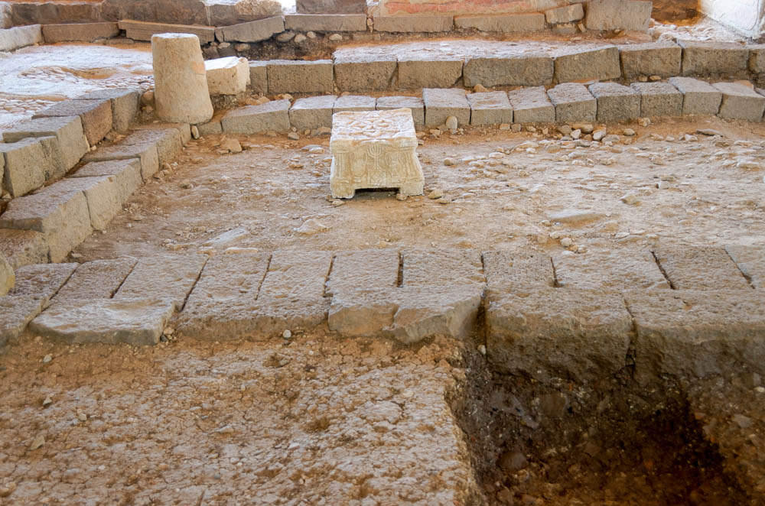
Magdala synagogue from north with ornamented table
Notes:
A unique feature of this synagogue was a decorated stone inscribed with a seven-branched menorah. According to the excavation director, Dina Avshalom-Gorni, “This is the first time that a menorah decoration has been discovered from the days when the Second Temple was still standing. This is the first menorah to be discovered in a Jewish context and that dates to the Second Temple period/beginning of the Early Roman period.”
tb053116433

Slide 48
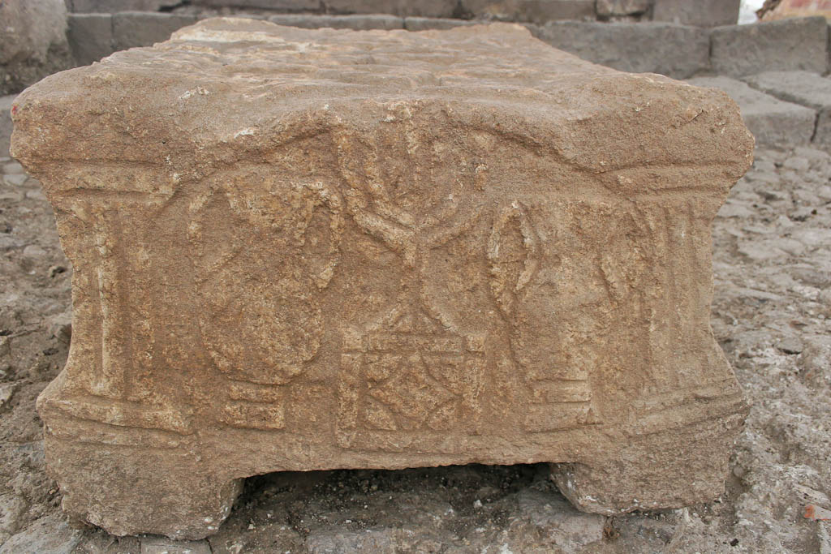
Magdala synagogue ornamented table
Notes:
This depiction of a menorah lends evidence to the belief that, even in the Second Temple period, there was some symbolic connection between synagogues and the temple. This side of the stone also depicts two amphorae and some sort of decorated platform.
gf123109097

Slide 49
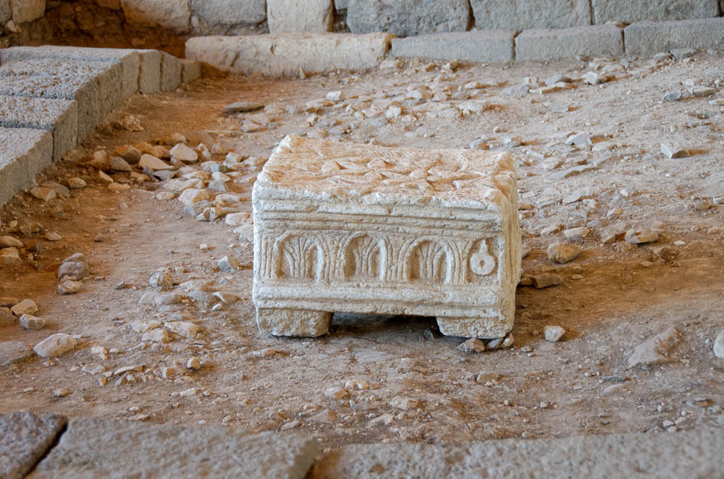
Magdala synagogue ornamented table
Notes:
Both long sides show the same scene. Though the arches are easy enough to understand, the hanging object on the edge of the scene is harder to interpret. It may depict something like a censer or oil lamp.
tb053116437

Slide 50
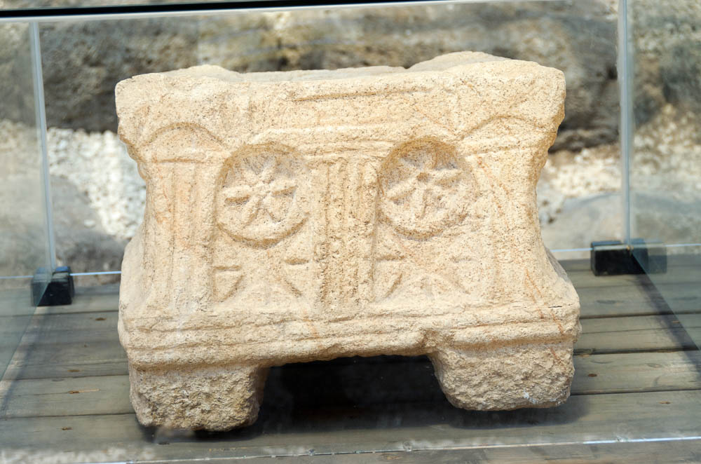
Magdala synagogue decorated table
Notes:
Because of the menorah on the opposite side of the table, there is an understandable instinct to interpret all of the table’s imagery in reference to the temple. Mordechai Aviam and Richard Bauckham therefore propose that this scene is a symbolic view of the Holy of Holies, with the wheels belonging to God’s wheeled throne (Aviam and Bauckham 2018: 141; Daniel 7:9).
tb053116556

Slide 51
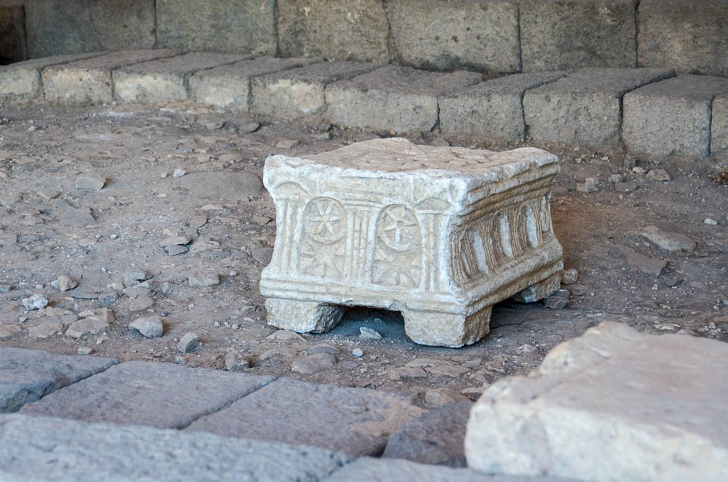
Magdala synagogue ornamented table
Notes:
Given that it was discovered in the synagogue’s main hall, the stone may possibly have served as a table (or base of a table) on which to rest the Torah during readings. But just like its iconography, the stone’s purpose is hard to interpret with confidence.
tb053116445

Slide 52
Magdala synagogue from south
Notes:
Given the synagogue’s relatively small size and peripheral placement, it may have been one of multiple synagogues in Magdala (Aviam 2018: 131).
tb053116444

Slide 53
Magdala synagogue from south
Notes:
tb053116446

Slide 54
Magdala synagogue from northeast
Notes:
In addition to the main hall, the synagogue also appears to have had smaller adjoining spaces, which may have been storage or study rooms.
tb053116436

Slide 55
Magdala synagogue column with painted plaster
Notes:
tb053116440

Slide 56
Magdala synagogue column with painted plaster
Notes:
Though the pale and dusty remains leave much to the imagination, the synagogue was once colorfully decorated. Note the remnants of red-painted plaster on this column.
tb053116439

Slide 57
Magdala synagogue from southeast
Notes:
tb053116438

Slide 58
Magdala synagogue painted plaster
Notes:
Fragmentary frescoes found in the synagogue suggest that much of the interior was painted in the Second Style.
tb053116448

Slide 59
Magdala synagogue fresco
Notes:
gf123109100

Slide 60
Magdala synagogue from south with mosaic floor
Notes:
Though not all sides of the hall have a mosaic floor, it appears that the community may have planned to pave the other sides, but simply never got around to it.
tb053116443

Slide 61
Magdala synagogue from northeast with mosaic floor
Notes:
tb053116442

Slide 62
Magdala synagogue from north with mosaic floor
Notes:
The synagogue was destroyed in the middle of the 1st century AD. Mordechai Aviam suggests that this destruction may have been in connection with Flavius Josephus’s fortification efforts (2018: 133).
tb053116435

Slide 63
Magdala synagogue from east with mosaic floor and ornamented table
Notes:
tb053116441

Slide 64
Magdala synagogue
Notes:
This photo of the synagogue from 2009 again provides an interesting window into the excavation’s development over time.
gf123109089

Slide 65
Magdala port from east
Notes:
Magdala’s harbor had a history spanning from the Late Hellenistic period to the Byzantine period (Lena 2018: 76). Among other things, the placement of structures has been helpful in approximating the Sea of Galilee’s water level in the Hellenistic period.
tb053116500

Slide 66
Magdala port from west
Notes:
Fishing was an essential part of Magdala’s economy. In his essay on the fishing industry at Magdala, Richard Bauckham identifies sardines, tilapia, barbels, and catfish as the most commercially important lake fish in the Hellenistic and Roman periods (2018: 187).
tb053116499

Slide 67
Magdala chapel, Duc In Altum
Notes:
Like several other of the Galilee sites, Magdala now has a chapel. Construction first began in 2009, and it was finished in 2014. The name Duc In Altum means “draw into the deep”—a reference to Luke 5:4. Given that it was built in the area of the ancient harbor, the name is appropriate.
tb053116462

Slide 68
Magdala pavement outside Duc In Altum
Notes:
tb053116496

Slide 69
Magdala chapel, Duc In Altum, Encounter chapel, woman touching Jesus's garment
Notes:
The pavement under and around this chapel has been dated to the 1st century. The decoration of this room, called the Encounter Chapel, is styled after Magdala’s ancient synagogue.
tb053116467

Slide 70
Magdala chapel, Duc In Altum, Encounter chapel, woman touching Jesus's garment
Notes:
tb053116468

Slide 71
Magdala chapel, Duc In Altum, Jesus calls disciples, fishers of men
Notes:
Duc In Altem has a set of four other chapels called the Mosaic Chapels. Shown here is the Fishers of Men Chapel, with a mosaic of Jesus calling Peter and Andrew.
tb053116489

Slide 72
Magdala chapel, Duc In Altum, Jesus calls disciples, fishers of men
Notes:
tb053116490

Slide 73
Magdala chapel, Duc In Altum, Jesus walking on water with Peter
Notes:
This is the Walking on Water Chapel. It faces the very same lake that Jesus walked on.
tb053116470

Slide 74
Magdala chapel, Duc In Altum, Jesus walking on water with Peter
Notes:
tb053116471

Slide 75
Magdala chapel, Duc In Altum, Jesus with daughter of Jairus
Notes:
This chapel is dedicated to a less-quoted story—one that nonetheless also took place near the Sea of Galilee.
tb053116492

Slide 76
Magdala chapel, Duc In Altum, Jesus with daughter of Jairus
Notes:
tb053116494

Slide 77
Magdala chapel, Duc In Altum, Jesus with Mary Magdalene
Notes:
The fourth chapel is (appropriately) dedicated to Mary Magdalene.
tb053116463

Slide 78
Magdala chapel, Duc In Altum, Jesus with Mary Magdalene
Notes:
Note the serpent (a symbol for the demonic) twined around the tree next to Mary, seeming to emerge from her cloak.
tb053116465

Slide 79
Magdala chapel, Duc In Altum, Boat chapel
Notes:
The Boat Chapel is Duc In Altum’s largest, with grand windows overlooking the sea.
tb053116474

Slide 80
Magdala chapel, Duc In Altum, Boat chapel view to Sea of Galilee
Notes:
tb053116481

Slide 81
Sea of Galilee, Plain of Gennesaret, Magdala from southwest
Notes:
During the 1st century AD Jewish Revolt, Magdala was a stronghold for Galilean rebels. In his exploration of Magdala’s role in the revolt, Morten Hørning Jensen reports an account from Josephus on how the conflict here was resolved: “It was on the shores of Taricheae [Magdala] that Jewish rebels, in a last desperate attempt to escape the Roman army, fled in boats only to be confronted with Roman soldiers on rafts. According to Josephus, the lake was mixed with blood and filled with corpses” (Jensen 2018: 269–70). See the next slide for labels.
tb061316440

Slide 82
Capernaum
Golan Heights
Bethsaida
Mt. of Beatitudes
Magdala
Plain of Gennesaret
Sea of Galilee, Plain of Gennesaret, Magdala from southwest
Notes:
During the 1st century AD Jewish Revolt, Magdala was a stronghold for Galilean rebels. In his exploration of Magdala’s role in the revolt, Morten Hørning Jensen reports an account from Josephus on how the conflict here was resolved: “It was on the shores of Taricheae [Magdala] that Jewish rebels, in a last desperate attempt to escape the Roman army, fled in boats only to be confronted with Roman soldiers on rafts. According to Josephus, the lake was mixed with blood and filled with corpses” (Jensen 2018: 269–70).
tb061316440

Slide 83
Sea of Galilee and Magdala from west
Notes:
References:
Aviam, Mordechai.
2018 The Synagogue. Pp. 127–133 in Magdala of Galilee: A Jewish City in the Hellenistic and Roman Period. Ed. Richard Bauckham. Waco, TX: Baylor University Press.
Aviam, Mordechai and Richard Bauckham.
2018 The Synagogue Stone. Pp. 135–159 in Magdala of Galilee: A Jewish City in the Hellenistic and Roman Period. Ed. Richard Bauckham. Waco, TX: Baylor University Press.
Bauckham, Richard.
2018 Magdala and the Fishing Industry. Pp. 185–267 in Magdala of Galilee: A Jewish City in the Hellenistic and Roman Period. Ed. Richard Bauckham. Waco, TX: Baylor University Press.
Jensen, Morten Hørning.
2018 Magdala/Taricheae and the Jewish Revolt. Pp. 269–86 in Magdala of Galilee: A Jewish City in the Hellenistic and Roman Period. Ed. Richard Bauckham. Waco, TX: Baylor University Press.
Laney, J. Carl.
1986 Geographical Aspects of the Gospel. Pp. 75–88 in Essays in Honor of J. Dwight Pentecost. Chicago: Moody.
Lena, Anna.
2018 The Harbor. Pp. 69–88 in Magdala of Galilee: A Jewish City in the Hellenistic and Roman Period. Ed. Richard Bauckham. Waco, TX: Baylor University Press.
Reich, Ronny and Marcela Zapata-Meza.
2018 The Domestic Miqva’ot. Pp. 109–125 in Magdala of Galilee: A Jewish City in the Hellenistic and Roman Period. Ed. Richard Bauckham. Waco, TX: Baylor University Press.
Strange, James F.
1992a Magdala. The Anchor Bible Dictionary, vol. 4, ed. D. N. Freedman. New York: Doubleday.
1992b Tiberias. The Anchor Bible Dictionary, vol. 6, ed. D. N. Freedman. New York: Doubleday.
Zapata-Meza, Marcela.
2018 Domestic and Mercantile Areas. Pp. 89–108 in Magdala of Galilee: A Jewish City in the Hellenistic and Roman Period. Ed. Richard Bauckham. Waco, TX: Baylor University Press.
tb061316443

Slide 84
Hippos
Golan Heights
Magdala
Arbel
Sea of Galilee and Magdala from west
Notes:
References:
Aviam, Mordechai.
2018 The Synagogue. Pp. 127–133 in Magdala of Galilee: A Jewish City in the Hellenistic and Roman Period. Ed. Richard Bauckham. Waco, TX: Baylor University Press.
Aviam, Mordechai and Richard Bauckham.
2018 The Synagogue Stone. Pp. 135–159 in Magdala of Galilee: A Jewish City in the Hellenistic and Roman Period. Ed. Richard Bauckham. Waco, TX: Baylor University Press.
Bauckham, Richard.
2018 Magdala and the Fishing Industry. Pp. 185–267 in Magdala of Galilee: A Jewish City in the Hellenistic and Roman Period. Ed. Richard Bauckham. Waco, TX: Baylor University Press.
Jensen, Morten Hørning.
2018 Magdala/Taricheae and the Jewish Revolt. Pp. 269–86 in Magdala of Galilee: A Jewish City in the Hellenistic and Roman Period. Ed. Richard Bauckham. Waco, TX: Baylor University Press.
Laney, J. Carl.
1986 Geographical Aspects of the Gospel. Pp. 75–88 in Essays in Honor of J. Dwight Pentecost. Chicago: Moody.
Lena, Anna.
2018 The Harbor. Pp. 69–88 in Magdala of Galilee: A Jewish City in the Hellenistic and Roman Period. Ed. Richard Bauckham. Waco, TX: Baylor University Press.
Reich, Ronny and Marcela Zapata-Meza.
2018 The Domestic Miqva’ot. Pp. 109–125 in Magdala of Galilee: A Jewish City in the Hellenistic and Roman Period. Ed. Richard Bauckham. Waco, TX: Baylor University Press.
Strange, James F.
1992a Magdala. The Anchor Bible Dictionary, vol. 4, ed. D. N. Freedman. New York: Doubleday.
1992b Tiberias. The Anchor Bible Dictionary, vol. 6, ed. D. N. Freedman. New York: Doubleday.
Zapata-Meza, Marcela.
2018 Domestic and Mercantile Areas. Pp. 89–108 in Magdala of Galilee: A Jewish City in the Hellenistic and Roman Period. Ed. Richard Bauckham. Waco, TX: Baylor University Press.
tb061316443

