Slide 1
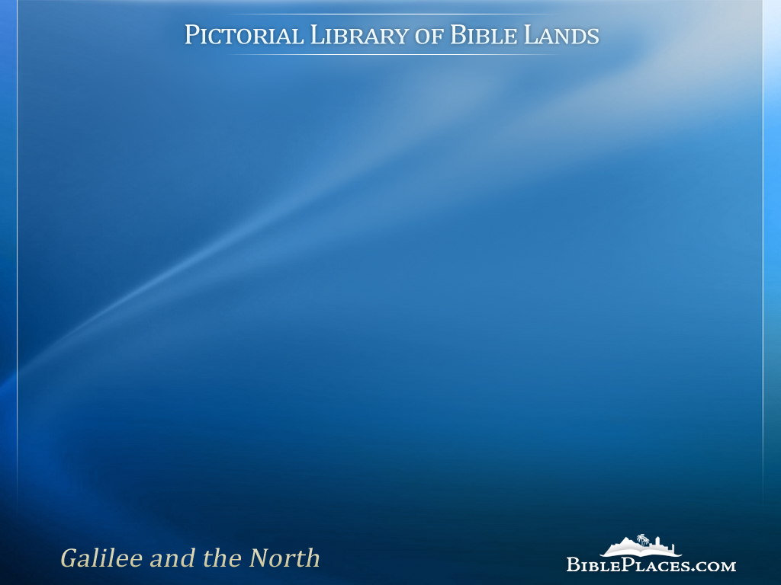
Sea of Galilee
Images from the Pictorial Library of Bible Lands, Revised and Expanded edition, Volume 1
Notes:
Why is the Galilee region a favorite region of Israel to so many? I think it has to do with its combination of beautiful landscapes and rich history. This is moreso for the Christian visitor who has heard the Gospel stories all of their lives. Almost all of Matthew, Mark, and Luke prior to Jesus' arrival in Jerusalem record his life and ministry in the Galilee.
To the traveler's great delight, the area is largely undeveloped today. When coming from Jerusalem where urban sprawl has conquered nearly everything not covered by a church, Galilee is a refreshing place to visualize the Savior healing, teaching, and loving his own. The photos below show scenes similar to what Jesus may have witnessed in the first century.
These images are a representative sample of the 1,100 images in the Galilee volume of the Pictorial Library of Bible Lands. This presentation, including its maps and photographs, are copyrighted by Todd Bolen. Permission to use is granted for personal and educational purposes. Commercial use or re-distribution requires written permission.

Slide 2
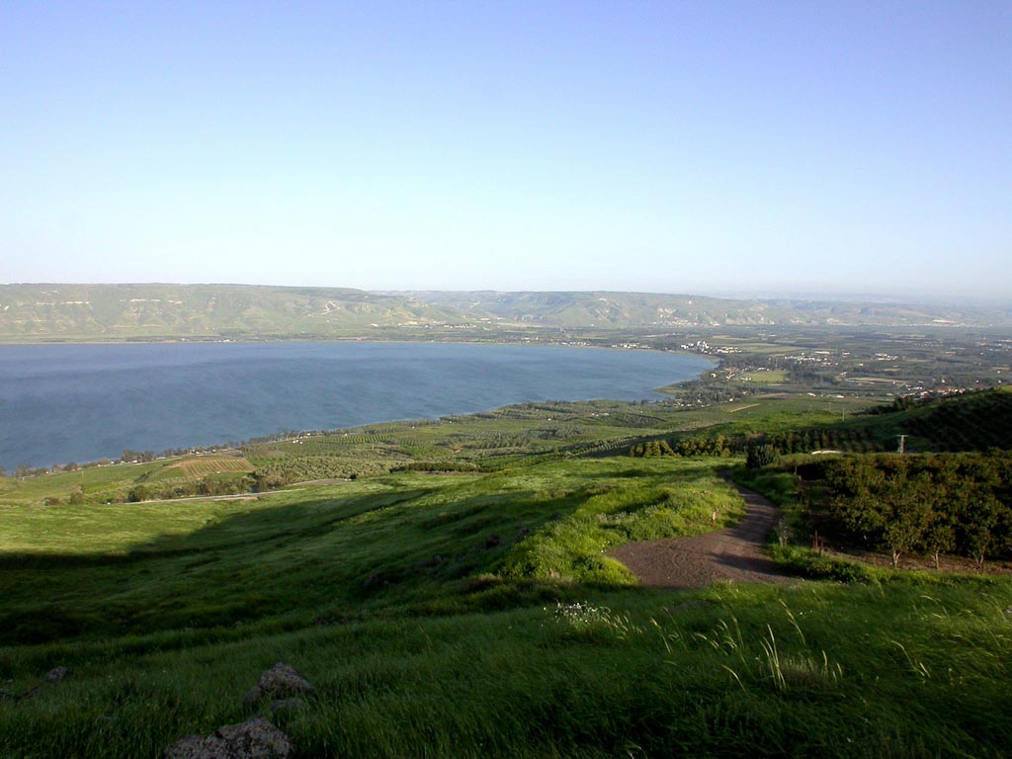
Sea of Galilee southern end from west
Notes:
The southern portion of the Sea of Galilee is an area that Jesus surely would have seen much of, but the Gospels do not record much of Jesus' ministry here. Two miracles were apparently performed on the opposite shore in what was then known as the Decapolis: the demons cast into the herd of pigs (Mark 5:1-20) and the feeding of the 4,000 (Matt 15:29-39). This photo shows the land in April after plentiful winter rains.
tb041003225

Slide 3
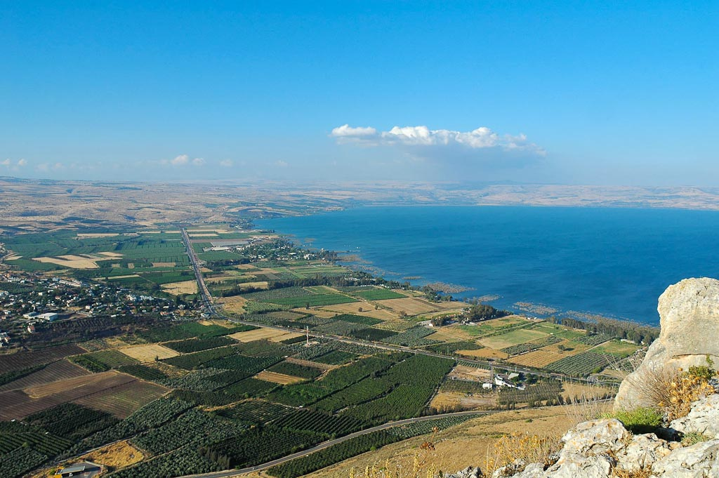
Plain of Gennesaret from southwest
Notes:
In contrast with the first photo, this view of the northwestern side of the Sea of Galilee shows the primary area of Jesus' ministry. Nearly every event, teaching, and miracle recorded in the Gospels in connection with the lake occurred within view of Mount Arbel. A few examples: the calling of the disciples, the feeding of the 5,000, the walking on water, and every event recorded in Capernaum. In addition, the traditional area of the Sermon on the Mount is located here.
tb053005508

Slide 4
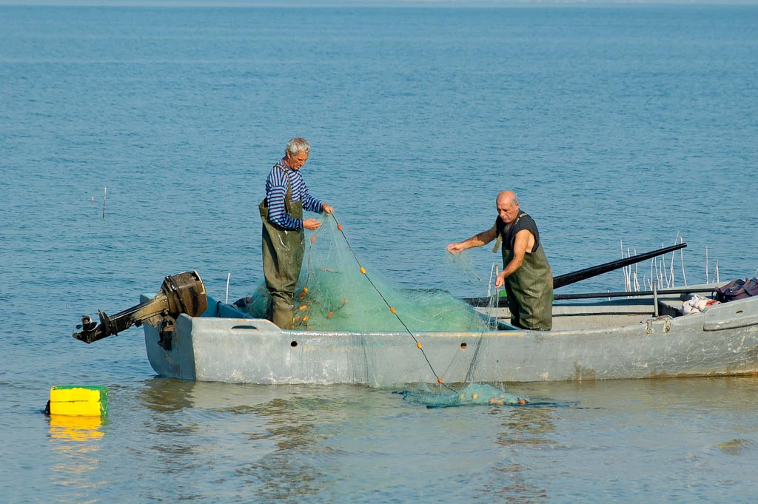
Fishermen on the Sea of Galilee
Notes:
Unlike in Jesus' day, there are few fishermen on the Sea of Galilee today. One of the reasons is that the supply of fish is greatly depleted. The fish farms in the valleys to the north and south meet much of the modern demand. But a few fishermen still practice the ancient craft, though their attire and locomotion has evolved.
tb101005875

Slide 5
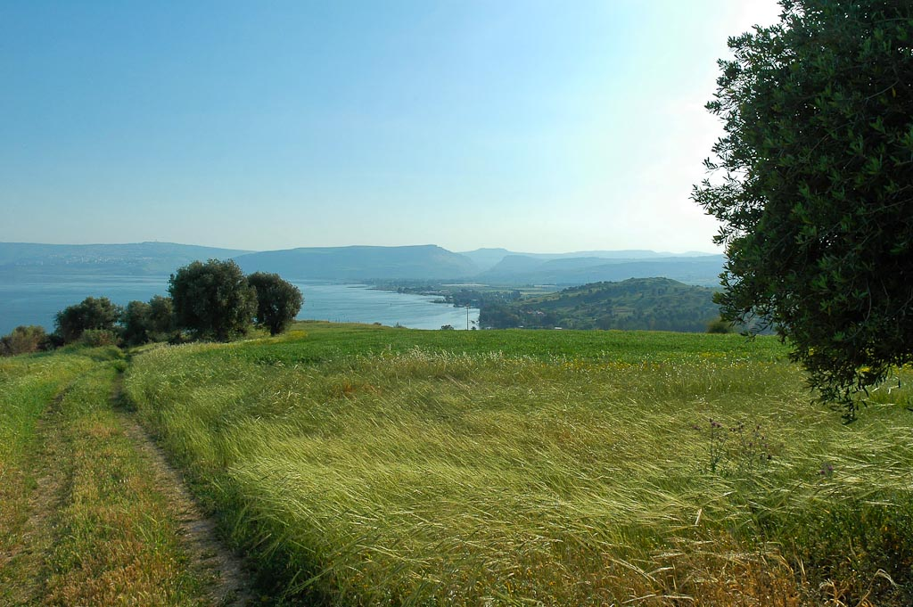
Mount of Beatitudes hillside and Sea of Galilee
Notes:
The Sermon on the Mount may be the most famous message in history (Matt 5-7), and the traditional location has a beautiful view of the Sea of Galilee. I usually advocate the site is possibly authentic for two reasons: (1) it is close to Capernaum and Heptapegon (Tabgha), both important in Jesus' ministry; (2) the size of the hill is suitable for a large crowd. What was the sermon all about? Jesus explained what was necessary in order to enter his kingdom. Those who are poor in spirit, meek, pure in heart, and have a righteousness greater than that of the teachers of the law will live with Jesus in his coming kingdom.
tb032805817

Slide 6
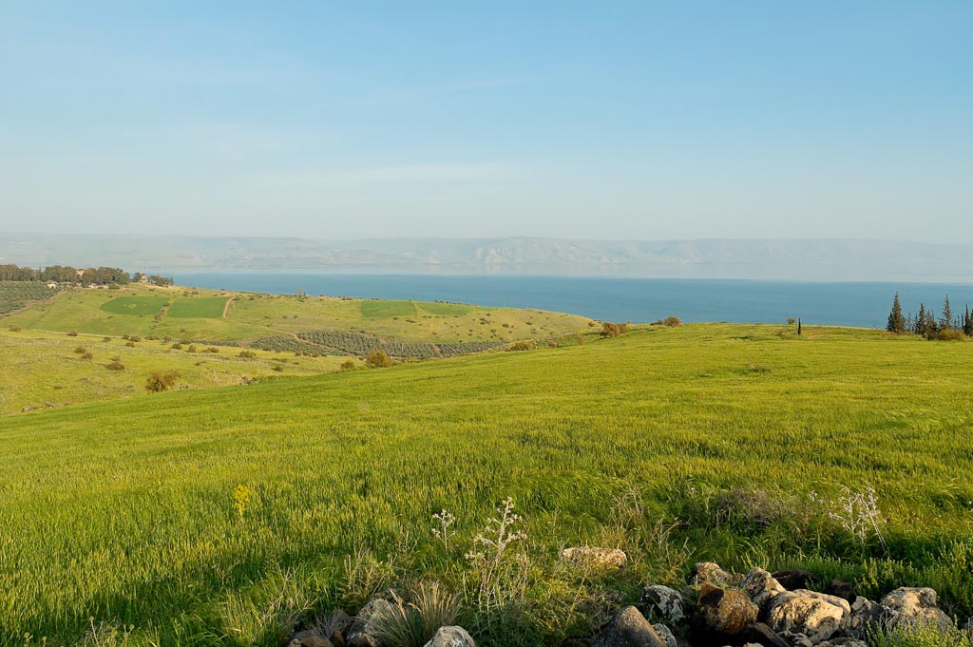
Mount of Beatitudes from west
Notes:
tb032805854

Slide 7
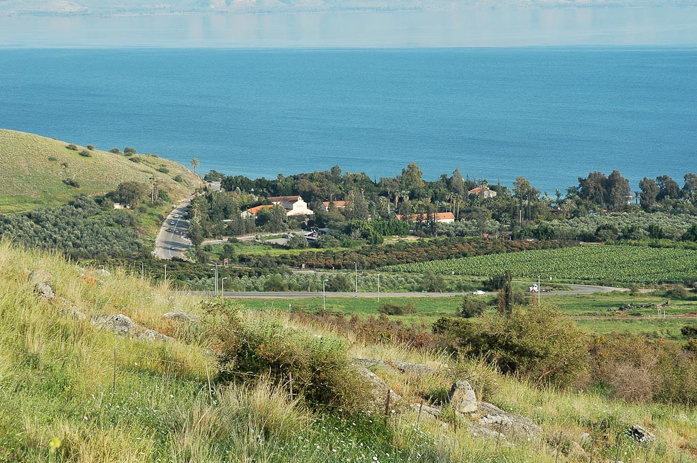
Tabgha from northwest
Notes:
tb032805829

Slide 8
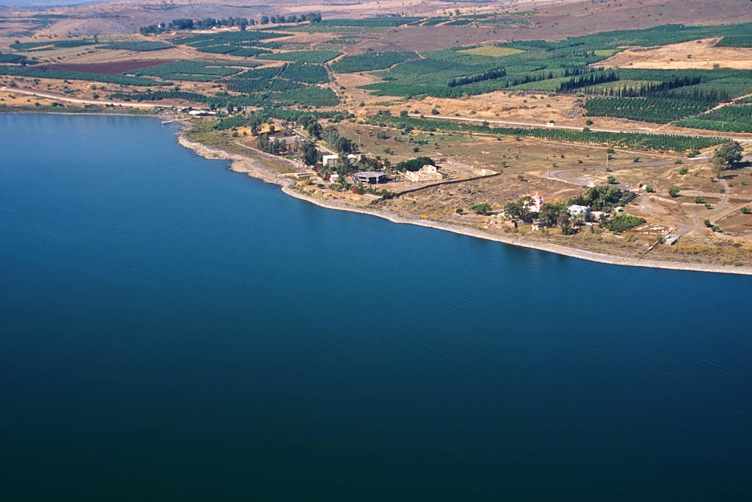
Capernaum area aerial from southeast
Notes:
If I could visit only one place in Galilee, I'd choose Capernaum. This seaside village was Jesus' home for three years of his earthly ministry and here he performed many miracles and taught many lessons. Where exactly did Jesus live in Capernaum? We don't know if Jesus lived with Peter's extended family (note the mention of Peter's mother-in-law, which indicates that Peter was married; Mark 1:30). Or perhaps Jesus' own family relocated with him from Nazareth—Mary and his four brothers and two (or more?) sisters. We know that at least on one occasion they were all in town (Mark 3:31). Ultimately we simply don't know where Jesus lived. Perhaps that is a good thing, lest someone erect another church over the spot.
tbs115190011

Slide 9
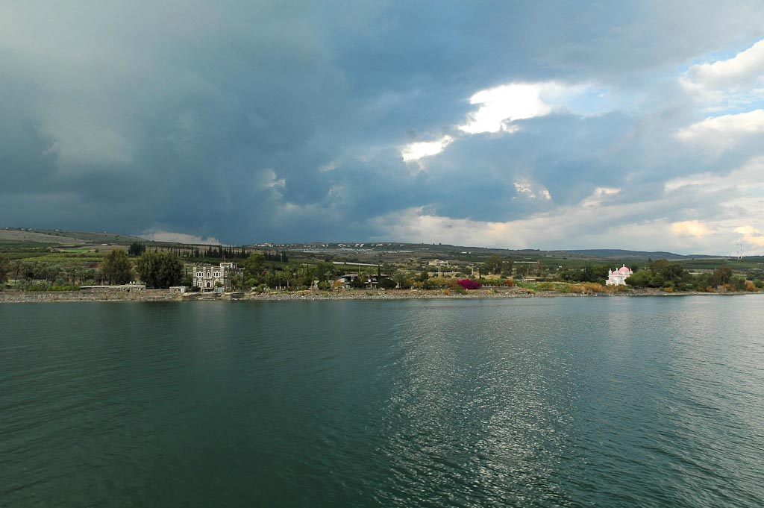
Capernaum from Sea of Galilee
Notes:
tb011306464

Slide 10
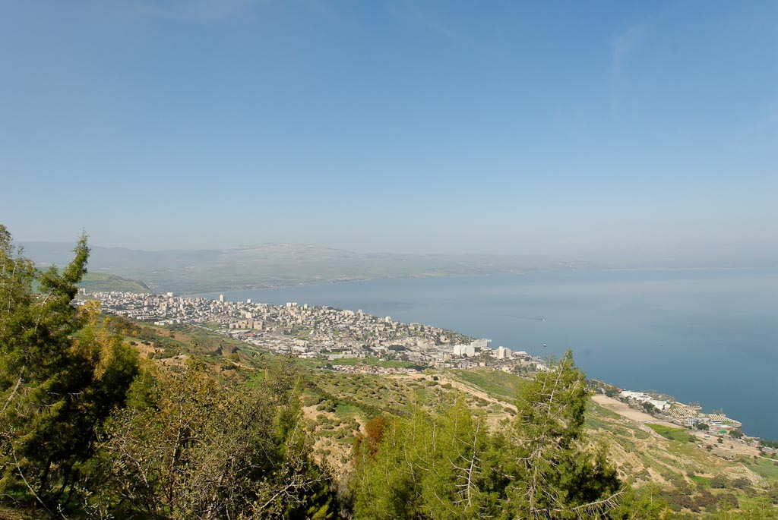
Tiberias and Mount Hermon from southwest
Notes:
tb022107074

Slide 11
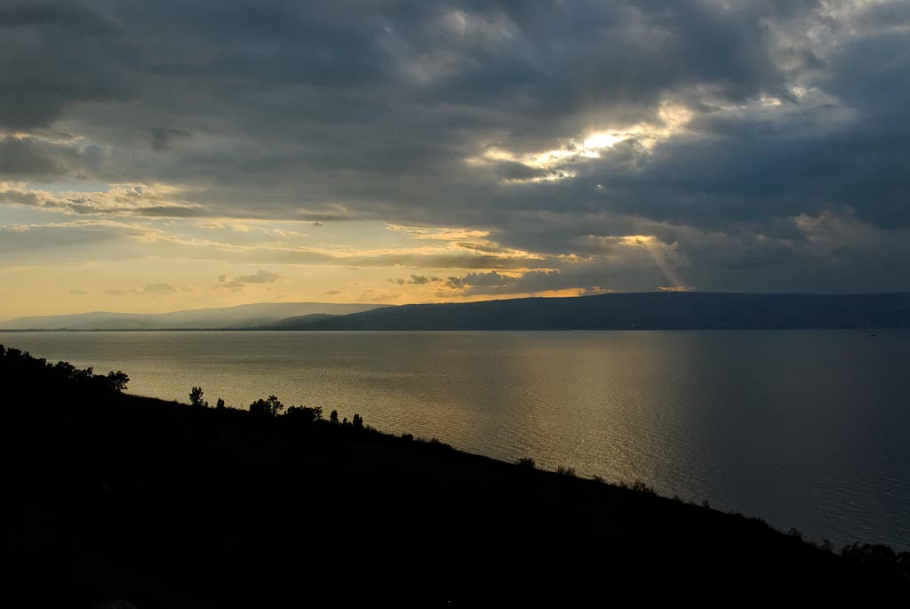
Sunset over Sea of Galilee from Kursi
Notes:
tb011212447

Slide 12
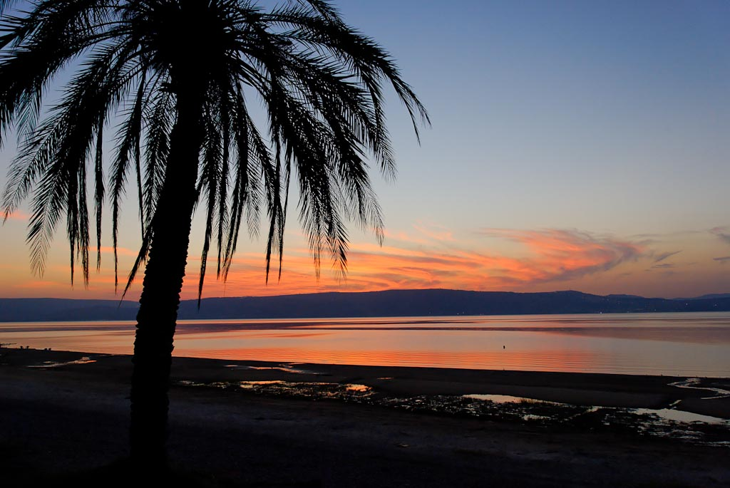
Sea of Galilee sunset
Notes:
Jesus was standing along these shores when the Pharisees and Sadducees asked him for a sign. His response: "When evening comes, you say, 'It will be fair weather, for the sky is red,' and in the morning, 'Today it will be stormy, for the sky is red and overcast.' You know how to interpret the appearance of the sky, but you cannot interpret the signs of the times" (Matt 16:2-3). These astute weathermen were staring at the Messiah and did not recognize him. Another sign would not solve their problem.
tb103106329

Slide 13
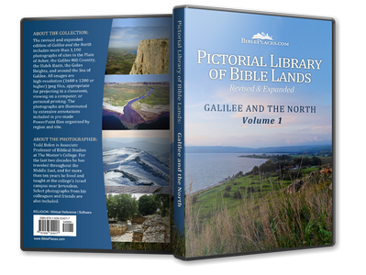
This sampler is taken from the Pictorial Library of Bible Lands, Revised and Expanded edition, Volume 1: Galilee and the North.
Galilee and the North includes more than 1,100 photos like these – all in high-resolution.
Each photo is clearly labeled. Most slides have descriptive explanations (see notes section below).
Designed for ease of use. PowerPoint presentations, jpg files, no watermarks, few restrictions.
If you don’t love it, return it!
Free shipping within U.S.
For more information about this volume, go to: http://www.bibleplaces.com/01-galilee-and-the-north-revised.htm

Slide 14
This sampler is taken from the Pictorial Library of Bible Lands, Revised and Expanded edition, Volume 1: Galilee and the North. Other presentations on this volume include:
Bethsaida
Capernaum
Chorazin
Dan
Galilee Hill Country
Gamla
Golan Heights
Hazor
Hippos
Huleh Basin
Jordan Rift
Jordan River North
Kedesh
Mount Hermon
Nazareth
Plain of Asher
Sea of Galilee-East Side
Sea of Galilee-Fishing
Sea of Galilee-Scenes and Sunsets
Sea of Galilee-West Side
Sepphoris
Tabgha
Tiberias
For more information about this volume, go to: http://www.bibleplaces.com/01-galilee-and-the-north-revised.htm

Slide 15
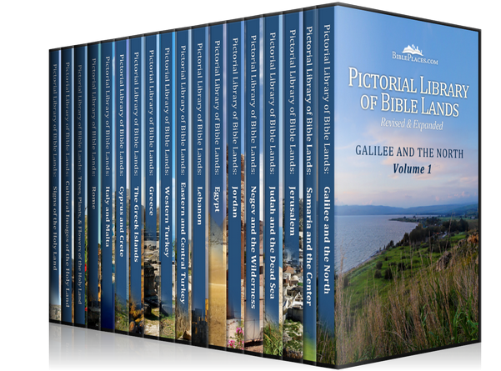
Galilee and the North is volume 1 of the Pictorial Library of Bible Lands, a collection of 17,600 high-resolution images of biblical sites and scenes. Other volumes in the collection include:
Samaria and the Center
Jerusalem
Judah and the Dead Sea
Negev and the Wilderness
Jordan
Egypt
Lebanon
Eastern and Central Turkey
Western Turkey
Greece
The Greek Islands
Cyprus and Crete
Italy and Malta
Rome
Trees, Plants, and Flowers of the Holy Land
Cultural Images of the Holy Land
Signs of the Holy Land
For more information about the Pictorial Library of Bible Lands, go to: http://www.bibleplaces.com/details.htm

